Slide 1
Mesoscale Modeling Branch
Geoff DiMego et al.
7 December 2015

Slide 2
Topics – All BRIEFLY
National Air Quality Forecast Capability
RTMA / URMA
HiResWindow and initial High Resolution Ensemble Forecast (HREF)
Short Range Ensemble Forecast (SREF)
RAP / HRRR
NAM / NAM Rapid Refresh (NAMRR)
The Future: HREF-SREF

Slide 3
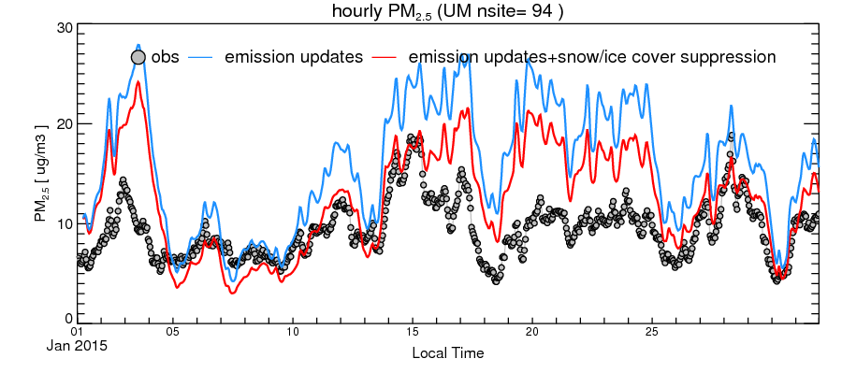
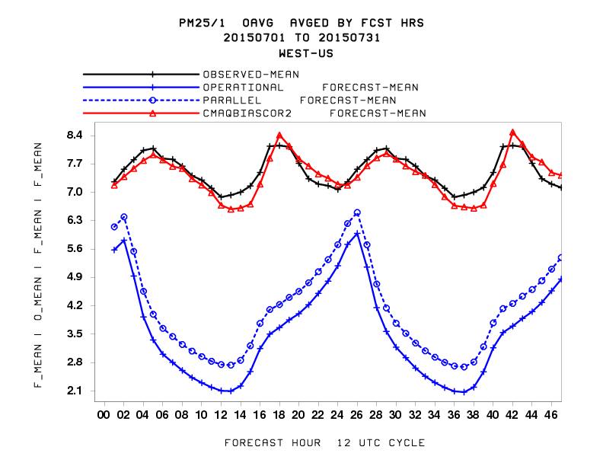
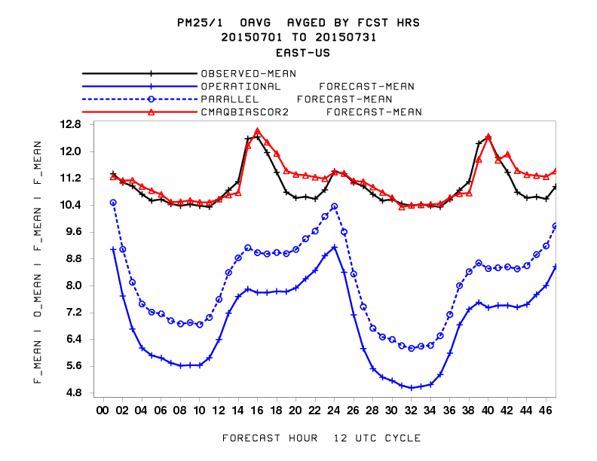
National Air Quality Forecast Capability (NAQFC) http://airquality.weather.gov/
Implementation on January 27, 2015:
First upgrade of chemical model for ozone predictions since implementation in 2007 (CB05 mechanism; monthly varying lateral boundary conditions for 36 gaseous and aerosol species; modified dry deposition velocity calculation; PBL height in the model constrained to be at least 50 m; faster removal of organic nitrate from the atmosphere)
Testing of fine particulate matter (PM2.5) predictions from the same operational system (inclusion of wild fire emission based on observed wildfire locations; suppression of soil emissions by ice or snow cover; inclusion of windblown dust emissions)
Emissions updates from May 1, 2015 (partial inclusion of US EPA 2011 NEI; new US residential wood combustion and oil and gas sectors; Mexico 2012 NEI; annual CEM point source update)
PM2.5 in Western US PM2.5 in Eastern US
UM
Bias for Upper Midwest region reduced by 52%
Testing shows that LBCs reduce prediction bias (blue circles). Analog technique (red) almost eliminates bias against observations (black).
FY 16 Planned Milestones:
Improve and publicly release PM2.5 predictions: link with global NGAC dust predictions through lateral boundary conditions; increase vertical resolution from 22 to 35 layers; include analog forecast technique for PM2.5 bias correction (Q2)
Implement operational PM2.5 predictions (Q4)
Update BlueSky smoke emissions and include smoke emissions for Canada used by Environment Canada (Q4)

Slide 4
RTMA / URMA Implementations and Plans
Q3FY15 (implemented 14 April 2015)
HRRR/NAM-nest background blend
Cloud amount analysis
Drastically reduced reject lists
Buddy and terrain enhanced gross error check for temperature
Q2FY16 (concurrent with National Blend of Models)
MinT/maxT for CONUS and AK URMAs (support National Blend)
Variational QC for temp/moisture/pressure obs
Q3FY16 (concurrent with RAPv3/HRRRv2)
URMA including minT/maxT for PR and HI (support National Blend)
Unified land/sea mask and terrain (support National Blend)
New variable: cloud ceiling height and sea-level Pressure
HRRRv2 and NAMRR for background
GLERL method over Great Lakes (support wave models)
Q1FY17? (planning stages)
Westward expansion of CONUS domain over Pacific (support OPC/Western Region)
15-minute updates (vs. hourly now) for ceiling and visibility (support FAA/HEMS)
New variables: significant wave height (support wave models and NDFD)

Slide 5
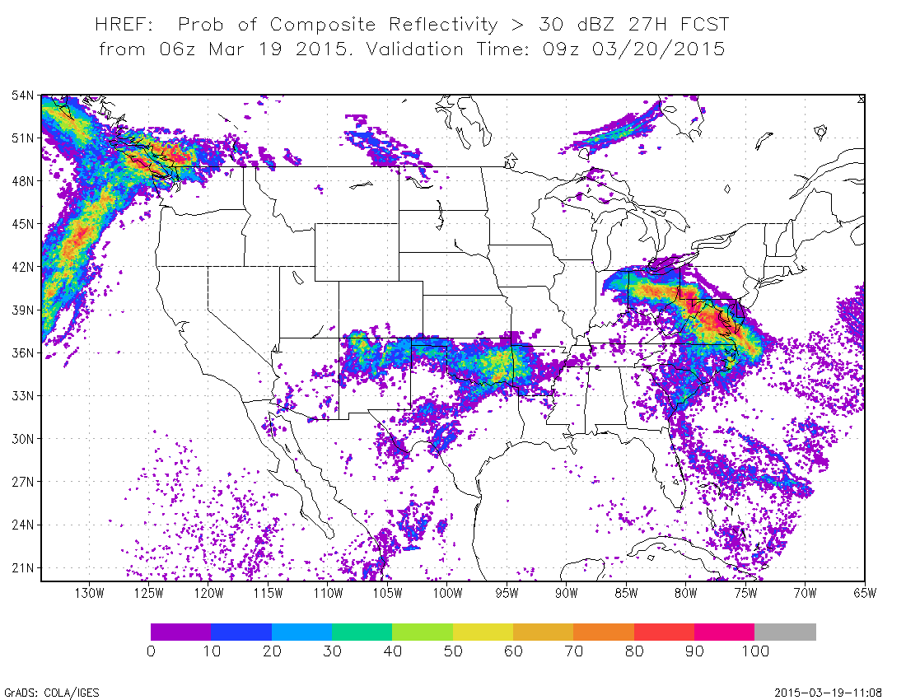
HiresW v6.1 / HREF v1.0 Implemented 8 September 2015
HiresW:
Increase from 40 to 50 vertical levs, most additions in PBL.
Modified WSM6 microphysics (WRF-ARW) to improve echo top heights for aviation
HREF:
Adds new set of ensemble products from multiple HiresW and NAM CONUS nest runs; prelude to a future true high-resolution ensemble forecast system
http://www.emc.ncep.noaa.gov/mmb/SREF_avia/FCST/HREF/web_site/html/prcp.html
Prob of REFC > 30 dBZ
24
12
0
+12
+24
+36
HiresW - ARW
HiresW - NMMB
NAM CONUS NEST

Slide 6
Oct. 21, 2015 SREF Major Upgrade
Changes | Benefits
3 model core system becomes 2 model core system (NMMB, WRF_ARW, WRF_NMM eliminated) Vertical resolution is increased from 35 to 40 layers (horizontal resolution remains the same of 16km) Ensemble membership is increased from 21 to 26 members IC diversity is enhanced: (a) mix use of multi analyses (NDAS, GFS and RAP) for each model core, and (b) blending of GEFS and SREF IC perturbations for all members Physics diversity is enhanced: (a) more variety of physics schemes, and (b) stochastic flavor in physics parameters (GWD and soil moisture) | Reduced cold bias in surface temperature (2m T) Reduced wet bias in surface moisture field (2m RH, not precipitation) Increased ensemble spread (diversity) especially for ARW members Improved guidance for winter storms but similar for warm season precipitation Improved overall skill of probabilistic forecasts in general Improved visibility and cloud ceiling etc. due to increased vertical resolution (verified by AWC)
Details available at http://www.emc.ncep.noaa.gov/mmb/SREF/SREF.html
or http://www.emc.ncep.noaa.gov/mmb/mmbpll/eric.html#TAB4

Slide 7
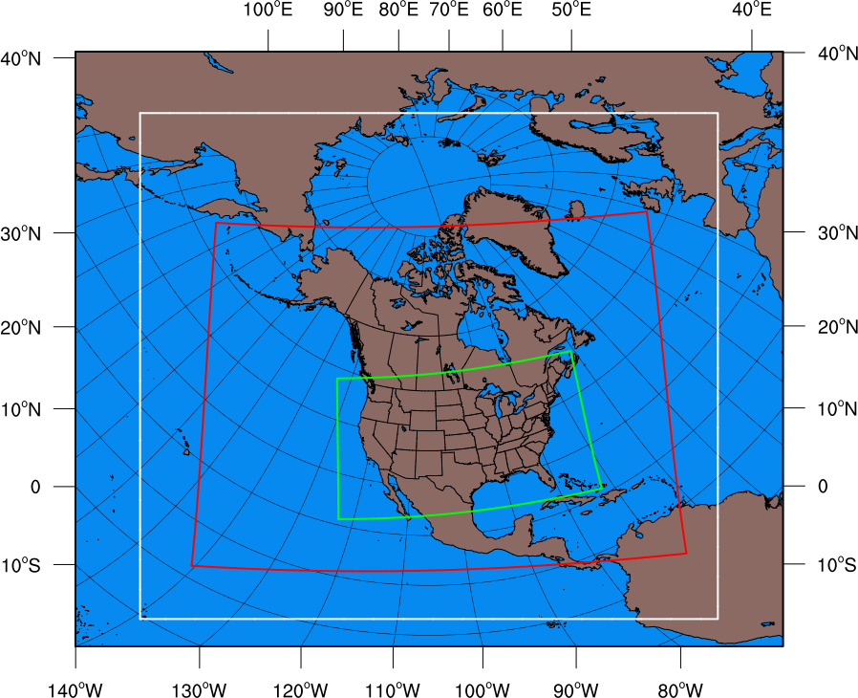
RAP/ HRRR: Hourly-Updated Weather Forecast Models
Targeting implementation in early May 2016
HRRR (and RAP) Future Milestones
HRRR Milestones
Component | RAPv3/HRRRv2 changes to remove RAPv2 warm/dry bias
GSI Data Assimilation | Canopy water cycling Temp pseudo-innovations thru model boundary layer More consistent use of surface temp/dewpoint data
GFO Convective Parameterization | Shallow cumulus radiation attenuation Improved retention of stratification atop mixed layer
Thompson Microphysics | Aerosol awareness for resolved cloud production Attenuation of shortwave radiation
MYNN Boundary Layer | Mixing length parameter changed Thermal roughness in surface layer changed Coupling boundary layer clouds to RRTMG radiation
RUC Land Surface Model | Reduced wilting point for more transpiration Keep soil moisture in croplands above wilting point
Expanded RAPv3 domain
13-km Rapid Refresh (RAPv3) – to 21h
Lateral Boundary Conditions
3km High-Resolution Rapid Refresh (HRRR)– to 18h

Slide 8
RAP/HRRR: Obs used (new RAPv3)
Hybrid ens/var 13km/3km GSI assimilation w/ radar-DFI-LH/
2016
Hourly Observation Type | Variables Observed | Observation Count
Rawinsonde | Temperature, humidity, wind, pressure | 125
Profiler – NOAA/ 915 MHz | Wind, virtual temperature | 2 / 20-30
Radar – VAD | Wind | 125
Radar | Radial velocity | 125 radars
Radar reflectivity – CONUS | 3-d refl➔Latent htg, rain,snow,graupel | ~1,500,000
Lightning – NLDN / GOES-R | Flash density ➔Proxy reflectivity | 10K
Aircraft | Wind, temperature | 3,000 -25,000
Aircraft - WVSS | Humidity | 0 - 800
Surface/METAR | Temperature, moisture, wind, press, clouds/ceiling, visibility, current weather | 2200 - 2500
Surface/Mesonet | Temperature, moisture, wind | ~5K-12K
Buoys/ships | Wind, pressure | 200 - 400
GOES AMVs | Wind | 10K
AMSU/HIRS/MHS (RARS) | Radiances (direct readout) | 760K/200K/200K
GOES | Radiances (fire location/intensity-smoke) | ~3,000K
GOES-R | Lightning, cloud-top cooling | >3,000K
GOES cloud-top press/temp | Brightness temp | ~380K
GPS – Precipitable water | Humidity – integrated water vapor | 300
METOP-B ASCAT | Winds | Monitor only
Future
Notes:
Observations of the earth system critical to prediction…the more the better with high-density radar and stat obs

Slide 9
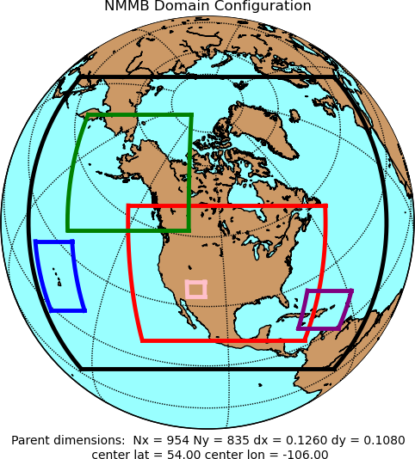
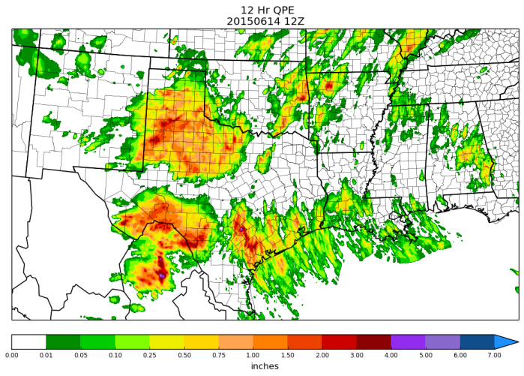
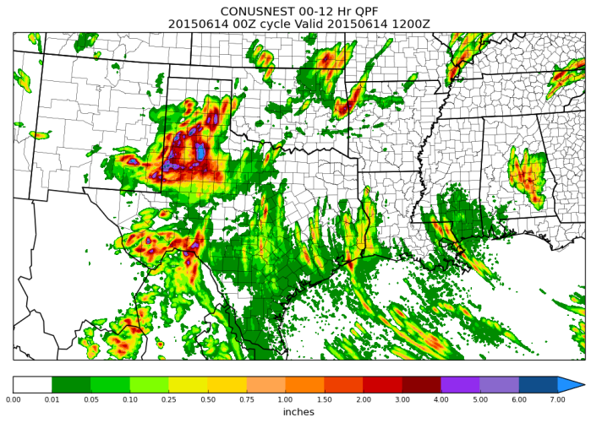
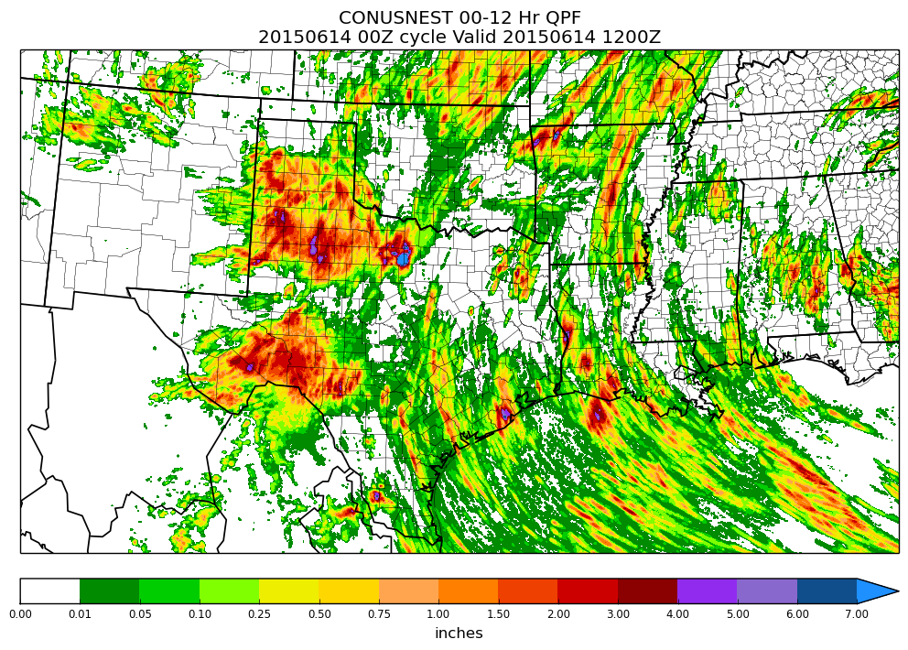
NAMv4: Hourly-Updated NAM Forecast System
Resolution changes
CONUS (4 km) and Alaska (6 km) nests → 3km (consistent w/ HRRR →HREF!)
Sync AK and CONUS On-Demand Fire Weather nests → 1.5 km
Model physics changes
More frequent calls to physics → Physics/dynamics more in sync (e.g. improved upper air, potentially improved nest QPF)
Improve effect of frozen soil on transpiration and soil evaporation → Improve cold season T/Td biases
Adjustment to convection in 12 km NAM → Improve QPF
Use of Radar Reflectivity-derived temperature tendencies in model's initialization
Improved short-term forecasts of storms at 3 km
Improved 00-12 hr QPF
Data Assimilation:
Hourly updates
DA cycles for 3 km CONUS and AK nests → Significantly less ‘spin-up’ time
New satellite radiances, satellite winds → Improved IC’s
RR
3 km
1.5 km
12 km
RR
June 14th, 2015: Stage IV Precip.
00Z 4 km Ops NAM CONUS nest
00Z 3 km NAMRR CONUS nest
00-12HR QPE
00-12HR QPF
00-12HR QPF
Developmental NAMRR webpage: http://www.emc.ncep.noaa.gov/mmb/jcarley/namrr/CONUSNEST

Slide 10
A Plan for a Regional Ensemble Guidance Suite to Replace the Current Disparate Set of Deterministic Guidance
What major performance issues are being addressed?
Lack of uncertainty guidance
Complicated regional production suite
Upgrades to production take time
What changes are being made?
Add convective-allowing-scale ensemble
Consolidate multiple regional components
Use aggressive “giant-leap” schedule for implementation in 2017
What are the expected resource allocation increases?
Very large increase … but I have a plan …
Access to Luna-Surge ~2 petaflop PEAK machines
Plan is 100% consistent with what was briefed to AA in March 2013
Follows the “Way Forward” laid out in the May 2010 NWS/OST White Paper by Eckel, Glahn, Hamill, Joslyn, Lapenta & Mass

Slide 11
Schedule
A single “giant-leap” implementation in late 2017 – Q1 FY2018
Eliminate DGEX and HiResWindow
This plan allows for the Control Members to continue making most existing deterministic guidance: i.e. RAP, HRRR, NAM, NAMRR, NAM-nest, FireWx, but
Establish firm sunset dates [2019?] for their ‘elimination’.

Slide 12
Mesoscale Ensembles Replace
Regional Deterministic Guidance
Start of WCOSS Phase1 ~2013-2015 | WCOSS Phase 1 + Phase 2 ~2015-2016 | End of WCOSS-era 2.8 petaflop aggregate
SREF continental scale | SREF continental scale | SREF continental scale
WRF-ARW, WRF-NMM, NMMB | WRF-ARW & NMMB | WRF-ARW & NMMB
7 each = 21 members 16 km / 35 levels | 13 each = 26 members ~12 km / 40-60 levels | 10 each = 20 members ~9 km (parent) / 50-60 levels
6 hourly to 84 hr | NARRE-TL run hourly to 18 hr 6 hourly to 84 hr | SREF [aka NARRE] run hourly to 24 hr 6 hourly to 96 hr
 | Product streams for all scales will need to be added, consolidated, repurposed & renamed. Products may have later delivery times.
Convection-Allowing-Scale | Convection-Allowing-Scale | Convection-Allowing-Scale
Irregular suite of guidance 3-6km [HiResWindows & NAM nests] Twice daily SSEO by SPC ~6 hourly to 48/60 hr for CONUS, Alaska, HI, PR | Single hourly 3 km HRRR & NAM nest Run to 18 hr for CONUS [& Alaska] Twice daily HREF-TL to 12 hr Upgrade irregular suite to ~3 km 6 hourly to 48/60 hr for CONUS, Alaska, HI, PR | HREF [aka HRRRE] Multiple hours 3 km Control run hourly to 24 hr 6/12 hourly extended to 60 hr for Alternating CONUS, Alaska [Hi, PR]
Storm Scale | Storm Scale | Storm Scale
Single placeable sub-nest 1.33-1.5 km (aka FireWx) Run 6 hourly to 36 hr | Single placeable sub-nest 1-1.5 km (aka FireWx) Run 6 hourly to 36 hr | Multiple placeable/movable sub-nests: ~1 km run hourly to 18 hr and [Run 6 hourly to 36 hr]
WILL BE A MAJOR CHALLENGE
Notes:
I’ve tweaked this slide

Slide 13
Plans for the future-1: All regional guidance moving to ensemble basis
Continental scale covering North America and adjacent waters at ~12 km will be called the Standard Resolution Ensemble Forecast [SREF] system.
This new SREF will replace:
the current 13 km RAP,
the current 12 km NAM,
the current 16 km SREF [Short Range Ensemble Forecast].
Forecasts to 21-24 hr will be made hourly (ctl members)
Current NARRE-TL, made up of RAP & NAM, can be seen here.
The acronym NARRE will no longer be used.
Forecasts to 84 hr will be made less frequently
Extending HREF members to longer ranger
Some members from 0-84 hr to make up ~20-26 membership
Likely to alternate between CONUS and Alaska

Slide 14
Plans for the future-2: All regional guidance moving to ensemble basis
The 3 km convection-allowing scale ensemble suite will be called the High Resolution Ensemble Forecast [HREF]
An HREF [time-lagged] webpage can be seen here.
HREF domains will include CONUS and Alaska at first.
Control members run hourly & cover all domains.
HREF will replace:
the current HiResWindow (except Guam),
the current NAM nests,
the upcoming NAMRR nests [see more here],
the current CONUS HRRR,
the upcoming Alaskan HRRR.
Prior acronyms HRRRE, NSSE, NCASE will be retired.
Periodically, 36-60 hr forecasts will be made
Likely to alternate between CONUS and Alaska.

Slide 15
Original March 2013 Projection for End State of 2 petaflop WCOSS ~2018
S
R
E
F
S
R
E
F
S
R
E
F
S
R
E
F
Hurricane
Hurricane
Hurricane
Hurricane
RTOFS
RTOFS
RTOFS
RTOFS
GEFS
GEFS
GEFS
GEFS
GDAS
GDAS
GDAS
GDAS
NAMext
GFS
NAMext
GFS
GFS
NAMext
NAMext
GFS
NMMB Storm Scale Ensemble members within CONUS and/or Alaska
NMMB HRRRE members CONUS, Alaska, Hawaii, Puerto Rico
ARW HRRRE members CONUS and Alaska
Convective Allowing Data Assimilation – NMMB
3D URMA / RUA / AoR
Convective Allowing Data Assimilation – ARW
CFSv3

Slide 16
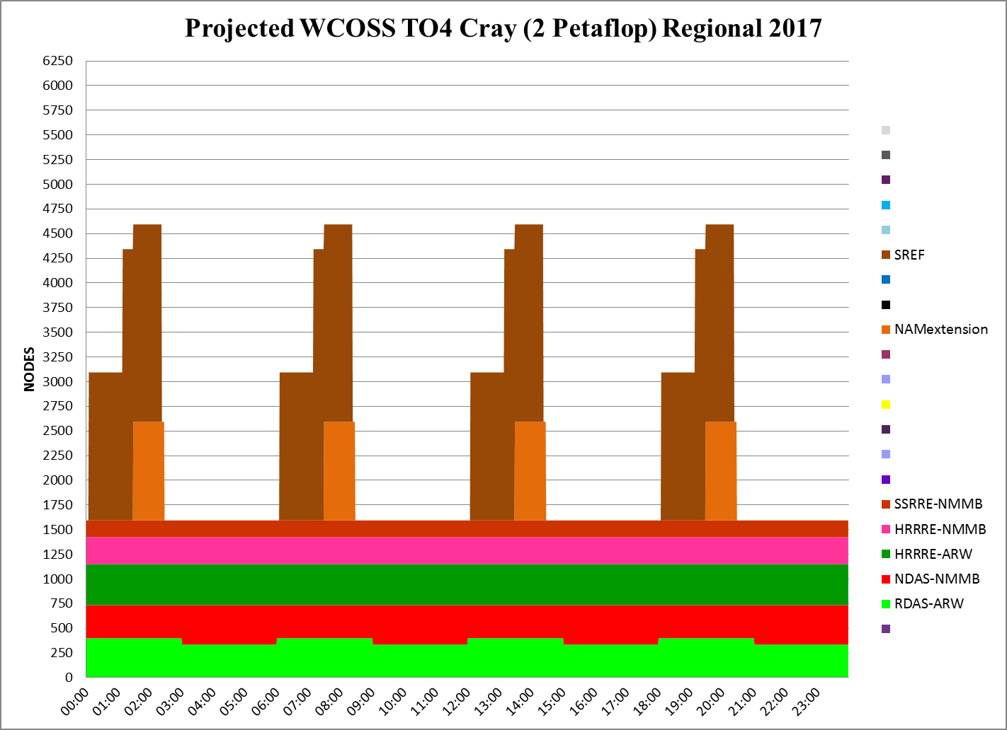
6250 nodes x 16 = 75000 CCS cores

Slide 17
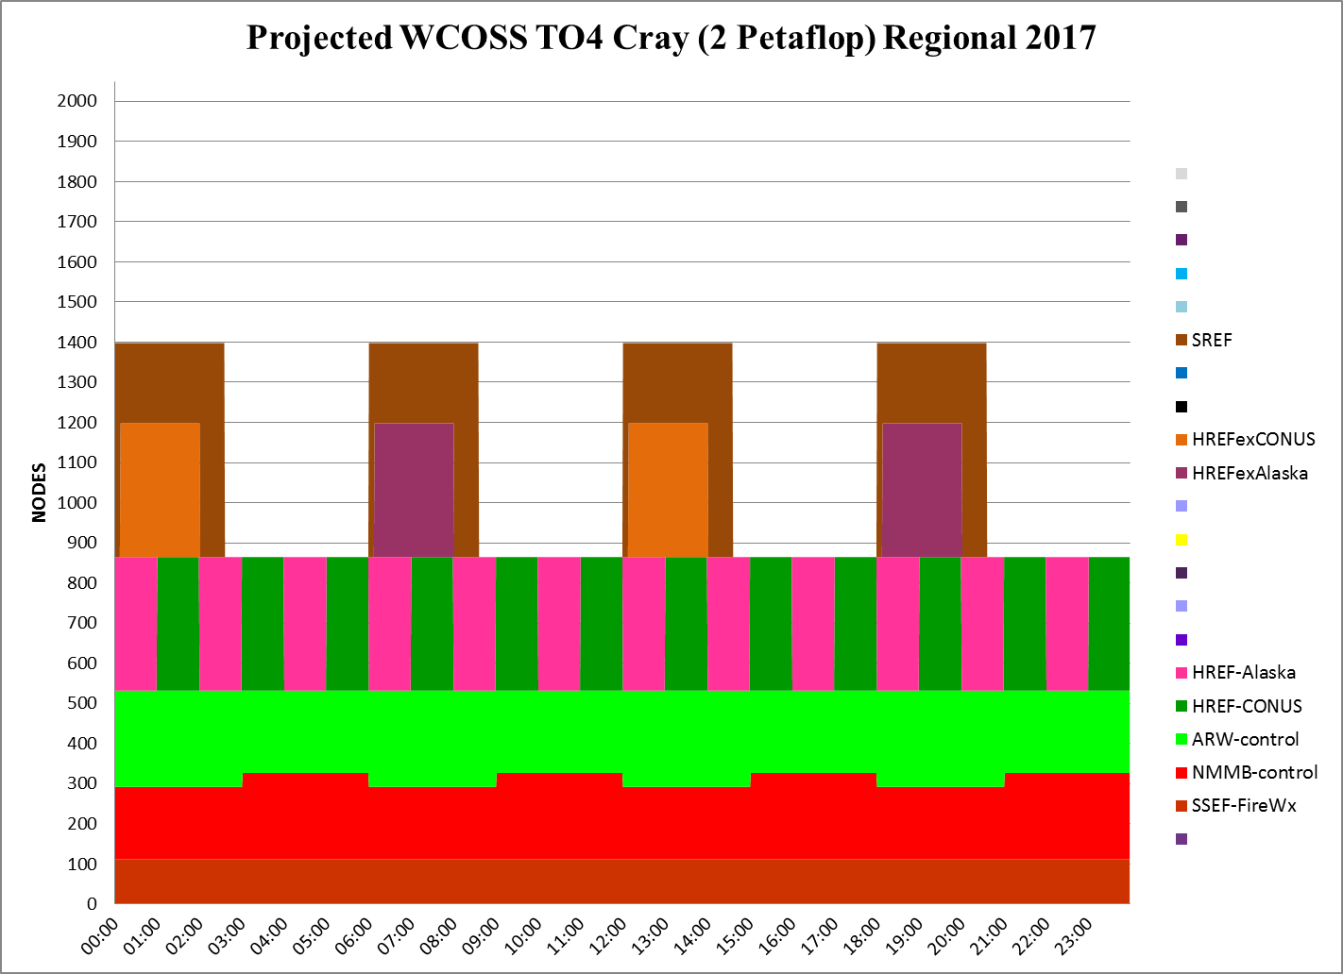
WCOSS TO4 Cray is 2.04 petaflop PEAK
2048 nodes x 24 = 49152 WCOSS cores

Slide 18
Implementation Consolidation
PRESENT FUTURE
RAP / HRRR
NARRE-TL
HiResWindow
HREF-TL
NAM/NAMRR
NDAS
DGEX
SREF
HREF-SREF
Challenges remain to establish:
a set of common output grids
a set of new delivery times

Slide 19
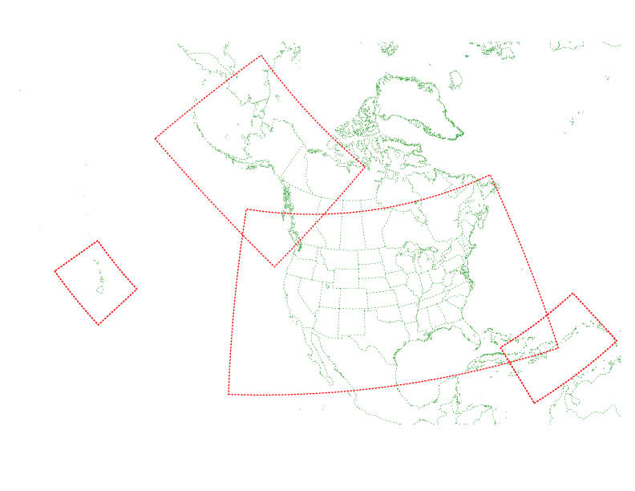
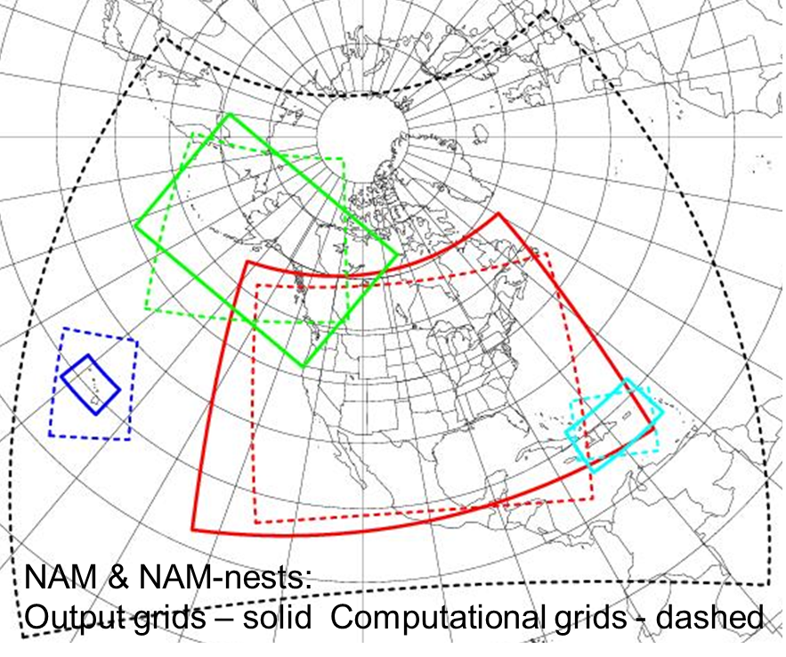
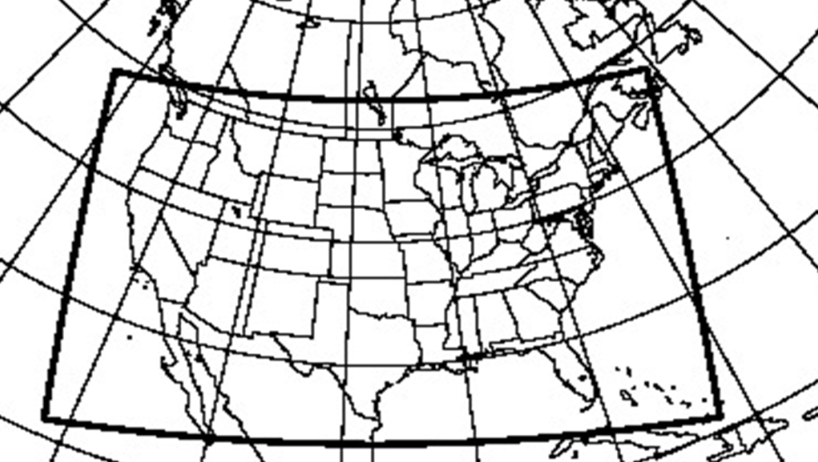
HiResWindow, NAM, and HRRR Grids & Domains
HI/Guam/PR :
3 km NMMB
3.8 km WRF-ARW
3 km NMMB
3.5 km WRF-ARW
06Z,18Z
3.6 km NMMB
4.2 km WRF-ARW
00Z,12Z
+ Guam
00Z,12Z
00Z,12Z
06Z,18Z
HRRR 3km GRID
Common Output Grid for HREF will be the NDFD grids which require very little downscaling and foreshadow resolution increase for HREF e.g. from 3km to 2.5km

