Slide 1
Mesoscale Modeling Branch NAM (mostly)
N
C
E
P
Geoff DiMego
geoff.dimego@noaa.gov
301-683-3764 NCWCP Room 2131
5 December 2012
Where the Nation’s climate and weather services begin

Slide 2
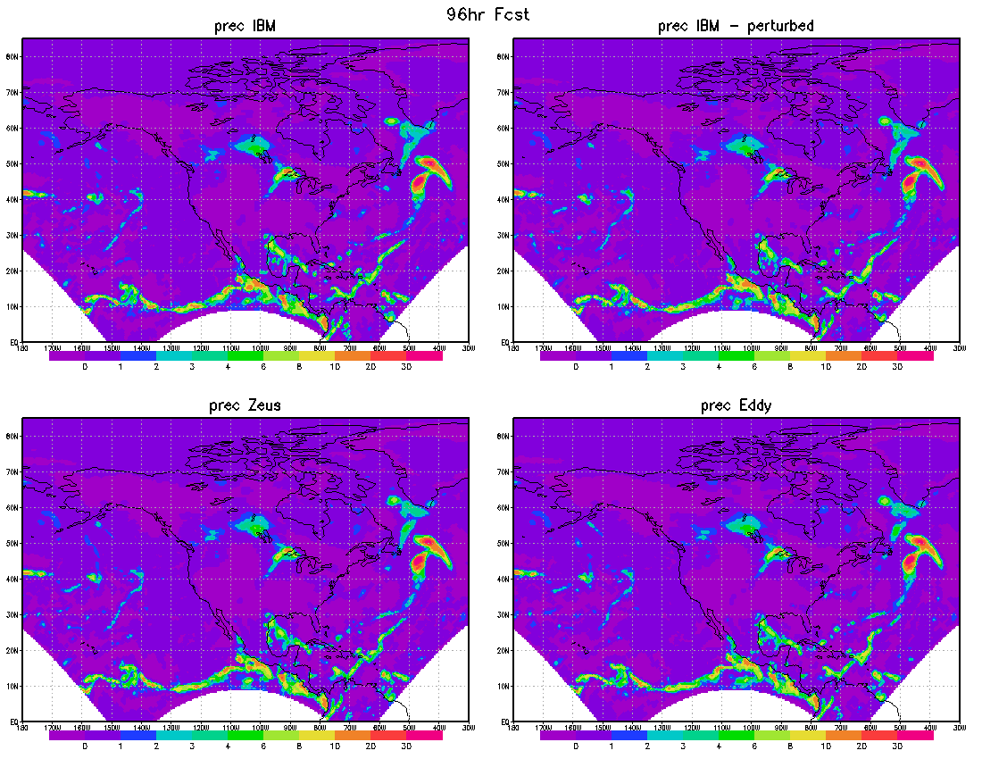
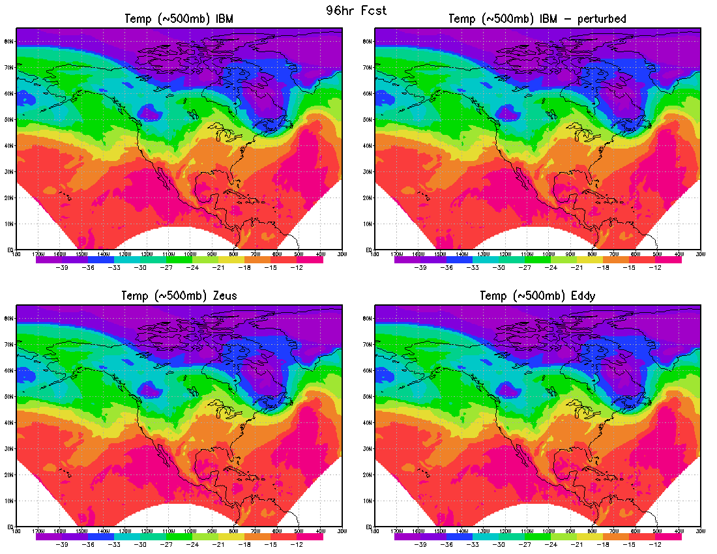
Transition to WCOSS
NUMBER 1
PRIORITY!
NUMBER 1
PRIORITY!
Differences of the NMMB model results between CCS and WCOSS Global folks (Mark) come up with idea of "counting butterflies": setup 2 experiments on original machine (IBM), one as control and the other one with perturbed initial conditions on sixth significant digit. Third experiment is running model with original initial conditions, but on new machine and then look at differences in RMSE between perturbed/nonperturbed original run and new/old machine. For this I used NMMB with NAM domain, but coarse resolution. I ran it for 4 days, but I'm sending you 4 options to chose from (1, 2, 3 or all 4 days - 1 day is more clear). Thanks to Ratko Vasic!!
Even a very small perturbation on current CCS caused higher RMS forecast differences than switching to WCOSS’ new platform & compiler.

Slide 3
T O P I C S
Observation Processing, Quality Control & Verification
HiResWindow and SPC runs
RTMA + Delayed Mesoscale Analysis
NAM: NDAS + NMMB + NEMS + Nesting
Derecho & Superstorm Sandy
Current NAM parallel
Efforts aimed at the future
Convergence of NAM+RAP -> NARRE+HRRRE

Slide 4
Obs Proc & QC
Past year:
Aircraft QC module from NRL July
Data Sharing Agreements signed with both Iberdrola & NextEra (Wind Energy Producers)
2013-2014: (besides WCOSS)
New VAD winds from 88D in NAM
Dual Pol decoder (NCO/SIB) and QC
Diurnal (T & q) and Directional (wind) QC lists used in GSI in RTMA and NAM
MySQL database for obs and verification

Slide 5
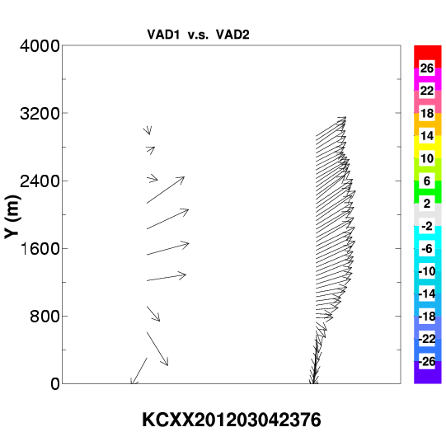
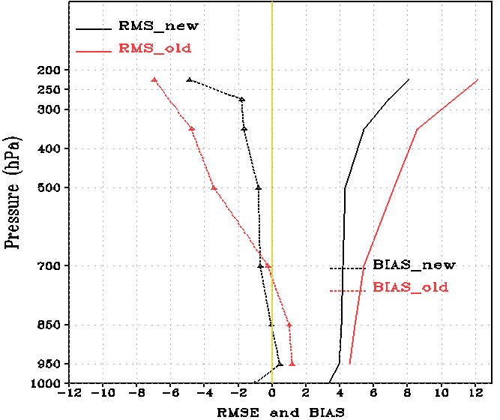
Difference Between New and Opnl VAD Wind
New VAD wind generated after Level-II data QC
Improved velocity dealiasing & clutter removal
Bird contaminated scans, CQC check 20/80k new VAD wind obs
Higher resolution in vertical
50 m vs 304.8 m
Higher frequency
5-10 min vs 30-40 min
Opnl VAD
New VAD

Slide 6
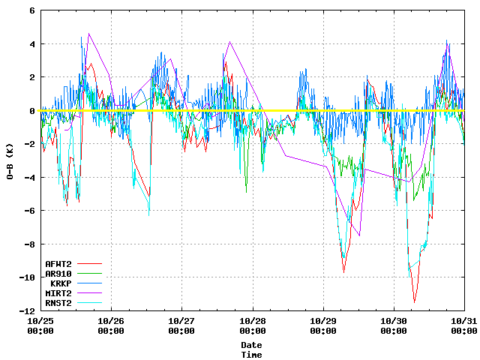
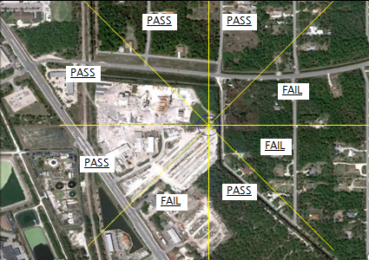
Combine Obs + Metadata for Smarter, Situational QC
Diurnal cycle (temps and moisture)
Directional wind bins (wind direction)
(Pass=use when wind direction is within range, wind is unobstructed)
(red and cyan stations flagged at night)

Slide 7
WFIP: Wind Forecast Improvement Project DOE-NOAA-Private Sector Project
Observation processing
Real-time ingest of experimental WFIP obs during 2011/2012 (profiler, rass, and sodar) but kept from RAP+NAM
Development of new data ingest and processing for instrumented tower and nacelle wind speed obs (in progress)
Data denial study (in progress)
Impact of field study observations on wind forecasts critical to wind power generation estimation
ESRL/PSD deployed profiler, rass and sodar data
Onsite instrumented tall tower (~80 m) and nacelle data
Development of additional NDAS/NAM cycling capabilities on NOAA R&D machine Zeus
Cycling steps for CONUS 4km nest for 3 hourly NDAS
Exercise hourly updated NAM cycle with digital filter
WFIP Northern Domain
Another instrumented domain in SW US

Slide 8
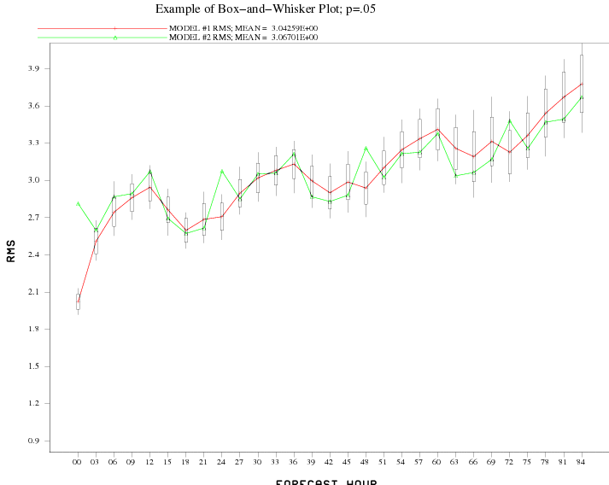
Verification Implementations
Systems
SREF – Updated for new Short Range Ensemble System
NGAC – NEMS GFS Aerosol Component
RAP – Rapid Refresh
New Variables
Best CAPE – 4-layer CAPE
Virtual CAPE
Confidence Tests
Box-and-whiskers now
on most FVS plots (thanks
to Keith Brill of HPC)
EMC Verification Website (intranet only):
http://emc-ls-sand02.ncep.noaa.gov/EMC_VSDB_verif/index.cgi

Slide 9
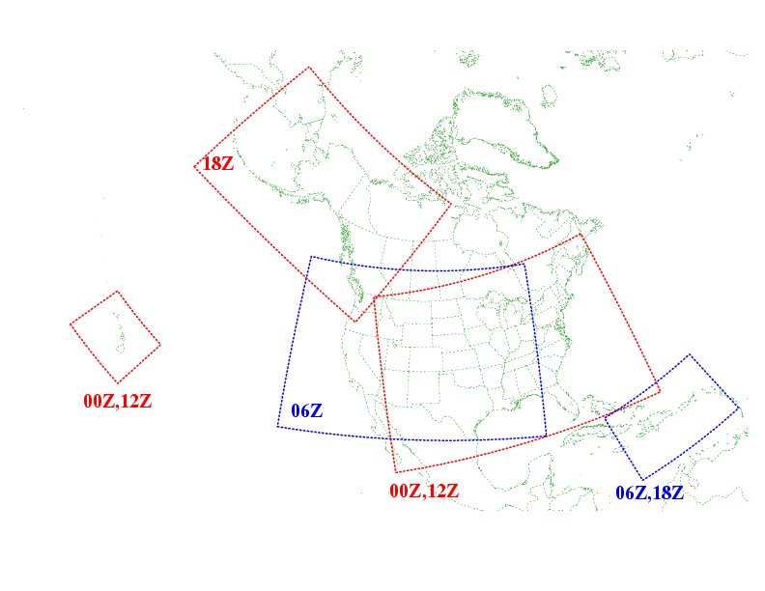
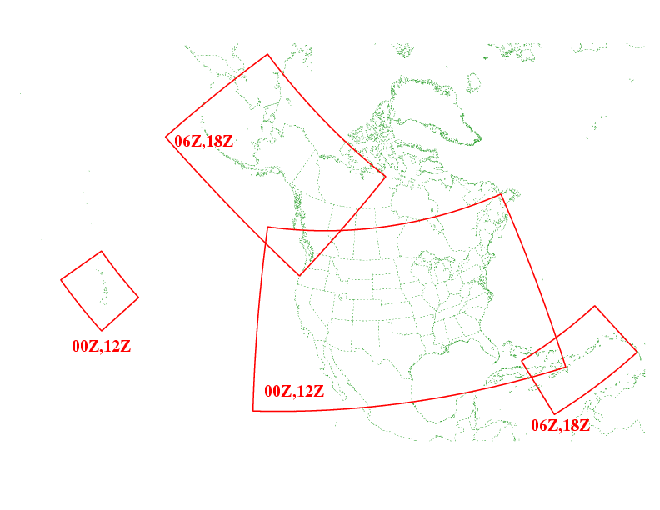
HiResWindow System
Current
Future
Alaska
~2.7 km NMMB
~3.6 km ARW
+ Guam (00Z, 12Z)
+ Guam (00Z, 12Z)
All domains 4 km NMM, 5.15 km ARW
No Diabatic Digital Filter
Matt Pyle’s non-operational run of NMM
non-AK domains ~3 km NMMB, 4 km ARW
With Diabatic Digital Filter (key to SPC’s SSEO & NCEP’s NSSE)
What is future of Matt’s SPC run – a topic
For Thursday morning’s discussions

Slide 10
RTMA UPGRADE PACKAGE
1. Upgrade Alaska RTMA to 3km (5.9km still available but just remapped)
2. Add RTMA Juneau-1.5km
3. Extend CONUS domain northward & produce NWRFC grid
4. Add Analysis of 10-m Wind Gust and Visibility
5. Improve first guess (RAP in Alaska & blend HWRF for tropical storms)
6. Improve the observation QC:
- Add diurnal reject lists for Temperature and moisture
- Add wind direction-stratified accept lists for mesonet winds
7. Use First Guess at the Appropriate Time (FGAT) and extend the assimilation time window from -/+12min to -/+30min.
8. Use bias correction for the First Guess Temperature
9. Background error covariances mapped to the high resolution terrain field as before

Slide 11
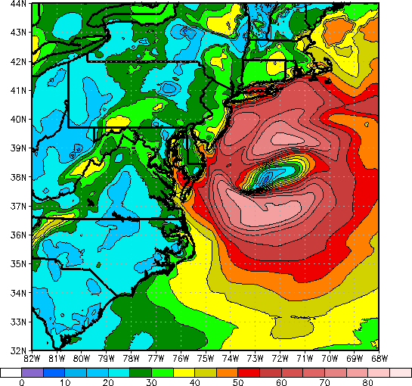
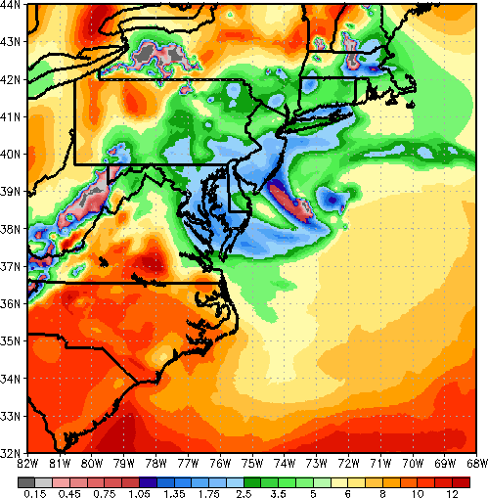
RTMA Enhancements (WCOSS)
New features in the RTMA parallels
Analyze 10-m wind gust and surface visibility
- For tropical cyclones, blend the RAP forecast with the HWRF forecast to provide a robust first guess for 10-m wind and wind gust
Hurricane Sandy: Evaluation done by NWS/Eastern Region for the period between 17 UTC and 23 UTC on Oct 29, 2012 showed the parallel RTMA did generally a good job of depicting the 10-m wind and wind gust. Some weak spots in the analysis were found in the Great Lakes and parts of Long Island. Figures show the analysis for 18z 29 Oct 2012 from 2.5km RTMA parallel.
Wind Gust (knots)
Work In progress
- Add GLERL-type pseudo-wind observations over water
Add the analysis of cloud ceiling, MSLP, and 10-m wind speed
Develop a Delayed Mesoscale Analysis (DMA) - Consider vortex relocation for the analysis of tropical storms in the DMA
Visibility (mi)
Visibility (mi)

Slide 12
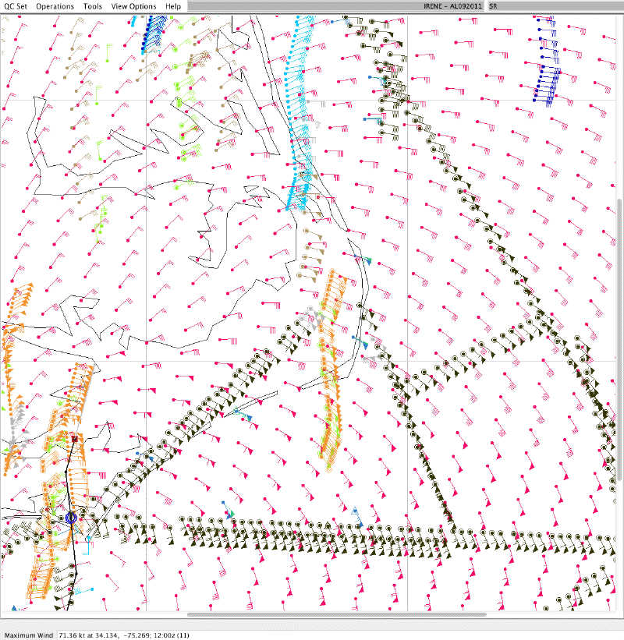
How a Vortex relocation in the DMA would help
Landfall of Hurricane Irene at 1200 UTC 27 Aug 2011
Red barbs show the RTMA wind speed (in knots)
Barbs of other colors represent various observations over a +/- 2h period
Black solid line shows the storm track, with the 2000 UTC storm center shown as a blue circle (see lower left corner of the plot).
RTMA/HWRF had the center
located some 10 km to the south!
Comparison on the northeast side of the storm suggest the RTMA/HWRF winds are weaker than the obs in the higher wind locations. However, if the RTMA/HWRF wind center were relocated 10 km northward, comparisons would be much closer in this portion of the storm.
Thanks to Drs. Mark Powell and Bachir Annane for providing figure and for the discussion

Slide 13
NMMB Reruns of Derecho Case
This link points to the summary of 4-km NMMB runs made (so far) by Eric Aligo with Brad Ferrier
In next 3 slides, the top row is always the same: 4-km NMMB run with light parameterized convection (fres=0.25) from the 15Z ESRL RAPv2.
1st loop compares the 4-km NMMB runs from the 15Z ESRL RAPv2 (with convection, fres=0.25) against the observed composite radar reflectivities & RTMA wind gusts.
2nd loop compares the 4-km NMMB runs with convection (fres=0.25, top row) versus without convection (bottom row) using the 15Z ESRL RAPv2 for initial & boundary conditions. (see Backup slides)
3rd loop compares the 4-km NMMB runs (with convection, fres=0.25) from the 15Z ESRL RAPv2 (top row) versus the 15Z NCEP RAPv1 (bottom row), showing the improvement provided by the experimental RAP analysis.

Slide 14
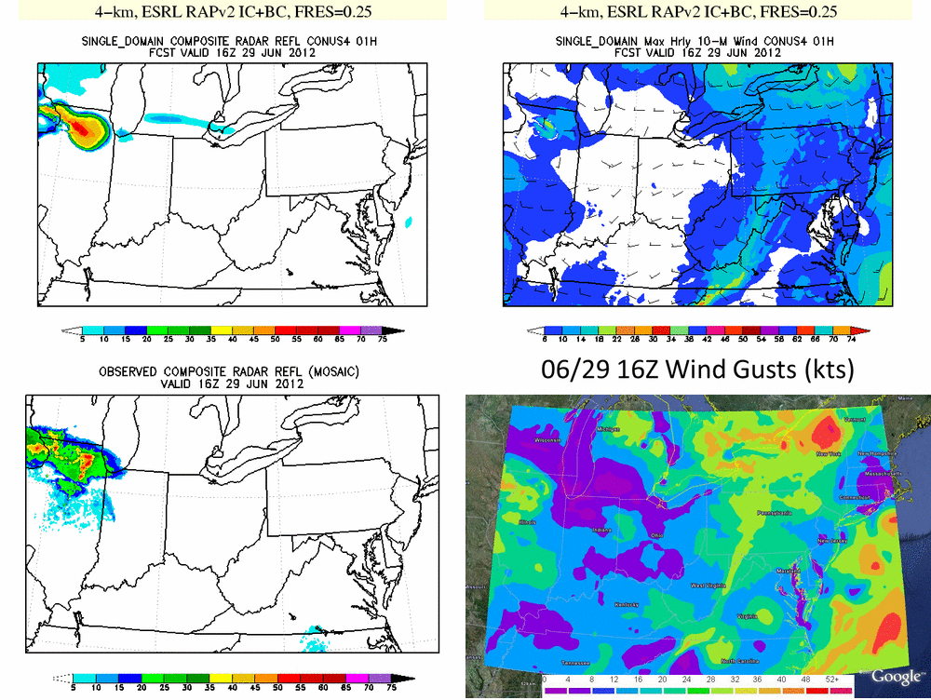

Slide 15
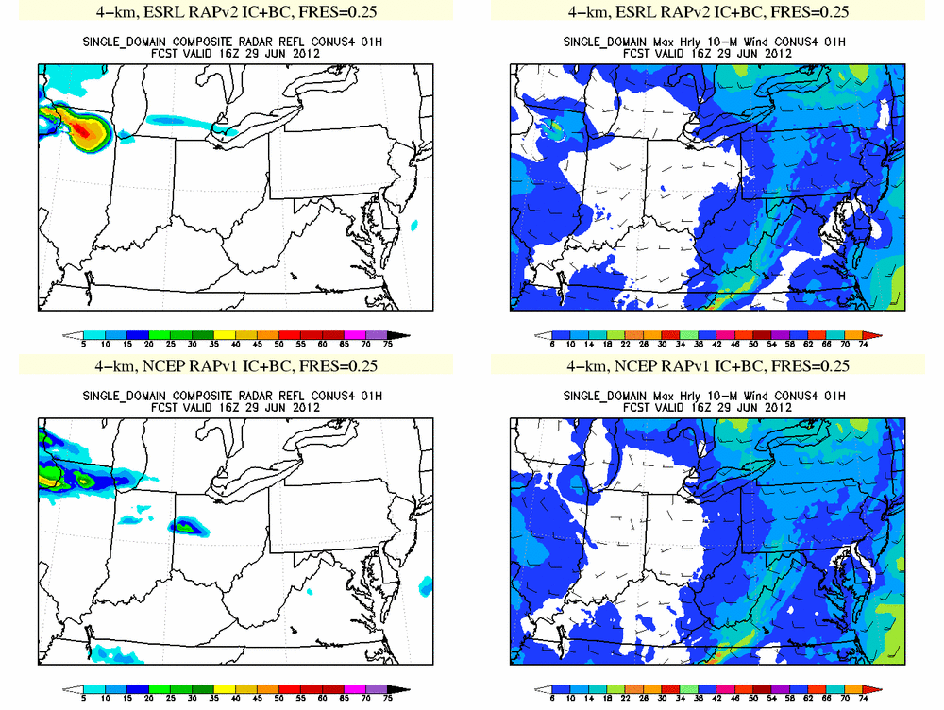
15

Slide 16
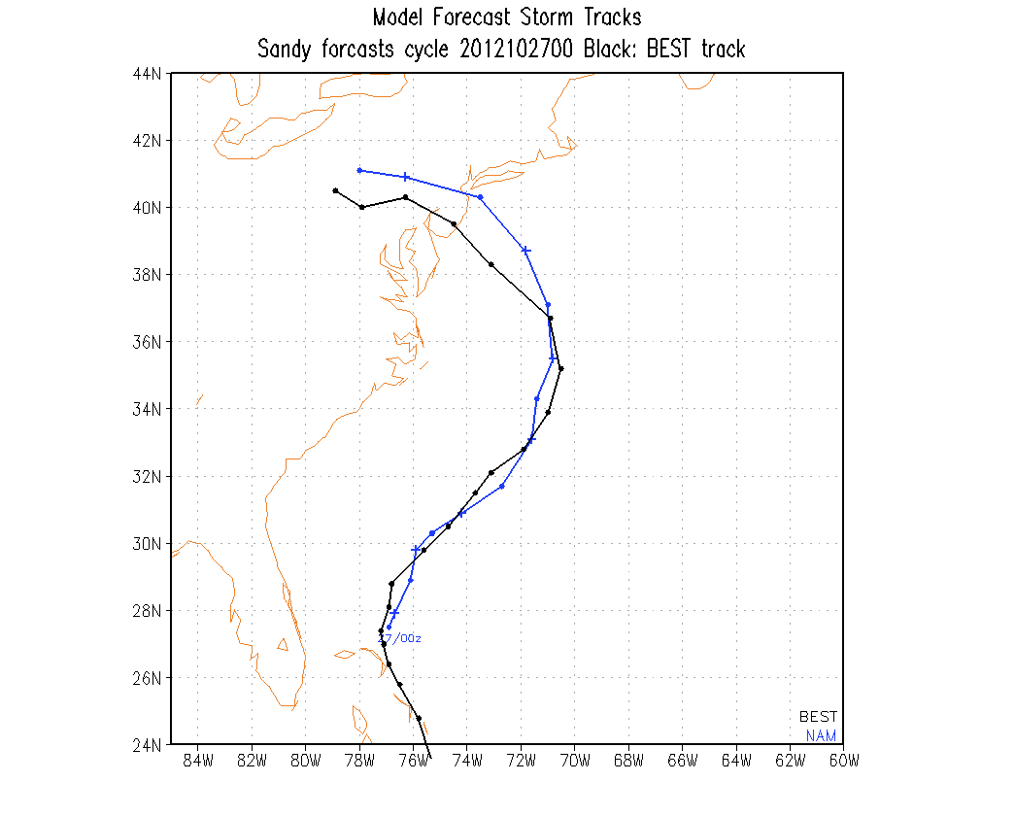
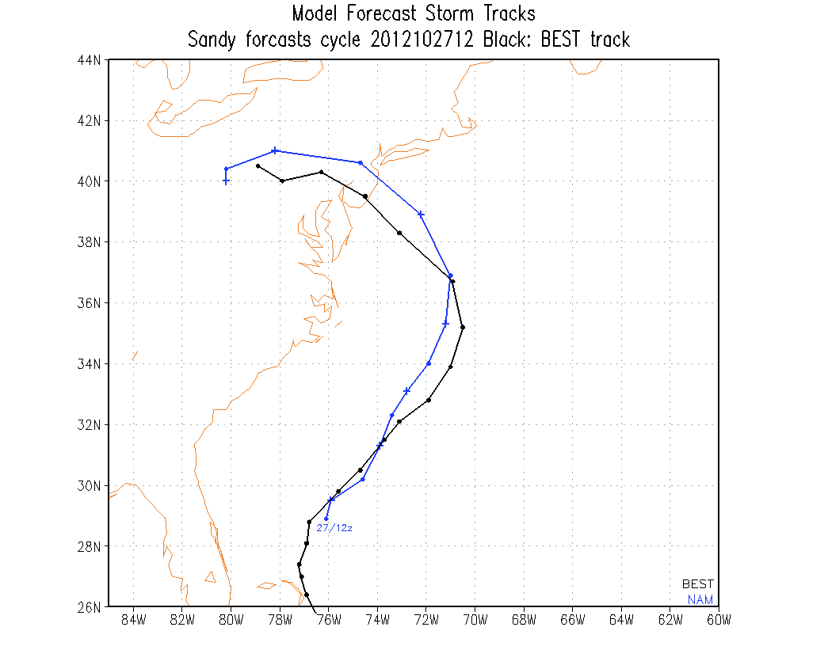
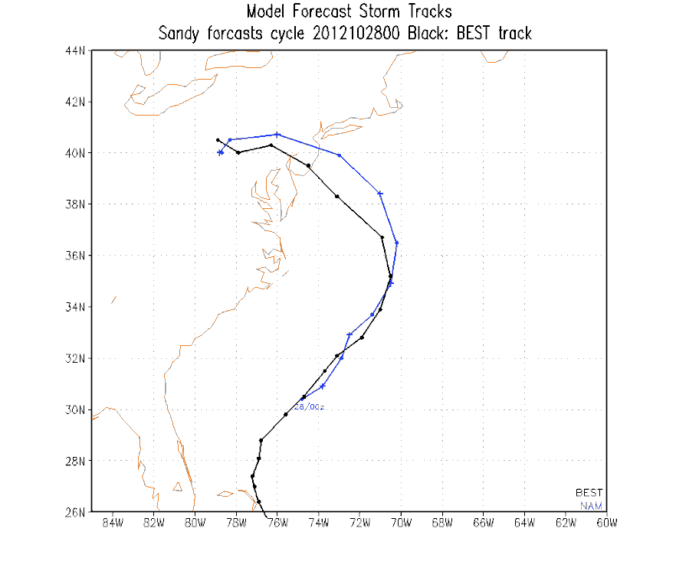
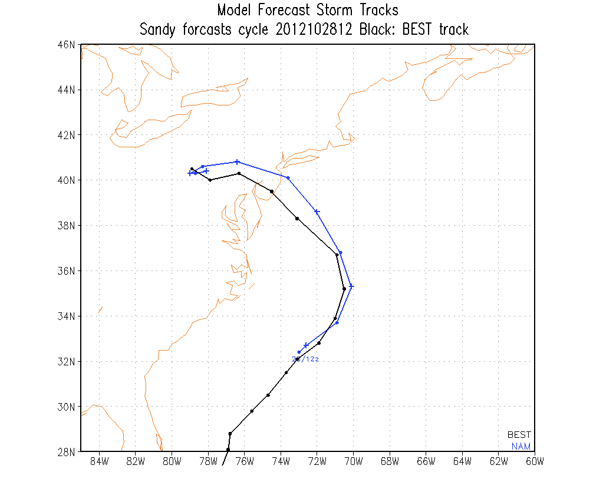
NAM Forecasts for Sandy Tracks
27/00z
27/12z
28/00z
28/12z

Slide 17
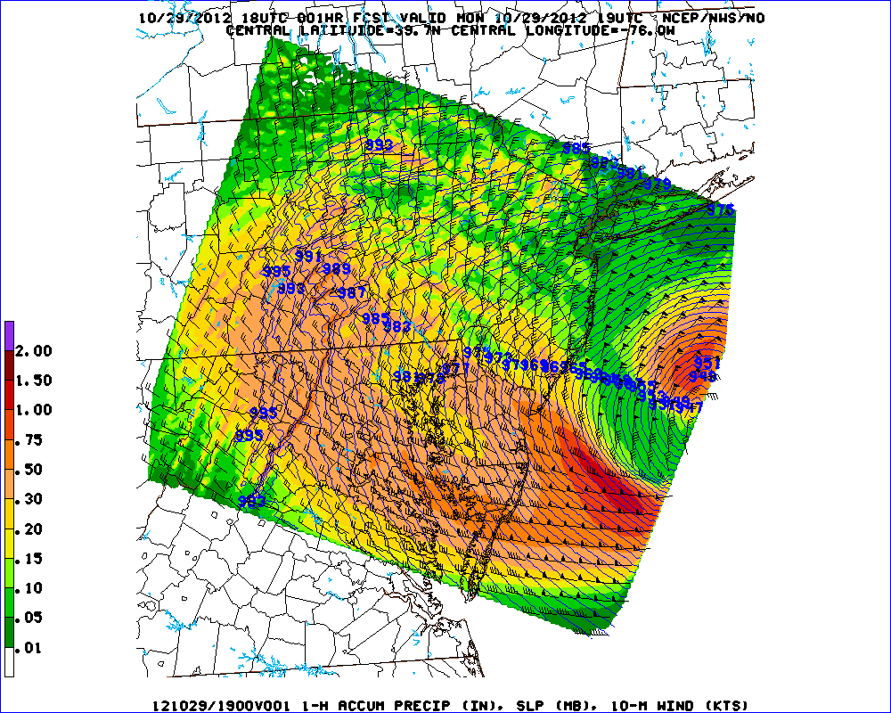
NAM 1.33 km nest from 18z 10/29/12 SLP, 1-h Accum Precip (in), 10-m wind (kt)

Slide 18
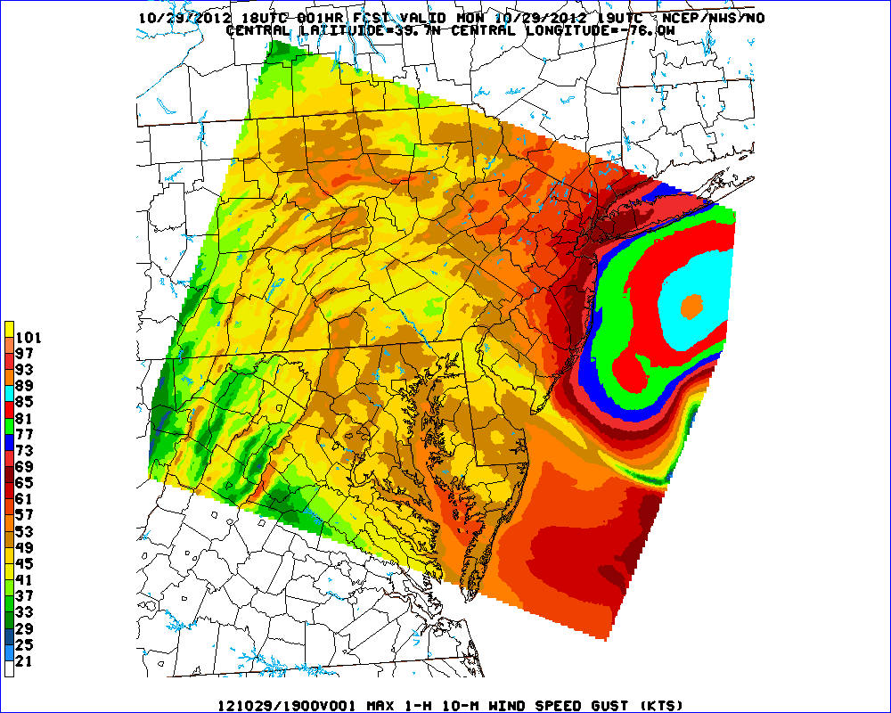
NAM 1.33 km nest from 18z 10/29/12 1-h Maximum Wind Speed Gust (kt)

Slide 19
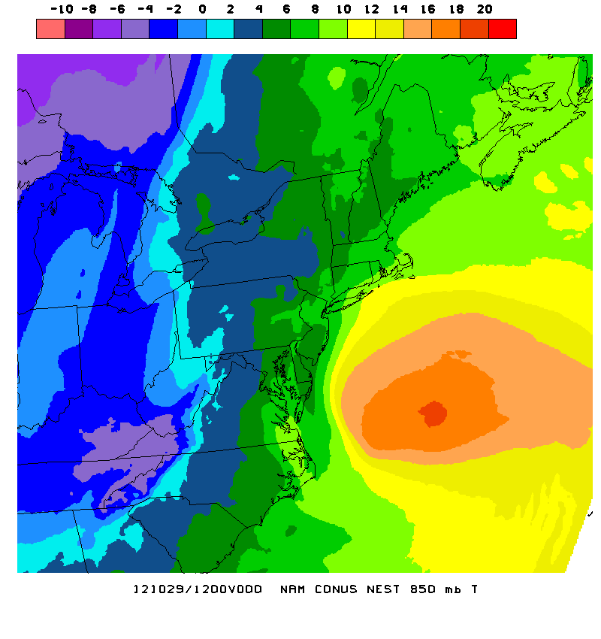
4 km NAM-Nest Transition of SANDY From WARM to COLD Core

Slide 20
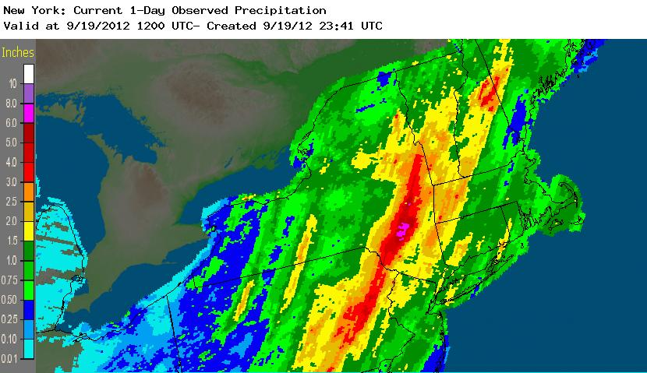
September Catskills Event
Speaking of NAM Nest…
Double NDFD resolution NAM-DNG being added
to AWIPS-SBN:
2.5 km CONUS and
3 km Alaska
6-8”
NAM f36
NAM NEST f36
7”+

Slide 21
GSI Changes in NAM Parallel
Hybrid var-ensemble analysis; added options for NDAS
Vertically integrated contribution to Psfc
Ability to bias correct the first guess with the ensemble mean
Vertically varying contributions from 3dvar and ensemble
RAOB level enhancement:
Use significant level data to create more dense profile data in the vertical
Helps reduce non-meteorological analysis profiles.
GPS bending angle instead of refractivity
Use RARS satellite radiances feed:
Created by direct read-out stations
Collected more quickly than the standard feed.
New VAD radar wind profiles
Use new RTMA QC: reject and use lists

Slide 22
Physics Changes in NAM Parallel
Gravity wave drag / mountain-blocking changes: more responsive to subgrid-scale terrain variability (impacts the synoptic scale)
Moister convective profiles so convection triggers less (fres=.75 in parent vs fres=.25 in nests)
RRTM (SW/LW) with enhancements:
Bug fix for sub-hourly zenith angle calculations
Updated O3, CO2 and other trace gases
Changes to albedo (removed diurnal variation)
Include effects of shallow (non-precipitating) convection
Remove 4x diffusion of moisture variables
Microphysics bug fix, reduced max. number concentration of ice
Notes:
2222

Slide 23
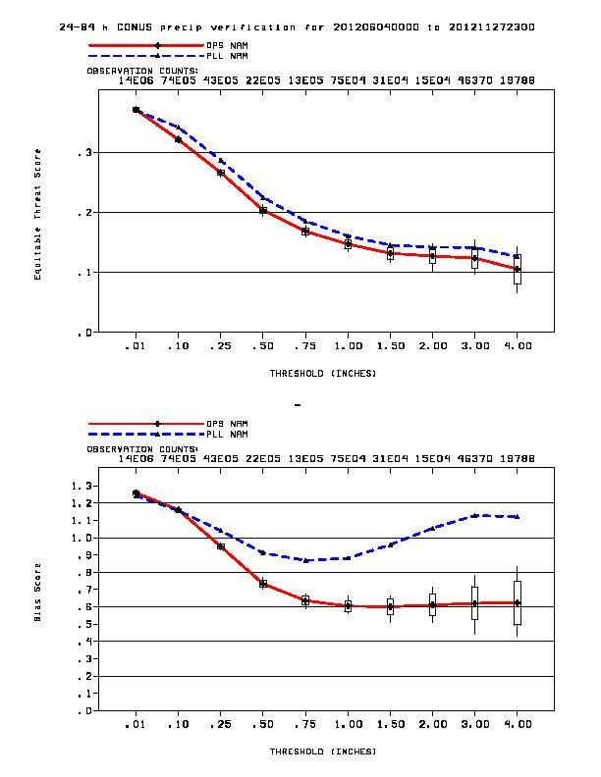
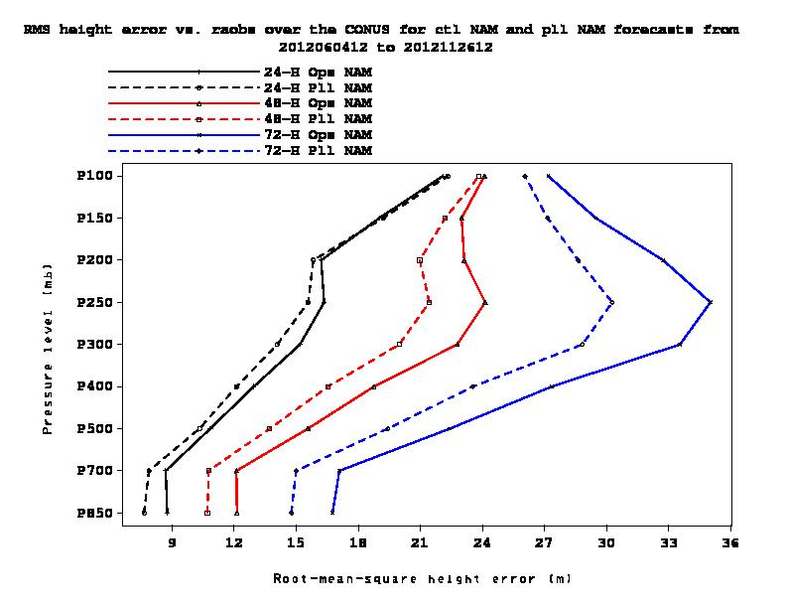
Verification from 1 June – 26 November 2012
Preliminary Testing for NAM
FY13 Upgrade Package
RMS Height error
24-h QPF, All Forecasts
Operational NAM
ETS
QPF Threshold = .01”-4”
Pressure (mb)
Parallel NAM
Bias
RMS Height Error (m)
Solid Red : Ops, Dashed Blue : Parallel
Day 1 = Black ; Day 2 = Red ; Day 3 = Blue
Notes:
2323

Slide 24
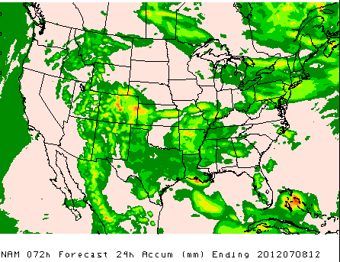
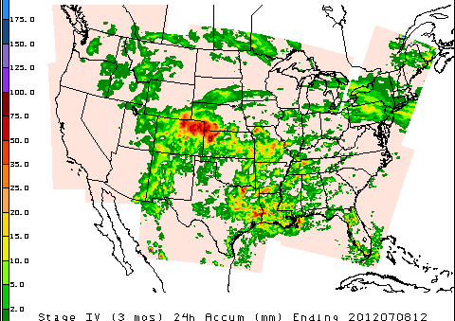
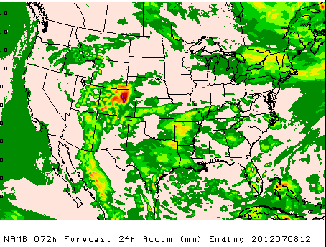
72-HR FCSTS
VALID 7/8/12
NAM
OBS
NAMB is NAM
real-time parallel
NAMB

Slide 25
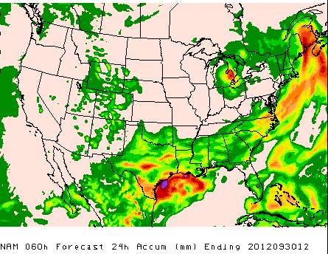
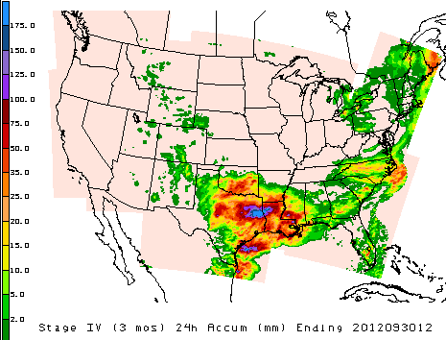
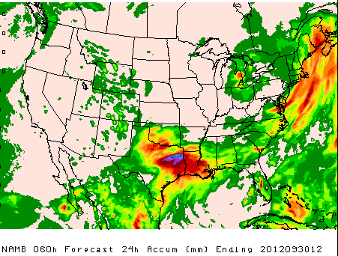
60-HR FCSTS
VALID 9/30/12
NAM
OBS
NAMB

Slide 26
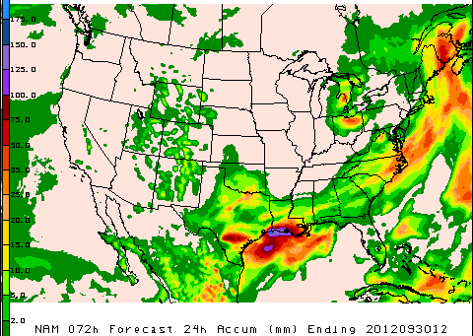
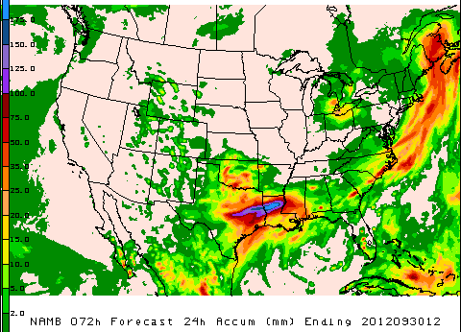
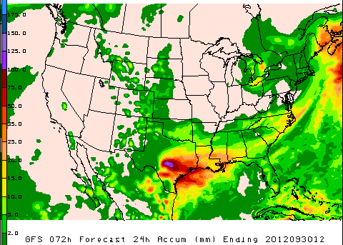
OBS
NAM
72-HR FCSTS VALID 9/30/12
NAMB
GFS

Slide 27
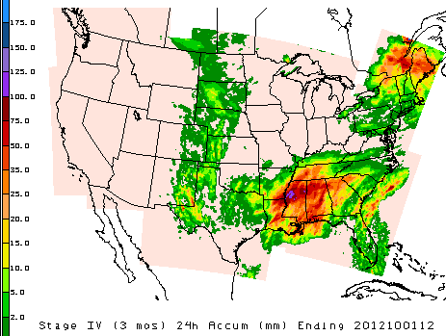
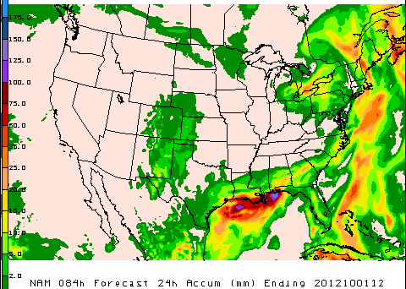
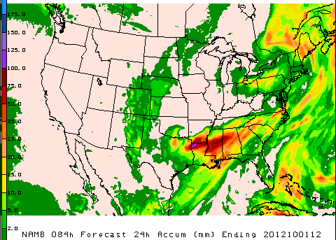
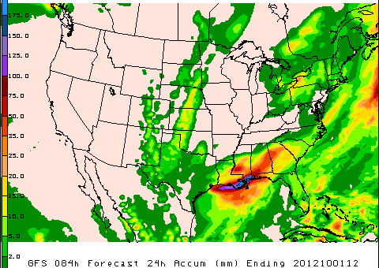
OBS
NAM
84-HR FCSTS VALID 10/01/12
NAMB
GFS

Slide 28
Future NAM Work
Add SREF to global ENKF in Hybrid-GSI
Satellite channel bias correction (from GDAS)
Diabatic Digital Filter Initialization
Tropical cyclone relocation (NAM & RTMA/DMA)
Add NAM’s own ENKF (beyond 2013)
New snowfall calculation (next slide)
Test ice nucleation formulation (see backup)
Convection bug-fix bundle (in NAMX)
ALL spokes of the “physics wheel of pain” …

Slide 29
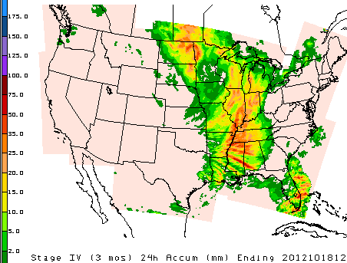
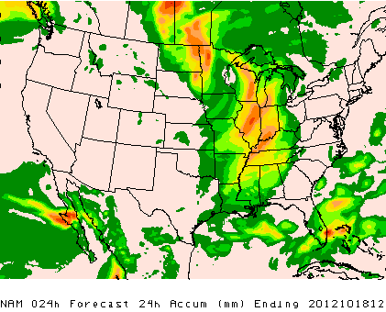
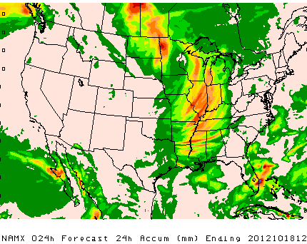
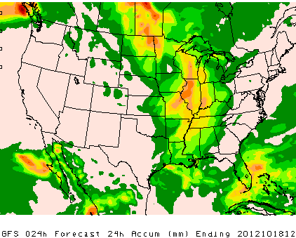
OBS
NAM
24-HR FCSTS VALID 10/18/12
NAMX
GFS
NAM

Slide 30
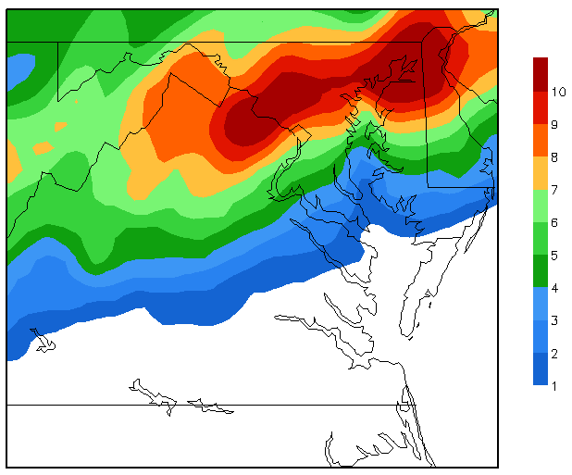
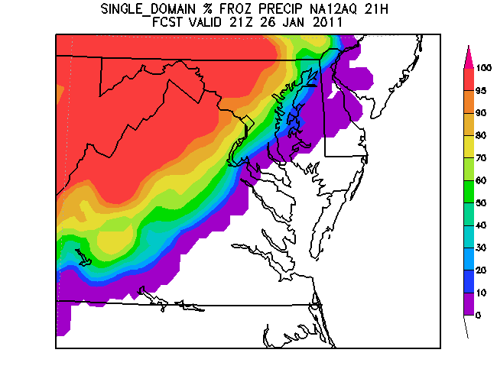
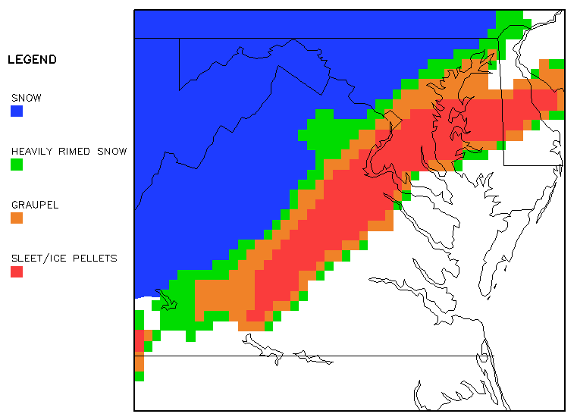
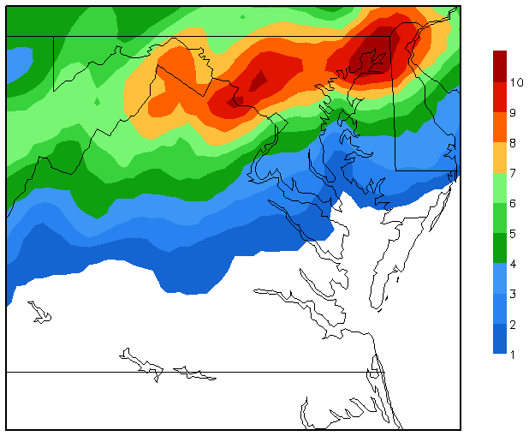
New method for predicting NAM snowfall (currently being tested HPC)
Uses the rime factor, percentage of frozen precip, and QPF to provide snowfall amounts with a varying snow-liquid ratio (SLR; algorithm is described here.)
Useful in areas of mixed precipitation
Varying SLR (lower right) reduced snow/ice accumulations by nearly 3” in some areas compared to the fixed 10:1 SLR (upper right)
26-27 January 2011
Snowfall Forecast (in) using a fixed 10:1 SLR
Rime Factor (RF)
Percentage of Frozen Precip
Snowfall Forecast (in) with a Varying SLR

Slide 31
2015-2016
North American Rapid Refresh ENSEMBLE (NARRE)
NMMB (from NCEP) & ARW (from ESRL) dynamic cores
Common use of NEMS infrastructure and GSI analysis
Common NAM parent domain at 10-12 km
Initially ~6 member ensemble made up of equal numbers of NMMB- & ARW-based configurations
Hourly updated with forecasts to 24 hours
NMMB & ARW control data assimilation cycles with 3-6 hr pre-forecast period (catch-up) with hourly updating
NAM & SREF 84 hr forecasts are extensions of the 00z, 06z, 12z, & 18z runs – for continuity sake.
SREF will be at same 10-12 km resolution as NARRE by then
SREF will have 21 members plus 6 from NARRE for total of 27
NARRE requires an increase in current HPCC funding

Slide 32
2017-2018
High Resolution Rapid Refresh ENSEMBLE (HRRRE)
Each member of NARRE contains 3 km nests
CONUS, Alaska, Hawaii & Puerto Rico/Hispaniola nests
The two control runs initialized with radar data & other hi-res obs
This capability puts NWS/NCEP[+OAR/ESRL] in a position to
Provide NextGen Enroute AND Terminal guidance (FWIS-like)
Provide PROBABILITY guidance with full Probability Density Function specified, hence uncertainty information too
Provide a vehicle to improve assimilation capabilities using hybrid (EnKF+4DVar) technique with current & future radar & satellite
Address Warn-on-Forecast as resolutions evolve towards ~1 km
NAM nests are extensions of the 00z, 06z, 12z & 18Z runs.
HRRRE requires an increase in HPCC funding over and above that required for the NARRE

Slide 33
T h a n k s ! A n y Q U E S T I O N S ? For more details, check out MMBackupSlides

