Slide 1
National Air Quality Forecast Capability: Updates to Operational CMAQ PM2.5 Predictions and Ozone Predictions and HYSPLIT Smoke Predictions
Operational Readiness Review
June 12, 2017
Notes:
<number>

Slide 2
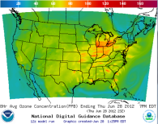
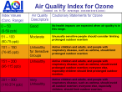
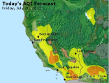
Background
Ongoing implementation of NOAA/NWS National Air Quality Forecast Capability (NAQFC) operationally to provide graphical and numerical guidance, as hourly gridded pollutant concentrations, to help prevent loss of life and adverse health impacts from exposure to poor air quality (AQ)
Exposure to fine particulate matter and ozone pollution leads to premature deaths: 50,000+ annually in the US (Science, 2005; recently updated to 100,000 deaths; Fann, 2011, Risk Analysis)
Direct impact on reducing loss of life: AQ forecasts have been shown to reduce hospital admissions due to poor air quality (Neidell, 2009, J. of Human Resources )
NOAA
develop & evaluate models; provide operational AQ predictions
NOAA’s AQ predictions leverage and contribute to partnerships with EPA and state and local agencies
EPA
maintain national emissions, monitoring data; disseminate/interpret AQ forecasts
State and local agencies
provide emissions, monitoring data, AQI forecasts
<number>
Notes:
<number>

Slide 3
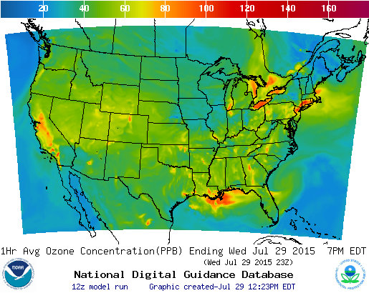
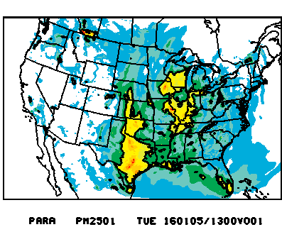
Community Multi-scale Air Quality (CMAQ) modeling system products
http://airquality.weather.gov/
http://www.emc.ncep.noaa.gov/mmb/aq/cmaqbc/web/html/index.html
µg/m³
Ozone predictions
PM2.5 predictions
Operational ozone predictions implemented for NE US in 2004, EUS in 2005, CONUS in 2007 and Nationwide in 2010.
Accuracy maintained over past 10 years: accounting for significant pollutant emission changes, weather and AQ model upgrades, as well as tighter warning thresholds used by state and local AQ forecasters in response to EPA's more stringent pollutant standards.
Fine particulate matter (PM2.5) predictions operational since 2016. Developmental testing begun in 2006.
<number>
Notes:
<number>

Slide 4
Ozone predictions from CMAQ system
Operational predictions at http://airquality.weather.gov
Model: Linked numerical prediction system
Operationally integrated on NCEP’s supercomputer
NOAA/EPA Community Multiscale Air Quality (CMAQ) model
NOAA/NCEP North American Mesoscale (NAM) numerical weather prediction
Observational Input:
NWS compilation of weather observations
EPA emissions inventory
Gridded forecast guidance products
On NWS servers: airquality.weather.gov and ftp-servers (12km resolution, hourly for 48 hours)
On EPA servers
Updated 2x daily
Verification basis, near-real time: Ground-level AIRNow observations of surface ozone
Customer outreach/feedback
State & Local AQ forecasters coordinated with EPA
Public and Private Sector AQ constituents
CONUS, wrt 70 ppb Threshold
Operational
Maintaining prediction accuracy as the warning threshold is lowered (now 70 ppb) and emissions of pollutants are changing
<number>

Slide 5
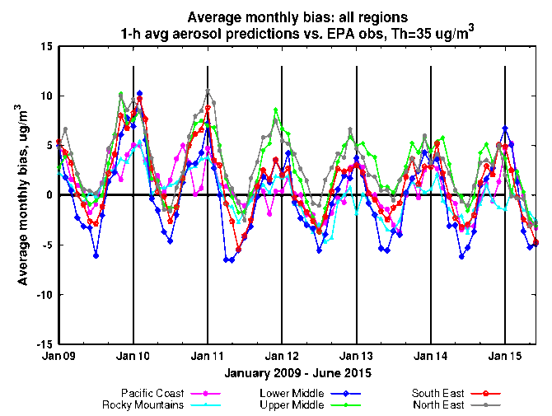
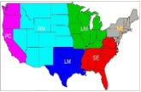
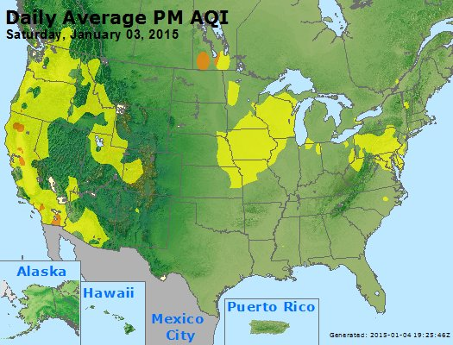
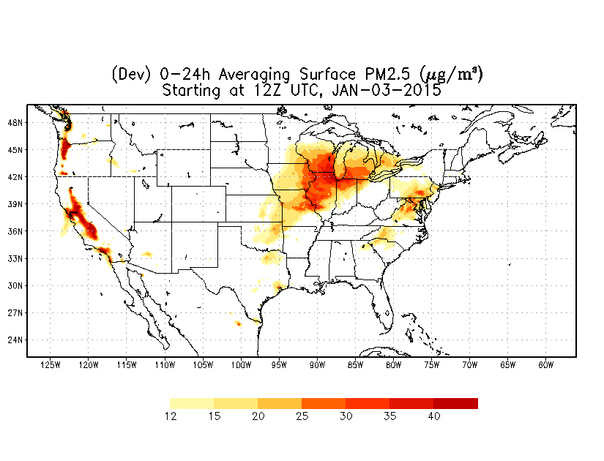
PM2.5 predictions from the same CMAQ system
Predictions for 48h at 12km resolution over CONUS
From NEI sources only before summer 2014
Community Multi-scale Air Quality(CMAQ) model:
CB05 gases, AERO-4 aerosols
Sea salt emissions, wildfire and dust emissions and suppression of soil emissions from snow/ice covered terrain included since summer 2014 (Lee et al., Weather and Forecasting 2016)
Model predictions exhibit seasonal prediction biases:
overestimate in the winter; underestimate in summer
Additional observational input: AIRNow PM2.5 observations for bias correction and verification
Forecast challenges
Improving sources for wildfire smoke and dust
Chemical mechanisms eg. SOA
Meteorology eg. PBL height
Chemical boundary conditions/trans-boundary inputs
NAQFC PM2.5 test predictions
<number>
Notes:
<number>

Slide 6
Updates to air quality predictions
Changes made for this upgrade:
Update of the chemical transport model to Community Multi-scale Air Quality (CMAQ) model v5.0.2 (155 species; improved heterogeneous, aqueous and winter-time reactions; aero6 with improved SOA and coarse mode PM)
Update of US Forecast Service BlueSky smoke emissions system to v3.5.1 (more detailed description of fuel loading, improved fuel consumption model and for HYSPLIT only an explicit fuel load map for Alaska)
Addition of 24-hour analysis cycle to include wildfire emissions at the time when they are observed
Update of the bias-correction post-processing for fine particulate matter (PM2.5) forecast guidance to use the Kalman Filter Analog (KFAN) technique
Update of point source emissions to projections for 2017 (starting on July 1, 2017)
Update of dust related aerosol species at the CMAQ lateral boundaries to use the NEMS Global Aerosol Component (NGAC) v2 forecasts
Expected Benefits from this upgrade:
Improved raw and bias-corrected fine PM2.5 forecast guidance
Improved summertime surface ozone forecast guidance, especially in coastal areas
Improved wildfire smoke predictions for CONUS and Alaska, especially from large forest fires in HYSPLIT
<number>

Slide 7
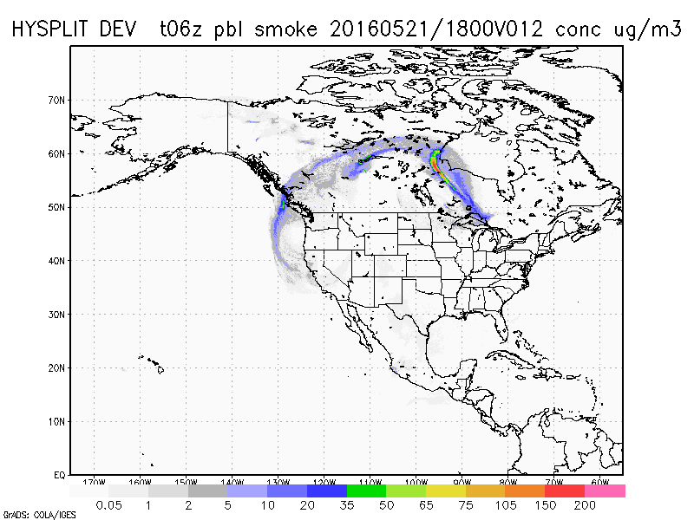
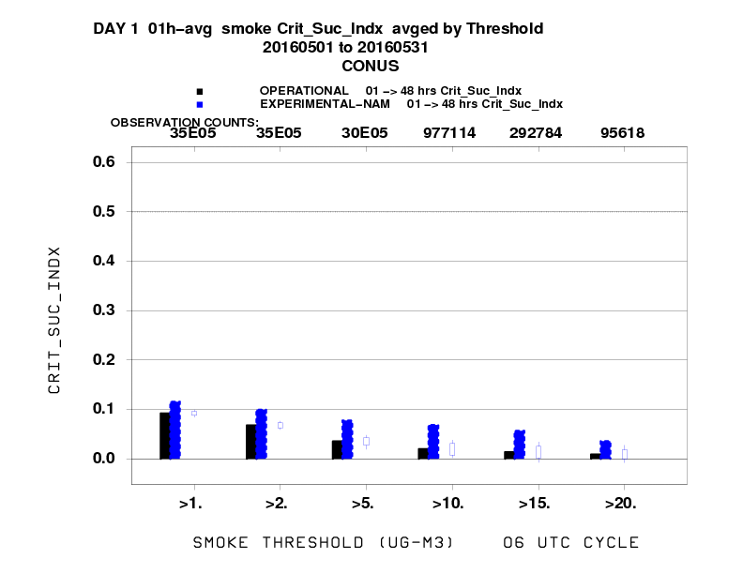
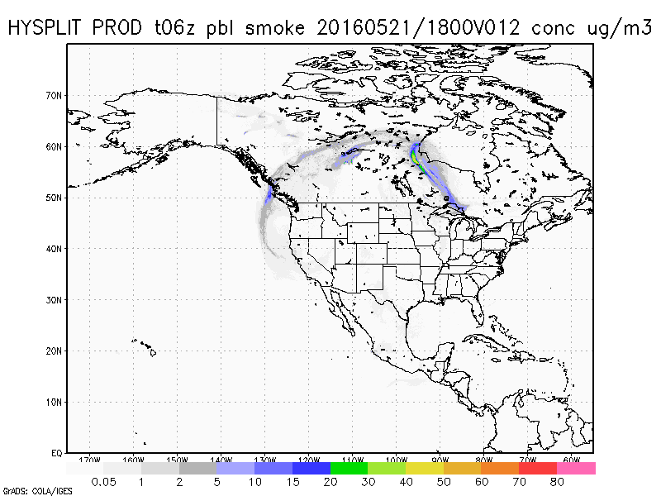
BlueSky Evaluation
Comparison of operational smoke predictions with those using the updated Bluesky for May 2016.
Operational HYSPLIT
HYSPLIT with updated BlueSky
HYSPLIT with updated BlueSky
Operational HYSPLIT
Improved skill scores in May from large Ft. McMurray fires
<number>

Slide 8
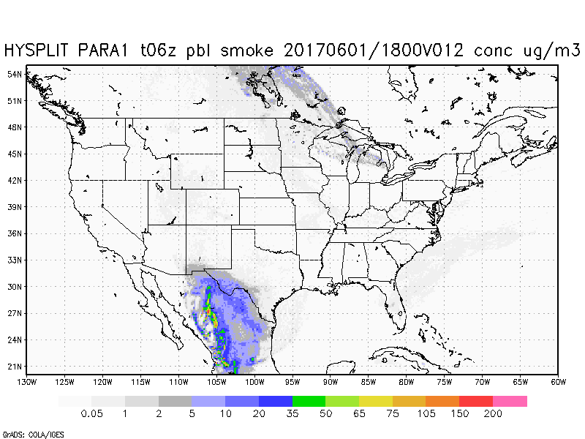
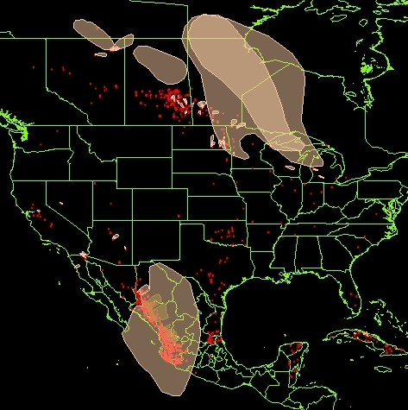
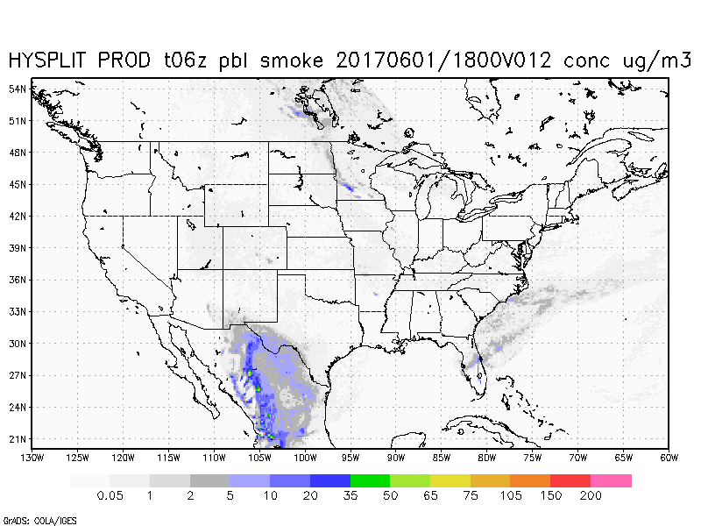
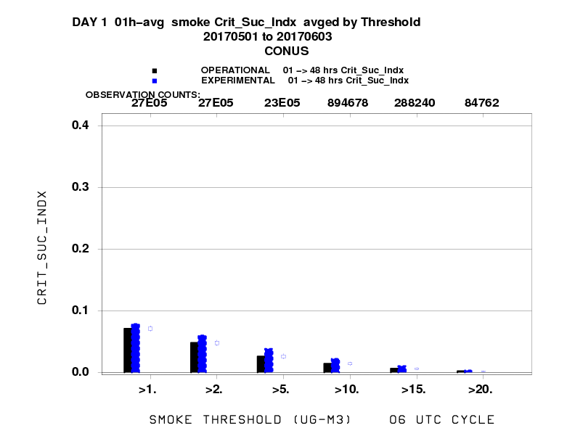
BlueSky Evaluation (cont.)
Comparison of current operational smoke predictions with those using the updated Bluesky in May-June 2017.
HYSPLIT with
updated BlueSky
June 1, 2017
Operational
HYSPLIT
CSI for May 2017
<number>

Slide 9
PM2.5 from wildfires in CMAQ
Better representation of wildfire smoke emissions based on detections of wildfire locations from satellite imagery, BlueSky system emissions, included over previous 24 hours when fires were detected and projected with reduced intensity into the 48 hour forecast period
Daily mean for Western US
Observations
Current model
Updated model
Bias correction of current model
µg/m³
PM2.5 in August 2015
<number>

Slide 10
Representation of wildfires – NW U.S. example on August 23, 2015
Current CMAQ
Updated CMAQ
µg/m³
Wildfires are strongly impacting air quality in the region
Observed daily maximum of hourly PM2.5 exceeds 55 µg/m³and even 100 µg/m³
Operational system predicts values below 25 µg/m³ for many of these monitors
Updated system in testing predicts values much closer observed
<number>

Slide 11
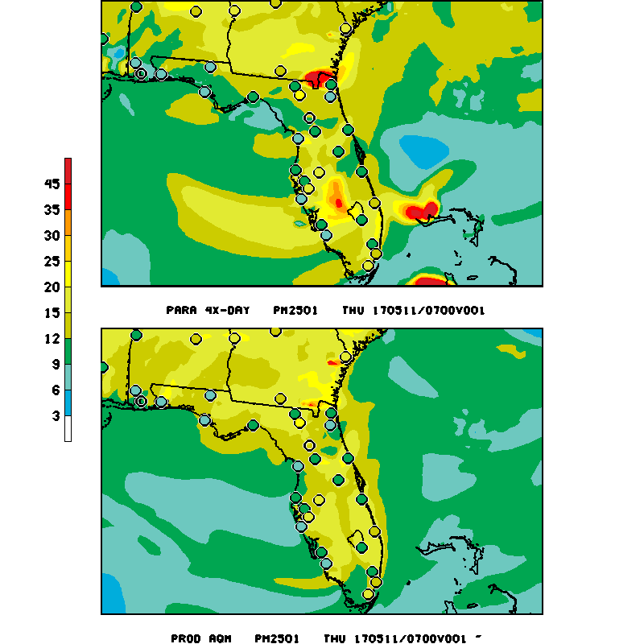
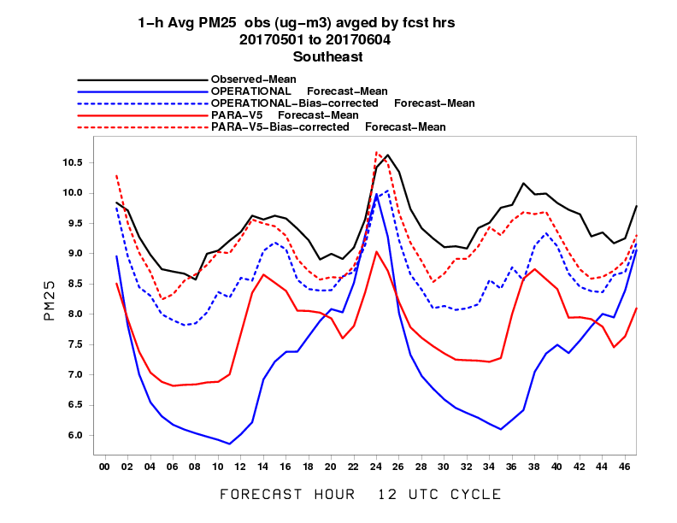
May 11 2017 Florida/Georgia Fires 1hr PM2.5 CMAQ loop
Updated CMAQ
Operational CMAQ
____ Operational
____ Updated
µg/m³
µg/m³
Updated model captures Florida and Bahama fires and follows observed diurnal pattern better
<number>

Slide 12
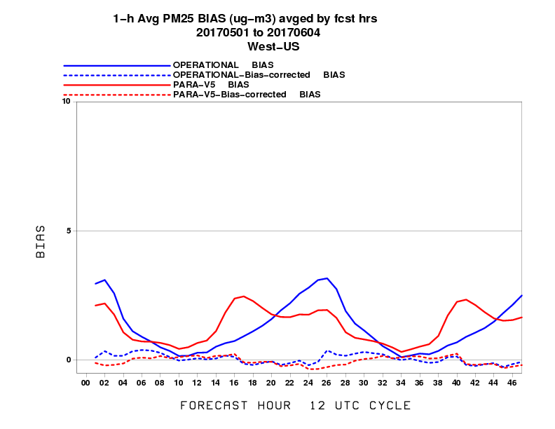
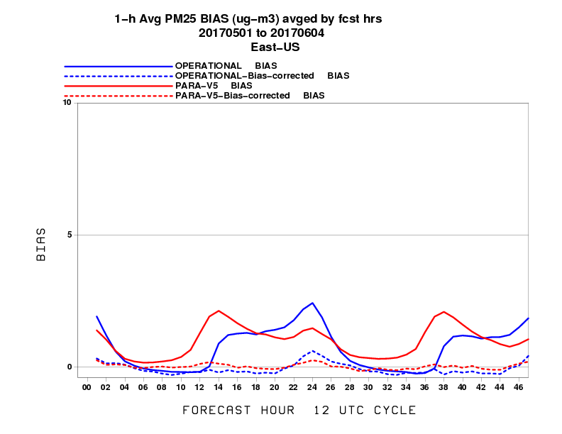
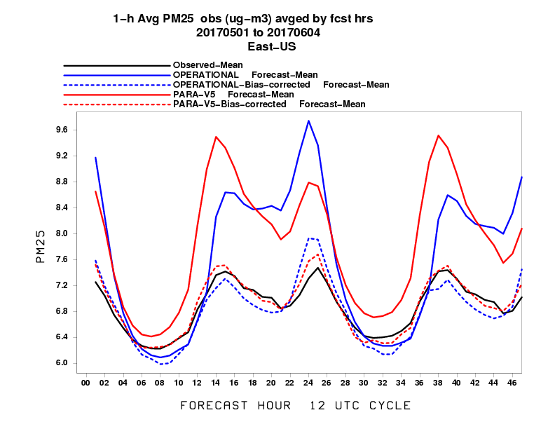
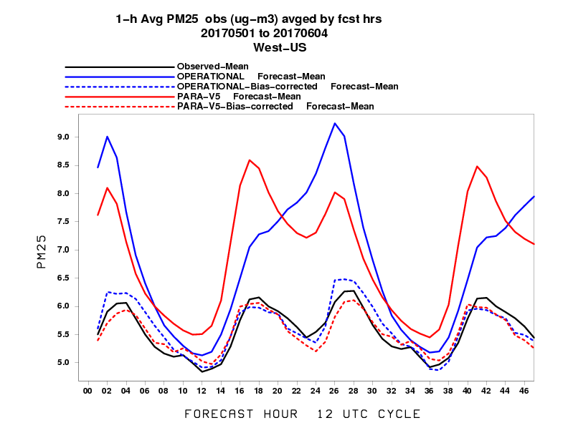
Statistical performance for PM2.5 (May 2017)
Western U.S.
Eastern U.S.
µg/m³
µg/m³
Bias
____ Operational
____ Updated
µg/m³
µg/m³
Mean
<number>

Slide 13
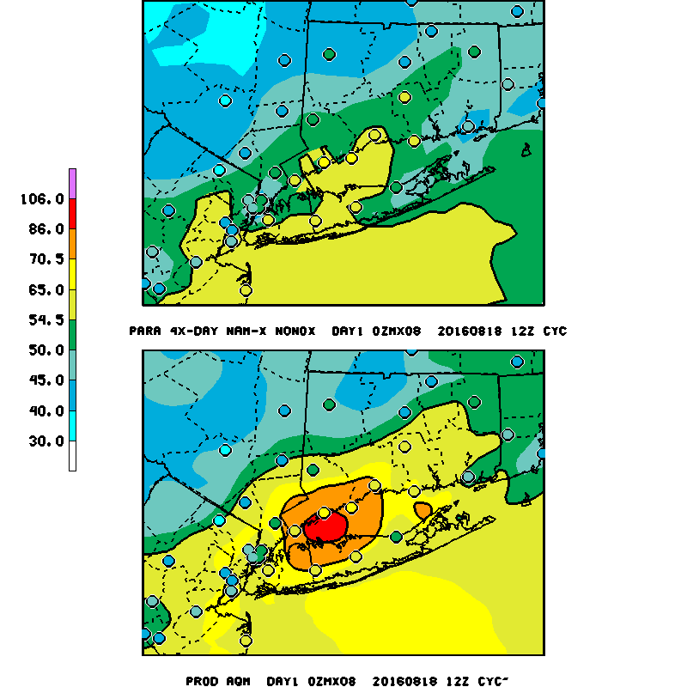
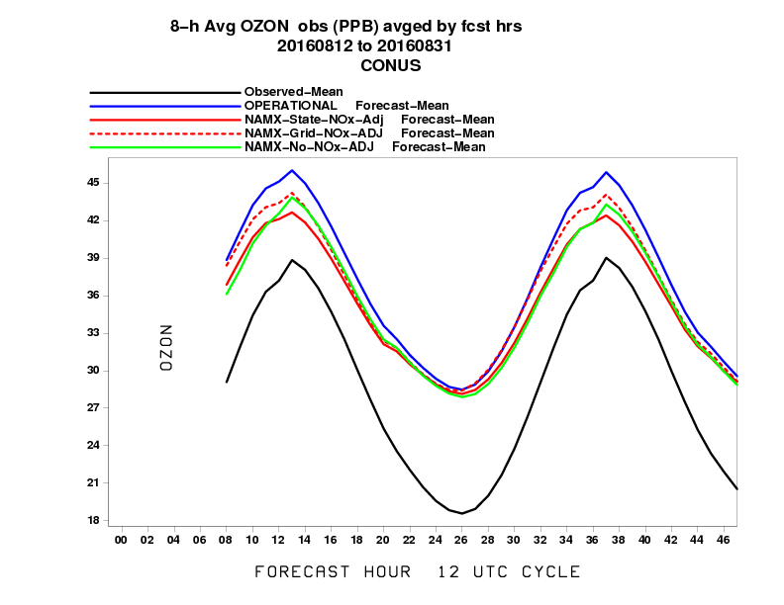
Improvements in ozone predictions in Eastern U.S.
Updated CMAQ
Updated CMAQ V5.0.2 showed a great improvement over operational for August 18, 2016 case.
Operational CMAQ
ppb
____ Operational
____ Updated
<number>

Slide 14
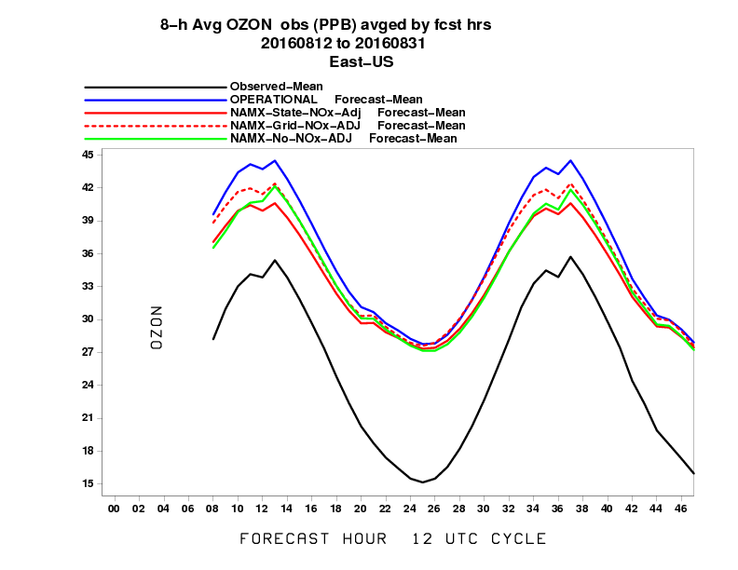
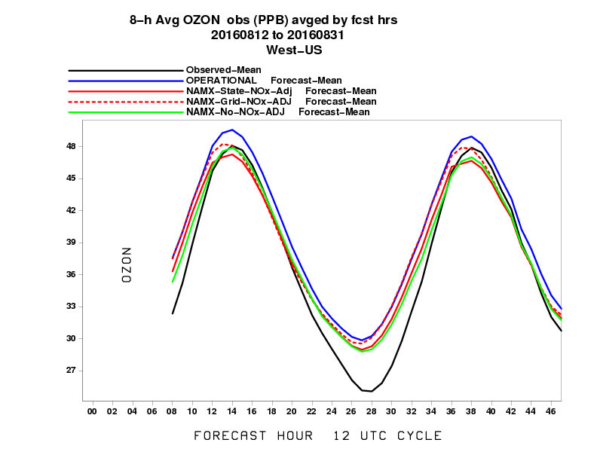
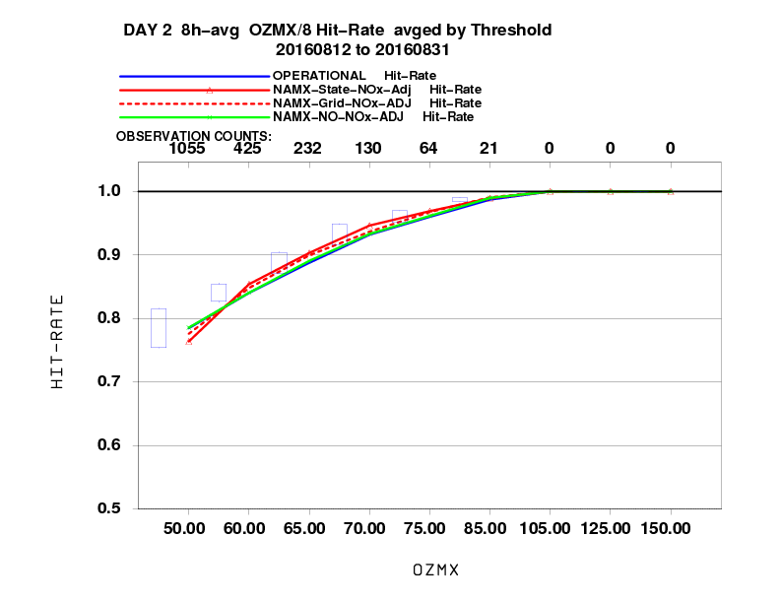
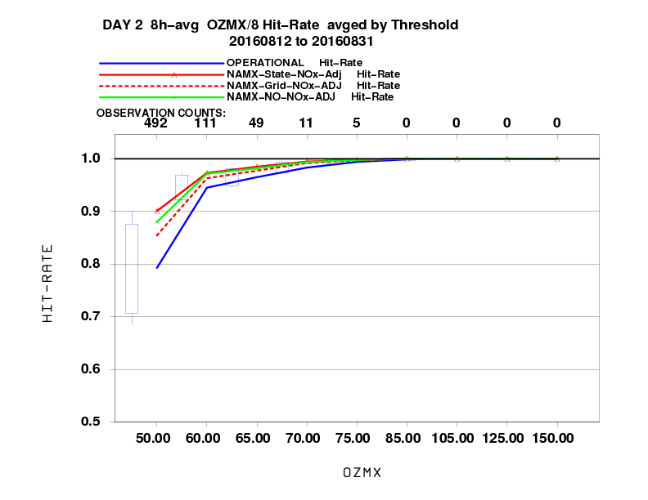
Statistical performance for Ozone (Aug 2016)
Western U.S.
Eastern U.S.
Mean
____ Operational
____ Updated
Fraction correct
<number>

Slide 15
Improvements in ozone near coastal areas Day 2 predictions for May 17, 2017 8h Max Ozone
More ozone formation in parallel run
Updated
ppb
Operational
<number>

Slide 16
Testing with Forecaster Feedback
Initial forecaster feedback was collected during the AQ forecasters focus group workshop in September 2016. Based on this feedback additional emissions configurations were tested and the final configuration was presented to the forecasters in January 2017.
Frozen model version predictions were provided by EMC retrospectively for August 2016, in real time since March 21, 2017 and continued by NCO since May 2, 2017 for 30-day parallel testing.
EMC provides parallel prediction maps and predicted values at monitor sites in text form to air quality forecasters.
<number>

Slide 17
Summary of Forecaster Feedback
Received recommendation to implement as proposed from AQ forecasters from
Maine,
Pennsylvania,
Virginia,
Connecticut,
North Carolina,
Texas,
Washington and
Maryland.
Additional feedback was received from Florida without a recommendation due to a limited evaluation.
<number>

Slide 18
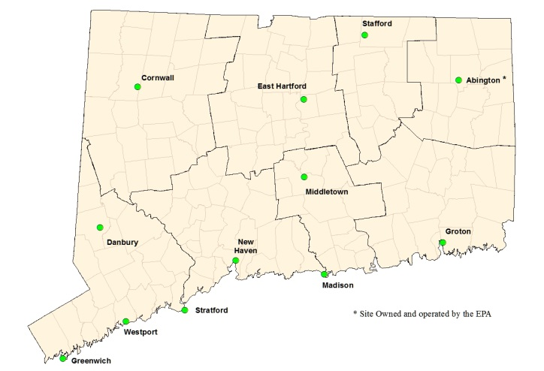
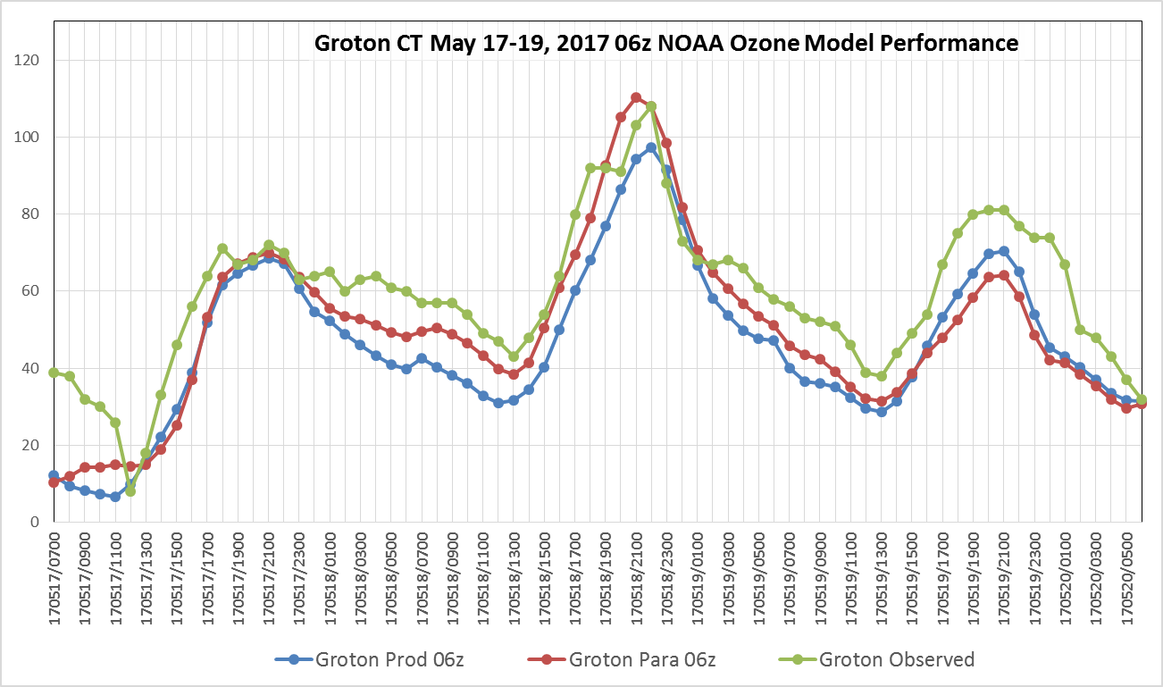
Ozone Feedback: Connecticut
The NOAA PARA ozone configuration had good performance during the May 16-18, 2017 smoke enhanced event over Connecticut.
Both the PROD and PARA performed well for the coastal sites with para being slightly more accurate
The PARA ozone run did perform better during the overnight hours, which is a major improvement.
<number>
Notes:
Day 3 was under estimated because the cold front was slower than the NAM predicted
2012 CMAS Conference

Slide 19
Ozone Feedback: Maryland
Considerable improvement in the spatial coverage of ozone exceedance events with the Para runs of the CMAQ model for August 2016 - May 31, 2017.
May 17-18, 2017 event
For May 17-18, 2017 event, both models under predicted regional ozone concentration however para did better regionally.
On May 17, I-95 corridor para predictions reasonably matched observed concentrations, over-prediction in the Bay and nearby land sites immediately adjacent to Baltimore by 5-20ppb
On May 18, the Para model also underpredicted ozone concentrations and exceedance extent and over-predicted within the Bay itself.
There is a slight risk the model may miss occasional exceedances, however, MDE [indicates] that the potential improvements are superior to current production model performance on [examined] exceedance events.
<number>

Slide 20
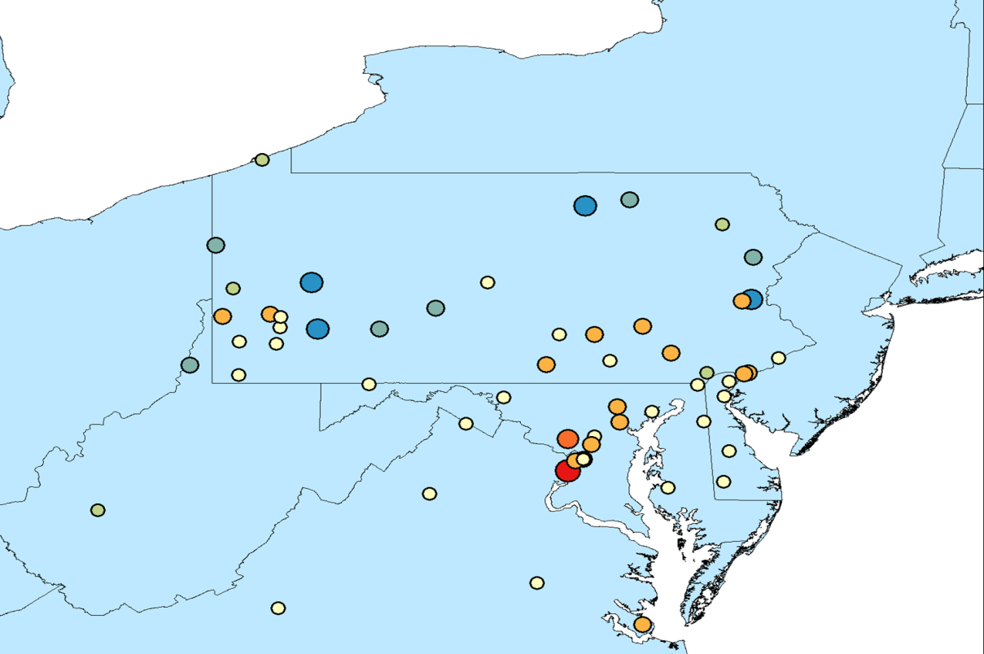
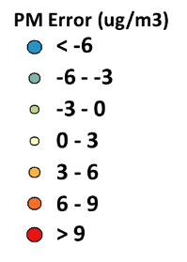
PM2.5/smoke Feedback: Maryland
The bias-corrected did better overall than the current non-corrected runs for March-May 2017.
The bias-correction often reduced the predicted daily PM2.5 concentration compared to the non-bias corrected version.
The Bias-correction often “over-did” the correction compared to the production runs which predicted wide-spread moderate, MDE forecasters see this as an overall improvement on a daily basis.
The ability to track smoke is better than before.
Dec 2016 – Mar 2017
PM_{2.5} bias for updated CMAQ raw model predictions
<number>

Slide 21
Additional Feedback Examples
Ozone
Have noticed an improvement through the spring compared to previous years, especially in handling of ozone formation/scavenging along the coast. (TX)
The upgraded model was helpful in forecast determinations. I found the AQM v5.0.2 to be an upgrade versus the NOAA [operational] CMAQ and the state of NC’s local CMAQ model.(NC)
Some marginal benefits in ozone predictions in the southern Chesapeake Bay. Furthermore, there was no degradation noted. We recommend implementation of AQM 5.0.2. (VA)
PARA was more skillful (less bias and less error) than PROD for late ozone season (PA)
PM2.5/smoke
BIAS corrected runs very accurate during the April event. During May 17 event, the PARA run did match some of the peak values that were smoke enhanced (CT)
Bias corrected predictions are more skillful than PROD for November 2016 (high PM2.5 month). The bias corrected predictions had less bias, lower error (all days). (PA)
HYSPLIT PARA run for April 11-12, 2017 outperformed the PROD for the northeast States (CT)
<number>

Slide 22
Recommendation for Implementation
Recommendation:
NWS deploy updated CMAQ for operational ozone predictions, bias corrected particulate matter (PM2.5) products, raw PM2.5 products and update of USFS BlueSky smoke emissions system used by CMAQ predictions and HYSPLIT smoke predictions in the operational air quality product suite.
<number>
Notes:
<number>

Slide 23
Acknowledgments: AQF implementation team members
Special thanks to previous NOAA and EPA team members who contributed to the system development
NOAA/NWS/STI Ivanka Stajner NAQFC Manager
NWS/AFSO Jannie Ferrell Outreach, Feedback
NWS/OD Cynthia Jones Data Communications
NWS/OSTI/MDL Marc Saccucci, Dave Ruth Dev. Verification, NDGD Product Development
NWS/STI Sikchya Upadhayay Program Support
NESDIS/NCDC Alan Hall Product Archiving
NWS/NCEP
Jeff McQueen, Jianping Huang, Ho-Chun Huang AQF model interface development, testing, & integration
Jun Wang, *Sarah Lu Global dust aerosol and feedback testing
*Brad Ferrier, *Eric Rogers, NAM coordination
*Hui-Ya Chuang
Geoff Manikin Smoke and dust product testing and integration
Rebecca Cosgrove, Steven Earle, Chris Magee NCO transition and systems testing
Mike Bodner, Andrew Orrison HPC coordination and AQF webdrawer
NOAA/OAR/ARL
Pius Lee, Daniel Tong, Li Pan CMAQ development, adaptation of AQ simulations for AQF
Hyun-Cheol Kim, Youhua Tang
Ariel Stein HYSPLIT adaptations
NESDIS/STAR Shobha Kondragunta Smoke and dust verification product development
NESDIS/OSDPD Liqun Ma, Mark Ruminski Production of smoke and dust verification products,
HMS product integration with smoke forecast tool
EPA/OAQPS partners:
Chet Wayland, Phil Dickerson, Brad Johns, John White AIRNow development, coordination with NAQFC
* Guest Contributors
<number>

Slide 24
Back-up
<number>

Slide 25
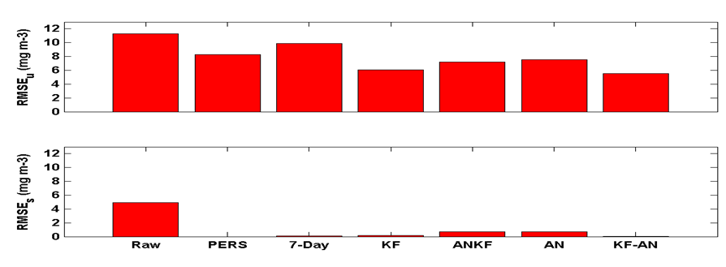
Bias correction for PM2.5 predictions
Quality control of the observations is essential
Five different post-processing techniques were tested
Raw: Hourly AIRNow data available in real-time
PERS: Persistence forecast
7-day: 7-day running mean subtraction
KF: Kalman-filter approach
ANKF: Analog forecast technique followed by Kalman filter approach
AN: Analog Forecast technique
KF-AN: Kalman-filter approach followed by Analog forecast technique
Unsystematic component of the RMSE (top panel) and systematic component of RMSE (bottom panel) using hourly values for the month of November evaluated at the 518 AIRNow PM2.5 sites.
I. Djalalova, L. Delle Monache, and J. Wilczak: PM2.5 analog forecast and Kalman filter post-processing for the Community Multiscale Air Quality (CMAQ) model, Atmospheric Environment, Volume 108, May
2015, pp.76–87.
<number>

Slide 26
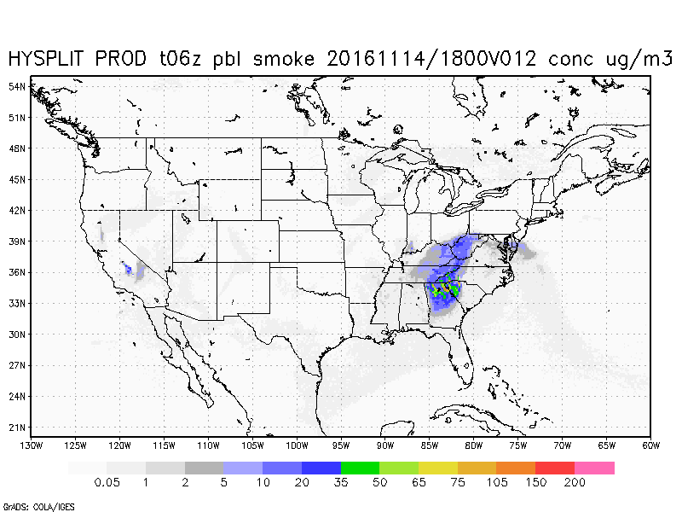
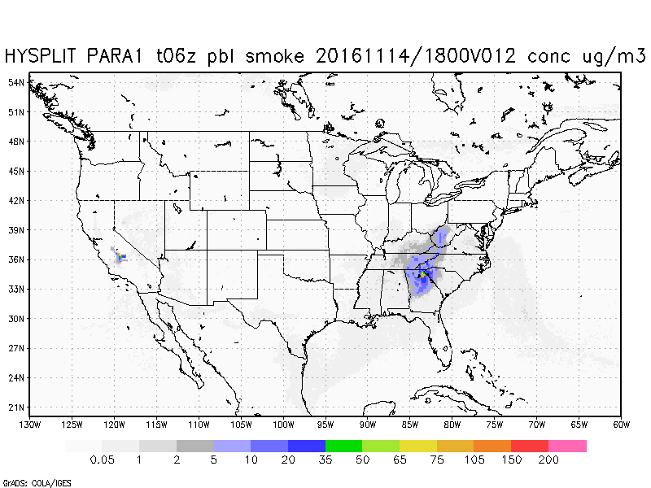
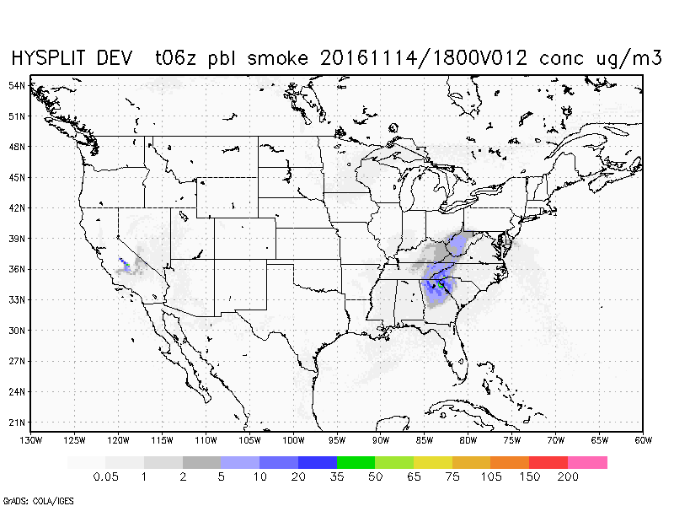
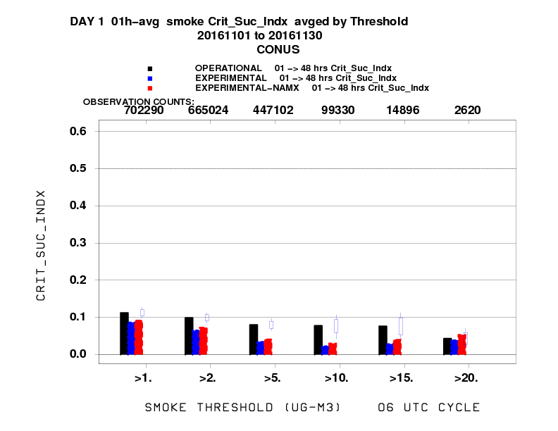
Updated BlueSky with NAMx
Example of South East U.S. fires in Nov 2016
Current operational HYSPLIT
HYSPLIT with updated BlueSky + NAMx
Operational HYSPLIT
HYSPLIT with updated BlueSky
HYSPLIT with updated BlueSky + NAMx
HYSPLIT with updated BlueSky
Poorer performance from smaller
smoldering fires at large concentrations
<number>
Notes:
Poorer performance for smaller eastern fires…but better performance for large forest fires
<number>

Slide 27
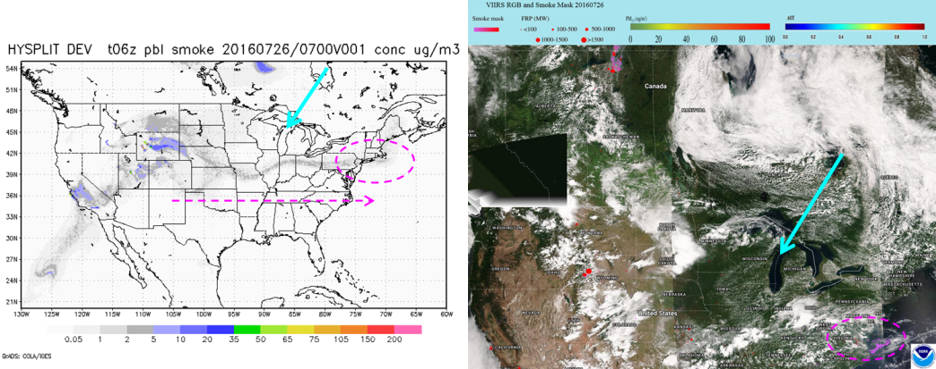
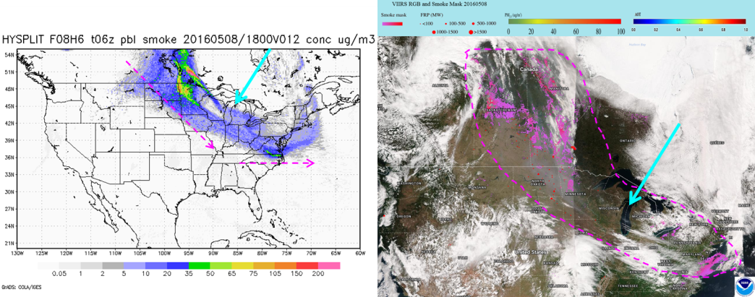
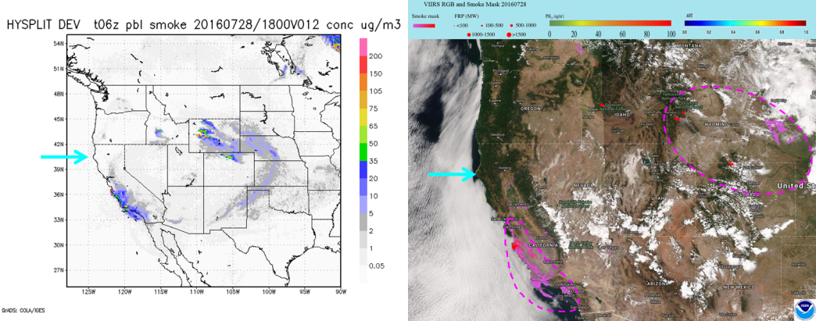
Blue Sky Evaluation (contd.)
Additional examples of smoke predictions with updated BlueSky
July 2016 Northern Wyoming Fires
May 2016 Ft McMurry (Canada) Fires
July 2016 California Big Surf Fires
Courtesy Ho-Chun Huang, EMC
eIDEA Smoke Mask
Notes:
This is run as part of HYSPLIT processing so it does impact HYSPLIT predictions as well. Both CMAQ and HYSPLIT use the same smoke emissions system.
Includes a more detailed land use/fuel loading. Worked closely with USFS to transition this code.
<number>

Slide 28
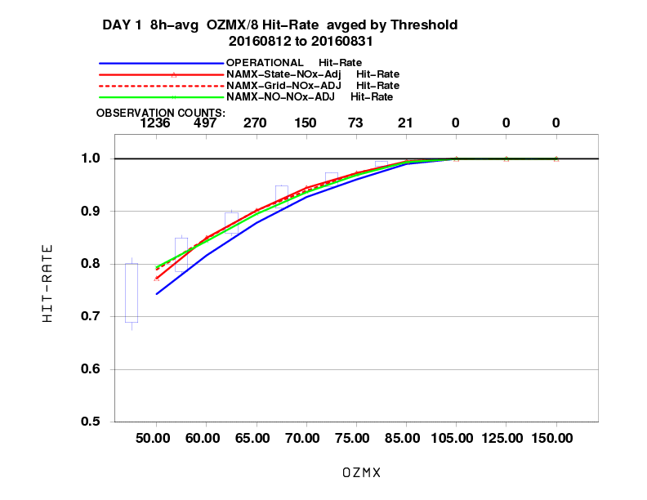
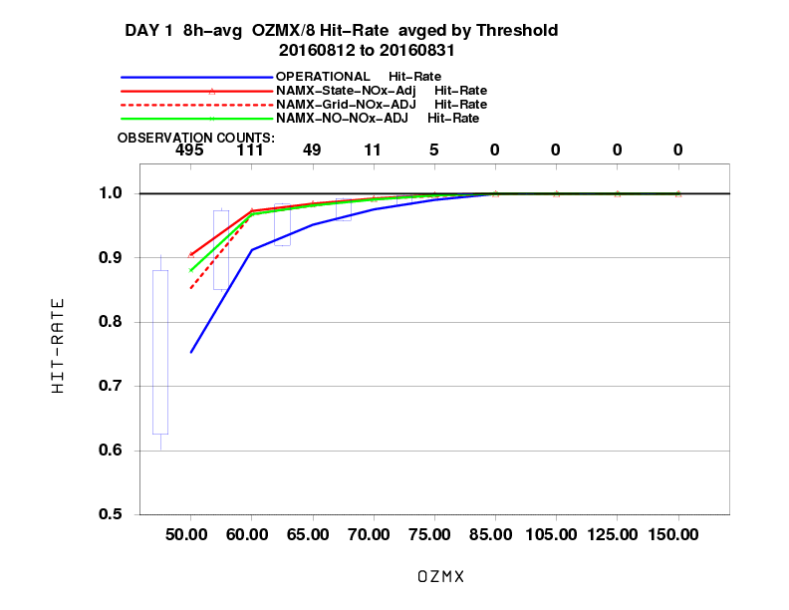
Statistical performance for Ozone (Aug 2016)
Fraction correct (Day 1)
Western U.S.
Eastern U.S.
<number>

Slide 29
NAQFC evaluation process
Coordination with a Focus Group of State Air Quality forecasters:
Retrospective and real-time runs from July 2016 – Present in following way
ARL Preliminary: Aug. 2015/Feb. 2016
EMC Real-Time: July 2016→March 2017
NCO Real-Time: April 2017→Present
EMC NAM-X Retrospectives : July 2016
EMC/ARL NOx emissions adjustments : Aug-Sept. 2016 retrospective
Provision of comparison graphics for key areas (EMC maintains NRT comparison graphics and verification web sites)
Provision of MS Excel ready (Ascii) time series files at AQ sites delivered to forecaster
Enable region specific feedback on model performance
<number>

