Slide 1
The Way Forward FY2017 & beyond ...
Initial version 27 Sep, subsequently presented / discussed at 24 Oct MEG-STI Hi-Res Ensemble Team 31 Oct NCEP/NWS SYNERGY 1 Dec Mesoscale Modeling Branch meeting
Geoff DiMego, Michael Farrar
Jacob Carley, Jun Du, Brad Ferrier
Geoff Manikin, Matt Pyle, Eric Rogers, et al.
5 December 2016 NCEP Production Suite Review

Slide 2
THE MESSAGE being blatantly clear - leaving no room for misinterpretation - read my lips
These short-term steps are transitional
Long term goal is unification around FV3
Majority of model development staff are NOW working on parallel FV3 transition projects:
3 km HWT Spring Program application with appropriate physics and performance
Running on WCOSS, in NEMS, with coupling
Limited area + grid enhancement capabilities
Nesting: static, telescoping, moving
Running with GSI-Ens-Hybrid Data Assimilation

Slide 3
EMC Mesoscale Systems In Chronological order
Implement NAMv4, FREEZE, move to cray: Q2FY17
FREEZE then port SREFv7 ‘as is’ to cray: Q3FY17
HiResWv7 & HREFv2 = Operationalized SSEO @ 3km, run ~3 hr earlier: Q4FY17 …then FREEZE it too [HiResWindow is already on cray, whereas HREF, which is just product generation, is currently on Phase 2]
RTMA/URMA (discussed 6 Dec) still actively being developed with biannual updates: Q2FY17,Q4FY17
HWRF/HNMMB [Q2FY17] continue their development (e.g. replace GFDL, add coupling etc.), but those efforts and lessons-learned will transition to FV3 when the time comes

Slide 4
NAMv4 January 2017
NAMv4
All nests now 3 km, all FireWx now 1.5km
More bulletproof + improved physics
Hourly updated DA & Cycled initialization for nests
Improved performance especially QPF [high bias greatly reduced]
NAM nests ready for use in HREFv2
Retire DGEX [ext to 8 days] & legacy grids
NAMv4.1
Too soon to drop parent (SPC & Alaska requirements)
Freeze, port as is to Cray, continue to drop legacy grids
Investigate swapping in FV3 dycore
Data assimilation, physics and nesting development resources applied to FV3 transition projects
NAMv4
Oct16
Jan17
Apr17
Jul17
Oct17
Jan18
Apr18
~Jan19
NAMv4.1
HREFv3

Slide 5
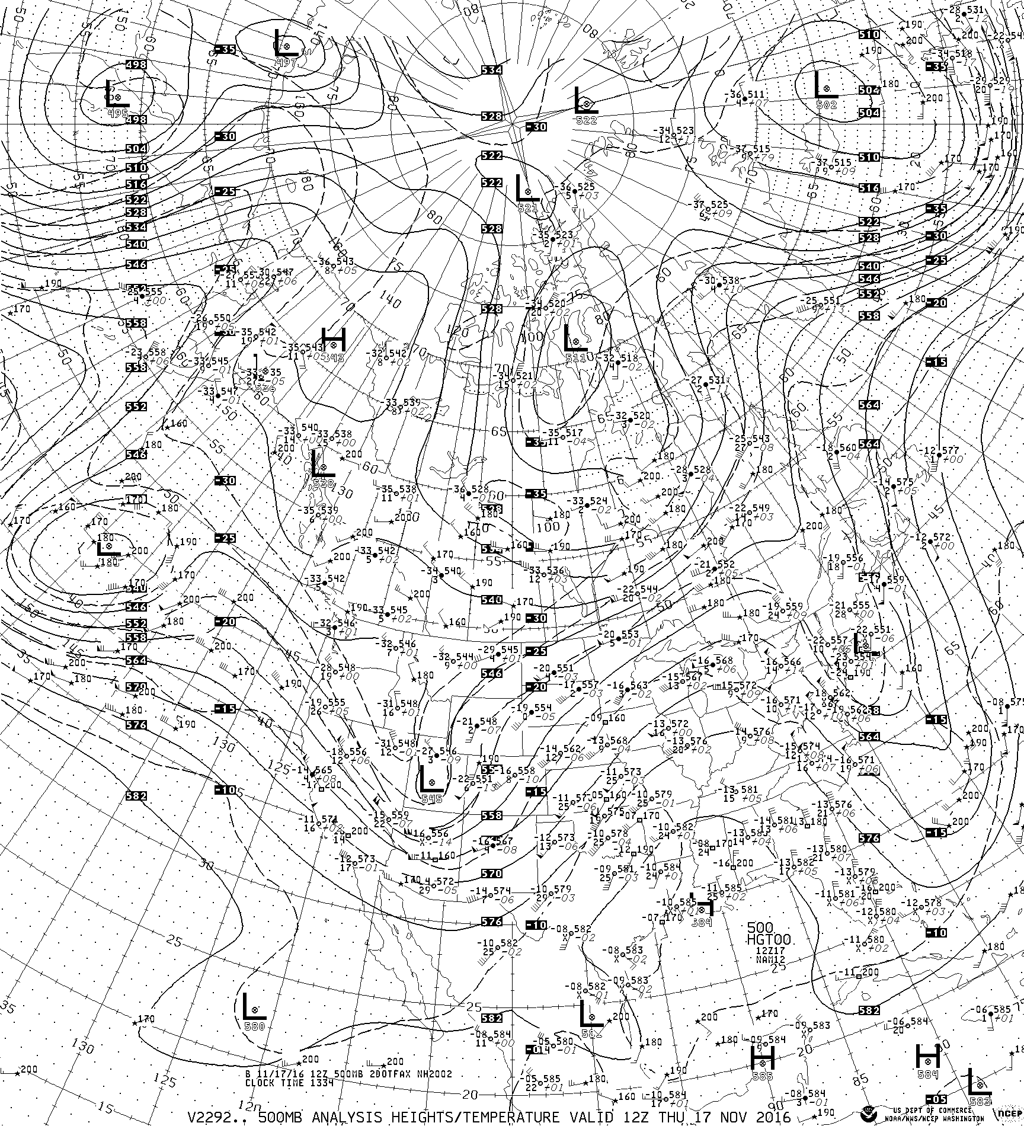
NAMv4 :
Products slated for removal
Public Information Statement 16-34
DGEX model run : turned off
Removed from NOAAPORT:
Legacy NAM FAX charts
22 km Alaska grid #217
5 km CONUS DNG grids
6 km Alaska DNG grids
From NCEP servers (NOMADS):
NAM 32km & 12km tiles
190.5 km LFM lookalike grids
45 km AK Grid #216 ICWF files
22.5 km AK Grid #217 ICWF files

Slide 6
SREFv7.1 August 2017
SREFv7.1
Oct16
Jan17
Apr17
Jul17
Oct17
Jan18
Apr18
Too soon to turn off SREF – it still out performs GEFS and meets SPC requirement – will keep it until GEFS is sufficiently improved
Freeze it - with no science development, there is no need for a science evaluation which saves computer & personnel resources and time
Port SREFv7 ‘as is’ to Cray
Only updating core/codes to latest WRF / NMMB versions
Take advantage of expanded RAP domain for init & lbc
Move SREF development resources to HREFv3
Explore stochastic methods with 3 km FV3
Move remaining SREF development resources to GEFS
No FV3 transition plan because it is expected to be replaced by FV3-based GEFS

Slide 7
HiResWv7 / HREFv2 August/September 2017
HRWv7
HREFv2
Oct16
Jan17
Apr17
Jul17
Oct17
Jan18
Apr18
~Jan19
HRRRv3
HREFv3
2016 HWT Spring Program & CLUE
Add NSSL-ARW => Operationalize SSEO
Standardize grid spacing to ~3 km … sized to fit into available resources
Run alongside NAM to deliver HREF/SSEO ~3 hr sooner without preemption
Run to 48 hr for CONUS at 0z &12z and for Alaska at 6z &18z
Update codes to latest WRF / NMMB versions, enhance products [e.g. neighborhood prob., prob. matched means], and distribute HREF ensemble products to AWIPS
Then FREEZE these components
SPC+GSD suggest extending HRRR runs to 36 hr to produce another candidate member – not an option until HRRRv3 in 2018 but certainly doable with HREFv3 if scores & resources warrant

Slide 8
HRRRv3 Spring 2018
RAPv3
HRRRv2
Oct16
Jan17
Apr17
Jul17
Oct17
Jan18
Apr18
~Jan19
HRRRv3
HREFv3
GSD’s HRRRv3 plans are ~aggressive
Expand CONUS domain to cover full NDFD grid
Add HRRR for Alaska
Extend to 36 hr every 12 hr for member in HREFv3
Ensemble data assimilation
HRRR ensemble free forecasts
Decisions needed by code delivery to EMC in June 2017
Must make evidence-based decisions
Validated requirements? … Are there alternatives?
Cost vs benefit: added value must justify large increase in resources
Will HRRR consumption restrict what can be done with HREFv3 et al?
Does it contribute to or detract from path to unification around FV3?

Slide 9
HREFv3 ~January 2019
Oct16
Jan17
Apr17
Jul17
Oct17
Jan18
Apr18
~Jan19
HREFv3
Design informed by HWT, Clue, MEG-STI CAM team and the newly formed SIP working group on meso unification
Starting with FV3 runs for 2017 HWT Spring Program, continued development & refinement by EMC & community produces candidate FV3 with appropriate performance characteristics at convective-allowing scales
Database of parallel/retro runs of candidate FV3 are collected along with HREFv2 components and extended HRRR runs
Evidence is examined to determine best performing HREFv3 configuration
Complete replacement using FV3 [w/ stochastic] – this would be ideal solution and would subsume NAM nests and HiResWindow and possibly HRRR
Partial replacement of components [e.g. NMMB]
Additional component along with existing components
Additional members (if resources warrant) to eliminate time-lagged members

