Slide 1
RTMA/URMA Stakeholder meeting
November 25, 2019

Slide 2
Meeting Overview
Version 2.8 Non-Precip
Schedule update (evaluation period has now ended)
Summary of science upgrade
Things we’ve changed during the eval
Preliminary results, new verification stats website
Ongoing obs flagging issues/discussion
Version 2.8 Precip Changes

Slide 3
V2.8 Schedule Update
Evaluation period ended November 22
Feedback is due December 3 (please use this survey)
Briefing to NCEP Director: December 10
Hand off to NCO shortly afterwards
Still on track for late March/early April implementation
Still subject to changes based on central ops, moratorium, decisions from senior management
We will maintain parallel in the meantime
Parallel runs on the ‘prod’ machine, should not be subject to WCOSS outages
Fields available here
More info: MEG-driven website

Slide 4
V2.8 Science Summary
This parallel DOES NOT use experimental/parallel RAP/HRRR data!
New wind adjustment: adjust for sensor height by provider
Dew point change, remove old filter from RUC/RAP era
New wave analysis for Great Lakes and Guam
Ceiling and cloud cover enhancements
Finer grid over Puerto Rico (2.5 --> 1.25 km)
Downscaling/background enhancements
Precipitation enhancements
More info in previous meeting and earlier MEG meeting
See website for more info and public versions/recordings of these decks

Slide 5
Changes During the Eval: Great Lakes
Significantly warmer temps over Great Lakes
There was nothing in the parallel that would have obviously caused this
Operational temps were much closer to those of buoys than parallel temps
Issue was traced to GLERL-temperature obs passing ‘buddy check’ despite being 10 F warmer than background
Buddy Check has now been turned off for GLERL type obs only

Slide 6
Other Small Changes
Wave Height bug in Guam
California utility company stations added
PG&E, SDGE, SoCal Edison
Being adjusted to 6 m sensor height per contact with Hanford and San Diego WFOs
We know there is interest, but we can’t put data into operations until the upgrade takes place
QC Flagging changes have come in and applied as they have come in.
May want to revisit some of the flagged CWOP wind sites once the adjustment goes into operations
Form available here (still works) or via VLab (when it works)

Slide 7
Verification Statistics
Verification webpage developed for the RTMA/URMA v2.8 evaluation
Webpage updates daily to include runs up to 23Z the preceding day
Computes statistics relative to METAR and ship observations (NOT mesonet)
Includes metrics such as bias-corrected RMSE, bias, performance diagrams, and violin plots
In the following plots:
RED is new (parallel) system
BLUE is old (operational) system
Shaded regions are confidence intervals
Background/First Guess on Left, Analysis on Right

Slide 8
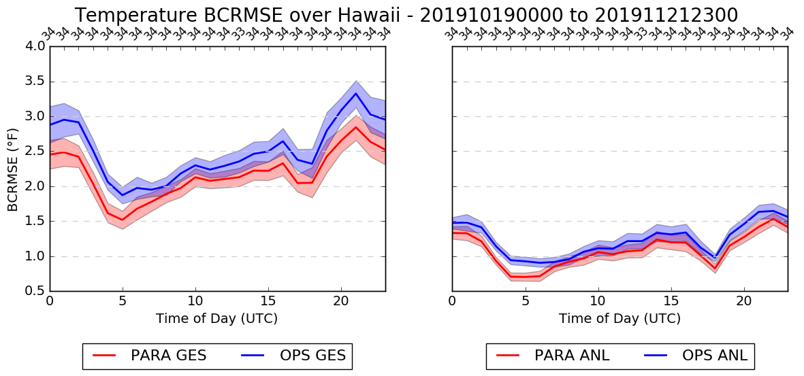
Temperature BCRMSE

Slide 9
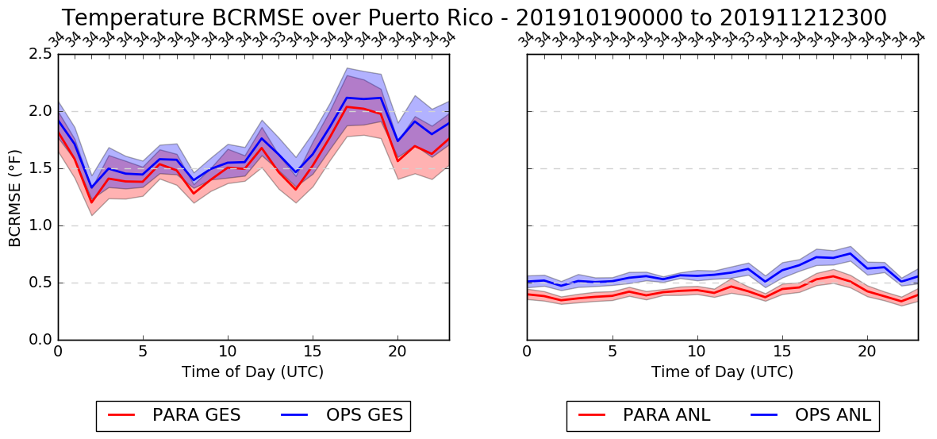
Temperature BCRMSE

Slide 10
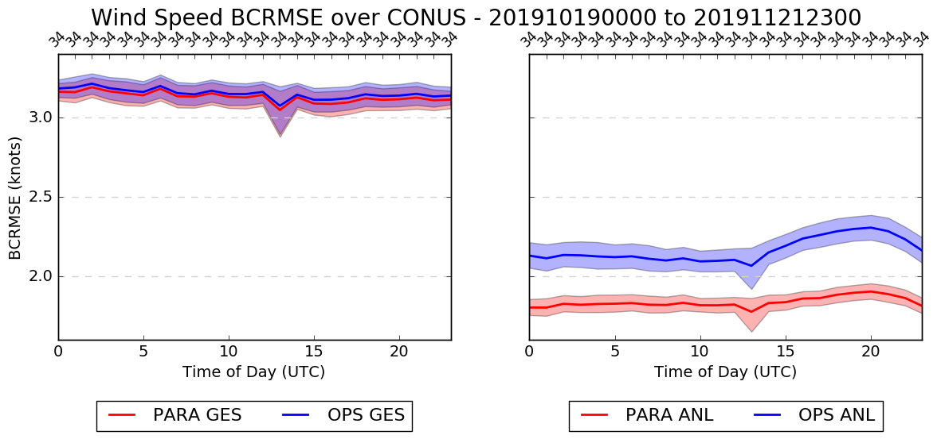
Wind Speed BCRMSE

Slide 11
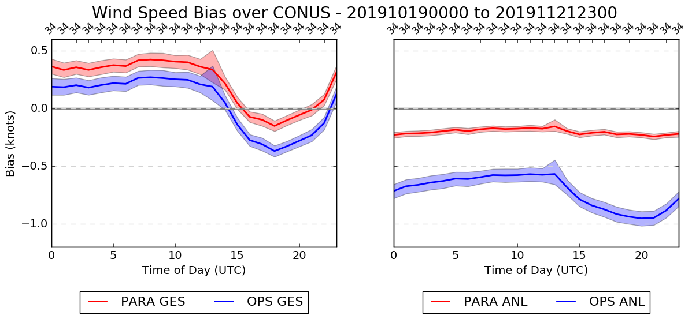
Wind Speed Bias

Slide 12
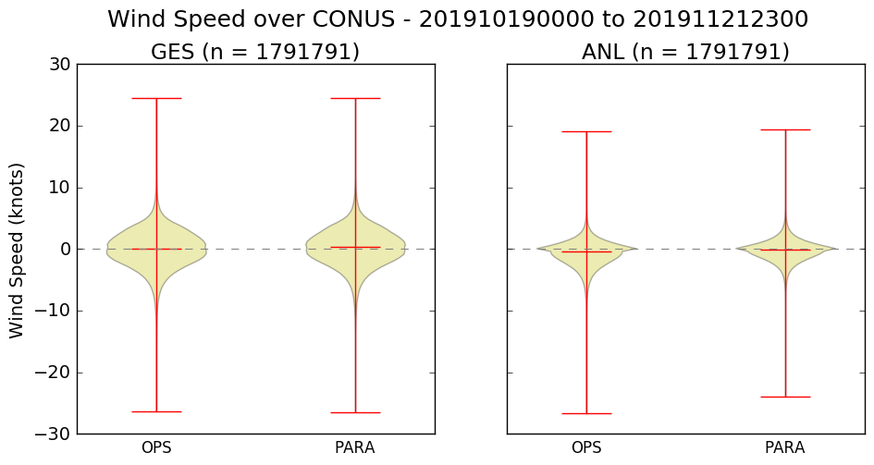
Wind Speed Violin Plot

Slide 13
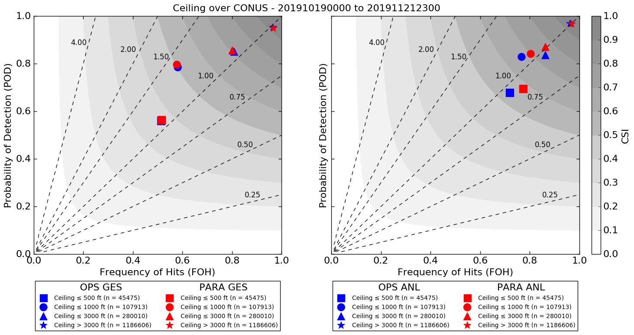
Ceiling Performance Diagram

Slide 14
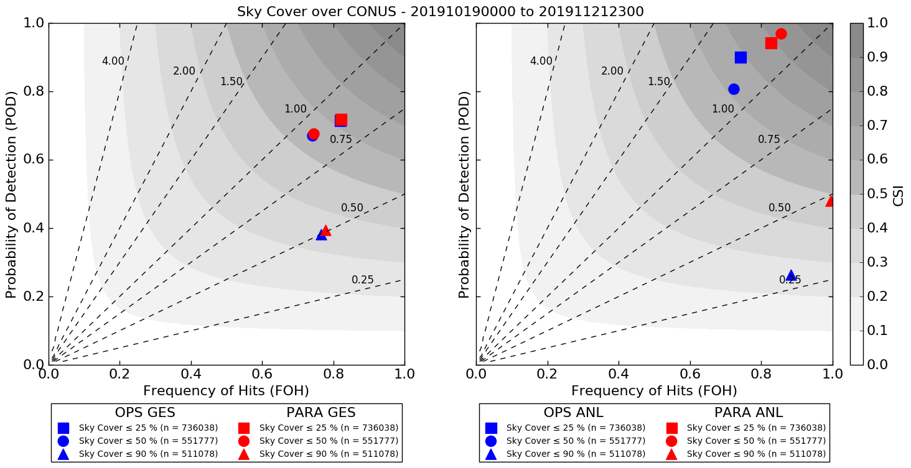
Sky Cover Performance Diagram

Slide 15
Observation Quality Control
KML files of obs used in old/operational version available here
Ob used or not used depending on color
KML files of obs used in new/parallel version available here
Wind and just obs that are ‘adjusted’ and used are white
Actual height is also available for each observation
Flagging is available, but clearly does not meet forecaster neers
Too slow/cumbersome to update
OBS_QC file available from offices
Must be updated regularly
Must get picked up on WCOSS so we can use it (not trivial)
In previous versions, obs have mistakenly stayed ‘flagged’ forever
In theory, this can be appended to the semi-fixed SDM reject list we use now

Slide 16
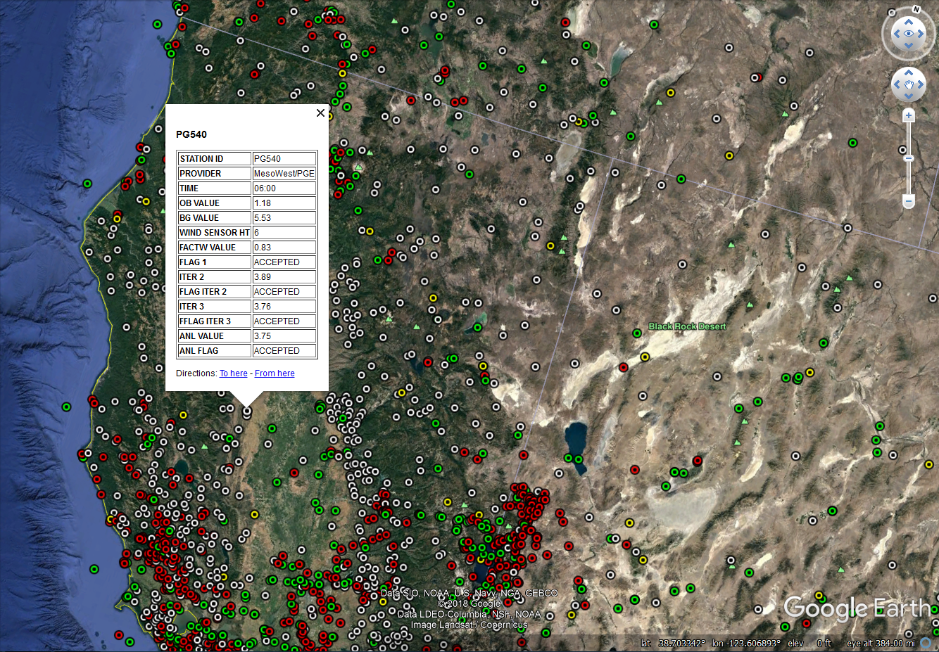

Slide 17
pcpRTMA/URMA: v2.8
Precip RTMA: replace first-run Stage II/IV with radar-only MRMS as source
Precip URMA: add NOHRSC snowfall analysis
Precip URMA: blending for a smoother offshore filling with MRMS and CMORPH
PCPANL v4.0 (upstream job of RTMA/URMA):
Discontinue Stage II analysis
Stage IV: change from GRIB1 to GRIB2
Request moving current run time hh:33 to hh:15 for pcpRTMA and hh:55 for PCPANL/pcpURMA

Slide 18
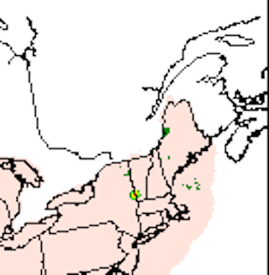
pcpRTMA Source
Current prod uses first run Stage IV supplemented by first run Stage II.
At the time of the pcpRTMA run (33 min past the top of the hour), the RFC QPEs (basis for Stage IV) generally do not yet have the benefit of human oversight/QC:
02Z 17 Dec 2017 (Saturday evening ET): bad gauge included in the first-run RFC QPE/pcpRTMA. NERFC removed the bad gauge within hours and pcpURMA was updated accordingly in the following hour’s rerun. pcpRTMA was only run once (“Real Time”) and the bull’s eye stayed in the RTMA.

Slide 19
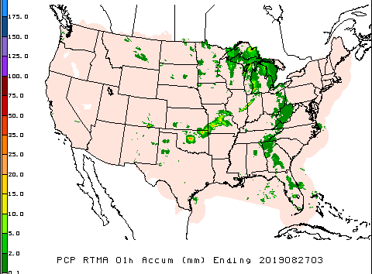
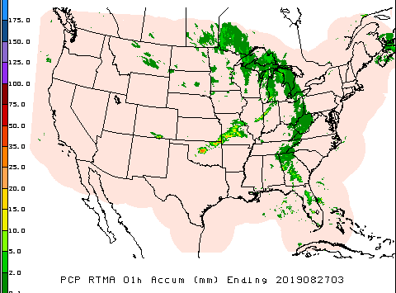
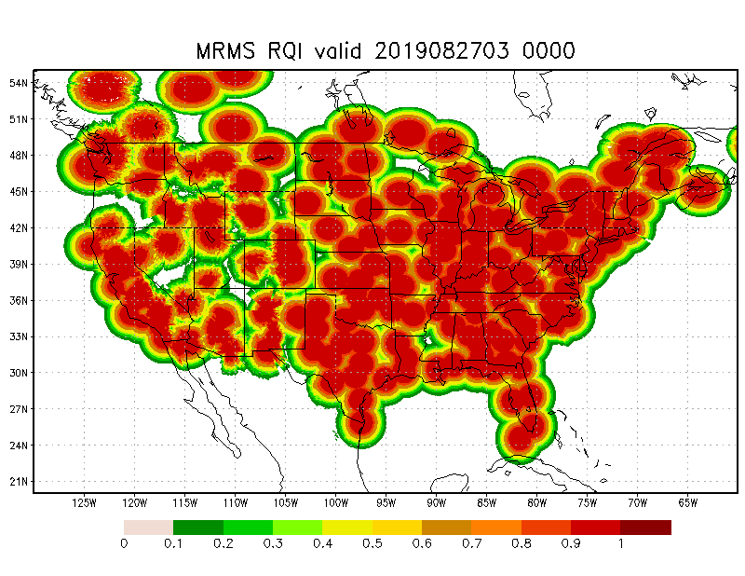
pcpRTMA using MRMS
In v2.8, we plan to use radar-only MRMS QPE (better timing & less affected by data outage than gauge-corrected MRMS QPE). Radar quality index (RQI) added as companion array to each hour’s pcpRTMA array - providing users with info about quality of the QPE. RQI arrays will be available on NOMADS, not AWIPS.
Prod
v2.8

Slide 20
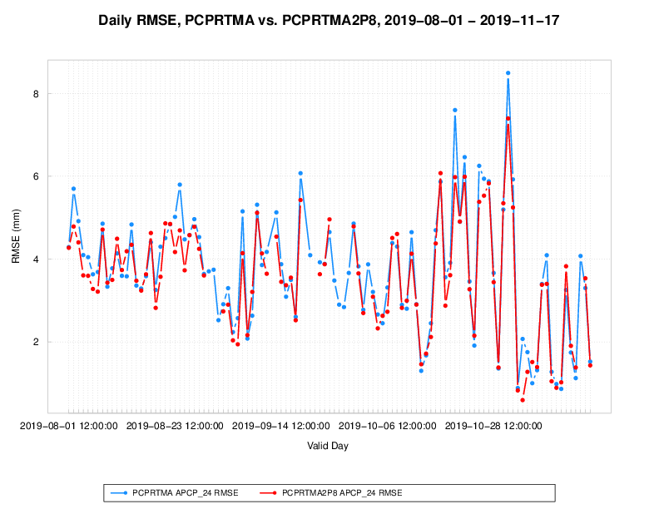
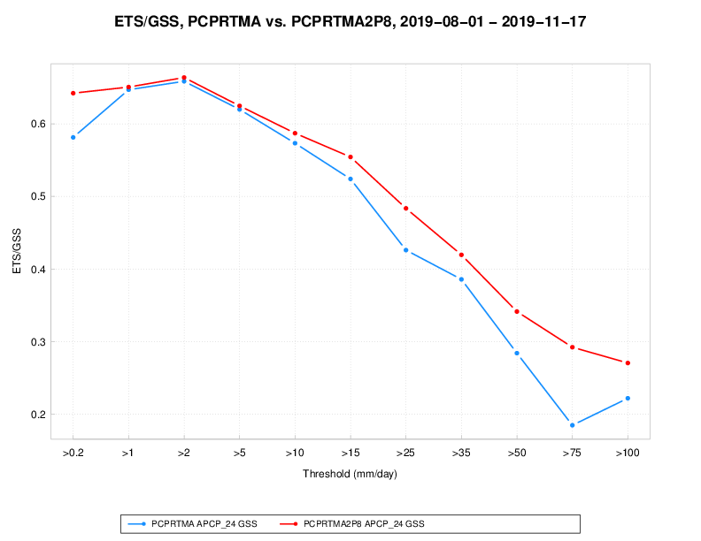
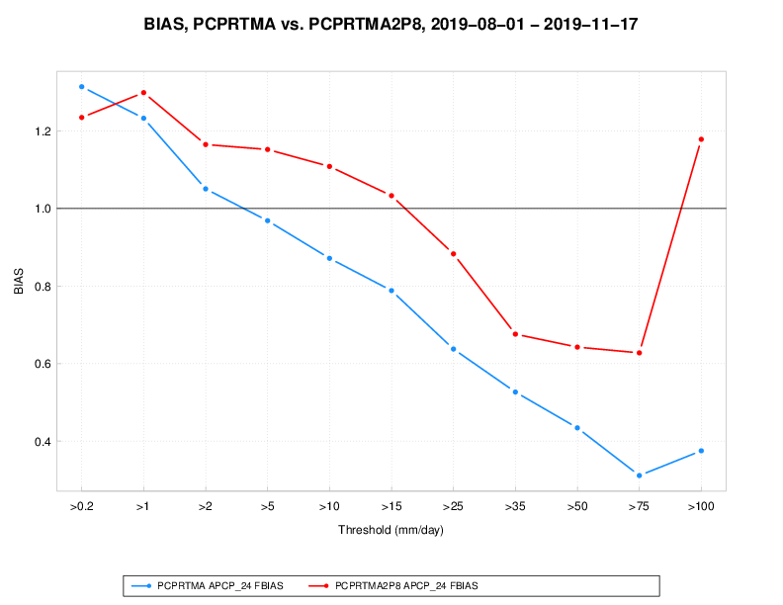
pcpRTMA using MRMS: validation
Prod vs. v2.8 pcpRTMA: validation against daily gauges (1 Aug - 17 Nov 2019)
Time series of RMSE ETS vs. threshold Bias vs. threshold

Slide 21
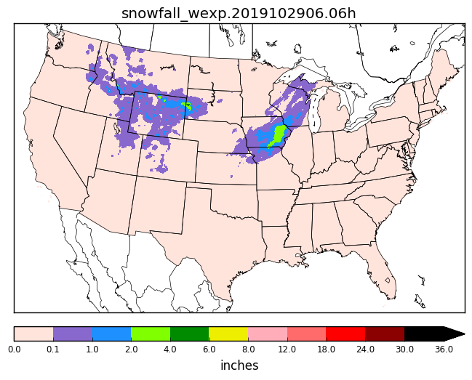
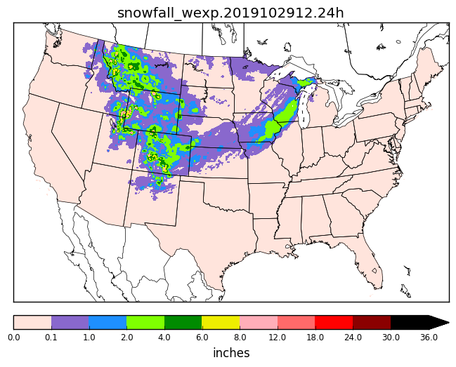
NOHRSC Snowfall Analysis for URMA
Add NOHRSC 6h/24h snowfall analysis to the precipitation URMA suite (dependent on data sent to NCEP via official ftp-in).
At the 18Z cycle (run at 18:55Z), process NOHRSC data for current day, $daym1/$daym2/$daym3/$daym5/$daym7. Data mapped from NOHRSC’s g184 to the expanded ConUS grid (WEXP) for NBM. g184 data sent out to AWIPS.

Slide 22
Improved Offshore Filling of pcpURMA
The primary source of ConUS pcpURMA is the NCEP Stage IV - mosaicked RFC QPEs, which is limited to RFC domains (largely land-only).
V2.7 introduced offshore filling of ConUS PCPURMA with 1) gauge-corrected MRMS (where RQI ≥ 0.1) and 2) CMORPH. Sometimes there are sharp discontinuities between MRMS and CMORPH; occasionally discontinuities are also seen at the boundary between RFC QPEs and MRMS.
Proposed solution (Yan Luo, Manuel Pondeca): apply Whittaker blending function (used in the production of RTMA background field) for a smoother pcpURMA offshore filling.

Slide 23
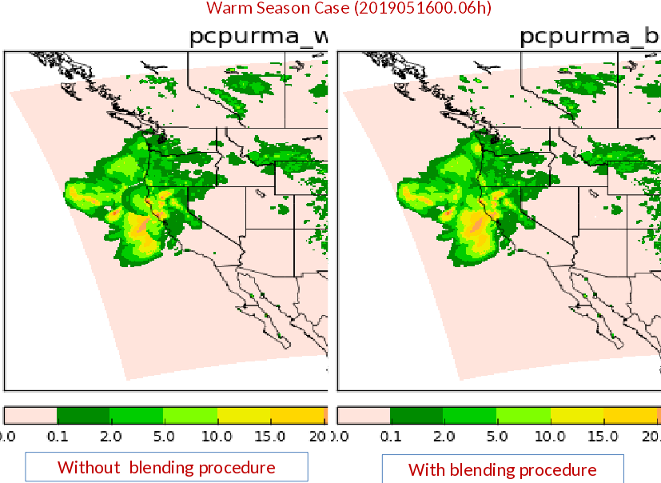
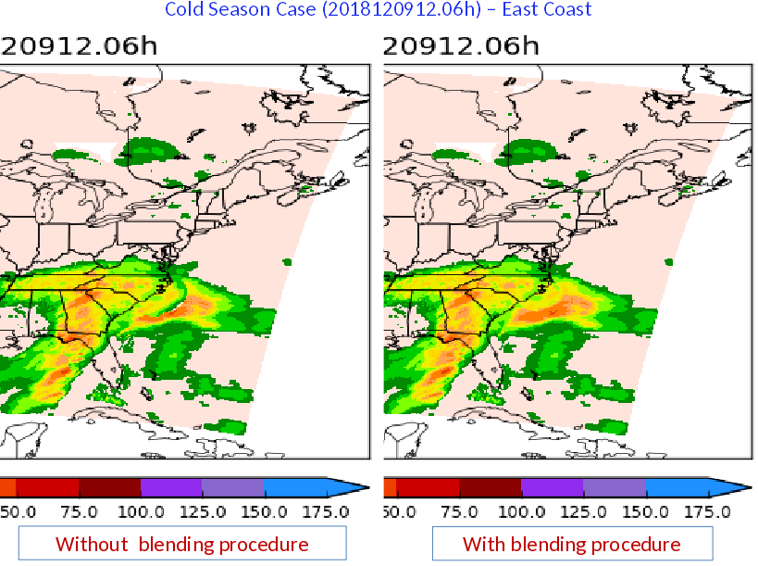
Examples of Blended Offshore PCPURMA
From Yan Luo:

Slide 24
Other Changes to Precip
Stage IV output to change from GRIB1 to GRIB2
Stage IV 24h mosaic (for water.weather.gov/precip): add an additional rerun at 30h after valid time (at 18:55Z) to supplement the current 1/2/3/5/7-day rerun schedule for the 24h mosaic, to give RFCs that have a missing QPE or need to update their QPEs a better chance to get their corrected data to water.weather.gov & the public quickly
Removal of Stage II analysis: pcpRTMA no longer dependent on Stage II; MRMS QPEs can now replace the Stage II
Changing current run time of hh:33 to hh:15 for pcpRTMA and hh:55 for PCPANL/pcpURMA

Slide 25
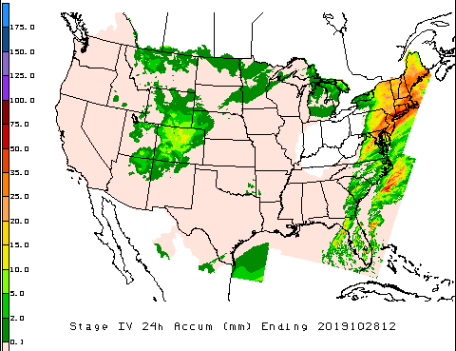
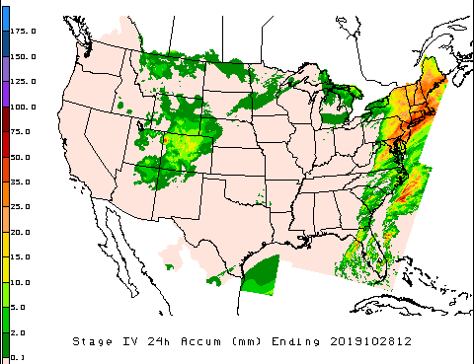
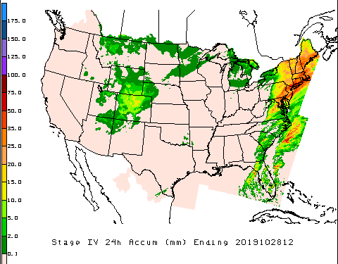
Benefit of the 30h ConUS re-mosaic for 24h Stage IV
For the 24h ending at 12Z 28 Oct, several hourly OHRFC QPEs were missing. Data received at 14:32Z 29th. There was also a problem with earlier QPEs from WGRFC that was corrected at 17:47Z 30th.
————————— after 18:33Z 29th —————————————
Para has complete coverage from the 30-h rerun. Prod still missing OHRFC area - had to wait until next day (12:33Z 30th) for complete coverage
——— after 12:33Z 31st ———
Corrected WGRFC QPE was used in the 3-day rerun in both prod/para
prod para prod/para

Slide 26
Request Changing Precip Run Times
Current production PCPANL/pcpRTMA/pcpURMA run at hh:33. Request advancing pcpRTMA by 18 minutes (at hh:15) and postponing PCPANL and pcpURMA by 22 min (to hh:55)
hh:00 hh:15 hh:33 hh:55
Prod precip suite currently runs at hh:33 due to Stage II/pcpRTMA dependency on METAR gauges, available at ~hh:30. Using MRMS as source for pcpRTMA removes this dependency. Running pcpRTMA at hh:15 (instead of even earlier) allows use of MRMS data within a ±10 min window in case of an outage near hh:00.
Postponing PCPANL(Stage IV), pcpURMA to hh:55 allows more current-hour’s RFC QPEs to be included in the ConUS mosaic (per request by OWP - plans to use Stage IV hourly mosaic for RIDGE II beginning in Q3 FY20)

Slide 27
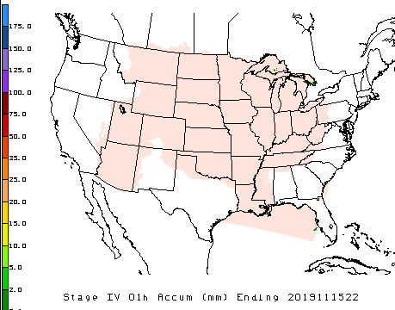
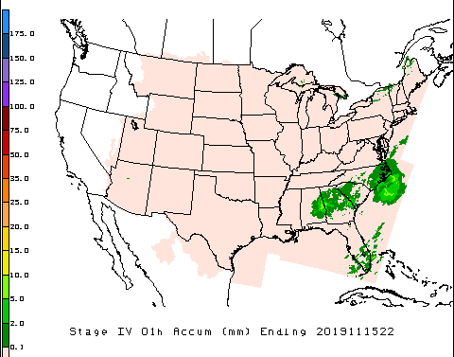
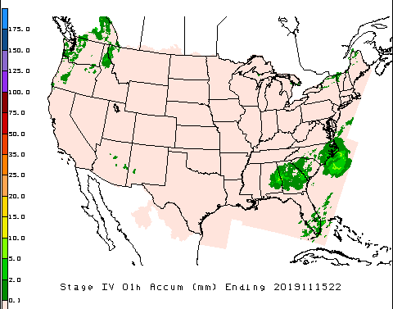
Delaying Stage IV from hh:33 to hh:55
1h mosaic for 22Z 15 Nov. At 22:33Z, some RFCs have not sent their QPEs for that hour yet. By 22:55Z
All RFCs that produce 1h QPEs have sent them. CNRFC/NWRFC do not have 1h QPEs; Stage IV provide coverage for that area using the RFCs’ 6h QPEs (received at 14;06/14:30 in this case) time-disaggregated using 1h MRMS data as weights.
prod, made at 22:33Z para, made at 22:55Z prod/para at 14:33/14:55Z
next day

Slide 28
Supplemental Material
Supplemental material for precipitation

Slide 29
Offshore pcpURMA Blending
Recent example: 24h ending at 12Z 16 Nov
Prod v2.8

Slide 30
Offshore pcpURMA Blending
Recent example: 24h ending at 12Z 20 Oct
Prod v2.8

Slide 31
For Users of PCPANL Output
Summary of changes for users of PCPANL (Stage II/IV) data planned for March 2020 with RTMA/URMA v2.8 implementation (https://www.emc.ncep.noaa.gov/users/meg/rtma_urma_v2p8/):
Stage II will be discontinued with the RTMA/URMA v2.8 implementation (scheduled for Mar 2020)
Stage IV will be in GRIB2 format, instead of GRIB1
Stage IV mosaicking will be done at hh:55 instead of hh:33 (per request by OWP, RFCs for RIDGE II, so that more RFC QPEs can be included for the current hour)
There is an additional re-run for 24h ConUS mosaic done at 30h after valid time (at the 18:55Z cycle), to supplement the current 1/2/3/5/7-day rerun schedule, done at 12:55Z, to give RFCs a better chance to have their re-sent or updated QPEs included in AHPS’s water.weather.gov/precip w/o waiting for the 2-day rerun the next day
Add’l info about the upcoming precip change for RTMA/URMA v2.8: https://docs.google.com/presentation/d/1GUjHKmD56AR1fxzgF-LexBsJTfs0KNEG4O7xonZpJ7g/edit?usp=sharing

Slide 32
Stage IV file name changes
Current production | New
ST4.yyyymmddhh.xxh.gz | st4_conus.yyyymmddhh.xxh.grb2
st4_ak.yyyymmddhh.xxh.gz | st4_ak.yyyymmddhh.xxh.grb2
st4_pr.yyyymmddhh.xxh.gz | st4_pr.yyyymmddhh.xxh.grb2
st4.yyyymmddhh.xxh.gif | st4_conus.yyyymmddhh.xxh.gif
Production data: https://nomads.ncep.noaa.gov/pub/data/nccf/com/pcpanl/prod/
Parallel data: https://para.nomads.ncep.noaa.gov/pub/data/nccf/com/pcpanl/para/

