Slide 1
V2.8 RTMA/URMA/RTMA-RU
Science Brief
Jacob R. Carley¹, Manuel Pondeca¹², Steve Levine¹³, Ying Lin¹, Yan Luo¹² Annette Gibbs¹², Jim Purser¹², Stylianos Flampouris¹², Xiaoyan Zhang¹², Matthew Morris¹³, Edward Colon¹², Runhua Yang¹², Gang Zhao¹², Jeff Whiting¹², and Daryl Kleist¹
And many other excellent folks from ESRL/GSD, NWS WFOs and Regions, MDL + the NBM team, and NCEP Centers
¹NCEP/EMC/Modeling and Data Assimilation Branch
²IM Systems Group
³Systems Research Group

Slide 2
V2.8 RTMA/URMA/RTMA-RU Timeline
NCO begins 30 day IT test
Science Briefings
12/9-10
March 2020
11/22
12/17
April 2020
Science evaluation ends
Hand off to NCO
Implementation
[latest estimate from NCO]

Slide 3
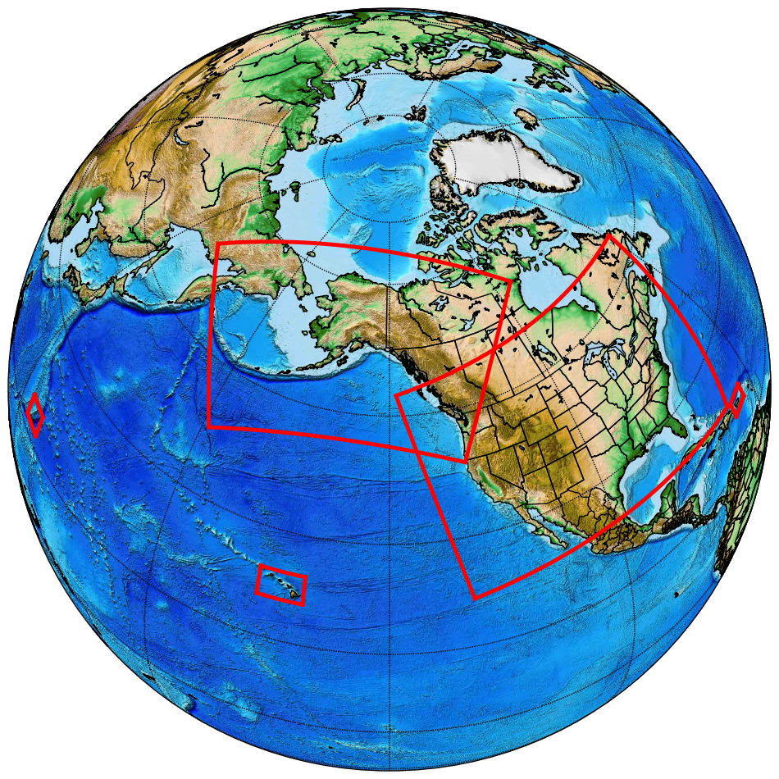
RTMA/URMA/RTMA-RU
2D, 2.5km* analysis of sensible wx elements
2DVar system
2m T and moisture, 10m wind and gust, ceiling, visibility, sky cover, wave height, etc.
Real Time Mesoscale Analysis (RTMA)
Hourly
Real time system for nowcasting and situational awareness
UnRestricted Mesoscale Analysis (URMA)
Runs 6 hours after RTMA to capture late arriving obs
Verification, calibration, analysis of record
Calibration in National Blend of Models
RTMA-Rapid Update
15-min updates, low-latency
Nowcasting, aviation, + situational awareness
RTMA-Rapid Update
RTMA
RTMA + URMA
*AK domains are currently at 3 km
*PR now at 1.25 km

Slide 4
v2.8 RTMA/URMA Upgrade: Highlights
Downscaling/background field improvements [All stakeholders]
2.5 km → 1.25 km for PR, consistent with NDFD [NBM, Puerto Rico]
Improved wind analysis with reduced low bias [All stakeholders]
Significant wave height for Guam and Great Lakes [NBM, Guam, Great Lakes]
Moisture/dew point analysis enhancements [NBM, W. Region, WFO Missoula]
Re-tuned sky cover analysis with enhanced QC [NBM, CONUS, AWC]
Consistent ceiling and sky analysis [All stakeholders, esp. AWC]
Precipitation enhancements [CONUS and coastal CONUS, WPC]
NOHRSC snow analysis [CONUS, WPC]
Expansion of upgrade for better fit to observations for OCONUS (already in CONUS) [NBM, OCONUS]
Many improvements continue to be motivated via collaboration with highly engaged stakeholder community

Slide 5
Downscaling updates for v2.8
***Background/first guess in RTMA/URMA***
HRRR Smartinit (sent to AWIPS)
Winds
Where the NDFD terrain > model terrain.
Maximum of the 10-m winds (instead of model level 1 winds) and vertically interpolated winds multiplied by 0.7 (to account for surface friction)
When NDFD terrain <= model terrain
The 10-m winds are used.
RAP Smartinit (not sent to AWIPS)
Use land sea mask for coastline adjustment instead of vegetation type
NAM Hawaii and Puerto Rico, HiresW Guam and RAP Smartinit (sent to AWIPS)
New temperature downscaling, consistent with HRRR approach
If NDFD terrain != model terrain
Use the local lapse rate, constrained between dry adiabatic and isothermal, to adjust the temperature
Puerto Rico grid change from 2.5 km to 1.25 km to be consistent with NDFD

Slide 6
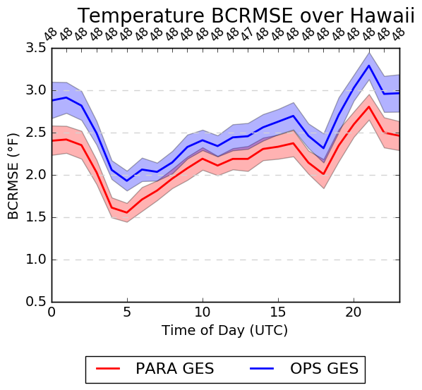
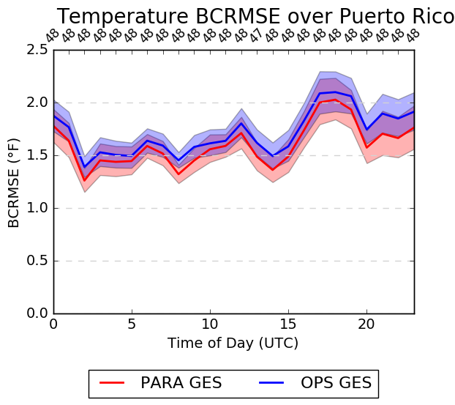
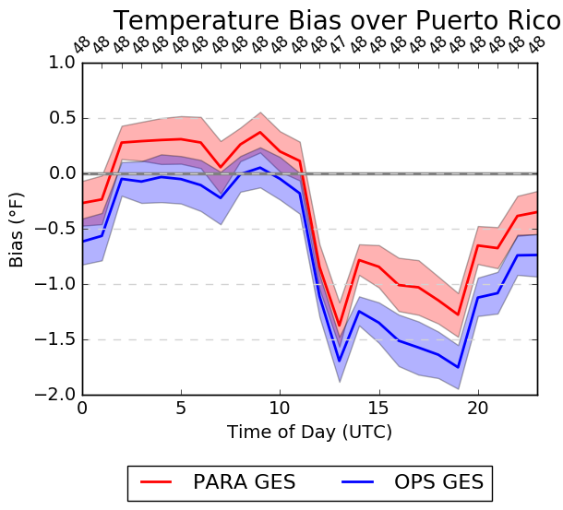
Temperature Time Series - Background
BCRMSE
OLD SYSTEM NEW SYSTEM
Bias
CONUS
Alaska
CONUS
Alaska
Hawaii
Puerto Rico
Hawaii
Puerto Rico
*stats are relative to METARs, buoys, and ships*

Slide 7
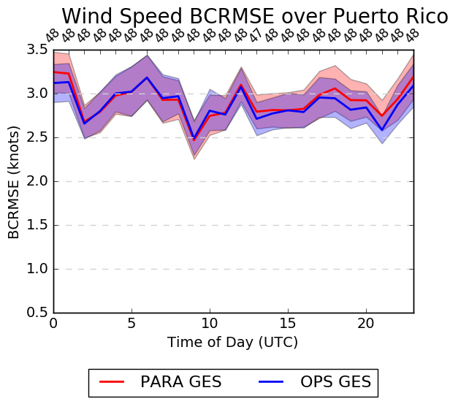
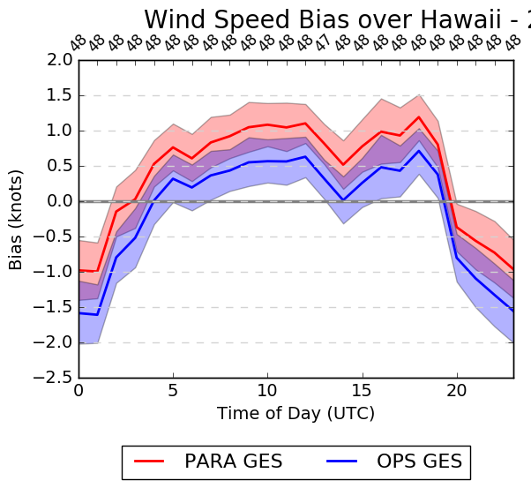
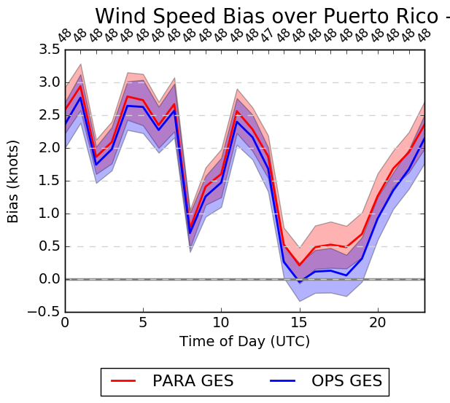
Wind Speed Time Series - Background
BCRMSE
OLD SYSTEM NEW SYSTEM
Bias
CONUS
Alaska
CONUS
Alaska
Hawaii
Puerto Rico
Hawaii
Puerto Rico
*stats are relative to METARs, buoys, and ships*

Slide 8
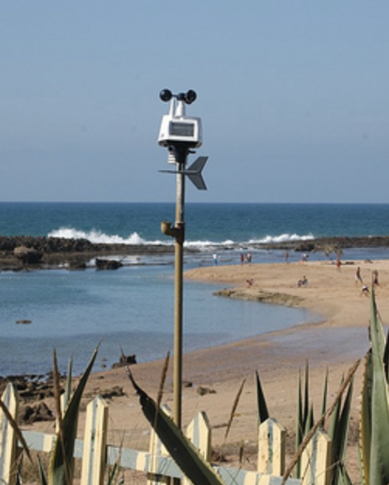
Wind Changes: Similarity Theory Adjustment
Has been assumed that all wind obs are taken at 10 m AGL
We know from looking at station photos that this is not true
For mesonets: wind sensor height will now be a function of provider/network
Current list of providers/heights
Background wind is adjusted via similarity theory to the same height as the observed wind
Observation is be compared against this adjusted background wind value
Similar adjustments made to gust analysis
Station photo from weather.gladstonefamily.net

Slide 9
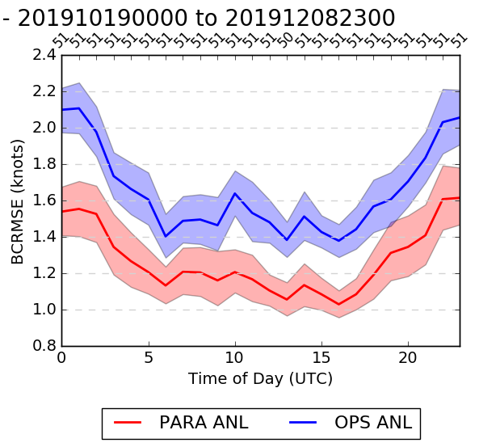
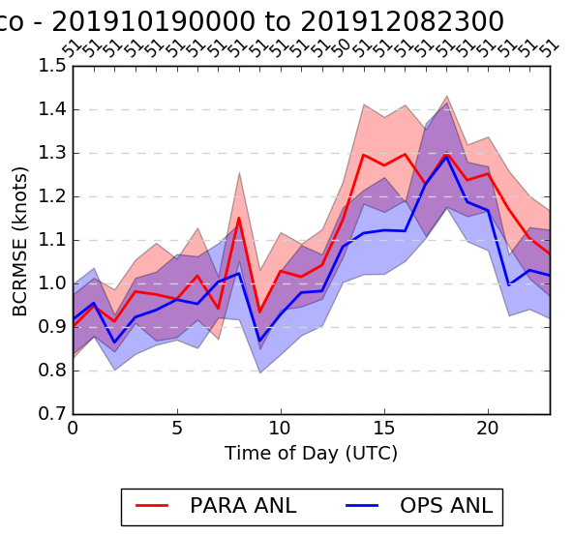
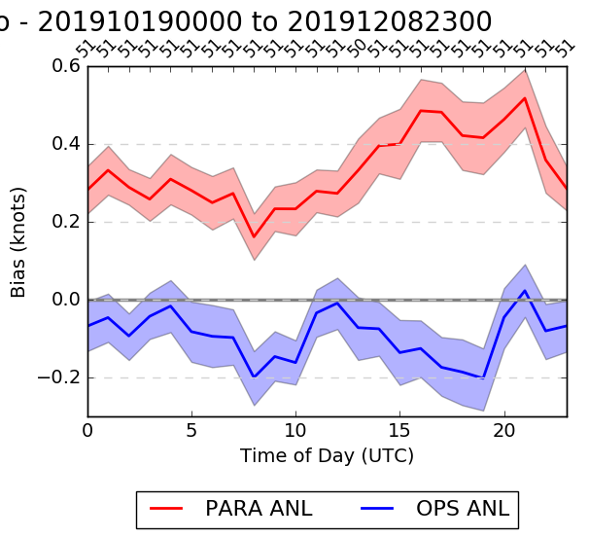
Wind Speed Time Series - Analysis
BCRMSE
OLD SYSTEM NEW SYSTEM
Bias
CONUS
Alaska
CONUS
Alaska
Hawaii
Puerto Rico
Hawaii
Puerto Rico
*stats are relative to METARs, buoys, and ships*

Slide 10
Significant Wave Height Upgrades
Preprocessing, downscaling and merging the multi-grid output, of the SWH background:
Adding the sea land mask → erroneous values from the background have been eliminated
Background can now be produced by an infinite number of background grids
e.g. for CONUS, waves from 6 grids are merged
Analysis for the Great Lakes is added, based on the GL forecasting system.
Sea/ice mask is applied (CONUS and AK), based on the NCEP operational ice coverage retrieval.
Significant Wave Height analysis is now provided for Guam (RTMA).

Slide 11
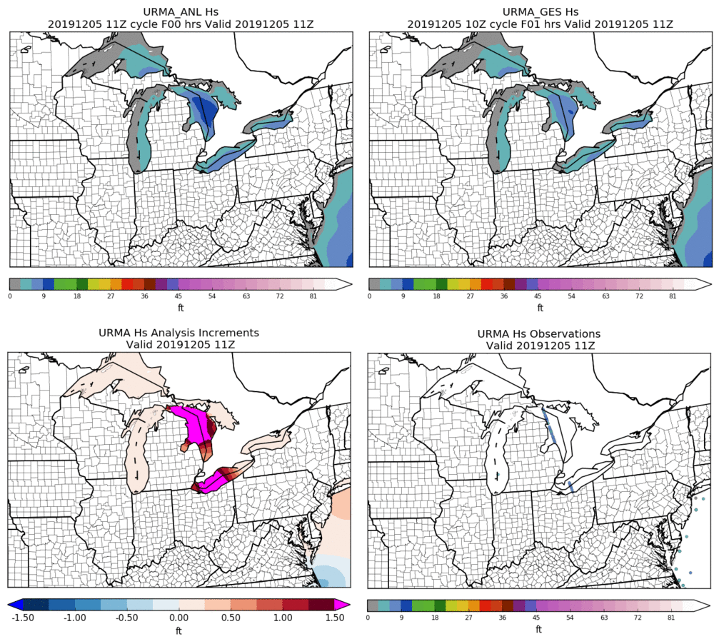
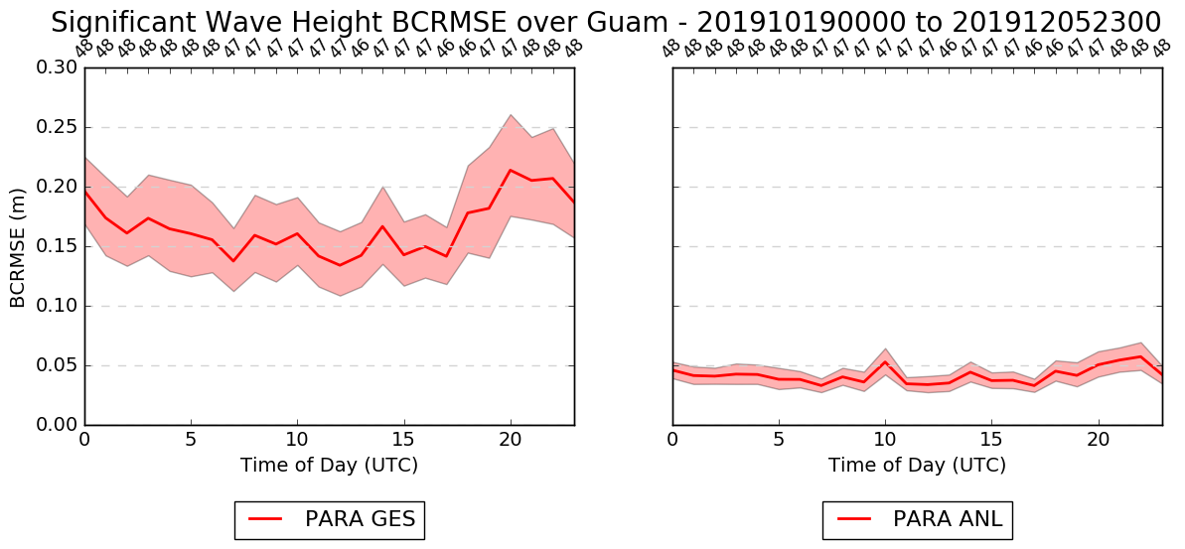
Wave Height v2.8
Great Lakes
Guam
*stats are relative to METARs, buoys, and ships*
Notes:
At the bottom right panel, satellite observations at two lakes

Slide 12
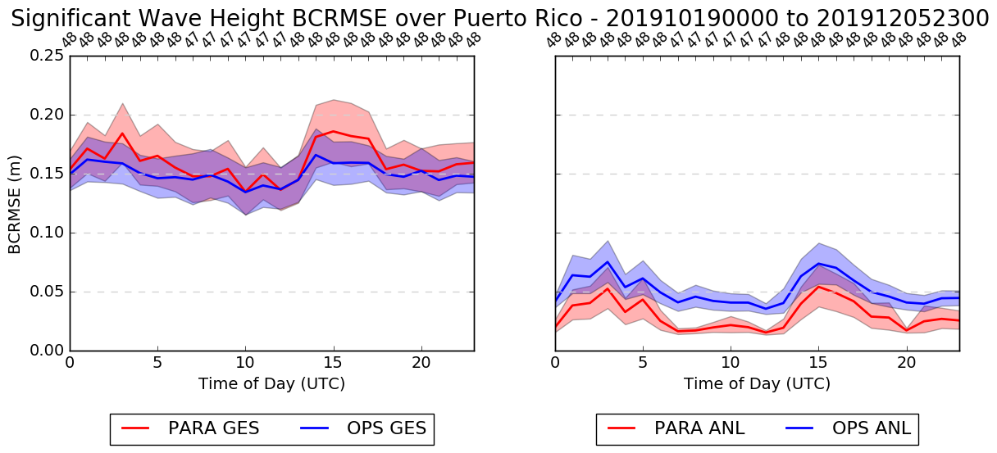
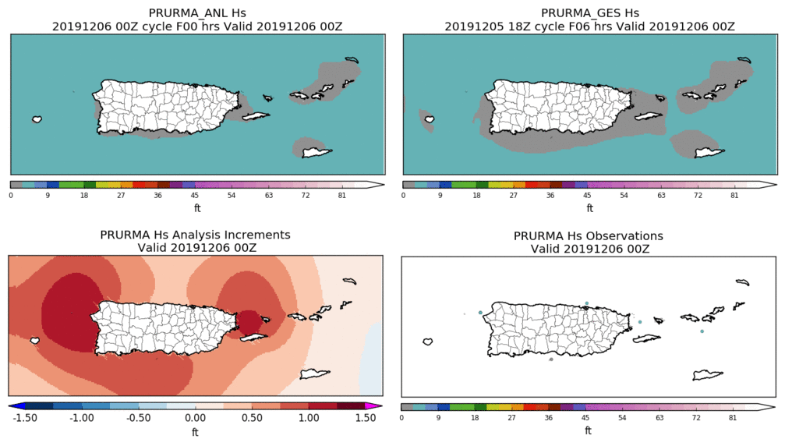
Puerto Rico Wave Height Stats
The spatial resolution of PR was doubled (from 2.5km to 1.25km):
The system’s parameters were recalibrated
PR URMA is now the wave analysis system with the highest spatial resolution globally
PR
New grid and higher resolution + new background error = closer fit to obs
*stats are relative to METARs, buoys, and ships*

Slide 13
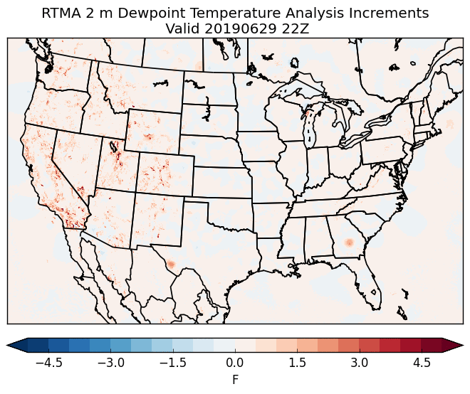
Dew Point Analysis Updates
Moist bias causing issues with FireWx
First noticed by WFO Missoula, MT
Operational Dew Point Product:
Q and surface press. analysis is used to derive Td
Analysis increments between the computed Td fields is smoothed via a “1-2-1” filter and added to the downscaled Td to generate the final analysis
The “1-2-1” smoothing filter has been switched off**
Impacts closely tied to steep terrain
Coordinated and approved with Western Region and WFO Missoula
22Z on 29 June 2019
Operational - Retrospective
**Very early RTMA (>10yrs ago) had serious issues with localized areas of unrealistically low dew points

Slide 14
Ceiling and Sky Cover Updates for v2.8
Ceiling is cleared (i.e., set to maximum ceiling value) when the analyzed sky cover is < 50%
Ensuring product consistency
Reject GOES Imager sky cover observations when:
The observation is < 30% and over water; and
Solar zenith angle is > 80° (i.e., late evening, overnight, or early morning)
Based upon feedback and consultation with GOES product developer and stakeholders
Reduced thinning of GOES sky cover observations (by half) and tripled the decorrelation length to address feedback of a “splotchy” sky cover analysis
Add sky cover analysis to RTMA-RU
Updates every 15 minutes

Slide 15
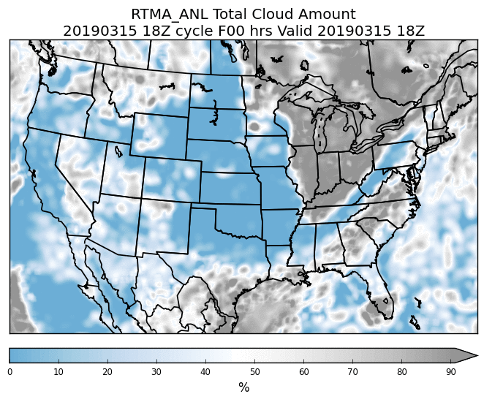
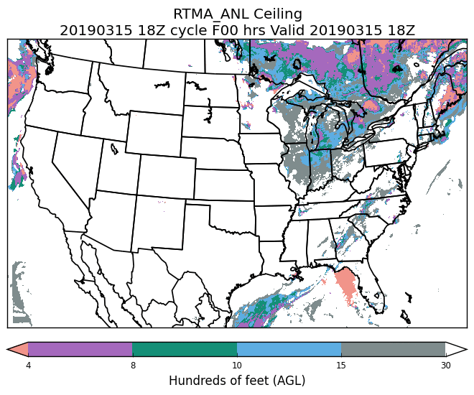
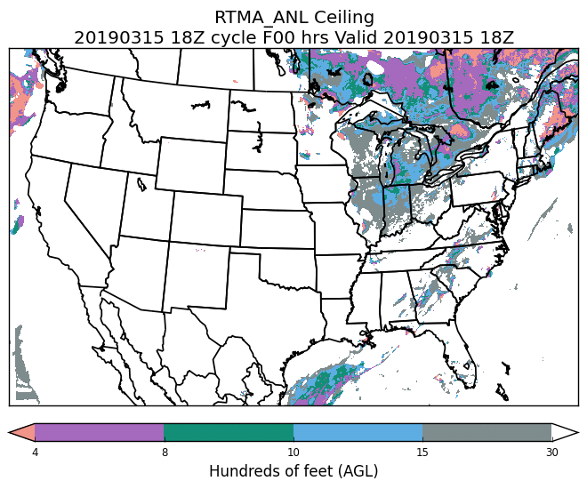
Example: Ceiling clearing
Sky Cover
Original Ceiling
Modified Ceiling
18Z on 15 March 2019

Slide 16
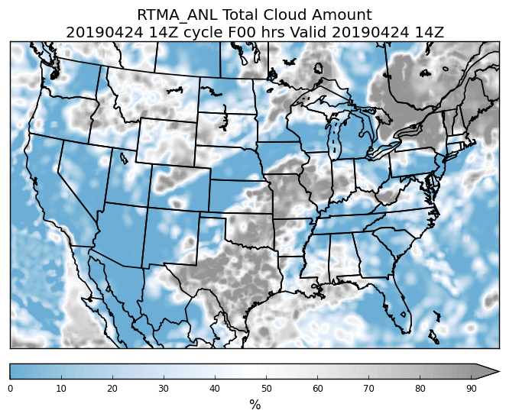
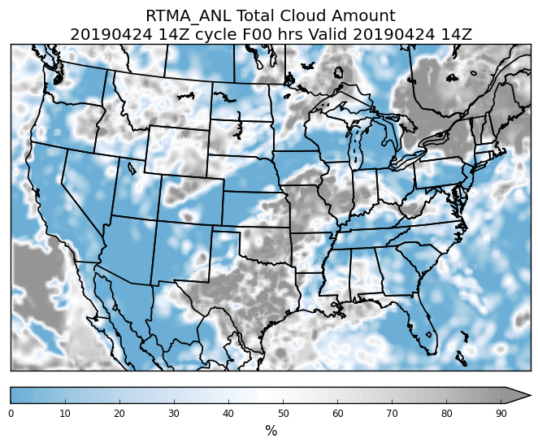
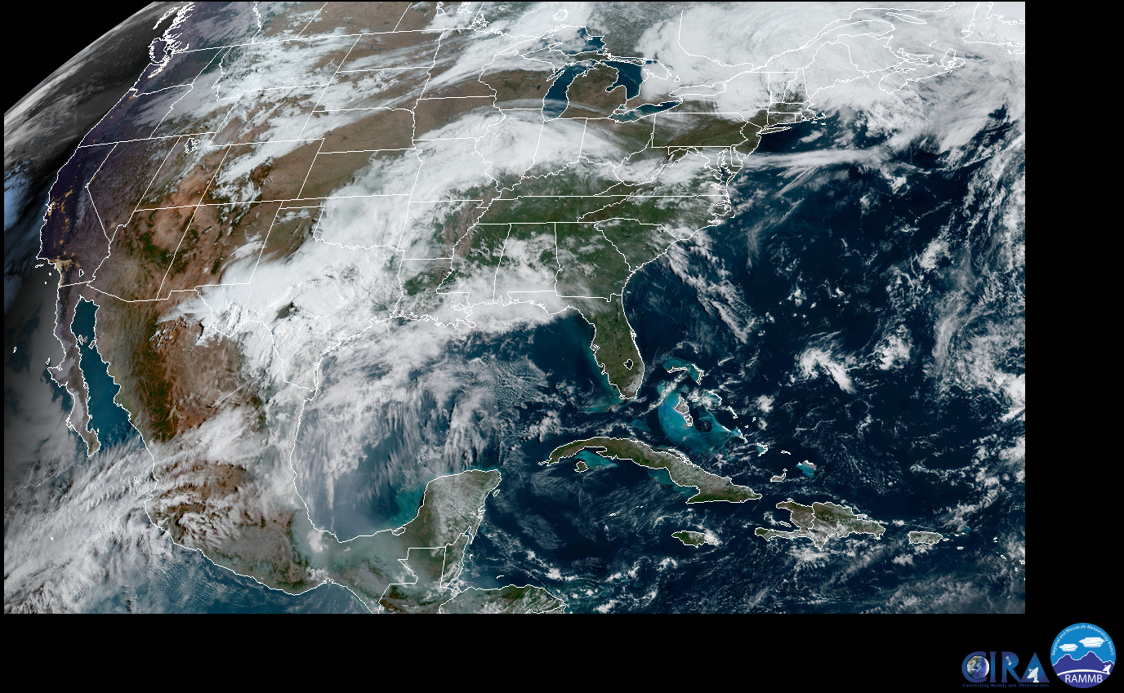
Example: Sky Cover QC
Original Sky Cover
Modified Sky Cover (QC)
VIS
14Z on 24 April 2019

Slide 17
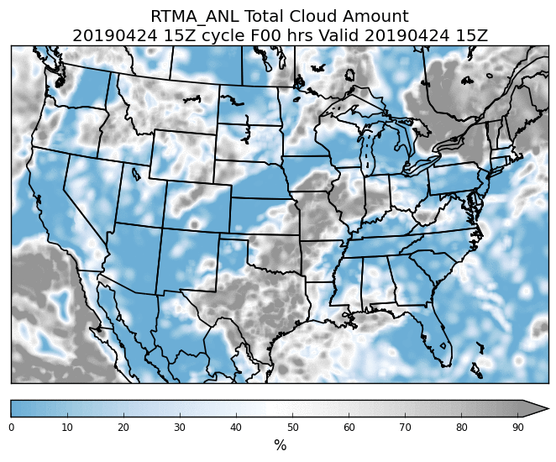
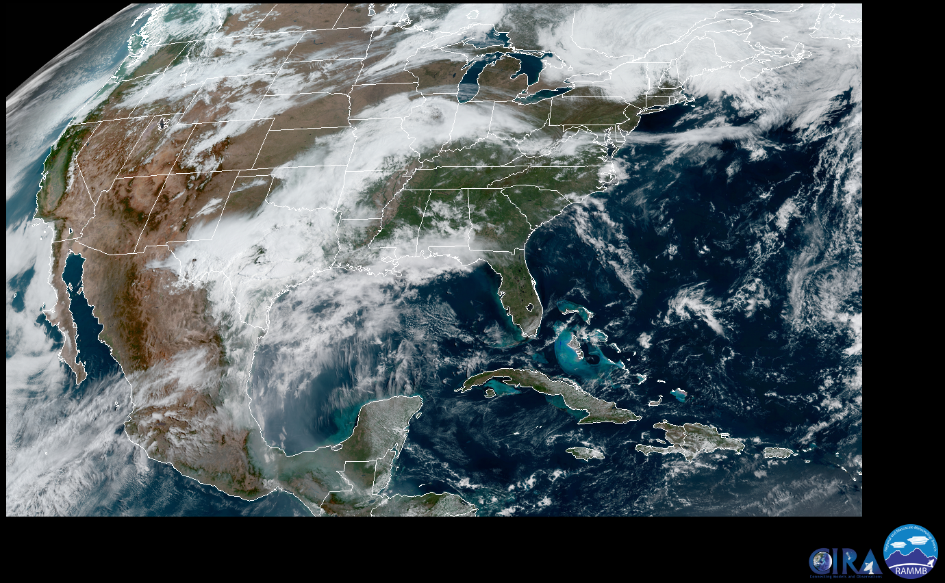
Example: Sky Cover QC
Original Sky Cover
Modified Sky Cover (QC)
VIS
15Z on 24 April 2019

Slide 18
Ceiling and Sky Cover Stats
*stats are relative to METARs, buoys, and ships*

Slide 19
QPE RTMA/URMA Changes for v2.8
Precip RTMA
Real time, low-latency QPE → currently from Stage II/IV (+33 min)
v2.8: Replace with radar-only MRMS; change hourly run schedule from hh:33 to hh:15
Improve latency
Situational awareness
Precip URMA
Backbone is Stage IV and is rerun regularly ~1 week after valid time to refine/enhance as RFCs transmit revised data (what the NBM uses)
v2.8: Add NOHRSC snowfall analysis
v2.8: Add a blending for a smoother offshore filling with MRMS and CMORPH QPE
v2.8: Change hourly run schedule for PCPANL/pcpURMA from hh:33 to hh:55
Request by OWP, RFCs for RIDGE II, so more RFC QPEs can be included for current hour
More complete coverage, earlier
PCPANL v4.0 (upstream job of RTMA/URMA):
Discontinue Stage II analysis - prod suite simplification
Add another 30h rerun of Stage IV 24h mosaic (for water.weather.gov/precip
Supplements the current ~daily rerun schedule and gives chance for updated RFC QPE’s to get out to public (e.g. water.weather.gov/precip)

Slide 20
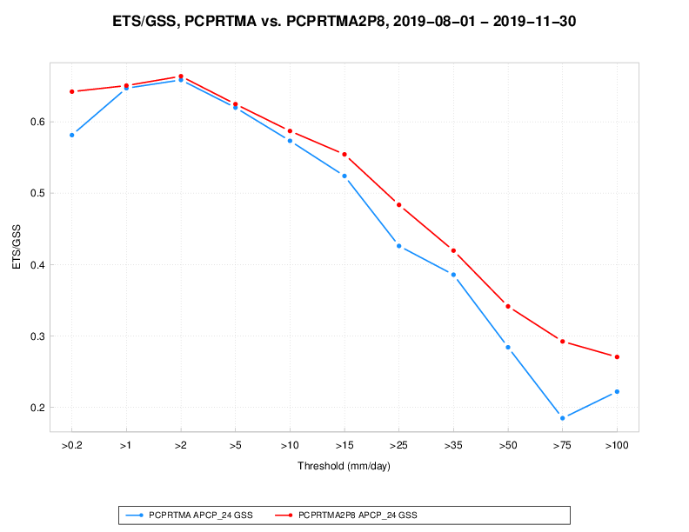
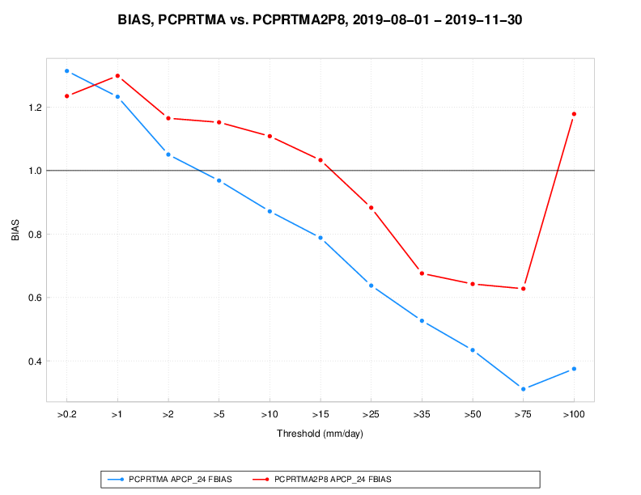
pcpRTMA using MRMS: validation
Prod vs. v2.8 pcpRTMA: 24 QPE validation vs. daily gauges (1 Aug - 30 Nov 2019)
ETS vs. threshold Bias vs. threshold

Slide 21
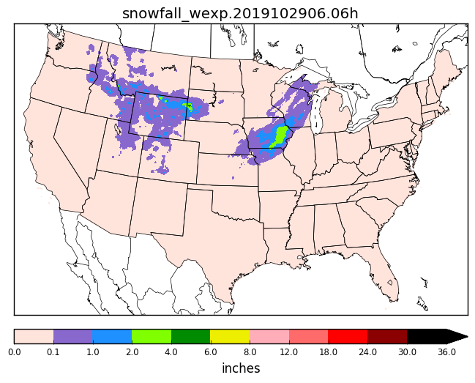
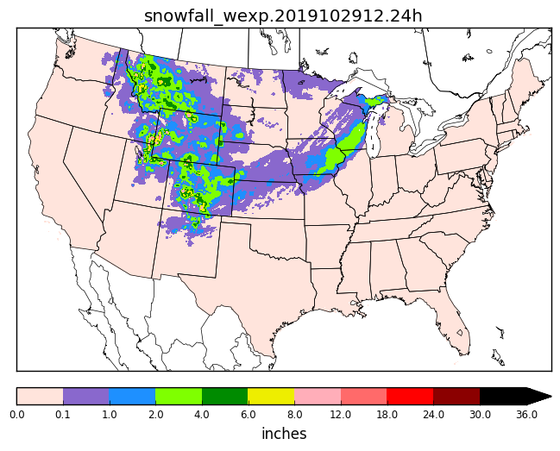
NOHRSC Snowfall Analysis for URMA
Add NOHRSC 6h/24h snowfall analysis to the precipitation URMA suite
At the 18Z cycle (run at 18:55Z), process NOHRSC data for current day AND the past 7 days to continually refine snow product
Data mapped from NOHRSC’s g184 to the expanded ConUS grid (WEXP) for NBM
g184 data sent out to AWIPS
6h Snowfall Accumulation
24h Snowfall Accumulation

Slide 22
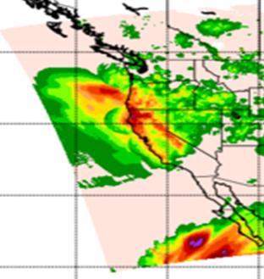
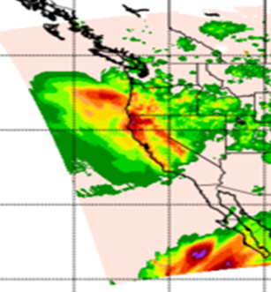
Improved Offshore Filling of pcpURMA
The primary source of ConUS pcpURMA is the NCEP Stage IV
mosaicked RFC QPEs → which is limited to RFC domains
V2.7 introduced offshore filling of ConUS PCPURMA with
Gauge-corrected MRMS (where RQI ≥ 0.1)
CMORPH
Sharp discontinuities can exist between these products
Solution → apply Whittaker blending function for a smoother pcpURMA offshore filling
Approach already used in RTMA/URMA to fill edges around domain
Prod
v2.8
24h ending 12Z 27 Nov

Slide 23
Evaluation Survey and Feedback
Evaluation completed via Google Form survey
Responses requested from all NWS regions, WPC, AWC and MDL
Survey was also sent to the field at large via MEG-maintained website
Website also linked to viewers and stats for the parallel, all previous relevant presentations
Much feedback also received via VLab community website and forum
Responses asking for implementation:
Eastern Region, Western Region, Southern Region, AK Region, WPC, MDL and 1 WFO
Response asking for changes
AWC detected a bug in the sky cover analysis at the end of the evaluation period
This bug has been corrected and AWC now recommends implementation

Slide 24
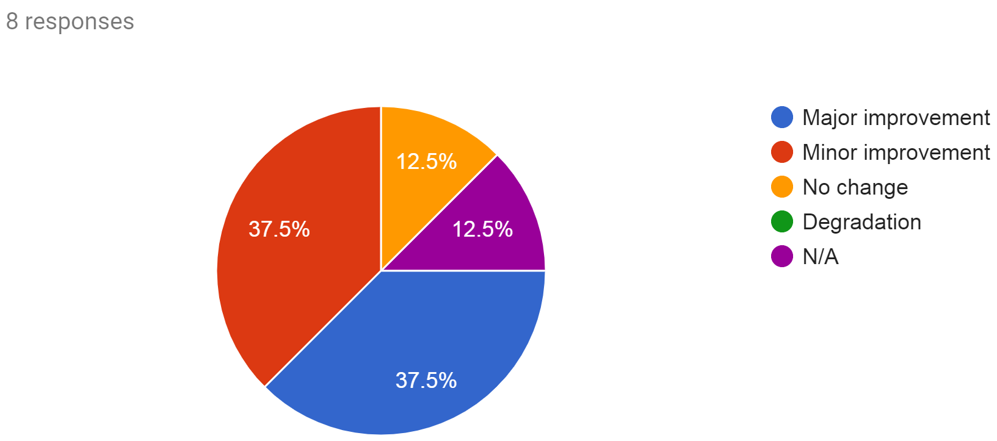
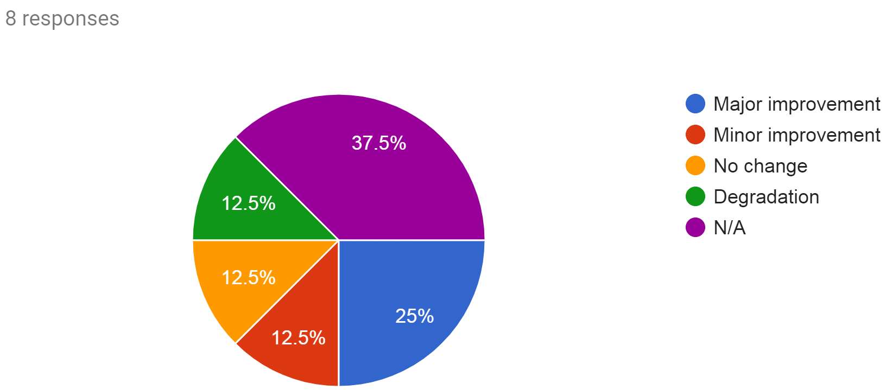
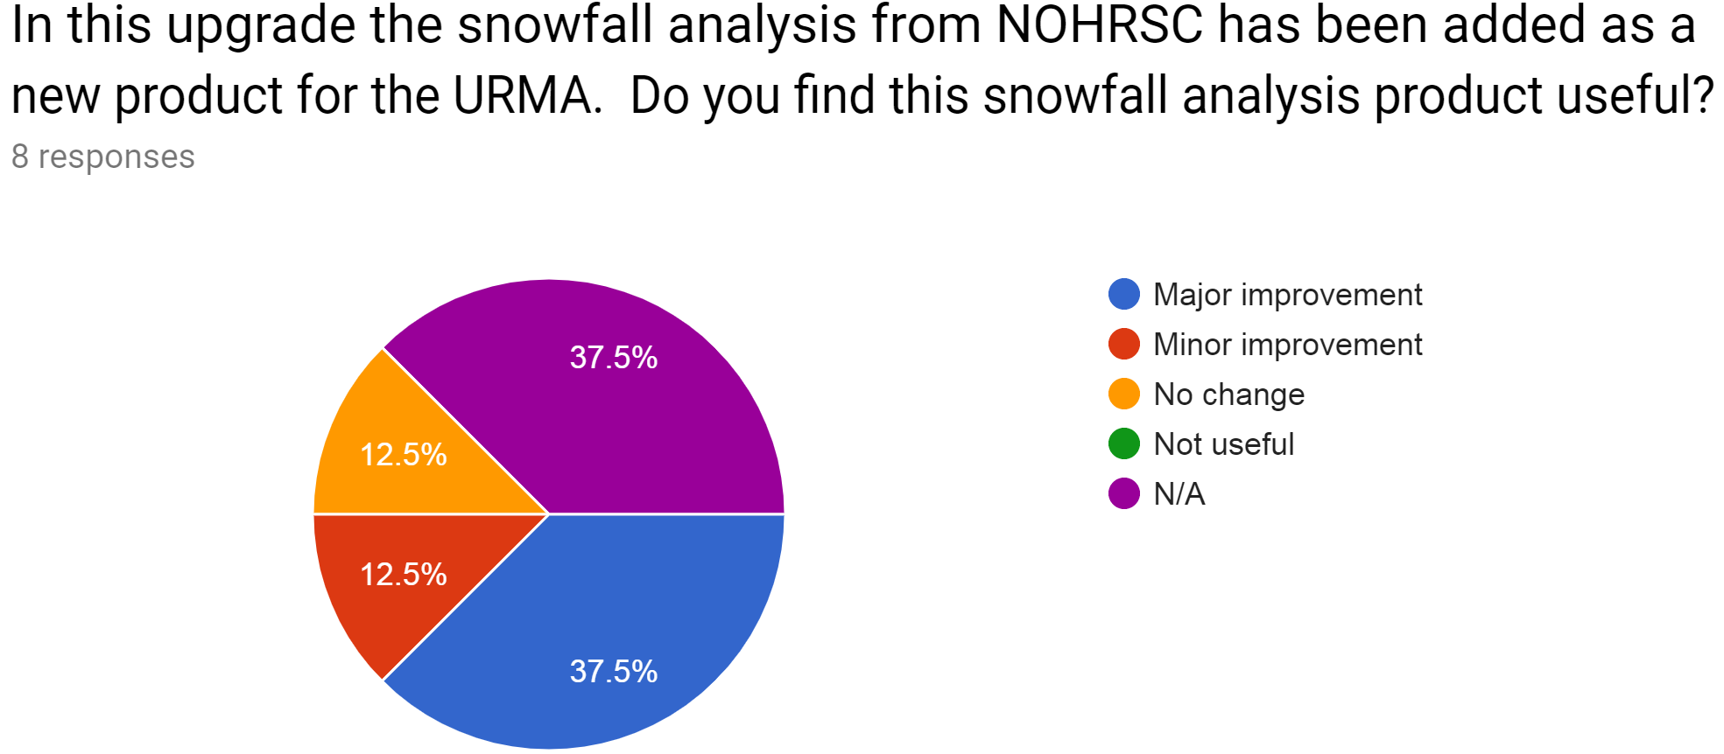
Evaluation Survey Results
Are there improvements in the winds?
Are there improvements in RTMA-precip?
Are there improvements in the URMA-precip?

Slide 25
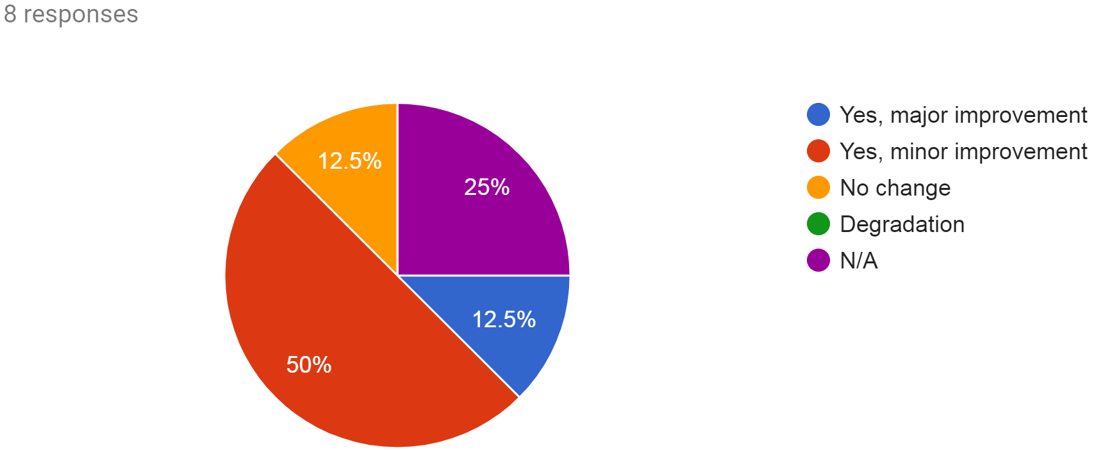
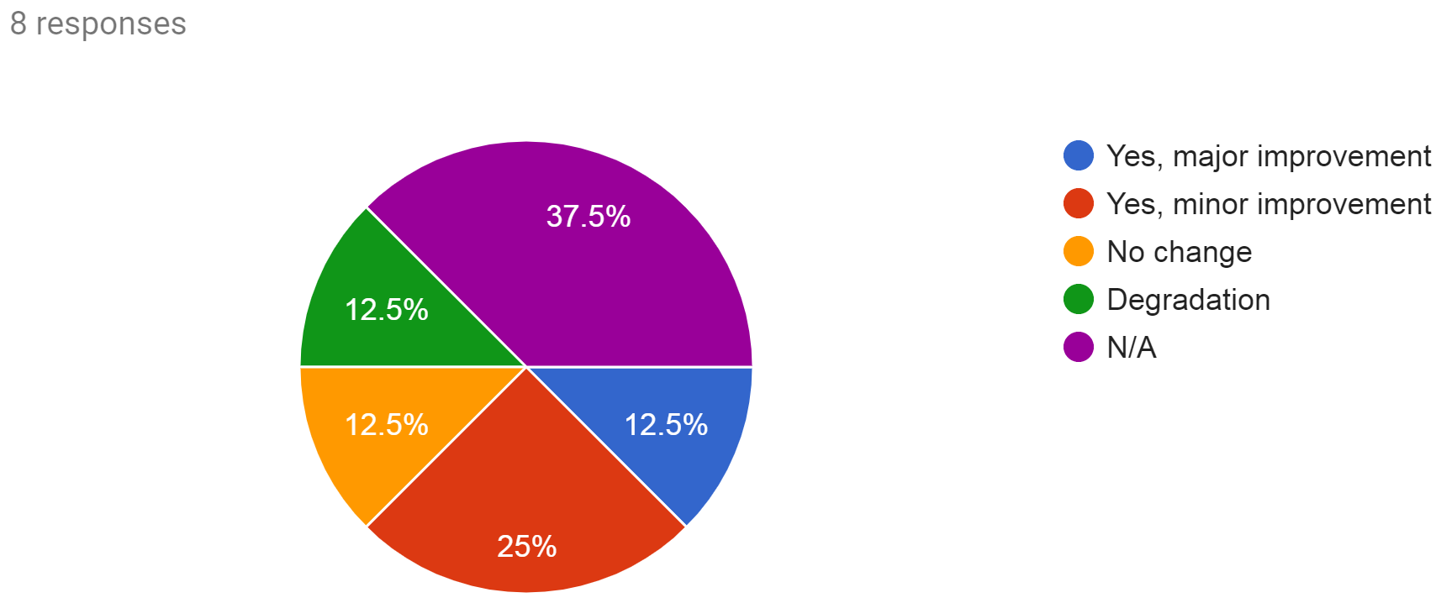
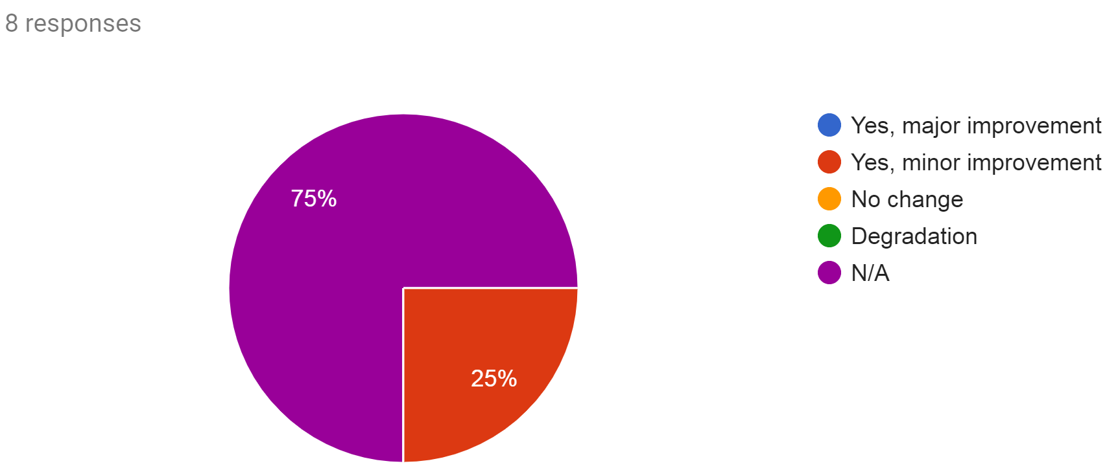
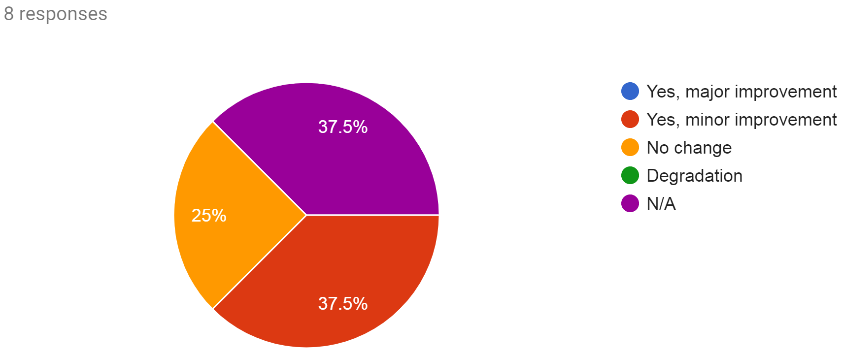
Evaluation Survey Results
Are there improvements in the ceiling?
Are there improvements in the sky cover?
Is the OCONUS selection algorithm an improvement?
Are there improvements in the dew point?

Slide 26
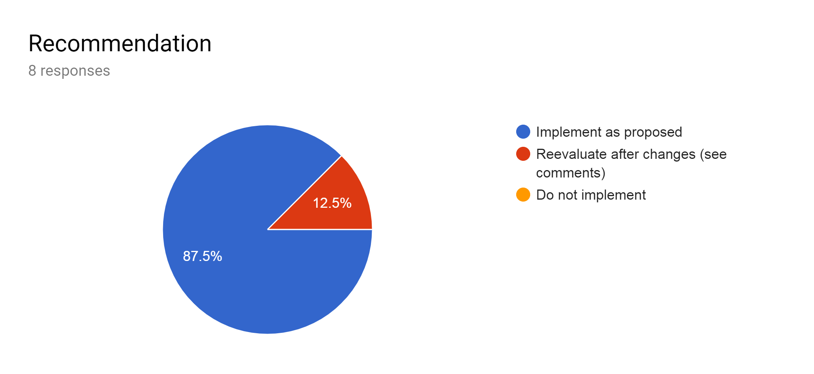
Evaluation Survey Results
Should RTMA/URMA be implemented into operations?
AWC detected a bug in the sky cover analysis which is now being addressed (next slide)

Slide 27
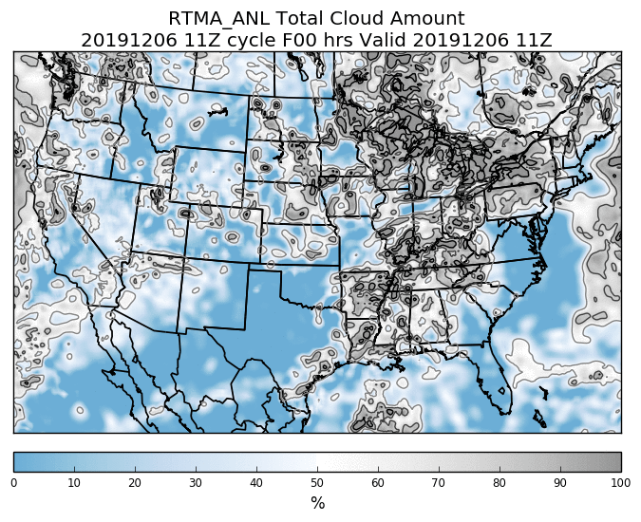
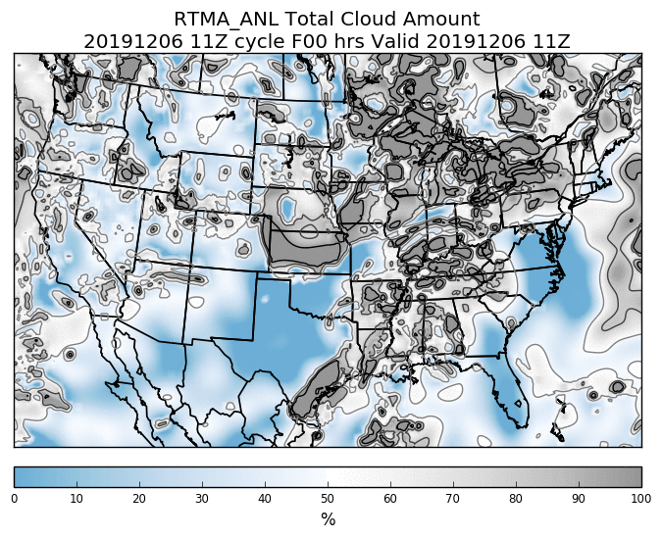
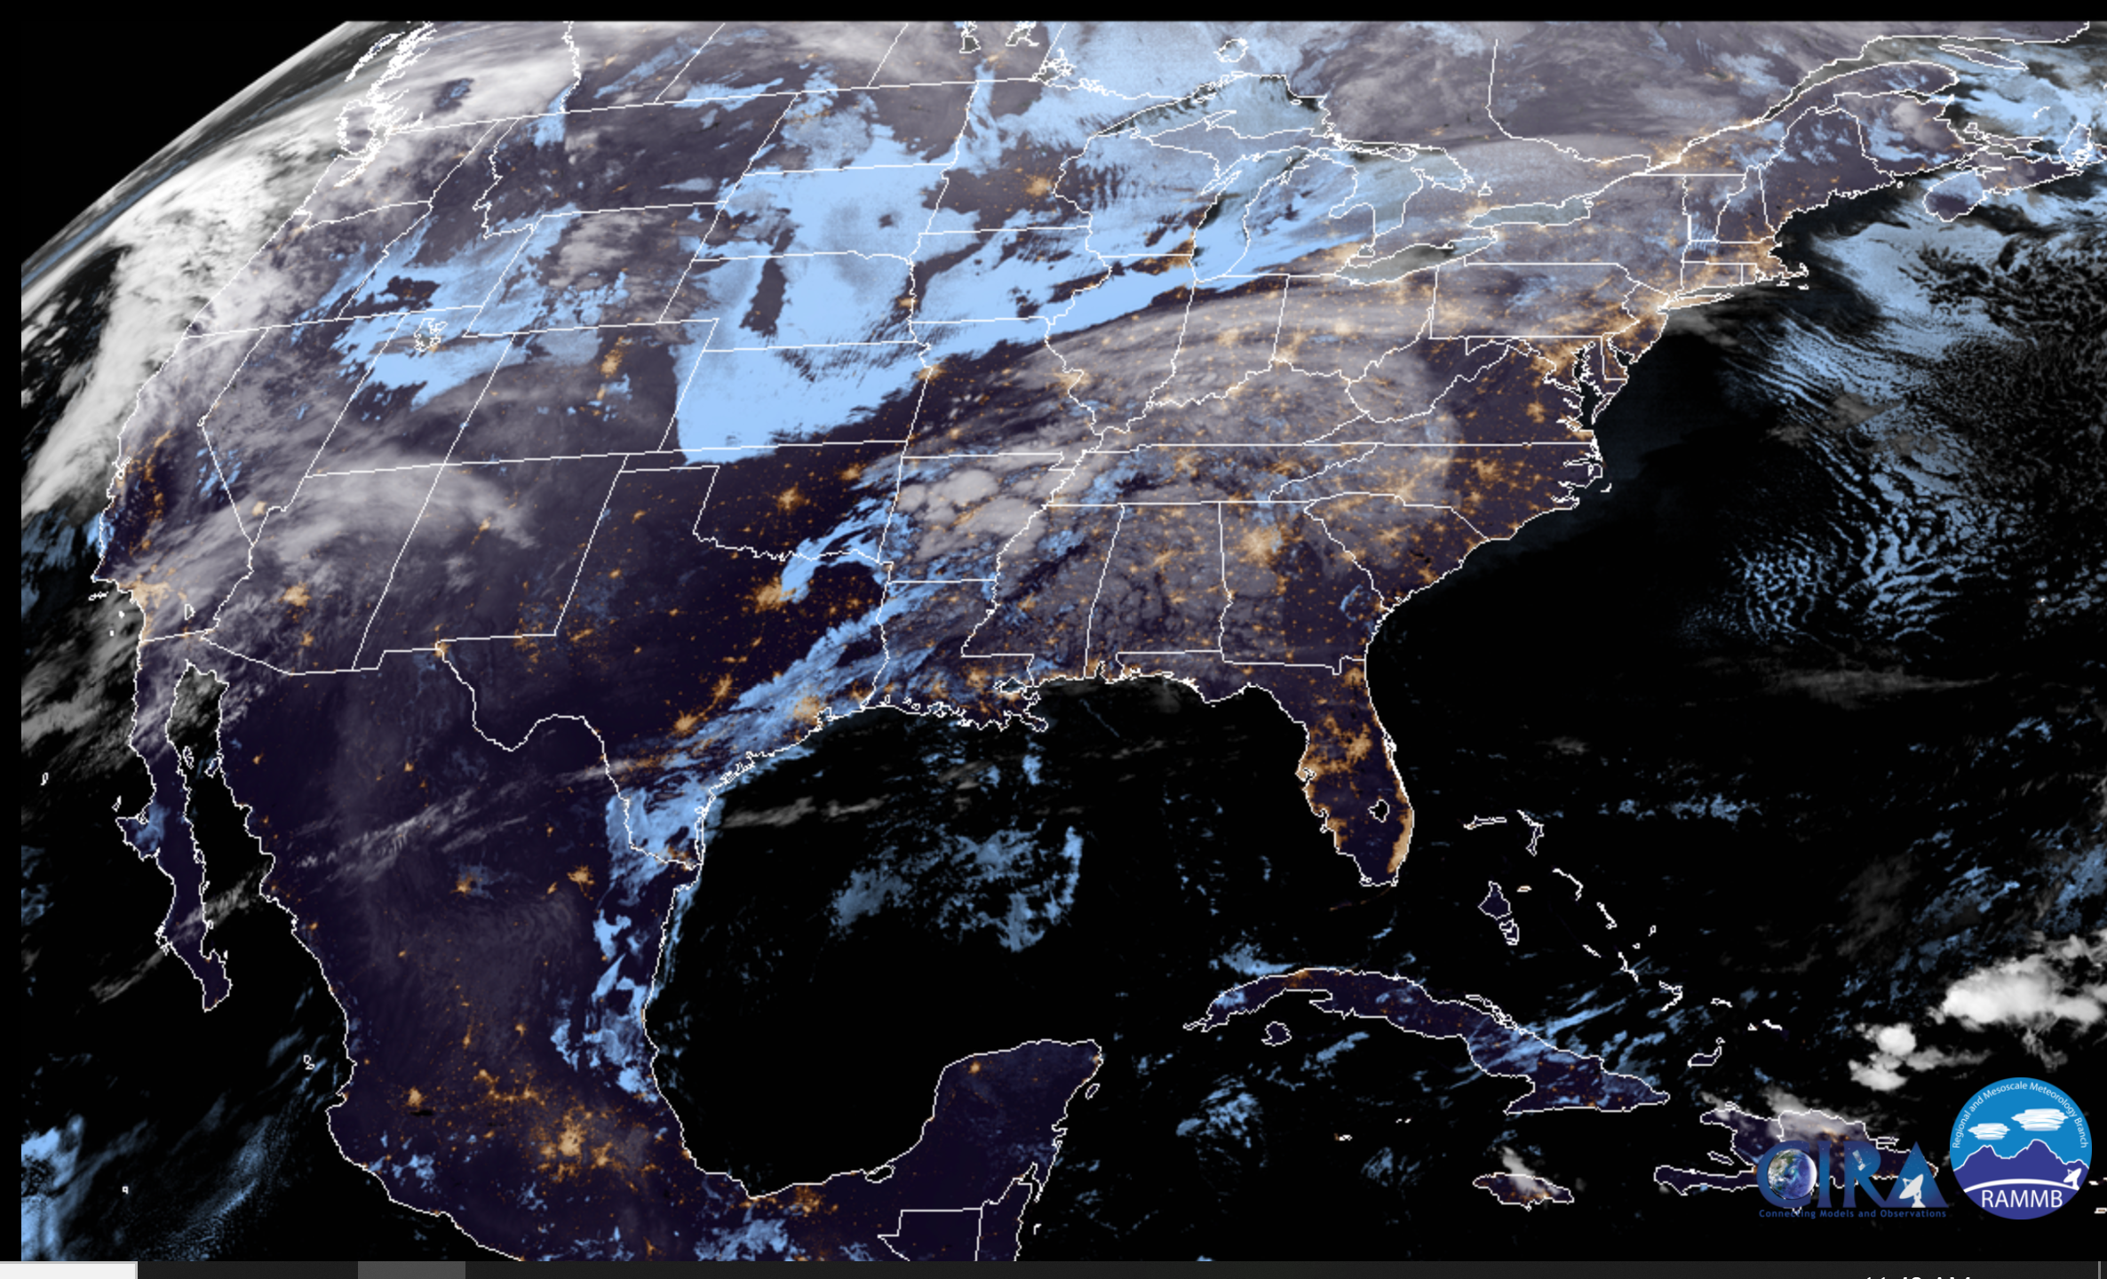
Sky Cover QC Additions
AWC evaluation noted cases during low sun angles where low ceilings were erroneously cleared by the ceiling consistency check owing to low analyzed values of sky cover.
GOES Imager sky cover QC was expanded to cover land areas beginning with the 14z (20z) URMA (RTMA) cycle on 5 December
Production
Parallel
*Thanks to AWC’s Jeremiah Pyle for identifying this issue and working with us!

Slide 28
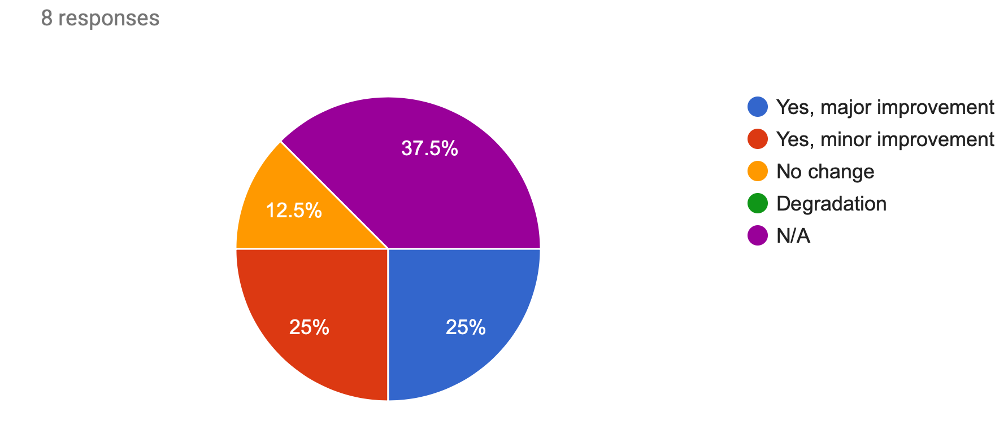
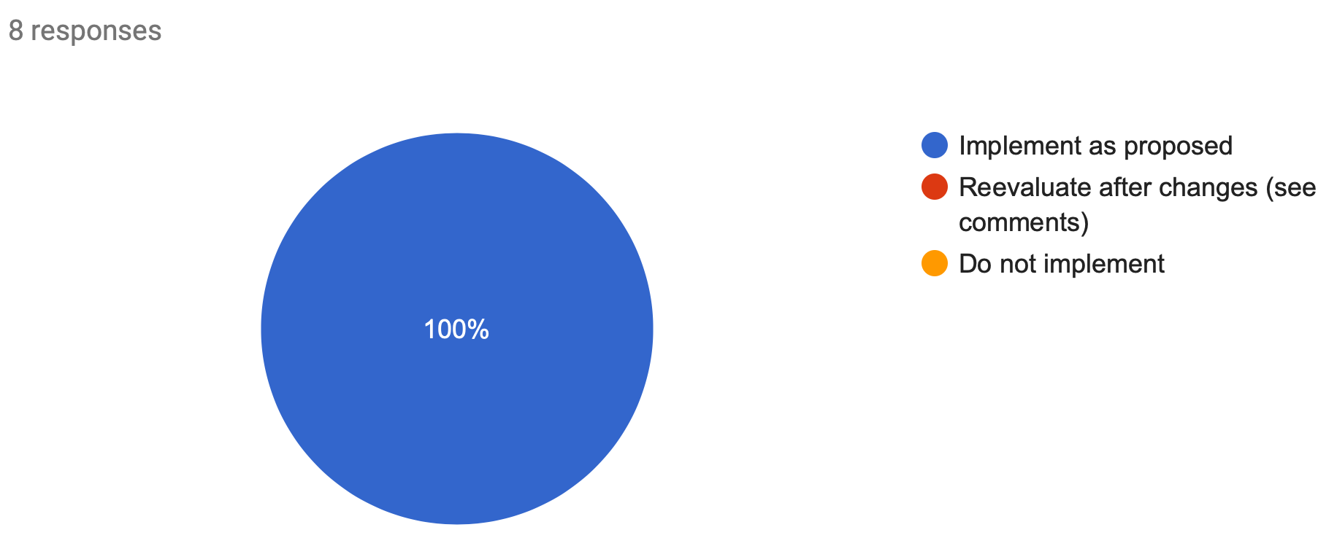
Evaluation Survey Results
Are there improvements in the sky cover?
Should RTMA/URMA be implemented into operations?
Link to all responses

Slide 29
Summary
Improved wind analysis through improved assimilation algorithm
Expanded support for waves to Great Lakes and Guam
Improved sky cover analysis and consistent with ceiling
A number of improvements/updates for precipitation
Offshore blending, NOHRSC snowfall, additional re-runs for better quality URMA QPE, MRMS
Much more → full evaluation page with complete stats
Schedule:
Code hand off to NCO: Dec. 17th
Implementation expected: Mid April, 2020
Final notes
This is the final 2D RTMA/URMA/RTMA-RU upgrade
3D-RTMA is coming in the FY23 timeframe!
RTMA/URMA/RTMA-RU/Precip benefits tremendously from an active and engaged user community → thank you!

Slide 30
Resources

Slide 31
Up/Downstream Changes
Upstream dependency changes
PCPANL v4.0 (upstream job of RTMA/URMA):
Discontinue Stage II analysis
Stage IV: change from GRIB1 to GRIB2
Obsproc upgrade
Adding GOES Imager for RTMA-RU
SmartInit Changes for RAP, HRRR, NAM
HiRes wave background
Product additions
NOHRSC snow
SBN changes for AWIPS
New PR grids (tentative approval)
NOHRSC (tentative approval)

Slide 32
Resource Changes
Minimal node use changes
Minor (>10%, ~100 GB/day) increase in disc space
New variable (sky cover) for RTMA-RU increased from ~180 GB/day to ~220 GB/day
New fields needed in smartinit files for enhanced wind assimilation - small increase locally
HRRR Smartinit has increased from ~13 GB/day to ~26 GB/day
RAP Smartinit has increased from ~7 GB/day to ~10 GB/day
HIRESW Guam Smartinit has increased from ~250 MB/day to ~280 MB/day
NAM Smartinit has increased from ~8 GB/day to ~14 GB/day (00-12 hours)
PR RTMA/URMA increased from ~15GB/day to ~30GB/day
Also includes impact of resolution change
WW3 background has increased from ~25 GB/day to ~50GB/day (temp space only)

Slide 33
Supplemental Slides

Slide 34
Ceiling and Sky Cover Stats - following QC extension
*stats are relative to METARs, buoys, and ships*

Slide 35
OCONUS: Updated Observation Selection Algorithm
Already in place over CONUS and Alaska, being expanded to other domains
Assimilate only the observation reported closest to the analysis time at each site
This adjustment allows for a closer fit to observations in each analysis as well as the improved use of special (SPECI) reports (ceiling and visibility).
The modified algorithm ensures the SPECIs always get the strongest weight in the analysis.
12Z Ops OCONUS RTMA/URMA considers all obs in the window and interpolates among them
11:30Z
12:00Z
12:30Z
37.6
37.8
38.3
38.6
T Obs from hypothetical station
37.5
38.1
Largest impacts:
Situations where the element in question may change rapidly
Frontal passages, valley drainage, etc.
Closer fit to observations
12Z v2.8 OCONUS RTMA/URMA
Only considers report closest to analysis time

Slide 36
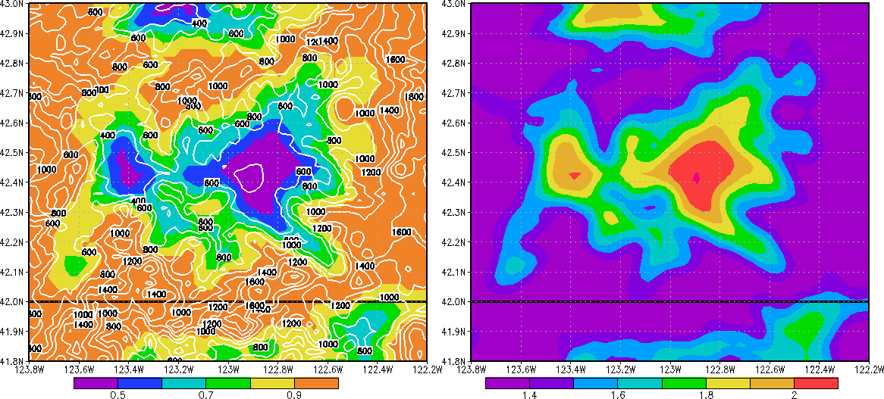
OCONUS: Revised 2m T Background Error Covariance
Analysis is a statistical combination of the observations and background, weighted by their respective errors
The background 2m T field can struggle in/around complex terrain (i.e. an error in the background)
Incorporate a valley map into the background error to inflate the errors in complex terrain
Fit observations more closely where the OCONUS RTMA/URMA background struggles - valley cold pools
Valley-map and Terrain (m)
Temperature Background Error Stdev (K)
*Implemented for CONUS in v2.7*

Slide 37
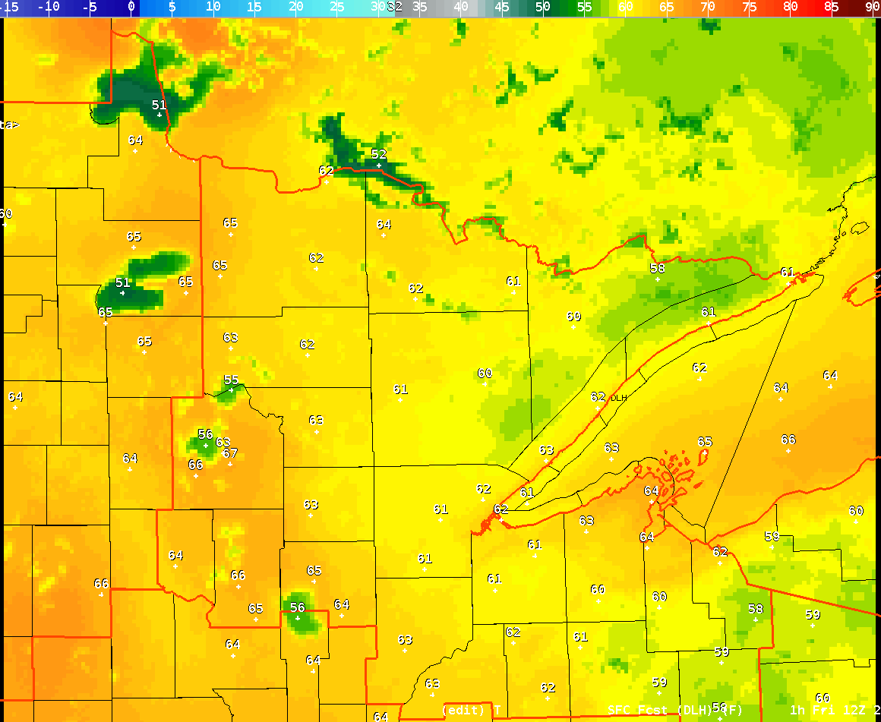
NOT Included Here: New RAP/HRRR
Our science evaluation does NOT include any data from the RAP/HRRR evaluation
Timing of evals and lack of CONUS HRRR availability prevented full testing
RTMA/URMA will likely be implemented before RAP/HRRR
We will likely run another parallel, at some point, when CONUS RAP/HRRR fields are available
Largest improvement in new RAP/HRRR: improved inland lake temperatures
Water temperature have been too cold before
New SST algorithm in HRRR

Slide 38
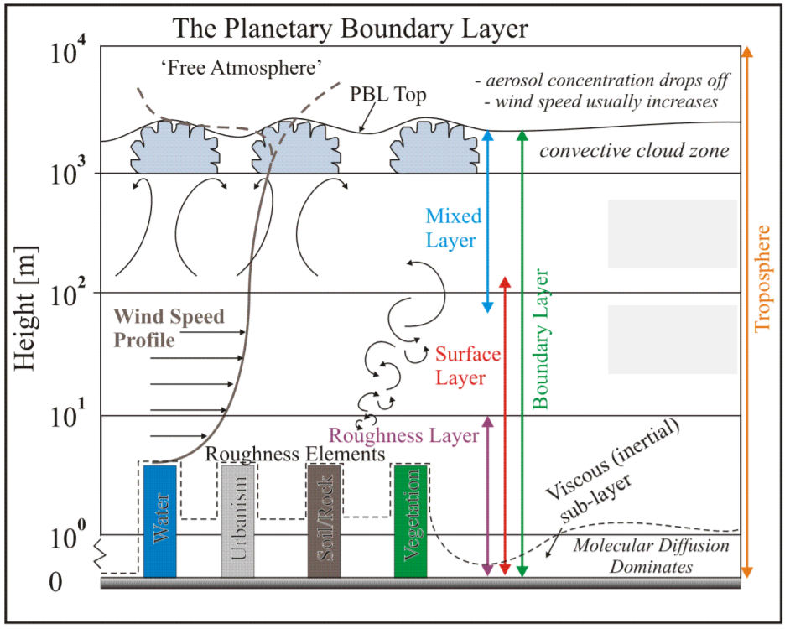
Wind Adjustment Procedure
Inputs
Lowest two sigma levels of background model
Background skin temperature
Land/sea mask value
Similarity Theory Adjustment
10 m wind factor is calculated based on local stability
Background winds are then multiplied by this factor
‘Adjusted’ background is then compared to observation to generate innovation and increment
Results in higher wind speeds in the analysis
Closer to METAR observed wind speed
Many mesonet wind obs will still not be used at all; more may need to be flagged (info here)
If background under forecasts wind speed, analysis winds will still be too light.

Slide 39
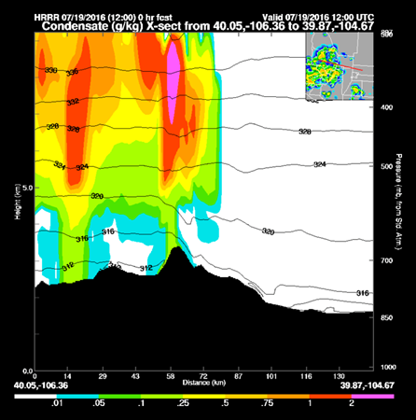
The Move to Three Dimensions
3D-RTMA/URMA
With sub-hourly updates
CONUS + Alaska to start
Joint development effort between EMC + ESRL/GSD
Real time, rapid updated analysis of 3D atmospheric fields
Severe and aviation weather parameters
Analysis of hydrometeor and cloud fields
Assimilation of radar observations
Heavy rainfall, etc.
Prototype 3D-RTMA
*Thanks to ESRL/GSD for this figure*

Slide 40
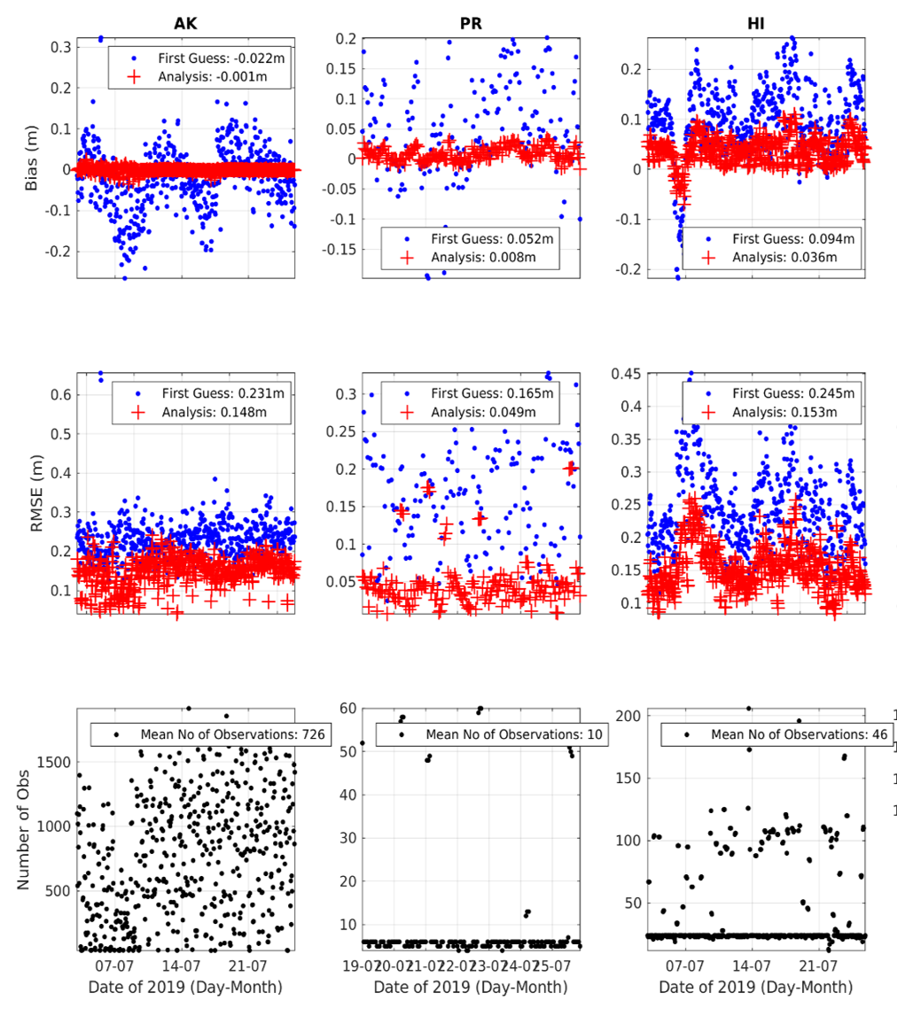
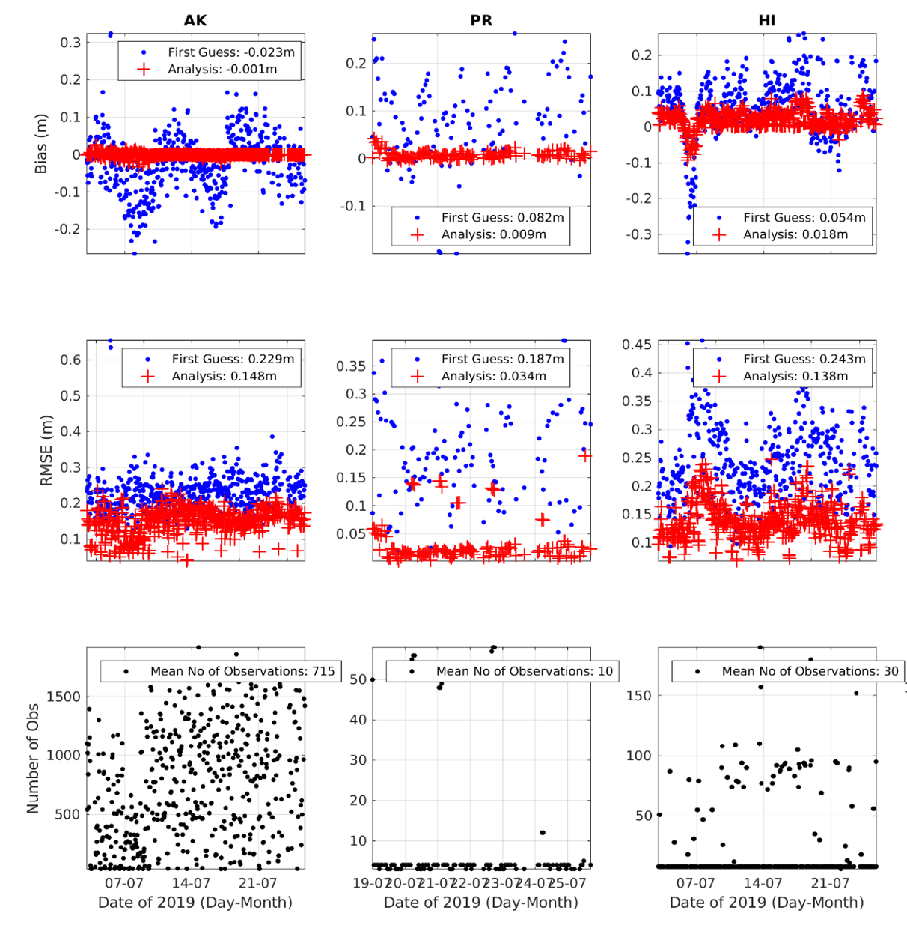
SWH OCONUS 2.8
URMA v2.7
URMA v2.8
Bias (m)
RMSE (m)
The 2.8 upgrades had positive or neutral effect on the analysis of SWH.
# Obs
Notes:
The difference in obs number is due to 1. the different initialization time and 2. Some failed analysis of the 2.8 parallel

Slide 41
Supplemental Material
Supplemental material for precipitation

Slide 42
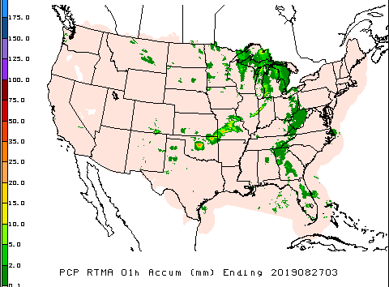
pcpRTMA using MRMS
Use radar-only MRMS QPE
Lower latency
Less affected by data outages than gauge-corrected MRMS QPE
Radar quality index (RQI) added as companion to each hour’s pcpRTMA array
Provide users with info about quality of the QPE
RQI arrays will be available on NOMADS (not AWIPS)
Prod
v2.8

Slide 43
Request Changing Precip Run Schedule
Current production PCPANL/pcpRTMA/pcpURMA run at hh:33
Request:
Advance pcpRTMA by 18 minutes (to hh:15)
Postpone PCPANL/pcpURMA by 22 min (to hh:55)
hh:00 hh:15 hh:33 hh:55
V2.8 pcpRTMA
Prod precip jobs
V2.8 pcpURMA/PcpANL
Prod precip suite currently runs at hh:33 due to Stage II/pcpRTMA dependency on METAR gauges, available at ~hh:30
Using MRMS as source for pcpRTMA removes this dependency → simpler
Running pcpRTMA at hh:15 (instead of even earlier) allows use of MRMS data within a ±10 min window in case of an outage near hh:00 → Reliability
Postponing PCPANL(Stage IV), pcpURMA to hh:55 → more current-hour’s RFC QPEs included
Per request by OWP - plans to use Stage IV hourly mosaic for RIDGE II beginning in Q3 FY20)

Slide 44
Delaying Stage IV from hh:33 to hh:55
22:33Z, some RFCs have not sent their QPEs for that hour yet.
22:55Z: All RFCs that produce 1h QPEs have sent them.
CNRFC/NWRFC do not have 1h QPEs;
Stage IV provide coverage for that area using the RFCs’ 6h QPEs (received at 14:06/14:30 in this case) time-disaggregated using 1h MRMS data as weights.
QPE appears next day (3rd panel)
prod, made at 22:33Z para, made at 22:55Z prod/para at 14:33/14:55Z
next day
Better coverage with small delay
1h mosaic for 22Z 15 Nov., 2019

Slide 45
Benefit of the 30h ConUS re-mosaic for 24h Stage IV
For the 24h ending at 12Z 28 Oct, several hourly OHRFC QPEs were missing. Data received at 14:32Z 29th. There was also a problem with earlier QPEs from WGRFC that was corrected at 17:47Z 30th.
————————— after 18:33Z 29th —————————————
Para has complete coverage from the 30-h rerun. Prod still missing OHRFC area - had to wait until next day (12:33Z 30th) for complete coverage
——— after 12:33Z 31st ———
Corrected WGRFC QPE was used in the 3-day rerun in both prod/para
prod para prod/para

Slide 46
Radar-Only vs. Gauge-Corrected MRMS QPE
Radar-only QPE
More timely!
A 2-minute lag vs. ~58min for gauge-corrected QPE
Radar-only QPE is available every 2 minutes
In case of a data outage at the top of the hour, QPE valid closest to the top of the hour (within ±10 min of hh:00:00) can be used for pcpRTMA.
E.g. on 26 Nov, gauge-corrected MRMS QPE was missing for 01/02/04Z. Radar-only QPE also had gaps: no data between 00:58:00 - 02:08:00Z and 03:58:00 - 04:10:00Z. No missing v2.8 pcpRTMA:
pcpRTMA valid at | From radar-only MRMS valid at
01Z | 00:58:00
02Z | 02:08:00
03Z | 03:00:00
04Z | 03:58:00

Slide 47
pcpRTMA Source
Current prod uses first run Stage IV supplemented by first run Stage II.
At the time of the pcpRTMA run (33 min past the top of the hour), the RFC QPEs (basis for Stage IV) generally do not yet have the benefit of human oversight/QC:
02Z 17 Dec 2017 (Saturday evening ET): bad gauge included in the first-run RFC QPE/pcpRTMA. NERFC removed the bad gauge within hours and pcpURMA was updated accordingly in the following hour’s rerun. pcpRTMA was only run once (“Real Time”) and the bull’s eye stayed in the RTMA.

Slide 48
pcpURMA Offshore Blending (Yan Luo)

Slide 49
Examples of Blended Offshore PCPURMA
From Yan Luo:

Slide 50
Offshore pcpURMA Blending
Recent example: 24h ending at 12Z 27 Nov
Prod v2.8
https://www.emc.ncep.noaa.gov/users/verification/precip/rtma-urma/v2p8/daily/plots/urma/pcpurma2.20191127.png

Slide 51
Offshore pcpURMA Blending
Recent example: 24h ending at 12Z 16 Nov
Prod v2.8

Slide 52
Offshore pcpURMA Blending
Recent example: 24h ending at 12Z 20 Oct
Prod v2.8

Slide 53
Offshore pcpURMA Blending
Recent example: 24h ending at 12Z 01 Dec
Prod v2.8
https://www.emc.ncep.noaa.gov/users/verification/precip/rtma-urma/v2p8/daily/plots/urma/pcpurma2.20191201.png

Slide 54
pcpRTMA/RTMA2.8/URMA2.8
RTMA vs. RTMAv2.8 vs. URMAv2.8, 16 Sept - 15 Nov, ConUS
Time series of RMSE ETS vs. threshold Bias vs. threshold

Slide 55
pcpRTMA/RTMA2.8/URMA2.8
RTMA vs. RTMAv2.8 vs. URMAv2.8, 16 Sept - 15 Nov, ABRFC
Time series of RMSE ETS vs. threshold Bias vs. threshold

Slide 56
pcpRTMA/RTMA2.8/URMA2.8
RTMA vs. RTMAv2.8 vs. URMAv2.8, 16 Sept - 15 Nov, CBRFC
Time series of RMSE ETS vs. threshold Bias vs. threshold

Slide 57
pcpRTMA/RTMA2.8/URMA2.8
RTMA vs. RTMAv2.8 vs. URMAv2.8, 16 Sept - 15 Nov, CNRFC
Time series of RMSE ETS vs. threshold Bias vs. threshold

Slide 58
pcpRTMA/RTMA2.8/URMA2.8
RTMA vs. RTMAv2.8 vs. URMAv2.8, 16 Sept - 15 Nov, LMRFC
Time series of RMSE ETS vs. threshold Bias vs. threshold

Slide 59
pcpRTMA/RTMA2.8/URMA2.8
RTMA vs. RTMAv2.8 vs. URMAv2.8, 16 Sept - 15 Nov, MARFC
Time series of RMSE ETS vs. threshold Bias vs. threshold

Slide 60
pcpRTMA/RTMA2.8/URMA2.8
RTMA vs. RTMAv2.8 vs. URMAv2.8, 16 Sept - 15 Nov, MBRFC
Time series of RMSE ETS vs. threshold Bias vs. threshold

Slide 61
pcpRTMA/RTMA2.8/URMA2.8
RTMA vs. RTMAv2.8 vs. URMAv2.8, 16 Sept - 15 Nov, NCRFC
Time series of RMSE ETS vs. threshold Bias vs. threshold

Slide 62
pcpRTMA/RTMA2.8/URMA2.8
RTMA vs. RTMAv2.8 vs. URMAv2.8, 16 Sept - 15 Nov, NERFC
Time series of RMSE ETS vs. threshold Bias vs. threshold

Slide 63
pcpRTMA/RTMA2.8/URMA2.8
RTMA vs. RTMAv2.8 vs. URMAv2.8, 16 Sept - 15 Nov, NWRFC
Time series of RMSE ETS vs. threshold Bias vs. threshold

Slide 64
pcpRTMA/RTMA2.8/URMA2.8
RTMA vs. RTMAv2.8 vs. URMAv2.8, 16 Sept - 15 Nov, OHRFC
Time series of RMSE ETS vs. threshold Bias vs. threshold

Slide 65
pcpRTMA/RTMA2.8/URMA2.8
RTMA vs. RTMAv2.8 vs. URMAv2.8, 16 Sept - 15 Nov, SERFC
Time series of RMSE ETS vs. threshold Bias vs. threshold

Slide 66
pcpRTMA/RTMA2.8/URMA2.8
RTMA vs. RTMAv2.8 vs. URMAv2.8, 16 Sept - 15 Nov, WGRFC
Time series of RMSE ETS vs. threshold Bias vs. threshold

Slide 67
For Users of PCPANL Output
Summary of changes for users of PCPANL (Stage II/IV) data planned for March 2020 with RTMA/URMA v2.8 implementation (https://www.emc.ncep.noaa.gov/users/meg/rtma_urma_v2p8/):
Stage II will be discontinued with the RTMA/URMA v2.8 implementation (scheduled for Mar 2020)
Stage IV will be in GRIB2 format, instead of GRIB1
Stage IV mosaicking will be done at hh:55 instead of hh:33 (per request by OWP, RFCs for RIDGE II, so that more RFC QPEs can be included for the current hour)
There is an additional re-run for 24h ConUS mosaic done at 30h after valid time (at the 18:55Z cycle), to supplement the current 1/2/3/5/7-day rerun schedule, done at 12:55Z, to give RFCs a better chance to have their re-sent or updated QPEs included in AHPS’s water.weather.gov/precip w/o waiting for the 2-day rerun the next day
Add’l info about the upcoming precip change for RTMA/URMA v2.8: https://docs.google.com/presentation/d/1GUjHKmD56AR1fxzgF-LexBsJTfs0KNEG4O7xonZpJ7g/edit?usp=sharing

