Slide 1
RTMA/URMA v2.8 Upgrade Overview
Stakeholder meeting: Sept 4, 2019

Slide 2
Outline
RTMA Overview (brief)
Quality Control/Flagging Situation and Overview
  No additional flagging until critical weather (Dorian) is over
Next upgrade: v2.8
  Wind changes
  Precip changes
  Significant Wave Height changes
  Downscaling/background changes
  Cloud Cover Improvements
  Evaluation Procedures (websites, links, etc.)
  New stats we are running at EMC
  Timeline

Slide 3
About RTMA/URMA Generally
Bias correction source for National Blend of Models
2D variational data assimilation system
  First guess from HRRR/RAP forecast after a downscaling process
  Observation include: METAR, buoy, mesonet, winds/wave heights retrieved from satellite data.
  A forecast error covariance model is applied, with consideration of topographical impact.
An ob’s influence is generally a function of nearby terrain or land/water boundary
  Maximum radius of influence, for most variables, is 80 km (flat area or over water)
Impact from nearby observations can overlap with each other
Precipitation analysis is called RTMA and URMA, but is a separate system
  Mostly consists of a blend of other precip datasets
RTMA = Real Time, URMA = 6 hours later, but the code is (mostly) the same
For more basic info, see our COMET documentation and VLab community page

Slide 4
Ongoing: Quality Control/Ob Flagging
Overview here
Easiest way to find out what is used or not: look at KML plots available here
  Obs are colored traffic-light style, click on points for more info
  If MADIS is getting the ob, we probably are too
  If you know of an ob that you don’t see, let us know
Want to flag obs?
  Flag a few: fill out the form (also available at VLab site)
  Flag a bunch: email us and we will work out specs
  We can flag only certain variables (keep temps/flag winds) if that is needed
  Flags are generally* applied on Friday afternoon
Don’t want to flag obs?
  Don’t be surprised when they are drawn for in RTMA/URMA, and later NBM

Slide 5
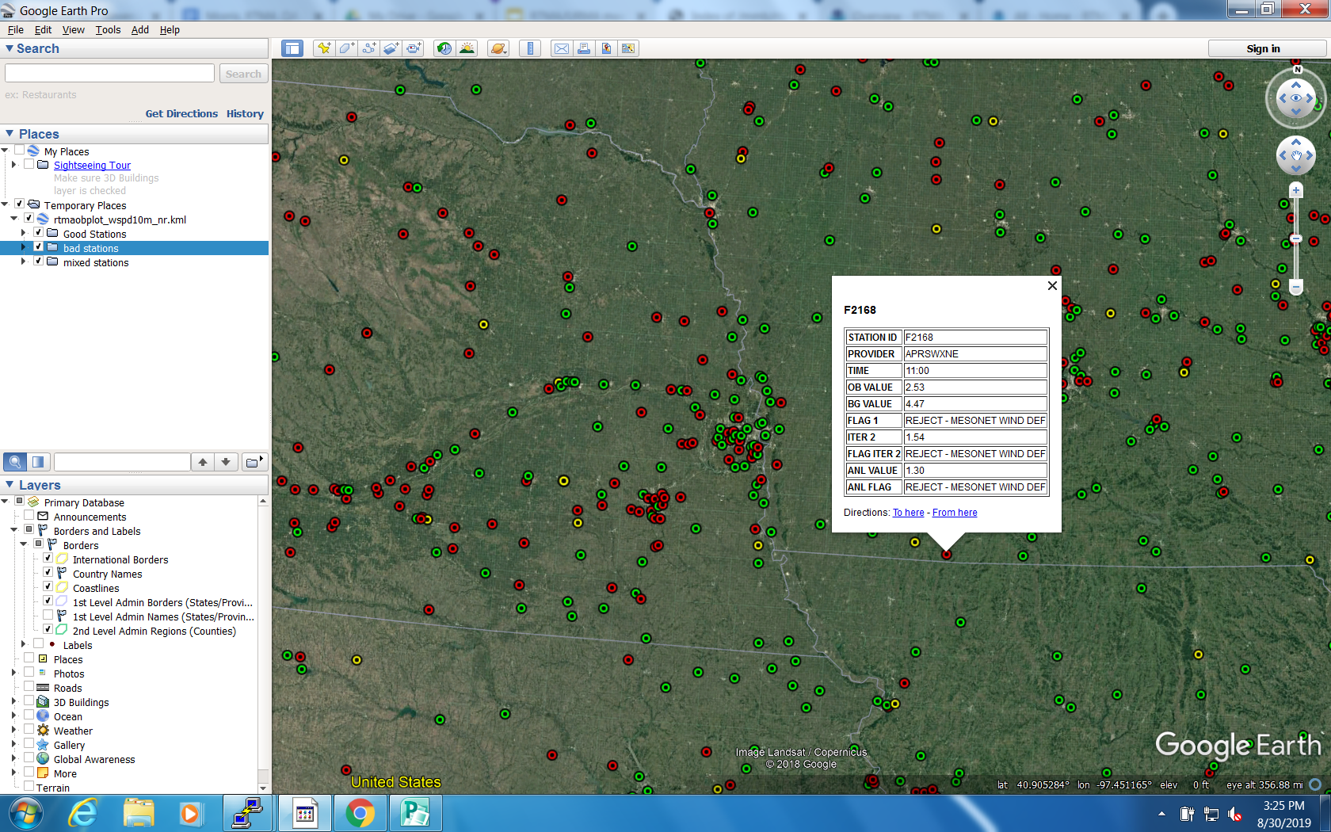

Slide 6
Timeline for Next Upgrade
First release to field within the next two weeks
  Public notification statement, viewer websites, FTP access
Formal Evaluation Period - likely September/October 2019
  Let system run, maybe make minor tweaks, collect feedback as necessary
  Generate verification stats over this period
  Some runs may be missed due to WCOSS outages/issues
Gather feedback, present summary to EMC mgmt, NCEP Director - Nov 2019
  If management approves, code will be ‘handed off’ to central operations in early December
  Code is ‘locked down’ at this point
  Exact timing depends on end of WCOSS moratorium (transition to Dell)
NCO builds and tests operational system - December-February
  Evaluation system would continue to run
Final IT test (30 days) is run by NCO, likely over March
  Dataflow aspects, testing with AWIPS, etc.
Implementation goal: late March, 2020

Slide 7
The Next Version of RTMA/URMA: V2.8
Wind Changes
  Include wind sensor height (don’t assume winds are at 10 m)
  Combine with similarity theory to lessen low wind bias
Precip enhancements
  Add NOHRSC snowfall analysis
  Precip RTMA: replace first-run Stage II/IV with radar-only MRMS as source
  Precip URMA: blending for a smoother offshore filling with MRMS and CMORPH
Wave height analysis over the Great Lakes and Guam
Downscaling/background changes
Dew point changes in areas of complex terrain
Ceiling/Cloud Cover enhancements
  Consistency between ceiling and cloud cover; add cloud cover in RTMA-RU
Finer grid over PR (2.5 km → 1.25 km)

Slide 8
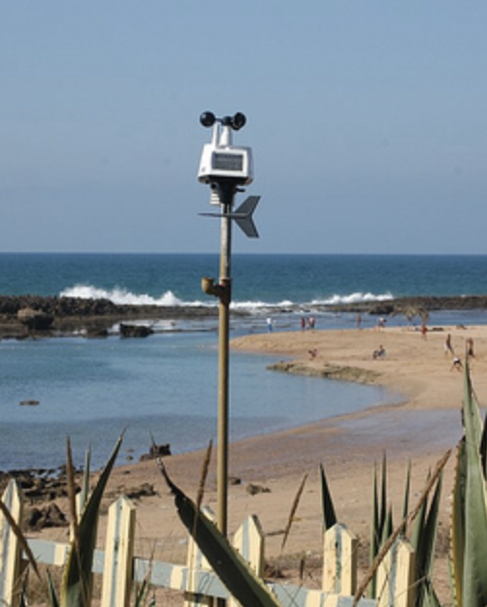
Wind Changes: Sensor Height
Up to now, it has been assumed that all wind obs are taken at 10 m AGL
  We know from looking at station photos that this is not true
For mesonets: wind sensor height will now be a function of provider
  Providers and subproviders are set and provided by MADIS
  Current list of providers/heights
  CWOP and AWS/Weatherbug assumed at 3 m now
  Contact us if you have additional information
  List gets ‘frozen’ when we hand this off (November)
Ob will be compared against background adjusted to same height as ob
  Two options still undergoing testing
Similar adjustments made to gust analysis

Slide 9
Two Options for Wind Adjustment
Option 1: Neutral Stability Profile
If (zob <= sfcr) factw=0.
Otherwise:
factw=log(zob/sfcr)/log(10/sfrc)
The computed factw parameter is used to rescale the background winds which are assumed to be at the 10-m level.
Option 2: Full Similarity Theory
Use similarity theory from the MM5 land surface model:
factw=factw(zob,skint,slmask,p1,p2,t1,t2,q1,q2,u1,v1)
Where:skint, slmask,p1,p2,t1,t2,q2,q2,u1,u1 come from the model providing the RTMA/URMA background. They represent the skin temperature, land-sea mask value, pressure at the 1st and 2nd half-sigma level, temperature at the 1st and 2nd half-sigma level, specific humidity at the 1st and 2nd half-sigma level, and u-wind and v-wind at the 1st half-sigma level.

Slide 10
Evaluation Procedure for Winds
Both Option 1 and Option 2 will run for the next week
  Only difference is wind assimilation option, otherwise both systems are identical
  All other elements of v2.8 are in both systems
We will run statistics to assess which option performs best
  More on the stats at the end of this slide deck
That system will become v2.8
We will distribute publicly at that point

Slide 11
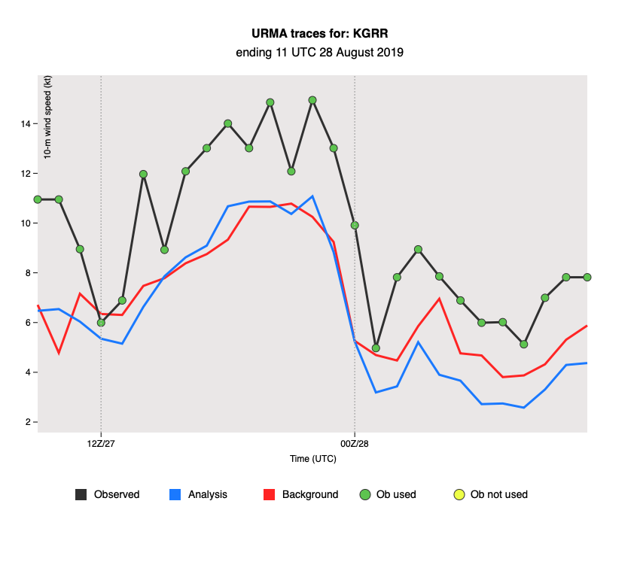
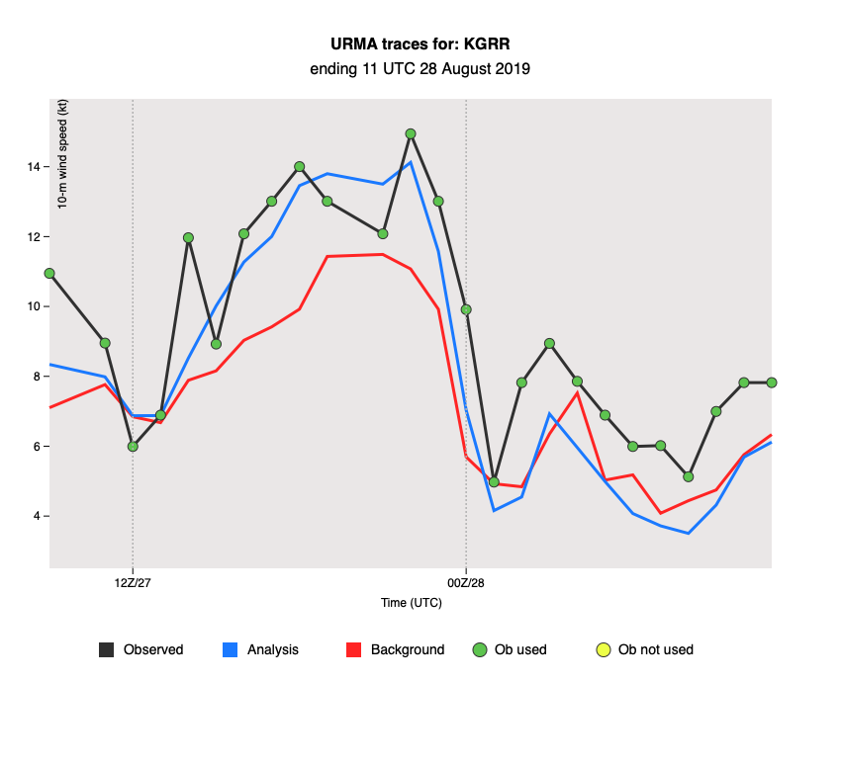
Wind Forward Operator Testing
Background
Analysis
Obs
Grand Rapids, Michigan: Option 1
Ops URMA
Para URMA
10m Wind Speed (kts)
10m Wind Speed (kts)
Test with simple wind profile adjustment
*Not all locations feature this large of an improvement

Slide 12
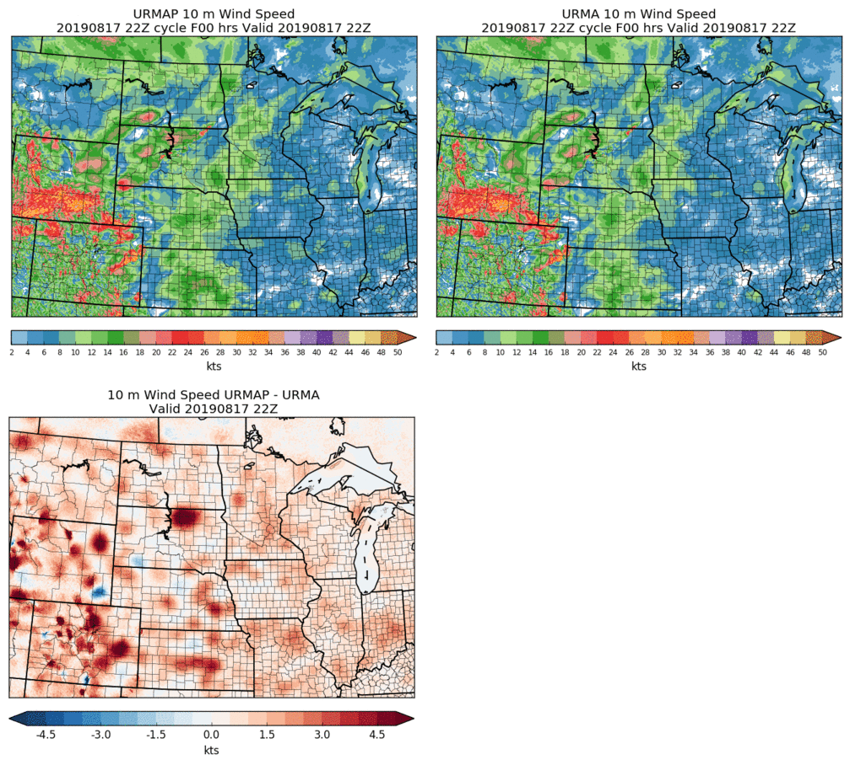
Wind Forward Operator Testing
NEW URMA
(Option 1)
OLD URMA
DIFFERENCE
OLD SYSTEM WINDIER
NEW SYSTEM WINDIER

Slide 13
NOHRSC Snowfall Analysis for URMA
Plan to add NOHRSC 6h/24h snowfall analysis to the precipitation URMA suite (dependent on NOHRSC production status/data sent to NCEP via official ftp-in).
Current parallel run: at 18-19Z each day, unofficially fetch (wget) and process NOHRSC data for current day, $daym1/$daym2/$daym3/$daym5/$daym7. Data mapped from NOHRSC’s g184 to the expanded ConUS grid (WEXP) for NBM. g184 data sent out to AWIPS.
The timing of the run/rerun is subject to change based on NOHRSC and user input.

Slide 14
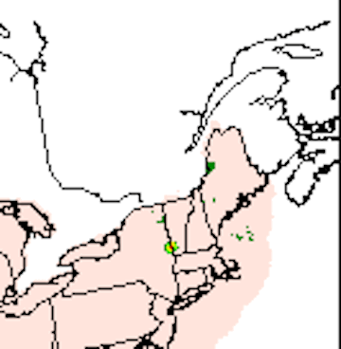
pcpRTMA Source
Current prod uses first run Stage IV supplemented by first run Stage II.
At the time of the pcpRTMA run (33 min past the top of the hour), the RFC QPEs (basis for Stage IV) generally do not yet have the benefit of human oversight/QC:
02Z 17 Dec 2017 (Saturday evening ET): bad gauge included in the first-run RFC QPE/pcpRTMA. NERFC removed the bad gauge within hours and pcpURMA was updated accordingly in the following hour’s rerun. pcpRTMA was only run once (“Real Time”) and the bull’s eye stayed in the RTMA.

Slide 15
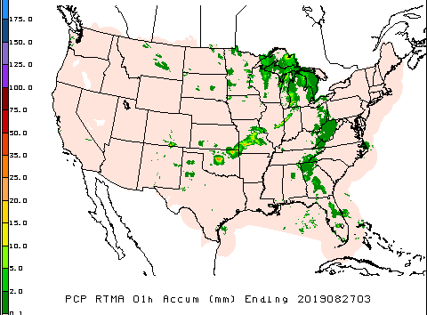
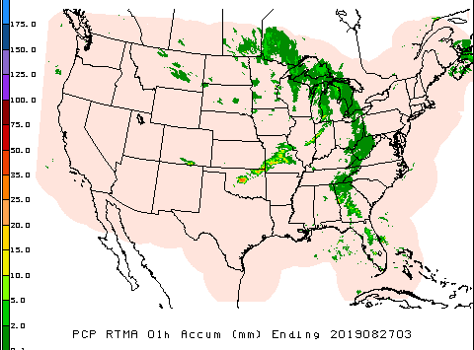
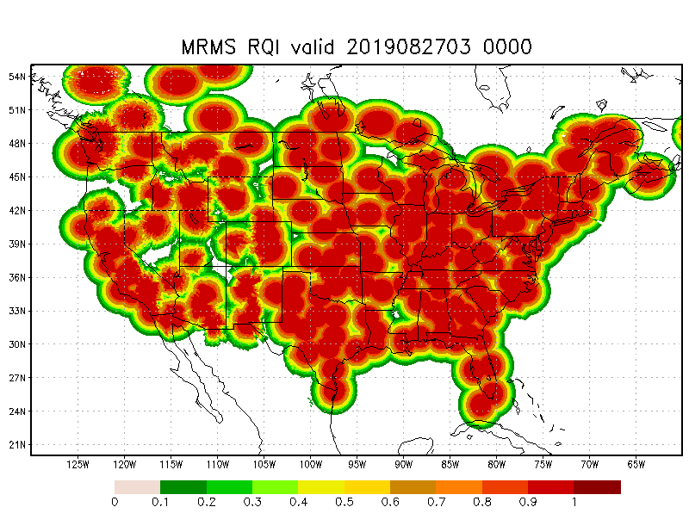
pcpRTMA using MRMS
In v2.8, we plan to use radar-only MRMS QPE (better timing & less affected by data outage than gauge-corrected MRMS QPE). Radar quality index (RQI) added as companion array to each hour’s pcpRTMA array - providing users with info about quality of the QPE.
Prod
v2.8

Slide 16
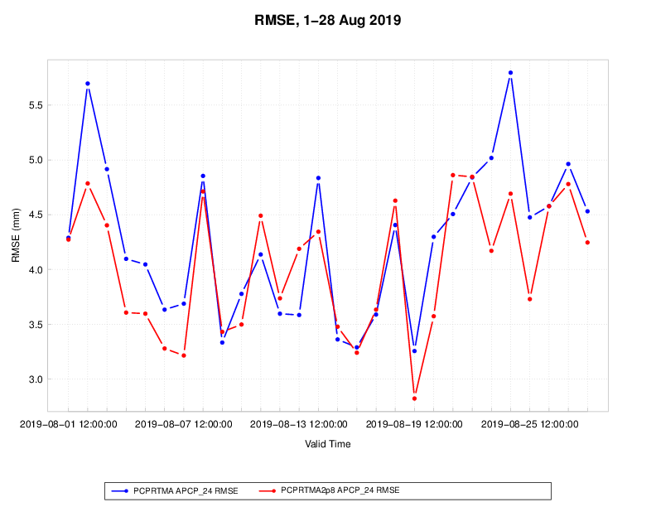
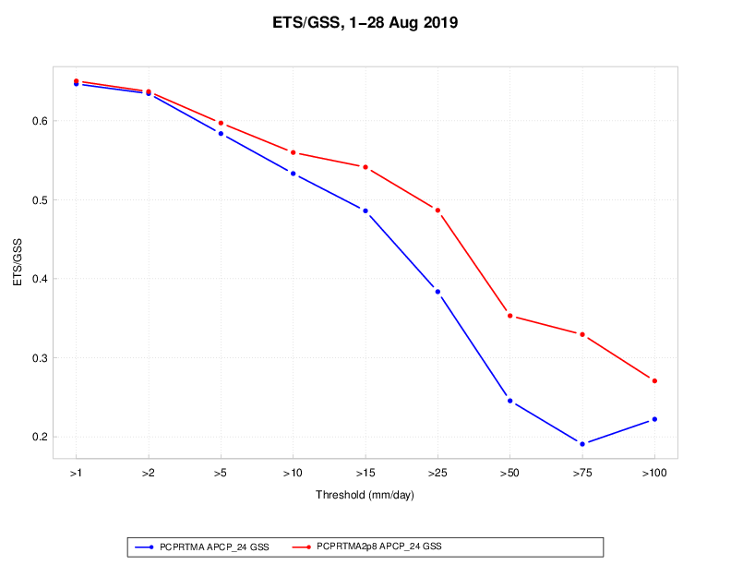
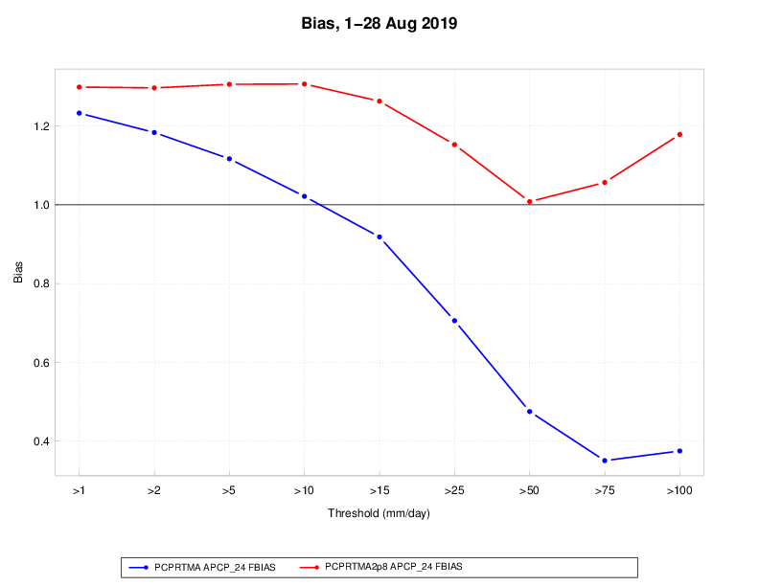
pcpRTMA using MRMS: validation
Prod vs. v2.8 pcpRTMA: validation against daily gauges (1-28 Aug 2019)
Time series of RMSE ETS vs. threshold Bias vs. threshold

Slide 17
Improved Offshore Filling of pcpURMA
The primary source of ConUS pcpURMA is the NCEP Stage IV - mosaicked RFC QPEs, which is limited to RFC domains (largely land-only).
V2.7 introduced offshore filling of ConUS PCPURMA with 1) gauge-corrected MRMS (where RQI ≥ 0.1) and 2) CMORPH. Sometimes there are sharp discontinuities between MRMS and CMORPH; occasionally discontinuities are also seen at the boundary between RFC QPEs and MRMS.
Proposed solution (Yan Luo, Manuel Pondeca): apply Whittaker blending function (used in the production of RTMA background field) for a smoother pcpURMA offshore filling.

Slide 18
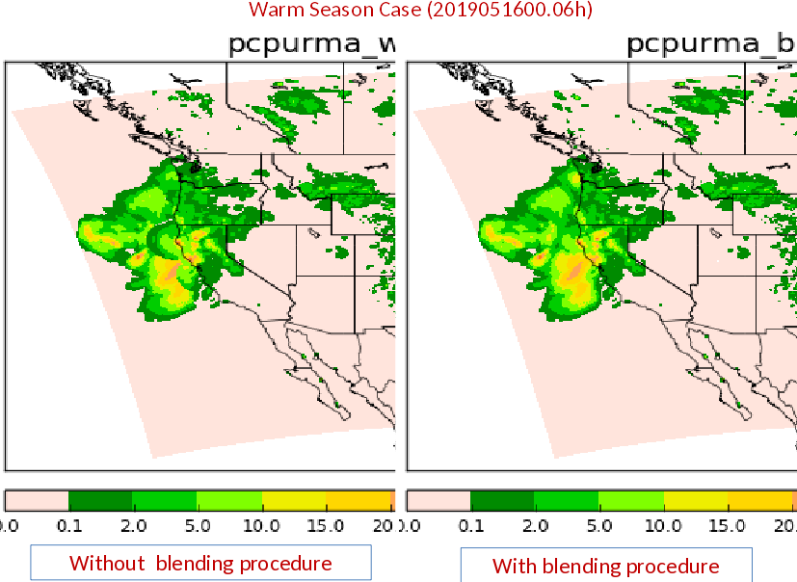
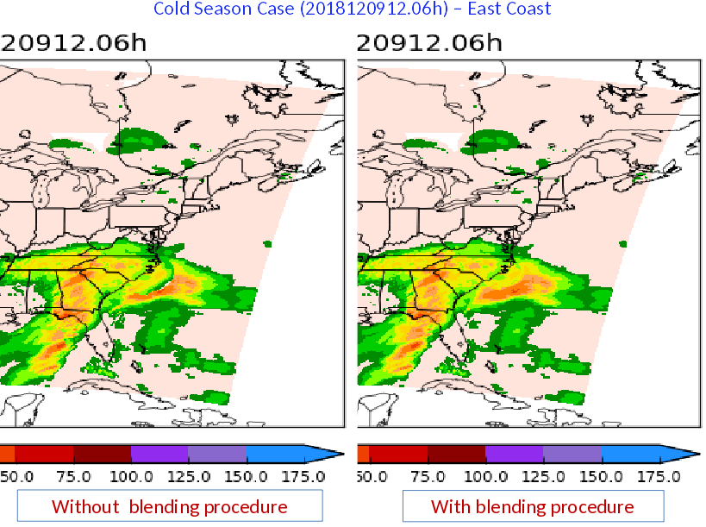
Examples of Blended Offshore PCPURMA
From Yan Luo:

Slide 19
Other Changes to Precip
Stage IV 24h mosaic (for water.weather.gov/precip): add an additional rerun at 30h after valid time (at 18:33Z) to supplement the current 1/2/3/5/7-day rerun schedule for the 24h mosaic, to give RFCs that have a missing QPE or need to update their QPEs a better chance to get their corrected data to water.weather.gov & the public quickly
Removal of Stage II analysis: pcpRTMA no longer dependent on Stage II; MRMS QPEs can now replace the Stage II.
  MRMS v12 planned for Jul-Sep 2020 implementation (Subject to Change), per https://blog.nssl.noaa.gov/mrms/code-updates/

Slide 20
Significant Wave Height Upgrades for 2.8
Preprocessing, downscaling and merging the multi-grid output, of the SWH background:
  By adding the sea land mask, erroneous values from the background have been eliminated,
  The background can be produced by an infinite number of background grids (e.g. for CONUS, waves from 6 grids are merged and using sea/land and ice mask).
Analysis for the Great Lakes is added, based on the GL forecasting system.
Sea/ice mask is applied (CONUS and AK), based on the NCEP operational ice coverage retrieval.
Significant Wave Height analysis is provided for Guam (RTMA).
The spatial resolution of PR was doubled (from 2.5km to 1.25km):
  The system’s parameters were recalibrated,
  PRURMA is the wave analysis system with the highest spatial resolution globally.

Slide 21
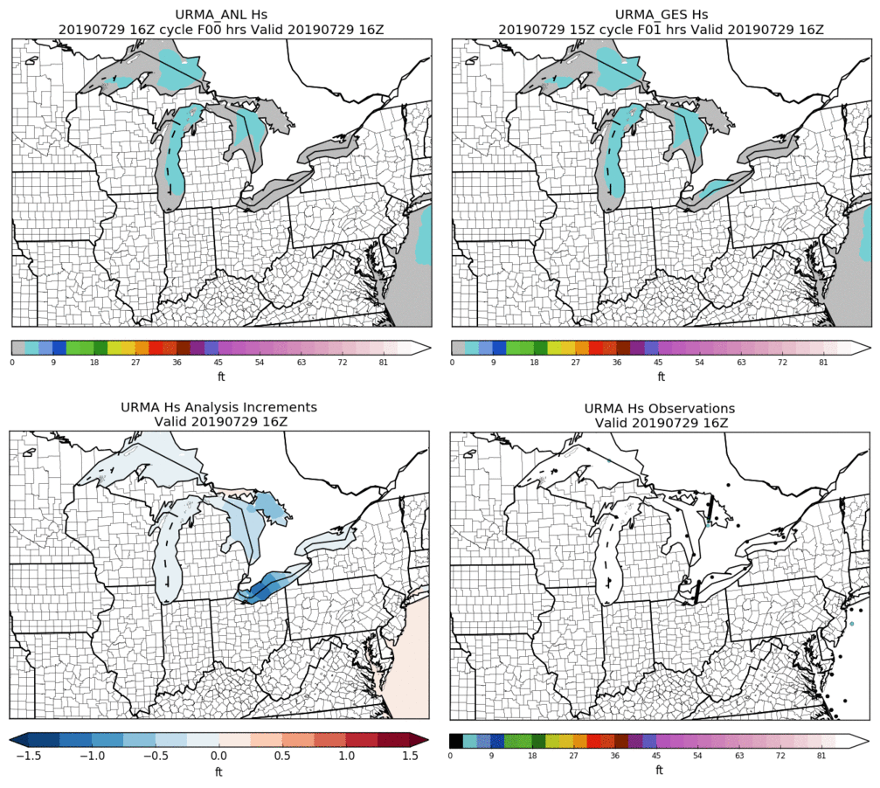
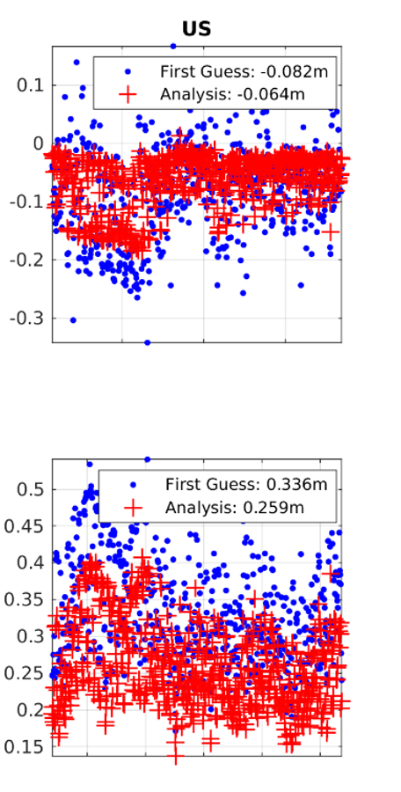
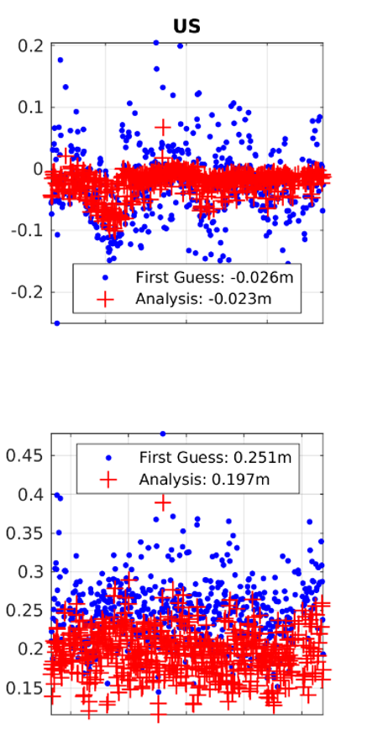
SWH CONUS 2.8
Great Lakes
Overall CONUS Performance
OLD URMA
NEW URMA
Bias (m)
Background preprocessing is the only difference. But there is significant reduction of the RMSE (~40%).
RMSE (m)
July 2019
July 2019
Notes:
At the bottom right panel, satellite observations at two lakes

Slide 22
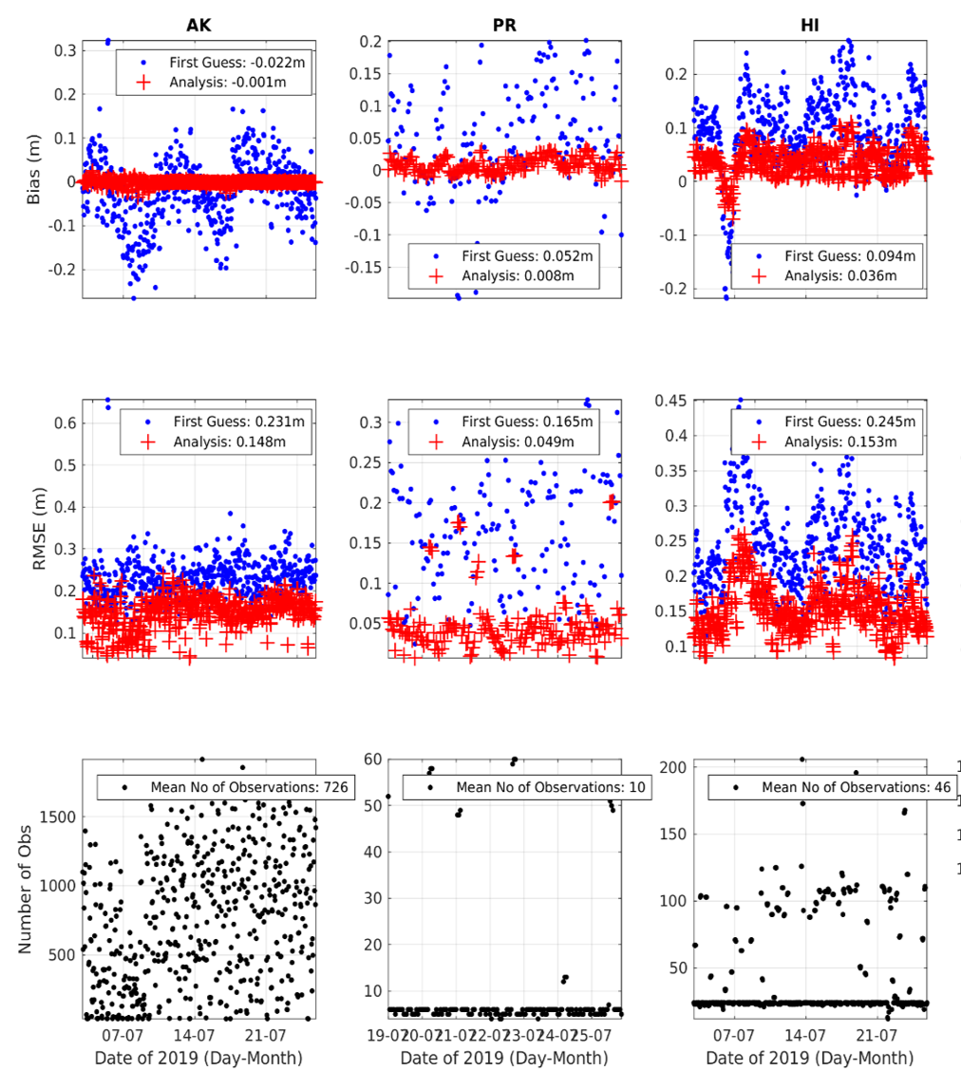
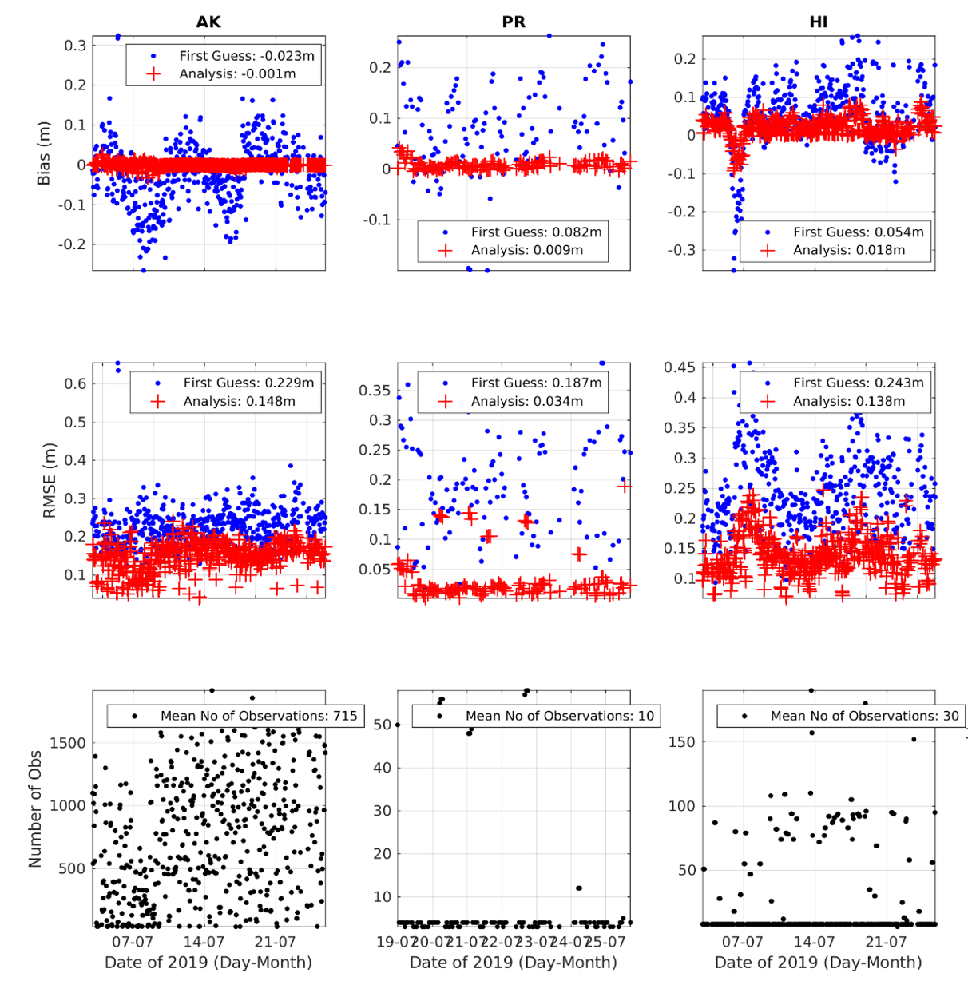
SWH OCONUS 2.8
URMA v2.7
URMA v2.8
Bias (m)
RMSE (m)
The 2.8 upgrades had positive or neutral effect on the analysis of SWH.
# Obs
Notes:
The difference in obs number is due to 1. the different initialization time and 2. Some failed analysis of the 2.8 parallel

Slide 23
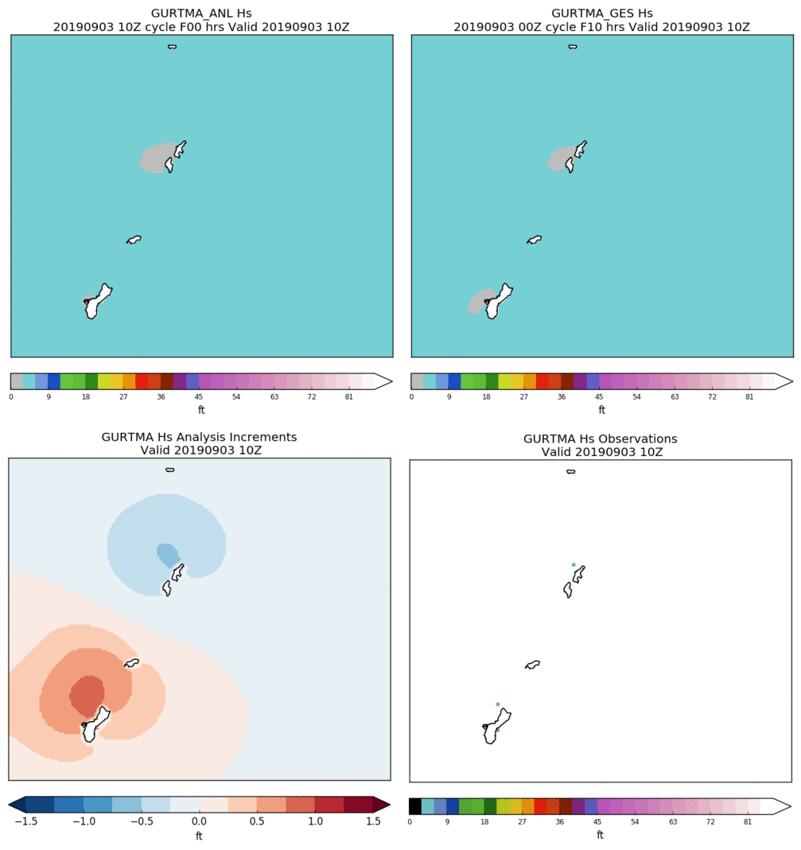
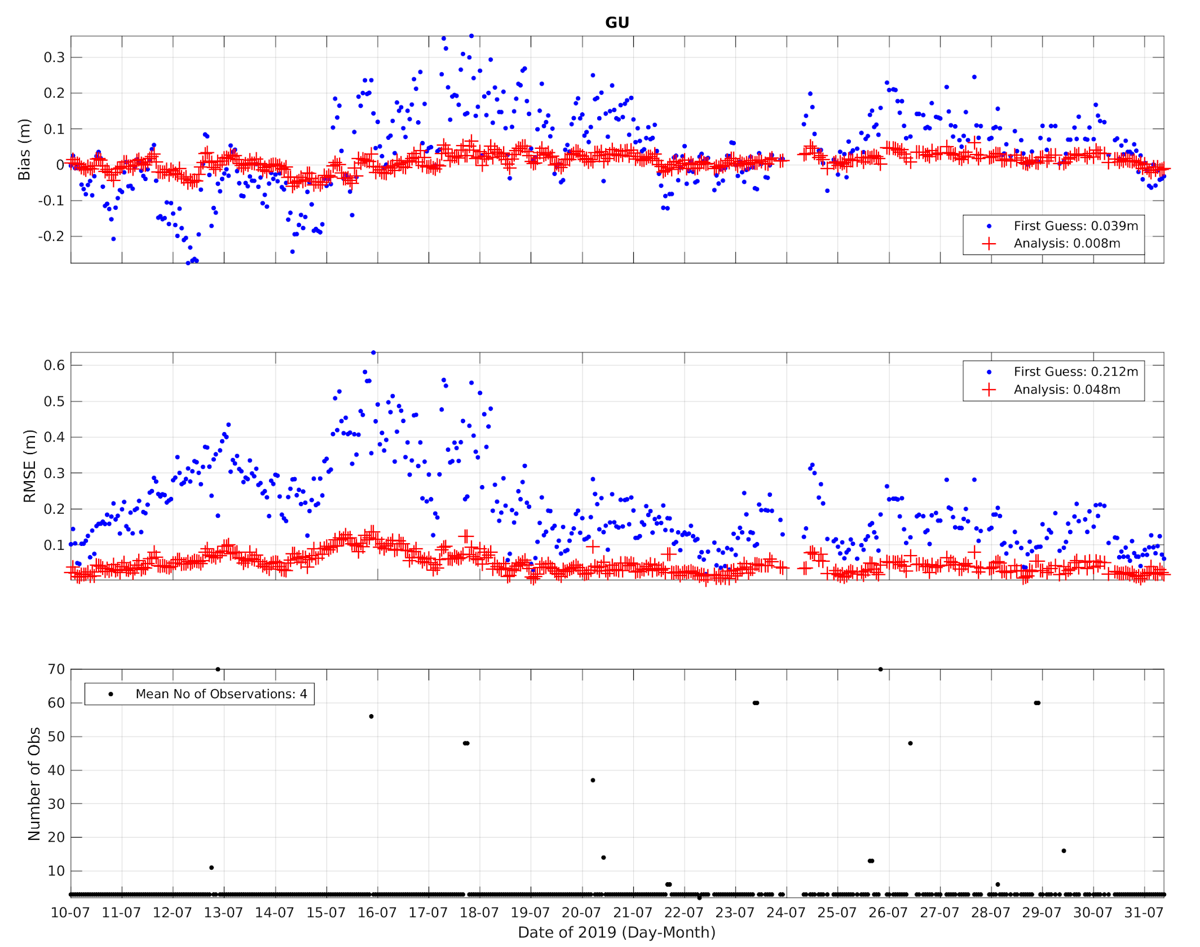
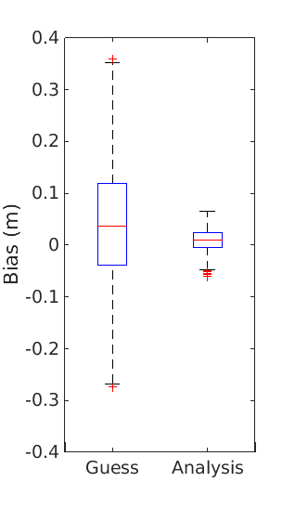
SWH RTMA GUAM
Example
Time series of Bias and RMSE
Synoptic Stats
Limited by the available observations: 3 in-situ and rare satellite crossings (~1/week).

Slide 24
Downscaling updates for v2.8
HRRR Smartinit
  Changed the wind downscaling to be the maximum of the 10-m winds (instead of model level 1 winds) and vertically interpolated winds multiplied by 0.7 (to account for surface friction). This is only done in the portion of the code where the NDFD terrain > model terrain. When NDFD terrain <= model terrain, the 10-m winds are used.
RAP Smartinit
  Used land sea mask for coastline adjustment instead of vegetation type.
NAM, HiresW Guam and RAP Smartinit
  Added new temperature and dew point temperature downscaling.
    If NDFD terrain != model terrain
    Use the local lapse rate (constrained between dry adiabatic and isothermal) to adjust the temperature.
    Use original dew point depression with the new downscaled temperature to obtain the downscaled dew point temperature.
NAM and RAP Smartinit
  Changed Puerto Rico grid from 2.5 km to 1.25 km.

Slide 25
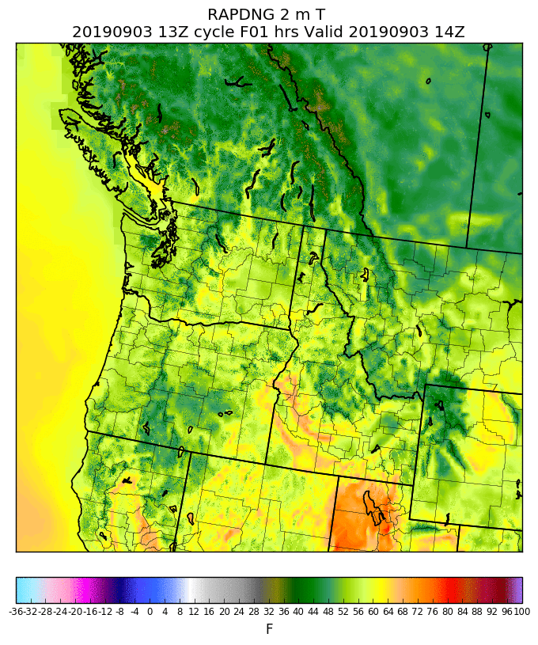
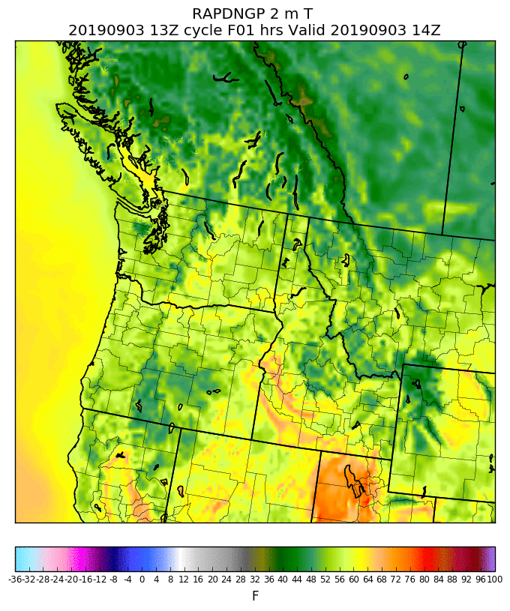
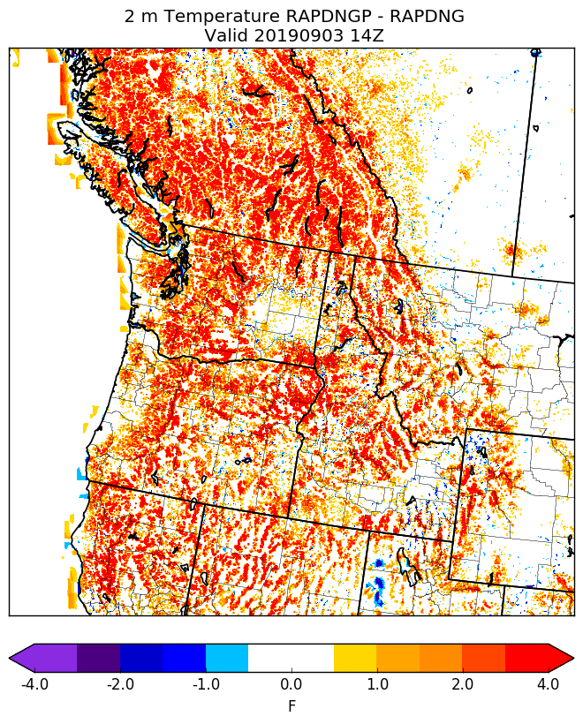
Example: Using land sea mask for coastline adjustment in RAP Smartinit
Production
Using vegetation type for coastline adjustment
Parallel
Using land sea mask for coastline adjustment
Parallel - Production
(differences over land are due to new T downscaling)

Slide 26
Dew Point Analysis Updates
First noticed by WFO Glasgow, MT
Operational Dew Point Analysis Procedure:
  Specific humidity and pressure analysis (background) is used to derive the analysis (background) dew point temperature
  The “analysis minus background” (increment[s]) between the computed Td fields is smoothed via a “1-2-1” filter and added to the downscaled dew point temperature to generate the final analysis
The smoothing via the “1-2-1” filter has been turned off in the parallel to mitigate a moist bias seen in regions of complex terrain

Slide 27
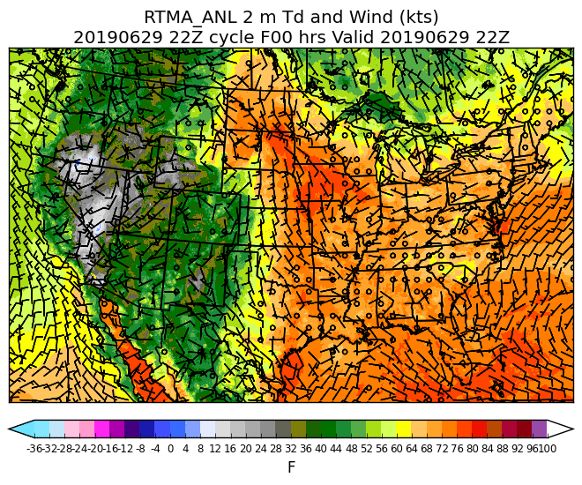

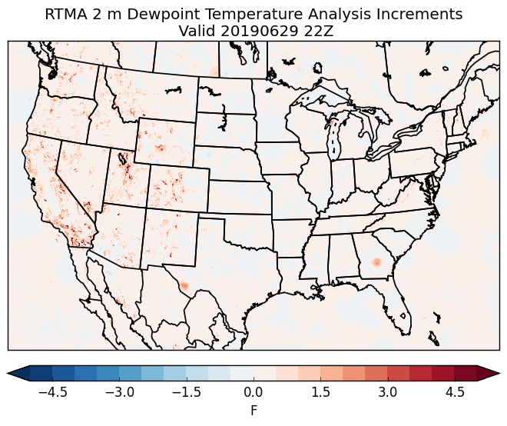
Example: Dew Point Updates
Operational Analysis
Retrospective (No smoothing) Analysis
Operational - Retrospective
22Z on 29 June 2019

Slide 28
Ceiling and Sky Cover Updates for v2.8
Ceiling is cleared (i.e., set to maximum ceiling value) when the analyzed sky cover is < 50%
  Ensuring product consistency
Reject GOES Imager sky cover observations when:
  The observation is < 30% and over water; and
  Solar zenith angle is > 80° (i.e., late evening, overnight, or early morning)
  Based upon feedback and consultation with GOES product developer
Reduced thinning of GOES sky cover observations (by half) and tripled the decorrelation length to address feedback of a “splotchy” sky cover analysis
Add sky cover analysis to RTMA-RU
  Updates every 15 minutes, previously updates every hour

Slide 29
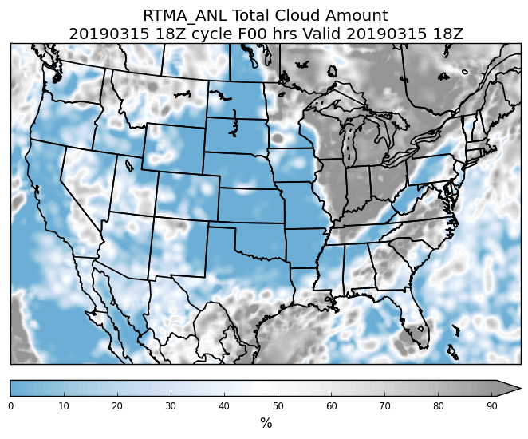
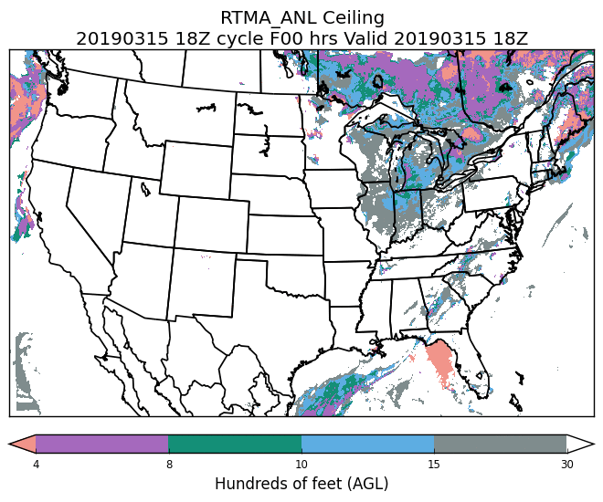
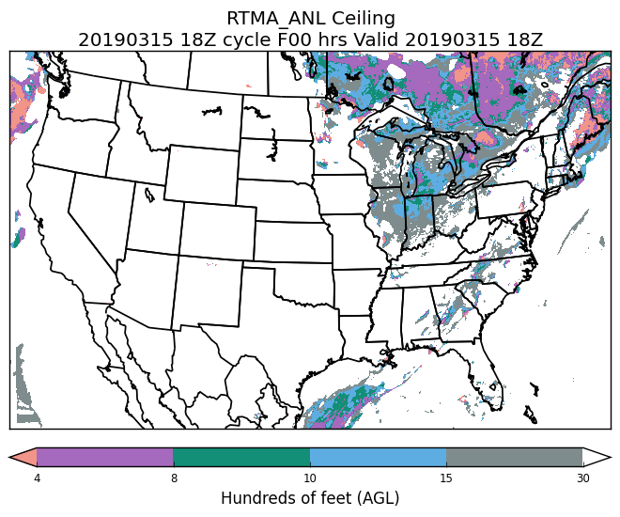
Example: Ceiling clearing
Sky Cover
Original Ceiling
Modified Ceiling
18Z on 15 March 2019

Slide 30
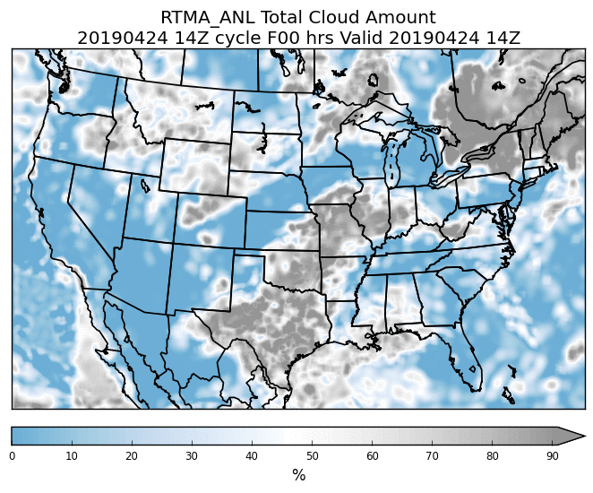
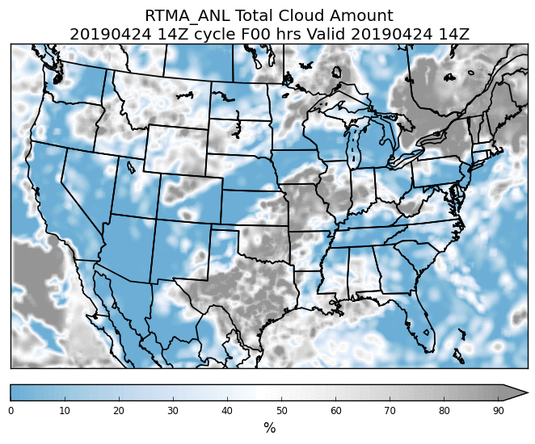
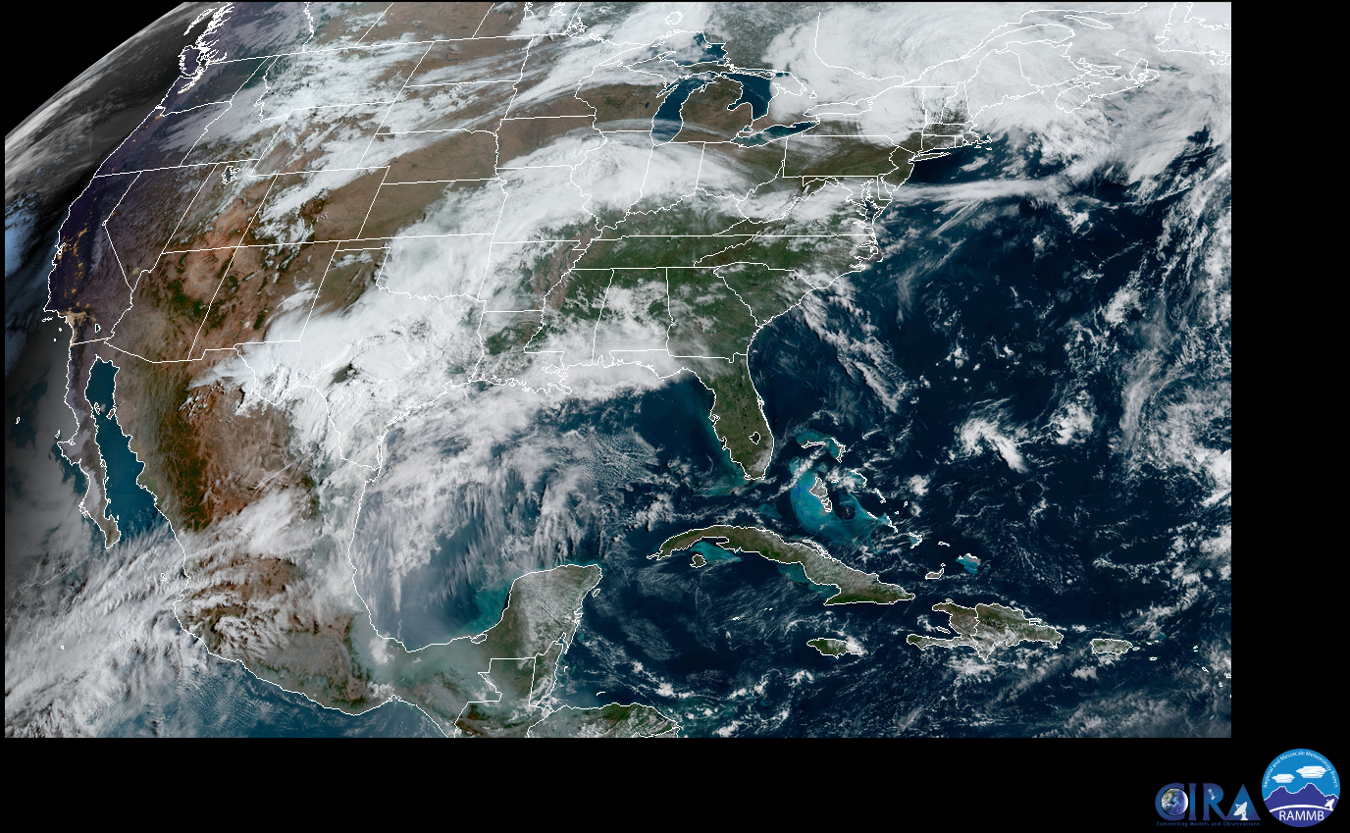
Example: Sky Cover QC
Original Sky Cover
Modified Sky Cover (QC)
VIS
14Z on 24 April 2019

Slide 31
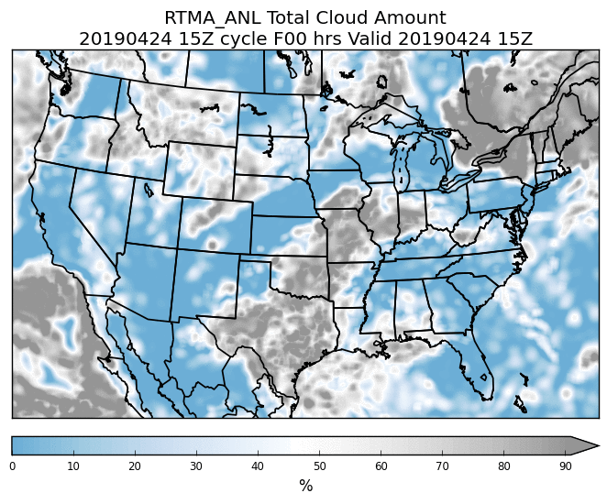

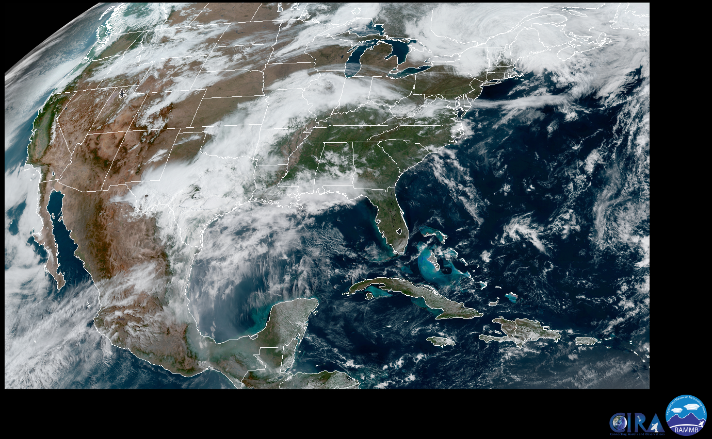
Example: Sky Cover QC
Original Sky Cover
Modified Sky Cover (QC)
VIS
15Z on 24 April 2019

Slide 32
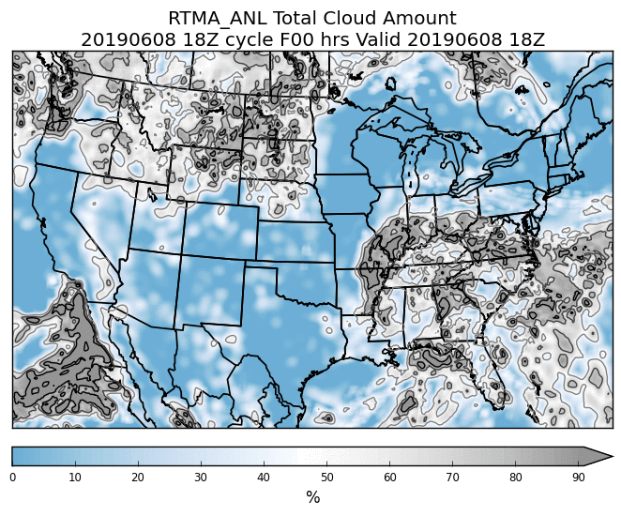
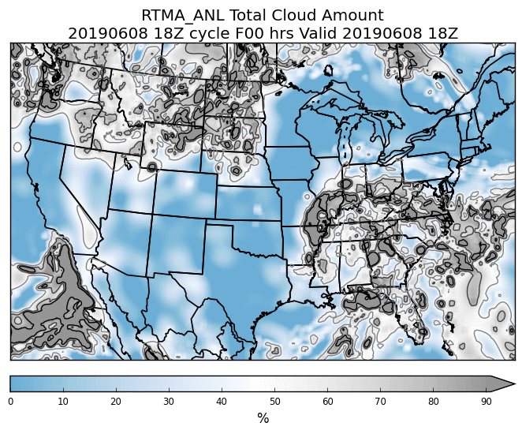
Example: Sky Cover Tuning
Current Configuration
Reduce thinning (by 50%) and triple decorrelation length
18Z on 6 June 2019

Slide 33
Evaluation Procedures
EMC Website
  Pre-selected zoom’s, compare both systems side-by-side, time series plots for specific obs
Veritas/NBM viewer
  Click on “Daily Analysis Review”
  Custom zoom, view systems side by side
WAVE viewer
Pull grids yourself off FTP server
  Address forthcoming

Slide 34
Evaluation Statistics
New statistics package has been developed
Compare analysis values against METAR observations only
  Includes all variations (ASOS, AWOS, etc.)
Time series stats include bias, RMSE
Boxplots show relative bias of the analysis
  Includes interquartile range of analysis/ob differences in a box, then outliers as points
We will generate these for most variables
Examples follow (illustrative → not yet reflection of final configuration)

Slide 35
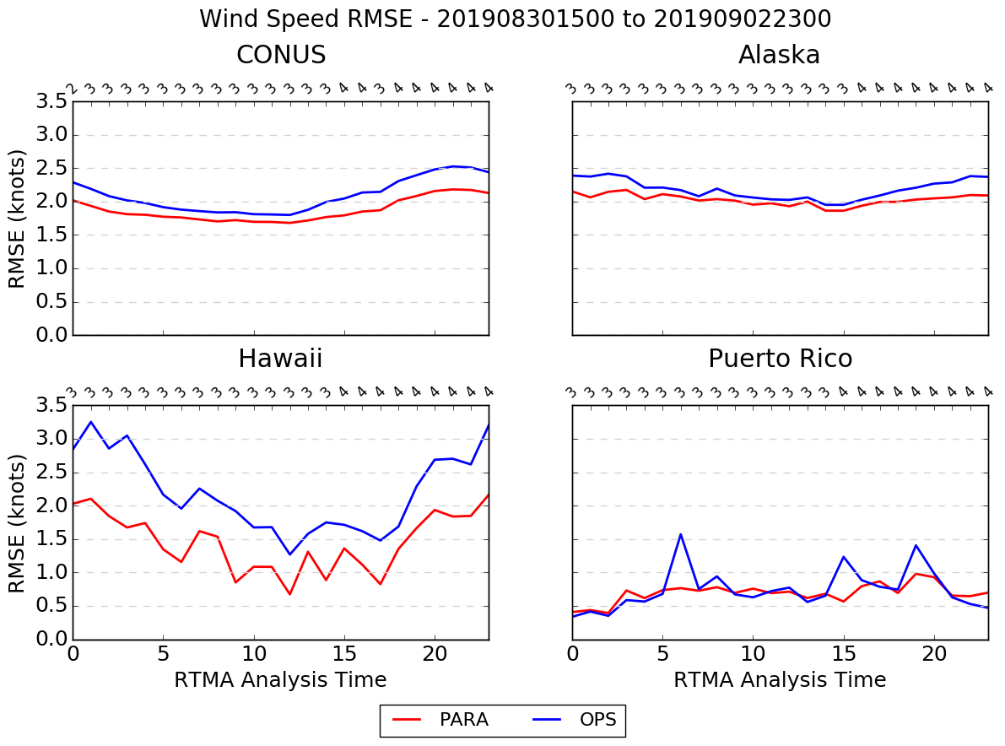
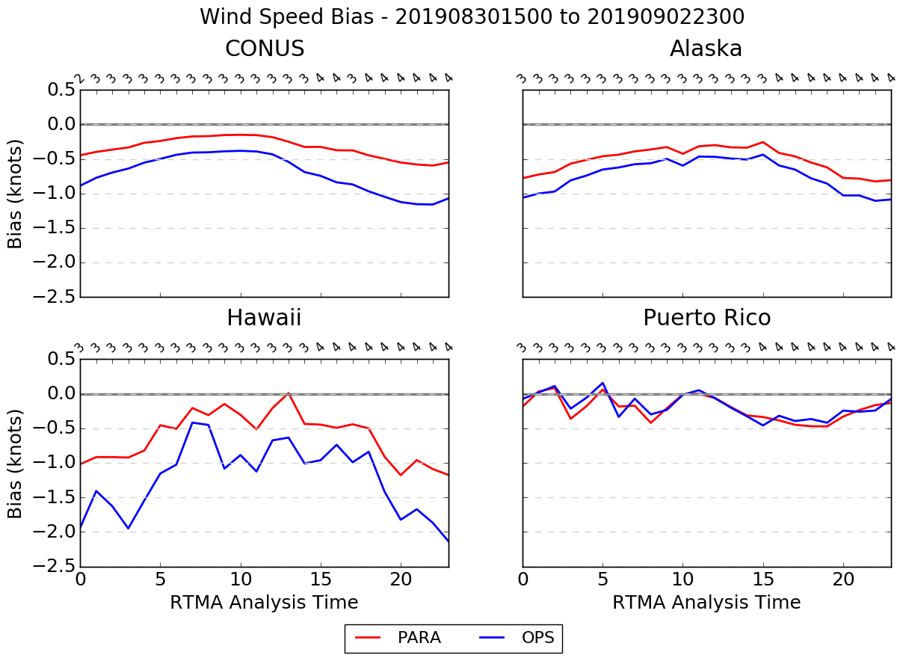
Wind Speed Time Series
RMSE
Bias

Slide 36
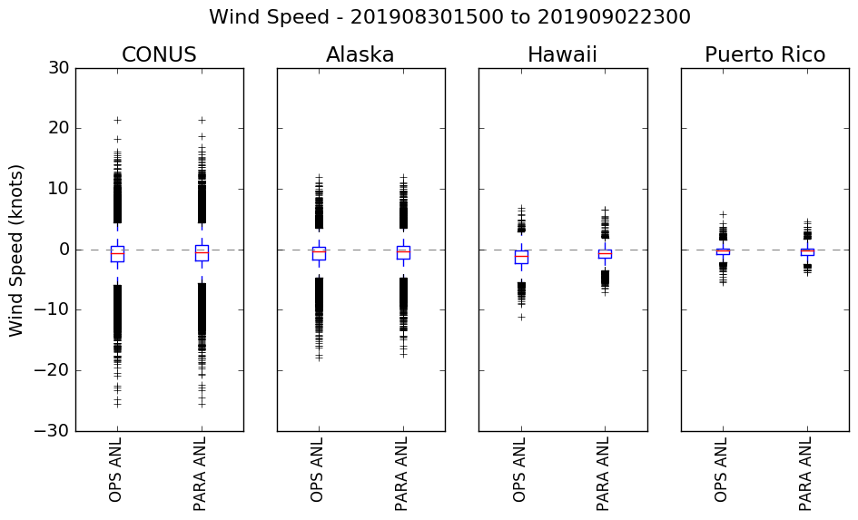
Wind Speed Boxplot

Slide 37
V2.8 RTMA/URMA/RTMA-RU Timeline
NCO begins 30 day IT test
End Eval
11/1
01/2020
~09/16
12/1
03/2020
Begin Eval
OD Brief and code hand off to NCO
(Approx.)
Implementation
[Q2FY20]

