Slide 1
RTMA/URMA v2.8 Upgrade Overview
MEG Talk: October 24, 2019

Slide 2
About RTMA/URMA Generally
Bias correction source for National Blend of Models
Many (most) NBM problems can now be traced back to URMA
2D variational data assimilation system
First guess from HRRR/RAP forecast after a downscaling process
Observation include: METAR, buoy, mesonet, winds/wave heights retrieved from satellite data.
A forecast error covariance model is applied, with consideration of topographical impact.
An ob’s influence is generally a function of nearby terrain or land/water boundary
Maximum radius of influence, for most variables, is 80 km (flat area or over water)
Impact from nearby observations can overlap with each other
Precipitation analysis is called RTMA and URMA, but is a separate system
Mostly consists of a blend of other precip datasets
RTMA = Real Time, URMA = 6 hours later, but the code is (mostly) the same
For more basic info, see our COMET documentation and VLab community page

Slide 3
Outline
Timeline
Wind changes
Lower wind speed bias due to similarity theory adjustment for mesonet obs
Significant Wave Height changes
Downscaling/background changes
HRRR downscaling changes will also show up in AWIPS HRRR output
Cloud Cover Improvements
QC enhancement to remove satellite data at dawn/duck
Finer grid over Puerto Rico (2.5 → 1.25 km)
Precip changes
Evaluation Procedures (websites, links, etc.)
New stats we are running at EMC

Slide 4
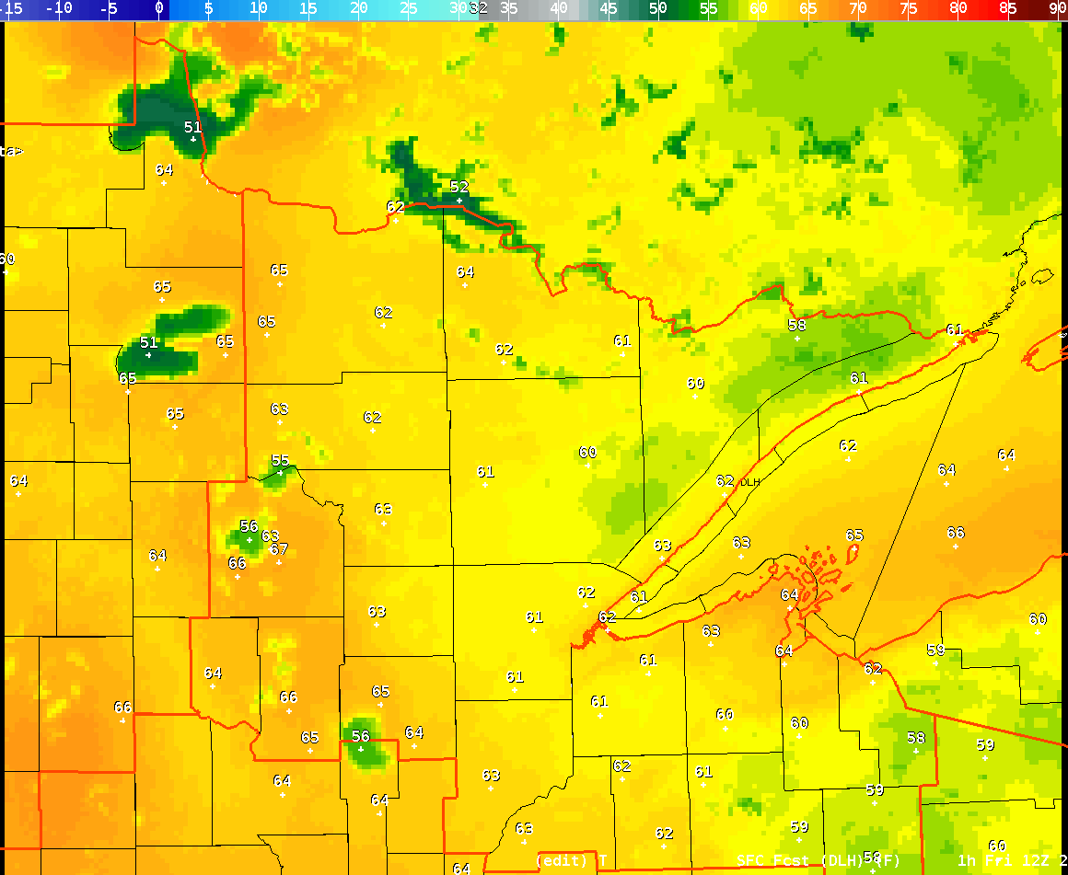
NOT Included Here: New RAP/HRRR
Our science evaluation does NOT include the RAP/HRRR upgrades presented here (earlier MEG meeting)
Fields aren’t available to us yet
RTMA/URMA will be implemented before RAP/HRRR
We will likely run another parallel, at some point, when CONUS RAP/HRRR fields are available
Largest improvement in new RAP/HRRR: improved inland lake temperatures
Water temperature have been too cold before
New SST algorithm in HRRR

Slide 5
Timeline for Next Upgrade
Formal Evaluation Period: October 23-November 22
Data available via para-NOMADS (look for “2dvaranl” files)
Let system run, maybe make minor tweaks, collect feedback as necessary
Generate verification stats over this period
Running on prod machine (yay!) but not under NCO 24-hour monitoring
Gather feedback, present summary to EMC mgmt/NCEP Director: mid Dec
If management approves, code will be ‘handed off’ to central operations in early December
Code is ‘locked down’ at this point
Exact timing depends on end of WCOSS moratorium (transition to Dell)
NCO builds and tests operational system - December-February
Evaluation system would continue to run
Final IT test (30 days) is run by NCO, likely over March
Dataflow aspects, testing with AWIPS, etc.
Implementation goal: late March, 2020

Slide 6
V2.8 RTMA/URMA/RTMA-RU Timeline
NCO begins 30 day IT test
End Eval
11/22
02/2020
10/23
12/17
03/2020
Begin Eval
OD Brief and code hand off to NCO
(Approx.)
Implementation
[Q2FY20]

Slide 7
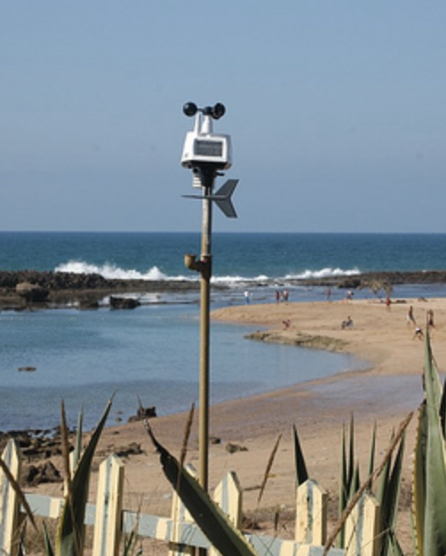
Wind Changes: Sensor Height
Up to now, it has been assumed that all wind obs are taken at 10 m AGL
We know from looking at station photos that this is not true
For mesonets: wind sensor height will now be a function of provider
Providers and subproviders are set and provided by MADIS
Current list of providers/heights
CWOP and AWS/Weatherbug assumed at 3 m now
Contact us if you have additional information
List gets ‘frozen’ when we hand this off (November)
Ob will be compared against background adjusted to same height as ob
Analysis is computed based on observation/background difference
Similar adjustments made to gust analysis
Station photo from weather.gladstonefamily.net

Slide 8
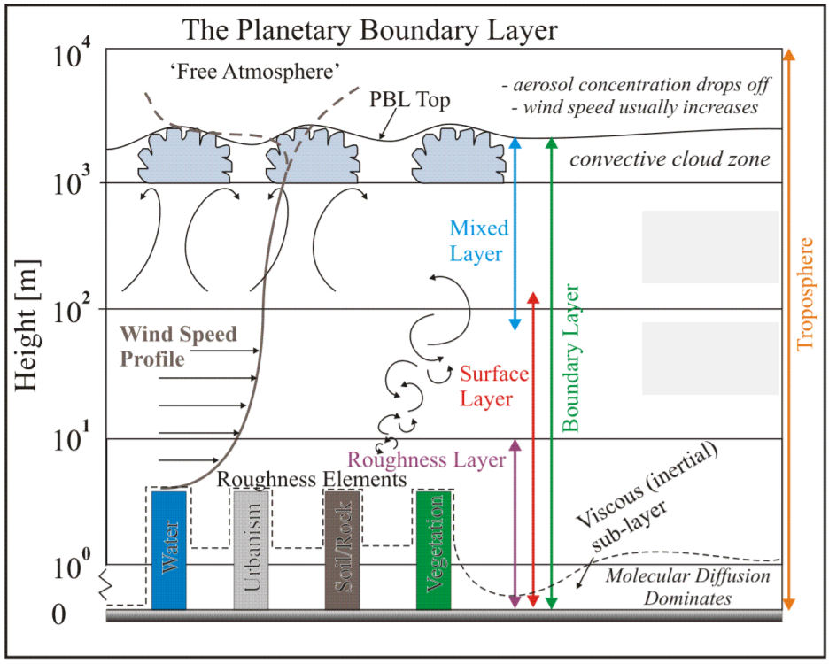
Wind Adjustment Procedure
Inputs
Lowest two sigma levels of background model
Background skin temperature
Land/sea mask value
Similarity Theory Adjustment
Same logic as used in MM5 Land Surface Model
10 m wind factor is calculated based on local lapse rate
Background winds are then multiplied by this factor
‘Adjusted’ background is then compared to observation to generate innovation and increment
Generally speaking, this should result in higher wind speeds in the analysis
Closer to METAR observed wind speed (we hope)
Many mesonet wind obs will still not be used at all; more may need to be flagged (info here)
If background under forecasts wind speed, analysis winds will still be too light.

Slide 9
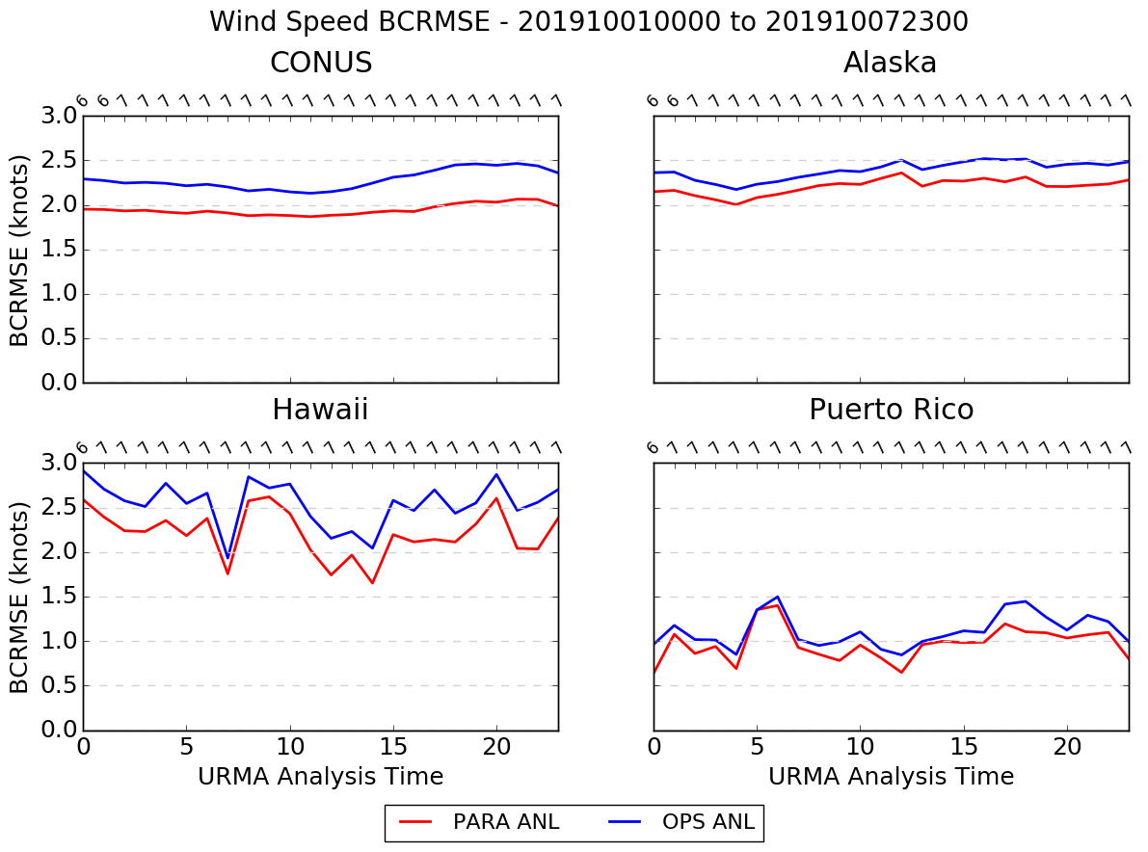
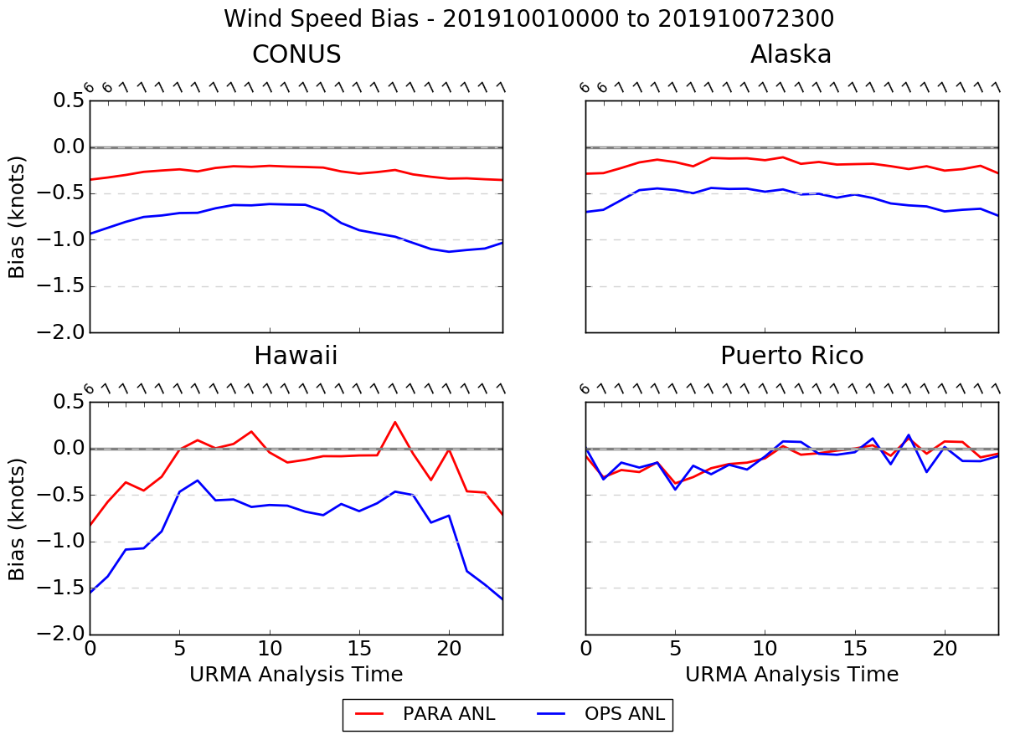
Wind Speed Time Series - Analysis
OLD SYSTEM NEW SYSTEM
BCRMSE
Bias

Slide 10
Significant Wave Height Upgrades for 2.8
Preprocessing, downscaling and merging the multi-grid output, of the SWH background:
By adding the sea land mask, erroneous values from the background have been eliminated,
The background can be produced by an infinite number of background grids (e.g. for CONUS, waves from 6 grids are merged and using sea/land and ice mask).
Analysis for the Great Lakes is added, based on the GL forecasting system.
Sea/ice mask is applied (CONUS and AK), based on the NCEP operational ice coverage retrieval.
Significant Wave Height analysis is provided for Guam (RTMA).
The spatial resolution of PR was doubled (from 2.5km to 1.25km):
The system’s parameters were recalibrated
PR URMA is the wave analysis system with the highest spatial resolution globally.

Slide 11
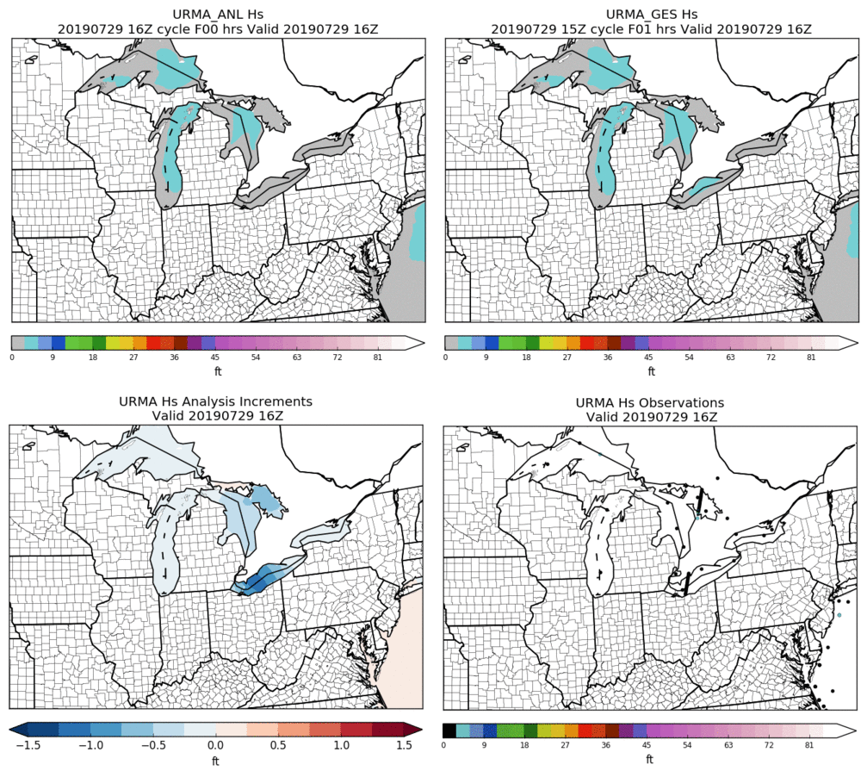
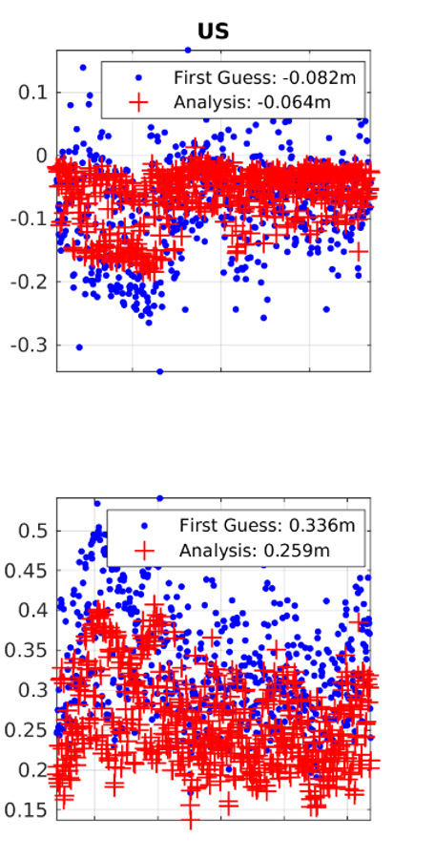
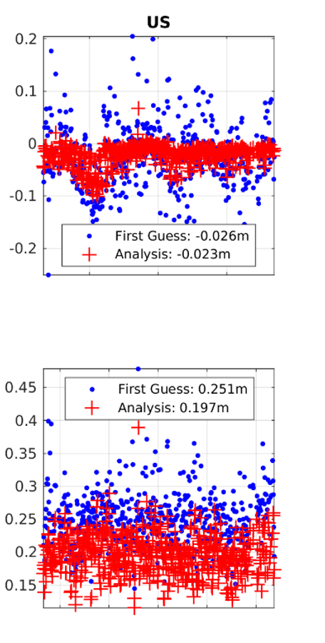
SWH CONUS 2.8
Great Lakes
Overall CONUS Performance
OLD URMA
NEW URMA
Bias (m)
Background preprocessing is the only difference. But there is significant reduction of the RMSE (~40%).
RMSE (m)
July 2019
July 2019
Notes:
At the bottom right panel, satellite observations at two lakes

Slide 12
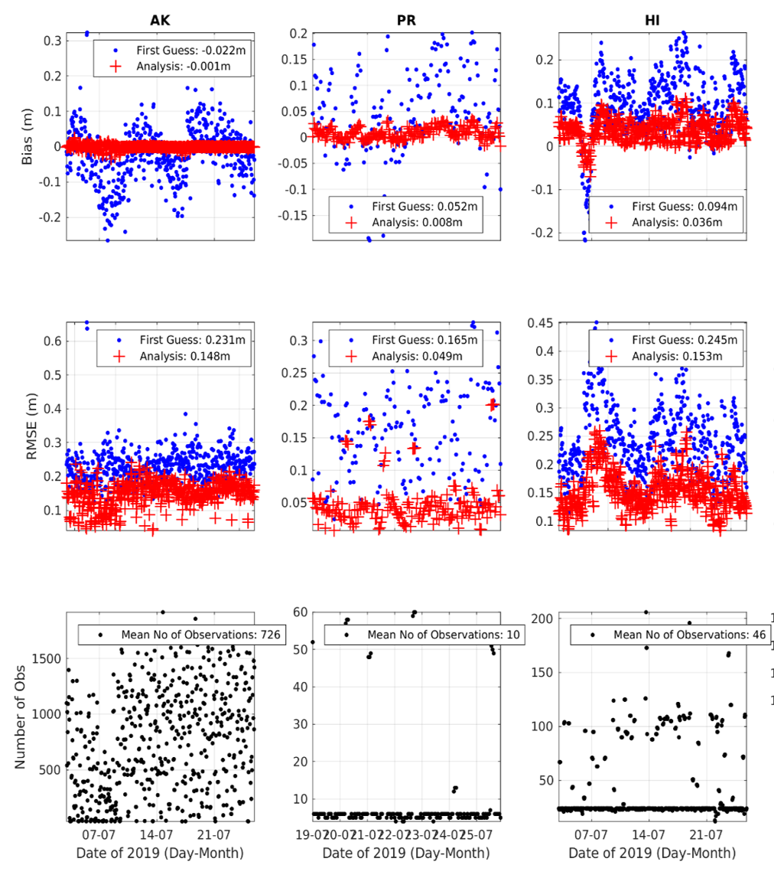
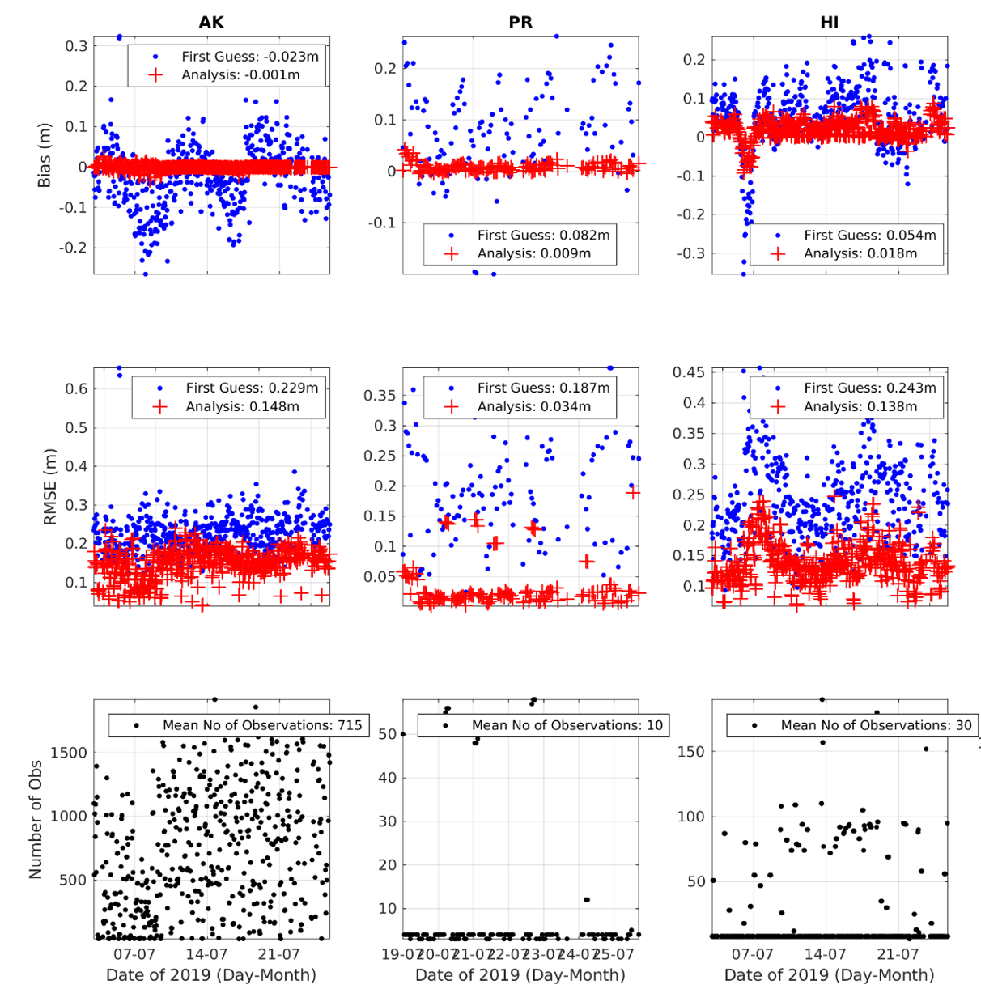
SWH OCONUS 2.8
URMA v2.7
URMA v2.8
Bias (m)
RMSE (m)
The 2.8 upgrades had positive or neutral effect on the analysis of SWH.
# Obs
Notes:
The difference in obs number is due to 1. the different initialization time and 2. Some failed analysis of the 2.8 parallel

Slide 13
Downscaling updates for v2.8
HRRR Smartinit
Changed the wind downscaling to be the maximum of the 10-m winds (instead of model level 1 winds) and vertically interpolated winds multiplied by 0.7 (to account for surface friction). This is only done in the portion of the code where the NDFD terrain > model terrain. When NDFD terrain <= model terrain, the 10-m winds are used.
RAP Smartinit
Used land sea mask for coastline adjustment instead of vegetation type.
NAM, HiresW Guam and RAP Smartinit
Added new temperature and dew point temperature downscaling.
If NDFD terrain != model terrain
Use the local lapse rate (constrained between dry adiabatic and isothermal) to adjust the temperature.
Use original dew point depression with the new downscaled temperature to obtain the downscaled dew point temperature.
NAM and RAP Smartinit
Changed Puerto Rico grid from 2.5 km to 1.25 km.

Slide 14
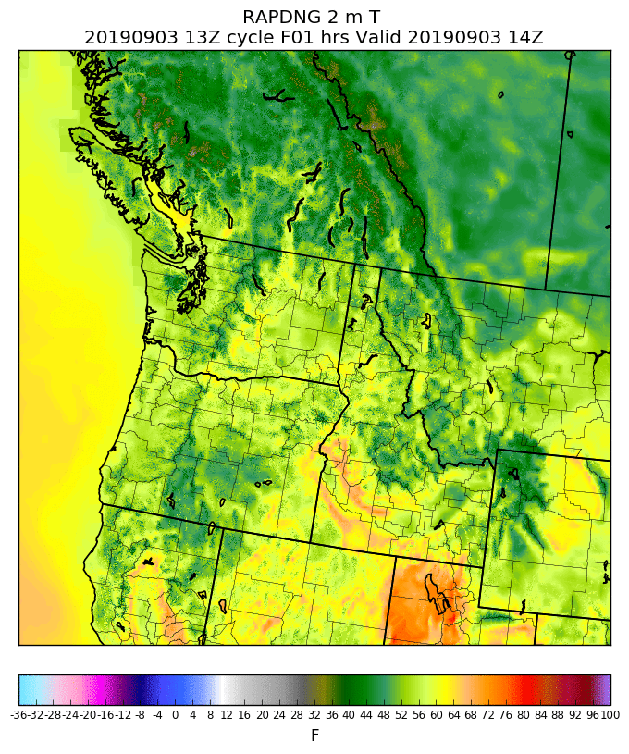
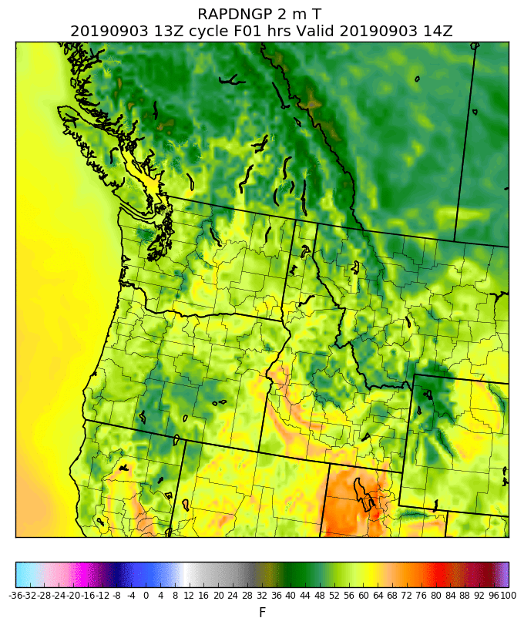
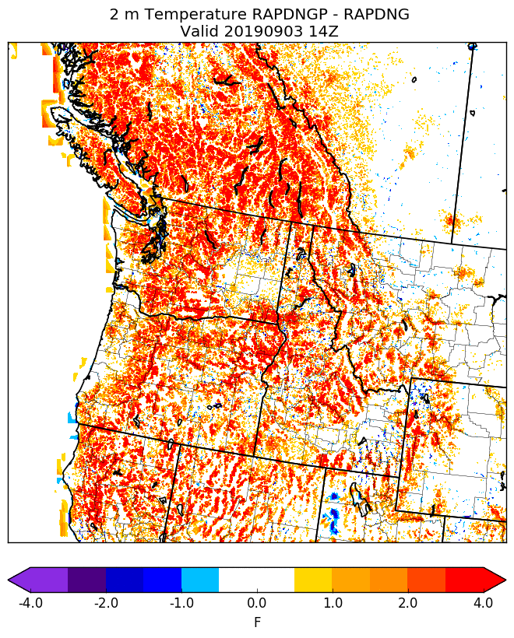
Example: Using land sea mask for coastline adjustment in RAP Smartinit
Production
Using vegetation type for coastline adjustment
Parallel
Using land sea mask for coastline adjustment
Parallel - Production
(differences over land are due to new T downscaling)

Slide 15
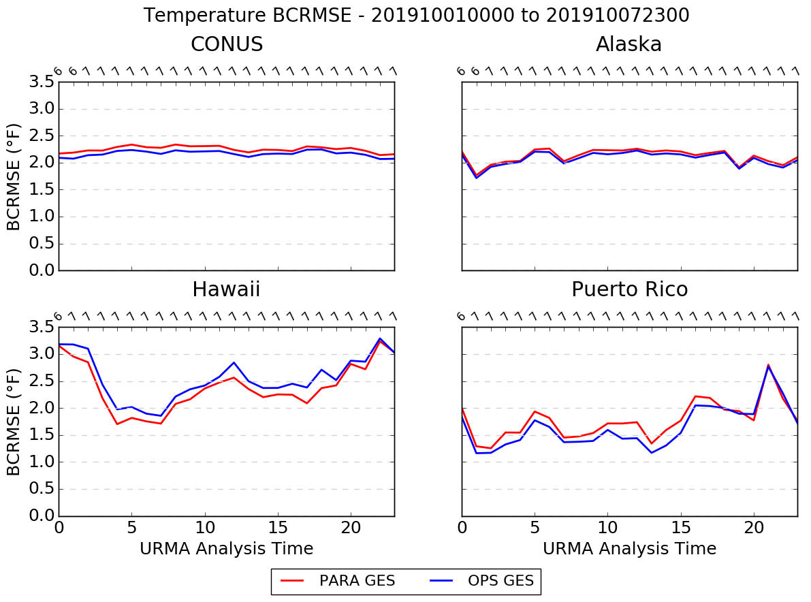
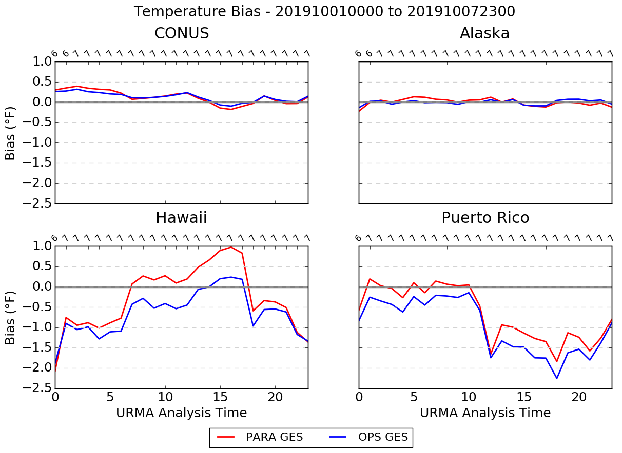
Temperature Time Series - Background
OLD SYSTEM NEW SYSTEM
BCRMSE
Bias

Slide 16
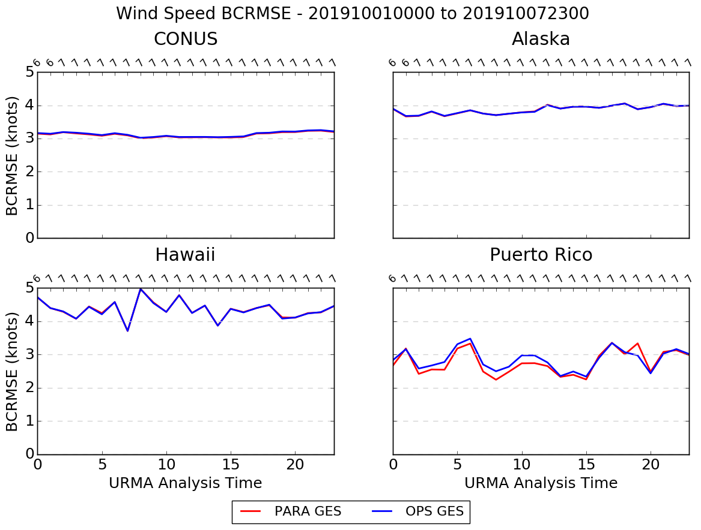
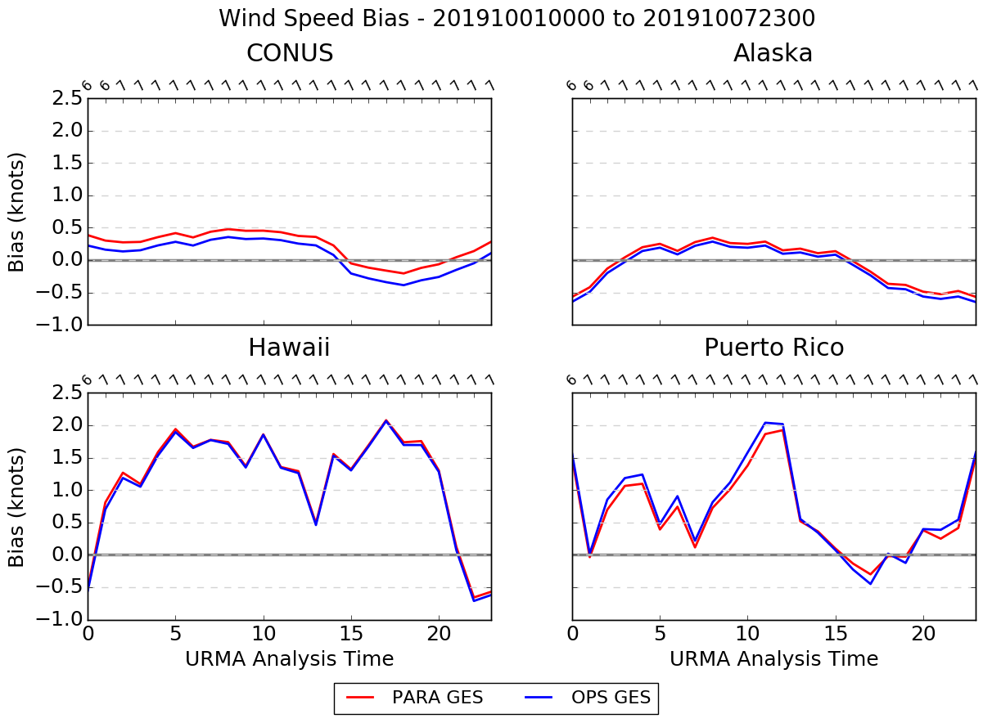
Wind Speed Time Series - Background
OLD SYSTEM NEW SYSTEM
BCRMSE
Bias

Slide 17
Dew Point Analysis Updates
First noticed by WFO Glasgow, MT
Operational Dew Point Analysis Procedure:
Specific humidity and pressure analysis (background) is used to derive the analysis (background) dew point temperature
The “analysis minus background” (increment[s]) between the computed Td fields is smoothed via a “1-2-1” filter and added to the downscaled dew point temperature to generate the final analysis
The smoothing via the “1-2-1” filter has been turned off in the parallel to mitigate a moist bias seen in regions of complex terrain

Slide 18
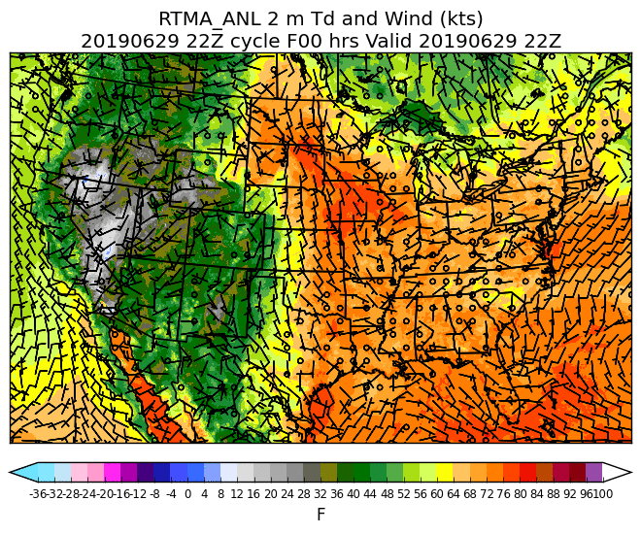
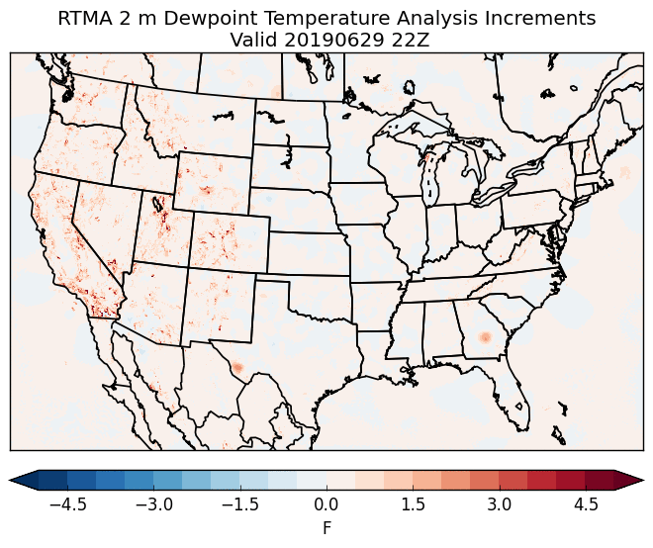
Example: Dew Point Updates
Operational Analysis
Retrospective (No smoothing) Analysis
Operational - Retrospective
22Z on 29 June 2019

Slide 19
Ceiling and Sky Cover Updates for v2.8
Ceiling is cleared (i.e., set to maximum ceiling value) when the analyzed sky cover is < 50%
Ensuring product consistency
Reject GOES Imager sky cover observations when:
The observation is < 30% and over water; and
Solar zenith angle is > 80° (i.e., late evening, overnight, or early morning)
Based upon feedback and consultation with GOES product developer
Reduced thinning of GOES sky cover observations (by half) and tripled the decorrelation length to address feedback of a “splotchy” sky cover analysis
Add sky cover analysis to RTMA-RU
Updates every 15 minutes, previously updates every hour

Slide 20
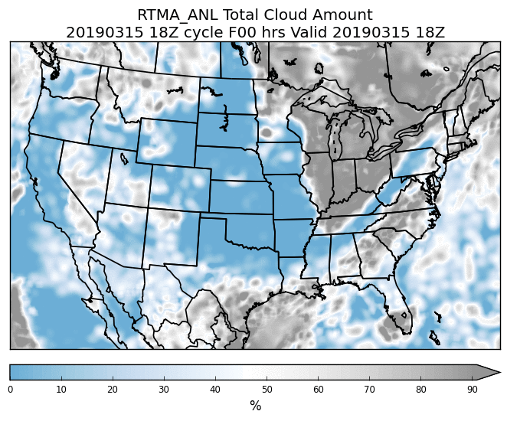
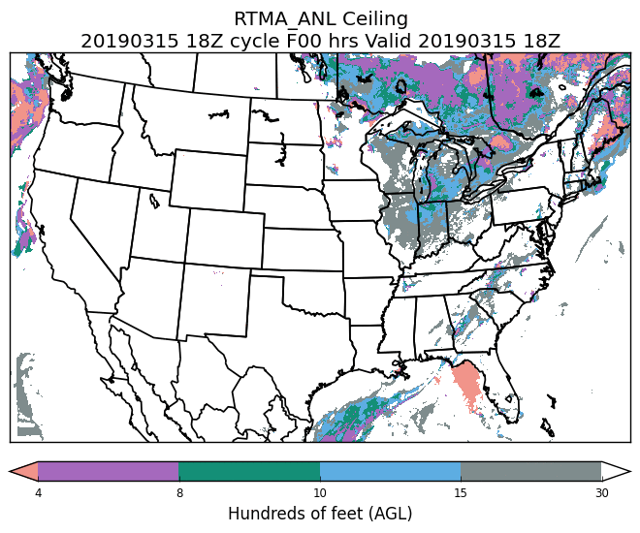
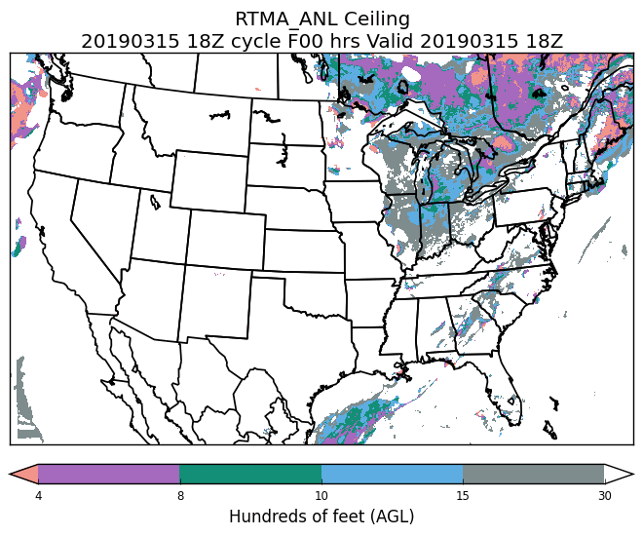
Example: Ceiling clearing
Sky Cover
Original Ceiling
Modified Ceiling
18Z on 15 March 2019

Slide 21
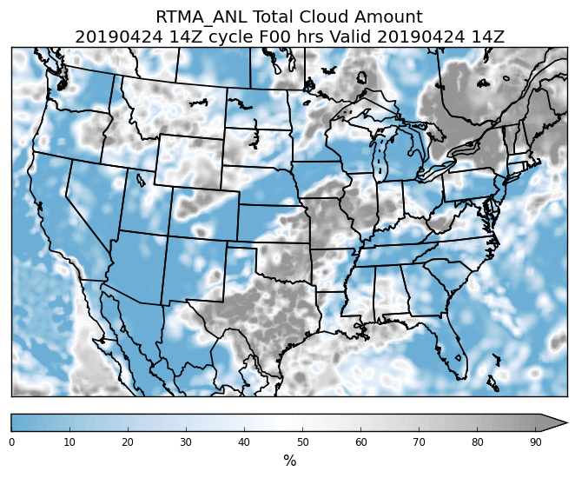
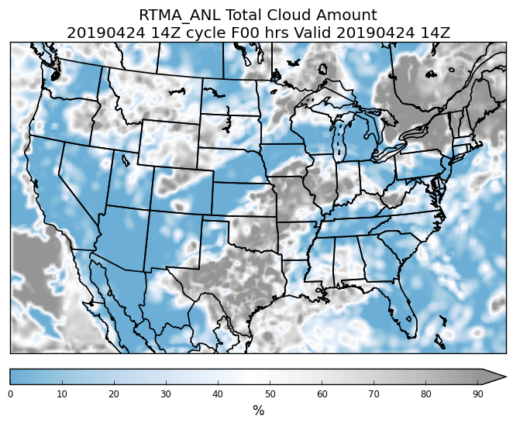
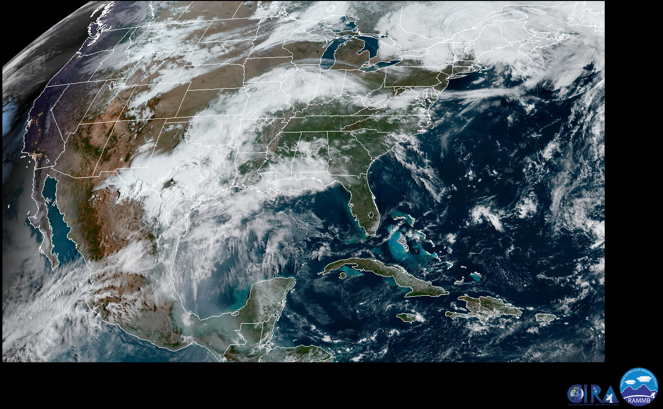
Example: Sky Cover QC
Original Sky Cover
Modified Sky Cover (QC)
VIS
14Z on 24 April 2019

Slide 22
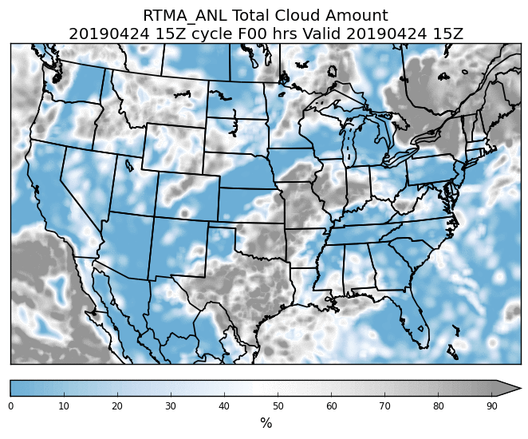
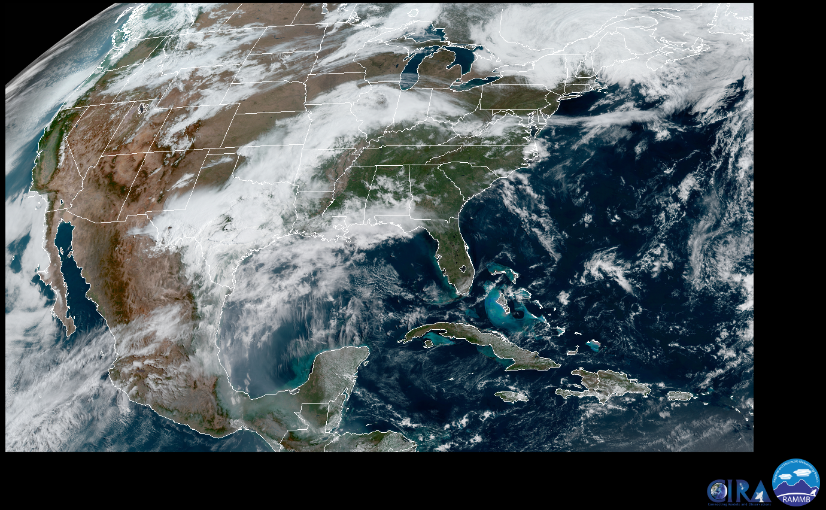
Example: Sky Cover QC
Original Sky Cover
Modified Sky Cover (QC)
VIS
15Z on 24 April 2019

Slide 23
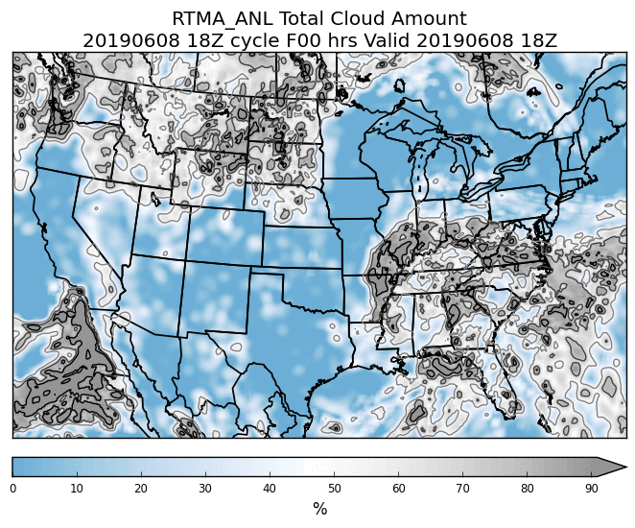
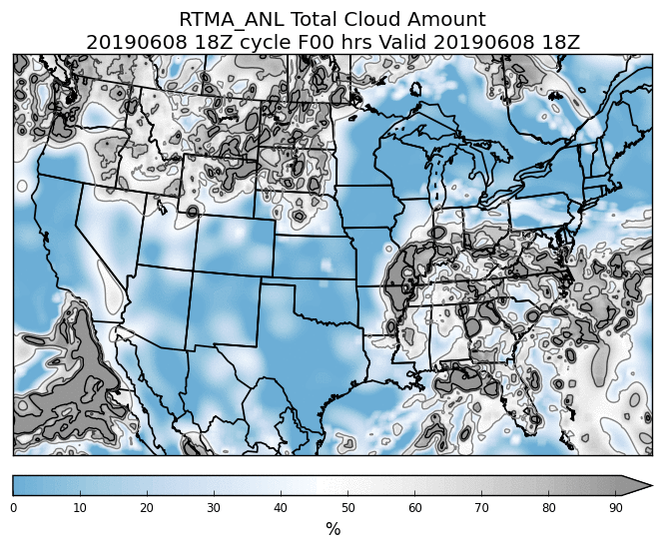
Example: Sky Cover Tuning
Current Configuration
Reduce thinning (by 50%) and triple decorrelation length
18Z on 6 June 2019

Slide 24
pcpRTMA/URMA: v2.8
Precip RTMA: replace first-run Stage II/IV with radar-only MRMS as source
Precip URMA: add NOHRSC snowfall analysis
Precip URMA: blending for a smoother offshore filling with MRMS and CMORPH
PCPANL v4.0 (upstream job of RTMA/URMA):
Discontinue Stage II analysis
Stage IV: change from GRIB1 to GRIB2

Slide 25
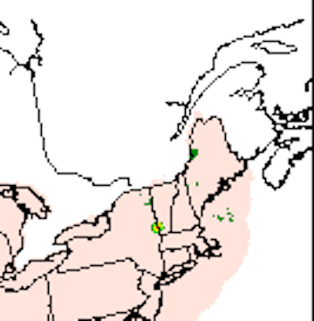
pcpRTMA Source
Current prod uses first run Stage IV supplemented by first run Stage II.
At the time of the pcpRTMA run (33 min past the top of the hour), the RFC QPEs (basis for Stage IV) generally do not yet have the benefit of human oversight/QC:
02Z 17 Dec 2017 (Saturday evening ET): bad gauge included in the first-run RFC QPE/pcpRTMA. NERFC removed the bad gauge within hours and pcpURMA was updated accordingly in the following hour’s rerun. pcpRTMA was only run once (“Real Time”) and the bull’s eye stayed in the RTMA.

Slide 26
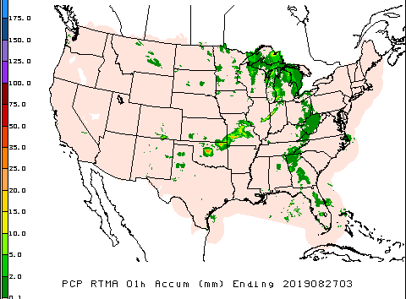
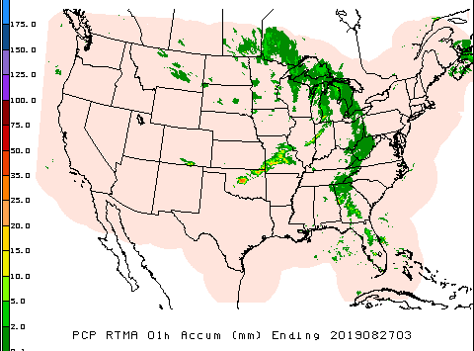
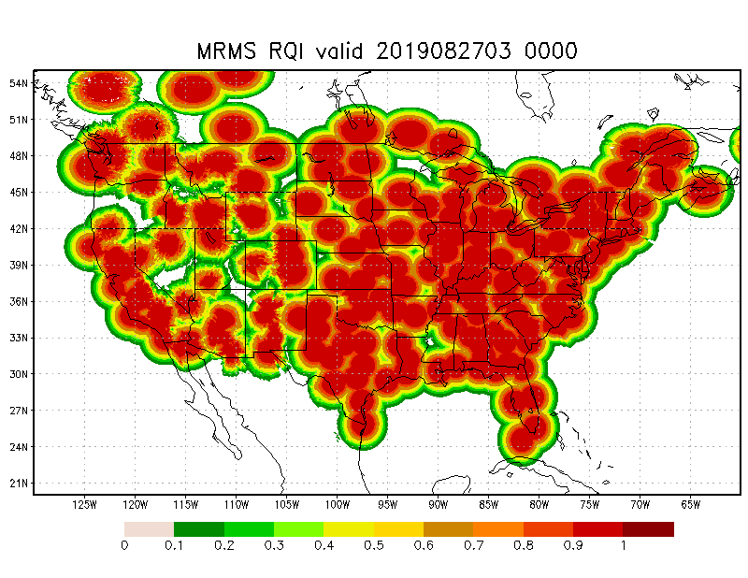
pcpRTMA using MRMS
In v2.8, we plan to use radar-only MRMS QPE (better timing & less affected by data outage than gauge-corrected MRMS QPE). Radar quality index (RQI) added as companion array to each hour’s pcpRTMA array - providing users with info about quality of the QPE. RQI arrays will be available on NOMADS, not AWIPS.
Prod
v2.8

Slide 27
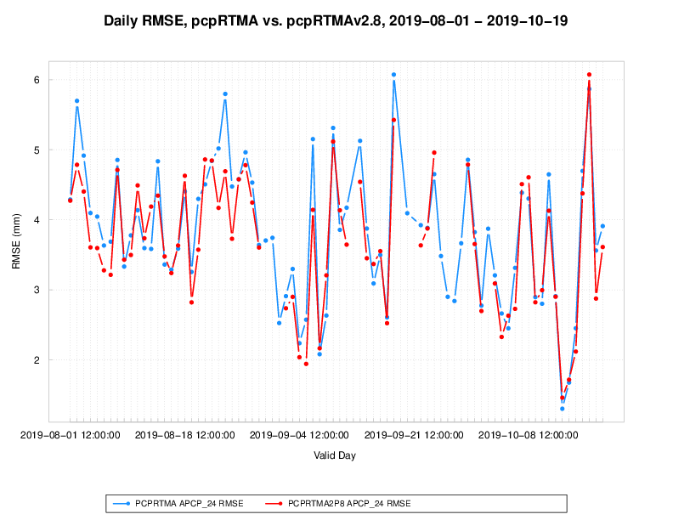
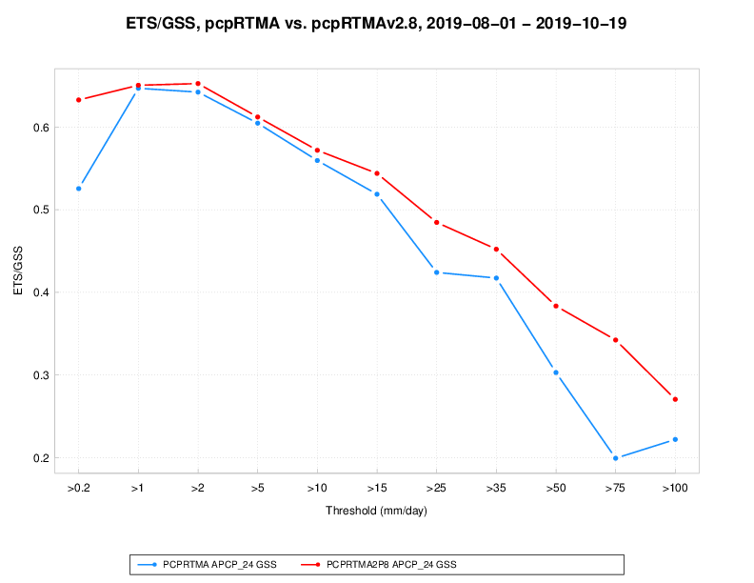
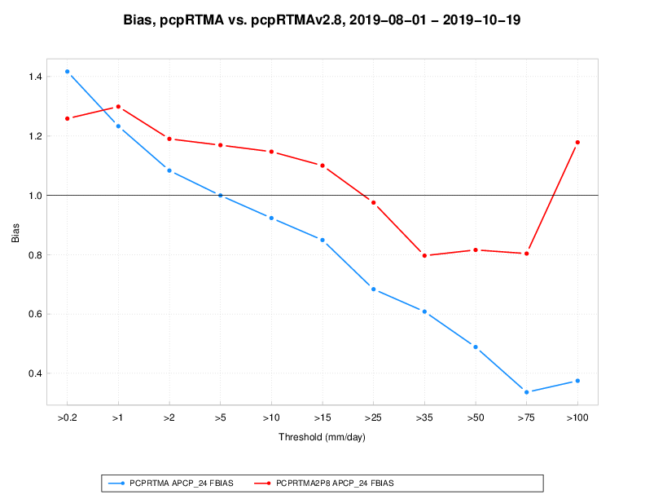
pcpRTMA using MRMS: validation
Prod vs. v2.8 pcpRTMA: validation against daily gauges (1 Aug - 19 Oct 2019)
Time series of RMSE ETS vs. threshold Bias vs. threshold

Slide 28
NOHRSC Snowfall Analysis for URMA
Add NOHRSC 6h/24h snowfall analysis to the precipitation URMA suite (dependent data sent to NCEP via official ftp-in).
Current parallel run: at 18-19Z each day, unofficially fetch (wget) and process NOHRSC data for current day, $daym1/$daym2/$daym3/$daym5/$daym7. Data mapped from NOHRSC’s g184 to the expanded ConUS grid (WEXP) for NBM. g184 data sent out to AWIPS.

Slide 29
Improved Offshore Filling of pcpURMA
The primary source of ConUS pcpURMA is the NCEP Stage IV - mosaicked RFC QPEs, which is limited to RFC domains (largely land-only).
V2.7 introduced offshore filling of ConUS PCPURMA with 1) gauge-corrected MRMS (where RQI ≥ 0.1) and 2) CMORPH. Sometimes there are sharp discontinuities between MRMS and CMORPH; occasionally discontinuities are also seen at the boundary between RFC QPEs and MRMS.
Proposed solution (Yan Luo, Manuel Pondeca): apply Whittaker blending function (used in the production of RTMA background field) for a smoother pcpURMA offshore filling.

Slide 30
pcpURMA Offshore Blending (Yan Luo)

Slide 31
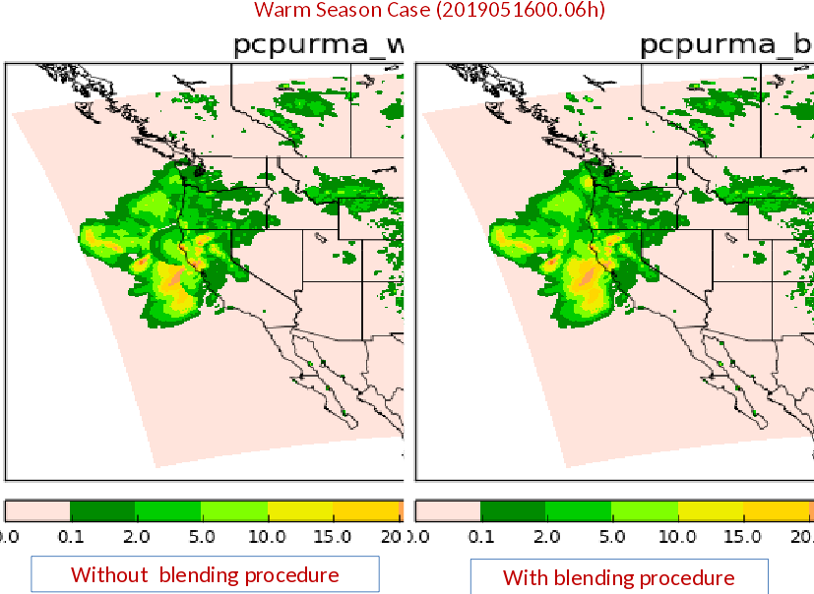
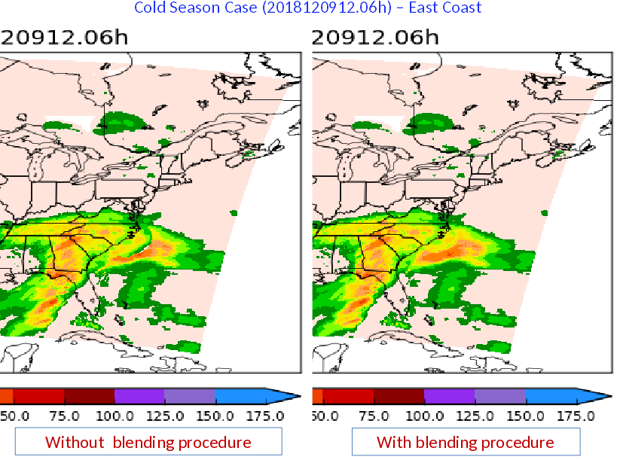
Examples of Blended Offshore PCPURMA
From Yan Luo:

Slide 32
Other Changes to Precipitation
Stage IV output to change from GRIB1 to GRIB2
Stage IV 24h mosaic (for water.weather.gov/precip): add an additional rerun at 30h after valid time (at 18:33Z) to supplement the current 1/2/3/5/7-day rerun schedule for the 24h mosaic, to give RFCs that have a missing QPE or need to update their QPEs a better chance to get their corrected data to water.weather.gov & the public quickly
Removal of Stage II analysis: pcpRTMA no longer dependent on Stage II; MRMS QPEs can now replace the Stage II

Slide 33
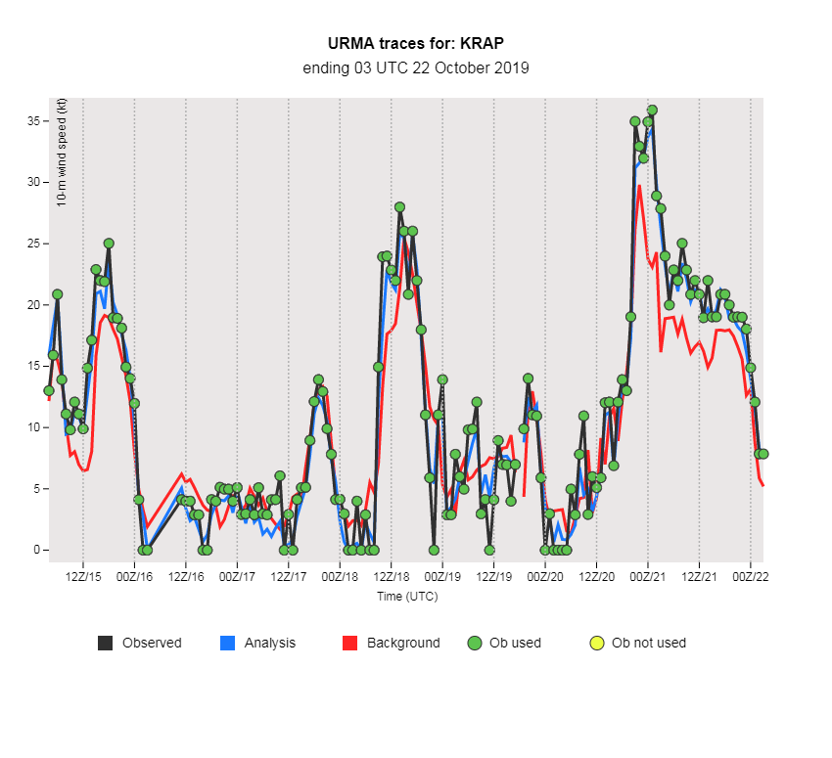
Ways to View/Evaluate
MEG-generated evaluation website
EMC Viewer
Includes time series plots showing ob/background/analysis values for selected METAR sites
NBM Veritas Viewer
NOAA login credentials required
Go to “Analysis Review” after clicking on a domain
WAVE viewer
Maintained by Bill Rasch/Western Region
NWS access only
https://para.nomads.ncep.noaa.gov/pub/data/nccf/com/urma/para/
Coming soon - websites with verification stats
Please send in evaluation via survey
Other feedback: rtma.feedback.vlab@noaa.gov

Slide 34
V2.8 RTMA/URMA/RTMA-RU Timeline
NCO begins 30 day IT test
End Eval
11/22
02/2020
10/23
12/17
03/2020
Begin Eval
OD Brief and code hand off to NCO
(Approx.)
Implementation
[Q2FY20]

Slide 35
BACKUP
SLIDES

Slide 36
Ongoing: Quality Control/Ob Flagging
Overview here
Easiest way to find out what is used or not: look at KML plots available here
Obs are colored traffic-light style, click on points for more info
If MADIS is getting the ob, we probably are too
If you know of an ob that you don’t see, let us know
Want to flag obs?
Flag a few: fill out the form (also available at VLab site)
Flag a bunch: email us and we will work out specs
We can flag only certain variables (keep temps/flag winds) if that is needed
Flags are generally* applied on Friday afternoon
Don’t want to flag obs?
Don’t be surprised when they are drawn for in RTMA/URMA, and later NBM
*Flagging is at EMC and SDM’s discretion, may be delayed by machine issues or critical weather

Slide 37
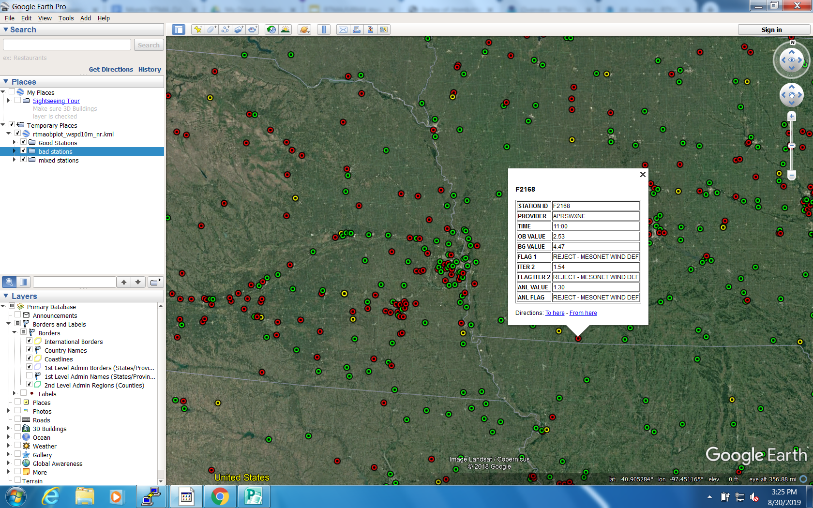

Slide 38
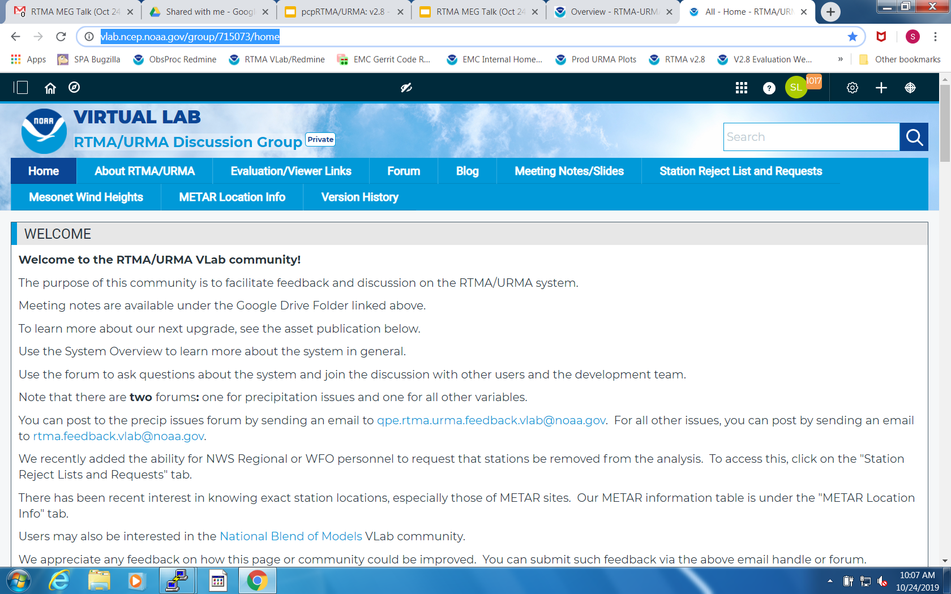
RTMA/URMA VLab Community

