Slide 1
RAP: May 2019
RAP-OPS
RAPv5_RC1

Slide 2
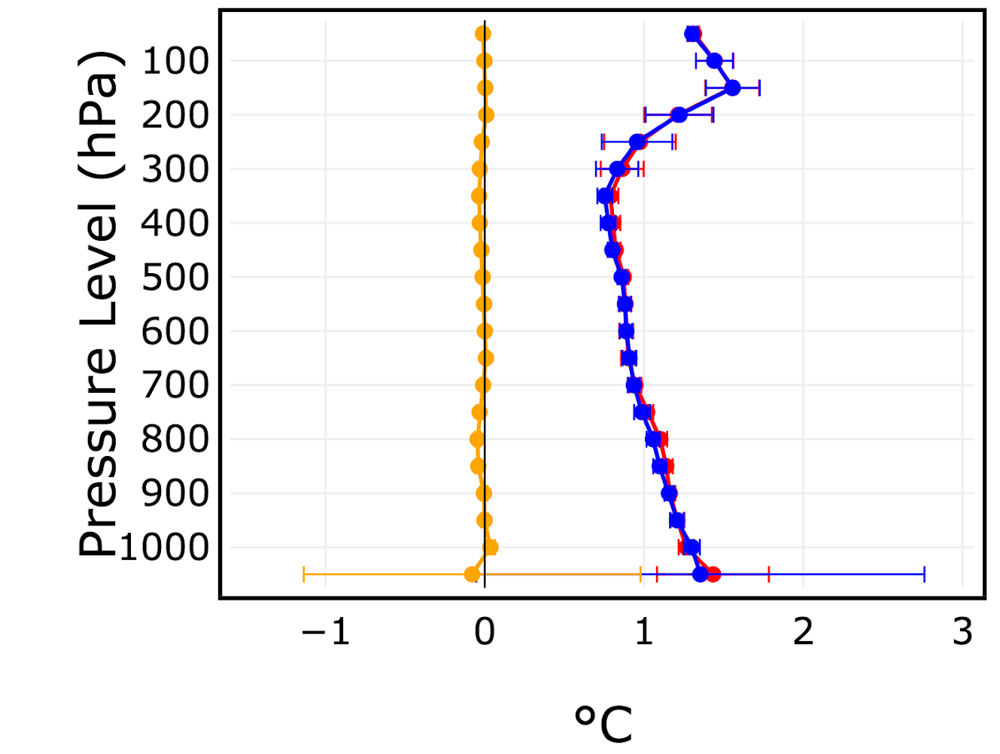
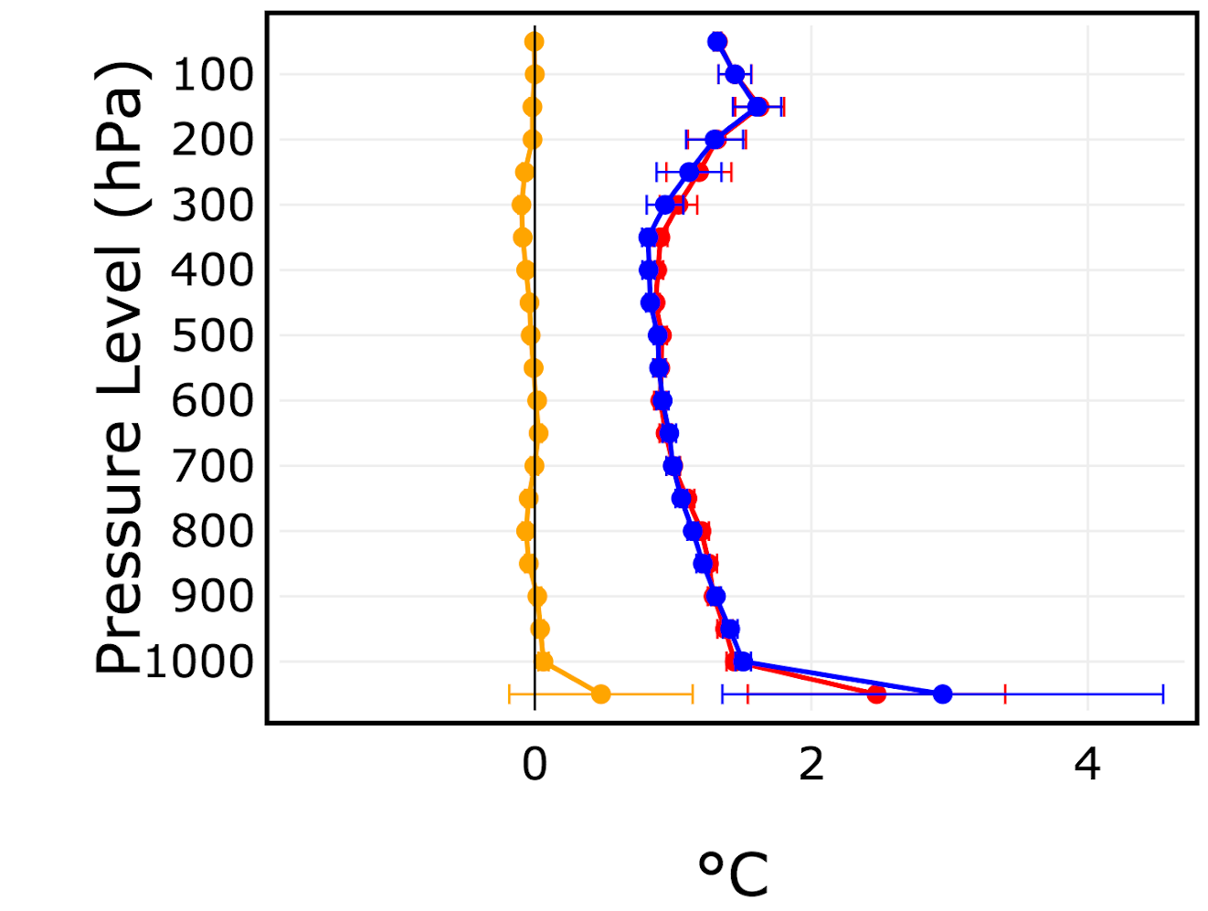
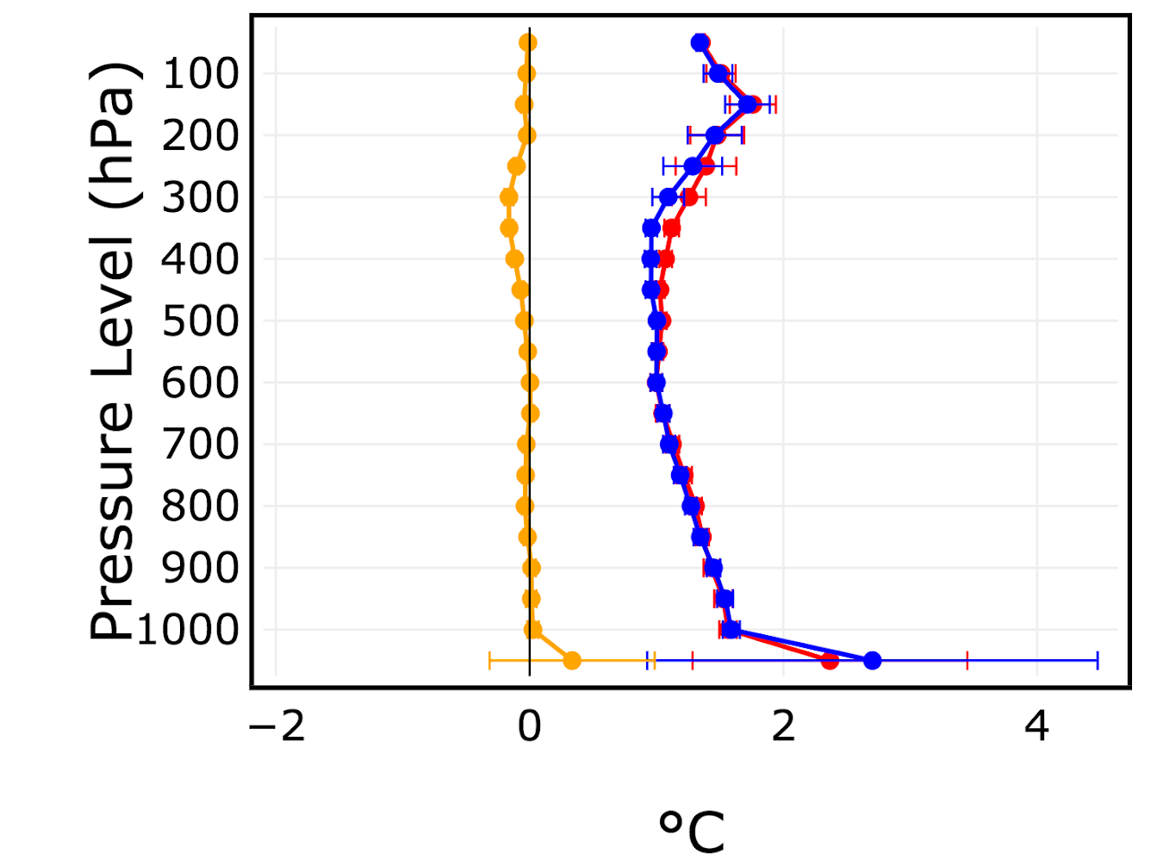
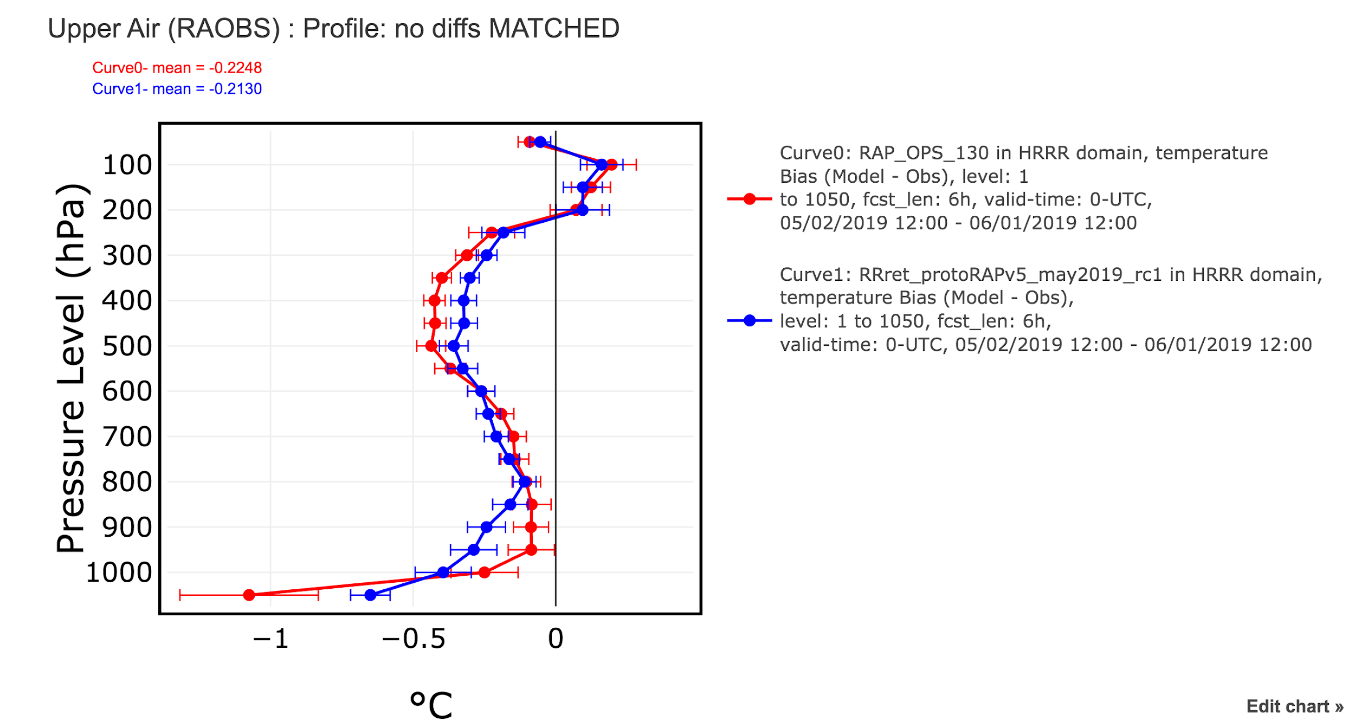
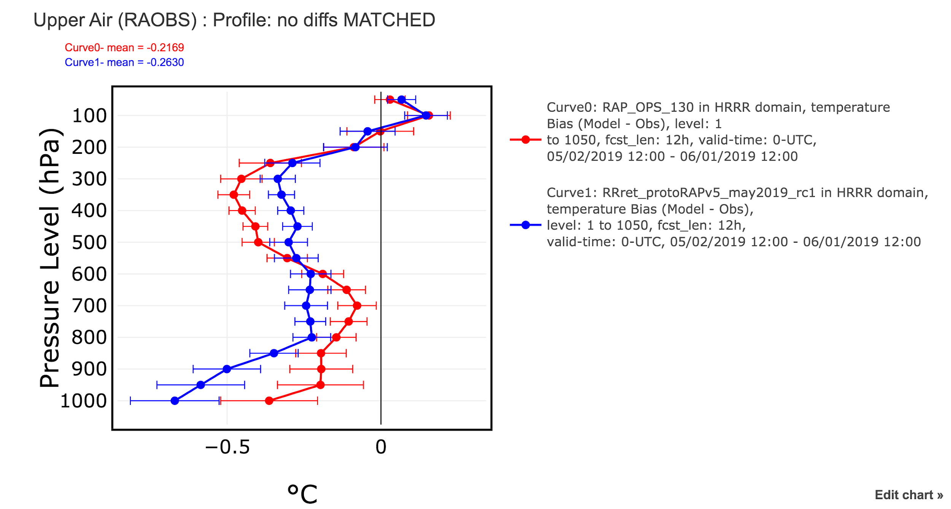
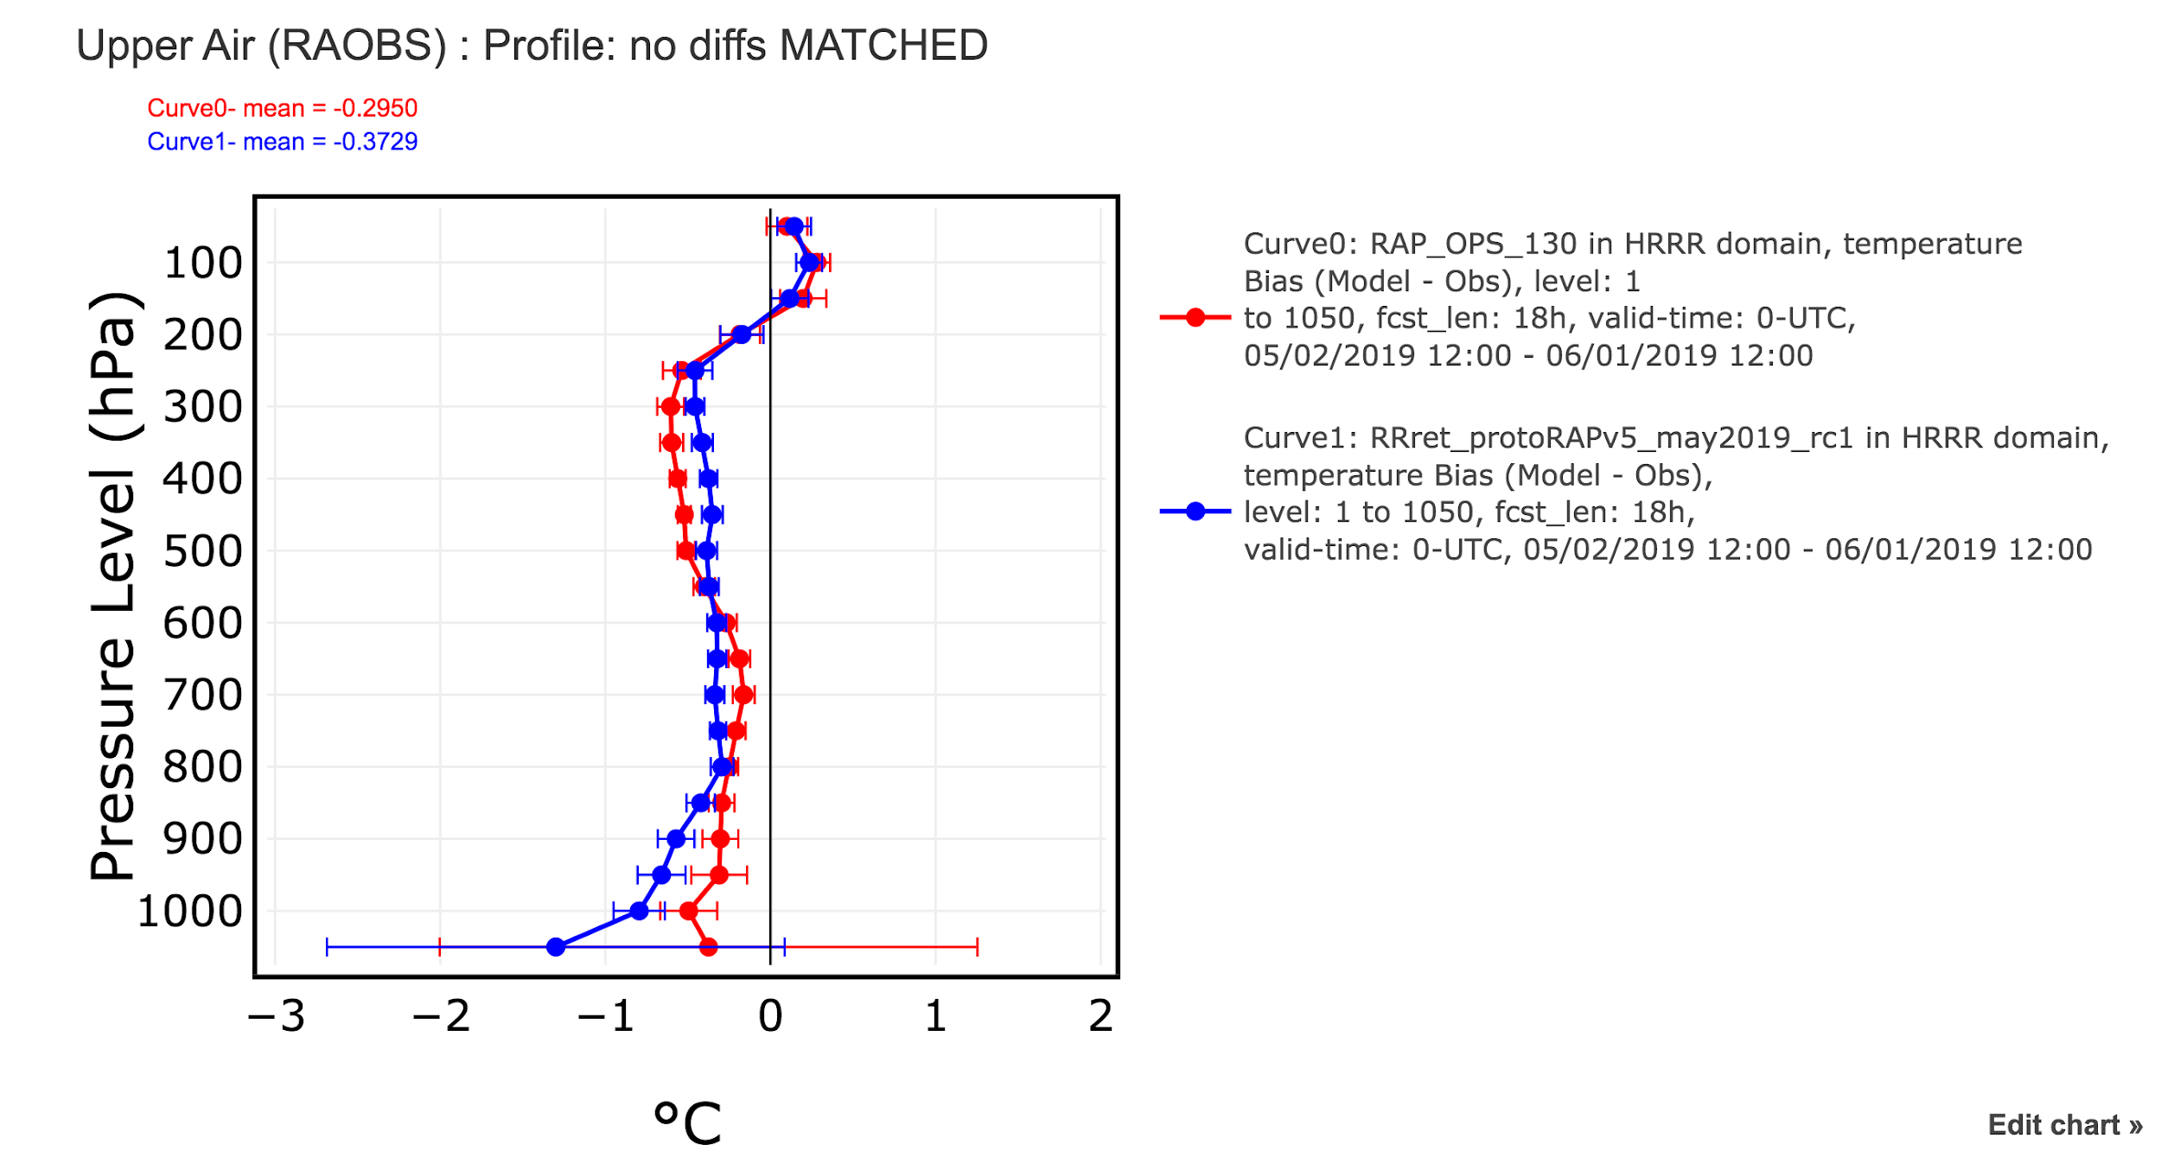
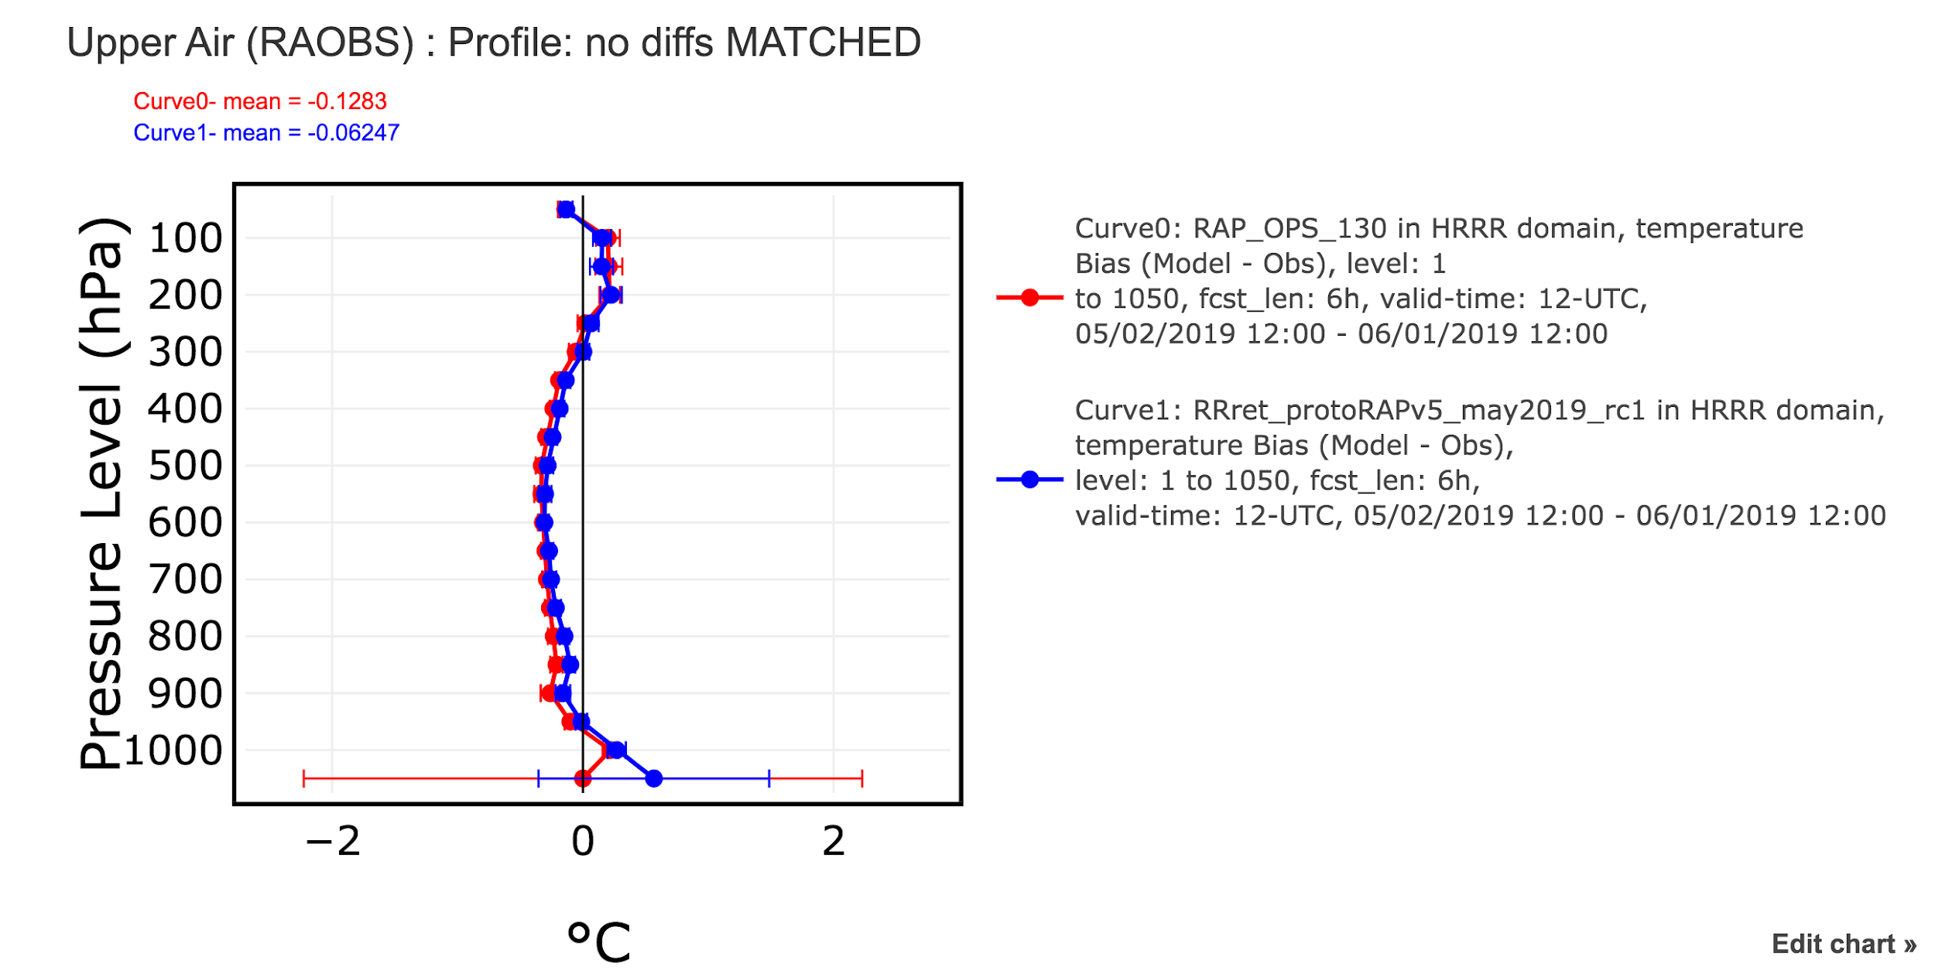
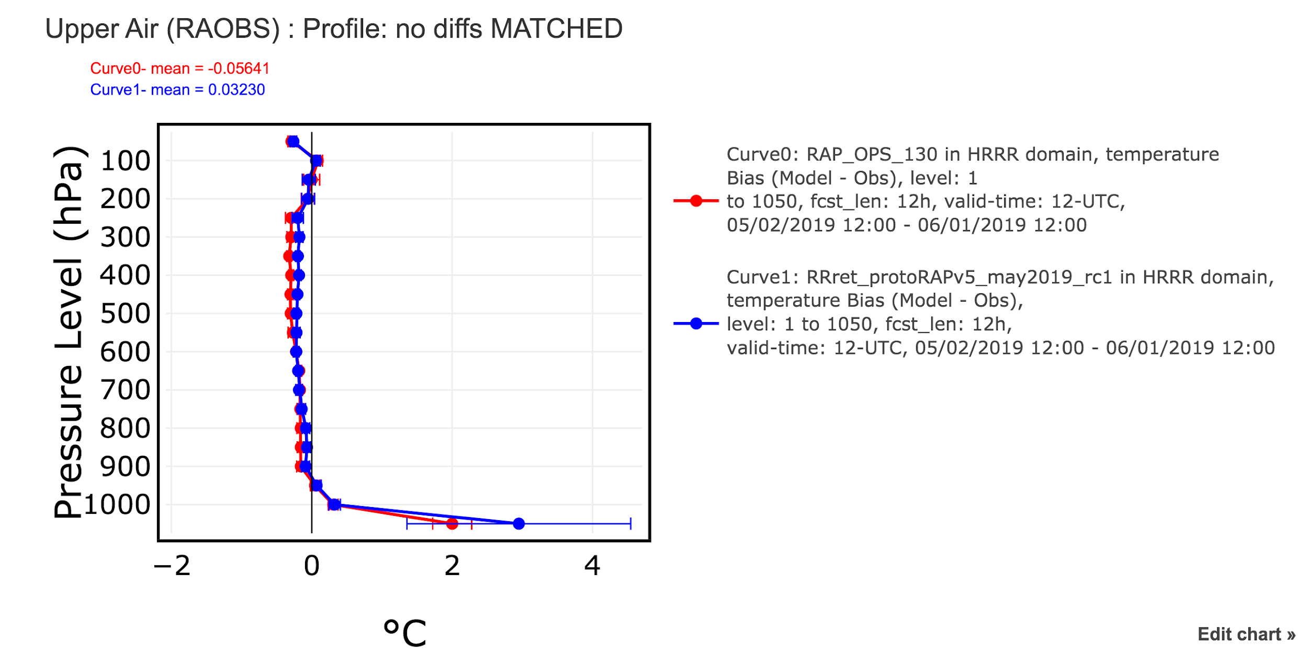
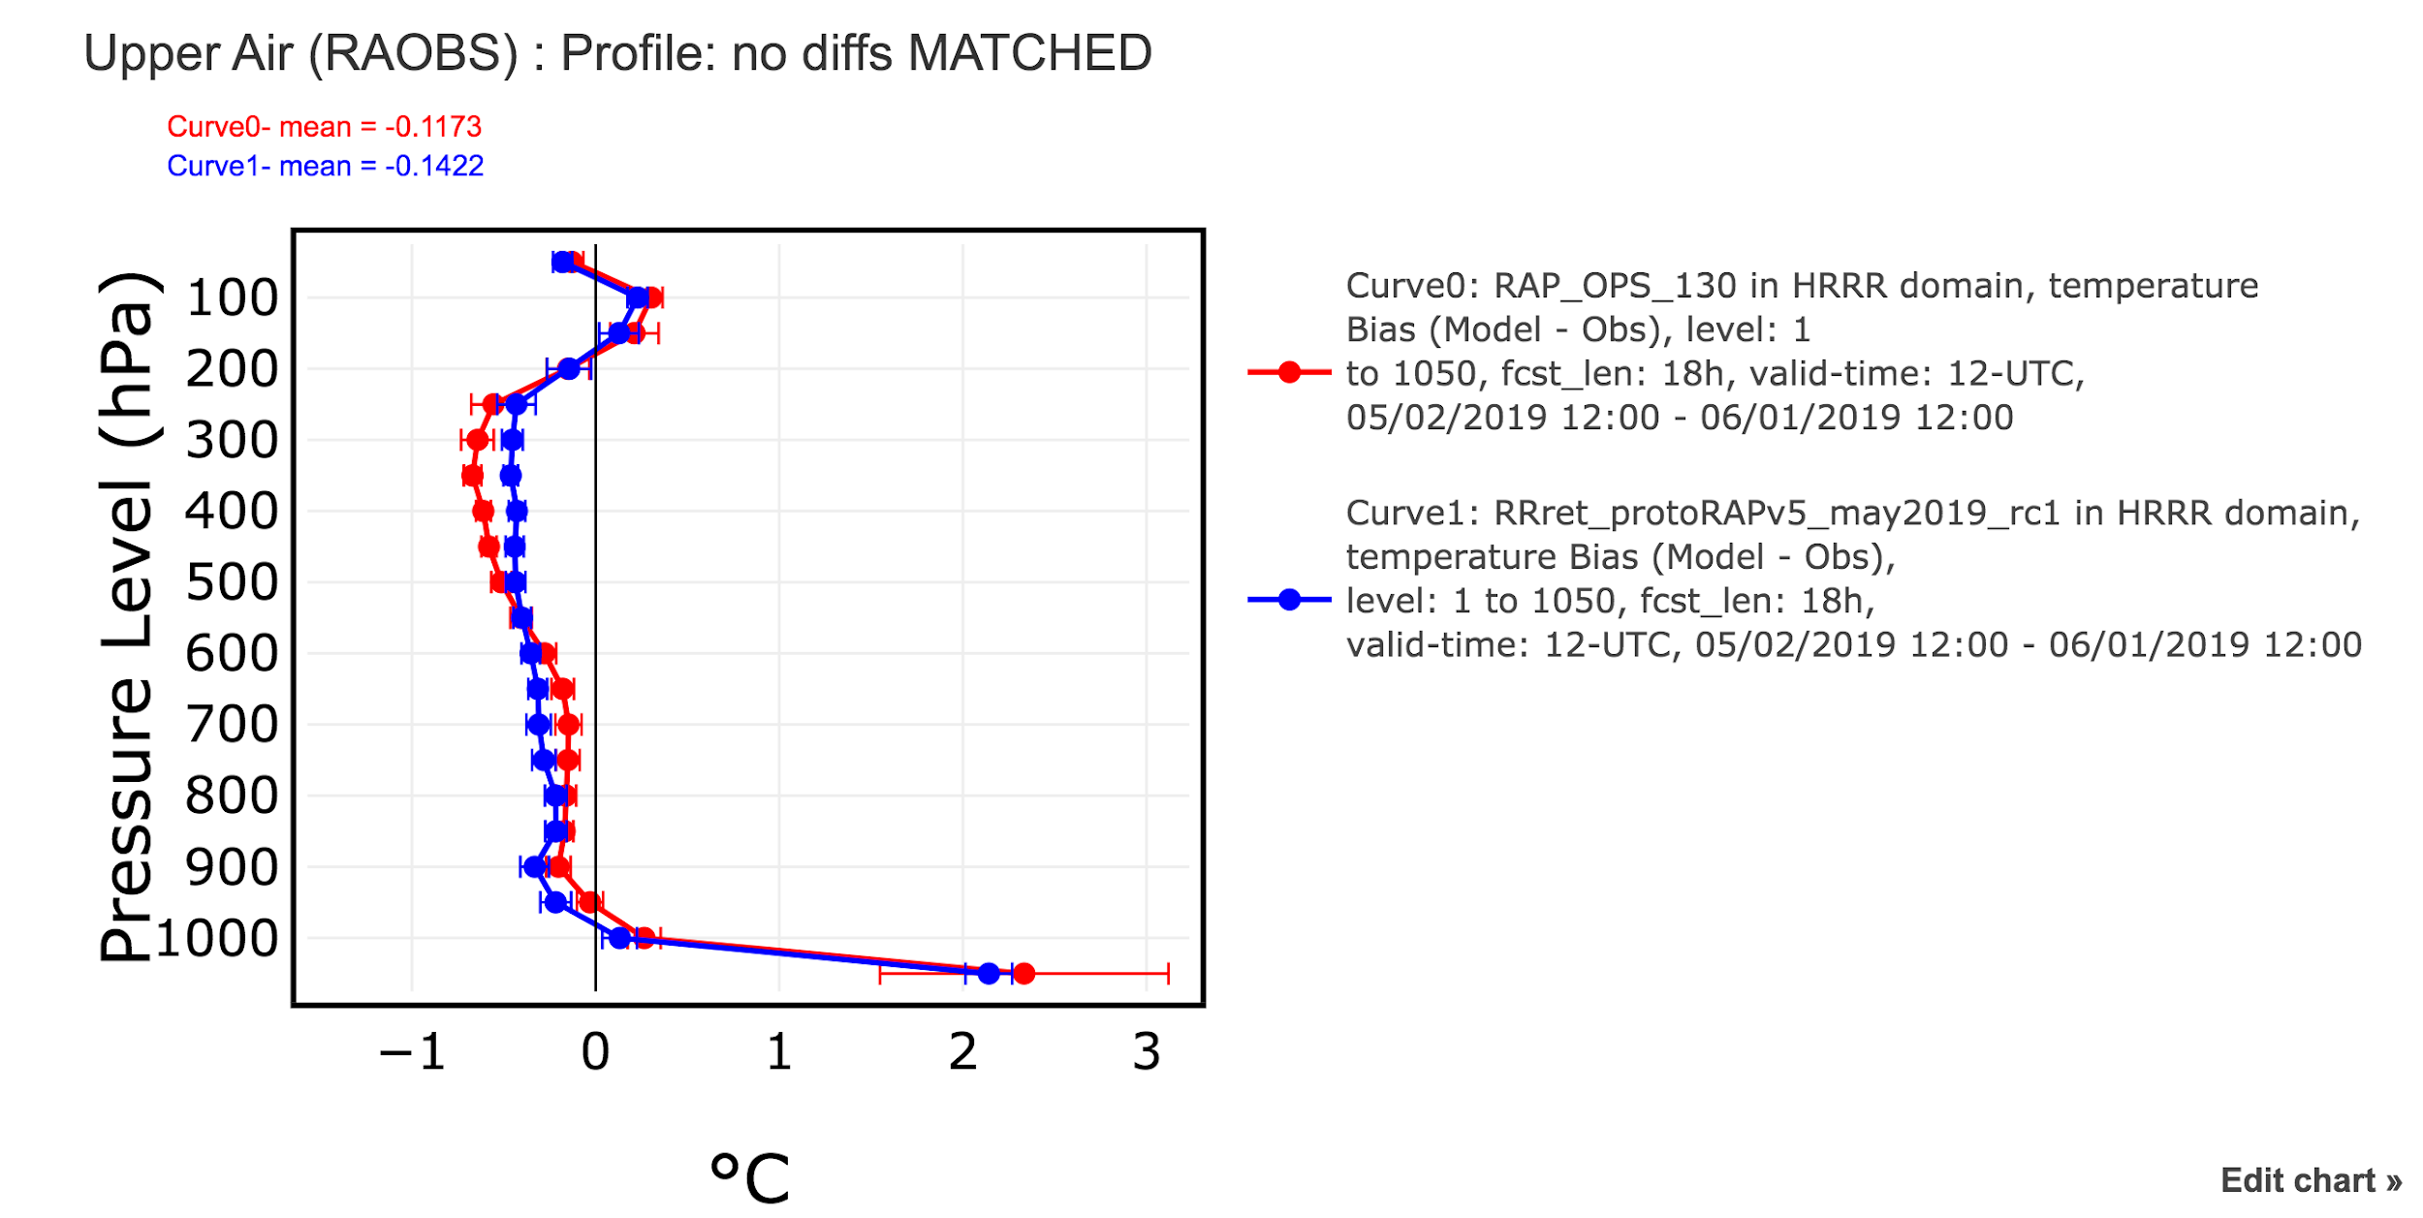
RAP: 1–31 May 2019
temperature
RAP-OPS
RAPv5
RMSE
6-h fcst
12-h fcst
18-h fcst
00-UTC bias
12-UTC bias

Slide 3
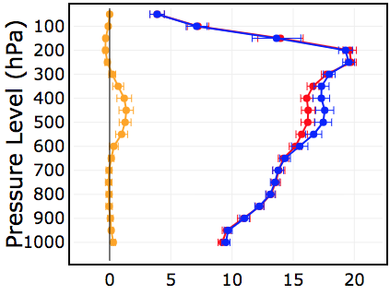
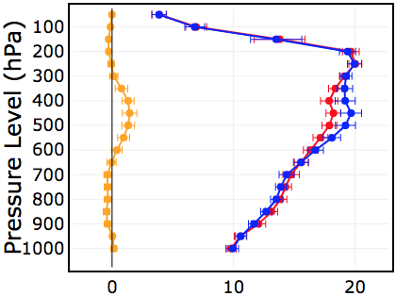
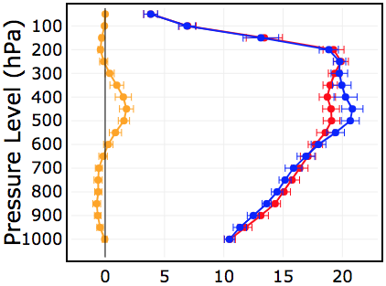
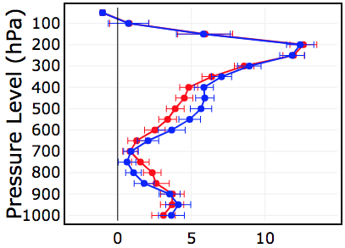
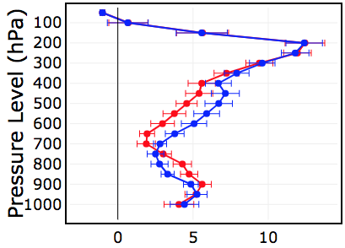
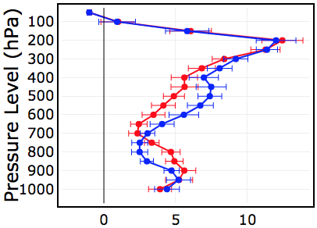
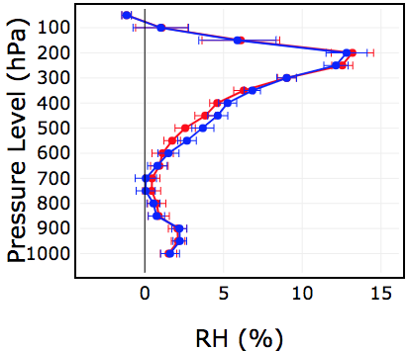
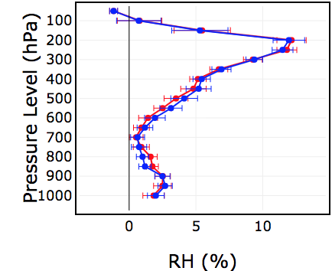
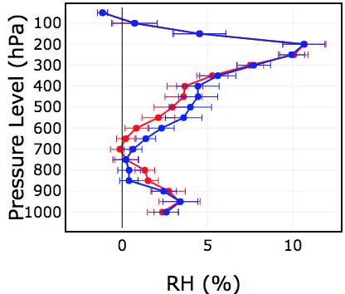
RAP: 1–31 May 2019
RHobT
RAP-OPS
RAPv5
6-h fcst
12-h fcst
18-h fcst
RMSE
00-UTC bias
12-UTC bias

Slide 4
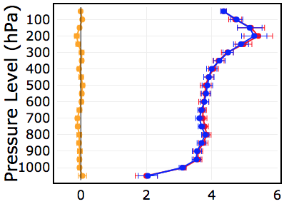
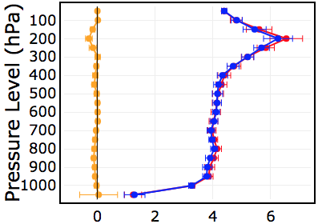
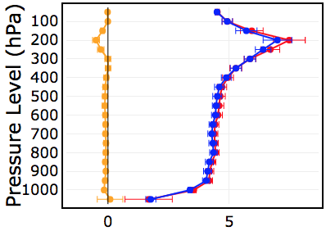
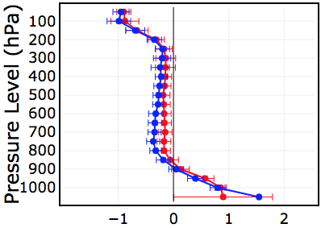
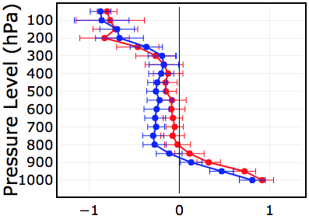
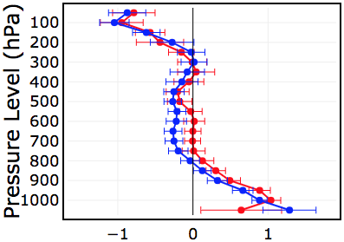
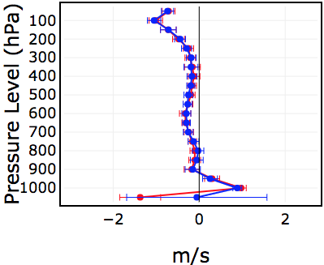
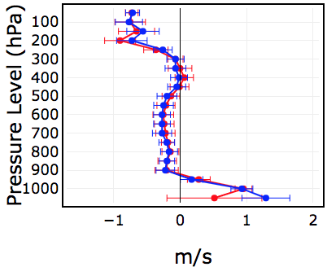
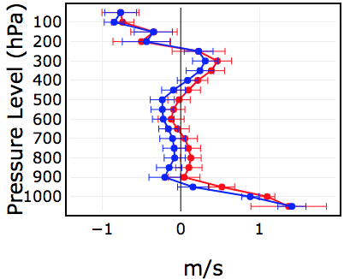
RAP: 1–31 May 2019
wind
6-h fcst
12-h fcst
18-h fcst
RAP-OPS
RAPv5
RMSE
00-UTC bias
12-UTC bias

Slide 5
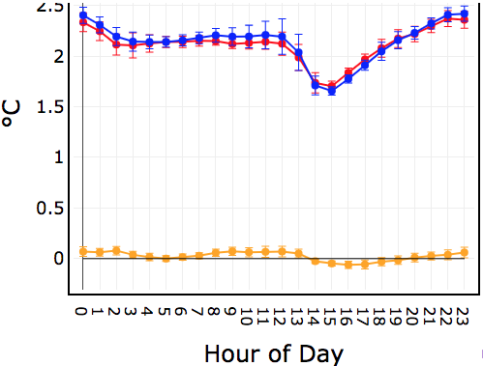
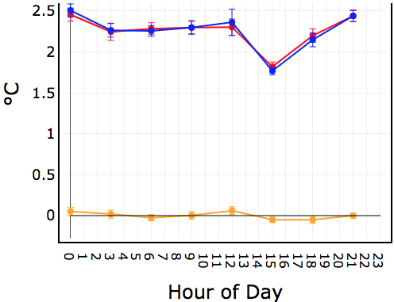
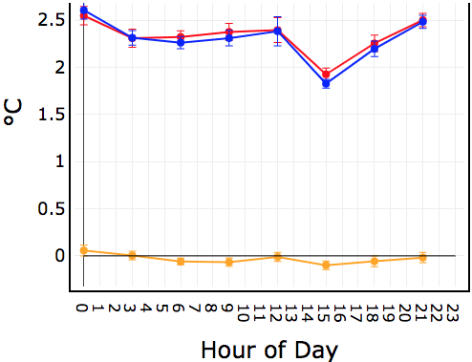
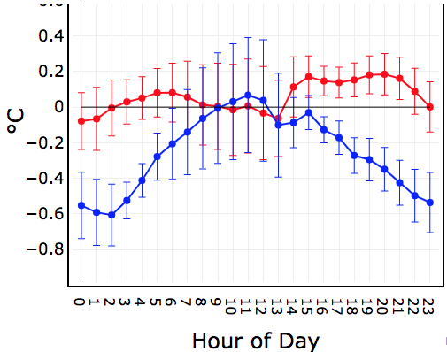
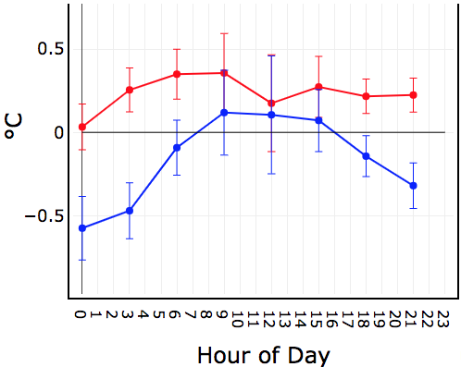
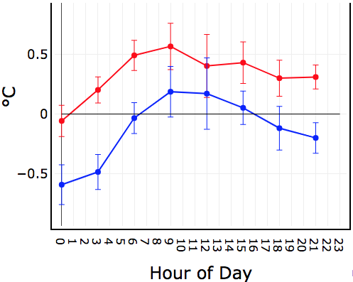
RAP: 1–31 May 2019
2-m temperature
W CONUS
RAP-OPS
RAPv5
6-h fcst
12-h fcst
18-h fcst
RMSE
bias

Slide 6
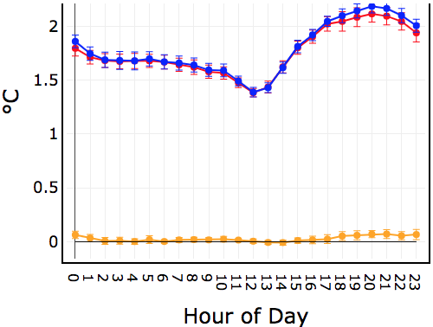
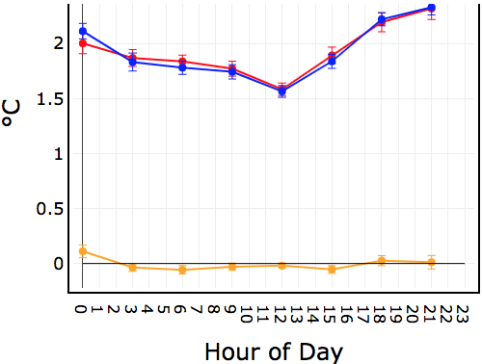
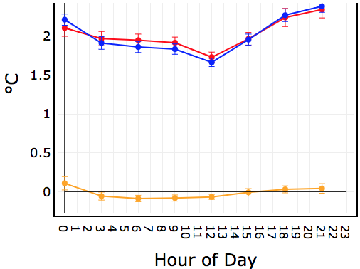
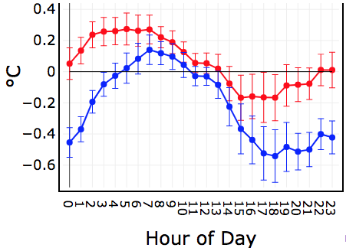
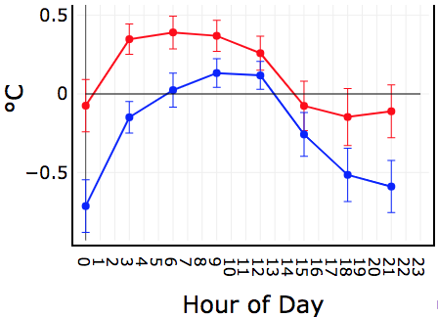
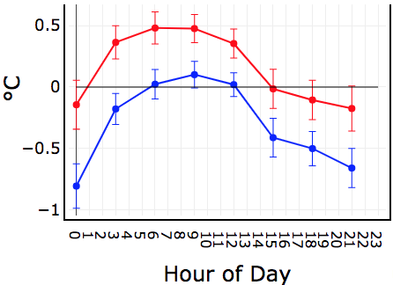
RAP: 1–31 May 2019
2-m temperature
E CONUS
RAP-OPS
RAPv5
6-h fcst
12-h fcst
18-h fcst
RMSE
bias

Slide 7
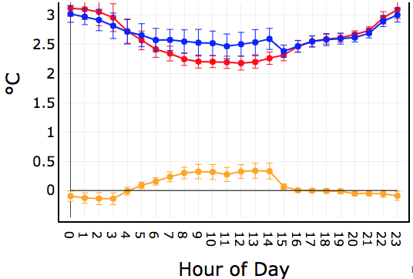
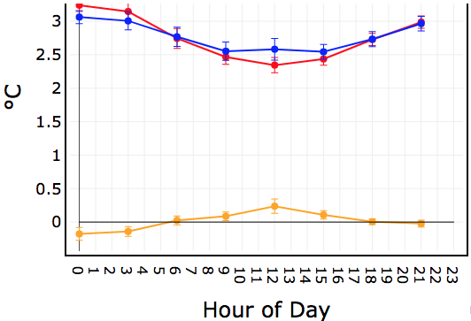
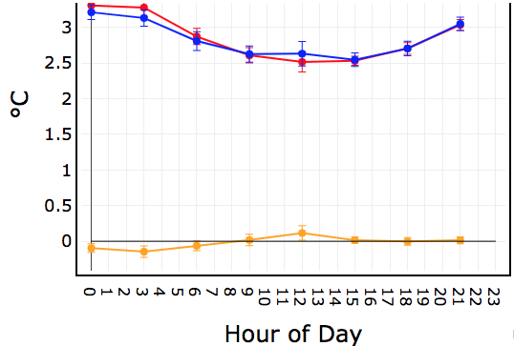
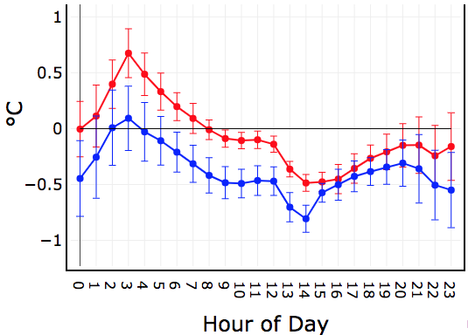
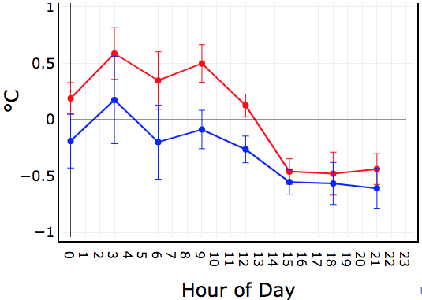
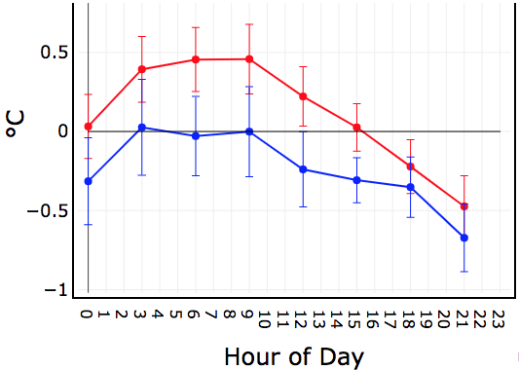
RAP: 1–31 May 2019
2-m dewpoint
W CONUS
RAP-OPS
RAPv5
6-h fcst
12-h fcst
18-h fcst
RMSE
bias

Slide 8
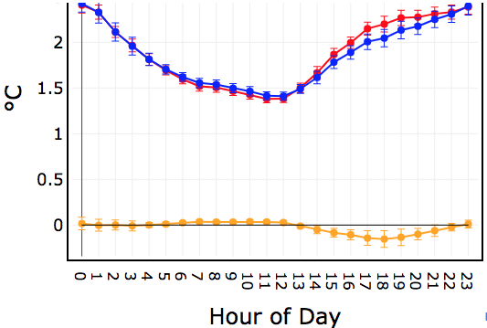
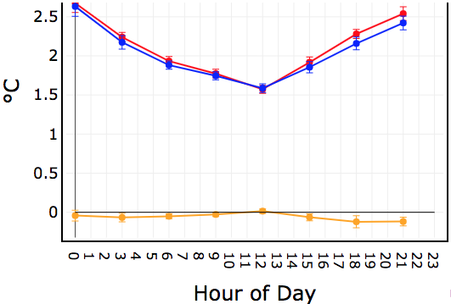
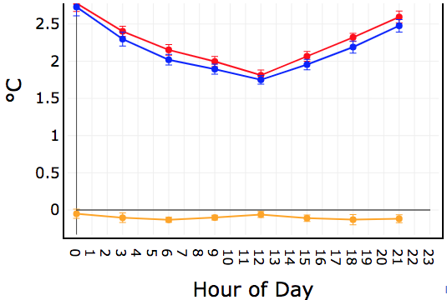
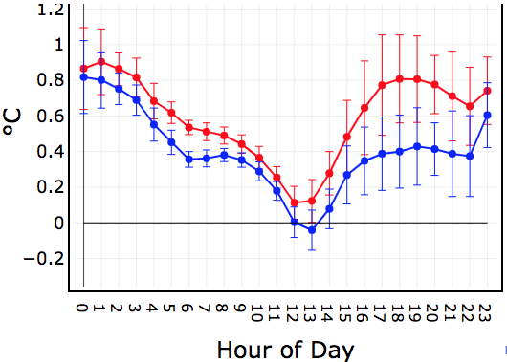
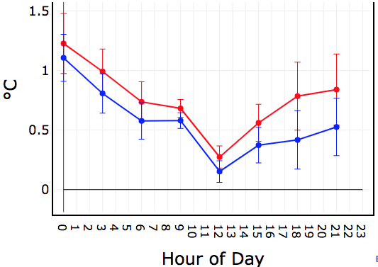

RAP: 1–31 May 2019
2-m dewpoint
E CONUS
RAP-OPS
RAPv5
6-h fcst
12-h fcst
18-h fcst
RMSE
bias

Slide 9






RAP: 1–31 May 2019
10-m wind
W CONUS
RAP-OPS
RAPv5
6-h fcst
12-h fcst
18-h fcst
RMSE
bias

Slide 10






RAP: 1–31 May 2019
10-m wind
E CONUS
RAP-OPS
RAPv5
6-h fcst
12-h fcst
18-h fcst
RMSE
bias

Slide 11






RAP QPF: 1–31 May 2019
W CONUS
RAP-OPS
RAPv5
1-h total
6-h total
12-h total
CSI (20 km)
0.01 0.1 0.25 0.5 1.0 1.5 2.0 3.0
Threshold (in)
0.01 0.1 0.25 0.5 1.0 1.5 2.0 3.0
Threshold (in)
0.01 0.1 0.25 0.5 1.0 1.5 2.0 3.0
Threshold (in)
freq bias
0.01 0.1 0.25 0.5 1.0 1.5 2.0 3.0
Threshold (in)
0.01 0.1 0.25 0.5 1.0 1.5 2.0 3.0
Threshold (in)
0.01 0.1 0.25 0.5 1.0 1.5 2.0 3.0
Threshold (in)

Slide 12






RAP QPF: 1–31 May 2019
E CONUS
RAP-OPS
RAPv5
1-h total
6-h total
12-h total
CSI (20 km)
0.01 0.1 0.25 0.5 1.0 1.5 2.0 3.0
Threshold (in)
0.01 0.1 0.25 0.5 1.0 1.5 2.0 3.0
Threshold (in)
0.01 0.1 0.25 0.5 1.0 1.5 2.0 3.0
Threshold (in)
freq bias
0.01 0.1 0.25 0.5 1.0 1.5 2.0 3.0
Threshold (in)
0.01 0.1 0.25 0.5 1.0 1.5 2.0 3.0
Threshold (in)
0.01 0.1 0.25 0.5 1.0 1.5 2.0 3.0
Threshold (in)

Slide 13






RAP ceiling: 1–31 May 2019
CONUS
RAP-OPS
RAPv5
500 ft
1000 ft
3000 ft
CSI
freq bias

Slide 14






RAP visibility: 1–31 May 2019
W CONUS
RAP-OPS
RAPv5
1 SM
3 SM
5 SM
CSI
freq bias

Slide 15






RAP visibility: 1–31 May 2019
E CONUS
RAP-OPS
RAPv5
1 SM
3 SM
5 SM
CSI
freq bias

Slide 16
HRRR: May 2019
HRRR-OPS
HRRRv4_RC1

Slide 17









HRRR: 1–31 May 2019
temperature
6-h fcst
12-h fcst
18-h fcst
HRRR-OPS
HRRRv4
RMSE
00-UTC bias
12-UTC bias

Slide 18









HRRR: 1–31 May 2019
RHobT
HRRR-OPS
HRRRv4
6-h fcst
12-h fcst
18-h fcst
RMSE
00-UTC bias
12-UTC bias

Slide 19









HRRR: 1–31 May 2019
wind
HRRR-OPS
HRRRv4
6-h fcst
12-h fcst
18-h fcst
RMSE
00-UTC bias
12-UTC bias

Slide 20






HRRR: 1–31 May 2019
2-m temperature
W CONUS
HRRR-OPS
HRRRv4
6-h fcst
12-h fcst
18-h fcst
RMSE
bias

Slide 21






HRRR: 1–31 May 2019
2-m temperature
E CONUS
HRRR-OPS
HRRRv4
6-h fcst
12-h fcst
18-h fcst
RMSE
bias

Slide 22






HRRR: 1–31 May 2019
2-m dewpoint
W CONUS
HRRR-OPS
HRRRv4
6-h fcst
12-h fcst
18-h fcst
RMSE
bias

Slide 23






HRRR: 1–31 May 2019
2-m dewpoint
E CONUS
HRRR-OPS
HRRRv4
6-h fcst
12-h fcst
18-h fcst
RMSE
bias

Slide 24






HRRR: 1–31 May 2019
10-m wind
W CONUS
HRRR-OPS
HRRRv4
6-h fcst
12-h fcst
18-h fcst
RMSE
bias

Slide 25






HRRR: 1–31 May 2019
10-m wind
E CONUS
HRRR-OPS
HRRRv4
6-h fcst
12-h fcst
18-h fcst
RMSE
bias

Slide 26






HRRR composite reflectivity: 1–31 May 2019
W CONUS
HRRR-OPS
HRRRv4
25 dBZ
35 dBZ
15 dBZ
CSI (20 km)
freq bias

Slide 27






HRRR composite reflectivity: 1–31 May 2019
E CONUS
HRRR-OPS
HRRRv4
25 dBZ
35 dBZ
15 dBZ
CSI (20 km)
freq bias

Slide 28






HRRR QPF: 1–31 May 2019
W CONUS
HRRR-OPS
HRRRv4
1-h total
6-h total
12-h total
CSI (20 km)
0.01 0.1 0.25 0.5 1.0 1.5 2.0 3.0
0.01 0.1 0.25 0.5 1.0 1.5 2.0 3.0
0.01 0.1 0.25 0.5 1.0 1.5 2.0 3.0
freq bias
0.01 0.1 0.25 0.5 1.0 1.5 2.0 3.0
0.01 0.1 0.25 0.5 1.0 1.5 2.0 3.0
0.01 0.1 0.25 0.5 1.0 1.5 2.0 3.0

Slide 29






HRRR QPF: 1–31 May 2019
E CONUS
HRRR-OPS
HRRRv4
1-h total
6-h total
12-h total
CSI (20 km)
0.01 0.1 0.25 0.5 1.0 1.5 2.0 3.0
0.01 0.1 0.25 0.5 1.0 1.5 2.0 3.0
0.01 0.1 0.25 0.5 1.0 1.5 2.0 3.0
freq bias
0.01 0.1 0.25 0.5 1.0 1.5 2.0 3.0
0.01 0.1 0.25 0.5 1.0 1.5 2.0 3.0
0.01 0.1 0.25 0.5 1.0 1.5 2.0 3.0

Slide 30






HRRR ceiling: 1–31 May 2019
W CONUS
HRRR-OPS
HRRRv4
500 ft
1000 ft
3000 ft
CSI
freq bias

Slide 31






HRRR ceiling: 1–31 May 2019
E CONUS
HRRR-OPS
HRRRv4
500 ft
1000 ft
3000 ft
CSI
freq bias

Slide 32






HRRR visibility: 1–31 May 2019
W CONUS
HRRR-OPS
HRRRv4
1 SM
3 SM
5 SM
CSI
freq bias

Slide 33






HRRR visibility: 1–31 May 2019
E CONUS
HRRR-OPS
HRRRv4
1 SM
3 SM
5 SM
CSI
freq bias

Slide 34
RAP: Jul 2018
RAP-OPS
RAPv5_RC1

Slide 35









RAPv5: 15 Jul - 15 Aug 2018
temperature
RAP-OPS
RAPv5
RMSE
6-h fcst
12-h fcst
18-h fcst
00-UTC bias
12-UTC bias

Slide 36









RAPv5: 15 Jul - 15 Aug 2018
RHobT
RAP-OPS
RAPv5
12-h fcst
6-h fcst
18-h fcst
RMSE
00-UTC bias
12-UTC bias

Slide 37









RAPv5: 15 Jul - 15 Aug 2018
wind
RAP-OPS
RAPv5
12-h fcst
6-h fcst
18-h fcst
RMSE
00-UTC bias
12-UTC bias

Slide 38






RAPv5: 15 Jul - 15 Aug 2018
2-m temperature
W CONUS
RAP-OPS
RAPv5
6-h fcst
12-h fcst
18-h fcst
RMSE
bias

Slide 39






RAPv5: 15 Jul - 15 Aug 2018
2-m temperature
E CONUS
RAP-OPS
RAPv5
6-h fcst
12-h fcst
18-h fcst
RMSE
bias

Slide 40






RAPv5: 15 Jul - 15 Aug 2018
2-m dewpoint
W CONUS
RAP-OPS
RAPv5
6-h fcst
12-h fcst
18-h fcst
RMSE
bias

Slide 41






RAPv5: 15 Jul - 15 Aug 2018
2-m dewpoint
E CONUS
RAP-OPS
RAPv5
6-h fcst
12-h fcst
18-h fcst
RMSE
bias

Slide 42






RAPv5: 15 Jul - 15 Aug 2018
10-m wind
W CONUS
RAP-OPS
RAPv5
6-h fcst
12-h fcst
18-h fcst
RMSE
bias

Slide 43






RAPv5: 15 Jul - 15 Aug 2018
10-m wind
E CONUS
RAP-OPS
RAPv5
6-h fcst
12-h fcst
18-h fcst
RMSE
bias

Slide 44






RAPv5 QPF: 15 Jul - 15 Aug 2018
E CONUS
RAP-OPS
RAPv5
1-h total
6-h total
12-h total
CSI (20 km)
0.01 0.1 0.25 0.5 1.0 1.5 2.0 3.0
Threshold (in)
0.01 0.1 0.25 0.5 1.0 1.5 2.0 3.0
Threshold (in)
0.01 0.1 0.25 0.5 1.0 1.5 2.0 3.0
Threshold (in)
freq bias
0.01 0.1 0.25 0.5 1.0 1.5 2.0 3.0
Threshold (in)
0.01 0.1 0.25 0.5 1.0 1.5 2.0 3.0
Threshold (in)
0.01 0.1 0.25 0.5 1.0 1.5 2.0 3.0
Threshold (in)

Slide 45






RAPv5 ceiling: 15 Jul - 15 Aug 2018
CONUS
RAP-OPS
RAPv5
500 ft
1000 ft
3000 ft
CSI
freq bias

Slide 46






RAPv5 visibility: 15 Jul - 15 Aug 2018
W CONUS
RAP-OPS
RAPv5
1 SM
3 SM
5 SM
CSI
freq bias

Slide 47






RAPv5 visibility: 15 Jul - 15 Aug 2018
E CONUS
RAP-OPS
RAPv5
1 SM
3 SM
5 SM
CSI
freq bias

Slide 48


RAPv5: 15 Jul - 15 Aug 2018
surface irradiance (GHI)
RAP-OPS
RAPv5_RC1
12-h MAE (26 km)
12-h bias (13 km)

Slide 49
HRRR: July 2018
HRRR-OPS
HRRRv4_RC1

Slide 50







HRRR: 15 Jul - 15 Aug 2018
temperature
12-h fcst
18-h fcst
HRRR-OPS
HRRRv4
6-h fcst
RMSE
00-UTC bias
12-UTC bias

Slide 51









HRRR: 15 Jul - 15 Aug 2018
RH
6-h fcst
12-h fcst
18-h fcst
HRRR-OPS
HRRRv4
RMSE
00-UTC bias
12-UTC bias

Slide 52









HRRR: 15 Jul - 15 Aug 2018
Wind
6-h fcst
12-h fcst
18-h fcst
HRRR-OPS
HRRRv4
RMSE
00-UTC bias
12-UTC bias

Slide 53






HRRR: 15 Jul - 15 Aug 2018
2-m temperature
W CONUS
HRRR-OPS
HRRRv4
6-h fcst
12-h fcst
18-h fcst
RMSE
bias

Slide 54






HRRR: 15 Jul - 15 Aug 2018
2-m temperature
E CONUS
HRRR-OPS
HRRRv4
6-h fcst
12-h fcst
18-h fcst
RMSE
bias

Slide 55






HRRR: 15 Jul - 15 Aug 2018
2-m dewpoint
W CONUS
HRRR-OPS
HRRRv4
6-h fcst
12-h fcst
18-h fcst
RMSE
bias

Slide 56






HRRR: 15 Jul - 15 Aug 2018
2-m dewpoint
E CONUS
HRRR-OPS
HRRRv4
6-h fcst
12-h fcst
18-h fcst
RMSE
bias

Slide 57






HRRR: 15 Jul - 15 Aug 2018
10-m wind
W CONUS
HRRR-OPS
HRRRv4
6-h fcst
12-h fcst
18-h fcst
RMSE
bias

Slide 58






HRRR: 15 Jul - 15 Aug 2018
10-m wind
E CONUS
HRRR-OPS
HRRRv4
6-h fcst
12-h fcst
18-h fcst
RMSE
bias

Slide 59


HRRRv4: 15 Jul - 14 Aug 2018
Cloud Ceiling (legacy diagnostic)
3000’
1000’
500’
CSI
HRRR-OPS
RC1 RETRO
Bias

Slide 60


HRRRv4: 15 Jul - 14 Aug 2018
Visibility
10mi
5mi
3mi
CSI
HRRR-OPS
RC1 RETRO
Bias

Slide 61


HRRRv4: 15 Jul - 14 Aug 2018
Smoke effect on visibility, NW CONUS
10mi
5mi
CSI
NO SMOKE
WITH SMOKE EFFECT
Bias

Slide 62






HRRRv4: 15 Jul - 14 Aug 2018
E CONUS reflectivity
15 dBZ
25 dBZ
35 dBZ
CSI (40 km)
HRRR-OPS
RC1 RETRO
freq bias

Slide 63






HRRRv4: 15 Jul - 14 Aug 2018
E CONUS precip
1-h total
6-h total
12-h total
CSI (40 km)
HRRR-OPS
RC1 RETRO
0.01 0.1 0.25 0.5 1 1.5 2 3
Threshold (in)
0.01 0.1 0.25 0.5 1 1.5 2 3
Threshold (in)
0.01 0.1 0.25 0.5 1 1.5 2 3
Threshold (in)
freq bias
0.01 0.1 0.25 0.5 1 1.5 2 3
Threshold (in)
0.01 0.1 0.25 0.5 1 1.5 2 3
Threshold (in)
0.01 0.1 0.25 0.5 1 1.5 2 3
Threshold (in)

Slide 64
RAPv5_rc1: Feb 2019
RAP-OPS
RAPv5_RC1

Slide 65









RAP: 1-28 Feb 2019
temperature
12-h fcst
18-h fcst
RAP-OPS
RAPv5
6-h fcst
RMSE
00-UTC bias
12-UTC bias

Slide 66









RAP: 1-28 Feb 2019
RHobT
6-h fcst
12-h fcst
18-h fcst
RAP-OPS
RAPv5
RMSE
00-UTC bias
12-UTC bias

Slide 67









RAP: 1-28 Feb 2019
wind
RAP-OPS
RAPv5
6-h fcst
12-h fcst
18-h fcst
RMSE
00-UTC bias
12-UTC bias

Slide 68





RAP: 1-28 Feb 2019
2-m temperature
W CONUS
RAP-OPS
RAPv5
6-h fcst
12-h fcst
18-h fcst
RMSE
bias

Slide 69






RAP: 1-28 Feb 2019
2-m temperature
E CONUS
RAP-OPS
RAPv5
6-h fcst
12-h fcst
18-h fcst
RMSE
bias

Slide 70






RAP: 1-28 Feb 2019
2-m Dew Pt
W CONUS
RAP-OPS
RAPv5
6-h fcst
12-h fcst
18-h fcst
RMSE
bias

Slide 71






RAP: 1-28 Feb 2019
2-m Dew Pt
E CONUS
RAP-OPS
RAPv5
6-h fcst
12-h fcst
18-h fcst
RMSE
bias

Slide 72






RAP: 1-28 Feb 2019
10m winds
W CONUS
RAP-OPS
RAPv5
6-h fcst
12-h fcst
18-h fcst
RMSE
bias

Slide 73






RAP: 1-28 Feb 2019
10m winds
E CONUS
RAP-OPS
RAPv5
6-h fcst
12-h fcst
18-h fcst
RMSE
bias

Slide 74






RAP ceiling: 1-28 Feb 2019
CONUS
RAP-OPS
RAPv5
500 ft
1000 ft
3000 ft
CSI
freq bias

Slide 75
HRRRv4_rc1: Feb 2019
HRRR-OPS
HRRRv4_RC1

Slide 76









HRRR: 1-28 Feb 2019
temperature
HRRR-OPS
HRRRv4
6-h fcst
12-h fcst
18-h fcst
RMSE
00-UTC bias
12-UTC bias

Slide 77









HRRR: 1-28 Feb 2019
RH
HRRR-OPS
HRRRv4
6-h fcst
12-h fcst
18-h fcst
RMSE
00-UTC bias
12-UTC bias

Slide 78









HRRR: 1-28 Feb 2019
Winds
HRRR-OPS
HRRRv4
6-h fcst
12-h fcst
18-h fcst
RMSE
00-UTC bias
12-UTC bias

Slide 79






HRRR: 1-28 Feb 2019
2-m temperature
W CONUS
HRRR-OPS
HRRRv4
6-h fcst
12-h fcst
18-h fcst
RMSE
bias

Slide 80






HRRR: 1-28 Feb 2019
2-m temperature
E CONUS
HRRR-OPS
HRRRv4
6-h fcst
12-h fcst
18-h fcst
RMSE
bias

Slide 81






HRRR: 1-28 Feb 2019
2-m Dew Pt
W CONUS
HRRR-OPS
HRRRv4
12-h fcst
18-h fcst
6-h fcst
RMSE
bias

Slide 82






HRRR: 1-28 Feb 2019
2-m Dew Pt
E CONUS
HRRR-OPS
HRRRv4
6-h fcst
12-h fcst
18-h fcst
RMSE
bias

Slide 83






HRRR: 1-28 Feb 2019
10m winds
W CONUS
HRRR-OPS
HRRRv4
6-h fcst
12-h fcst
18-h fcst
RMSE
bias

Slide 84






HRRR: 1-28 Feb 2019
10m winds
E CONUS
HRRR-OPS
HRRRv4
6-h fcst
12-h fcst
18-h fcst
RMSE
bias

Slide 85






HRRR ceiling: 1-28 Feb 2019
W CONUS
HRRR-OPS
HRRRv4
500 ft
1000 ft
3000 ft
CSI
freq bias

Slide 86






HRRR ceiling: 1-28 Feb 2019
E CONUS
HRRR-OPS
HRRRv4
500 ft
1000 ft
3000 ft
CSI
freq bias

Slide 87






HRRR visibility: 1-28 Feb 2019
W CONUS
HRRR-OPS
HRRRv4
1 SM
3 SM
5 SM
CSI
freq bias

Slide 88






HRRR visibility: 1-28 Feb 2019
E CONUS
HRRR-OPS
HRRRv4
1 SM
3 SM
5 SM
CSI
freq bias

Slide 89






HRRR QPF: 1-28 Feb 2019
W CONUS
HRRR-OPS
HRRRv4
1-h total
6-h total
12-h total
CSI (20 km)
0.01 0.1 0.25 0.5 1.0 1.5 2.0 3.0
0.01 0.1 0.25 0.5 1.0 1.5 2.0 3.0
0.01 0.1 0.25 0.5 1.0 1.5 2.0 3.0
freq bias
0.01 0.1 0.25 0.5 1.0 1.5 2.0 3.0
0.01 0.1 0.25 0.5 1.0 1.5 2.0 3.0
0.01 0.1 0.25 0.5 1.0 1.5 2.0 3.0

Slide 90






HRRR QPF: 1-28 Feb 2019
E CONUS
HRRR-OPS
HRRRv4
6-h total
12-h total
1-h total
0.01 0.1 0.25 0.5 1.0 1.5 2.0 3.0
0.01 0.1 0.25 0.5 1.0 1.5 2.0 3.0
0.01 0.1 0.25 0.5 1.0 1.5 2.0 3.0
0.01 0.1 0.25 0.5 1.0 1.5 2.0 3.0
0.01 0.1 0.25 0.5 1.0 1.5 2.0 3.0
0.01 0.1 0.25 0.5 1.0 1.5 2.0 3.0

