Slide 1
The MEG Perspective on the
Implementation of RAPv5/HRRRv4
Chris MacIntosh & Logan Dawson
EMC Model Evaluation Group Webinar
3 December 2020
Contributions from: Geoff Manikin, Alicia Bentley, Shannon Shields, and Marcel Caron

Slide 2
RAPv5/HRRRv4 Verification Summary
Evaluation Metric | CONUS – East | CONUS – West | Alaska
Upper Air Temperature | Better RMSE / Slight low-level cool bias at 00 UTC |  | Better RMSE / Low-level warm bias reduced
Upper Air RH | Better RMSE / Lower levels run slightly more moist |  | Better RMSE / Bias unchanged
Upper Air Winds | Better RMSE / Low-level bias improved, midlevel winds are slightly slower |  | RMSE changes vary / Bias unchanged
2-m Temperature | Better RMSE / Prior warm bias reduced, but evening cool bias now introduced | Better RMSE and overall bias magnitude reduced | Better RMSE / Prior warm bias reduced, but evening cool bias now introduced
2-m Dewpoint | Better RMSE | Better RMSE / Warm-season dry bias improved | Better RMSE / Bias unchanged
10-m Winds | High bias increased | Low bias improved | Better RMSE and bias in cool season / Worse in warm season

Slide 3
RAPv5/HRRRv4 Verification Summary
Evaluation Metric | CONUS – East | CONUS – West | Alaska
Ceiling | Better CSI / Improved bias, except at < 1000 ft
Visibility | Better CSI / Improved bias, except at < 1 mile for CONUS (< 3 miles for Alaska)
Cloud Cover | Better ETS & RMSE / Bias magnitude unchanged |  | Better ETS/RMSE/Bias
QPF | Generally improved FSS and CSI / Reduced high bias in short-range / Higher bias in longer accumulations | Model runs a bit too dry now for short-range accumulations | N/A
Reflectivity | Short range improved / Higher bias at longer leads |  | N/A

Slide 4


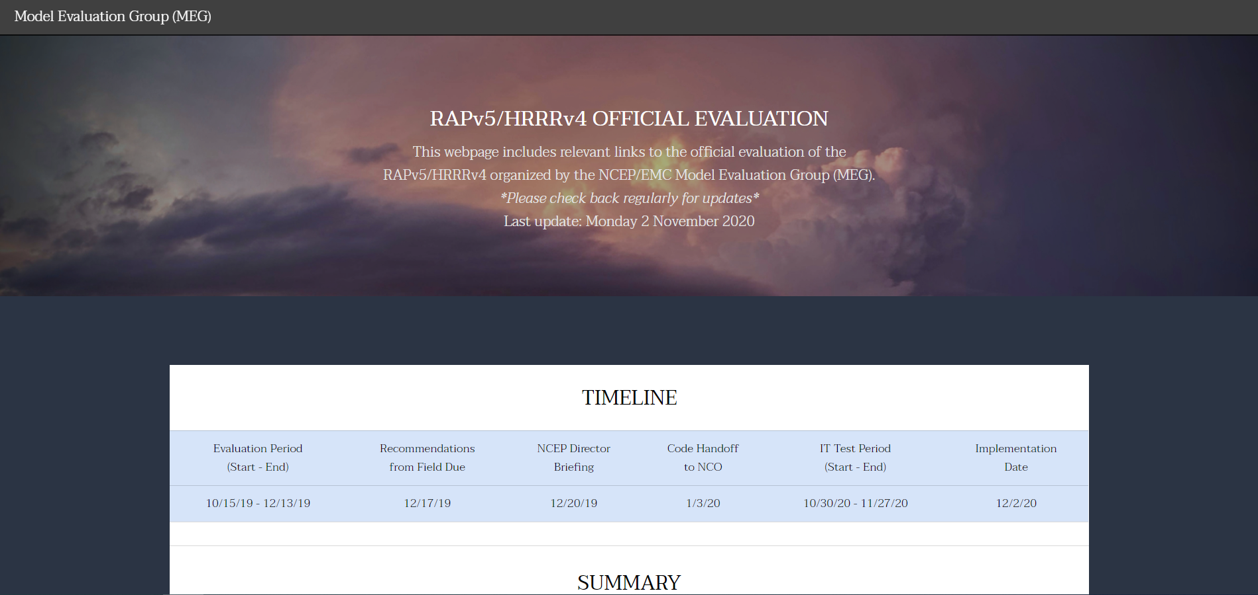
NATIONAL OCEANIC AND ATMOSPHERIC ADMINISTRATION
RAPv5/HRRRv4 Evaluation Webpage
https://www.emc.ncep.noaa.gov/users/meg/rapv5_hrrrv4/

Slide 5
NATIONAL OCEANIC AND ATMOSPHERIC ADMINISTRATION
RAPv5/HRRRv4 Strengths
More realistic cloud depiction and temps under cloud cover
Improved meteorology over small lakes / Great Lakes
Some benefits from HRRRDAS
Better handling of organized convective systems at longer ranges
Stronger updraft helicity signals
Better with instability forecasts along boundaries
Improvements due to explicit smoke prediction
Better depiction of hail threat

Slide 6
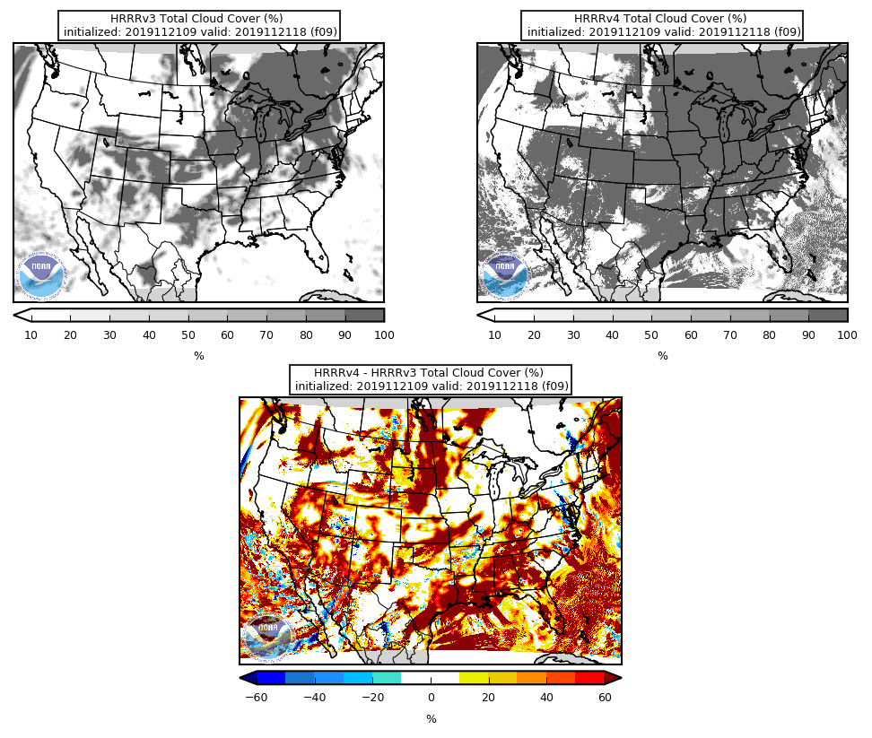
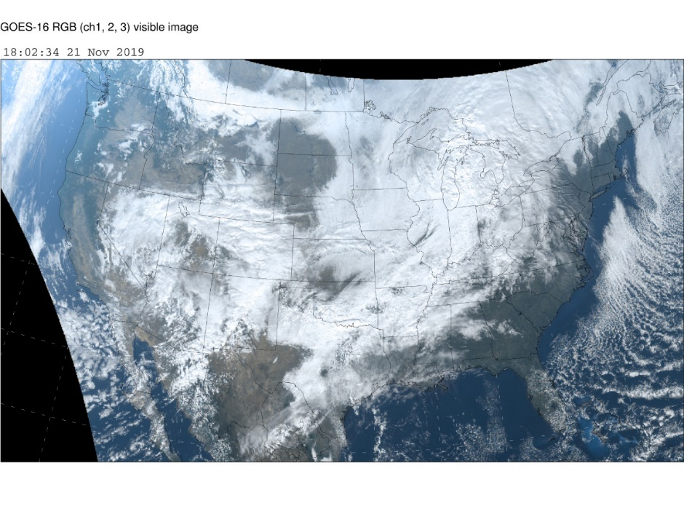
NATIONAL OCEANIC AND ATMOSPHERIC ADMINISTRATION
More Realistic Cloud Depiction
Init: 09Z 11/21/2019
Valid: 18Z 11/21/2019 (F09)
Compared to satellite image, HRRRv4 represents total cloud cover better than HRRRv3
Result of better retention of shallow clouds/cloudy air masses & sub-grid changes
HRRRv3
HRRRv4
v4 − v3

Slide 7
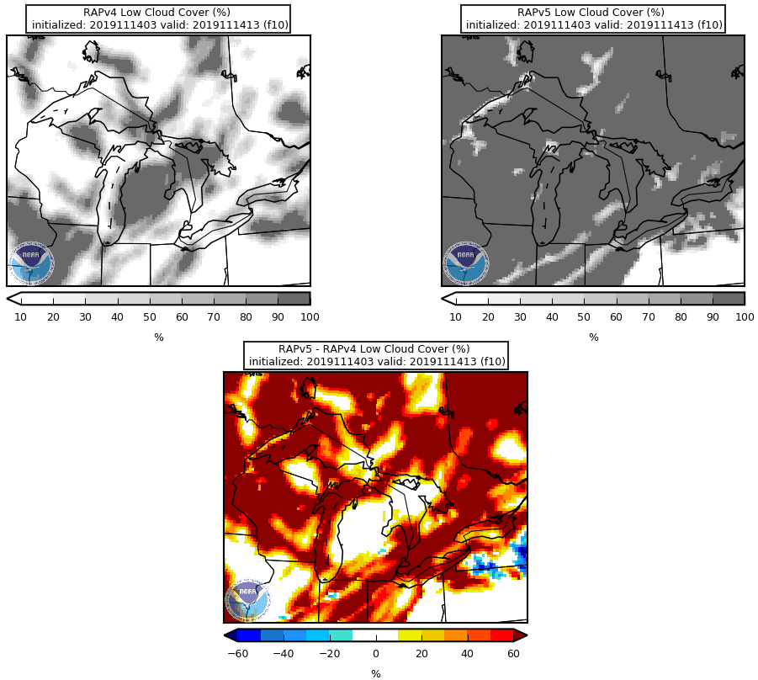
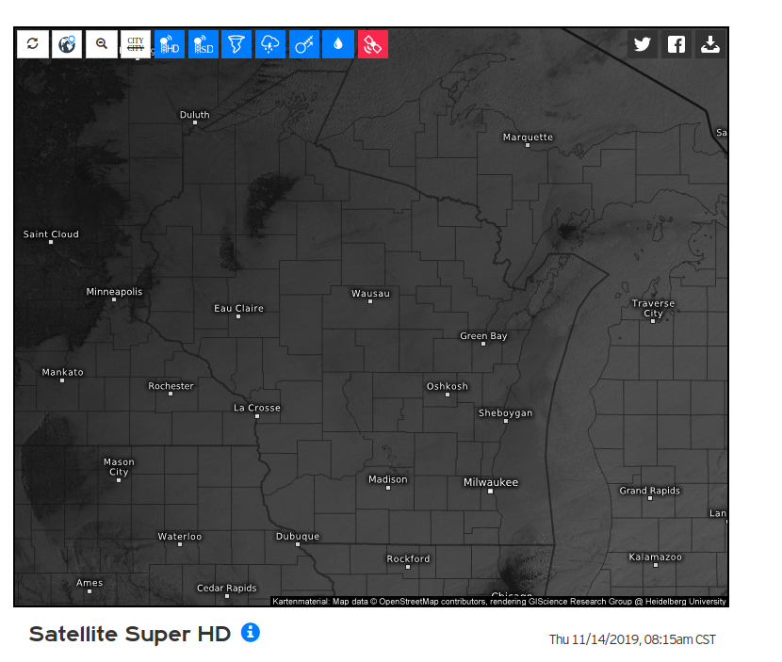
NATIONAL OCEANIC AND ATMOSPHERIC ADMINISTRATION
More Realistic Temps Under Cloud Cover
Init: 03Z 11/14/2019
Valid: 13Z 11/14/2019 (F10)
RAPv5 correctly predicts more low-level clouds than RAPv4, leading to
warmer/more correct surface temps
RAPv4
RAPv5
v5 − v4

Slide 8
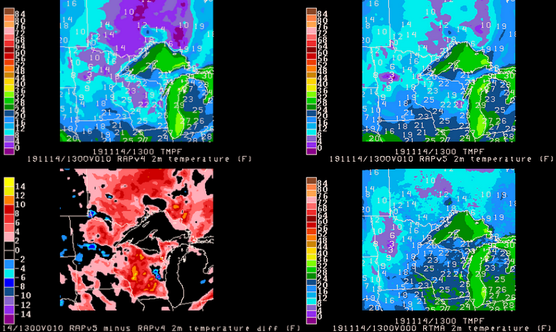
NATIONAL OCEANIC AND ATMOSPHERIC ADMINISTRATION
More Realistic Temps Under Cloud Cover
Init: 03Z 11/14/2019
Valid: 13Z 11/14/2019 (F10)
RAPv4
RAPv5
RAPv5 temps are closer to observed
in WI
v5 − v4
RTMA
ANL

Slide 9
NATIONAL OCEANIC AND ATMOSPHERIC ADMINISTRATION
RAPv5/HRRRv4 Strengths
More realistic cloud depiction and temps under cloud cover
Improved meteorology over small lakes / Great Lakes
Some benefits from HRRRDAS
Better handling of organized convective systems at longer ranges
Stronger updraft helicity signals
Better with instability forecasts along boundaries
Improvements due to explicit smoke prediction
Better depiction of hail threat

Slide 10
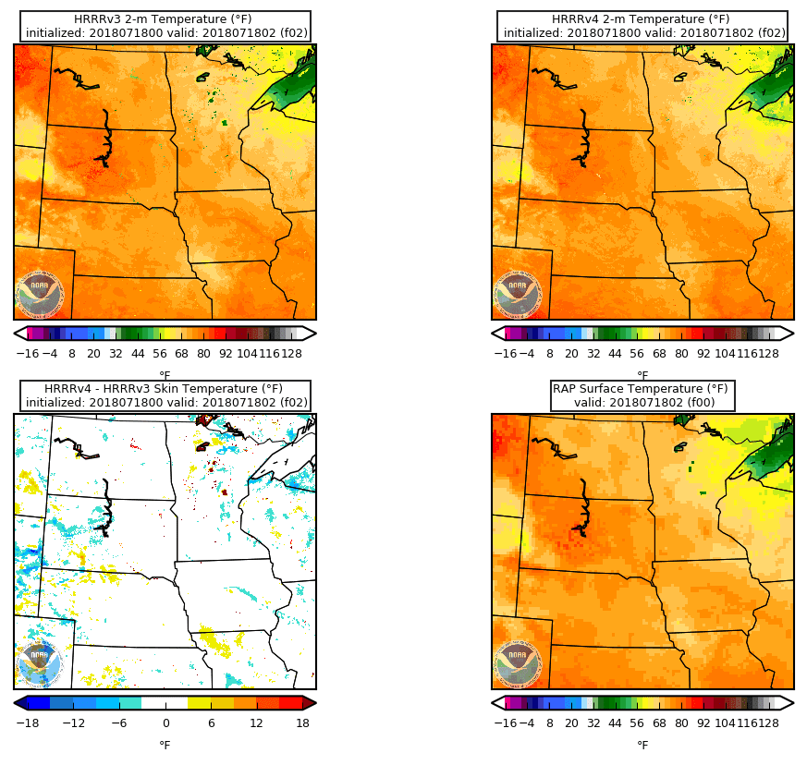
NATIONAL OCEANIC AND ATMOSPHERIC ADMINISTRATION
Better Temps for Small Lakes
Init: 00Z 7/18/2018
Valid: 02Z 7/18/2018 (F02)
A lake model was added to address the well-known cold bias for small lakes in HRRRv3
Small lakes are clearly and correctly much warmer in HRRRv4
HRRRv3
HRRRv4
v4 − v3

Slide 11
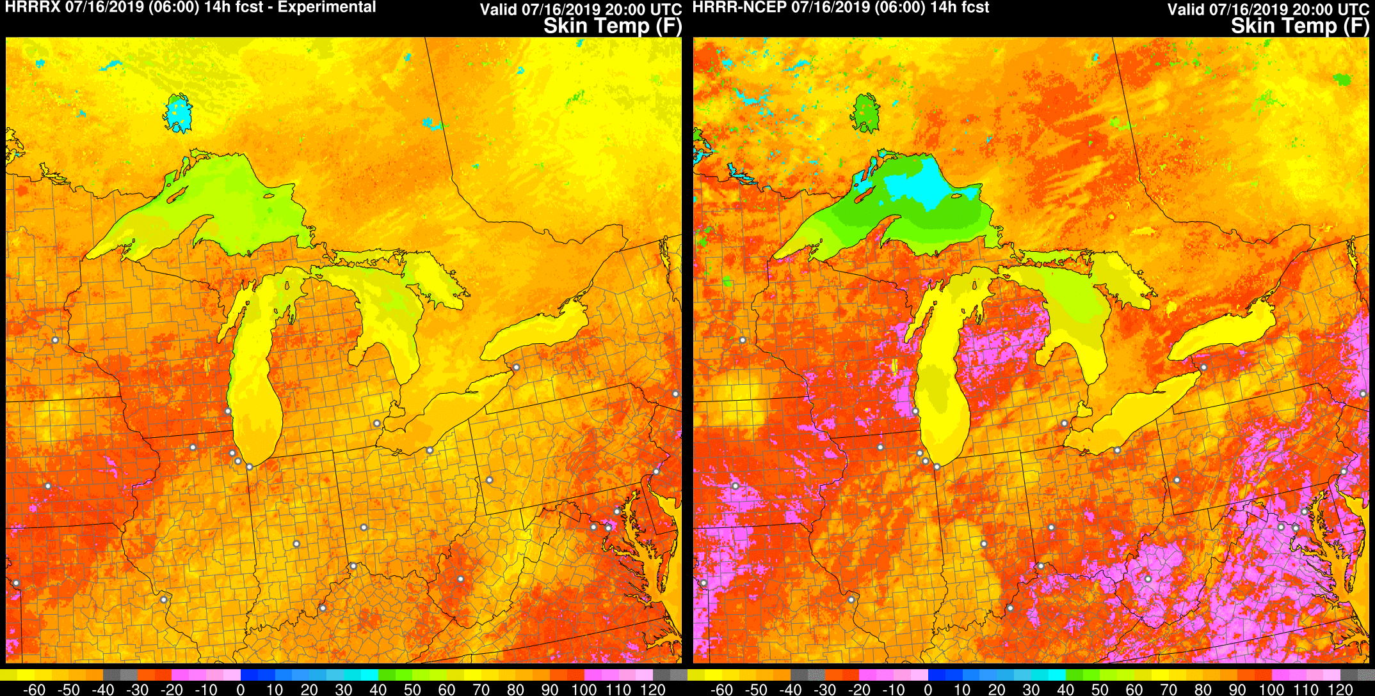
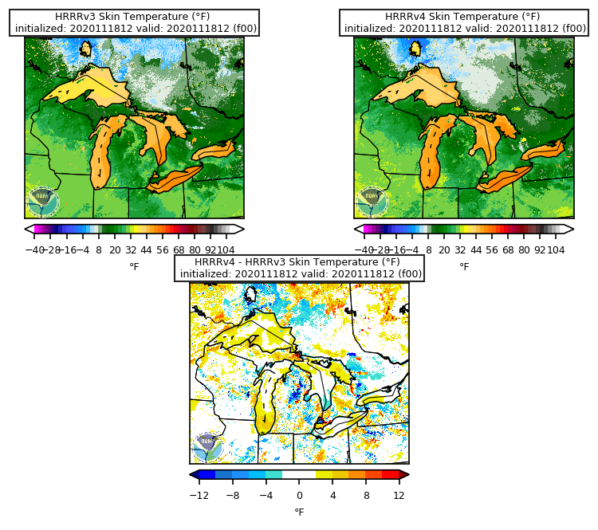
NATIONAL OCEANIC AND ATMOSPHERIC ADMINISTRATION
Improved Meteorology over Great Lakes
FVCOM-based Great Lake temperatures in HRRRv4 (HRRRX) (ESRL-GLERL collaboration)
HRRRv4
HRRRv3
HRRRv3
HRRRv4
v4 − v3
Great Lakes are mostly warmer in HRRRv4 during current cool season
Init: 06Z 7/16/2019
Valid: 20Z 7/16/2019 (F14)
11

Slide 12


NATIONAL OCEANIC AND ATMOSPHERIC ADMINISTRATION
Improved Meteorology over Great Lakes
HRRR vs HRRRx | Wind Evaluation at Buoys in Lake Superior
HRRRv4 shows improvement in Great Lake wind speeds during high wind events
HRRRv4 shows lower-biased wind speeds at low winds as compared to HRRRv3
Obs
HRRRv3
HRRRv4
12

Slide 13
NATIONAL OCEANIC AND ATMOSPHERIC ADMINISTRATION
Improved Meteorology over Great Lakes
HRRRv3
HRRRv4
HRRRv3
HRRRv4
v4 − v3
v4 − v3
Init: 12Z 12/4/2019
Valid: 21Z 12/4/2019 (F09)
Init: 12Z 12/4/2019
Valid: 12Z 12/5/2019 (F24)
Larger QPF downstream
of Great Lakes in HRRRv4
13
See 19 Nov 20 MEG Presentation for more on RAPv5/HRRRv4 Winter Wx Forecasts

Slide 14
NATIONAL OCEANIC AND ATMOSPHERIC ADMINISTRATION
RAPv5/HRRRv4 Strengths
More realistic cloud depiction and temps under cloud cover
Improved meteorology over small lakes / Great Lakes
Some benefits from HRRRDAS
Better handling of organized convective systems at longer ranges
Stronger updraft helicity signals
Better with instability forecasts along boundaries
Improvements due to explicit smoke prediction
Better depiction of hail threat

Slide 15
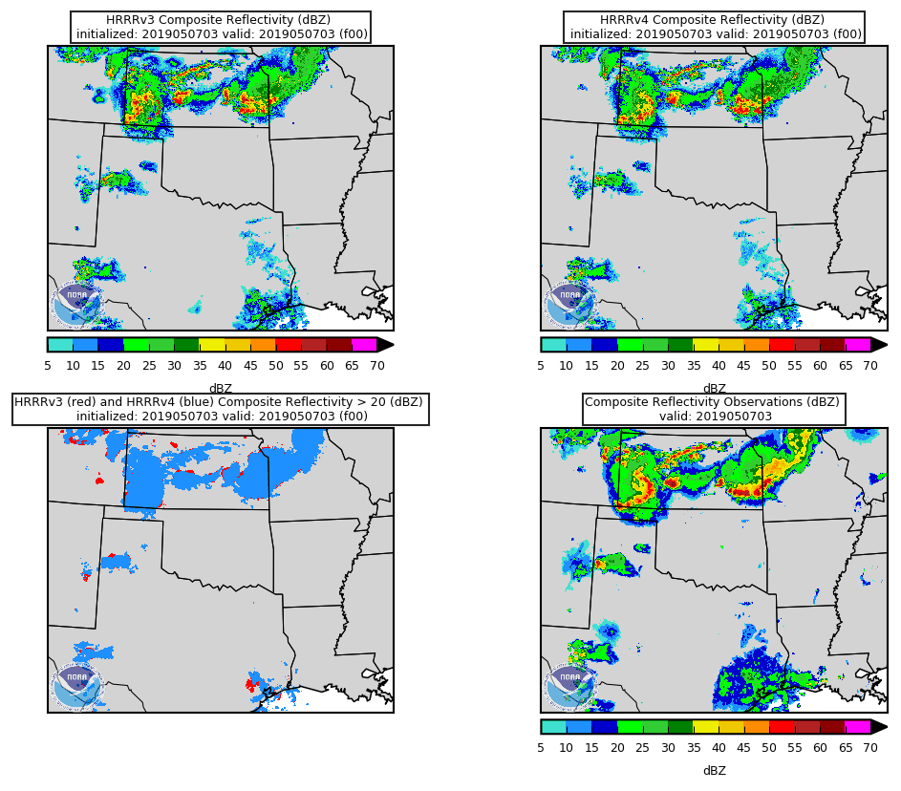
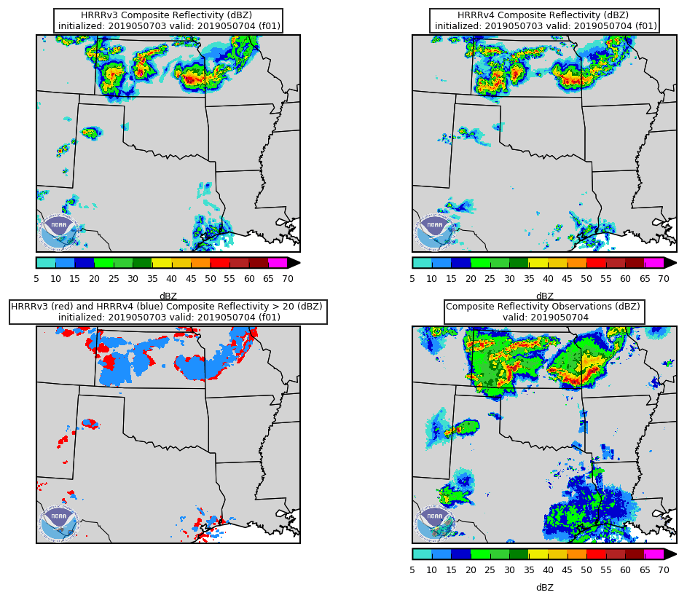
NATIONAL OCEANIC AND ATMOSPHERIC ADMINISTRATION
Some Benefits from HRRRDAS
Init: 03Z 5/7/2019
Valid: 03-04Z 5/7/2019 (F00-01)
HRRRv4, with HRRRDAS, clearly does a better job initializing the convection in KS than HRRRv3
Resulting 1-hr forecast is also improved
HRRRv3
HRRRv4
Obs
HRRRv3
HRRRv4
Obs
15

Slide 16
NATIONAL OCEANIC AND ATMOSPHERIC ADMINISTRATION
RAPv5/HRRRv4 Strengths
More realistic cloud depiction and temps under cloud cover
Improved meteorology over small lakes / Great Lakes
Some benefits from HRRRDAS
Better handling of organized convective systems at longer ranges
Stronger updraft helicity signals
Better with instability forecasts along boundaries
Improvements due to explicit smoke prediction
Better depiction of hail threat

Slide 17
NATIONAL OCEANIC AND ATMOSPHERIC ADMINISTRATION
Better Handling of MCSs at Longer Ranges
(top)
Init: 12Z 5/19/2019
Valid: 00Z 5/21/2019 (F36)
(bottom)
Init: 00Z 5/6/2019
Valid: 00Z 5/7/2019 (F24)
HRRRv3
HRRRv4
Obs
HRRRv3 has distinct cells in central OK, which are correctly removed in HRRRv4
HRRRv4 is better with a more organized MCS impacting the Kansas City metro area
HRRRv3
HRRRv4
Obs
17

Slide 18
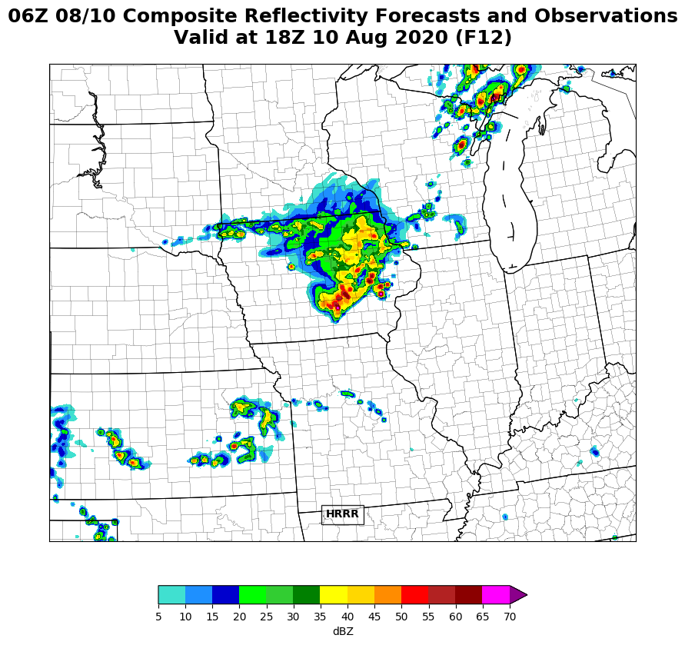
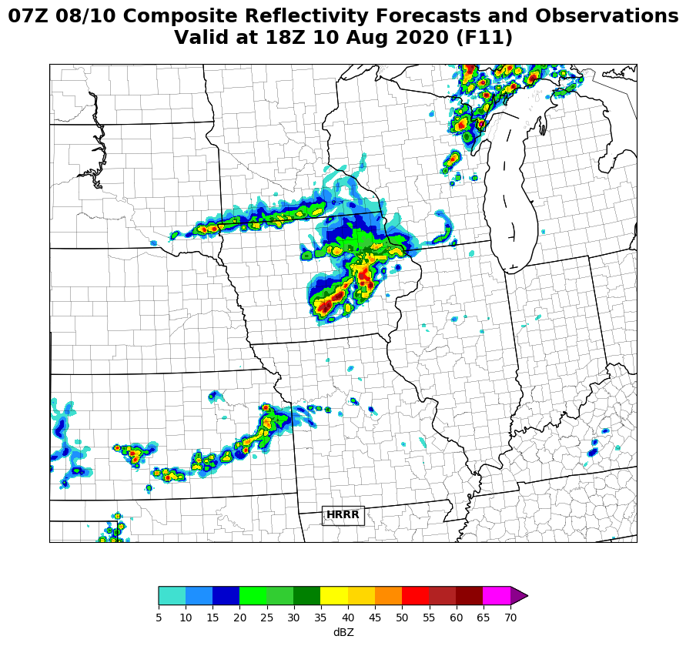
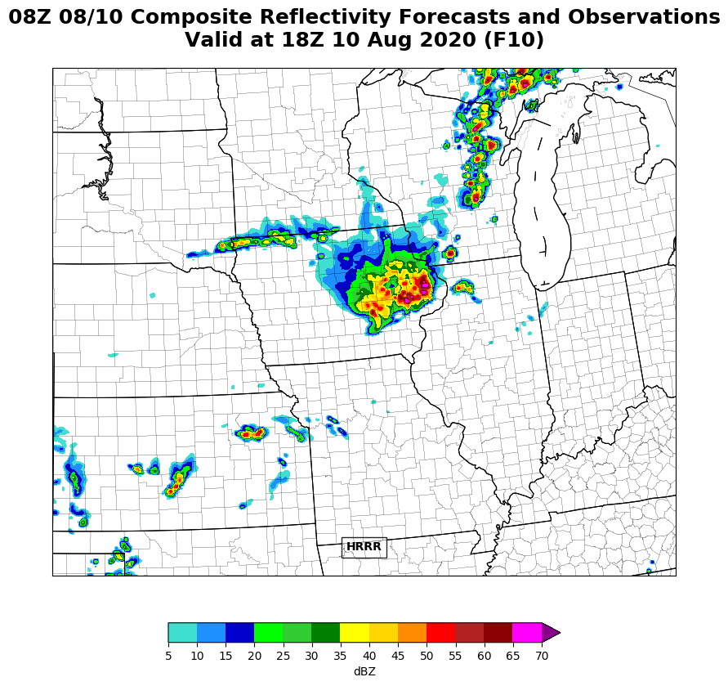
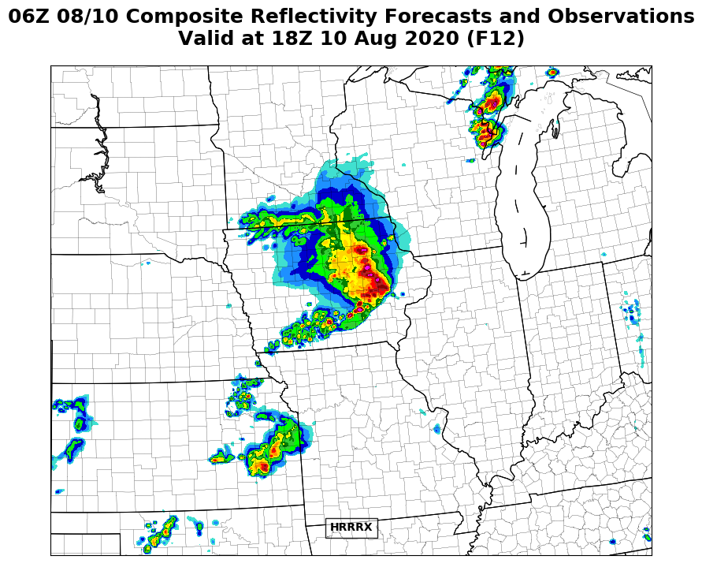
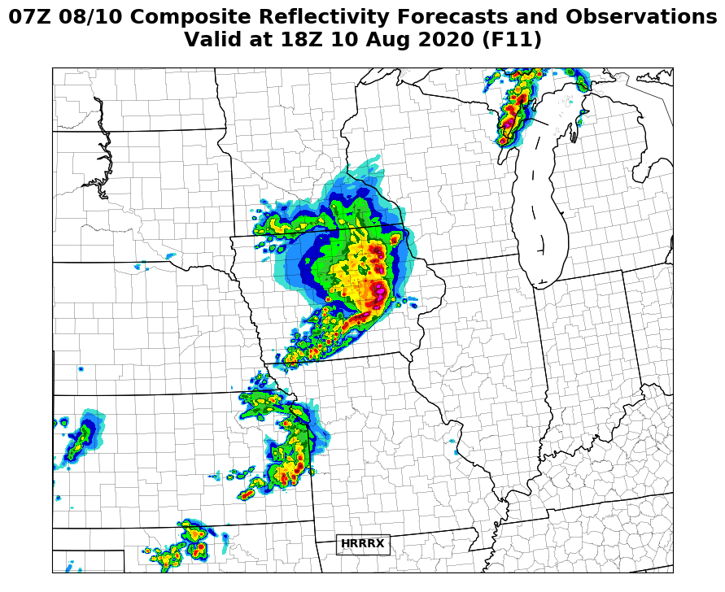
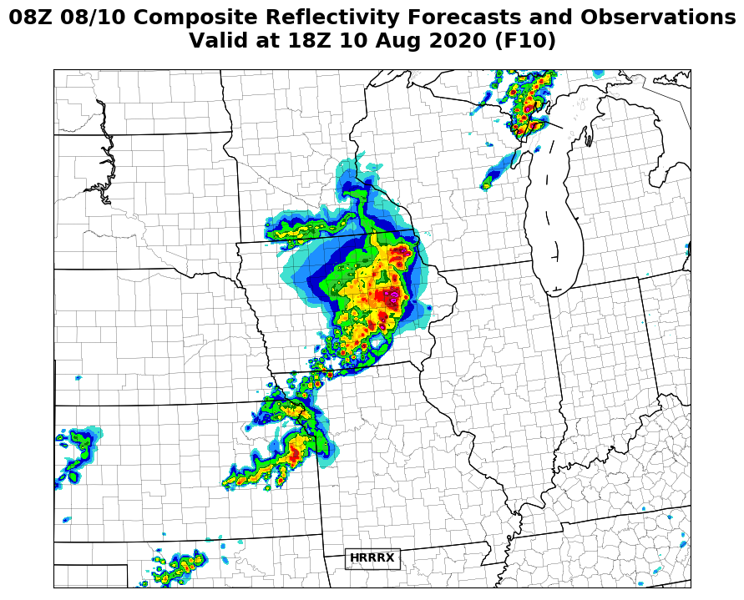
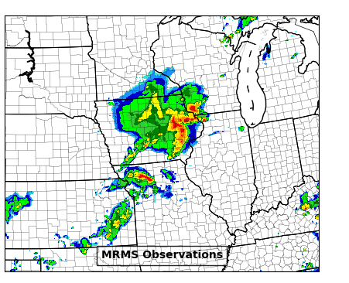
NATIONAL OCEANIC AND ATMOSPHERIC ADMINISTRATION
Iowa Derecho: 06-08Z HRRRv3 vs HRRRv4
Valid: 18Z 8/10/20
HRRRv4 consistently shows more of an organized system with bow echo characteristics, although, HRRRv4 is consistently too slow for this event
HRRRv3
HRRRv4
18

Slide 19
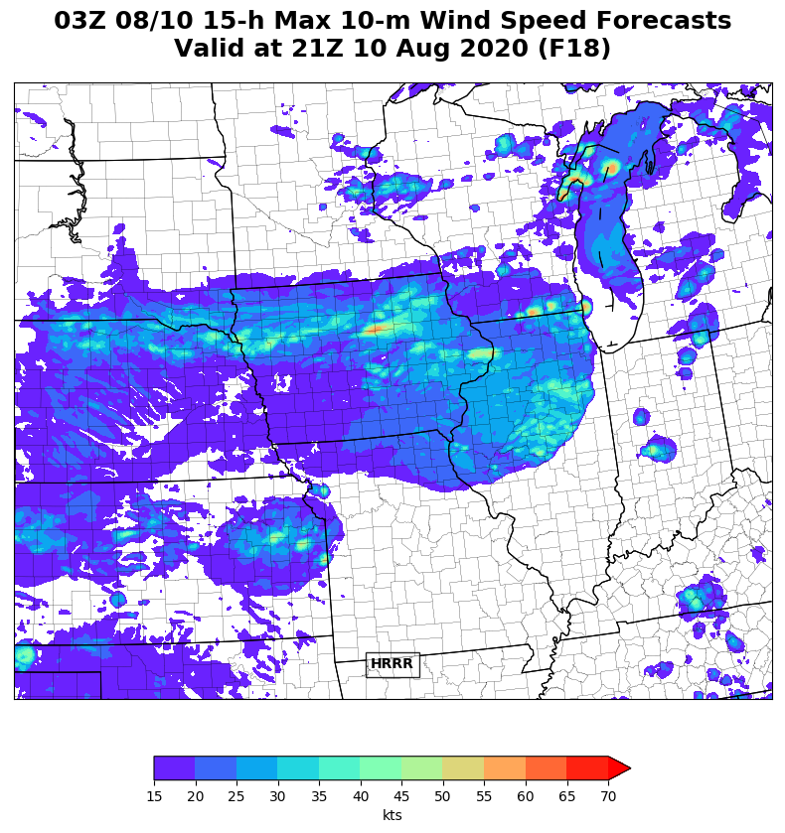
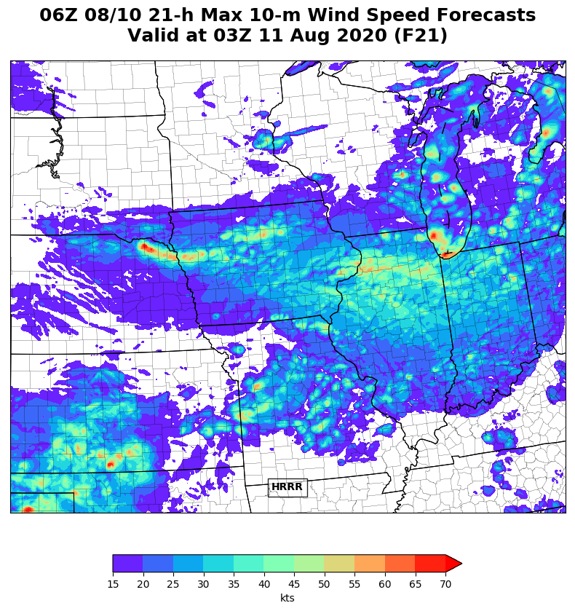
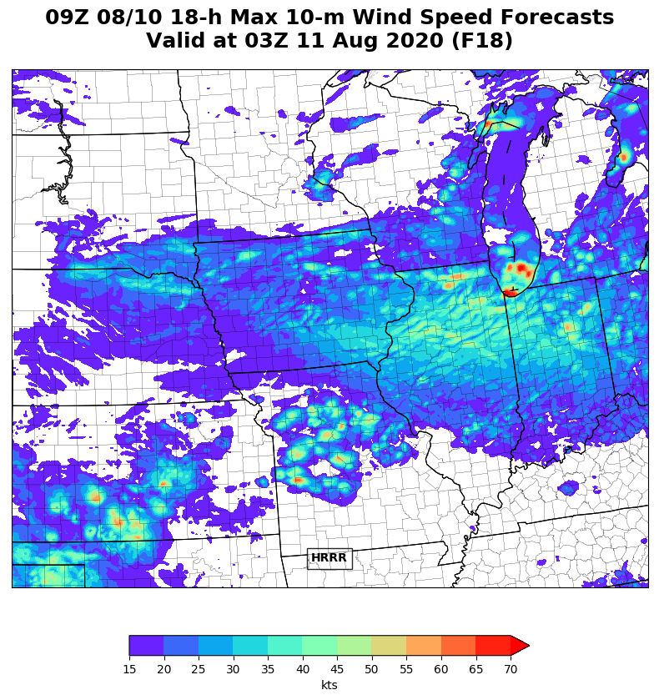
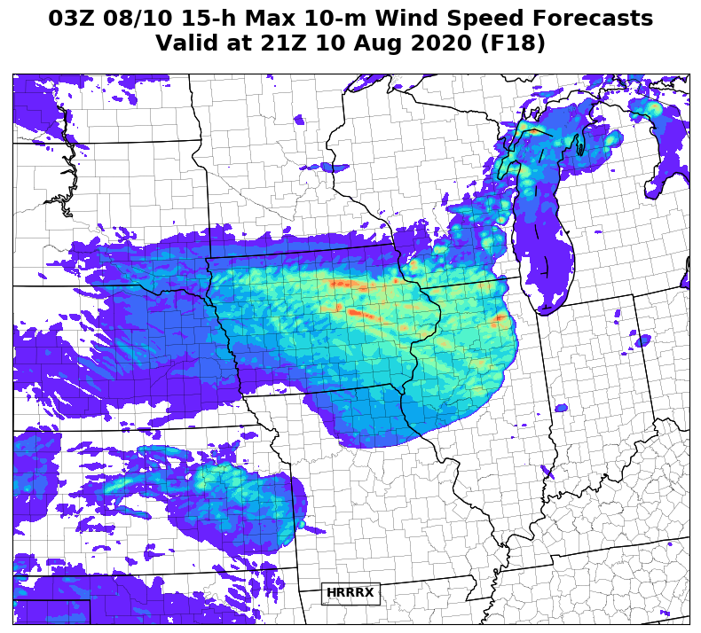
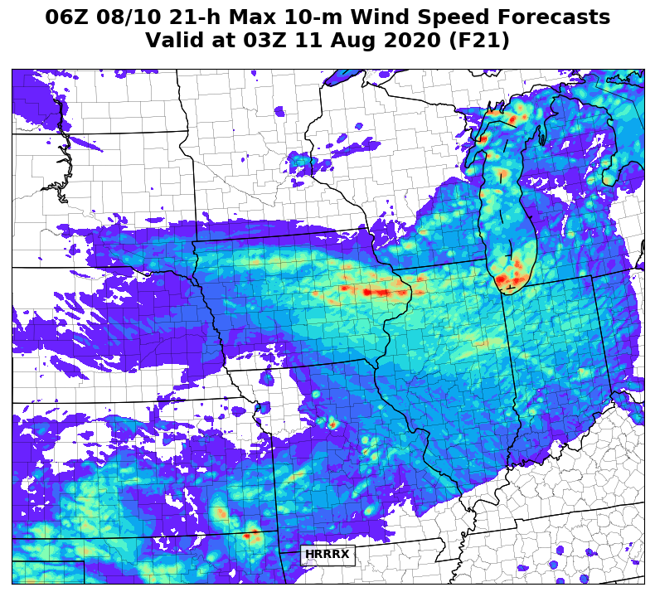
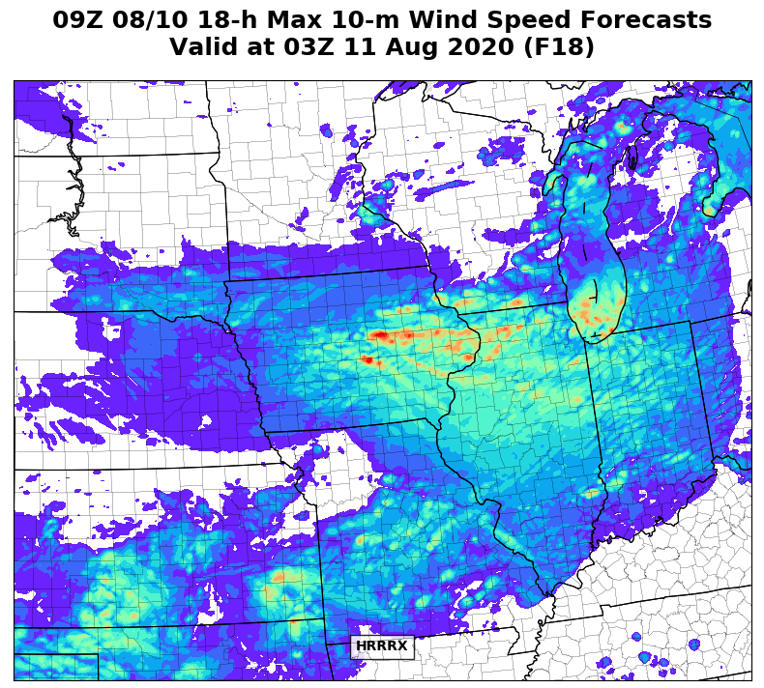
NATIONAL OCEANIC AND ATMOSPHERIC ADMINISTRATION
Iowa Derecho: HRRRv3 vs HRRRv4 Wind Swaths
03z
06z
09z
Init: 03-09Z 8/10/20
The HRRRv4 wind solutions correctly have (1) stronger overall winds and more coverage further east; (2) stronger winds starting earlier in the system’s life over central IA; (3) narrow corridors of very intense winds over eastern IA
Would like to see HRRRv4 predict stronger winds extending east into Chicago metro and IN
HRRRv3
Valid 03-21z
Valid 06-03z
Valid 09-03z
HRRRv4
19
See 29 Oct 20 MEG Presentation for more on Iowa Derecho model performance

Slide 20
NATIONAL OCEANIC AND ATMOSPHERIC ADMINISTRATION
RAPv5/HRRRv4 Strengths
More realistic cloud depiction and temps under cloud cover
Improved meteorology over small lakes / Great Lakes
Some benefits from HRRRDAS
Better handling of organized convective systems at longer ranges
Stronger updraft helicity signals
Better with instability forecasts along boundaries
Improvements due to explicit smoke prediction
Better depiction of hail threat

Slide 21
NATIONAL OCEANIC AND ATMOSPHERIC ADMINISTRATION
Stronger Updraft Helicity Signals
Init: 12Z 5/19/2019
Valid: 00Z 5/21/2019 (F36)
HRRRv3
HRRRv4
Plenty of retro cases showed
stronger UH signals in HRRRv4
(as intended)
Difficult to verify, but there were examples in which strong HRRRv4 UH tracks were associated with storm reports
v4 − v3
21

Slide 22
NATIONAL OCEANIC AND ATMOSPHERIC ADMINISTRATION
RAPv5/HRRRv4 Strengths
More realistic cloud depiction and temps under cloud cover
Improved meteorology over small lakes / Great Lakes
Some benefits from HRRRDAS
Better handling of organized convective systems at longer ranges
Stronger updraft helicity signals
Better with instability forecasts along boundaries
Improvements due to explicit smoke prediction
Better depiction of hail threat

Slide 23
NATIONAL OCEANIC AND ATMOSPHERIC ADMINISTRATION
Better Instability Forecasts Along Boundaries
Init: 00Z 5/20/2019
Valid: 00Z 5/21/2019 (F24)
HRRRv3
HRRRv4
Magnitude of CAPE is correctly reduced along boundaries in HRRRv4
v4 − v3
RAP ANL
23

Slide 24
NATIONAL OCEANIC AND ATMOSPHERIC ADMINISTRATION
RAPv5/HRRRv4 Strengths
More realistic cloud depiction and temps under cloud cover
Improved meteorology over small lakes / Great Lakes
Some benefits from HRRRDAS
Better handling of organized convective systems at longer ranges
Stronger updraft helicity signals
Better with instability forecasts along boundaries
Improvements due to explicit smoke prediction
Better depiction of hail threat

Slide 25
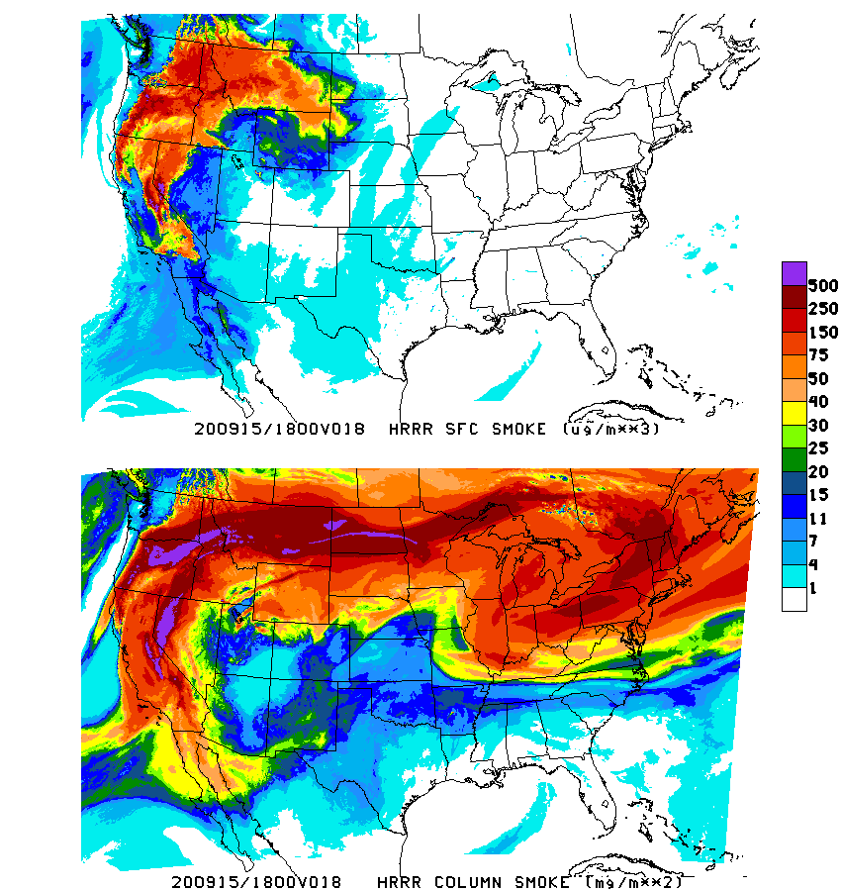
NATIONAL OCEANIC AND ATMOSPHERIC ADMINISTRATION
Improvements Due to Explicit Smoke Prediction
Init: 00Z 9/15/2020
Valid: 18Z 9/15/2020 (F18)
HRRR
Surface
Smoke
HRRRv4 shows a wide swath of smoke associated with the wildfires in CA and the Pacific Northwest
HRRR
Column
Smoke
25

Slide 26
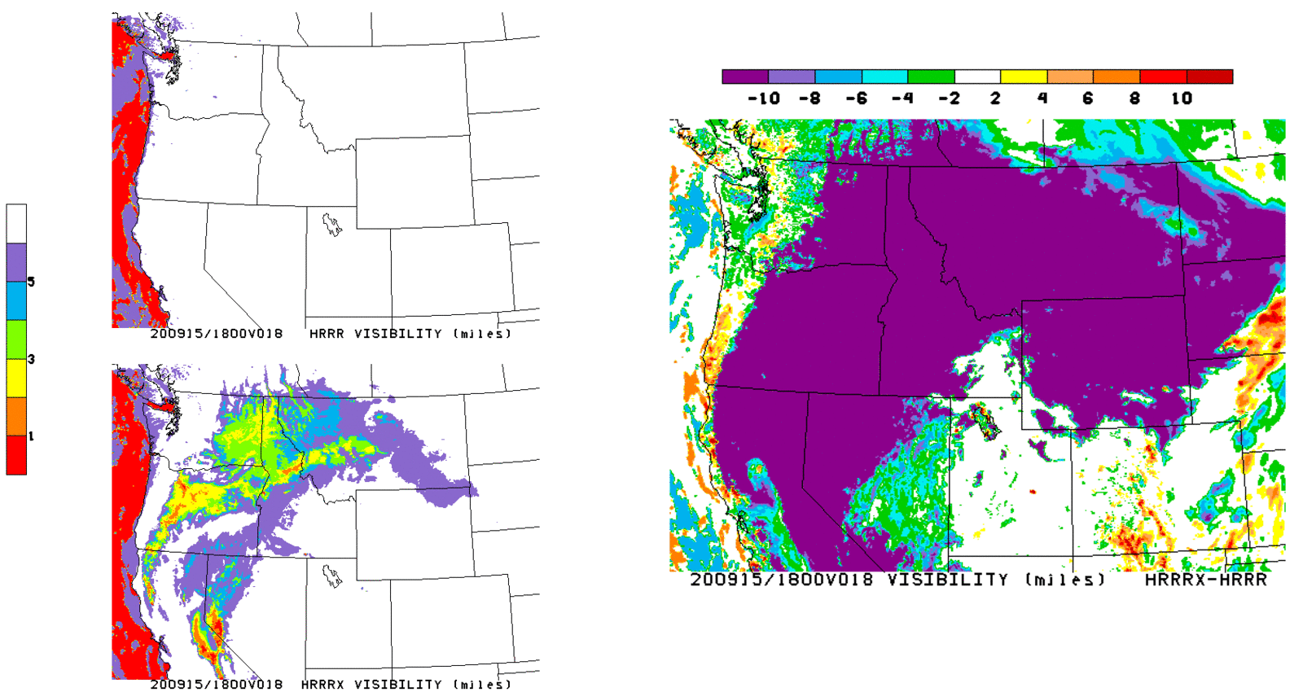
NATIONAL OCEANIC AND ATMOSPHERIC ADMINISTRATION
Improvements Due to Explicit Smoke Prediction
HRRRv3
Init: 00Z 9/15/2020
Valid: 18Z 9/15/2020 (F18)
HRRRv4 shows a wide swath of smoke associated with the wildfires in CA and the Pacific Northwest
HRRRv4 correctly shows lower visibility due to smoke, with HRRRv3 not showing any reduced visibility in the region
v4 − v3
HRRRv4
26

Slide 27
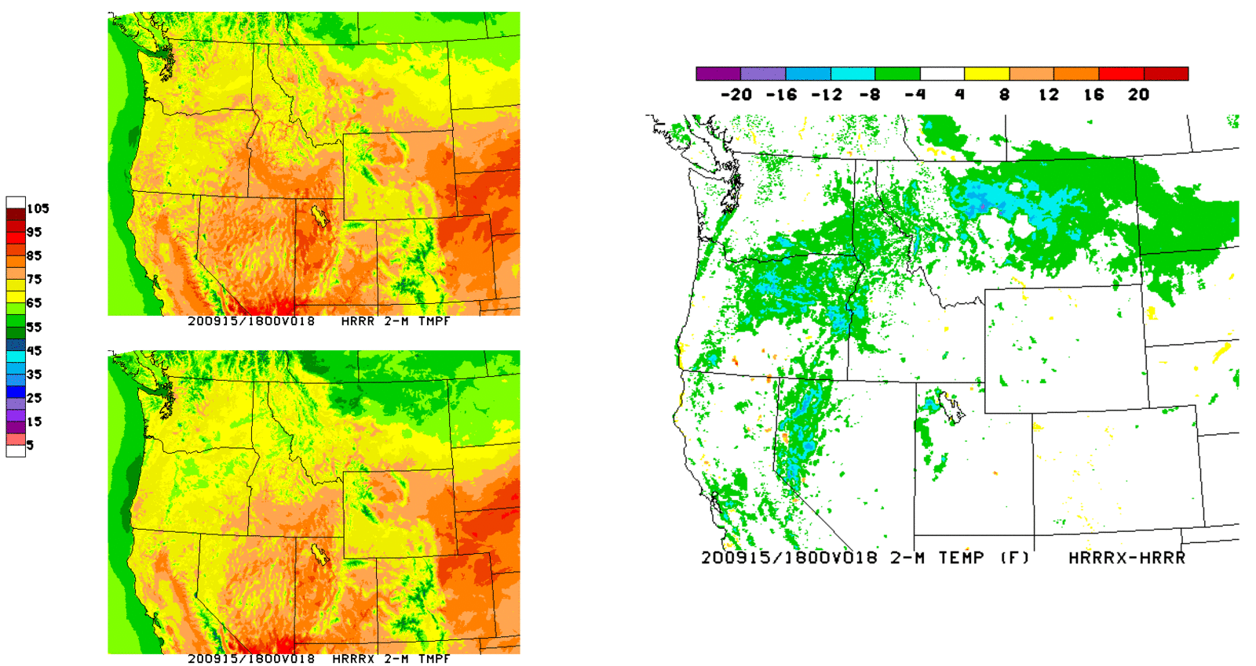
NATIONAL OCEANIC AND ATMOSPHERIC ADMINISTRATION
Improvements Due to Explicit Smoke Prediction
HRRRv3
Init: 00Z 9/15/2020
Valid: 18Z 9/15/2020 (F18)
HRRRv4 shows a wide swath of smoke associated with the wildfires in CA and the Pacific Northwest
HRRRv4 correctly shows lower visibility due to smoke, with HRRRv3 not showing any reduced visibility in the region
HRRRv4 also shows lower temps over much of the region compared to HRRRv3
v4 − v3
HRRRv4

Slide 28
NATIONAL OCEANIC AND ATMOSPHERIC ADMINISTRATION
RAPv4/HRRRv5 Strengths
More realistic cloud depiction and temps under cloud cover
Improved meteorology over small lakes / Great Lakes
Some benefits from HRRRDAS
Better handling of organized convective systems at longer ranges
Stronger updraft helicity signals
Better with instability forecasts along boundaries
Improvements due to explicit smoke prediction
Better depiction of hail threat

Slide 29
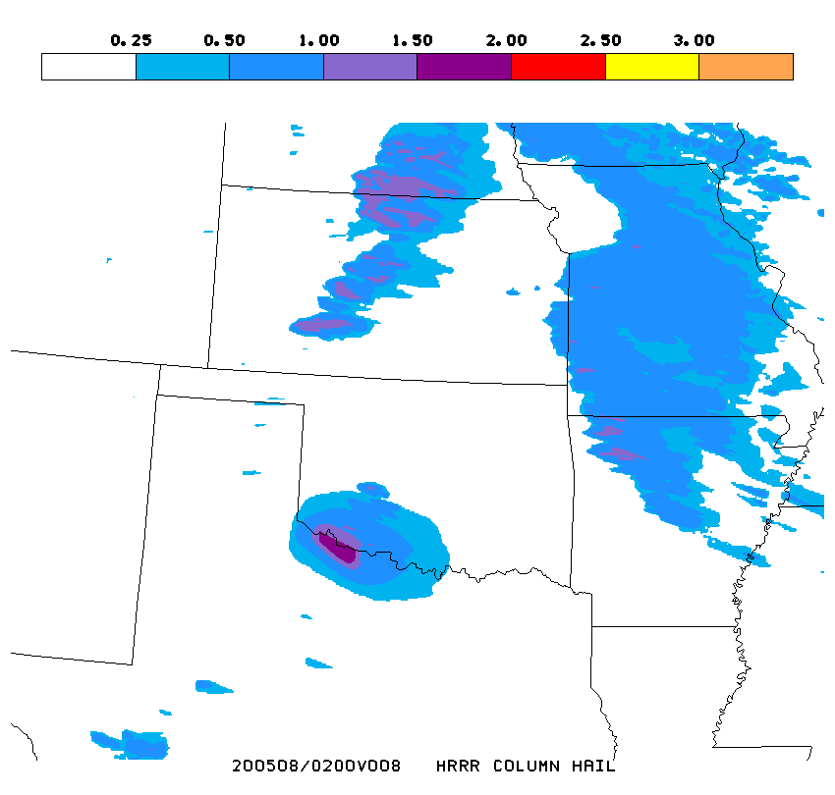
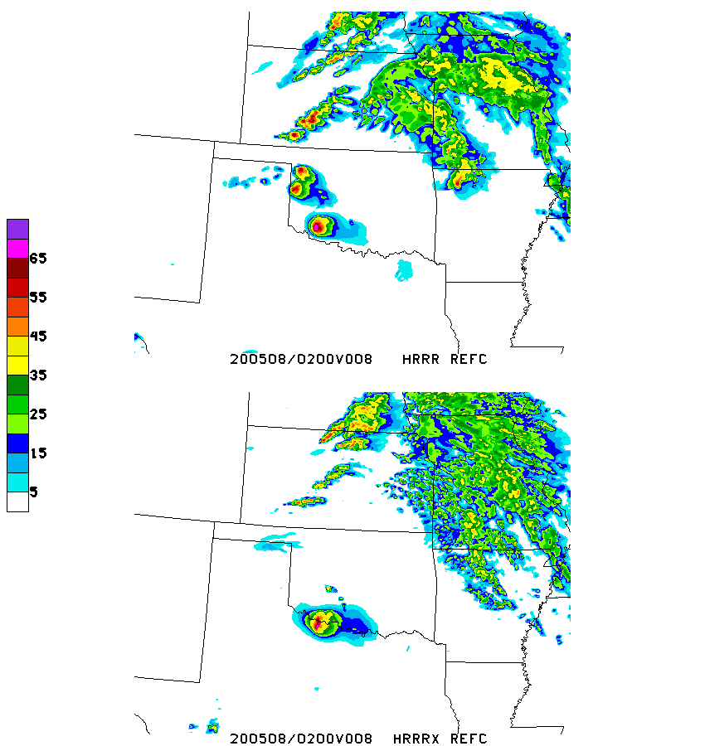
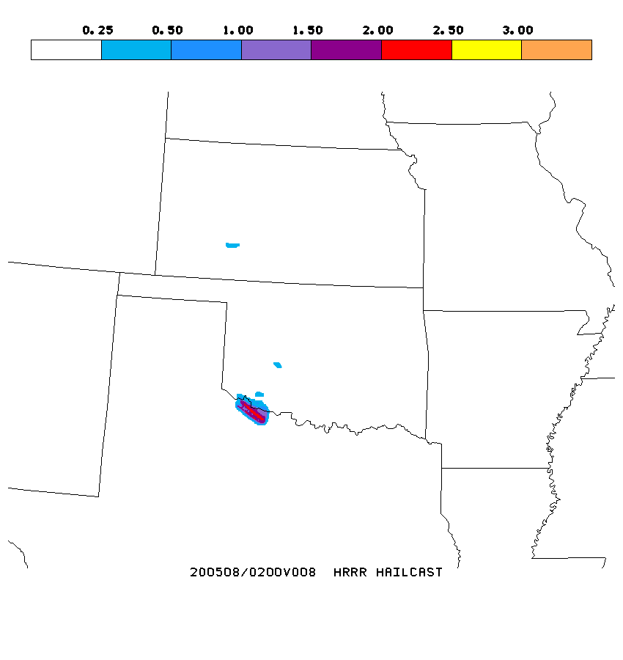
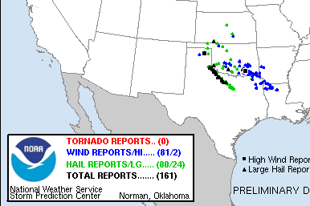
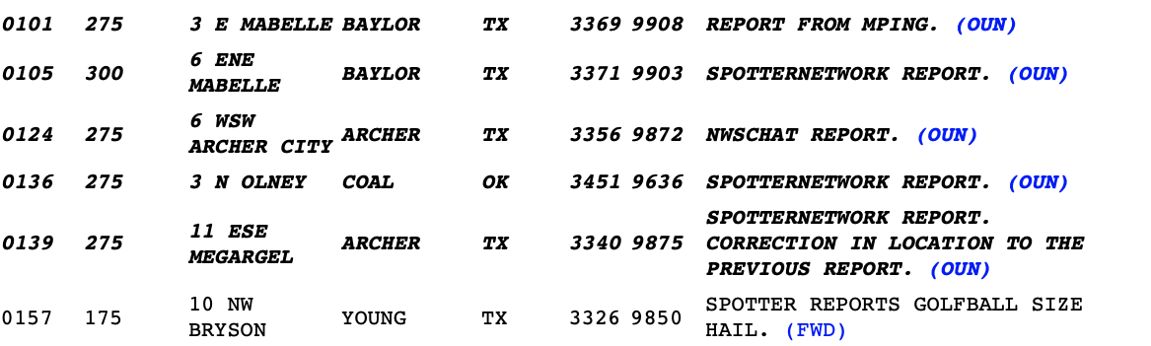
NATIONAL OCEANIC AND ATMOSPHERIC ADMINISTRATION
Better Depiction of Hail Threat
HRRRv4
Column
Hail
Init: 18Z 5/7/2020
Valid: 02Z 5/8/2020 (F08)
HRRRv4 HAILCAST product better shows significant hail threat in the Red River Valley
HRRRv4
Reflectivity
HRRRv4
HAILCAST
29

Slide 30
RAPv5/HRRRv4 Concerns
Delayed triggering of convection in HRRRv4
Late day low-level cool bias
Instability reduced in warm sector
Coverage of heavy QPF is too large in some spring events
Snow amounts can be too high, especially in the West
Large 2-m temperature errors when cloud cover is overdone
Increased high bias for ceiling and visibility
Low QPF bias in the West

Slide 31
Delayed Convective Triggering in HRRRv4
Obs
HRRRv3
HRRRv4
HRRRv4 was well behind HRRRv3 with triggering observed convection
HRRRv4 usually catches up to HRRRv3 evolution once initiation occurs

Slide 32
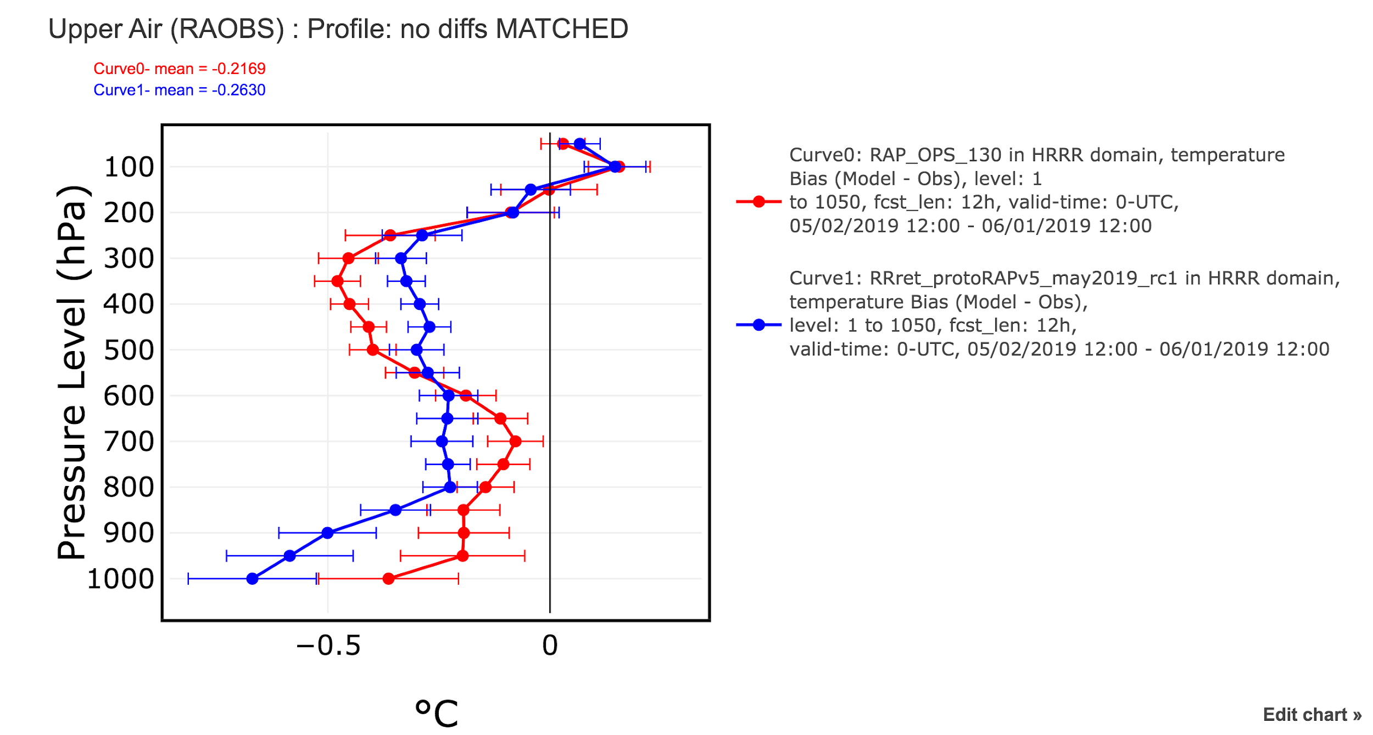
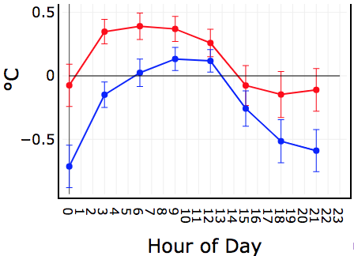
Late Day Low-Level Cool Bias
RAP: 1–31 May 2019
CONUS Temp Bias
East 2-m Temp Bias
12-h FCST Valid 00Z
RAPv4
RAPv5
Temps are colder throughout much of the lower troposphere
Bias is most pronounced in late afternoon and early evening

Slide 33
Cool Bias Leads to Low CAPE Bias
HRRRv3
HRRRv4
Surface-Based CAPE Forecasts
Init: 15Z 5/23/2019
Valid: 21Z 5/23/2019 (F06)
Instability (CAPE) was consistently and incorrectly reduced in warm sector, largely due to cooler low-level temps
v4 – v3
RAP ANL

Slide 34
Coverage of High QPF Is Too Large in Some Spring Events
HRRRv3
HRRRv4
HRRRv3
HRRRv4
12Z 5/23/19 36h FCST
VALID 00Z 5/25/19
12Z 5/1/19 36h FCST
VALID 00Z 5/3/19
v4 – v3
Stage IV
v4 – v3
Stage IV

Slide 35
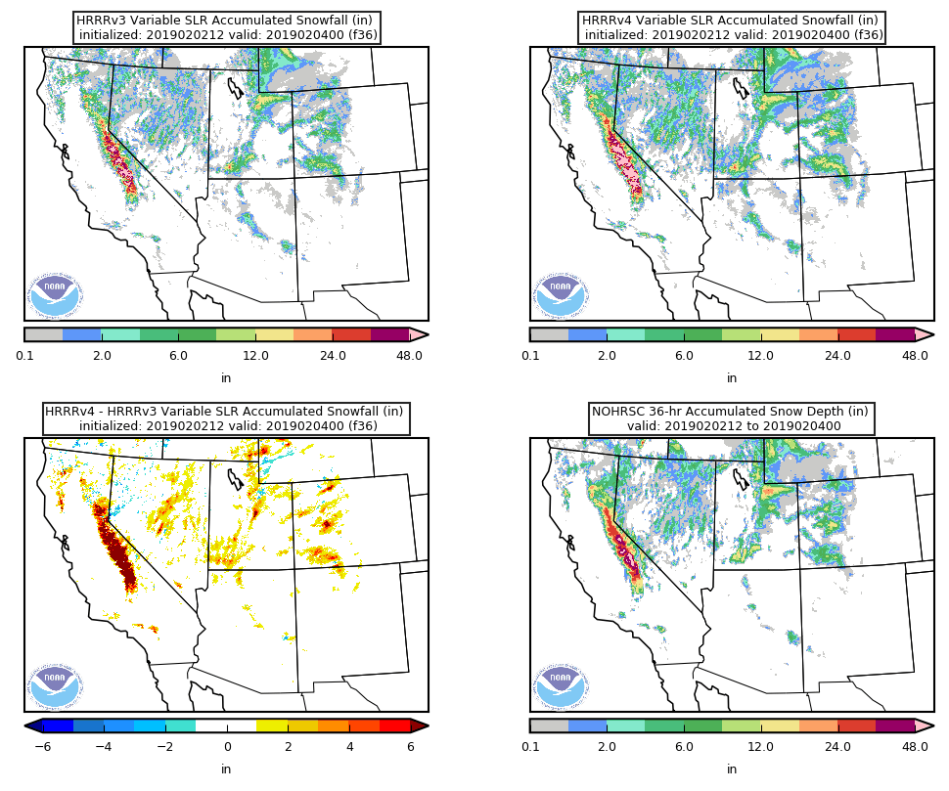
Snow Totals with New SLR Can Be Too High
HRRRv3
HRRRv4
HRRRv3
HRRRv4
12Z 2/2/19 36h FCST
VALID 00Z 2/4/19
12Z 2/11/19 36h FCST
VALID 00Z 2/13/19
v4 – v3
NOHRSC
v4 – v3
NOHRSC
HRRRv4 snow totals are largely improved with the new SLR (see 11/19/2020 MEG), but they are sometimes too high. It may be best to conclude that HRRRv4 simply provides a nice upper bound for snow totals.

Slide 36
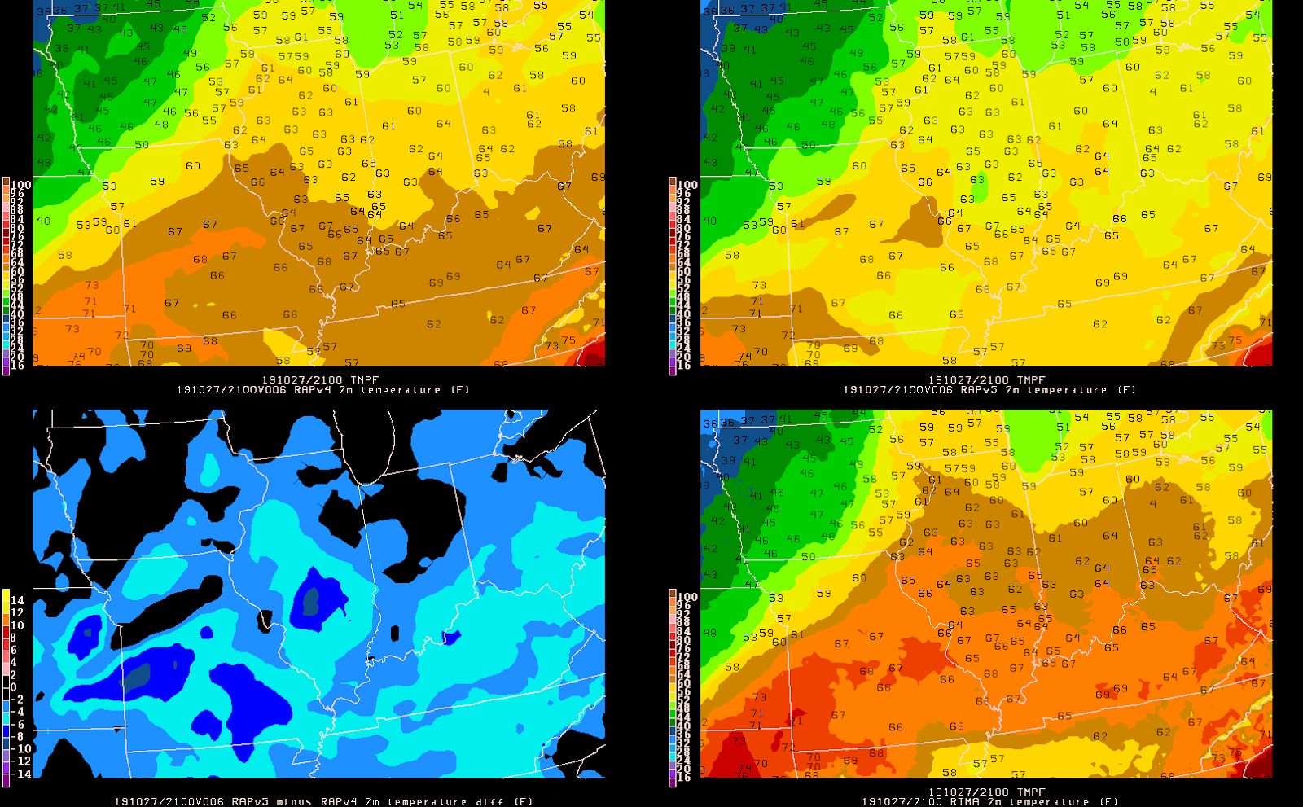
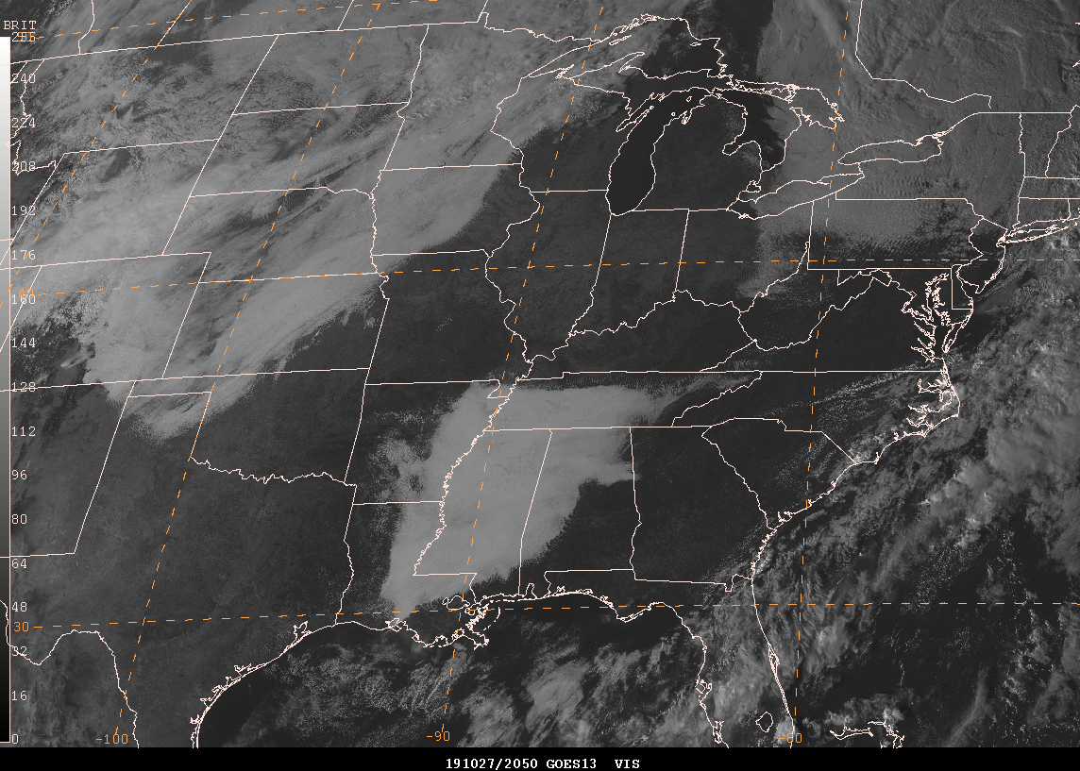
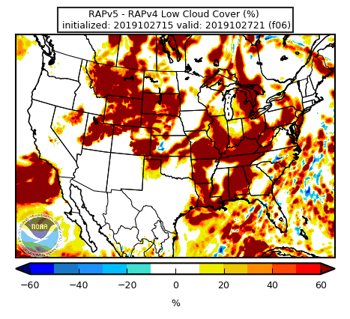
Temps Can Be Too Cold When Cloud Cover Is Overdone
Init: 15Z 10/27/2019 Valid: 21Z 10/27/2019 (F06)
RAPv4
RAPv5
v5 – v4
RTMA
ANL

Slide 37
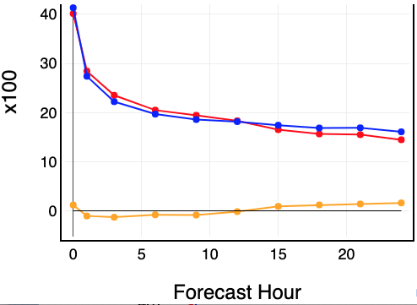
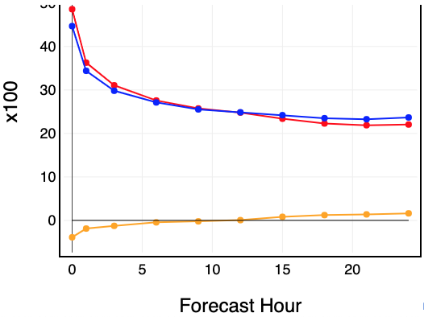
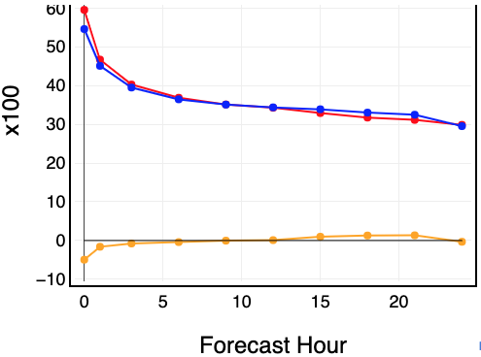
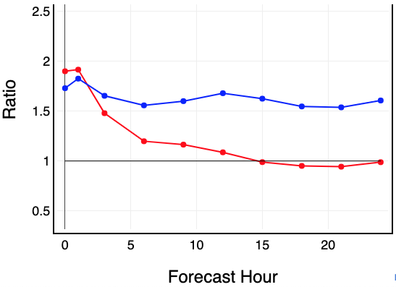
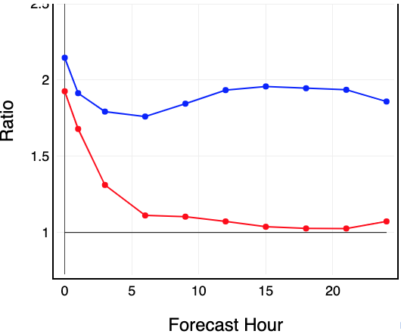
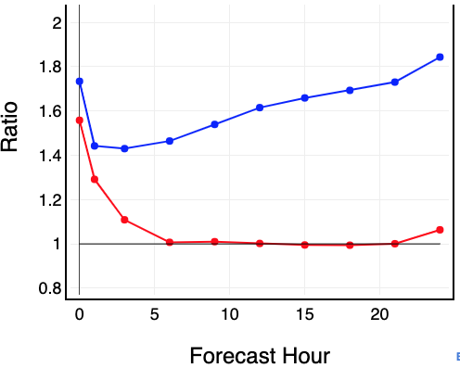
Increased High Bias for Ceilings and Visibility
RAP Ceiling: 15 Jul – 15 Aug 2018
< 500 ft
< 1000 ft
< 3000 ft
CSI
RAPv4
RAPv5
DIFF
FREQ BIAS

Slide 38
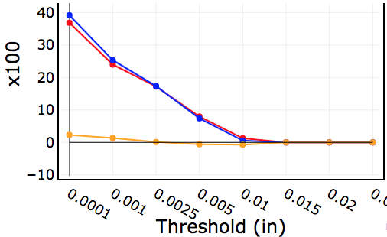
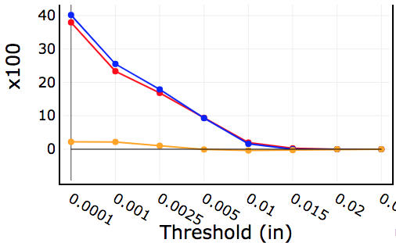
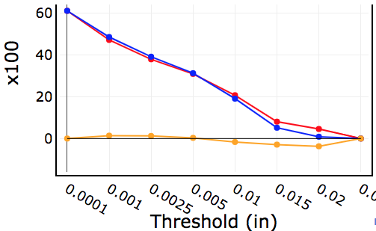
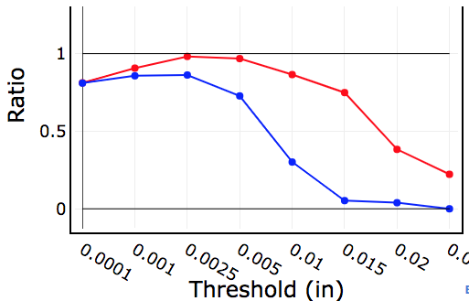
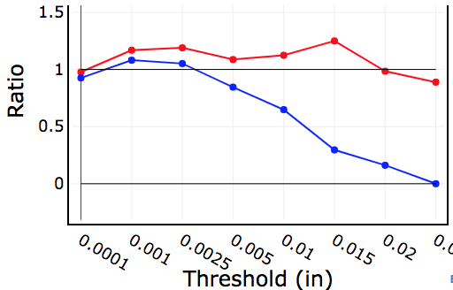
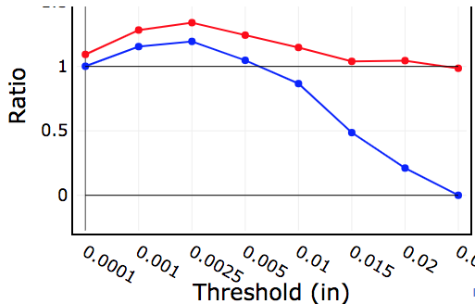
Low QPF Bias in the West
RAP QPF
1-h Total
6-h Total
12-h Total
CSI
0.01 0.1 0.25 0.5 1.0 1.5 2.0 3.0
Threshold (in)
0.01 0.1 0.25 0.5 1.0 1.5 2.0 3.0
Threshold (in)
0.01 0.1 0.25 0.5 1.0 1.5 2.0 3.0
Threshold (in)
RAPv4
RAPv5
DIFF
FREQ BIAS
0.01 0.1 0.25 0.5 1.0 1.5 2.0 3.0
Threshold (in)
0.01 0.1 0.25 0.5 1.0 1.5 2.0 3.0
Threshold (in)
0.01 0.1 0.25 0.5 1.0 1.5 2.0 3.0
Threshold (in)
Possible small sample size and other challenges of verifying QPF in the West
Did not see strong examples of this in the retro runs

Slide 39
Overall Impressions
The MEG believes the biggest benefits of this package are the overall improved handling of cloud cover, the improvements to the Great Lakes and small lake temperatures, benefits from the HRRRDAS, the stronger winds over water, general improvement in the sensible weather stats, and the treatment of smoke and new smoke output
There will be benefits to RTMA (especially with the small lakes), the NBM, and HREF (which will be able to use the forecast extensions in HREFv3)
More minor improvements include better winter simulated reflectivity, stronger updraft helicity signals, and better instability forecasts near boundaries
Based on formal recommendations at the end of the evaluation period, the field is extremely excited about the smoke output, improved handling of clouds, and the water temps for small lakes and Great Lakes

Slide 40
Overall Impressions
The MEG’s biggest concerns are further delayed triggering of convection (although this behavior is not consistent), given that the last HRRR upgrade (v3) also had some issues with delayed triggering, and the late day low-level cool bias which has implications for instability forecasts
Minor concerns include cloud cover sometimes being overpredicted leading to temperatures that are too cool along with a high bias for ceiling height, snow amounts that can be too high, and extremely high QPF in some spring cases
For more detailed information (including retrospective graphics, stats, and previous presentations), please visit the RAPv5/HRRRv4 Official Evaluation webpage:
https://www.emc.ncep.noaa.gov/users/meg/rapv5_hrrrv4

Slide 41
The Big Picture
This is the final RAP/HRRR upgrade; we will move to the FV3-based Rapid Refresh Forecast System (RRFS) in 3-4 years
HRRRv4 will be included as an additional member in HREFv3
Physics improvements and storm-scale ensemble data assimilation upgrades included in this implementation will be critical to the successful development of RRFS
Development of a RRFS prototype is already well underway with collaboration between EMC, GSL, and NSSL

Slide 42


Toward a Simpler, UFS-based Production Suite (notional)
Disclaimer: This is a plan; all decisions will be driven by evidence
42

