Slide 1
NATIONAL OCEANIC AND ATMOSPHERIC ADMINISTRATION
An Update on HREFv3 (and RAPv5/HRRRv4)
Geoff Manikin & Logan Dawson
EMC Model Evaluation Group Webinar
June 25, 2020

Slide 2
RAPv5/HRRRv4
Originally scheduled for implementation in late May
3 stability-related crashes during NCO IT testing; the parallels were suspended on June 11
2 crashes were in the HRRRDAS, and one was in the RAP
All were the result of numerical instability due to vertical velocities exceeding CFL criteria in or near deep moist convection in the lateral boundary region where the RAP (or HRRRDAS) interfaces with the GFS

Slide 3
RAPv5/HRRRv4 (cont.)
There have been crashes due to this issue in the operational RAP since the implementation of GFSv15 in June 2019
The GFDL microphysical scheme in the FV3-based GFS generates strong convective signals, relative to the ARW, which can lead to large discrepancies at the boundaries
The crashes result from large vertical velocities promoted from deep convection and a significant mismatch between the interior RAP and exterior GFS solutions
In operations, crashed cases are quickly successfully run by skipping the update to the boundaries
RAPv5 had modifications to address the boundary problems, but while these were successful in reducing the frequency of crashes, they did not eliminate them

Slide 4
Proposed Solution
Enable the Implicit-Explicit Vertical Advection (IEVA) scheme in RAPv5
Large vertical velocities for a given grid spacing and time step are managed implicitly to avoid a vertical CFL violation and resultant crash
The IEVA scheme has been in HRRRv4 (including the HRRRDAS) throughout the entire science evaluation

Slide 5
Improved Vertical Velocities in Convection Collaboration with NSSL
From previous
MEG presentations
during the RAPv5/HRRRv4
evaluation
HRRRv3
HRRRv4
4-h forecasts valid 2200 UTC 1 May 2018
Use of Implicit-Explicit Vertical Advection (IEVA) allows for:
Use of existing time-step (20s) while retaining stability
Removal of microphysics latent heating rate limiter
Prediction of more extreme vertical velocities in convection
Higher values of updraft-helicity
HRRRv3
HRRRv4
12-h forecasts valid 0600 UTC 2 May 2018
Slight change in precipitation

Slide 6
The Concern
A ”science change” that alters the characteristics of the model output would invalidate the science evaluation conducted last fall
There is a need to demonstrate that this proposed change does not affect the output in such a way
GSL has run a one-week RAPv5 parallel with the IEVA scheme activated to assess the scientific impact and has generated stats
The changes are overall small and generally confined to the boundary regions

Slide 7
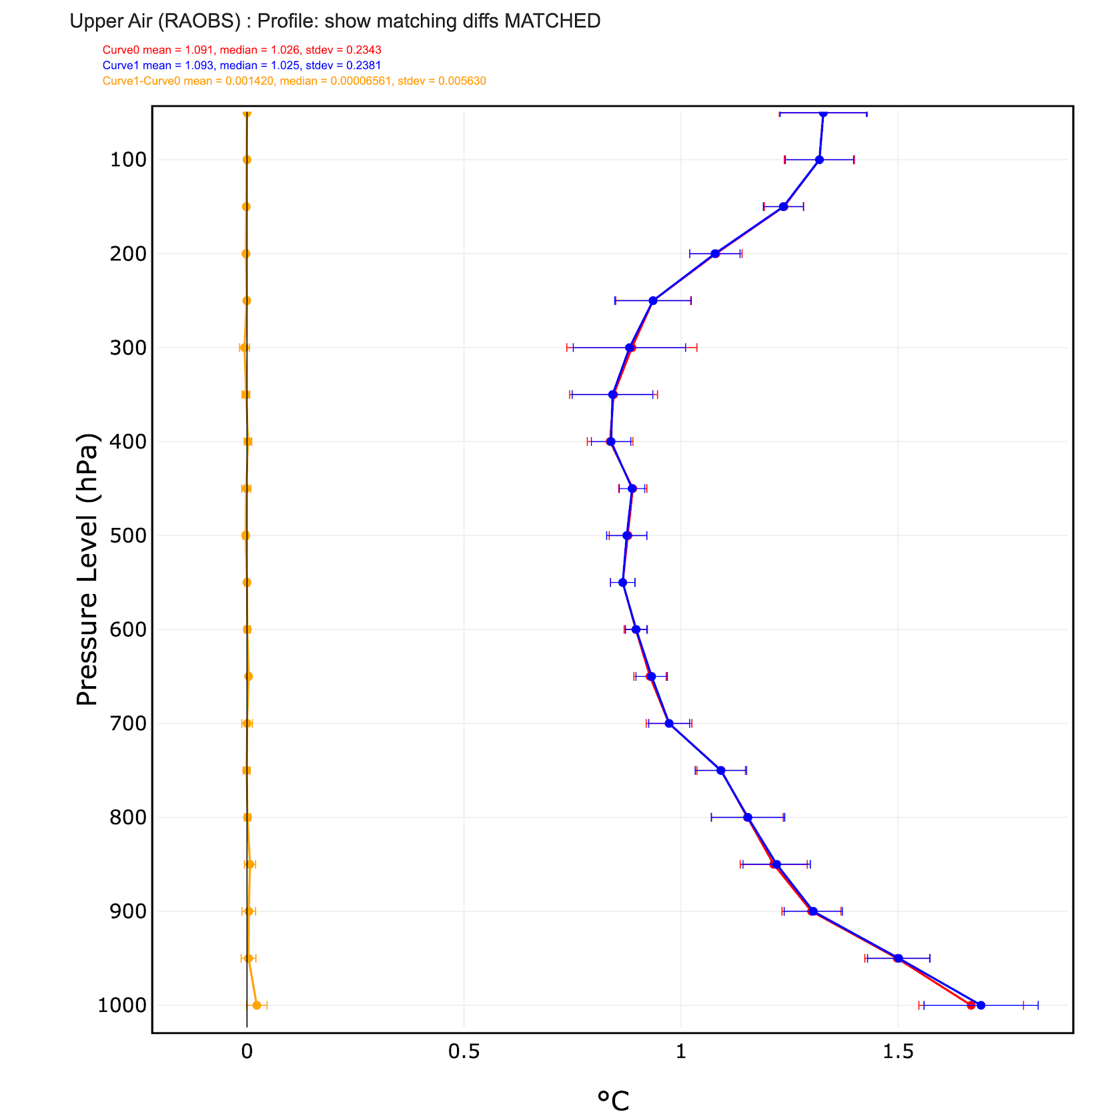
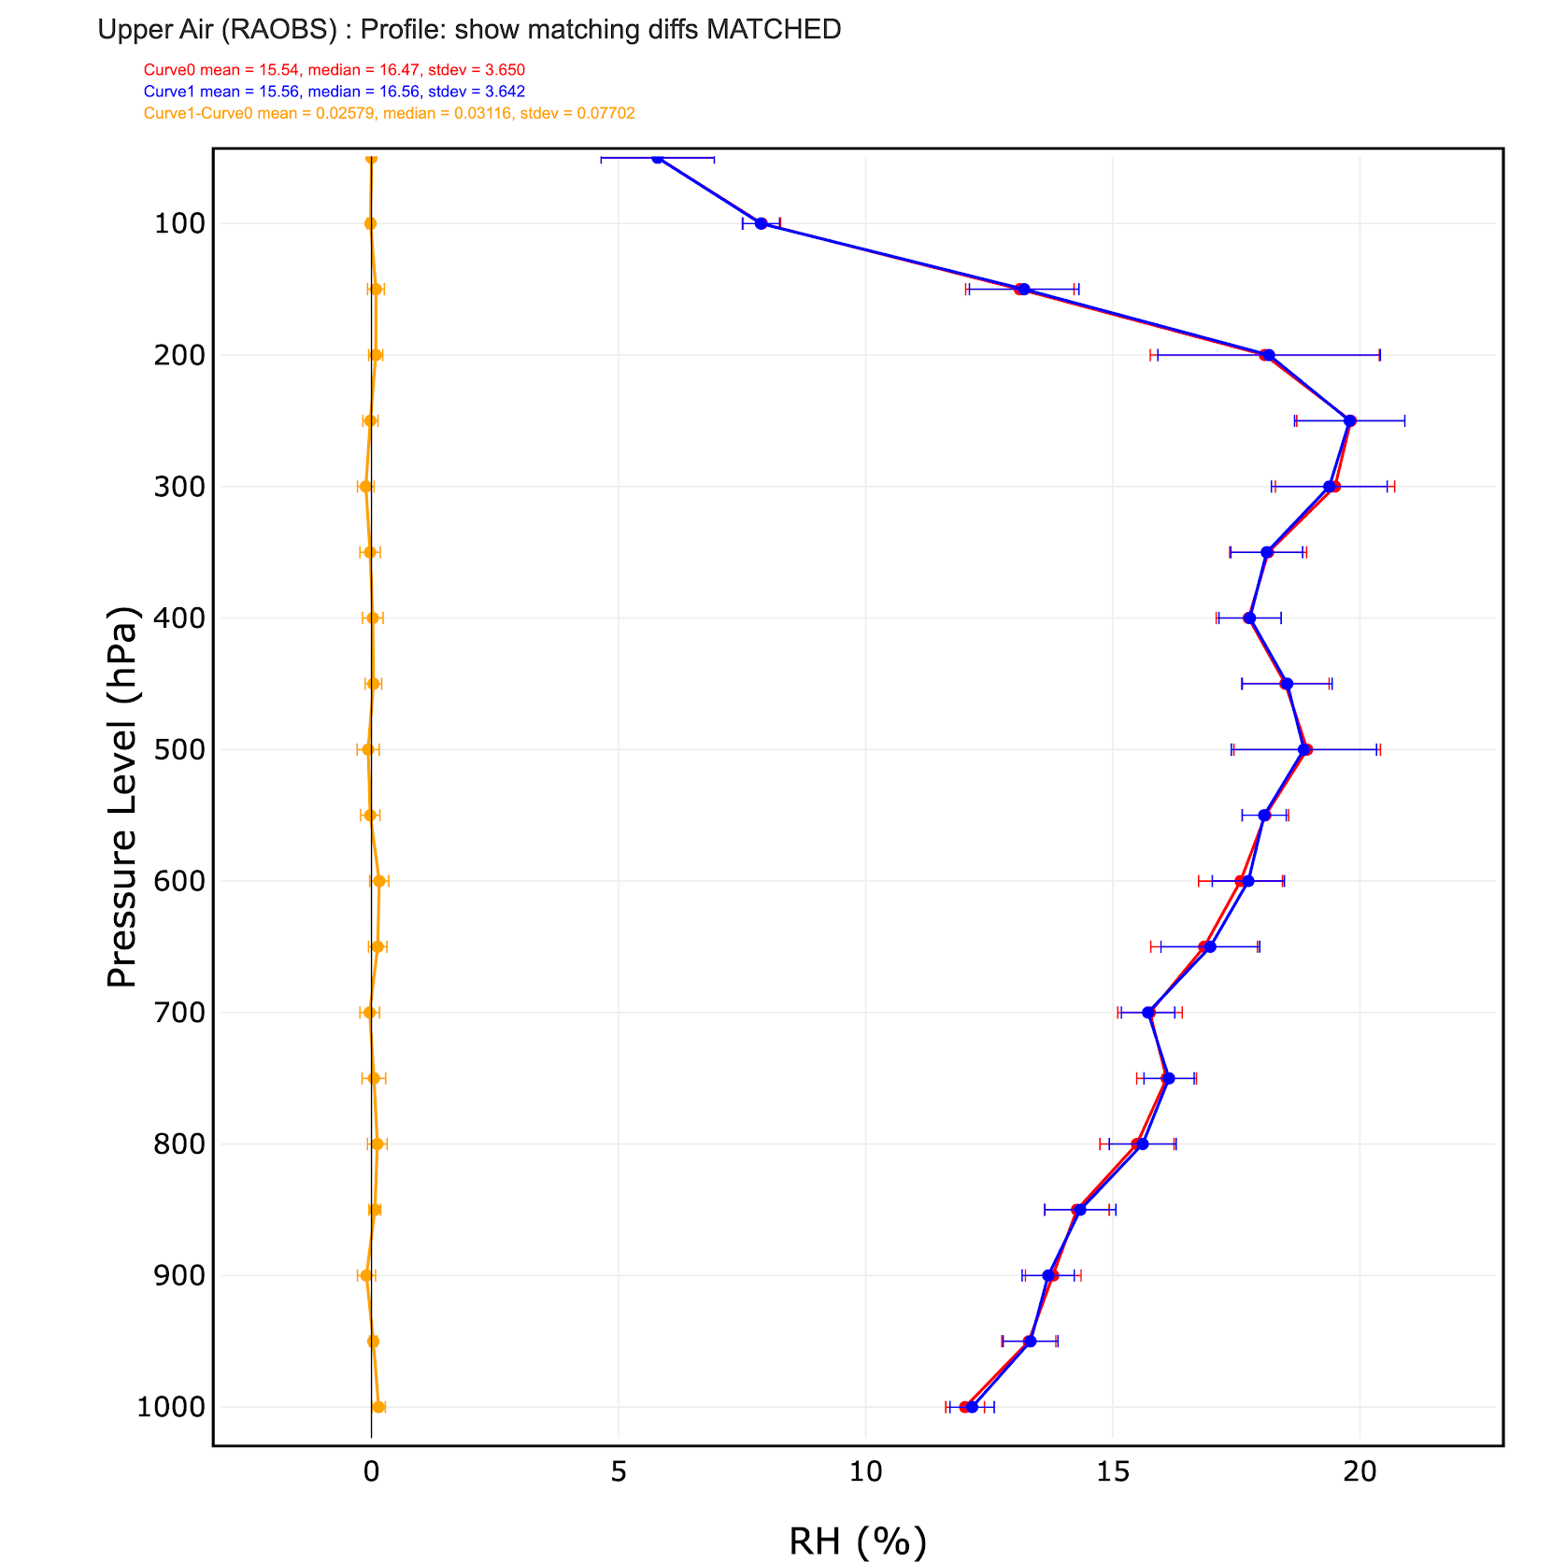
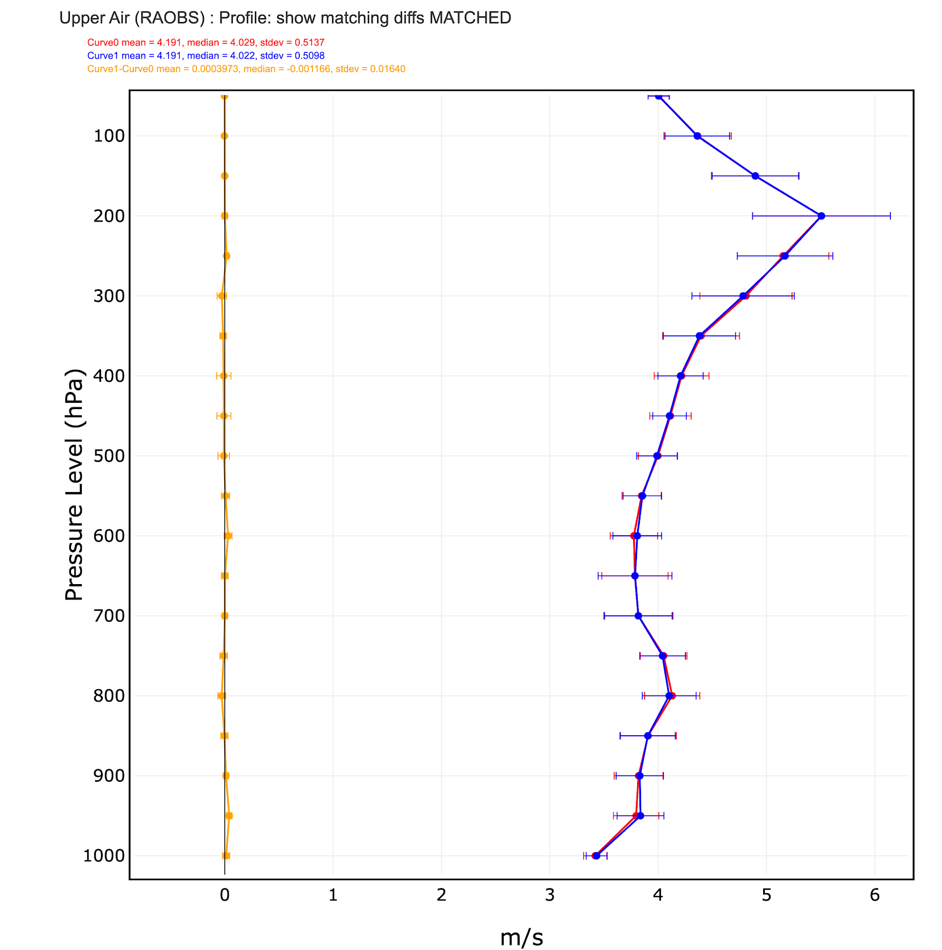
RAPv5 Retrospectives
1-8 June 2020
12-hr RMSE Upper-Air vs RAOBs
Temp
RH
Wind
RAPv5 (no IEVA)
RAPv5 (IEVA)
Difference
No statistically significant differences

Slide 8
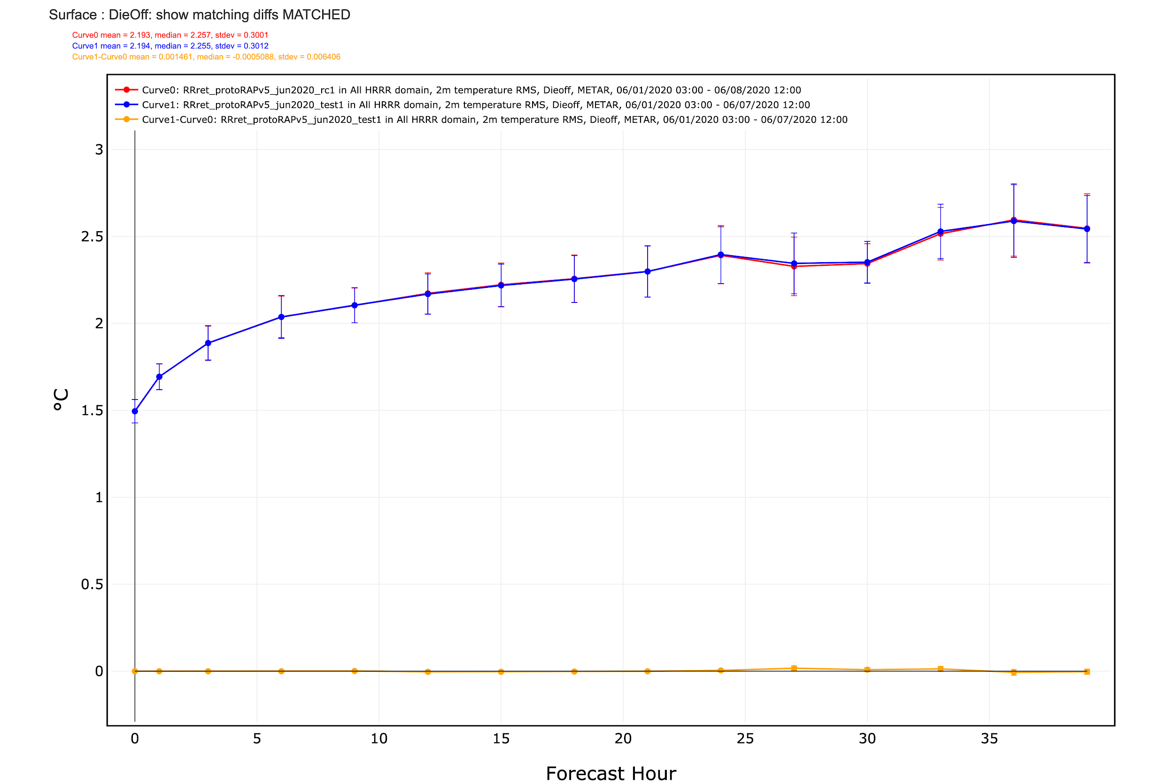
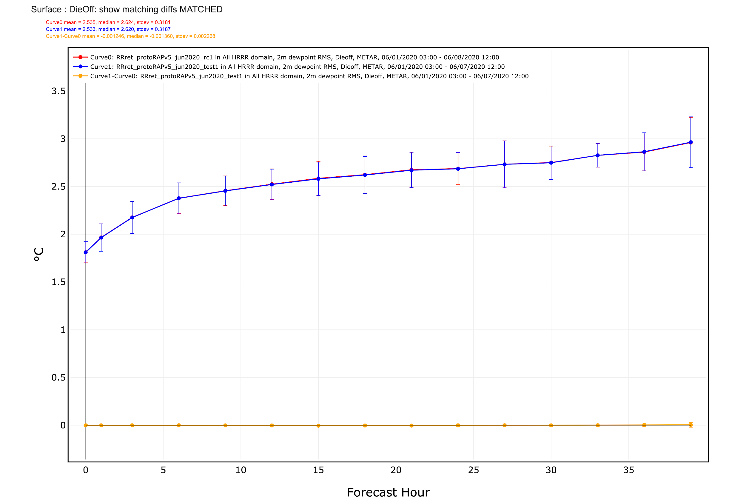
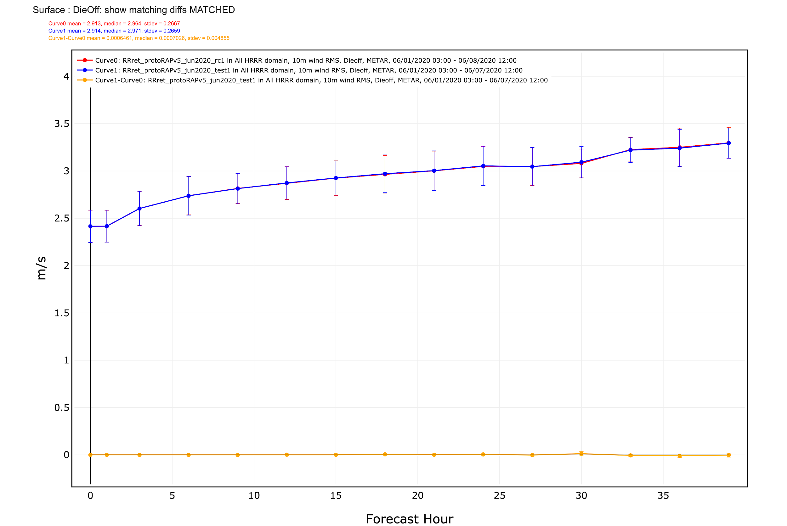
RAPv5 Retrospectives
1-8 June 2020
RMSE Surface vs METARs
2m Temp
2m Dewpoint
10m Wind
RAPv5 (no IEVA)
RAPv5 (IEVA)
Difference
No statistically significant differences

Slide 9
The RAPv5/HRRRv4 Plan
Pending approval to make the IEVA change, NCEP will plan for RAPv5/HRRRv4 system tests to assess stability
If EMC and NCO stability tests are successful, RAPv5/HRRRv4 will be implemented in November 2020
The RTMA/URMAv2.8 implementation, which was coupled with the RAPv5/HRRRv4 upgrade, has been decoupled and will be implemented on July 23

