Slide 1
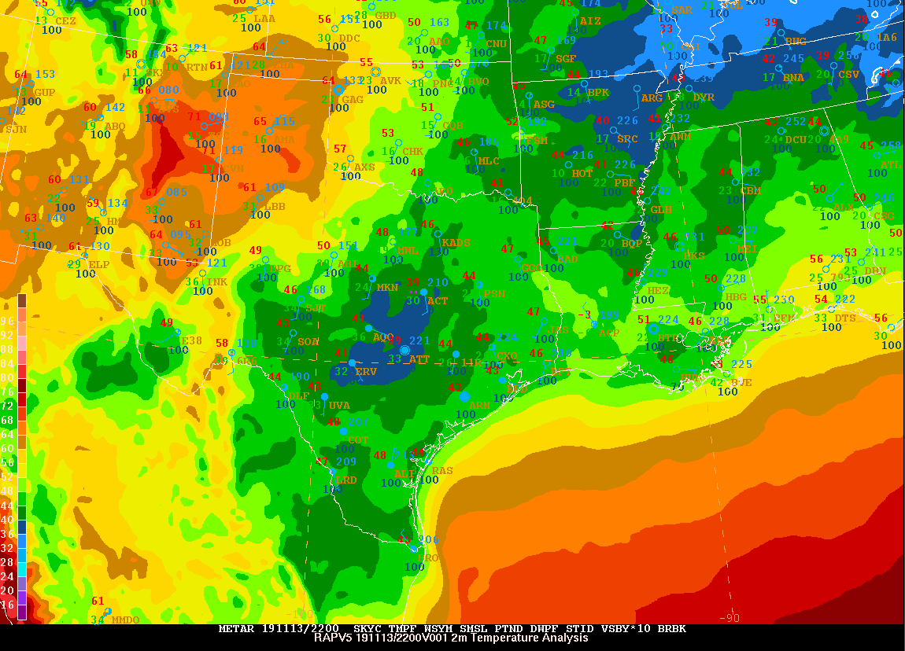
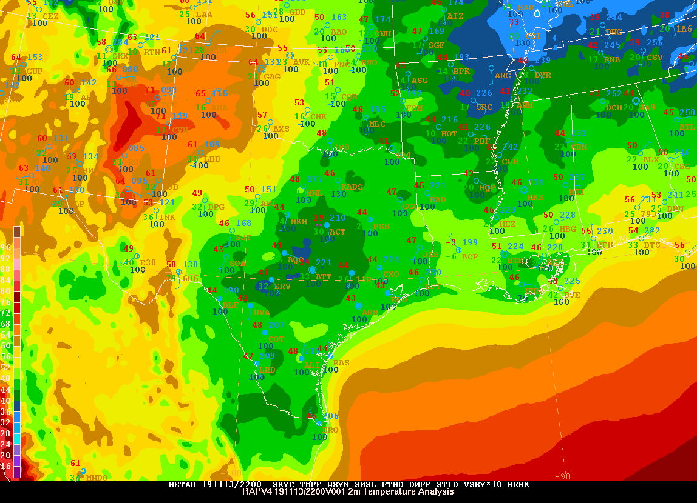
MEG DISCUSSION An Update on the RAPv5/HRRRv4 Evaluation
21 November 2019
Geoff Manikin
geoffrey.manikin@noaa.gov

Slide 2
What’s Next?
BIG PICTURE REMINDERS
RAPv5/HRRRv4 implementation scheduled for Q3FY20
Code handoff to NCO must occur by the first week of January 2020, so the evaluation must be wrapped up by mid-December (12/13/19)
EMC cannot run HRRR-CONUS and HRRR-AK parallels simultaneously, so we had to split up the evaluation period for HRRR
This is the final RAP/HRRR upgrade; we will move to the FV3-based Rapid Refresh Forecast System (RRFS) in 3-4 years

Slide 3
STATUS UPDATE
The RAPv5 parallel continues to run
The HRRRv4-Alaska parallel was run 15 October to 13 November
The HRRRv4-CONUS parallel is being run 15 November to 13 December
Model runs covering 3 one-month RAP and HRRR-CONUS retrospective periods encompassing summer 2018, winter 2019, and spring 2019 (May – active convective month) are wrapping up; the MEG has started plotting graphics
2 one-month HRRR-AK retrospective periods covering summer 2018 and winter 2019 will commence soon
Evaluations will be due 17 December
Acting NCEP Director will be briefed around 20 December
Implementation targeted for June 2020

Slide 4
What’s Next?
HOW to EVALUATE
Grib2 and station time series bufr output available on EMC ftp server and paranomads for all real-time parallels
Real-time Parallel Graphics for RAP (entire period)
Real-time Parallel Graphics for HRRR-AK (ended 11/13/19)
Real-time Parallel Graphics for HRRR-CONUS (now available)
Graphics for selected HRRR-CONUS retrospective cases (now available)
Graphics for selected HRRR-AK retrospective cases (will populate when runs begin)
Statistics from real-time and retrospective parallels (available soon)
Continuing MEG presentations

Slide 5
What’s Next?
HOW to EVALUATE
Real-Time RAP para data: ftp://ftp.emc.ncep.noaa.gov/mmb/mmbpll/rappara
https://para.nomads.ncep.noaa.gov/pub/data/nccf/com/rap/para
Real-Time HRRR para data: ftp://ftp.emc.ncep.noaa.gov/mmb/mmbpll/hrrrpara
https://para.nomads.ncep.noaa.gov/pub/data/nccf/com/hrrr/para
Retro RAP data: ftp://gsdftp.fsl.noaa.gov/retro/rap
Retro HRRR data: ftp://gsdftp.fsl.noaa.gov/retro/hrrr

Slide 6
2020 RAPv5/HRRRv4 Changes
Model | Data Assimilation | Land-surface / post
WRF-ARWv3.9+ incl. phys changes Physics changes: MYNN PBL update – better sub-grid clouds, improved EDMF mixing - remove limit for subgrid qc/qi - decrease subgrid qc/qi radii RRTMG modifications for subgrid clouds Aerosols sources/sinks – fire/smoke, dust - Add smoke with VIIRS FRP Improved land-surface/snow model including better 2m T/Td diagnostics Latest Grell-Freitas conv (RAP only) Lake model for small lakes Enhanced gravity-wave drag Numerics changes: Reduced 6th order diffusion inc. hydrom Removal of mp_tend_lim Explicit-Implicit vertical advection | Merge with GSI trunk – 2019 New Observations for assimilation: GOES-16 radiances, CrIS/ATMS TC vitals for trop cyclone location/strength Aircraft/raob moisture obs for p<300 hPa VIIRS/MODIS fire radiative power Assimilation Methods: HRRR - 3km ensemble DA (36 mems out to 1h) – HRRRDAS mean for HRRR IC and BEC | Switch to MODIS albedo (higher), replace 1-deg albedo. Add zenith-ang albedo adj 15” resolution land use data Fractional sea/lake ice concentration FVCOM data for Great Lakes lake temp/ice concentration VIIRS/MODIS/GOES fire radiative power HAILCAST diagnostic Smoke (2.5 pm) products
Extend 03/09/15/21z RAP to f51
Extend 00/06/12/18z HRRRs to f48

Slide 7
WHAT TO LOOK FOR
Is there improvement (or, at a minimum, limited degradation) in overall synoptic and mesoscale performance (including boundary layer structure and dryline position)?
Does the HRRRDAS improve initialization and maintenance of convection?
Are there improved vertical velocity (and UH) signals in convection?
Is the new smoke output useful?
Is there better representation of temperatures of small lakes?
Are the temperatures of the Great Lakes handled better?
Is there improved retention of shallow cloudy air masses?
Is there improvement in snowfall amounts?
Are there benefits in extending some RAP forecasts to 51 hours and HRRR forecasts to 48 hours?

Slide 8
What’s Next?
MEG EVALUATION PAGE
https://www.emc.ncep.noaa.gov/users/meg/rapv5_hrrrv4/

Slide 9
What’s Next?
COMPARISON GRAPHICS
for Real-Time Parallels
https://www.emc.ncep.noaa.gov/users/meg/rapv5_hrrrv4/comp/

Slide 10
A Few Quick Observations From the Parallels

Slide 11
HRRR-CONUS COMPARISON GRAPHICSRR
VALID 12z
VALID 21z
RAPv5/HRRRv4
often become
significantly cooler
than ops during
late afternoon;
still assessing
whether correct

Slide 12
FVCOM-based Great Lakes Temps/Ice CLM-based Inland Lake Surface Temps
FVCOM lake temperatures (ESRL-GLERL collaboration)

Slide 13
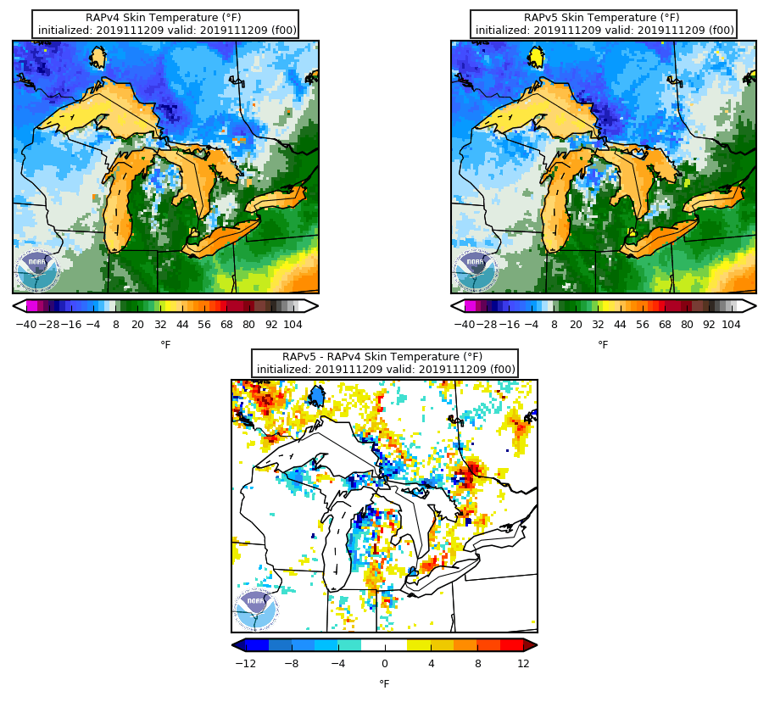
FVCOM Lake Temps Are NOT Being Used in the RAP

Slide 14
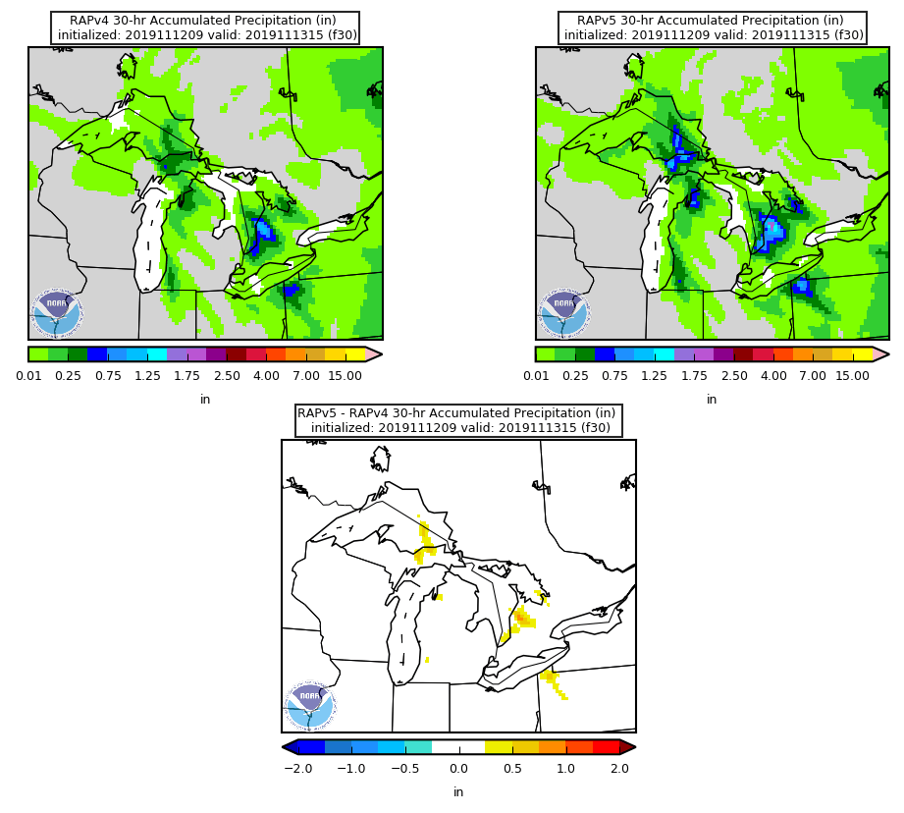
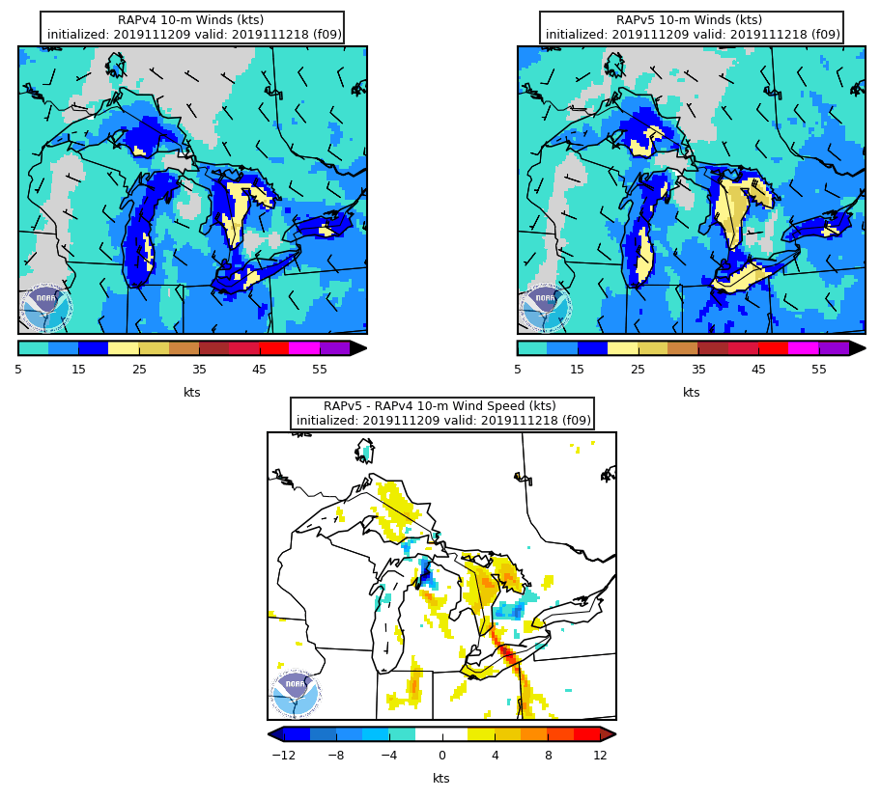
We are seeing enhanced lake-effect totals
in the RAP, but it’s not due to lake temps
It’s likely due to the intentionally stronger 10m
winds over water, leading to enhanced
fluxes and convergence in the areas downstream
z

Slide 15
HRRR-CONUS RETROSPECTIVE GRAPHICS ARE BECOMING AVAILABLE

Slide 16
HRRRv4, with the HRRRDAS, clearly does a
better job initializing the KS convection

Slide 17
Resulting 1h HRRRv4 forecast is clearly better

Slide 18
6h evolution in south-central KS is better in HRRRv4

Slide 19
Some Concerns About Late Initiation in HRRRv4
Very early impression, though, is that when initiation
in HRRRv4 is delayed, it’s only by an hour or two

Slide 20
Some Concerns About Late Initiation in HRRRv4

Slide 21
Continued Interaction with Mike Baldwin’s Synoptic
Meteorology Class at Purdue as They Assist With
The RAPv5 Evaluation
The next slides are contributions from these students

Slide 22
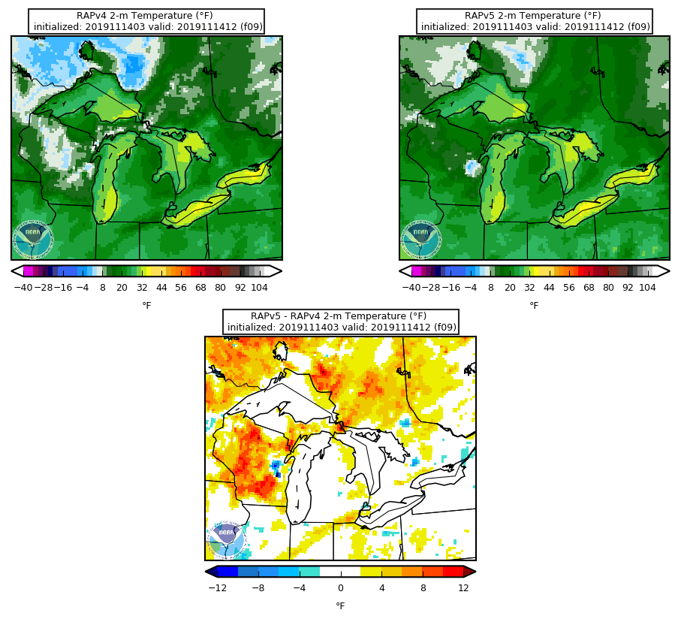
Connor: Temperature Difference on the November 14th 03Z run valid 12Z November 14th
The 03Z November 14 run of the RAPv4 and RAPv5 had a drastic temperature difference at 12Z on November 14. The RAPv5 was noticeably warmer across Wisconsin than the RAPv4 by 2 to 8°.

Slide 23
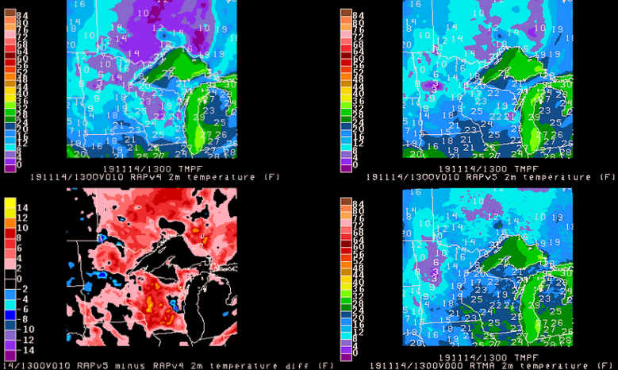
Abby
Cycle: 2019 11 14 03Z
Valid: 2019 11 14 13z (f10)
RAPv4
RAPv5
PRINTED
NUMBERS
ARE OBS
DIFF
RTMA
ANL
RAPv5 was closer to observed temperatures.
Still colder than observed
Notes:
Cycle 2019 11 14 03Z
Valid: 2019 11 14 13 f(10)
RAP5 is hotter than RAP 4 especially in Wisconsin.
RAP5 also has more low clouds for several hours before this

Slide 24
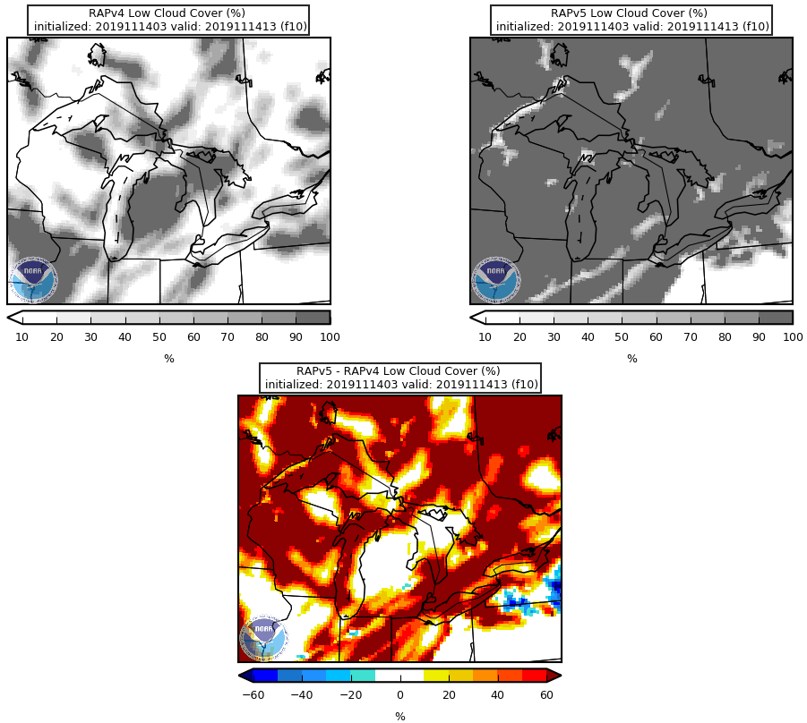
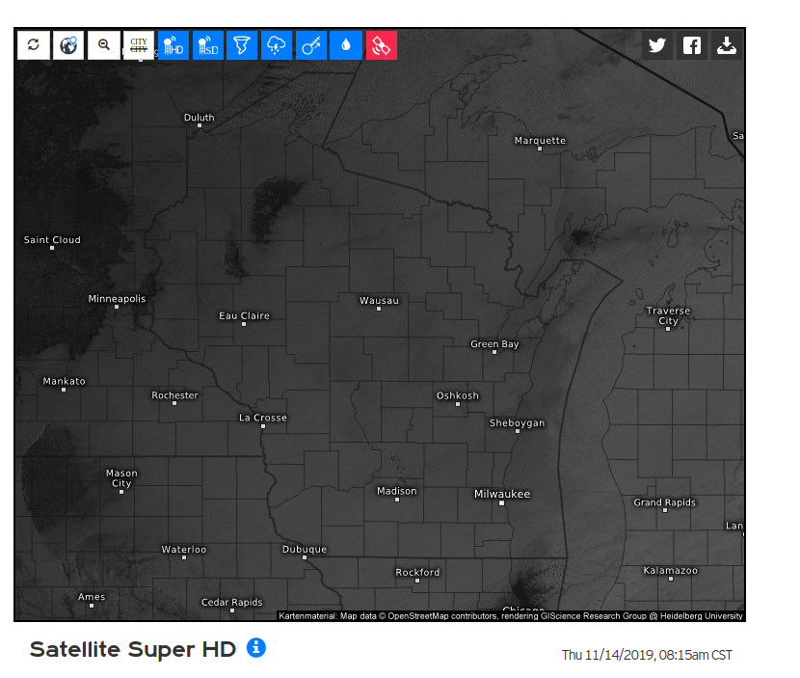
Abby
RAPv5 correctly predicted more low level clouds for several hours, leading to the warmer
surface temps
Notes:
Clouds weren’t as heavy as RAP5 had
Sounding are the same
Observed sounding was drying than both

Slide 25
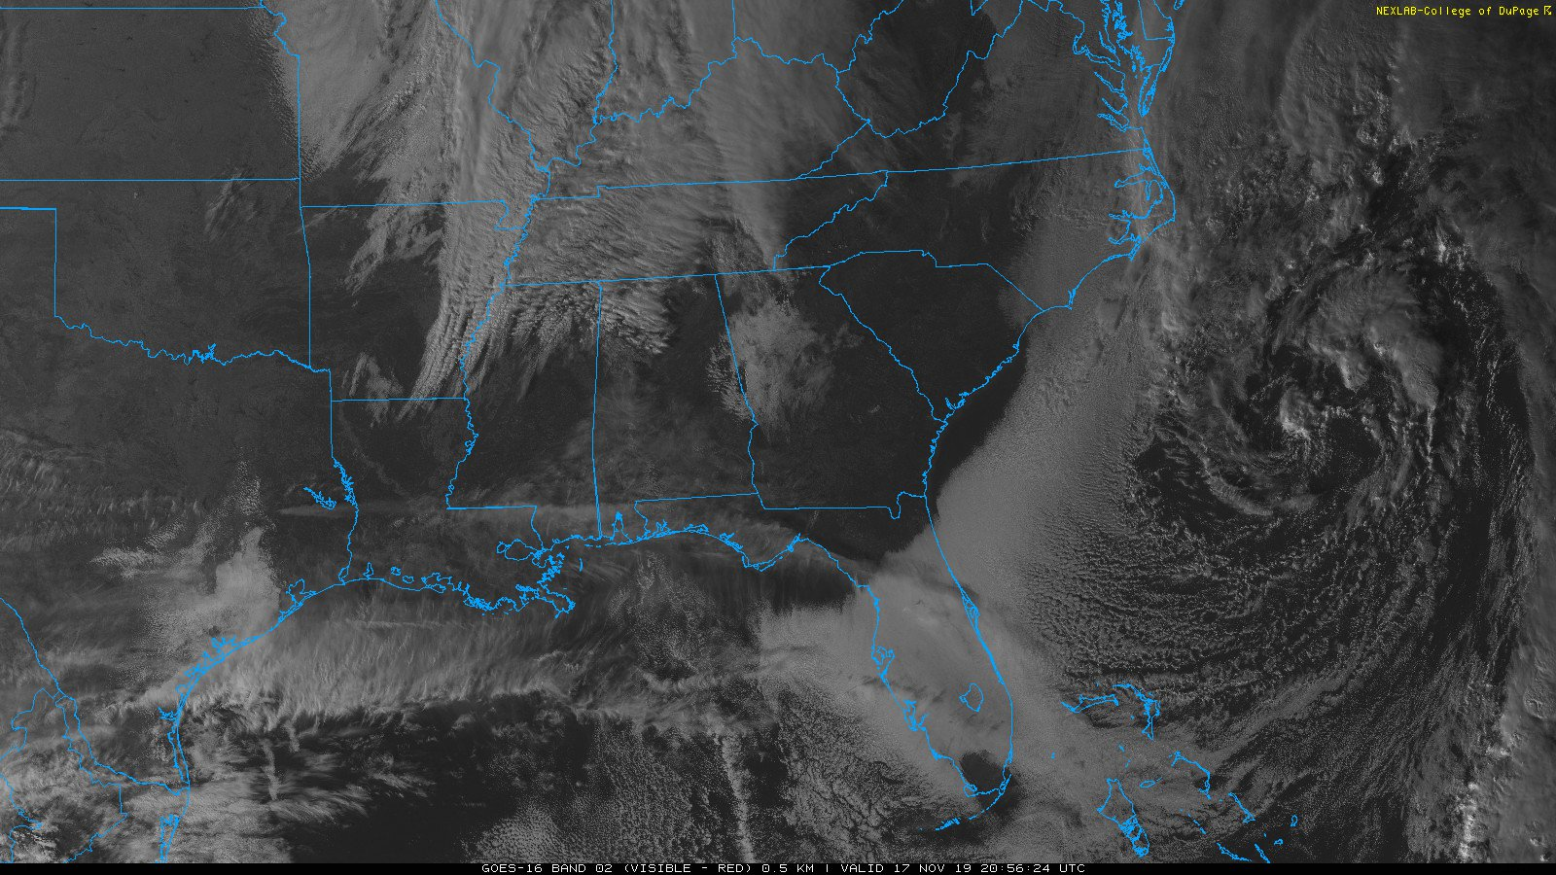
RAPv5 a bit worse
with cloud cover
RAPv5 better
with cloud cover

Slide 26
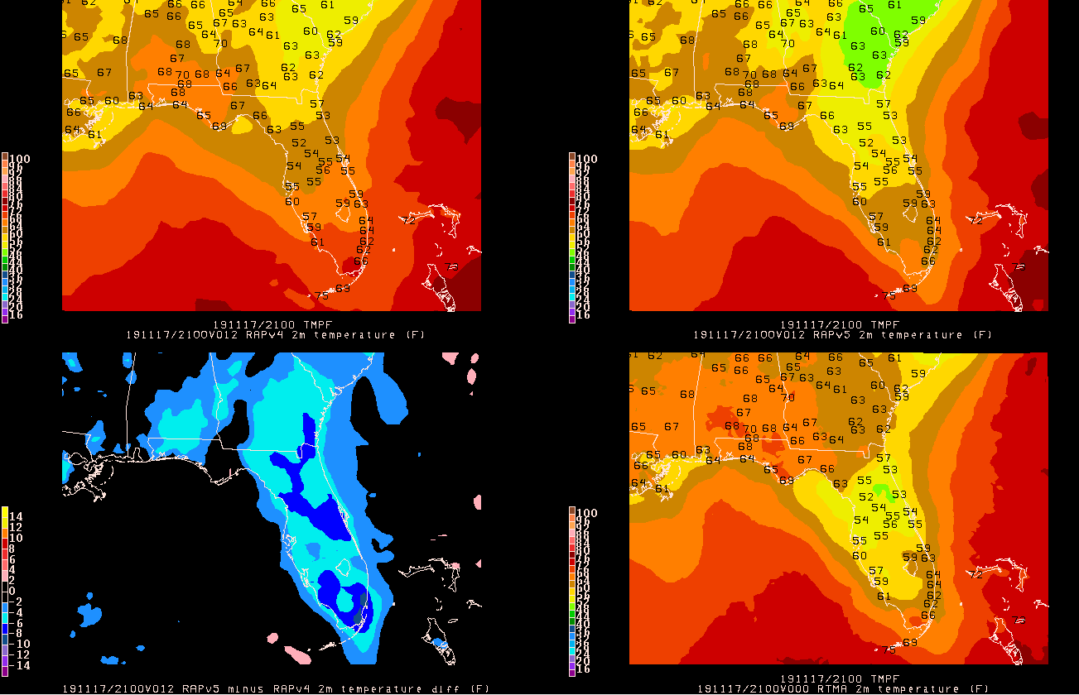
17 Nov
09Z run
12h fcst
Valid
17 Nov 21z
RAPv4
RAPv5
FL: better
GA: worse
SC: worse
AL:worse
Better temps where clouds were better
but too cold
where clouds
were overdone
PRINTED
NUMBERS
ARE OBS
RTMA
ANL
RAPv5 colder
where it shows
more clouds on
previous slide
DIFF

Slide 27
NEXT STEPS
Start digging into the retro cases (best opportunity to assess the warm season)
Will have stats for real-time and retro runs available soon to quantify
the subjective assessments

