Slide 1
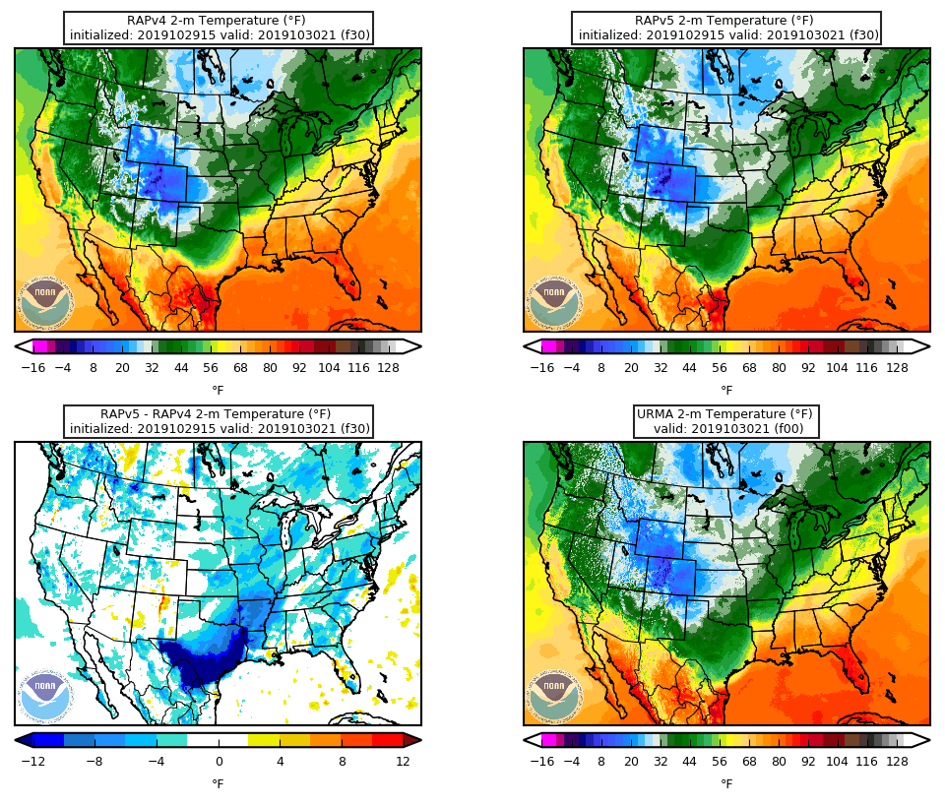
Preliminary RAPv5 Stats and a Recent HRRRv4 Success
31 October 2019 MEG Briefing
Logan Dawson
NCEP/EMC Model Evaluation Group
Ed Szoke
ESRL/GSD

Slide 2
Preliminary RAPv5 Stats
Caveats:
Only ~2 weeks worth of stats
Statistical significance on scorecard is not computed with bootstrapping

Slide 3
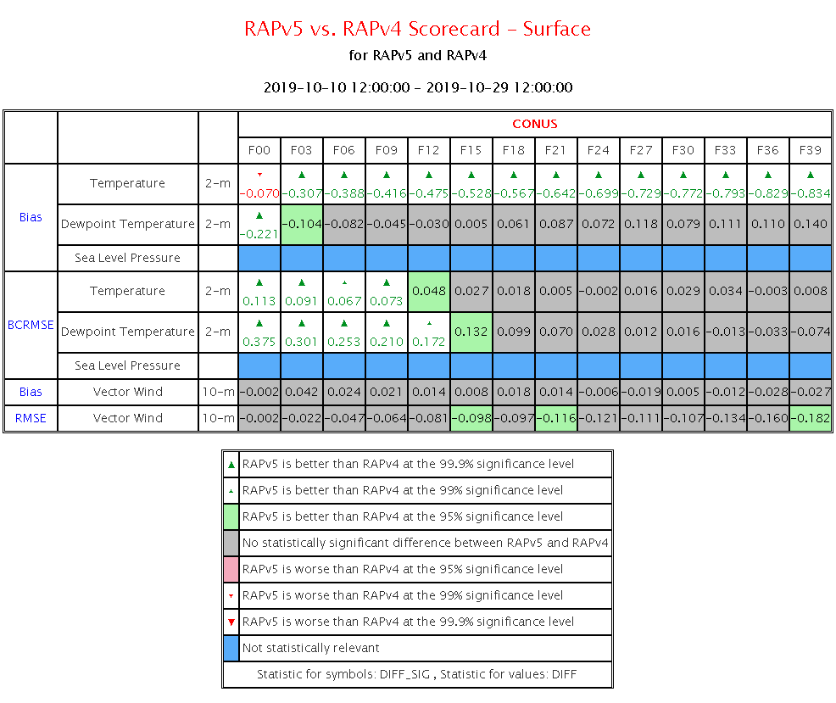
RAPv5 Shows Some Improvements in 2-m Temperatures and Dewpoints
RAPv5 2-m temperature bias is improved throughout the forecast period
RAPv5 2-m temp and dewpoint RMSEs are improved during the first 12-h of the forecast
Otherwise, little statistical significance between RAPv4 and RAPv5
BCRMSE = Bias-Corrected RMSE

Slide 4
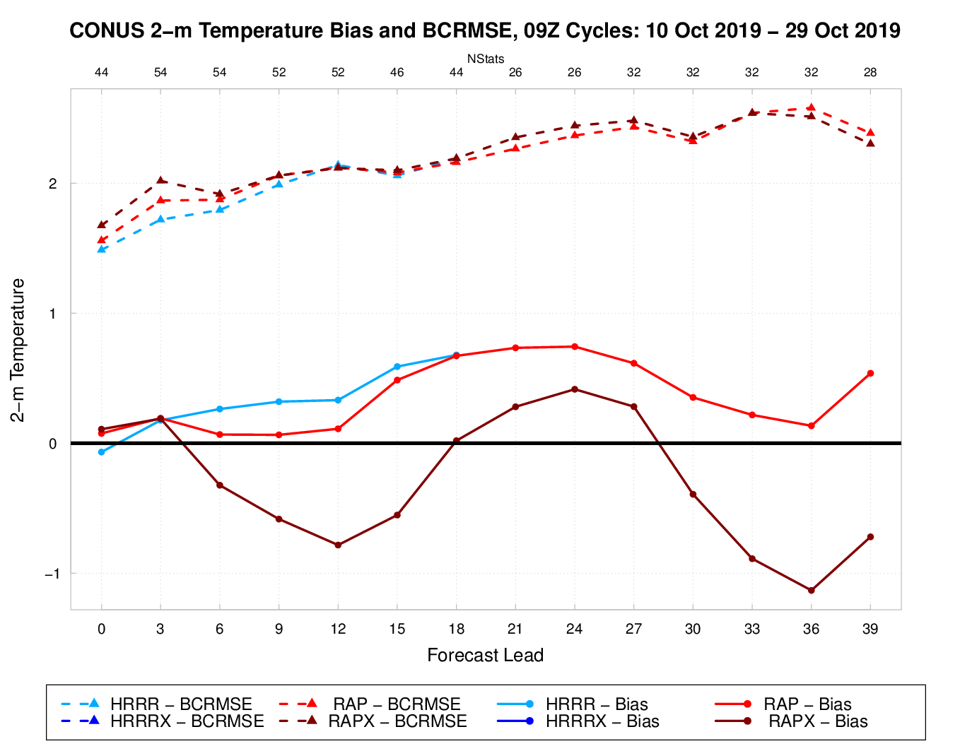
RAPv5 (RAPX) 2-m Temps Are Too Cool During the Day, Slightly Too Warm (But Improved) Overnight
2-m T Bias (solid) and BCRMSE (dashed) for 09Z Cycles
RAPv5 showed a stronger diurnal variability in 2-m T bias
RAPv4 had a warm bias throughout the period
RAPv5 improves the overnight warm bias, but it introduces a daytime cool bias
When aggregating all cycles and forecast leads together, RAPv5 bias is probably close to zero
12Z
00Z
12Z
00Z

Slide 5
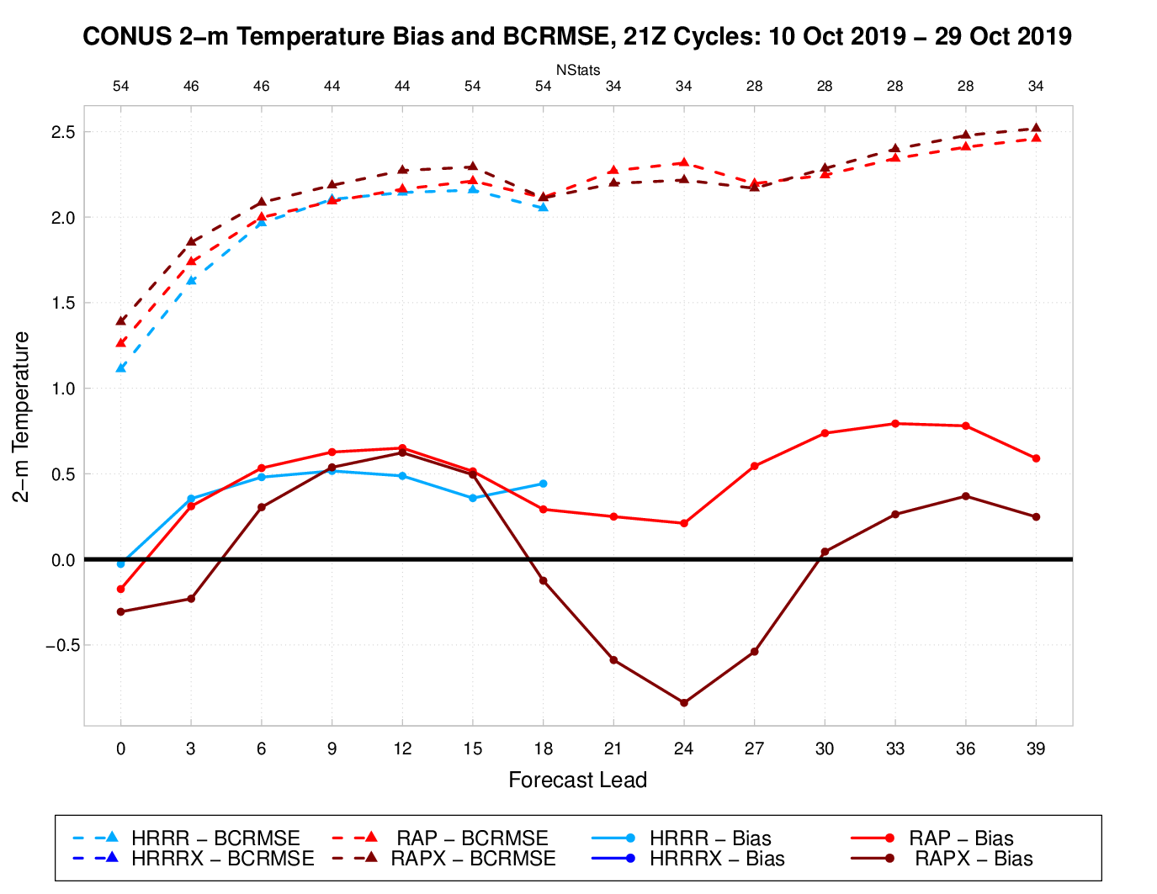
RAPv5 2-m Temps Are Too Cool During the Day, Slightly Too Warm (But Improved) Overnight
2-m T Bias (solid) and BCRMSE (dashed) for 21Z Cycles
RAPv5 showed a stronger diurnal variability in 2-m T bias
RAPv4 had a warm bias throughout the period
RAPv5 improves the overnight warm bias, but it introduces a daytime cool bias
When aggregating all cycles and forecast leads together, RAPv5 bias is probably close to zero
00Z
12Z
00Z
12Z

Slide 6
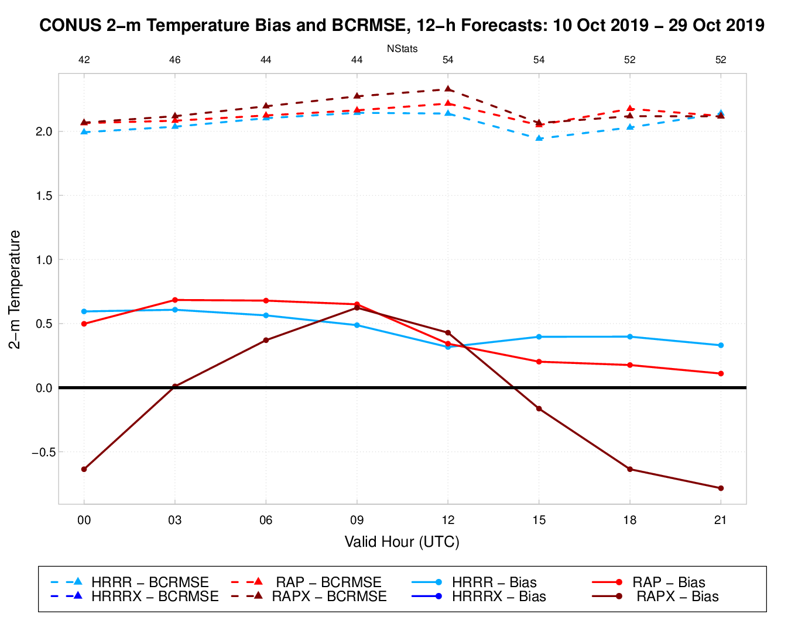
RAPv5 2-m Temps Are Too Cool During the Day, Slightly Too Warm (But Improved) Overnight
2-m T Bias (solid) and BCRMSE (dashed) for 12-h Forecasts
RAPv4 had a warm bias for all valid hours in this period
RAPv5 had a warm bias overnight, but a cool bias during daytime hours
Some indication that the daytime cool bias in RAPv5 may be worse for Day 2 forecasts compared to Day 1 forecasts
Although, much fewer cases for Day 2 RAP forecasts

Slide 7
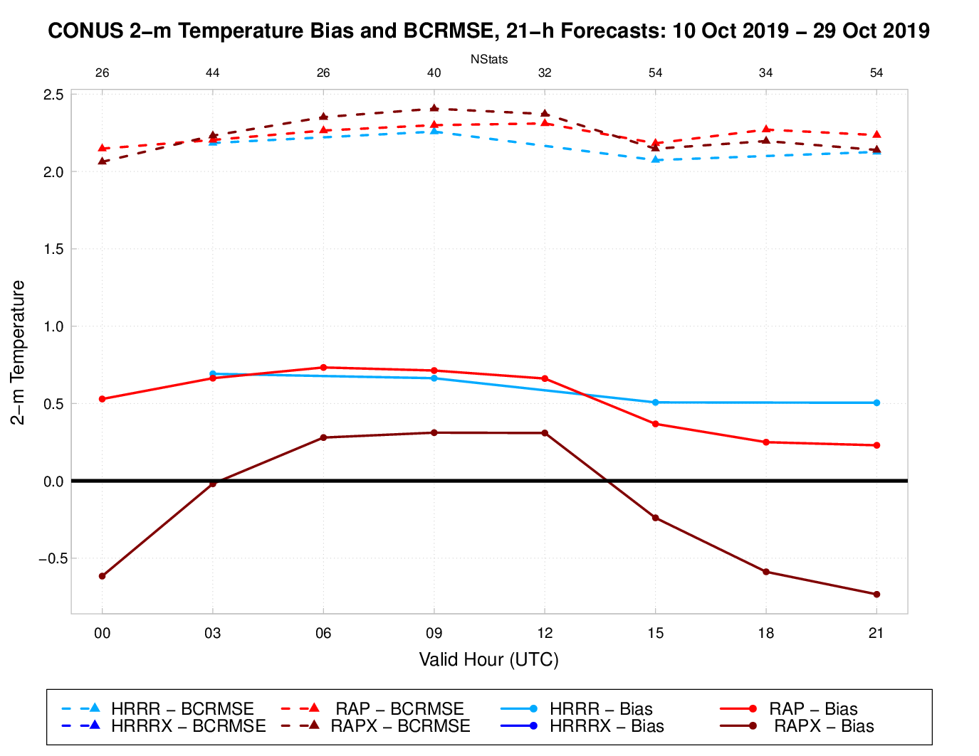
RAPv5 2-m Temps Are Too Cool During the Day, Slightly Too Warm Overnight
2-m T Bias (solid) and BCRMSE (dashed) for 21-h Forecasts
RAPv4 had a warm bias for all valid hours in this period
RAPv5 had a warm bias overnight, but a cool bias during daytime hours
Some indication that the daytime cool bias in RAPv5 may be worse for Day 2 forecasts compared to Day 1 forecasts
Although, much fewer cases for Day 2 RAP forecasts

Slide 8
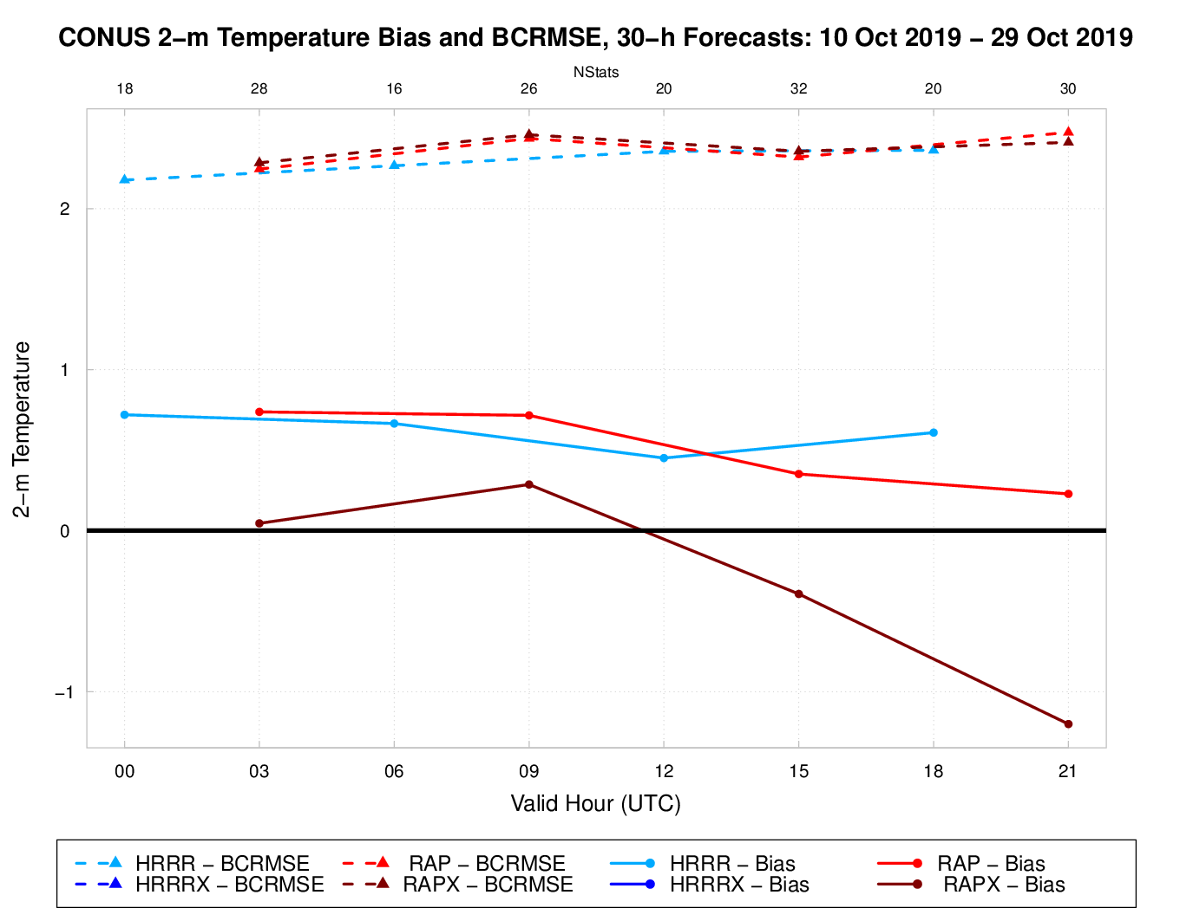
RAPv5 2-m Temps Are Too Cool During the Day, Slightly Too Warm Overnight
2-m T Bias (solid) and BCRMSE (dashed) for 30-h Forecasts
RAPv4 had a warm bias for all valid hours in this period
RAPv5 had a warm bias overnight, but a cool bias during daytime hours
Some indication that the daytime cool bias in RAPv5 may be worse for Day 2 forecasts compared to Day 1 forecasts
Although, much fewer cases for Day 2 RAP forecasts

Slide 9
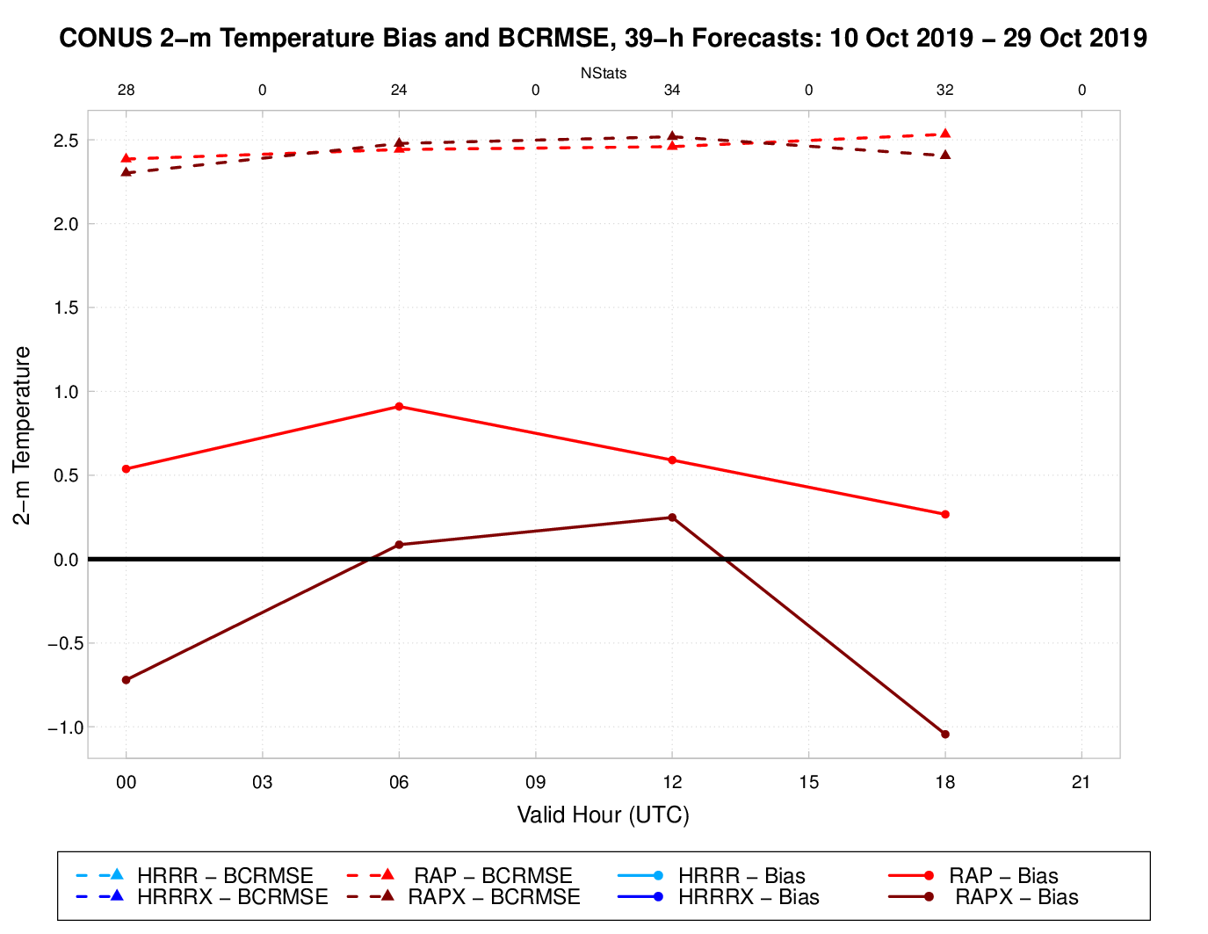
RAPv5 2-m Temps Are Too Cool During the Day, Slightly Too Warm Overnight
2-m T Bias (solid) and BCRMSE (dashed) for 39-h Forecasts
RAPv4 had a warm bias for all valid hours in this period
RAPv5 had a warm bias overnight, but a cool bias during daytime hours
Some indication that the daytime cool bias in RAPv5 may be worse for Day 2 forecasts compared to Day 1 forecasts
Although, much fewer cases for Day 2 RAP forecasts

Slide 10
Summary
Again, very preliminary stats. More stats will be generated and populated online in the coming weeks.
Overall, surface verification is comparable or shows some slight improvement in RAPv5
Daytime cool bias is consistent with subjective evaluation of forecasts so far.
Changes to the PBL and radiation schemes (to better represent sub-grid clouds) as well as the well-documented GFS low-level cold bias are likely contributing to this daytime cool bias in RAPv5.

Slide 11
A Recent HRRRv4 Success
Slides compiled by Ed Szoke (ESRL/GSD)
Caveats:
Only one case and one forecast cycle
Results from GSD’s HRRR-CONUS parallel, which should be configured as NCEP’s HRRR-CONUS parallel will be (beginning ~Nov. 15th)

Slide 12
Forecast for Dallas EF3 tornado on 21 October 2019
So far, looking at one run time (21z/20 Oct)
Big difference in that the HRRRX predicts supercells developing west of Dallas with about the right timing and moving across the Dallas area
But the Ops HRRR misses these completely
Both end up developing a strong line along the cold front later in the forecast (the Dallas supercells develop well ahead of the front).

Slide 13
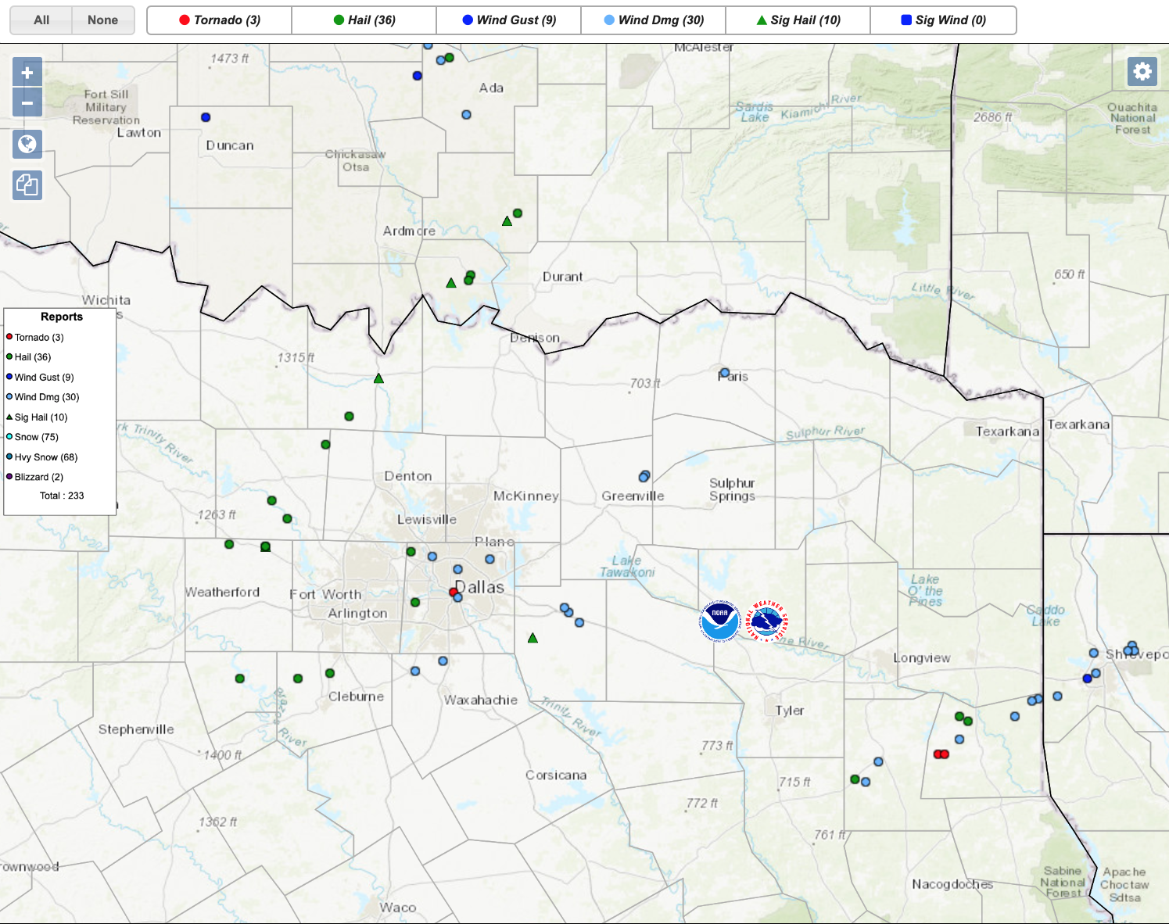
Severe reports from 15z/20 Oct to 04z/21 Oct 2019
The Dallas tornado is shown right near the “D” in Dallas. It began at 0202z on 21 October.

Slide 14
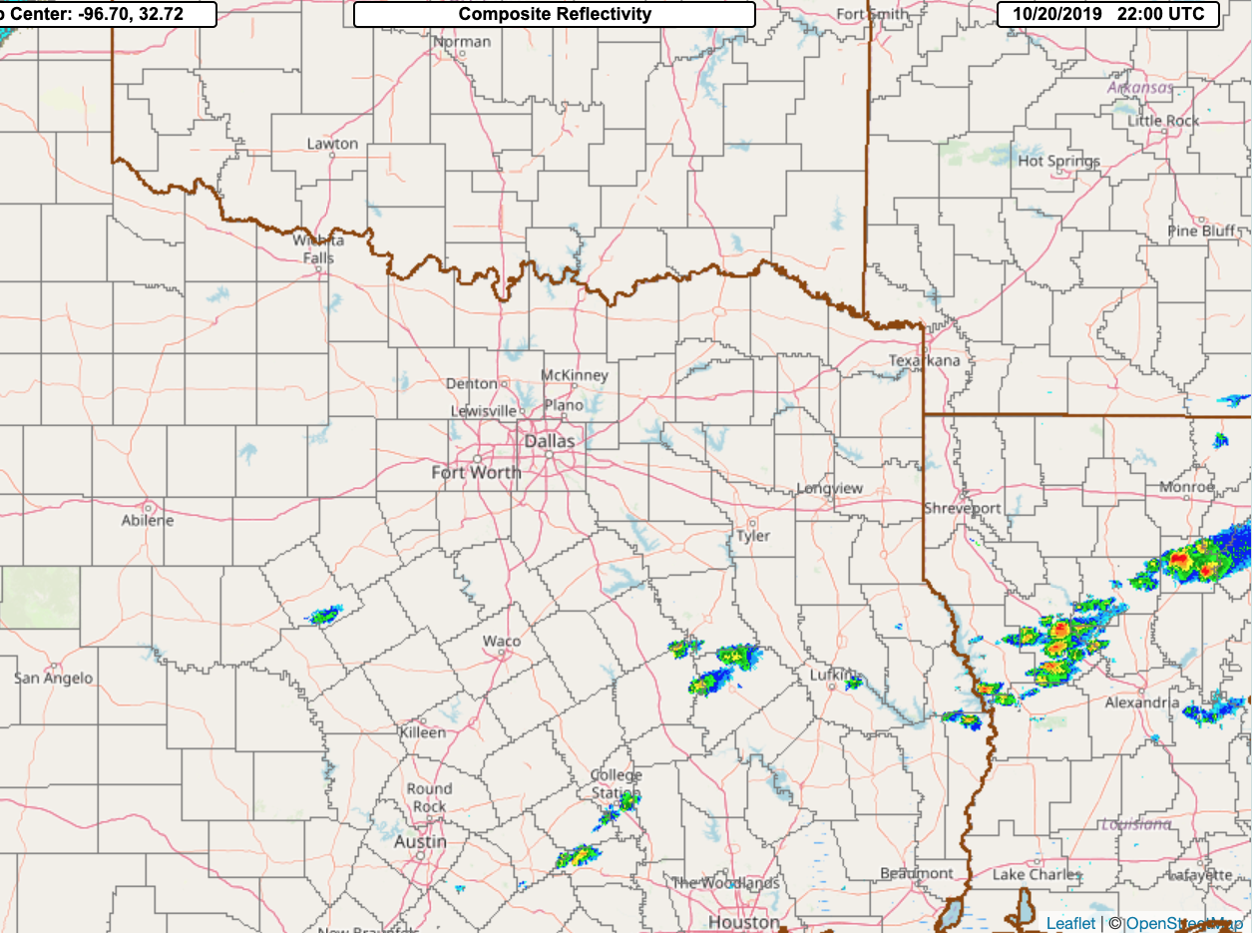
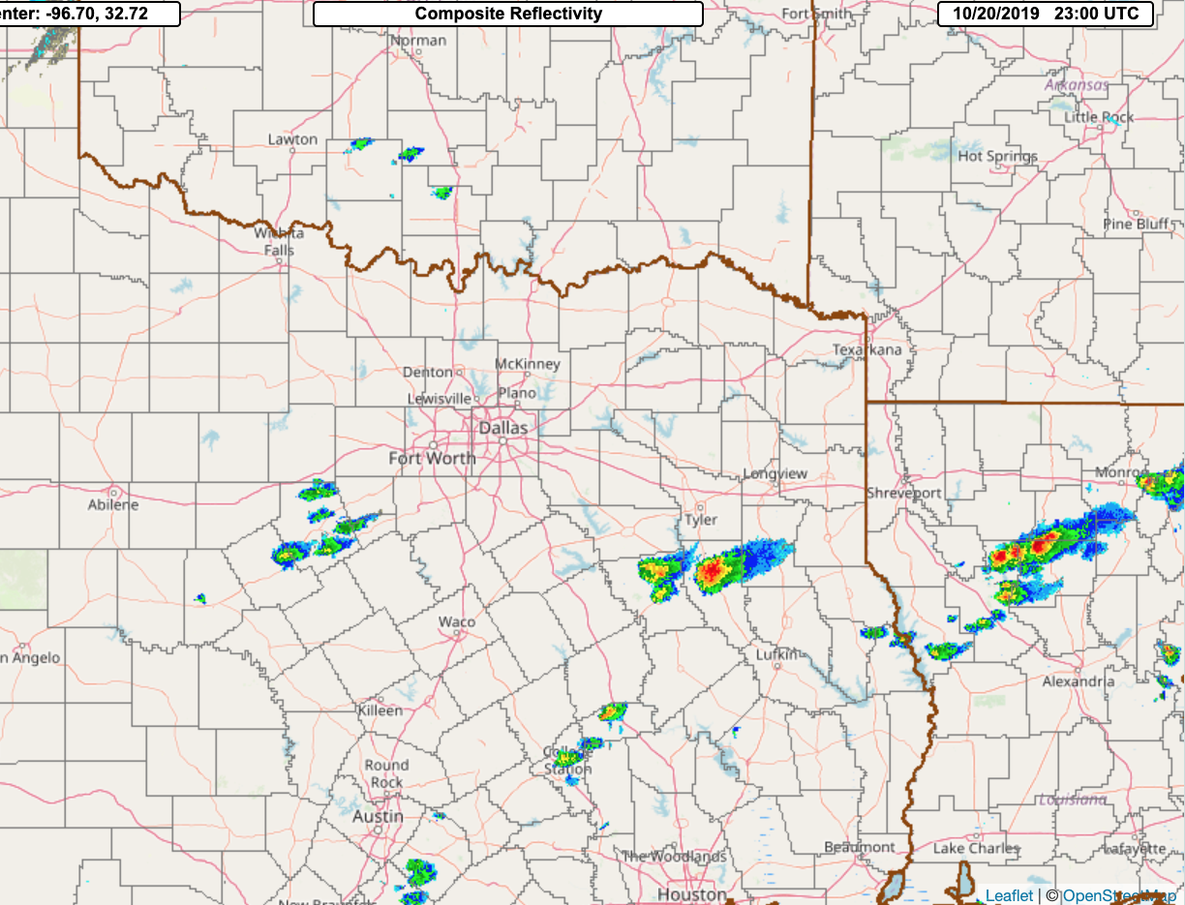
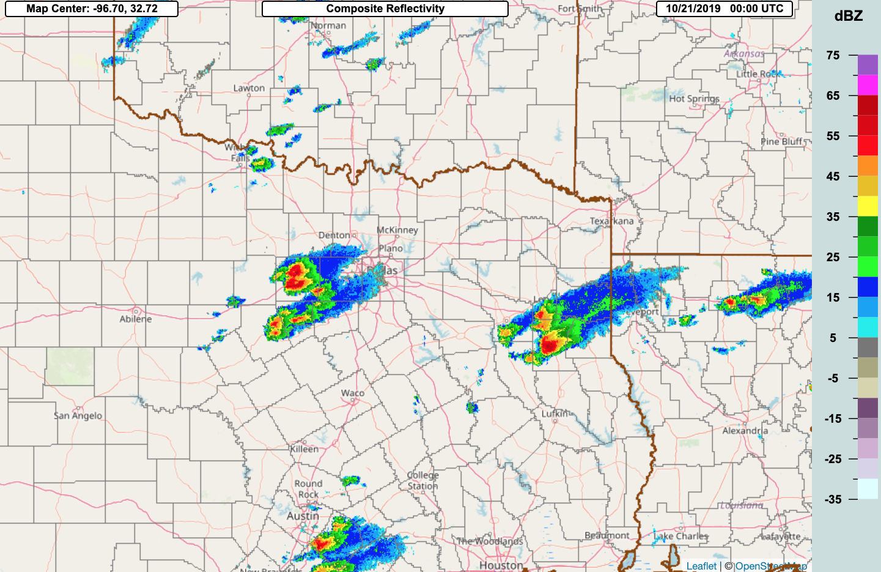
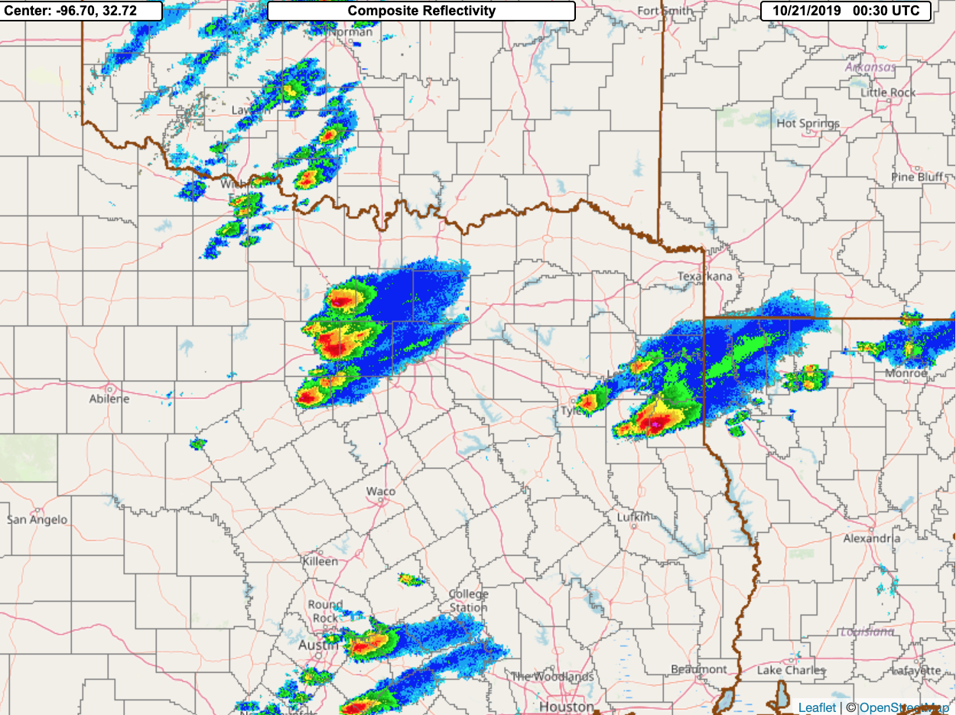
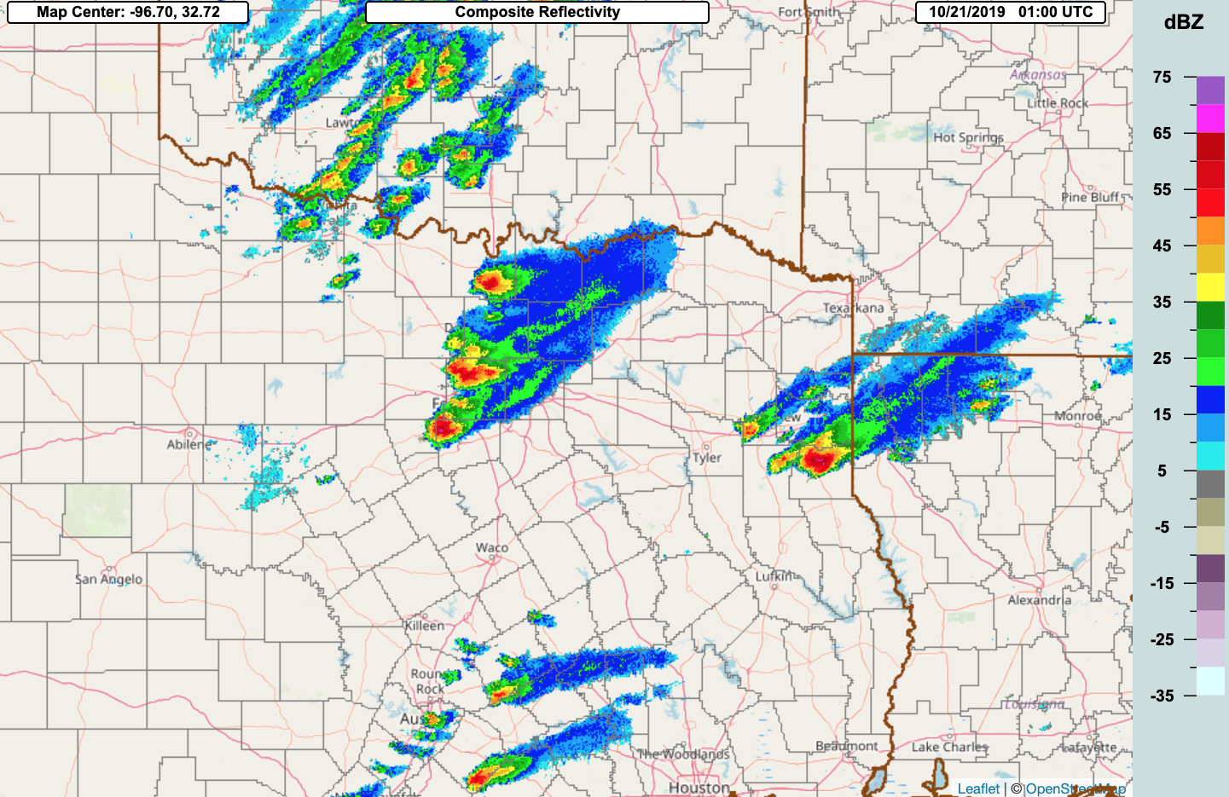
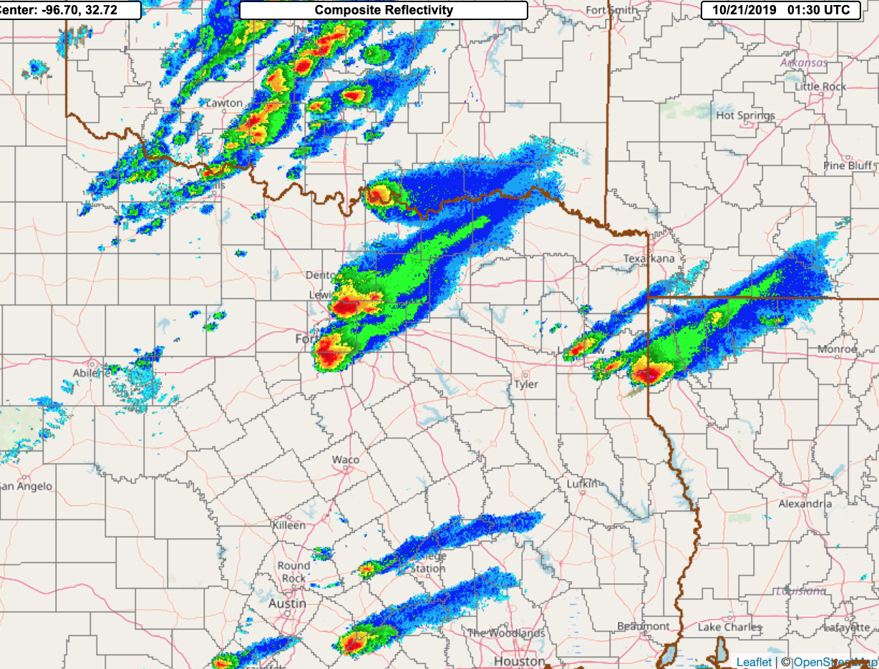
20-21 October 2019 Composite reflectivity – 2 supercells develop west of Dallas, with the northern one producing the tornado at 0202z.
2200z
2300z
00z/21 October
1200z
1300z
0030z
0100z
0130z

Slide 15
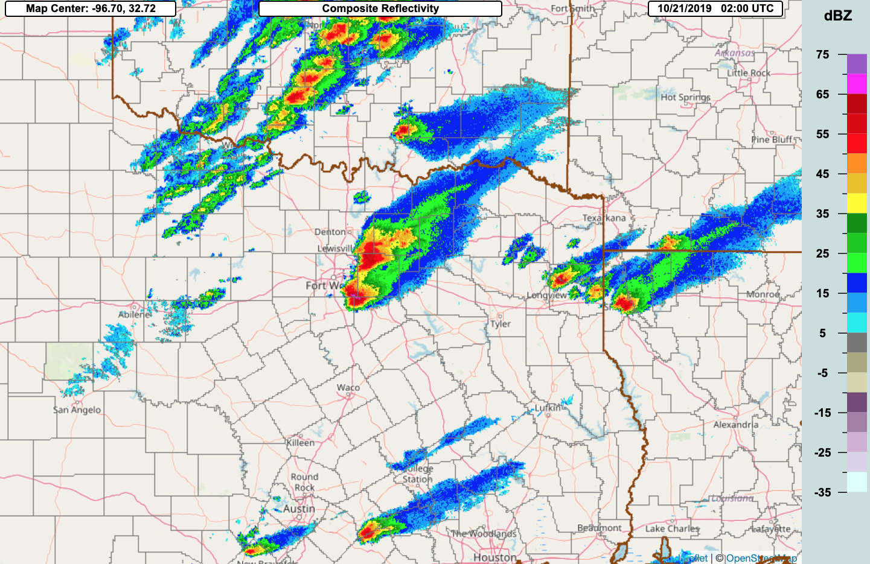
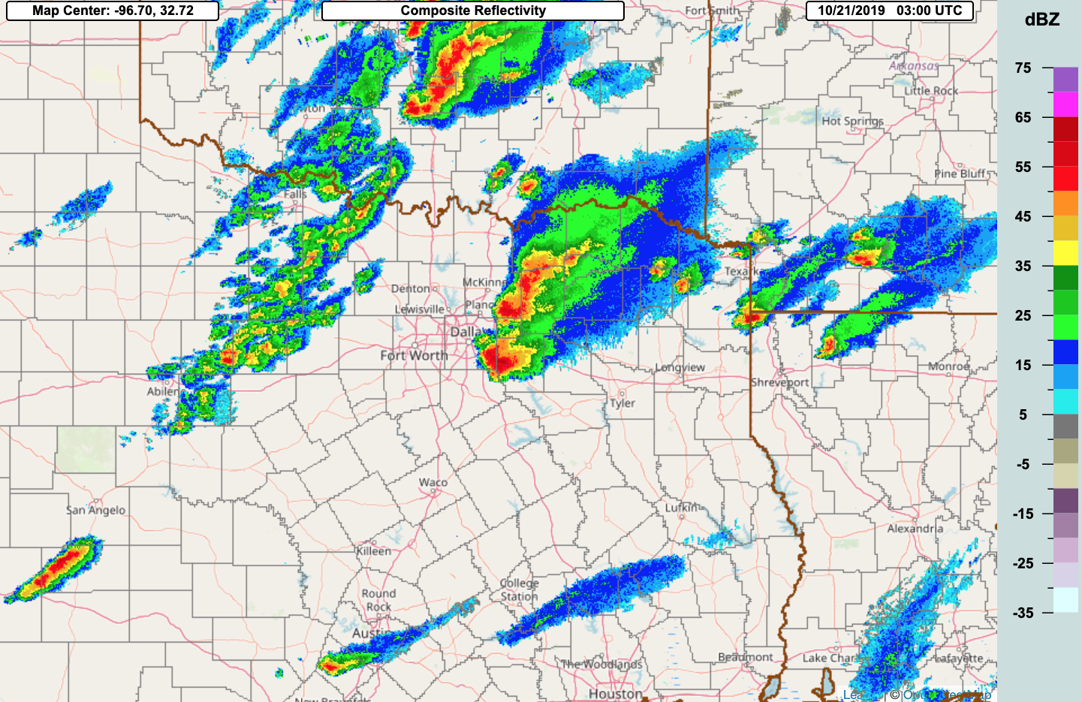
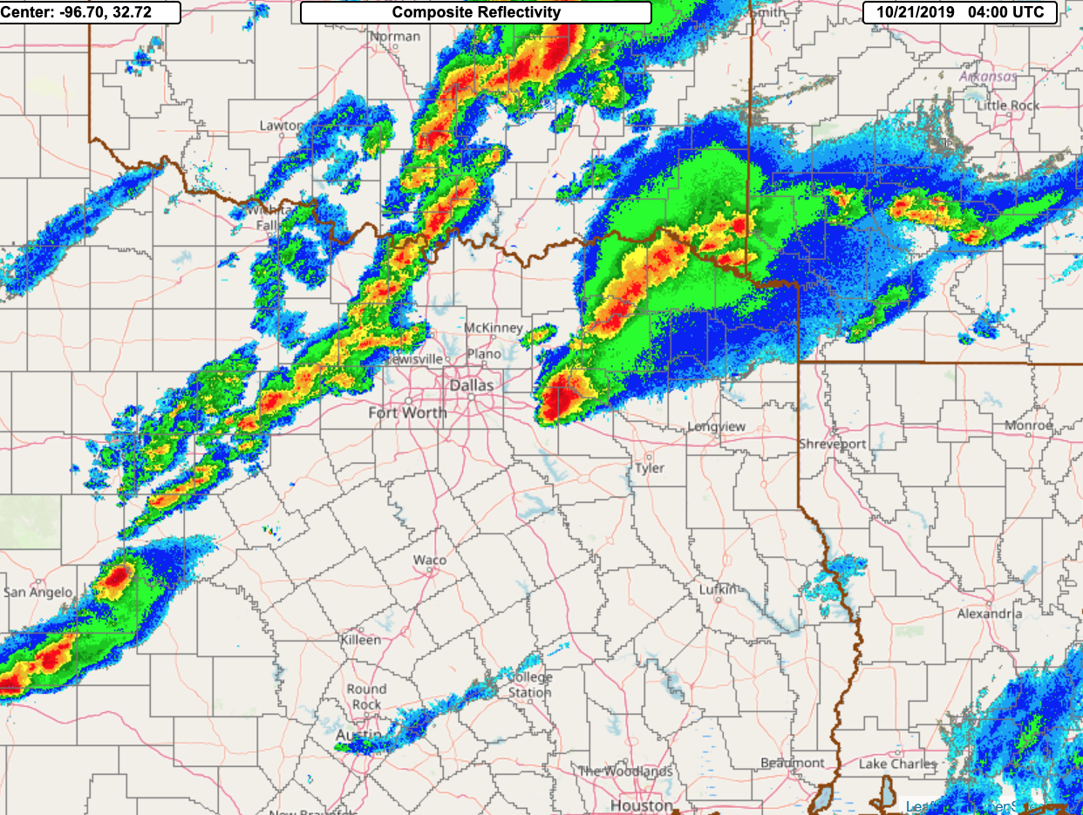
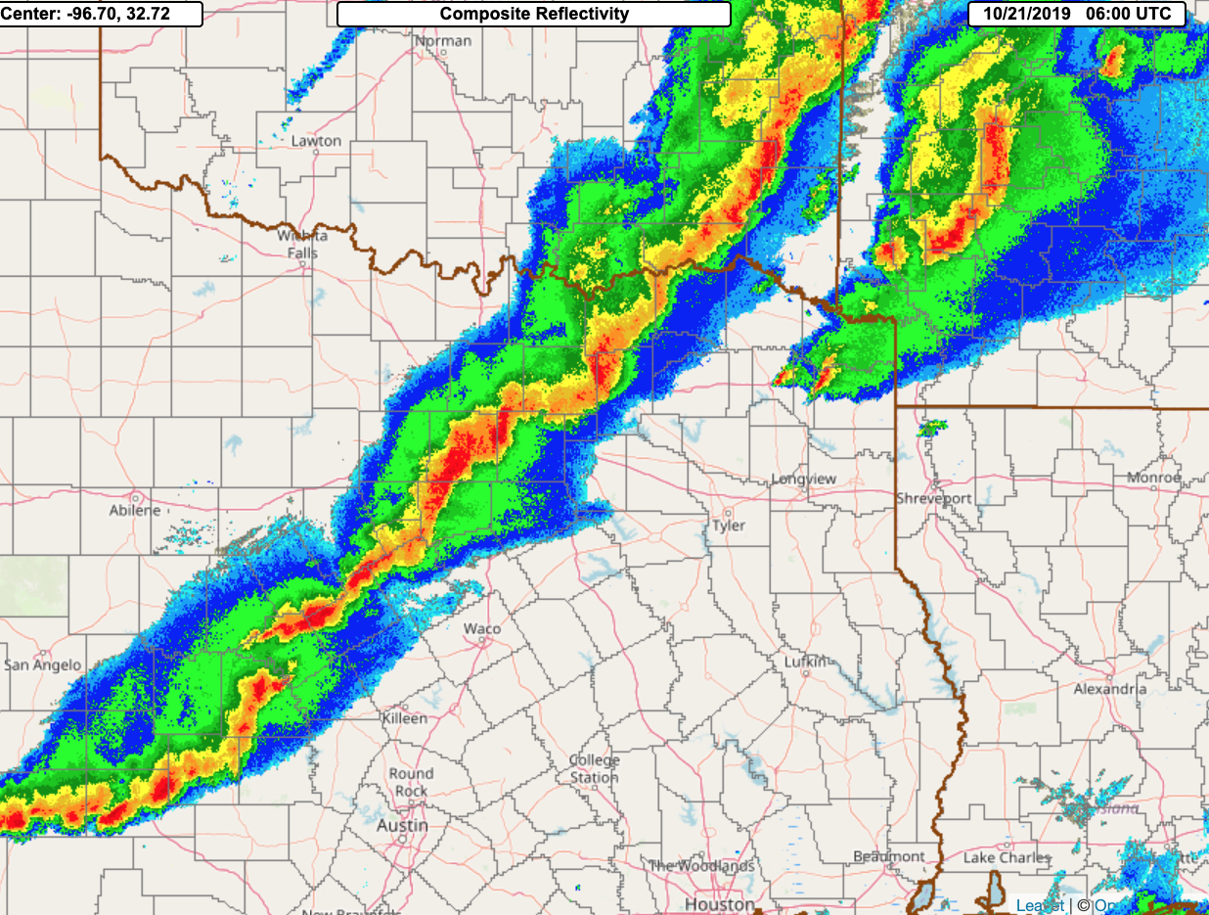
21 October 2019 Composite reflectivity – the supercells ahead of the main line along the approaching strong cold front.
0200z
0300z
0400z
0600z

Slide 16
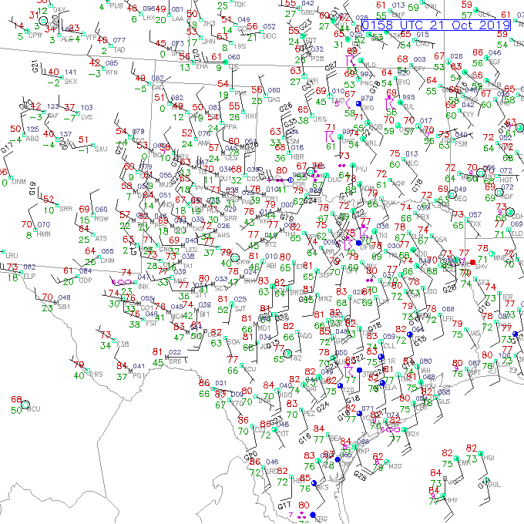
At 02z the cold front is still well to the west of Dallas, with a surface low in OK.

Slide 17
21z/20 October Composite Reflectivity forecasts The beginning of the cells that reach Dallas are in the red circle in the observed reflectivity, with the HRRRX faster to develop them.
Ops HRRR
HRRRX
MRMS observed Composite Reflectivity
1-h valid 22z
2-h valid 23z

Slide 18
21z/20 October Composite Reflectivity forecasts HRRRX remains well ahead of the HRRR with the development of the supercells west of Dallas, in agreement with MRMS.
Ops HRRR
HRRRX
MRMS observed Composite Reflectivity
3-h valid 00z/21 Oct
4-h valid 01z

Slide 19
21z/20 October Composite Reflectivity forecasts The HRRR continues to miss the supercells moving through Dallas, but not the HRRRX. The EF3 tornado occurs at 0202z.
Ops HRRR
HRRRX
MRMS observed Composite Reflectivity
5-h valid 02z
6-h valid 03z

Slide 20
21z/20 October Composite Reflectivity forecasts The HRRR never did get the Dallas area supercells. Both have a strong line along the cold front by 06z.
Ops HRRR
HRRRX
MRMS observed Composite Reflectivity
7-h valid 04z
9-h valid 06z

Slide 21
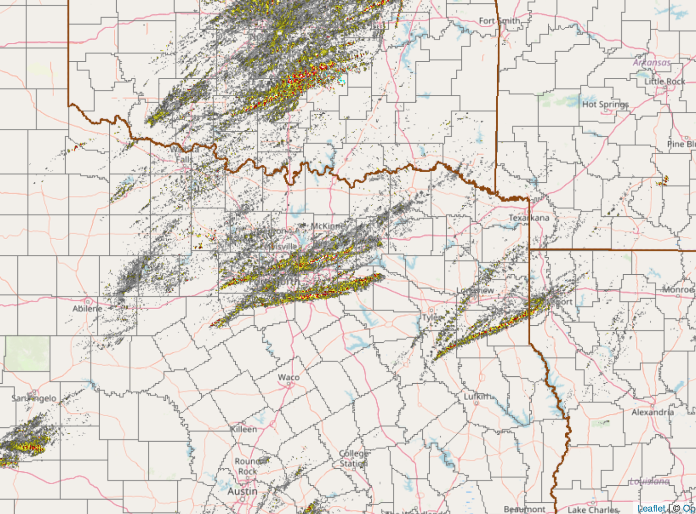
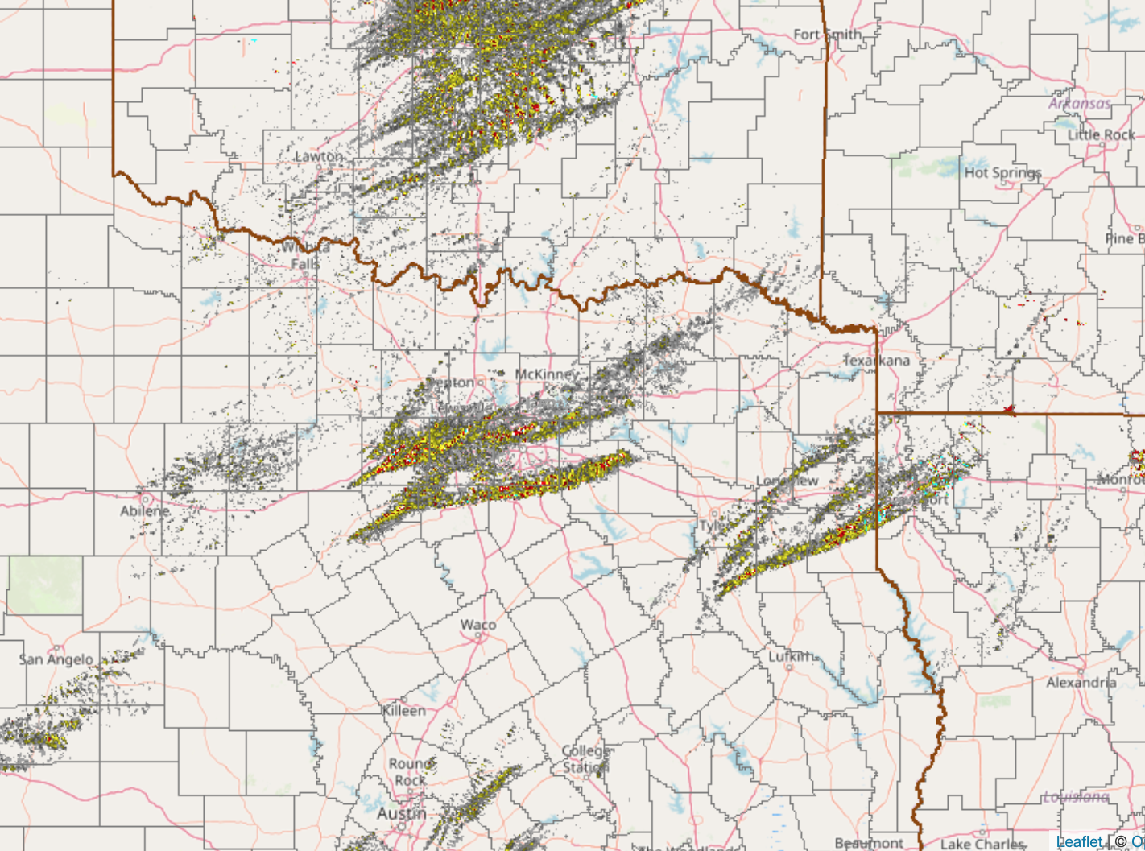
MRMS Rotation Tracks for 6-h ending 04z/21 October 2019
Low-level
Mid-level
It looks like there were 3 distinct supercell tracks in the Dallas area (one supercell produced the only observed tornado).

Slide 22
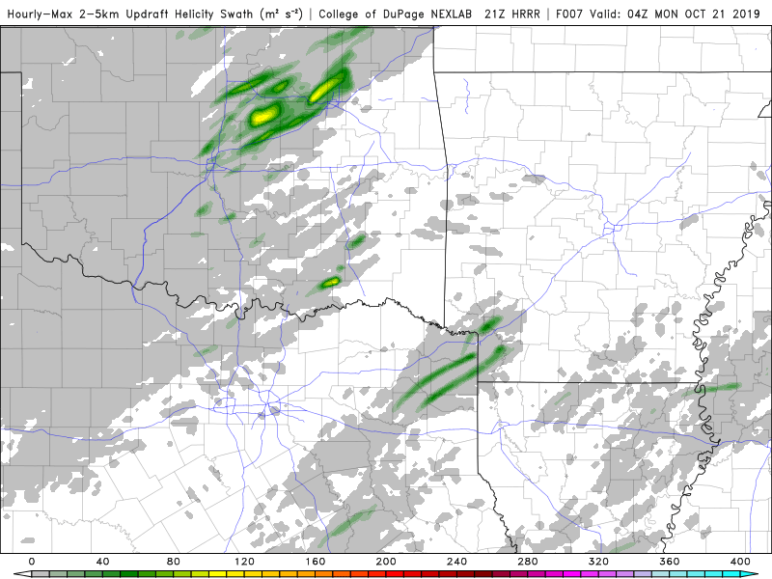
Run Total 2-5 km UH Forecasts from the 21z/20 Oct HRRR runs ending at 04z/21 October 2019
Ops HRRR
HRRRX
Since the HRRR missed the supercells in the Dallas area we of course see no UH signal.
The HRRRX has several long-track supercells.

Slide 23
Retrospective Cases Will Be Available in the Coming Weeks
www.emc.ncep.noaa.gov/users/meg/rapv5_hrrrv4/retros

