Slide 1
MEG DISCUSSION Initial Findings from the RAPv5/HRRRv4 Evaluation
Shannon Shields
NCEP/EMC Model Evaluation Group
October 31, 2019

Slide 2
Timeline
The evaluation period will run 15 October to 13 December 2019
The RAPv5 parallel will be run throughout the evaluation period
The HRRRv4-Alaska parallel will be run 15 October to 13 November
The HRRRv4-CONUS parallel will be run 14 November to 13 December
3 one-month RAP and HRRR-CONUS retrospective periods will cover summer 2018, winter 2019, and spring 2019 (May – active convective month)
2 one-month HRRR-AK retrospective periods will cover summer 2018 and winter 2019
Evaluations will be due 17 December
Acting NCEP Director will be briefed around 20 December
Code handoff to NCO must occur by the first week of January 2020
Implementation targeted for June 2020

Slide 3
2020 RAPv5/HRRRv4 Changes
Model | Data Assimilation | Land-surface / post
WRF-ARWv3.9+ incl. phys changes Physics changes: MYNN PBL update – better sub-grid clouds, improved EDMF mixing - remove limit for subgrid qc/qi - decrease subgrid qc/qi radii RRTMG modifications for subgrid clouds Aerosols sources/sinks – fire/smoke, dust - Add smoke with VIIRS FRP Improved land-surface/snow model including better 2m T/Td diagnostics Latest Grell-Freitas conv (RAP only) Lake model for small lakes Enhanced gravity-wave drag Numerics changes: Reduced 6th order diffusion inc. hydrom Removal of mp_tend_lim Explicit-Implicit vertical advection | Merge with GSI trunk – 2019 New Observations for assimilation: GOES-16 radiances, CrIS/ATMS TC vitals for trop cyclone location/strength Aircraft/raob moisture obs for p<300 hPa VIIRS/MODIS fire radiative power Assimilation Methods: HRRR - 3km ensemble DA (36 mems out to 1h) – HRRRDAS mean for HRRR IC and BEC | Switch to MODIS albedo (higher), replace 1-deg albedo. Add zenith-ang albedo adj 15” resolution land use data Fractional sea/lake ice concentration FVCOM data for Great Lakes lake temp/ice concentration VIIRS/MODIS/GOES fire radiative power HAILCAST diagnostic Smoke (2.5 pm) products
Extend 03/09/15/21z RAP to f51
Extend 00/06/12/18z HRRRs to f48

Slide 4
Data Links
Real-Time RAP para data: ftp://ftp.emc.ncep.noaa.gov/mmb/mmbpll/rappara
Real-Time HRRR para data: ftp://ftp.emc.ncep.noaa.gov/mmb/mmbpll/hrrrpara
Retro RAP data: ftp://gsdftp.fsl.noaa.gov/retro/rap
Retro HRRR data: ftp://gsdftp.fsl.noaa.gov/retro/hrrr

Slide 5
MEG Evaluation Page
https://www.emc.ncep.noaa.gov/users/meg/rapv5_hrrrv4/

Slide 6
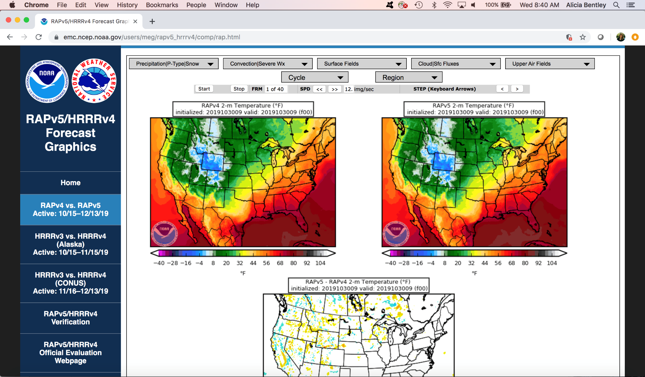
Comparison Graphics
for Real-Time Parallels
https://www.emc.ncep.noaa.gov/users/meg/rapv5_hrrrv4/comp/

Slide 7
RAPv5 Preliminary Findings

Slide 8
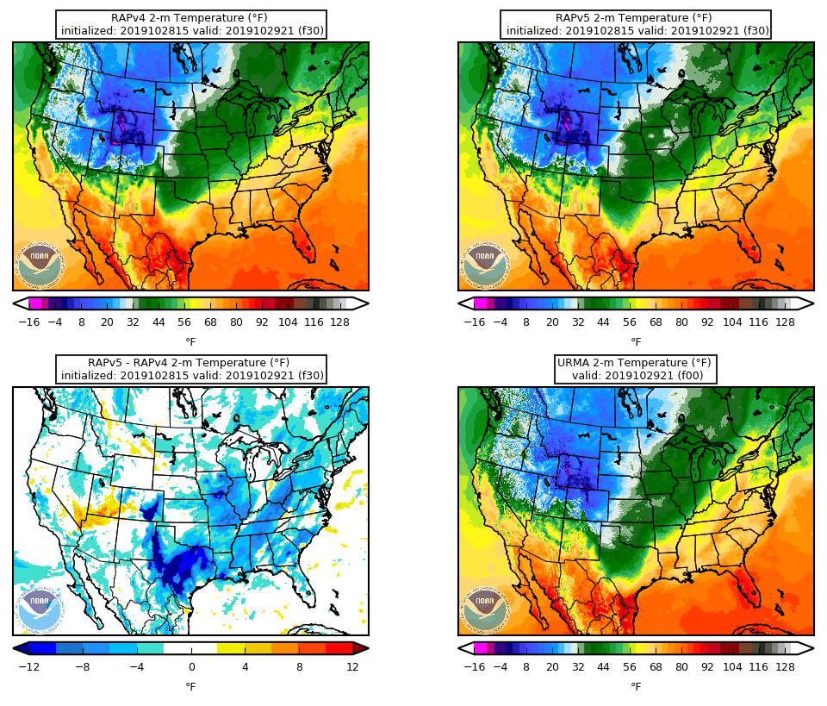
2-m Temperature
Init. 15Z 10/28/19
Valid 21Z 10/29/19
RAPv5 considerably colder than RAPv4 during the day (especially around 20Z validation time)
Up to 12° cooler in large region of TX

Slide 9
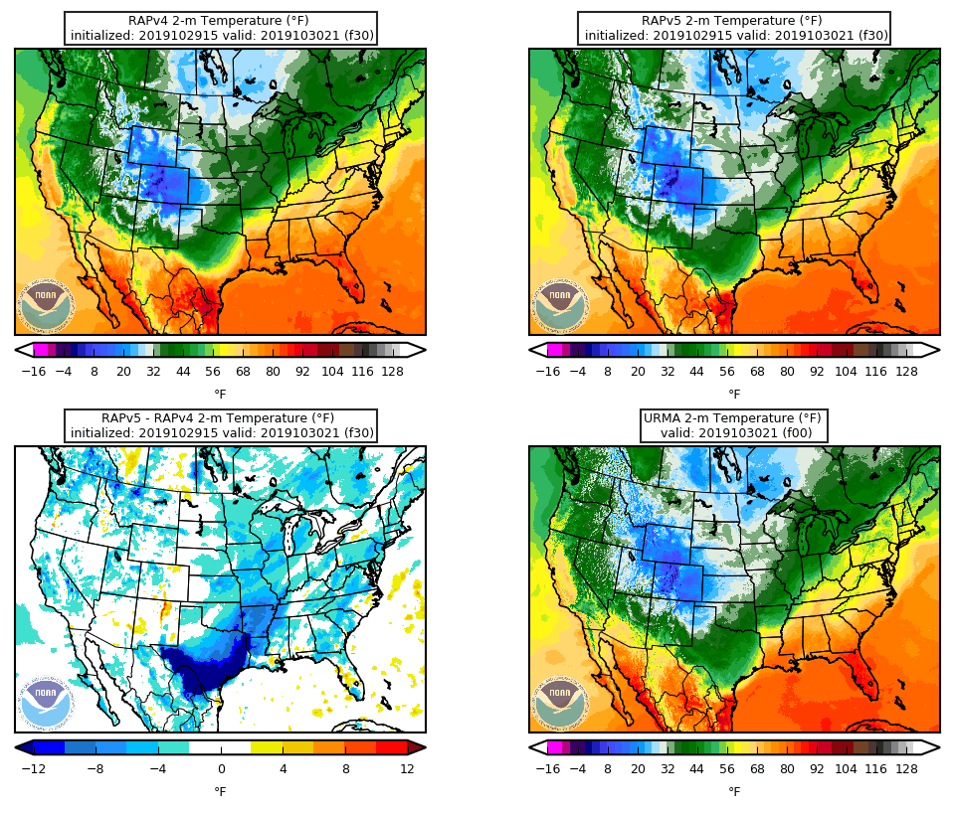
2-m Temperature
Init. 15Z 10/29/19
Valid 21Z 10/30/19
RAPv5 considerably colder than RAPv4 during the day (especially around 20Z validation time)
Up to 12° cooler in southern TX
GSD test showing RAP low-level cold bias

Slide 10
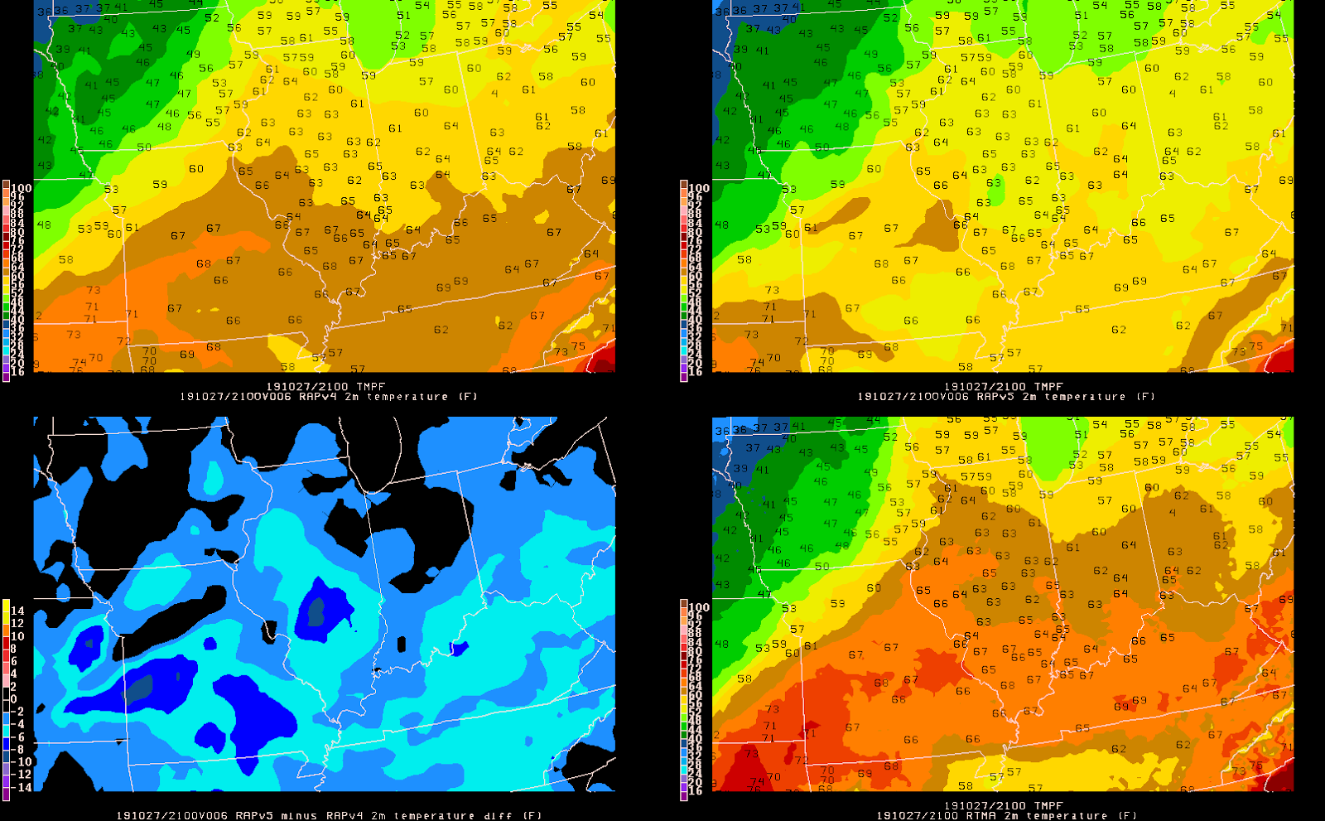
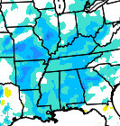
2-m Temperature
Courtesy of Lauren Warner (Purdue)
Init. 15Z 10/27/19
Valid 21Z 10/27/19
RAPv5 cooler than RAPv4 by 6-8°
The RAPv5 temperatures were off by up to 10° from the observed in areas with the most change

Slide 11
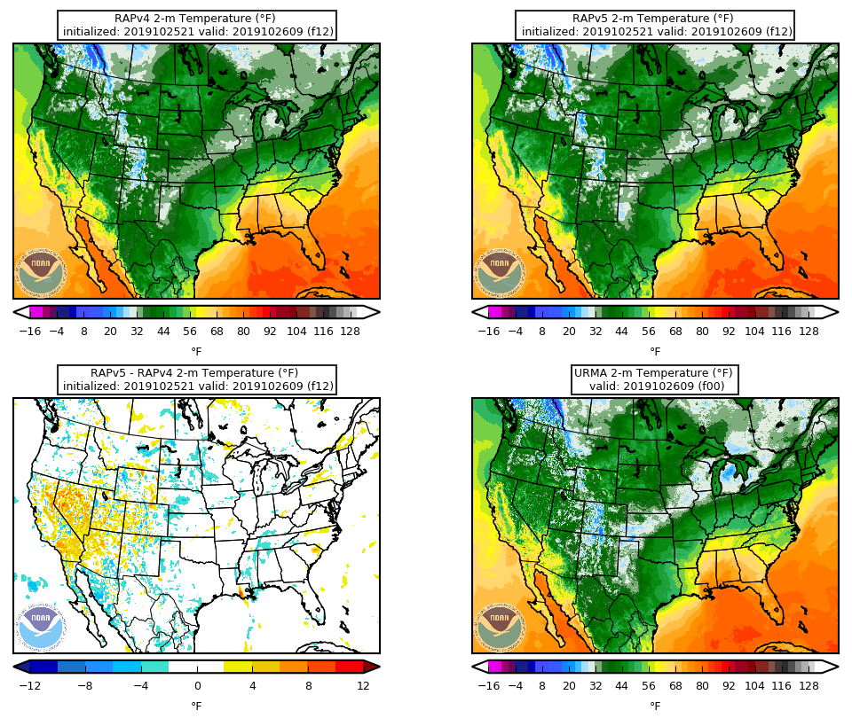
2-m Temperature
Init. 21Z 10/25/19
Valid 9Z 10/26/19
RAPv5 warmer than RAPv4 at night in the western U.S.

Slide 12
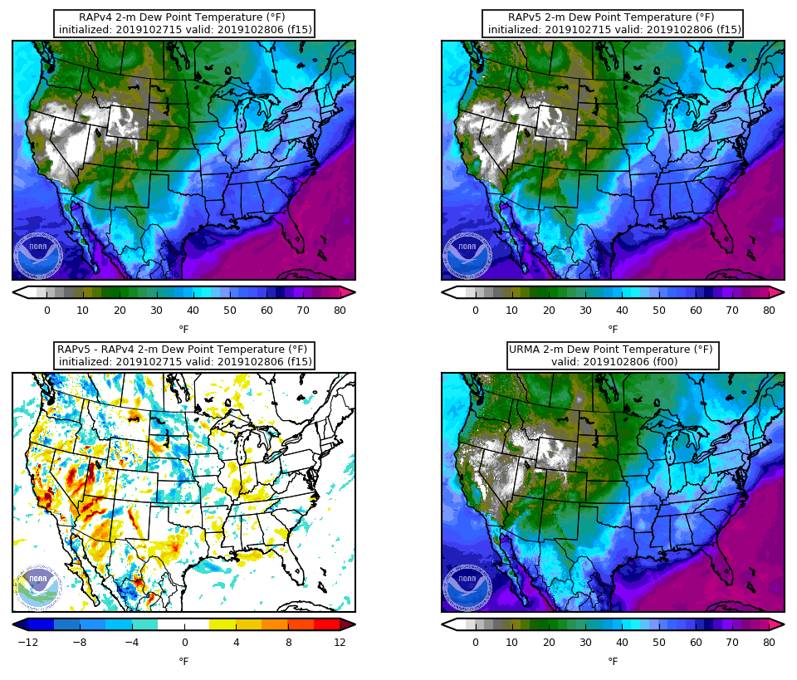
2-m Dewpoint Temperature
Init. 15Z 10/27/19
Valid 6Z 10/28/19
Higher dewpoint temps in RAPv5 around 0Z validation time in western U.S.

Slide 13
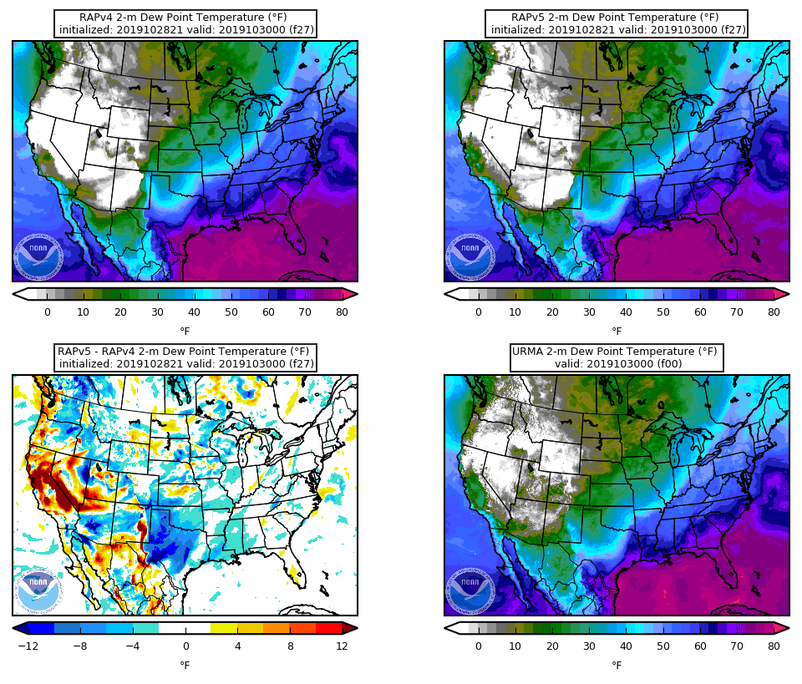
2-m Dewpoint Temperature
Init. 21Z 10/28/19
Valid 0Z 10/30/19
Higher dewpoint temps in RAPv5 around 0Z validation time in western U.S.

Slide 14
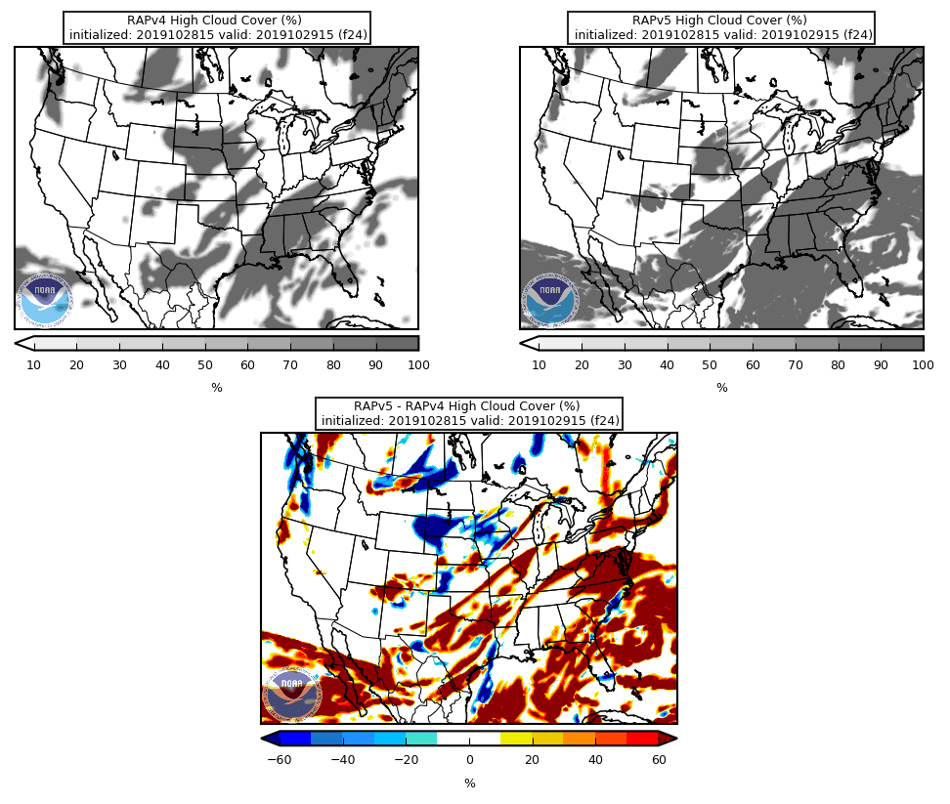
High Cloud Cover
Init. 15Z 10/28/19
Valid 15Z 10/29/19
Overall higher cloud cover in RAPv5 compared to RAPv4

Slide 15
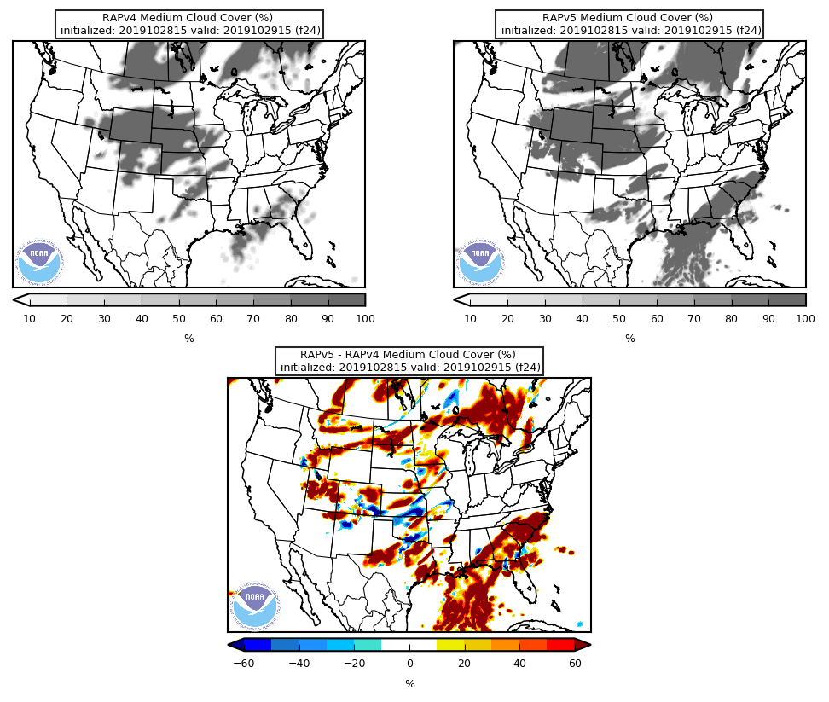
Medium Cloud Cover
Init. 15Z 10/28/19
Valid 15Z 10/29/19
Overall higher cloud cover in RAPv5 compared to RAPv4

Slide 16
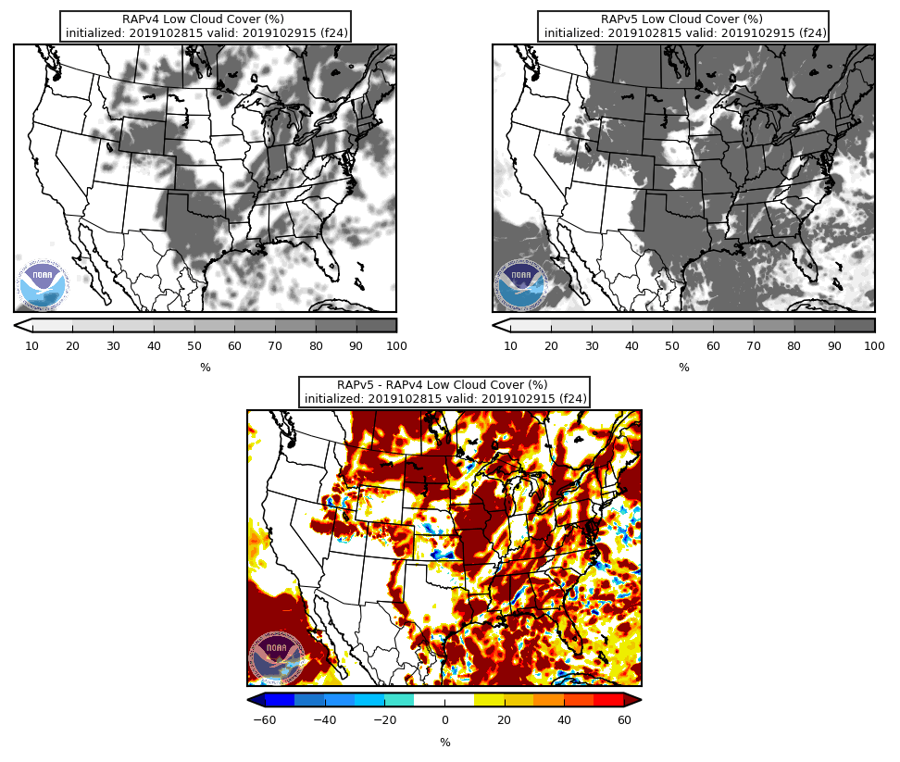
Low Cloud Cover
Init. 15Z 10/28/19
Valid 15Z 10/29/19
Much higher cloud cover in RAPv5 compared to RAPv4

Slide 17
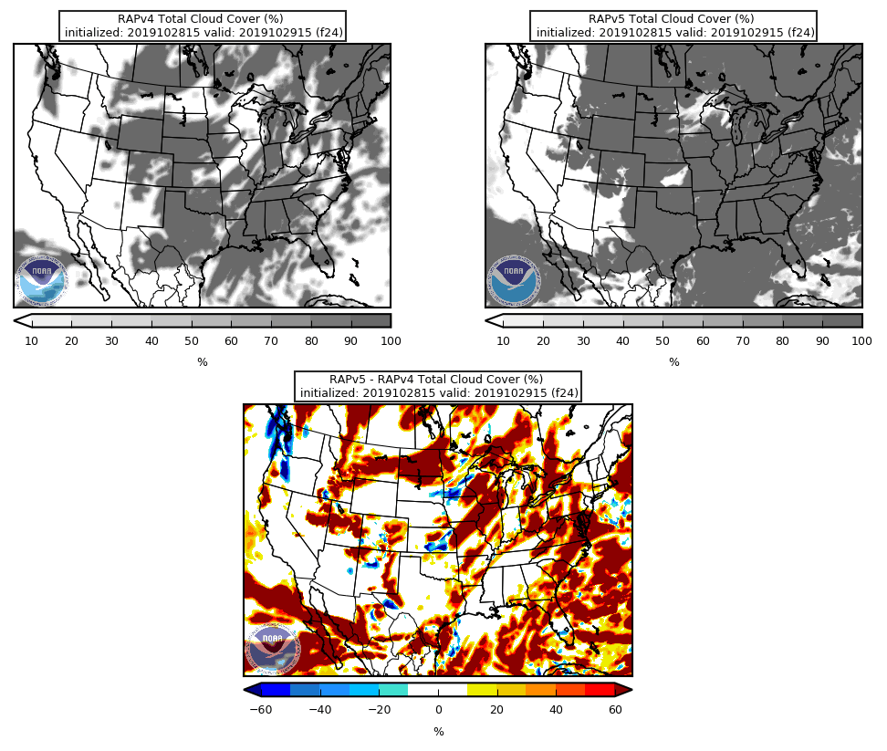
Total Cloud Cover
Init. 15Z 10/28/19
Valid 15Z 10/29/19
Overall higher cloud cover at all levels in RAPv5 compared to RAPv4 with greatest contribution from low levels

Slide 18
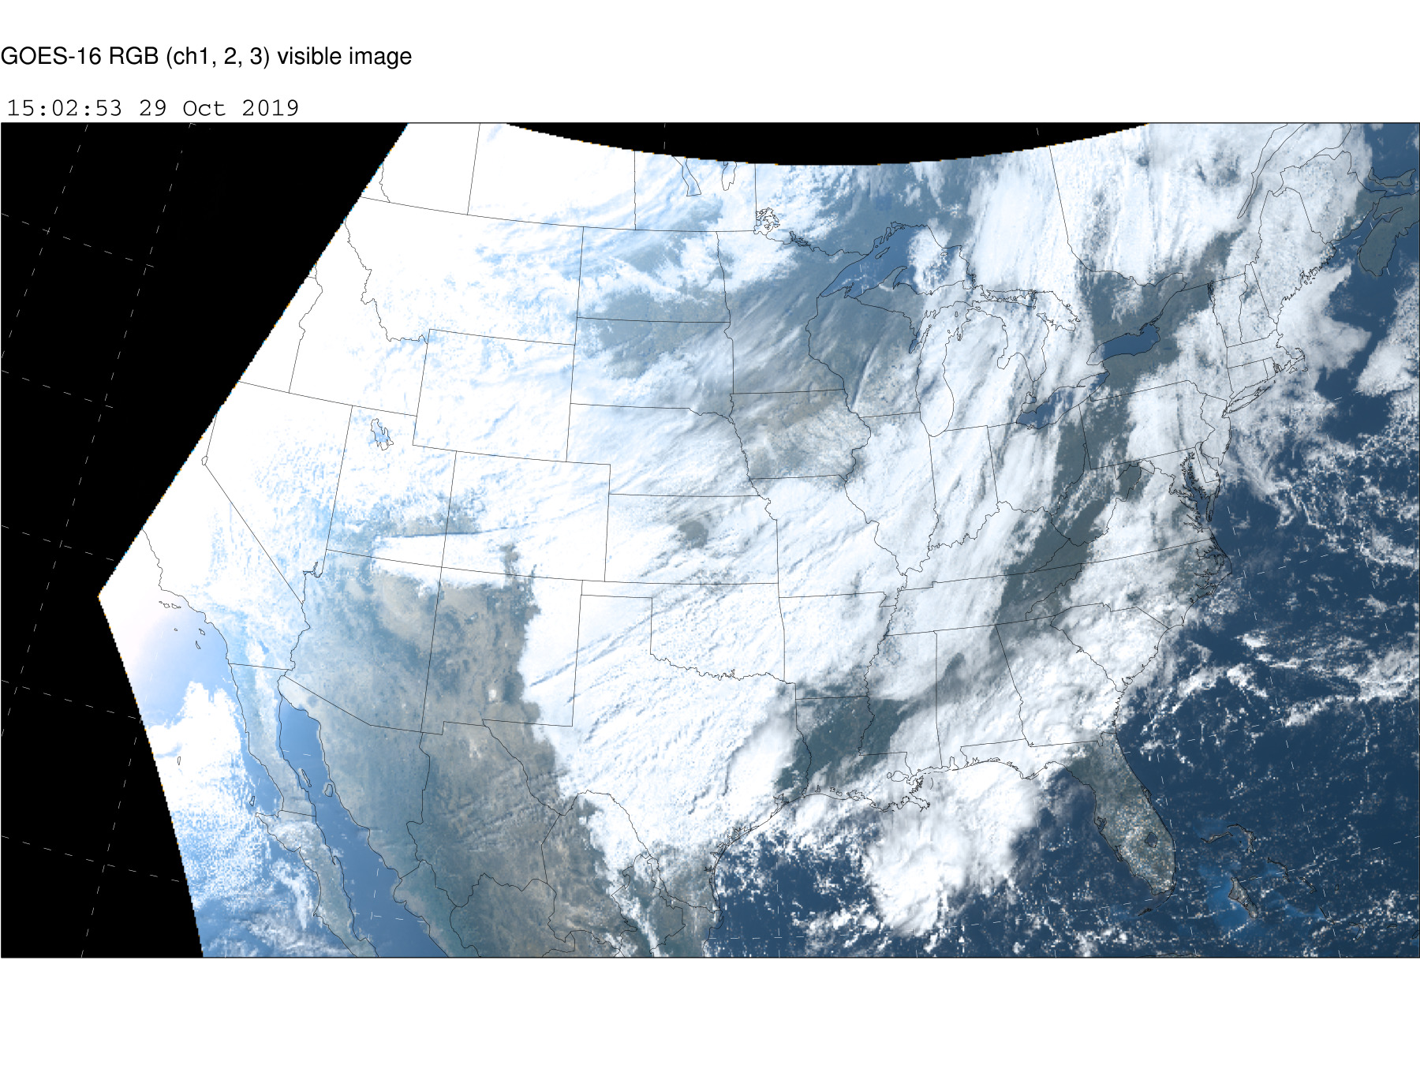
Cloud Cover Verification
Valid 15Z 10/29/19
Overall RAPv5 did well/ captured most of the cloudy regions
RAPv5 overestimated clouds over FL and eastern U.S. region
RAPv5 seemed to forecast better than RAPv4 in CO, central MT, and northern UT

Slide 19
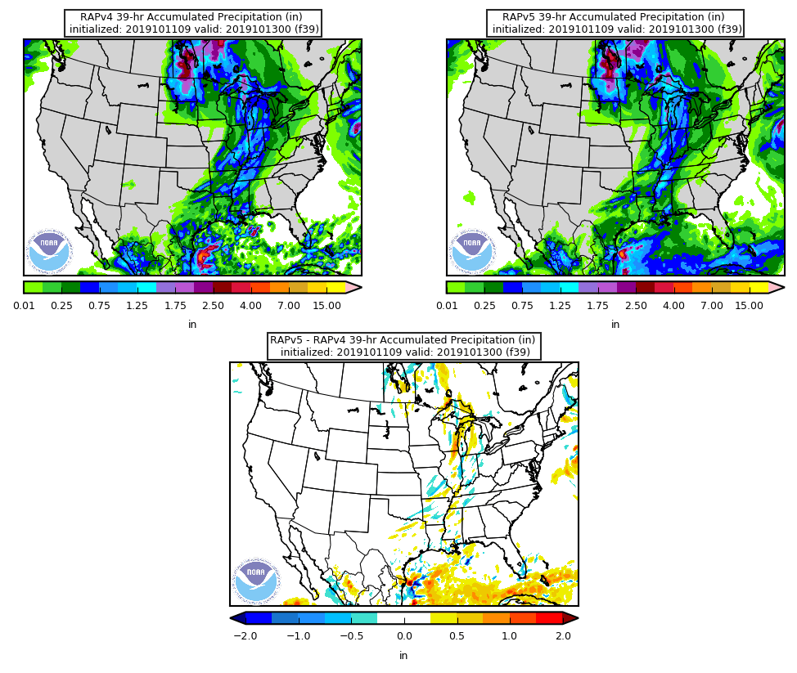
39-hr Accumulated Precipitation
Init. 9Z 10/11/19
Valid 0Z 10/13/19
Increased precip in RAPv5 compared to RAPv4 for southern Gulf of Mexico

Slide 20
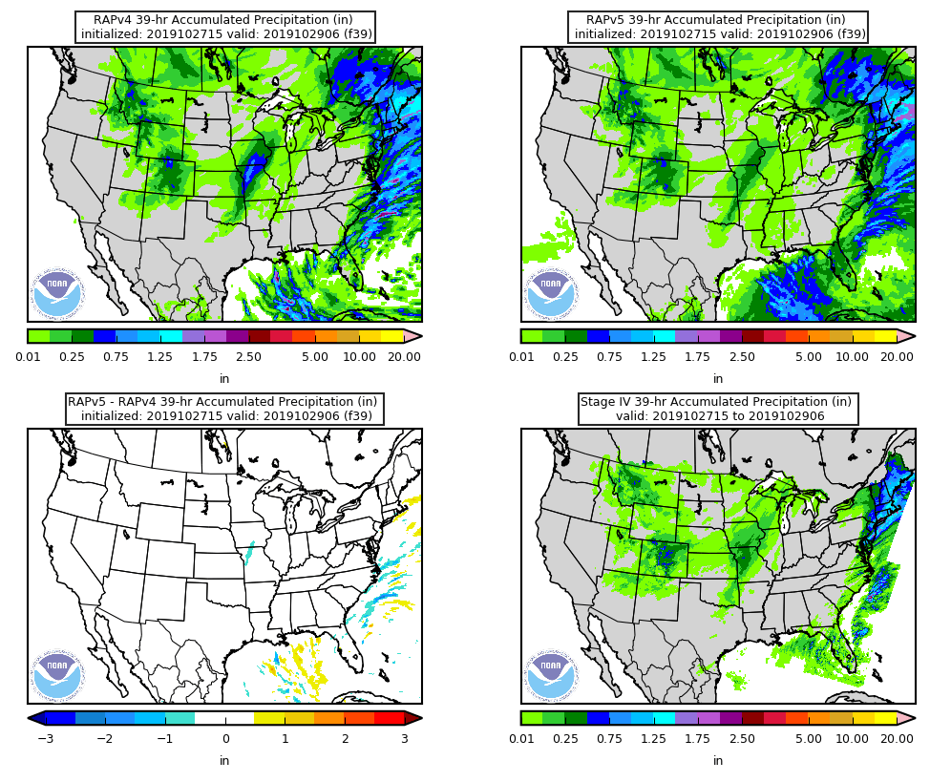
39-hr Accumulated Precipitation
Init. 15Z 10/27/19
Valid 6Z 10/29/19
Increased precip in RAPv5 compared to RAPv4 for Gulf of Mexico
Decreased precip in RAPv5 compared to RAPv4 for IA/MO

Slide 21
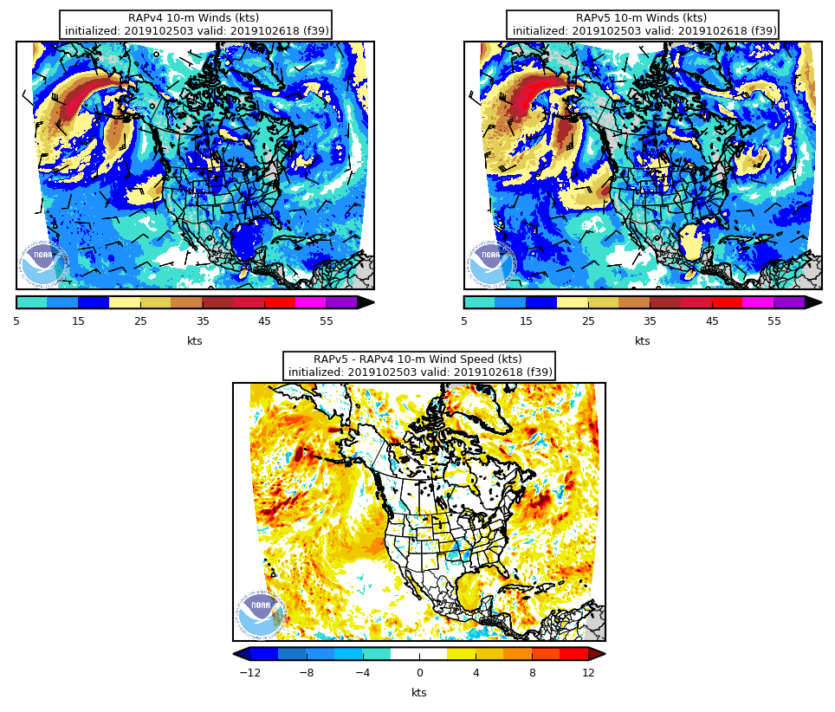
10-m Wind Speed
Init. 3Z 10/25/19
Valid 18Z 10/26/19
Largest increases in 10-m wind speeds are over water
in RAPv5-RAPv4 difference field graphic

Slide 22
10-m Wind Speed
Init. 3Z 10/30/19
Valid 9Z 10/30/19
Again, RAPv5 10-m winds are consistently stronger over large bodies of water
However, wind speeds over higher terrain often appear weaker

Slide 23
10-m Wind Speed
Init. 3Z 10/30/19
Valid 9Z 10/30/19
Weaker RAPv5 speeds
over most of the
higher terrain of the
southwest U.S.

Slide 24
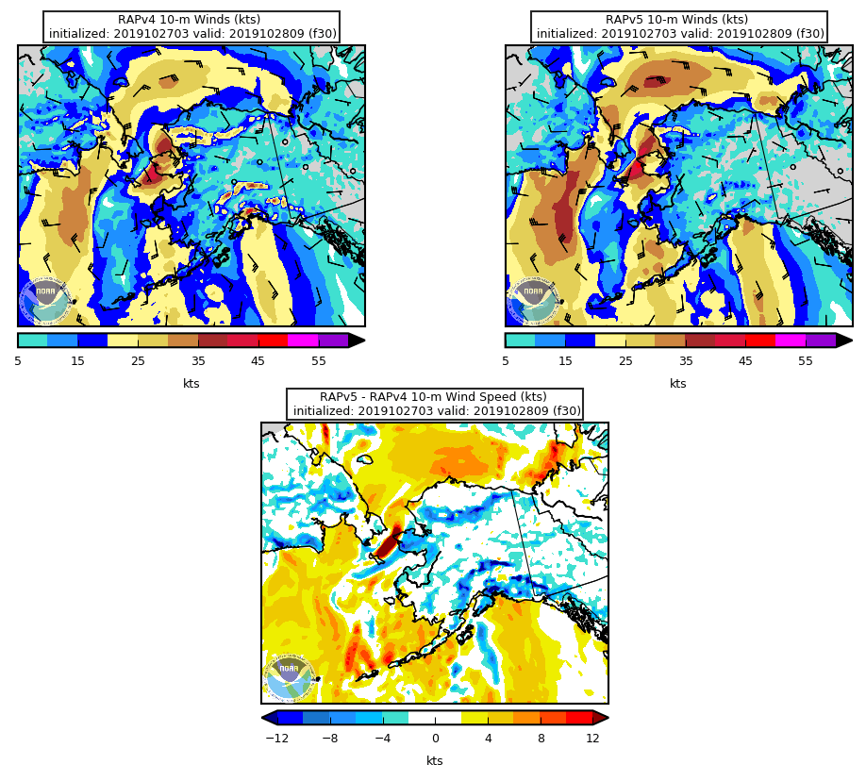
10-m Wind Speed
Init. 3Z 10/27/19
Valid 9Z 10/28/19
AK case also shows weaker RAPv5 speeds
over high terrain with stronger winds over ocean

Slide 25
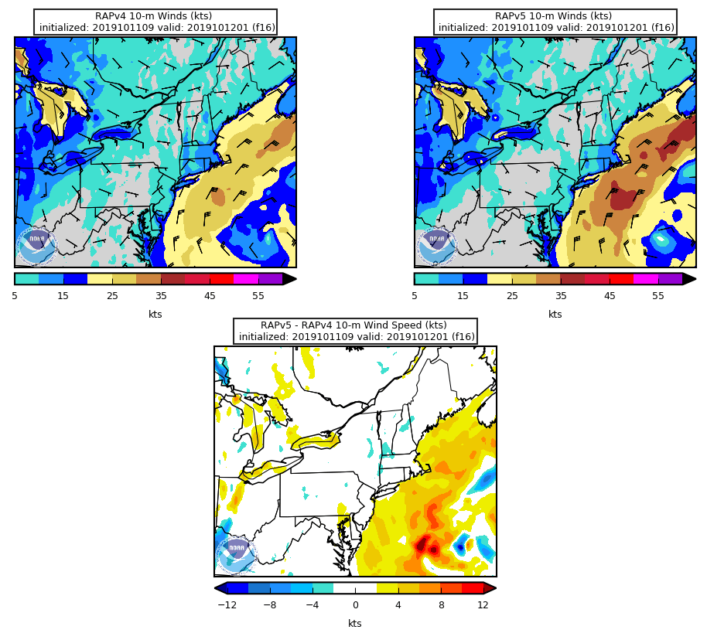
10-m Wind Speed
Init. 9Z 10/11/19
Valid 1Z 10/12/19
Increased 10-m wind speeds in RAPv5 compared to RAPv4 for Subtropical Storm Melissa

Slide 26
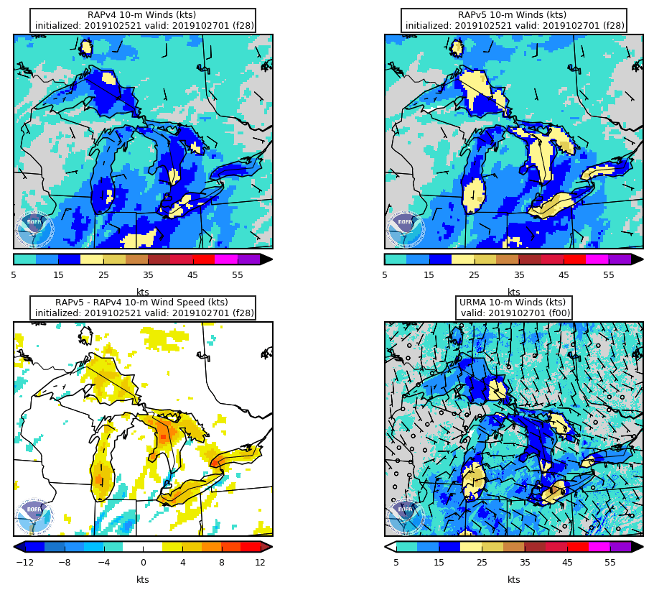
10-m Wind Speed
Init. 21Z 10/25/19
Valid 1Z 10/27/19
Increased 10-m wind speeds in RAPv5 compared to RAPv4 over Great Lakes

Slide 27
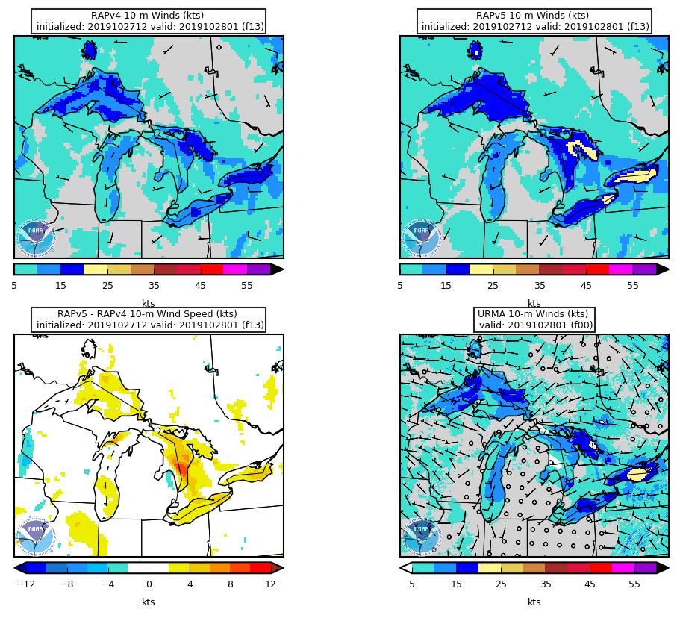
10-m Wind Speed
Init. 12Z 10/27/19
Valid 1Z 10/28/19
Increased 10-m wind speeds in RAPv5 compared to RAPv4 over Great Lakes

Slide 28
Summary of Preliminary Findings
The RAPv5 has colder 2-m temps than RAPv4 during the day over most of the U.S.
The RAPv5 has warmer 2-m temps than RAPv4 during the overnight hours in the western U.S./mountainous regions
The RAPv5 has higher 2-m dewpoint temps than RAPv4 at around 0Z validation time in the western U.S.
There is higher cloud cover at all levels in RAPv5 compared to RAPv4 with the greatest increases from low-level clouds
For longer runs that extend to 39 hrs, the accumulated precip increases in RAPv5 compared to RAPv4 for the Gulf of Mexico
The RAPv5 contains stronger 10-m wind speeds than the RAPv4 over the western Atlantic, eastern Pacific, Great Lakes, and within storms
The RAPv5 has weaker 10-m wind speeds than the RAPv4 over high terrain
RAPv5 or v4 better? Mostly inconclusive at this time, but RAPv5 seems better w/ 2-m dewpoint temps in western U.S.

