Slide 1
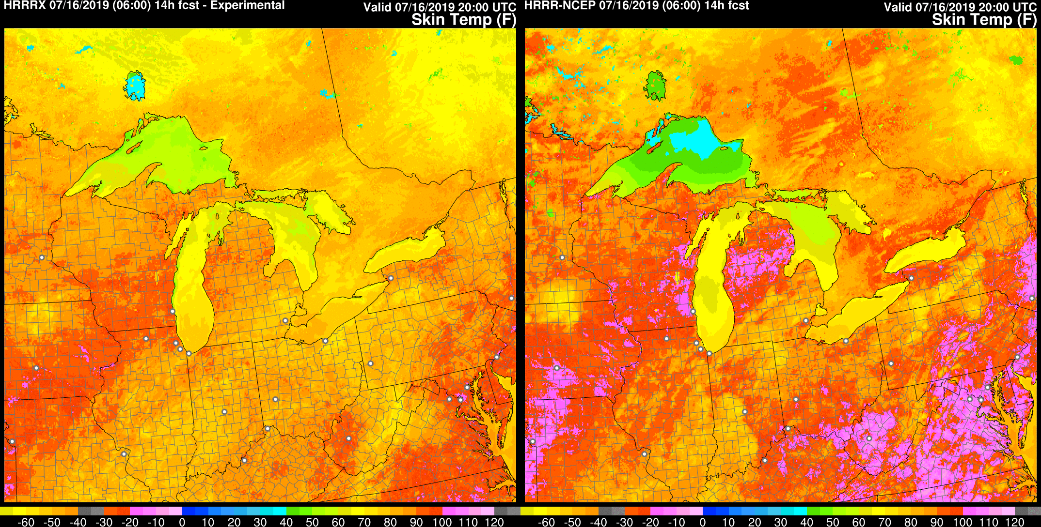
MEG DISCUSSION The RAPv5/HRRRv4 Evaluation
10 October 2019
Geoff Manikin NCEP/EMC geoffrey.manikin@noaa.gov
Curtis Alexander ESRL/GSD curtis.alexander@noaa.gov

Slide 2
What’s Next?
BIG PICTURE
RAPv5/HRRRv4 implementation scheduled for Q3FY20
Code handoff to NCO must occur by the first week of January 2020, so the evaluation must be wrapped up by mid-December
Building of the parallels was delayed, so to meet the schedule, the evaluation period will be slightly compacted
EMC cannot run HRRR-CONUS and HRRR-AK parallels simultaneously
This is the final RAP/HRRR upgrade; we will move to the FV3-based Rapid Refresh Forecast System (RRFS) in 3-4 years

Slide 3
What’s Next?
THE PLAN
The evaluation period will run 15 October to 13 December 2019
The RAPv5 parallel will be run throughout the evaluation period
The HRRRv4-Alaska parallel will be run 15 October to 13 November
The HRRRv4-CONUS parallel will be run 14 November to 13 December
3 one-month RAP and HRRR-CONUS retrospective periods will cover summer 2018, winter 2019, and spring 2019 (May – active convective month)
2 one-month HRRR-AK retrospective periods will cover summer 2018 and and winter 2019
Evaluations will be due 17 December
Acting NCEP Director will be briefed around 20 December
Implementation targeted for June 2020

Slide 4
What’s Next?
HOW to EVALUATE
Grib2 and station time series bufr output available on EMC ftp server (and eventually paranomads) for all real-time parallels
Real-time Parallel Graphics for RAP (entire period)
Real-time Parallel Graphics for HRRR-AK (during first month)
Real-time Parallel Graphics for HRRR-CONUS (second month)
Graphics for selected HRRR-CONUS retrospective cases (will start to populate web site in next few weeks)
Graphics for selected HRRR-AK retrospective cases (will populate after real-time HRRR-AK parallel is turned off)
Statistics from real-time and retrospective parallels (available soon)
MEG presentations over the next two months

Slide 5
What’s Next?
HOW to EVALUATE
Real-Time RAP para data: ftp://ftp.emc.ncep.noaa.gov/mmb/mmbpll/rappara
Real-Time HRRR para data: ftp://ftp.emc.ncep.noaa.gov/mmb/mmbpll/hrrrpara
Retro RAP data: ftp://gsdftp.fsl.noaa.gov/retro/rap
Retro HRRR data: ftp://gsdftp.fsl.noaa.gov/retro/hrrr

Slide 6
WHAT TO LOOK FOR
Is there improvement (or, at a minimum, limited degradation) in overall synoptic and mesoscale performance (including boundary layer structure and dryline position)?
Does the HRRRDAS improve initialization and maintenance of convection?
Are there improved vertical velocity (and UH) signals in convection?
Is the new smoke output useful?
Is there better representation of temperatures of small lakes?
Are the temperatures of the Great Lakes handled better?
Is there improved retention of shallow cloudy air masses?
Is there improvement in snowfall amounts?
Are there benefits in extending some RAP forecasts to 51 hours and HRRR forecasts to 48 hours?

Slide 7
What’s Next?
MEG EVALUATION PAGE
https://www.emc.ncep.noaa.gov/users/meg/rapv5_hrrrv4/

Slide 8
What’s Next?
COMPARISON GRAPHICS
for Real-Time Parallels
https://www.emc.ncep.noaa.gov/users/meg/rapv5_hrrrv4/comp/

Slide 9
What’s Next?
COMPARISON GRAPHICS
for Retrospectives Coming Soon

Slide 10
2020 RAPv5/HRRRv4 Changes
Model | Data Assimilation | Land-surface / post
WRF-ARWv3.9+ incl. phys changes Physics changes: MYNN PBL update – better sub-grid clouds, improved EDMF mixing - remove limit for subgrid qc/qi - decrease subgrid qc/qi radii RRTMG modifications for subgrid clouds Aerosols sources/sinks – fire/smoke, dust - Add smoke with VIIRS FRP Improved land-surface/snow model including better 2m T/Td diagnostics Latest Grell-Freitas conv (RAP only) Lake model for small lakes Enhanced gravity-wave drag Numerics changes: Reduced 6th order diffusion inc. hydrom Removal of mp_tend_lim Explicit-Implicit vertical advection | Merge with GSI trunk – 2019 New Observations for assimilation: GOES-16 radiances, CrIS/ATMS TC vitals for trop cyclone location/strength Aircraft/raob moisture obs for p<300 hPa VIIRS/MODIS fire radiative power Assimilation Methods: HRRR - 3km ensemble DA (36 mems out to 1h) – HRRRDAS mean for HRRR IC and BEC | Switch to MODIS albedo (higher), replace 1-deg albedo. Add zenith-ang albedo adj 15” resolution land use data Fractional sea/lake ice concentration FVCOM data for Great Lakes lake temp/ice concentration VIIRS/MODIS/GOES fire radiative power HAILCAST diagnostic Smoke (2.5 pm) products
Extend 03/09/15/21z RAP to f51
Extend 00/06/12/18z HRRRs to f48

Slide 11
HRRRv3 Initialization from RAPv4
13 km RAP
13z
14z
15z
Obs
GFS
Ens
Obs
GFS
Ens
Obs
GFS
Ens
GSI
Hybrid
GSI
Hybrid
GSI
Hybrid
HM
Obs
HM
Obs
HM
Obs
GSI HM Anx
GSI HM Anx
GSI HM Anx
1 hr fcst
1 hr fcst
Refl
Obs
Refl
Obs
Refl
Obs
Digital
Filter
Digital
Filter
Digital
Filter
21 hr fcst
21 hr fcst
21 hr fcst
3 km
HRRR
Obs
GSI
Hybrid
GFS
Ens
3-km Interp
1 hr pre-fcst
HMObs
GSI HM Anx
Refl Obs
18 hr fcst

Slide 12
HRRRv4 Initialization
13 km RAP
13z
14z
15z
Obs
GFS
Ens
Obs
GFS
Ens
Obs
GFS
Ens
GSI
Hybrid
GSI
Hybrid
GSI
Hybrid
HM
Obs
HM
Obs
HM
Obs
GSI HM Anx
GSI HM Anx
GSI HM Anx
1 hr fcst
1 hr fcst
Refl
Obs
Refl
Obs
Refl
Obs
Digital
Filter
Digital
Filter
Digital
Filter
21 hr fcst
21 hr fcst
21 hr fcst
HRRRDAS
Ens
3 km
HRRR
Obs
GSI
Hybrid
HRRRDAS Mean
1 hr pre-fcst
HMObs
GSI HM Anx
Refl Obs
18 hr fcst

Slide 13
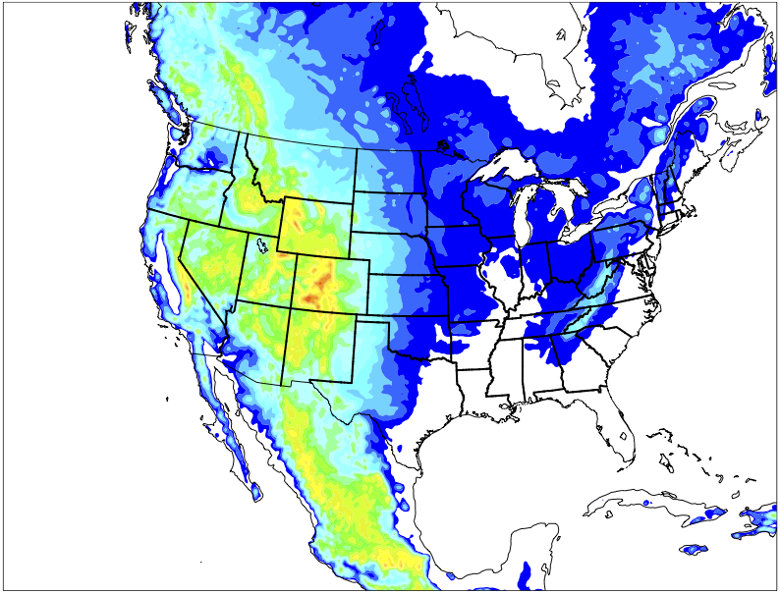
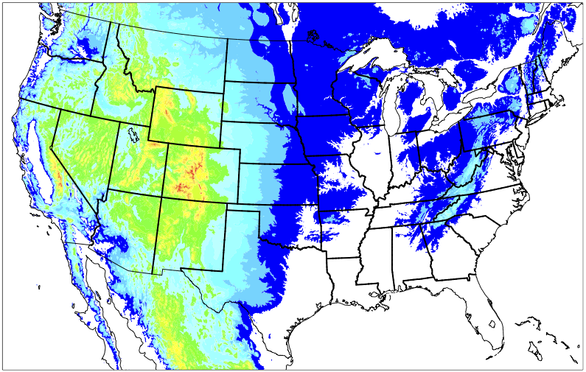
HRRR Data Assimilation System (HRRRDAS)
Collaboration from NSSL, EMC, NCAR and OU
DA
Ens
09z
11z
10z
RAPv5 (Mean)
36 15-km
1-hr fcsts
Conv Obs
+
18 GDAS (Perturbations)
15-km GSI-EnKF
Conv + Radar Obs
36 15-km
1-hr fcsts
3-km GSI-EnKF
36 3-km
1-hr fcsts
36 3-km
1-hr fcsts
Δx = 3 km
Δx = 3 km
Δx = 3 km
Δx = 3 km
Δx = 3 km
Δx = 3 km
Δx = 3 km
Δx = 3 km
Δx = 3 km
Δx = 3 km
Δx = 3 km
Δx = 3 km
Δx = 15 km
Δx = 3 km
Δx = 15 km
Δx = 3 km
Δx = 15 km
Δx = 3 km
Δx = 15 km
Δx = 3 km
Δx = 15 km
Δx = 3 km
Δx = 15 km
Δx = 3 km
Δx = 15 km
Δx = 3 km
Δx = 15 km
Δx = 3 km
Δx = 15 km
Δx = 3 km
Δx = 15 km
Δx = 3 km
Δx = 15 km
Δx = 3 km
Δx = 15 km
Δx = 3 km
RAP/HRRR
Soil Moisture Perts
RAP/HRRR
Soil Moisture Perts
Δx = 15 km
Δx = 3 km
Δx = 15 km
Δx = 3 km
Δx = 15 km
Δx = 3 km
Δx = 15 km
Δx = 3 km
Δx = 15 km
Δx = 3 km
Δx = 15 km
Δx = 3 km
Δx = 15 km
Δx = 3 km
Δx = 15 km
Δx = 3 km
Δx = 15 km
Δx = 3 km
Δx = 15 km
Δx = 3 km
Δx = 15 km
Δx = 3 km
Δx = 15 km
Δx = 3 km
Δx = 15 km
Δx = 3 km
Δx = 15 km
Δx = 3 km
Δx = 15 km
Δx = 3 km
Δx = 15 km
Δx = 3 km
Δx = 15 km
Δx = 3 km
Δx = 15 km
Δx = 3 km
Δx = 15 km
Δx = 3 km
Δx = 15 km
Δx = 3 km
Δx = 15 km
Δx = 3 km
Δx = 15 km
Δx = 3 km
Δx = 15 km
Δx = 3 km
Δx = 15 km
Δx = 3 km
Δx = 15 km
Δx = 3 km
Δx = 15 km
Δx = 3 km
Δx = 15 km
Δx = 3 km
Δx = 15 km
Δx = 3 km
Δx = 15 km
Δx = 3 km
Δx = 15 km
Δx = 3 km
Δx = 15 km
Δx = 15 km
Δx = 15 km
Δx = 15 km
Δx = 15 km
Δx = 15 km
Δx = 15 km
Δx = 15 km
Δx = 15 km
Δx = 15 km
Δx = 15 km
Δx = 15 km
RAP/HRRR
Soil Moisture Perts
Sources of Spread
Hourly DA (posterior inflation)
Lower boundary perturbations (soil moisture)
Lateral boundary perturbations
18 members re-initialized at 09z and inserted at 10z
18 members re-initialized at 21z and inserted at 22z

Slide 14
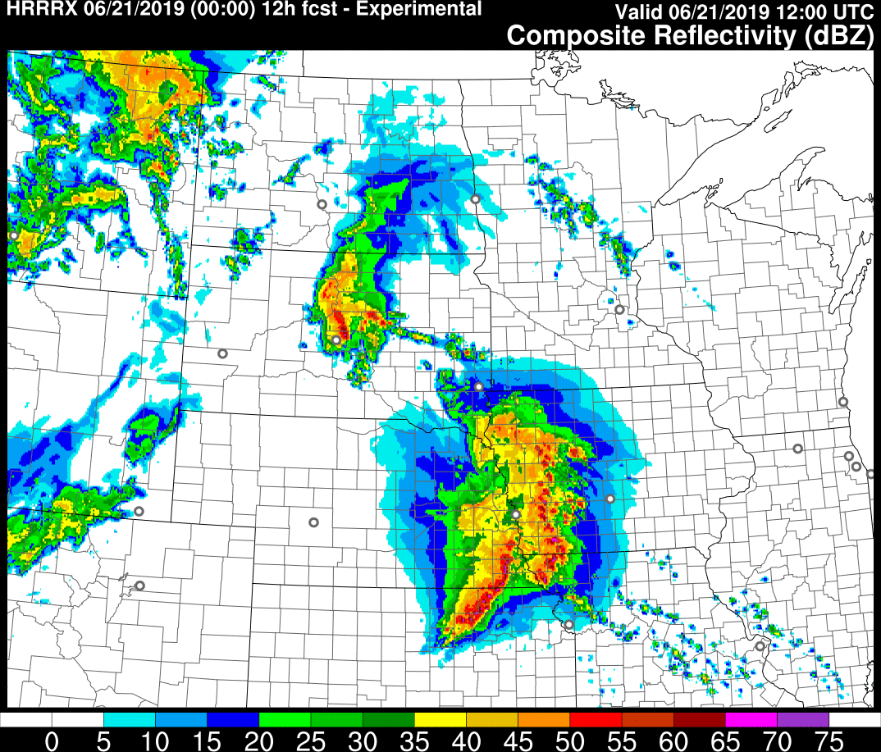
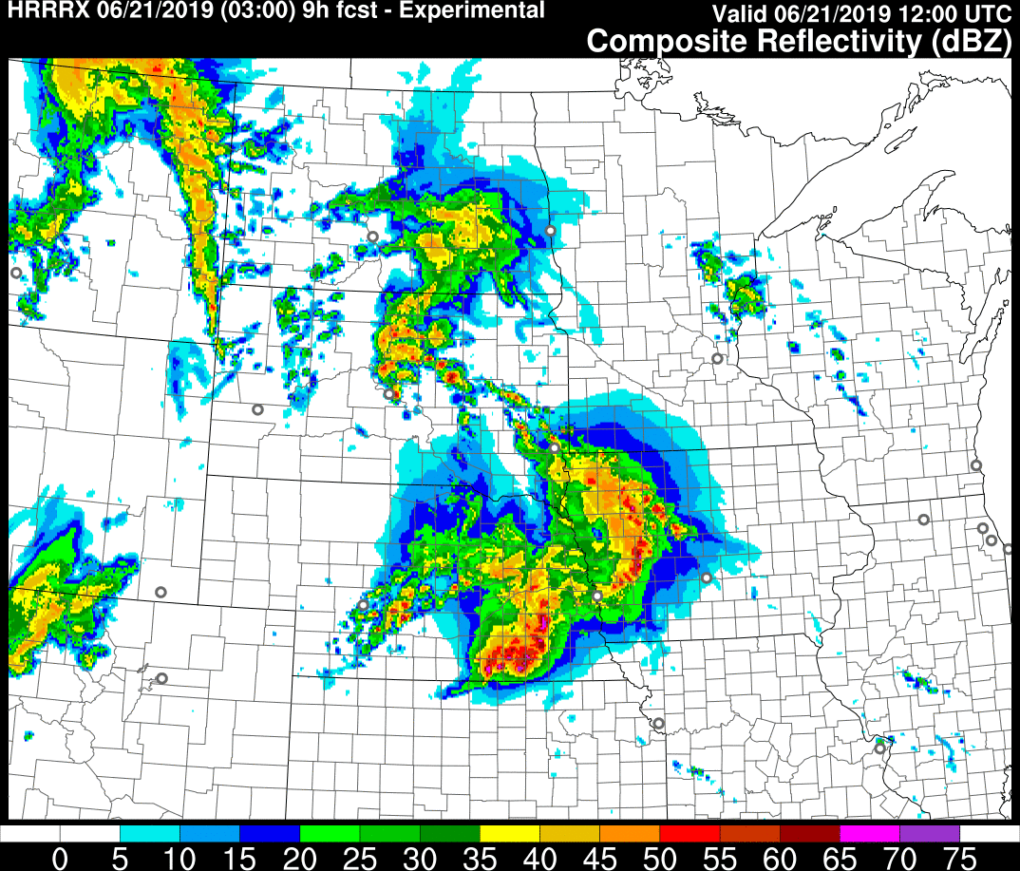
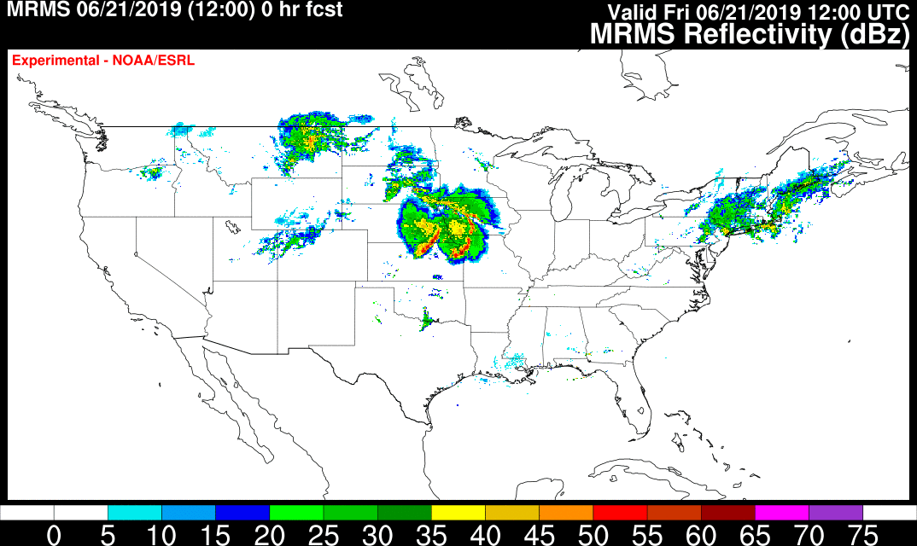
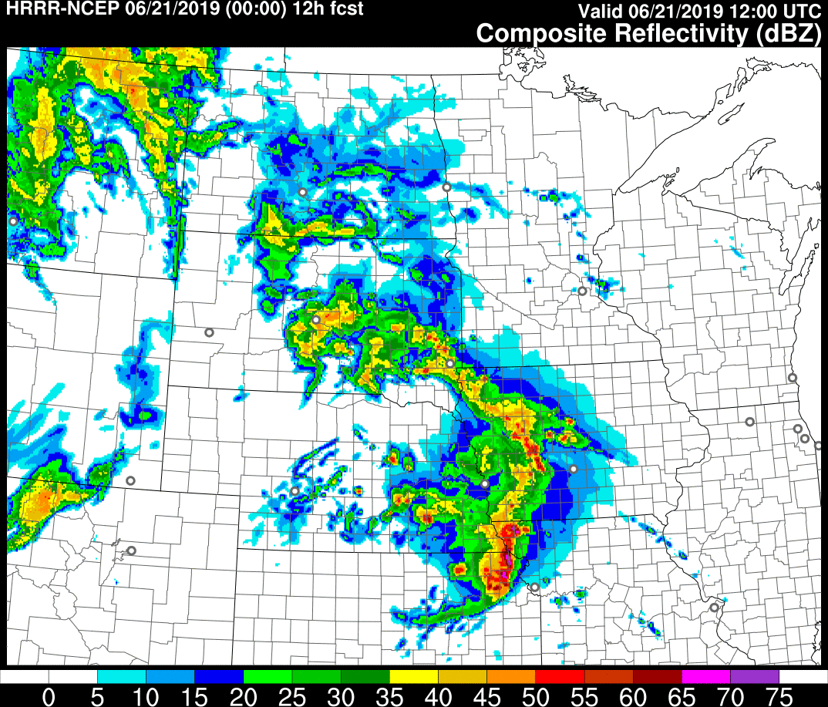
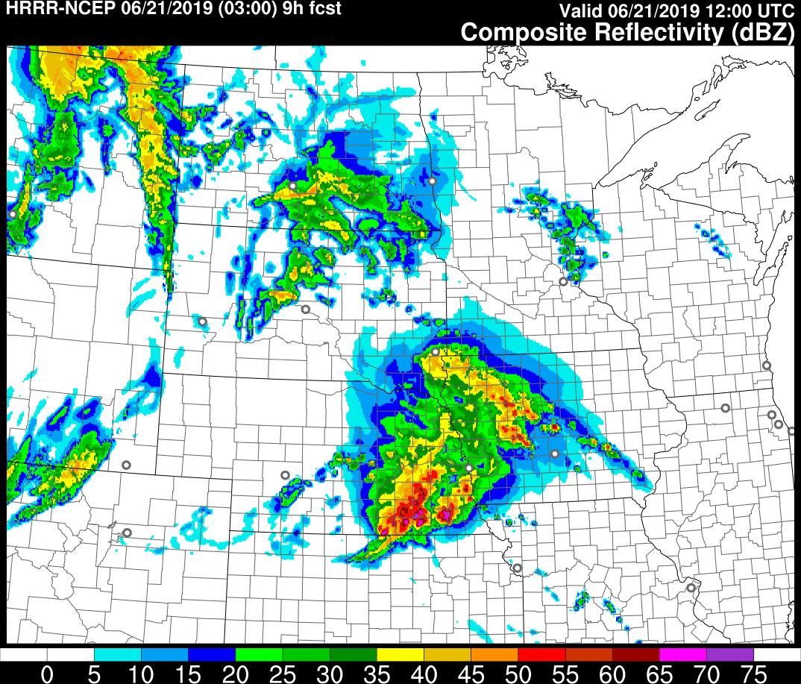
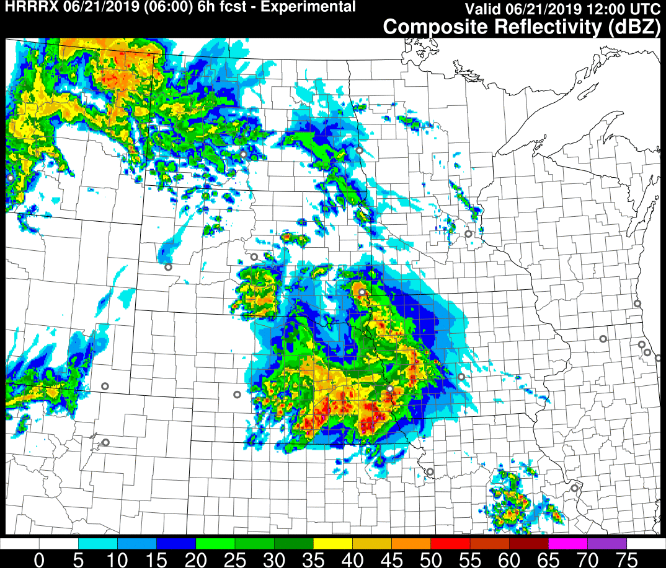
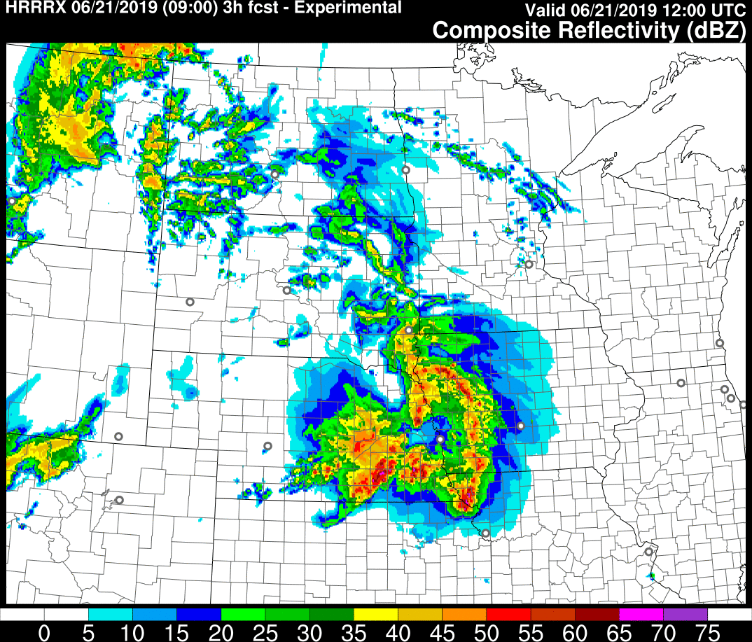
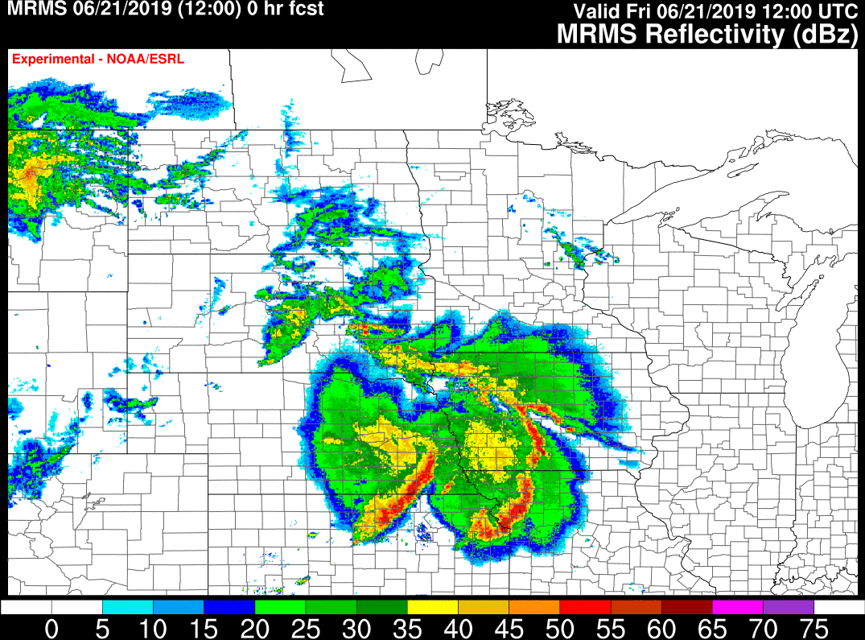
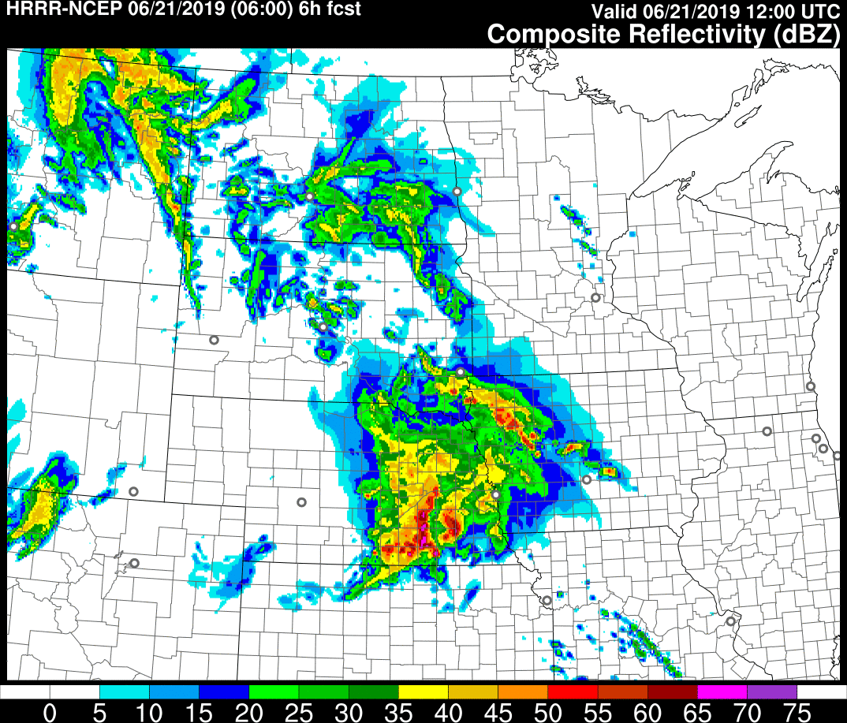
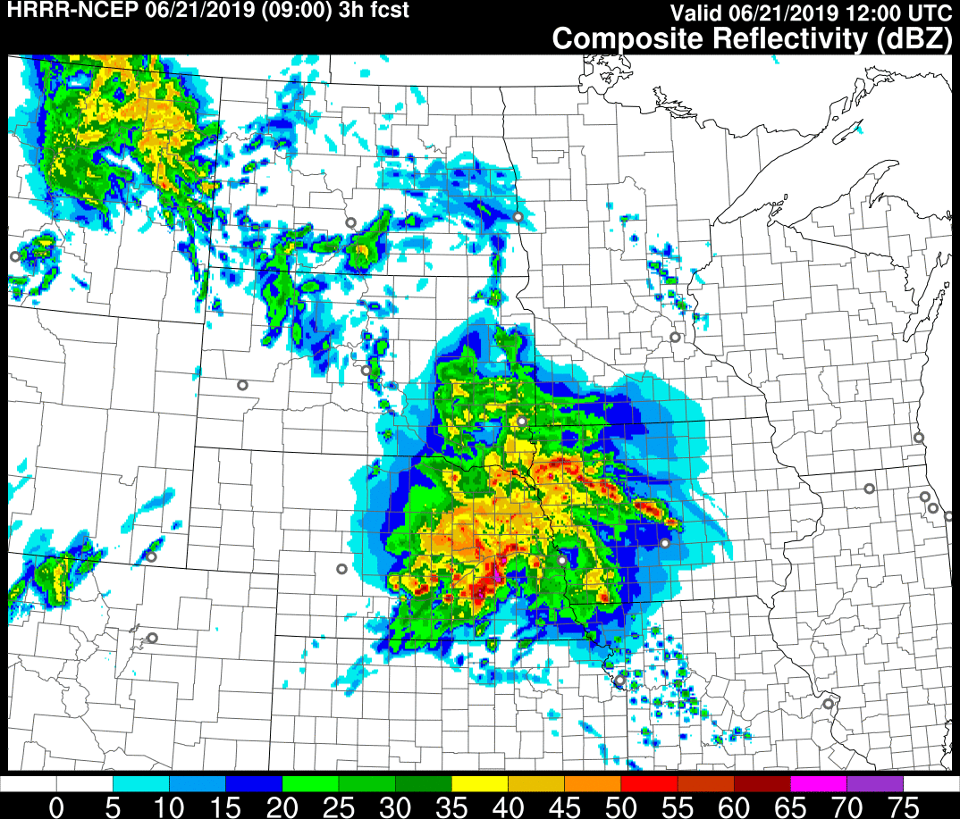
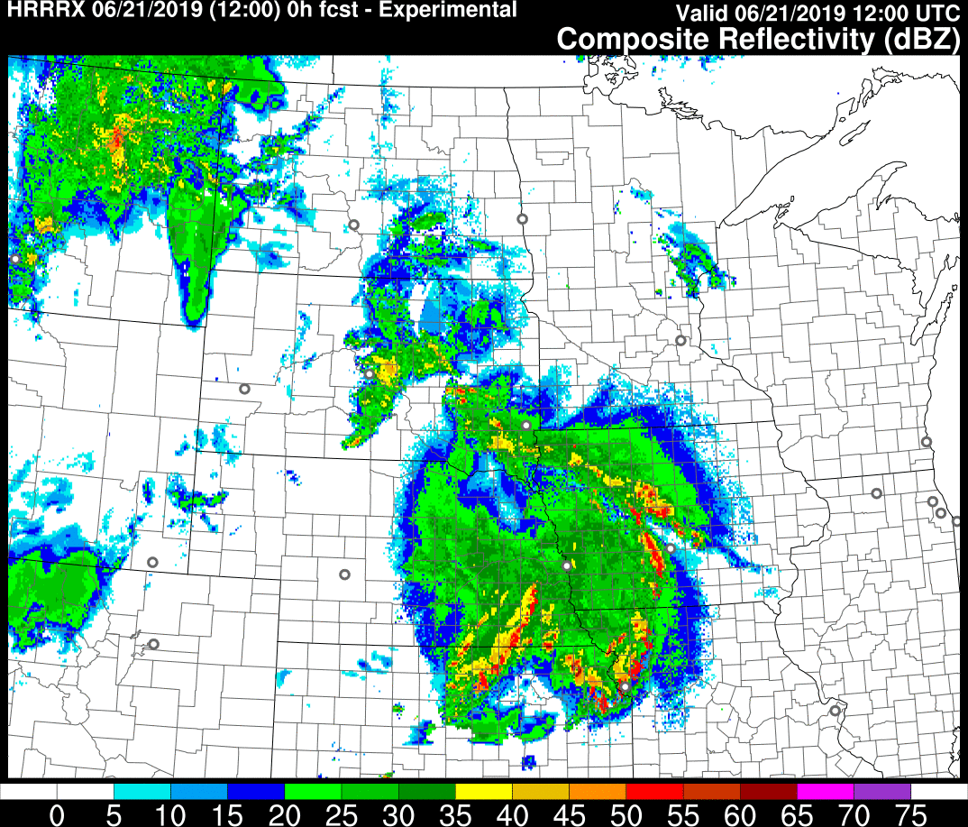
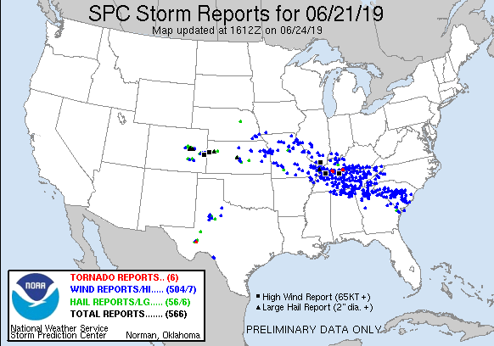
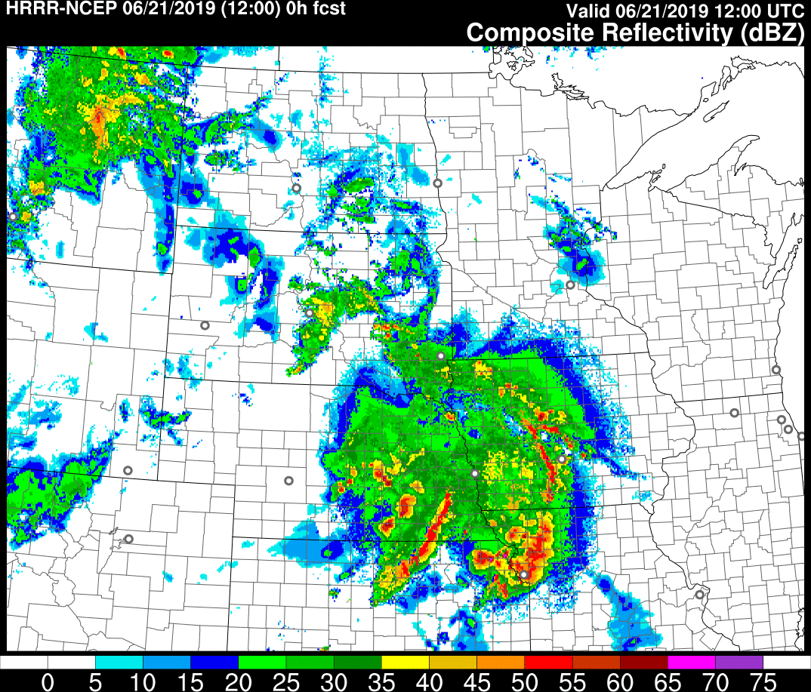
Potential HRRRDAS Initialization Benefits
Case Study 12 UTC 21 June 2019
0z+12hr
3z+9hr
12z 21 June 2019
0z+12hr
3z+9hr
6z+3hr
9z+3hr
12z 21 June 2019
6z+3hr
9z+3hr
12z+0hr
12z+0hr

Slide 15
Improved Vertical Velocities in Convection Collaboration with NSSL
HRRRv3
HRRRv4
4-h forecasts valid 2200 UTC 1 May 2018
Use of Implicit-Explicit Vertical Advection (IEVA) allows for:
Use of existing time-step (20s) while retaining stability
Removal of microphysics latent heating rate limiter
Prediction of more extreme vertical velocities in convection
Higher values of updraft-helicity
HRRRv3
HRRRv4
12-h forecasts valid 0600 UTC 2 May 2018
Slight change in precipitation

Slide 16
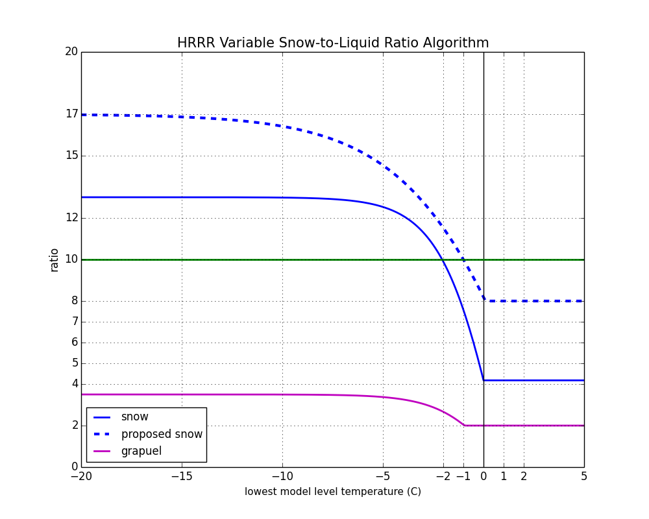
Updated RAPv5/HRRRv4 variable-density snow accumulation SLR=f(T) Algorithm
New prototype RAPv5/HRRRv4 -- based on two years of development/testing/evaluation (WPC/WFOs)
Current Operational RAPv4/HRRRv3

Slide 17
FVCOM-based Great Lakes Temps/Ice CLM-based Inland Lake Surface Temps
FVCOM lake temperatures (ESRL-GLERL collaboration)
CLM Inland-Lake
Temperatures
(reduced cold bias in warm season)

Slide 18
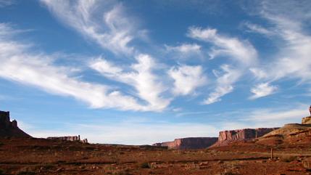
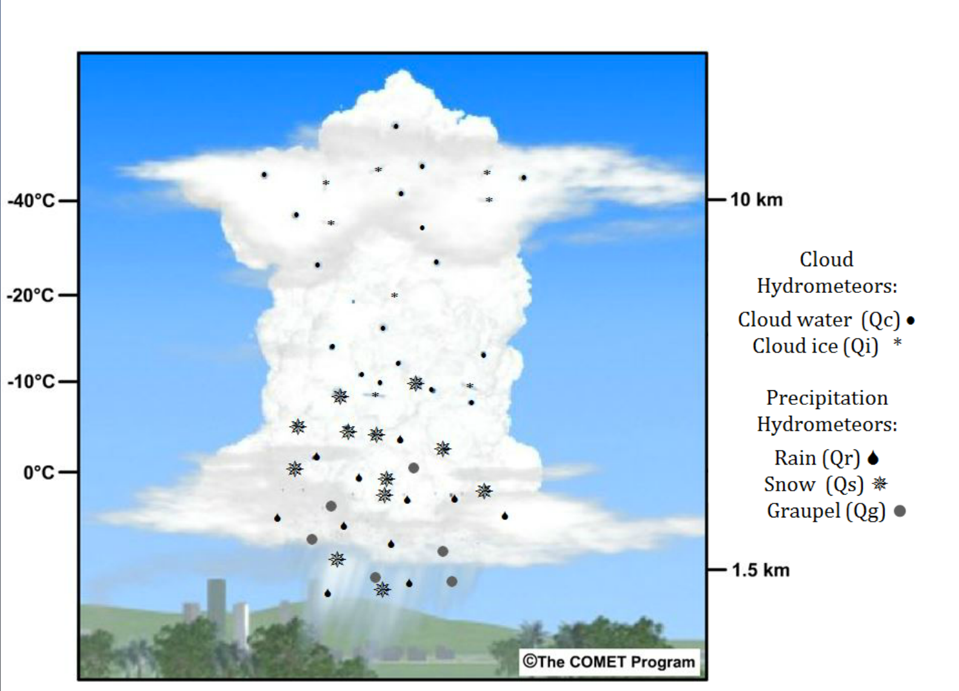
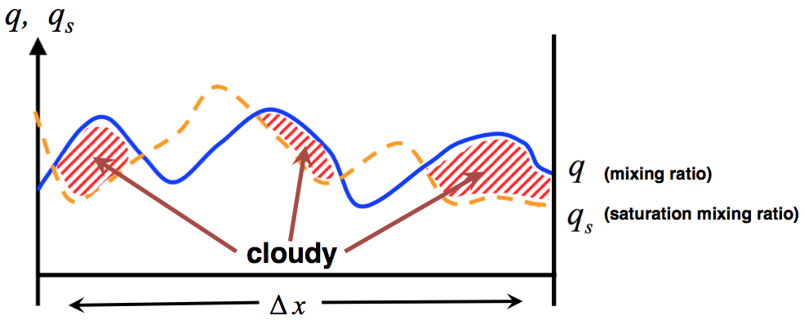
Physics Development Emphasis: Sub-Grid Clouds
Explicit (Resolved) Clouds/Precipitation
Sub-Grid (Unresolved) Clouds
RAP and HRRR use the Thompson
microphysics scheme with 5 hydrometeor types
Adapted from Fig. 2 of Tompkins (2009)
Assume a PDF of s (saturation ratio)
Parameterize:
assume subgrid PDFs for thermodynamic variables
Chaboureau and Bechtold (2002)
Retrieve Cloud Fraction, Cloud Condensate

Slide 19
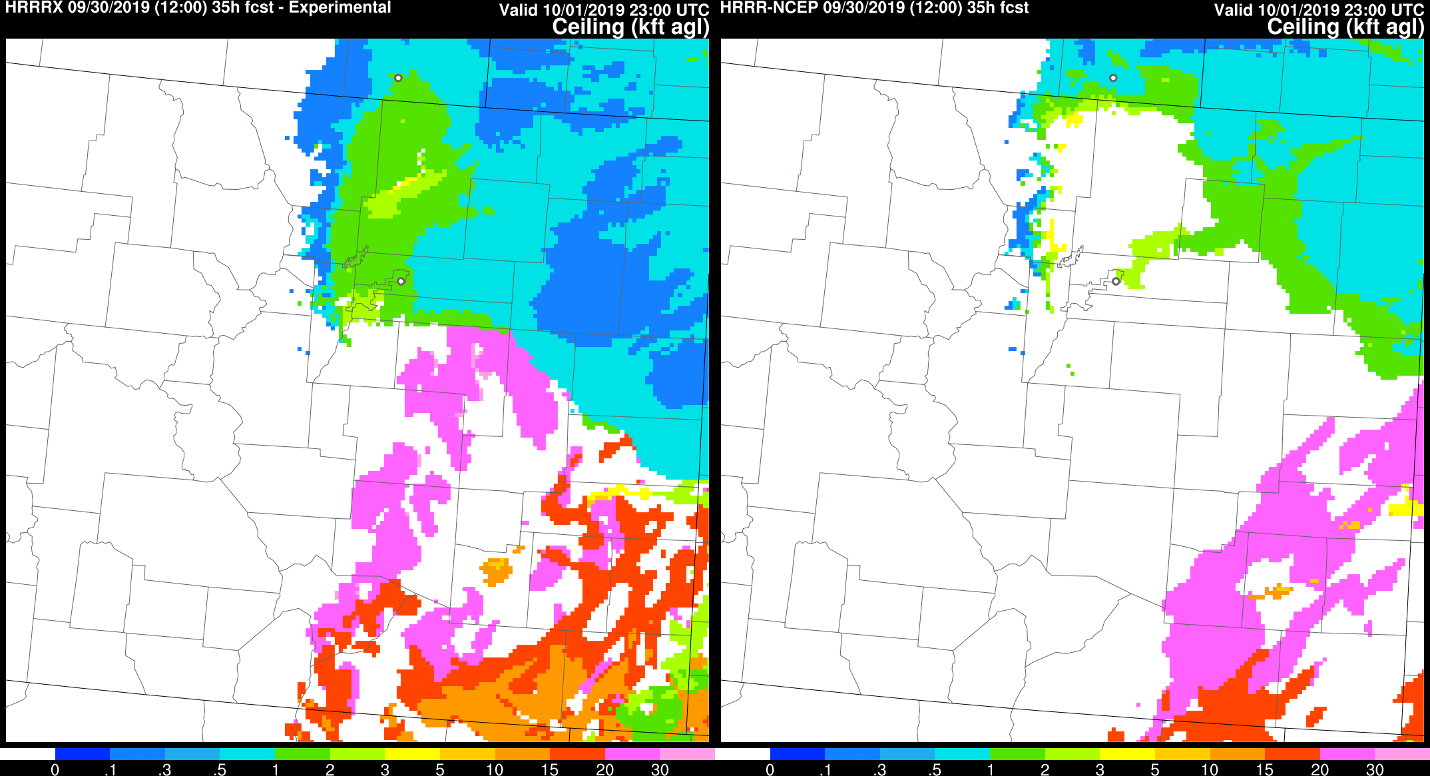
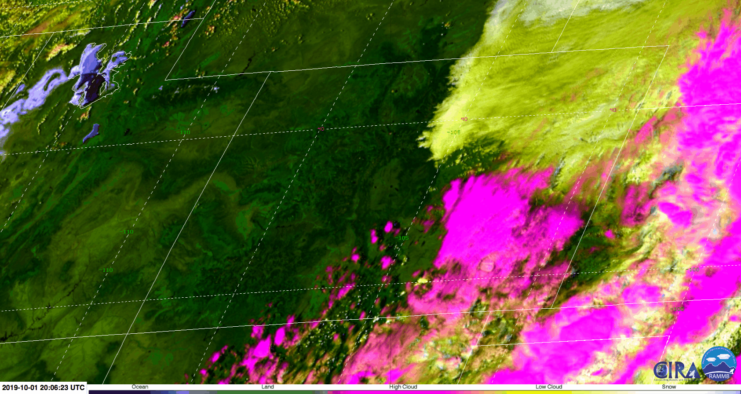
Improved Retention of Shallow Cloud/Cloudy Airmasses (feedback from BOU WFO)
35-h ceiling forecasts
Init: 1200 UTC 30 Sep 2019
Valid: 2300 UTC 1 Oct 2019
1 Oct 2019: shallow frontal-inversion stratus in weak upslope flow behind surface cold front
HRRRv4
HRRRv3 (OPS)
GOES multispectral: 20–23 UTC 1 Oct

Slide 20
Dryline Position and Evolution
27 hr Forecasts Valid
03 UTC 27 May 2019
Operational HRRRv3
Experimental HRRRv4
Surface Analysis
Dryline still mixing eastward
Dryline retreating westward

Slide 21
Dryline Position and Evolution
27 hr Forecasts Valid
03 UTC 27 May 2019
Operational HRRRv3
Experimental HRRRv4
Surface Analysis
Dryline still mixing eastward
Dryline retreating westward

Slide 22
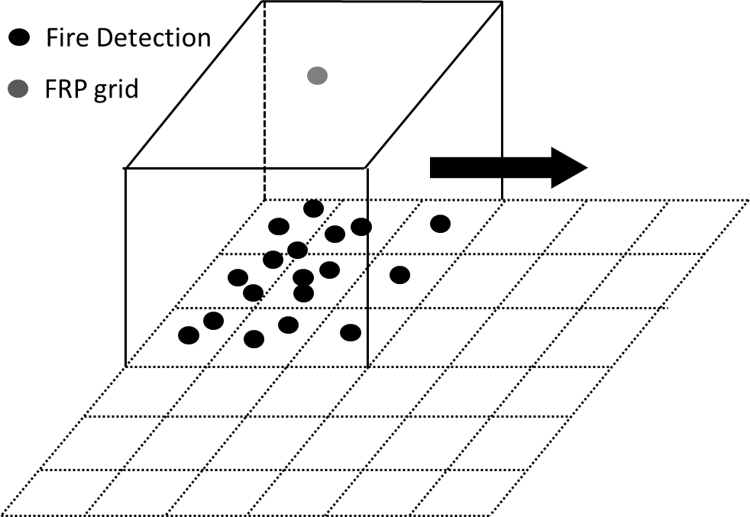
RAP, HRRR, and HRRR-AK Smoke Prediction
Parallel RAP and HRRR runs
-- Specification of smoke from VIIRS fire radiative power (FRP)
-- 3D transport of smoke, interaction with physics (radiation, wet deposition)
-- Only slightly greater computational cost than standard runs for RAPv5/HRRRv4
Clustering of
fire detections on
FRP grid
Averaged FRP data
mapped to HRRR domain

Slide 23
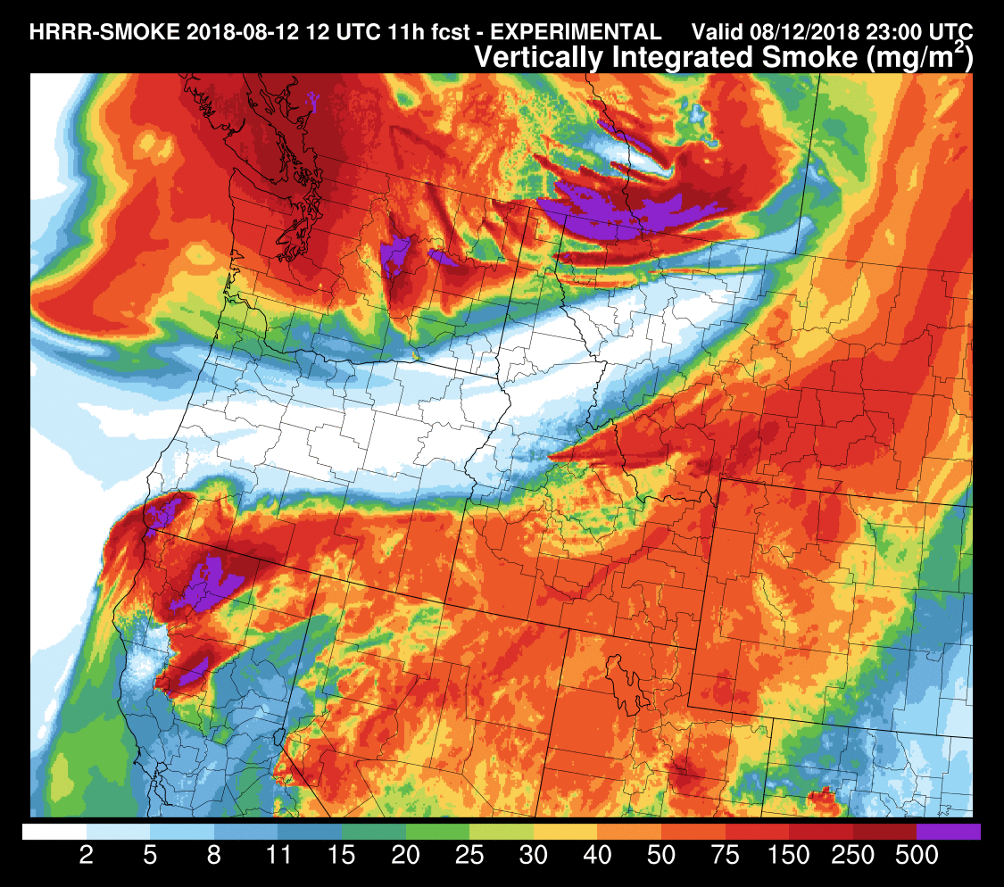
RAP, HRRR, and HRRR-AK Smoke Prediction
HRRR
(NO smoke)
12z+11h fcst
2m temperature
HRRR-
smoke
12z +
11h fcst
vertically
integrated
smoke (mg/m²)
HRRR-
smoke
12z+11h fcst
2m temperature

Slide 24
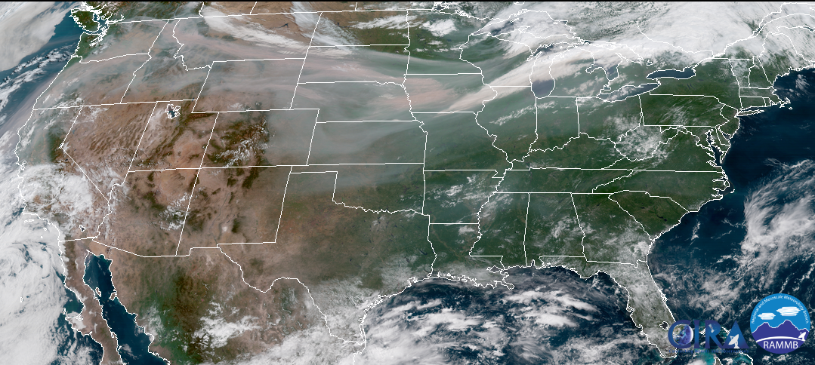
RAP, HRRR, and HRRR-AK Smoke Prediction
2m Temp bias
Vertically Integrated Smoke (mg/m²)
Error
10m Wind bias
Error
GOES-R
HRRR-X
HRRR-Smoke (with feedback)

Slide 25
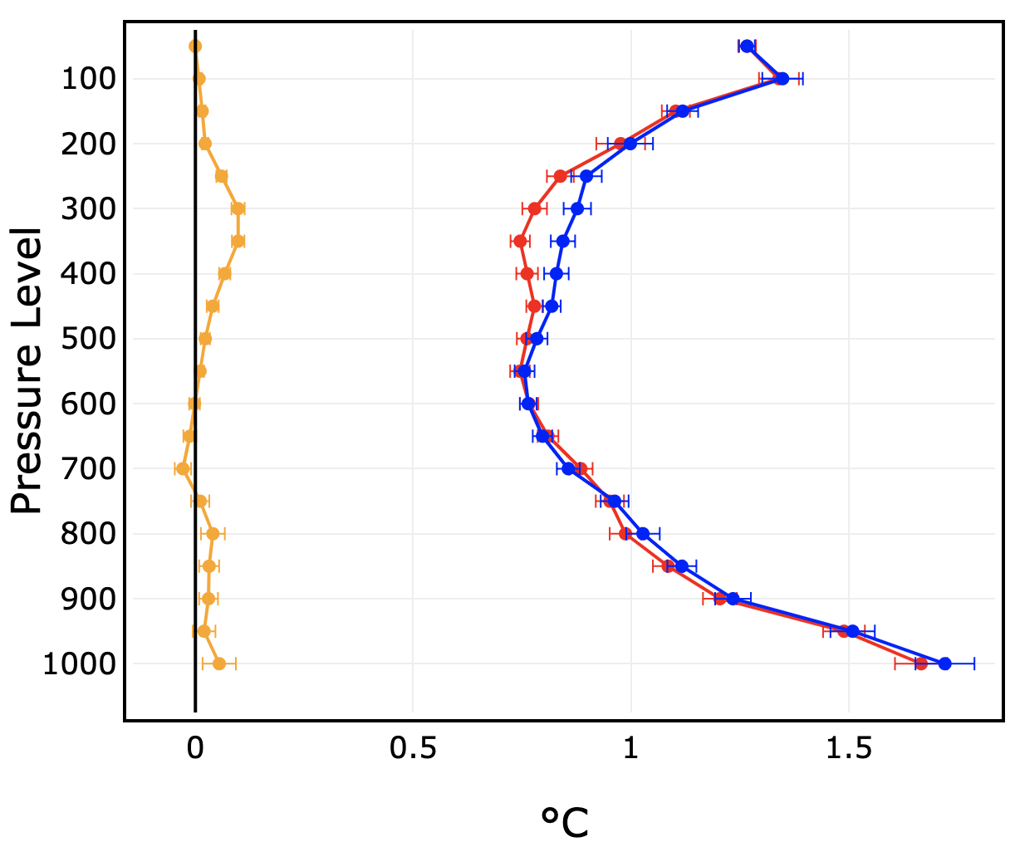
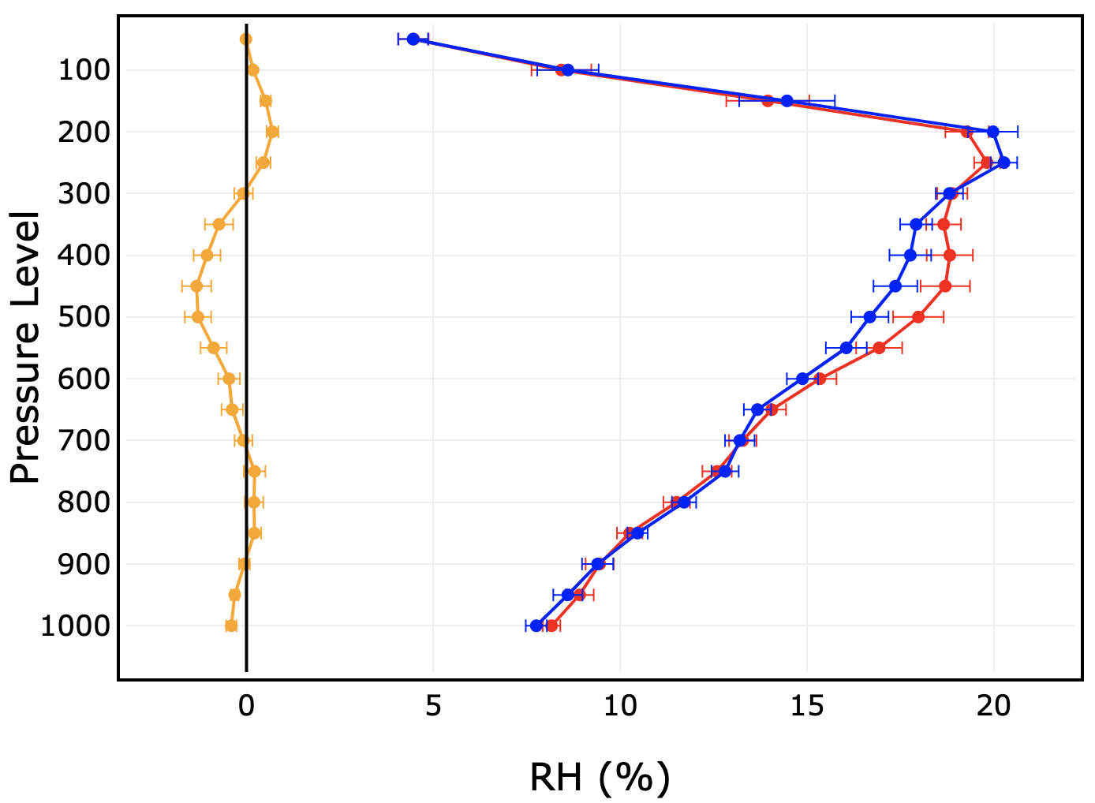
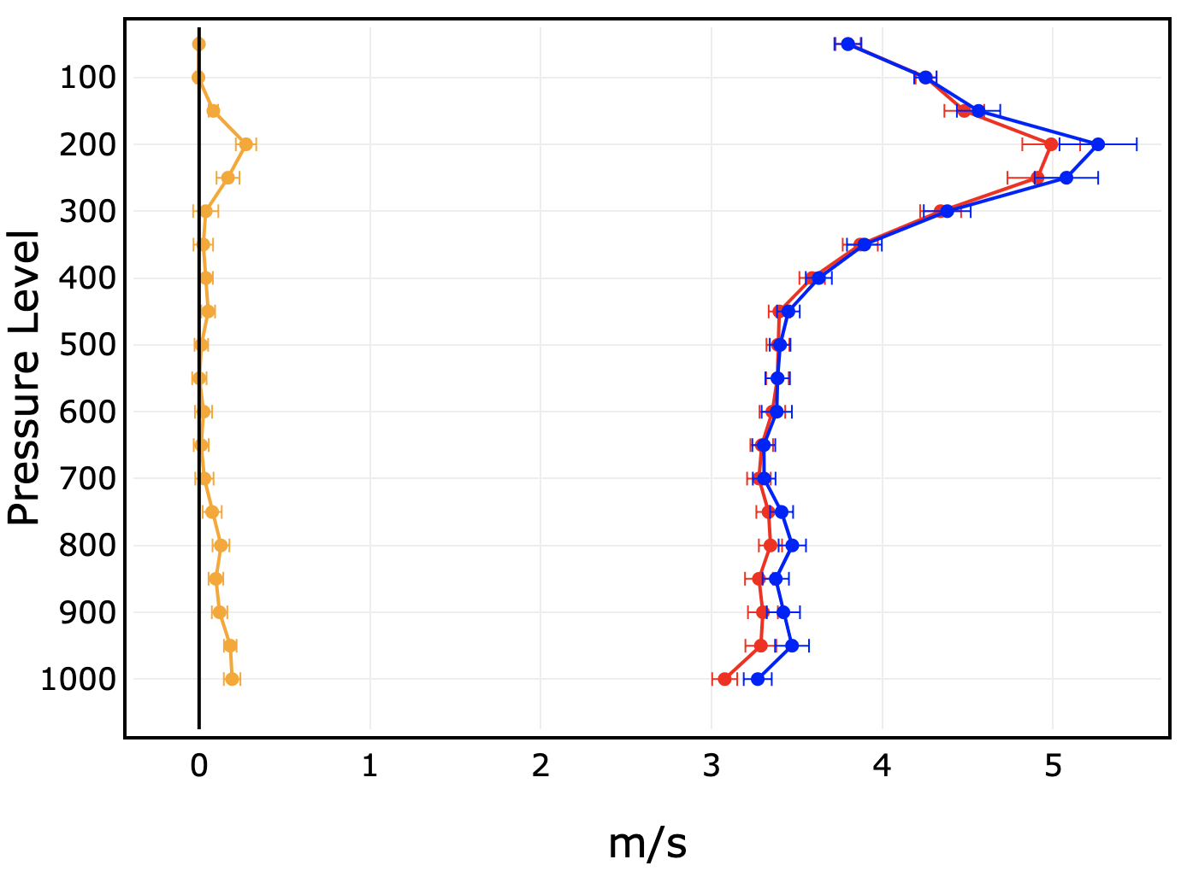
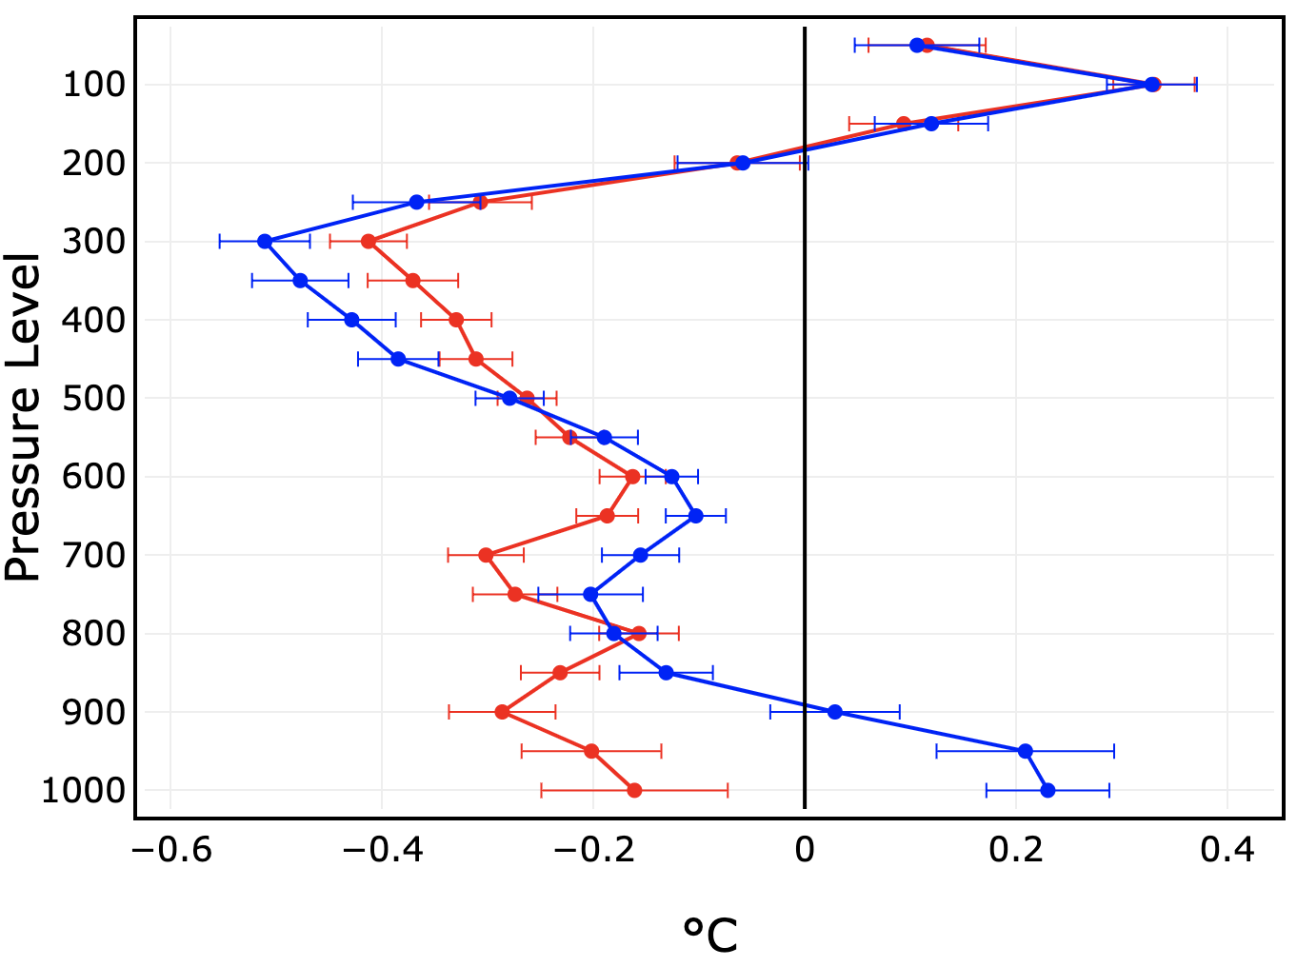
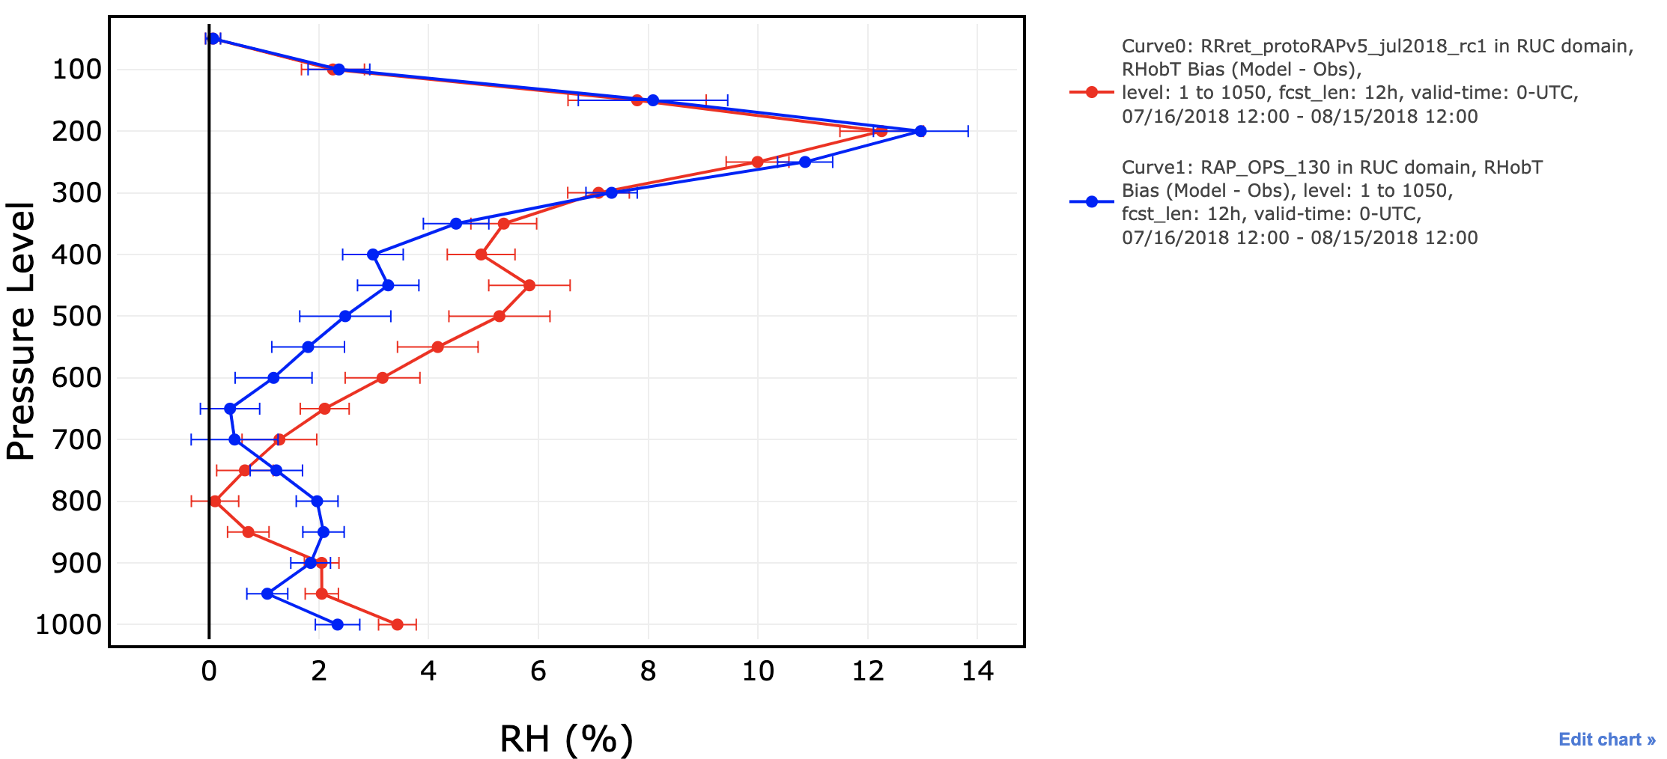
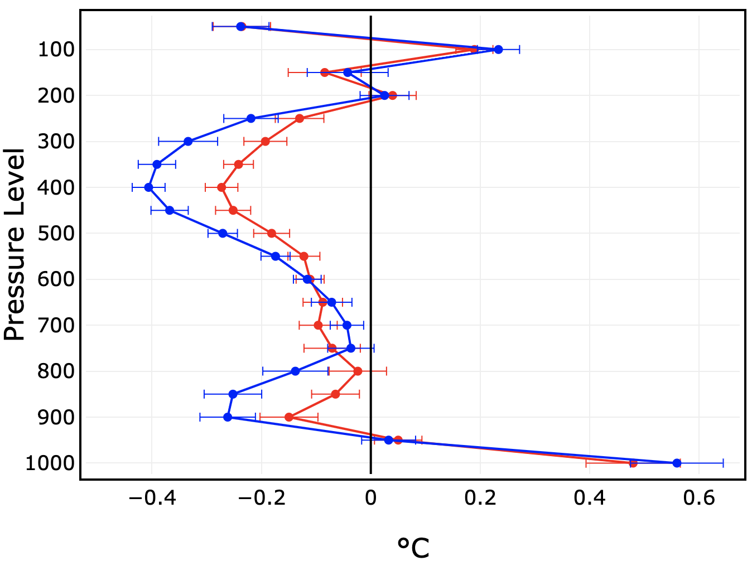
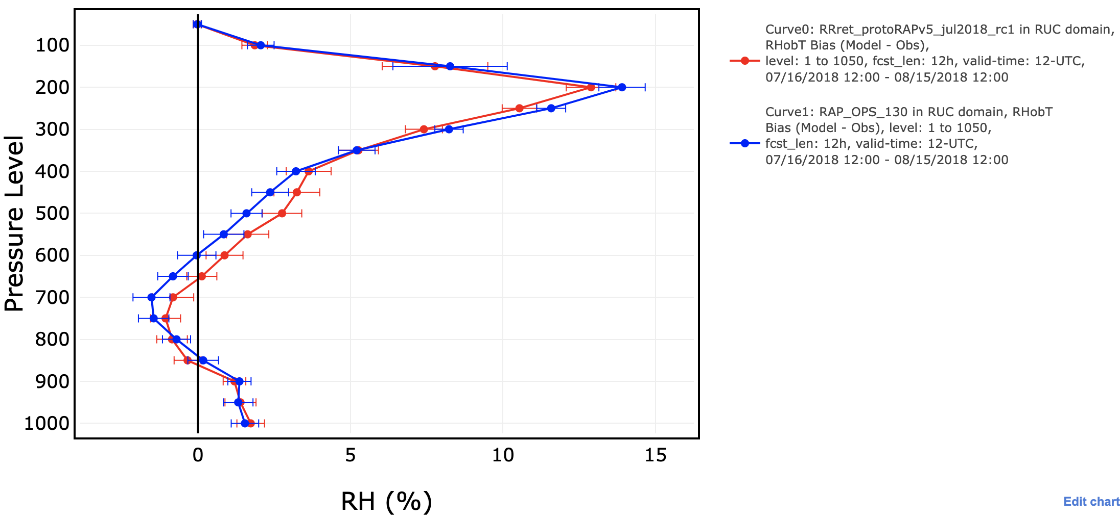
RAPv5: 13 Jul - 14 Aug 2018
temp
RHobT
wind
RAP-OPS
RAPv5_RC1
12-h RMSE
12-h bias
00 UTC
12-h bias
12 UTC

Slide 26
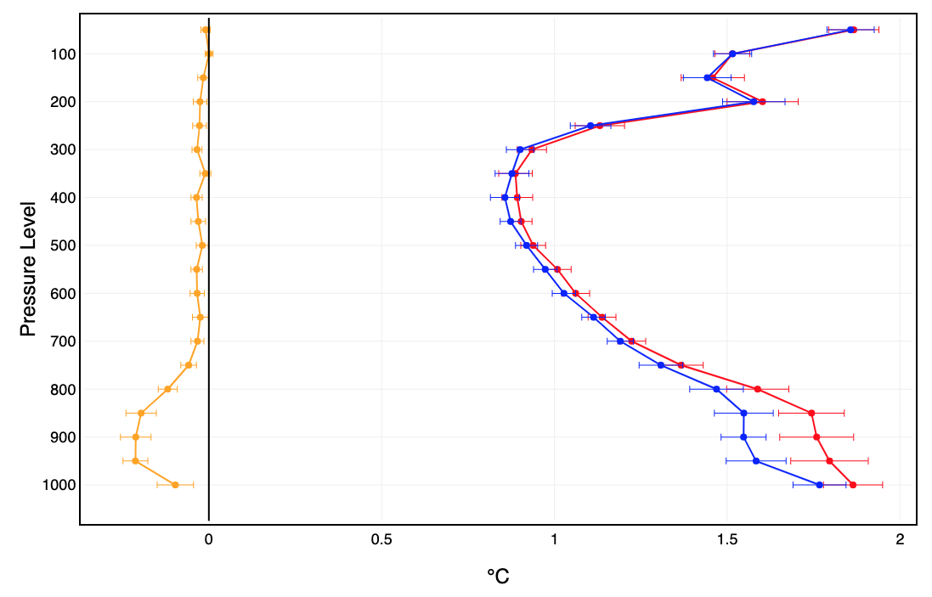
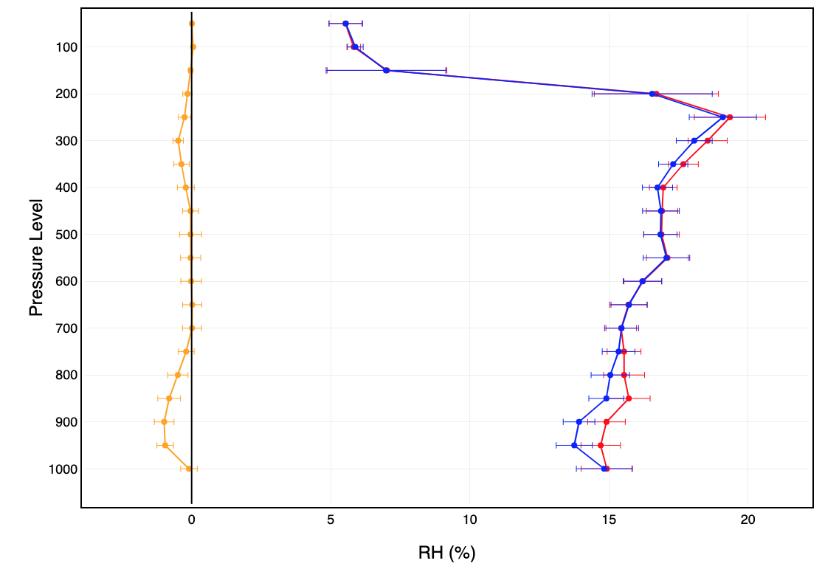
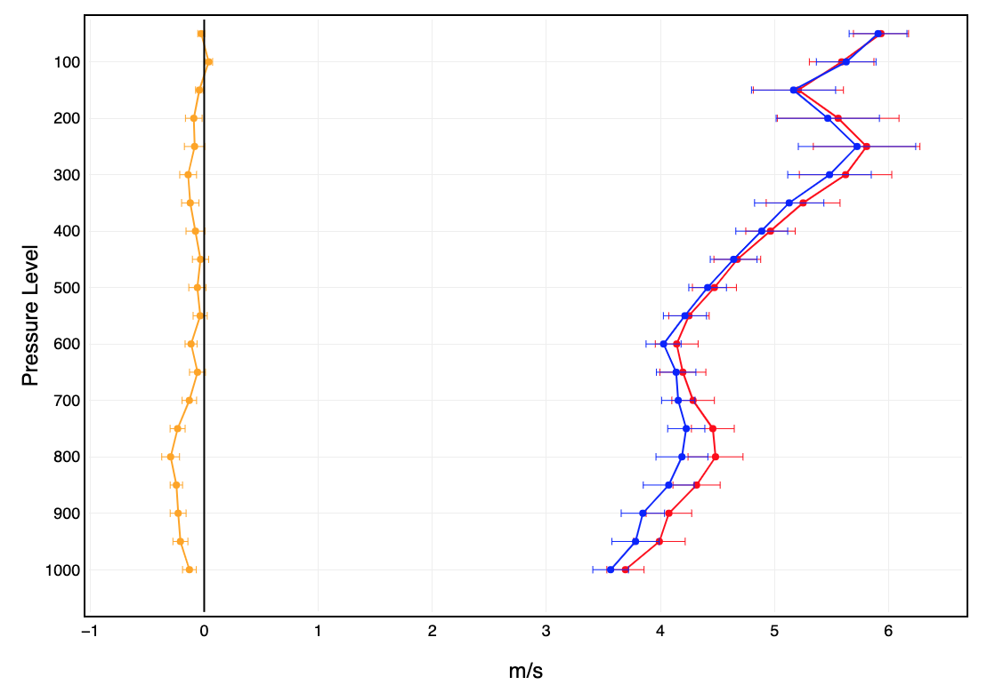
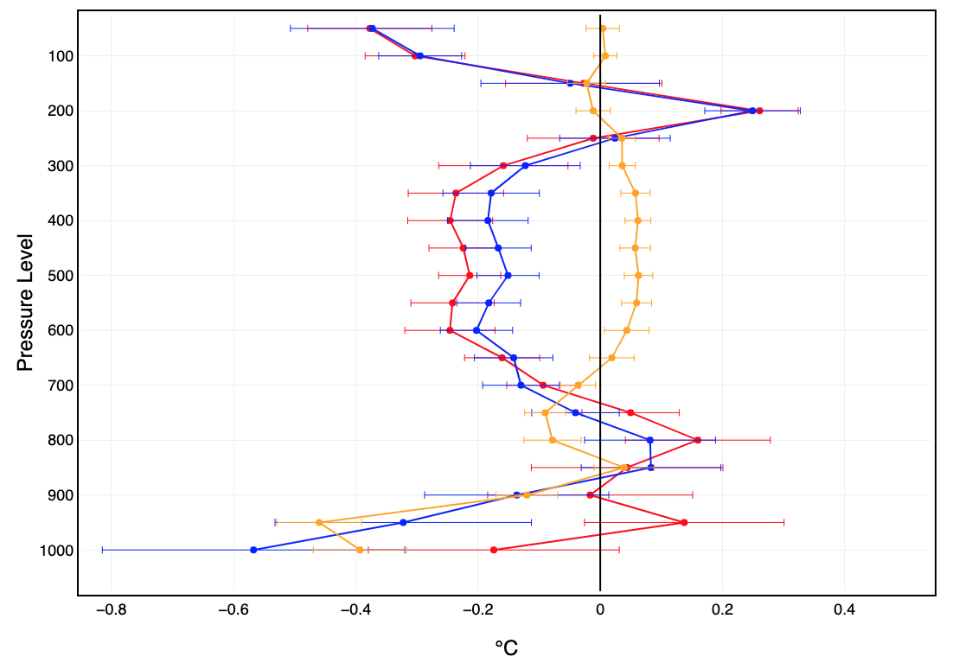
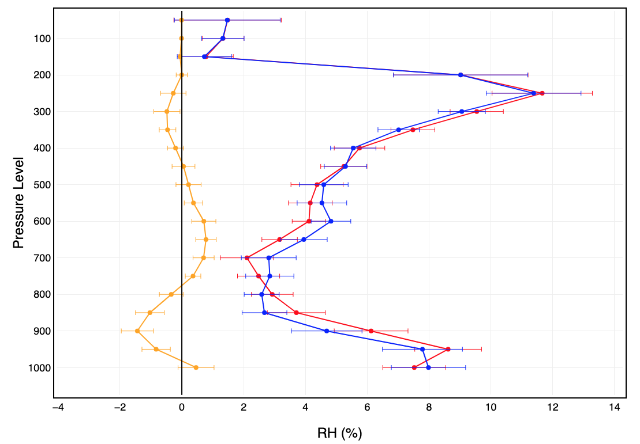
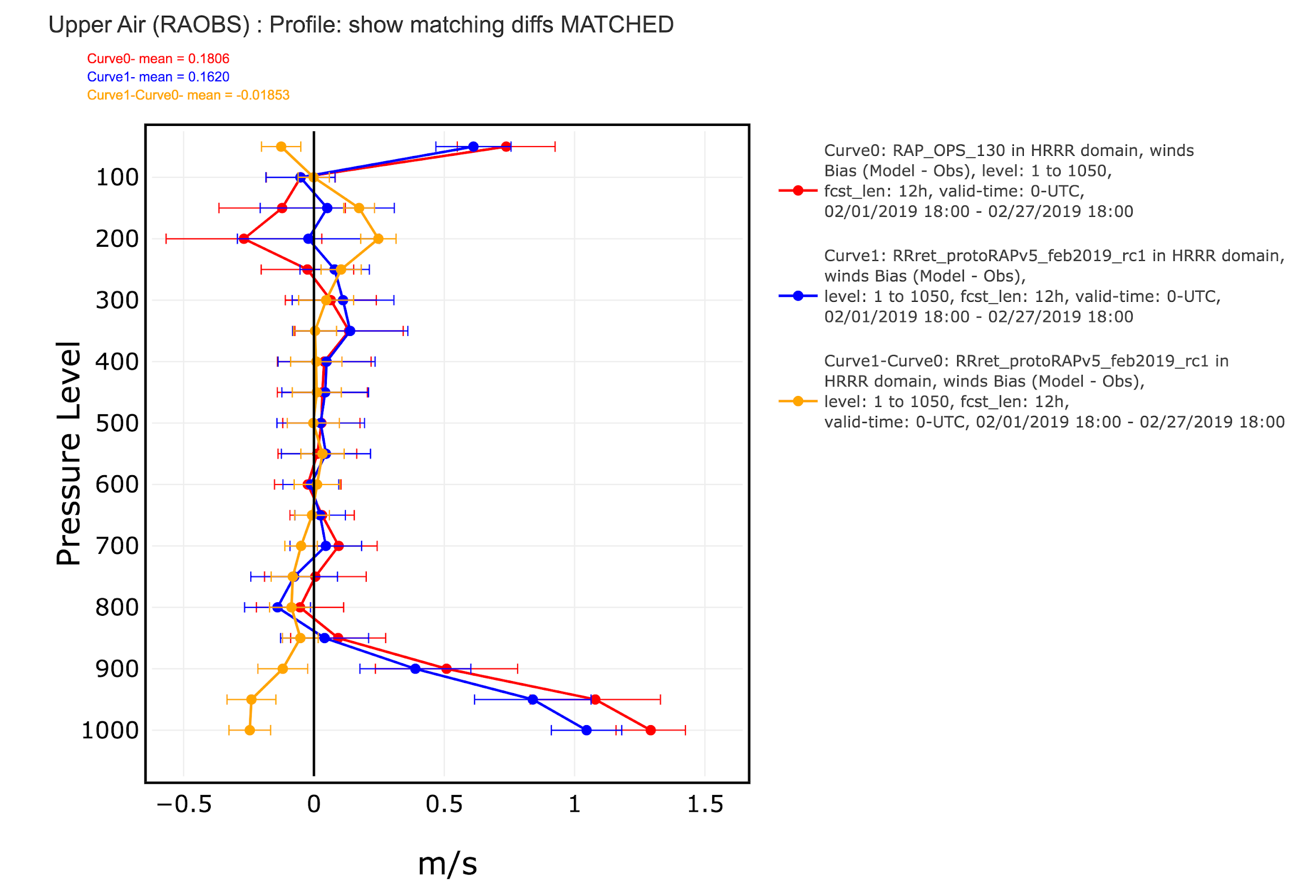
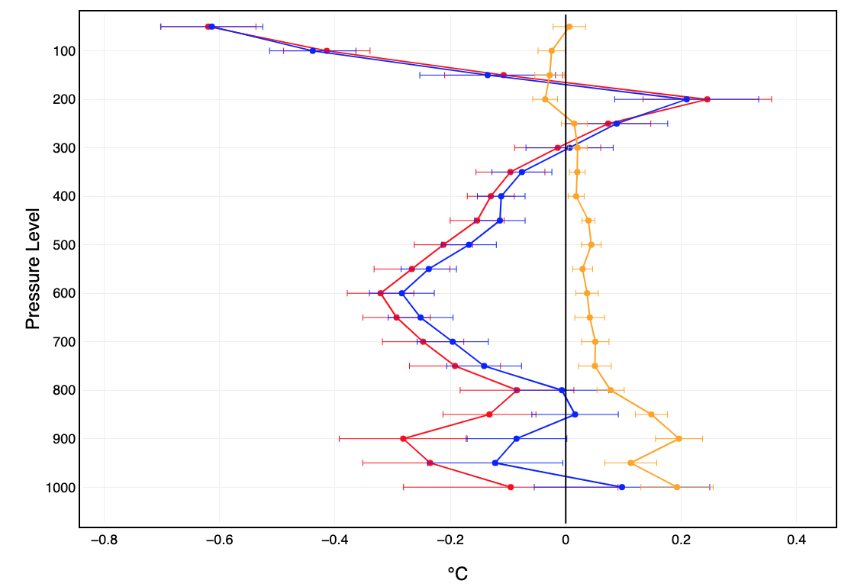
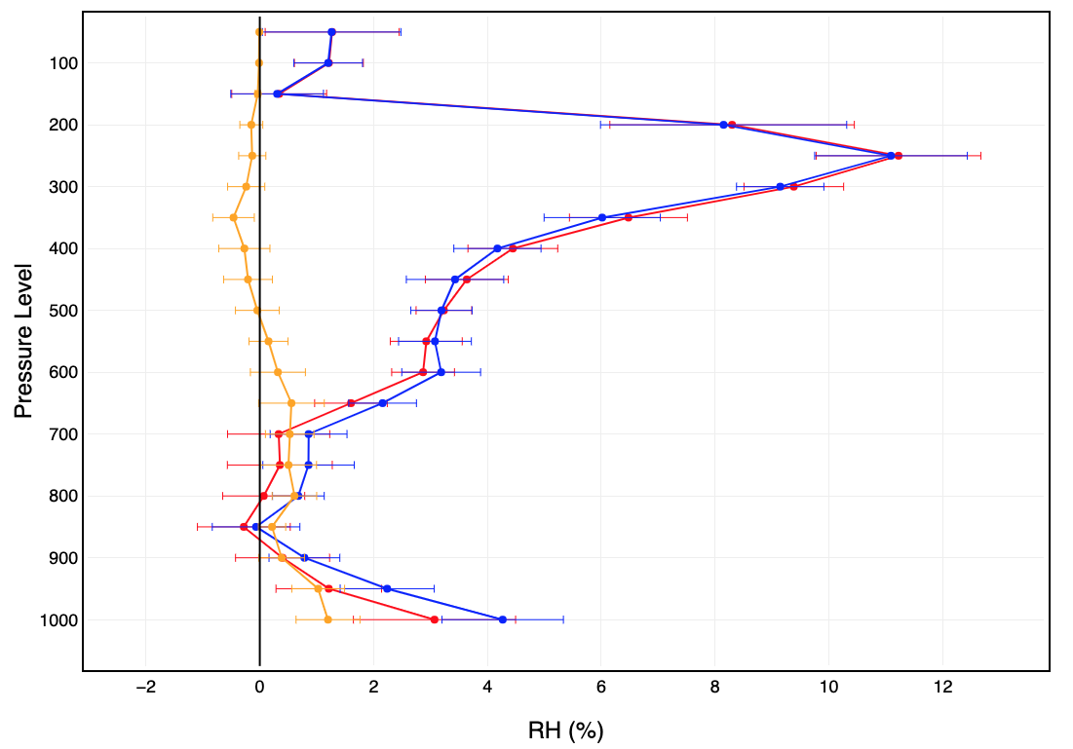
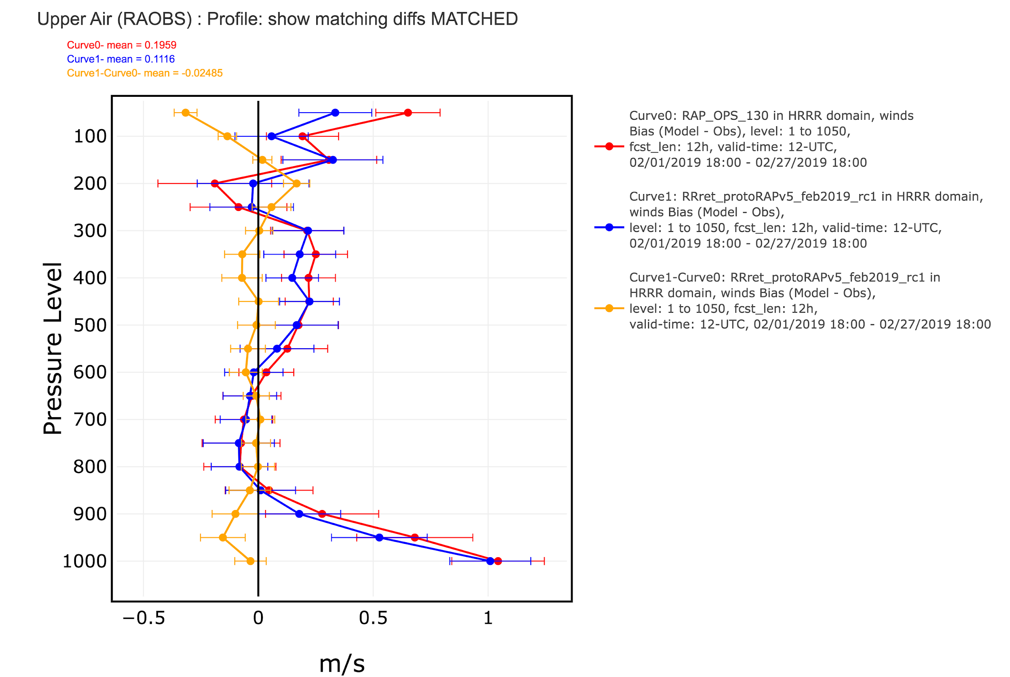
RAPv5: 1-27 Feb 2019
temp
RHobT
wind
RAP-OPS
RAPv5_RC1
12-h RMSE
12-h bias
00 UTC
12-h bias
12 UTC

Slide 27
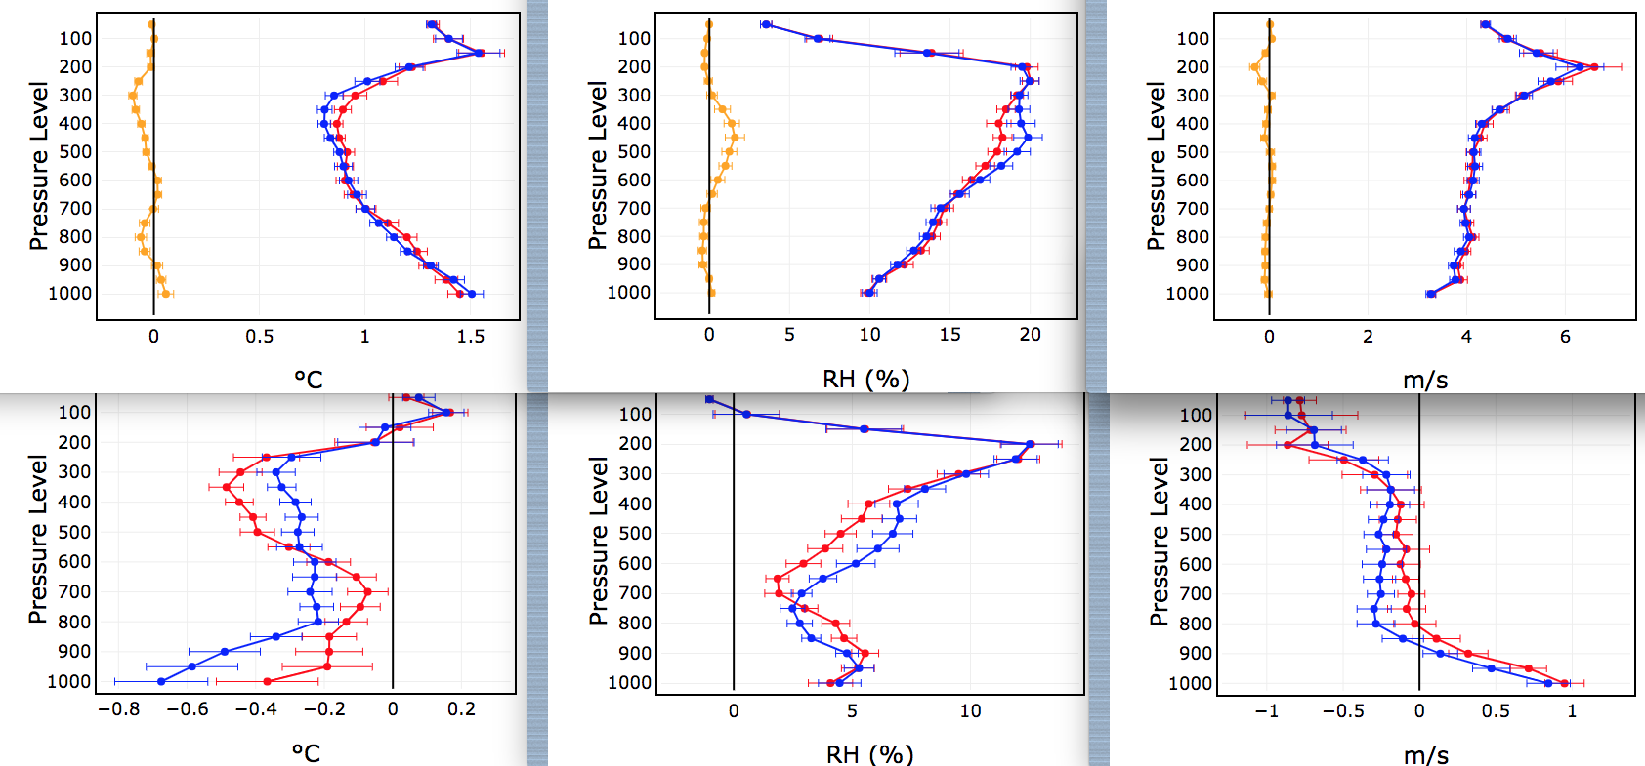
RAPv5: 1–31 May 2019
temp
RHobT
wind
RAP-OPS
RAPv5_RC1
12-h RMSE
12-h bias, 00 UTC
12-h bias, 12 UTC

Slide 28
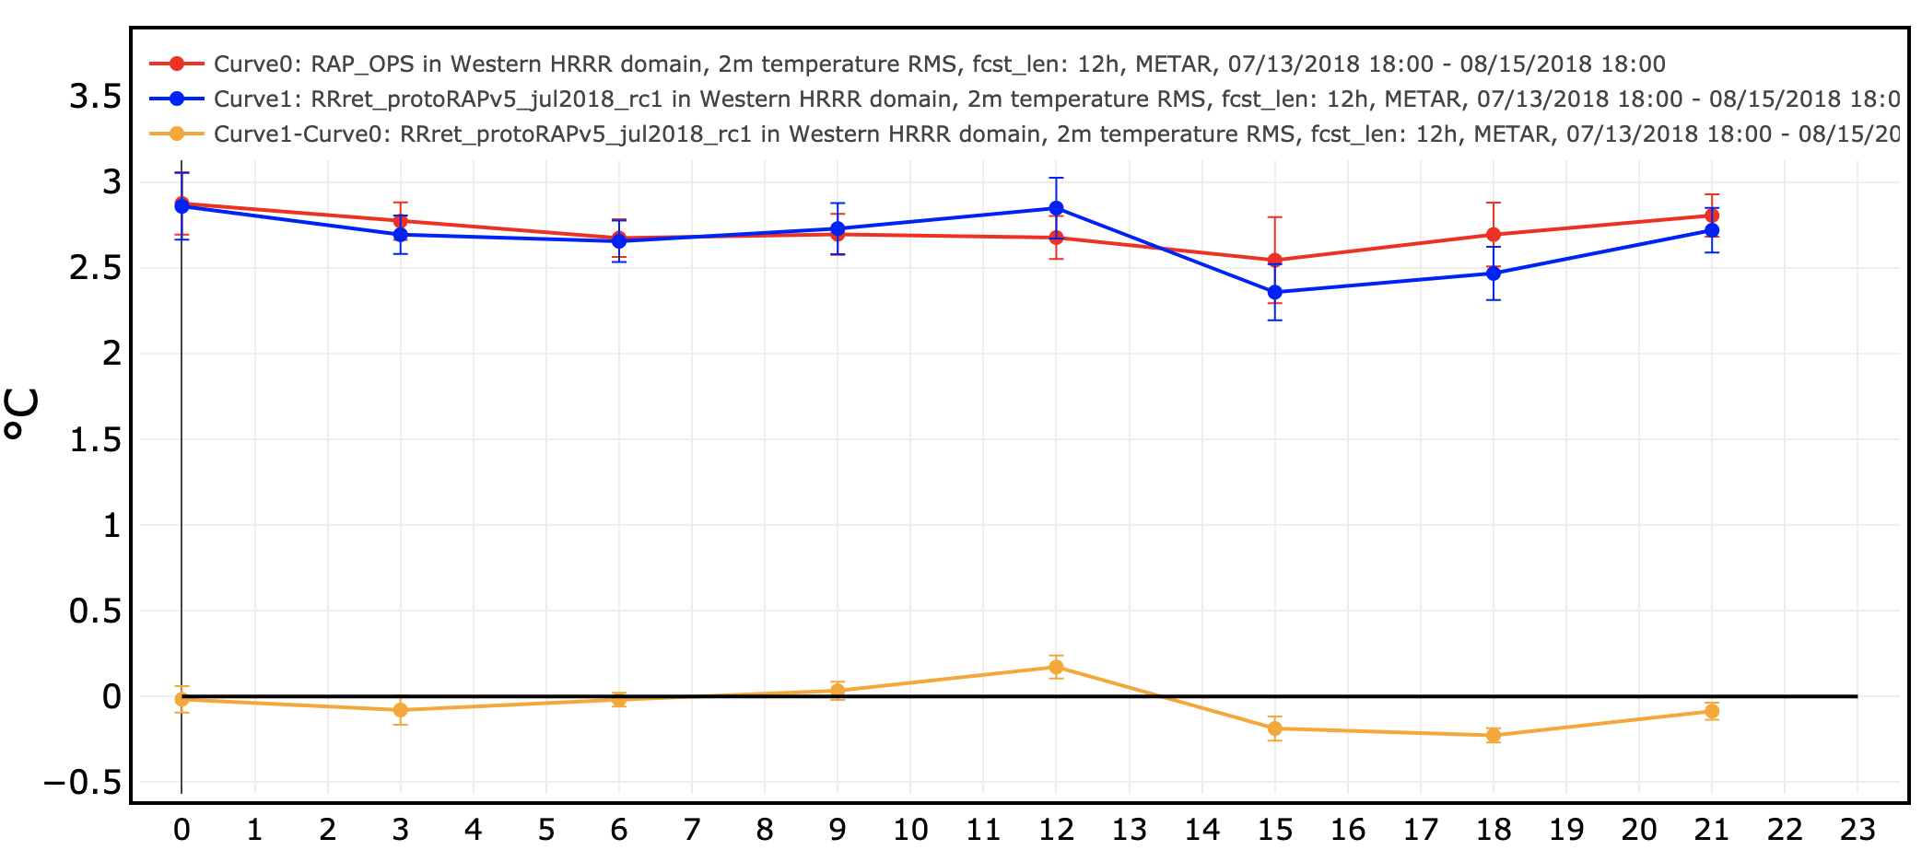
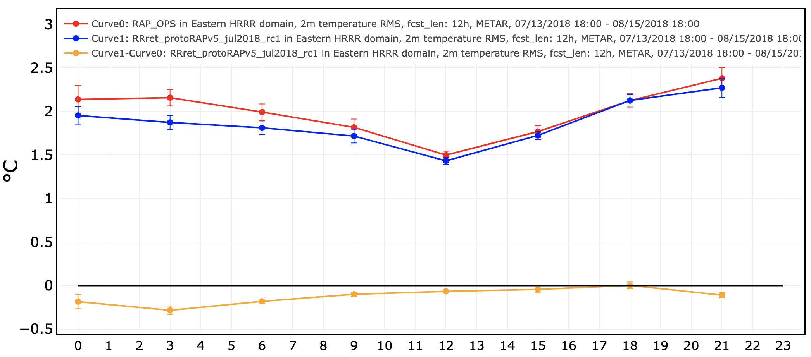
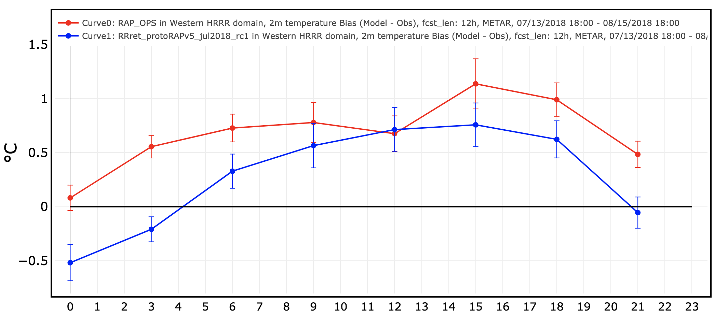
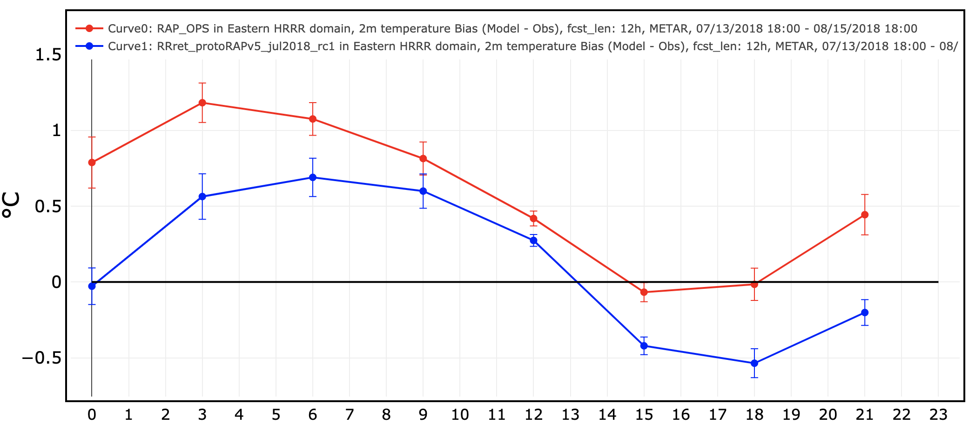
RAPv5: 13 Jul - 14 Aug 2018
W CONUS
E CONUS
RAP-OPS
RAPv5_RC1
2-m temp
12-h RMSE
2-m temp
12-h bias

Slide 29
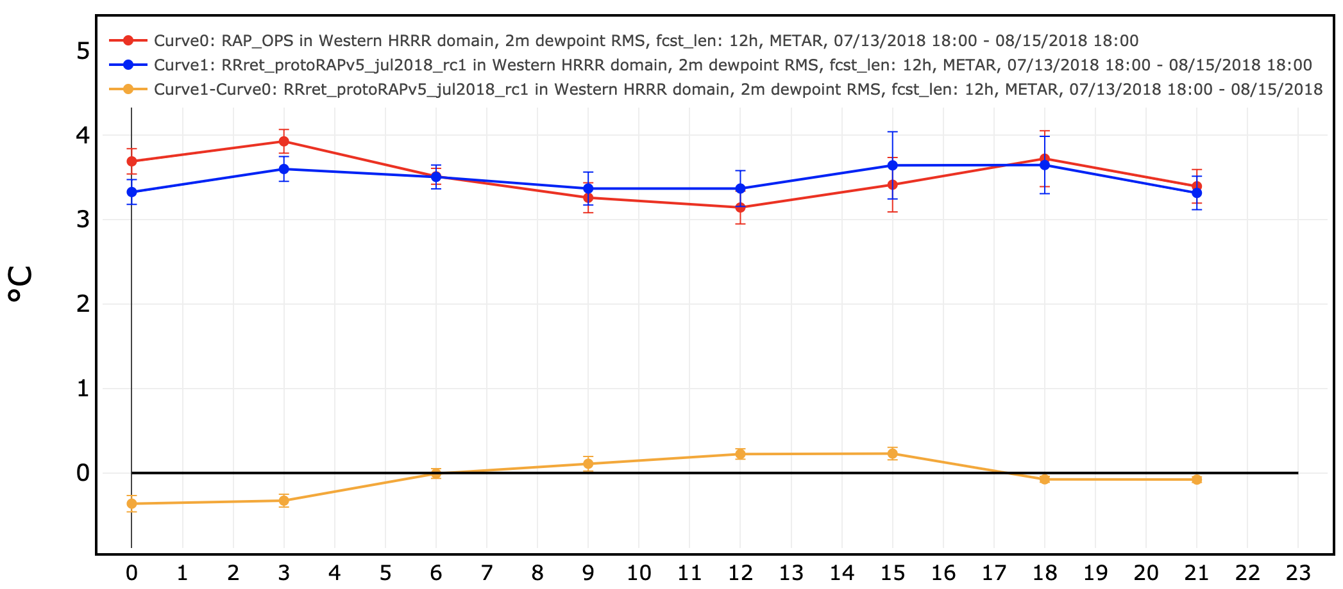
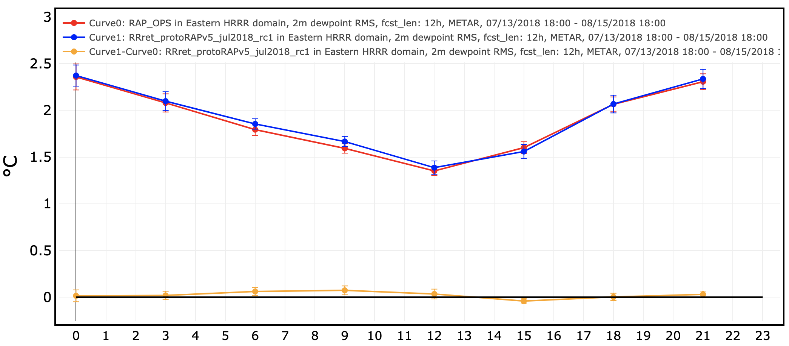
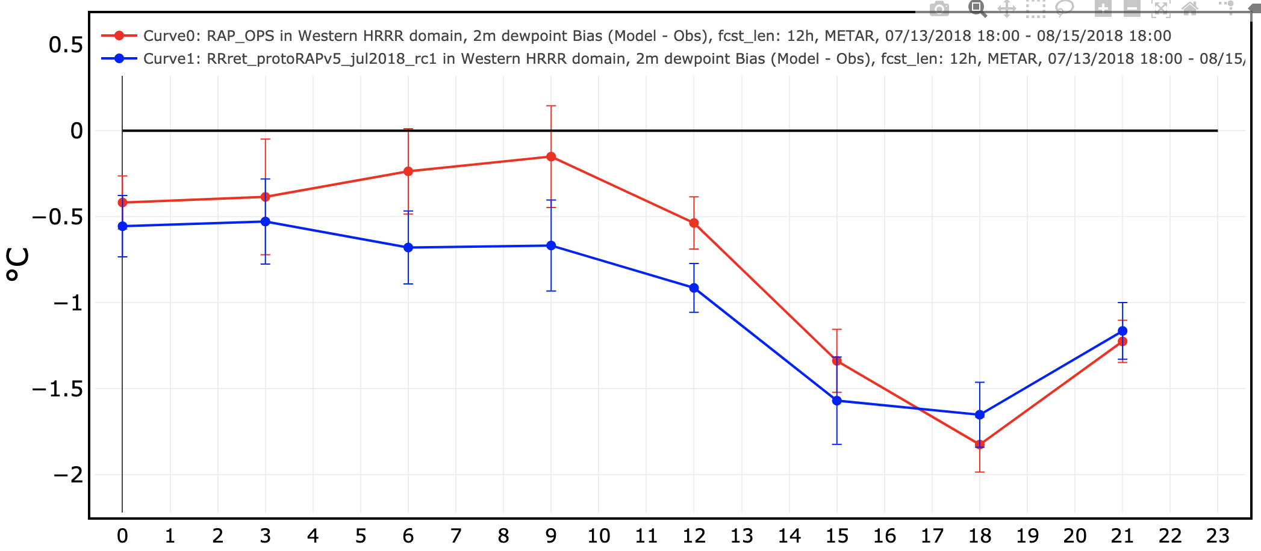
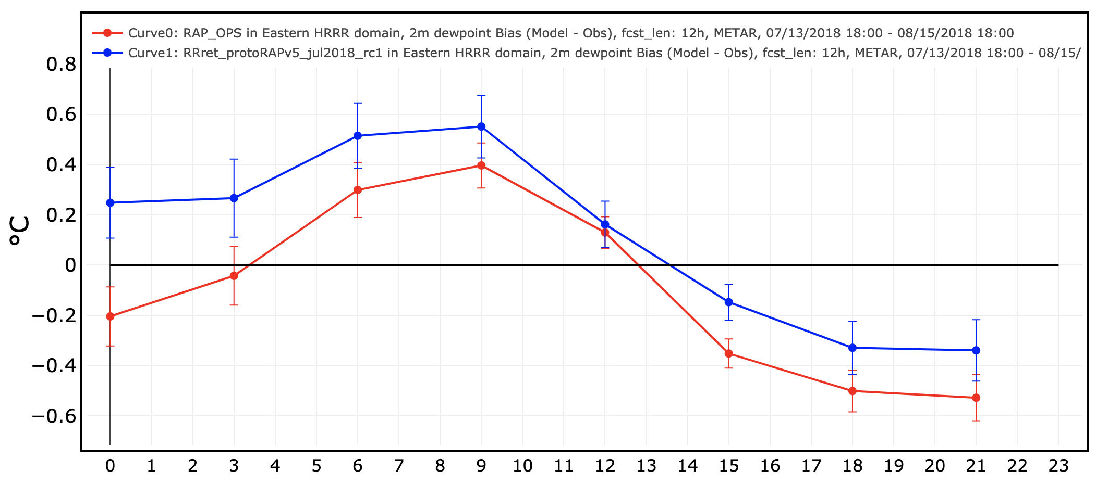
RAPv5: 13 Jul - 14 Aug 2018
W CONUS
E CONUS
RAP-OPS
RAPv5_RC1
2-m dewpoint
12-h RMSE
2-m dewpoint
12-h bias

Slide 30
RAPv5: 13 Jul - 14 Aug 2018
W CONUS
E CONUS
RAP-OPS
RAPv5_RC1
10-m wind
12-h RMSE
10-m wind
12-h bias

Slide 31
RAPv5: 16 Jul - 14 Aug 2018
surface irradiance (GHI)
RAP-OPS
RAPv5_RC1
12-h MAE (26 km)
12-h bias (13 km)

Slide 32
RAPv5: 1–27 Feb 2019
W CONUS
E CONUS
RAP-OPS
RAPv5_RC1
2-m T
12-h RMSE
2-m T
12-h bias

Slide 33
RAPv5: 1–27 Feb 2019
E CONUS
W CONUS
RAP-OPS
RAPv5_RC1
2-m dewpoint
12-h RMSE
2-m dewpoint
12-h bias

Slide 34
RAPv5: 1–27 Feb 2019
E CONUS
W CONUS
RAP-OPS
RAPv5_RC1
10m wind
12-h RMSE
10m wind
12-h bias

Slide 35
RAPv5: 1–31 May 2019
RAP-OPS
RAPv5_RC1
W CONUS
E CONUS
2-m temp
12-h RMSE
2-m temp
12-h bias

Slide 36
RAPv5: 1–31 May 2019
W CONUS
E CONUS
RAP-OPS
RAPv5_RC1
2-m dewpoint
12-h RMSE
2-m dewpoint
12-h bias

Slide 37
RAPv5: 1–31 May 2019
W CONUS
E CONUS
RAP-OPS
RAPv5_RC1
10-m wind
12-h RMSE
10-m wind
12-h bias

Slide 38
HRRR-AKv4 Performance

Slide 39
--- HRRR-AK GSD
--- HRRR-AK oper
3000’ ceiling
TSS die-off
7-15-2019 – 9-15-2019
3000’ ceiling
Bias die-off
7-15-2019 – 9-15-2019
--- HRRR-AK GSD
--- HRRR-AK oper

Slide 40
--- HRRR-AK GSD
--- HRRR-AK oper
1000’ ceiling
TSS die-off
7-15-2019 – 9-15-2019
1000’ ceiling
Bias die-off
7-15-2019 – 9-15-2019
--- HRRR-AK GSD
--- HRRR-AK oper

Slide 41
--- HRRR-AK GSD
--- HRRR-AK oper
500’ ceiling
TSS die-off
7-15-2019 – 9-15-2019
500’ ceiling
Bias die-off
7-15-2019 – 9-15-2019
--- HRRR-AK GSD
--- HRRR-AK oper

Slide 42
2m Temperature
RMS error die-off
7-15-2019 – 9-15-2019
--- HRRR-AK GSD
--- HRRR-AK oper
2m Temperature
Bias error die-off
7-15-2019 – 9-15-2019

Slide 43
2m Dew Point
RMS error die-off
7-15-2019 – 9-15-2019
--- HRRR-AK GSD
--- HRRR-AK oper
2m Dew Point
Bias error die-off
7-15-2019 – 9-15-2019

Slide 44
10m Winds
RMS error die-off
7-15-2019 – 9-15-2019
--- HRRR-AK GSD
--- HRRR-AK oper
10m Winds
Bias error die-off
7-15-2019 – 9-15-2019

Slide 45
What’s Next?
A FEW KEY POINTS
Some graphics are being generated this week; we’re working to make the parallels and graphics more reliable for the start of the evaluation period next week
The parallels will be run during development supercomputer outages, but the graphics will not
One of these outages may occur next week

Slide 46
What’s Next?
THANK YOUS
The GSD staff for their work building the RAPv5/HRRRv4 systems
Ben Blake, Ming Hu, Sam Trahan, David Dowell for getting the parallels up and running
Alicia Bentley (with help from Ben Blake) getting the real-time graphics running
Logan Dawson for running verification stats and getting the retro graphics running

