Slide 1


NATIONAL OCEANIC AND ATMOSPHERIC ADMINISTRATION
HREFv3 Field Evaluations
Chris MacIntosh, Logan Dawson, Geoff Manikin, Alicia Bentley, Shannon Shields, and Philippe Papin
EMC Model Evaluation Group Webinar
13 August 2020

Slide 2
NATIONAL OCEANIC AND ATMOSPHERIC ADMINISTRATION
Outline
Summary of HREFv3 evaluation comments/recommendations
from the field (NWS Regions, Centers, and stakeholders)
Summary of HREFv3 verification statistics
Overall impressions of HREFv3
Thank you to those who submitted formal evaluations and those
who provided subjective feedback during the evaluation period

Slide 3
NATIONAL OCEANIC AND ATMOSPHERIC ADMINISTRATION
Field Evaluations of HREFv3
Information that users were asked to provide:
What are your overall impressions of the performance of the proposed HREFv3 system relative to the current operational HREFv2?
How useful is the extended forecast length (to 48 h) for you?
Do you find the Ensemble Agreement Scale (EAS) probabilities to be a useful addition to the neighborhood maximum (NBMAX) probabilities for QPF?

Slide 4
NATIONAL OCEANIC AND ATMOSPHERIC ADMINISTRATION
Field Evaluations of HREFv3
Information that users were asked to provide:
Was the Local Probability Matched Mean (LPMM) QPF an improvement over the Probability Matched Mean (PMM)?
Was the 10 m wind modification to increase signal for strong wind events successful?
What was your impression of the performance of the HRW-FV3 member, relative to the HRW-NMMB member?
What is your recommendation?

Slide 5
NATIONAL OCEANIC AND ATMOSPHERIC ADMINISTRATION
NWS Alaska Region
The parallel HREFv3 is overall equal to the operational HREFv2.
48 h forecast length allows fire weather and aviation interests more lead time to better prepare for convective risks and fire weather conditions.
EAS could be extremely useful, but highest QPF events occurred during evaluation hiatus.
LPMM appeared to be an improvement, but unable to evaluate during highest QPF events.
The HREFv2 probabilities (using instantaneous wind speed and point probabilities) looked better than in HREFv3.
HRW-FV3 overall performed worse than HRW-NMMB.
Supports the implementation of HREFv3.

Slide 6
NATIONAL OCEANIC AND ATMOSPHERIC ADMINISTRATION
Fire Wx Guidance Can Benefit from Stronger Winds
HREFv2
PROB
HREFv3
PROB
HREFv3 better signals threat for fire weather conditions over NM
FV3 contributed stronger wind speeds (by 5-9+ kts) than the NMMB across much of NM and CO
RAP Analysis
10-m Wind > 17.5 kt & 2-m RH < 20%
NMMB
FV3
FV3 – NMMB
Diff

Slide 7
NATIONAL OCEANIC AND ATMOSPHERIC ADMINISTRATION
EAS Probabilities Are Quite Useful in Terrain
Probability of 24-h QPF > 1”
Probability of 24-h QPF > 2”
HREFv2 NBMAX
HREFv3 EAS
HREFv2 NBMAX
HREFv3 EAS
Init: 06Z 23 May Valid: 12Z 24 May (F30)
Difficult to analyze observed precip in Alaska, but the EAS probabilities are clearly defining key topographical features along the complex terrain of the coastline

Slide 8
NATIONAL OCEANIC AND ATMOSPHERIC ADMINISTRATION
NWS Central Region
The parallel HREFv3 is an improvement over the operational HREFv2.
48 h forecast length is very useful for messaging, particularly in situations of low confidence.
EAS probabilities were helpful in certain situations, but forecaster training needed to fully utilize them.
LPMM is an improvement over PMM.
HRW-FV3 overall performed better than HRW-NMMB.
Supports the implementation of HREFv3.

Slide 9
NATIONAL OCEANIC AND ATMOSPHERIC ADMINISTRATION
NWS Eastern Region
The parallel HREFv3 is overall equal to the operational HREFv2.
48 h forecast length is very useful – a significant enhancement.
The HREFv3 probabilities (using hourly maximum wind speed and a small neighborhood probability) looked better than in HREFv2.
Concerns regarding low CAPE bias and lower frequencies of significantly reduced ceilings and visibilities.
Neutral on the implementation of HREFv3.

Slide 10
NATIONAL OCEANIC AND ATMOSPHERIC ADMINISTRATION
Contribution of Low FV3 CAPE May Be More important for Low Instability Events
F06
Valid
18z
5/29/20
MIXED LAYER CAPE
(MLCAPE)
NMMB
FV3
ANL
F09
Valid
21z
5/29/20

Slide 11
NATIONAL OCEANIC AND ATMOSPHERIC ADMINISTRATION
Contribution of Low FV3 CAPE May Be More important for Low Instability Events
PROB MLCAPE > 1000
ANL
CAPE > 1000
Both the mean
and the prob > 1000
show meaningful
impact from the
FV3 contribution
F06
Valid
18z
5/29/20
HREFv2
HREFv3
MEAN MLCAPE
ANL
ML CAPE

Slide 12
NATIONAL OCEANIC AND ATMOSPHERIC ADMINISTRATION
NWS Southern Region
The parallel HREFv3 is an improvement over the operational HREFv2.
48 h forecast length is useful to allow hazard assessment into the Day 2 period.
EAS was especially useful in terrain.
LPMM was an improvement, producing a more representative forecast in many instances.
The HREFv3 probabilities (using hourly maximum wind speed and a small neighborhood probability) looked better than in HREFv2.
HRW-FV3 is superior to HRW-NMMB, but the low CAPE bias in FV3 certainly deteriorates certain aspects of the convective forecast at times.
Supports the implementation of HREFv3.

Slide 13
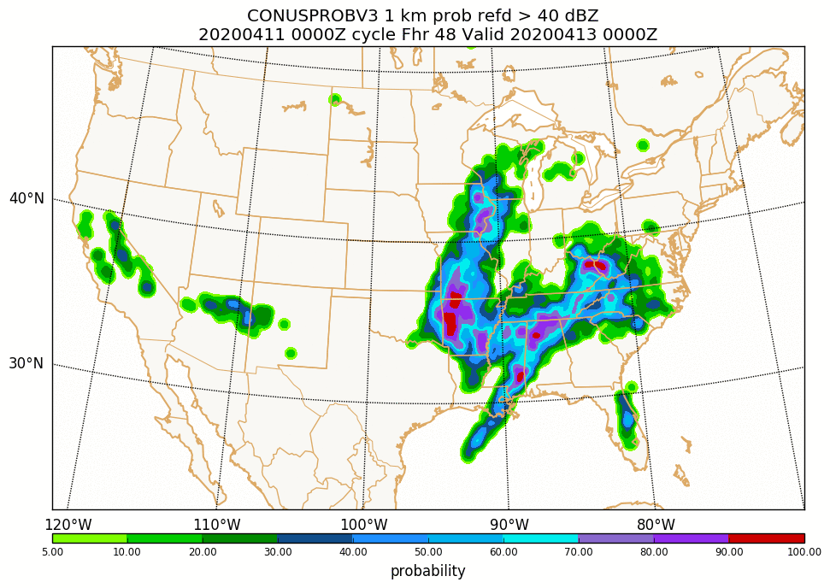
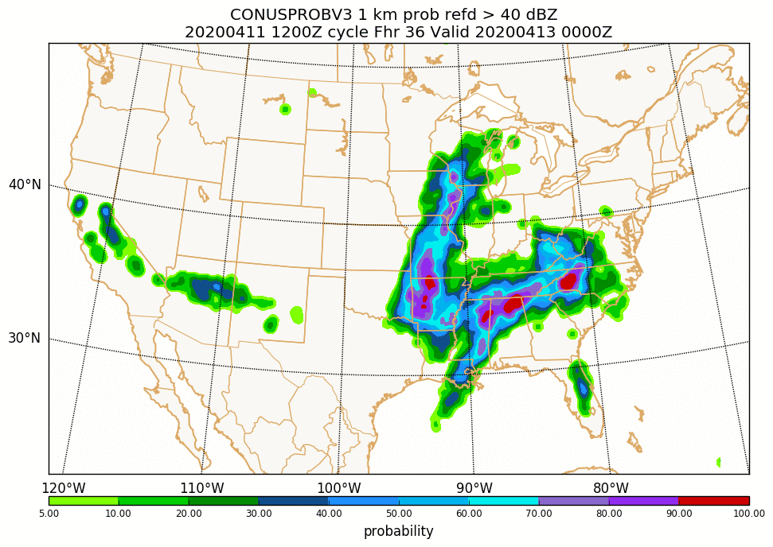
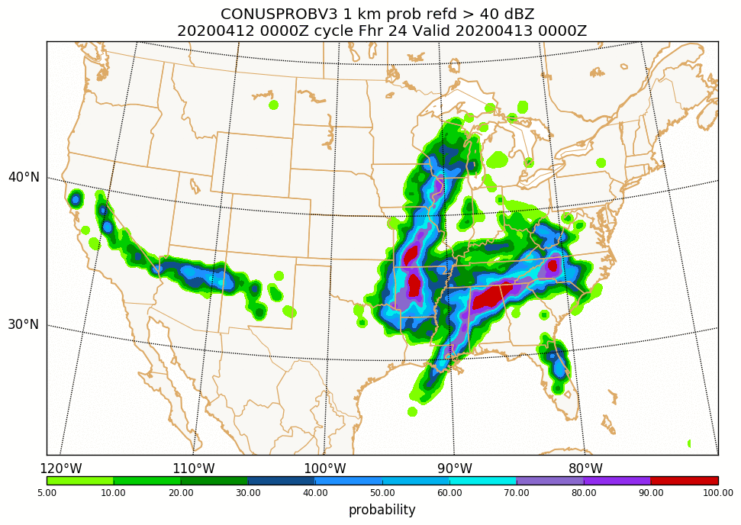
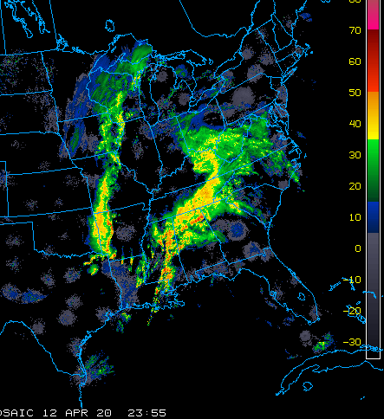
NATIONAL OCEANIC AND ATMOSPHERIC ADMINISTRATION
Extension to 48 Hours
F48
F36
F24
HREFv3 Probability of 1-km REFD > 40 dBZ
Valid: 00Z 13 April 2020
Having CAM ensemble guidance throughout Day 2 can be useful, particularly in synoptically-driven or more organized events
Note: Some time-lagged members will drop out at 36 and 42 hours, so remaining members will have more impact on products in later forecast hours

Slide 14
NATIONAL OCEANIC AND ATMOSPHERIC ADMINISTRATION
Wind Probabilities and Convective Wind Events
RTMA
10-m Wind > 30 kt
Probability of
10-m Wind > 30 kt
HREFv2
HREFv3
Forecasts and RTMA Analysis Valid at 00Z 16 May
REFC
PMM
HREFv3 computes wind probabilities using the max value over the previous hour within a 10-km neighborhood
30-kt threshold seems to be a good proxy for significant convective gusts, at least in higher instability environments

Slide 15
NATIONAL OCEANIC AND ATMOSPHERIC ADMINISTRATION
NWS Western Region
The parallel HREFv3 is an improvement over the operational HREFv2.
48 h forecast length provides an ensemble perspective into Day 2, allowing for the extension of IDSS messaging of probabilities further out.
EAS was especially useful in terrain, but perhaps too restrictive in isolated events.
LPMM was an improvement, retaining the high end values while reducing spatial coverage to draw out the true message.
Supports the implementation of HREFv3.

Slide 16
NATIONAL OCEANIC AND ATMOSPHERIC ADMINISTRATION
EAS Probabilities Are Quite Useful in Terrain
HREFv2 NBMAX
HREFv3 EAS
Stage IV > 0.5”
At 0.5” threshold, EAS generally provides good detail highlighting areas of observed QPF > 0.5”
  Removes false alarm along central CA coast
At 1” threshold, EAS correctly removes the false alarm areas in NBMAX, but missed an analyzed max
EAS works well in terrain because members are more likely to agree in orographically-forced QPF events
Prob.
> 0.5”
Stage IV > 1”
Prob.
> 1”
Init: 12Z 17 May Valid: 06Z 18 May (F18)

Slide 17
NATIONAL OCEANIC AND ATMOSPHERIC ADMINISTRATION
STI CAM SOO Team
The parallel HREFv3 is an improvement over the operational HREFv2.
EAS probabilities may be best used in tandem with NBMAX.
Lightning product especially useful when precipitation and reflectivity forecasts are accurate.
Notable benefits to forecast operations in Alaska.
HRW-FV3 was an outlier as often as HRW-NMMB, but may be a benefit as it adds diversity to the ensemble solution.
Concerns regarding low CAPE bias and lower frequencies of significantly reduced ceilings and visibilities.

Slide 18
NATIONAL OCEANIC AND ATMOSPHERIC ADMINISTRATION
Methodology to Define Outlier Member
Examined paintball plots of 40 dBZ reflectivity forecasts from HREFv2.1 and HREFv3 for the period of the 2020 HWT SFE (27 April – 29 May; M-F).
Subjectively rated HRW-NMMB (HREFv2.1) and HRW-FV3 (HREFv3) as being a “bad outlier” or “within the envelope” relative to the other respective HREF members.
Provided one rating per 0000 UTC forecast cycle of the “lowest” category (e.g., if the HRW-NMMB was a “bad outlier” at any point in the next convective day, it was assigned that rating for the cycle).
Focused on primary severe weather threat area within the SFE domain

Slide 19
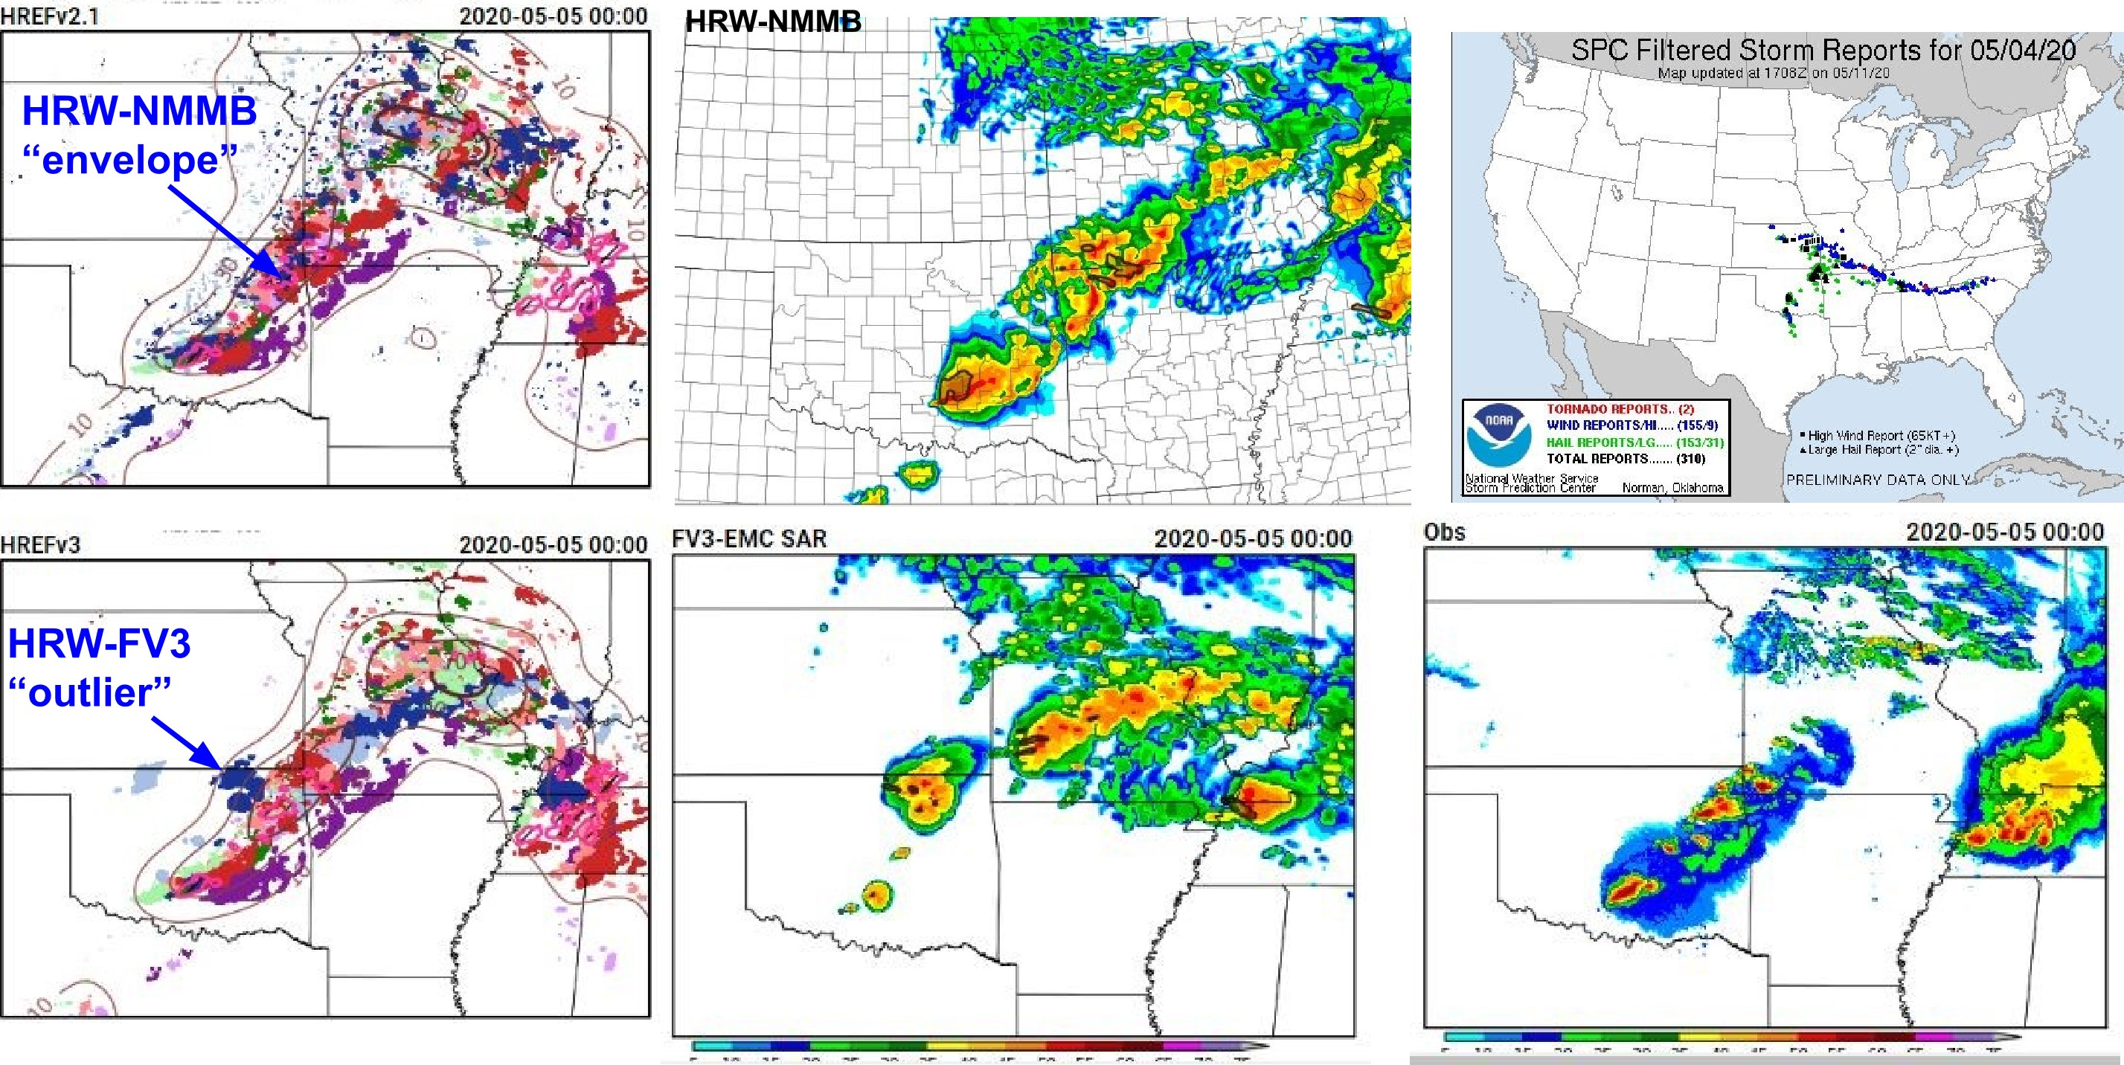
NATIONAL OCEANIC AND ATMOSPHERIC ADMINISTRATION
Outlier Example from 00 UTC 5 May 2020

Slide 20
NATIONAL OCEANIC AND ATMOSPHERIC ADMINISTRATION
Outlier Frequency Results
Model | “Bad Outlier” | “Within the Envelope”
HRW-NMMB | 6/22 (27%) | 16/22 (73%)
HRW-FV3 | 7/22 (32%) | 15/22 (68%)

Slide 21
NATIONAL OCEANIC AND ATMOSPHERIC ADMINISTRATION
FAA Aviation Weather Research Branch
The parallel HREFv3 is an improvement over the operational HREFv2
Forecasts extension makes HREF more useful for the Traffic Flow Management Convective Forecast (TCF), the primary product used for assessing convective weather impacts into Day 2
EAS probabilities add useful detail to precipitation forecasts
Favors addition of the HRRR into HREF with this implementation, but expressed concern about whether the FV3 member is ready for operations
Supports the proposed implementation of HREFv3

Slide 22
NATIONAL OCEANIC AND ATMOSPHERIC ADMINISTRATION
Aviation Weather Center
The parallel HREFv3 is overall equal to the operational HREFv2
Forecasts out to 48 hours will benefit aviation-focused convective products, allowing extension into the full Day 2 period
HiResW FV3 overall performed worse than HiResW NMMB for C&V guidance
HRW-FV3 struggled to develop fog and low clouds, especially along the West Coast where forecasts are very important to airport operations
HRW-FV3 low bias decreases the HREF C&V probabilities, but signals for problem areas are still identifiable
Supports the proposed implementation of HREFv3

Slide 23
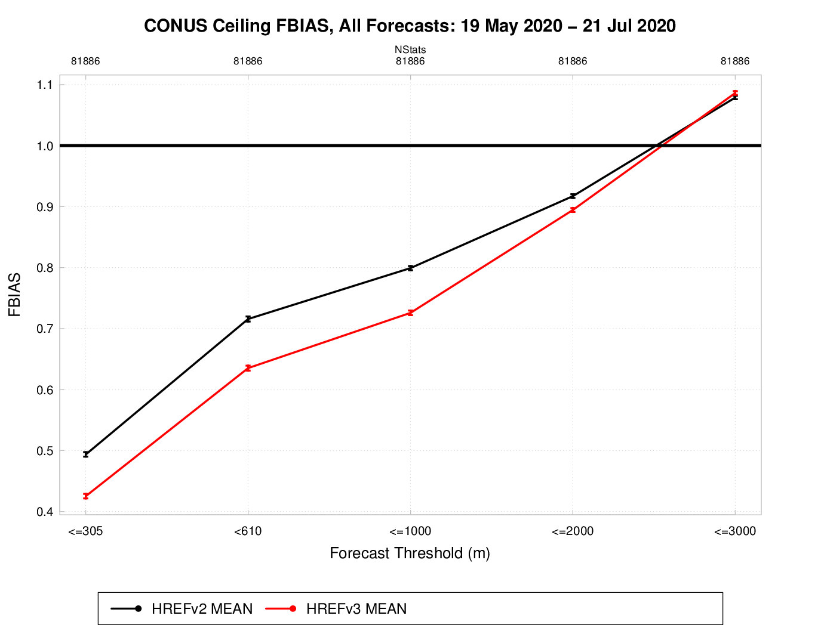
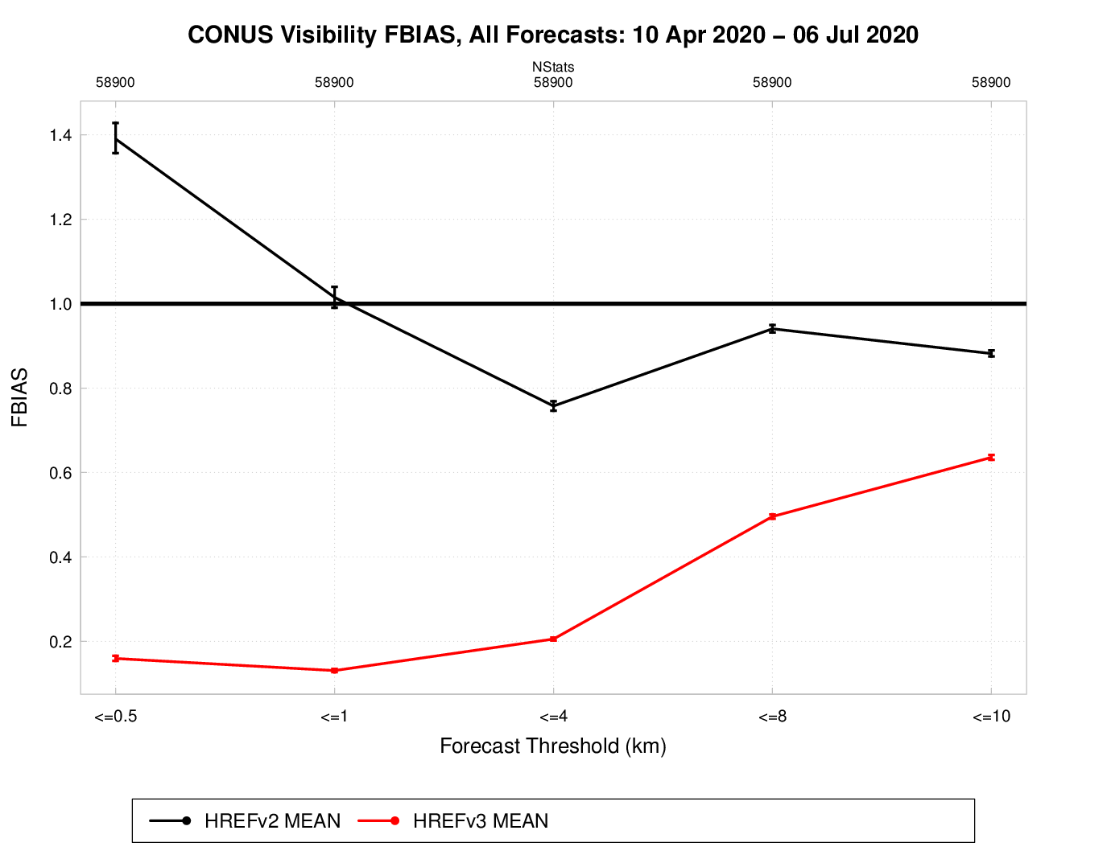
NATIONAL OCEANIC AND ATMOSPHERIC ADMINISTRATION
HREFv3 CONUS Ceiling & Visibility Bias
HREFv2
HREFv3
Ceiling FBIAS
Visibility FBIAS
Reduced bias for lower ceiling thresholds
Reduced bias for visibility at all thresholds

Slide 24
NATIONAL OCEANIC AND ATMOSPHERIC ADMINISTRATION
HREFv3 Impacted By Lack of Fog & Low Cloud in FV3
Visibility Valid 15z 5/26/20 (F27)
NMMB
FV3
FV3
NMMB clearly has too much coverage of low visibility with coastal stratus, but FV3 has too little
HREFv3 replaces the member with the highest bias for low visibilities (NMMB) with the member with the lowest bias for low visibilities (FV3)

Slide 25
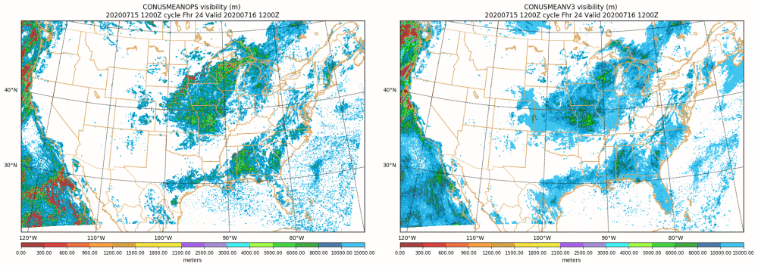
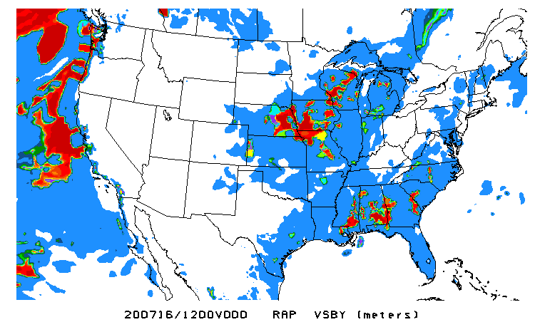
NATIONAL OCEANIC AND ATMOSPHERIC ADMINISTRATION
HREFv3 Mean Underpredicts Coverage of Low Visibilities
MEAN VSBY
HREFv2
HREFv3
Much less coverage of the very
low visibility amounts in v3
ANL

Slide 26
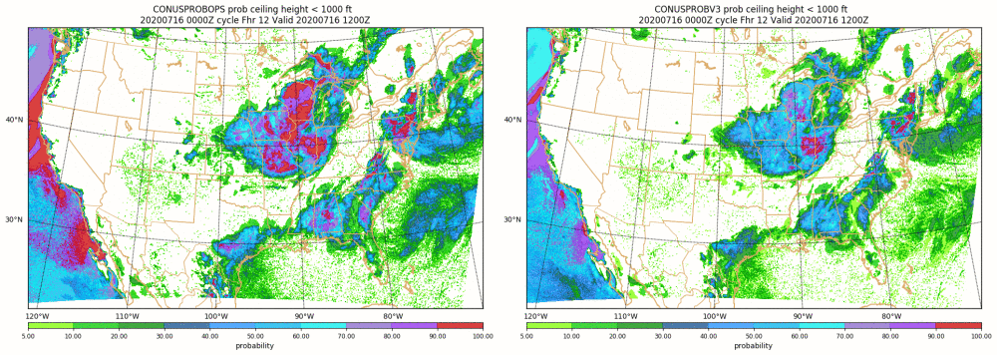
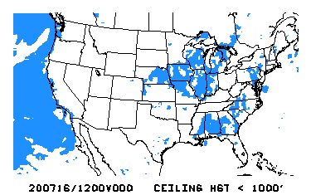
NATIONAL OCEANIC AND ATMOSPHERIC ADMINISTRATION
Reduced Probabilities, But Signals Are Still Present
PROB
CEILING
< 1000’
HREFv2
HREFv3
Ceiling probabilities are reduced,
but coverage is relatively unchanged
ANL

Slide 27
NATIONAL OCEANIC AND ATMOSPHERIC ADMINISTRATION
Storm Prediction Center
The parallel HREFv3 is an improvement over the operational HREFv2
Forecast extension is very useful for Day 2 Convective Outlook, especially with recent switch to individual hazard probabilities on Day 2
Forecast extension is very useful for Day 2 Fire Weather Outlook; provides hi-res guidance for fire weather conditions in complex terrain and dry environments
HiResW FV3 overall performed better than HiResW NMMB for convective and fire wx forecasts
Largest concern is with low instability bias in HRW-FV3, though it often doesn’t seem to negatively impact convective evolution
HREFv3 appears to be an improvement over HREFv2.1 (uses HRRRv3 members) for severe weather. Sets a very high standard for the future RRFS
Supports the proposed implementation of HREFv3

Slide 28

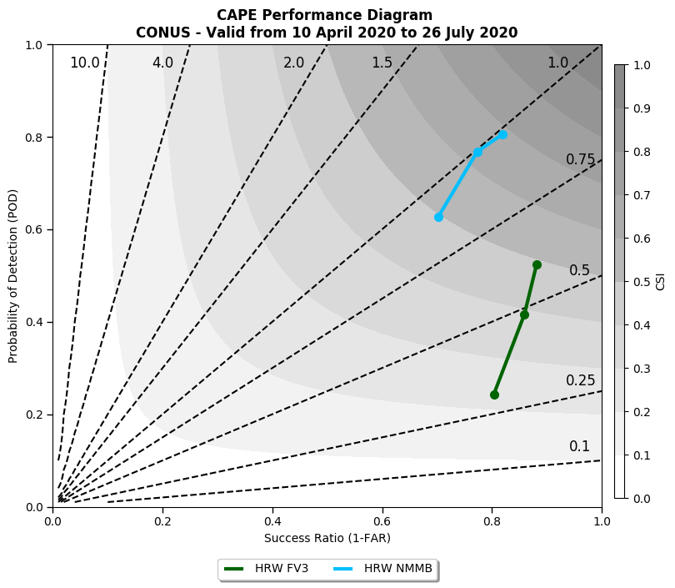
HRW-FV3 Replacing HRW-NMMB
Point verification surface-based CAPE (500,1000,2000 J/kg)
Biggest concern with HRW-FV3 is very low CAPE bias
This bias seems to stem from the odd combination of a cool, dry low-level/surface bias in the warm sector
However, based on reflectivity stats, it doesn’t seem to often be a detriment to convective evolution
SBCAPE; CONUS; 00/12Z Runs; F00-48
20200410-20200726
HRW-FV3 HRW-NMMB
SPC HREFv3 Evaluation

Slide 29
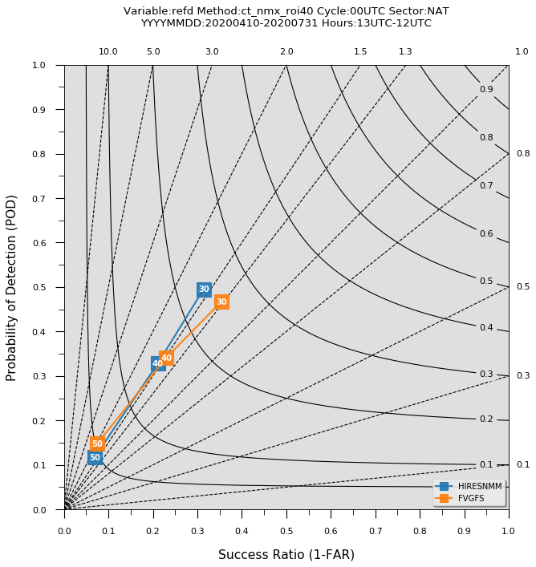
HRW-FV3 Replacing HRW-NMMB
40-km neighborhood verification of 1-km AGL reflectivity
The HRW-FV3 and HRW-NMMB have similar bias characteristics, even though the forecasts often look very different (upcoming slides)
The HRW-FV3 reveals an improvement in CSI at all dBZ thresholds over HRW-NMMB
1km REF; CONUS; 00Z Runs; F13-36
20200410-20200731
HRW-FV3
HRW-NMMB
SPC HREFv3 Evaluation

Slide 30
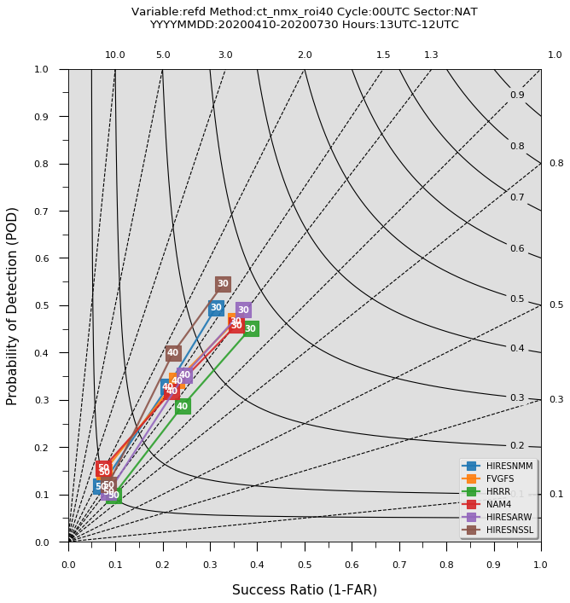
HRW-FV3 Replacing HRW-NMMB
40-km neighborhood verification of 1-km AGL reflectivity
How do these runs compare to other HREF members?
The HRW-ARW and HRW-NSSL runs have the highest CSI
The HRW-FV3 has higher CSI values at 40 dBZ than the HRRRv3, NAM Nest, and HRW-NMMB!
1km REF; CONUS; 00Z Runs; F13-36
20200410-20200730
HRRRv3
HRW-ARW
HRW-NSSL
NAM Nest
HRW-FV3
HRW-NMMB
SPC HREFv3 Evaluation

Slide 31
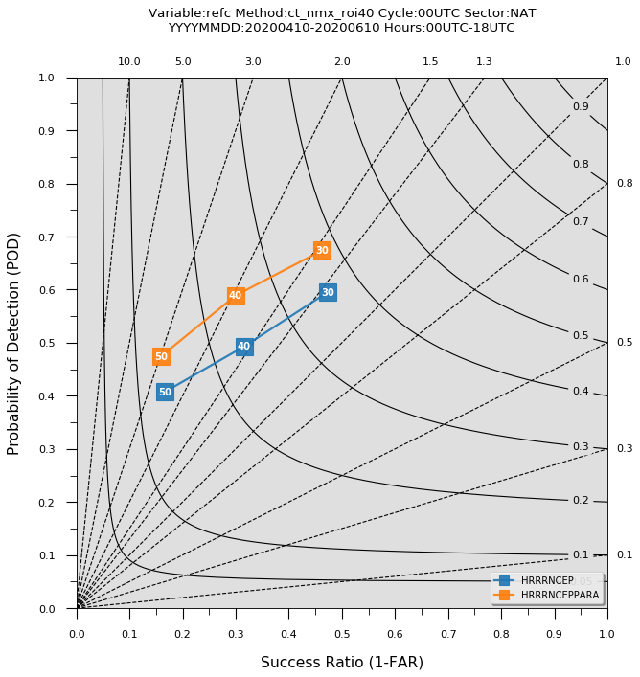
Addition of HRRRv4
40-km neighborhood verification of composite reflectivity
Although the HRRRv4 evaluation has already been performed, wanted to check on the impact of reflectivity bug fix
While there is an increased frequency bias in HRRRv4, the POD is notably improved, leading to an increase in CSI
CREF; CONUS; 00Z Runs; F00-18
20200410-20200610
HRRRv4
HRRRv3
SPC HREFv3 Evaluation

Slide 32
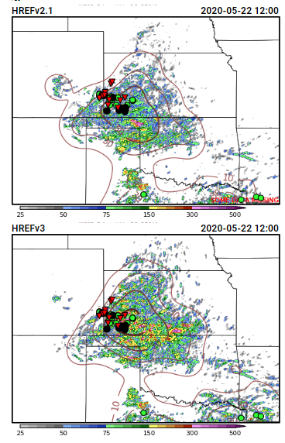
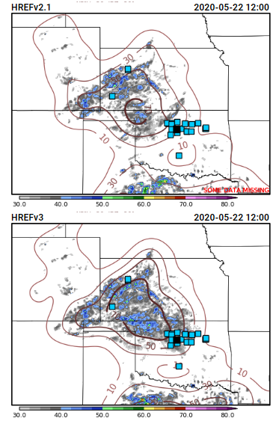
HREFv3 Replacing HREFv2.1
UH
10-m Wind
Example forecast of 24-h ensemble max and neighborhood probability fields from 21 May 2020
Forecasts were often similar between HREFv3 and HREFv2.1
Larger differences often revealed an improvement for HREFv3 (bottom row) over HREFv2.1 (top row)

Slide 33
NATIONAL OCEANIC AND ATMOSPHERIC ADMINISTRATION
Weather Prediction Center
The parallel HREFv3 is overall equal to the operational HREFv2
Forecast extension represents a potentially significant benefit with increased use of HREF for the Day 2 QPF and winter weather forecasts
EAS probabilities were extremely useful, especially when used in tandem with NBMAX probabilities
HREFv3 LPM mean QPF was an improvement over HREFv2 PM mean QPF
HiResW FV3 overall performed worse than HiResW NMMB
Expressed concern that HREFv3 will be less likely to capture events associated with lower instability
Supports the proposed implementation of HREFv3

Slide 34
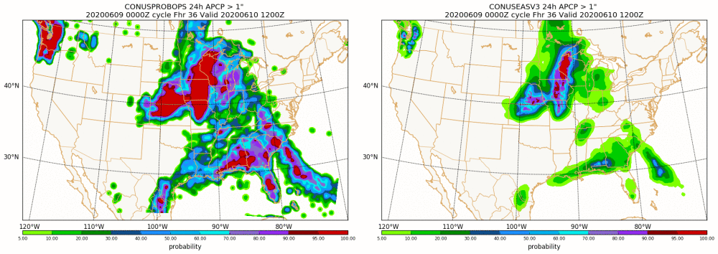
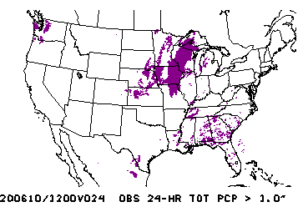
PROB
24-h QPF
> 1”
NBMAX
EAS
Terrain Example
EAS more useful guidance in the terrain
EAS able to better pinpoint favorable areas, NBMAX too broad
ANL > 1”

Slide 35
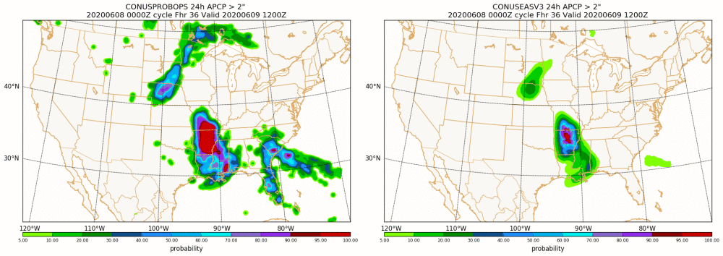
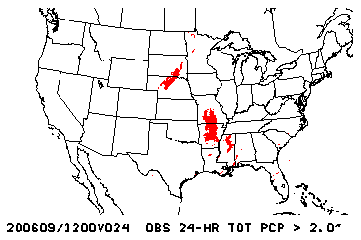
PROB
24-h QPF
> 1”
NBMAX
EAS
NBMAX and EAS used in tandem
High EAS probabilities over AR/MO indicate greater confidence in a widespread area of 2”+ rain
Higher EAS probabilities over NE/SD correctly direct your attention to that area vs the area of similar NBMAX over GA/SC
ANL > 1”

Slide 36
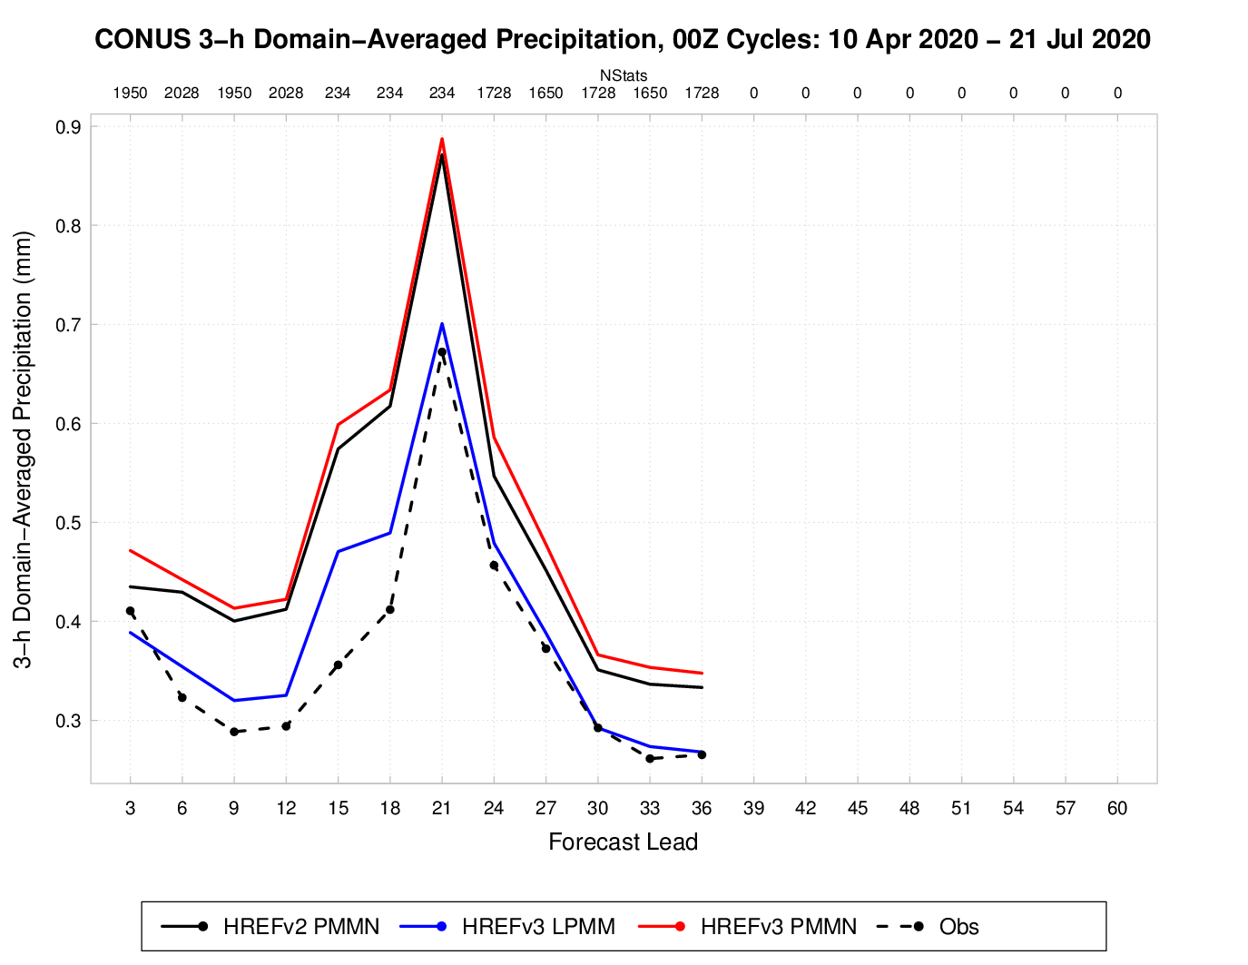
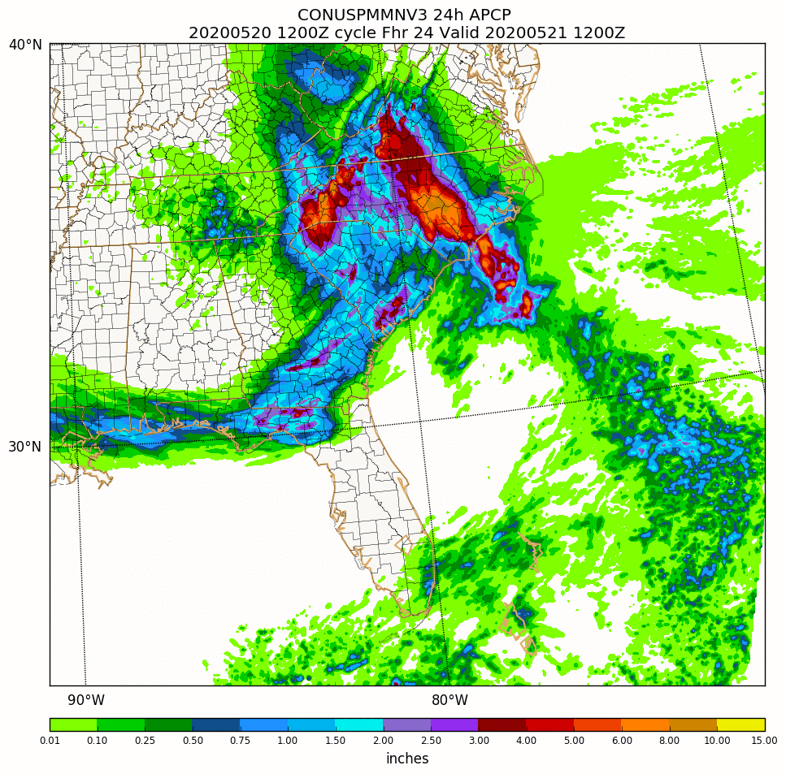
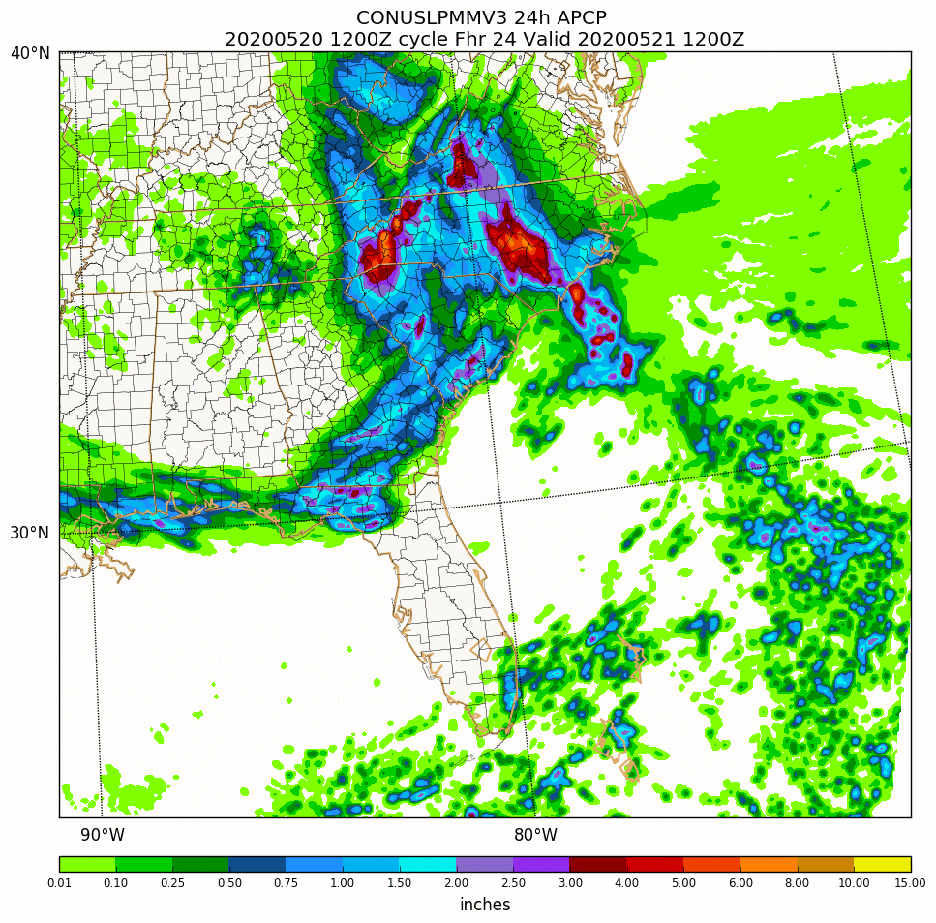
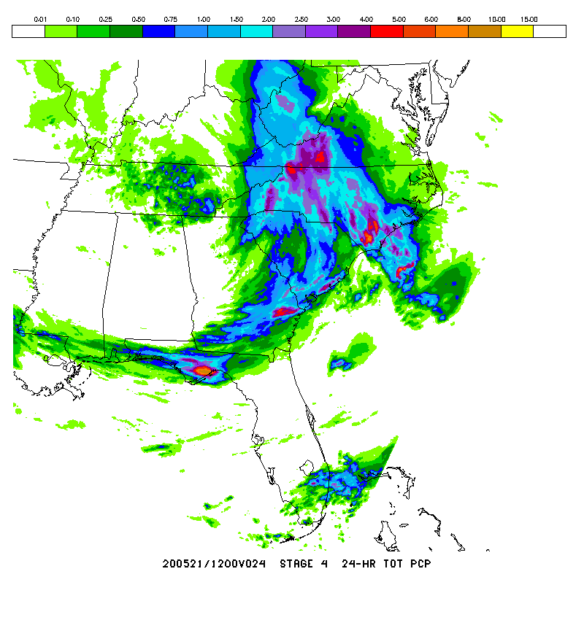
NATIONAL OCEANIC AND ATMOSPHERIC ADMINISTRATION
Addition of LPMM QPF Is an Improvement
HREFv3
PMMN
HREFv3
LPMM
HREFv2 PMMN
HREFv3 PMMN
HREFv3 LPMM
Stage IV
Similar to subjective evaluations during WPC/HMT’s FFaIR experiment, LPMM reduced the PMMN’s high bias for heavy amounts
LPMM domain-averaged QPF matches the observed diurnal variability quite well

Slide 37
NATIONAL OCEANIC AND ATMOSPHERIC ADMINISTRATION
Summary and Overall Impressions

Slide 38
NATIONAL OCEANIC AND ATMOSPHERIC ADMINISTRATION
Outline
Summary of HREFv3 evaluation comments/recommendations
from the field (NWS Regions, Centers, and stakeholders)
Summary of HREFv3 verification statistics
Overall impressions of HREFv3

Slide 39
NATIONAL OCEANIC AND ATMOSPHERIC ADMINISTRATION
HREFv3 Verification Summary
The summary chart on the following slide is a subjective attempt to condense objective stats from different metrics, thresholds, etc. into an easily digestible chart.
  A UFS-R2O project is funded to explore reducing scorecards into similar summaries, while doing so in a more objective manner
Subjective descriptions are scaled as follows:
Degraded
Mostly
Somewhat
Neutral
Somewhat
Mostly
Improved

Slide 40
NATIONAL OCEANIC AND ATMOSPHERIC ADMINISTRATION
HREFv3 Verification Summary
Forecast Parameter | CONUS – East | CONUS – West | Alaska
Upper Air (Z, T, V) | Mostly Improved |  | Somewhat Improved
2-m Temperature | Mostly Improved | Improved | Improved
2-m Dewpoint | Improved | Improved | Improved
10-m Winds | Somewhat Degraded | Somewhat Degraded | Somewhat Degraded
Cloud Cover | Mostly Improved | Somewhat Improved | Improved
Ceiling | Somewhat Degraded | Somewhat Degraded | Improved
Visibility | Mostly Degraded | Mostly Degraded | Improved
CAPE | Degraded |  | N/A
QPF | Mostly Improved | Mostly Improved | N/A
Reflectivity | Improved |  | N/A
Echo Top | Neutral |  | N/A

Slide 41
NATIONAL OCEANIC AND ATMOSPHERIC ADMINISTRATION
Outline
Summary of HREFv3 evaluation comments/recommendations
from the field (NWS Regions, Centers, and stakeholders)
Summary of HREFv3 verification statistics
Overall impressions of HREFv3

Slide 42
NATIONAL OCEANIC AND ATMOSPHERIC ADMINISTRATION
Key Remarks from Evaluators
Region/Center | Recommendation | Key Remarks
Alaska Region | Implement | Extension will benefit Day 2 forecasting interests. EAS probs and LPMM QPF appear to be extremely useful improvements. Preferred HREFv2 wind prob computation. FV3 runs were overall worse than NMMB runs
Central Region | Implement | Useful for messaging, particularly in situations of low confidence. EAS probs and LPMM QPF appear to be useful improvements. A slight situation-dependent nod to FV3 over NMMB
Eastern Region | Neutral | Forecast extension is a significant enhancement. Preferred HREFv3 wind probs computation. Very concerned about degraded CAPE and C&V performance. Time to RRFS was a factor in recommendation.
Southern Region | Implement | Extension will allow for Day 2 hazard assessment. Like QPF product additions. Instability bias can degrade some aspects of convective forecasts at times.
Western Region | Implement | Forecast extension will help Day 2 IDSS messaging. LPMM is an improvement. EAS probs are useful in terrain, but can sometimes be too restrictive

Slide 43
NATIONAL OCEANIC AND ATMOSPHERIC ADMINISTRATION
Key Remarks from Evaluators
Region/Center | Recommendation | Key Remarks
Aviation Weather Center | Implement | Extension will benefit Day 2 forecast products. Concerned about degraded C&V performance attributable to lack of fog and low clouds in FV3 runs
Storm Prediction Center | Implement | Extension is useful for Day 2 forecast products. Concerned about low instability bias, but convective forecasts aren’t negatively impacted. HRRRv4 and HRW-FV3 improve upon HRRRv3 and HRW-NMMB for convective forecasts.
Weather Prediction Center | Implement | Extension may benefit Day 2 forecast products. EAS and LPMM products are useful additions. Concerned about QPF events in low instability environments.
STI CAM SOO Team | N/A | EAS probs complement NBMAX probs. FV3 outlier frequency is similar to NMMB. Lightning product is useful. Benefits to AK operations. Concerned about degraded CAPE and C&V performance.
FAA Weather Research Branch | Implement | Extension will benefit Day 2 forecast products. Favor addition of the HRRR, but concerned FV3 member may not be ready for ops

Slide 44
NATIONAL OCEANIC AND ATMOSPHERIC ADMINISTRATION
Overall Impressions: Common Concerns
Overall, parallel guidance was considered as good or slightly better than operational guidance, with the exception of instability, ceiling, and visibility.
All participating evaluators and stakeholders are generally supportive of the proposed implementation.
Common Concerns
Reduction in instability due to characteristics of the FV3 member
Significant reduction of forecasts of very low visibility
Fewer forecasts of lower ceilings

Slide 45
NATIONAL OCEANIC AND ATMOSPHERIC ADMINISTRATION
Addressing CAPE, Ceiling, and Visibility Concerns
Using These HREFv3 Products in the Field
Concerns with CAPE and C&V guidance are most striking in the mean products
As an example, for LIFR and IFR conditions when ceilings are very low and/or visibilities are quite restricted, the HREFv3 means will be unable to show very low C&V values if the FV3 members predict clear sky instead of fog or low cloud
The CAPE and C&V probability products are impacted, but to a lesser extent
Probabilistic signals for LIFR or IFR conditions will still be discernable, but upper-end probabilities might be reduced from 80-90% to 50-70%
Forecaster education will be imperative to ensure the best use of HREFv3 CAPE and C&V guidance. The mean products for these fields must be used with caution.
Calibrating to and leaning on the probability products will be the best way to extract the most value out of the HREFv3 guidance for CAPE, ceiling, and visibility

Slide 46
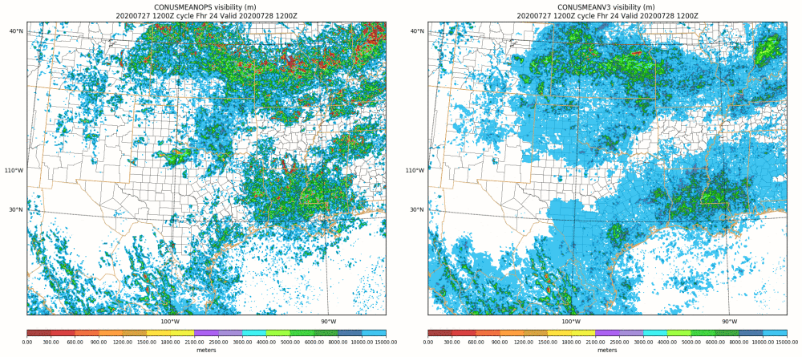
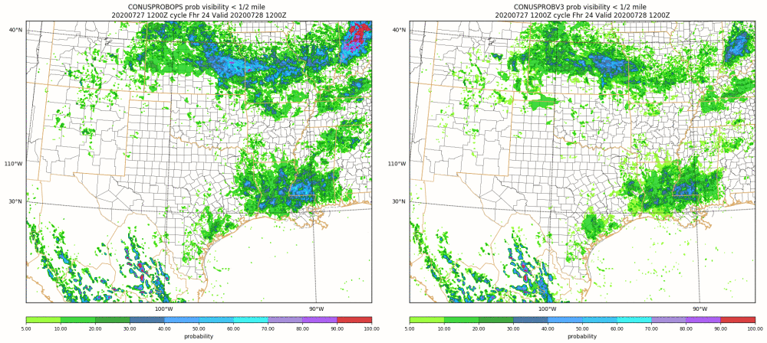
NATIONAL OCEANIC AND ATMOSPHERIC ADMINISTRATION
Addressing CAPE, Ceiling, and Visibility Concerns
MEAN VSBY
HREFv3 mean shows almost
no values of low visibility
HREFv2
HREFv3
PROB VSBY < ½ mile
HREFv3 still has modest
probabilities of low visibility
HREFv2
HREFv3

Slide 47
NATIONAL OCEANIC AND ATMOSPHERIC ADMINISTRATION
Addressing CAPE, Ceiling, and Visibility Concerns
Some evaluators and other partners have raised the legitimate question as to whether the HiResW FV3 member was “ready for primetime”
Over the past year, HiResW FV3 runs with roughly similar configurations have performed comparably to some ops CAMs, like the HRRR, NAM Nest, and NMMB. SPC’s reflectivity stats for April to June support this, despite the CAPE concerns.
Although we haven’t previously discussed it in this venue, EMC developers and the MEG are aware that the HRW-FV3 showed more improvement over the HRW-NMMB during the cool season. Marked changes in FV3 performance characteristics between March and April were investigated.
We cautiously suspect that some of the HiResW FV3 concerns will be mitigated and overall synoptic performance will improve during the cool season.

Slide 48
NATIONAL OCEANIC AND ATMOSPHERIC ADMINISTRATION
Addressing CAPE, Ceiling, and Visibility Concerns
Model Development
Concerns with HREFv3 are attributable to deficiencies in the FV3 member, as it’s currently configured
FV3-CAM developers are already moving forward with physics upgrades that mitigate these issues in the RRFS baseline configuration. These upgrades and associated infrastructure were not quite ready in time for the HREFv3 implementation.
Verification and Products
To emphasize the importance and value of the CAPE and C&V probability products, VPPPG staff will continue refining probabilistic verification and will make probabilistic metrics more of a focus for the RRFS evaluation
VPPPG will also have a careful review of further product additions and changes necessary to better extract useful information from the RRFS

Slide 49
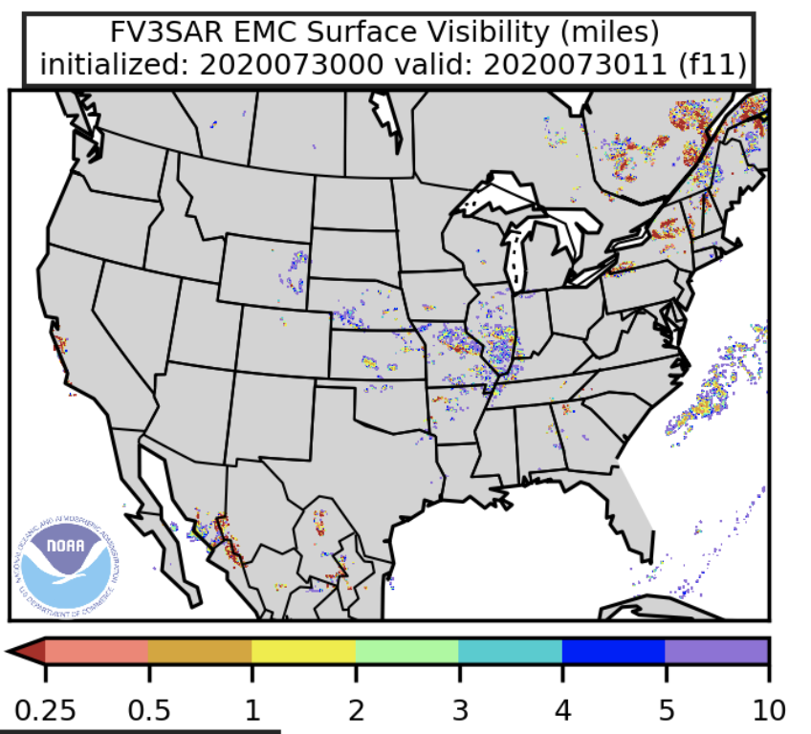
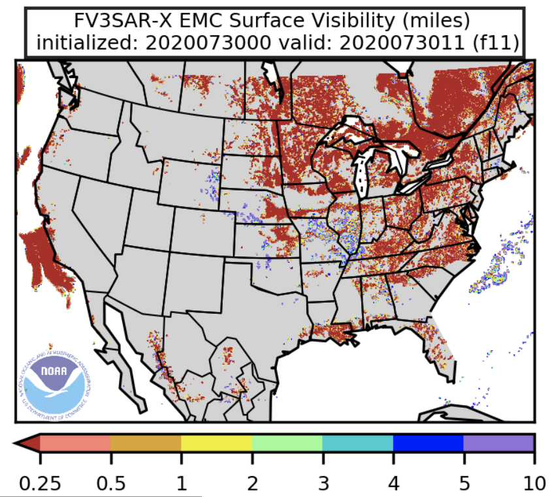
NATIONAL OCEANIC AND ATMOSPHERIC ADMINISTRATION
Addressing CAPE, Ceiling, and Visibility Concerns
On the right, experimental Hi-Res FV3 configuration using Thompson microphysics and MYNN PBL scheme consistently shows much lower visibility (including West Coast marine stratus)
Should consider replacing visibility mean with local probability-matched mean for RRFS

Slide 50
NATIONAL OCEANIC AND ATMOSPHERIC ADMINISTRATION
Overall Impressions: Common Positives
Forecast extension to 48 hours
Synoptic and surface sensible weather guidance is generally improved
LPM mean QPF is an improvement upon PM mean QPF, often producing a more representative forecast
EAS probabilities are a useful addition, especially in terrain and at lower QPF thresholds
New wind probability computation is favored to the current computation and can provide a decent proxy for significant convective wind gusts
Lightning product is a useful addition. New thresholds for other products are useful additions as well.
Better representations of tropical cyclones

Slide 51
NATIONAL OCEANIC AND ATMOSPHERIC ADMINISTRATION
Next Steps
The NCEP Office of the Director briefing will be held on August 28
Pending approval, code handoff is targeted for early September, and implementation is targeted for late December 2020
  Implementation is contingent upon a successful prior implementation of HRRRv4 in November
This will be the final regional/CAM implementation before we move to the FV3-based CAM ensemble, the Rapid Refresh Forecast System (RRFS), in ~2023
HREFv3 Official Evaluation Webpage
https://www.emc.ncep.noaa.gov/users/meg/hrefv3/

Slide 52
NATIONAL OCEANIC AND ATMOSPHERIC ADMINISTRATION
Acknowledgements
Project Manager: Matthew Pyle
FV3-CAM model: Jim Abeles, Eric Aligo, Tom Black, Ben Blake, Jacob Carley, Dusan Jovic, Ying Lin, Eric Rogers, Ed Strobach, Xiaoyan Zhang
HRRRv4 model: Trevor Alcott, Curtis Alexander, Ravan Ahmadov, Amanda Back, Hannah Barnes, Stan Benjamin, John Brown, David Dowell, Jeff Duda, Jason English, Guoqing Ge, George Grell, Siwei He, Ming Hu, Eric James, Jaymes Kenyon, Terra Ladwig, Haidao Lin, Joe Olson, Tanya Smirnova, Mike Toy, Greg Thompson, Steve Weygandt
VPPPGB: Geoff Manikin, Logan Dawson, Binbin Zhou, Perry Shafran, Chris MacIntosh, Alicia Bentley, Shannon Shields, Philippe Papin
Management: Jian-Wen Bao, Arun Chawla, Jason Levit, Daryl Kleist, Vijay Tallapragada
STI CAM SOO team: Mark Chenard, Adam Clark, Mike Evans, Rob Hepper, Tom Hultquist, Israel Jirak, Dave Levin, Geoff Manikin, Bryan Mroczka, Emily Niebuhr, Andy Taylor

