Slide 1
HREFv3 Evaluation
MEG STI CAM Team
23 July 2020

Slide 2
MEG STI CAM Team
Purpose: Evaluate convection-allowing models (CAMs) and CAM ensembles proposed for implementation, including new products
HREFv3 Evaluation: HREFv3 adds the HRRRv4 members and replaces HRW-NMMB with HRW-FV3. The addition of the HRRR to HREF is long overdue, so this evaluation focuses mostly on products
Current Members (Org) - Evaluation Topic:
Geoff Manikin (EMC) | Bryan Mroczka (SR) - Winds
Rob Hepper (AWC) - Aviation | Mike Evans (ER) - Instability
Marc Chenard (WPC) - QPF | Andy Taylor (WR) - Lightning
Emily Niebuhr (AR) - Alaska | Israel Jirak (SPC) - Severe/Outlier Frequency
Dave Levin (AR) - Alaska | Tom Hultquist (CR)

Slide 3
Aviation
Rob Hepper, AWC

Slide 4
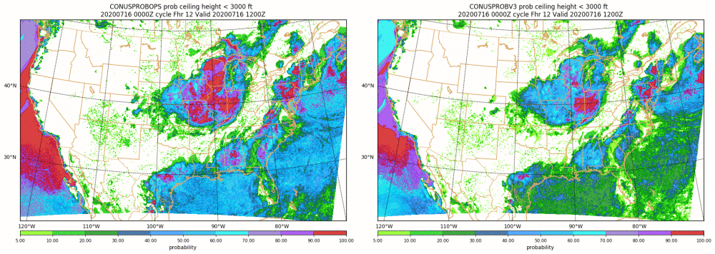
Ceiling
Lower probabilities almost across the board
Improvement in some areas (Gulf & East Coast), perhaps not in others (West Coast)

Slide 5
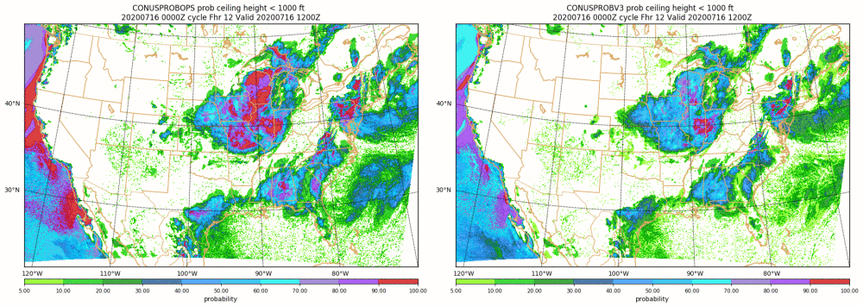
Ceiling
Lower probabilities almost across the board
Improvement in some areas (Gulf Coast), perhaps not in others (West Coast)

Slide 6
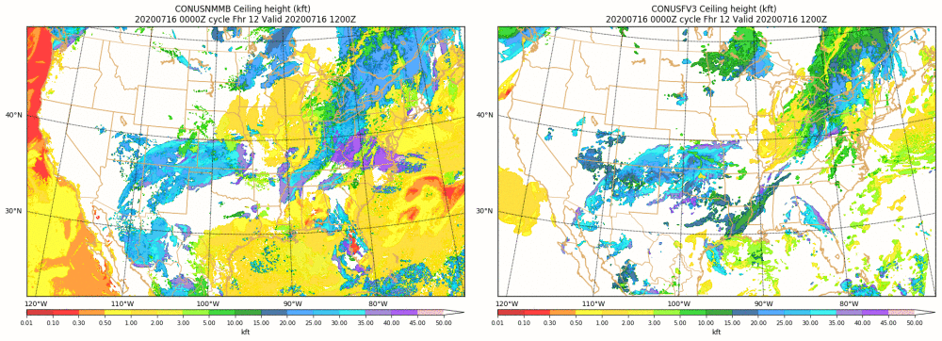
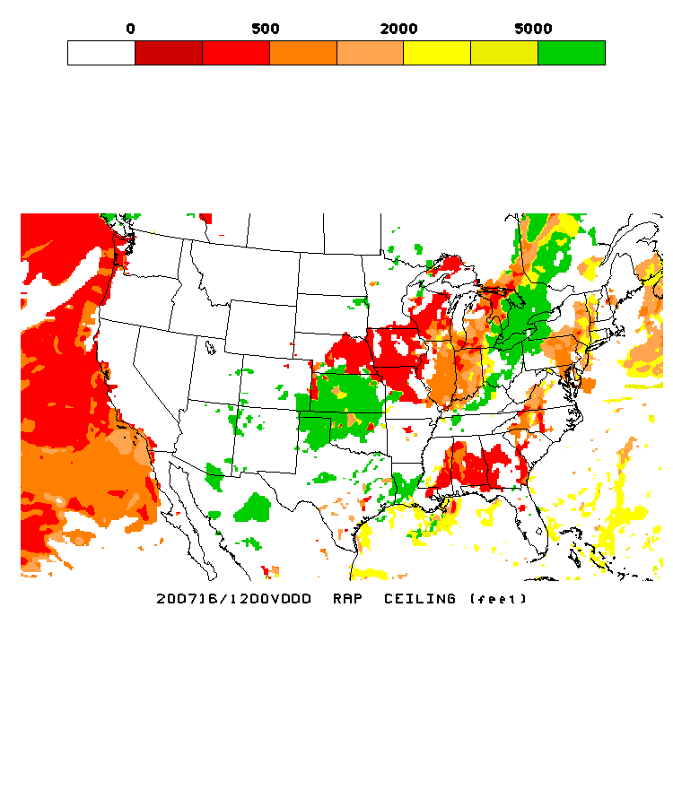
Ceiling
Large differences between NMMB and FV3, results in mixed bag
Very few appearances of low ceilings or visibilities from FV3 on the West Coast

Slide 7
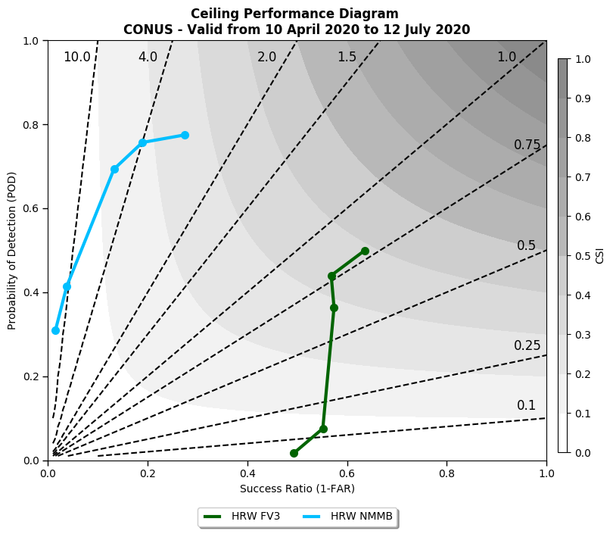

Slide 8
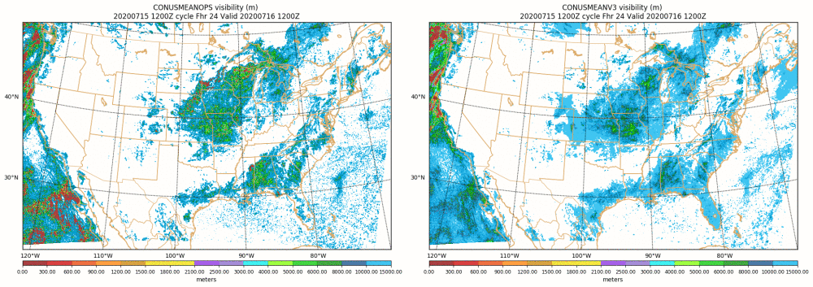
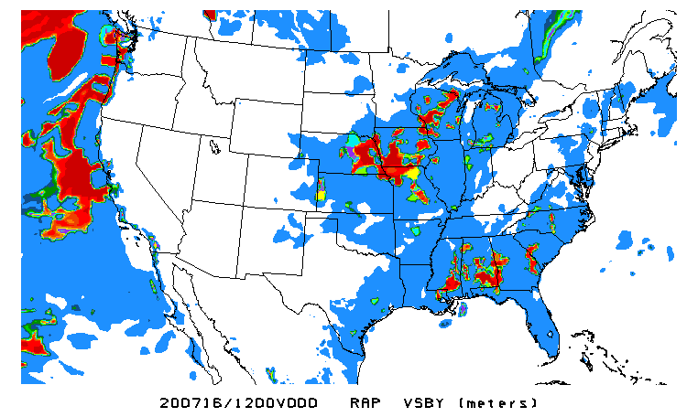
Visibility
Wider envelopes of high visibilities (10+ kft)
More focused areas of mid-range visibilities (4-10 kft)
Mixed bag at lower visibilities

Slide 9
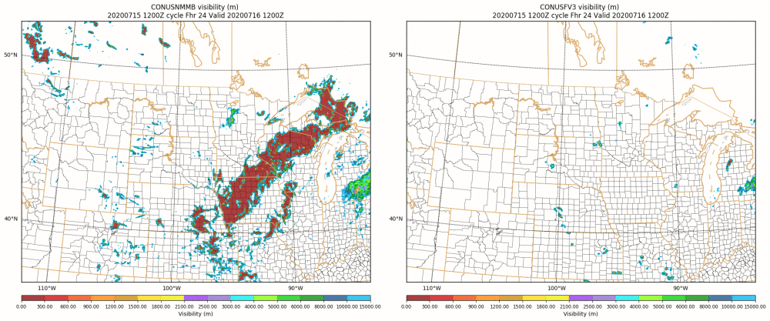
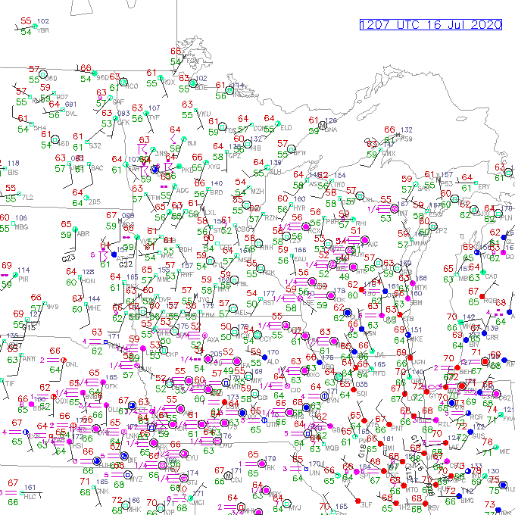
Visibility
FV3 does not depict fog development nearly as often as NMMB

Slide 10
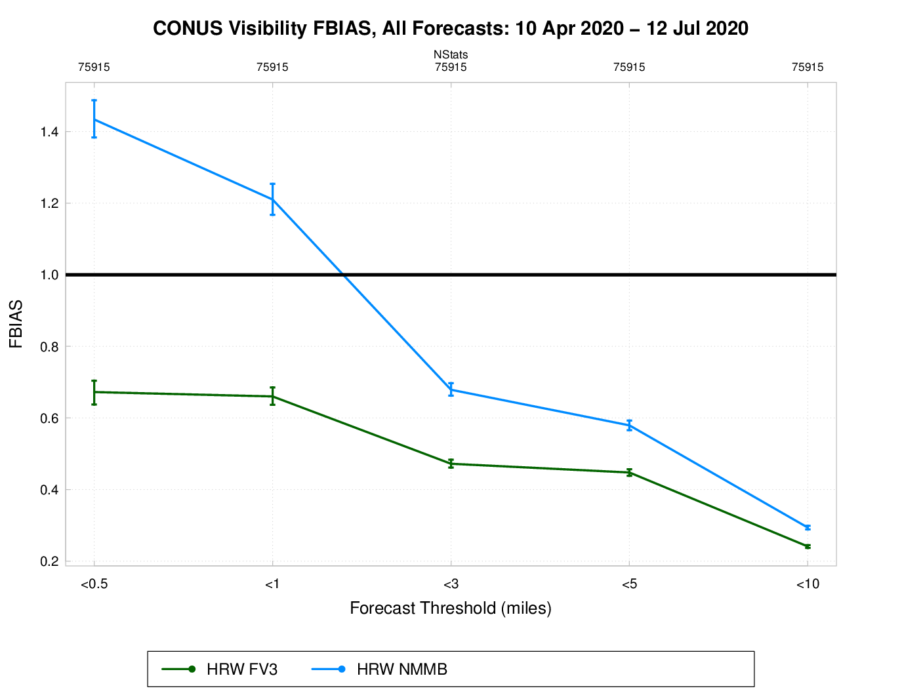

Slide 11
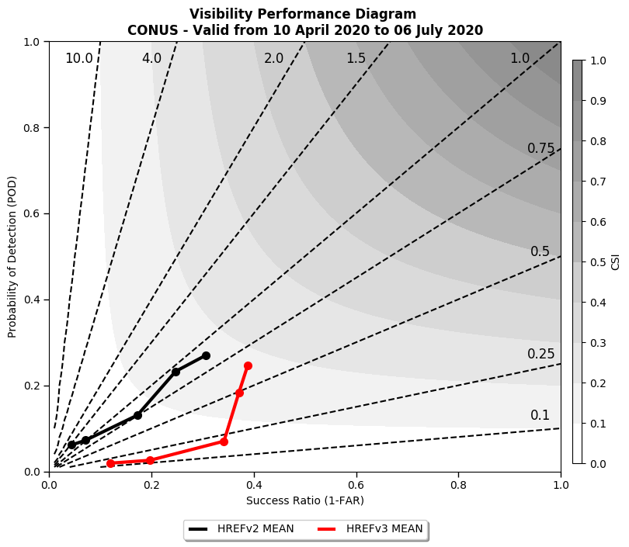

Slide 12
Summary
Main differences in ceiling and visibility guidance between HREFv2 and HREFv3 seem tied to replacing the high frequency biased NMMB with the low frequency biased FV3
Little change to placement of features
Generally lower threshold probabilities in v3 for both ceiling and visibility
Generally higher ensemble mean values in v3 for both ceiling and visibility
Lack of low ceilings or visibility along the west coast due to marine stratus/fog noted throughout the evaluation from the FV3
Important to capture development/behavior of clouds along the west coast for airport operations

Slide 13
QPF
Marc Chenard, WPC

Slide 14
Neighborhood (NBMAX) vs Ensemble Agreement Scale (EAS) probabilities
NBMAX Probabilities: Accounts for forecast displacement between members by searching over a local neighborhood of points, and only evaluating the neighborhood maximum value. Neighborhood extends 40km out from a point and the probabilities are smoothed.
Provides a smooth, spatially broad signal
Current method used in HREFv2
Heavily utilized at WPC for Excessive Rainfall Outlook. Mainly 2”,3”,5” for 24 hrs and 1”,2” for hourly
EAS Probabilities: Based on fractional coverage exceeding a threshold within a 10-100km radius, using a smaller radius when members agree closely, and a larger scale when they are less similar.
Has the appearance of an intelligently smoothed point probability
New for HREFv3

Slide 15
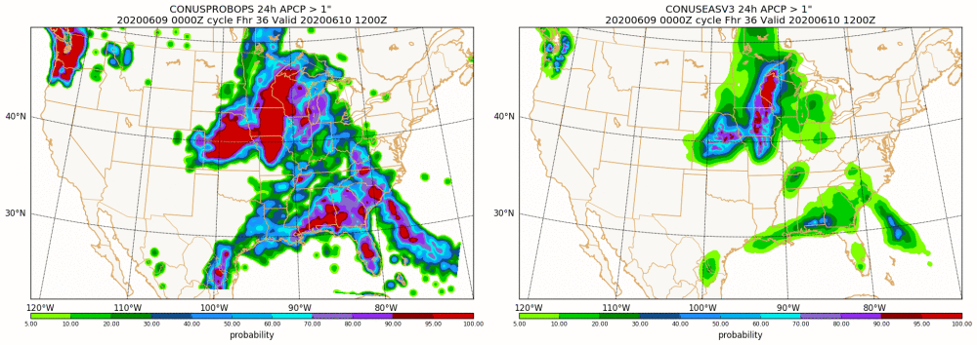
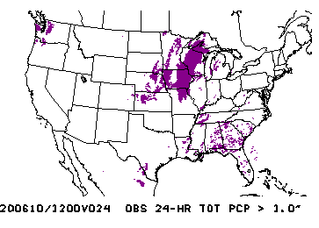
NBMAX
EAS
Terrain Example
EAS more useful guidance in the terrain
EAS able to better pinpoint favorable areas, NBMAX too broad

Slide 16
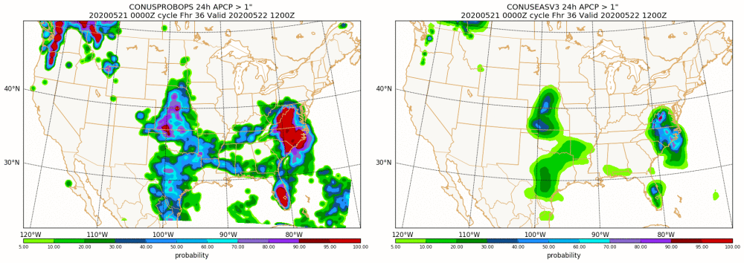
NBMAX
EAS
EAS adding value
EAS adds useful detail over both regions of organized heavy rainfall...Plains and NC/VA

Slide 17
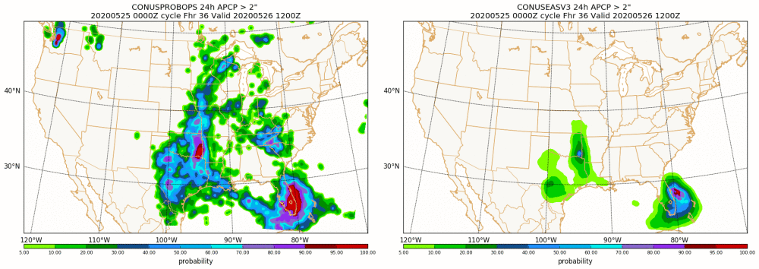
NBMAX
EAS
EAS adding value
EAS adds useful detail over eastern OK and southeast FL over the NBMAX

Slide 18
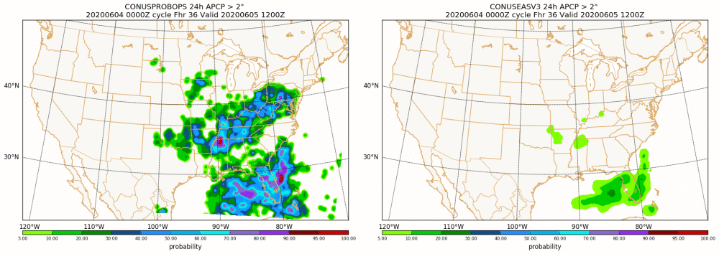
NBMAX
EAS
EAS less useful
EAS could misleadingly imply little to no threat of 2”+ amounts over the TN/OH Valley and Mid Atlantic
NBMAX would indicate a threat of 2”+ amounts

Slide 19
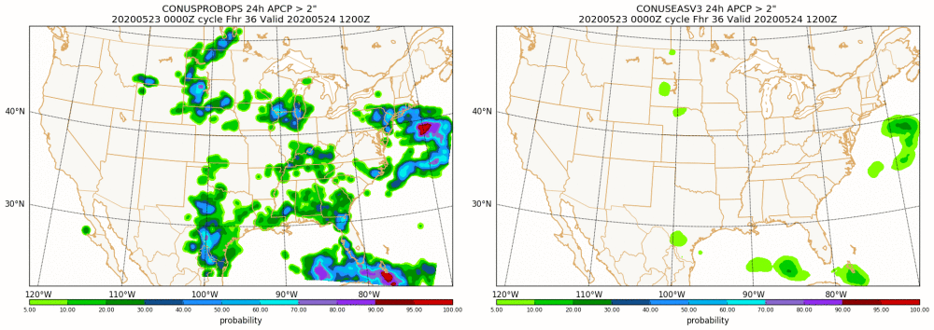
NBMAX
EAS
EAS less useful
Isolated/disorganized convective rainfall typically not depicted well by EAS
NBMAX, while typically too broad, gives indication of upper bound possibilities

Slide 20
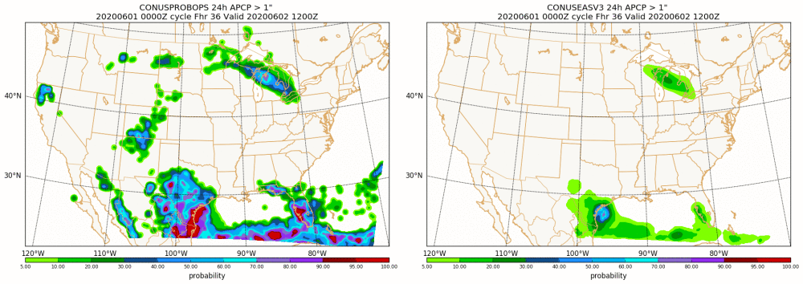
NBMAX
EAS
EAS less useful
Isolated heavy rain in AZ/NM/CO
Indication of the threat in NBMAX but not the EAS.
The Southwest can be sensitive to these localized heavy rains...burn scars and/or other sensitive locations

Slide 21
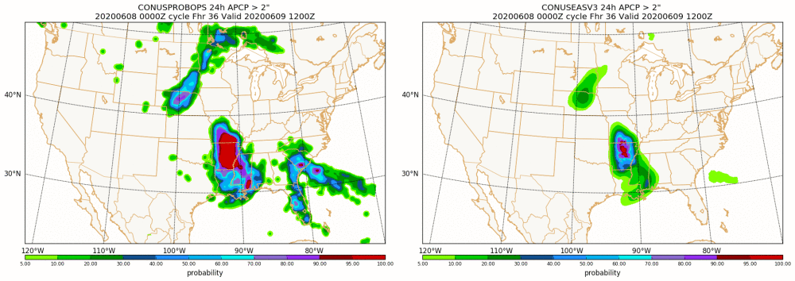
NBMAX
EAS
NBMAX and EAS used in tandem
High EAS probabilities over AR/MO indicate greater confidence in a widespread area of 2”+ rain
Higher EAS probabilities over NE/SD correctly direct your attention to that area vs the area of similar NBMAX over GA/SC

Slide 22
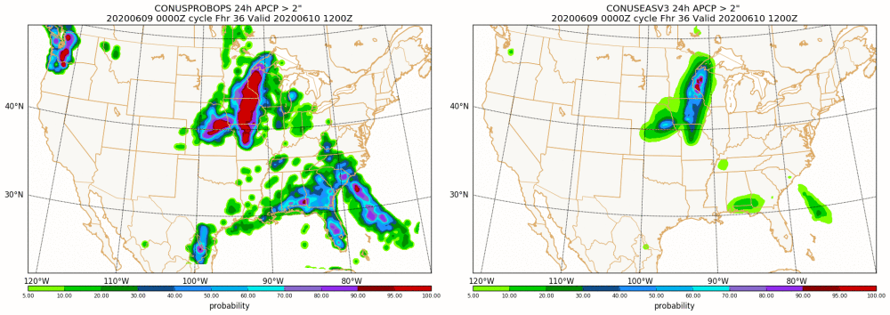
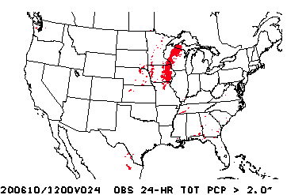
NBMAX
EAS
NBMAX and EAS used in tandem
High EAS probabilities over IA/MN/WI indicate higher confidence in a widespread area of 2”+ rain
NBMAX correctly indicates 2”+ risk over the southeast
EAS adds value in indicating the threat is likely isolated (low probs), with the best chance of a cluster over southern AL

Slide 23
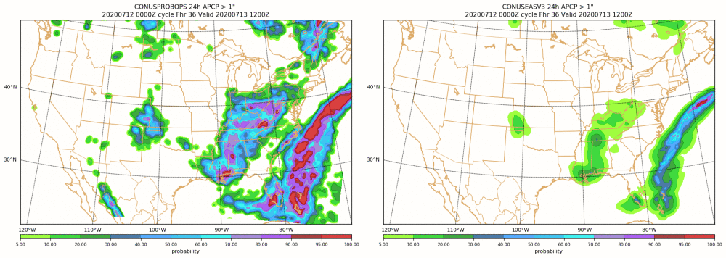
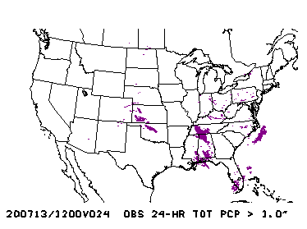
NBMAX
EAS
NBMAX and EAS used in tandem
NBMAX correctly indicates 2”+ risk over a broad swath in the east
EAS adds value in indicating the threat is generally isolated (low probs)
EAS also adds value by indicating the areas where 2”+ amounts may be more concentrated...KS/OK, TN/MS, Gulf Coast

Slide 24
Summary
EAS closer to a point probability, so can be useful for forecasting QPF amounts, but may miss the potential for isolated higher totals.
EAS signal can indicate an organized/widespread threat and/or good model agreement. Can provide better detail than the NBMAX in these events.
EAS typically better/more useful than NBMAX in areas of terrain.
EAS may incorrectly imply no/low threat when model spread is high and/or the threat is isolated/localized in nature.
Using them in tandem may be the best option. They can complement each other.
Use NBMAX to identify areas where heavy rain is possible, use EAS to get an idea of the nature of the event...how organized and/or focused the threat is.
High end events tend to be focused/organized...so should see a signal in the EAS. Can add confidence to a forecast.
Forecasters used to looking at NBMAX probabilities will need to calibrate to the EAS given the much lower values typically seen.

Slide 25
Alaska
Emily Niebuhr, AR
Dave Levin, AR
Fairbanks WFO

Slide 26
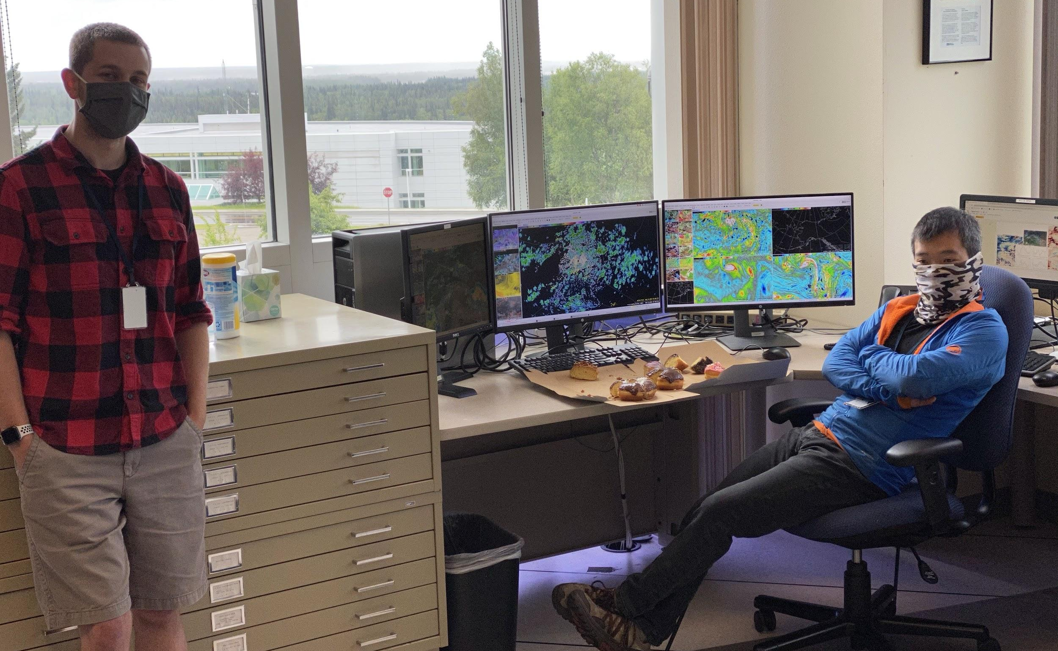
Special Thanks to Fairbanks Forecasters
Especially SOO Victor Proton, Luke Culver, Jason Ahsenmacher
Arctic Testbed and Proving Ground Provided daily comparison slides of FV3-SAR vs NMMB.
Motivation Convection poses significant fire risk / aviation community especially within interior Alaska
Challenges of forecasting weakly forced convection in arctic environment

Slide 27
Fairbanks Inputs: Forecaster Perspective
Motivation:
Arctic convection has significant impacts on interior Alaska by posing aviation hazard as well as fire ignition.
Global models usually are unable to capture local features that may influence convection such as hills or low mountains
“We always love having more hi-res guidance to use!”
Main Question: How might the new model implementation impact convection?
“One thing I've noticed is that the FV3 generally has the typical Interior diurnal showers/thunderstorms dissipating later on in the night (around 12Z), while the NMMB generally has them dissipating around 06Z. Typically, the 06-09Z time frame is more accurate for the Interior.”
FV3 has been a bit too low on CAPE and has a cool bias
FV3 still looks too "smoothed" in reflectivity which I fear may hurt the overall HREF means by being too low. While the NMMB can sometimes look "spurious", it better captures the nature of your average Interior DMC than the FV3.
How do forecasters interact with ensemble mesoscale tools?
I use the products similar to how SPC uses the CAMs, for insurance, looking at what type of possible storm modes, how widespread convective activity will be, etc.

Slide 28
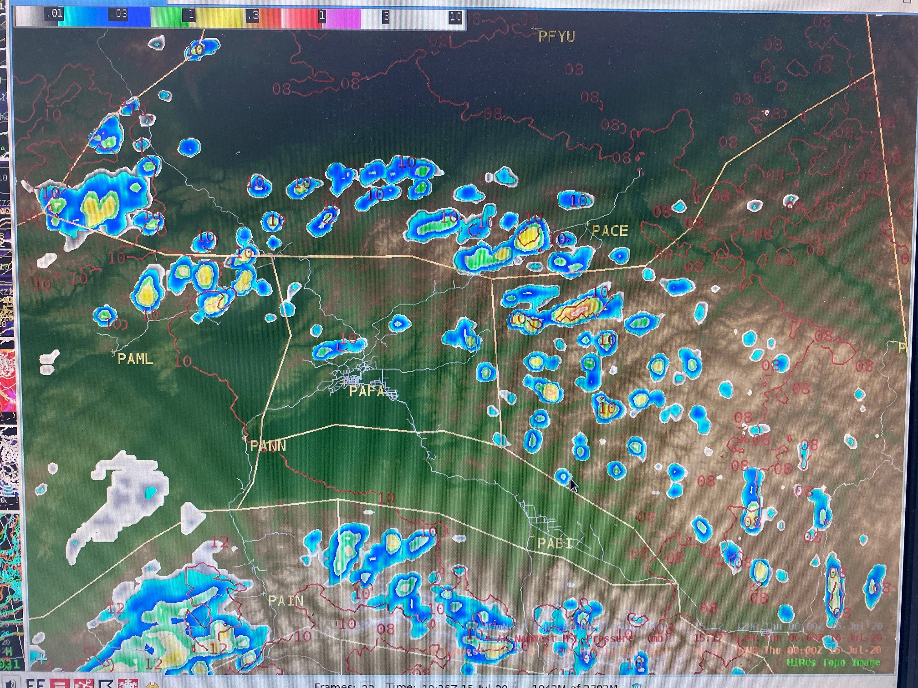
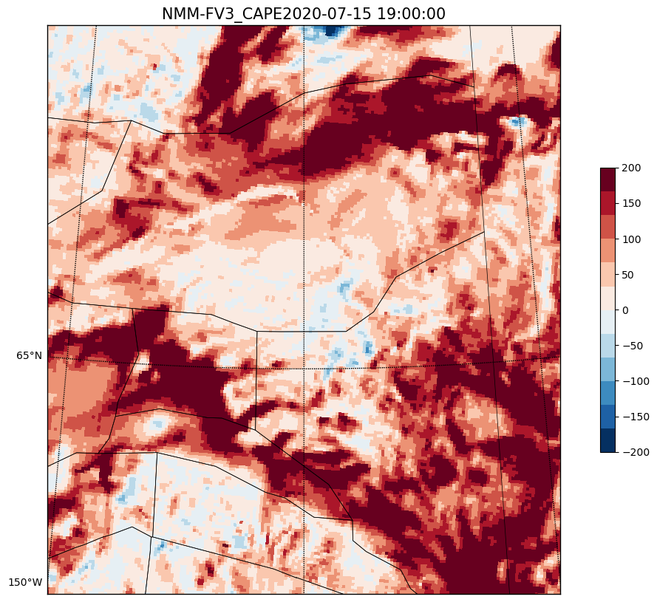
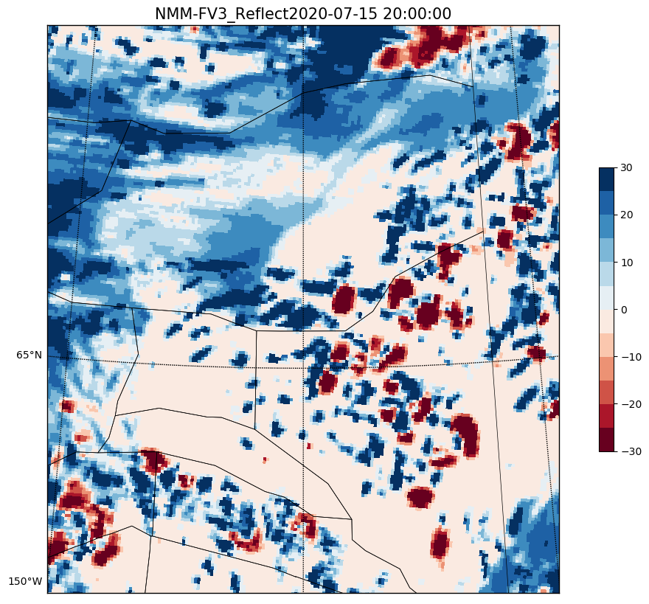
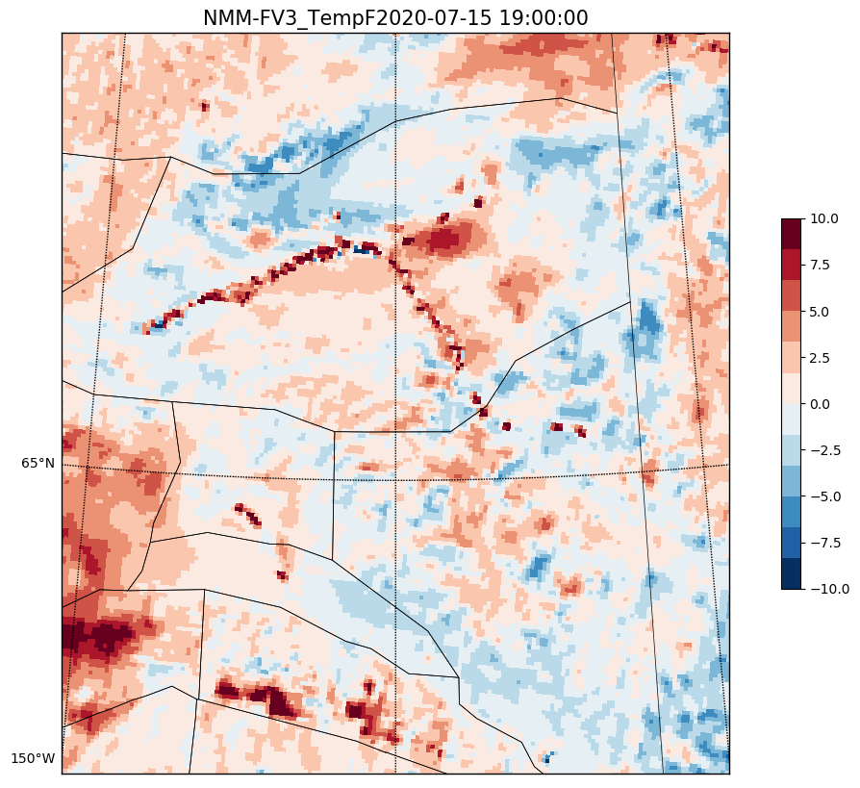
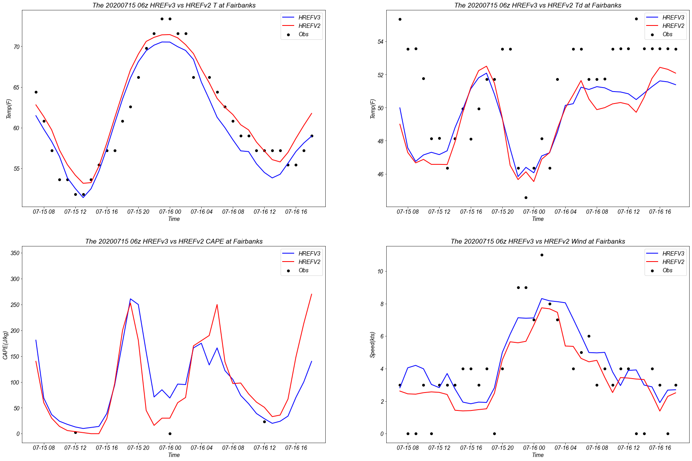
Performance during low convective events
Both models indicate a convective environment
FV3 appears to underestimate CAPE in low-cape environments
Slight cool bias during day, greater cool bias at night

Slide 29
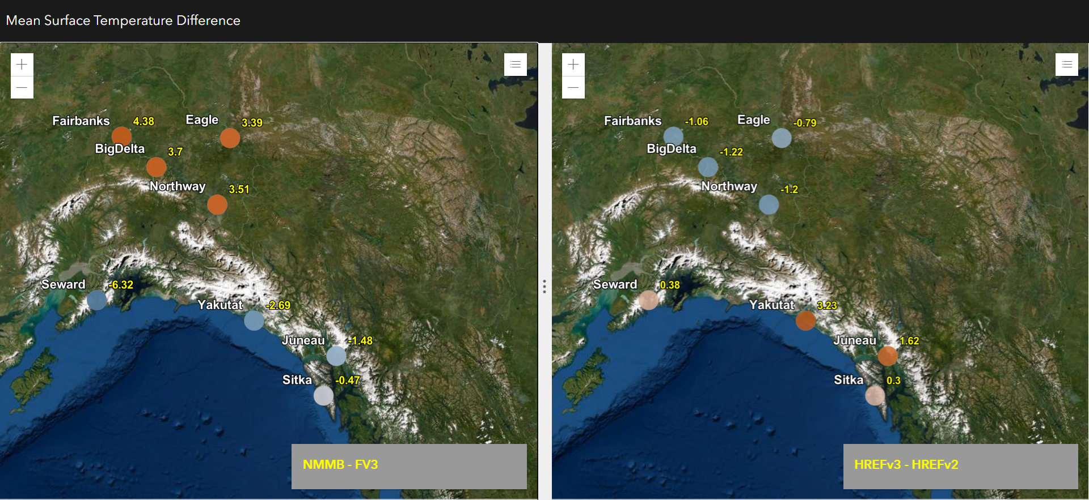
Point Time Series Analysis
Likewise, the HREFv3 (incorporating FV3) was cooler than the operational HREF for interior sites. This pattern was also reversed for coastal sites, though not as pronounced.
NMMB had warmer surface temperatures on average than the FV3 for interior sites.
This pattern was reversed for coastal marine sites
Notes:
Provided time series plots of temperature, dewpoint, surface based CAPE, and wind speed to support WFO Fairbanks evaluation during the period from 06/25 until 07/15.
These plots are for all 06Z runs of NMMB/FV3 as well as HREFv3/v2 for all forecast times for surface temperature
One thing that stood out was the propensity for NMMB to be significantly warmer/cooler than the FV3 for interior/coastal sites. This was also reflected but to not as great an extent in the HFEFv3/v2 differences.
Surface Td showed some tendency in the same manner as the temperatures but definitely not as great a degree of difference
FV3 wind speeds (10m) were higher than the NMMB by about 2kts on average over interior Alaska but lower by about 1-2kts over coastal marine Alaska. This is not our typical wind season so winds were never that strong during the evalution period. These differences did not show up significantly in comparing HREFv3 to the operational HREF.
CAPE was higher in NMMB/HREFv2 across all sites as expected

Slide 30
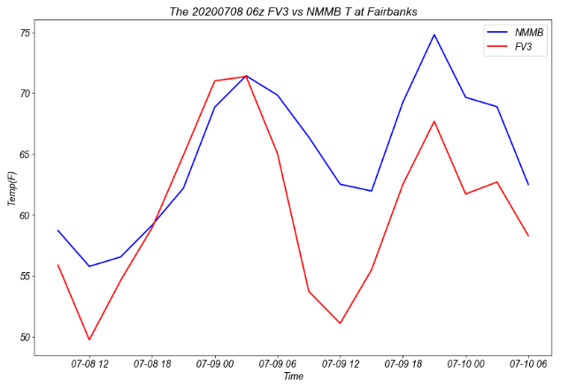
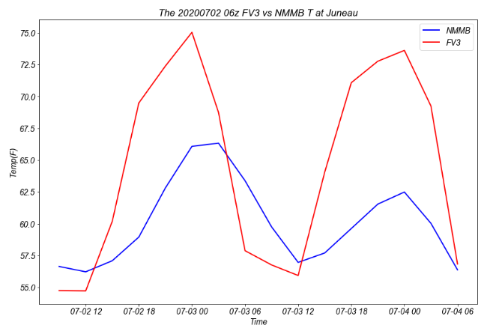
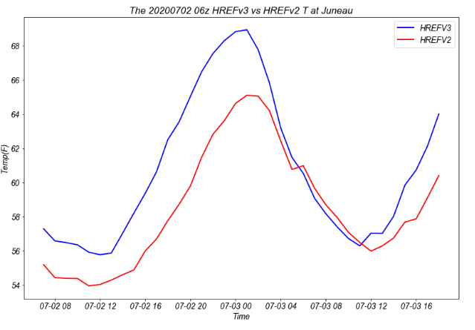
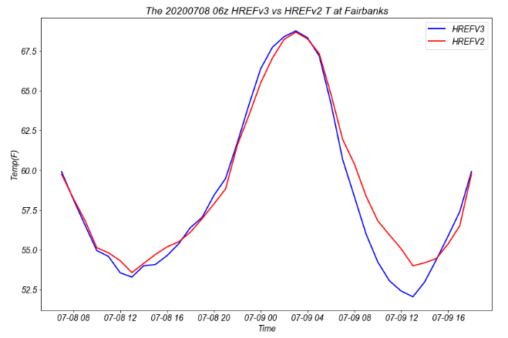
Point Time Series Analysis
Largest cool bias for interior sites was in diurnal minimums and quicker onset of cooling in the evening
Largest warm bias for coastal sites was for maximum temperatures with larger diurnal ranges noted in general. This was especially true on full sun days with offshore flow.
Notes:
Td showed minor bias of the same nature but the amplitude of the bias was much less. Additionally the Td bias was spread over all hours and not predictable in diurnal timing like the T bias.
Potential implications for convection timing and development? Surface visibility (fog) for aviation?
The larger diurnal range actually fit the observations better in most cases, though the timing of the sharp decrease of temps in the evening was too early in most cases (very long days in the summer up here)
The larger diurnal range may not be the best later in the year for coastal sites especially in cool, marine airmasses, but it works pretty well in the summer.
This could help explain some of the low CAPE bias on the FV3 which then is reflected in the HREFv3.
All these biases are present, but much more muted in the HREFv3

Slide 31
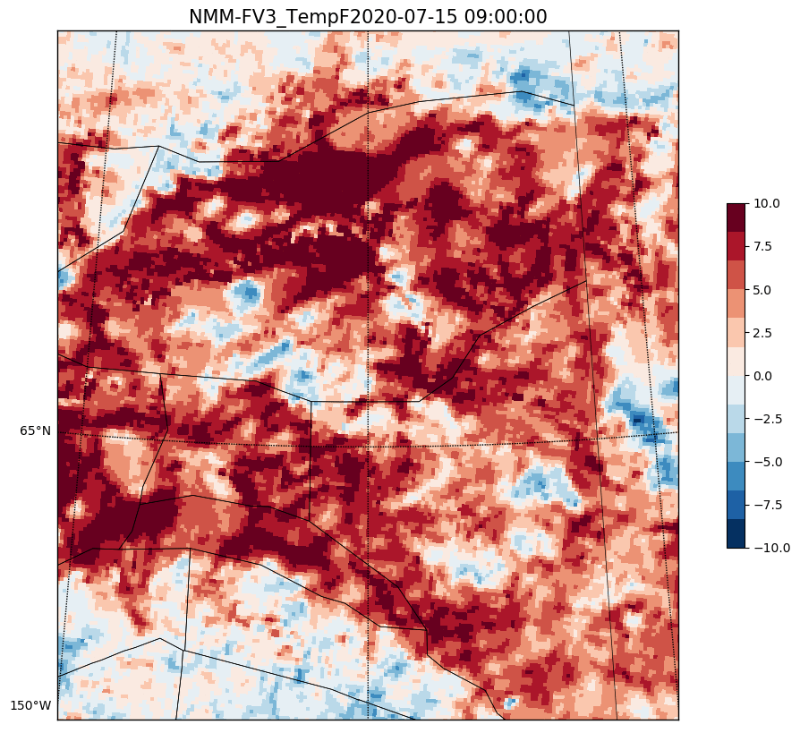
Conclusions
Implications of swapping NMMB with FV3-SAR:
Lower temperature bias in the morning likely leads to lower CAPE values resulting in a delay in convective initiation. Important implications for shallow arctic convection.
Smoothed composite reflectivity
Forecaster concerns that model may under-depict the severity of extreme precipitation events during unusual events (none during test period)
Forecaster implications: could result in less/later detection of smaller convective events which still have significant implications for Alaska Aviation community
Tools for ensemble mesoscale modeling:
Forecasters found the lightning tool quite helpful
Would be great to have a team to continue to work with forecasters to determine where ensemble outputs provide the greatest value
Requests for Future Study:
I would certainly use it a lot more regularly for all types of weather if there were more 'Region' options with reference points on the maps (forecast zones, points for cities, etc.). This would have the potential to be VERY useful in coastal areas for visibility/ceiling forecasting, and anywhere for winter weather! We always love having more hi-res guidance to use!

Slide 32
Wind Speed Probability
Bryan Mroczka, SR

Slide 33
Abbreviated Summary
HREF-V3 and HREF-V2 wind speed probabilities both show an over-representative of the analyzed URMA wind speed. The HREF-V3 showed a greater bias compared to HREF-V2.
HREF-V3 forecasts featured larger areal expanses to individual probability ranges for a given wind speed threshold compared to HREF-V2.
The reliability of the ensembles was higher throughout forecast hours for V2 compared to V3.
The time of year (main mode of convective winds vs synoptic) likely contributed to the following verification.

Slide 34
Study Methodology
Example:
Reliability (40-50) =
# of gridpoints forecast by HREF at 40-50% probability for 20kt winds that also have an URMA value >= 20kts
# of total gridpoints forecast by HREF at 40-50% probabiltiy for 20kt winds.
Utilize 100 unique HREF-V3 & HREF-V2 runs during May, June, & early July.
Separate into individual datasets the gridded bins for various probability ranges (00-10%, 10-20%...90-100%) for each wind speed threshold (20, 30, 40 knots).
Create URMA wind speed threshold datasets matching the forecast hours times (6, 12, 18, 24, 30, & 36) for the individual HREF runs.
Compare each gridded set of bins and forecast hours with the respective URMA results to determine a reliability for each model probability range for given wind speed.

Slide 35
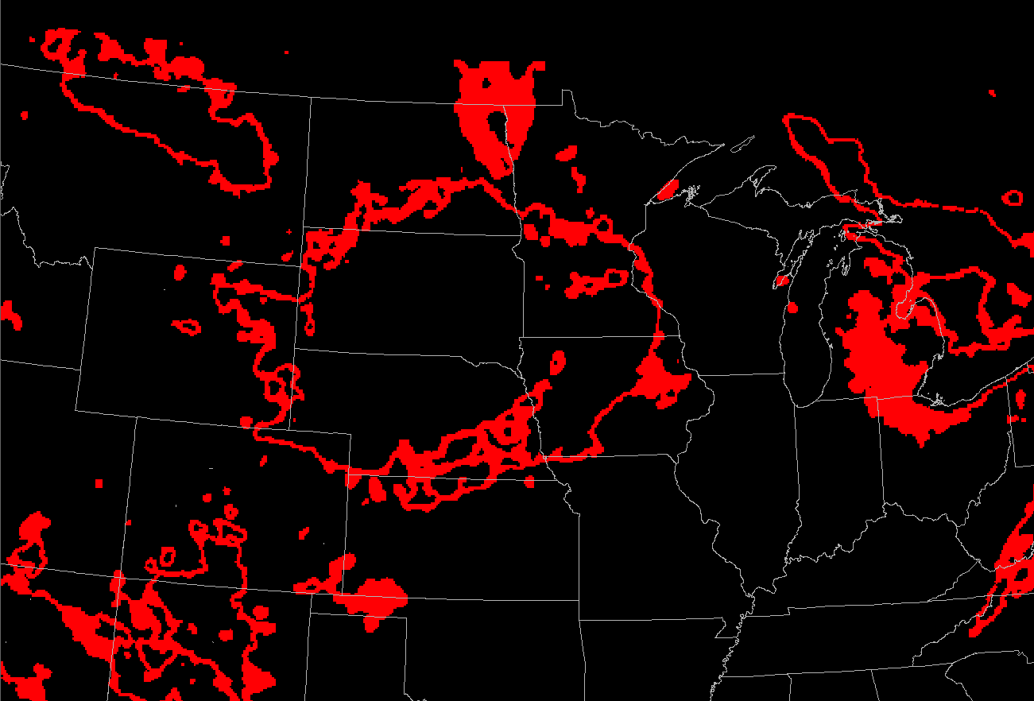
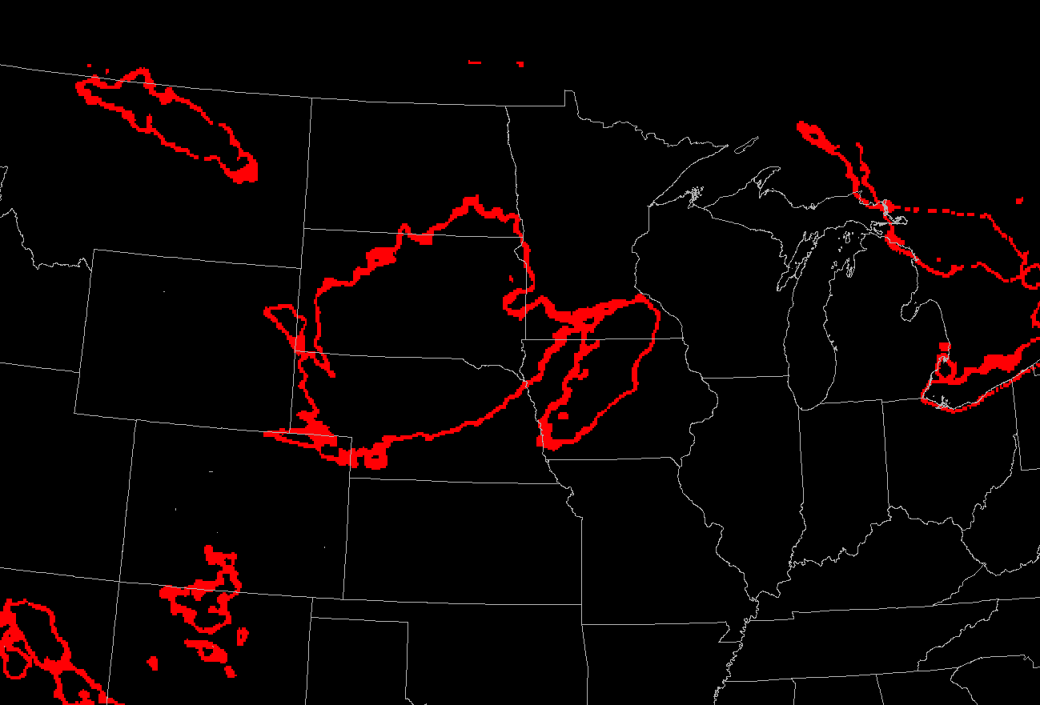
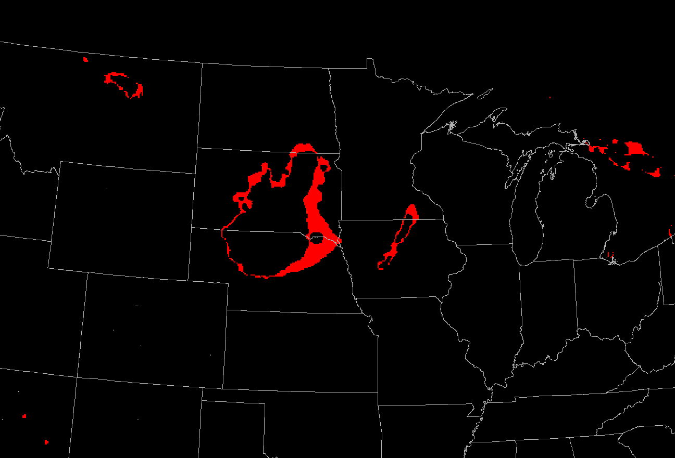
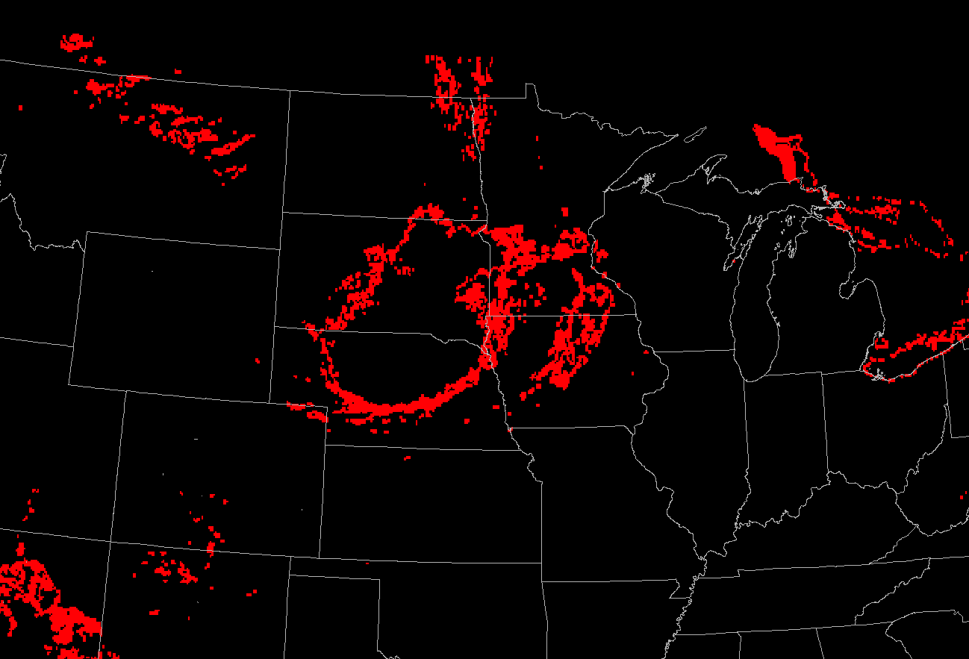
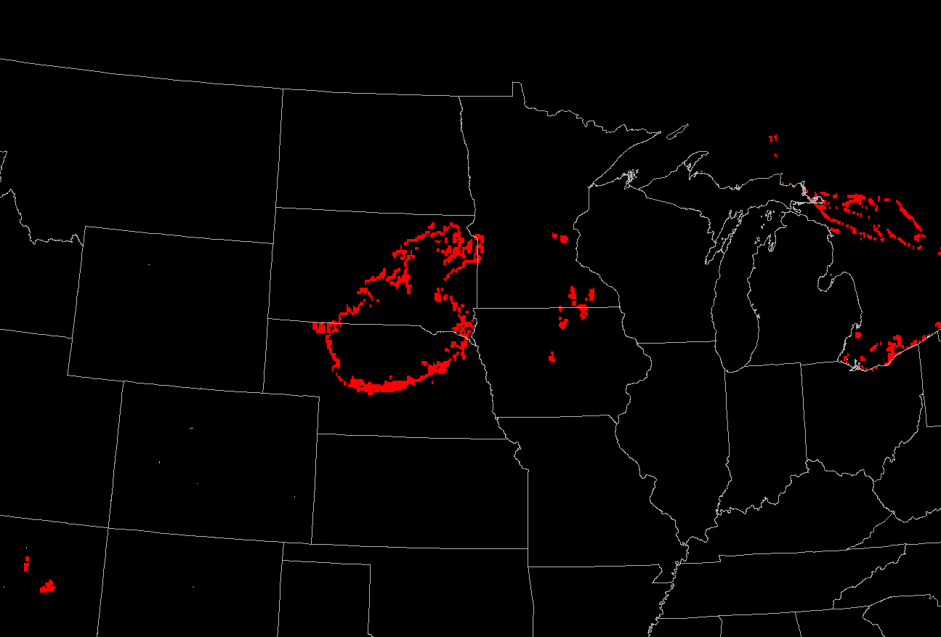
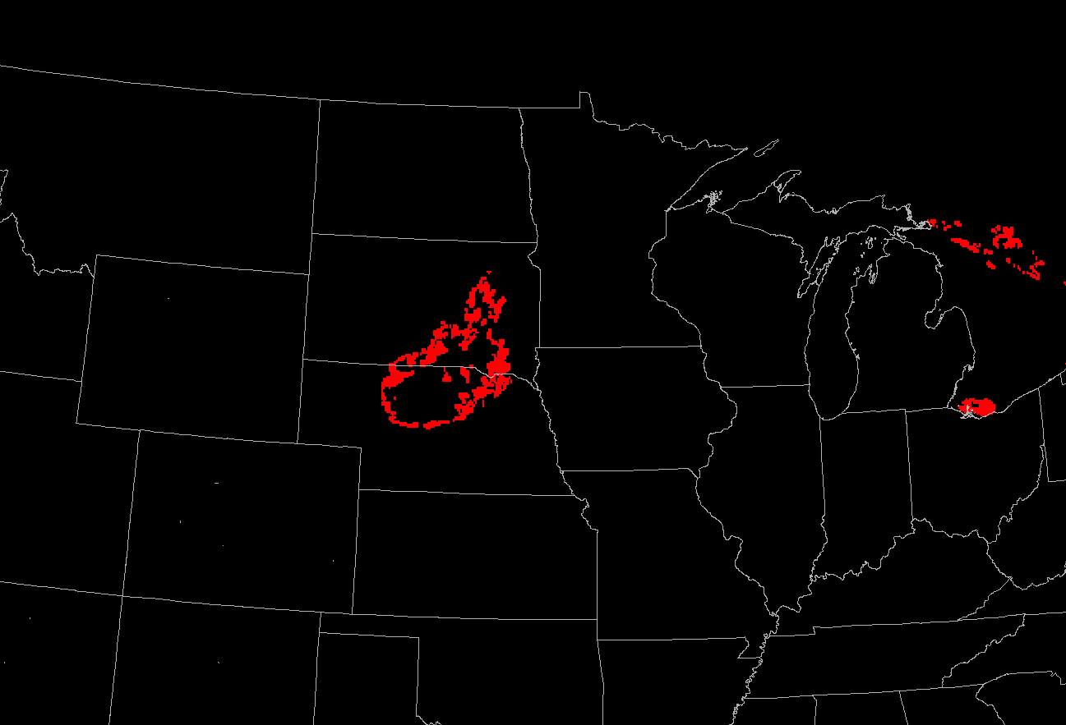
HREF V3
10-20% chance wsp >= 20 knots
HREF V3
40-50% chance wsp >= 20 knots
HREF V3
80-90% chance wsp >= 20 knots
HREF V2
10-20% chance wsp >= 20 knots
HREF V2
40-50% chance wsp >= 20 knots
HREF V2
80-90% chance wsp >= 20 knots
Notes:
HREF V2
80-90% chance wsp >= 20 knots

Slide 36
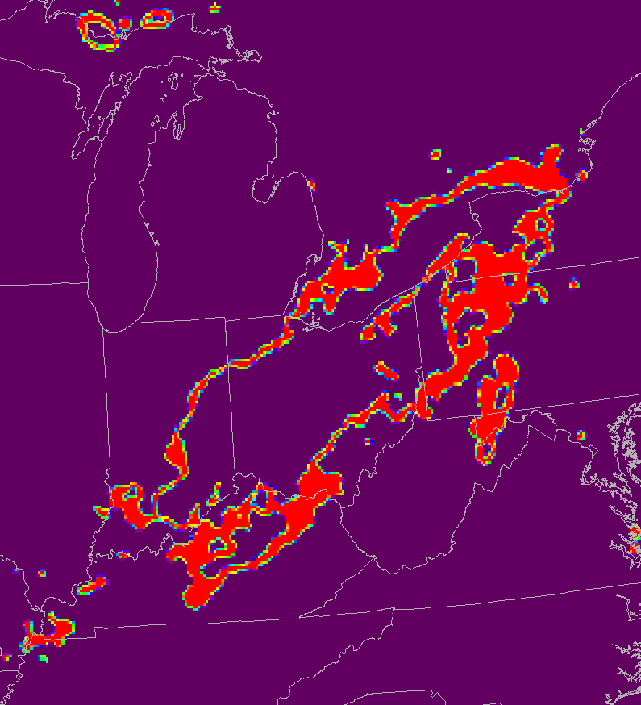
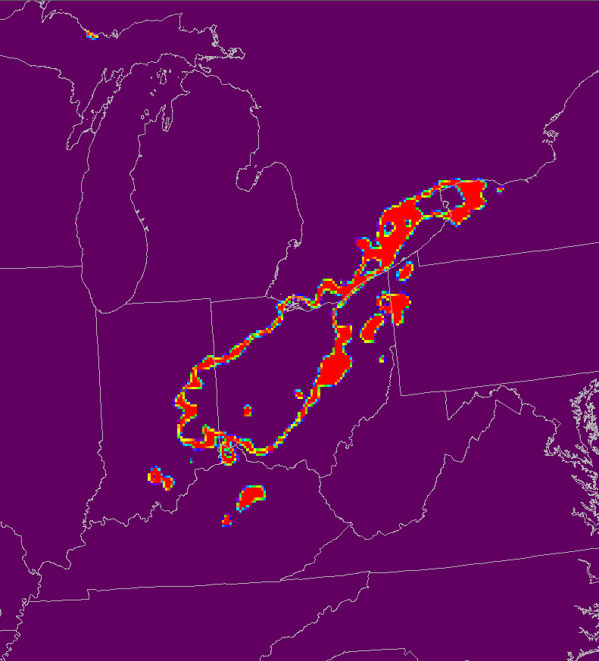
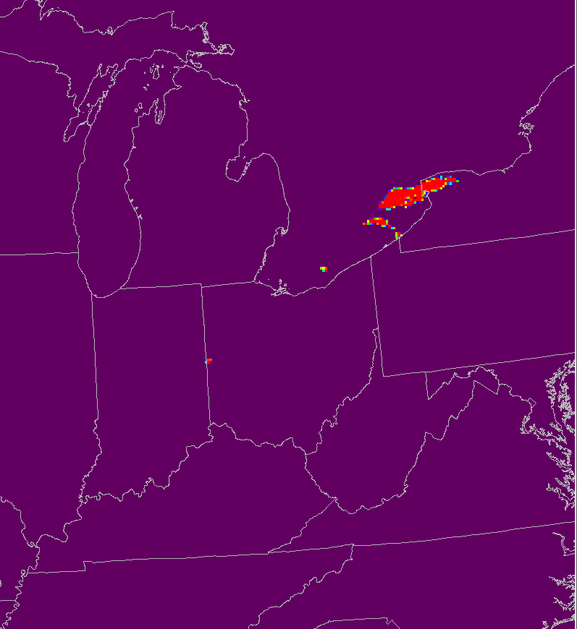
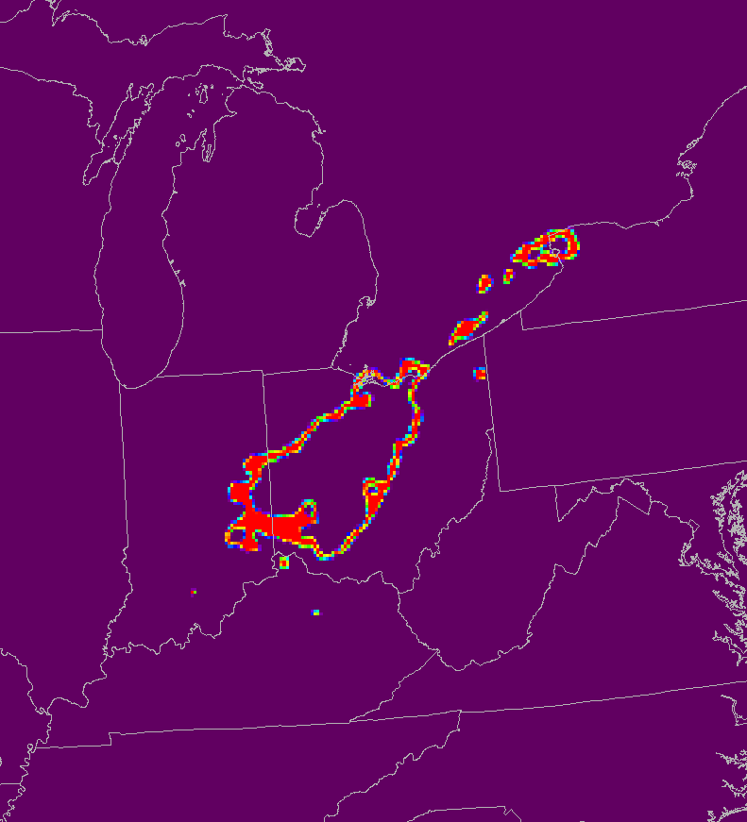
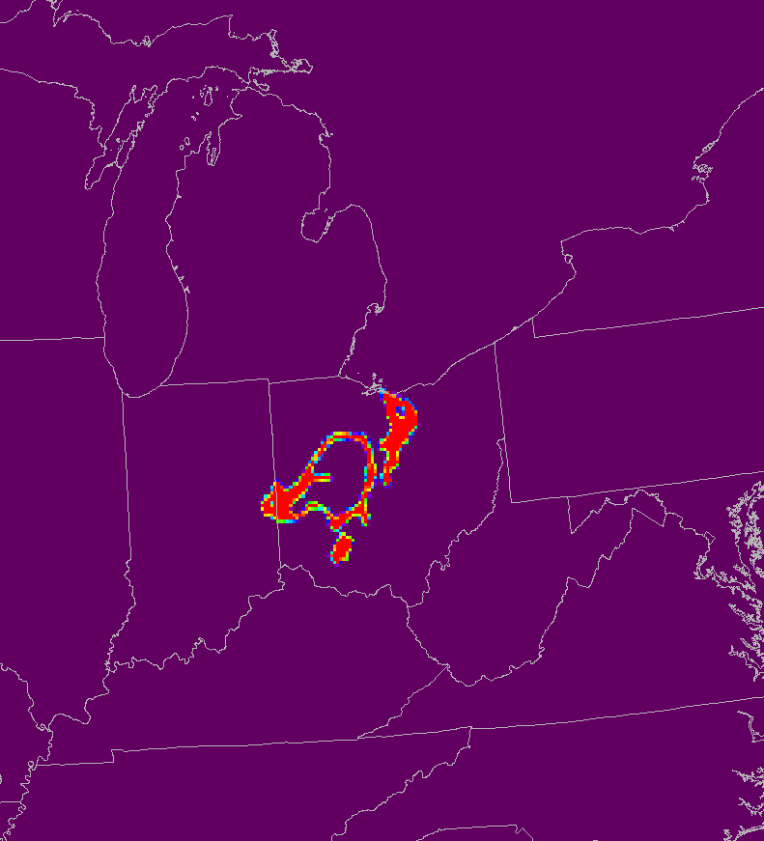
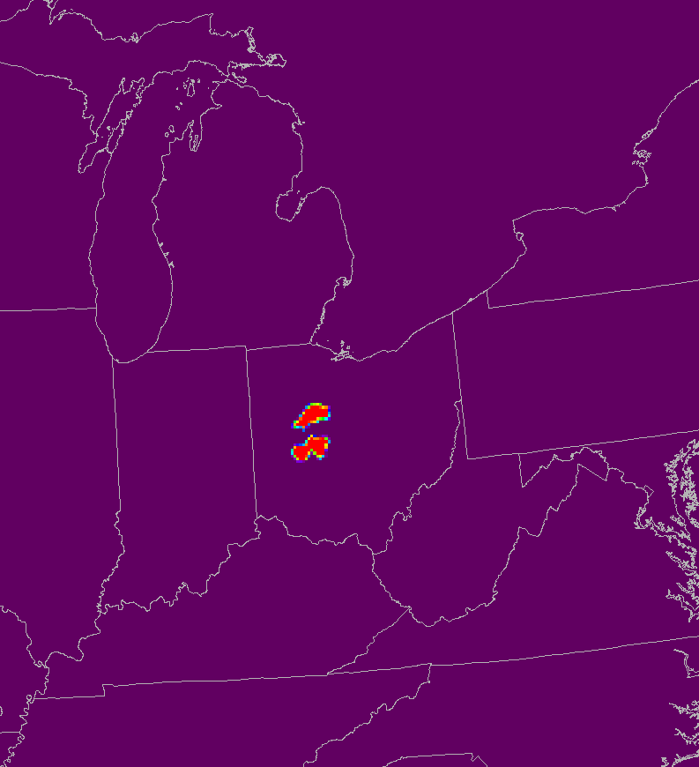
Over-forecast convection example from less predictable / weaker forced pattern
HREF V3
10-20% chance wsp >= 20 knots
HREF V3
40-50% chance wsp >= 20 knots
HREF V3
80-90% chance wsp >= 20 knots
URMA Wind Speed >= 20kts
HREF V3 20kts
10-20%
HREF V3 20 kts
30-40%
HREF V2
10-20% chance wsp >= 20 knots
HREF V3 20kts
80-90%
HREF V3 20kts
40-50%
HREF V2
40-50% chance wsp >= 20 knots
HREF V2
80-90% chance wsp >= 20 knots
HREF V3 20kts
60-70%
Notes:
HREF V2
80-90% chance wsp >= 20 knots

Slide 37
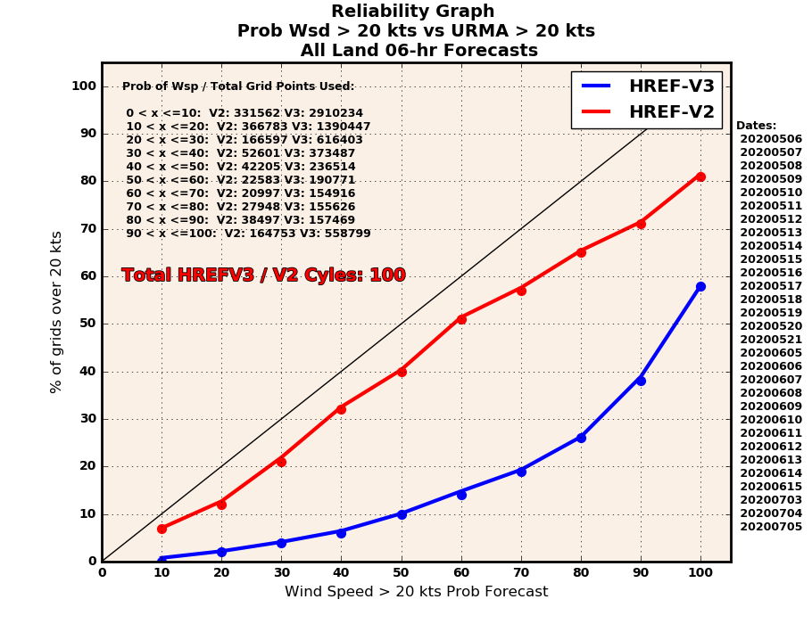
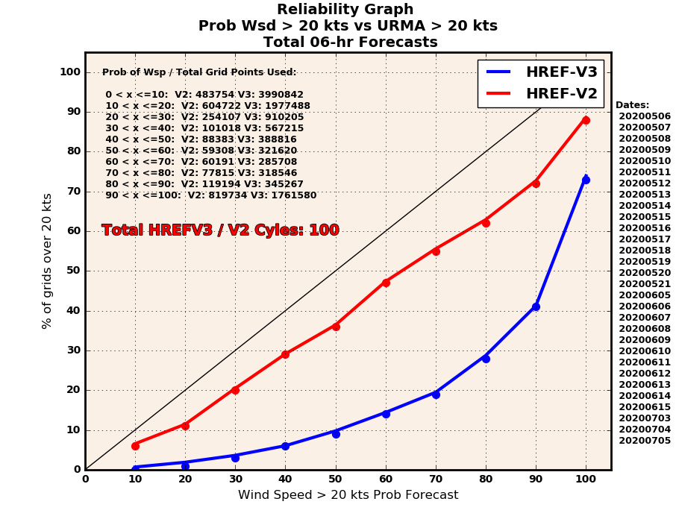
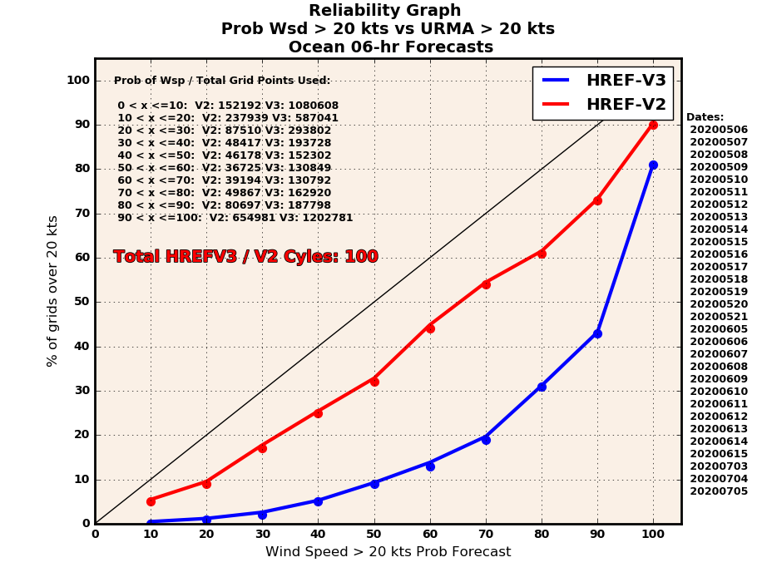
Wsp >= 20 knots Reliability Graphs - Fcst Hour 6

Slide 38
Wsp >= 20 knots Reliability Graphs - Fcst Hour 18

Slide 39
Wsp >= 20 knots Reliability Graphs - Fcst Hour 36

Slide 40
Wsp >= 30 knots Reliability Graphs - Fcst Hour 12

Slide 41
Wsp >= 40 knots Reliability Graphs - Fcst Hour 24

Slide 42
Summary- Wind Speed Probability
HREF-V3 and HREF-V2 wind speed probability thresholds are both over-representative of the analyzed URMA wind speed. The HREF-V3 showed a greater bias compared to HREF-V2.
HREF-V3 forecasts featured larger areal expanses to individual probability ranges for a given wind speed threshold compared to HREF-V2.
The model reliability was higher throughout the probability bins and forecast hours for V2 compared to V3.
The time of year (main mode of convective winds) likely contributed to these bias scores. The HREF V3 did do well on occasions with stronger forcing and resulting large convective complexes. Weaker forcing days, which are more common, with less defined convection (spatial and temporal) tended to be more likely to be over-forecast by the ensemble and likely contribute to the lower scores.
The full range of graphs for all forecast hour and wind speed thresholds can be shared by google drive by request.

Slide 43
Instability
Mike Evans, ER

Slide 44
Classic southern plains severe - May 14, 2020
Notes:
First case is a classic severe weather set up over the southern plains on May 14, 2020.

Slide 45
MLCAPE comparison valid 21z
HREFv2
HREFv3
ANL
Notes:
The spatial distribution of MLCAP is very similar between the v2 and v2, although v2 has larger values. The placement of the dry line is very similar in both ensembles. Looking at the analysis, there is an area of reduced CAPE in central Texas missed by both ensembles. The larger values in v2 over Oklahoma are better than in v3, however v3 would verify better to the south where analyzed CAPES are lower.

Slide 46
Northeast convection with scattered severe - July 13, 2020
Notes:
A more recent event over the northeast is shown next. Scattered severe storms developed along and near the stationary front over New England.

Slide 47
Probability MLCAPE > 1000 J/kg July 13 21z
HREF v2
HREF v3
Notes:
Probabilities for MLCAPE values greater than 1000 J/kg are higher in v2.

Slide 48
MLCAPE NMMB vs FV3 21z
NMMB
FV3
Notes:
This was likely due to higher probabilities in the NMMB member vs the FV3.

Slide 49
Routine convection - northeast July 13 21z
HREF v2
HREF v3
ANL
Notes:
Higher forecast values of CAPE in the v2 can be seen on this slide. This looks like a better forecaster than v3, based on the analysis which showed widespread areas of 1000 J/kg.

Slide 50
July 10, 2020 - Tropical Storm Fay - 21z
Notes:
Finally, we will look at the environment associated with Fay as it moved up the coast on July 10th.

Slide 51
Probability MLCAPE > 500 J/kg July 10 21z
HREF v2
HREF v3
Notes:
Probabilities of MLCAPE greater than 500 J/kg are shown on this slide. As is usual, values of CAPE were mostly higher in v2 compared to v3. Both models showed a minimum of CAPE near and north of Fay, where steadier rain was forecast.

Slide 52
Tropical Storm Fay - northeast July 10 21z
HREF v2
HREF v3
ANL
Notes:
Values of CAPE are pretty similar near the tropical storm, with slightly higher values to the north over New England. An area of high instability over New England was under-forecast in both ensembles. Higher instability over the Ohio Valley and western Pa was better depicted by the v2.

Slide 53
MLCAPE NMMB vs FV3 21z
NMMB
FV3
Notes:
The NMMB member was more unstable in most areas vs. the FV3 including New England and the Ohio Valley, and this better matched the analysis.

Slide 54
Instability - summary
V2 mostly forecast more instability / CAPE than V3
Differences were mostly due to NMMB values larger than FV3 values
Higher V2 forecasts were mostly closer to observed values
Spatial patterns of CAPE were very similar between the two versions (dry line placement, axis of high and low values, ect)

Slide 55
Lightning
Andy Taylor, WR

Slide 56
18 May, Southeast US
13z
18z
Notes:
Highest probs at 13z associated with TS Arthur and a small area near Mobile. Note the general increase in probs, especially over inland areas, from 13z to 18z.

Slide 57
18 May Southeast US MRMS Reflectivity
13z
18z
Notes:
MRMS composite reflectivity is being used here because it’s much clearer to see than the lightning density plots. The HREF lightning probs identified precipitation at 13z, but the main areas of lightning were offshore over the Gulf of Mexico and associated with TS Arthur. A general increase in convective activity was observed by 18z, with associated lightning over inland areas.

Slide 58
Near Midnight MDT 20 May, northern Rockies
Notes:
Highest probs just east of the mountains. MRMS reflectivity shows the discrete cells in this area intensified after 06z, with some forming even farther east.

Slide 59
7 am CDT 5 Jun, Gulf Coast
Notes:
HREFv3 forecast an area of 30-50 percent lightning probs along the TX and LA coast, which was not realized. The corresponding MRMS composite reflectivity image to the right shows no convective activity in the area.

Slide 60
9 Jun, North Central US
Notes:
All in all, the HREFv3 lightning probabilities match fairly well with the MRMS reflectivity image in this example.

Slide 61
2 Jul, SW Monsoon
Notes:
We finish with two cases from the SW monsoon. First, a case where the lightning probs were on the high end over northern Arizona, but less activity than forecast by the HREFv3 was observed. The forecast for eastern NM and southeast AZ was reasonable.

Slide 62
11 Jul, SW Monsoon
Notes:
Second, a case where low-end lightning probs were forecast across AZ, with much more convective activity observed than forecast by the HREFv3.

Slide 63
Points to Remember
Lightning
Not a lightning strike density product, just a broad sense of where precipitation is forecast to occur and where sufficient charge separation exists to support lightning
If the HREFv3 spatial precipitation distribution and reflectivity forecast is good, the lightning prob forecast tends to be good, and vice versa
Probs typically max out around 50%, over 70% is infrequent
High lightning probs tend to be associated w/ strong forcing

Slide 64
Severe/Outlier Frequency
Israel Jirak, SPC

Slide 65
2020 HWT SFE CAM Ensemble Subjective Ratings
While HREFv3 was not directly compared to HREFv2 during the HWT SFE, it was rated subjectively higher than HREFv2.1 and all other experimental CAM ensembles for severe weather forecasting
Experimental CAM Ensembles

Slide 66
Outlier Frequency of HREF members
The HRW NMMB tends to be an outlier in the HREF more frequently than any other current members
Is the HRW-FV3 a less frequent outlier than the HRW-NMMB?
Courtesy of Brett Roberts

Slide 67
Methodology to Define Outlier Member
Examined paintball plots of 40 dBZ reflectivity forecasts from HREFv2.1 and HREFv3 for the period of the 2020 HWT SFE (27 April - 29 May; M-F)
Subjectively rated HRW-NMMB (HREFv2.1) and HRW-FV3 (HREFv3) as being a “bad outlier” or “within the envelope” relative to the other respective HREF members.
Provided one rating per 0000 UTC forecast cycle of the “lowest” category (e.g., if the HRW-NMMB was a “bad outlier” at any point in the next convective day, it was assigned that rating for the cycle)
Focused on primary severe weather threat area within the SFE domain

Slide 68
Outlier Frequency Results
Model | “Bad Outlier” | “Within the Envelope”
HRW-NMMB | 6/22 (27%) | 16/22 (73%)
HRW-FV3 | 7/22 (32%) | 15/22 (68%)

Slide 69
Outlier Example: 04 May
HRW-NMMB
HRW-NMMB
“envelope”
HRW-FV3
“outlier”

Slide 70
Outlier Example: 21 May
HRW-NMMB
HRW-NMMB
“Outlier”
HRW-FV3
“Envelope”

Slide 71
Outlier Example: 21 May
HRW-NMMB
HRW-NMMB
HRW-FV3

Slide 72
Outlier Example: 22 May
HRW-NMMB
HRW-NMMB “outlier”
HRW-FV3
“outlier”

Slide 73
Summary
Implementation of HREFv3 is a must!
HREFv3 appears to be a notable improvement even over HREFv2.1 (with HRRRv3 members) for severe weather, which will create a very high standard for the future RRFS
The HRW-FV3 seems to be an outlier in the HREF as often as the HRW-NMMB, but perhaps that’s not surprising (or bad - from a diversity perspective), given different initial conditions (GFS) and different model core/physics (FV3) from all of the other members

Slide 74
QPF
Tom Hultquist, CR

