Slide 1
NATIONAL OCEANIC AND ATMOSPHERIC ADMINISTRATION
NCEP OD Science and Decisional Brief
GDAS/GFS v16.0: Upgrades to the Global Forecast System for implementation in Q2FY21
First major upgrade to the UFS Medium Range Weather Application Coupled to the Global Wave Model
Presented by:
Vijay Tallapragada and Geoff Manikin
Environmental Modeling Center
5 October 2020

Slide 2
NATIONAL OCEANIC AND ATMOSPHERIC ADMINISTRATION
GFSv16 Acknowledgements
Project Manager: Vijay Tallapragada
Project Leads: Fanglin Yang & Russ Treadon
Model: Jongil Han, Jack Kain, Weizhong Zheng, George Gayno, Helin Wei, Ruiyu Sun, Moorthi Shrinivas, Anning Chen, Rongqian Yang, Xingren Wu, Xiaqiong Zhou, Valery Yudin, Youlong Xia, Jesse Meng, Henrique Alves, Roberto Padilla, Jessica Meixner, Ali Abdolali, Jian-Wen Bao, Henry Juang, Sajal Kar
Data Assimilation: Jeff Whitaker, Catherine Thomas, Cory Martin, Wanshu Wu, Phil Pegion, Haixia Liu, Kristen Bathmann, Andrew Collard, Xu Li, Yanqiu Zhu, Xiujuan Su, Jim Purser, Shelley Melchior, Sudhir Nadiga, Steve Stegall
Post & VV: Hui-ya Chuang, Wen Meng, Boi Vuong, Mallory Row, Guang-Ping Lou, Yali Mao, Jiayi Peng, Deanna Spindler, Todd Spindler, Roberto Padilla, Geoff Manikin, Alicia Bentley, Logan Dawson, Shannon Shields, Chris MacIntosh, Philippe Papin
Infrastructure: Jun Wang, Kate Friedman, Mark Iredell, Hang Lei, Eric Rogers, Lin Gan, George Vandenberghe, James Abeles, Gerhard Theurich, Edward Hartnett, Farida Adimi
EMC Management: Ivanka Stajner, Vijay Tallapragada, Arun Chawla, Jason Levit, Avichal Mehra, Daryl Kleist, Fanglin Yang
NCO: Carissa Klemmer, Steven Earle, Anne Myckow, Dataflow team
External Collaborators: CPC, GFDL, GSL, PSL and NCAR/CGD
STI SOO Team: Robert Ballard, Warren Blier, Mike Fowle, Chris Karstens, Mark Klein, David Levin, Bill Martin, Emily Niebuhr, Jack Settelmaier, Steverino Silberberg, Ben Trabing, Brian Zachry

Slide 3
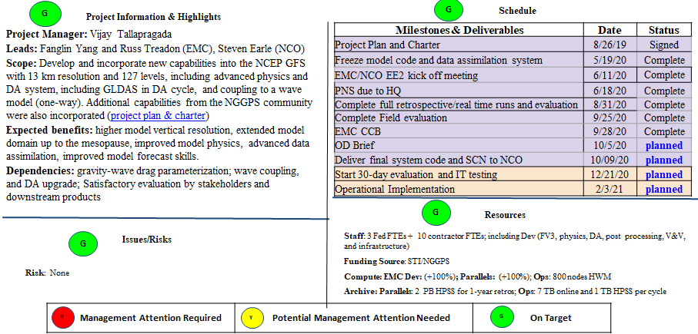
NATIONAL OCEANIC AND ATMOSPHERIC ADMINISTRATION
GDAS/GFSv16 Status as of 10/5/20

Slide 4
NATIONAL OCEANIC AND ATMOSPHERIC ADMINISTRATION
GDAS/GFSv16 Project Plan
GFSv16 Project Plan and Charter Approved by EMC and NCO

Slide 5
NATIONAL OCEANIC AND ATMOSPHERIC ADMINISTRATION
Contents
Scope and objectives of GDAS/GFSv16 upgrade
Science and Product changes
Retrospective and real-time performance evaluation
Downstream model evaluation
Benefits and concerns
System configuration and resource requirements

Slide 6
NATIONAL OCEANIC AND ATMOSPHERIC ADMINISTRATION
Scope and objectives of GDAS/GFSv16
Increase the vertical resolution (long awaited) and advanced physics to enhance the model representation of the atmosphere, improve the DA algorithms, and include more observations (satellite and in-situ) for better initial conditions
Couple the deterministic global wave model with the atmospheric model using the UFS coupling framework (simplification of production suite)
Scientific priorities: Improve the forecast skill while addressing known issues from GFSv15 evaluation
Excessive cold bias in the winter season
Progressive bias for synoptic scale systems
Less skillful TC track forecasts, especially for stronger storms
Low bias for stratospheric temperature forecasts
Precipitation dry bias for moderate rainfall
Poor representation of boundary layer inversions
Improve products and add new variables requested by the users
Conduct comprehensive testing and evaluation including downstream models to demonstrate the benefits of this upgrade

Slide 7
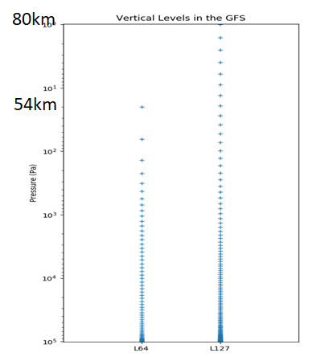
NATIONAL OCEANIC AND ATMOSPHERIC ADMINISTRATION
Change History of GFS Configurations
Mon/Year | Lev | Truncations | Z-cor/dyncore | Major components upgrade
Aug 1980 | 12 | R30 (375km) | Sigma Eulerian | first global spectral model, rhomboidal
Oct 1983 | 12 | R40 (300km) | Sigma Eulerian
Apr 1985 | 18 | R40 (300km) | Sigma Eulerian | GFDL Physics
Aug 1987 | 18 | T80 (150km) | Sigma Eulerian | First triangular truncation; diurnal cycle
Mar 1991 | 18 | T126 (105km) | Sigma Eulerian
Aug 1993 | 28 | T126 (105km) | Sigma Eulerian | Arakawa-Schubert convection
Jun 1998 | 42 | T170 (80km) | Sigma Eulerian | Prognostic ozone; SW from GFDL to NASA
Oct 1998 | 28 | T170 (80km) | Sigma Eulerian | the restoration
Jan 2000 | 42 | T170 (80km) | Sigma Eulerian | first on IBM
Oct 2002 | 64 | T254 (55km) | Sigma Eulerian | RRTM LW;
May 2005 | 64 | T382 (35km) | Sigma Eulerian | 2L OSU to 4L NOAH LSM; high-res to 180hr
May 2007 | 64 | T382 (35km) | Hybrid Eulerian | SSI to GSI
Jul 2010 | 64 | T574 (23km) | Hybrid Eulerian | RRTM SW; New shallow cnvtion; TVD tracer
Jan 2015 | 64 | T1534 (13km) | Hybrid Semi-Lag | SLG; Hybrid EDMF; McICA etc
May2016 | 64 | T1534 (13km) | Hybrid Semi-Lag | 4-D Hybrid En-Var DA
Jun2017 | 64 | T1534 (13km) | Hybrid Semi-Lag | NEMS GSM, advanced physics
Jun 2019 | 64 | FV3 (13km) | Finite-Volume | NGGPS FV3 dycore, GFDL MP
Feb 2021 | 127 | FV3 (13km) | Finite-Volume | IAU, LETKF, TKE-EDMF, uGWD
18 years !

Slide 8
NATIONAL OCEANIC AND ATMOSPHERIC ADMINISTRATION
GFSv16: Major Changes to the Forecast Model
Model resolution:
Increased vertical layers from 64 to 127 & raised model top from 54 km to 80 km
Physics updates:
PBL/turbulence: Replaced K-EDMF with sa-TKE-EDMF (Revised background diffusivity as a stability dependent function)
GWD: Added a parameterization for subgrid scale nonstationary gravity-wave drag
Radiation: Updated calculation of solar radiation absorption by water clouds; Updated cloud overlap assumptions.
Microphysics: Updated GFDL microphysics scheme for computing ice cloud effective radius
Noah LSM: Revised ground heat flux calculation over snow covered surface; Introduced vegetation impact on surface energy budget over urban area
Coupling to Wave Model:
One-way coupling of atmospheric model with Global Wave Model (WaveWatch III, Multi_1)

Slide 9
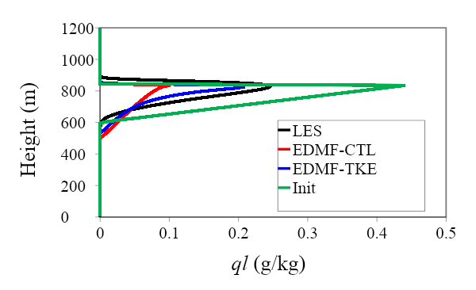
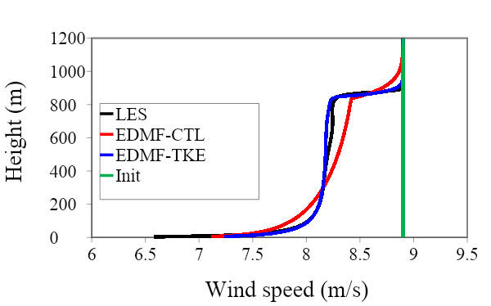
NATIONAL OCEANIC AND ATMOSPHERIC ADMINISTRATION
GFSv16: Major Changes to the Forecast Model
New TKE-EDMF PBL:
Higher-order accuracy in turbulence representation, less diffusive than K-EDMF
Advection of turbulence by the grid-mean flows
Inclusion of moist processes
Mass-flux representation for the nonlocal momentum mixing
EDMF parameterization for the stratocumulus-top-driven turbulence mixing
Scale awareness
Interaction of TKE with cumulus convection
cloud water
wind speed

Slide 10
NATIONAL OCEANIC AND ATMOSPHERIC ADMINISTRATION
GFSv16: Major Changes to the Forecast Model
Non-Stationary GWD: Impact on QBO/SAO
In collaboration with CIRES, UCB

Slide 11
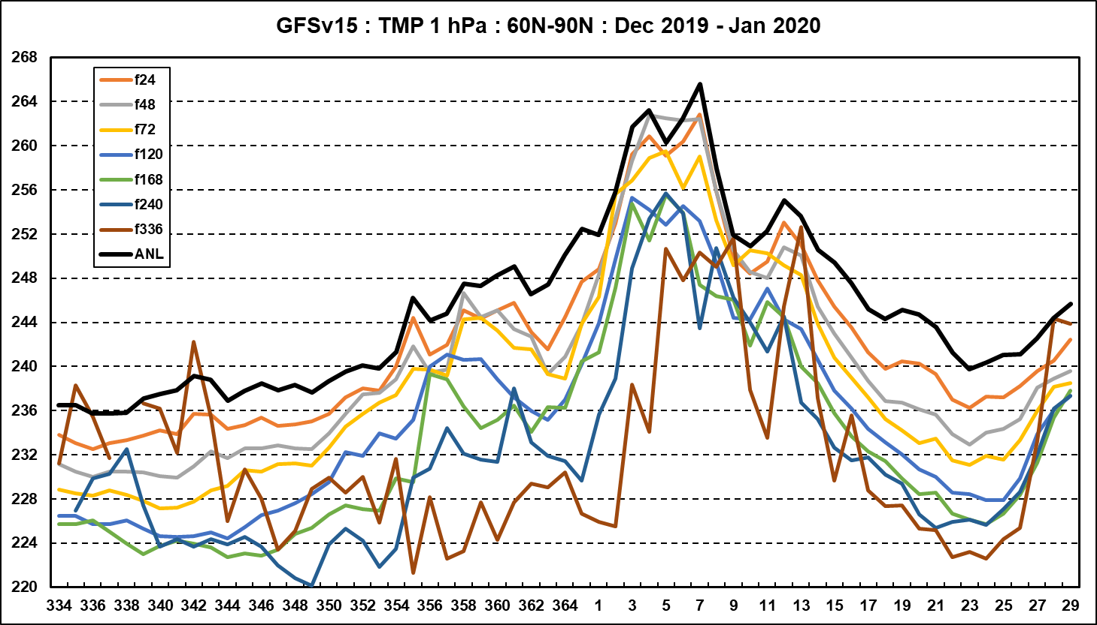
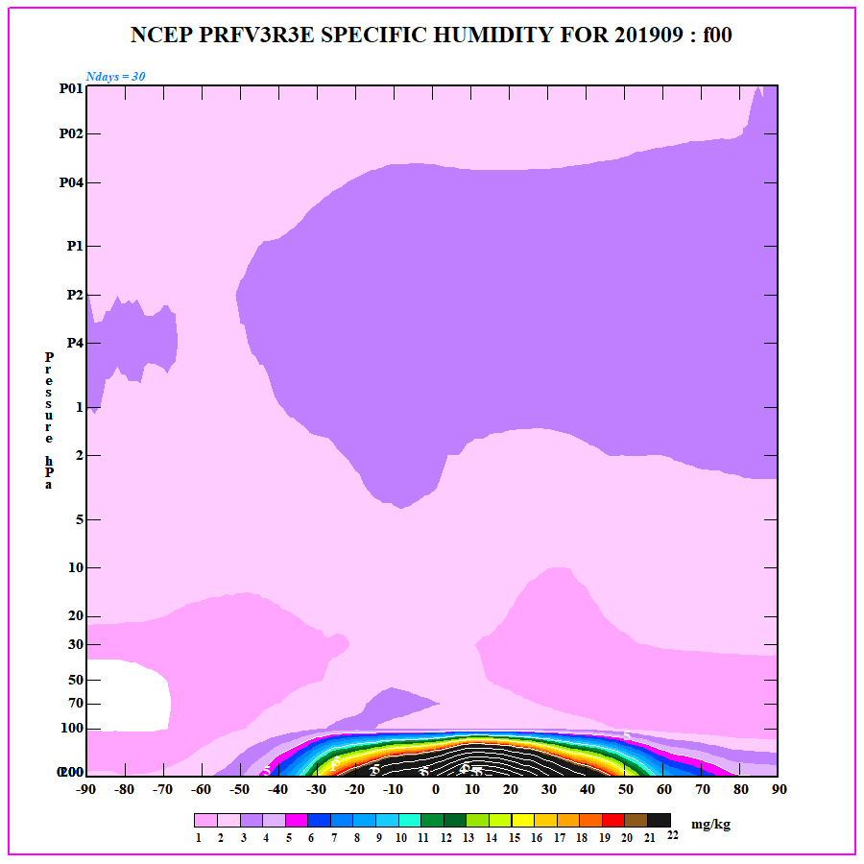
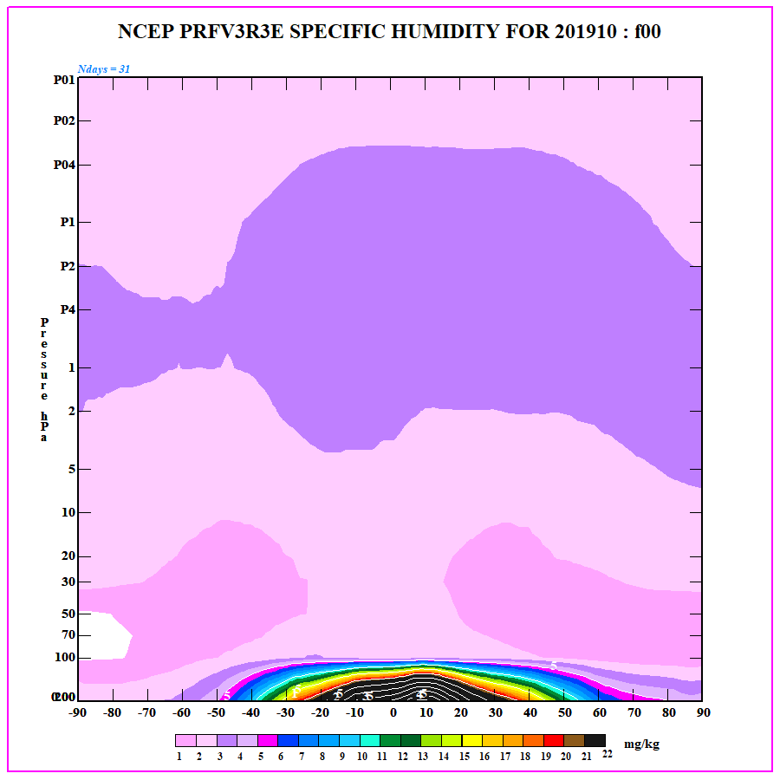
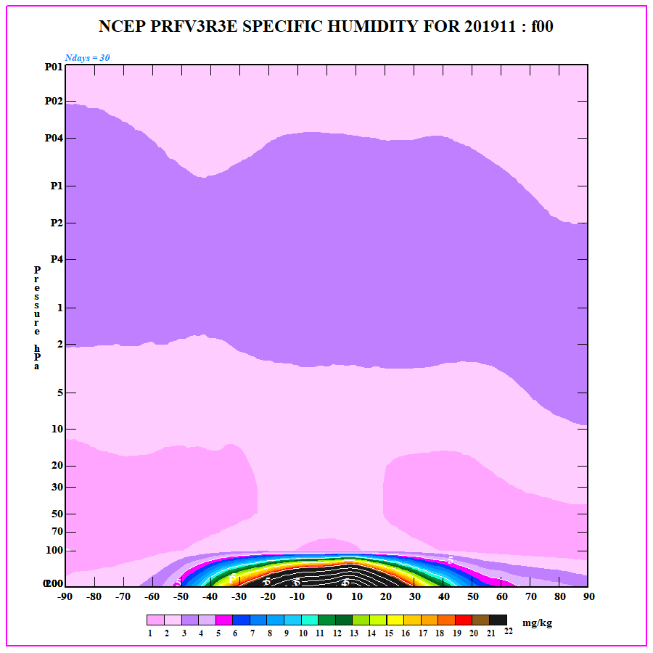
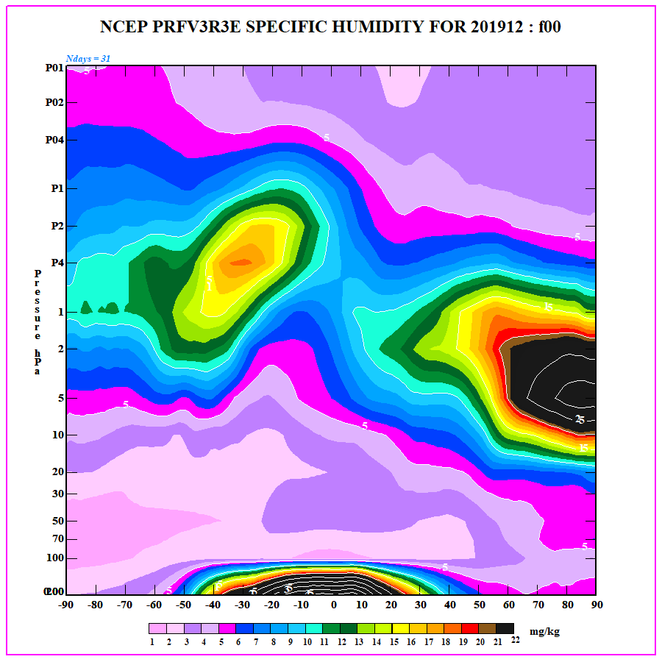
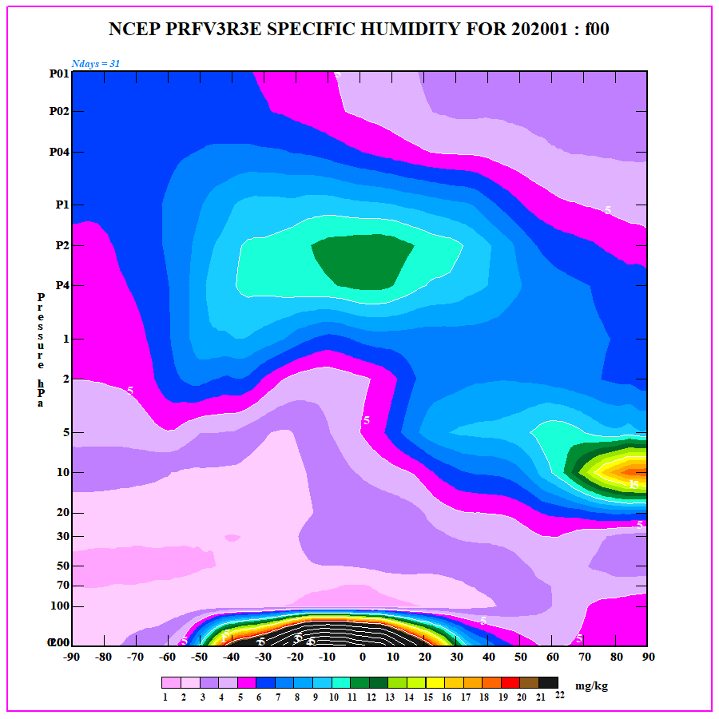
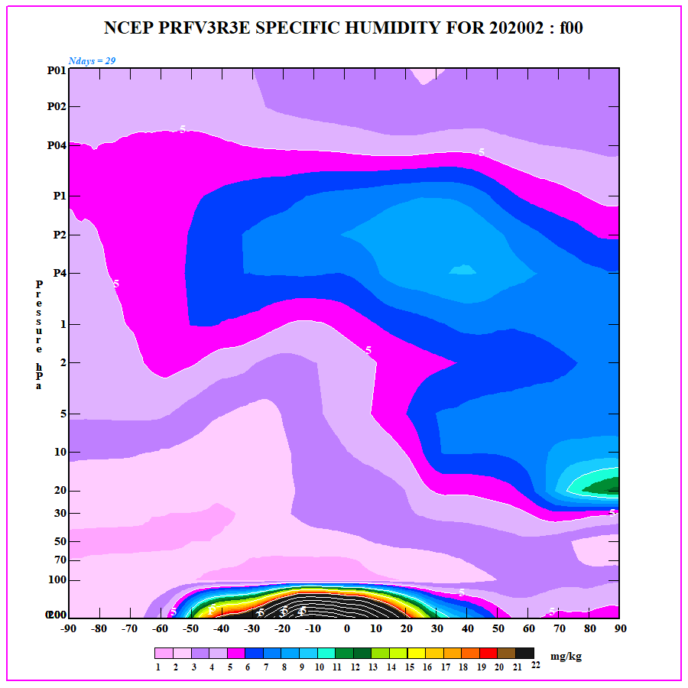
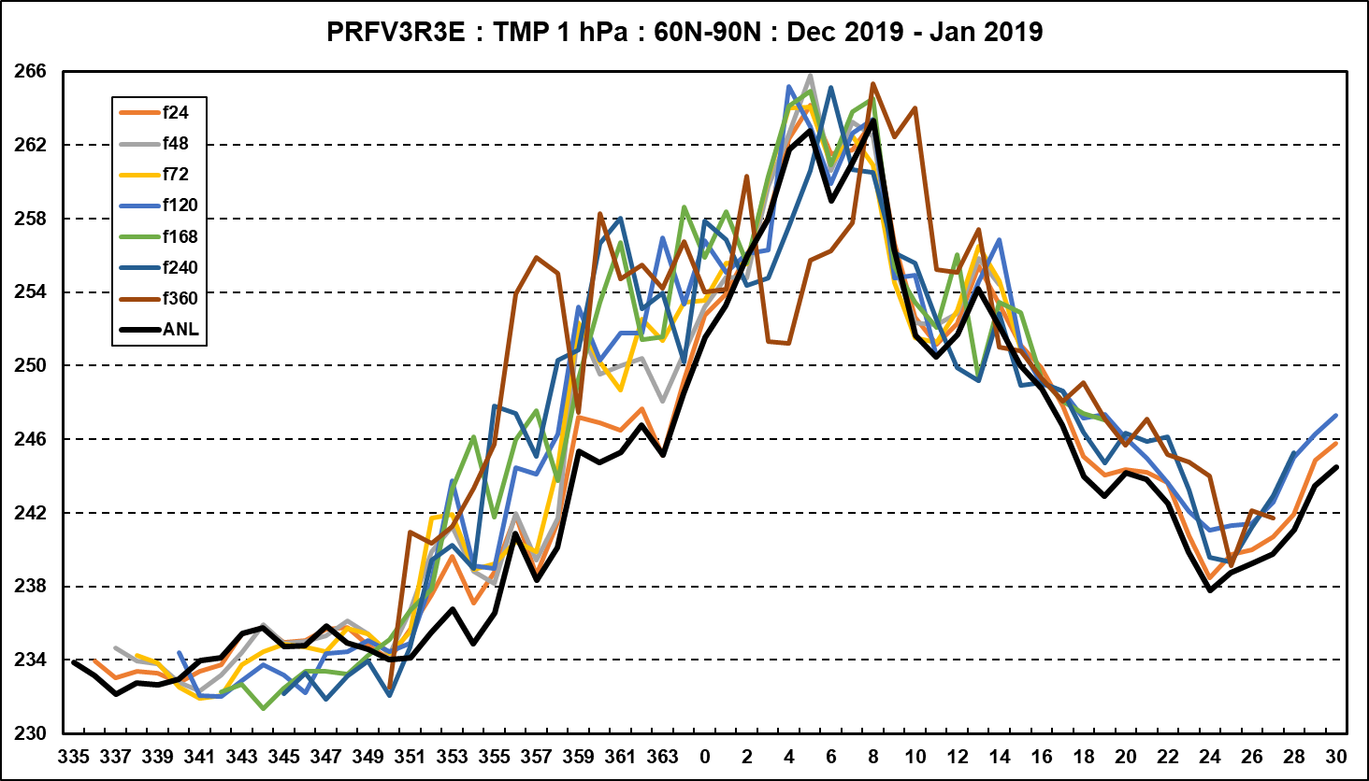
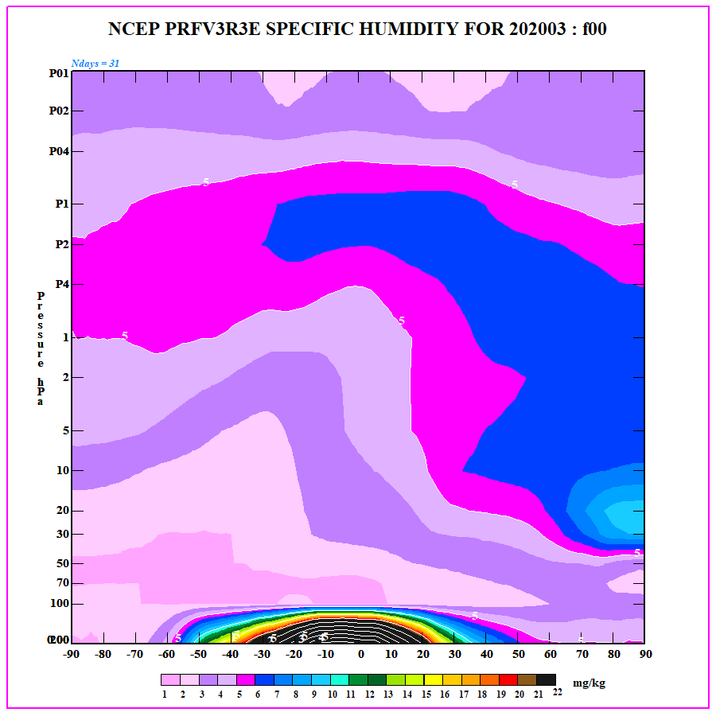
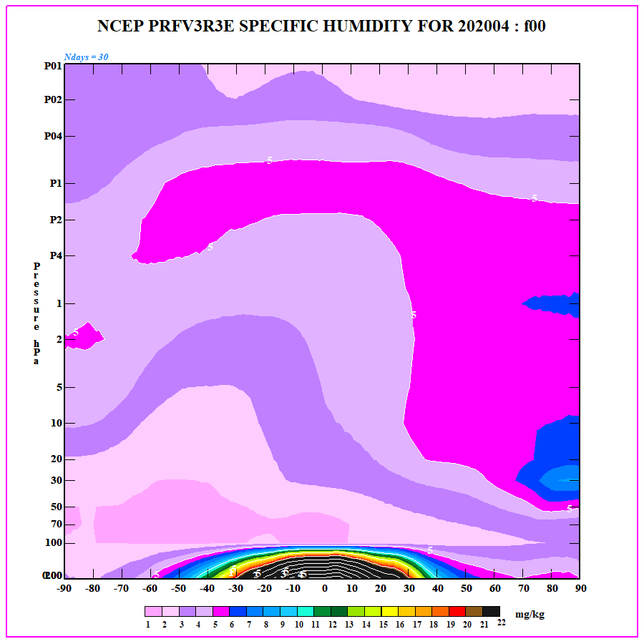
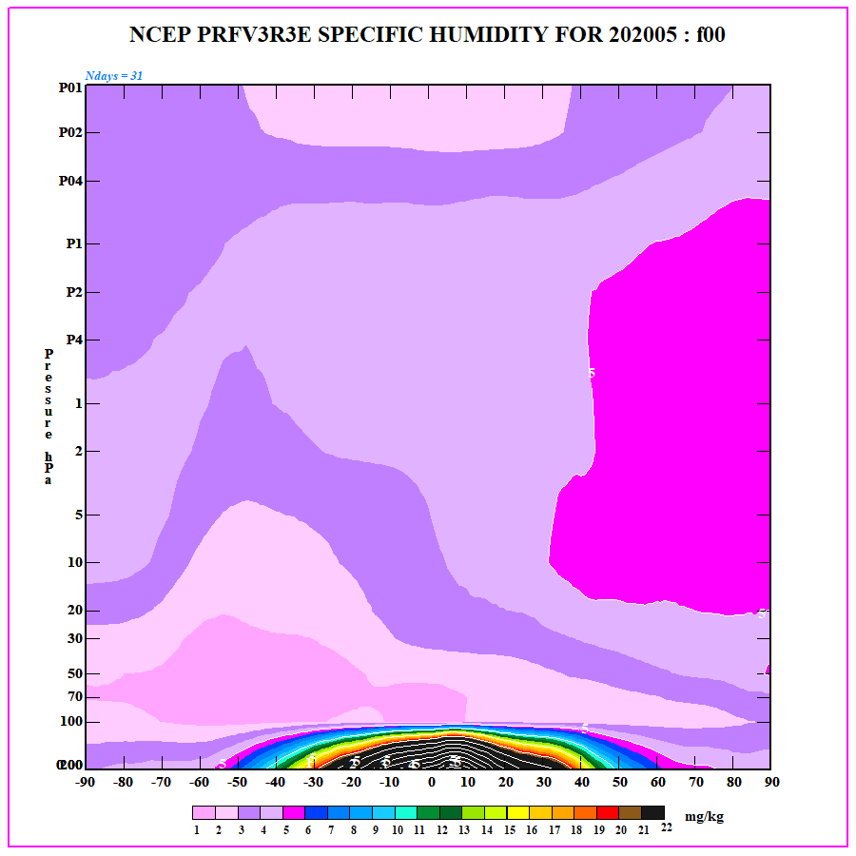
NATIONAL OCEANIC AND ATMOSPHERIC ADMINISTRATION
Forecast improvements in the Stratosphere
Improved 1-hPa Temperatures :
60N-90N Dec 2019 – Jan 2020
Figures courtesy: Craig Long, CPC
Captured water vapor seasonal cycle in the stratosphere, compares well with UARS HALOE observations (Sept. 2019-May 2020)
09-11/2019
12/2019-02/2020
GFSv16
03-05/2020

Slide 12
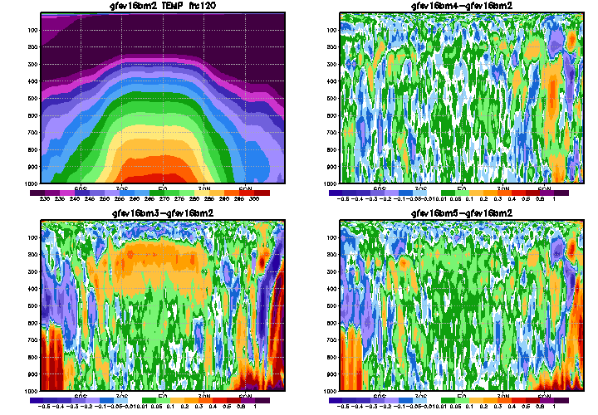
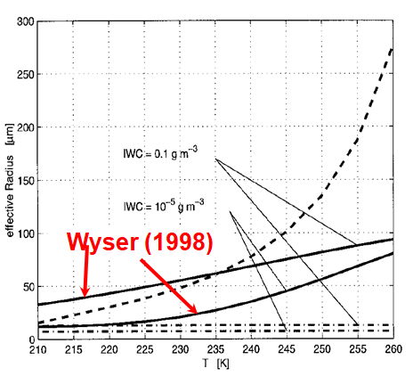
NATIONAL OCEANIC AND ATMOSPHERIC ADMINISTRATION
Improved ice cloud – radiation interactions
Use Wyser (1998) formula to calculate r_{eff-ice} as a function of q_{i} and T for q_{i} > qmin instead of using a constant r_{eff-ice}
In collaboration with GFDL
reduced tropospheric cold bias

Slide 13
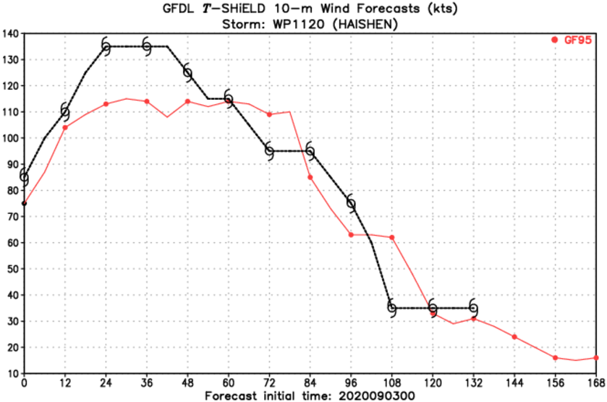
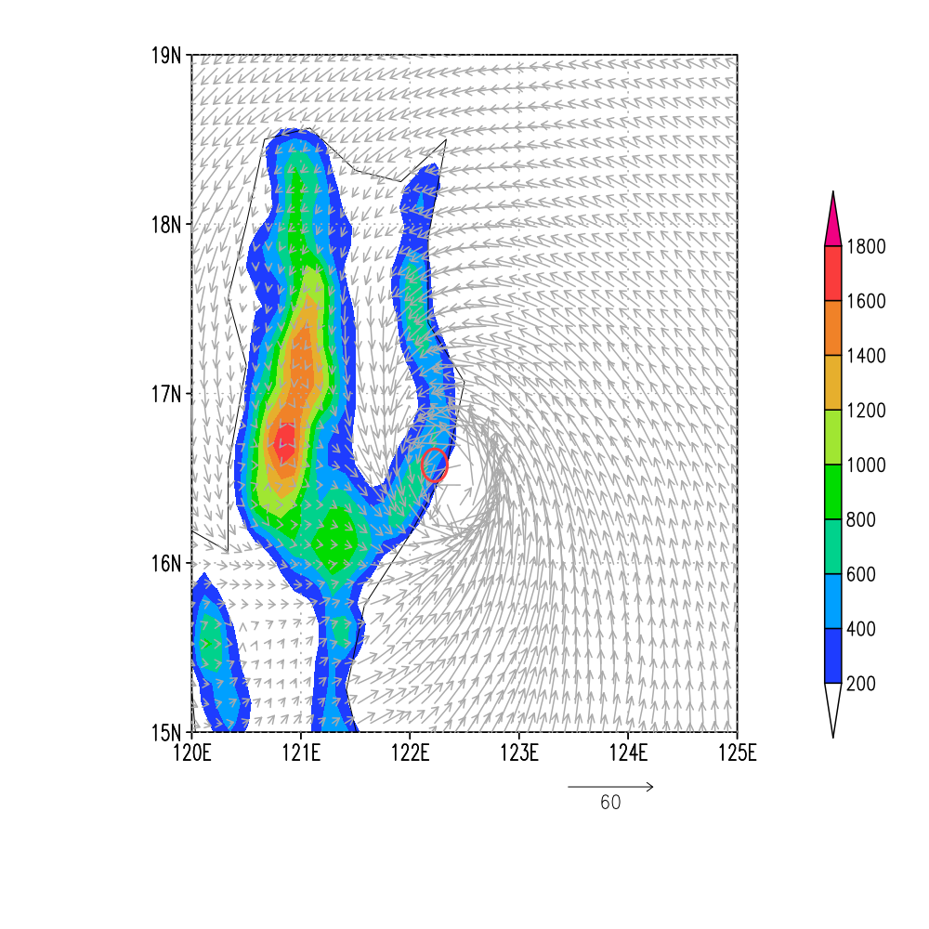
NATIONAL OCEANIC AND ATMOSPHERIC ADMINISTRATION
Addressing Model Stability Issues
The GFS.v16 had a few model crashes in early September when a strong typhoon passed over a small island over southern Japan. EMC worked with GFDL to diagnose the cause of the crashes and tested a few options to stabilize the model. All crashed cycles had excessive vertical velocities (>300 m/s) and delp becoming negative.
The model failures have close resemblance to similar failed cases for GEFSv12, which was addressed by applying the 2dz filter to 100hPa and above (n_sponge=23 instead of 4). However, GFSv16 with similar settings (n_sponge=40) did not recover the failures.
After several trials, a solution was implemented by extending the delta-z filter in the vertical from the model top down to the tropopause and increasing the value of a minimum layer thickness parameter which enforces height monotonicity.
In collaboration with GFDL
All crashed cases were recovered.
This solution was tested in both forecast-only experiments and a cycled experiment. It has a very small impact on the forecast skills and proved to be efficient in removing the model instability issues.
w=-354m/s at (i,j,k)=(741,558,125)

Slide 14
NATIONAL OCEANIC AND ATMOSPHERIC ADMINISTRATION
One-Way Coupling to Wave Model
Operational Multi_1 (GWMv3)
GFSv16-Wave Component
Arctic Polar Stereographic
18 km resolution
50°N to 90°N
Global grid: 30 arc min
Regional grids: 10 arc min
ak_10m; wc_10m; at_10m; ep_10m
Coastal grids: 4 arc min
ak_4m; wc_4m; at_4m
No ocean current interactions
Arctic Polar Stereographic: 9 km resolution
50°N to 90°N
Global grid: 16 km (10 arcmin)
15°S to 52.5°N
Southern Ocean : 25 km (15 arcmin)
10.5°S to 79.5°S
Removal of regional and coastal grids
New RTOFS ocean surface current forcing up to 192h
Forecasts will be extended from 180 hr to 384 hr.
Improved Wave Physics

Slide 15
NATIONAL OCEANIC AND ATMOSPHERIC ADMINISTRATION
Major Upgrades to GDAS
Local Ensemble Kalman Filter (LETKF) with model space localization and linearized observation operator
to replace the Ensemble Square Root Filter (EnSRF)
4-Dimensional Incremental Analysis Update (4D-IAU)
Turn on SKEB in EnKF forecasts
New variational QC
Apply Hilbert curve to aircraft data
Correlated observation error for CrIS over sea surfaces and IASI over sea and land
Update temperature aircraft bias correction with safeguard
Assimilate AMSU-A channel 14 and ATMS channel 15 w/o bias correction
Assimilate CSR data from ABI_G16, AHI_Himawari8, and SEVIRI_M08; AVHRR from NOAA-19 and Metop-B for NSST
Assimilate additional GPSRO (add Metop-C GRAS, More Cosmic-2)
Assimilate high-density flight-level wind, temperature, and moisture observations (HDOBS) in tropical storm environment (first time in operations for GFS)
Reduce the distance threshold for inner core dropsonde data to 55km (from 111km or 3*RMW) and add a wind threshold of 32 m/s to allow more dropsonde data being assimilated
Use CRTM v2.3.0

Slide 16
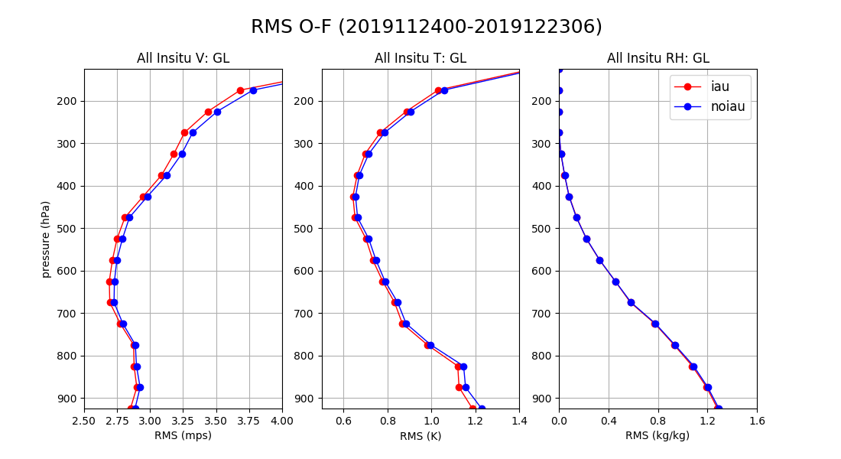
NATIONAL OCEANIC AND ATMOSPHERIC ADMINISTRATION
4D-Incremental Analysis Update (IAU)
In collaboration with OAR/PSL

Slide 17
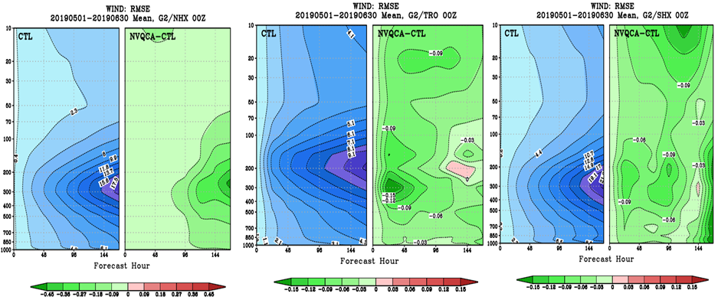
NATIONAL OCEANIC AND ATMOSPHERIC ADMINISTRATION
New Variational Quality Control Algorithm
A new variational quality control is applied to conventional observations.
Previous variational quality control could not be applied in the first iterations of minimization due to the possibility of multiple minima in the cost function.
New probability density function formulation greatly reduces the possibility of multiple minima.
Greatest impact in wind RMSE and in the northern hemisphere.

Slide 18
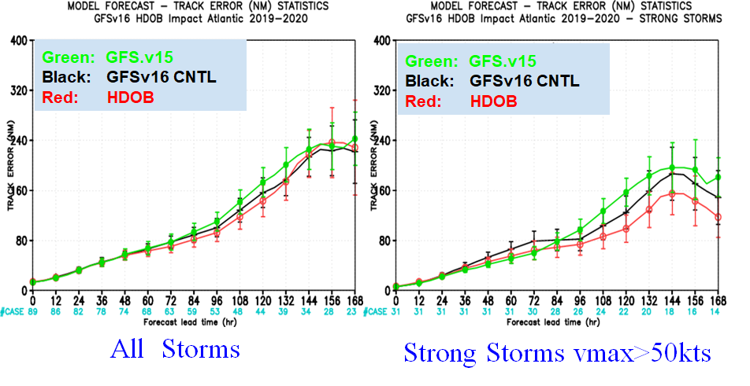
NATIONAL OCEANIC AND ATMOSPHERIC ADMINISTRATION
New Assimilation of HDOBS
Significant improvements in track forecast errors, especially for strong storms

Slide 19
NATIONAL OCEANIC AND ATMOSPHERIC ADMINISTRATION
Infrastructure changes
Change the model output format from nemsio to compressed netCDF
A new parallel I/O was developed with updated netCDF and HDF libraries
3D Atmospheric fields will have 5x compression (33.6 GB to 6.7 GB, lossy compression)
Surface 2D fields will have 2.5x compression (2.8 GB to 1.1 GB, lossless compression)
Pre-Processing Changes
obsproc_global and obsproc_prep was updated to process new satellite observations, high density aircraft observations, and to work with model history files in netCDF format.
Inline Post-Processing
Inline post makes use of forecast data saved in memory for post processing, reduces I/O activity, and speeds up the entire forecast system.
A Post library was created using the offline post Fortran programs. It can be called by the Write Grid Component within the forecast model.
Since lossy compression is applied for writing out forecast history files, inline post generates more accurate products than the standalone offline post.
Simulated satellite radiance and WAFS files are still made by the offline post.

Slide 20
NATIONAL OCEANIC AND ATMOSPHERIC ADMINISTRATION
Product changes
Unification of isobaric state fields
All isobaric state fields in pgrb2 files will have the same 41 levels at all forecast hrs and analysis time
New Products
Add more pressure levels (at 0.01, 0.02, 0.04, 0.07, 0.1, 0.2, 0.7 hPas) in the upper stratosphere and the mesosphere in pgrb2 files
Other new products include cloud ceiling, total column and low/mid/high cloud fractions, and radar reflectivity at 1 km/4 km and 1st/2nd model level above ground.
FSU storm genesis verification stats
Bufr sounding data will have 127 levels instead of 64 with some addition changes to terrain adjustments
Delayed products
synthetic GOES products
Replaced products
Replace filtered Shuell SLP with unfiltered one using same ID PRMSL
Replace legacy synthetic nadir GOES 12/13 with synthetic nadir ABI GOES-R products
Removed products
Three legacy bulletins (navy bull, wintemv bull, gdas bull)
5-wave height (5WAVH) in all GFS pgb files, AWIPS 20km grids (CONUS, Alaska, Puerto Rico, Pacific region) and AWIPS LAT/LON 1.0 degree grid
Lifted Index in GFS Flux files
SPFH at 16 levels from pgrb2b

Slide 21
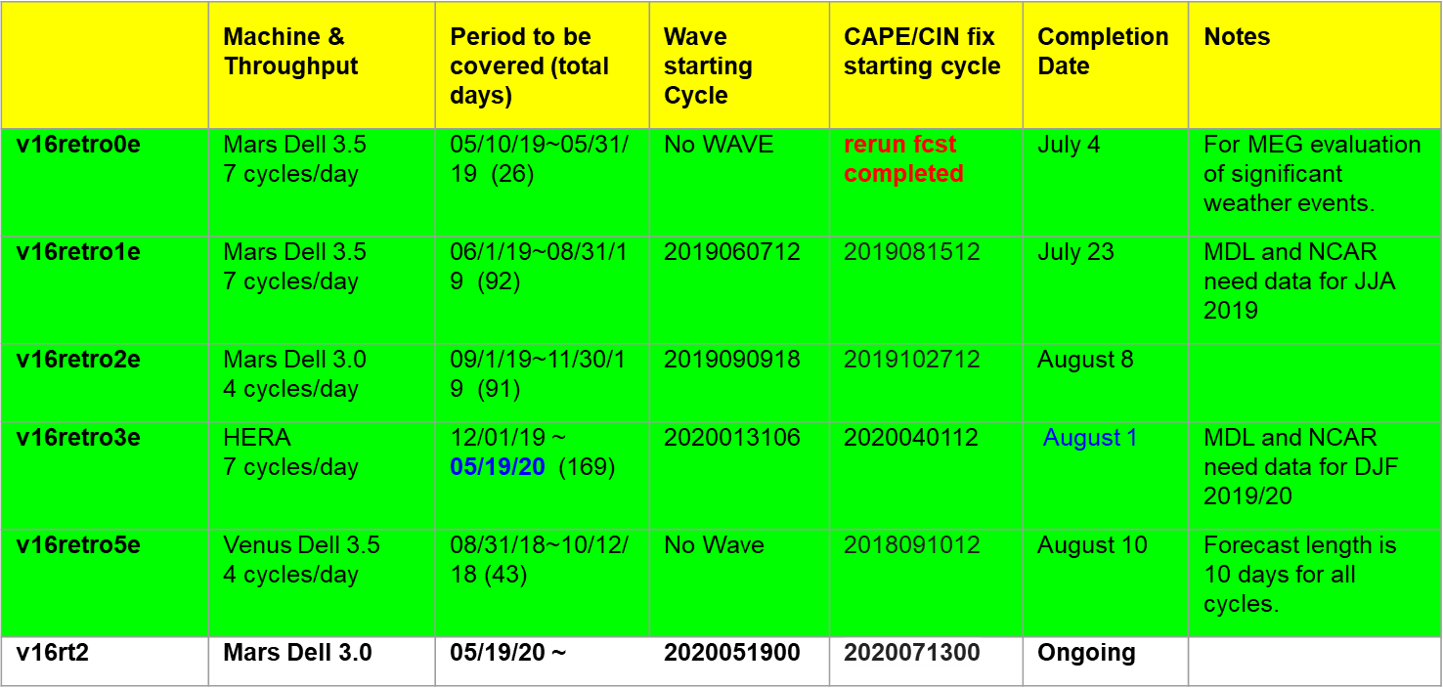
NATIONAL OCEANIC AND ATMOSPHERIC ADMINISTRATION
Retrospective and Real-Time Parallels

Slide 22
NATIONAL OCEANIC AND ATMOSPHERIC ADMINISTRATION
Evaluation of GFSv16 Performance
Independent assessment of GFSv16 retrospectives by EMC MEG Group (statistical using METplus and subjective using case studies)
Summary of field evaluations
Evaluation of impact of GFSv16 on downstream models
Benefits and concerns

Slide 23
NATIONAL OCEANIC AND ATMOSPHERIC ADMINISTRATION
The Evaluation of GFSv16
GFSv15 (F120)
GFSv16 (F120)
GFS Analysis
L
L
Geoff Manikin, Alicia Bentley, Shannon Shields, Philippe Papin, Logan Dawson, Chris MacIntosh
EMC Model Evaluation Group Presentation to the NCEP Director
5 October 2020
Acknowledgements: Jason Levit, Deanna Spindler, Mallory Row, Zhan Zhang

Slide 24
NATIONAL OCEANIC AND ATMOSPHERIC ADMINISTRATION
GFSv16 Evaluation Details
The GFSv16 official evaluation included analyses of:
Retrospectives (5/5/19–5/18/20; added 8/31/18–10/12/18)
Statistics
50 Case Studies
Real-time Parallel (5/19/20–present)
Statistics
Representative examples
The GFSv16 official evaluation also included an STI team of NWS SOOs tasked with analyzing GFSv16 forecasts in a testbed format

Slide 25
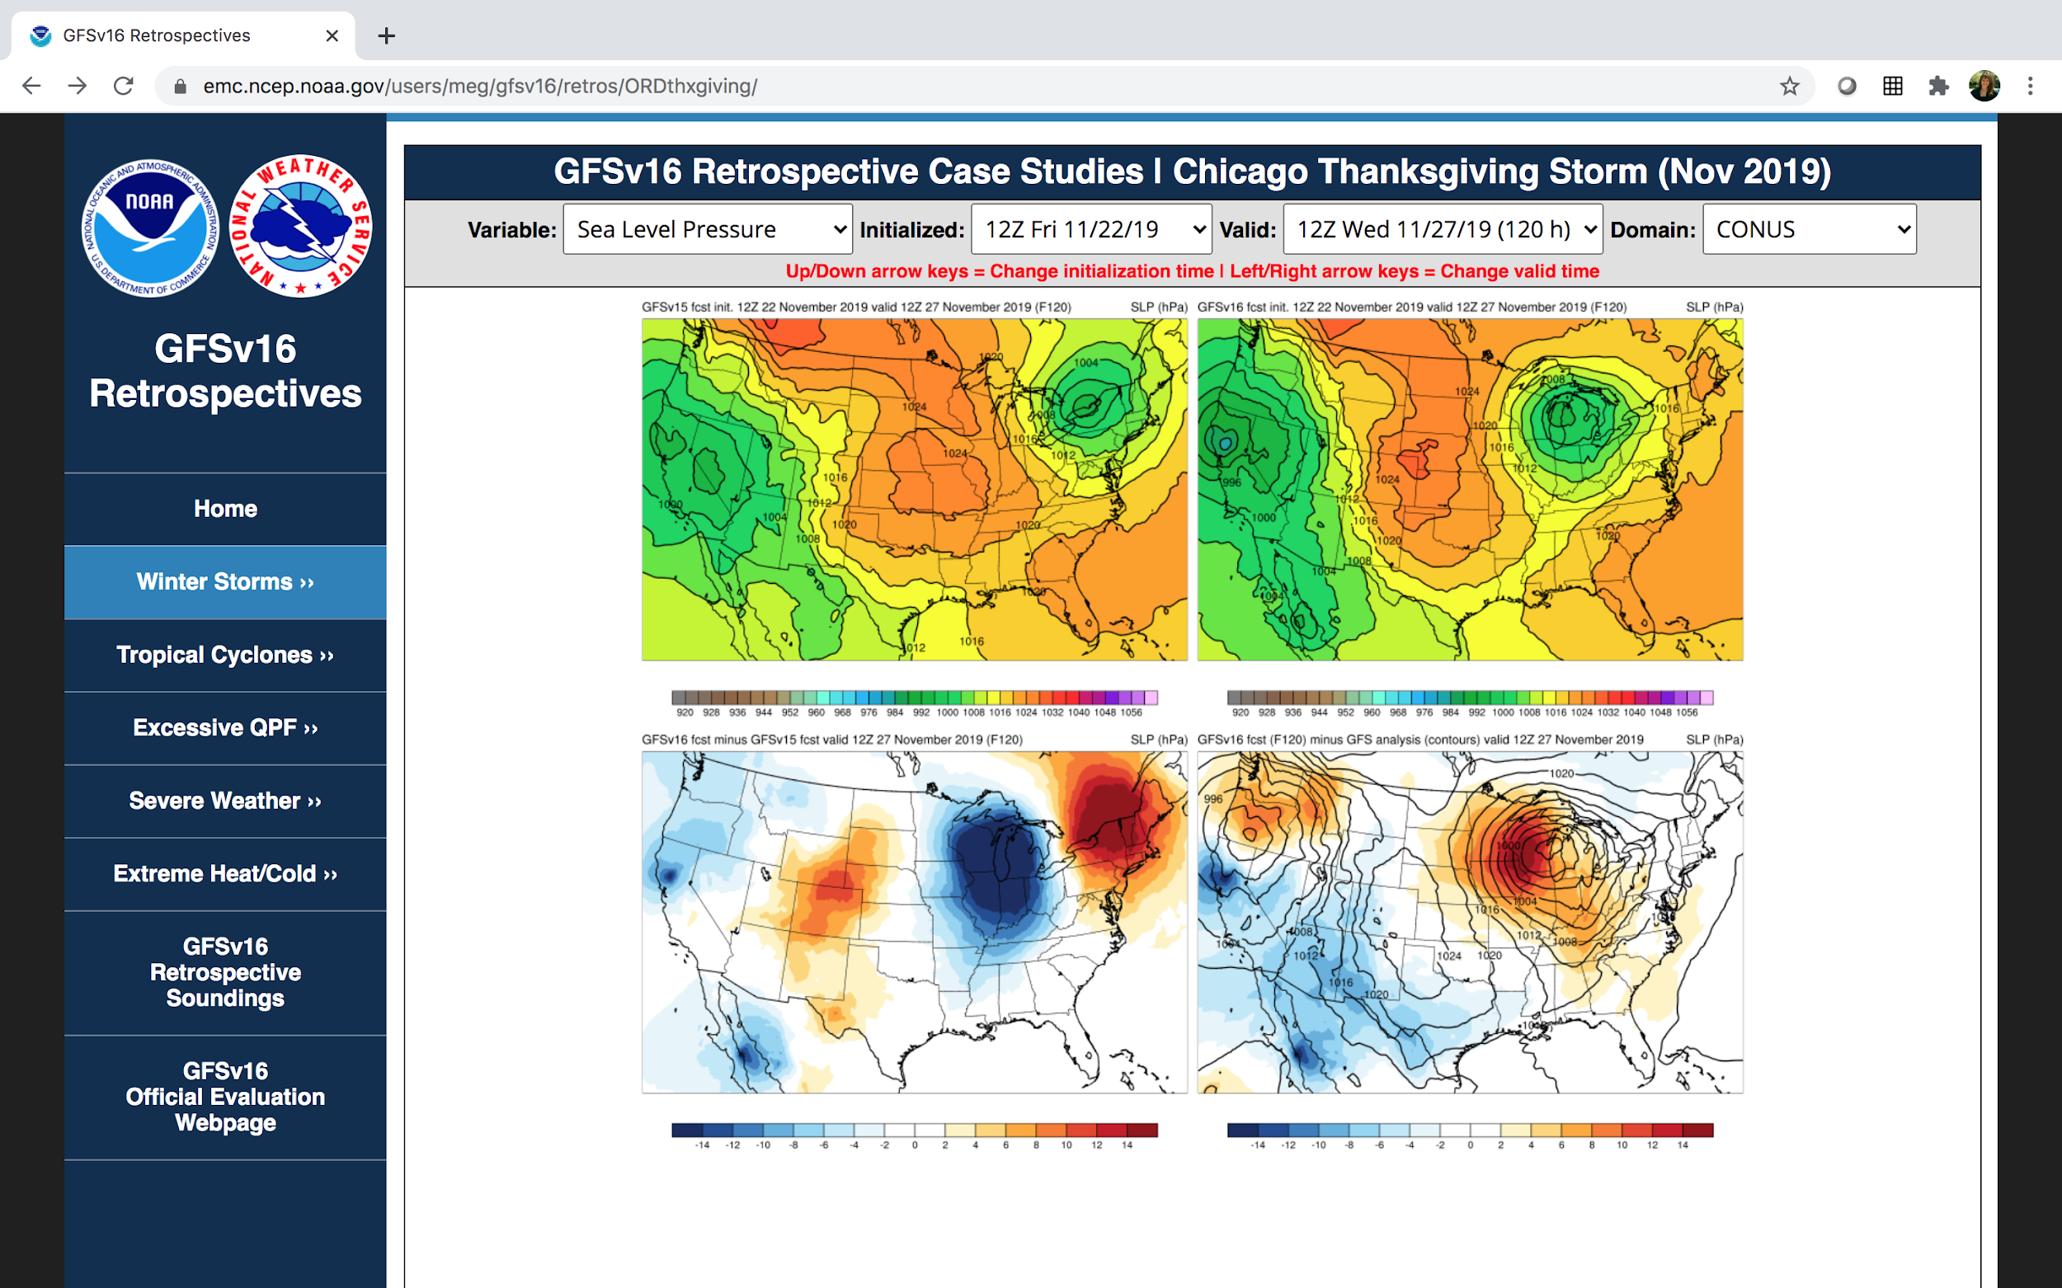
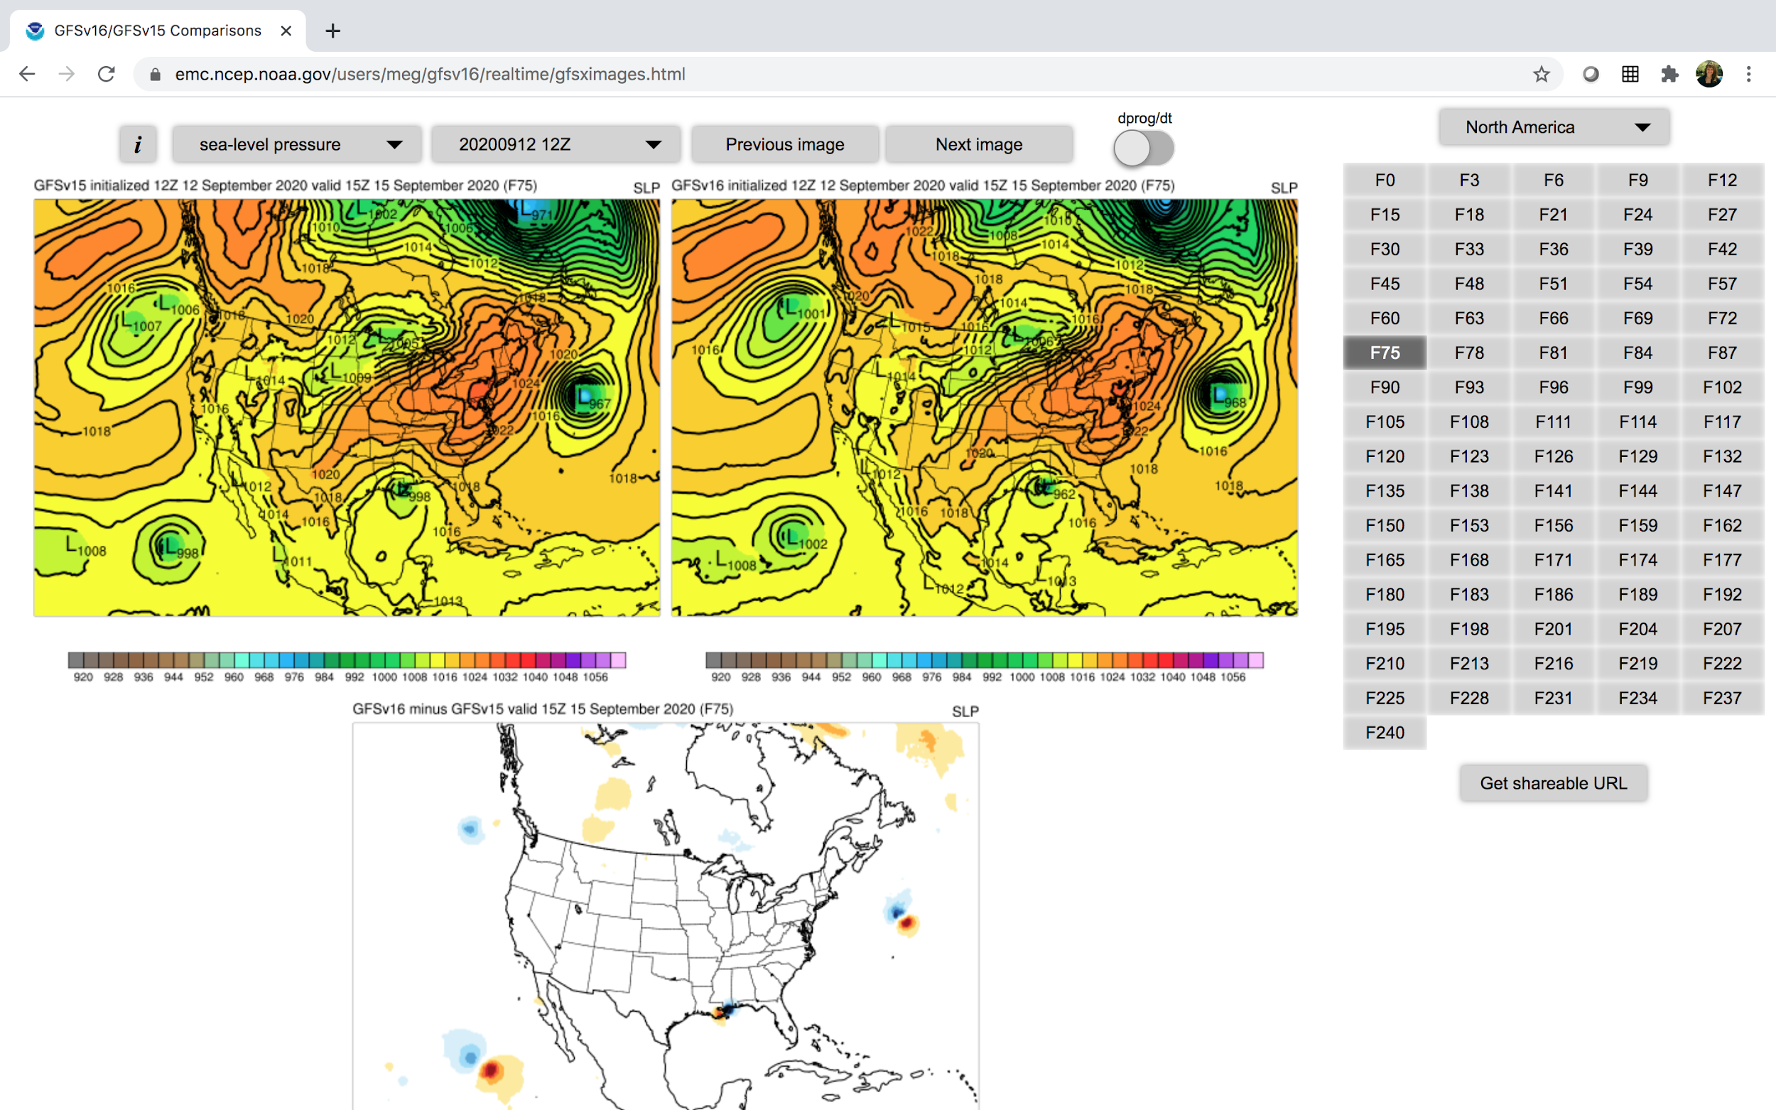
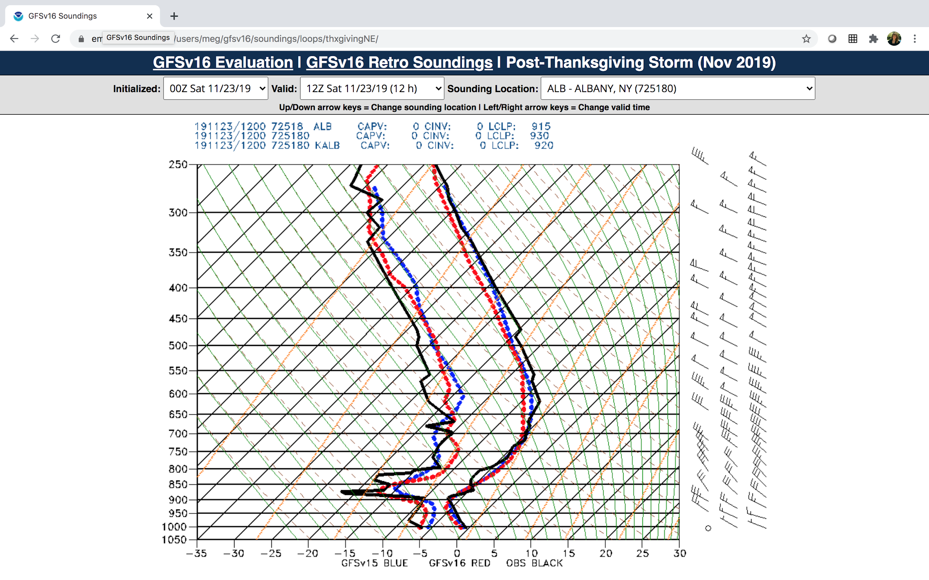
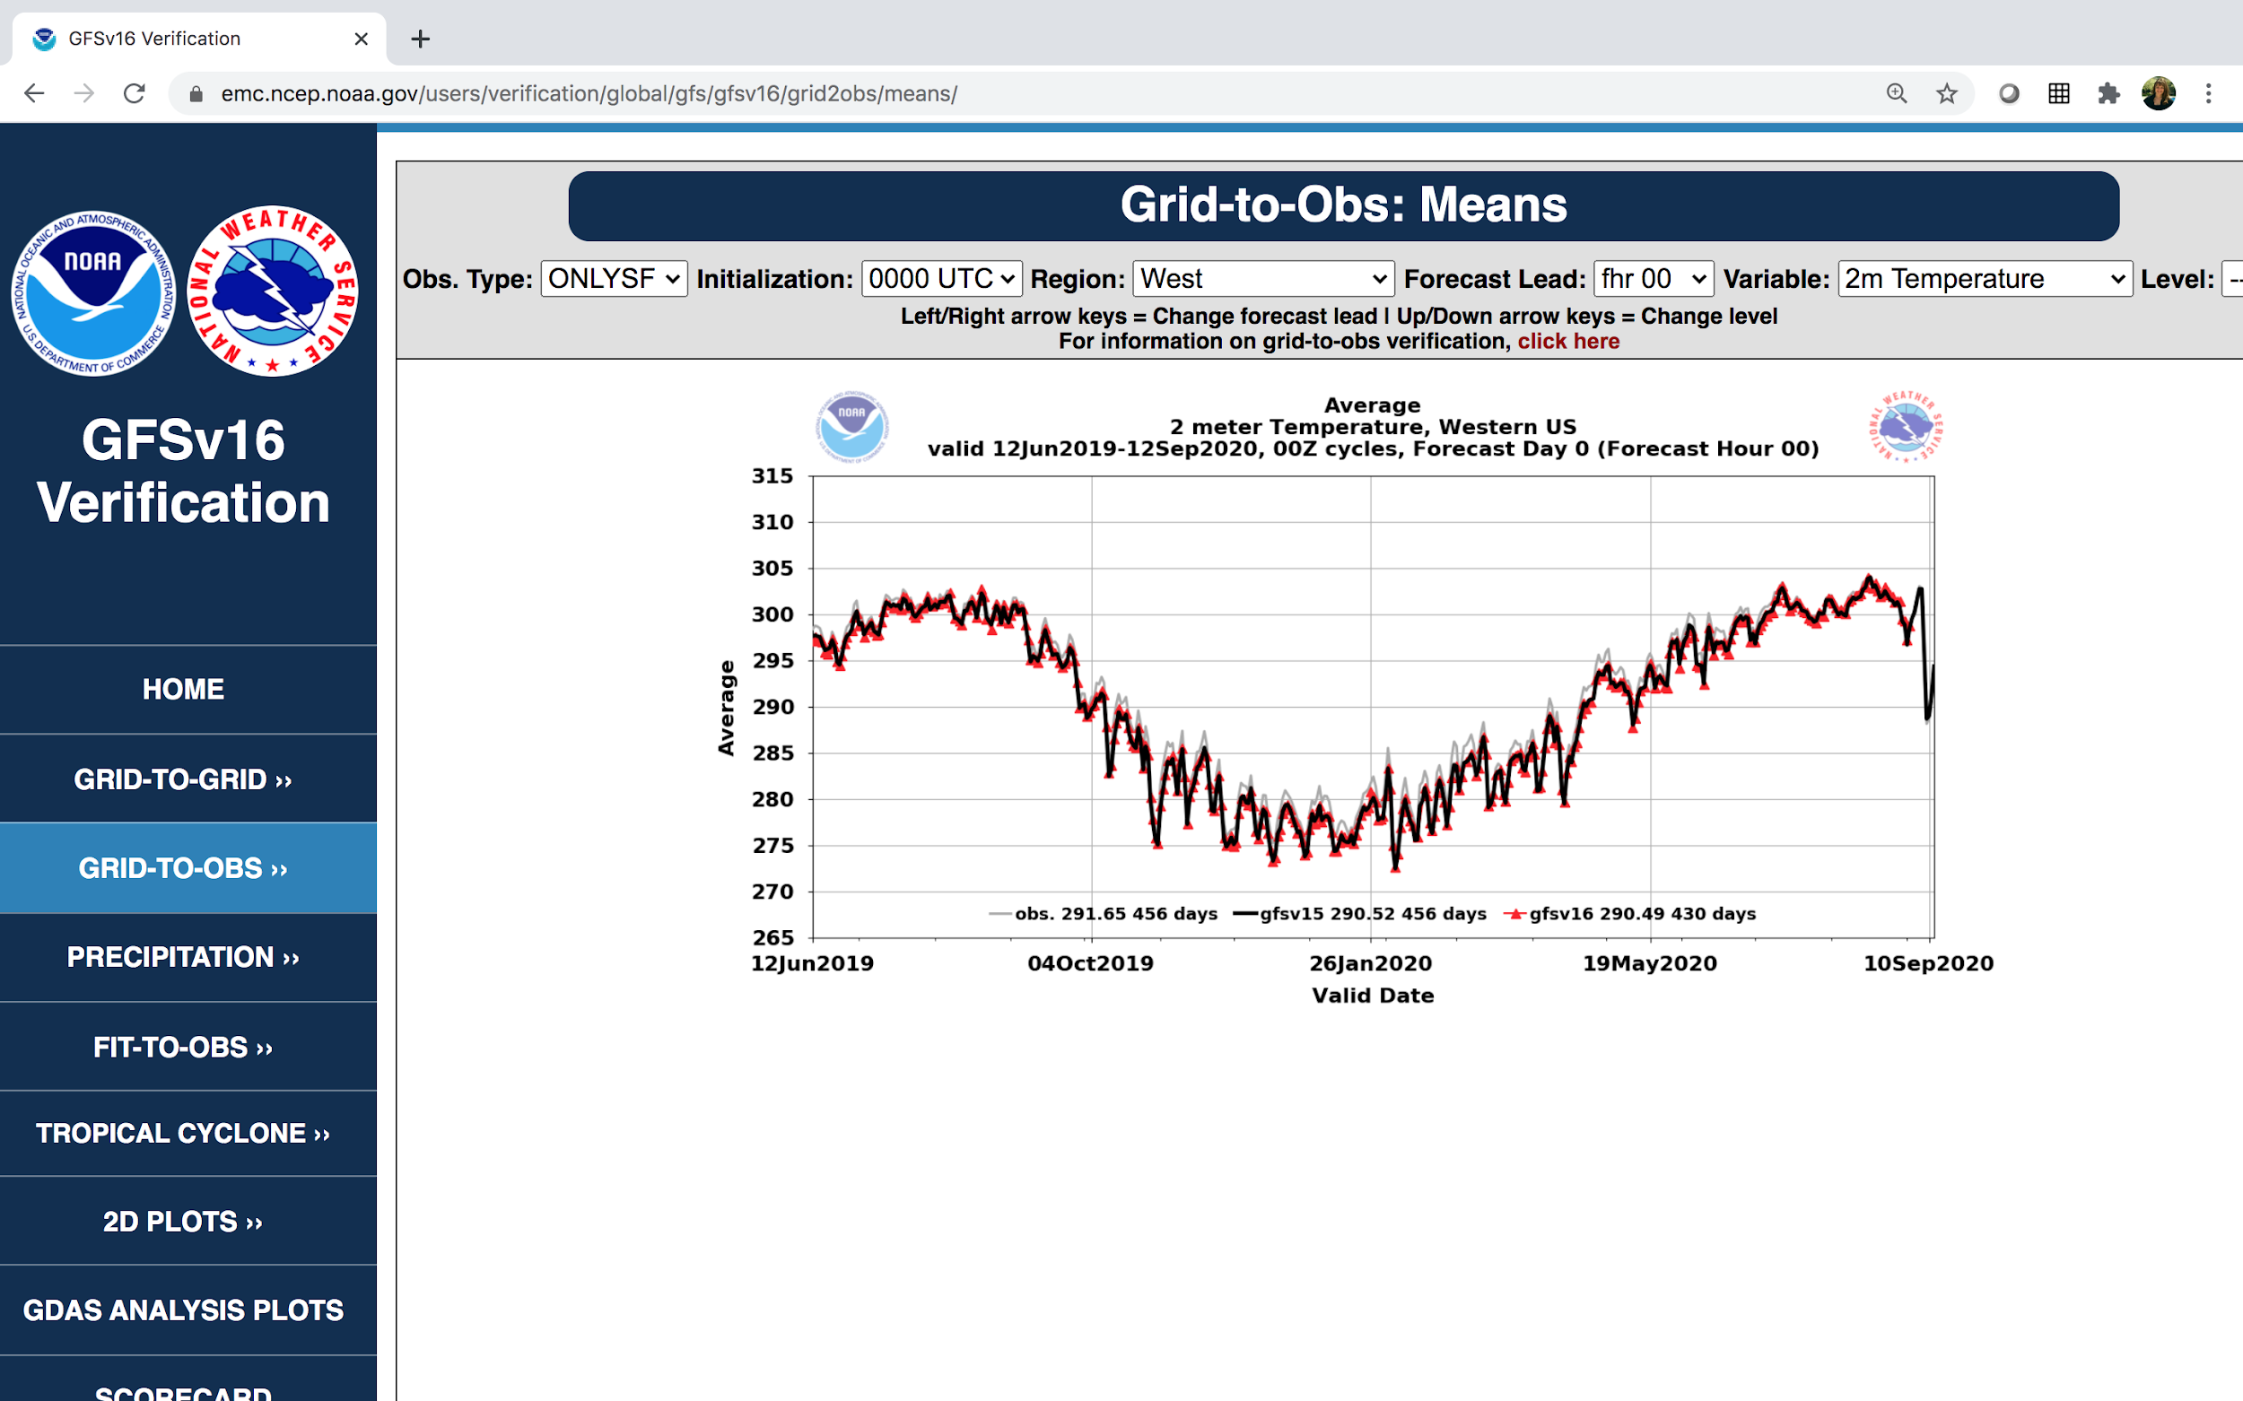
NATIONAL OCEANIC AND ATMOSPHERIC ADMINISTRATION
GFSv16 Evaluation Resources (VPPPG)
Retrospective Case Studies
Real-time Forecast Maps
METplus!!
Retrospective Soundings
Retrospective/Real-time Stats

Slide 26
NATIONAL OCEANIC AND ATMOSPHERIC ADMINISTRATION
Summary of GFSv16 Verification Statistics
Improvement Neutral Degradation Bold indicates MEG emphasis
Parameter | Remarks
200/250-hPa Winds | Existing NH & SH low bias in GFSv15 worse in GFSv16, but mitigated in tropics & over U.S. RMSE higher initially and in tropics, but reduced in medium range for NH & SH.
500-hPa Height | Improved NH & SH 500-hPa AC scores in medium-range. Lower NH & SH RMSE at most lead times.
850-hPa Winds | Existing NH & SH low bias in GFSv15 worse in GFSv16, especially in tropics. RMSE higher initially, but significantly reduced in short-to-medium range for NH & SH.
850-hPa Temp. | Mitigated cold bias seen in GFSv15 during NH cool season in medium- and extended- ranges. Lower NH & SH RMSE in the medium-range. Colder temperatures in short-range, especially in NH cool season short-range forecast.
1000-hPa Height | Improved NH & SH 1000-hPa AC scores at most lead times. Lower NH & SH RMSE at most lead times.
10-m Winds | Little change in bias overall over the U.S. Slight but significant decrease in RMSE in short-to-medium range.

Slide 27
NATIONAL OCEANIC AND ATMOSPHERIC ADMINISTRATION
Summary of GFSv16 Verification Statistics
Parameter | Remarks
2-m Temp. | Mitigated cold bias over CONUS during cool season at longer lead times. Lower RMSE over CONUS during cool season at longer lead times. Inconsistent CONUS bias signal comparing 2019 & 2020 warm seasons. Higher RMSE over Eastern U.S. during warm season at most lead times.
Low-Level Moisture/ 2-m Dewpoint | Introduced significant low bias over CONUS at short lead times (correlated with dry soil moisture); bias worse in summer, more negligible in winter. RMSE increased in short-range but reduced in medium-range.
Precipitation | U.S. ETS significantly improved at most 24h thresholds at most lead times. U.S. high bias reduced at low thresholds; low bias reduced at higher thresholds.
CAPE (real-time) | RMSE increased; existing low GFSv15 bias made significantly worse
TC Track | Reduced errors overall for strong TCs but slow & right-of-track biases at long lead times.
TC Size | Reduced low bias in 34-kt wind radii as GFSv16 produces larger and stronger TCs.

Slide 28
NATIONAL OCEANIC AND ATMOSPHERIC ADMINISTRATION
Summary of GFSv16 Verification Statistics
Parameter | Remarks
TC Intensity | Lower intensity error at almost all lead times in North Atlantic. Less of a weak bias at longer lead times in North Atlantic. Similar intensity error at almost all lead times in East Pacific. Slightly less of a weak bias at longer lead times in East Pacific. Tendency to strengthen most TCs in the long-range.
TC Genesis | POD improved in both NATL & EPAC, but FAR also increased. Overall CSI increase. Increased TC genesis lead time, but many TCs still completely missed by both models. Too many false alarms from 50°-70°W.
HWRF | Improved track & intensity forecast when initialized with GFSv16.
HMON | Degraded track forecast for NATL when initialized with GFSv16 but improved for EPAC. Intensity forecast improved.
Waves | Lower globally-averaged RMSE & bias for sig. wave height in GFS-Wave. GFS-Wave better at predicting global sig. wave height, peak period, & wind speed Some regional degradation of waves forecasts (sig, wave height and wind speed) where the high-resolution Multi-1 output grids are not available in GFS-Wave

Slide 29
NATIONAL OCEANIC AND ATMOSPHERIC ADMINISTRATION
Overall Atmospheric Impressions of GFSv16
Region | Recommendation | Key Remarks
Eastern Region | Implement | Improvement with PBL structure, cold-air damming, and medium-range Ptype. Low CAPE bias and low-level cold bias in cool season (short-term) concerns.
Central Region | Implement | Notable synoptic improvements in medium-range.; cases of overmixed PBL in warm season. Improvement in low-level temps (reduction in 2-m cold bias). Some erroneous late day decoupling
Southern Region | Implement | Evidence of improved temp. profile in shallow, cold air masses. Larger TC FAR and right-of-track bias. Low warm season CAPE.
Western Region | Implement | Improvement in low-level temps. Better details in QPF, winds, temps/RH. Noticeable improvement in the mid-range.
Alaska Region | Implement | More significant cyclones, improved PBL & better cold low-level temp. Large 2-m temp. change flipping from warm to cold bias.
Pacific Region | Implement | Significantly better TC genesis; some increase in false alarms. With stronger TCs, GFSv16 has better track, size, and intensity. Some false TC interactions in GFSv16.

Slide 30
NATIONAL OCEANIC AND ATMOSPHERIC ADMINISTRATION
Overall Atmospheric Impressions of GFSv16
Center | Recommendation | Key Remarks
WPC | Implement | Progressive bias in GFSv15 appears mitigated (handles synoptic scale better). Better captured higher QPF and cold-air damming in East. Tendency to over-forecast sleet and low CAPE bias concerns.
SPC | Neutral | Improved forecasts of frontal boundaries for a few cases. Degradation in low-level temps during warm season. Drier soil moisture exacerbates the 2-m dewpoint and low instability biases when coupled with overmixing bias.
NHC | Neutral | Improvements to TC intensity/wind radii and increased lead time and false alarms for genesis. Increased right-of-track & along-track bias.
AWC | Implement | Mitigation of progressive bias seen in GFSv15. Better ability to capture cold-air damming events. Better jet stream forecasts. Slightly better PBL. Improvement in low-level temps.
CPC | Implement | Slightly improved 500-hPa heights. Temps get warmer with forecast time in winter latitudes. Winter (summer) zonal winds decrease (increase) with lead time. Ozone in polar night issue.
First Energy Corp | Implement | Many parameters behaved similarly between the two versions. More realistic surface pressure intensity. Views GFSv16 as a foundational component of the UFS.

Slide 31
NATIONAL OCEANIC AND ATMOSPHERIC ADMINISTRATION
Overall Impressions of GFSv16 Waves
Center/Region | Recommendation | Key Remarks
Ocean Prediction Center | Do NOT Implement | No improved reliability in forecasts of ocean waves. Improvement of wave height bias over the north Pacific, but a consistent lack of improvement over the north Atlantic. Period and direction seemed better, but wind speed and wave height are worse over North Atlantic and west coast which potentially hurts OPC ops. Low bias for the highest wave heights.
National Hurricane Center | Neutral | Unsure about improved reliability in forecasts of ocean waves. Slightly higher Hs RMSE 00-48 hr and a slight low wave height bias. GFS-Wave lowest in 95th quantile stats vs. obs and Multi_1. Slightly lower long distance-traveled swell.
Eastern Region | Implement | Improved reliability in forecasts of ocean waves. Increase in error/bias in some areas is smaller than overall improvement. Some concern of operational issues with coarser grids in GFS-Wave.

Slide 32
NATIONAL OCEANIC AND ATMOSPHERIC ADMINISTRATION
Waves Concerns
Buoys Overall | Sig Wave Height | Wind Speed | Peak Period
Subjective | Multi-1 | GFS Wave | GFS Wave
Objective/month | Multi-1 | GFS Wave | GFS Wave
Objective/fcst | Tie | Tie | GFS Wave
From Deanna Spindler
Buoys (coastal areas) and satellite data (open ocean) were used to compare the existing Multi-1 global wave model with GFSv16 (GFS Wave - wave component coupled to atmosphere)
Regionally, Multi-1 has better sig. wave heights and wind speeds. Globally, GFS-Wave has better sig. wave heights, wind speed, and peak period
Near the coastal US,
Multi-1 performs better, as
expected due to the loss of
the 4 arcmin grids
Satellite Overall | Sig Wave Height | Wind Speed
Global | GFS Wave | GFS Wave
North Atlantic (at_10m) | Multi-1 | Multi-1
US West Coast (wc_10m) | Multi-1 | Multi-1

Slide 33
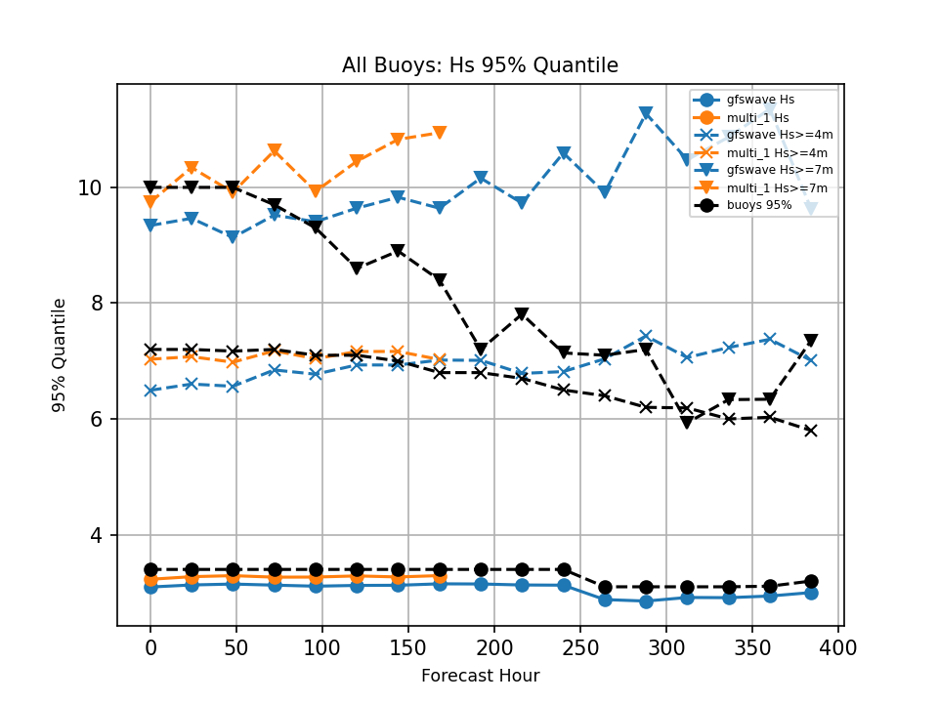
NATIONAL OCEANIC AND ATMOSPHERIC ADMINISTRATION
Waves Concerns
95% Quantile Wave Height is around 3m, and Multi-1 holds a slight edge
For larger waves, sample size is quite small, and both Multi-1 and GFS-Wave overpredict “dangerous seas” (according to buoy data), but Multi-1 does better with the larger waves in the early forecast hours
OPC deems better detection of large waves as critical to their operations

Slide 34
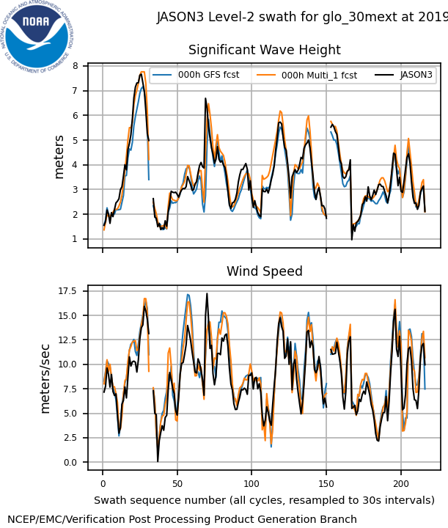
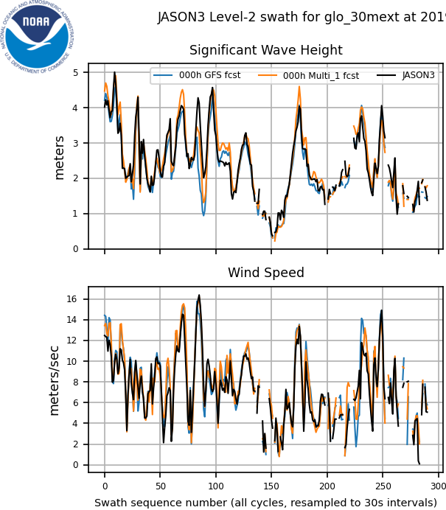
NATIONAL OCEANIC AND ATMOSPHERIC ADMINISTRATION
Waves Concerns
2019092000
2019112600
These examples show that Multi-1 overestimates wave height on the open seas and that GFSv16 may be overall better with the largest waves
It’s tough to discern this in the stats, though, since smaller waves dominate

Slide 35
NATIONAL OCEANIC AND ATMOSPHERIC ADMINISTRATION
Common Strengths From All Evaluations
Notable improvements in synoptic-scale performance in the medium-range
Progressive bias in GFSv15 appears mitigated with better consistency catching correct solutions earlier
Improved frontal positions and QPF
Improvement in low-level temperature forecasts (mitigation of the winter low-level cold bias)
Better ability to resolve shallow, cold air masses and some associated cold air damming events
Improvements to TC intensity and increased lead time for genesis
With stronger TCs, GFSv16 has overall better track, size, and intensity

Slide 36
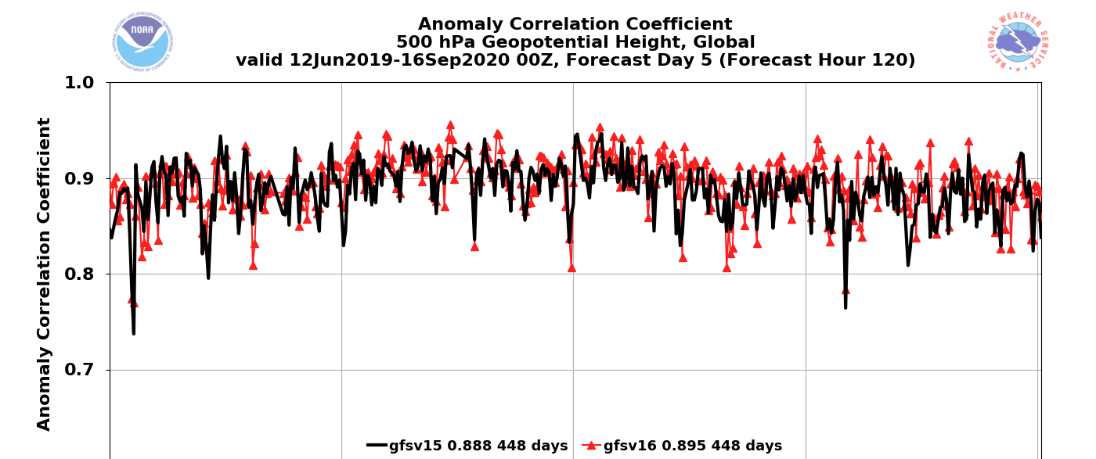
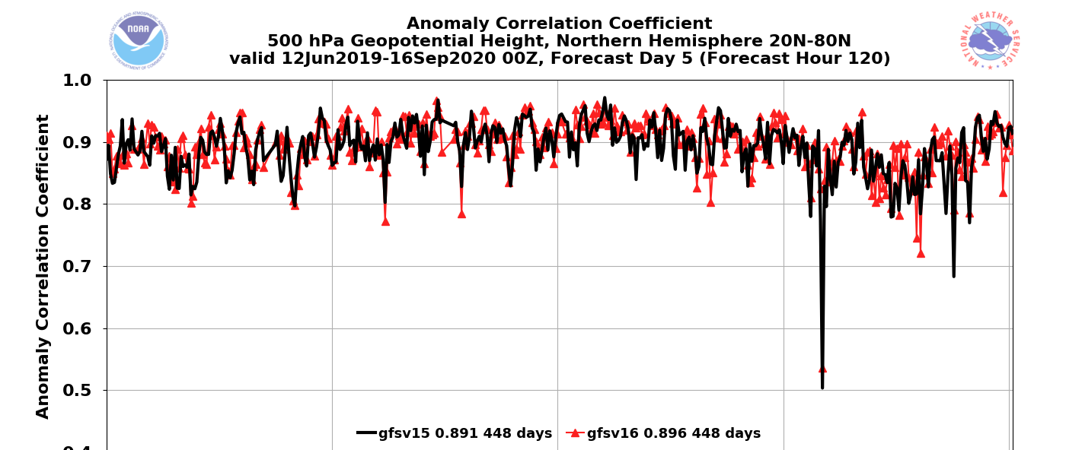
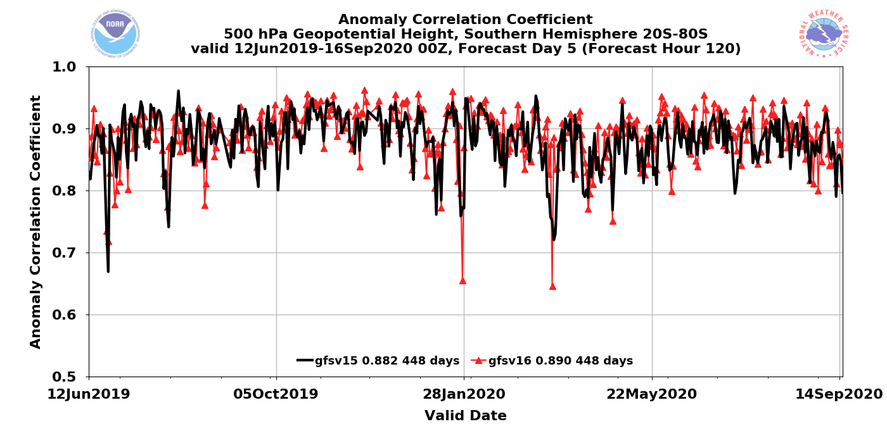
NATIONAL OCEANIC AND ATMOSPHERIC ADMINISTRATION
Strengths: 500-hPa AC Scores (Global)
Valid: 6/12/19–9/16/20
(Day 5)
GFSv15 = .888
GFSv16 = .895
Global
GFSv16−GFSv15
GFSv15 = .891
GFSv16 = .896
NH
GFSv15 = .882
GFSv16 = .890
SH
Statistically Significant

Slide 37
NATIONAL OCEANIC AND ATMOSPHERIC ADMINISTRATION
GFSv16 AC Scores (NH 500-hPa Z at Day 5)
 | GFSv15 (OPS) | GFSv16 (RETRO)
Fall 2018 | 0.916 | 0.916
May 2019 | 0.880 | 0.897
Summer 2019 | 0.880 | 0.888
Fall 2019 | 0.897 | 0.901
Winter/Spring 2020 | 0.909 | 0.913
Real-Time Parallel | 0.864 | 0.871
Full Retro Period | 0.890 | 0.896

Slide 38
NATIONAL OCEANIC AND ATMOSPHERIC ADMINISTRATION
GFSv16 NWS SOO Team Synoptic Ratings
 | GFSv16 vs. GFSv15 Mean Rating (−3 to +3) | % GFSv16 was as good or better than GFSv15 | % GFSv16 was worse than GFSv15
Extended Range (days 8-10) | 0.35 | 78% | 22%
Medium Range (days 4-7) | 0.59 | 83% | 17%
Short Range (days 1-3) | 0.07 | 85% | 15%

Slide 39
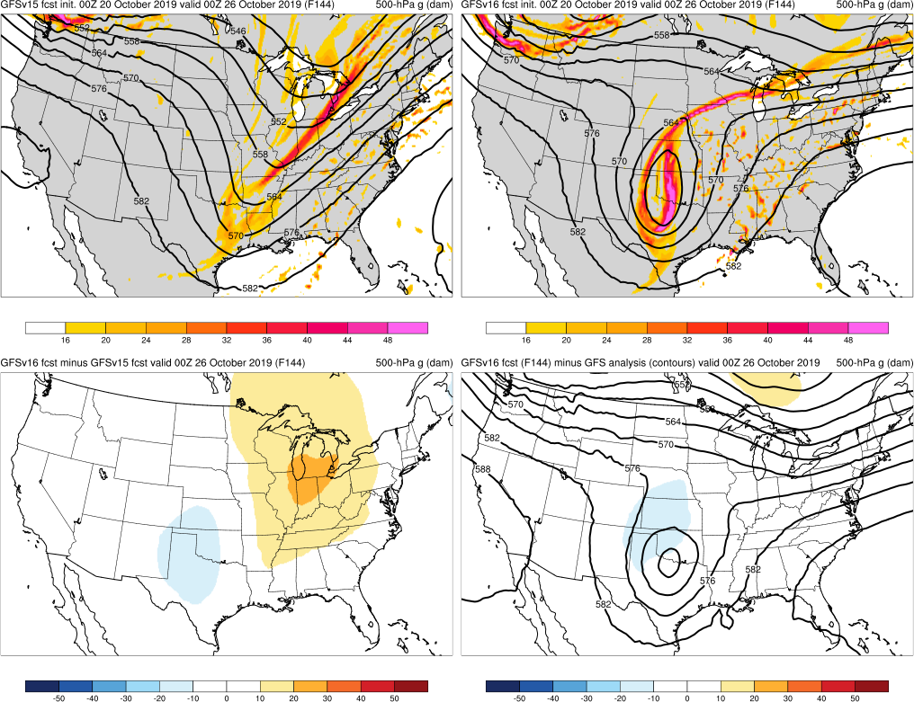
NATIONAL OCEANIC AND ATMOSPHERIC ADMINISTRATION
Strengths: Captures Synoptic Pattern Better
GFSv15
GFSv16
TC Olga Case
Fcst: 00z 10/20/20 (F144) Valid: 00Z 10/26/20
GFSv16 forecasted the location of this and other cutoff lows earlier and more consistently than GFSv15, with some mitigation of the progressive issue noted in the GFSv15 evaluation
Several evaluators noted that GFSv16 showed more run-to-run continuity than GFSv15
v16−v15
GFS Anl.

Slide 40
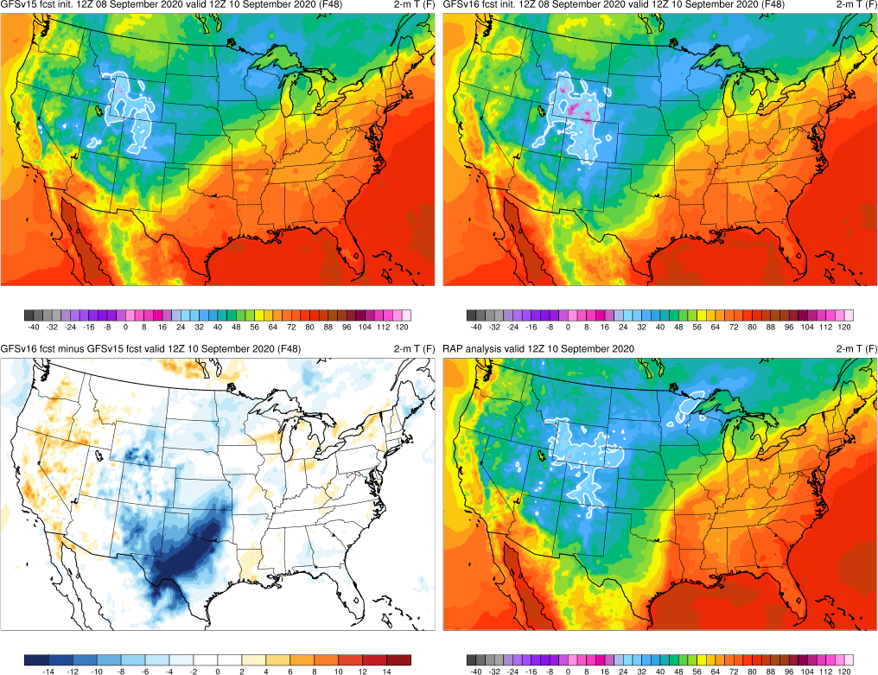
NATIONAL OCEANIC AND ATMOSPHERIC ADMINISTRATION
Strengths: Position of Frontal Boundaries
Cold Front Example
Fcst: 12z 09/08/20 (F048) Valid: 12Z 09/10/20
GFSv15
GFSv16
GFSv16 forecasted the position of the cold front more correctly and consistently than GFSv15
v16−v15
RAP Anl.
Thanks to Steverino Silberberg (AWC) from NWS SOO Team

Slide 41
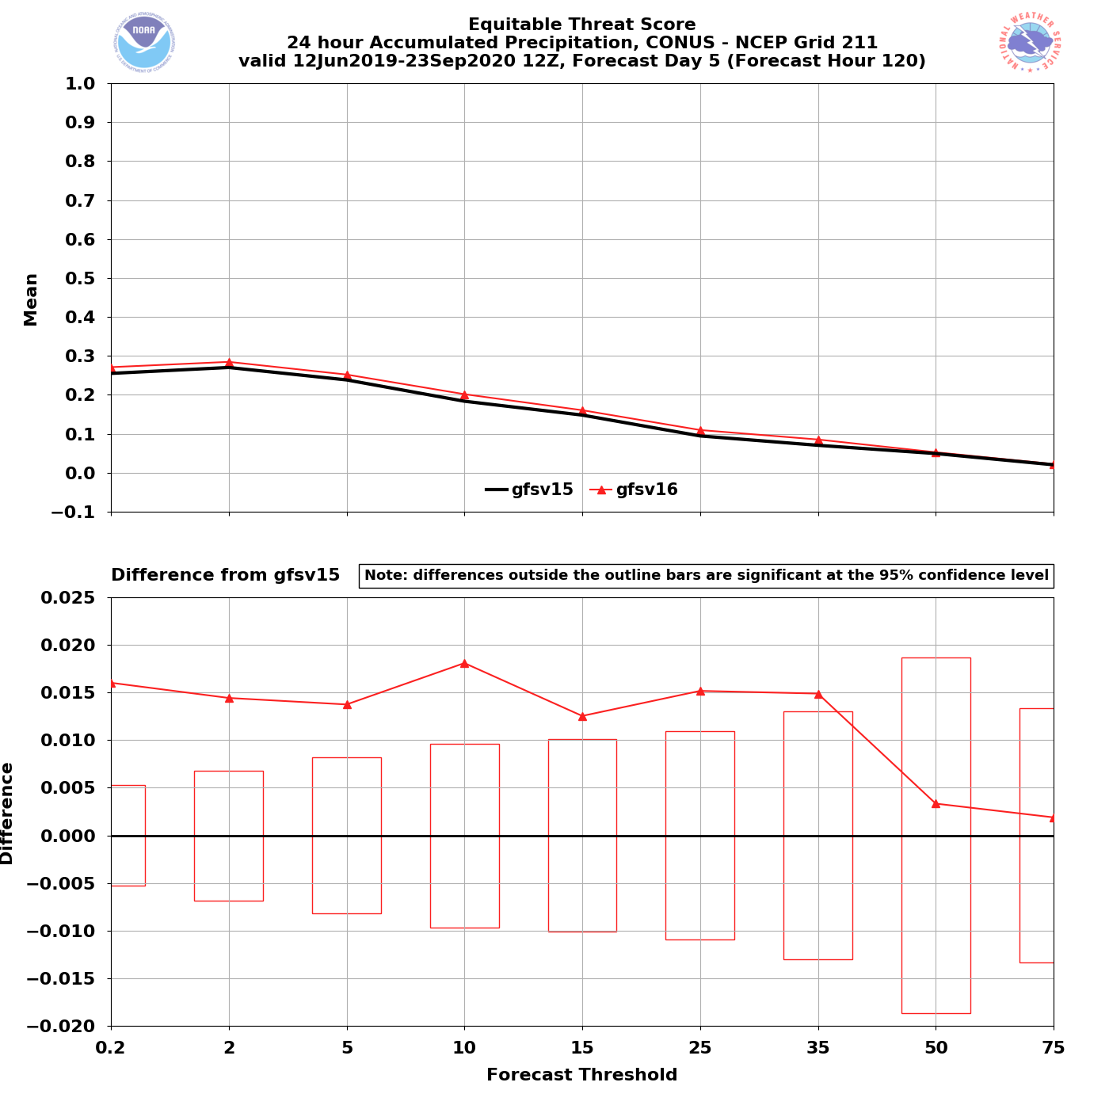
NATIONAL OCEANIC AND ATMOSPHERIC ADMINISTRATION
Strengths: Improved QPF ETS and Bias
Valid: 6/12/19–9/23/20 (F120)
Equitable Threat Score (ETS)
24-h QPF ETS
24-h QPF improvements appear most pronounced in the medium range, which is consistent w/ improved 500-hPa AC scores
F120: Statistically significant improvement at 0.2–35 mm thresholds
Statistically Significant

Slide 42
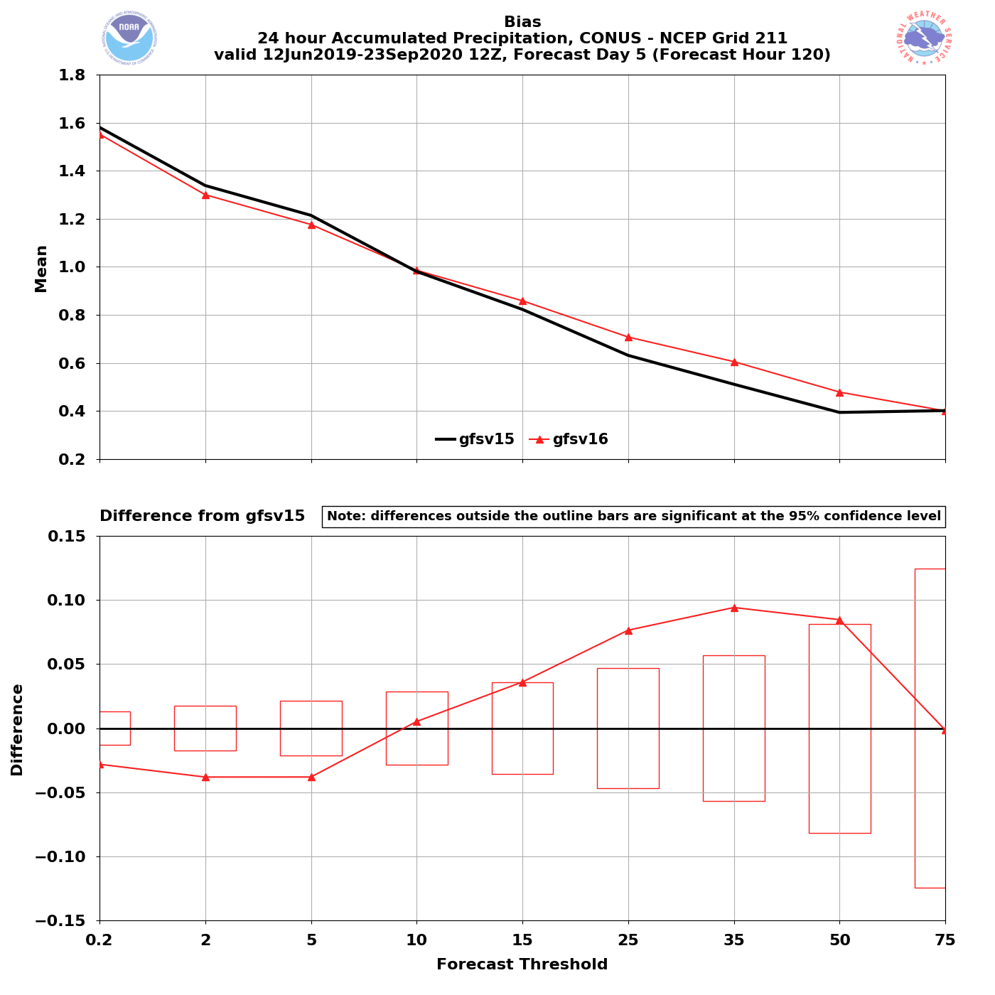
NATIONAL OCEANIC AND ATMOSPHERIC ADMINISTRATION
Strengths: Improved QPF ETS and Bias
Valid: 6/12/19–9/23/20 (F120)
Bias
24-h QPF Bias
24-h QPF bias improvements also most pronounced in the medium range
Reduction of the high bias at lower QPF thresholds is statistically significant
Reduction of the low bias at medium-to-high QPF thresholds is statistically significant
Overall bias improvement is seen in the short range as well
Statistically Significant

Slide 43
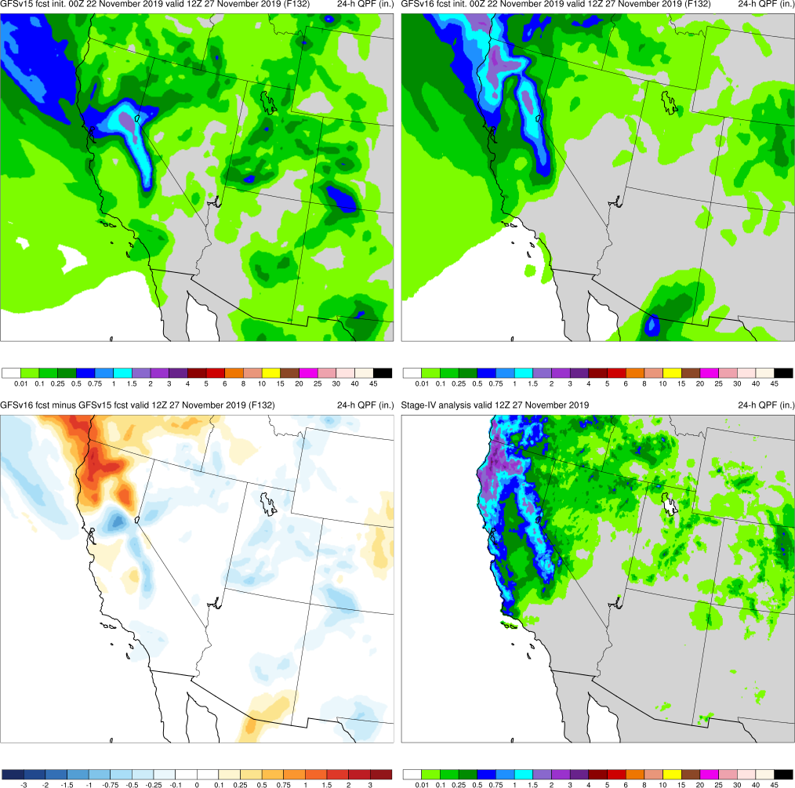
NATIONAL OCEANIC AND ATMOSPHERIC ADMINISTRATION
Strengths: Improved QPF ETS and Bias
West Coast Bomb Cyclone Case
Fcst: 00z 11/22/19 (F132) Valid: 12Z 11/27/19
GFSv16 consistently had (correctly) higher QPF amounts inland over N California and Oregon for this case
GFSv15
GFSv16
v16−v15
Stage IV

Slide 44
NATIONAL OCEANIC AND ATMOSPHERIC ADMINISTRATION
Common Strengths From All Evaluations
Notable improvements in synoptic-scale performance in the medium-range
Progressive bias in GFSv15 appears mitigated with better consistency catching correct solutions earlier
Improved frontal positions and QPF
Improvement in low-level temperature forecasts (mitigation of the winter low-level cold bias)
Better ability to resolve shallow, cold air masses and some associated cold air damming events
Improvements to TC intensity and increased lead time for genesis
With stronger TCs, GFSv16 has overall better track, size, and intensity

Slide 45
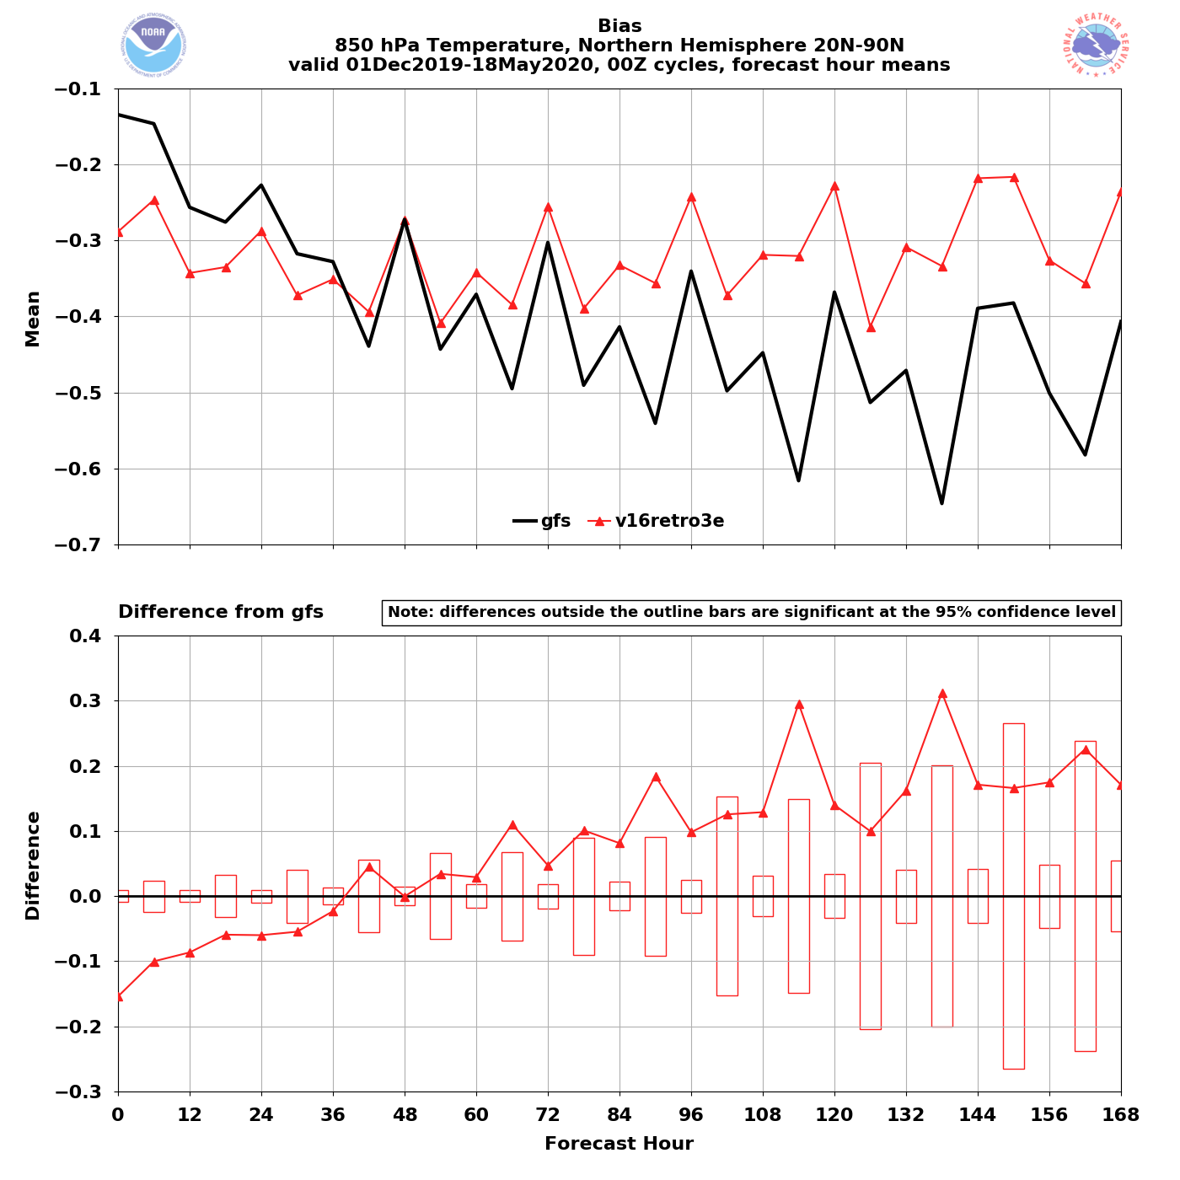
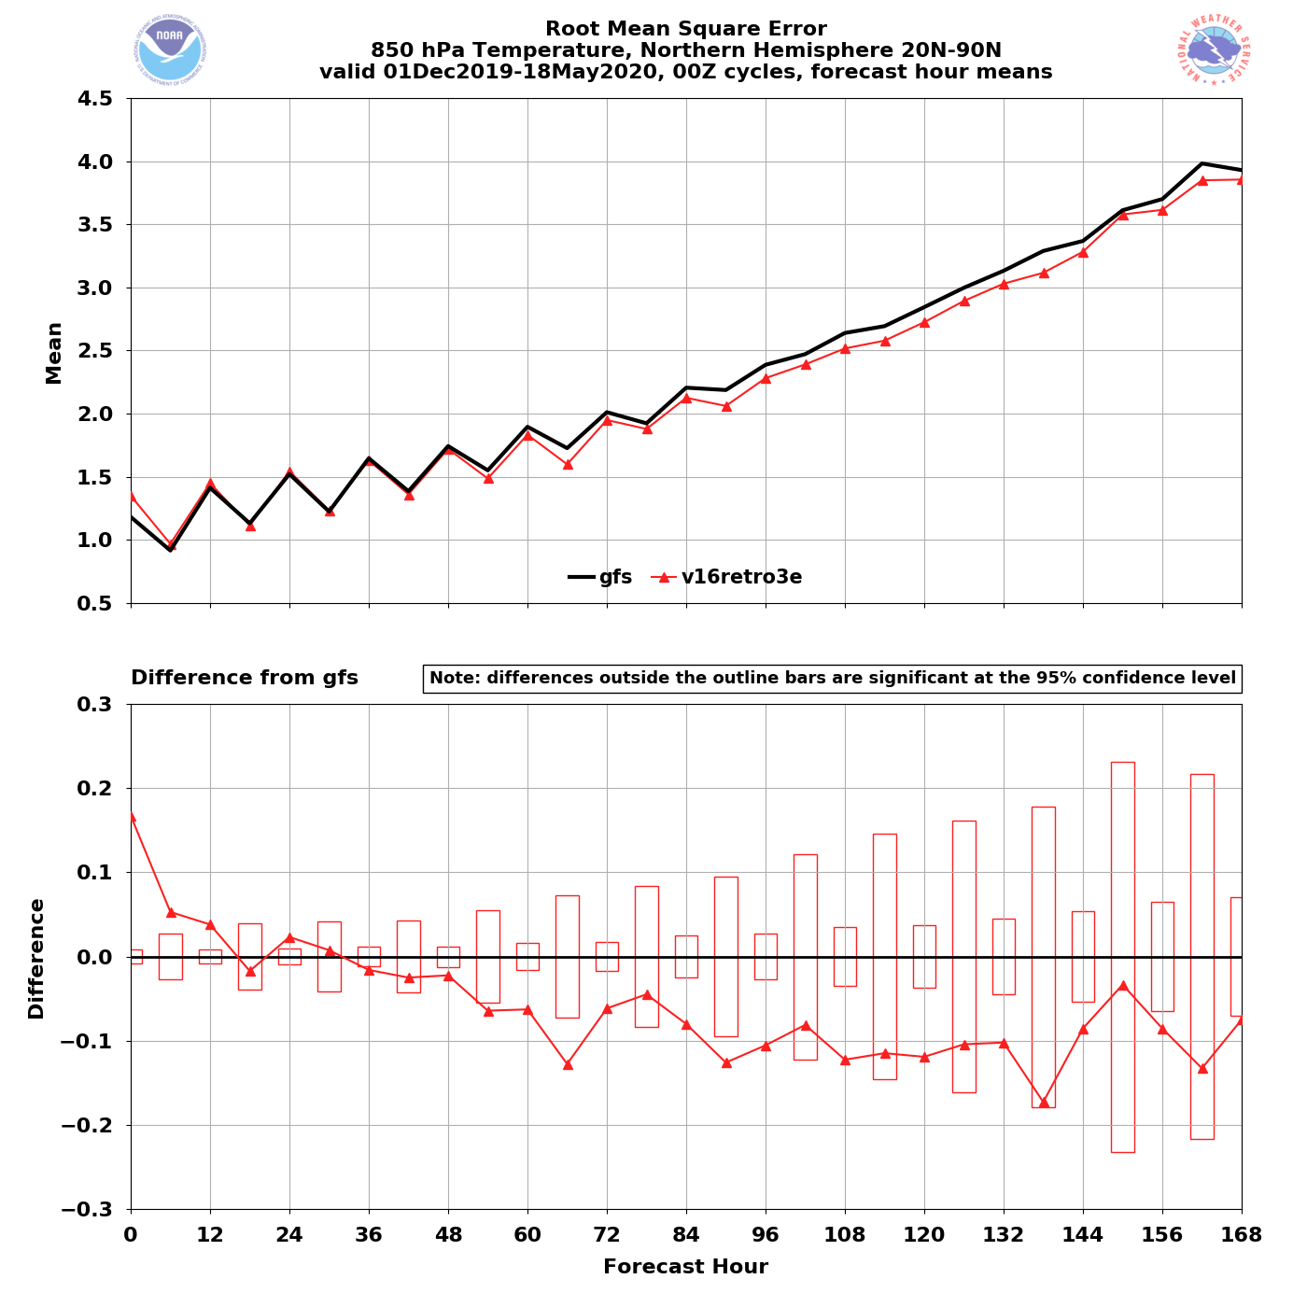
NATIONAL OCEANIC AND ATMOSPHERIC ADMINISTRATION
Strengths: Mitigated Low-Level Cold Bias
GFSv15 has a known low-level cold bias that gets worse with lead time
NH – Winter/Spring 2020
NH – Winter/Spring 2020
00Z
cycles
GFSv16
GFSv15
GFSv16
850T
Bias
GFSv15
850T
RMSE
Grid-to- Obs
GFSv16 − GFSv15
GFSv16 − GFSv15
GFSv16 has less of a cold bias at longer lead times
GFSv16 has lower RMSE at and after F036

Slide 46
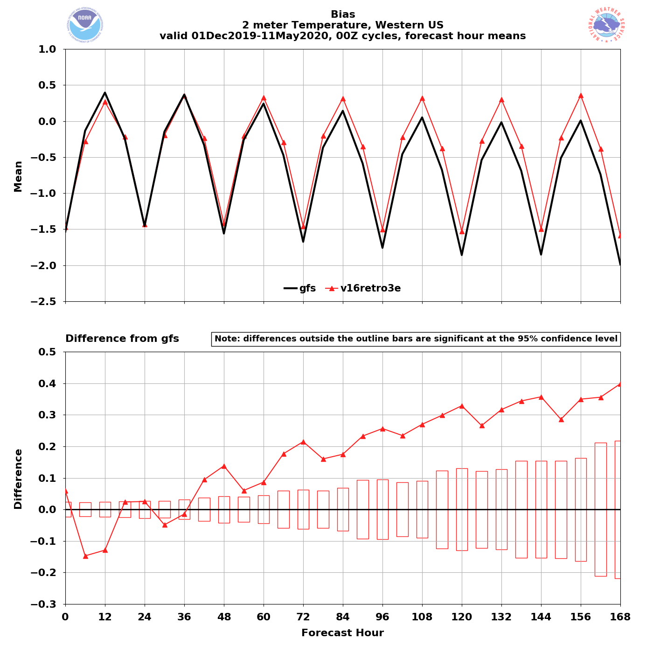
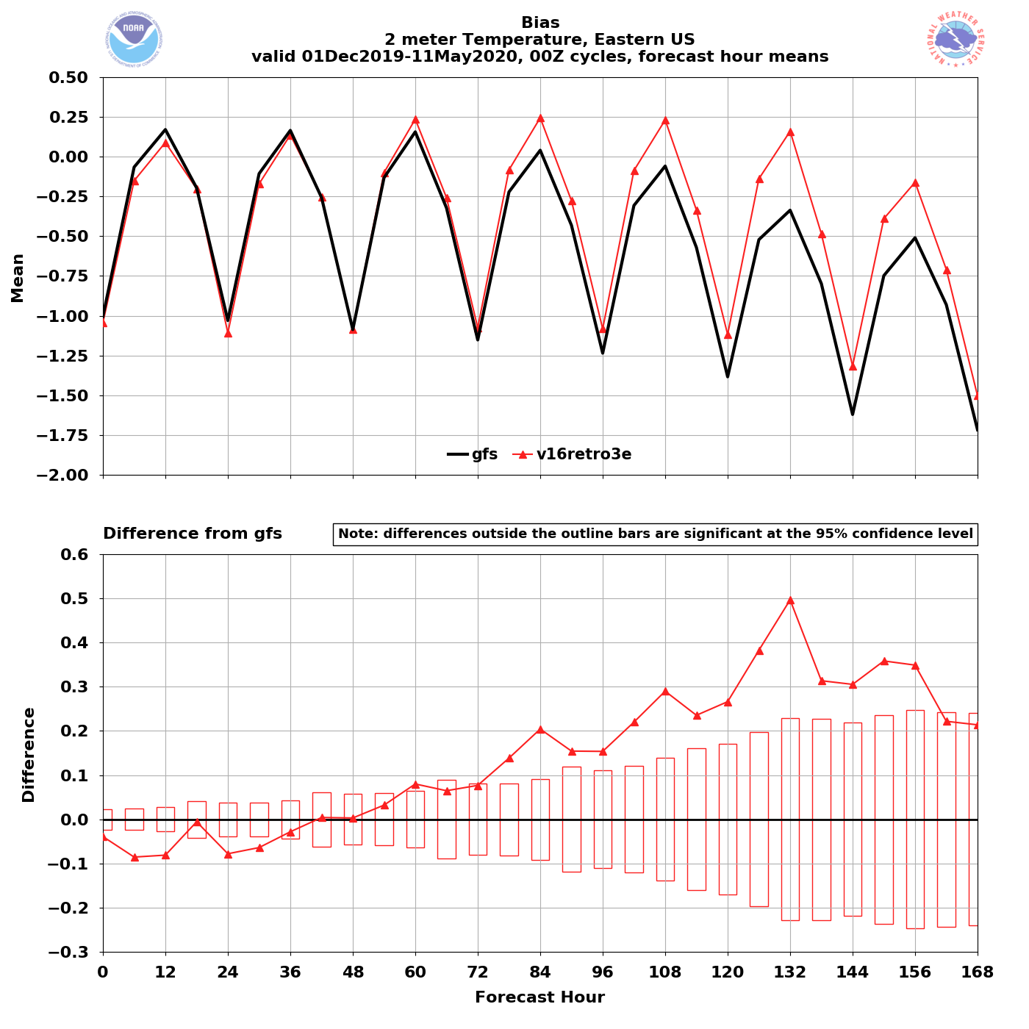
NATIONAL OCEANIC AND ATMOSPHERIC ADMINISTRATION
Strengths: Mitigated Low-Level Cold Bias
Western US – Winter/Spr. 2020
Eastern US – Winter/Spr. 2020
00Z
cycles
GFSv15
GFSv16
GFSv15
GFSv16
2-m T Bias
2-m T Bias
Grid-to- Obs
GFSv16 has less of a cold bias at longer lead times for 00z
valid times
GFSv16 has less of a cold bias at longer lead times

Slide 47
NATIONAL OCEANIC AND ATMOSPHERIC ADMINISTRATION
Common Strengths From All Evaluations
Notable improvements in synoptic-scale performance in the medium-range
Progressive bias in GFSv15 appears mitigated with better consistency, catching correct solutions earlier
Improved frontal positions and QPF
Improvement in low-level temperature forecasts (mitigation of the winter low-level cold bias)
Better ability to resolve shallow, cold air masses and some associated cold air damming events
Improvements to TC intensity and increased lead time for genesis
With stronger TCs, GFSv16 has overall better track, size, and intensity

Slide 48
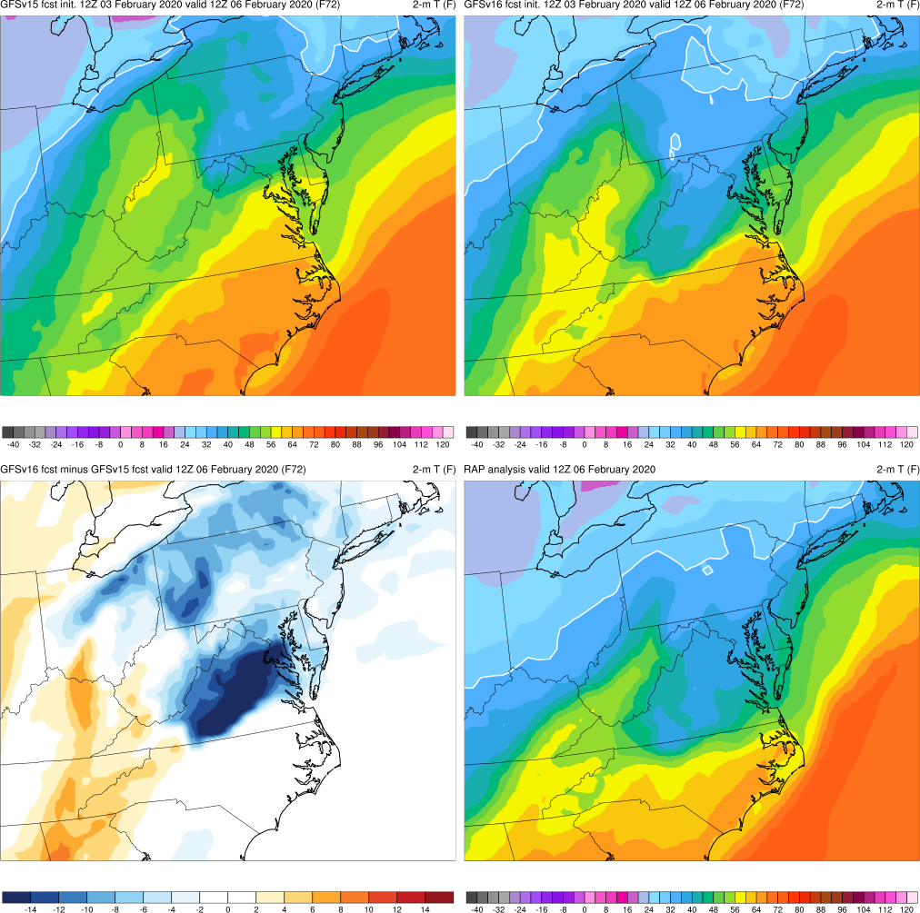
NATIONAL OCEANIC AND ATMOSPHERIC ADMINISTRATION
Strengths: Temps in Shallow, Cold Air Masses
GFSv15
GFSv16
Mid-Atlantic Severe Case
Fcst: 12z 02/03/20 (F072) Valid: 12Z 02/06/20
GFSv16 was correctly colder than GFSv15 over VA/MD area, where cold air damming is occurring along the eastern Appalachians
Improved 2-m T forecasts in shallow, cold air masses may be tied to a better handling of low-level clouds
This is a long-standing GFS issue for which there seems to be some v16 improvement
v16−v15
RAP Anl.

Slide 49
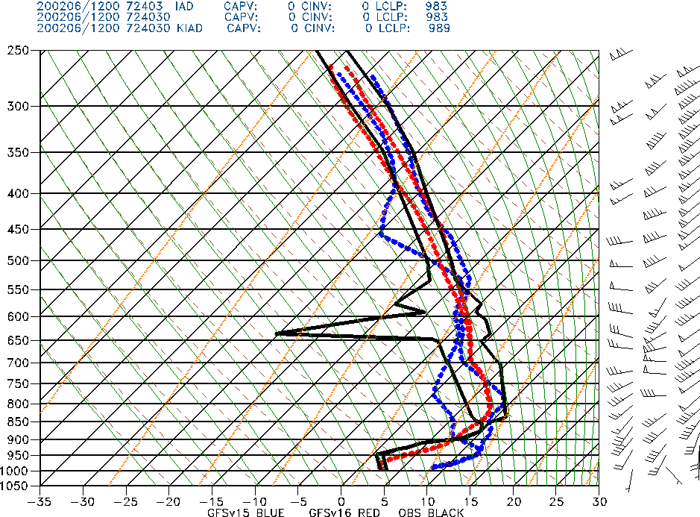
NATIONAL OCEANIC AND ATMOSPHERIC ADMINISTRATION
Strengths: Temps in Shallow, Cold Air Masses
Mid-Atlantic Severe Case
Fcst: 12z 02/03/20 (F072) Valid: 12Z 02/06/20
Dulles, VA
(IAD)
OBS
GFSv15
GFSv16
F072: GFSv16 was correctly colder than GFSv15 over VA/MD area, where cold air damming is occurring along the eastern Appalachians
Improved 2-m T forecasts in shallow, cold air masses may to be tied to a better handling of low-level clouds

Slide 50
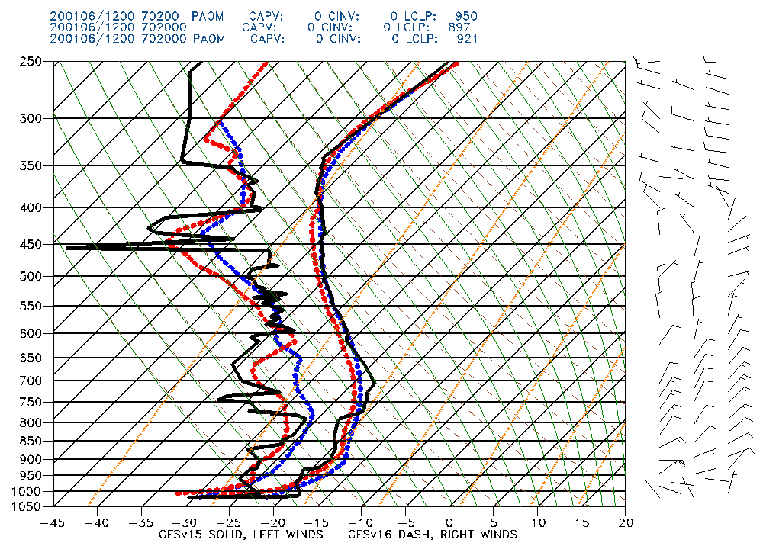
NATIONAL OCEANIC AND ATMOSPHERIC ADMINISTRATION
Strengths: Temps in Shallow, Cold Air Masses
Fcst: 00z 01/06/20 (F012) Valid: 12Z 01/06/20
Nome, AK
(KOME)
Example of here of dramatic improvement in GFSv16 with handling the low-level temp. profile in a shallow arctic air mass over Alaska
Alaska Region did note some overall GFSv16 improvement in this type of event
OBS
GFSv15
GFSv16

Slide 51
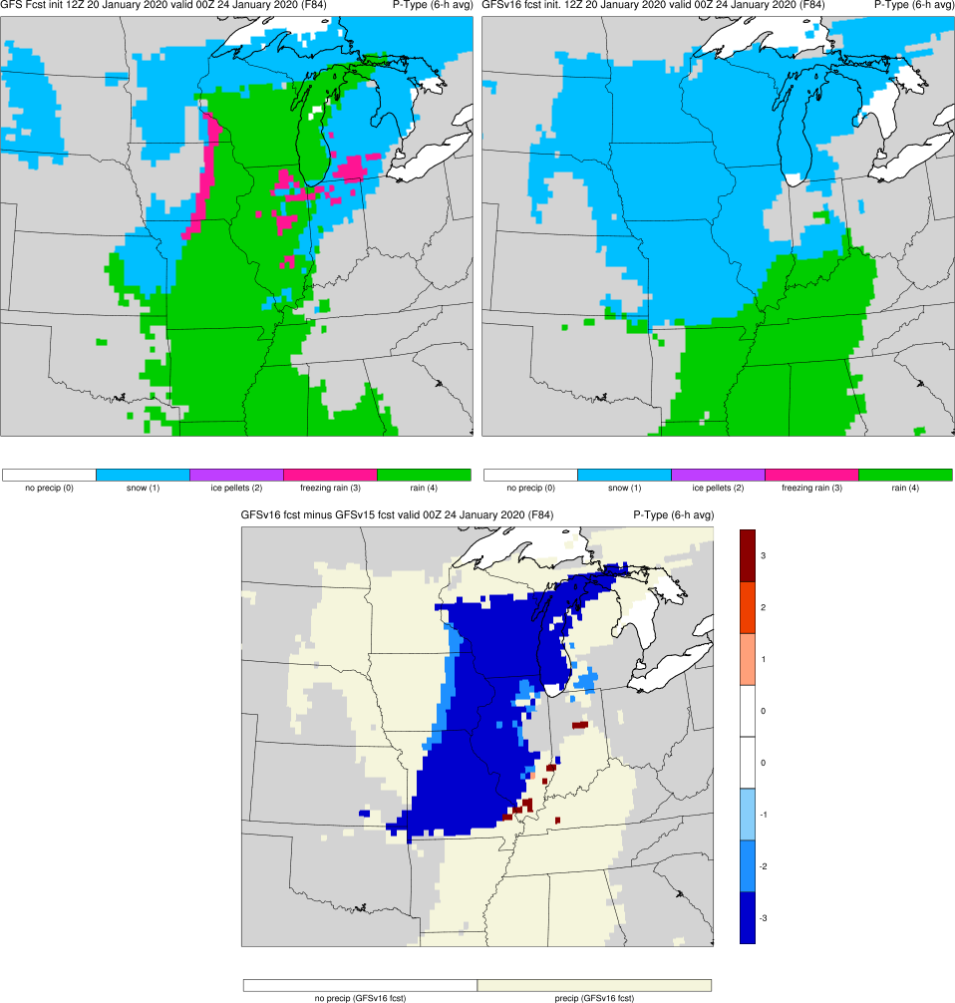
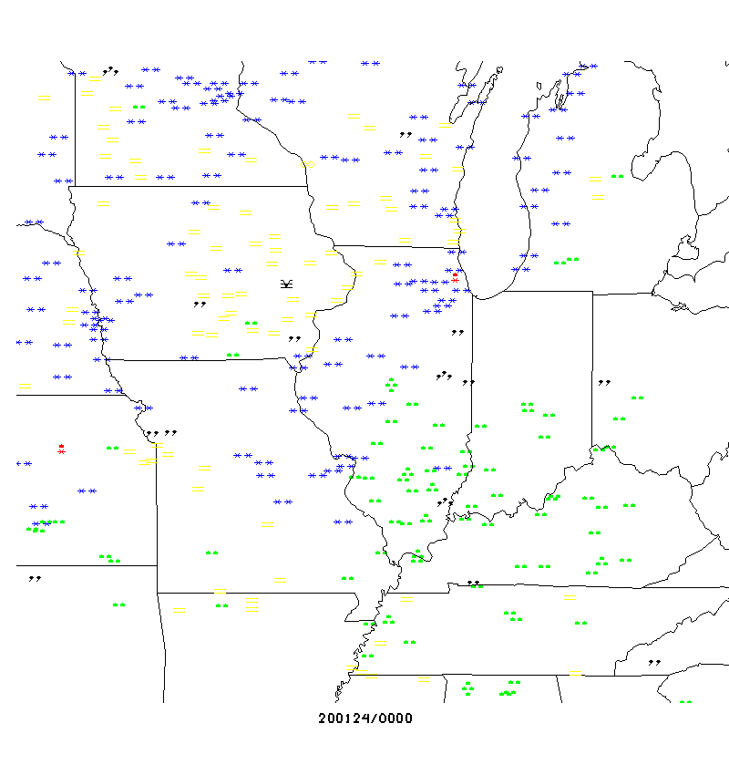
NATIONAL OCEANIC AND ATMOSPHERIC ADMINISTRATION
Strengths: Resolved Low-level Warming Issue
Midwest Ptype Event
Fcst: 12z 01/20/20 (F084)
Valid: 00Z 01/24/20
An odd GFSv15 low-level warming issue that was seen a few cases last winter in GFSv15 appears to be resolved in GFSv16. In this example, GFSv15 forecasts rain over IA/IL/WI/MO where snow occurred; GFSv16 forecast is much improved
GFSv15
GFSv16
v16−v15
Obs
Thanks to Ray Wolf (WFO DVN)
See 2/6/20 MEG Presentation

Slide 52
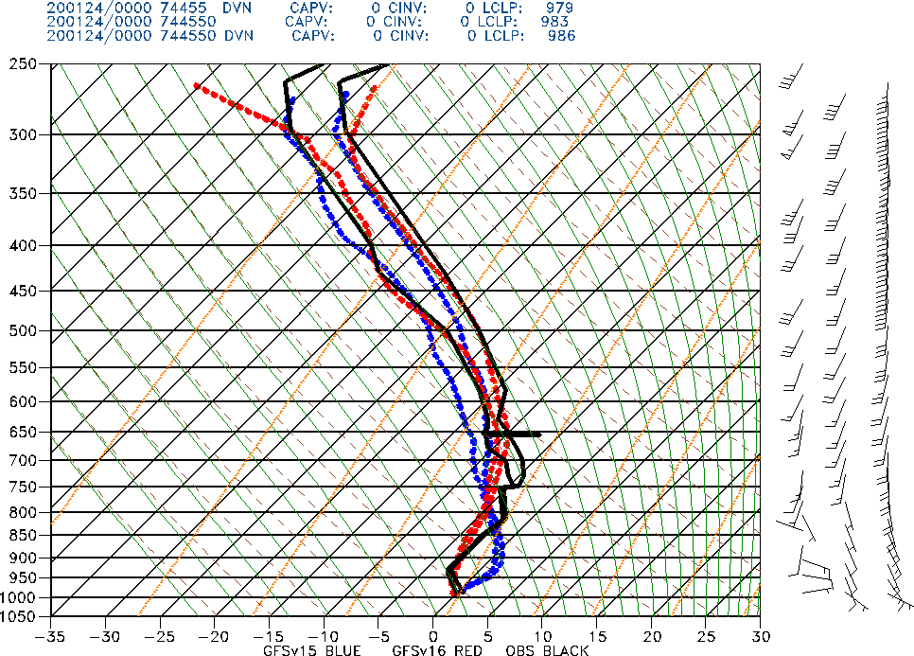
NATIONAL OCEANIC AND ATMOSPHERIC ADMINISTRATION
Strengths: Resolved Low-level Warming Issue
Midwest Ptype Event
Fcst: 12z 01/20/20 (F084) Valid: 00Z 01/24/20
Davenport, IA
(DVN)
The improvement is shown in this example in which GFSv15 shows erroneous low-level warming that did not occur. GFSv16 has a correctly colder profile
GFSv15
GFSv16
OBS

Slide 53
NATIONAL OCEANIC AND ATMOSPHERIC ADMINISTRATION
Common Strengths From All Evaluations
Notable improvements in synoptic-scale performance in the medium-range
Progressive bias in GFSv15 appears mitigated with better consistency catching correct solutions earlier
Improved frontal positions and QPF
Improvement in low-level temperature forecasts (mitigation of the winter low-level cold bias)
Better ability to resolve shallow, cold air masses and some associated cold air damming events
Improvements to TC intensity and increased lead time for genesis
With stronger TCs, GFSv16 has overall better track, size, and intensity

Slide 54
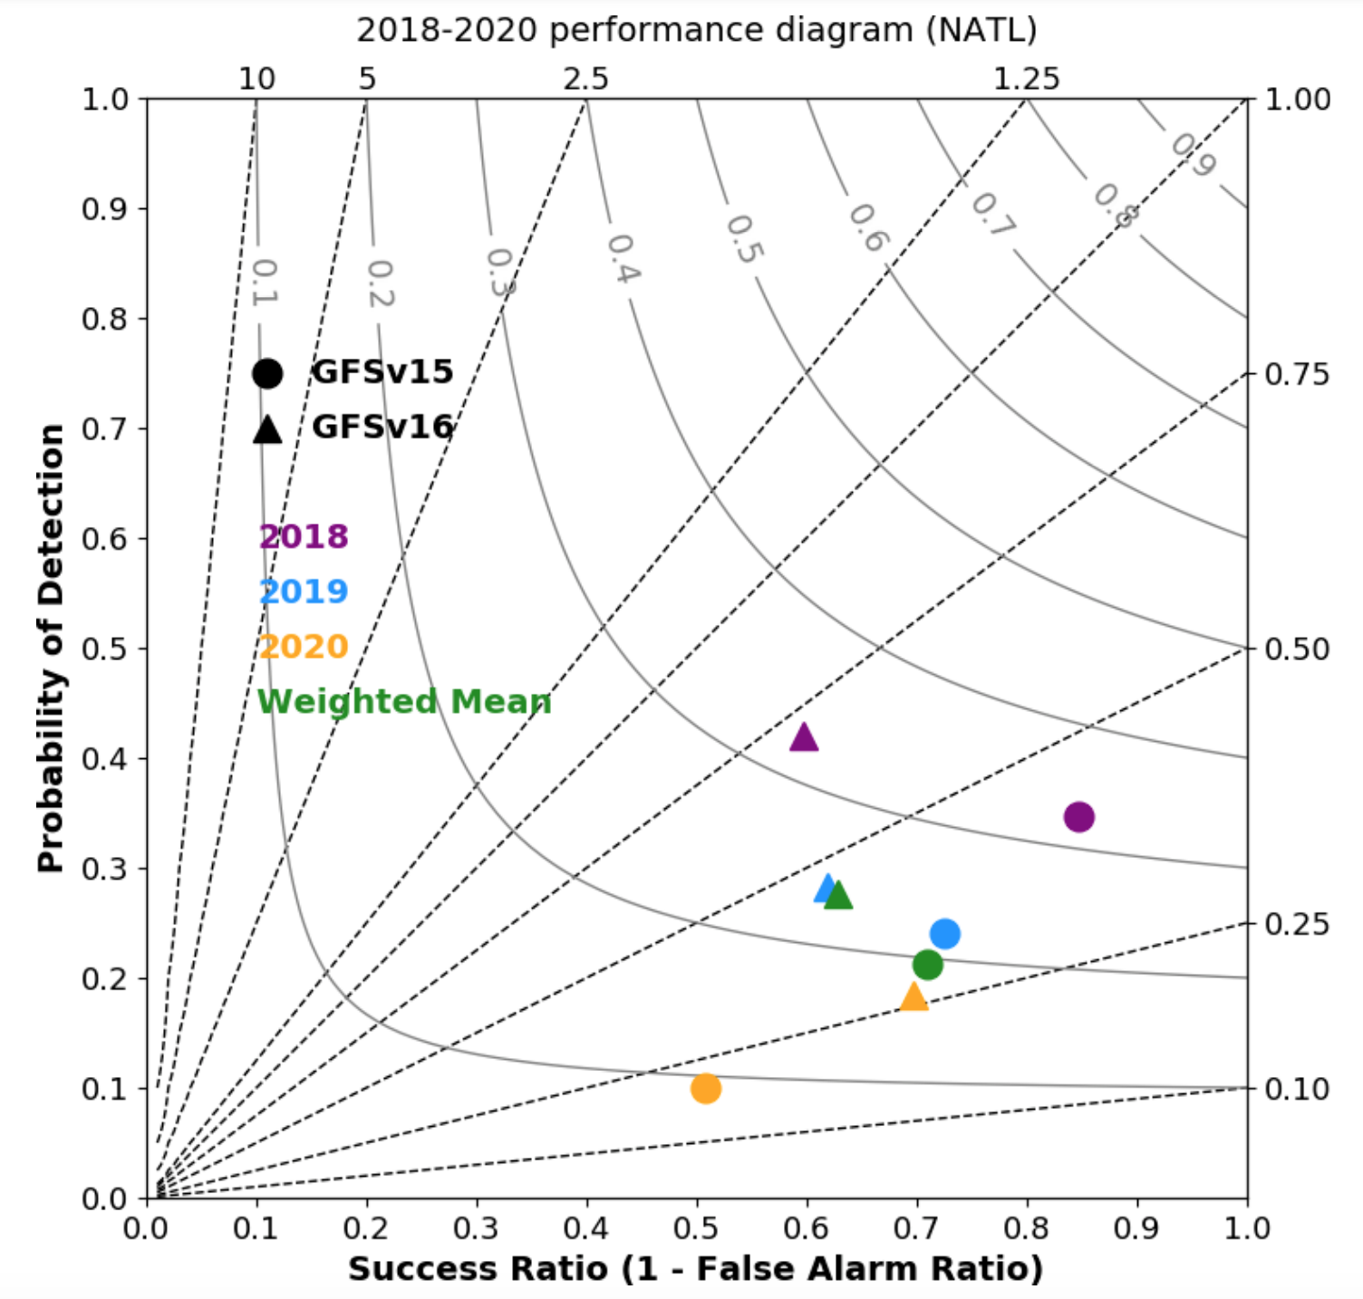
NATIONAL OCEANIC AND ATMOSPHERIC ADMINISTRATION
Strengths: Identifies TCs More Often & Earlier
Legend:
x-axis: Success Ratio (1−FAR)
y-axis: Probability Of Detection (POD)
dashed lines: Frequency Bias
solid lines: Critical Success Index (CSI)
All values would equal 1 in a perfectly performing model
On average, GFSv16 exhibits:
Larger POD and CSI (closer to 1)
Frequency Bias is closer to 1
Smaller Success Ratio (FAR too high)
GFSv16 is more cyclogenetic than GFSv15, and it identifies genesis with more lead time
Thanks to Dan Halperin (ERAU)

Slide 55
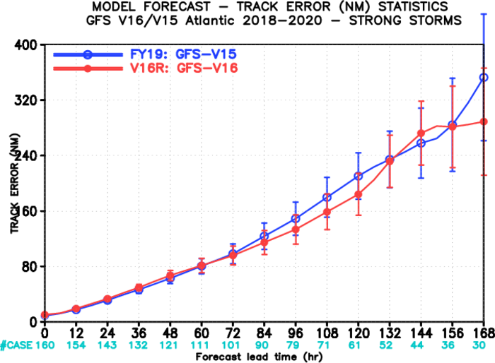
NATIONAL OCEANIC AND ATMOSPHERIC ADMINISTRATION
Strengths: Improved Medium-Range Track Error
North Atlantic Track Error (nm) for TCs ≥65 kt
East Pacific Track Error (nm) for TCs ≥65 kt
GFSv15
GFSv15
GFSv16
GFSv16
Images provided by Jiayi Peng
GFSv16 has lower track error than GFSv15 for strong TCs (≥65 kt) during most of the medium range in both the North Atlantic and East Pacific

Slide 56
NATIONAL OCEANIC AND ATMOSPHERIC ADMINISTRATION
Strengths: Improved Medium-Range Track Error
GFSv15
GFSv16
TC Dorian
Fcst: 00z 08/30/19 (F132) Valid: 12Z 09/04/19
GFSv16 forecasted Dorian to track north of Puerto Rico more than 24 h earlier than GFSv15 (not shown)
Shown here, GFSv16 forecasted Dorian to turn right and skim the Florida coast 36 h earlier than GFSv15
v16−v15
GFS Anl.

Slide 57
NATIONAL OCEANIC AND ATMOSPHERIC ADMINISTRATION
Strengths: Improved TC Intensity in N Atlantic
North Atlantic Intensity Error (kt)
North Atlantic Intensity Bias (kt)
Strong
GFSv15
GFSv16
Weak
GFSv15
GFSv16
Images provided by Jiayi Peng
GFSv16 has lower intensity error than GFSv15 at almost all lead times in the N Atlantic
GFSv16 has less of a weak bias than GFSv15 at longer lead times

Slide 58
NATIONAL OCEANIC AND ATMOSPHERIC ADMINISTRATION
Strengths: Improved TC Intensity in N Atlantic
GFSv15
GFSv16
TC Michael
Fcst: 12z 10/08/18 (F048) Valid: 12Z 10/10/18
Michael: GFSv16 consistently (and correctly) forecasted a stronger TC than GFSv15
v16−v15
RAP Anl.
Best Track:
125 kt

Slide 59
NATIONAL OCEANIC AND ATMOSPHERIC ADMINISTRATION
Common Concerns Across the Evaluations
Increased right-of-track bias at longer lead times for North Atlantic TCs
Larger TC False Alarm Rate (FAR) in the western North Atlantic (70°W–50°W)
Tendency to strengthen all TCs in the long range (pre-formation, not in stats)
Exacerbation of low instability (i.e., CAPE) bias that already existed in GFSv15, driven largely by dry soil moisture
Lack of considerable improvement in forecasting radiation inversions

Slide 60
NATIONAL OCEANIC AND ATMOSPHERIC ADMINISTRATION
Concerns: Increased Right-of-Track Bias
N Atlantic Along-Track Bias
N Atlantic Across-Track Bias
Fast
Right
GFSv16
GFSv15
GFSv15
GFSv16
Slow
Left
Images provided by Jiayi Peng
A slower and right-of-track bias at longer lead times suggests that GFSv16 may be recurving TCs earlier than GFSv15
GFSv16 has a larger slow bias than GFSv15 that grows with forecast length in the N Atlantic
GFSv16 has a larger right-of-track bias than GFSv15 that is largest at longer lead times

Slide 61
NATIONAL OCEANIC AND ATMOSPHERIC ADMINISTRATION
Concerns: Increased Right-of-Track Bias
TC Isaias
Fcst: 18z 07/30/20 (F096) Valid: 18Z 08/03/20
GFSv16 was often further right of track than v15 in the short and medium ranges. Both are also too fast in this example.
GFSv15
GFSv16
v16−v15
GFS Anl.

Slide 62
NATIONAL OCEANIC AND ATMOSPHERIC ADMINISTRATION
Common Concerns Across the Evaluations
Increased right-of-track bias at longer lead times for North Atlantic TCs
Larger TC False Alarm Rate (FAR) in the western North Atlantic (70°W–50°W)
Tendency to strengthen all TCs in the long range (pre-formation, not in stats)
Exacerbation of low instability (i.e., CAPE) bias that already existed in GFSv15, driven largely by dry soil moisture
Lack of considerable improvement in forecasting radiation inversions

Slide 63
NATIONAL OCEANIC AND ATMOSPHERIC ADMINISTRATION
Larger TC False Alarm Rate
From Dan Halperin, ERAU
A further left than the of the same color indicates that v16 has a higher false alarm rate for that season
While preliminary 2020 numbers look good for v16, the weighted mean for the three TC seasons shows that v16 has a larger FAR

Slide 64
NATIONAL OCEANIC AND ATMOSPHERIC ADMINISTRATION
Larger TC False Alarm Rate
From Dan Halperin, ERAU
Large number of false alarms in GFSv16, relative to v15, between 50º and 70º W

Slide 65
NATIONAL OCEANIC AND ATMOSPHERIC ADMINISTRATION
Common Concerns Across the Evaluations
Increased right-of-track bias at longer lead times for North Atlantic TCs
Larger TC False Alarm Rate (FAR) in the western North Atlantic (70°W–50°W)
Tendency to strengthen TCs in the long range (pre-formation, not in stats)
Exacerbation of low instability (i.e., CAPE) bias that already existed in GFSv15, driven largely by dry soil moisture
Lack of considerable improvement in forecasting radiation inversions

Slide 66
NATIONAL OCEANIC AND ATMOSPHERIC ADMINISTRATION
Concerns: Strengthens Too Many TCs
TCs Laura/Marco
Fcst: 18z 08/18/20(F144) Valid: 18Z 08/24/20
Marco: GFSv16 had better track forecasts, but 15 consecutive v16 cycles had Marco as a sub 982 low (with many in the 950s and 960s); no GFSv15 cycle was that intense
GFSv15
GFSv16
Laura: GFSv16 did well with many aspects of the intensity forecast, but this example shows a major threat to south FL that did not materialize
v16−v15
GFS Anl.

Slide 67
NATIONAL OCEANIC AND ATMOSPHERIC ADMINISTRATION
Common Concerns Across the Evaluations
Increased right-of-track bias at longer lead times for North Atlantic TCs
Larger TC False Alarm Rate (FAR) in the western North Atlantic (70°W–50°W)
Tendency to strengthen all TCs in the long range (pre-formation, not in stats)
Exacerbation of low instability (i.e., CAPE) bias that already existed in GFSv15, driven largely by dry soil moisture
Lack of considerable improvement in forecasting radiation inversions

Slide 68
NATIONAL OCEANIC AND ATMOSPHERIC ADMINISTRATION
CAPE Magnitudes Are Reduced in GFSv16
GFSv15
GFSv16
Obs
Operational GFSv15 CAPE analyses/forecasts are consistently lower than obs
CAPE magnitudes in GFSv16 analyses/forecasts are consistently lower than those from GFSv15

Slide 69
NATIONAL OCEANIC AND ATMOSPHERIC ADMINISTRATION
CAPE Magnitudes Are Reduced in GFSv16
GFSv15
GFSv16
v16 - v15
F024
F024
F024
Surface-Based CAPE Forecasts (left and middle) and Forecast Differences (right)
Init: 00Z 07/23/20 Valid: 00Z 07/24/20 (F024)
GFSv16 CAPE was notably lower across the Northern and Central Plains, as well as over the Gulf Coast region and southeast; smaller reductions over the northeast, Ohio Valley, and Mexico

Slide 70
NATIONAL OCEANIC AND ATMOSPHERIC ADMINISTRATION
CAPE Magnitudes Are Reduced in GFSv16
GFSv15
GFSv16
RAP ANL
F024
F024
Surface-Based CAPE Forecasts (left and middle) and Analysis (right)
Init: 00Z 07/23/20 Valid: 00Z 07/24/20 (F024)
The higher CAPE values in GFSv15 are almost always better, and even those are too low
The only cumulative negative SOO team rating (across their complete set of ratings) was for short-range forecasts of CAPE

Slide 71
NATIONAL OCEANIC AND ATMOSPHERIC ADMINISTRATION
Drier Soil Reduces Boundary Layer Moisture
v16 - v15 Differences
F024
Top Level Soil Moisture
F024
2-m Dew Point
F024
Sfc-Based CAPE
F024
Init: 00Z 07/23/20 Valid: 00Z 07/23/20 (F024)
GFSv16 top level soil moisture is considerably drier than in v15
Good alignment between lower 2-m dew points and largest areas of reduced CAPE

Slide 72
NATIONAL OCEANIC AND ATMOSPHERIC ADMINISTRATION
Tendency to Overmix the Boundary Layer
GFSv15 GFSv16 Obs
Fort Worth, TX (FWD)
Norman, OK
(OUN)
Init: 12Z 08/16/20 Valid: 00Z 08/17/20 (F012)
GFSv16 PBL was drier/warmer/deeper than GFSv15 and obs in the unstable air

Slide 73
NATIONAL OCEANIC AND ATMOSPHERIC ADMINISTRATION
Exacerbation of Warm Season Low-Level Dry Bias
GFSv15 Td>=60F
GFSv16 Td>=60F
GFSv15 Td>=70F
GFSv16 Td>=70F
GFSv15
GFSv16
Northern Plains 2-m Td Bias as a
Function of Forecast Lead
Frequency Bias for 2-m TD > 60F as a
Function of Forecast Lead
courtesy: SPC

Slide 74
NATIONAL OCEANIC AND ATMOSPHERIC ADMINISTRATION
Common Concerns Across the Evaluations
Increased right-of-track bias at longer lead times for North Atlantic TCs
Larger TC False Alarm Rate (FAR) in the western North Atlantic (70°W–50°W)
Tendency to strengthen all TCs in the long range (pre-formation, not in stats)
Exacerbation of low instability (i.e., CAPE) bias that already existed in GFSv15, driven largely by dry soil moisture
Lack of considerable improvement in forecasting radiation inversions

Slide 75
NATIONAL OCEANIC AND ATMOSPHERIC ADMINISTRATION
Inversions
2m Temp Errors Analysis - Forecast
Fcst: 12Z 04/29/20 (F024)
Valid: 12Z 04/30/20
Very large errors for a short range forecast. GFSv16 appears to offer very slight improvement, but both forecasts are far too warm over the Plains and upper Midwest
The lack of a sufficiently strong inversion shows up well in the forecast soundings
GFS
v15
NAM error map for same case shows
that this type of case (strong radiational cooling) can be handled better
GFS
v16

Slide 76
NATIONAL OCEANIC AND ATMOSPHERIC ADMINISTRATION
Inversions - BIS soundings
OBS
v15
v16
Bismarck, ND (BIS)
OBS
GFSV15
GFSv16
Fcst: 12Z 04/29/20 (F024)
Valid: 12Z 04/30/20
GFSv15 and v16 both fail to capture the strength of the low-level inversion and end up way too warm at the lowest levels
GFSv16 shows very modest improvement over v15
Note how the observed winds are weak at the lowest level; both GFS versions have winds that are too strong

Slide 77
NATIONAL OCEANIC AND ATMOSPHERIC ADMINISTRATION
Summary of GFSv16 Evaluations
There were 12 recommendations submitted for the atmospheric component of the evaluation: 10 recommended implementation, and 2 were neutral
The biggest overall positives are the improved medium range synoptic performance of GFSv16 and the mitigated low-level cold bias in the cool season
The biggest negative is the reduction of warm season CAPE values that are already too low in GFSv15
Tropical performance has a mix of improvements and degradation.
There were 3 recommendations submitted for the waves component of the evaluation: 1 recommended implementation, 1 was neutral, and 1 did not recommend implementation
The biggest waves concerns are along the U.S. West Coast and over the North Atlantic, where users like the higher-resolution Multi-1 output grids

Slide 78
NATIONAL OCEANIC AND ATMOSPHERIC ADMINISTRATION
Evaluation Reports from the Field
WPC: Mark Klein
NHC: Mike Brennan
SPC: Israel Jirak
Alaska Region: Emily Niebuhr
OPC: Darin Figurskey

Slide 79
NATIONAL OCEANIC AND ATMOSPHERIC ADMINISTRATION
Evaluation of Downstream Models: HWRF
H221: HWRF (with GFS v16) vs H220 (Operational HWRF) for NATL Basin (Late model)
H221 shows improved track skill for all lead times with skill > 5% at Day 3. Intensity skill is also mostly positive except at days 1 and 5 where it is marginally below H220.

Slide 80
NATIONAL OCEANIC AND ATMOSPHERIC ADMINISTRATION
Evaluation of Downstream Models: HWRF
H221: HWRF (with GFS v16) vs H220 (Operational HWRF) for EPAC Basin (Late model)
For EPAC basin, H221 shows significantly improved track skill for all lead times with skill > 20% at Days 4 and 5. Intensity skill is negative between hrs 30-60 but positive for longer lead times at Days 3-5. Overall, intensity skill for H221 is neutral.

Slide 81
NATIONAL OCEANIC AND ATMOSPHERIC ADMINISTRATION
Evaluation of Downstream Models: HMON
M221: HMON (with GFS v16) vs M220 (Operational HMON) for NATL Basin (Late model)
M221 is behind on track skill but within 5% of most lead times after Day 1. Intensity skill is ahead at all lead times as compared to M220 reaching ~10% from Days 2-4.

Slide 82
NATIONAL OCEANIC AND ATMOSPHERIC ADMINISTRATION
Evaluation of Downstream Models: HMON
M221: HMON (with GFS v16) vs M220 (Operational HMON) for EPAC Basin (Late model)
For EPAC basin, M221 shows significantly improved track skill for all lead times after Day 1 with skill reaching > 10% at Days 4 and 5. Intensity skill is neutral up to Day 3 and then much improved for Days 4 and 5.

Slide 83
NATIONAL OCEANIC AND ATMOSPHERIC ADMINISTRATION
Evaluation of Downstream Models: GEFS
Configuration:
n_sponge=23; Initial perturbations from EnKF f06, with a 20% reduction globally and all vertical levels (3D)
Experiment periods and verifications
Against own analysis and the GEFSv11; Summer month: 7/15 - 8/15/2020
Winter month 1/1 - 1/31/2020
Summer
Winter
Compared to GEFSv11, about 20 hours improvement of CRPS for NH 500 hPa for both summer and winter months (similar performance compared to GEFSv12, evaluation done for a different 20-day period in summer, not shown)

Slide 84
NATIONAL OCEANIC AND ATMOSPHERIC ADMINISTRATION
Evaluation of Downstream Models: GEFS
NH 500hPa Ensemble Mean RMS & Spread
Summer
Winter
After 20% globally reduced initial perturbations from EnKF 6hr forecast, we have seen a reasonable spread for short lead-times, and very comfortable error-spread ratio for all the lead-times. The ensemble mean RMS errors are reduced and ensemble spread increased for all extended forecasts.

Slide 85
NATIONAL OCEANIC AND ATMOSPHERIC ADMINISTRATION
Evaluation of Downstream Models: GEFS
Summer
Tropical 850hPa Wind Ensemble Mean RMS & Spread
Winter
In tropics, the over-dispersion from GEFSv12 is similar to what was observed before. However, tropical analysis did have large uncertainty. The RMS error could be over/underestimated from single analysis. Evaluation against consensus analysis confirms over-dispersive nature of GEFSv12 tropical winds in the lower troposphere.

Slide 86
NATIONAL OCEANIC AND ATMOSPHERIC ADMINISTRATION
Evaluation of Downstream Models: GEFS
>1 mm/24 hrs
>10 mm/24 hrs
Summertime QPF Brier Skill Score (BSS) and reliability diagrams
There is significant improvement of PQPF forecasts for all threats and all forecast lead-time. The precipitation forecasts are much more reliable than GEFSv11.

Slide 87
NATIONAL OCEANIC AND ATMOSPHERIC ADMINISTRATION
Evaluation of Downstream Models: NWPS
NWPS v1.3 Para with GFSv15
NWPS v1.3 Para with GFSv16
Changes from GFSv15 to GFSv16 do not adversely affect downstream NWPS
New wave boundary conditions from GFSv16-Wave appear realistic
U10
U10
36 coastal WFO model domains
Each uses wave boundary conditions from Global WW3
U10 wind fields are used as fail-over in case on-demand GFE forecaster wind fields are unavailable
Hs
Hs
Impact of GFSv16-Wave BCs & GFSv16 U10 atmospheric forcing

Slide 88
NATIONAL OCEANIC AND ATMOSPHERIC ADMINISTRATION
Evaluation of Downstream Models: LAMP
Limited impact assessment on LAMP from the GFSv16 upgrade
Some differences, particularly in bias scores, but not egregious
Biggest concern was the impact on C&V for the cool season. No alarming differences between OPER LAMP and PARA LAMP for C&V for the sample verified

Slide 89
NATIONAL OCEANIC AND ATMOSPHERIC ADMINISTRATION
Summary of GFSv16 Downstream Evaluations
HWRF driven by GFSv16 showed general improvement in the North Atlantic Basin for both track and intensity, significant improvement in the Eastern Pacific track forecasts, and mixed results for intensity forecasts.
HMON driven by GFSv16 showed some degradation in the North Atlantic track forecasts, however, small improvements in the intensity forecasts are noted. Eastern Pacific performance is significantly positive for track forecasts while intensity forecasts have improved beyond day 2.
GEFS driven by GFSv16 showed improved CRPS for NH and Tropics. QPF BSS and reliability are significantly improved. Over dispersiveness of winds in the tropics is a concern.
NWPS driven by GFSv16 winds and GFSv16 waves showed no adverse impacts.
LAMP driven by GFSv16 showed similar performance compared to GFSv15 forcing.
All other downstream applications are technically compatible to handle GFSv16 IC/BCs.

Slide 90
NATIONAL OCEANIC AND ATMOSPHERIC ADMINISTRATION
Addressing the concerns on GFS-Waves
OPC has noted degradation of wave forecasts along the U.S. West Coast and over the North Atlantic, where Multi-1 output fared better, especially the 95th percentile winds and seas aggregated over all buoys seemed to be in the favor of Multi-1. However, period and direction seemed better on the GFSv16, and there are improvements in the North Pacific and other global regions.
Removal of high-resolution coastal grids could be contributing to the loss of skill from GFSv16-Waves. However, introduction of wave-ocean current interactions, and improved physics are desirable additions to the wave model.
EMC is conducting evaluation of several cases suggested by OPC to provide more comprehensive assessment of GFSv16-waves, which might help alleviate these concerns.
We haven’t done any evaluation of Multi_1 wave model driven by GFSv16, which may carry similar risks.
We are working in close collaboration with OPC on improving the GFS-Wave component to improve the forecast performance, with possible mitigation steps including re-optimization of physics and/or grid resolutions, and look for out-of-cycle opportunities to upgrade the waves in GFS.

Slide 91
NATIONAL OCEANIC AND ATMOSPHERIC ADMINISTRATION
Impact on Computational Resources
GFSv15 HWM
396 nodes
350 nodes
270 nodes
GFSv16 HWM
760 nodes
668 nodes

Slide 92
NATIONAL OCEANIC AND ATMOSPHERIC ADMINISTRATION
Impact on Timing, Volume, Archive & NOMADS
Delays in v16 with respect to v15
gfs_prep+anal+fcst runs 23.8 min. longer (from 134.4 min. to 158.2 min), still within 8min/day
gdas runs longer by about 19.5 min to 24 min(00z)
enkf runs longer by about 27.5 min
No impact on product delivery times
Daily total data volume (4 cycles) will be reduced from 43TB to 29TB
Significant reduction in enkfgdas forecast output as well as gfs forecast output
HPSS archives will also be reduced from 3.1TB per cycle to 2.9TB per cycle (including waves)
Changes in GFS data disseminated to NOMADS
Size of pgrb products will increase by 80 GB per cycle due to increased vertical levels, precision, and number of variables requested by users (details)
Size of forecast files decreased by 369 GB per cycle. Net decrease of 289 GB per cycle.
PNS issued for product removal: https://www.nco.ncep.noaa.gov/pmb/changes/gfsv16_removal_grids.shtml
No comments received
SCN describing all changes (draft): https://docs.google.com/document/d/1pDLqP6ne2grEJ2vMfw7RnkwyzRsGpGPMb1d2DeDuu2E/edit

Slide 93
NATIONAL OCEANIC AND ATMOSPHERIC ADMINISTRATION
Workflow Changes for GFSv16

Slide 94
NATIONAL OCEANIC AND ATMOSPHERIC ADMINISTRATION
GFSv16 Development and T2O Timeline
Project Plan and Charter drafted and approved – 9/5/2019
Freeze GFSv16 configuration (including waves) for retrospectives – 5/19/2020
Produce full retrospective and real-time experiments: 8/31/2020
Deliver PNS to HQ:
Complete field evaluation: 9/25/2020
EMC CCB: 9/30/2020
MEG final briefing: 10/1/2020
Science briefing to NCEP OD: 10/05/2020 → Completed today
Final IT and EE2 compliance – 10/08/2020
Deliver final package to NCO: 10/09/2020
Transition to Operations: 02/03/2021 (Planned)

Slide 95
NATIONAL OCEANIC AND ATMOSPHERIC ADMINISTRATION
Going Forward
The next upgrades to the GFS are not planned until 2024:
GFSv17 and GEFSv13 will be combined into one single implementation, using fully coupled UFS with coupled data assimilation.
New concerns noted from GFSv16 will become the focus areas for improvement while continue advancing the forecast skill for all metrics
Increased right-of-track bias at longer lead times for North Atlantic TCs
Larger TC False Alarm Rate (FAR) in the western North Atlantic (70°W–50°W)
Tendency to strengthen all TCs in the long range (pre-formation, not in stats)
Exacerbation of low instability (i.e., CAPE) bias that already existed in GFSv15, driven largely by dry soil moisture
Lack of considerable improvement in forecasting radiation inversions
Weaker significant wave heights for high wind events near the coastal regions and in the West Coast
Looking forward to have increased community engagement to continuously advance our GFS!
We now know WHAT. We need to answer WHY?

Slide 96
NATIONAL OCEANIC AND ATMOSPHERIC ADMINISTRATION
Request for Approval of GFSv16 Implementation
The primary objectives of Q3FY21 GDAS/GFSv16 upgrades are met:
Increase the vertical resolution (from 64 to 127 levels), implementation of advanced physics; Advanced 4D-IAU data assimilation with LETKF, new Variational QC and use of additional satellite and aircraft (HDOBS) data; One-way coupling to deterministic Global Wave Model (WaveWatch III) within the UFS framework towards simplifying the production suite.
Evaluation based on 1.5 year retrospective and real-time experiments and for atmospheric and wave components
Excessive cold bias in the winter season – mitigated
Progressive bias for synoptic scale systems - improved
Less skillful TC track forecasts, especially for stronger storms - improved, especially with HDOBS assimilation
Low bias for stratospheric temperature forecasts - improved
Precipitation dry bias for moderate rainfall - improved
Poor representation of boundary layer inversions – Not much improvement.
Favorable evaluation & endorsement from stakeholders (except OPC).
EMC requests NCEP Director to approve implementation of Q3FY21 GDAS/GFSv16 package into operations

