Slide 1
NATIONAL OCEANIC AND ATMOSPHERIC ADMINISTRATION
GFSv16 MEG Evaluation Overview
GFSv15 (F120)
GFSv16 (F120)
GFS Analysis
L
L
Geoff Manikin, Alicia Bentley, Shannon Shields, Chris MacIntosh, Philippe Papin, Logan Dawson
EMC Model Evaluation Group Webinar
24 September 2020

Slide 2
NATIONAL OCEANIC AND ATMOSPHERIC ADMINISTRATION
Goals of the GFSv16 Upgrade
Reduce the low-level cold bias seen in GFSv15 during the cool season
Improve handling of inversions in the planetary boundary layer (PBL)
Reduce near-surface temperature biases in all seasons
Improve forecasts of the upper atmosphere
Replace the operational Global Wave Deterministic model (Multi-1) with a wave component coupled to the atmosphere (in GFSv16)
Transition GFS evaluation materials from VSDB to MET/METplus

Slide 3
NATIONAL OCEANIC AND ATMOSPHERIC ADMINISTRATION
GFSv16 Updates
Model resolution:
Increased vertical resolution from 64 to 127 layers and model top raised from 54 km to 80 km
Physics updates
PBL/turbulence: K-EDMF => sa-TKE-EDMF
Orographic Gravity Wave Drag: => Orographic + non-orographic GWDs
Radiation: Updates to cloud-overlap assumptions
Microphysics: Improvements to GFDL MP
Coupling to Wave
One-way coupling of atmospheric model with Global Wave Model (GWM)
Major Data Assimilation Upgrades:
Local Ensemble Kalman Filter (LETKF)
4-Dimensional Incremental Analysis Update (4DIAU)
Height increments are added, and specific humidity increments are reduced in the stratosphere and mesosphere
Improved Near Surface Sea Temperature (NSST) analysis
Land Data Assimilation (GLDAS) for spinning up soil moisture

Slide 4
NATIONAL OCEANIC AND ATMOSPHERIC ADMINISTRATION
GFSv16 Evaluation Details
The GFSv16 official evaluation included analyses of:
Retrospectives (5/5/19–5/18/20; added 8/31/18–10/12/18)
Statistics
Case Studies
Real-time Parallel (5/19/20–present)
Statistics
Representative examples
The GFSv16 official evaluation also incorporated the findings of an STI team of NWS SOOs tasked with analyzing GFSv16 forecasts

Slide 5
NATIONAL OCEANIC AND ATMOSPHERIC ADMINISTRATION
GFSv16 Evaluation Details
GFSv16 evaluation statistics were generated for a variety of retrospective and real-time streams (webpage links are in blue)
GFSv16 Retrospective Stream 0 (5/5/19–5/31/19) [Click here]
GFSv16 Retrospective Stream 1 (6/1/19–8/31/19) [Click here]
GFSv16 Retrospective Stream 2 (9/1/19–11/30/19) [Click here]
GFSv16 Retrospective Stream 3 (12/1/19–5/18/20) [Click here]
GFSv16 Retrospective Stream 4 (combined with Stream 3)
GFSv16 Retrospective Stream 5 (8/31/18–10/12/18) [Click here]
GFSv16 Real-time Stream (5/19/20–present) [Click here]

Slide 6
NATIONAL OCEANIC AND ATMOSPHERIC ADMINISTRATION
GFSv16 Case Studies (N = 50)
Tropical Cyclones
Winter Storms
North Atlantic
Florence (2018) Michael (2018)
Barry (2019)
Dorian (2019)
Humberto (2019)
Imelda (2019)
Karen (2019)
Lorenzo (2019) Nestor (2019)
Olga (2019)
East Pacific
Barbara (2019) Erick/Flossie (2019)
Juliette (2019)
Kiko (2019)
Lorena (2019)
South Pacific
Sarai (2019)
Vicky (2020)
Northern U.S. October Snow (Oct 2019)
Alaska Snow Storm (Nov 2019)
West Coast Bomb Cyclone (Nov 2019)
Chicago Thanksgiving Travel (Nov 2019)
Eastern N. American Bomb (Dec 2019)
NY Ice Storm (Dec 2019)
Alaska New Year Storm (Jan 2019)
Pacific Northwest Windstorm (Jan 2019)
Nova Scotia Cyclone (Jan 2020)
Mid-West ptype Issues (Jan 2020)
Alaskan Cyclone (Jan 2020)

Slide 7
NATIONAL OCEANIC AND ATMOSPHERIC ADMINISTRATION
GFSv16 Case Studies (N = 50)
Severe Weather
Excessive QPF
Mid-May Severe (May 2019)
Late-May Severe (May 2019)
Mid-Atlantic Severe (Feb 2020)
Tennessee Tornadoes (Feb 2020)
Easter Sunday Severe (Apr 2020)
Southeast Severe (Apr 2020)
Southern Plains ENH (May 2020)
California Storm (May 2019)
Halloween Storm (Oct/Nov 2019)
Post-Thanksgiving Storm (Nov/Dec 2019)
Northwest Atmospheric River (Jan 2020)
Southern U.S. QPF (Feb 2020)
Extreme Temps
Mem. Day Heat (May 2019)
San Francisco Heat (Jun 2019)
Eastern U.S. Heat (Jul 2019)
Alaska Wildfires (Aug 2020)
Southern U.S. Heat (Aug 2019)
Intermountain W Cold (Oct 2019)
Central U.S. Cold (Nov 2020)
January Cold Blast (Jan 2020)
Valentine’s Day (Feb 2020)
Mother’s Day Cold (May 2020)

Slide 8
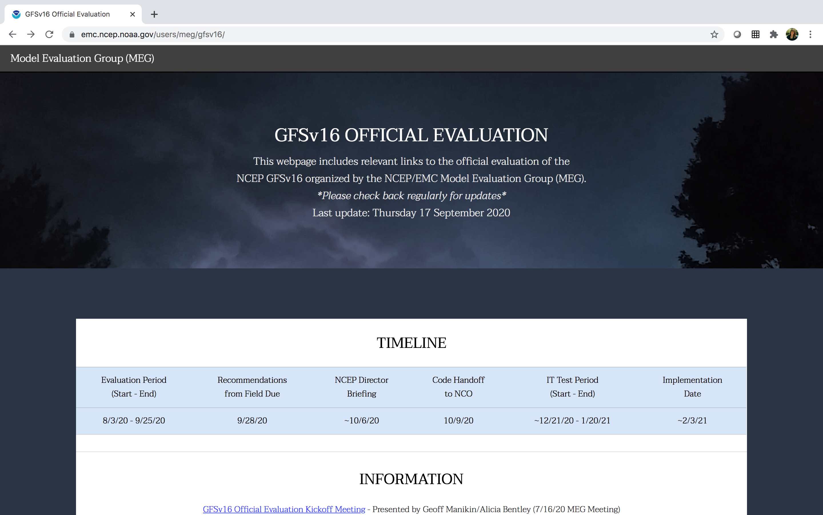
NATIONAL OCEANIC AND ATMOSPHERIC ADMINISTRATION
GFSv16 Evaluation Webpage
https://www.emc.ncep.noaa.gov/users/meg/gfsv16/

Slide 9
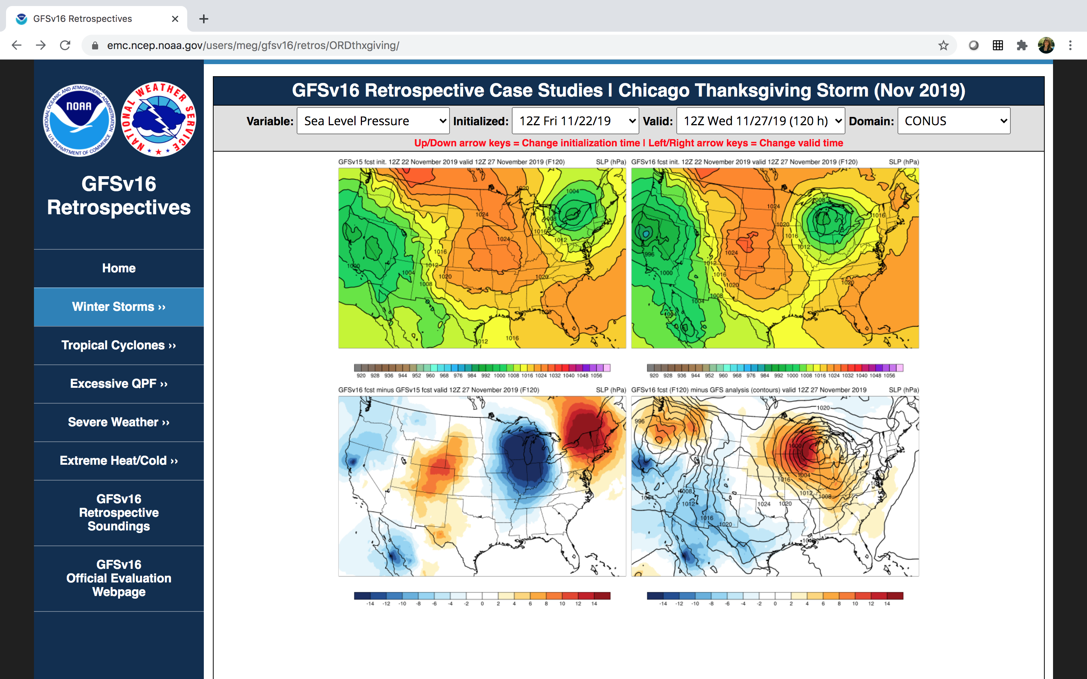
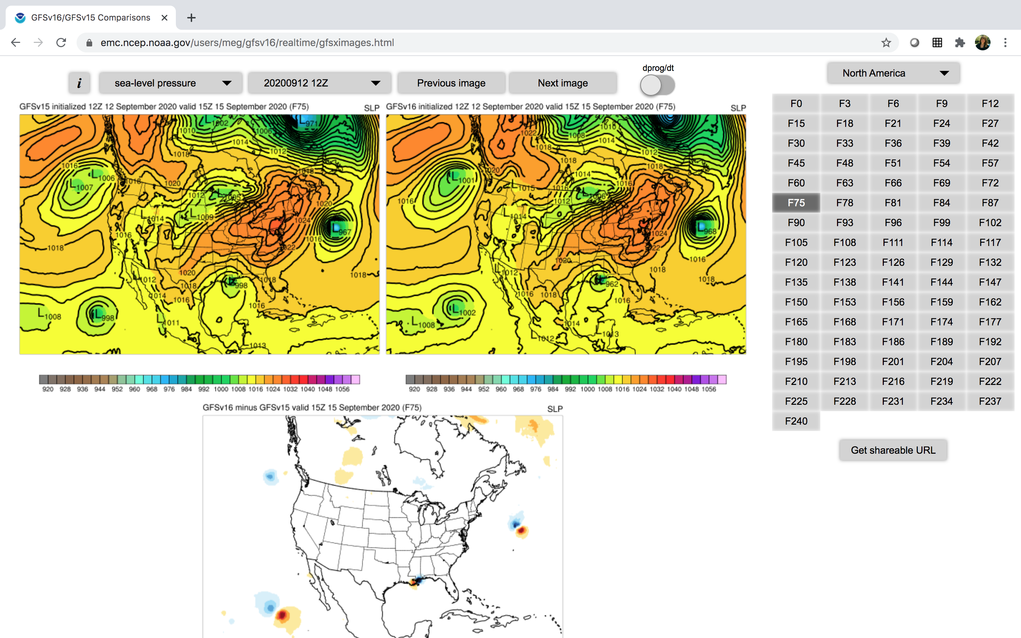
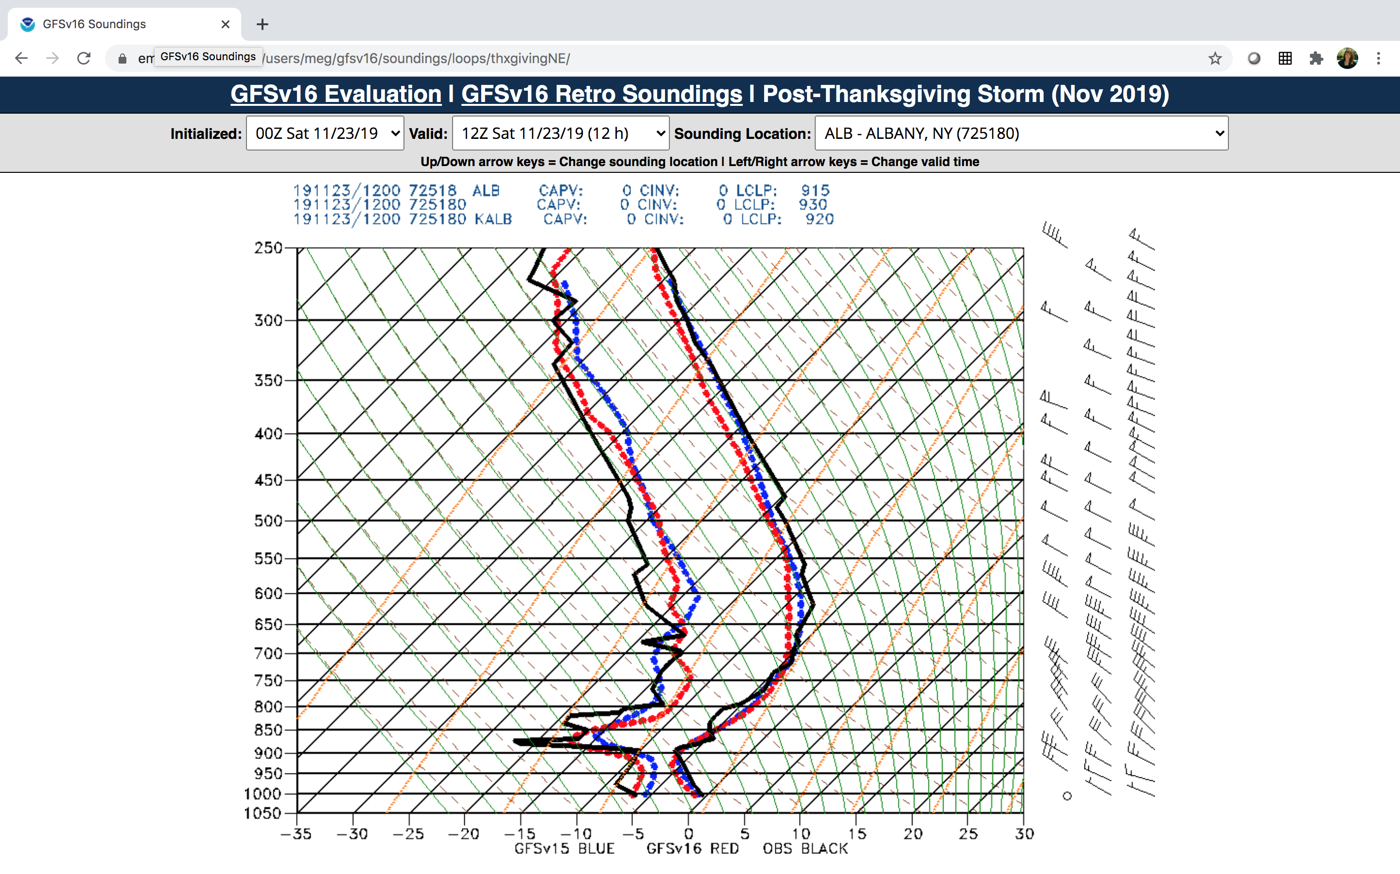
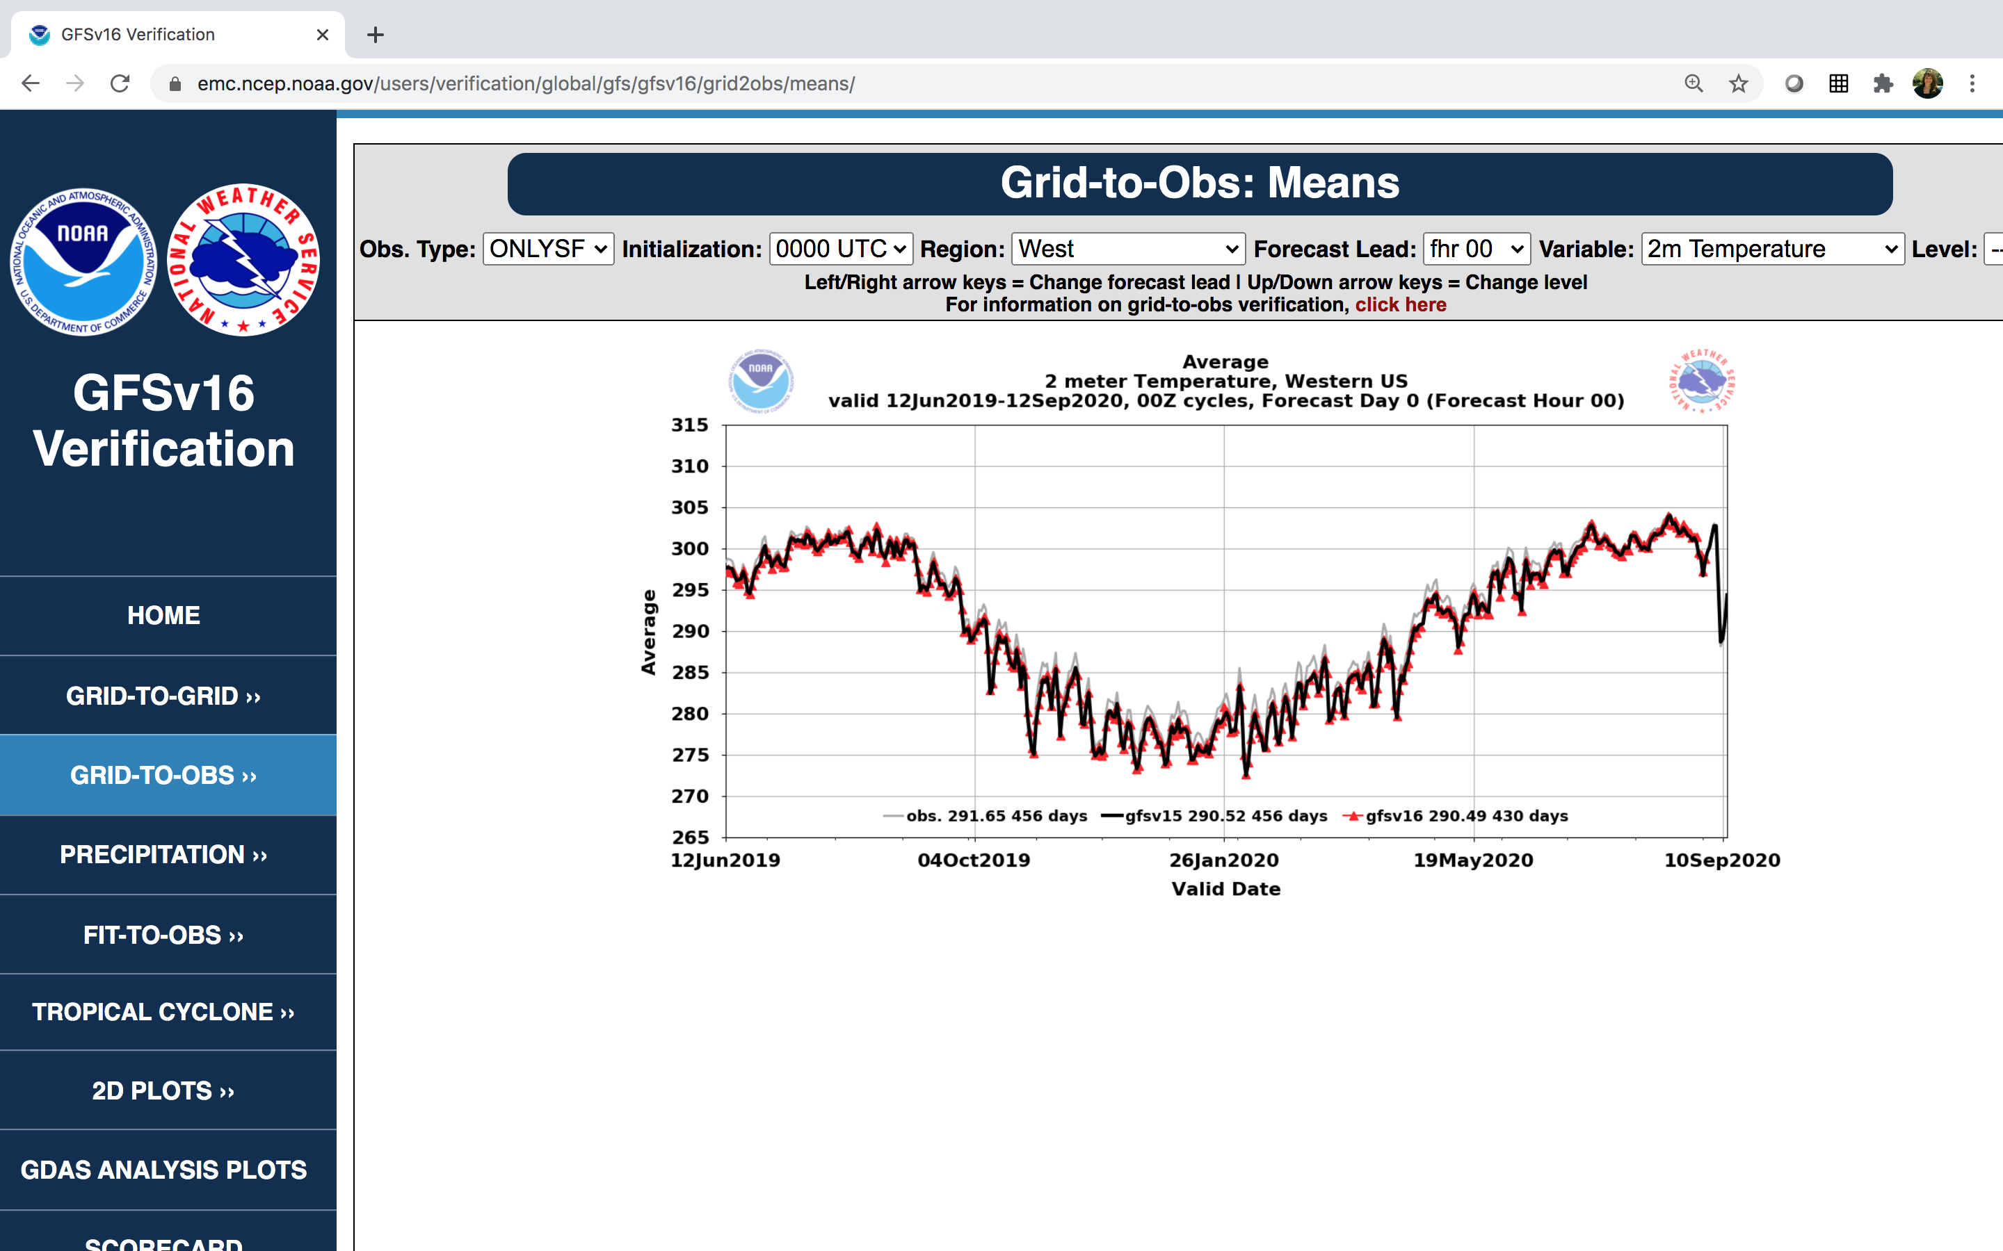
NATIONAL OCEANIC AND ATMOSPHERIC ADMINISTRATION
GFSv16 Evaluation Resources (VPPPG)
Retrospective Case Studies
Real-time Forecast Maps
Retrospective Soundings
Retrospective/Real-time Stats

Slide 10
NATIONAL OCEANIC AND ATMOSPHERIC ADMINISTRATION
Strengths of GFSv16
Improved 500-hPa AC scores in the medium range (better with synoptic pattern)
Some indication that GFSv15 progressive issue has been improved
Improved position of relevant frontal boundaries
Mitigated the low-level cold bias seen in GFSv15 during the cool season
Identifies TC threats more often and at longer lead times
Overall, positive impact on HWRF forecasts
Improved QPF Equitable Threat Scores (ETS) and bias in the medium range
Overall, improved snowfall location and amounts at longer lead times
Resolved low-level warming issue seen in a few GFSv15 cases
Improved ability to capture the temperature profile in shallow, cold air masses
GFS Wave has lower globally-averaged RMSE and bias for Sig. Wave Height

Slide 11
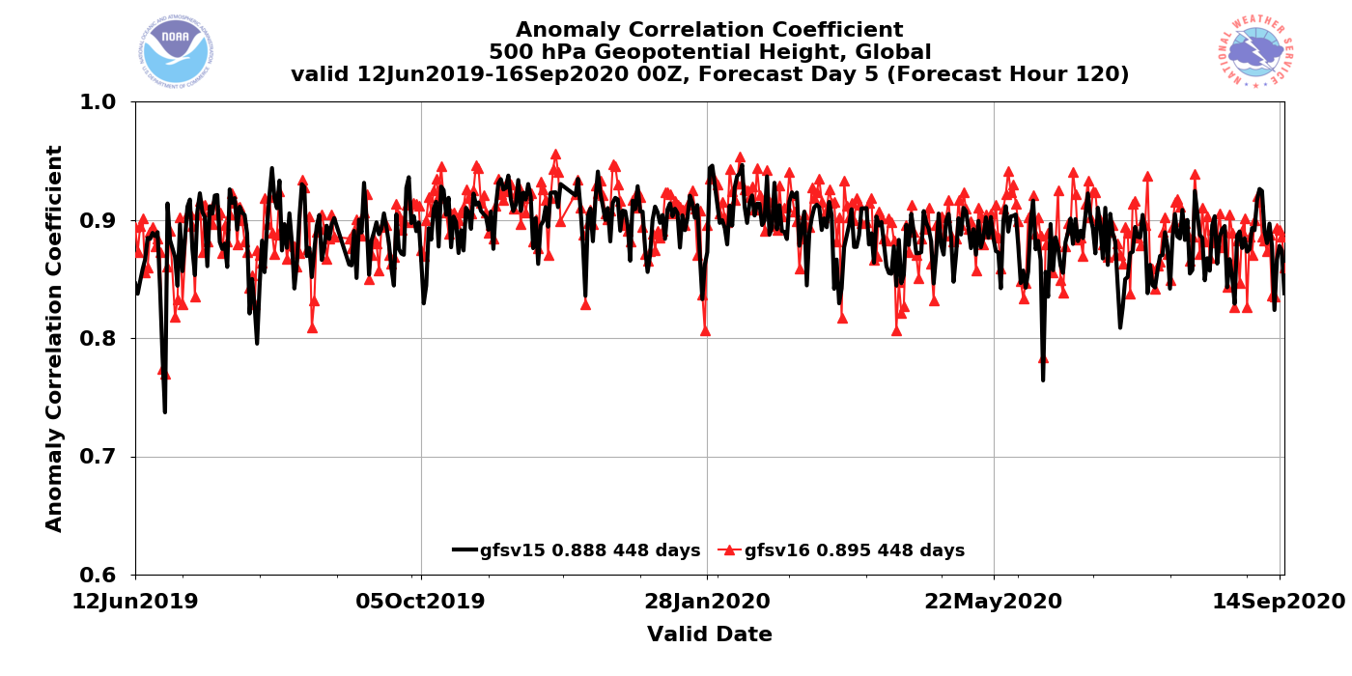
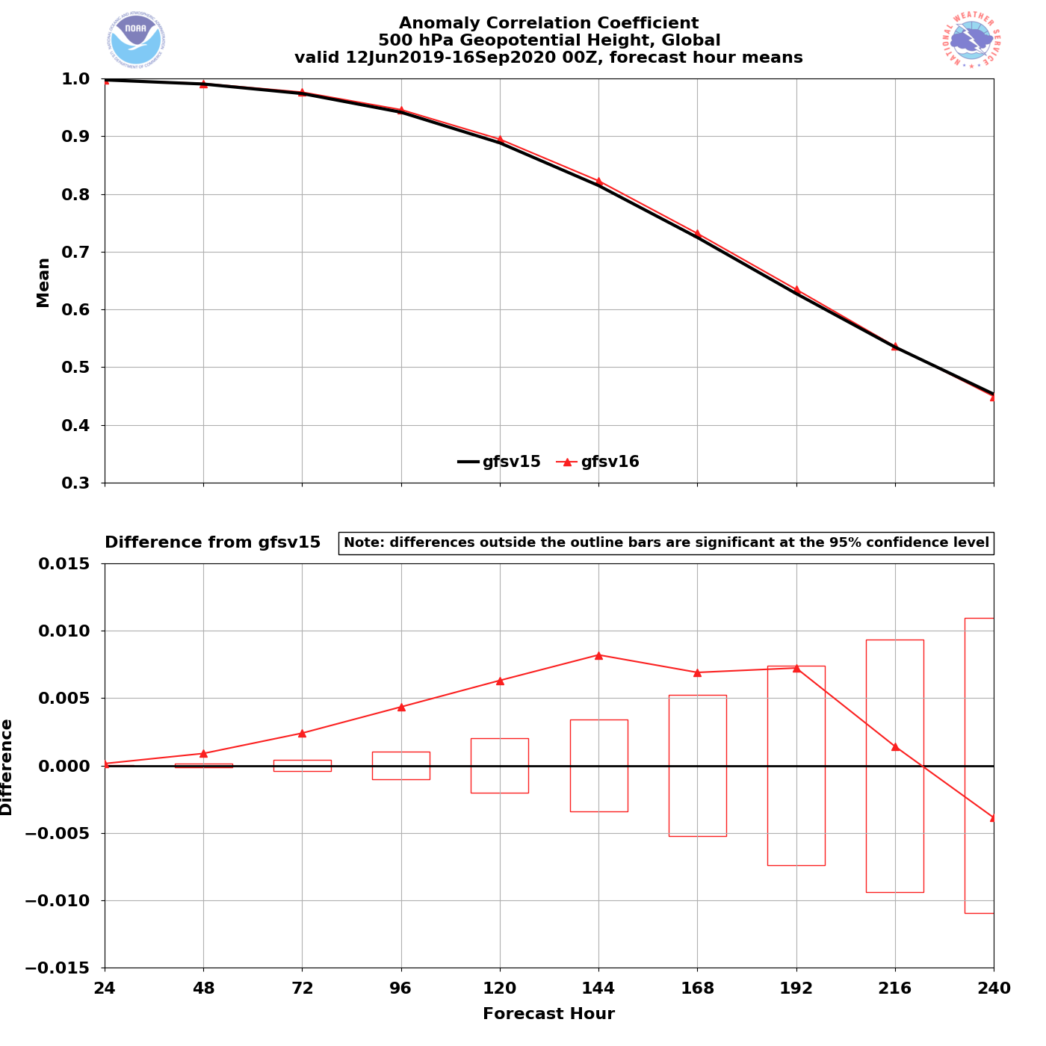
NATIONAL OCEANIC AND ATMOSPHERIC ADMINISTRATION
Strengths: 500-hPa AC Scores (Global)
Valid: 6/12/19–9/16/20 (Day 5)
GFSv15 = .888
GFSv16 = .895
GFSv16 had higher AC scores than GFSv15 at the majority of forecast lead times (Days 1–9)
GFSv16 had statistically significantly higher AC scores at Days 2–7
GFSv16−GFSv15

Slide 12
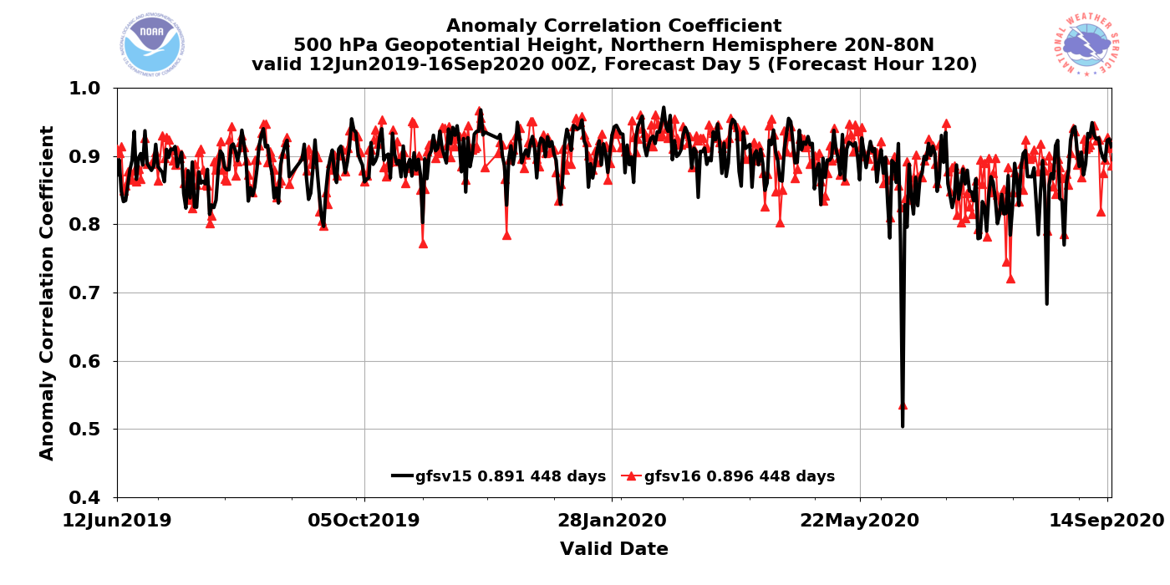
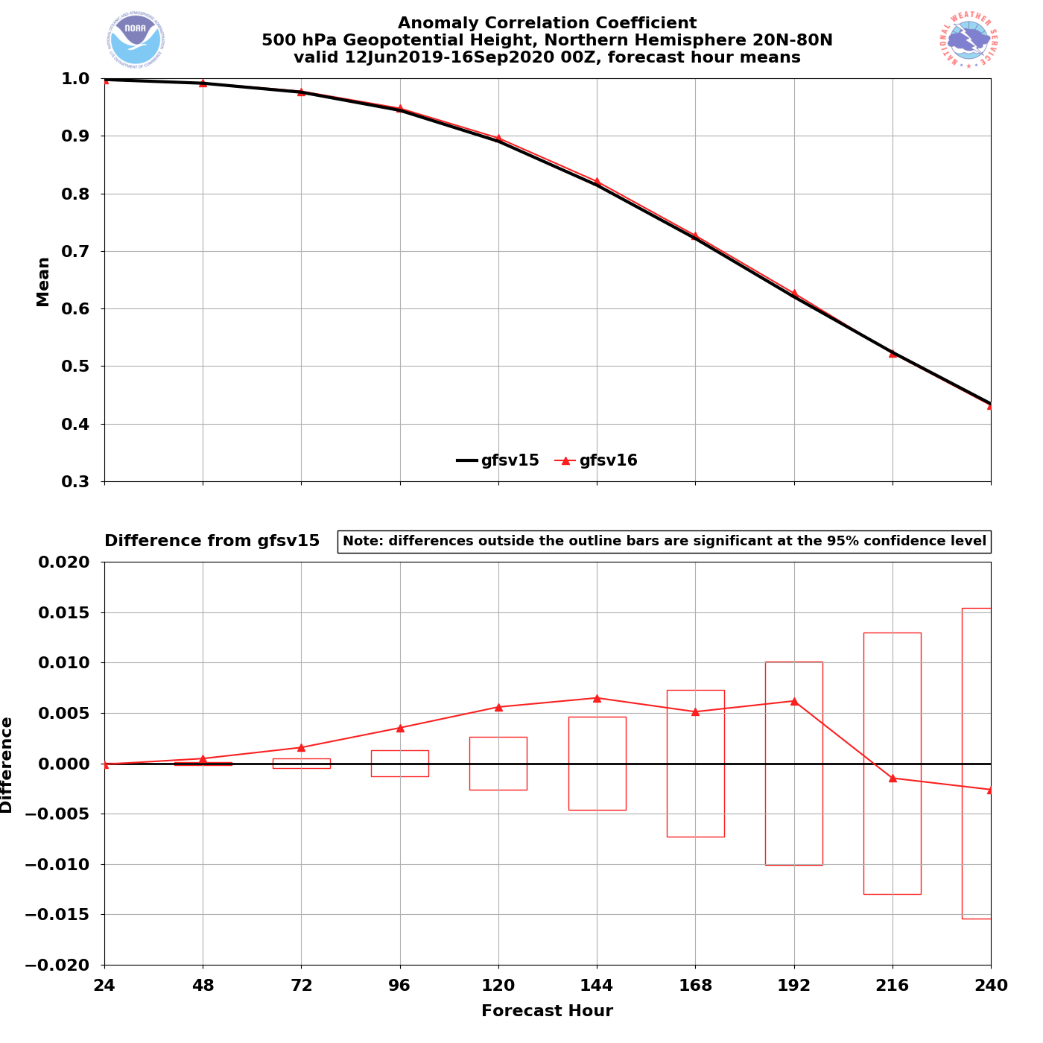
NATIONAL OCEANIC AND ATMOSPHERIC ADMINISTRATION
Strengths: 500-hPa AC Scores (NH)
Valid: 6/12/19–9/16/20 (Day 5)
GFSv15 = .891
GFSv16 = .896
GFSv16 had higher AC scores than GFSv15 at the majority of forecast lead times (Days 1–8)
GFSv16 had statistically significantly higher AC scores at Days 2–6
GFSv16−GFSv15

Slide 13
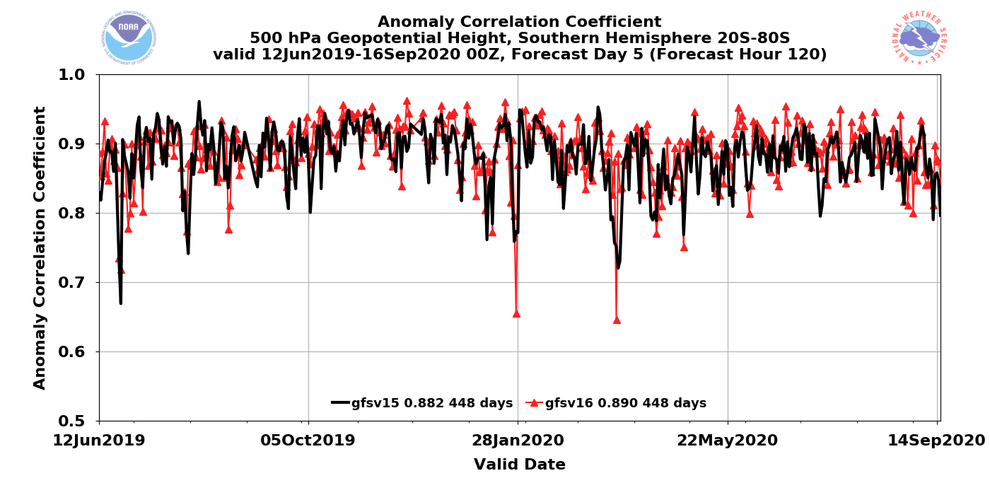
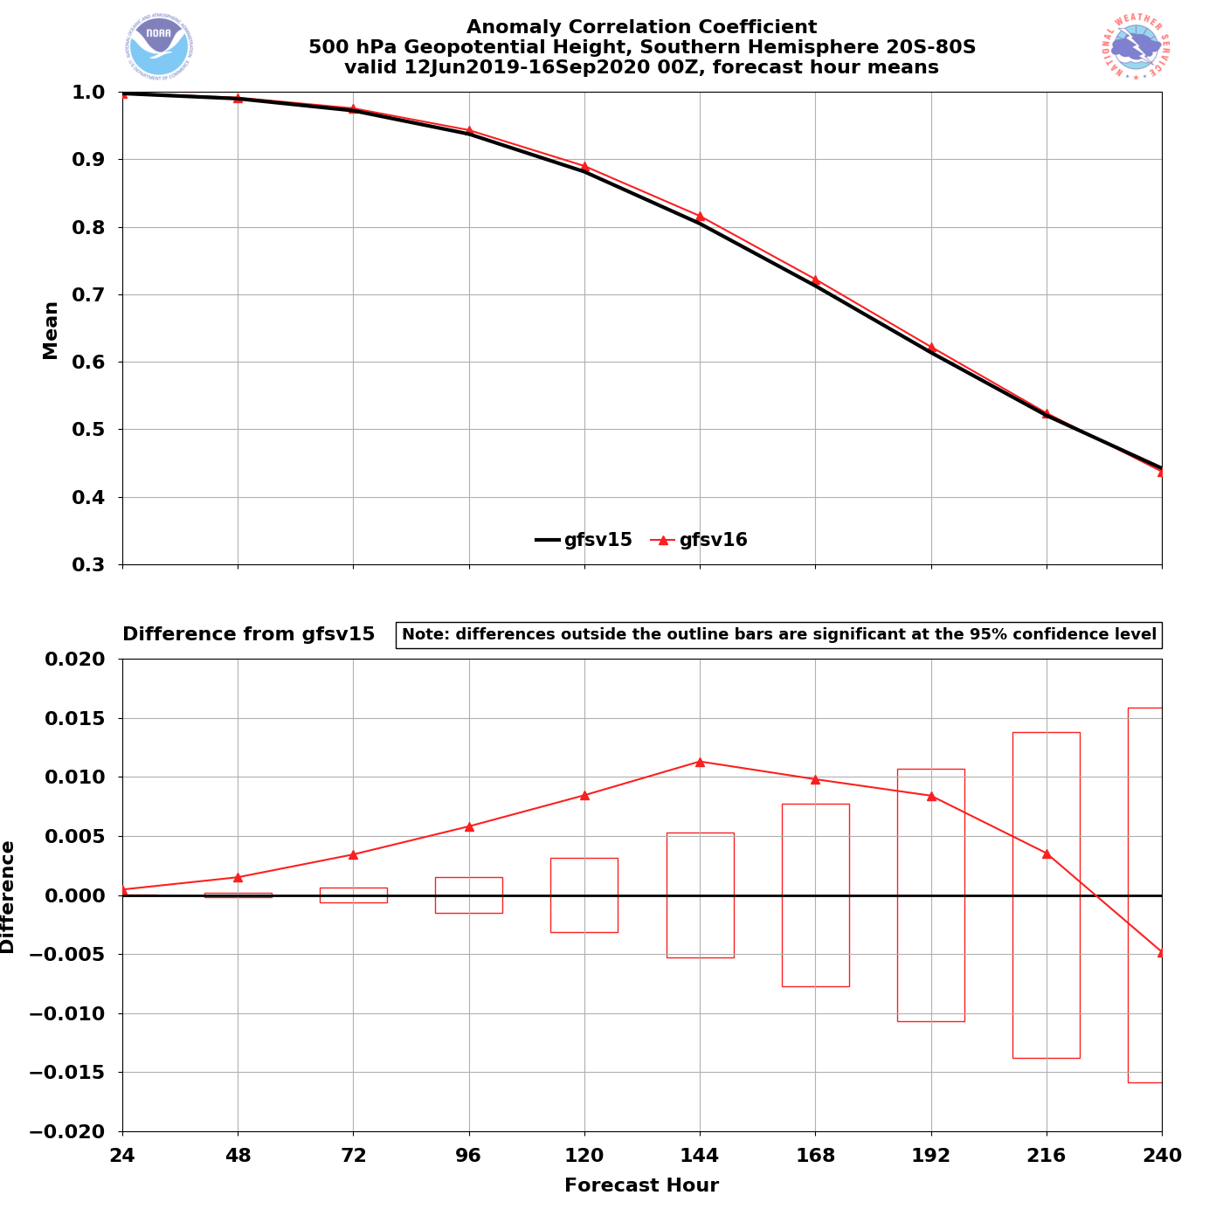
NATIONAL OCEANIC AND ATMOSPHERIC ADMINISTRATION
Strengths: 500-hPa AC Scores (SH)
Valid: 6/12/19–9/16/20 (Day 5)
GFSv15 = .882 GFSv16 = .890
GFSv16 had higher AC scores than GFSv15 at the majority of forecast lead times (Days 1–9)
GFSv16 had statistically significantly higher AC scores at Days 1–7
GFSv16−GFSv15

Slide 14
NATIONAL OCEANIC AND ATMOSPHERIC ADMINISTRATION
GFSv16 AC Scores (NH 500-hPa Z at Day 5)
 | GFSv15 (OPS) | GFSv16 (RETRO)
Fall 2018 | 0.916 | 0.916
May 2019 | 0.880 | 0.897
Summer 2019 | 0.880 | 0.888
Fall 2019 | 0.897 | 0.901
Winter/Spring 2020 | 0.909 | 0.913
August 2020 | 0.860 | 0.868
Full Retro Period | 0.891 | 0.896

Slide 15
NATIONAL OCEANIC AND ATMOSPHERIC ADMINISTRATION
GFSv16 NWS SOO Team Synoptic Ratings
 | GFSv16 vs. GFSv15 Mean Rating (−3 to +3) | % GFSv16 was as good or better than GFSv15 | % GFSv16 was worse than GFSv15
Extended Range | 0.35 | 78% | 22%
Medium Range | 0.59 | 83% | 17%
Short Range | 0.07 | 85% | 15%

Slide 16
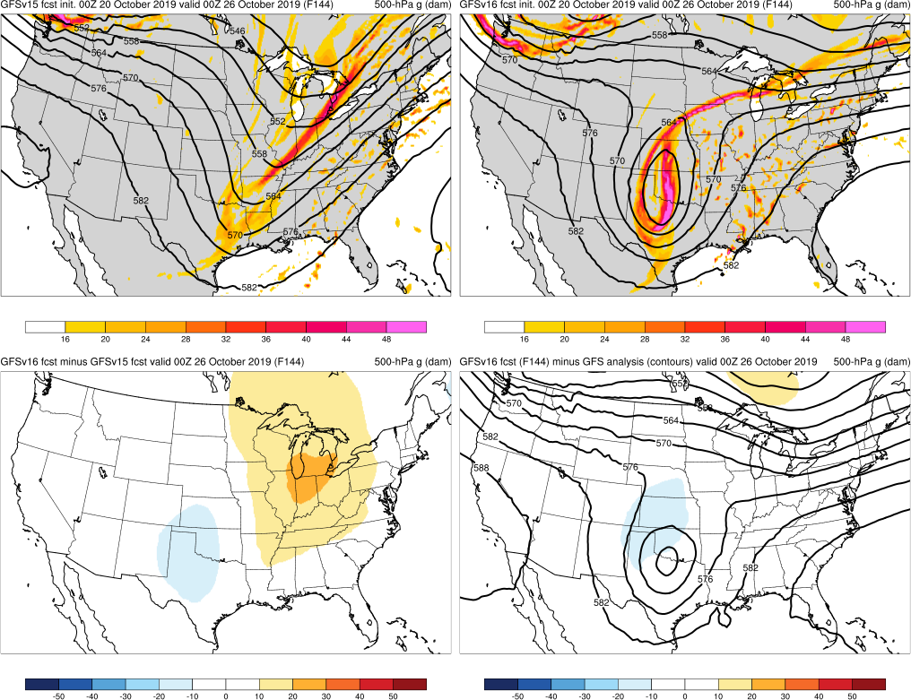
NATIONAL OCEANIC AND ATMOSPHERIC ADMINISTRATION
Strengths: Captures Synoptic Pattern Better
GFSv15
GFSv16
TC Olga (F144) Valid: 00Z 10/26/19
GFSv16 forecasted the location of the cutoff low earlier and more consistently than GFSv15:
TC Olga
v16−v15
GFS Anl.

Slide 17
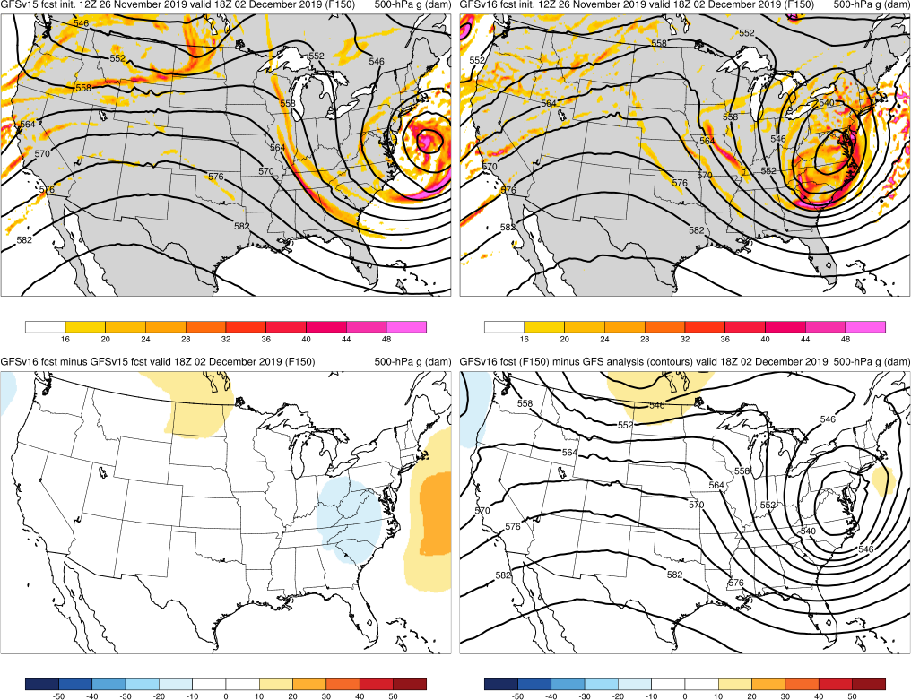
NATIONAL OCEANIC AND ATMOSPHERIC ADMINISTRATION
Strengths: Captures Synoptic Pattern Better
GFSv15
GFSv16
Post-Thanksgiving Storm (F150) Valid: 18Z 12/02/19
GFSv16 forecasted the location of the cutoff low earlier and more consistently than GFSv15:
TC Olga
Post-Thanksgiving Storm
v16−v15
GFS Anl.

Slide 18
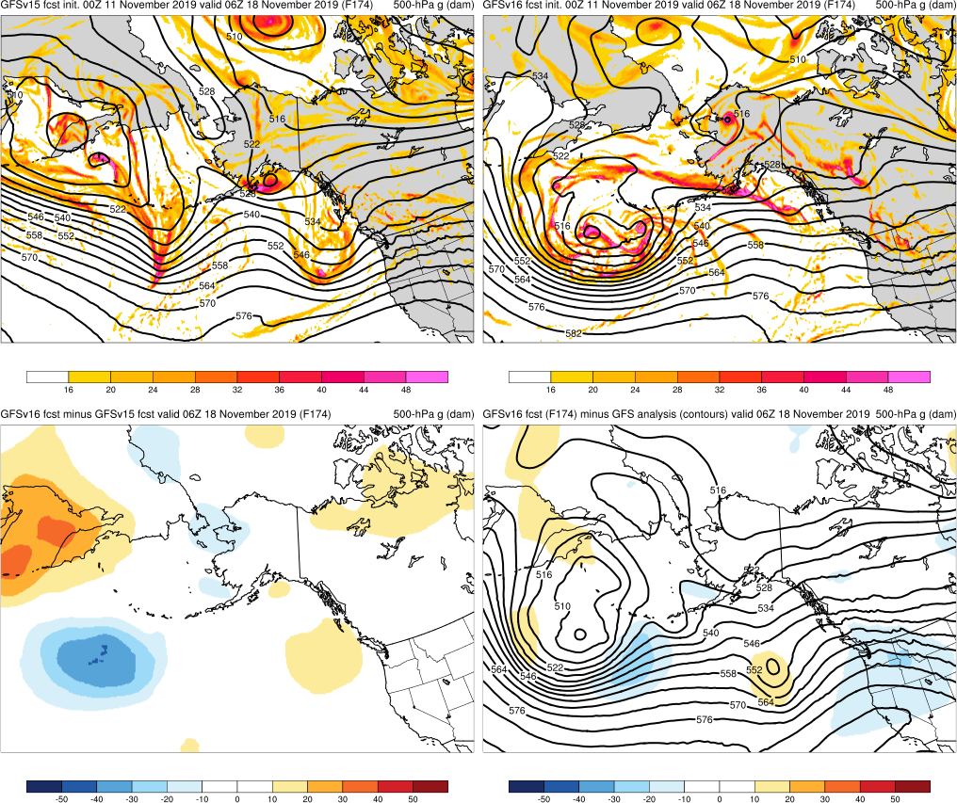
NATIONAL OCEANIC AND ATMOSPHERIC ADMINISTRATION
Strengths: Captures Synoptic Pattern Better
GFSv15
GFSv16
North Pacific Cyclone (F174) Valid: 06Z 11/18/19
GFSv16 forecasted the location of the cutoff low earlier and more consistently than GFSv15:
TC Olga
Post-Thanksgiving Storm
North Pacific Cyclone
v16−v15
GFS Anl.

Slide 19
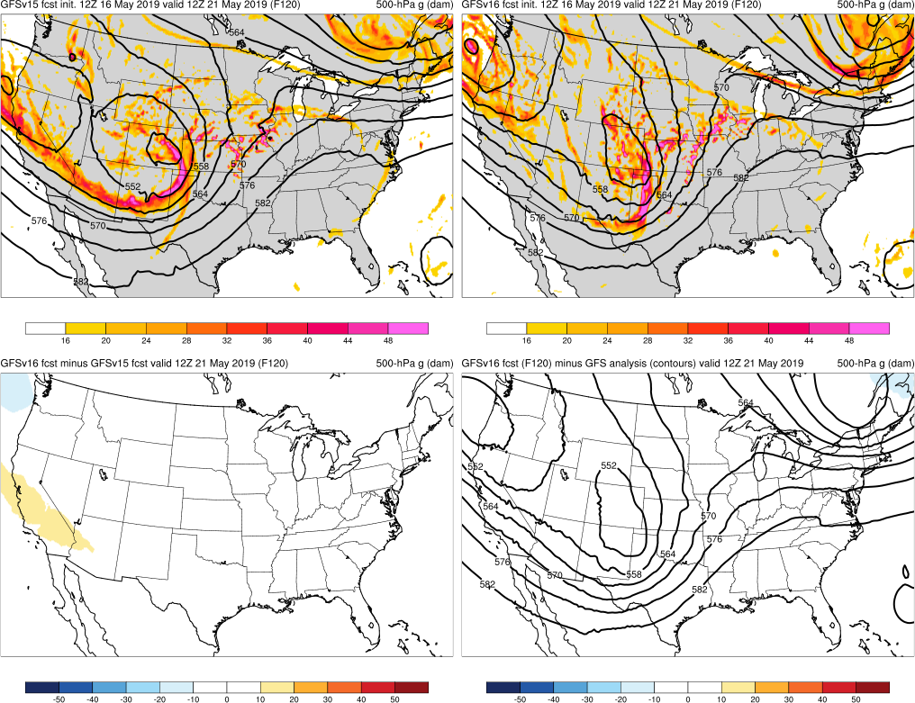
NATIONAL OCEANIC AND ATMOSPHERIC ADMINISTRATION
Strengths: Captures Synoptic Pattern Better
May 2019 High Risk (F120) Valid: 12Z 5/21/19
GFSv16 forecasted the location of the cutoff low earlier and more consistently than GFSv15:
TC Olga
Post-Thanksgiving Storm
North Pacific Cyclone
May 2019 High Risk
GFSv15
GFSv16
v16−v15
GFS Anl.

Slide 20
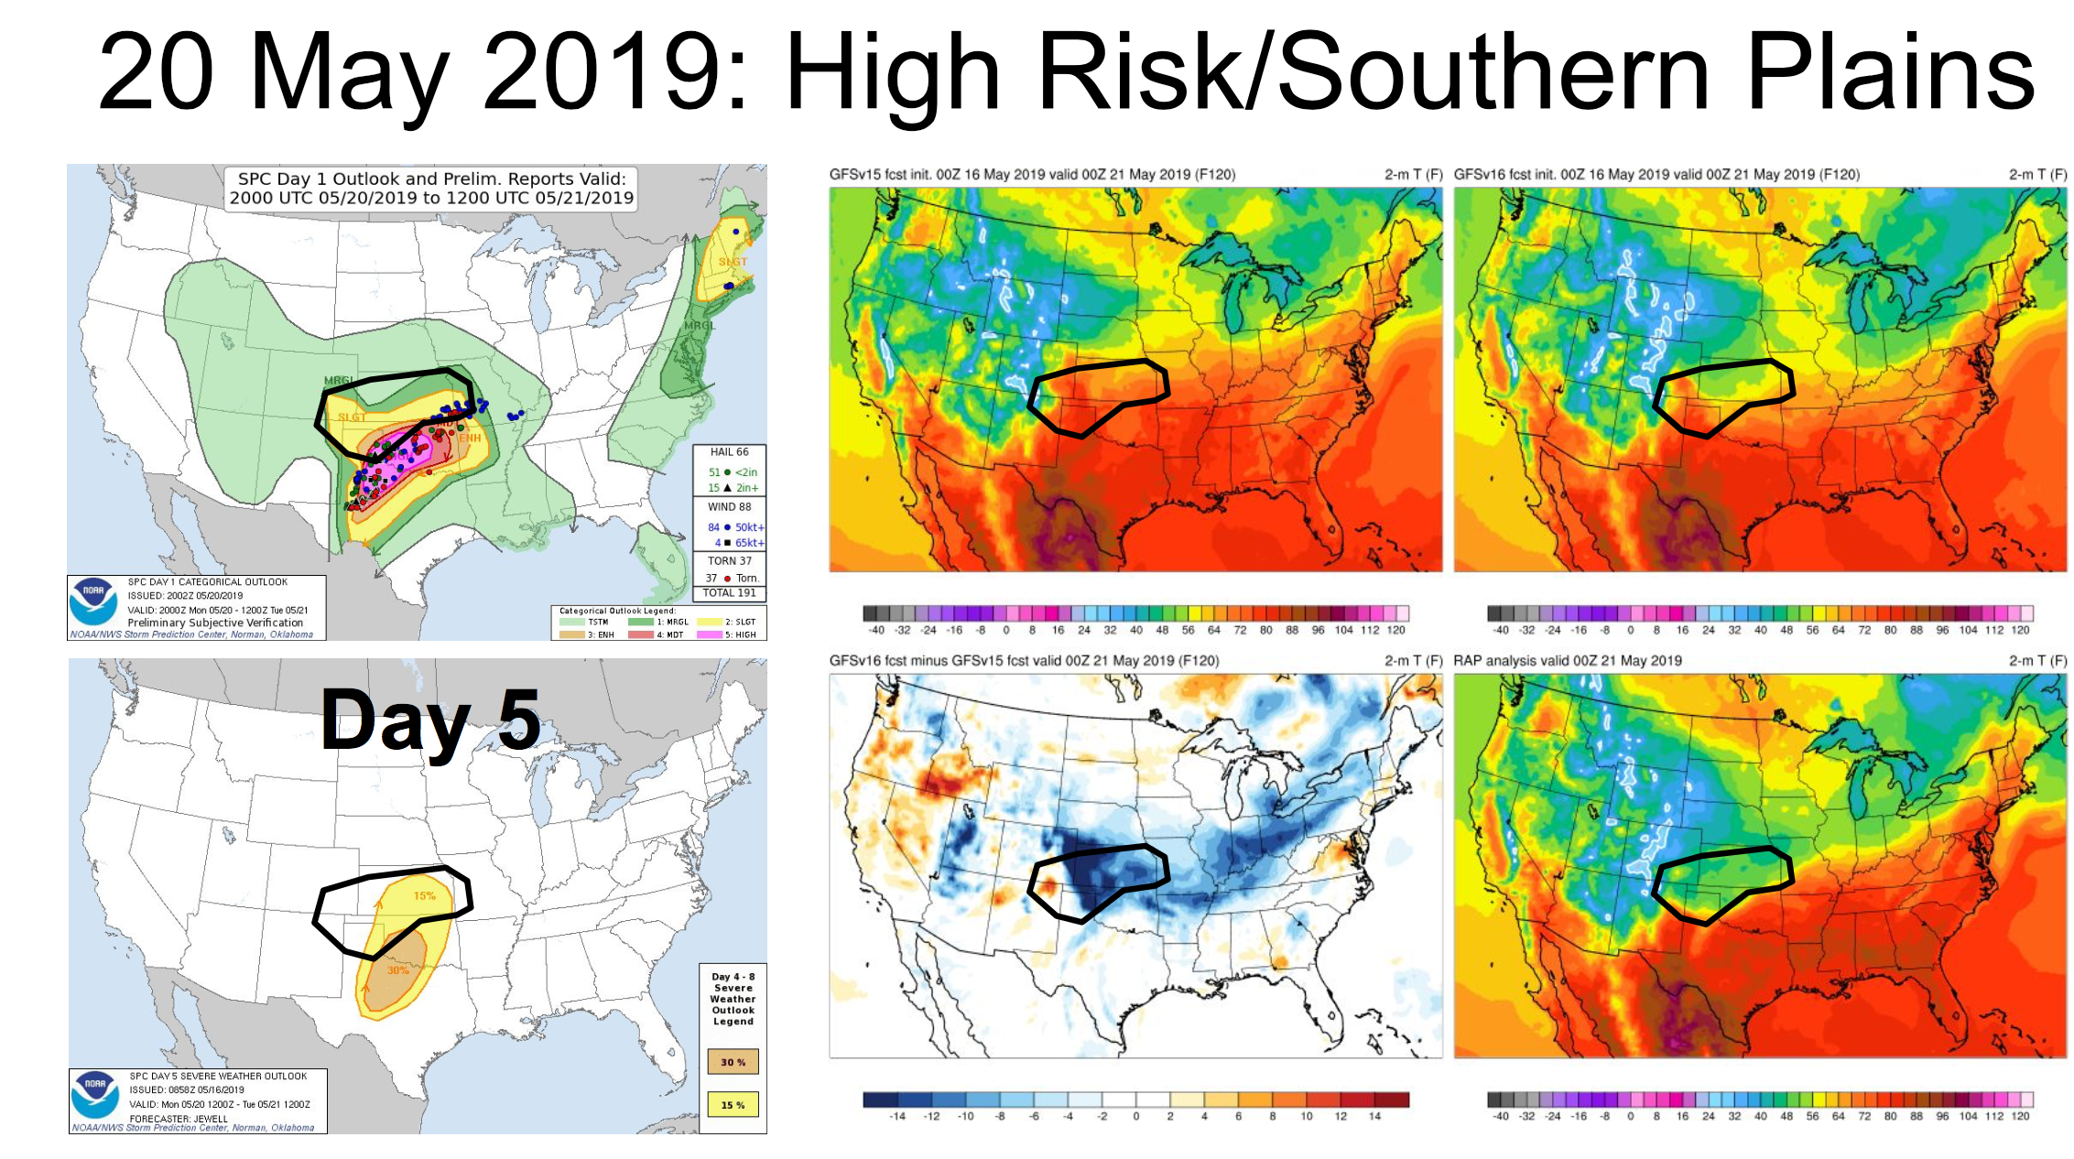
NATIONAL OCEANIC AND ATMOSPHERIC ADMINISTRATION
Strengths: Position of Frontal Boundaries
GFSv15
GFSv16
Warm front
placement was correctly further south
v16−v15
RAP Anl.
Thanks to Chris Karstens (SPC) from NWS SOO Team

Slide 21
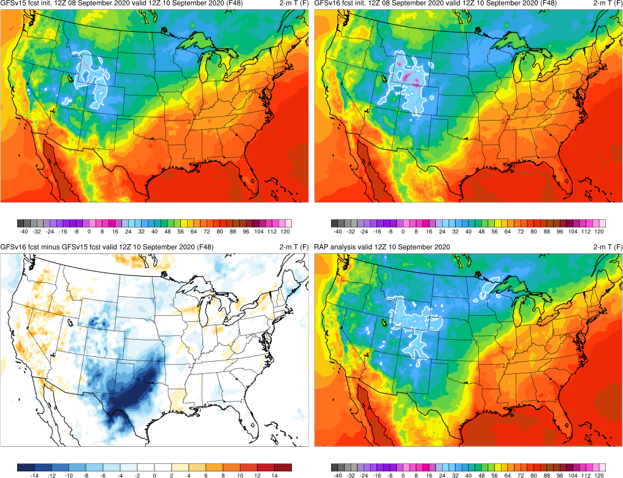
NATIONAL OCEANIC AND ATMOSPHERIC ADMINISTRATION
Strengths: Position of Frontal Boundaries
Cold Front Example (F048) Valid: 12Z 09/10/20
GFSv15
GFSv16
GFSv16 forecasted the position of the cold front more correctly and consistently than GFSv15
v16−v15
RAP Anl.
Thanks to Steverino Silberberg (AWC) from NWS SOO Team

Slide 22
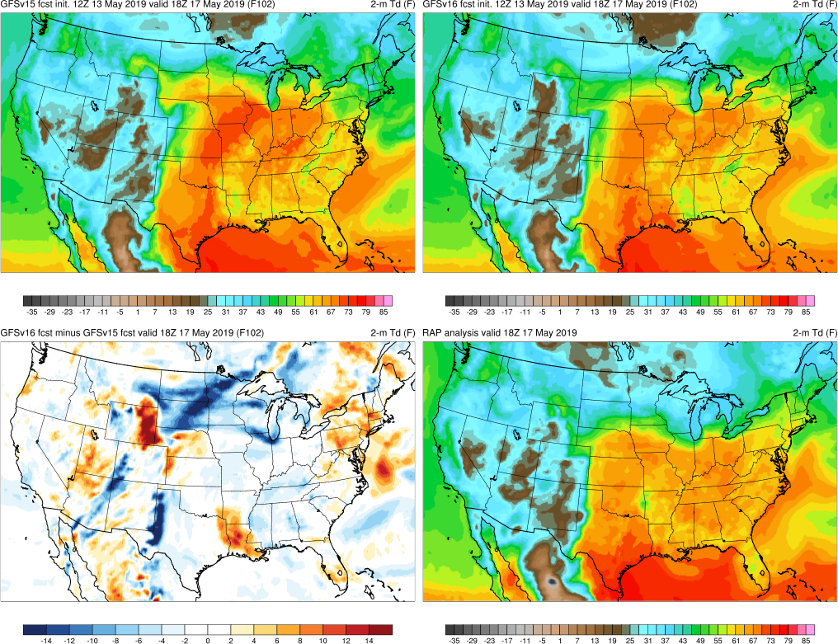
NATIONAL OCEANIC AND ATMOSPHERIC ADMINISTRATION
Strengths: Position of Frontal Boundaries
Dry Line Example (F102) Valid: 18Z 05/17/19
GFSv15
GFSv16
GFSv16 forecasted the position of the dryline more correctly and consistently than GFSv15
v16−v15
RAP Anl.

Slide 23
NATIONAL OCEANIC AND ATMOSPHERIC ADMINISTRATION
Strengths of GFSv16
Improved 500-hPa AC scores in the medium range (better with synoptic pattern)
Some indication that GFSv15 progressive issue has been improved
Improved position of relevant frontal boundaries
Mitigated the low-level cold bias seen in GFSv15 during the cool season
Identifies TC threats more often and at longer lead times
Overall, positive impact on HWRF forecasts
Improved QPF Equitable Threat Scores (ETS) and bias in the medium range
Overall, improved snowfall location and amounts at longer lead times
Resolved low-level warming issue seen in a few GFSv15 cases
Improved ability to capture the temperature profile in shallow, cold air masses
GFS Wave has lower globally-averaged RMSE and bias for Sig. Wave Height

Slide 24
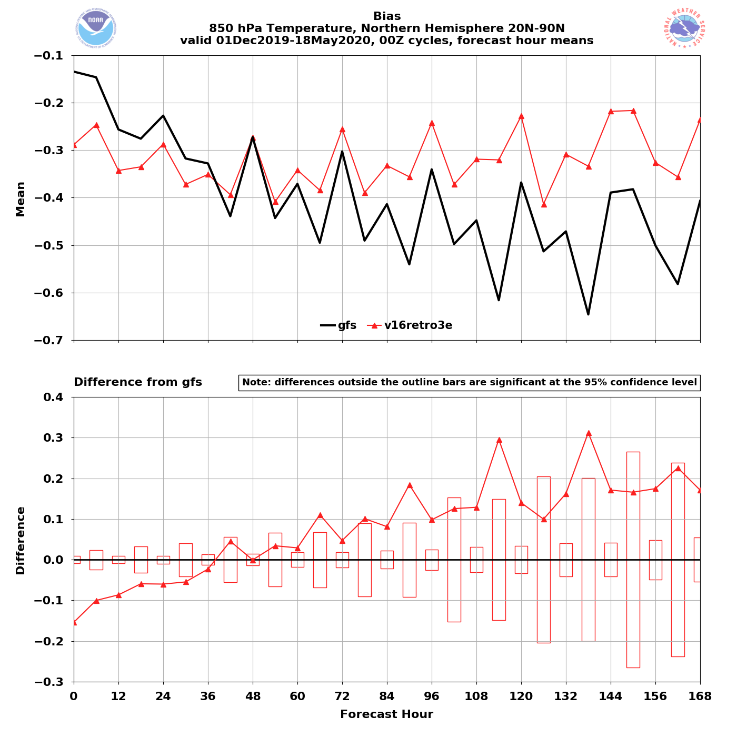
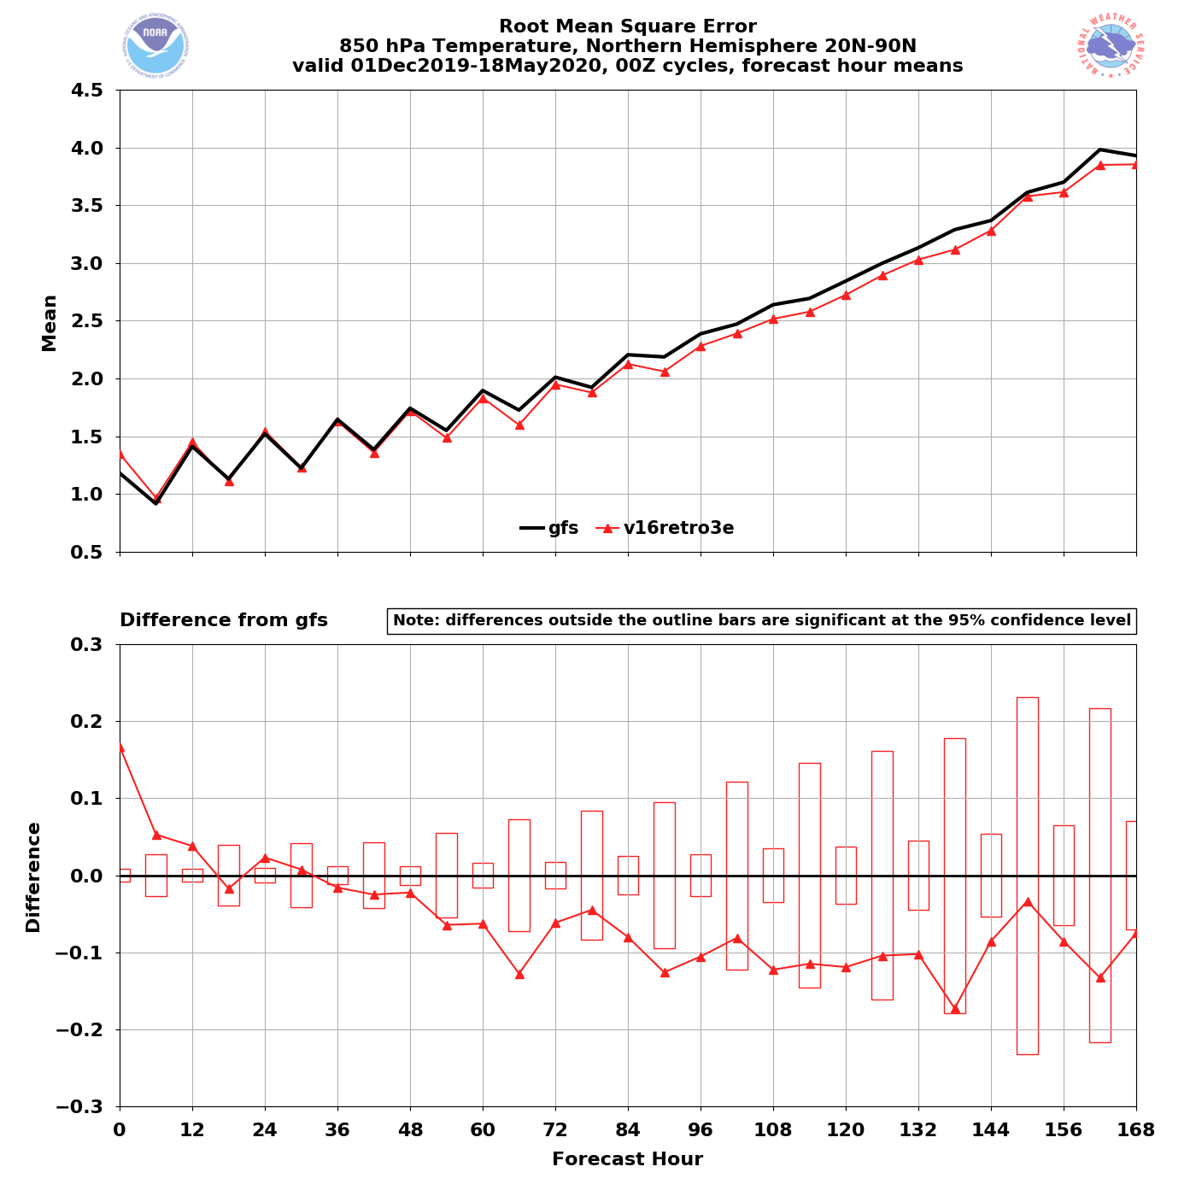
NATIONAL OCEANIC AND ATMOSPHERIC ADMINISTRATION
Strengths: Mitigated Low-Level Cold Bias
GFSv15 has a known low-level cold bias that gets worse with lead time
NH – Winter/Spring 2020
NH – Winter/Spring 2020
00Z
cycles
GFSv16
GFSv15
GFSv16
850T
Bias
GFSv15
850T
RMSE
Grid-to- Obs
GFSv16 − GFSv15
GFSv16 − GFSv15
GFSv16 has less of a cold bias at longer lead times
GFSv16 has lower RMSE at and after F036

Slide 25
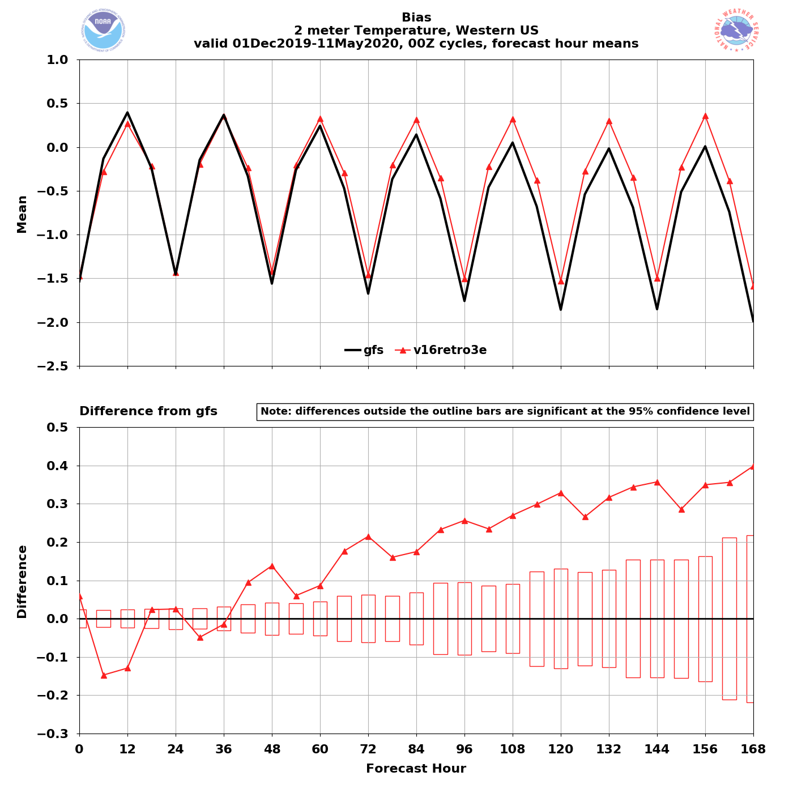
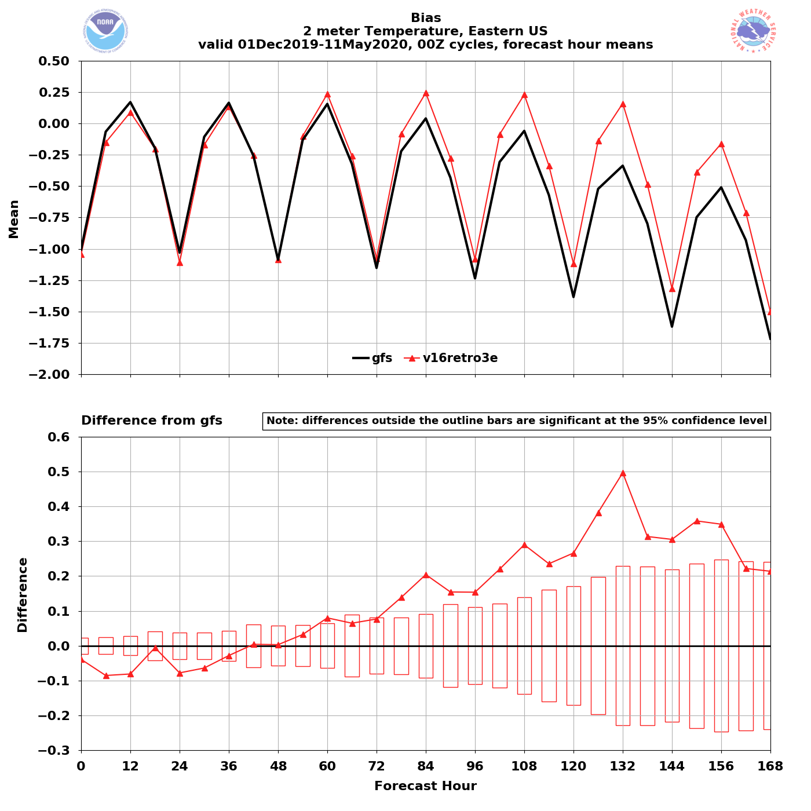
NATIONAL OCEANIC AND ATMOSPHERIC ADMINISTRATION
Strengths: Mitigated Low-Level Cold Bias
Western US – Winter/Spr. 2020
Eastern US – Winter/Spr. 2020
00Z
cycles
GFSv15
GFSv16
GFSv15
GFSv16
2-m T Bias
2-m T Bias
Grid-to- Obs
GFSv16 has less of a cold bias at longer lead times
GFSv16 has less of a cold bias at longer lead times

Slide 26
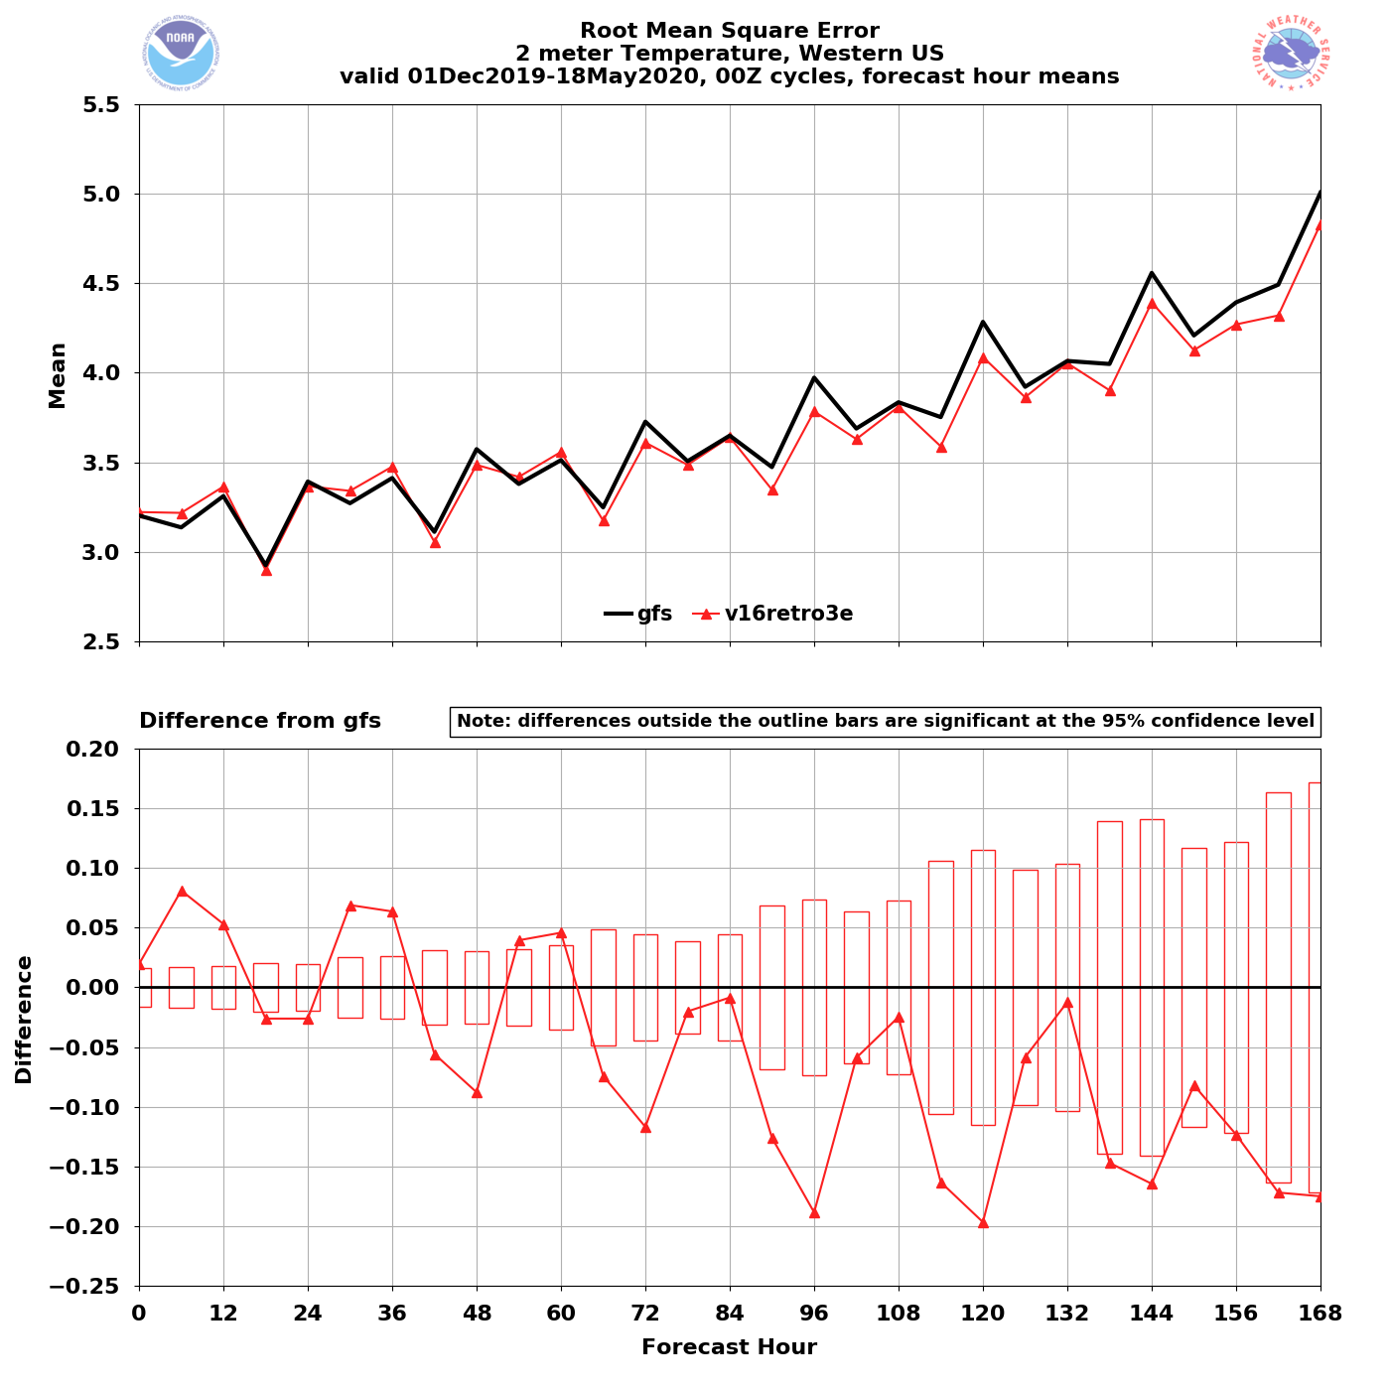
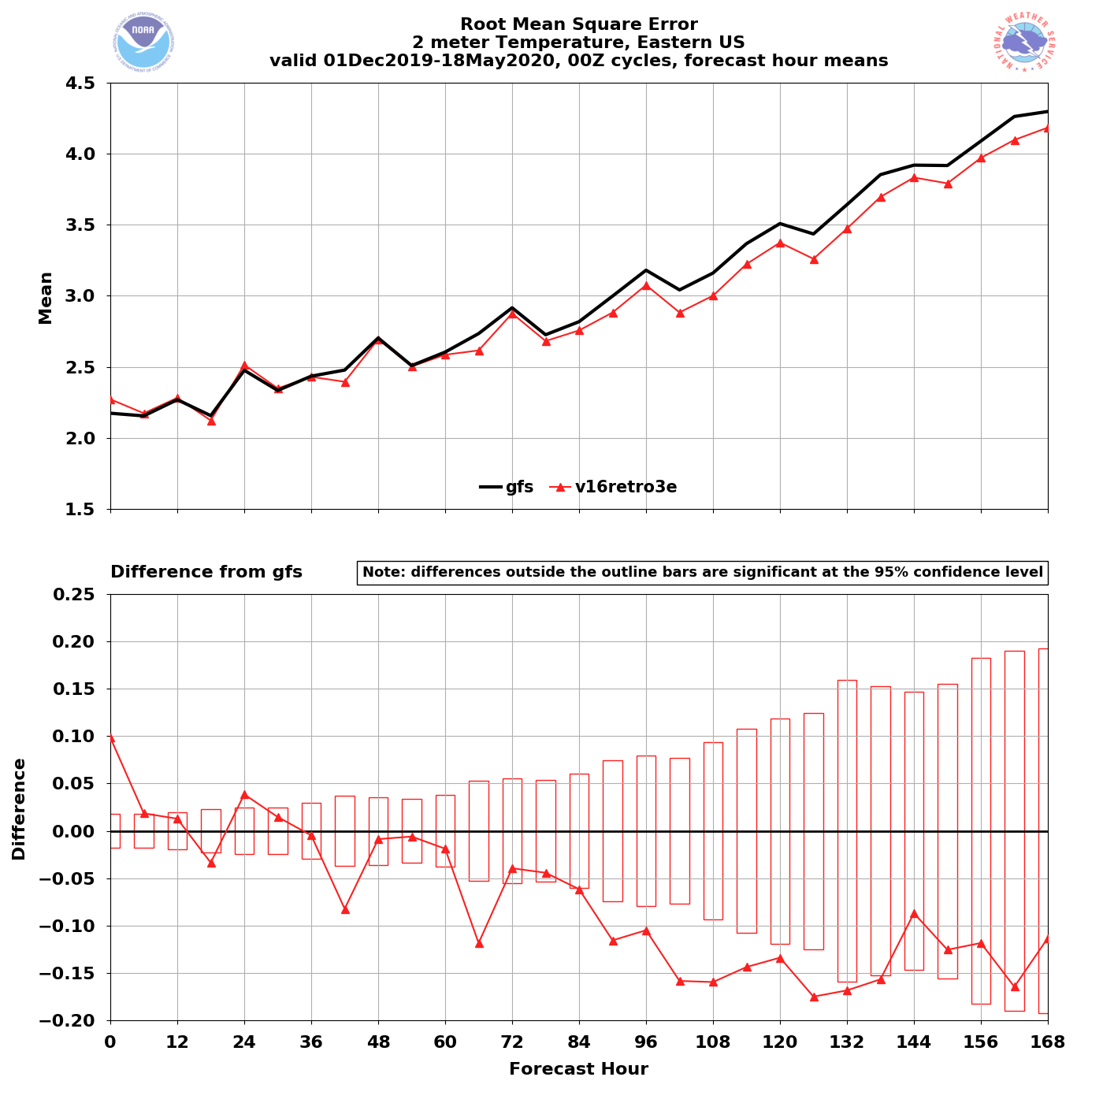
NATIONAL OCEANIC AND ATMOSPHERIC ADMINISTRATION
Strengths: Mitigated Low-Level Cold Bias
Western US – Winter/Spr. 2020
Eastern US – Winter/Spr. 2020
GFSv15
GFSv16
GFSv15
GFSv16
00Z
cycles
2-m T RMSE
2-m T RMSE
Grid-to- Obs
GFSv16 has lower RMSE at longer leads
GFSv16 has lower RMSE at longer leads

Slide 27
NATIONAL OCEANIC AND ATMOSPHERIC ADMINISTRATION
Strengths of GFSv16
Improved 500-hPa AC scores in the medium range (better with synoptic pattern)
Some indication that GFSv15 progressive issue has been improved
Improved position of relevant frontal boundaries
Mitigated the low-level cold bias seen in GFSv15 during the cool season
Identifies TC threats more often and at longer lead times
Overall, positive impact on HWRF forecasts
Improved QPF Equitable Threat Scores (ETS) and bias in the medium range
Overall, improved snowfall location and amounts at longer lead times
Resolved low-level warming issue seen in a few GFSv15 cases
Improved ability to capture the temperature profile in shallow, cold air masses
GFS Wave has lower globally-averaged RMSE and bias for Sig. Wave Height

Slide 28
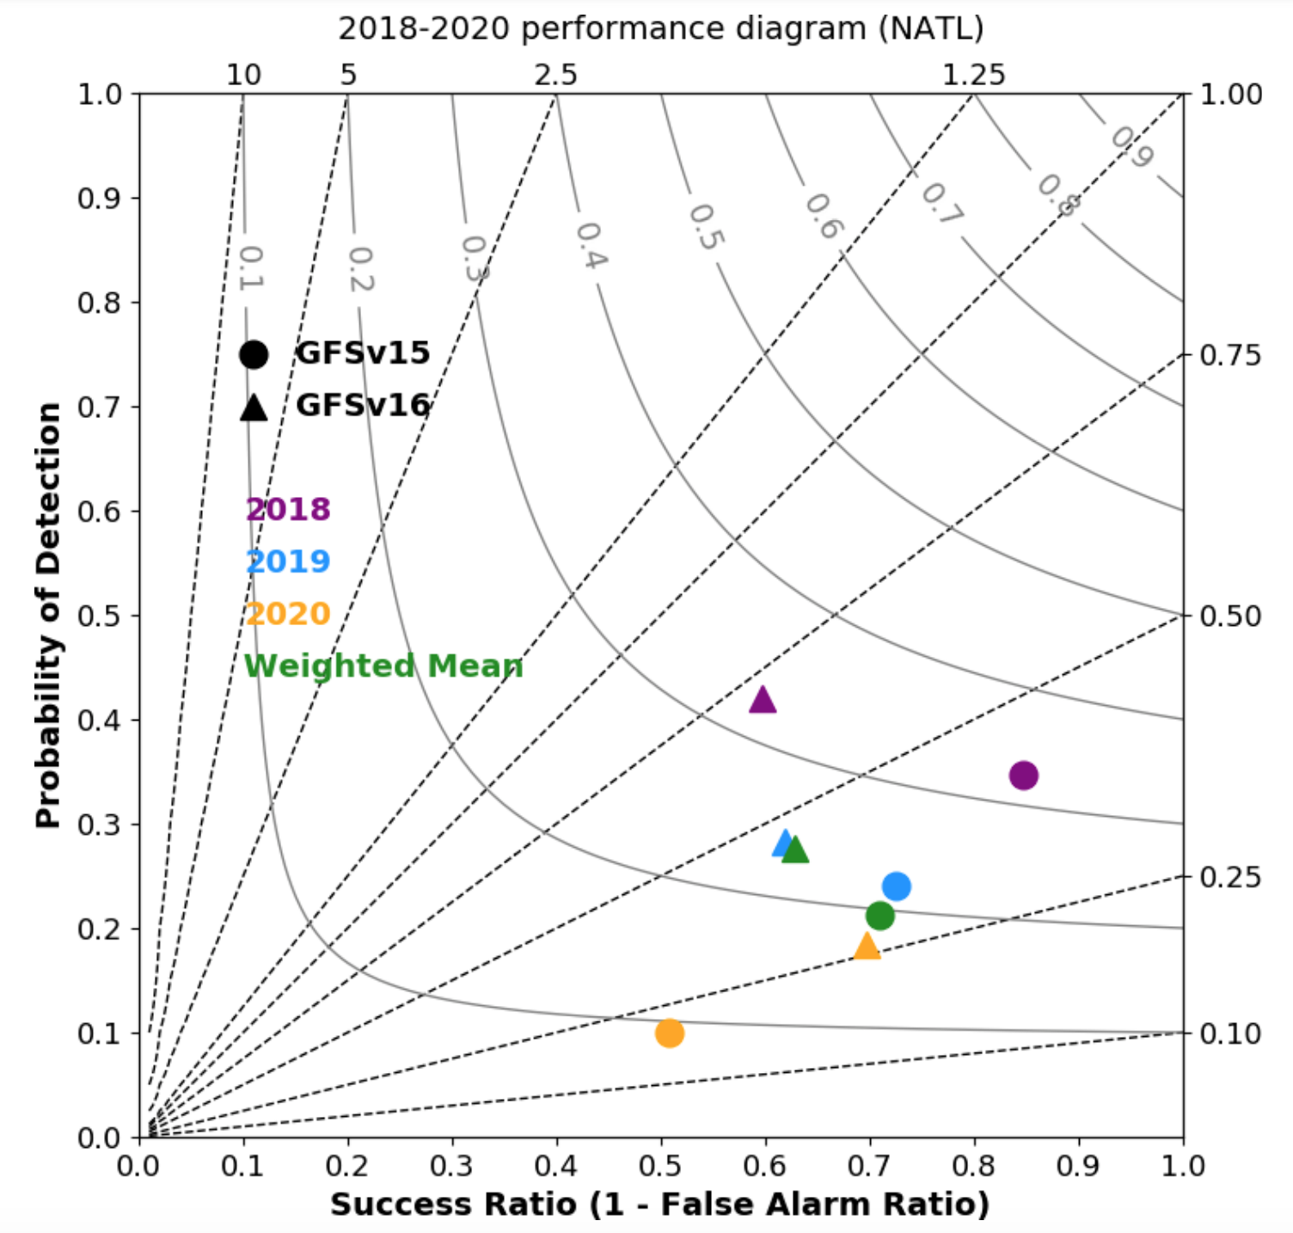
NATIONAL OCEANIC AND ATMOSPHERIC ADMINISTRATION
Strengths: Identifies TCs More Often & Earlier
Legend:
x-axis: Success Ratio (1−FAR)
y-axis: Probability Of Detection (POD)
dashed lines: Frequency Bias
solid lines: Critical Success Index (CSI)
All values would equal 1 in a perfectly performing model
On average, GFSv16 exhibits:
Larger POD and CSI (closer to 1)
Frequency Bias is closer to 1
Smaller Success Ratio (FAR too high)
GFSv16 is more cyclogenetic than GFSv15
Thanks to Dan Halperin (ERAU)

Slide 29
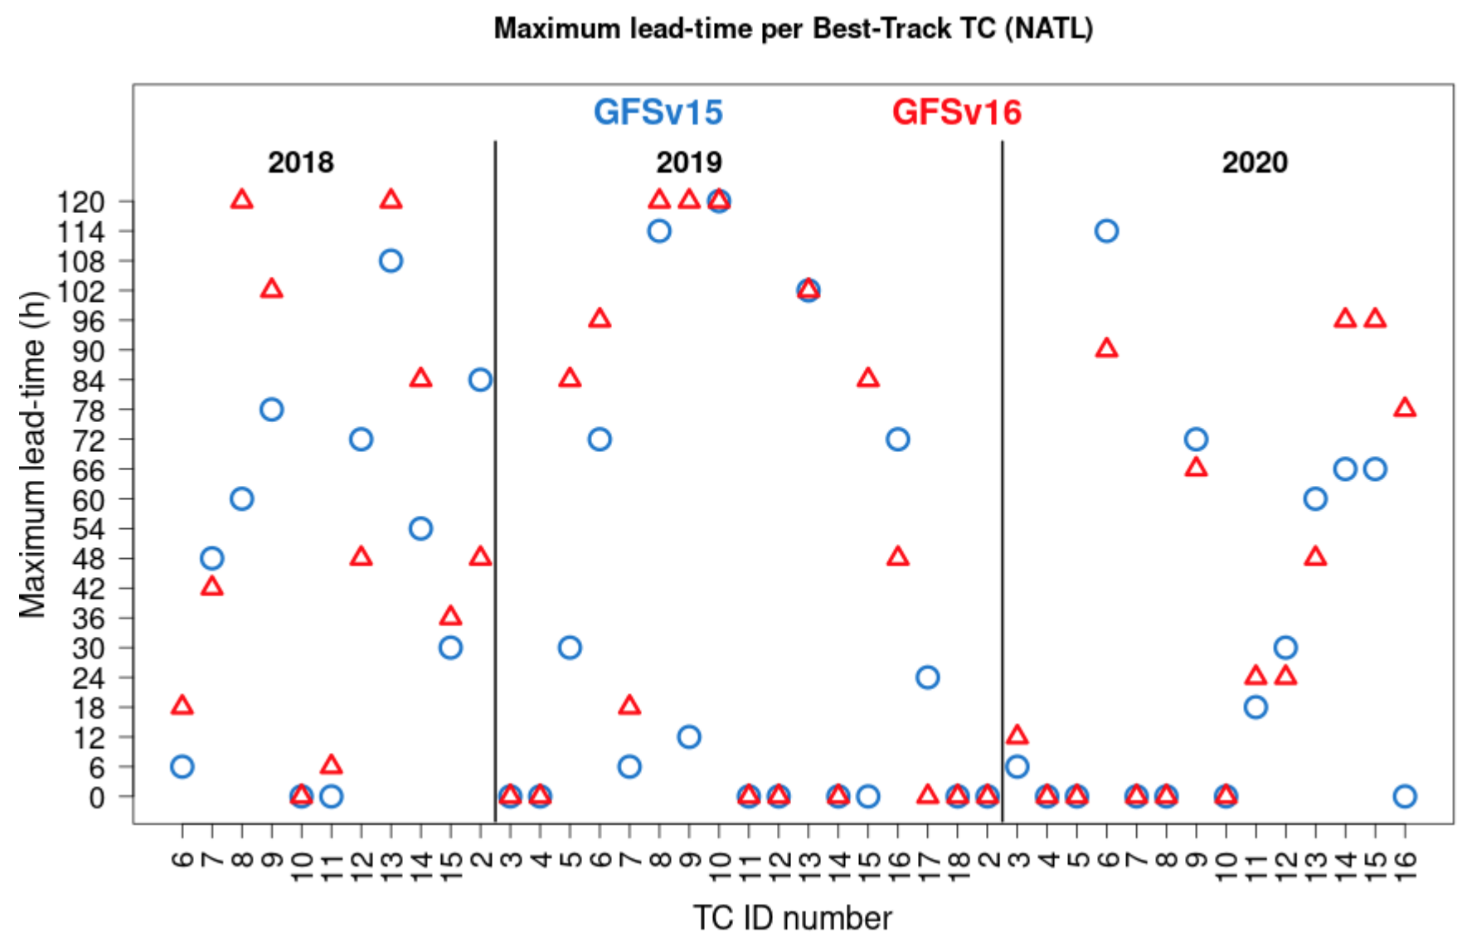
NATIONAL OCEANIC AND ATMOSPHERIC ADMINISTRATION
Strengths: Identifies TCs More Often & Earlier
Lead time: Difference between the model initialization time and Best Track genesis time
Max. lead time is 120 h (the forecast hour the tracker was run out to)
Median of max lead time:
GFSv15: 21 h
GFSv16: 39 h
GFSv16 identifies genesis at longer lead times

Slide 30
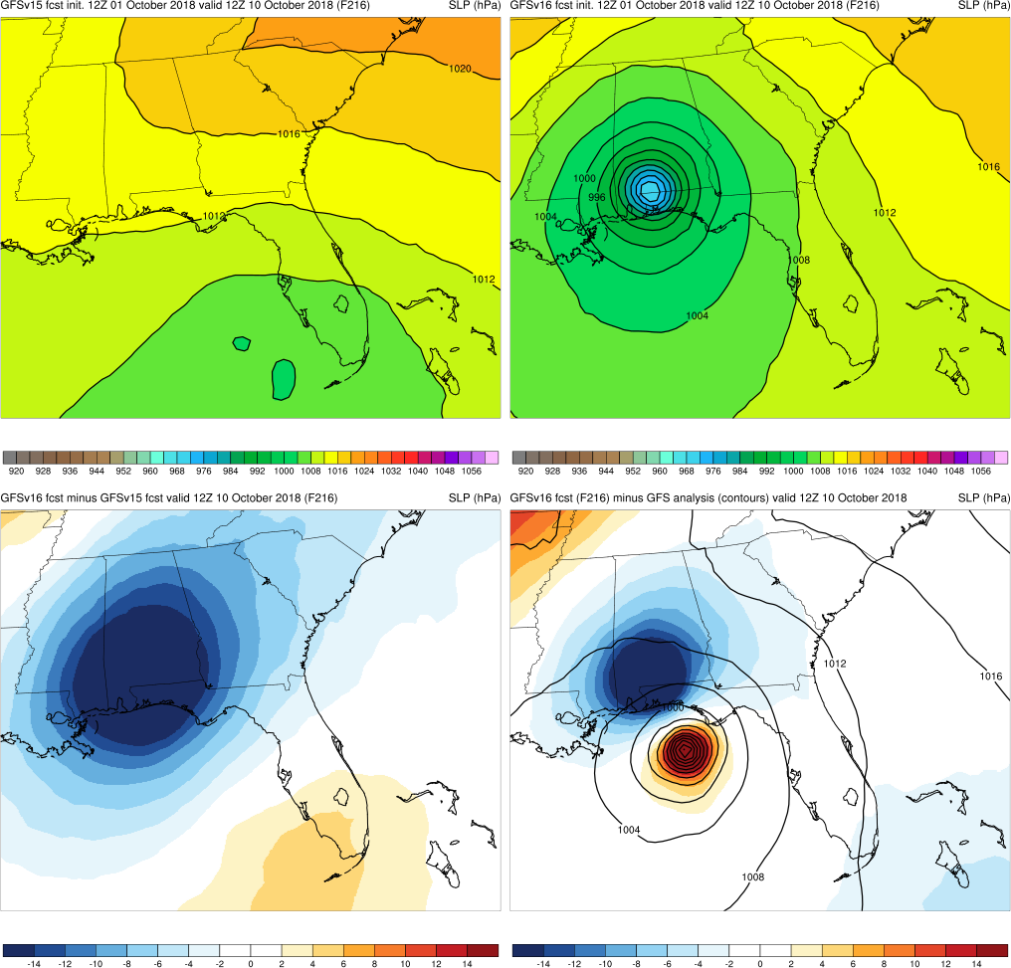
NATIONAL OCEANIC AND ATMOSPHERIC ADMINISTRATION
Strengths: Identifies TCs More Often & Earlier
GFSv15
GFSv16
Michael (F216) Valid: 12Z 10/10/18
Michael: GFSv16 forecasted a TC making landfall in the Gulf of Mexico days earlier than GFSv15
v16−v15
GFS Anl.

Slide 31
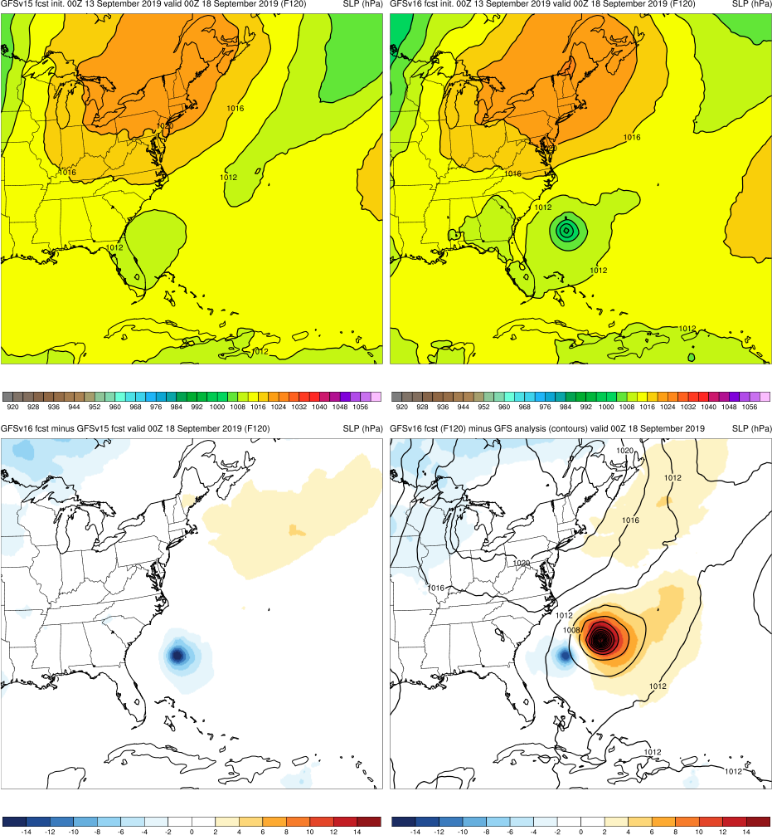
NATIONAL OCEANIC AND ATMOSPHERIC ADMINISTRATION
Strengths: Identifies TCs More Often & Earlier
GFSv15
GFSv16
Humberto (F120) Valid: 00Z 09/18/19
Michael: GFSv16 forecasted a TC making landfall in the Gulf of Mexico days earlier than GFSv15
Humberto: GFSv16 forecasted a TC to approach Bermuda 12 h earlier than GFSv15
v16−v15
GFS Anl.

Slide 32
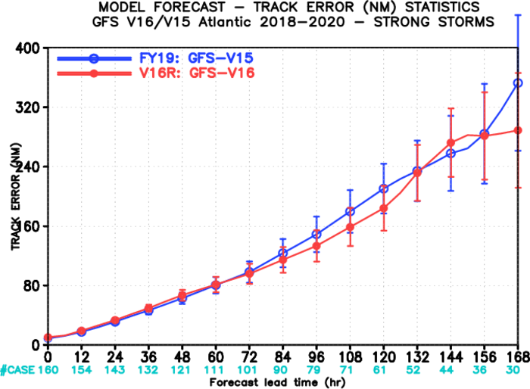
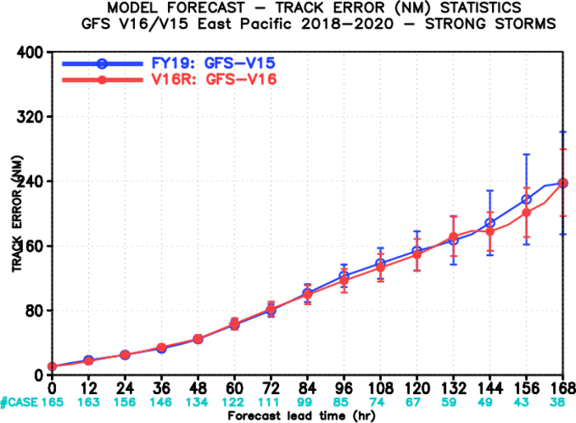
NATIONAL OCEANIC AND ATMOSPHERIC ADMINISTRATION
Strengths: Improved medium-range track error
North Atlantic Track Error (nm) for TCs ≥65 kt
East Pacific Track Error (nm) for TCs ≥65 kt
GFSv15
GFSv15
GFSv16
GFSv16
Images provided by Jiayi Peng
GFSv16 has lower track error than GFSv15 for strong TCs (≥65 kt) during most of the medium range in both the North Atlantic and East Pacific

Slide 33
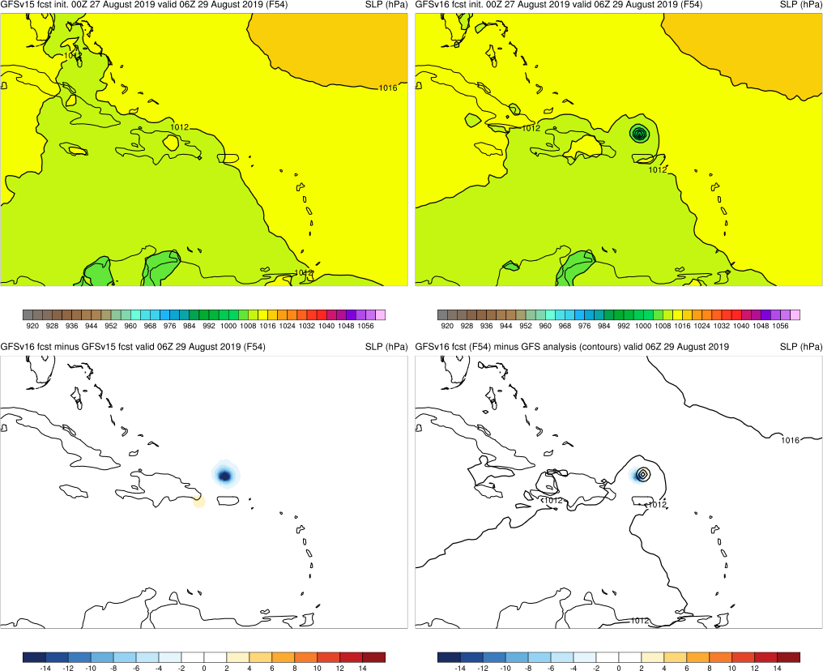
NATIONAL OCEANIC AND ATMOSPHERIC ADMINISTRATION
Strengths: Improved medium-range track error
GFSv15
GFSv16
Dorian (F054) Valid: 06Z 08/29/19
Dorian: GFSv16 forecasted Dorian to track north of Puerto Rico more than 24 h earlier than GFSv15
v16−v15
GFS Anl.

Slide 34
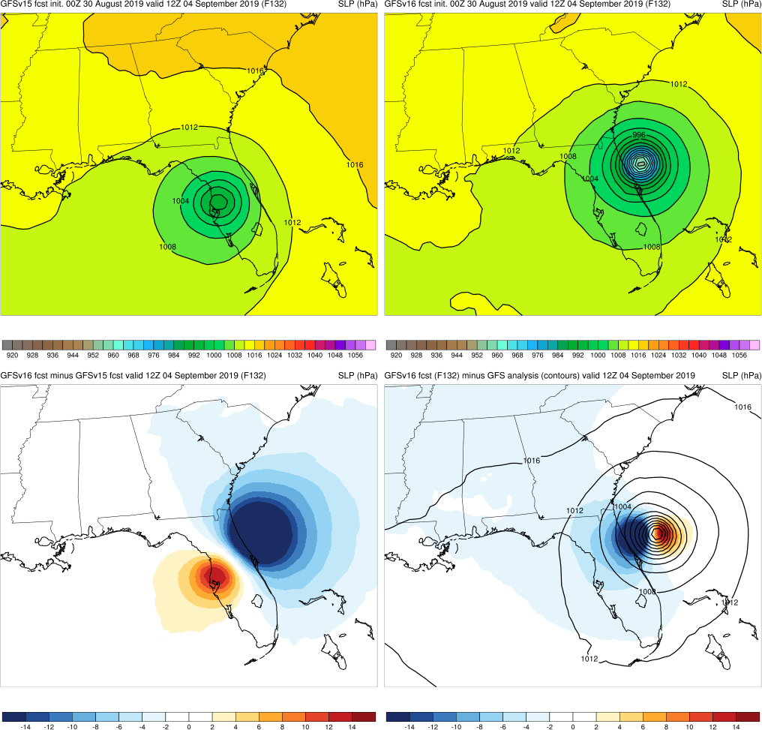
NATIONAL OCEANIC AND ATMOSPHERIC ADMINISTRATION
Strengths: Improved medium-range track error
GFSv15
GFSv16
Dorian (F132) Valid: 12Z 09/04/19
Dorian: GFSv16 forecasted Dorian to track north of Puerto Rico more than 24 h earlier than GFSv15
Dorian: GFSv16 forecasted Dorian to turn right and skim the Florida coast 36 h earlier than GFSv15
v16−v15
GFS Anl.

Slide 35
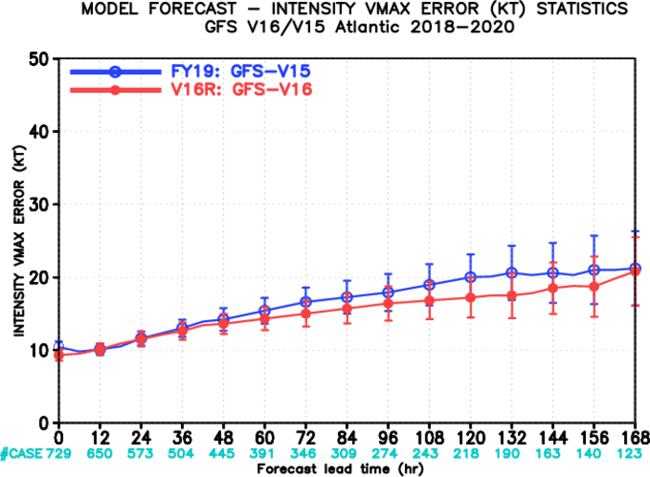
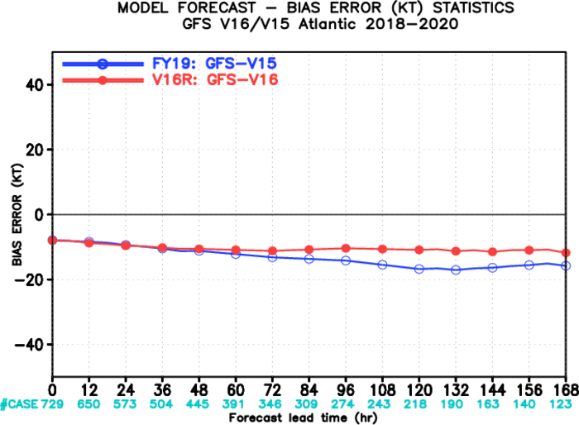
NATIONAL OCEANIC AND ATMOSPHERIC ADMINISTRATION
Strengths: Improved TC Intensity in N Atlantic
North Atlantic Intensity Error (kt)
North Atlantic Intensity Bias (kt)
Strong
GFSv15
GFSv16
Weak
GFSv15
GFSv16
Images provided by Jiayi Peng
GFSv16 has lower intensity error than GFSv15 at almost all lead times in the N Atlantic
GFSv16 has less of a weak bias than GFSv15 at longer lead times

Slide 36
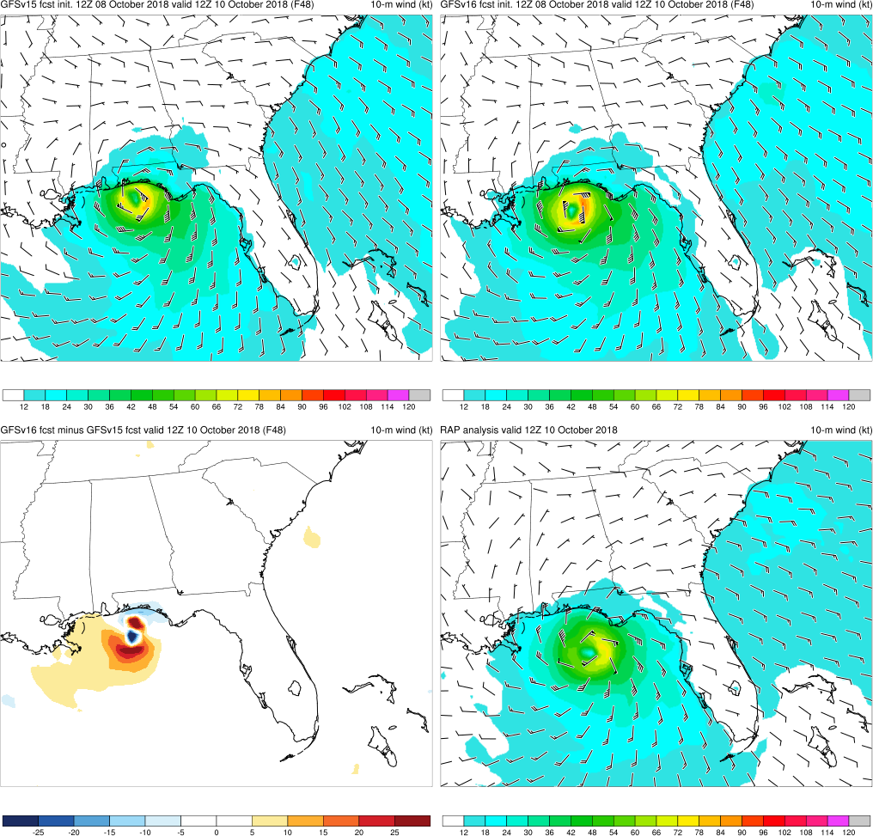
NATIONAL OCEANIC AND ATMOSPHERIC ADMINISTRATION
Strengths: Improved TC Intensity in N Atlantic
GFSv15
GFSv16
Michael (F048) Valid: 12Z 10/10/18
Michael: GFSv16 consistently (and correctly) forecasted a stronger TC than GFSv15
v16−v15
RAP Anl.
Best Track:
125 kt

Slide 37
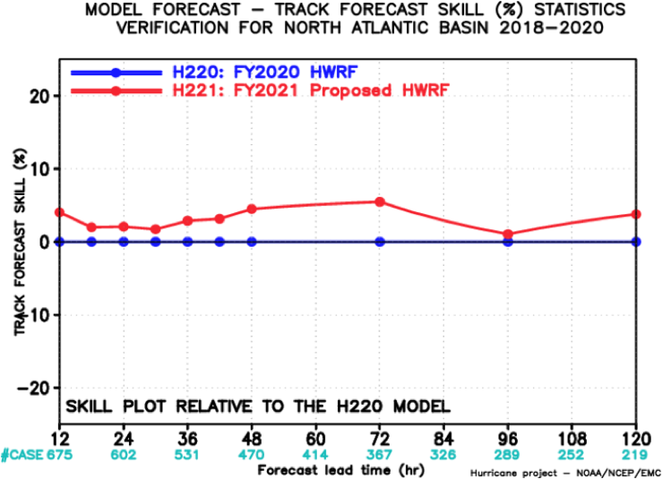
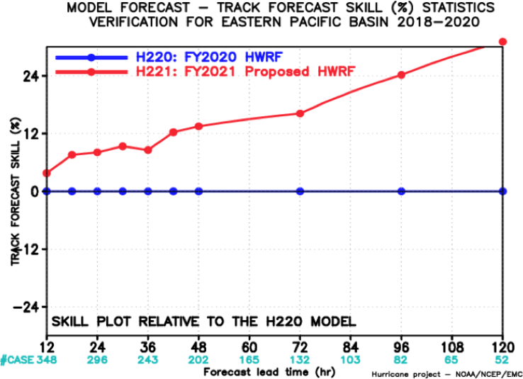
NATIONAL OCEANIC AND ATMOSPHERIC ADMINISTRATION
Strengths: Positive Impact on HWRF
Images provided by Zhan Zhang
Better
Better
HWRF (w/ GFSv16)
HWRF (w/ GFSv16)
HWRF (OPS)
HWRF (OPS)
Worse
Worse
North Atlantic Track Forecast Skill Relative to Operational HWRF (%)
East Pacific Track Forecast Skill Relative to Operational HWRF (%)
HWRF (v16) has improved track forecast skill relative to HWRF (OPS) in the NATL and EPAC. Intensity is also improved in the NATL and similar in the EPAC (not shown).

Slide 38
NATIONAL OCEANIC AND ATMOSPHERIC ADMINISTRATION
Strengths of GFSv16
Improved 500-hPa AC scores in the medium range (better with synoptic pattern)
Some indication that GFSv15 progressive issue has been improved
Improved position of relevant frontal boundaries
Mitigated the low-level cold bias seen in GFSv15 during the cool season
Identifies TC threats more often and at longer lead times
Overall, positive impact on HWRF forecasts
Improved QPF Equitable Threat Scores (ETS) and bias in the medium range
Overall, improved snowfall location and amounts at longer lead times
Resolved low-level warming issue seen in a few GFSv15 cases
Improved ability to capture the temperature profile in shallow, cold air masses
GFS Wave has lower globally-averaged RMSE and bias for Sig. Wave Height

Slide 39
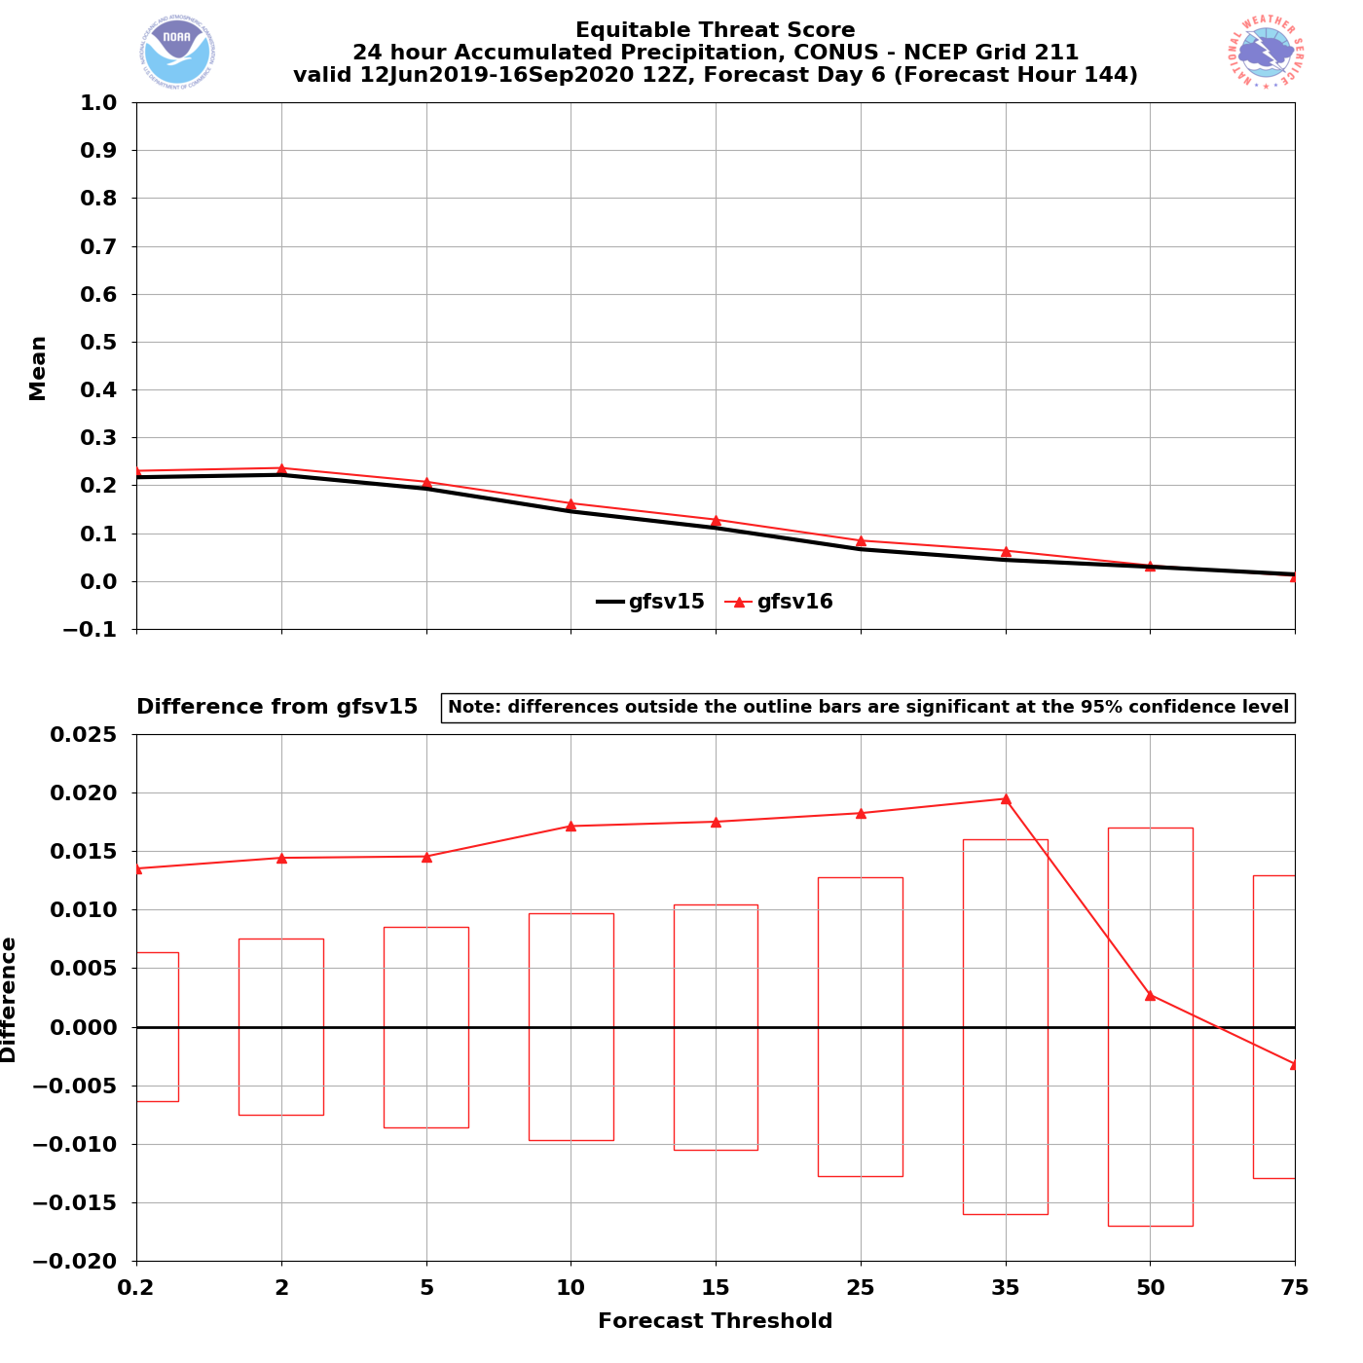
NATIONAL OCEANIC AND ATMOSPHERIC ADMINISTRATION
Strengths: Improved QPF ETS and Bias
Valid: 6/12/19–9/16/20 (F144)
Equitable Threat Score (ETS)
24-h QPF ETS
24-h QPF improvements appear most pronounced in the medium range, which is consistent w/ improved 500-hPa AC scores
F144: Statistically significant improvement at 0.2–35 mm thresholds
Statistically Significant

Slide 40
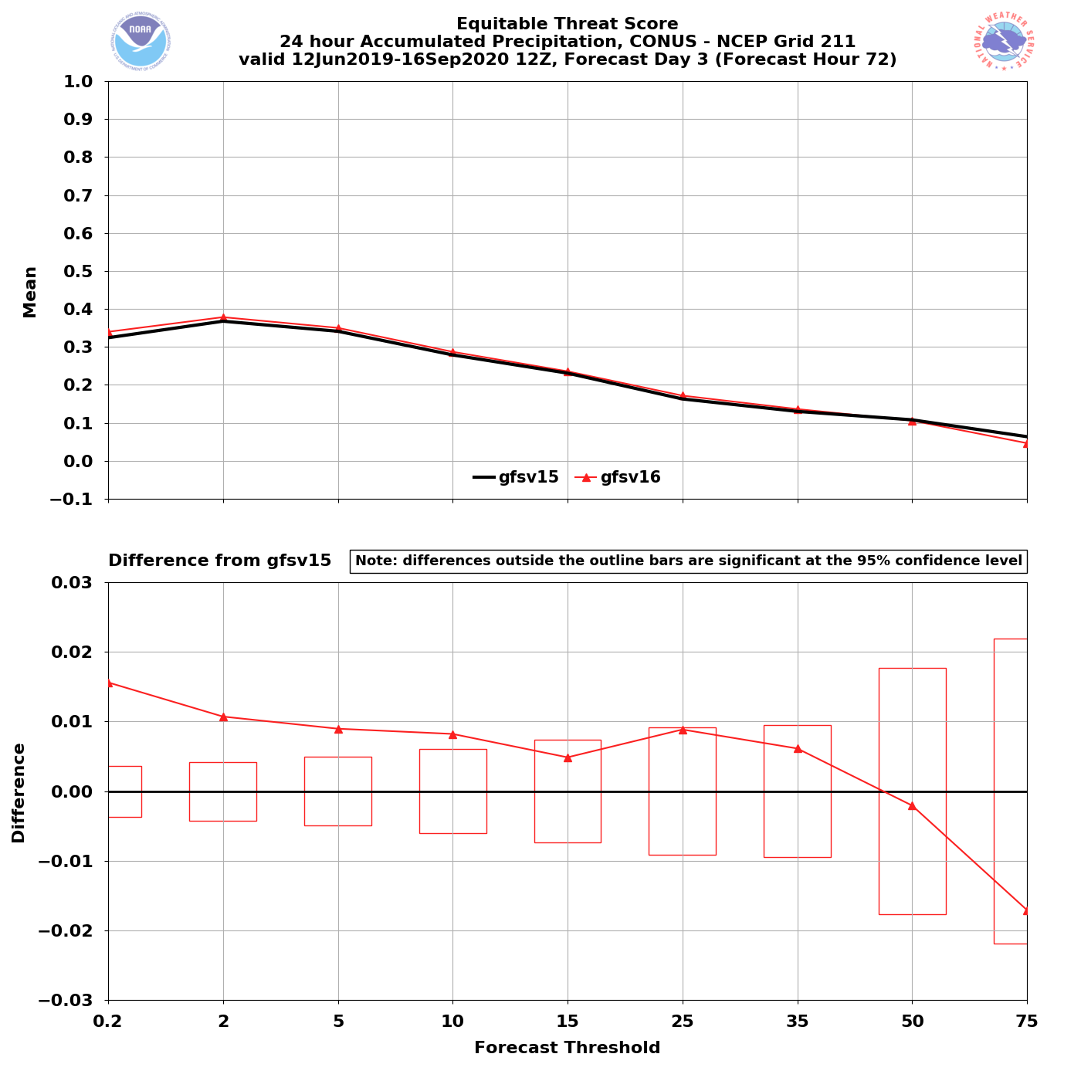
NATIONAL OCEANIC AND ATMOSPHERIC ADMINISTRATION
Strengths: Improved QPF ETS and Bias
Valid: 6/12/19–9/16/20 (F072)
Equitable Threat Score (ETS)
24-h QPF ETS
24-h QPF improvements appear most pronounced in the medium range, which is consistent w/ improved 500-hPa AC scores
F144: Statistically significant improvement at 0.2–35 mm thresholds
F072: Statistically significant improvement at 0.2–10 mm thresholds
Statistically Significant

Slide 41
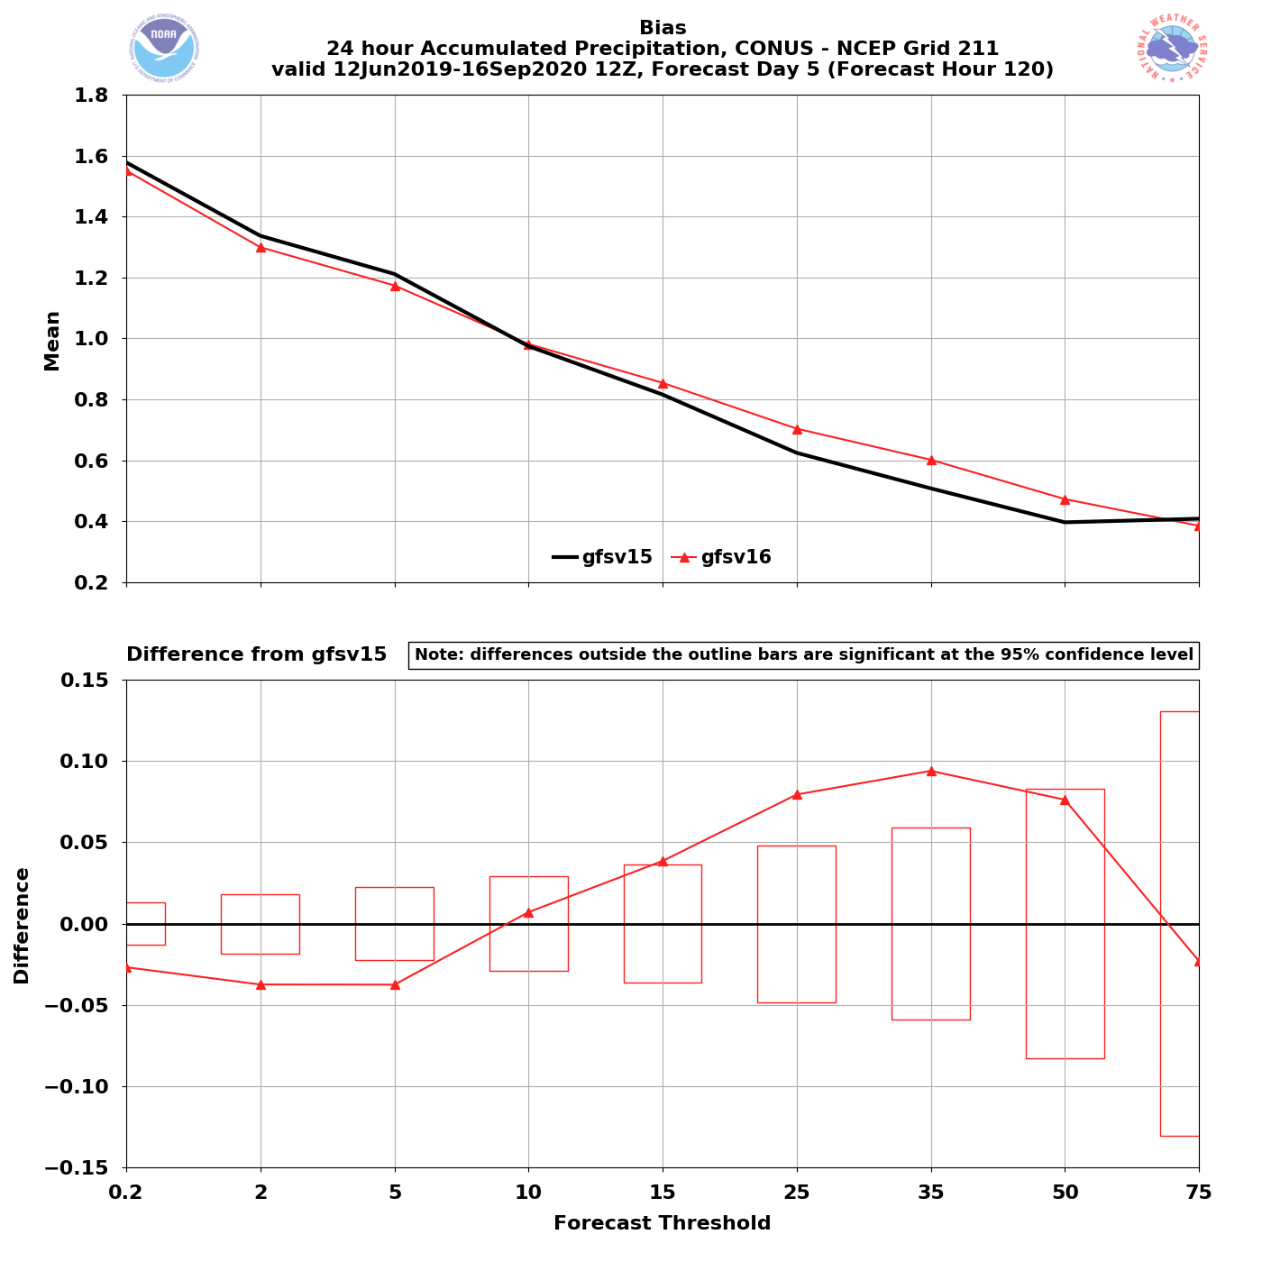
NATIONAL OCEANIC AND ATMOSPHERIC ADMINISTRATION
Strengths: Improved QPF ETS and Bias
Valid: 6/12/19–9/16/20 (F120)
Bias
24-h QPF Bias
24-h QPF bias improvements also most pronounced in the medium range
Reduction of the high bias at lower QPF thresholds is statistically significant
Reduction of the low bias at medium-to-high QPF thresholds is statistically significant
Statistically Significant

Slide 42
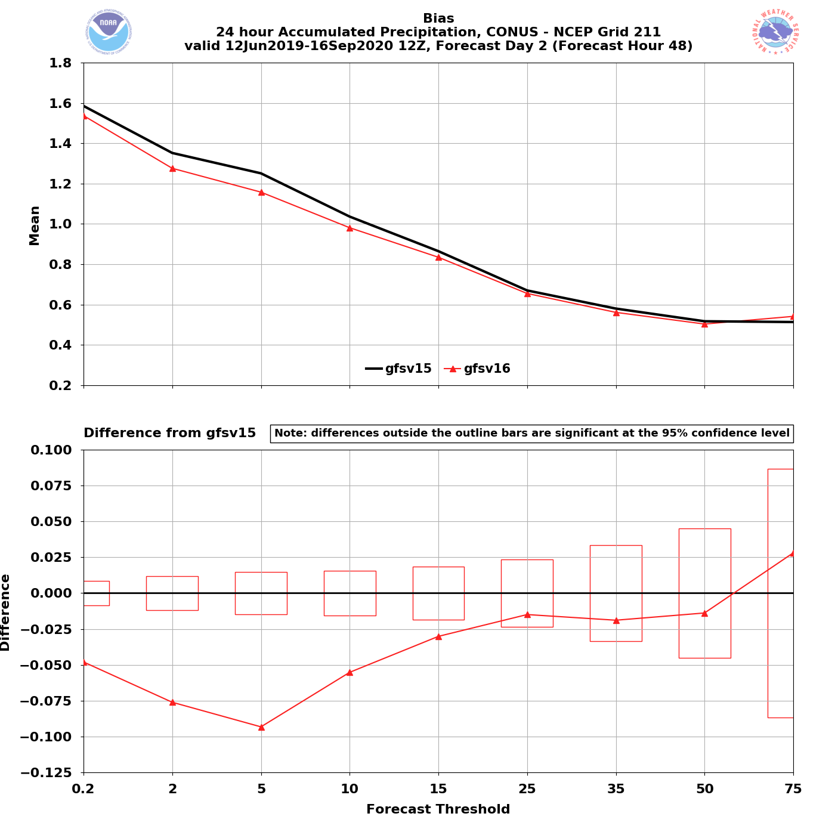
NATIONAL OCEANIC AND ATMOSPHERIC ADMINISTRATION
Strengths: Improved QPF ETS and Bias
Valid: 6/12/19–9/16/20 (F048)
Bias
24-h QPF Bias
24-h QPF bias improvements also most pronounced in the medium range
Reduction of the high bias at lower QPF thresholds is statistically significant
Reduction of the low bias at medium-to-high QPF thresholds is statistically significant
Statistically Significant
At shorter lead times, statistically significant improvements for smaller QPF thresholds

Slide 43
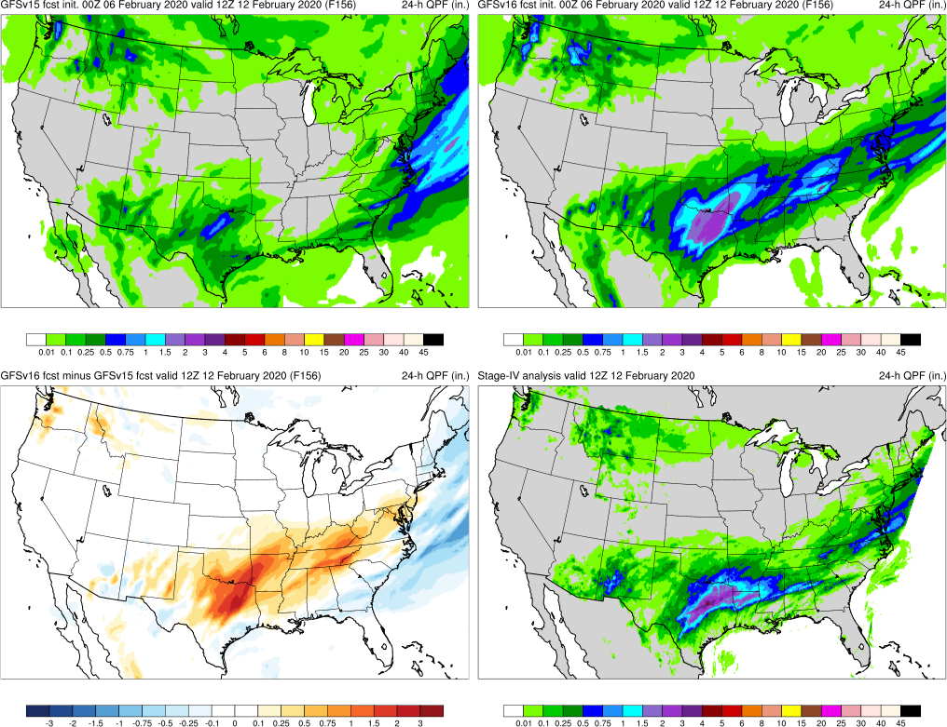
NATIONAL OCEANIC AND ATMOSPHERIC ADMINISTRATION
Strengths: Improved QPF ETS and Bias
Southern U.S. QPF (F156) Valid: 12Z 02/12/20
GFSv15
GFSv16
Southern U.S.: GFSv16 consistently generated more precipitation in Texas and overall had better forecasts at most lead times
v16−v15
Stage IV

Slide 44
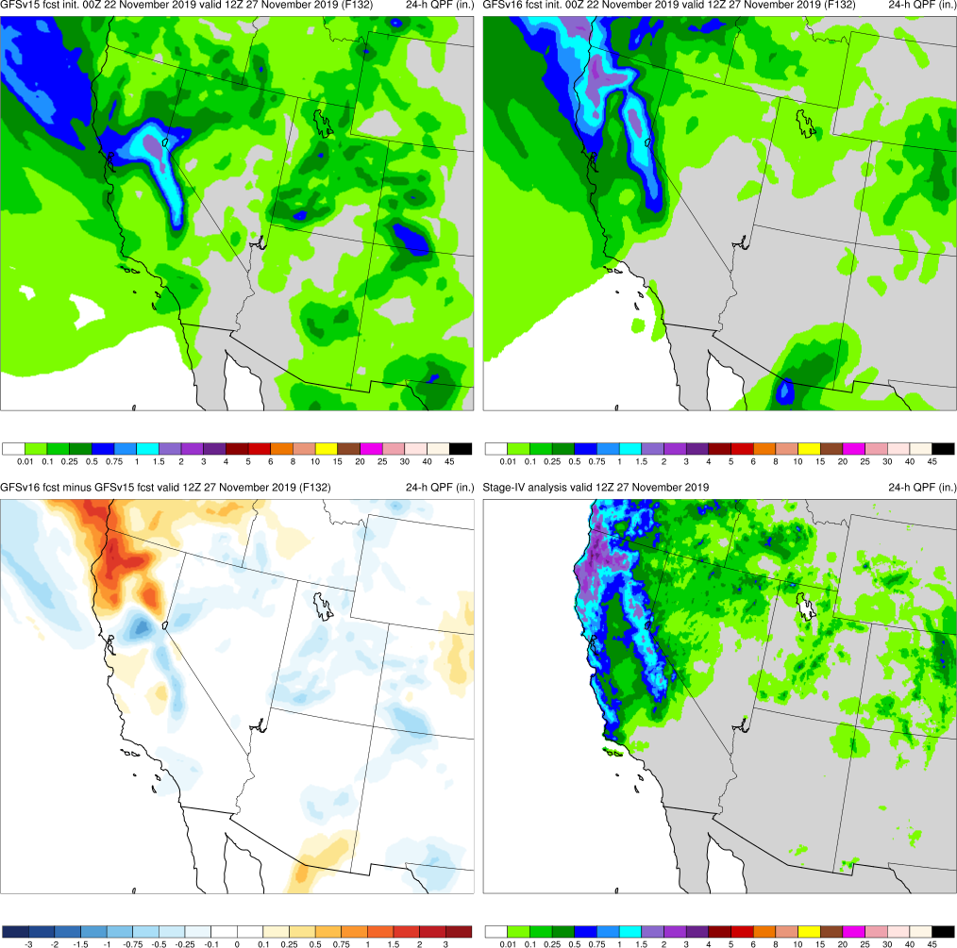
NATIONAL OCEANIC AND ATMOSPHERIC ADMINISTRATION
Strengths: Improved QPF ETS and Bias
West Coast Bomb Cyclone (F132) Valid: 12Z 11/27/19
Southern U.S.: GFSv16 consistently generated more precipitation in Texas and overall had better forecasts at most lead times
W Coast Bomb: GFSv16 consistently had (correctly) higher QPF amounts inland over N California and Oregon
GFSv15
GFSv16
v16−v15
Stage IV

Slide 45
NATIONAL OCEANIC AND ATMOSPHERIC ADMINISTRATION
Strengths of GFSv16
Improved 500-hPa AC scores in the medium range (better with synoptic pattern)
Some indication that GFSv15 progressive issue has been improved
Improved position of relevant frontal boundaries
Mitigated the low-level cold bias seen in GFSv15 during the cool season
Identifies TC threats more often and at longer lead times
Overall, positive impact on HWRF forecasts
Improved QPF Equitable Threat Scores (ETS) and bias in the medium range
Overall, improved snowfall location and amounts at longer lead times
Resolved low-level warming issue seen in a few GFSv15 cases
Improved ability to capture the temperature profile in shallow, cold air masses
GFS Wave has lower globally-averaged RMSE and bias for Sig. Wave Height

Slide 46
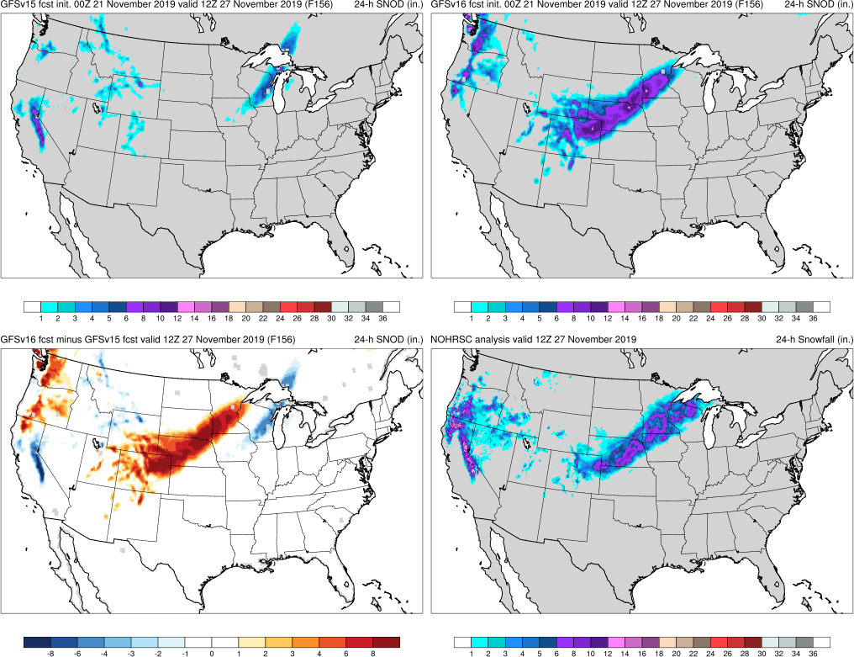
NATIONAL OCEANIC AND ATMOSPHERIC ADMINISTRATION
Strengths: Improved Snowfall Forecasts
Thanksgiving Storms (F156) Valid: 12Z 11/27/19
Thxgiving: GFSv16 forecasted a Great Plains snowfall event 48 h earlier than GFSv15
GFSv15
GFSv16
v16−v15
NOHRSC

Slide 47
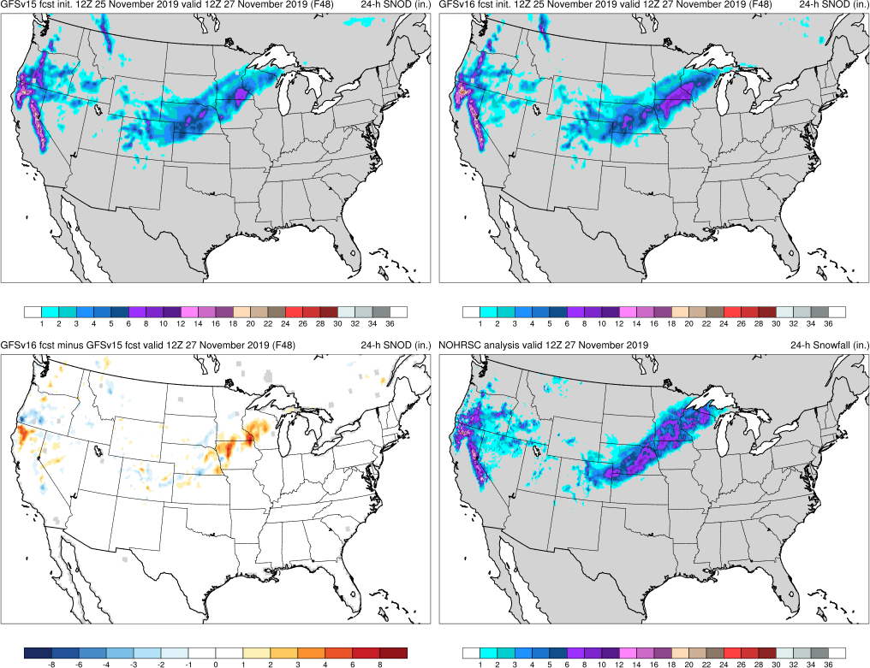
NATIONAL OCEANIC AND ATMOSPHERIC ADMINISTRATION
Strengths: Improved Snowfall Forecasts
Thanksgiving Storms (F048) Valid: 12Z 11/27/19
Thxgiving: GFSv16 forecasted a Great Plains snowfall event 48 h earlier than GFSv15
GFSv15
GFSv16
v16−v15
NOHRSC

Slide 48
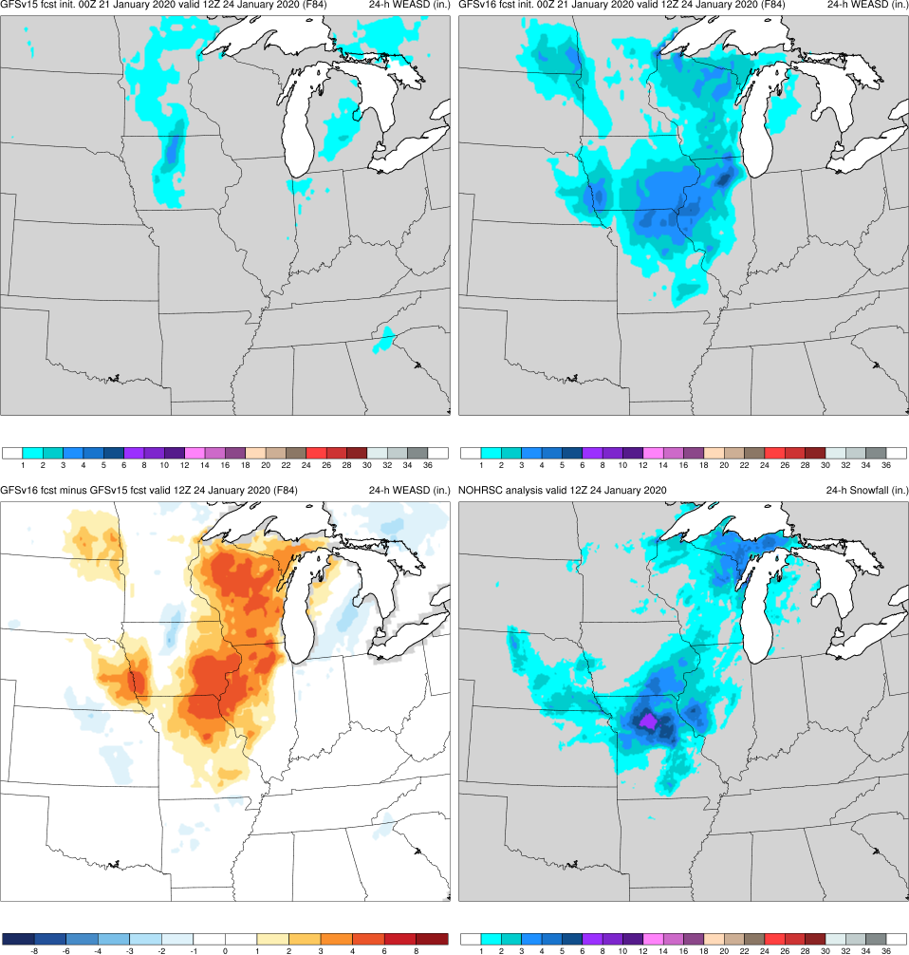
NATIONAL OCEANIC AND ATMOSPHERIC ADMINISTRATION
Strengths: Improved Snowfall Forecasts
Midwest Ptype Event (F084) Valid: 12Z 01/24/20
Thxgiving: GFSv16 forecasted a Great Plains snowfall event 48 h earlier than GFSv15
Midwest Ptype: GFSv16 forecasted snow in MO, IA, and IL that was not shown by GFSv15 at any lead time
GFSv15
GFSv16
v16−v15
NOHRSC

Slide 49
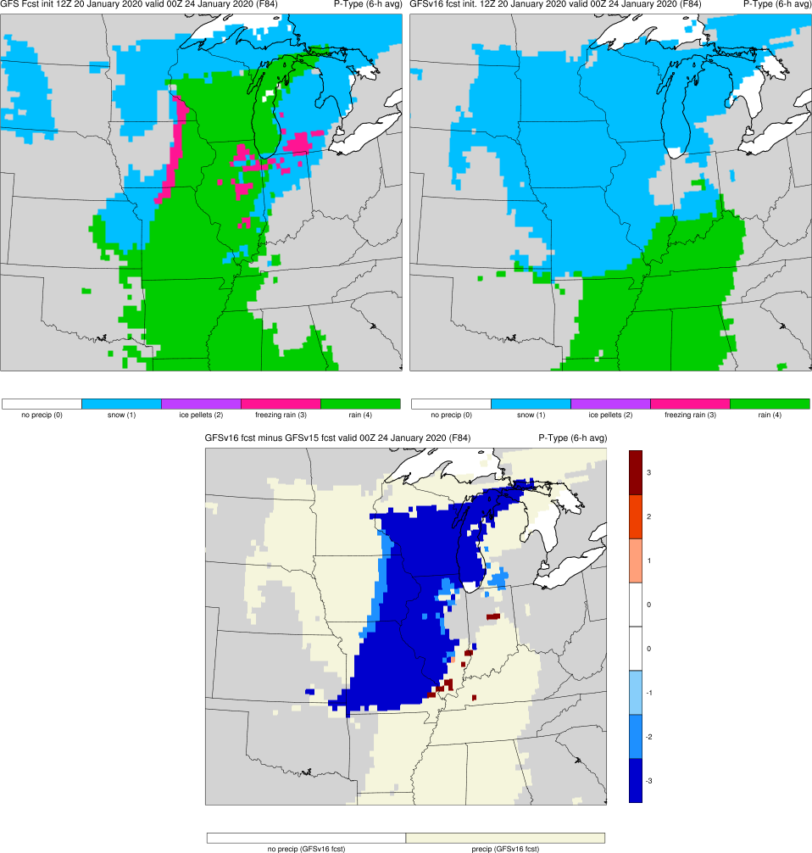
NATIONAL OCEANIC AND ATMOSPHERIC ADMINISTRATION
Strengths: Resolved Low-level Warming Issue
Midwest Ptype Event (F084) Valid: 00Z 01/24/20
Midwest Ptype: GFSv16 forecasted snow in MO/IA/WI that GFSv15 did not. GFSv15 low-level warming issue appears to be resolved.
GFSv15
GFSv16
v16−v15
Obs
Thanks to Ray Wolf (WFO DVN)
See 2/6/20 MEG Presentation

Slide 50
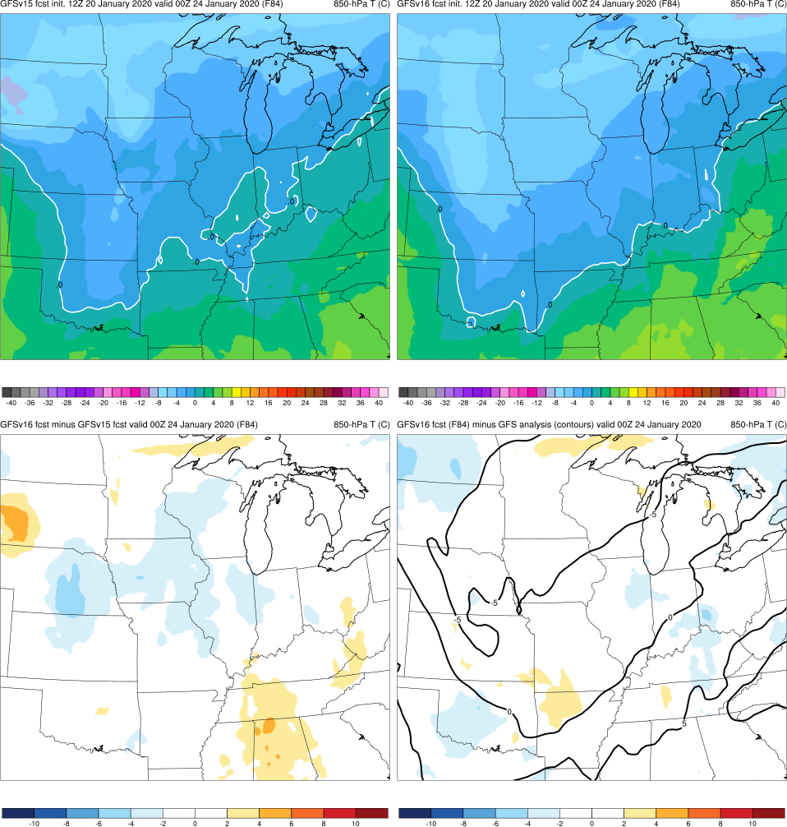
NATIONAL OCEANIC AND ATMOSPHERIC ADMINISTRATION
Strengths: Resolved Low-level Warming Issue
Midwest Ptype Event (F084) Valid: 00Z 01/24/20
Midwest Ptype: GFSv16 forecasted snow in MO/IA/WI that GFSv15 did not. GFSv15 low-level warming issue appears to be resolved.
GFSv15
GFSv16
v16−v15
GFS Anl.

Slide 51
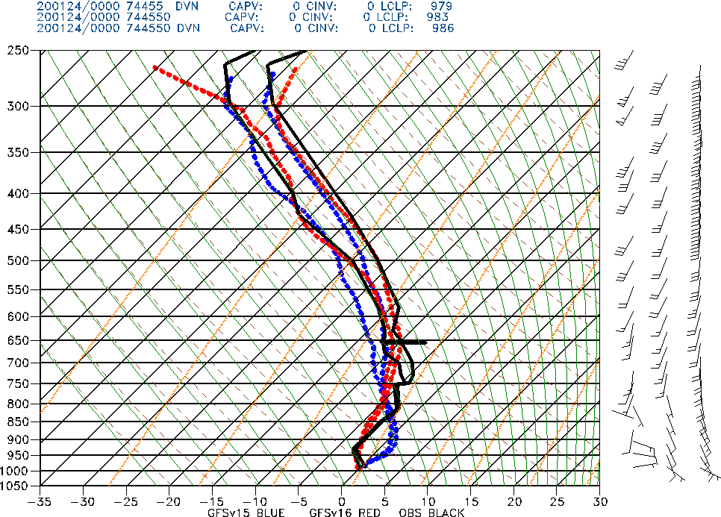
NATIONAL OCEANIC AND ATMOSPHERIC ADMINISTRATION
Strengths: Resolved Low-level Warming Issue
Midwest Ptype Event (F084) Valid: 00Z 01/24/20
Davenport, IA
Midwest Ptype: GFSv16 forecasted snow in MO/IA/WI that GFSv15 did not. GFSv15 low-level warming issue appears to be resolved.
GFSv15
GFSv16
OBS

Slide 52
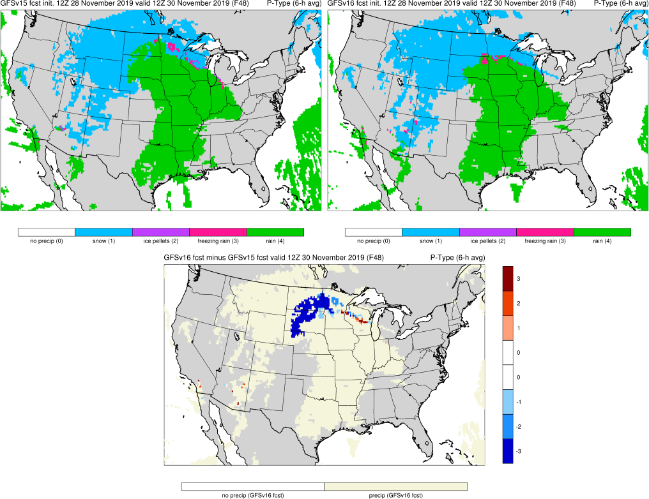
NATIONAL OCEANIC AND ATMOSPHERIC ADMINISTRATION
Strengths: Resolved Low-level Warming Issue
Northern Plains Ptype (F048) Valid: 12Z 11/30/19
Midwest Ptype: GFSv16 forecasted snow in MO/IA/WI that GFSv15 did not. GFSv15 low-level warming issue appears to be resolved.
N Plains: GFSv16 forecasted snow is MN/ND/SD that GFSv15 did not
GFSv15
GFSv16
v16−v15
Obs
Thanks to Chauncy Schultz (WFO BIS)
See 2/6/20 MEG Presentation

Slide 53
NATIONAL OCEANIC AND ATMOSPHERIC ADMINISTRATION
Strengths: Resolved Low-level Warming Issue
Northern Plains Ptype (F048) Valid: 12Z 11/30/19
Rapid City, SD
Midwest Ptype: GFSv16 forecasted snow in MO/IA/WI that GFSv15 did not. GFSv15 low-level warming issue appears to be resolved.
N Plains: GFSv16 forecasted snow is MN/ND/SD that GFSv15 did not
GFSv15
GFSv16
OBS

Slide 54
NATIONAL OCEANIC AND ATMOSPHERIC ADMINISTRATION
Strengths of GFSv16
Improved 500-hPa AC scores in the medium range (better with synoptic pattern)
Some indication that GFSv15 progressive issue has been improved
Improved position of relevant frontal boundaries
Mitigated the low-level cold bias seen in GFSv15 during the cool season
Identifies TC threats more often and at longer lead times
Overall, positive impact on HWRF forecasts
Improved QPF Equitable Threat Scores (ETS) and bias in the medium range
Overall, improved snowfall location and amounts at longer lead times
Resolved low-level warming issue seen in a few GFSv15 cases
Improved ability to capture the temperature profile in shallow, cold air masses
GFS Wave has lower globally-averaged RMSE and bias for Sig. Wave Height

Slide 55
NATIONAL OCEANIC AND ATMOSPHERIC ADMINISTRATION
Strengths: Temps in shallow, cold air masses
Cold air damming events have always been a major weakness of the GFS, likely connected to the systematic problems with developing and maintaining inversions
Cold air damming events have always been known as a strength of the NAM (especially the 3-km NAM nest)
There has always been some thought that vertical resolution in the boundary layer helps with modeling shallow, cold air masses, so additional vertical layers in GFSv16 may help

Slide 56
NATIONAL OCEANIC AND ATMOSPHERIC ADMINISTRATION
Strengths: Temps in shallow, cold air masses
GFSv15
GFSv16
Mid-Atlantic SVR (F072) Valid: 12Z 2/06/20
F072: GFSv16 was correctly colder than GFSv15 over VA/MD area, where cold air damming is occurring along the eastern Appalachians
Improved 2-m T forecasts in shallow, cold air masses may be tied to a better handling of low-level clouds
v16−v15
RAP Anl.

Slide 57
NATIONAL OCEANIC AND ATMOSPHERIC ADMINISTRATION
Strengths: Temps in shallow, cold air masses
Dulles, VA
Mid-Atlantic SVR (F072) Valid: 12Z 2/06/20
OBS
GFSv15
GFSv16
F072: GFSv16 was correctly colder than GFSv15 over VA/MD area, where cold air damming is occurring along the eastern Appalachians
Improved 2-m T forecasts in shallow, cold air masses may to be tied to a better handling of low-level clouds

Slide 58
NATIONAL OCEANIC AND ATMOSPHERIC ADMINISTRATION
Strengths of GFSv16
Improved 500-hPa AC scores in the medium range (better with synoptic pattern)
Some indication that GFSv15 progressive issue has been improved
Improved position of relevant frontal boundaries
Mitigated the low-level cold bias seen in GFSv15 during the cool season
Identifies TC threats more often and at longer lead times
Overall, positive impact on HWRF forecasts
Improved QPF Equitable Threat Scores (ETS) and bias in the medium range
Overall, improved snowfall location and amounts at longer lead times
Resolved low-level warming issue seen in a few GFSv15 cases
Improved ability to capture the temperature profile in shallow, cold air masses
GFS Wave has lower globally-averaged RMSE and bias for Sig. Wave Height

Slide 59
NATIONAL OCEANIC AND ATMOSPHERIC ADMINISTRATION
Strengths: Lower SWH RMSE/Bias Globally
GFS Wave−Multi-1 SWH RMSE
GFS Wave−Multi-1 SWH Bias
GFS Wave has lower globally-average RMSE and bias for Significant Wave Height (SWH) than Multi-1, primarily due to large improvements in the Indian Ocean

Slide 60
NATIONAL OCEANIC AND ATMOSPHERIC ADMINISTRATION
Concerns for GFSv16
Increased right-of-track bias at longer lead times for North Atlantic TCs
Larger TC False Alarm Rate (FAR) in the western North Atlantic (70°W–50°W)
Tendency to strengthen all TCs in the long range (pre-formation, not in stats)
Degradation of HMON performance
Some regional degradation of waves forecasts
Exacerbation of low instability (i.e., CAPE) bias that already existed in GFSv15, driven largely by dry soil moisture
Colder low-level temperature analyses, especially in the cool season
Lack of considerable improvement in forecasting radiation inversions

Slide 61
NATIONAL OCEANIC AND ATMOSPHERIC ADMINISTRATION
Concerns: Increased Right-of-Track Bias
N Atlantic Along-Track Bias
N Atlantic Across-Track Bias
Fast
Right
GFSv16
GFSv15
GFSv15
GFSv16
Slow
Left
Images provided by Jiayi Peng
A slower and right-of-track bias at longer lead times suggests that GFSv16 may be recurving TCs earlier than GFSv15
GFSv16 has a larger slow bias than GFSv15 that grows with forecast length in the N Atlantic
GFSv16 has a larger right-of-track bias than GFSv15 that is largest at longer lead times

Slide 62
NATIONAL OCEANIC AND ATMOSPHERIC ADMINISTRATION
Concerns: Increased Right-of-Track Bias
Isaias (F096) Valid: 18Z 8/03/20
Isaias: GFSv16 was often further right of track than v15 in the short and medium ranges. Both are also too fast in this example.
GFSv15
GFSv16
v16−v15
GFS Anl.

Slide 63
NATIONAL OCEANIC AND ATMOSPHERIC ADMINISTRATION
Concerns: Increased Right-of-Track Bias
Lorenzo (F156) Valid: 00Z 10/02/19
Isaias: GFSv16 was often further right of track than v15 in the short and medium ranges. Both are also too fast in this example
Lorenzo: GFSv16 was further right-of-track than v15 (and analysis) as the TC moved NE towards Ireland
GFSv15
GFSv16
v16−v15
GFS Anl.

Slide 64
NATIONAL OCEANIC AND ATMOSPHERIC ADMINISTRATION
Concerns for GFSv16
Increased right-of-track bias at longer lead times for North Atlantic TCs
Larger TC False Alarm Rate (FAR) in the western North Atlantic (70°W–50°W)
Tendency to strengthen all TCs in the long range (pre-formation, not in stats)
Degradation of HMON performance
Some regional degradation of waves forecasts
Exacerbation of low instability (i.e., CAPE) bias that already existed in GFSv15, driven largely by dry soil moisture
Colder low-level temperature analyses, especially in the cool season
Lack of considerable improvement in forecasting radiation inversions

Slide 65
NATIONAL OCEANIC AND ATMOSPHERIC ADMINISTRATION
Larger TC False Alarm Rate
From Dan Halperin, ERAU
A further left than the of the same color indicates that v16 has a higher false alarm rate for that season
While preliminary 2020 numbers look good for v16, the weighted mean for the three TC seasons shows that v16 has a larger FAR

Slide 66
NATIONAL OCEANIC AND ATMOSPHERIC ADMINISTRATION
Larger TC False Alarm Rate
From Dan Halperin, ERAU
Large number of false alarms in GFSv16, relative to v15, between 50º and 70º W

Slide 67
NATIONAL OCEANIC AND ATMOSPHERIC ADMINISTRATION
Concerns for GFSv16
Increased right-of-track bias at longer lead times for North Atlantic TCs
Larger TC False Alarm Rate (FAR) in the western North Atlantic (70°W–50°W)
Tendency to strengthen all TCs in the long range (pre-formation, not in stats)
Degradation of HMON performance
Some regional degradation of waves forecasts
Exacerbation of low instability (i.e., CAPE) bias that already existed in GFSv15, driven largely by dry soil moisture
Colder low-level temperature analyses, especially in the cool season
Lack of considerable improvement in forecasting radiation inversions

Slide 68
NATIONAL OCEANIC AND ATMOSPHERIC ADMINISTRATION
Concerns: Strengthens Too Many TCs
Laura/Marco (F144) Valid: 18Z 08/24/20
Marco: GFSv16 had better track forecasts, but 15 consecutive v16 cycles had Marco as a sub 982 low (with many in the 950s and 960s); no GFSv15 cycle was that intense
GFSv15
GFSv16
Laura: GFSv16 did well with many aspects of the intensity forecast, but this example shows a major threat to south FL that did not materialize
v16−v15
GFS Anl.

Slide 69
NATIONAL OCEANIC AND ATMOSPHERIC ADMINISTRATION
Concerns for GFSv16
Increased right-of-track bias at longer lead times for North Atlantic TCs
Larger TC False Alarm Rate (FAR) in the western North Atlantic (70°W–50°W)
Tendency to strengthen all TCs in the long range (pre-formation, not in stats)
Degradation of HMON performance
Some regional degradation of waves forecasts
Exacerbation of low instability (i.e., CAPE) bias that already existed in GFSv15, driven largely by dry soil moisture
Colder low-level temperature analyses, especially in the cool season
Lack of considerable improvement in forecasting radiation inversions

Slide 70
NATIONAL OCEANIC AND ATMOSPHERIC ADMINISTRATION
Degraded HMON NATL Tracks
Atlantic Basin track forecasts are degraded when initializing with GFSv16
From
Zhan Zhang
That said, EPAC track forecasts are improved, and intensity forecasts (not shown) are overall improved

Slide 71
NATIONAL OCEANIC AND ATMOSPHERIC ADMINISTRATION
Concerns for GFSv16
Increased right-of-track bias at longer lead times for North Atlantic TCs
Larger TC False Alarm Rate (FAR) in the western North Atlantic (70°W–50°W)
Tendency to strengthen all TCs in the long range (pre-formation, not in stats)
Degradation of HMON performance
Some regional degradation of waves forecasts
Exacerbation of low instability (i.e., CAPE) bias that already existed in GFSv15, driven largely by dry soil moisture
Colder low-level temperature analyses, especially in the cool season
Lack of considerable improvement in forecasting radiation inversions

Slide 72
NATIONAL OCEANIC AND ATMOSPHERIC ADMINISTRATION
Waves Concerns
Buoys Overall | Sig Wave Height | Wind Speed | Peak Period
Subjective | Multi-1 | GFS Wave | GFS Wave
Objective/month | Multi-1 | GFS Wave | GFS Wave
Objective/fcst | Tie | Tie | GFS Wave
From Deanna Spindler
Buoys (coastal areas) and satellite data (open ocean) were used to compare the existing Multi-1 global wave model with GFSv16 (GFS Wave - wave component coupled to atmosphere)
Regionally, Multi-1 has better sig wave heights and wind speeds
Near the coastal US,
Multi-1 performs better, as
expected due to the loss of
the 4 arcmin grids
Satellite Overall | Sig Wave Height | Wind Speed
Global | GFS Wave | GFS Wave
North Atlantic (at_10m) | Multi-1 | Multi-1
US West Coast (wc_10m) | Multi-1 | Multi-1

Slide 73
NATIONAL OCEANIC AND ATMOSPHERIC ADMINISTRATION
Concerns for GFSv16
Increased right-of-track bias at longer lead times for North Atlantic TCs
Larger TC False Alarm Rate (FAR) in the western North Atlantic (70°W–50°W)
Tendency to strengthen all TCs in the long range (pre-formation, not in stats)
Degradation of HMON performance
Some regional degradation of waves forecasts
Exacerbation of low instability (i.e., CAPE) bias that already existed in GFSv15, driven largely by dry soil moisture
Colder low-level temperature analyses, especially in the cool season
Lack of considerable improvement in forecasting radiation inversions

Slide 74
NATIONAL OCEANIC AND ATMOSPHERIC ADMINISTRATION
GFSv16 Severe Weather: Concerns
Instability guidance is degraded relative to GFSv15
GFSv16 surface-based CAPE magnitudes are consistently lower at all valid times and at all forecast lead times
Drier top-layer soil moisture initial conditions promote overmixing of the PBL, leading to a reduction in available low-level moisture
Possible additional issue with occasional signs of early decoupling of the surface layer

Slide 75
NATIONAL OCEANIC AND ATMOSPHERIC ADMINISTRATION
CAPE Magnitudes Are Reduced in GFSv16
GFSv15
GFSv16
Obs
Lower GFSv16 CAPE magnitudes are most pronounced at 00Z valid times
Focusing on 00Z/12Z valid times since special 06Z/18Z soundings counts are limited

Slide 76
NATIONAL OCEANIC AND ATMOSPHERIC ADMINISTRATION
CAPE Magnitudes Are Reduced in GFSv16
GFSv15
GFSv16
Obs
Operational GFSv15 CAPE analyses/forecasts are consistently lower than obs
CAPE magnitudes in GFSv16 analyses/forecasts are consistently lower than those from GFSv15

Slide 77
NATIONAL OCEANIC AND ATMOSPHERIC ADMINISTRATION
CAPE Magnitudes Are Reduced in GFSv16
GFSv15
GFSv16
v16 - v15
F024
F024
F024
Surface-Based CAPE Forecasts (left and middle) and Forecast Differences (right)
Init: 00Z 23 July 2020 Valid: 00Z 24 July 2020 (F024)
GFSv16 CAPE was notably lower across the Northern and Central Plains, as well as over the Gulf Coast region and southeast; smaller reductions over the northeast, Ohio Valley, and Mexico

Slide 78
NATIONAL OCEANIC AND ATMOSPHERIC ADMINISTRATION
CAPE Magnitudes Are Reduced in GFSv16
GFSv15
GFSv16
RAP ANL
F024
F024
Surface-Based CAPE Forecasts (left and middle) and Analysis (right)
Init: 00Z 23 July 2020 Valid: 00Z 24 July 2020 (F024)
The higher CAPE values in GFSv15 are almost always better, and even those are too low

Slide 79
NATIONAL OCEANIC AND ATMOSPHERIC ADMINISTRATION
SOO Team CAPE Ratings
Lowest overall ratings from the SOO team case ratings were for CAPE
The only negative cumulative rating in the entire SOO assessment was for short-range CAPE forecasts
A large number of ‘0’ (little difference) ratings for cool-season events skew the “as good or better” numbers
 | Mean Rating -3 to +3 | % GFSv16 as good or better than GFSv15 | % GFSv16 worse than GFSv15
Extended Range | 0.04 | 70 | 30
Medium Range | 0.21 | 74 | 26
Short Range | -0.20 | 75 | 25

Slide 80
NATIONAL OCEANIC AND ATMOSPHERIC ADMINISTRATION
Drier Soil Reduces Boundary Layer Moisture
v16 - v15 Differences
F024
Top Level Soil Moisture
F024
2-m Dew Point
F024
Sfc-Based CAPE
F024
Init: 00Z 23 July 2020 Valid: 00Z 24 July 2020 (F024)
GFSv16 top level soil moisture is considerably drier than in v15
Good alignment between lower 2-m dew points and largest areas of reduced CAPE

Slide 81
NATIONAL OCEANIC AND ATMOSPHERIC ADMINISTRATION
Tendency to Overmix the Boundary Layer
CAPE
2-m Td
GFSv15
GFSv16
GFSv15
GFSv16
RAP
ANL
RAP
ANL
v16 - v15
v16 - v15
Init: 12Z 16 August 2019 Valid: 00Z 17 August 2019 (F012)
Largest CAPE reductions are collocated with largest 2-m dewpoint reductions

Slide 82
NATIONAL OCEANIC AND ATMOSPHERIC ADMINISTRATION
Tendency to Overmix the Boundary Layer
GFSv15 GFSv16 Obs
Fort Worth, TX (FWD)
Norman, OK
(OUN)
Init: 12Z 16 August 2019 Valid: 00Z 17 August 2019 (F012)
GFSv16 PBL was drier/warmer/deeper than GFSv15 and obs in the unstable air

Slide 83
NATIONAL OCEANIC AND ATMOSPHERIC ADMINISTRATION
Tendency to Overmix the Boundary Layer
Experiments run by Weizhong Zheng
F12 qv at FWD
F12 qv at FWD
OBS
GFSv16
GFSv16 w/ v15 atm
IC + v16 sfc IC
GFSv16 w/ v15 IC
GFSv16
GFSv16 w/ old PBL
GFSv16 w/ v15 IC
GFSv16 w/ old PBL +
v15 IC
Minor sensitivity to PBL scheme; major
sensitivity to initial conditions
Most of the initial condition sensitivity is to the
surface states and not the atmospheric states

Slide 84
NATIONAL OCEANIC AND ATMOSPHERIC ADMINISTRATION
Warm/Dry Bias Exacerbated Across the Great Plains
2-m T
2-m Td
GFSv15
GFSv16
Northern Plains 2-m T (left) and 2-m Td (right) Bias as a Function of Forecast Lead
Similar bias exists, but to a lesser extent, in neighboring regions

Slide 85
NATIONAL OCEANIC AND ATMOSPHERIC ADMINISTRATION
Early Surface Decoupling?
F012
F015
F018
Surface-Based CAPE Forecasts Differences
(GFSv16 - GFSv15)
Init: 00Z 8/10/2020
GFSv16 lower
GFSv16 higher
F021
F024
Is early surface decoupling playing a role in maximizing CAPE reductions at 00Z?

Slide 86
NATIONAL OCEANIC AND ATMOSPHERIC ADMINISTRATION
Early Surface Decoupling Examples
GFSv15 GFSv16 Obs
Brookhaven, NY
Denver, CO

Slide 87
NATIONAL OCEANIC AND ATMOSPHERIC ADMINISTRATION
Concerns for GFSv16
Increased right-of-track bias at longer lead times for North Atlantic TCs
Larger TC False Alarm Rate (FAR) in the western North Atlantic (70°W–50°W)
Tendency to strengthen all TCs in the long range (pre-formation, not in stats)
Degradation of HMON performance
Some regional degradation of waves forecasts
Exacerbation of low instability (i.e., CAPE) bias that already existed in GFSv15, driven largely by dry soil moisture
Colder low-level temperature analyses, especially in the cool season
Lack of considerable improvement in forecasting radiation inversions

Slide 88
NATIONAL OCEANIC AND ATMOSPHERIC ADMINISTRATION
Colder 850-hPa Analyses
GFSv15 issue with low-level cold bias that grows with forecast length (most evident in the cool season) has clearly been mitigated
That said, the analyses and very short range v16 forecasts are colder than those in v15 (00z cycles are shown here, but the issue is independent of cycle)

Slide 89
NATIONAL OCEANIC AND ATMOSPHERIC ADMINISTRATION
Colder 850-hPa Analyses
This low-level analysis cold bias appears
to be mostly a cool season issue
It’s also worth noting that the entire vertical profile of the v16 T analysis is colder

Slide 90
NATIONAL OCEANIC AND ATMOSPHERIC ADMINISTRATION
Colder 850-hPa Analyses
What does the analysis cold bias look like on a contoured map?
v15
OBS
ANL
6h FCST
(guess)
v16
GFSv16-GFSv15 F00 Temperature
valid 00z 18 October 2019

Slide 91
NATIONAL OCEANIC AND ATMOSPHERIC ADMINISTRATION
Concerns for GFSv16
Increased right-of-track bias at longer lead times for North Atlantic TCs
Larger TC False Alarm Rate (FAR) in the western North Atlantic (70°W–50°W)
Tendency to strengthen all TCs in the long range (pre-formation, not in stats)
Degradation of HMON performance
Some regional degradation of waves forecasts
Exacerbation of low instability (i.e., CAPE) bias that already existed in GFSv15, driven largely by dry soil moisture
Colder low-level temperature analyses, especially in the cool season
Lack of considerable improvement in forecasting radiation inversions

Slide 92
NATIONAL OCEANIC AND ATMOSPHERIC ADMINISTRATION
Inversions
2m Temp Errors Analysis - Forecast
Init: 12Z 29 April 2020
Valid: 12Z 30 April 2020 (F024)
Very large errors for a short range forecast. GFSv16 appears to offer very slight improvement, but both forecasts are far too warm over the Plains and upper Midwest
The lack of a sufficiently strong inversion shows up well in the forecast soundings
GFS
v15
NAM error map for same case shows
that this type of case (strong radiational cooling) can be handled better
GFS
v16

Slide 93
NATIONAL OCEANIC AND ATMOSPHERIC ADMINISTRATION
Inversions - BIS soundings
OBS
v15
v16
Bismarck, ND BIS
OBS
GFSV15
GFSv16
Init: 12Z 29 April 2020
Valid: 12Z 30 April 2020 (F024)
GFSv15 and v16 both fail to capture the strength of the low-level inversion and end up way too warm at the lowest levels
GFSv16 shows very modest improvement over v15
Note how the observed winds are weak at the lowest level; both GFS versions have winds that are too strong

Slide 94
NATIONAL OCEANIC AND ATMOSPHERIC ADMINISTRATION
Higher Expectations For Inversions
A stated goal of this upgrade was improved handling of low-level inversions
There is improvement in the handling of inversions that occur due to shallow, cold air masses, but the improvement in the handling of radiation inversions is very small
We know that much better forecasts in this type of environment are possible, and this must continue to be a priority target for improvement in the next version of the GFS

Slide 95
NATIONAL OCEANIC AND ATMOSPHERIC ADMINISTRATION
“Incomplete” Concerns
These are issues observed in a few cases, but we were unable to find sufficient evidence to list these with confidence as concerns
Low-level warm bias increasing in summer
Tendency to predict too much sleet (warm noses too strong) in warm advection precip events
Feedback of dry soil to the synoptic scale

Slide 96
NATIONAL OCEANIC AND ATMOSPHERIC ADMINISTRATION
Summer Low-Level Warm Bias?
Some impressive cases, but stats were inconclusive
Valid: 00Z 7/30/19 (F240)
Valid: 00Z 8/27/19 (F240)
GFSv15
GFSv16
GFSv15
GFSv16
GFS ANL + v16 Errors
GFS ANL + v16 Errors
v16−v15
v16−v15

Slide 97
F006
GFS v16
GFS v15
NATIONAL OCEANIC AND ATMOSPHERIC ADMINISTRATION
Overly Strong Warm Layers in WAA Precip?
GFSv15
GFSv16
V16 predicted more sleet than v15 in several cases (and it was too much), but the behavior was not consistent, and the 2019-20 retro season was not ideal for assessing warm air advection precip events
Several forecast soundings showed v16 being too warm with the “warm nose” in the vertical temperature profile

Slide 98
F006
GFS v16
GFS v15
NATIONAL OCEANIC AND ATMOSPHERIC ADMINISTRATION
Feedback From Dry Soil to Synoptic Scale?
V16 was too progressive for this case in the medium range, with v15 considerably better
Differences in evolution were loosely tied to precip patterns in the Midwest, which were driven by soil moisture
Connection was not fully established, and this is a single case
GFSv15
GFSv16
F120 Valid 0000 UTC
11 Sep 2020
ANL

Slide 99
NATIONAL OCEANIC AND ATMOSPHERIC ADMINISTRATION
The Final Word
There are several notable improvements in GFSv16: substantial mitigation of the low-level cold bias at longer forecast ranges and improved medium range synoptic performance (objective AND subjective), including improved QPF scores, are especially prominent
Tropical performance is a bit mixed, with improved intensity, some improvement with hurricane tracks, and better probability of detection. These are somewhat offset by a larger right-of-track bias and a higher false alarm rate, as well as the tendency to over-intensify modest systems. HWRF runs with GFSv16 initializations appear to be improved, but it’s less clear for HMON
Low instability was already a major problem in the GFS, and it’s worse in this version; dry soil appears to be the major factor, leading to overmixed warm season PBLs and reduced low-level moisture

Slide 100
NATIONAL OCEANIC AND ATMOSPHERIC ADMINISTRATION
The Final Word
Replacing the deterministic Multi-1 global wave model with GFSv16 having the wave component coupled to the atmosphere overall improves global wave predictions, but the impact is mixed regionally. The loss of the 4 arcmin grids degrades performance in the coastal U.S. regions, as expected
There appears to be some improvement in the handling of shallow low-level cold air masses in GFSv16, and an issue in GFSv15 with odd profiles in some precip type events has been resolved, but the targeted significant improvements in the handling of radiation inversions did not materialize and remains a priority target for improvement
Finally, low-level temperature analyses are overall notably too cold in the cool season, which has implications for downstream applications

Slide 101
NATIONAL OCEANIC AND ATMOSPHERIC ADMINISTRATION
Announcements
GEFSv12 was implemented into operations yesterday (9/23) with the 12z cycle. Please visit the GEFSv12 evaluation web page for more information
The GFSv16 field recommendations are due by the end of Monday (9/28)
We will review the field recommendations at next week’s MEG webinars. We’ll also have short presentations on the waves component and more details on the impact of GFSv16 initial conditions on HWRF and HMON
The GFSv16 scientific briefing to the NCEP Office of the Director will be held on October 5 at 1700 UTC

Slide 102
NATIONAL OCEANIC AND ATMOSPHERIC ADMINISTRATION
GFSv16 Acknowledgements
Project Manager: Vijay Tallapragada
Project Leads: Fanglin Yang, Russ Treadon
Model: Jongil Han, Jack Kain, Weizhong Zheng, George Gayno, Helin Wei, Ruiyu Sun, Moorthi Shrinivas, Anning Chen, Rongqian Yang, Xingren Wu, Xiaqiong Zhou, Valery Yudin, Youlong Xia, Jesse Meng, Henrique Alves, Roberto Padilla, Jessica Meixner, Ali Abdolali
Data Assimilation: Jeff Whitaker, Catherine Thomas, Cory Martin, Wanshu Wu, Haixia Liu, Kristen Bathmann, Andrew Collard, Xu Li, Yanqiu Zhu, Xiujuan Su, Shelley Melchior, Sudhir Nadiga, Steve Stegall
VPPPG Branch: Hui-ya Chuang, Wen Meng, Boi Vuong, Mallory Row, Guang-Ping Lou, Yali Mao, Jiayi Peng, Deanna Spindler, Todd Spindler, Roberto Padilla, Geoff Manikin, Alicia Bentley, Logan Dawson, Shannon Shields, Chris MacIntosh, Philippe Papin
Infrastructure: Jun Wang, Kate Friedman, Mark Iredell, Hang Lei, Eric Rogers, George Vandenberghe, James Abeles, Gerhard Theurich, Edward Hartnett, Farida Adimi
Management: Arun Chawla, Jason Levit, Avichal Mehra, Daryl Kleist, Jian-Wen Bao
NCO: Carissa Klemmer, Steven Earle, Anne Myckow, Dataflow team
External Collaborators: GFDL, GSL, PSL and NCAR/CGD
STI SOO Team: Robert Ballard, Warren Blier, Mike Fowle, Chris Karstens, Mark Klein, David Levin, Bill Martin, Emily Niebuhr, Jack Settelmaier, Steverino Silberberg, Ben Trabing, Brian Zachry

