Slide 1
NATIONAL OCEANIC AND ATMOSPHERIC ADMINISTRATION
GFSv16 Temperature Case Highlights
GFSv15
GFSv16
RAP Anl.
Shannon Shields
EMC Model Evaluation Group Webinar
10 September 2020

Slide 2
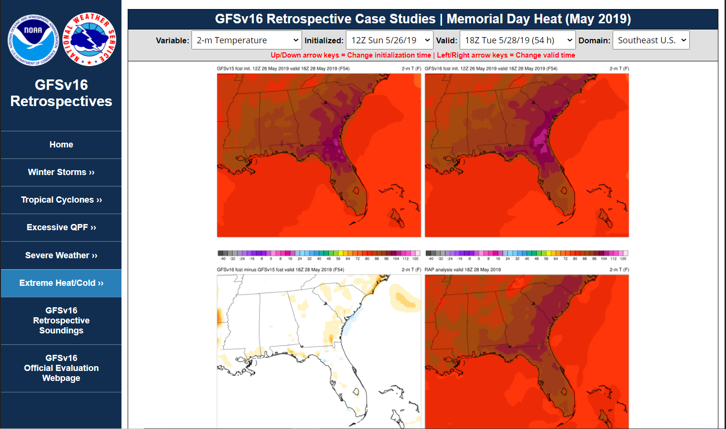
NATIONAL OCEANIC AND ATMOSPHERIC ADMINISTRATION
GFSv16 Retrospectives: Extreme Heat/Cold
https://www.emc.ncep.noaa.gov/users/meg/gfsv16/retros/

Slide 3
NATIONAL OCEANIC AND ATMOSPHERIC ADMINISTRATION
GFSv16 Retrospective Streams
Listed below are the GFSv16 retrospective streams with links to stats
GFSv16 Retrospective Stream 0 (5/5/19–5/31/19) [Click here]
GFSv16 Retrospective Stream 1 (6/1/19–8/31/19) [Click here]
GFSv16 Retrospective Stream 2 (9/1/19–11/30/19) [Click here]
GFSv16 Retrospective Stream 3 (12/1/19–5/18/20) [Click here]
GFSv16 Retrospective Stream 4 (combined with Stream 3)
GFSv16 Retrospective Stream 5 (8/31/18–10/12/18) [Click here]
GFSv16 Real-time Stream (5/19/20–present) [Click here]

Slide 4
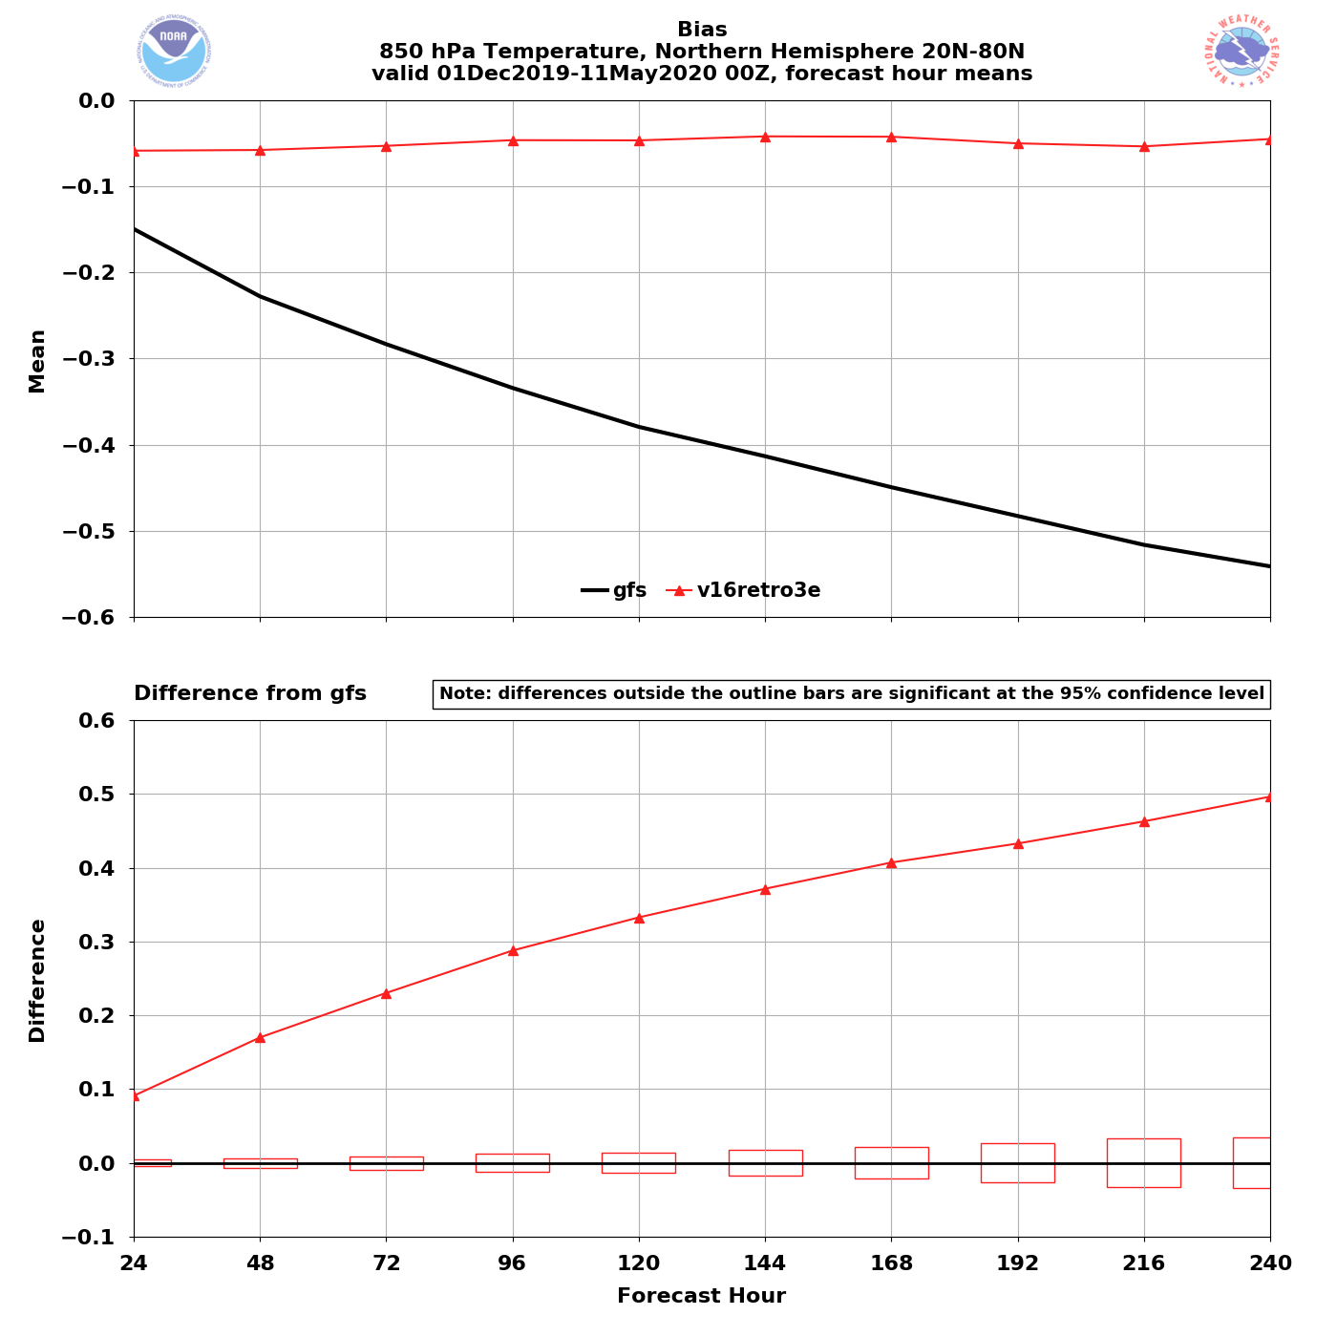
NATIONAL OCEANIC AND ATMOSPHERIC ADMINISTRATION
GFSv16 850-hPa Temperature Bias: Winter/Spr. 2020
NH – Winter/Spr. 2020
GFSv15 has a known low-level cold bias that increases with lead time
GFSv16 has a negligible cold bias at all lead times
GFSv16
GFSv15
850 T Bias (valid 00Z)
GFSv16 − GFSv15
Examples of this Winter/Spring 2020 850-hPa reduced cold bias can be seen in the retrospective case studies…

Slide 5
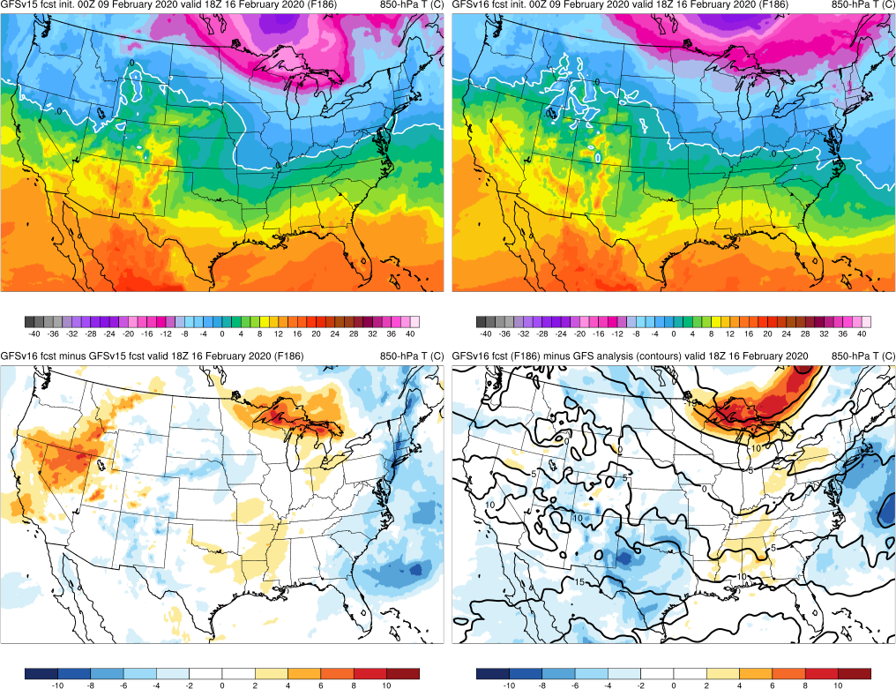
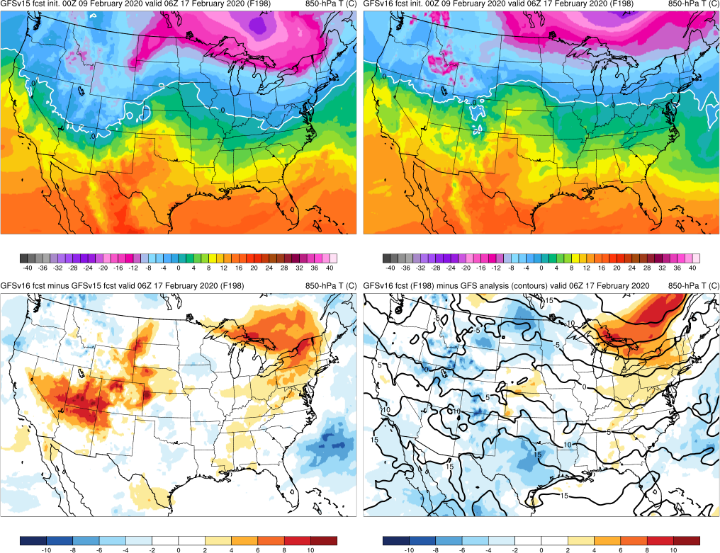
NATIONAL OCEANIC AND ATMOSPHERIC ADMINISTRATION
GFSv16 850-hPa Temperature Bias: Winter/Spr. 2020
Valid: 18Z 2/16/20 (F186)
Valid: 06Z 2/17/20 (F198)
GFSv16 is warmer than GFSv15 (reduced cold bias)
GFSv16 has a slight cold bias compared to analysis
GFSv15
GFSv16
v16−v15
GFS Anl.

Slide 6
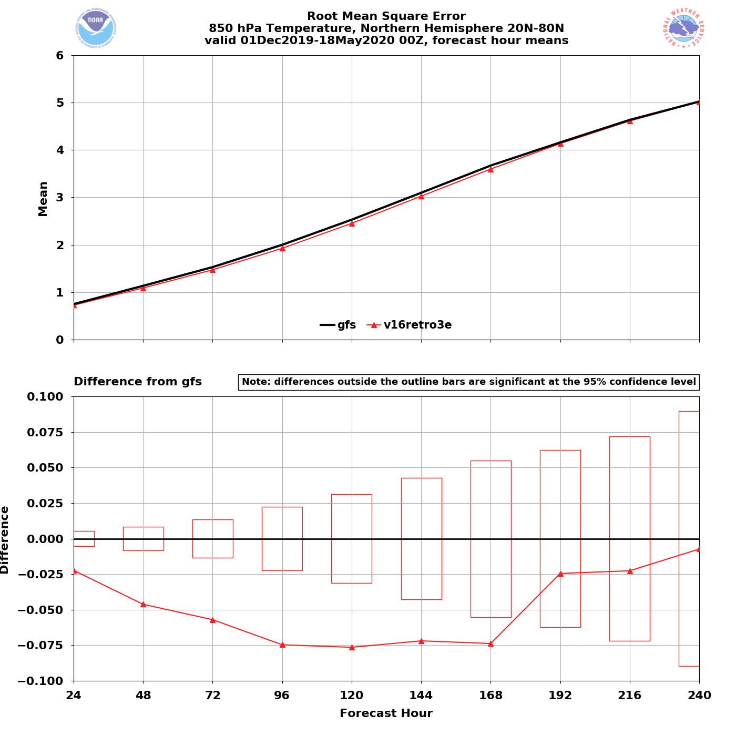
NATIONAL OCEANIC AND ATMOSPHERIC ADMINISTRATION
GFSv16 850-hPa Temperature RMSE: Winter/Spr. 2020
NH – Winter/Spr. 2020
850 T RMSE (valid 00Z)
GFSv16 has lower RMSE at all lead times
Statistically significant from F24-F168
GFSv16
GFSv15
GFSv16 − GFSv15

Slide 7
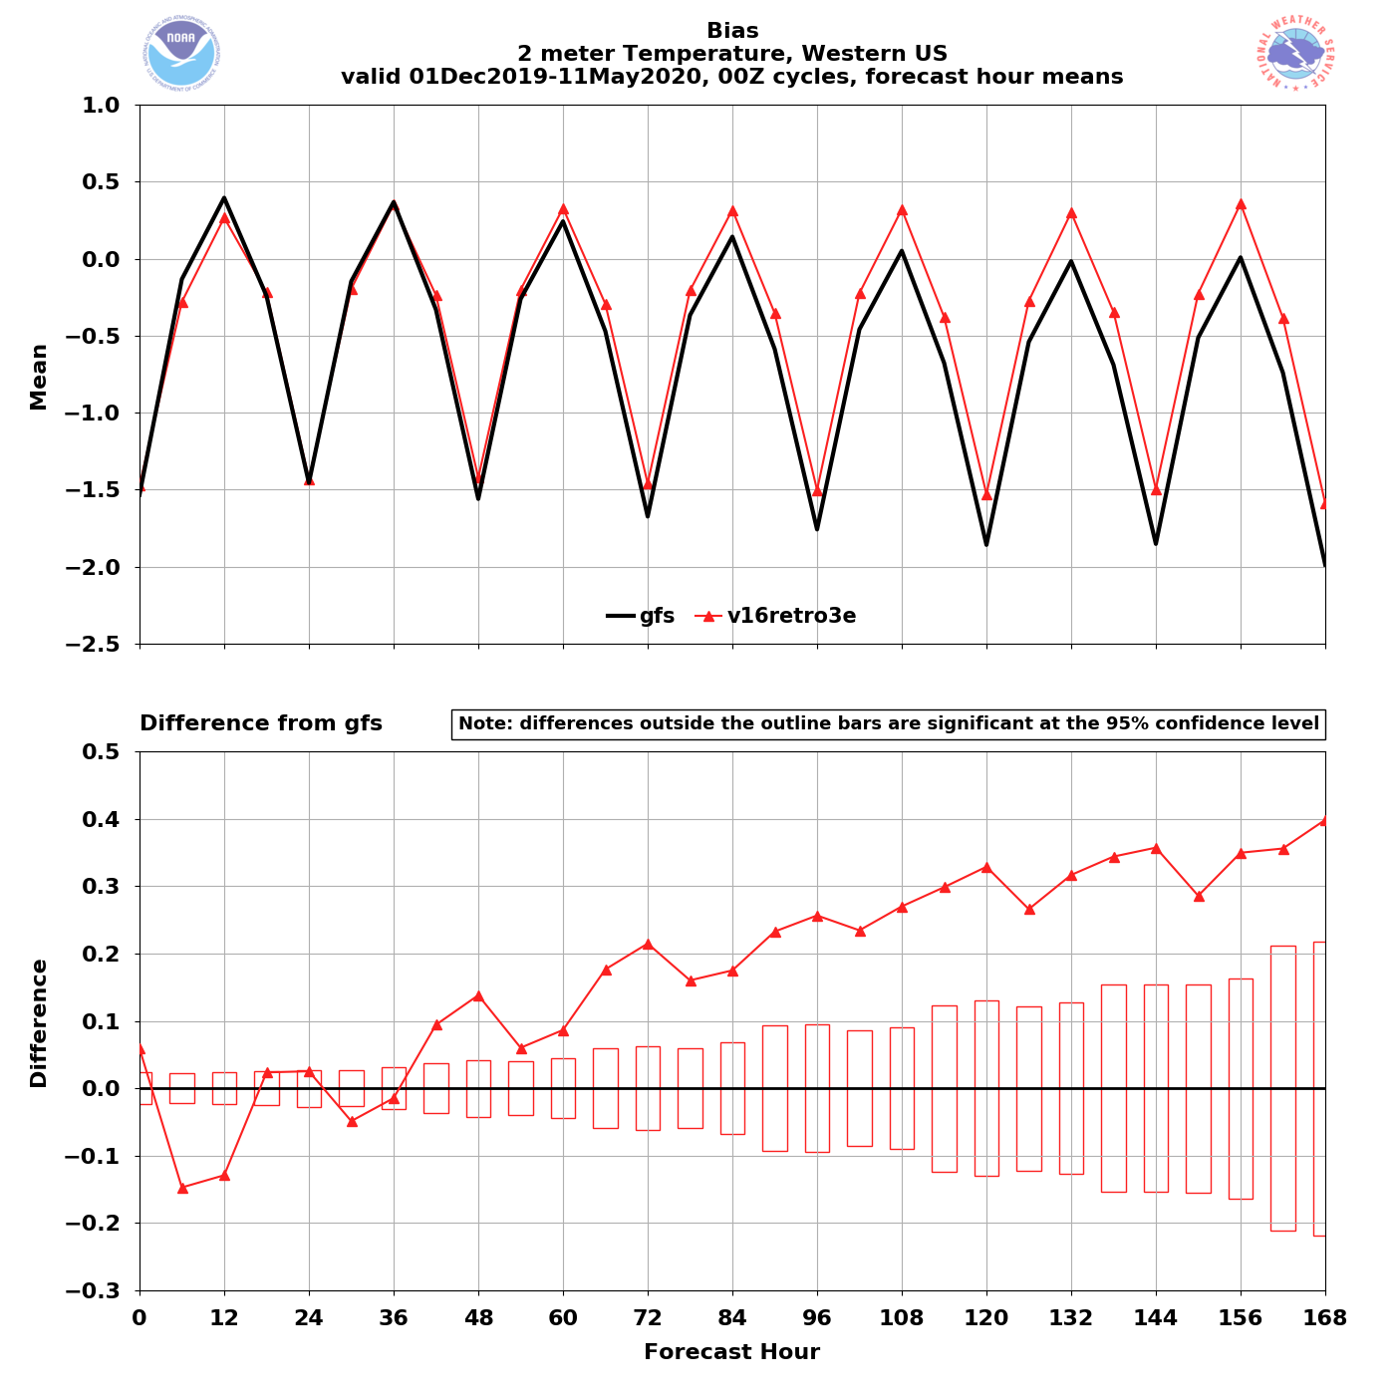
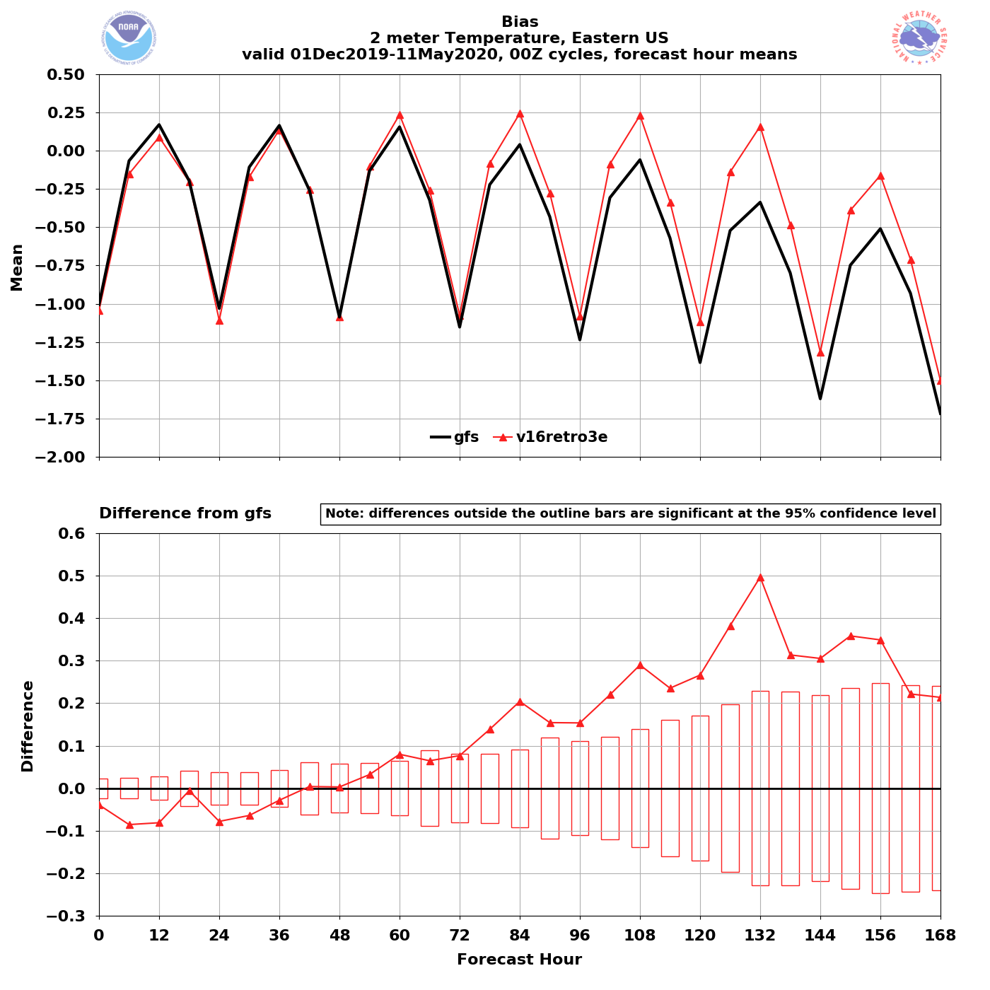
NATIONAL OCEANIC AND ATMOSPHERIC ADMINISTRATION
GFSv16 2-m Temperature Bias: Winter/Spr. 2020
Western US – Winter/Spr. 2020
Eastern US – Winter/Spr. 2020
2-m T Bias (00Z cycles)
GFSv15
GFSv16
GFSv15
GFSv16
GFSv16 has less of a cold bias at longer lead times
GFSv16 has less of a cold bias at longer lead times

Slide 8
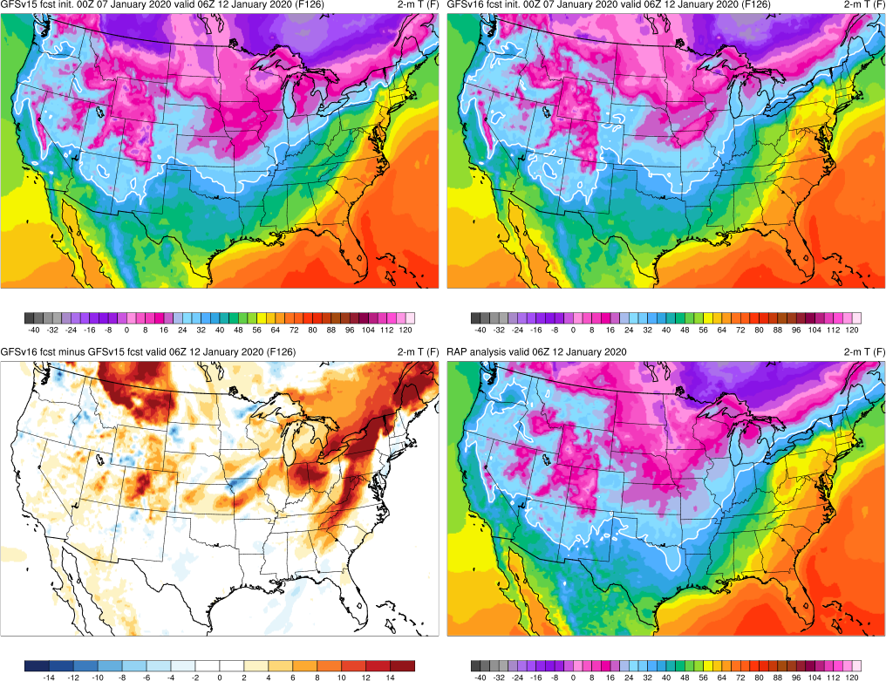
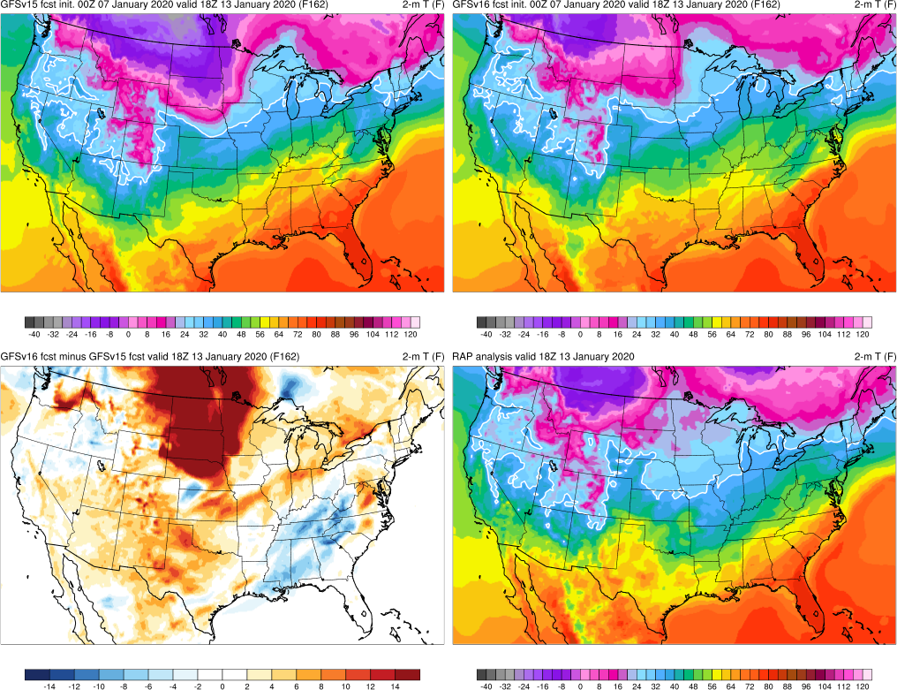
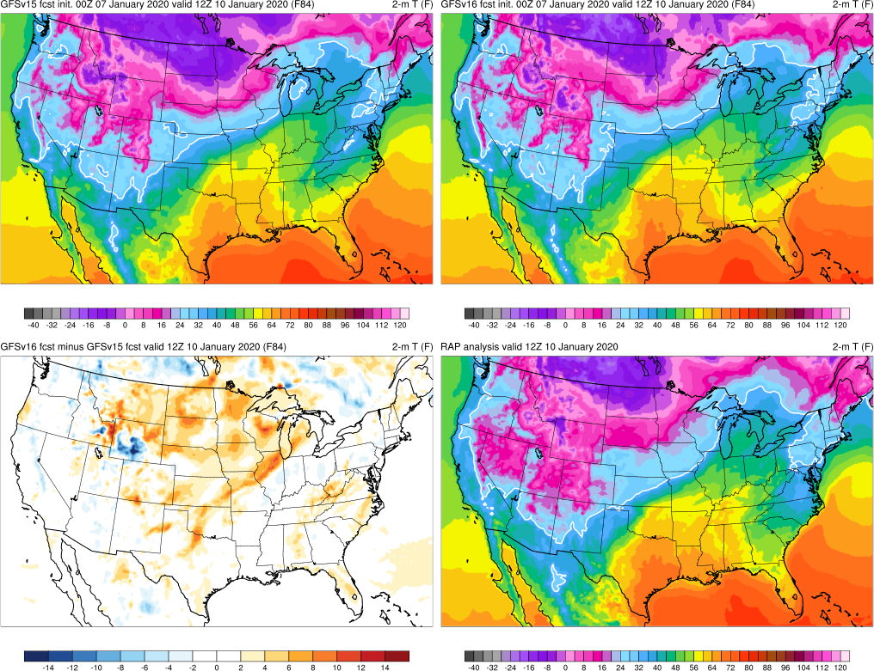
NATIONAL OCEANIC AND ATMOSPHERIC ADMINISTRATION
GFSv16 2-m Temperature Bias: Winter/Spr. 2020
Valid: 12Z 1/10/20 (F84)
Valid: 06Z 1/12/20 (F126)
Valid: 18Z 1/13/20 (F162)
At longer lead times, GFSv16 is overall warmer than GFSv15 over CONUS
GFSv15
GFSv16
v16−v15
RAP Anl.

Slide 9
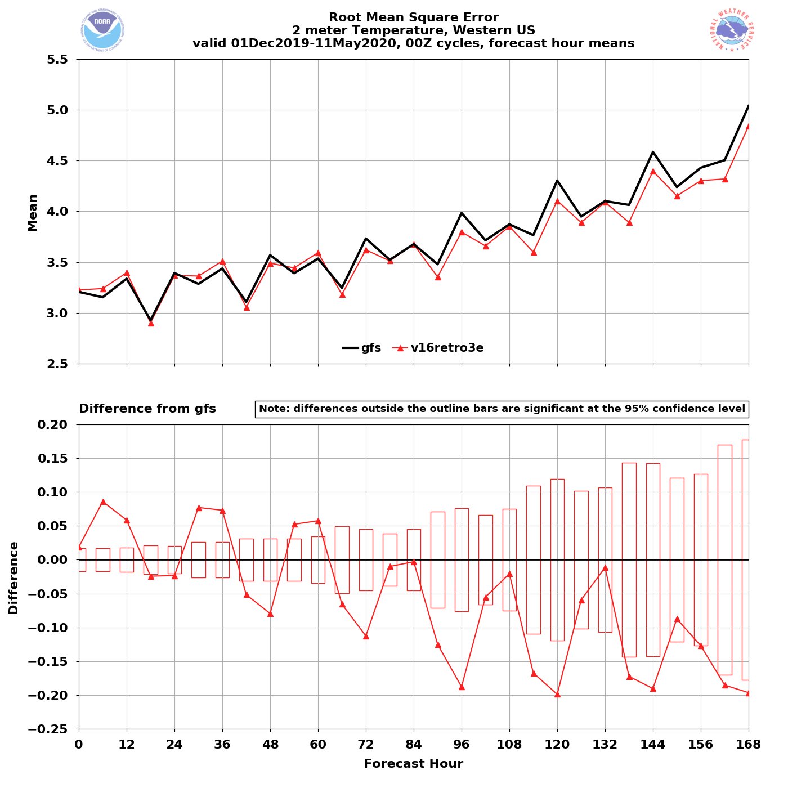
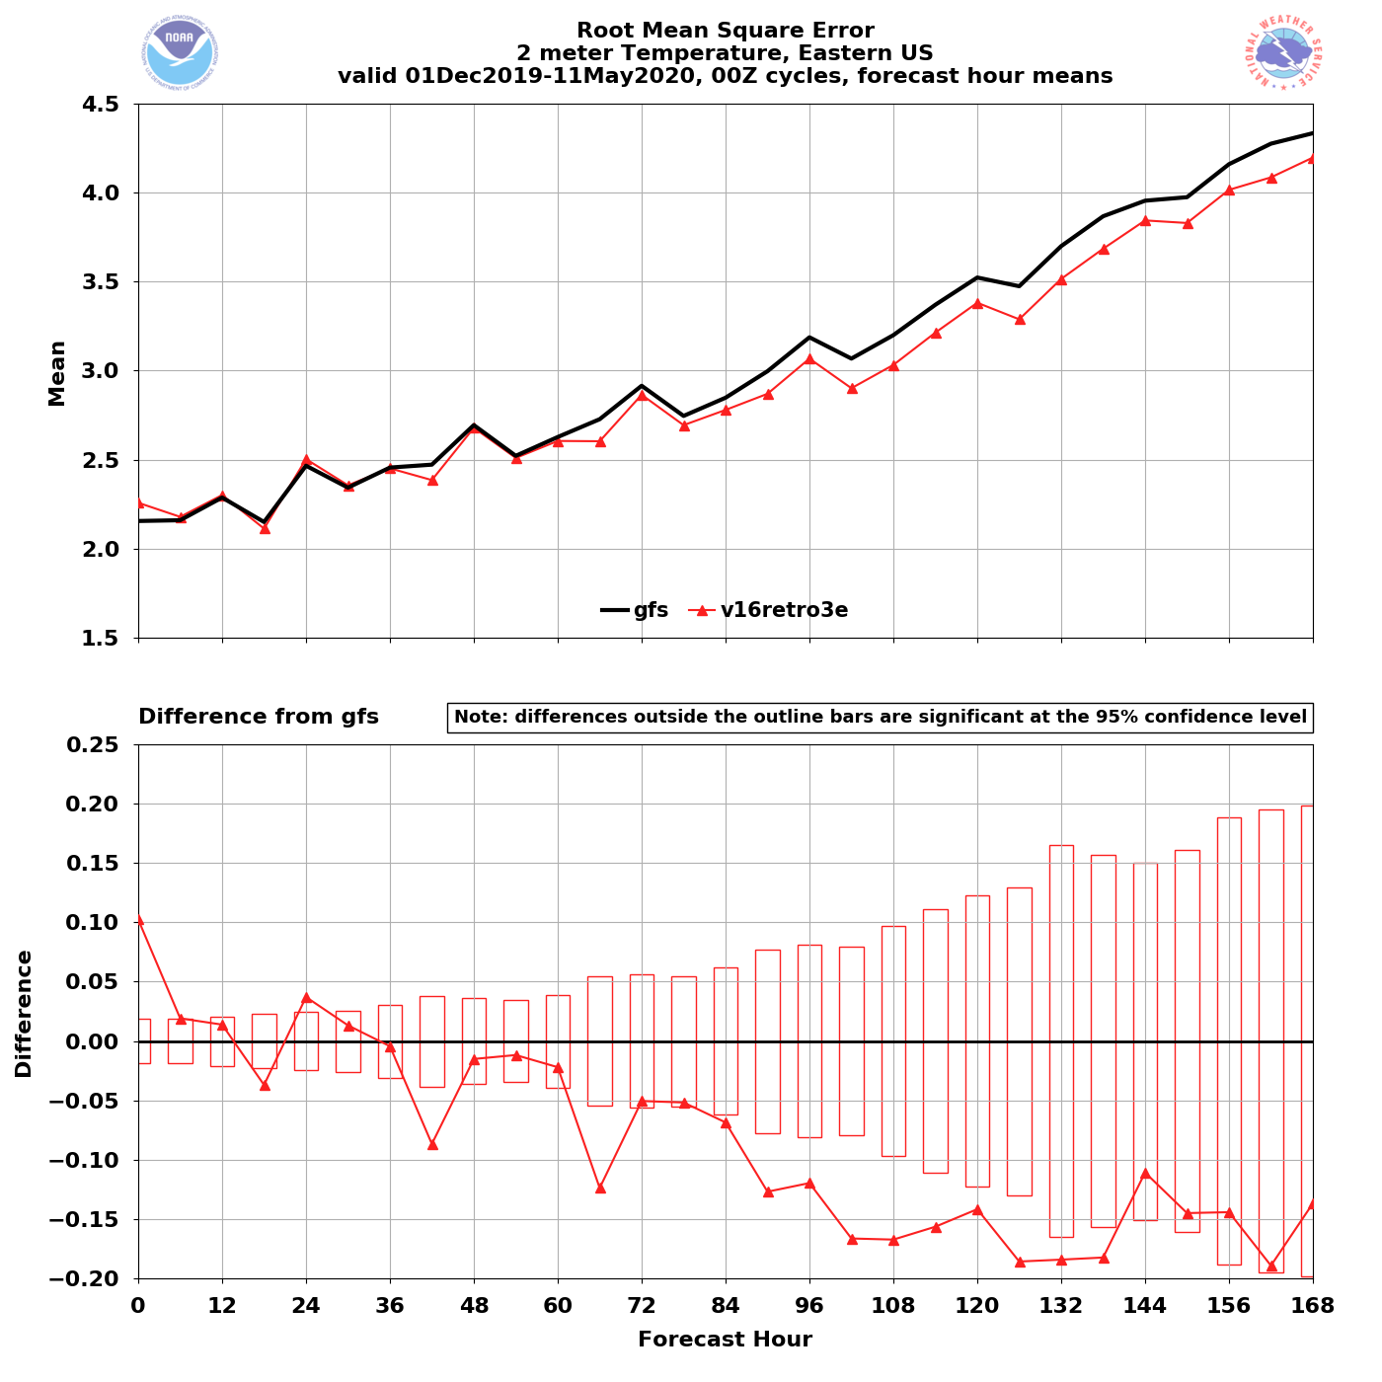
NATIONAL OCEANIC AND ATMOSPHERIC ADMINISTRATION
GFSv16 2-m Temperature RMSE: Winter/Spr. 2020
Western US – Winter/Spr. 2020
Eastern US – Winter/Spr. 2020
2-m T RMSE
(00Z cycles)
2-m T RMSE
(00Z cycles)
GFSv15
GFSv16
GFSv15
GFSv16
GFSv16 has lower RMSE at longer leads
GFSv16 has lower RMSE at longer leads

Slide 10
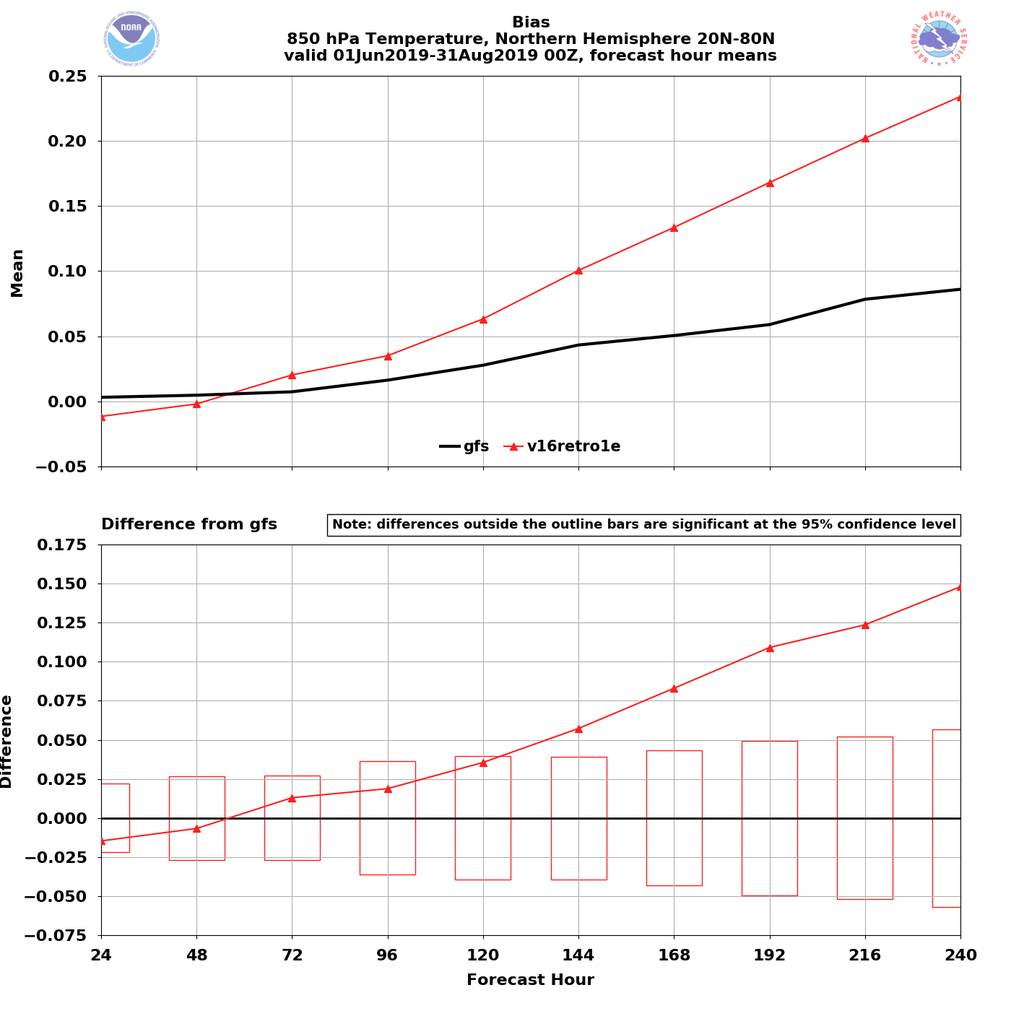
NATIONAL OCEANIC AND ATMOSPHERIC ADMINISTRATION
GFSv16 850-hPa Temperature Bias: Summer 2019
NH – Summer 2019
850 T Bias (valid 00Z)
GFSv16
GFSv16 has a warm bias starting at F72 that grows with lead time (statistically significant from F144-F240)
GFSv15
GFSv16 − GFSv15
Examples of this Summer 2019 850-hPa warm bias can be seen in the retrospective case studies…

Slide 11
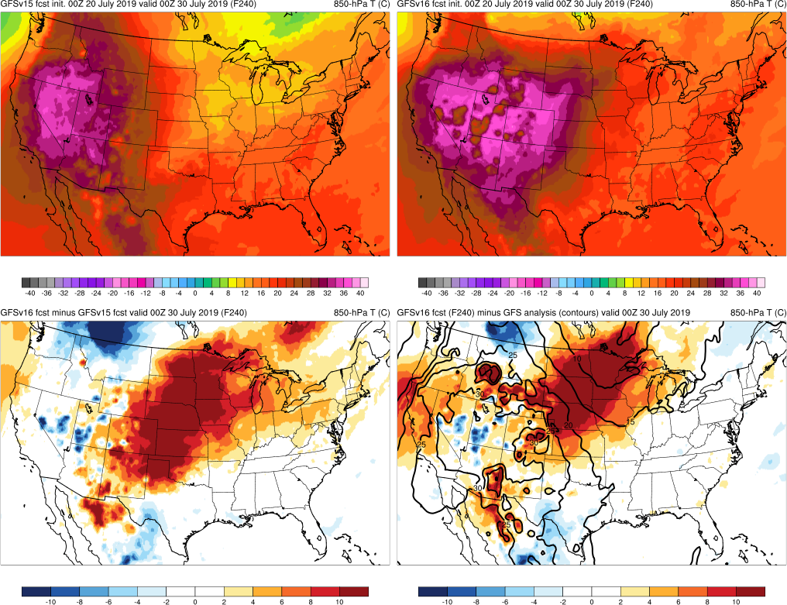
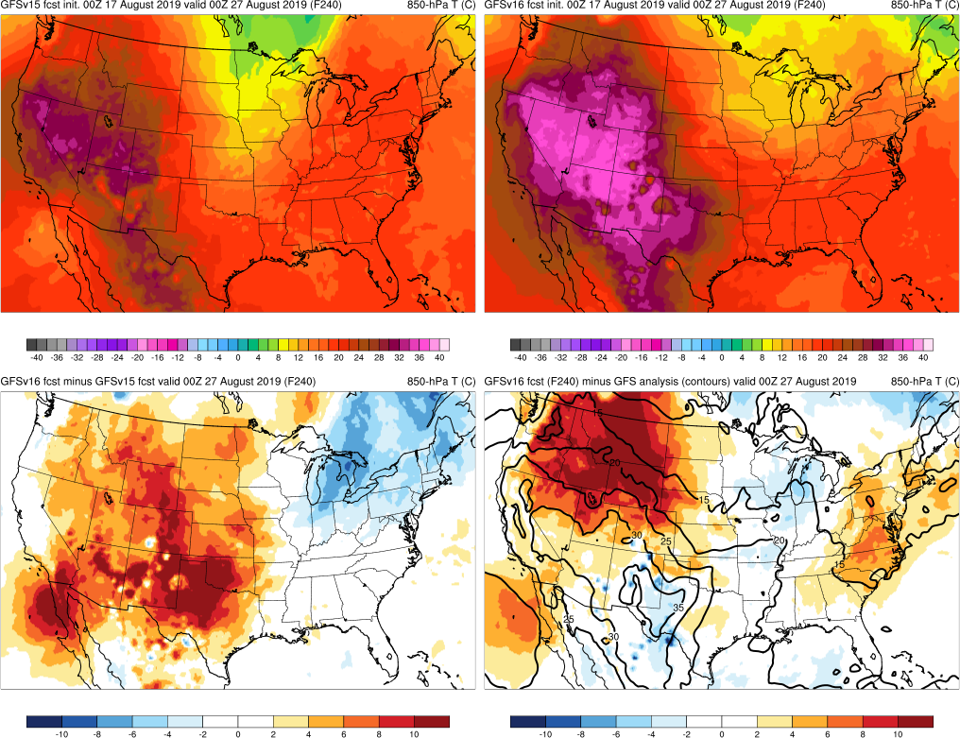
NATIONAL OCEANIC AND ATMOSPHERIC ADMINISTRATION
GFSv16 850-hPa Temperature Bias: Summer 2019
Large warm bias in GFSv16
Valid: 00Z 7/30/19 (F240)
Valid: 00Z 8/27/19 (F240)
GFSv15
GFSv16
GFSv15
GFSv16
v16−v15
GFS Anl.
v16−v15
GFS Anl.

Slide 12
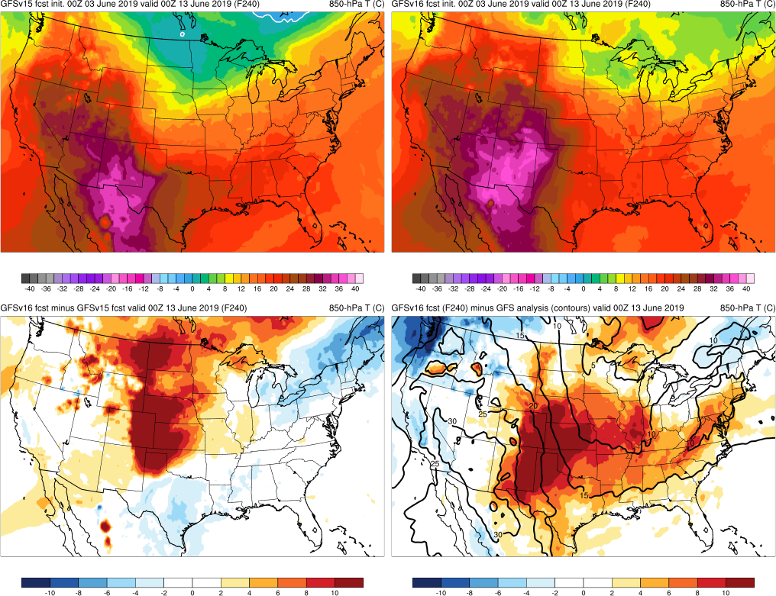
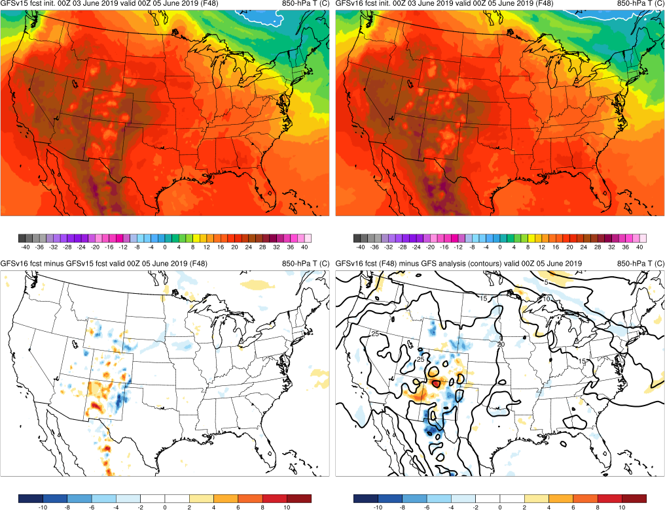
NATIONAL OCEANIC AND ATMOSPHERIC ADMINISTRATION
GFSv16 850-hPa Temperature Bias: Summer 2019
Valid: 00Z 6/5/19 (F48)
Valid: 00Z 6/13/19 (F240)
Warm bias in GFSv16 grows with lead time
This is observed in other warm season cases too
GFSv15
GFSv16
GFSv15
GFSv16
v16−v15
GFS Anl.
v16-v15
GFS Anl.

Slide 13
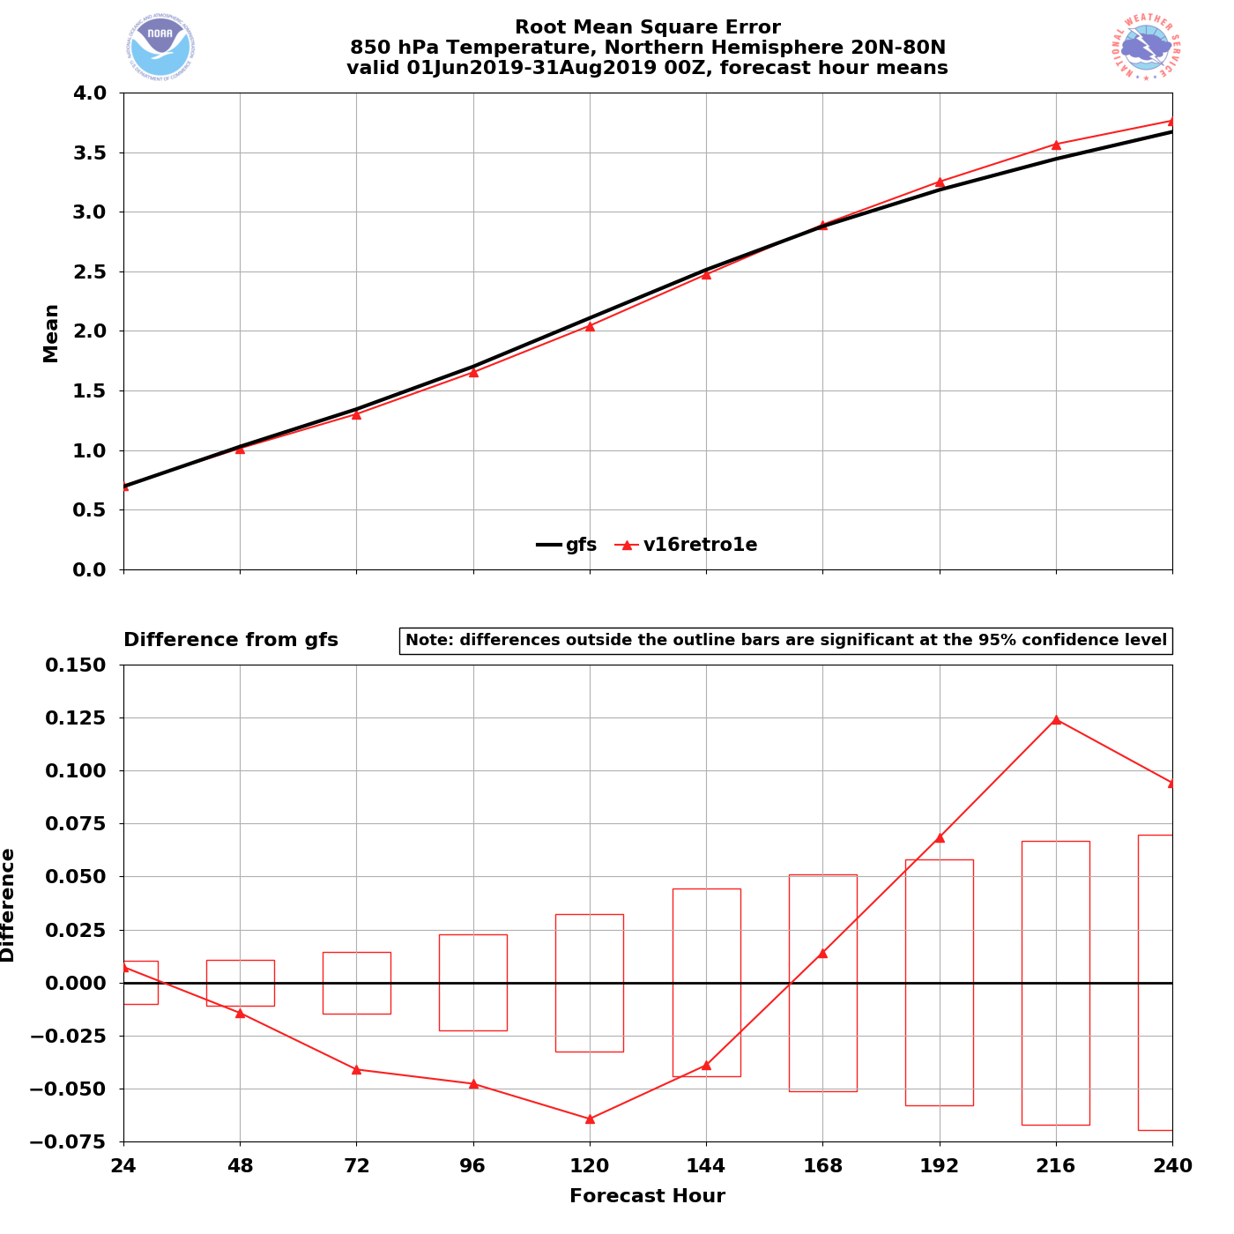
NATIONAL OCEANIC AND ATMOSPHERIC ADMINISTRATION
GFSv16 850-hPa Temperature RMSE: Summer 2019
NH – Summer 2019
850 T RMSE (valid 00Z)
GFSv16 has lower RMSE in medium range, but higher RMSE in long range
GFSv16
GFSv15
GFSv16 − GFSv15

Slide 14
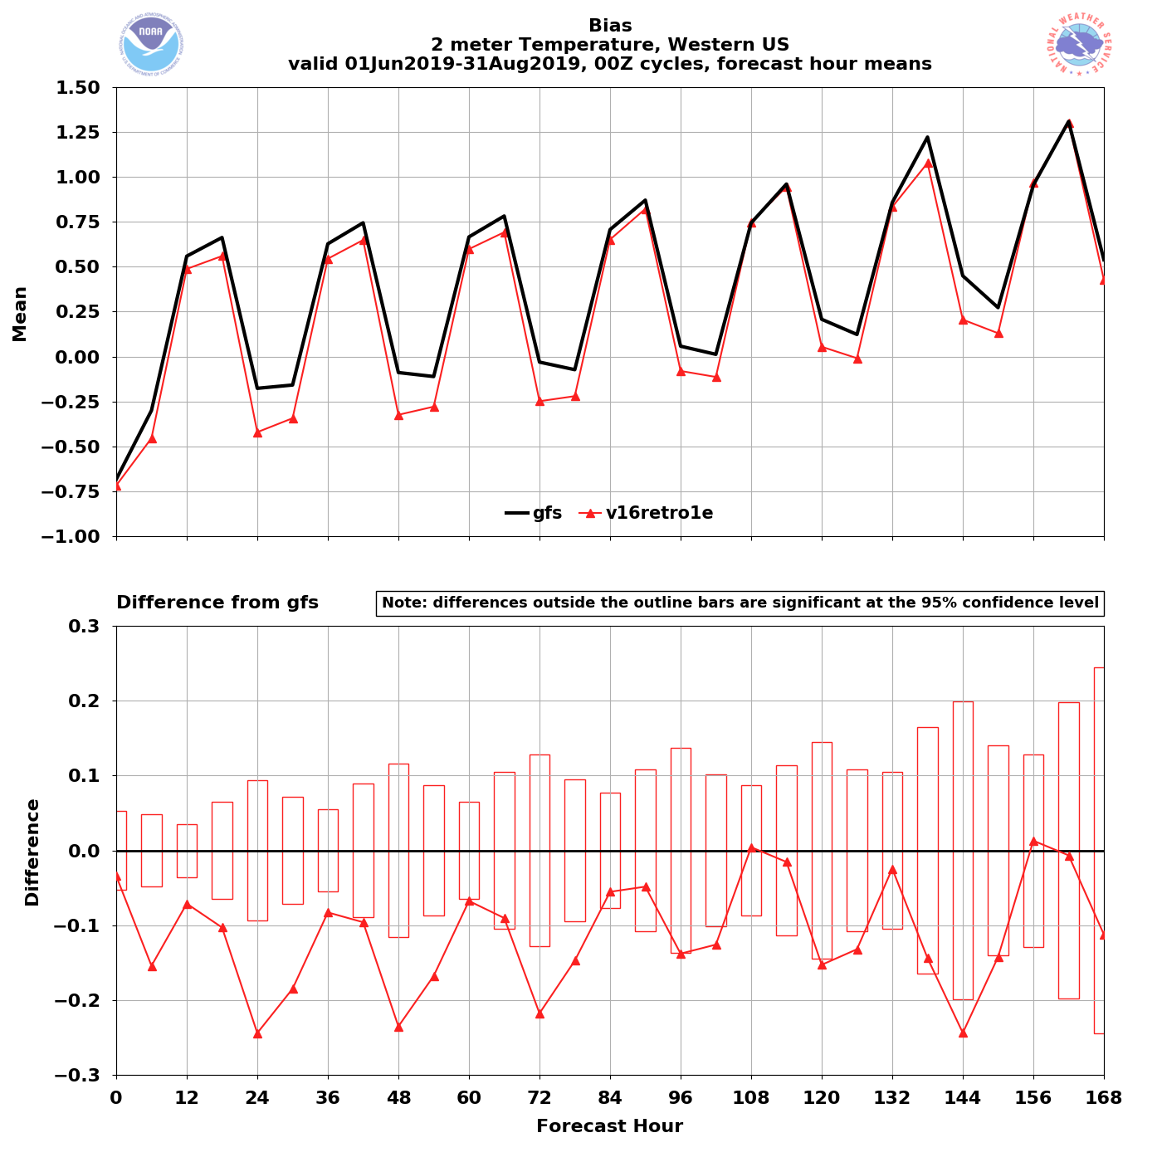
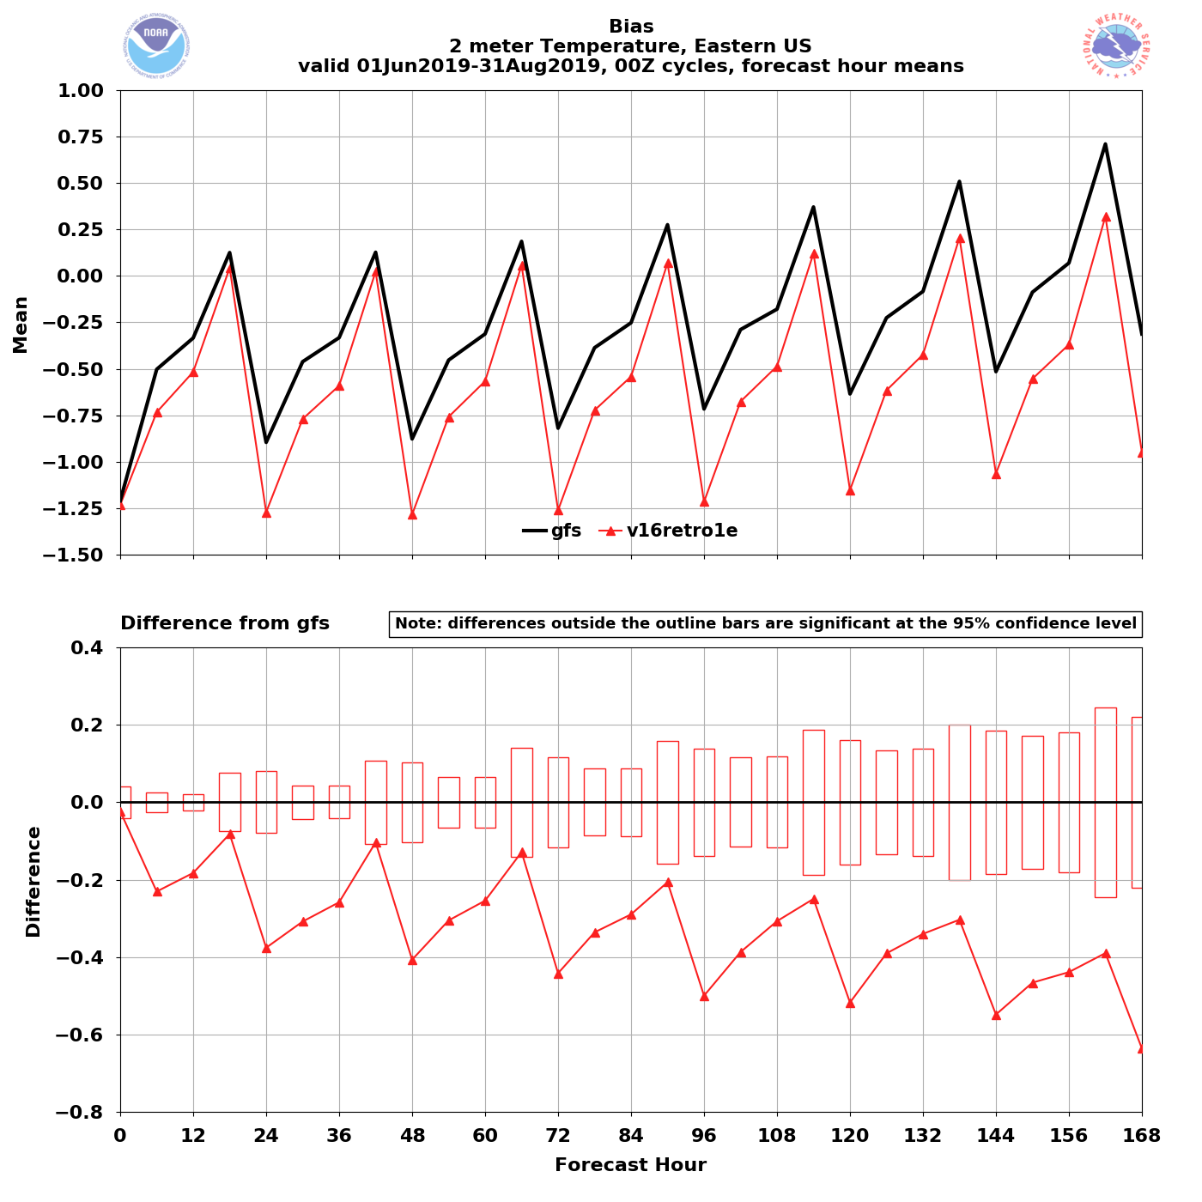
NATIONAL OCEANIC AND ATMOSPHERIC ADMINISTRATION
GFSv16 2-m Temperature Bias: Summer 2019
Western US – Summer 2019
Eastern US – Summer 2019
2-m T Bias (00Z cycles)
GFSv15
GFSv16
GFSv15
GFSv16
GFSv16 is colder than GFSv15 at almost all lead times
GFSv16 has a larger
cold bias at almost all lead times

Slide 15
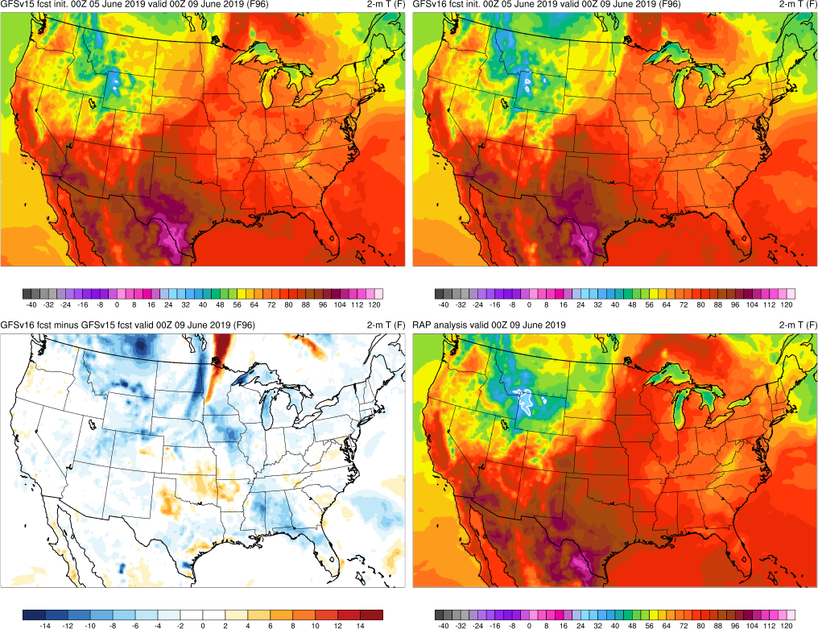
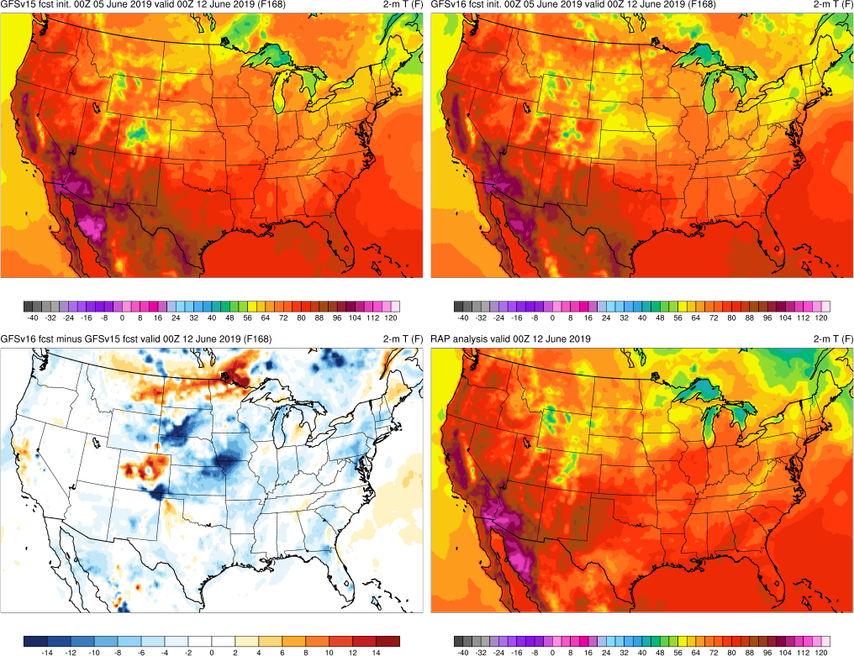
NATIONAL OCEANIC AND ATMOSPHERIC ADMINISTRATION
GFSv16 2-m Temperature Bias: Summer 2019
Valid: 00Z 6/9/19 (F96)
Valid: 00Z 6/12/19 (F168)
GFSv16 is colder than GFSv15, especially over Eastern U.S.
GFSv15
GFSv16
GFSv15
GFSv16
v16−v15
RAP Anl.
v16−v15
RAP Anl.

Slide 16
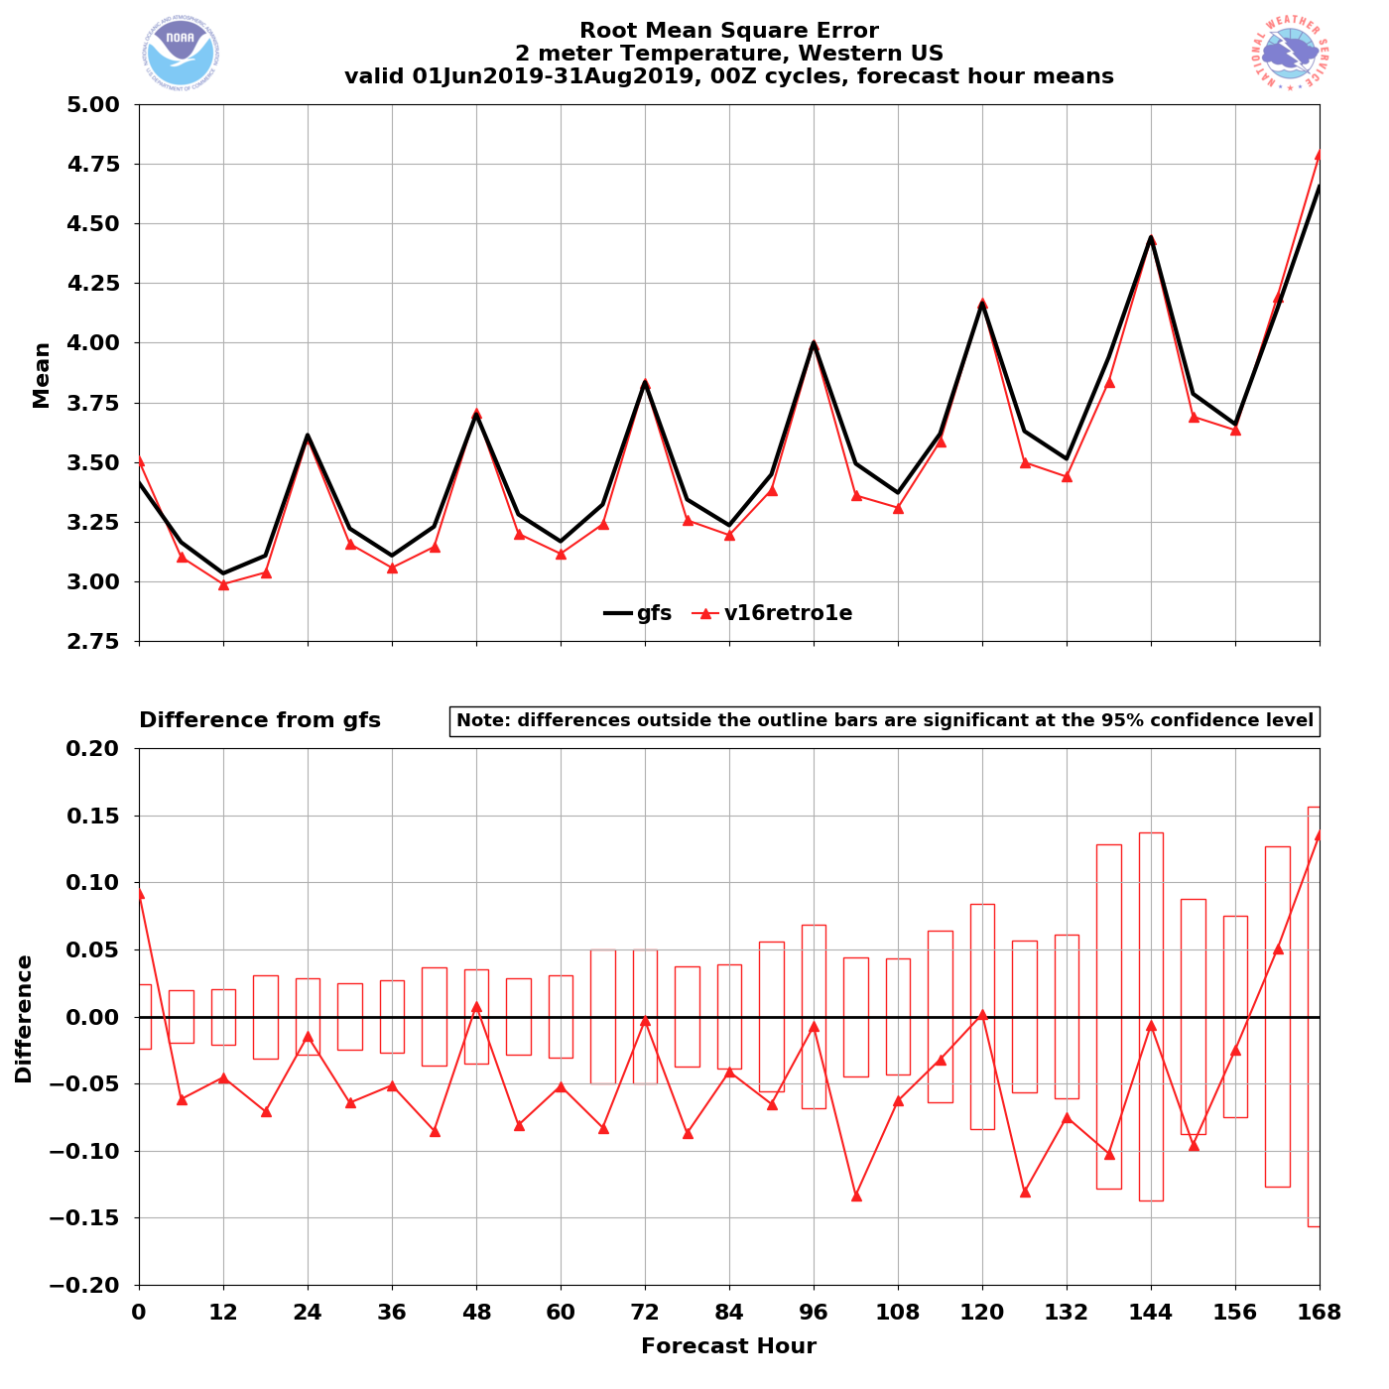
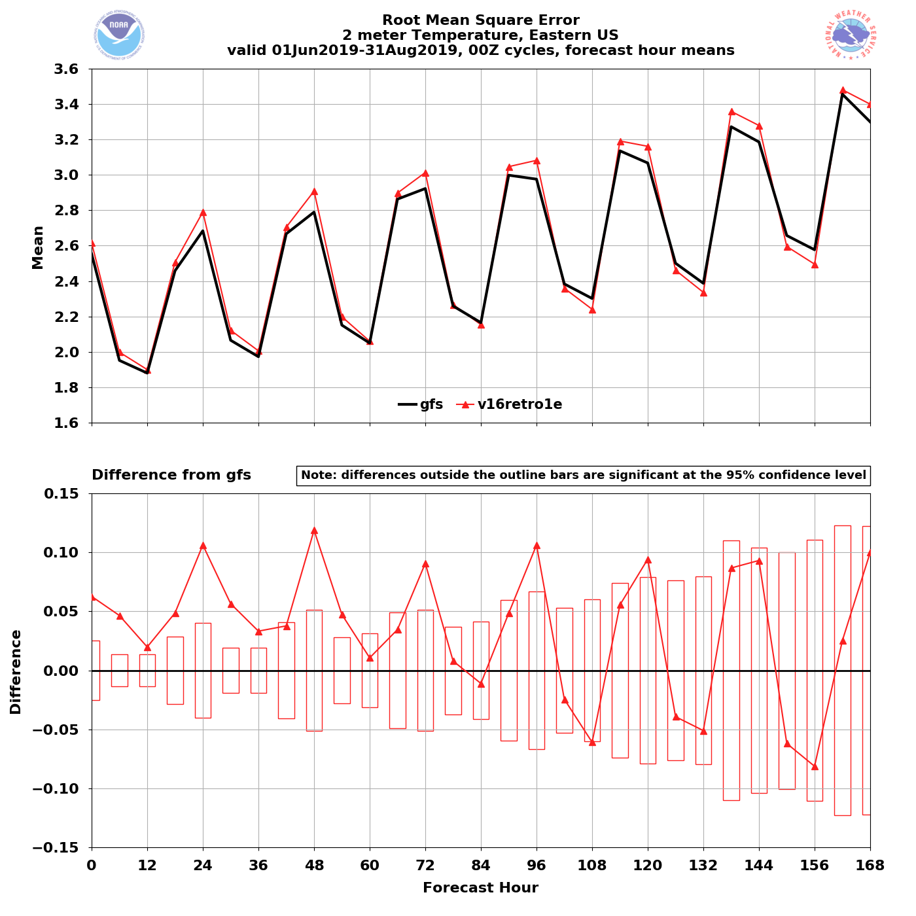
NATIONAL OCEANIC AND ATMOSPHERIC ADMINISTRATION
GFSv16 2-m Temperature RMSE: Summer 2019
Western US – Summer 2019
Eastern US – Summer 2019
2-m T RMSE
(00Z cycles)
GFSv15
GFSv16
GFSv15
GFSv16
GFSv16 has lower
RMSE at most lead times
GFSv16 has higher
RMSE at most lead times

Slide 17
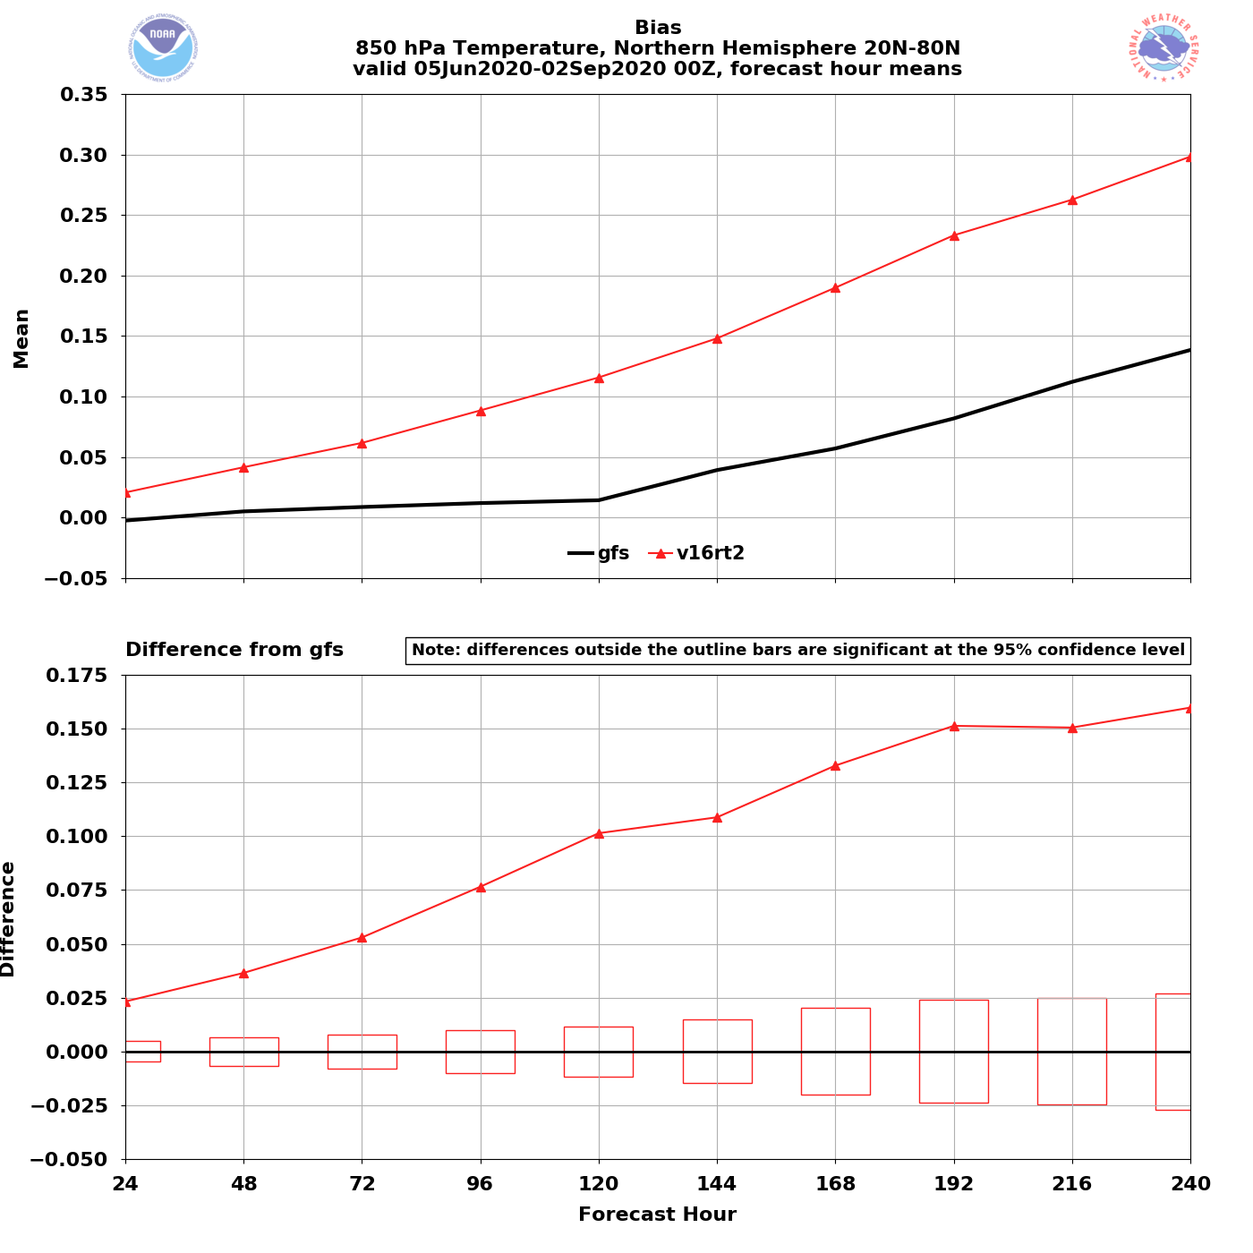
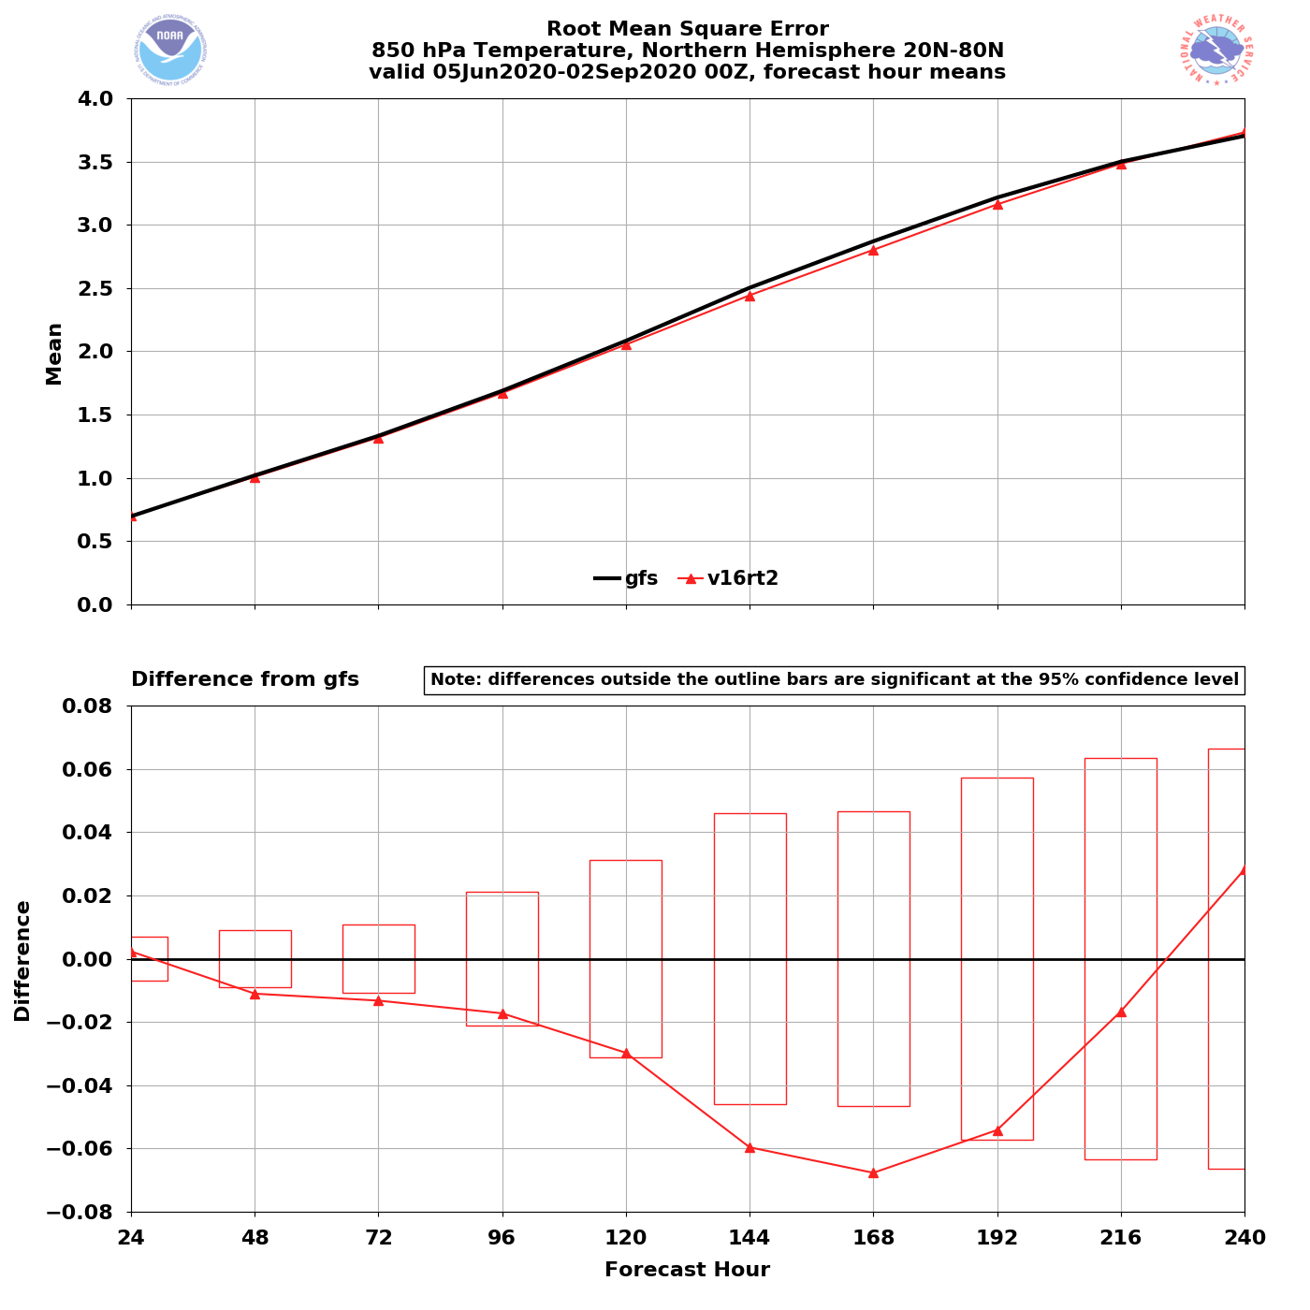
NATIONAL OCEANIC AND ATMOSPHERIC ADMINISTRATION
GFSv16 850-hPa Temperature Bias and RMSE: Summer 2020
NH – Summer 2020
NH – Summer 2020
850 T Bias (valid 00Z)
GFSv16
850 T RMSE (valid 00Z)
GFSv16
GFSv15
GFSv15
GFSv16 has a larger warm bias at all lead times
GFSv16 has lower RMSE at all lead times

Slide 18
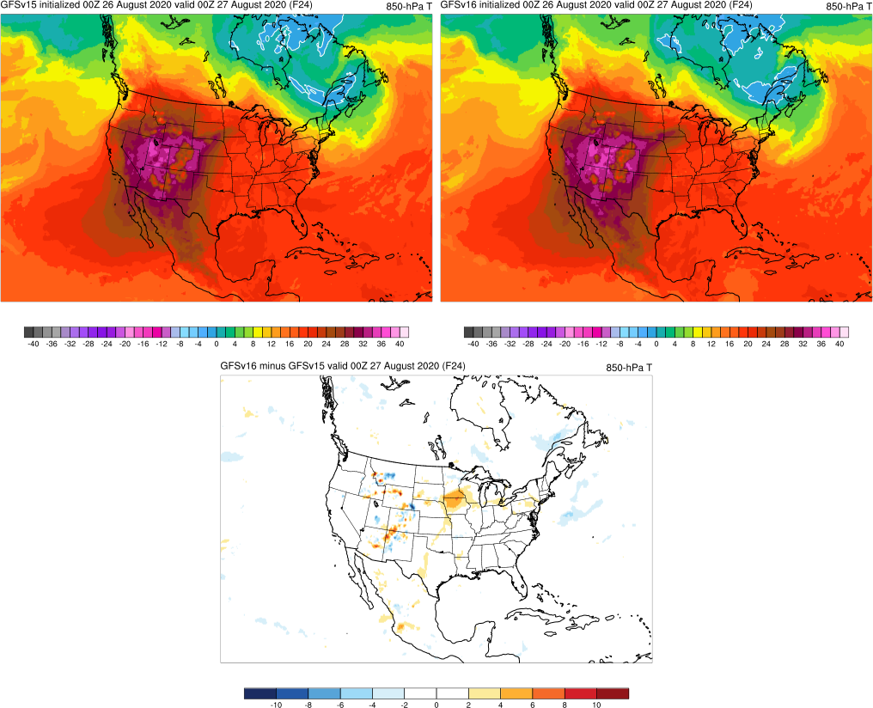
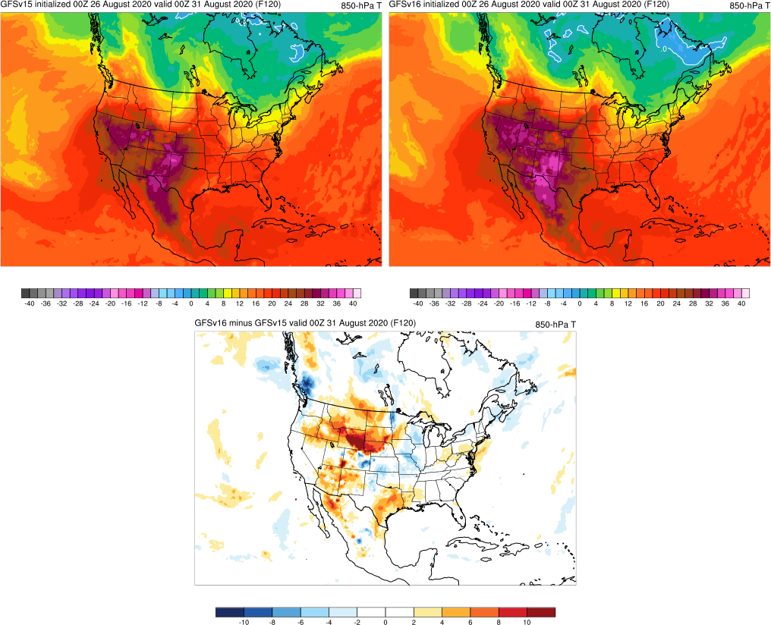
NATIONAL OCEANIC AND ATMOSPHERIC ADMINISTRATION
GFSv16 850-hPa Temperature Bias: Summer 2020
Valid: 12Z 1/10/20 (F84)
Valid: 06Z 1/12/20 (F126)
Valid: 00Z 8/27/20 (F24)
Valid: 00Z 8/31/20 (F120)
GFSv16 850-hPa warm bias increases with lead time
GFSv15
GFSv15
GFSv16
GFSv16
v16−v15
v16−v15

Slide 19
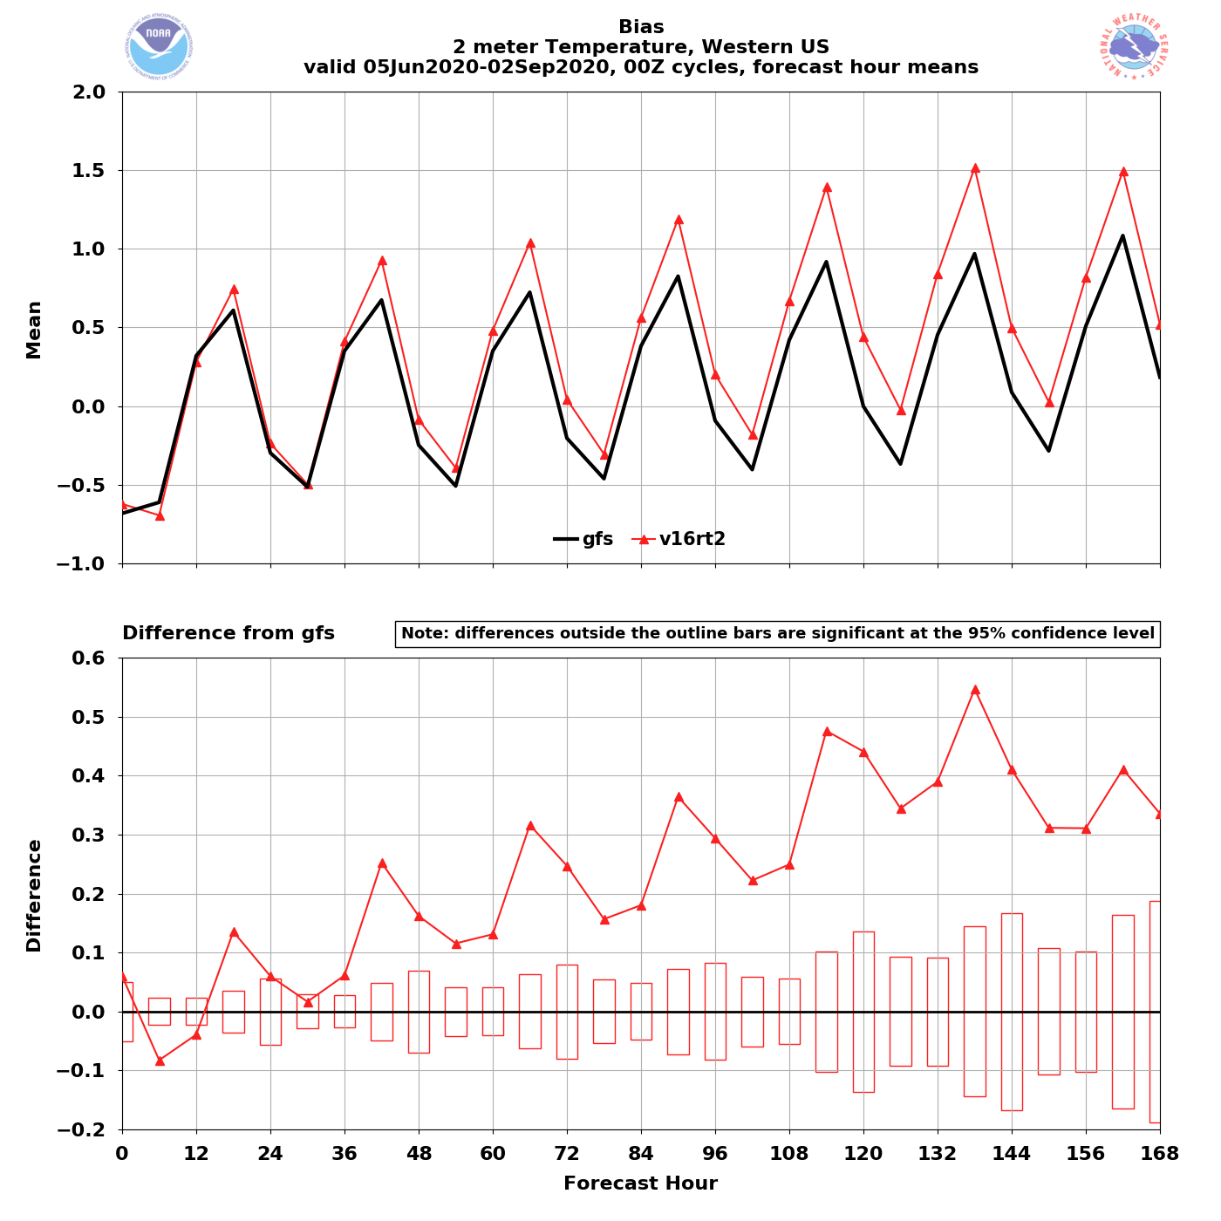
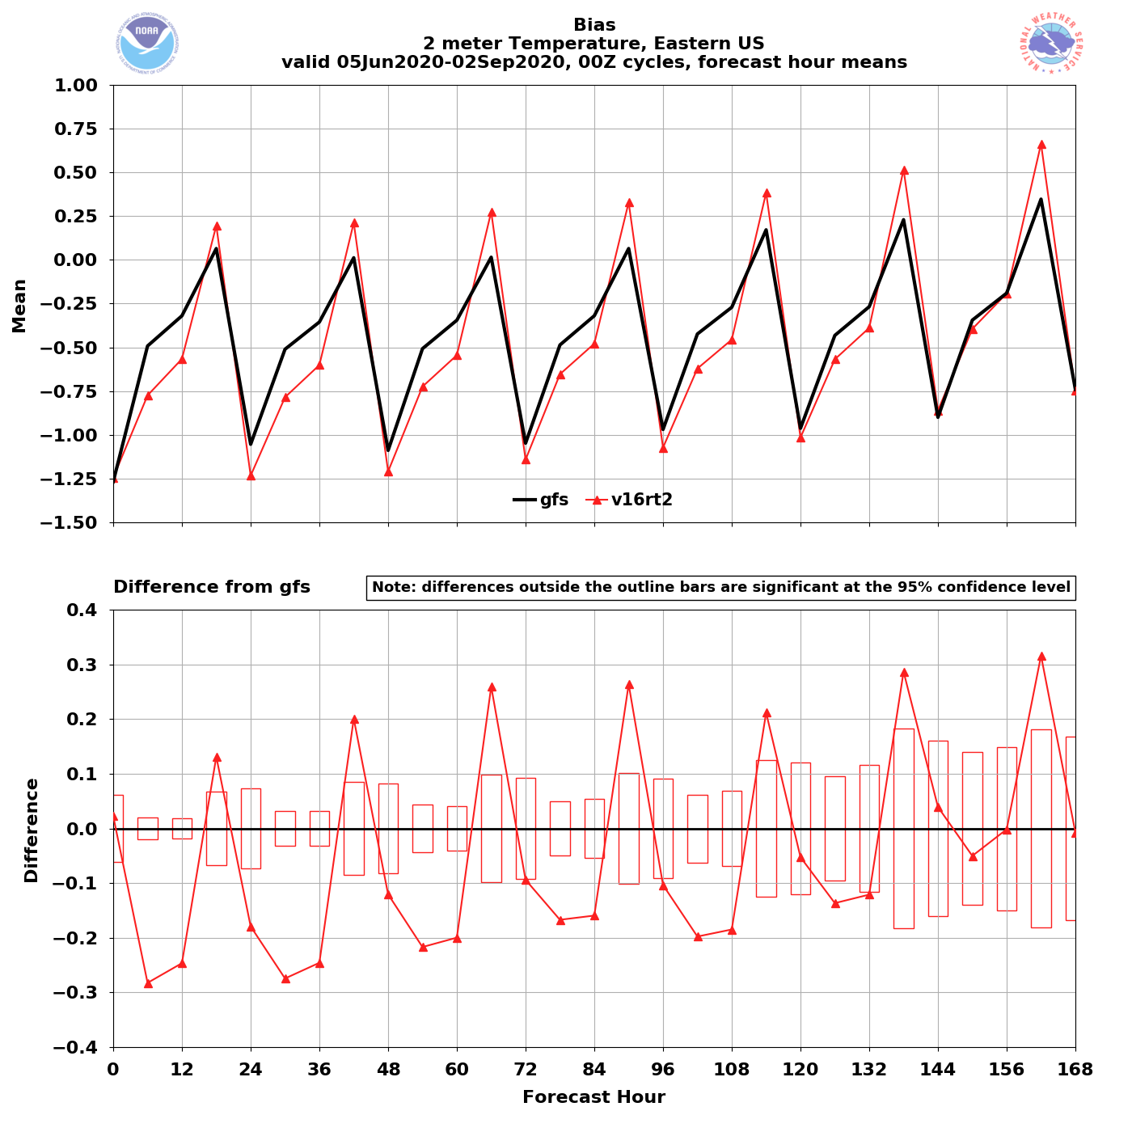
NATIONAL OCEANIC AND ATMOSPHERIC ADMINISTRATION
GFSv16 2-m Temperature Bias: Summer 2020
Western US – Summer 2020
Eastern US – Summer 2020
2-m T Bias (00Z cycles)
GFSv16
2-m T Bias (00Z cycles)
GFSv16
GFSv15
GFSv15
GFSv16 has a larger warm bias at most lead times
GFSv16 has a larger cold bias at most lead times

Slide 20
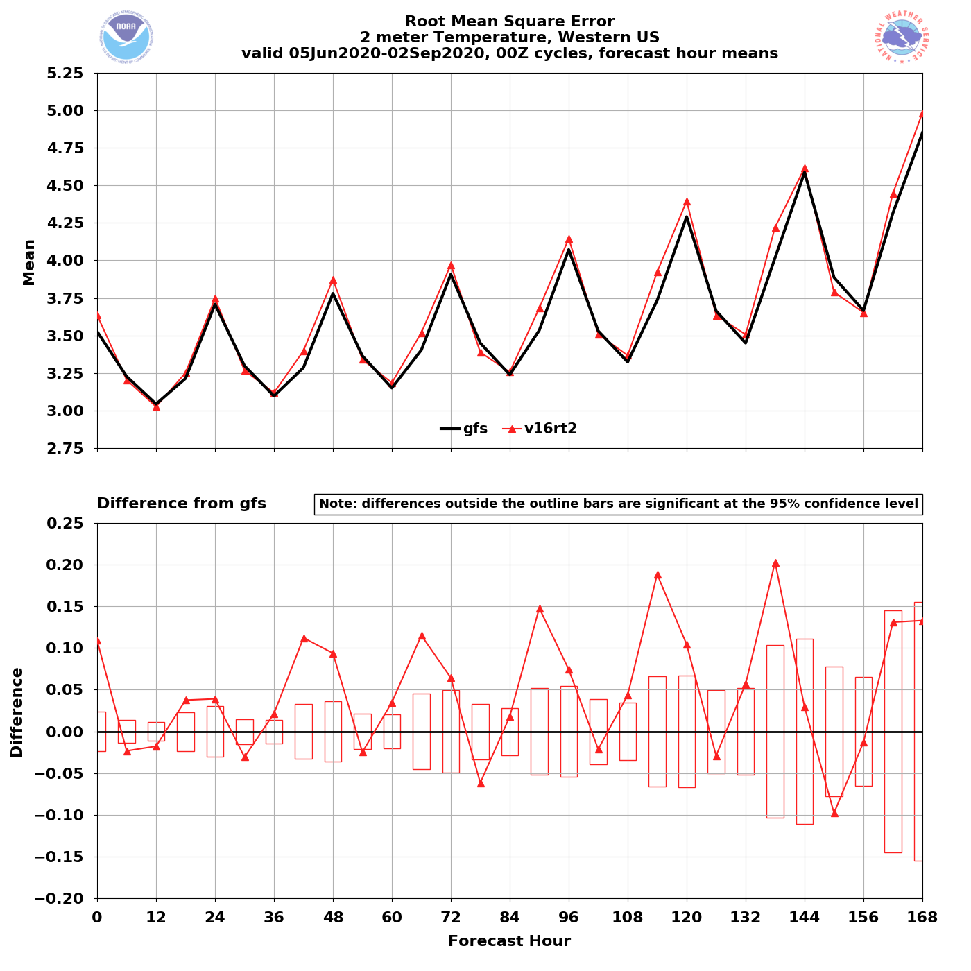
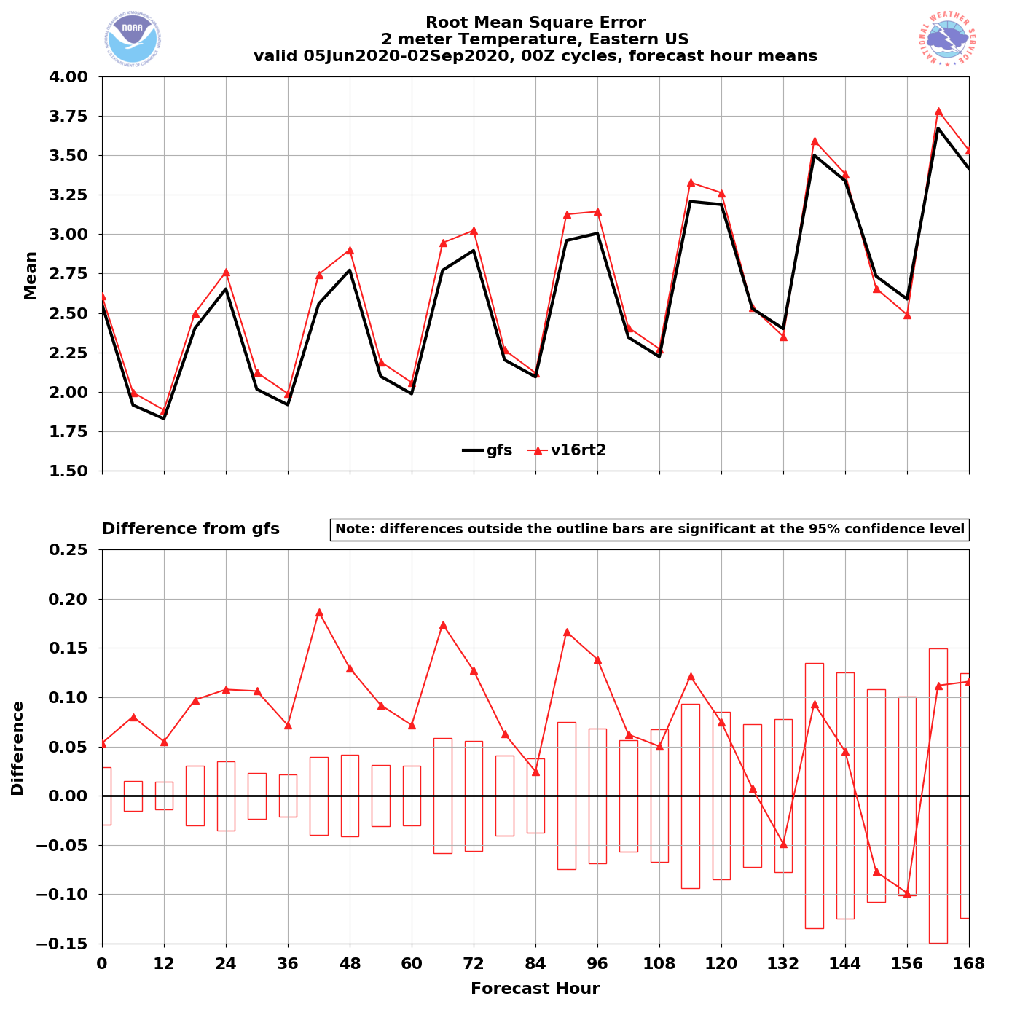
NATIONAL OCEANIC AND ATMOSPHERIC ADMINISTRATION
GFSv16 2-m Temperature RMSE: Summer 2020
Western US – Summer 2020
Eastern US – Summer 2020
2-m T RMSE (00Z cycles)
GFSv16
2-m T RMSE (00Z cycles)
GFSv16
GFSv15
GFSv15
GFSv16 has the same or larger RMSE
GFSv16 has larger RMSE at most lead times

Slide 21
NATIONAL OCEANIC AND ATMOSPHERIC ADMINISTRATION
GFSv16 Temperature Statistics: Summary
The low-level cold bias present in GFSv15 during the cool season has been reduced in GFSv16 (lower 2-m temp RMSE at longer lead times across CONUS)
GFSv16 reduces 2-m temps across the CONUS in summer 2019, which results in lower RMSE across the western U.S. and higher RMSE across the eastern U.S.
GFSv16 has an 850-hPa warm bias that grows with lead time for NH in summer 2019 and 2020
GFSv16 has a larger 2-m warm (cold) bias at most lead times over western (eastern) U.S. for summer 2020

Slide 22
NATIONAL OCEANIC AND ATMOSPHERIC ADMINISTRATION
GFSv16 Retrospectives: Temp Case Studies
Extreme Heat
Memorial Day Heat (May 2019)
San Francisco Heat (June 2019)
Eastern U.S. Heat (July 2019)
Alaskan Wildfires (Aug 2019)
Southern U.S. Heat (Aug 2019)
Extreme Cold
Intermountain West Cold (Oct 2019)
Central U.S. Cold Surge (Nov 2019)
January Cold Blast (Jan 2020)
Valentine’s Day Cold (Feb 2020)
Mother’s Day Weekend Cold (May 2020)

Slide 23
NATIONAL OCEANIC AND ATMOSPHERIC ADMINISTRATION
GFSv16 Temperature Highlights
Extreme Heat
Memorial Day Heat (May 2019)
San Francisco Heat (June 2019)
Eastern U.S. Heat (July 2019)
Alaskan Wildfires (Aug 2019)
Southern U.S. Heat (Aug 2019)

Slide 24
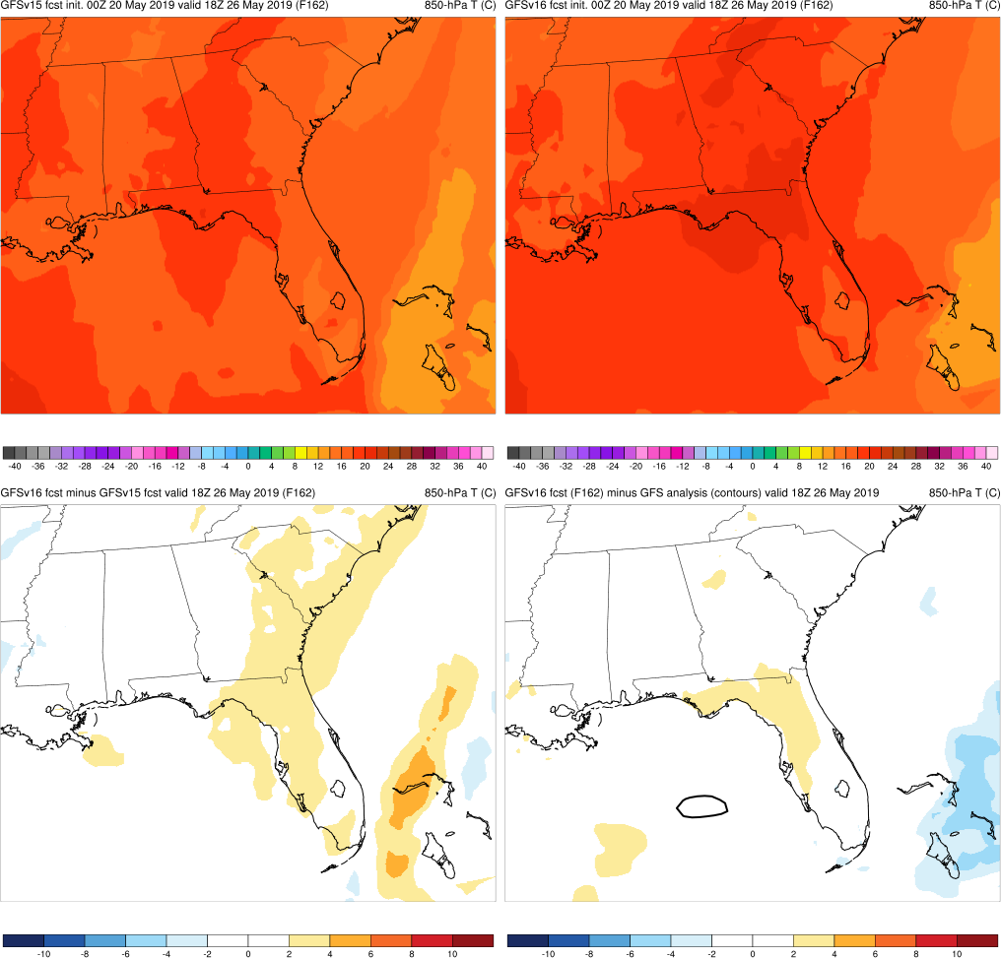
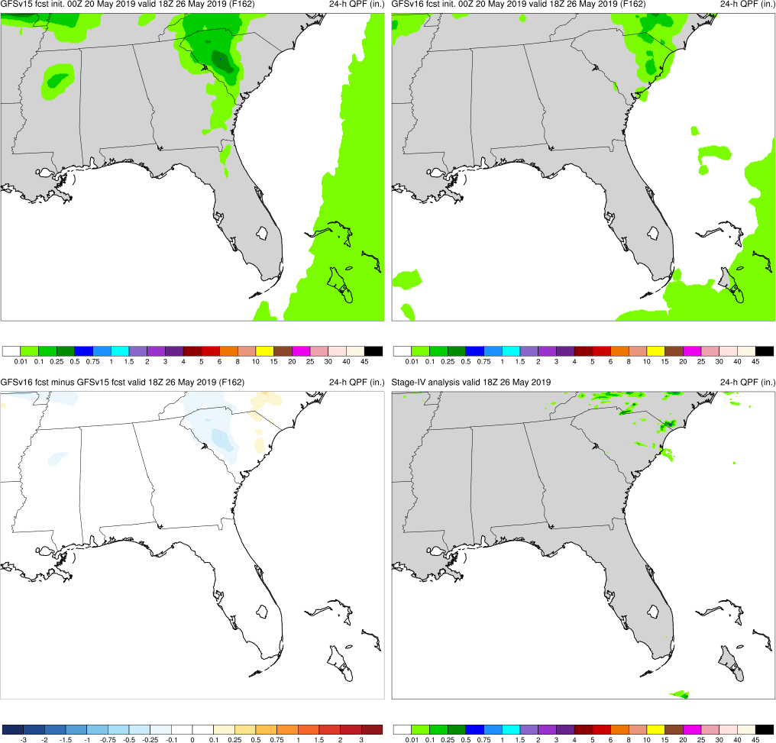
GFSv15
GFSv16
Memorial Day Heat
Valid: 18Z 5/26/19 (F162)
GFSv16 warmer and drier than GFSv15 at longer lead times
850-hPa Temperature
v16−v15
GFS Anl.
24-h QPF

Slide 25
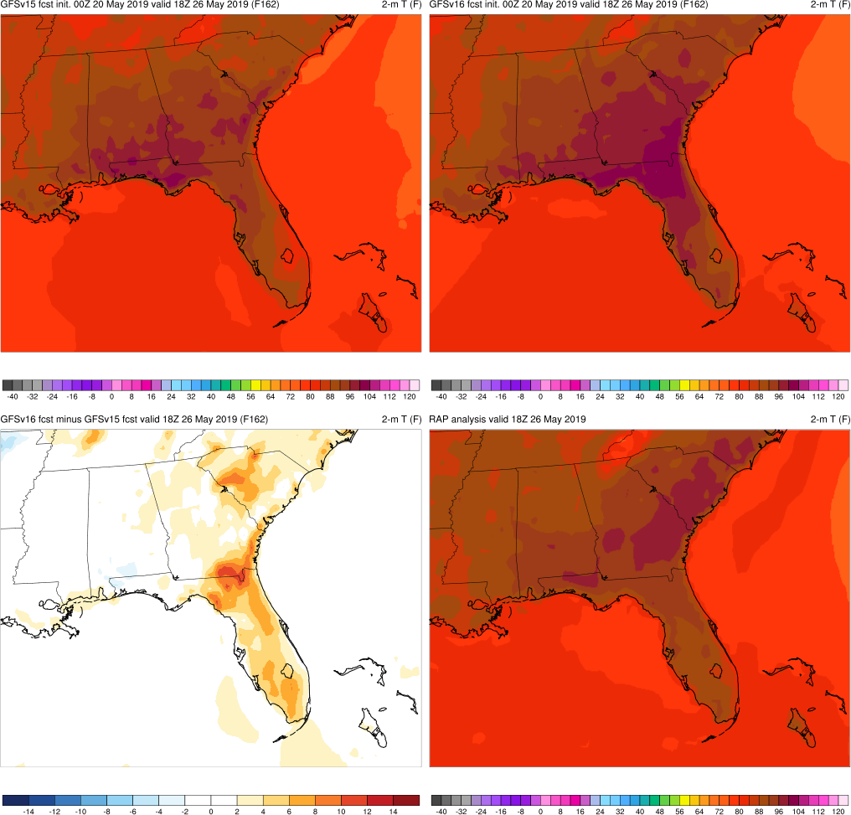
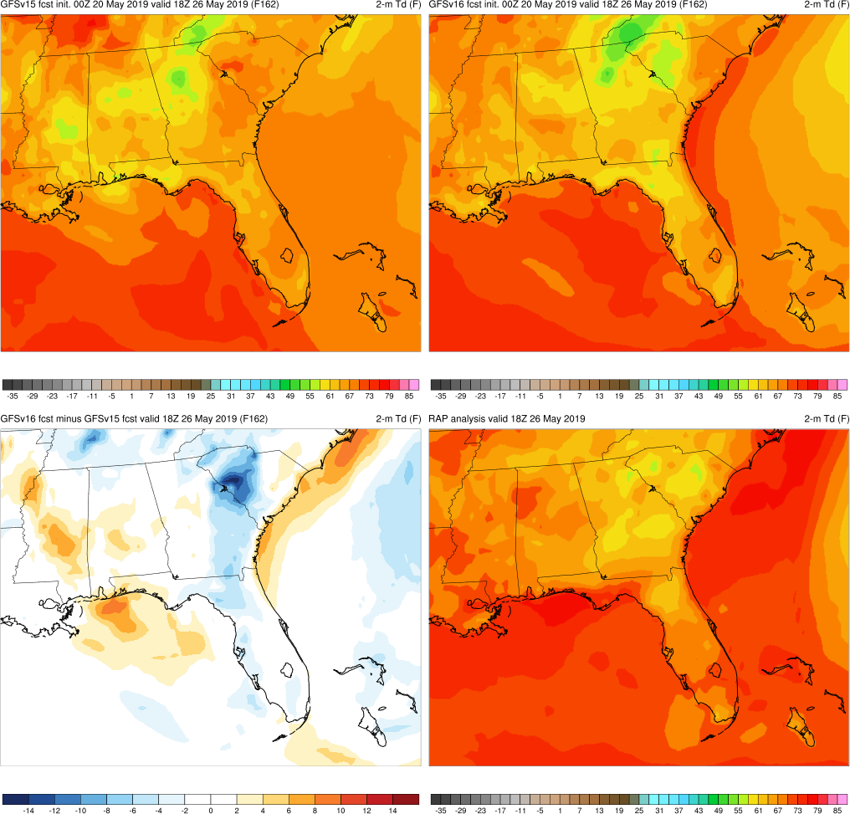
GFSv15
GFSv16
Memorial Day Heat
Valid: 18Z 5/26/19 (F162)
GFSv16 warmer and drier than GFSv15 at longer lead times
2-m Temperature
v16−v15
RAP Anl.
2-m Dewpoint

Slide 26
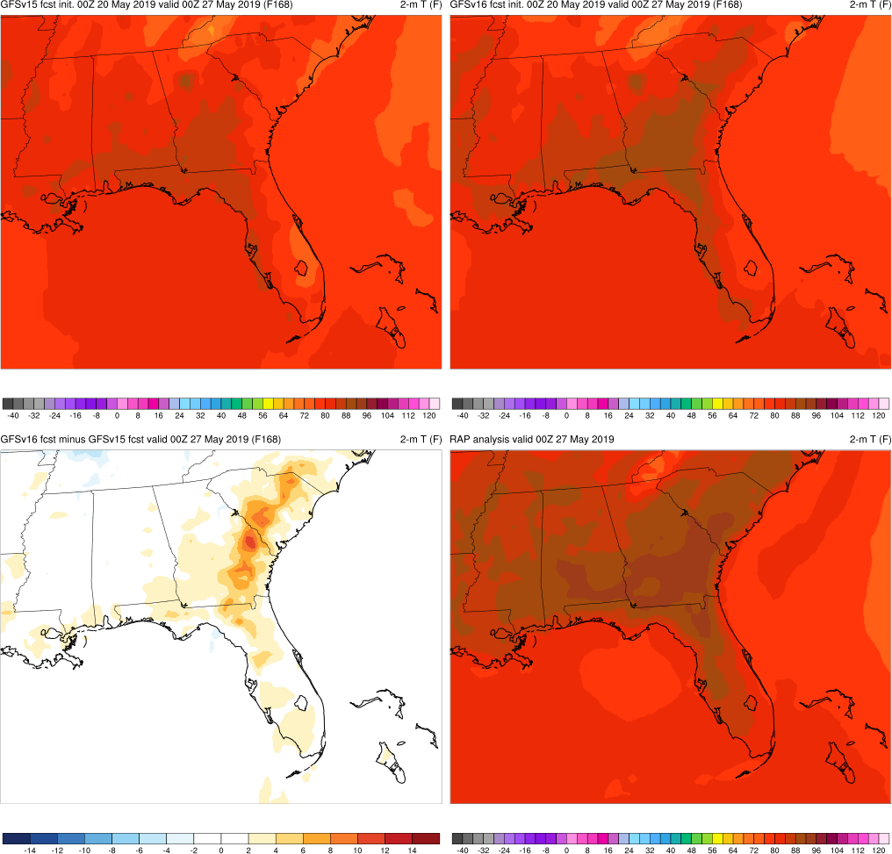
Memorial Day Heat
Valid: 00Z 5/27/19 (F168)
GFSv16 had a correctly warmer forecast over Southeast
GFSv15
GFSv16
v16−v15
RAP Anl.

Slide 27
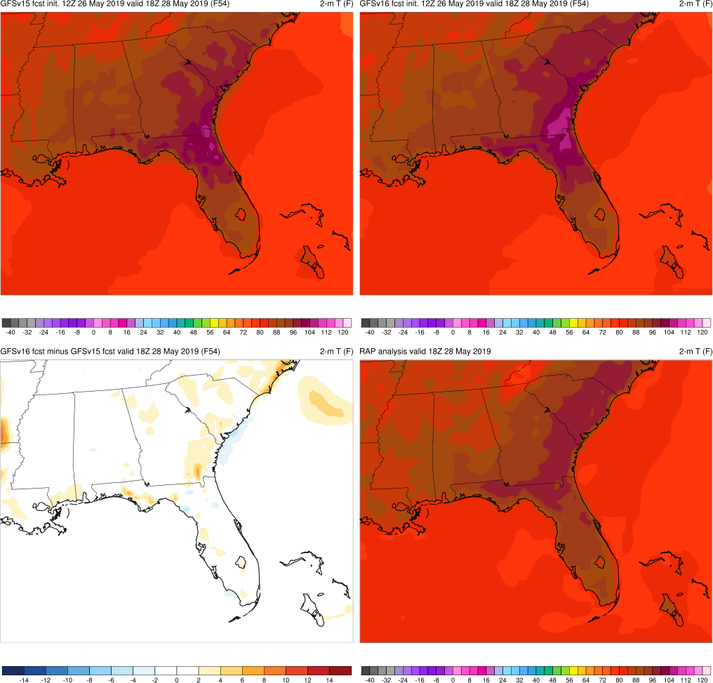
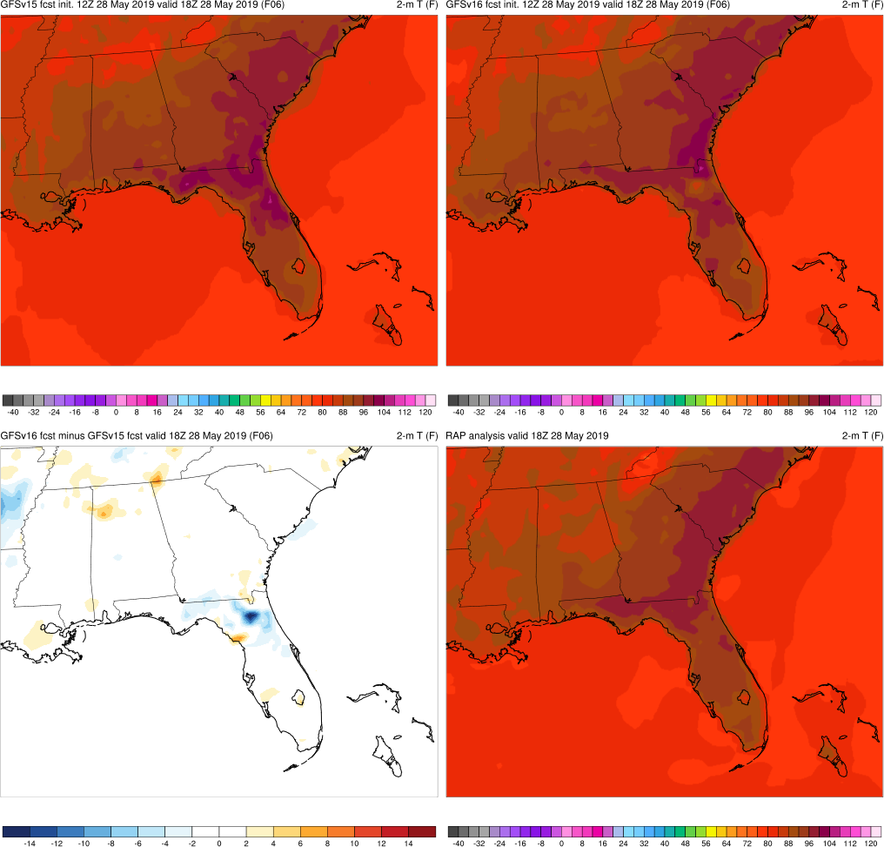
Memorial Day Heat
Valid: 18Z 5/28/19 (F06)
Memorial Day Heat
Valid: 18Z 5/28/19 (F54)
GFSv16 correctly extended warmer 2-m temps into NC
Anomalous warm spot observed over GA-FL border in both GFSv15 and GFSv16 (more noticeable in GFSv16)
GFSv15
GFSv15
GFSv16
GFSv16
Overall, GFSv16 was warmer in this retro case (correctly so in Carolinas)
v16−v15
RAP Anl.
v16−v15
RAP Anl.

Slide 28
NATIONAL OCEANIC AND ATMOSPHERIC ADMINISTRATION
GFSv16 Temperature Highlights
Extreme Heat
Memorial Day Heat (May 2019)
San Francisco Heat (June 2019)
Eastern U.S. Heat (July 2019)
Alaskan Wildfires (Aug 2019)
Southern U.S. Heat (Aug 2019)

Slide 29
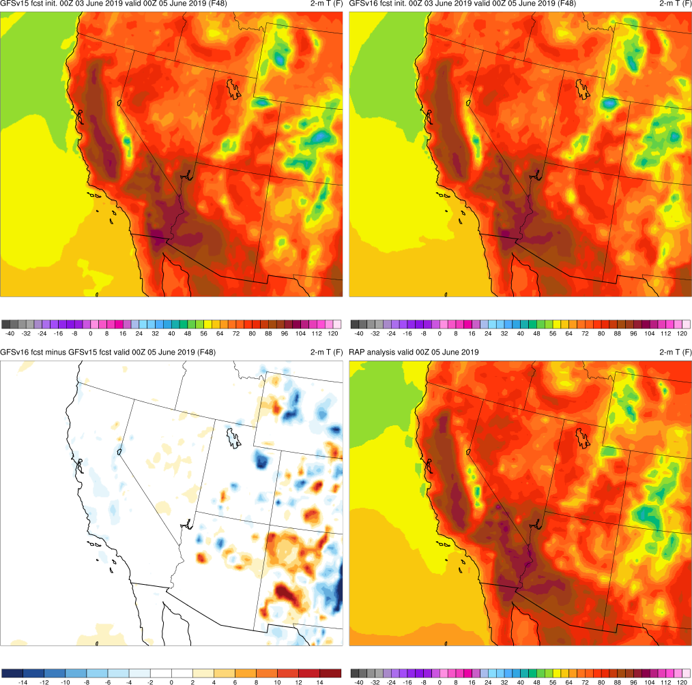
San Francisco Heat
Valid: 00Z 6/5/19 (F48)
Better indication of extreme heat in central CA in GFSv15 (GFSv16 colder)
GFSv15
GFSv16
v16−v15
RAP Anl.

Slide 30
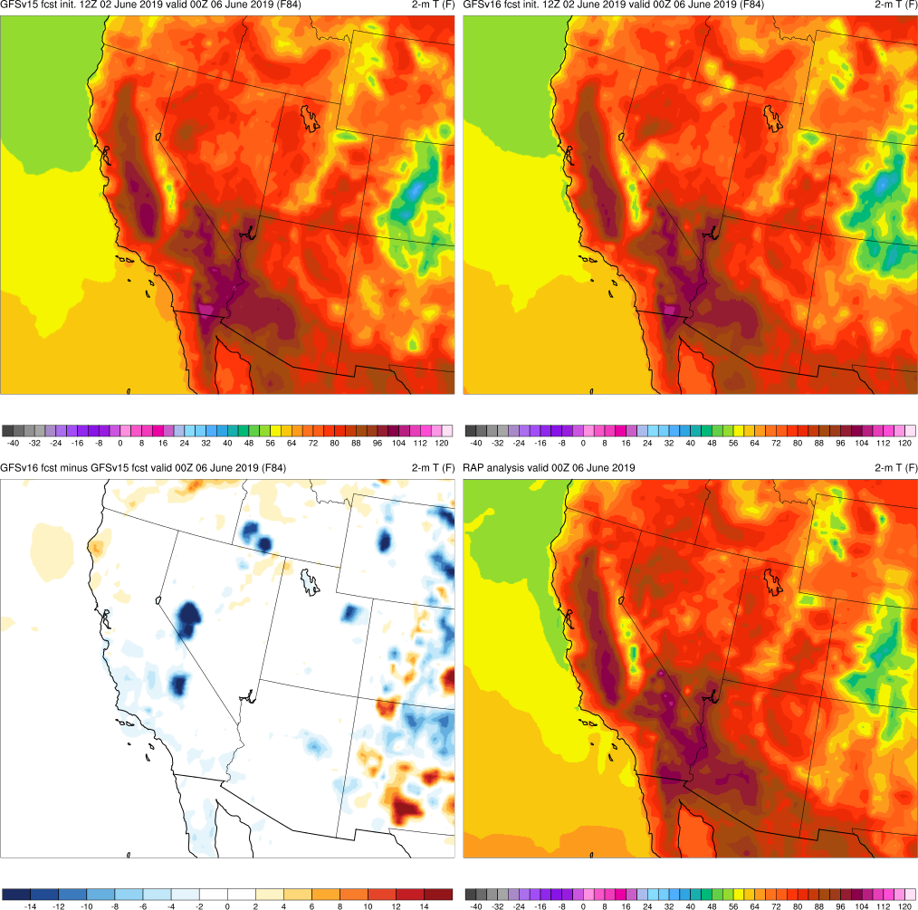
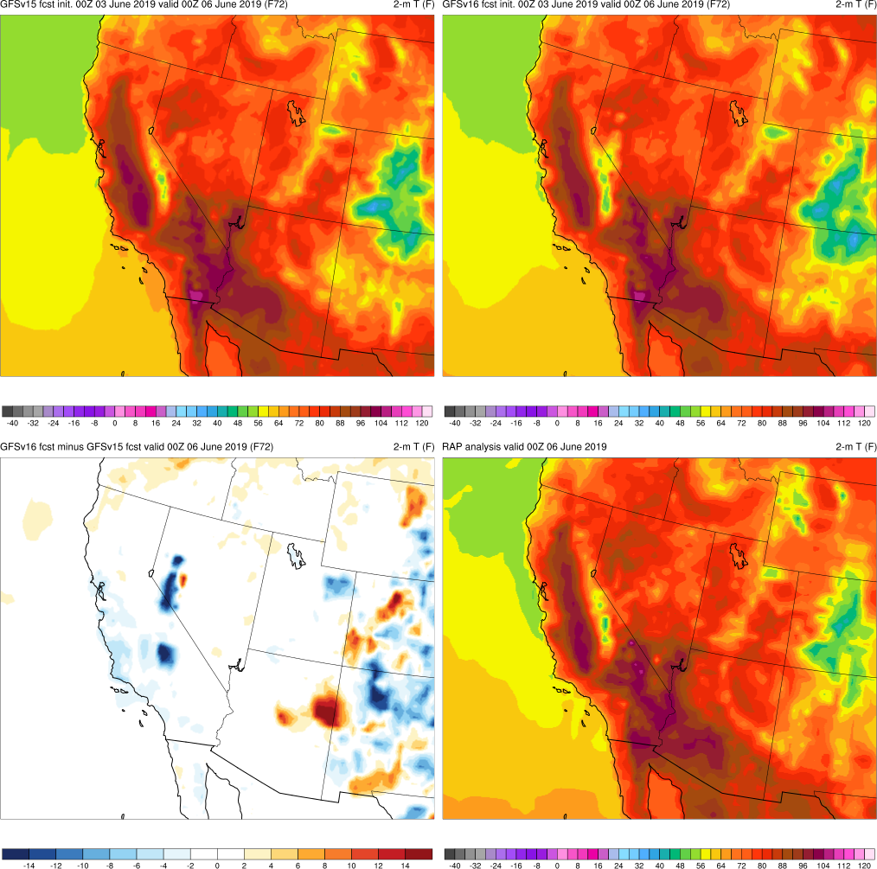
San Francisco Heat
Valid: 00Z 6/6/19 (F72)
San Francisco Heat
Valid: 00Z 6/6/19 (F84)
GFSv16 slightly colder along southern CA coast with much colder spots around the Sierra Nevada (convective cold pools)
By F72, both GFSv16 and GFSv15 extended >96°F 2-m temps northward (east of San Francisco)
GFSv15
GFSv16
v16−v15
RAP Anl.

Slide 31
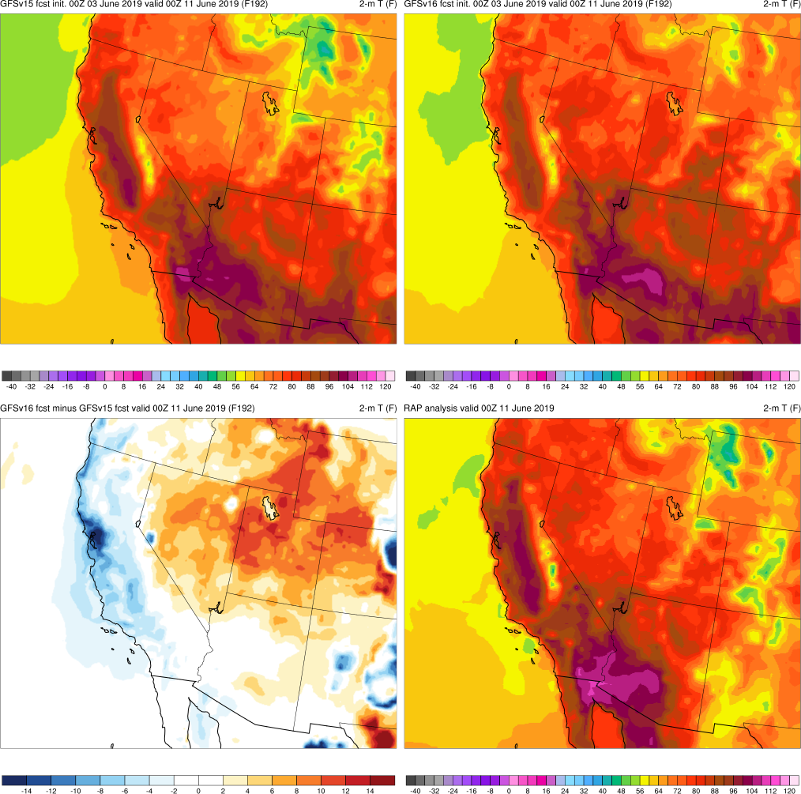
San Francisco Heat
Valid: 00Z 6/11/19 (F192)
San Francisco Heat
Valid: 00Z 6/6/19 (F84)
GFSv16 was colder along CA coast/central CA in most cycles compared to GFSv15 and analysis
GFSv15
GFSv16
v16−v15
RAP Anl.

Slide 32
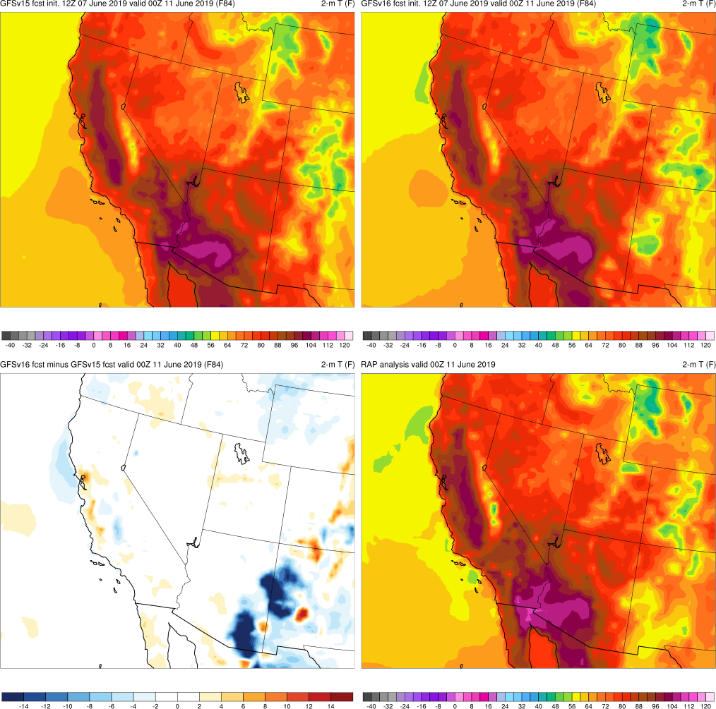
San Francisco Heat
Valid: 00Z 6/11/19 (F84)
San Francisco Heat
Valid: 00Z 6/6/19 (F84)
GFSv16 was colder along CA coast/central CA in most cycles compared to GFSv15 and analysis
However, for a few cycles at this valid time, GFSv16 was warmer along CA coast and correctly warmer around San Francisco
GFSv15
GFSv16
v16−v15
RAP Anl.

Slide 33
NATIONAL OCEANIC AND ATMOSPHERIC ADMINISTRATION
GFSv16 Temperature Highlights
Extreme Heat
Memorial Day Heat (May 2019)
San Francisco Heat (June 2019)
Eastern U.S. Heat (July 2019)
Alaskan Wildfires (Aug 2019)
Southern U.S. Heat (Aug 2019)

Slide 34
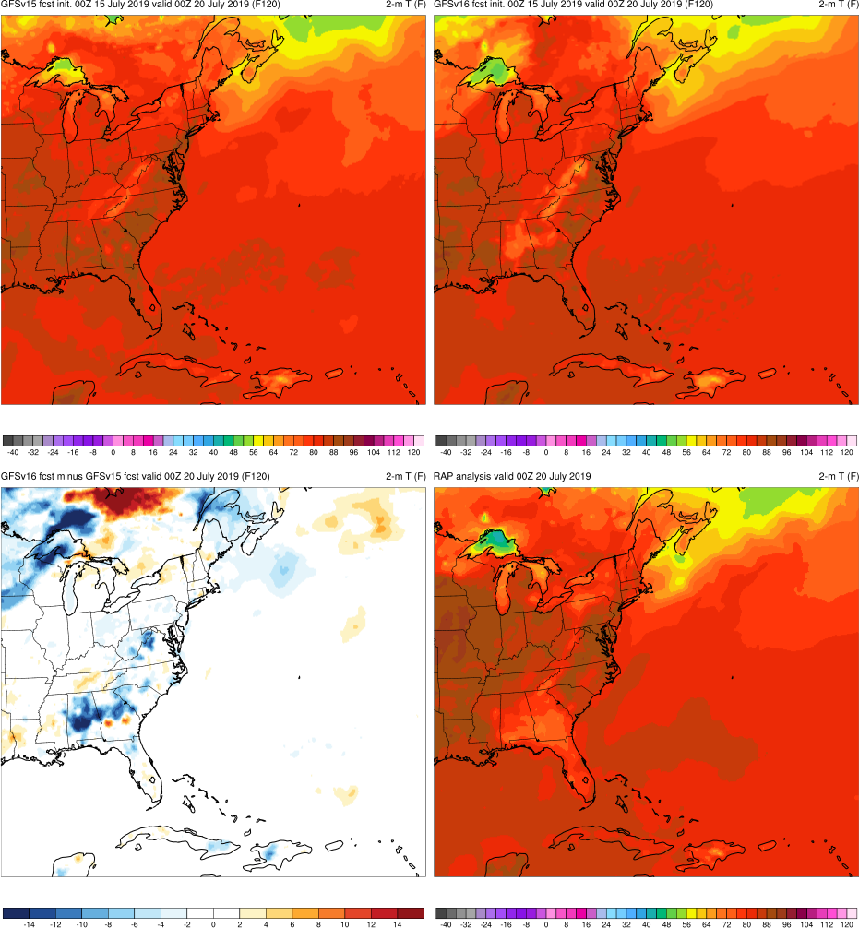
Eastern U.S. Heat
Valid: 00Z 7/20/19 (F120)
San Francisco Heat
Valid: 00Z 6/6/19 (F84)
GFSv16 correctly colder over AL, GA, and SC, but was slightly too cold over WV/VA border (convective cold pool)
GFSv16 correctly colder over Lake Superior
GFSv15
GFSv16
v16−v15
RAP Anl.

Slide 35
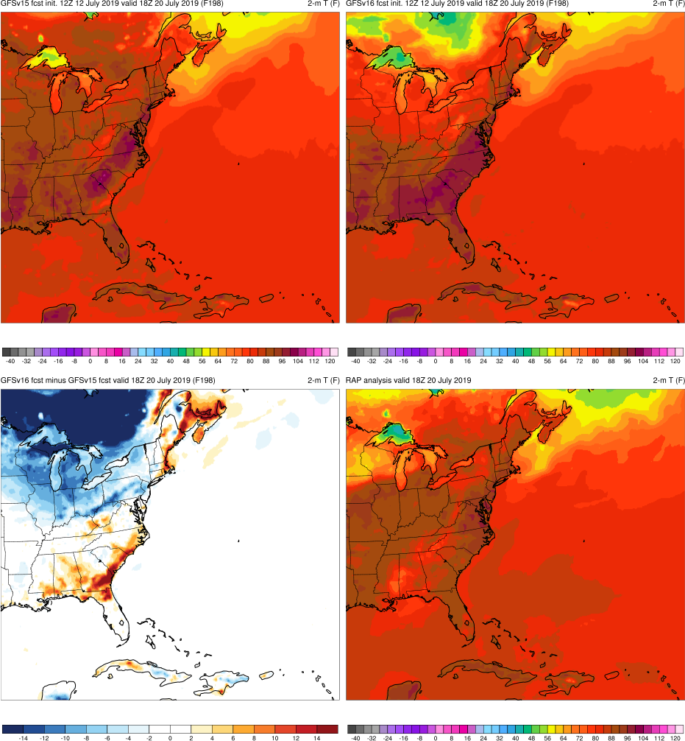
Eastern U.S. Heat
Valid: 18Z 7/20/19 (F198)
San Francisco Heat
Valid: 00Z 6/6/19 (F84)
GFSv16 was incorrectly colder in Midwest and Mid-Atlantic (Canadian air mass)
GFSv16 was also incorrectly warmer along southeast U.S. coast
GFSv16 correctly colder over Lake Superior
GFSv15
GFSv16
v16−v15
RAP Anl.

Slide 36
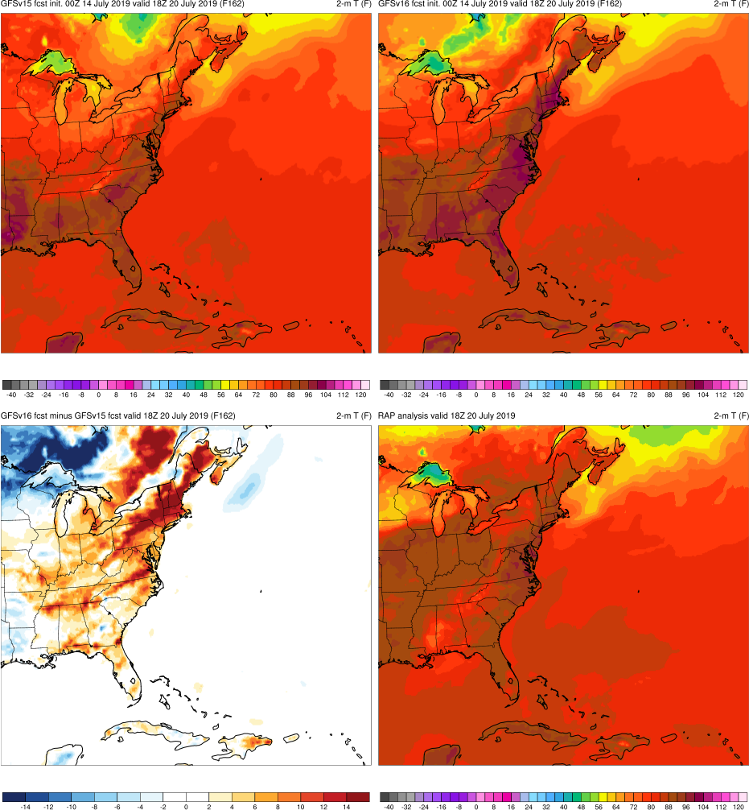
Eastern U.S. Heat
Valid: 18Z 7/20/19 (F162)
San Francisco Heat
Valid: 00Z 6/6/19 (F84)
GFSv16 extended temps >104°F up along the East Coast that were too warm
GFSv15 had slightly better forecast
GFSv16 correctly colder over Lake Superior
GFSv15
GFSv16
v16−v15
RAP Anl.

Slide 37
NATIONAL OCEANIC AND ATMOSPHERIC ADMINISTRATION
GFSv16 Temperature Highlights
Extreme Heat
Memorial Day Heat (May 2019)
San Francisco Heat (June 2019)
Eastern U.S. Heat (July 2019)
Alaskan Wildfires (Aug 2019)
Southern U.S. Heat (Aug 2019)

Slide 38
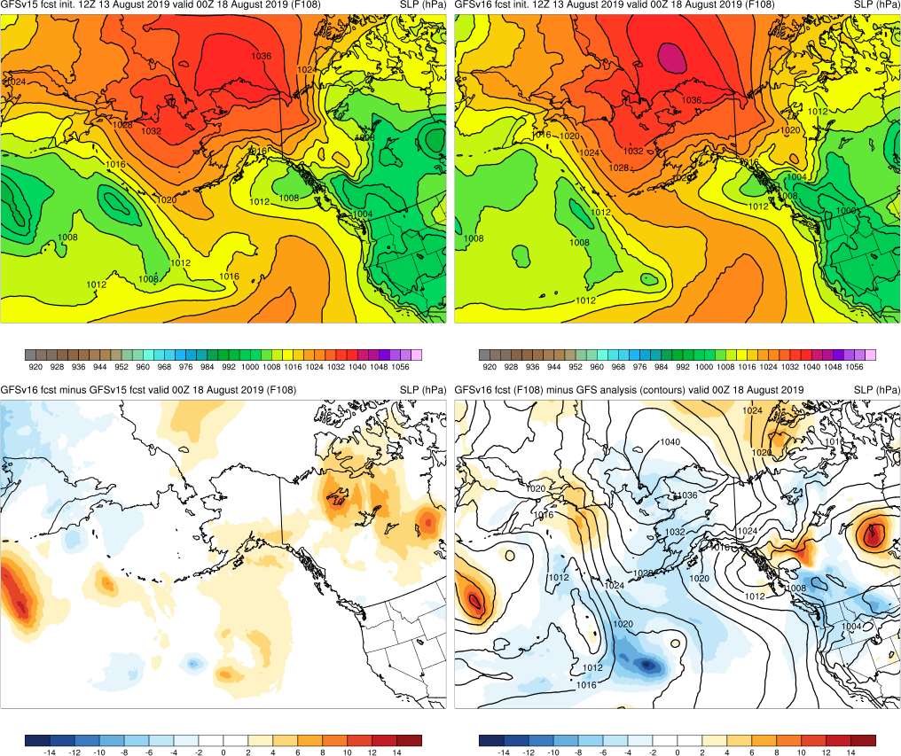
Alaskan Wildfires
Valid: 00Z 8/18/19 (F108)
San Francisco Heat
Valid: 00Z 6/6/19 (F84)
GFSv16 forecasted 1040-hPa high north of Alaska earlier than GFSv15 and was more consistent with this feature
GFSv15
GFSv16
v16−v15
GFS Anl.

Slide 39
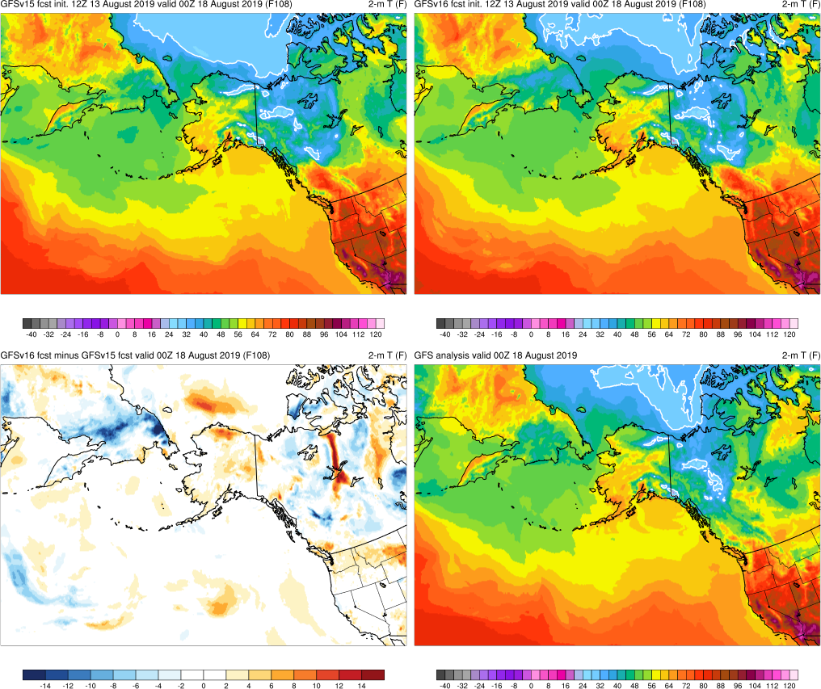
Alaskan Wildfires
Valid: 00Z 8/18/19 (F108)
San Francisco Heat
Valid: 00Z 6/6/19 (F84)
GFSv16 forecasted correctly warmer 2-m temps over Alaska
Overall, GFSv16 had better 2-m temp forecasts at this valid time
GFSv15
GFSv16
v16−v15
GFS Anl.

Slide 40
NATIONAL OCEANIC AND ATMOSPHERIC ADMINISTRATION
GFSv16 Temperature Highlights
Extreme Heat
Memorial Day Heat (May 2019)
San Francisco Heat (June 2019)
Eastern U.S. Heat (July 2019)
Alaskan Wildfires (Aug 2019)
Southern U.S. Heat (Aug 2019)

Slide 41
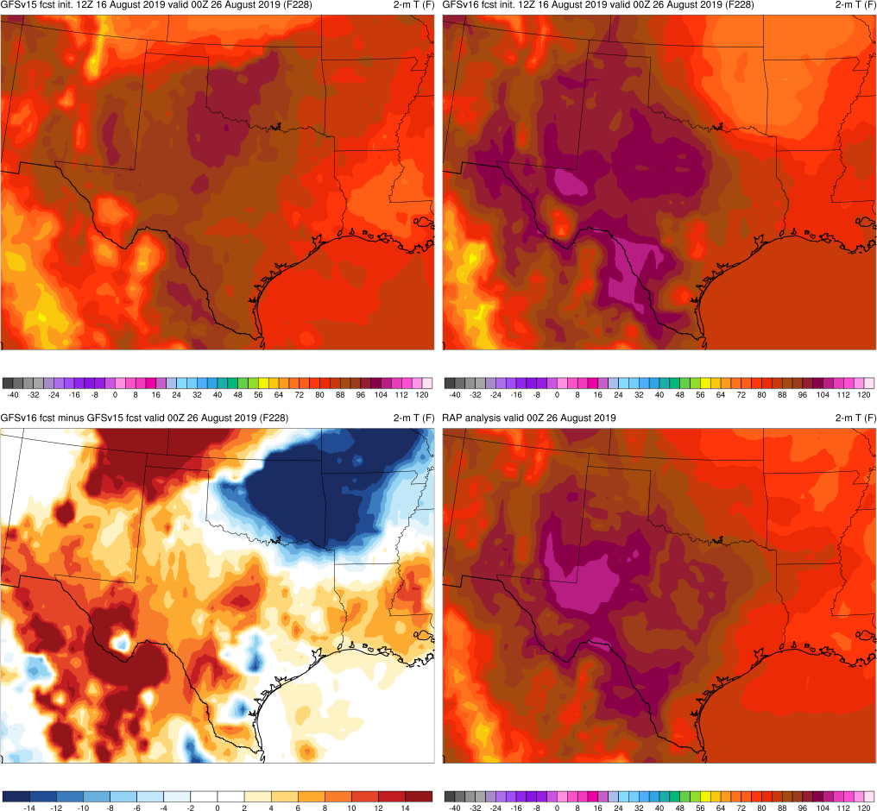
Southern U.S. Heat
Valid: 00Z 8/26/19 (F228)
San Francisco Heat
Valid: 00Z 6/6/19 (F84)
GFSv16 had better indication/location of extreme heat over NM and TX
However, GFSv16 was too cold over eastern OK, western AR, and southern MO (GFSv15 was too warm over these regions)
GFSv15
GFSv16
v16−v15
RAP Anl.

Slide 42
Southern U.S. Heat
Valid: 00Z 8/26/19 (F168)
San Francisco Heat
Valid: 00Z 6/6/19 (F84)
GFSv16 had better indication of extreme heat over TX, although it was too warm over OK
GFSv15
GFSv16
v16−v15
RAP Anl.

Slide 43
Southern U.S. Heat
Valid: 00Z 8/26/19 (F24)
San Francisco Heat
Valid: 00Z 6/6/19 (F84)
GFSv16 had slightly better orientation of extreme temps over TX
Overall correctly higher temps in GFSv16
GFSv15
GFSv16
v16−v15
RAP Anl.

Slide 44
2-m Dewpoint
Southern U.S. Heat
Valid: 00Z 8/26/19 (F72)
Southern U.S. Heat
Valid: 00Z 8/26/19 (F120)
San Francisco Heat
Valid: 00Z 6/6/19 (F84)
GFSv15 extended drier air further south than GFSv16
Both GFSv15 and GFSv16 extended the drier air further south at F72
However, neither GFSv16 nor GFSv15 fully captured the dryline in TX
GFSv15
GFSv15
GFSv16
GFSv16
v16−v15
RAP Anl.
v16−v15
RAP Anl.

Slide 45
NATIONAL OCEANIC AND ATMOSPHERIC ADMINISTRATION
GFSv16 Temperature Highlights
Extreme Cold
Intermountain West Cold (Oct 2019)
Central U.S. Cold Surge (Nov 2019)
January Cold Blast (Jan 2020)
Valentine’s Day Cold (Feb 2020)
Mother’s Day Weekend Cold (May 2020)

Slide 46
Intermountain West Cold
Valid: 12Z 10/26/19 (F144)
Southern U.S. Heat
Valid: 00Z 8/26/19 (F120)
500-hPa Geopotential Height
San Francisco Heat
Valid: 00Z 6/6/19 (F84)
GFSv16 had a better synoptic forecast with trough/cutoff located over TX/OK
GFSv15 was much too progressive with trough with no indication of cutoff
This led to better temperature forecasts…
GFSv15
GFSv16
v16−v15
GFS Anl.

Slide 47
Intermountain West Cold
Valid: 12Z 10/26/19 (F144)
Southern U.S. Heat
Valid: 00Z 8/26/19 (F120)
850-hPa Temperature
San Francisco Heat
Valid: 00Z 6/6/19 (F84)
GFSv16 had a better 850-hPa temp forecast, especially over the East
GFSv15 extended the cold air too far south due to the progressive and deep 500-hPa trough
GFSv15
GFSv16
v16−v15
GFS Anl.

Slide 48
Intermountain West Cold
Valid: 12Z 10/26/19 (F144)
Southern U.S. Heat
Valid: 00Z 8/26/19 (F120)
2-m Temperature
San Francisco Heat
Valid: 00Z 6/6/19 (F84)
GFSv16 had a better 2-m temp forecast over the central U.S. and SE
GFSv15 extended the cold air too far south
GFSv15
GFSv16
v16−v15
RAP Anl.

Slide 49
Intermountain West Cold
Valid: 12Z 10/30/19 (F192)
Southern U.S. Heat
Valid: 00Z 8/26/19 (F120)
San Francisco Heat
Valid: 00Z 6/6/19 (F84)
GFSv16 was correctly warmer than GFSv15 over the eastern U.S.
GFSv15
GFSv16
v16−v15
RAP Anl.

Slide 50
NATIONAL OCEANIC AND ATMOSPHERIC ADMINISTRATION
GFSv16 Temperature Highlights
Extreme Cold
Intermountain West Cold (Oct 2019)
Central U.S. Cold Surge (Nov 2019)
January Cold Blast (Jan 2020)
Valentine’s Day Cold (Feb 2020)
Mother’s Day Weekend Cold (May 2020)

Slide 51
Central U.S. Cold Surge
Valid: 00Z 11/12/19 (F192)
GFSv16 correctly extended colder air further south over West and Midwest
GFSv15
GFSv16
v16−v15
RAP Anl.

Slide 52
Central U.S. Cold Surge
Valid: 00Z 11/12/19 (F108)
GFSv16 had a slightly better synoptic forecast
GFSv16 had correct positioning of cold air over West and Central U.S.
GFSv16 was correctly warmer than GFSv15 over East U.S.
GFSv15
GFSv15
GFSv16
GFSv16
v16−v15
v16−v15
GFS Anl.
RAP Anl.

Slide 53
Central U.S. Cold Surge
Valid: 00Z 11/12/19 (F72)
GFSv16 was slightly less progressive (better) with trough
GFSv16 had correct positioning of cold air over West and Central U.S.
GFSv16 was correctly warmer than GFSv15 over East U.S.
GFSv15
GFSv15
GFSv16
GFSv16
v16−v15
RAP Anl.
v16−v15
GFS Anl.

Slide 54
Central U.S. Cold Surge
Valid: 00Z 11/12/19 (F36)
GFSv16 correctly extended cold air south over TX
GFSv16 was incorrectly warmer than GFSv15 over IA
Overall, this case was a big win for GFSv16
GFSv15
GFSv16
v16−v15
RAP Anl.

Slide 55
NATIONAL OCEANIC AND ATMOSPHERIC ADMINISTRATION
GFSv16 Temperature Highlights
Extreme Cold
Intermountain West Cold (Oct 2019)
Central U.S. Cold Surge (Nov 2019)
January Cold Blast (Jan 2020)
Valentine’s Day Cold (Feb 2020)
Mother’s Day Weekend Cold (May 2020)

Slide 56
January Cold Blast
Valid: 12Z 1/14/20 (F132)
GFSv16 warmer than GFSv15 over most of CONUS, especially over West and central U.S.
GFSv15 incorrectly extended colder air too far south/east into Northern Plains
GFSv15
GFSv16
v16−v15
RAP Anl.

Slide 57
January Cold Blast
Valid: 00Z 1/16/20 (F204)
GFSv16 warmer than GFSv15 over West and Central U.S. (GFSv15 extends cold air too far south)
GFSv16 incorrectly colder over East
GFSv15
GFSv16
v16−v15
RAP Anl.

Slide 58
January Cold Blast
Valid: 00Z 1/17/20 (F216)
GFSv15 extended cold air too deep into TX
GFSv16 correctly warmer in East
GFSv15
GFSv16
v16−v15
RAP Anl.

Slide 59
January Cold Blast
Valid: 12Z 1/18/20 (F144)
GFSv15 extended cold air too deep into OK and AR
GFSv16 correctly colder in East
For this case, GFSv15 often extended cold air too far south into U.S., whereas GFSv16 had warmer/more correct 2-m temps
GFSv15
GFSv16
v16−v15
RAP Anl.

Slide 60
NATIONAL OCEANIC AND ATMOSPHERIC ADMINISTRATION
GFSv16 Temperature Highlights
Extreme Cold
Intermountain West Cold (Oct 2019)
Central U.S. Cold Surge (Nov 2019)
January Cold Blast (Jan 2020)
Valentine’s Day Cold (Feb 2020)
Mother’s Day Weekend Cold (May 2020)

Slide 61
Valentine’s Day Cold
Valid: 12Z 2/6/20 (F48)
GFSv16 had correctly colder 2-m temps in TX and eastern U.S.
This was observed in other cycles
GFSv15
GFSv16
v16−v15
RAP Anl.

Slide 62
Valentine’s Day Cold
Valid: 12Z 2/14/20 (F192)
GFSv15 had better synoptic forecast with eastern U.S. trough
GFSv16 had incorrect trough over western U.S.
GFSv15
GFSv15
GFSv16
GFSv16
2-m temp forecasts reflected these synoptic differences
v16−v15
GFS Anl.
v16−v15
RAP Anl.

Slide 63
Valentine’s Day Cold
Valid: 12Z 2/14/20 (F108)
GFSv16 had better synoptic forecast with positively-tilted trough
GFSv15
GFSv15
GFSv16
GFSv16
GFSv16 thus had better 2-m temp forecast
v16−v15
GFS Anl.
v16−v15
RAP Anl.

Slide 64
Valentine’s Day Cold
Valid: 06Z 2/17/20 (F198)
Valentine’s Day Cold
Valid: 18Z 2/16/20 (F186)
850-hPa Temperature
Valentine’s Day Cold
Valid: 18Z 2/17/20 (F210)
GFSv16 was better with placement of freezing contour over western CONUS at later lead times (synoptic influences)
GFSv15
GFSv16
GFSv15
GFSv16
GFSv15
GFSv16
v16−v15
GFS Anl.
v16−v15
GFS Anl.
v16−v15
GFS Anl.

Slide 65
NATIONAL OCEANIC AND ATMOSPHERIC ADMINISTRATION
GFSv16 Temperature Highlights
Extreme Cold
Intermountain West Cold (Oct 2019)
Central U.S. Cold Surge (Nov 2019)
January Cold Blast (Jan 2020)
Valentine’s Day Cold (Feb 2020)
Mother’s Day Weekend Cold (May 2020)

Slide 66
Mother’s Day Weekend Cold
Valid: 06Z 5/9/20 (F198)
Mother’s Day Weekend Cold
Valid: 18Z 5/8/20 (F186)
850-hPa Temperature
Mother’s Day Weekend Cold
Valid: 12Z 5/9/20 (F36)
GFSv16 better with placement of freezing contour at longer lead times
Freezing contour shifted too far west in GFSv15 (synoptic influences)
Often colder air mass in GFSv15
GFSv15
GFSv16
GFSv15
GFSv16
v16−v15
GFS Anl.
v16−v15
GFS Anl.

Slide 67
Mother’s Day Weekend Cold
Valid: 12Z 5/9/20 (F204)
GFSv16 correctly colder over Northeast
GFSv15
GFSv16
v16−v15
RAP Anl.

Slide 68
Mother’s Day Weekend Cold
Valid: 12Z 5/9/20 (F180)
GFSv16 correctly colder over Northeast due to cyclone/synoptic forecast
GFSv15
GFSv16
GFSv15
GFSv16
GFSv16
GFSv16 had correct position and strength of cyclone
GFSv15
v16−v15
GFS Anl.
v16−v15
RAP Anl.
v16−v15
GFS Anl.

Slide 69
Mother’s Day Weekend Cold
Valid: 12Z 5/9/20 (F24)
Mother’s Day Weekend Cold
Valid: 12Z 5/9/20 (F36)
GFSv16 correctly colder over Northeast, although slightly too cold over PA
Correct indication/footprint of colder temps over eastern NY in GFSv16
GFSv15
GFSv15
GFSv16
GFSv16
Overall, GFSv16 correctly had colder temps and more consistent forecasts in NE for this case
v16−v15
v16−v15
RAP Anl.
RAP Anl.

Slide 70
NATIONAL OCEANIC AND ATMOSPHERIC ADMINISTRATION
GFSv16 Temperature Highlights: Summary
Overall, GFSv16 forecasted extreme heat the same or slightly better than GFSv15
For the examined cases, GFSv16 had colder 2-m temps than GFSv15 in the warm season
Overall, GFSv16 forecasted extreme cold better than GFSv15
For the examined cases, GFSv16 had warmer 850-hPa and 2-m temps than GFSv15 in the cold season
GFSv16 correctly reduced the known low-level cold bias in GFSv15
GFSv16 was often better with placement of freezing contour at longer lead times
Overall, better synoptic forecasts in GFSv16 led to better temperature forecasts
Consolidates NCEP/EMC verification and evaluation functions to efficiently and consistently support all modeling groups
Removes evaluation functions from the model science chain of command, ensuring independent model evaluations

Slide 71
NATIONAL OCEANIC AND ATMOSPHERIC ADMINISTRATION
GFSv16 Temperature Highlights
Extra Slides
Consolidates NCEP/EMC verification and evaluation functions to efficiently and consistently support all modeling groups
Removes evaluation functions from the model science chain of command, ensuring independent model evaluations

Slide 72
Memorial Day Heat
Valid: 18Z 5/26/19 (F114)
Anomalous warm spot in GFSv15 persisted until F6
GFSv16 either did not have this spot or had a smaller spot that was not consistent across forecasts for this valid time

Slide 73
San Francisco Heat
Valid: 00Z 6/6/19 (F84)
GFSv16 slightly colder along southern CA coast with much colder spots around the Sierra Nevada

Slide 74
Eastern U.S. Heat
Valid: 18Z 7/20/19 (F186)
San Francisco Heat
Valid: 00Z 6/6/19 (F84)
GFSv16 was incorrectly colder in/around MD
GFSv16 was correctly warmer across Midwest

Slide 75
Alaskan Wildfires
Valid: 00Z 8/18/19 (F00)
Alaskan Wildfires
Valid: 00Z 8/18/19 (F12)
Alaskan Wildfires
Valid: 00Z 8/18/19 (F24)
Alaskan Wildfires
Valid: 00Z 8/18/19 (F36)
Alaskan Wildfires
Valid: 00Z 8/18/19 (F48)
San Francisco Heat
Valid: 00Z 6/6/19 (F84)
However, at shorter lead times, GFSv15 had correct location/shape of high
GFSv16 did not start to indicate correct shape of high until F12

Slide 76
Intermountain West Cold
Valid: 00Z 10/30/19 (F96)
Southern U.S. Heat
Valid: 00Z 8/26/19 (F120)
San Francisco Heat
Valid: 00Z 6/6/19 (F84)
GFSv15 colder/better than GFSv16 over WA, OR, and NV
GFSv16 noticeably warmer over most of CONUS

Slide 77
Intermountain West Cold
Valid: 12Z 10/30/19 (F240)
Southern U.S. Heat
Valid: 00Z 8/26/19 (F120)
San Francisco Heat
Valid: 00Z 6/6/19 (F84)
GFSv16 had correctly colder air over MT, CO, ND, SD, NE, and MN (too cold over Northeast)
However, GFSv16 was too warm over portions of the West, Midwest, and South U.S.

Slide 78
Central U.S. Cold Surge
Valid: 00Z 11/12/19 (F204)
GFSv16 correctly extended colder air further south over West and Midwest

Slide 79
Central U.S. Cold Surge
Valid: 00Z 11/12/19 (F180)
GFSv15 had a slightly better synoptic forecast
GFSv15 correctly extended colder air further south over Texas (GFSv16 too warm)

Slide 80
Central U.S. Cold Surge
Valid: 00Z 11/12/19 (F108)
GFSv16 had a slightly better synoptic forecast
GFSv16 had correct positioning of cold air over West and Central U.S.
GFSv16 was correctly warmer than GFSv15 over East U.S.

Slide 81
January Cold Blast
Valid: 12Z 1/11/20 (F84)
GFSv16 warmer than GFSv15 over Midwest
GFSv16 was more correct with position of freezing contour

