Slide 1
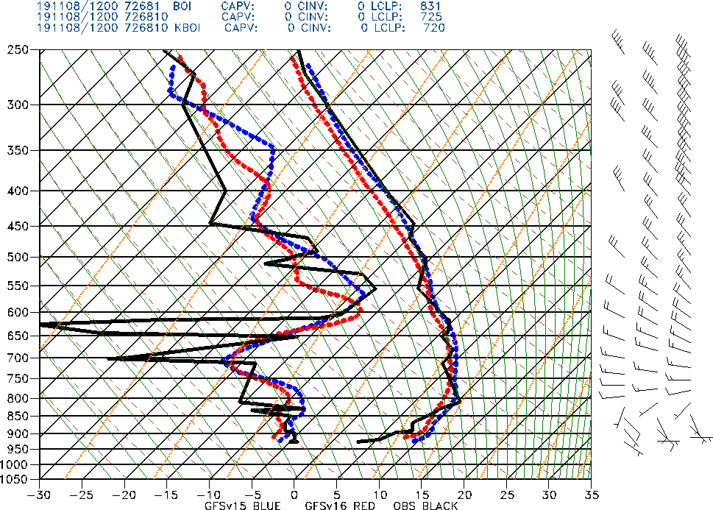
NATIONAL OCEANIC AND ATMOSPHERIC ADMINISTRATION
GFSv16 Vertical Profile Assessment
Geoff Manikin
EMC Model Evaluation Group Webinar
September 10, 2020

Slide 2
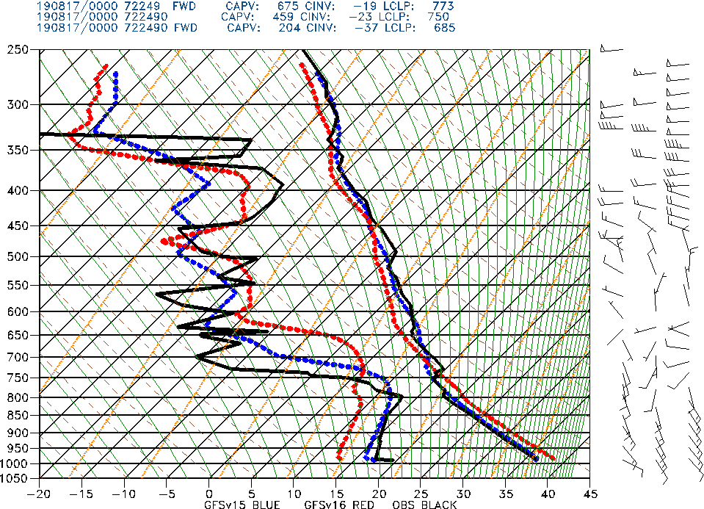
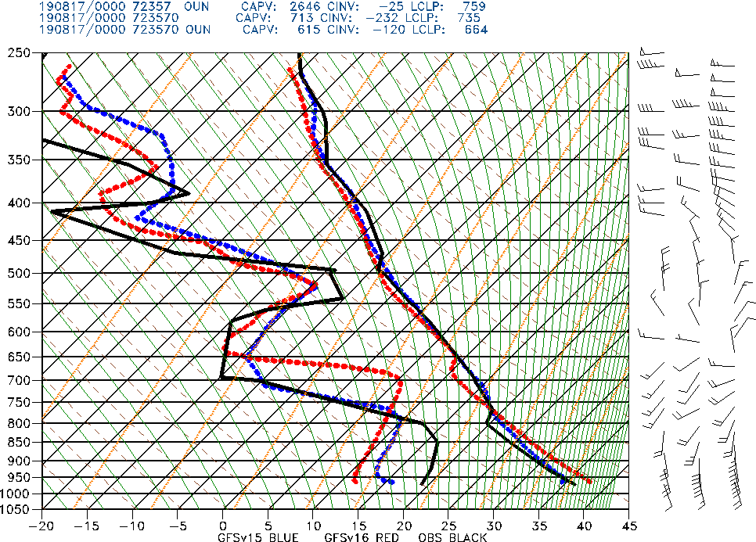
NATIONAL OCEANIC AND ATMOSPHERIC ADMINISTRATION
Tendency to Overmix the Boundary Layer
From last week:
GFSv15 GFSv16 Obs
Ft Worth,
TX
Norman, OK
Init: 12Z 16 August 2019 Valid: 00Z 17 August 2020 (F012)
GFSv16 PBL was drier/warmer/deeper than GFSv15 and obs in the unstable air

Slide 3
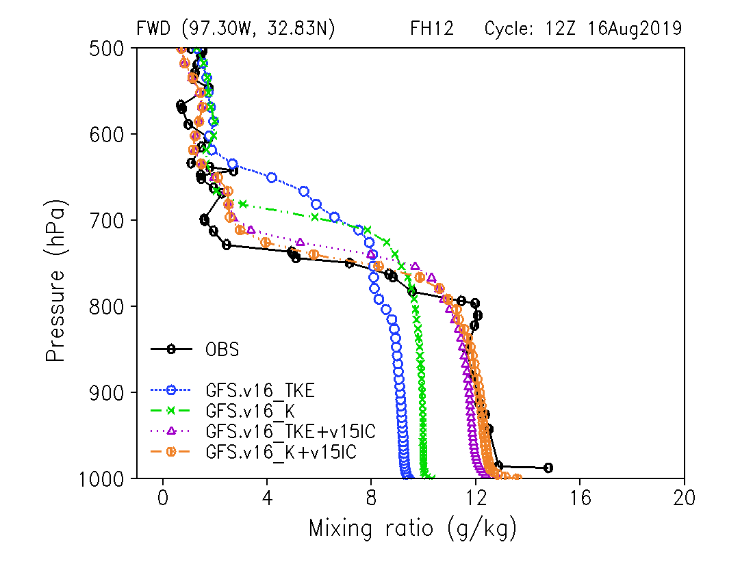
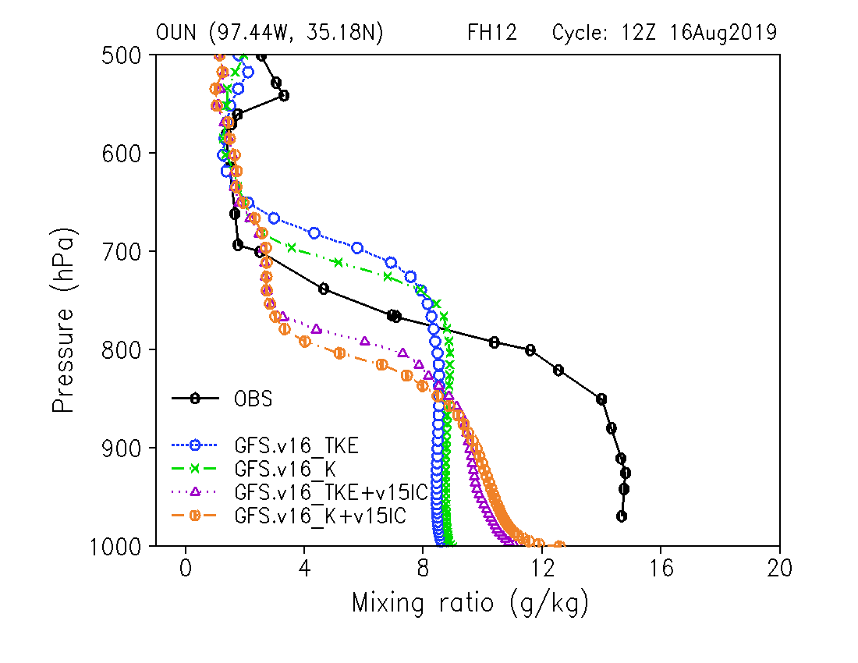
NATIONAL OCEANIC AND ATMOSPHERIC ADMINISTRATION
Sensitivity Tests
Courtesy Weizhong Zheng, EMC
Fort Worth,
TX
Norman,
OK
GFSv16
GFSv16 w/ old PBL
GFSv16 w/ v15 IC
GFSv16 w/ old PBL + v15 IC
GFSv16
GFSv16 w/ old PBL
GFSv16 w/ v15 IC
GFSv16 w/ old PBL + v15 IC
In this example, the low-level PBL moisture profile (and depth) was improved by running the old PBL scheme; it became even better using v15 initial conditions
In this example, the low-level PBL moisture profile (and depth) was improved by running the old PBL scheme and v15 initial conditions, but the magnitude of the improvement was limited

Slide 4
NATIONAL OCEANIC AND ATMOSPHERIC ADMINISTRATION
Today’s Focus
The issues with too deep and too dry PBLs in the warm season appear to be driven by a combination of the new version of the PBL scheme and the dry soil (that seems to be associated with using the CCPA precip analyses to spin up the soil moisture in the GLDAS)
This presentation will focus on vertical profiles and resultant temperatures in colder air masses
Particular focus will be on radiation inversions and cold air damming events

Slide 5
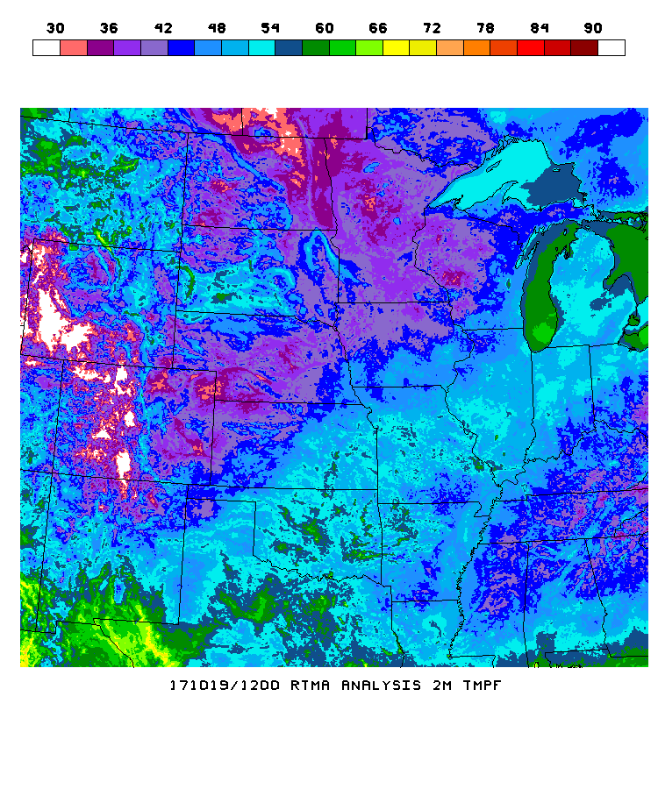
NATIONAL OCEANIC AND ATMOSPHERIC ADMINISTRATION
Background
From a presentation given at the UFS Strategic Implementation Plan Coordination Meeting in May 2019
CONCERNS WITH THE GFS THAT EXISTED PRIOR TO V15
1) Struggles with Inversions
NAM
GFSv14
ANALYSIS
OPS GFS has 6h
2-m temp errors
exceeding 15F

Slide 6
NATIONAL OCEANIC AND ATMOSPHERIC ADMINISTRATION
Goals of the GFSv16 Upgrade
From the MEG GFSv16 Evaluation Kickoff Webinar on 7/16/20
Improve handling of inversions in the PBL
Reduce the cold bias in the lower troposphere in winter
Reduce surface temperature biases
Improve forecasts in the upper atmosphere
Replace the operational Global Wave Deterministic (Multi_1) model with the wave component coupled to the atmosphere (in GFSv16)

Slide 7
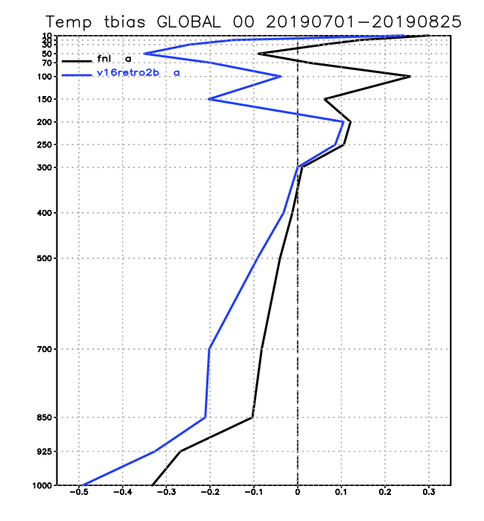
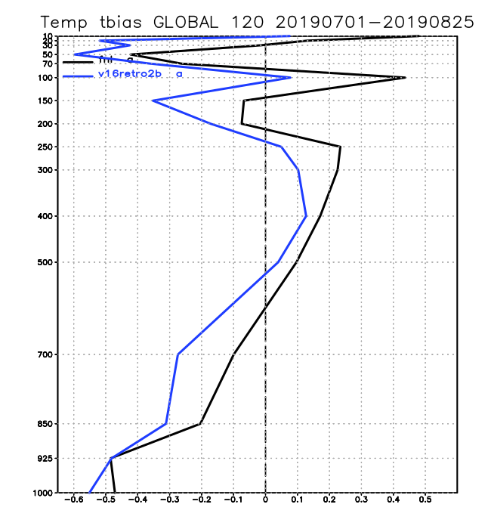
NATIONAL OCEANIC AND ATMOSPHERIC ADMINISTRATION
Early May 2020 Concerns in Initial GFSv16 Version
Temperature Biases Verified against RAOBS, Summer 2019 (retro2b)
GLB, Analysis
GLB, FH120
OPS GFS
TEST GFS
exacerbated
existing low-level
cold bias

Slide 8
NATIONAL OCEANIC AND ATMOSPHERIC ADMINISTRATION
Early May 2020 Updates to GFSv16
Removal of a constraint from the TKE-EDMF PBL scheme over land that limits the strength of vertical mixing under stable boundary layer conditions. This constraint often causes decoupling between the atmosphere and the underlying surface, leading to surface cold biases under these conditions
An update was made to the cumulus convective scheme to increase maximum cloud-base mass flux which increases convective precipitation and subsidence warming in the lower troposphere
In response to CPC’s evaluation of the GFSv16 parallels, divergence and vorticity damping in the upper atmosphere was reduced to enhance the strength of upper atmosphere jet streams
A solar radiation bug in the RRTM-global (which has a minor impact on radiation balance in the mesosphere) was fixed

Slide 9
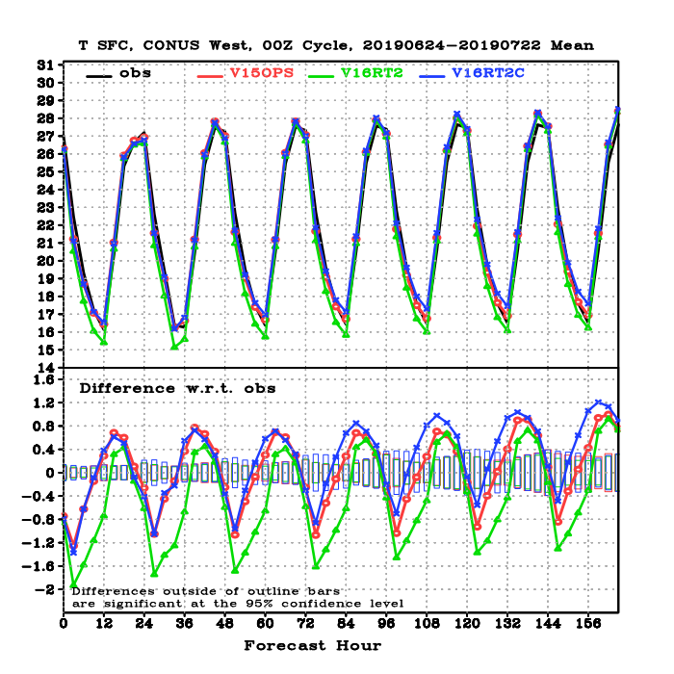
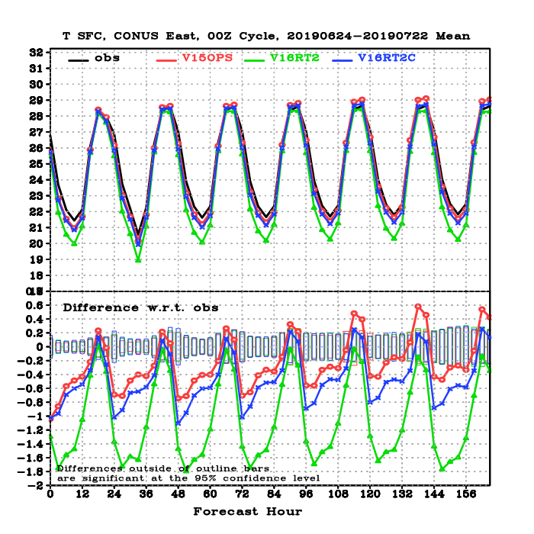
NATIONAL OCEANIC AND ATMOSPHERIC ADMINISTRATION
Impact of May 2020 Updates
West CONUS
East CONUS
OBS
OPS GFS
GFSv16 April Ver
GFSv16 Test
T2m verification
against station observations
V16Test: Significantly reduced cold biases over east in the late afternoon and nighttime
(up to 1.2 ºC). Reduced cold bias in west, slight warm bias at night. This became GFSv16.

Slide 10
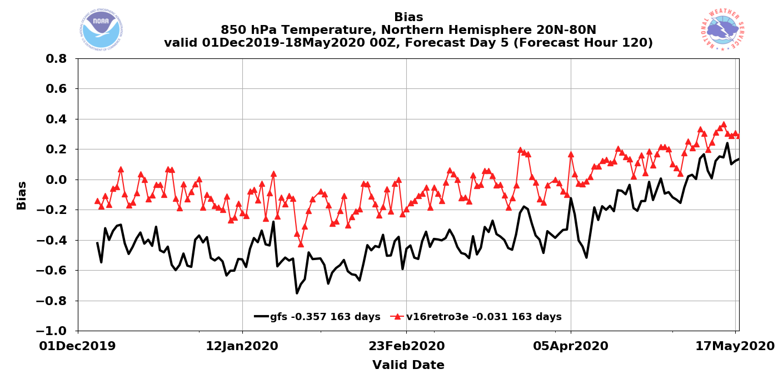
NATIONAL OCEANIC AND ATMOSPHERIC ADMINISTRATION
GFSv16 Cool Season Bias
The low-level cool season cold temperature bias has clearly been mitigated in v16

Slide 11
NATIONAL OCEANIC AND ATMOSPHERIC ADMINISTRATION
Early May 2020 Updates to GFSv16
Removal of a constraint from the TKE-EDMF PBL scheme over land that limits the strength of vertical mixing under stable boundary layer conditions. This constraint often causes decoupling between the atmosphere and the underlying surface, leading to surface cold biases under these conditions
An update was made to the cumulus convective scheme to increase maximum cloud-base mass flux which increases convective precipitation and subsidence warming in the lower troposphere
In response to CPC’s evaluation of the GFSv16 parallels, divergence and vorticity damping in the upper atmosphere was reduced to enhance the strength of upper atmosphere jet streams
A solar radiation bug in the RRTM-global (which has a minor impact on radiation balance in the mesosphere) was fixed
Initial attempts to improve the GFS handling of inversions seemed to make the model cold bias even worse
The cold bias issues were reversed with the May updates, but there was removal of what were likely some of the key changes to potentially improve inversion forecasts
Need to see what inversions look like in the final GFSv16 configuration

Slide 12
NATIONAL OCEANIC AND ATMOSPHERIC ADMINISTRATION
Radiation Inversions
The GFS has long struggled with radiation inversions, leading to large 2m temperature forecast errors in the early morning in clear sky, dry air, and light wind synoptic environments, even at short forecast ranges
The GFS typically underdoes the strength of the inversion, leading to 2m temperature forecasts that are far too warm
10m wind speeds are too strong, allowing for stronger mixing than what actually occurs

Slide 13
NATIONAL OCEANIC AND ATMOSPHERIC ADMINISTRATION
Radiational Cooling Case
Valid: 12Z 30 April 2020
Relaxed pressure gradient across much of central U.S., implying very light winds and likely overnight decoupling
Cloud fields confirm clear skies west of the Mississippi River
Ideal conditions for radiation inversions and strong cooling

Slide 14
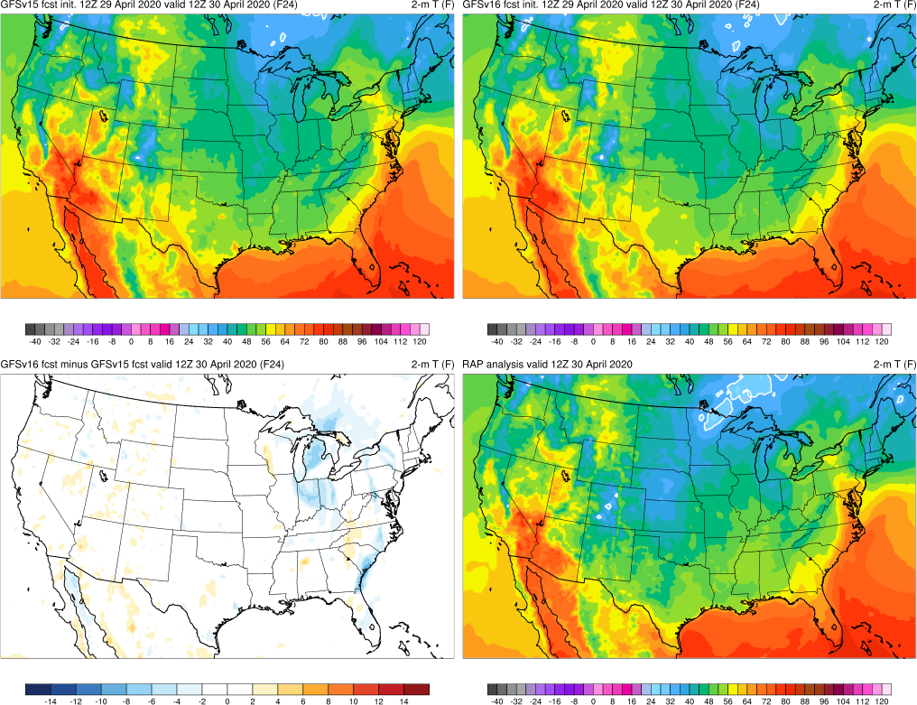
NATIONAL OCEANIC AND ATMOSPHERIC ADMINISTRATION
Radiational Cooling Case
Init: 12Z 29 April 2020
Valid: 12Z 30 April 2020 (F024)
Visually comparing analysis (lower right) to the forecasts, both GFSv15 and v16 are clearly too warm over much of the Plains region
Differences between GFSv15 and v16 appear to overall be small

Slide 15
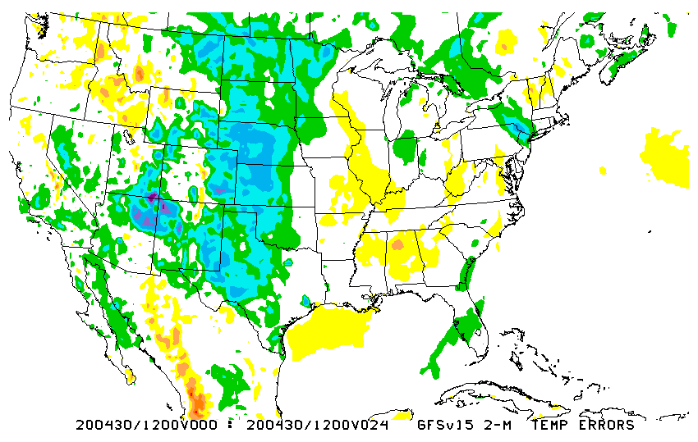
NATIONAL OCEANIC AND ATMOSPHERIC ADMINISTRATION
Radiational Cooling Case
2m Temp Errors Analysis - Forecast
Init: 12Z 29 April 2020
Valid: 12Z 30 April 2020 (F024)
We can quantify the errors, and they’re fairly significant for a 24h forecast; GFSv16 appears to offer very slight improvement, but both forecasts are far too warm over the plains and upper Midwest
The lack of a sufficiently strong inversion shows up well in the forecast soundings
GFSv15
GFSv16

Slide 16
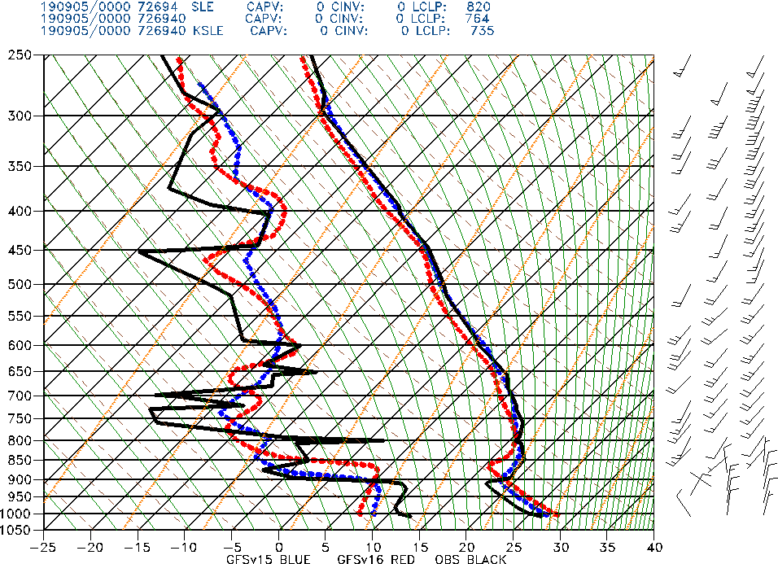
NATIONAL OCEANIC AND ATMOSPHERIC ADMINISTRATION
Sounding Image Format
OBS
GFSV15
GFSv16
OBS
v15
v16

Slide 17
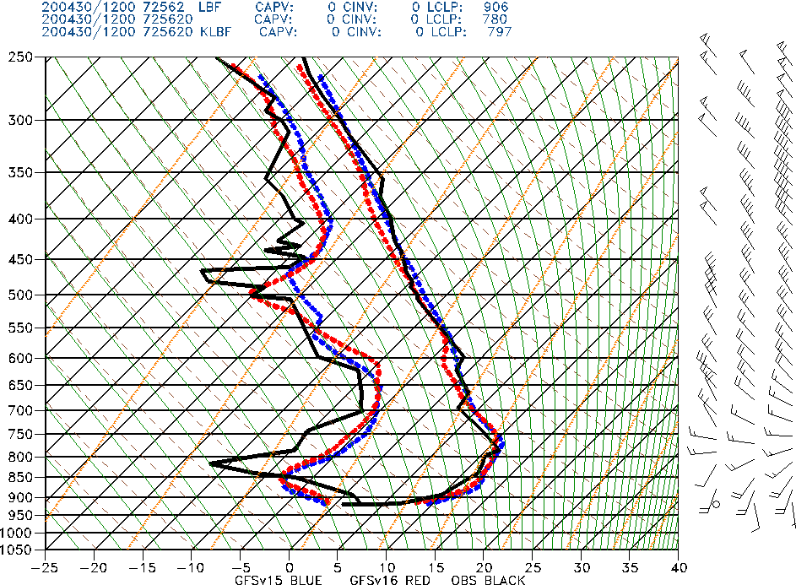
NATIONAL OCEANIC AND ATMOSPHERIC ADMINISTRATION
LBF Soundings
North Platte, NE LBF
OBS
GFSV15
GFSv16
Init: 12Z 29 April 2020
Valid: 12Z 30 April 2020 (F024)
GFSv15 and v16 both fail to capture the strength of the low-level inversion and end up way too warm at the lowest levels
GFSv16 is slightly better than v15
Note how the observed winds are calm at the lowest level; both GFS versions have non-zero winds at the lowest level, although v16 is better than v15

Slide 18
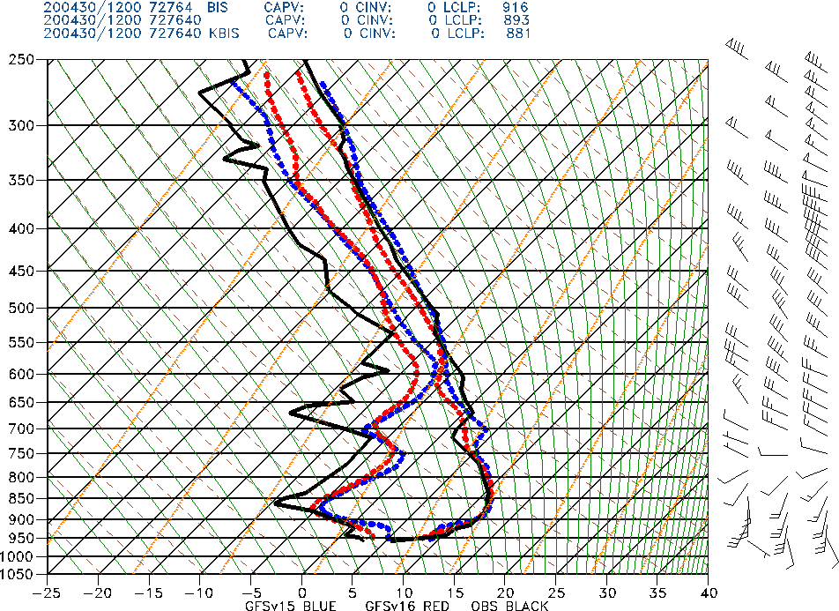
NATIONAL OCEANIC AND ATMOSPHERIC ADMINISTRATION
BIS Soundings
Bismarck, ND BIS
OBS
GFSV15
GFSv16
Init: 12Z 29 April 2020
Valid: 12Z 30 April 2020 (F024)
GFSv15 and v16 both fail to capture the strength of the low-level inversion and end up way too warm at the lowest levels
GFSv16 again shows very modest improvement over v15
Note how the observed winds are weak at the lowest level; both GFS versions have winds that are too strong

Slide 19
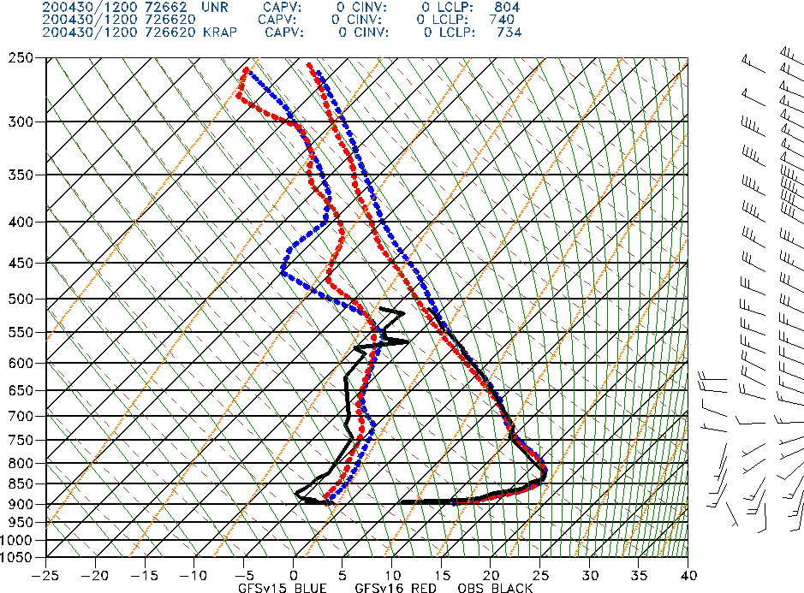
NATIONAL OCEANIC AND ATMOSPHERIC ADMINISTRATION
UNR Soundings
Rapid City, SD UNR
OBS
GFSV15
GFSv16
Init: 12Z 29 April 2020
Valid: 12Z 30 April 2020 (F024)
GFSv15 and v16 both fail to capture the strength of the low-level inversion and end up way too warm at the lowest levels
GFSv16 has effectively the same low level profile as v15
Both GFS versions have winds at the lowest level that are stronger than observed

Slide 20
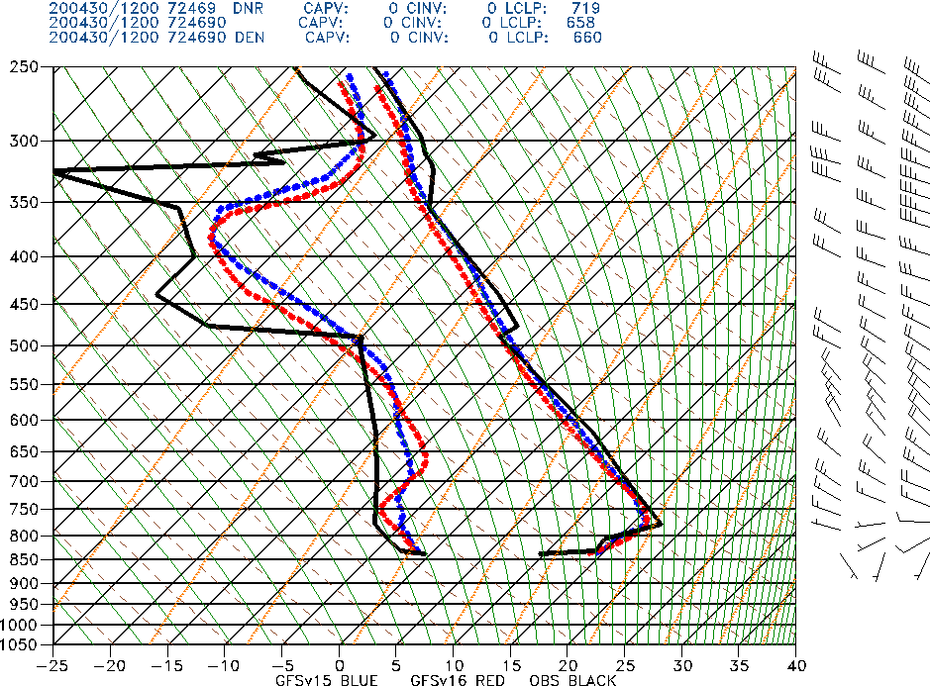
NATIONAL OCEANIC AND ATMOSPHERIC ADMINISTRATION
DNR Soundings
Denver, CO DNR
OBS
GFSV15
GFSv16
Init: 12Z 29 April 2020
Valid: 12Z 30 April 2020 (F024)
GFSv15 and v16 both fail to capture the strength of the low-level inversion and end up way too warm at the lowest levels
GFSv16 has effectively the same low level profile as v15

Slide 21
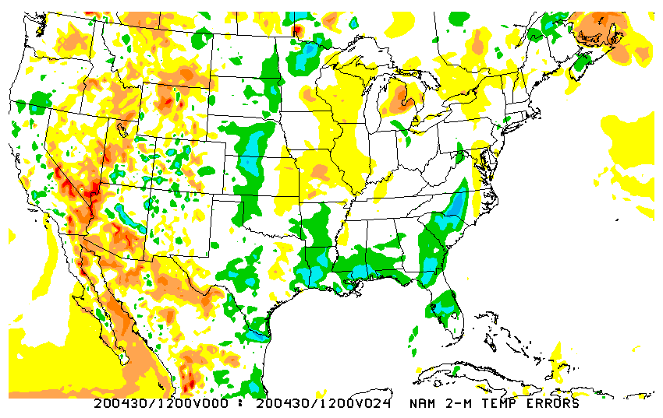
NATIONAL OCEANIC AND ATMOSPHERIC ADMINISTRATION
NAM Comparisons
2m Temp Errors Analysis - Forecast
Init: 12Z 29 April 2020
Valid: 12Z 30 April 2020 (F024)
The focus of this presentation obviously isn’t a NAM assessment, but examining the NAM reveals that this type of event *can* be forecasted better
The NAM forecast isn’t anything close to perfect, and there are other issues with it, but it is clearly capturing the colder early morning temperatures associated with the radiation inversion much better
NAM
GFSv16

Slide 22
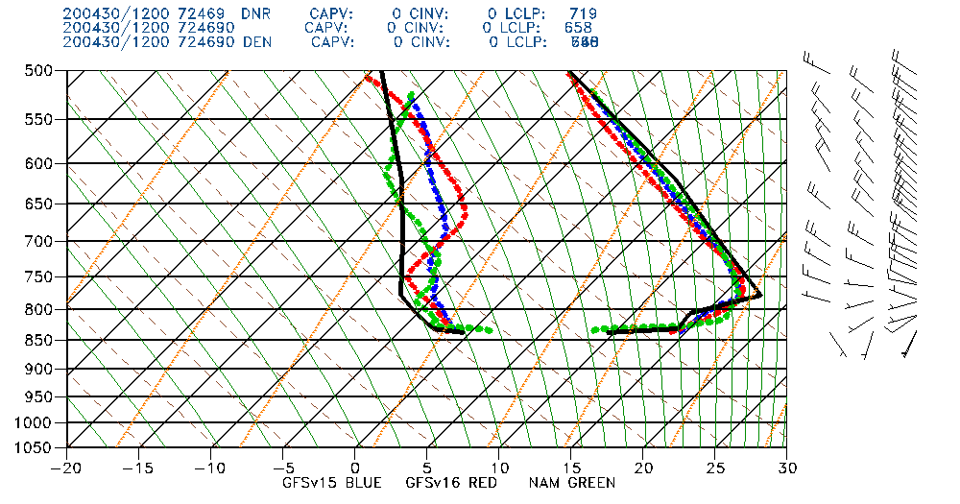
NATIONAL OCEANIC AND ATMOSPHERIC ADMINISTRATION
DNR Soundings
Denver, CO DNR
OBS
GFSV15
GFSv16
NAM
Init: 12Z 29 April 2020
Valid: 12Z 30 April 2020 (F024)
NAM (green) clearly captures the low-level inversion better than either version of the GFS (and is actually a bit too strong with it)

Slide 23
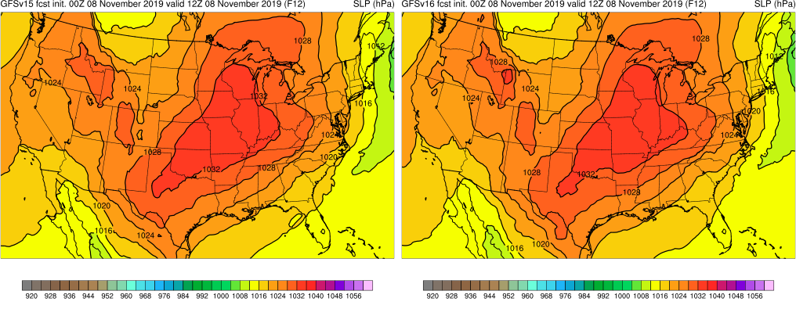
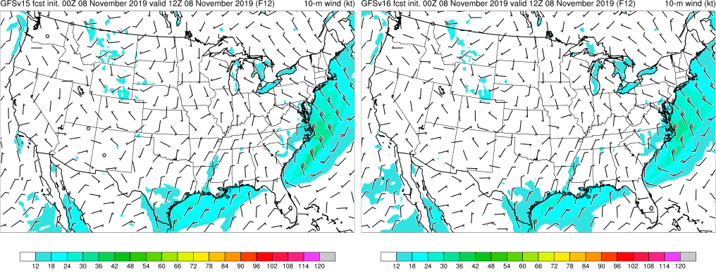
NATIONAL OCEANIC AND ATMOSPHERIC ADMINISTRATION
Another Radiational Cooling Case
Valid: 12Z 8 November 2020
Relaxed pressure gradient across much of Midwest, Plains, and western U.S., implying very light winds and likely overnight decoupling
10m wind field (shown) and cloud fields (not shown) indicate ideal conditions for radiation inversions and strong cooling over much of the U.S.

Slide 24
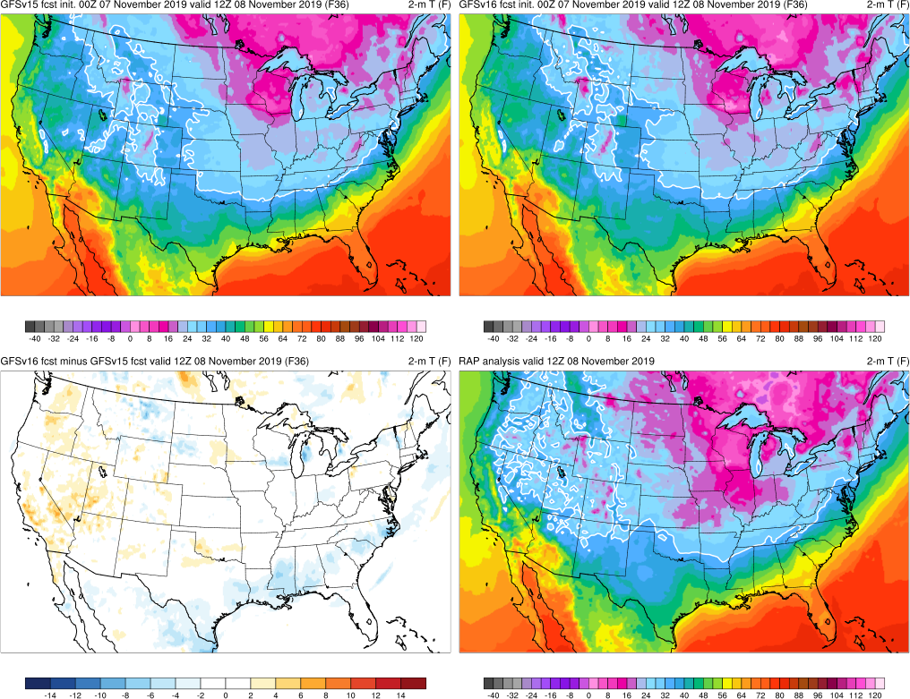
NATIONAL OCEANIC AND ATMOSPHERIC ADMINISTRATION
Another Radiational Cooling Case
Init: 00Z 7 November 2019
Valid: 12Z 8 November 2019 (F036)
Visually comparing analysis (lower right) to the forecasts, both GFSv15 and v16 are clearly too warm over much of the Midwest, Northern Plains, and the Intermountain West
V16 is warmer than v15 in a fairly sizable area of the West

Slide 25
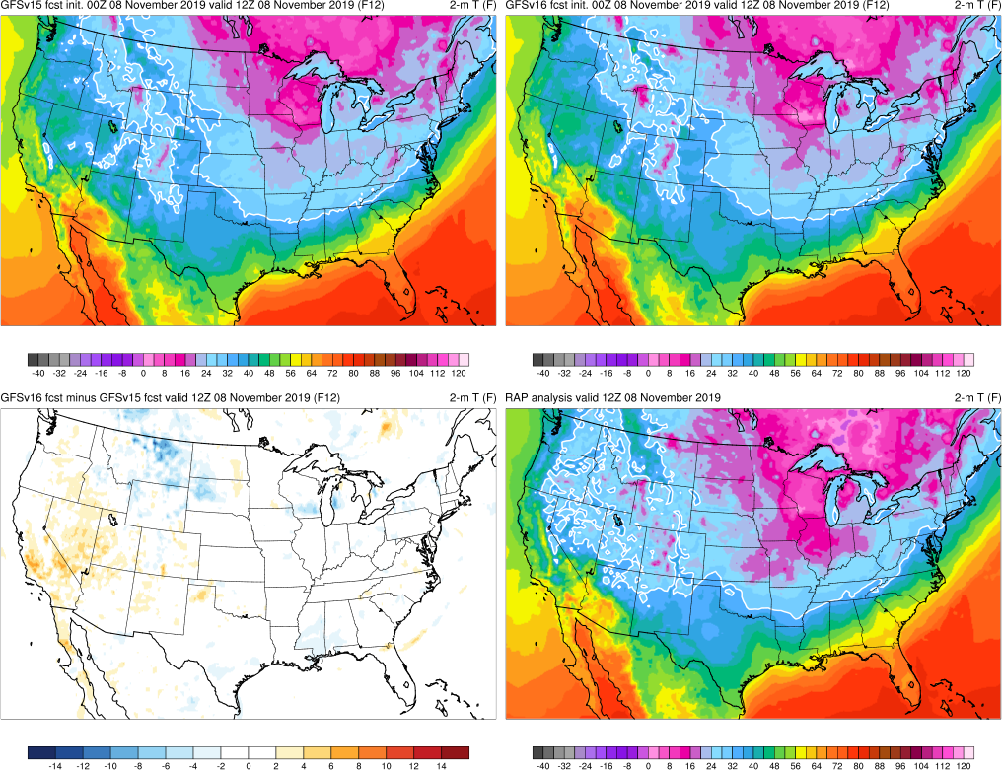
NATIONAL OCEANIC AND ATMOSPHERIC ADMINISTRATION
Another Radiational Cooling Case
Init: 00Z 8 November 2019
Valid: 12Z 8 November 2019 (F012)
Visually comparing analysis (lower right) to the forecasts, both GFSv15 and v16 are clearly too warm over much of the Midwest, Northern Plains, and the Intermountain West
Both models have correctly trended colder over the Upper Midwest since the f36 forecast
V16 still warmer than v15 over parts of the West

Slide 26
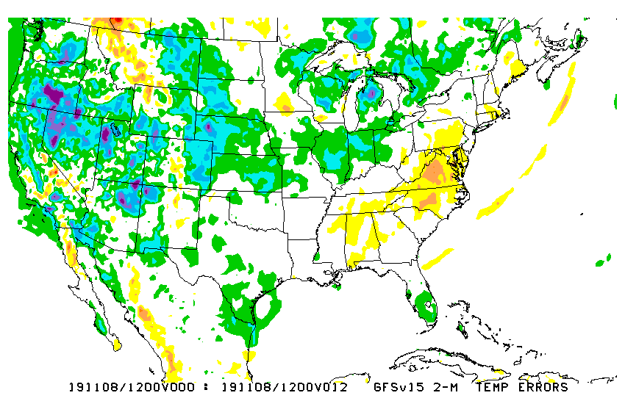
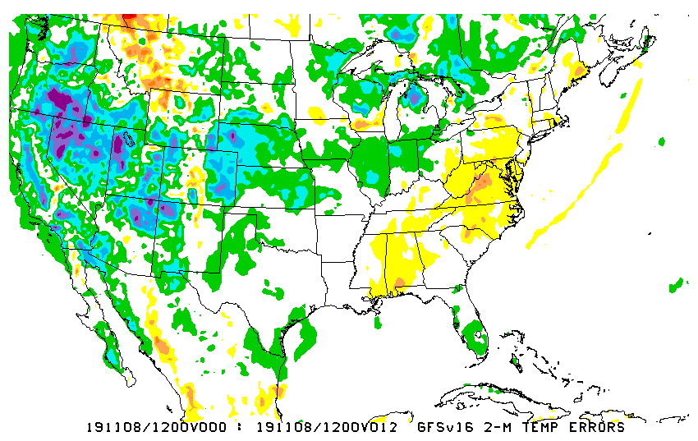
NATIONAL OCEANIC AND ATMOSPHERIC ADMINISTRATION
Temperature Errors
2m Temp Errors Analysis - Forecast
Init: 00Z 8 November 2020
Valid: 12Z 8 November 2020 (F012)
The errors are quite significant for a 12h forecast
GFSv16 appears to have larger (too warm) errors over parts of the west (OR/ID/UT/NV/AZ/CA), but it looks better in MT/ND/SD
Forecast soundings reveal that both versions of the GFS are struggling with low-level inversions
GFSv15
GFSv16

Slide 27
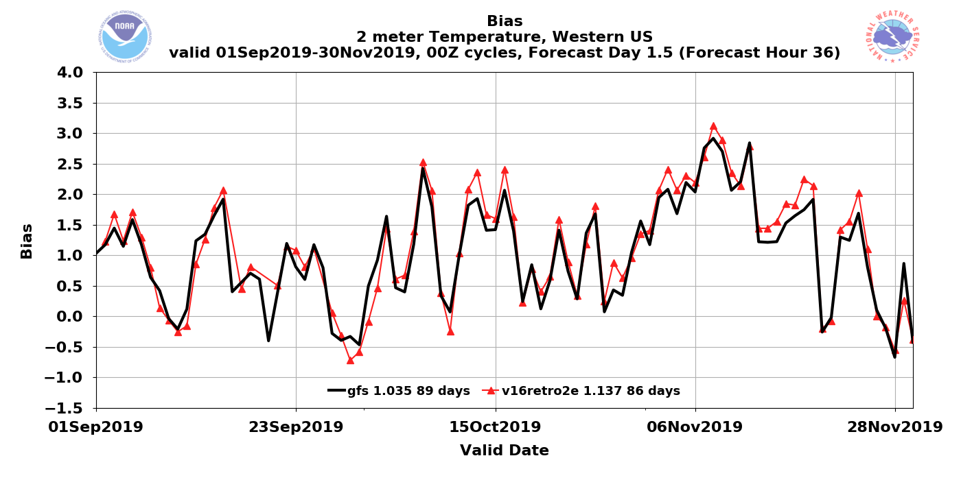
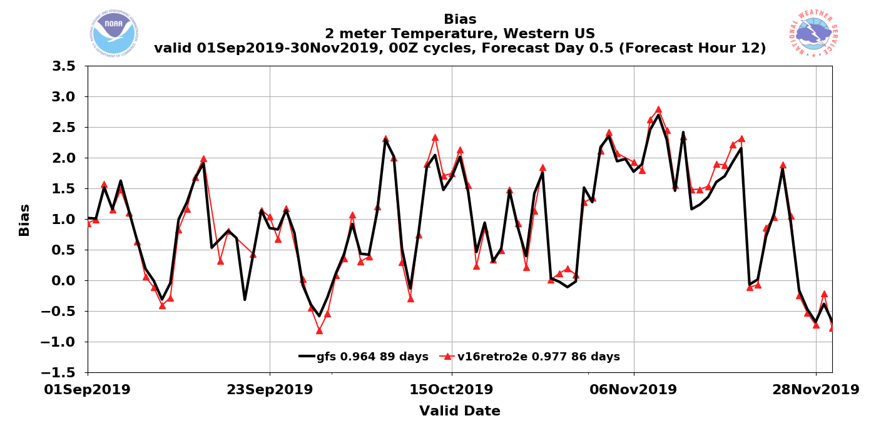
NATIONAL OCEANIC AND ATMOSPHERIC ADMINISTRATION
This Case is Clear in the Daily Stats
2m Temperature Bias Stats for the Western U.S.
F36
F12
The largest 2m temp warm bias during the fall 2019 retro period, for both GFS versions, occurred around this date

Slide 28
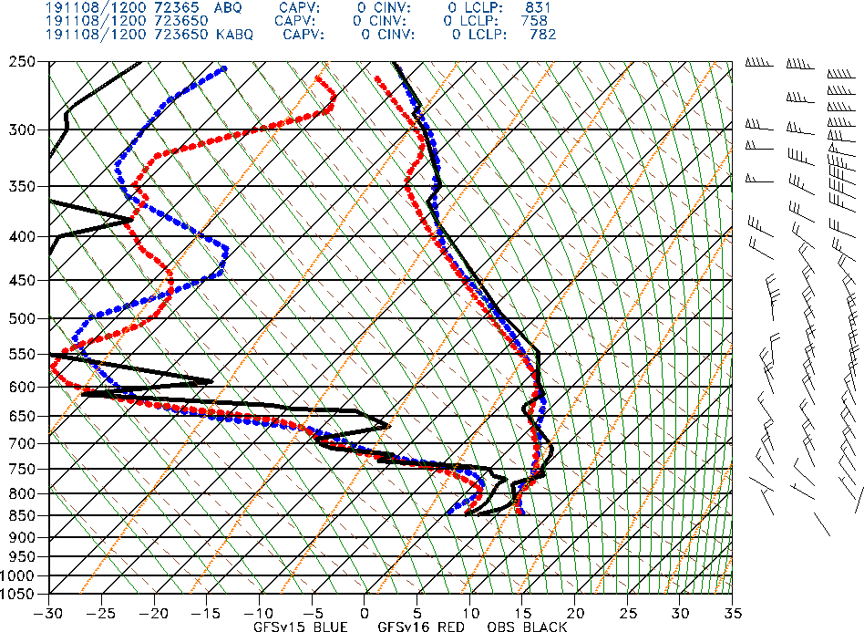
NATIONAL OCEANIC AND ATMOSPHERIC ADMINISTRATION
ABQ Soundings
Albuquerque, NM ABQ
OBS
GFSV15
GFSv16
Init: 00Z 8 November 2019
Valid: 12Z 8 November 2019 (F012)
GFSv15 and v16 both fail to capture the strength of the low-level inversion and end up way too warm at the lowest levels
GFSv16 has effectively the same low level temperature profile as v15

Slide 29
NATIONAL OCEANIC AND ATMOSPHERIC ADMINISTRATION
BOI Soundings
Boise, ID BOI
OBS
GFSV15
GFSv16
Init: 00Z 8 November 2019
Valid: 12Z 8 November 2019 (F012)
GFSv15 and v16 both fail to capture the strength of the low-level inversion and end up way too warm at the lowest levels
GFSv16 appears slightly (correctly) cooler than v15 in the low levels

Slide 30
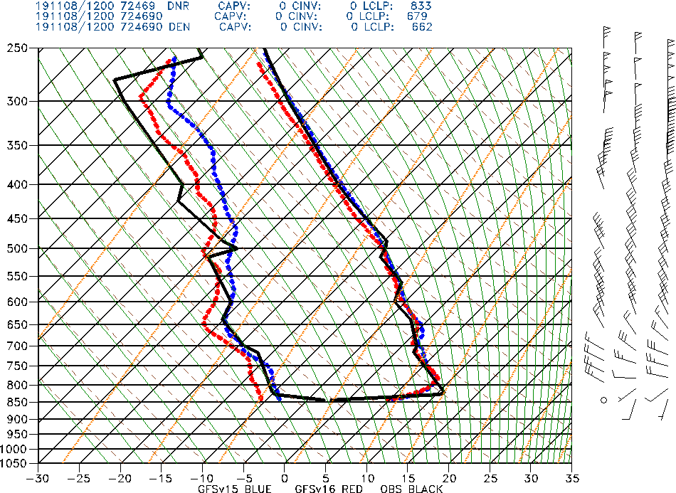
NATIONAL OCEANIC AND ATMOSPHERIC ADMINISTRATION
GFSv16 Temperatures
Denver, CO DNR
OBS
GFSV15
GFSv16
Init: 00Z 8 November 2019
Valid: 12Z 8 November 2019 (F012)
GFSv15 and v16 both fail to capture the strength of the low-level inversion and end up way too warm at the lowest levels
GFSv15 and v16 have effectively the same low level temperature profile
GFSv16 correctly shows weaker winds at the lowest level than v15

Slide 31
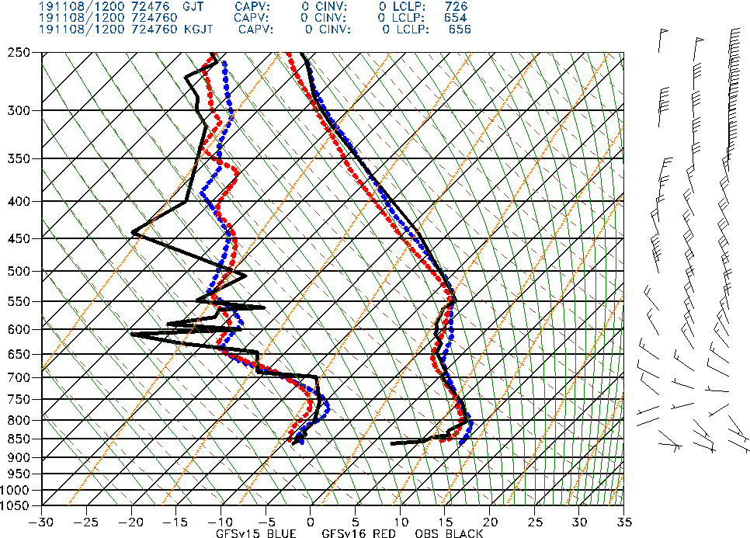
NATIONAL OCEANIC AND ATMOSPHERIC ADMINISTRATION
GJT Soundings
Grand Junction, CO GJT
OBS
GFSV15
GFSv16
Init: 00Z 8 November 2019
Valid: 12Z 8 November 2019 (F012)
GFSv15 and v16 both fail to capture the strength of the low-level inversion and end up way too warm at the lowest levels
GFSv16 is, however, an improvement over v15 here

Slide 32
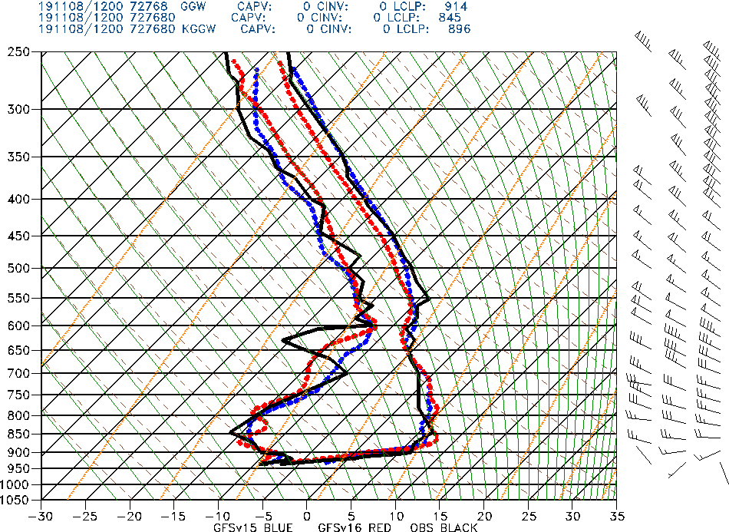
NATIONAL OCEANIC AND ATMOSPHERIC ADMINISTRATION
GGW Soundings
Glasgow, MT GGW
OBS
GFSV15
GFSv16
Init: 00Z 8 November 2019
Valid: 12Z 8 November 2019 (F012)
Here, v16 appears to be a substantial improvement over v15, consistent with the better 2m temperature errors (slide 23) over eastern MT
V16, however, is slightly too warm at the top of the inversion

Slide 33
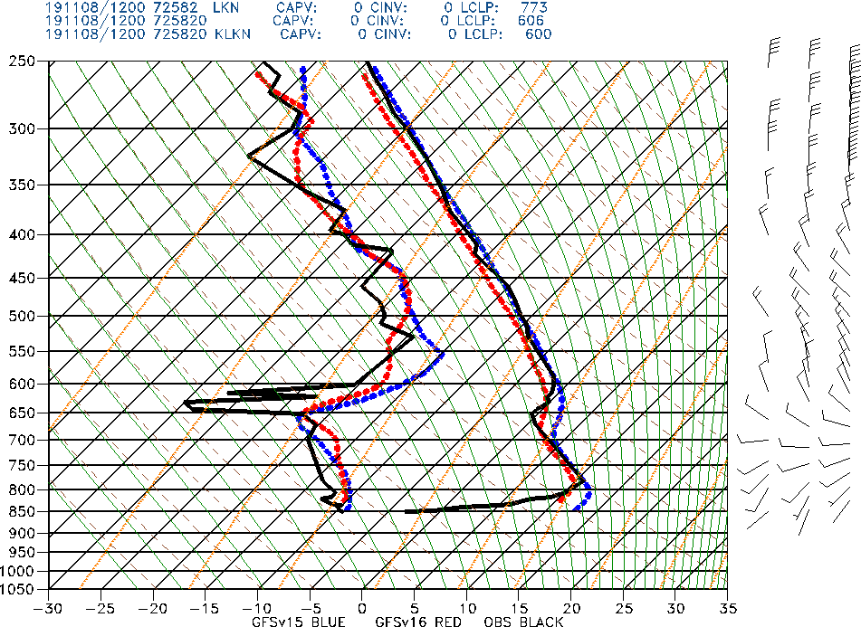
NATIONAL OCEANIC AND ATMOSPHERIC ADMINISTRATION
LKN Soundings
Elko, NV LKN
OBS
GFSV15
GFSv16
Init: 00Z 8 November 2019
Valid: 12Z 8 November 2019 (F012)
GFSv15 and v16 both fail to capture the strength of the low-level inversion and end up way too warm at the lowest levels
GFSv16 appears slightly (correctly) cooler than v15 in the low levels

Slide 34
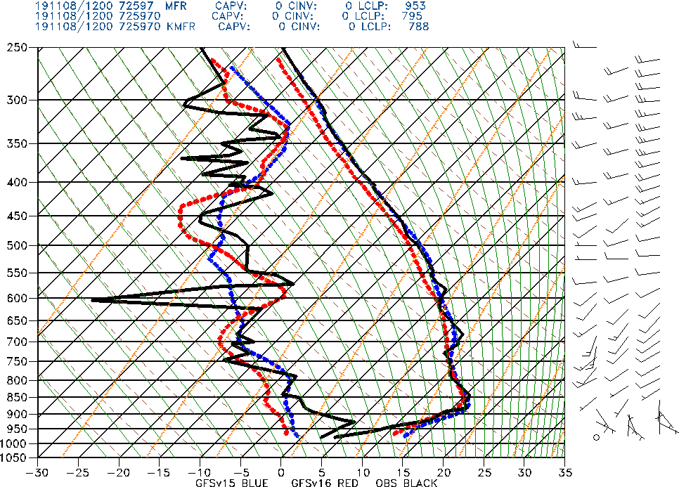
NATIONAL OCEANIC AND ATMOSPHERIC ADMINISTRATION
MFR Soundings
Medford, OR MFR
OBS
GFSV15
GFSv16
Init: 00Z 8 November 2019
Valid: 12Z 8 November 2019 (F012)
GFSv15 and v16 both fail to capture the strength of the low-level inversion and end up way too warm at the lowest levels
GFSv16 appears slightly (correctly) cooler than v15 in the low levels

Slide 35
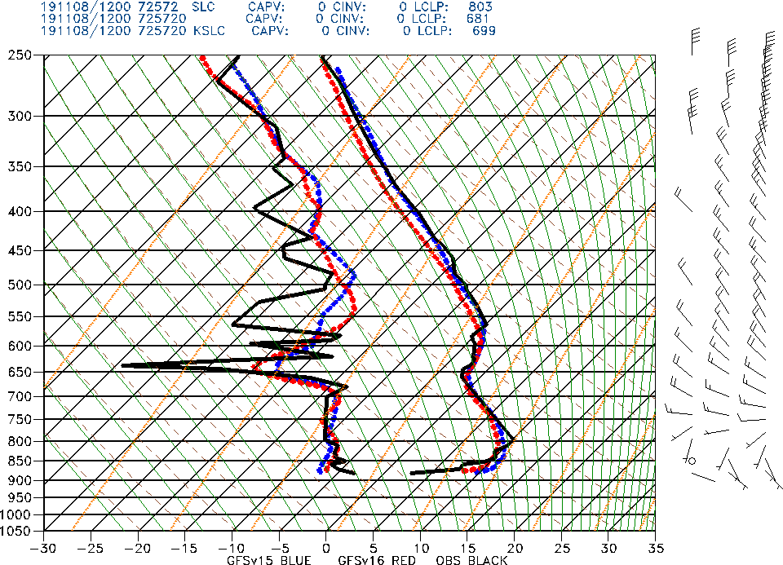
NATIONAL OCEANIC AND ATMOSPHERIC ADMINISTRATION
SLC Soundings
Salt Lake City, UT SLC
OBS
GFSV15
GFSv16
Init: 00Z 8 November 2019
Valid: 12Z 8 November 2019 (F012)
GFSv15 and v16 both fail to capture the strength of the low-level inversion and end up way too warm at the lowest levels
GFSv16 appears slightly (correctly) cooler than v15 in the low levels

Slide 36
NATIONAL OCEANIC AND ATMOSPHERIC ADMINISTRATION
Cold Air Damming
Cold air damming events have always been a major weakness of the GFS, likely connected to the systematic problems with developing/maintaining inversions
Cold air damming events have always been known as a strength of the NAM, especially the NAM Nest
There has always been some thought that vertical resolution in the boundary layer helps with modeling shallow cold air masses, so there is perhaps some hope with the extra vertical layers in GFSv16

Slide 37
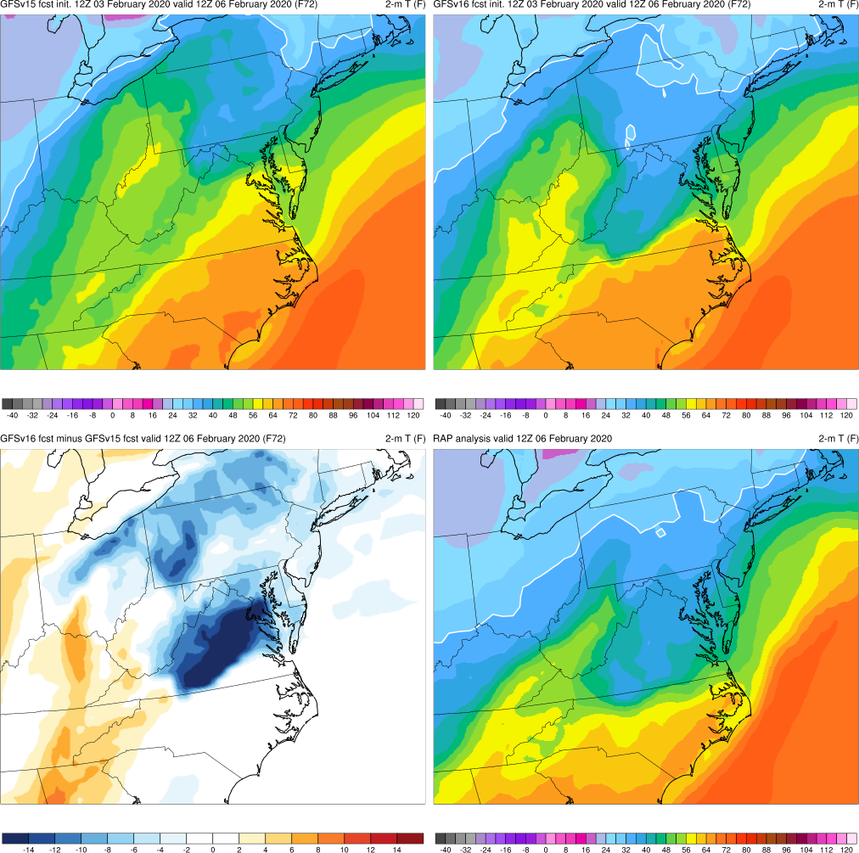
NATIONAL OCEANIC AND ATMOSPHERIC ADMINISTRATION
Cold Air Damming Example
Init: 12Z 3 February 2020
Valid: 12Z 6 February 2020 (F072)
It’s very clear than v16 is correctly colder than v15 across the VA/MD/DE area where the cold air is dammed up against the Appalachians; the difference field is incredibly impressive across VA
V16 is also clearly better with the push of warmer air on the west side of the Appalachians

Slide 38
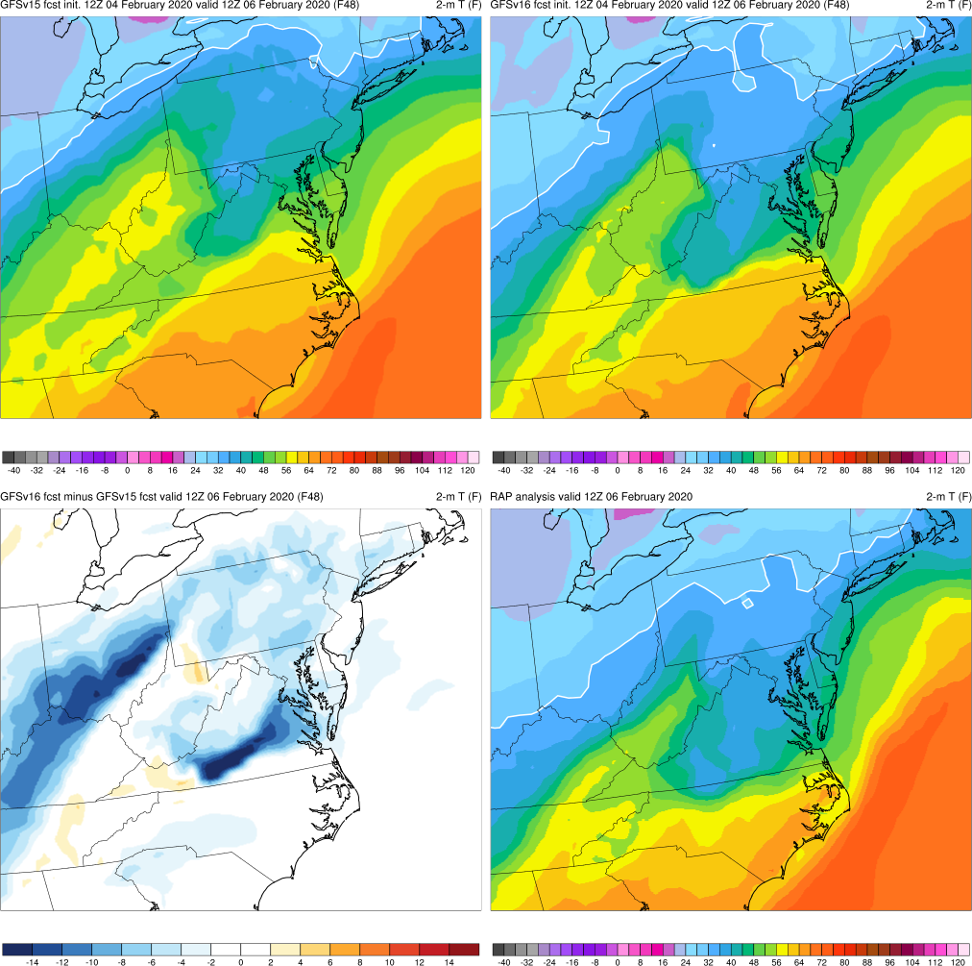
NATIONAL OCEANIC AND ATMOSPHERIC ADMINISTRATION
Cold Air Damming Example
Init: 12Z 4 February 2020
Valid: 12Z 6 February 2020 (F048)
It’s very clear than v16 is correctly colder than v15 across the VA/MD/DE area where the cold air is dammed up against the Appalachians
V15 is also clearly better with the push of warmer air on the west side of the Appalachians
V15 is much improved over its f72 forecast, but v16 is still clearly an improvement

Slide 39
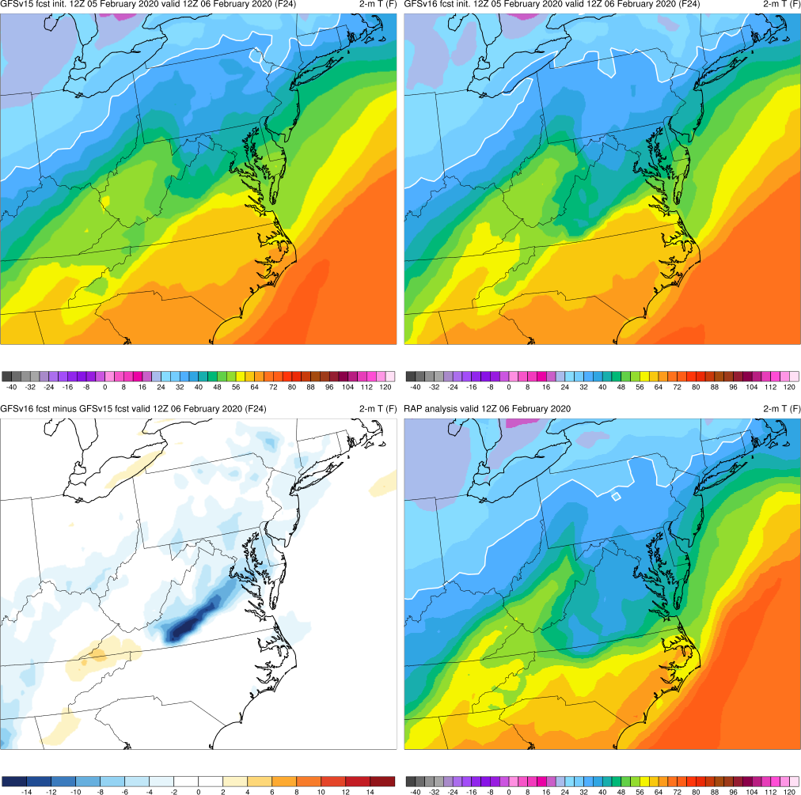
NATIONAL OCEANIC AND ATMOSPHERIC ADMINISTRATION
Cold Air Damming Example
Init: 12Z 5 February 2020
Valid: 12Z 6 February 2020 (F024)
The gap between the v15 and v16 forecasts has closed further, but v16 is still correctly colder
Both GFS versions are too warm across southern VA and and the Carolinas

Slide 40
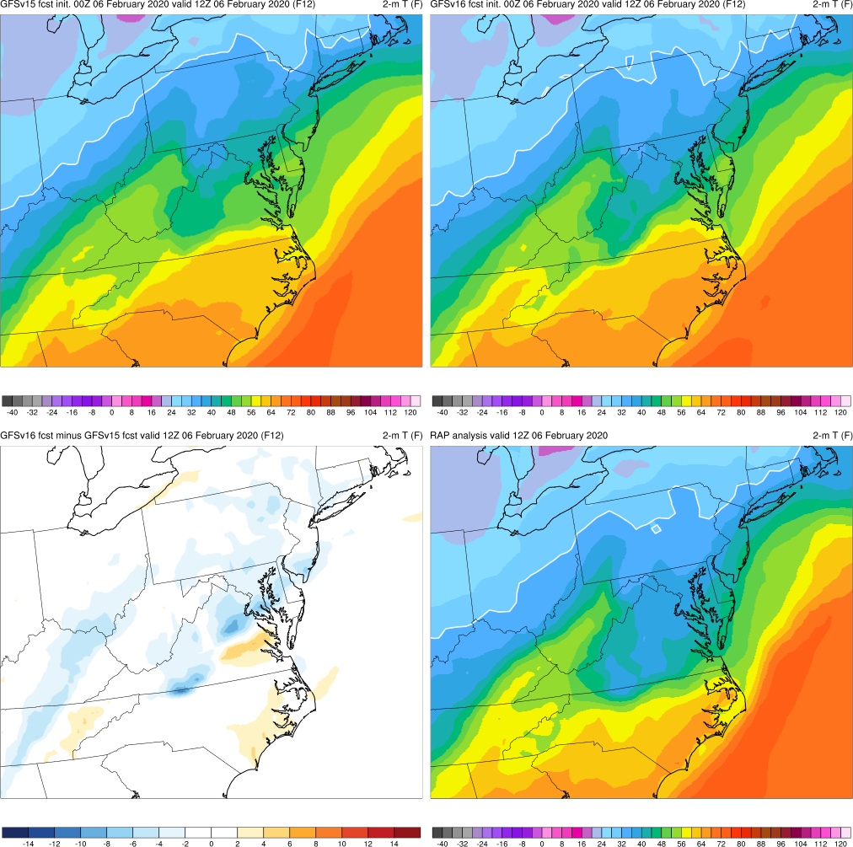
NATIONAL OCEANIC AND ATMOSPHERIC ADMINISTRATION
Cold Air Damming Example
Init: 00Z 6 February 2020
Valid: 12Z 6 February 2020 (F012)
The gap between the v15 and v16 forecasts has closed further, but v16 is still correctly colder
V16 is still not cold enough over parts of VA and the Carolinas

Slide 41
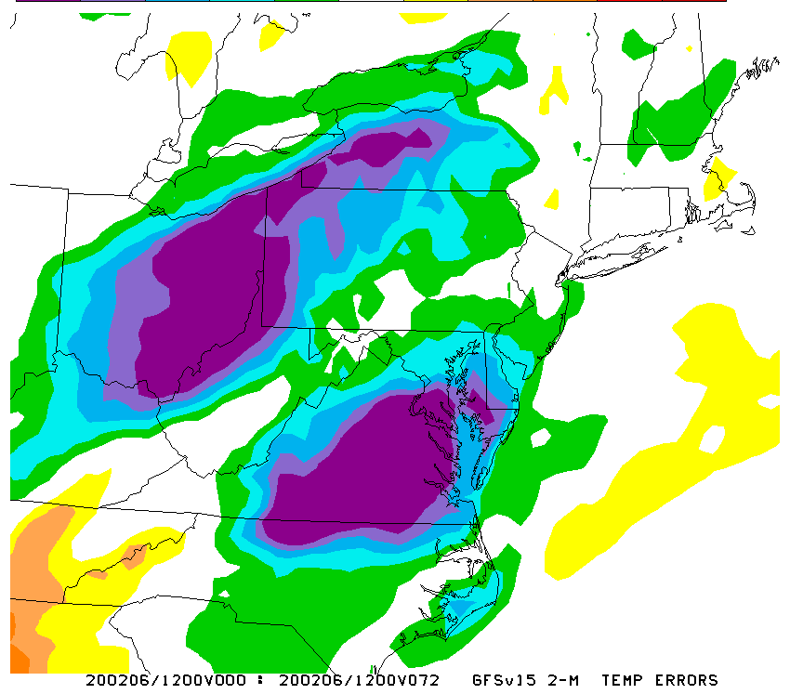
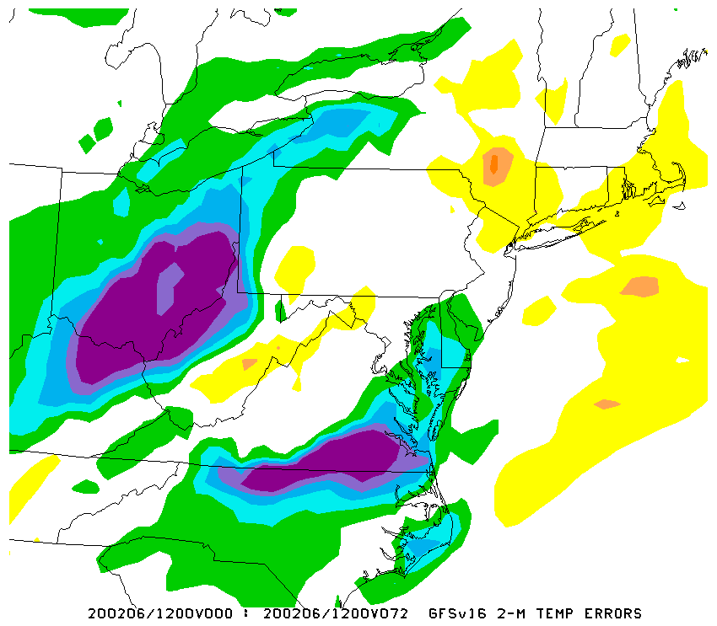
NATIONAL OCEANIC AND ATMOSPHERIC ADMINISTRATION
Errors For This Case
2m Temp Errors Analysis - Forecast
GFSv15
GFSv16
Init: 12Z 3 February 2020
Valid: 12Z 6 February 2020 (F072)
Comparing the forecast plots, it’s very clear than v16 is correctly colder than v15 across the VA/MD/DE area where the cold air is dammed up against the Appalachians
Quantifying the errors shows the improvement over VA (and MD/DE and OH and western NY/PA)

Slide 42
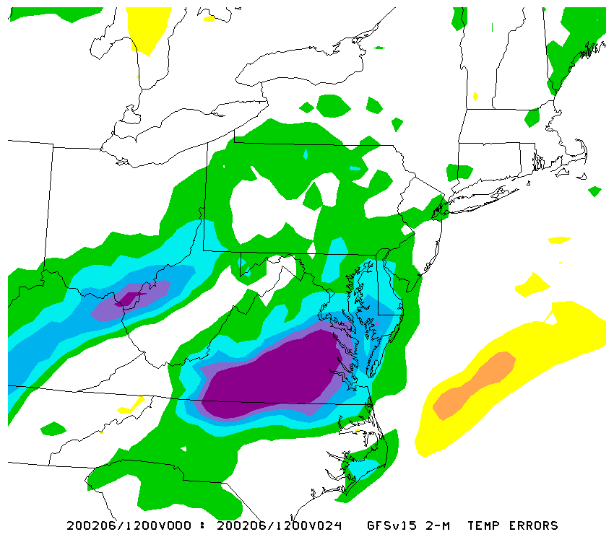
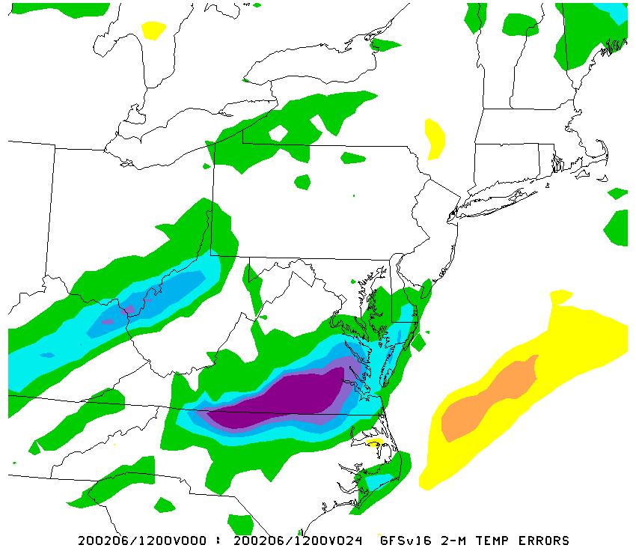
NATIONAL OCEANIC AND ATMOSPHERIC ADMINISTRATION
Errors For This Case
2m Temp Errors Analysis - Forecast
GFSv15
GFSv16
Init: 12Z 5 February 2020
Valid: 12Z 6 February 2020 (F024)
Comparing the forecast plots, it’s very clear than v16 is correctly colder than v15 across the VA/MD/DE area where the cold air is dammed up against the Appalachians
Quantifying the errors shows the improvement over VA (and to a lesser extent west of the Appalachians)

Slide 43
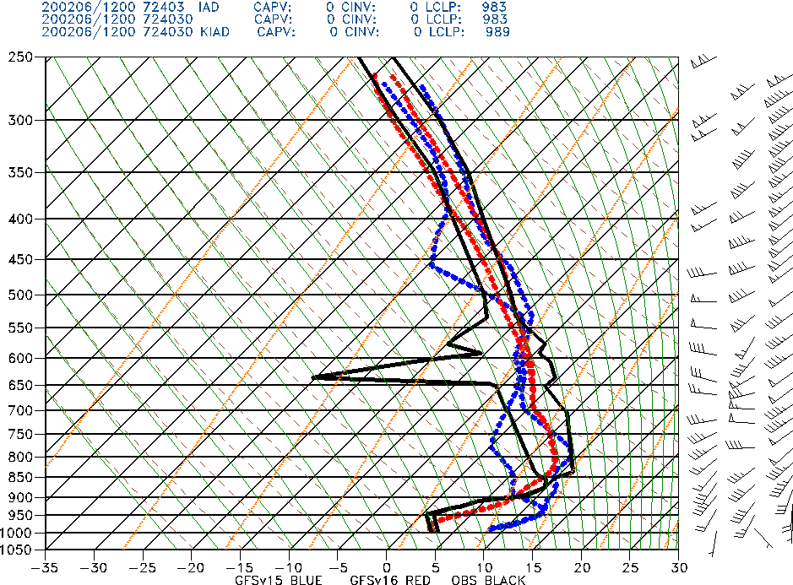
NATIONAL OCEANIC AND ATMOSPHERIC ADMINISTRATION
IAD Soundings
Dulles, VA IAD
OBS
GFSV15
GFSv16
Init: 12Z 3 February 2020
Valid: 12Z 6 February 2019 (F072)
GFSv15 fails to capture the strength of the low-level inversion, but v16 here is a massive improvement
Again, this example is not a radiation inversion; this is a sounding within a very shallow cold air mass

Slide 44
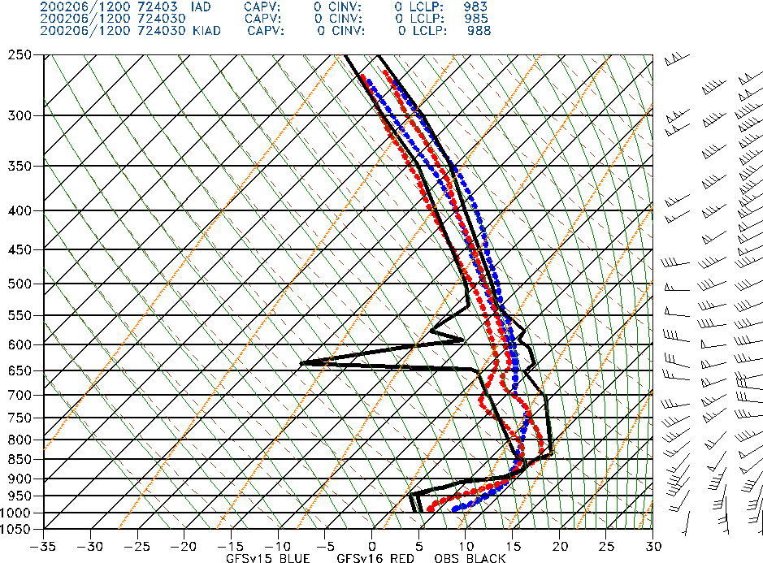
NATIONAL OCEANIC AND ATMOSPHERIC ADMINISTRATION
IAD Soundings
Dulles, VA IAD
OBS
GFSV15
GFSv16
Init: 00z 6 February 2020
Valid: 12Z 6 February 2019 (F012)
GFSv15 fails to capture the strength of the low-level inversion, but v16 here is a massive improvement (although not as good as at f72)
This is an impressive improvement for a 12h forecast

Slide 45
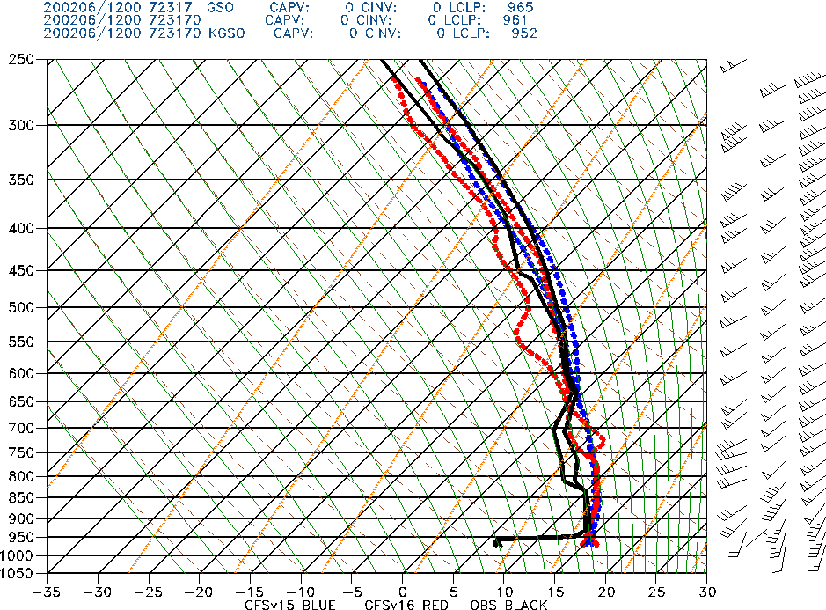
NATIONAL OCEANIC AND ATMOSPHERIC ADMINISTRATION
GSO Soundings
Greensboro, NC GSO
OBS
GFSV15
GFSv16
Init: 00Z 5 February 2020
Valid: 12Z 6 February 2019 (F012)
Near the southern edge of the damming, neither v15 nor v16 is able to capture the low-level cold air remaining in place, a bit disappointing for a 12h forecast
The observed sounding has northeast winds at the lowest level, while both GFS versions have modest southerly winds

Slide 46
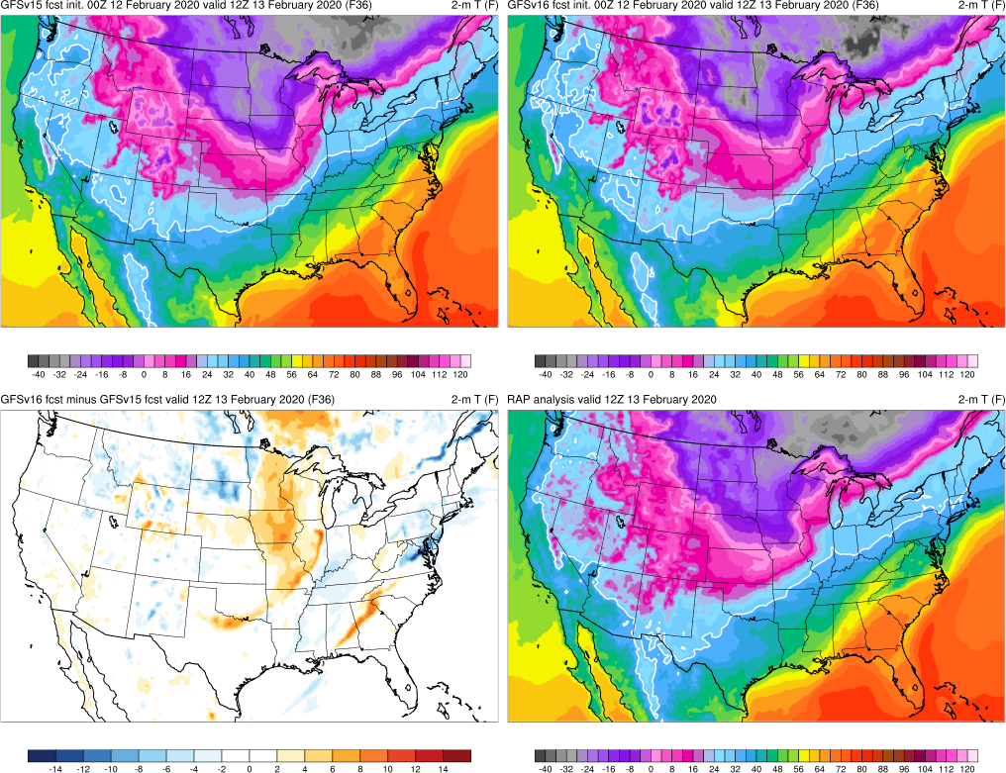
NATIONAL OCEANIC AND ATMOSPHERIC ADMINISTRATION
One More Modest Example
Init: 00Z 12 February 2020
Valid: 12Z 13 February 2020 (F036)
Not as dramatic of an event, but damming is still evident in the analysis over the Mid-Atlantic
V16 is still not cold enough over parts of VA and the Carolinas, but the difference field shows improvement relative to v15 in the DC area

Slide 47
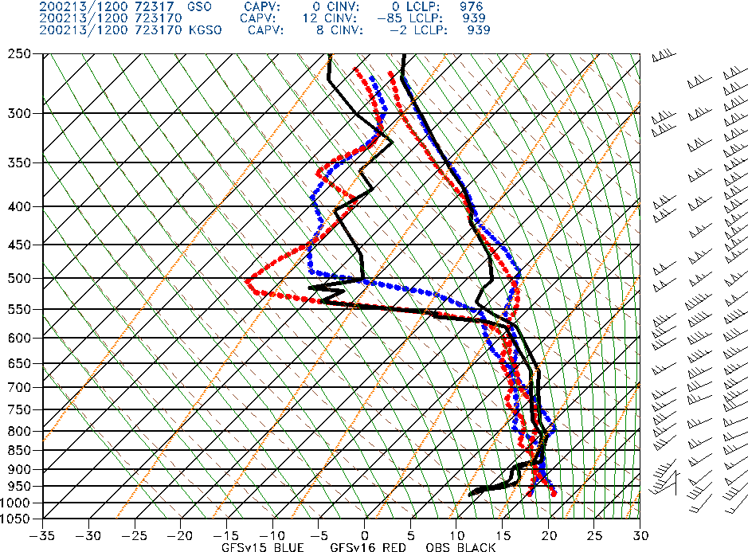
NATIONAL OCEANIC AND ATMOSPHERIC ADMINISTRATION
GSO Soundings
Greensboro, NC GSO
OBS
GFSV15
GFSv16
Init: 00Z13 February 2020
Valid: 12Z 13 February 2019 (F012)
Just like in the previous case, neither v15 nor v16 is able to capture the low-level cold air remaining in place close to the southern edge of the damming, a bit disappointing for a 12h forecast (this is
The observed sounding has northeast winds at the lowest level, while both GFS versions have strong southerly winds

Slide 48
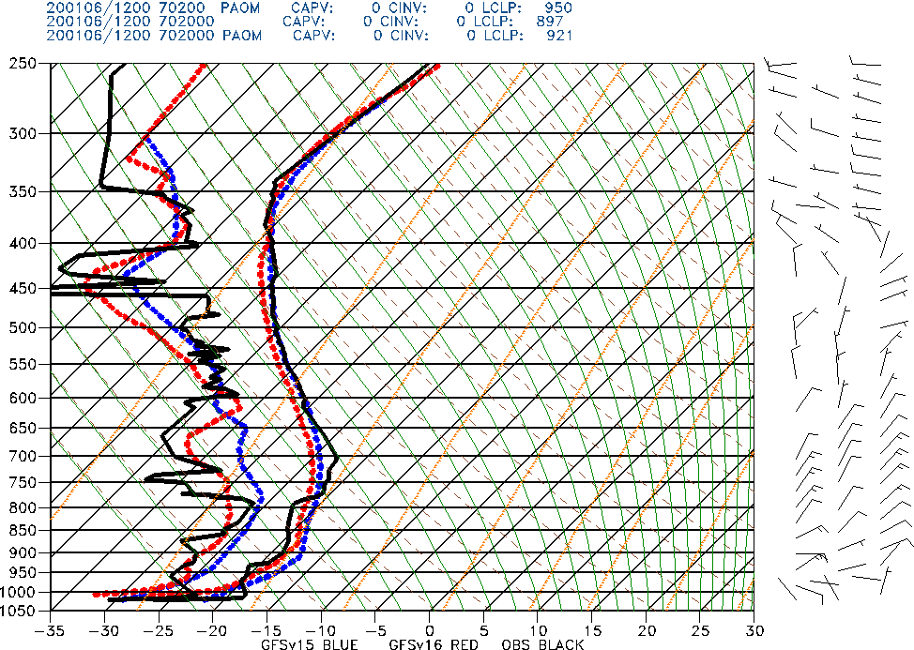
NATIONAL OCEANIC AND ATMOSPHERIC ADMINISTRATION
Shallow Arctic Air Masses over Alaska
Nome, AK PAOM
OBS
GFSV15
GFSv16
Init: 00Z 6 January 2020
Valid: 12Z 6 January 2019 (F012)
Impressive strength of low-level inversion in v16 relative to v15

Slide 49
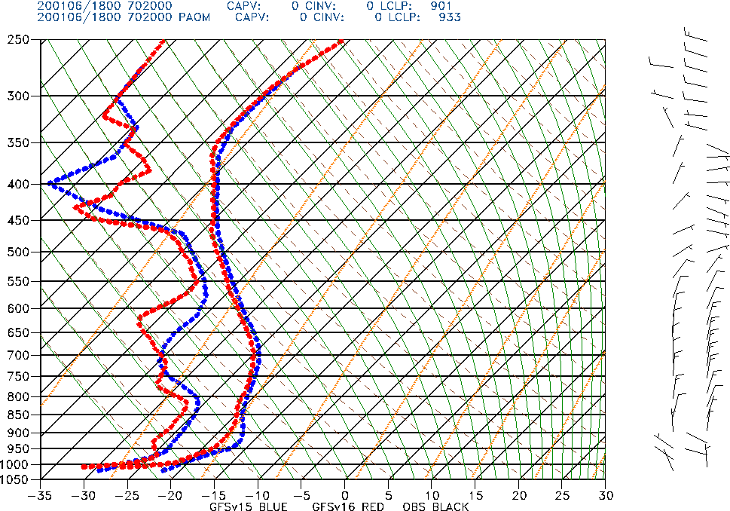
NATIONAL OCEANIC AND ATMOSPHERIC ADMINISTRATION
Shallow Arctic Air Masses over Alaska
Nome, AK PAOM
OBS
GFSV15
GFSv16
GFSV15
GFSv16
Init: 00Z 6 January 2020
Valid: 18Z 6 January 2019 (F018)
The difference in handling of the low-level frigid air mass is shown more clearly by examining a forecast hour at which observations are not available

Slide 50
NATIONAL OCEANIC AND ATMOSPHERIC ADMINISTRATION
Final Thoughts
As noted last week, warm season soundings in unstable environments tend to be too dry in the low levels and often display a boundary layer that is too deep
There appears to be some potential for systematic improvement in the handling of shallow cold air masses and related cold air damming events in GFSv16
Improving the handling of low-level temperature inversions was a primary goal of the GFSv16 upgrade; while there are signs of modest improvement, there is still a long way to go with this important aspect of model performance

