Slide 1
NATIONAL OCEANIC AND ATMOSPHERIC ADMINISTRATION
GFSv16 Severe Weather: Strengths and Concerns
GFSv15
GFSv16
v16 - v15
Logan Dawson EMC Model Evaluation Group Webinar
3 September 2020

Slide 2
NATIONAL OCEANIC AND ATMOSPHERIC ADMINISTRATION
GFSv16 Severe Weather: Strengths
Improved synoptic predictability can highlight some severe weather threats earlier than GFSv15
Handles the position of relevant frontal boundaries better
Tends to have better dryline positions

Slide 3
NATIONAL OCEANIC AND ATMOSPHERIC ADMINISTRATION
GFSv16 Severe Weather: Strengths
Improved synoptic predictability can highlight some severe weather threats earlier than GFSv15
Handles the position of relevant frontal boundaries better
Tends to have better dryline positions

Slide 4
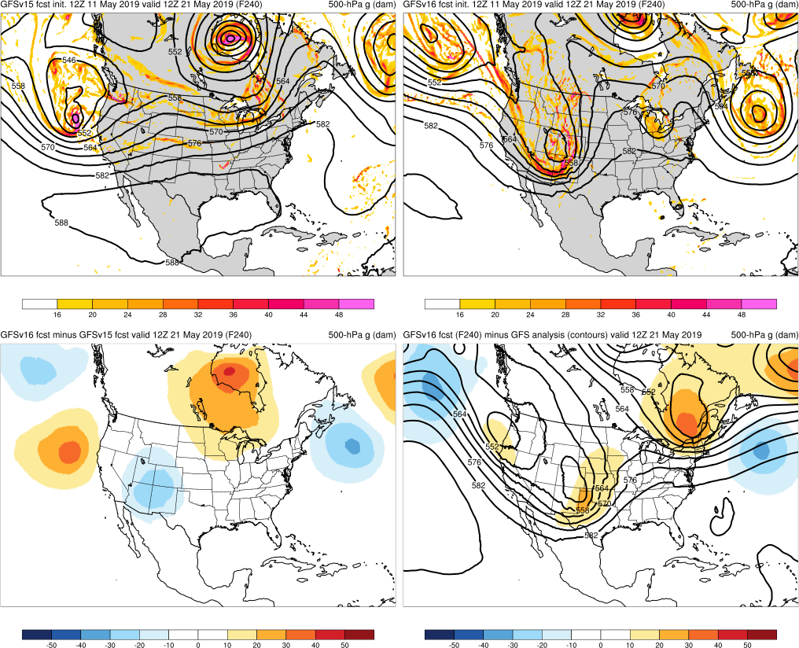
NATIONAL OCEANIC AND ATMOSPHERIC ADMINISTRATION
Improved Synoptic Predictability
May 2019 High Risk
(20–21 May 2019)
Init: 12Z 11 May 2019
Valid: 12Z 21 May 2019 (F240)
GFSv16 had an excellent 10-day forecast for the Intermountain West trough that was the feature of interest for the 20 May 2019 High Risk Day
GFSv16 predicted this pattern change before GFSv15
GFSv15
GFSv16
GFS
ANL
v16 - v15

Slide 5
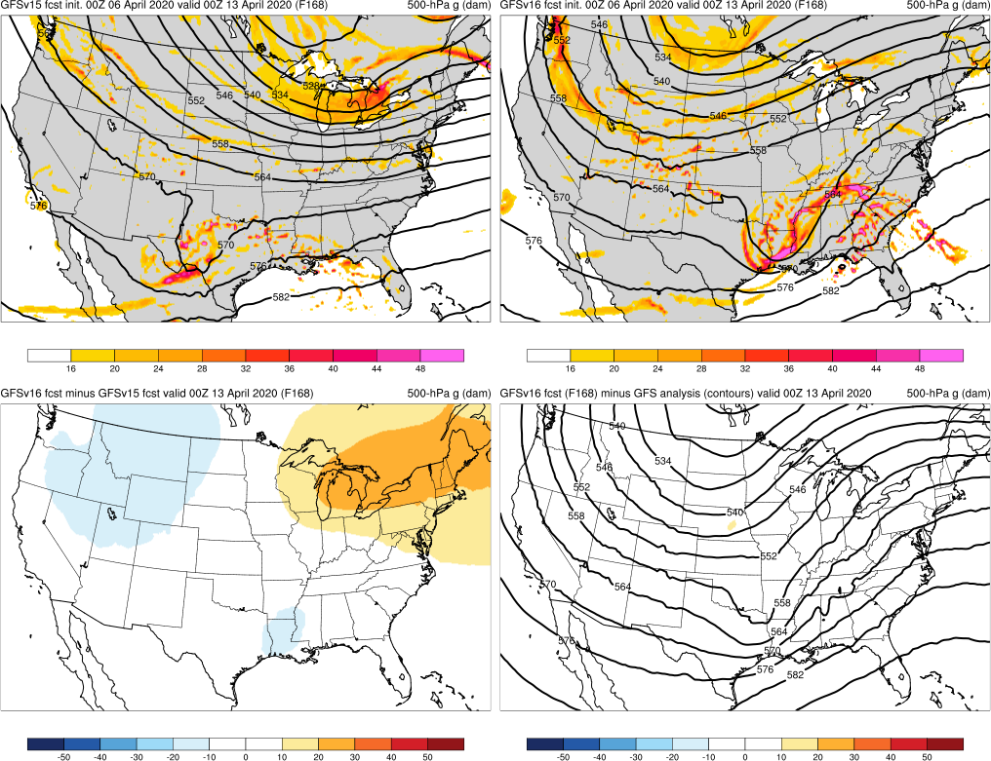
NATIONAL OCEANIC AND ATMOSPHERIC ADMINISTRATION
Improved Synoptic Predictability
Easter Sunday Outbreak
(12–13 April 2020)
GFSv15
GFSv16
Init: 00Z 6 April 2020
Valid: 00Z 13 April 2020 (F168)
GFSv16 was slightly too progressive, but still progged a potent upper trough posing a threat to the Deep South with 7 days of lead time
v16 - v15
GFS
ANL

Slide 6
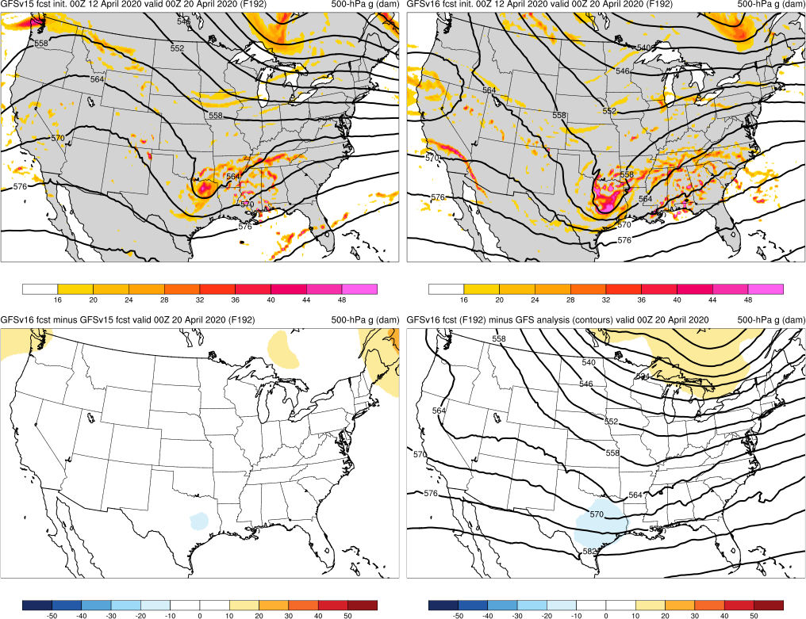
NATIONAL OCEANIC AND ATMOSPHERIC ADMINISTRATION
Improved Synoptic Predictability
Southeast Moderate Risk
(19–20 April 2020)
GFSv15
GFSv16
Init: 00Z 12 April 2020
Valid: 00Z 20 April 2020 (F192)
GFSv15 and GFSv16 correctly progged the timing and position of the shortwave trough
Both models forecasted this trough at longer lead times, but GFSv16 was too fast and
GFSv15 was too slow
v16 - v15
GFS
ANL

Slide 7
NATIONAL OCEANIC AND ATMOSPHERIC ADMINISTRATION
GFSv16 Severe Weather: Strengths
Improved synoptic predictability can highlight some severe weather threats earlier than GFSv15
Handles the position of relevant frontal boundaries better
Tends to have better dryline positions

Slide 8
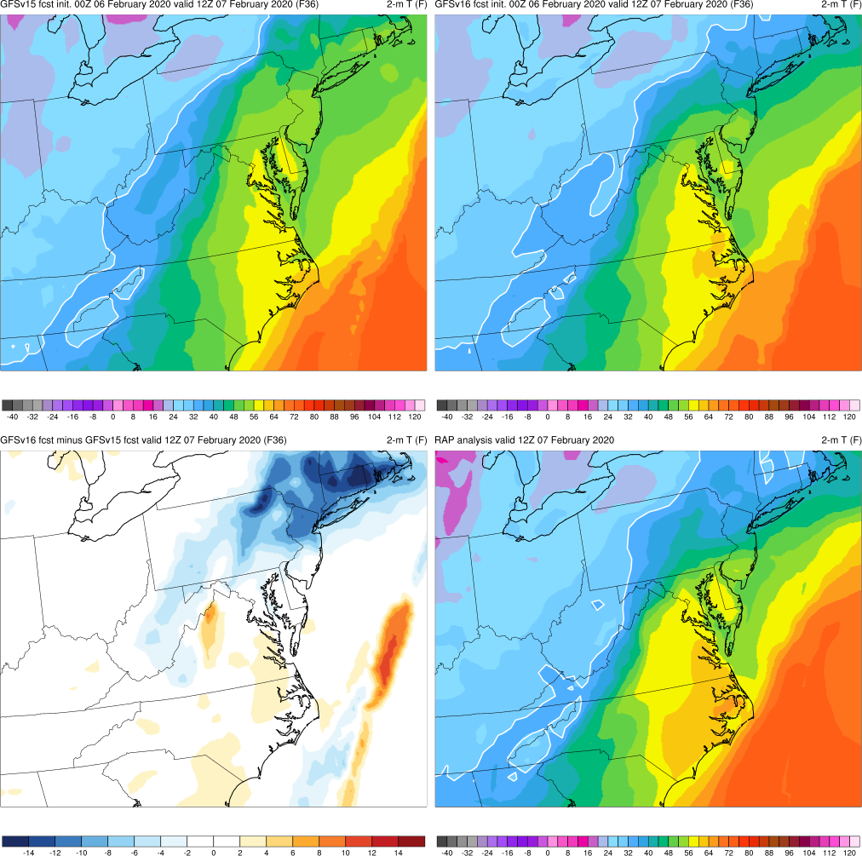
NATIONAL OCEANIC AND ATMOSPHERIC ADMINISTRATION
Improved Positioning of Frontal Boundaries
GFSv15
GFSv16
Mid-Atlantic Severe
(7 February 2020)
Init: 00Z 6 February 2020
Valid: 12Z 7 February 2020 (F036)
GFSv16 forecasts for the Mid-Atlantic Severe event consistently forecasted the warm front position better than GFSv15
Frontal position and 2-m temps were identified as important factors in the northward extent of convection
(see 2/13/20 MEG presentation)
v16 - v15
RAP
ANL

Slide 9
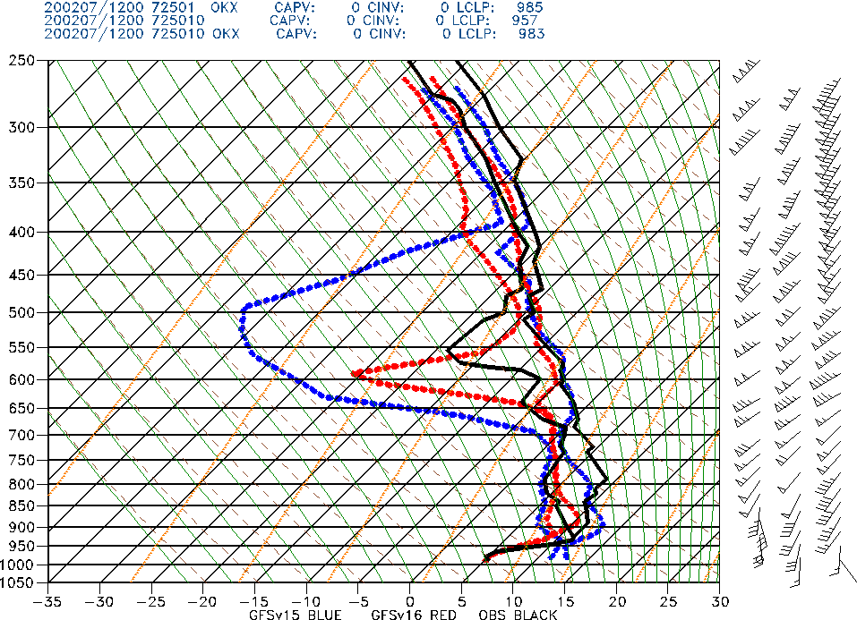
NATIONAL OCEANIC AND ATMOSPHERIC ADMINISTRATION
Improved Positioning of Frontal Boundaries
GFSv15 GFSv16 Obs
Mid-Atlantic Severe
(7 February 2020)
Brookhaven, NY
Init: 00Z 6 February 2020
Valid: 12Z 7 February 2020 (F036)
Sounding at Brookhaven, NY (OKX) shows a clear improvement in the low-level T/Td profiles from GFSv16
Warm front had advanced to the north of OKX in GFSv15

Slide 10
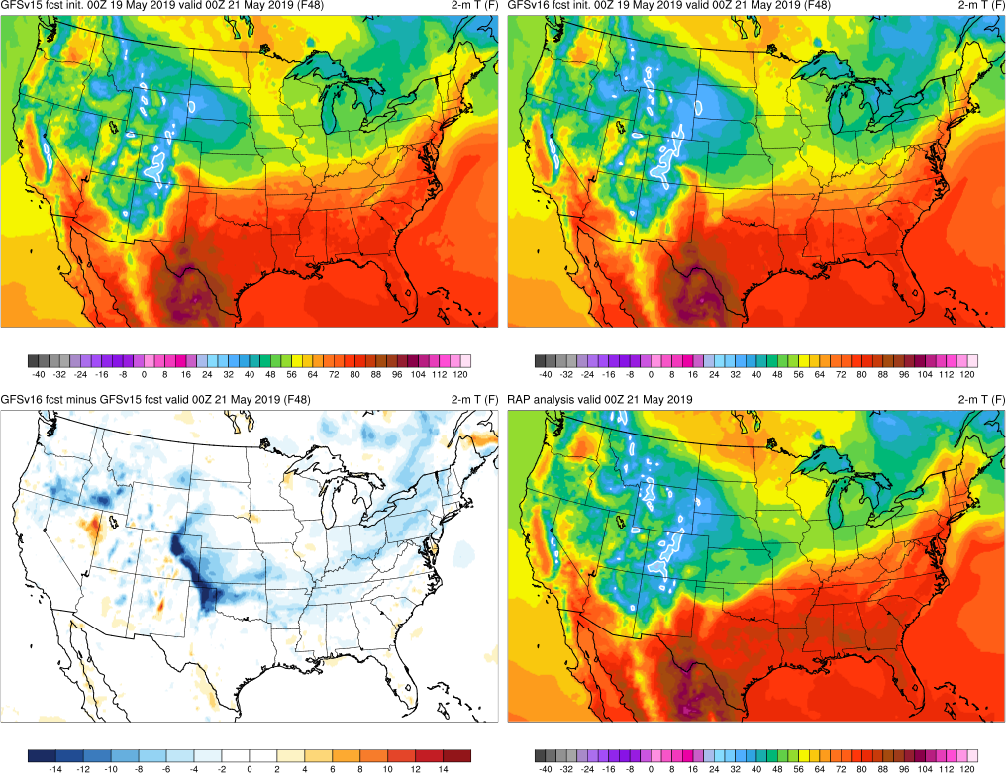
NATIONAL OCEANIC AND ATMOSPHERIC ADMINISTRATION
Improved Positioning of Frontal Boundaries
May 2019 Severe
(20–21 May 2019)
Init: 00Z 19 May 2019
Valid: 00Z 21 May 2019 (F048)
While still too far north, GFSv16 showed a better indication of the outflow boundary / cold front pushing into the TX panhandle and NW Oklahoma
GFSv15
GFSv16
RAP
ANL
v16 - v15

Slide 11
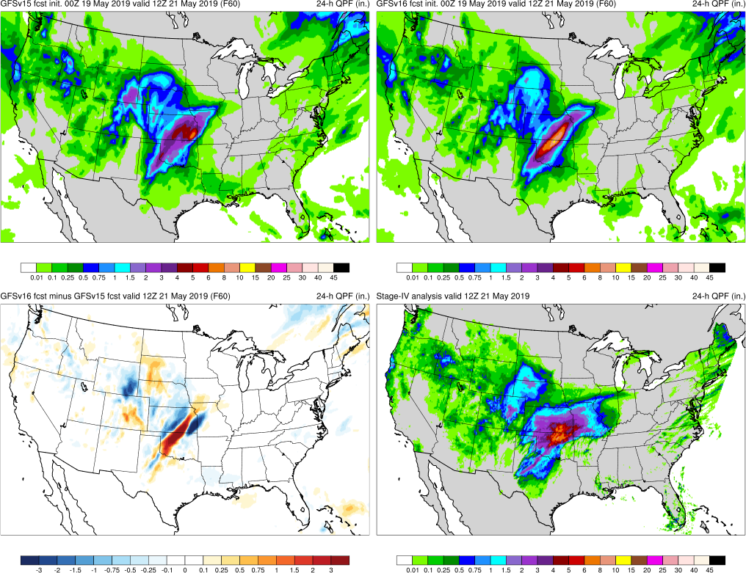
NATIONAL OCEANIC AND ATMOSPHERIC ADMINISTRATION
Improved Positioning of Frontal Boundaries
May 2019 Severe
(20–21 May 2019)
Init: 00Z 19 May 2019
Valid: 12Z 21 May 2019 (F060)
With the frontal boundary located further south at F048 in GFSv16, its 24-h precip max at F060 was also correctly located further south
GFSv15
GFSv16
Stage
IV
v16 - v15

Slide 12
NATIONAL OCEANIC AND ATMOSPHERIC ADMINISTRATION
GFSv16 Severe Weather: Strengths
Improved synoptic predictability can highlight some severe weather threats earlier than GFSv15
Handles the position of relevant frontal boundaries better
Tends to have better dryline positions

Slide 13
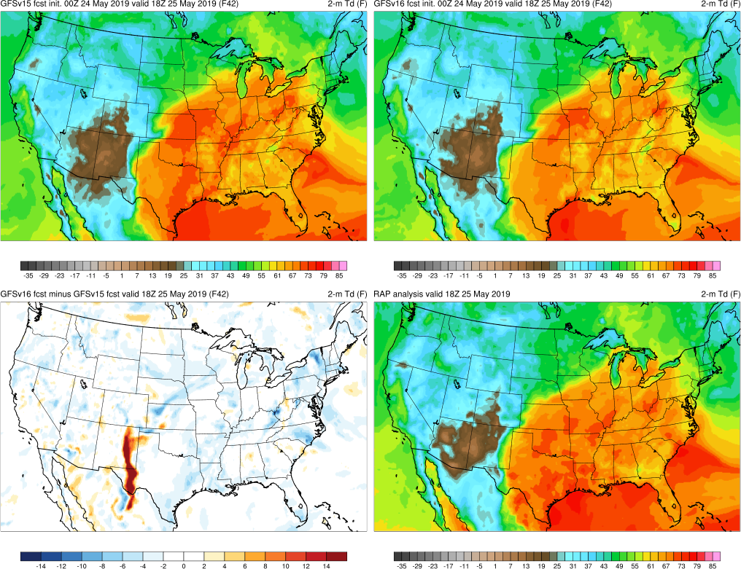
NATIONAL OCEANIC AND ATMOSPHERIC ADMINISTRATION
Some Improvement with Dryline Positioning
May 2019 Severe
(25 May 2019)
Init: 00Z 24 May 2019
Valid: 18Z 25 May 2019 (F042)
Dryline across west Texas and eastern New Mexico is clearly more correctly positioned further to the west in GFSv16
GFSv15
GFSv16
RAP
ANL
v16 - v15

Slide 14
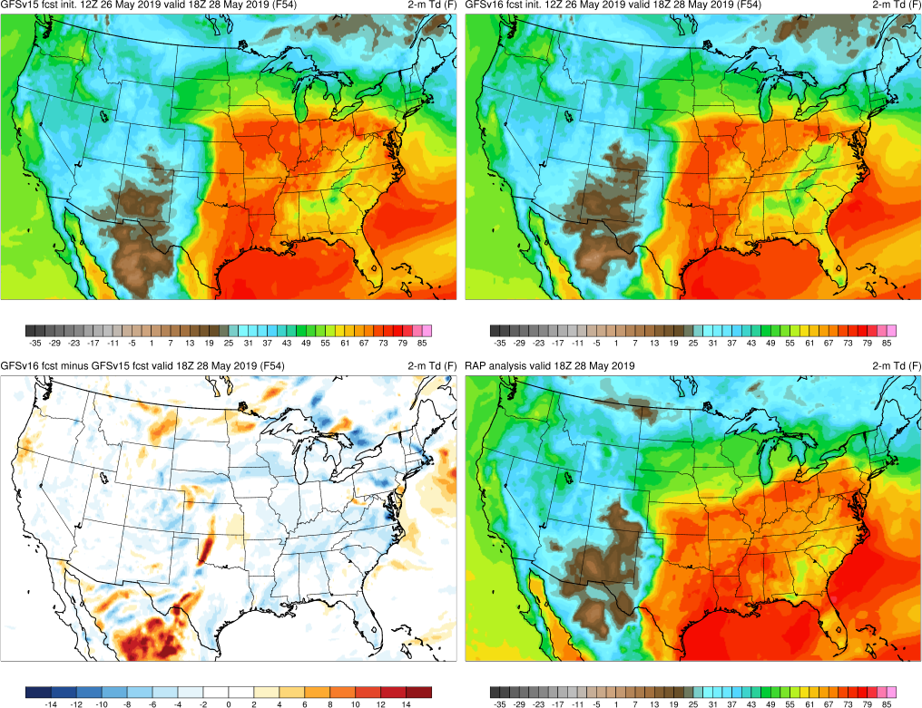
NATIONAL OCEANIC AND ATMOSPHERIC ADMINISTRATION
Some Improvement with Dryline Positioning
May 2019 Severe
(28 May 2019)
Init: 00Z 26 May 2019
Valid: 18Z 28 May 2019 (F054)
Dryline across Texas, Oklahoma, and Kansas is further west and better located in GFSv16
The most benefit is seen in the Day 2–4 time range, likely resulting from better synoptic performance
GFSv15
GFSv16
RAP
ANL
v16 - v15

Slide 15
NATIONAL OCEANIC AND ATMOSPHERIC ADMINISTRATION
GFSv16 Severe Weather: Concerns
Instability guidance is degraded relative to GFSv15
GFSv16 surface-based CAPE magnitudes are consistently lower at all valid times and at all forecast lead times
Some contributing factors:
Drier top-layer soil initial conditions tend to reduce available boundary layer moisture
Overmixing can lead to boundary layers being too warm, dry, and deep at times
Tendency for the surface to decouple too early in the East?

Slide 16
NATIONAL OCEANIC AND ATMOSPHERIC ADMINISTRATION
GFSv16 CAPE Verification
Grid-to-obs verification of surface-based CAPE at available upper air observation sites
CAPE is verified at 06Z and 18Z when special soundings are available
Due to an earlier bug in the post-processing of GFSv16 CAPE, stats will be heavily weighted toward the real-time parallel period (see 8/6/20 MEG presentation on GFSv16 stats for more details)

Slide 17
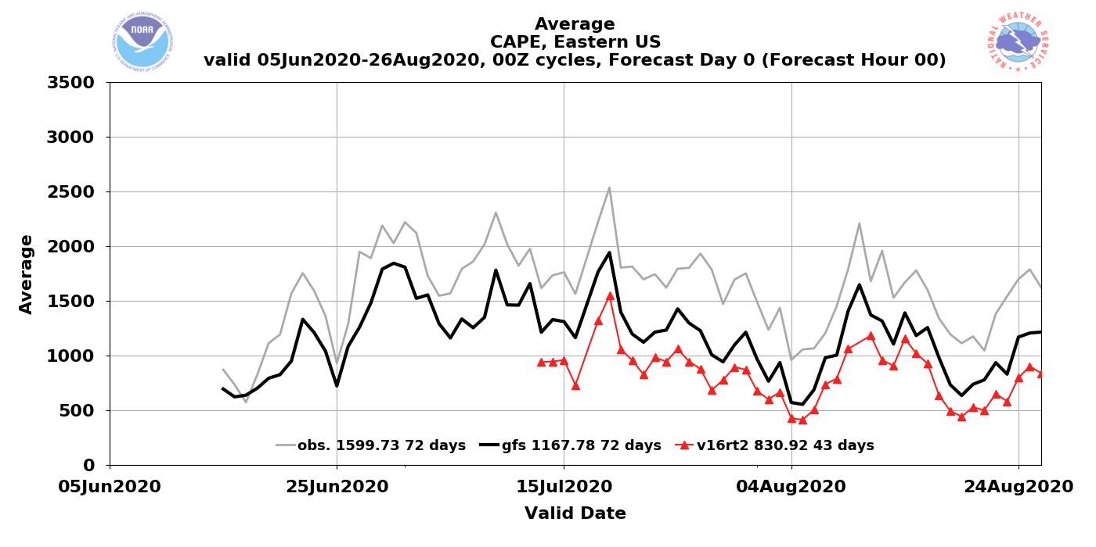
NATIONAL OCEANIC AND ATMOSPHERIC ADMINISTRATION
CAPE Magnitudes Are Reduced in GFSv16
GFSv15
GFSv16
Obs
Operational GFSv15 CAPE analyses/forecasts are consistently lower than obs
CAPE magnitudes in GFSv16 analyses/forecasts are consistently lower than those from GFSv15

Slide 18
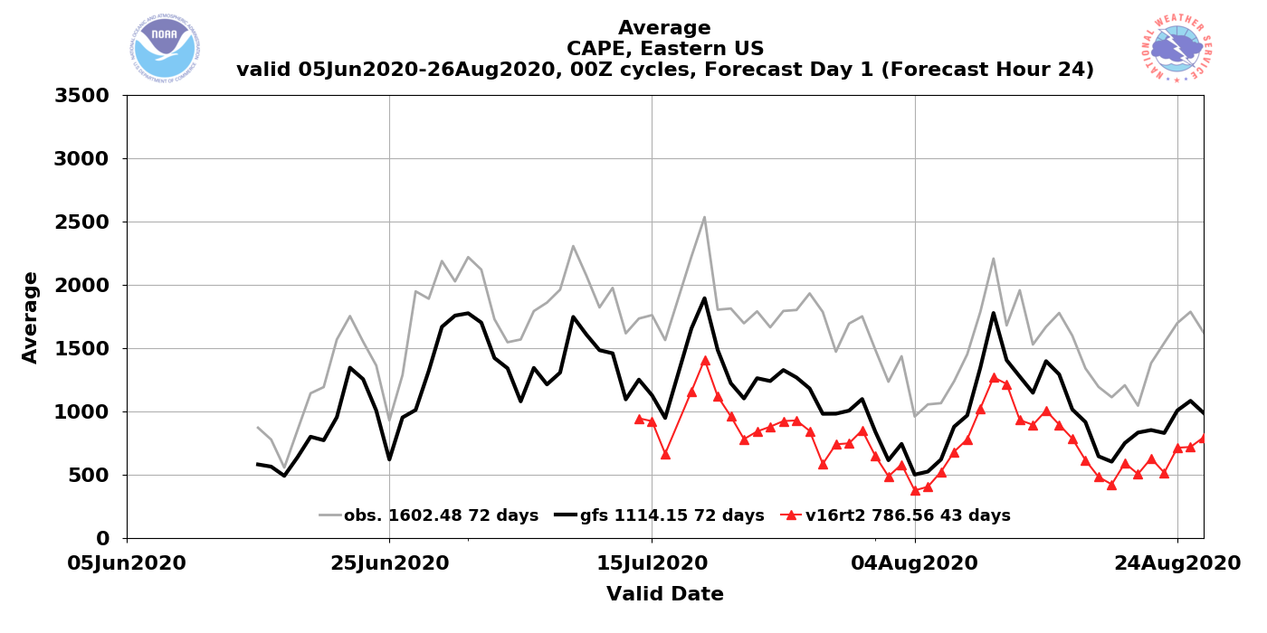
NATIONAL OCEANIC AND ATMOSPHERIC ADMINISTRATION
CAPE Magnitudes Are Reduced in GFSv16
GFSv15
GFSv16
Obs
Operational GFSv15 CAPE analyses/forecasts are consistently lower than obs
CAPE magnitudes in GFSv16 analyses/forecasts are consistently lower than those from GFSv15

Slide 19
NATIONAL OCEANIC AND ATMOSPHERIC ADMINISTRATION
CAPE Magnitudes Are Reduced in GFSv16
GFSv15
GFSv16
Obs
Lower GFSv16 CAPE magnitudes are most pronounced at 00Z valid times
Focusing on 00Z/12Z valid times since special 06Z/18Z soundings counts are limited

Slide 20
NATIONAL OCEANIC AND ATMOSPHERIC ADMINISTRATION
CAPE Magnitudes Are Reduced in GFSv16
GFSv15
GFSv16
v16 - v15
F024
F024
F024
Surface-Based CAPE Forecasts (left and middle) and Forecast Differences (right)
Init: 00Z 23 July 2020 Valid: 00Z 24 July 2020 (F024)
GFSv16 CAPE was notably lower across the Northern Plains and Upper Midwest
CAPE was also generally reduced across the eastern/southern CONUS and Mexico

Slide 21
NATIONAL OCEANIC AND ATMOSPHERIC ADMINISTRATION
CAPE Magnitudes Are Reduced in GFSv16
GFSv15
GFSv16
RAP ANL
F024
F024
F00
Surface-Based CAPE Forecasts (left and middle) and Analysis (right)
Init: 00Z 23 July 2020 Valid: 00Z 24 July 2020 (F024)
GFSv16 CAPE was notably lower across the Northern Plains and Upper Midwest
CAPE was also generally reduced across the eastern/southern CONUS and Mexico

Slide 22
NATIONAL OCEANIC AND ATMOSPHERIC ADMINISTRATION
CAPE Magnitudes Are Reduced in GFSv16
GFSv15
GFSv16
v16 - v15
F024
F024
F024
Surface-Based CAPE Forecasts (left and middle) and Forecast Differences (right)
Init: 00Z 10 August 2020 Valid: 00Z 11 August 2020 (F024)
CAPE max over Midwest is reasonably similar between GFSv15 and GFSv16
GFSv16 CAPE is also largely reduced across the southern Plains and Southeast

Slide 23
NATIONAL OCEANIC AND ATMOSPHERIC ADMINISTRATION
CAPE Magnitudes Are Reduced in GFSv16
GFSv15
GFSv16
RAP ANL
F024
F024
F00
Surface-Based CAPE Forecasts (left and middle) and Analysis (right)
Init: 00Z 10 August 2020 Valid: 00Z 11 August 2020 (F024)
CAPE max over Midwest is reasonably similar between GFSv15 and GFSv16
GFSv16 CAPE is also largely reduced across the southern Plains and Southeast

Slide 24
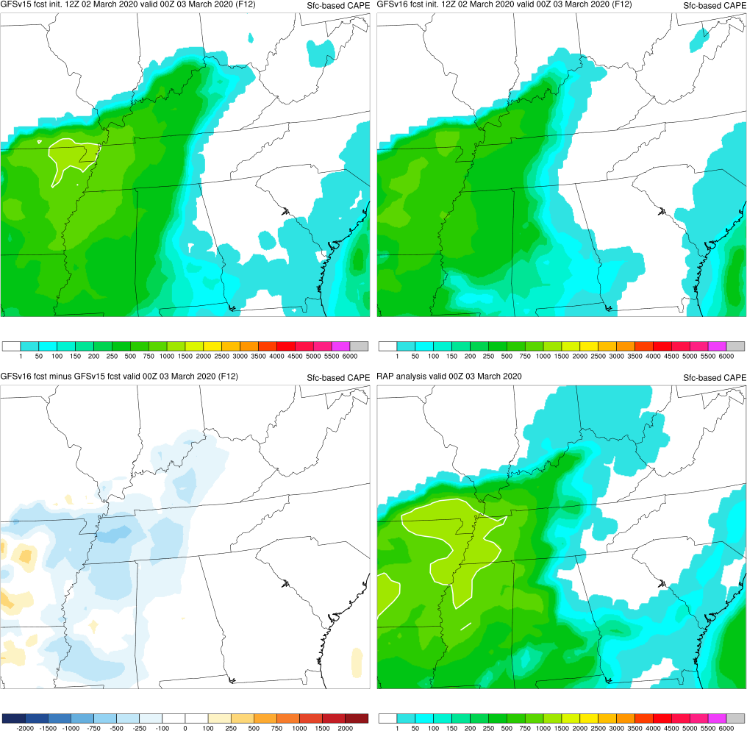
NATIONAL OCEANIC AND ATMOSPHERIC ADMINISTRATION
CAPE Magnitudes Are Reduced in GFSv16
Tennessee Tornadoes
(3 March 2020)
Init: 12Z 2 March 2020
Valid: 00Z 3 March 2020 (F012)
GFSv16 CAPE was ~100-500 J/kg lower than GFSv15 across portions of MS, AR, and TN
Both forecasts underestimated the coverage of CAPE > 1500 J/kg (light green) highlighted by the RAP analysis
GFSv15
GFSv16
RAP
ANL
v16 - v15

Slide 25
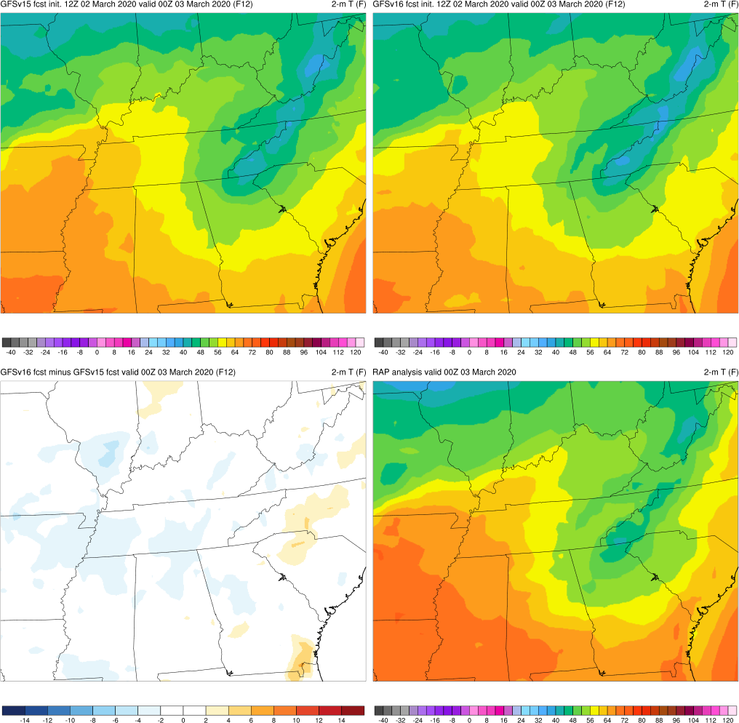
NATIONAL OCEANIC AND ATMOSPHERIC ADMINISTRATION
CAPE Magnitudes Are Reduced in GFSv16
Tennessee Tornadoes
(3 March 2020)
Init: 12Z 2 March 2020
Valid: 00Z 3 March 2020 (F012)
2-m temps across the Lower Mississippi Valley were slightly lower in GFSv16
GFSv15
GFSv16
RAP
ANL
v16 - v15

Slide 26
NATIONAL OCEANIC AND ATMOSPHERIC ADMINISTRATION
GFSv16 Severe Weather: Concerns
Instability guidance is degraded relative to GFSv15
GFSv16 surface-based CAPE magnitudes are consistently lower at all valid times and at all forecast lead times
Some contributing factors:
Drier top-layer soil initial conditions tend to reduce available boundary layer moisture
Overmixing can lead to boundary layers being too warm, dry, and deep at times
Tendency for the surface to decouple too early in the East?

Slide 27
NATIONAL OCEANIC AND ATMOSPHERIC ADMINISTRATION
Drier Soil Reduces Boundary-Layer Moisture
GFSv15
GFSv16
v16 - v15
F024
F024
F024
Surface-Based CAPE Forecasts (left and middle) and Forecast Differences (right)
Init: 00Z 23 August 2020 Valid: 00Z 24 August 2020 (F024)
Largest GFSv16 reductions were in the CAPE max over the Corn Belt
CAPE reductions in South and East were smaller in magnitude than earlier 8/11 example

Slide 28
NATIONAL OCEANIC AND ATMOSPHERIC ADMINISTRATION
Drier Soil Reduces Boundary-Layer Moisture
GFSv15
GFSv16
RAP ANL
F024
F024
F00
Surface-Based CAPE Forecasts (left and middle) and Analysis (right)
Init: 00Z 23 August 2020 Valid: 00Z 24 August 2020 (F024)
Largest GFSv16 reductions were in the CAPE max over the Corn Belt
CAPE reductions in South and East were smaller in magnitude than earlier 8/11 example

Slide 29
NATIONAL OCEANIC AND ATMOSPHERIC ADMINISTRATION
Drier Soil Reduces Boundary-Layer Moisture
0-10cm Soil Moisture
2-m T
2-m Td
GFSv16 – GFSv15 Forecast Differences
Init: 00Z 23 August 2020 Valid: 00Z 23 August 2020 (F000)
GFSv16 was initialized with drier soil states than GFSv15 across the CONUS
GFSv16 dewpoints were initialized lower as well, but not as dramatically as the top-layer soil

Slide 30
NATIONAL OCEANIC AND ATMOSPHERIC ADMINISTRATION
Drier Soil Reduces Boundary-Layer Moisture
0-10cm Soil Moisture
2-m T
2-m Td
GFSv16 – GFSv15 Forecast Differences
Init: 00Z 23 August 2020 Valid: 00Z 24 August 2020 (F024)
By F024, lower dewpoints expanded over the Corn Belt and the eastern corridor of the Plains
Overmixing is likely a factor with dewpoint reductions growing during the forecast period

Slide 31
NATIONAL OCEANIC AND ATMOSPHERIC ADMINISTRATION
GFSv16 Severe Weather: Concerns
Instability guidance is degraded relative to GFSv15
GFSv16 surface-based CAPE magnitudes are consistently lower at all valid times and at all forecast lead times
Some contributing factors:
Drier top-layer soil initial conditions tend to reduce available boundary layer moisture
Overmixing can lead to boundary layers being too warm, dry, and deep at times
Tendency for the surface to decouple too early in the East?

Slide 32
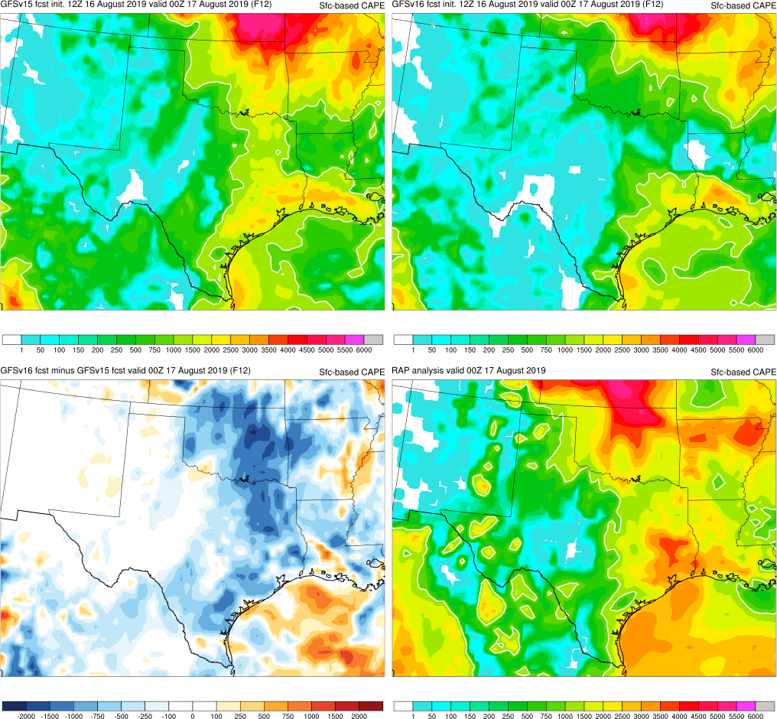
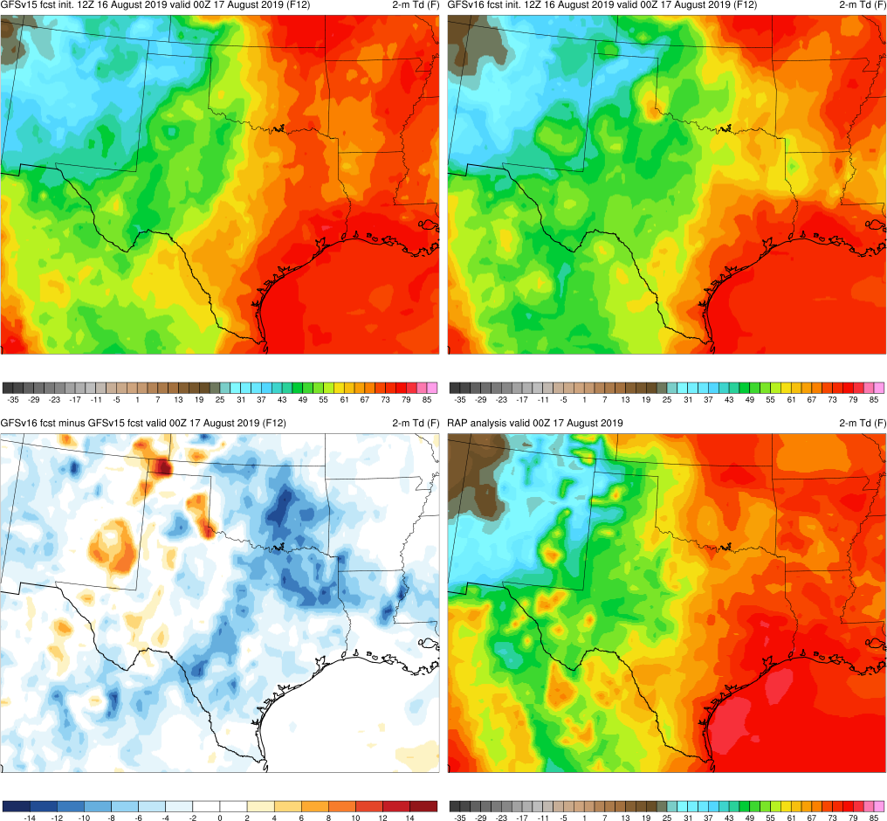
NATIONAL OCEANIC AND ATMOSPHERIC ADMINISTRATION
Tendency to Overmix the Boundary Layer
CAPE
2-m Td
GFSv15
GFSv16
GFSv15
GFSv16
RAP
ANL
RAP
ANL
v16 - v15
v16 - v15
Init: 12Z 16 August 2019 Valid: 00Z 17 August 2019 (F012)
Largest CAPE reductions are collocated with largest 2-m dewpoint reductions

Slide 33
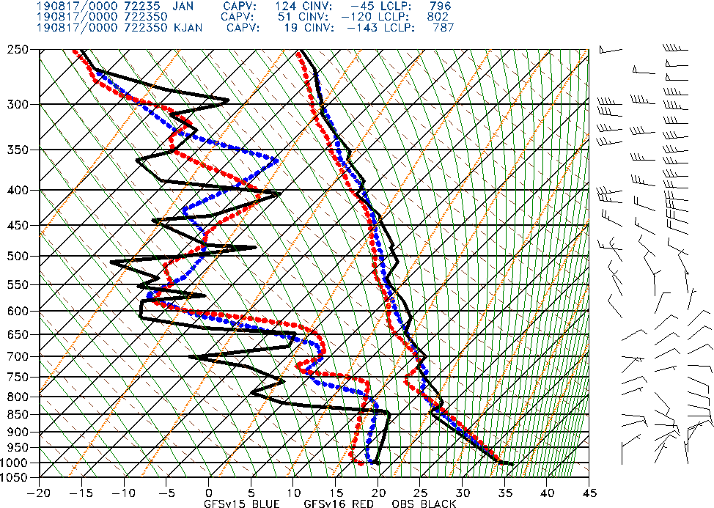
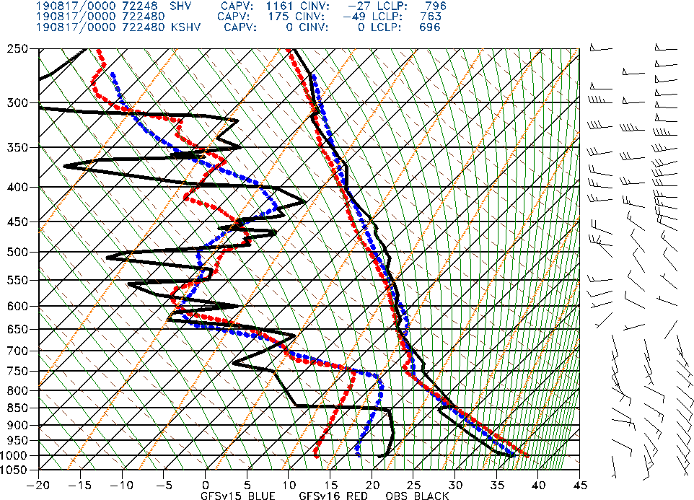
NATIONAL OCEANIC AND ATMOSPHERIC ADMINISTRATION
Tendency to Overmix the Boundary Layer
GFSv15 GFSv16 Obs
Jackson, MS
Shreveport, LA
Init: 12Z 16 August 2019 Valid: 00Z 17 August 2019 (F012)
GFSv16 PBL was drier/warmer/deeper than GFSv15 and obs in the unstable air

Slide 34
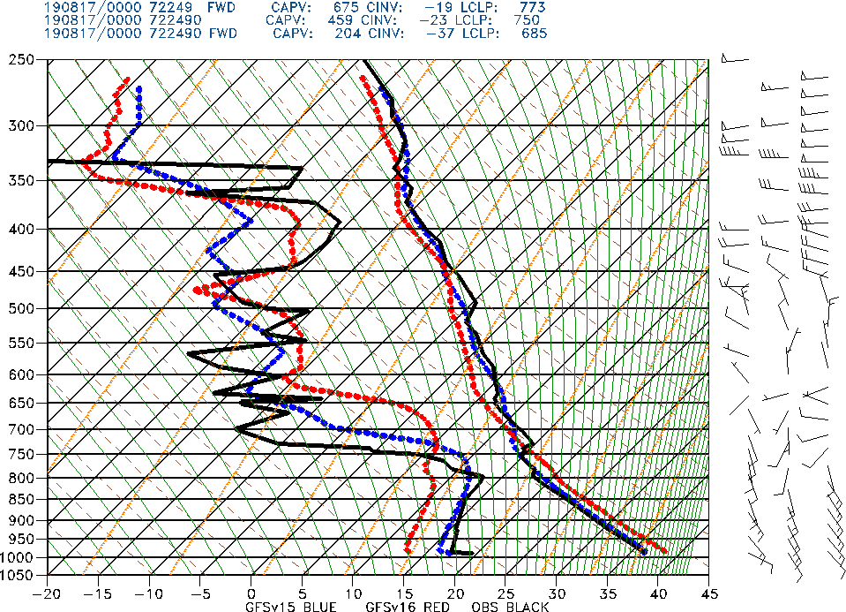
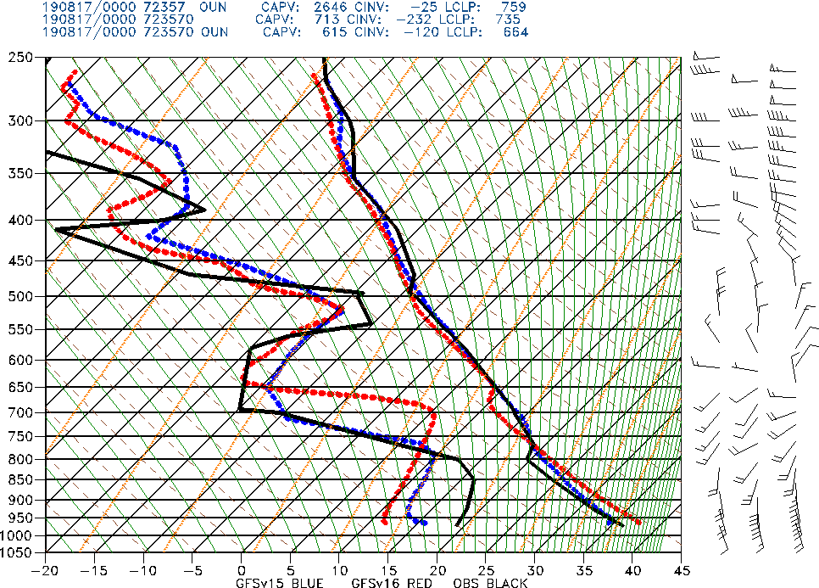
NATIONAL OCEANIC AND ATMOSPHERIC ADMINISTRATION
Tendency to Overmix the Boundary Layer
GFSv15 GFSv16 Obs
Fort Worth, TX
Oklahoma City, OK
Init: 12Z 16 August 2019 Valid: 00Z 17 August 2019 (F012)
GFSv16 PBL was drier/warmer/deeper than GFSv15 and obs in the unstable air

Slide 35
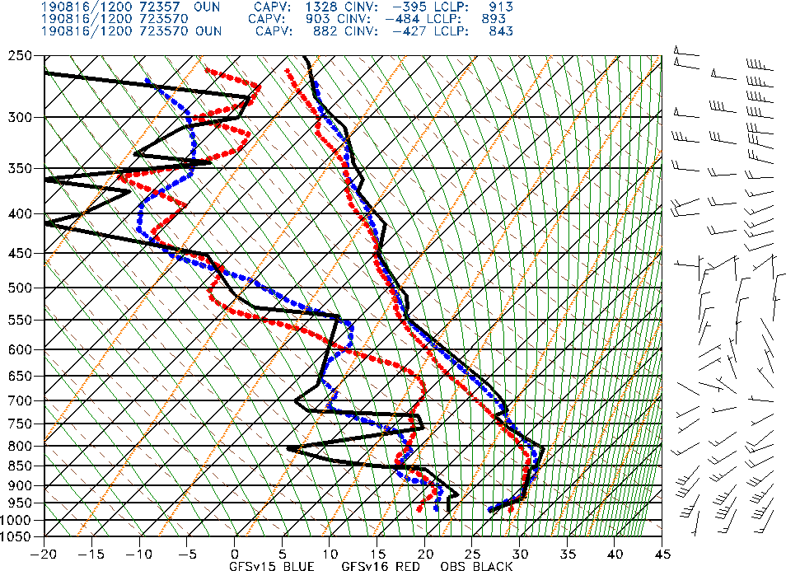
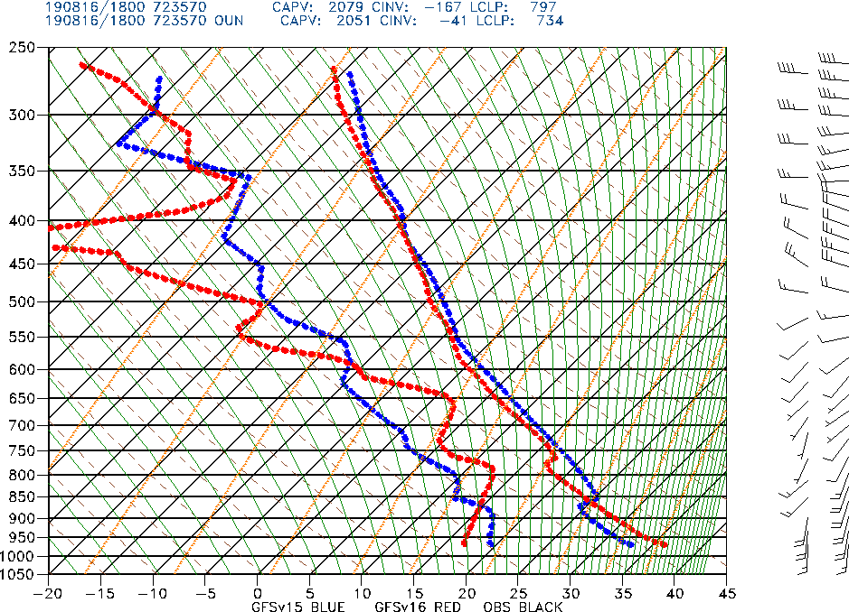
NATIONAL OCEANIC AND ATMOSPHERIC ADMINISTRATION
Tendency to Overmix the Boundary Layer
GFSv15 GFSv16 Obs
F000
F006
F012
Evolution of Upper Air Soundings at Oklahoma City, OK (OUN)
12Z 16 August 2019 Initialization
GFSv16 was initialized slightly too warm/dry, and this progressed through the day
By 00Z (F012), the GFSv16 PBL was significantly drier than GFSv15 or obs

Slide 36
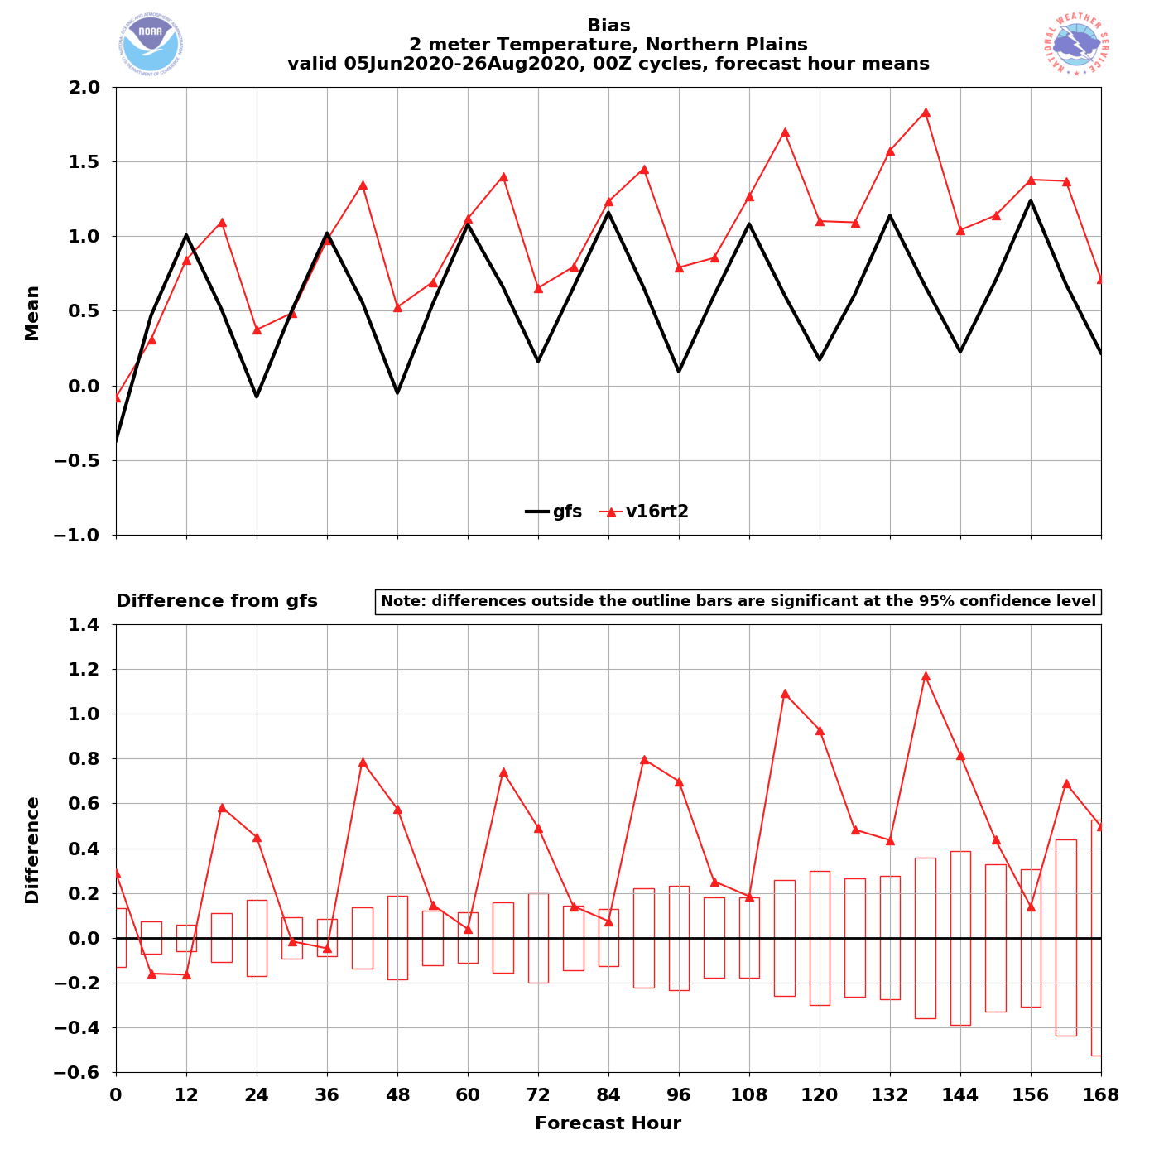
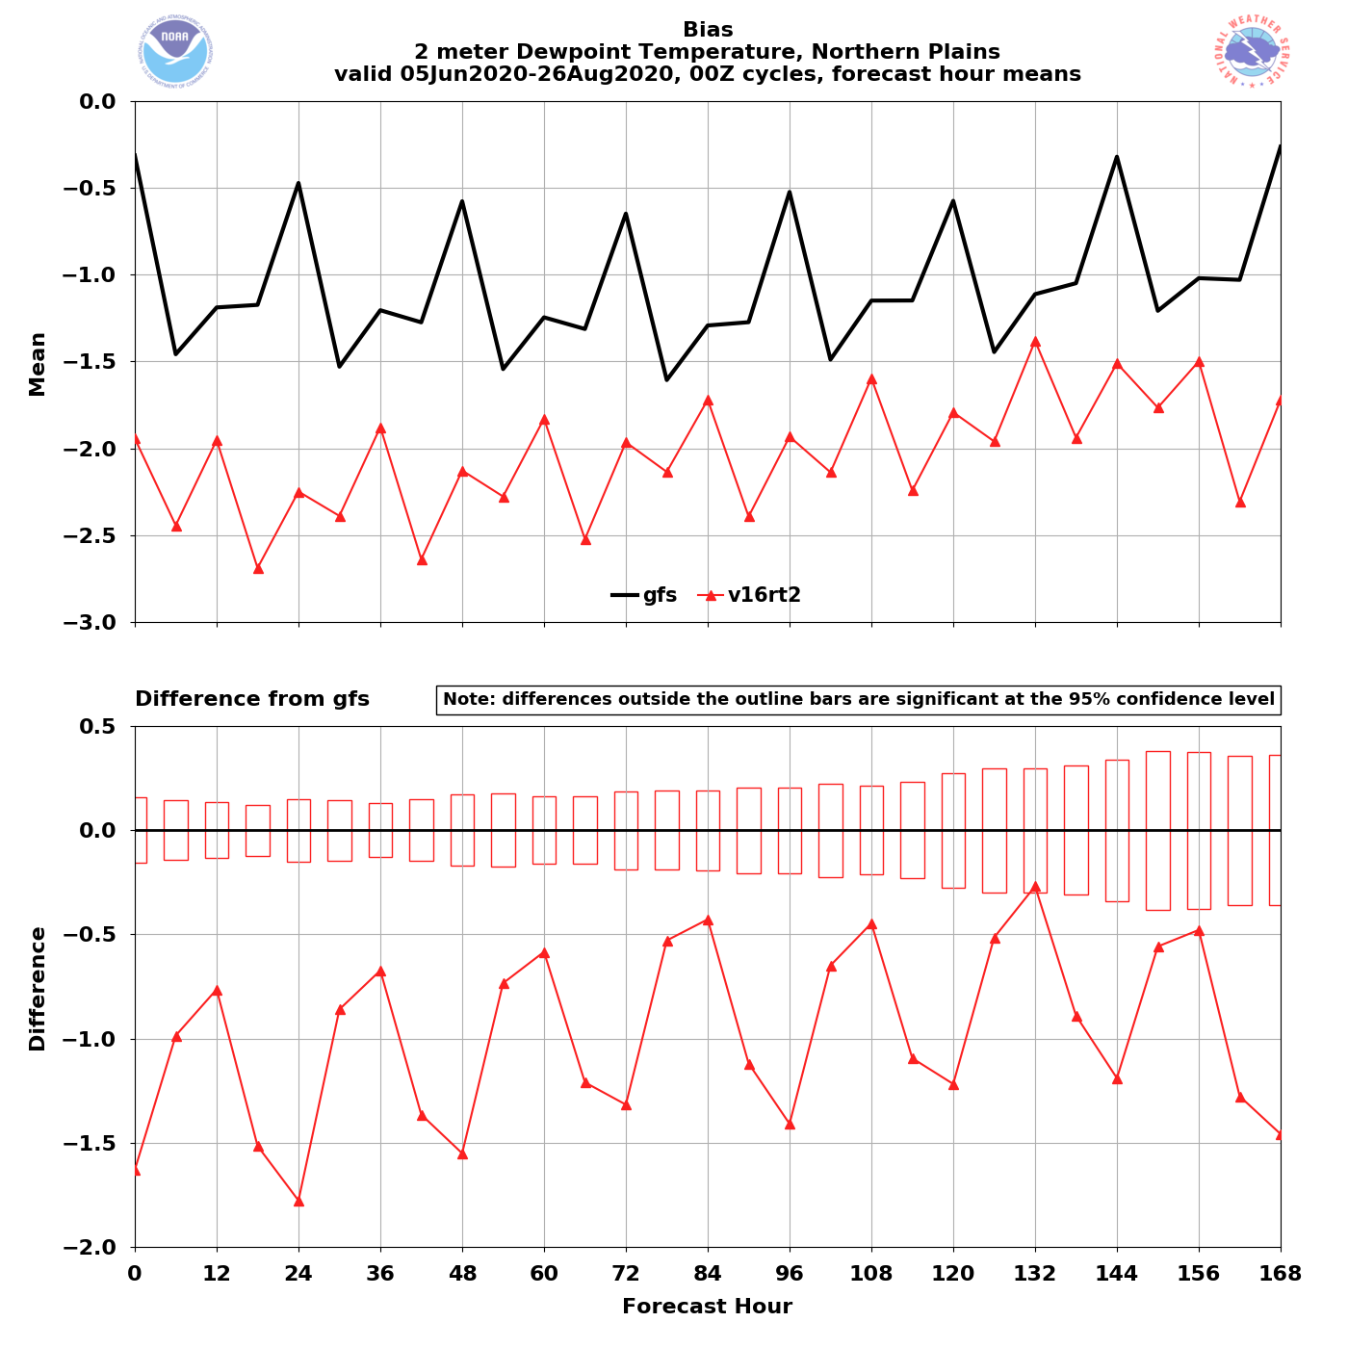
NATIONAL OCEANIC AND ATMOSPHERIC ADMINISTRATION
Warm/Dry Bias Exacerbated Across the Great Plains
2-m T
2-m Td
GFSv15
GFSv16
Northern Plains 2-m T (left) and 2-m Td Bias as a Function of Forecast Lead
Similar bias exists, but to a lesser extent, in neighboring regions

Slide 37
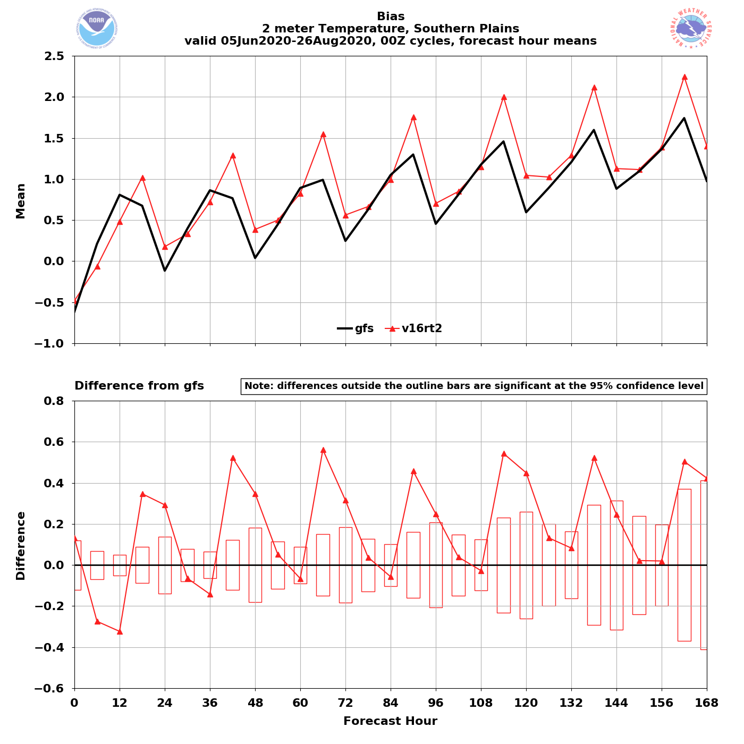
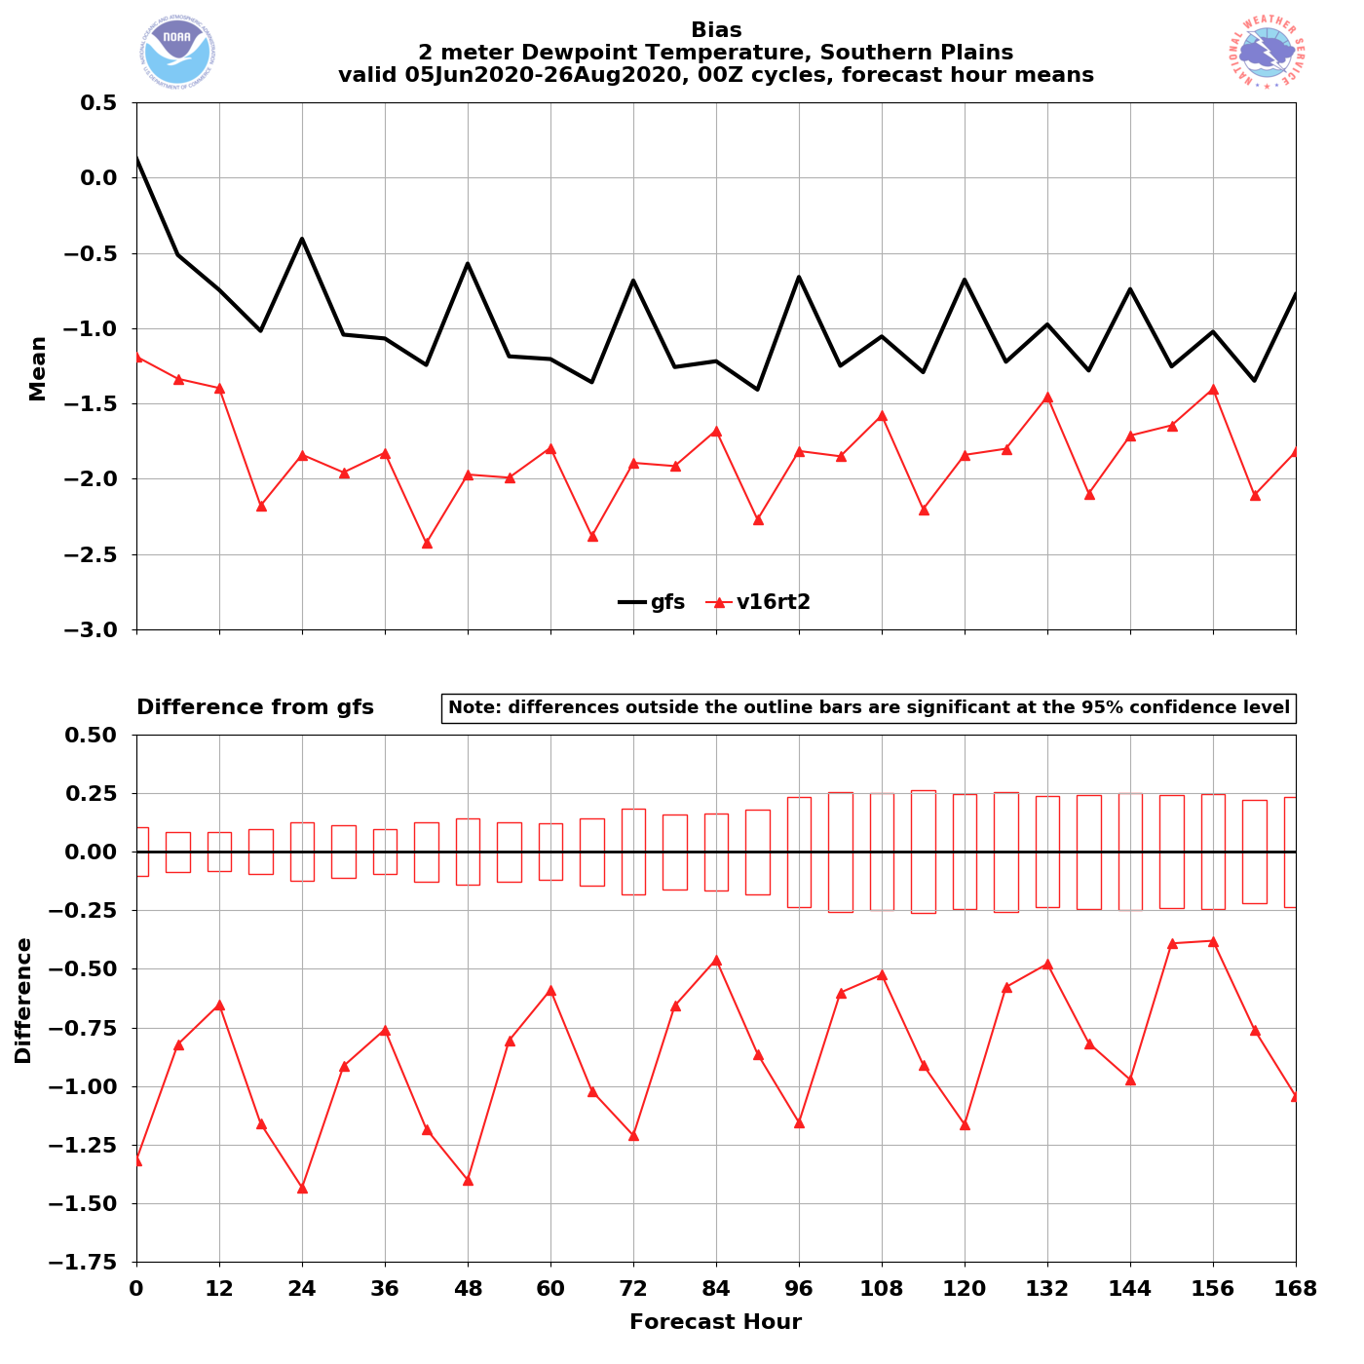
NATIONAL OCEANIC AND ATMOSPHERIC ADMINISTRATION
Warm/Dry Bias Exacerbated Across the Great Plains
2-m T
2-m Td
GFSv15
GFSv16
Southern Plains 2-m T (left) and 2-m Td Bias as a Function of Forecast Lead
Similar bias exists, but to a lesser extent, in neighboring regions

Slide 38
NATIONAL OCEANIC AND ATMOSPHERIC ADMINISTRATION
GFSv16 Severe Weather: Concerns
Instability guidance is degraded relative to GFSv15
GFSv16 surface-based CAPE magnitudes are consistently lower that GFSv15 magnitudes at all valid times and at all forecast lead times
Some contributing factors:
Drier top-layer soil initial conditions tend to reduce available boundary layer moisture
Overmixing can lead to boundary layers being too warm, dry, and deep at times
Tendency for the surface to decouple too early in the East?

Slide 39
NATIONAL OCEANIC AND ATMOSPHERIC ADMINISTRATION
Early Surface Decoupling Across the East?
GFSv15
GFSv16
v16 - v15
Surface-Based CAPE Forecasts (left and middle) and Forecast Differences (right)
Init: 00Z 10 August 2020 Valid: 00Z 11 August 2020 (F024)
GFSv16 CAPE is also largely reduced across the southern Plains and Southeast
Let’s see how these differences evolved throughout the forecast…

Slide 40
NATIONAL OCEANIC AND ATMOSPHERIC ADMINISTRATION
Early Surface Decoupling Across the East?
F012
F015
F018
Surface-Based CAPE Forecasts Differences
(GFSv16 - GFSv15)
Init: 00Z 8/10/2020
GFSv16 lower
GFSv16 higher
F021
F024
Is early surface decoupling playing a role in maximizing CAPE reductions at 00Z?

Slide 41
NATIONAL OCEANIC AND ATMOSPHERIC ADMINISTRATION
Early Surface Decoupling Across the East?
GFSv15
GFSv16
Obs
Lower GFSv16 CAPE magnitudes are more pronounced at 00Z valid times than at 12Z valid times

Slide 42
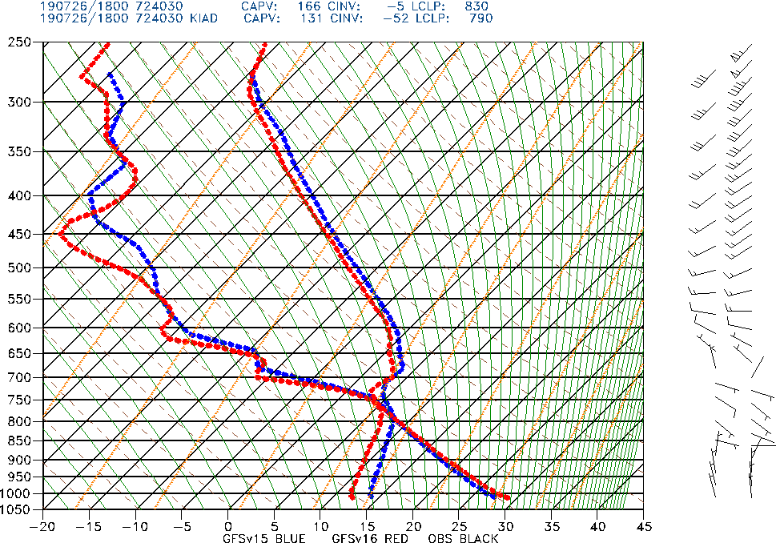
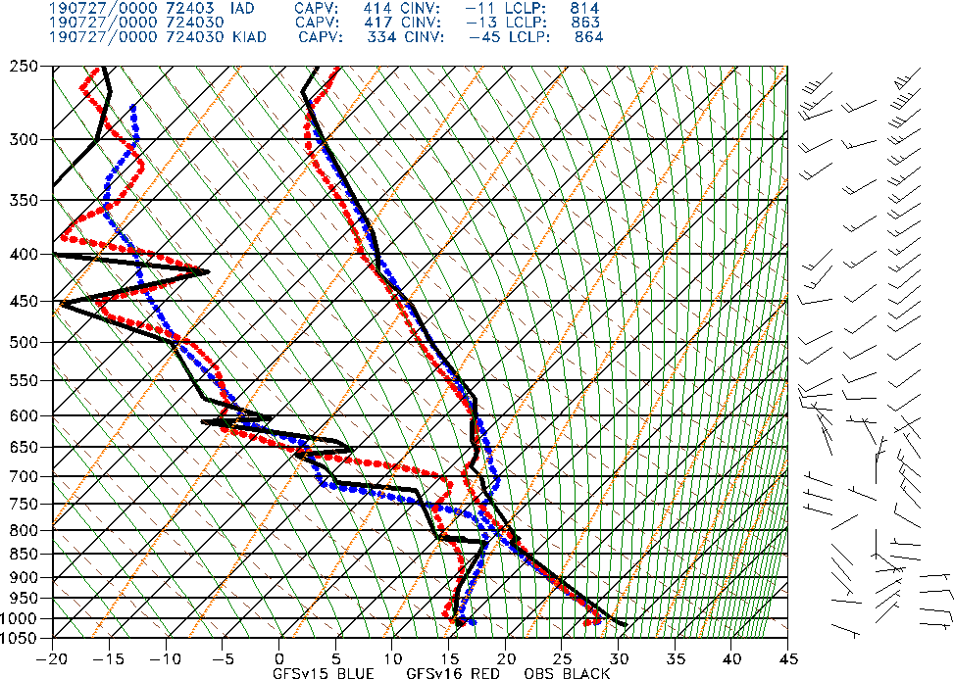
NATIONAL OCEANIC AND ATMOSPHERIC ADMINISTRATION
Early Surface Decoupling Across the East?
GFSv15 GFSv16 Obs
Sterling, VA
18Z (F006)
Sterling, VA
00Z (F012)
Init: 12Z 26 July 2019
Both GFS versions were fully mixed out at 18Z and began to cool too quickly by 00Z

Slide 43
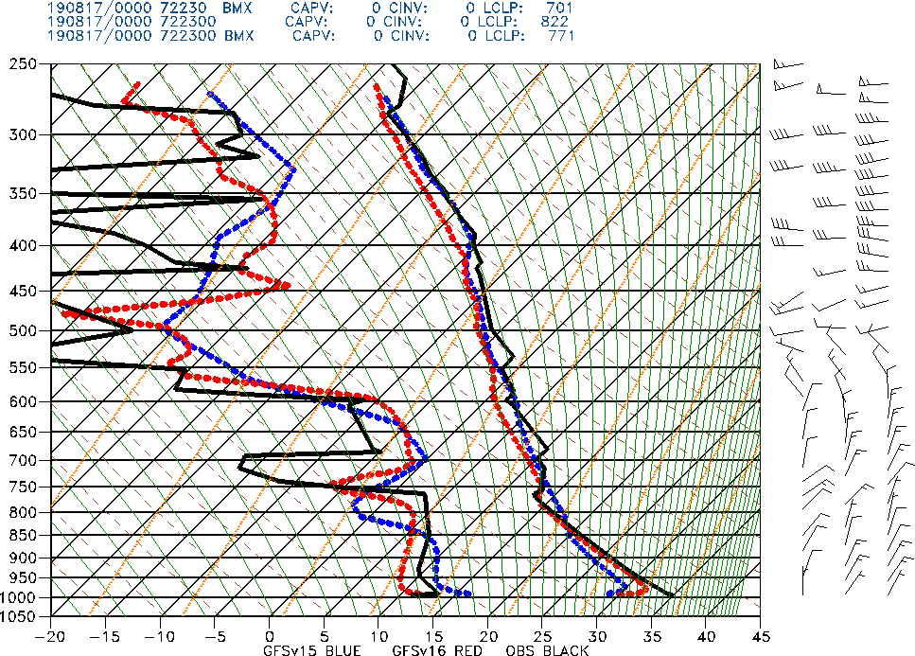
NATIONAL OCEANIC AND ATMOSPHERIC ADMINISTRATION
Early Surface Decoupling Across the East?
GFSv15 GFSv16 Obs
Finding multiple representative examples in the retrospective soundings was somewhat of a challenge
Other potential examples were identified in more unstable environments, but nearby diurnal convection made positive identification somewhat tricky
Birmingham, AL
F024
Init: 00Z 17 August 2019

Slide 44
NATIONAL OCEANIC AND ATMOSPHERIC ADMINISTRATION
GFSv16 Severe Weather: Summary
GFSv16 strengths for severe weather include:
Better capturing of synoptic forcing features at longer lead times
Better positioning of relevant frontal boundaries
Better positioning of drylines, especially in the medium range
The primary severe weather related concern with GFSv16 is an exacerbation of a low instability bias that already exists in GFSv15
Factors contributing to the reduction of CAPE in GFSv16:
Drier top-layer soil conditions leads to reductions in available boundary-layer moisture
Overmixing can result in PBLs that are too warm, dry, and deep
Early surface decoupling may be reducing 00Z 2-m temps in the East

