Slide 1
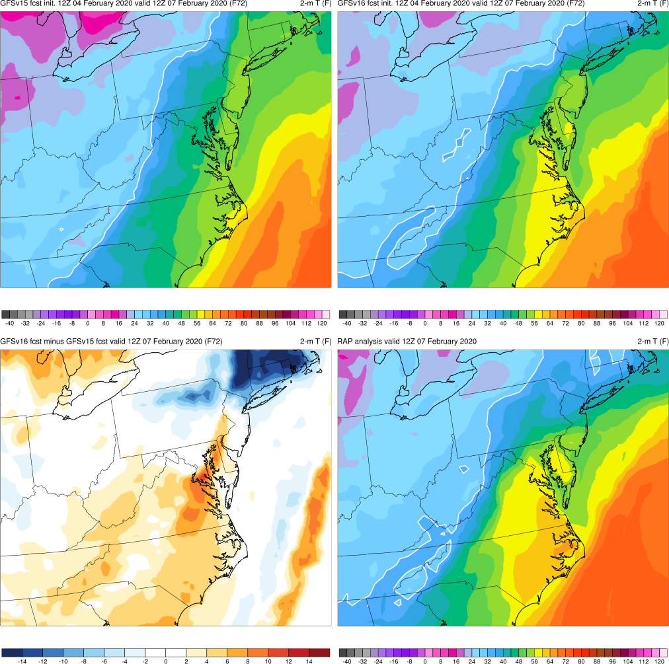
NATIONAL OCEANIC AND ATMOSPHERIC ADMINISTRATION
GFSv16 Case Studies: Severe Weather
GFSv15
GFSv16
RAP Anl.
Chris MacIntosh EMC Model Evaluation Group Webinar
3 September 2020

Slide 2
NATIONAL OCEANIC AND ATMOSPHERIC ADMINISTRATION
GFSv16 Retrospectives: Severe Weather
GFSv16 severe weather case studies:
Mid-Atlantic Severe (Feb 6-7, 2020)
Tennessee Tornadoes (Mar 2-3, 2020)
Easter Sunday (Apr 12-13, 2020)
Southeast Severe (Apr 19-23, 2020)
Mid-May (May 17-22, 2019)
Late May (May 23-29, 2019)
https://www.emc.ncep.noaa.gov/users/meg/gfsv16/retros/

Slide 3
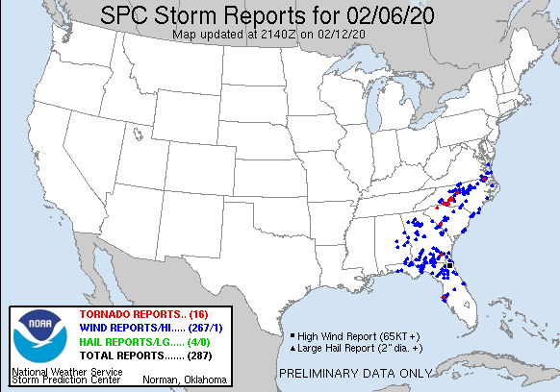
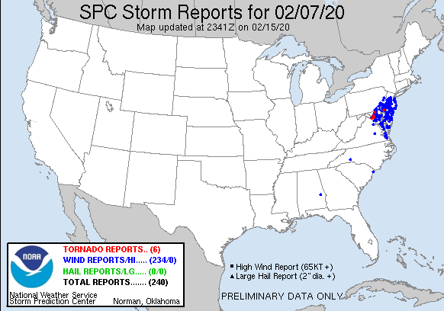
NATIONAL OCEANIC AND ATMOSPHERIC ADMINISTRATION
Mid-Atlantic Severe (Feb 6-7, 2020)

Slide 4
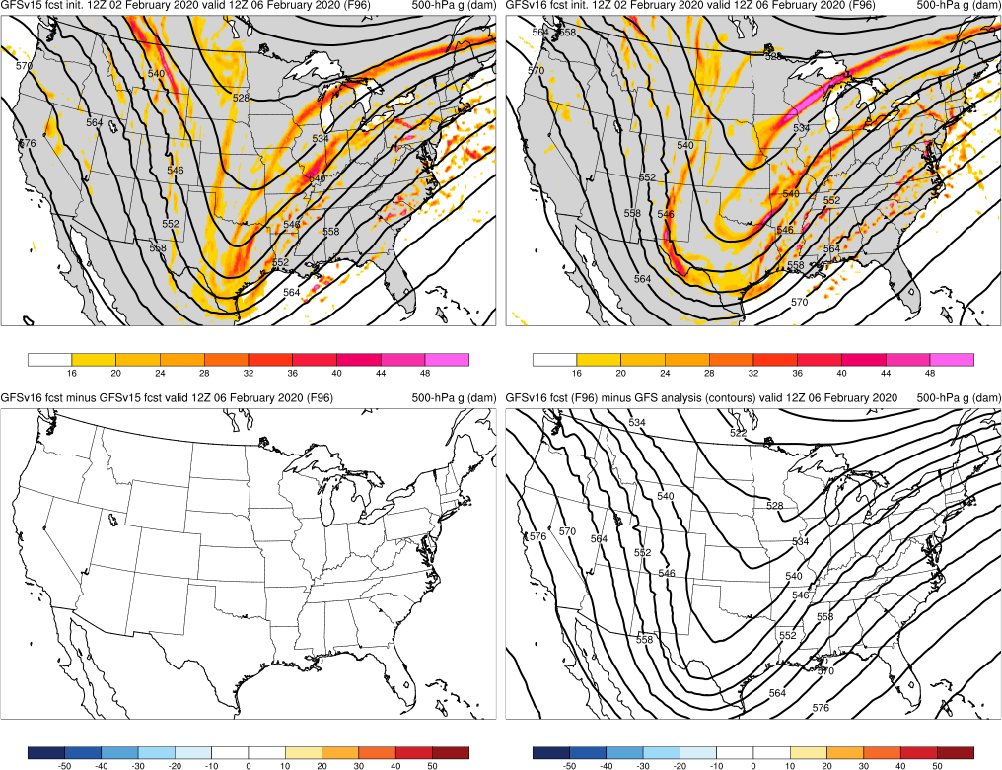
NATIONAL OCEANIC AND ATMOSPHERIC ADMINISTRATION
Mid-Atlantic Severe: 500-hPa Heights
Mid-Atlantic Severe (F096) Valid: 12Z 02/06/20
GFSv15
GFSv16
Both GFSv15 and GFSv16 showed potential for positively-tilted trough
v16−v15
GFS Anl.

Slide 5
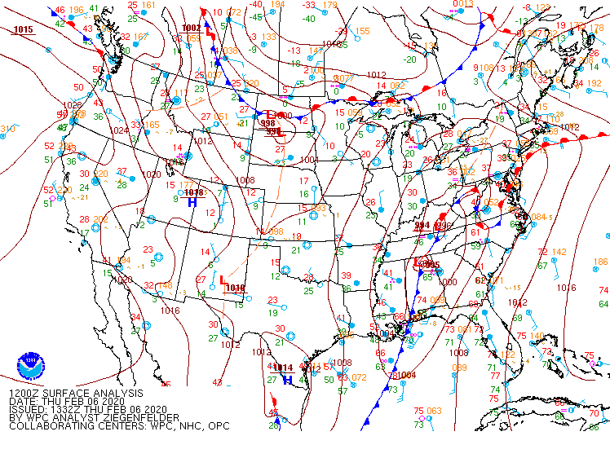
NATIONAL OCEANIC AND ATMOSPHERIC ADMINISTRATION
Mid-Atlantic Severe: WPC Analysis
Mid-Atlantic Severe Valid: 12Z 02/06/20

Slide 6
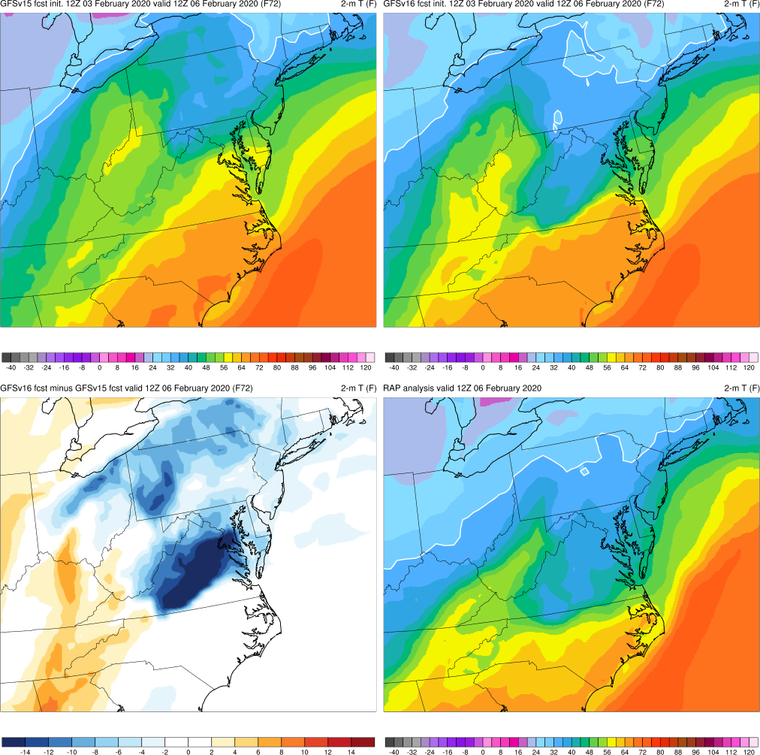
NATIONAL OCEANIC AND ATMOSPHERIC ADMINISTRATION
Mid-Atlantic Severe: 2-m T
GFSv15
GFSv16
Mid-Atlantic Severe (F072) Valid: 12Z 02/06/20
GFSv16 forecasted a strong cold-air damming event at 72 h that was poorly handled by GFSv15 at all lead times
v16−v15
RAP Anl.

Slide 7
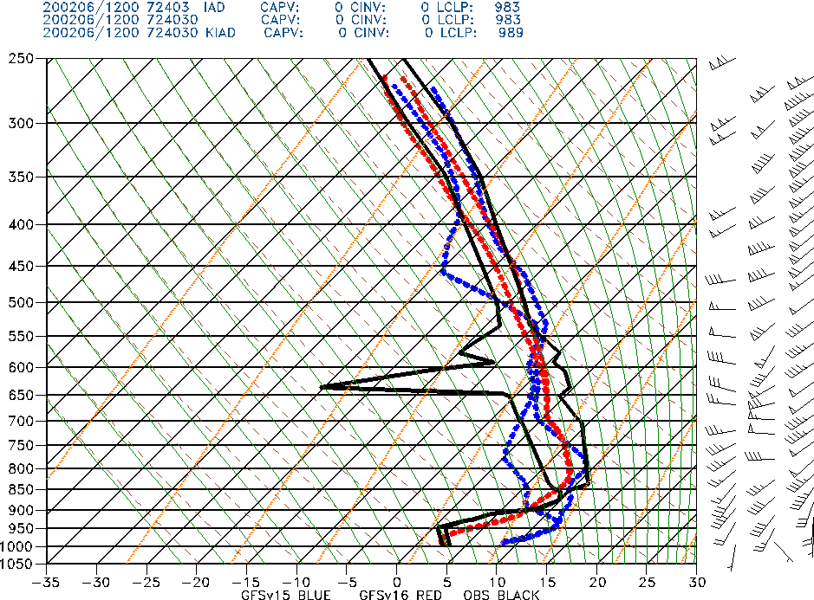
NATIONAL OCEANIC AND ATMOSPHERIC ADMINISTRATION
Mid-Atlantic Severe: IAD Sounding
Mid-Atlantic Severe (F072) Valid: 12Z 02/06/20
Sterling, VA
GFSv16 forecasted a strong cold-air damming event at 72 h that was poorly handled by GFSv15 at all lead times
GFSv16 forecasted the low-level inversion at IAD much better than GFSv15
GFSv15
GFSv16
OBS

Slide 8
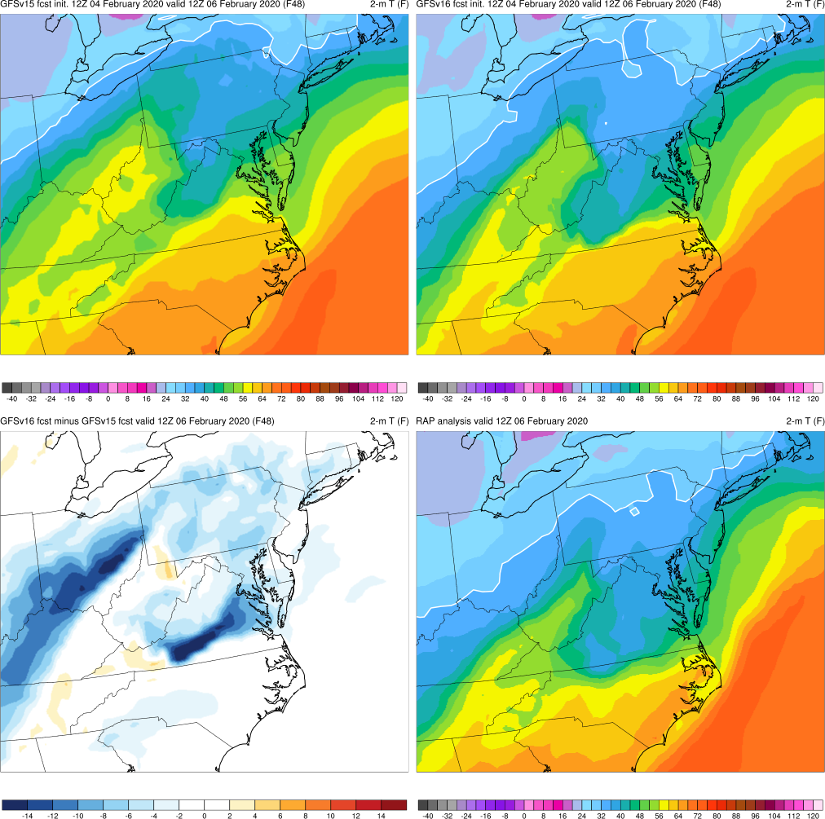
NATIONAL OCEANIC AND ATMOSPHERIC ADMINISTRATION
Mid-Atlantic Severe: 2-m T
GFSv15
GFSv16
Mid-Atlantic Severe (F048) Valid: 12Z 02/06/20
GFSv16 forecasted a strong cold-air damming event at 72 h that was poorly handled by GFSv15 at all lead times
v16−v15
RAP Anl.

Slide 9
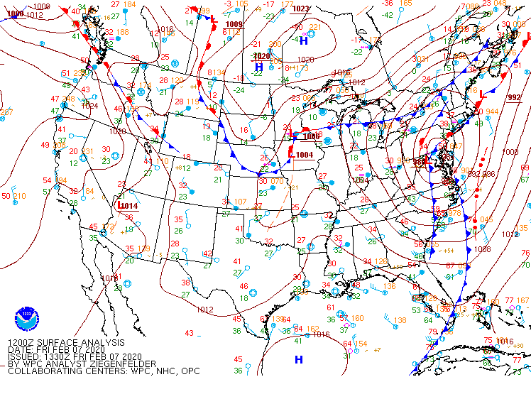
NATIONAL OCEANIC AND ATMOSPHERIC ADMINISTRATION
Mid-Atlantic Severe: WPC Analysis
Mid-Atlantic Severe Valid: 12Z 02/07/20

Slide 10
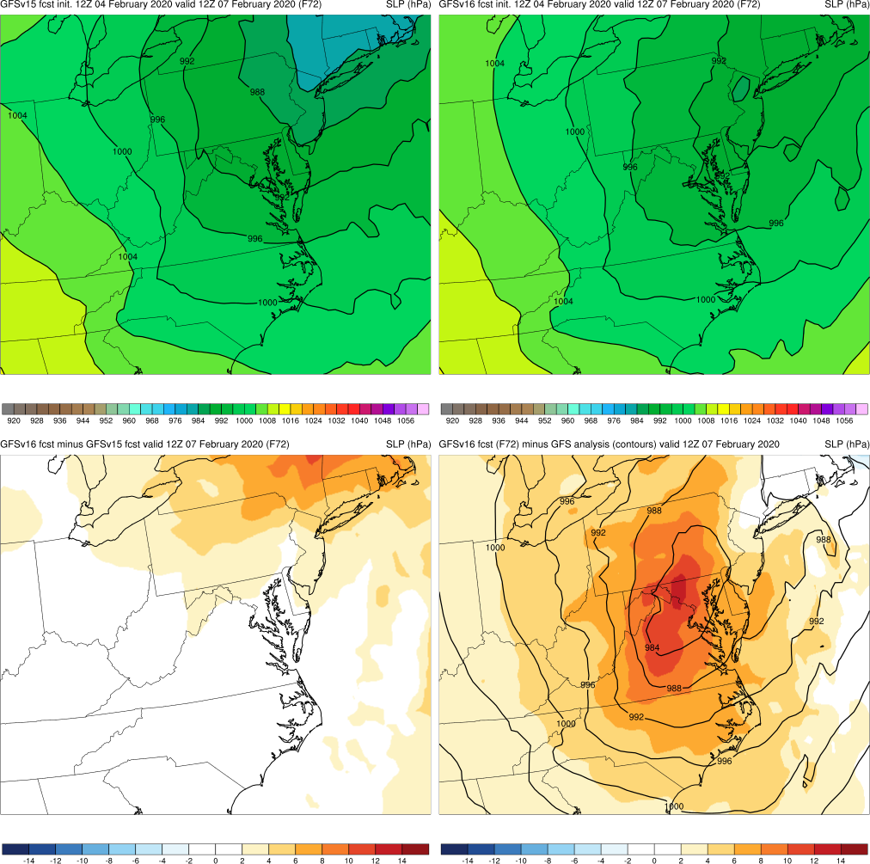
NATIONAL OCEANIC AND ATMOSPHERIC ADMINISTRATION
Mid-Atlantic Severe: SLP
Mid-Atlantic Severe (F072) Valid: 12Z 02/07/20
GFSv15 more correctly forecasted the strength of the low than GFSv16
GFSv15
GFSv16
v16−v15
GFS Anl.

Slide 11
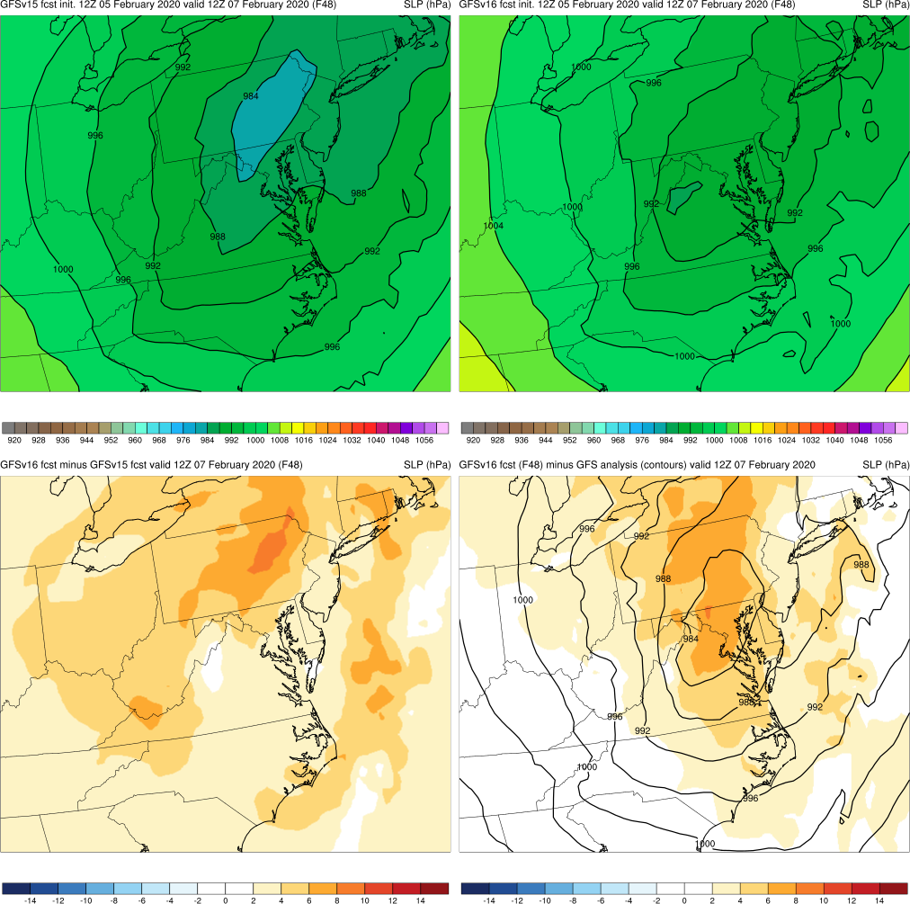
NATIONAL OCEANIC AND ATMOSPHERIC ADMINISTRATION
Mid-Atlantic Severe: SLP
Mid-Atlantic Severe (F048) Valid: 12Z 02/07/20
GFSv15 more correctly forecasted the strength of the low than GFSv16
GFSv15
GFSv16
v16−v15
GFS Anl.

Slide 12
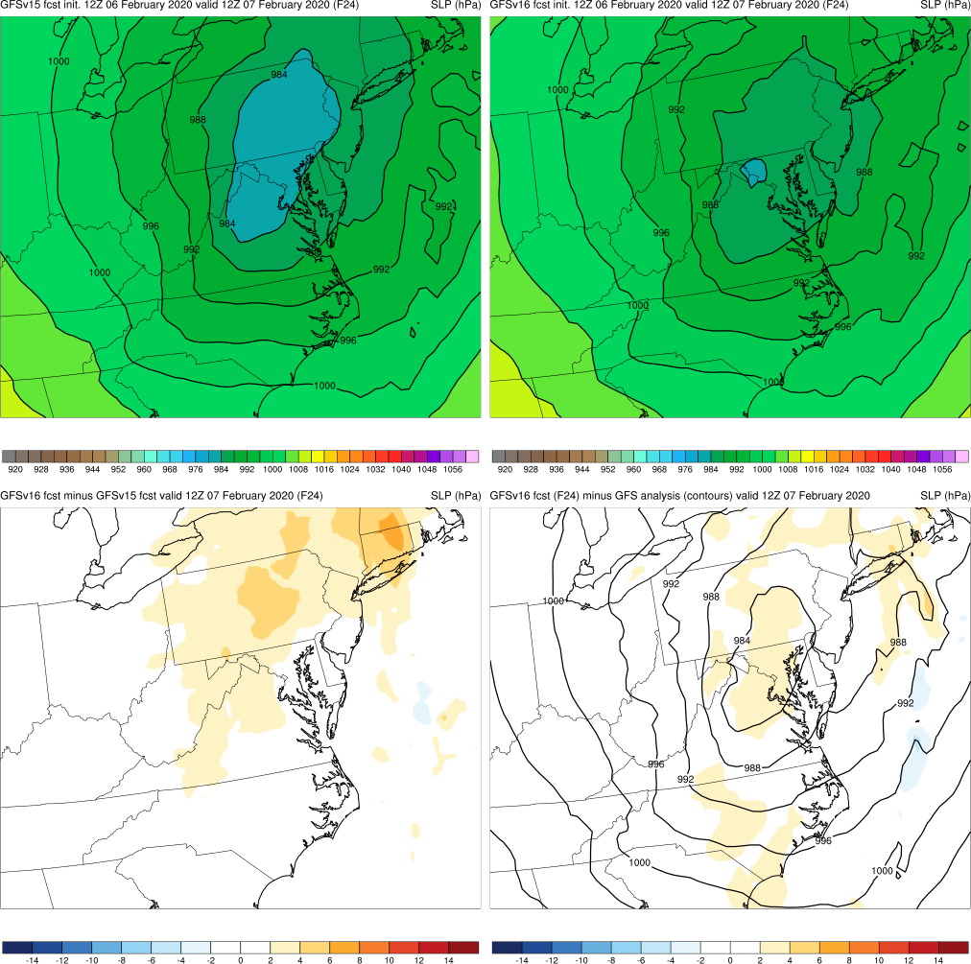
NATIONAL OCEANIC AND ATMOSPHERIC ADMINISTRATION
Mid-Atlantic Severe: SLP
Mid-Atlantic Severe (F024) Valid: 12Z 02/07/20
GFSv15 more correctly forecasted the strength of the low than GFSv16
GFSv15
GFSv16
v16−v15
GFS Anl.

Slide 13
NATIONAL OCEANIC AND ATMOSPHERIC ADMINISTRATION
Mid-Atlantic Severe: 2-m T
Mid-Atlantic Severe (F072) Valid: 12Z 02/07/20
GFSv15 more correctly forecasted the strength of the low than GFSv16
GFSv16 forecasted correct position/orientation of cold and stationary fronts 24 h before GFSv15
GFSv15
GFSv16
v16−v15
RAP Anl.

Slide 14
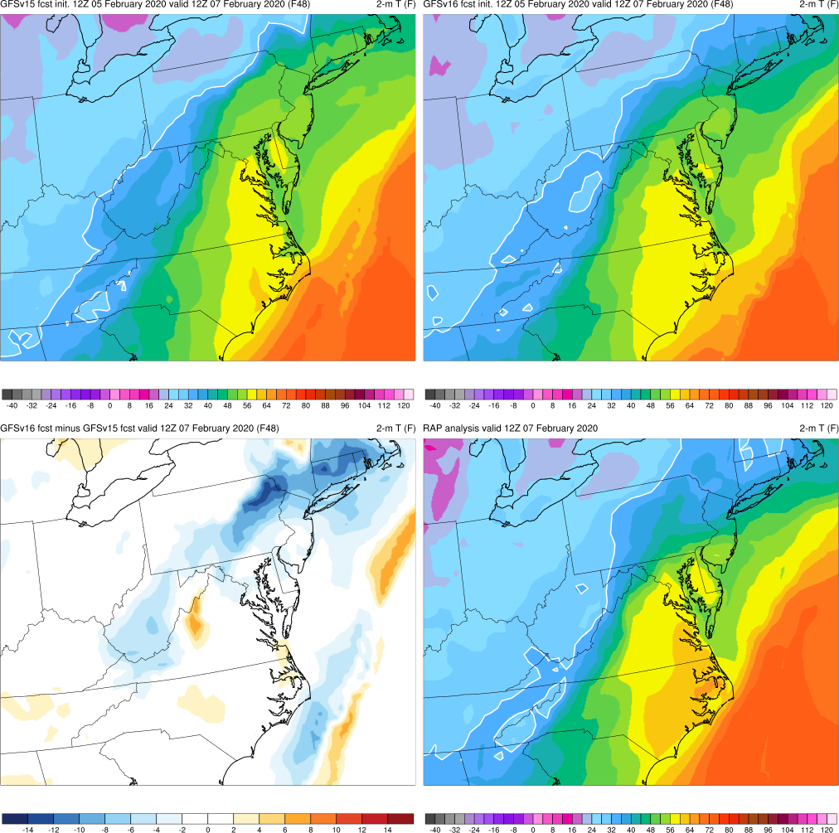
NATIONAL OCEANIC AND ATMOSPHERIC ADMINISTRATION
Mid-Atlantic Severe: 2-m T
Mid-Atlantic Severe (F048) Valid: 12Z 02/07/20
GFSv15 more correctly forecasted the strength of the low than GFSv16
GFSv16 forecasted correct position/orientation of cold and stationary fronts 24 h before GFSv15
GFSv15
GFSv16
v16−v15
RAP Anl.

Slide 15
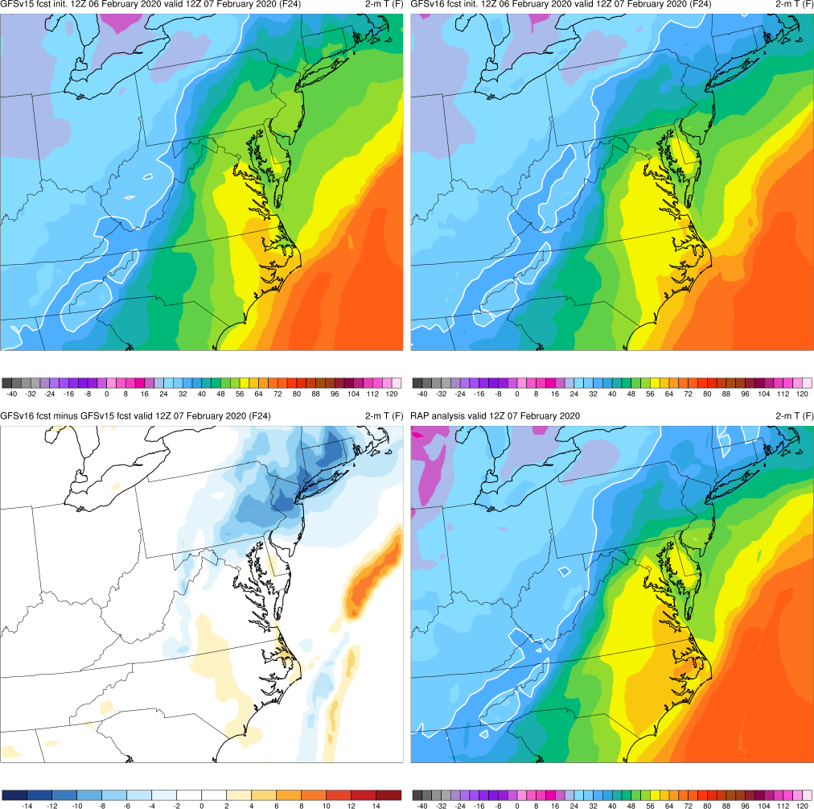
NATIONAL OCEANIC AND ATMOSPHERIC ADMINISTRATION
Mid-Atlantic Severe: 2-m T
Mid-Atlantic Severe (F024) Valid: 12Z 02/07/20
GFSv15 more correctly forecasted the strength of the low than GFSv16
GFSv16 forecasted correct position/orientation of cold and stationary fronts 24 h before GFSv15
GFSv15
GFSv16
v16−v15
RAP Anl.

Slide 16
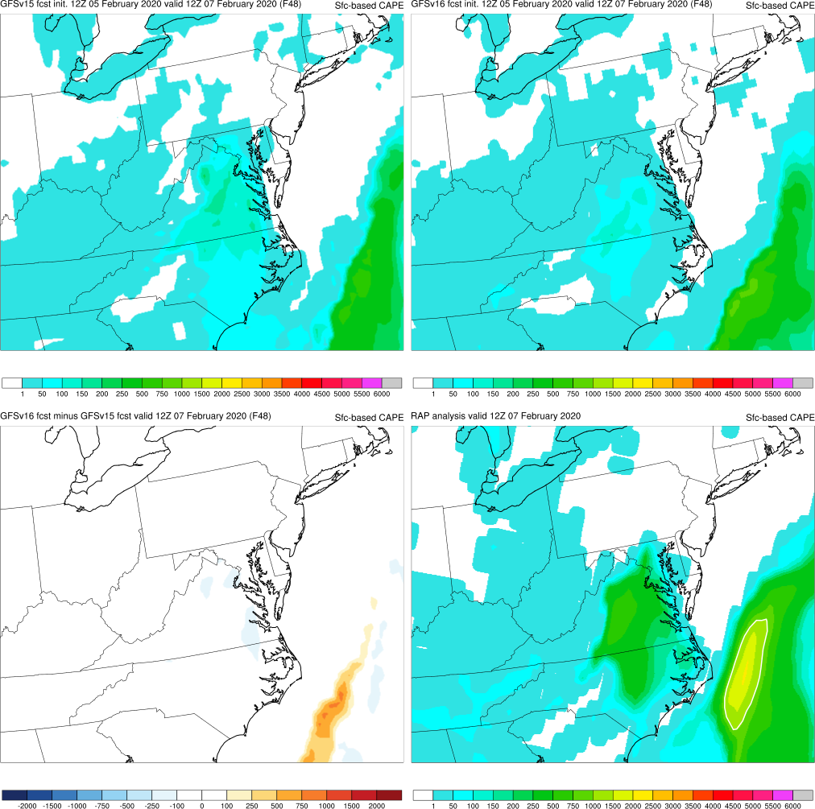
NATIONAL OCEANIC AND ATMOSPHERIC ADMINISTRATION
Mid-Atlantic Severe: Surface-based CAPE
GFSv15
GFSv16
Mid-Atlantic Severe (F048) Valid: 12Z 02/07/20
GFSv15 more correctly forecasted the strength of the low than GFSv16
GFSv16 forecasted correct position/orientation of cold and stationary fronts 24 h before GFSv15
GFSv15/16 both under-forecasted surface-based CAPE (SBCAPE)
v16−v15
RAP Anl.

Slide 17
NATIONAL OCEANIC AND ATMOSPHERIC ADMINISTRATION
GFSv16 Retrospectives: Severe Weather
GFSv16 severe weather case studies:
Mid-Atlantic Severe (Feb 6-7, 2020)
Tennessee Tornadoes (Mar 2-3, 2020)
Easter Sunday (Apr 12-13, 2020)
Southeast Severe (Apr 19-23, 2020)
Mid-May (May 17-22, 2019)
Late May (May 23-29, 2019)
https://www.emc.ncep.noaa.gov/users/meg/gfsv16/retros/

Slide 18
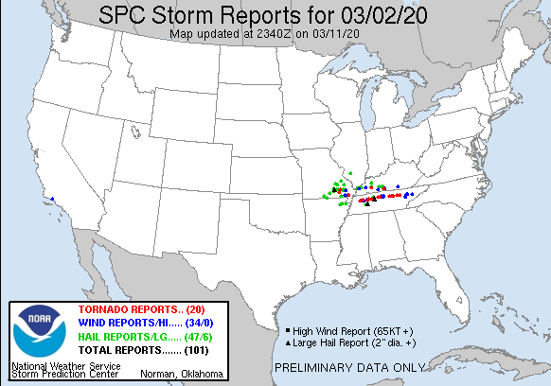
NATIONAL OCEANIC AND ATMOSPHERIC ADMINISTRATION
Tennessee Tornadoes (Mar 2-3, 2020)

Slide 19
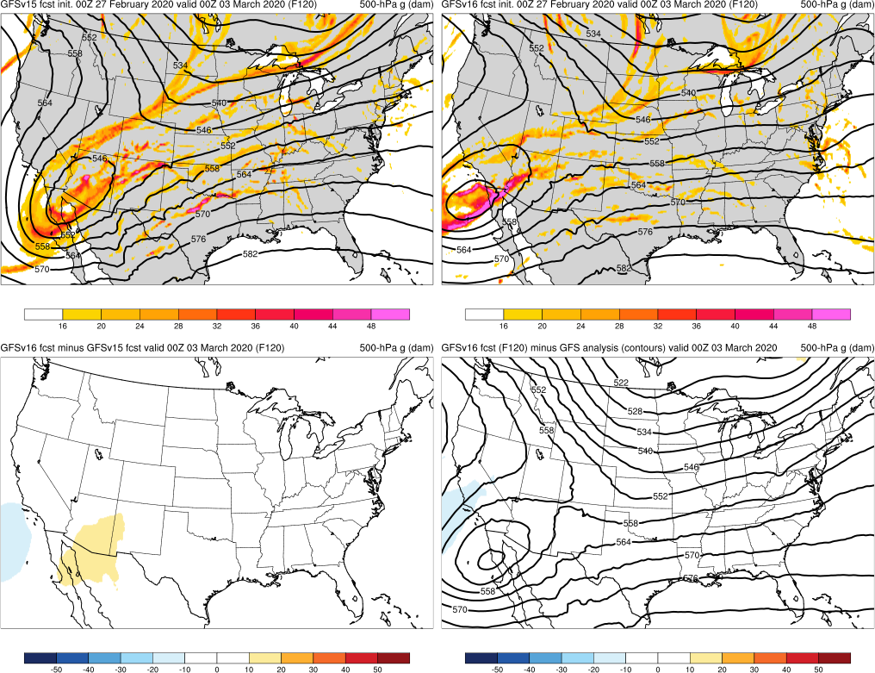
NATIONAL OCEANIC AND ATMOSPHERIC ADMINISTRATION
Tennessee Tornadoes: 500-hPa Heights
Tennessee Tornadoes (F120) Valid: 00Z 03/03/20
GFSv15
GFSv16
GFSv16 forecasted cutoff over Baja Peninsula more correctly and consistently than GFSv15
GFSv16 forecasted zonal flow over the eastern US more correctly and consistently than GFSv15
v16−v15
GFS Anl.

Slide 20
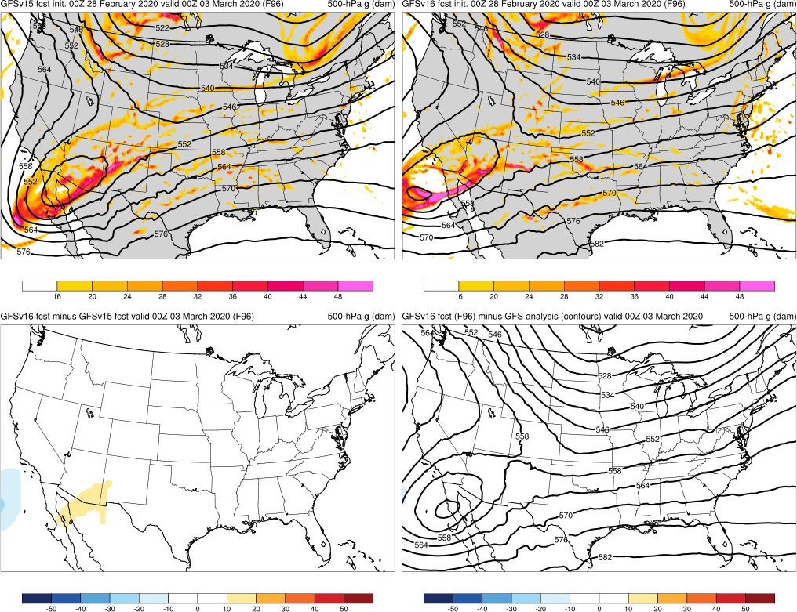
NATIONAL OCEANIC AND ATMOSPHERIC ADMINISTRATION
Tennessee Tornadoes: 500-hPa Heights
Tennessee Tornadoes (F096) Valid: 00Z 03/03/20
GFSv15
GFSv16
GFSv16 forecasted cutoff over Baja Peninsula more correctly and consistently than GFSv15
GFSv16 forecasted zonal flow over the eastern US more correctly and consistently than GFSv15
v16−v15
GFS Anl.

Slide 21
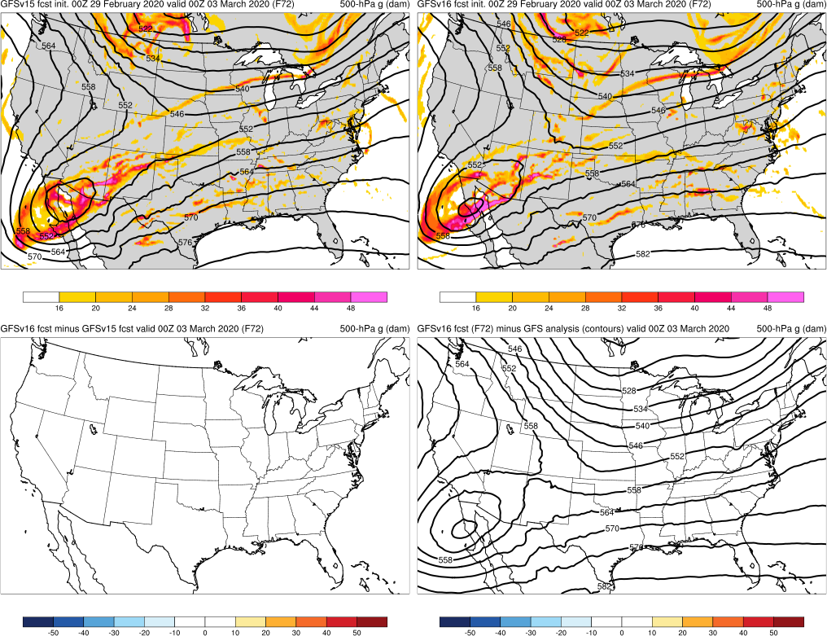
NATIONAL OCEANIC AND ATMOSPHERIC ADMINISTRATION
Tennessee Tornadoes: 500-hPa Heights
Tennessee Tornadoes (F072) Valid: 00Z 03/03/20
GFSv15
GFSv16
GFSv16 forecasted cutoff over Baja Peninsula more correctly and consistently than GFSv15
GFSv16 forecasted zonal flow over the eastern US more correctly and consistently than GFSv15
v16−v15
GFS Anl.

Slide 22
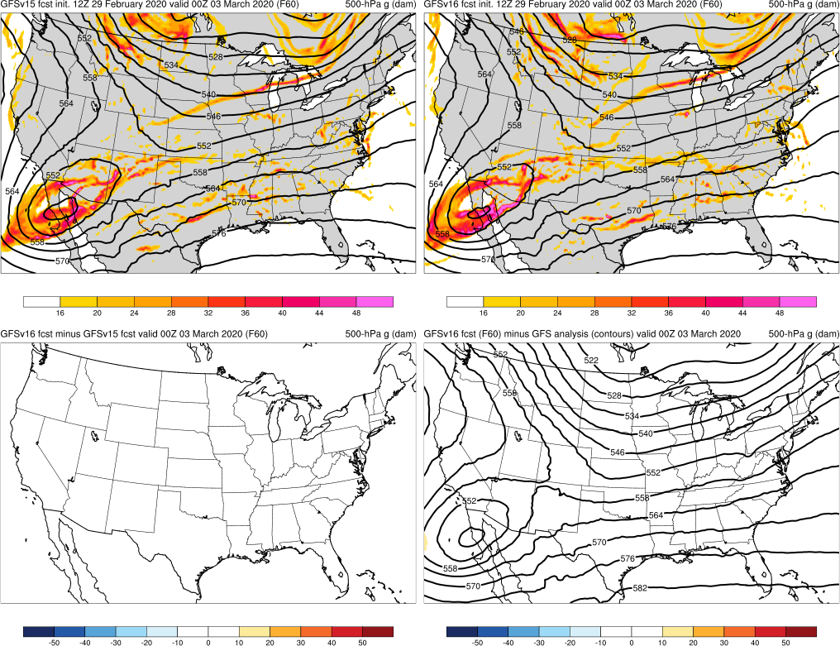
NATIONAL OCEANIC AND ATMOSPHERIC ADMINISTRATION
Tennessee Tornadoes: 500-hPa Heights
Tennessee Tornadoes (F060) Valid: 00Z 03/03/20
GFSv15
GFSv16
GFSv16 forecasted cutoff over Baja Peninsula more correctly and consistently than GFSv15
GFSv16 forecasted zonal flow over the eastern US more correctly and consistently than GFSv15
v16−v15
GFS Anl.

Slide 23
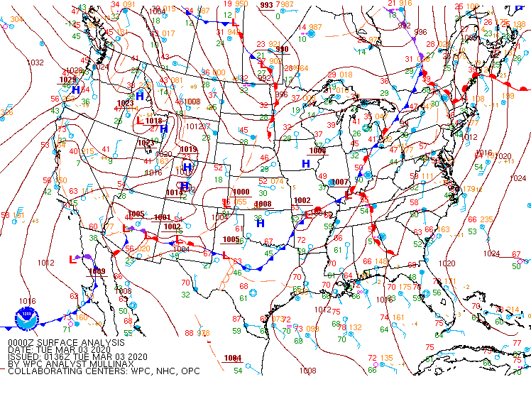
NATIONAL OCEANIC AND ATMOSPHERIC ADMINISTRATION
Tennessee Tornadoes: WPC Analysis
Tennessee Tornadoes Valid: 00Z 03/03/20

Slide 24
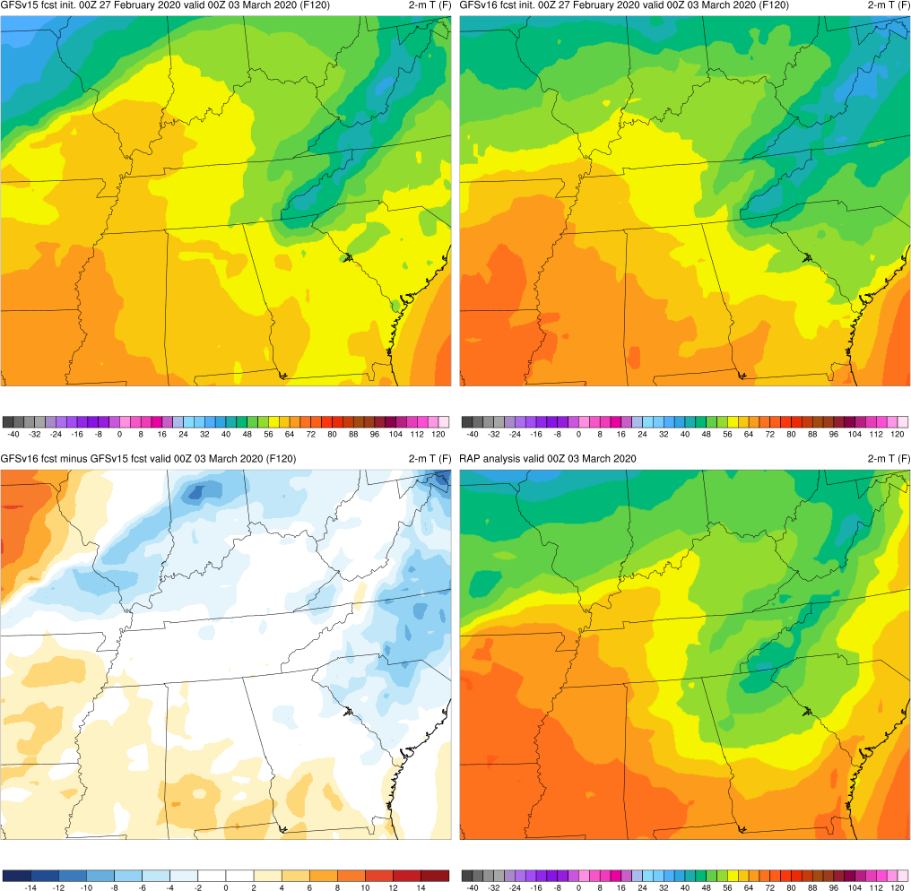
NATIONAL OCEANIC AND ATMOSPHERIC ADMINISTRATION
Tennessee Tornadoes: 2-m T
Tennessee Tornadoes (F120) Valid: 00Z 03/03/20
GFSv16 forecasted correct orientation/position of stationary front at F120, 24 h before GFSv15
GFSv15
GFSv16
v16−v15
RAP Anl.

Slide 25
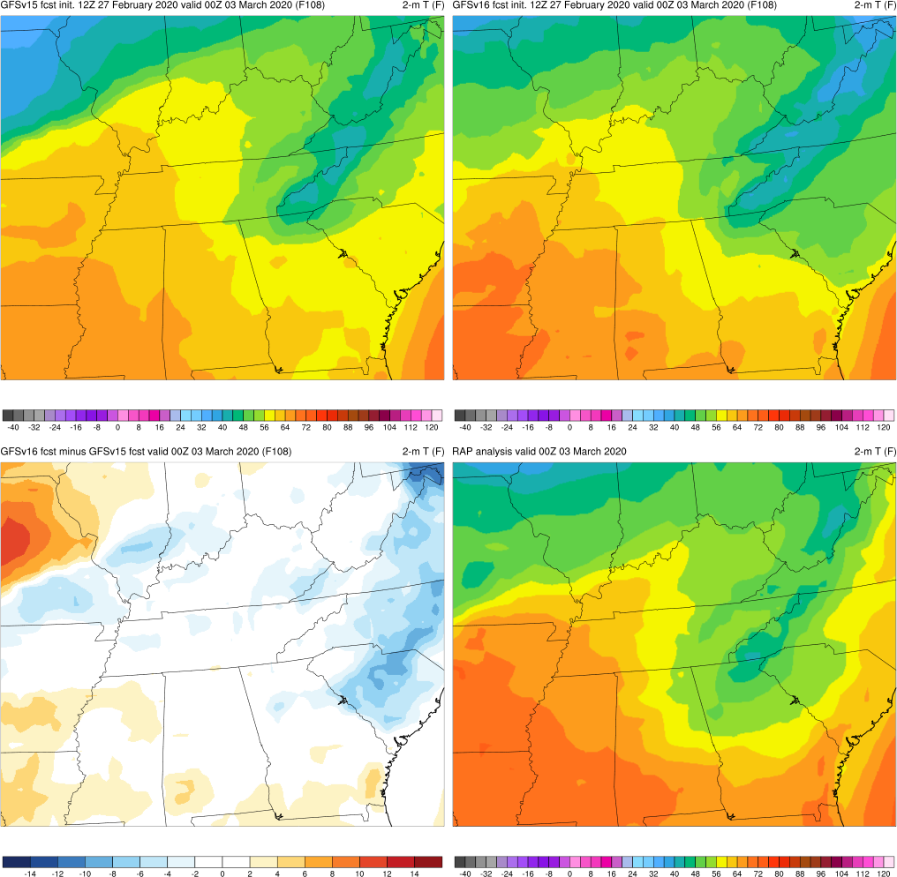
NATIONAL OCEANIC AND ATMOSPHERIC ADMINISTRATION
Tennessee Tornadoes: 2-m T
Tennessee Tornadoes (F108) Valid: 00Z 03/03/20
GFSv16 forecasted correct orientation/position of stationary front at F120, 24 h before GFSv15
GFSv15
GFSv16
v16−v15
RAP Anl.

Slide 26
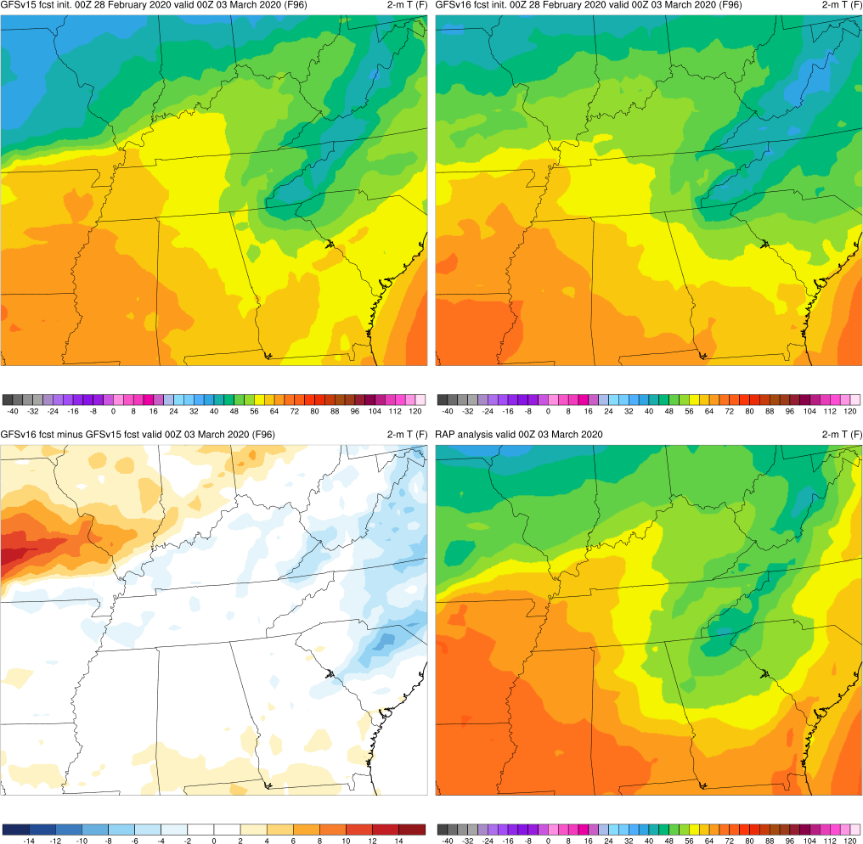
NATIONAL OCEANIC AND ATMOSPHERIC ADMINISTRATION
Tennessee Tornadoes: 2-m T
Tennessee Tornadoes (F096) Valid: 00Z 03/03/20
GFSv16 forecasted correct orientation/position of stationary front at F120, 24 h before GFSv15
GFSv15
GFSv16
v16−v15
RAP Anl.

Slide 27
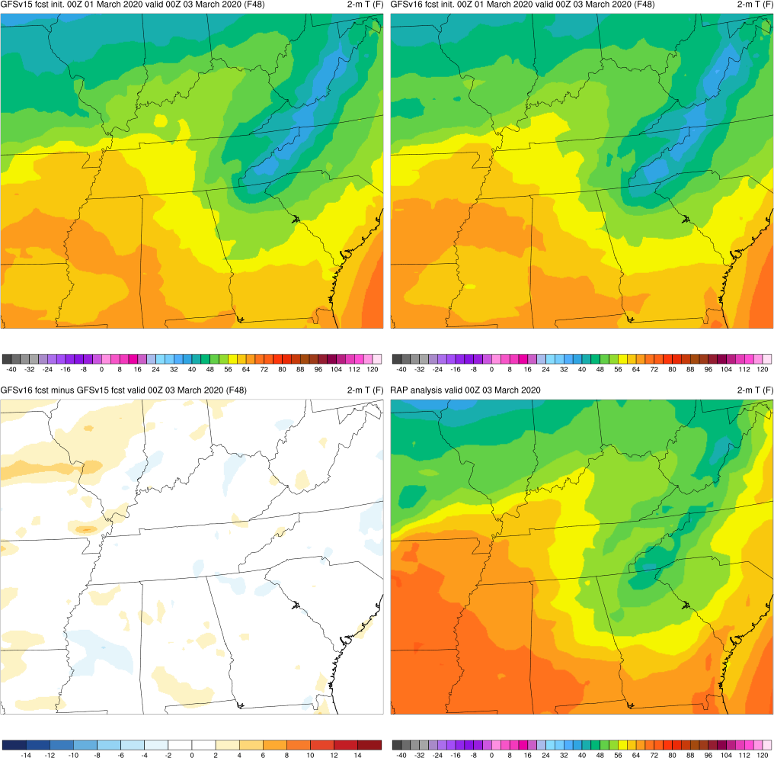
NATIONAL OCEANIC AND ATMOSPHERIC ADMINISTRATION
Tennessee Tornadoes: 2-m T
Tennessee Tornadoes (F048) Valid: 00Z 03/03/20
GFSv16 forecasted correct orientation/position of stationary front at F120, 24 h before GFSv15
GFSv15
GFSv16
v16−v15
RAP Anl.

Slide 28
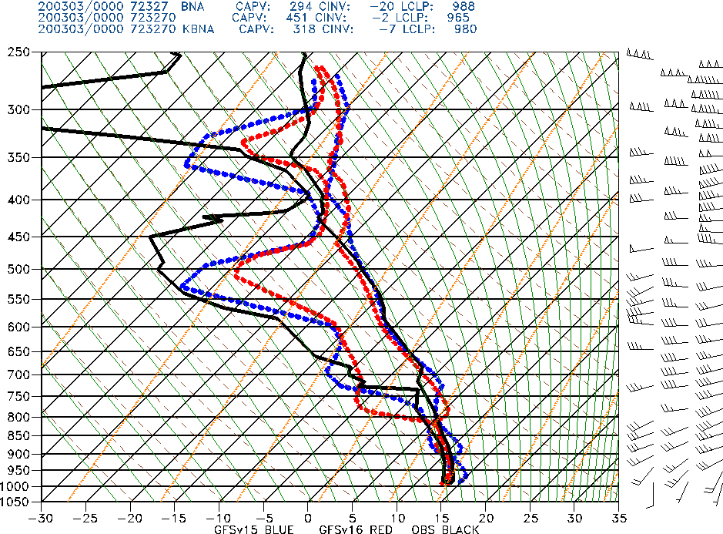
NATIONAL OCEANIC AND ATMOSPHERIC ADMINISTRATION
Tennessee Tornadoes: BNA Sounding
Tennessee Tornadoes (F048) Valid: 00Z 03/03/20
Nashville, TN
GFSv16 forecasted correct orientation/position of warm front 24 h before GFSv15
GFSv16 handled low-level temp/moisture profile at BNA better than GFSv15
GFSv15
GFSv16
OBS

Slide 29
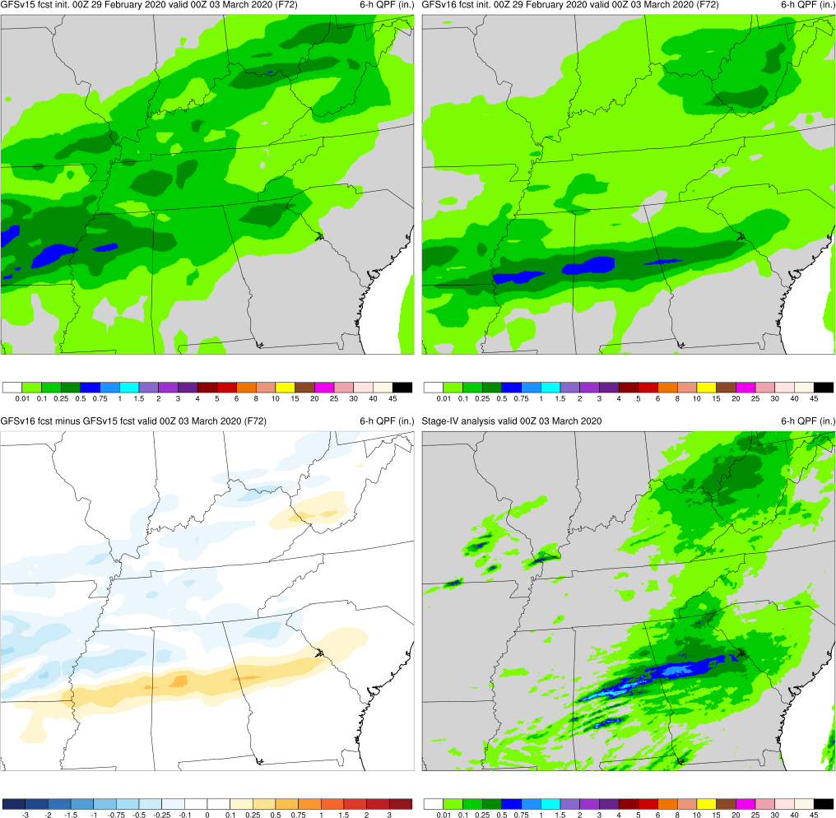
NATIONAL OCEANIC AND ATMOSPHERIC ADMINISTRATION
Tennessee Tornadoes: 6-h QPF
GFSv15
GFSv16
Tennessee Tornadoes (F072) Valid: 00Z 03/03/20
GFSv16 forecasted lower precip amounts over TN more consistently than GFSv15, which benefitted CAPE guidance
v16−v15
S-IV Anl.

Slide 30
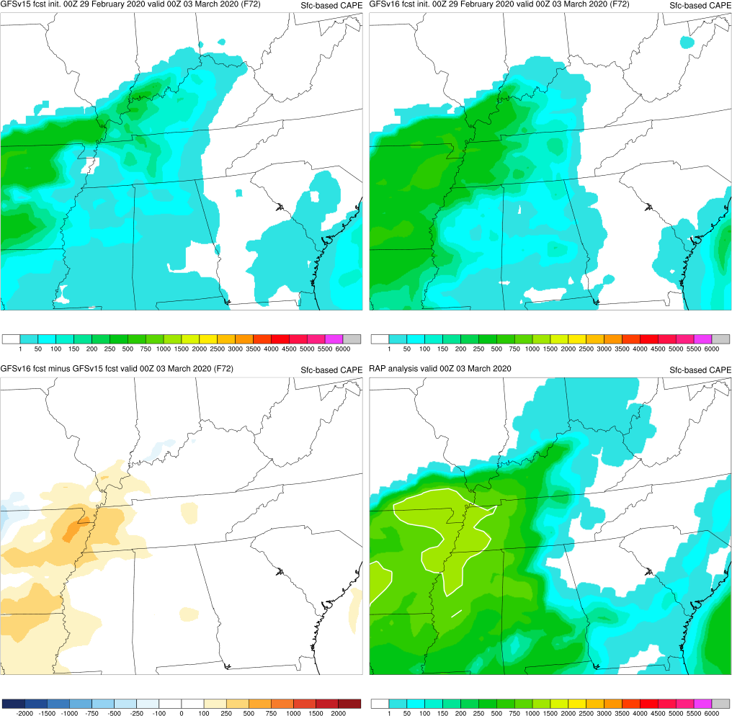
NATIONAL OCEANIC AND ATMOSPHERIC ADMINISTRATION
Tennessee Tornadoes: SBCAPE
GFSv15
GFSv16
Tennessee Tornadoes (F072) Valid: 00Z 03/03/20
GFSv16 forecasted lower precip amounts over TN more consistently than GFSv15, which benefitted CAPE guidance
GFSv16 more correctly quantified the severe environment over TN
v16−v15
RAP Anl.

Slide 31
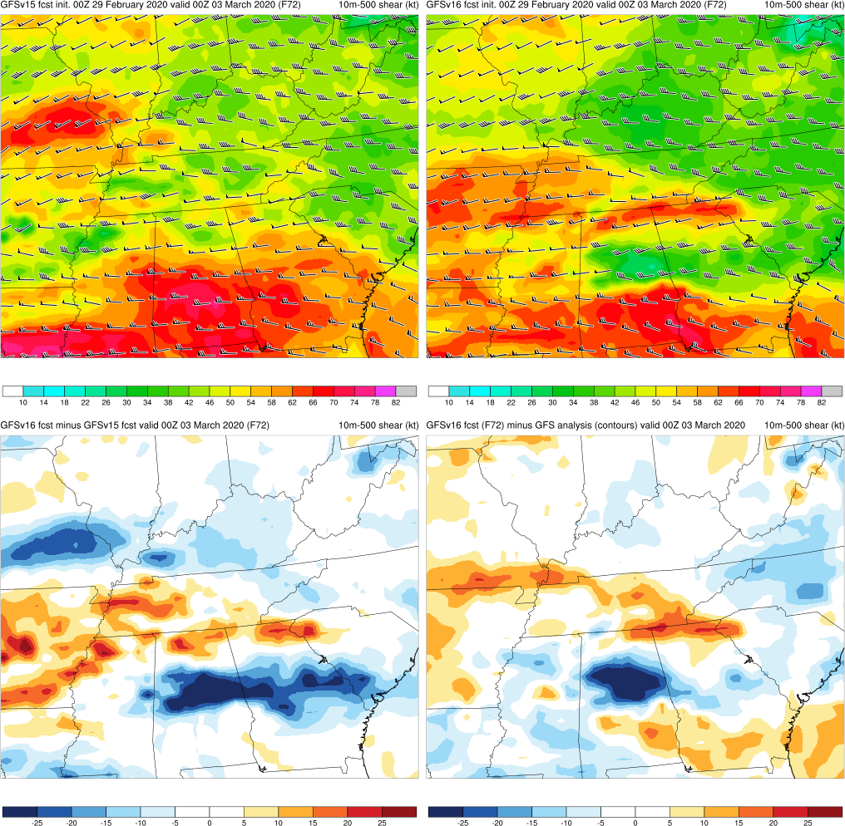
NATIONAL OCEANIC AND ATMOSPHERIC ADMINISTRATION
Tennessee Tornadoes: 0-6 km Shear
GFSv15
GFSv16
Tennessee Tornadoes (F072) Valid: 00Z 03/03/20
GFSv16 forecasted lower precip amounts over TN more consistently than GFSv15, which benefitted CAPE guidance
GFSv16 more correctly quantified the severe environment over TN
v16−v15
Anl. – v16

Slide 32
NATIONAL OCEANIC AND ATMOSPHERIC ADMINISTRATION
GFSv16 Retrospectives: Severe Weather
GFSv16 severe weather case studies:
Mid-Atlantic Severe (Feb 6-7, 2020)
Tennessee Tornadoes (Mar 2-3, 2020)
Easter Sunday (Apr 12-13, 2020)
Southeast Severe (Apr 19-23, 2020)
Mid-May (May 17-22, 2019)
Late May (May 23-29, 2019)
https://www.emc.ncep.noaa.gov/users/meg/gfsv16/retros/

Slide 33
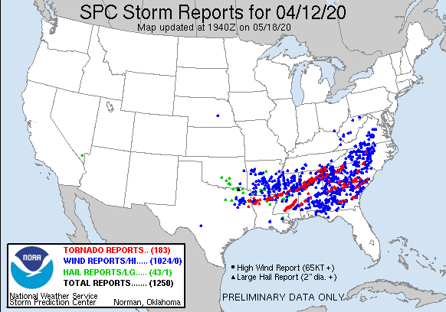
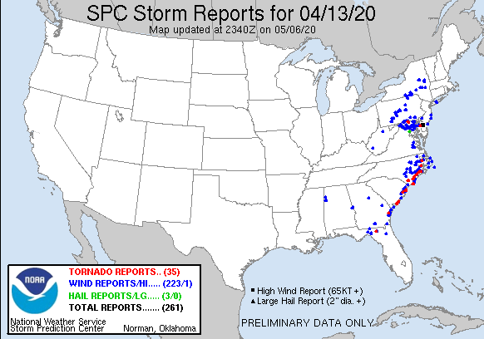
NATIONAL OCEANIC AND ATMOSPHERIC ADMINISTRATION
Easter Sunday (Apr 12-13, 2020)

Slide 34
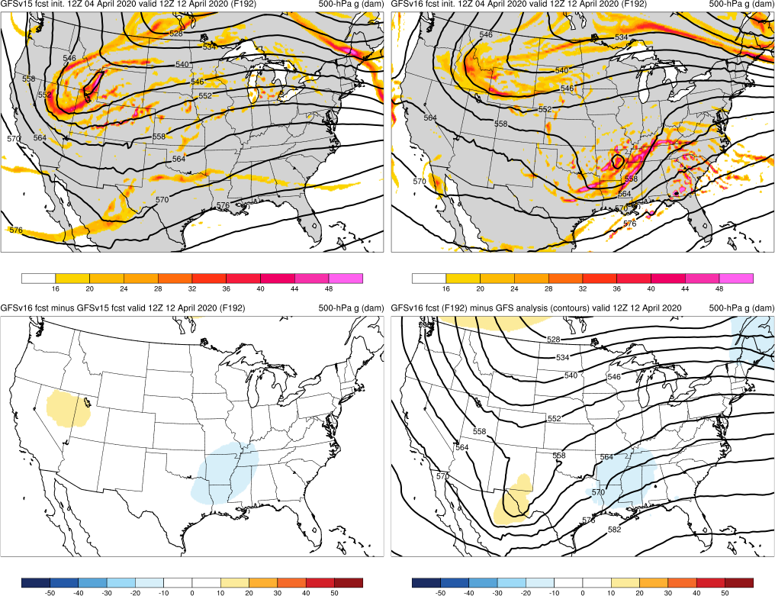
NATIONAL OCEANIC AND ATMOSPHERIC ADMINISTRATION
Easter Sunday: 500-hPa Heights
Easter Sunday (F192) Valid: 12Z 04/12/20
GFSv15
GFSv16
Despite being too progressive, GFSv16 consistently forecasted a trough affecting the Southeast US 72 h before GFSv15
v16−v15
GFS Anl.

Slide 35
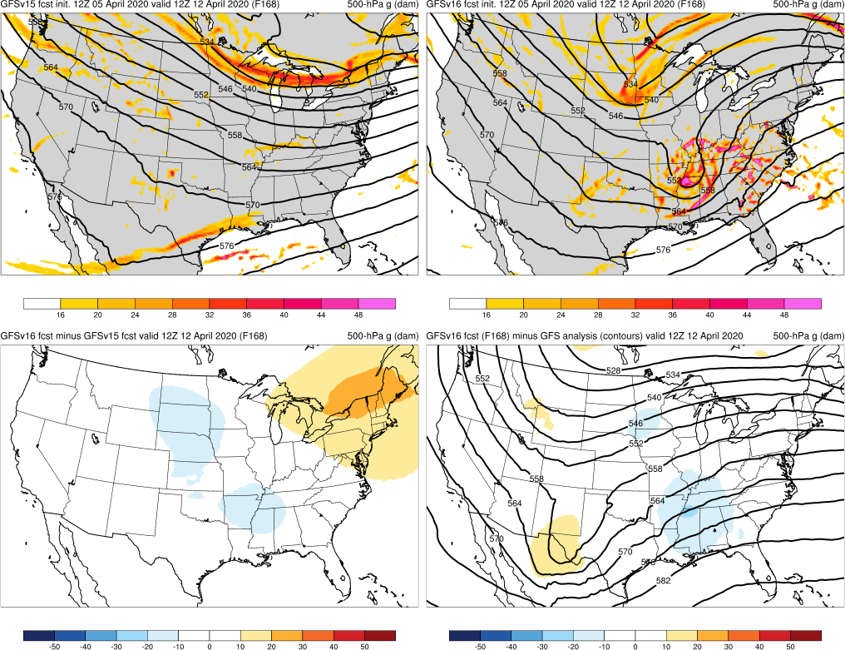
NATIONAL OCEANIC AND ATMOSPHERIC ADMINISTRATION
Easter Sunday: 500-hPa Heights
Easter Sunday (F168) Valid: 12Z 04/12/20
GFSv15
GFSv16
Despite being too progressive, GFSv16 consistently forecasted a trough affecting the Southeast US 72 h before GFSv15
v16−v15
GFS Anl.

Slide 36
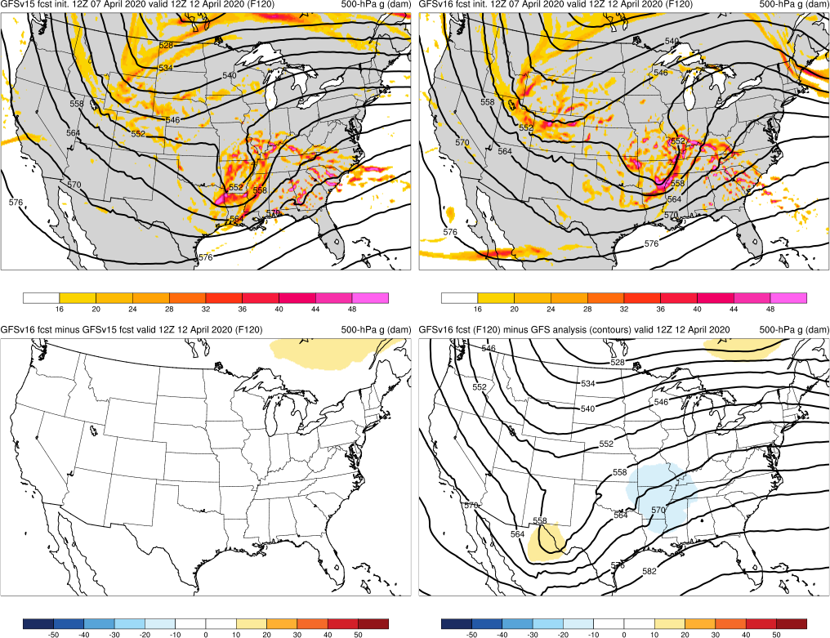
NATIONAL OCEANIC AND ATMOSPHERIC ADMINISTRATION
Easter Sunday: 500-hPa Heights
Easter Sunday (F120) Valid: 12Z 04/12/20
GFSv15
GFSv16
Despite being too progressive, GFSv16 consistently forecasted a trough affecting the Southeast US 72 h before GFSv15
v16−v15
GFS Anl.

Slide 37
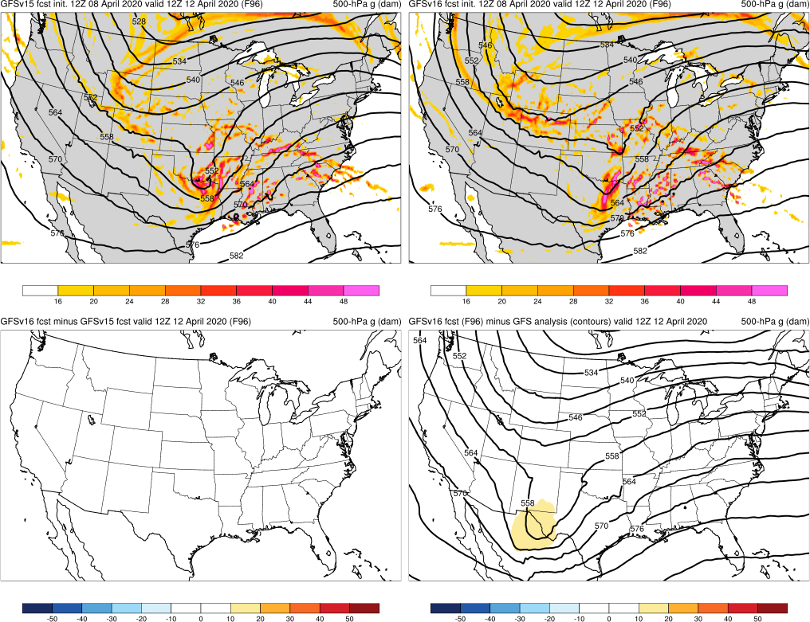
NATIONAL OCEANIC AND ATMOSPHERIC ADMINISTRATION
Easter Sunday: 500-hPa Heights
Easter Sunday (F096) Valid: 12Z 04/12/20
GFSv15
GFSv16
Despite being too progressive, GFSv16 consistently forecasted a trough affecting the Southeast US 72 h before GFSv15
v16−v15
GFS Anl.

Slide 38
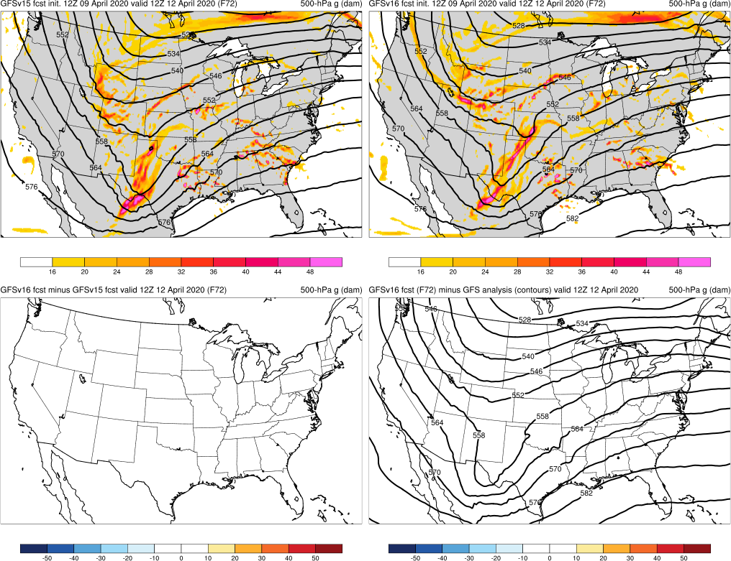
NATIONAL OCEANIC AND ATMOSPHERIC ADMINISTRATION
Easter Sunday: 500-hPa Heights
Easter Sunday (F072) Valid: 12Z 04/12/20
GFSv15
GFSv16
Despite being too progressive, GFSv16 consistently forecasted a trough affecting the Southeast US 72 h before GFSv15
v16−v15
GFS Anl.

Slide 39
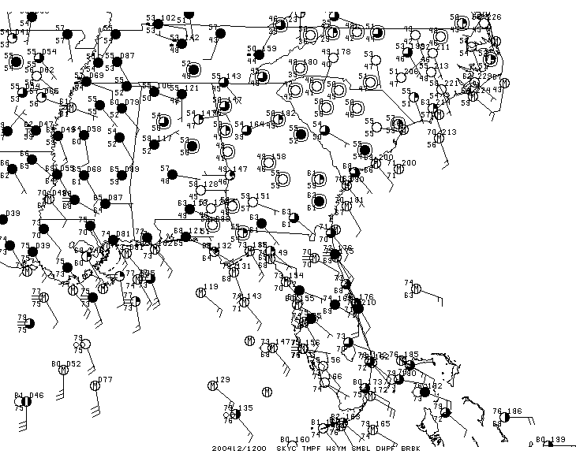
NATIONAL OCEANIC AND ATMOSPHERIC ADMINISTRATION
Easter Sunday: Surface Analysis
Easter Sunday Valid: 12Z 04/12/20

Slide 40
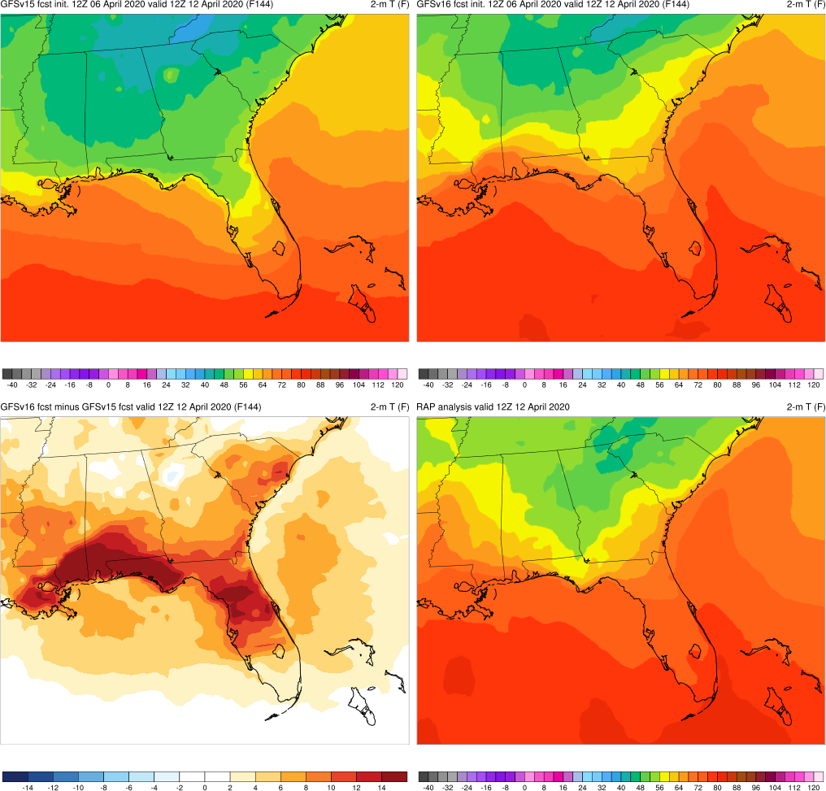
NATIONAL OCEANIC AND ATMOSPHERIC ADMINISTRATION
Easter Sunday: 2-m T
Easter Sunday (F144) Valid: 12Z 04/12/20
GFSv16 forecasted correct orientation of warm front 24 h before GFSv15
GFSv15
GFSv16
v16−v15
RAP Anl.

Slide 41
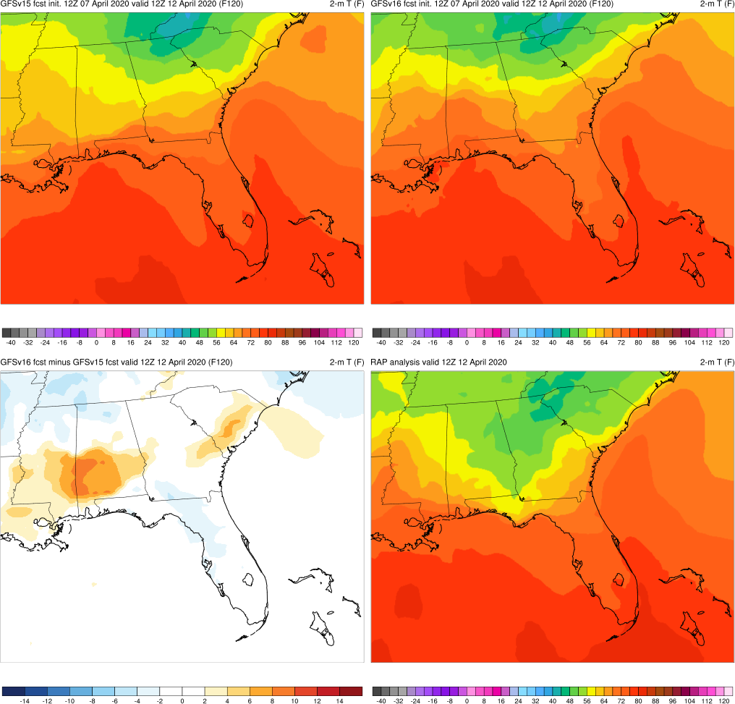
NATIONAL OCEANIC AND ATMOSPHERIC ADMINISTRATION
Easter Sunday: 2-m T
Easter Sunday (F120) Valid: 12Z 04/12/20
GFSv16 forecasted correct orientation of warm front 24 h before GFSv15
GFSv15
GFSv16
v16−v15
RAP Anl.

Slide 42
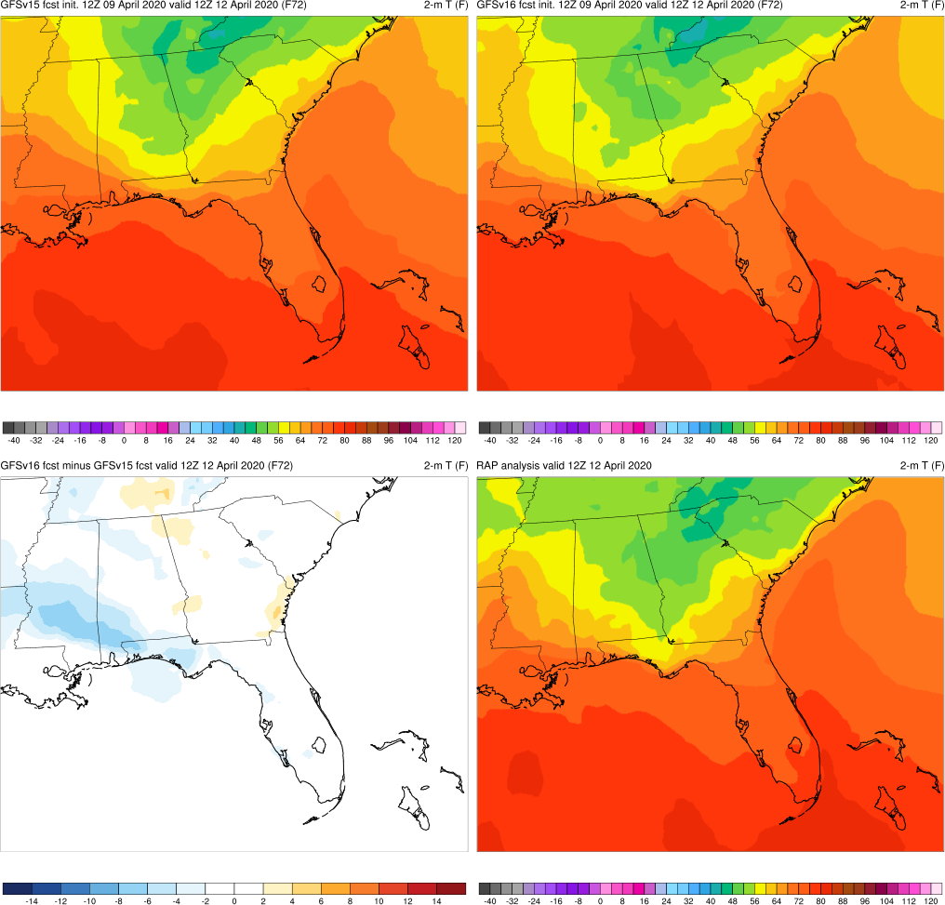
NATIONAL OCEANIC AND ATMOSPHERIC ADMINISTRATION
Easter Sunday: 2-m T
Easter Sunday (F072) Valid: 12Z 04/12/20
GFSv16 forecasted correct orientation of warm front 24 h before GFSv15
GFSv15
GFSv16
v16−v15
RAP Anl.

Slide 43
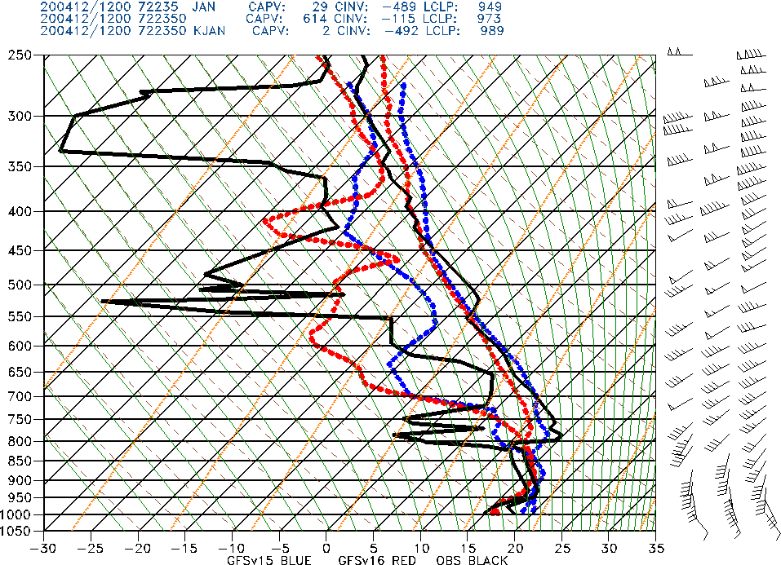
NATIONAL OCEANIC AND ATMOSPHERIC ADMINISTRATION
Easter Sunday: JAN Sounding
Easter Sunday (F072) Valid: 12Z 04/12/20
Jackson, MS
GFSv16 forecasted correct orientation of 12z warm front 24 h before GFSv15
GFSv16 handled low-level temp/moisture profile at JAN better than GFSv15
GFSv15
GFSv16
OBS

Slide 44
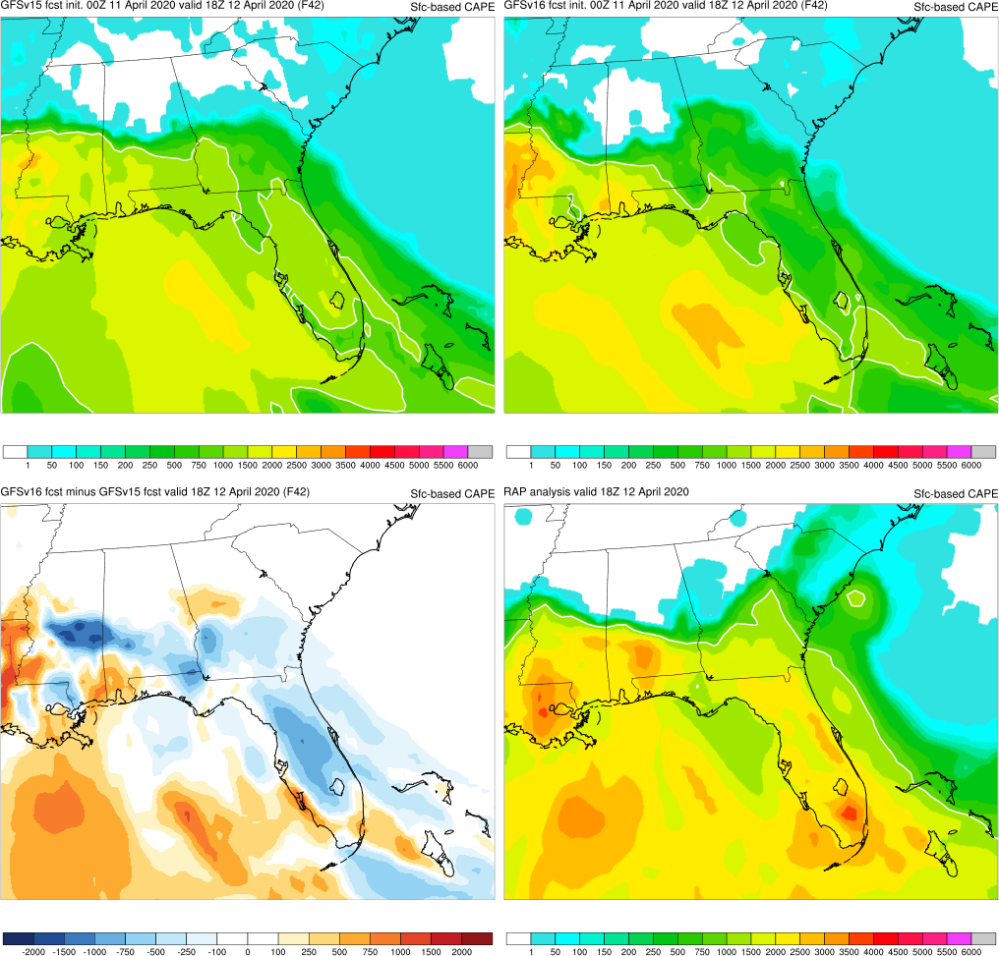
NATIONAL OCEANIC AND ATMOSPHERIC ADMINISTRATION
Easter Sunday: SBCAPE
Easter Sunday (F042) Valid: 18Z 04/12/20
GFSv16 forecasted SBCAPE that was closer to analyzed in the main threat area than GFSv15
GFSv15
GFSv16
v16−v15
RAP Anl.

Slide 45
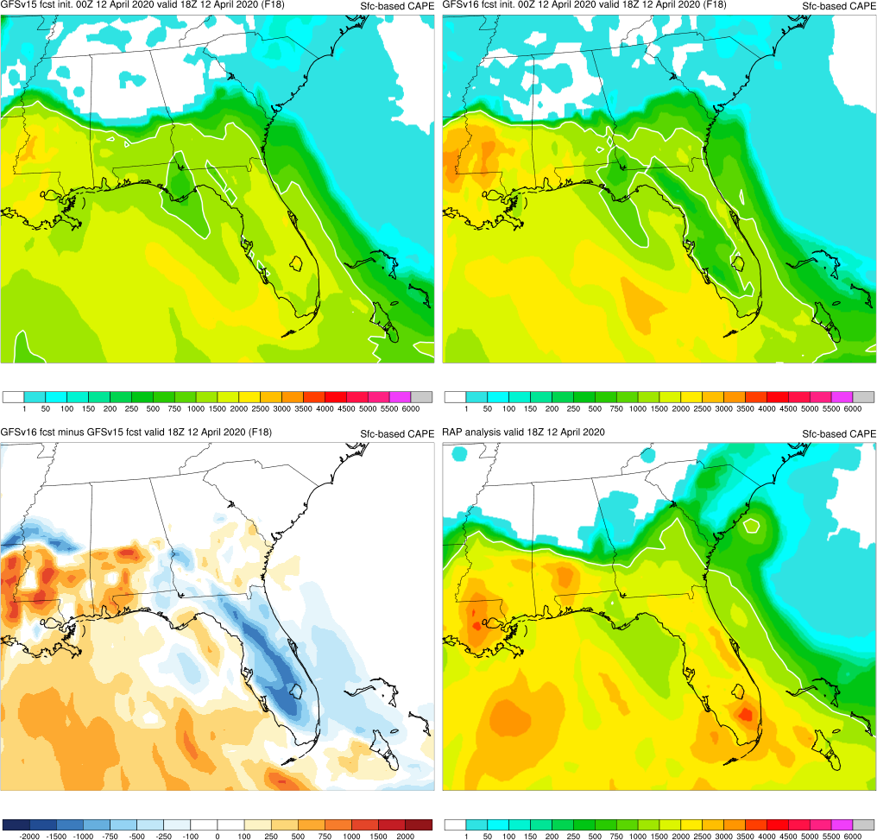
NATIONAL OCEANIC AND ATMOSPHERIC ADMINISTRATION
Easter Sunday: SBCAPE
Easter Sunday (F018) Valid: 18Z 04/12/20
GFSv16 forecasted SBCAPE that was closer to analyzed in the main threat area than GFSv15
GFSv15
GFSv16
v16−v15
RAP Anl.

Slide 46
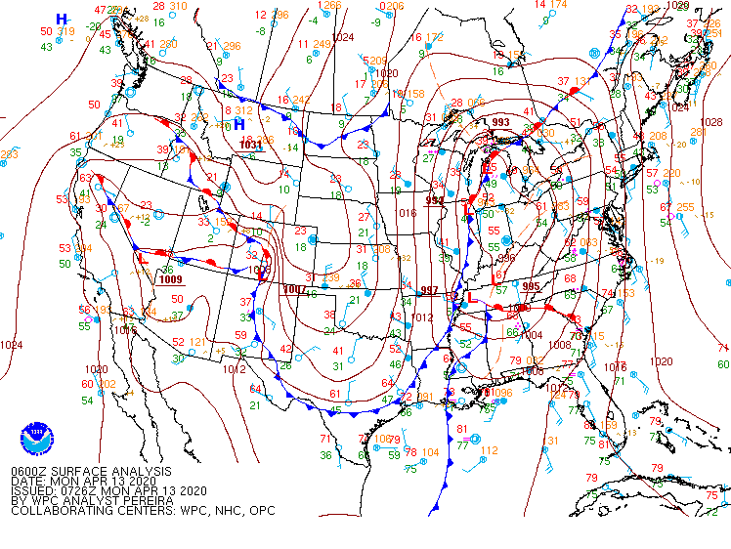
NATIONAL OCEANIC AND ATMOSPHERIC ADMINISTRATION
Easter Sunday: WPC Analysis
Easter Sunday Valid: 06Z 04/13/20

Slide 47
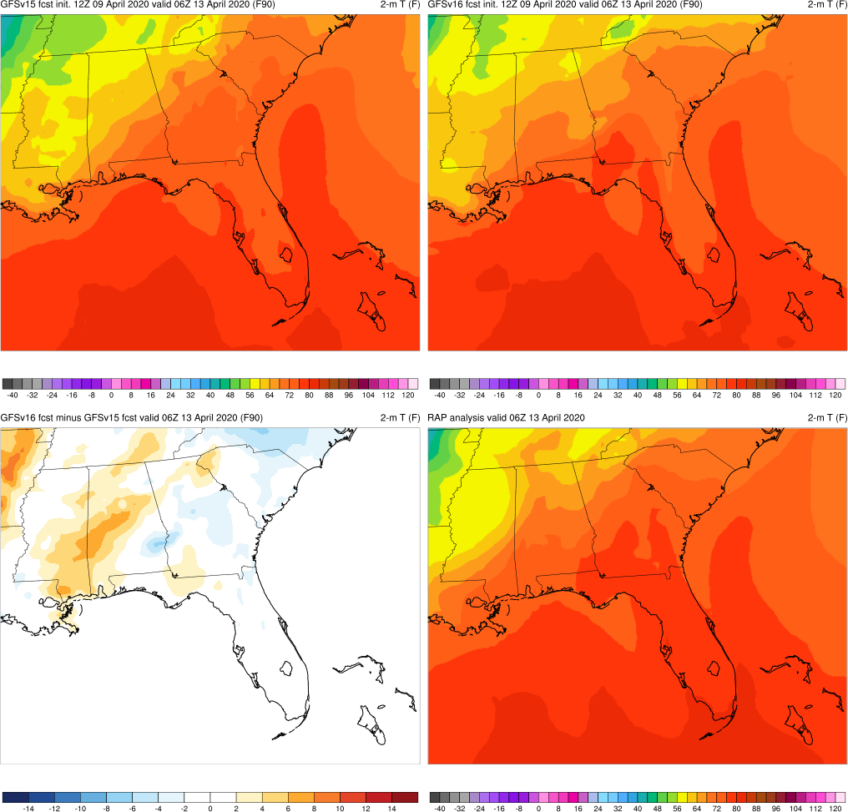
NATIONAL OCEANIC AND ATMOSPHERIC ADMINISTRATION
Easter Sunday: 2-m T
Easter Sunday (F090) Valid: 06Z 04/13/20
GFSv16 was more correct and consistent with position/orientation of warm and cold fronts than GFSv15
GFSv15
GFSv16
v16−v15
RAP Anl.

Slide 48
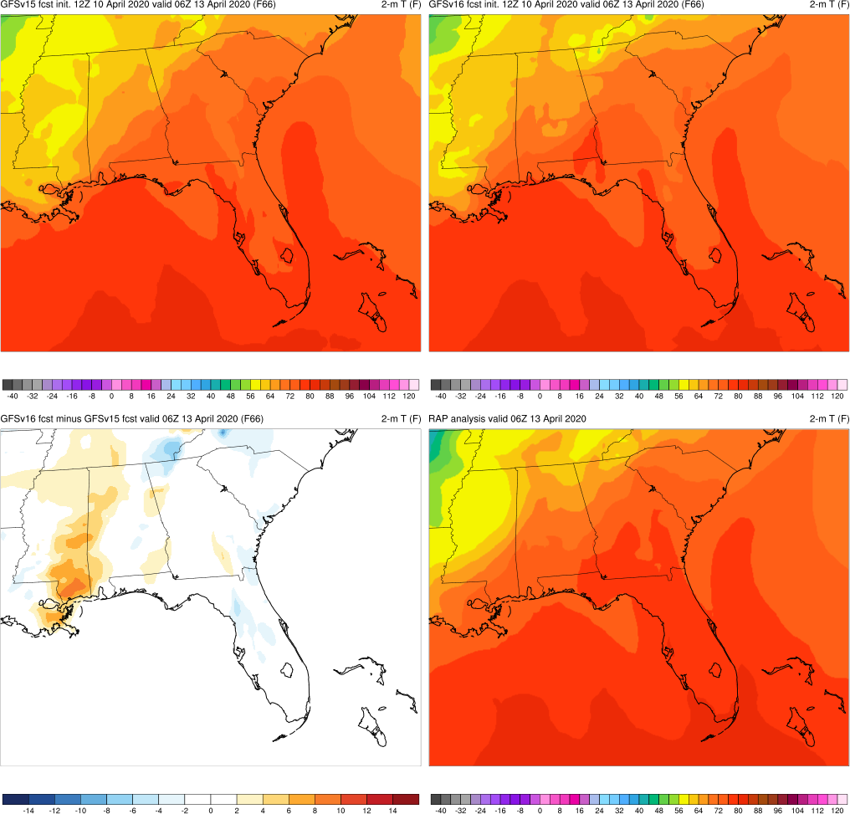
NATIONAL OCEANIC AND ATMOSPHERIC ADMINISTRATION
Easter Sunday: 2-m T
Easter Sunday (F066) Valid: 06Z 04/13/20
GFSv16 was more correct and consistent with position/orientation of warm and cold fronts than GFSv15
GFSv15
GFSv16
v16−v15
RAP Anl.

Slide 49
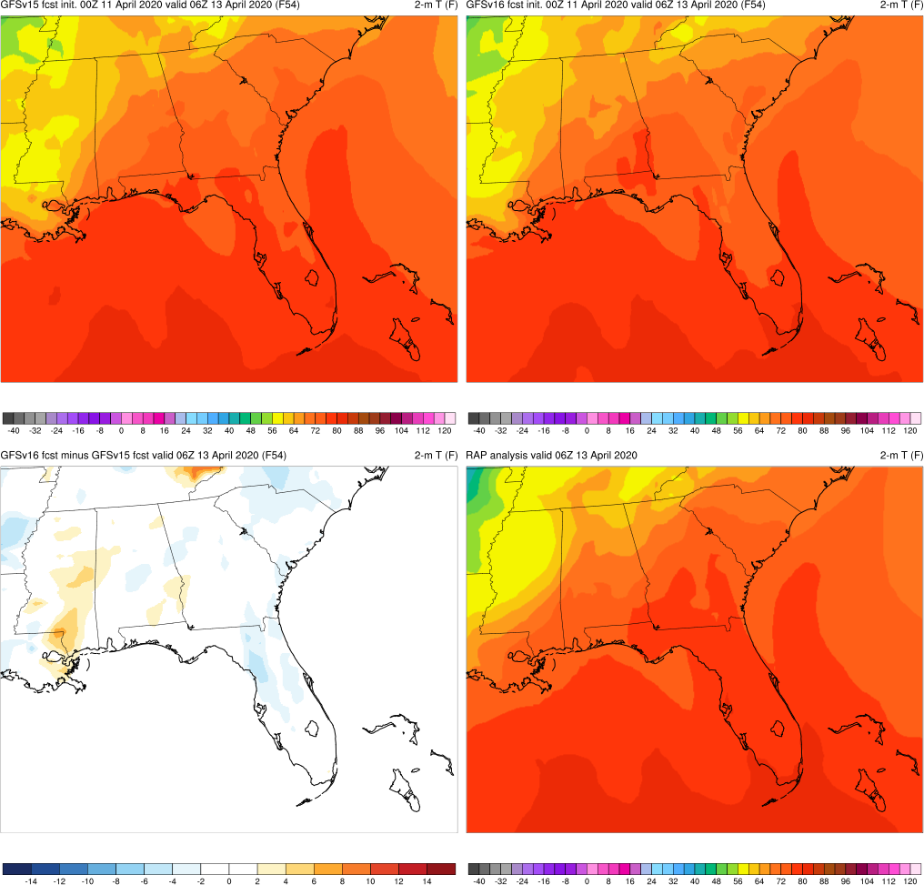
NATIONAL OCEANIC AND ATMOSPHERIC ADMINISTRATION
Easter Sunday: 2-m T
Easter Sunday (F054) Valid: 06Z 04/13/20
GFSv16 was more correct and consistent with position/orientation of warm and cold fronts than GFSv15
GFSv15
GFSv16
v16−v15
RAP Anl.

Slide 50
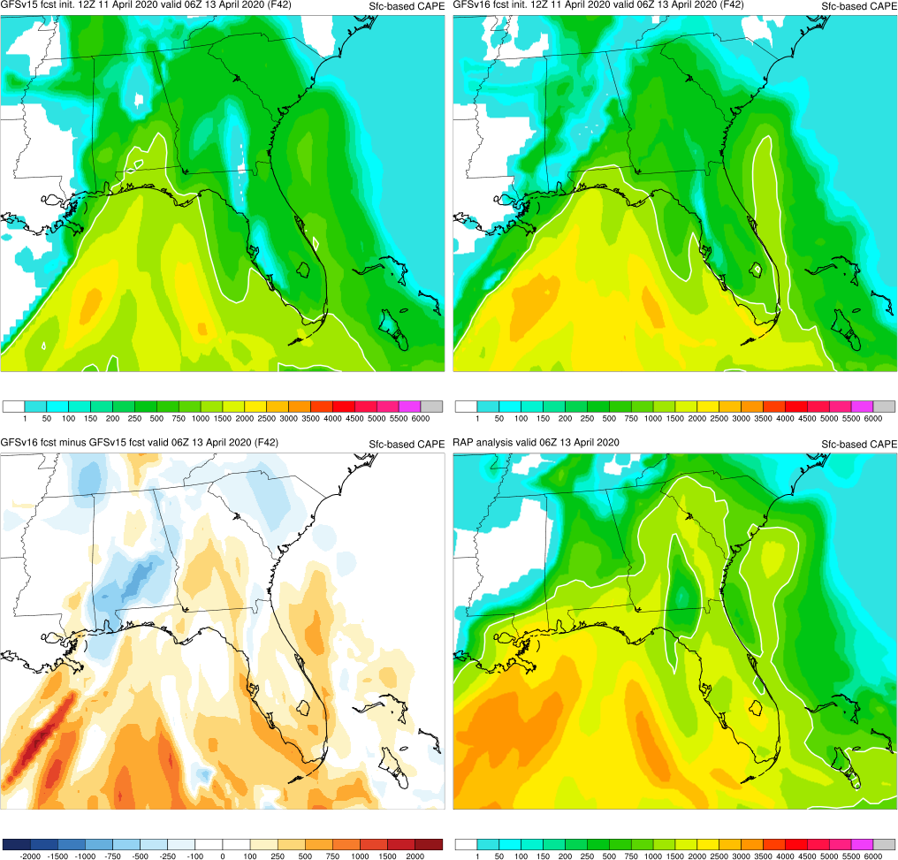
NATIONAL OCEANIC AND ATMOSPHERIC ADMINISTRATION
Easter Sunday: SBCAPE
Easter Sunday (F042) Valid: 06Z 04/13/20
GFSv16 was more correct and consistent with position/orientation of warm and cold fronts than GFSv15
Both GFSv15 and GFSv16 poorly forecasted SBCAPE ahead of convective line in GA/SC
GFSv15
GFSv16
v16−v15
RAP Anl.

Slide 51
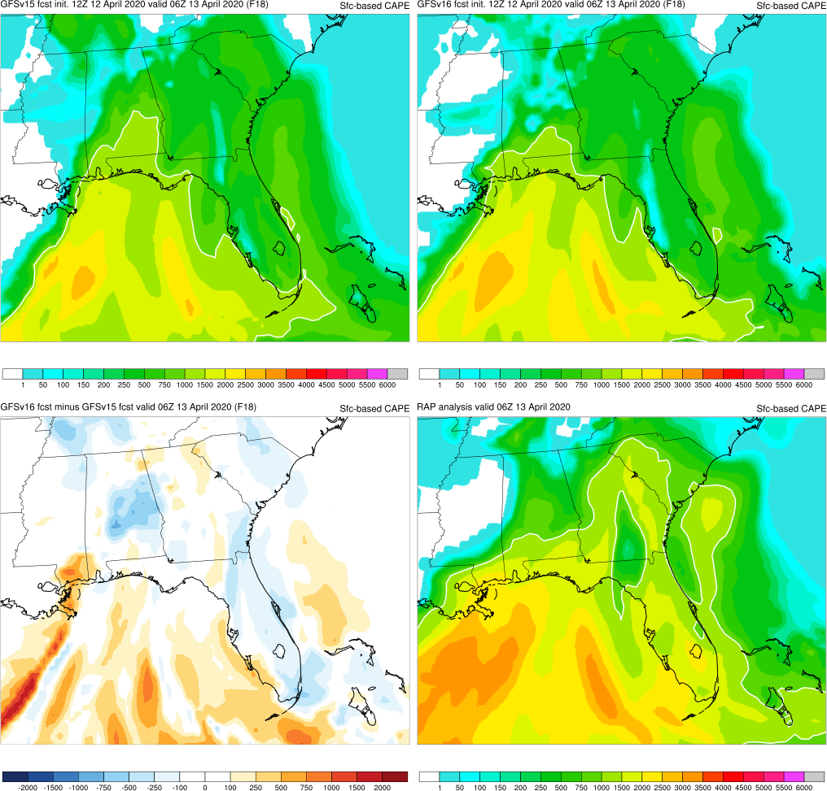
NATIONAL OCEANIC AND ATMOSPHERIC ADMINISTRATION
Easter Sunday: SBCAPE
Easter Sunday (F018) Valid: 06Z 04/13/20
GFSv16 was more correct and consistent with position/orientation of warm and cold fronts than GFSv15
Both GFSv15 and GFSv16 poorly forecasted SBCAPE ahead of convective line in GA/SC
GFSv15
GFSv16
v16−v15
RAP Anl.

Slide 52
NATIONAL OCEANIC AND ATMOSPHERIC ADMINISTRATION
GFSv16 Retrospectives: Severe Weather
GFSv16 severe weather case studies:
Mid-Atlantic Severe (Feb 6-7, 2020)
Tennessee Tornadoes (Mar 2-3, 2020)
Easter Sunday (Apr 12-13, 2020)
Southeast Severe (Apr 19-23, 2020)
Mid-May (May 17-22, 2019)
Late May (May 23-29, 2019)
https://www.emc.ncep.noaa.gov/users/meg/gfsv16/retros/

Slide 53
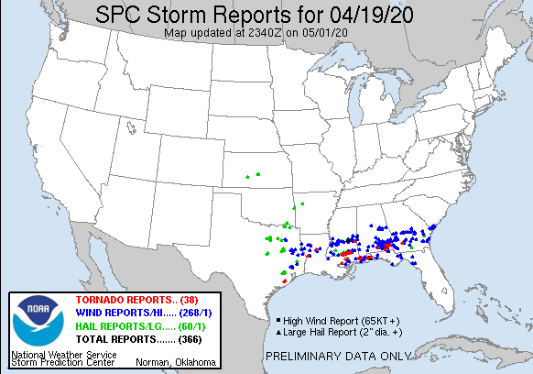
NATIONAL OCEANIC AND ATMOSPHERIC ADMINISTRATION
Southeast Severe (Apr 19-23, 2020)

Slide 54
NATIONAL OCEANIC AND ATMOSPHERIC ADMINISTRATION
Southeast Severe: 500-hPa Heights
Southeast Severe (F120) Valid: 12Z 04/22/20
GFSv15
GFSv16
GFSv16 forecasted structure of trough 24 h earlier than GFSv15
GFSv15 forecasted location of trough more correctly than GFSv16
v16−v15
GFS Anl.

Slide 55
NATIONAL OCEANIC AND ATMOSPHERIC ADMINISTRATION
Southeast Severe: 500-hPa Heights
Southeast Severe (F096) Valid: 12Z 04/22/20
GFSv15
GFSv16
GFSv16 forecasted structure of trough 24 h earlier than GFSv15
GFSv15 forecasted location of trough more correctly than GFSv16
v16−v15
GFS Anl.

Slide 56
NATIONAL OCEANIC AND ATMOSPHERIC ADMINISTRATION
Southeast Severe: 500-hPa Heights
Southeast Severe (F072) Valid: 12Z 04/22/20
GFSv15
GFSv16
GFSv16 forecasted structure of trough 24 h earlier than GFSv15
GFSv15 forecasted location of trough more correctly than GFSv16
v16−v15
GFS Anl.

Slide 57
NATIONAL OCEANIC AND ATMOSPHERIC ADMINISTRATION
Southeast Severe: WPC Analysis
Southeast Severe Valid: 00Z 04/23/20

Slide 58
NATIONAL OCEANIC AND ATMOSPHERIC ADMINISTRATION
Southeast Severe: 2-m Td
Southeast Severe (F072) Valid: 00Z 04/23/20
GFSv15
GFSv16
GFSv16 forecasted the correct position/orientation of cold front 24 h before GFSv15
v16−v15
GFS Anl.

Slide 59
NATIONAL OCEANIC AND ATMOSPHERIC ADMINISTRATION
Southeast Severe: 2-m Td
Southeast Severe (F048) Valid: 00Z 04/23/20
GFSv15
GFSv16
GFSv16 forecasted the correct position/orientation of cold front 24 h before GFSv15
v16−v15
GFS Anl.

Slide 60
NATIONAL OCEANIC AND ATMOSPHERIC ADMINISTRATION
Southeast Severe: LCH Sounding
Southeast Severe (F072) Valid: 00Z 04/23/20
Lake Charles, LA
GFSv16 forecasted the correct position/orientation of cold front 24 h before GFSv15
GFSv16 handled low-level temp/moisture profile at LCH better than GFSv15
GFSv15
GFSv16
OBS

Slide 61
NATIONAL OCEANIC AND ATMOSPHERIC ADMINISTRATION
Southeast Severe: 500-hPa Heights
Southeast Severe (F084) Valid: 00Z 04/24/20
GFSv15
GFSv16
GFSv16 forecasted structure and location of trough 48 h earlier than GFSv15
v16−v15
GFS Anl.

Slide 62
NATIONAL OCEANIC AND ATMOSPHERIC ADMINISTRATION
Southeast Severe: 500-hPa Heights
Southeast Severe (F060) Valid: 00Z 04/24/20
GFSv15
GFSv16
GFSv16 forecasted structure and location of trough 48 h earlier than GFSv15
v16−v15
GFS Anl.

Slide 63
NATIONAL OCEANIC AND ATMOSPHERIC ADMINISTRATION
Southeast Severe: 500-hPa Heights
Southeast Severe (F036) Valid: 00Z 04/24/20
GFSv15
GFSv16
GFSv16 forecasted structure and location of trough 48 h earlier than GFSv15
v16−v15
GFS Anl.

Slide 64
NATIONAL OCEANIC AND ATMOSPHERIC ADMINISTRATION
GFSv16 Retrospectives: Severe Weather
GFSv16 severe weather case studies:
Mid-Atlantic Severe (Feb 6-7, 2020)
Tennessee Tornadoes (Mar 2-3, 2020)
Easter Sunday (Apr 12-13, 2020)
Southeast Severe (Apr 19-23, 2020)
Mid-May (May 17-22, 2019)
Late May (May 23-29, 2019)
https://www.emc.ncep.noaa.gov/users/meg/gfsv16/retros/

Slide 65
NATIONAL OCEANIC AND ATMOSPHERIC ADMINISTRATION
Mid-May (May 17-22, 2019)

Slide 66
NATIONAL OCEANIC AND ATMOSPHERIC ADMINISTRATION
Mid-May: 500-hPa Heights
Mid-May (F180) Valid: 12Z 05/17/19
12z 5/17/20: GFSv16 forecasted the considerable synoptic pattern change 72 h earlier than GFSv15
GFSv15
GFSv16
v16−v15
GFS Anl.

Slide 67
NATIONAL OCEANIC AND ATMOSPHERIC ADMINISTRATION
Mid-May: 500-hPa Heights
Mid-May (F156) Valid: 12Z 05/17/19
12z 5/17/20: GFSv16 forecasted the considerable synoptic pattern change 72 h earlier than GFSv15
GFSv15
GFSv16
v16−v15
GFS Anl.

Slide 68
NATIONAL OCEANIC AND ATMOSPHERIC ADMINISTRATION
Mid-May: 500-hPa Heights
Mid-May (F108) Valid: 12Z 05/17/19
12z 5/17/20: GFSv16 forecasted the considerable synoptic pattern change 72 h earlier than GFSv15
GFSv15
GFSv16
v16−v15
GFS Anl.

Slide 69
NATIONAL OCEANIC AND ATMOSPHERIC ADMINISTRATION
Mid-May: 500-hPa Heights
Mid-May (F192) Valid: 12Z 05/22/19
12z 5/17/20: GFSv16 forecasted the considerable synoptic pattern change 72 h earlier than GFSv15
12z 5/22/20: GFSv16 forecasted the structure of the cutoff more correctly and consistently than GFSv15
GFSv15
GFSv16
v16−v15
GFS Anl.

Slide 70
NATIONAL OCEANIC AND ATMOSPHERIC ADMINISTRATION
Mid-May: 500-hPa Heights
Mid-May (F156) Valid: 12Z 05/22/19
12z 5/17/20: GFSv16 forecasted the considerable synoptic pattern change 72 h earlier than GFSv15
12z 5/22/20: GFSv16 forecasted the structure of the cutoff more correctly and consistently than GFSv15
GFSv15
GFSv16
v16−v15
GFS Anl.

Slide 71
NATIONAL OCEANIC AND ATMOSPHERIC ADMINISTRATION
Mid-May: 500-hPa Heights
Mid-May (F132) Valid: 12Z 05/22/19
12z 5/17/20: GFSv16 forecasted the considerable synoptic pattern change 72 h earlier than GFSv15
12z 5/22/20: GFSv16 forecasted the structure of the cutoff more correctly and consistently than GFSv15
GFSv15
GFSv16
v16−v15
GFS Anl.

Slide 72
NATIONAL OCEANIC AND ATMOSPHERIC ADMINISTRATION
Mid-May: 500-hPa Heights
Mid-May (F108) Valid: 12Z 05/22/19
12z 5/17/20: GFSv16 forecasted the considerable synoptic pattern change 72 h earlier than GFSv15
12z 5/22/20: GFSv16 forecasted the structure of the cutoff more correctly and consistently than GFSv15
GFSv15
GFSv16
v16−v15
GFS Anl.

Slide 73
NATIONAL OCEANIC AND ATMOSPHERIC ADMINISTRATION
Mid-May: WPC Analysis
Mid-May Valid: 18Z 05/17/19

Slide 74
NATIONAL OCEANIC AND ATMOSPHERIC ADMINISTRATION
Mid-May: 2-m Td
Mid-May (F102) Valid: 18Z 05/17/19
GFSv15
GFSv16
GFSv16 forecasted the position of the dryline more correctly and consistently than GFSv15
GFSv16 under-forecasted Td over much of the warm sector
v16−v15
RAP Anl.

Slide 75
NATIONAL OCEANIC AND ATMOSPHERIC ADMINISTRATION
Mid-May: 2-m Td
Mid-May (F078) Valid: 18Z 05/17/19
GFSv15
GFSv16
GFSv16 forecasted the position of the dryline more correctly and consistently than GFSv15
GFSv16 under-forecasted Td over much of the warm sector
v16−v15
RAP Anl.

Slide 76
NATIONAL OCEANIC AND ATMOSPHERIC ADMINISTRATION
Mid-May: 2-m Td
Mid-May (F054) Valid: 18Z 05/17/19
GFSv15
GFSv16
GFSv16 forecasted the position of the dryline more correctly and consistently than GFSv15
GFSv16 under-forecasted Td over much of the warm sector
v16−v15
RAP Anl.

Slide 77
NATIONAL OCEANIC AND ATMOSPHERIC ADMINISTRATION
Mid-May: SBCAPE
Mid-May (F042) Valid: 18Z 05/17/19
GFSv15
GFSv16
GFSv16 forecasted the position of the dryline more correctly and consistently than GFSv15
GFSv16 under-forecasted Td over much of the warm sector
GFSv16 forecasted considerably lower SBCAPE than GFSv15
v16−v15
RAP Anl.

Slide 78
NATIONAL OCEANIC AND ATMOSPHERIC ADMINISTRATION
Mid-May: SBCAPE
Mid-May (F018) Valid: 18Z 05/17/19
GFSv15
GFSv16
GFSv16 forecasted the position of the dryline more correctly and consistently than GFSv15
GFSv16 under-forecasted Td over much of the warm sector
GFSv16 forecasted considerably lower SBCAPE than GFSv15
v16−v15
RAP Anl.

Slide 79
NATIONAL OCEANIC AND ATMOSPHERIC ADMINISTRATION
Mid-May: DDC Sounding
Mid-May (F084) Valid: 00Z 05/18/19
Dodge City, KS
GFSv16 overall handled the low-level temp/moisture profile at DDC better than GFSv15, but incorrectly strengthened inversion around 750-850 hPa
GFSv15
GFSv16
OBS

Slide 80
NATIONAL OCEANIC AND ATMOSPHERIC ADMINISTRATION
Mid-May: DRT Sounding
Mid-May (F084) Valid: 00Z 05/18/19
Del Rio, TX
GFSv16 overall handled the low-level temp/moisture profile at DDC better than GFSv15, but incorrectly strengthened inversion around 750-850 hPa
GFSv16 produced an overmixed PBL at DRT
GFSv15
GFSv16
OBS

Slide 81
NATIONAL OCEANIC AND ATMOSPHERIC ADMINISTRATION
GFSv16 Retrospectives: Severe Weather
GFSv16 severe weather case studies:
Mid-Atlantic Severe (Feb 6-7, 2020)
Tennessee Tornadoes (Mar 2-3, 2020)
Easter Sunday (Apr 12-13, 2020)
Southeast Severe (Apr 19-23, 2020)
Mid-May (May 17-22, 2019)
Late May (May 23-29, 2019)
https://www.emc.ncep.noaa.gov/users/meg/gfsv16/retros/

Slide 82
NATIONAL OCEANIC AND ATMOSPHERIC ADMINISTRATION
Late May (May 23-29, 2019)

Slide 83
NATIONAL OCEANIC AND ATMOSPHERIC ADMINISTRATION
Late May: 500-hPa Heights
Late May (F168) Valid: 12Z 05/26/19
GFSv16 forecasted the structure of the cutoff and trough more correctly and consistently than GFSv15
GFSv15
GFSv16
v16−v15
GFS Anl.

Slide 84
NATIONAL OCEANIC AND ATMOSPHERIC ADMINISTRATION
Late May: 500-hPa Heights
Late May (F144) Valid: 12Z 05/26/19
GFSv16 forecasted the structure of the cutoff and trough more correctly and consistently than GFSv15
GFSv15
GFSv16
v16−v15
GFS Anl.

Slide 85
NATIONAL OCEANIC AND ATMOSPHERIC ADMINISTRATION
Late May: 500-hPa Heights
Late May (F120) Valid: 12Z 05/26/19
GFSv16 forecasted the structure of the cutoff and trough more correctly and consistently than GFSv15
GFSv15
GFSv16
v16−v15
GFS Anl.

Slide 86
NATIONAL OCEANIC AND ATMOSPHERIC ADMINISTRATION
Late May: 500-hPa Heights
Late May (F096) Valid: 12Z 05/26/19
GFSv16 forecasted the structure of the cutoff and trough more correctly and consistently than GFSv15
GFSv15
GFSv16
v16−v15
GFS Anl.

Slide 87
NATIONAL OCEANIC AND ATMOSPHERIC ADMINISTRATION
Late May: WPC Analysis
Late May Valid: 18Z 05/26/19

Slide 88
NATIONAL OCEANIC AND ATMOSPHERIC ADMINISTRATION
Late May: 2-m Td
Mid-May (F102) Valid: 18Z 05/26/19
GFSv15
GFSv16
GFSv16 forecasted the position of the dryline more correctly and consistently than GFSv15
GFSv16 under-forecasted Td over much of the warm sector
v16−v15
RAP Anl.

Slide 89
NATIONAL OCEANIC AND ATMOSPHERIC ADMINISTRATION
Late May: 2-m Td
Mid-May (F078) Valid: 18Z 05/26/19
GFSv15
GFSv16
GFSv16 forecasted the position of the dryline more correctly and consistently than GFSv15
GFSv16 under-forecasted Td over much of the warm sector
v16−v15
RAP Anl.

Slide 90
NATIONAL OCEANIC AND ATMOSPHERIC ADMINISTRATION
Late May: 2-m Td
Mid-May (F054) Valid: 18Z 05/26/19
GFSv15
GFSv16
GFSv16 forecasted the position of the dryline more correctly and consistently than GFSv15
GFSv16 under-forecasted Td over much of the warm sector
v16−v15
RAP Anl.

Slide 91
NATIONAL OCEANIC AND ATMOSPHERIC ADMINISTRATION
Late May: SBCAPE
Mid-May (F042) Valid: 18Z 05/26/19
GFSv15
GFSv16
GFSv16 forecasted the position of the dryline more correctly and consistently than GFSv15
GFSv16 under-forecasted Td over much of the warm sector
GFSv16 forecasted considerably lower SBCAPE than GFSv15
v16−v15
RAP Anl.

Slide 92
NATIONAL OCEANIC AND ATMOSPHERIC ADMINISTRATION
Late May: SBCAPE
Mid-May (F018) Valid: 18Z 05/26/19
GFSv15
GFSv16
GFSv16 forecasted the position of the dryline more correctly and consistently than GFSv15
GFSv16 under-forecasted Td over much of the warm sector
GFSv16 forecasted considerably lower SBCAPE than GFSv15
v16−v15
RAP Anl.

