Slide 1
NATIONAL OCEANIC AND ATMOSPHERIC ADMINISTRATION
GFSv16 Case Studies: Winter Weather
GFSv15 (F120)
GFSv16 (F120)
GFS Analysis
L
L
Alicia Bentley EMC Model Evaluation Group Webinar
27 August 2020

Slide 2
NATIONAL OCEANIC AND ATMOSPHERIC ADMINISTRATION
GFSv16 Winter Weather: Strengths
Improved 500-hPa geo. height AC scores in the medium range
Overall, captures the synoptic pattern better and more consistently (i.e., forecasts jump around less) in the medium and short range
Some indication that progressiveness of cutoff lows is reduced
Overall, improved snowfall locations and amounts at all lead times
Overall, improved medium-range precipitation type (ptype) forecasts
Low-level warming issue seen in GFSv15 has been resolved

Slide 3
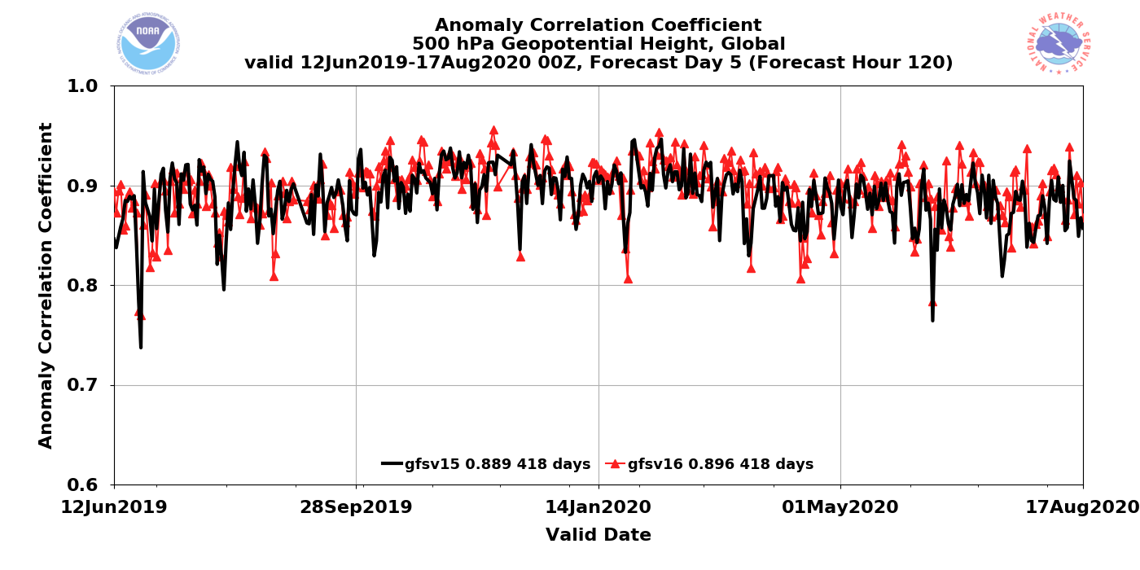
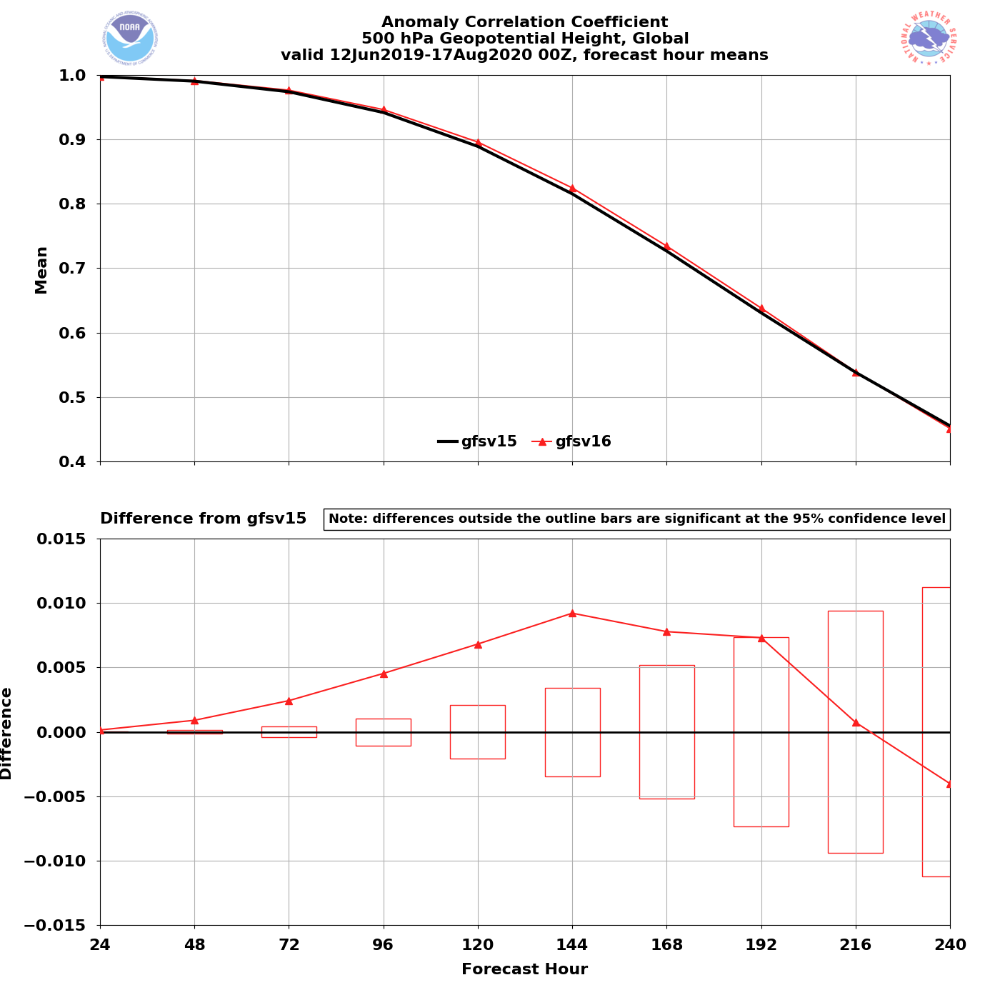
NATIONAL OCEANIC AND ATMOSPHERIC ADMINISTRATION
Strengths: 500-hPa AC Scores (Global)
Valid: 6/12/19–8/17/20 (Day 5)
GFSv15 = .889
GFSv16 = .896
GFSv16 had higher AC scores than GFSv15 at the majority of forecast lead times (Days 1–9)
GFSv16 had statistically significantly higher AC scores at Days 2–7
GFSv16−GFSv15

Slide 4
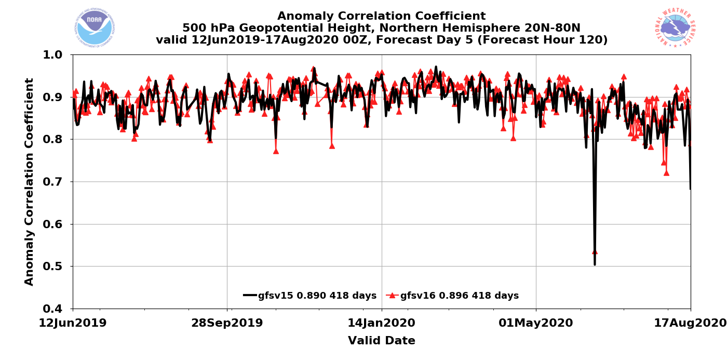
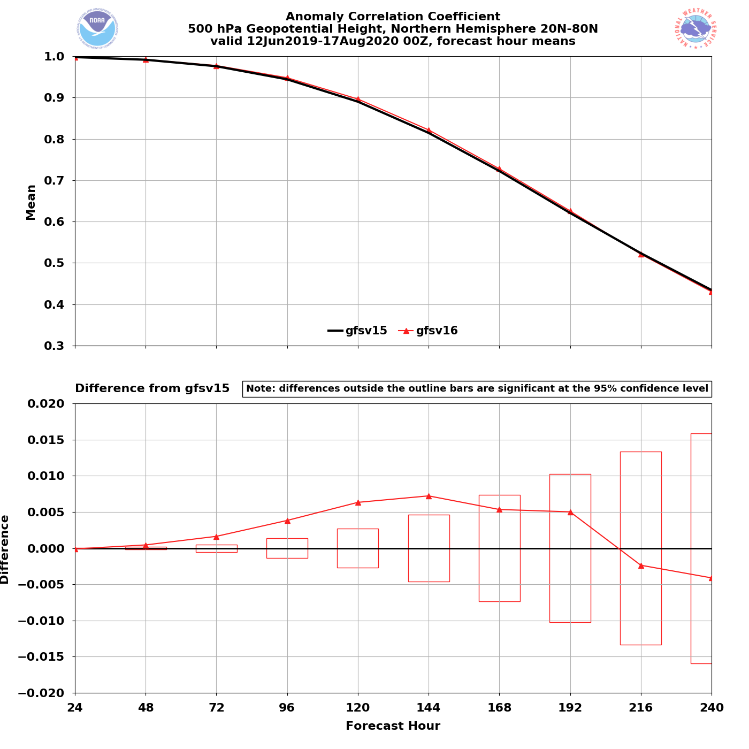
NATIONAL OCEANIC AND ATMOSPHERIC ADMINISTRATION
Strengths: 500-hPa AC Scores (NH)
Valid: 6/12/19–8/17/20 (Day 5)
GFSv15 = .890
GFSv16 = .896
GFSv16 had higher AC scores than GFSv15 at the majority of forecast lead times (Days 1–8)
GFSv16 had statistically significantly higher AC scores at Days 2–6
GFSv16−GFSv15

Slide 5
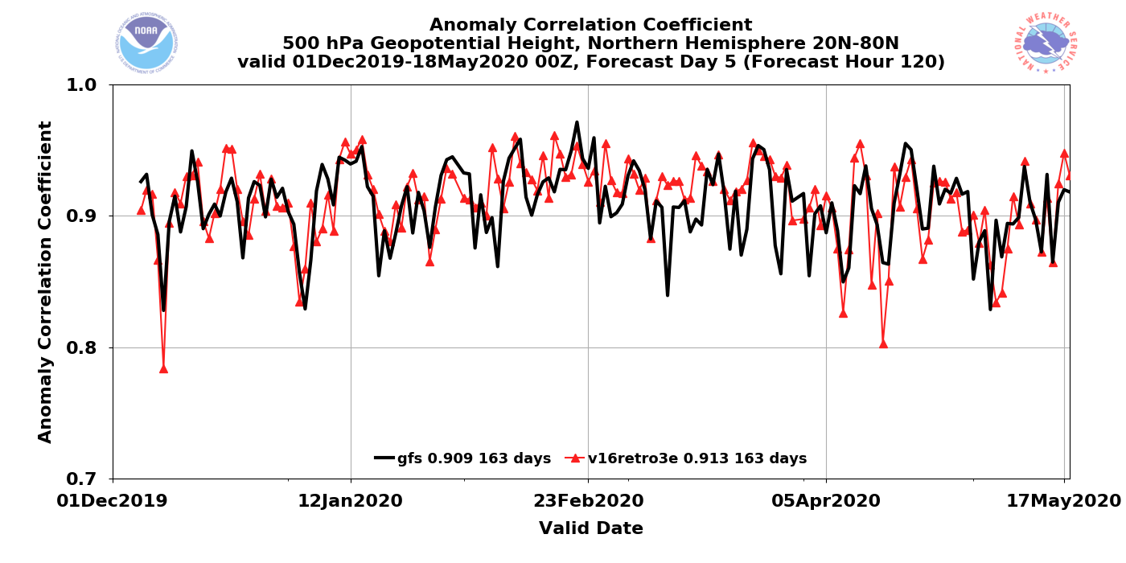
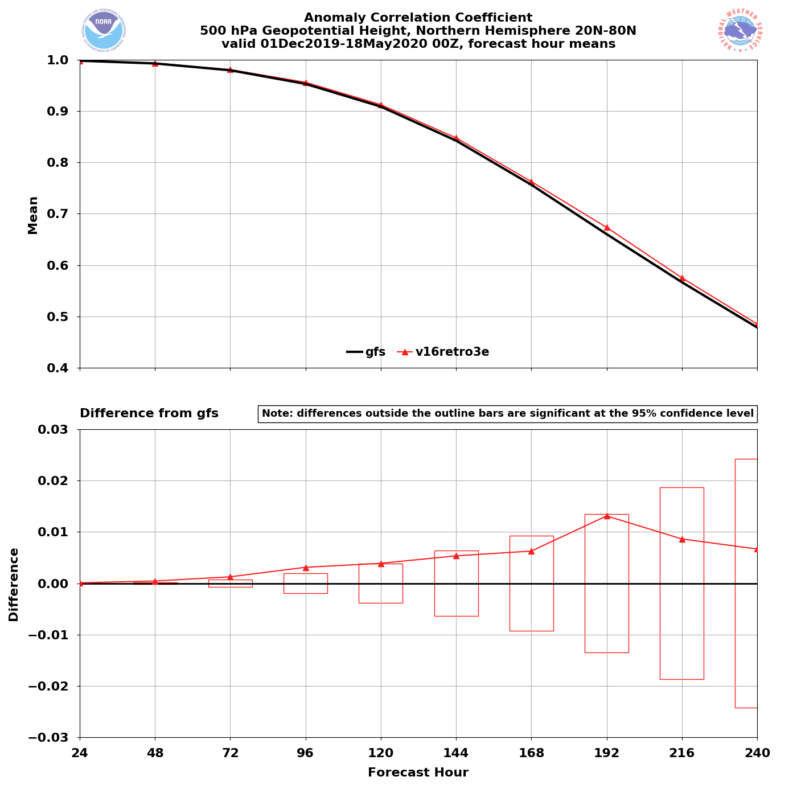
NATIONAL OCEANIC AND ATMOSPHERIC ADMINISTRATION
Strengths: 500-hPa AC Scores (NH Winter)
Valid: 12/1/19–5/18/20 (Day 5)
GFSv15 = .909
GFSv16 = .913
GFSv16 had higher AC scores than GFSv15 at all forecast lead times (Days 1–10)
GFSv16 had statistically significantly higher AC scores at Days 2–4
GFSv16−GFSv15

Slide 6
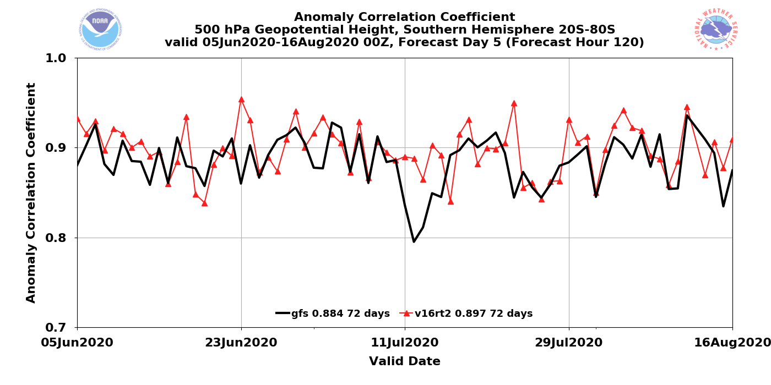
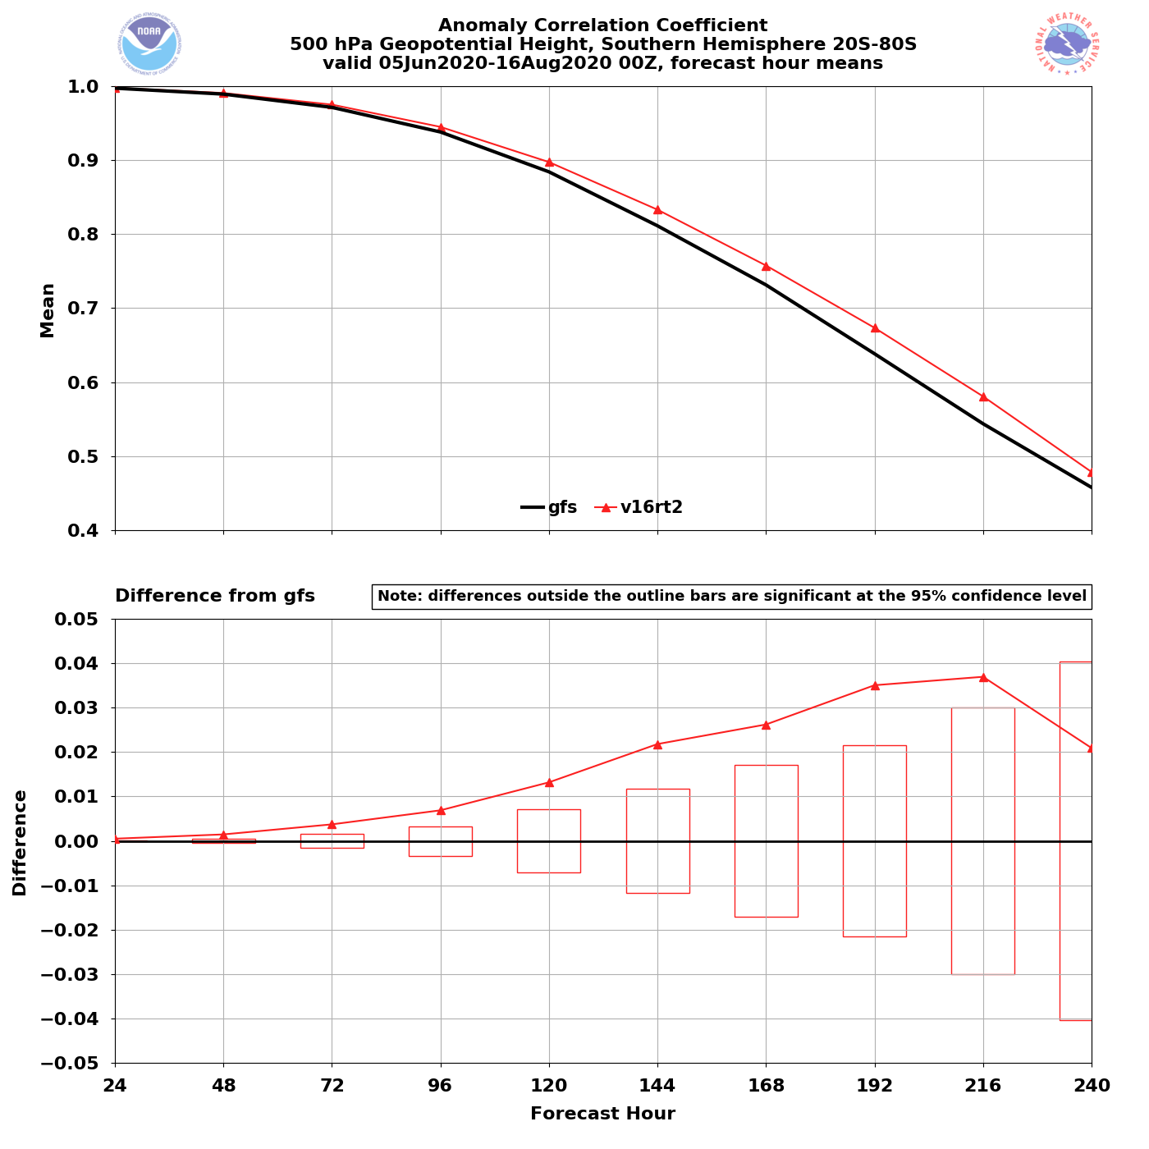
NATIONAL OCEANIC AND ATMOSPHERIC ADMINISTRATION
Strengths: 500-hPa AC Scores (SH Winter)
Valid: 6/5/20–8/16/20 (Day 5)
GFSv15 = .884 GFSv16 = .897
GFSv16 had higher AC scores than GFSv15 at all forecast lead times (Days 1–10)
GFSv16 had statistically significantly higher AC scores at Days 2–9
GFSv16−GFSv15

Slide 7
NATIONAL OCEANIC AND ATMOSPHERIC ADMINISTRATION
GFSv16 Winter Weather: Strengths
Improved 500-hPa geo. height AC scores in the medium range
Overall, captures the synoptic pattern better and more consistently (i.e., forecasts jump around less) in the medium and short range
Some indication that progressiveness of cutoff lows is reduced
Overall, improved snowfall locations and amounts at all lead times
Overall, improved medium-range precipitation type (ptype) forecasts
Low-level warming issue seen in GFSv15 has been resolved

Slide 8
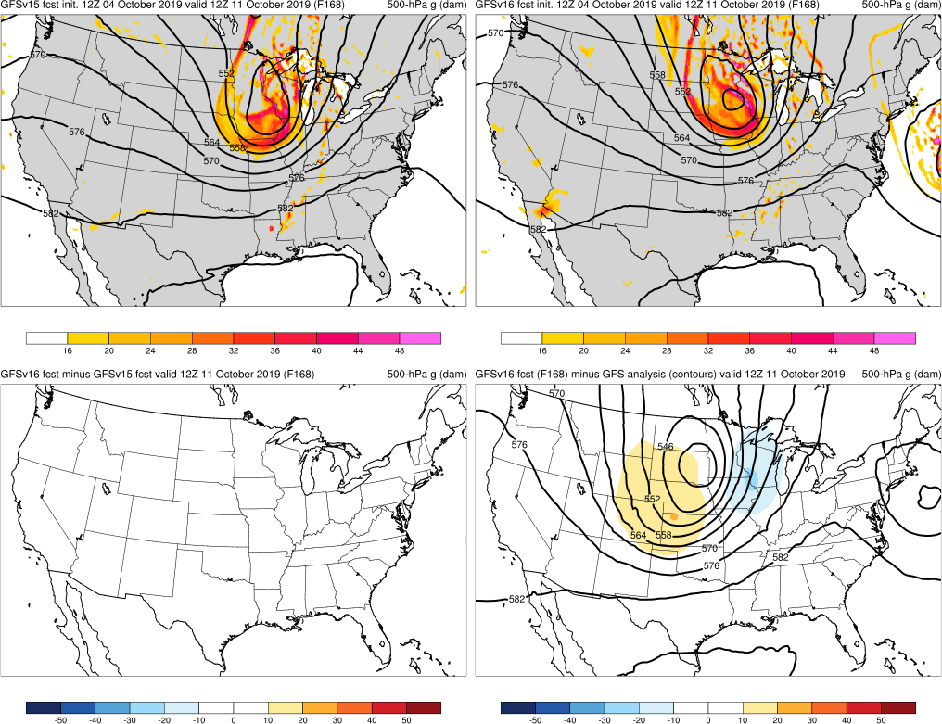
NATIONAL OCEANIC AND ATMOSPHERIC ADMINISTRATION
Strengths: Captures Synoptic Pattern Better
October Snow Storm (F168) Valid: 12Z 10/11/19
Oct Snow: GFSv16 forecasted the structure of the cutoff low earlier and more consistently than GFSv15
GFSv15
GFSv16
v16−v15
GFS Anl.

Slide 9
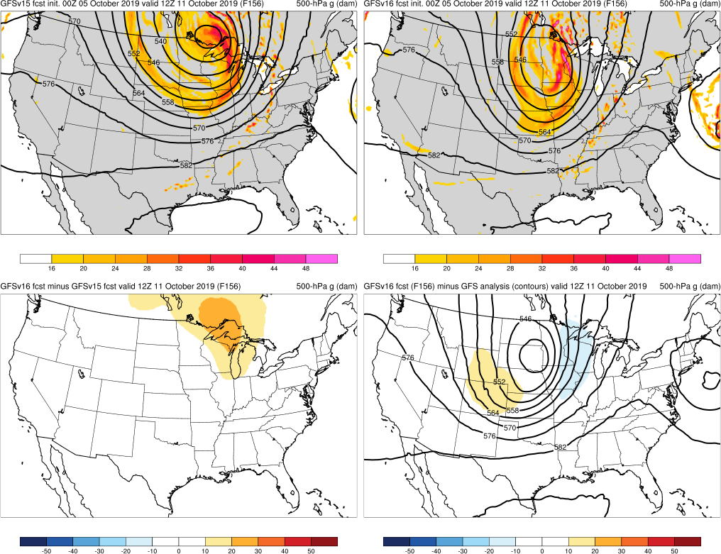
NATIONAL OCEANIC AND ATMOSPHERIC ADMINISTRATION
Strengths: Captures Synoptic Pattern Better
October Snow Storm (F156) Valid: 12Z 10/11/19
Oct Snow: GFSv16 forecasted the structure of the cutoff low earlier and more consistently than GFSv15
GFSv15
GFSv16
v16−v15
GFS Anl.

Slide 10
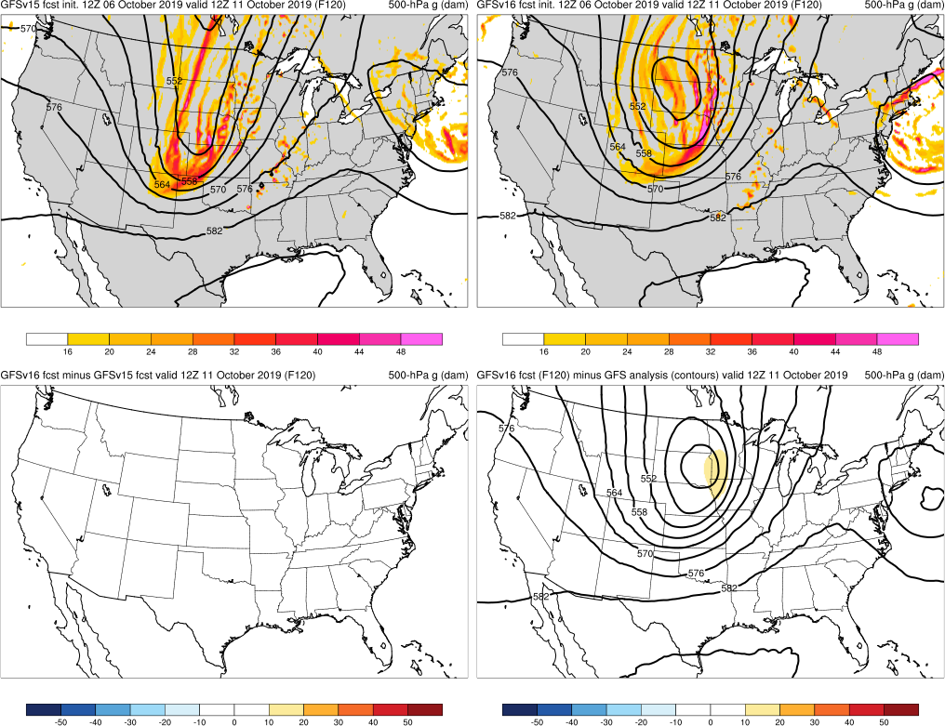
NATIONAL OCEANIC AND ATMOSPHERIC ADMINISTRATION
Strengths: Captures Synoptic Pattern Better
October Snow Storm (F120) Valid: 12Z 10/11/19
Oct Snow: GFSv16 forecasted the structure of the cutoff low earlier and more consistently than GFSv15
GFSv15
GFSv16
v16−v15
GFS Anl.

Slide 11
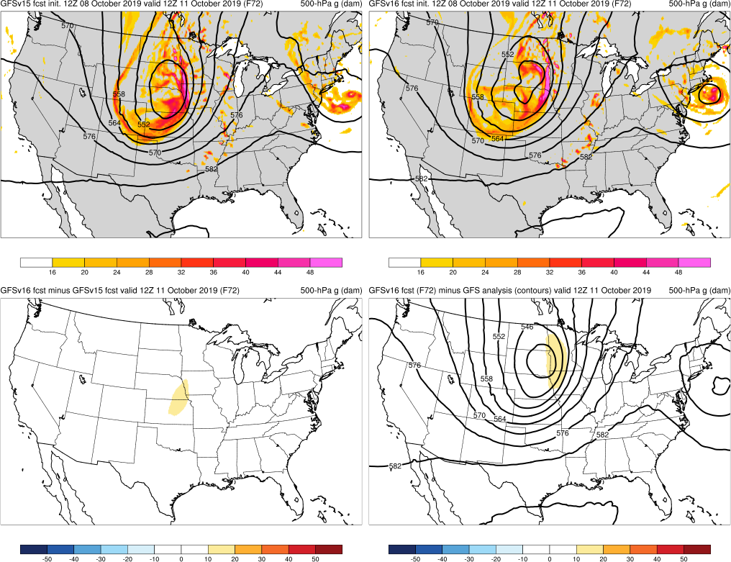
NATIONAL OCEANIC AND ATMOSPHERIC ADMINISTRATION
Strengths: Captures Synoptic Pattern Better
October Snow Storm (F072) Valid: 12Z 10/11/19
Oct Snow: GFSv16 forecasted the structure of the cutoff low earlier and more consistently than GFSv15
GFSv15
GFSv16
v16−v15
GFS Anl.

Slide 12
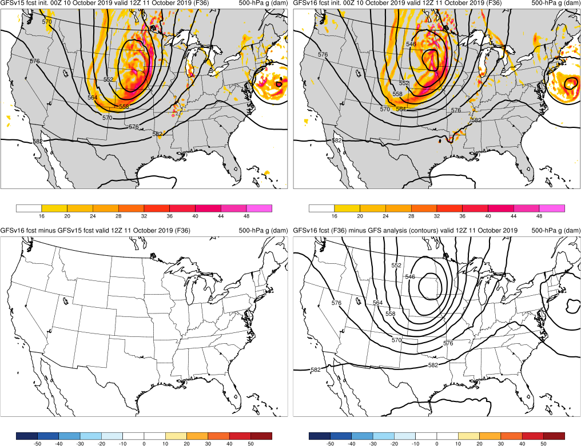
NATIONAL OCEANIC AND ATMOSPHERIC ADMINISTRATION
Strengths: Captures Synoptic Pattern Better
October Snow Storm (F036) Valid: 12Z 10/11/19
Oct Snow: GFSv16 forecasted the structure of the cutoff low earlier and more consistently than GFSv15
GFSv15
GFSv16
v16−v15
GFS Anl.

Slide 13
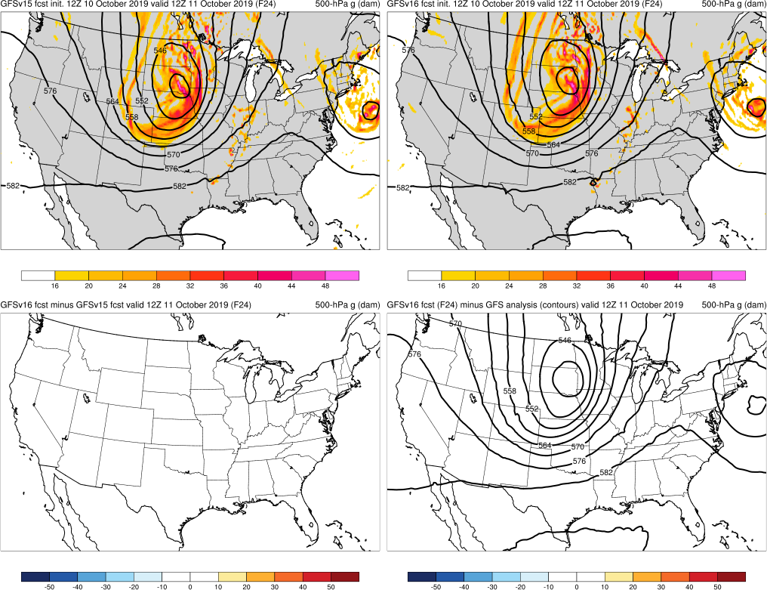
NATIONAL OCEANIC AND ATMOSPHERIC ADMINISTRATION
Strengths: Captures Synoptic Pattern Better
October Snow Storm (F024) Valid: 12Z 10/11/19
Oct Snow: GFSv16 forecasted the structure of the cutoff low earlier and more consistently than GFSv15
GFSv15
GFSv16
v16−v15
GFS Anl.

Slide 14
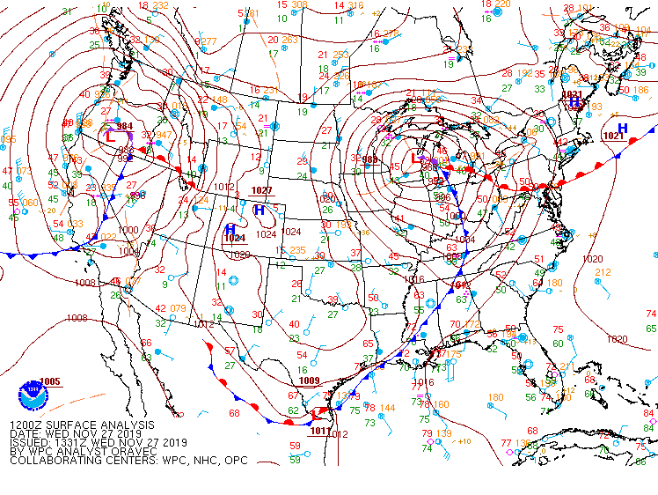
NATIONAL OCEANIC AND ATMOSPHERIC ADMINISTRATION
Strengths: Captures Synoptic Pattern Better
Thanksgiving Storms (F000) Valid: 12Z 11/27/19
Oct Snow: GFSv16 forecasted the structure of the cutoff low earlier and more consistently than GFSv15
Thxgiving: GFSv16 forecasted the structure of troughs & cutoff earlier and more consistently than GFSv15
WPC Surface Analysis

Slide 15
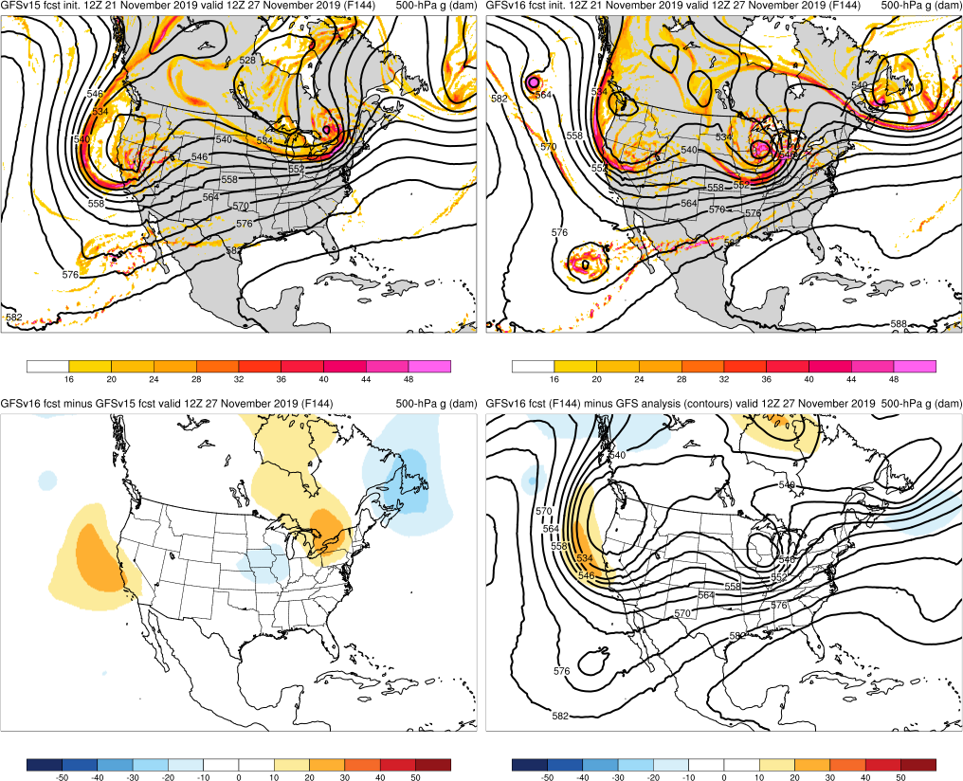
NATIONAL OCEANIC AND ATMOSPHERIC ADMINISTRATION
Strengths: Captures Synoptic Pattern Better
Thanksgiving Storms (F144) Valid: 12Z 11/27/19
Oct Snow: GFSv16 forecasted the structure of the cutoff low earlier and more consistently than GFSv15
Thxgiving: GFSv16 forecasted the structure of troughs & cutoff earlier and more consistently than GFSv15
GFSv15
GFSv16
v16−v15
GFS Anl.

Slide 16
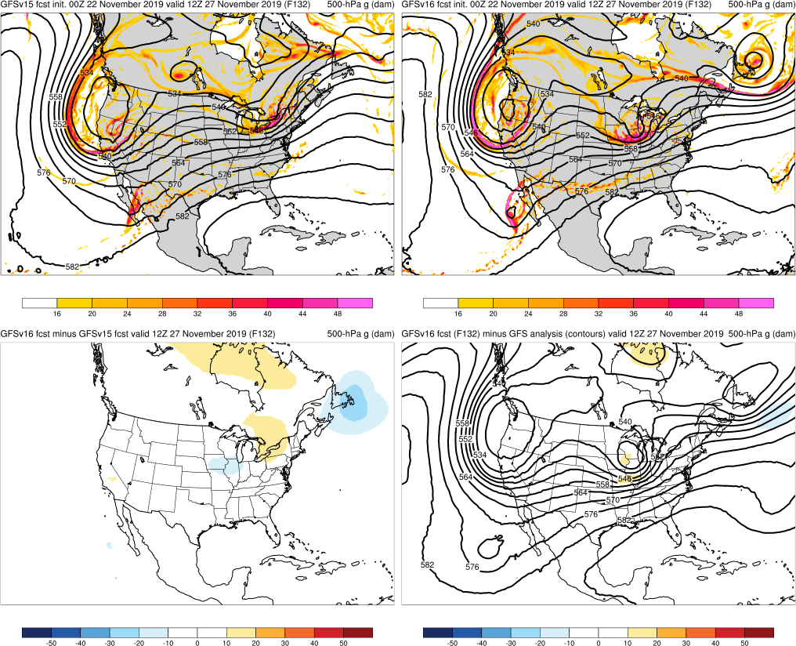
NATIONAL OCEANIC AND ATMOSPHERIC ADMINISTRATION
Strengths: Captures Synoptic Pattern Better
Thanksgiving Storms (F132) Valid: 12Z 11/27/19
Oct Snow: GFSv16 forecasted the structure of the cutoff low earlier and more consistently than GFSv15
Thxgiving: GFSv16 forecasted the structure of troughs & cutoff earlier and more consistently than GFSv15
GFSv15
GFSv16
v16−v15
GFS Anl.

Slide 17
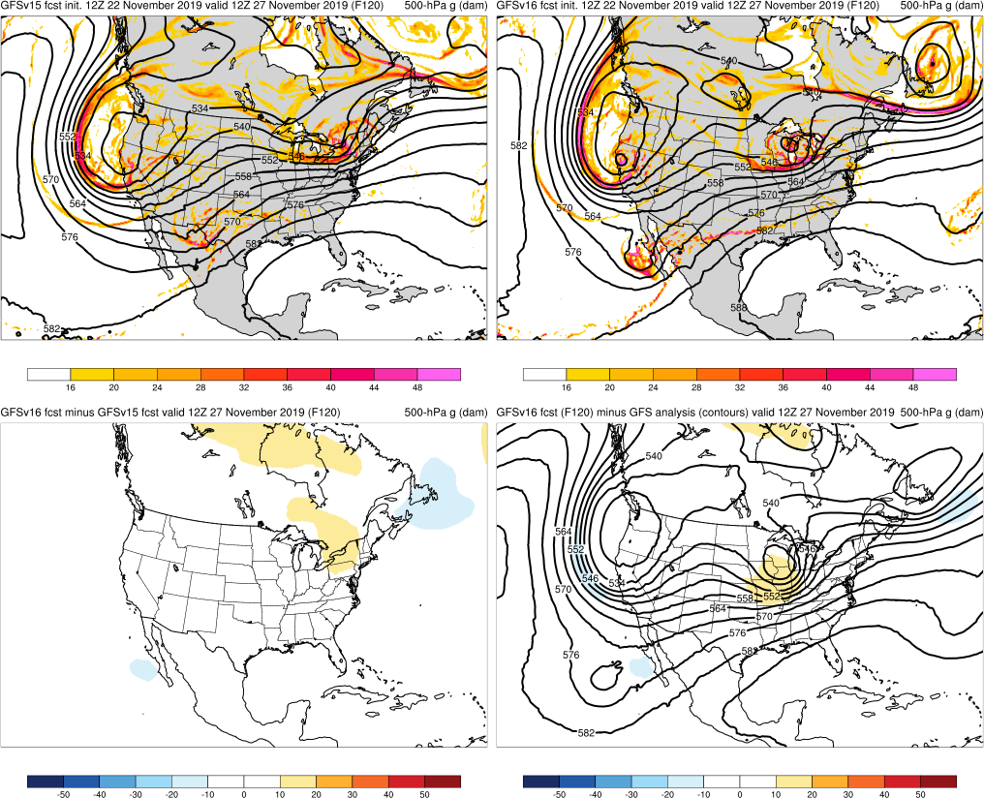
NATIONAL OCEANIC AND ATMOSPHERIC ADMINISTRATION
Strengths: Captures Synoptic Pattern Better
Thanksgiving Storms (F120) Valid: 12Z 11/27/19
Oct Snow: GFSv16 forecasted the structure of the cutoff low earlier and more consistently than GFSv15
Thxgiving: GFSv16 forecasted the structure of troughs & cutoff earlier and more consistently than GFSv15
GFSv15
GFSv16
v16−v15
GFS Anl.

Slide 18
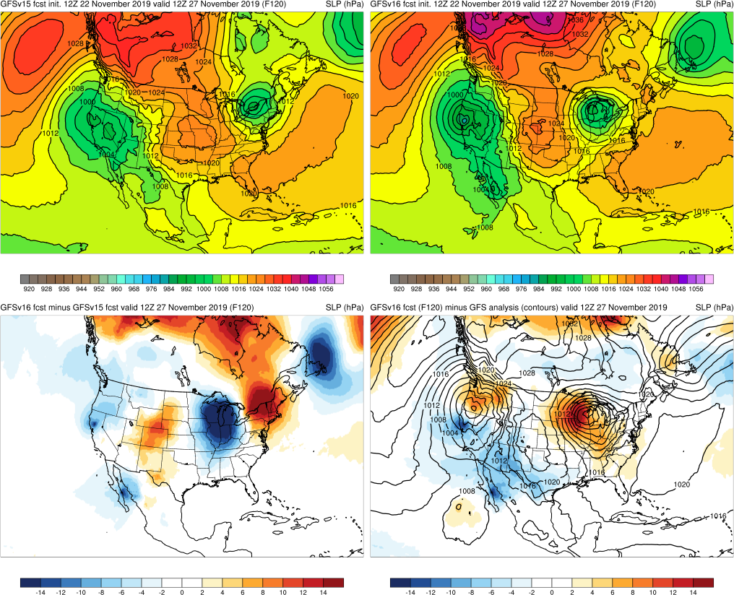
NATIONAL OCEANIC AND ATMOSPHERIC ADMINISTRATION
Strengths: Captures Synoptic Pattern Better
Thanksgiving Storms (F120) Valid: 12Z 11/27/19
Oct Snow: GFSv16 forecasted the structure of the cutoff low earlier and more consistently than GFSv15
Thxgiving: GFSv16 forecasted the structure of troughs & cutoff earlier and more consistently than GFSv15
GFSv15
GFSv16
v16−v15
GFS Anl.

Slide 19
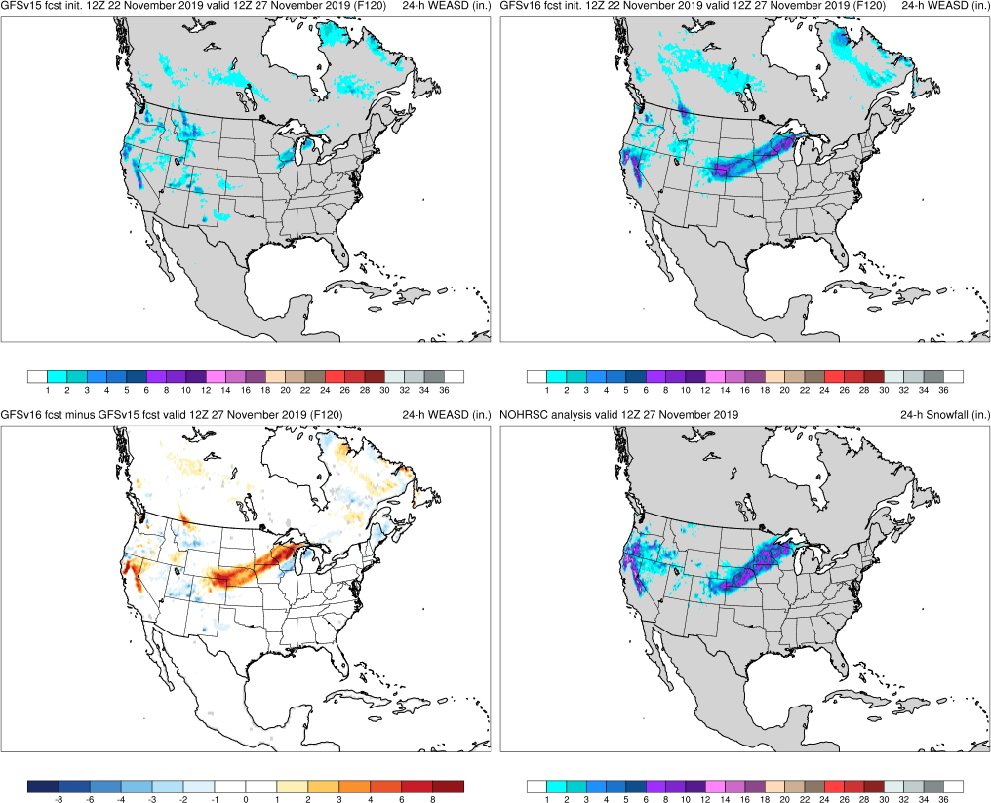
NATIONAL OCEANIC AND ATMOSPHERIC ADMINISTRATION
Strengths: Captures Synoptic Pattern Better
Thanksgiving Storms (F120) Valid: 12Z 11/27/19
Oct Snow: GFSv16 forecasted the structure of the cutoff low earlier and more consistently than GFSv15
Thxgiving: GFSv16 forecasted the structure of troughs & cutoff earlier and more consistently than GFSv15
GFSv15
GFSv16
v16−v15
NOHRSC

Slide 20
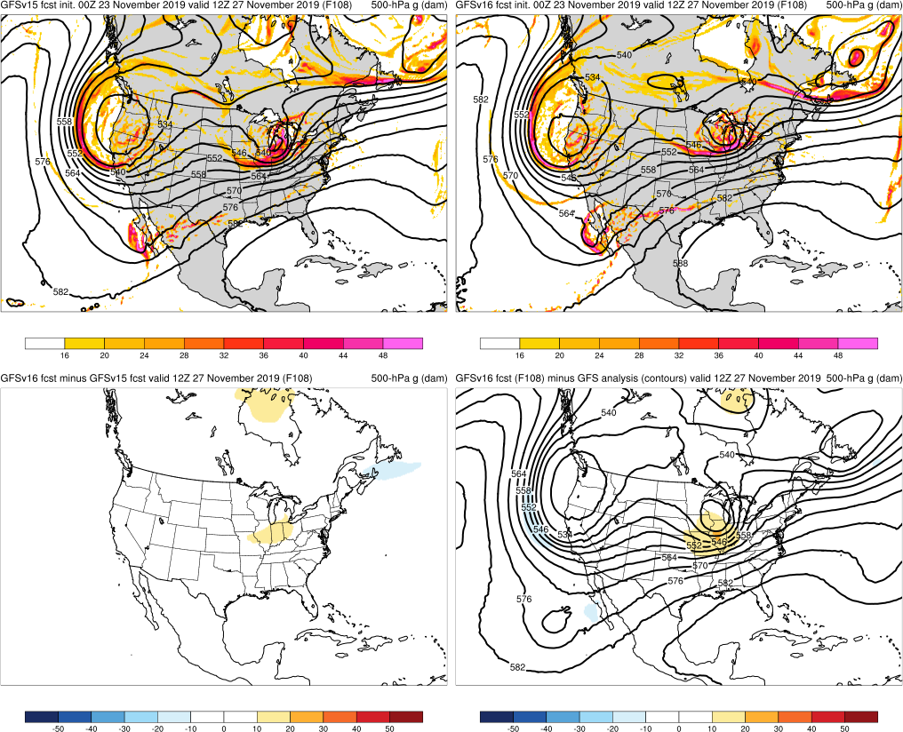
NATIONAL OCEANIC AND ATMOSPHERIC ADMINISTRATION
Strengths: Captures Synoptic Pattern Better
Thanksgiving Storms (F108) Valid: 12Z 11/27/19
Oct Snow: GFSv16 forecasted the structure of the cutoff low earlier and more consistently than GFSv15
Thxgiving: GFSv16 forecasted the structure of troughs & cutoff earlier and more consistently than GFSv15
GFSv15
GFSv16
v16−v15
GFS Anl.

Slide 21
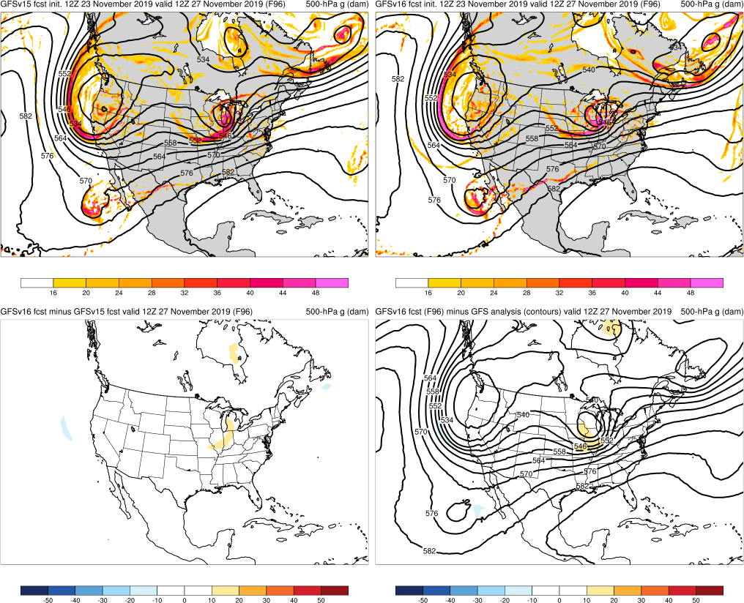
NATIONAL OCEANIC AND ATMOSPHERIC ADMINISTRATION
Strengths: Captures Synoptic Pattern Better
Thanksgiving Storms (F096) Valid: 12Z 11/27/19
Oct Snow: GFSv16 forecasted the structure of the cutoff low earlier and more consistently than GFSv15
Thxgiving: GFSv16 forecasted the structure of troughs & cutoff earlier and more consistently than GFSv15
GFSv15
GFSv16
v16−v15
GFS Anl.

Slide 22
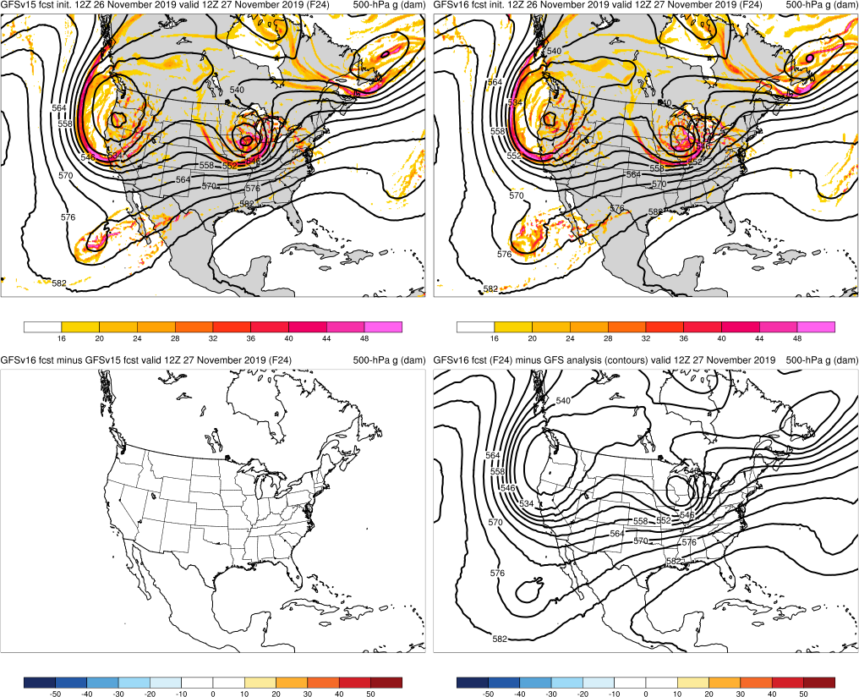
NATIONAL OCEANIC AND ATMOSPHERIC ADMINISTRATION
Strengths: Captures Synoptic Pattern Better
Thanksgiving Storms (F024) Valid: 12Z 11/27/19
Oct Snow: GFSv16 forecasted the structure of the cutoff low earlier and more consistently than GFSv15
Thxgiving: GFSv16 forecasted the structure of troughs & cutoff earlier and more consistently than GFSv15
GFSv15
GFSv16
v16−v15
GFS Anl.

Slide 23
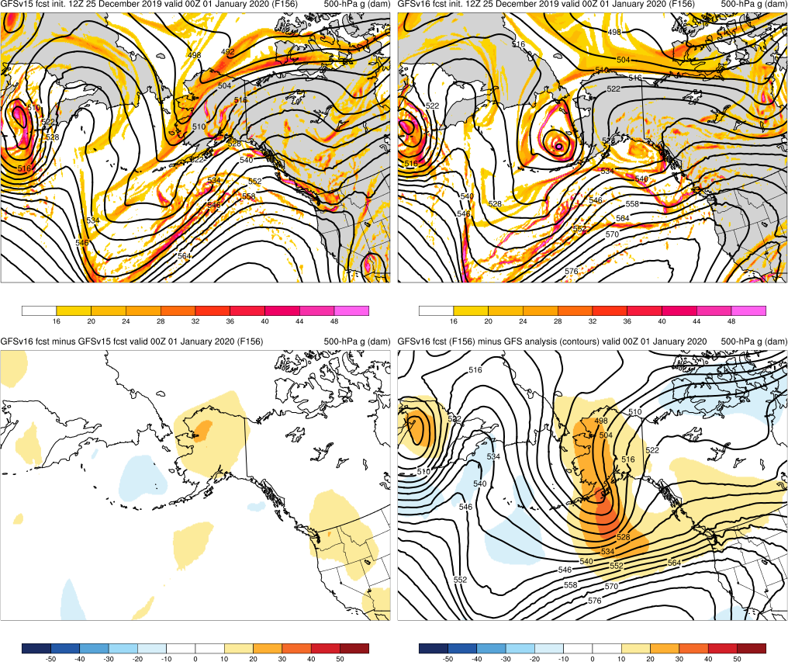
NATIONAL OCEANIC AND ATMOSPHERIC ADMINISTRATION
Strengths: Captures Synoptic Pattern Better
AK New Year Storm (F156) Valid: 00Z 01/01/20
Oct Snow: GFSv16 forecasted the structure of the cutoff low earlier and more consistently than GFSv15
Thxgiving: GFSv16 forecasted the structure of troughs & cutoff earlier and more consistently than GFSv15
AK New Year: GFSv16 forecasted a negatively-tilted trough over the Aleutians days before GFSv15
GFSv15
GFSv16
v16−v15
GFS Anl.

Slide 24
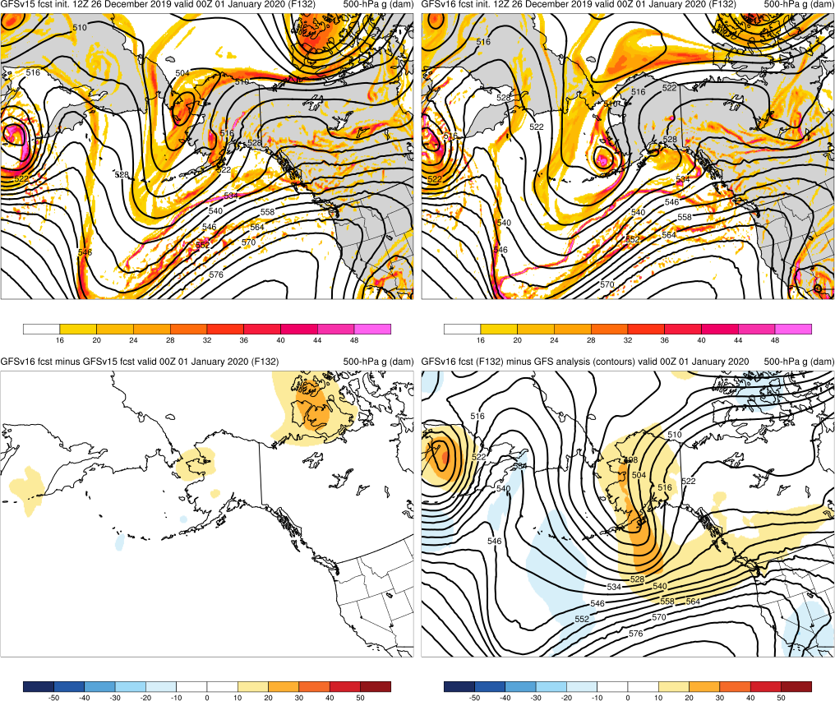
NATIONAL OCEANIC AND ATMOSPHERIC ADMINISTRATION
Strengths: Captures Synoptic Pattern Better
AK New Year Storm (F132) Valid: 00Z 01/01/20
Oct Snow: GFSv16 forecasted the structure of the cutoff low earlier and more consistently than GFSv15
Thxgiving: GFSv16 forecasted the structure of troughs & cutoff earlier and more consistently than GFSv15
AK New Year: GFSv16 forecasted a negatively-tilted trough over the Aleutians days before GFSv15
GFSv15
GFSv16
v16−v15
GFS Anl.

Slide 25
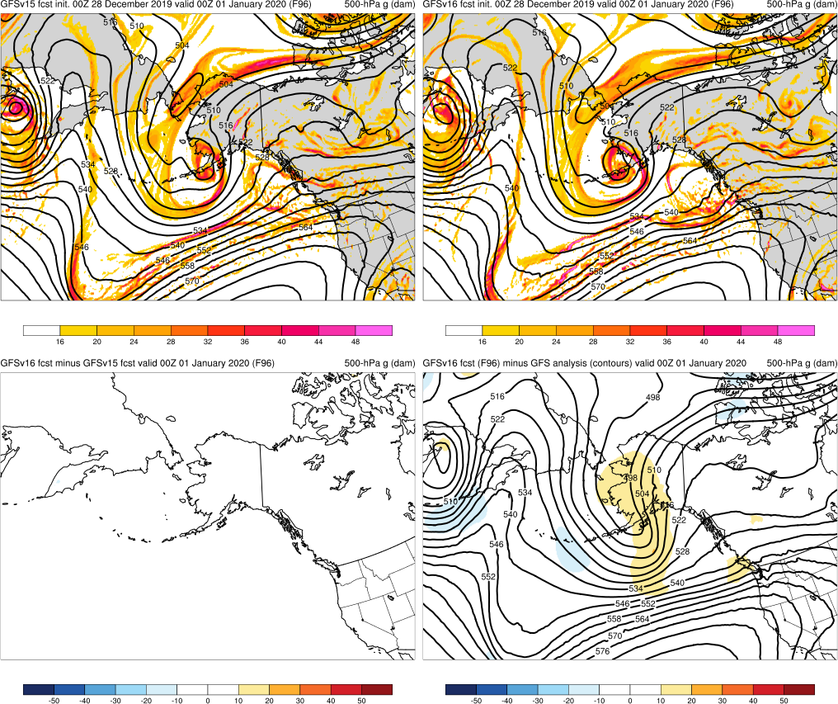
NATIONAL OCEANIC AND ATMOSPHERIC ADMINISTRATION
Strengths: Captures Synoptic Pattern Better
AK New Year Storm (F096) Valid: 00Z 01/01/20
Oct Snow: GFSv16 forecasted the structure of the cutoff low earlier and more consistently than GFSv15
Thxgiving: GFSv16 forecasted the structure of troughs & cutoff earlier and more consistently than GFSv15
AK New Year: GFSv16 forecasted a negatively-tilted trough over the Aleutians days before GFSv15
GFSv15
GFSv16
v16−v15
GFS Anl.

Slide 26
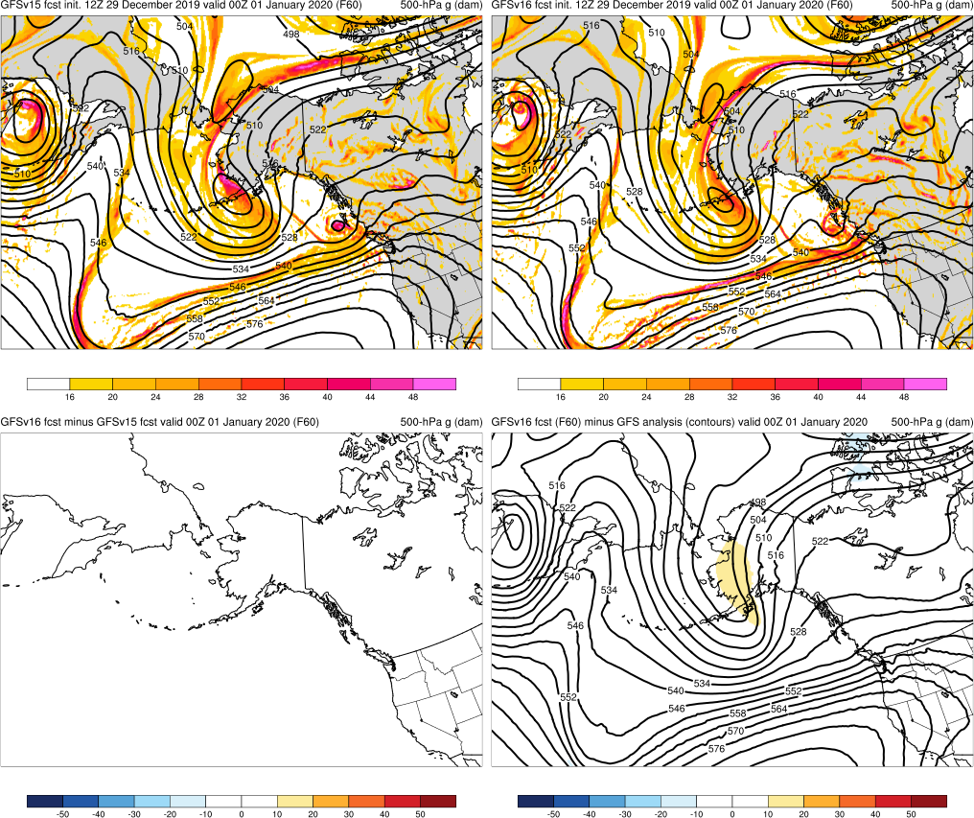
NATIONAL OCEANIC AND ATMOSPHERIC ADMINISTRATION
Strengths: Captures Synoptic Pattern Better
AK New Year Storm (F060) Valid: 00Z 01/01/20
Oct Snow: GFSv16 forecasted the structure of the cutoff low earlier and more consistently than GFSv15
Thxgiving: GFSv16 forecasted the structure of troughs & cutoff earlier and more consistently than GFSv15
AK New Year: GFSv16 forecasted a negatively-tilted trough over the Aleutians days before GFSv15
GFSv15
GFSv16
v16−v15
GFS Anl.

Slide 27
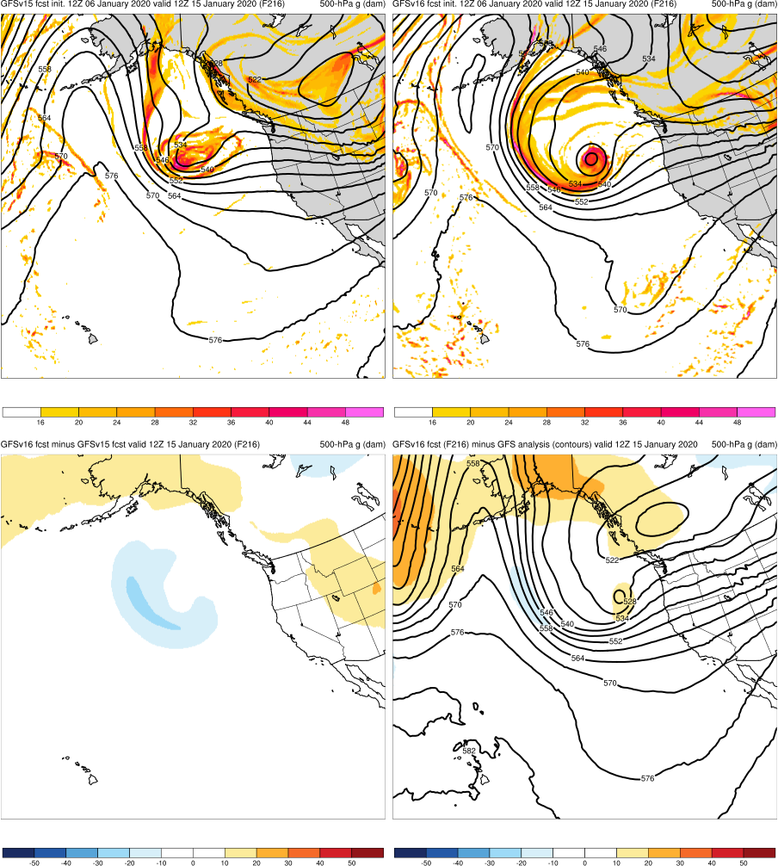
NATIONAL OCEANIC AND ATMOSPHERIC ADMINISTRATION
Strengths: Captures Synoptic Pattern Better
Pacific NW Windstorm (F216) Valid: 12Z 01/15/20
Pac NW Windstorm: GFSv16 forecasted the structure of the cutoff low and trough earlier and more consistently than GFSv15
GFSv15
GFSv16
v16−v15
GFS Anl.

Slide 28
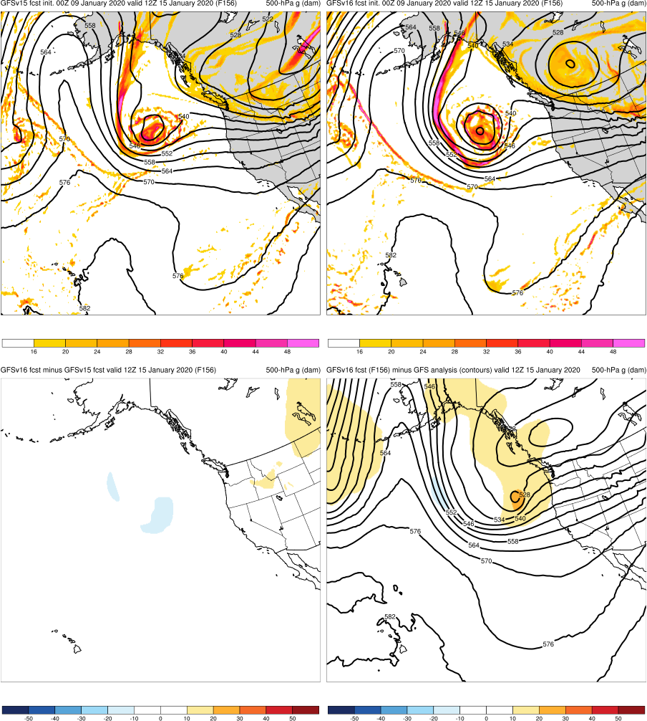
NATIONAL OCEANIC AND ATMOSPHERIC ADMINISTRATION
Strengths: Captures Synoptic Pattern Better
Pacific NW Windstorm (F156) Valid: 12Z 01/15/20
Pac NW Windstorm: GFSv16 forecasted the structure of the cutoff low and trough earlier and more consistently than GFSv15
GFSv15
GFSv16
v16−v15
GFS Anl.

Slide 29
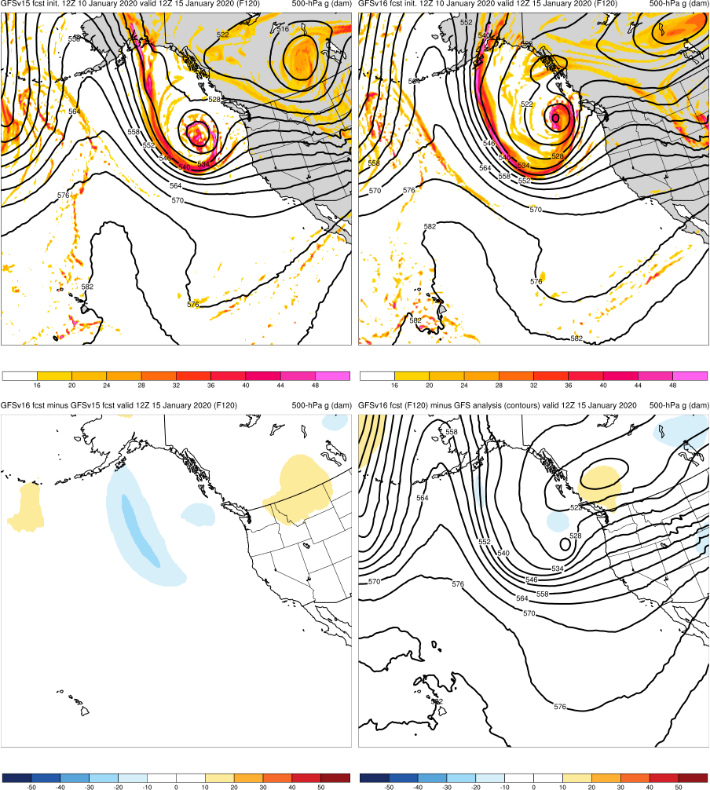
NATIONAL OCEANIC AND ATMOSPHERIC ADMINISTRATION
Strengths: Captures Synoptic Pattern Better
Pacific NW Windstorm (F120) Valid: 12Z 01/15/20
Pac NW Windstorm: GFSv16 forecasted the structure of the cutoff low and trough earlier and more consistently than GFSv15
GFSv15
GFSv16
v16−v15
GFS Anl.

Slide 30
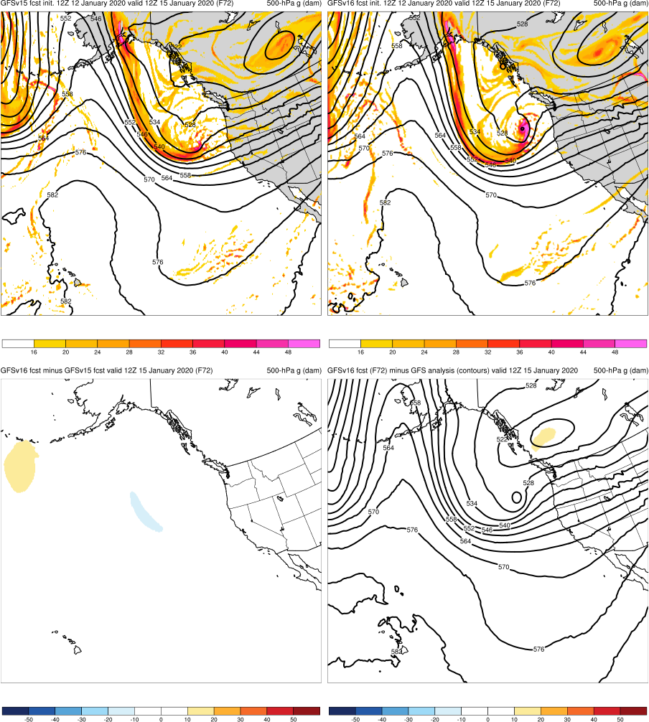
NATIONAL OCEANIC AND ATMOSPHERIC ADMINISTRATION
Strengths: Captures Synoptic Pattern Better
Pacific NW Windstorm (F072) Valid: 12Z 01/15/20
Pac NW Windstorm: GFSv16 forecasted the structure of the cutoff low and trough earlier and more consistently than GFSv15
GFSv15
GFSv16
v16−v15
GFS Anl.

Slide 31
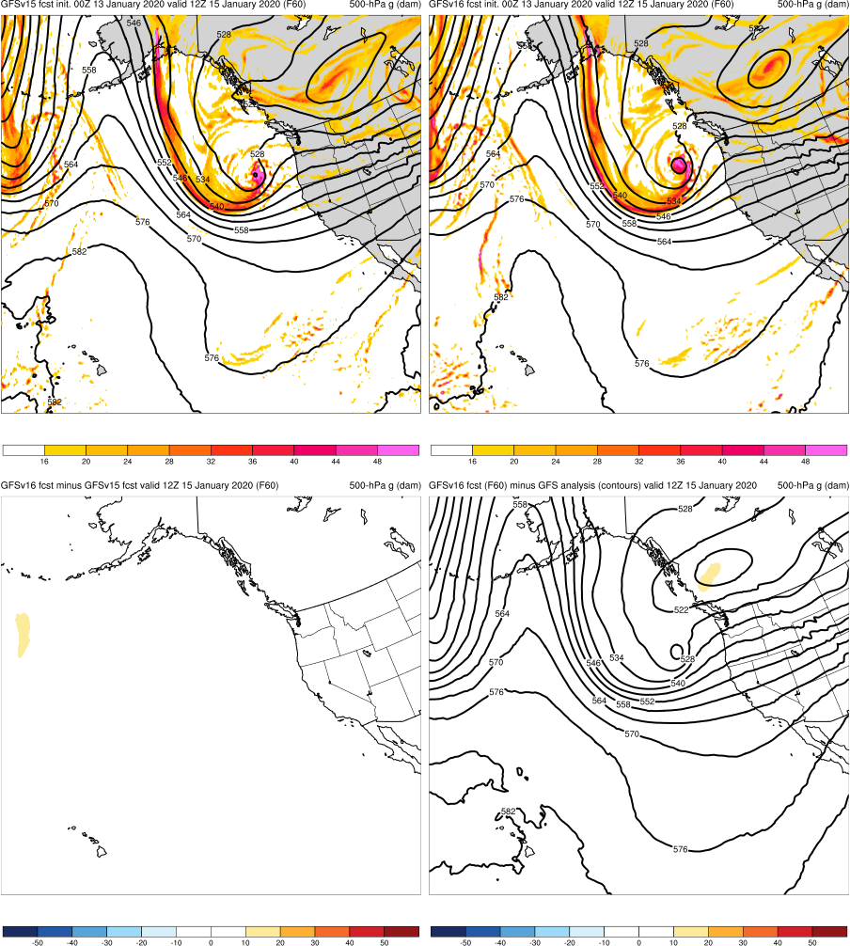
NATIONAL OCEANIC AND ATMOSPHERIC ADMINISTRATION
Strengths: Captures Synoptic Pattern Better
Pacific NW Windstorm (F060) Valid: 12Z 01/15/20
Pac NW Windstorm: GFSv16 forecasted the structure of the cutoff low and trough earlier and more consistently than GFSv15
GFSv15
GFSv16
v16−v15
GFS Anl.

Slide 32
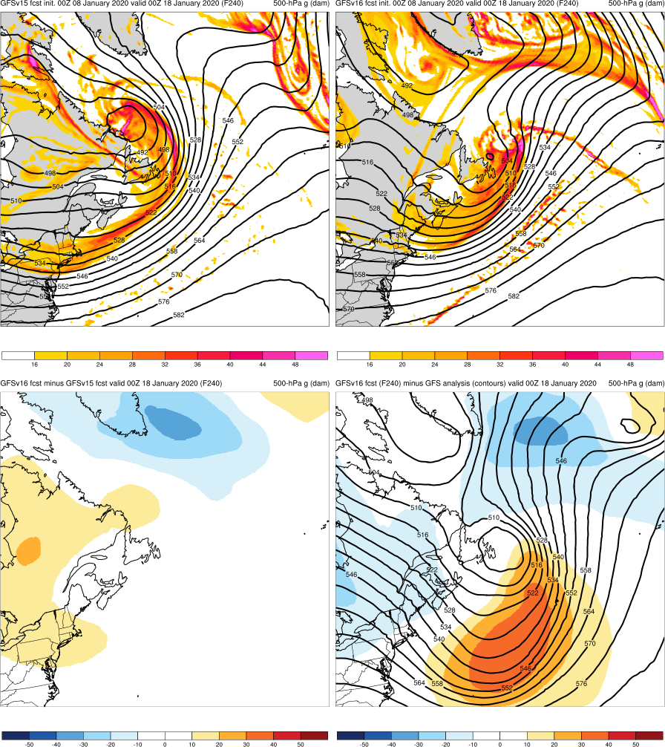
NATIONAL OCEANIC AND ATMOSPHERIC ADMINISTRATION
Strengths: Captures Synoptic Pattern Better
Newfoundland Cyclone (F240) Valid: 00Z 01/18/20
Pac NW Windstorm: GFSv16 forecasted the structure of the cutoff low and trough earlier and more consistently than GFSv15
Newfoundland Cyclone: GFSv16 forecasted the location of the trough and cutoff low earlier and more consistently than GFSv15
GFSv15
GFSv16
v16−v15
GFS Anl.

Slide 33
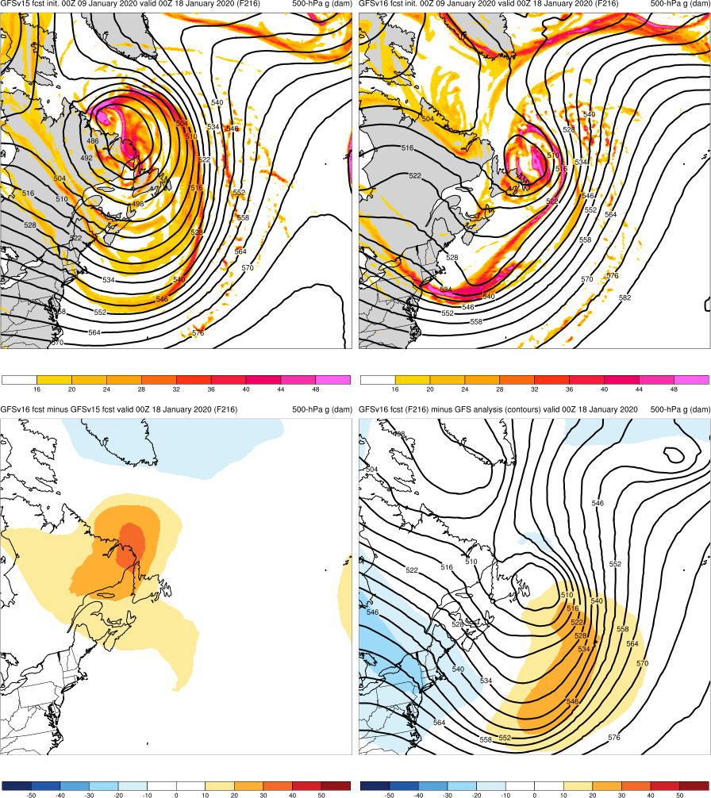
NATIONAL OCEANIC AND ATMOSPHERIC ADMINISTRATION
Strengths: Captures Synoptic Pattern Better
Newfoundland Cyclone (F216) Valid: 00Z 01/18/20
Pac NW Windstorm: GFSv16 forecasted the structure of the cutoff low and trough earlier and more consistently than GFSv15
Newfoundland Cyclone: GFSv16 forecasted the location of the trough and cutoff low earlier and more consistently than GFSv15
GFSv15
GFSv16
v16−v15
GFS Anl.

Slide 34
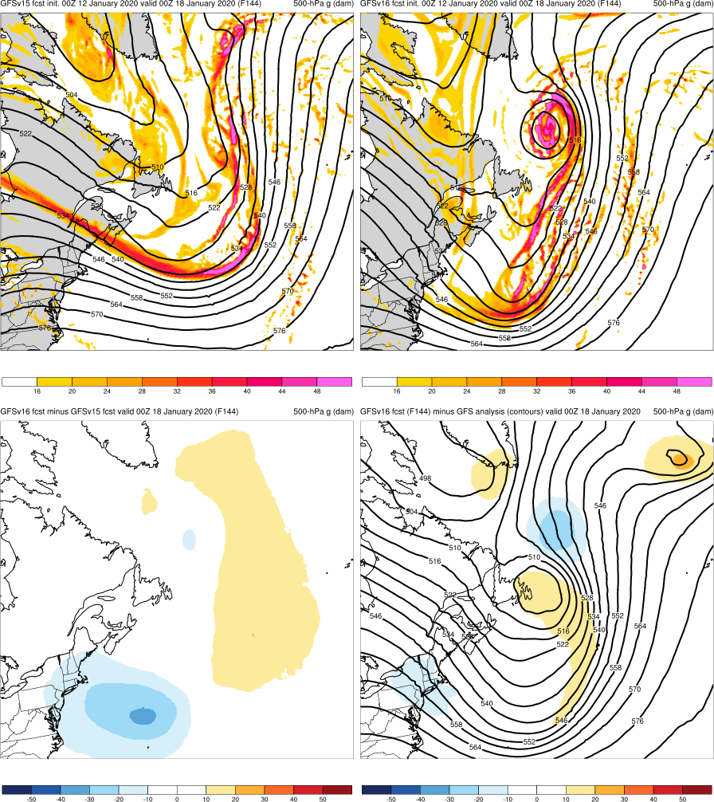
NATIONAL OCEANIC AND ATMOSPHERIC ADMINISTRATION
Strengths: Captures Synoptic Pattern Better
Newfoundland Cyclone (F144) Valid: 00Z 01/18/20
Pac NW Windstorm: GFSv16 forecasted the structure of the cutoff low and trough earlier and more consistently than GFSv15
Newfoundland Cyclone: GFSv16 forecasted the location of the trough and cutoff low earlier and more consistently than GFSv15
GFSv15
GFSv16
v16−v15
GFS Anl.

Slide 35
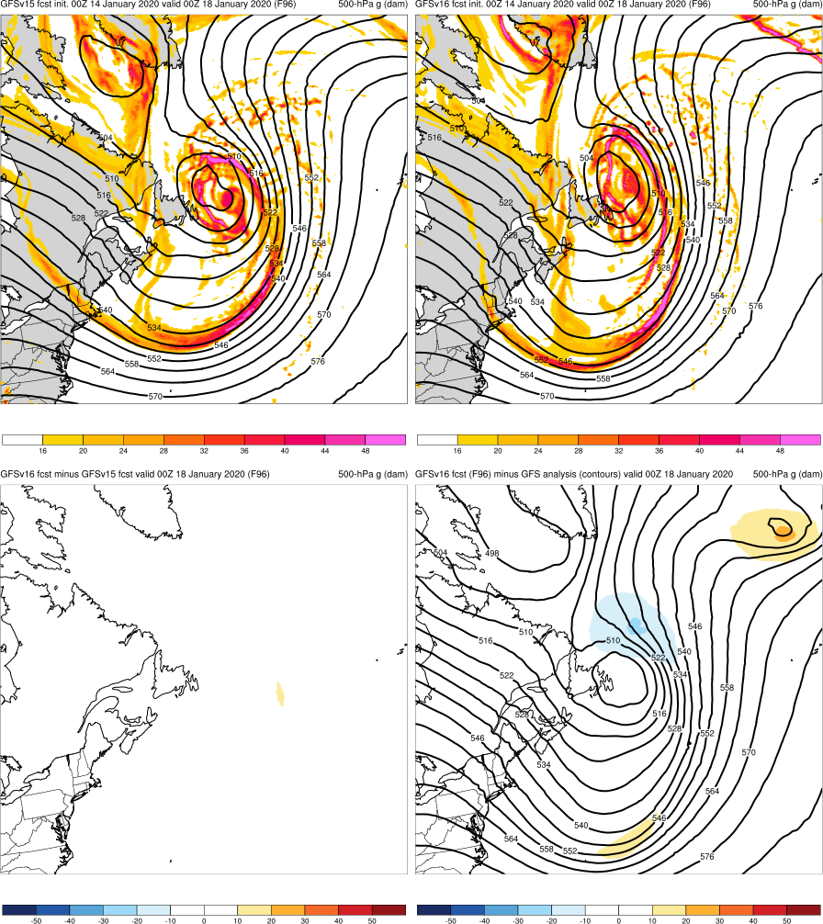
NATIONAL OCEANIC AND ATMOSPHERIC ADMINISTRATION
Strengths: Captures Synoptic Pattern Better
Newfoundland Cyclone (F096) Valid: 00Z 01/18/20
Pac NW Windstorm: GFSv16 forecasted the structure of the cutoff low and trough earlier and more consistently than GFSv15
Newfoundland Cyclone: GFSv16 forecasted the location of the trough and cutoff low earlier and more consistently than GFSv15
GFSv15
GFSv16
v16−v15
GFS Anl.

Slide 36
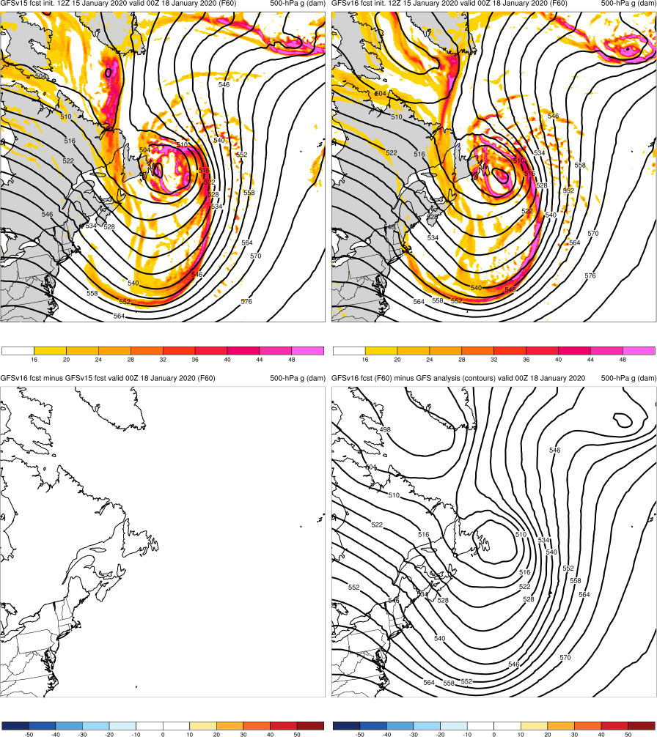
NATIONAL OCEANIC AND ATMOSPHERIC ADMINISTRATION
Strengths: Captures Synoptic Pattern Better
Newfoundland Cyclone (F060) Valid: 00Z 01/18/20
Pac NW Windstorm: GFSv16 forecasted the structure of the cutoff low and trough earlier and more consistently than GFSv15
Newfoundland Cyclone: GFSv16 forecasted the location of the trough and cutoff low earlier and more consistently than GFSv15
GFSv15
GFSv16
v16−v15
GFS Anl.

Slide 37
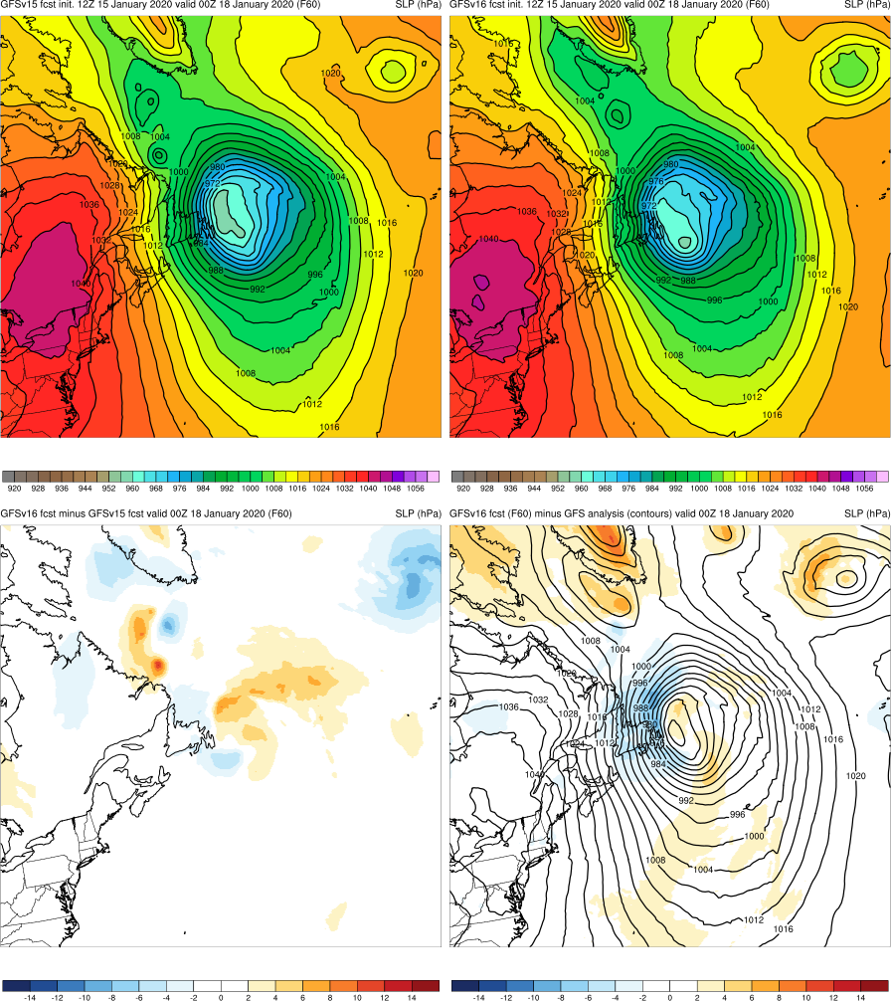
NATIONAL OCEANIC AND ATMOSPHERIC ADMINISTRATION
Strengths: Captures Synoptic Pattern Better
Newfoundland Cyclone (F060) Valid: 00Z 01/18/20
Pac NW Windstorm: GFSv16 forecasted the structure of the cutoff low and trough earlier and more consistently than GFSv15
Newfoundland Cyclone: GFSv16 forecasted the location of the trough and cutoff low earlier and more consistently than GFSv15
GFSv15
GFSv16
v16−v15
GFS Anl.

Slide 38
NATIONAL OCEANIC AND ATMOSPHERIC ADMINISTRATION
GFSv16 Winter Weather: Strengths
Improved 500-hPa geo. height AC scores in the medium range
Overall, captures the synoptic pattern better and more consistently (i.e., forecasts jump around less) in the medium and short range
Some indication that progressiveness of cutoff lows is reduced
Overall, improved snowfall locations and amounts at all lead times
Overall, improved medium-range precipitation type (ptype) forecasts
Low-level warming issue seen in GFSv15 has been resolved

Slide 39
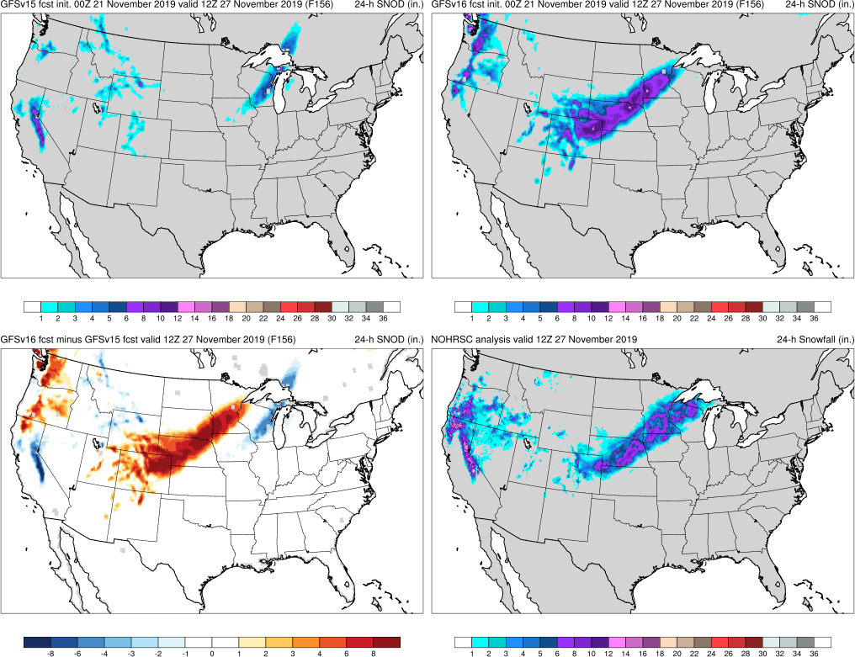
NATIONAL OCEANIC AND ATMOSPHERIC ADMINISTRATION
Strengths: Improved Snowfall Forecasts
Thanksgiving Storms (F156) Valid: 12Z 11/27/19
Thxgiving: GFSv16 forecasted a Great Plains snowfall event 48 h earlier than GFSv15
GFSv15
GFSv16
v16−v15
NOHRSC

Slide 40
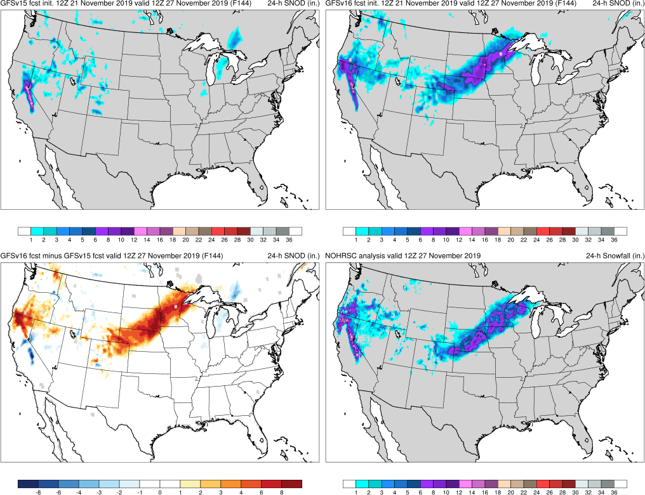
NATIONAL OCEANIC AND ATMOSPHERIC ADMINISTRATION
Strengths: Improved Snowfall Forecasts
Thanksgiving Storms (F144) Valid: 12Z 11/27/19
Thxgiving: GFSv16 forecasted a Great Plains snowfall event 48 h earlier than GFSv15
GFSv15
GFSv16
v16−v15
NOHRSC

Slide 41
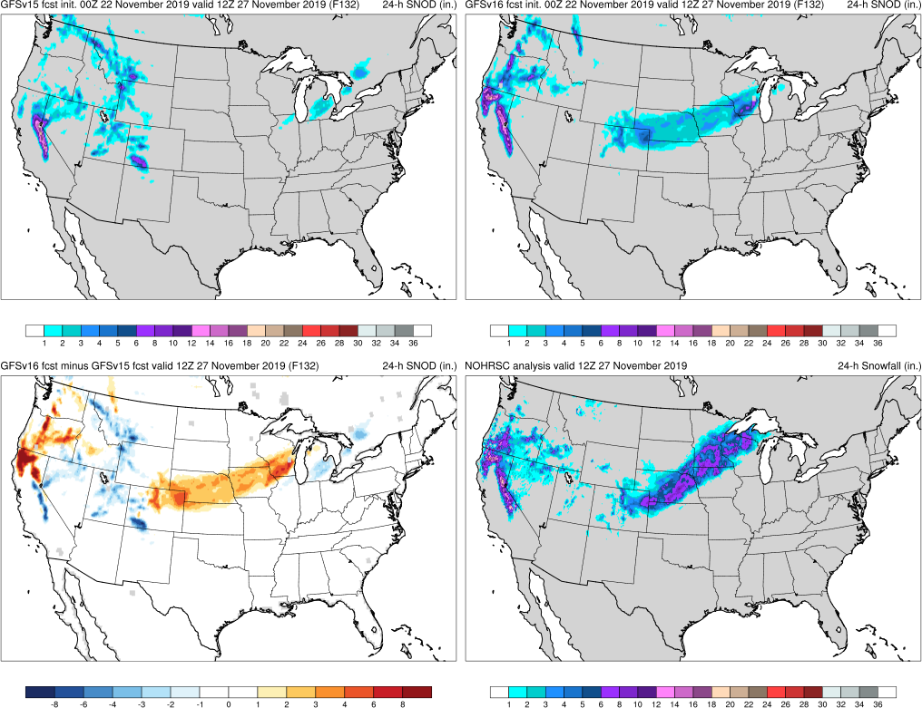
NATIONAL OCEANIC AND ATMOSPHERIC ADMINISTRATION
Strengths: Improved Snowfall Forecasts
Thanksgiving Storms (F132) Valid: 12Z 11/27/19
Thxgiving: GFSv16 forecasted a Great Plains snowfall event 48 h earlier than GFSv15
GFSv15
GFSv16
v16−v15
NOHRSC

Slide 42
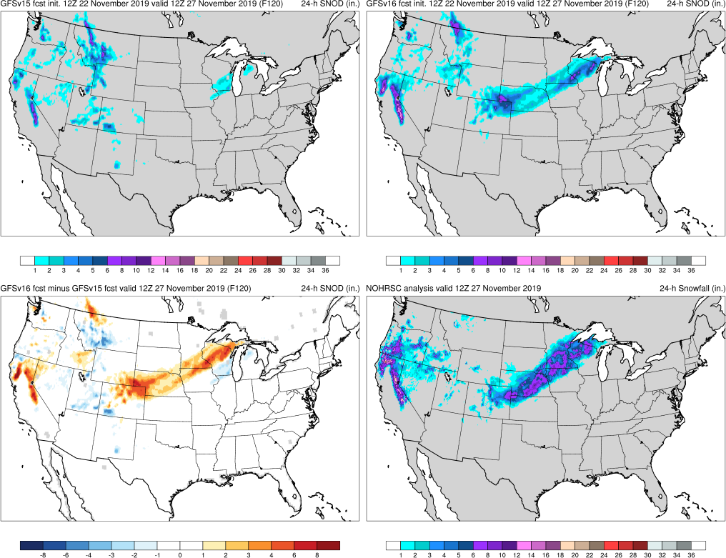
NATIONAL OCEANIC AND ATMOSPHERIC ADMINISTRATION
Strengths: Improved Snowfall Forecasts
Thanksgiving Storms (F120) Valid: 12Z 11/27/19
Thxgiving: GFSv16 forecasted a Great Plains snowfall event 48 h earlier than GFSv15
GFSv15
GFSv16
v16−v15
NOHRSC

Slide 43
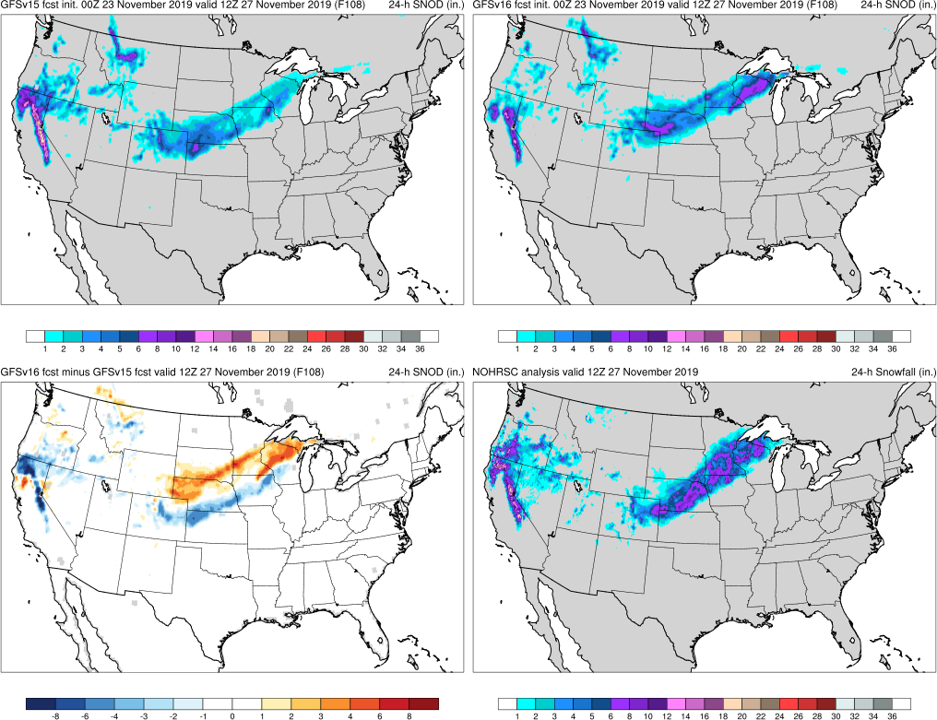
NATIONAL OCEANIC AND ATMOSPHERIC ADMINISTRATION
Strengths: Improved Snowfall Forecasts
Thanksgiving Storms (F108) Valid: 12Z 11/27/19
Thxgiving: GFSv16 forecasted a Great Plains snowfall event 48 h earlier than GFSv15
GFSv15
GFSv16
v16−v15
NOHRSC

Slide 44
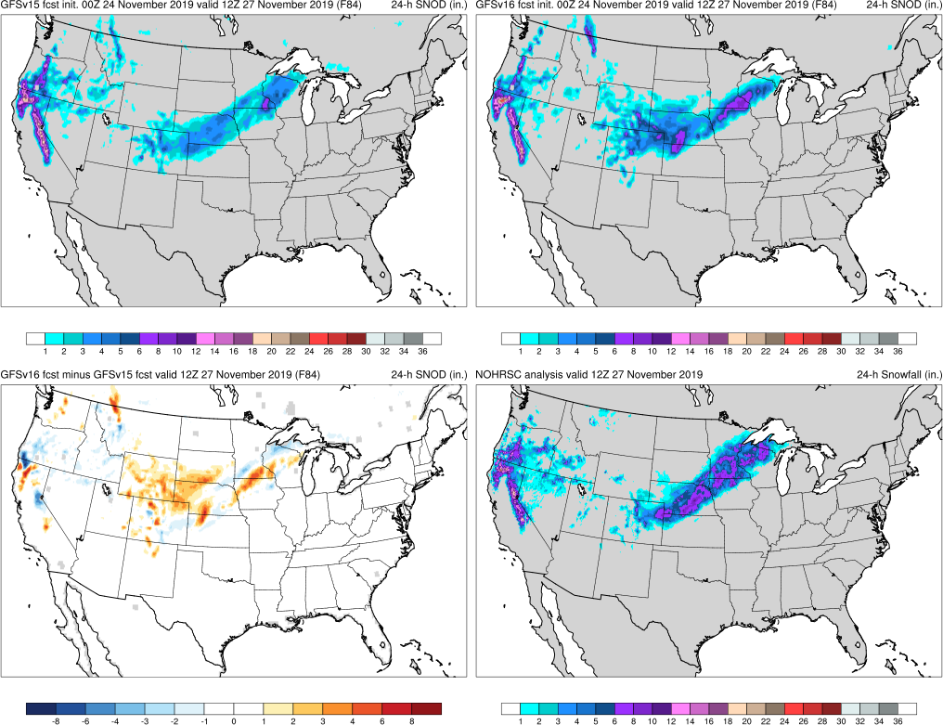
NATIONAL OCEANIC AND ATMOSPHERIC ADMINISTRATION
Strengths: Improved Snowfall Forecasts
Thanksgiving Storms (F084) Valid: 12Z 11/27/19
Thxgiving: GFSv16 forecasted a Great Plains snowfall event 48 h earlier than GFSv15
GFSv15
GFSv16
v16−v15
NOHRSC

Slide 45
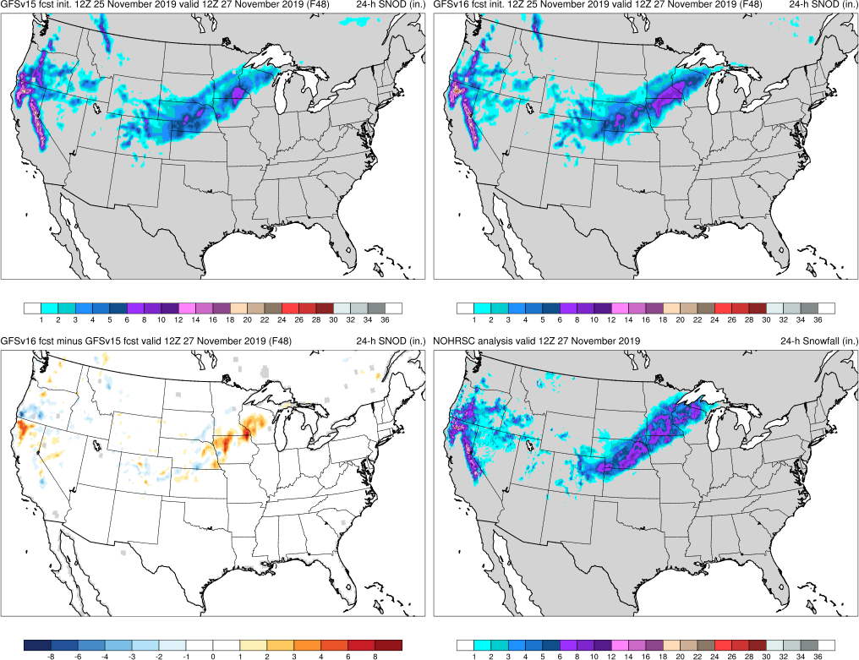
NATIONAL OCEANIC AND ATMOSPHERIC ADMINISTRATION
Strengths: Improved Snowfall Forecasts
Thanksgiving Storms (F048) Valid: 12Z 11/27/19
Thxgiving: GFSv16 forecasted a Great Plains snowfall event 48 h earlier than GFSv15
GFSv15
GFSv16
v16−v15
NOHRSC

Slide 46
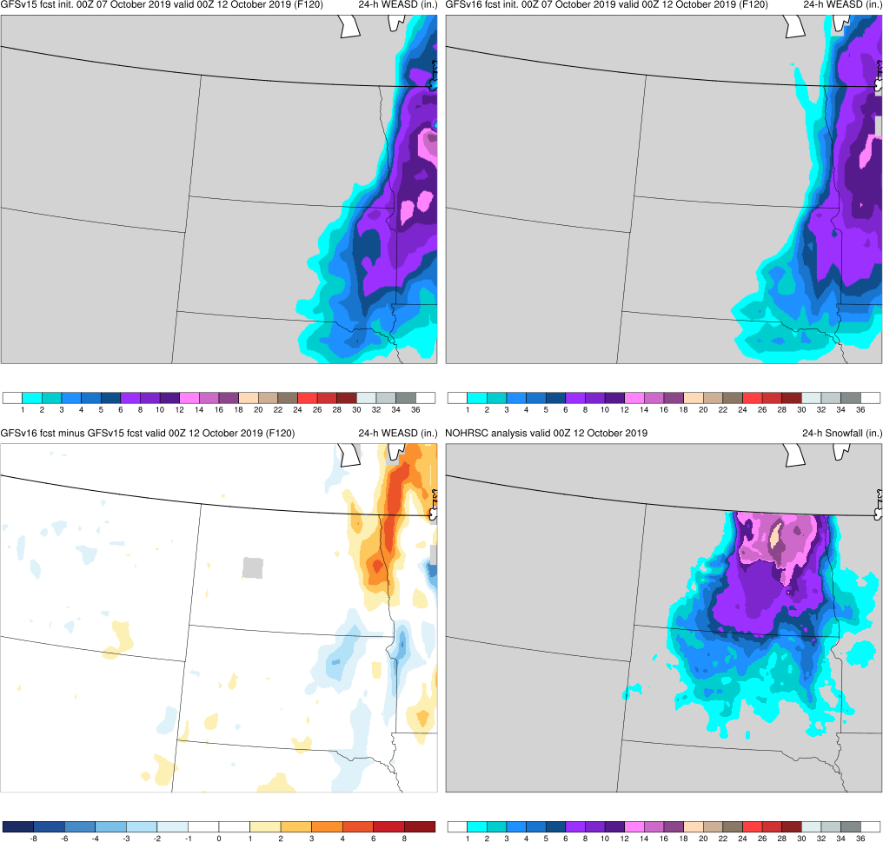
NATIONAL OCEANIC AND ATMOSPHERIC ADMINISTRATION
Strengths: Improved Snowfall Forecasts
October Snow Storm (F120) Valid: 00Z 10/12/19
Thxgiving: GFSv16 forecasted a Great Plains snowfall event 48 h earlier than GFSv15
Oct Snow: GFSv16 forecasted a better snowfall footprint and more accurate amounts than GFSv15
GFSv15
GFSv16
v16−v15
NOHRSC

Slide 47
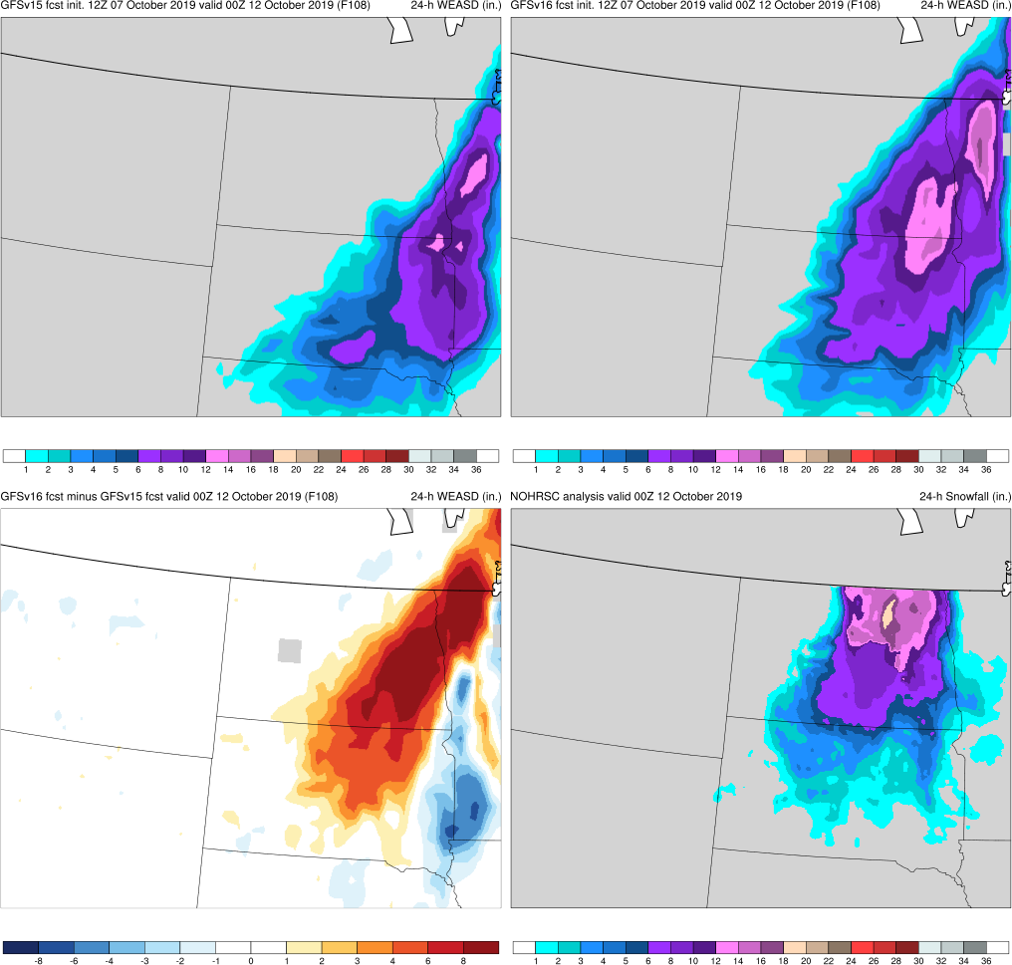
NATIONAL OCEANIC AND ATMOSPHERIC ADMINISTRATION
Strengths: Improved Snowfall Forecasts
October Snow Storm (F108) Valid: 00Z 10/12/19
Thxgiving: GFSv16 forecasted a Great Plains snowfall event 48 h earlier than GFSv15
Oct Snow: GFSv16 forecasted a better snowfall footprint and more accurate amounts than GFSv15
GFSv15
GFSv16
v16−v15
NOHRSC

Slide 48
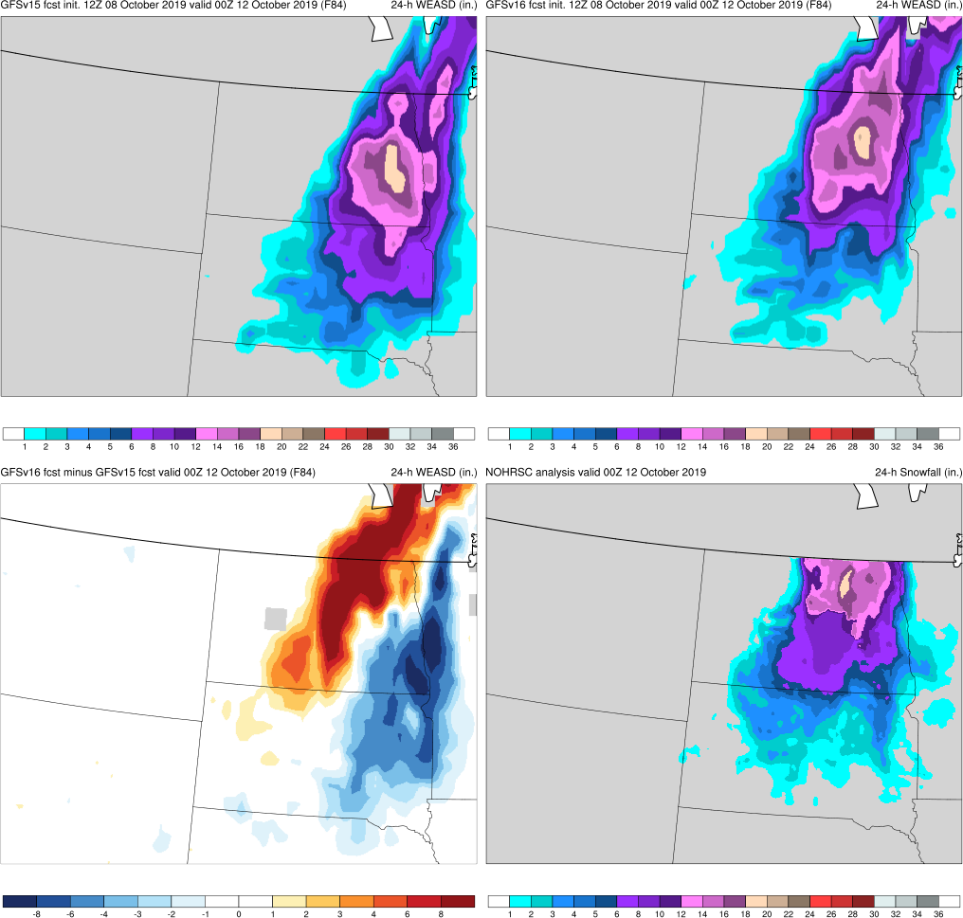
NATIONAL OCEANIC AND ATMOSPHERIC ADMINISTRATION
Strengths: Improved Snowfall Forecasts
October Snow Storm (F084) Valid: 00Z 10/12/19
Thxgiving: GFSv16 forecasted a Great Plains snowfall event 48 h earlier than GFSv15
Oct Snow: GFSv16 forecasted a better snowfall footprint and more accurate amounts than GFSv15
GFSv15
GFSv16
v16−v15
NOHRSC

Slide 49
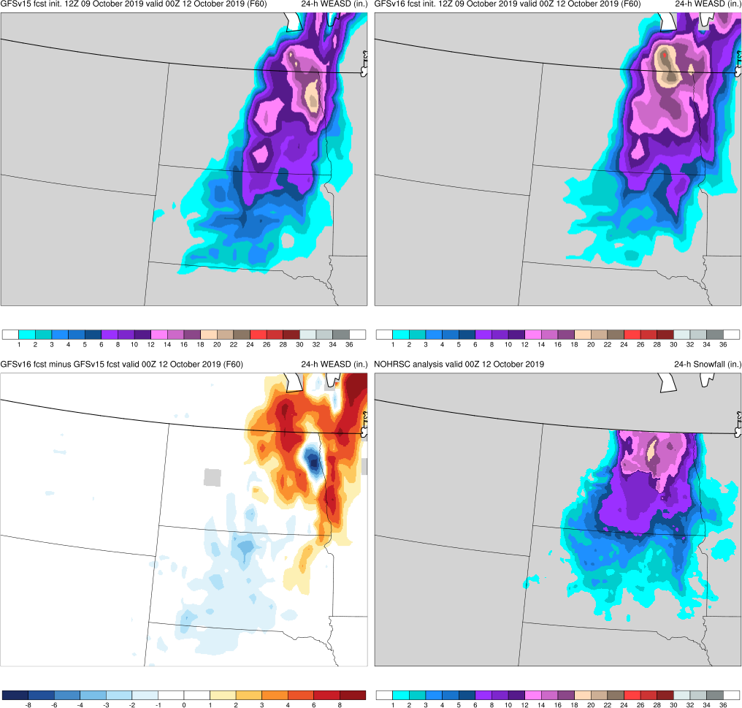
NATIONAL OCEANIC AND ATMOSPHERIC ADMINISTRATION
Strengths: Improved Snowfall Forecasts
October Snow Storm (F060) Valid: 00Z 10/12/19
Thxgiving: GFSv16 forecasted a Great Plains snowfall event 48 h earlier than GFSv15
Oct Snow: GFSv16 forecasted a better snowfall footprint and more accurate amounts than GFSv15
GFSv15
GFSv16
v16−v15
NOHRSC

Slide 50
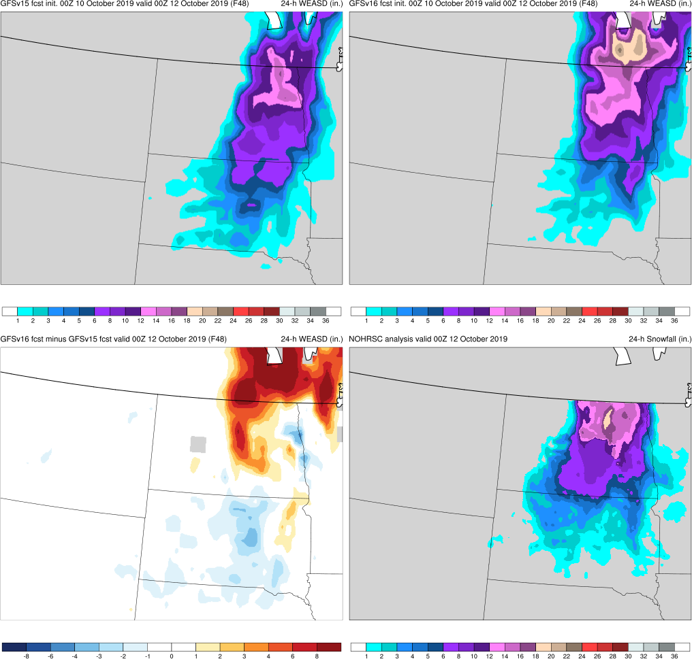
NATIONAL OCEANIC AND ATMOSPHERIC ADMINISTRATION
Strengths: Improved Snowfall Forecasts
October Snow Storm (F048) Valid: 00Z 10/12/19
Thxgiving: GFSv16 forecasted a Great Plains snowfall event 48 h earlier than GFSv15
Oct Snow: GFSv16 forecasted a better snowfall footprint and more accurate amounts than GFSv15
GFSv15
GFSv16
v16−v15
NOHRSC

Slide 51
NATIONAL OCEANIC AND ATMOSPHERIC ADMINISTRATION
Strengths: Improved Snowfall Forecasts
October Snow Storm (F024) Valid: 00Z 10/12/19
Thxgiving: GFSv16 forecasted a Great Plains snowfall event 48 h earlier than GFSv15
Oct Snow: GFSv16 forecasted a better snowfall footprint and more accurate amounts than GFSv15
GFSv15
GFSv16
v16−v15
NOHRSC

Slide 52
NATIONAL OCEANIC AND ATMOSPHERIC ADMINISTRATION
Strengths: Improved Snowfall Forecasts
Midwest Ptype Event (F096) Valid: 12Z 01/24/20
Thxgiving: GFSv16 forecasted a Great Plains snowfall event 48 h earlier than GFSv15
Oct Snow: GFSv16 forecasted a better snowfall footprint and more accurate amounts than GFSv15
Midwest Ptype: GFSv16 forecasted snow in MO, IA, and IL that was not shown by GFSv15 at any lead time
GFSv15
GFSv16
v16−v15
NOHRSC

Slide 53
NATIONAL OCEANIC AND ATMOSPHERIC ADMINISTRATION
Strengths: Improved Snowfall Forecasts
Midwest Ptype Event (F084) Valid: 12Z 01/24/20
Thxgiving: GFSv16 forecasted a Great Plains snowfall event 48 h earlier than GFSv15
Oct Snow: GFSv16 forecasted a better snowfall footprint and more accurate amounts than GFSv15
Midwest Ptype: GFSv16 forecasted snow in MO, IA, and IL that was not shown by GFSv15 at any lead time
GFSv15
GFSv16
v16−v15
NOHRSC

Slide 54
NATIONAL OCEANIC AND ATMOSPHERIC ADMINISTRATION
Strengths: Improved Snowfall Forecasts
Midwest Ptype Event (F060) Valid: 12Z 01/24/20
Thxgiving: GFSv16 forecasted a Great Plains snowfall event 48 h earlier than GFSv15
Oct Snow: GFSv16 forecasted a better snowfall footprint and more accurate amounts than GFSv15
Midwest Ptype: GFSv16 forecasted snow in MO, IA, and IL that was not shown by GFSv15 at any lead time
GFSv15
GFSv16
v16−v15
NOHRSC

Slide 55
NATIONAL OCEANIC AND ATMOSPHERIC ADMINISTRATION
Strengths: Improved Snowfall Forecasts
Midwest Ptype Event (F036) Valid: 12Z 01/24/20
Thxgiving: GFSv16 forecasted a Great Plains snowfall event 48 h earlier than GFSv15
Oct Snow: GFSv16 forecasted a better snowfall footprint and more accurate amounts than GFSv15
Midwest Ptype: GFSv16 forecasted snow in MO, IA, and IL that was not shown by GFSv15 at any lead time
GFSv15
GFSv16
v16−v15
NOHRSC

Slide 56
NATIONAL OCEANIC AND ATMOSPHERIC ADMINISTRATION
Strengths: Improved Snowfall Forecasts
Midwest Ptype Event (F024) Valid: 12Z 01/24/20
Thxgiving: GFSv16 forecasted a Great Plains snowfall event 48 h earlier than GFSv15
Oct Snow: GFSv16 forecasted a better snowfall footprint and more accurate amounts than GFSv15
Midwest Ptype: GFSv16 forecasted snow in MO, IA, and IL that was not shown by GFSv15 at any lead time
GFSv15
GFSv16
v16−v15
NOHRSC

Slide 57
NATIONAL OCEANIC AND ATMOSPHERIC ADMINISTRATION
GFSv16 Winter Weather: Strengths
Improved 500-hPa geo. height AC scores in the medium range
Overall, captures the synoptic pattern better and more consistently (i.e., forecasts jump around less) in the medium and short range
Some indication that progressiveness of cutoff lows is reduced
Overall, improved snowfall locations and amounts at all lead times
Overall, improved medium-range precipitation type (ptype) forecasts
Low-level warming issue seen in GFSv15 has been resolved

Slide 58
NATIONAL OCEANIC AND ATMOSPHERIC ADMINISTRATION
Strengths: Improved Ptype Forecasts
Midwest Ptype Event (F084) Valid: 00Z 01/24/20
Midwest Ptype: GFSv16 forecasted snow in MO/IA/WI that GFSv15 did not. GFSv15 low-level warming issue appears to be resolved.
GFSv15
GFSv16
v16−v15
Obs
Thanks to Ray Wolf (WFO DVN)
See 2/6/20 MEG Presentation

Slide 59
NATIONAL OCEANIC AND ATMOSPHERIC ADMINISTRATION
Strengths: Improved Ptype Forecasts
Midwest Ptype Event (F084) Valid: 00Z 01/24/20
Midwest Ptype: GFSv16 forecasted snow in MO/IA/WI that GFSv15 did not. GFSv15 low-level warming issue appears to be resolved.
GFSv15
GFSv16
v16−v15
GFS Anl.

Slide 60
NATIONAL OCEANIC AND ATMOSPHERIC ADMINISTRATION
Strengths: Improved Ptype Forecasts
Midwest Ptype Event (F084) Valid: 00Z 01/24/20
Davenport, IA
Midwest Ptype: GFSv16 forecasted snow in MO/IA/WI that GFSv15 did not. GFSv15 low-level warming issue appears to be resolved.
GFSv15
GFSv16
OBS

Slide 61
NATIONAL OCEANIC AND ATMOSPHERIC ADMINISTRATION
Strengths: Improved Ptype Forecasts
Midwest Ptype Event (F024) Valid: 00Z 01/24/20
Midwest Ptype: GFSv16 forecasted snow in MO/IA/WI that GFSv15 did not. GFSv15 low-level warming issue appears to be resolved.
GFSv15
GFSv16
v16−v15
Obs

Slide 62
NATIONAL OCEANIC AND ATMOSPHERIC ADMINISTRATION
Strengths: Improved Ptype Forecasts
Midwest Ptype Event (F024) Valid: 00Z 01/24/20
Davenport, IA
Midwest Ptype: GFSv16 forecasted snow in MO/IA/WI that GFSv15 did not. GFSv15 low-level warming issue appears to be resolved.
GFSv15
GFSv16
OBS

Slide 63
NATIONAL OCEANIC AND ATMOSPHERIC ADMINISTRATION
Strengths: Improved Ptype Forecasts
Northern Plains Ptype (F072) Valid: 12Z 11/30/19
Midwest Ptype: GFSv16 forecasted snow in MO/IA/WI that GFSv15 did not. GFSv15 low-level warming issue appears to be resolved.
N Plains: GFSv16 forecasted snow is MN/ND/SD that GFSv15 did not
GFSv15
GFSv16
v16−v15
Obs
Thanks to Chauncy Schultz (WFO BIS)
See 2/6/20 MEG Presentation

Slide 64
NATIONAL OCEANIC AND ATMOSPHERIC ADMINISTRATION
Strengths: Improved Ptype Forecasts
Northern Plains Ptype (F048) Valid: 12Z 11/30/19
Midwest Ptype: GFSv16 forecasted snow in MO/IA/WI that GFSv15 did not. GFSv15 low-level warming issue appears to be resolved.
N Plains: GFSv16 forecasted snow is MN/ND/SD that GFSv15 did not
GFSv15
GFSv16
v16−v15
Obs

Slide 65
NATIONAL OCEANIC AND ATMOSPHERIC ADMINISTRATION
Strengths: Improved Ptype Forecasts
Northern Plains Ptype (F048) Valid: 12Z 11/30/19
Rapid City, SD
Midwest Ptype: GFSv16 forecasted snow in MO/IA/WI that GFSv15 did not. GFSv15 low-level warming issue appears to be resolved.
N Plains: GFSv16 forecasted snow is MN/ND/SD that GFSv15 did not
GFSv15
GFSv16
OBS

Slide 66
NATIONAL OCEANIC AND ATMOSPHERIC ADMINISTRATION
Strengths: Improved Ptype Forecasts
Northern Plains Ptype (F048) Valid: 12Z 11/30/19
Bismarck, ND
Midwest Ptype: GFSv16 forecasted snow in MO/IA/WI that GFSv15 did not. GFSv15 low-level warming issue appears to be resolved.
N Plains: GFSv16 forecasted snow is MN/ND/SD that GFSv15 did not
GFSv15
GFSv16
OBS

Slide 67
NATIONAL OCEANIC AND ATMOSPHERIC ADMINISTRATION
Strengths: Improved Ptype Forecasts
Northern Plains Ptype (F036) Valid: 12Z 11/30/19
Bismarck, ND
Midwest Ptype: GFSv16 forecasted snow in MO/IA/WI that GFSv15 did not. GFSv15 low-level warming issue appears to be resolved.
N Plains: GFSv16 forecasted snow is MN/ND/SD that GFSv15 did not
GFSv15
GFSv16
OBS

Slide 68
NATIONAL OCEANIC AND ATMOSPHERIC ADMINISTRATION
Strengths: Improved Ptype Forecasts
New York Ice Event (F132) Valid: 12Z 12/30/19
Midwest Ptype: GFSv16 forecasted snow in MO/IA/WI that GFSv15 did not. GFSv15 low-level warming issue appears to be resolved.
N Plains: GFSv16 forecasted snow is MN/ND/SD that GFSv15 did not
NY Ice Event: GFSv16 forecasted FZ and IP across NY, VT, and NH by F132, 36 h earlier than GFSv15
GFSv15
GFSv16
v16−v15
Obs

Slide 69
NATIONAL OCEANIC AND ATMOSPHERIC ADMINISTRATION
Strengths: Improved Ptype Forecasts
New York Ice Event (F120) Valid: 12Z 12/30/19
Midwest Ptype: GFSv16 forecasted snow in MO/IA/WI that GFSv15 did not. GFSv15 low-level warming issue appears to be resolved.
N Plains: GFSv16 forecasted snow is MN/ND/SD that GFSv15 did not
NY Ice Event: GFSv16 forecasted FZ and IP across NY, VT, and NH by F132, 36 h earlier than GFSv15
GFSv15
GFSv16
v16−v15
Obs

Slide 70
NATIONAL OCEANIC AND ATMOSPHERIC ADMINISTRATION
Strengths: Improved Ptype Forecasts
New York Ice Event (F108) Valid: 12Z 12/30/19
Midwest Ptype: GFSv16 forecasted snow in MO/IA/WI that GFSv15 did not. GFSv15 low-level warming issue appears to be resolved.
N Plains: GFSv16 forecasted snow is MN/ND/SD that GFSv15 did not
NY Ice Event: GFSv16 forecasted FZ and IP across NY, VT, and NH by F132, 36 h earlier than GFSv15
GFSv15
GFSv16
v16−v15
Obs

Slide 71
NATIONAL OCEANIC AND ATMOSPHERIC ADMINISTRATION
Strengths: Improved Ptype Forecasts
New York Ice Event (F096) Valid: 12Z 12/30/19
Midwest Ptype: GFSv16 forecasted snow in MO/IA/WI that GFSv15 did not. GFSv15 low-level warming issue appears to be resolved.
N Plains: GFSv16 forecasted snow is MN/ND/SD that GFSv15 did not
NY Ice Event: GFSv16 forecasted FZ and IP across NY, VT, and NH by F132, 36 h earlier than GFSv15
GFSv15
GFSv16
v16−v15
Obs

Slide 72
NATIONAL OCEANIC AND ATMOSPHERIC ADMINISTRATION
GFSv16 Case Studies: Winter Weather
Improved 500-hPa geo. height AC scores in the medium range
Overall, captures the synoptic pattern better and more consistently in the medium and short range (i.e., forecasts jump around less)
Some indication that progressiveness of cutoff lows is reduced
Overall, improved snowfall locations and amounts at all lead times
Overall, improved medium-range precipitation type (ptype) forecasts
Low-level warming issue seen in GFSv15 has been resolved

