Slide 1
NATIONAL OCEANIC AND ATMOSPHERIC ADMINISTRATION
GFSv16 Case Studies: QPF Cases
GFSv15 (F156)
GFSv16 (F156)
StageIV
24 h QPF (shaded, in)
Philippe Papin EMC Model Evaluation Group Webinar
27 August 2020

Slide 2
NATIONAL OCEANIC AND ATMOSPHERIC ADMINISTRATION
GFSv16 Retrospective Streams
GFSv16 retro streams were run in parallel across multiple supercomputers
Link to stats
GFSv16 Retrospective Stream 0 (5/5/19–5/31/19) [Click here]
GFSv16 Retrospective Stream 1 (6/1/19–8/31/19) [Click here]
GFSv16 Retrospective Stream 2 (9/1/19–11/30/19) [Click here]
GFSv16 Retrospective Stream 3 (12/1/19–5/18/20) [Click here]
GFSv16 Retrospective Stream 4 (combined with Stream 3)
GFSv16 Retrospective Stream 5 (8/31/18–10/12/18) [Click here]
GFSv16 Real-time Stream (5/19/20–present) [Click here]

Slide 3
NATIONAL OCEANIC AND ATMOSPHERIC ADMINISTRATION
GFSv16 Retrospectives: QPF Case Studies
QPF Cases
Halloween Storm (Oct/Nov 2019)
Post-Thanksgiving Storm (Nov/Dec 2019)
California Spring Storm (May 2019)
Pacific NW Atmospheric River (Jan/Feb 2020)
Southern U.S. QPF (Feb 2020)
Winter Storm Cases
West Coast Bomb Cyclone (Nov 2019)
New York Ice Event (Dec 2019)
Alaskan New Year Storm (Jan 2020)
TC Cases
Imelda (Sep 2019)
Olga (Oct 2019)
Severe Weather Cases
Easter Sunday Outbreak (Apr 2020)

Slide 4
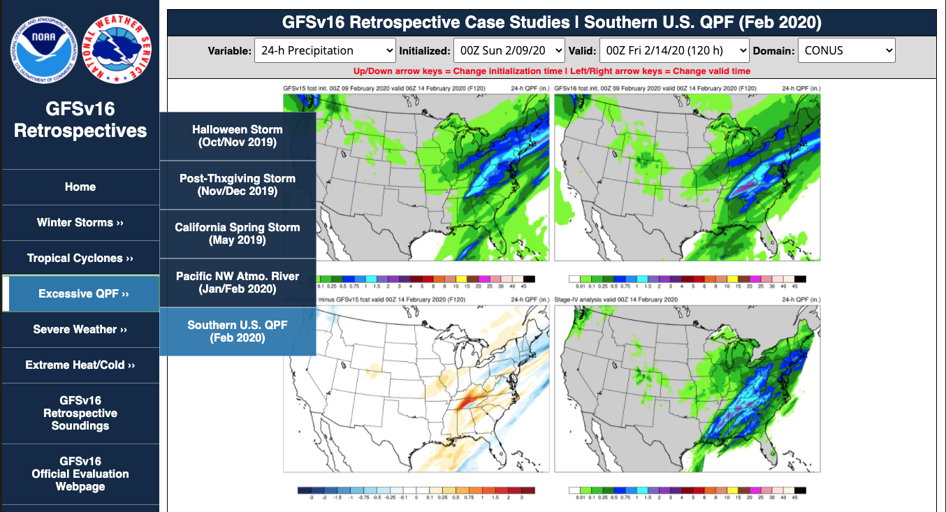
NATIONAL OCEANIC AND ATMOSPHERIC ADMINISTRATION
GFSv16 Retrospectives: QPF Case Studies
https://www.emc.ncep.noaa.gov/users/meg/gfsv16/retros/

Slide 5
NATIONAL OCEANIC AND ATMOSPHERIC ADMINISTRATION
GFSv16 QPF Cases: Strengths
Better QPF general statistics at most precipitation amounts
0.2 to 35 mm/24 h thresholds
Overall better QPF forecasts in a variety of different cases
Winter Storms, Atmospheric Rivers, Tropical Cyclones, etc.
Improvements in many cases are resulting from better synoptic weather forecasts
Often resulting from less progressive flow pattern

Slide 6
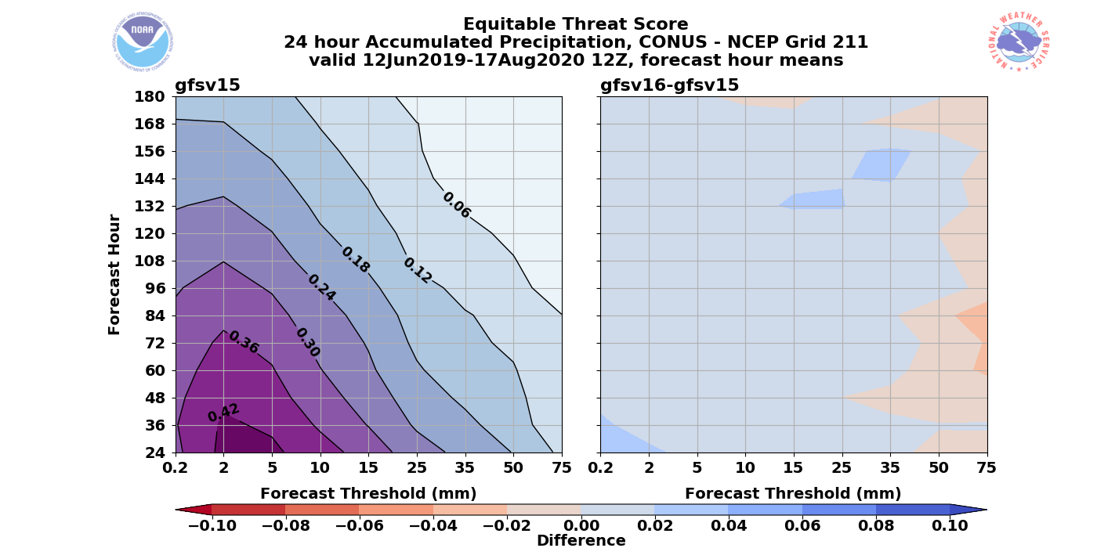
NATIONAL OCEANIC AND ATMOSPHERIC ADMINISTRATION
GFSv16 QPF General Statistics
Equitable Threat Score
24h precipitation forecasts improved at most lead times
F24–F168
24h precipitation forecast improved at most thresholds
0.2 mm–35 mm
Some degraded skill at larger thresholds
>35 mm
Not statistically significant
GFSv16 Worse
GFSv16 Better
Full Retrospective & Real-Time Period: 12 June 2019 – 17 Aug 2020

Slide 7
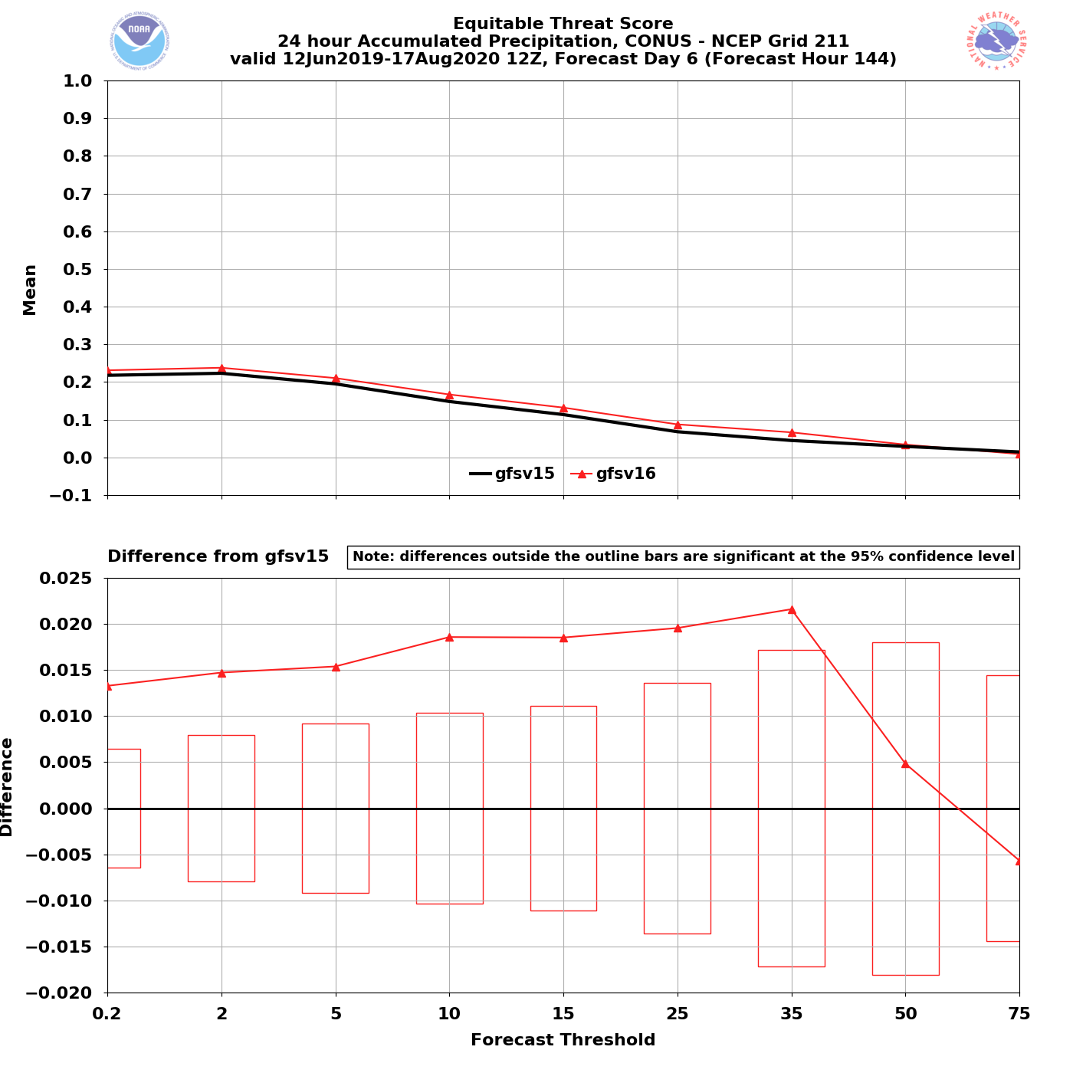
NATIONAL OCEANIC AND ATMOSPHERIC ADMINISTRATION
GFSv16 QPF General Statistics
24h QPF Valid F144
24 h QPF improvements appear most pronounced in medium range (F120-F144)
Statistically Significant improvement of 0.2 mm–35 mm thresholds
Statistically Significant

Slide 8
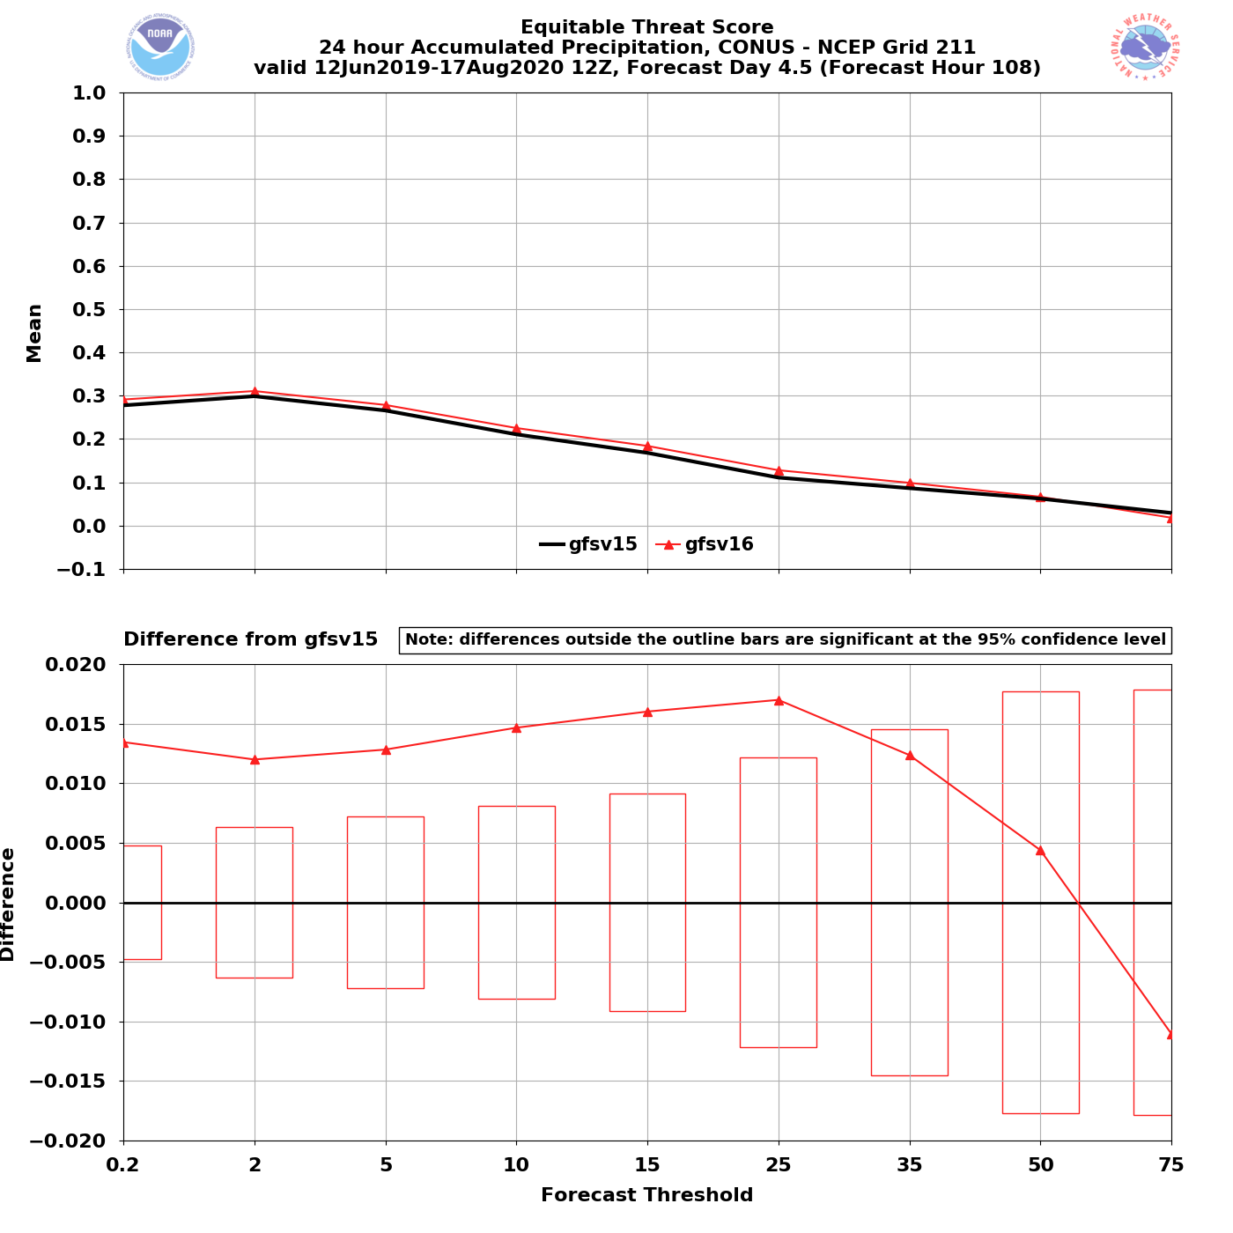
NATIONAL OCEANIC AND ATMOSPHERIC ADMINISTRATION
GFSv16 QPF General Statistics
24h QPF Valid F108
24 h QPF improvements appear most pronounced in medium range (F120-F144)
Statistically Significant improvement of 0.2 mm–35 mm thresholds
Statistically Significant

Slide 9
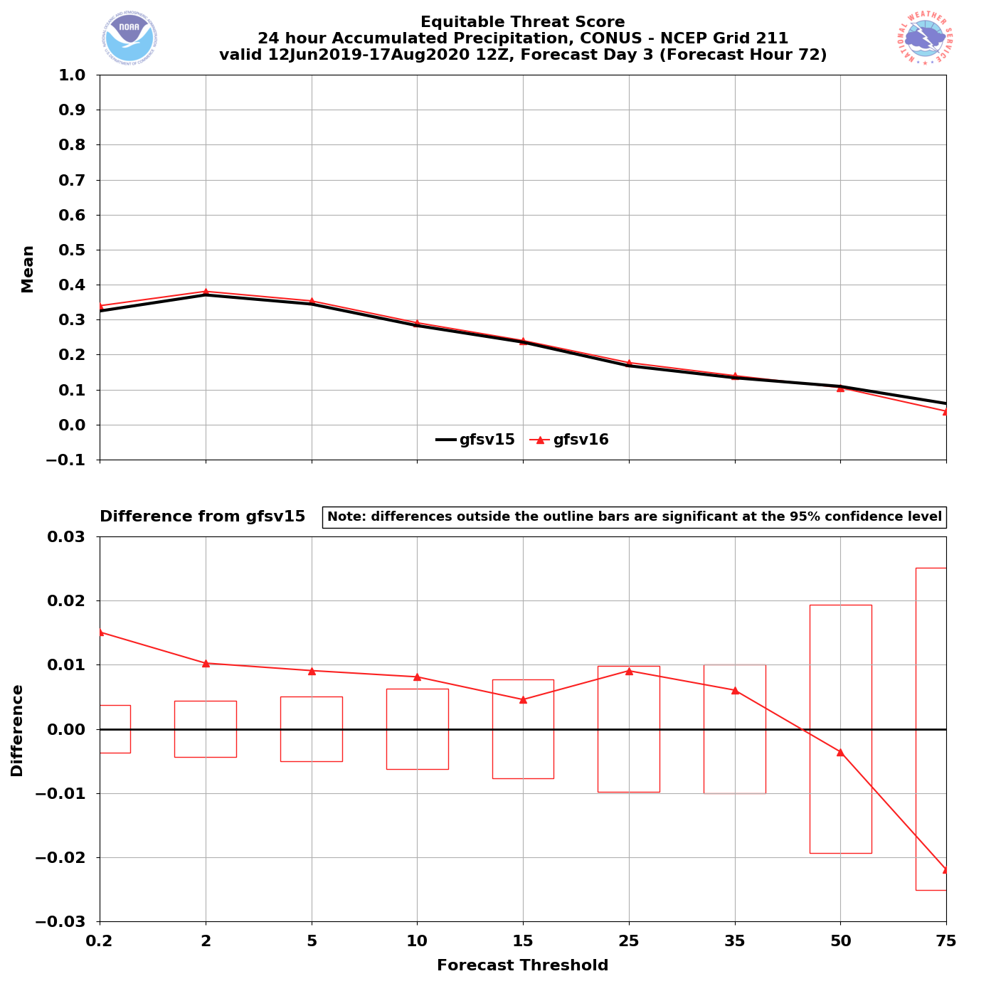
NATIONAL OCEANIC AND ATMOSPHERIC ADMINISTRATION
GFSv16 QPF General Statistics
24h QPF Valid F72
24 h QPF improvements appear most pronounced in medium range (F120-F144)
Statistically Significant improvement of 0.2 mm–35 mm thresholds
Still an improvement at shorter lead times, though more so at lower thresholds
Statistically Significant

Slide 10
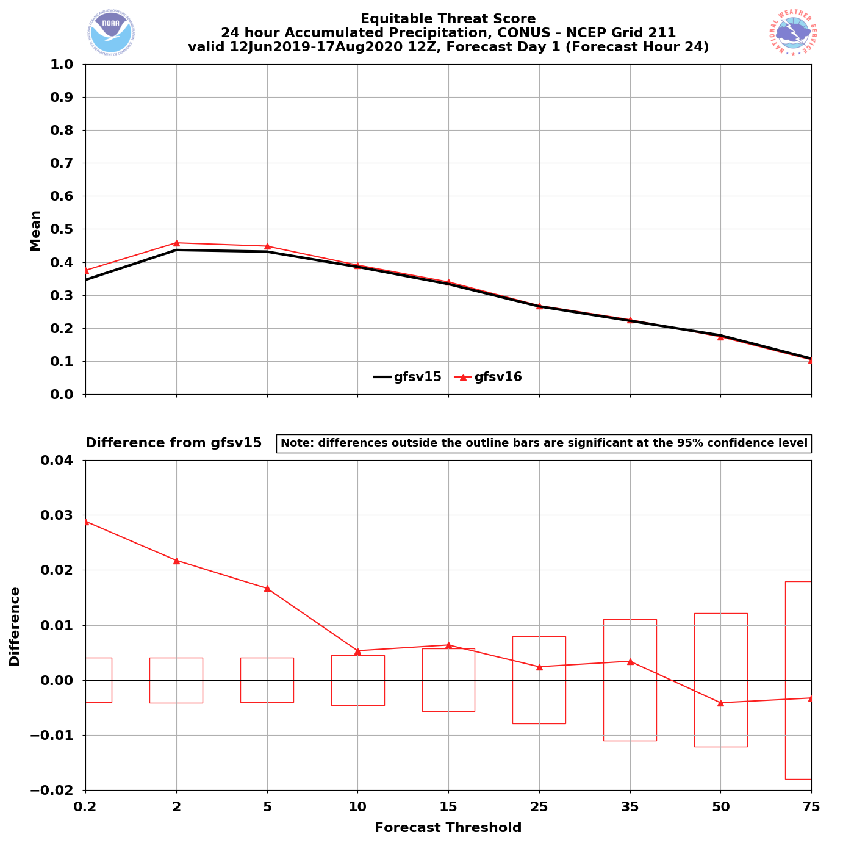
NATIONAL OCEANIC AND ATMOSPHERIC ADMINISTRATION
GFSv16 QPF General Statistics
24h QPF Valid F24
24 h QPF improvements appear most pronounced in medium range (F120-F144)
Statistically Significant improvement of 0.2 mm–35 mm thresholds
Still an improvement at shorter lead times, though more so at lower thresholds
Statistically Significant

Slide 11
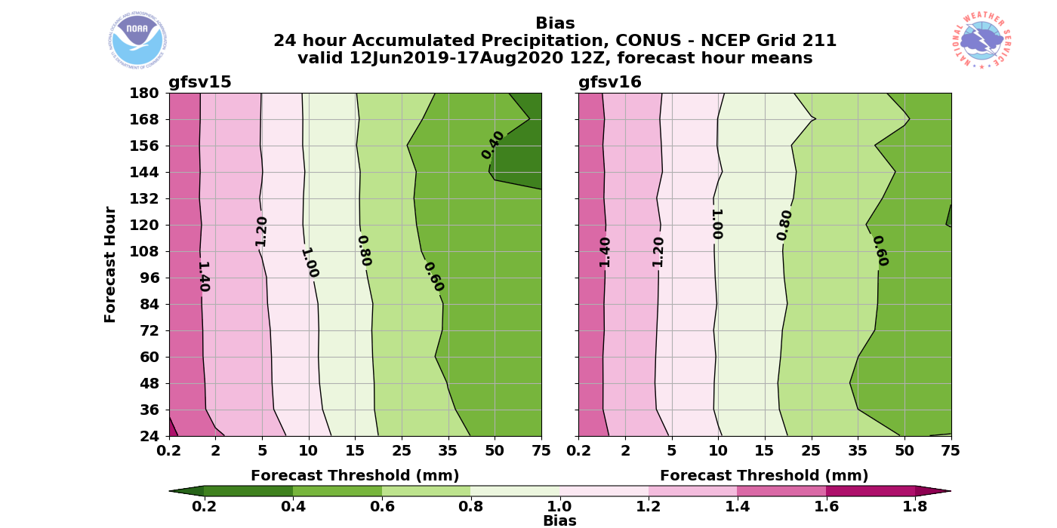
NATIONAL OCEANIC AND ATMOSPHERIC ADMINISTRATION
GFSv16 QPF General Statistics
Bias
High 24h QPF bias reduced at small thresholds
0.2 mm–10 mm
Low 24h QPF bias reduced at large thresholds
>15 mm
Little change with thresholds that were already near no bias (1.0)
10 mm
Under forecast
Over forecast
Full Retrospective Period: 12 June 2019 – 17 Aug 2020

Slide 12
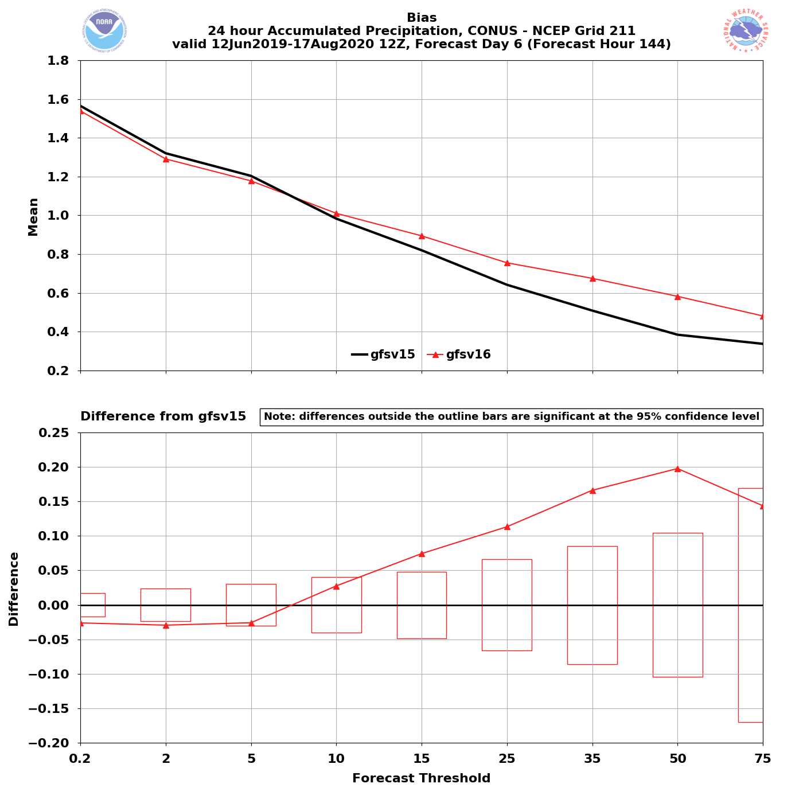
NATIONAL OCEANIC AND ATMOSPHERIC ADMINISTRATION
GFSv16 QPF General Statistics
Bias
24h QPF Valid F144
24 h QPF bias improvements also most pronounced in medium range (F120-F144)
Reduction of high bias at 0.2 mm–5 mm statistically significant
Reduction of low bias at medium precipitation thresholds (15 mm–50 mm) statistically significant
Statistically Significant

Slide 13
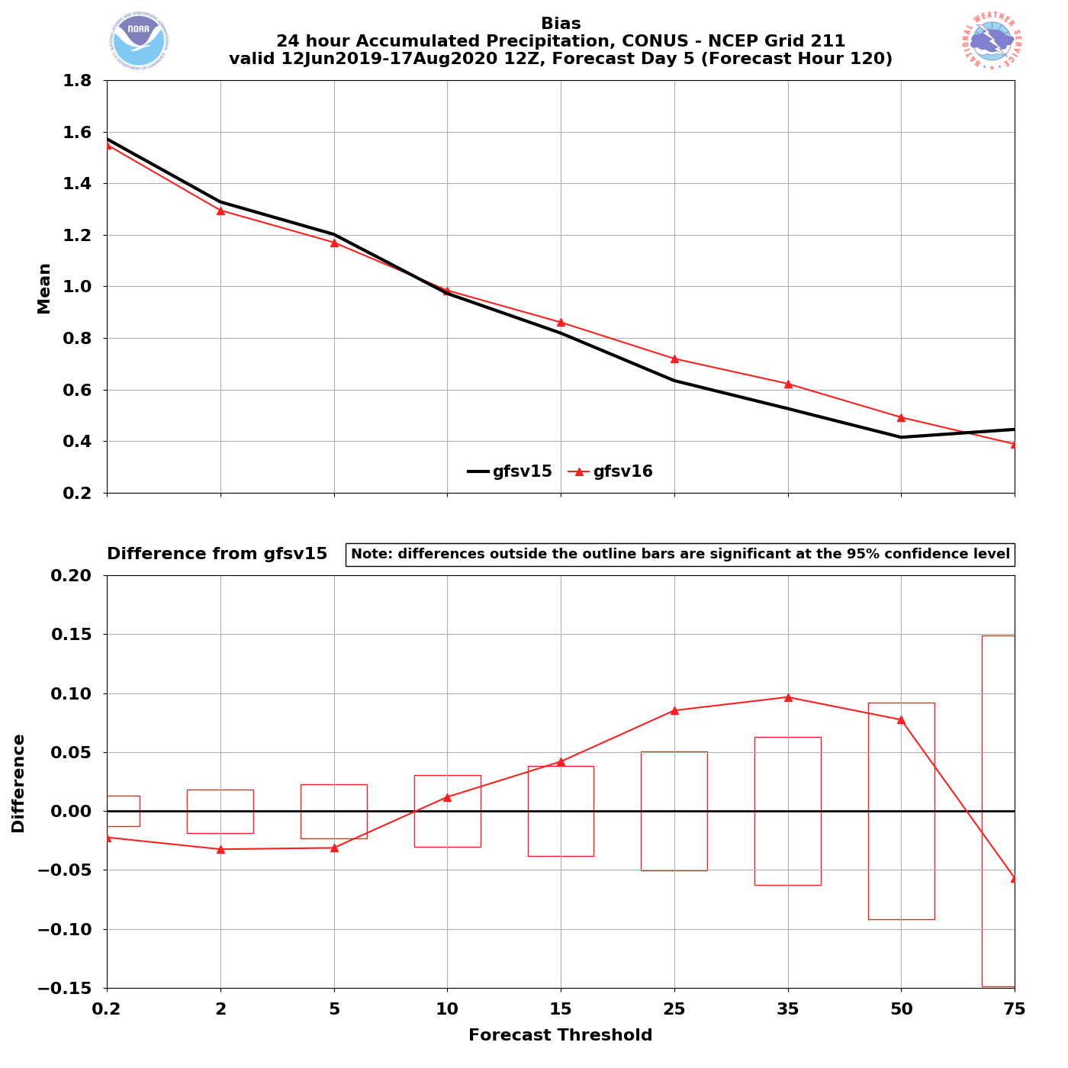
NATIONAL OCEANIC AND ATMOSPHERIC ADMINISTRATION
GFSv16 QPF General Statistics
Bias
24h QPF Valid F120
24 h QPF bias improvements also most pronounced in medium range (F120-F144)
Reduction of high bias at 0.2 mm–5 mm statistically significant
Reduction of low bias at medium precipitation thresholds (15 mm–50 mm) statistically significant
Statistically Significant

Slide 14
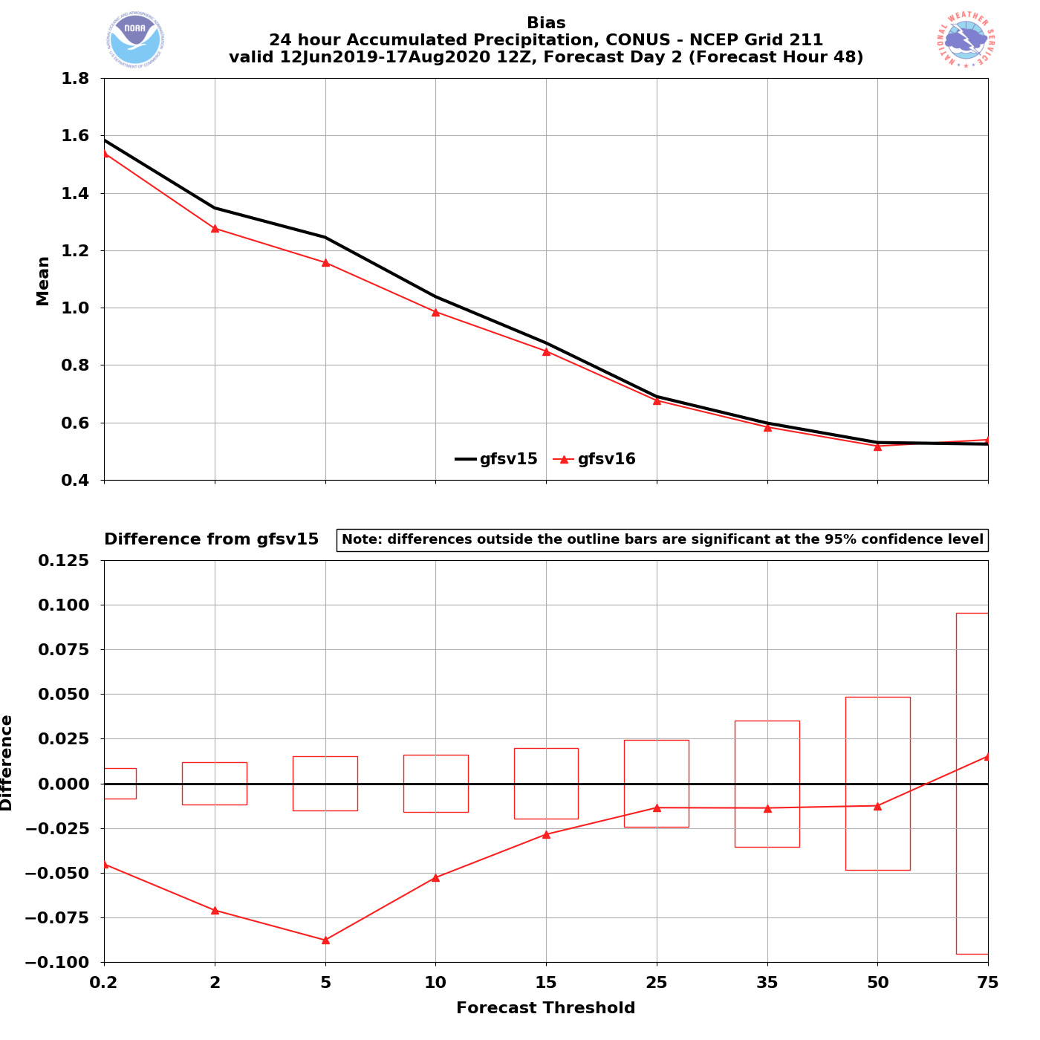
NATIONAL OCEANIC AND ATMOSPHERIC ADMINISTRATION
GFSv16 QPF General Statistics
Bias
24h QPF Valid F48
24 h QPF bias improvements also most pronounced in medium range (F120-F144)
Reduction of high bias at 0.2 mm–5 mm statistically significant
Reduction of low bias at medium precipitation thresholds (15 mm–50 mm) statistically significant
Statistically Significant
At shorter lead times (F24-F48) similar improvements for smaller QPF thresholds
0.2 mm–15 mm statistically significant

Slide 15
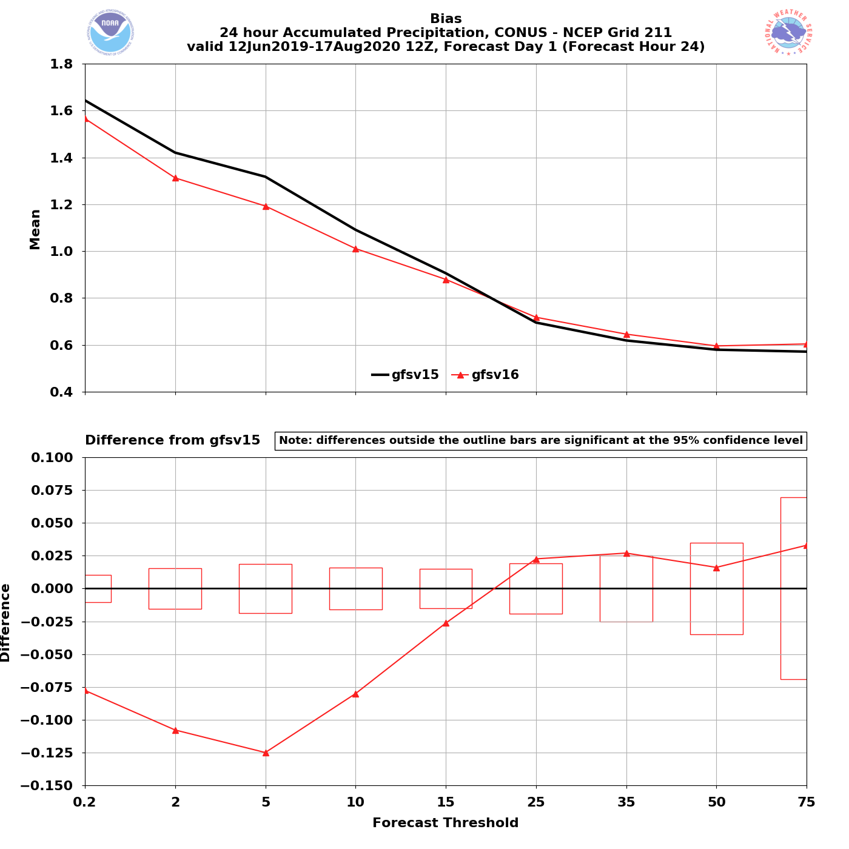
NATIONAL OCEANIC AND ATMOSPHERIC ADMINISTRATION
GFSv16 QPF General Statistics
Bias
24h QPF Valid F24
24 h QPF bias improvements also most pronounced in medium range (F120-F144)
Reduction of high bias at 0.2 mm–5 mm statistically significant
Reduction of low bias at medium precipitation thresholds (15 mm–50 mm) statistically significant
Statistically Significant
At shorter lead times (F24-F48) similar improvements for smaller QPF thresholds
0.2 mm–15 mm statistically significant

Slide 16
NATIONAL OCEANIC AND ATMOSPHERIC ADMINISTRATION
GFSv16 QPF General Statistics
Bias
24h QPF Valid F24
24 h QPF bias improvements also most pronounced in medium range (F120-F144)
Reduction of high bias at 0.2 mm–5 mm statistically significant
Reduction of low bias at medium precipitation thresholds (15 mm–50 mm) statistically significant
Statistically Significant
At shorter lead times (F24-F48) similar improvements for smaller QPF thresholds
0.2 mm–15 mm statistically significant
Do We See Similar Improvements in individual Case Studies?

Slide 17
NATIONAL OCEANIC AND ATMOSPHERIC ADMINISTRATION
GFSv16 Retrospectives: QPF Case Studies
QPF Cases
Halloween Storm (Oct/Nov 2019)
Post-Thanksgiving Storm (Nov/Dec 2019)
California Spring Storm (May 2019)
Pacific NW Atmospheric River (Jan/Feb 2020)
Southern U.S. QPF (Feb 2020)
Winter Storm Cases
West Coast Bomb Cyclone (Nov 2019)
New York Ice Event (Dec 2019)
Alaskan New Year Storm (Jan 2020)
TC Cases
Imelda (Sep 2019)
Olga (Oct 2019)
Severe Weather Cases
Easter Sunday Outbreak (Apr 2020)

Slide 18
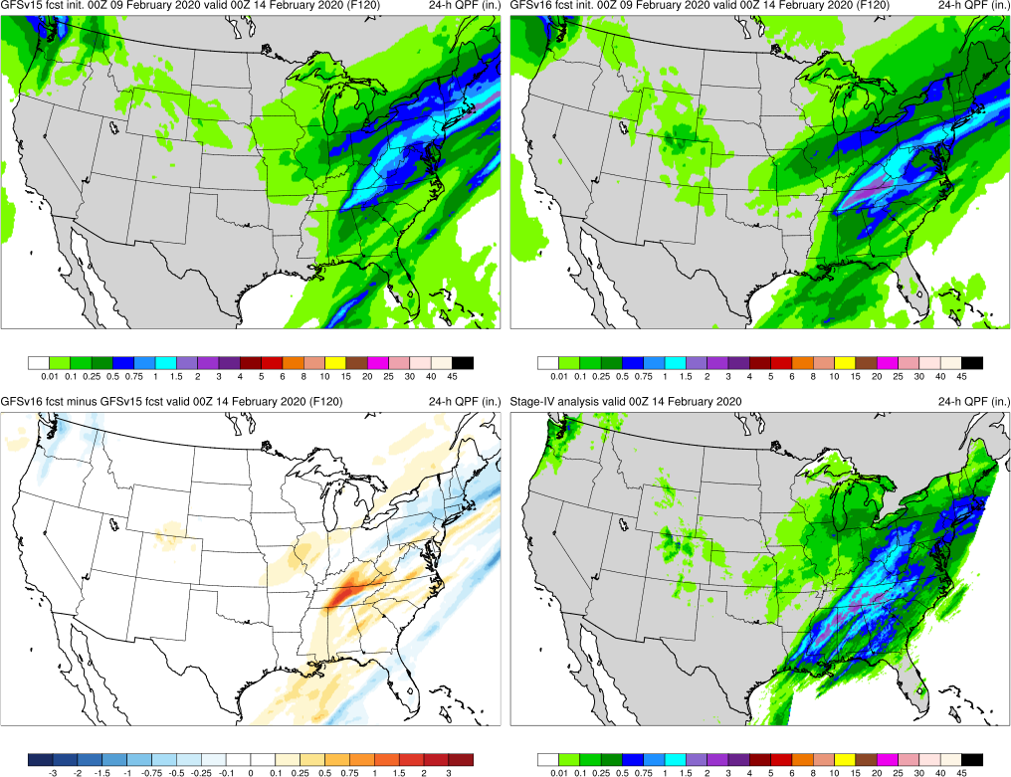
NATIONAL OCEANIC AND ATMOSPHERIC ADMINISTRATION
GFSv16 Retrospectives: QPF Case Studies
Graphics Setup
Top: GFSv15 (left)
GFSv16 (right)
Bottom Left: GFSv16−GFSv15 (shaded)
GFSv15
GFSv16
Bottom Right: Verifying Dataset (shaded)
v16-v15
StageIV
GFSv15 More Precip
GFSv16 More Precip

Slide 19
NATIONAL OCEANIC AND ATMOSPHERIC ADMINISTRATION
GFSv16 Retrospectives: QPF Case Studies
QPF Cases
Halloween Storm (Oct/Nov 2019)
Post-Thanksgiving Storm (Nov/Dec 2019)
California Spring Storm (May 2019)
Pacific NW Atmospheric River (Jan/Feb 2020)
Southern U.S. QPF (Feb 2020)
Winter Storm Cases
West Coast Bomb Cyclone (Nov 2019)
New York Ice Event (Dec 2019)
Alaskan New Year Storm (Jan 2020)
TC Cases
Imelda (Sep 2019)
Olga (Oct 2019)
Severe Weather Cases
Easter Sunday Outbreak (Apr 2020)

Slide 20
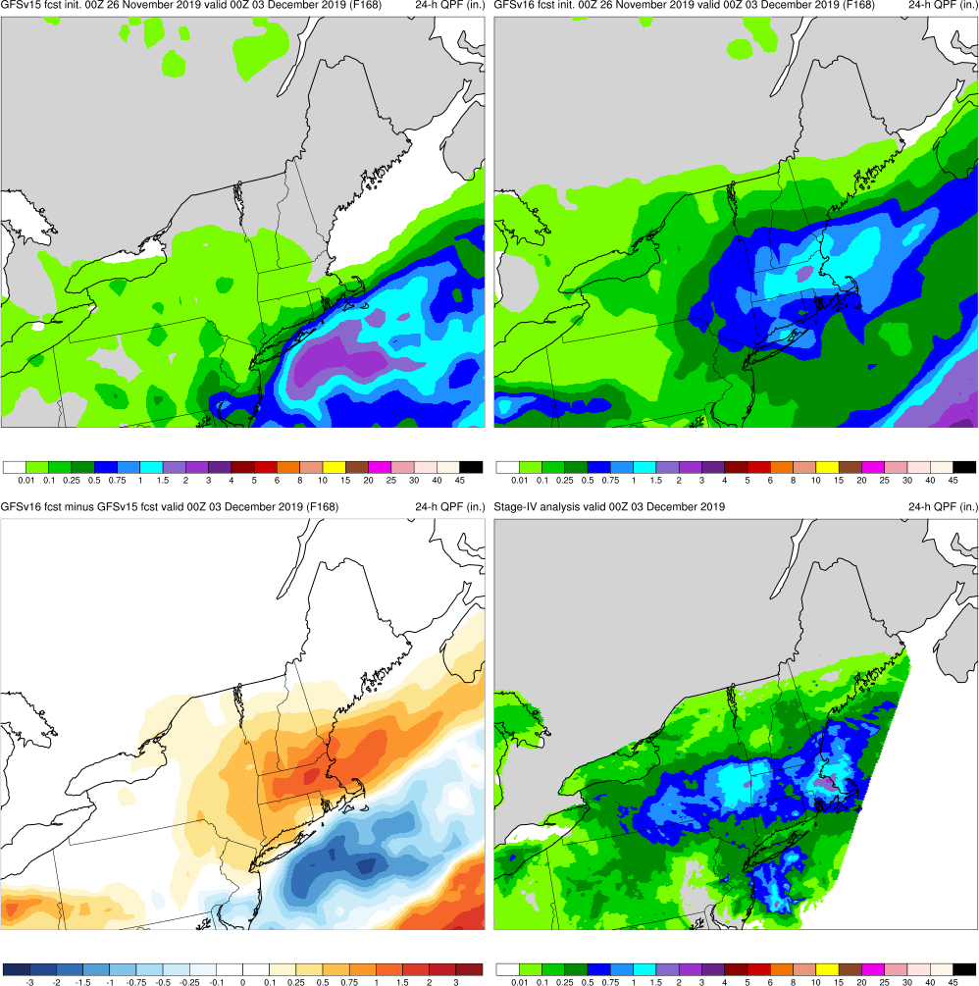
NATIONAL OCEANIC AND ATMOSPHERIC ADMINISTRATION
GFSv16 QPF Case Highlights
GFSv15
GFSv16
Post Thanksgiving Storm (F168) Valid: 00Z 12/03/19
Post Thanksgiving Storm: GFSv16 had more accurate QPF forecast in interior New England in medium range
v16−v15
StageIV

Slide 21
NATIONAL OCEANIC AND ATMOSPHERIC ADMINISTRATION
GFSv16 QPF Case Highlights
GFSv15
GFSv16
Post Thanksgiving Storm (F156) Valid: 00Z 12/03/19
Post Thanksgiving Storm: GFSv16 had more accurate QPF forecast in interior New England in medium range
v16−v15
StageIV

Slide 22
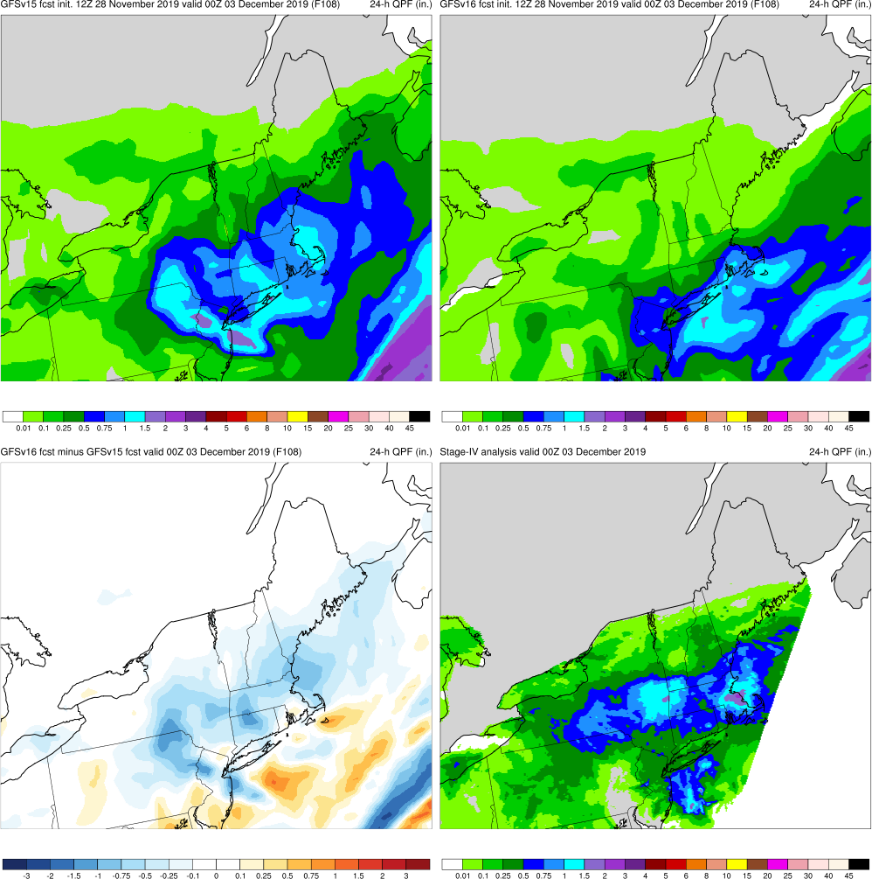
NATIONAL OCEANIC AND ATMOSPHERIC ADMINISTRATION
GFSv16 QPF Case Highlights
GFSv15
GFSv16
Post Thanksgiving Storm (F108) Valid: 00Z 12/03/19
Post Thanksgiving Storm: GFSv16 had more accurate QPF forecast in interior New England in medium range
Brief period where GFSv15 was better, but even at F24, GFSv16 captures max swath over Hudson River valley correctly
v16−v15
StageIV

Slide 23
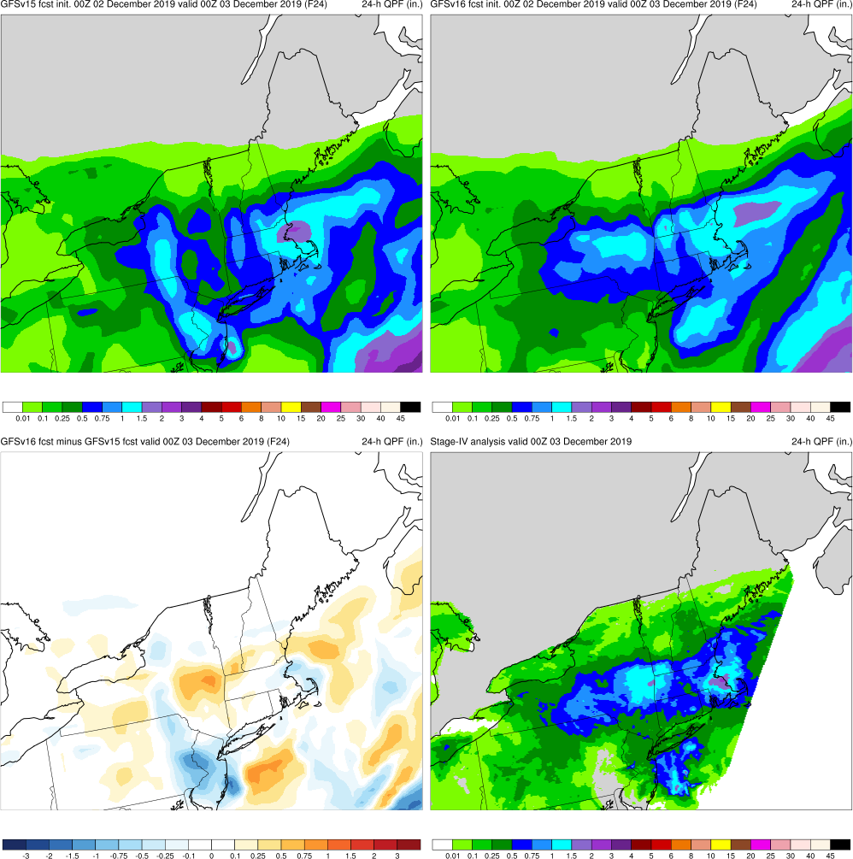
NATIONAL OCEANIC AND ATMOSPHERIC ADMINISTRATION
GFSv16 QPF Case Highlights
GFSv15
GFSv16
Post Thanksgiving Storm (F24) Valid: 00Z 12/03/19
Post Thanksgiving Storm: GFSv16 had more accurate QPF forecast in interior New England in medium range
Brief period where GFSv15 was better, but even at F24, GFSv16 captures max swath over Hudson River valley correctly
v16−v15
StageIV

Slide 24
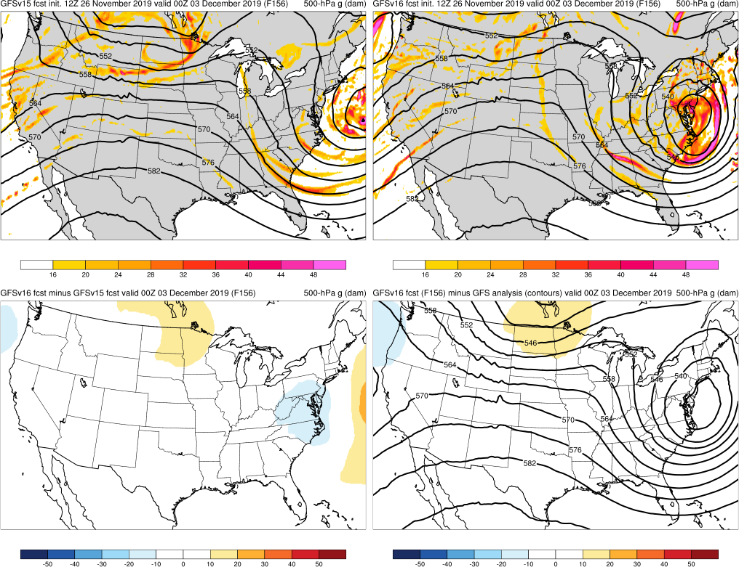
NATIONAL OCEANIC AND ATMOSPHERIC ADMINISTRATION
GFSv16 QPF Case Highlights
500-hPa Geopotential Height (contours), Vorticity (shaded)
Post Thanksgiving Storm (F156) Valid: 00Z 12/03/19
Post Thanksgiving Storm: GFSv16 had more accurate QPF forecast in interior New England in medium range
Brief period where GFSv15 was better, but even at F24, GFSv16 captures max swath over Hudson River valley correctly
Better medium range forecast due to less progressive trough/cutoff low
GFSv15
GFSv16
v16−v15
GFS Anl.

Slide 25
NATIONAL OCEANIC AND ATMOSPHERIC ADMINISTRATION
GFSv16 Retrospectives: QPF Case Studies
QPF Cases
Halloween Storm (Oct/Nov 2019)
Post-Thanksgiving Storm (Nov/Dec 2019)
California Spring Storm (May 2019)
Pacific NW Atmospheric River (Jan/Feb 2020)
Southern U.S. QPF (Feb 2020)
Winter Storm Cases
West Coast Bomb Cyclone (Nov 2019)
New York Ice Event (Dec 2019)
Alaskan New Year Storm (Jan 2020)
TC Cases
Imelda (Sep 2019)
Olga (Oct 2019)
Severe Weather Cases
Easter Sunday Outbreak (Apr 2020)

Slide 26
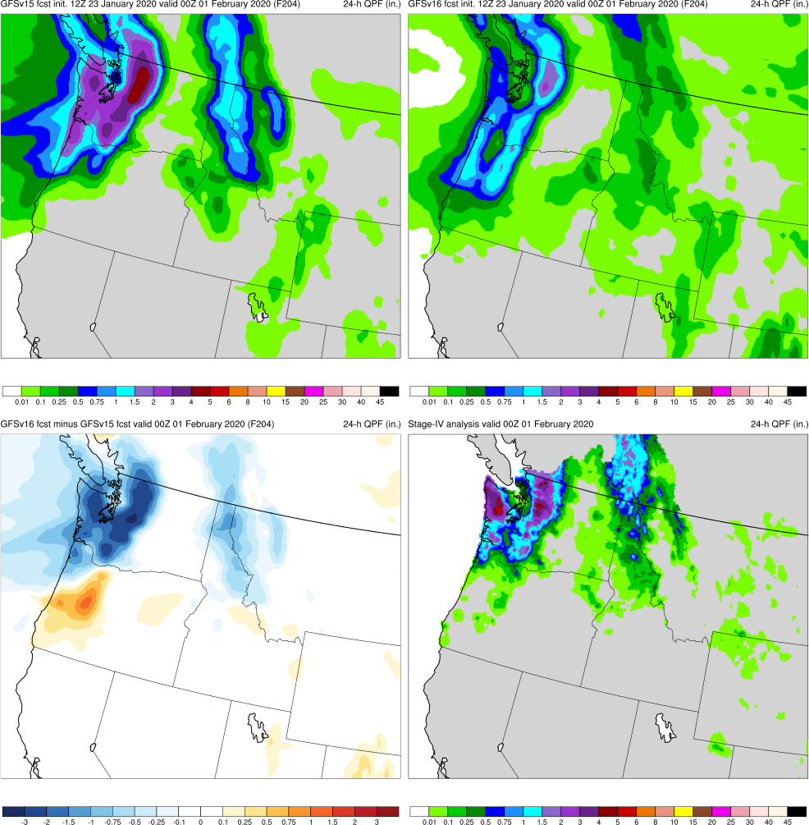
NATIONAL OCEANIC AND ATMOSPHERIC ADMINISTRATION
GFSv16 QPF Case Highlights
Pacific NW Atmos River (F204) Valid: 00Z 02/01/20
GFSv15 initially did better at long lead times (F156 and beyond).
GFSv16 had correctly higher QPF extending further south into WA in short-medium range (F120 and within)
GFSv15
GFSv16
v16−v15
StageIV

Slide 27
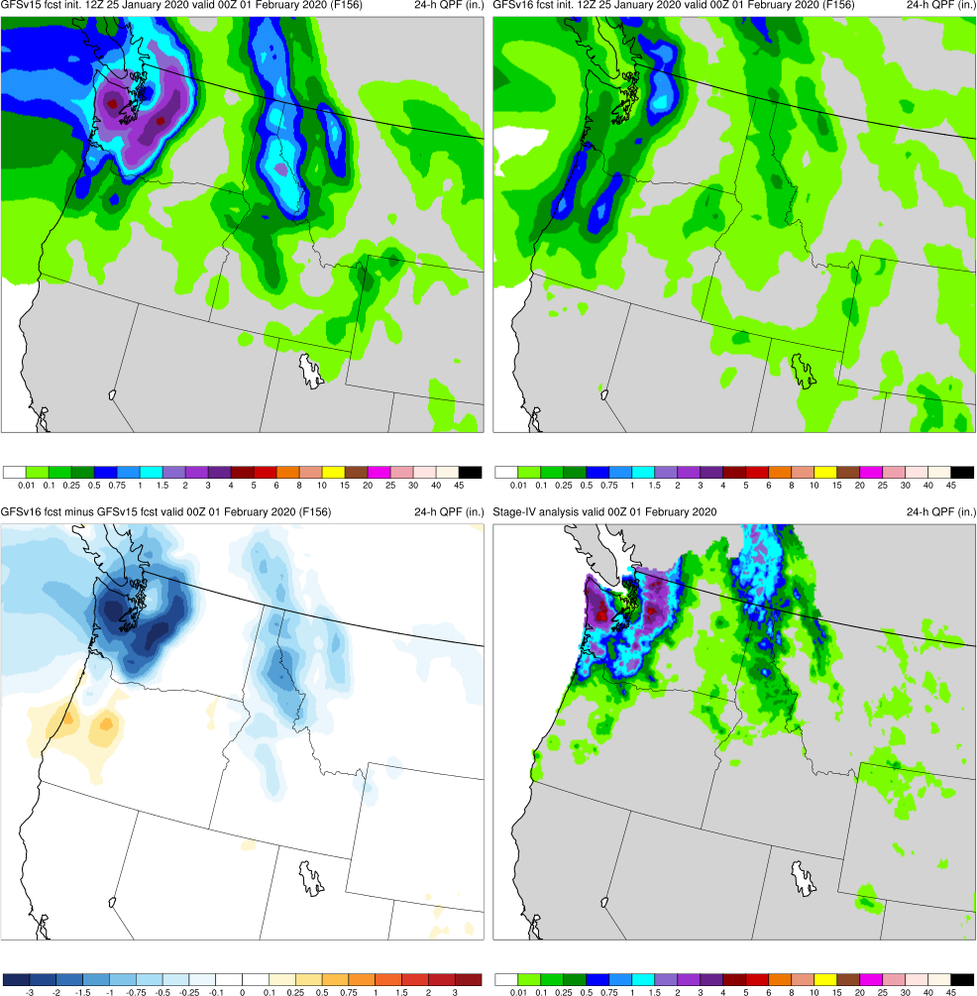
NATIONAL OCEANIC AND ATMOSPHERIC ADMINISTRATION
GFSv16 QPF Case Highlights
Pacific NW Atmos River (F156) Valid: 00Z 02/01/20
GFSv15 initially did better at long lead times (F156 and beyond).
GFSv16 had correctly higher QPF extending further south into WA in short-medium range (F120 and within)
GFSv15
GFSv16
v16−v15
StageIV

Slide 28
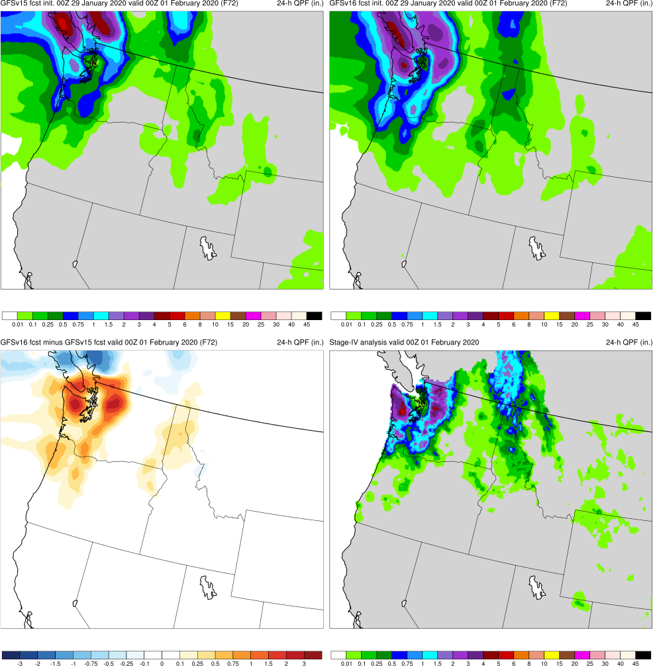
NATIONAL OCEANIC AND ATMOSPHERIC ADMINISTRATION
GFSv16 QPF Case Highlights
Pacific NW Atmos River (F72) Valid: 00Z 02/01/20
GFSv15 initially did better at long lead times (F156 and beyond).
GFSv16 had correctly higher QPF extending further south into WA in short-medium range (F120 and within)
GFSv15
GFSv16
v16−v15
StageIV

Slide 29
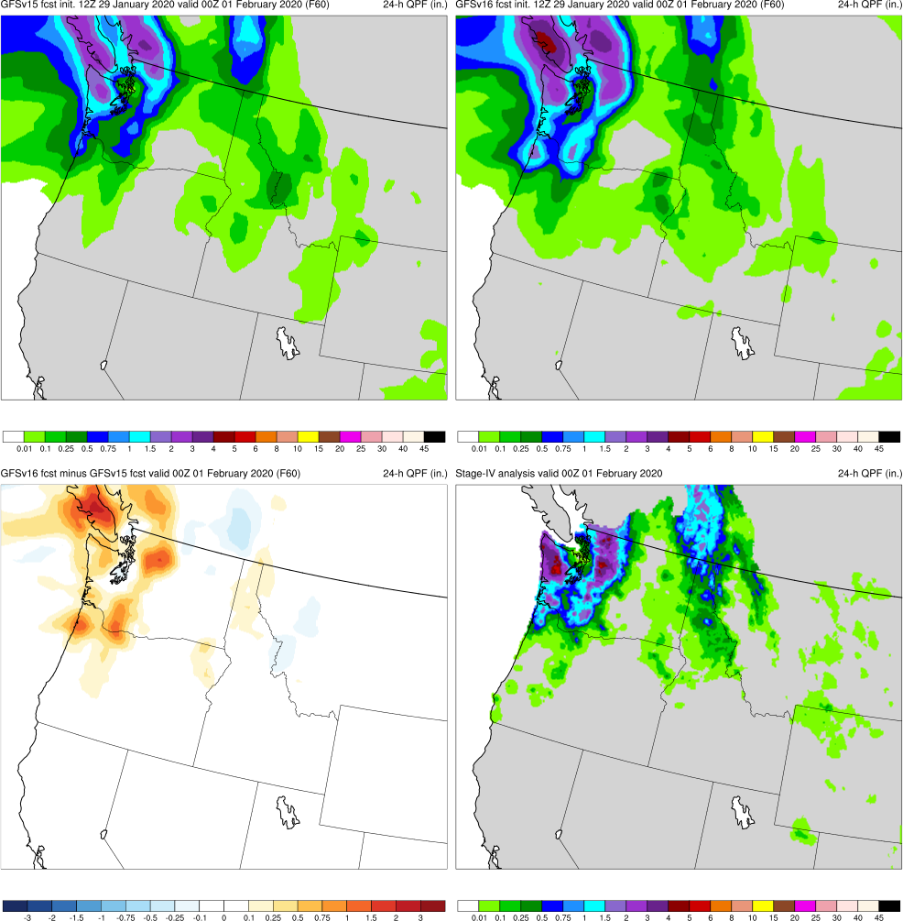
NATIONAL OCEANIC AND ATMOSPHERIC ADMINISTRATION
GFSv16 QPF Case Highlights
Pacific NW Atmos River (F60) Valid: 00Z 02/01/20
GFSv15 initially did better at long lead times (F156 and beyond).
GFSv16 had correctly higher QPF extending further south into WA in short-medium range (F120 and within)
GFSv15
GFSv16
v16−v15
StageIV

Slide 30
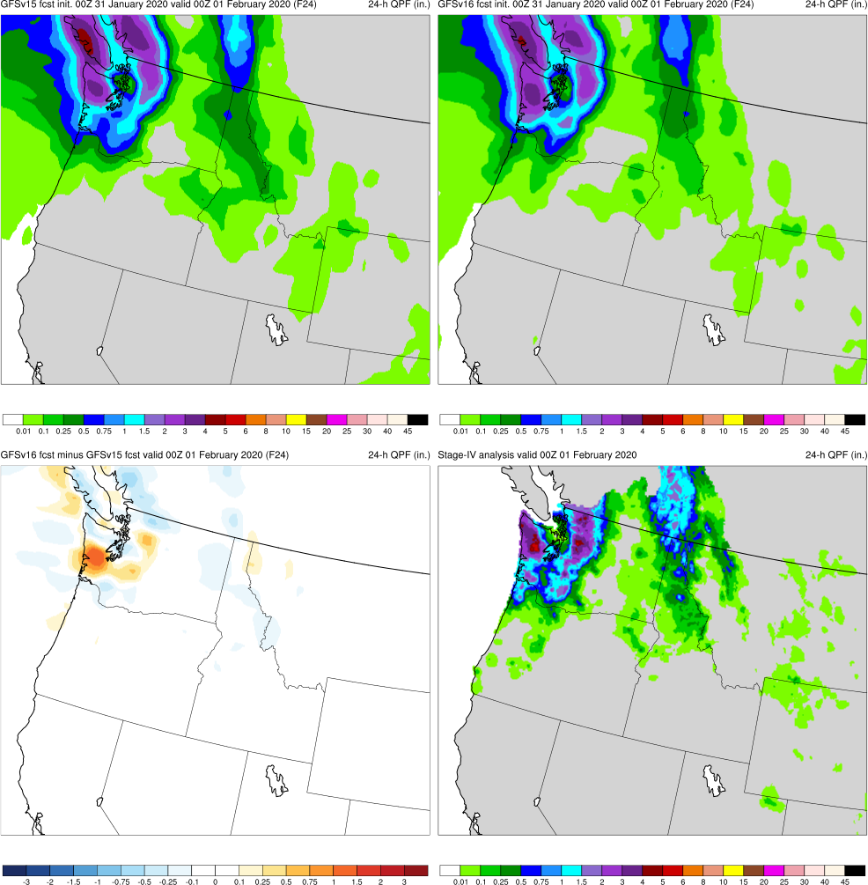
NATIONAL OCEANIC AND ATMOSPHERIC ADMINISTRATION
GFSv16 QPF Case Highlights
Pacific NW Atmos River (F24) Valid: 00Z 02/01/20
GFSv15 initially did better at long lead times (F156 and beyond).
GFSv16 had correctly higher QPF extending further south into WA in short-medium range (F120 and within)
GFSv15
GFSv16
v16−v15
StageIV

Slide 31
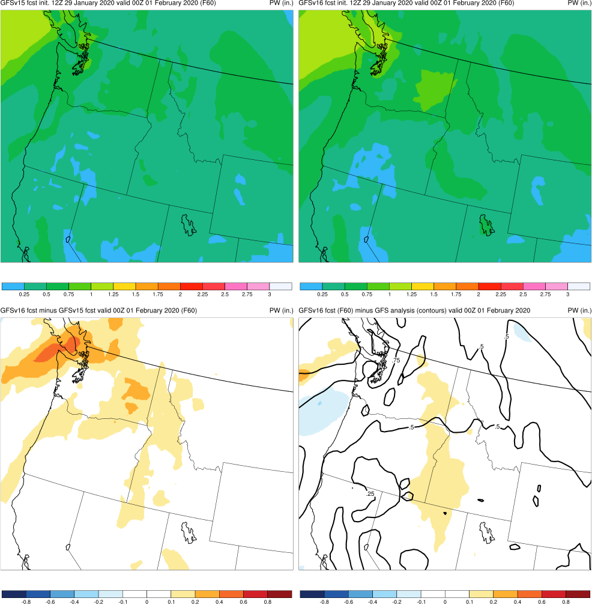
NATIONAL OCEANIC AND ATMOSPHERIC ADMINISTRATION
GFSv16 QPF Case Highlights
Pacific NW Atmos River (F60) Valid: 00Z 02/01/20
GFSv15 initially did better at long lead times (F156 and beyond).
GFSv16 had correctly higher QPF extending further south into WA in short-medium range (F120 and within)
Precipitable Water (shaded)
GFSv15
GFSv16
Better GFSv16 forecasts were related to having higher precipitable water being advected over the higher terrain
v16−v15
GFS Anl.

Slide 32
NATIONAL OCEANIC AND ATMOSPHERIC ADMINISTRATION
GFSv16 Retrospectives: QPF Case Studies
QPF Cases
Halloween Storm (Oct/Nov 2019)
Post-Thanksgiving Storm (Nov/Dec 2019)
California Spring Storm (May 2019)
Pacific NW Atmospheric River (Jan/Feb 2020)
Southern U.S. QPF (Feb 2020)
Winter Storm Cases
West Coast Bomb Cyclone (Nov 2019)
New York Ice Event (Dec 2019)
Alaskan New Year Storm (Jan 2020)
TC Cases
Imelda (Sep 2019)
Olga (Oct 2019)
Severe Weather Cases
Easter Sunday Outbreak (Apr 2020)

Slide 33
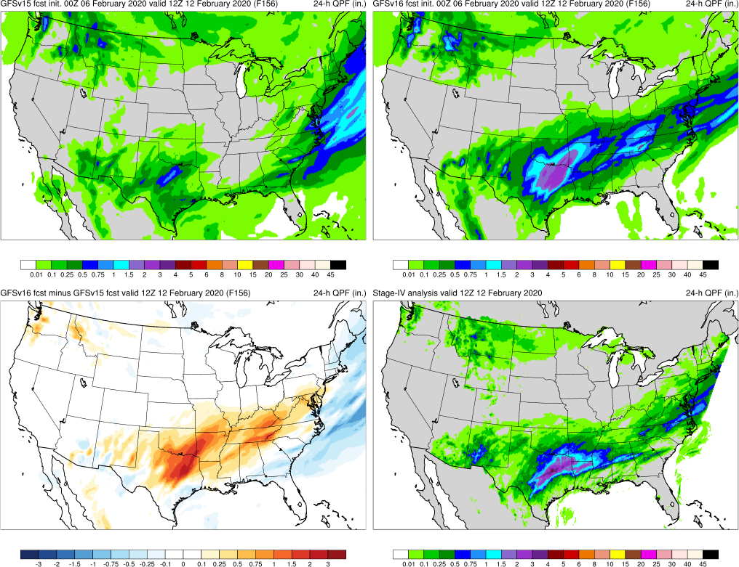
NATIONAL OCEANIC AND ATMOSPHERIC ADMINISTRATION
GFSv16 QPF Case Highlights
Southern US QPF (F156) Valid: 12Z 02/12/20
GFSv15
GFSv16
GFSv16 consistently generated more precipitation in Texas and overall has better forecasts at most lead times
v16−v15
StageIV

Slide 34
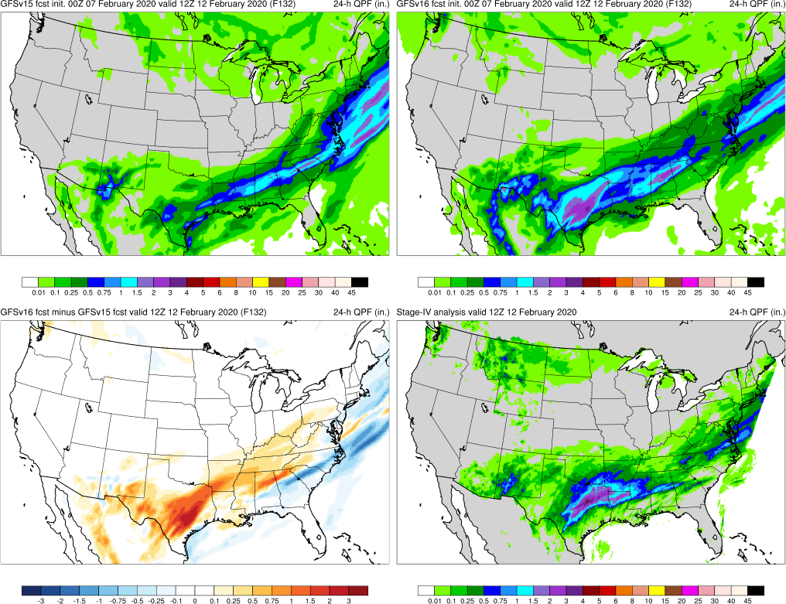
NATIONAL OCEANIC AND ATMOSPHERIC ADMINISTRATION
GFSv16 QPF Case Highlights
Southern US QPF (F132) Valid: 12Z 02/12/20
GFSv15
GFSv16
GFSv16 consistently generated more precipitation in Texas and overall has better forecasts at most lead times
v16−v15
StageIV

Slide 35
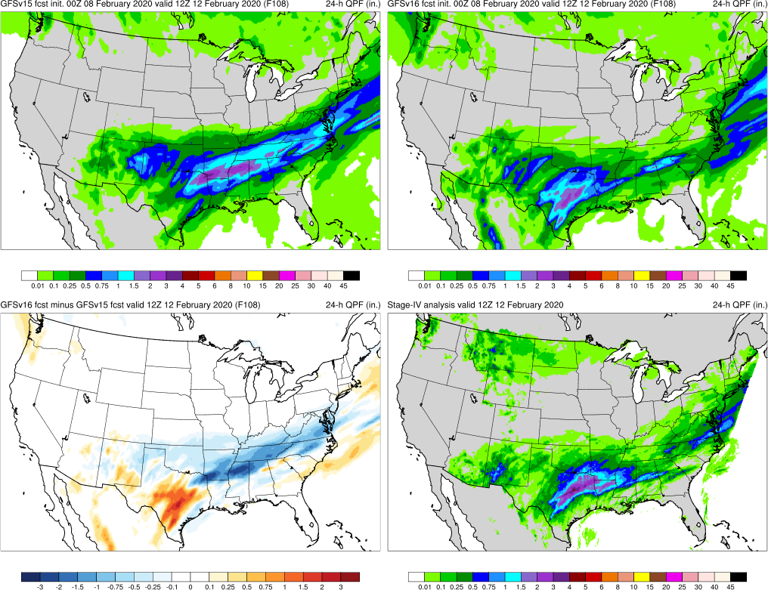
NATIONAL OCEANIC AND ATMOSPHERIC ADMINISTRATION
GFSv16 QPF Case Highlights
Southern US QPF (F108) Valid: 12Z 02/12/20
GFSv15
GFSv16
GFSv16 consistently generated more precipitation in Texas and overall has better forecasts at most lead times
v16−v15
StageIV

Slide 36
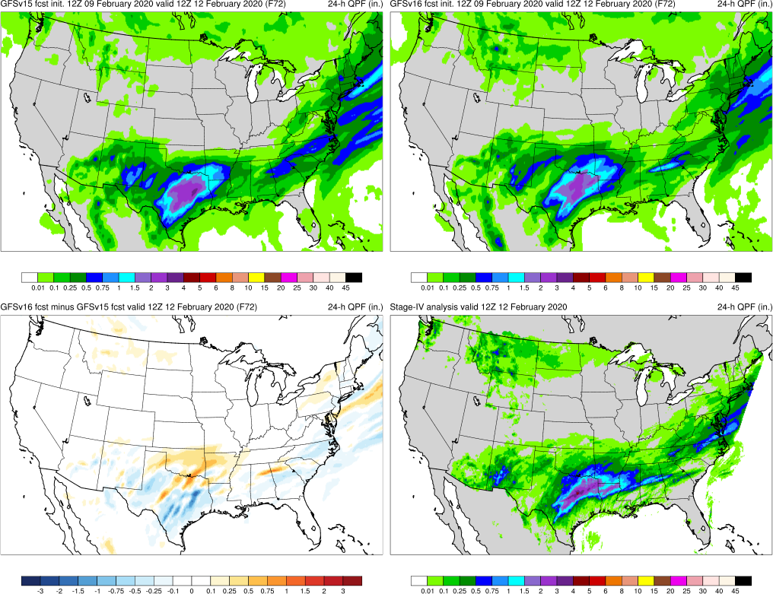
NATIONAL OCEANIC AND ATMOSPHERIC ADMINISTRATION
GFSv16 QPF Case Highlights
Southern US QPF (F72) Valid: 12Z 02/12/20
GFSv15
GFSv16
GFSv16 consistently generated more precipitation in Texas and overall has better forecasts at most lead times
v16−v15
StageIV

Slide 37
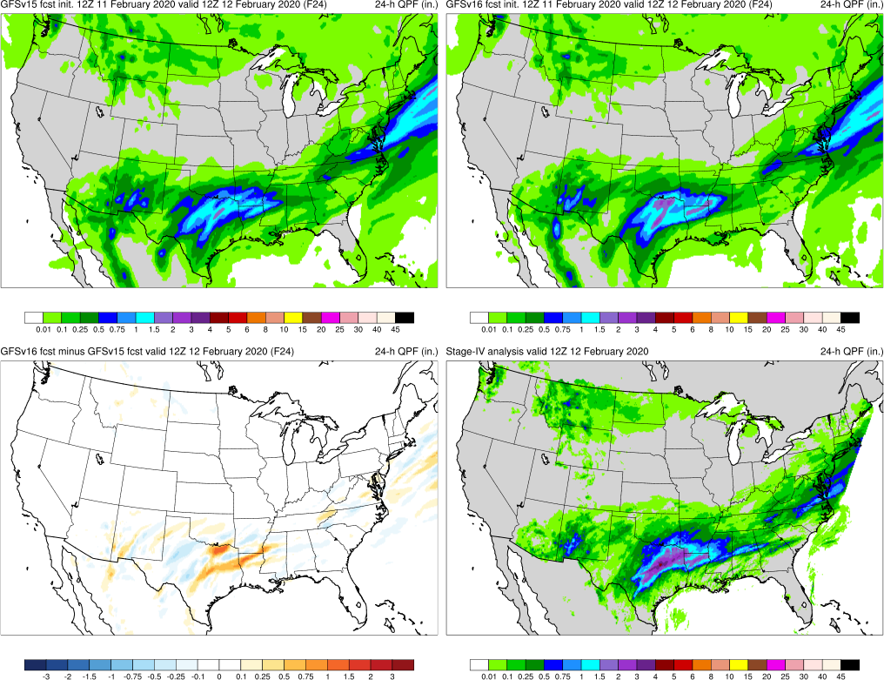
NATIONAL OCEANIC AND ATMOSPHERIC ADMINISTRATION
GFSv16 QPF Case Highlights
Southern US QPF (F24) Valid: 12Z 02/12/20
GFSv15
GFSv16
GFSv16 consistently generated more precipitation in Texas and overall has better forecasts at most lead times
v16−v15
StageIV

Slide 38
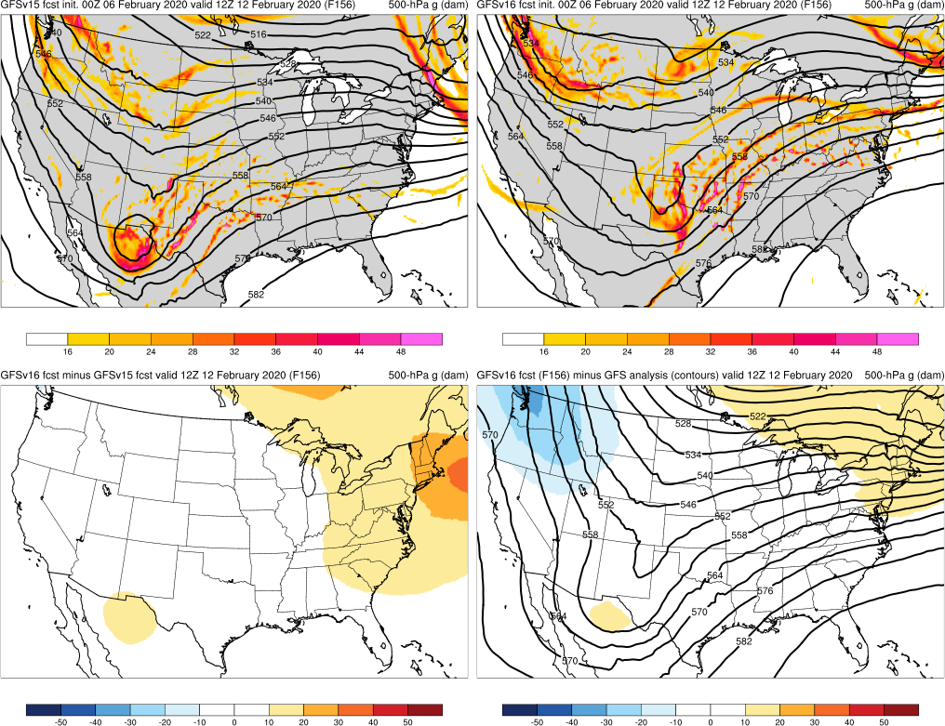
NATIONAL OCEANIC AND ATMOSPHERIC ADMINISTRATION
GFSv16 QPF Case Highlights
500-hPa Geopotential Height (contours), Vorticity (shaded)
Southern US QPF (F156) Valid: 12Z 02/12/20
GFSv15
GFSv16
GFSv16 consistently generated more precipitation in Texas and overall has better forecasts at most lead times
Synoptic pattern in GFSv16 was a bit too progressive, but not progressive enough in GFSv15
v16−v15
GFS Anl.

Slide 39
NATIONAL OCEANIC AND ATMOSPHERIC ADMINISTRATION
GFSv16 Retrospectives: QPF Case Studies
QPF Cases
Halloween Storm (Oct/Nov 2019)
Post-Thanksgiving Storm (Nov/Dec 2019)
California Spring Storm (May 2019)
Pacific NW Atmospheric River (Jan/Feb 2020)
Southern U.S. QPF (Feb 2020)
Winter Storm Cases
West Coast Bomb Cyclone (Nov 2019)
New York Ice Event (Dec 2019)
Alaskan New Year Storm (Jan 2020)
TC Cases
Imelda (Sep 2019)
Olga (Oct 2019)
Severe Weather Cases
Easter Sunday Outbreak (Apr 2020)

Slide 40
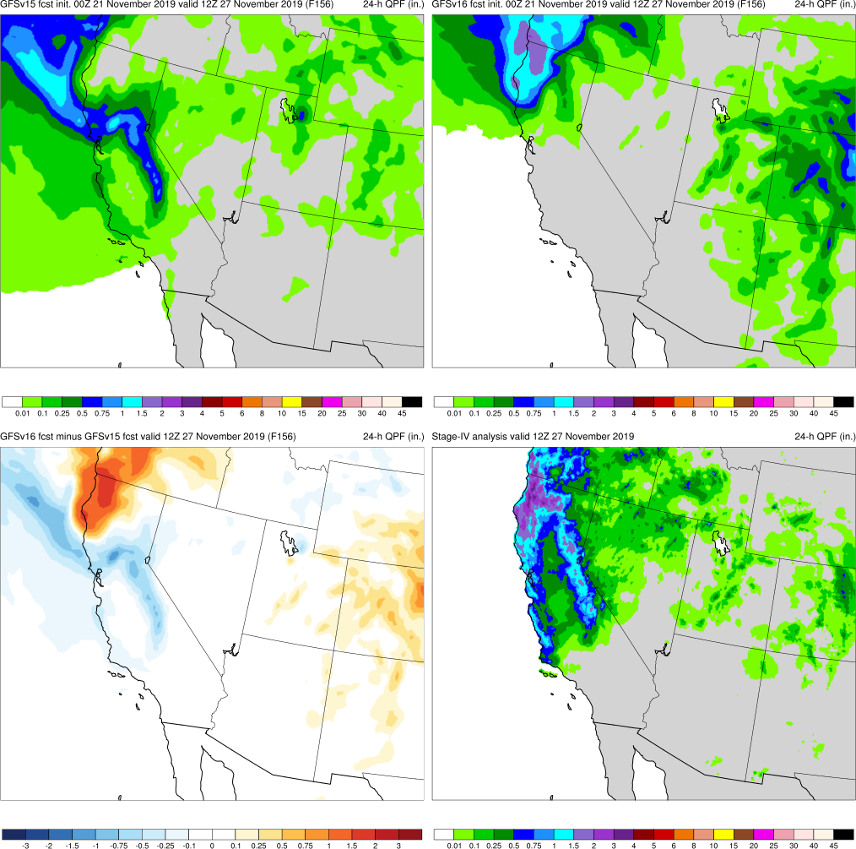
NATIONAL OCEANIC AND ATMOSPHERIC ADMINISTRATION
GFSv16 QPF Case Highlights
West Coast Bomb Cyclone (F156) Valid: 12Z 11/27/19
GFSv16 consistently had higher QPF amounts inland over N California and Oregon
GFSv15
GFSv16
v16−v15
StageIV

Slide 41
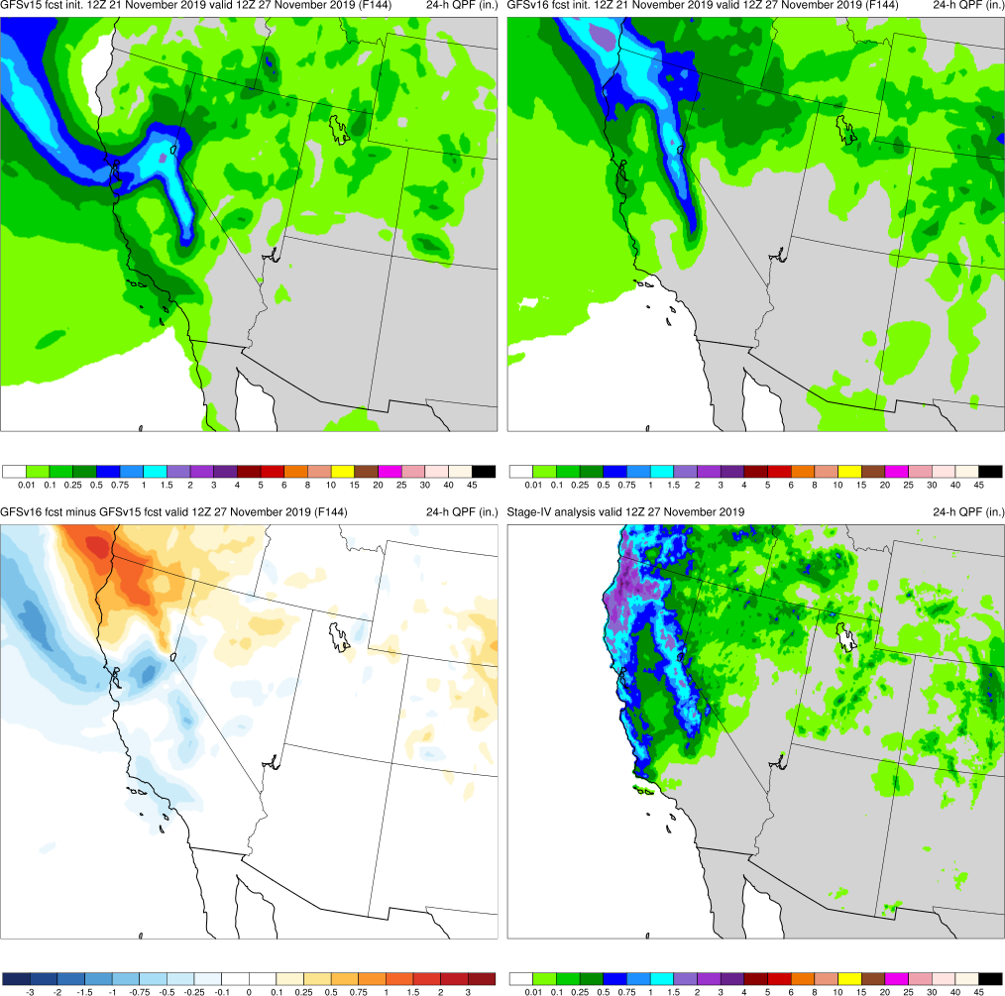
NATIONAL OCEANIC AND ATMOSPHERIC ADMINISTRATION
GFSv16 QPF Case Highlights
West Coast Bomb Cyclone (F144) Valid: 12Z 11/27/19
GFSv16 consistently had higher QPF amounts inland over N California and Oregon
GFSv15
GFSv16
v16−v15
StageIV

Slide 42
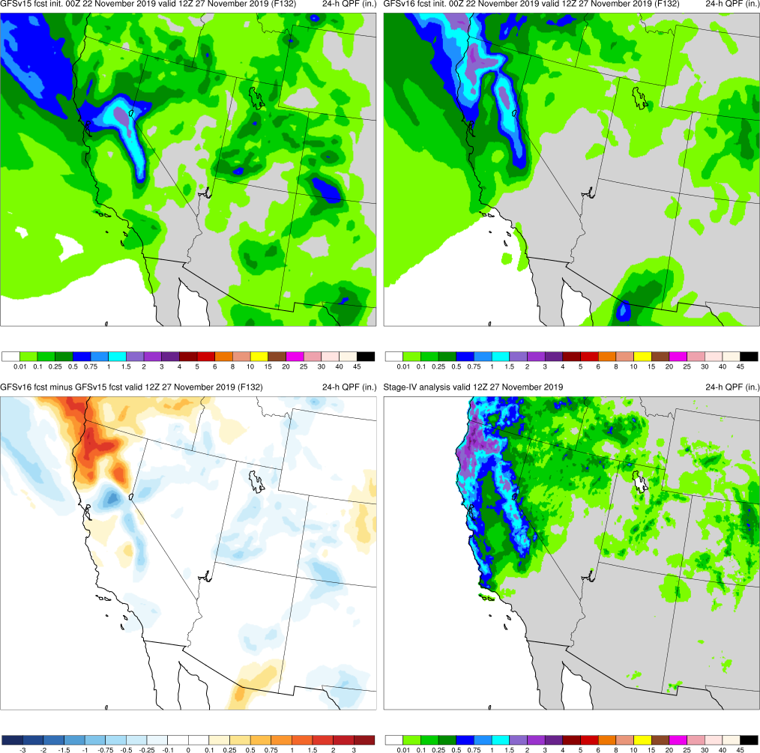
NATIONAL OCEANIC AND ATMOSPHERIC ADMINISTRATION
GFSv16 QPF Case Highlights
West Coast Bomb Cyclone (F132) Valid: 12Z 11/27/19
GFSv16 consistently had higher QPF amounts inland over N California and Oregon
GFSv15
GFSv16
v16−v15
StageIV

Slide 43
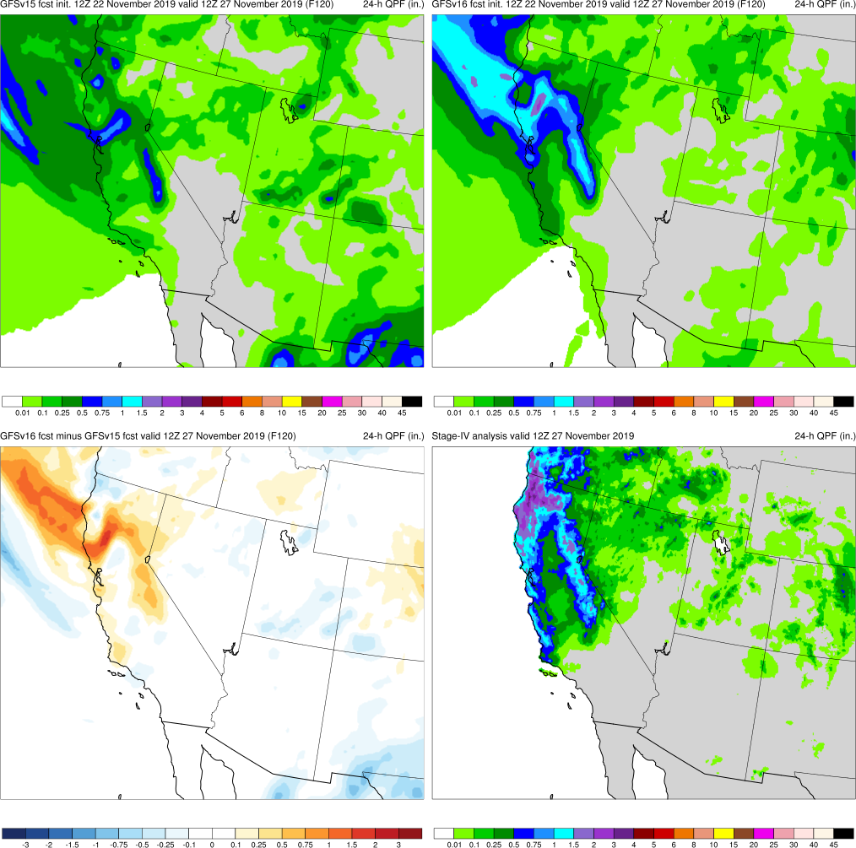
NATIONAL OCEANIC AND ATMOSPHERIC ADMINISTRATION
GFSv16 QPF Case Highlights
West Coast Bomb Cyclone (F120) Valid: 12Z 11/27/19
GFSv16 consistently had higher QPF amounts inland over N California and Oregon
GFSv15
GFSv16
v16−v15
StageIV

Slide 44
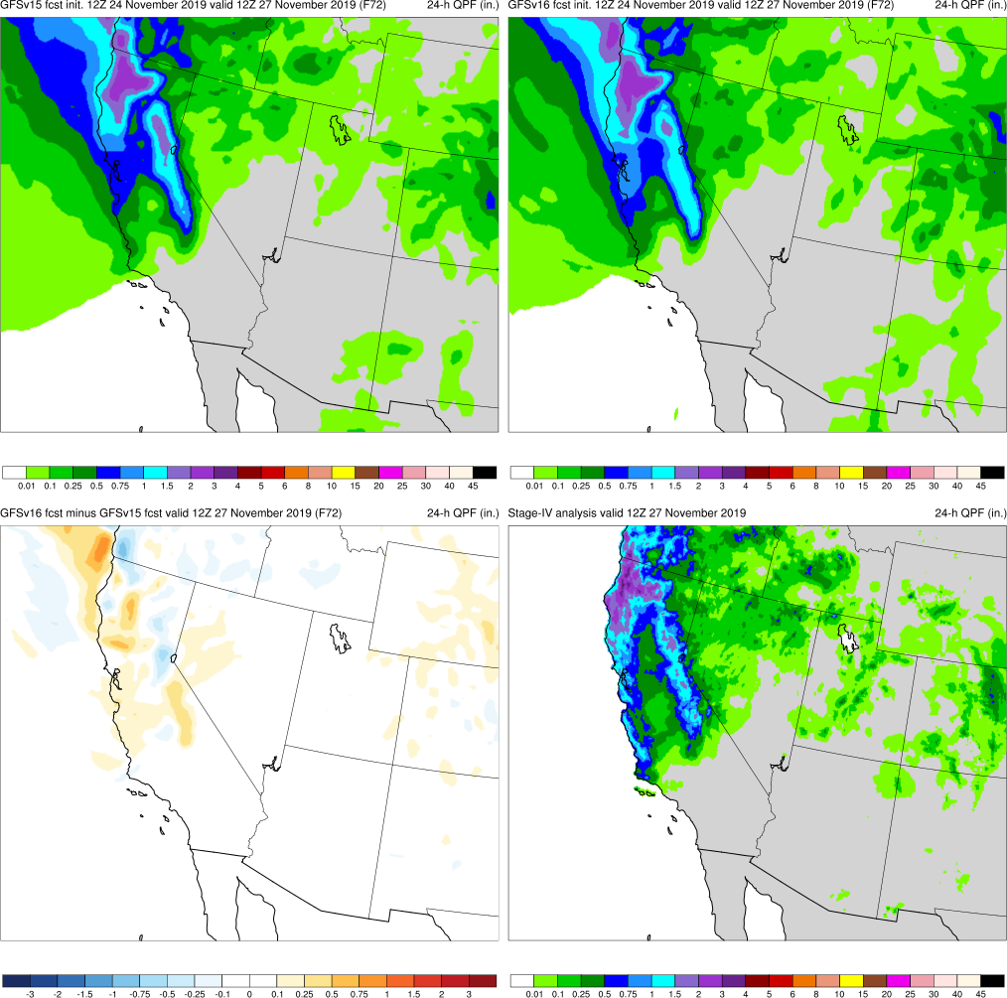
NATIONAL OCEANIC AND ATMOSPHERIC ADMINISTRATION
GFSv16 QPF Case Highlights
West Coast Bomb Cyclone (F72) Valid: 12Z 11/27/19
GFSv16 consistently had higher QPF amounts inland over N California and Oregon
GFSv15
GFSv16
v16−v15
StageIV

Slide 45
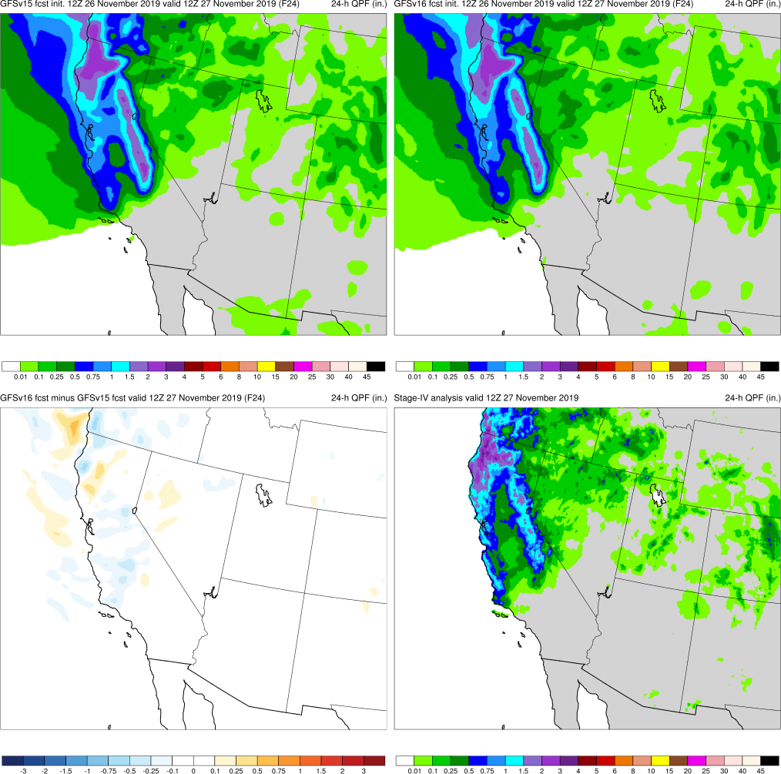
NATIONAL OCEANIC AND ATMOSPHERIC ADMINISTRATION
GFSv16 QPF Case Highlights
West Coast Bomb Cyclone (F24) Valid: 12Z 11/27/20
GFSv16 consistently had higher QPF amounts inland over N California and Oregon
GFSv15
GFSv16
v16−v15
StageIV

Slide 46
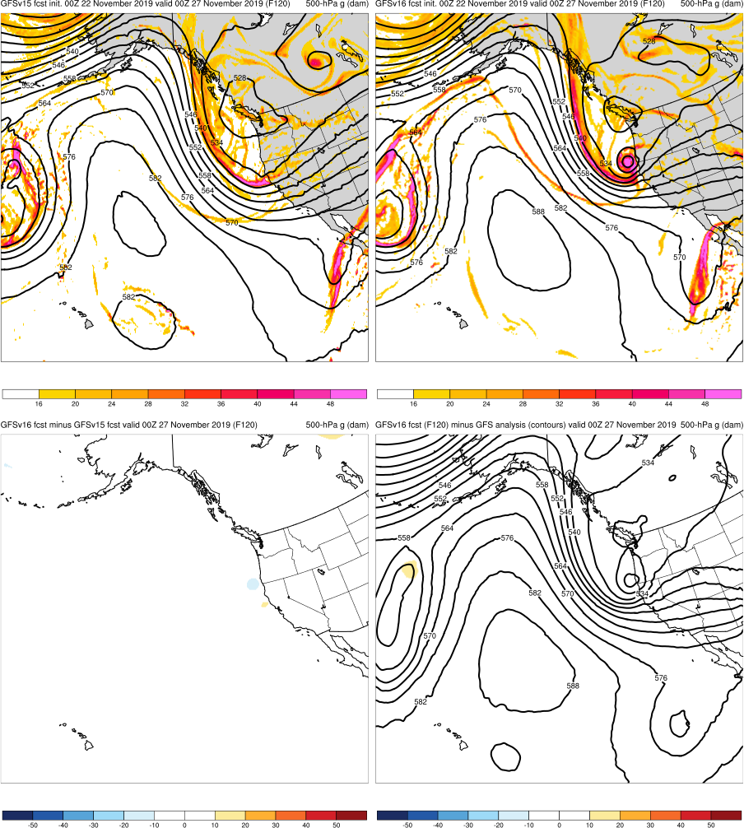
NATIONAL OCEANIC AND ATMOSPHERIC ADMINISTRATION
GFSv16 QPF Case Highlights
500-hPa Geopotential Height (contours), Vorticity (shaded)
West Coast Bomb Cyclone (F120) Valid: 00Z 11/27/19
972 hPa
1000 hPa
L
L
GFSv16 consistently had higher QPF amounts inland over N California and Oregon
Earlier good forecasts related to developing powerful cyclone within longwave trough aided by stronger moisture feed
GFSv15
GFSv16
973 hPa
L
v16−v15
GFS Anl.

Slide 47
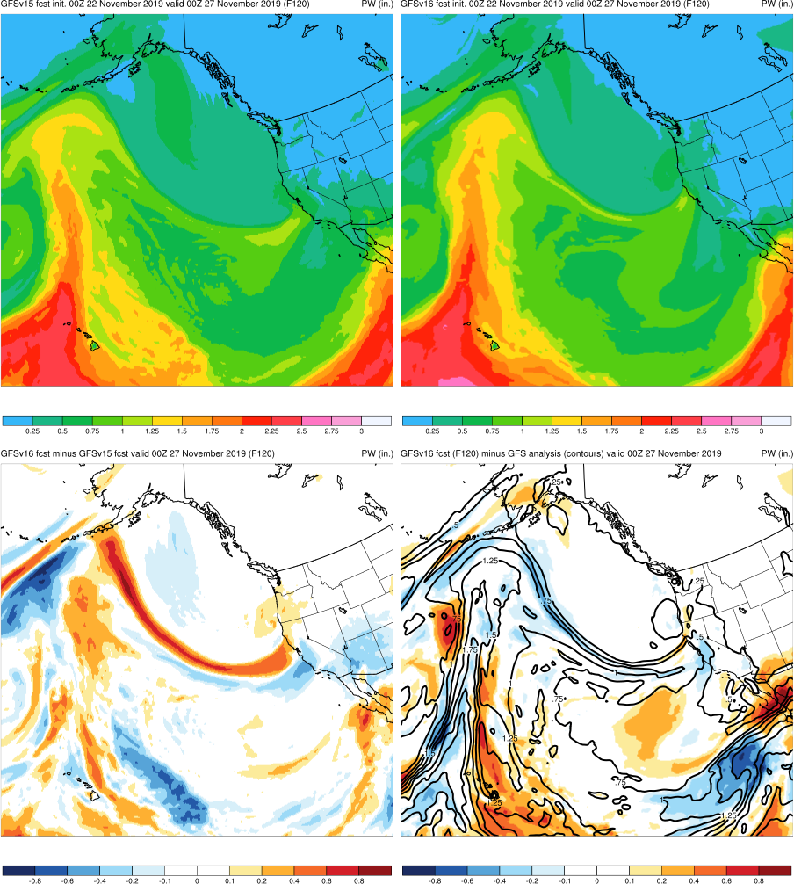
NATIONAL OCEANIC AND ATMOSPHERIC ADMINISTRATION
GFSv16 QPF Case Highlights
Precipitable Water (shaded)
West Coast Bomb Cyclone (F120) Valid: 00Z 11/27/19
972 hPa
1000 hPa
L
L
GFSv16 consistently had higher QPF amounts inland over N California and Oregon
Earlier good forecasts related to developing powerful cyclone within longwave trough aided by stronger moisture feed
GFSv15
GFSv16
973 hPa
L
More Moisture
v16−v15
GFS Anl.

Slide 48
NATIONAL OCEANIC AND ATMOSPHERIC ADMINISTRATION
GFSv16 Retrospectives: QPF Case Studies
QPF Cases
Halloween Storm (Oct/Nov 2019)
Post-Thanksgiving Storm (Nov/Dec 2019)
California Spring Storm (May 2019)
Pacific NW Atmospheric River (Jan/Feb 2020)
Southern U.S. QPF (Feb 2020)
Winter Storm Cases
West Coast Bomb Cyclone (Nov 2019)
New York Ice Event (Dec 2019)
Alaskan New Year Storm (Jan 2020)
TC Cases
Imelda (Sep 2019)
Olga (Oct 2019)
Severe Weather Cases
Easter Sunday Outbreak (Apr 2020)

Slide 49
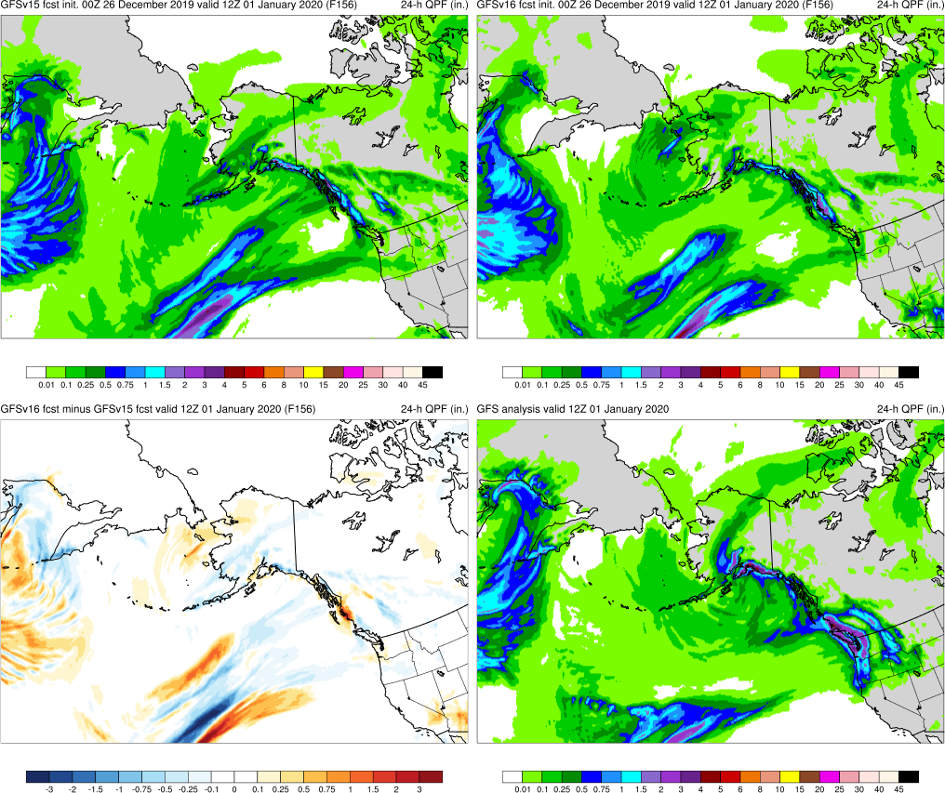
NATIONAL OCEANIC AND ATMOSPHERIC ADMINISTRATION
GFSv16 QPF Case Highlights
Alaskan New Year Storm (F156) Valid: 12Z 01/01/20
GFSv16 had too much precipitation shifted west either offshore or just along the W Alaska coast
GFSv15
GFSv16
v16−v15
GFS Anl.

Slide 50
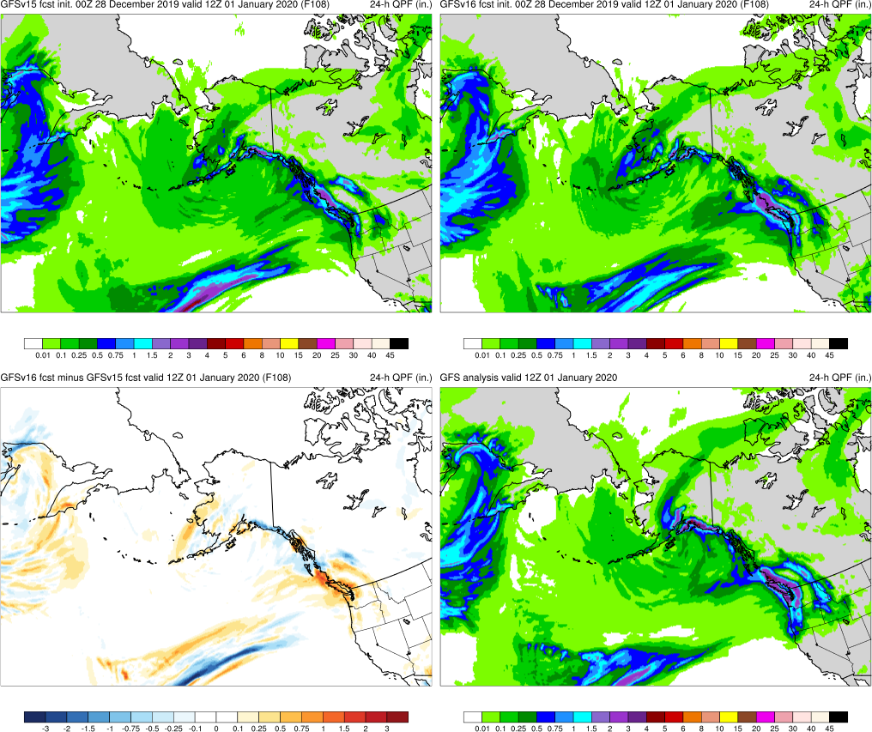
NATIONAL OCEANIC AND ATMOSPHERIC ADMINISTRATION
GFSv16 QPF Case Highlights
Alaskan New Year Storm (F108) Valid: 12Z 01/01/20
GFSv16 had too much precipitation shifted west either offshore or just along the W Alaska coast
GFSv15
GFSv16
v16−v15
GFS Anl.

Slide 51
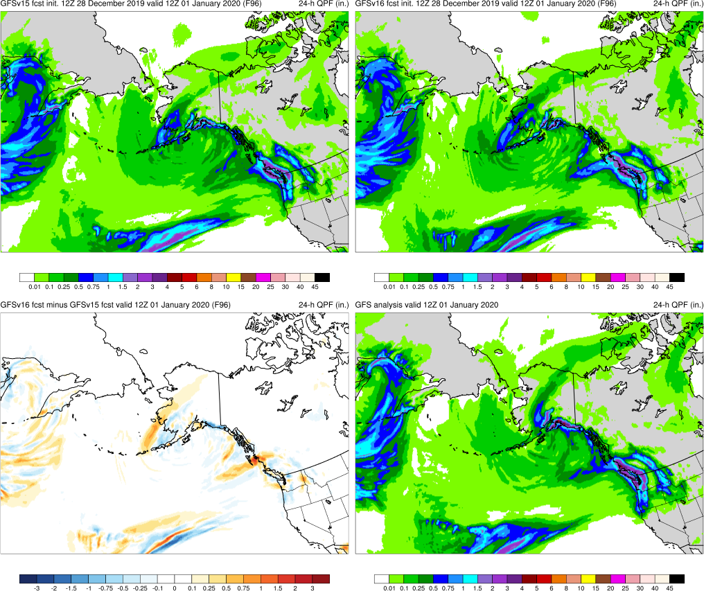
NATIONAL OCEANIC AND ATMOSPHERIC ADMINISTRATION
GFSv16 QPF Case Highlights
Alaskan New Year Storm (F96) Valid: 12Z 01/01/20
GFSv16 had too much precipitation shifted west either offshore or just along the W Alaska coast
GFSv15
GFSv16
v16−v15
GFS Anl.

Slide 52
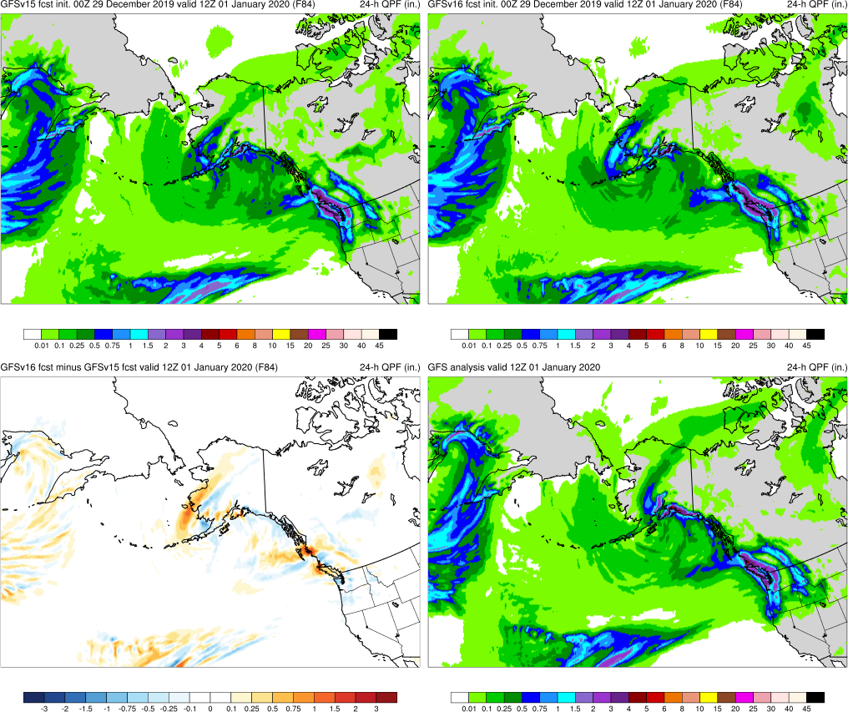
NATIONAL OCEANIC AND ATMOSPHERIC ADMINISTRATION
GFSv16 QPF Case Highlights
Alaskan New Year Storm (F84) Valid: 12Z 01/01/20
GFSv16 had too much precipitation shifted west either offshore or just along the W Alaska coast
GFSv15
GFSv16
v16−v15
GFS Anl.

Slide 53
NATIONAL OCEANIC AND ATMOSPHERIC ADMINISTRATION
GFSv16 Retrospectives: QPF Case Studies
QPF Cases
Halloween Storm (Oct/Nov 2019)
Post-Thanksgiving Storm (Nov/Dec 2019)
California Spring Storm (May 2019)
Pacific NW Atmospheric River (Jan/Feb 2020)
Southern U.S. QPF (Feb 2020)
Winter Storm Cases
West Coast Bomb Cyclone (Nov 2019)
New York Ice Event (Dec 2019)
Alaskan New Year Storm (Jan 2020)
TC Cases
Imelda (Sep 2019)
Olga (Oct 2019)
Severe Weather Cases
Easter Sunday Outbreak (Apr 2020)

Slide 54
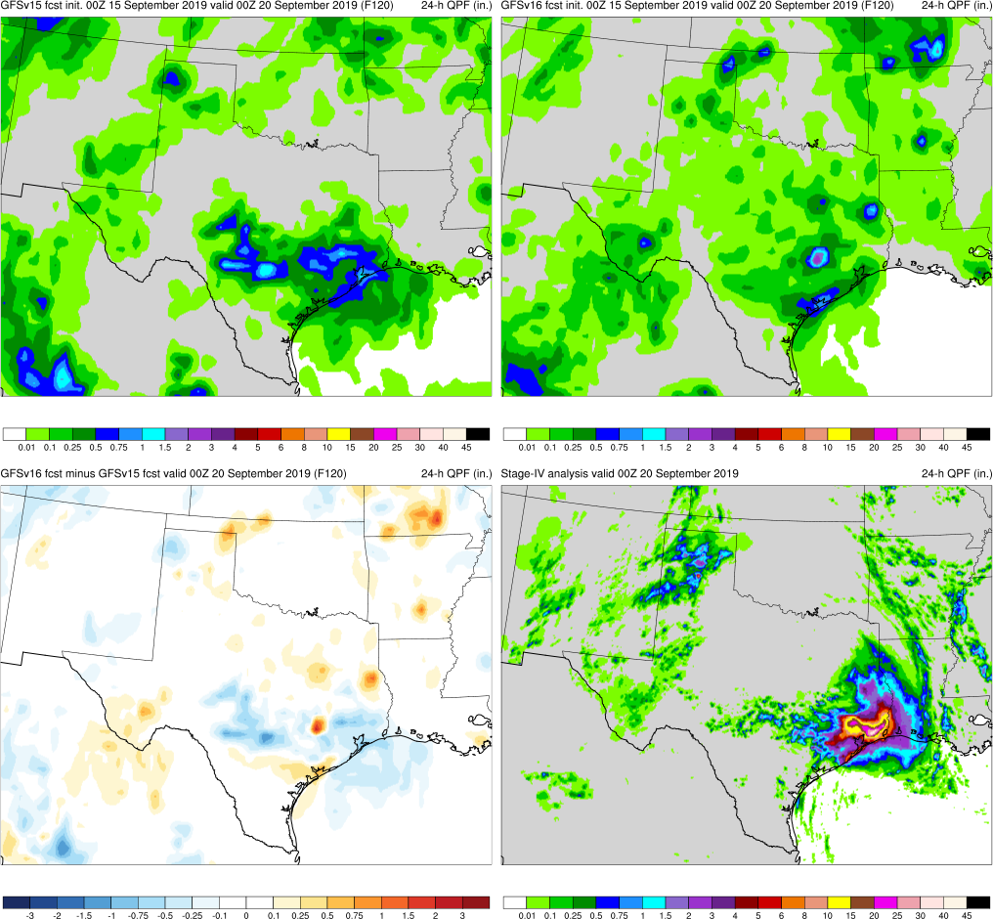
NATIONAL OCEANIC AND ATMOSPHERIC ADMINISTRATION
GFSv16 QPF Case Highlights
GFSv16
Imelda (F120) Valid: 00Z 09/20/19
GFSv15
Both GFSv16 and GFSv15 have only weak precipitation signal in medium range due to poor TC forecast
v16−v15
StageIV

Slide 55
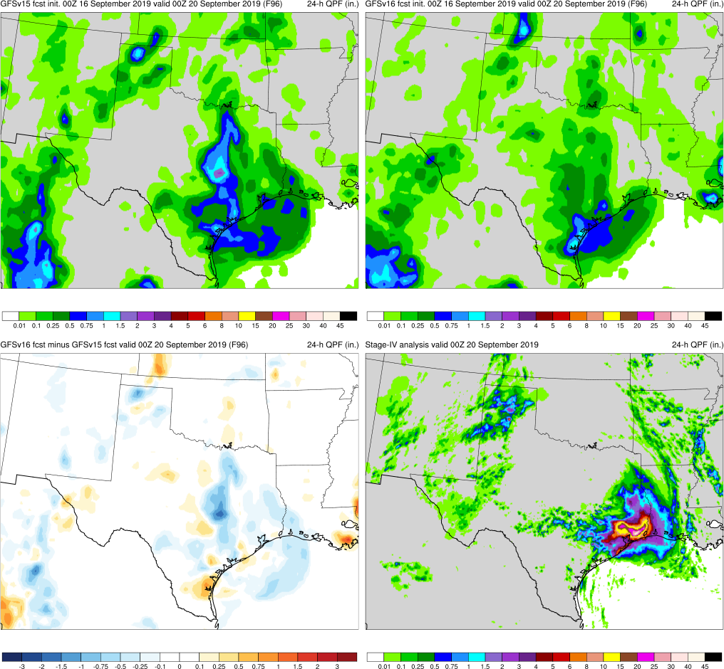
NATIONAL OCEANIC AND ATMOSPHERIC ADMINISTRATION
GFSv16 QPF Case Highlights
GFSv16
Imelda (F96) Valid: 00Z 09/20/19
GFSv15
Both GFSv16 and GFSv15 have only weak precipitation signal in medium range due to poor TC forecast
v16−v15
StageIV

Slide 56
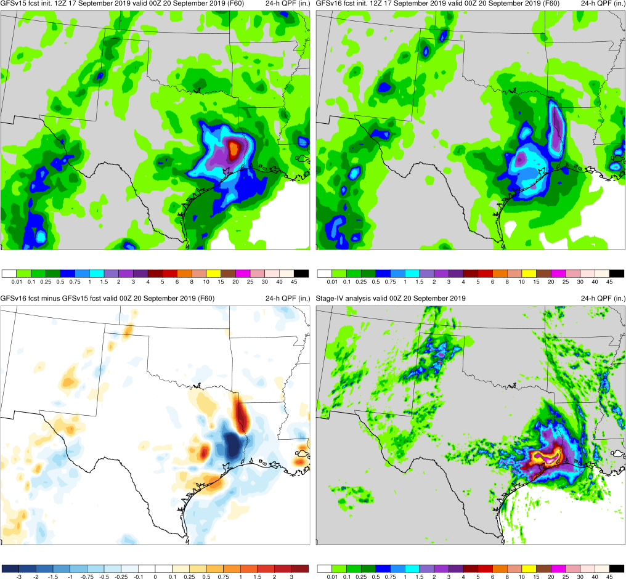
NATIONAL OCEANIC AND ATMOSPHERIC ADMINISTRATION
GFSv16 QPF Case Highlights
GFSv16
Imelda (F60) Valid: 00Z 09/20/19
GFSv15
Both GFSv16 and GFSv15 have only weak precipitation signal in medium range due to poor TC forecast
v16−v15
StageIV

Slide 57
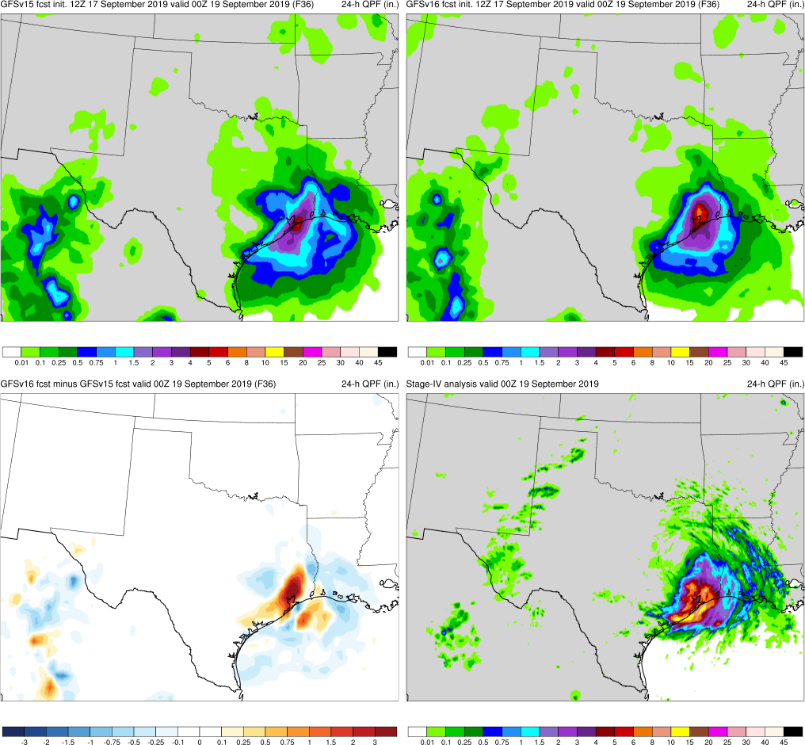
NATIONAL OCEANIC AND ATMOSPHERIC ADMINISTRATION
GFSv16 QPF Case Highlights
GFSv16
Imelda (F36) Valid: 00Z 09/20/19
GFSv15
Both GFSv16 and GFSv15 have only weak precipitation signal in medium range due to poor TC forecast
Higher 24h precipitation amounts in GFSv16 outperforming GFSv15 in final few cycles before verification
v16−v15
StageIV

Slide 58
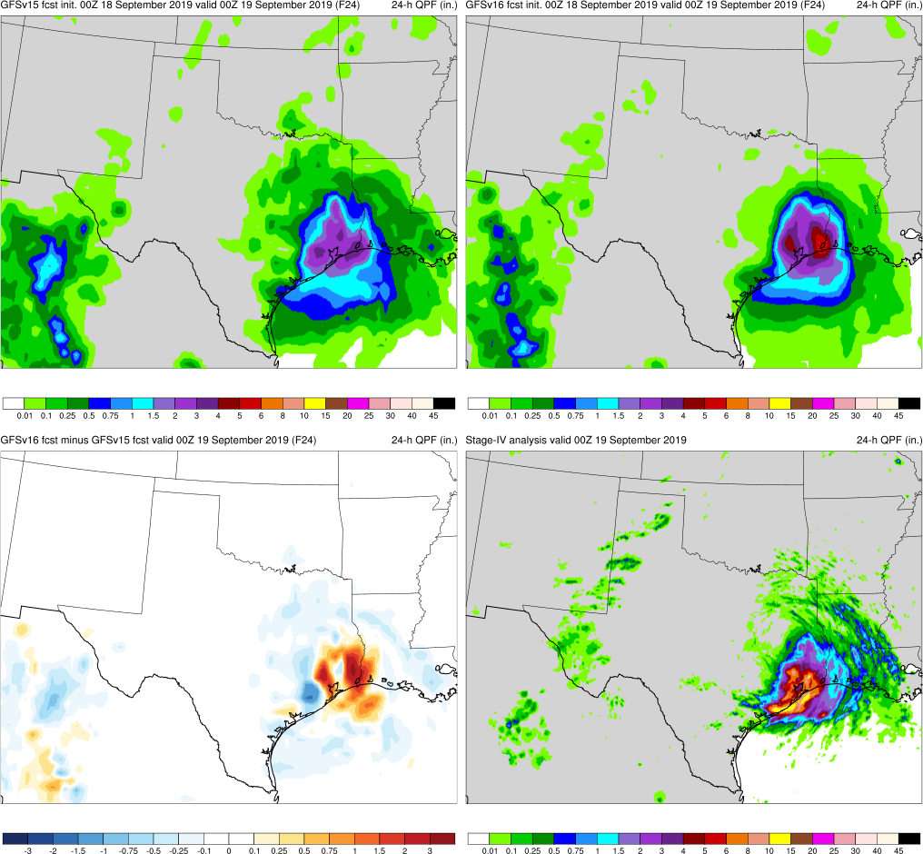
NATIONAL OCEANIC AND ATMOSPHERIC ADMINISTRATION
GFSv16 QPF Case Highlights
GFSv16
Imelda (F24) Valid: 00Z 09/20/19
GFSv15
Both GFSv16 and GFSv15 have only weak precipitation signal in medium range due to poor TC forecast
Higher 24h precipitation amounts in GFSv16 outperforming GFSv15 in final few cycles before verification
v16−v15
StageIV

Slide 59
NATIONAL OCEANIC AND ATMOSPHERIC ADMINISTRATION
GFSv16 Retrospectives: QPF Case Studies
QPF Cases
Halloween Storm (Oct/Nov 2019)
Post-Thanksgiving Storm (Nov/Dec 2019)
California Spring Storm (May 2019)
Pacific NW Atmospheric River (Jan/Feb 2020)
Southern U.S. QPF (Feb 2020)
Winter Storm Cases
West Coast Bomb Cyclone (Nov 2019)
New York Ice Event (Dec 2019)
Alaskan New Year Storm (Jan 2020)
TC Cases
Imelda (Sep 2019)
Olga (Oct 2019)
Severe Weather Cases
Easter Sunday Outbreak (Apr 2020)

Slide 60
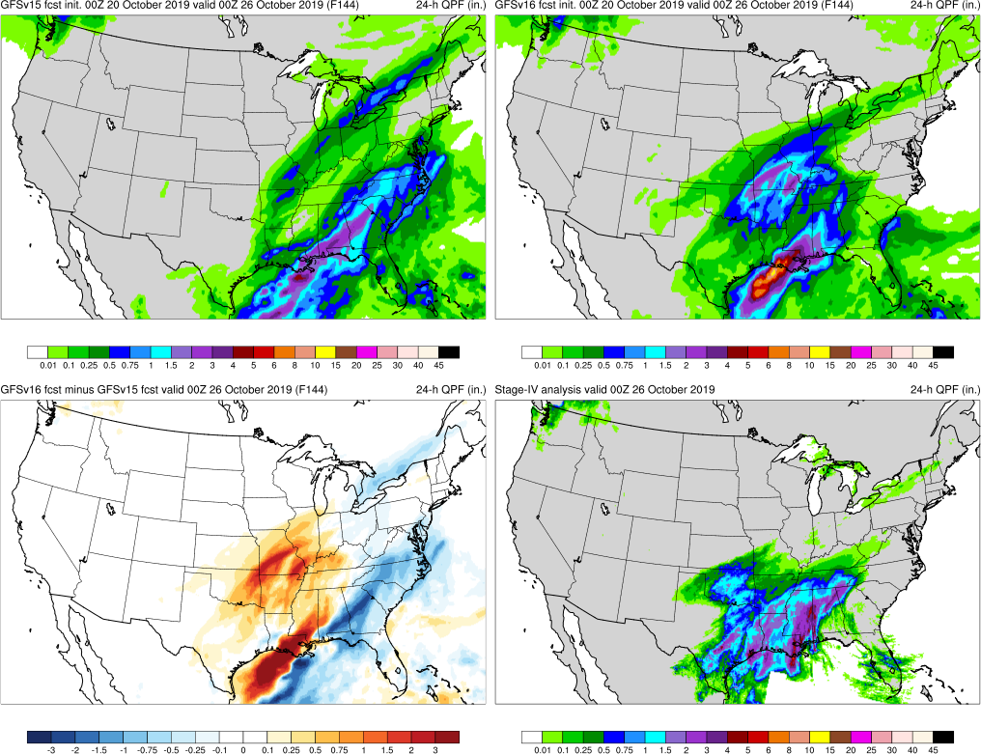
NATIONAL OCEANIC AND ATMOSPHERIC ADMINISTRATION
GFSv16 QPF Case Highlights
Olga (F144) Valid: 00Z 10/26/19
GFSv15
GFSv16
GFSv16 generally had a better precipitation forecast in the medium range especially to the north and west versus GFSv15
v16−v15
StageIV

Slide 61
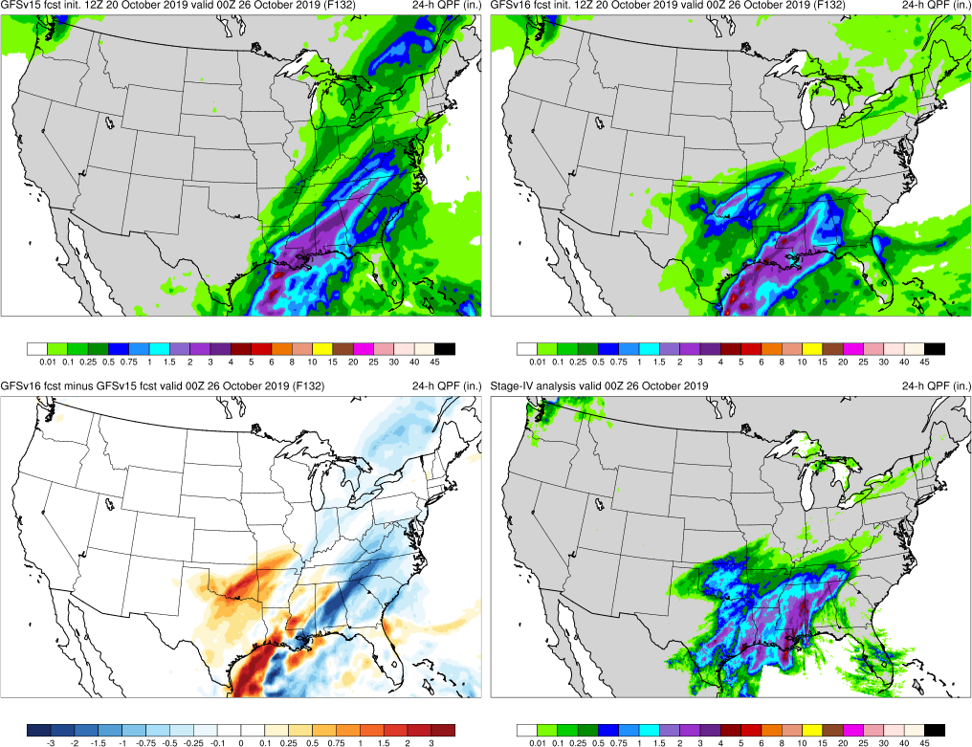
NATIONAL OCEANIC AND ATMOSPHERIC ADMINISTRATION
GFSv16 QPF Case Highlights
Olga (F132) Valid: 00Z 10/26/19
GFSv15
GFSv16
GFSv16 generally had a better precipitation forecast in the medium range especially to the north and west versus GFSv15
v16−v15
StageIV

Slide 62
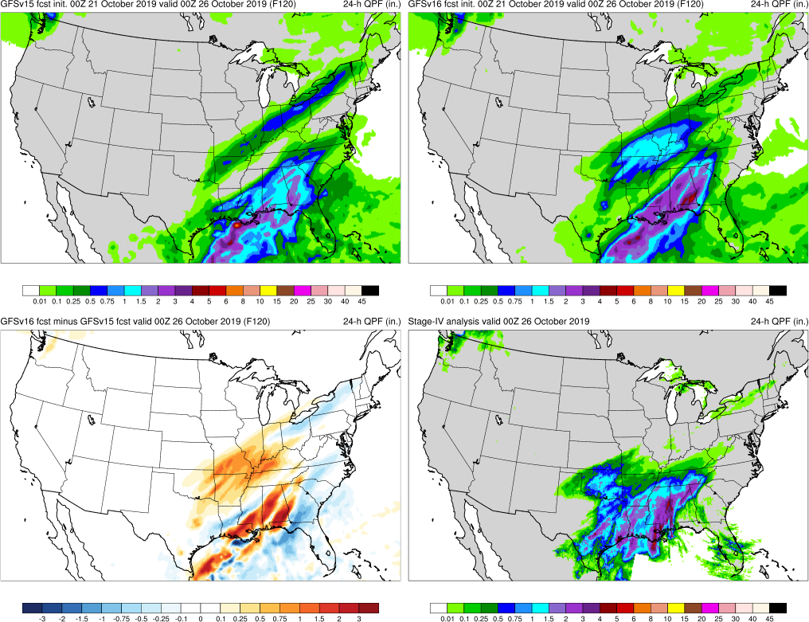
NATIONAL OCEANIC AND ATMOSPHERIC ADMINISTRATION
GFSv16 QPF Case Highlights
Olga (F120) Valid: 00Z 10/26/19
GFSv15
GFSv16
GFSv16 generally had a better precipitation forecast in the medium range especially to the north and west versus GFSv15
v16−v15
StageIV

Slide 63
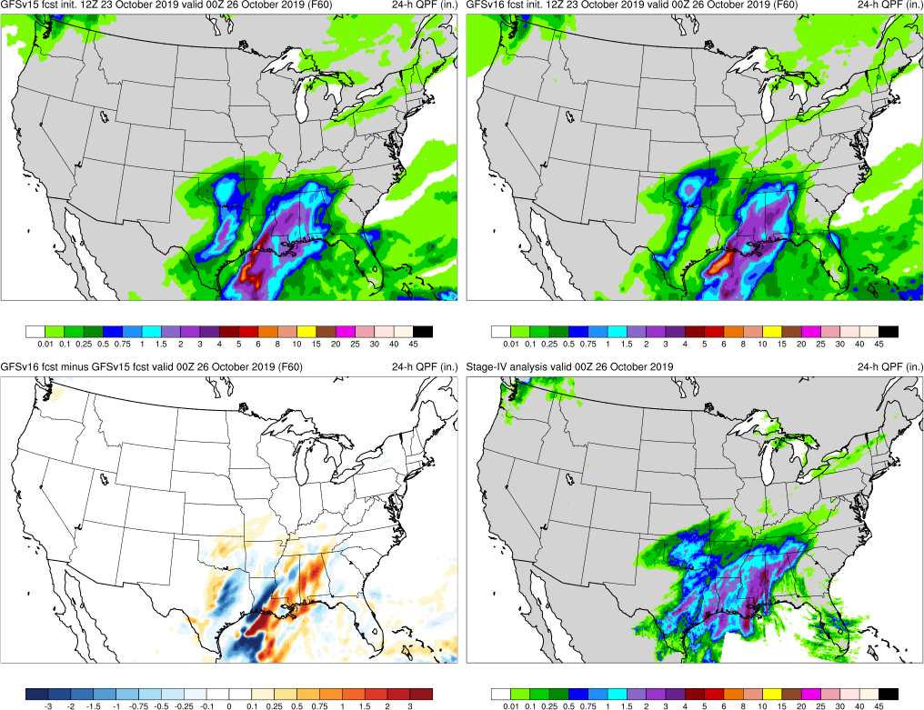
NATIONAL OCEANIC AND ATMOSPHERIC ADMINISTRATION
GFSv16 QPF Case Highlights
Olga (F60) Valid: 00Z 10/26/19
GFSv15
GFSv16
GFSv16 generally had a better precipitation forecast in the medium range especially to the north and west versus GFSv15
v16−v15
StageIV

Slide 64
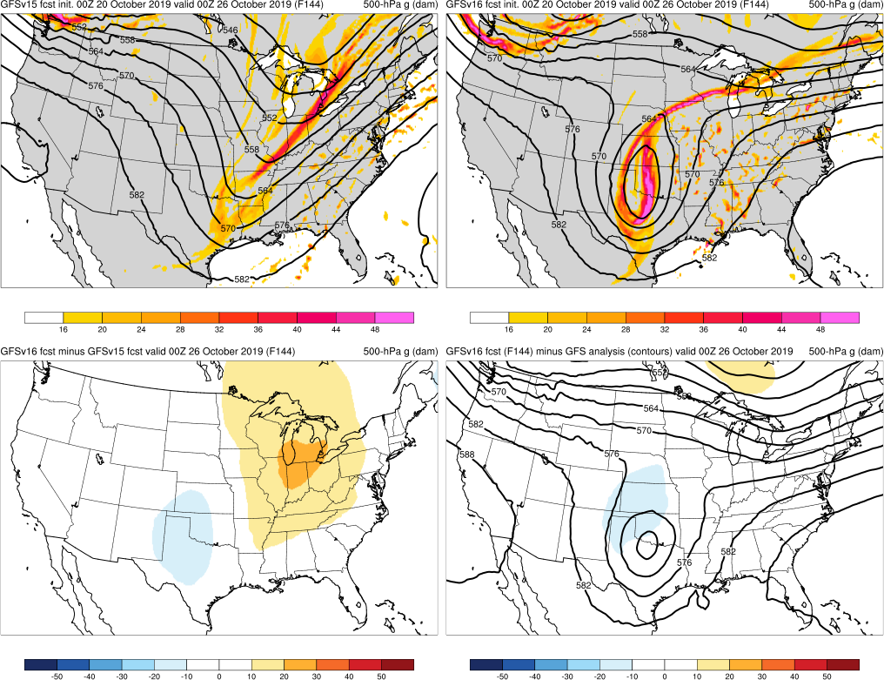
NATIONAL OCEANIC AND ATMOSPHERIC ADMINISTRATION
GFSv16 QPF Case Highlights
500-hPa Geopotential Height (contours), Vorticity (shaded)
Olga (F144) Valid: 00Z 10/26/19
GFSv15
GFSv16
GFSv16 generally had a better precipitation forecast in the medium range especially to the north and west versus GFSv15
Improved forecast due to better representation of a less progressive synoptic pattern (cutoff 500-hPa low)
v16−v15
GFS Anl.

Slide 65
NATIONAL OCEANIC AND ATMOSPHERIC ADMINISTRATION
GFSv16 Retrospectives: QPF Case Studies
QPF Cases
Halloween Storm (Oct/Nov 2019)
Post-Thanksgiving Storm (Nov/Dec 2019)
California Spring Storm (May 2019)
Pacific NW Atmospheric River (Jan/Feb 2020)
Southern U.S. QPF (Feb 2020)
Winter Storm Cases
West Coast Bomb Cyclone (Nov 2019)
New York Ice Event (Dec 2019)
Alaskan New Year Storm (Jan 2020)
TC Cases
Imelda (Sep 2019)
Olga (Oct 2019)
Severe Weather Cases
Easter Sunday Outbreak (Apr 2020)

Slide 66
NATIONAL OCEANIC AND ATMOSPHERIC ADMINISTRATION
GFSv16 QPF Case Highlights
Easter Sunday Outbreak (F144) Valid: 12Z 04/13/20
GFSv15
GFSv16
Both GFSv15 and GFSv16 are too far east with heavy precipitation amounts in this 24h period in medium range
Both highlight widespread >2” amounts, but GFSv16 has many runs too far south with axis of heaviest rain
v16−v15
StageIV

Slide 67
NATIONAL OCEANIC AND ATMOSPHERIC ADMINISTRATION
GFSv16 QPF Case Highlights
Easter Sunday Outbreak (F120) Valid: 12Z 04/13/20
GFSv15
GFSv16
Both GFSv15 and GFSv16 are too far east with heavy precipitation amounts in this 24h period in medium range
Both highlight widespread >2” amounts, but GFSv16 has many runs too far south with axis of heaviest rain
v16−v15
StageIV

Slide 68
NATIONAL OCEANIC AND ATMOSPHERIC ADMINISTRATION
GFSv16 QPF Case Highlights
Easter Sunday Outbreak (F108) Valid: 12Z 04/13/20
GFSv15
GFSv16
Both GFSv15 and GFSv16 are too far east with heavy precipitation amounts in this 24h period in medium range
Both highlight widespread >2” amounts, but GFSv16 has many runs too far south with axis of heaviest rain
v16−v15
StageIV

Slide 69
NATIONAL OCEANIC AND ATMOSPHERIC ADMINISTRATION
GFSv16 QPF Case Highlights
Easter Sunday Outbreak (F96) Valid: 12Z 04/13/20
GFSv15
GFSv16
Both GFSv15 and GFSv16 are too far east with heavy precipitation amounts in this 24h period in medium range
Both highlight widespread >2” amounts, but GFSv16 has many runs too far south with axis of heaviest rain
v16−v15
StageIV

Slide 70
NATIONAL OCEANIC AND ATMOSPHERIC ADMINISTRATION
GFSv16 QPF Case Highlights
Easter Sunday Outbreak (F48) Valid: 12Z 04/13/20
GFSv15
GFSv16
Both GFSv15 and GFSv16 are too far east with heavy precipitation amounts in this 24h period in medium range
Both highlight widespread >2” amounts, but GFSv16 has many runs too far south with axis of heaviest rain
v16−v15
StageIV

Slide 71
NATIONAL OCEANIC AND ATMOSPHERIC ADMINISTRATION
GFSv16 QPF Case Highlights
Easter Sunday Outbreak (F24) Valid: 12Z 04/13/20
GFSv15
GFSv16
Both GFSv15 and GFSv16 are too far east with heavy precipitation amounts in this 24h period in medium range
Both highlight widespread >2” amounts, but GFSv16 has many runs too far south with axis of heaviest rain
v16−v15
StageIV

Slide 72
NATIONAL OCEANIC AND ATMOSPHERIC ADMINISTRATION
GFSv16 QPF Case Highlights
500-hPa Geopotential Height (contours), Vorticity (shaded)
Easter Sunday Outbreak (F120) Valid: 12Z 04/13/20
GFSv15
GFSv16
Both GFSv15 and GFSv16 are too far east with heavy precipitation amounts in this 24h period in medium range
Both highlight widespread >2” amounts, but GFSv16 has many runs too far south with axis of heaviest rain
Shortwave negatively-tilted trough too progressive in both GFSv15 and GFSv16 in medium range
v16−v15
GFS Anl.

Slide 73
NATIONAL OCEANIC AND ATMOSPHERIC ADMINISTRATION
GFSv16 QPF Case Highlights
500-hPa Geopotential Height (contours), Vorticity (shaded)
Easter Sunday Outbreak (F48) Valid: 12Z 04/13/20
GFSv15
GFSv16
Both GFSv15 and GFSv16 are too far east with heavy precipitation amounts in this 24h period in medium range
Both high light widespread >2” amounts, but GFSv16 has many runs too far south with axis of heaviest rain
Shortwave negatively-tilted trough too progressive in both GFSv15 and GFSv16 in medium range
v16−v15
GFS Anl.

Slide 74
NATIONAL OCEANIC AND ATMOSPHERIC ADMINISTRATION
GFSv16 QPF Cases: Strengths
Better QPF general statistics at most precipitation amounts
0.2 to 35 mm/24 h thresholds
Overall better QPF forecasts in a variety of different cases
Winter Storms, Atmospheric Rivers, Tropical Cyclones, etc.
Improvements in many cases are resulting from better synoptic weather forecasts
Often resulting from less progressive flow pattern

Slide 75
NATIONAL OCEANIC AND ATMOSPHERIC ADMINISTRATION
GFSv16 QPF Cases: Strengths
Better QPF general statistics at most precipitation amounts
0.2 to 35 mm/24 h thresholds
Overall better QPF forecasts in a variety of different cases
Winter Storms, Atmospheric Rivers, Tropical Cyclones, etc.
Improvements in many cases area resulting from better synoptic weather forecasts
Often resulting from less progressive flow pattern
Similar Improvements also seen in Winter Storms specifically?

