Slide 1
NATIONAL OCEANIC AND ATMOSPHERIC ADMINISTRATION
GFSv16 Tropical Cyclones: Highlights
GFSv15
GFSv16
GFS Anl.
Shannon Shields
EMC Model Evaluation Group Webinar
20 August 2020

Slide 2
NATIONAL OCEANIC AND ATMOSPHERIC ADMINISTRATION
GFSv16 Retrospective Streams
GFSv16 retro streams are being run in parallel across multiple supercomputers
GFSv16 Retrospective Stream 0 (5/5/19–5/31/19) [Click here]
GFSv16 Retrospective Stream 1 (6/1/19–8/31/19) [Click here]
GFSv16 Retrospective Stream 2 (9/1/19–11/30/19) [Click here]
GFSv16 Retrospective Stream 3 (12/1/19–5/18/20) [Click here]
GFSv16 Retrospective Stream 4 (combined with Stream 3)
GFSv16 Retrospective Stream 5 (8/31/18–10/12/18) [Click here]
GFSv16 Real-time Stream (5/19/19–present) [Click here]

Slide 3
NATIONAL OCEANIC AND ATMOSPHERIC ADMINISTRATION
GFSv16 Retrospectives: TC Case Studies
North Atlantic
Hurricane Florence (Sep 2018)
Hurricane Michael (Oct 2018)
Hurricane Barry (July 2019)
Hurricane Dorian (Aug/Sep 2019)
Hurricane Humberto (Sep 2019)
Tropical Storm Imelda (Sep 2019)
Tropical Storm Karen (Sep 2019)
Hurricane Lorenzo (Sep/Oct 2019)
Tropical Storm Nestor (Oct 2019)
Tropical Storm Olga (Oct 2019)
East Pacific
Hurricane Barbara (June/July 2019)
TCs Erick and Flossie (July/Aug 2019)
Hurricane Juliette (Aug/Sep 2019)
Hurricane Kiko (Sep 2019)
Hurricane Lorena (Sep 2019)
South Pacific
Tropical Cyclone Sarai (Dec 2019)
Tropical Cyclone Vicky (Feb 2020)

Slide 4
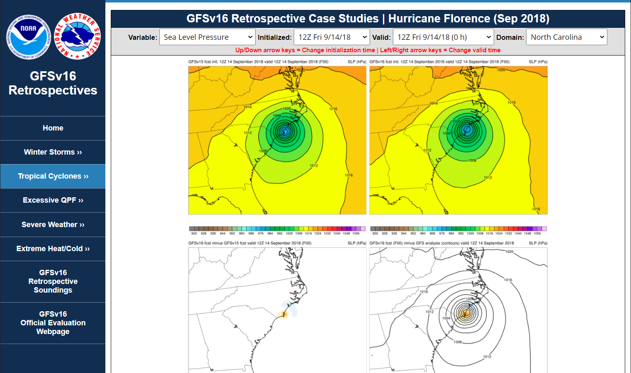
NATIONAL OCEANIC AND ATMOSPHERIC ADMINISTRATION
GFSv16 Retrospectives: Tropical Cyclones
https://www.emc.ncep.noaa.gov/users/meg/gfsv16/retros/

Slide 5
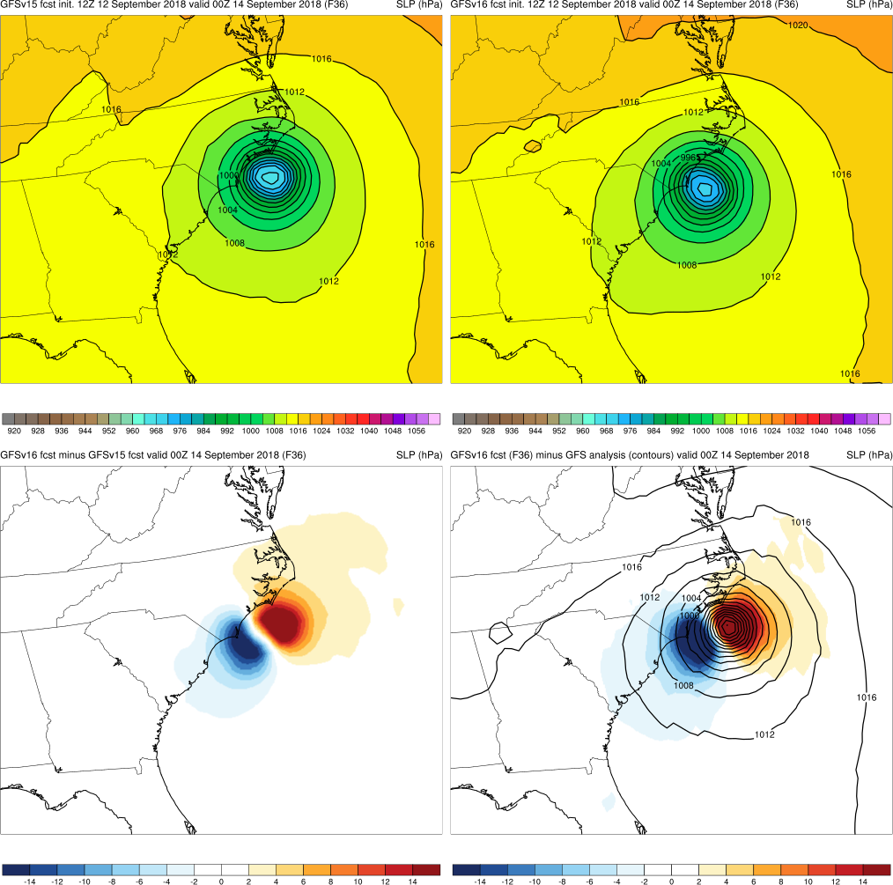
NATIONAL OCEANIC AND ATMOSPHERIC ADMINISTRATION
GFSv16 Retrospectives: Tropical Cyclones
Top: GFSv15 (left)
GFSv16 (right)
Graphics Setup
GFSv15
GFSv16
Bottom Left: GFSv16−GFSv15 (shaded)
Bottom Right: GFS analysis (contours)
GFSv16−GFS analysis (shaded)
v16−v15
GFS Anl.

Slide 6
NATIONAL OCEANIC AND ATMOSPHERIC ADMINISTRATION
GFSv16 Tropical Cyclone Highlights
GFSv16 Wins
Hurricane Florence (Sep 2018)
Hurricane Michael (Oct 2018)
Hurricane Dorian (Aug/Sep 2019)
Hurricane Juliette (Aug/Sep 2019)
Hurricane Humberto (Sep 2019)
Tropical Storm Imelda (Sep 2019)
Hurricane Lorena (Sep 2019)
Tropical Storm Nestor (Oct 2019)
Tropical Storm Olga (Oct 2019)
Tropical Cyclone Vicky (Feb 2020)

Slide 7
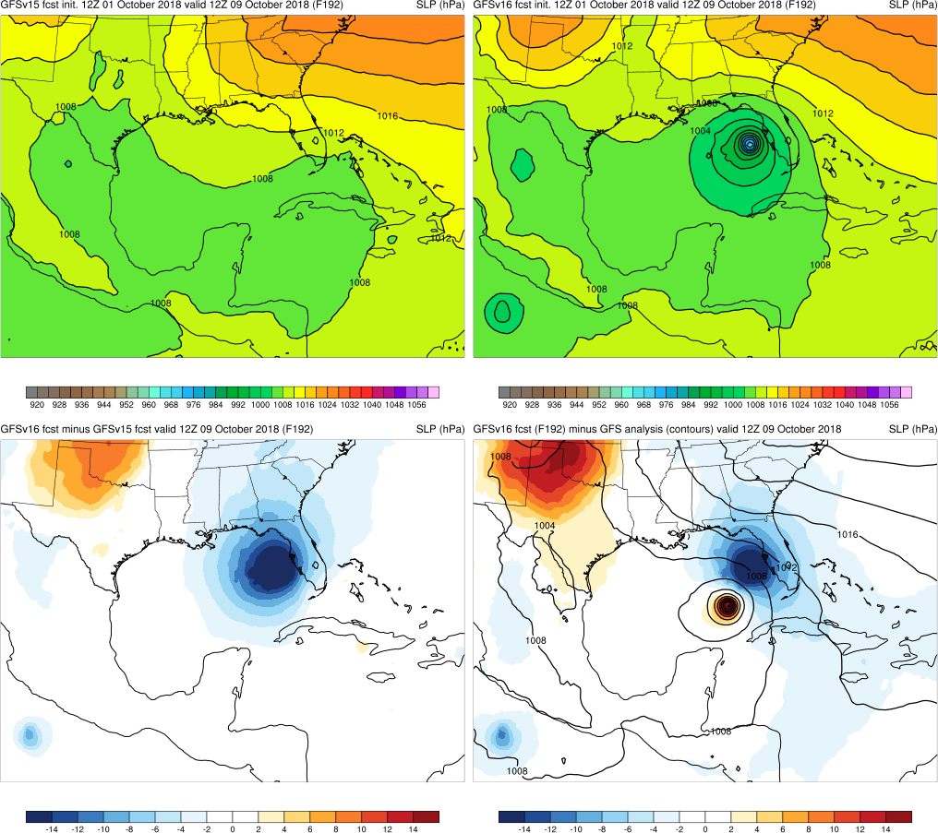
Michael (2018)
Init.: 12Z 10/1/2018 (F192)
GFSv16 forecasted a strong cyclone, while GFSv15 had no indication of TC
In 9 out of 21 cycles for this case, GFSv16 correctly had a TC while GFSv15 had little to no indication of a TC
GFSv16 displayed a fast, right-of-track bias
GFSv15
GFSv16
v16−v15
GFS Anl.

Slide 8
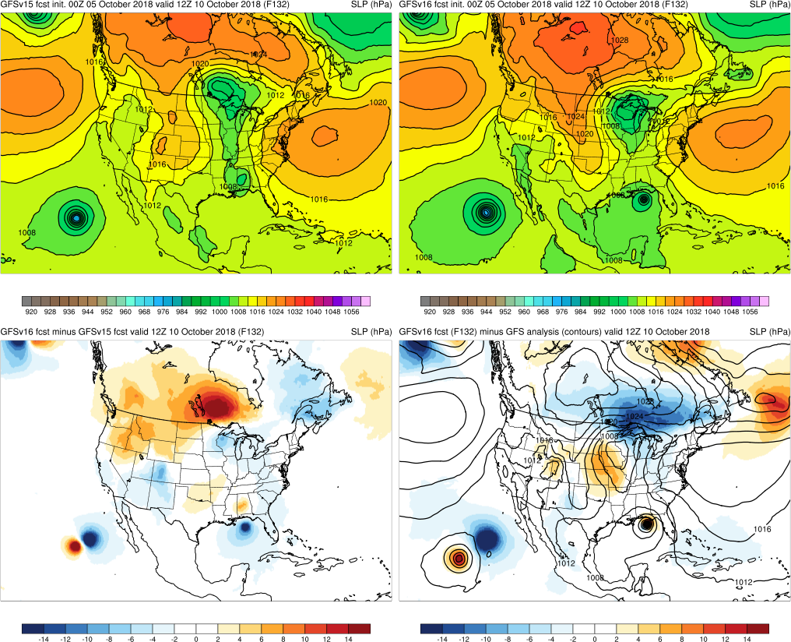
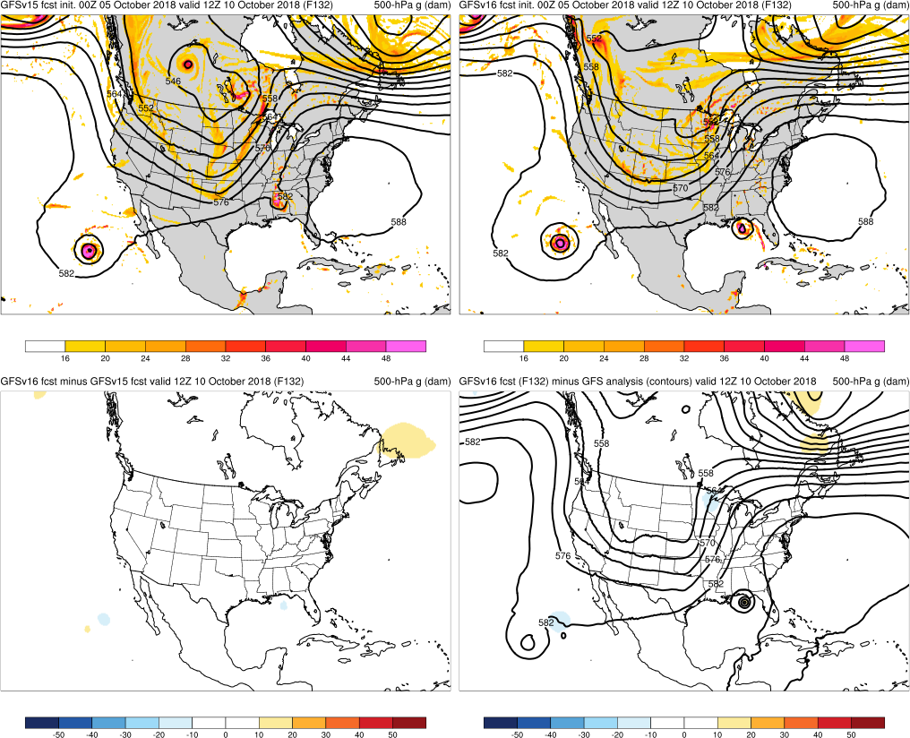
Michael (2018)
Init.: 00Z 10/5/2018 (F132)
Due to faster track, GFSv15 had TC rejoining the flow too soon while GFSv16 had the correct location
This pattern was observed in multiple cycles
GFSv15
GFSv16
v16−v15
GFS Anl.

Slide 9
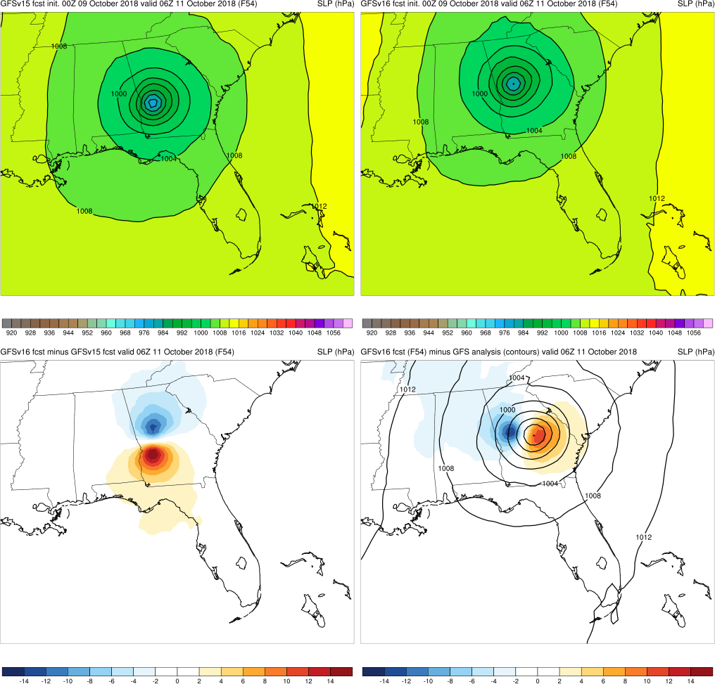
Michael (2018)
Init.: 00Z 10/9/2018 (F54)
GFSv16 was faster than GFSv15, but correctly so
Both showed a left-of-track bias, which was observed in other cycles at/after landfall
This left-of-track bias was noticeable in the QPF fields
GFSv15
GFSv16
v16−v15
GFS Anl.

Slide 10
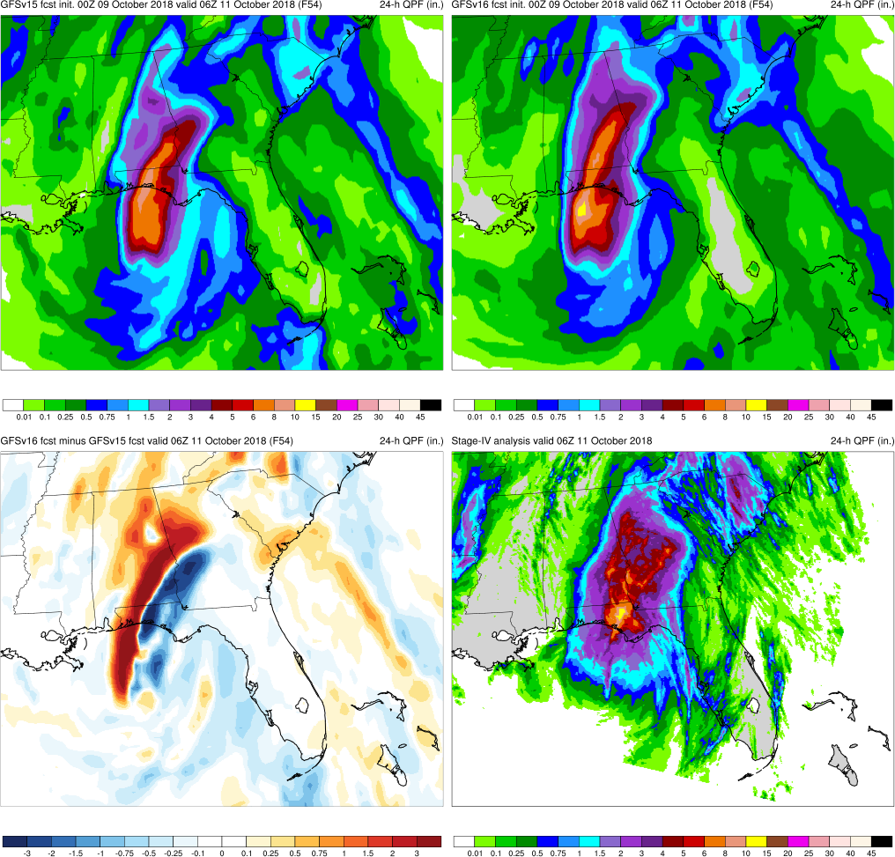
Michael (2018)
Init.: 00Z 10/9/2018 (F54)
GFSv16 was faster than GFSv15, but correctly so
Both showed a left-of-track bias, which was observed in other cycles at/after landfall
This left-of-track bias was noticeable in the QPF fields
Both GFSv16 and GFSv15 had precip axis shifted too far west (GFSv16 more so)
GFSv15
GFSv16
v16−v15
Stage-IV

Slide 11
NATIONAL OCEANIC AND ATMOSPHERIC ADMINISTRATION
GFSv16 Tropical Cyclone Highlights
GFSv16 Wins
Hurricane Florence (Sep 2018)
Hurricane Michael (Oct 2018)
Hurricane Dorian (Aug/Sep 2019)
Hurricane Juliette (Aug/Sep 2019)
Hurricane Humberto (Sep 2019)
Tropical Storm Imelda (Sep 2019)
Hurricane Lorena (Sep 2019)
Tropical Storm Nestor (Oct 2019)
Tropical Storm Olga (Oct 2019)
Tropical Cyclone Vicky (Feb 2020)

Slide 12
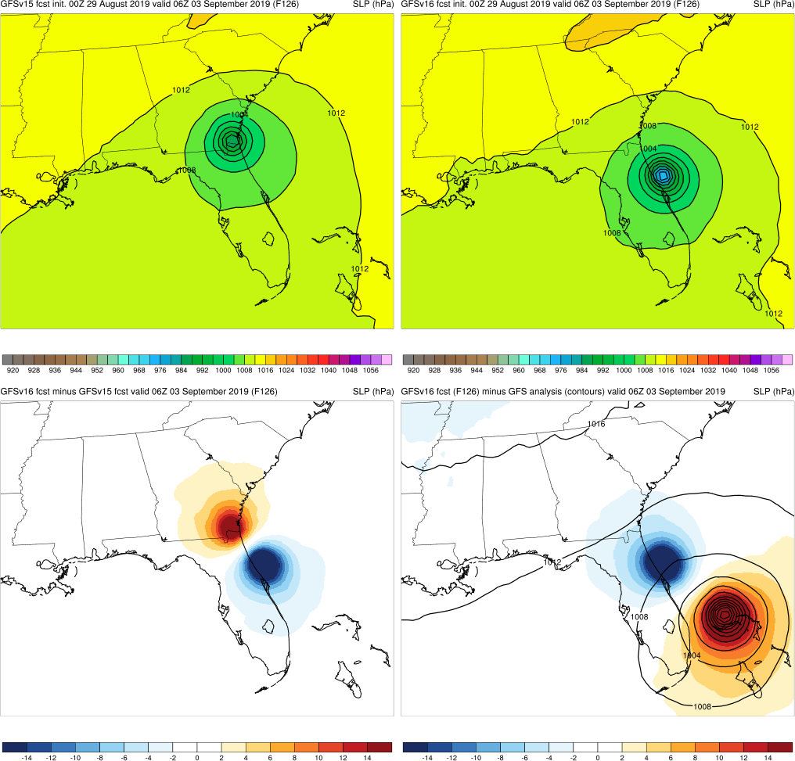
Dorian (2019)
Init.: 12Z 8/27/2019 (F132)
GFSv16 consistently kept Dorian east of Florida unlike GFSv15
Fast track bias in both, but GFSv15 was often much faster
GFSv15
GFSv16
v16−v15
GFS Anl.
Init.: 00Z 8/29/2019 (F126)

Slide 13
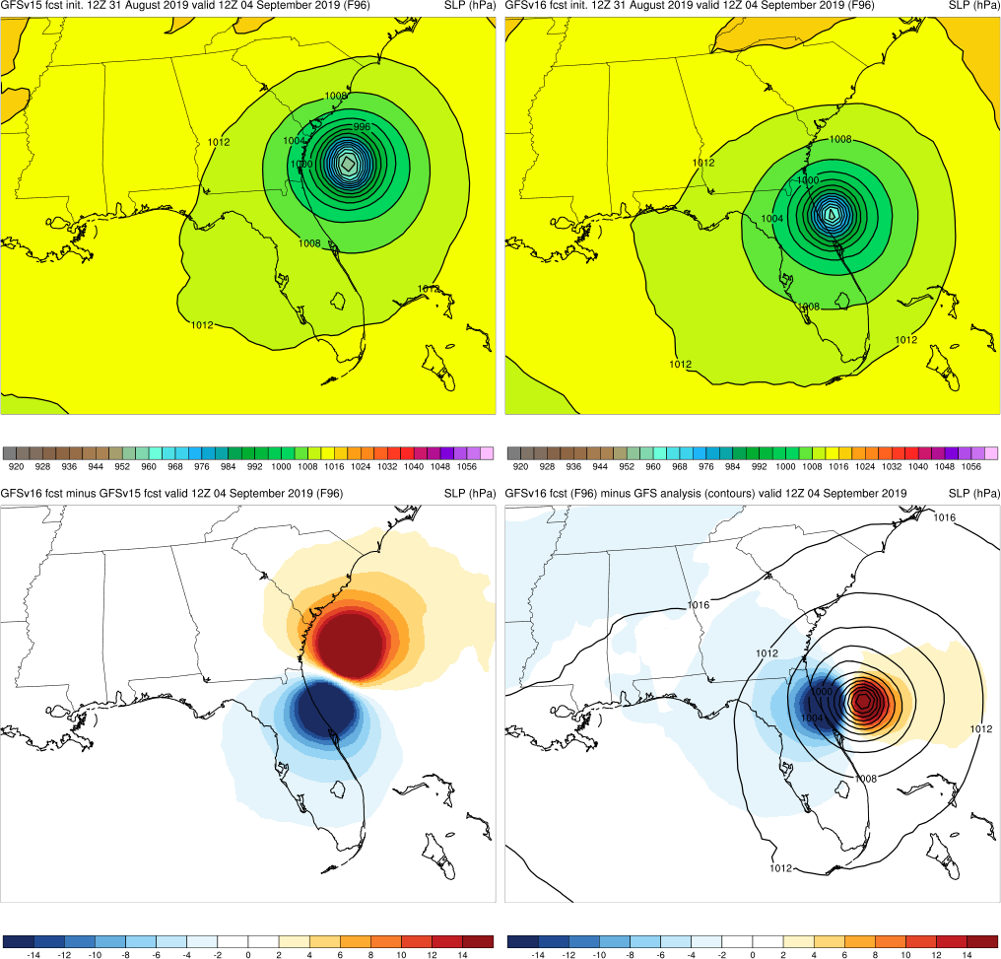
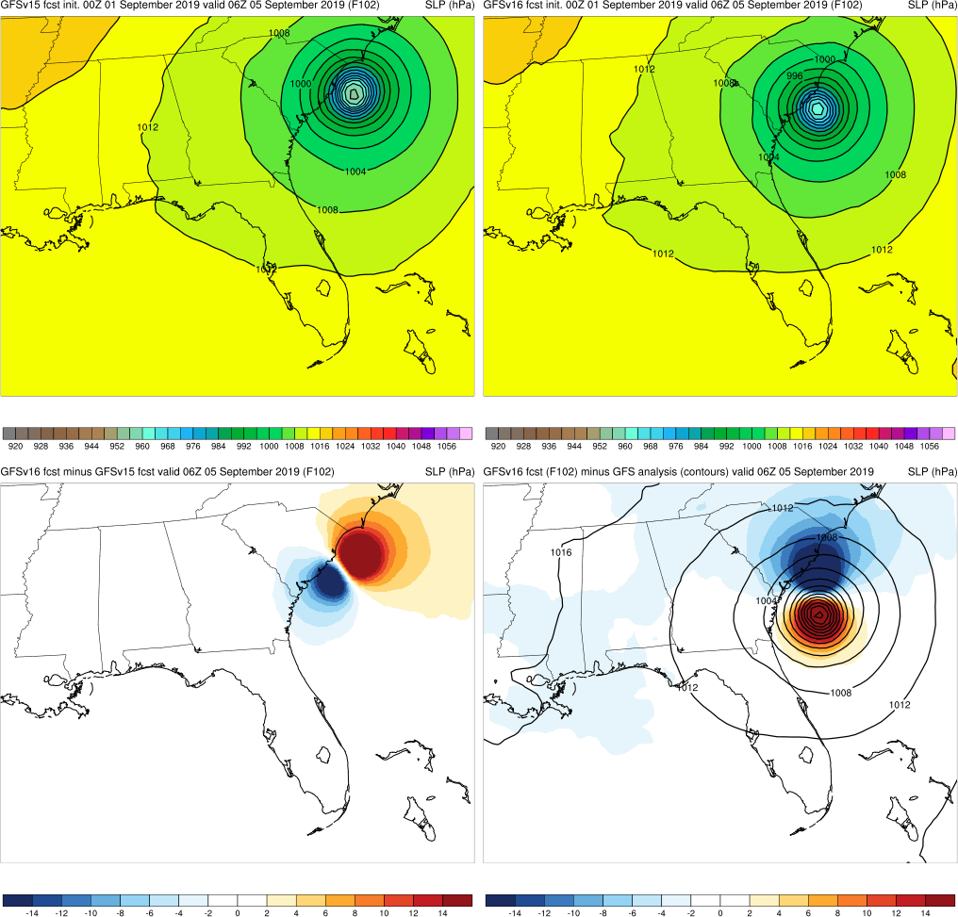
Dorian (2019)
Init.: 12Z 8/31/2019 (F96)
GFSv16 was correctly slower and farther south than GFSv15
However, GFSv16 shifted the TC closer to the coast
GFSv15
GFSv16
v16−v15
GFS Anl.
Init.: 00Z 9/1/2019 (F102)

Slide 14
Dorian (2019)
GFSv15
GFSv16
Overall, better track and intensity forecasts in GFSv16
Intensity is almost statistically significantly better from F114-F138
Track is almost statistically significantly better from F102-F126
GFSv15
GFSv16

Slide 15
NATIONAL OCEANIC AND ATMOSPHERIC ADMINISTRATION
GFSv16 Tropical Cyclone Highlights
GFSv16 Wins
Hurricane Florence (Sep 2018)
Hurricane Michael (Oct 2018)
Hurricane Dorian (Aug/Sep 2019)
Hurricane Juliette (Aug/Sep 2019)
Hurricane Humberto (Sep 2019)
Tropical Storm Imelda (Sep 2019)
Hurricane Lorena (Sep 2019)
Tropical Storm Nestor (Oct 2019)
Tropical Storm Olga (Oct 2019)
Tropical Cyclone Vicky (Feb 2020)

Slide 16
Juliette (2019)
Init.: 12Z 8/27/2019 (F240)
GFSv16 correctly had a strong cyclone while GFSv15 had no TC indication
GFSv16 correctly had a stronger cyclone than GFSv15 from F192-F240
Overall, GFSv16 had a correctly stronger TC than GFSv15 from 8/27 to 8/31 for most forecast hours
GFSv15
GFSv16
v16−v15
GFS Anl.

Slide 17
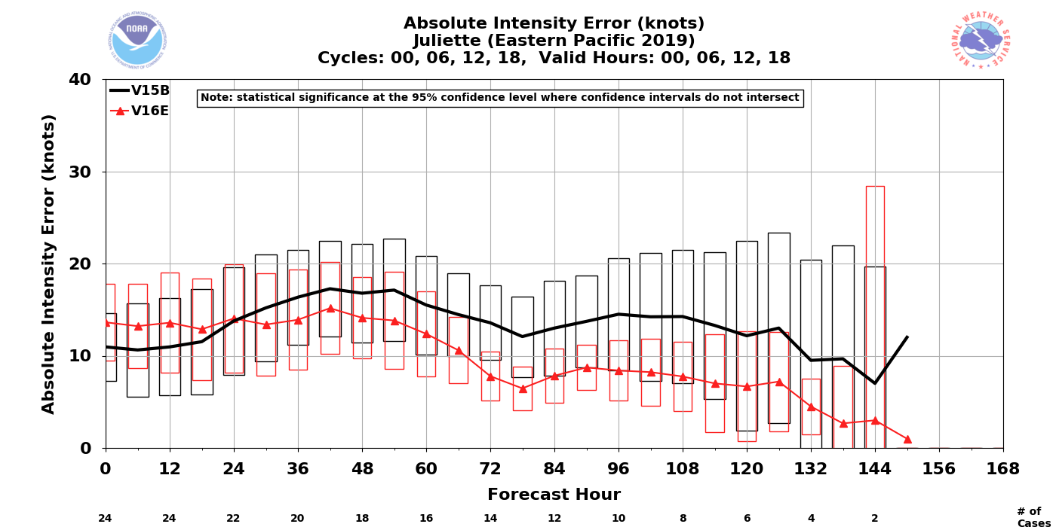
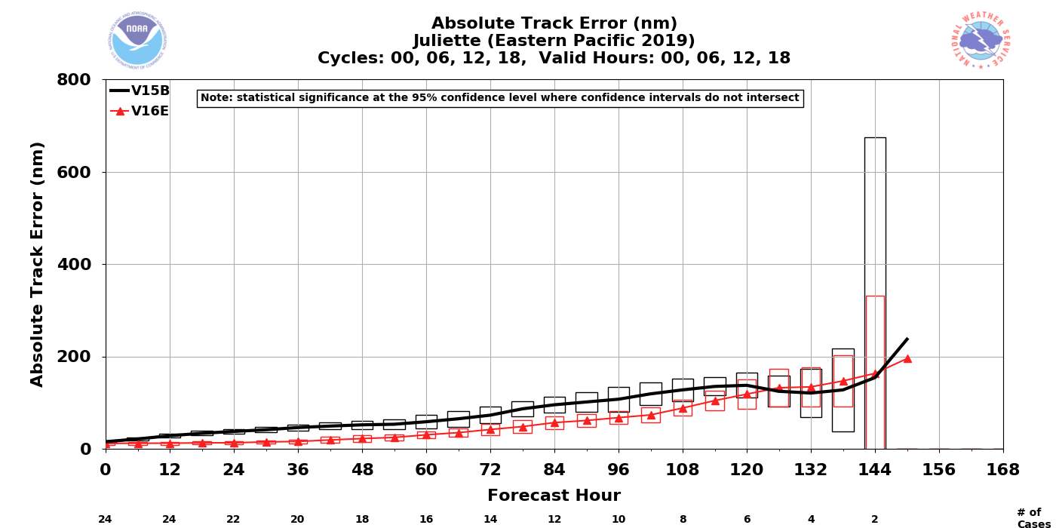
Juliette (2019)
GFSv15
GFSv16
Correctly stronger TC in GFSv16 in earlier initializations
However, in later initializations, GFSv16 displayed a fast, right-of-track bias with a TC that was too intense
Overall, better track and intensity forecasts in GFSv16 (statistically significantly better for track)
GFSv15
GFSv16

Slide 18
NATIONAL OCEANIC AND ATMOSPHERIC ADMINISTRATION
GFSv16 Tropical Cyclone Highlights
GFSv16 Wins
Hurricane Florence (Sep 2018)
Hurricane Michael (Oct 2018)
Hurricane Dorian (Aug/Sep 2019)
Hurricane Juliette (Aug/Sep 2019)
Hurricane Humberto (Sep 2019)
Tropical Storm Imelda (Sep 2019)
Hurricane Lorena (Sep 2019)
Tropical Storm Nestor (Oct 2019)
Tropical Storm Olga (Oct 2019)
Tropical Cyclone Vicky (Feb 2020)

Slide 19
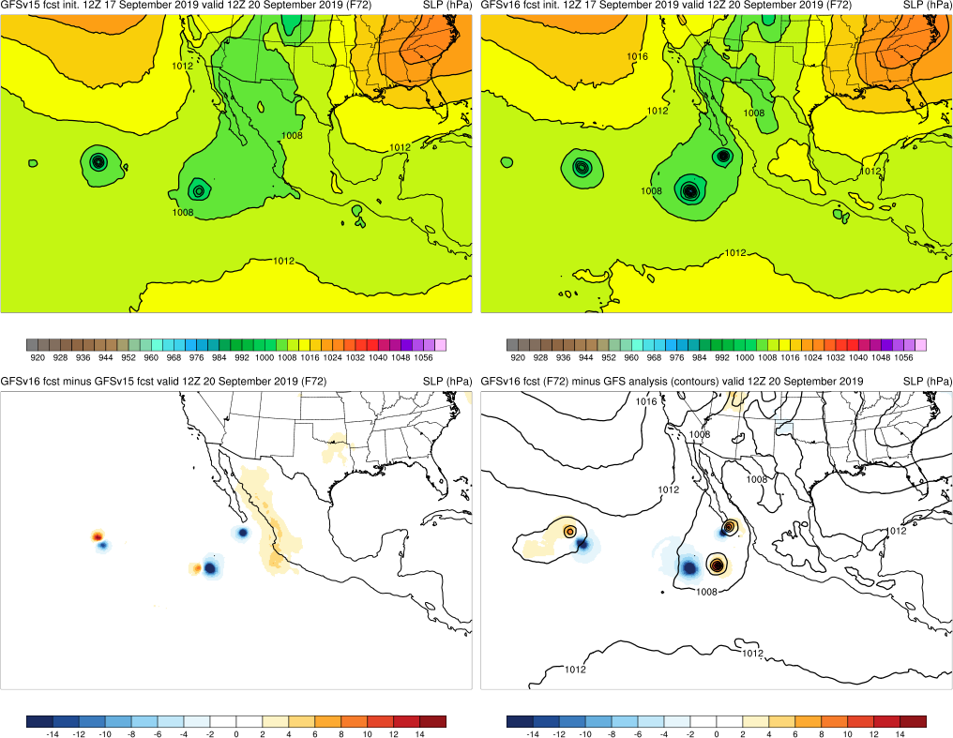
Lorena (2019)
Init.: 12Z 9/17/2019 (F72)
GFSv16 correctly forecasted three TCs in the Eastern Pacific, while GFSv15 only forecasted two TCs
GFSv16 forecasted the correct number of TCs from F36-F102 (GFSv15 did not)
This was observed in other initializations
Kiko
Lorena
Mario
GFSv15
GFSv16
v16−v15
GFS Anl.

Slide 20
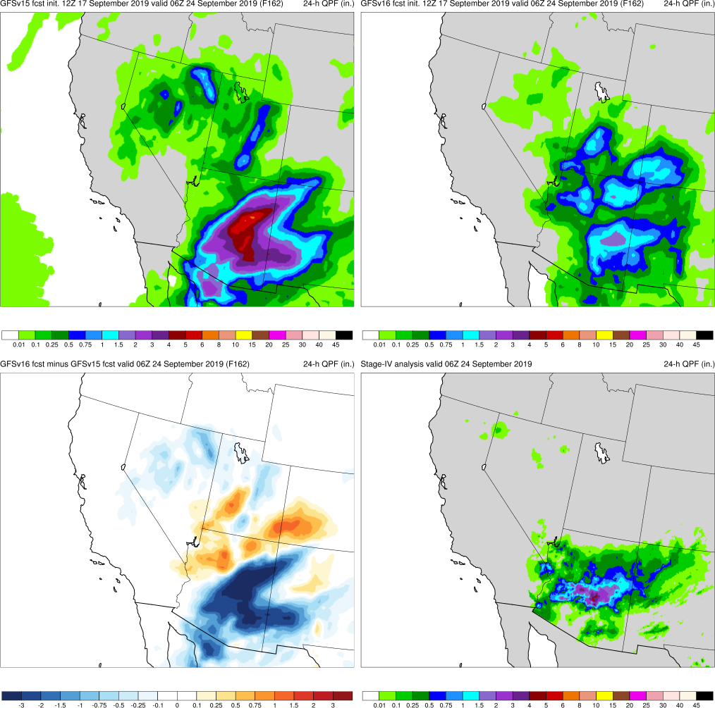
Lorena (2019)
Init.: 12Z 9/17/2019 (F162)
GFSv16 had considerably better southwest U.S. precip amounts than GFSv15 around Day 7
GFSv16 also had more correct 24-hr QPF forecasts in the medium range
Both GFSv16 and GFSv15 provided similar guidance in the short range
GFSv15
GFSv16
v16−v15
Stage-IV

Slide 21
NATIONAL OCEANIC AND ATMOSPHERIC ADMINISTRATION
GFSv16 Tropical Cyclone Highlights
GFSv16 Wins
Hurricane Florence (Sep 2018)
Hurricane Michael (Oct 2018)
Hurricane Dorian (Aug/Sep 2019)
Hurricane Juliette (Aug/Sep 2019)
Hurricane Humberto (Sep 2019)
Tropical Storm Imelda (Sep 2019)
Hurricane Lorena (Sep 2019)
Tropical Storm Nestor (Oct 2019)
Tropical Storm Olga (Oct 2019)
Tropical Cyclone Vicky (Feb 2020)

Slide 22
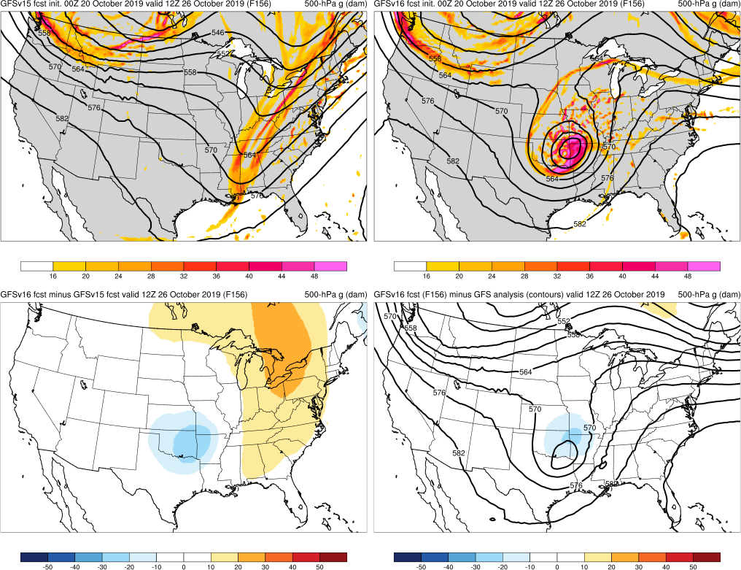
Olga (2019)
Init.: 00Z 10/20/2019 (F156)
GFSv16 had a much better synoptic forecast than GFSv15
Olga had a short lifespan as a TC before making landfall with limited predictability, but GFSv16 forecasts were consistently correctly less progressive with the upper trough that steered Olga
This was true even at shorter forecast ranges
GFSv15
GFSv16
v16−v15
GFS Anl.

Slide 23
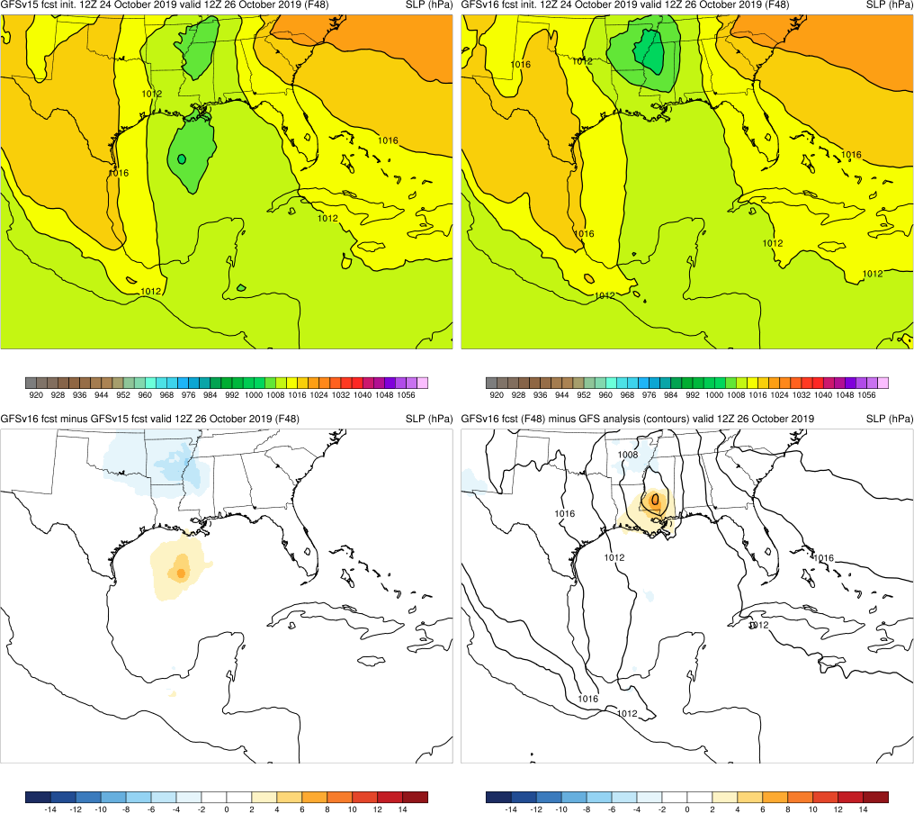
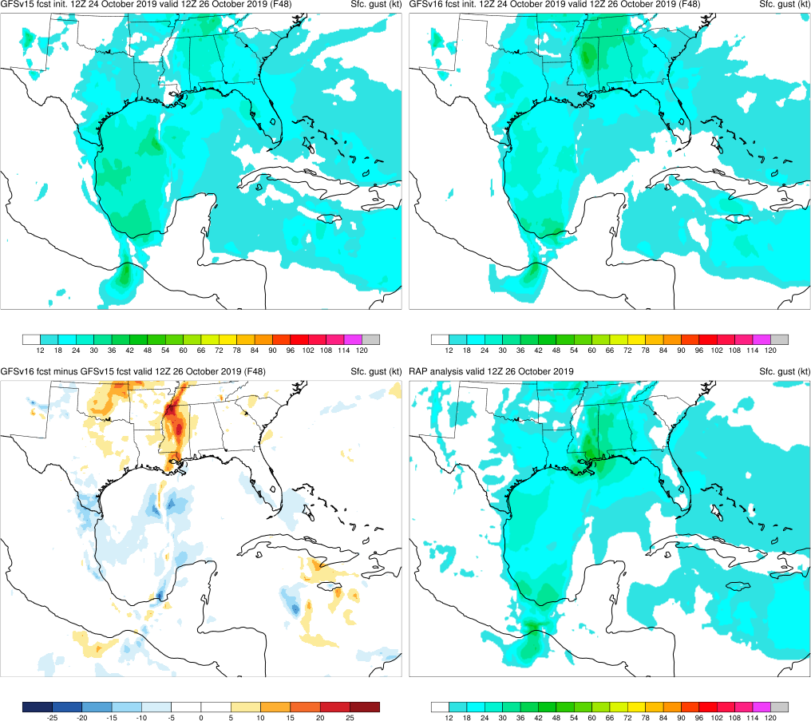
Olga (2019)
Init.: 12Z 10/24/2019 (F48)
Due to better synoptic forecasts, GFSv16 was able to sort out details and location of the Post-TC better than GFSv15
GFSv15
GFSv16
v16−v15
GFS Anl.

Slide 24
NATIONAL OCEANIC AND ATMOSPHERIC ADMINISTRATION
GFSv16 Tropical Cyclone Highlights
GFSv16 Wins
Hurricane Florence (Sep 2018)
Hurricane Michael (Oct 2018)
Hurricane Dorian (Aug/Sep 2019)
Hurricane Juliette (Aug/Sep 2019)
Hurricane Humberto (Sep 2019)
Tropical Storm Imelda (Sep 2019)
Hurricane Lorena (Sep 2019)
Tropical Storm Nestor (Oct 2019)
Tropical Storm Olga (Oct 2019)
Tropical Cyclone Vicky (Feb 2020)

Slide 25
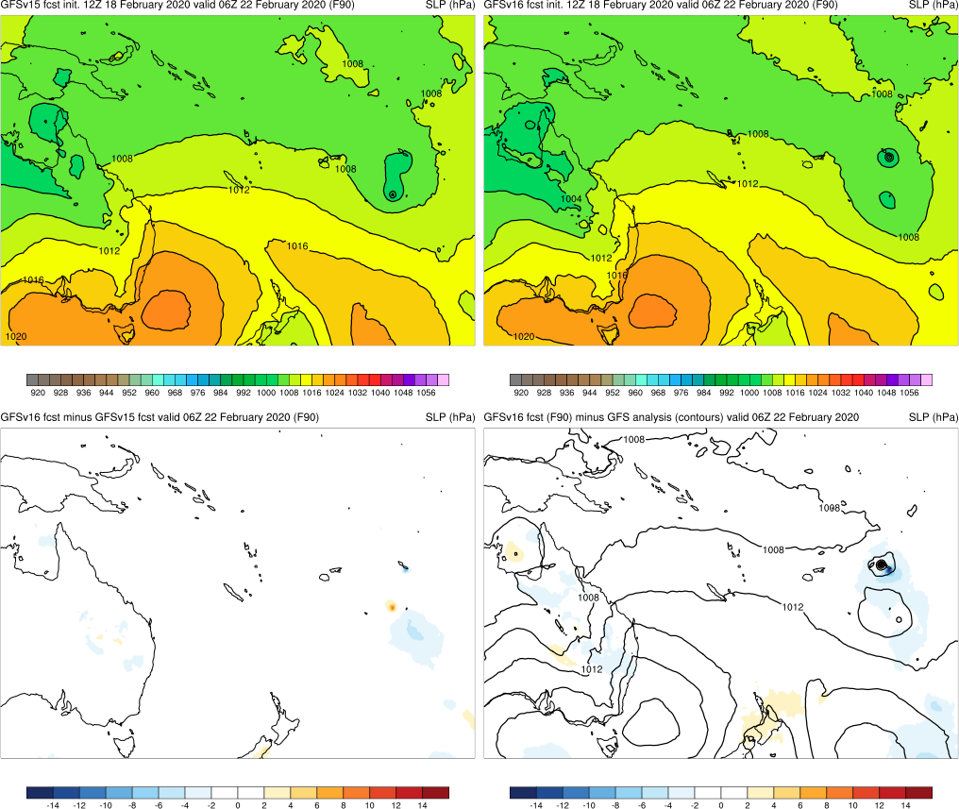
Vicky (2020)
Init.: 12Z 2/18/2020 (F90)
GFSv16 had better track and intensity forecasts for Vicky in the medium range
GFSv15
GFSv16
v16−v15
GFS Anl.

Slide 26
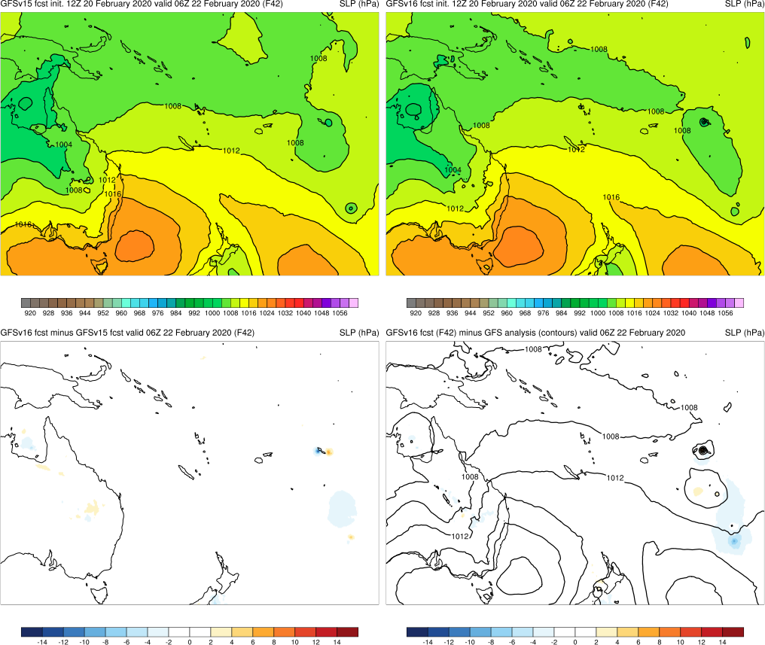
Vicky (2020)
Init.: 12Z 2/20/2020 (F42)
GFSv16 had better track and intensity forecasts for Vicky in the medium range
GFSv16 had better track and intensity forecasts for Vicky in the short range
GFSv15
GFSv16
v16−v15
GFS Anl.

Slide 27
NATIONAL OCEANIC AND ATMOSPHERIC ADMINISTRATION
GFSv16 Tropical Cyclone Highlights
GFSv16 Real-time Wins
Hurricane Douglas (July 2020)
Hurricane Isaias (July/Aug 2020)

Slide 28
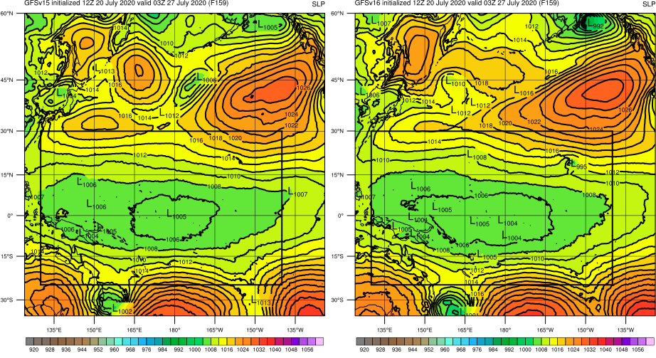
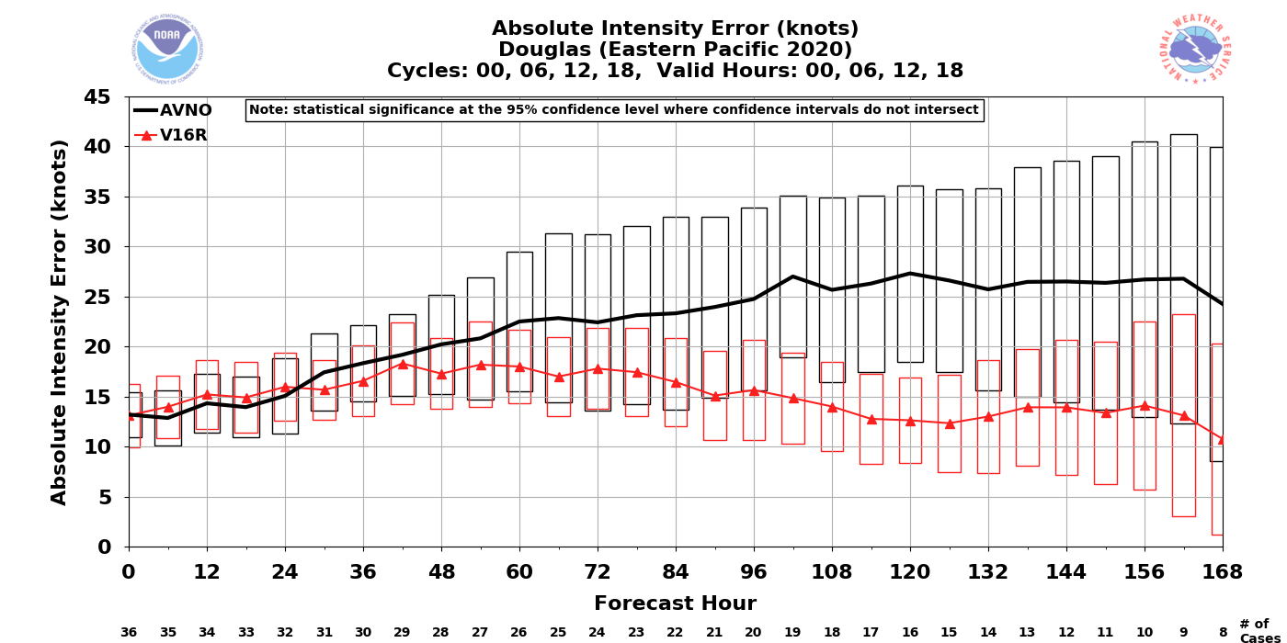
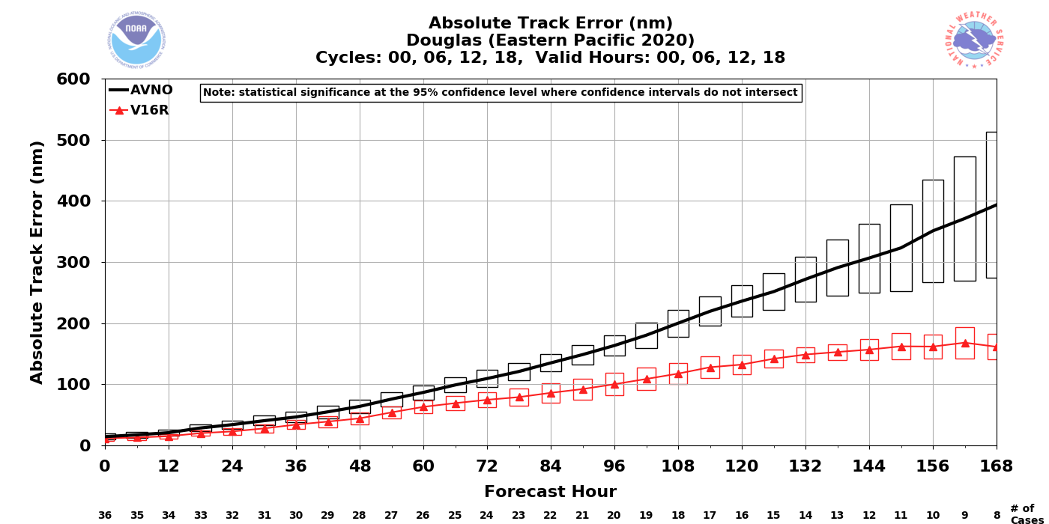
Douglas (2020)
Init.: 12Z 7/20/2020 (F159)
Overall, better track and intensity forecasts in GFSv16
Intensity is almost statistically significantly better from F102-F126 (significant at F120)
Track is statistically significantly better for almost all forecast hours
GFSv15
GFSv16
GFSv15
GFSv16
GFSv15
GFSv16

Slide 29
NATIONAL OCEANIC AND ATMOSPHERIC ADMINISTRATION
GFSv16 Tropical Cyclone Highlights
GFSv16 Real-time Wins
Hurricane Douglas (July 2020)
Hurricane Isaias (July/Aug 2020)

Slide 30
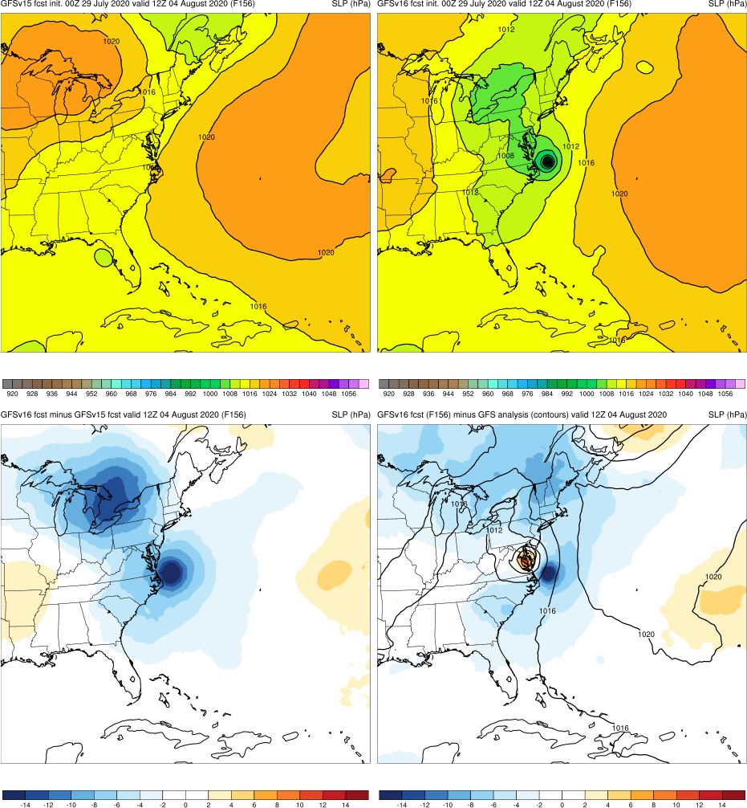
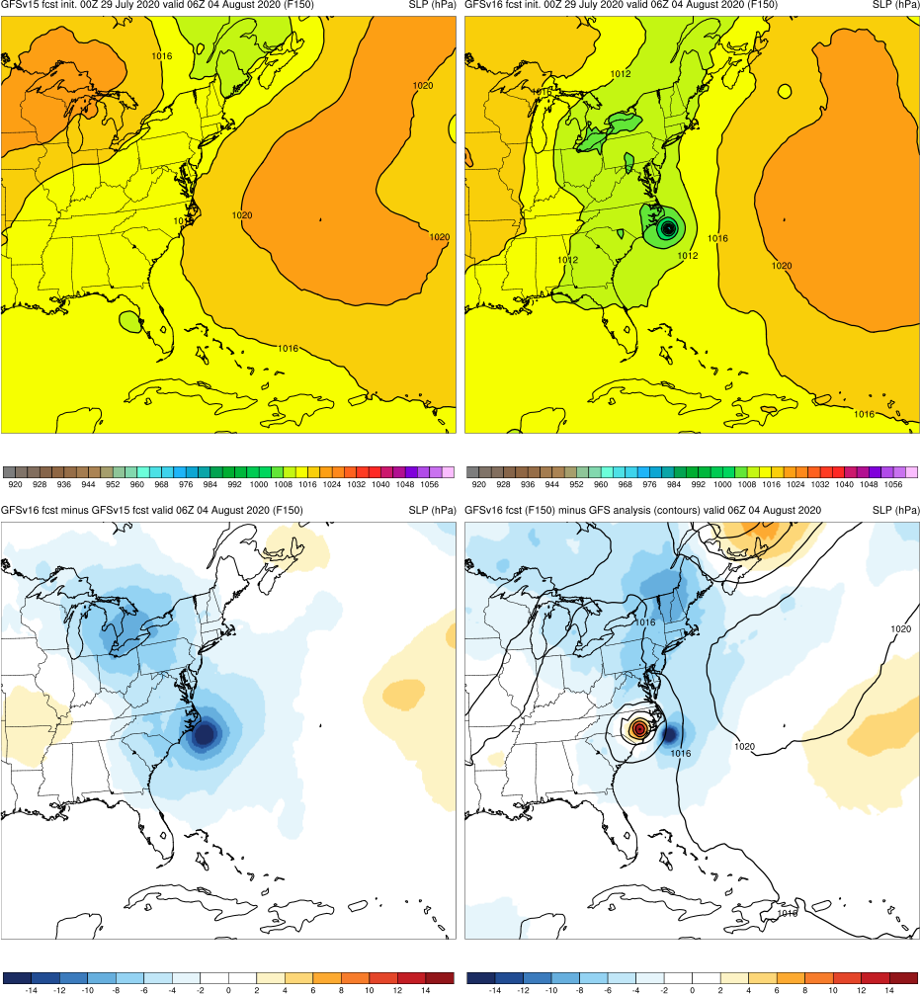
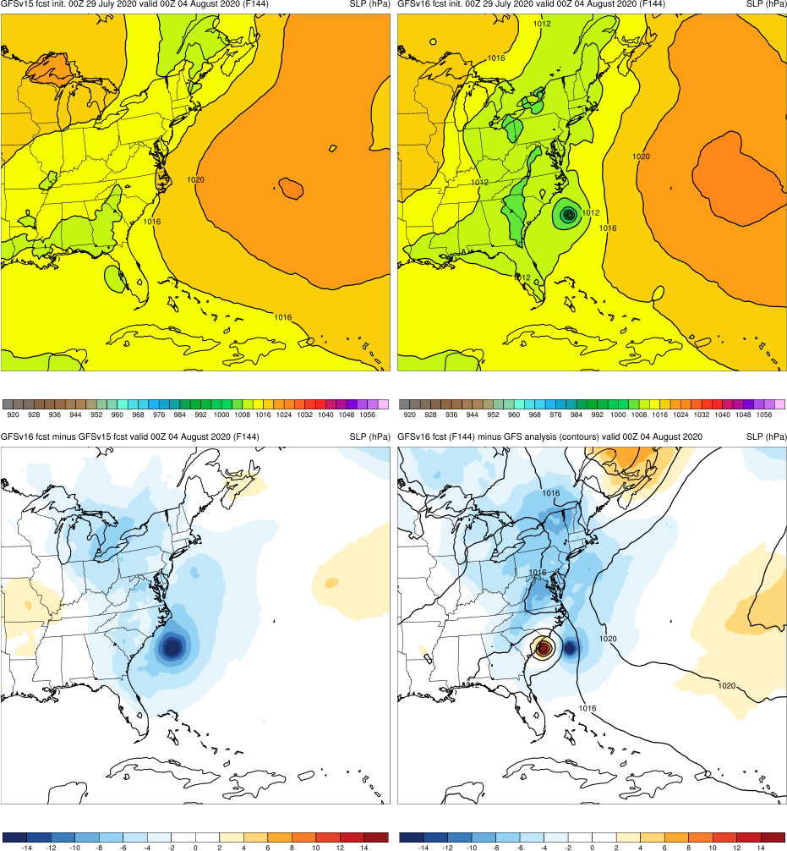
Isaias (2020)
GFSv15
GFSv15
GFSv16
GFSv15
GFSv16
GFSv16
Init.: 00Z 7/29/2020 (F144-F156)
GFSv16 correctly had Isaias tracking along the East Coast while GFSv15 did not
GFSv15 had an incorrect indication of a TC along the Florida Gulf Coast
This was observed in other forecast hours
v16−v15
v16−v15
GFS Anl.
v16−v15
GFS Anl.
GFS Anl.

Slide 31
NATIONAL OCEANIC AND ATMOSPHERIC ADMINISTRATION
GFSv16 Tropical Cyclone Highlights
GFSv15 Wins
Hurricane Barbara (June/July 2019)
TCs Erick and Flossie (July/Aug 2019)
Hurricane Kiko (Sep 2019)
Hurricane Lorenzo (Oct 2019)

Slide 32
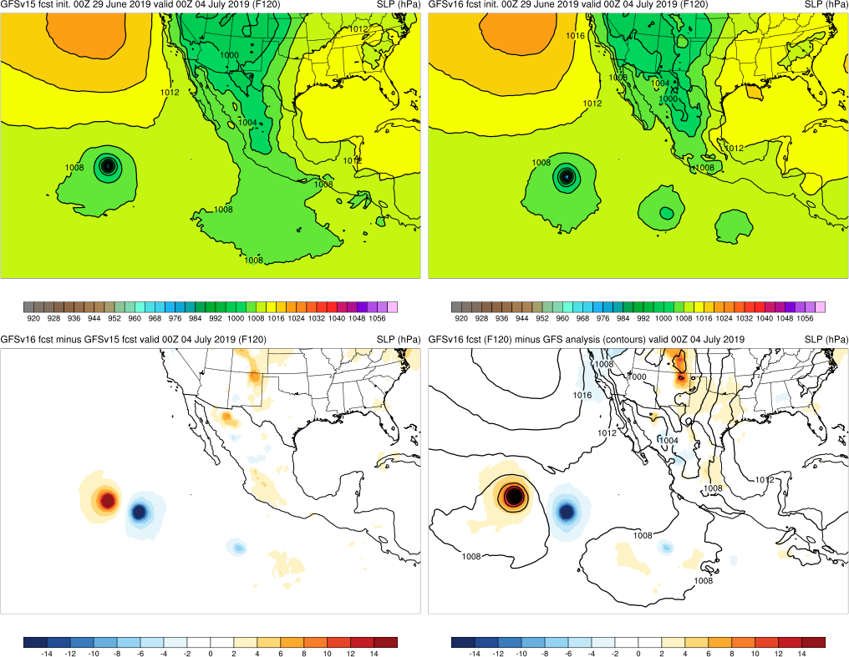
Barbara (2019)
Init.: 00Z 6/29/2019 (F120)
GFSv16 was slower with Barbara than GFSv15 and Best Track (kept it further east)
GFSv15
GFSv16
v16−v15
GFS Anl.

Slide 33
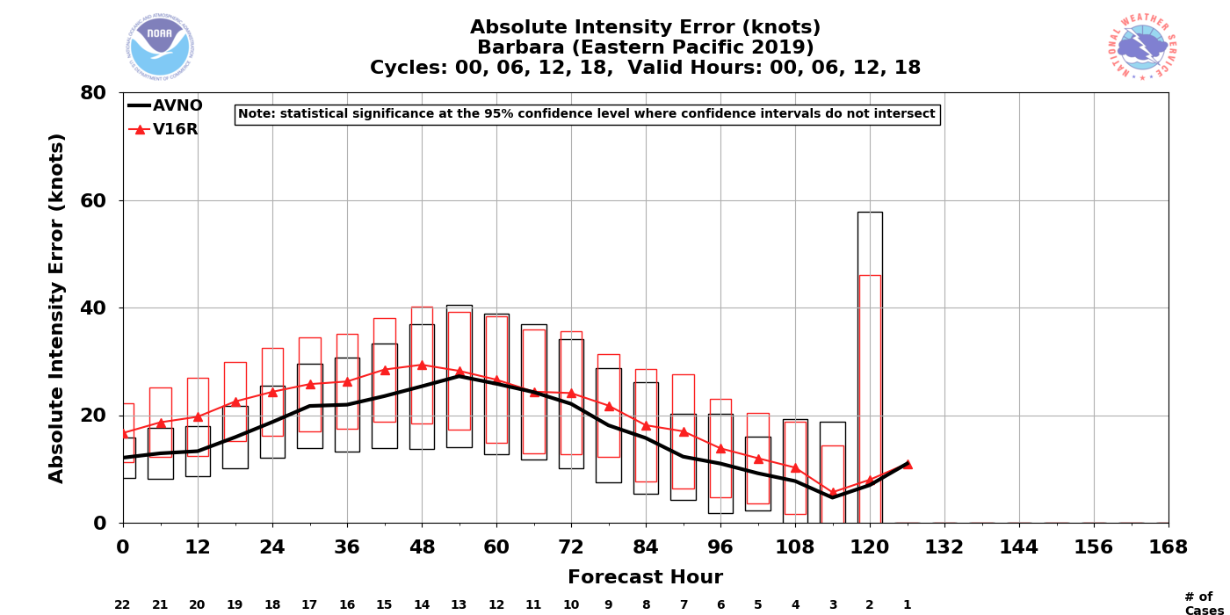
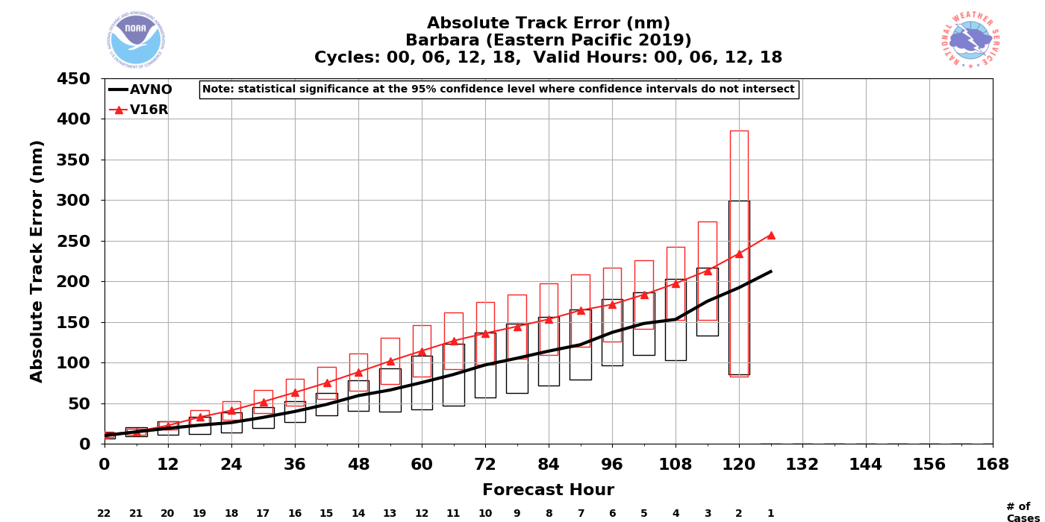
Barbara (2019)
GFSv15
GFSv16
GFSv16 was slower with Barbara than GFSv15 and Best Track (kept it further east)
GFSv16 incorrectly brought a stronger TC toward Hawaii for several forecast cycles (also still too slow/east)
GFSv16 has higher intensity errors than GFSv15 for most forecast hours
GFSv16 has worse track errors, consistent with being too slow and far east in most forecast cycles
GFSv15
GFSv16

Slide 34
NATIONAL OCEANIC AND ATMOSPHERIC ADMINISTRATION
GFSv16 Tropical Cyclone Highlights
GFSv15 Wins
Hurricane Barbara (June/July 2019)
TCs Erick and Flossie (July/Aug 2019)
Hurricane Kiko (Sep 2019)
Hurricane Lorenzo (Oct 2019)

Slide 35
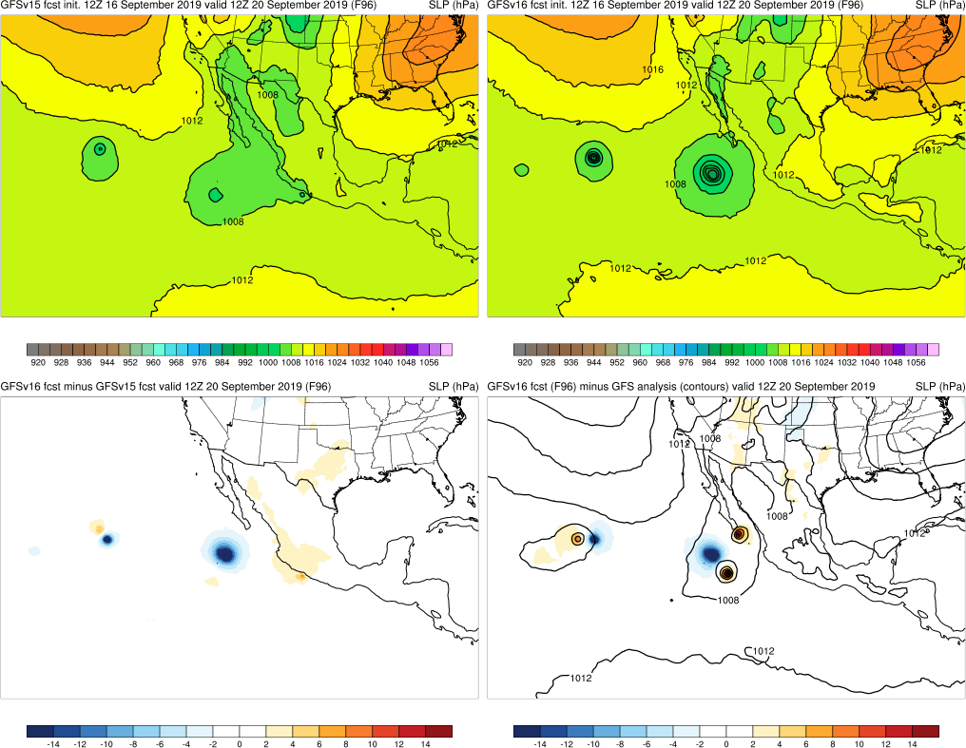
GFSv15
GFSv16
Kiko (2019)
Init.: 12Z 9/16/2019 (F96)
After Kiko’s peak intensity (12z 15 Sep), GFSv16 was too strong compared to GFSv15 and analysis, leading to worse intensity errors in the medium range (not statistically significant)
Statistically significantly higher track errors in GFSv16 at F30-F78
v16−v15
GFS Anl.
GFSv15
GFSv16
GFSv15
GFSv16

Slide 36
NATIONAL OCEANIC AND ATMOSPHERIC ADMINISTRATION
GFSv16 Tropical Cyclone Highlights
GFSv15 Wins
Hurricane Barbara (June/July 2019)
TCs Erick and Flossie (July/Aug 2019)
Hurricane Kiko (Sep 2019)
Hurricane Lorenzo (Oct 2019)

Slide 37
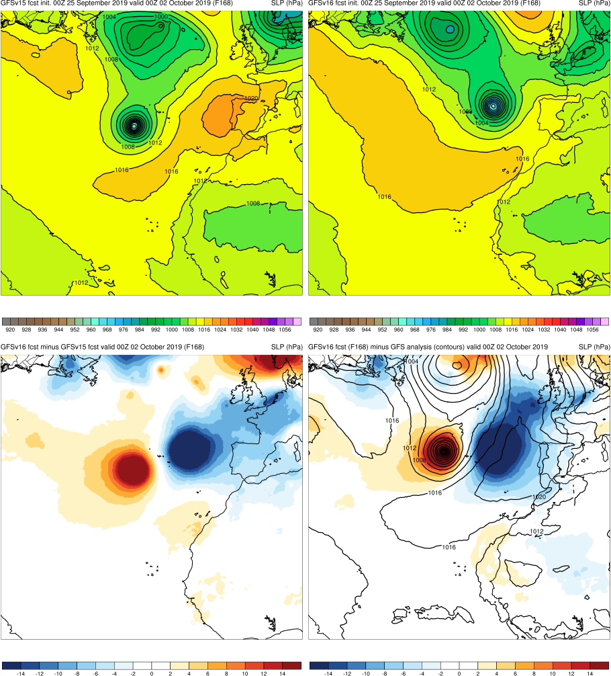
Lorenzo (2019)
Init.: 00Z 9/25/2019 (F168)
GFSv16 recurved Lorenzo too early, and approached Ireland faster than GFSv15/Best Track for multiple cycles
Total precipitation fields highlighted this early recurvature and faster motion
GFSv15
GFSv16
v16−v15
GFS Anl.

Slide 38
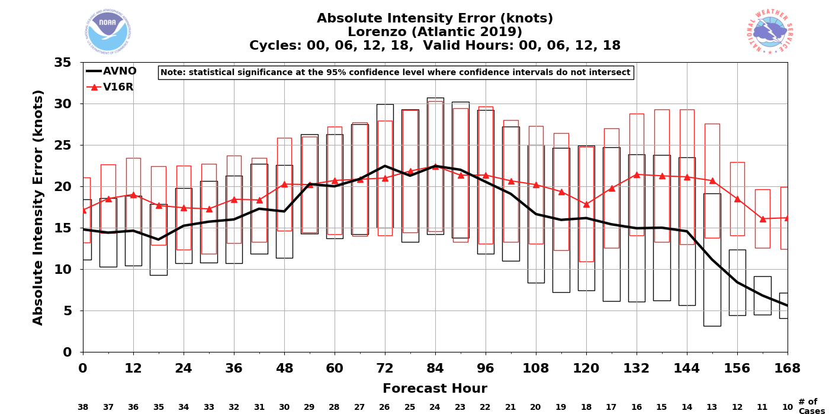
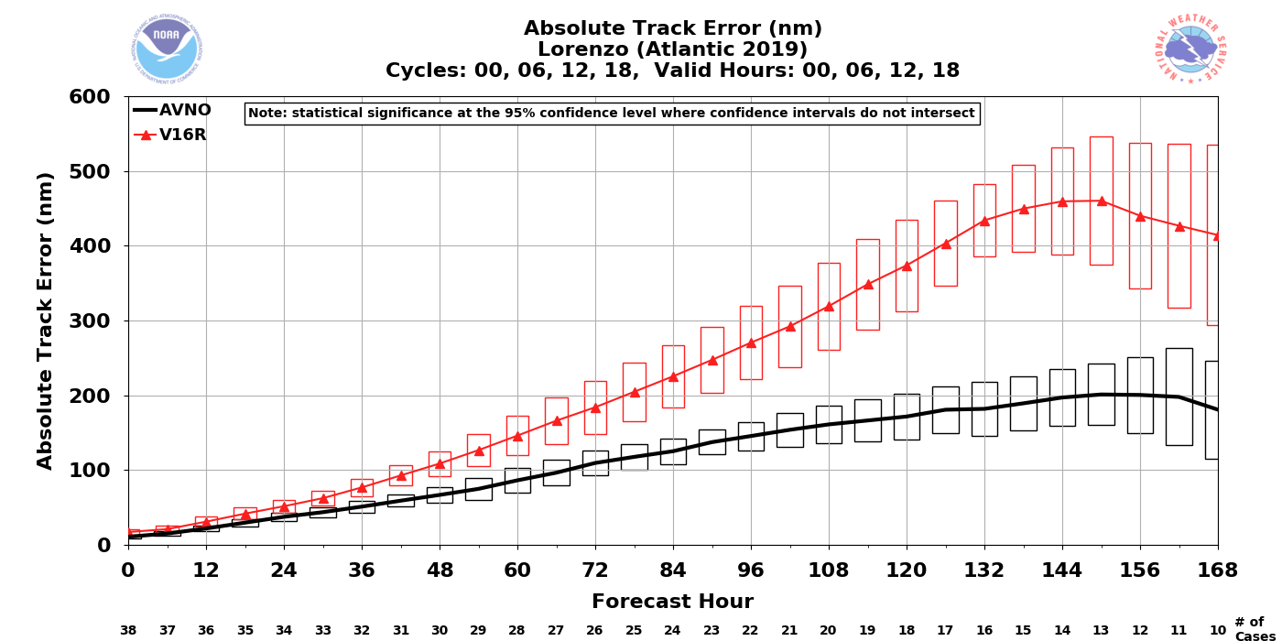
Lorenzo (2019)
GFSv15
GFSv16
GFSv16 recurved Lorenzo too early, and approached Ireland faster than GFSv15/Best Track for multiple cycles
Total precipitation fields highlighted this early recurvature & faster motion
Numerous runs with an early recurvature result in the worst track error differences of the TC retro cases
This case also has worse intensity errors for GFSv16 (significant at F156-F168)
GFSv15
GFSv16

Slide 39
NATIONAL OCEANIC AND ATMOSPHERIC ADMINISTRATION
GFSv16 Tropical Cyclone Highlights
Mixed Results
Hurricane Barry (July 2019)
Tropical Storm Karen (Sep 2019)
Tropical Cyclone Sarai (Dec 2019)

Slide 40
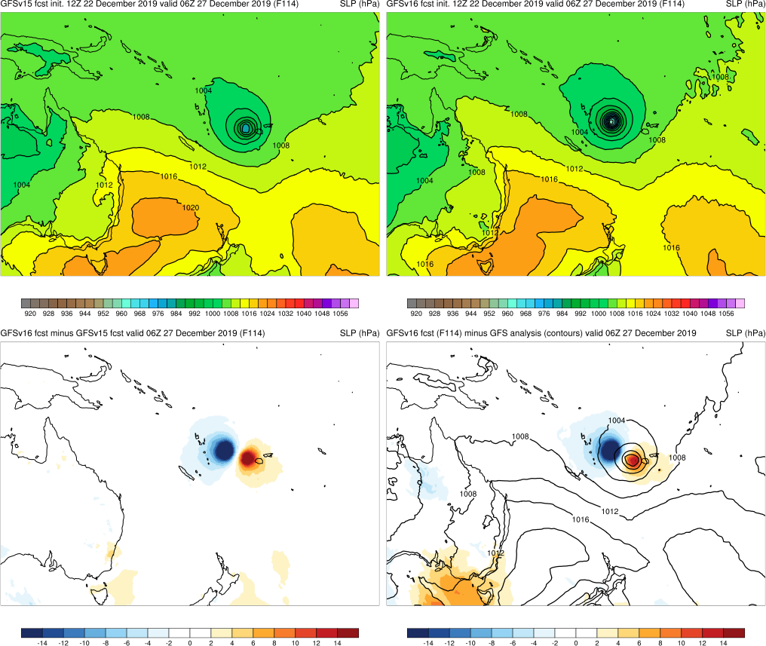
Sarai (2019)
Init.: 12Z 12/22/2019 (F114)
GFSv16 had a slower and more intense cyclone
From 00Z 12/20 to 00Z 12/23, GFSv16 had a slow bias and GFSv15 had a better TC location
GFSv15
GFSv16
v16−v15
GFS Anl.

Slide 41
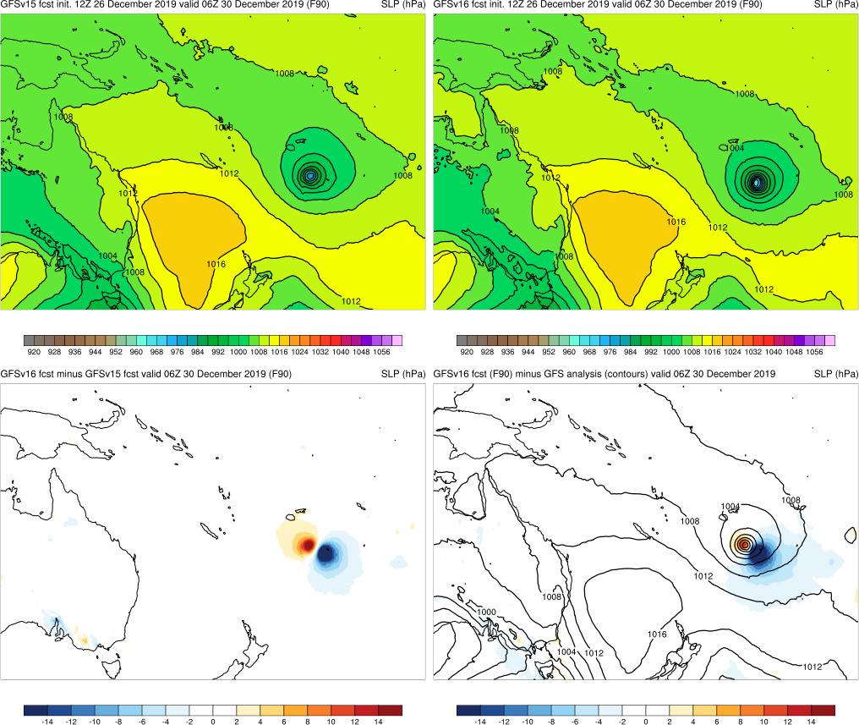
Sarai (2019)
Init.: 12Z 12/26/2019 (F90)
From 00Z 12/20 to 00Z 12/23, GFSv16 had a slow bias and GFSv15 had a better TC location
From 12Z 12/25 to 00Z 12/27, GFSv16 displayed a fast bias once Sarai passed Fiji
GFSv15
GFSv16
v16−v15
GFS Anl.

Slide 42
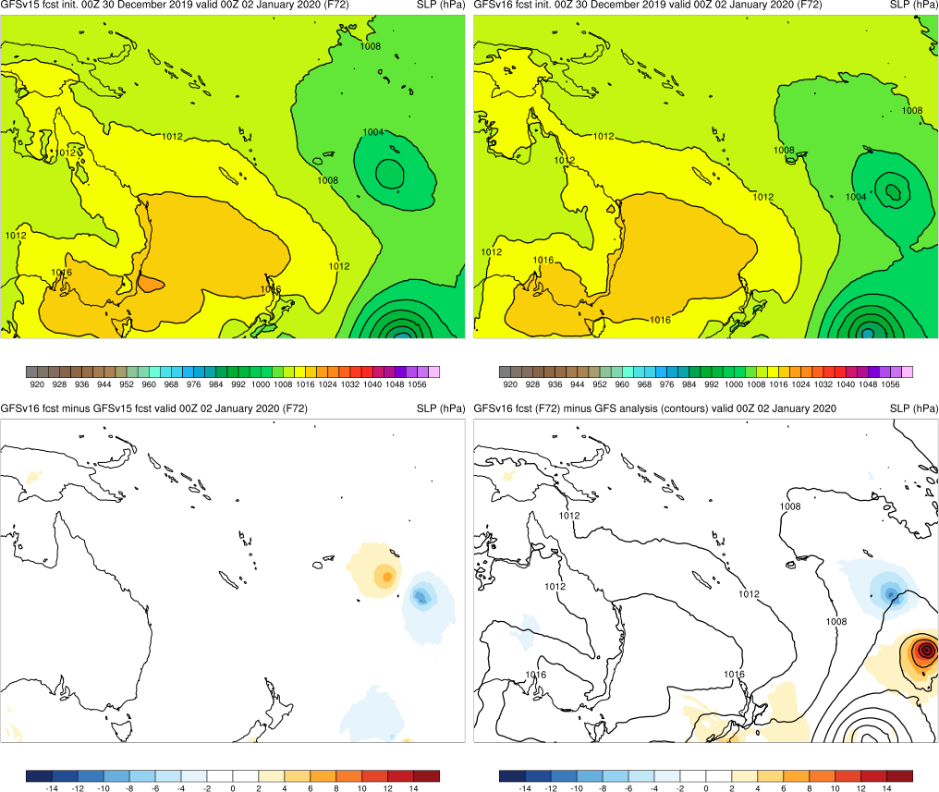
Sarai (2019)
Init.: 00Z 12/30/2019 (F72)
From 00Z 12/20 to 00Z 12/23, GFSv16 had a slow bias and GFSv15 had a better TC location
From 12Z 12/25 to 00Z 12/27, GFSv16 displayed a fast bias once Sarai passed Fiji
From 12Z 12/27 to 00Z 12/30, GFSv16 again displayed a slow bias compared to analysis (GFSv15 lagged even more)
GFSv15
GFSv16
v16−v15
GFS Anl.

Slide 43
NATIONAL OCEANIC AND ATMOSPHERIC ADMINISTRATION
GFSv16 TC Highlights: Summary
Overall, GFSv16 forecasted TC track and intensity better than GFSv15 for Michael, Dorian, Juliette, Lorena, Olga, and Vicky
GFSv16 often predicted TC threat earlier with a correctly stronger cyclone
For Lorena, GFSv16 had better southwest U.S. precip amounts than GFSv15
For Olga, a better sense of the synoptic environment led to better TC forecasts
Overall, GFSv15 forecasted TC track and intensity better than GFSv16 for Hurricanes Barbara, Kiko, and Lorenzo
For Barbara, GFSv16 had a slow, right-of-track bias
For Kiko, GFSv16 incorrectly forecasted a stronger TC in the medium range
Lorenzo’s early recurvature/fast track in GFSv16 led to very large track errors
For some cases such as Tropical Cyclone Sarai, GFSv16 did not provide consistently better or worse guidance than GFSv15
Consolidates NCEP/EMC verification and evaluation functions to efficiently and consistently support all modeling groups
Removes evaluation functions from the model science chain of command, ensuring independent model evaluations

