Slide 1
GFSv16 Wave
August 6, 2020
GFSv16-Wave Group: Jose-Henrique Alves, Deanna Spindler, Todd Spindler, Roberto Padilla, Jessica Meixner, Bhavani Rajan
National Weather Service

Slide 2
Outline
NCEP Operational Global Wave Model
GFSv16 Wave Component
Grid Redesign
Ocean Surface Current Forcing
Objective Physics/Source-Term Optimization
Extended Forecast Range: 180h to 384h
Product Changes and Removals
GFSv16 Wave Evaluation Plan
Parameters and statistics
Introduction to the validation websites
Request for field evaluators

Slide 3
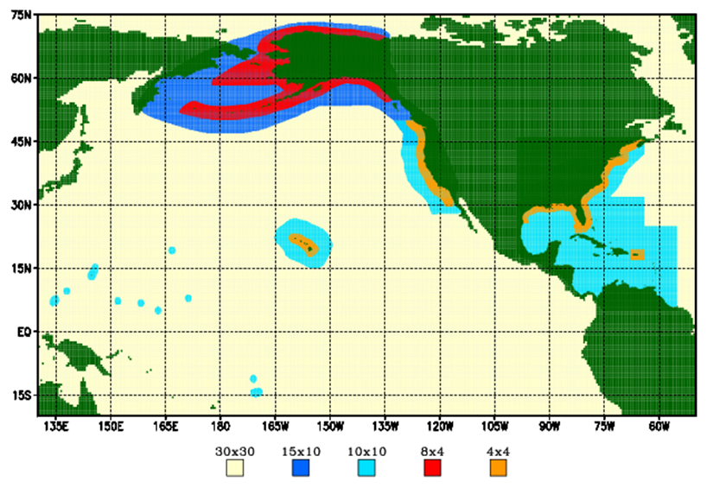
NCEP Operational Global Wave Model
Uses the WAVEWATCH III model
Global wave model with a mosaic of 9 two-way nested regular spherical grids
Driven by 10 m GFS winds:
3 hourly
4 cycles a day: 9 h hindcasts,
180 h (7.5 days) forecasts
No data assimilation
Website : http://polar.ncep.noaa.gov/waves

Slide 4
Grid Mosaic
NCEP Global Wave
GFSv16 Wave
Arctic Polar Stereographic
18 km resolution
50°N to 90°N
Global grid: 30 arc min
Regional grids: 10 arc min
ak_10m
wc_10m
at_10m
ep_10m
Coastal grids: 4 arc min
ak_4m
wc_4m
at_4m
Arctic Polar Stereographic
9 km resolution
50°N to 90°N
Global core
16 km (10 arcmin)
15°S to 52.5°N
Southern Ocean
25 km (15 arcmin)
10.5°S to 79.5°S

Slide 5
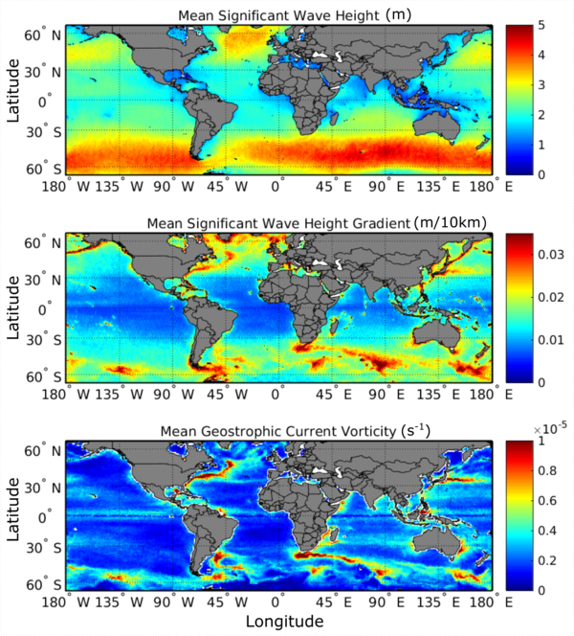
Global Real Time Ocean Forecast System (RTOFS) surface current forcing
Waves travelling against current
Steeper
Model is forced by the wind speed relative to the currents
resulting force is stronger when the wind is opposing the current

Slide 6
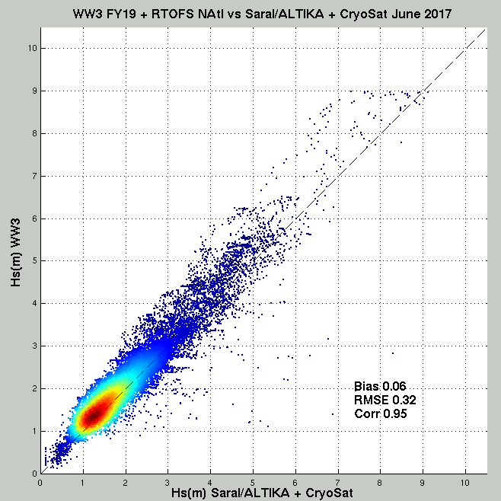
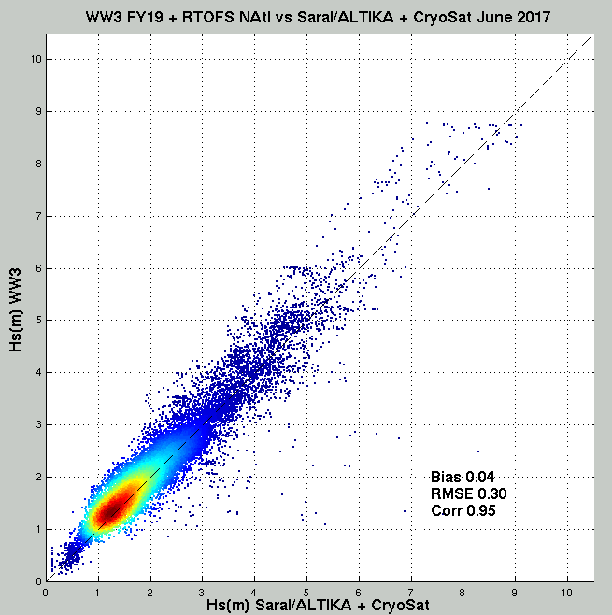
RTOFS Currents and North Atlantic Hs
Wave model vs Altimeter sig. wave heights over June 2017, within North Atlantic
No currents
Surface currents included
Bias 0.06
RMSE 0.32
Corr 0.95
Bias 0.04
RMSE 0.30
Corr 0.95
Left: no currents; Right: RTOFS surface current effects included.
RMS error and Bias reduced.

Slide 7
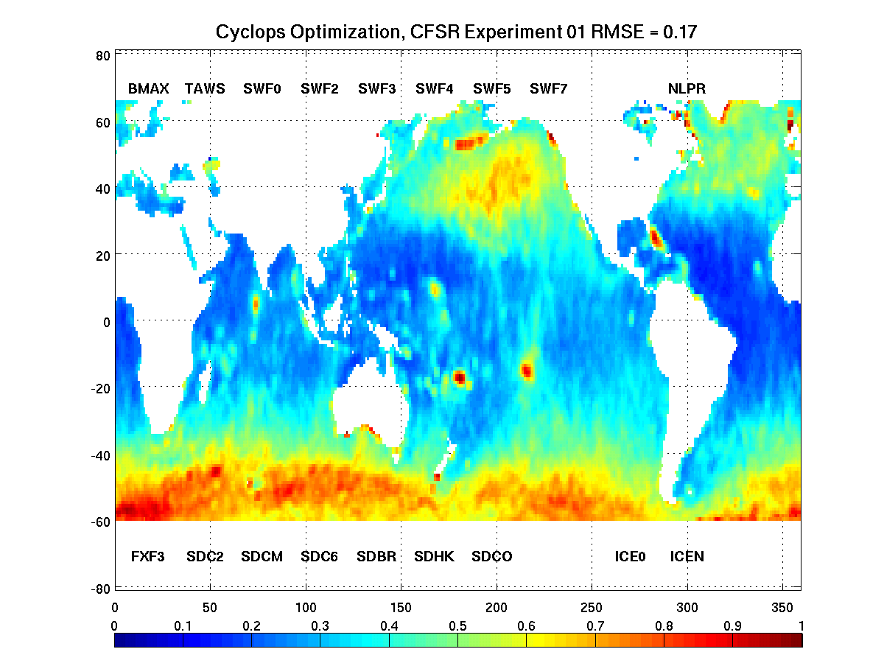
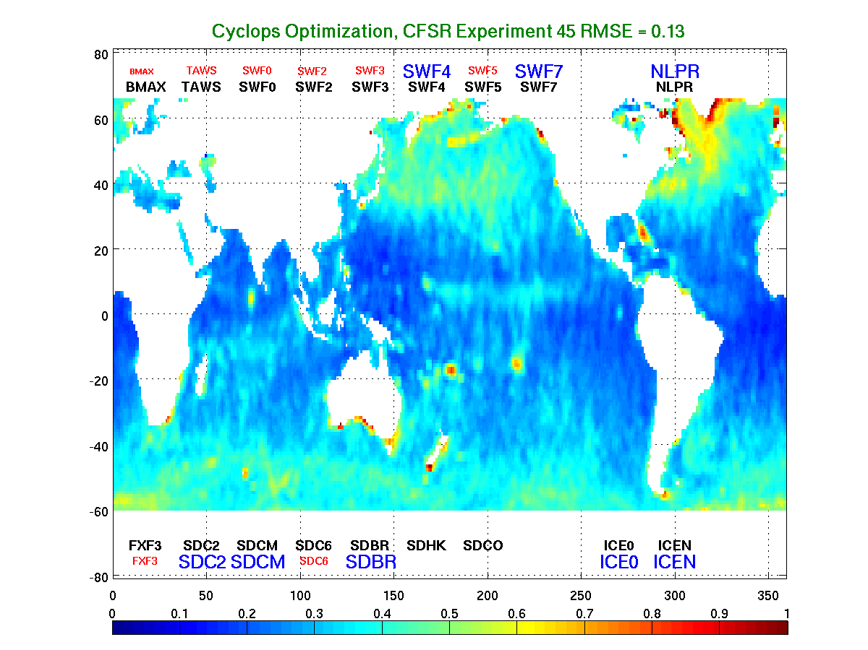
Optimization: Improved Wave-Height Skill
Model vs Altimeter Hs,
Operational model (top),
Optimized model (bottom),
Global RMSE reduced
0.17m → 0.13m
High-latitude RMSE:
~1m → < 0.5m,
Global bias reduction
0.2m → 0.04m,
High-latitude bias: reduced
0.8m → 0.3m.

Slide 8
Product Changes
(affects WCOSS, NOMADS, ftp and NOAAPORT)
Full PNS: https://www.weather.gov/media/notification/pdf2/pns20-33multi_1_removal.pdf
New computational grid grib2 files
Northern hemisphere 0p16 (10 arcmin)
Replaces global 30 arc min and all regional grids
Southern Hemisphere 0p25 (15 arcmin)
Replaces global 30 arcmin
Arctic polar-stereographic 9km
Replaces Arctic 18km
New global extended 0p25 (15 arcmin)
Replaces global extended 30 arcmin

Slide 9
Products Removed
(affects WCOSS, NOMADS, ftp and NOAAPORT)
Full PNS: https://www.weather.gov/media/notification/pdf2/pns20-33multi_1_removal.pdf
All products from legacy grids
awk, enp, wna, nww3, wam
Wave steepness files (wstp)
All 4-arcmin gridded data will be removed
ak_4m, at_4m, wc_4m
Alaska ak_10m data
Replaced by a full Arctic 9km dataset
Binary forcing files (icean_5m, gfs_30m) will be removed
CSV bulletins (csbull) will be removed
Regular and compressed bulletins remain
Notes:
Wave steepness files will be removed because this parameter can be reconstructed directly from wave heights and periods available in grib2 data.
Binary forcing files will be removed as these will be deprecated by virtue of wave model inputs being provided without files via coupled system.

Slide 10
Output Grib2 files
Currently from NCEP Global Wave:
glo_30mext, glo_30m, at_10, wc_10, ak_10m, ep_10m, at_4m, wc_4m, ak_4m
New in GFSv16 Wave:
Native: global.0p16, arctic.9km, gsouth.0p25
Post-processed: global.0p25, atlocn.0p16, wcoast.0p16, epacif.0p16

Slide 11
GFSv16 Wave Evaluation Plan
GFSv16 Wave Data:
Retro1: 20190608 - 20190831
Missing: 20190901-20190909
Retro2: 20190910 - 20191130
Missing: 20191201 - 20200131
Retro3: 20200201 - 20200519
Realtime: 20200519 forwards
NOTE: GFS-Wave missing first week of Sep 2019
(Hurr. Dorian) due to stopping the model run on May 22nd (lack of CDO), and all of Dec 2019 and Jan 2020 due to difficulty getting the wave model to run on Hera.

Slide 12
GFSv16 Wave Evaluation Plan
GFSv16 Wave Data:
Retro1: 20190608 - 20190831
Missing: 20190901-20190909
Retro2: 20190910 - 20191130
Missing: 20191201 - 20200131
Retro3: 20200201 - 20200519
Realtime: 20200519 forwards
Significant wave height (Hs), Peak wave period (Tp), Surface wind speed (u10) and direction (udir)
Time-series of the measured data versus the models, as well as Bias, RMSE, SI, Correlation, 95% quantile
Websites with validation graphics for the GFSv16-Wave versus the NCEP operational global wave model are provided:
For buoys: https://polar.ncep.noaa.gov/waves/validation/gfsv16/buoys
For altimeters: https://polar.ncep.noaa.gov/waves/validation/gfsv16/satellite

Slide 13
GFSv16 Wave Evaluation Plan
GFSv16 Wave Data:
Retro1: 20190608 - 20190831
Missing: 20190901-20190909
Retro2: 20190910 - 20191130
Missing: 20191201 - 20200131
Retro3: 20200201 - 20200519
Realtime: 20200519 forwards
Significant wave height (Hs), Peak wave period (Tp), Surface wind speed (u10) and direction (udir)
Time-series of the measured data versus the models, as well as Bias, RMSE, SI, Correlation, 95% quantile
MEG presentation
to brief the waves customers and field evaluators
Websites with validation graphics for the GFSv16-Wave versus the NCEP operational global wave model are provided:
For buoys: https://polar.ncep.noaa.gov/waves/validation/gfsv16/buoys
For altimeters: https://polar.ncep.noaa.gov/waves/validation/gfsv16/satellite
A Google Form document will be shared with the field evaluators, with requests that it be completed no later than September 28, 2020.
Contact: Deanna.Spindler@noaa.gov

Slide 14
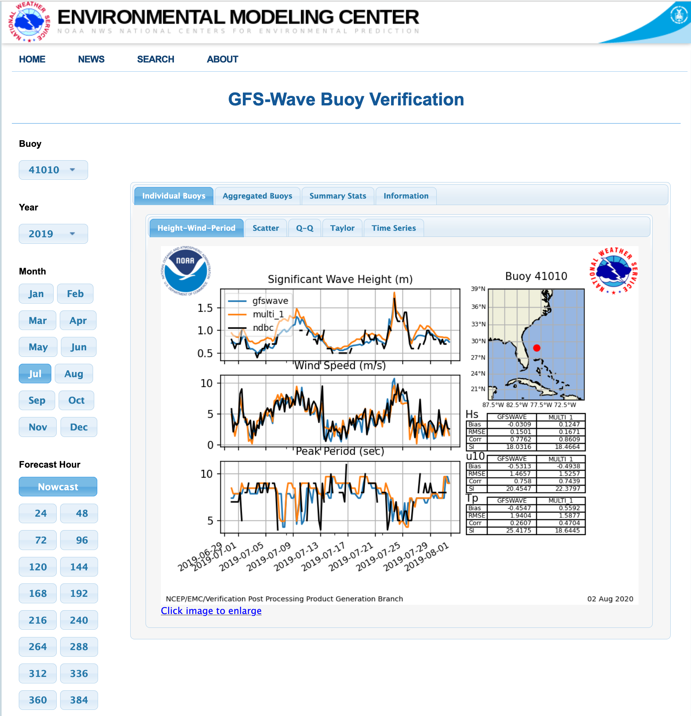
Information
GFSWave: blue line
Multi_1: orange line
NDBC: black line
Buoy
Individual Buoys
Additional plots
Year
Sig. Wave Height (Hs)
10m Wind Speed (u10)
Peak Period (Tp)
Month
Location Map
Bias, RMSE,Corr, SI for each model and variable:
Hs, u10, Tp
Fcst Hr
Monthly statistics
Click image to enlarge

Slide 15
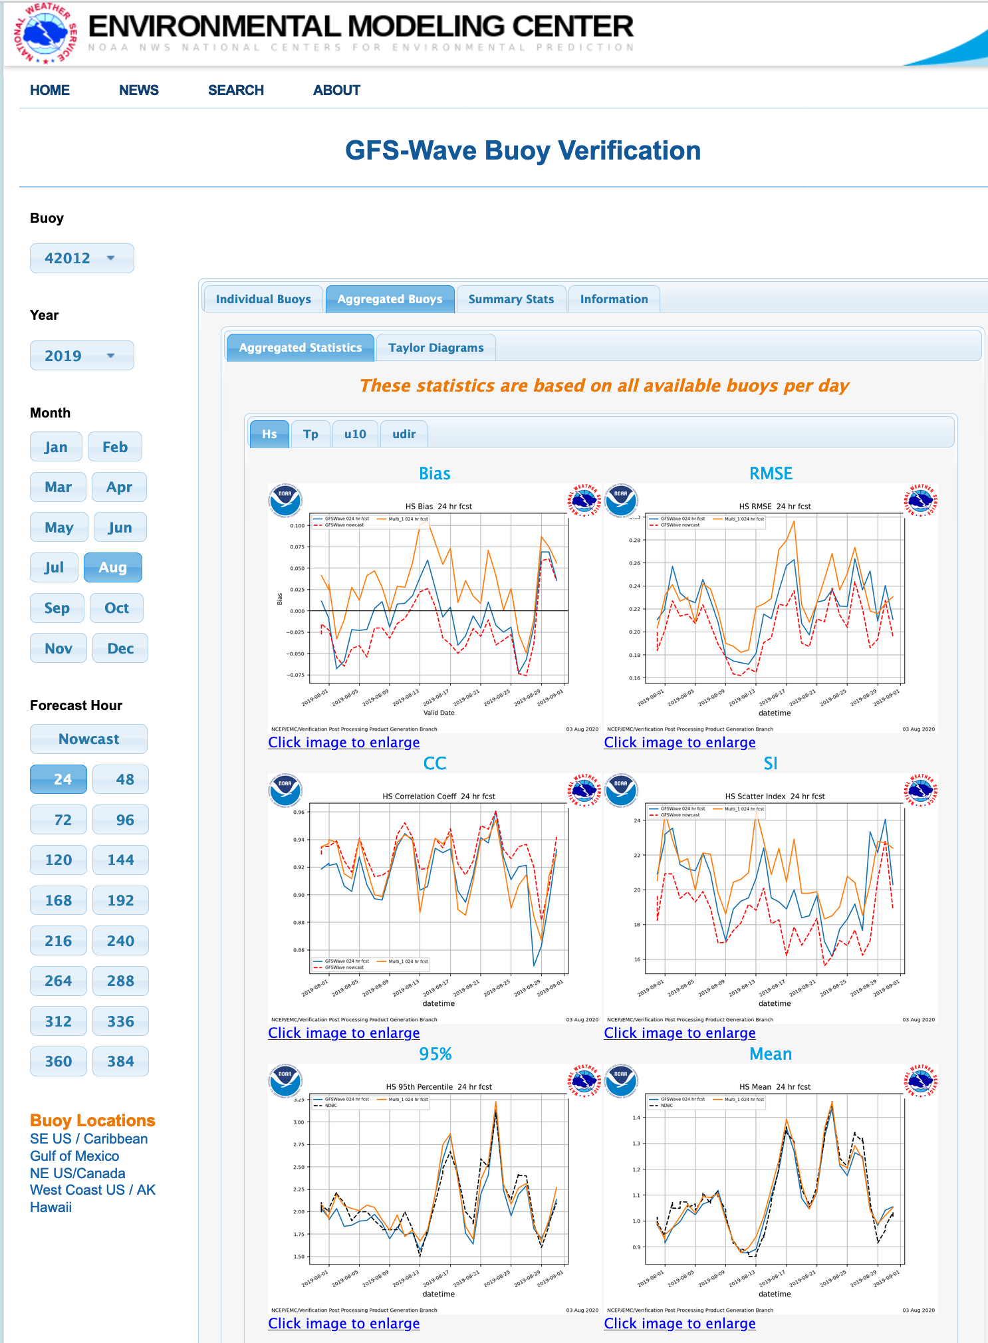
GFSWave: blue line
Multi_1: orange line
Buoy
Aggregated Buoys
Hs: Sig. Wave Height
Tp: Peak Period
u10: 10m Wind Speed
udir: Wind Direction
Year
Month
Calculated daily:
Bias, RMSE
CC (correlation coef.)
SI (scatter index)
95%, Mean
Fcst Hr
Per day of month
Click image to enlarge

Slide 16
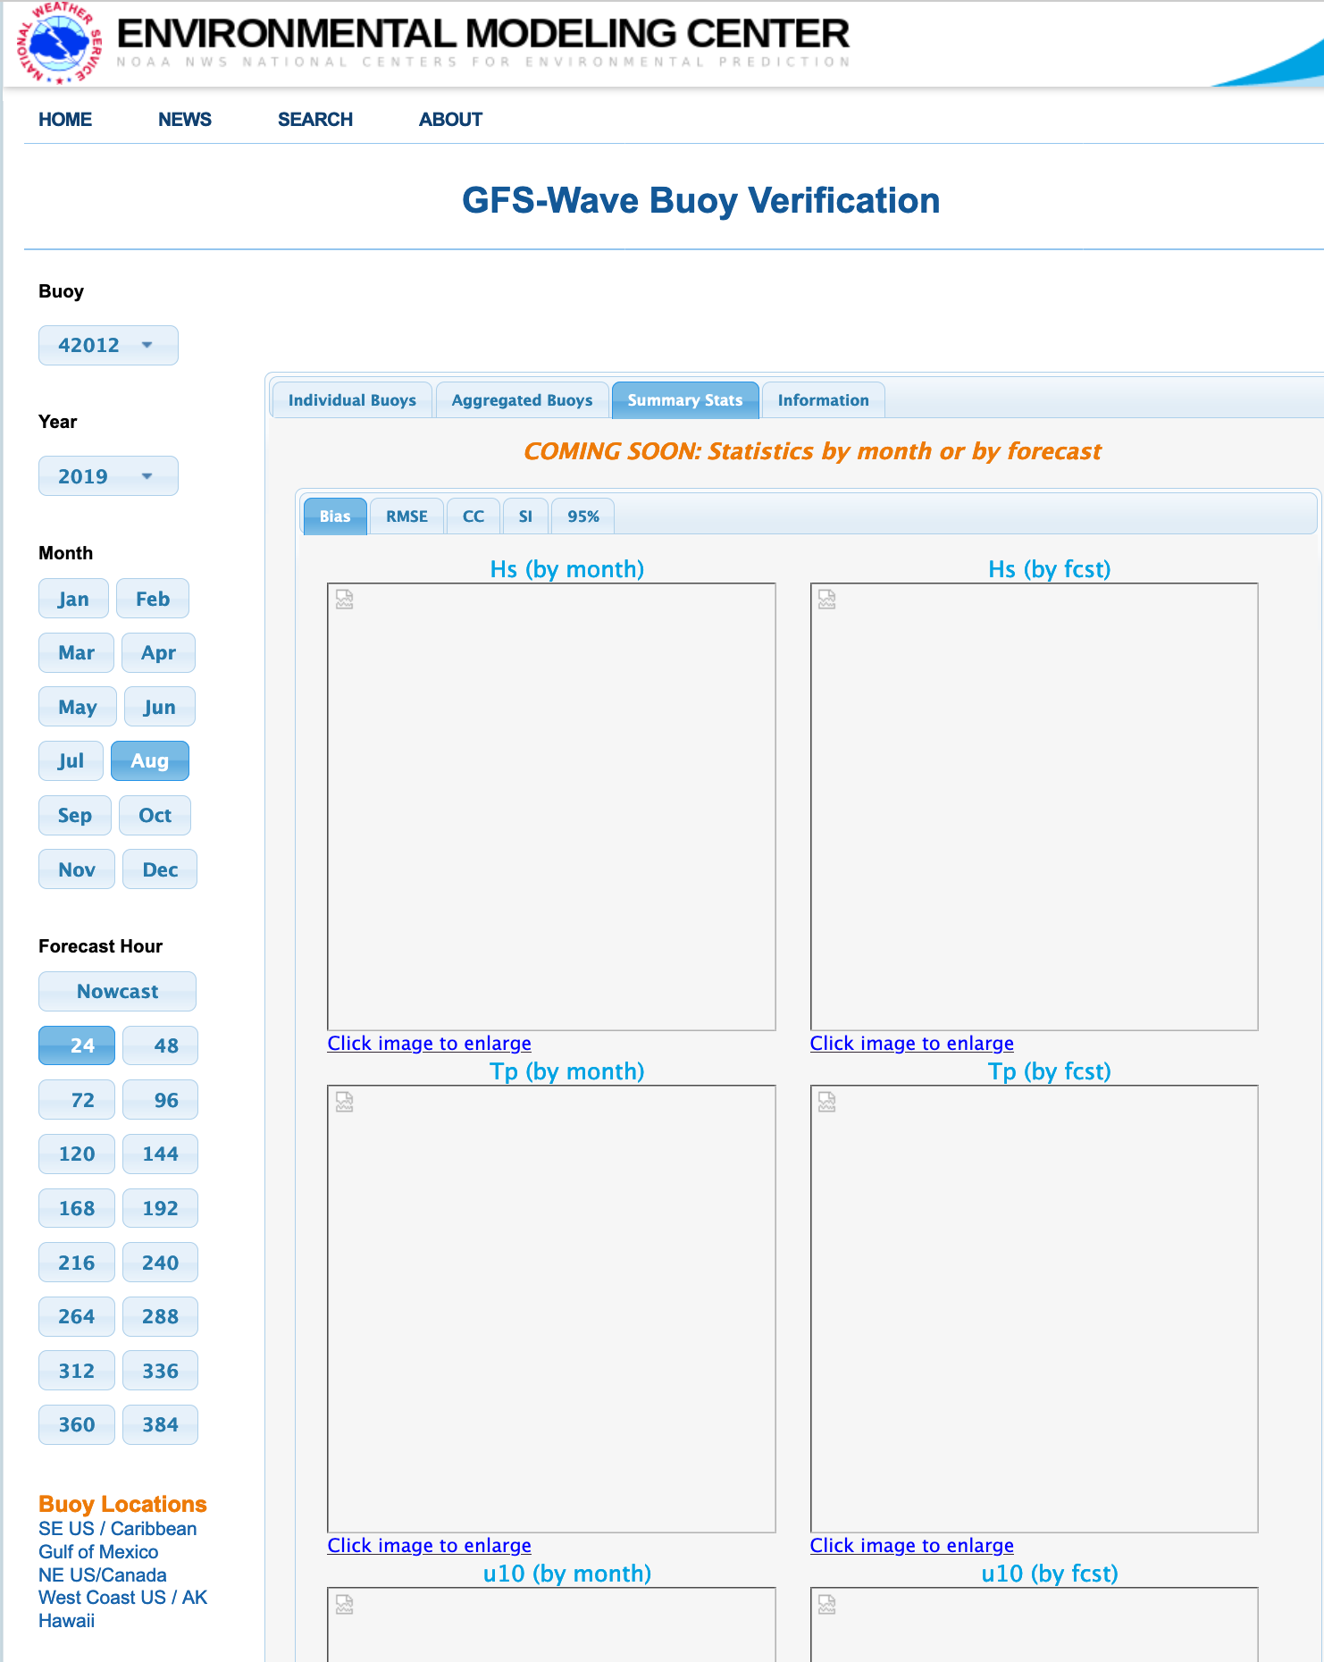
Selectors don’t work here
Summary Statistics: all buoys, all times
COMING SOON:
when the retro’s are done
Bias, RMSE, CC, SI, 95%
Hs, Tp, u10, udir
By month
By fcst hr
Scroll down to see all

Slide 17
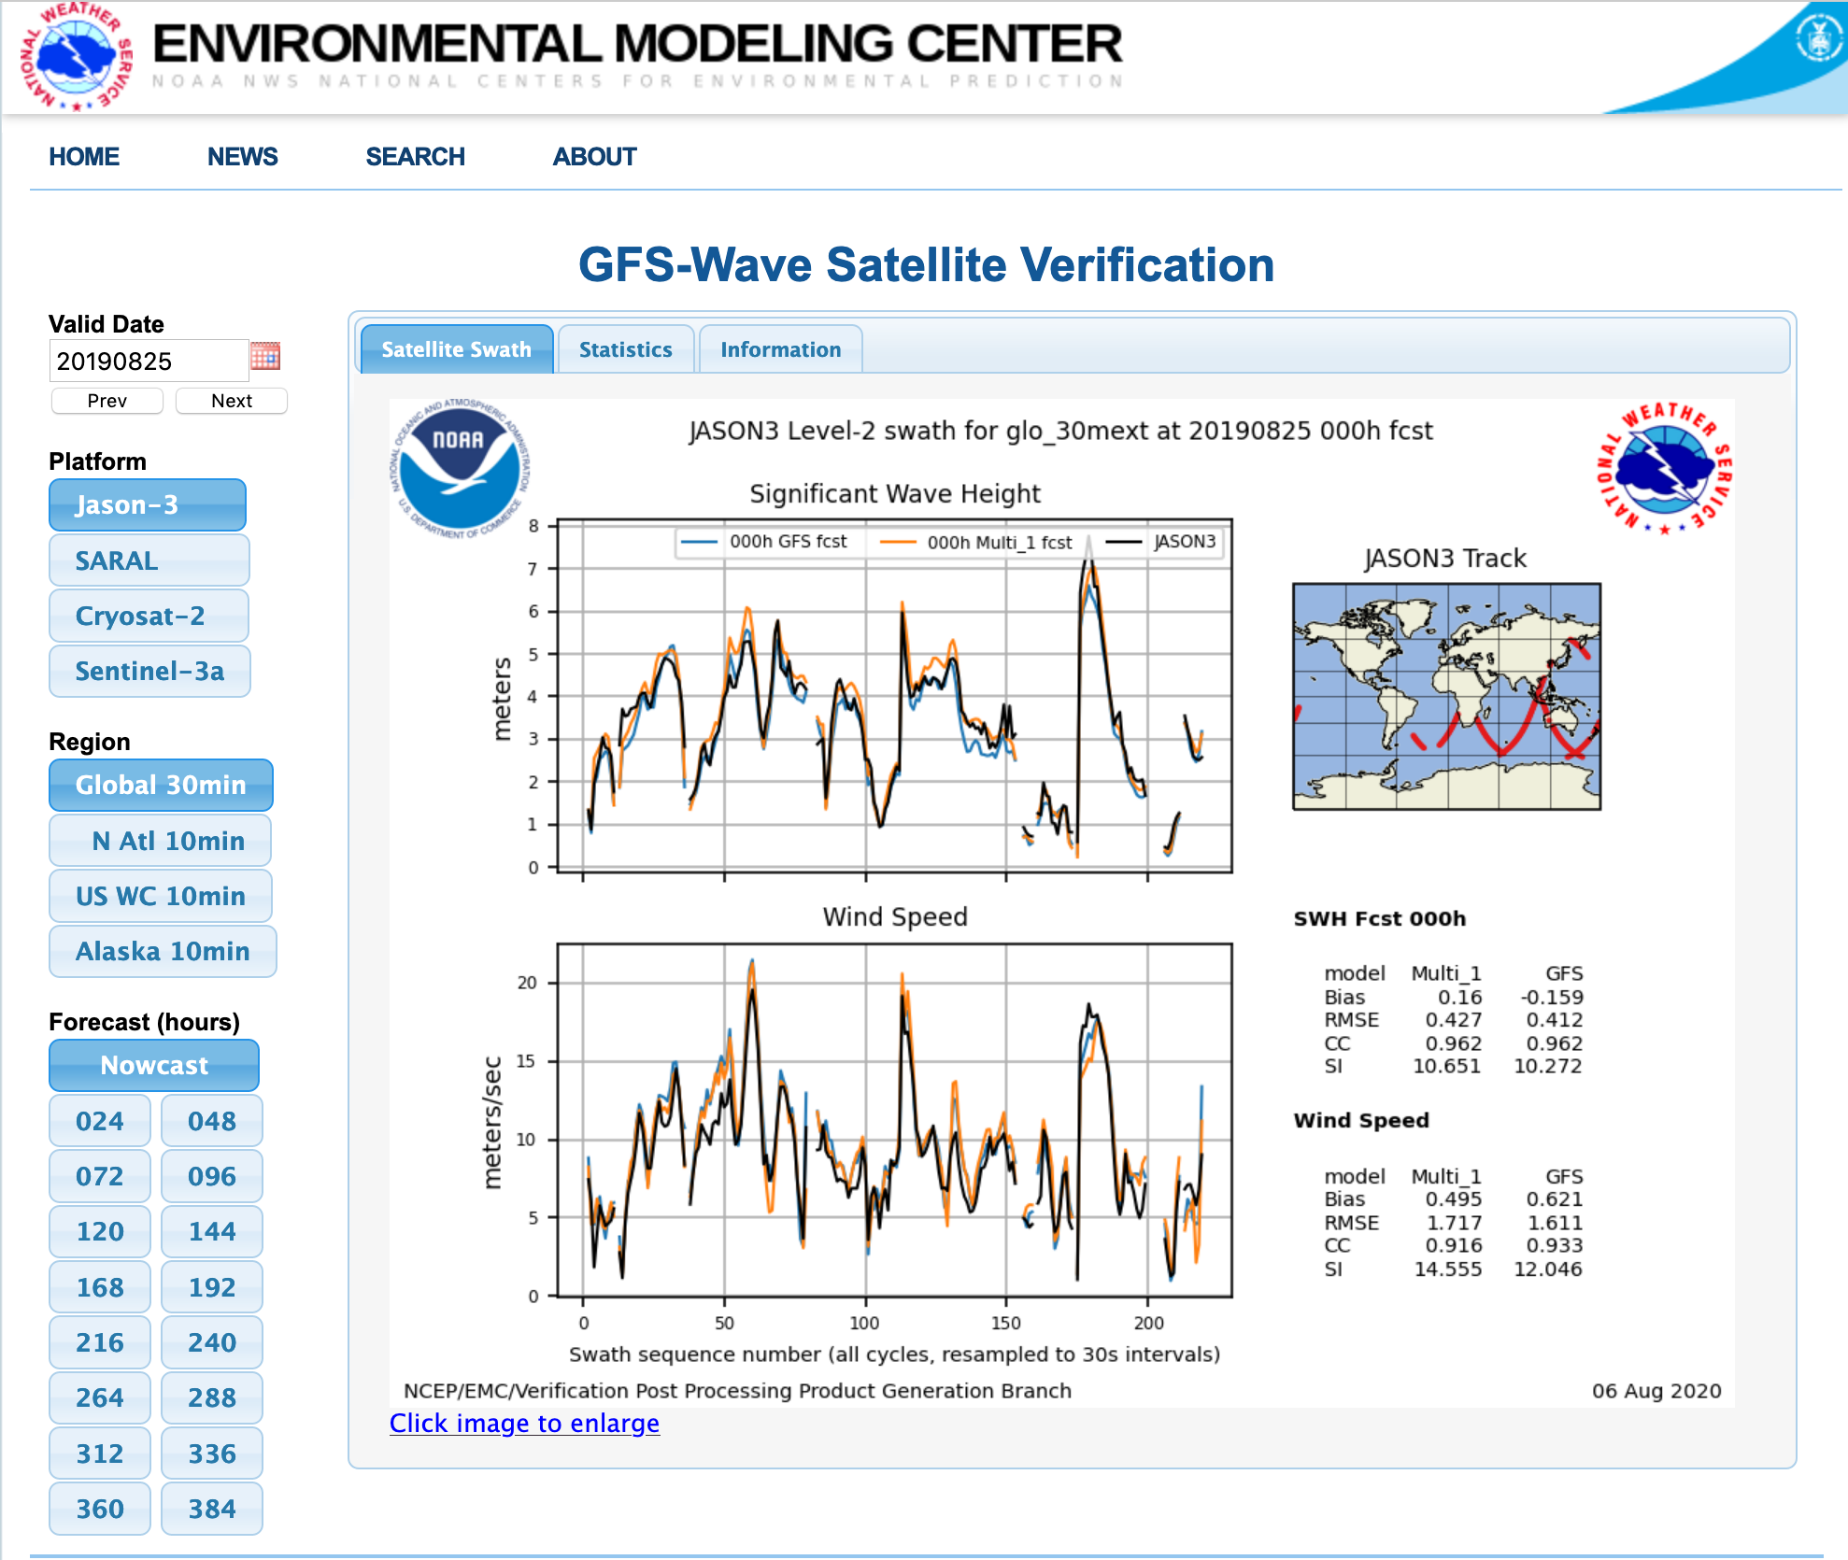
Information
Regions!
GFSWave: blue line
Multi_1: orange line
Altimeter: black line
Along-track match-ups
Bias, RMSE, CC, SI
per model, for
Sig. Wave Height (SWH) and Wind Speed
now familiar click image to enlarge

Slide 18
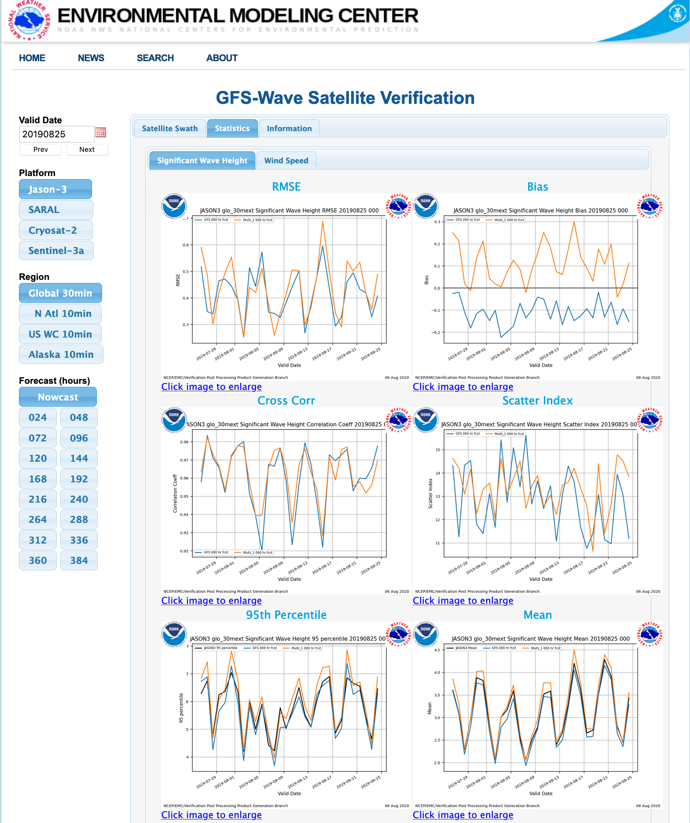
Statistics
Sig. Wave Height, Wind Speed
Valid Date
RMSE
Bias
Cross Corr
Scatter Index
95%
Mean
Calculated
daily, plotted with a 30-day lookback
By Platform, Region and
Forecast Hour
GFSWave: blue line
Multi_1: orange line

Slide 19
We’re looking for field evaluators who are willing to fill out an 8-question form. If interested, please contact Deanna.Spindler@noaa.gov
Thank you!
Any questions?

