Slide 1
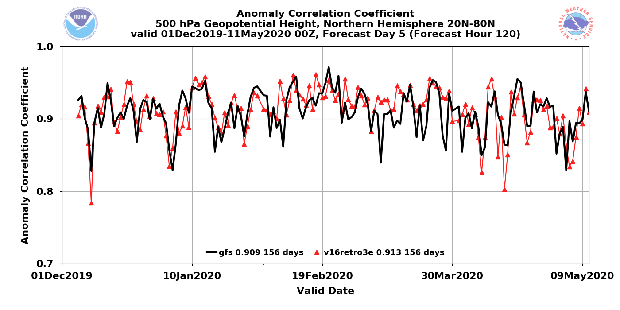
NATIONAL OCEANIC AND ATMOSPHERIC ADMINISTRATION
Overview of GFSv16 Verification Statistics
Chris MacIntosh and Alicia Bentley EMC Model Evaluation Group Webinar – 6 August 2020
Special thanks to Mallory Row for generating these MET/METplus graphics

Slide 2
NATIONAL OCEANIC AND ATMOSPHERIC ADMINISTRATION
Quick Facts about GFSv16
Model resolution:
Increased vertical resolution from 64 to 127 layers and model top raised from 54 km to 80 km
Physics updates:
PBL/turbulence: K-EDMF => sa-TKE-EDMF
Orographic Gravity Wave Drag: => Orographic + non-orographic GWDs
Radiation: Updates to cloud-overlap assumptions
Microphysics: Improvements to GFDL MP
Coupling to Wave
One-way coupling of atmospheric model with Global Wave Model (GWM)
Major Data Assimilation Upgrades:
Local Ensemble Kalman Filter (LETKF)
4-Dimensional Incremental Analysis Update (4DIAU)
Height increments are added, and specific humidity increments are reduced in the stratosphere and mesosphere
Improved Near Surface Sea Temperature (NSST) analysis
Land Data Assimilation (GLDAS) for spinning up soil moisture

Slide 3
NATIONAL OCEANIC AND ATMOSPHERIC ADMINISTRATION
GFSv16 Verification Statistics
GFSv16 verification statistics are generated for a variety of streams, which are being run in parallel across multiple supercomputers
GFSv16 Retrospective Stream 0 (5/5/19–5/31/19) [Click here]
GFSv16 Retrospective Stream 1 (6/1/19–8/31/19) [Click here]
GFSv16 Retrospective Stream 2 (9/1/19–11/30/19) [Click here]
GFSv16 Retrospective Stream 3 (12/1/19–5/18/20) [Click here]
GFSv16 Retrospective Stream 4 (combined with Stream 3)
GFSv16 Retrospective Stream 5 (8/31/18–10/12/18) [Click here]
GFSv16 Real-time Stream (5/19/19–present) [Click here]

Slide 4
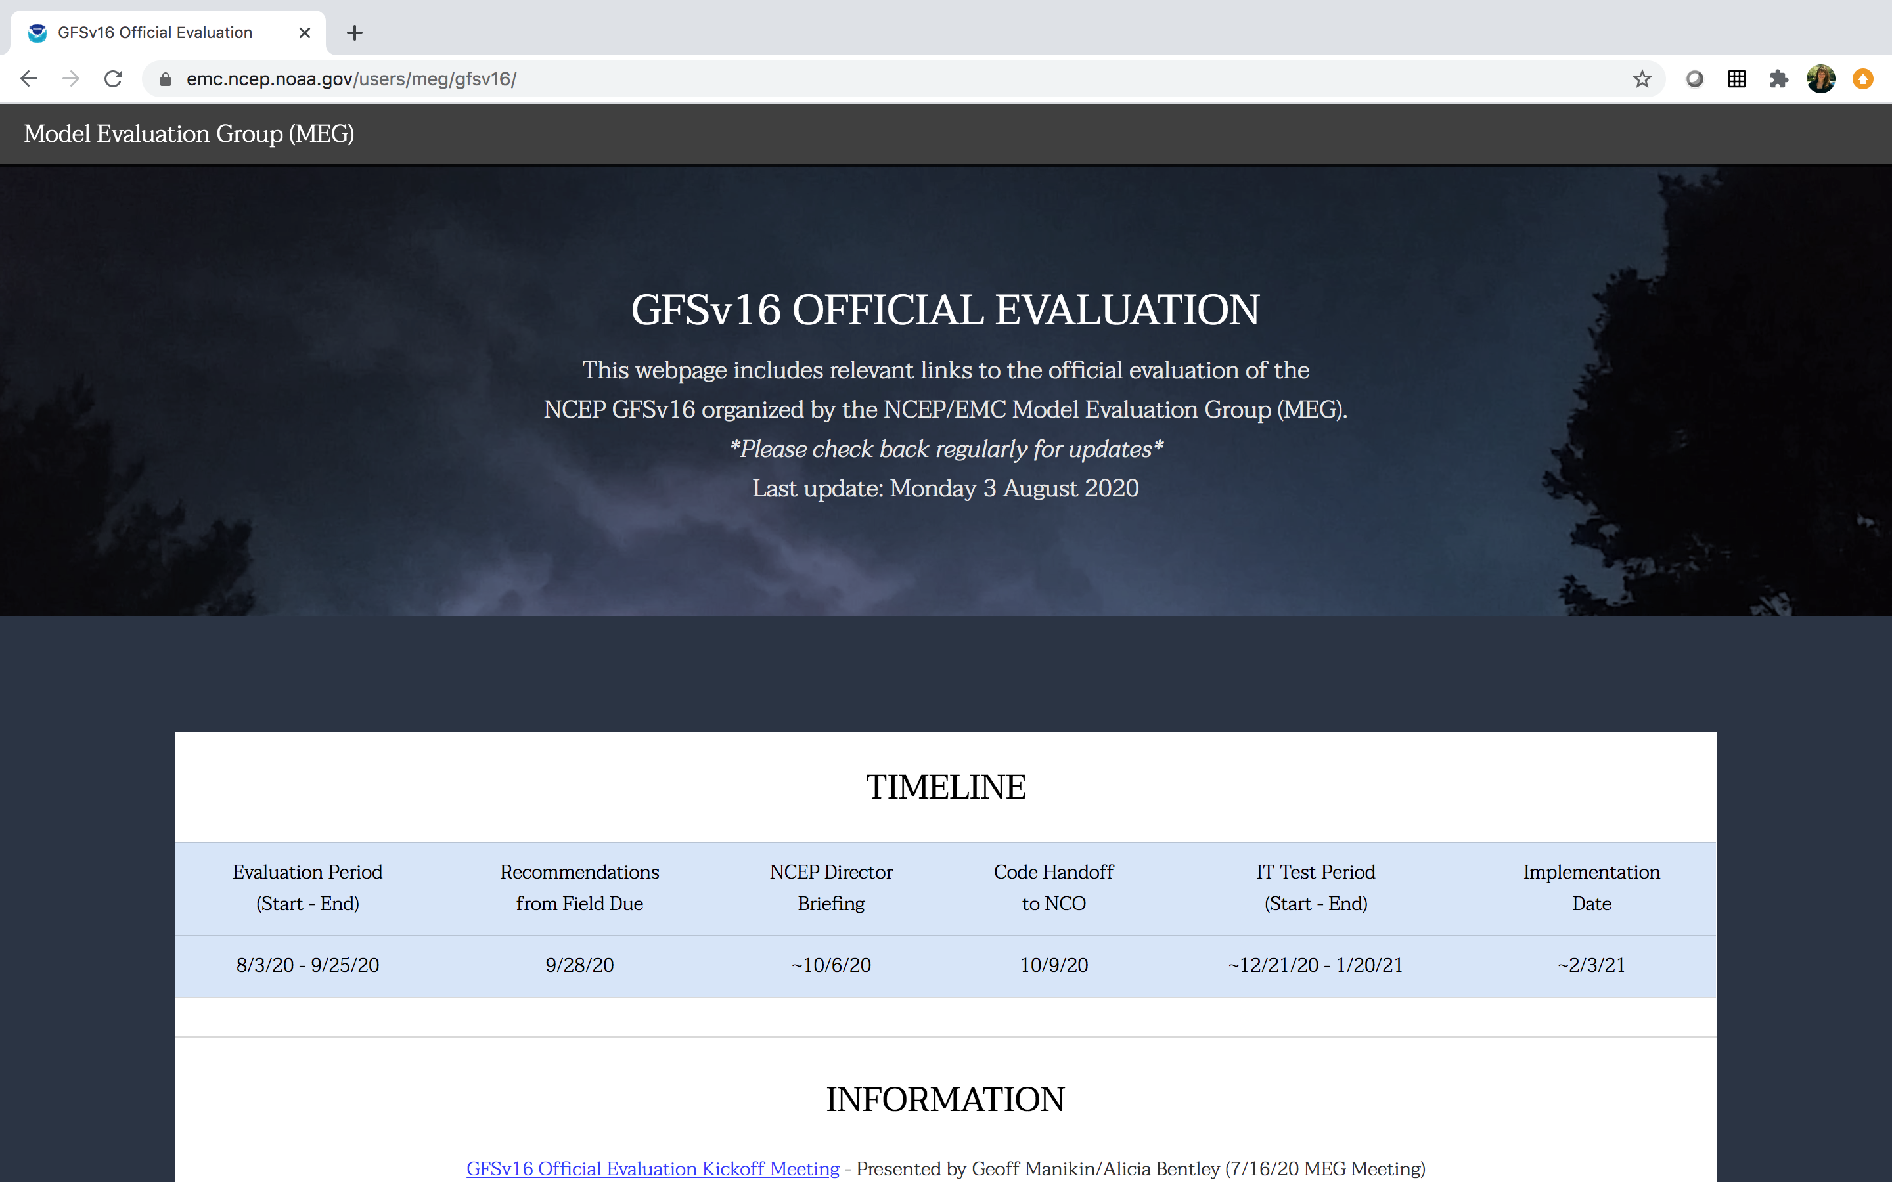
NATIONAL OCEANIC AND ATMOSPHERIC ADMINISTRATION
https://www.emc.ncep.noaa.gov/users/meg/gfsv16/

Slide 5
NATIONAL OCEANIC AND ATMOSPHERIC ADMINISTRATION
https://www.emc.ncep.noaa.gov/users/meg/gfsv16/

Slide 6
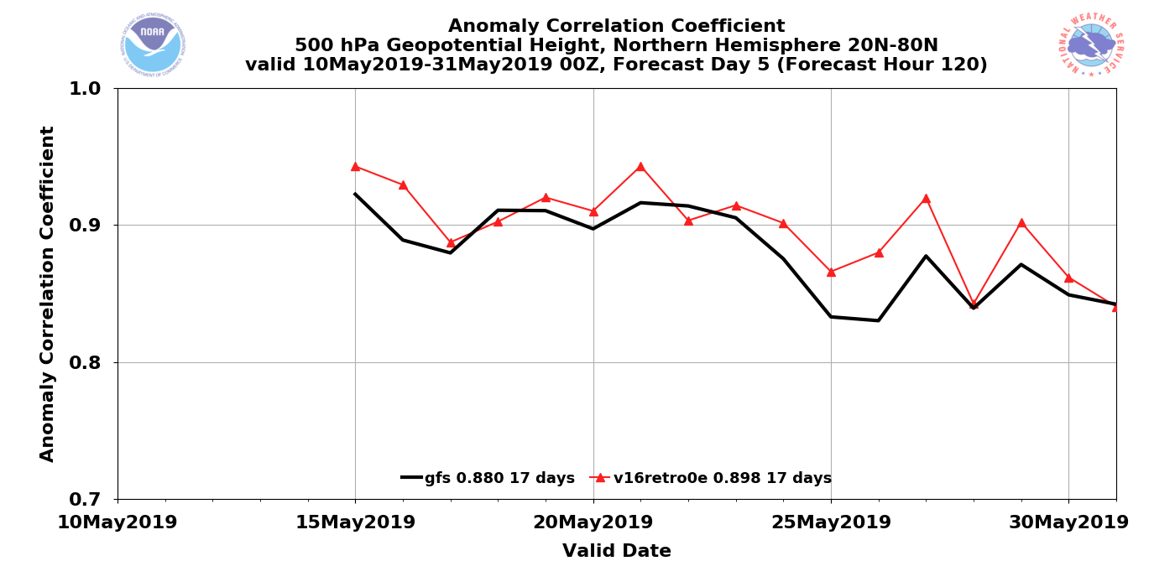
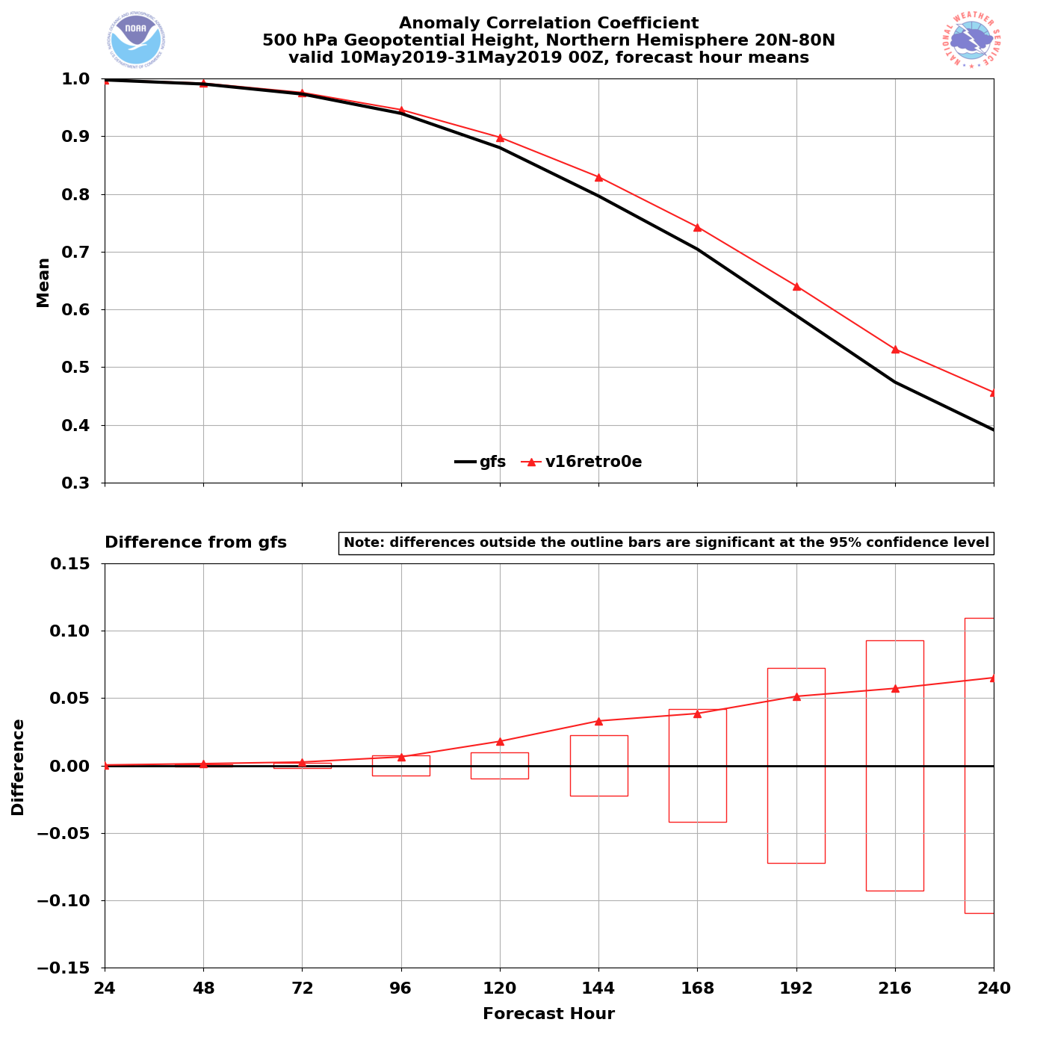
NATIONAL OCEANIC AND ATMOSPHERIC ADMINISTRATION
GFSv16 AC Scores (NH 500-hPa Z) [Stream 0]
Valid: 5/15/19–5/31/19 (Day 5)
GFSv15 = .880 GFSv16 = .898
GFSv16 had higher AC scores than GFSv15 at all forecast lead times (Days 0–10)
GFSv16 had statistically significantly higher AC scores at Days 5–6

Slide 7
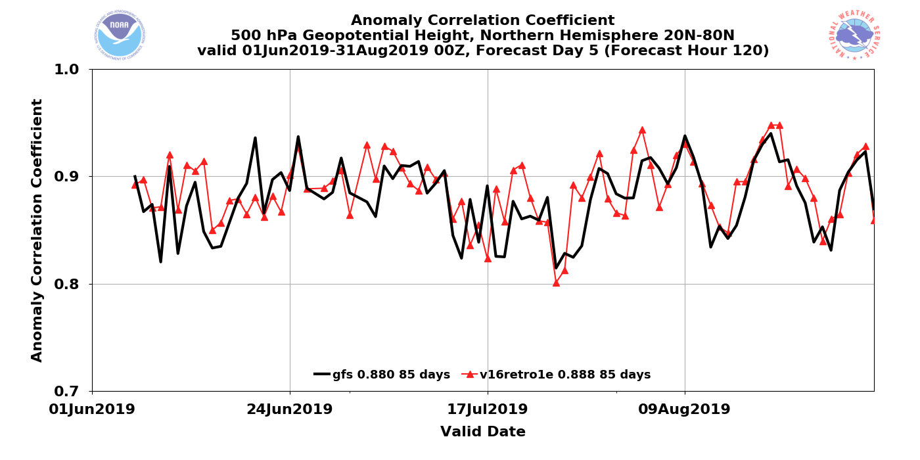
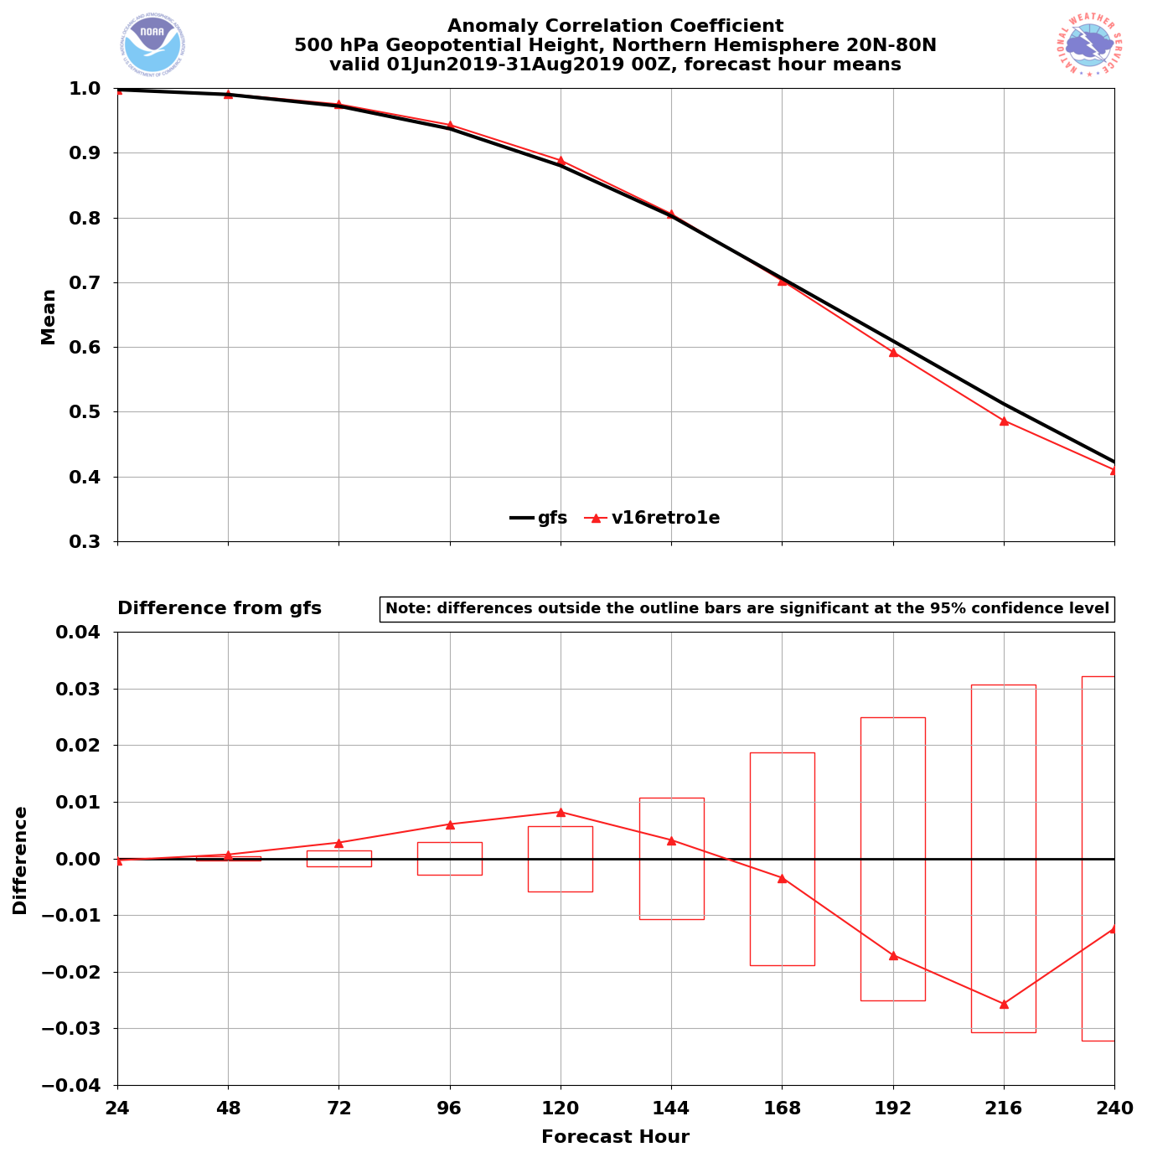
NATIONAL OCEANIC AND ATMOSPHERIC ADMINISTRATION
GFSv16 AC Scores (NH 500-hPa Z) [Stream 1]
Valid: 6/5/19–8/31/19 (Day 5)
GFSv15 = .880 GFSv16 = .888
GFSv16 had higher AC scores than GFSv15 at Days 0–6 and lower AC scores at Days 7–10
GFSv16 had statistically significantly higher AC scores at Days 3–5

Slide 8
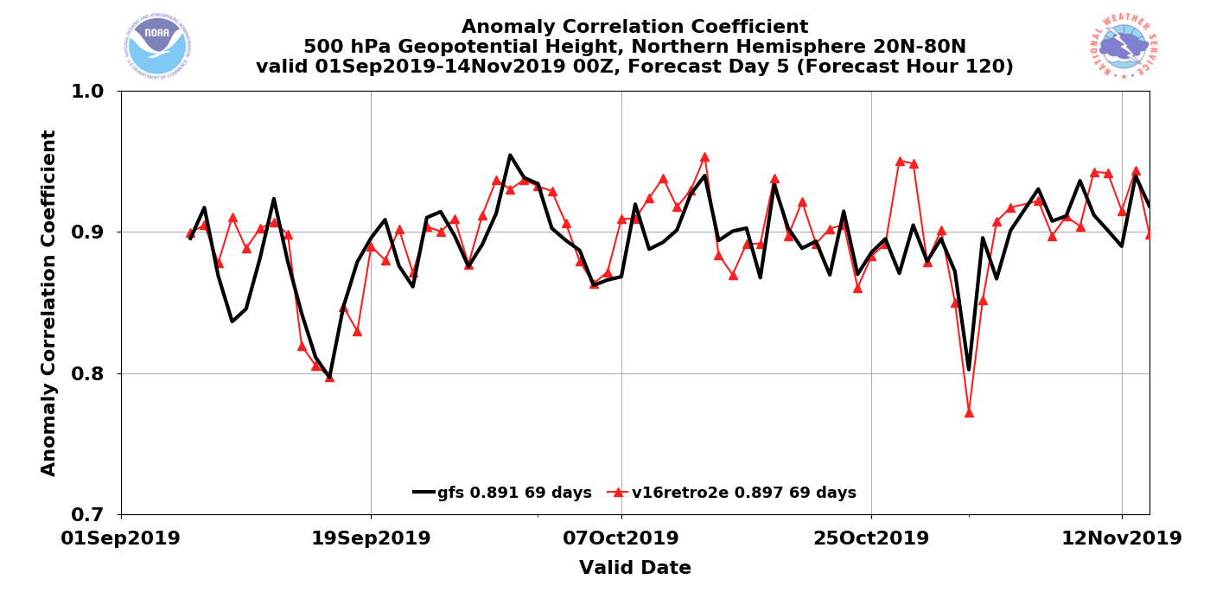
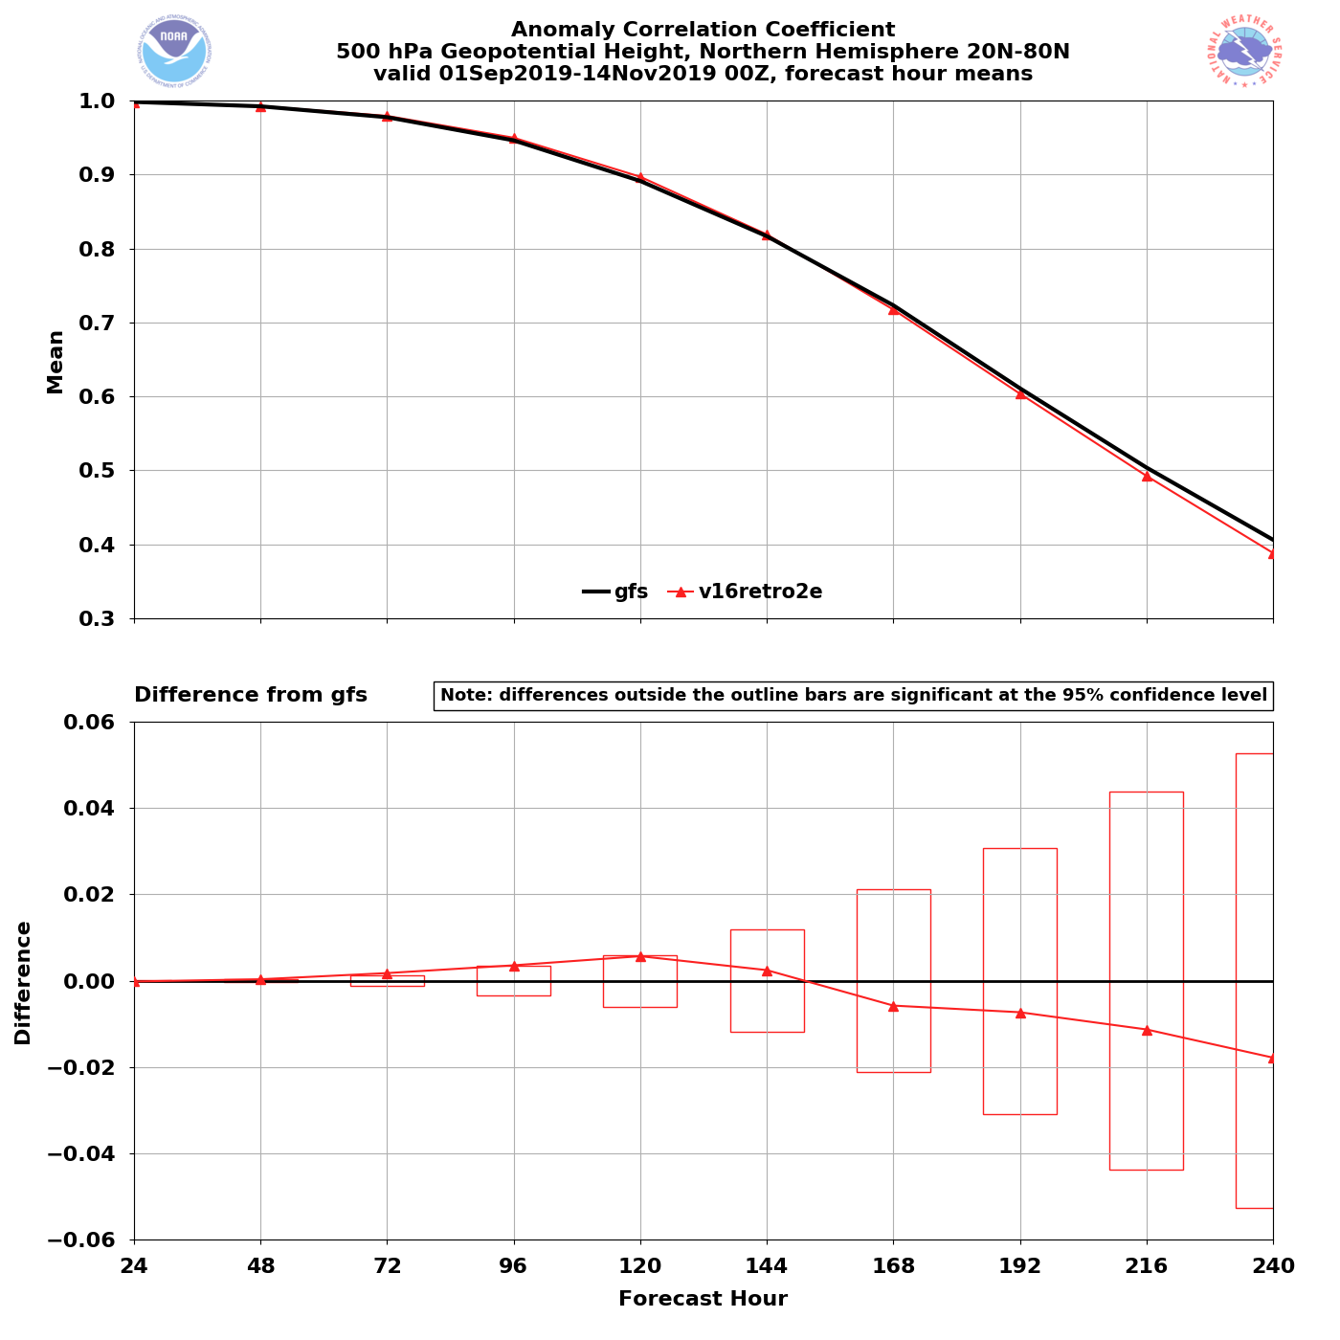
NATIONAL OCEANIC AND ATMOSPHERIC ADMINISTRATION
GFSv16 AC Scores (NH 500-hPa Z) [Stream 2]
Valid: 9/5/19–11/14/19 (Day 5)
GFSv15 = .891 GFSv16 = .897
GFSv16 had higher AC scores than GFSv15 at Days 0–6 and slightly lower AC scores at Days 7–10
GFSv16 did not have statistically significantly different AC scores

Slide 9
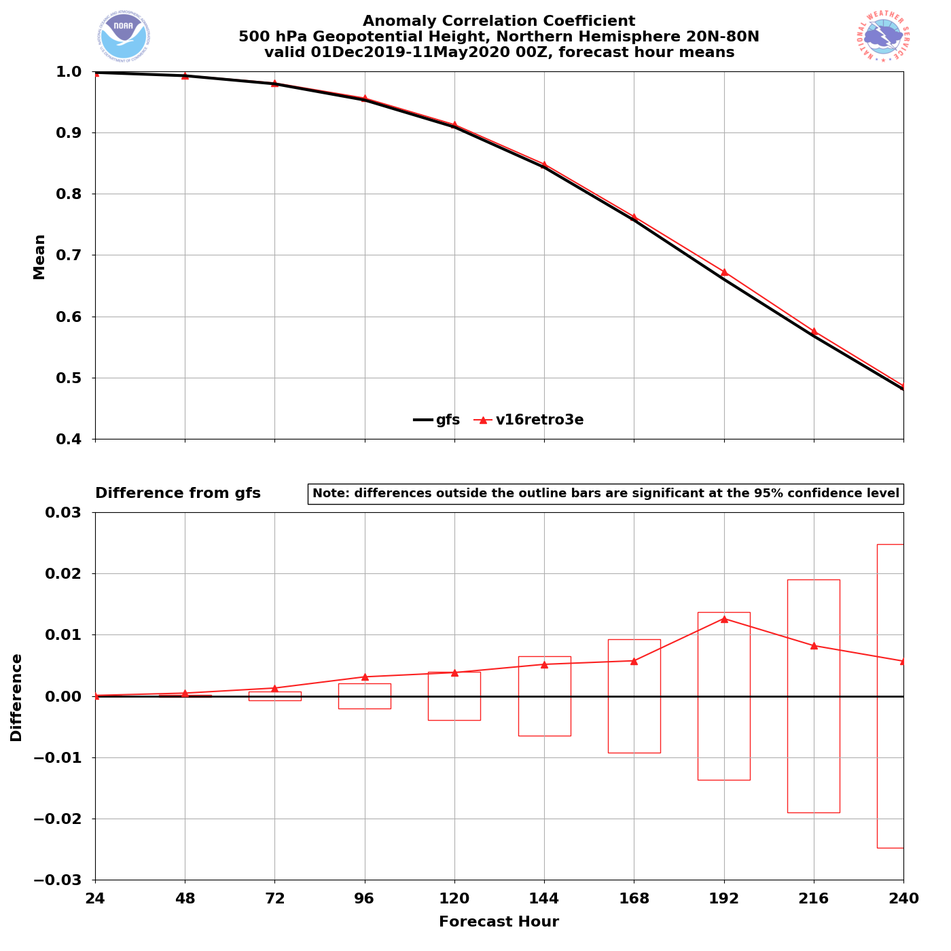
NATIONAL OCEANIC AND ATMOSPHERIC ADMINISTRATION
GFSv16 AC Scores (NH 500-hPa Z) [Stream 3]
Valid: 12/5/19–5/11/20 (Day 5)
GFSv15 = .909 GFSv16 = .913
GFSv16 had higher AC scores than GFSv15 at all forecast lead times (Days 0–10)
GFSv16 had statistically significantly higher AC scores at Days 3–4

Slide 10
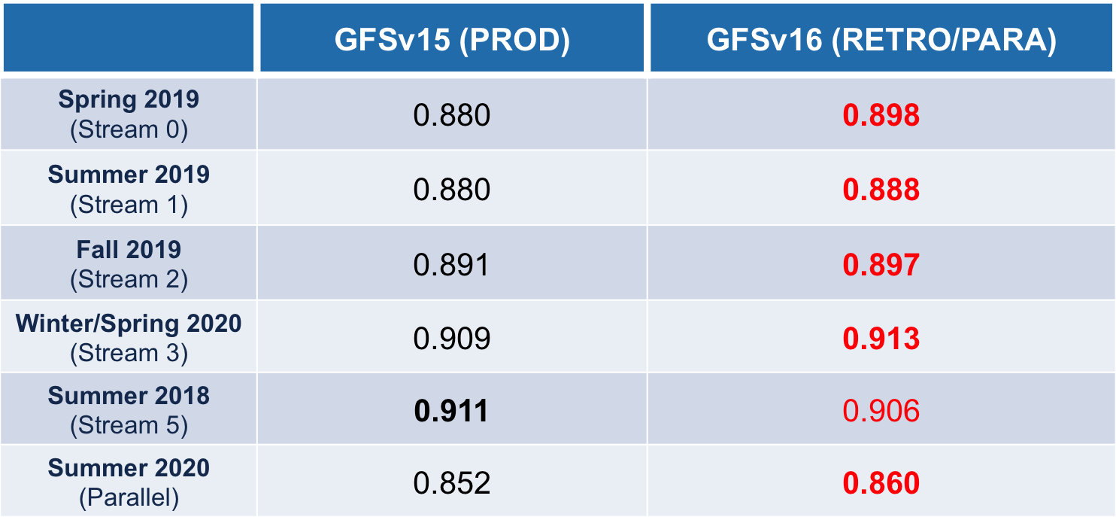
NATIONAL OCEANIC AND ATMOSPHERIC ADMINISTRATION
GFSv16 AC Scores (NH 500-hPa Z at Day 5)

Slide 11
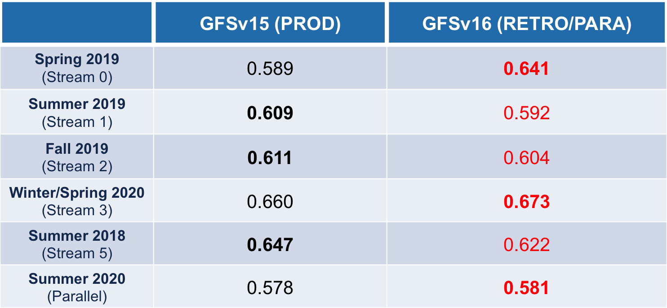
NATIONAL OCEANIC AND ATMOSPHERIC ADMINISTRATION
GFSv16 AC Scores (NH 500-hPa Z at Day 8)

Slide 12
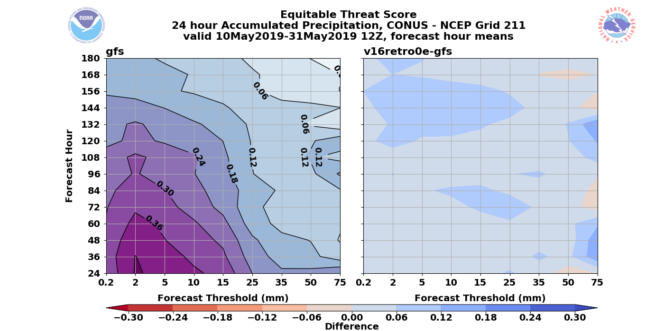
NATIONAL OCEANIC AND ATMOSPHERIC ADMINISTRATION
GFSv16 QPF Equitable Threat Scores & Bias
ETS
GFSv15
Spring 2019 – 24-h QPF
GFSv16 has improved ETS values at all thresholds
v16−v15
Blue =
Better
Orange = Worse

Slide 13
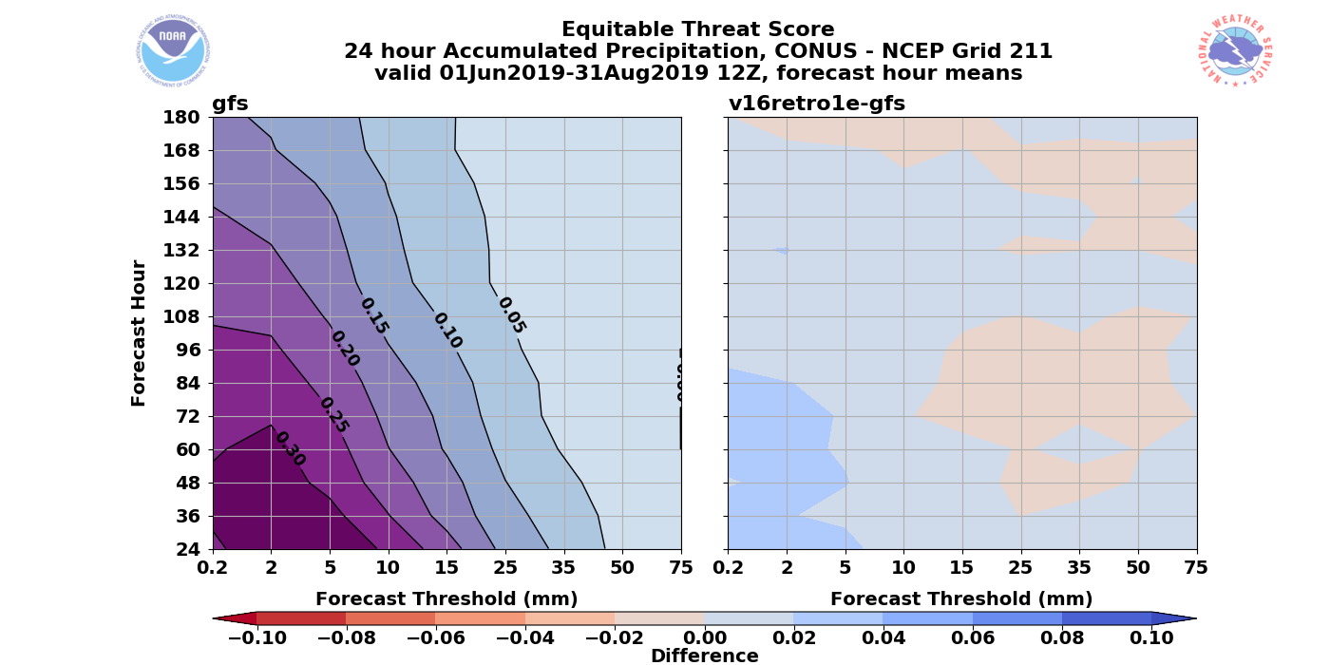
NATIONAL OCEANIC AND ATMOSPHERIC ADMINISTRATION
GFSv16 QPF Equitable Threat Scores & Bias
ETS
GFSv15
Summer 2019 – 24-h QPF
GFSv16 has improved ETS values at lower thresholds
v16−v15
Blue =
Better
Orange = Worse

Slide 14
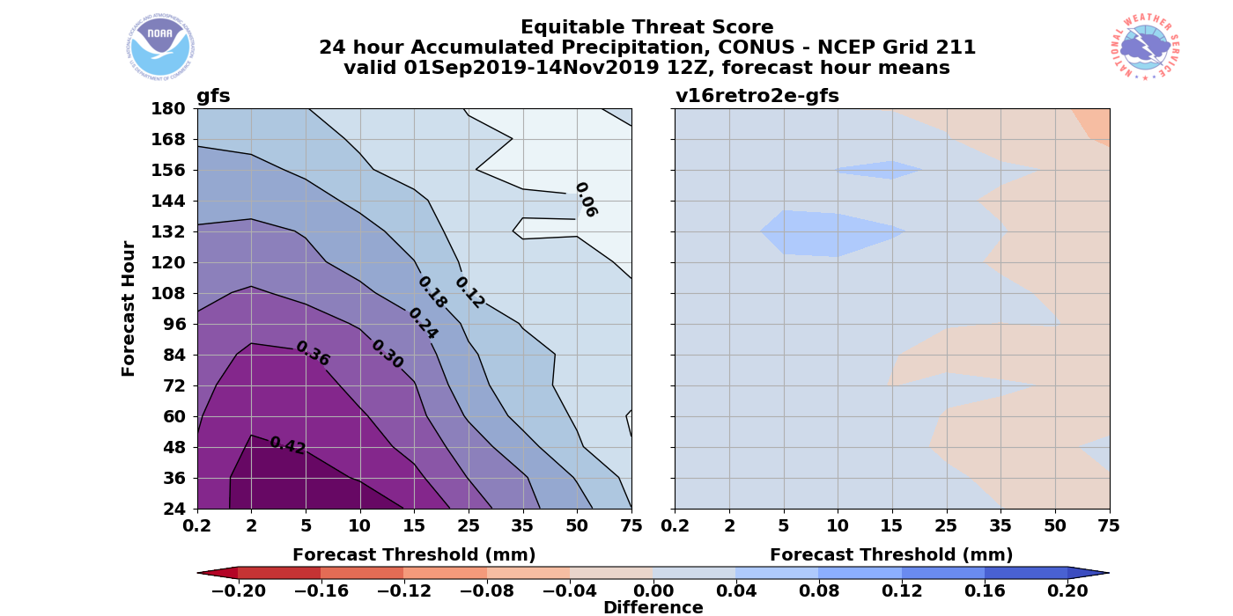
NATIONAL OCEANIC AND ATMOSPHERIC ADMINISTRATION
GFSv16 QPF Equitable Threat Scores & Bias
ETS
GFSv15
Fall 2019 – 24-h QPF
GFSv16 has improved ETS values at lower thresholds
v16−v15
Blue =
Better
Orange = Worse

Slide 15
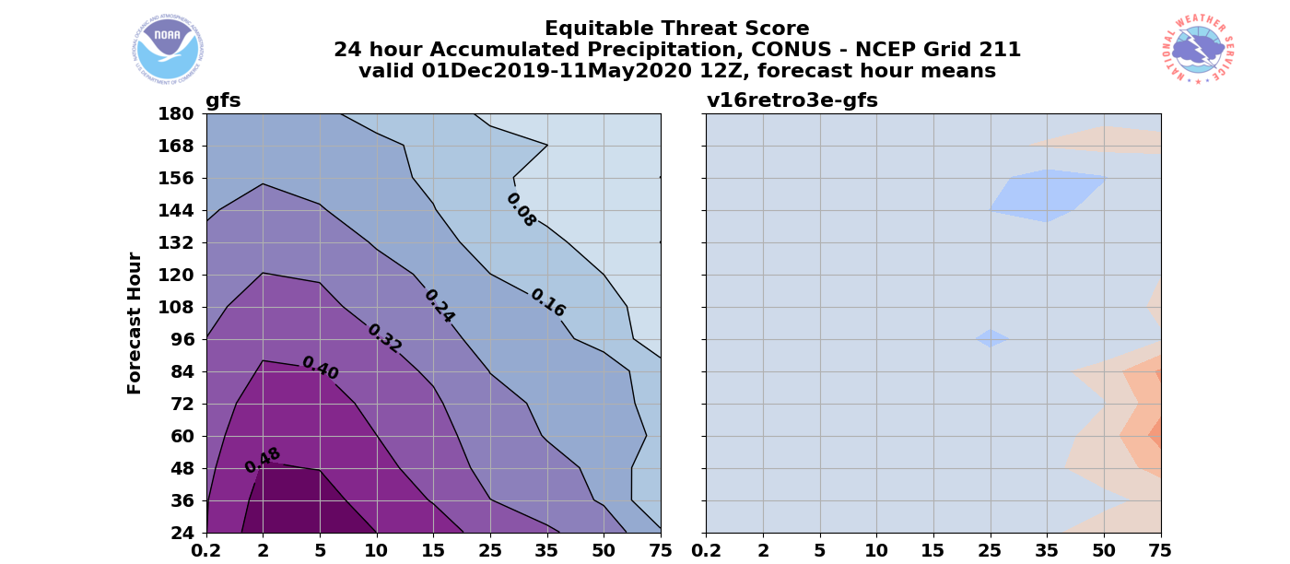
NATIONAL OCEANIC AND ATMOSPHERIC ADMINISTRATION
GFSv16 QPF Equitable Threat Scores & Bias
ETS
GFSv15
Winter/Spring 2020 – 24-h QPF
GFSv16 has improved ETS
values at lower thresholds
v16−v15
Blue =
Better
Orange = Worse

Slide 16
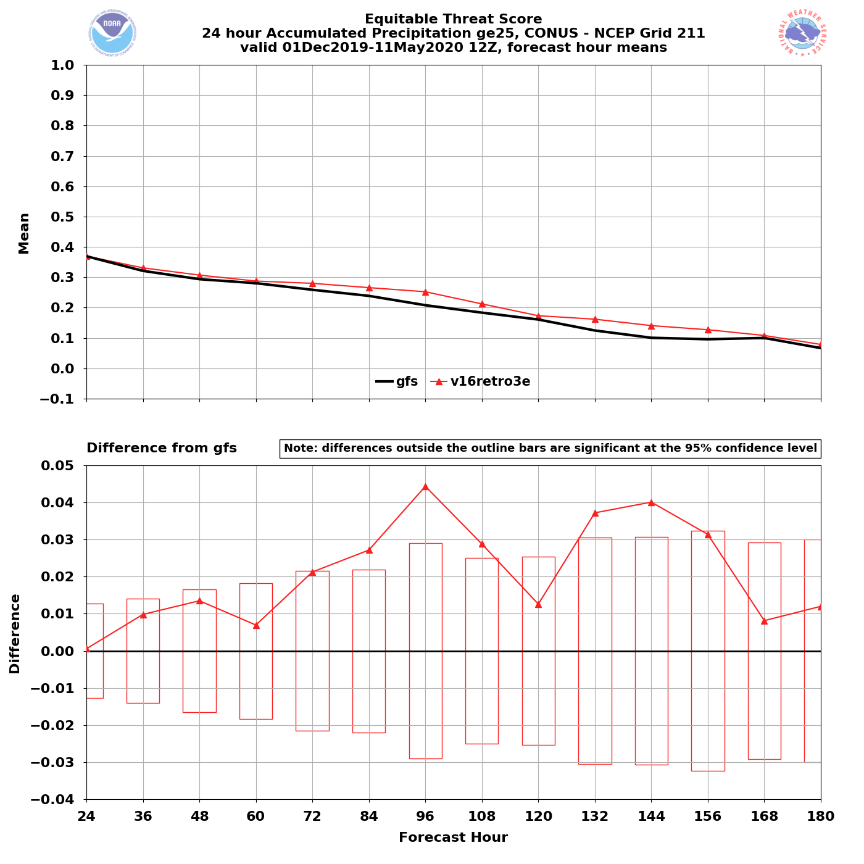
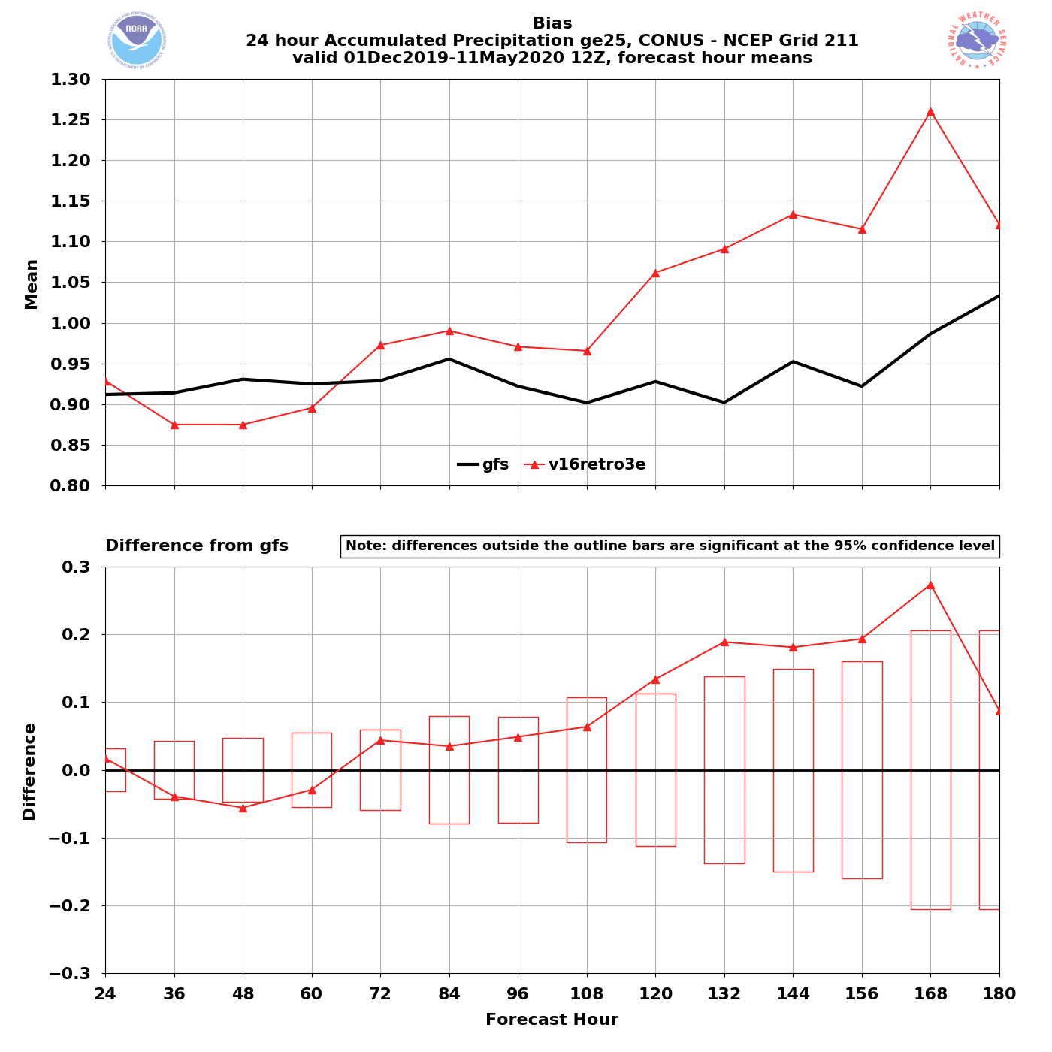
NATIONAL OCEANIC AND ATMOSPHERIC ADMINISTRATION
GFSv16 QPF Equitable Threat Scores & Bias
Winter/Spring 2020 – 24-h QPF
Winter/Spring 2020 – 24-h QPF
ETS
25mm
Bias
GFSv16 has better ETS values than GFSv15 at all lead times
GFSv16 has a stat. sig. higher bias than GFSv15 at longer lead times

Slide 17
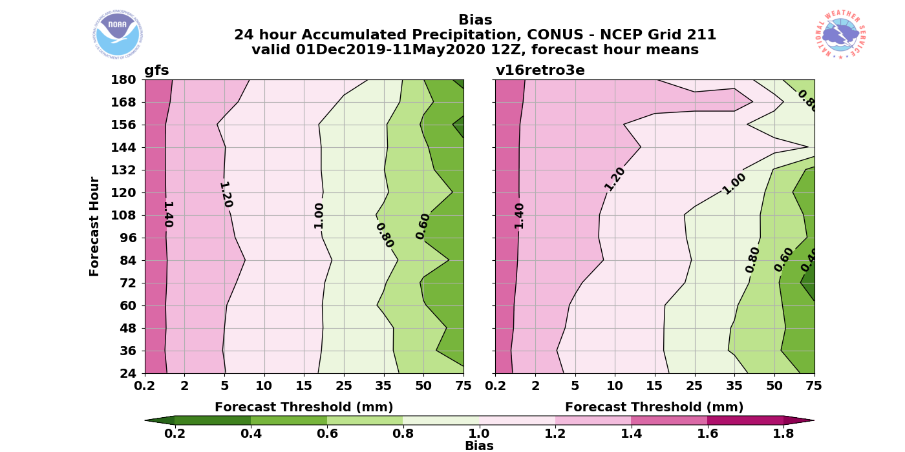
NATIONAL OCEANIC AND ATMOSPHERIC ADMINISTRATION
GFSv16 QPF Equitable Threat Scores & Bias
Bias
GFSv15
Winter/Spring 2020 – 24-h QPF
GFSv16
GFSv16 had a higher bias than GFSv15 at larger thresholds and at longer lead times

Slide 18
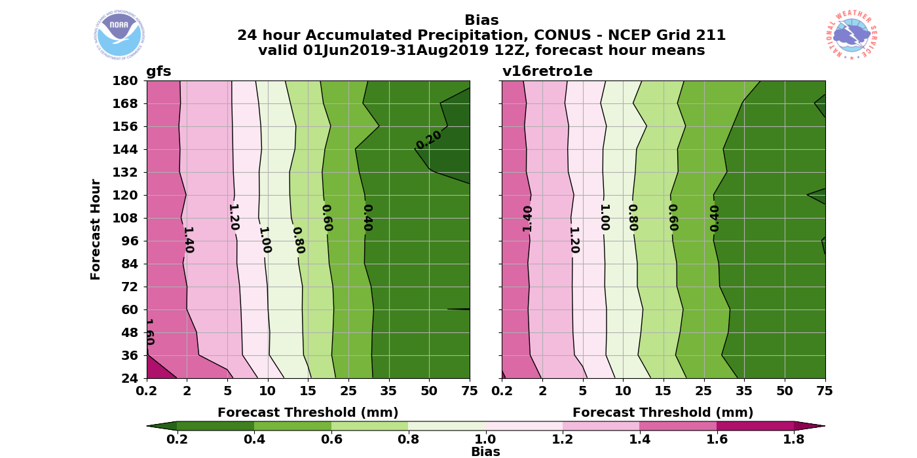
NATIONAL OCEANIC AND ATMOSPHERIC ADMINISTRATION
GFSv16 QPF Equitable Threat Scores & Bias
Bias
GFSv15
Summer 2019 – 24-h QPF
GFSv16
GFSv16 had a drier bias at smaller thresholds than GFSv15

Slide 19
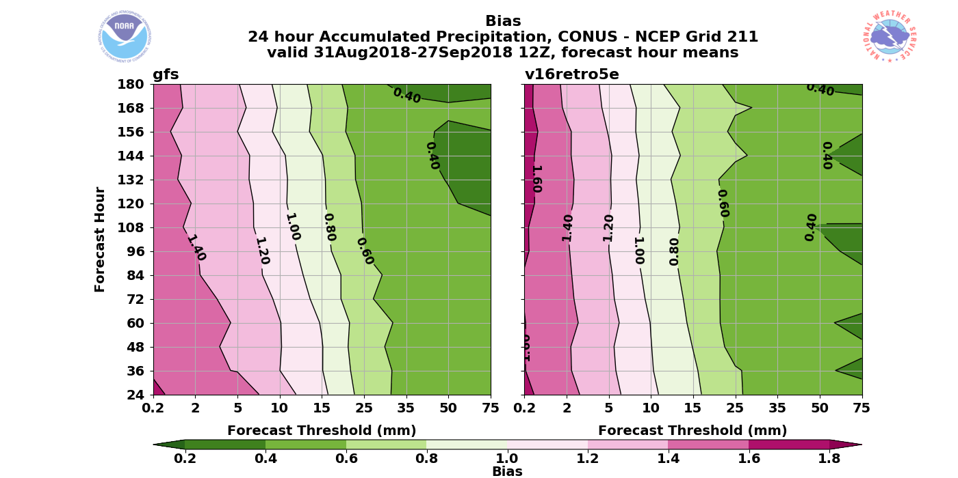
NATIONAL OCEANIC AND ATMOSPHERIC ADMINISTRATION
GFSv16 QPF Equitable Threat Scores & Bias
Bias
GFSv15
Summer 2018 – 24-h QPF
GFSv16
GFSv16 had a drier bias at smaller thresholds than GFSv15

Slide 20
NATIONAL OCEANIC AND ATMOSPHERIC ADMINISTRATION
GFSv16: Low Height and Cold Bias?
GFSv15 has a known low height and low-level cold bias that gets worse with lead time
NH – Winter 2018/2019
NH – Winter 2018/2019
GFSv14
GFSv14
GFSv15
500Z
Bias
850T
Bias
GFSv15
GFSv15 − GFSv14
GFSv15 − GFSv14

Slide 21
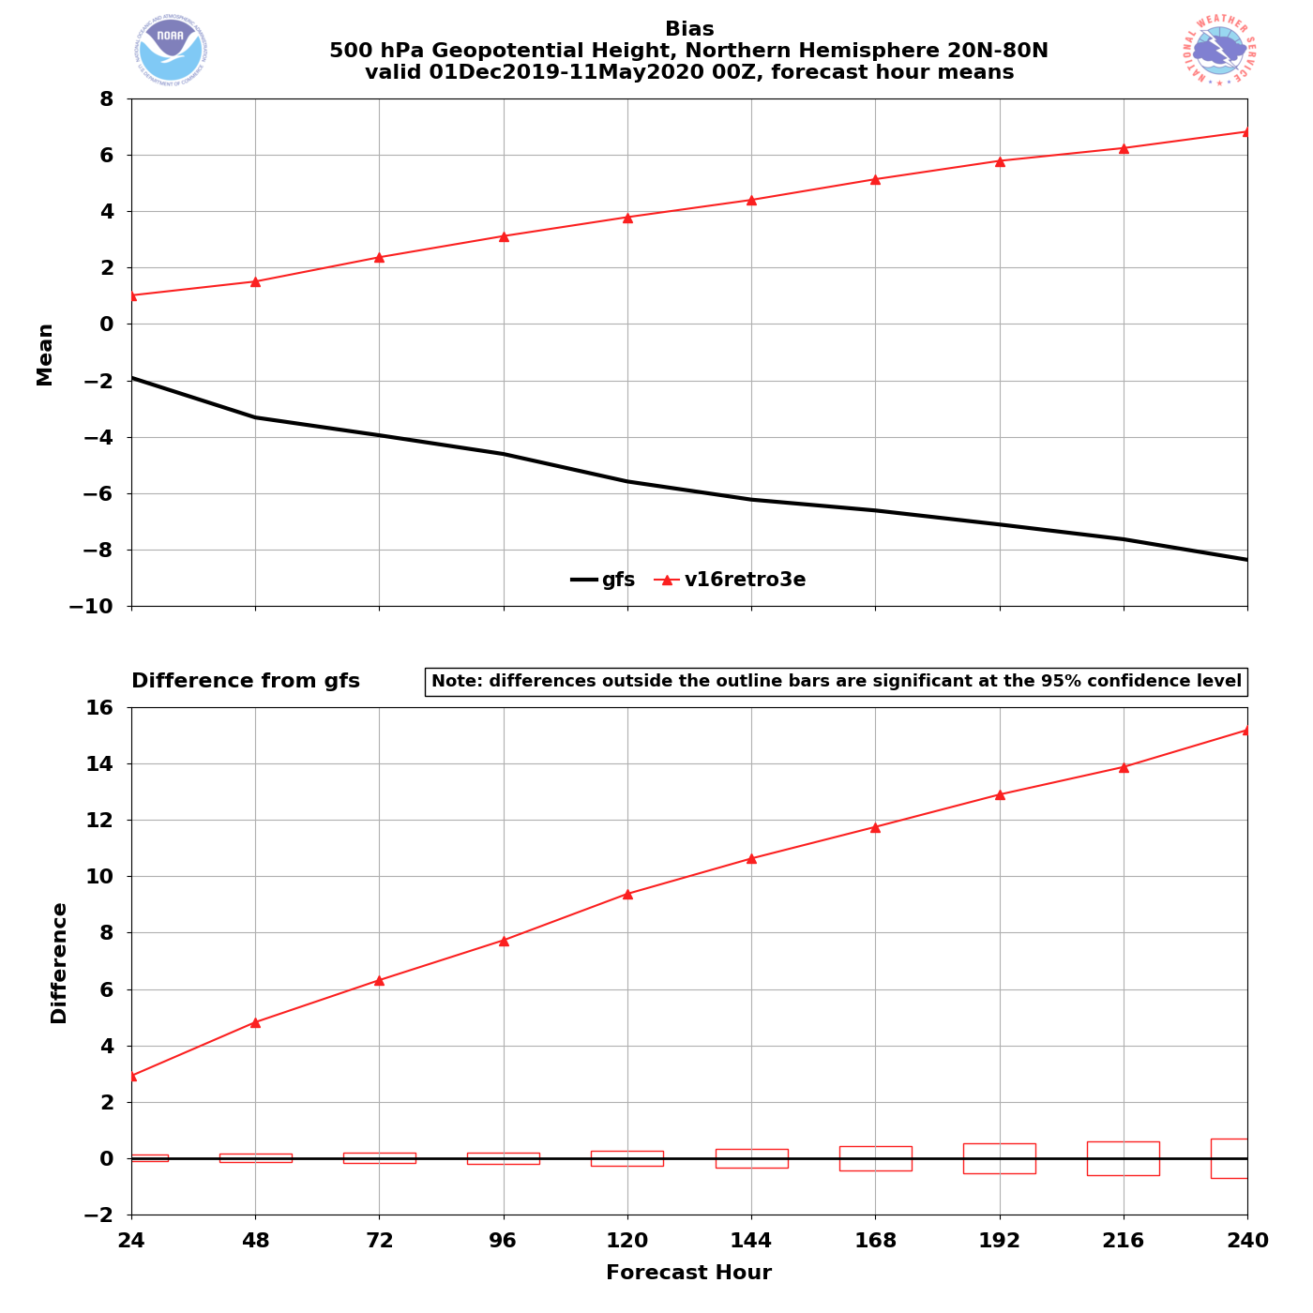
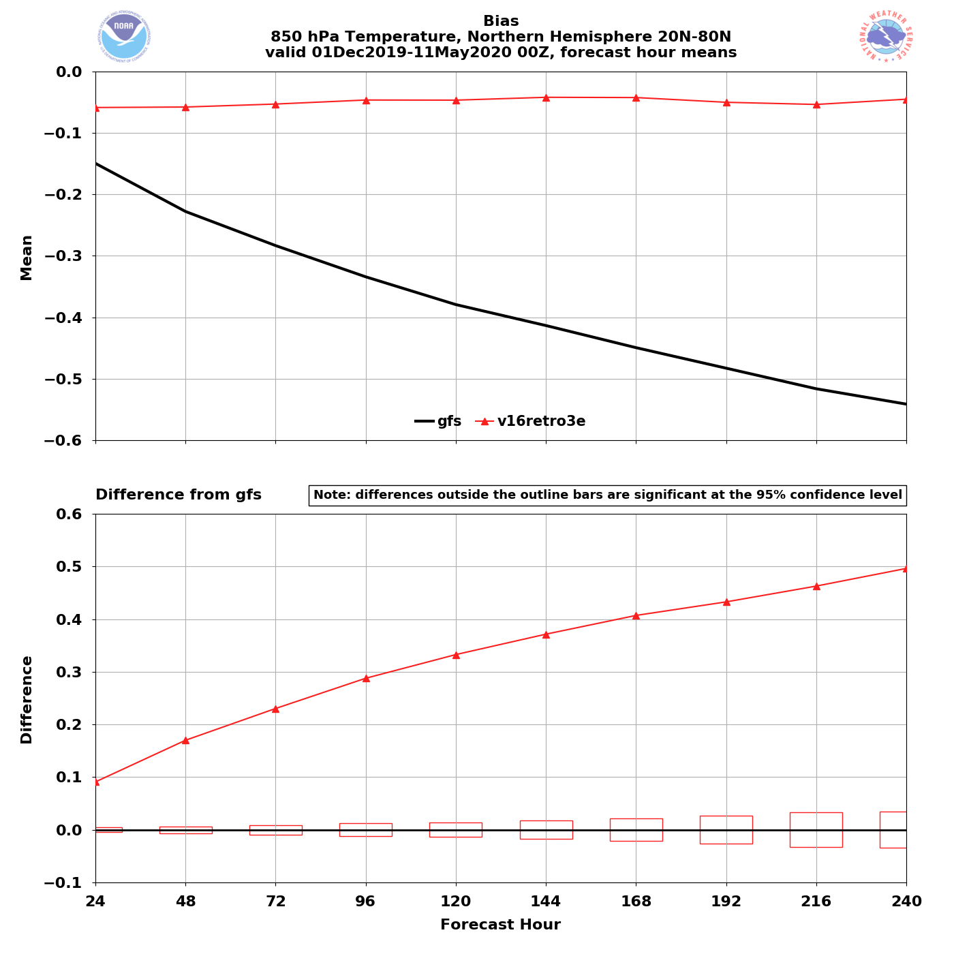
NATIONAL OCEANIC AND ATMOSPHERIC ADMINISTRATION
GFSv16: Low Height and Cold Bias?
GFSv15 has a known low height and low-level cold bias that gets worse with lead time
NH – Winter/Spring 2020
NH – Winter/Spring 2020
GFSv16
GFSv16
GFSv15
GFSv15
500Z
Bias
850T
Bias
GFSv16 − GFSv15
GFSv16 − GFSv15
GFSv16 has a high height bias that gets worse with lead time
GFSv16 has a negligible cold bias at all lead times

Slide 22
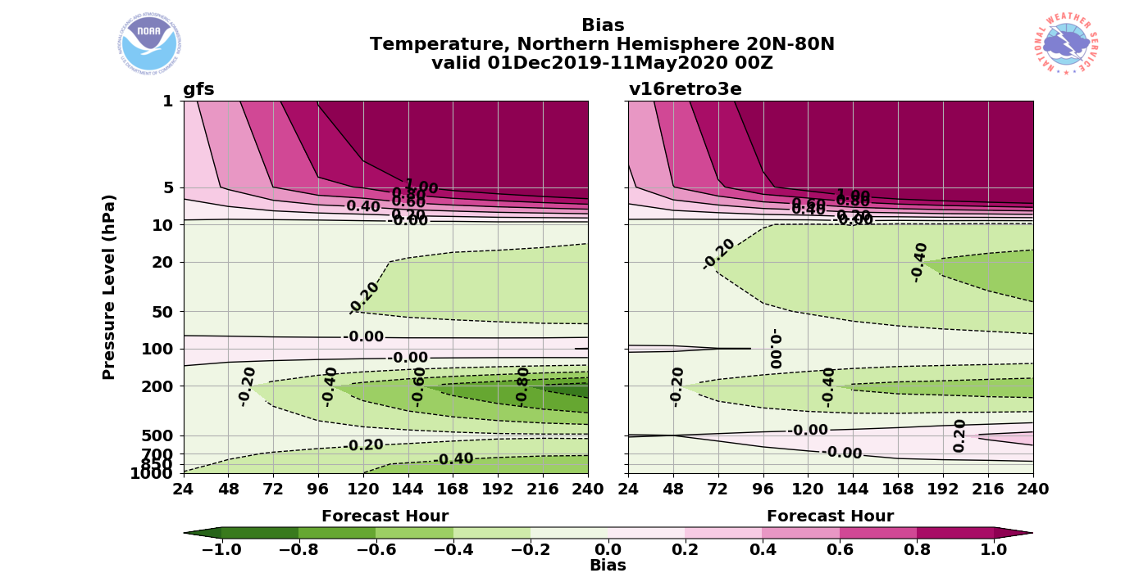
NATIONAL OCEANIC AND ATMOSPHERIC ADMINISTRATION
GFSv16: Low Height and Cold Bias?
Vertical Profile – Temp. Bias
NH – Winter/Spring 2020
GFSv15
GFSv16
GFSv15 has a jet-level and low-
level cold bias that increase with forecast lead time
GFSv16 has reduced the jet-level and low-level cold bias, but has a mid-level warm bias that increases with forecast lead time

Slide 23
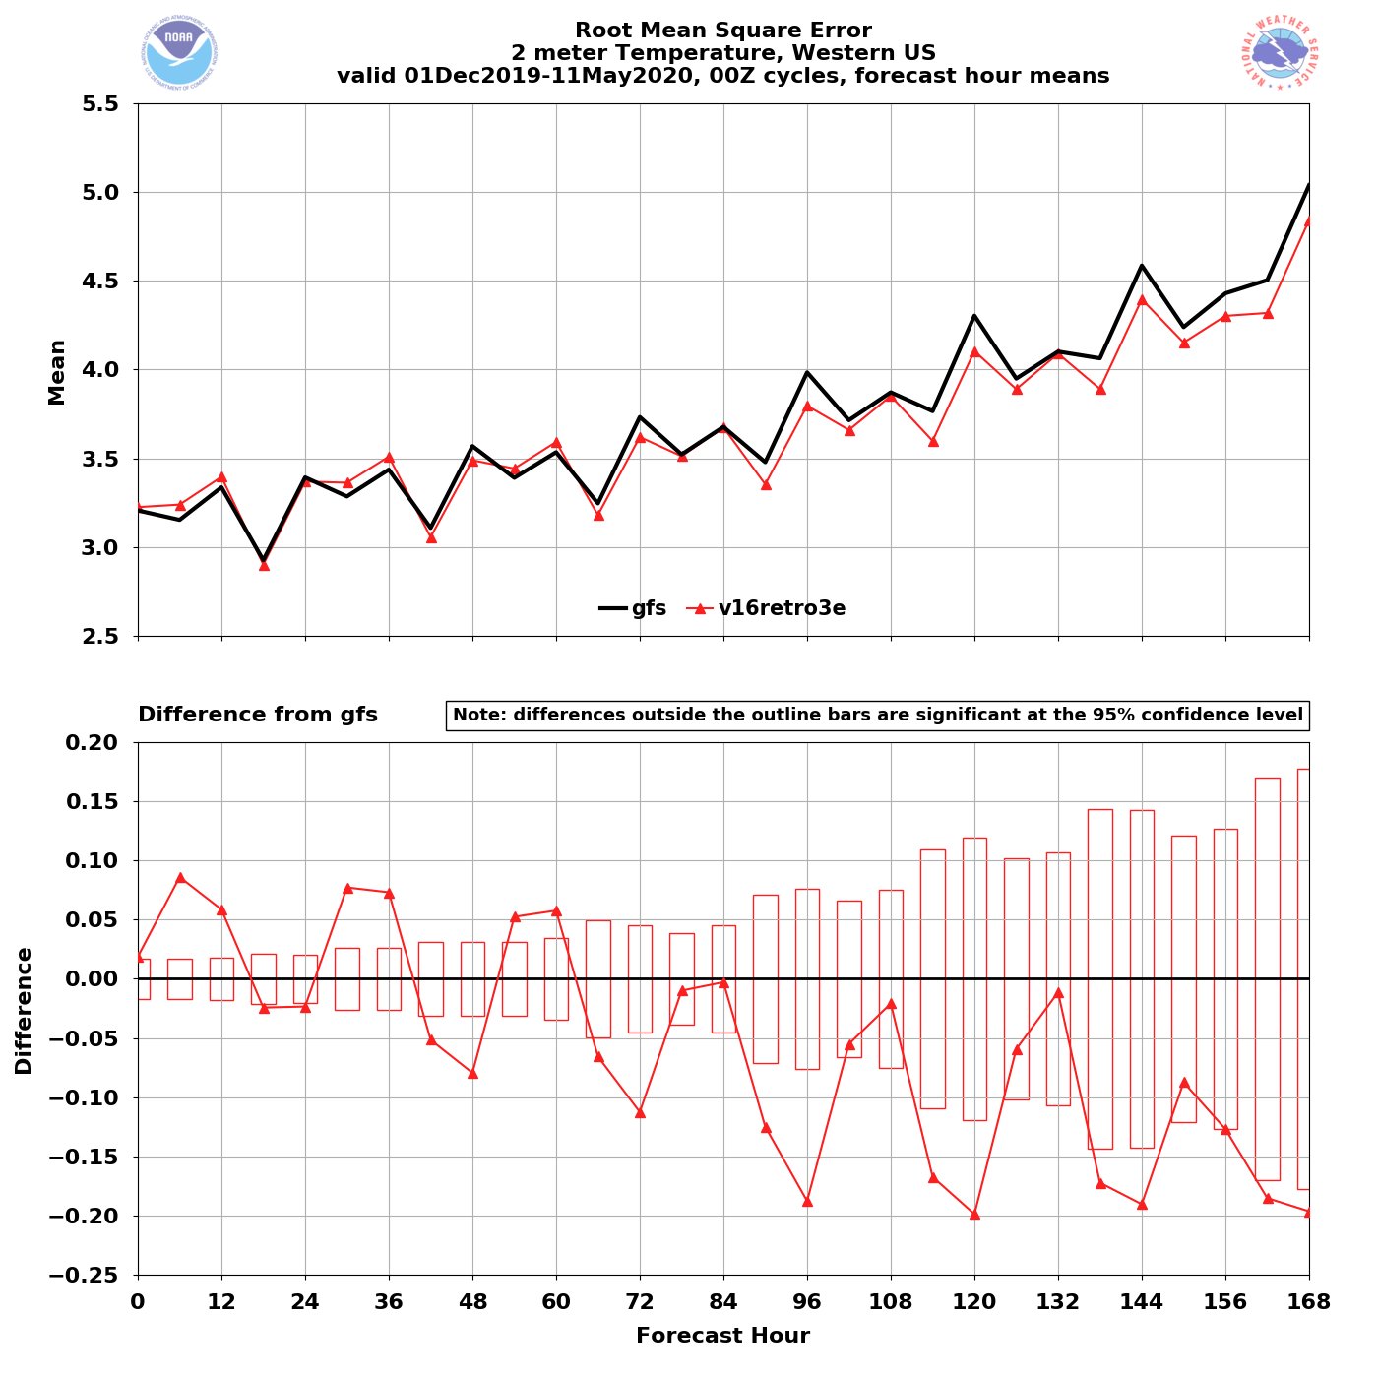
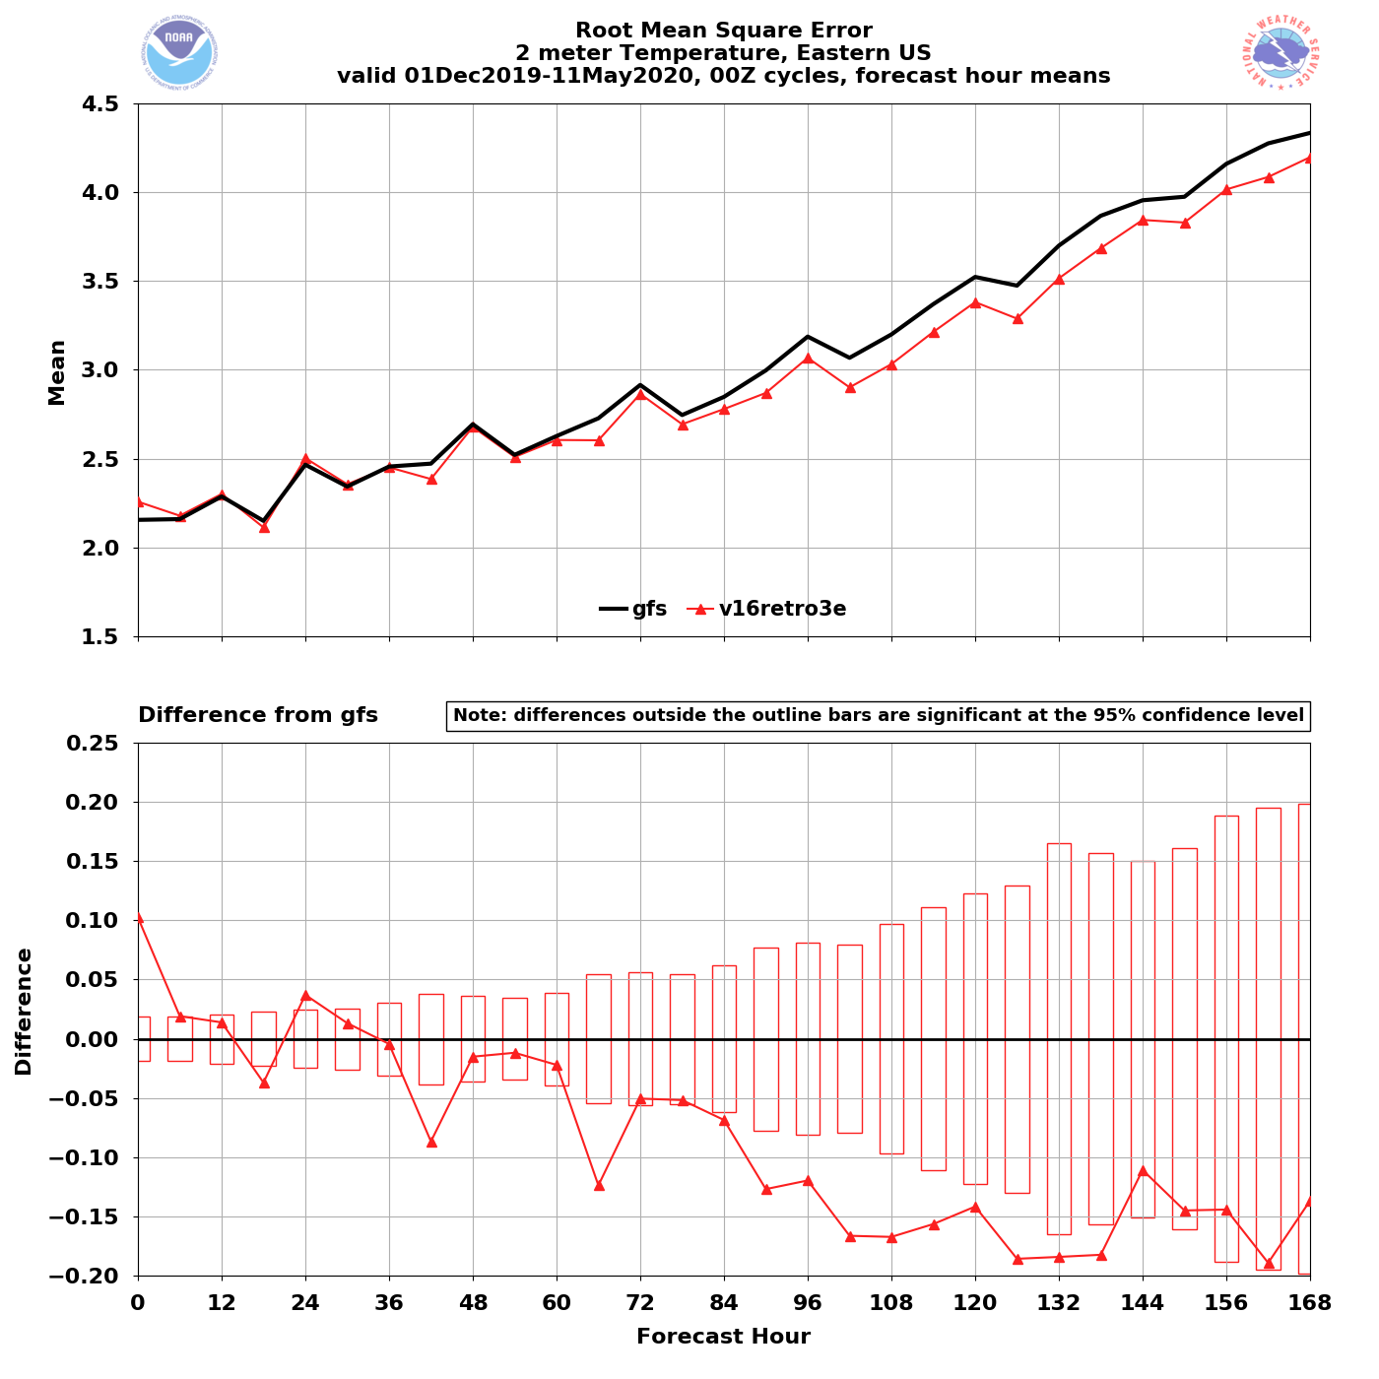
NATIONAL OCEANIC AND ATMOSPHERIC ADMINISTRATION
GFSv16 2-m Temperature RMSE and Bias
00Z
cycles
Western US – Winter/Spr. 2020
Eastern US – Winter/Spr. 2020
RMSE
GFSv15
GFSv16
GFSv15
GFSv16
GFSv16 has lower RMSE at longer leads
GFSv16 has lower RMSE at longer leads

Slide 24
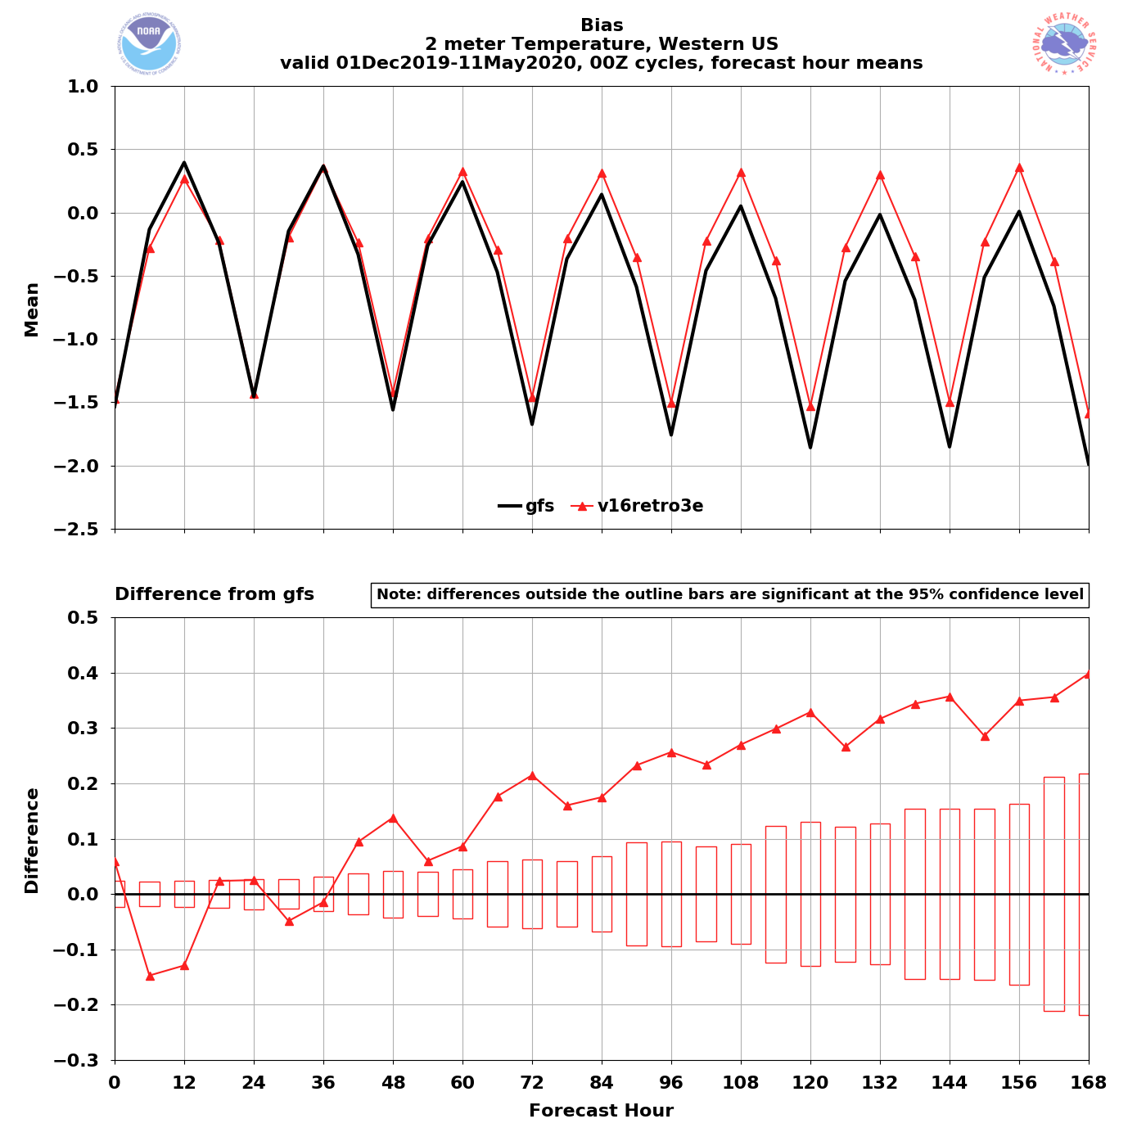
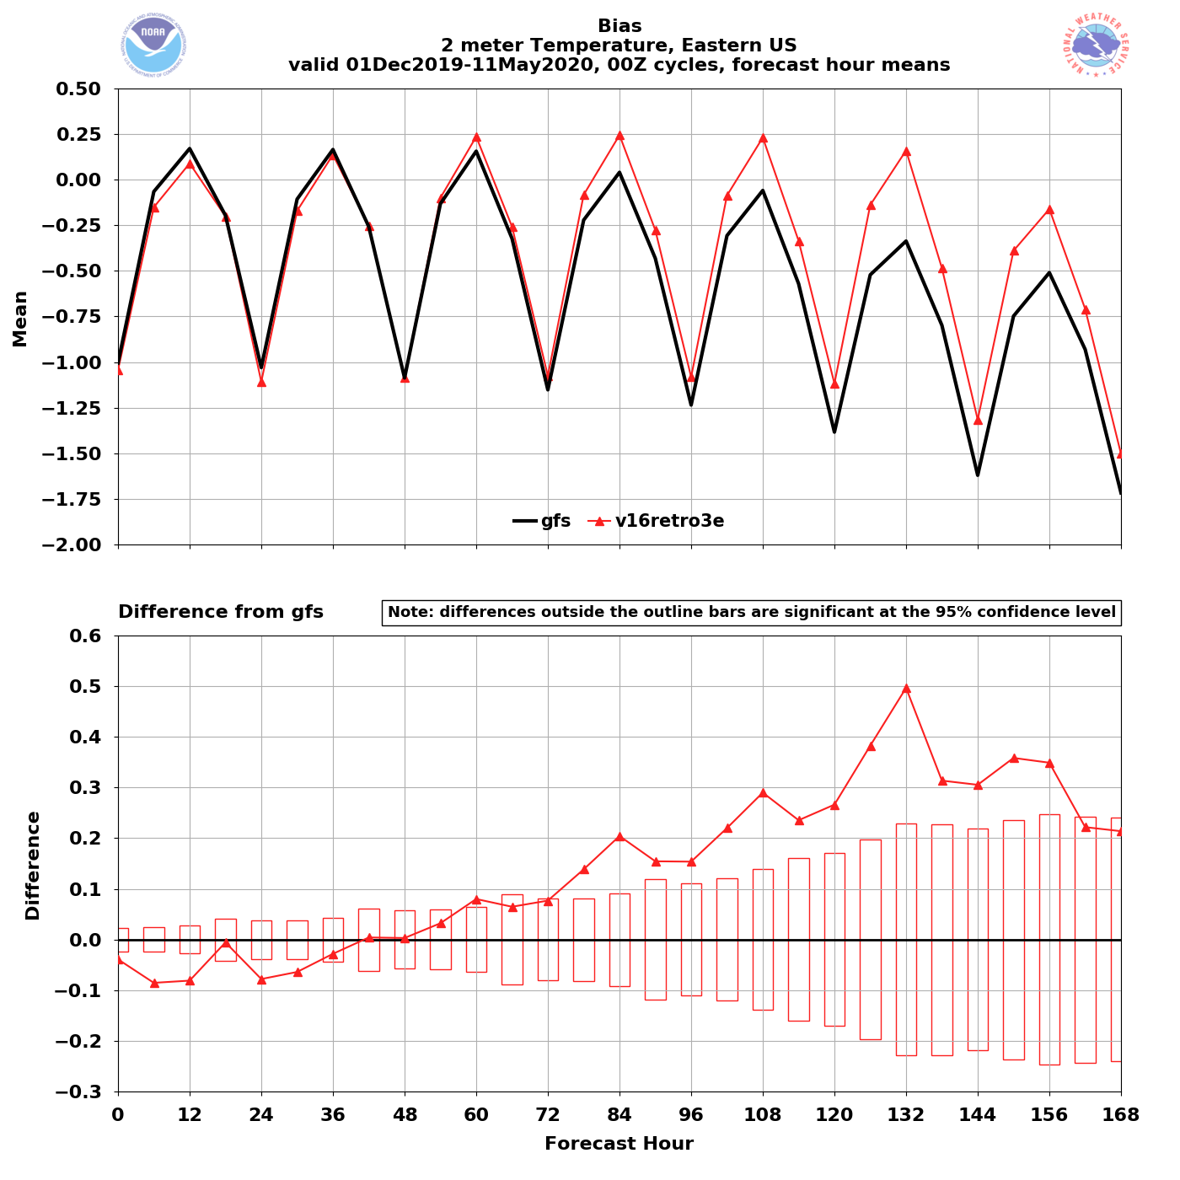
NATIONAL OCEANIC AND ATMOSPHERIC ADMINISTRATION
GFSv16 2-m Temperature RMSE and Bias
Western US – Winter/Spr. 2020
Eastern US – Winter/Spr. 2020
Bias
GFSv15
GFSv16
GFSv15
GFSv16
GFSv16 has less of a cold bias at longer lead times
GFSv16 has less of a cold bias at longer lead times

Slide 25
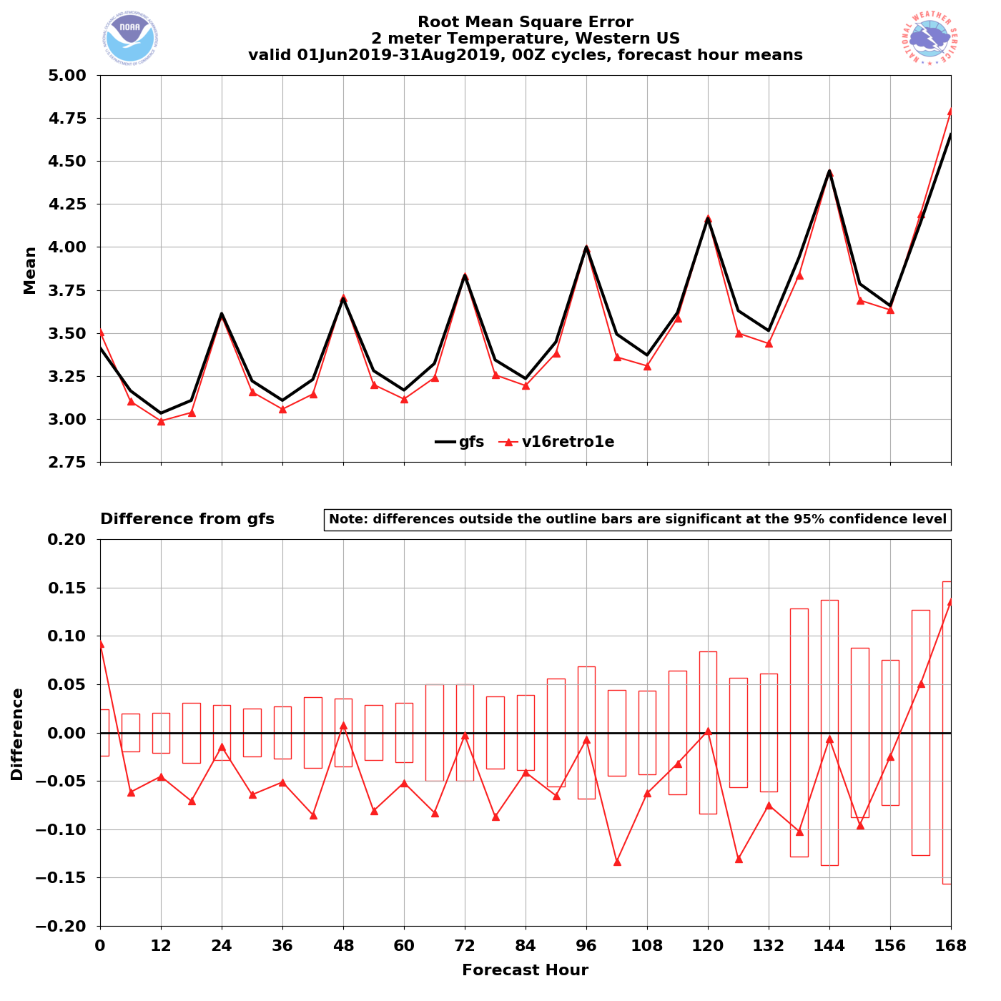
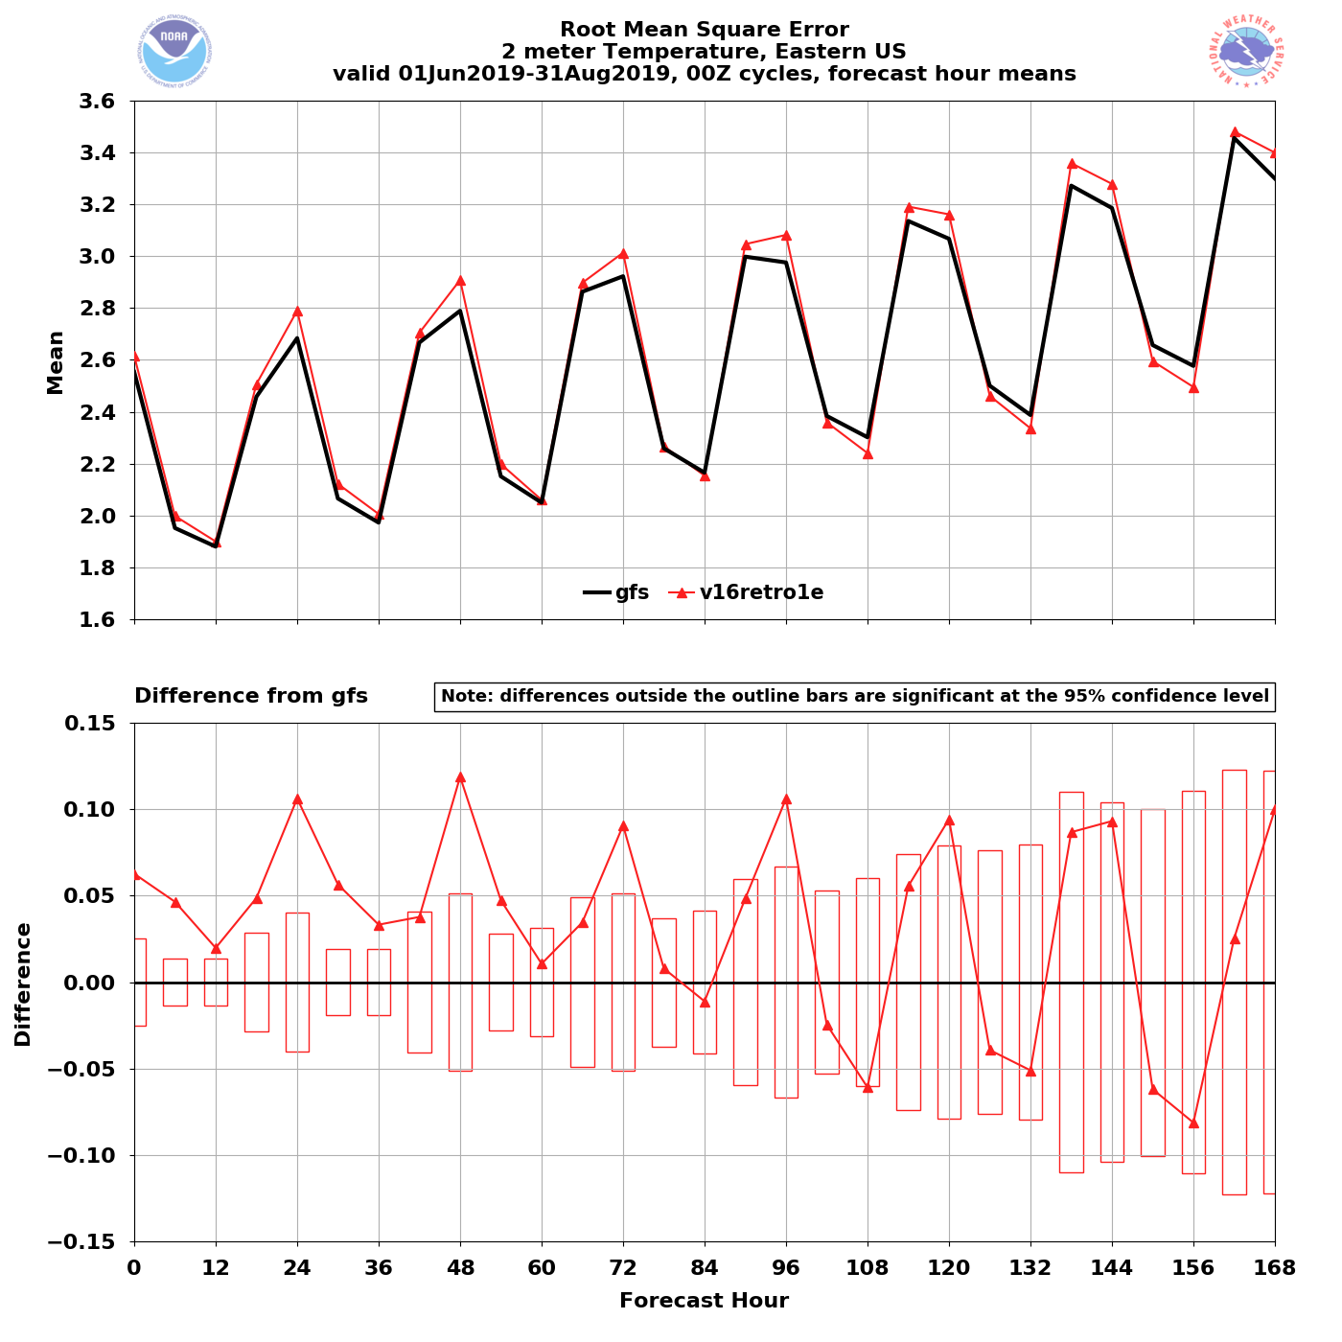
NATIONAL OCEANIC AND ATMOSPHERIC ADMINISTRATION
GFSv16 2-m Temperature RMSE and Bias
Western US – Summer 2019
Eastern US – Summer 2019
RMSE
GFSv15
GFSv16
GFSv15
GFSv16
GFSv16 has lower
RMSE at most lead times
GFSv16 has higher
RMSE at most lead times

Slide 26
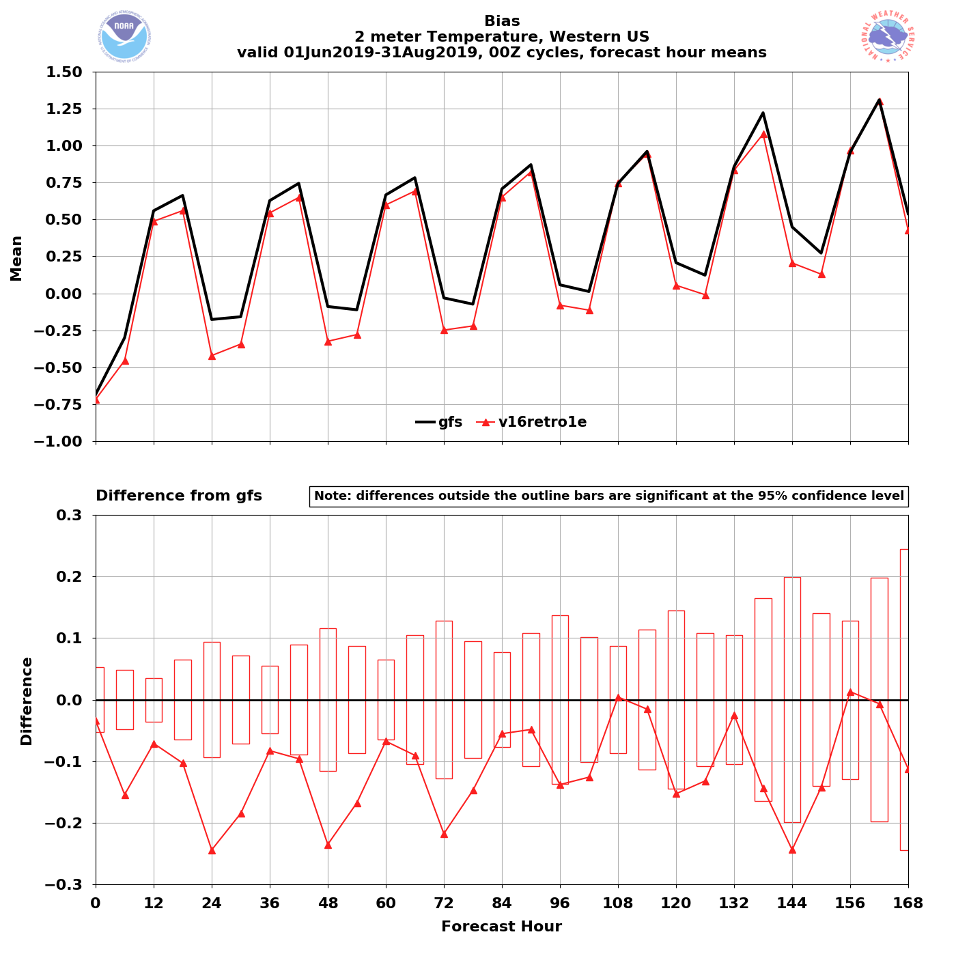
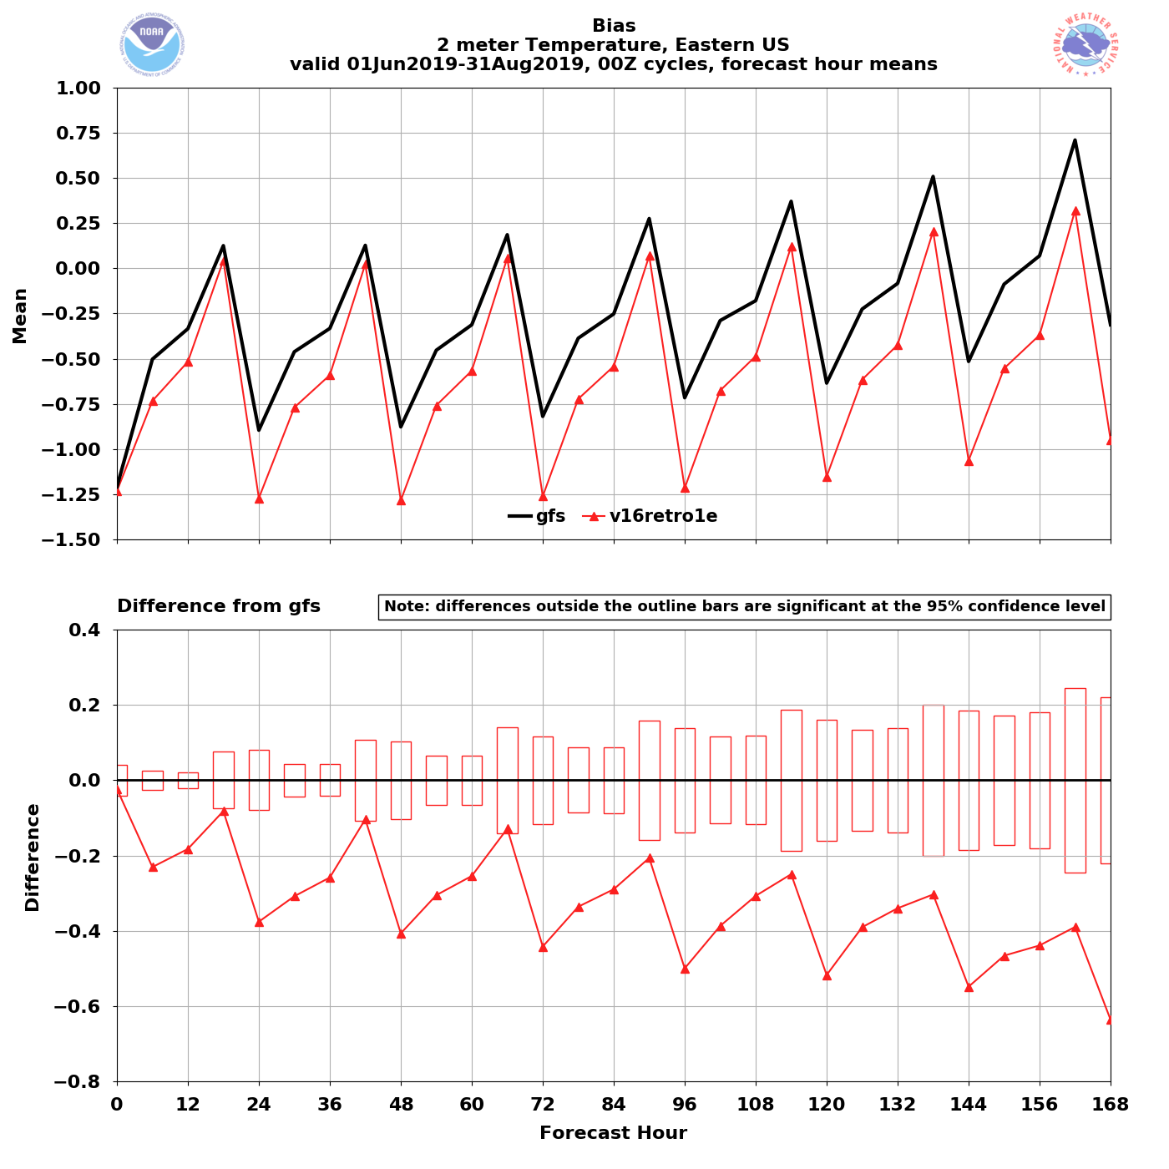
NATIONAL OCEANIC AND ATMOSPHERIC ADMINISTRATION
GFSv16 2-m Temperature RMSE and Bias
Western US – Summer 2019
Eastern US – Summer 2019
Bias
GFSv15
GFSv16
GFSv15
GFSv16
GFSv16 is colder than GFSv15 at almost all lead times
GFSv16 has a larger
cold bias at almost all lead times

Slide 27
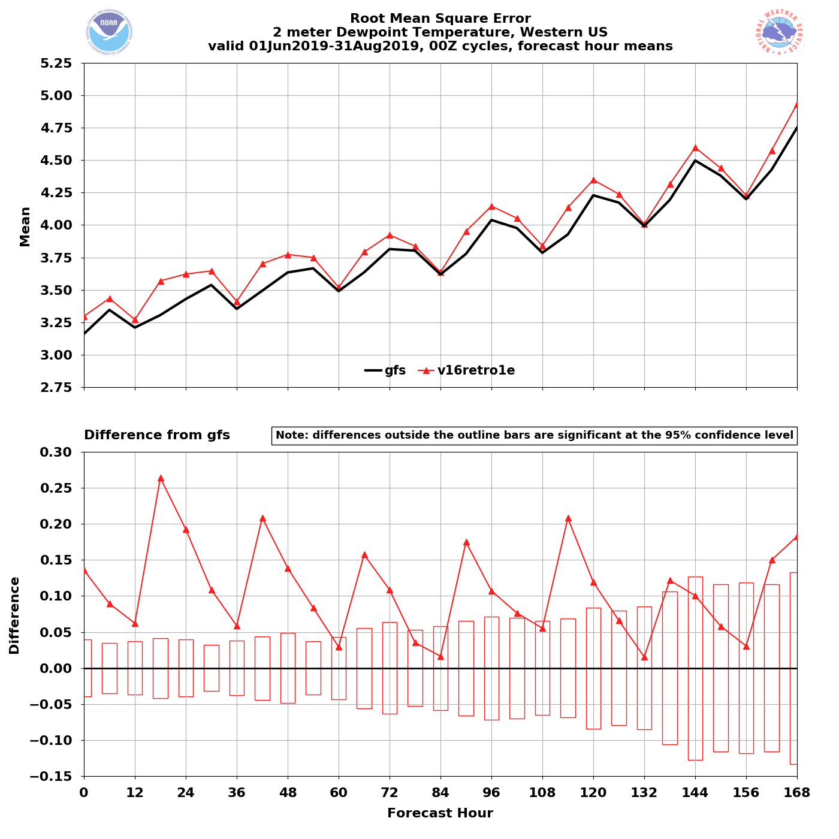
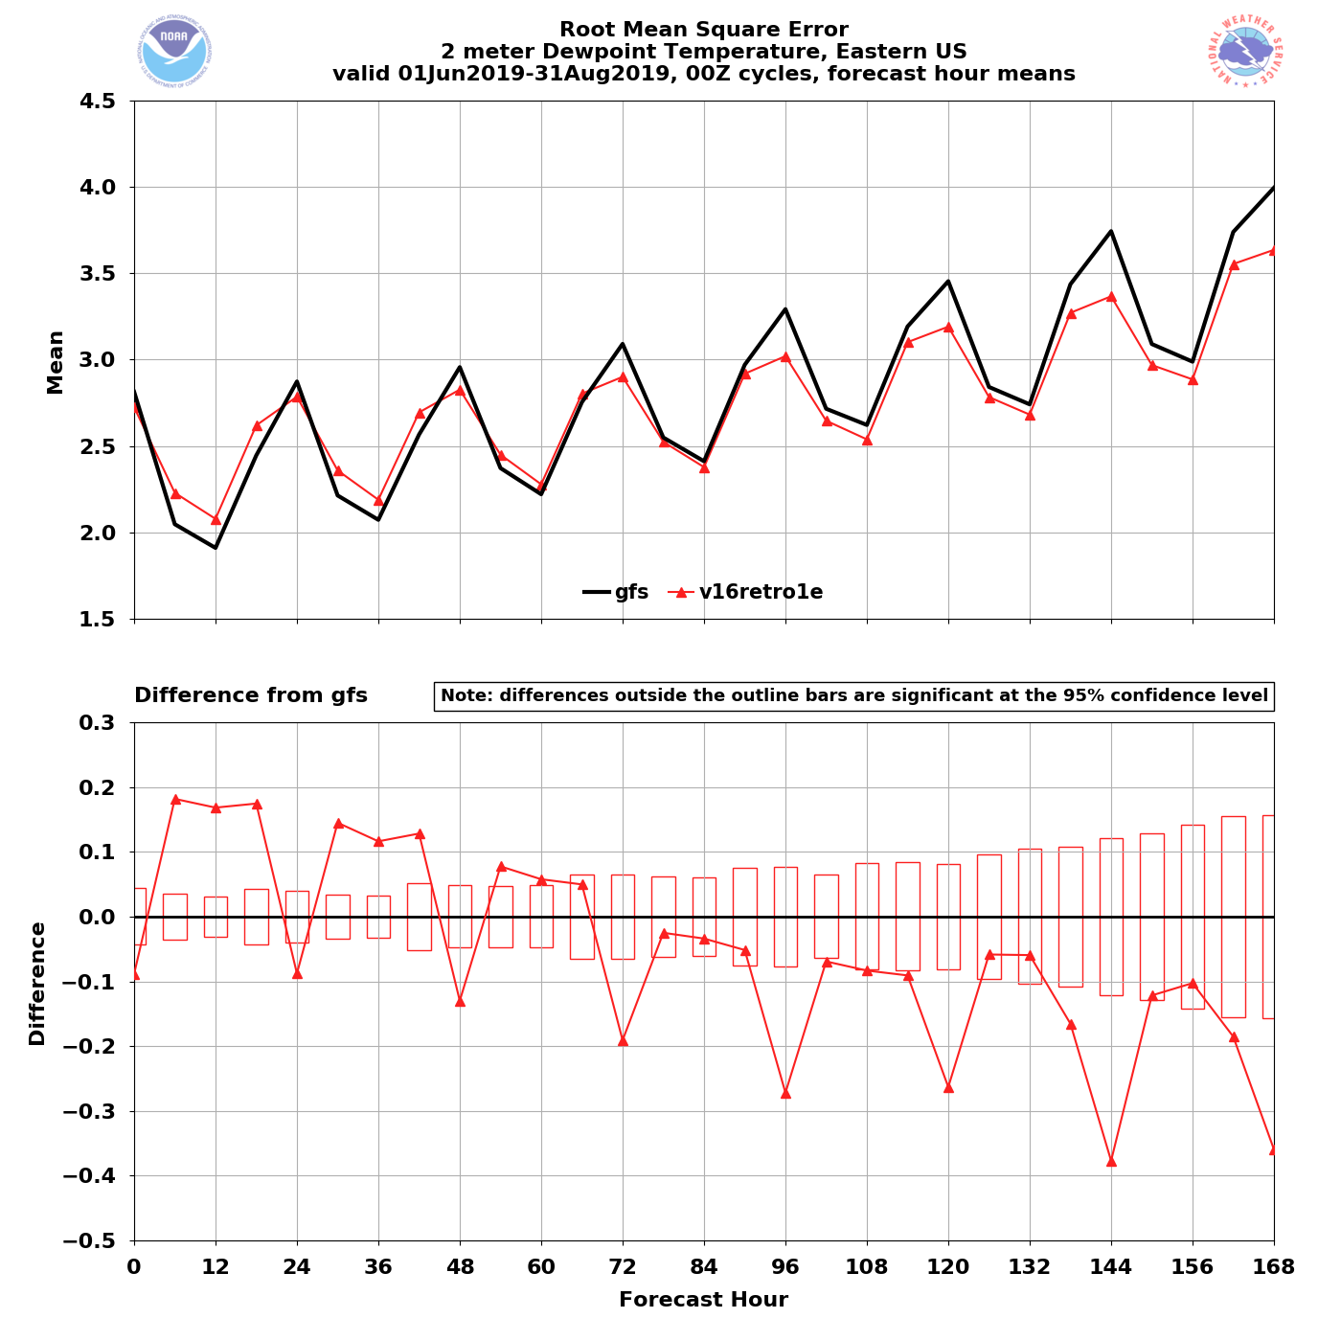
NATIONAL OCEANIC AND ATMOSPHERIC ADMINISTRATION
GFSv16 2-m Dew Point RMSE and Bias
Western US – Summer 2019
Eastern US – Summer 2019
RMSE
GFSv15
GFSv16
GFSv15
GFSv16
GFSv16 has higher
RMSE at all lead times
GFSv16 has higher RMSE at shorter lead times and lower at longer lead times

Slide 28
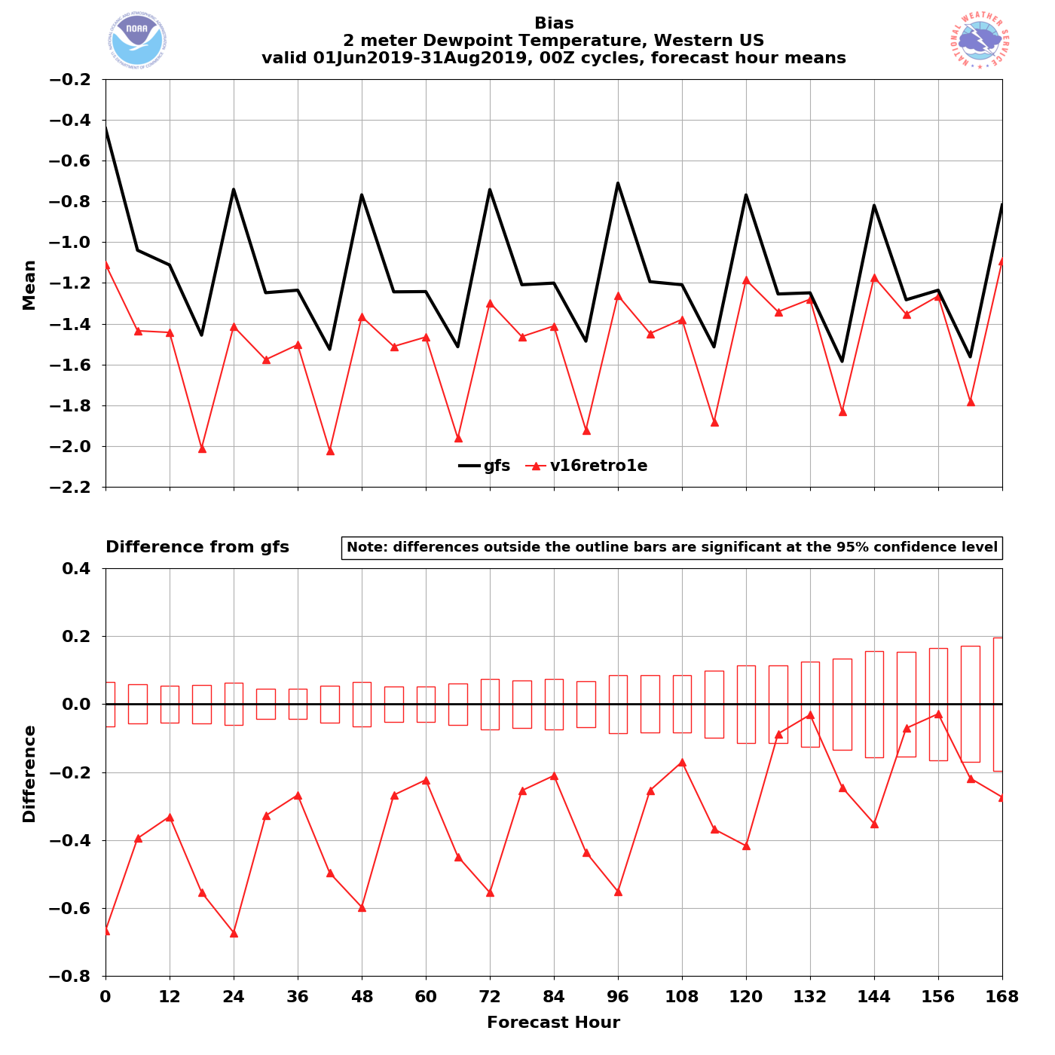
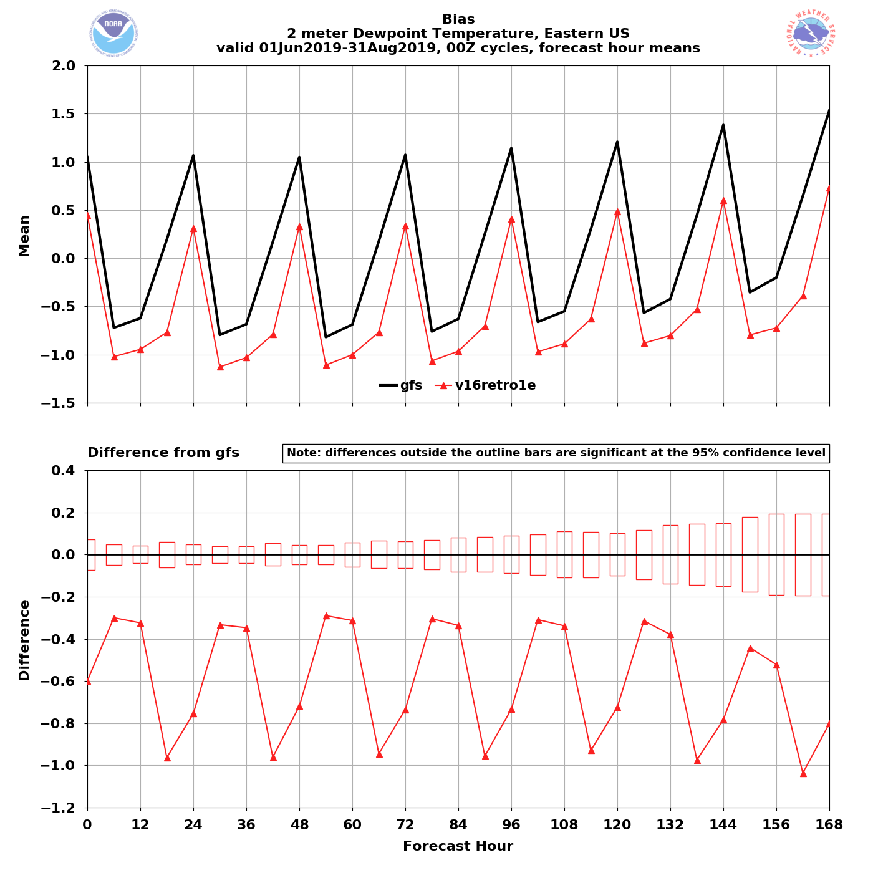
NATIONAL OCEANIC AND ATMOSPHERIC ADMINISTRATION
GFSv16 2-m Dew Point RMSE and Bias
Western US – Summer 2019
Eastern US – Summer 2019
Bias
GFSv15
GFSv16
GFSv15
GFSv16
GFSv16 has a larger dry bias that gets smaller at longer lead times
GFSv16 is drier than GFSv15, with a dry bias that gets smaller at longer lead times

Slide 29
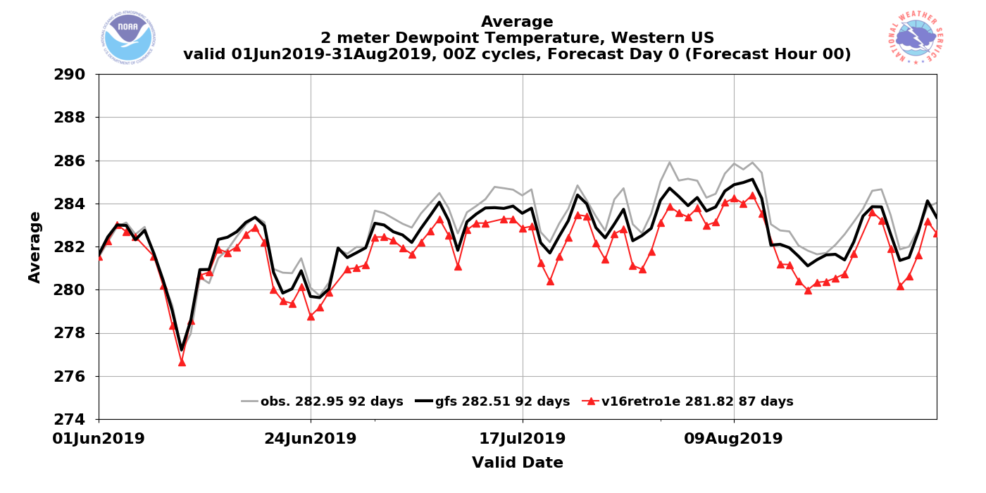
NATIONAL OCEANIC AND ATMOSPHERIC ADMINISTRATION
GFSv16 2-m Dew Point (mean values)
Observations
GFSv15
GFSv16
Western US – Summer 2019 (F000)
GFSv16 has lower 2-m dew points than GFSv15 and observations during peak summer
GFSv16 and GFSv15 were close to observations in ~June

Slide 30
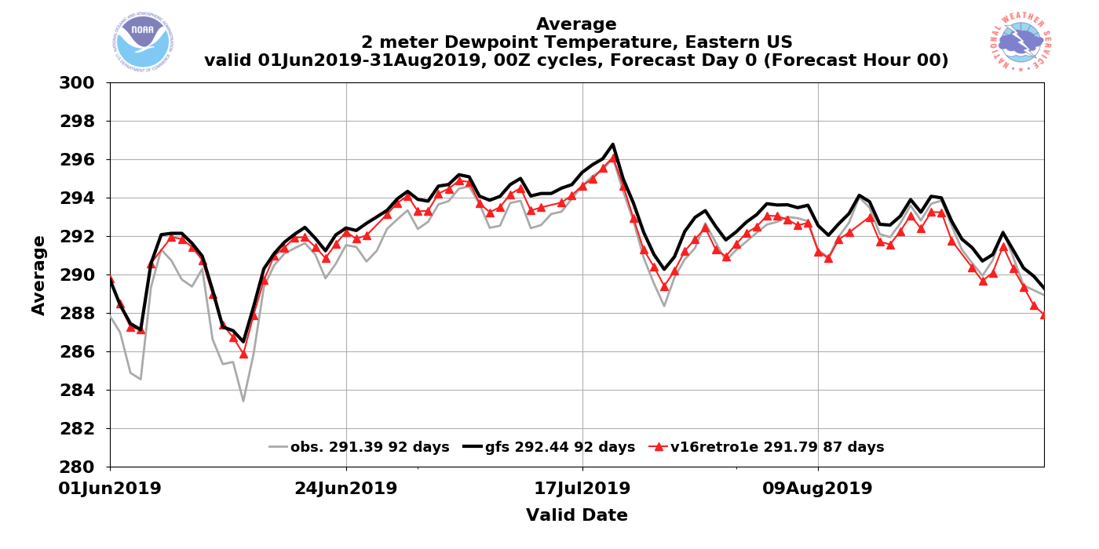
NATIONAL OCEANIC AND ATMOSPHERIC ADMINISTRATION
GFSv16 2-m Dew Point (mean values)
Observations
GFSv15
GFSv16
Eastern US – Summer 2019 (F000)
GFSv16 consistently closer than GFSv15 to observations at F000 in peak summer
GFSv16 and GFSv15 both have higher dew points than observations in ~June

Slide 31
NATIONAL OCEANIC AND ATMOSPHERIC ADMINISTRATION
GFSv16 2-m Dew Point (mean values)
Observations
GFSv15
GFSv16
Eastern US – Summer 2019 (F000)
GFSv16 consistently closer than GFSv15 to observations at F000 in peak summer
GFSv16 and GFSv15 both have higher dew points than observations in ~June
GFSv16 always has lower 2-m dew points than GFSv15 at F000

Slide 32
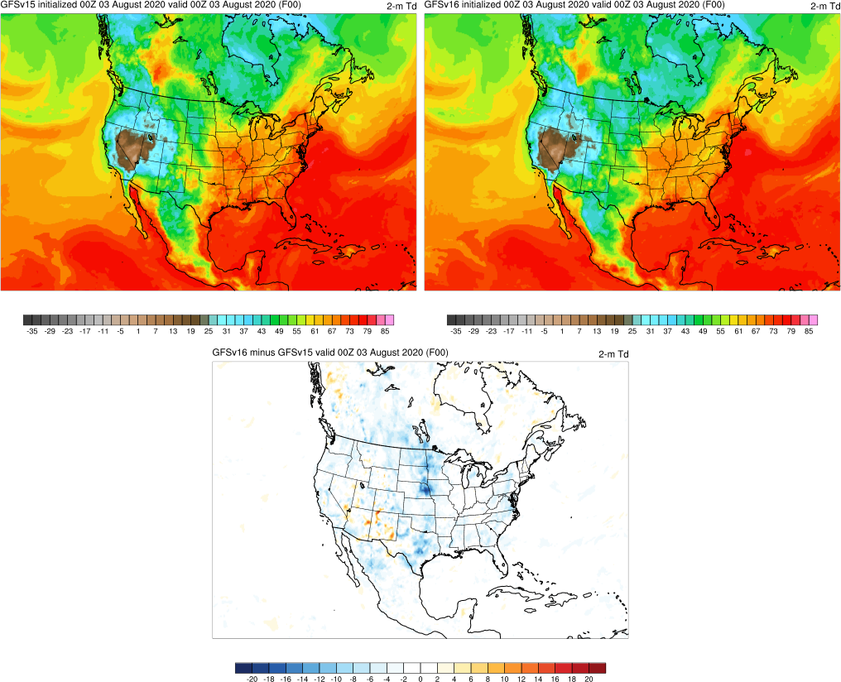
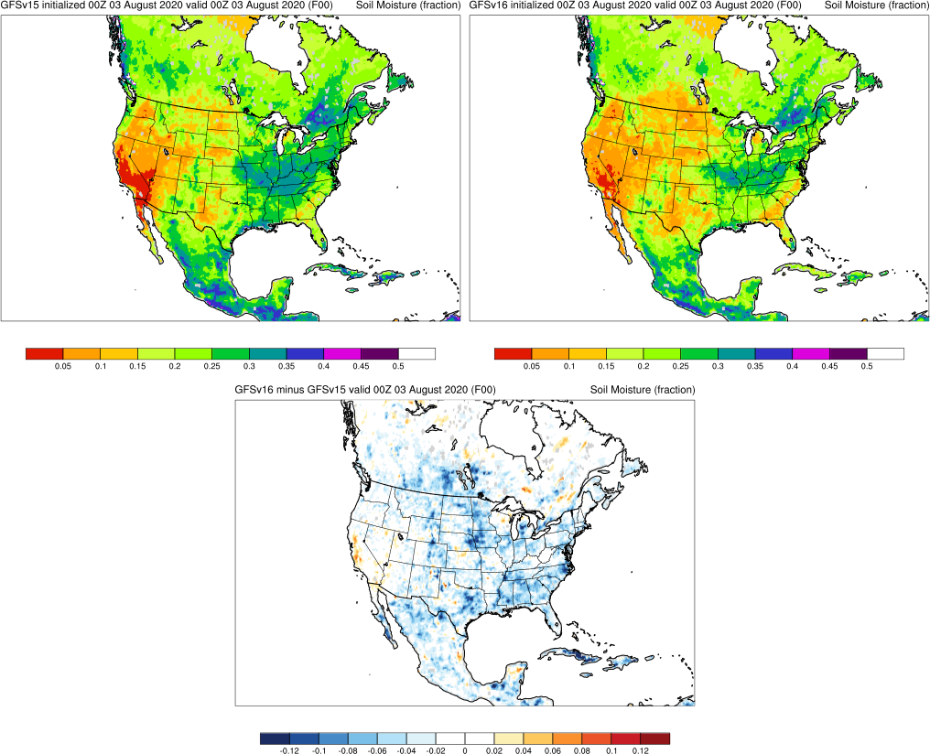
NATIONAL OCEANIC AND ATMOSPHERIC ADMINISTRATION
GFSv16 Moisture Differences (F000)
2-m Dew Point
0–10-cm Soil Moisture
GFSv15
GFSv16
GFSv15
GFSv16
Dew points and soil moisture are consistently lower in GFSv16 at all lead times (only F000 shown here)
Related to modifications that were made to GLDAS?
v16−v15
v16−v15

Slide 33
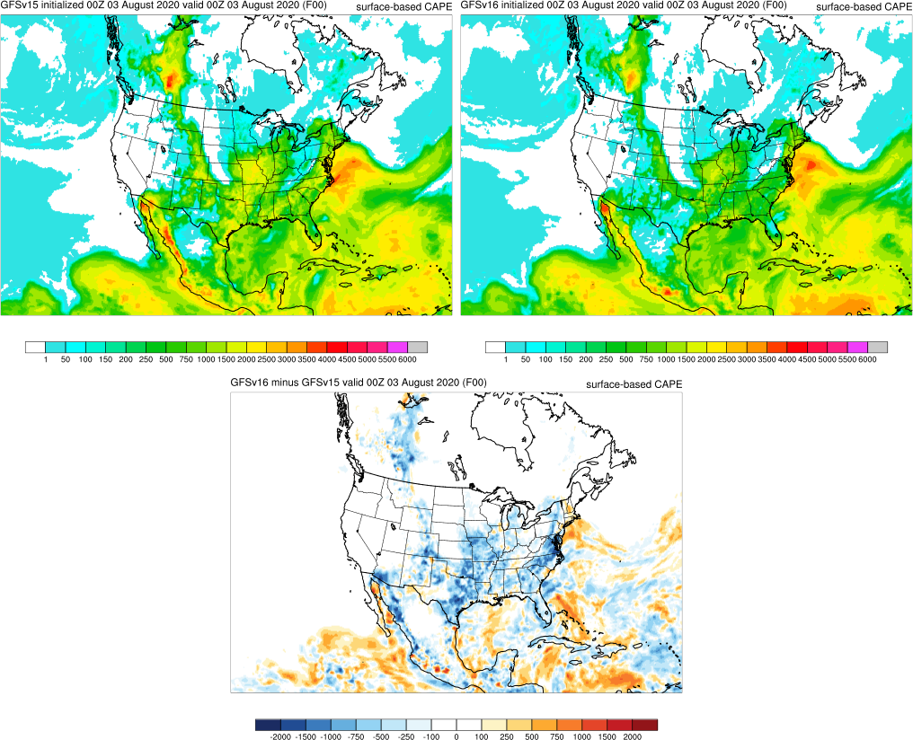
NATIONAL OCEANIC AND ATMOSPHERIC ADMINISTRATION
GFSv16 CAPE Differences (F000)
Surface-based CAPE
0–10-cm Soil Moisture
GFSv15
GFSv16
GFSv15
GFSv16
Lower 2-m dew points and soil moisture in GFSv16 results in reduced surface-based CAPE
CAPE was already low in GFSv15, and now lower in GFSv16
v16−v15
v16−v15

Slide 34
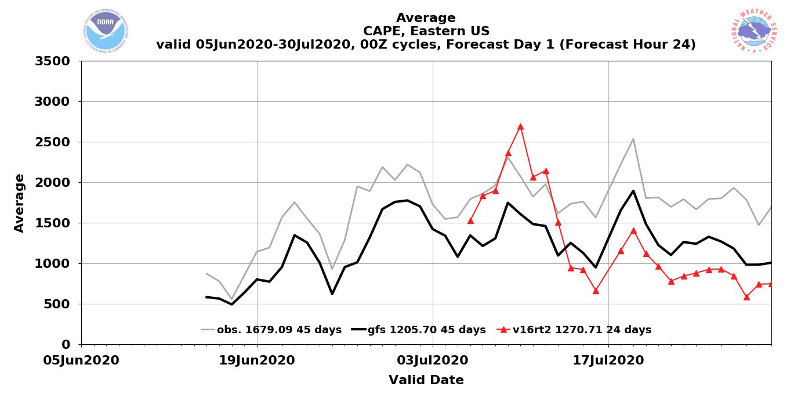
NATIONAL OCEANIC AND ATMOSPHERIC ADMINISTRATION
GFSv16 CAPE (time series of mean values)
Surface-based CAPE
Observations
GFSv15
GFSv16
Eastern US – Summer 2020 (F024)
CAPE was already low in GFSv15, and now lower in GFSv16
CAPE was fixed in real-time parallel on 13 July 2020

Slide 35
NATIONAL OCEANIC AND ATMOSPHERIC ADMINISTRATION
GFSv16 Verification Statistics: Summary
GFSv16 has higher 500-hPa AC scores than GFSv15 at Days 2–6.
GFSv16 AC scores are not statistically significantly different from GFSv15 at Days 7–10, and can be better or worse depending on the retro stream.
GFSv16 has higher 24-h QPF ETS than GFSv15 at smaller QPF thresholds at almost all forecast lead times.
GFSv16 has higher 24-h QPF bias than GFSv15 at larger QPF thresholds and longer lead times and a lower 24-h QPF bias than GFSv15 at smaller QPF thresholds and shorter lead times during winter/spring.
GFSv16 has a drier 24-h QPF bias than GFSv15 at the majority of QPF thresholds during summer.

Slide 36
NATIONAL OCEANIC AND ATMOSPHERIC ADMINISTRATION
GFSv16 Verification Statistics: Summary
The low-level cold bias present in GFSv15 during the cool season has been reduced in GFSv16 (lower 2-m temp RMSE at all lead times across CONUS).
GFSv16 has a high height bias at 500 hPa that gets larger with forecast lead time due to increased heating in the mid-levels (less net height bias overall).
GFSv16 reduces 2-m temps across the CONUS in summer, which results in lower RMSE across the western US & higher RMSE across the eastern US.
GFSv16 reduces 2-m dew points across the CONUS at all lead times, potentially related to a consistent reduction in 0–10-cm soil moisture.
GFSv16 has less surface-based CAPE than GFSv15 during the warm season, likely related to reduced 2-m temp and 2-m dew point values.

Slide 37
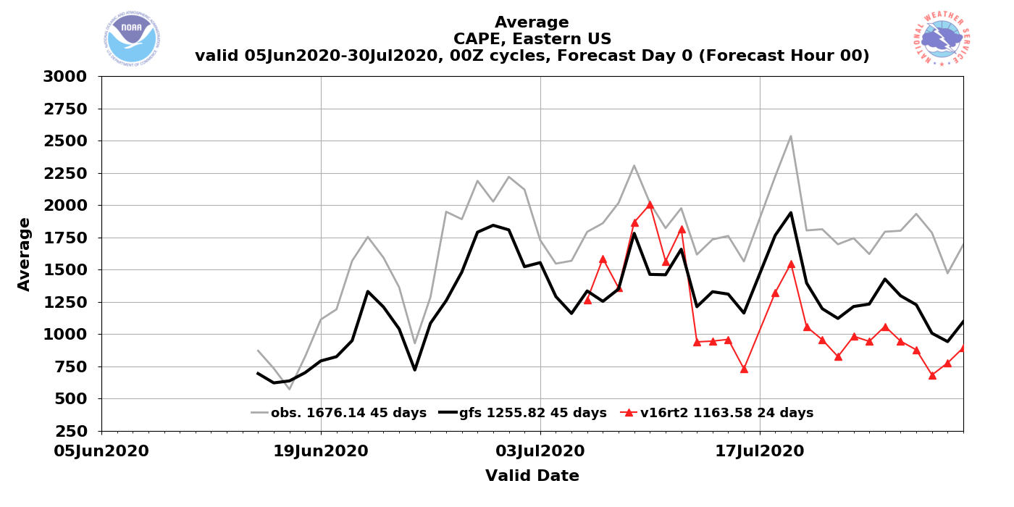
NATIONAL OCEANIC AND ATMOSPHERIC ADMINISTRATION
GFSv16 CAPE (time series of mean values)
Surface-based CAPE
Observations
GFSv15
GFSv16
Eastern US – Summer 2020 (F000)
CAPE was already low in GFSv15, and now lower in GFSv16
CAPE was fixed in real-time parallel on 13 July 2020

Slide 38
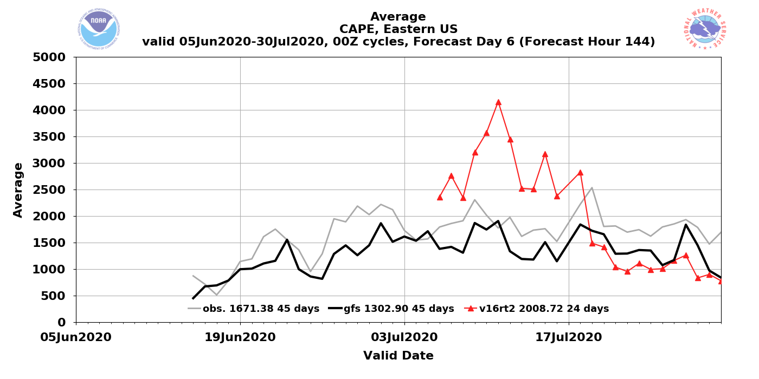
NATIONAL OCEANIC AND ATMOSPHERIC ADMINISTRATION
GFSv16 CAPE (time series of mean values)
Surface-based CAPE
Observations
GFSv15
GFSv16
Eastern US – Summer 2020 (F144)
CAPE was already low in GFSv15, and now lower in GFSv16
CAPE was fixed in real-time parallel on 13 July 2020

Slide 39
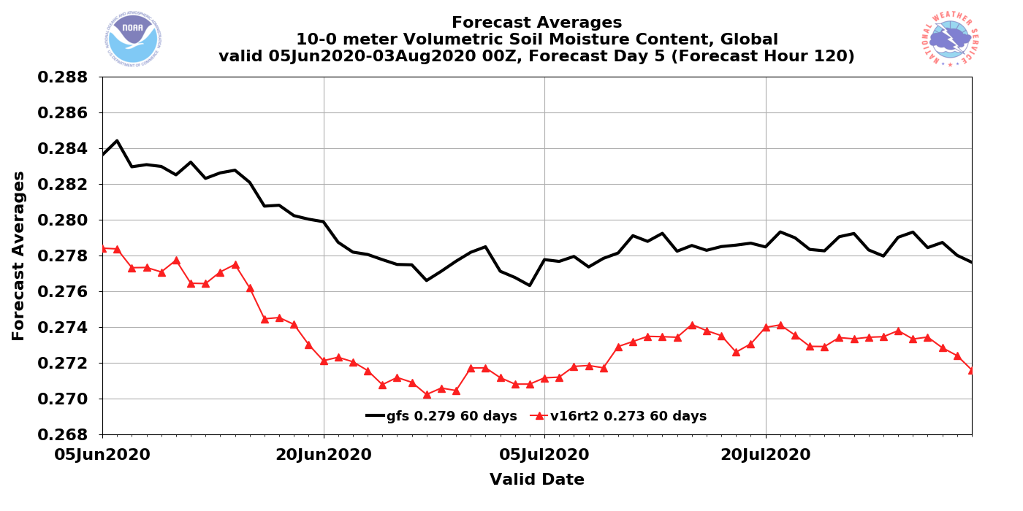
NATIONAL OCEANIC AND ATMOSPHERIC ADMINISTRATION
Soil Moisture (time series of mean values)

Slide 40
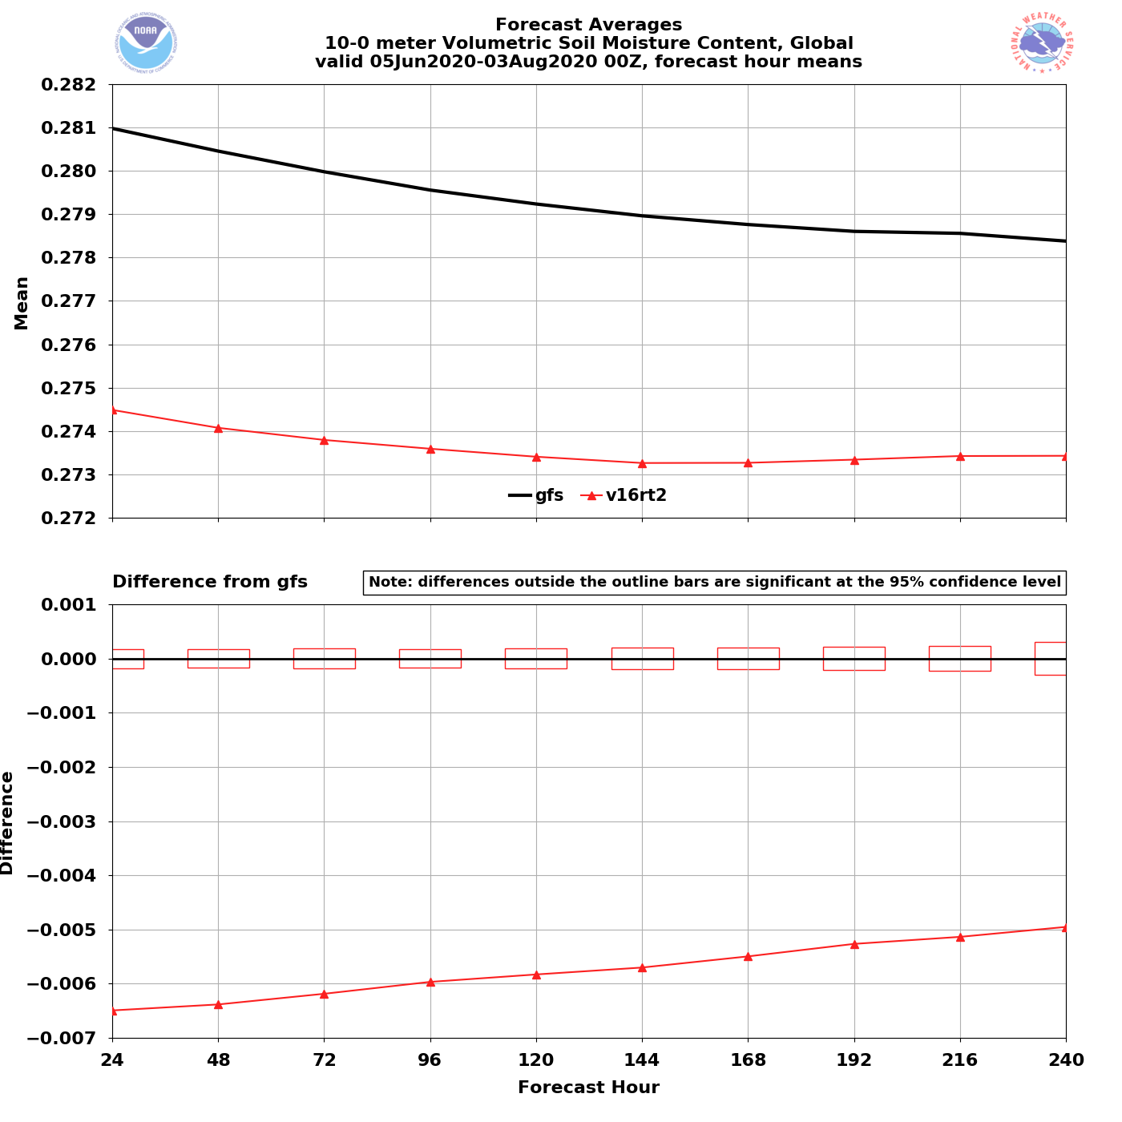
NATIONAL OCEANIC AND ATMOSPHERIC ADMINISTRATION
Soil Moisture (dieoff curve mean values)

