Slide 1
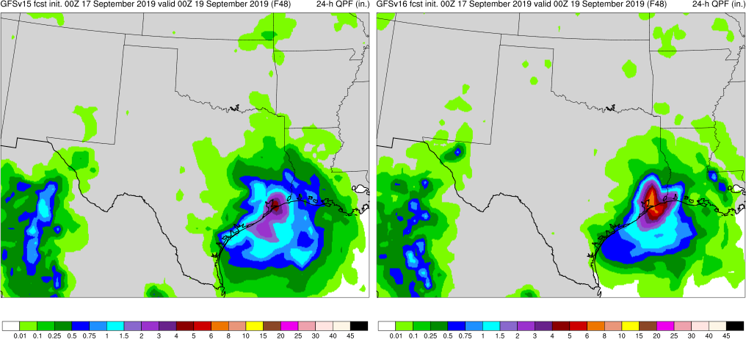
GFSv16 Evaluation Kickoff
NATIONAL OCEANIC AND ATMOSPHERIC ADMINISTRATION
Geoff Manikin, Alicia Bentley, Shannon Shields, Philippe Papin,
Logan Dawson, and Chris Macintosh Model Evaluation Group
Fanglin Yang and Russ Treadon GFSv16 Project Leads
Vijay Tallapragada GFSv16 Project Manager
Jason Levit Evaluation Project Manager
MEG WEBINAR July 16, 2020

Slide 2
NATIONAL OCEANIC AND ATMOSPHERIC ADMINISTRATION
Acknowledgements
Project Manager: Vijay Tallapragada
Project Leads: Fanglin Yang, Russ Treadon
Model: Jongil Han, Jack Kain, Weizhong Zheng, George Gayno, Helin Wei, Ruiyu Sun, Moorthi Shrinivas, Anning Chen, Rongqian Yang, Xingren Wu, Xiaqiong Zhou, Valery Yudin, Youlong Xia, Jesse Meng, Henrique Alves, Roberto Padilla, Jessica Meixner, Ali Abdolali
Data Assimilation: Jeff Whitaker, Catherine Thomas, Cory Martin, Wanshu Wu, Haixia Liu, Kristen Bathmann, Andrew Collard, Xu Li, Yanqiu Zhu, Xiujuan Su, Shelley Melchior, Sudhir Nadiga, Steve Stegall
VPPGB: Hui-ya Chuang, Wen Meng, Boi Vuong, Mallory Row, Guang-Ping Lou, Yali Ma, Jiayi Peng, Deanna Spindler, Todd Spindler, Roberto Padilla, Geoff Manikin, Alicia Bentley, Logan Dawson, Shannon Shields, Chris Macintosh, Philippe Papin
Infrastructure : Jun Wang, Kate Friedman, Mark Iredell, Hang Lei, Eric Rogers, George Vandenberghe, James Abeles, Gerhard Theurich, Edward Hartnett, Farida Adimi
Management: Arun Chawla, Jason Levit, Avichal Mehra, Daryl Kleist, Jian-Wen Bao
NCO: Carissa Klemmer, Steven Earle, Anne Myckow, data-flow team
External Collaborators: GFDL, GSL, PSL and NCAR/CGD

Slide 3
NATIONAL OCEANIC AND ATMOSPHERIC ADMINISTRATION
History of GFS Implementations
Mon/Year | Lev | Truncations | Z-cor/dyncore | Major components upgrade
Aug 1980 | 12 | R30 (375km) | Sigma Eulerian | first global spectral model, rhomboidal
Oct 1983 | 12 | R40 (300km) | Sigma Eulerian
Apr 1985 | 18 | R40 (300km) | Sigma Eulerian | GFDL Physics
Aug 1987 | 18 | T80 (150km) | Sigma Eulerian | First triangular truncation; diurnal cycle
Mar 1991 | 18 | T126 (105km) | Sigma Eulerian
Aug 1993 | 28 | T126 (105km) | Sigma Eulerian | Arakawa-Schubert convection
Jun 1998 | 42 | T170 (80km) | Sigma Eulerian | Prognostic ozone; SW from GFDL to NASA
Oct 1998 | 28 | T170 (80km) | Sigma Eulerian | the restoration
Jan 2000 | 42 | T170 (80km) | Sigma Eulerian | first on IBM
Oct 2002 | 64 | T254 (55km) | Sigma Eulerian | RRTM LW;
May 2005 | 64 | T382 (35km) | Sigma Eulerian | 2L OSU to 4L NOAH LSM; high-res to 180hr
May 2007 | 64 | T382 (35km) | Hybrid Eulerian | SSI to GSI
Jul 2010 | 64 | T574 (23km) | Hybrid Eulerian | RRTM SW; New shallow cnvtion; TVD tracer
Jan 2015 | 64 | T1534 (13km) | Hybrid Semi-Lag | SLG; Hybrid EDMF; McICA etc
May2016 | 64 | T1534 (13km) | Hybrid Semi-Lag | 4-D Hybrid En-Var DA
Jun2017 | 64 | T1534 (13km) | Hybrid Semi-Lag | NEMS GSM, advanced physics
Jun 2019 | 64 | FV3 (13km) | Finite-Volume | NGGPS FV3 dycore, GFDL MP
Last change
to # of levels
occurred in 2002

Slide 4
NATIONAL OCEANIC AND ATMOSPHERIC ADMINISTRATION
Goals of the GFSv16 Upgrade
Improve handling of inversions in the PBL
Reduce the cold bias in the lower troposphere in winter
Reduce surface temperature biases
Improve forecasts in the upper atmosphere
Replace the operational Global Wave Deterministic (Multi_1) model with the wave component coupled to the atmosphere (in GFSv16)

Slide 5
NATIONAL OCEANIC AND ATMOSPHERIC ADMINISTRATION
Major Changes
Model resolution:
Increased vertical resolution from 64 to 127 layers and model top raised from 54 km to 80 km
Physics updates
PBL/turbulence: K-EDMF => sa-TKE-EDMF
Orographic Gravity Wave Drag: => Orographic + non-orographic GWDs
Radiation: updates to cloud-overlap assumptions
Microphysics: Improvements to GFDL MP
Coupling to Wave
One-way coupling of atmospheric model with Global Wave Model (GWM)
Major Data Assimilation Upgrades:
Local Ensemble Kalman Filter (LETKF)
4-Dimensional Incremental Analysis Update (4DIAU)
Height increments are added, and specific humidity increments are reduced in the stratosphere and mesosphere
Improved Near Surface Sea Temperature (NSST) analysis
Land Data Assimilation (GLDAS) for spinning up soil moisture

Slide 6
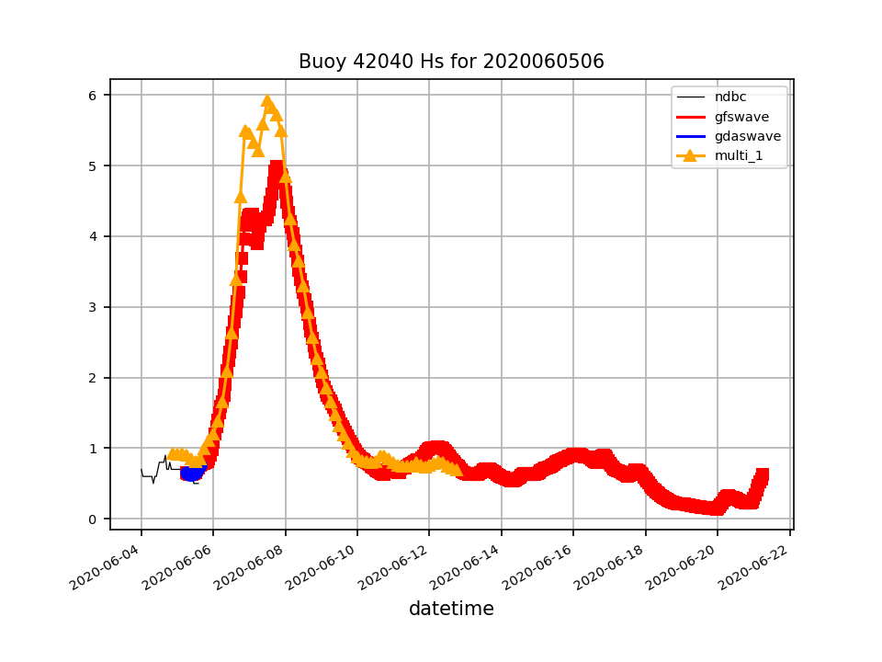
NATIONAL OCEANIC AND ATMOSPHERIC ADMINISTRATION
Changes to Waves
Deanna Spindler, Todd Spindler, Jessica Meixner
Upgrades to the NCEP Global Wave Model include:
- Unification with the GFS via 1-way coupling
- Grid redesign. All regional and global grids replaced by:
* 9km polar stereographic cap at +50N to the north pole
* Regular northern hemisphere 10 arcmin grid 12.5S-55N
* Regular southern hemisphere 15 arcmin grid
- Ocean surface-current forcing (RTOFS)
- Improved physics: source-term coefficients were tuned using an objective framework
- Extended forecast range, from 240h (10 days) to 384h (16 days)

Slide 7
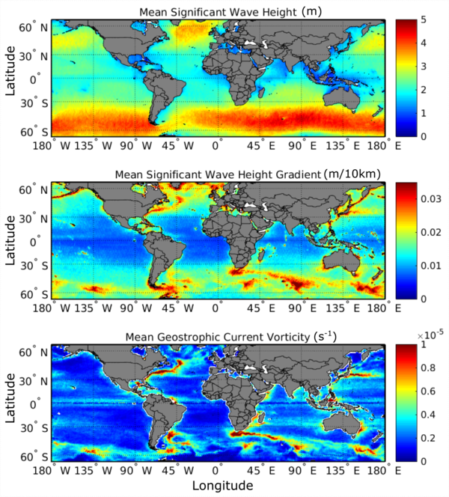
NATIONAL OCEANIC AND ATMOSPHERIC ADMINISTRATION
RTOFS Surface Current Forcing
Waves against current
Steeper
Wind opposing current
Stronger forcing

Slide 8
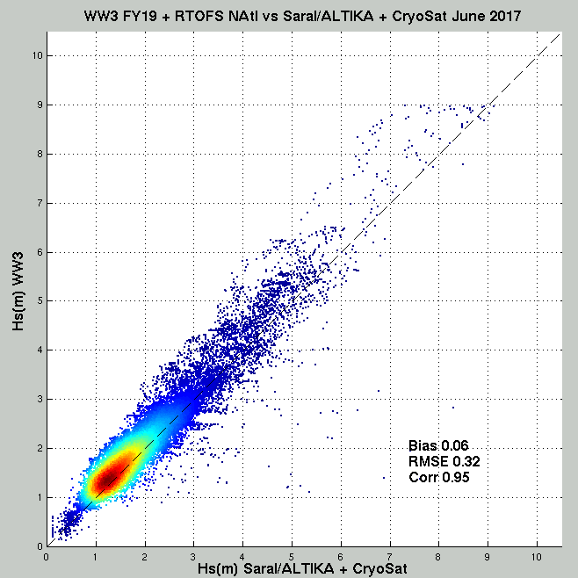
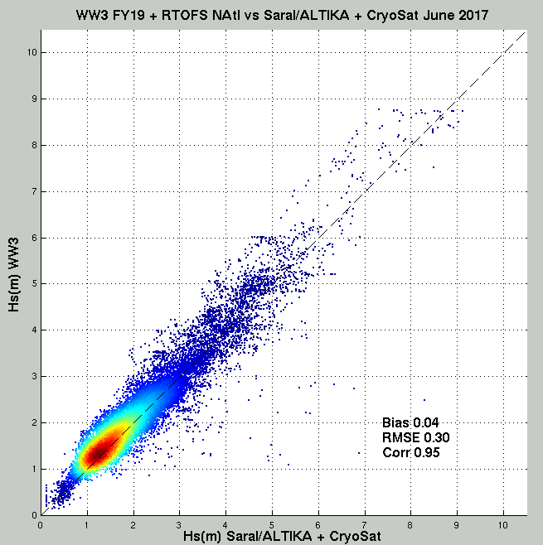
NATIONAL OCEANIC AND ATMOSPHERIC ADMINISTRATION
RTOFS Current and North Atlantic Wave Height
Wave model vs
altimeter wave
heights (Hs) in
the North Atlantic
June 2017
Left: no currents; Right: RTOFS surface current effects included,
RMS error and Bias significantly reduced.

Slide 9
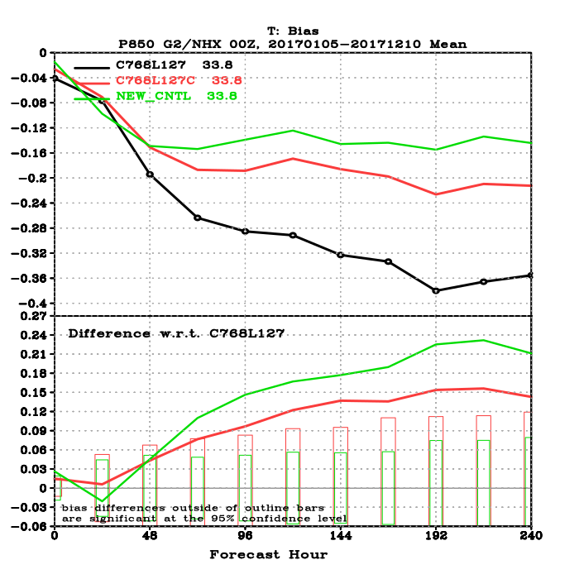
An attempt to upgrade to NOAH MP Land-Surface Model
Noah
Noah-MP
Reduced temperature bias in the lower troposphere
Single
surface temperature
Multiple surface temperatures and distinct canopy
C768L127 GFS forecasts initialized with IFS ICs, every 10 days for the period from Jan 5 through Dec 31, 2017.
Temperature biases on 850 hPa in the Northern Hemisphere (20N-80N), verified against IFS analyses
T_{can}
T_{skin}
Noah-MP
T_{snow}(z)
T_{bc}
Snow
T_{g}
Snow
Noah LSM
3-layer snow
9

Slide 10
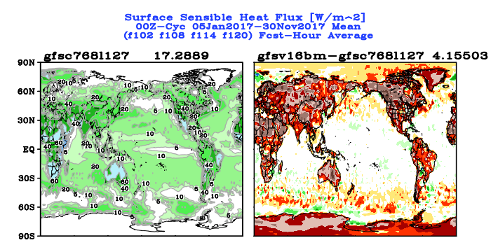
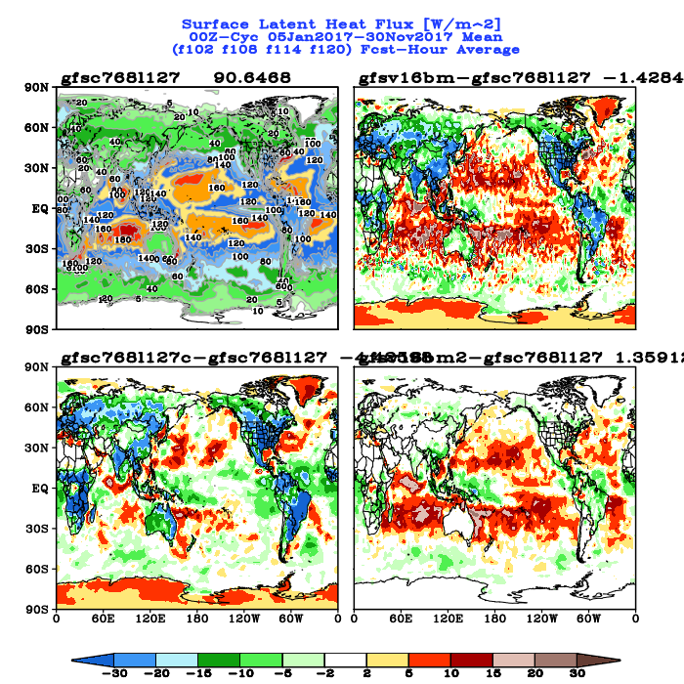
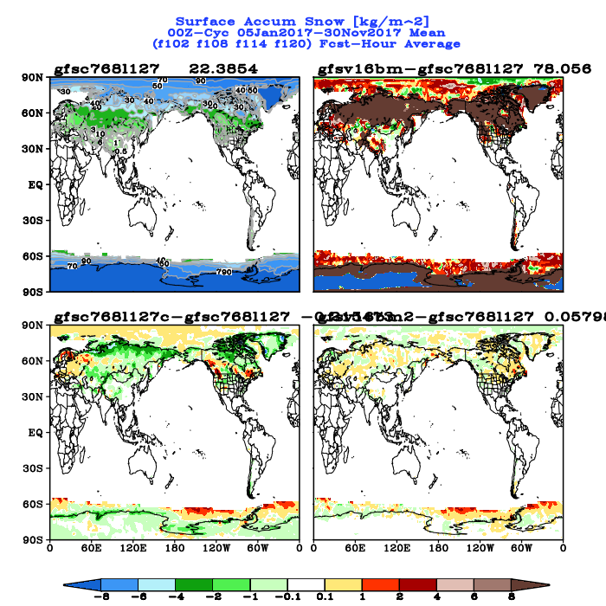
However …… including Noah-MP brought other issues
NATIONAL OCEANIC AND ATMOSPHERIC ADMINISTRATION
Problems with NOAH MP LSM
SH
LH
Excessive SH
Reduced LH
Too much snow (a spin-up issue)
Snow
- Needs further development
- Removed from GFSv16 upgrade
- New ground heat flux calculation over
snow is retained

Slide 11
NATIONAL OCEANIC AND ATMOSPHERIC ADMINISTRATION
Initial Testing of the GFSv16 Upgrade
FH102, US night
Summer 2019
FH108, US morning
COLDER
T2m Diffs
Test - Ops
FH114, US midday
FH120, US late afternoon

Slide 12
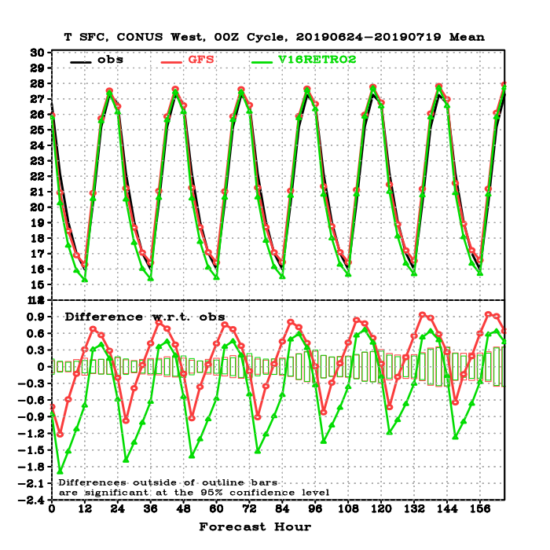
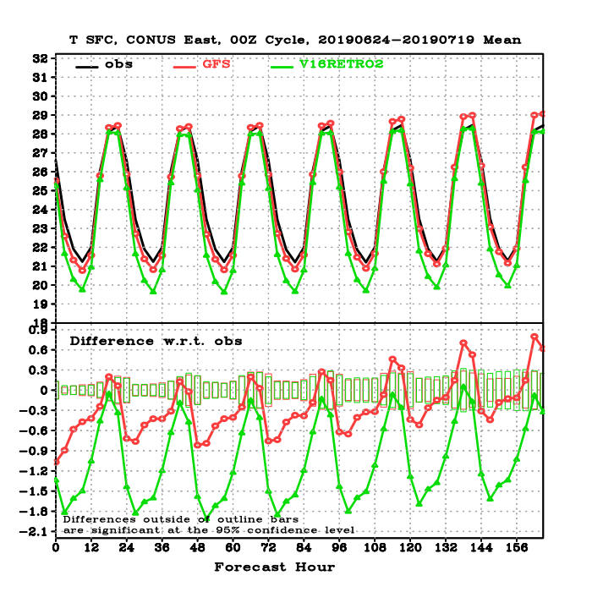
NATIONAL OCEANIC AND ATMOSPHERIC ADMINISTRATION
Initial Testing of the GFSv16 Upgrade
CONUS West
CONUS East
OBS
OPS GFS
TEST GFS
T2m Verification
against station observations
Test clearly incorrectly much colder late at night

Slide 13
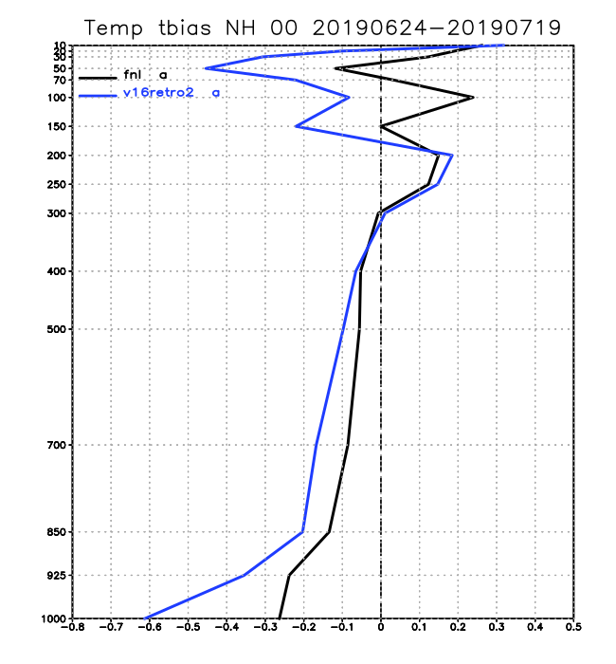
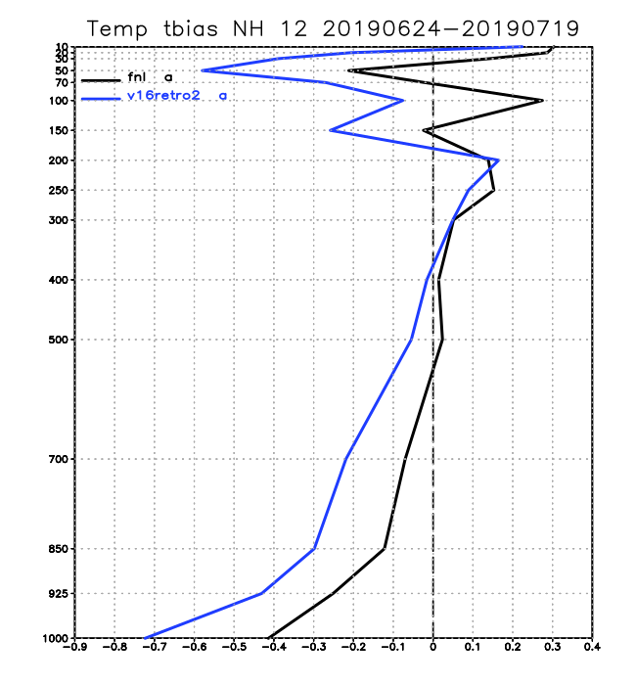
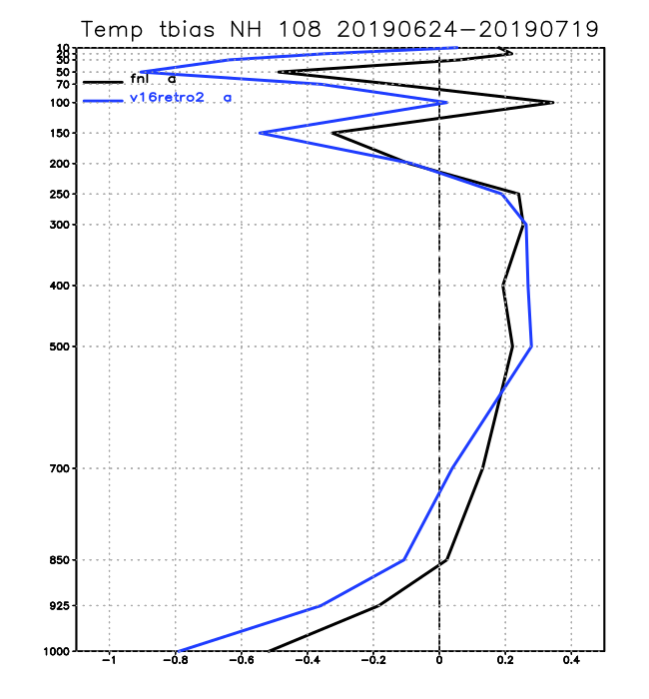
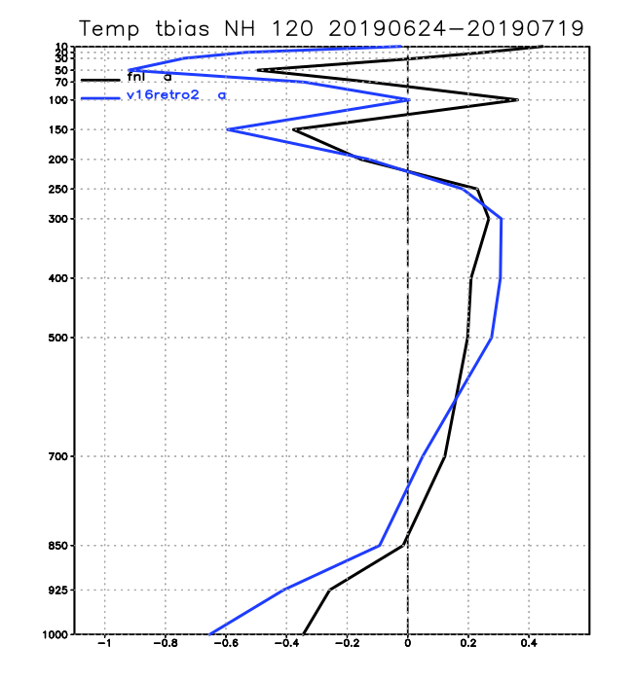
NATIONAL OCEANIC AND ATMOSPHERIC ADMINISTRATION
Initial Testing of the GFSv16 Upgrade
Summer 2019
Temperature Verification against Rawinsonde Observations
NH FH00
NH FH12
NH FH108
NH FH120
OPS GFS
TEST GFS
Again, the test was noticeably colder in the lower troposphere

Slide 14
NATIONAL OCEANIC AND ATMOSPHERIC ADMINISTRATION
Early April 2020 Updates
Changes were made to the real-time parallel and summer retrospective stream, based on a series of sensitivity experiments, to reduce the low-level cold bias
Use an increased minimum mixing length (10m => 15m) and background diffusivity (0.1m^2/s => 0.15 m^2/s) in the inversion layers, which were expected to decrease low clouds and to increase downward heat transport in nighttime.
Turn on canopy heat storage parameterization (CHSP)
Use an updated thermal roughness length computation

Slide 15
NATIONAL OCEANIC AND ATMOSPHERIC ADMINISTRATION
Early May 2020 Concerns
During the first week of May, issues were noted:
Overall, the surface cold biases had been reduced in CONUS West and East, but large cold biases still existed in a few sub-regions (e.g., NEC, NWC, and APL) in all GFSv16 parallels
Verified to RAOBS, GFSv16 still had larger cold biases than the current operational model in both analyses and forecasts in the lower troposphere.

Slide 16
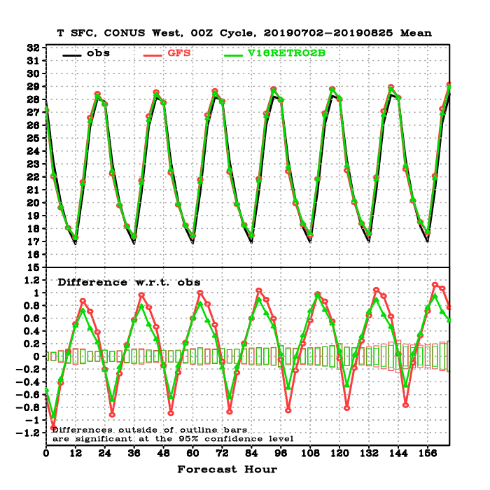
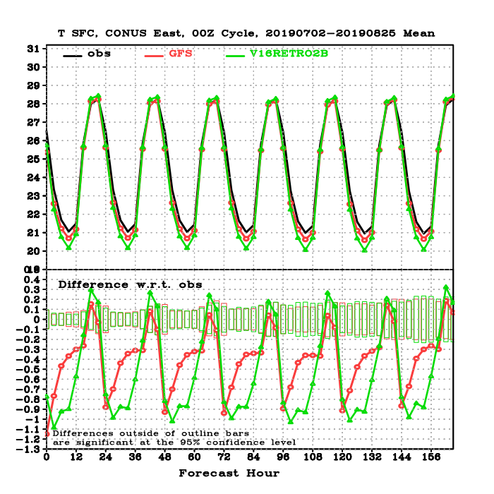
NATIONAL OCEANIC AND ATMOSPHERIC ADMINISTRATION
Early May 2020 Concerns
CONUS West
CONUS East
OBS
OPS GFS
TEST GFS
T2m Verification
against station observations
Test clearly still too cold at night in the east

Slide 17
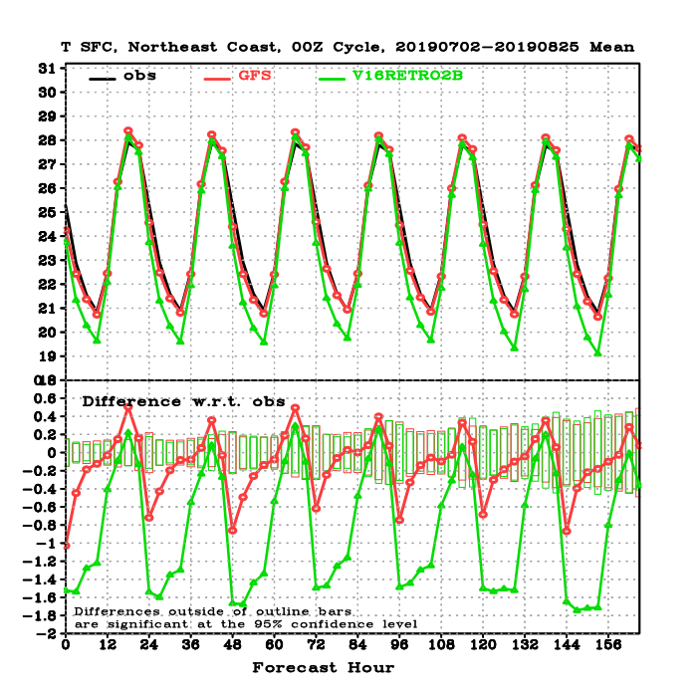
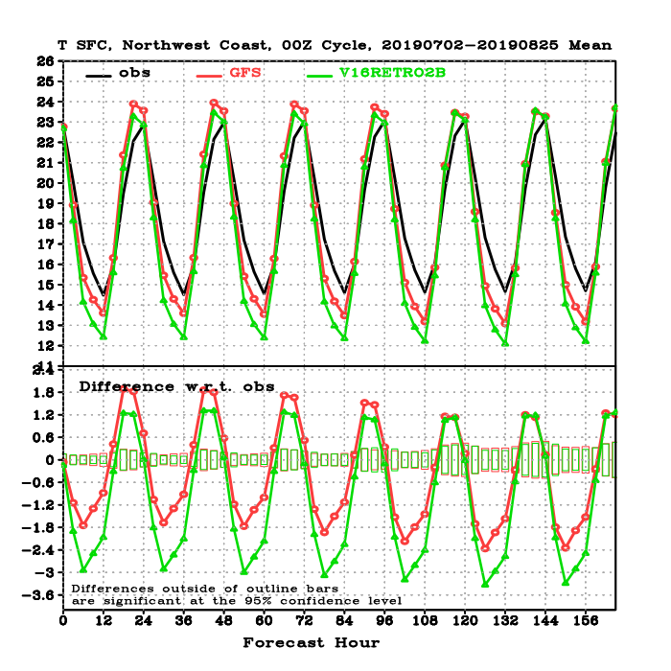
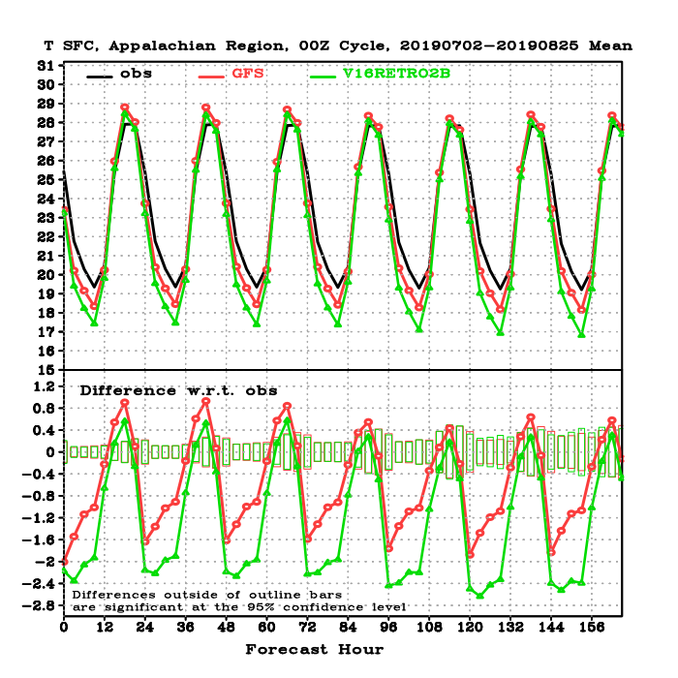
NATIONAL OCEANIC AND ATMOSPHERIC ADMINISTRATION
Early May 2020 Concerns
OBS
OPS GFS
TEST GFS
T2m Verification
against station observations
Northeast
Northwest
Appalachians

Slide 18
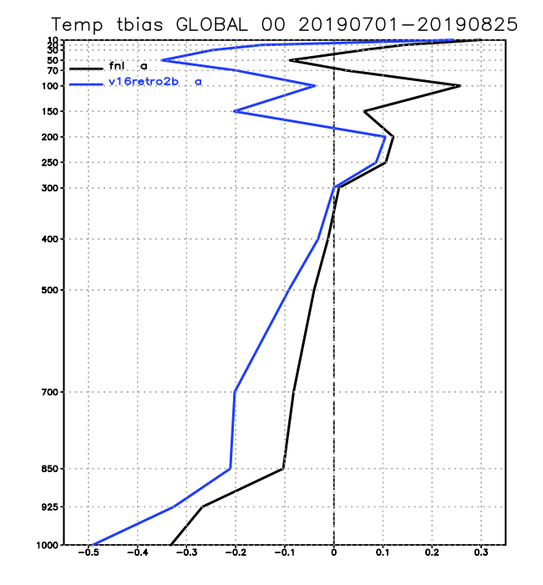
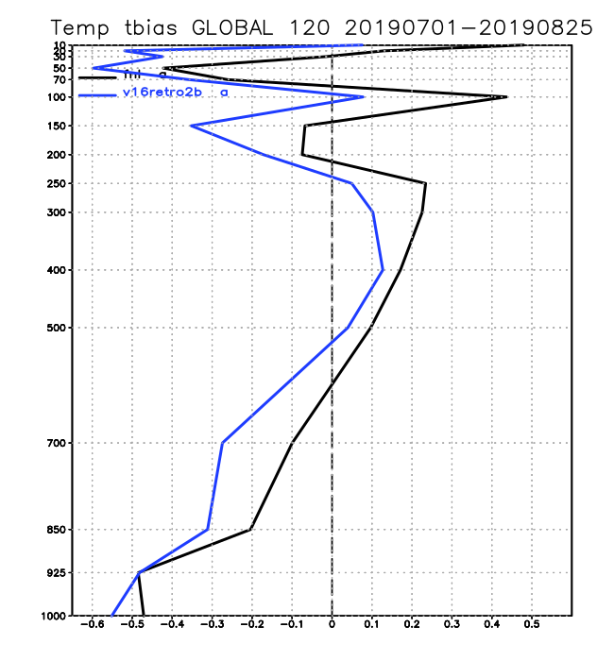
NATIONAL OCEANIC AND ATMOSPHERIC ADMINISTRATION
Early May 2020 Concerns
Temperature Biases Verified against RAOBS, summer 2019 (retro2b)
GLB, Analysis
GLB, FH120
OPS GFS
TEST GFS

Slide 19
NATIONAL OCEANIC AND ATMOSPHERIC ADMINISTRATION
Early May 2020 Updates
Based on these findings, EMC management was asked to consider 3 options in early May
Option 1 was to freeze the retro tests, make changes, reset clock for real-time experiment, run forecast-only experiments up to the date at which the retros were frozen, and then resume fully cycled retro experiments
Option 2 was to make changes, reset the clock for the real-time experiment, and then completely redo the retro experiments
Option 3 was to cancel the implementation and return to development
Option 2 was approved

Slide 20
NATIONAL OCEANIC AND ATMOSPHERIC ADMINISTRATION
Early May 2020 Updates
Removal of a constraint from the TKE-EDMF PBL scheme over land that limits the strength of vertical mixing under stable boundary layer conditions. This constraint often causes decoupling between the atmosphere and the underlying surface, leading to surface cold biases under these conditions
An update was made to the cumulus convective scheme to increase maximum cloud-base mass flux which increases convective precipitation and subsidence warming in the lower troposphere
In response to CPC’s evaluation of the GFSv16 parallels, divergence and vorticity damping in the upper atmosphere was reduced to enhance the strength of upper atmosphere jet streams
A solar radiation bug in the RRTM-global (which has a minor impact on radiation balance in the mesosphere) was fixed

Slide 21
NATIONAL OCEANIC AND ATMOSPHERIC ADMINISTRATION
Regarding the Vertical Mixing Change
By analyzing GFSv16 summer retrospective parallel and performing several sensitivity tests, Weizhong Zheng found that the cold biases in v16rt2 (the GFSv16 configuration at that time) mostly occur under clear sky and weak wind conditions, e.g., very stable boundary conditions.
TKE-EDMF puts an upper-bound constraint on the strength of vertical mixing over inversion layers, but does not have a lower-bound constraint. Very small or zero vertical mixing can lead to land-atmosphere decoupling, causing surface cold biases.
This constraint was removed.

Slide 22
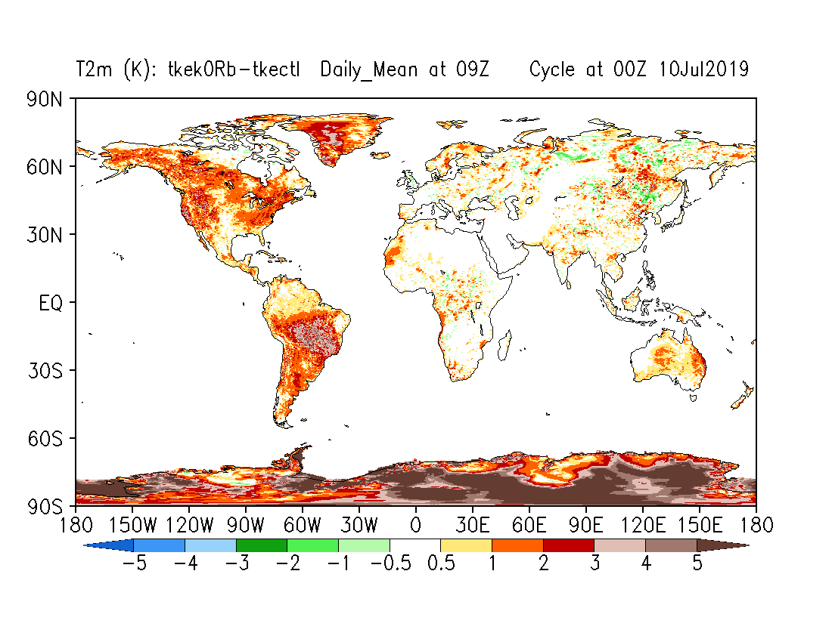
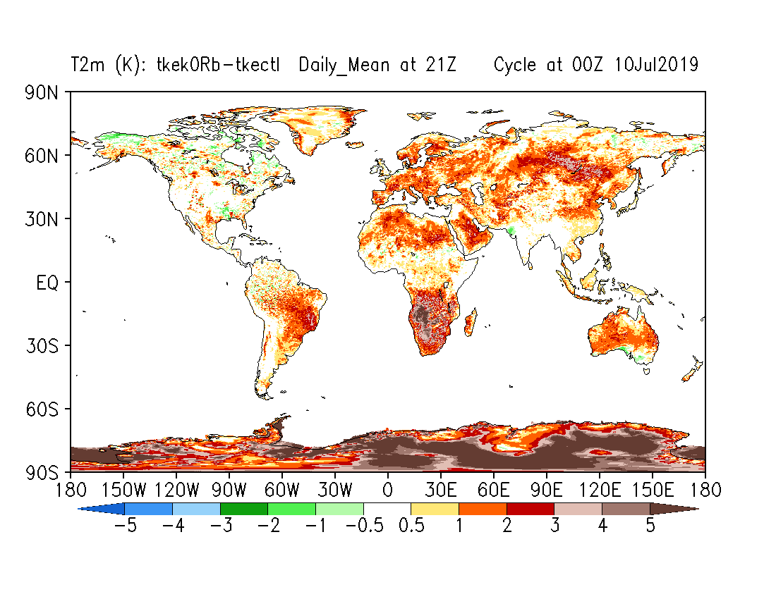
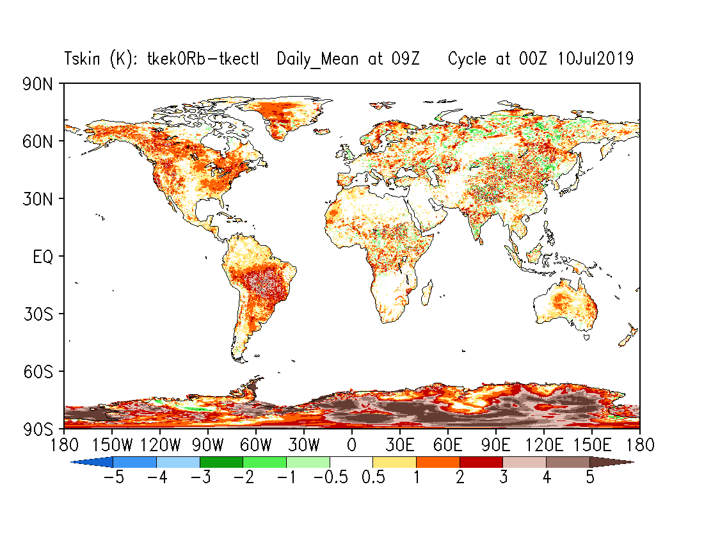
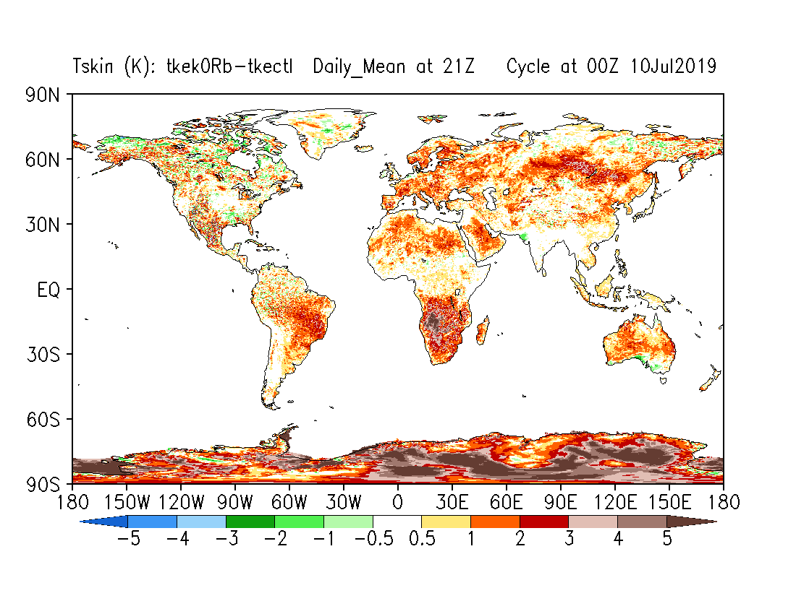
Forecast-only runs: T2m & Tskin Differences EXP-CTL IC 00Z,10 Jul 2019
tkeK0Rb-tkectl
CTL: Model version before the early April upgrade.
T2m_09Z
T2m_21Z
Ave: FH00-144
Tskin_09Z
Tskin_21Z
Substantially increased T2m and Tskin globally, especially nighttime.

Slide 23
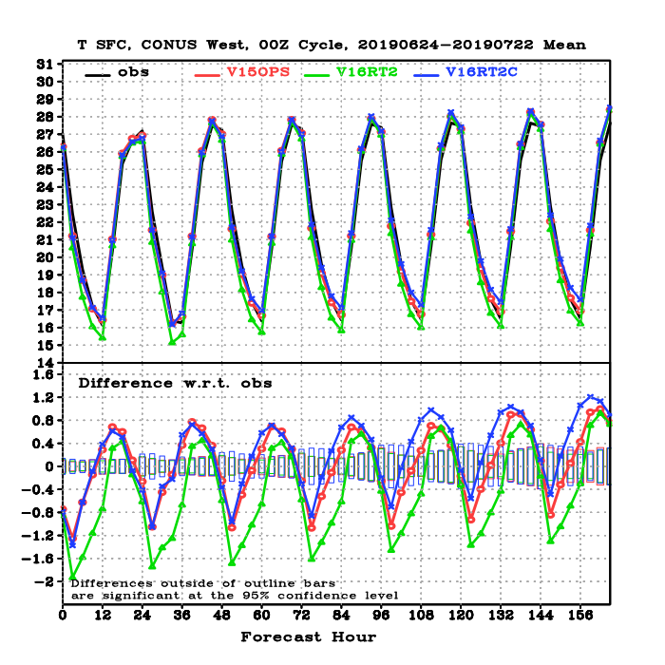
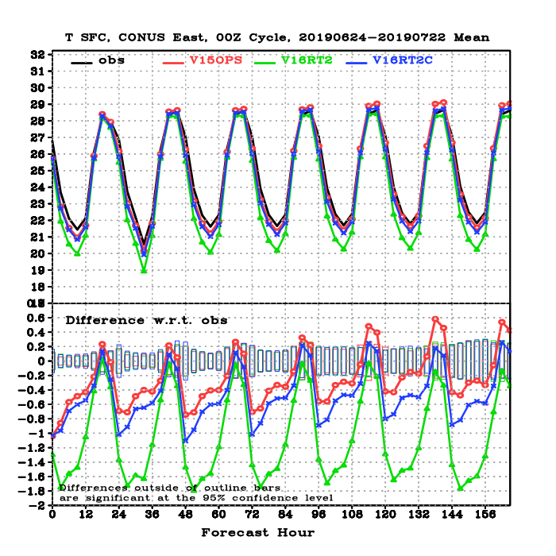
NATIONAL OCEANIC AND ATMOSPHERIC ADMINISTRATION
Impact of May 2020 Updates
West CONUS
East CONUS
OBS
OPS GFS
GFSv16 April Ver
GFSv16 Test
T2m Verification
against station observations
V16Test: Significantly reduced cold biases over east in the late afternoon and nighttime
(up to 1.2 ºC). Reduced cold bias in west, slight warm bias at night

Slide 24
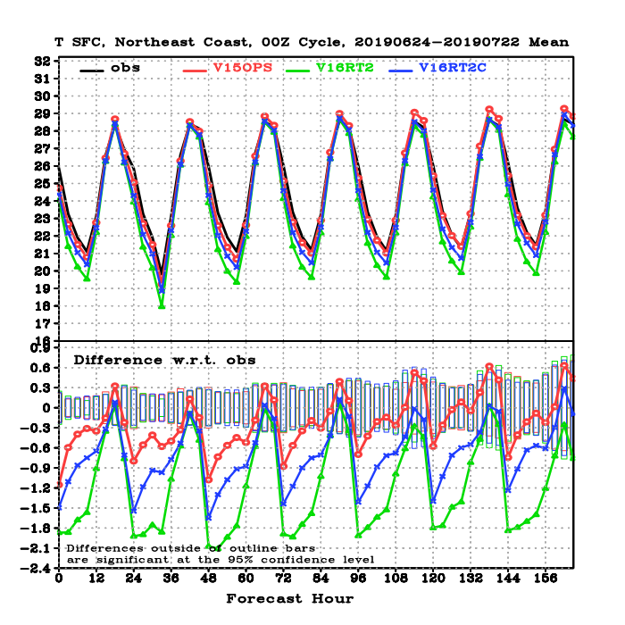
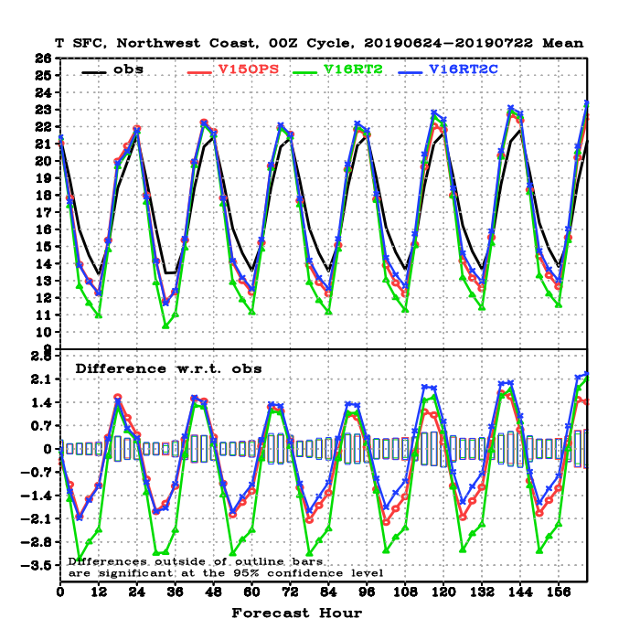
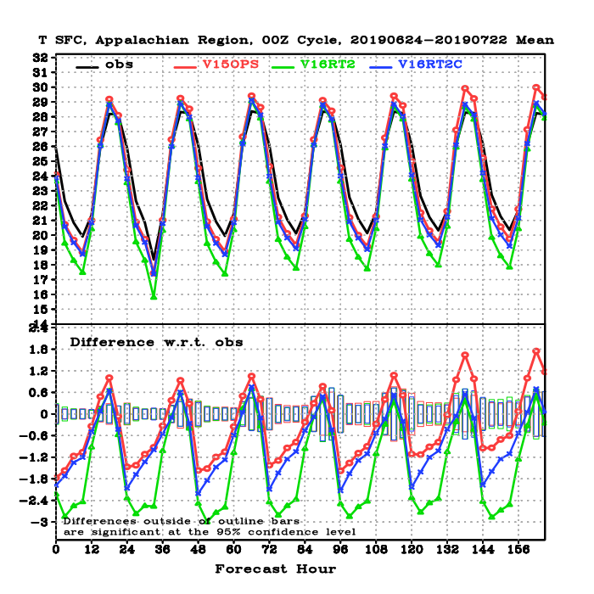
NATIONAL OCEANIC AND ATMOSPHERIC ADMINISTRATION
Impact of May 2020 Updates
Northeast
Northwest
Appalachians
Cold bias significantly reduced, although still colder than v15 in some regions

Slide 25
NATIONAL OCEANIC AND ATMOSPHERIC ADMINISTRATION
Upper Atmospheric Forecasts
Issue: Craig Long (CPC) demonstrated that upper atmospheric jets in early versions of GFSv16 were too weak at longer forecast lengths and that temperatures in the polar regions at night were too warm
Mitigation: reducing divergence and vorticity damping in the upper atmosphere in the GFS forecast cycle

Slide 26
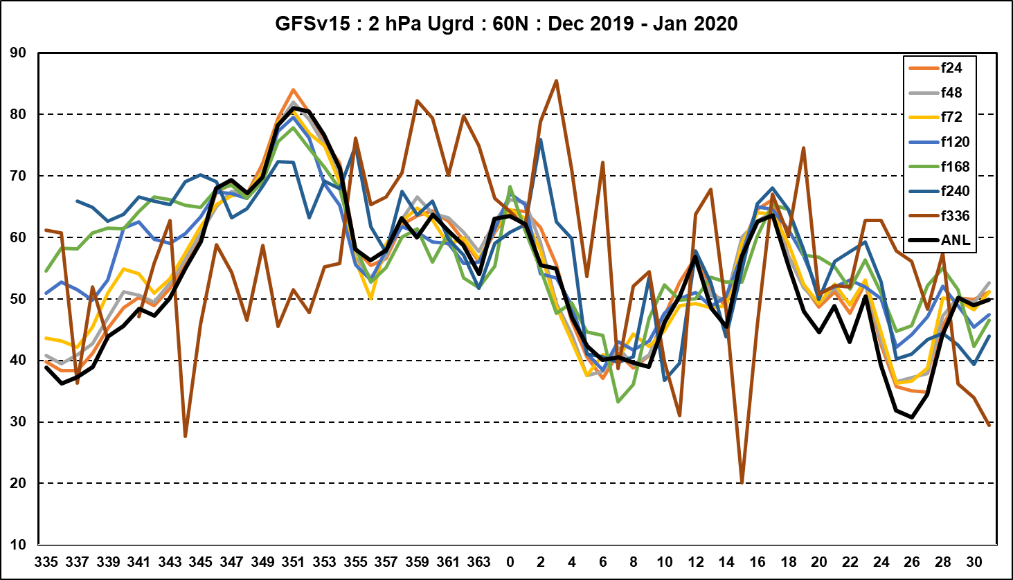
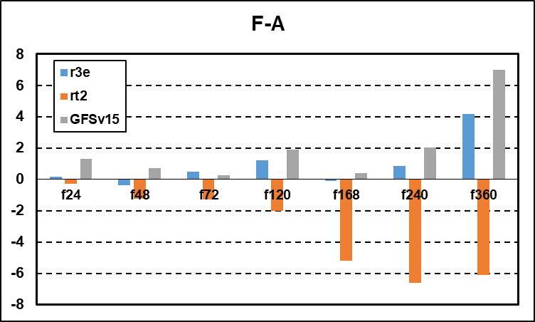
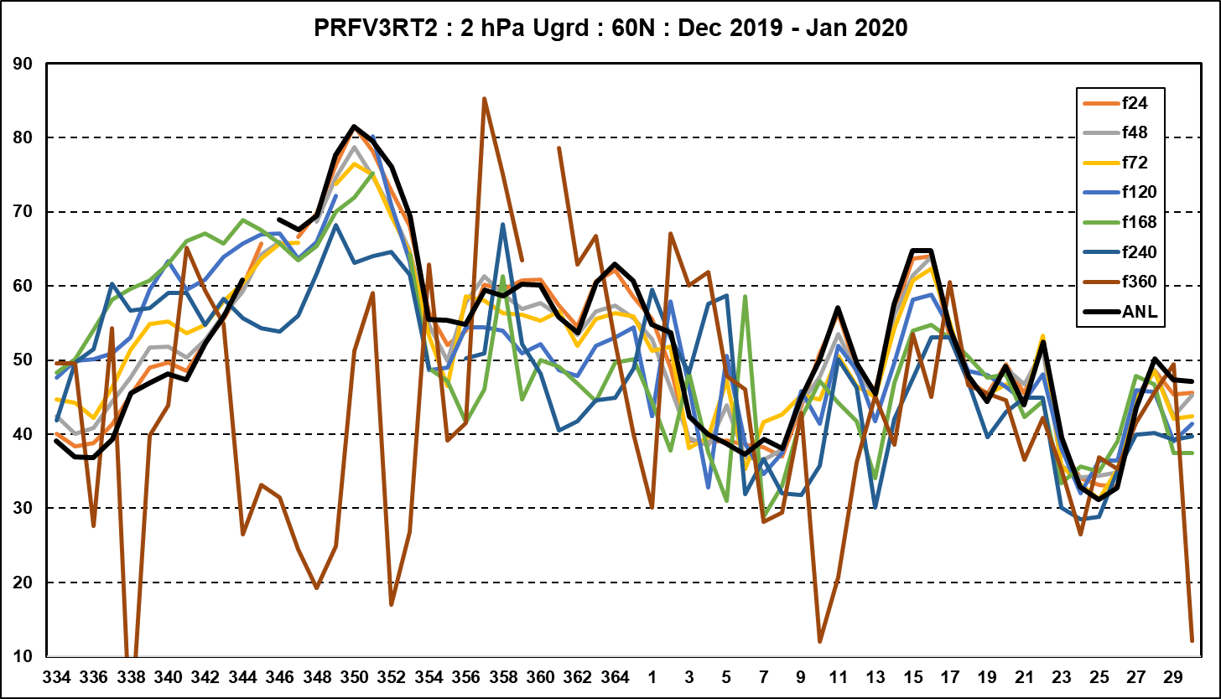
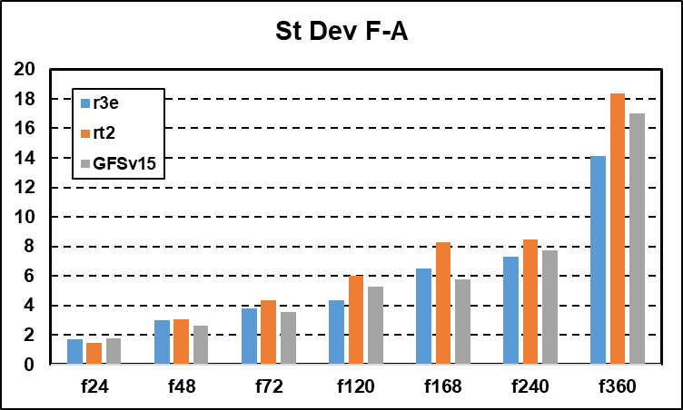
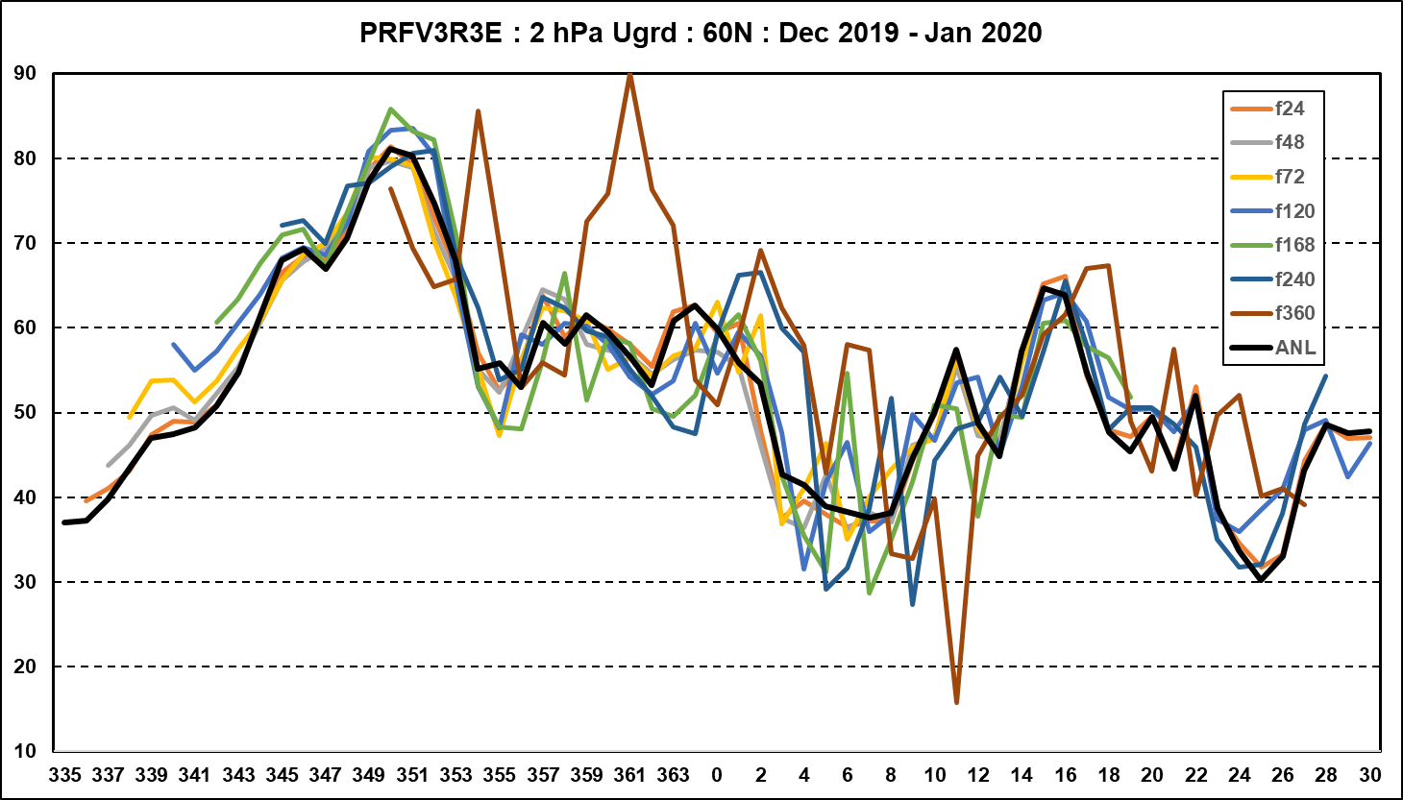
NATIONAL OCEANIC AND ATMOSPHERIC ADMINISTRATION
Upper Atmospheric Forecasts
GFSv15
2 hPa Zonal Wind
60N-90N
Dec 2019 – Jan 2020
Early
GFSv16
Version
Ops GFS
Early GFSv16
Final GFSv16
Final
GFSv16
Version

Slide 27
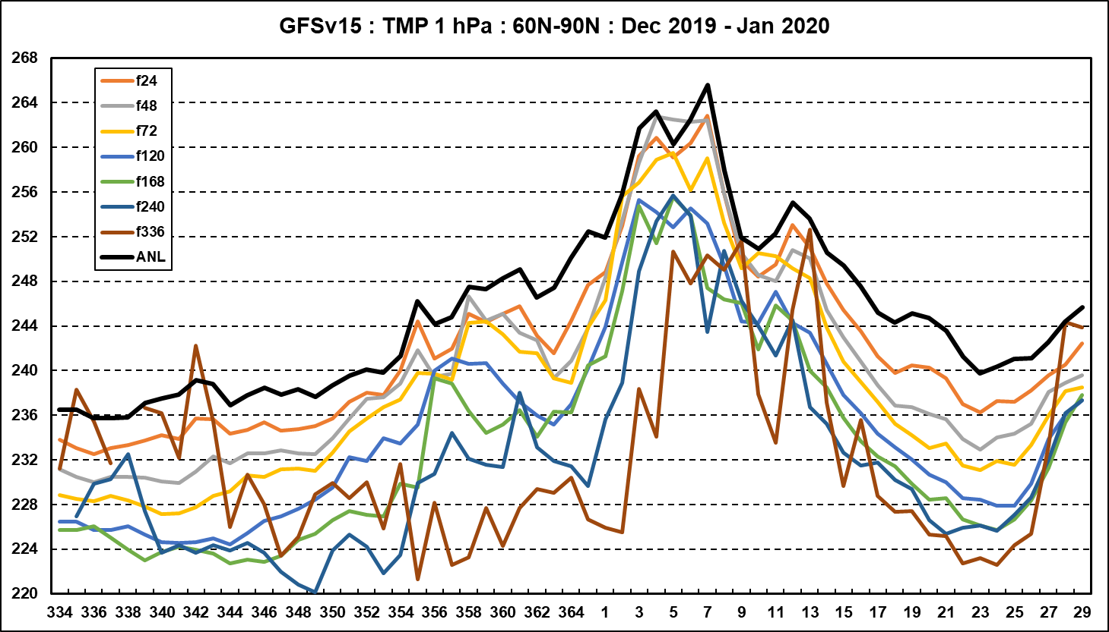
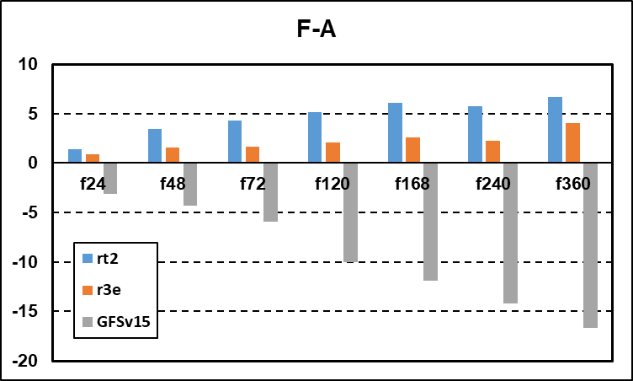
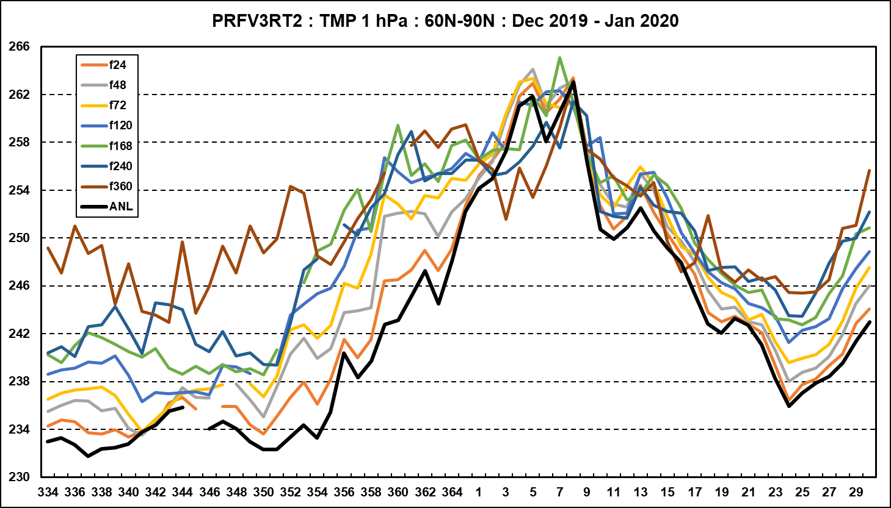
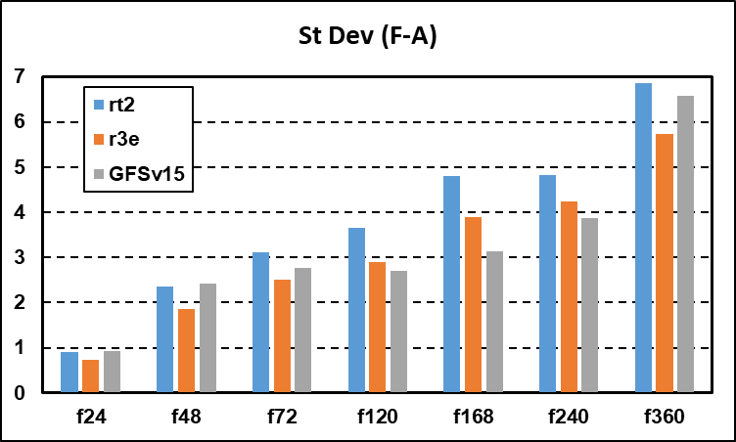
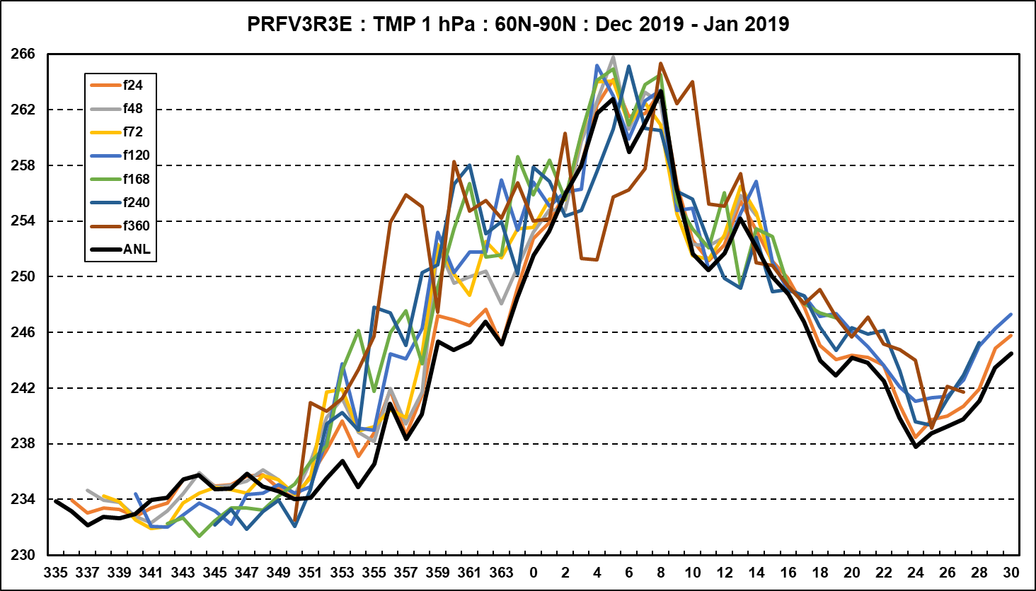
NATIONAL OCEANIC AND ATMOSPHERIC ADMINISTRATION
Upper Atmospheric Forecasts
GFSv15
1 hPa Temperatures
60N-90N
Dec 2019 – Jan 2020
Early
GFSv16
Version
Ops GFS
Early GFSv16
Final GFSv16
Final
GFSv16
Version
Colors are NOT the
same as on previous slide

Slide 28
NATIONAL OCEANIC AND ATMOSPHERIC ADMINISTRATION
Product Changes – Atmospheric Parameters
Unification: All isobaric state fields in pgrb2 files will have the same 41 levels at all forecast hours
New products:
Add more pressure levels (at 0.01, 0.02, 0.04, 0.07, 0.1, 0.2, 0.7 hPas) in the upper stratosphere and the mesosphere in pgrb2 files
Other new parameters include ceiling, instantaneous total column and low/mid/high cloud fractions, and radar reflectivity at 1 km/4 km and 1st/2nd model level above ground.
Replaced products:
Replace filtered Shuell SLP with unfiltered one using same ID PRMSL
Replace legacy synthetic nadir GOES 12/13 with synthetic nadir ABI GOES-R products
Products moved to different files:
Isobaric SPFH moved from pgrb2b to pgrb2 files and removed at 16 levels
Turbulence and Icing severity products moved to new file gfs.tHHz.wafs_0p25.fFF.grib2
Changes in Grib2 IDs:
low/middle/high cloud from TCDC to LCDC, MCDC, HCDC
Icing Severity parameter from 234 to 37, mnemonics from ICSEV to ICESEV
See PNS on GFS V16 product removal for information on plans to retire products

Slide 29
NATIONAL OCEANIC AND ATMOSPHERIC ADMINISTRATION
Product Changes – Station Time Series BUFR output
Add in the extra vertical levels
Add station character IDs
Remove terrain adjustments of temperature and moisture profiles
SLP will be reduced from the model surface height
Surface evaporation parameter changed from W/m^2 (sfc latent heat net flux) to kg/m^2 (evaporation)

Slide 30
NATIONAL OCEANIC AND ATMOSPHERIC ADMINISTRATION
Product Changes – WAVES
Removed products (affects com, NOMADS, ftp and NOAAPORT)
Full PNS: https://www.weather.gov/media/notification/pdf2/pns20-33multi_1_removal.pdf
All products from legacy grids awk, enp, wna, nww3, wam
Wave steepness files (wstp)
All 4-arcmin gridded data will be removed (ak_4m, at_4m, wc_4m)
Alaska ak_10m data (replaced by a full Arctic 9km dataset)
Binary forcing files will be removed
csv-bulletins (csbull) will be removed

Slide 31
NATIONAL OCEANIC AND ATMOSPHERIC ADMINISTRATION
Product Changes – WAVES
Changes in products (affects com, NOMADS, ftp and NOAAPORT)
New computational grid grib2 files
Northern hemisphere 0p16
Replaces global 30 arc min and all regional grids
Southern Hemisphere 0p25
Replaces global 30 arcmin
Arctic polar-stereographic 9km
Replaces Arctic 18km
New global extended 0p25
Replaces global extended 30 arcmin

Slide 32
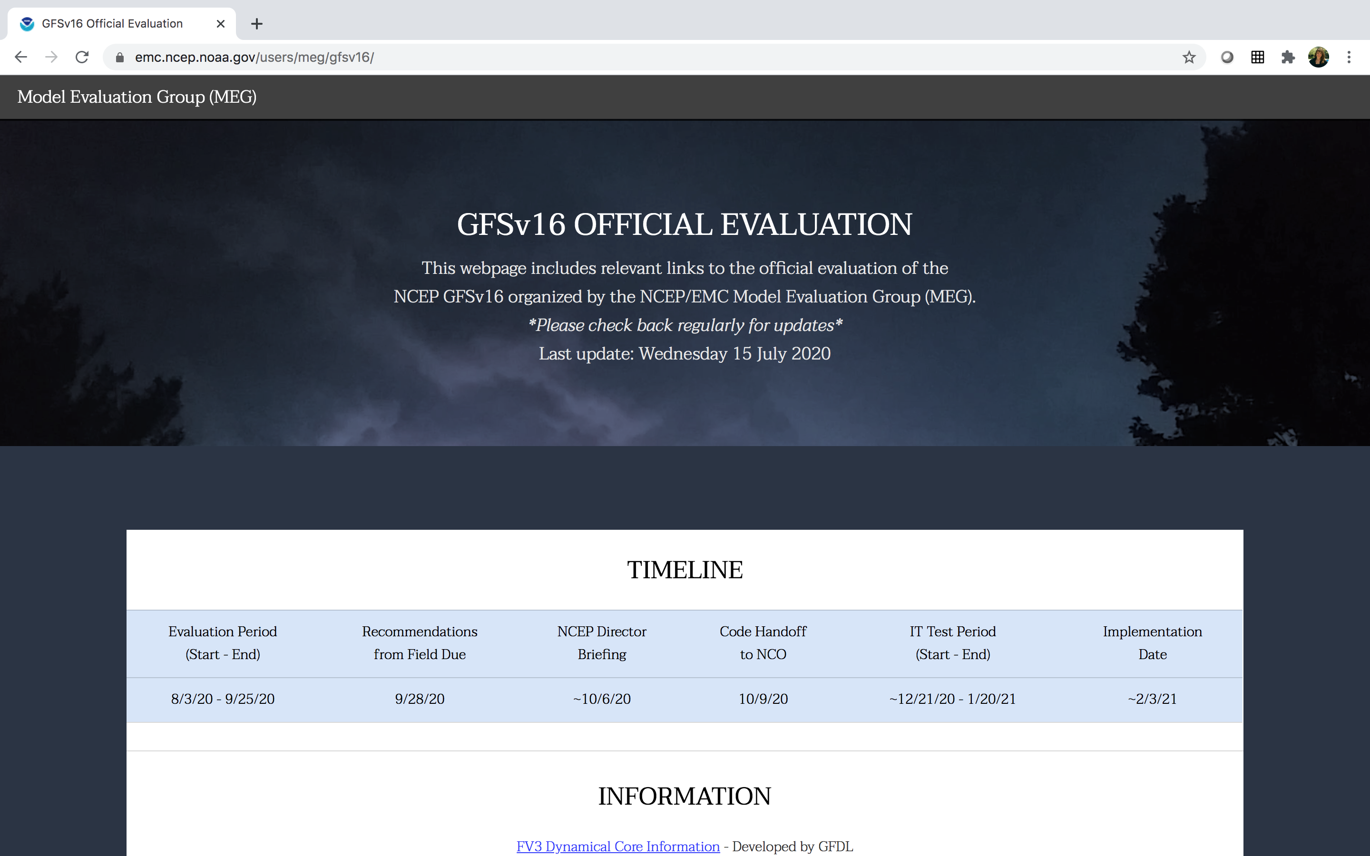
NATIONAL OCEANIC AND ATMOSPHERIC ADMINISTRATION
https://www.emc.ncep.noaa.gov/users/meg/gfsv16/

Slide 33
NATIONAL OCEANIC AND ATMOSPHERIC ADMINISTRATION
GFSv16 Evaluation Details
The GFSv16 official evaluation will include analyses of:
Retrospectives (5/5/19–5/18/20; added 8/31/18–10/12/18)
Statistics
Case Studies
Real-time Parallel (5/19/20–present)
Statistics
Representative examples
The GFSv16 official evaluation will also incorporate the findings of an STI team of NWS SOOs tasked with analyzing GFSv16 forecasts

Slide 34
NATIONAL OCEANIC AND ATMOSPHERIC ADMINISTRATION
GFSv16 Evaluation: Statistics
GFSv16 evaluation statistics will be generated for a variety of streams, which are run in parallel across multiple supercomputers
GFSv16 Retrospective Stream 0 (5/5/19–5/31/19) [Click here]
GFSv16 Retrospective Stream 1 (6/1/19–8/31/19) [Click here]
GFSv16 Retrospective Stream 2 (9/1/19–11/30/19) [Click here]
GFSv16 Retrospective Stream 3 (12/1/19–5/18/19) [Click here]
GFSv16 Real-time Stream (5/19/19–present) [Click here]
GFSv16 Retrospective Stream 0 (5/5/19–5/31/19)
GFSv16 Retrospective Stream 1 (6/1/19–8/31/19)
GFSv16 Retrospective Stream 2 (9/1/19–11/30/19)
GFSv16 Retrospective Stream 3 (12/1/19–5/18/19)
GFSv16 Real-time Stream (5/19/19–present)
Additional Retro TC season (8/31/18–10/12/18) [Click here]

Slide 35
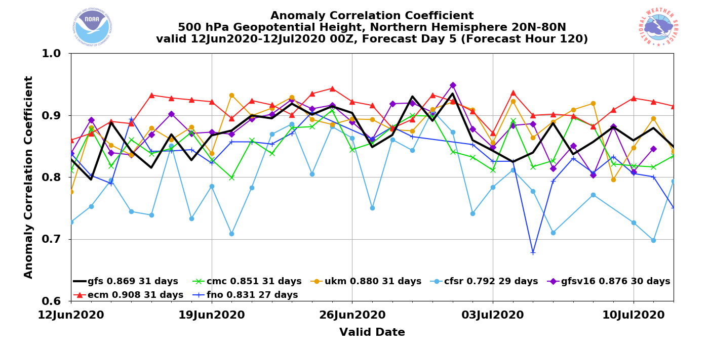
NATIONAL OCEANIC AND ATMOSPHERIC ADMINISTRATION
GFSv16 Evaluation: Statistics
GFSv16 evaluation statistics will be generated using MET/METplus:

Slide 36
NATIONAL OCEANIC AND ATMOSPHERIC ADMINISTRATION
GFSv16 Evaluation: Case Studies (N = 50)
Tropical Cyclones
Winter Storms
North Atlantic
Florence (2018) Michael (2018)
Barry (2019)
Dorian (2019)
Humberto (2019)
Imelda (2019)
Karen (2019)
Lorenzo (2019) Nestor (2019)
Olga (2019)
Arthur (2020)
East Pacific
Barbara (2019) Erick/Flossie (2019)
Juliette (2019)
Kiko (2019)
Lorena (2019)
South Pacific
Sarai (2019)
Northern U.S. October Snow (Oct 2019)
Alaska Snow Storm (Nov 2019)
West Coast Bomb Cyclone (Nov 2019)
Chicago Thanksgiving Travel (Nov 2019)
Eastern N. American Bomb (Dec 2019)
NY Ice Storm (Dec 2019)
Alaska New Year Storm (Jan 2019)
Pacific Northwest Windstorm (Jan 2019)
Nova Scotia Cyclone (Jan 2020)
Mid-West ptype Issues (Jan 2020)
Alaskan Cyclone (Jan 2020)

Slide 37
NATIONAL OCEANIC AND ATMOSPHERIC ADMINISTRATION
GFSv16 Evaluation: Case Studies (N = 50)
Severe Weather
Excessive QPF
Mid-May Severe (May 2019)
Late-May Severe (May 2019)
Mid-Atlantic Severe (Feb 2020)
Tennessee Tornadoes (Feb 2020)
Easter Sunday Severe (Apr 2020)
Southeast Severe (Apr 2020)
Southern Plains ENH (May 2020)
California Storm (May 2019)
Halloween Storm (Oct/Nov 2019)
Post-Thanksgiving Storm (Nov/Dec 2019)
Northwest Atmospheric River (Jan 2020)
Southern U.S. QPF (Feb 2020)
Extreme Temps
Mem. Day Heat (May 2019)
San Francisco Heat (Jun 2019)
Eastern U.S. Heat (Jul 2019)
Alaska Wildfires (Aug 2020)
Southern U.S. Heat (Aug 2019)
Intermountain W Cold (Oct 2019)
Central U.S. Cold (Nov 2020)
January Cold Blast (Jan 2020)
Valentine’s Day (Feb 2020)
Mother’s Day Cold (May 2020)

Slide 38
NATIONAL OCEANIC AND ATMOSPHERIC ADMINISTRATION
GFSv16 Evaluation: Case Study Parameters
Sea Level Pressure
Surface-based CAPE
Surface Wind Gusts
2-m Temperature
2-m Dew Point
10-m Wind Speed
10-m to 500-hPa Wind Shear
850-hPa Wind Speed
850-hPa Temperature
500-hPa Geopotential Height
250-hPa Wind Speed
Precipitable Water
6-h Average Low Cloud
6-h Average High Cloud
6-h Accumulated Precipitation
24-h Accumulated Precipitation
Total Accumulated Precipitation
Precipitation Type
6-h Accumulated WEASD (Snow)
24-h Accumulated WEASD (Snow)
6-h Accumulated SNOD (Snow)
24-h Accumulated SNOD (Snow)
Instantaneous Snow Depth
Composite Reflectivity

Slide 39
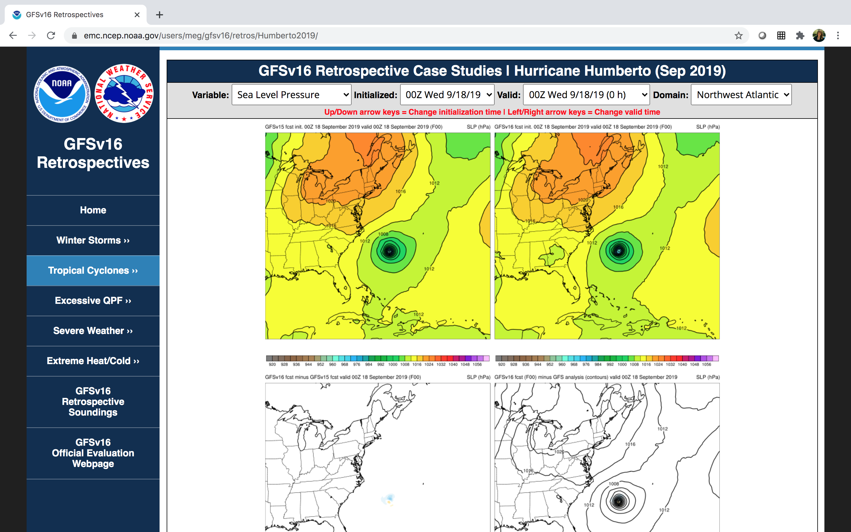
NATIONAL OCEANIC AND ATMOSPHERIC ADMINISTRATION
GFSv16 Evaluation: Case Study Webpage
https://www.emc.ncep.noaa.gov/users/meg/gfsv16/retros/

Slide 40
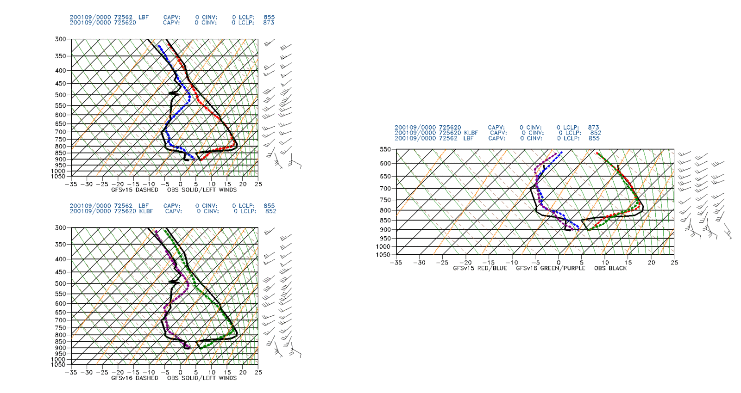
NATIONAL OCEANIC AND ATMOSPHERIC ADMINISTRATION
GFSv16 Evaluation: Case Study Soundings
Generated from station time-series BUFR data
Four cycles plotted per case study
Forecasts plotted every 6 h out to 120 h
Total of 84 sounding sites available
https://www.emc.ncep.noaa.gov/users/ meg/gfsv16/soundings/

Slide 41
NATIONAL OCEANIC AND ATMOSPHERIC ADMINISTRATION
GFSv16 Evaluation: Real-time Parameters
Sea Level Pressure
Surface-based CAPE
Surface Wind Gusts
2-m Temperature
2-m Dew Point
10-m Wind Speed
10-m to 500-hPa Wind Shear
850-hPa Wind Speed
850-hPa Temperature
500-hPa Geopotential Height
250-hPa Wind Speed
Precipitable Water
Skin Temperature
Inst./Average Total Cloud Cover
Inst./Average Low Cloud Cover
Inst./Average Middle Cloud Cover
Inst./ Average High Cloud Cover
Cloud Ceiling Height
Surface Visibility
0–10-cm Soil Temperature
0–10-cm Soil Moisture
3-h Accumulated Precipitation
24-h/Total Accumulated Precipitation
Precipitation Type
Composite/1-km Reflectivity
PBL Height

Slide 42
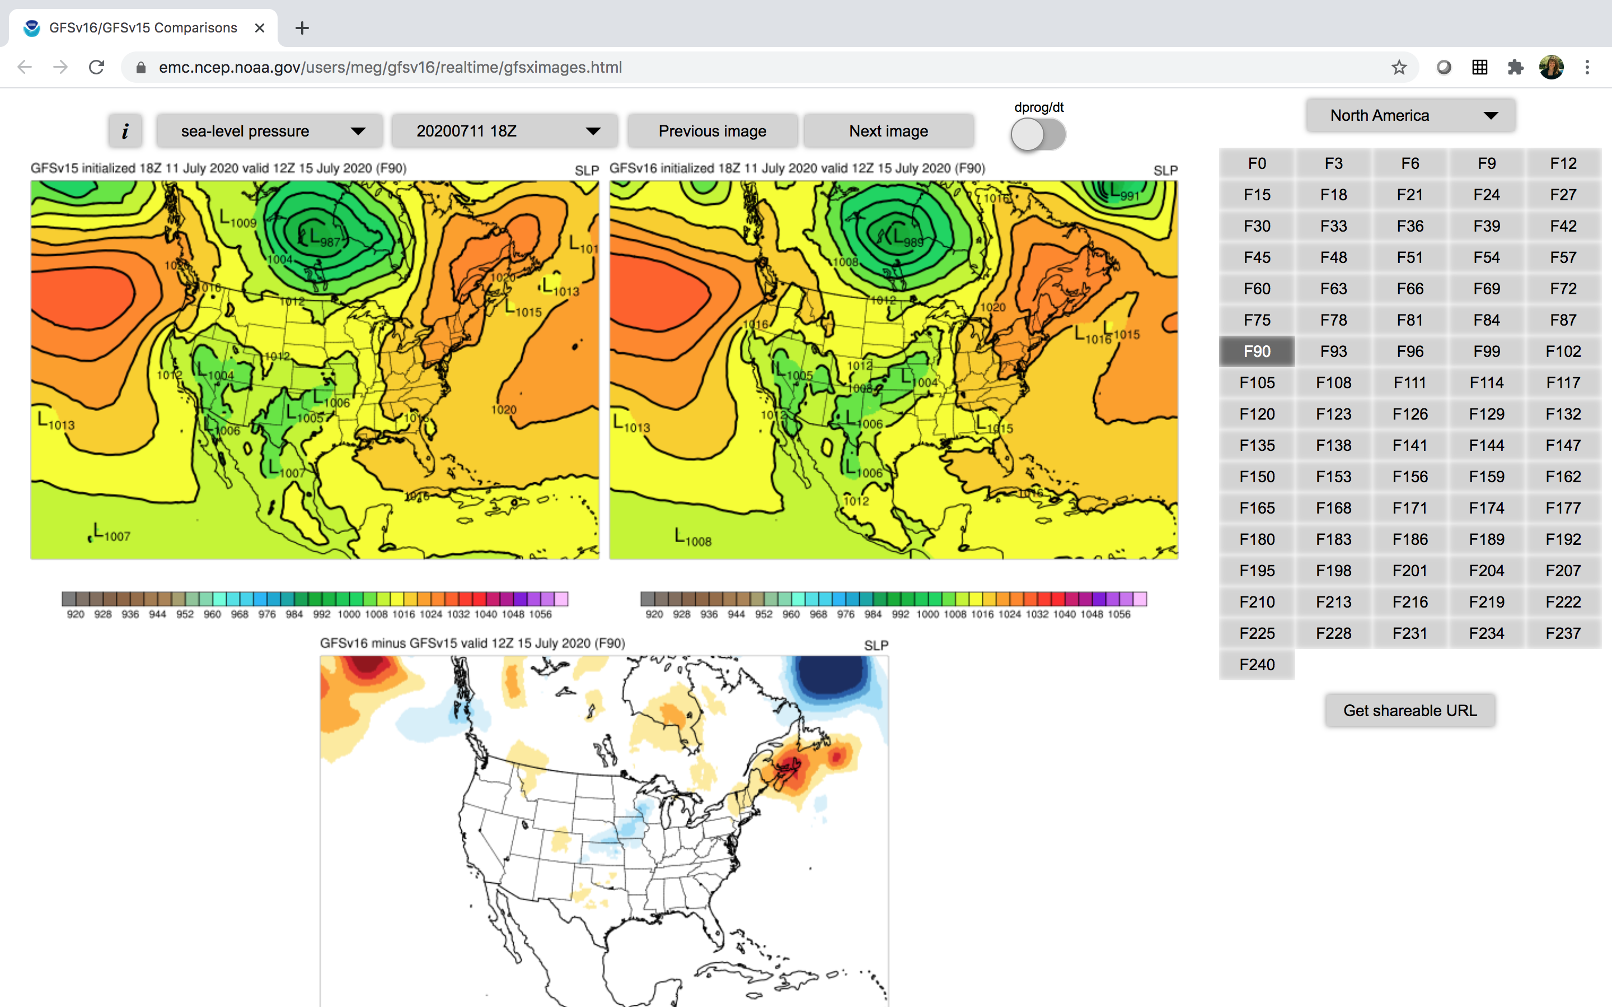
NATIONAL OCEANIC AND ATMOSPHERIC ADMINISTRATION
GFSv16 Evaluation: Real-time Forecast Plots
https://www.emc.ncep.noaa.gov/users/ meg/gfsv16/realtime/gfsximages.html

Slide 43
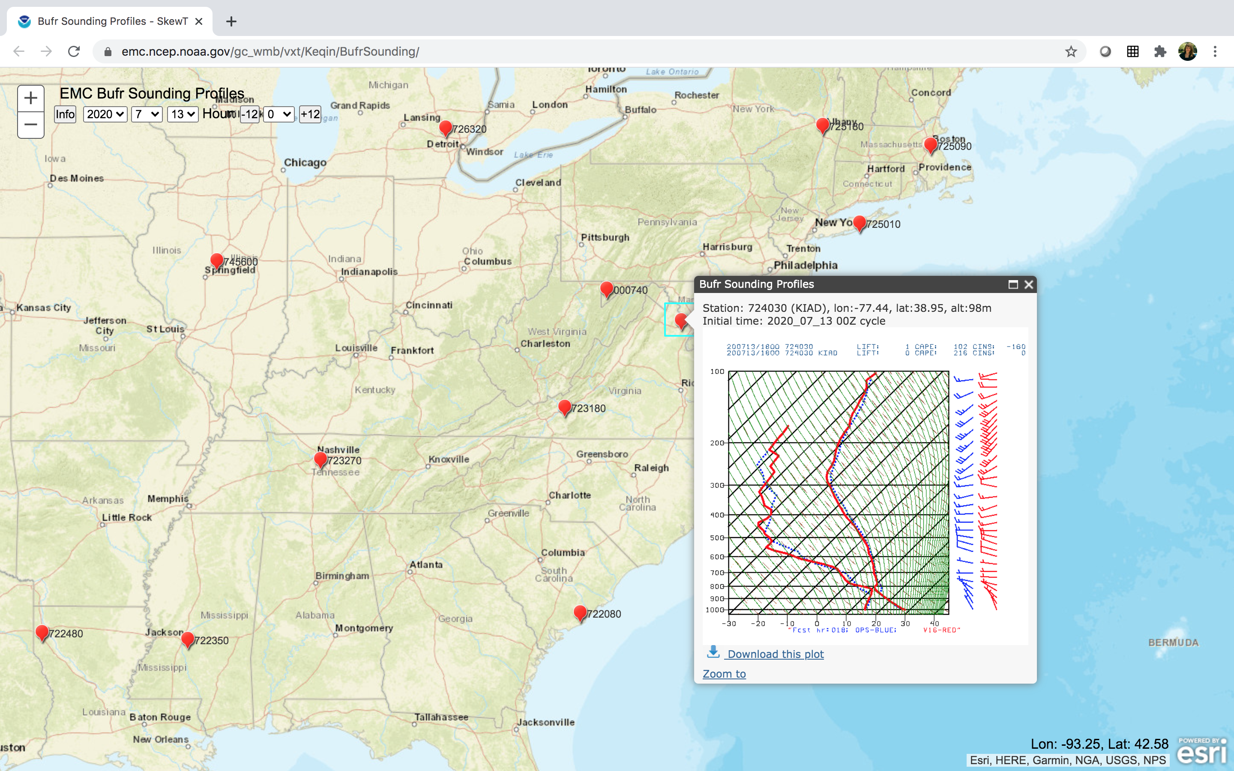
NATIONAL OCEANIC AND ATMOSPHERIC ADMINISTRATION
GFSv16 Evaluation: Real-time Soundings
https://www.emc.ncep.noaa.gov/gc_wmb/vxt/Keqin/BufrSounding/

Slide 44
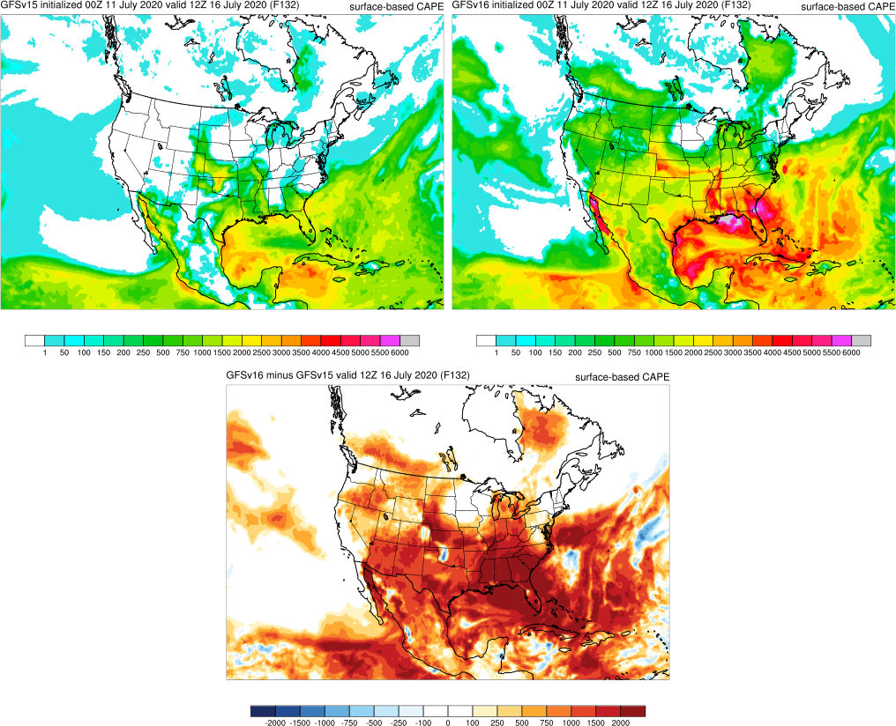
NATIONAL OCEANIC AND ATMOSPHERIC ADMINISTRATION
GFSv16 Evaluation: CAPE correction
The MEG became concerned during the late spring about very large surface-based CAPE values in the GFSv16 real-time parallel
Gridded CAPE values in the early morning were much too large
Gridded CAPE values were inconsistent with vertical profiles
GFSv15
GFSv16
GFSv16 − GFSv15

Slide 45
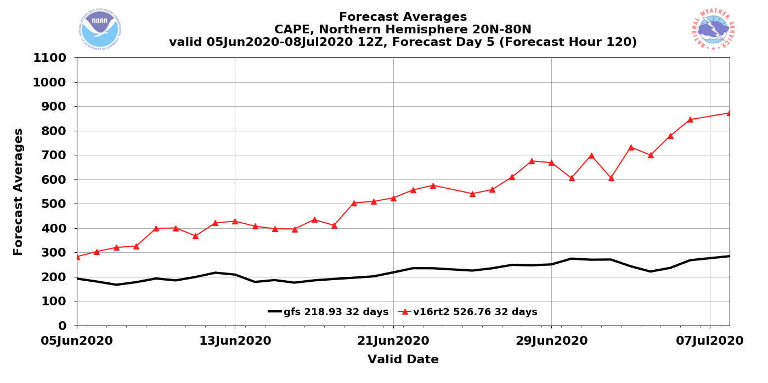
NATIONAL OCEANIC AND ATMOSPHERIC ADMINISTRATION
GFSv16 Evaluation: CAPE correction
Mean CAPE comparisons show GFSv16 values getting larger in June
GFSv16
GFSv15

Slide 46
NATIONAL OCEANIC AND ATMOSPHERIC ADMINISTRATION
GFSv16 Evaluation: CAPE correction
EMC Post-Processing Group Findings:
The CAPE computation searches from the LFC to the EL (the EL is defined as the highest level in the model at which the parcel temperature exceeds the environmental temperature)
GFSv16 has a higher model top than GFSv15, so the search for the EL (which moves up through the column) was finding temps near the model top where the parcel temperature was warmer
EMC Post-Processing Team Findings:
An EL near 0.1 mb was adding in CAPE in the mesosphere and adding CIN in the stratosphere
There is no error in CAPE computations. The higher model top in GFSv16 was allowing the code to identify ELs in the mesosphere.

Slide 47
EL
PARCEL PATH
(solid black line)
LCL

Slide 48
EL
CAPE = Orange
CIN = Blue
LCL

Slide 49
0.1 mb
Extended the GFSv16 model top to a higher level
1 mb
CIN = Blue
100 mb
WITH NEW GFSv16 MODEL TOP AND WITHOUT ANY CODE CHANGE: EL is much higher and new shaded areas are also tallied in CAPE/CIN computations
CAPE = Orange
LCL

Slide 50
NATIONAL OCEANIC AND ATMOSPHERIC ADMINISTRATION
GFSv16 Evaluation: CAPE correction
CAPE Correction:
The Post-Processing Group is changing the CALCAPE computation to stop at 1 mb in its upward search for the EL
This prevents CALCAPE from finding the EL in the mesosphere, and subsequently adding CAPE in the mesosphere and CIN in the stratosphere

Slide 51
NATIONAL OCEANIC AND ATMOSPHERIC ADMINISTRATION
GFSv16 Evaluation: CAPE correction
Before
CAPE Changes
Before − After
After

Slide 52
NATIONAL OCEANIC AND ATMOSPHERIC ADMINISTRATION
GFSv16 Evaluation: CAPE correction
Before
CAPE Changes
RAP Analysis
After
CAPE “After” is underdone, but that represents a low GFS instability bias

Slide 53
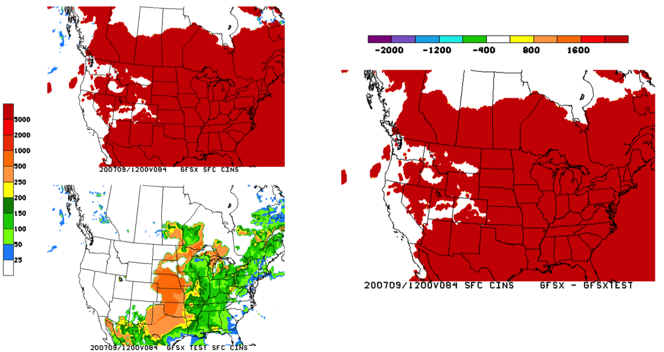
NATIONAL OCEANIC AND ATMOSPHERIC ADMINISTRATION
GFSv16 Evaluation: CAPE correction
Before
CIN Changes
Before − After
After

Slide 54
NATIONAL OCEANIC AND ATMOSPHERIC ADMINISTRATION
GFSv16 Evaluation: CAPE correction
Before
CIN Changes
RAP Analysis
After

Slide 55
NATIONAL OCEANIC AND ATMOSPHERIC ADMINISTRATION
GFSv16 Evaluation: CAPE correction
CAPE/CIN in winter were rarely inflated (the mesosphere is not nearly as cold, so an incorrectly high EL is not found)

Slide 56
NATIONAL OCEANIC AND ATMOSPHERIC ADMINISTRATION
GFSv16 Evaluation: CAPE correction
Solution for GFSv16 evaluation:
CAPE has been fixed in the GFSv16 real-time parallel, so there will be several months of corrected CAPE values to analyze
Many GFSv16 retrospectives have already been run. CAPE has been corrected in all ongoing retrospective streams, and efforts will be made to go back and rerun all severe weather case studies
CAPE statistics will only be computed during retrospective periods when CAPE has been corrected
GFSv16 real-time data is currently available on para-nomads. We encourage users to pull data and check the products that they use.

Slide 57
NATIONAL OCEANIC AND ATMOSPHERIC ADMINISTRATION
GFSv16 Evaluation: CAPE correction
GFSv16
GFSv15

Slide 58
NATIONAL OCEANIC AND ATMOSPHERIC ADMINISTRATION
GFSv16 Evaluation: Retrospective Status

Slide 59
GFSv16 Wave Evaluation Plan
GFSv16 Wave Data:
Retro1: 20190608 - 20190831
Missing: 20190901-20190909
Retro2: 20190910 - 20191130
Missing: 20191201 - 20200131
Retro3: 20200201 - 20200519
Realtime: 20200519 forwards

Slide 60
GFSv16 Wave Evaluation Plan
GFSv16 Wave Data:
Retro1: 20190608 - 20190831
Missing: 20190901-20190909
Retro2: 20190910 - 20191130
Missing: 20191201 - 20200131
Retro3: 20200201 - 20200519
Realtime: 20200519 forwards
Significant wave height (Hs), Peak wave period (Tp), Surface wind speed (u10) and direction (udir)
Time-series of the data versus the models, as well as Bias, RMSE, SI, Correlation, 95% quantile
Websites with validation graphics for the GFS-Wave versus the NCEP operational global wave will be provided:
For buoys: https://polar.ncep.noaa.gov/waves/validation/gfsv16/buoys/
Perhaps altimeters: https://polar.ncep.noaa.gov/waves/validation/gfsv16/satellite/

Slide 61
GFSv16 Wave Evaluation Plan
GFSv16 Wave Data:
Retro1: 20190608 - 20190831
Missing: 20190901-20190909
Retro2: 20190910 - 20191130
Missing: 20191201 - 20200131
Retro3: 20200201 - 20200519
Realtime: 20200519 forwards
Significant wave height (Hs), Peak wave period (Tp), Surface wind speed (u10) and direction (udir)
Time-series of the data versus the models, as well as Bias, RMSE, SI, Correlation, 95% quantile
MEG presentation
(August 6, 2020)
to brief the waves customers and field evaluators on the coming changes
Websites with validation graphics for the GFS-Wave versus the NCEP operational global wave will be provided:
For buoys: https://polar.ncep.noaa.gov/waves/validation/gfsv16/buoys/
Perhaps altimeters: https://polar.ncep.noaa.gov/waves/validation/gfsv16/satellite/
A Google Form document will be shared with the field evaluators, with requests that it be completed no later than September 28, 2020.

Slide 62
GFSv16 Wave Evaluation Plan
GFSv16 Wave Data:
Retro1: 20190608 - 20190831
Missing: 20190901-20190909
Retro2: 20190910 - 20191130
Missing: 20191201 - 20200131
Retro3: 20200201 - 20200519
Realtime: 20200519 forwards
Significant wave height (Hs), Peak wave period (Tp), Surface wind speed (u10) and direction (udir)
Time-series of the data versus the models, as well as Bias, RMSE, SI, Correlation, 95% quantile
MEG presentation
(August 6, 2020)
to brief the waves customers and field evaluators on the coming changes
Websites with validation graphics for the GFS-Wave versus the NCEP operational global wave will be provided:
For buoys: https://polar.ncep.noaa.gov/waves/validation/gfsv16/buoys/
Perhaps altimeters: https://polar.ncep.noaa.gov/waves/validation/gfsv16/satellite/
To be included in the Wave field evaluation, contact: Deanna.Spindler@noaa.gov
A Google Form document will be shared with the field evaluators, with requests that it be completed no later than September 28, 2020.

Slide 63
NATIONAL OCEANIC AND ATMOSPHERIC ADMINISTRATION
GFSv16 Evaluation: Timeline
MEG Kickoff Webinar: 7/16/2020
Field Evaluation: 8/3/2020–9/25/2020
MEG Evaluation Briefing: 9/24/2020
Field Recommendations Due: 9/28/2020
NCEP Director Briefing: 10/6/2020
Code Delivery to NCO: 10/9/2020
NCO 30-day IT Test: 12/21/2020
Implementation Date: 2/3/2021

Slide 64
NATIONAL OCEANIC AND ATMOSPHERIC ADMINISTRATION
Tentative MEG Timeline
July 16: GFSv16 Kickoff
July 23: HREFv3 CAM SOO Team
July 30: MEG HREFv3 Eval. Overview
Aug 6: GFSv16 Statistics & Wave Intro.
Aug 13: Recap HREFv3 Field Evals.
Aug 20: Tropical Cyclone Cases
Aug 27: Winter Weather/QPF Cases
Sep 3: Severe Weather Cases
Sep 10: Temperature Cases/Soundings
Sep 17: GFSv16 SOO Team Presents
Sep 24: MEG GFSv16 Eval. Overview
Oct 1: Recap GFSv16 Field Evals.
Oct 8: No Webinar

Slide 65
NATIONAL OCEANIC AND ATMOSPHERIC ADMINISTRATION
Important GFSv16 Evaluation Links
GFSv16 Official Evaluation Webpage
https://www.emc.ncep.noaa.gov/users/meg/gfsv16/
GFSv16 Retrospective Case Studies
https://www.emc.ncep.noaa.gov/users/meg/gfsv16/retros/
GFSv16 Real-time Forecast Graphics
https://www.emc.ncep.noaa.gov/users/meg/gfsv16/realtime/gfsximages.html

Slide 66
NATIONAL OCEANIC AND ATMOSPHERIC ADMINISTRATION
EXTRA SLIDES
EXTRA SLIDES

Slide 67
GFS V16: Major Upgrades to Forecast Model
Model resolution:
Increased vertical resolution from 64 to 127 layers and raise model top from 54 km to 80 km
Physics updates
BL/turbulence: Replaced K-EDMF with sa-TKE-EDMF
Revised background diffusivity as a stability dependent function
GWD: Added a parameterization for subgrid scale nonstationary gravity-wave drag
Radiation: Updated calculation of solar radiation absorption by water clouds; Updated cloud overlap assumptions.
Microphysics: Updated GFDL microphysics scheme for computing ice cloud effective radius
Noah LSM: Revised ground heat flux calculation over snow covered surface; Introduced vegetation impact on surface energy budget over urban area
Coupling to Wave
One-way coupling of atmospheric model with Global Wave Model (WaveWatch III)
Coupling to GLDAS
Spin up land states using CPC Gauge precipitation in the GDAS 00Z cycle

Slide 68
GFS V16: One-Way Coupling to WAVE
4 The operational Global Wave Deterministic (Multi_1) model will be replaced by the wave component coupled to the atmosphere in GFSv16
WAVE in GFSv16 will retain the following features from wave_multi_1:
Global WAVEWATCH III model with two-way nested grid mosaic,
4 daily cycles,
Ice concentrations from NCEP 1/12º analysis.
The following features will be added or changed:
New computational spatial grid mosaic,
Increase global core resolution from ½ to ⅙ degree in the Northern Hemisphere, and to ¼ degree in the Southern Hemisphere,
Increase Arctic polar stereographic grid resolution from 18 km to 9 km.
The new grid mosaic will replace all Multi_1 and 10 arcmin grids.
New RTOFS ocean surface current forcing up to 192h,
Multi_1 9h hindcasts will be replaced by the wave step run within the GDAS cycle,
Forecasts will be extended from 180 hr to 384 hr.

Slide 69
GFS V16: Major Upgrades to Data Assimilation
Local Ensemble Kalman Filter (LETKF)
with model space localization and linearized observation operator
to replace the Ensemble Square Root Filter (EnSRF)
4-Dimensional Incremental Analysis Update (4D-IAU)
Turn on SKEB in EnKF forecasts
Update variational QC
Apply Hilbert curve to aircraft data
Correlated observation error for CrIS over sea surfaces and IASI over sea and land
Update aircraft bias correction with safeguard
Assimilate AMSU-A channel 14 and ATMS channel 15 w/o bias correction
Assimilate CSR data from ABI_G16, AHI_Himawari8, and SEVIRI_M08
Assimilate AVHRR from NOAA-19 and Metop-B for NSST
Use CRTM v2.3.0

