Slide 1
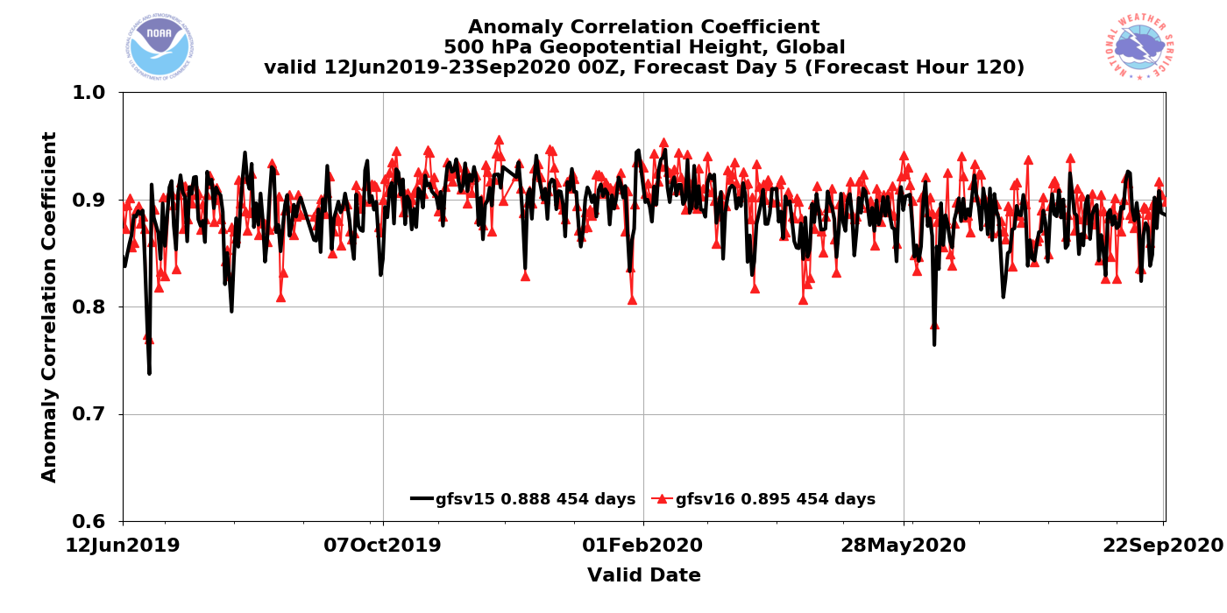
NATIONAL OCEANIC AND ATMOSPHERIC ADMINISTRATION
GFSv16 Field Evaluations (Waves & Days 1-10 Weather)
Shannon Shields and Philippe Papin
EMC Model Evaluation Group Webinar
1 October 2020

Slide 2
NATIONAL OCEANIC AND ATMOSPHERIC ADMINISTRATION
Conclusion of the GFS-Wave Evaluation
Review of official evaluation comments and recommendations from NWS Regions/Centers and other partners
Overall impressions of GFS-Wave system

Slide 3
NATIONAL OCEANIC AND ATMOSPHERIC ADMINISTRATION
Field Evaluations for GFS-Wave
Information that users were asked to provide:
What are your overall impressions of the GFS-Wave system?
Do you see improved reliability in forecasts of ocean waves?
Do you have any other comments or concerns regarding the proposed implementation?
What is your recommendation?
Thank you to all who submitted formal recommendations and to those who provided subjective feedback during the evaluation period

Slide 4
NATIONAL OCEANIC AND ATMOSPHERIC ADMINISTRATION
NWS Eastern Region
GFS-Wave is an improvement over the NCEP operational global wave model.
Improved reliability in forecasts of ocean waves.
Increase in error/bias in some areas is smaller than overall improvement.
Some concern that if GFS-Wave replaces the higher resolution Multi-1, there could be operational issues where the coarser grids do not align as well with the coastal land vs. water points, forcing GFE to do some unrealistic interpolations (not clear if this is being looked at).
Supports implementation of GFS-Wave.

Slide 5
NATIONAL OCEANIC AND ATMOSPHERIC ADMINISTRATION
National Hurricane Center (NHC)
GFS-Wave is overall equal to the NCEP operational global wave model.
Mixed results in monthly statistical analysis, with buoy and altimeter data showing GFS-Wave with a slightly higher Hs RMSE 00-48 hr, and a slight low Hs bias. Models appear to be closer in forecasts beyond 72-96 hrs. The 95th quartile stats show the GFS-Wave lowest vs obs and Multi-1.
Multi-1 still has a low bias for long distance traveled swell, and the statistics suggest that this will now be even slightly lower with the GFS-Wave.
Very hesitant to give a thumbs-down on this upgrade, given all the advances in both GFSv16 and GFS-Wave. Expect significant improvements to the ensemble probabilistic forecasts with increased GEFS members and modest improvement in dispersion.
Neutral regarding the proposed implementation of GFS-Wave.

Slide 6
NATIONAL OCEANIC AND ATMOSPHERIC ADMINISTRATION
Ocean Prediction Center (OPC)
GFS-Wave is overall inferior to the NCEP operational global wave model.
No improved reliability in forecasts of ocean waves.
Wave height bias compared to altimeter showed fairly consistent improvement of the GFSv16 over the North Pacific, but a fairly consistent lack of improvement over the North Atlantic.
95th percentile winds & seas (highest events) aggregated over all buoys seemed to swing heavily in favor of multiwave at almost every hour (low bias for highest wave heights in GFS-Wave).
Period & direction seemed better in GFSv16, but forecasts for safety of life at sea particularly focus on the winds & seas.
Due to reliance on the best possible wind and wave conditions for forecasts, anything that diminishes accuracy of these fields will not help forecasters assist vulnerable vessels on the open ocean through forecasts and warnings.
GFS-Wave has lower resolution than Multi-1. It appears the Multi-1 gets the benefit of 4 arcmin grids.
Does NOT recommend implementing GFS-Wave.

Slide 7
NATIONAL OCEANIC AND ATMOSPHERIC ADMINISTRATION
Conclusion of the GFS-Wave Evaluation
Review of official evaluation comments and recommendations from NWS Regions/Centers and other partners
Overall impressions of GFS-Wave system

Slide 8
NATIONAL OCEANIC AND ATMOSPHERIC ADMINISTRATION
Overall Impressions of GFS-Wave
Improvement Neutral Degradation
Center/Region | Recommendation | Key Remarks
Eastern Region | Implement | Improved reliability in forecasts of ocean waves. Increase in error/bias in some areas is smaller than overall improvement. Some concern of operational issues with coarser grids in GFS-Wave.
National Hurricane Center | Neutral | Unsure of improved reliability in forecasts of ocean waves. Slightly higher Hs RMSE 00-48 hr and a slight low Hs bias. GFS-Wave lowest in 95th quartile stats vs. obs and Multi-1. Slightly lower long distance traveled swell.
Ocean Prediction Center | Do NOT Implement | No improved reliability in forecasts of ocean waves. Improvement of wave height bias over the North Pacific, but a consistent lack of improvement over the North Atlantic. Period and direction seemed better, but wind speed and wave height are worse over North Atlantic and west coast which hurts OPC ops. GFS-Wave has lower resolution than Multi-1. Low bias for highest wave heights.

Slide 9
NATIONAL OCEANIC AND ATMOSPHERIC ADMINISTRATION
Conclusion of the GFSv16 Evaluation (Atmosphere)
Summary of GFSv16 verification statistics
Summary of GFSv16 evaluation comments/recommendations from the field (e.g., NWS Regions and Centers)
Overall impressions of GFSv16

Slide 10
NATIONAL OCEANIC AND ATMOSPHERIC ADMINISTRATION
Summary of GFSv16 Verification Statistics
Parameter | Remarks
200/250-hPa Winds | Existing NH & SH low bias in GFSv15 worse in GFSv16, but mitigated in tropics & over U.S. RMSE higher initially and in tropics but reduced in medium range for NH & SH.
500-hPa Height | Improved NH & SH 500-hPa AC scores in the medium range. Lower NH & SH RMSE at most lead times.
850-hPa Winds | Existing NH & SH low bias in GFSv15 made worse in GFSv16, especially in tropics. RMSE higher initially but significantly reduced in short to medium range for NH & SH.
850-hPa Temp. | Mitigated cold bias seen in GFSv15 during NH cool season in medium & extended range. Lower NH & SH RMSE in the medium range. Colder temperatures in short range, especially in NH cool season short-range forecast.
1000-hPa Height | Improved NH & SH 1000-hPa AC scores at most lead times. Lower NH & SH RMSE at most lead times.
10-m Winds | Little change in bias overall over the U.S. Slight but significant decrease in RMSE in short to medium range.
Improvement Neutral Degradation
*Mainly based on Grid-to-Obs

Slide 11
NATIONAL OCEANIC AND ATMOSPHERIC ADMINISTRATION
Summary of GFSv16 Verification Statistics
Parameter | Remarks
2-m Temp. | Mitigated cold bias over CONUS during cool season at longer lead times. Lower RMSE over CONUS during cool season at longer lead times. Inconsistent CONUS bias signal comparing 2019 & 2020 warm seasons. Higher RMSE over Eastern U.S. during warm season at most lead times.
Low-Level Moisture/ 2-m Dewpoint | Introduced significant low bias over CONUS at short lead times (likely related to soil moisture); bias worse in summer, more negligible in winter. RMSE increased in short range but reduced in medium range.
Precipitation | U.S. ETS significantly improved at most 24h precipitation thresholds at most lead times. U.S. high bias reduced at low thresholds; low bias reduced at medium to high thresholds.
CAPE (real-time) | RMSE increased; existing low GFSv15 bias made significantly worse.
TC Track | Reduced errors overall for strong TCs. However, slow & right-of-track bias at long lead times.
TC Size | Reduced low bias in 34-kt wind radii as GFSv16 produces larger TCs.
Improvement Neutral Degradation
*Mainly based on Grid-to-Obs

Slide 12
NATIONAL OCEANIC AND ATMOSPHERIC ADMINISTRATION
Summary of GFSv16 Verification Statistics
Parameter | Remarks
TC Intensity | Lower intensity error at almost all lead times in North Atlantic. Less of a weak bias at longer lead times in North Atlantic. Similar intensity error at almost all lead times in East Pacific. Slightly less of a weak bias at longer lead times in East Pacific. Tendency to strengthen all TCs in the long range.
TC Genesis | POD improved in both NATL & EPAC but FAR also increased. Overall increase in CSI. Increased TC genesis lead time but many TCs still completely missed by both models. Too many false alarms from 50°-70°W.
HWRF | Improved track & intensity forecast when initialized with GFSv16.
HMON | Degraded track forecast for NATL when initialized with GFSv16 but improved for EPAC. Intensity forecast improved.
Waves | Lower globally-averaged RMSE & bias for Sig. Wave Height in GFS-Wave. Some regional degradation of waves forecasts (high-resolution Multi-1 output grids are not available in GFS-Wave).
Improvement Neutral Degradation

Slide 13
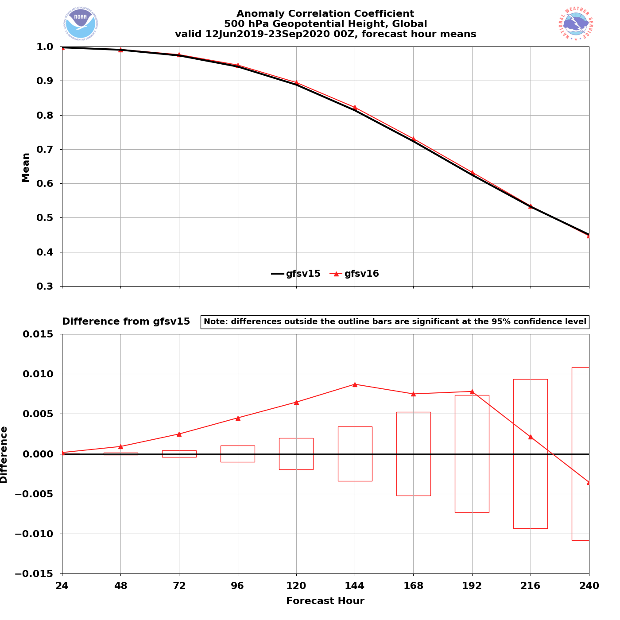
NATIONAL OCEANIC AND ATMOSPHERIC ADMINISTRATION
Strengths: 500-hPa AC Scores (Global)
Valid: 6/12/19–9/23/20 (Day 5)
GFSv15 = .888
GFSv16 = .895
GFSv16 had higher AC scores than GFSv15 at the majority of forecast lead times (Days 1–9)
GFSv16 had statistically significantly higher AC scores at Days 2–8
GFSv16−GFSv15

Slide 14
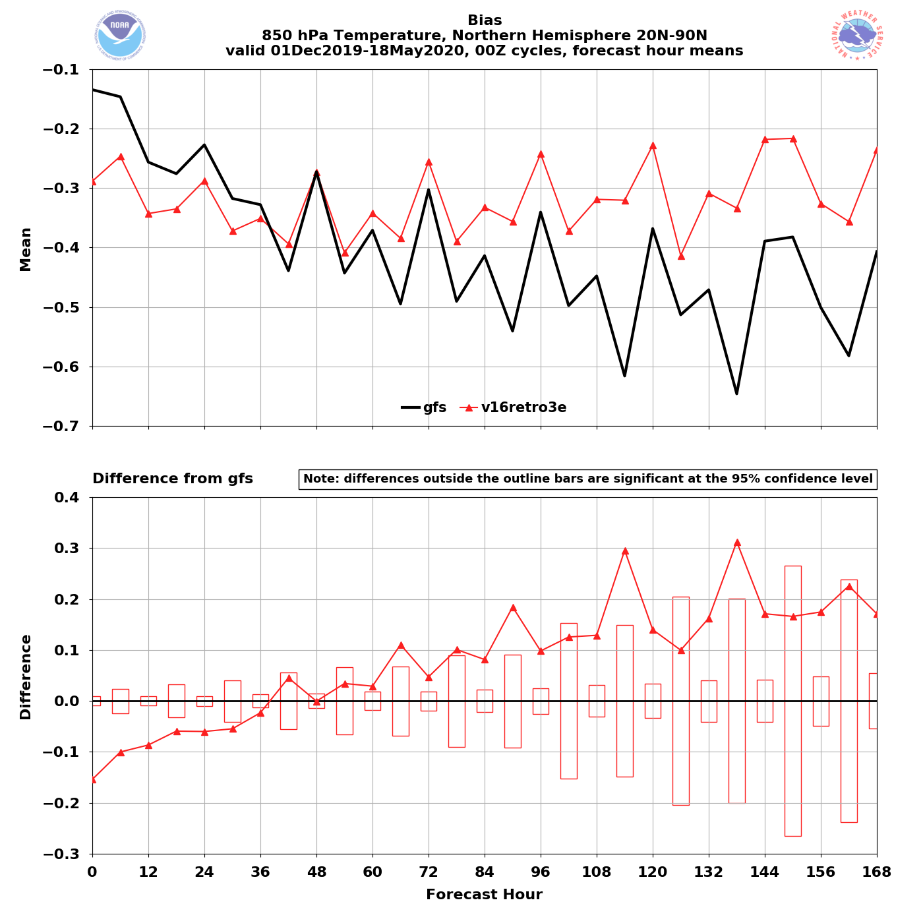
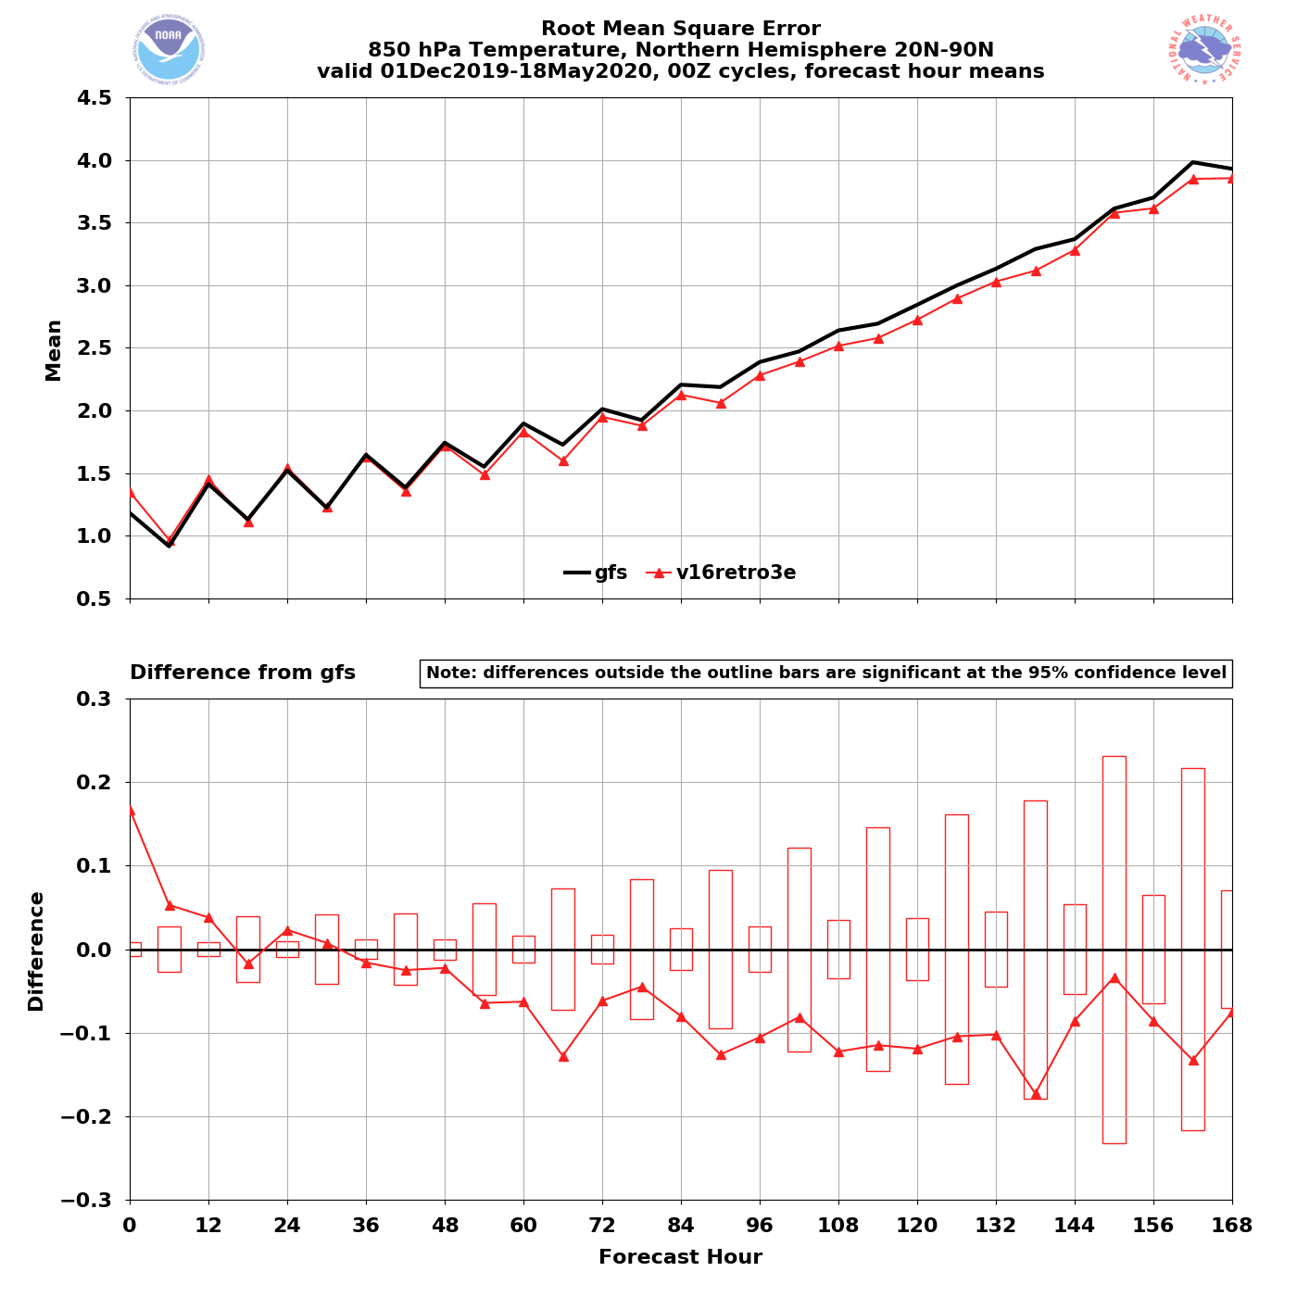
NATIONAL OCEANIC AND ATMOSPHERIC ADMINISTRATION
Strengths: Mitigated Low-Level Cold Bias
GFSv15 has a known low-level cold bias that gets worse with lead time
NH – Winter/Spring 2020
NH – Winter/Spring 2020
00Z
cycles
GFSv16
GFSv15
GFSv16
850T
Bias
GFSv15
850T
RMSE
Grid-to- Obs
GFSv16 − GFSv15
GFSv16 − GFSv15
GFSv16 has less of a cold bias at longer lead times
GFSv16 has lower RMSE at and after F036

Slide 15
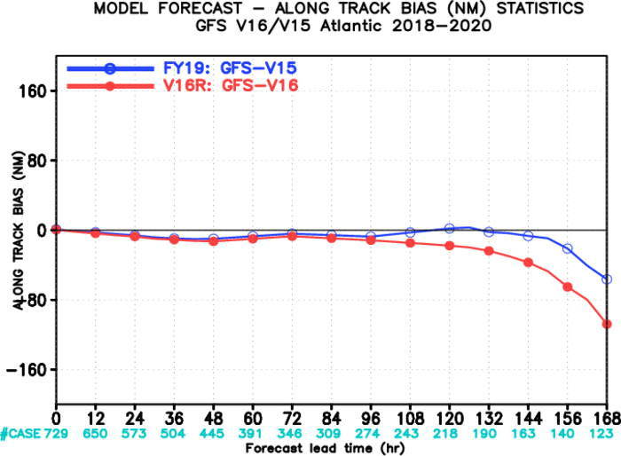
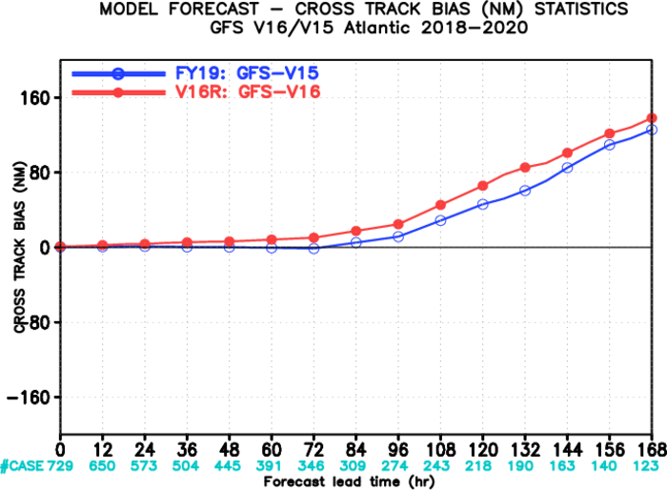
NATIONAL OCEANIC AND ATMOSPHERIC ADMINISTRATION
Concerns: Increased Right-of-Track Bias
N Atlantic Along-Track Bias
N Atlantic Across-Track Bias
Fast
Right
GFSv16
GFSv15
GFSv15
GFSv16
Slow
Left
Images provided by Jiayi Peng
A slower and right-of-track bias at longer lead times suggests that GFSv16 may be recurving TCs earlier than GFSv15
GFSv16 has a larger slow bias than GFSv15 that grows with forecast length in the N Atlantic
GFSv16 has a larger right-of-track bias than GFSv15 that is largest at longer lead times

Slide 16
NATIONAL OCEANIC AND ATMOSPHERIC ADMINISTRATION
CAPE Magnitudes Are Reduced in GFSv16
GFSv15
GFSv16
Obs
Lower GFSv16 CAPE magnitudes are most pronounced at 00Z valid times
Focusing on 00Z/12Z valid times since special 06Z/18Z soundings counts are limited

Slide 17
NATIONAL OCEANIC AND ATMOSPHERIC ADMINISTRATION
Conclusion of the GFSv16 Evaluation (Atmosphere)
Summary of GFSv16 verification statistics
Summary of GFSv16 evaluation comments/recommendations from the field (e.g., NWS Regions and Centers)
Overall impressions of GFSv16
Thank you to those who submitted formal recommendations and those who provided subjective feedback during the evaluation period

Slide 18
NATIONAL OCEANIC AND ATMOSPHERIC ADMINISTRATION
Field Evaluations for GFSv16
Information that users were asked to provide:
What are your overall impressions of GFSv16? Your answer should be based on a combination of retrospective case assessments and verification statistics.
Please comment on your overall synoptic impressions of the GFSv16.
A goal of this upgrade is improvement in GFS PBL structure, including the handling of inversions. How would you describe how GFSv16 handles vertical profiles in the lower levels?

Slide 19
NATIONAL OCEANIC AND ATMOSPHERIC ADMINISTRATION
Field Evaluations for GFSv16
Information that users were asked to provide:
Another goal of this upgrade is to improve low-level temperature forecasts, with particular focus on mitigating the winter low-level cold bias. Please comment on the low-level temperature forecasts.
Please provide any additional comments you have regarding the proposed implementation of GFSv16.
What is your recommendation?

Slide 20
NATIONAL OCEANIC AND ATMOSPHERIC ADMINISTRATION
NWS Eastern Region
GFSv16 is an overall improvement over the operational GFSv15.
Generally an improvement especially in synoptic performance.
There is improvement in GFSv16 with PBL structure.
Improvement in cold-air damming particularly valuable with the GFSv16 upgrade.
Nice to see medium-range P-type improvements.
Improvement in low-level temperature forecast in GFSv16 thanks to mitigating cold bias at medium & long-range forecasts.
Concerns related to low bias in CAPE & remaining low-level cold bias in cool season in short-term period.
Supports the implementation of GFSv16.

Slide 21
NATIONAL OCEANIC AND ATMOSPHERIC ADMINISTRATION
NWS Central Region
GFSv16 is an overall improvement over the operational GFSv15.
Most notable improvements in the medium range (Days 4-6), regarding the synoptic evolution of systems.
There are no systematic differences in the PBL structure between GFSv15 and v16.
Some small improvement in the low-level PBL structure in the cold season—however also noted several cases during the warm season where the moisture (Td) profiles appeared better in GFSv15 (GFSv16 PBL overmixed). Also noted a strange sfc inversion in GFSv16 developing by 00UTC in the warm season (too early).
Improvement in low-level temperature forecasts in GFSv16.
Slight improvement (reduction in the 2-m cold bias) in several cold season events.
Supports the implementation of GFSv16.

Slide 22
NATIONAL OCEANIC AND ATMOSPHERIC ADMINISTRATION
NWS Southern Region
GFSv16 is an overall improvement over the operational GFSv15.
Overall improvement seen in verification scores and retrospectives.
No systematic differences in PBL structure between GFSv15 and GFSv16.
No major improvement to handling of radiation inversions and some evidence PBL warm-season dry bias is worse in GFSv16.
Some evidence of improved handling of temperature profile in shallow, cold air masses.
Several concerns noted: Larger TC false alarm rate and right-of-track bias, substantial low CAPE bias, especially in warm season which could affect operational assessment of pre-convective environments.
Supports the implementation of GFSv16.

Slide 23
NATIONAL OCEANIC AND ATMOSPHERIC ADMINISTRATION
NWS Western Region
GFSv16 is an overall improvement over the operational GFSv15.
Better details in important western region fields, such as QPF, winds, temps/RH. Subjective improvement overall is slight, but some extreme cases show improvement in v16.
No real improvement seen in marine stratus; cloud details inland are slightly improved.
No systematic differences in the PBL structure between GFSv15 and v16.
Improvement in low-level temperature forecasts in GFSv16.
Upgrades in GFSv16 appear to generally be as good or better in most items explored for WR.
Higher resolution will be of value to WR.
Noticeable improvement in the mid-range period.
Supports the implementation of GFSv16.

Slide 24
NATIONAL OCEANIC AND ATMOSPHERIC ADMINISTRATION
NWS Alaska Region
GFSv16 is an overall improvement over the operational GFSv15.
Overall improvement with better performance with significant low-pressure events in medium range, most notably with August 2019 case study and another recent strong cyclone in August 2020.
Some improvement in PBL structure with improved decoupling in light wind situations. Wind profiles somewhat more realistic in areas of complex terrain.
Some improvement and some degradation in low-level temperature forecasts, with better representativeness of cold low-level temps in broader cold air masses.
Concerns related to large changes in 2-m temperature forecast on the order 2-3°C in warm season. Sometimes the biases flipped from warm to cold with changes larger in high-latitudes than in the mid-latitude.
Supports the implementation of GFSv16.

Slide 25
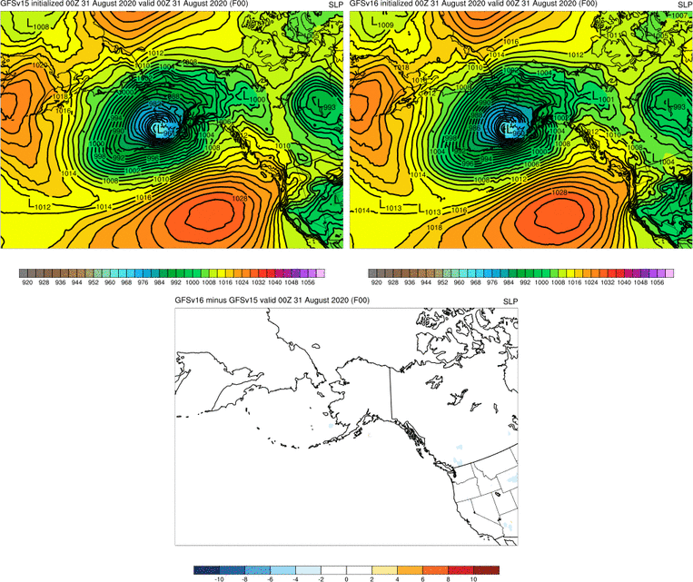
MSLP: Operational GFS vs GFSv16
Image courtesy of Jason Ahsenmacher (WFO Fairbanks)
GFSv16 was consistent with a track much closer to reality from about F120 onward
Operational GFS trended much too far south, then had to correct at the last minute
GFSv16 was much less “jumpy” overall with the low position and strength
5 Day Dprog/DT (20 model runs)

Slide 26
NATIONAL OCEANIC AND ATMOSPHERIC ADMINISTRATION
NWS Pacific Region
GFSv16 is an overall improvement over the operational GFSv15.
GFSv16 does significantly better with TC genesis, though with some increase in false alarms.
When TCs are stronger, GFSv16 has better track, size, and intensity.
More aggressive in developing tropical cyclones, which occasionally causes false binary interactions.
Occasionally TC tracks are slower, right and/or poleward compared to GFSv15 and Best Track.
Supports the implementation of GFSv16.

Slide 27
NATIONAL OCEANIC AND ATMOSPHERIC ADMINISTRATION
Weather Prediction Center (WPC)
GFSv16 is an overall improvement over the operational GFSv15.
Handles synoptic scale better than GFSv15, especially in medium range (Days 4-7).
Progressive bias in GFSv15 appears mitigated with better consistency catching correct solutions earlier.
Some mitigation of low-level warm bias in precipitation transition zones and better cold-air damming in the East. Bulk stats show improvement in cold bias not increasing with forecast time.
Overall improvement in QPF. Even in similar synoptic patterns, GFSv16 often better captured higher QPF as illustrated in improved bias in bulk statistics.
Concerns related to potential P-type tendency to over-forecast sleet & low bias in CAPE forecasts that could limit convection in marginal instability cases.
Supports the implementation of GFSv16.

Slide 28
NATIONAL OCEANIC AND ATMOSPHERIC ADMINISTRATION
Storm Prediction Center (SPC)
GFSv16 overall performs similarly to the operational GFSv15.
Improved forecasts of relevant frontal boundaries for a few examined severe weather cases.
There are no systematic differences in the PBL structure between GFSv15 and v16.
Low bias in 2-m dewpoint, and instability is worse in the GFSv16 than GFSv15 during the warm season over the CONUS, especially in favorable severe weather environments.
Degradation in low-level temp. forecasts during warm season; GFSv16 has larger cold bias and Mean Absolute Error than GFSv15.
Drier soil moisture conditions in GFSv16 have exacerbated the dry 2-m dewpoint and low instability biases when coupled with the overmixing bias of the PBL scheme. Given this degradation, it may be difficult for SPC forecasters to realize medium-range improvements for other evaluation metrics in the warm season.
Neutral regarding the proposed implementation of GFSv16.

Slide 29
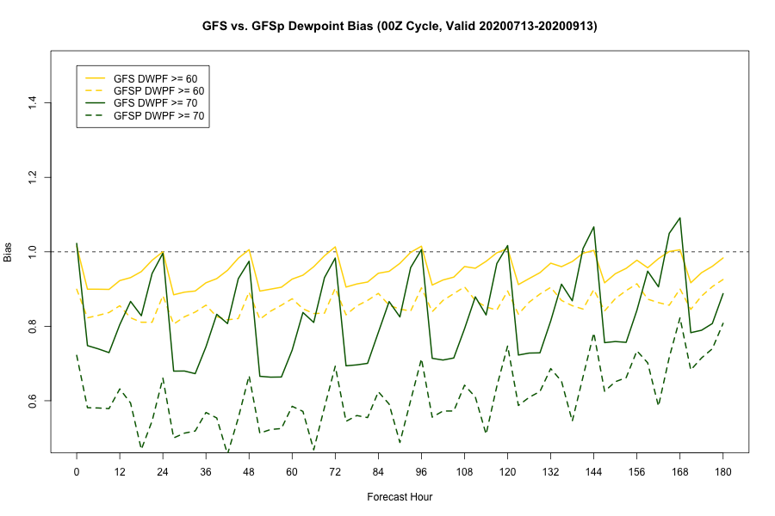
Statistical Evaluation: 2-m Td Freq. Bias
Both versions of GFS have a low frequency bias for 2-m Td at 60F & 70F
GFSv16 has a notably lower frequency bias, especially for dewpoints >=70F
GFSv15 Td>=60F
GFSv16 Td>=60F
GFSv15 Td>=70F
GFSv16 Td>=70F
GEFSv11
GEFSv12
Israel Jirak, Andy Dean, and Chris Karstens
NOAA/NWS/NCEP/Storm Prediction Center
Dillon Blount and Clark Evans
University of Wisconsin-Milwaukee
SPC GFSv16 Evaluation

Slide 30
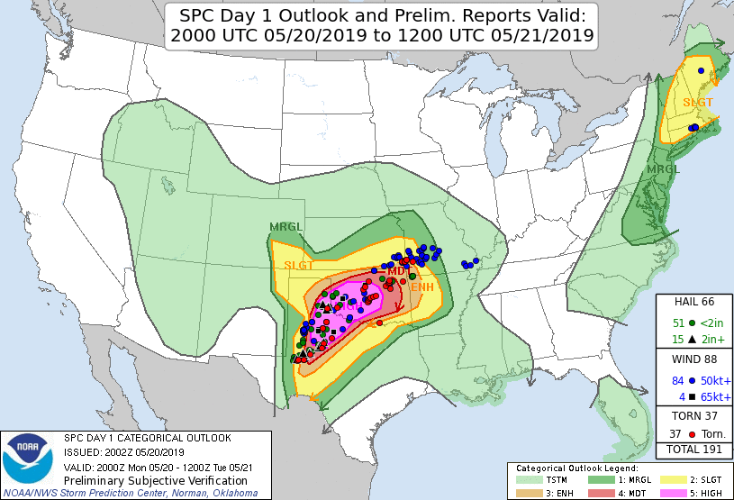
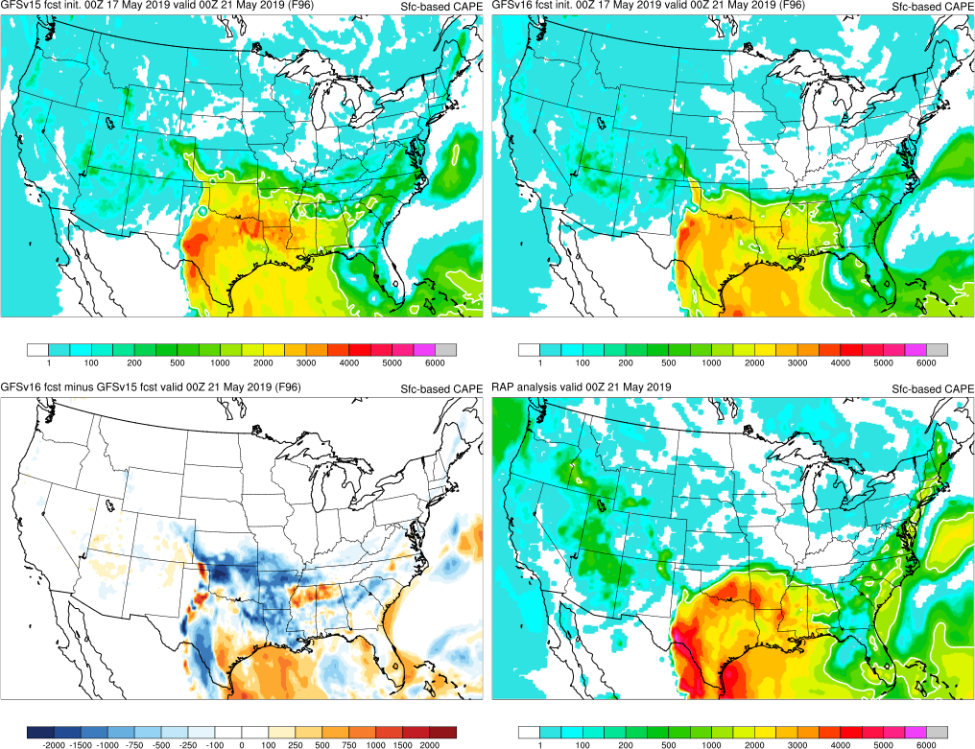
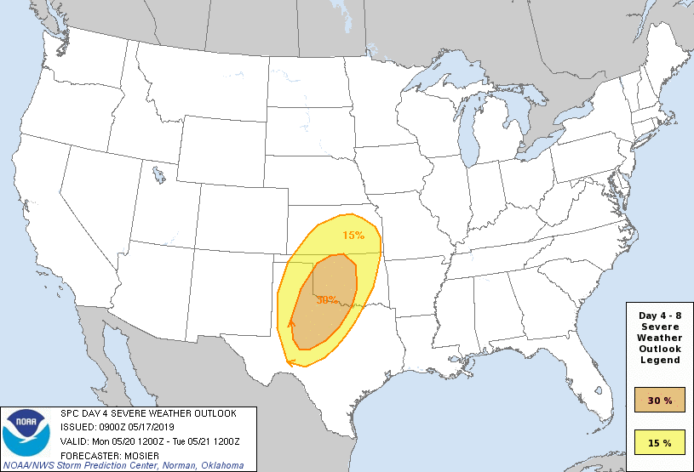
20 May 2019: High Risk/Southern Plains
SBCAPE
GFSv16 has better handle on northern edge of instability
Day 4
Peak CAPE magnitudes underdone in warm sector for both versions
GFSv16 has lower overall instability in warm sector
SPC GFSv16 Evaluation

Slide 31
NATIONAL OCEANIC AND ATMOSPHERIC ADMINISTRATION
National Hurricane Center (NHC)
GFSv16 overall performs similarly to the operational GFSv15.
Synoptic scale performance in medium range appears improved in GFSv16, but GFSv15 is similar or slightly better in the short range.
Improvements to GFSv16 TC intensity forecasts and increased lead time for genesis events.
Increased number of false alarms for genesis events and frequent overestimation in intensity.
Increase in right-of-track and along-track bias in GFSv16.
Track consensus (TVCN) for NATL degraded by 1-2% through forecast day 3 but improved 2-3% after day 4. Track consensus unchanged for East Pacific.
Overall, GFSv16 improvements approximately balanced by degradations.
Neutral regarding the proposed implementation of GFSv16.

Slide 32
NATIONAL OCEANIC AND ATMOSPHERIC ADMINISTRATION
Aviation Weather Center (AWC)
GFSv16 is an overall improvement over the operational GFSv15.
Mitigation of the progressive bias seen in GFSv15.
GFSv16 has better ability to capture cold-air damming events east of Rockies and Appalachians.
Better jet stream forecasts (speed, location, vertical/horizontal shear) helping to improve AWC’s turbulence forecast.
Slightly better PBL with respect to low-level cold air, which is very important for icing and low-level turbulence diagnosis and forecasts.
Improvement in low-level temperature forecasts in GFSv16.
Supports the implementation of GFSv16.

Slide 33
NATIONAL OCEANIC AND ATMOSPHERIC ADMINISTRATION
Climate Prediction Center (CPC)
GFSv16 is an overall improvement over the operational GFSv15.
Slightly improved Anomaly Correlation Skill for 500-hPa heights for Days 6-10 and Days 8-14 averaged.
GFSv16 has temperatures closely matching MERRA-2 but warming with lead time in winter.
GFSv16 zonal winds decrease with lead time in winter while summer zonal winds increase with lead time.
Forecast ozone in tropics is better (smaller errors), but ozone in polar night (cool season) has large errors that grow with time.
Mesosphere looks reasonable.
Supports the implementation of GFSv16.

Slide 34
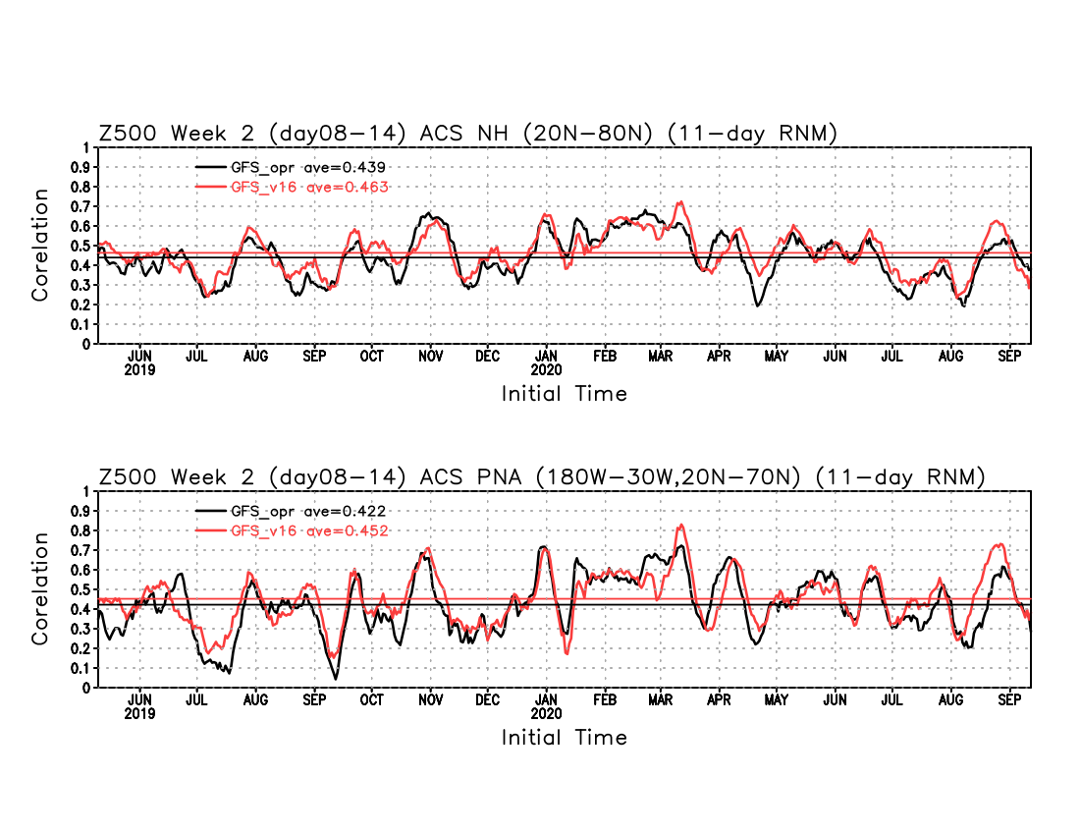
Anomaly Correlation Skill (ACS) for 500 mb height Week 2 (day 08-14 average) forecasts
GFSv15 = .439
GFSv16 = .463
Plots courtesy of Mingyue Chen (CPC)
GFSv15 = .422
GFSv16 = .452

Slide 35
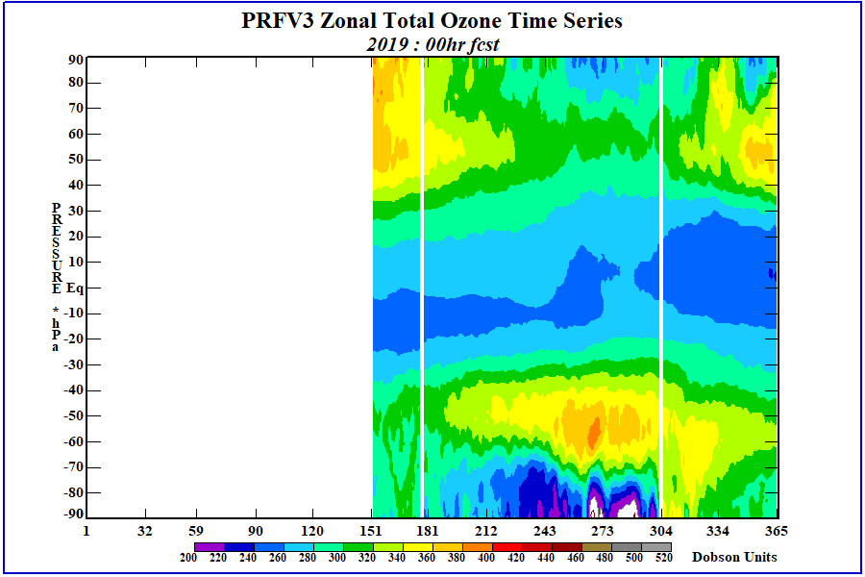
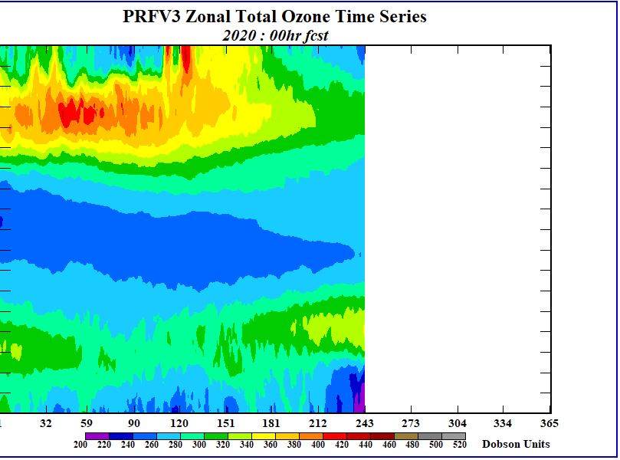
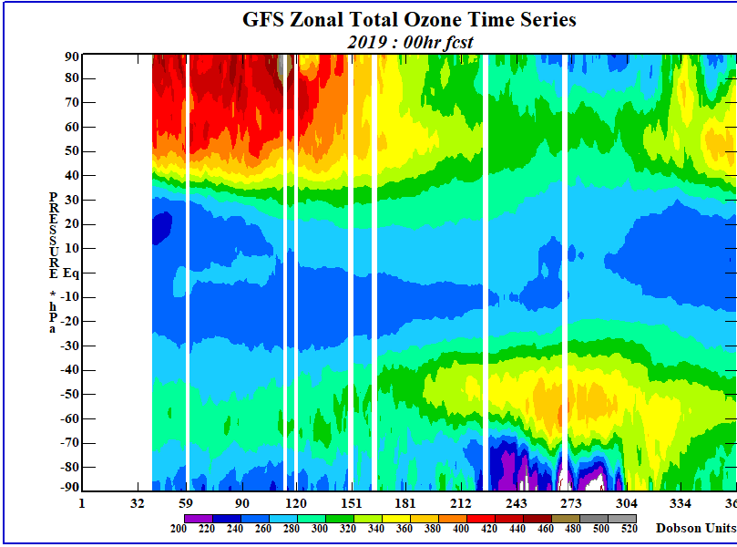
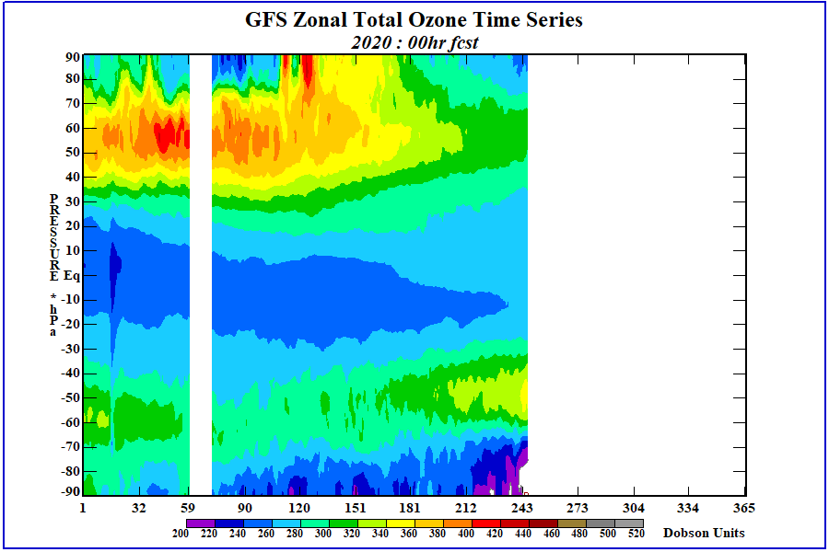
Total Column Ozone
PRFv3
Plots courtesy of Craig Long (CPC)
Agreement is good except in polar night latitudes
GFSv15

Slide 36
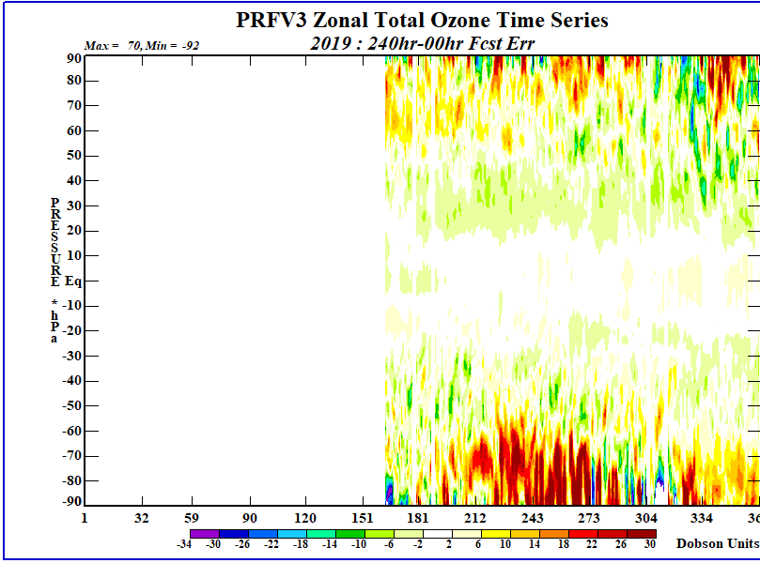
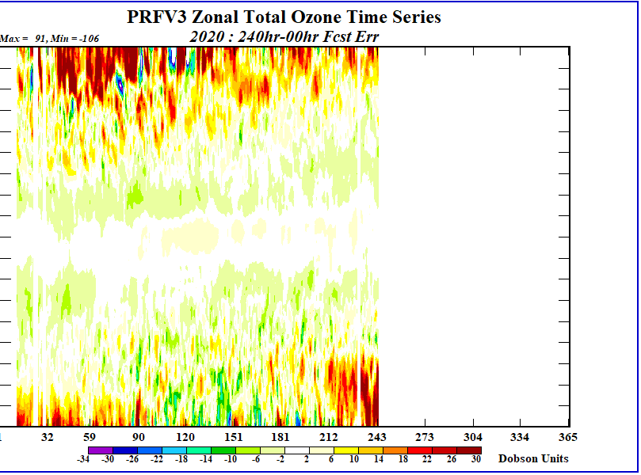
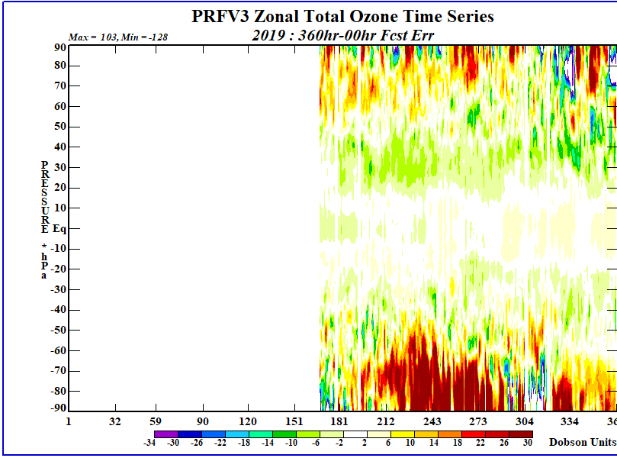
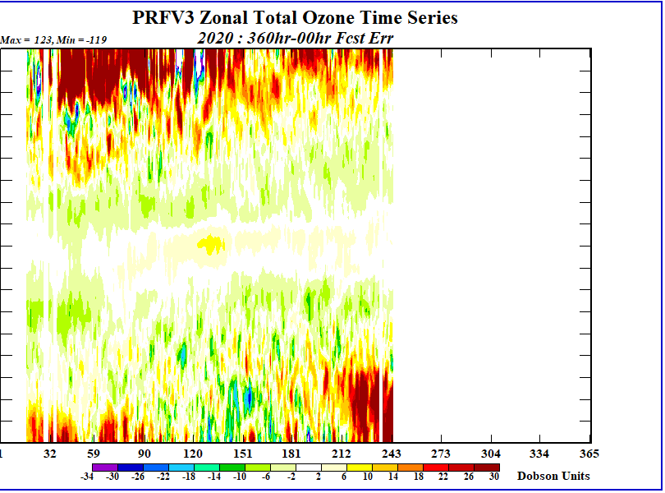
PRFv3 Ozone Forecasts
f240-f00
Plots courtesy of Craig Long (CPC)
Small errors here
Large errors here
PRFv3 ozone forecast errors are small in tropics
f360-f00
Still small errors here
Larger errors here

Slide 37
NATIONAL OCEANIC AND ATMOSPHERIC ADMINISTRATION
FirstEnergy Corp
GFSv16 is an overall improvement over the operational GFSv15.
Some of the fields (such as QPF and locally derived wind gust) exhibited the same amount of continuity (or lack thereof) as the operational version.
However, others, like the surface pressure fields, were notably more realistic in intensity compared to the operational version.
At many times, the mass fields were extremely similar to each other out through F120 and sometimes to F216.
View the GFSv16 as a needed progression and foundational component in the continuum of the UFS.
Supports the implementation of GFSv16.

Slide 38
NATIONAL OCEANIC AND ATMOSPHERIC ADMINISTRATION
Conclusion of the GFSv16 Evaluation (Atmosphere)
Summary of GFSv16 verification statistics
Summary of GFSv16 evaluation comments/recommendations from the field (e.g., NWS Regions and Centers)
Overall impressions of GFSv16

Slide 39
NATIONAL OCEANIC AND ATMOSPHERIC ADMINISTRATION
Overall Impressions of GFSv16
Region | Recommendation | Key Remarks
Eastern Region | Implement | Improvement with PBL structure, cold-air damming, and medium-range P-type. Low CAPE bias and low-level cold bias in cool season (short-term) concerns.
Central Region | Implement | Notable synoptic improvements in medium range. Small improvement in low-level PBL in cold season; cases of overmixed PBL in warm season. Improvement in low-level temps (reduction in 2-m cold bias).
Southern Region | Implement | Evidence of improved temp. profile in shallow, cold air masses. Larger TC FAR and right-of-track bias. Low CAPE bias, especially in warm season.
Western Region | Implement | Better details in QPF, winds, temps/RH. Improvement in low-level temps. Higher resolution. Noticeable improvement in the mid-range.
Alaska Region | Implement | More significant cyclones, improved PBL & better cold low-level temp. Large 2-m temp. change flipping from warm to cold bias.
Pacific Region | Implement | Significantly better TC genesis; some increase in false alarms. With stronger TCs, GFSv16 has better track, size, and intensity.

Slide 40
NATIONAL OCEANIC AND ATMOSPHERIC ADMINISTRATION
Overall Impressions of GFSv16
Center | Recommendation | Key Remarks
WPC | Implement | Progressive bias in GFSv15 appears mitigated (handles synoptic scale better). Better captured higher QPF and cold-air damming in East. Tendency to over-forecast sleet and low CAPE bias concerns.
SPC | Neutral | Improved forecasts of frontal boundaries for a few cases. Low-level temp degradation during warm season. Drier soil exacerbates low 2-m dewpoint & instability bias when coupled with overmixing PBL bias.
NHC | Neutral | Improvements to TC intensity/wind radii and increased TC genesis lead time/false alarms. Increased right-of-track that gets worse at longer lead times & along-track bias.
AWC | Implement | Mitigation of progressive bias seen in GFSv15. Better ability to capture cold-air damming events. Better jet stream forecasts. Slightly better PBL. Improvement in low-level temps.
CPC | Implement | Slightly improved 500-hPa heights. Temps get warmer with forecast time in winter latitudes. Winter (summer) zonal winds decrease (increase) with lead time. Ozone errors in polar night issue.
FirstEnergy Corp | Implement | More realistic sfc pressure intensity. Similar continuity in many parameters. GFSv16 needed as foundational UFS component.

Slide 41
NATIONAL OCEANIC AND ATMOSPHERIC ADMINISTRATION
Overall Impressions of GFSv16
Common Strengths
Notable improvements in synoptic scale performance in the medium range (Days 4-6)
Progressive bias in GFSv15 appears mitigated with more consistency & earlier correct solutions
Improved frontal positions and QPF
Improvement in low-level temperature forecasts (mitigation of the winter low-level cold bias)
Improvements to TC intensity and increased lead time for genesis events
With stronger TCs, GFSv16 has overall better track, size, and intensity
Better ability to resolve shallow, cold air masses and some associated cold-air damming events

Slide 42
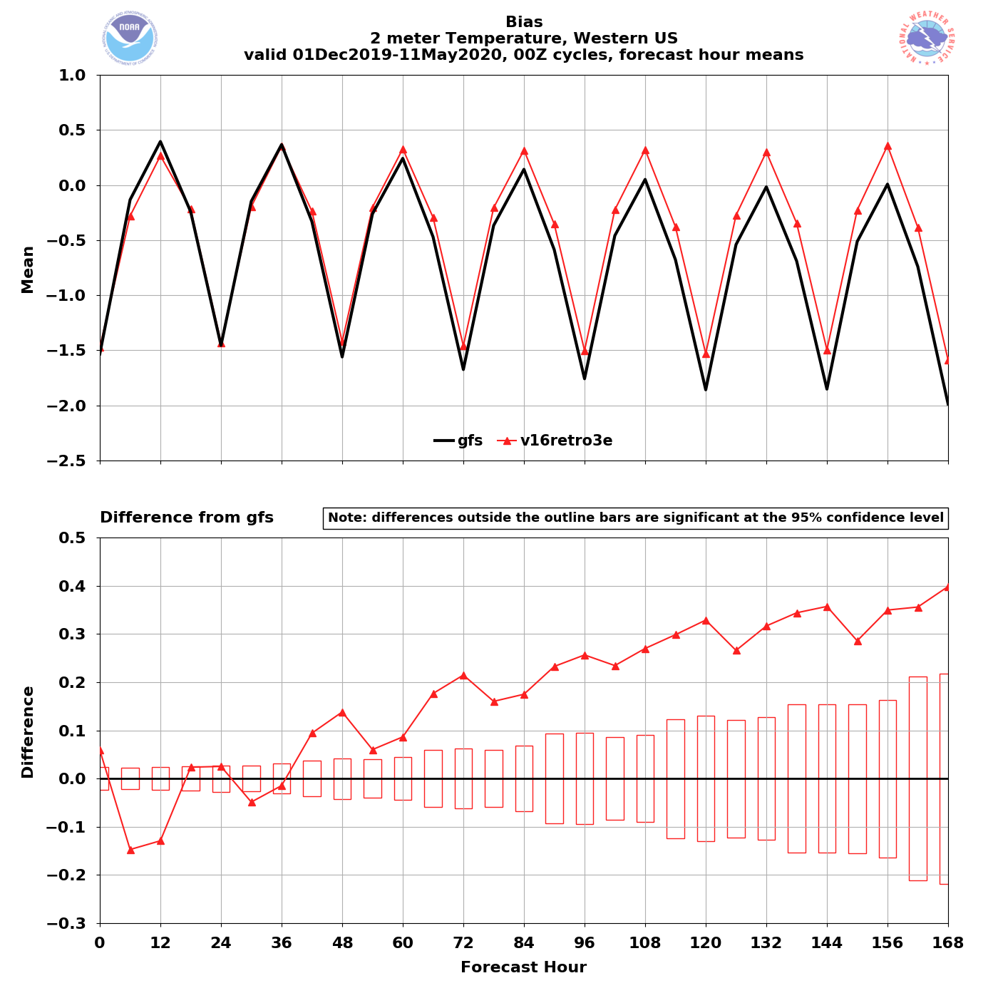
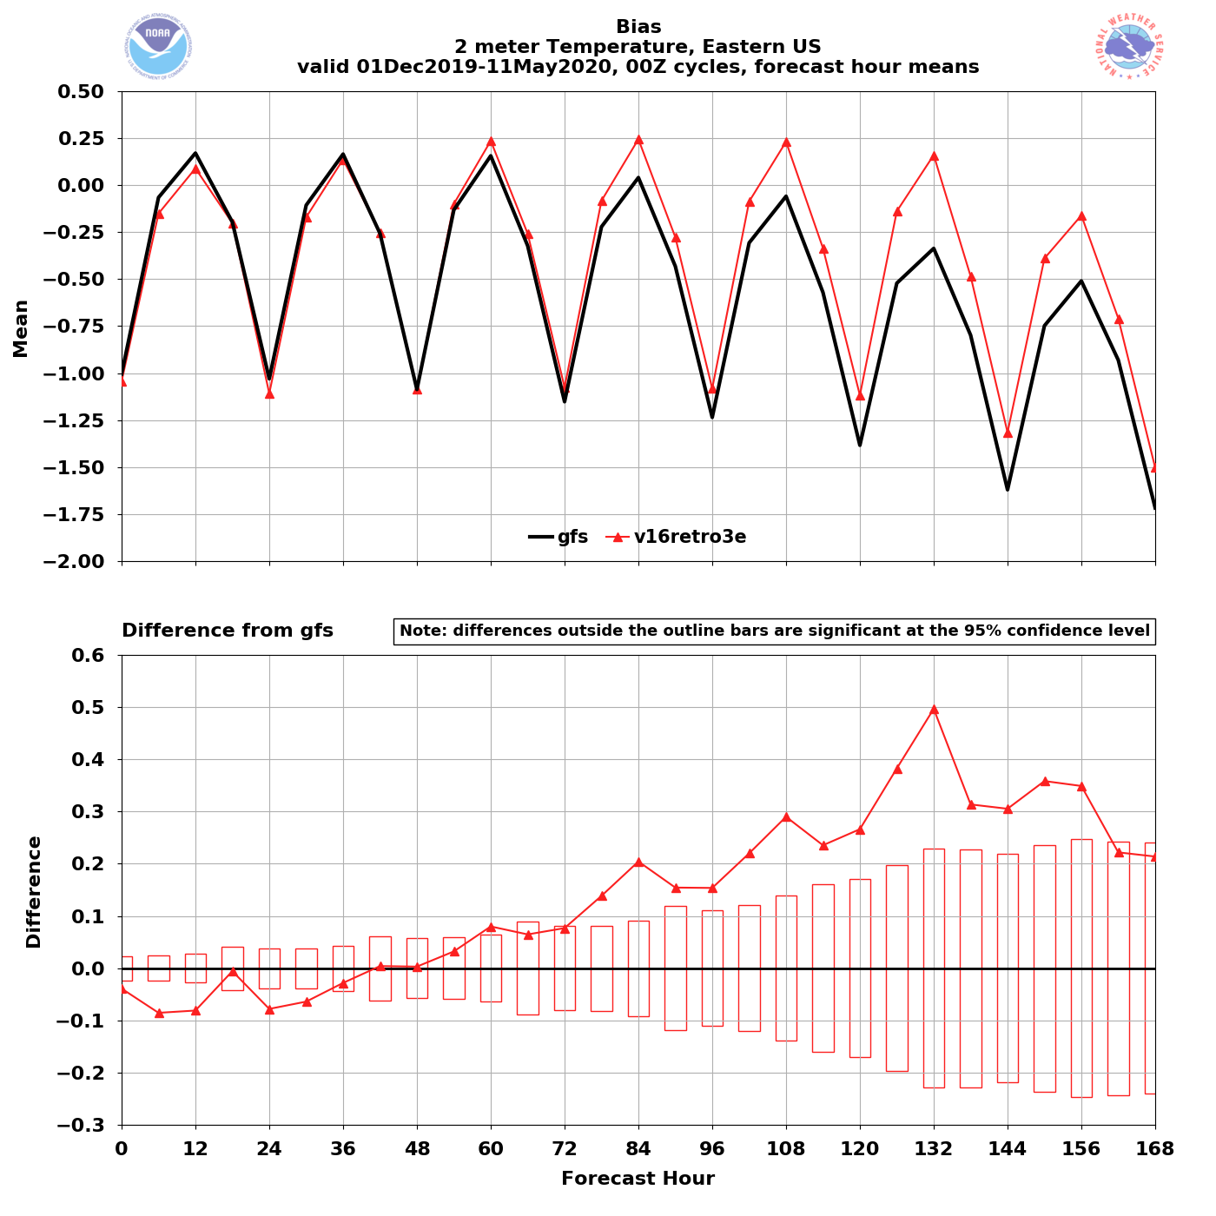
NATIONAL OCEANIC AND ATMOSPHERIC ADMINISTRATION
Strengths: Mitigated Low-Level Cold Bias
Western US – Winter/Spr. 2020
Eastern US – Winter/Spr. 2020
00Z
cycles
GFSv15
GFSv16
GFSv15
GFSv16
2-m T Bias
2-m T Bias
Grid-to- Obs
GFSv16 has less of a cold bias at longer lead times
GFSv16 has less of a cold bias at longer lead times

Slide 43
NATIONAL OCEANIC AND ATMOSPHERIC ADMINISTRATION
Overall Impressions of GFSv16
Common Concerns
Low CAPE bias, especially during the warm season in environments favorable for supporting severe weather (Low CAPE associated with drier low-levels and soil moisture conditions)
Low-level moisture/2-m dewpoint dry bias in GFSv16 (PBL overmixed) during warm season (associated with drier soil conditions)
Larger TC False Alarm Rate (FAR) and right-of-track bias

Slide 44
NATIONAL OCEANIC AND ATMOSPHERIC ADMINISTRATION
Drier Soil Associated With Lower Boundary Layer Moisture
v16 - v15 Differences
F024
Top Level Soil Moisture
F024
2-m Dew Point
F024
Sfc-Based CAPE
F024
Init: 00Z 23 July 2020 Valid: 00Z 24 July 2020 (F024)
GFSv16 top level soil moisture is considerably drier than in v15
Good alignment between lower 2-m dew points and largest areas of reduced CAPE
44

Slide 45
NATIONAL OCEANIC AND ATMOSPHERIC ADMINISTRATION
Next Steps
NCEP Director briefing on 10/5/20
Code handoff to NCO on 10/9/20
NCO 30-day IT test from ~12/21/20 to 1/20/21
Implementation date ~2/3/21
https://www.emc.ncep.noaa.gov/users/meg/gfsv16/

