Slide 1
FV3-GEFS Retro-spective Run
TC track verification
2017: 00Z 06/01----11/30 12Z 07/01----10/31 2018: 00Z 05/01----11/30 12Z 07/01----10/31 2019: 00Z 05/01----11/30 12Z 07/01----10/31

Slide 2
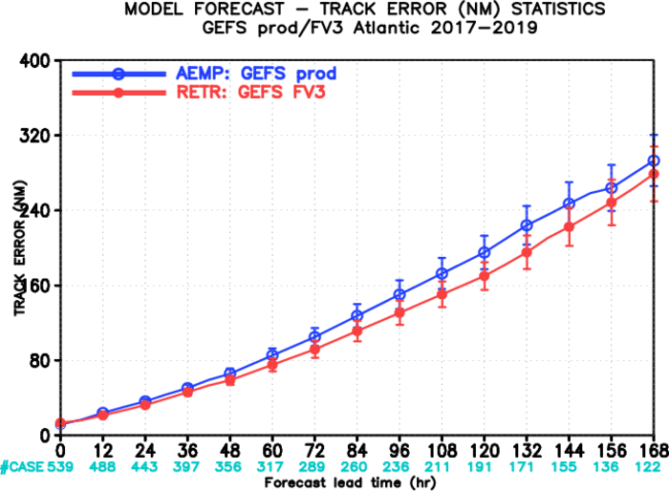
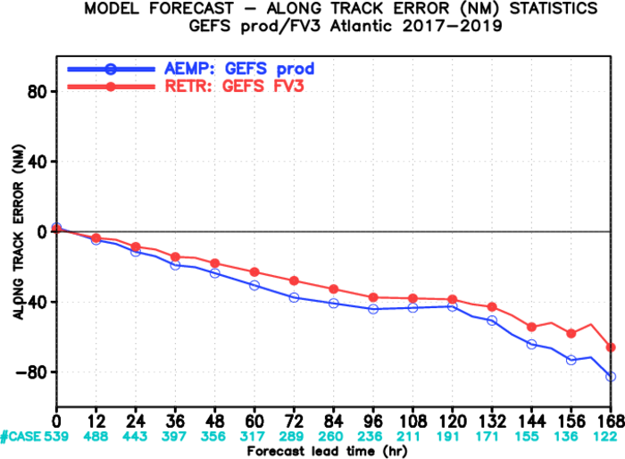
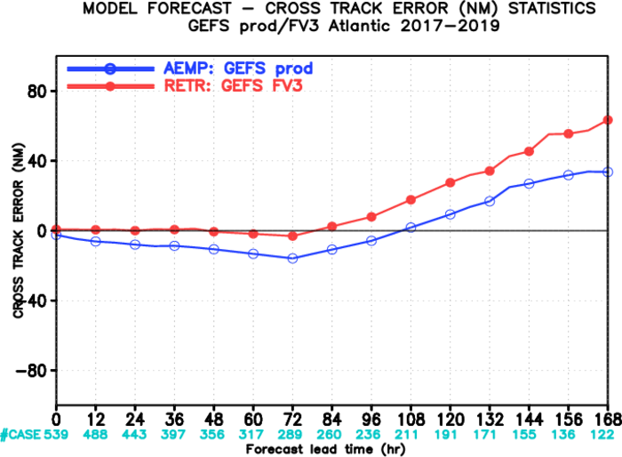

Slide 3
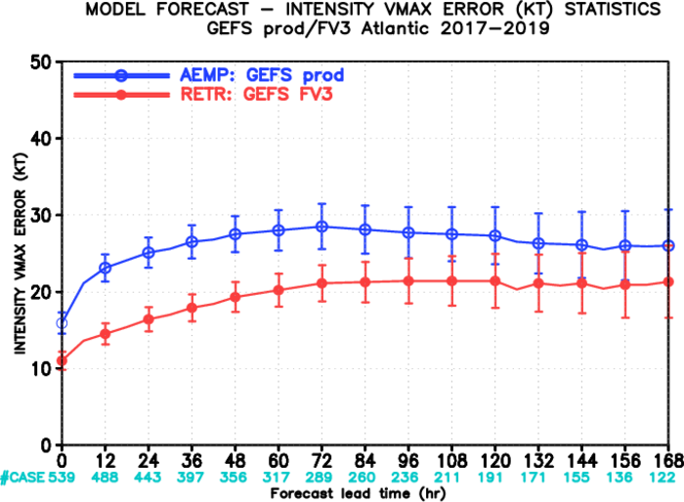
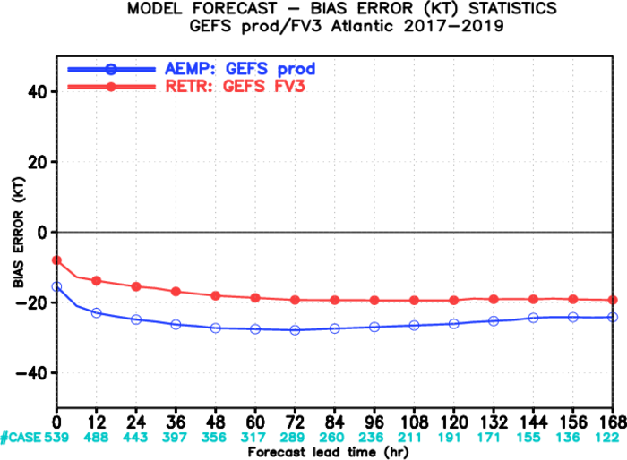
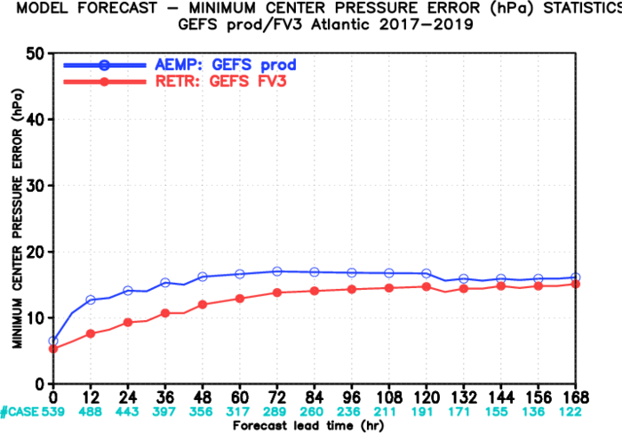

Slide 4
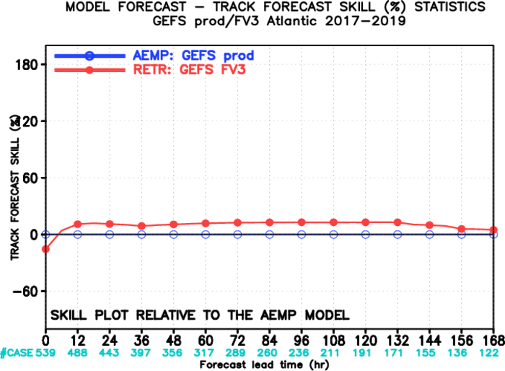
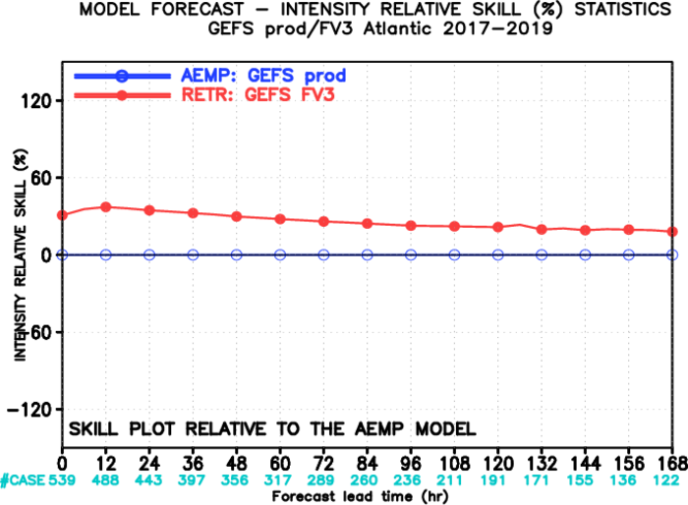
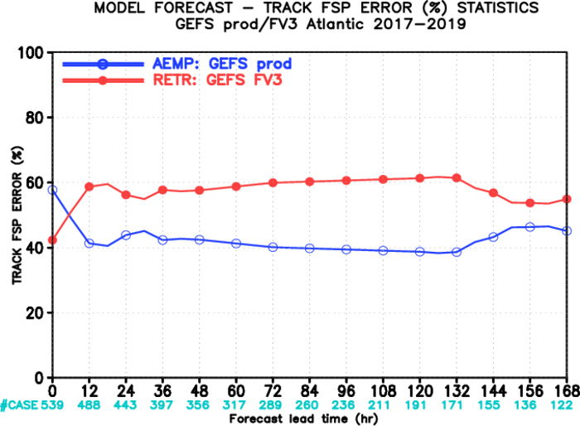
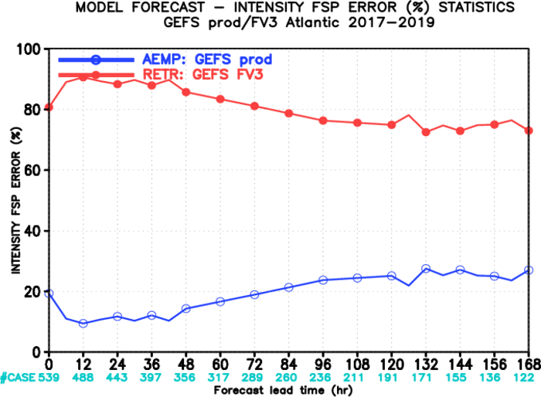

Slide 5
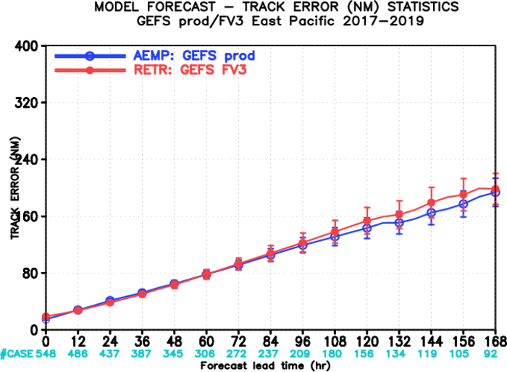
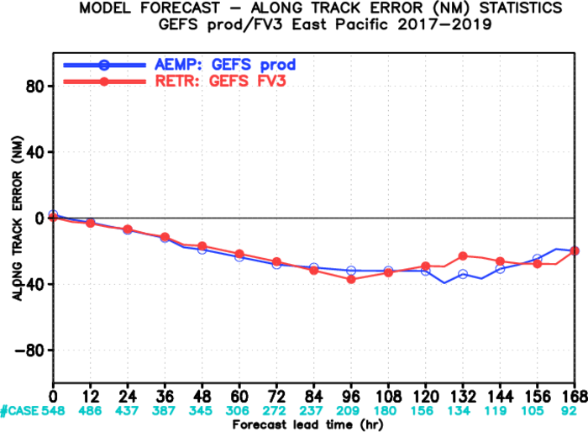
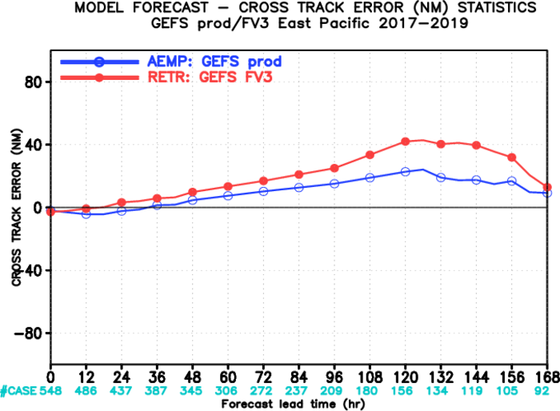

Slide 6
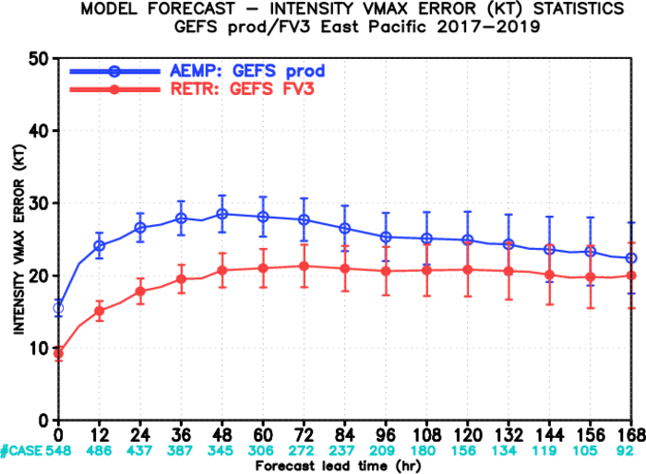
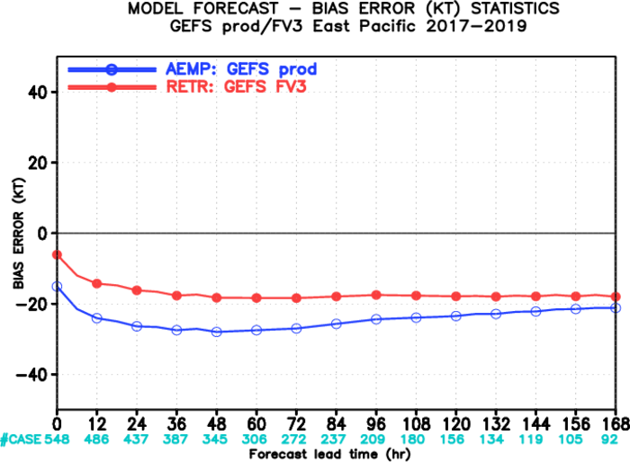
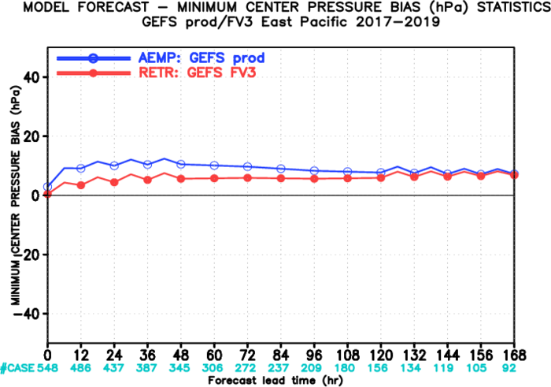

Slide 7
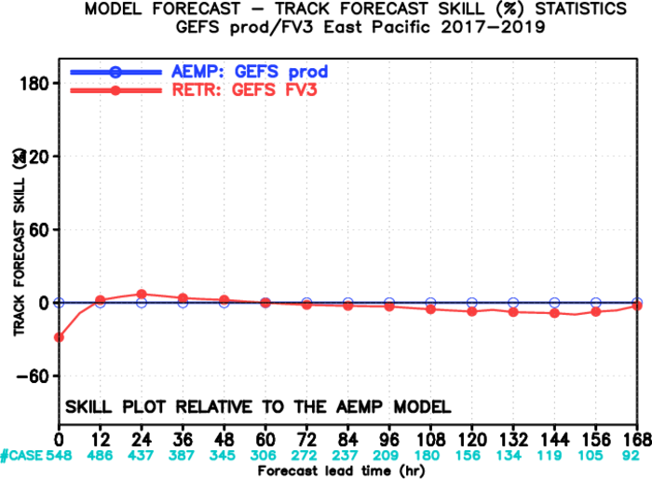
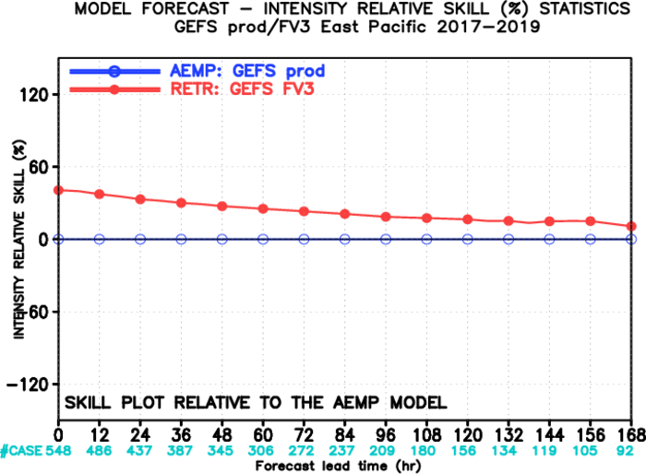
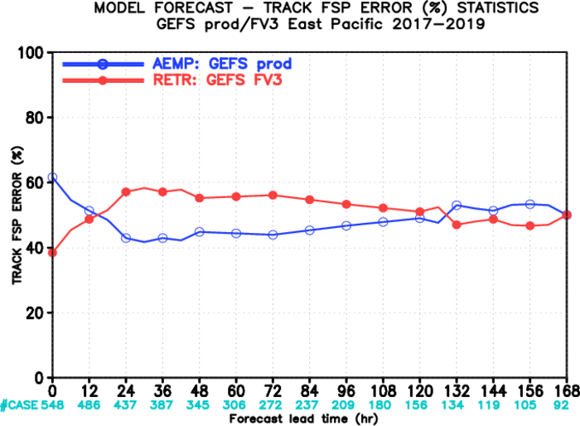
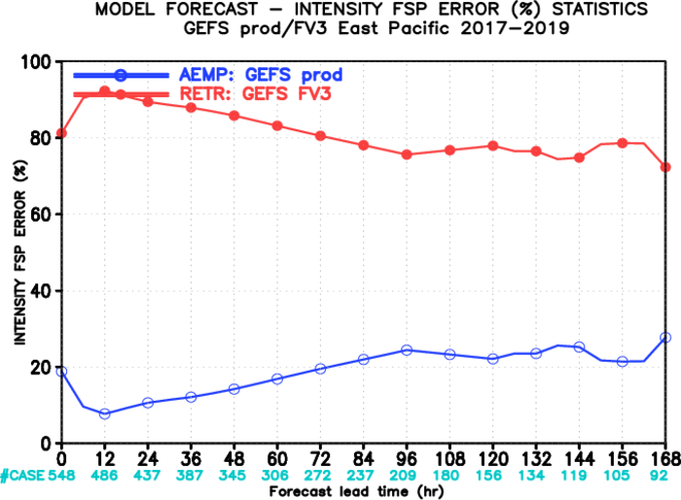

Slide 8
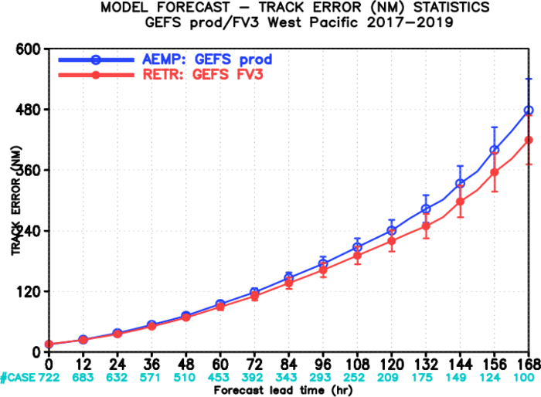
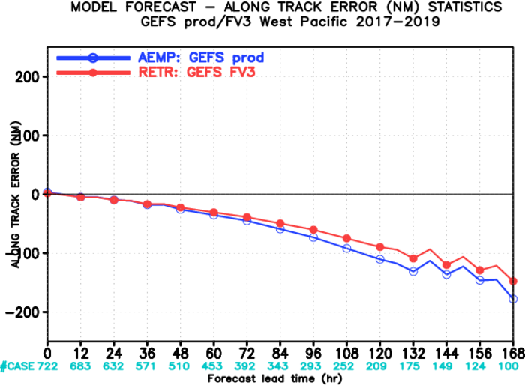
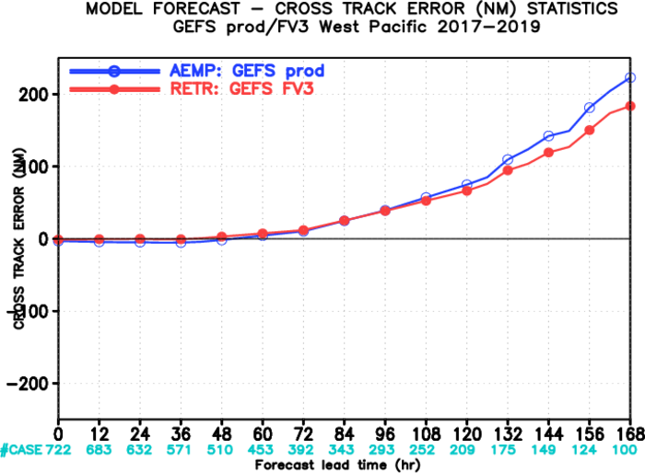

Slide 9
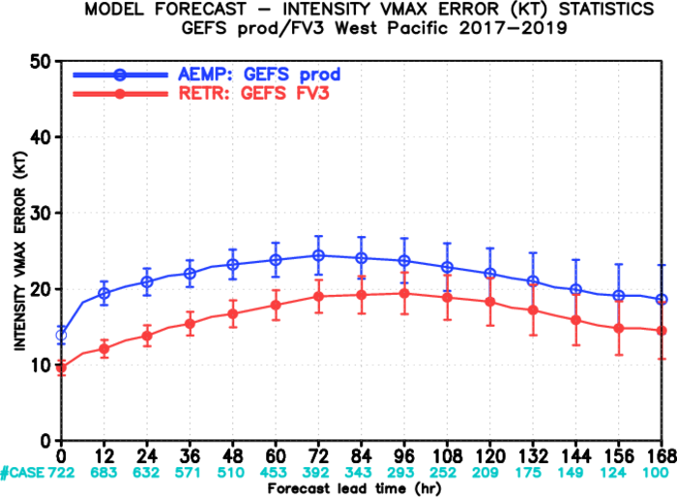
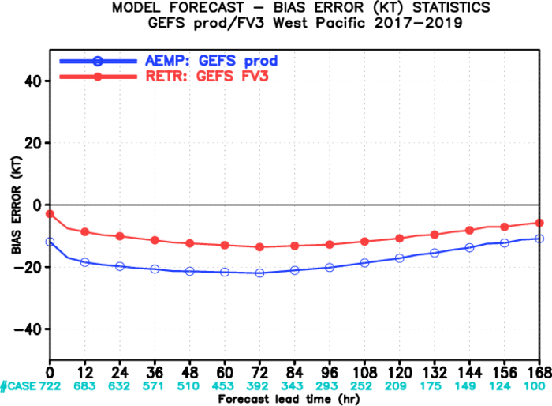
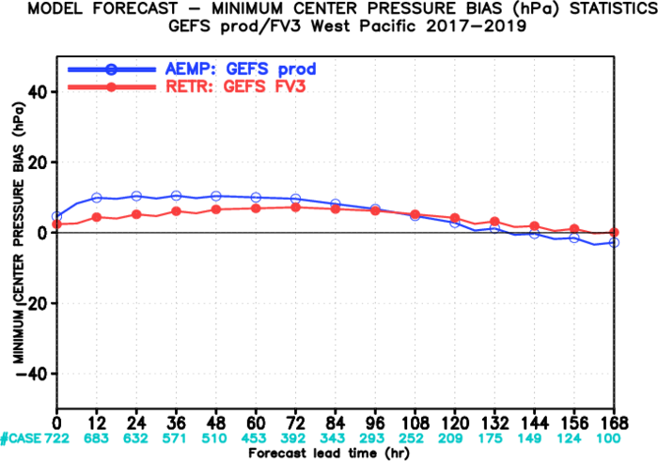

Slide 10
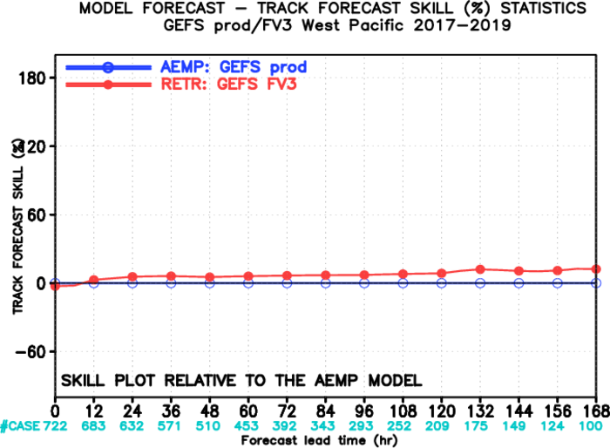
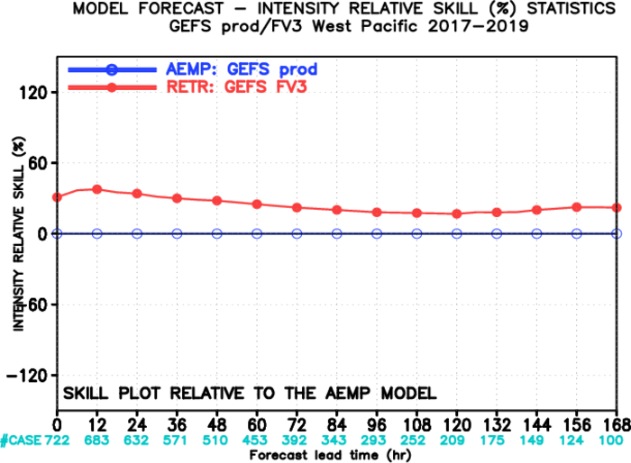
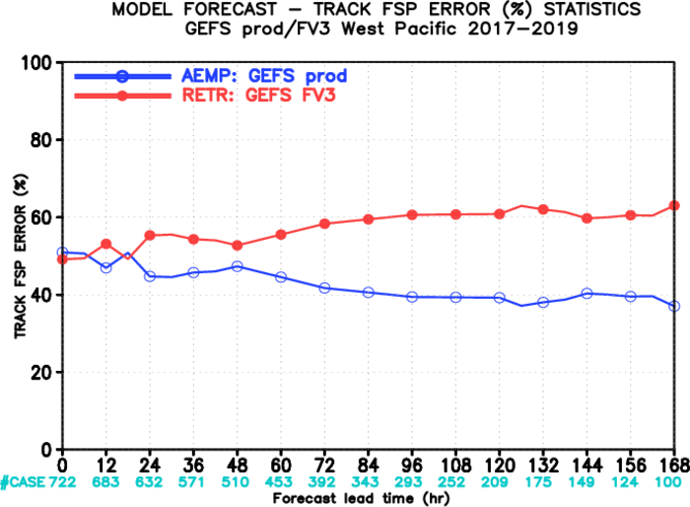
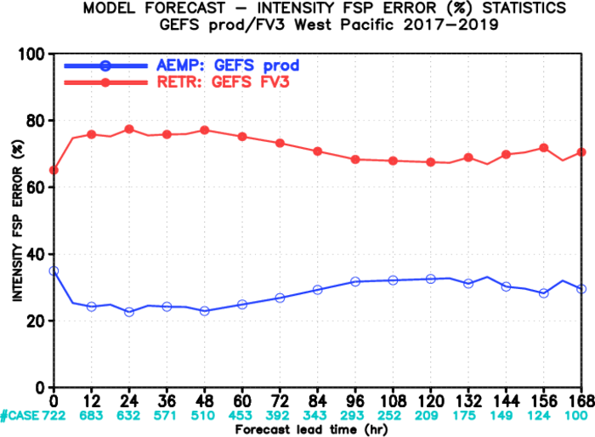

Slide 11
2017 June 01--Nov. 30 (00Z ) TC track error/spread (AL/EP/WP)
AEMP----GEFS-prod error
AESD ---- GEFS-prod spread
RETR ---- GEFS-FV3- error
RESD ---- GEFS-FV3- spread
Track error /spread (NM)
Forecast hours
CASES 568 513 465 407 362 280 215 164 134 105

Slide 12
2018 May 01--Nov. 30 (00Z ) TC track error/spread (AL/EP/WP)
Track error /spread (NM)
Forecast hours
CASES 700 639 581 524 473 371 290 226 178 139

Slide 13
2019 May 01--Nov. 30 (00Z ) TC track error/spread (AL/EP/WP)
Track error /spread (NM)
Forecast hours
CASES 515 461 411 359 315 244 185 132 87 56

