Slide 1
CPC Evaluation of GEFSv12
Mingyue Chen
Mike Charles
Lindsey Long
Craig Long
Kyle MacRitchie
Hui Wang
Matt Rosencrans

Slide 2
Constraints
Week - 2
Most of GEFSv12 retrospective unusable for CPC (stop at fhr 240)
Used last years of GEFSv12 reforecast data instead. Adv: V12
Subset of 5 out of 21 GEFSv10 real-time members was used to make the two datasets more homogeneous.
Week - 3/4
No major issues noted

Slide 3
500 hPa Heights
Mingyue Chen

Slide 4
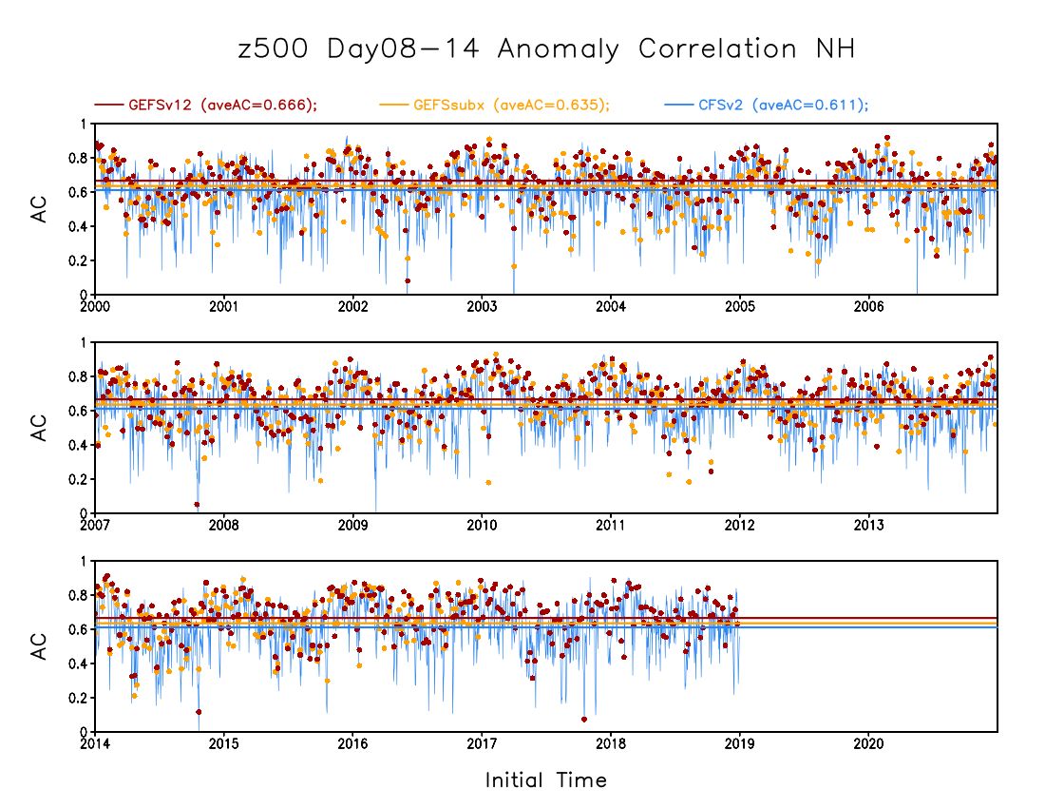
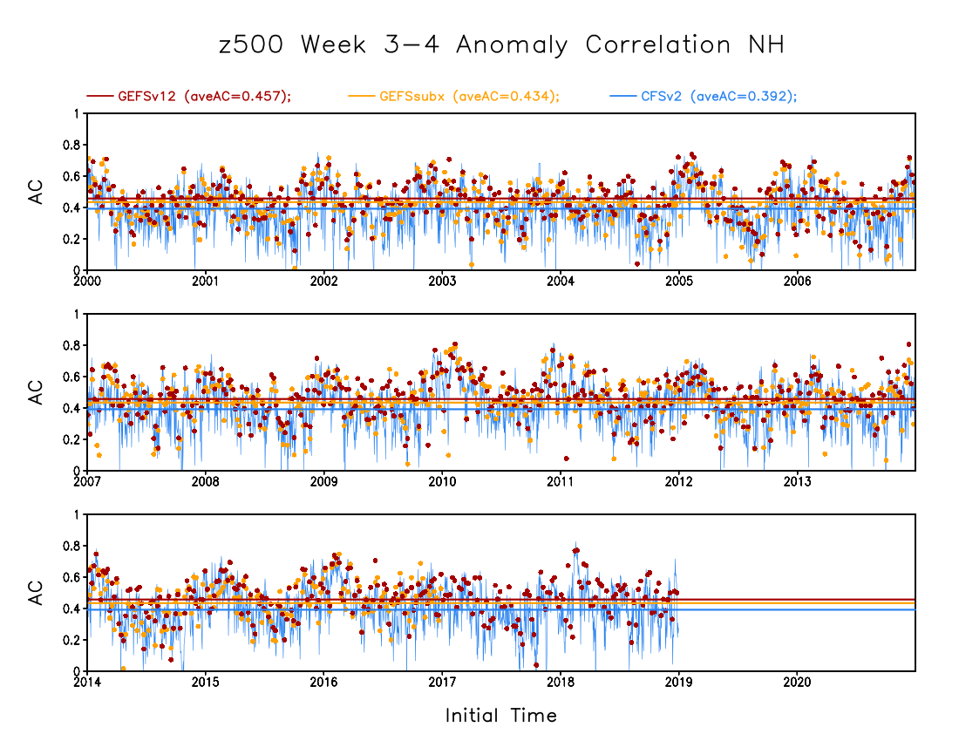
GEFSv12 | 0.666
GEFSSubX | 0.635
CFSv2 | 0.611
GEFSv12 | 0.457
GEFSSubX | 0.434
CFSv2 | 0.392

Slide 5
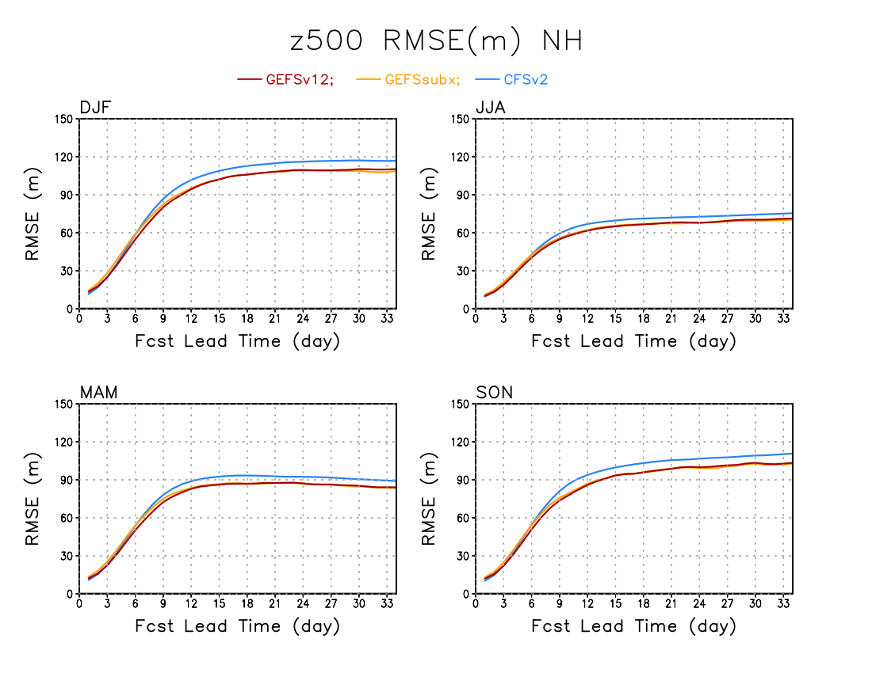

Slide 6
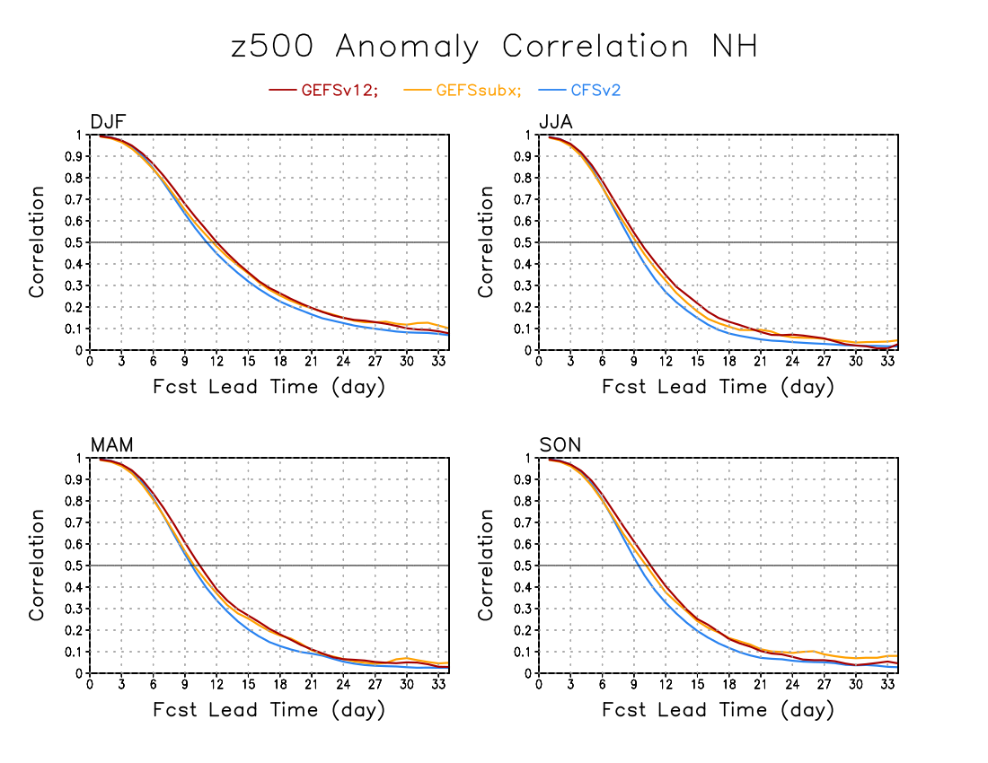
Day which AC=0.5 | NH |  |  |  | PNA
 | DJF | MAM | JJA | SON | DJF | MAM | JJA | SON
GEFSv12 | 12 | 10 | 9 | 10 | 12 | 10 | 9 | 10
GEFSsubx | 11 | 9 | 9 | 10 | 12 | 9 | 8 | 10
CFSv2 | 11 | 9 | 8 | 9 | 11 | 9 | 8 | 9
Notes:
GEFSv12 shows better time-averaged spatial correlation skill than GEFSsubx and CFSv2 for forecasts of Day 6-10, Day 8-14, and Weeks 3-4 over extra-tropical NH (20N-80N) and PNA sector.

Slide 7
Stratosphere
Craig Long

Slide 8
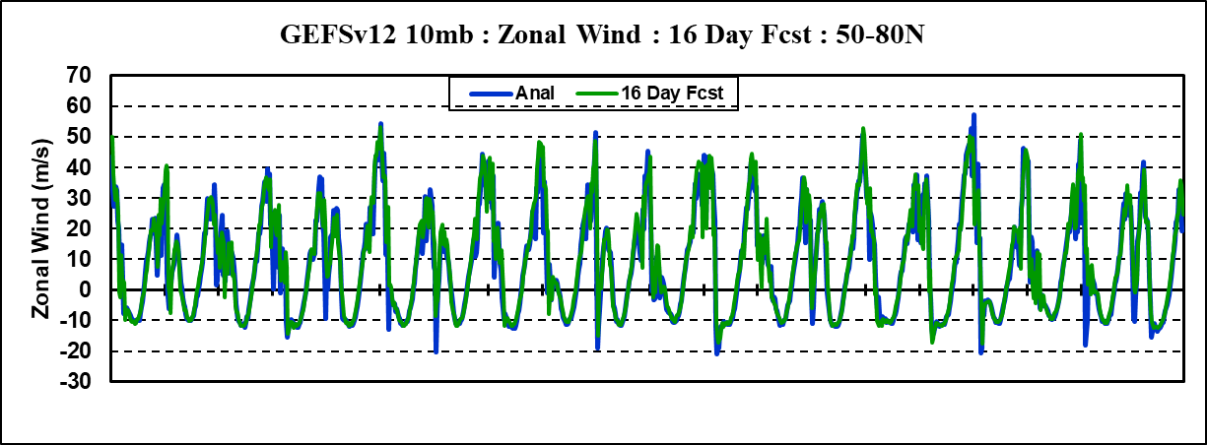
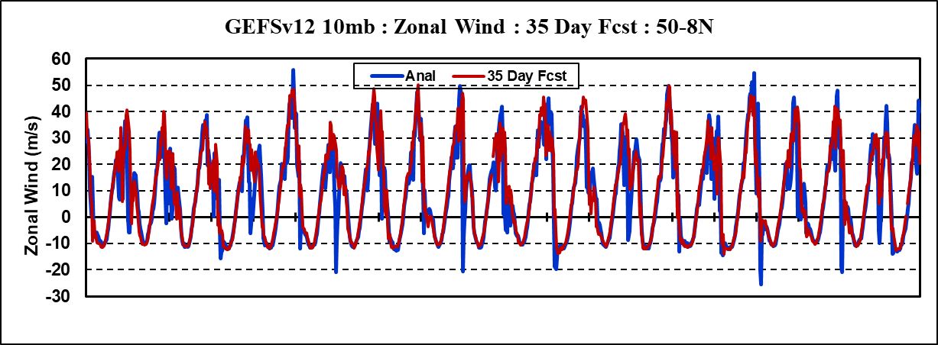
35 Day ReFcsts : NH Polar Jet : 10mb
Similar time series set up as NH Polar Temps:
Analysis and 16 day fcsts are shown in top plot.
analysis and 35 day fcsts are shown in bottom plot.
During Sudden Warmings polar winds will decelerate and may become Easterly for a short period of time.
Commonly, 60N at 10 mb is used to denote a Major SSW if the winds become Easterly (denoted by ).
2000
2005
2010
2015
2020
2000
2005
2010
2015
2020
Both 10 & 50 mb time series show:
Winter max winds are under fcst
Sudden warmings (wind decelerate/reverse) under forecast/not forecasted

Slide 9
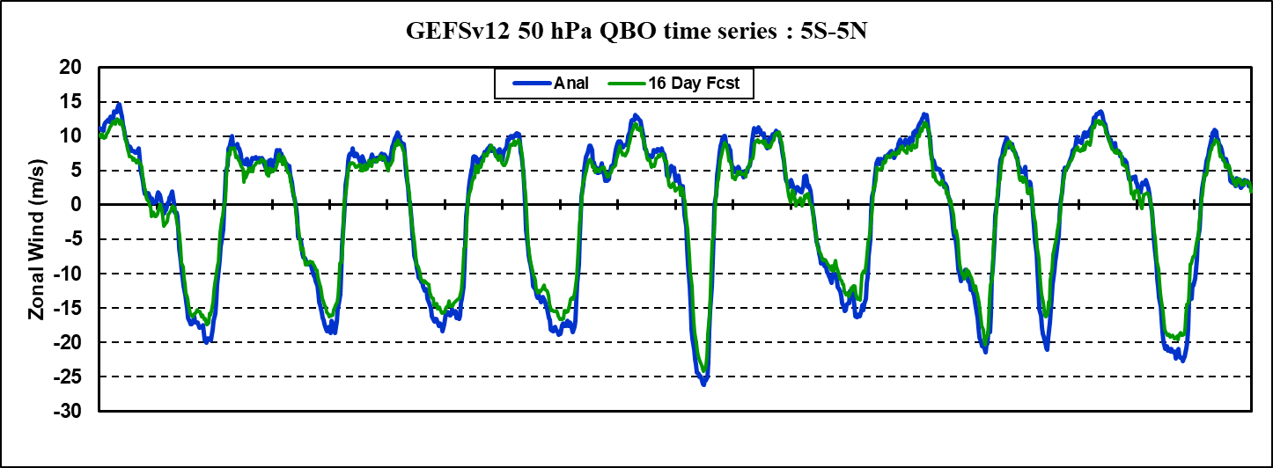
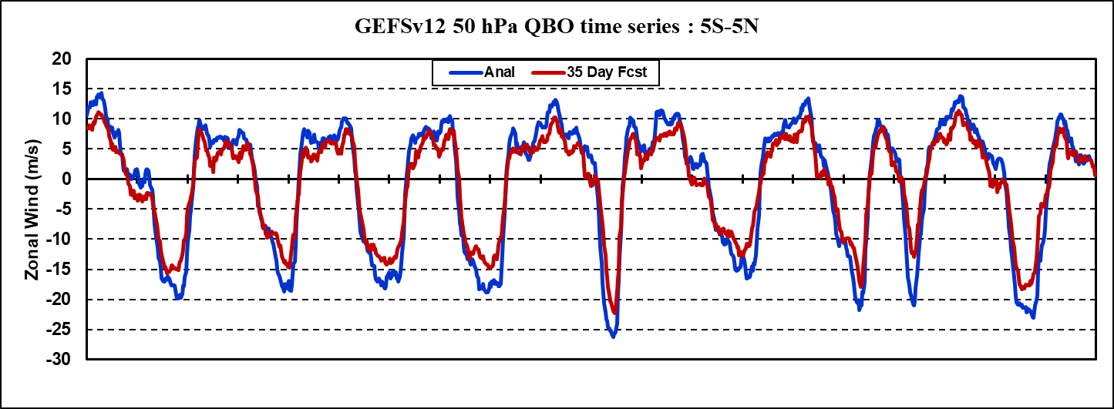
35 Day ReFcsts : QBO zonal winds : 50mb
Retention of QBO structure is good. Some S2S models relax their QBO winds to easterlies by 35 days.
2000
2005
2010
2015
2020
2000
2005
2010
2015
2020
Notes:
Capturing QBO state well preserved out to 35 days.
Westerlies become more under forecast with time which did not happen at 10mb.
Easterlies also become more under-forecast with time.

Slide 10
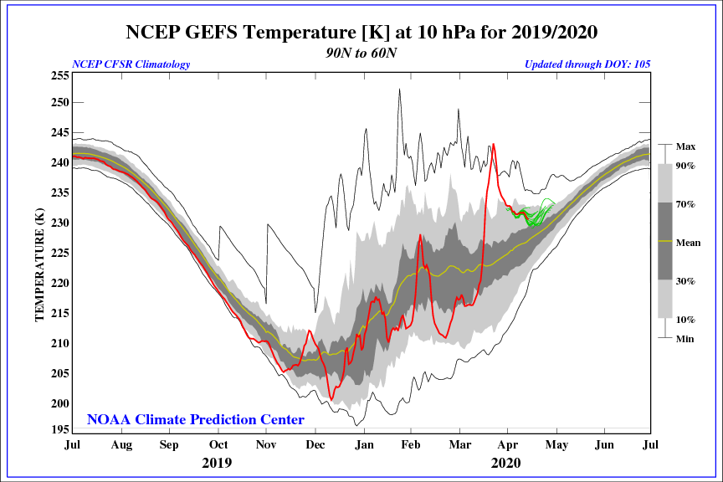
Evaluation of Retrospectives
In Oct and Nov of 2019 NH polar temps progressively became colder but at the end of Nov there was a period of warming.
Daily analysis and forecasts (4, 8, 12, & 16 day) are examined to see how well this event was captured.
Notes:
Unfortunately, the retrospectives ended in Nov 2019. Nov and Dec showed large variances in the GEFSv11 forecasts longer than 10 days. But Nov is good enough to show this.

Slide 11
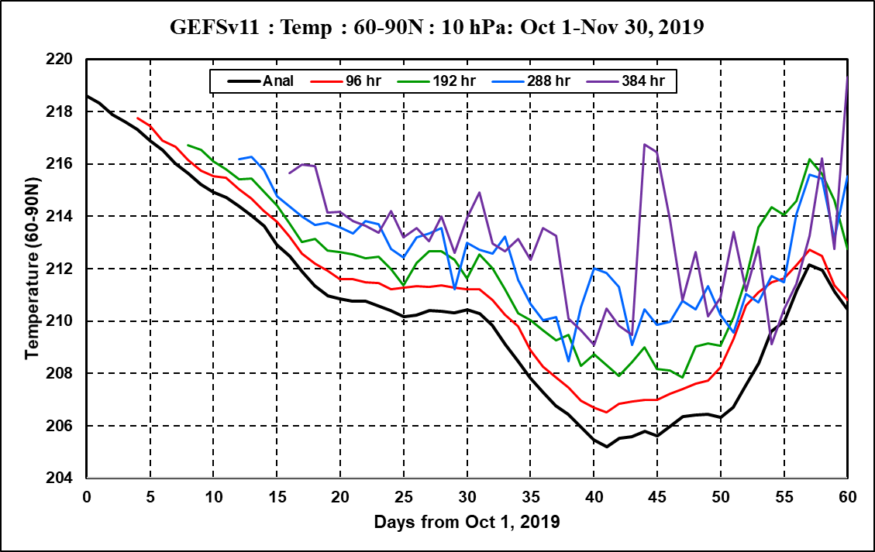
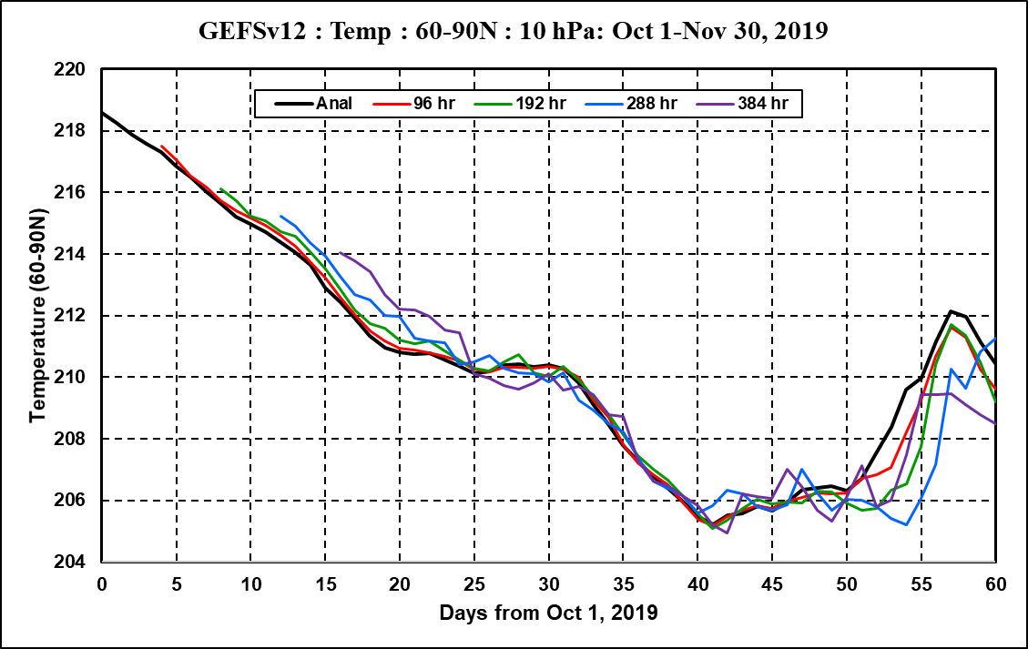
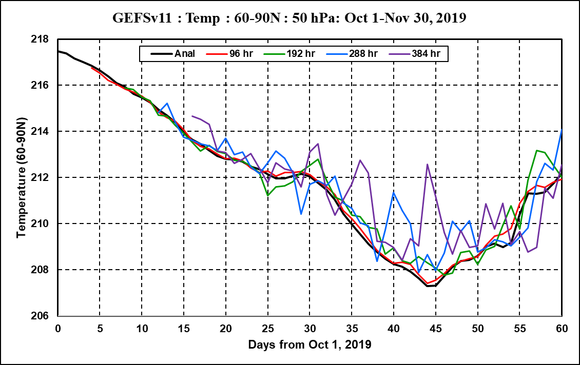
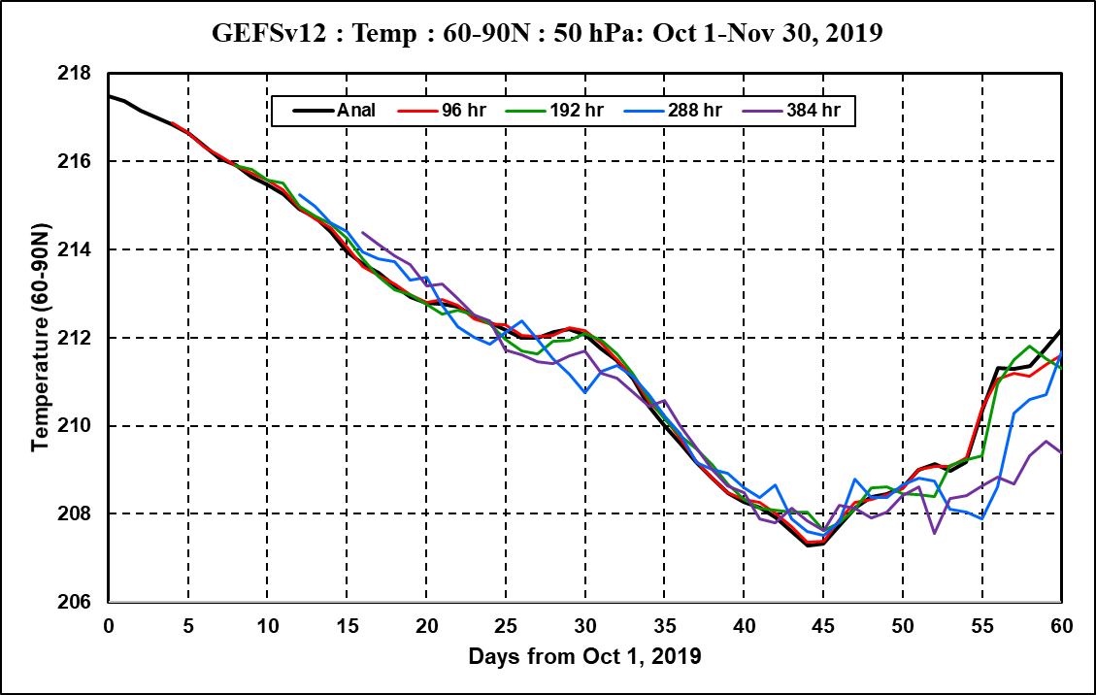
Retrospectives : Temperature : 60-90N
Anl
96 hr
192 hr
288 hr
384 hr
Less day-to-day variability. Better accuracy.
GEFSv11 10mb
GEFSv12 10mb
GEFSv11 50mb
GEFSv12 50mb
“Vast” improvement of GEFSv12 12 & 16 day fcsts wrt GEFSv11
Notes:
Plotted are analysis, 96,192,288,384 hr fcsts beginning Nov 1 through Nov 30. The forecasts are at their validation date.

Slide 12
Next slides show zonal mean forecast errors from day 1 to day 16 for the month of November 2019.
Shown are T and u at pressure levels 10, 50, and 100 mb.
All slides show that the monthly mean forecast errors for GEFSv12 are smaller at most latitudes than GEFSv11.
Notes:
Something special about this case study? (Arun)

Slide 13
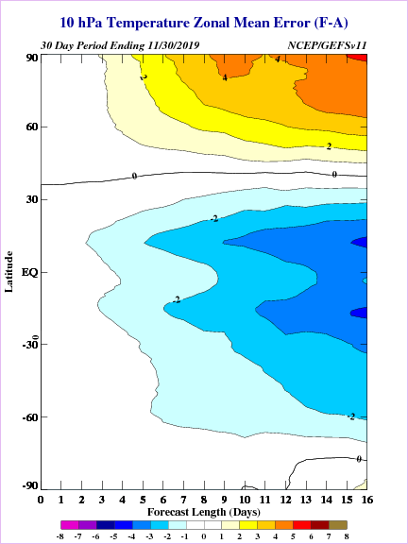
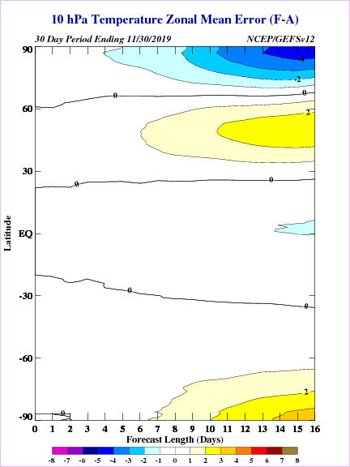
10 hPa Temperature Fcst Errors
30 day errors ending Nov 30, 2019
GEFSv11
GEFSv12 Retro

Slide 14
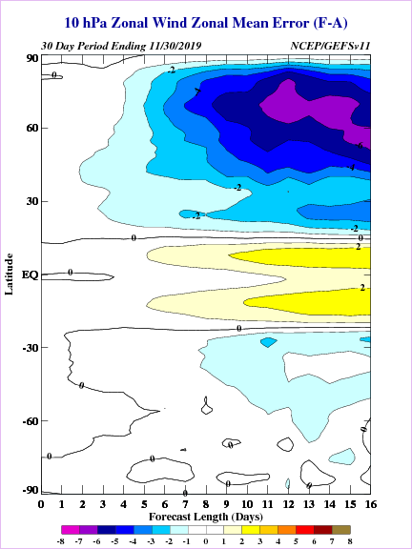
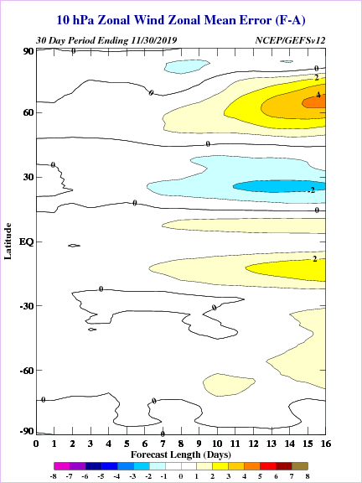
10 hPa Zonal Wind Fcst Errors
30 day errors ending Nov 30, 2019
GEFSv11
GEFSv12 Retro

Slide 15
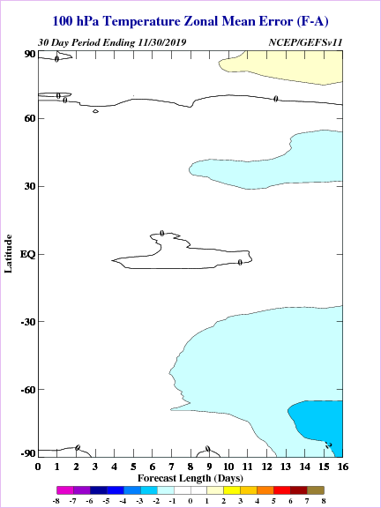
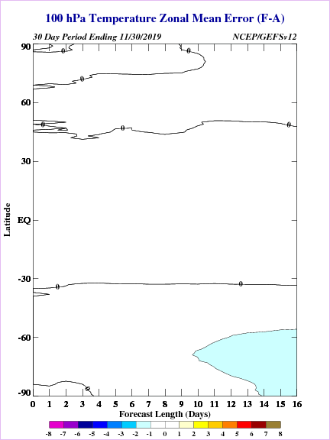
100 hPa Temperature Fcst Errors
30 day errors ending Nov 30, 2019
GEFSv11
GEFSv12 Retro

Slide 16
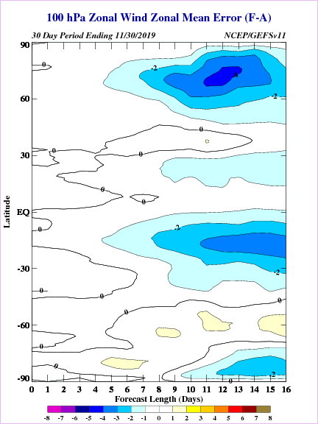
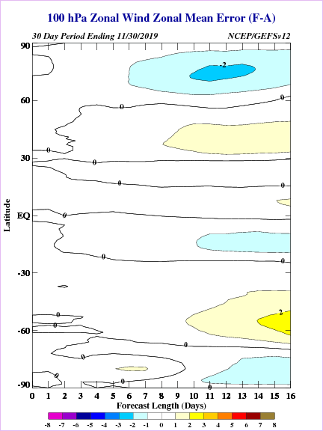
100 hPa Zonal Wind Fcst Errors
30 day errors ending Nov 30, 2019
GEFSv11
GEFSv12 Retro

Slide 17
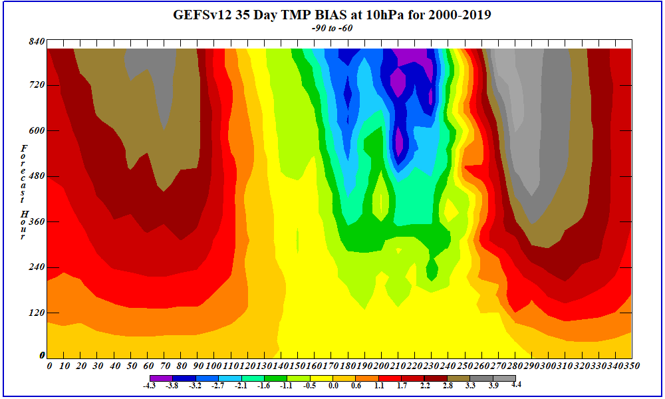
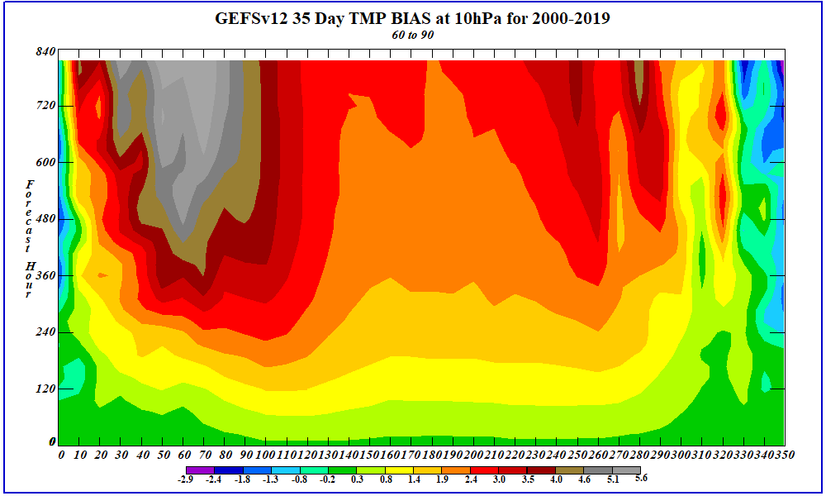
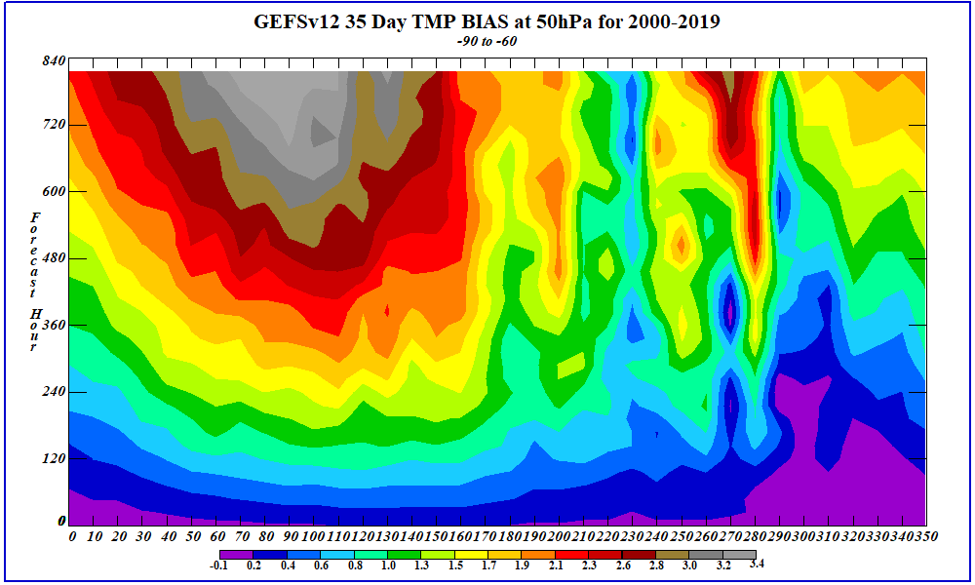
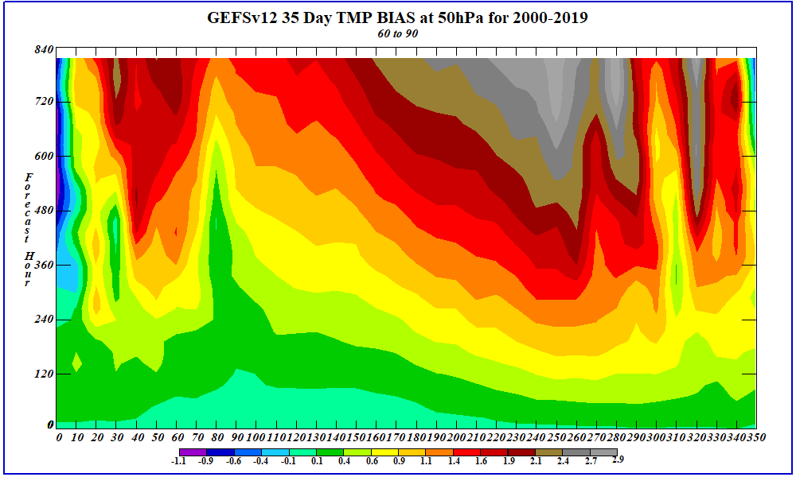
0-35 Day Temperature Bias (F-A) Growth (2000-2019)
SH 60-90S
NH 60-90N
10 mb
10 mb
50 mb
50 mb
Notes:
These plots show the growth of the temperature bias (F-A) using the once-per-week 35 day fcsts from 2000-2019. Daily differences are binned into 7 day periods to produce better stats for a total of 52 bins for the entire year. The “interesting” +/-/+ structure occurs during the winter months. The next slide addresses this.

Slide 18
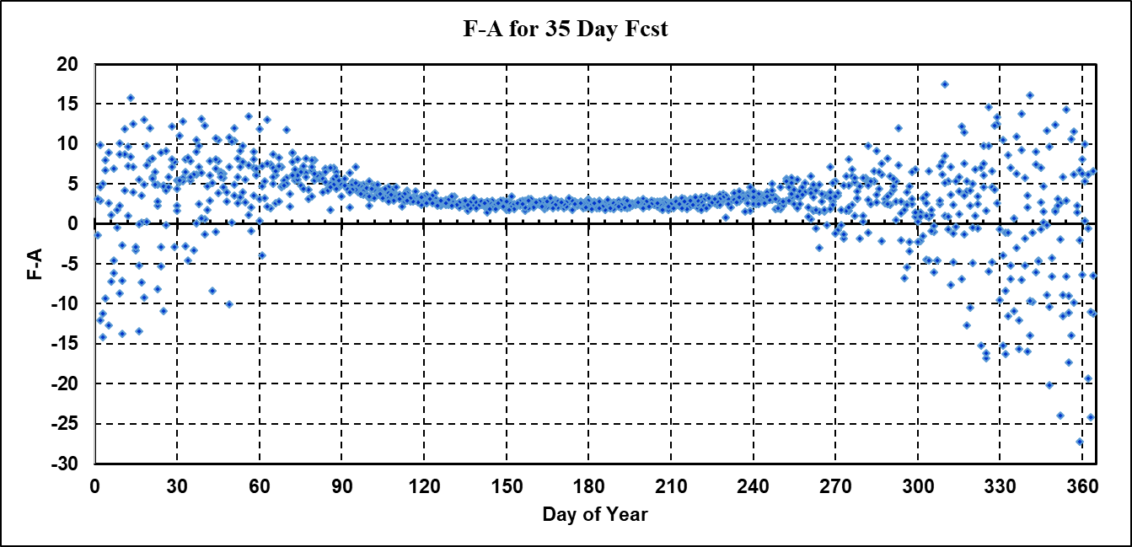
Uncertainty in Determining Bias for Any Single Day
Small Uncertainty
Large Uncertainty
Notes:
This slide addresses the peculiar forecast error structure in the previous slide. During the summer months the F-A are consistent. Here the bias is certain. In the winter months each day-of-year may have large F-A due to winter warmings. Thus a mean bias has no meaning because the uncertainty is very large. This uncertainty grows with forecast time. The once-per-week 35 day fcst does not provide adequate numbers to perform meaningful statistics. In the SH, due to less temperatuere variability, the uncertainty at longer fcst times is smaller.

Slide 19
Stratosphere Summary
Temperatures:
NH & SH summer fcst temps increasingly are warmer than analysis
NH winter fcst temps also increasingly warmer than analysis
Longer forecasts miss sudden warmings in NH.
Winds:
NH winter max winds are under-forecast
NH sudden warming wind deceleration not caught in longer forecasts
QBO:
Structure is maintained throughout the 35 forecast day period
Intensity of both westerlies and easterlies become smaller with forecast time.
Retrospectives:
T and u - Zonal mean forecast errors are smaller for GEFSv12 compared to GEFSv11.
Long Term Statistics:
Performing one 35 day run per week may hinder ability to determine Bias and rms errors
10 Member spread increases during NH winter months and SH winter-to-spring transition.

Slide 20
Week-2 Temperature
Mike Charles

Slide 21
Data
Forecast lead: Week-2 (fhrs 198 to 360)
Spatial resolution: 1° (GEFSv12 interpolated to 1°)
Calibration training data:
GEFSv10: GEFSv10 reforecasts (11 members) from 1986 to 2015
GEFSv12: GEFSv12 reforecasts (5 members) from 1989 to 2018
Forecasts verified:
Verification for 2016 to 2018
GEFSv10: Independent real-time GEFSv10 forecasts (daily, subset of 5 members) *
GEFSv12: Non-independent GEFSv12 reforecasts (daily, 5 members) *
Observations: Subset of CADB stations available in the VWT
* GEFSv12 retrospective runs unusable for CPC (stop at fhr 240) – needed to use GEFSv12 reforecast data instead. This gives GEFSv12 an advantage as the forecasts verified are not independent. A subset of 5 out of 21 GEFSv10 real-time members was used to make the two datasets more homogeneous.

Slide 22
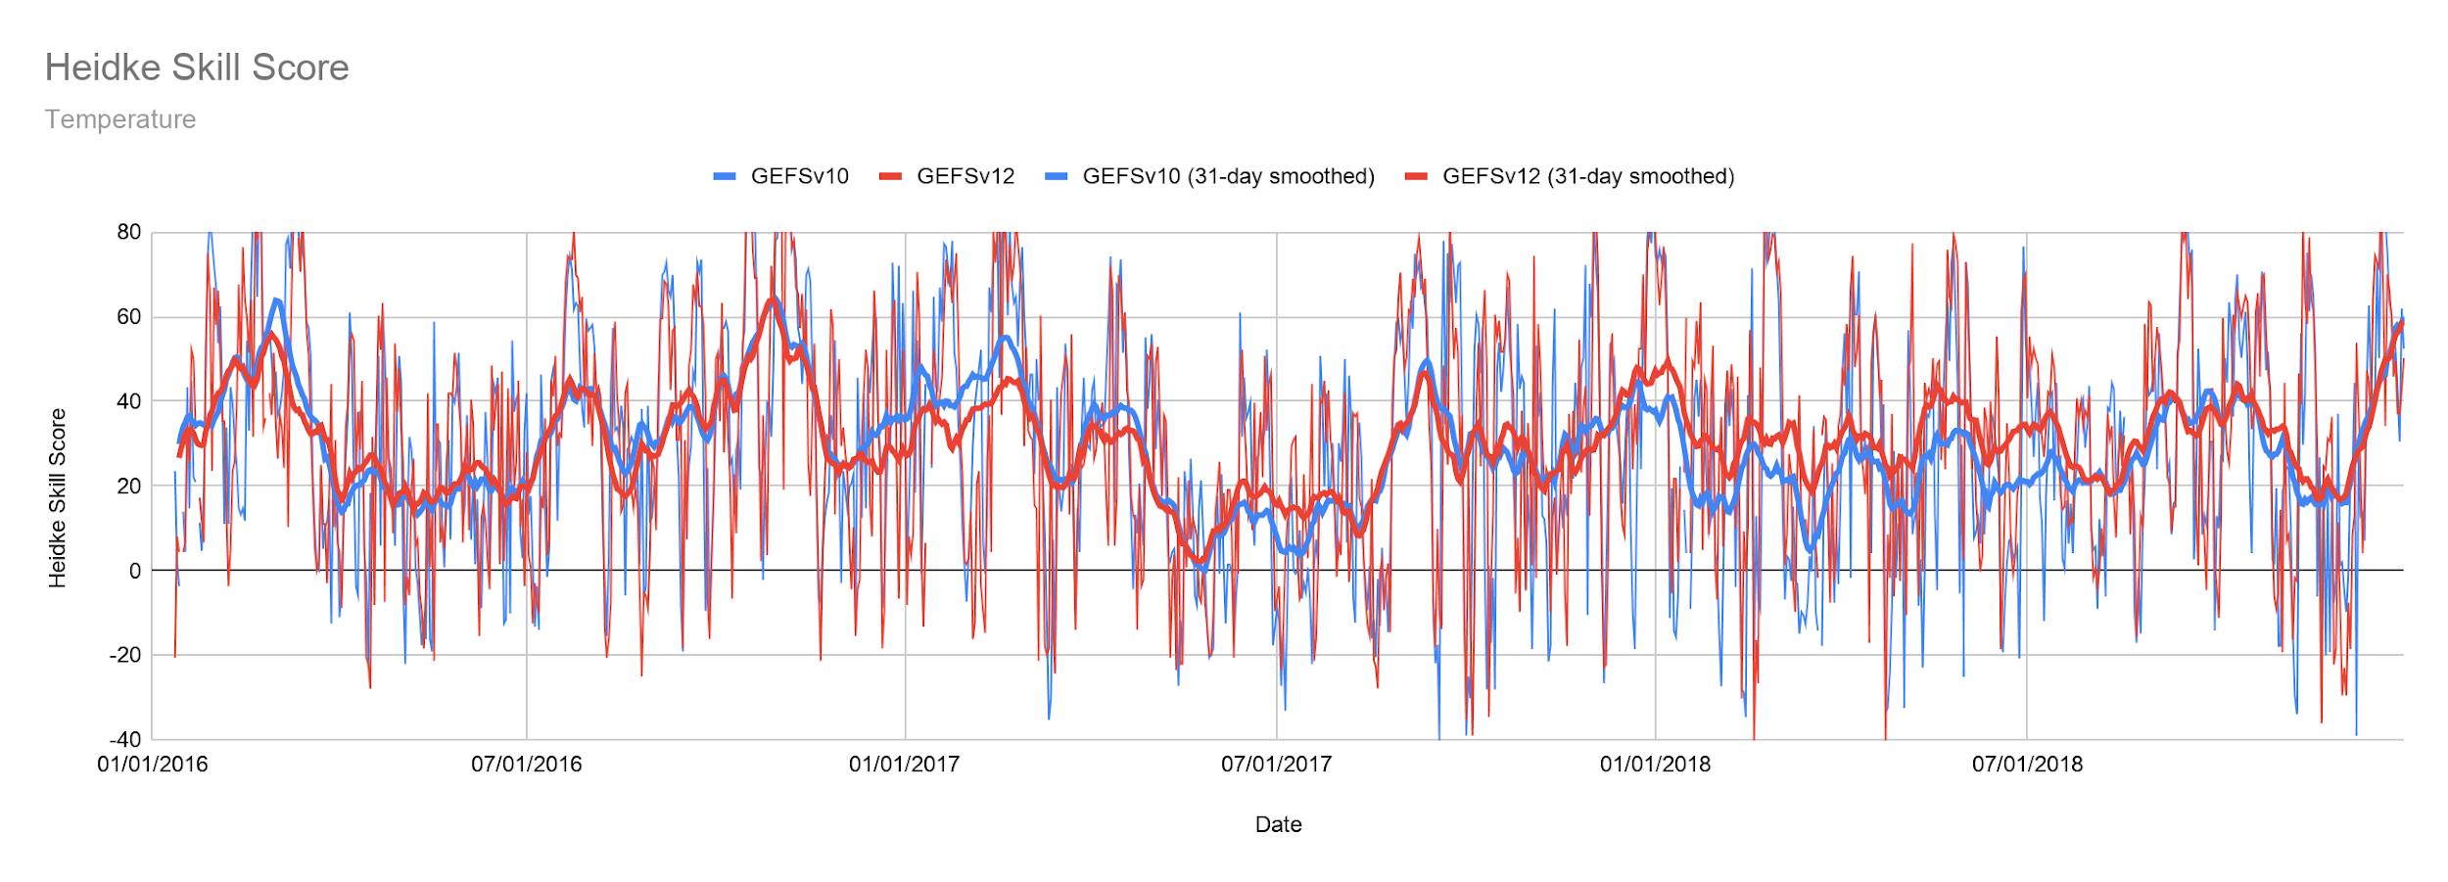
Heidke Skill Score Timeseries
Temperature

Slide 23
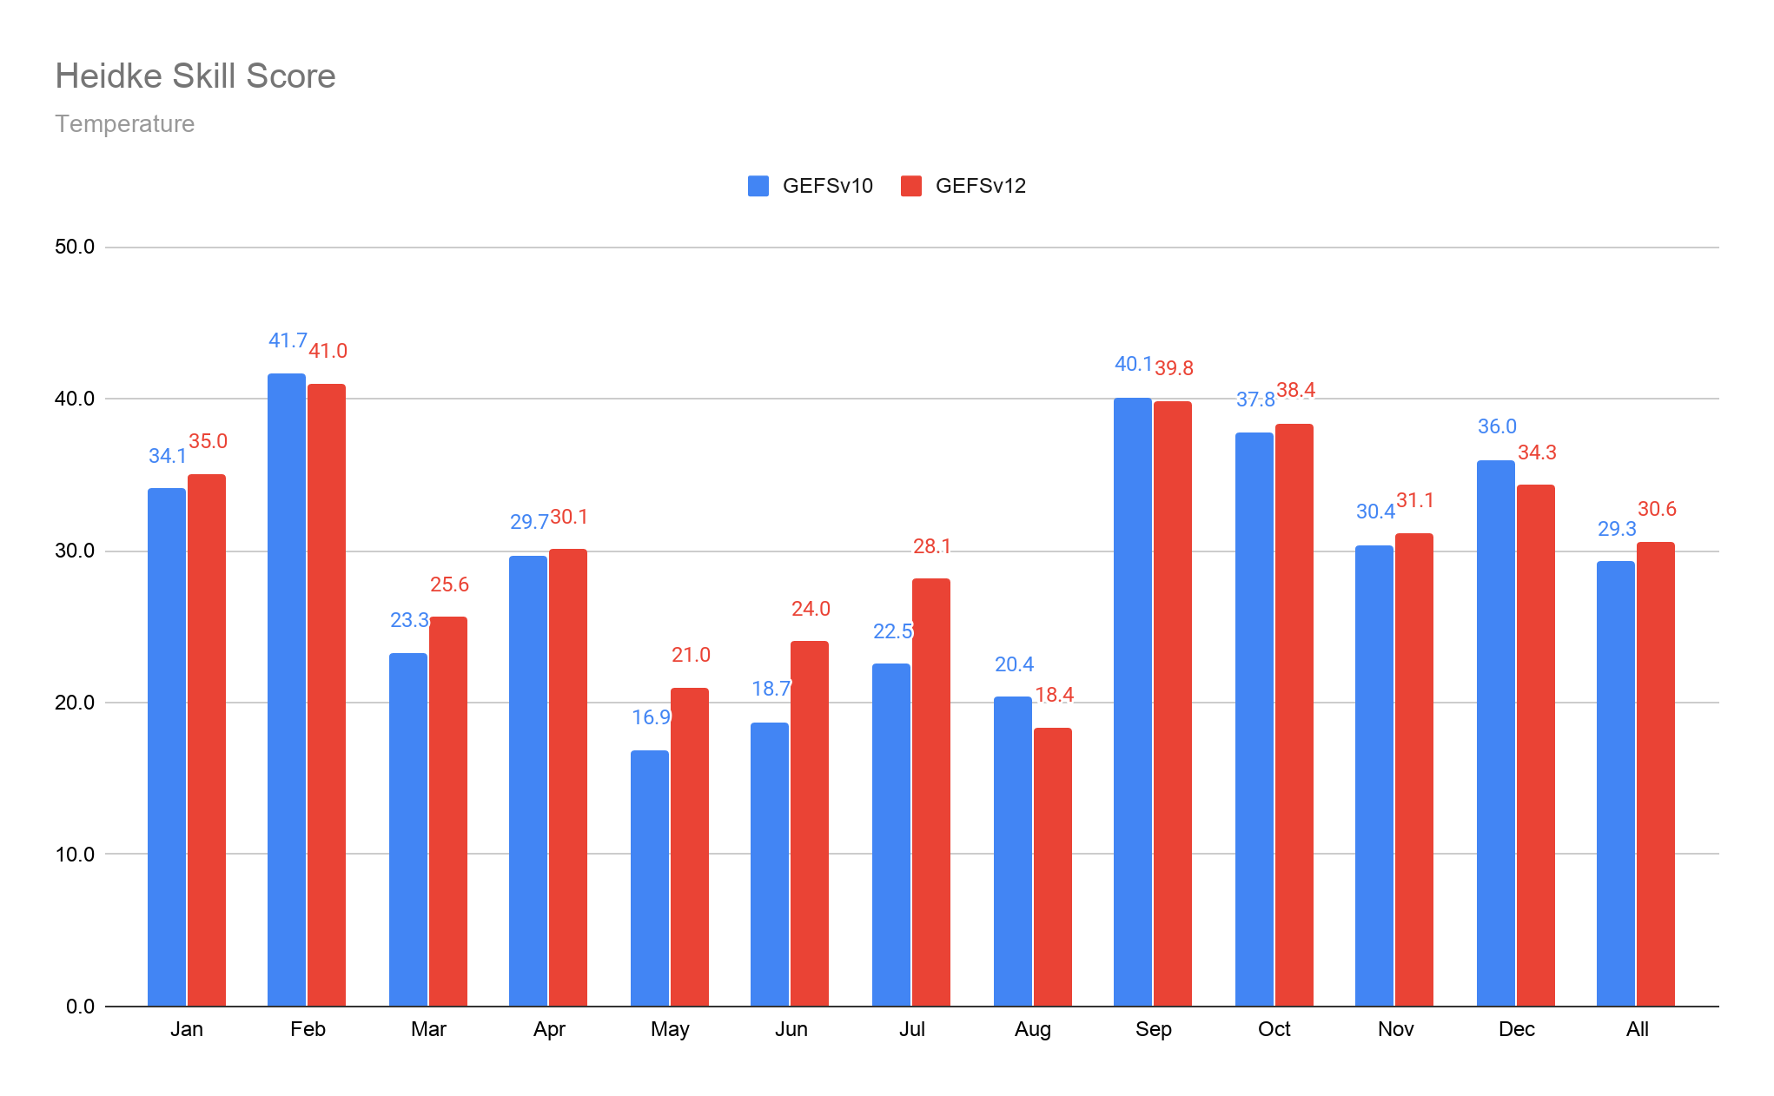
Average Heidke Skill Score
GEFSv12 HSS is higher in 8 out of 12 months – especially in May, June, and July
Overall GEFSv12 skill higher than GEFSv10 (95% sig.)
Temperature
Notes:
If possible, include the mean over the entire period (Arun)

Slide 24
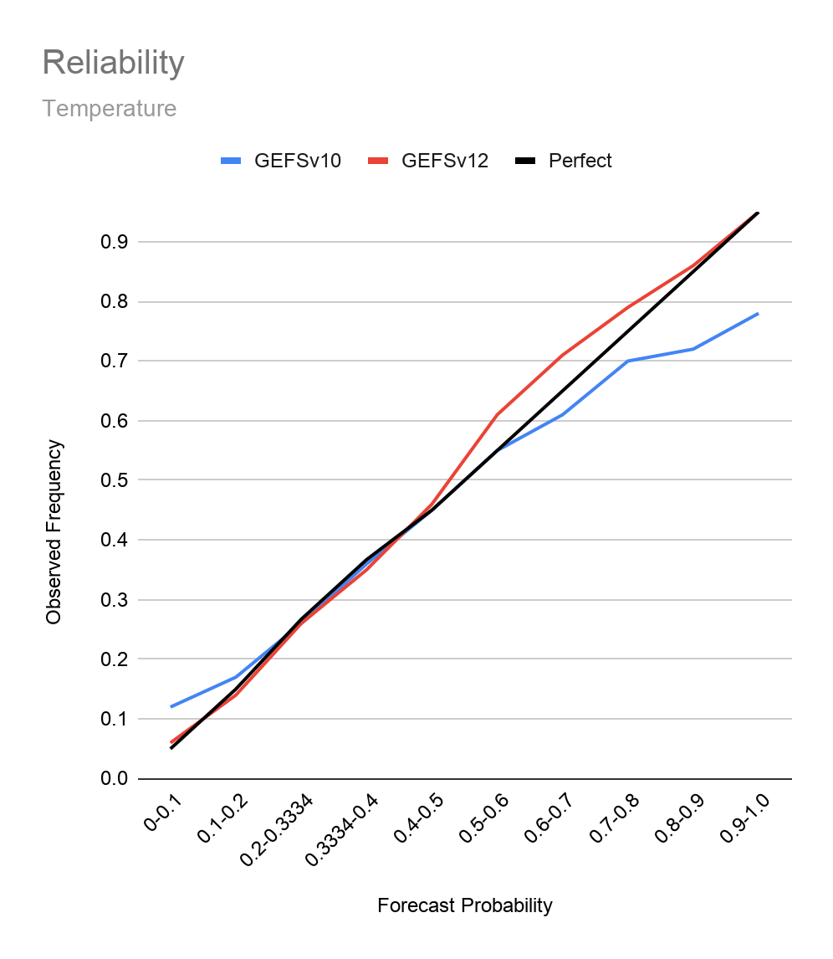
Reliability
GEFSv12 slightly under-confident above 50% probs.
GEFSv10 overconfident above 60% probs.
CAVEAT – Both reliabilities are expected to be better if all members from each ensemble were used
Temperature

Slide 25
Week-2 Precipitation
Mike Charles

Slide 26
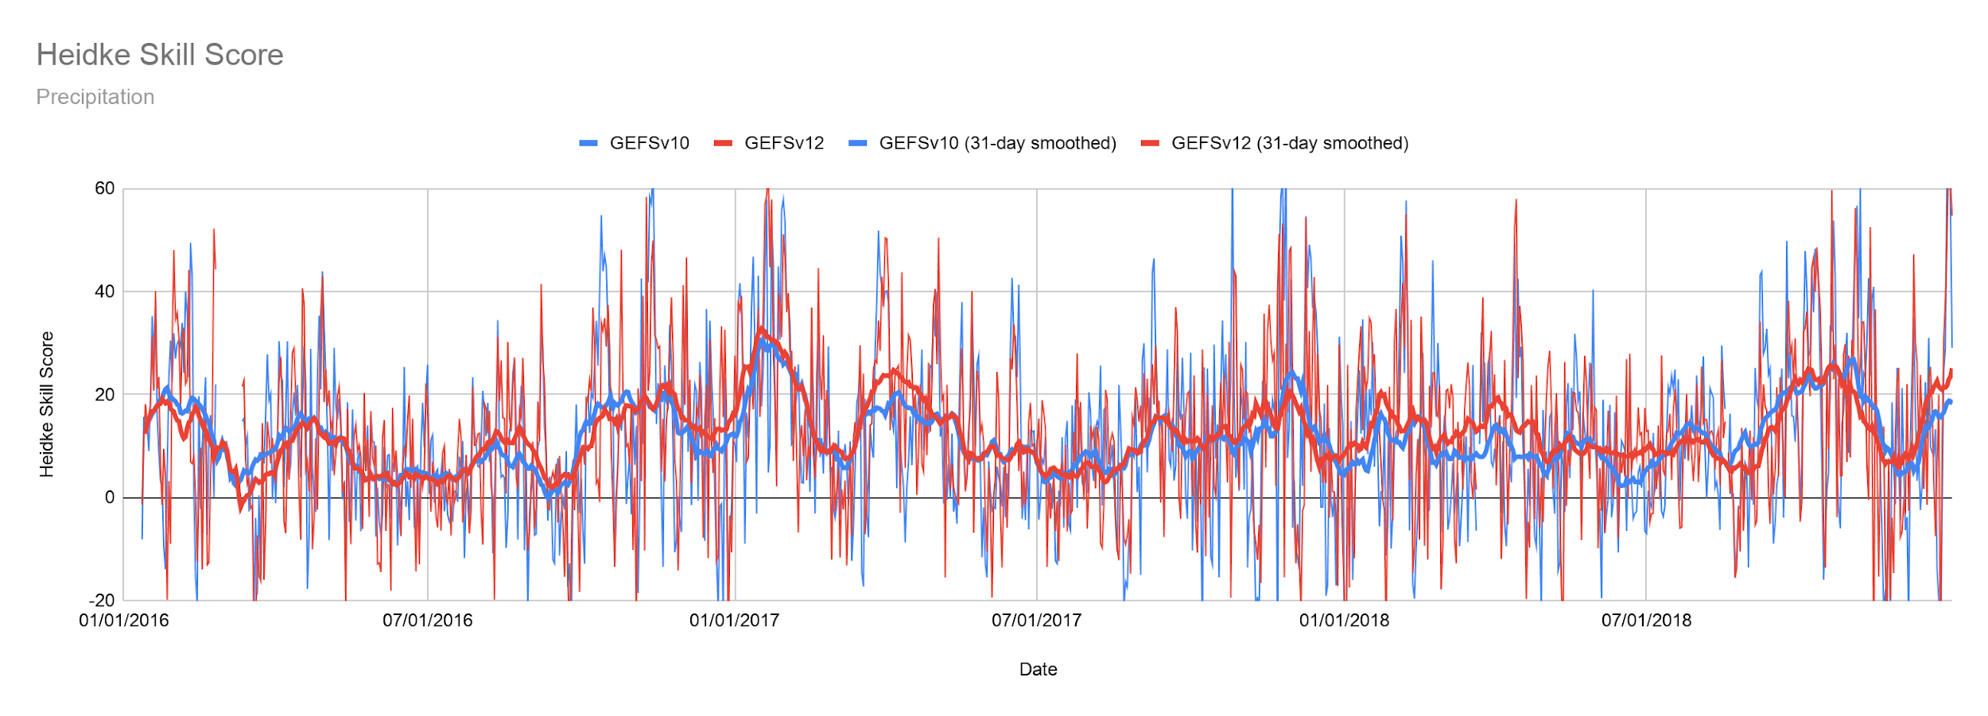
Heidke Skill Score Timeseries
Precipitation

Slide 27
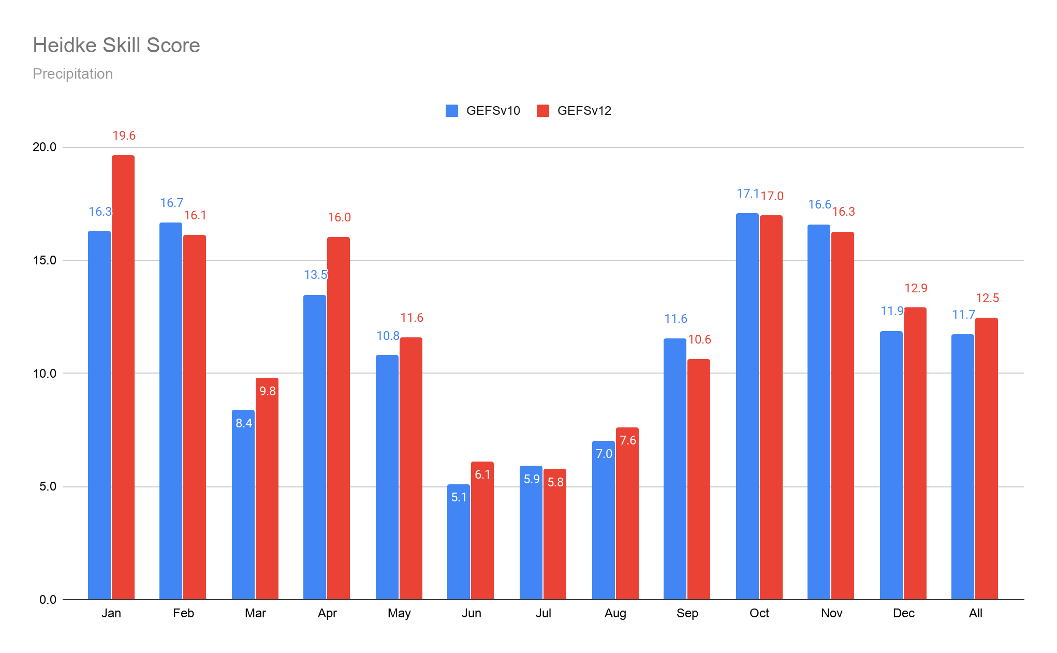
Average Heidke Skill Score
GEFSv12 HSS is during 8 out of 12 months
Overall GEFSv12 skill higher than GEFSv10, but only 87% statistically significant
Precipitation
Notes:
If possible, include the mean over the entire period (Arun)
Just note that scales on y-axis are different from that for temperature (Arun)

Slide 28
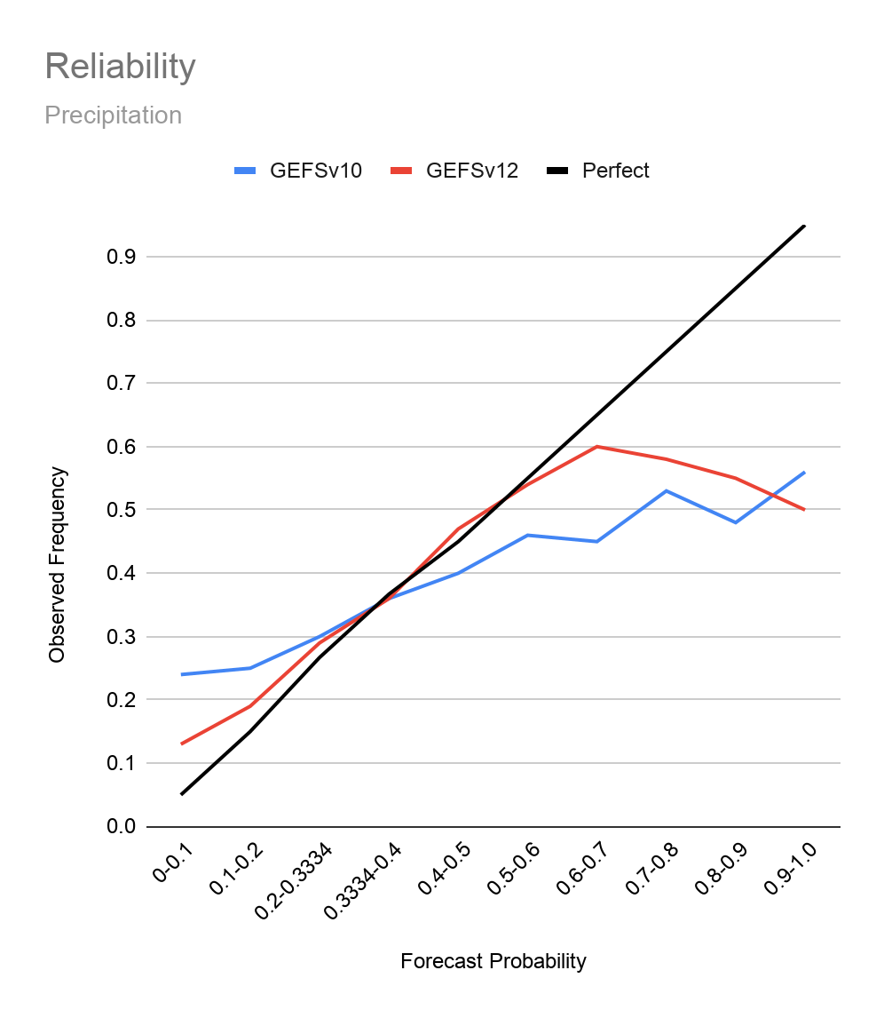
Reliability
Both models are overconfident
GEFSv10 less overconfident for probabilities less than 60%
CAVEAT – Both reliabilities are expected to be better if all members from each ensemble were used
Precipitation

Slide 29
Week 3/4 Temperature
Kyle MacRitchie

Slide 30
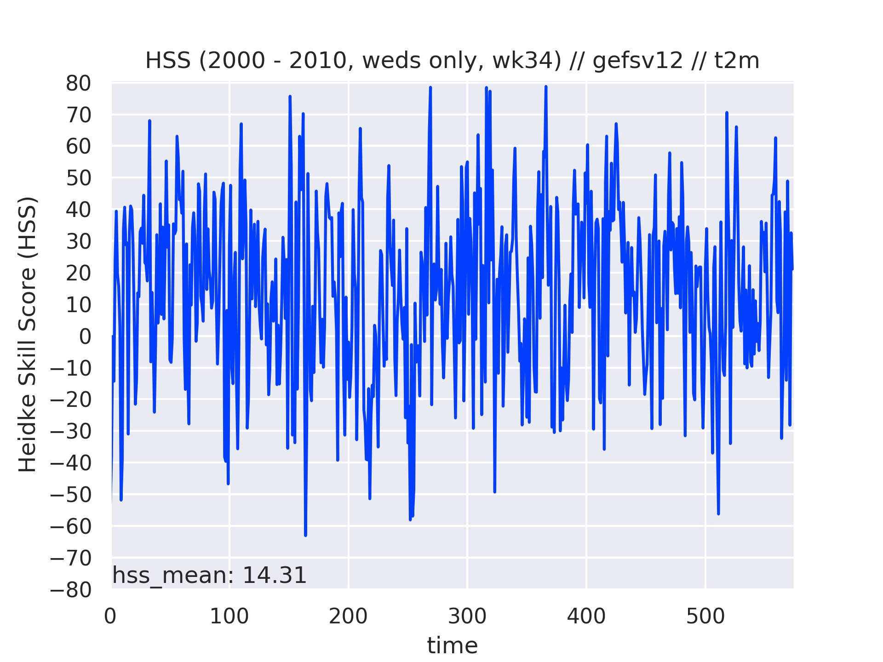
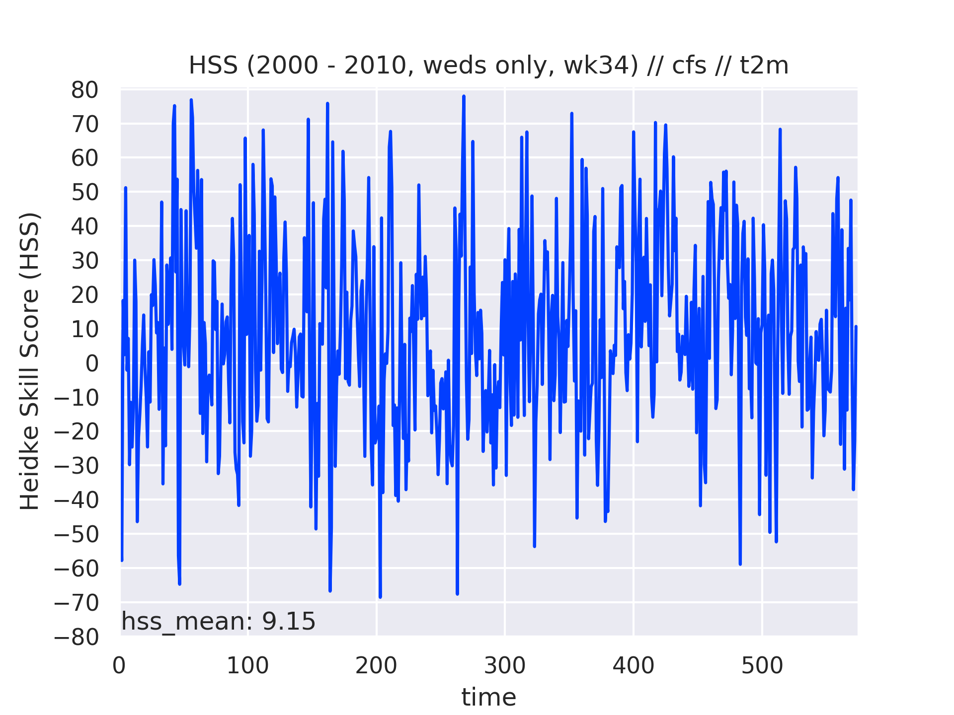
t2m: GEFSv12 vs CFS for 2000-2010
Summary:
The GEFSv12 is noticeably better than the CFS over this time period.
The difference between these means passes a t-test at 95%.
Notes:
HSS values are computed for each forecast over the entire map, weighted by cosine(latitude)
Calibrated numbers are not plotted because although our ensemble regression algorithm reduces probabilities, it rarely has an effect on their signs and the calibrated means are nearly identical

Slide 31
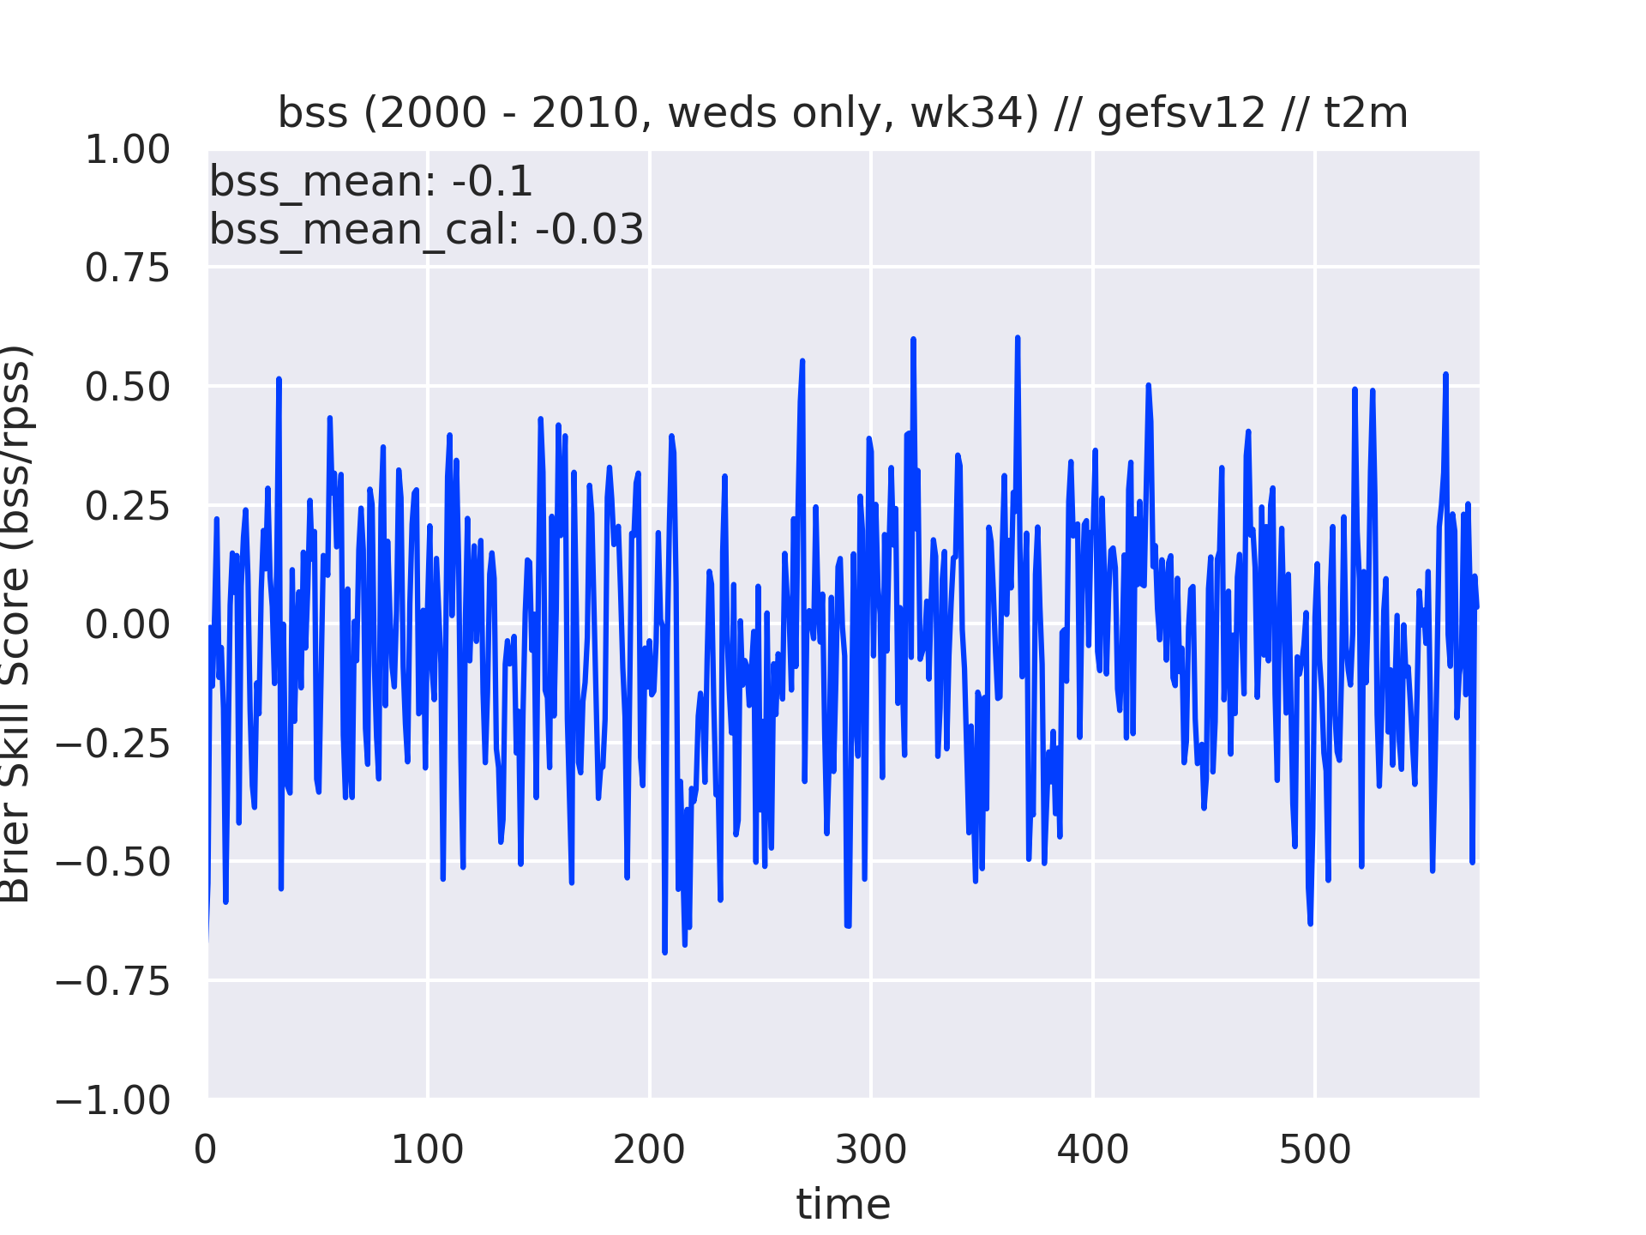
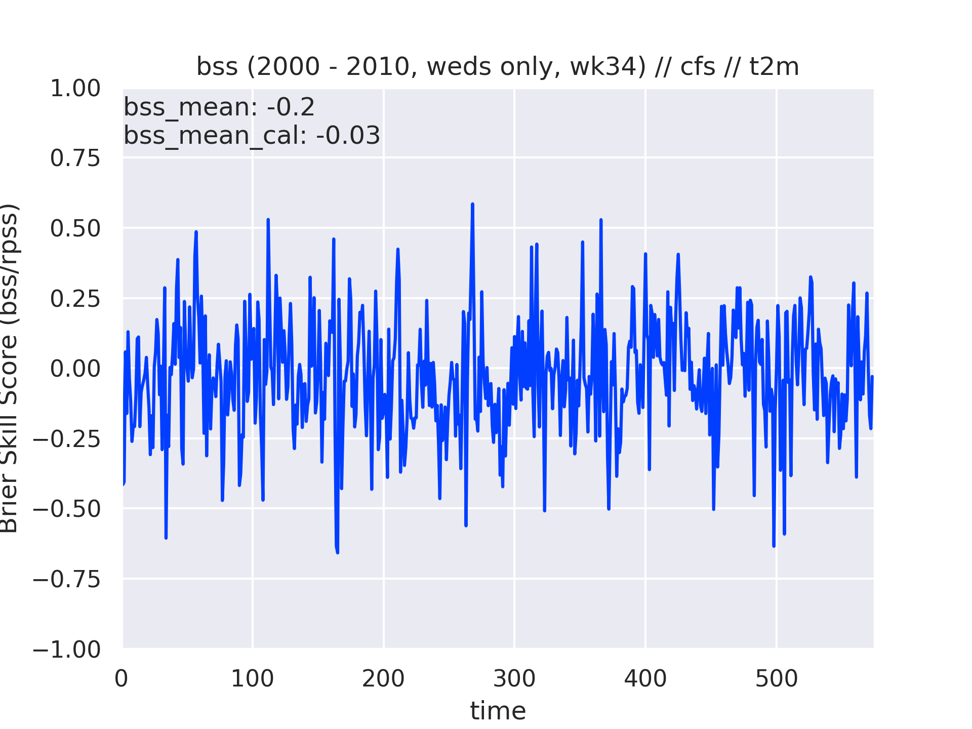
t2m: GEFSv12 vs CFS for 2000-2010
Summary:
The GEFSv12 is slightly better uncalibrated, and identical when calibrated.

Slide 32
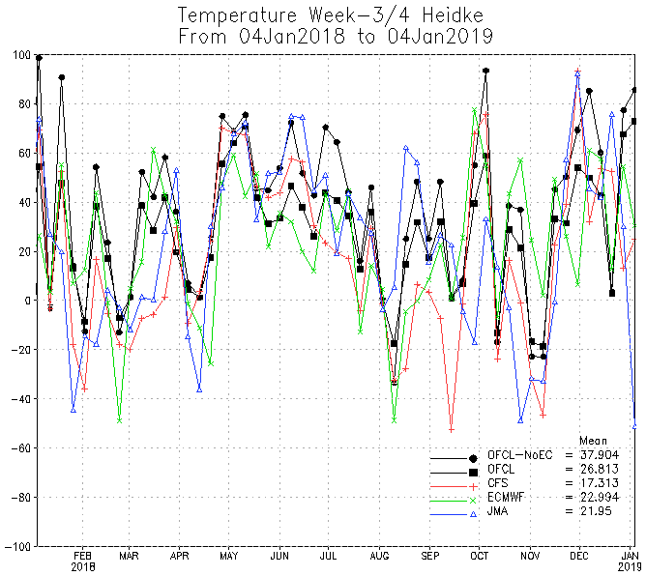
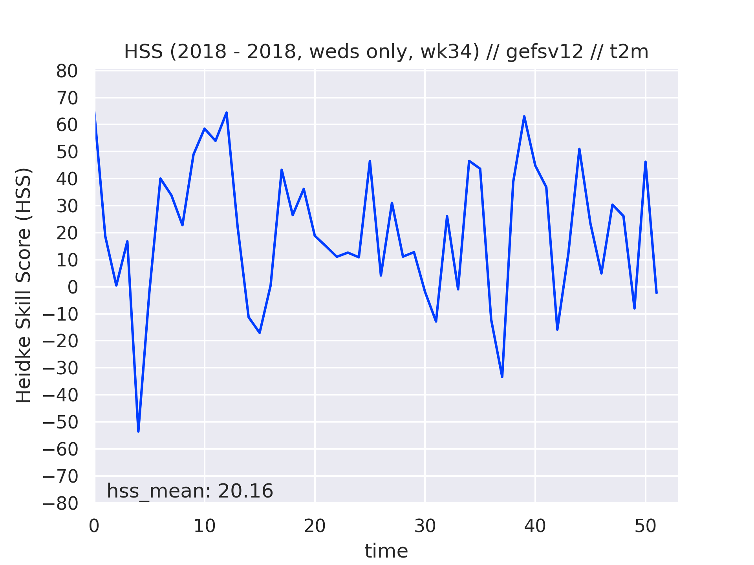
Temperature: 2018 Comparison
Summary:
The GEFSv12 holds its own among the other models and bests the CFS by about 3 points.

Slide 33
Week 3/4 Precipitation
Kyle MacRitchie

Slide 34
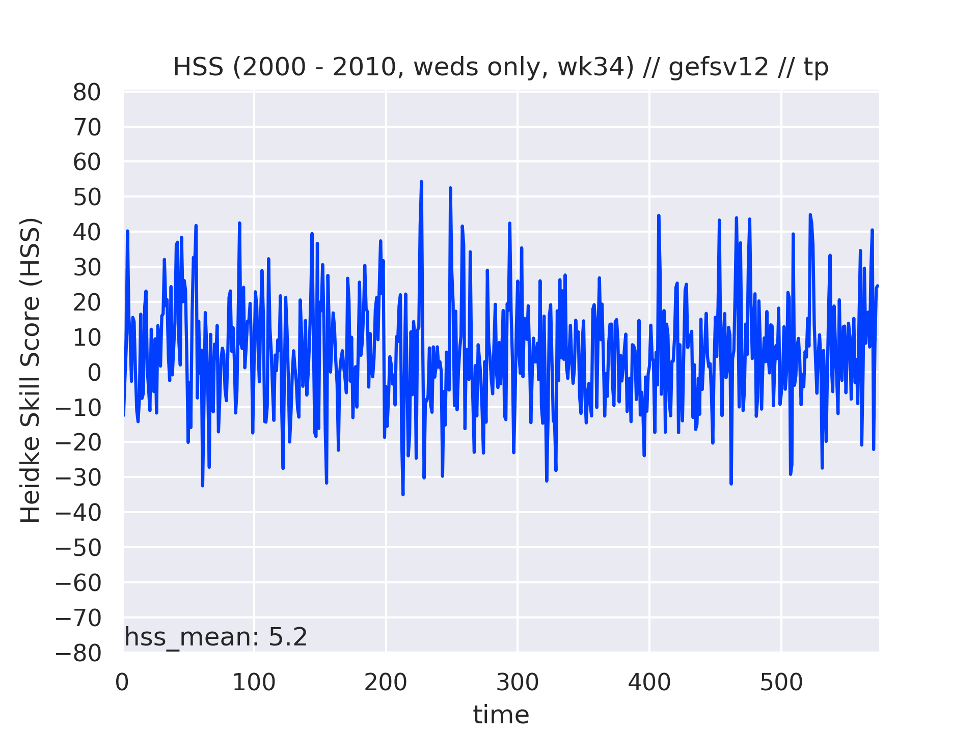
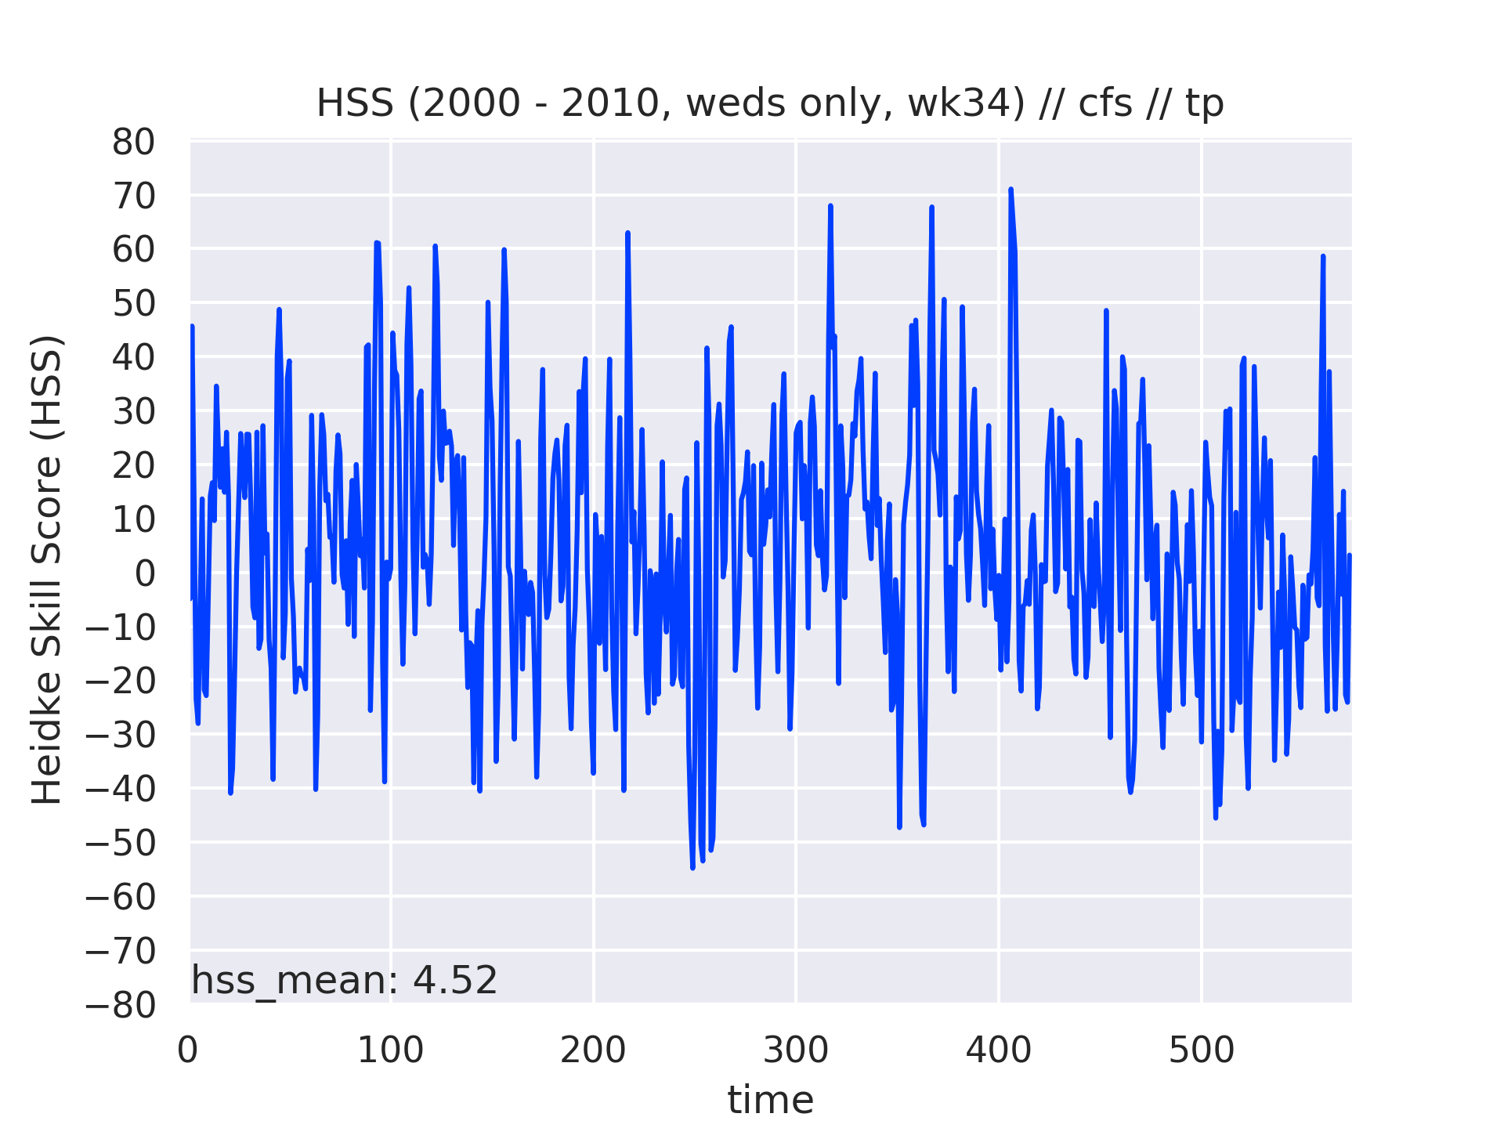
precip: GEFSv12 vs CFS for 2000-2010
Summary:
The GEFSv12 is slightly better than the CFS over this time period.
The difference between these means does not pass a t-test at 95%.
Notes:
HSS values are computed for each forecast over the entire map, weighted by cosine(latitude)
Calibrated numbers are not plotted because although our ensemble regression algorithm reduces probabilities, it rarely has an effect on their signs and the calibrated means are nearly identical
Intresting that forecast-to-forecast variability for GFSv12 is so much smaller than for CFSv2 (Arun))

Slide 35
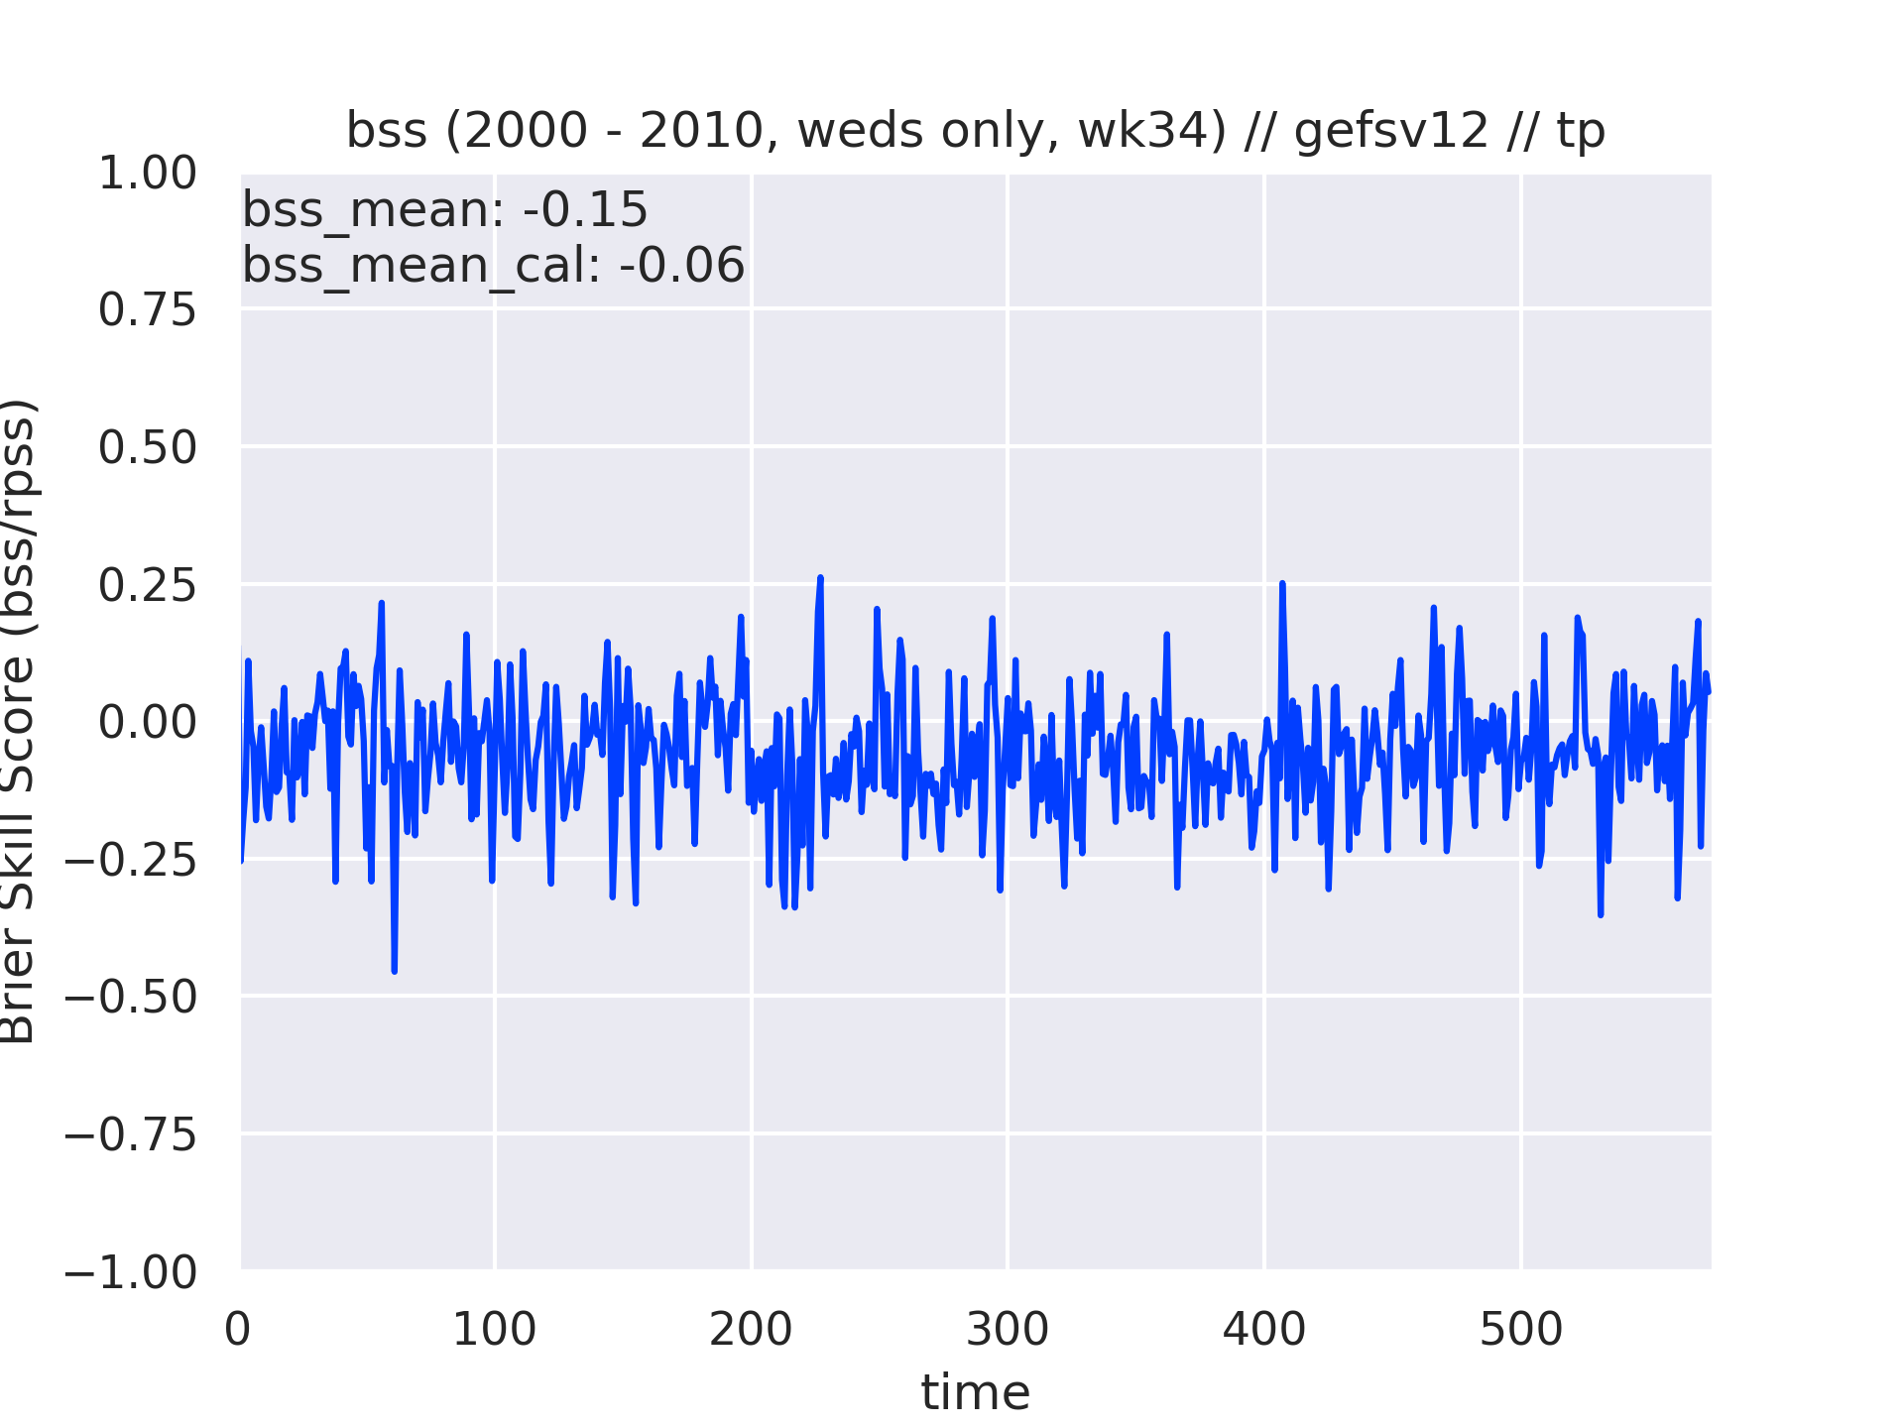
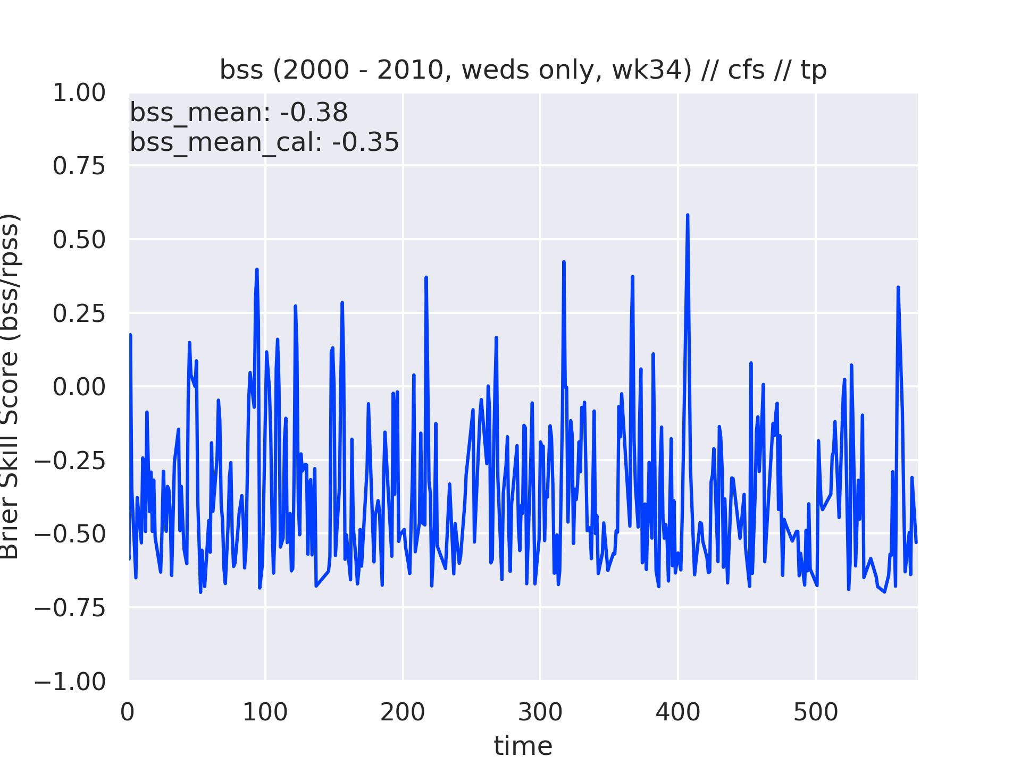
precip: GEFSv12 vs CFS for 2000-2010
Summary:
The GEFSv12 has higher BSS than the CFS and less variance.

Slide 36
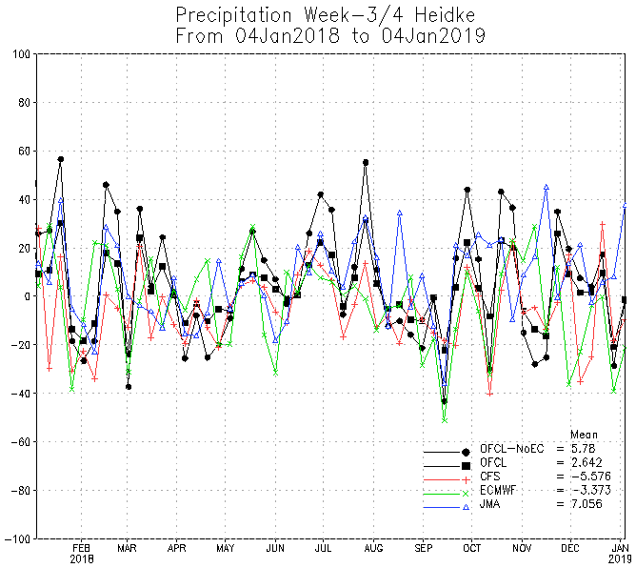
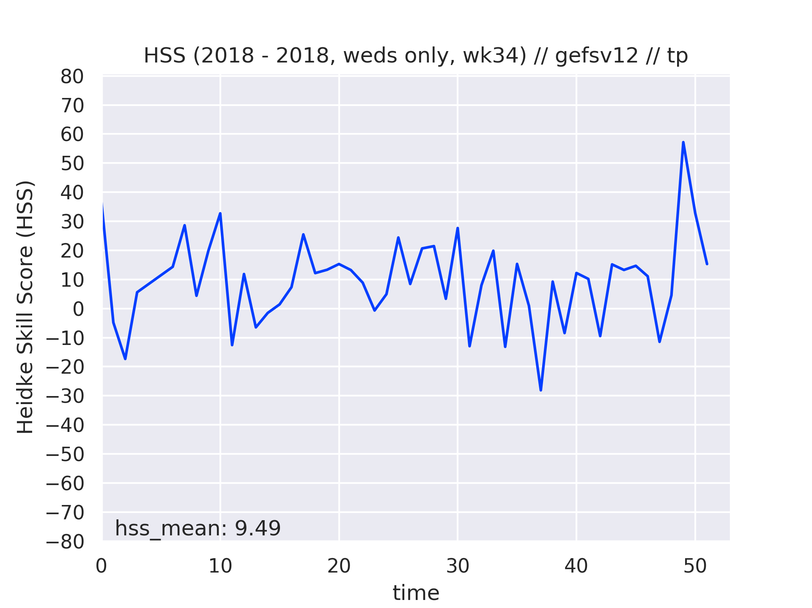
Precipitation: 2018 Comparison
Summary:
The GEFSv12 seems to do well with precipitation. One reason for this that the plot on the left measures precipitation against a climatology of median values whereas the one on the right uses mean values.

Slide 37
Tropical Cyclone Counts / Tracks
Lindsey Long

Slide 38
Weekly Storm Count and Tracks
Data are grouped into weekly forecast periods starting on Day +2, out to week 4.
Each week forecast represents how many storms are present during that weekly period, not just genesis.
One storm can be counted in multiple weeks.
Climatology based on week number (Weeks 1-22)
Wednesday different each year
ie. Wk1: May 31 – Jun 6… Wk22: Oct 24 – Oct 31
Tracks filtered using false alarm clim from reforecasts

Slide 39
Anomaly Correlations - WNP
GEFS outperforms the other models in Weeks 1-2 and is on par with CFS in weeks 3-4.
Years of Note
Good: 2004, 2005?
Bad: 2006

Slide 40
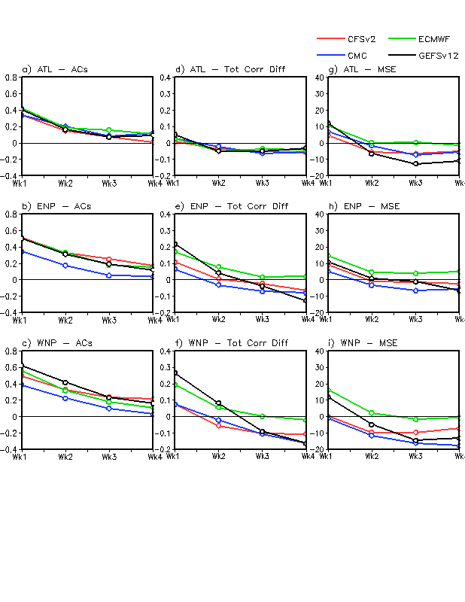
AC Difference from obs. seasonal cycle
Anomaly Corr.
MSE
Atlantic
E. Pacific
W. Pacific
Notes:
Needs reformatting (?)

Slide 41
Hit and False Alarm Rates – Week1
GEFSv12 has very high hit rates, but also highest FA rates - Asian coast/N.Philippines. High skill in WNP consistent with storm count scores. Atlantic “patchy” compared to other basins.

Slide 42
Hit and False Alarm Rates – Week2
GEFSv12 maintains better hit rate, but forecasts unreliable because of high FA rate, versus ECMWF which has a very low FA rate. Trend continues in weeks 3 and 4 (next slides).

Slide 43
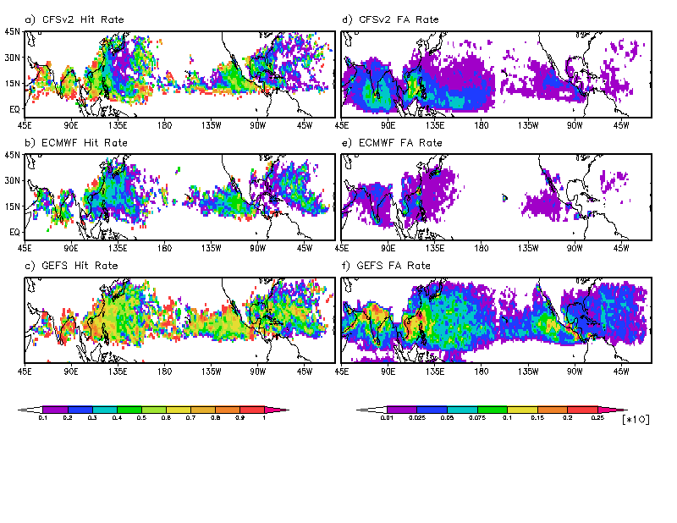
Hit and False Alarm Rates – Week3

Slide 44
Hit and False Alarm Rates – Week4

Slide 45
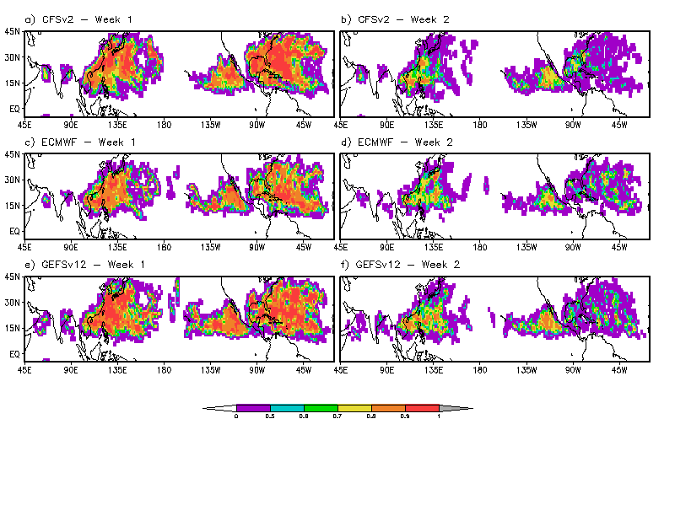
SEDS – Weeks 1&2 for Sept
SEDS combines hit and FA rates to better portray usefulness of forecasts.
GEFS is consistent with other models in forecasting presence of a storm.
Note, other months have similar results.

Slide 46
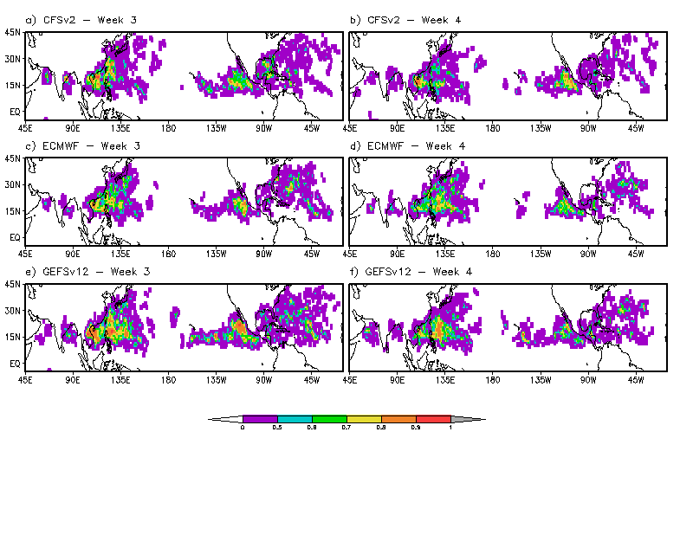
SEDS – Weeks 3&4 for Sept
Models show continued drop in skill in later leads.
Still pockets of skill in Pacific.

Slide 47
Supercell Convective Parameter
Hui Wang

Slide 48
Derived SCP (Supercell Composite Parameter) from
OBS (CFSR)
FV3 GEFS hindcast
1989 – 2019 (31 years)
6 hourly data
Daily 14-day hindcast
5 ensemble members
Compared monthly climatology between GEFS and OBS over
1989 – 1999
2000 – 2019

Slide 49
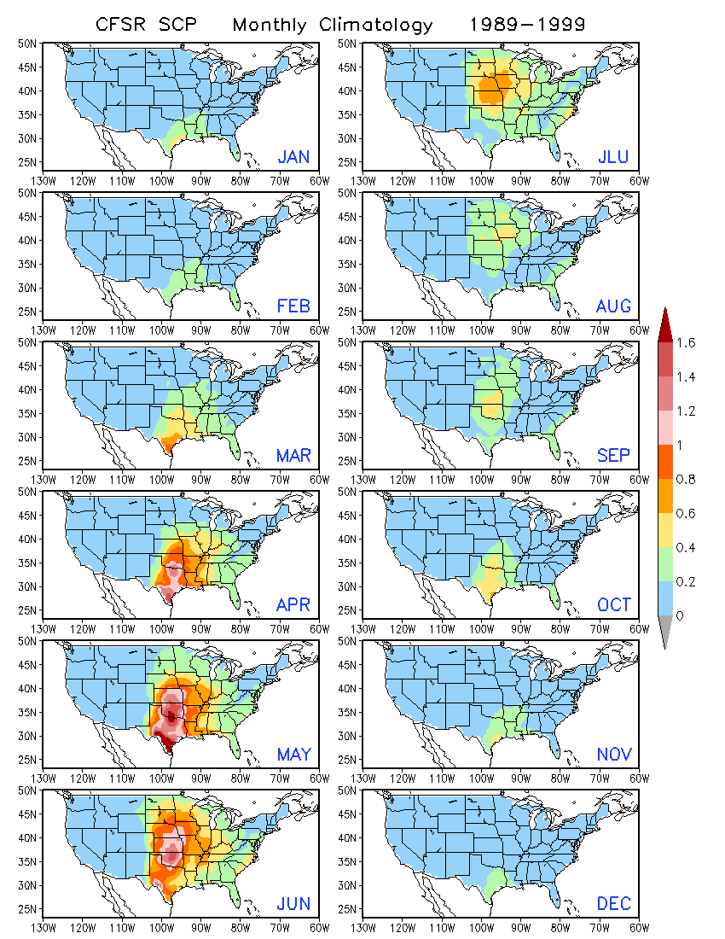
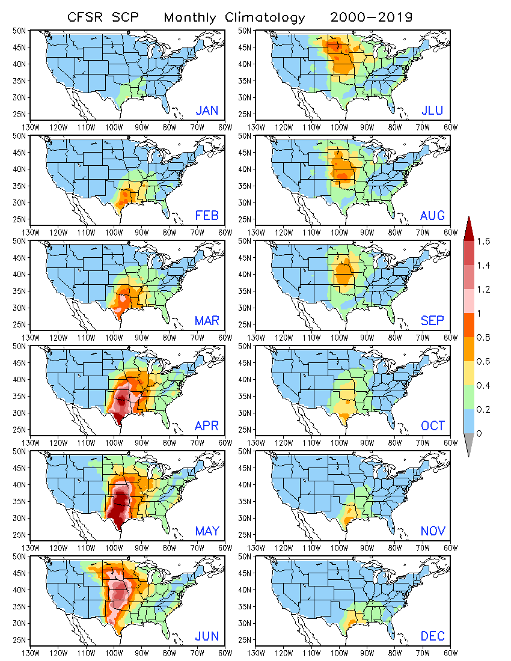
00–19 climo > 89–99.

Slide 50
FV3 GEFS Climatology
1989 – 1999
2000 – 2019
Day-1 forecast

Slide 51
Compared to OBS
Weaker
Stronger
00–19 model climo > 89–99.

Slide 53
GEFSv11

Slide 54
Lessons Learned
Retrospectives are the independent data - need 3 years of retrospective, out to Week4
Need to better agree upon metrics ahead of time.
Even if agreed upon, familiarity is part of it.
CPC needs to systematize our evaluations to where we can drop new GEFS gribs into folder (rfcst, retro) and obs into another, and just let it run. - Facilitate faster feedback.

Slide 55
Summary
T & P
Week 2 - improved*
Week 3/4 T & P - improved
Z500
Week 2,3/4 - improved
Tropical Cyclones
Week 2 - improved vs CFSv2, similar to ECWMF
Week 3/4 - improved - all models struggle
Stratosphere
GEFSv12 - largely an improvement, still work to be done
Overall - Recommend implementation

