Slide 1
NATIONAL OCEANIC AND ATMOSPHERIC ADMINISTRATION
GEFSv12 Field Evaluations (Days 1–10 Weather)
Alicia Bentley EMC Model Evaluation Group Webinar
30 April 2020
Special thanks to Yan Luo and Jiayi Peng for generating verification graphics

Slide 2
NATIONAL OCEANIC AND ATMOSPHERIC ADMINISTRATION
Outline
Summary of GEFSv12 verification statistics
Summary of GEFSv12 evaluation comments/recommendations from the field (e.g., NWS Regions and Centers)
Overall impressions of GEFSv12

Slide 3
NATIONAL OCEANIC AND ATMOSPHERIC ADMINISTRATION
Summary of GEFSv12 Verification Statistics
PARAMETER | SKILL | SPREAD | BIAS
250-hPa winds (NH) | Improved | Improved | Somewhat Improved
500-hPa height (NH) | Improved | Improved | Somewhat Degraded
850-hPa winds (NH) | Improved | Improved | Neutral
850-hPa temp. (NH) | Improved | Improved | Somewhat Degraded
1000-hPa height (NH) | Improved | Improved | Somewhat Degraded
10-m winds (NH) | Improved | Improved | Neutral
2-m temp. (NH) | Improved | Improved | Improved
Precipitation (NH) | Improved | Improved | Degraded (higher amts)
TC Tracks (N. Atlantic) | Somewhat Improved | Improved | Degraded (across track)
TC Tracks (E. Pacific) | Somewhat Degraded | Improved | Degraded (across track)

Slide 4
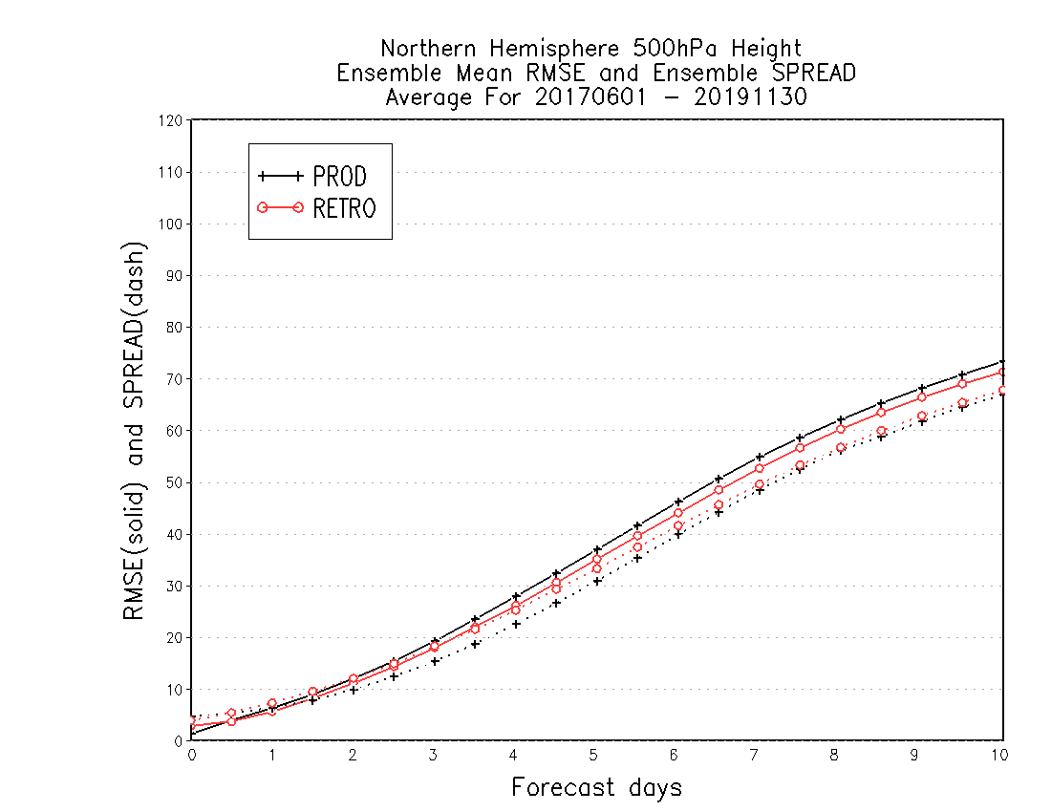
NATIONAL OCEANIC AND ATMOSPHERIC ADMINISTRATION
Summary of GEFSv12 Verification Statistics
DAY 5 – NH 500-hPa Z Time Series
NH by Lead Time (6/2017–11/2019)
GEFSv12 has lower RMSE than GEFSv11 at Day 5 and a RMSE-to-Spread ratio closer to 1
GEFSv12 has lower RMSE and more spread than GEFSv11 in the medium range
RMSE = solid
Spread = dashed
June 2017
Sep 2018
Dec 2019

Slide 5
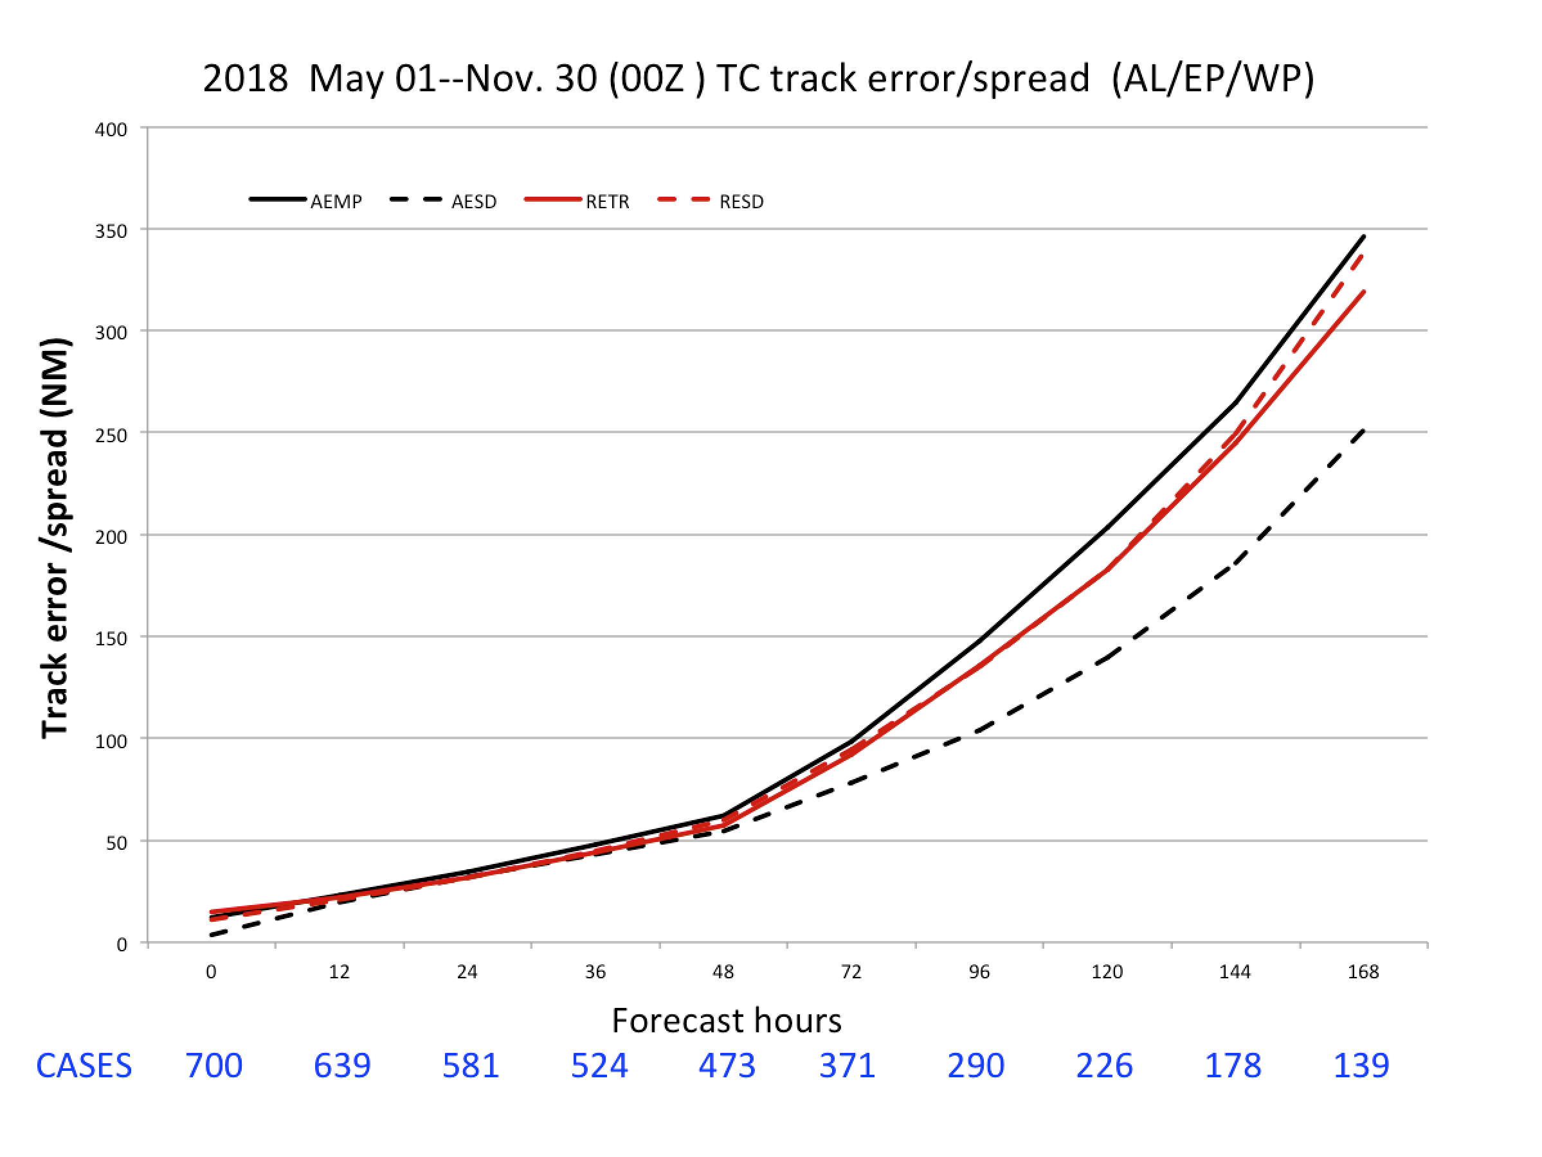
NATIONAL OCEANIC AND ATMOSPHERIC ADMINISTRATION
Summary of GEFSv12 Verification Statistics
Lower RMSE in GEFSv12 at most lead times (Days 3–7)
Increased spread in GEFSv12 at most lead times (Days 3–7)
GEFSv11 is underdispersive (separation between black lines)
GEFSv12 is more dispersive, giving a better representation of the range of possible outcomes (red lines on top of each other)
GEFSv11 Track Error
GEFSv11 Spread GEFSv12 Track Error
GEFSv12 Spread
Image provided by Jiayi Peng

Slide 6
NATIONAL OCEANIC AND ATMOSPHERIC ADMINISTRATION
Summary of GEFSv12 Verification Statistics
NH 850-hPa temp.
NH 2-m temp.
GEFSv12 mean has a colder 850-hPa temperature bias than GEFSv11, but GEFSv12 mean has a warmer 2-m temperature bias than GEFSv11 (changes to ground heat flux?), significantly mitigating an existing 2-m temperature cold bias in GEFSv11.
STTP has minor contribution to tropics
STTP overdispersion in winter hemisphere

Slide 7
NATIONAL OCEANIC AND ATMOSPHERIC ADMINISTRATION
Summary of GEFSv12 Verification Statistics
PARAMETER | SKILL | SPREAD | BIAS
250-hPa winds (SH) | Improved | Neutral | Somewhat Improved
500-hPa height (SH) | Improved | Neutral | Somewhat Degraded
850-hPa winds (SH) | Improved | Somewhat Improved | Somewhat Degraded
850-hPa temp. (SH) | Improved | Somewhat Improved | Degraded
1000-hPa height (SH) | Improved | Somewhat Improved | Somewhat Degraded
10-m winds (SH) | Improved | Improved | Neutral
2-m temp. (SH) | Improved | Improved | Improved
250-hPa winds (Tropics) | Improved | Considerably Improved | Neutral
850-hPa winds (Tropics) | Improved | Considerably Improved | Somewhat Improved
10-m winds (Tropics) | Improved | Considerably Improved | Somewhat Degraded

Slide 8
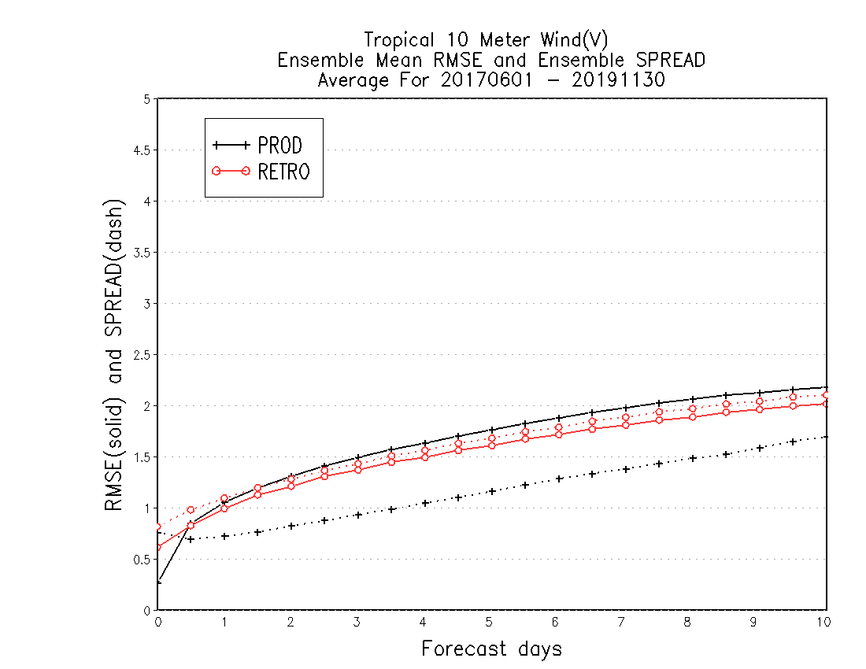
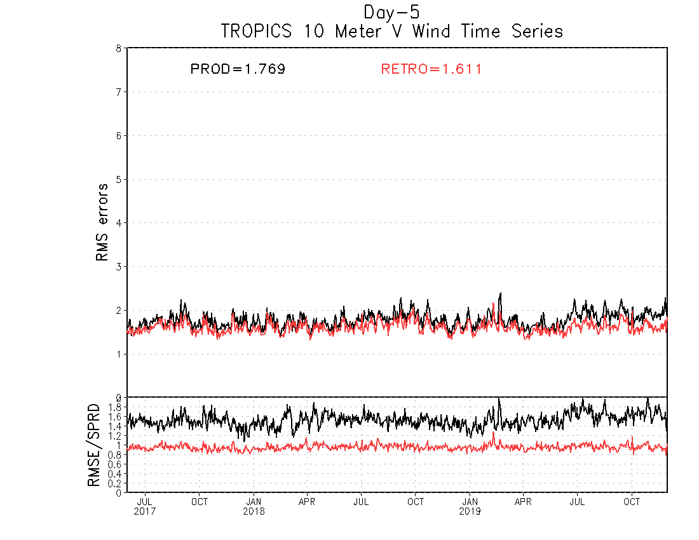
NATIONAL OCEANIC AND ATMOSPHERIC ADMINISTRATION
Summary of GEFSv12 Verification Statistics
DAY 5 – Tropics 10-m vwind Time Series
Tropics by Lead Time (6/2017–11/2019)
GEFSv12 has lower RMSE than GEFSv11 at Day 5 and a RMSE-to-Spread ratio closer to 1
GEFSv12 has lower RMSE and more spread than GEFSv11 at almost all forecast lead times
RMSE = solid
Spread = dashed
June 2017
Sep 2018
Dec 2019

Slide 9
NATIONAL OCEANIC AND ATMOSPHERIC ADMINISTRATION
Outline
Summary of GEFSv12 verification statistics
Summary of GEFSv12 evaluation comments/recommendations from the field (e.g., NWS Regions and Centers)
Overall impressions of GEFSv12
Thank you to those who submitted formal evaluations and those who provided subjective feedback during the evaluation period

Slide 10
NATIONAL OCEANIC AND ATMOSPHERIC ADMINISTRATION
Field Evaluations of GEFSv12
Information that users were asked to provide:
What are your overall impressions of the weeks 1–2 atmospheric performance in GEFSv12?
Comment on your overall synoptic impressions of GEFSv12.
Assess the amount/quality of spread in GEFSv12 vs. GEFSv11.
Comment on the overall spread of GEFSv12 vs. GEFSv11.
What is your recommendation?

Slide 11
NATIONAL OCEANIC AND ATMOSPHERIC ADMINISTRATION
NWS Eastern Region
GEFSv12 is an overall improvement over the operational GEFSv11.
GEFSv12 often performed better synoptically, sometimes identifying winter storms 24-h before GEFSv11. Noted tendency for GEFSv12 to be warmer than GEFSv11 during major cold air outbreaks, but remarked that GEFSv12 was overall more accurate during these events.
GEFSv12 is more dispersive relative to GEFSv11 in a meaningful way.
The improved spread of GEFSv12 shows-up particularly well in tropical cyclone track forecasts, though a notable right-of-track bias exists in GEFSv12.
Supports the implementation of GEFSv12.

Slide 12
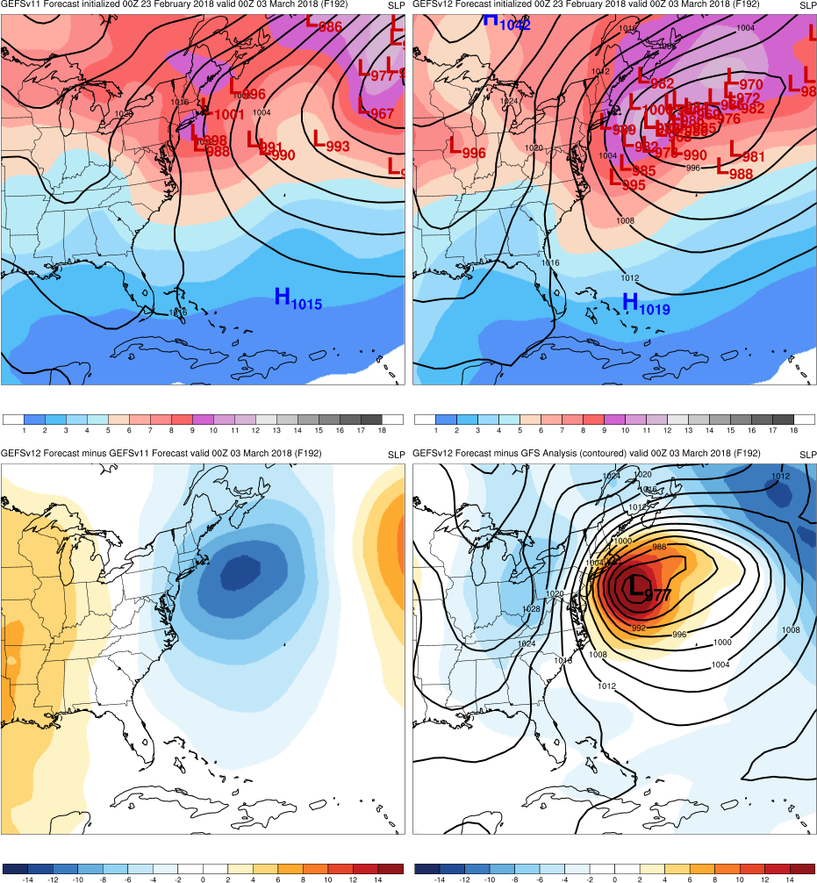
Mid-Atlantic Windstorm
Init.: 0000 UTC 2/23/2018 (F192)
The majority of GEFSv12 members forecast a strong cyclone off the East Coast prior to the majority of GEFSv11 members
The majority of GEFSv11 shift to the west, forecasting a strong cyclone off the East Coast, by F168 (e.g., 24-h after GEFSv12)
GEFSv11
GEFSv12
v12−v11
GFS Anl.

Slide 13
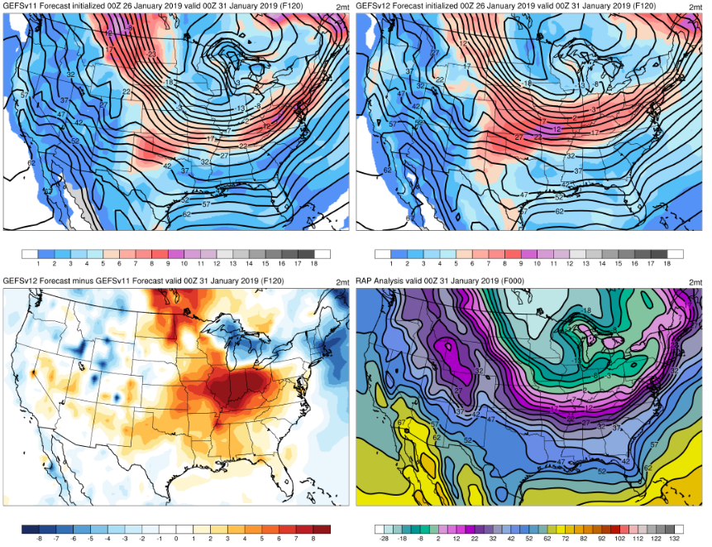
GEFSv11/GEFSv12 Spread Comparison (SOOs)
120-h fcst valid at 00Z 31 Jan 2019
Arctic Air Outbreak (Jan/Feb 2019)
GEFSv12 is better & GEFSv11 is too aggressive w/ the cold dome into the Great Lakes & OH Valley
v11 is overconfident in its temps; v12 has more spread all along the tight baroclinic zone
SOO Team Finding: GEFSv12 often exhibited quality spread in highlighting areas of uncertainty (e.g., baroclinic zones, noses of low level jets/moisture plumes)
GEFSv11
GEFSv12
v12−v11
RAP Anl.

Slide 14
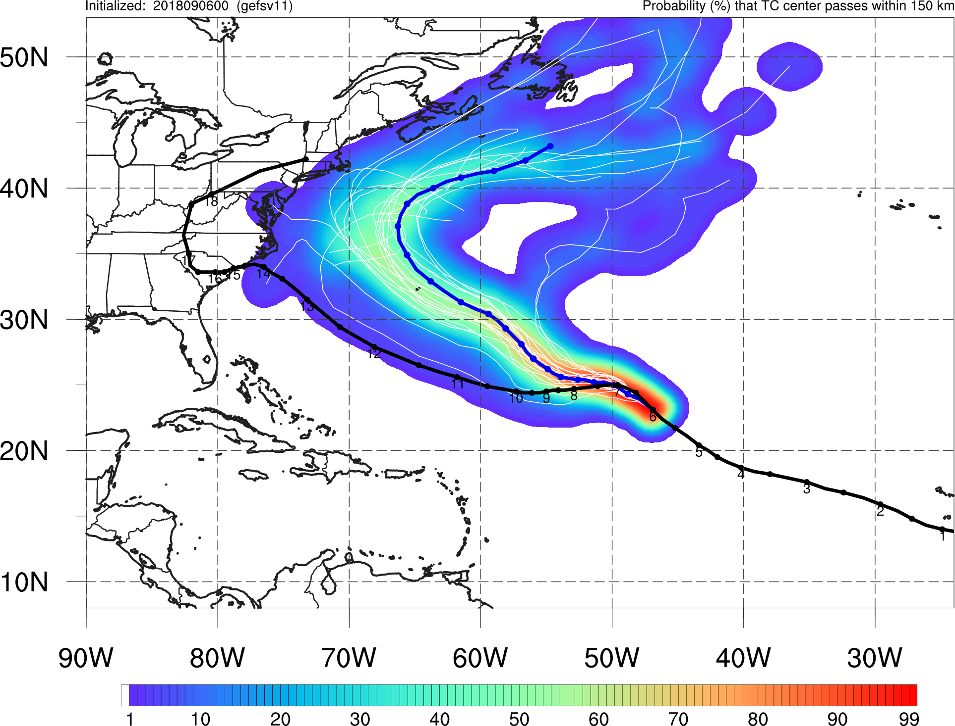
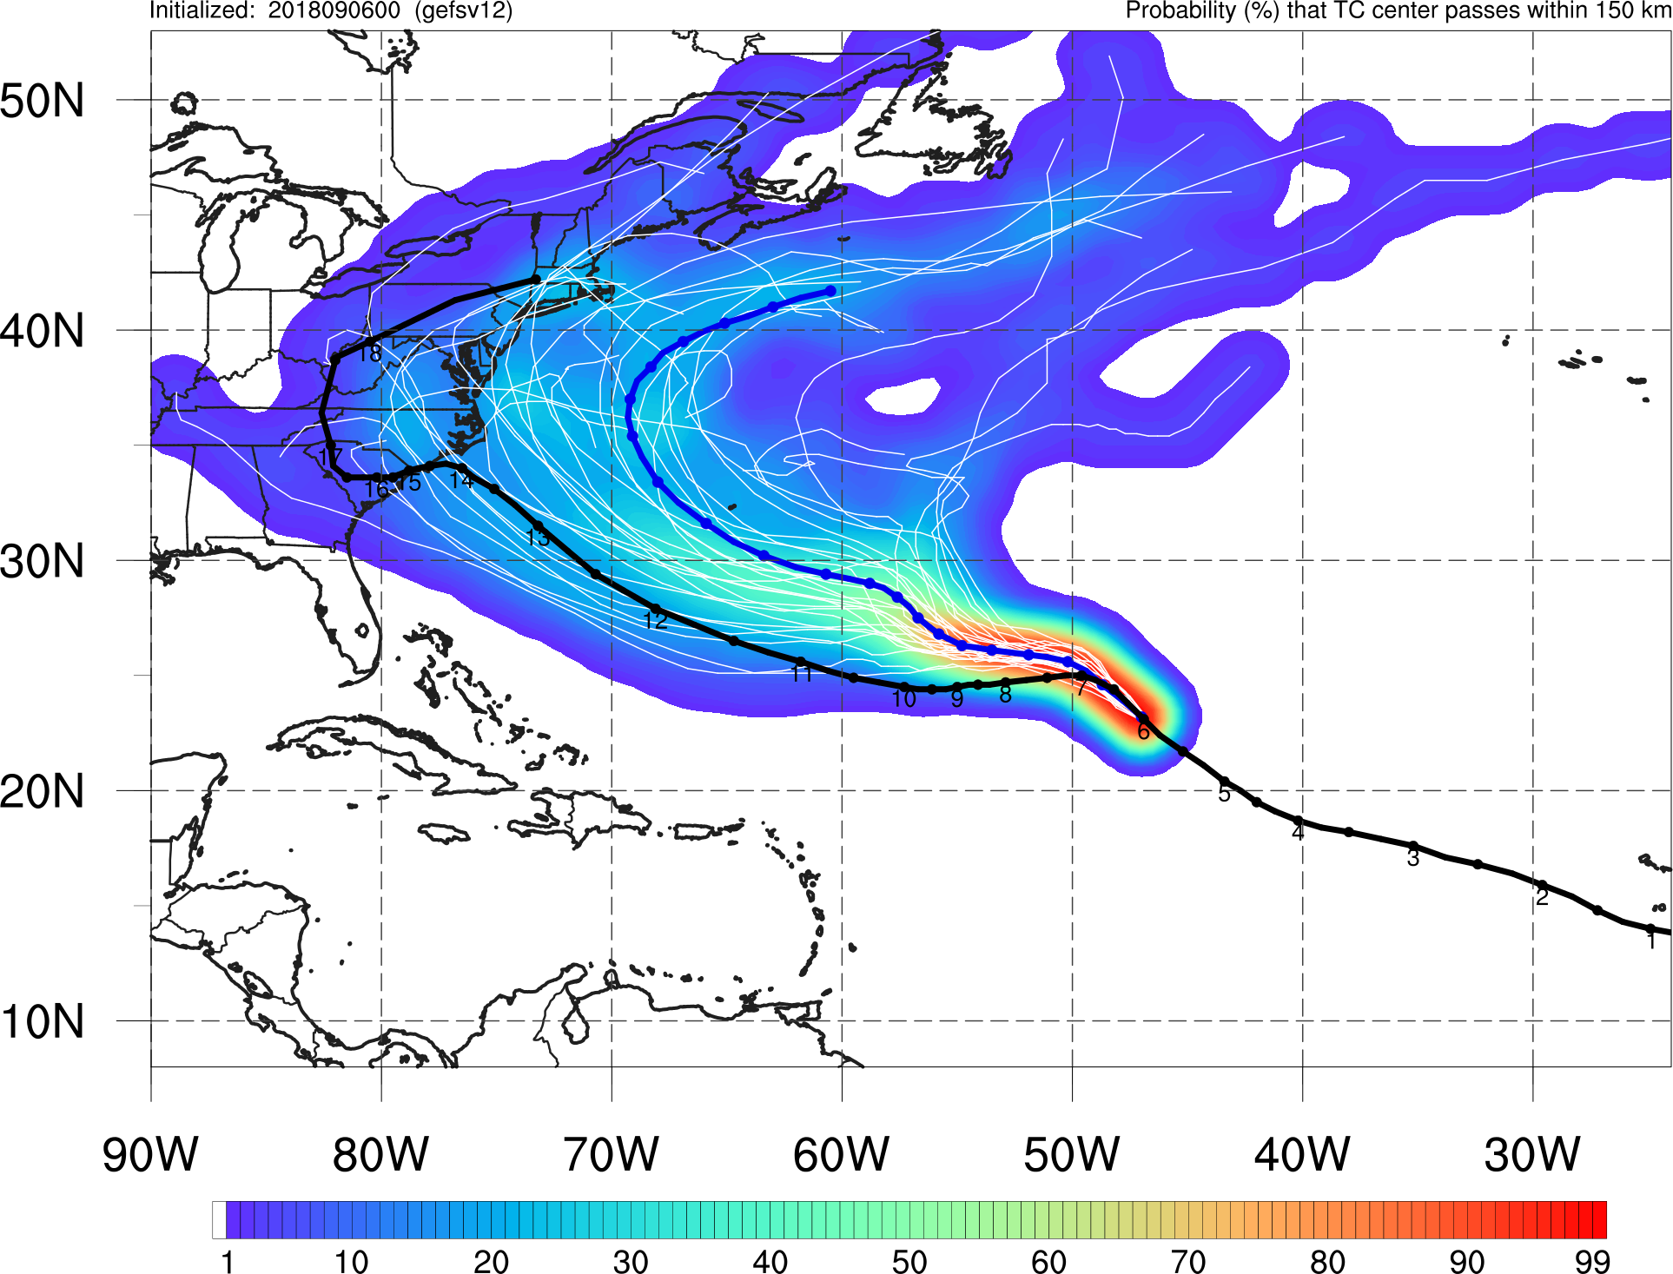
NATIONAL OCEANIC AND ATMOSPHERIC ADMINISTRATION
Increased Spread in TC tracks
Florence Init: 00Z 9/06/18
GEFSv11
GEFSv12
GEFSv11 indicates a high probability of Florence recurving off the East Coast, whereas Best Track (no recurvature) is well within the GEFSv12 envelope of possible solutions

Slide 15
NATIONAL OCEANIC AND ATMOSPHERIC ADMINISTRATION
NWS Central Region
GEFSv12 is an overall improvement over the operational GEFSv11.
GEFSv12 often outperformed GEFSv11 synoptically. GEFSv12 has considerably more spread, which better encapsulated the envelope of possible solutions. GEFSv12 shows improved performance over complex terrain.
GEFSv12 is more dispersive relative to GEFSv11 in a meaningful way.
GEFSv12 consistently showed more spread than GEFSv11. The spread was more meaningful because it highlighted important gradients (e.g., nose of a LLJ, sharp baroclinic zones) where one would expect more uncertainty.
Supports the implementation of GEFSv12.

Slide 16
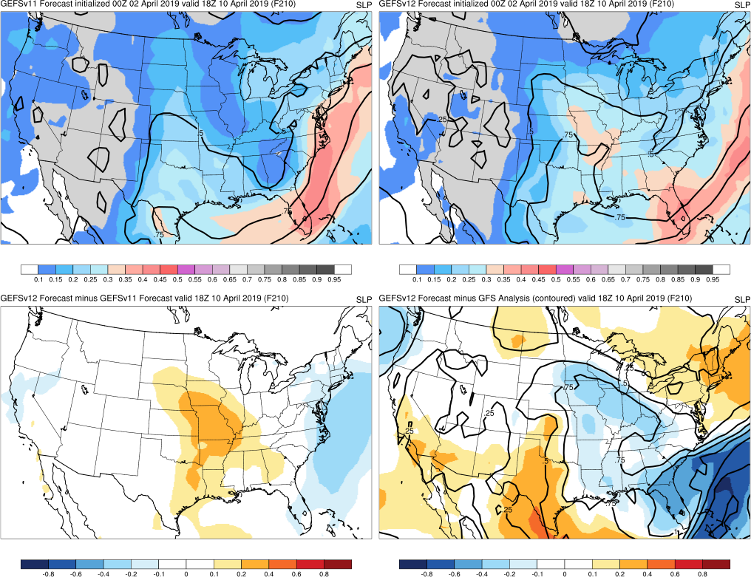
NATIONAL OCEANIC AND ATMOSPHERIC ADMINISTRATION
NWS Central Region
Valid at 1800 UTC 10 April 2019
Central U.S. Cyclone
GEFSv11
GEFSv12
Init.: 0000 UTC 4/02/2019 (F210)
GEFSv12 did a considerably better job with the precipitable water (PW) plume than GEFSv11
Had 0.2–0.3” more PW in central U.S.
Noticably better with 0.75” contour
v12−v11
GFS Anl.
GEFSv12 had more spread, and it
is at the leading edge of 0.75” PW plume, which is more useful

Slide 17
NATIONAL OCEANIC AND ATMOSPHERIC ADMINISTRATION
NWS Southern Region
GEFSv12 is an overall improvement over the operational GEFSv11.
Agree with the the EMC Model Evaluation Group's assessment: a noticeable step forward in ensemble modeling will be realized with the new GEFSv12 system.
GEFSv12 is more dispersive relative to GEFSv11 in a meaningful way.
Overall improved spread in nearly all of the fields examined.
Supports the implementation of GEFSv12.

Slide 18
NATIONAL OCEANIC AND ATMOSPHERIC ADMINISTRATION
NWS Western Region
GEFSv12 is an overall improvement over the operational GEFSv11.
Overall improvement in areas such as 500-hPa AC scores, increased dispersion, improved terrain resolved features, QPF, temperatures in basins, etc. Somewhat concerned with poor long-range performance in a few Western U.S. case studies.
GEFSv12 is more dispersive relative to GEFSv11 in a meaningful way.
More of the cases showed valuable spread in terms of uncertainty and also for better messaging capabilities. A few cases possibly showed too much spread, but too early to tell if this is an issue or just a result of a more dispersive ensemble.
Supports the implementation of GEFSv12.

Slide 19
GEFSv11
GEFSv12
Low Skill Period
Init.: 0000 UTC 1/26/2018 (F192)
Val.: 0000 UTC 2/03/2018
Example of GEFSv12 having some issues in the eastern Pacific, complicating attempts to identify the medium range pattern changes in the western U.S.
While SOO team ratings for GEFSv12 were overall very good, problems with longer range forecasts (and lower ratings) along the West Coast were a consistent finding in the cases examined
v12−v11
GFS Anl.

Slide 20
NATIONAL OCEANIC AND ATMOSPHERIC ADMINISTRATION
NWS Alaska Region
GEFSv12 is an overall improvement over the operational GEFSv11.
GEFSv12 shows some definite benefits over GEFSv11, mainly due to increased spread (allowing the envelope of possible solutions to include reality more often). One potential negative is the progressive bias that is more pronounced in v12.
GEFSv12 is more dispersive relative to GEFSv11 in a meaningful way.
GEFSv12 shows an increase in spread. Mean signals may appear more washed out due to this increase, but that doesn’t necessarily indicate an inferior forecast. It will be important to have the right tools to diagnose the spread/possible solutions.
Supports the implementation of GEFSv12.

Slide 21
Alaskan Cyclone
Init.: 0000 UTC 09/23/2017 (F144)
GEFSv12 was able to forecast the overall synoptic pattern earlier & more accurately than GEFSv11, resulting in more accurate extratropical cyclone track and intensity forecasts in the long and medium range
Example of 500-hPa spaghetti plots (also available online), with analyzed 576-dam and 534-dam contours (black), ensemble mean (red), and ensemble members (blue)
GEFSv11
GEFSv12

Slide 22
NATIONAL OCEANIC AND ATMOSPHERIC ADMINISTRATION
Weather Prediction Center (WPC)
GEFSv12 is an overall improvement over the operational GEFSv11.
Major improvement in QPF reliability. Probabilistic fields will provide more useful guidance. More realistic depictions of QPF and snow at higher elevations. One concern is the low mean-QPF bias at moderate to heavy amounts.
GEFSv12 is more dispersive relative to GEFSv11 in a meaningful way.
Increased spread proved useful to the forecasting process. Fewer forecasts where observations fell outside the envelope. Spread maxima were able to indicate the clustering of members around different solutions (important to convey to partners). Spread often located in tight gradients, providing better uncertainty information.
Supports the implementation of GEFSv12.

Slide 23
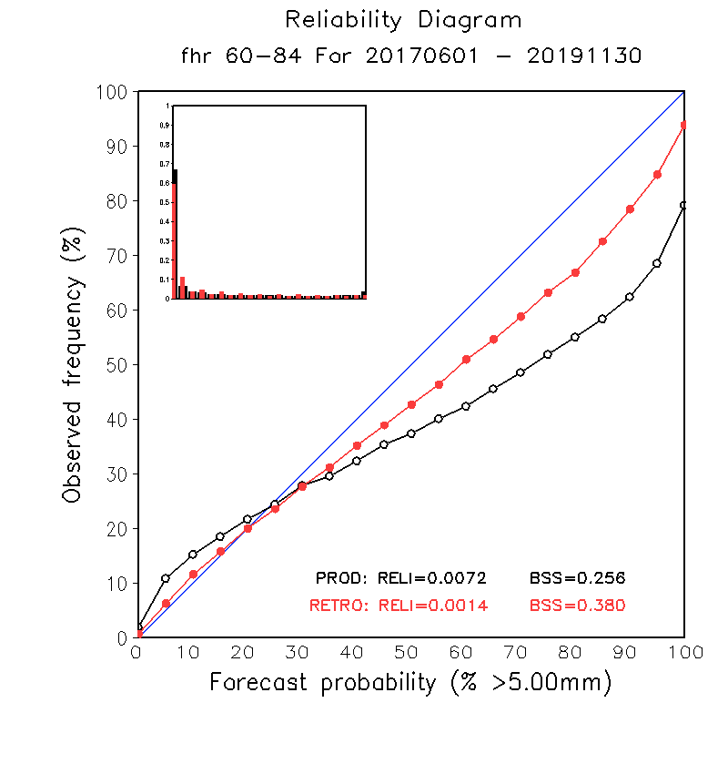
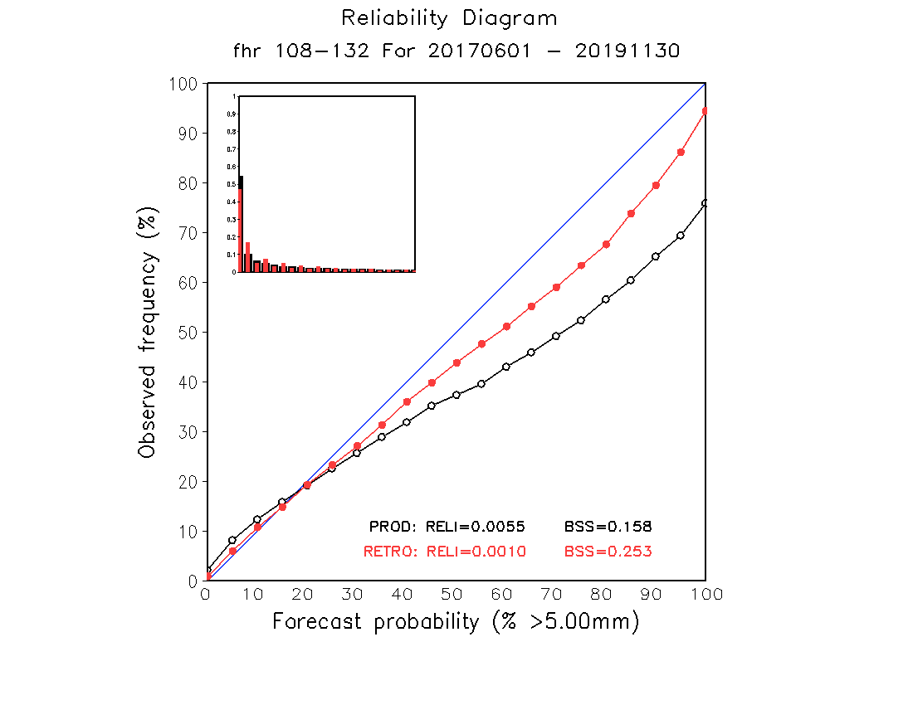
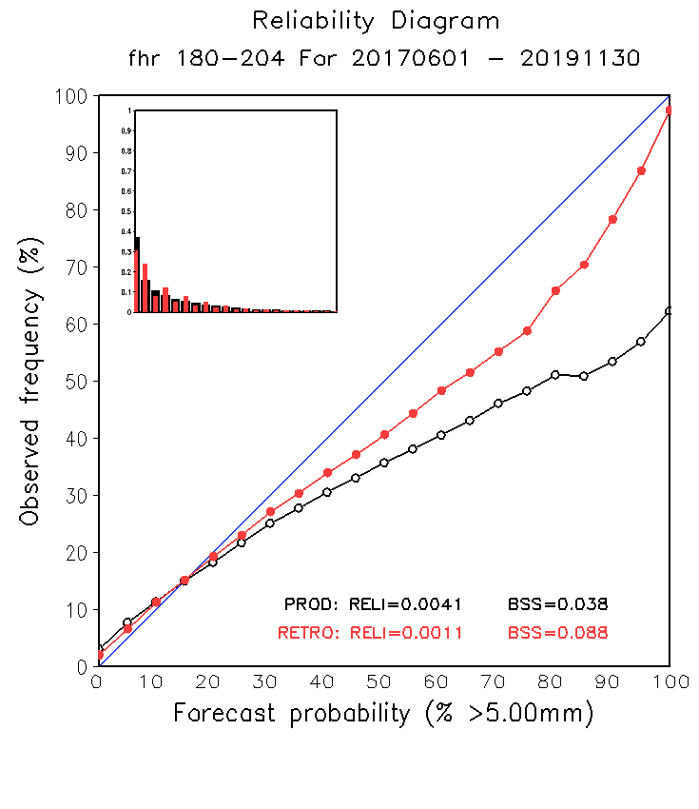
NATIONAL OCEANIC AND ATMOSPHERIC ADMINISTRATION
GEFSv12 CONUS Precip.: Reliability Diagrams
DAY 3
DAY 5
DAY 8
GEFSv12 precipitation forecasts are more reliable than GEFSv11 precipitation forecasts (red line closer to diagonal blue line) at all lead times

Slide 24
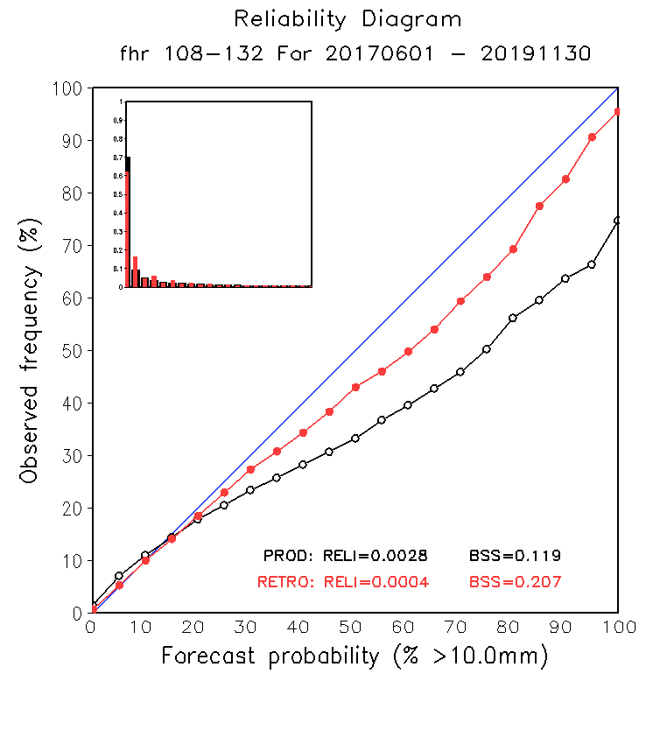
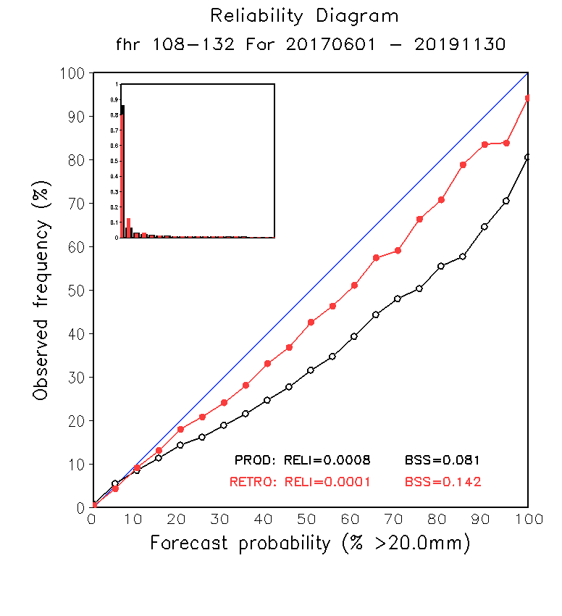
NATIONAL OCEANIC AND ATMOSPHERIC ADMINISTRATION
GEFSv12 CONUS Precip.: Reliability Diagrams
5mm/ 24h
10mm/ 24h
20mm/ 24h
GEFSv12 precipitation forecasts are more reliable than GEFSv11 precipitation forecasts (red line closer to diagonal blue line) at all precipitation thresholds

Slide 25
West Coast Atmo. River
Init.: 0000 UTC 3/20/2018 (F084)
The precip. maxima over the Sierra Nevada Mountains correctly has higher magnitude
in GEFSv12, likely due to GEFSv12 being run at higher model resolution, leading to a better representation of terrain
GEFSv11
GEFSv12
v12−v11
Stage IV

Slide 26
NATIONAL OCEANIC AND ATMOSPHERIC ADMINISTRATION
GEFSv12 CONUS Precip.: Equitable Threat Score
ETS
BIAS
GEFSv12 mean has higher ETS values than GEFSv11 mean at lower precip thresholds
GEFSv12 mean has a larger low bias than GEFSv11 mean at higher precip thresholds

Slide 27
NATIONAL OCEANIC AND ATMOSPHERIC ADMINISTRATION
Storm Prediction Center (SPC)
GEFSv12 is an overall improvement over the operational GEFSv11.
Impressive statistical improvement of GEFSv12 over GEFSv11. The practical improvement is somewhat masked for severe weather forecasting by systematic biases inherited from the GFS: progressive nature of shortwave troughs and the overmixing in the PBL along and near moisture gradients.
GEFSv12 is more dispersive relative to GEFSv11 in a meaningful way.
Improved dispersion results in improved probabilistic thunderstorm proxy forecasts and improved 2-m dewpoint z-scores (beyond F36). Significant improvement seen in precipitation forecast reliability diagrams.
Supports the implementation of GEFSv12.

Slide 28
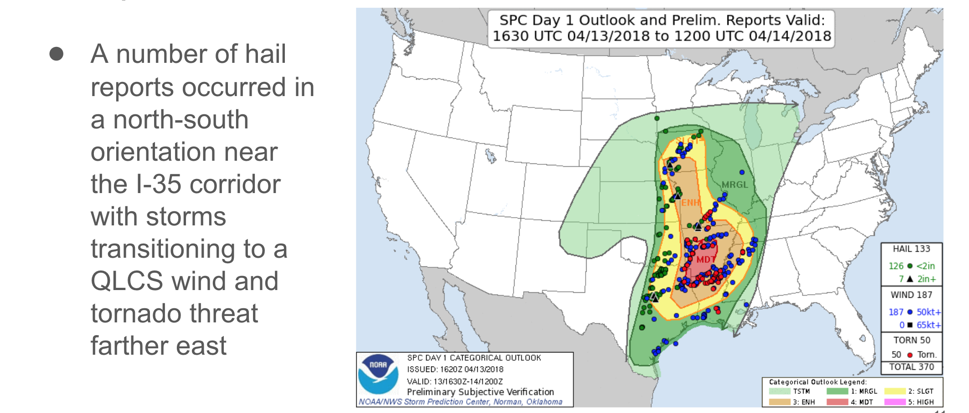
NATIONAL OCEANIC AND ATMOSPHERIC ADMINISTRATION
Storm Prediction Center (SPC)
ArkLaTex Event (13 April 2018): Overview
Thanks to Israel Jirak/Andy Dean

Slide 29
NATIONAL OCEANIC AND ATMOSPHERIC ADMINISTRATION
Storm Prediction Center (SPC)
ArkLaTex Event (13 April 2018): Predictability

Slide 30
NATIONAL OCEANIC AND ATMOSPHERIC ADMINISTRATION
Storm Prediction Center (SPC)
ArkLaTex Event (13 April 2018): Day 6
GEFSv11
GEFSv12
GEFSv11
GEFSv12
v12−v11
GFS Anl.
v12−v11
RAP Anl.

Slide 31
NATIONAL OCEANIC AND ATMOSPHERIC ADMINISTRATION
Storm Prediction Center (SPC)
ROC

Slide 32
NATIONAL OCEANIC AND ATMOSPHERIC ADMINISTRATION
Storm Prediction Center (SPC)
Dewpoint (Td) z-score
([OBS−MEAN]/STDEV)

Slide 33
NATIONAL OCEANIC AND ATMOSPHERIC ADMINISTRATION
National Hurricane Center (NHC)
GEFSv12 is an overall improvement over the operational GEFSv11.
Hurricane track skill is improved for N. Atlantic forecasts from 12–132 h by ~10%. Hurricane track skill is degraded for E. Pacific forecasts from 60–168 h by ~8%. Right-of-track track bias gets worse at longer lead times. GEFSv12 has large improvements in hurricane intensity skill for both basins.
GEFSv12 is more dispersive relative to GEFSv11 in a meaningful way.
Larger spread in GEFSv12 better captures range of potential tracks. Spread has a better correlation with track errors through Day 4 in the N. Atlantic and at all times in the E. Pacific, suggesting that larger spread is communicating larger uncertainty.
Supports the implementation of GEFSv12.

Slide 34
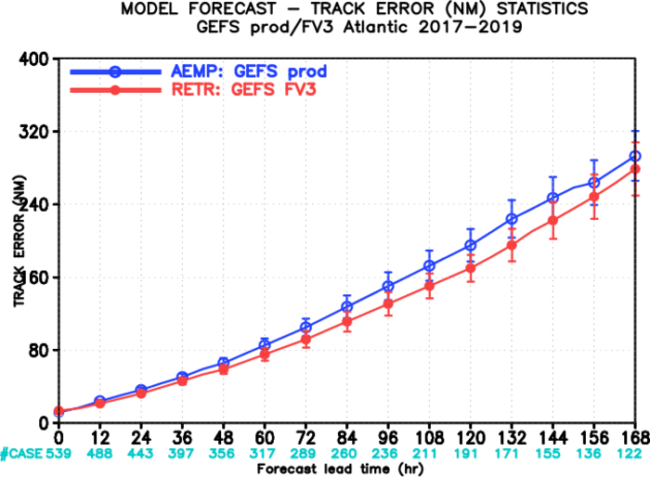
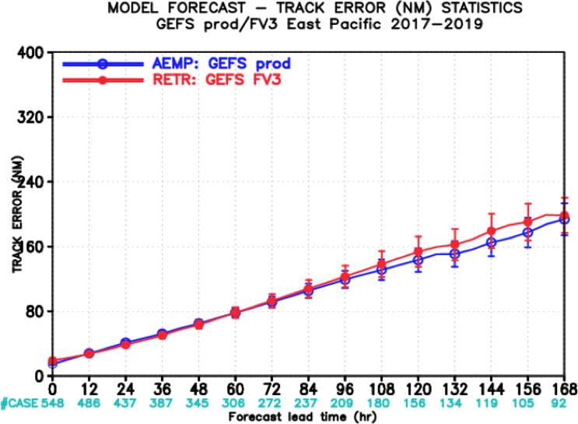
NATIONAL OCEANIC AND ATMOSPHERIC ADMINISTRATION
GEFSv12 Tropical Cyclone Statistics
N. Atlantic Track Error
E. Pacific Track Error
GEFSv12 has comparable or slightly less track error than GEFSv11 in N. Atlantic
GEFSv12 has comparable or slightly more track error than GEFSv11 in E. Pacific

Slide 35
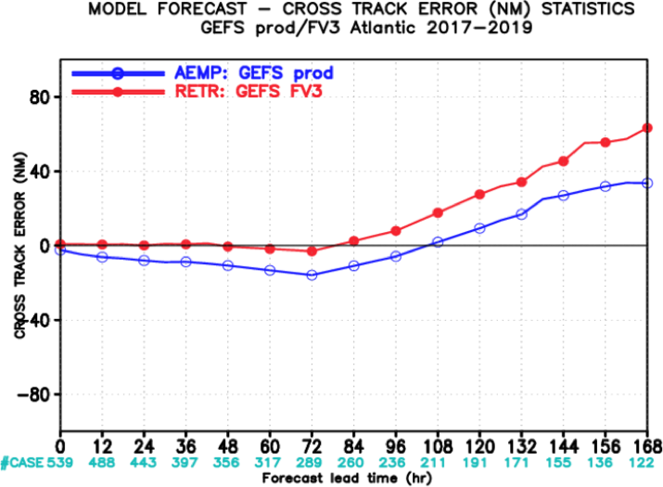
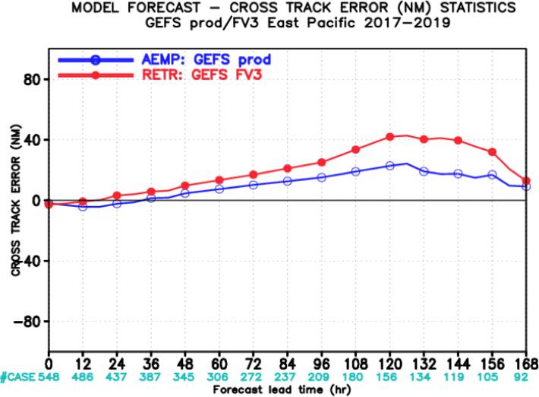
NATIONAL OCEANIC AND ATMOSPHERIC ADMINISTRATION
Concerns: Right-of-track bias in TC tracks
N. Atlantic Across-Track Error
E. Pacific Across-Track Error
Right
Right
Left
GEFSv12 bias is shifted to the right relative to GEFSv11
Left
GEFSv12 has more right-of-track error than GEFSv11
at longer lead times in the North Atlantic and East Pacific

Slide 36
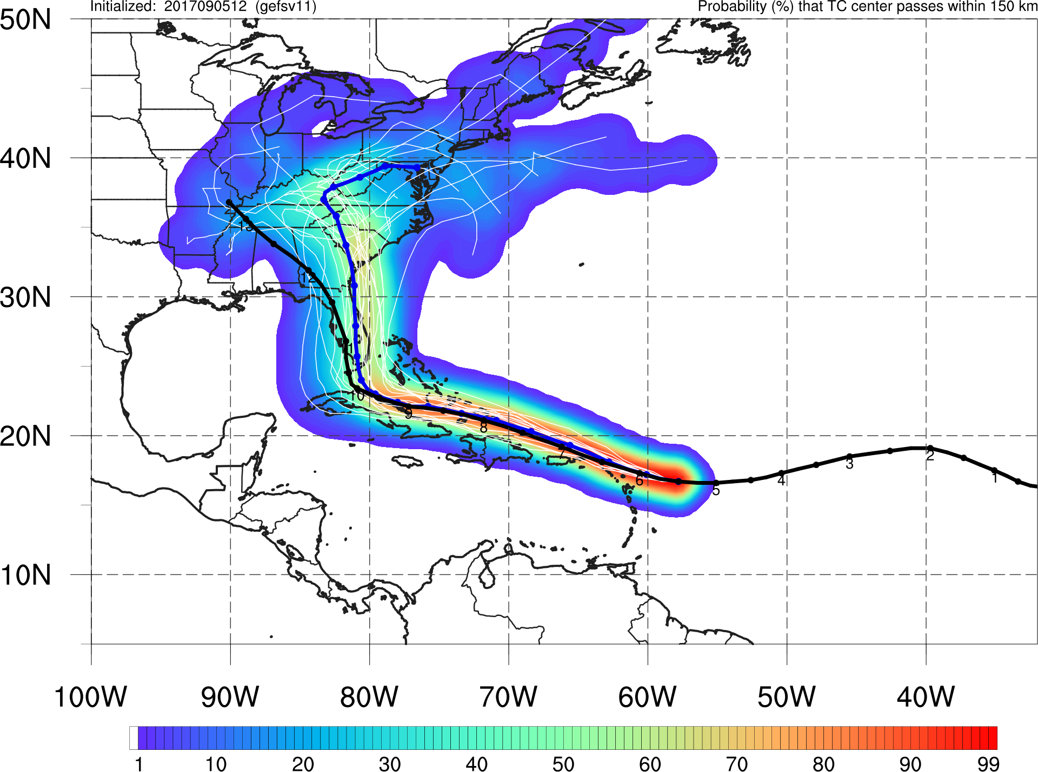
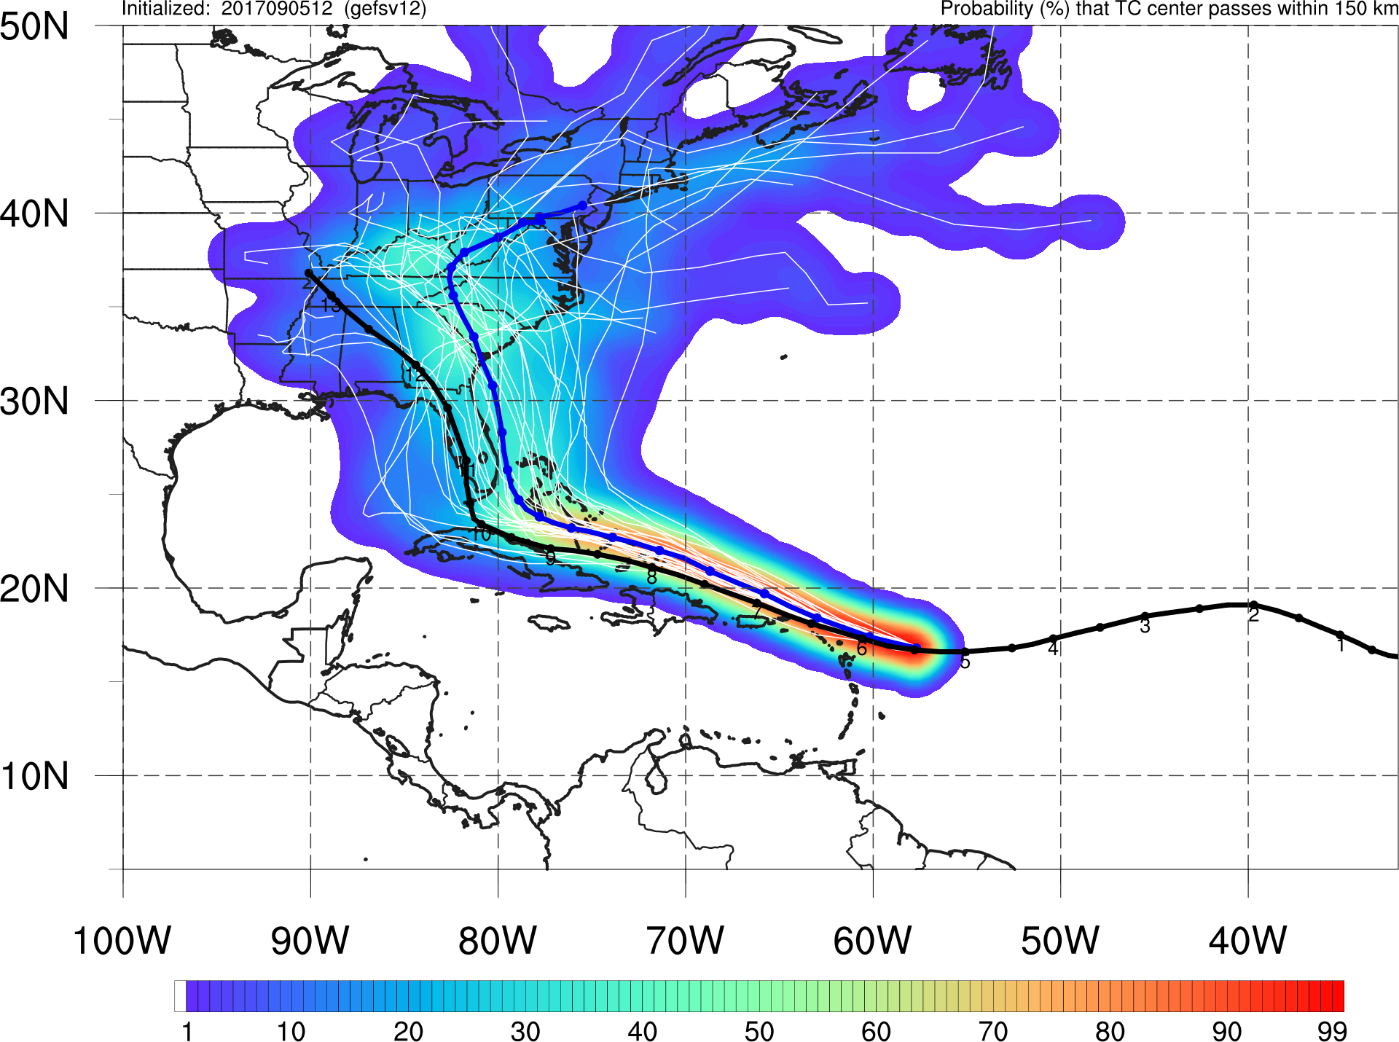
NATIONAL OCEANIC AND ATMOSPHERIC ADMINISTRATION
Improved spread, but right-of-track bias
Irma
Init: 12Z 9/05/17
GEFSv11
GEFSv12
GEFSv11 is in good agreement with Best Track at shorter lead times, but becomes right of Best Track at longer lead times. GEFSv12 is further right than GEFSv11 at all lead times.

Slide 37
NATIONAL OCEANIC AND ATMOSPHERIC ADMINISTRATION
Outline
Summary of GEFSv12 verification statistics
Summary of GEFSv12 evaluation comments/recommendations from the field (e.g., NWS Regions and Centers)
Overall impressions of GEFSv12

Slide 38
NATIONAL OCEANIC AND ATMOSPHERIC ADMINISTRATION
Overall Impressions of GEFSv12
Region | Recommendation | Key Remarks
Eastern Region | Implement | GEFSv12 had significantly better synoptic performance. Improved spread in TC tracks, with increased right-of-track bias.
Central Region | Implement | GEFSv12 outperformed GEFSv11 synoptically. Improved spread, which better encapsulated the envelope of potential solutions and highlighted important gradients. Improved performance in areas of complex terrain.
Southern Region | Implement | A noticeable step forward in ensemble modeling. Overall improved spread in nearly all fields.
Western Region | Implement | Overall improvements in AC scores, dispersion, terrain resolved features, etc. Concerned with the performance of a few of the cases in the West showing long-range forecast degradation.
Alaska Region | Implement | GEFSv12 shows definite benefits over GEFSv11, mainly due to its increased spread. GEFSv12 can have a progressive bias.

Slide 39
NATIONAL OCEANIC AND ATMOSPHERIC ADMINISTRATION
Overall Impressions of GEFSv12
Center | Recommendation | Key Remarks
WPC | Implement | Major improvements in QPF reliability and over complex terrain. Probabilistic fields will provide more useful guidance. Concerned about the low mean QPF bias at moderate to heavy amounts. Increased spread (particularly in regions with tight gradients), provides better uncertainty information to forecasters.
SPC | Implement | Impressive general statistical improvement. Systematic biases: progressive shortwave troughs and overmixing in the PBL along and near moisture gradients. Improved dispersion, probabilistic thunderstorm proxy forecasts, and 2-m dewpoint z-scores. Significant improvement in precipitation reliability diagrams.
NHC | Implement | Large improvements in hurricane intensity skill. Hurricane track forecasts are improved in the NATL and degraded in the EPAC. Right-of-track track bias gets worse at longer lead times. Larger spread in GEFSv12 better captures range of potential tracks.

Slide 40
NATIONAL OCEANIC AND ATMOSPHERIC ADMINISTRATION
Overall Impressions of GEFSv12
All participating evaluators support implementation
Common Concerns
GEFSv12 can be too progressive with cutoff lows/shortwave troughs
Increased right-of-track bias in tropical cyclone track forecasts
Overmixing in the PBL along/near moisture gradients (reduced CAPE)
Low mean-QPF bias at moderate to heavy precipitation thresholds

Slide 41
NATIONAL OCEANIC AND ATMOSPHERIC ADMINISTRATION
Overall Impressions of GEFSv12
Common Strengths
Improved synoptic performance
More dispersive (⬆ spread); captures envelope of possible solutions
Higher spread is located in meaningful areas (e.g., tight gradients)
Improved tropical cyclone track forecasts in the North Atlantic
Improved and more reliable precipitation forecasts
Improved precipitation forecasts over complex terrain

Slide 42
NATIONAL OCEANIC AND ATMOSPHERIC ADMINISTRATION
Next Steps
EMC CCB meeting on 5/1/20
NCEP Director briefing on 5/5/20
Code handoff to NCO on 5/15/20
NCO 30-day IT test from ~7/27/20 to 8/26/20
Implementation date on ~9/7/20
https://www.emc.ncep.noaa.gov/users/meg/gefsv12/

