Slide 1
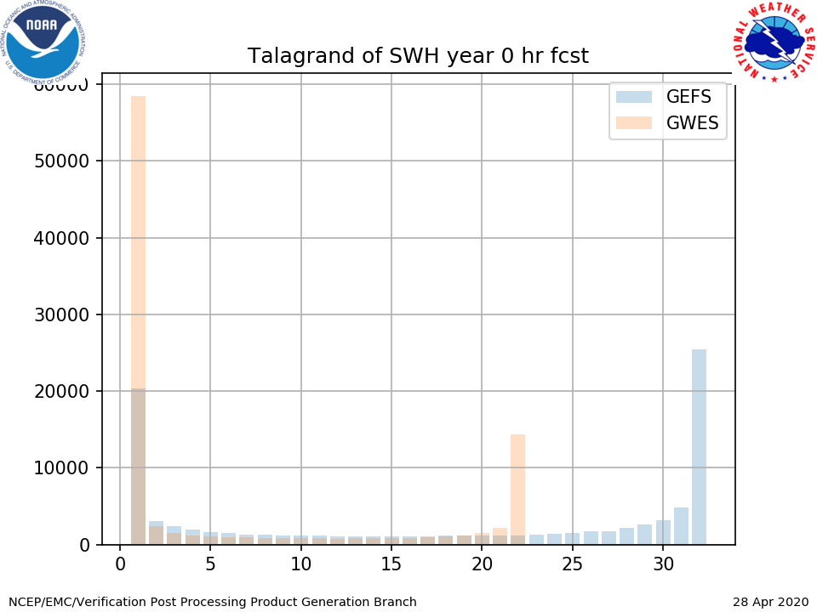
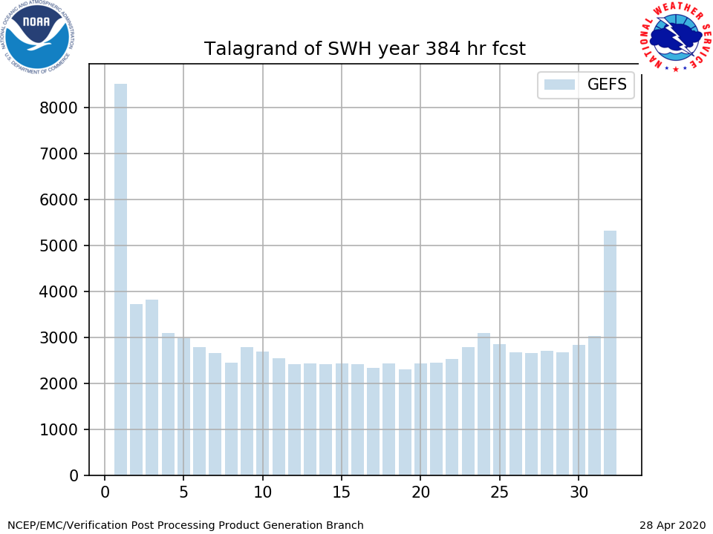
NATIONAL OCEANIC AND ATMOSPHERIC ADMINISTRATION
UFS - Global Ensemble Forecast System
GEFSv12-Wave Overview of Upgrades & Verification Statistics
Jose-Henrique Alves & Deanna Spindler
GEFSv12 Wave Team: Todd Spindler, Roberto Padilla, Bhavani Rajan EMC Model Evaluation Group Webinar
30 April 2020

Slide 2
NATIONAL OCEANIC AND ATMOSPHERIC ADMINISTRATION
Outline
Overview of Wave Model upgrade
Summary of GEFSv12-Wave verification statistics

Slide 3
GEFSv12-Wave Configurations
Components | GWESv3.0 (Jul. 2014) | GEFSv12 (Sept. 2020)
WAVEWATCH III | WW3v4.15 | WW3v7.00
Physics | Ardhuin et al (2010) + DIA | Ardhuin et al (2010) + DIA
Initialization | 24h Hindcast | Previous cycle 6h
Wind Forcing | GEFS grib2 3h | NEMS FV3-coupled 1h
Ice Forcing | NCEP/EMC daily 1/12º analysis | NCEP/EMC daily 1/12º analysis
Horizontal Resolution | 0.5º x 0.5º | 0.25º x 0.25º
Daily frequency | 00, 06, 12 and 18UTC | 00, 06, 12 and 18UTC
Forecast length | 10 days | 16 days
Members | Control + 20 pert members | Control + 30 pert members
Output resolution | 0.5º x 0.5º | 0.25º x 0.25º
Output frequency | 3h the first 8 days; 6h the rest | 3h the first 10 days; 6h the rest
Implementation | December 2nd 2015 | September 2020

Slide 4
GWES Integration to GEFS - Highlights
GWES→GEFSv12 wave component→GEFSv12-Wave
“The first global-scale UFS coupled system at NCEP”
System changes inherited by wave component:
Integration of a wave model to the NCEP global-workflow,
Increased ensemble membership (21→31),
Extended forecast range: 240h to 384h (16 days).
Wave model/component changes:
Improved source-terms,
Objective optimization for FV3 surface-wind forcing,
Additional (third) swell partition in gridded outputs,
Increased spherical grid resolution: ½º to ¼º global.

Slide 5
NATIONAL OCEANIC AND ATMOSPHERIC ADMINISTRATION
Outline
Overview of Wave Model upgrade
Summary of GEFSv12-Wave verification statistics

Slide 6
GEFSv12-Wave Validation
Retrospectives: Dec 1, 2018 - Nov 30, 2019
00Z Cycle
31 Members
16 days
Validation Statistics
Parameters: Significant wave height - Hs
Peak Period - Tp
RMSE, Bias, CRPS, 95% Quantile
Talagrand
NDBC network (~150 buoys) and Jason-3/SARAL altimeters
Verified vs op GWES and deterministic wave model (multi_1)

Slide 7
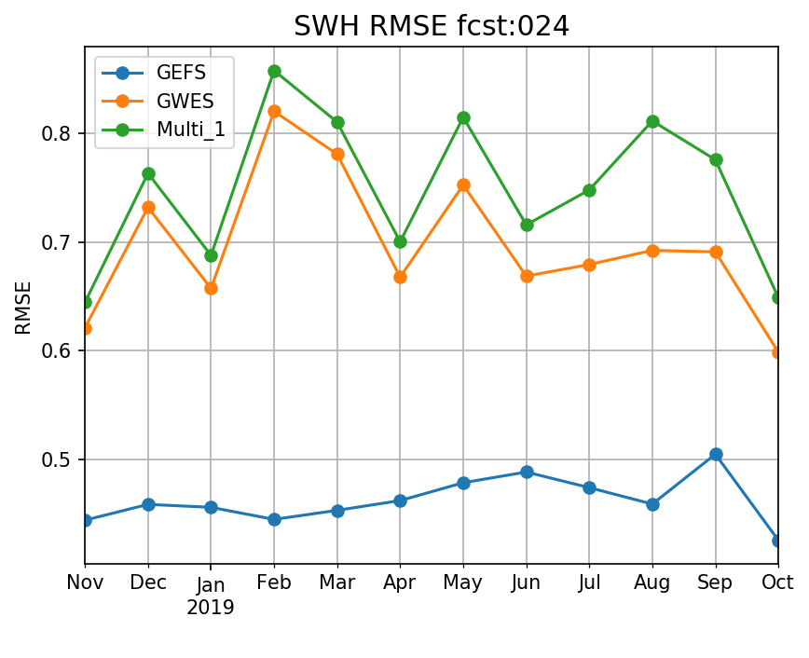
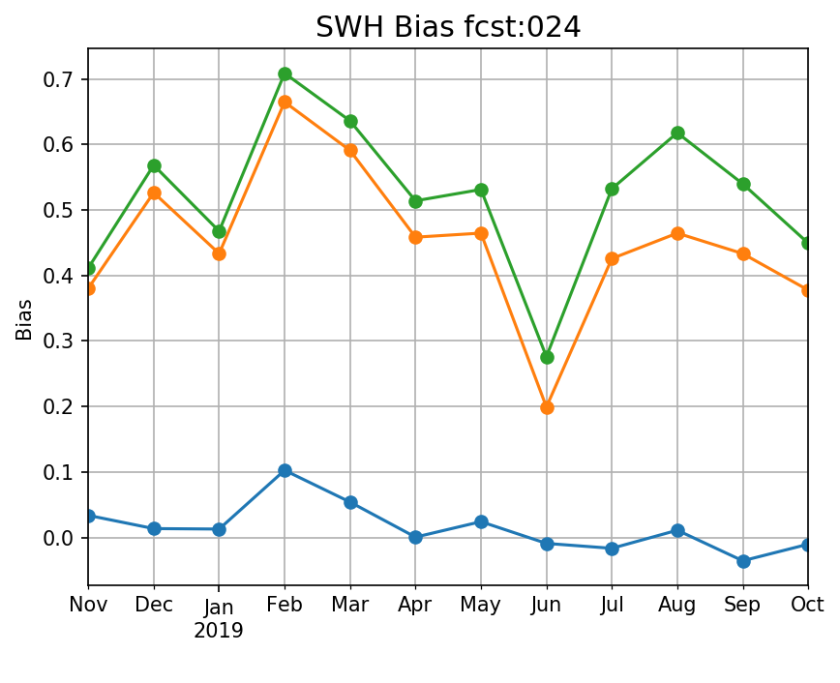
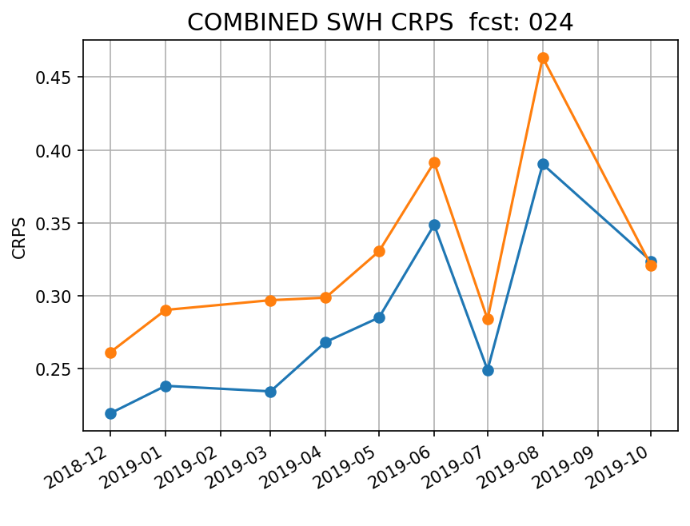
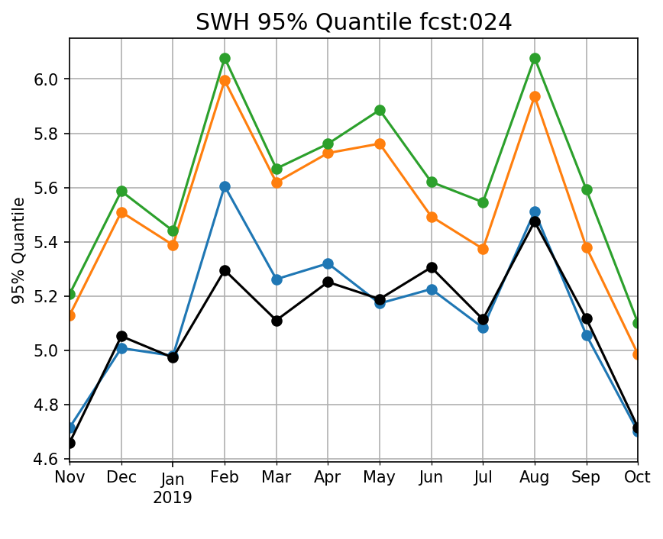
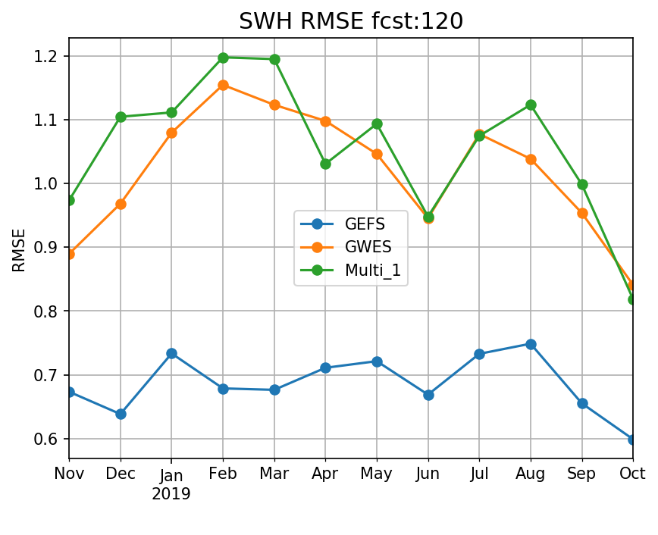
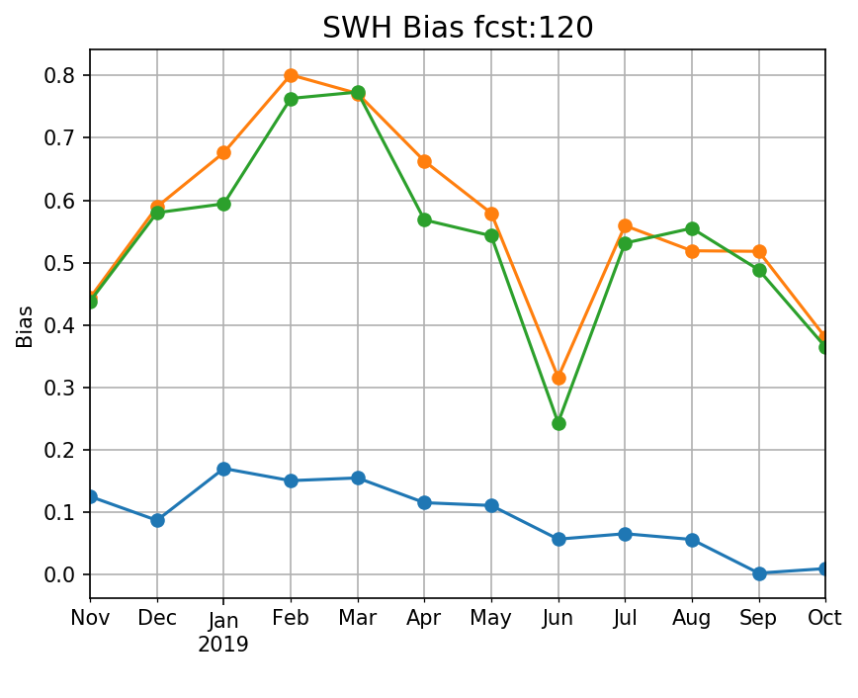
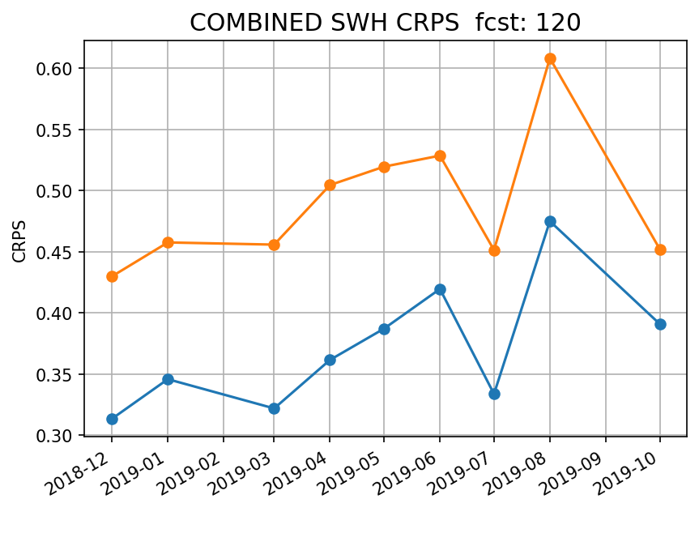
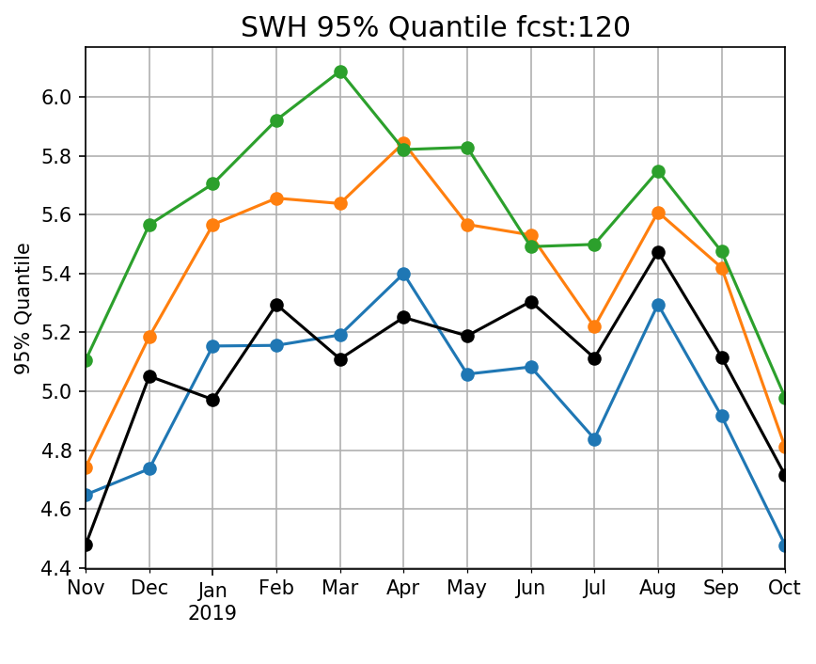
Monthly Hs Statistics - Days 1 & 5 - Altimeters
Significantly reduced Hs error and bias consistently through year in short and long fcst ranges
Ensemble wave-heights from upgrade have higher accuracy and predictability.
Storm waves better predicted through year in short and long fcst ranges

Slide 8
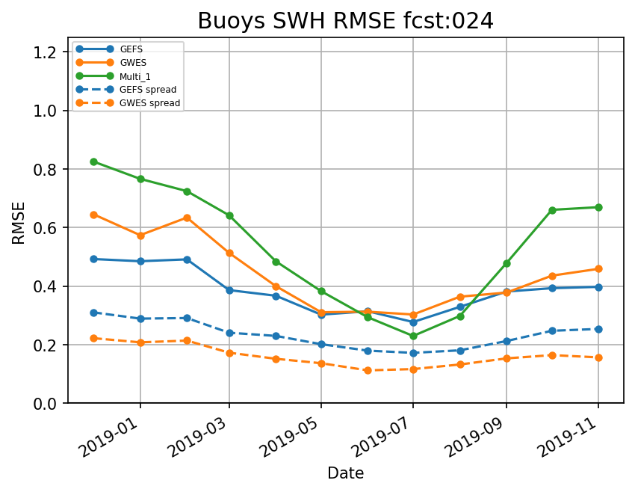
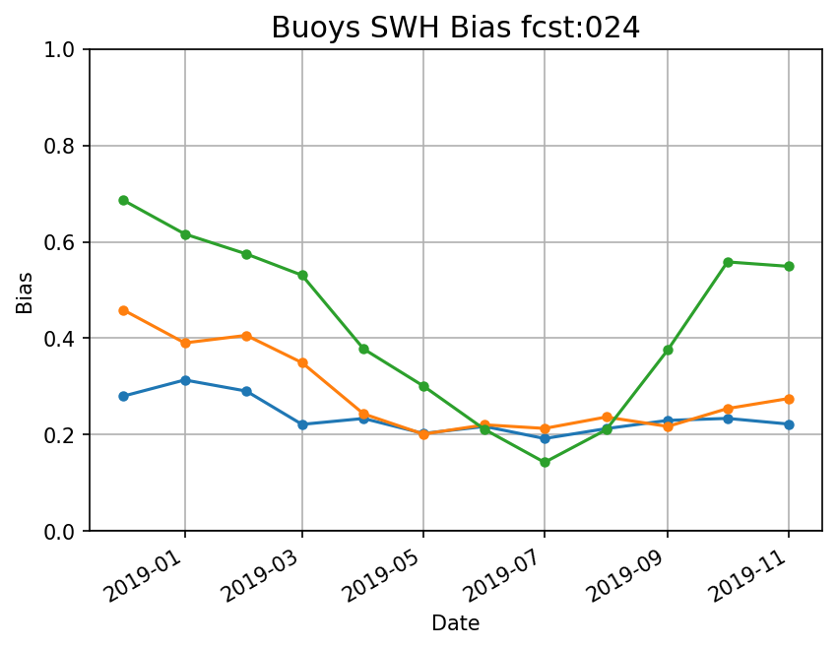
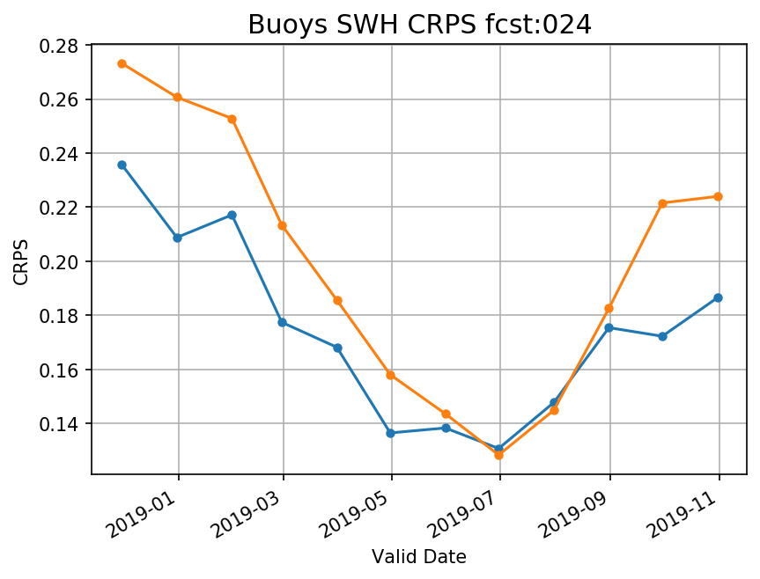
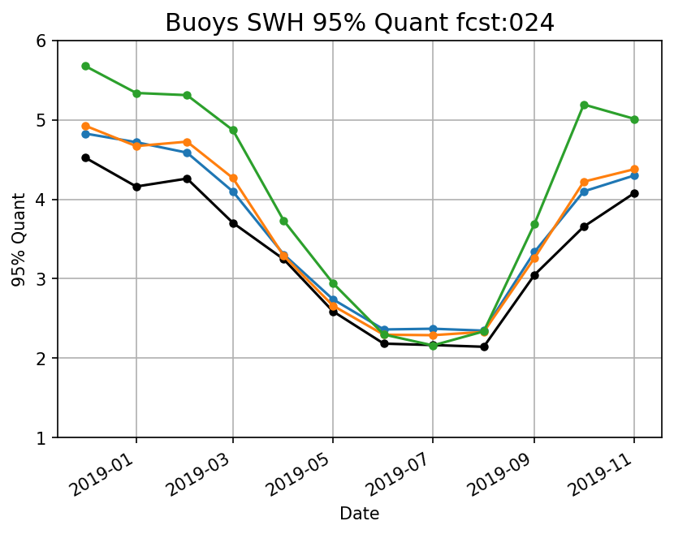
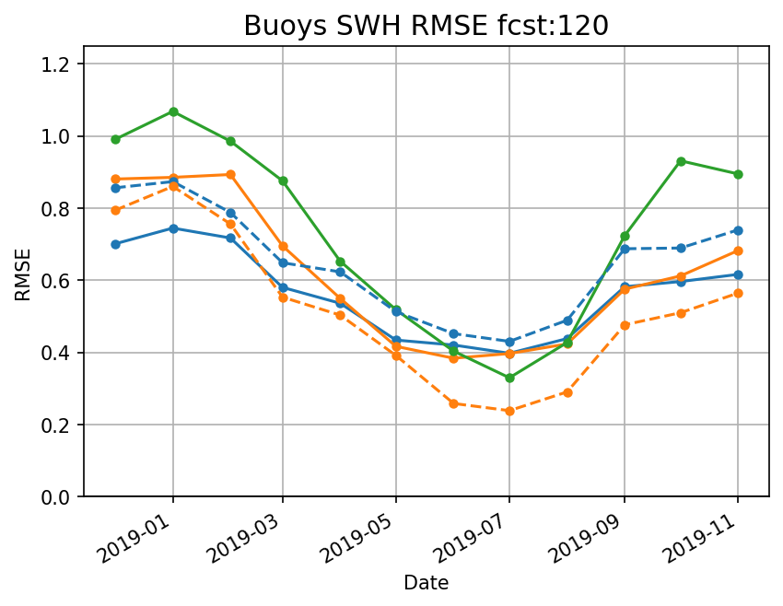
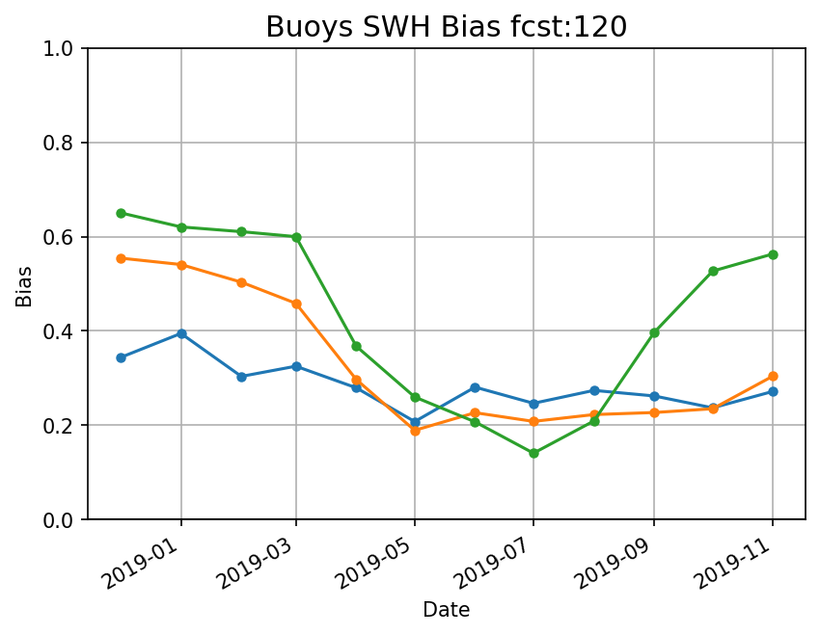
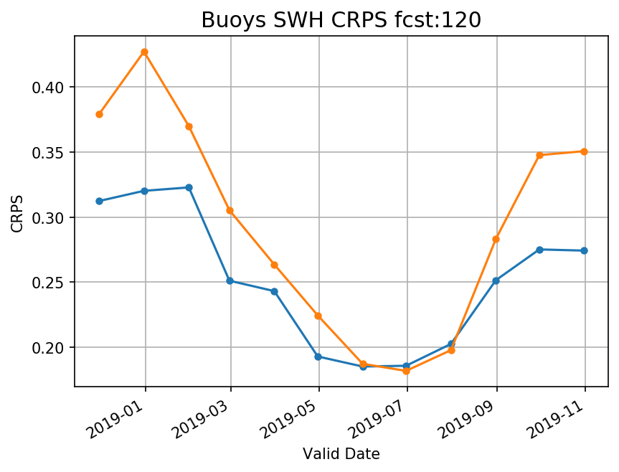
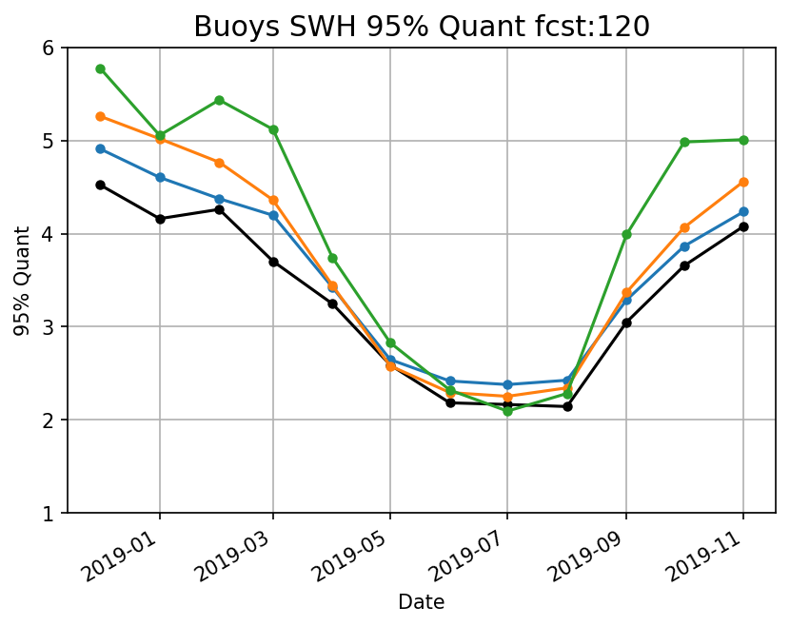
Monthly Hs Statistics - Days 1 & 5 - Buoys
Buoy data confirms altimeter validation: significantly reduced Hs error and bias. Also note larger spread, and closer relationship between RMSE and spread.
Hs ensemble from upgrade is more accurate, provides higher predictability.
Storm waves better predicted through year in short and long fcst ranges.

Slide 9
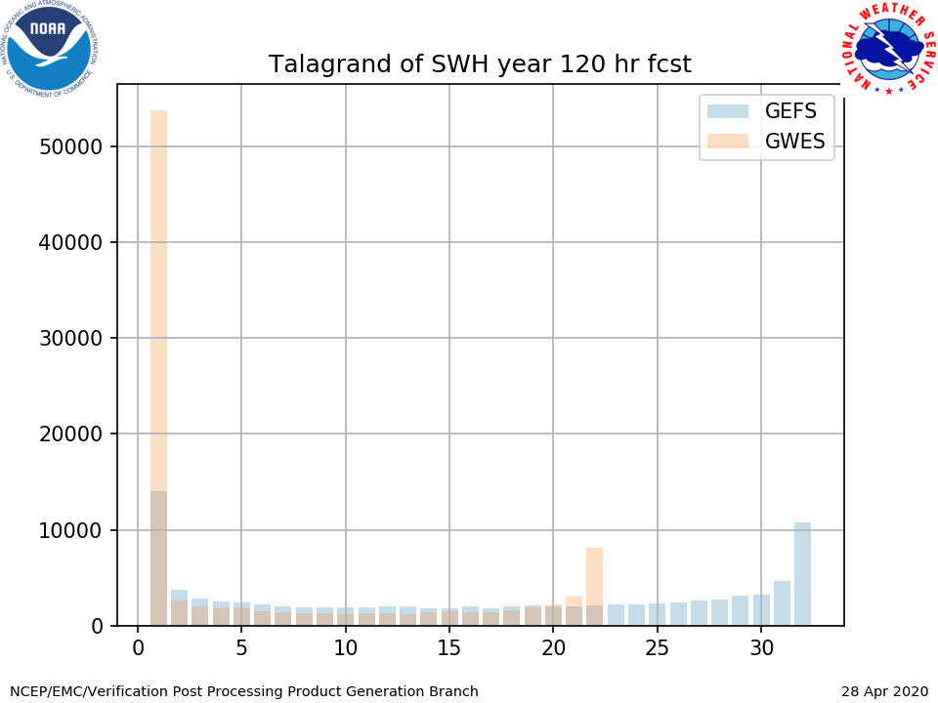
Hs Talagrand Entire Retro - Days 1 & 5
Relative to GWES, the upgraded GEFS-Wave reduces significantly the positive bias, ensuring improved reliability particularly at longer forecast ranges. System is nevertheless still somewhat under dispersive.

Slide 10
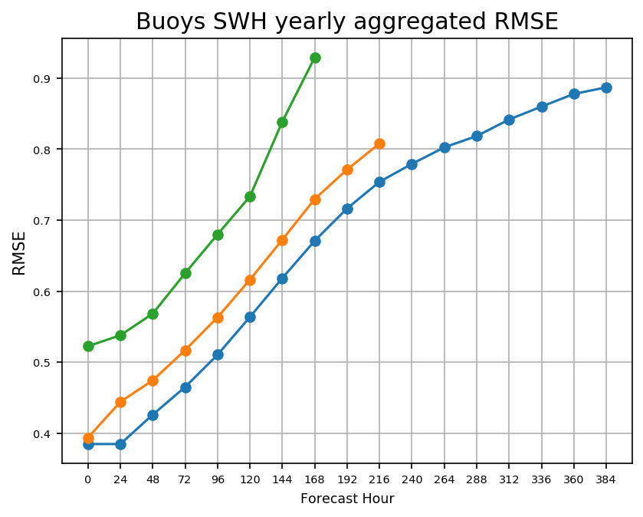
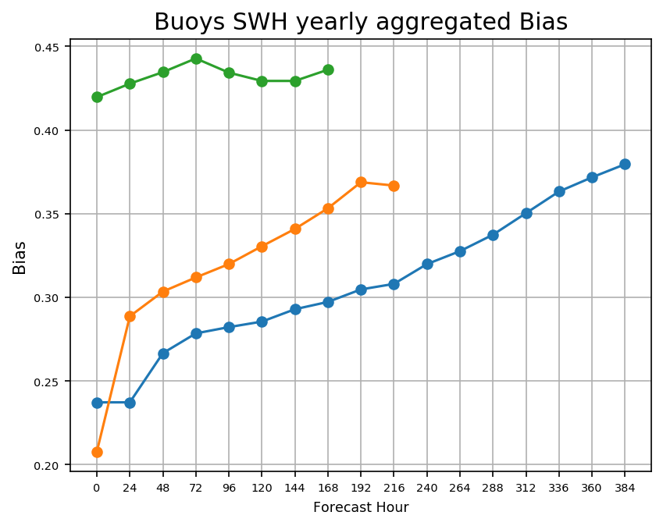
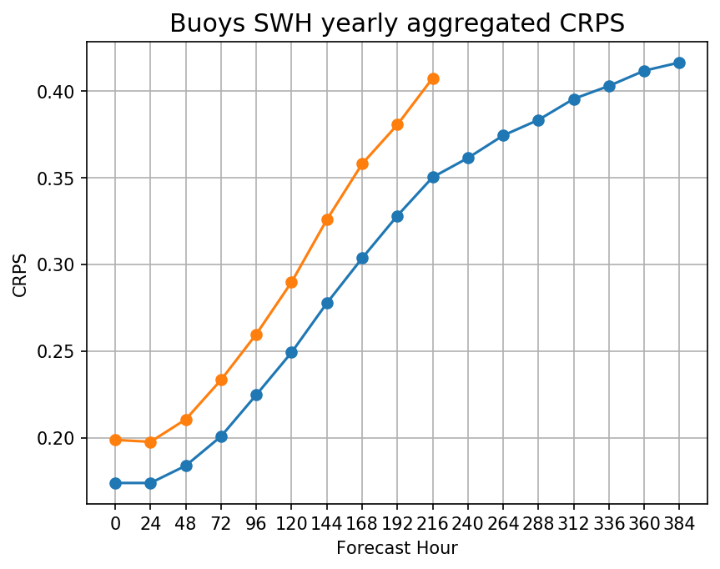
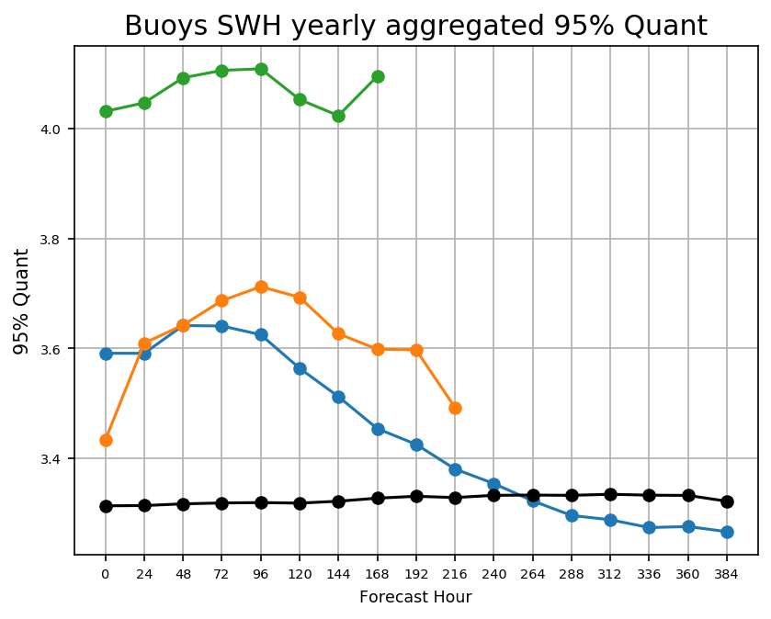
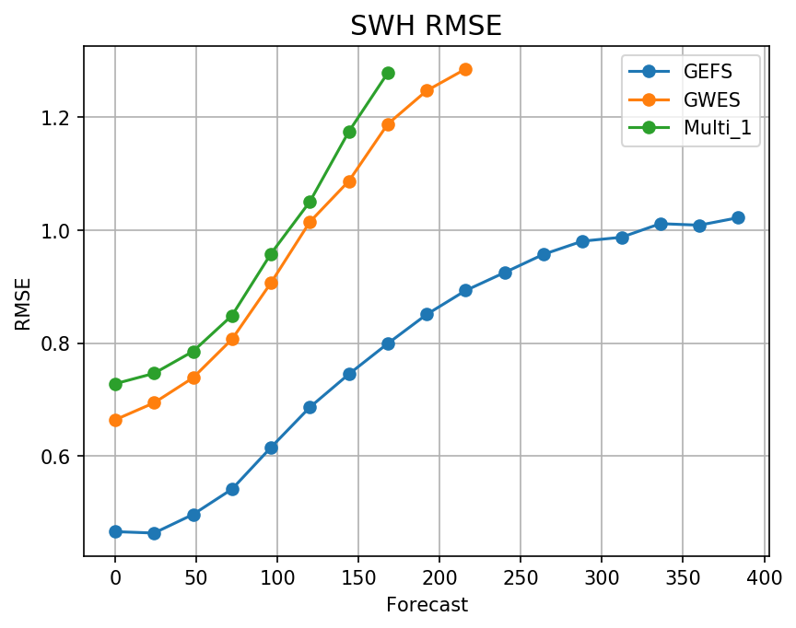
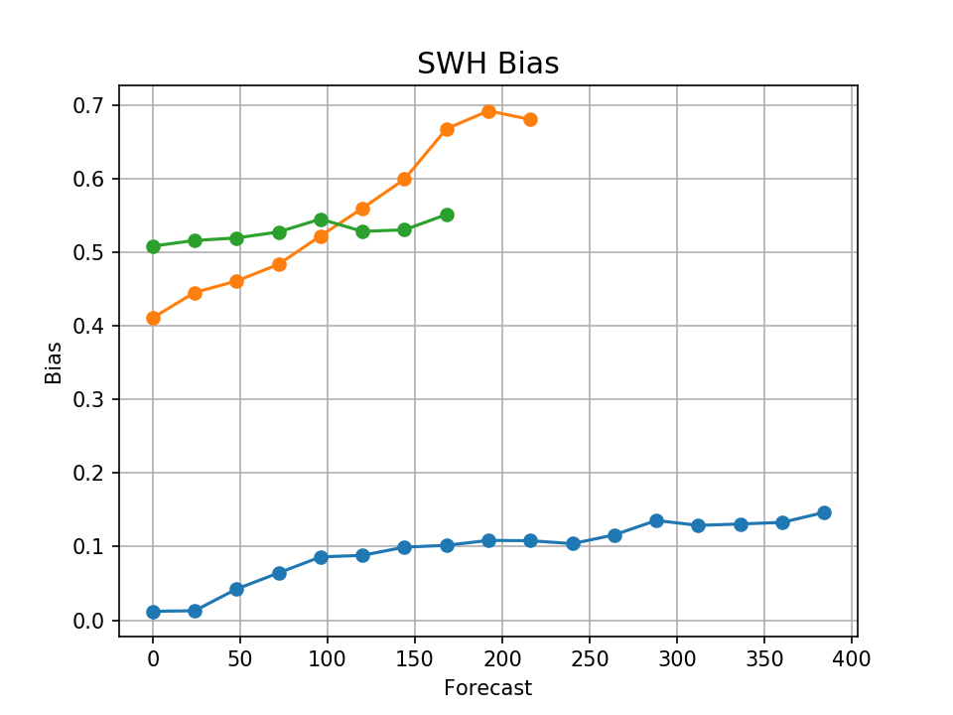
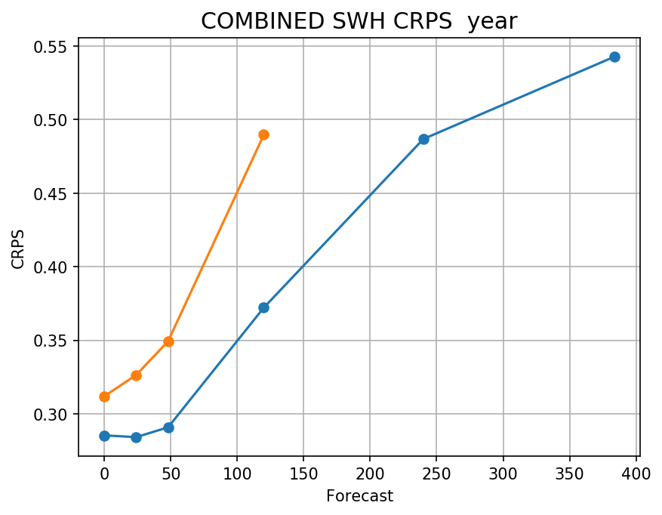
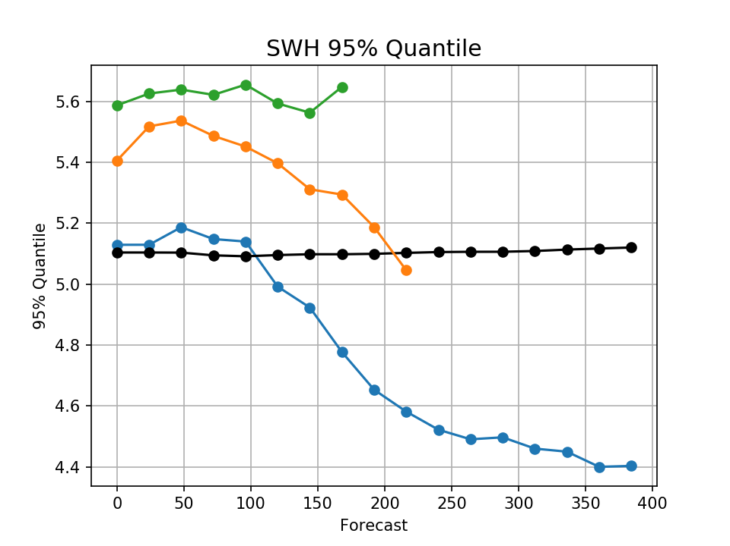
Hs Statistics Entire Retro by Forecast Range
Data from the entire validation period confirms: in all forecast ranges, relative to buoys and altimeters, Hs from upgrade significantly reduces Hs error and bias, improves predictability and forecasts of storm waves. Note that extended forecast range provides skillful forecast. New model 10-day forecast is equivalent in skill to 5-day current operational, 16-day, equivalent to 10-day.
NDBC Buoys
Jason-3/SARAL Altimeters

Slide 11
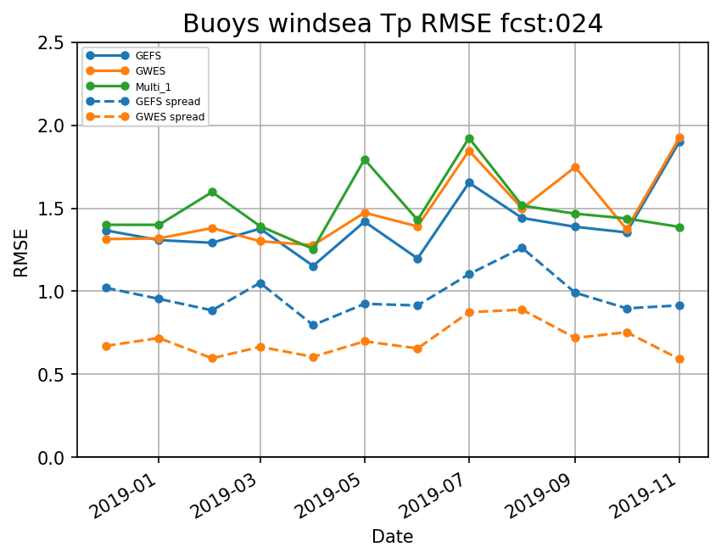
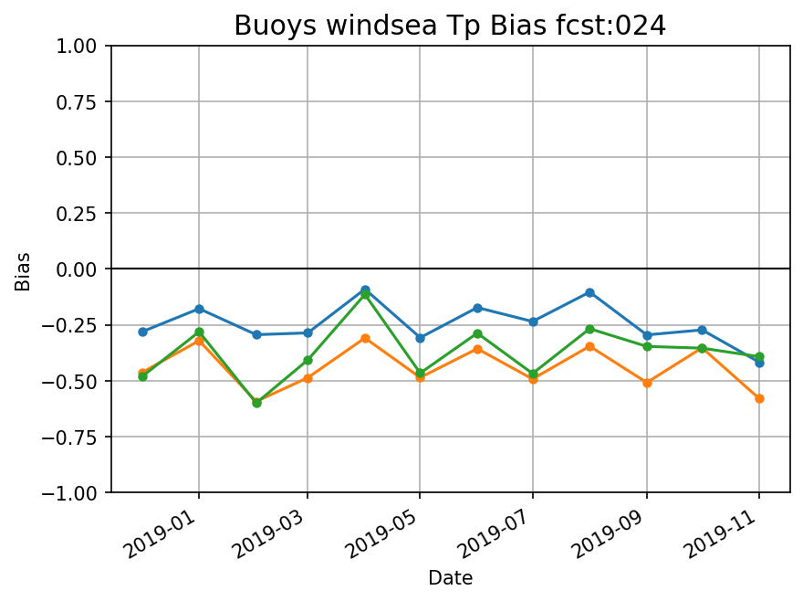
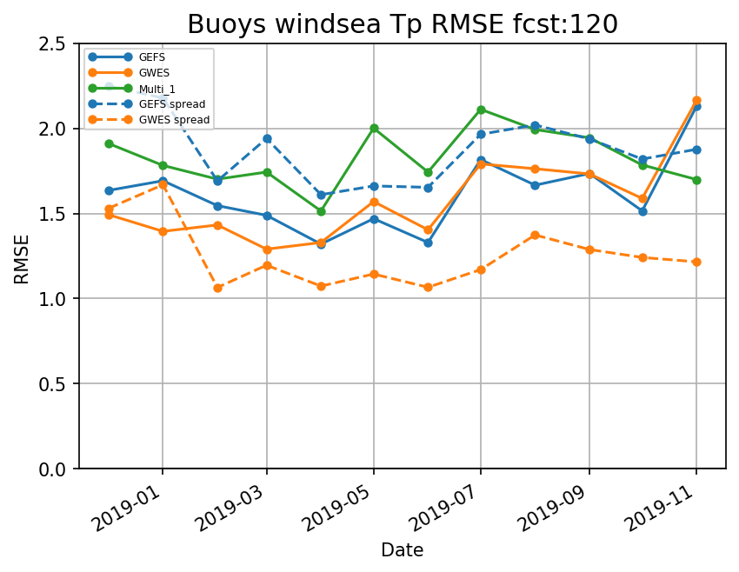
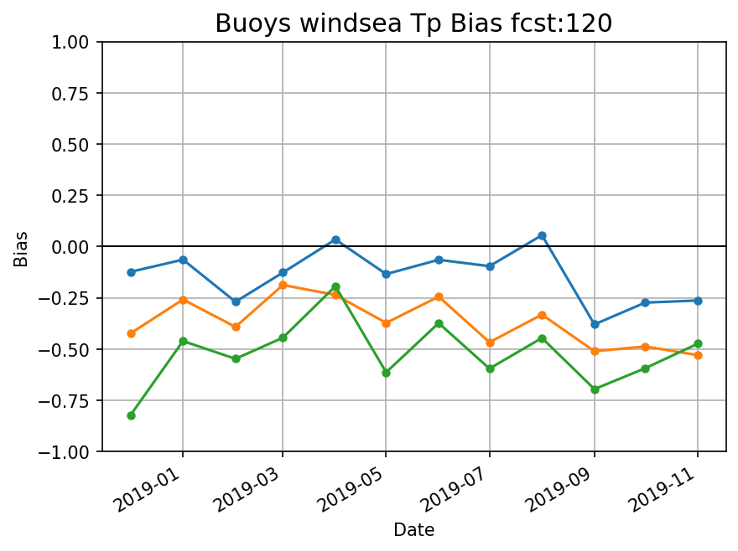
Windsea Tp Statistics - Days 1 & 5 - Buoys
No significant improvements in shorter Tp associated with windseas in the short forecast range. At longer range, slight improvement in bias.
Larger spread more closely matching RMSE indicates better representation of uncertainty, particularly at longer forecast range.

Slide 12
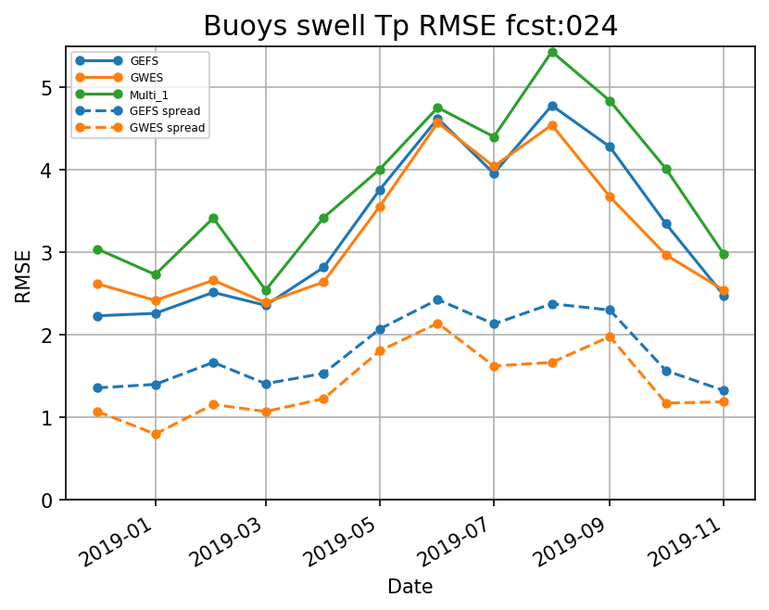
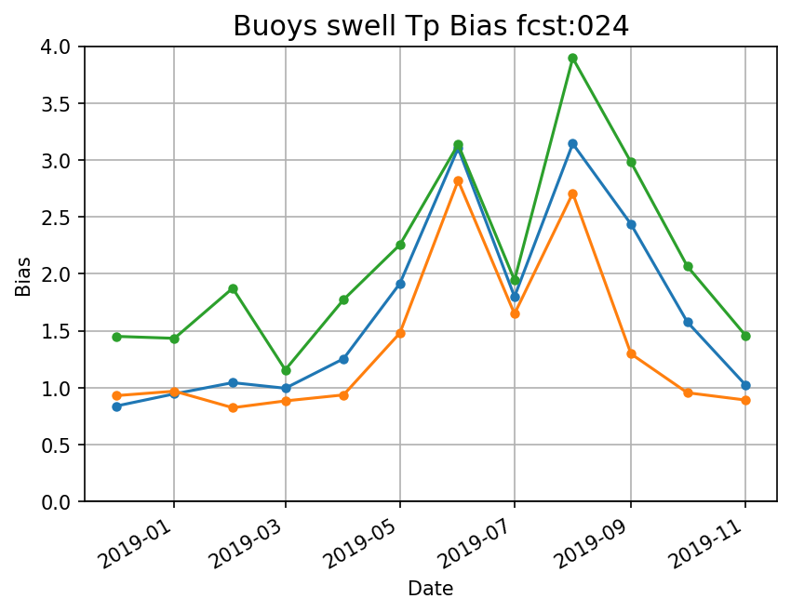
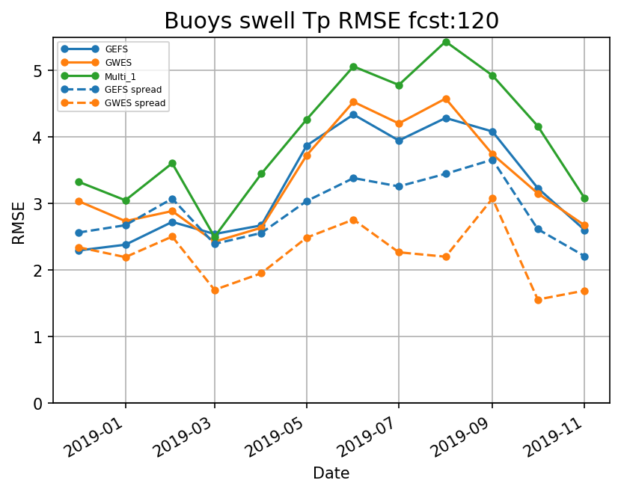
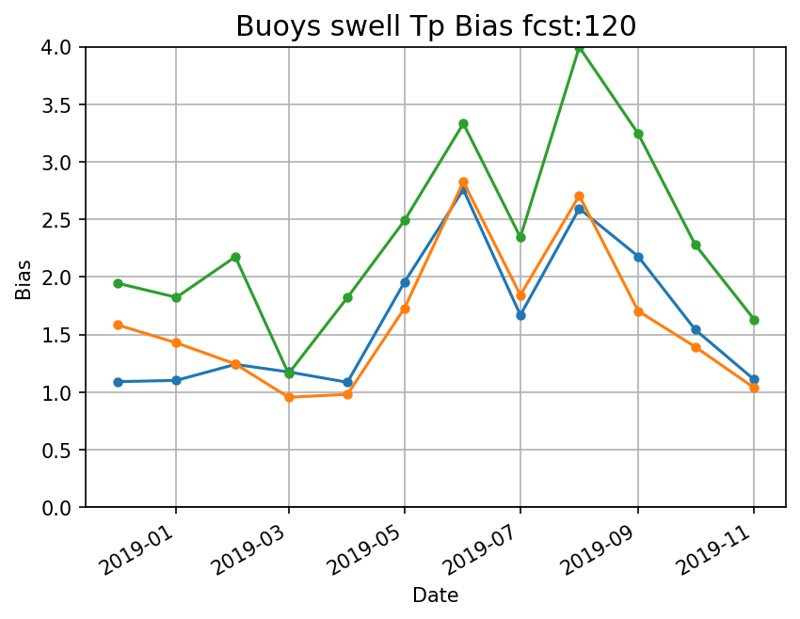
Swell Tp Statistics - Days 1 & 5 - Buoys
No noticeable improvements in longer Tp associated with swell in the short forecast range. At longer range, slight improvement in bias.
Larger spread more closely matching RMSE indicates slightly improved representation of uncertainty, particularly at the longer forecast range.

Slide 13
Evaluation of aerosol forecast using GEFS-Aerosol at NOAA/National Weather Service
Joint collaboration between NCEP/EMC and NOAA/ESRL/GSL and CSL,
NOAA/OAR/ARL, NOAA/NESDIS and NASA/GSFC
NCEP/EMC/ARL Team: Li Pan, Barry Baker, Partha S. Bhattacharjee, Jeff Mcqueen;
OAR/ESRL/GSD: Kate Zhang, Raffaele Montuoro, Samuel Trahan, Stuart Mckeen, Judy Henderson, Gregory Frost, Georg Grell;
NCEP/EMC/GEFS Team: Walter Kolczynski, Dingchen Hou, Xianwu Xue, Yuejian Zhu;
NCEP/EMC/EIB: Jun Wang, Gan Lin, Kate Friedman;
NCEP/EMC/UPP: Wen Meng

Slide 14
GEFS-Aerosols in GEFS v12
Resolution: c384 (~25km horizontal resolution) L64 to 5 days, 6-hourly global forecast and 4x/day (00, 06, 12 and 18)
Meteorology : GEFS, based on GFSv15
Aerosol : Inline aerosol representation based on GOCART (Dust, Organic and Black carbon, Sea-salt, Sulfate)
Transport:
Sub-grid scale tracer transport and wet scavenging included in GFS-Physics - SAS scheme and planetary boundary layer (PBL)
Fluxes are calculated positive definite
Deposition:
Wet deposition (for aerosols and sulfate) and dry deposition (all species)
Anthropogenic Emissions: CEDS-2014 (SO₂, PSO₄, POC, PEC)
Biomass burning: NESDIS Global Biomass Burning Emission Product (GBBEPx) used for fire size and location (Zhang et al., 2012); 1d wind shear-dependent cloud model used to simulate plume tilt and Fire Radiative Power (FRP) is used to determine injection heights
Dust: 5 size bins
FENGSHA dust scheme: scheme used in current NAQFC (Tong et al. 2016)
Sea-salt: NASA GEOS-5 GOCART
Marine Dimethyl Sulfide: GOCART with monthly values as in Lana et al. (2011)
Chemistry cycled for initial conditions, but GFSv15 analysis for meteorology

Slide 15
GEFS-Aerosols Products
GEFS-Aerosols provides 0.25, 0.5 degree forecast products in GRIB2 format 4 times per day
Product files and their contents include:
2d fields : Aerosol Optical Depth (AOD) at 340, 440, 550, 660, 860, 1063 and 1110nm from 0-120 hours
Particulate matter (PM10 and PM2.5) for 0-120 hours.
Total AOD at 550nm contains fields from all 5 species (dust, sea-salt, carbonaceous aerosols, sulfate AOD) along with emission, sedimentation, dry deposition and wet deposition fluxes.
Single scatter albedo and asymmetric factor for total aerosols at 340nm
3d fields : Aerosol mixing ration of species at model levels along with pressure, temperature and RH, winds, heights.

Slide 16
Verification Dataset
6-hourly AOD forecast from International Cooperative for Aerosol Prediction Multi-model Ensemble (ICAP-MME) (Peng et al., 2019) – uses data assimilation
AOD analysis from MERRA2 (Randles et al., 2017)
Daily MODIS total AOD from collection 6.1 - combined dark target and deep blue (DT and DB)
Daily VIIRS AOD at 0.25x0.25 degree
Total AOD from AERONET station data – Version 3, level 1.5
results from daily model forecasts between July, 2019 – March, 2020
For dust evaluation another 4 months run from March-June, 2019 completed (with WRF-Chem MODIS emission in place of GBBEPx for smoke emission).
AOD at 550nm used for verification with observation

Slide 17
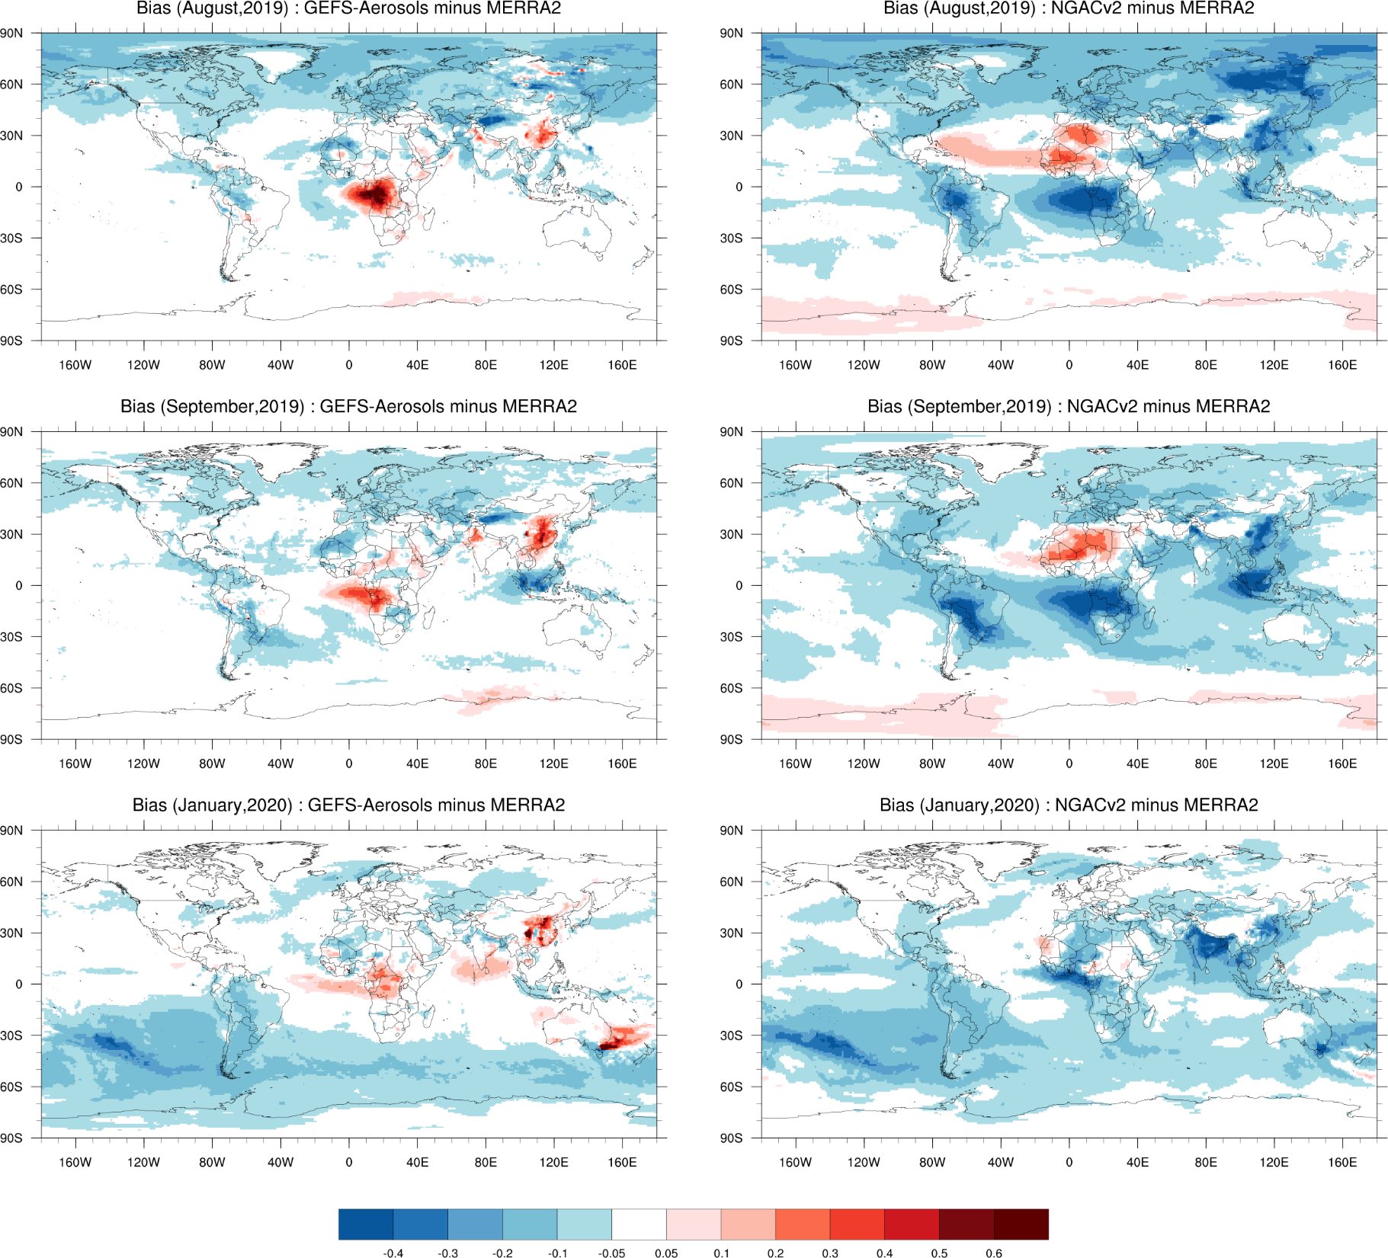
Monthly average Day 1 Total AOD Forecast bias
against MERRA2
GEFS-Aerosol
NGACv2
Major improvements in terms of bias over aerosol source and downwind regions
Large over prediction over Saharan dust region by NGACv2 is reduced
Over biomass burning regions, GEFS-Aerosol shows less bias for Siberian and Amazon fires
Over prediction over Africa and Australian fire from GEFS-Aerosol
August, 2019
September, 2019
Check other months figures at :
https://www.emc.ncep.noaa.gov/gc_wmb/parthab/GEFS-Aerosol/html/fv3_mongridstat_png.html
January, 2020

Slide 18
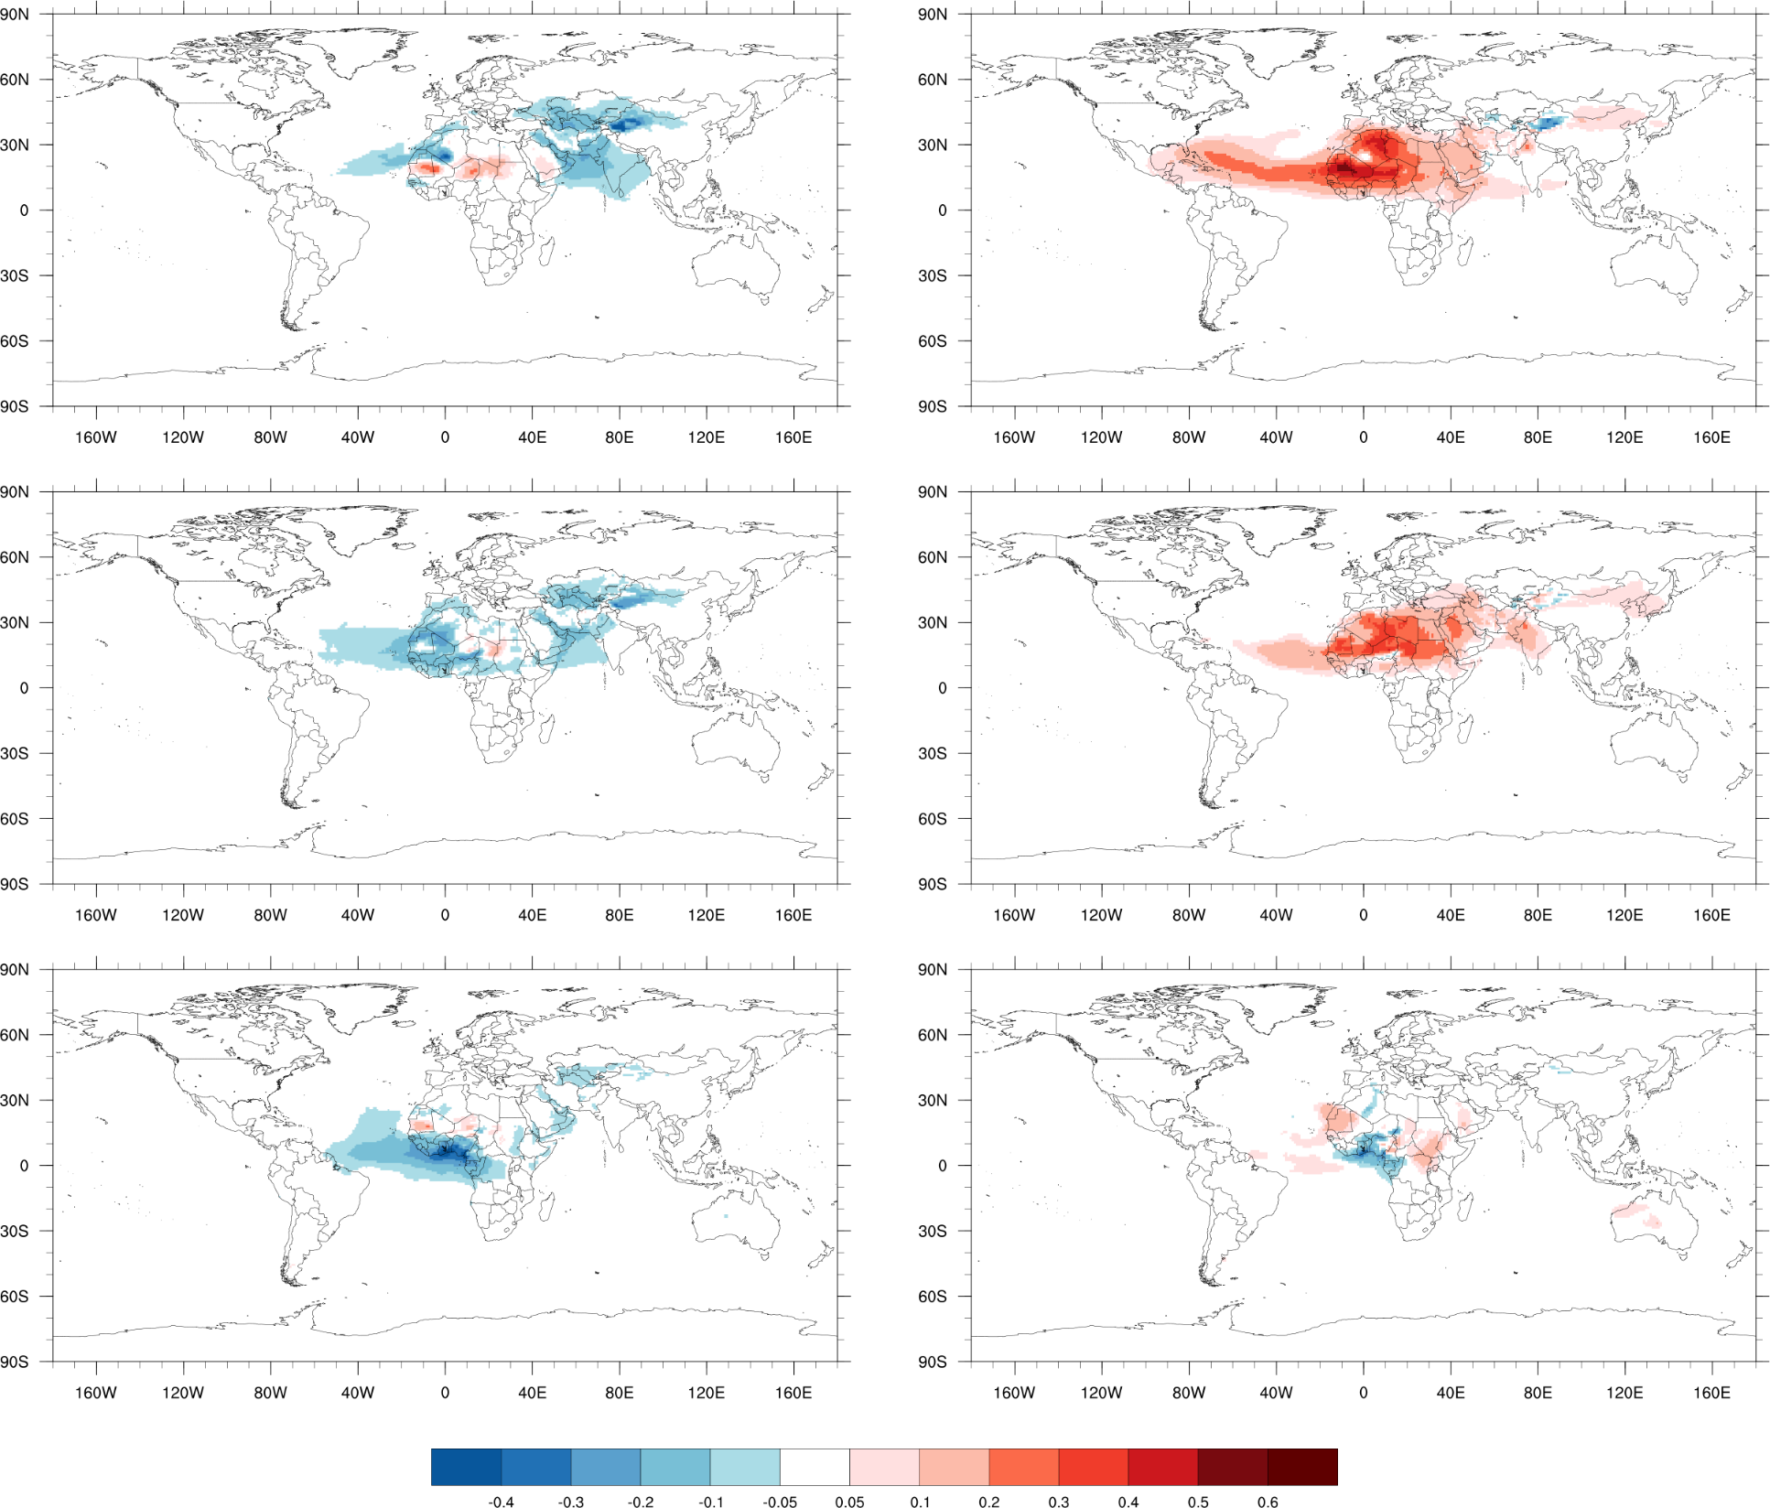
Day 1 Dust AOD Forecast bias
(against GEOS5 analysis)
GEFS-Aerosol
NGACv2
August, 2019
Over prediction over Saharan dust region by NGACv2 in both source and downwind region
GEFS-Aerosol under predicts over the Taklamakan desert. However, when compared with ECMWF CAMS analysis we do not see such bias over the region.
In January, some of dust under prediction over Western Africa could be due to mix of dust and smoke in analysis.
September, 2019
January, 2020

Slide 19
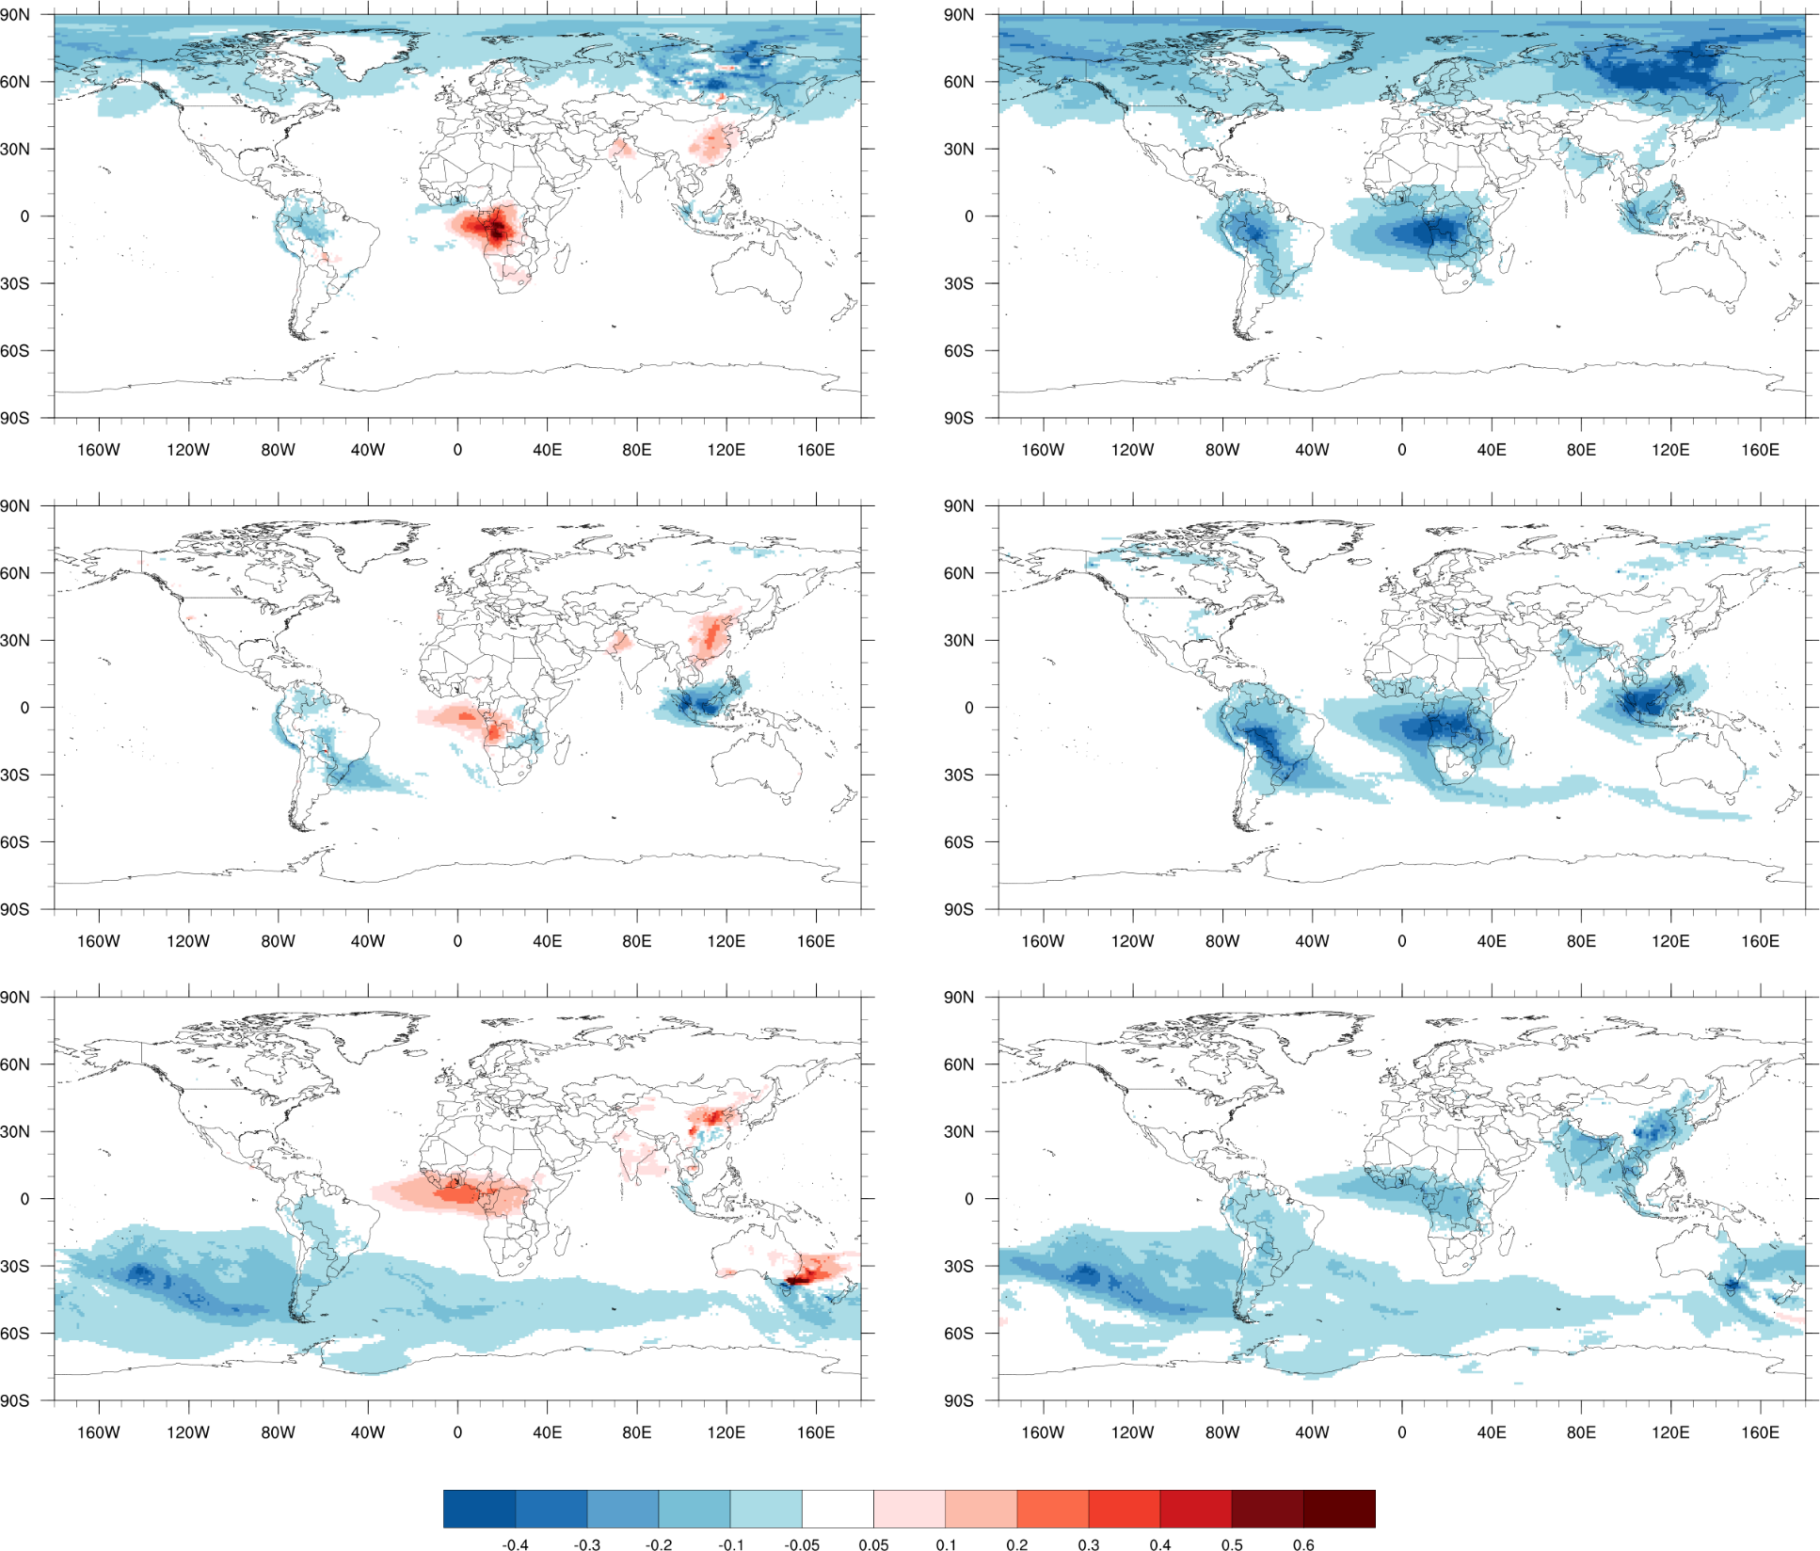
Day 1 Organic Carbon AOD Forecast bias
(against GEOS5 analysis)
GEFS-Aerosol
NGACv2
August, 2019
Less rain over Southern Africa lead to less removal of aerosol and high bias in the burning season
In January, over prediction of OC AOD near source region (extreme event)
September, 2019
January, 2020

Slide 20
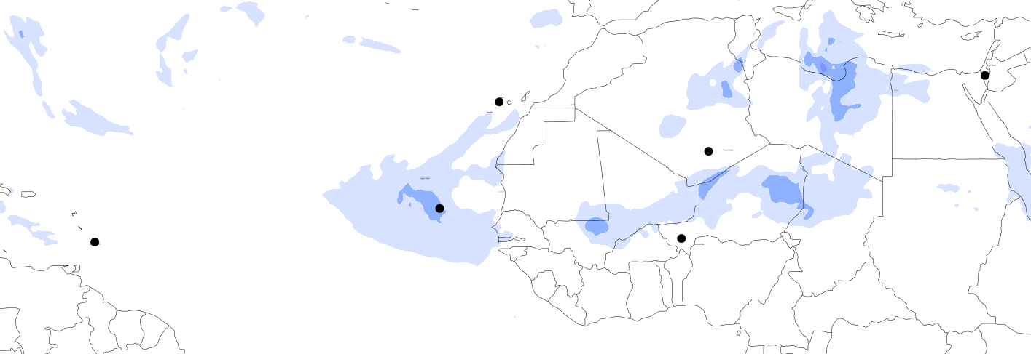
AERONET Stations
Sede Boker
Tenerife
Cape Verde
Tamanrassett
Ragged Point
Banizoumbu
AERONET
GEFS-Aerosol
NGACv2
AERONET

Slide 21
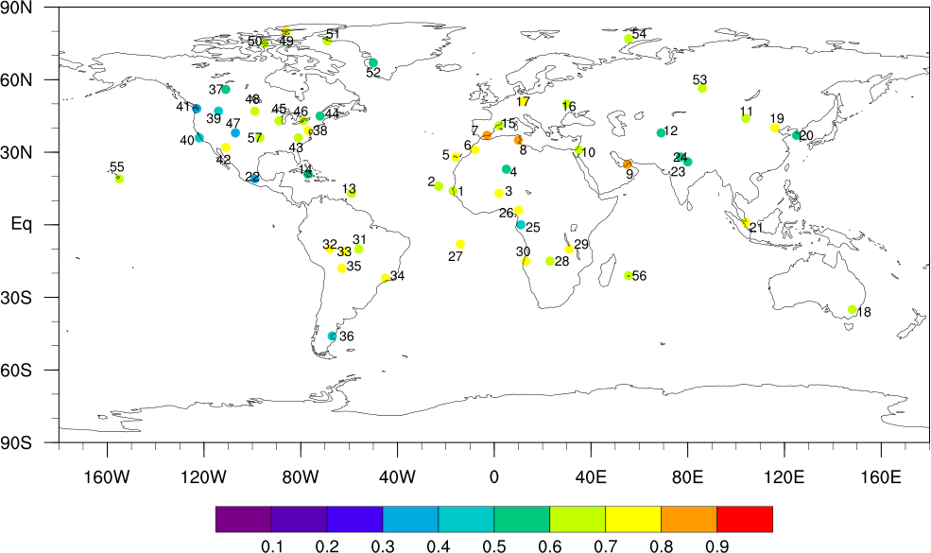
Correlation (R) based on Day 1 forecast of GEFS-Aerosol and AERONET

Slide 22
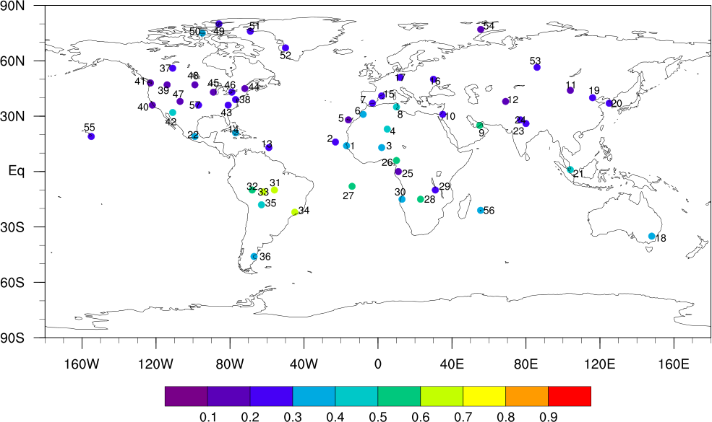
Correlation (R) based on Day 1 forecast of NGACv2 and AERONET

Slide 23
Correlation (R) based on Day 1 forecast and AERONET (March – June, 2019)
GEFS-Aerosol
NGACv2

Slide 24
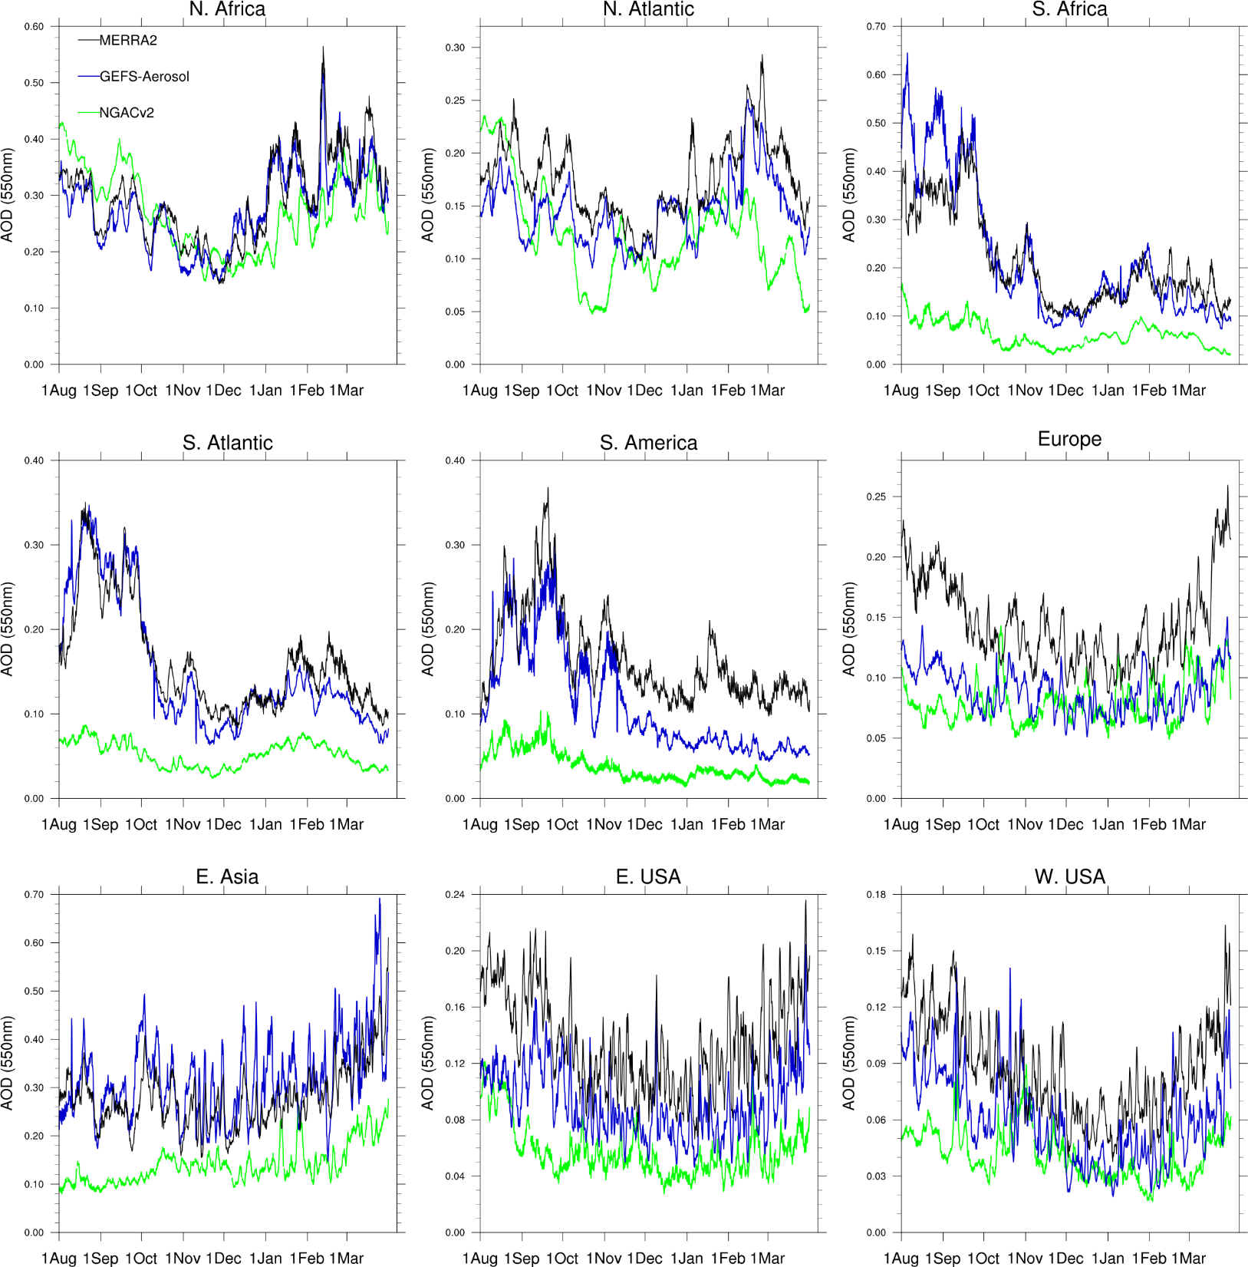
Day 1 Total AOD forecast time series against Reanalysis
Improvement over major global regions
Area averages over North Africa (0°-35°N, 18°W-30°E) – Source of Saharan dust
N. Atlantic (0°-40°N, 10°-80°W) – transportation of dust, OC, seasalt
Southern Africa (0°-35°S, 8°-35°E) – Biomass burning season (July – October).
South Atlantic (0°-35°S, 40°W-20°E) – transport of smoke aerosol
South America (0°-35°S, 35°W-80°W) – Major biomass burning season (August-November)
Europe (35°-65°N, 10°W-50°E) – pollution
East Asia (20°-48°N, 100°-140°E) – OC, Sulfate + pollution
Eastern USA (25°-48°N, 68°-95°W) and Western USA (25°- 48°N, 95°-125°W) – Dust, OC, Sulfate + pollution

Slide 25
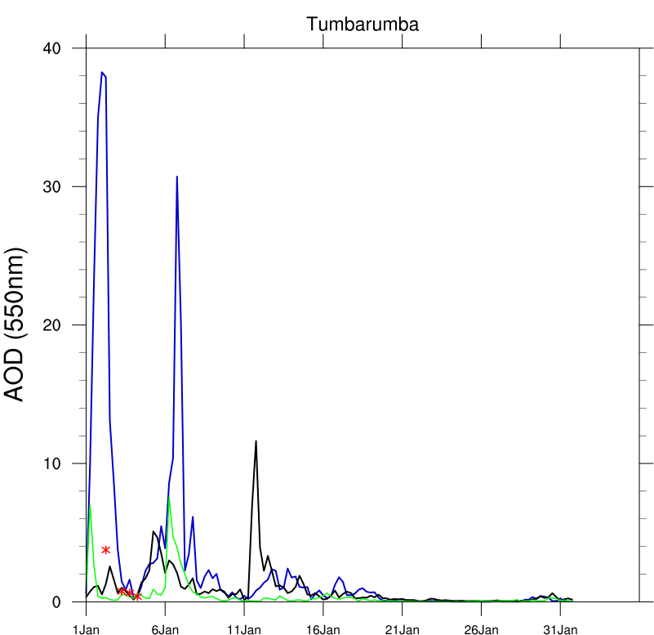
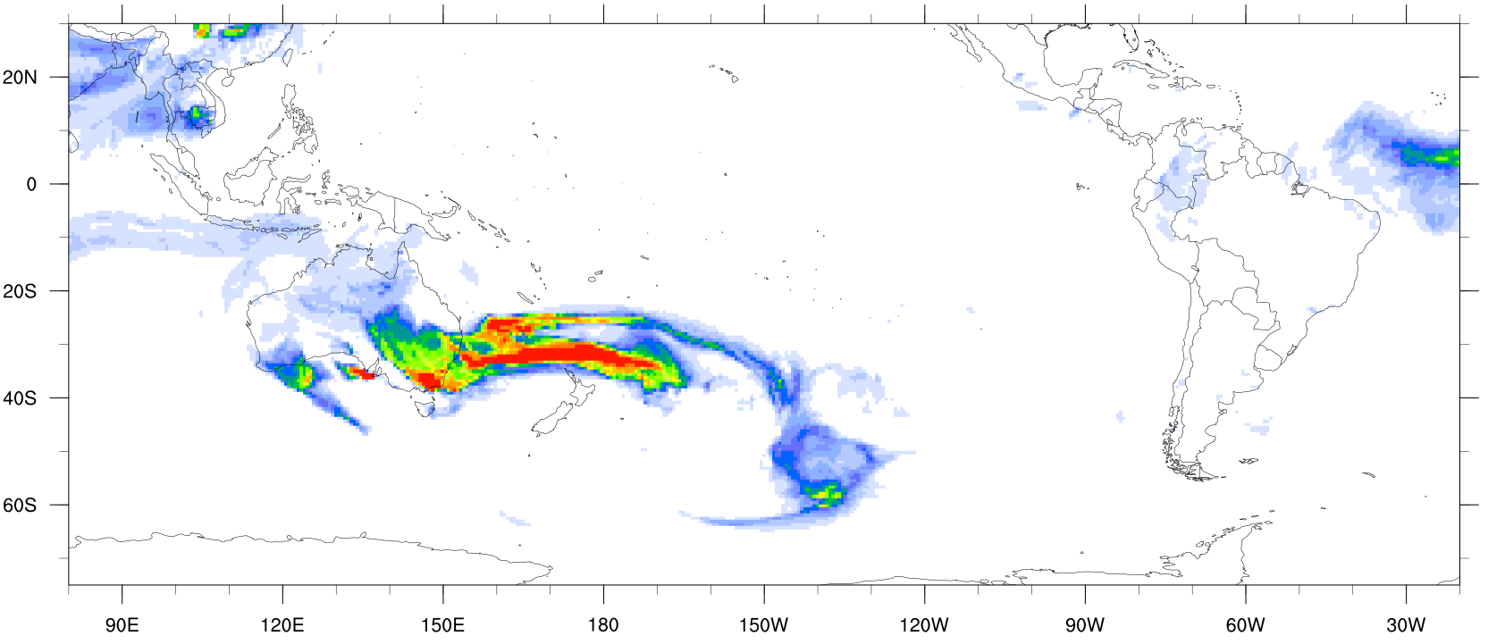
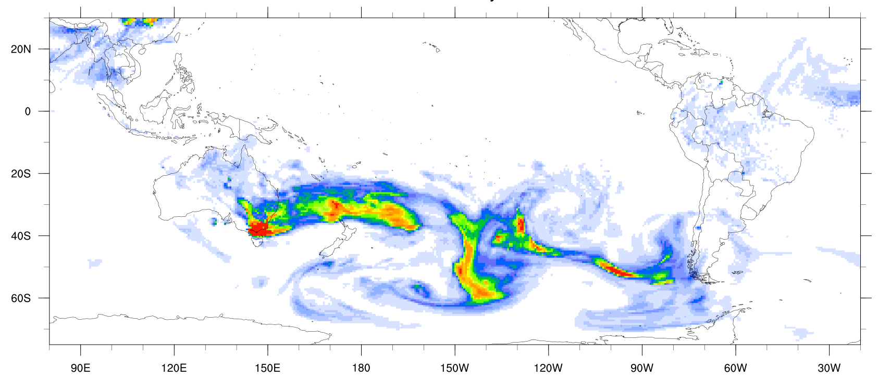
Extreme aerosol event : Australian fire
Unprecedented number of fires burned in Australia releasing large amounts of emissions into the atmosphere in December 2019 and January, 2020
Very high Total AOD (>30) near the fire region in GEFS-Aerosol and under prediction over Southern Pacific in January
GEFS-Aerosol (OC AOD, 6th Jan)
GEFS-Aerosol
ICAP
NGACv2
MERRA2 analysis

Slide 26
Conclusions
Overall, GEFS-Aerosol out-performs operational NGACv2 in the study period. Day-1 model forecast bias
improved against MERRA2 analysis and ICAP forecast. Higher resolution (0.25 degree), upgraded core(FV3) and physics,
newer emission, improved vertical transport with plume-rise reduced bias with respect to dust, OC and sulfate AOD analysis.
Improved AOD variability with GEFS-Aerosol when compared against more than 50 Aeronet sites worldwide
GEFS-Aerosol shows reduction in dust emission over the Saharan dust source, but downwind sites over western Africa shows
improved correlation against surface observation sites than NGACv2.
Over biomass burning events, GEFS-Aerosol captured major fires over Southern Africa, Siberia, Central Amazon and Central
America much better than NGACv2. However, lack of removal process in central Africa produced an over-prediction of AOD.
Future Work :
Extreme fire event over Australia produced very high AOD near the source region in January, 2020. However, model largely underpredicts transported AOD over the Southern Pacific (caused by overestimation of large-scale wet deposition).
GEFS-Aerosol bias and RMSE improved over Asia, particularly over Indian subcontinent. Over Eastern China
overestimation of sulfate and OC AOD is noticed (partly COVID related).
Inclusion of Aerosol data assimilation, cloud/Radiation aerosol interactions, tests with GFSv16.

Slide 27
GEFS-Aerosol verification webpage links
Retro time period : March 2019 to June 2019 and July 2019 to February 2020
Every day 6-hourly AOD forecast from GEFS-Aerosol verified against ICAP-MME up to 5 days (global and regions)
(Link : https://www.emc.ncep.noaa.gov/gc_wmb/parthab/GEFS-Aerosol/html/fv3_aod_png.html)
24-hour model forecast compared against daily MODIS and VIIRS observation
(Link : https://www.emc.ncep.noaa.gov/gc_wmb/parthab/GEFS-Aerosol/html/fv3_dailysataod_png.html)
AERONET observation
(Link : https://www.emc.ncep.noaa.gov/gc_wmb/parthab/GEFS-Aerosol/html/fv3_monaeronet_png.html)
Monthly Grid Statistics (with MERRA2, ICAP-MME for total, dust, OC, Sulfate and Seasalt AOD)
(Link : https://www.emc.ncep.noaa.gov/gc_wmb/parthab/GEFS-Aerosol/html/fv3_mongridstat_png.html)
Monthly time series over different regions of the globe
(Link : https://www.emc.ncep.noaa.gov/gc_wmb/parthab/GEFS-Aerosol/html/fv3_monregionts_png.html)

Slide 28
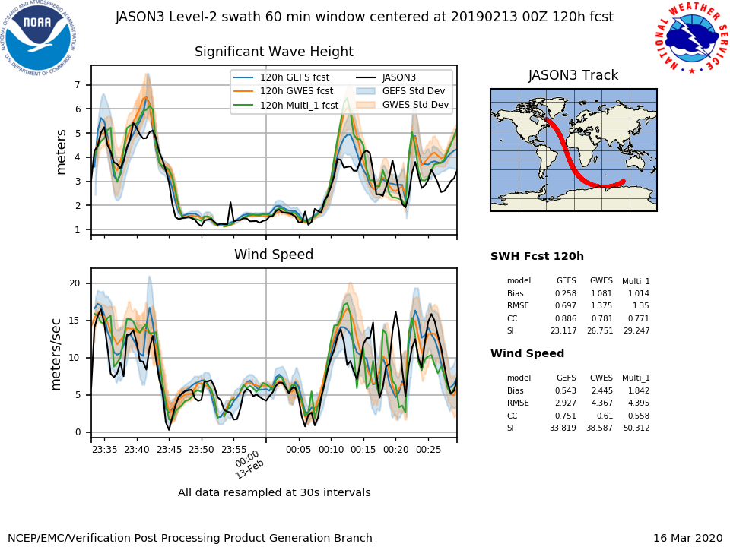
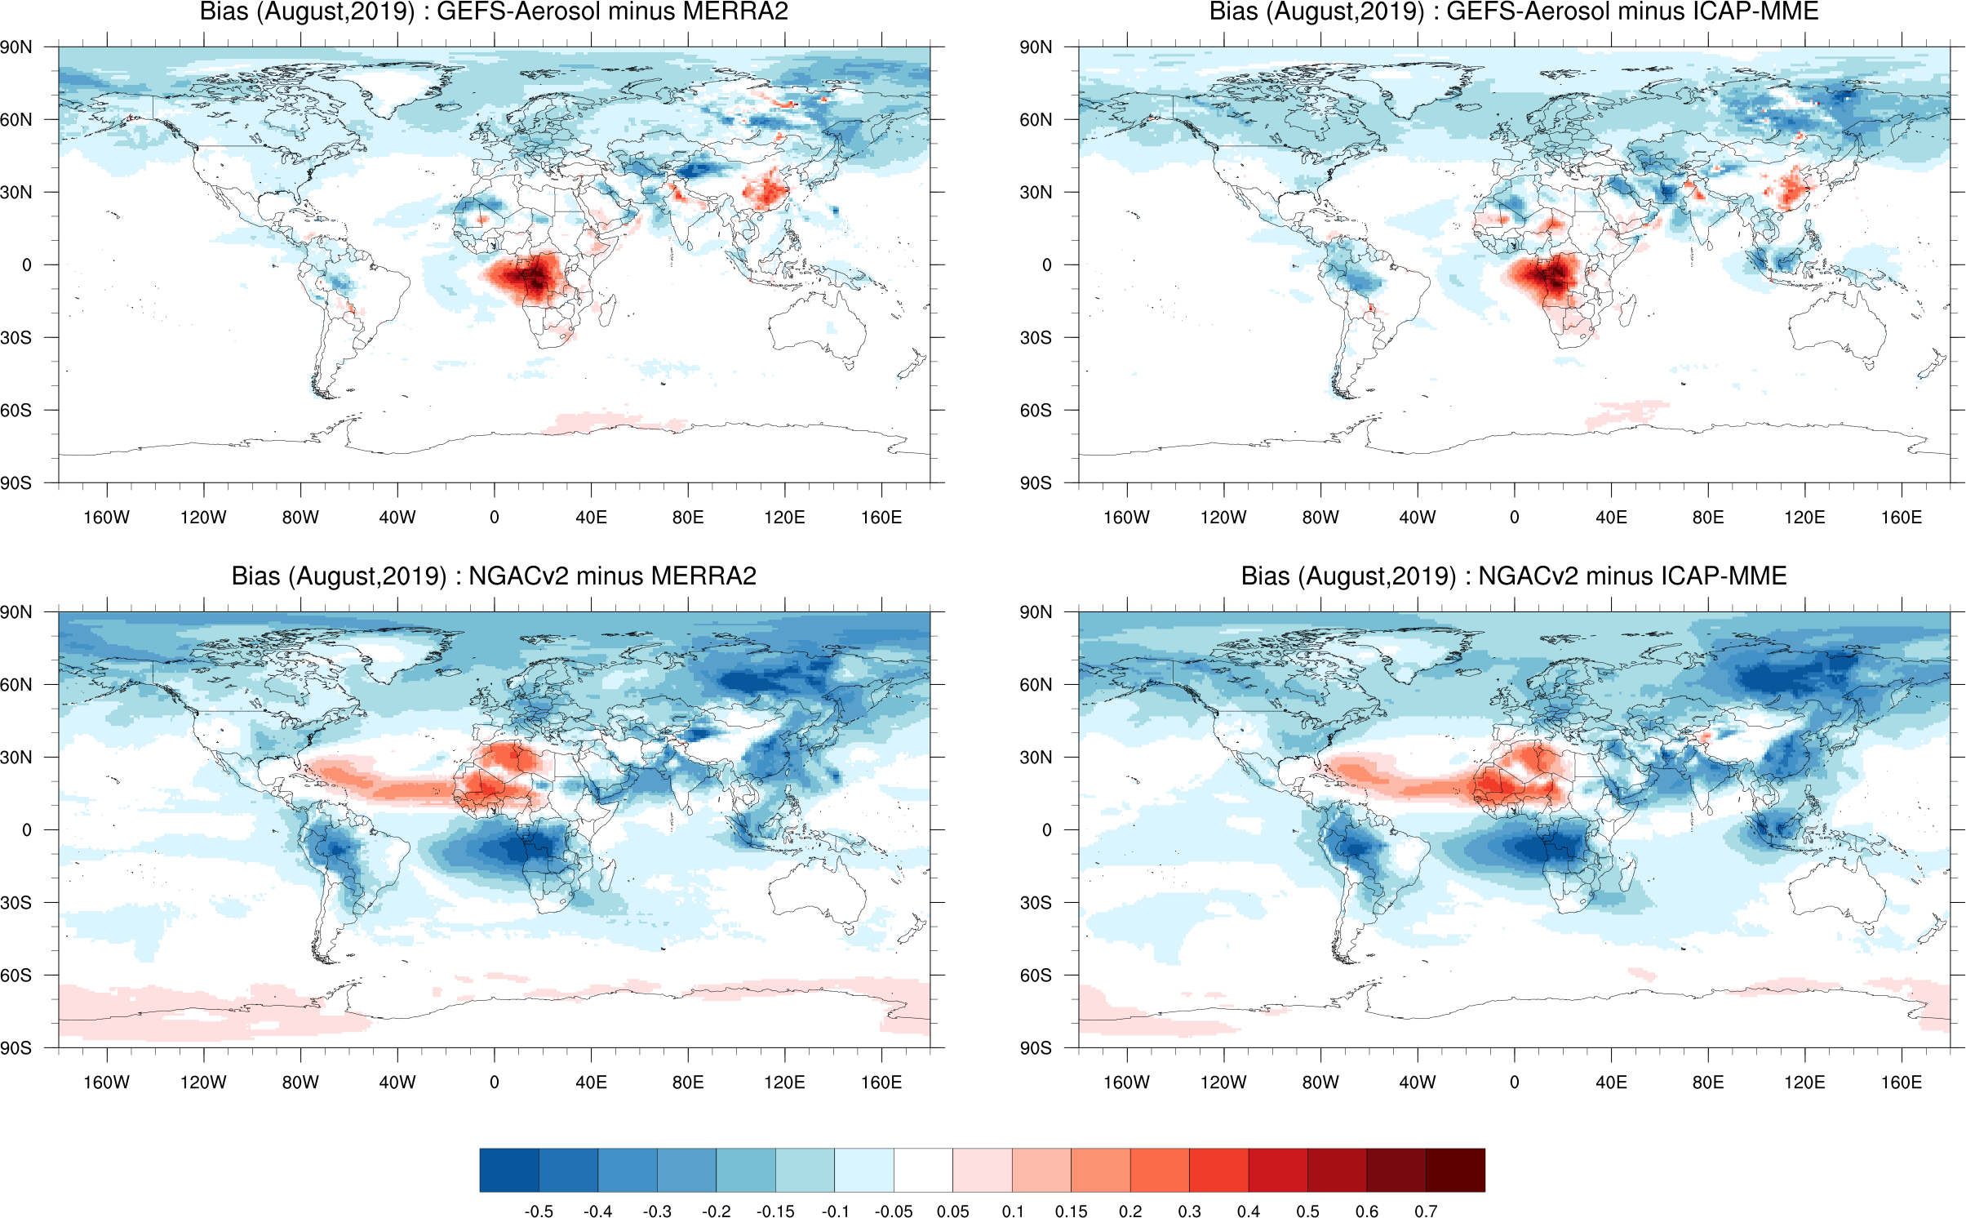
NATIONAL OCEANIC AND ATMOSPHERIC ADMINISTRATION
GEFSv12 Field Evaluations (Waves, Aerosols, & Weeks 2-4 Weather)
Shannon Shields
EMC Model Evaluation Group Webinar
30 April 2020

Slide 29
NATIONAL OCEANIC AND ATMOSPHERIC ADMINISTRATION
Conclusion of the GEFSv12-Waves Evaluation
Summary of verification statistics
Review of official evaluation comments and recommendations from NWS Regions/Centers and other partners
Overall impressions
Special thanks to Jose-Henrique Alves, Deanna Spindler, and Todd Spindler for generating verification summary table

Slide 30
NATIONAL OCEANIC AND ATMOSPHERIC ADMINISTRATION
GEFSv12-Waves Verification Summary
Metric | Significant Wave Height | Peak Wave Period
 |  | Windseas | Swell
Skill | Improved | Neutral | Neutral
Reliability | Improved | N/A | N/A
RMSE | Improved | Neutral | Neutral
Spread | Improved | Improved | Improved
Bias | Improved | Slightly Improved | Neutral
95% Quantile | Improved | N/A | N/A

Slide 31
NATIONAL OCEANIC AND ATMOSPHERIC ADMINISTRATION
Conclusion of the GEFSv12-Waves Evaluation
Summary of verification statistics
Review of official evaluation comments and recommendations from NWS Regions/Centers and other partners
Overall impressions

Slide 32
NATIONAL OCEANIC AND ATMOSPHERIC ADMINISTRATION
Official Evaluations for GEFSv12-Waves
WHAT WE ASKED USERS TO EVALUATE
What are your overall impressions of the GEFS-Wave system?
Do you see improved reliability in forecasts of ocean waves?
Do you see overall larger and more meaningful spread in GEFS-Wave?
Thank you to all who submitted formal evaluations and to those who provided subjective feedback during the evaluation period

Slide 33
NATIONAL OCEANIC AND ATMOSPHERIC ADMINISTRATION
Ocean Prediction Center (OPC)
The parallel version is an improvement over the operational Global Wave Ensemble System (GWES)
For Jan-Mar & forecast hours 24, 48, 72, 96, 120 and 168, GEFS showed reduced bias & lower RMSE for significant wave height; a clear improvement
The demonstrated improved skill is more than enough to approve this upgrade
The increased resolution, extension of the forecast range to 384 hours, increasing the number of members from 21 to 31, and adding a third swell partition are significant upgrades
Improved reliability in forecasts of ocean waves
Overall larger and more meaningful spread in GEFS-Wave
Based on Jason3 altimeter wave heights and the Std Dev displayed in the swath comparisons for F120 and F168, it does look like there is increased spread
GEFS with waves looks to be a good starting block to support the effort of extending prediction beyond week 1
Supports proposed implementation of GEFS-Waves

Slide 34
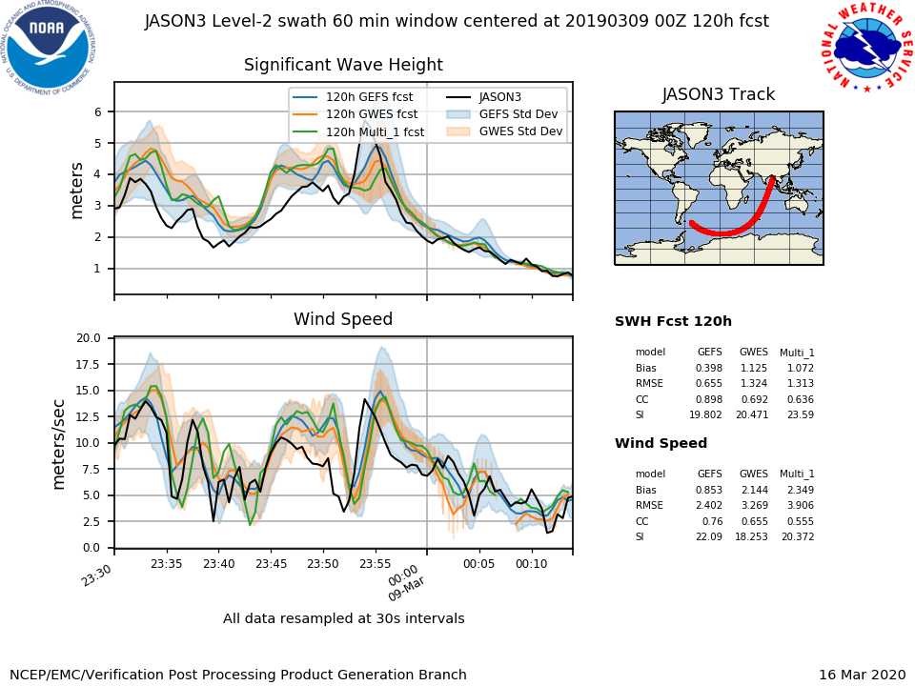
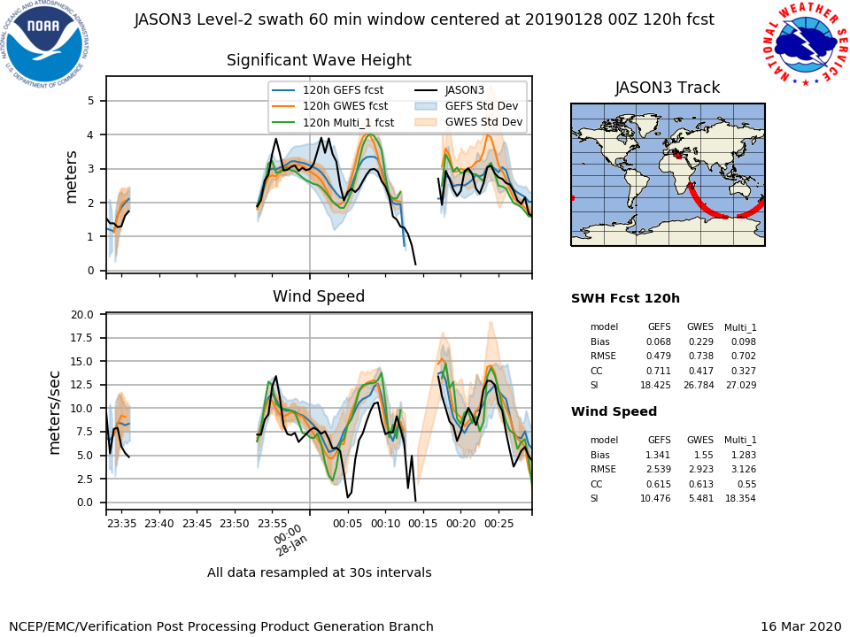
NATIONAL OCEANIC AND ATMOSPHERIC ADMINISTRATION
GEFSv12-Waves vs GWES Satellite Verification (120h)

Slide 35
NATIONAL OCEANIC AND ATMOSPHERIC ADMINISTRATION
NWS Alaska Region
The parallel version is an improvement over the operational GWES
Significantly lower bias during the typically difficult to forecast winter season; important implications for Alaska
Skill is particularly apparent on day 7 where forecast skill typically depreciates
Improved reliability in forecasts of ocean waves
Unsure of overall larger and more meaningful spread in GEFS-Wave
It seemed that especially for the Gulf of Alaska that the spread would often be quite high and above what ended up being the final verification; would be interesting to better understand this behavior
Would like to work with the GEFS team on some case studies this upcoming winter to determine how wave models could be better integrated into a long-term forecast
Supports proposed implementation of GEFS-Waves

Slide 36
NATIONAL OCEANIC AND ATMOSPHERIC ADMINISTRATION
ECCC-MSC (CMC)
The parallel version is an improvement over the operational GWES
RMSE and bias of the ensemble mean appear to have improved in the North Hemisphere winter
Did not notice any systematic degradation
Looking at the cases of Dorian and Humberto, short-range forecasts appear neutral
Improved reliability in forecasts of ocean waves
Overall larger and more meaningful spread in GEFS-Wave
Spread is the most noticeable improvement; important as dispersion is a weak point of the operational ensemble
Approve of extended range to 16 days and the use of hourly input
Supports proposed implementation of GEFS-Waves

Slide 37
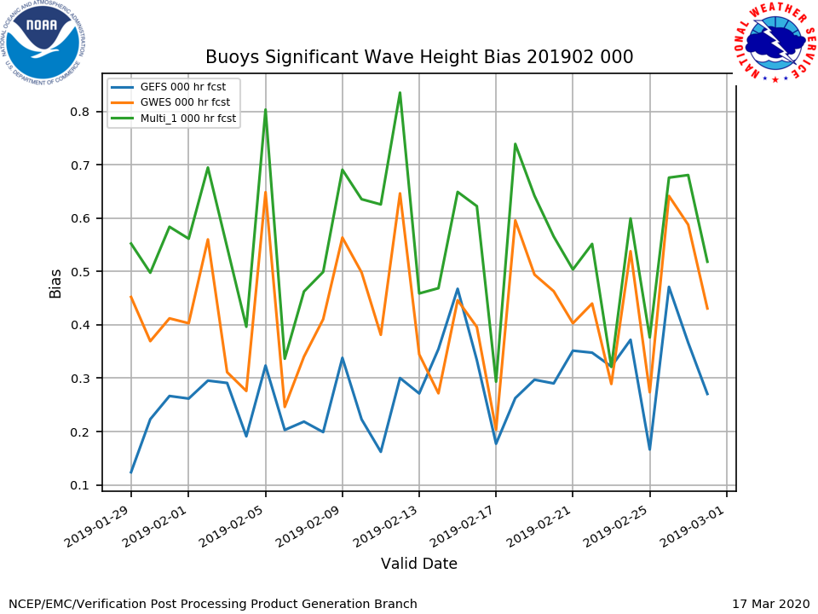
NATIONAL OCEANIC AND ATMOSPHERIC ADMINISTRATION
Buoy Sig. Wave Height Bias & RMSE (Ensemble Mean)
Overall reduced bias and less RMSE in GEFSv12 for the winter months (Feb and March 2019 shown here)

Slide 38
NATIONAL OCEANIC AND ATMOSPHERIC ADMINISTRATION
National Hurricane Center (NHC)
The parallel version is an improvement over the operational GWES
Substantial upgrades to the overall system, including increased resolution, extended forecast range with increased temporal resolution from days 8-10, increased ensemble members, and an additional swell partition
Significant wave height verification is greatly improved for the ensemble mean while peak period is more neutral
Improved reliability in forecasts of ocean waves
Overall larger and more meaningful spread in GEFS-Wave
The Talagrand diagrams show improvements in the spread and reducing the positive bias
The model improvements and verification statistics more than support implementation
Supports proposed implementation of GEFS-Waves

Slide 39
NATIONAL OCEANIC AND ATMOSPHERIC ADMINISTRATION
Conclusion of the GEFSv12-Waves Evaluation
Summary of verification statistics
Review of official evaluation comments and recommendations from NWS Regions/Centers and other partners
Overall impressions

Slide 40
NATIONAL OCEANIC AND ATMOSPHERIC ADMINISTRATION
Key Remarks from Evaluators
Region | Recommendation | Key Remarks
Ocean Prediction Center | Implement | For all time steps GEFS-Wave is showing reduced bias and lower RMSE. A clear improvement. The increased resolution, extension of the forecast range to 384 hours, increasing the number of members from 21 to 31, and adding a third swell partition are significant upgrades.
Alaska Region | Implement | The bias is significantly lower during the typically difficult to forecast winter season. This has important implications for Alaska - which often experiences intense and difficult to forecast storms in the winter. Skill is particularly apparent on the day 7 where forecast skill typically depreciates. It seemed that especially for the Gulf of Alaska that the spread would often be quite high and above the final verification.
Canadian Meteorological Center - ECCC | Implement | The most noticeable improvement is in spread. RMSE and bias of the ensemble mean appear to have improved in the North Hemisphere winter, this is notable considering the operational ensemble was already good with respect to this. No systematic degradation was noticed.
National Hurricane Center | Implement | There are substantial upgrades to the overall system. Significant wave height verification is greatly improved for the ensemble mean while peak period is more neutral. The model improvements and verification statistics more than support implementation.

Slide 41
NATIONAL OCEANIC AND ATMOSPHERIC ADMINISTRATION
Overall Impressions for GEFSv12-Waves
Overall, the parallel version is an improvement over the operational GWES. All participating evaluators support the proposed implementation.
Alaska Region Concern:
Overdispersive in Gulf of Alaska
Common Positives:
Reduced bias & lower RMSE in winter season
Improved reliability in forecasts of ocean waves
Overall larger and more meaningful spread in GEFS-Wave
Extension of forecast range to 16 days

Slide 42
NATIONAL OCEANIC AND ATMOSPHERIC ADMINISTRATION
Conclusion of the GEFSv12-Aerosols Evaluation
Summary of verification statistics
Review of official evaluation comments and recommendations from NWS Regions/Centers and other partners
Overall impressions
Special thanks to Jeff McQueen for generating verification summary table

Slide 43
NATIONAL OCEANIC AND ATMOSPHERIC ADMINISTRATION
GEFSv12-Aerosols Verification Summary
Bias for Day 1 Aerosol Optical Depth (AOD) forecast (July 2019 – March 2020)
Event | Period | Bias | Comment
African Dust | Full | Improved
African Biomass Burning | Summer | Neutral | NESDIS GBBEPx adjustment
South America Biomass Burning | Summer | Improved
Asian Sulfate | Fall/Winter | Neutral | Strong overprediction (COVID related)
North America | Full | Improved | Overpredict ag fires
Ocean sea-salt | Full | Neutral | Wet scavenging likely too low

Slide 44
NATIONAL OCEANIC AND ATMOSPHERIC ADMINISTRATION
Conclusion of the GEFSv12-Aerosols Evaluation
Summary of verification statistics
Review of official evaluation comments and recommendations from NWS Regions/Centers and other partners
Overall impressions

Slide 45
NATIONAL OCEANIC AND ATMOSPHERIC ADMINISTRATION
Official Evaluations for GEFSv12-Aerosols
WHAT WE ASKED USERS TO EVALUATE
What are your overall impressions of the GEFSv12 Aerosol member system?
Do you see overall improvement in the dust prediction of GEFS-Aerosols compared to NEMS Global Aerosol Component (NGAC)?
Do you have any other comments or concerns regarding the proposed implementation or performance of other aerosol species compared to NGAC (e.g.: Black Carbon from wildfire smoke, Sulfates from anthropogenic emissions...)?
Thank you to all who submitted formal evaluations and to those who provided subjective feedback during the evaluation period

Slide 46
NATIONAL OCEANIC AND ATMOSPHERIC ADMINISTRATION
NWS Western Region
The parallel version is an improvement over the operational NGAC
Improvement over NGAC is based on the August 2019 stats and the small sample of wildfire cases in the West
Overall improvement in the dust prediction of GEFS-Aerosols compared to NGAC
Supports proposed implementation of GEFSv12-Aerosols

Slide 47
Day 1 Total AOD Forecast bias against MERRA2 and ICAP
GEFS-Aerosol
Similarity in biases against MERRA2 and ICAP for GEFS-Aerosol – showing marked improvement than NGACv2
Differences between two sets of observations – less bias over the Taklamakan desert in ICAP than MERRA2
NGACv2

Slide 48
NATIONAL OCEANIC AND ATMOSPHERIC ADMINISTRATION
Air Resources Laboratory (ARL)
The parallel version is an improvement over the operational NGAC
GEFS-Aerosol model provides superior boundary conditions for the National Air Quality Forecasting Capability (NAQFC), aka FV3-CMAQ
Overall improvement in the dust prediction of GEFS-Aerosols compared to NGAC
Model-simulated elemental carbon and black carbon fields showed more accurate signals from the GEFS-Aerosol system than the NGAC system
Supports proposed implementation of GEFSv12-Aerosols

Slide 49
72-hr FV3-CMAQ: Williams Flats fires Aug 6-9 2019
Comparison: Prod-NGAC vs. GEFS-Aerosol as NAQFC-β-LBC
Configuration | Met Model driver | Fire Emission | Plume rise | Fire mask / heat flux & duration | Diurnal burn strength | CMAQ version /forecast | LBCs | Impact Assessments
Experiment # 1 (ARL) | FV3GFS 1x/day 12 Z cycle | GBBEPx 0.1º SF: 1/.25/.25 | Briggs | Fire emission where FF>0.4 | EPA Climo | CMAQ 5.0.2/72 hr | NGAC LBC | Impact of GBBEPx + NGAC Dust LBCs
Experiment #2 (EMC) | FV3GFS 4x/day | GBBEPx 0.1º SF: 1/.25/.25 Turned off Gas-phase GBBEPx | Briggs | Fire emission where FF>0.4 | EPA climo | CMAQ 5.0.2/72 hr | GEFS- Aerosol LBCs | Impact of GBBEPx + GEFS-Aerosol Dust + Smoke LBCs
Patrick Campbell and Pius Lee AIR Resources Laboratory (ARL) /OAR
Jianping Huang and Jeff McQueen EMC /NCEP

Slide 50
Spatial Comparisons of PM_{2.5} vs. AIRNOW
Exp. #1: GBBEPx with NGAC Dust LBCs
Exp. #2: GBBEPx with GEFS-Aerosol Dust + Smoke LBCs
Lower NMB and higher IOA for GEFS-Aerosol LBCs
NMB | -14.4%
NME | 43.6%
IOA | 0.48
NMB | +0.74%
NME | 43.6%
IOA | 0.53
Notes:
Average of day1 24-hr forecasts for 2019-08-06_13 to 2019-08-08_12

Slide 51
CMAQ-AIRNOW PM_{2.5} Evaluation - Region 10
Exp#1
NMB=-29.2%
NME=44.5%
Exp#2
NMB=-4.1%
NME=40.1%
Exp#1
Corr = 0.45
Exp#2
Corr = 0.51
Exp#1
IOA = 0.53
Exp#2
IOA = 0.65
Notes:
Average of day1 24-hr forecasts for 2019-08-06_13 to 2019-08-08_12

Slide 52
Summary
Studied prod-NGAC versus GEFS-Aerosol-derived LBC for NAQFC-β (FV3-CMAQ);
Applied for August 6-9 2019 (Williams Flats fire — during NOAA-NASA FIREX-AQ campaign);
PM_{2.5} Forecast using GEFS-Aerosol-derived LBC better than that using LBC from prod-NGAC :
CONUS: Reduced NMB by ~50% and improved IOA by ~10%
Over North-West (region 10): Reduced NMB 7 folds, improved IOA by ~20%, and
increased correlation ~10%

Slide 53
NATIONAL OCEANIC AND ATMOSPHERIC ADMINISTRATION
NWS Southern Region
The parallel version is an improvement over the operational NGAC
It appears there is indeed ample reflection of the higher-resolution aerosol information provided in the GEFSv12 data
Comparing errors of GEFSv12 vs NGAC relative to MERR/IMME (observed), GEFSv12 appears to have smaller errors; almost always in area, and often in magnitude as well
Overall improvement in the dust prediction of GEFS-Aerosols compared to NGAC
Improvement seems to be even better in the dust forecasts, vs the Total AOD views
Supports proposed implementation of GEFSv12-Aerosols

Slide 54
Monthly average Day 1 Total AOD Forecast bias
against MERRA2
GEFS-Aerosol
NGACv2
Major improvements in terms of bias over aerosol source and downwind regions
Large over prediction over Saharan dust region by NGACv2 is reduced
Over biomass burning regions, GEFS-Aerosol shows less bias for Siberian and Amazon fires
Over prediction over Africa and Australian fire from GEFS-Aerosol
August, 2019
September, 2019
Other montlhly averages at:
https://www.emc.ncep.noaa.gov/gc_wmb/parthab/GEFS-Aerosol/html/fv3_mongridstat_png.html
January, 2020

Slide 55
Monthly average Day 1 Dust AOD Forecast bias (against GEOS5 analysis)
GEFS-Aerosol
NGACv2
August, 2019
Over prediction over Saharan dust region by NGACv2 in both source and downwind region
GEFS-Aerosol under predicts over the Taklamakan desert. However, when compared with ECMWF CAMS analysis we do not see such bias over the region.
In January, some dust under prediction over Western Africa could be due to mix of dust and smoke in analysis.
September, 2019
January, 2020

Slide 56
NATIONAL OCEANIC AND ATMOSPHERIC ADMINISTRATION
NWS Alaska Region
The parallel version is an improvement over the operational NGAC
GEFS-Aerosols member showed promise
Greatest strength for long-term transport events; does not seem to detect local fire and smoke events due to lower resolution
Unsure of overall improvement in the dust prediction of GEFS-Aerosols compared to NGAC
Appears to hold promise to help our aviation forecasters handle ash resuspension events such as those that happen in Kamchatka Peninsula, Aleutian Chain, and Alaskan Peninsula, but did not have specific events to review
In case study of greatest concern, the correct smoke did not occur, but this may have been due to unavailability of GBBEPx emissions
Looking forward to collaborating with GEFS AER team this summer to see how model performs during the smoke season with new fire initialization
Supports proposed implementation of GEFSv12-Aerosols

Slide 57
NATIONAL OCEANIC AND ATMOSPHERIC ADMINISTRATION
U.S. Naval Research Laboratory (NRL)
The parallel version is an improvement over the operational NGAC
Significant biases still exist, but overall GEFS-Aerosols member looks much better than NGAC
Overall improvement in the dust prediction of GEFS-Aerosols compared to NGAC
With improved biomass burning, GEFS-Aerosols would likely also be improved
However, in some places like Africa, the bias is only shifting signs
Supports proposed implementation of GEFSv12-Aerosols

Slide 58
Monthly average Day 1 Total AOD Forecast bias
against MERRA2
GEFS-Aerosol
NGACv2
Major improvements in terms of bias over aerosol source and downwind regions
Large over prediction over Saharan dust region by NGACv2 is reduced
Over biomass burning regions, GEFS-Aerosol shows less bias for Siberian and Amazon fires
Over prediction over Africa and Australian fire from GEFS-Aerosol
August, 2019
September, 2019
Other montlhly averages at:
https://www.emc.ncep.noaa.gov/gc_wmb/parthab/GEFS-Aerosol/html/fv3_mongridstat_png.html
January, 2020

Slide 59
NATIONAL OCEANIC AND ATMOSPHERIC ADMINISTRATION
Climate Prediction Center (CPC)
The parallel version is an improvement over the operational NGAC
Aerosol forecasts will improve UV Index forecasts; current product uses seasonal climatology that does not capture smoke at all
Overall improvement in the dust prediction of GEFS-Aerosols compared to NGAC
Higher resolution in GEFS-Aerosols
Expect smoke to be adverted better than NGAC
Supports proposed implementation of GEFSv12-Aerosols

Slide 60
NATIONAL OCEANIC AND ATMOSPHERIC ADMINISTRATION
Conclusion of the GEFSv12-Aerosols Evaluation
Summary of verification statistics
Review of official evaluation comments and recommendations from NWS Regions/Centers and other partners
Overall impressions

Slide 61
NATIONAL OCEANIC AND ATMOSPHERIC ADMINISTRATION
Key Remarks from Evaluators
Region | Recommendation | Key Remarks
Western Region | Implement | Not a huge amount of wildfire cases to examine, regarding smoke in the West. However, the few cases looked at, as well as Aug. 2019 stats, indicated improvement over NGAC.
Air Resources Laboratory | Implement | GEFS-Aerosol model gave superior input than that from NGAC for National Air Quality Forecasting Capability. Model-simulated elemental carbon and black carbon fields showed more accurate signals from the GEFS-Aerosol system than the NGAC system.
Southern Region | Implement | It appears there is indeed ample reflection of the higher-resolution aerosol information provided in the GEFSv12 data. Comparing errors of GEFSv12 vs NGAC relative to MERR/IMME (observed), GEFSv12 appears to have smaller errors; almost always in area, and often in magnitude as well. Improvement seems to be even better in the dust forecasts, vs the Total AOD views.
Alaska Region | Implement | Greatest strength for long-term transport events; does not seem to detect local fire and smoke events due to lower resolution. Appears to hold promise to help our aviation forecasters handle ash resuspension events. In case study of greatest concern, the correct smoke did not occur, but this may have been due to unavailability of GBBEPx emissions.

Slide 62
NATIONAL OCEANIC AND ATMOSPHERIC ADMINISTRATION
Key Remarks from Evaluators
Region | Recommendation | Key Remarks
U.S. Naval Research Laboratory | Implement | Significant biases still exist, but overall GEFS-Aerosols member looks much better than NGAC. With improved biomass burning, GEFS-Aerosols would likely also be improved. However, in some places like Africa, the bias is only shifting signs.
Climate Prediction Center | Implement | Aerosol forecasts will improve UV Index forecasts; current product uses seasonal climatology that does not capture smoke at all. Higher resolution in GEFS-Aerosols. Expect smoke to be adverted better than NGAC.

Slide 63
NATIONAL OCEANIC AND ATMOSPHERIC ADMINISTRATION
Overall Impressions for GEFSv12-Aerosols
Overall, the parallel version is an improvement over the operational NGAC. All participating evaluators support the proposed implementation.
Alaska Region Concern:
GEFS-Aerosols member did not seem to detect local fire and smoke events
Common Positives:
5 out of 6 evaluators saw overall improvement in the dust prediction of GEFS-Aerosols compared to NGAC
More accurate signals and smaller errors in GEFSv12-Aerosols compared to NGAC

Slide 64
NATIONAL OCEANIC AND ATMOSPHERIC ADMINISTRATION
Official Evaluations for GEFSv12 Weeks 3-4 Atmosphere
CPC is the only evaluator, so no official form was distributed
CPC examined week 2 forecasts in addition to weeks 3 and 4
Thank you to CPC for their extremely thorough review. Matt Rosencrans will present the entire assessment at the 5/14/20 MEG webinar.

Slide 65
NATIONAL OCEANIC AND ATMOSPHERIC ADMINISTRATION
Climate Prediction Center (CPC)
The parallel version is an improvement over GEFSv10 in week 2 and over GEFSv11 and CFSv2 in weeks 3 and 4
GEFSv12 was an improvement for temperature and 500 hPa heights during weeks 2, 3, and 4; there was also some likely improvement in precipitation
GEFSv12 was an improvement over CFSv2 for week 2 tropical cyclone forecasts and similar to the ECMWF; GEFSv12 was an improvement at weeks 3 and 4 for tropical cyclones, but all models struggle
GEFSv12 was largely an improvement in the stratosphere (improved T and u), but there is much room for improvement
Supports proposed implementation of GEFSv12

Slide 66
GEFSsubx is a
special config
of GEFSv11,
run to 35 days
for comparison
GEFSv12 was an improvement over GEFSsubx and CFSv2

Slide 67
2mt: GEFSv12 vs CFS for 2000-2010
Summary:
The GEFSv12 is noticeably better than the CFS over this time period.
The difference between these means passes a t-test at 95%.
Notes:
HSS values are computed for each forecast over the entire map, weighted by cosine(latitude)
Calibrated numbers are not plotted because although our ensemble regression algorithm reduces probabilities, it rarely has an effect on their signs and the calibrated means are nearly identical

Slide 68
precip: GEFSv12 vs CFS for 2000-2010
Summary:
The GEFSv12 is slightly better than the CFS over this time period.
The difference between these means does not pass a t-test at 95%.
Notes:
HSS values are computed for each forecast over the entire map, weighted by cosine(latitude)
Calibrated numbers are not plotted because although our ensemble regression algorithm reduces probabilities, it rarely has an effect on their signs and the calibrated means are nearly identical
Intresting that forecast-to-forecast variability for GFSv12 is so much smaller than for CFSv2 (Arun))

Slide 69
Extra Slides
Special thanks to Partha Bhattacharjee for generating RMSE verification tables

Slide 70
NATIONAL OCEANIC AND ATMOSPHERIC ADMINISTRATION
RMSE for Day 1 total AOD forecast against MERRA2
*Australian fire

Slide 71
NATIONAL OCEANIC AND ATMOSPHERIC ADMINISTRATION
Day 1 AOD forecast RMSE at AERONET locations (July 2019–March 2020)

Slide 72
NATIONAL OCEANIC AND ATMOSPHERIC ADMINISTRATION
Day 1 AOD forecast RMSE at AERONET locations (July 2019–March 2020)

