Slide 1
NATIONAL OCEANIC AND ATMOSPHERIC ADMINISTRATION
GEFSv12 Retrospective Case Studies: Severe Weather
GEFSv11
GEFSv12
GFS Anl.
Logan Dawson
EMC Model Evaluation Group Webinar
2 April 2020

Slide 2
NATIONAL OCEANIC AND ATMOSPHERIC ADMINISTRATION
GEFSv12 Retrospectives: Severe Weather
GEFSv12 retrospectives initialized at 0000 UTC during 6/1/17–11/30/19
Extra hurricane initializations at 1200 UTC during 6/1–9/30 (2017, 2018, 2019)
GEFSv12 severe weather case studies:
Early November (5–6 November 2017)
OH Valley Outbreak (24–25 February 2018)
ArkLaTex Event (13–14 April 2018)
Negatively-Tilted Trough (1–2 May 2018)
Late May (11–28 May 2019)
Consolidates NCEP/EMC verification and evaluation functions to efficiently and consistently support all modeling groups
Removes evaluation functions from the model science chain of command, ensuring independent model evaluations
https://www.emc.ncep.noaa.gov/users/meg/gefsv12/retros/

Slide 3
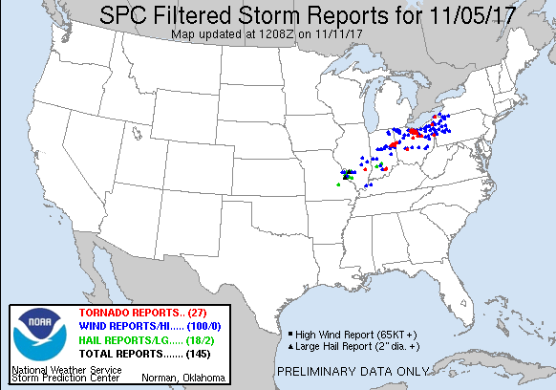
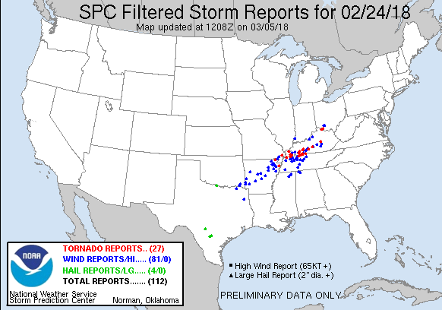
Early November
(5–6 November 2017)
OH Valley Outbreak
(24–25 February 2018)

Slide 4
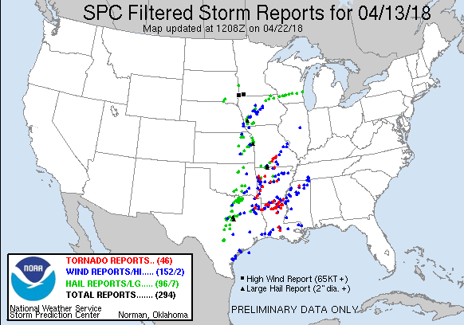
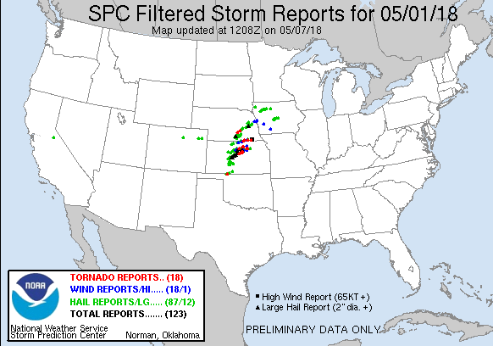
ArkLaTex Event
(13–14 April 2018)
Negatively Tilted Trough
(1–2 May 2018)

Slide 5
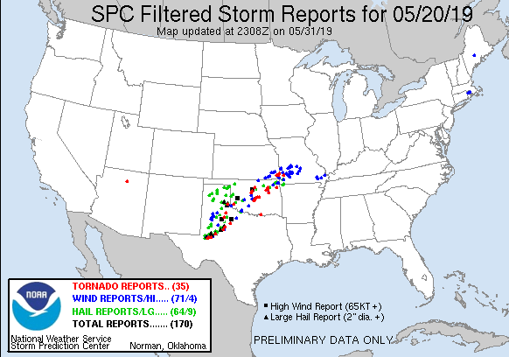
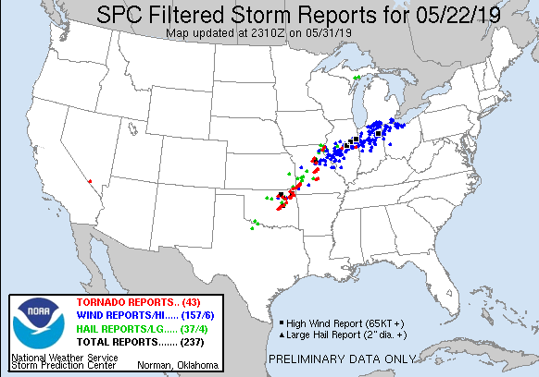
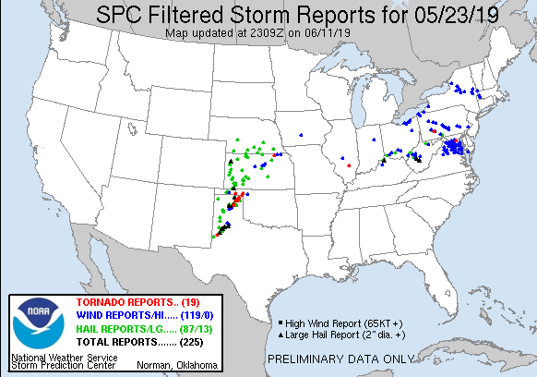
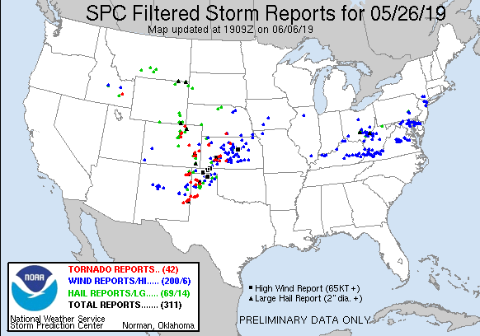
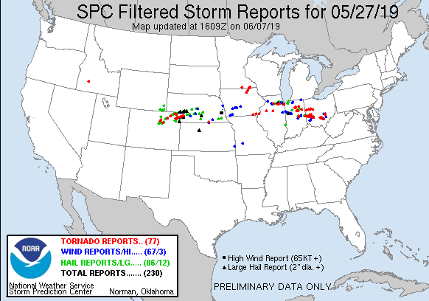
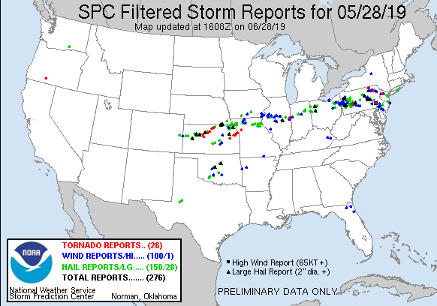
Late May (2019)
Sampling of outbreaks that occurred in late May 2019

Slide 6
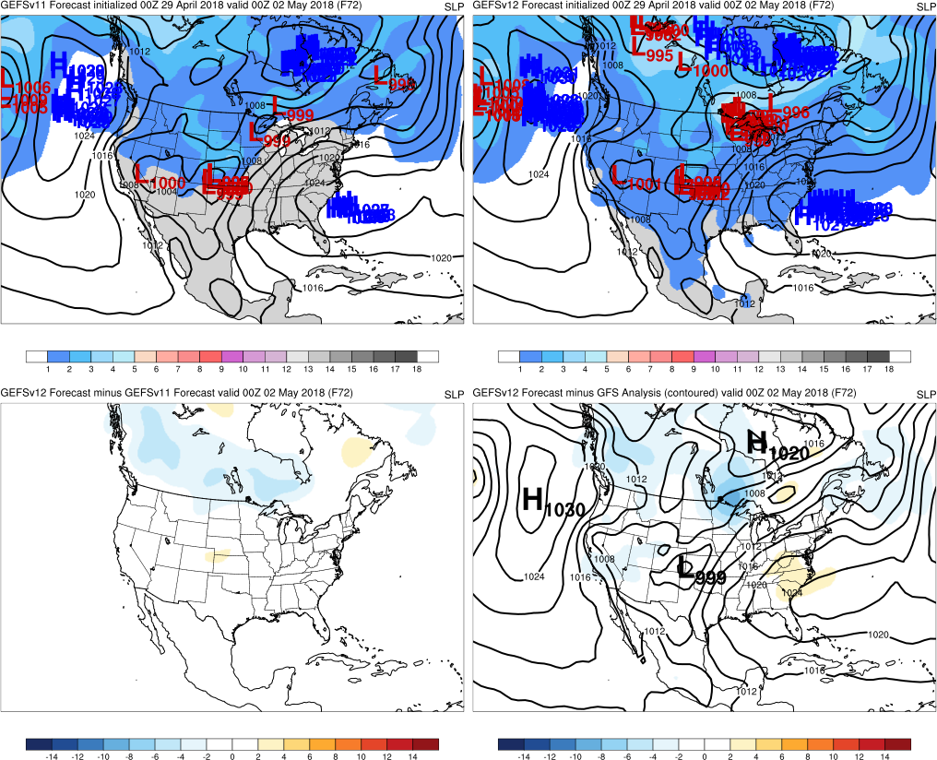
NATIONAL OCEANIC AND ATMOSPHERIC ADMINISTRATION
GEFSv12 Retrospectives: Severe Weather
Top: Mean (contours)
Spread (shaded)
Low Locations
GEFSv11
GEFSv12
Graphics Setup
Bottom Left: GEFSv12−GEFSv11 mean (shaded)
v12−v11
GFS Anl.
Bottom Right: GFS analysis (contours)
GEFSv12−GFS analysis (shaded)

Slide 7
NATIONAL OCEANIC AND ATMOSPHERIC ADMINISTRATION
GEFSv12 Severe Weather: Takeaways
GEFSv12 typically predicts synoptic forcing as well as or better than
GEFSv11
The big pattern change in the second half of May 2019 was well-
predicted in GEFSv11 and GEFSv12
Increased spread has impact on CAPE mean and probability fields
GEFSv12 has a tendency to overmix on prominent drylines days
Some indication that GEFSv12 spins up convection better than
GEFSv11, leading to improvement in short-range QPF

Slide 8
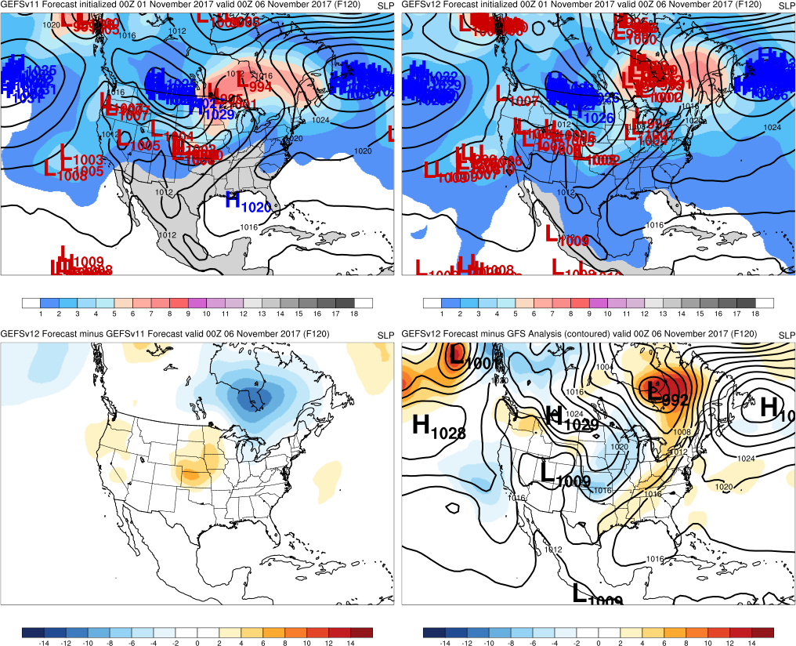
Early November (2017)
Init.: 0000 UTC 11/1/2017
Valid: 0000 UTC 11/6/2017 (F120)
F120: Many GEFSv12 members correctly forecasted a low near Hudson Bay while only one GEFSv11 member did
GEFSv11
GEFSv12
v12−v11
GFS Anl.

Slide 9
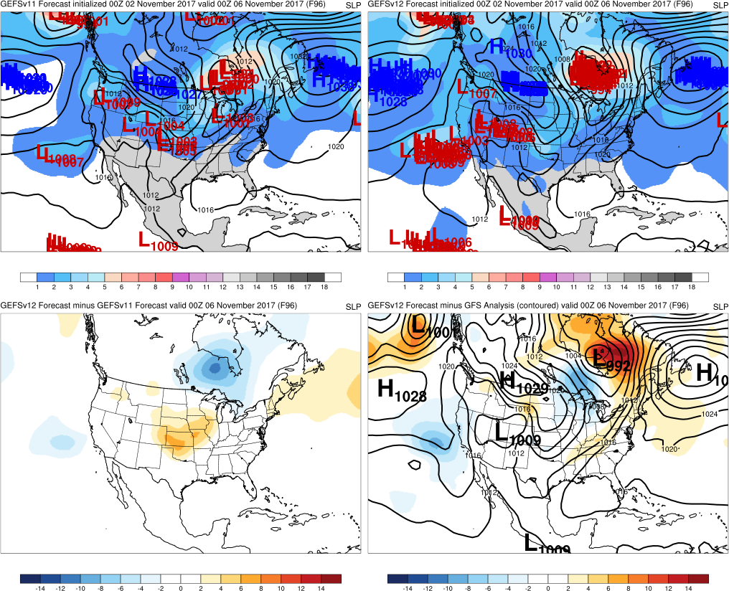
Early November (2017)
Init.: 0000 UTC 11/2/2017
Valid: 0000 UTC 11/6/2017 (F096)
F120: Many GEFSv12 members correctly forecasted a low near Hudson Bay while only one GEFSv11 member did
F096: GEFSv12 members were all in agreement with the low location and associated frontal boundary. GEFSv11
members slowly began catching on
GEFSv11
GEFSv12
v12−v11
GFS Anl.

Slide 10
Early November (2017)
Init.: 0000 UTC 11/1/2017
Valid: 0000 UTC 1/6/2017 (F120)
Going back to the F120 forecast…
GEFSv11
GEFSv12
v12−v11
GFS Anl.

Slide 11
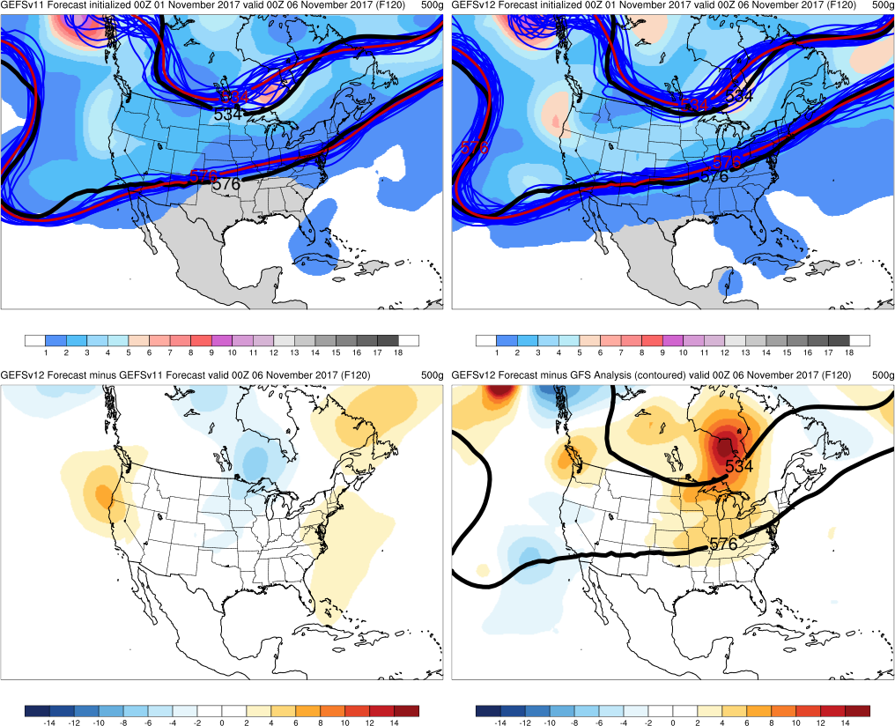
Early November (2017)
Init.: 0000 UTC 11/1/2017
Valid: 0000 UTC 11/6/2017 (F120)
Going back to the F120 forecast, GEFSv12
better predicted the shortwave trough over
southern Canada
GEFSv11
GEFSv12
v12−v11
GFS Anl.
500-hPa spaghetti plot with 576-dam and 534-dam
member (blue) and mean (red) forecast and analysis (black) contours

Slide 12
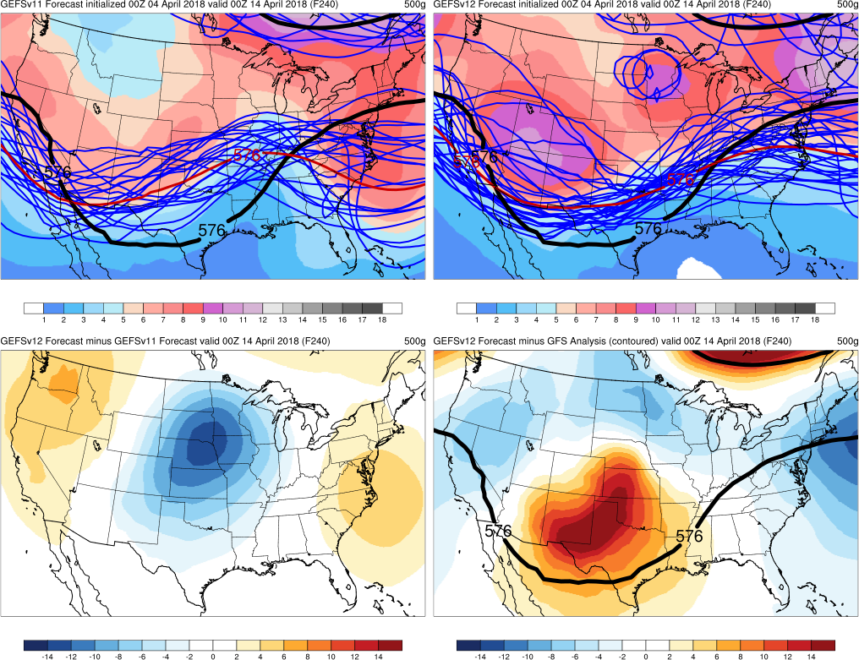
ArkLaTex Outbreak (2018)
Init.: 0000 UTC 4/4/2018
Valid: 0000 UTC 4/14/2018 (F240)
F240: As expected, both versions had large
spread, but GEFSv12 mean had lower
heights than GEFSv11 over central CONUS
and higher heights over coasts where ridges
were located
GEFSv12 did slightly better predicting the
ridge-trough-ridge pattern 10 days in
advance of the outbreak
GEFSv11
GEFSv12
v12−v11
GFS Anl.

Slide 13
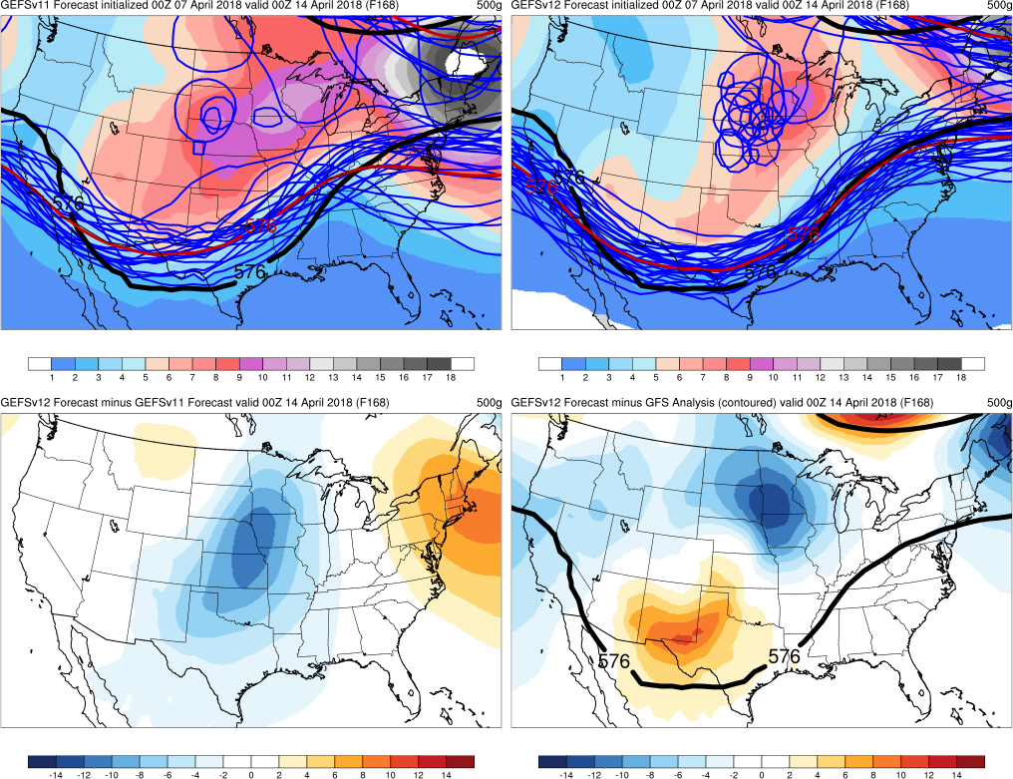
ArkLaTex Outbreak (2018)
Init.: 0000 UTC 4/7/2018
Valid: 0000 UTC 4/14/2018 (F168)
F240: As expected, both versions had large
spread, but GEFSv12 mean had lower
heights than GEFSv11 over central CONUS
and higher heights over coasts where ridges
were located
F216 through F120: GEFSv12 continued
predicting lower heights than GEFSv11
over the central CONUS
F168 through F120: Relative to the GFS
analysis, GEFSv12 predicted heights that
were too low over the Upper Midwest
GEFSv11
GEFSv12
v12−v11
GFS Anl.

Slide 14
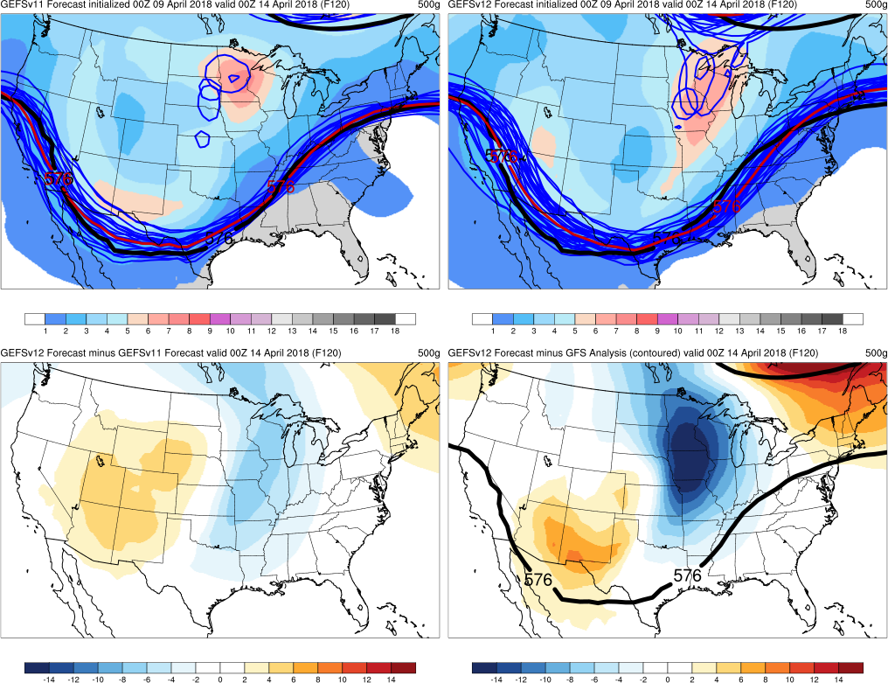
ArkLaTex Outbreak (2018)
Init.: 0000 UTC 4/9/2018
Valid: 0000 UTC 4/14/2018 (F120)
F240: As expected, both versions had large
spread, but GEFSv12 mean had lower
heights than GEFSv11 over central CONUS
and higher heights over coasts where ridges
were located
F216 through F120: GEFSv12 continued
predicting lower heights than GEFSv11
over the central CONUS
F168 through F120: Relative to the GFS
analysis, GEFSv12 predicted heights that
were too low over the Upper Midwest
GEFSv11
GEFSv12
v12−v11
GFS Anl.

Slide 15
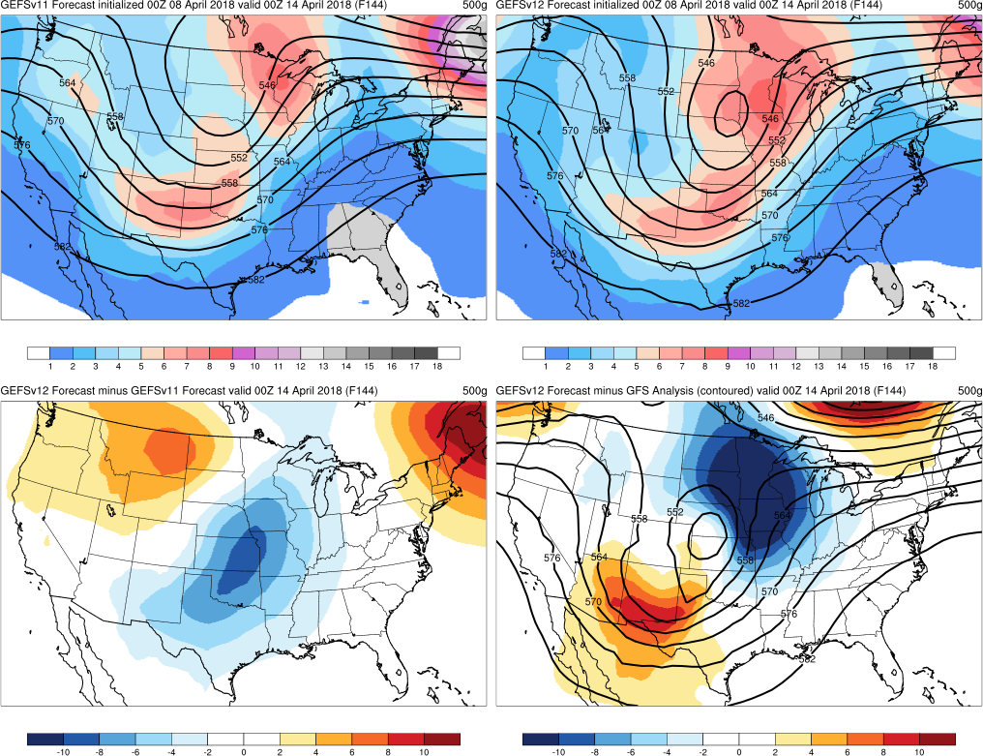
ArkLaTex Outbreak (2018)
Init.: 0000 UTC 4/8/2018
Valid: 0000 UTC 4/14/2018 (F144)
F144: GEFSv12 mean correctly showed
a 500 mb cutoff low located over the central
CONUS. The mean cutoff was positioned
slightly north and east of the analyzed cutoff
GEFSv11
GEFSv12
v12−v11
GFS Anl.
Progressive cutoff lows noted in some of the winter storms cases
was noted in the ArkLaTex case

Slide 16
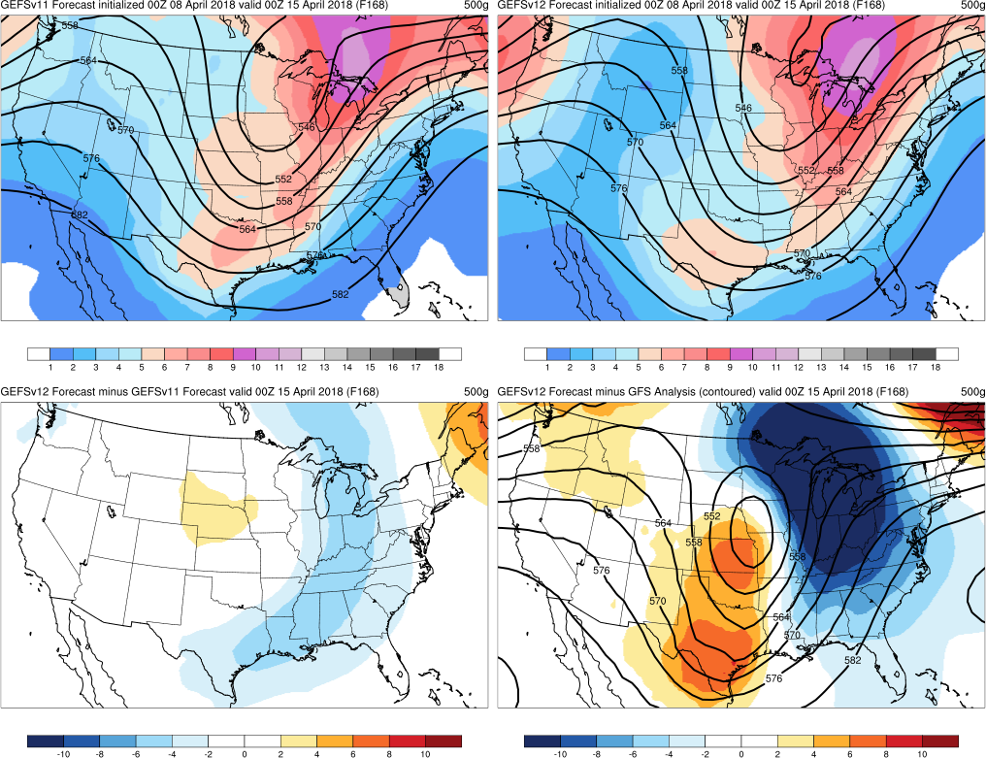
ArkLaTex Outbreak (2018)
Init.: 0000 UTC 4/8/2018
Valid: 0000 UTC 4/15/2018 (F168)
F144: GEFSv12 mean correctly showed
a 500 mb cutoff low located over the central
CONUS. The mean cutoff was positioned
slightly north and east of the analyzed cutoff
F168: Many GEFSv12 members incorrectly
showed the cutoff rejoining the midlatitude
flow
GEFSv11
GEFSv12
v12−v11
GFS Anl.
Progressive cutoff lows noted in some of the winter storms cases
was noted in the ArkLaTex case

Slide 17
NATIONAL OCEANIC AND ATMOSPHERIC ADMINISTRATION
GEFSv12 Severe Weather: Takeaways
GEFSv12 typically predicts synoptic forcing as well as or better than
GEFSv11
The big pattern change in the second half of May 2019 was well-
predicted in GEFSv11 and GEFSv12
Increased spread has impact on CAPE mean and probability fields
GEFSv12 has a tendency to overmix on prominent drylines days
Some indication that GEFSv12 spins up convection better than
GEFSv11, leading to improvement in short-range QPF

Slide 18
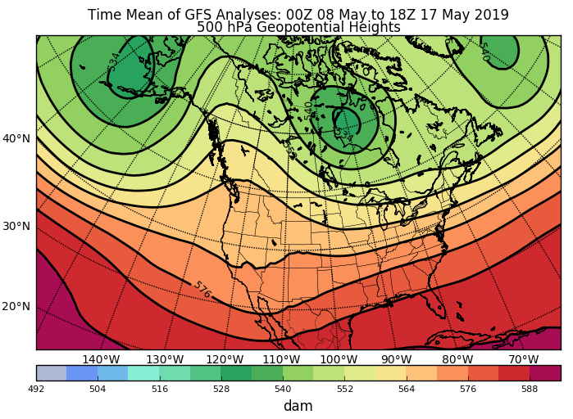
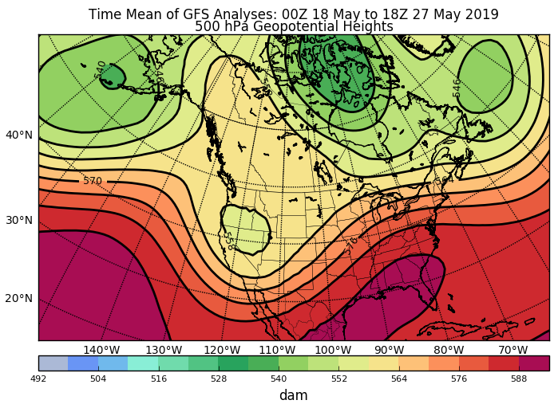
NATIONAL OCEANIC AND ATMOSPHERIC ADMINISTRATION
May 2019 Pattern Change
Time Mean of 500mb GFS Analyses:
00Z 8 May to 18Z 17 May
Time Mean of 500mb GFS Analyses:
00Z 18 May to 18Z 27 May
Synoptic pattern became much more favorable for repeated rounds of severe
weather across the central CONUS during the latter half of the month

Slide 19
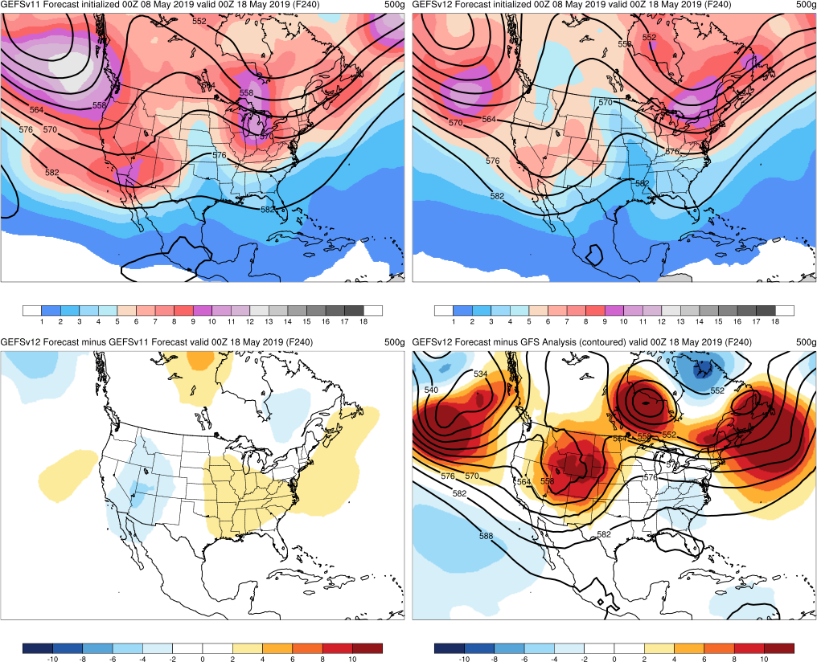
Late May (2019)
Init.: 0000 UTC 5/8/2019
Valid: 0000 UTC 5/18/2019 (F240)
F240: 18 May was the first day with a
predominant western US trough, and
GEFSv12 better predicted this pattern on
Day 10
GEFSv11 predicted the pattern slightly
better on Days 7 and 8 though
GEFSv11
GEFSv12
v12−v11
GFS Anl.

Slide 20
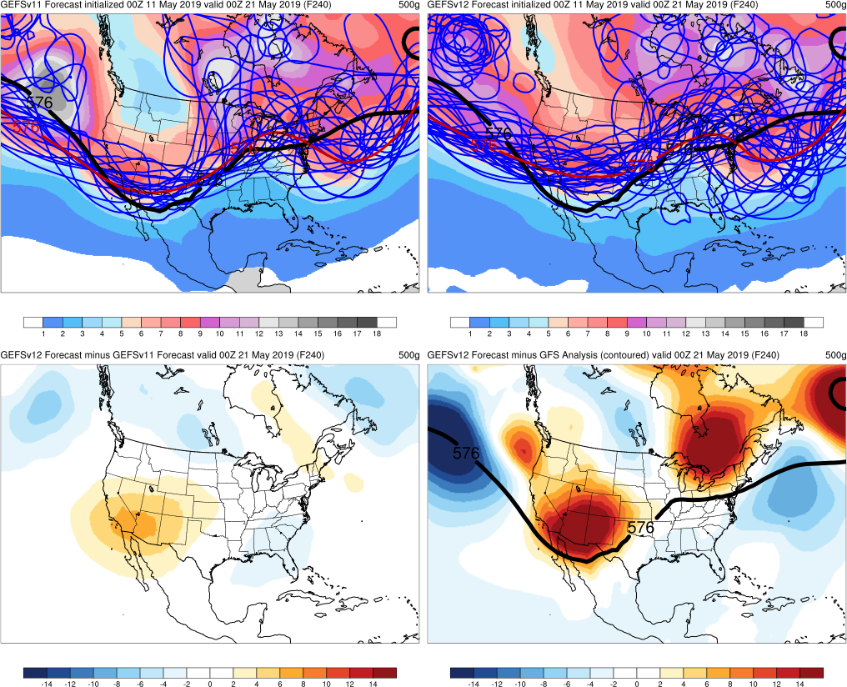
Late May (2019)
Init.: 0000 UTC 5/11/2019
Valid: 0000 UTC 5/21/2019 (F240)
F240: Both means suggested a western US
trough. More agreement among GEFSv11
members led to a deeper western trough
in its mean
GEFSv11
GEFSv12
v12−v11
GFS Anl.

Slide 21
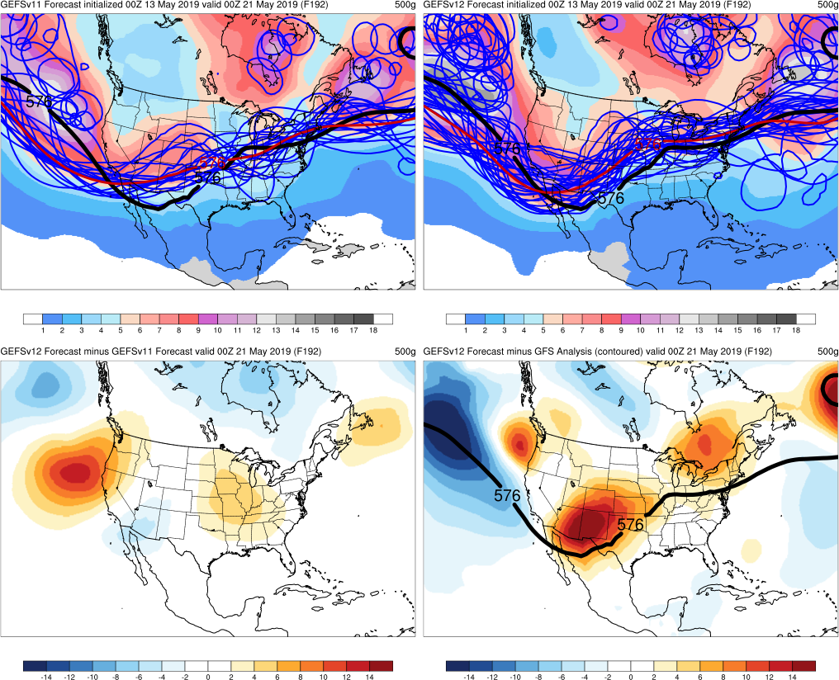
Late May (2019)
Init.: 0000 UTC 5/13/2019
Valid: 0000 UTC 5/21/2019 (F192)
F240: Both means suggested a western US
trough. More agreement among GEFSv11
members led to a deeper western trough
in its mean
F192: GEFSv12 members & mean showed
a more amplified pattern than GEFSv11.
Both versions were slightly slow with timing
GEFSv11
GEFSv12
v12−v11
GFS Anl.

Slide 22
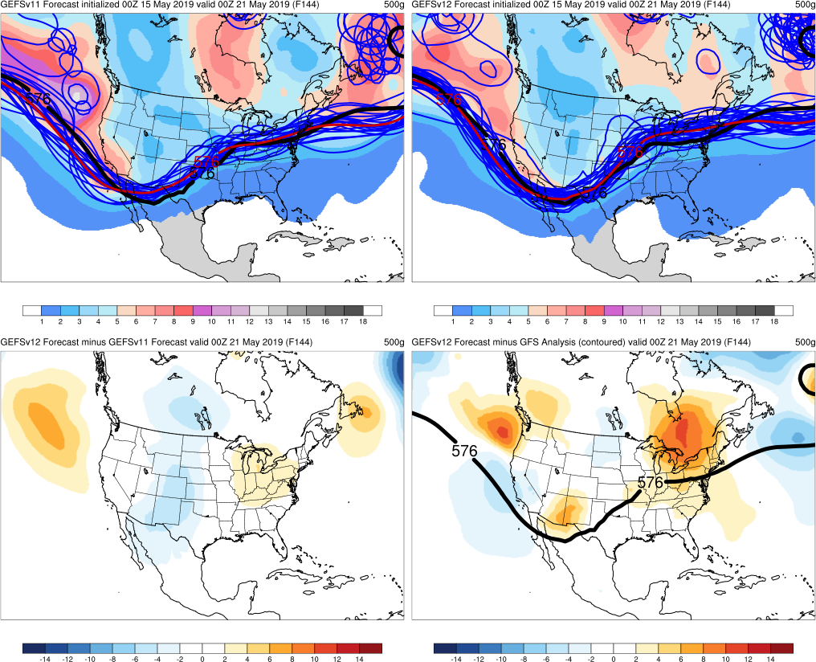
Late May (2019)
Init.: 0000 UTC 5/15/2019
Valid: 0000 UTC 5/21/2019 (F144)
F240: Both means suggested a western US
trough. More agreement among GEFSv11
members led to a deeper western trough
in its mean
F192: GEFSv12 members & mean showed
a more amplified pattern than GEFSv11.
Both versions were slightly slow with timing.
F144: Both versions had good forecasts,
but GEFSv12 mean was slightly better with
the amplitude and position of the trough axis
GEFSv11
GEFSv12
v12−v11
GFS Anl.

Slide 23
NATIONAL OCEANIC AND ATMOSPHERIC ADMINISTRATION
GEFSv12 Severe Weather: Takeaways
GEFSv12 typically predicts synoptic forcing as well as or better than
GEFSv11
The big pattern change in the second half of May 2019 was well-
predicted in GEFSv11 and GEFSv12
Increased spread has impact on CAPE mean and probability fields
GEFSv12 has a tendency to overmix on prominent drylines days
Some indication that GEFSv12 spins up convection better than
GEFSv11, leading to improvement in short-range QPF

Slide 24
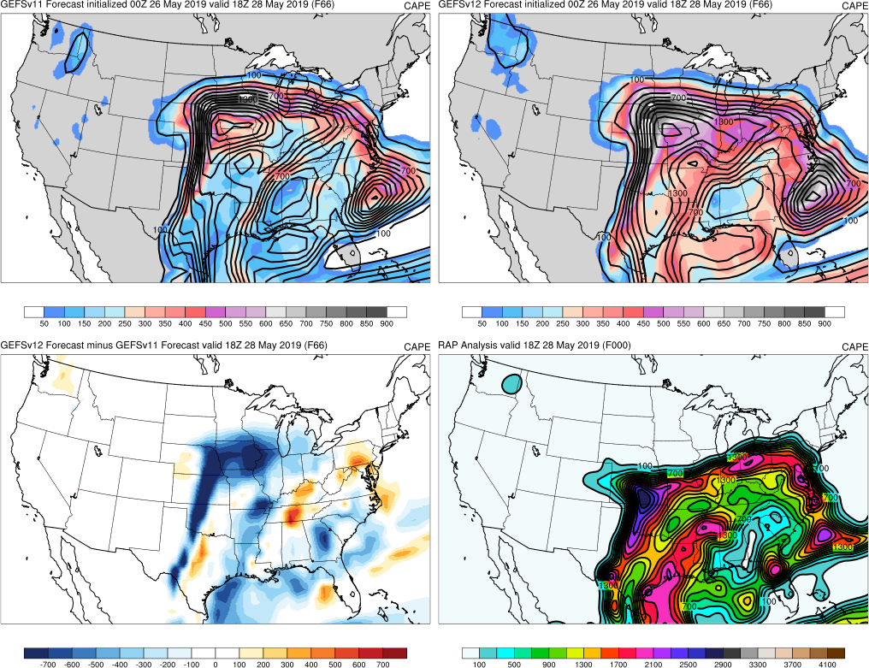
Late May (2019)
GEFSv11
GEFSv12
Init.: 0000 UTC 5/26/2019
Valid: 0000 UTC 5/28/2019 (F066)
At 18Z valid times, GEFSv12 mean tended
to show lower CAPE magnitudes than
GEFSv11 mean
(note broad areas of blue in diff. field)
v12−v11
RAP Anl.

Slide 25
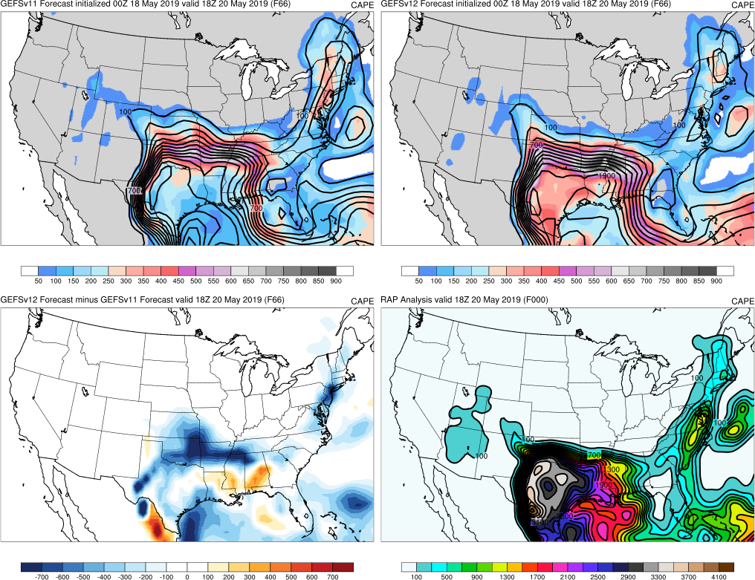
Late May (2019)
GEFSv11
GEFSv12
Init.: 0000 UTC 5/18/2019
Valid: 0000 UTC 5/20/2019 (F066)
At 18Z valid times, GEFSv12 mean tended
to show lower CAPE magnitudes than
GEFSv11 mean
(note broad areas of blue in diff. field)
v12−v11
RAP Anl.

Slide 26
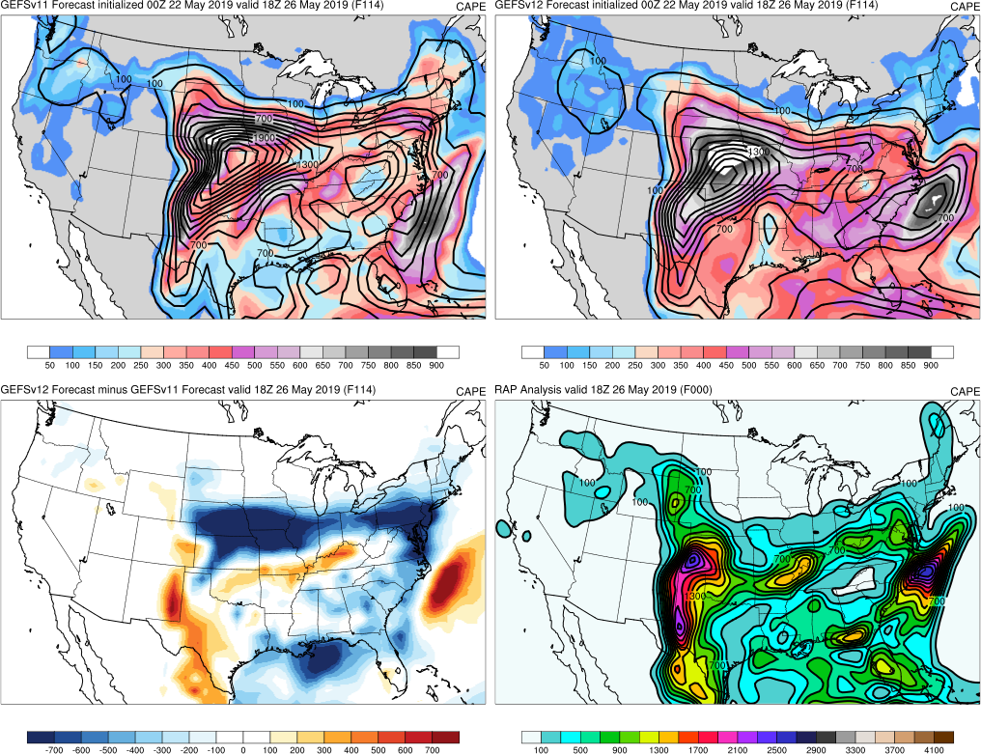
Late May (2019)
GEFSv11
GEFSv12
Init.: 0000 UTC 5/22/2019
Valid: 0000 UTC 5/26/2019 (F114)
At 18Z valid times, GEFSv12 mean tended
to show lower CAPE magnitudes than
GEFSv11 mean
(note broad areas of blue in diff. field)
Lower mean CAPE magnitudes are often
more prominent in medium-range forecasts
beyond Day 3
v12−v11
RAP Anl.

Slide 27
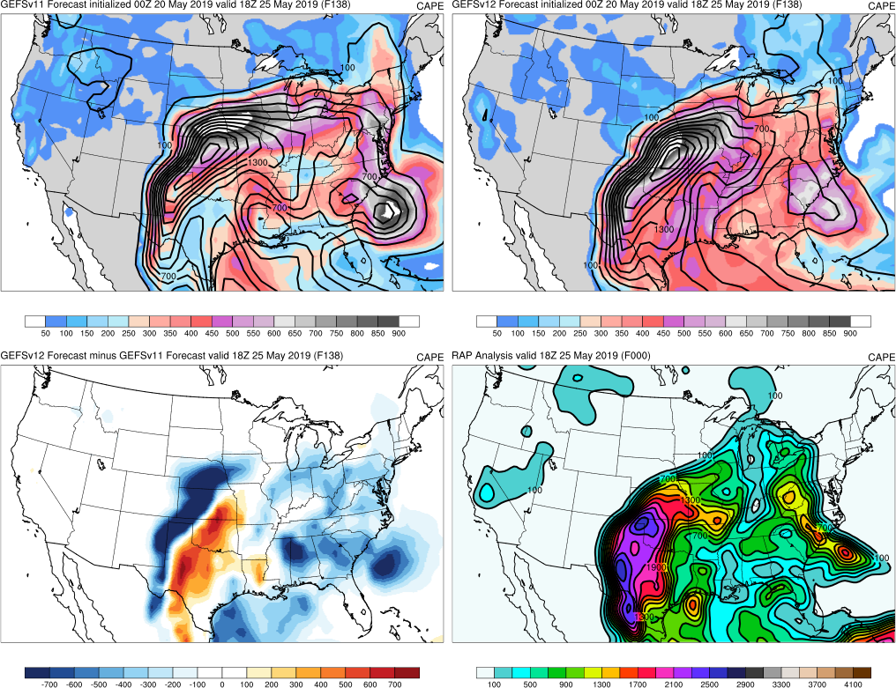
Late May (2019)
GEFSv11
GEFSv12
Init.: 0000 UTC 5/20/2019
Valid: 0000 UTC 5/25/2019 (F138)
At 18Z valid times, GEFSv12 mean tended
to show lower CAPE magnitudes than
GEFSv11 mean
(note broad areas of blue in diff. field)
Lower mean CAPE magnitudes are often
more prominent in medium-range forecasts
beyond Day 3
v12−v11
RAP Anl.

Slide 28
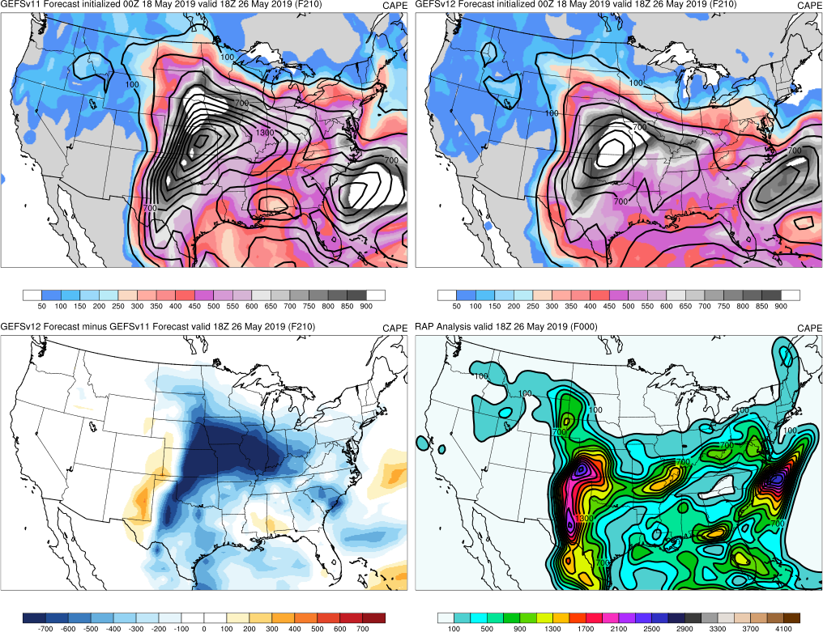
Late May (2019)
GEFSv11
GEFSv12
Init.: 0000 UTC 5/18/2019
Valid: 0000 UTC 5/26/2019 (F210)
At 18Z valid times, GEFSv12 mean tended
to show lower CAPE magnitudes than
GEFSv11 mean
(note broad areas of blue in diff. field)
Lower mean CAPE magnitudes are often
more prominent in medium-range forecasts
beyond Day 3
v12−v11
RAP Anl.

Slide 29
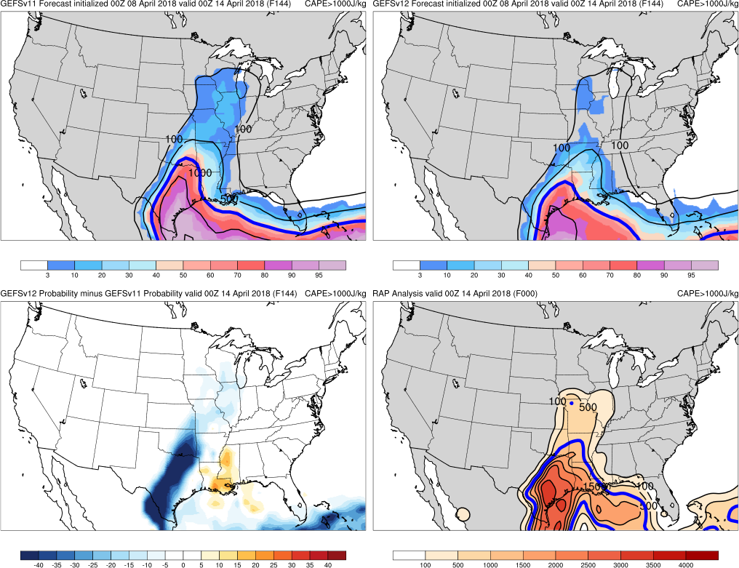
Probability of CAPE > 1000 J/kg
ArkLaTex Outbreak (2018)
GEFSv11
GEFSv12
Init.: 0000 UTC 4/8/2018
Valid: 0000 UTC 4/14/2019 (F144)
This signal can also show up at 00Z valid
times and in associated probability fields
Seeing the impact of
increased spread?
Synoptic differences?
Thermodynamic differences?
v12−v11
RAP Anl.
Top: CAPE probability (shaded) and CAPE mean (contoured)
Bottom Left: GEFSv12–GEFSv11 probability difference

Slide 30
Late May (2019)
GEFSv11
Control
GEFSv12
Control
Init.: 0000 UTC 5/18/2019
Valid: 0000 UTC 5/26/2019 (F162)
Individual member forecasts indicate that
increased spread in GEFSv12 leads to
lower means and probabilities for
medium-range CAPE forecasts
Control: Similar forecasts, and max CAPE
is higher in GEFSv12
Member 2: GEFSv12 clearly has large
synoptic differences from GEFSv11 and
the RAP analysis
Instances like the control member diffs
may be more common than instances like
the Member 2 differences
GEFSv11
Mem 2
GEFSv12
Mem 2
RAP Anl.

Slide 31
NATIONAL OCEANIC AND ATMOSPHERIC ADMINISTRATION
GEFSv12 Severe Weather: Takeaways
GEFSv12 typically predicts synoptic forcing as well as or better than
GEFSv11
The big pattern change in the second half of May 2019 was well-
predicted in GEFSv11 and GEFSv12
Increased spread has impact on CAPE mean and probability fields
GEFSv12 has a tendency to overmix on prominent drylines days
Some indication that GEFSv12 spins up convection better than
GEFSv11, leading to improvement in short-range QPF

Slide 32
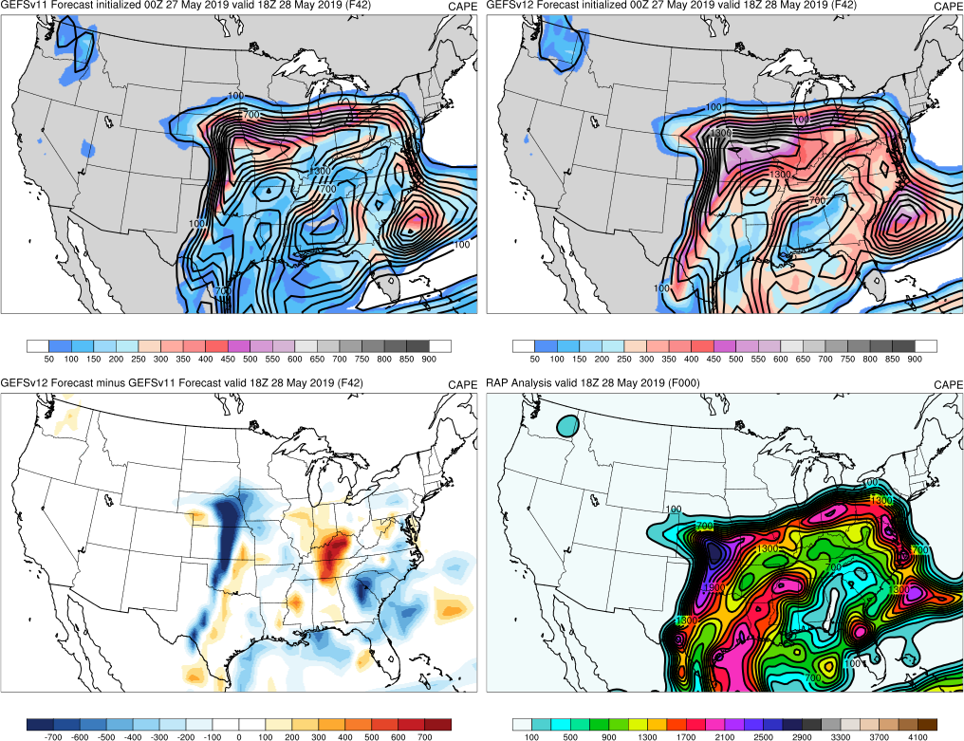
Late May (2019)
GEFSv11
GEFSv12
Init.: 0000 UTC 5/27/2019
Valid: 0000 UTC 5/28/2019 (F042)
In some short-range forecasts for
days with prominent drylines, mean
difference fields show a dipole along the
western edge of the instability axis
This dryline position bias is due to
overmixing of the PBL, which appears more
pronounced in GEFSv12 than GEFSv11
v12−v11
RAP Anl.

Slide 33
Late May (2019)
GEFSv11
GEFSv12
Init.: 0000 UTC 5/27/2019
Valid: 0000 UTC 5/28/2019 (F042)
During the evaluation of GFSv15, examples
of similar dipoles were seen indicating the
PBL overmixed to a greater degree in
GFSv15 than in GFSv14
The signal of a dryline position bias in
GEFSv12 and GFSv15 is likely attributable
to the combination of the physics (land sfc
and PBL schemes) being used along
with the FV3 dycore
v12−v11
RAP Anl.

Slide 34
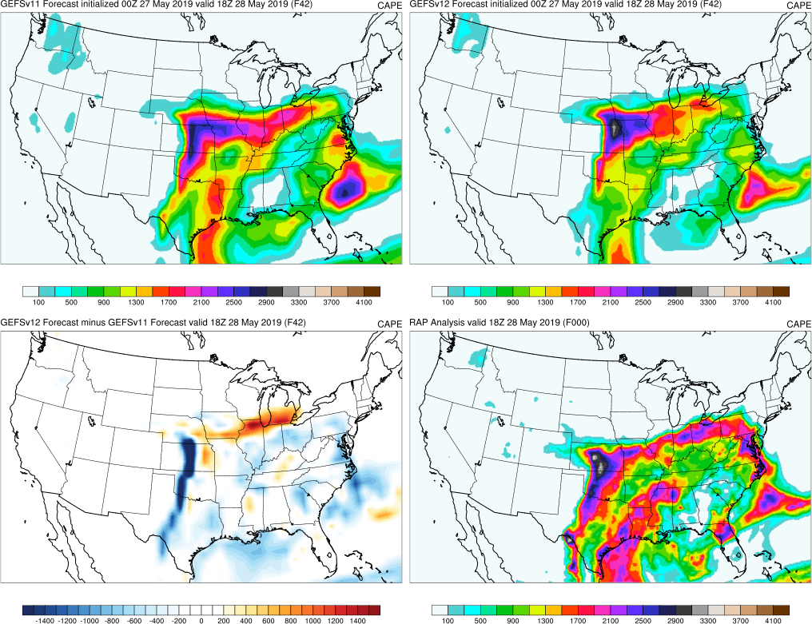
Late May (2019)
GEFSv11 Mem 1
GEFSv12 Mem 1
Init.: 0000 UTC 5/27/2019
Valid: 0000 UTC 5/28/2019 (F042)
Member forecasts confirm that the dryline
position tended to be incorrectly further
east relative to GEFSv11 and RAP analysis
v12−v11
RAP Anl.

Slide 35
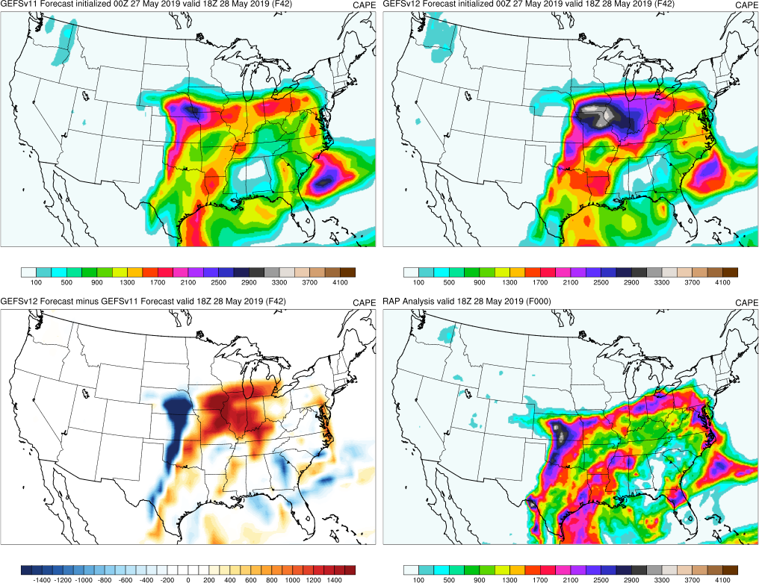
Late May (2019)
GEFSv11 Mem 7
GEFSv12 Mem 7
Init.: 0000 UTC 5/27/2019
Valid: 0000 UTC 5/28/2019 (F042)
Member forecasts confirm that the dryline
position tended to be incorrectly further
east relative to GEFSv11 and RAP analysis
While it’s not seen in every member
comparison or every cycle, this was a
common occurrence at this valid time and
on other prominent dryline days
(e.g., 17 May and 25 May 2019)
v12−v11
RAP Anl.

Slide 36
NATIONAL OCEANIC AND ATMOSPHERIC ADMINISTRATION
GEFSv12 Severe Weather: Takeaways
GEFSv12 typically predicts synoptic forcing as well as or better than
GEFSv11
The big pattern change in the second half of May 2019 was well-
predicted in GEFSv11 and GEFSv12
Increased spread has impact on CAPE mean and probability fields
GEFSv12 has a tendency to overmix on prominent drylines days
Some indication that GEFSv12 spins up convection better than
GEFSv11, leading to improvement in short-range QPF

Slide 37
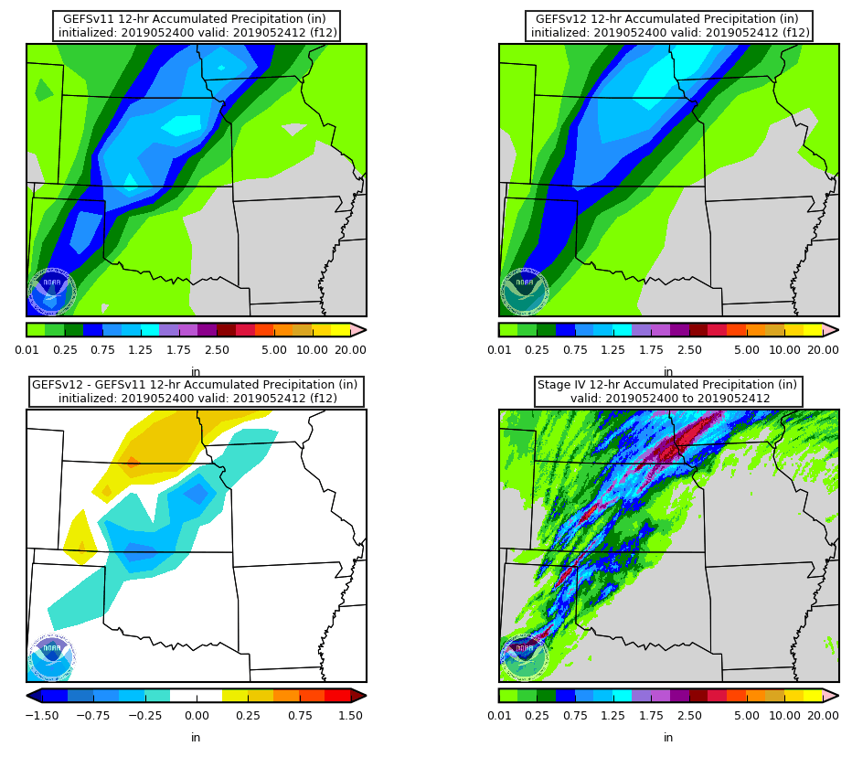
Late May (2019)
Init.: 0000 UTC 5/24/2019
Valid: 1200 UTC 5/24/2019 (F012)
F012: GEFSv11 mean QPF shows localized
maxima while GEFSv12 mean has a
smoother appearance. GEFSv12 better
shows the heaviest amounts would be
located near Omaha
GEFSv11 Mean
GEFSv12 Mean
v12−v11
ST4 Anl.

Slide 38
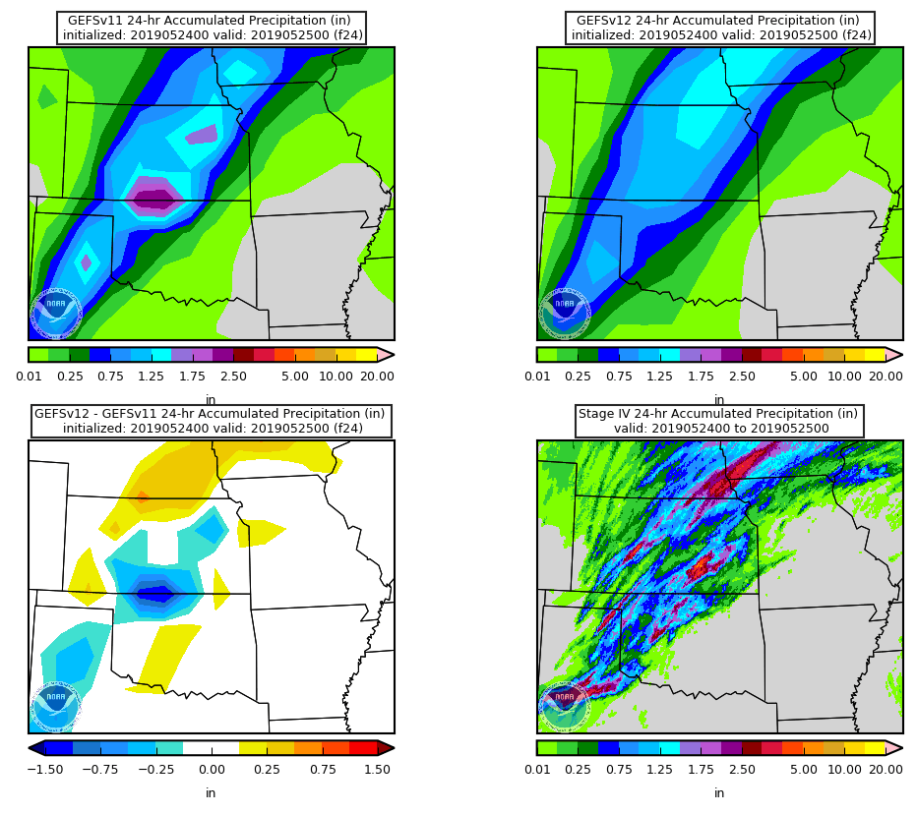
Late May (2019)
Init.: 0000 UTC 5/24/2019
Valid: 1200 UTC 5/24/2019 (F024)
F012: GEFSv11 mean QPF shows localized
maxima while GEFSv12 mean has a
smoother appearance. GEFSv12 better
shows the heaviest amounts would be
located near Omaha
F024: GEFSv11 mean QPF local maxima
exceeded 2”, but are not necessarily
correctly located. GEFSv12 mean shows
broadbrushed 1”+ accumulations
QPF stats show that the GEFSv11 mean
is overconfident and the GEFSv12 mean
is more reliable
GEFSv11 Mean
GEFSv12 Mean
v12−v11
ST4 Anl.

Slide 39
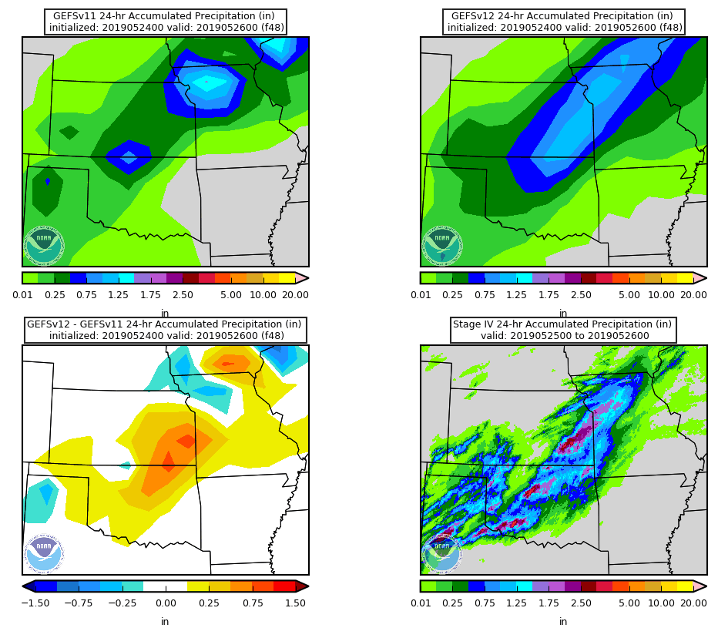
Late May (2019)
Init.: 0000 UTC 5/24/2019
Valid: 0000 UTC 5/25/2019 (F048)
F048: GEFSv11 mean continued showing
localized QPF maxima, and GEFSv12 mean
continued its smoother appearance
GEFSv12 mean QPF better indicated the
heaviest QPF amounts from KC metro
into southeast Kansas
GEFSv11 Mean
GEFSv12 Mean
v12−v11
ST4 Anl.

Slide 40
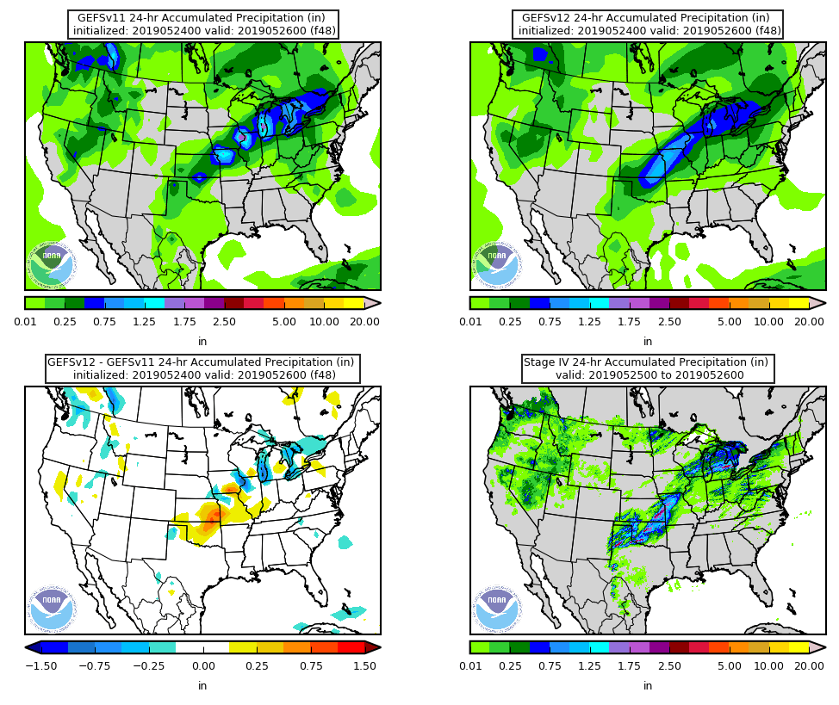
Late May (2019)
Init.: 0000 UTC 5/24/2019
Valid: 0000 UTC 5/25/2019 (F048)
F048: On the CONUS scale, GEFSv12
mean forecast provides a more realistic
appearance overall
As discussed in previous presentations
about the GEFSv12 retros, probability-
mean QPF would likely show better
amplitude in the GEFSv12 accumulations
GEFSv11 Mean
GEFSv12 Mean
v12−v11
ST4 Anl.

Slide 41
NATIONAL OCEANIC AND ATMOSPHERIC ADMINISTRATION
GEFSv12 Severe Weather: Takeaways
GEFSv12 typically predicts synoptic forcing as well as or better than
GEFSv11
The big pattern change in the second half of May 2019 was well-
predicted in GEFSv11 and GEFSv12
Increased spread has impact on CAPE mean and probability fields
Some indication of overmixing in GEFSv12 on prominent drylines days
Some indication that GEFSv12 spins up convection better than
GEFSv11, leading to improvement in short-range QPF

