Slide 1
NATIONAL OCEANIC AND ATMOSPHERIC ADMINISTRATION
GEFSv12 Retrospective Case Studies: Low Skill/Dropouts
GEFSv11
GEFSv12
GFS Anl.
Shannon Shields
EMC MEG Meeting
2 April 2020

Slide 2
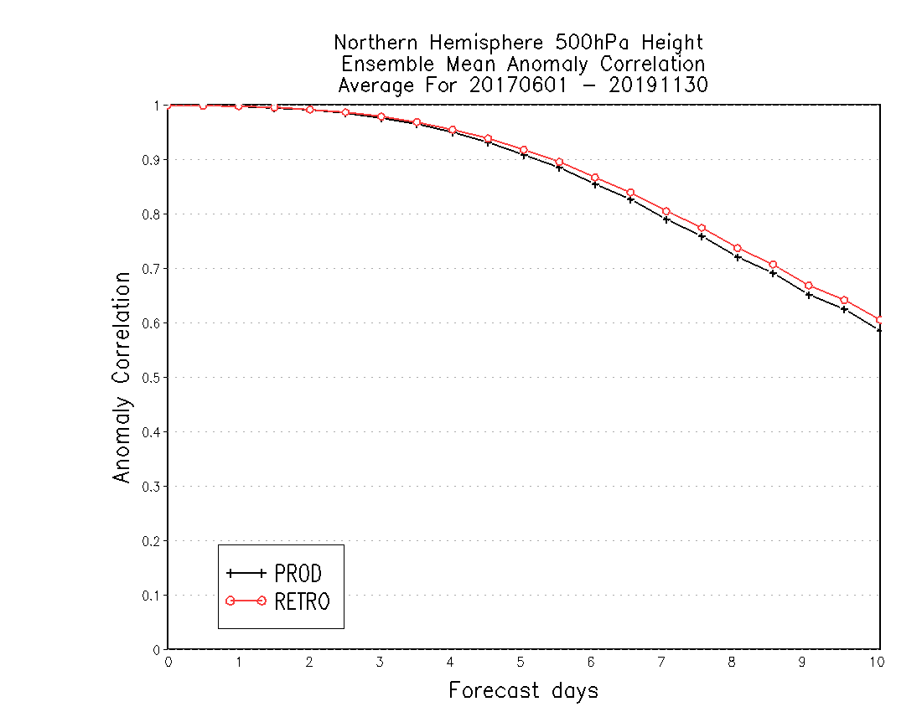
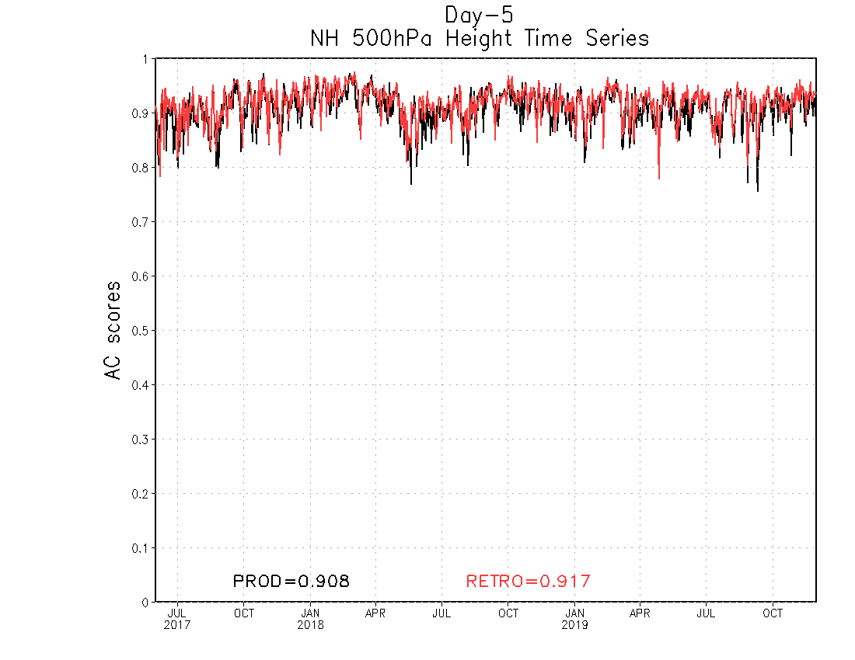
NATIONAL OCEANIC AND ATMOSPHERIC ADMINISTRATION
GEFSv12 Anomaly Correlation (AC) Scores
DAY 5 – NH 500-hPa Time Series
NH by Lead Time (6/2017–11/2019)
GEFSv12 has higher 500-hPa AC scores than GEFSv11 at Day 5
GEFSv12 has higher NH 500-hPa AC scores than GEFSv11 at all lead times from Day 0 to Day 10
GEFSv11 = .908 GEFSv12 = .917
June 2017
Sep 2018
Dec 2019

Slide 3
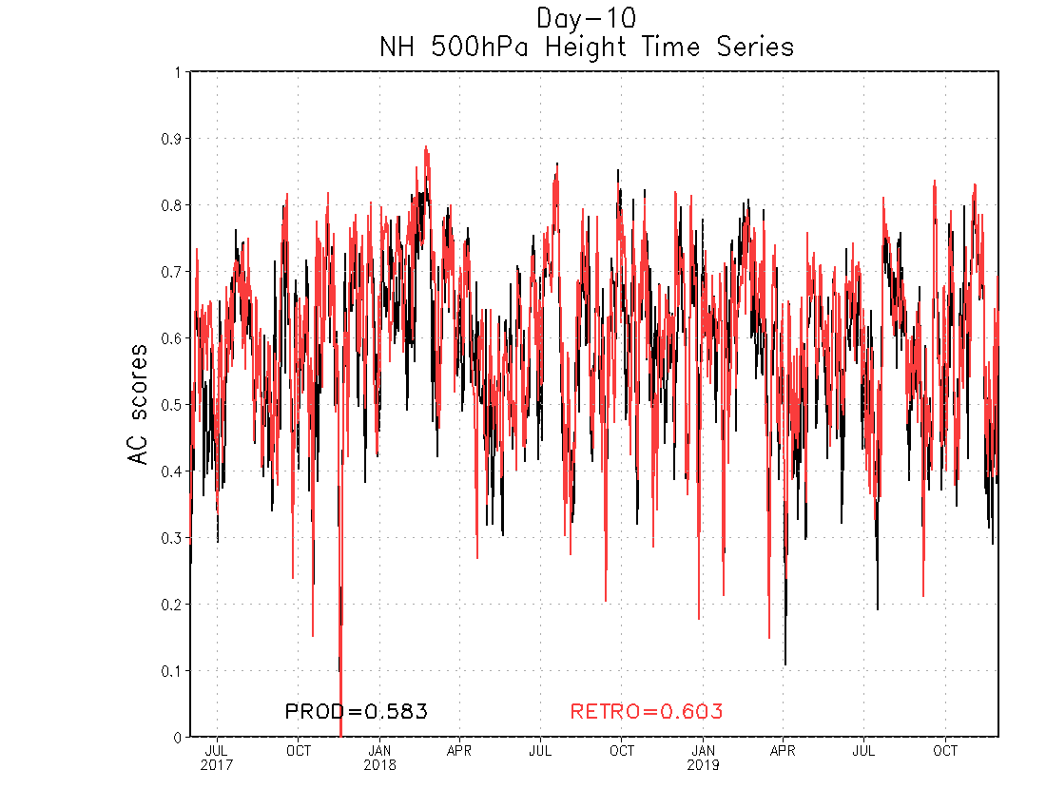
NATIONAL OCEANIC AND ATMOSPHERIC ADMINISTRATION
GEFSv12 Anomaly Correlation (AC) Scores
DAY 10 – NH 500-hPa Time Series
NH by Lead Time (6/2017–11/2019)
GEFSv12 has higher 500-hPa AC scores than GEFSv11 at Day 10
GEFSv12 has higher NH 500-hPa AC scores than GEFSv11 at all lead times from Day 0 to Day 10
GEFSv11 = .583 GEFSv12 = .603
June 2017
Sep 2018
Dec 2019

Slide 4
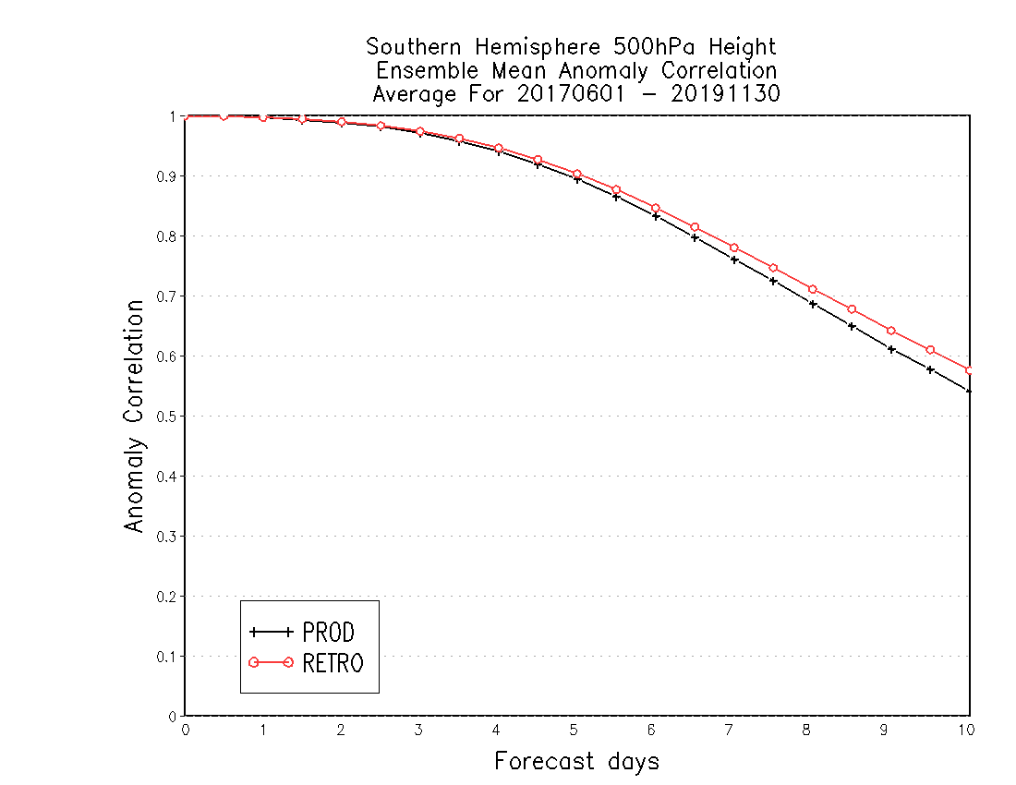
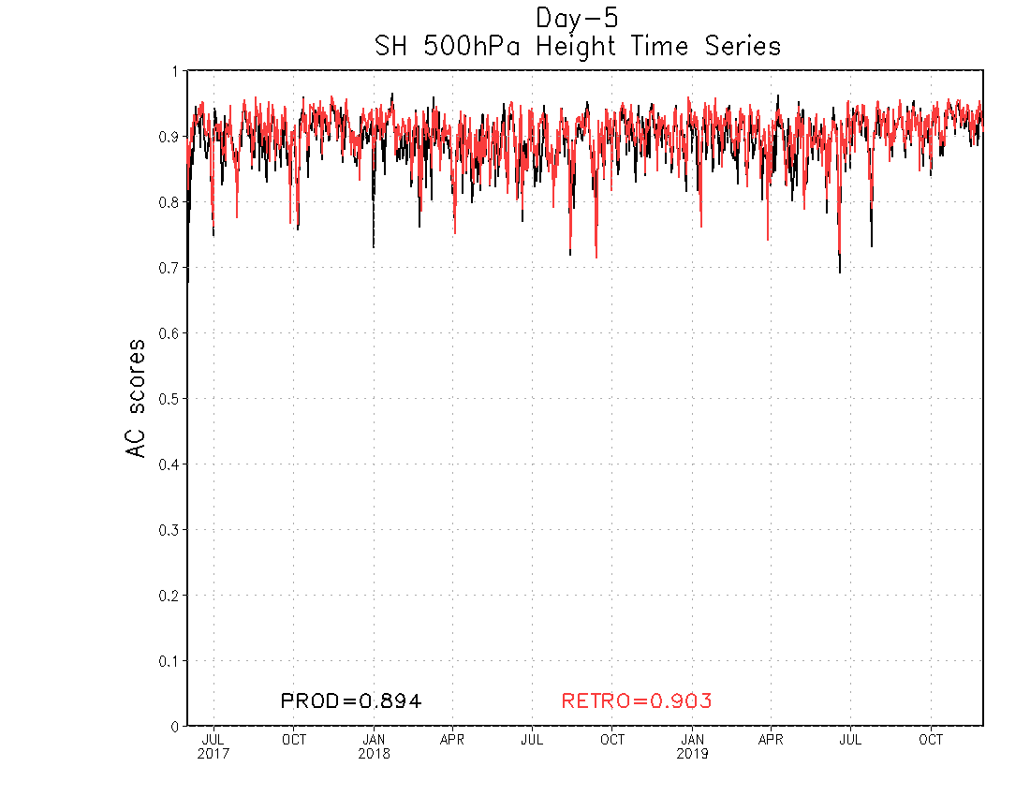
NATIONAL OCEANIC AND ATMOSPHERIC ADMINISTRATION
GEFSv12 Anomaly Correlation (AC) Scores
DAY 5 – SH 500-hPa Time Series
SH by Lead Time (6/2017–11/2019)
GEFSv12 has higher 500-hPa AC scores than GEFSv11 at Day 5
GEFSv12 has higher SH 500-hPa AC scores than GEFSv11 at all lead times from Day 0 to Day 10
GEFSv11 = .894 GEFSv12 = .903
June 2017
Sep 2018
Dec 2019

Slide 5
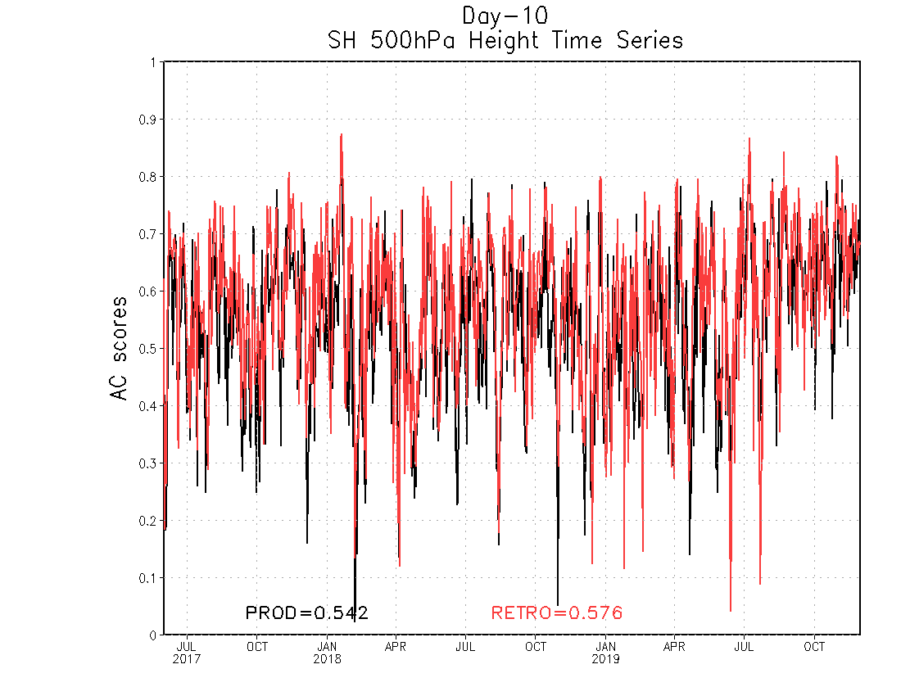
NATIONAL OCEANIC AND ATMOSPHERIC ADMINISTRATION
GEFSv12 Anomaly Correlation (AC) Scores
DAY 10 – SH 500-hPa Time Series
SH by Lead Time (6/2017–11/2019)
GEFSv12 has higher 500-hPa AC scores than GEFSv11 at Day 10
GEFSv12 has higher SH 500-hPa AC scores than GEFSv11 at all lead times from Day 0 to Day 10
GEFSv11 = .542 GEFSv12 = .576
June 2017
Sep 2018
Dec 2019

Slide 6
NATIONAL OCEANIC AND ATMOSPHERIC ADMINISTRATION
GEFSv12 NH AC Scores (500-hPa Z at Day 5)
 | GEFSv11 (PROD) | GEFSv12 (RETRO)
Fall 2019 | 0.909 | 0.920
Summer 2019 | 0.902 | 0.912
Spring 2019 | 0.901 | 0.912
Winter 2018/2019 | 0.910 | 0.918
Fall 2018 | 0.923 | 0.928
Summer 2018 | 0.899 | 0.908
Spring 2018 | 0.907 | 0.916
Winter 2017/2018 | 0.929 | 0.939
Fall 2017 | 0.913 | 0.921
Summer 2017 | 0.884 | 0.896

Slide 7
NATIONAL OCEANIC AND ATMOSPHERIC ADMINISTRATION
GEFSv12 NH AC Scores (500-hPa Z at Day 10)
 | GEFSv11 (PROD) | GEFSv12 (RETRO)
Fall 2019 | 0.564 | 0.589
Summer 2019 | 0.575 | 0.594
Spring 2019 | 0.537 | 0.573
Winter 2018/2019 | 0.621 | 0.620
Fall 2018 | 0.607 | 0.604
Summer 2018 | 0.590 | 0.608
Spring 2018 | 0.574 | 0.588
Winter 2017/2018 | 0.671 | 0.706
Fall 2017 | 0.560 | 0.577
Summer 2017 | 0.538 | 0.578

Slide 8
NATIONAL OCEANIC AND ATMOSPHERIC ADMINISTRATION
GEFSv12 Verification Statistics: Summary
GEFSv12 has higher 500-hPa AC scores than GEFSv11 at all lead times (Days 0-10) for NH and SH
GEFSv12 has higher 500-hPa AC scores than GEFSv11 at Day 5 during all seasons between Summer 2017 and Fall 2019 for NH
GEFSv12 has as good or higher 500-hPa AC scores than GEFSv11 at Day 10 during all seasons for NH

Slide 9
NATIONAL OCEANIC AND ATMOSPHERIC ADMINISTRATION
GEFSv12 Retrospectives: Low Skill/Dropouts
GEFSv12 retrospectives initialized at 0000 UTC during 6/1/17–11/30/19
Extra hurricane initializations at 1200 UTC during 6/1–9/30 (2017, 2018, 2019)
GEFSv12 Low Skill case studies:
Atlantic Pattern Issues (Aug 2017)
North America Pattern Issues (Sep 2017)
Low Skill Period (Feb 2018)
Western U.S. Pattern Issues (Dec 2018)
Low Skill Period (Jan 2019)
Consolidates NCEP/EMC verification and evaluation functions to efficiently and consistently support all modeling groups
Removes evaluation functions from the model science chain of command, ensuring independent model evaluations

Slide 10
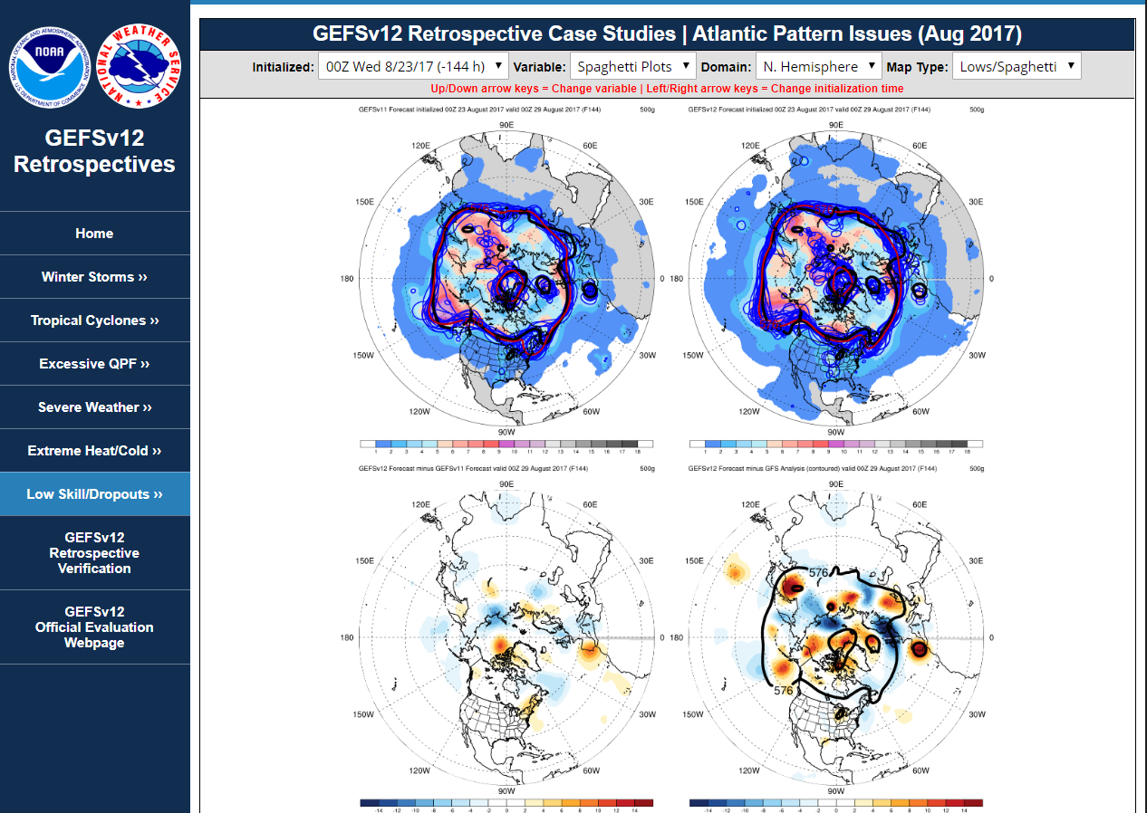
NATIONAL OCEANIC AND ATMOSPHERIC ADMINISTRATION
GEFSv12 Retrospectives: Low Skill/Dropouts
https://www.emc.ncep.noaa.gov/users/meg/gefsv12/retros/

Slide 11
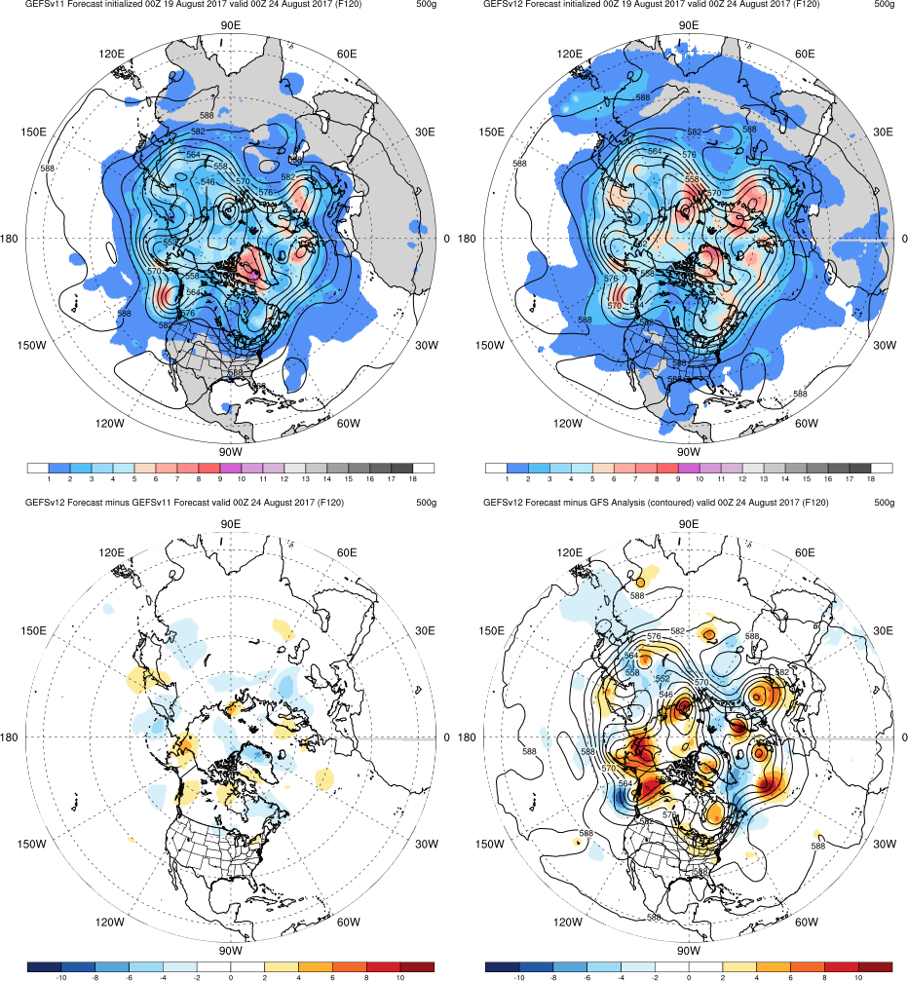
NATIONAL OCEANIC AND ATMOSPHERIC ADMINISTRATION
GEFSv12 Retrospectives: Low Skill/Dropouts
GEFSv11
GEFSv12
Top: Mean (contours)
Spread (shaded)
Graphics Setup
Bottom Left: GEFSv12−GEFSv11 (shaded)
v12−v11
GFS Anl.
Bottom Right: GFS analysis (contours)
GEFSv12−GFS analysis (shaded)

Slide 12
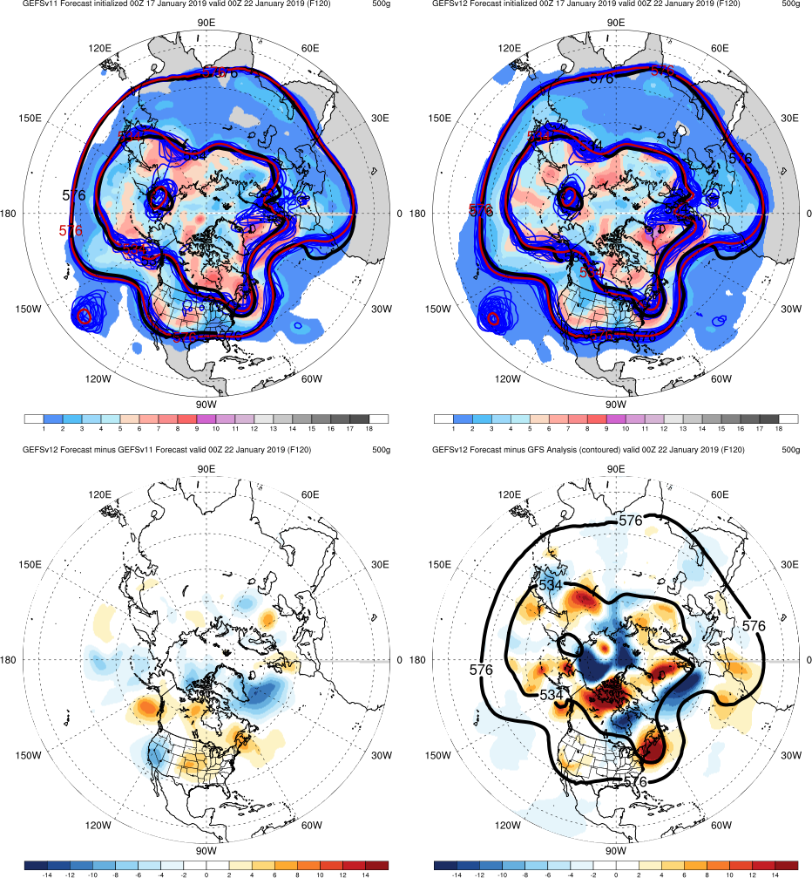
NATIONAL OCEANIC AND ATMOSPHERIC ADMINISTRATION
GEFSv12 Retrospectives: Low Skill/Dropouts
GEFSv11
GEFSv12
Top: Ensemble Mean (contours)
Ensemble Members (contours)
GFS analysis (contours)
Spread (shaded)
Graphics Setup
Bottom Left: GEFSv12−GEFSv11 (shaded)
Example of 500-hPa spaghetti plot with 576-dam and 534-dam forecast and analysis contours
v12−v11
GFS Anl.
Bottom Right: GFS analysis (contours)
GEFSv12−GFS analysis (shaded)

Slide 13
NATIONAL OCEANIC AND ATMOSPHERIC ADMINISTRATION
GEFSv12 Retrospectives: Low Skill/Dropouts
Low Skill Cases
Atlantic Pattern Issues (Aug 2017)
North America Pattern Issues (Sep 2017)
Low Skill Period (Feb 2018)
Western U.S. Pattern Issues (Dec 2018)
Low Skill Period (Jan 2019)

Slide 14
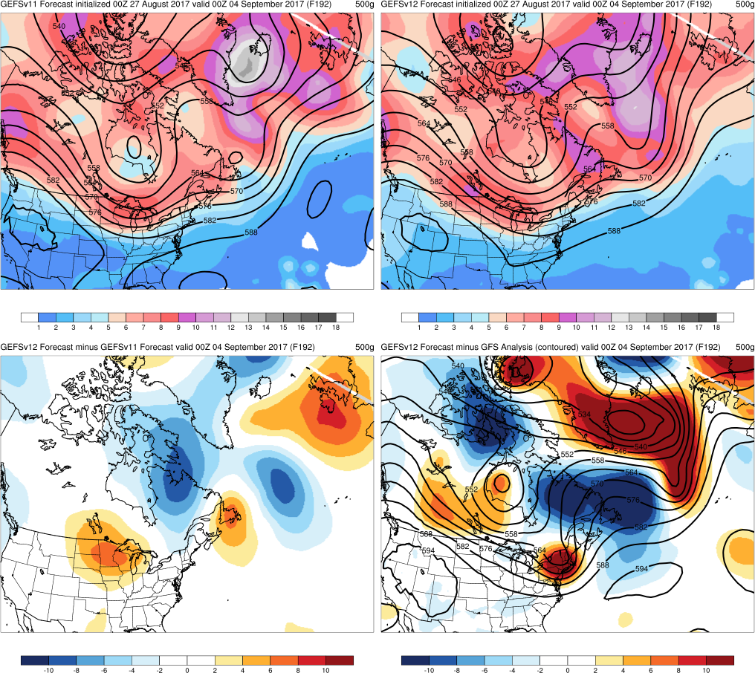
Atlantic Pattern Issues
GEFSv11
GEFSv12
Init.: 00Z 8/27/2017 (F192)
GEFSv12 has a more accurate trough/ridge/trough pattern over North America/Atlantic than GEFSv11 (accurately more progressive)
v12−v11
GFS Anl.

Slide 15
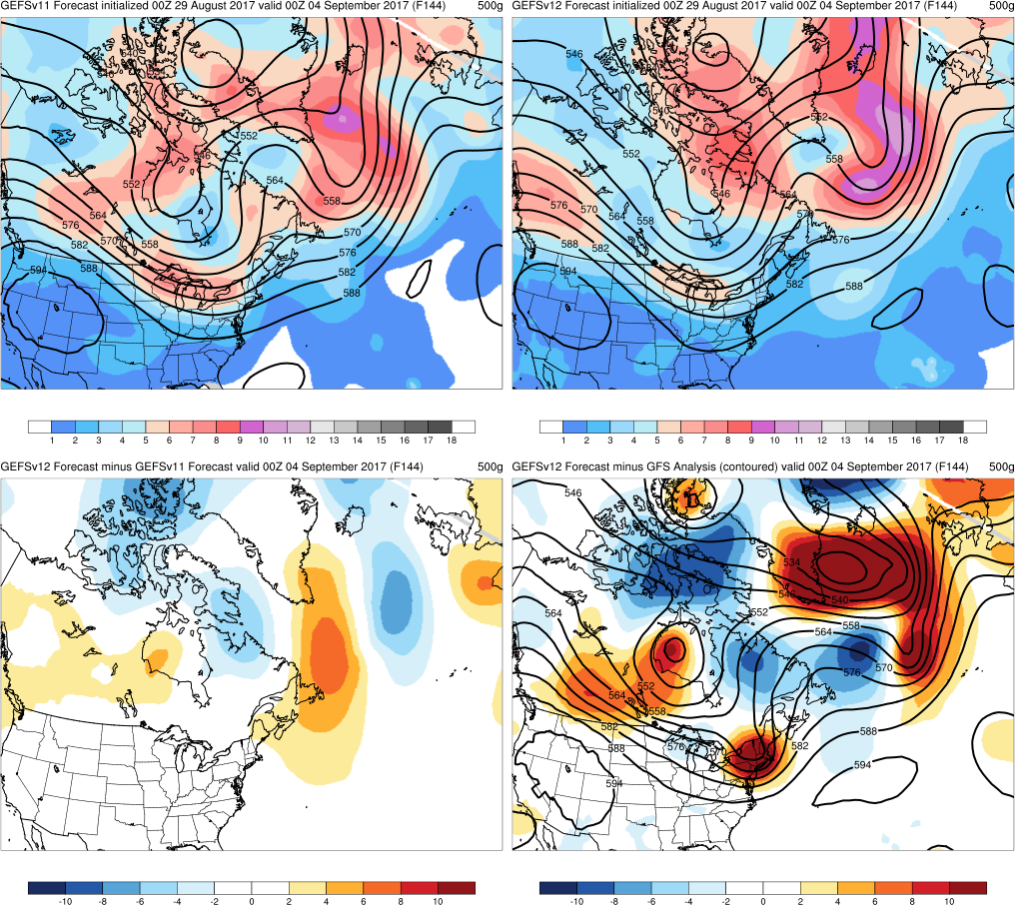
Atlantic Pattern Issues
GEFSv11
GEFSv12
Init.: 00Z 8/29/2017 (F144)
The GEFSv11 pattern is more tilted, but GEFSv12 is better with the location of the ridge and trough in the North Atlantic
v12−v11
GFS Anl.

Slide 16
NATIONAL OCEANIC AND ATMOSPHERIC ADMINISTRATION
GEFSv12 Retrospectives: Low Skill/Dropouts
Low Skill Cases
Atlantic Pattern Issues (Aug 2017)
North America Pattern Issues (Sep 2017)
Low Skill Period (Feb 2018)
Western U.S. Pattern Issues (Dec 2018)
Low Skill Period (Jan 2019)

Slide 17
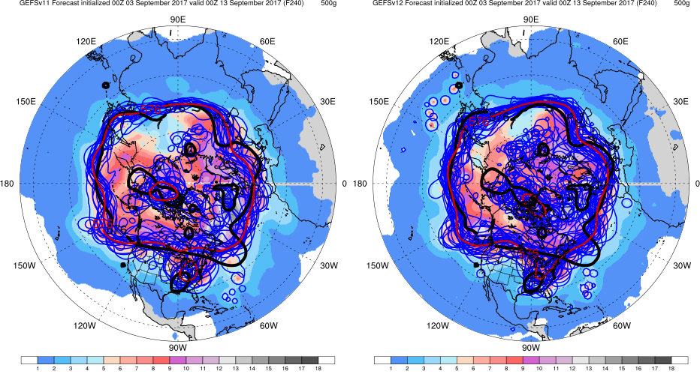
N. America Pattern Issues
Init.: 00Z 9/3/2017 (F240)
GEFSv11
GEFSv12
GEFSv11 mean forecasts a cutoff over OH while GEFSv12 does not (observed from F240-F192)
One GEFSv12 member correctly forecasts a small cutoff near CA coast

Slide 18
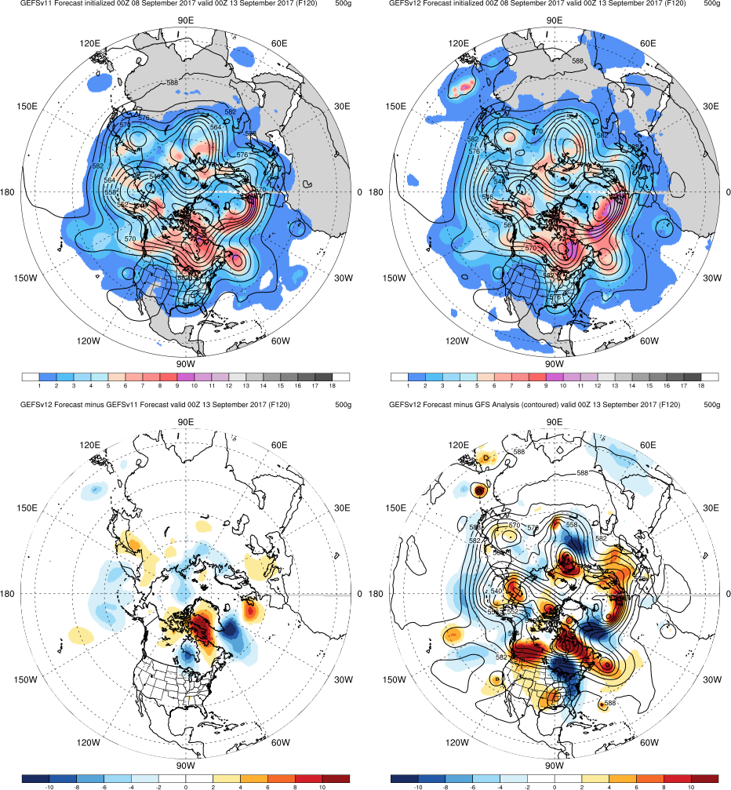
GEFSv11
GEFSv12
N. America Pattern Issues
Init.: 00Z 9/8/2017 (F120)
GEFSv12 and GEFSv11 have similar cutoff/trough features over eastern and western North America
However, GEFSv11 forecasts a cutoff feature within the trough over the SE U.S. (slightly more indication of a cyclone) while GEFSv12 only forecasts the trough
v12−v11
GFS Anl.

Slide 19
NATIONAL OCEANIC AND ATMOSPHERIC ADMINISTRATION
GEFSv12 Retrospectives: Low Skill/Dropouts
Low Skill Cases
Atlantic Pattern Issues (Aug 2017)
North America Pattern Issues (Sep 2017)
Low Skill Period (Feb 2018)
Western U.S. Pattern Issues (Dec 2018)
Low Skill Period (Jan 2019)

Slide 20
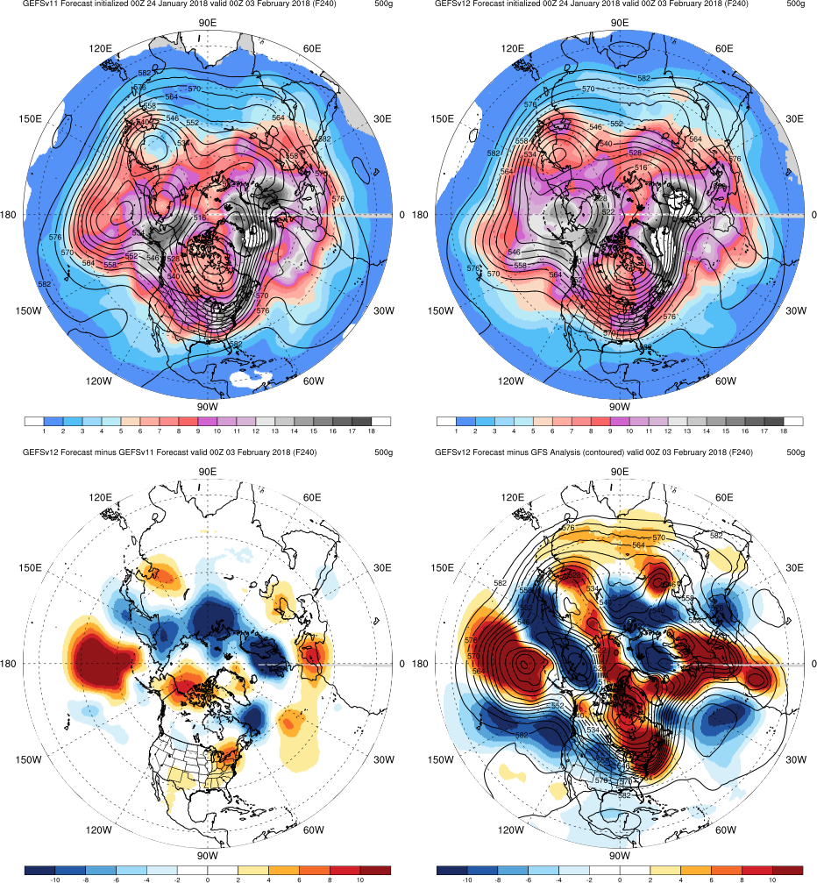
GEFSv11
GEFSv12
Feb 2018 Low Skill
Init.: 00Z 1/24/2018 (F240)
GEFSv11 forecasts a cutoff low south of the Aleutian Islands while GEFSv12 does not
GEFSv12 is more progressive with the ridge/trough pattern in the Atlantic while GEFSv11 pattern is out-of-phase; both too slow with trough over NW Africa
Neither GEFSv12 nor GEFSv11 forecast the narrow trough near the Caspian Sea
v12−v11
GFS Anl.

Slide 21
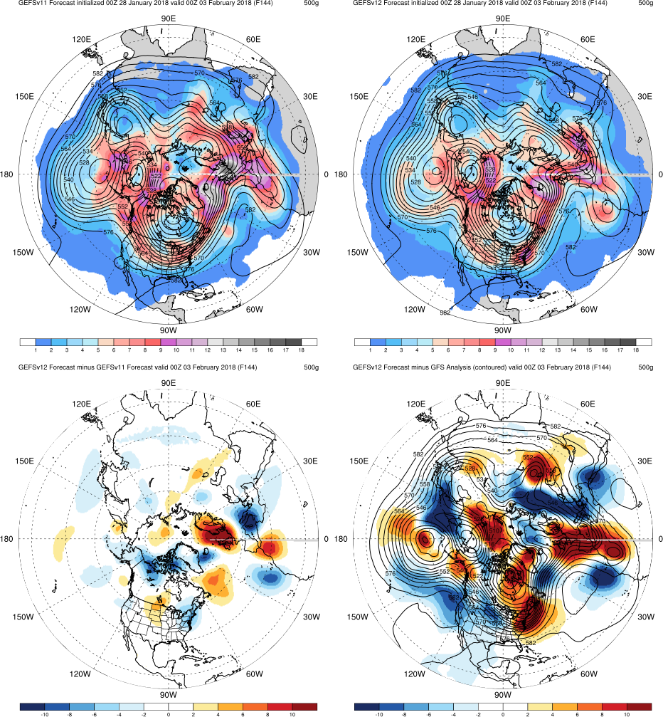
GEFSv11
GEFSv12
Feb 2018 Low Skill
Init.: 00Z 1/28/2018 (F144)
Both GEFSv12 and GEFSv11 forecast a cutoff low south of the Aleutian Islands
GEFSv11 is slightly better with the ridge/trough pattern orientation in the Atlantic, although GEFSv12 indicates cutoff within trough; both too slow with trough over NW Africa
GEFSv11 has a slightly more defined trough near the Caspian Sea than GEFSv12
v12−v11
GFS Anl.

Slide 22
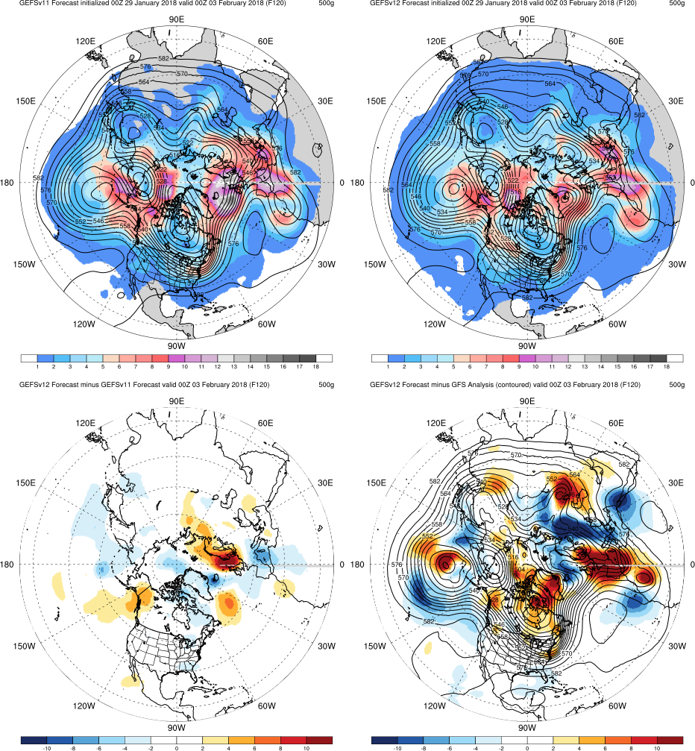
GEFSv11
GEFSv12
Feb 2018 Low Skill
Init.: 00Z 1/29/2018 (F120)
GEFSv12 forecasts a more defined cutoff low south of the Aleutian Islands than GEFSv11
GEFSv11 indicates cutoff within trough while GEFSv12 interior trough contour is better placed inland; both too slow with trough over NW Africa
GEFSv11 has a slightly more defined trough near the Caspian Sea than GEFSv12
v12−v11
GFS Anl.

Slide 23
NATIONAL OCEANIC AND ATMOSPHERIC ADMINISTRATION
GEFSv12 Retrospectives: Low Skill/Dropouts
Low Skill Cases
Atlantic Pattern Issues (Aug 2017)
North America Pattern Issues (Sep 2017)
Low Skill Period (Feb 2018)
Western U.S. Pattern Issues (Dec 2018)
Low Skill Period (Jan 2019)

Slide 24
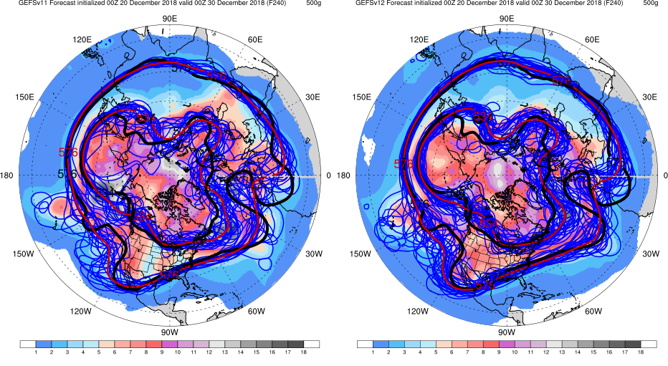
Western U.S. Pattern Issues
Init.: 00Z 12/20/2018 (F240)
GEFSv11
GEFSv12
Both GEFSv12 and GEFSv11 completely miss the trough/ridge pattern off the U.S. west coast
Both GEFSv12 and GEFSv11 are too progressive with 534-dam ridge

Slide 25
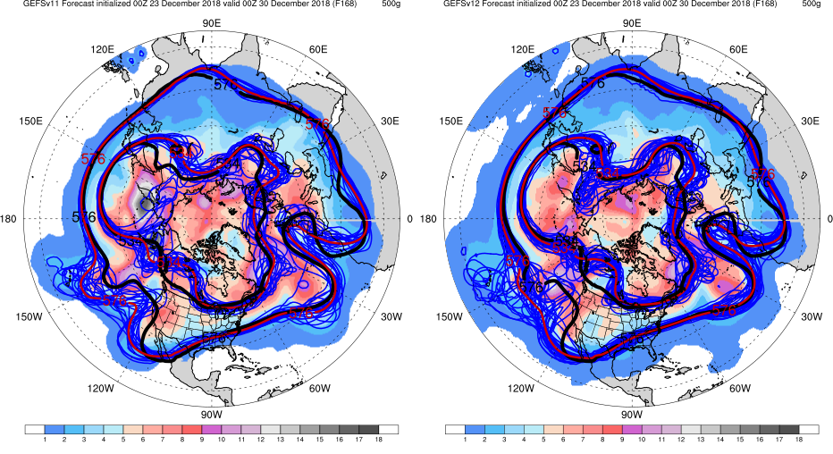
Western U.S. Pattern Issues
Init.: 00Z 12/23/2018 (F168)
GEFSv11
GEFSv12
GEFSv11 576-dam mean better forecasts the trough/ridge pattern off the U.S. west coast
GEFSv12 trough/ridge pattern is much less amplified (almost zonal)

Slide 26
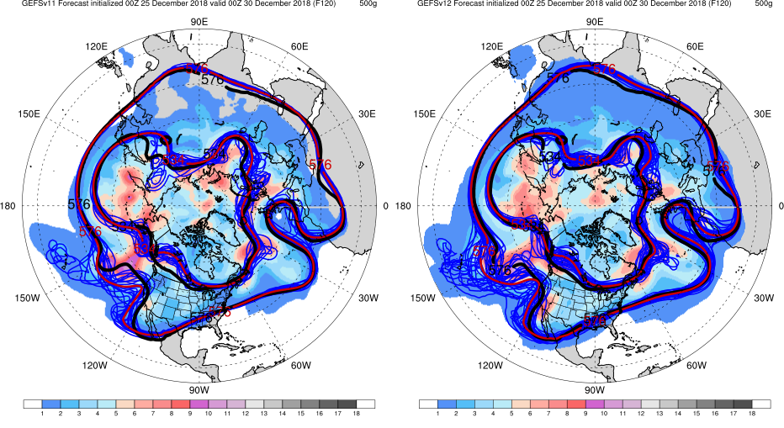
Western U.S. Pattern Issues
Init.: 00Z 12/25/2018 (F120)
GEFSv11
GEFSv12
GEFSv12 576-dam trough axis better aligns with analysis; slightly wider ridge than GEFSv11
GEFSv11 trough base is displaced and ridge is more narrow

Slide 27
NATIONAL OCEANIC AND ATMOSPHERIC ADMINISTRATION
GEFSv12 Retrospectives: Low Skill/Dropouts
Low Skill Cases
Atlantic Pattern Issues (Aug 2017)
North America Pattern Issues (Sep 2017)
Low Skill Period (Feb 2018)
Western U.S. Pattern Issues (Dec 2018)
Low Skill Period (Jan 2019)

Slide 28
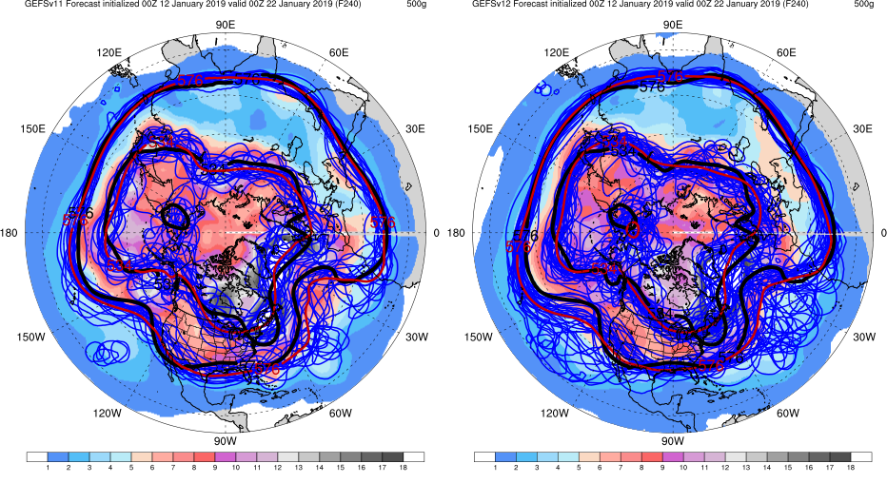
Jan 2019 Low Skill
Init.: 00Z 1/12/2019 (F240)
GEFSv11
GEFSv12
GEFSv12 and GEFSv11 have similar broad trough over North America (534-dam mean)
GEFSv11 has more amplified 576-dam ridge in the Atlantic

Slide 29
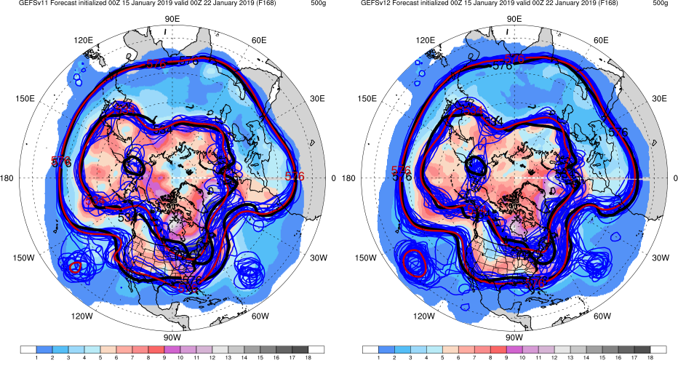
Jan 2019 Low Skill
Init.: 00Z 1/15/2019 (F168)
GEFSv11
GEFSv12
The 534-dam trough axis over North America in GEFSv12 is more accurately shifted to the east
GEFSv12 has a 576-dam pattern closer to analysis

Slide 30
Jan 2019 Low Skill
Init.: 00Z 1/17/2019 (F120)
GEFSv11
GEFSv12
The base of the 534-dam trough in GEFSv11 is closer to analysis over NE U.S.
GEFSv11 has a more accurate 576-dam ridge pattern in the Atlantic

Slide 31
NATIONAL OCEANIC AND ATMOSPHERIC ADMINISTRATION
GEFSv12 Low Skill/Dropouts: Summary
Overall, GEFSv12 forecasted the synoptic pattern as well or slightly better than GEFSv11 in the examined cases
For the Atlantic Pattern Issues case, GEFSv12 was more progressive than GEFSv11 which improved the forecast
GEFSv12 and GEFSv11 forecast errors were commonly associated with trough/ridge/trough patterns over the northeast U.S. and Atlantic
In these examined cases, increased spread in GEFSv12 sometimes improved and sometimes degraded the synoptic pattern forecast (varied from cycle to cycle)
Improvements due to increased spread were more subtle in GEFSv12
Less spread in GEFSv11 sometimes worked to its advantage when members agreed on the correct solution
Consolidates NCEP/EMC verification and evaluation functions to efficiently and consistently support all modeling groups
Removes evaluation functions from the model science chain of command, ensuring independent model evaluations

