Slide 1
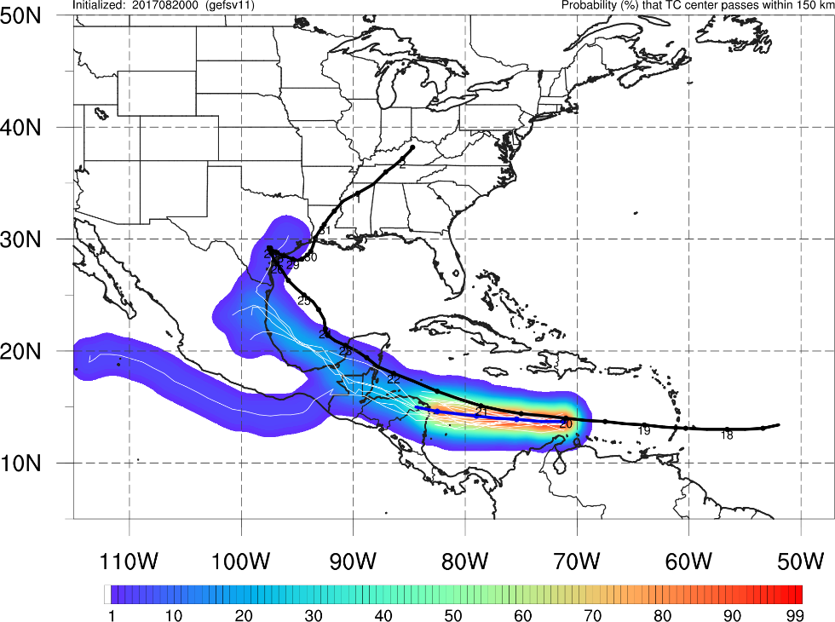
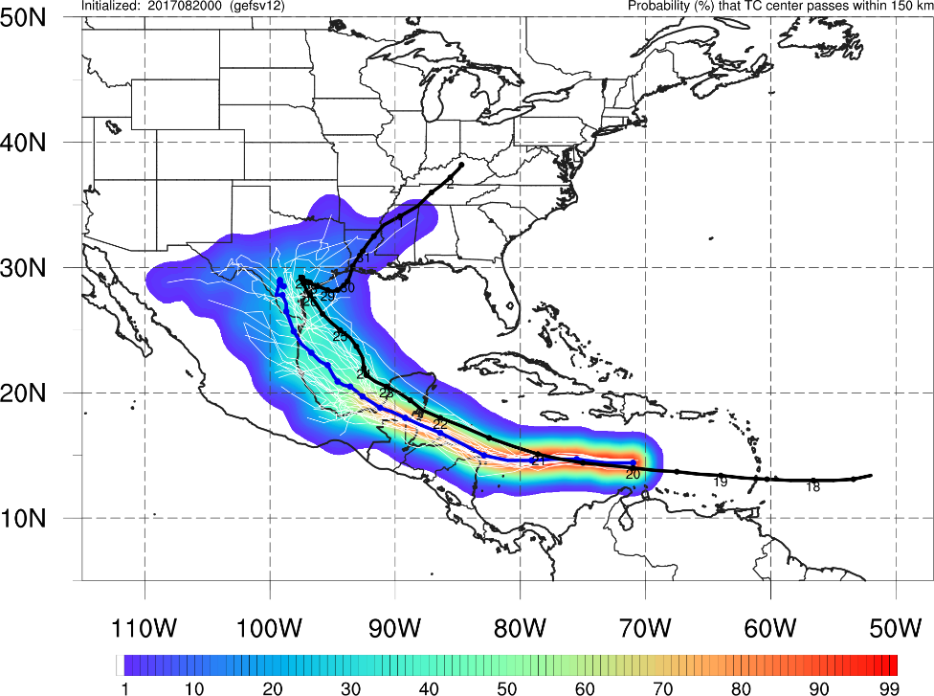
NATIONAL OCEANIC AND ATMOSPHERIC ADMINISTRATION
GEFSv12 Retrospective Case Studies: Tropical Cyclones
GEFSv11
GEFSv12
Shannon Shields and Alicia Bentley
EMC Model Evaluation Group Webinar
26 March 2020

Slide 2
NATIONAL OCEANIC AND ATMOSPHERIC ADMINISTRATION
GEFSv12 Tropical Cyclone Statistics
Periods of TC Verification
2017: 0000 UTC (06/01–11/30) 1200 UTC (07/01–10/31) 2018: 0000 UTC (05/01–11/30) 1200 UTC (07/01–10/31) 2019: 0000 UTC (05/01–11/30) 1200 UTC (07/01–10/31)
Special thanks to Jiayi Peng for generating the following graphics

Slide 3
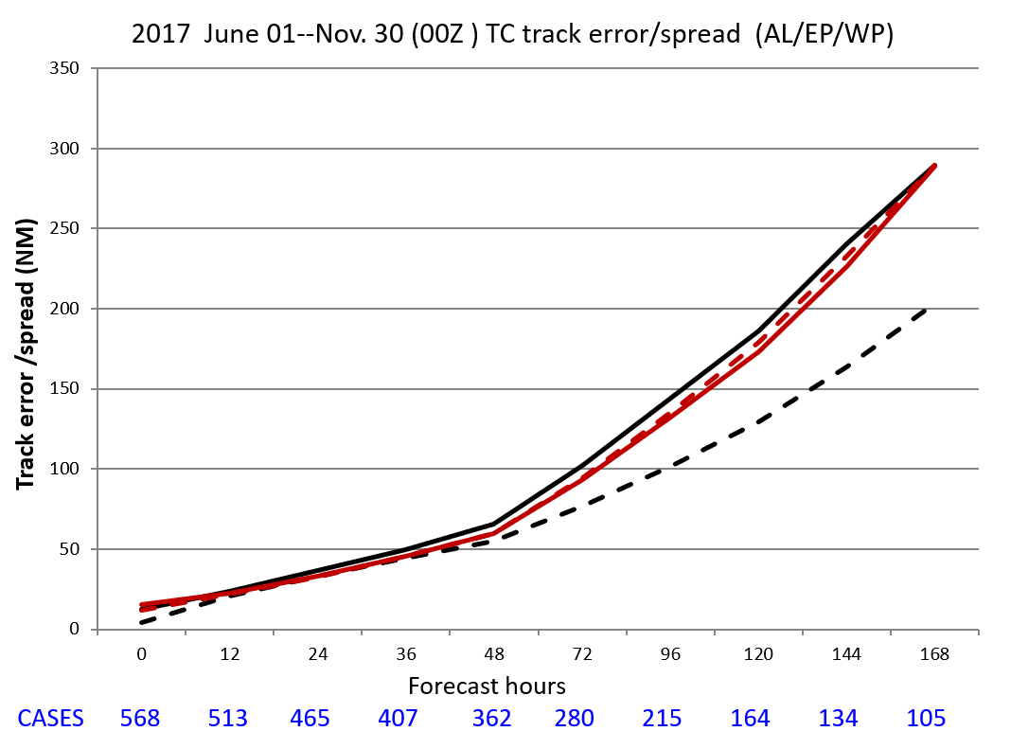
NATIONAL OCEANIC AND ATMOSPHERIC ADMINISTRATION
GEFSv12 Tropical Cyclone Statistics
Lower RMSE in GEFSv12 at most lead times (Days 2–6)
Increased spread in GEFSv12 at most lead times (Days 3–7)
GEFSv11 RMSE
GEFSv11 Spread GEFSv12 RMSE
GEFSv12 Spread

Slide 4
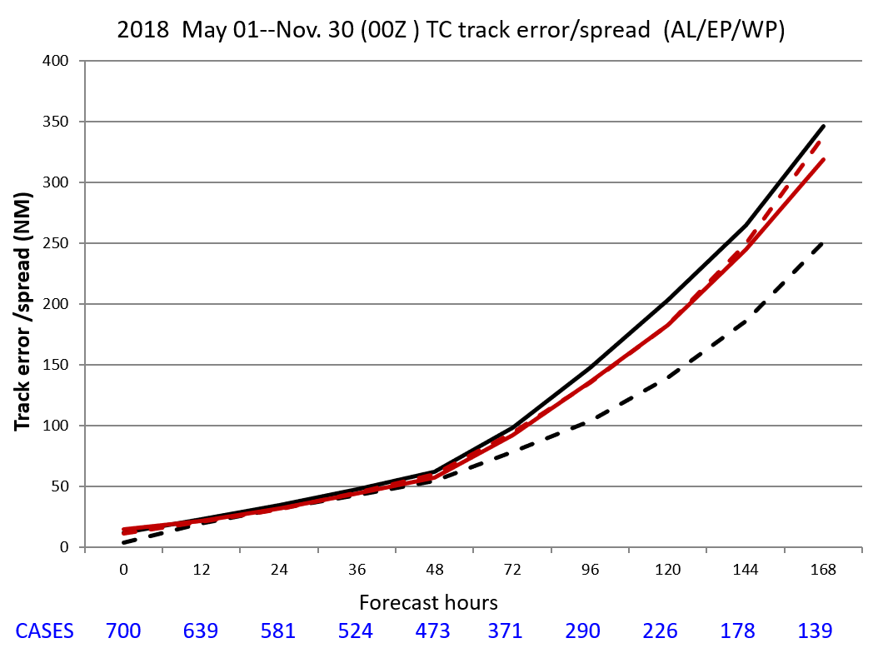
NATIONAL OCEANIC AND ATMOSPHERIC ADMINISTRATION
GEFSv12 Tropical Cyclone Statistics
Lower RMSE in GEFSv12 at most lead times (Days 3–7)
Increased spread in GEFSv12 at most lead times (Days 3–7)
GEFSv11 RMSE
GEFSv11 Spread GEFSv12 RMSE
GEFSv12 Spread

Slide 5
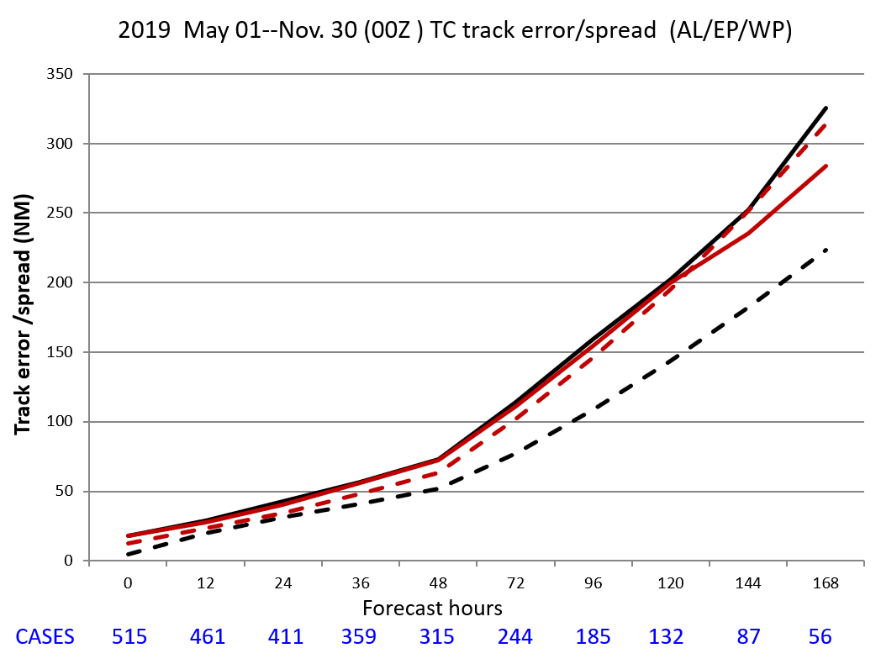
NATIONAL OCEANIC AND ATMOSPHERIC ADMINISTRATION
GEFSv12 Tropical Cyclone Statistics
Lower RMSE in GEFSv12 at longer lead times (Days 5–7)
Increased spread in GEFSv12 at most lead times (Days 2–7)
GEFSv11 RMSE
GEFSv11 Spread GEFSv12 RMSE
GEFSv12 Spread

Slide 6
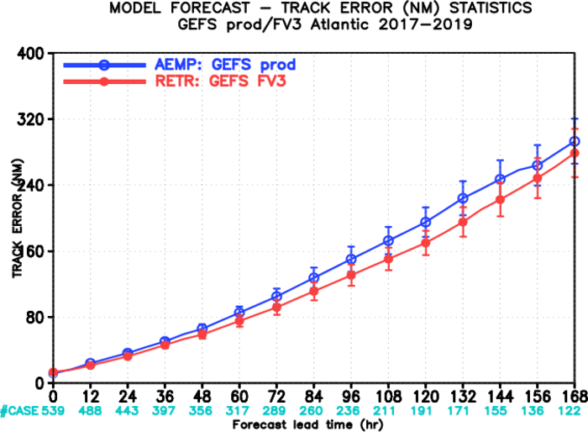
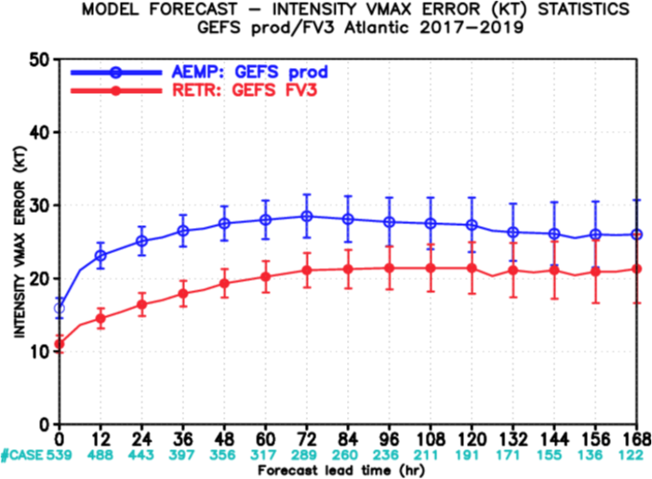
NATIONAL OCEANIC AND ATMOSPHERIC ADMINISTRATION
GEFSv12 Tropical Cyclone Statistics
NATL Track Error
NATL Intensity Error
GEFSv12 has less track and intensity error than GEFSv11 at all lead times
GEFSv12 intensity forecasts are S.S. better than GEFSv11 at shorter lead times

Slide 7
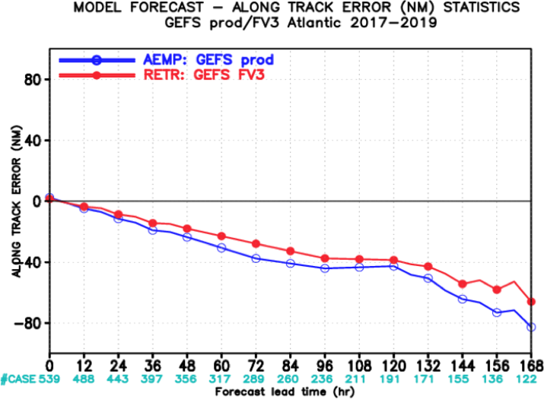
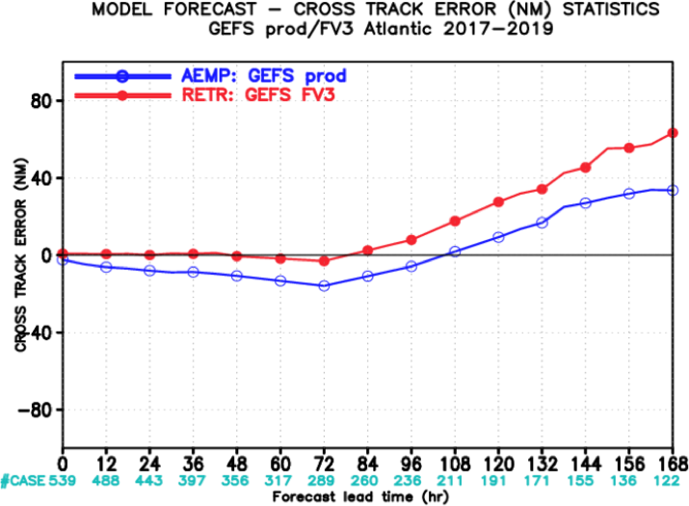
NATIONAL OCEANIC AND ATMOSPHERIC ADMINISTRATION
GEFSv12 Tropical Cyclone Statistics
NATL Along Track Error
NATL Across Track Error
GEFSv12 has less along-track error than GEFSv11 (less of a slow bias)
GEFSv12 has more right-of-track error than GEFSv11 at longer lead times

Slide 8
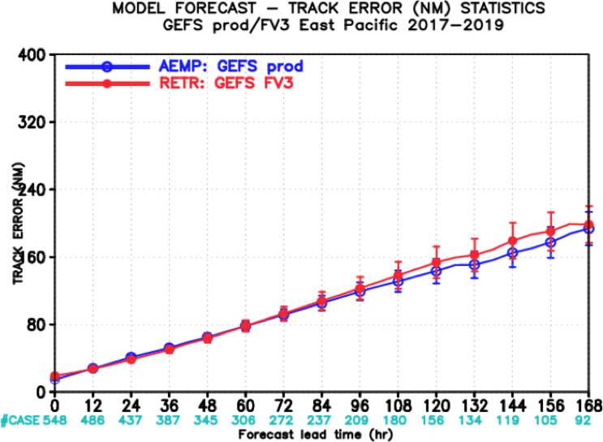
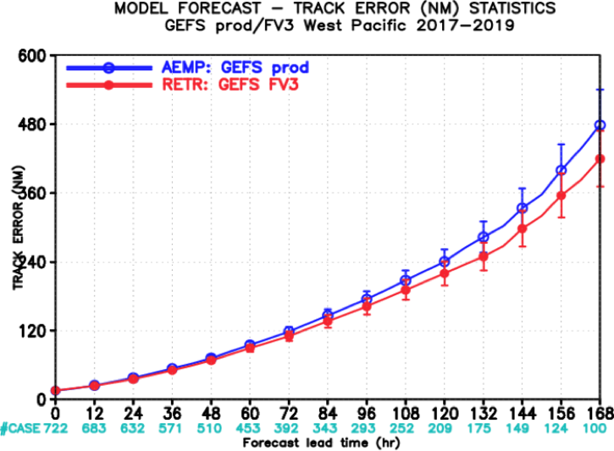
NATIONAL OCEANIC AND ATMOSPHERIC ADMINISTRATION
GEFSv12 Tropical Cyclone Statistics
EPAC Track Error
WPAC Track Error
GEFSv12 has comparable or slightly more track error than GEFSv11 (not SS) for EPAC
GEFSv12 has comparable or slightly less track error than GEFSv11 (not SS) for WPAC

Slide 9
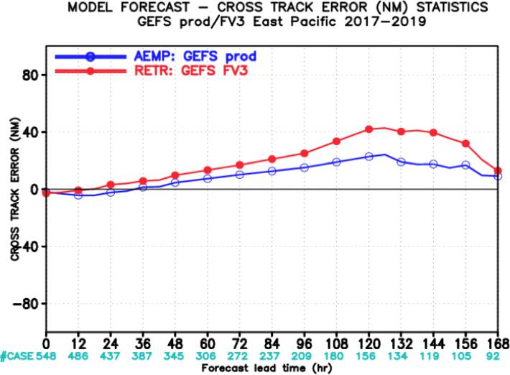
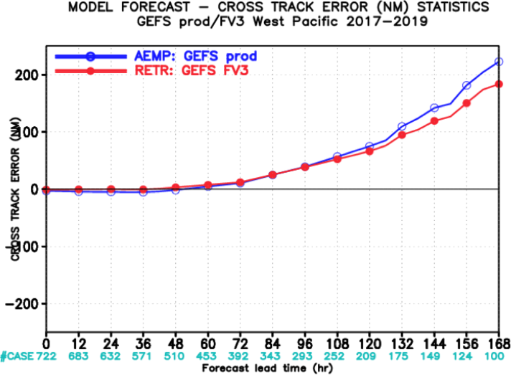
NATIONAL OCEANIC AND ATMOSPHERIC ADMINISTRATION
GEFSv12 Tropical Cyclone Statistics
EPAC Across Track Error
WPAC Across Track Error
GEFSv12 has more right-of-track error than GEFSv11 for EPAC
GEFSv12 has comparable or less right-of-track error than GEFSv11 for WPAC

Slide 10
NATIONAL OCEANIC AND ATMOSPHERIC ADMINISTRATION
GEFSv12 Verification Statistics: Summary
GEFSv12 has comparable or less TC track error than GEFSv11 in the NATL/WPAC, and comparable or slightly more track error in the EPAC
GEFSv12 has comparable or more right-of-track error than GEFSv11 in the NATL/EPAC, and comparable or less right-of-track error in the WPAC
GEFSv12 has more spread than GEFSv11 at most lead times for the combined NATL/EPAC/WPAC basins

Slide 11
NATIONAL OCEANIC AND ATMOSPHERIC ADMINISTRATION
GEFSv12 Retrospectives: Tropical Cyclones
GEFSv12 retrospectives initialized at 0000 UTC during 6/1/17–11/30/19
Extra hurricane initializations at 1200 UTC during 6/1–9/30 (2017, 2018, 2019)
GEFSv12 TC case studies:
Hurricane Noru (Jul/Aug 2017) Hurricane Barry (July 2019)
Hurricane Harvey (Aug 2017) Hurricane Dorian (Aug/Sep 2019)
Hurricane Irma (Sep 2017)
Hurricane Maria (Sep 2017)
Hurricane Nate (Sep/Oct 2017)
Tropical Storm Alberto (May 2018)
Hurricane Lane (Aug 2018)
Hurricane Florence (Sep 2018)
Hurricane Walaka (Sep/Oct 2018)
Hurricane Michael (Oct 2018)
Consolidates NCEP/EMC verification and evaluation functions to efficiently and consistently support all modeling groups
Removes evaluation functions from the model science chain of command, ensuring independent model evaluations

Slide 12
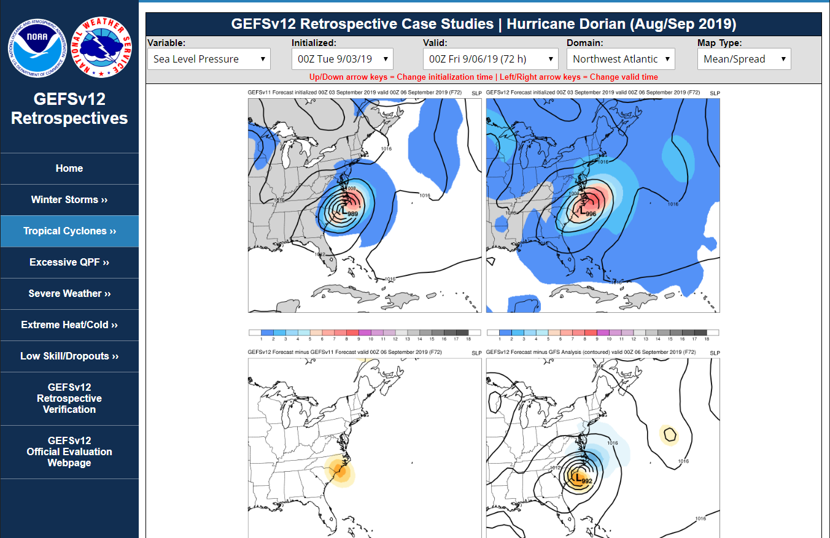
NATIONAL OCEANIC AND ATMOSPHERIC ADMINISTRATION
GEFSv12 Retrospectives: Tropical Cyclones
https://www.emc.ncep.noaa.gov/users/meg/gefsv12/retros/

Slide 13
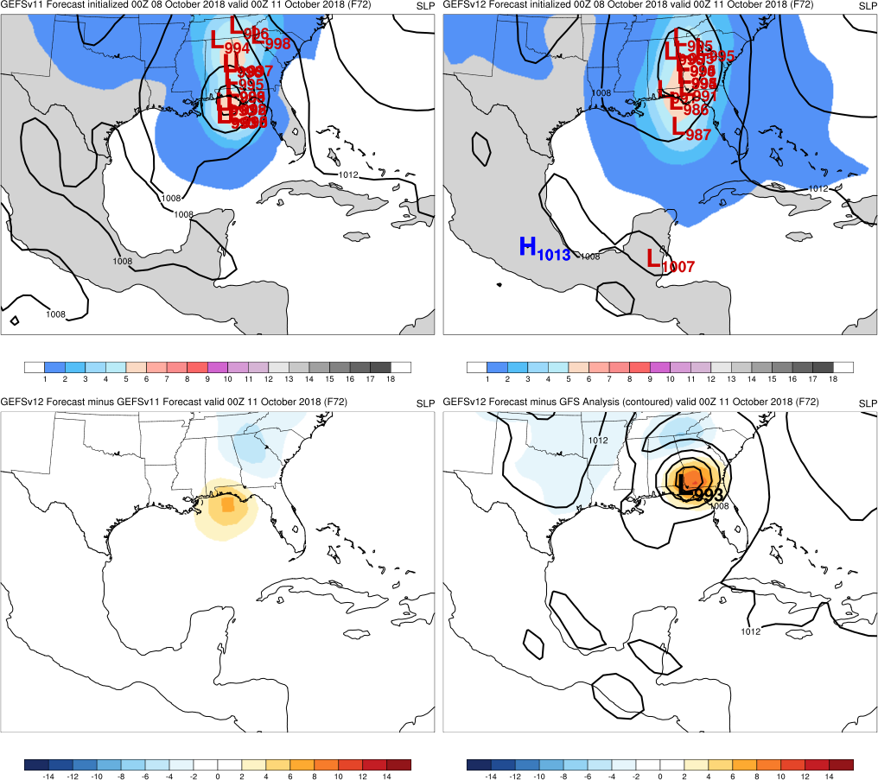
NATIONAL OCEANIC AND ATMOSPHERIC ADMINISTRATION
GEFSv12 Retrospectives: Tropical Cyclones
Top: Mean (contours)
Spread (shaded)
Low Locations
Graphics Setup
GEFSv11
GEFSv12
Bottom Left: GEFSv12−GEFSv11 (shaded)
Bottom Right: GFS analysis (contours)
GEFSv12−GFS analysis (shaded)
v12−v11
GFS Anl.

Slide 14
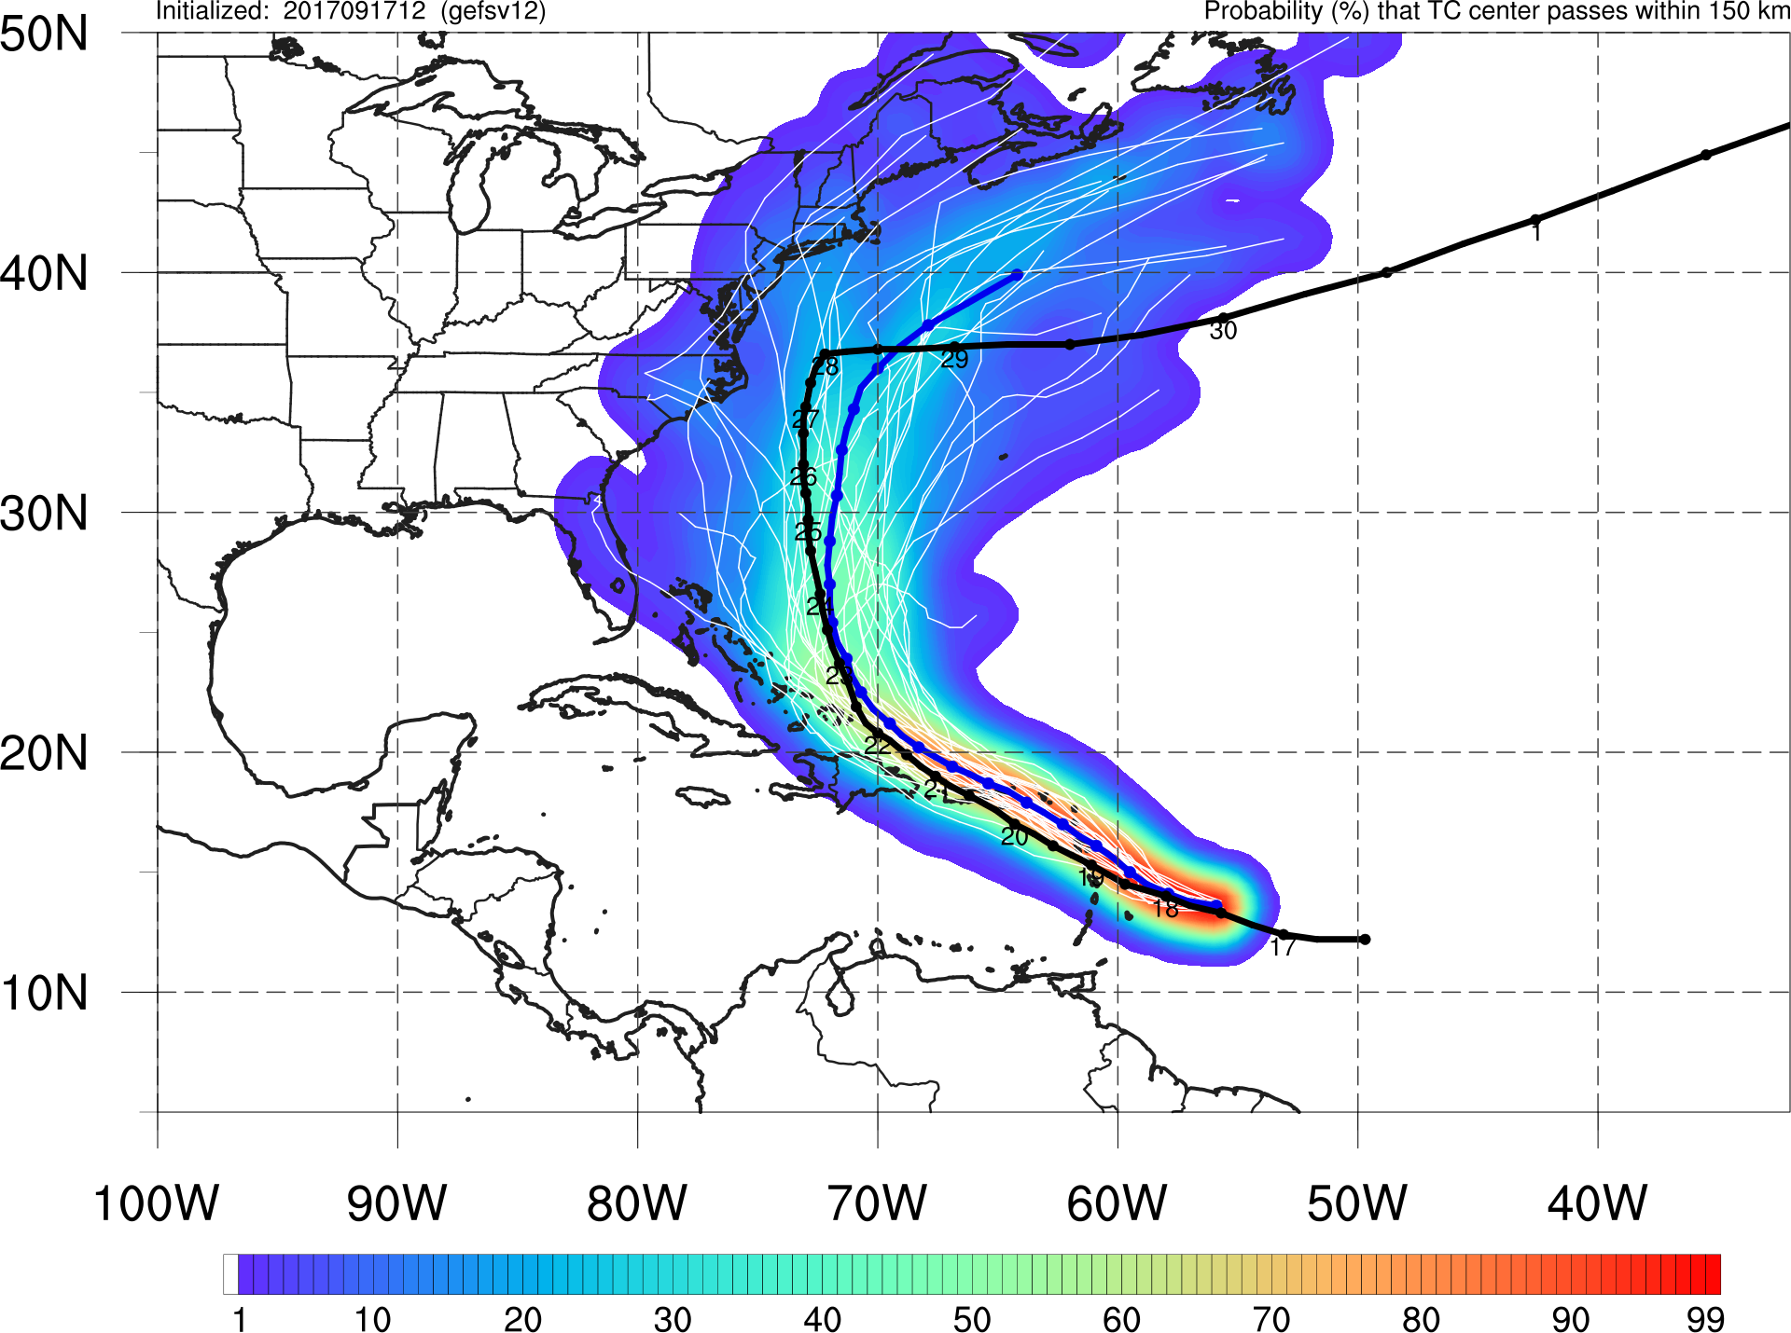
NATIONAL OCEANIC AND ATMOSPHERIC ADMINISTRATION
GEFSv12 Retrospectives: Tropical Cyclones
GEFSv12
Graphics Setup
Ensemble Member Track

Slide 15
NATIONAL OCEANIC AND ATMOSPHERIC ADMINISTRATION
GEFSv12 Tropical Cyclone Highlights
GEFSv12 Wins
Hurricane Harvey (Aug 2017)
Hurricane Dorian (Aug/Sep 2019)
Hurricane Noru (Jul/Aug 2017)

Slide 16
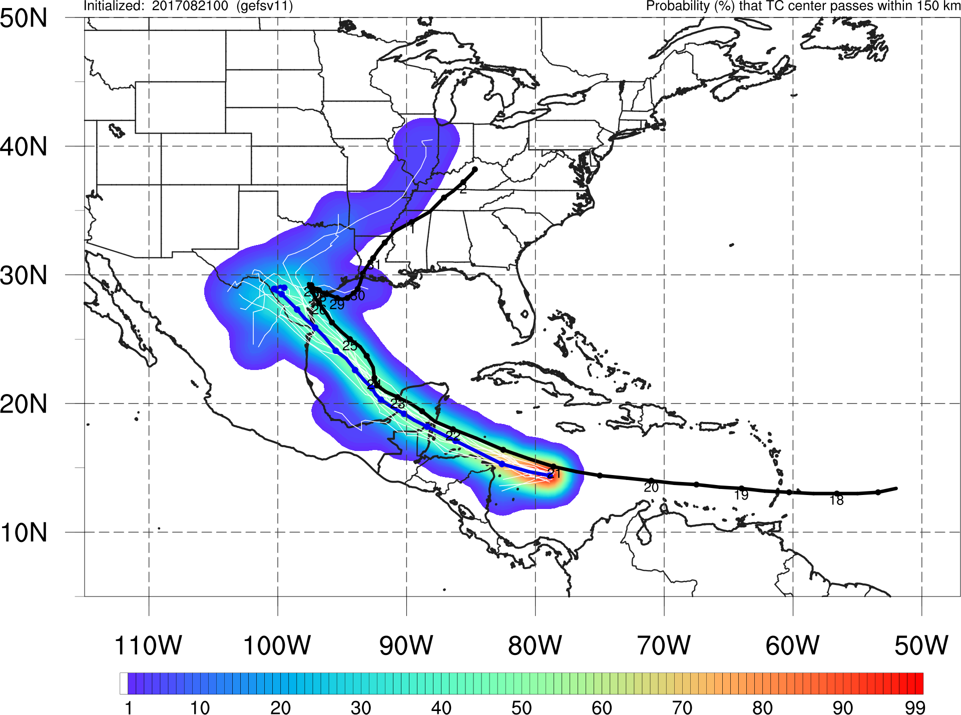
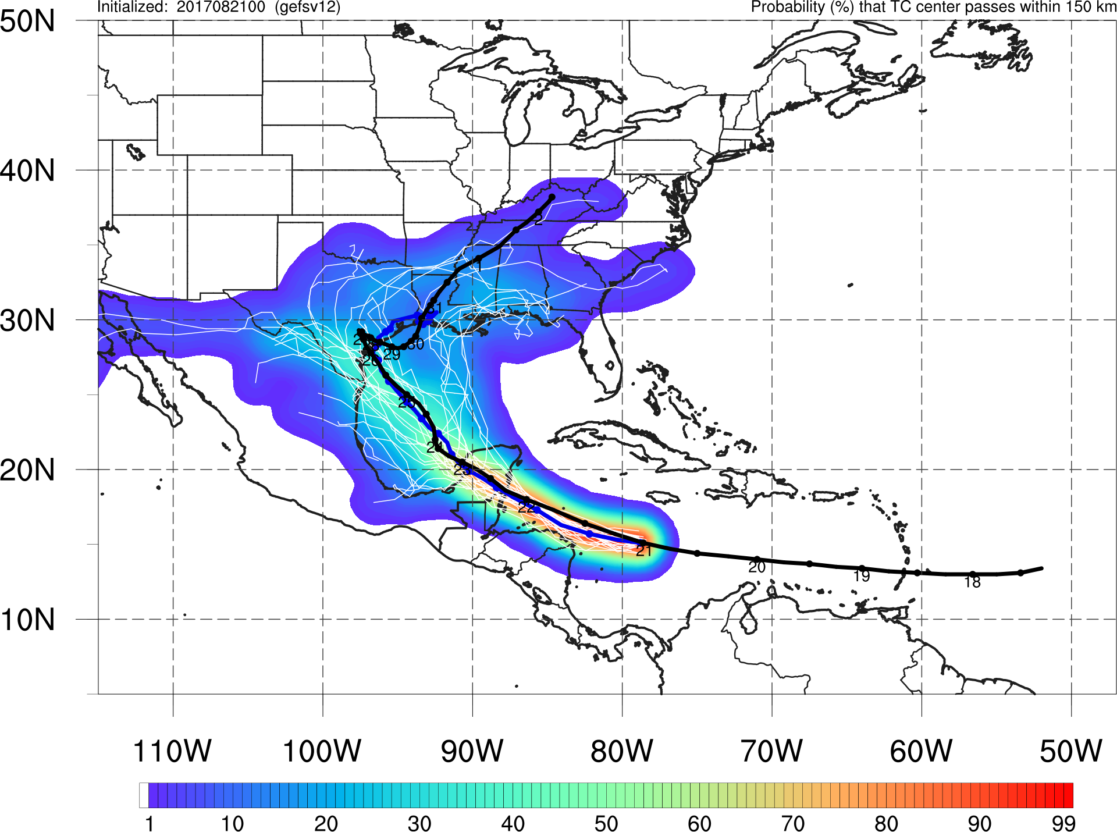
Hurricane Harvey
Init.: 00Z 8/21/2017
GEFSv11
GEFSv12
GEFSv12 mean track is an improvement over GEFSv11 and captures landfall better
Best Track is contained within GEFSv12 envelope vs. outside GEFSv11 envelope

Slide 17
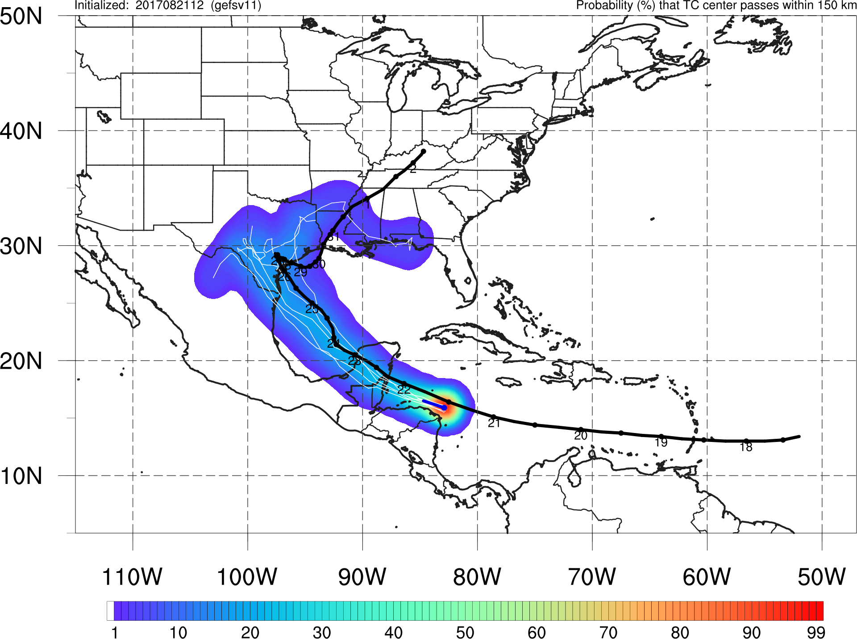
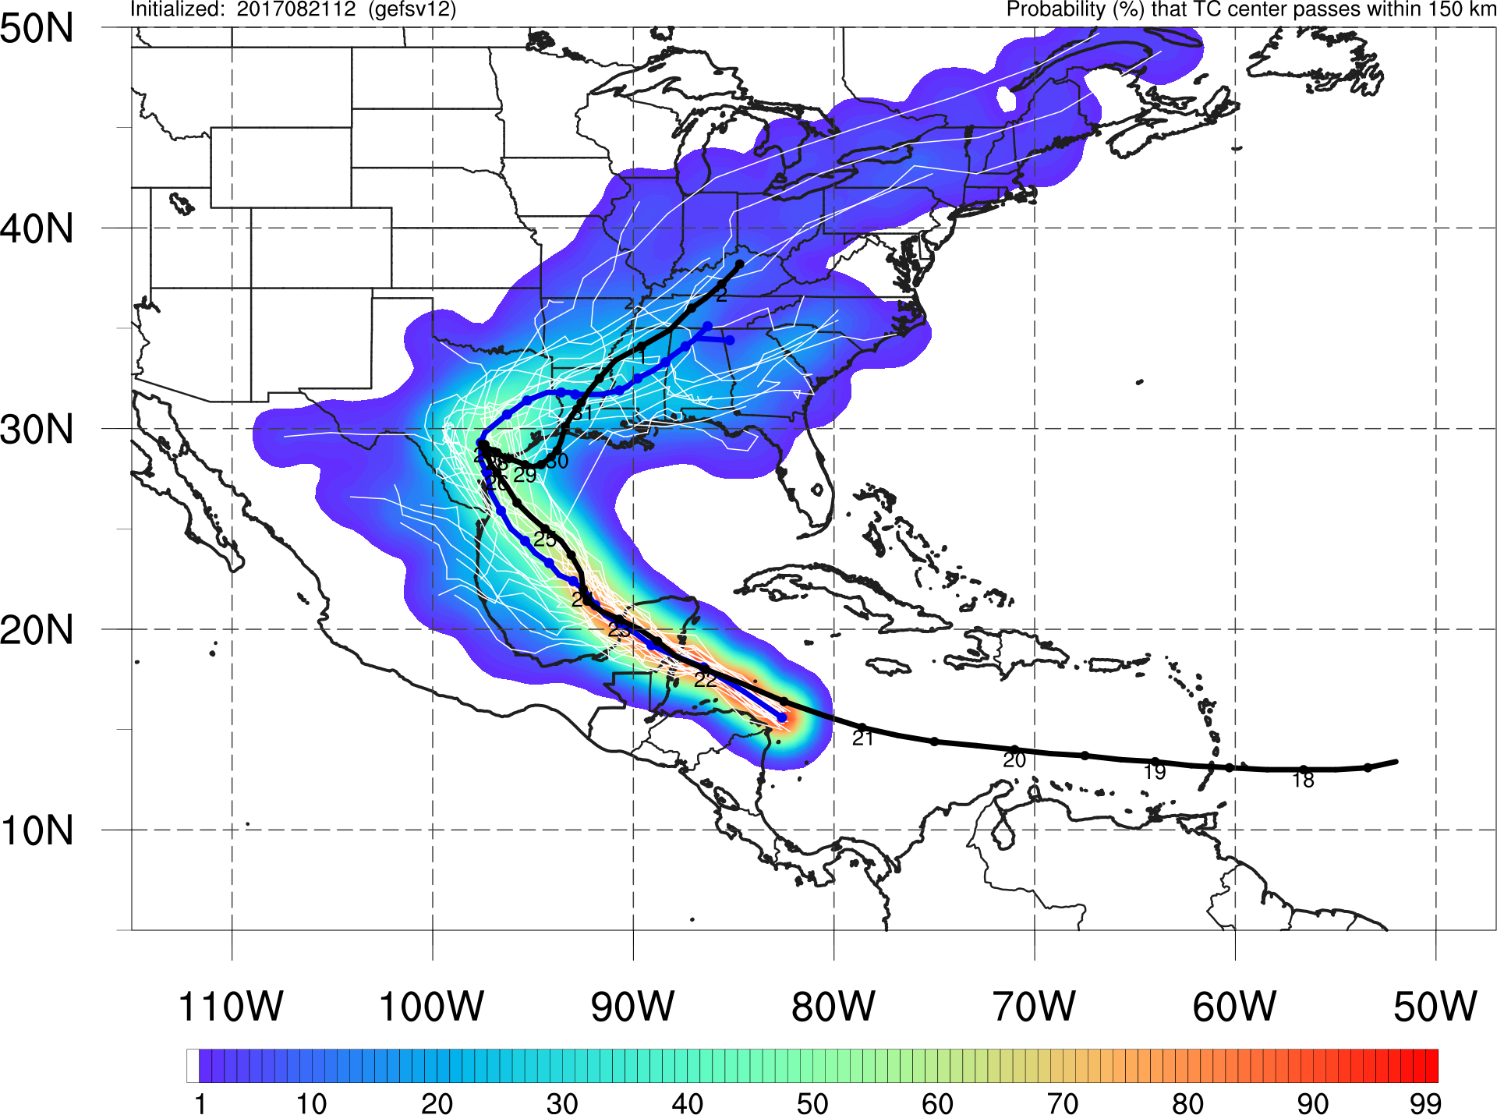
Hurricane Harvey
Init.: 12Z 8/21/2017
GEFSv11
GEFSv12
Many GEFSv12 members cross the Yucatan and track north towards TX, while only a few GEFSv11 members make it across the Yucatan
GEFSv12 contains the Best Track in its envelope better than GEFSv11

Slide 18
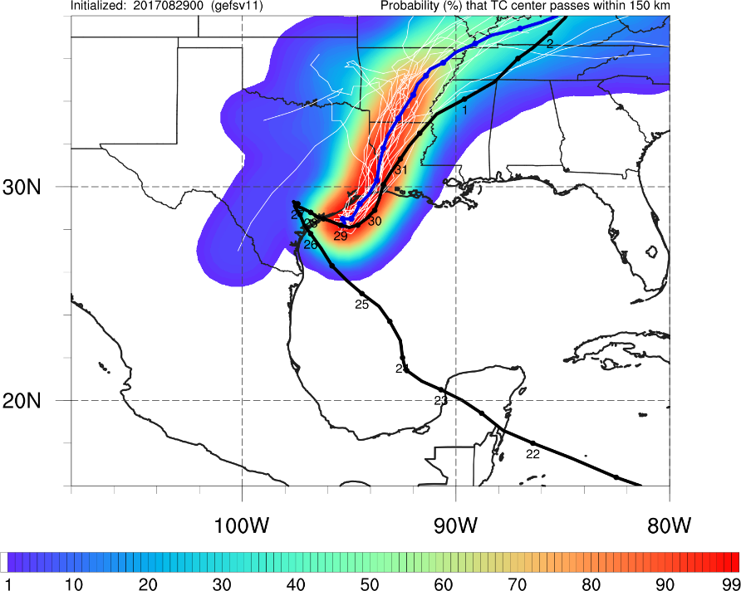
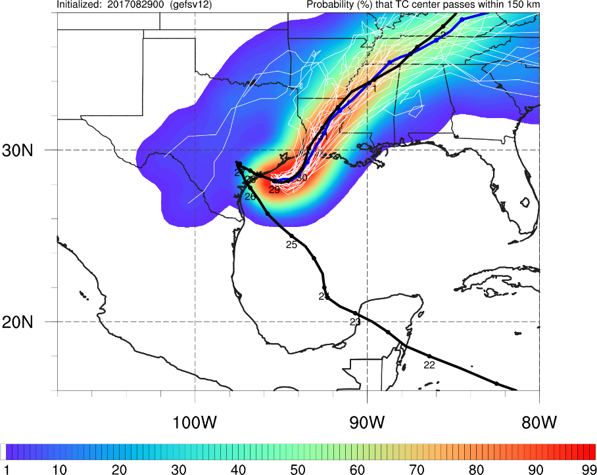
Hurricane Harvey
Init.: 00Z 8/29/2017
GEFSv11
GEFSv12
After Harvey goes back out over the Gulf, GEFSv12 is much better with track; Best Track ends up almost outside of the GEFSv11 envelope

Slide 19
NATIONAL OCEANIC AND ATMOSPHERIC ADMINISTRATION
GEFSv12 Tropical Cyclone Highlights
GEFSv12 Wins
Hurricane Harvey (Aug 2017)
Hurricane Dorian (Aug/Sep 2019)
Hurricane Noru (Jul/Aug 2017)

Slide 20
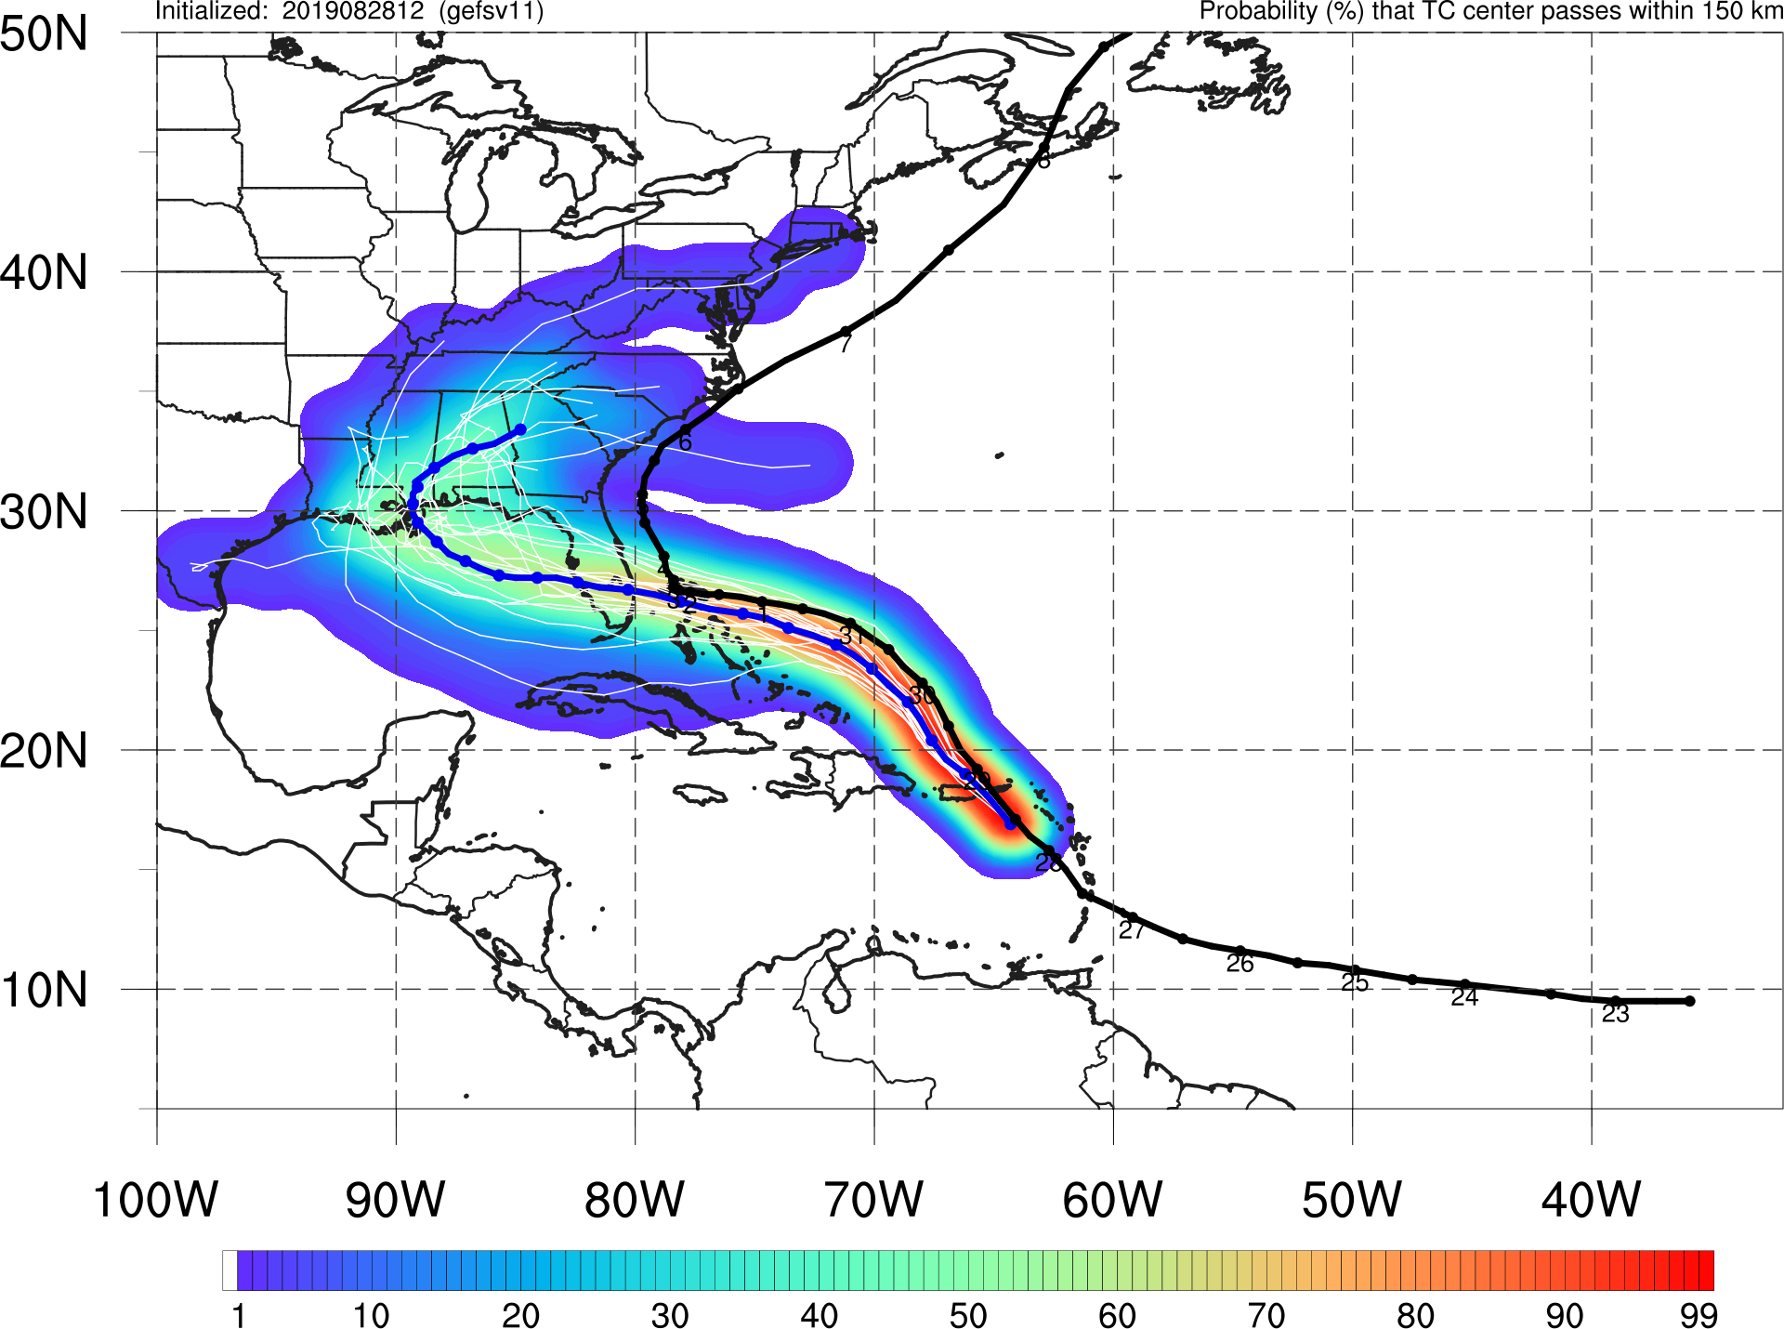
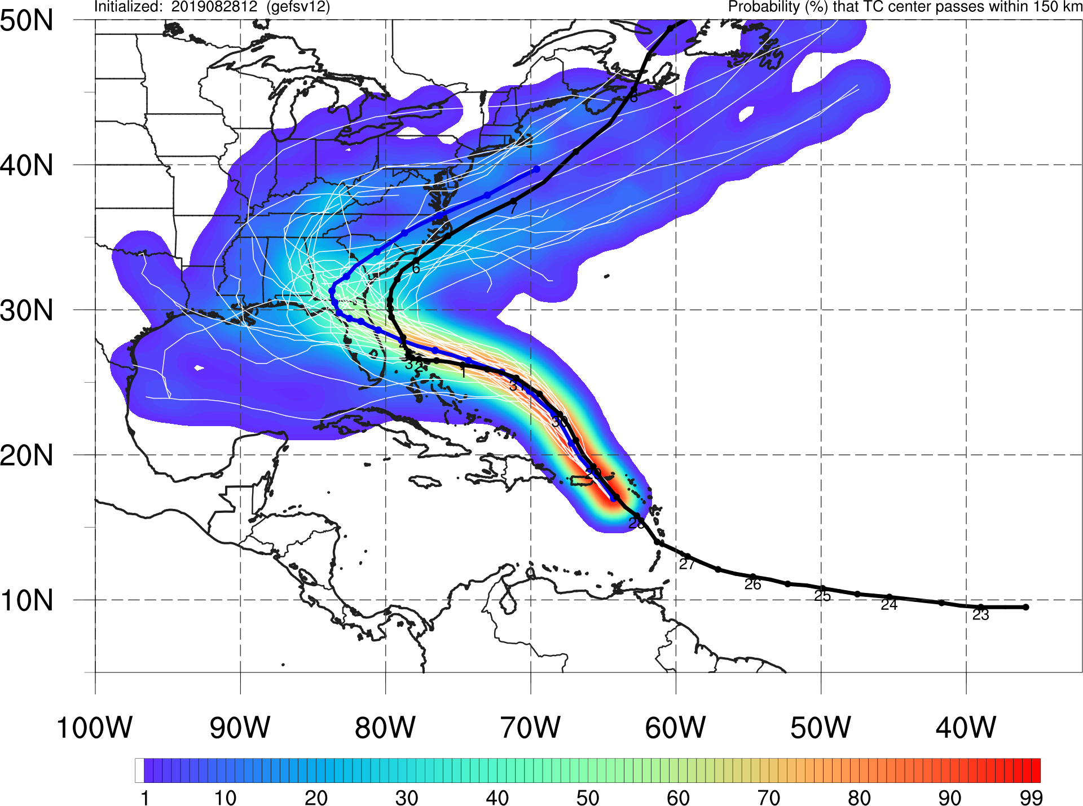
Hurricane Dorian
Init.: 12Z 8/28/2019
GEFSv11
GEFSv12
GEFSv11 is overconfident in an incorrect solution (Florida & Gulf Coast landfalls)
Even though the mean shows FL landfall, GEFSv12 has more spread with some
members beginning to show a totally offshore solution

Slide 21
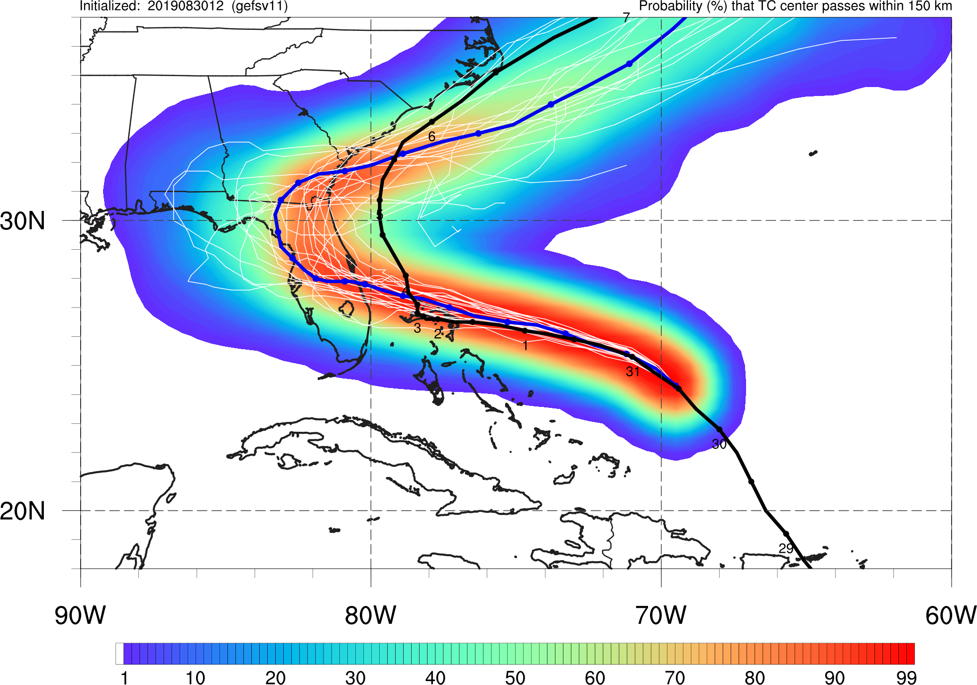
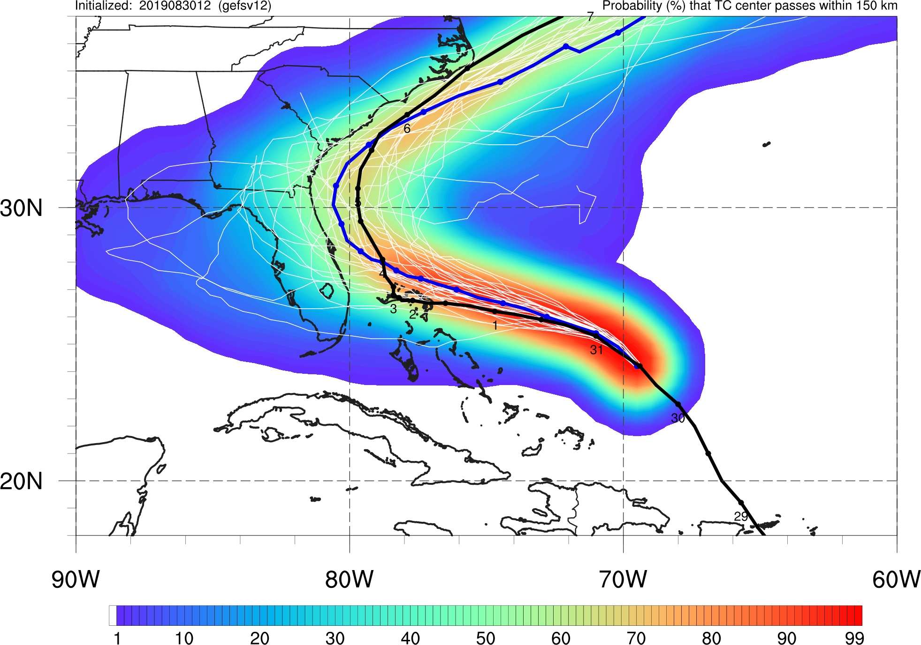
Hurricane Dorian
Init.: 12Z 8/30/2019
GEFSv11
GEFSv12
GEFSv11 is overconfident in an incorrect forecast showing FL landfall and part of the Best Track is outside of the envelope
GEFSv12 still shows potential for a FL/Gulf Coast landfall, but the mean track correctly stays offshore

Slide 22
NATIONAL OCEANIC AND ATMOSPHERIC ADMINISTRATION
GEFSv12 Tropical Cyclone Highlights
GEFSv12 Wins
Hurricane Harvey (Aug 2017)
Hurricane Dorian (Aug/Sep 2019)
Hurricane Noru (Jul/Aug 2017)

Slide 23
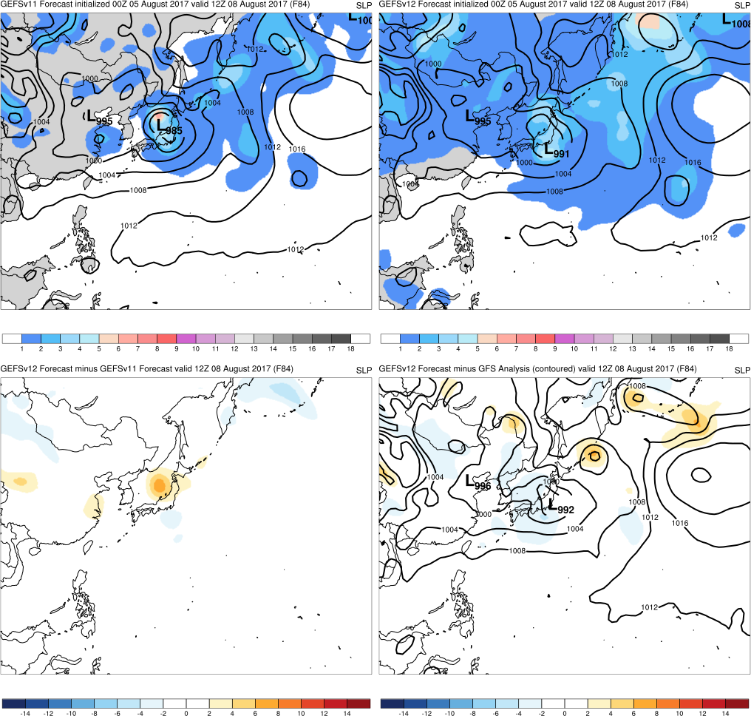
Hurricane Noru
Init.: 00Z 8/5/2017 (F084)
GEFSv12 mean low is more similar to analysis in terms of location while GEFSv11 mean is incorrectly west of Japan
GEFSv11
GEFSv12
v12−v11
GFS Anl.

Slide 24
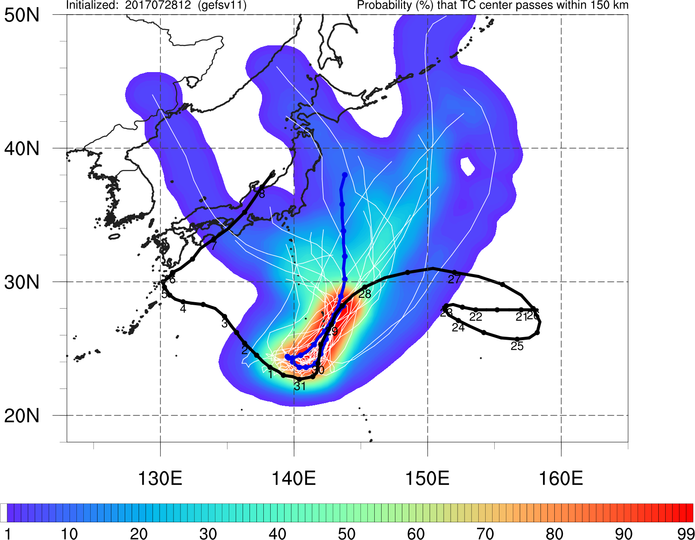
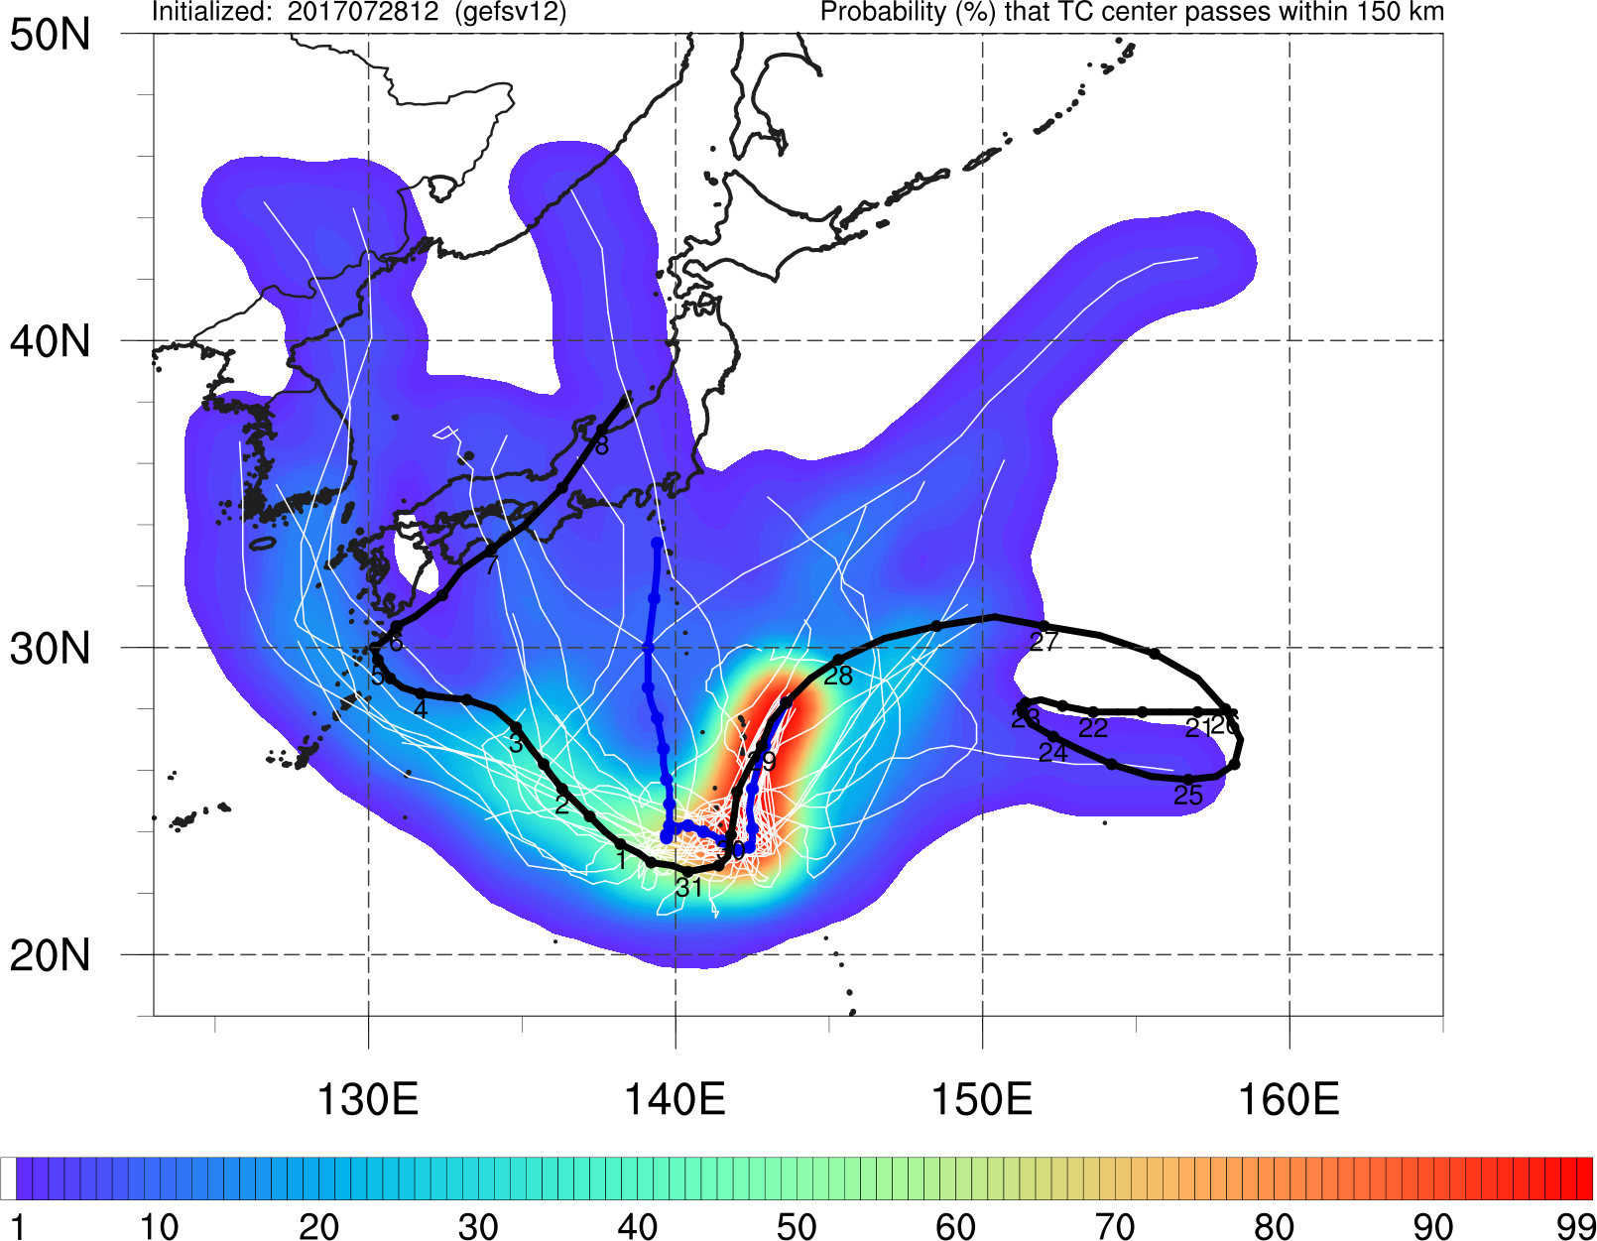
Hurricane Noru
Init.: 12Z 7/28/2017
GEFSv11
GEFSv12
GEFSv12 mean track is more accurate than GEFSv11 and has Best Track within envelope (more members tracking NW)

Slide 25
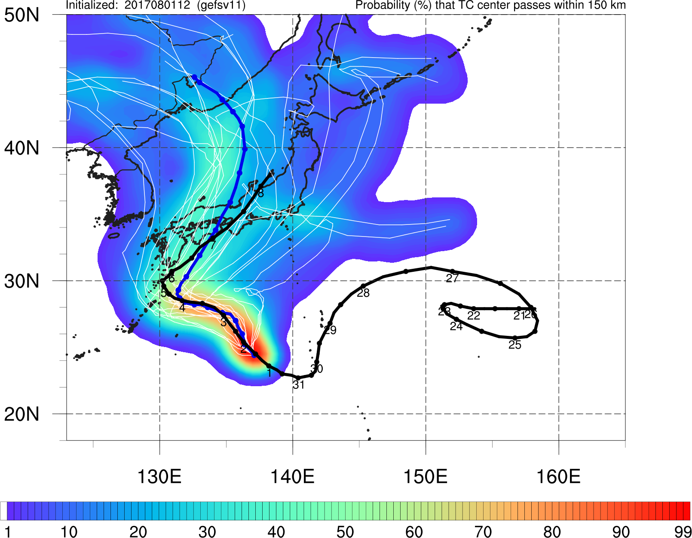
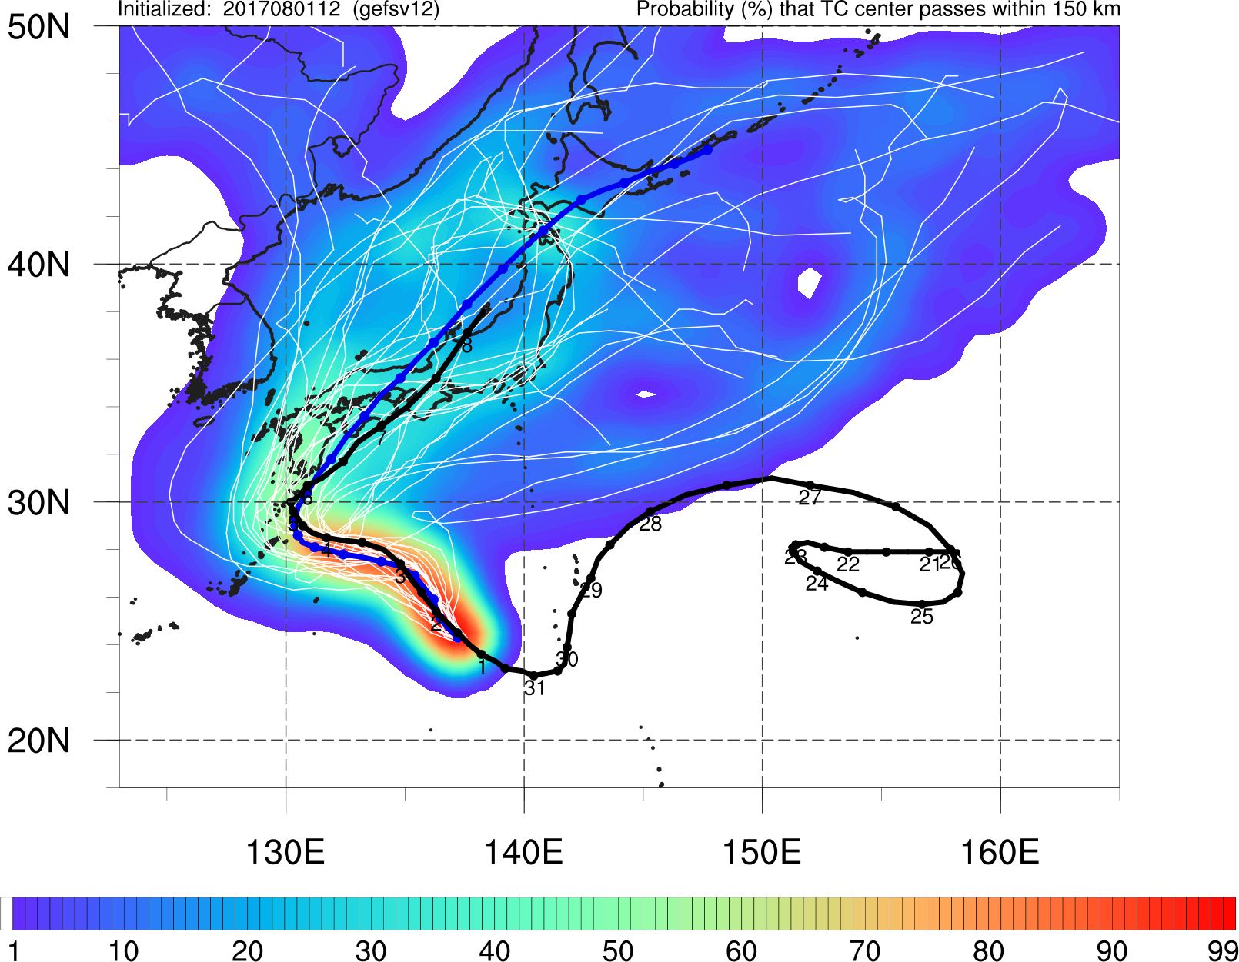
Hurricane Noru
Init.: 12Z 8/1/2017
GEFSv11
GEFSv12
GEFSv12 mean track is more accurate than GEFSv11, especially at NE turn towards Japan, whereas GEFSv11 mean track veers off to NW

Slide 26
NATIONAL OCEANIC AND ATMOSPHERIC ADMINISTRATION
GEFSv12 Tropical Cyclone Highlights
GEFSv11 Wins
Hurricane Barry (July 2019)
Hurricane Lane (Aug 2018)
Hurricane Walaka (Sep/Oct 2018)

Slide 27
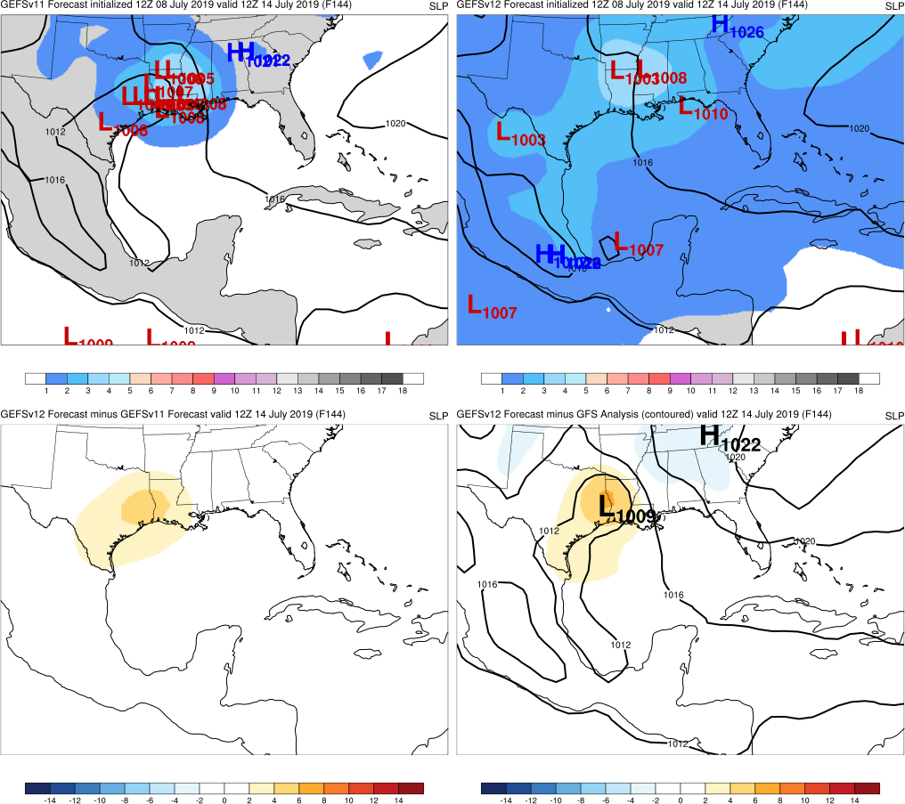
Hurricane Barry
Init.: 12Z 7/8/2019 (F144)
F144: Many more GEFSv11 members forecast Barry’s approximate location compared to GEFSv12 members
F120-F072: GEFSv11 continues to better forecast Barry’s location while some GEFSv12 members indicate landfall in southern TX
GEFSv11
GEFSv12
v12−v11
GFS Anl.

Slide 28
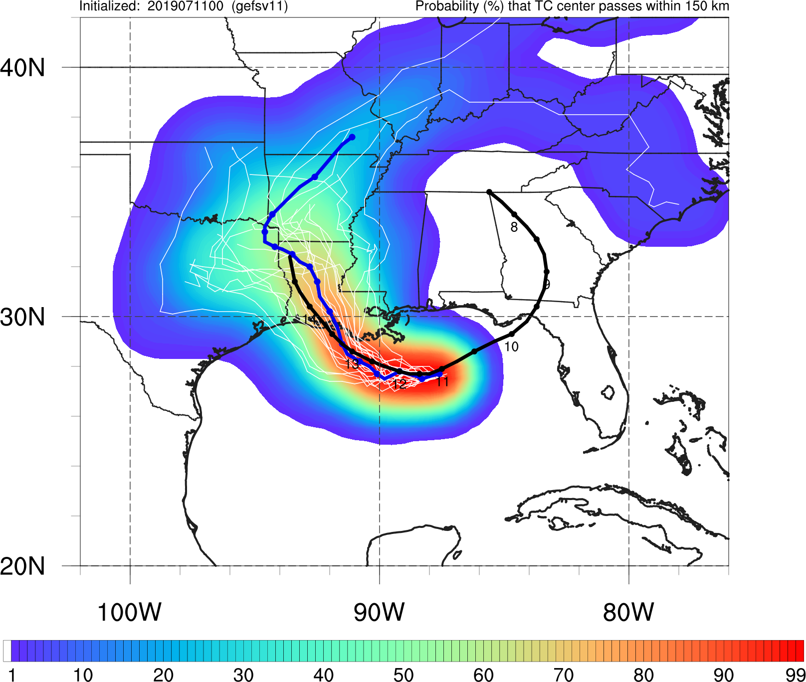
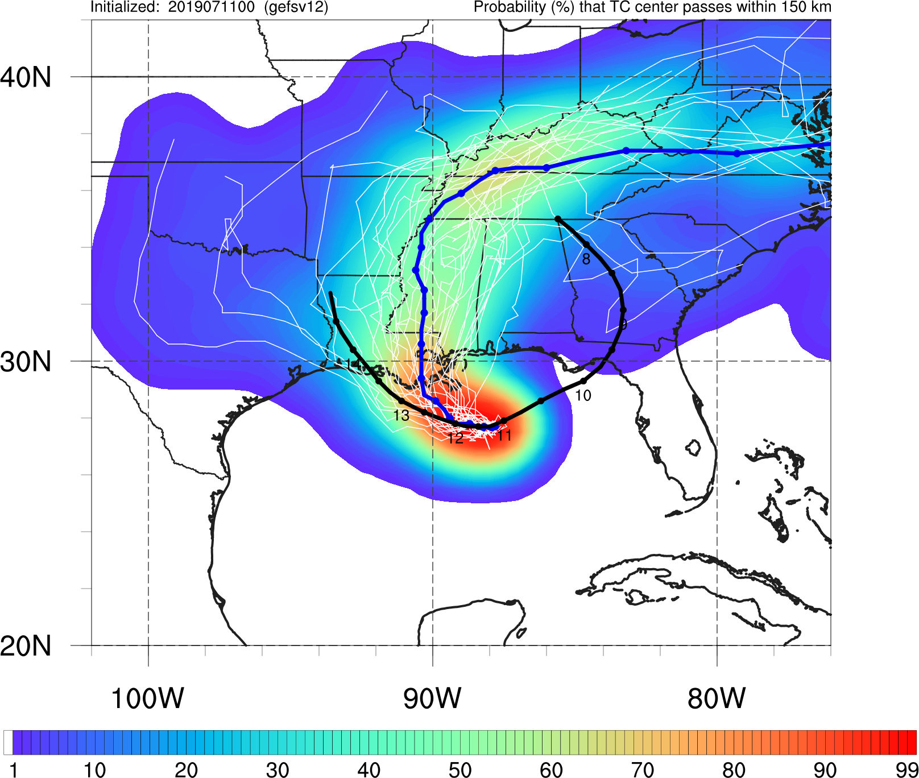
Hurricane Barry
Init.: 00Z 7/11/2019
GEFSv11
GEFSv12
GEFSv11 mean track and landfall location are much more accurate than GEFSv12
GEFSv12 mean track is too far east, incorrectly tracking over MS

Slide 29
NATIONAL OCEANIC AND ATMOSPHERIC ADMINISTRATION
GEFSv12 Tropical Cyclone Highlights
GEFSv11 Wins
Hurricane Barry (July 2019)
Hurricane Lane (Aug 2018)
Hurricane Walaka (Sep/Oct 2018)

Slide 30
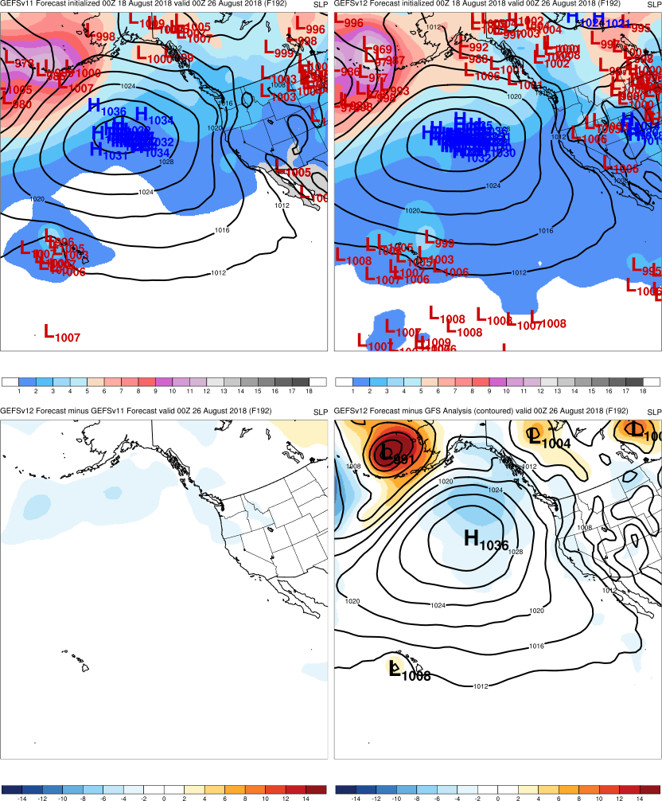
Hurricane Lane
GEFSv11
GEFSv12
Init.: 00Z 8/18/2018 (F192)
GEFSv11 members have better focus on cyclone location near Hawaii; GEFSv12 members are very spread out
v12−v11
GFS Anl.

Slide 31
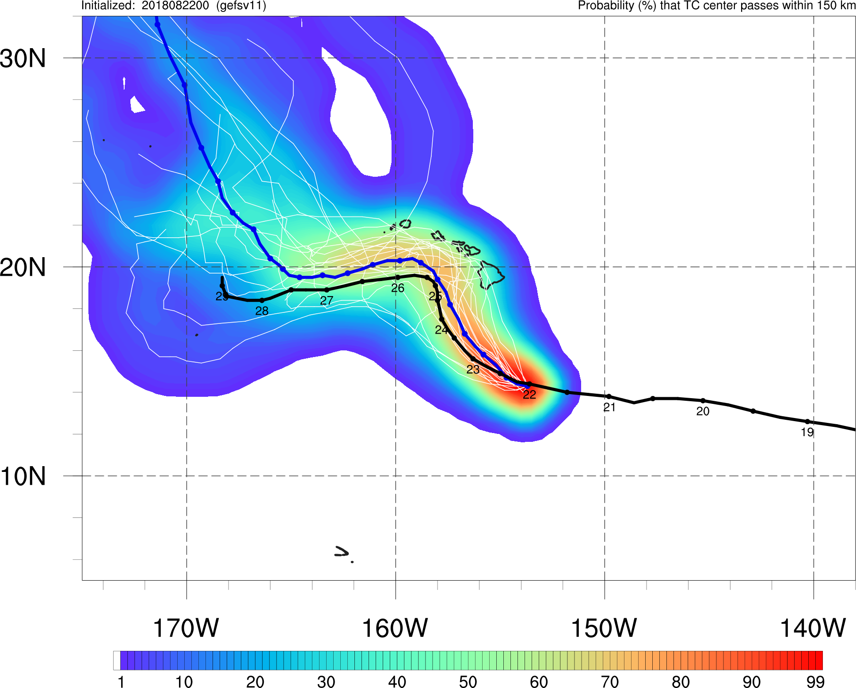
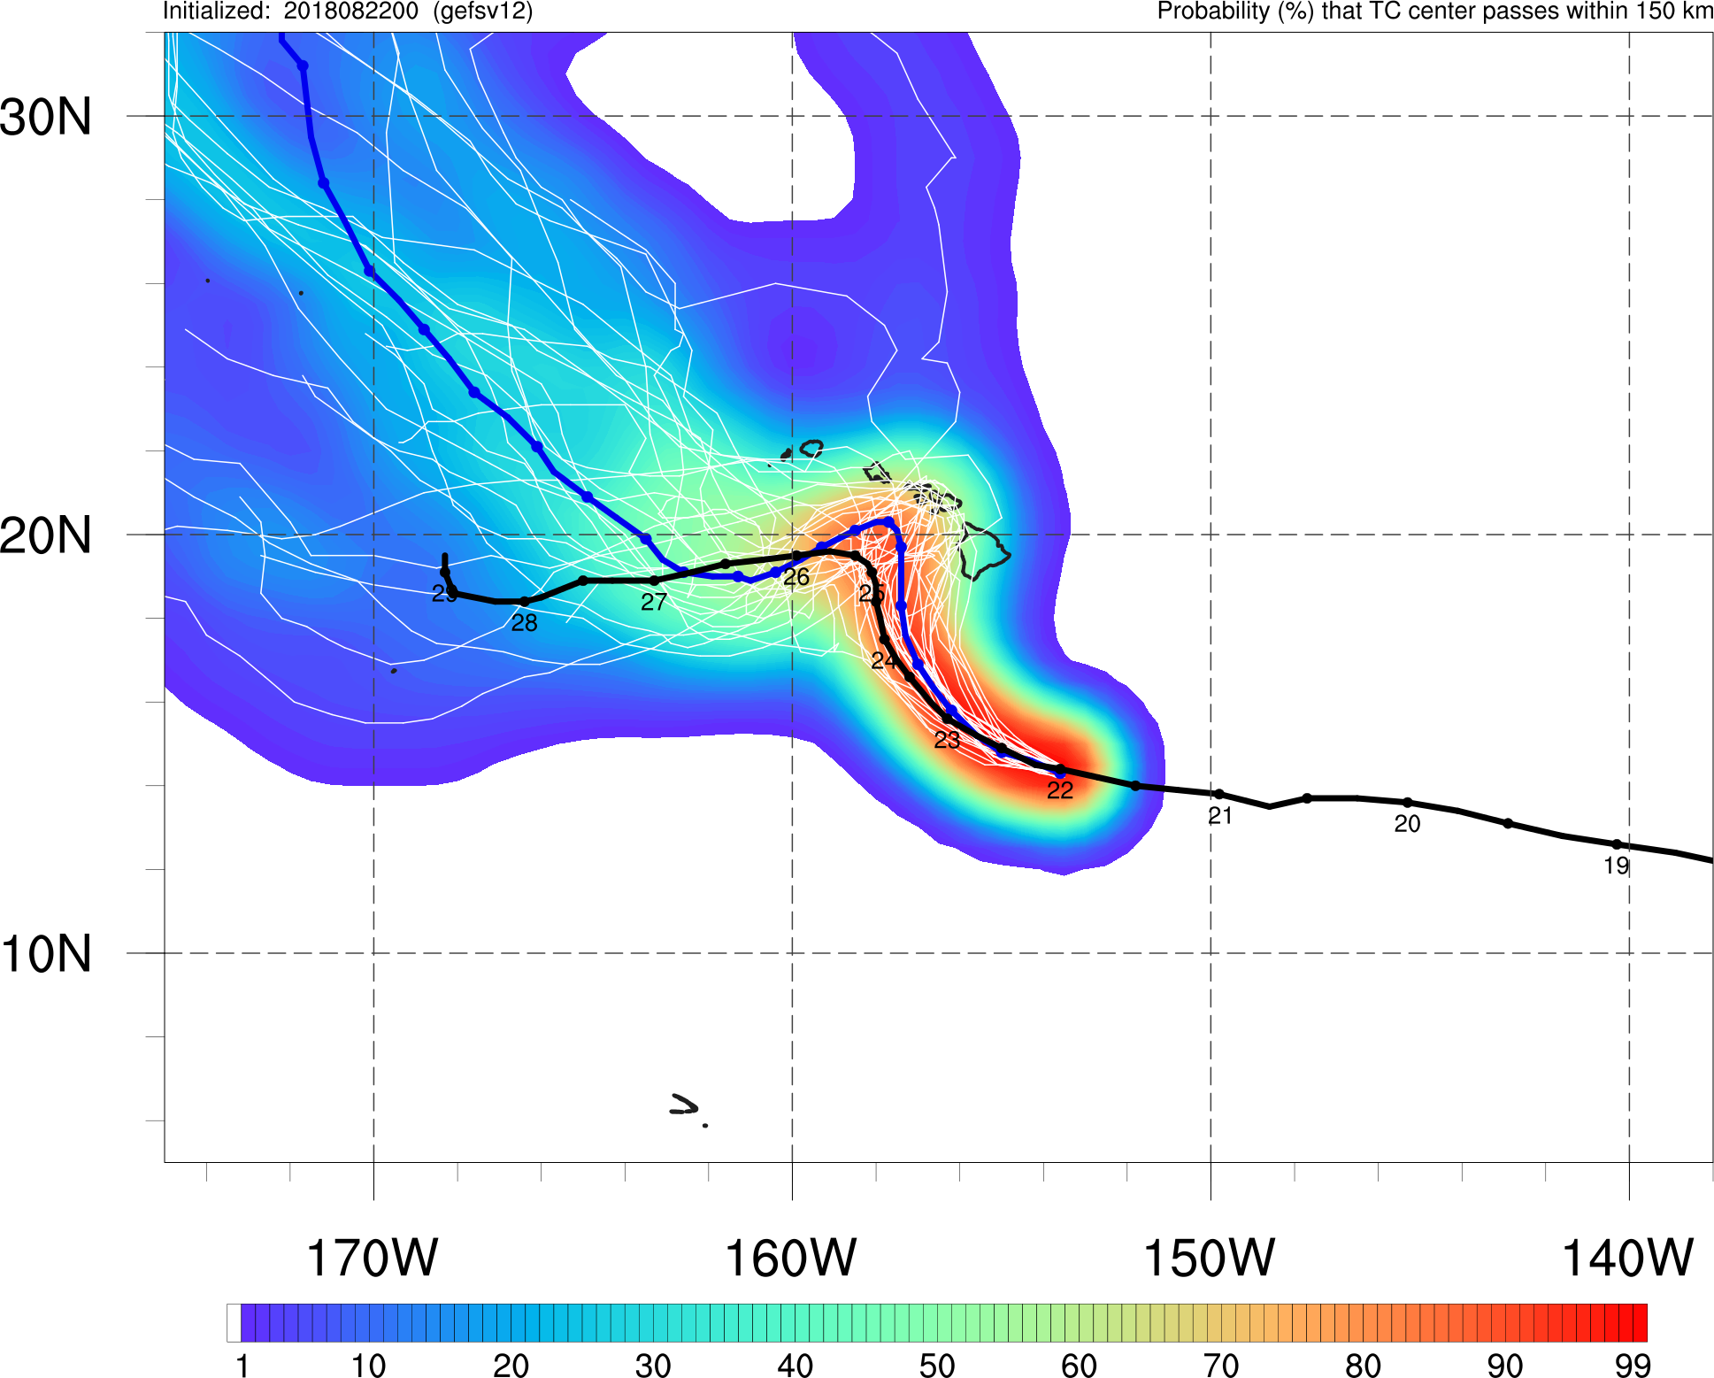
Hurricane Lane
Init.: 00Z 8/22/2018
GEFSv11
GEFSv12
GEFSv12 mean track and members indicate a much stronger (and incorrect) threat to the Hawaiian Islands
GEFSv11 mean is closer to Best Track at peak of turn

Slide 32
NATIONAL OCEANIC AND ATMOSPHERIC ADMINISTRATION
GEFSv12 Tropical Cyclone Highlights
GEFSv11 Wins
Hurricane Barry (July 2019)
Hurricane Lane (Aug 2018)
Hurricane Walaka (Sep/Oct 2018)

Slide 33
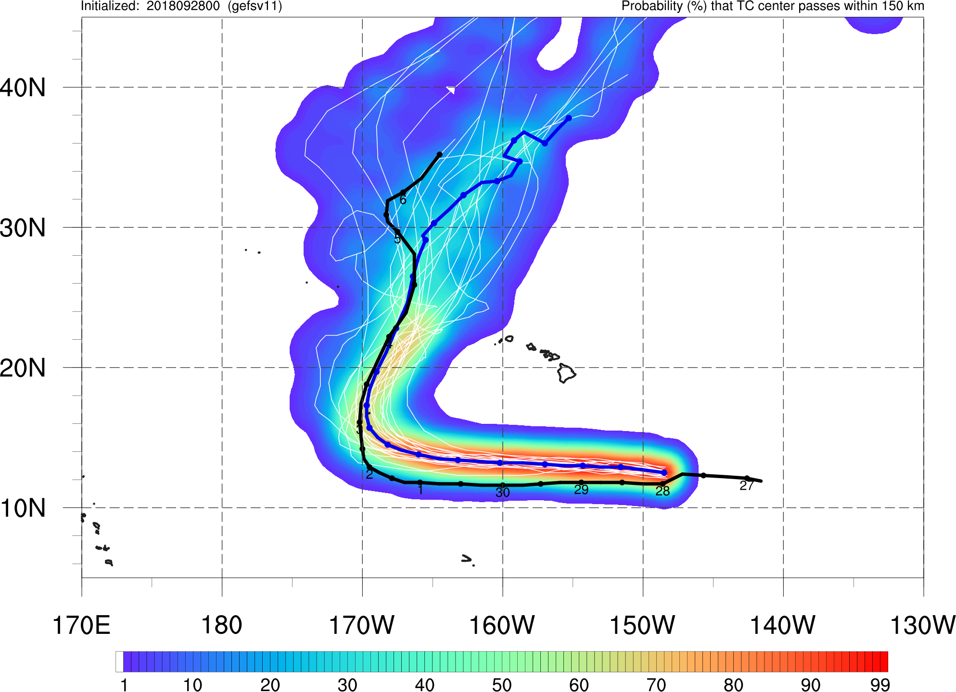
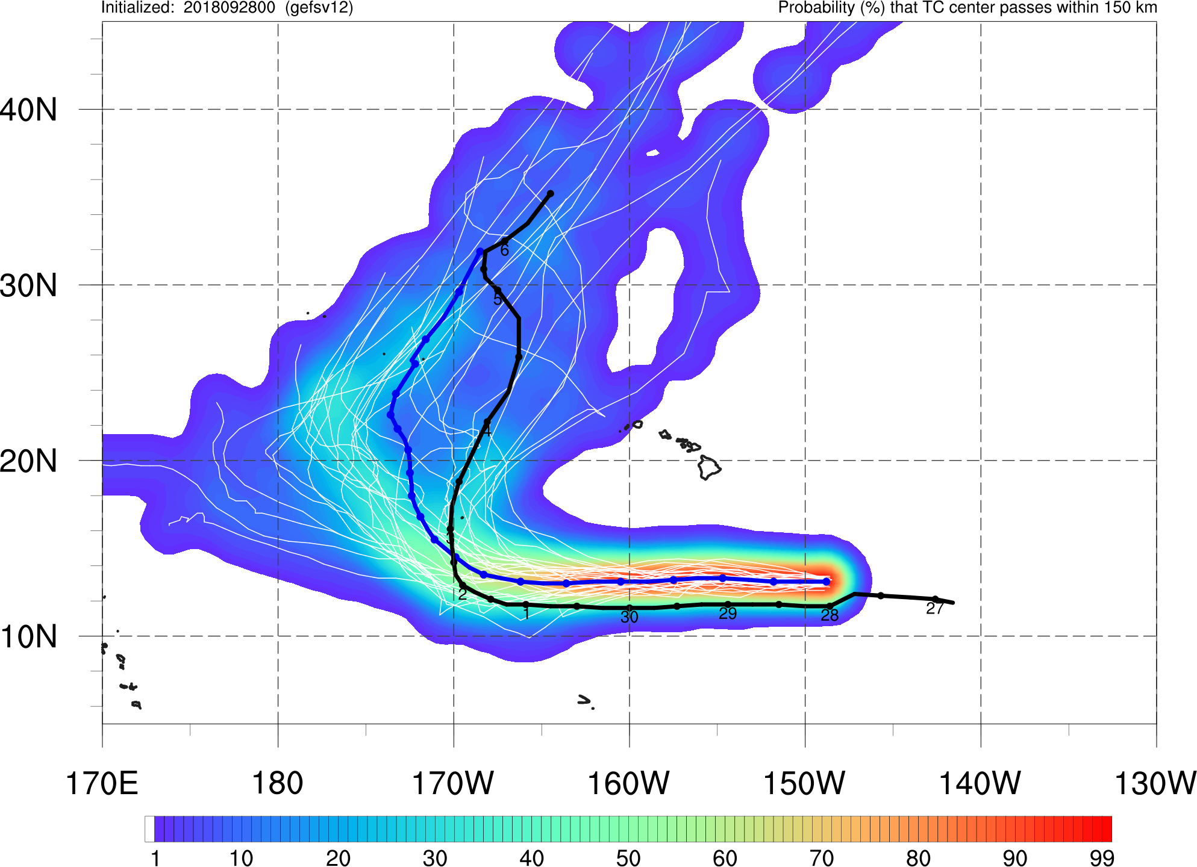
Hurricane Walaka
Init.: 00Z 9/28/2018
GEFSv11
GEFSv12
GEFSv12 and GEFSv11 both signal little to no threat to the main Hawaiian Islands
GEFSv11 mean better matches Best Track, with GEFSv12 mean being too far west
GEFSv12 track forecasts have higher spread than GEFSv11 track forecasts

Slide 34
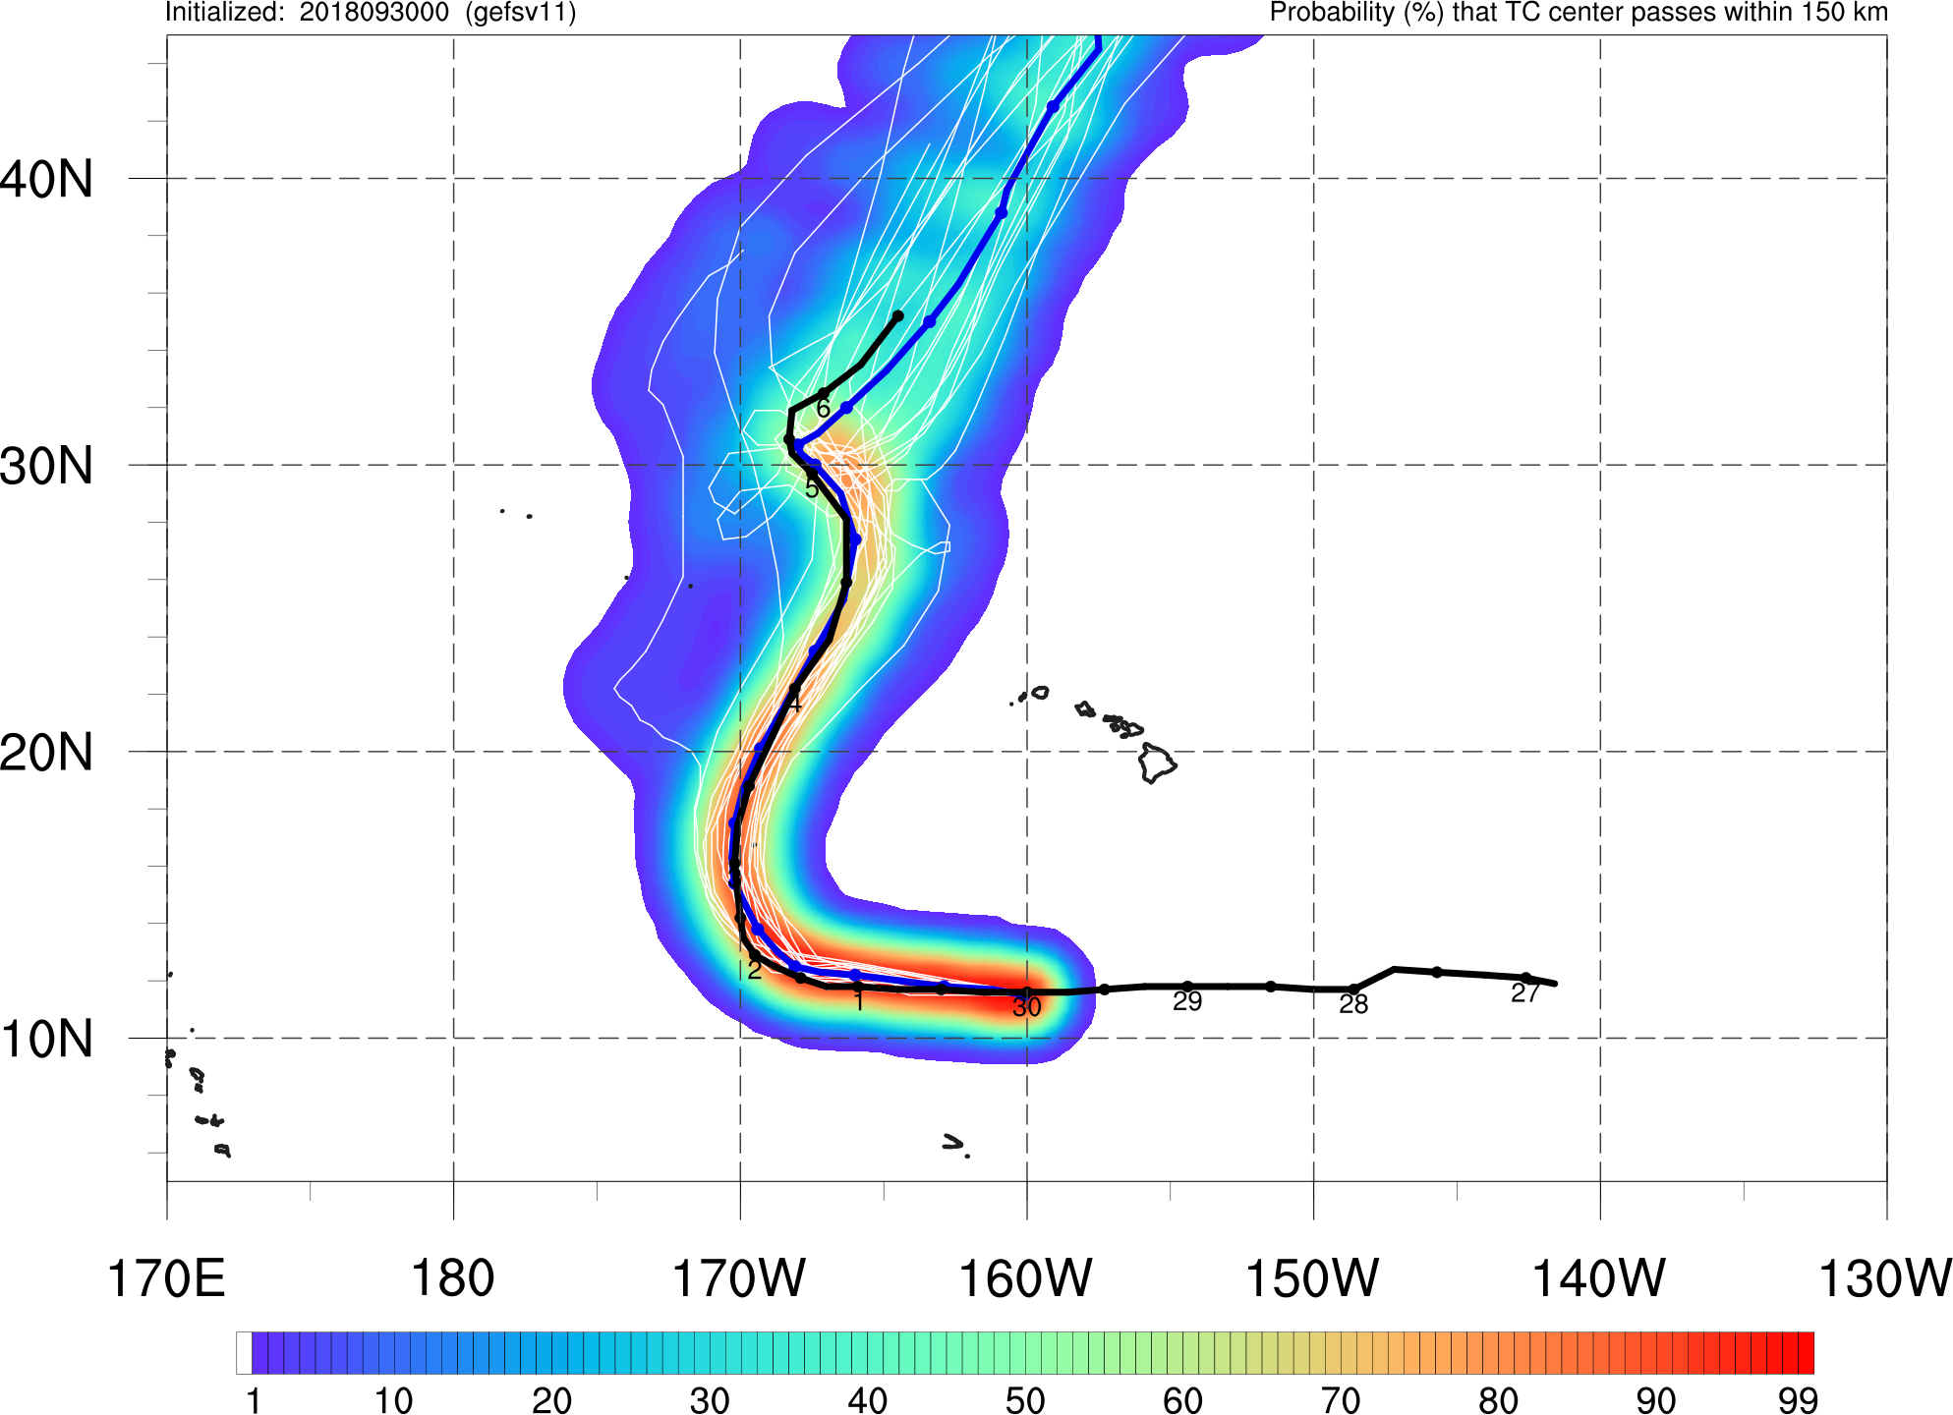
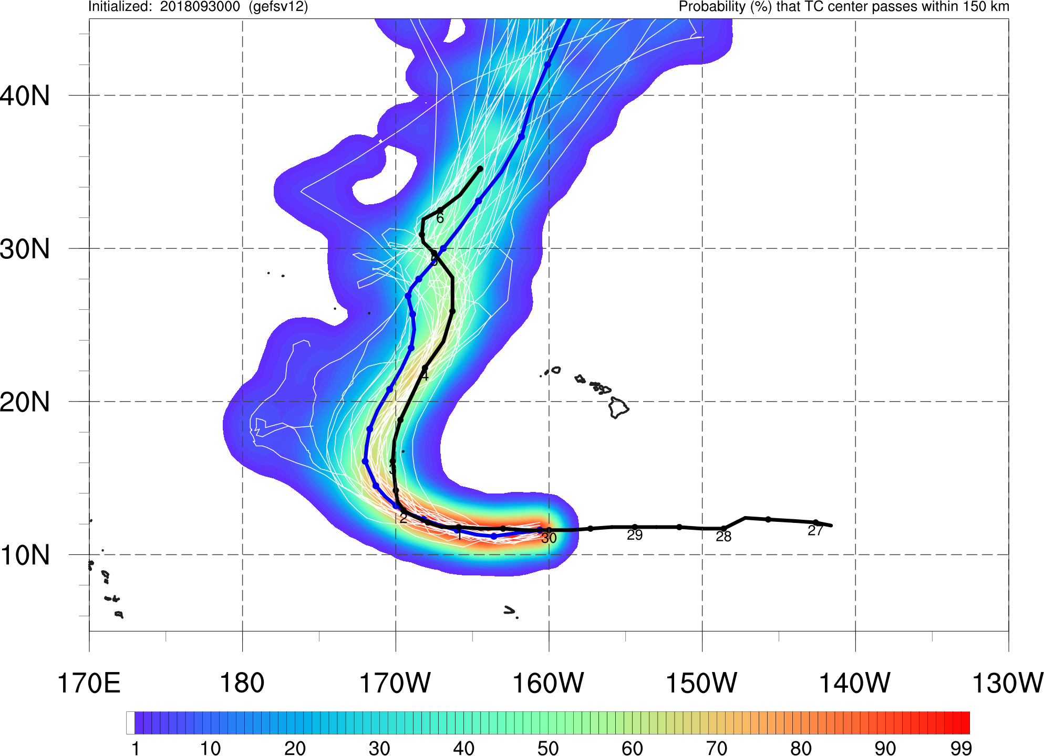
Hurricane Walaka
Init.: 00Z 9/30/2018
GEFSv11
GEFSv12
GEFSv11 mean better matches Best Track, even capturing turns later in track
GEFSv12 mean is still too far west

Slide 35
NATIONAL OCEANIC AND ATMOSPHERIC ADMINISTRATION
GEFSv12 Tropical Cyclone Highlights
Mixed Results
Hurricane Irma (Sep 2017)
Hurricane Maria (Sep 2017)

Slide 36
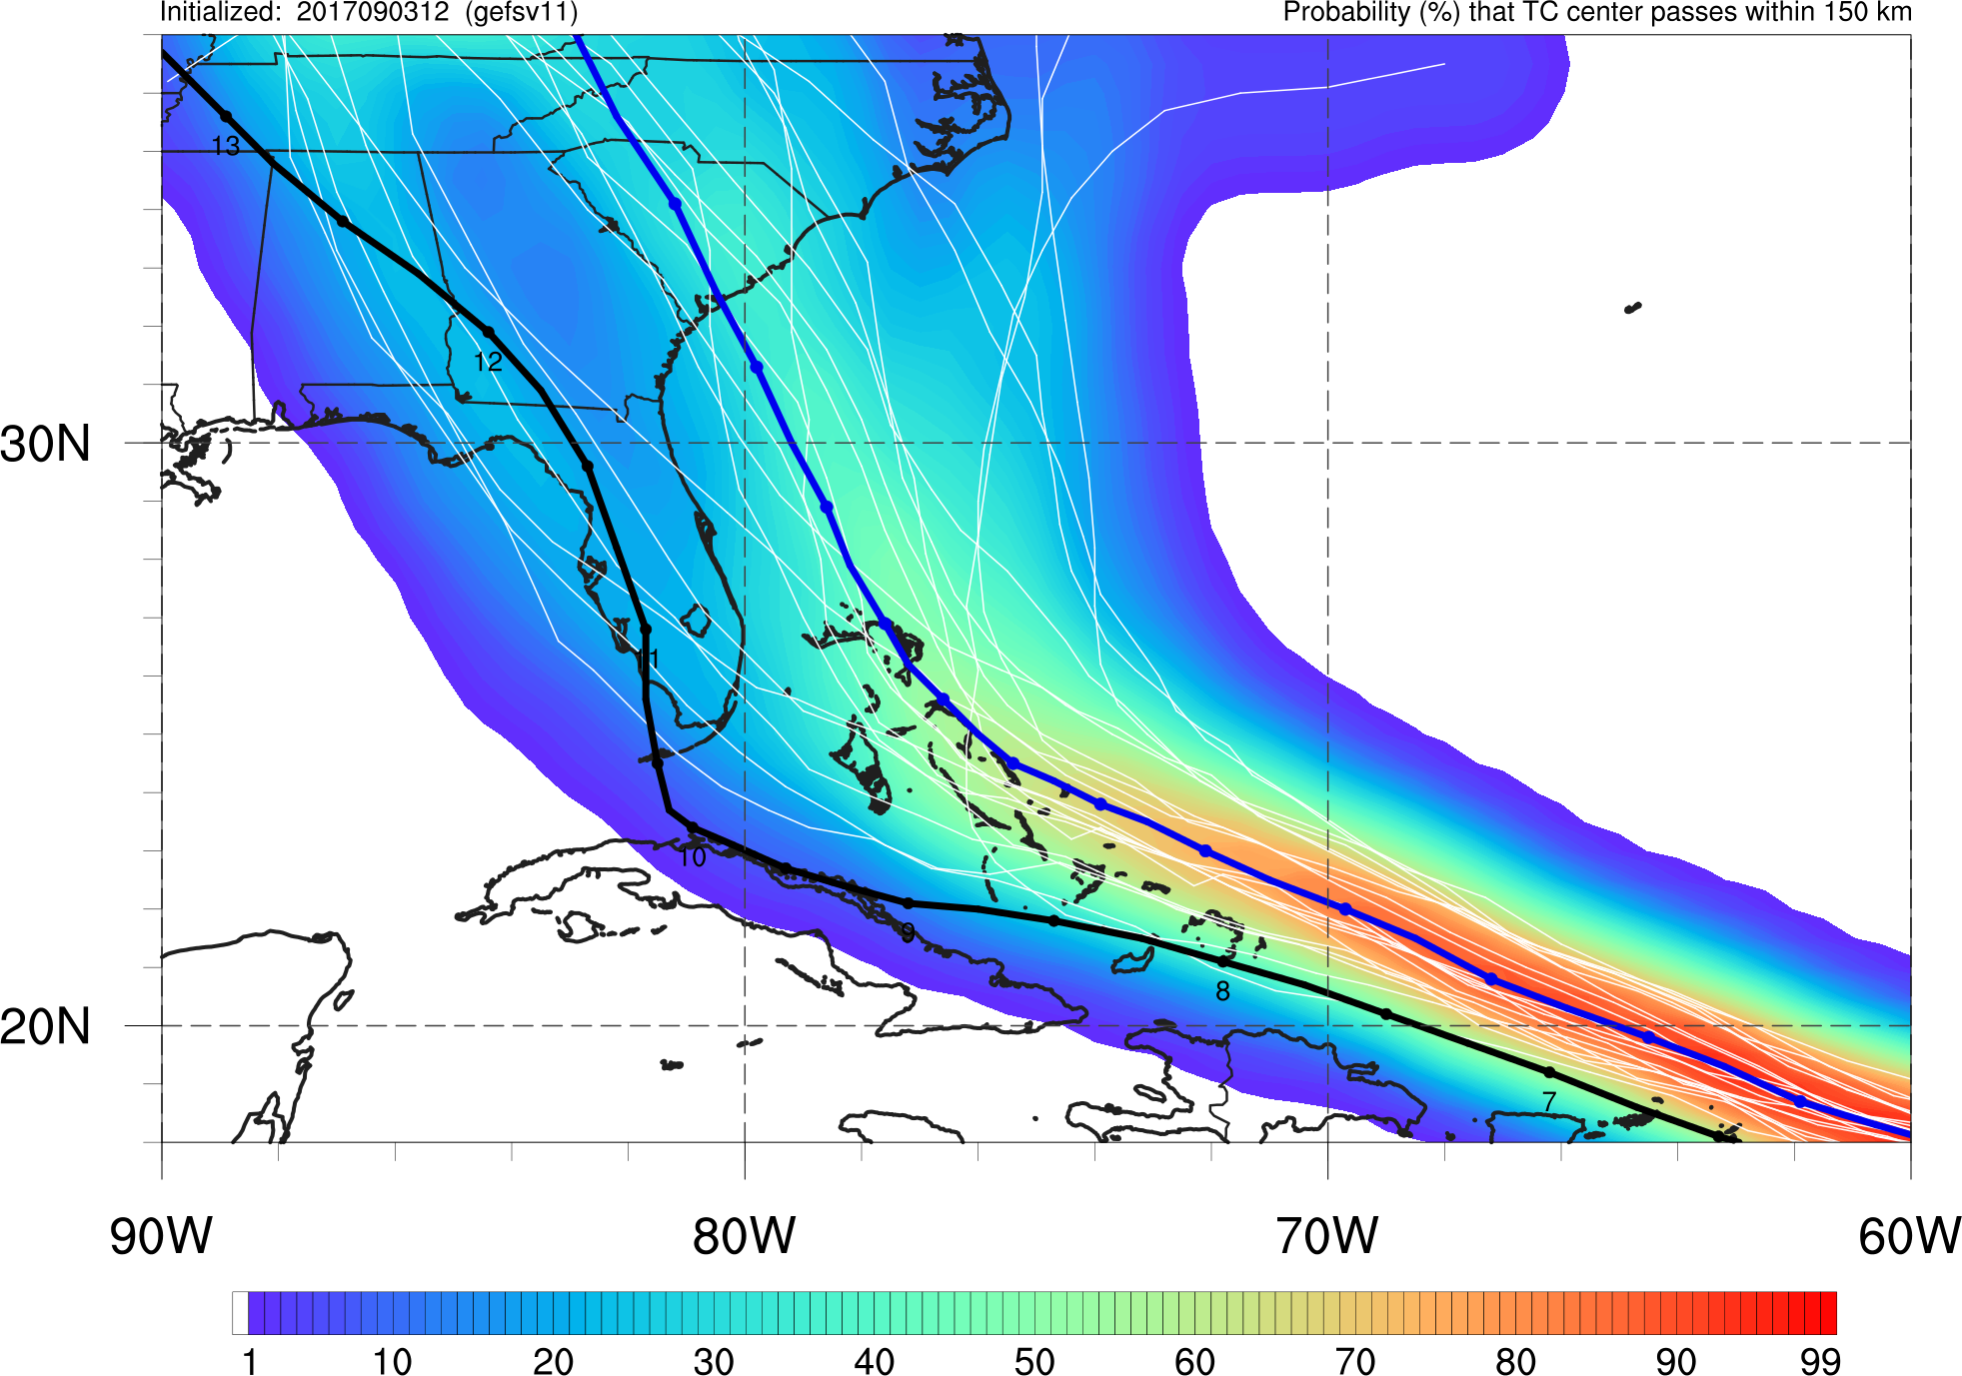
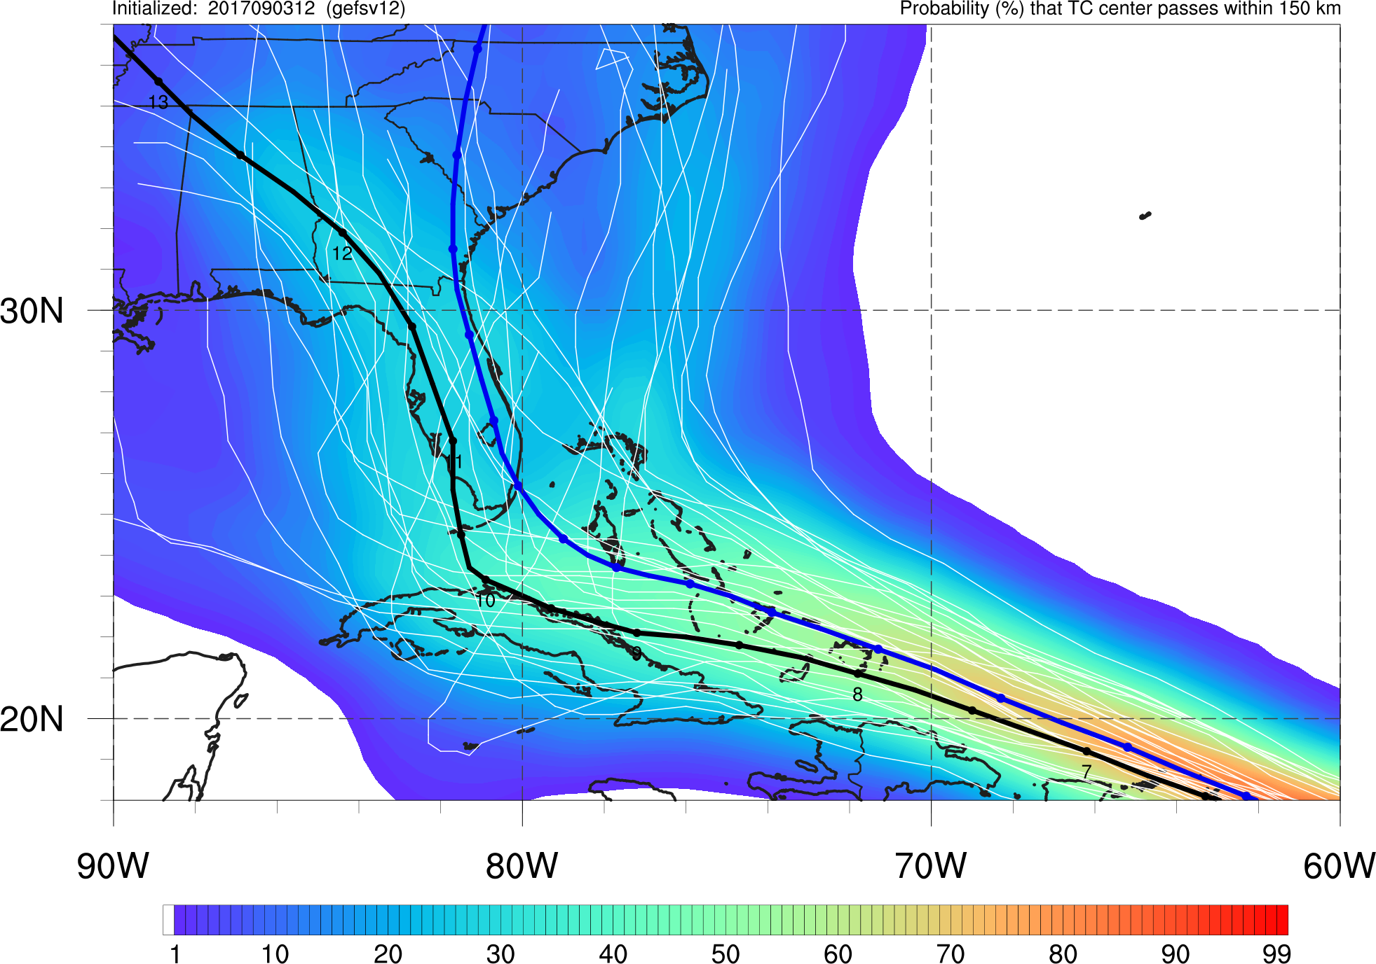
Hurricane Irma
Init.: 12Z 9/3/2017
GEFSv11
GEFSv12
GEFSv12 mean track is correctly further left, capturing landfall and track through FL
GEFSv11 mean track is too far east of Best Track, missing FL landfall

Slide 37
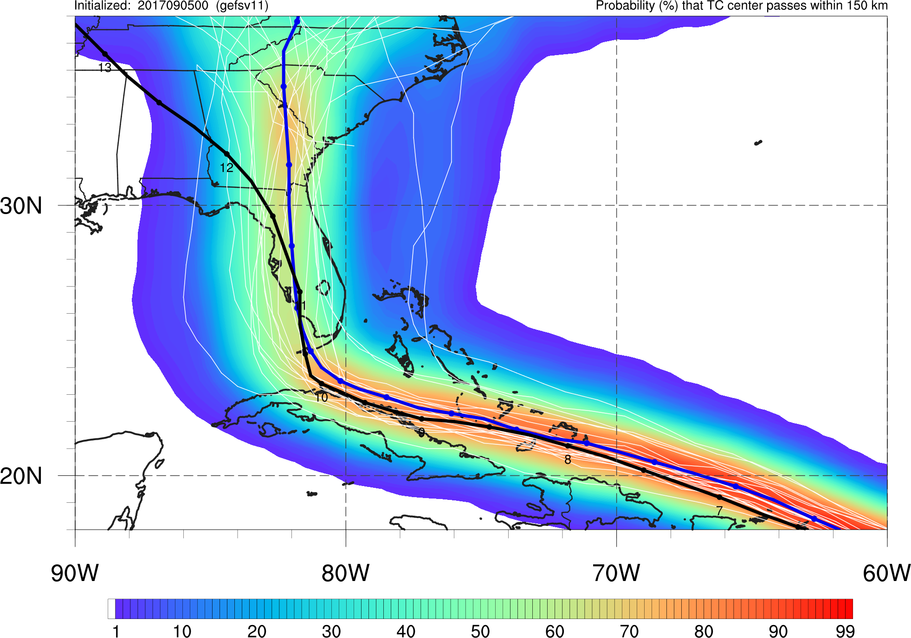
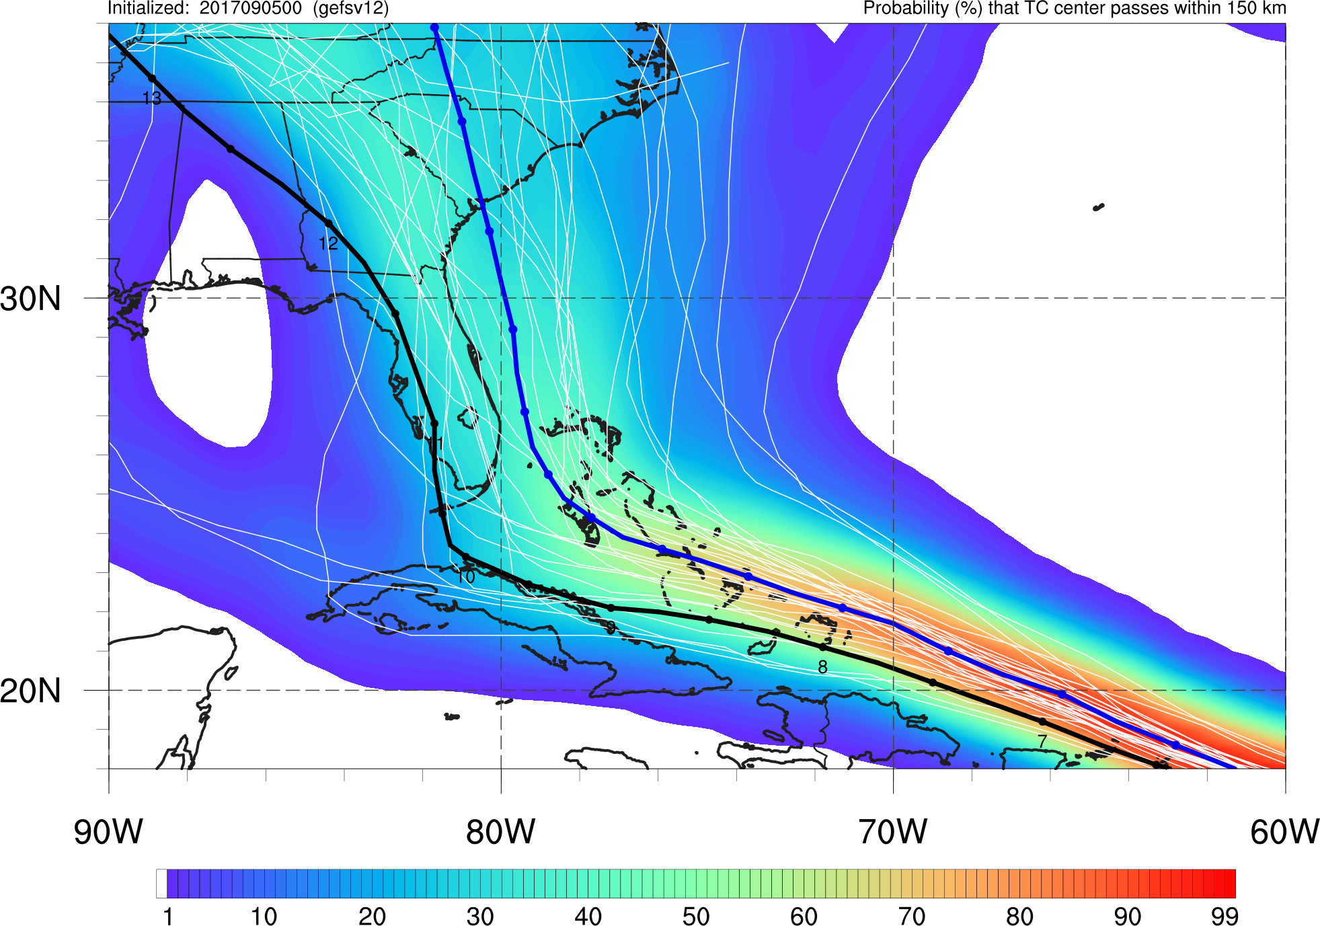
Hurricane Irma
Init.: 00Z 9/5/2017
GEFSv11
GEFSv12
GEFSv11 mean track is correctly further left, capturing landfall and track through FL
GEFSv12 mean track and many members are too far east, missing FL landfall

Slide 38
NATIONAL OCEANIC AND ATMOSPHERIC ADMINISTRATION
GEFSv12 Tropical Cyclone Highlights
Mixed Results
Hurricane Irma (Sep 2017)
Hurricane Maria (Sep 2017)

Slide 39
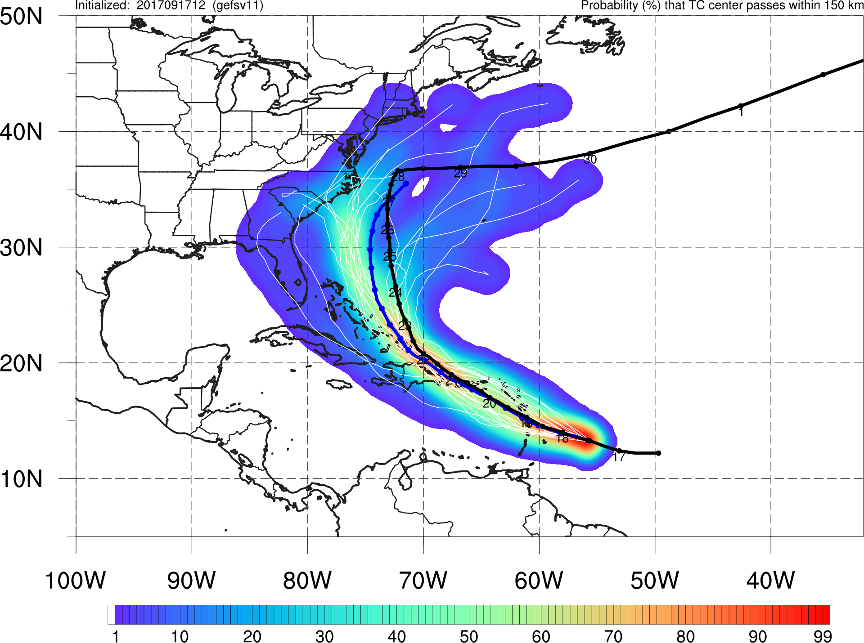
Hurricane Maria
Init.: 12Z 9/17/2017
GEFSv11
GEFSv12
GEFSv11
GEFSv12
GEFSv11 mean track is closer to Best Track near Puerto Rico while GEFSv12 has right-of-track bias
However, GEFSv12 mean track north of Dominican Republic is closer to Best Track while GEFSv11 has left-of-track bias

Slide 40
NATIONAL OCEANIC AND ATMOSPHERIC ADMINISTRATION
GEFSv12 TC Highlights: Summary
Overall, GEFSv12 forecasted TC track better than GEFSv11 for Hurricanes Harvey, Dorian, and Noru
With increased spread, GEFSv12 more frequently captured the Best Track within its envelope
Overall, GEFSv11 forecasted TC track better than GEFSv12 for Hurricanes Lane, Walaka, and Barry
With reduced spread (and a correct forecast), GEFSv11 provided a more useful forecast
For some cases such as Hurricanes Irma and Maria, GEFSv12 did not provide consistently better or worse guidance than GEFSv11
Consolidates NCEP/EMC verification and evaluation functions to efficiently and consistently support all modeling groups
Removes evaluation functions from the model science chain of command, ensuring independent model evaluations

Slide 41
NATIONAL OCEANIC AND ATMOSPHERIC ADMINISTRATION
GEFSv12 Tropical Cyclones:
Strengths and Concerns

Slide 42
NATIONAL OCEANIC AND ATMOSPHERIC ADMINISTRATION
GEFSv12 Tropical Cyclones: Strengths
Increased spread in tropical cyclone (TC) tracks
Overall, captures threats from TCs at longer lead times
Overall, improved location of QPF maxima

Slide 43
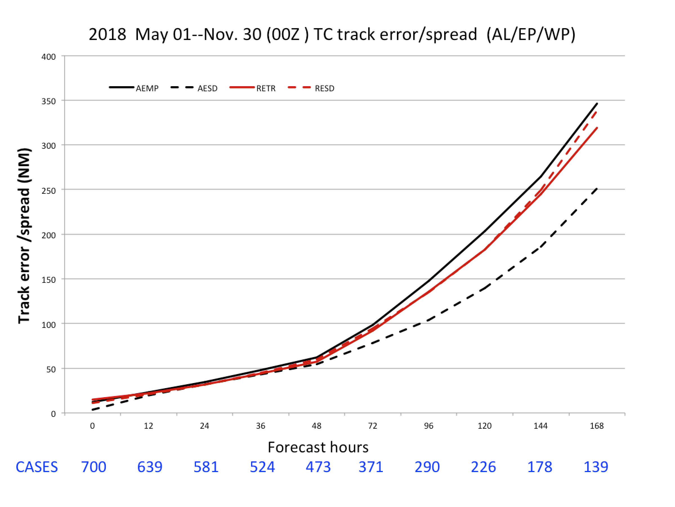
NATIONAL OCEANIC AND ATMOSPHERIC ADMINISTRATION
Strengths: Increased Spread in TC tracks
Lower RMSE in GEFSv12 at most lead times (Days 3–7)
Increased spread in GEFSv12 at most lead times (Days 3–7)
GEFSv11 is underdispersive (separation between black lines)
GEFSv12 is not underdispersive, giving a better representation of the range of possible outcomes (red lines on top of each other)
GEFSv11 RMSE
GEFSv11 Spread GEFSv12 RMSE
GEFSv12 Spread
Image provided by Jiayi Peng

Slide 44
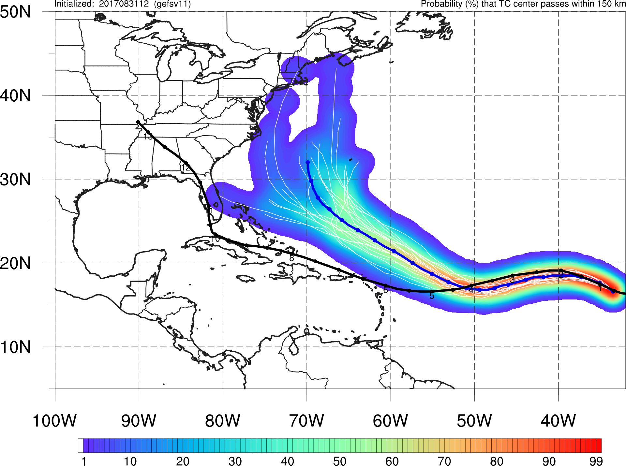
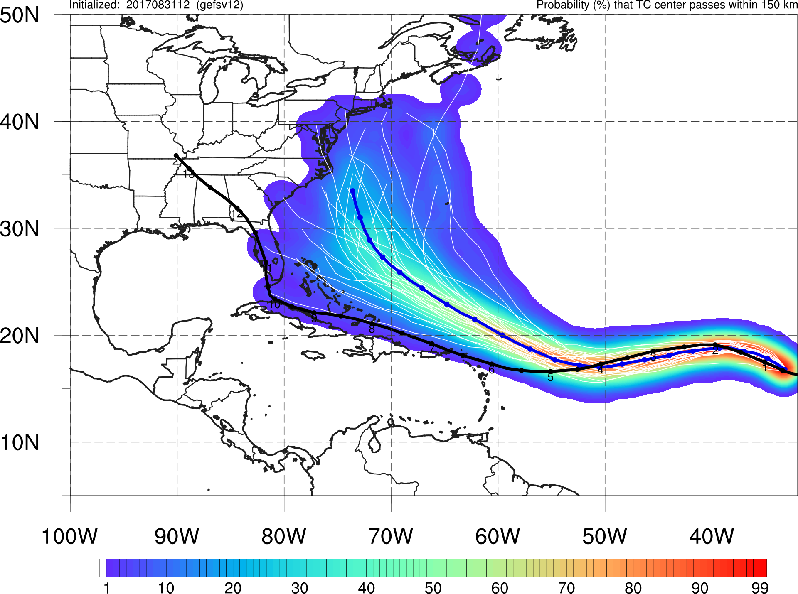
NATIONAL OCEANIC AND ATMOSPHERIC ADMINISTRATION
Strengths: Increased Spread in TC tracks
Irma Init: 12Z 8/31/17
GEFSv11
GEFSv12
GEFSv11 does not capture the Best Track of Irma within its envelope of possible solutions, whereas GEFSv12 does (and continues to improve in subsequent cycles)

Slide 45
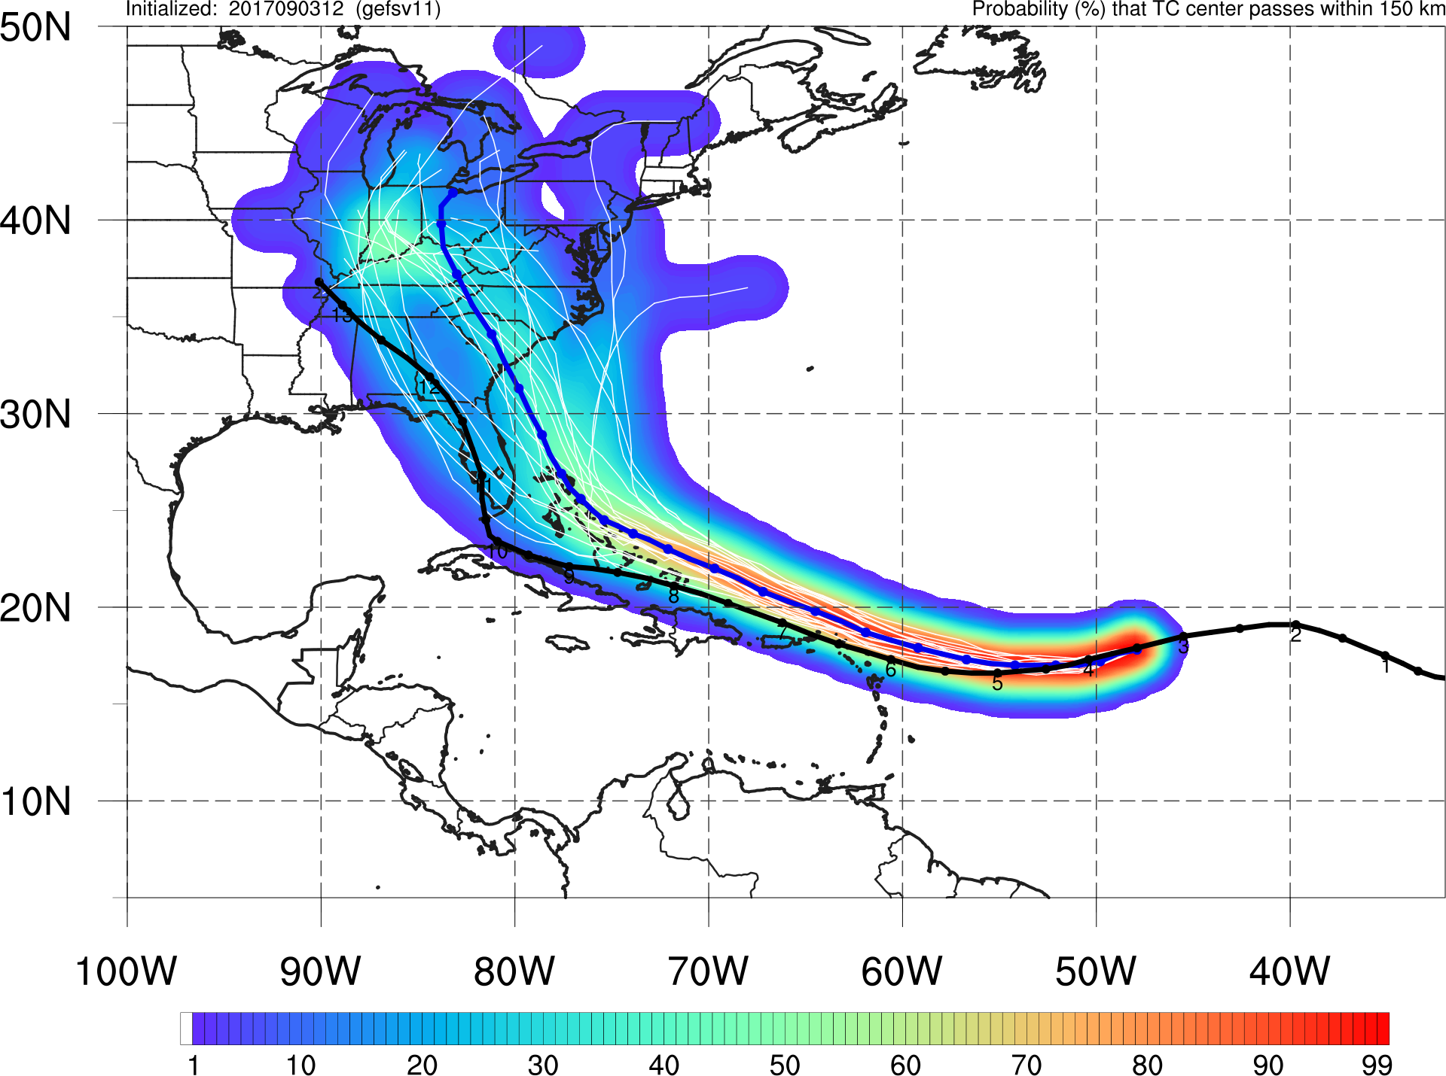
NATIONAL OCEANIC AND ATMOSPHERIC ADMINISTRATION
Strengths: Increased Spread in TC tracks
Irma Init: 12Z 9/03/17
GEFSv11
GEFSv12
GEFSv11 appears fairly certain of East Coast landfall, whereas GEFSv12 suggests the possibility of a sharp turn to the north over Florida or the eastern Gulf of Mexico

Slide 46
NATIONAL OCEANIC AND ATMOSPHERIC ADMINISTRATION
Strengths: Increased Spread in TC tracks
Florence Init: 00Z 9/06/18
GEFSv11
GEFSv12
GEFSv11 indicates a high probability of Florence recurving off the East Coast, whereas Best Track (no recurvature) is well within the GEFSv12 envelope of possible solutions

Slide 47
NATIONAL OCEANIC AND ATMOSPHERIC ADMINISTRATION
Strengths: Increased Spread in TC tracks
Florence Init: 00Z 9/07/18
GEFSv11
GEFSv12
GEFSv11 indicates a high probability of Florence recurving off the East Coast, whereas Best Track (no recurvature) is well within the GEFSv12 envelope of possible solutions

Slide 48
NATIONAL OCEANIC AND ATMOSPHERIC ADMINISTRATION
Strengths: Captures Threats at Longer Leads
Florence Init: 00Z 9/07/18
GEFSv11
GEFSv12
GEFSv11 indicates a high probability of Florence recurving off the East Coast, whereas Best Track (no recurvature) is well within the GEFSv12 envelope of possible solutions

Slide 49
NATIONAL OCEANIC AND ATMOSPHERIC ADMINISTRATION
Strengths: Increased Spread in TC tracks
Noru Init: 00Z 7/29/17
GEFSv11
GEFSv12
GEFSv11 indicates a high probability of Noru not making landfall in southern Japan, whereas its turn to the northwest is within the GEFSv12 envelope of possible solutions

Slide 50
NATIONAL OCEANIC AND ATMOSPHERIC ADMINISTRATION
Strengths: Increased Spread in TC tracks
Barry Init: 12Z 7/10/19
GEFSv11
GEFSv12
There are cases where GEFSv11 locks in to a solution that verifies well. Here, the increased spread (and large number of eastward tracks) in GEFSv12 leads to inferior guidance.

Slide 51
NATIONAL OCEANIC AND ATMOSPHERIC ADMINISTRATION
Strengths: Increased Spread in TC tracks
GEFSv11 is notably underdispersive with TC tracks. GEFSv12 gives a better representation of the range of possible outcomes.
GEFSv11’s underdispersiveness can make the model look overly certain of a particular outcome
When GEFSv11 is underdispersive and wrong, it looks terrible.
When GEFSv11 is underdispersive and right, it looks amazing.
GEFSv12 subjectively and objectively offers improved guidance relative to GEFSv11 in terms of forecast spread.
GEFSv11 is notably underdispersive. GEFSv12 gives a better representation of the range of possible outcomes.
GEFSv11’s underdispersiveness can make the ensemble look overly certain of a particular outcome.

Slide 52
NATIONAL OCEANIC AND ATMOSPHERIC ADMINISTRATION
GEFSv12 Tropical Cyclones: Strengths
Increased spread in tropical cyclone (TC) tracks
Overall, captures threats from TCs at longer lead times
Overall, improved location of QPF maxima

Slide 53
NATIONAL OCEANIC AND ATMOSPHERIC ADMINISTRATION
Strengths: Captures Threats at Longer Leads
GEFSv11
GEFSv12
Maria (F192) Valid: 12Z 9/20/17
F192: GEFSv12 indicates the potential for Maria to impact the Caribbean earlier than GEFSv11
v12−v11
GFS Anl.

Slide 54
NATIONAL OCEANIC AND ATMOSPHERIC ADMINISTRATION
Strengths: Captures Threats at Longer Leads
GEFSv11
GEFSv12
Maria (F168) Valid: 12Z 9/20/17
F192: GEFSv12 indicates the potential for Maria to impact the Caribbean earlier than GEFSv11
F168: GEFSv12 continues to indicate the potential for Maria to impact the Caribbean. GEFSv11 begins to increase the number of members that include Maria.
v12−v11
GFS Anl.

Slide 55
NATIONAL OCEANIC AND ATMOSPHERIC ADMINISTRATION
Strengths: Captures Threats at Longer Leads
GEFSv11
GEFSv12
Harvey (F144) Valid: 00Z 8/26/17
F144: GEFSv12 indicates the potential for a TC to approach the Texas coast. GEFSv11 is further south, and with only 2 members.
v12−v11
GFS Anl.

Slide 56
NATIONAL OCEANIC AND ATMOSPHERIC ADMINISTRATION
Strengths: Captures Threats at Longer Leads
Harvey Init: 00Z 8/20/17
GEFSv11
GEFSv12
Six days prior to landfall, no GEFSv11 member has Harvey making landfall in Texas. GEFSv12 is able to indicate a potential threat to Texas days in advance.

Slide 57
NATIONAL OCEANIC AND ATMOSPHERIC ADMINISTRATION
Strengths: Captures Threats at Longer Leads
Harvey Init: 12Z 8/20/17
GEFSv11
GEFSv12
GEFSv11 takes Harvey west into central America, with a few members crossing the Yucatan. GEFSv12 is able to indicate a potential threat to Texas days in advance.

Slide 58
NATIONAL OCEANIC AND ATMOSPHERIC ADMINISTRATION
Strengths: Captures Threats at Longer Leads
Florence Init: 00Z 9/06/18
GEFSv11
GEFSv12
GEFSv11 indicates a high probability of Florence recurving off the East Coast, whereas GEFSv12 begins to suggest the possibility of an East Coast landfall (more like Best Track)

Slide 59
NATIONAL OCEANIC AND ATMOSPHERIC ADMINISTRATION
Strengths: Captures Threats at Longer Leads
Florence Init: 00Z 9/07/18
GEFSv11
GEFSv12
GEFSv11 indicates a high probability of Florence recurving off the East Coast, whereas GEFSv12 has landfall or a brush with the East Coast looking increasing likely

Slide 60
NATIONAL OCEANIC AND ATMOSPHERIC ADMINISTRATION
Strengths: Captures Threats at Longer Leads
Florence Init: 00Z 9/07/18
GEFSv11
GEFSv12
GEFSv11 indicates a high probability of Florence recurving off the East Coast, whereas GEFSv12 has landfall or a brush with the East Coast looking increasing likely

Slide 61
NATIONAL OCEANIC AND ATMOSPHERIC ADMINISTRATION
Strengths: Captures Threats at Longer Leads
Florence Init: 12Z 9/09/18
GEFSv11
GEFSv12
GEFSv11 brings Florence close to the Outer Banks and stalls, whereas the GEFSv12 mean (and the vast majority of individual members) suggest landfall in the Carolinas

Slide 62
NATIONAL OCEANIC AND ATMOSPHERIC ADMINISTRATION
Strengths: Captures Threats at Longer Leads
Florence Init: 00Z 9/11/18
GEFSv11
GEFSv12
GEFSv11 is still showing Florence stalling along the Outer Banks before a NC/VA landfall, whereas GEFSv12 becomes more locked in on a central NC landfall (spread decreases)

Slide 63
NATIONAL OCEANIC AND ATMOSPHERIC ADMINISTRATION
GEFSv12 Tropical Cyclones: Strengths
Increased spread in tropical cyclone (TC) tracks
Overall, captures threats from TCs at longer lead times
Overall, improved location of QPF maxima

Slide 64
NATIONAL OCEANIC AND ATMOSPHERIC ADMINISTRATION
Strengths: Improved Location of max QPF
Michael (F156) Valid: 12Z 10/11/18
F156: GEFSv12 indicates potential for higher 24-h QPF totals from the FL panhandle, across AL/GA/SC, whereas GEFSv11 does not
GEFSv11
GEFSv12
v12−v11
Stage IV

Slide 65
NATIONAL OCEANIC AND ATMOSPHERIC ADMINISTRATION
Strengths: Improved Location of max QPF
Michael (F132) Valid: 12Z 10/11/18
F156: GEFSv12 indicates potential for higher 24-h QPF totals from the FL panhandle, across AL/GA/SC, whereas GEFSv11 does not
F132: GEFSv12 continues to have the highest 24-h QPF totals located over FL panhandle and AL/GA/SC. GEFSv11 QPF max. off the coast.
GEFSv11
GEFSv12
v12−v11
Stage IV

Slide 66
NATIONAL OCEANIC AND ATMOSPHERIC ADMINISTRATION
Strengths: Improved Location of max QPF
Florence (F096) Valid: 00Z 09/15/18
F096: GEFSv12 indicates that the highest 24-h QPF totals will be along the NC/SC coast earlier than GEFSv11 (too far to the northeast)
GEFSv11
GEFSv12
v12−v11
Stage IV

Slide 67
NATIONAL OCEANIC AND ATMOSPHERIC ADMINISTRATION
Strengths: Improved Location of max QPF
Florence (F048) Valid: 00Z 09/15/18
F096: GEFSv12 indicates that the highest 24-h QPF totals will be along the NC/SC coast earlier than GEFSv11 (too far to the northeast)
F048: GEFSv12 correctly forecasts >2.5”/24 h totals from northeast NC into eastern SC, while GEFSv11 forecasts >2.5”/24 h in NC only
GEFSv11
GEFSv12
v12−v11
Stage IV

Slide 68
NATIONAL OCEANIC AND ATMOSPHERIC ADMINISTRATION
Strengths: Improved Location of max QPF
Alberto (F096) Valid: 00Z 05/30/18
F096: GEFSv12 correctly indicates the highest QPF totals across AL, while GEFSv11 keeps max offshore
GEFSv11
GEFSv12
v12−v11
Stage IV

Slide 69
NATIONAL OCEANIC AND ATMOSPHERIC ADMINISTRATION
Strengths: Improved Location of max QPF
Alberto (F072) Valid: 00Z 05/30/18
F096: GEFSv12 correctly indicates the highest QPF totals across AL, while GEFSv11 keeps max offshore
F072: GEFSv12 correctly indicates the highest QPF totals across AL. Both GEFSv11/GEFSv12 show an extension into Appalachians.
GEFSv11
GEFSv12
v12−v11
Stage IV

Slide 70
NATIONAL OCEANIC AND ATMOSPHERIC ADMINISTRATION
Strengths: Improved Location of max QPF
Alberto (F048) Valid: 00Z 05/30/18
F096: GEFSv12 correctly indicates the highest QPF totals across AL, while GEFSv11 keeps max offshore
F072: GEFSv12 correctly indicates the highest QPF totals across AL. Both GEFSv11/GEFSv12 show an extension into Appalachians.
F048: GEFSv12 doesn’t extend far enough N, but GEFSv11 too far E
GEFSv11
GEFSv12
v12−v11
Stage IV

Slide 71
NATIONAL OCEANIC AND ATMOSPHERIC ADMINISTRATION
Strengths: Improved Location of max QPF
Irma (F096) Valid: 00Z 09/12/17
F096: GEFSv12 correctly shifts the highest QPF totals more inland compared to GEFSv11 (offshore)
GEFSv11
GEFSv12
v12−v11
Stage IV

Slide 72
NATIONAL OCEANIC AND ATMOSPHERIC ADMINISTRATION
Strengths: Improved Location of max QPF
Irma (F072) Valid: 00Z 09/12/17
F096: GEFSv12 correctly shifts the highest QPF totals more inland compared to GEFSv11 (offshore)
F072: GEFSv12 and GEFSv11 both shift to the southwest. GEFSv12 correctly cuts off the highest QPF totals (>2”/24 h) in central SC and extends into Alabama.
GEFSv11
GEFSv12
v12−v11
Stage IV

Slide 73
NATIONAL OCEANIC AND ATMOSPHERIC ADMINISTRATION
GEFSv12 Tropical Cyclones: Concerns
Right-of-track bias in TC tracks at longer lead times
Low bias in mean QPF amounts associated with landfalling TCs
Likely due to increased spread (not necessarily a weakness)

Slide 74
NATIONAL OCEANIC AND ATMOSPHERIC ADMINISTRATION
Concerns: Right-of-track bias in TC tracks
N. Atlantic Track Error
N. Atlantic Across-Track Error
Right
GEFSv12 bias is shifted to the right relative to GEFSv11
Left
Images provided by Jiayi Peng
GEFSv12 has less track error than GEFSv11 at all lead times
GEFSv12 has more right-of-track error than GEFSv11 at longer lead times

Slide 75
NATIONAL OCEANIC AND ATMOSPHERIC ADMINISTRATION
Concerns: Right-of-track bias in TC tracks
GEFSv11
GEFSv12
Maria (F144) Valid: 12Z 9/20/17
F144: GEFSv12 exhibits a right-of-track bias at longer lead times, consistent with statistics
v12−v11
GFS Anl.

Slide 76
NATIONAL OCEANIC AND ATMOSPHERIC ADMINISTRATION
Concerns: Right-of-track bias in TC tracks
GEFSv11
GEFSv12
Maria (F072) Valid: 12Z 9/20/17
F144: GEFSv12 exhibits a right-of-track bias at longer lead times, consistent with statistics
F072: As lead time decreases, GEFSv12 retains a small right- of-track bias (see diff. fields)
v12−v11
GFS Anl.

Slide 77
NATIONAL OCEANIC AND ATMOSPHERIC ADMINISTRATION
Concerns: Right-of-track bias in TC tracks
GEFSv11
GEFSv12
Maria (F048) Valid: 12Z 9/20/17
F144: GEFSv12 exhibits a right-of-track bias at longer lead times, consistent with statistics
F072: As lead time decreases, GEFSv12 retains a small right- of-track bias (see diff. fields)
F048: As lead time decreases, GEFSv12 still retains a small right-of-track bias (see diff. fields)
v12−v11
GFS Anl.

Slide 78
NATIONAL OCEANIC AND ATMOSPHERIC ADMINISTRATION
Concerns: Right-of-track bias in TC tracks
Maria Init: 12Z 9/18/17
GEFSv11
GEFSv12
GEFSv11 is in line with Best Track early on and is left of Best Track at longer lead times. GEFSv12 is right of Best Track immediately and remains so for the majority of the forecast.

Slide 79
NATIONAL OCEANIC AND ATMOSPHERIC ADMINISTRATION
Concerns: Right-of-track bias in TC tracks
Maria Init: 00Z 9/19/17
GEFSv11
GEFSv12
GEFSv11 is closer to Best Track than GEFSv12, especially early in the forecast. GEFSv12 is right of Best Track immediately and remains so for the majority of the forecast.

Slide 80
NATIONAL OCEANIC AND ATMOSPHERIC ADMINISTRATION
Concerns: Right-of-track bias in TC tracks
Maria Init: 12Z 9/19/17
GEFSv11
GEFSv12
GEFSv11 is closer to Best Track than GEFSv12, especially early in the forecast. GEFSv12 is right of Best Track immediately and remains so for the majority of the forecast.

Slide 81
NATIONAL OCEANIC AND ATMOSPHERIC ADMINISTRATION
Concerns: Right-of-track bias in TC tracks
Florence Init: 00Z 9/04/18
GEFSv11
GEFSv12
GEFSv11 is left of Best Track (BT) at shorter lead times and right of BT at longer lead times. GEFSv12 is closer to BT at shorter lead times and more right of BT at longer lead times.

Slide 82
NATIONAL OCEANIC AND ATMOSPHERIC ADMINISTRATION
Concerns: Right-of-track bias in TC tracks
Florence Init: 00Z 9/05/18
GEFSv11
GEFSv12
GEFSv11 is left of Best Track (BT) at shorter lead times and right of BT at longer lead times. GEFSv12 is closer to BT at shorter lead times and more right of BT at longer lead times.

Slide 83
NATIONAL OCEANIC AND ATMOSPHERIC ADMINISTRATION
Concerns: Right-of-track bias in TC tracks
Florence Init: 00Z 9/06/18
GEFSv11
GEFSv12
As Florence approaches its left turn, GEFSv11 and GEFSv12 flip-flop. GEFSv12 becomes closer to BT than GEFSv11, and the GEFSv12 mean remains left of GEFSv11 until landfall.

Slide 84
NATIONAL OCEANIC AND ATMOSPHERIC ADMINISTRATION
Concerns: Right-of-track bias in TC tracks
Alberto
Init: 00Z 5/26/18
GEFSv11
GEFSv12
GEFSv11 is left of Best Track at shorter lead times & right of Best Track at longer lead times. GEFSv12 is closer to Best Track at all lead times, but also right of Best Track at longer leads.

Slide 85
NATIONAL OCEANIC AND ATMOSPHERIC ADMINISTRATION
Concerns: Right-of-track bias in TC tracks
Irma
Init: 00Z 9/05/17
GEFSv11
GEFSv12
GEFSv11 is in good agreement with Best Track at shorter lead times, but becomes right of Best Track at longer lead times. GEFSv12 is further right than GEFSv11 at all lead times.

Slide 86
NATIONAL OCEANIC AND ATMOSPHERIC ADMINISTRATION
Concerns: Right-of-track bias in TC tracks
Irma
Init: 12Z 9/05/17
GEFSv11
GEFSv12
GEFSv11 is in good agreement with Best Track at shorter lead times, but becomes right of Best Track at longer lead times. GEFSv12 is further right than GEFSv11 at all lead times.

Slide 87
NATIONAL OCEANIC AND ATMOSPHERIC ADMINISTRATION
Concerns: Right-of-track bias in TC tracks
Nate
Init: 12Z 10/04/18
GEFSv11
GEFSv12
GEFSv11 is left of Best Track at the majority of forecast lead times. GEFSv12 is closer to Best Track at shorter lead times, and right of Best Track at longer lead times.

Slide 88
NATIONAL OCEANIC AND ATMOSPHERIC ADMINISTRATION
Concerns: Right-of-track bias in TC tracks
Nate
Init: 12Z 10/05/17
GEFSv11
GEFSv12
GEFSv11 is left of Best Track at shorter lead times, & right of Best Track at longer lead times. GEFSv12 is closer to Best Track at shorter leads, & more right of Best Track at longer leads.

Slide 89
NATIONAL OCEANIC AND ATMOSPHERIC ADMINISTRATION
Concerns: Right-of-track bias in TC tracks
Nate
Init: 12Z 10/06/17
GEFSv11
GEFSv12
GEFSv11 is left of Best Track at shorter lead times, & right of Best Track at longer lead times. GEFSv12 is closer to Best Track at shorter leads, & more right of Best Track at longer leads.

Slide 90
NATIONAL OCEANIC AND ATMOSPHERIC ADMINISTRATION
Concerns: Right-of-track bias in TC tracks
Lane
Init: 00Z 8/21/18
GEFSv11
GEFSv12
GEFSv11 and GEFSv12 are both right of Best Track at the majority of lead times. GEFSv12 becomes right of Best Track immediately, with the largest separation at longer lead times.

Slide 91
NATIONAL OCEANIC AND ATMOSPHERIC ADMINISTRATION
Concerns: Right-of-track bias in TC tracks
Lane
Init: 00Z 8/23/18
GEFSv11
GEFSv12
GEFSv11 and GEFSv12 are both right of Best Track at all lead times. GEFSv12 brings Lane further to the right (closer to Hawaii) than GEFSv11.

Slide 92
NATIONAL OCEANIC AND ATMOSPHERIC ADMINISTRATION
GEFSv12 Tropical Cyclones: Concerns
Right-of-track bias in TC tracks at longer lead times
Low bias in mean QPF amounts associated with landfalling TCs
Likely due to increased spread (not necessarily a weakness)
Concern:
Will forecasters understand that reduced mean QPF amounts in GEFSv12 are likely the result of increased ensemble spread and not necessarily due to less precipitation in the forecast (especially at longer lead times)?

Slide 93
NATIONAL OCEANIC AND ATMOSPHERIC ADMINISTRATION
Concerns: Low bias in mean QPF amounts
Florence (F096) Valid: 00Z 09/15/18
F096: GEFSv12 indicates that the highest mean 24-h QPF totals will be along the NC/SC coast earlier than GEFSv11, but mean amounts are lower than GEFSv11/Stage IV
GEFSv11
GEFSv12
v12−v11
Stage IV

Slide 94
NATIONAL OCEANIC AND ATMOSPHERIC ADMINISTRATION
Concerns: Low bias in mean QPF amounts
Florence (F096) Valid: 00Z 09/15/18
F096: GEFSv12 indicates that the highest mean 24-h QPF totals will be along the NC/SC coast earlier than GEFSv11, but mean amounts are lower than GEFSv11/Stage IV
F096: GEFSv12 has considerably more spread in the MSLP field and 6-h QPF field than GEFSv11, suggesting that the highest mean QPF amounts would be washed out
GEFSv11
GEFSv12
v12−v11
GFS Anl.

Slide 95
NATIONAL OCEANIC AND ATMOSPHERIC ADMINISTRATION
Concerns: Low bias in mean QPF amounts
Florence (F096) Valid: 00Z 09/15/18
F096: GEFSv12 indicates that the highest mean 24-h QPF totals will be along the NC/SC coast earlier than GEFSv11, but mean amounts are lower than GEFSv11/Stage IV
F096: GEFSv12 has considerably more spread in the MSLP field and 6-h QPF field than GEFSv11, suggesting that the highest mean QPF amounts would be washed out
GEFSv11
GEFSv12
v12−v11
GFS Anl.

Slide 96
NATIONAL OCEANIC AND ATMOSPHERIC ADMINISTRATION
Concerns: Low bias in mean QPF amounts
Harvey (F030) Valid: 06Z 08/27/17
GEFSv11
GEFSv12
v12−v11
Stage IV

Slide 97
NATIONAL OCEANIC AND ATMOSPHERIC ADMINISTRATION
Concerns: Low bias in mean QPF amounts
Harvey (F030) Valid: 06Z 08/27/17
Michael (F048) Valid: 00Z 10/12/18
GEFSv11
GEFSv12
v12−v11
Stage IV

Slide 98
NATIONAL OCEANIC AND ATMOSPHERIC ADMINISTRATION
Concerns: Low bias in mean QPF amounts
Harvey (F030) Valid: 06Z 08/27/17
Michael (F048) Valid: 00Z 10/12/18
GEFSv11
GEFSv12
Barry (F024) Valid: 12Z 07/15/19
v12−v11
Stage IV

Slide 99
NATIONAL OCEANIC AND ATMOSPHERIC ADMINISTRATION
Concerns: Low bias in mean QPF amounts
Harvey (F030) Valid: 06Z 08/27/17
Michael (F048) Valid: 00Z 10/12/18
GEFSv11
GEFSv12
Barry (F024) Valid: 12Z 07/15/19
Dorian (F060) Valid: 12Z 09/06/12
v12−v11
Stage IV

Slide 100
NATIONAL OCEANIC AND ATMOSPHERIC ADMINISTRATION
GEFSv12 Tropical Cyclones: Summary
The low bias at high QPF thresholds in GEFSv12 accentuates the need for probability-matched mean QPF products in future versions of the GEFS, similar to what it currently generated in the operational HREF
Probability-Matched (PM) Mean
Restores amplitude from the individual ensemble member forecasts, but guided by the skill of the arithmetic mean (which typically highlights proper regions, but underdoes amounts).
A global system would
actually likely need
Local PM Mean products, which would restore amplitude regionally
CCPA
Mean
PM Mean

Slide 101
NATIONAL OCEANIC AND ATMOSPHERIC ADMINISTRATION
GEFSv12 Tropical Cyclones: Summary
GEFSv12 Strengths:
Increased spread in TC tracks (GEFSv11 was underdispersive)
Overall, the threats from TCs are captured at longer lead times
Overall, improved location of QPF maxima
GEFSv12 Concerns:
Increased right-of-track bias in TC tracks at longer lead times
Low bias in mean QPF amounts associated with landfalling TCs
Reduction in mean is likely due to increased spread
Need to have Probability-Matched Mean products available in future GEFS versions

