Slide 1
NATIONAL OCEANIC AND ATMOSPHERIC ADMINISTRATION
GEFSv12 Retrospective Case Studies: Winter Storms
GEFSv11
GEFSv12
GFS Anl.
Alicia Bentley
EMC Model Evaluation Group Webinar
19 March 2020

Slide 2
NATIONAL OCEANIC AND ATMOSPHERIC ADMINISTRATION
Quick Facts about GEFSv12
 | GEFSv11 (PROD) | GEFSv12 (RETRO)
Model | GSM (hydro) | FV3 (non-hydro)
Microphysics | ZHAO-CARR MP | GFDL MP
IC uncertainty | EnKF TC perturbed after relocation | EnKF No relocation
Model uncertainty | STTP | Stochastic physics (SPPT + SKEB)
Resolution | TL574L64 (~33km), 0-8 days TL382L64 (~50km), 8-16 days | C384L64 (~25km)
Forecast days | 16 days | 16 days (06Z, 12Z and 18Z) 35 days (00Z)
Ensemble size | 21 members | 31 members
Ocean forcing | Persistent + relaxation SST | NSST and 2-tiered SST

Slide 3
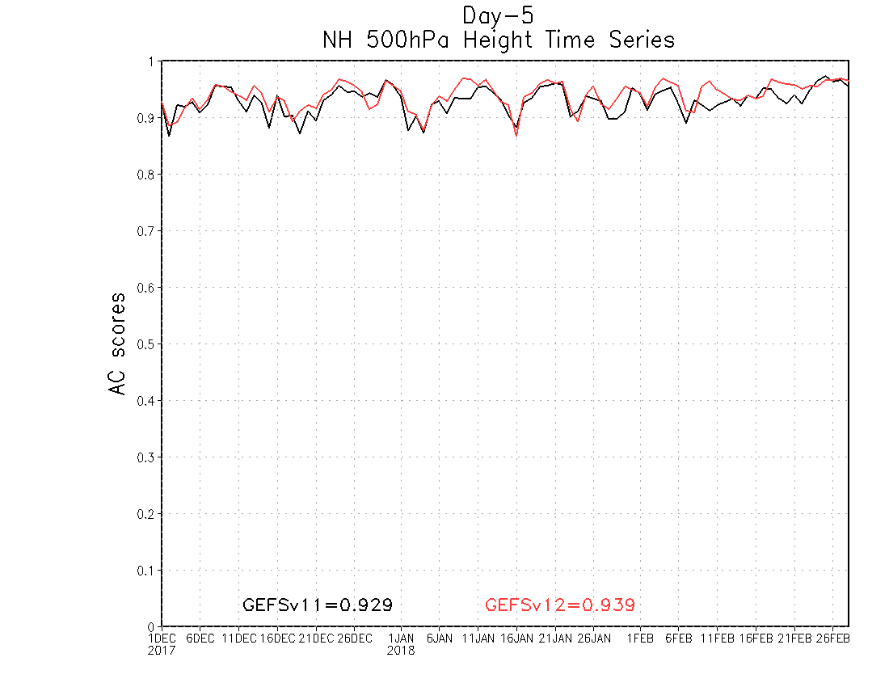
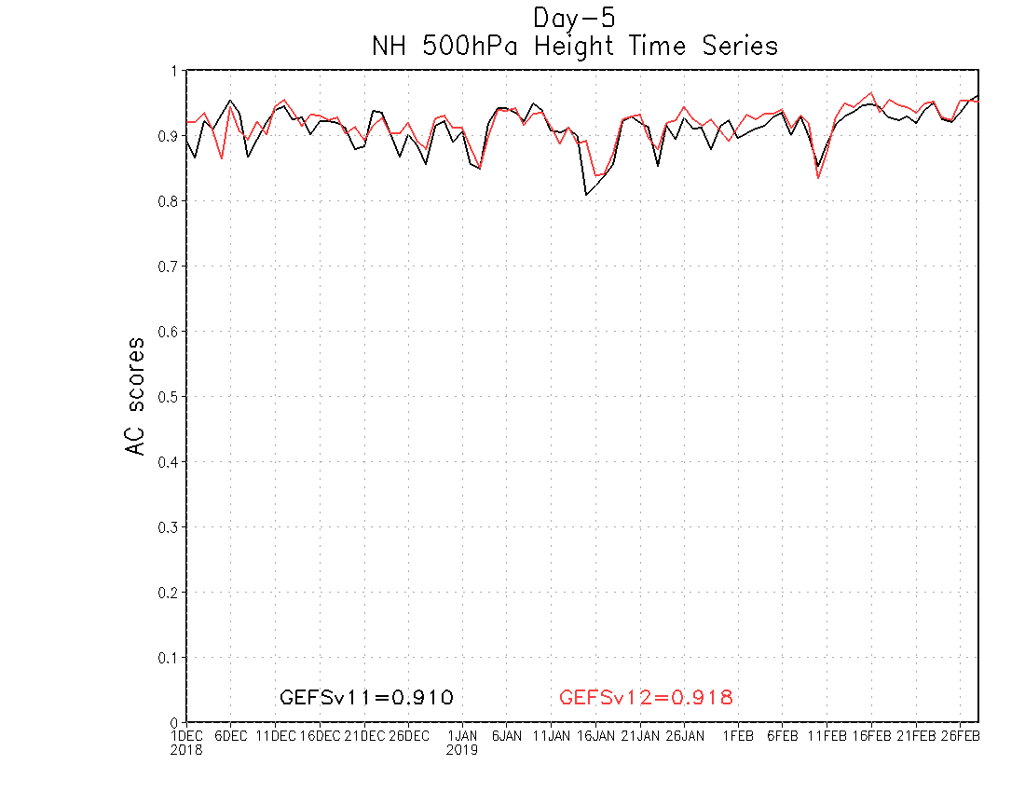
NATIONAL OCEANIC AND ATMOSPHERIC ADMINISTRATION
GEFSv12 Winter AC Scores
DAY 5 – NH Winter 500-hPa Anomaly Correlation (AC) Scores
GEFSv12 has higher NH Winter 500-hPa AC scores than GEFSv11 at Day 5
GEFSv11 = .929 GEFSv12 = .939
GEFSv11 = .910 GEFSv12 = .918
12/2017
3/2018
12/2018
3/2019

Slide 4
NATIONAL OCEANIC AND ATMOSPHERIC ADMINISTRATION
GEFSv12 AC Scores (500-hPa Z at Day 5)
 | GEFSv11 (PROD) | GEFSv12 (RETRO)
Fall 2019 | 0.909 | 0.920
Summer 2019 | 0.902 | 0.912
Spring 2019 | 0.901 | 0.912
Winter 2018/2019 | 0.910 | 0.918
Fall 2018 | 0.923 | 0.928
Summer 2018 | 0.899 | 0.908
Spring 2018 | 0.907 | 0.916
Winter 2017/2018 | 0.929 | 0.939
Fall 2017 | 0.913 | 0.921
Summer 2017 | 0.884 | 0.896

Slide 5
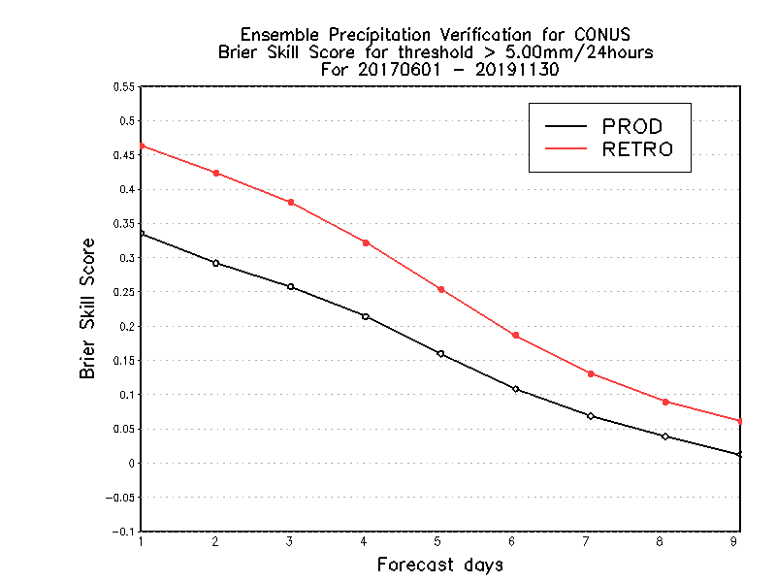
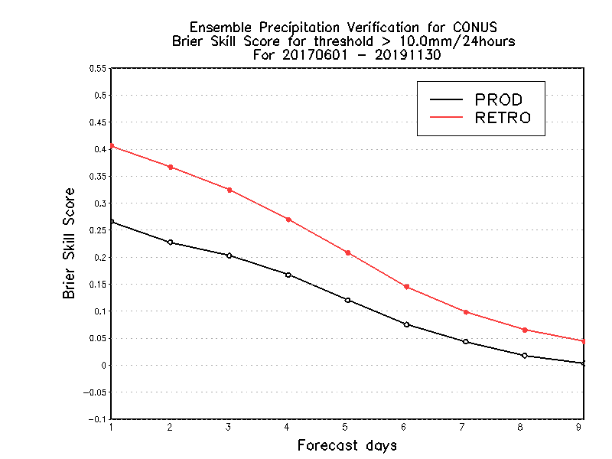
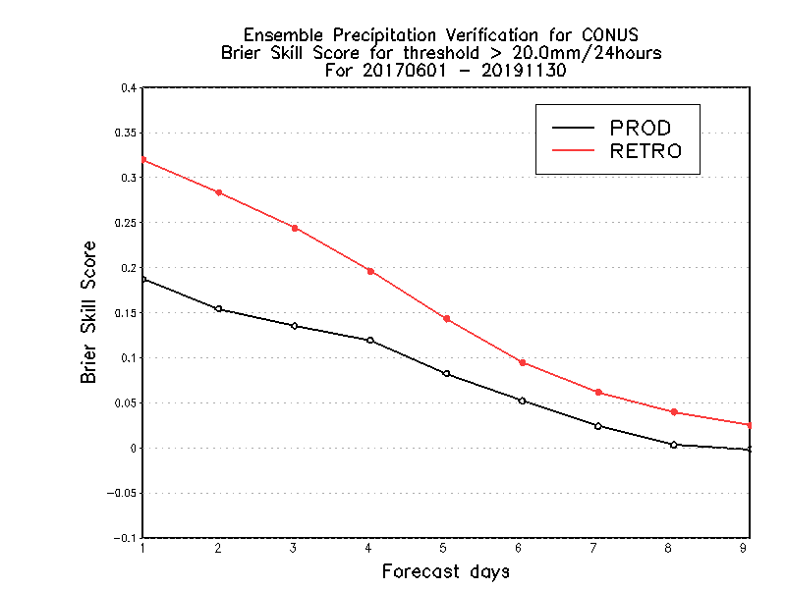
NATIONAL OCEANIC AND ATMOSPHERIC ADMINISTRATION
GEFSv12 CONUS Precip.: Brier Skill Score
5mm/24h
10mm/24h
20mm/24h
Brier Skill Score (→)
Forecast Lead Time (→)
Forecast Lead Time (→)
Forecast Lead Time (→)
GEFSv12 mean has higher Brier Skill Scores than GEFSv11 mean at all lead times and thresholds
STTP has minor contribution to tropics
STTP overdispersion in winter hemisphere

Slide 6
NATIONAL OCEANIC AND ATMOSPHERIC ADMINISTRATION
GEFSv12 CONUS Precip.: Equitable Threat Score
Equitable Threat Score
BIAS
GEFSv12 mean has higher ETS values than GEFSv11 mean at lower precip thresholds
GEFSv12 mean has a larger low bias than GEFSv11 mean at higher precip thresholds

Slide 7
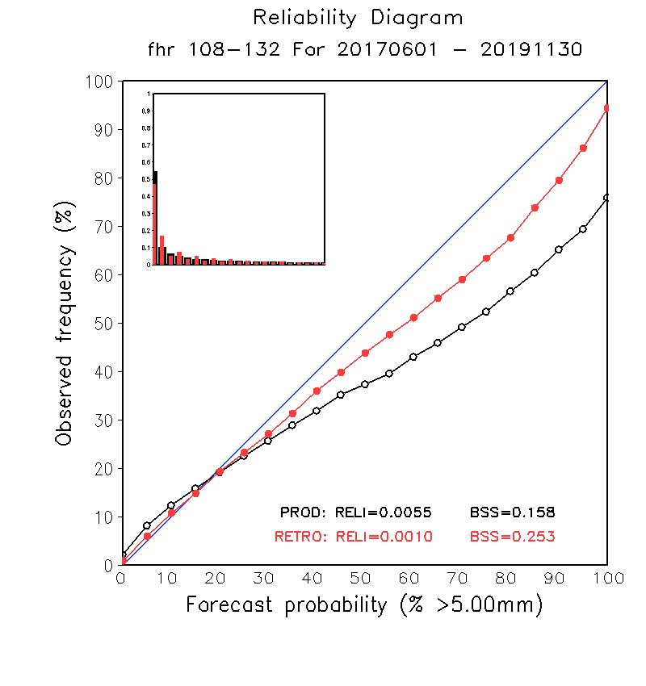
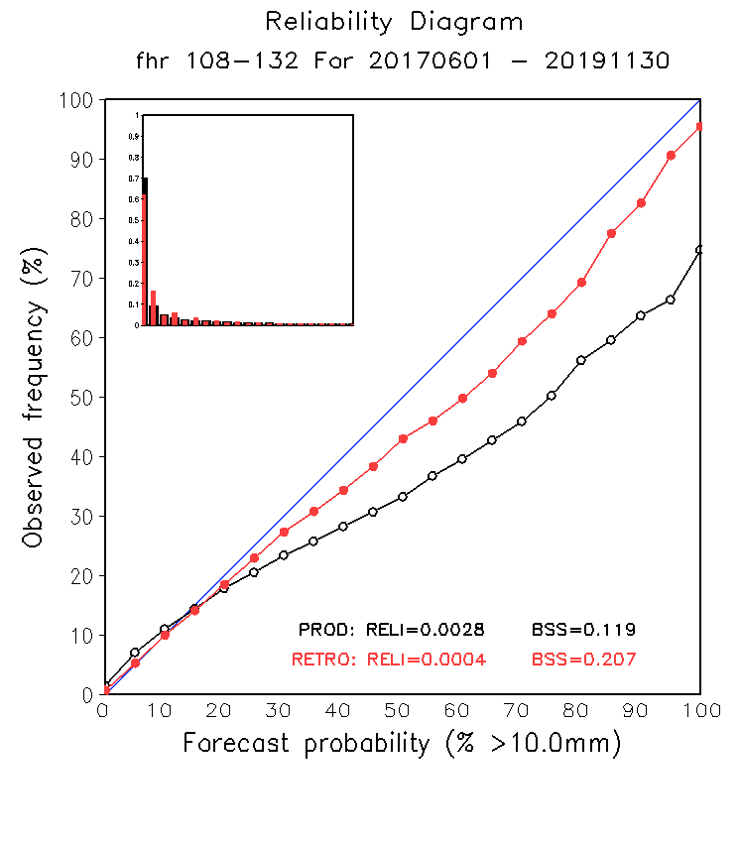
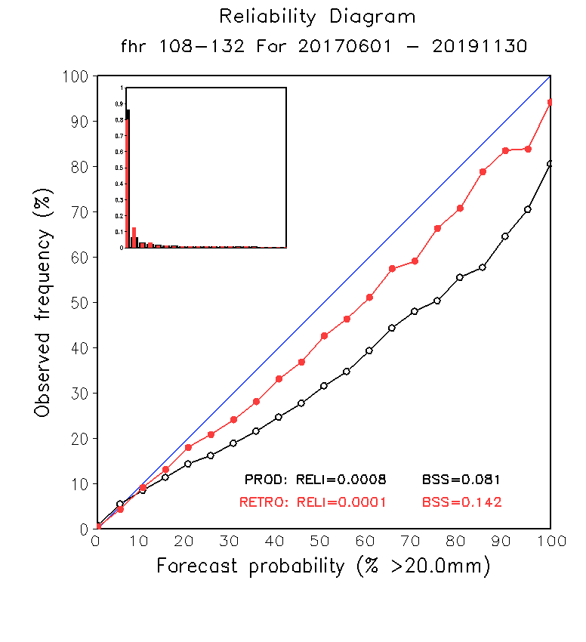
NATIONAL OCEANIC AND ATMOSPHERIC ADMINISTRATION
GEFSv12 CONUS Precip.: Reliability Diagrams
5mm/ 24h
10mm/ 24h
20mm/ 24h
GEFSv12 is “more reliable” than GEFSv11 (red line closer to diagonal blue line) at all precipitation thresholds at Day 5 (F108-F132)

Slide 8
NATIONAL OCEANIC AND ATMOSPHERIC ADMINISTRATION
GEFSv12 Retrospectives: Winter Storms
GEFSv12 retrospectives initialized at 0000 UTC during 6/1/17–11/30/19
Extra hurricane initializations at 1200 UTC during 6/1–9/30 (2017, 2018, 2019)
GEFSv12 Winter Storm case studies include:
Alaskan Cyclone (Sep 2017)
Southeast U.S. Snowstorm (Dec 2017)
East Coast “Bomb” Cyclone (Jan 2018)
West Coast Atmospheric River (Mar 2018)
Mid-Atlantic Windstorm (Mar 2018)
Alaskan Cyclone (Apr 2018)
Mid-Atlantic Snowstorm (Nov 2018)
Pacific Northwest Snowstorm (Feb 2019)
Central U.S. “Bomb” Cyclone (Mar 2019)
Consolidates NCEP/EMC verification and evaluation functions to efficiently and consistently support all modeling groups
Removes evaluation functions from the model science chain of command, ensuring independent model evaluations

Slide 9
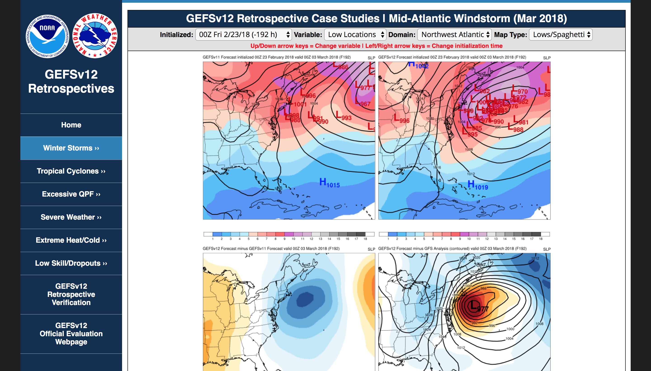
NATIONAL OCEANIC AND ATMOSPHERIC ADMINISTRATION
GEFSv12 Retrospectives: Winter Storms
https://www.emc.ncep.noaa.gov/users/meg/gefsv12/retros/

Slide 10
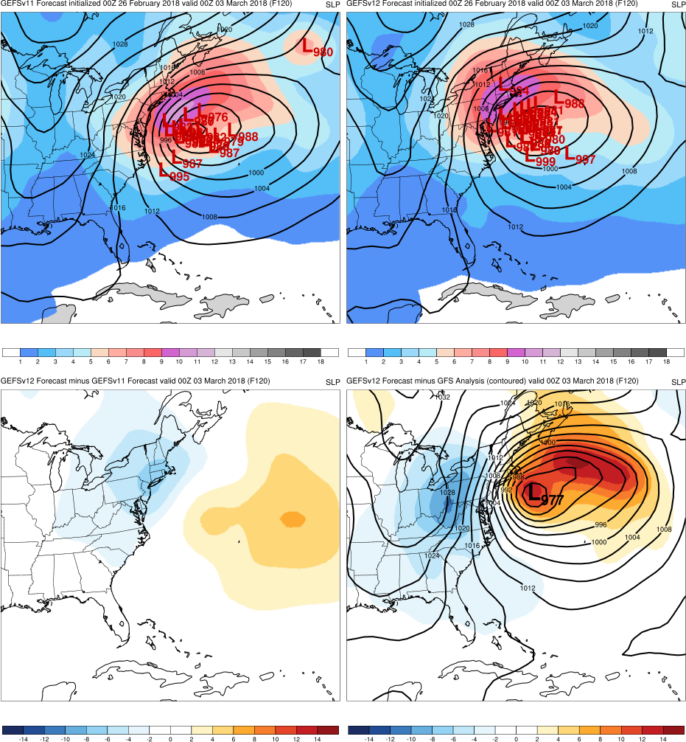
NATIONAL OCEANIC AND ATMOSPHERIC ADMINISTRATION
GEFSv12 Retrospectives: Winter Storms
Top: Mean (contours)
Spread (shaded)
Low Locations
Graphics Setup
GEFSv11
GEFSv12
Bottom Left: GEFSv12−GEFSv11 (shaded)
Bottom Right: GFS analysis (contours)
GEFSv12−GFS analysis (shaded)
v12−v11
GFS Anl.

Slide 11
NATIONAL OCEANIC AND ATMOSPHERIC ADMINISTRATION
GEFSv12 Retrospectives: Winter Storms
Reminder of different ways to display snowfall:
SNOD = Accumulated Snow Depth
WEASD = Water Equivalent Snow Depth (10:1 snow-liquid ratio is usually applied)

Slide 12
NATIONAL OCEANIC AND ATMOSPHERIC ADMINISTRATION
GEFSv12 Retrospectives: Winter Storms
East Coast Extratropical Cyclones
Mid-Atlantic Windstorm (Mar 2018)
East Coast “Bomb” Cyclone (Jan 2018)
Mid-Atlantic Snowstorm (Nov 2018)
Southeast U.S. Snowstorm (Dec 2017)

Slide 13
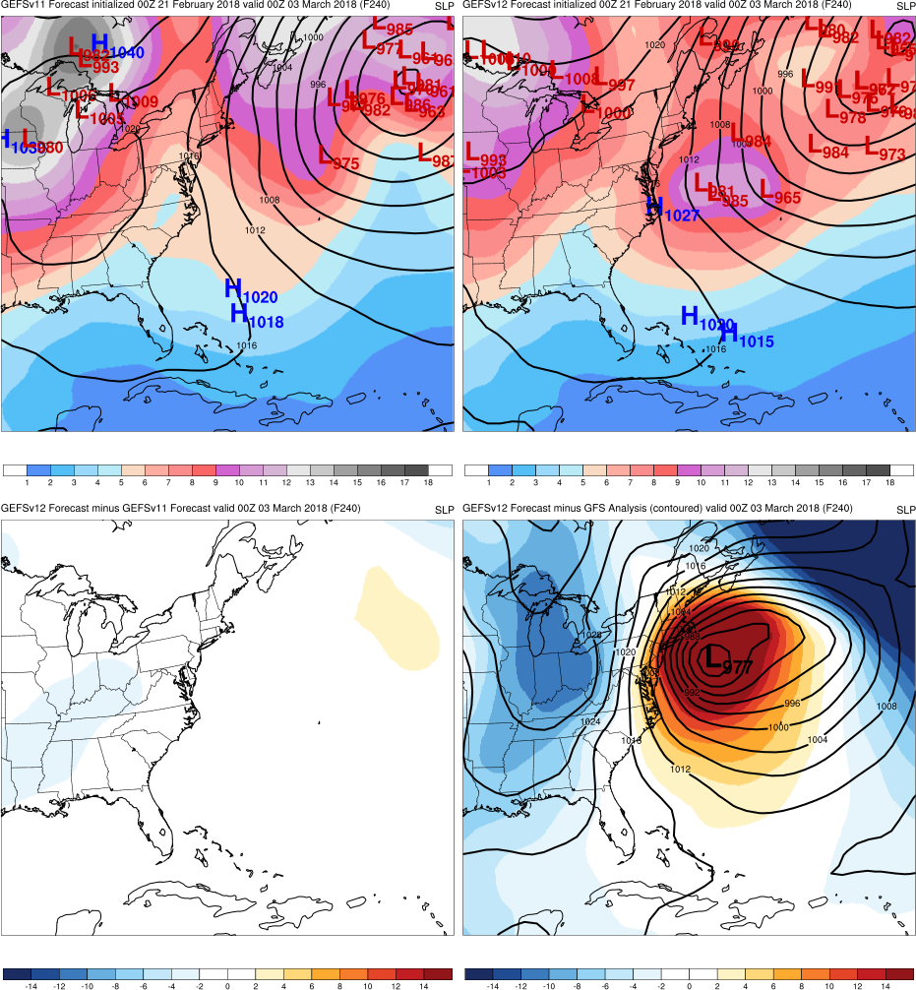
Mid-Atlantic Windstorm
Init.: 0000 UTC 2/21/2018 (F240)
F240: GEFSv12 and GEFSv11 forecast the cyclone too far E, but a few GEFSv12 members suggest a possible coastal low
GEFSv11
GEFSv12
v12−v11
GFS Anl.

Slide 14
Mid-Atlantic Windstorm
Init.: 0000 UTC 2/23/2018 (F192)
F240: GEFSv12 and GEFSv11 forecast the cyclone too far E, but a few GEFSv12 members suggest a possible coastal low
F192: GEFSv12 members correctly shift the cyclone closer to the East Coast, while GEFSv11 does not
GEFSv11
GEFSv12
v12−v11
GFS Anl.

Slide 15
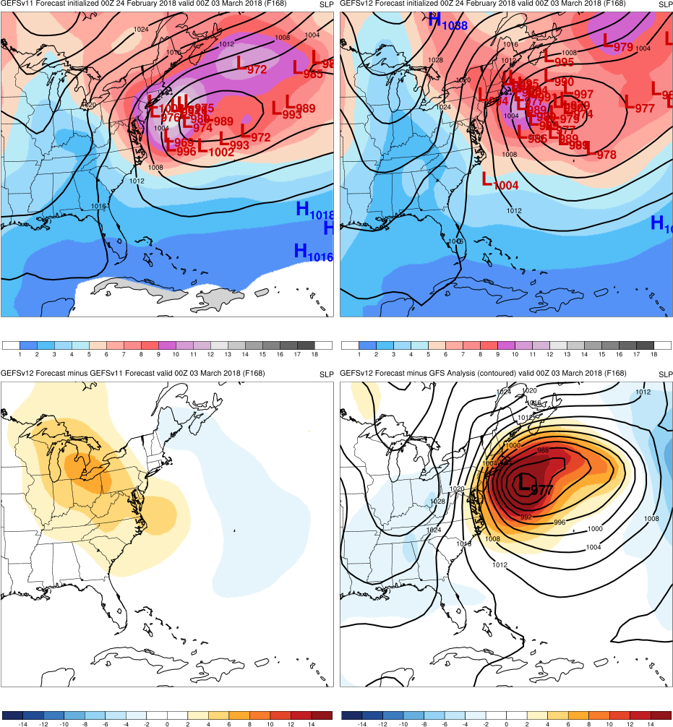
Mid-Atlantic Windstorm
Init.: 0000 UTC 2/24/2018 (F168)
F240: GEFSv12 and GEFSv11 forecast the cyclone too far E, but a few GEFSv12 members suggest a possible coastal low
F192: GEFSv12 members correctly shift the cyclone closer to the East Coast, while GEFSv11 does not
F168: GEFSv11 starts to shift from E to W
GEFSv11
GEFSv12
v12−v11
GFS Anl.

Slide 16
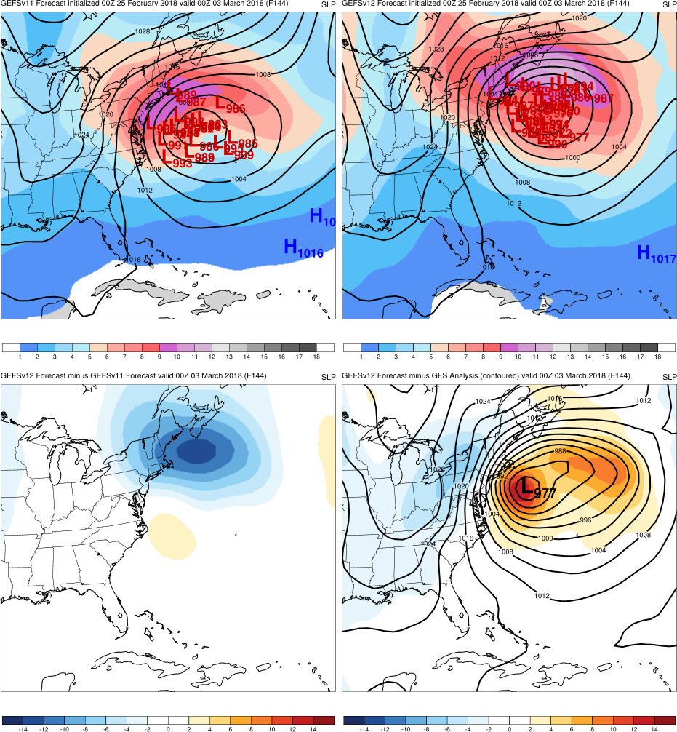
Mid-Atlantic Windstorm
Init.: 0000 UTC 2/25/2018 (F144)
F240: GEFSv12 and GEFSv11 forecast the cyclone too far E, but a few GEFSv12 members suggest a possible coastal low
F192: GEFSv12 members correctly shift the cyclone closer to the East Coast, while GEFSv11 does not
F168: GEFSv11 starts to shift from E to W
F144: GEFSv12 and GEFSv11 both shift west, but GEFSv12 is (correctly) deeper
GEFSv11
GEFSv12
v12−v11
GFS Anl.

Slide 17
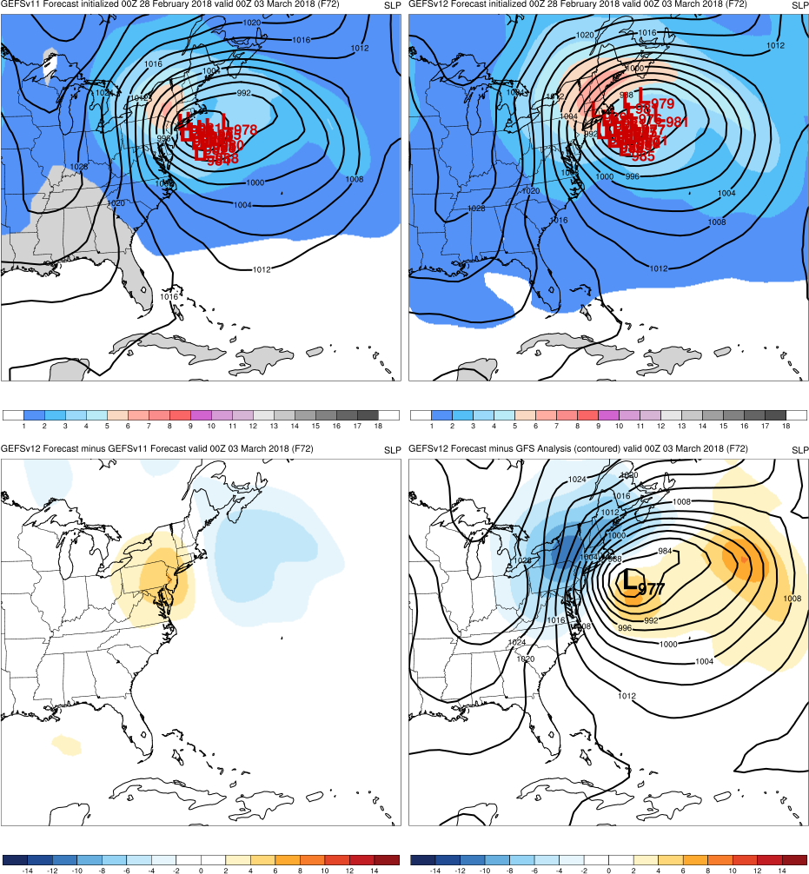
Mid-Atlantic Windstorm
Init.: 0000 UTC 2/28/2018 (F072)
F240: GEFSv12 and GEFSv11 forecast the cyclone too far E, but a few GEFSv12 members suggest a possible coastal low
F192: GEFSv12 members correctly shift the cyclone closer to the East Coast, while GEFSv11 does not
F168: GEFSv11 starts to shift from E to W
F144: GEFSv12 and GEFSv11 both shift west, but GEFSv12 is (correctly) deeper
F072: GEFSv12 and GEFSv11 both shift west and lock onto the correct low location
GEFSv11
GEFSv12
v12−v11
GFS Anl.

Slide 18
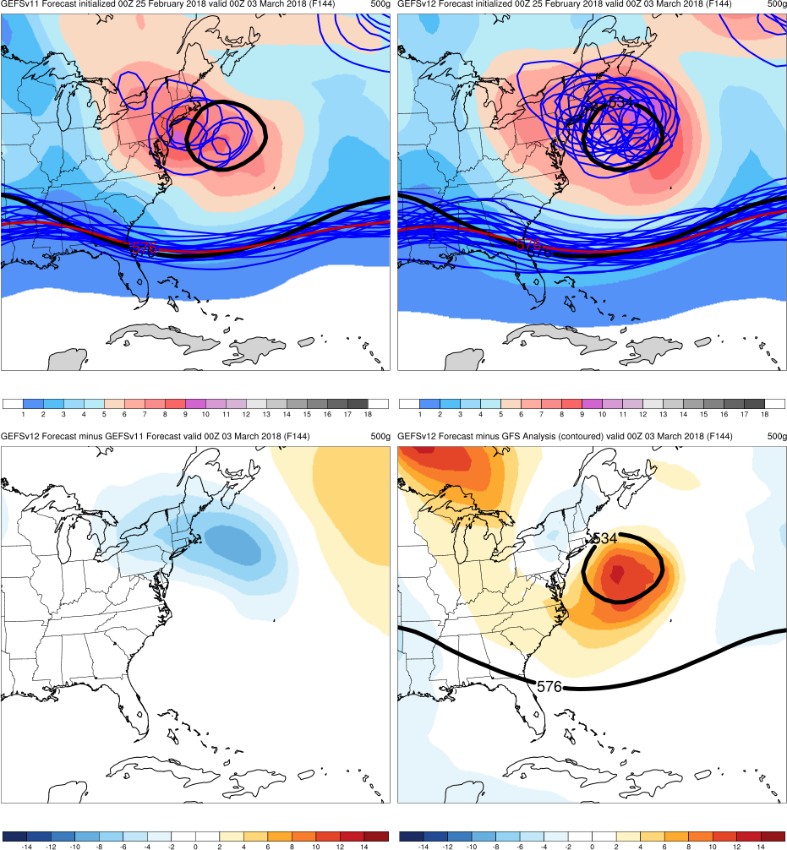
Mid-Atlantic Windstorm
Init.: 0000 UTC 2/25/2018 (F144)
GEFSv12 was able to forecast the overall synoptic pattern (e.g., cutoff low formation) earlier than GEFSv11, resulting in more accurate cyclone track and intensity forecasts in the long and medium range
Example of 500-hPa spaghetti plots (also available online), with analyzed 576-dam and 534-dam contours (black), ensemble mean (red), and ensemble members (blue)
GEFSv11
GEFSv12
v12−v11
GFS Anl.

Slide 19
NATIONAL OCEANIC AND ATMOSPHERIC ADMINISTRATION
GEFSv12 Retrospectives: Winter Storms
East Coast Extratropical Cyclones
Mid-Atlantic Windstorm (Mar 2018)
East Coast “Bomb” Cyclone (Jan 2018)
Mid-Atlantic Snowstorm (Nov 2018)
Southeast U.S. Snowstorm (Dec 2017)

Slide 20
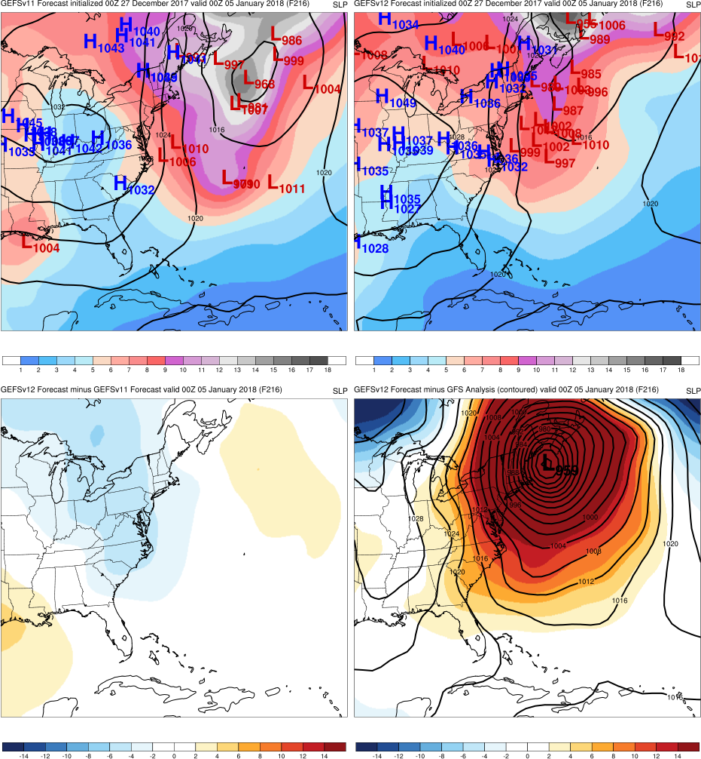
East Coast “Bomb” Cyclone
Init.: 0000 UTC 12/27/2017 (F216)
F216: GEFSv12 has larger percentage of members forecasting a coastal low. Most members in both versions are too weak.
GEFSv11
GEFSv12
v12−v11
GFS Anl.

Slide 21
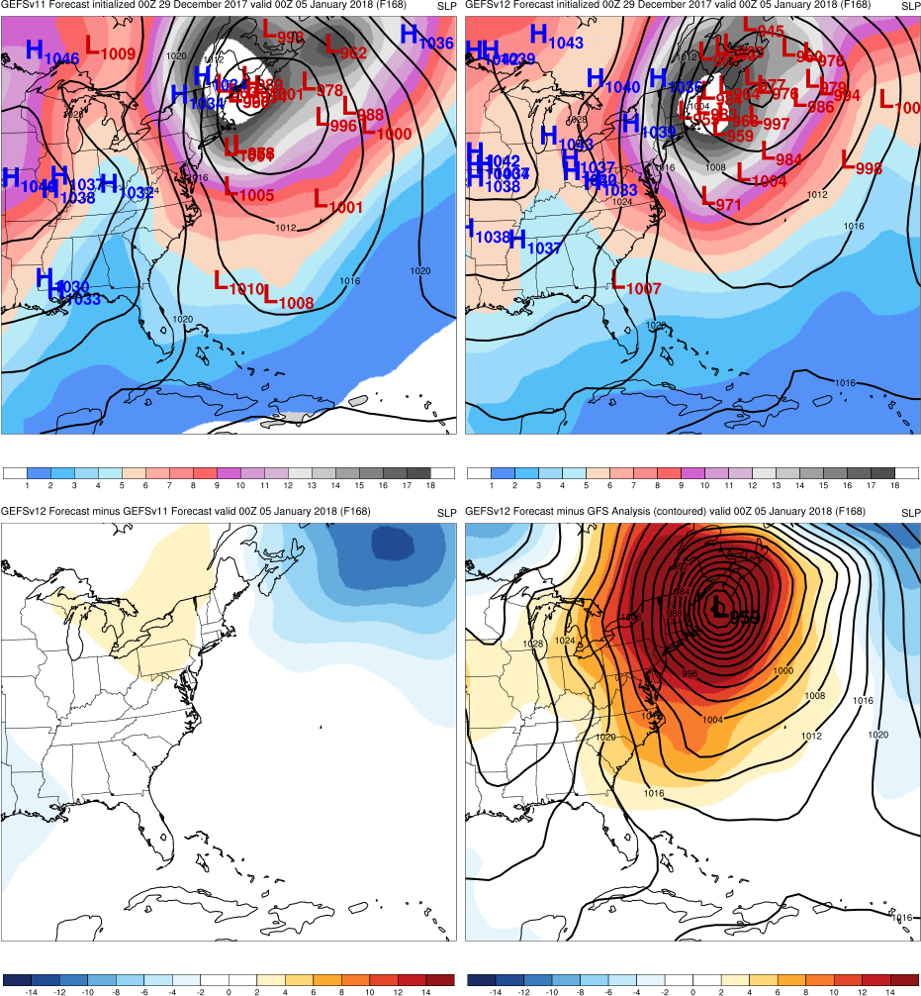
East Coast “Bomb” Cyclone
Init.: 0000 UTC 12/29/2017 (F168)
F216: GEFSv12 has larger percentage of members forecasting a coastal low. Most members in both versions are too weak.
F168: GEFSv12 forecasts location/intensity of “bomb” cyclone earlier than GEFSv11
GEFSv11
GEFSv12
v12−v11
GFS Anl.

Slide 22
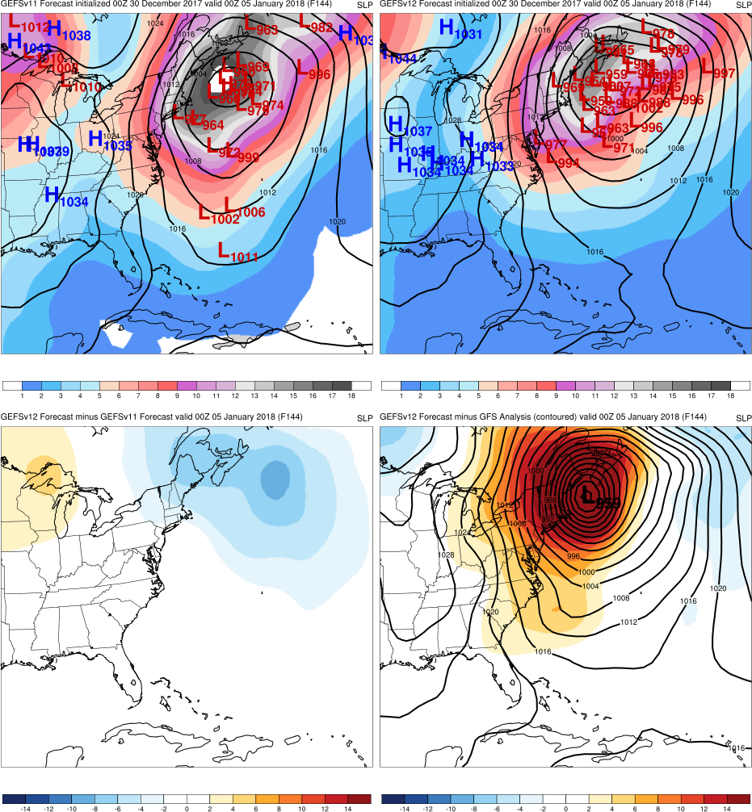
East Coast “Bomb” Cyclone
Init.: 0000 UTC 12/30/2017 (F144)
F216: GEFSv12 has larger percentage of members forecasting a coastal low. Most members in both versions are too weak.
F168: GEFSv12 forecasts location/intensity of “bomb” cyclone earlier than GEFSv11
F144: GEFSv11 forecasts a few lows much too far south; GEFSv12 closer to analysis
GEFSv11
GEFSv12
v12−v11
GFS Anl.

Slide 23
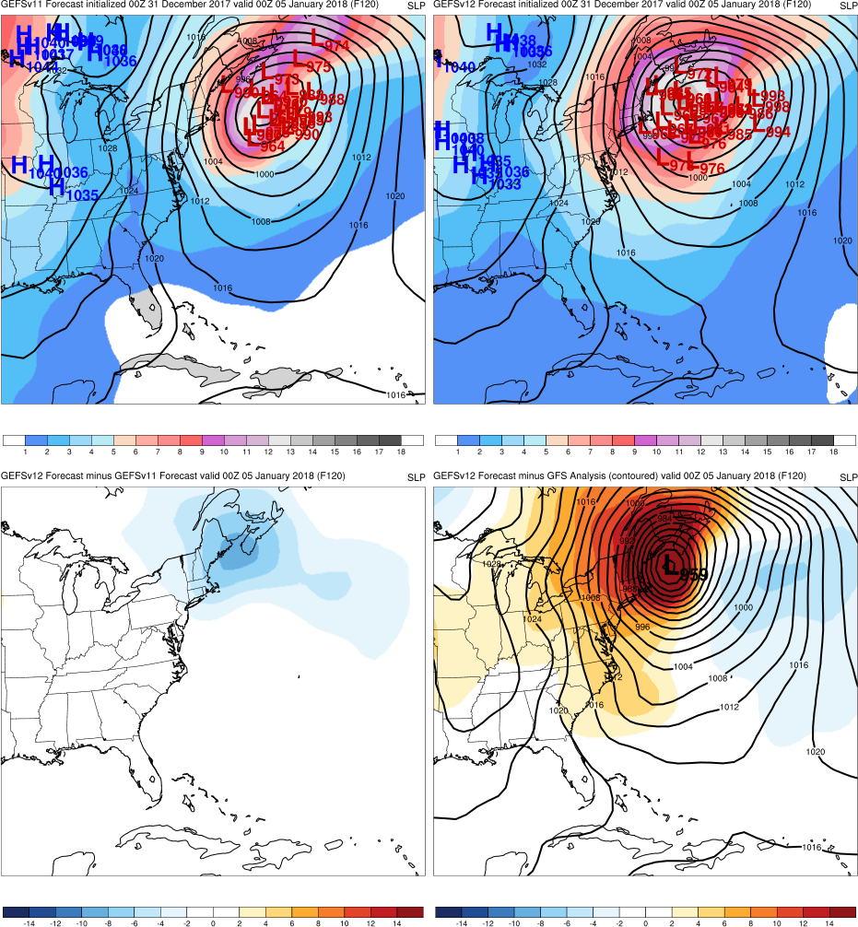
East Coast “Bomb” Cyclone
Init.: 0000 UTC 12/31/2017 (F120)
F216: GEFSv12 has larger percentage of members forecasting a coastal low. Most members in both versions are too weak.
F168: GEFSv12 forecasts location/intensity of “bomb” cyclone earlier than GEFSv11
F144: GEFSv11 forecasts a few lows much too far south; GEFSv12 closer to analysis
F120: GEFSv11 comes inline w/ GEFSv12
GEFSv11
GEFSv12
v12−v11
GFS Anl.

Slide 24
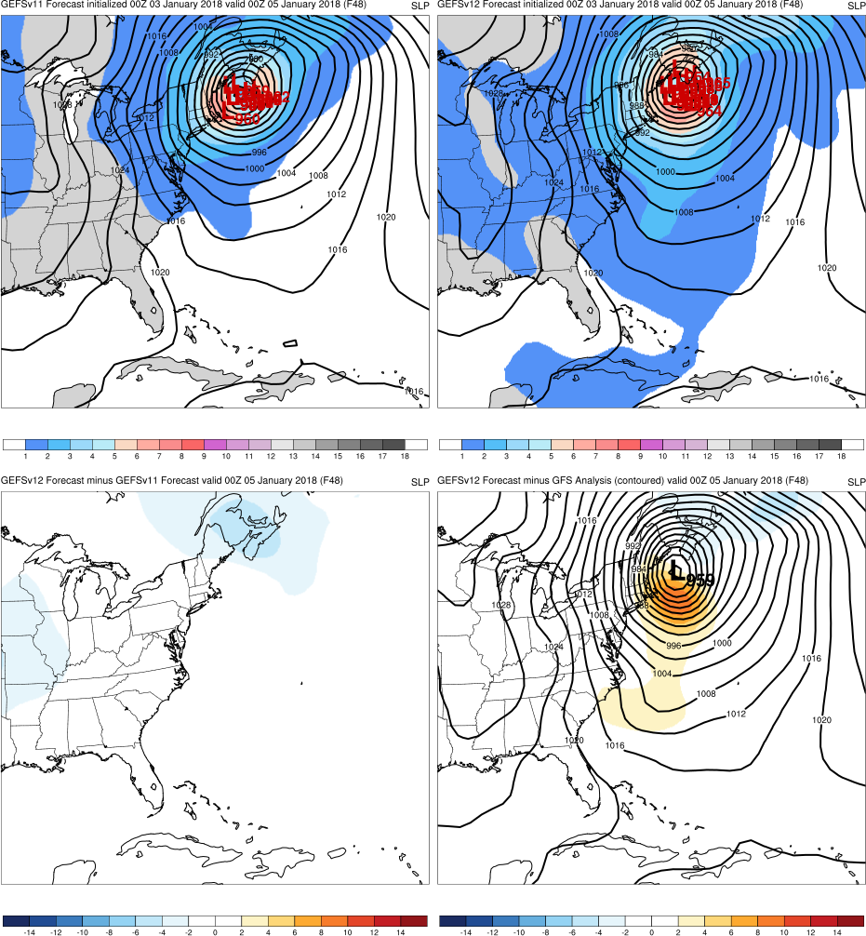
East Coast “Bomb” Cyclone
Init.: 0000 UTC 01/03/2018 (F048)
F216: GEFSv12 has larger percentage of members forecasting a coastal low. Most members in both versions are too weak.
F168: GEFSv12 forecasts location/intensity of “bomb” cyclone earlier than GEFSv11
F144: GEFSv11 forecasts a few lows much too far south; GEFSv12 closer to analysis
F120: GEFSv11 comes inline w/ GEFSv12
F048: GEFSv12 and GEFSv11 shift west w/ shorter lead time toward GFS analysis
GEFSv11
GEFSv12
v12−v11
GFS Anl.

Slide 25
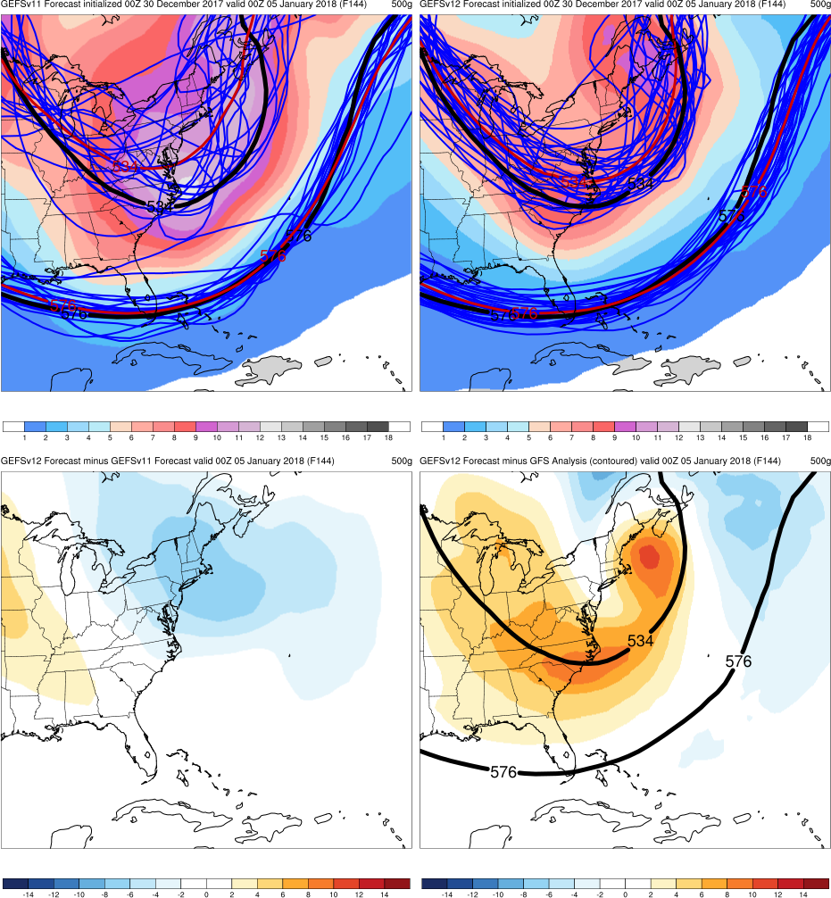
East Coast “Bomb” Cyclone
Init.: 0000 UTC 12/30/2017 (F144)
GEFSv12 was able to forecast the overall synoptic pattern earlier & more accurately than GEFSv11, resulting in more accurate extratropical cyclone track and intensity forecasts in the long and medium range
Example of 500-hPa spaghetti plots (also available online), with analyzed 576-dam and 534-dam contours (black), ensemble mean (red), and ensemble members (blue)
GEFSv11
GEFSv12
v12−v11
GFS Anl.

Slide 26
NATIONAL OCEANIC AND ATMOSPHERIC ADMINISTRATION
GEFSv12 Retrospectives: Winter Storms
East Coast Extratropical Cyclones
Mid-Atlantic Windstorm (Mar 2018)
East Coast “Bomb” Cyclone (Jan 2018)
Mid-Atlantic Snowstorm (Nov 2018)
Southeast U.S. Snowstorm (Dec 2017)

Slide 27
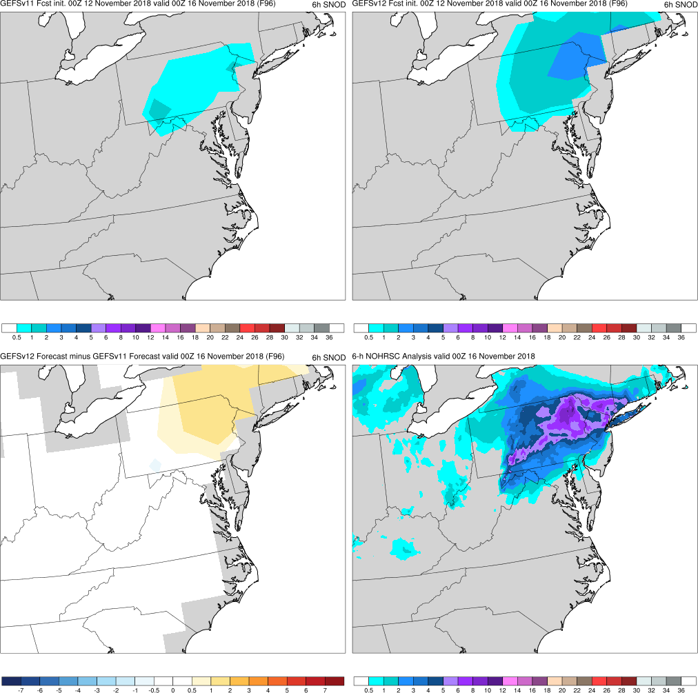
6-h SNOD
Mid-Atlantic Snowstorm
Init.: 0000 UTC 11/12/2018 (F096)
F096: GEFSv12 and GEFSv11 ens. means start forecasting snow in the Mid-Atlantic. GEFSv12 forecasts more than GEFSv11.
GEFSv11
GEFSv12
v12−v11
NOHRSC

Slide 28
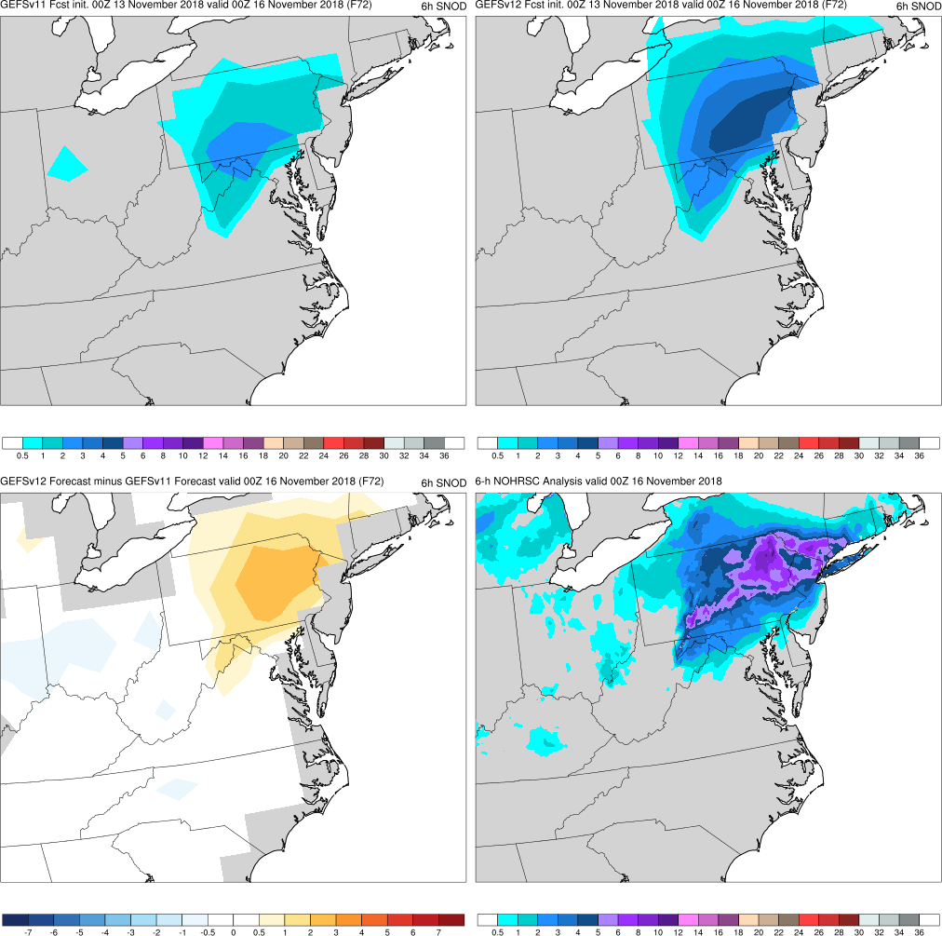
6-h SNOD
Mid-Atlantic Snowstorm
Init.: 0000 UTC 11/13/2018 (F072)
F096: GEFSv12 and GEFSv11 ens. means start forecasting snow in the Mid-Atlantic. GEFSv12 forecasts more than GEFSv11.
F072: GEFSv12 forecasts higher 6-h snowfall totals over a more accurate footprint than GEFSv11 (more surface lows)
GEFSv11
GEFSv12
v12−v11
NOHRSC

Slide 29
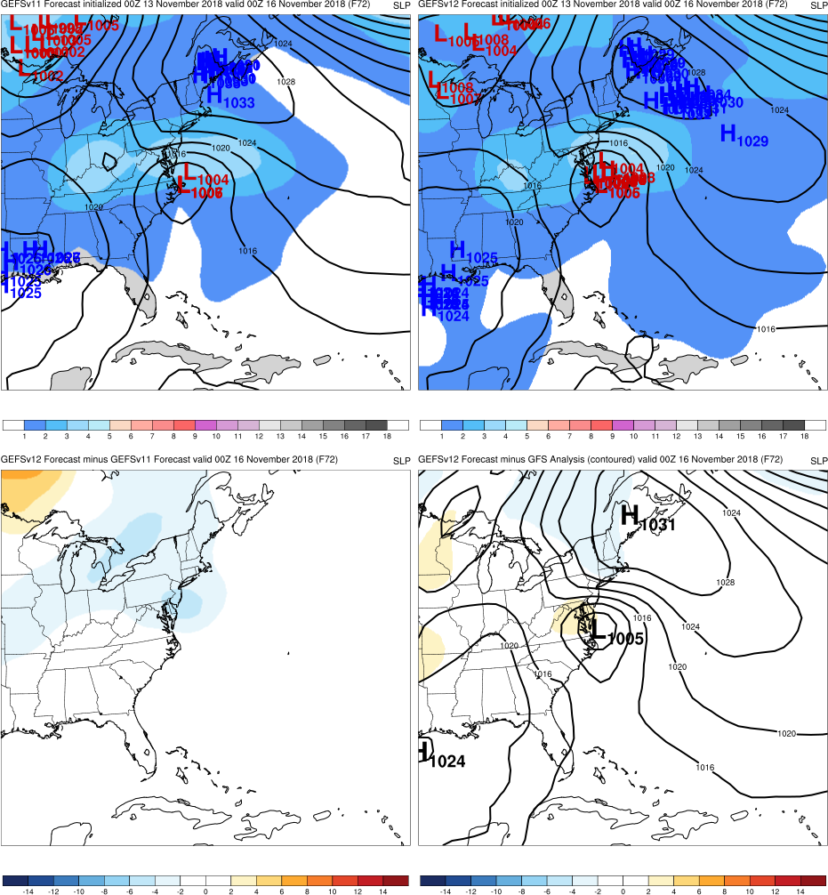
Mid-Atlantic Snowstorm
Init.: 0000 UTC 11/13/2018 (F072)
F096: GEFSv12 and GEFSv11 ens. means start forecasting snow in the Mid-Atlantic. GEFSv12 forecasts more than GEFSv11.
F072: GEFSv12 forecasts higher 6-h snowfall totals over a more accurate footprint than GEFSv11 (more surface lows)
GEFSv11
GEFSv12
v12−v11
GFS Anl.

Slide 30
6-h SNOD
Mid-Atlantic Snowstorm
Init.: 0000 UTC 11/13/2018 (F072)
F096: GEFSv12 and GEFSv11 ens. means start forecasting snow in the Mid-Atlantic. GEFSv12 forecasts more than GEFSv11.
F072: GEFSv12 forecasts higher 6-h snowfall totals over a more accurate footprint than GEFSv11 (more surface lows)
GEFSv11
GEFSv12
v12−v11
NOHRSC

Slide 31
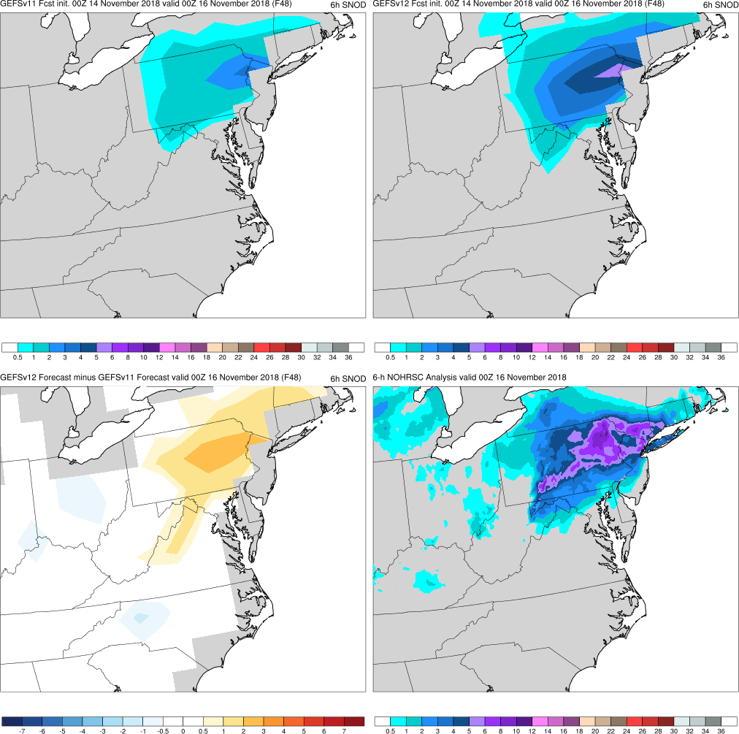
6-h SNOD
Mid-Atlantic Snowstorm
Init.: 0000 UTC 11/14/2018 (F048)
F096: GEFSv12 and GEFSv11 ens. means start forecasting snow in the Mid-Atlantic. GEFSv12 forecasts more than GEFSv11.
F072: GEFSv12 forecasts higher 6-h snowfall totals over a more accurate footprint than GEFSv11 (more surface lows)
F048: GEFSv12 continues to forecast higher 6-h snowfall totals over a more accurate footprint than GEFSv11
GEFSv11
GEFSv12
v12−v11
NOHRSC

Slide 32
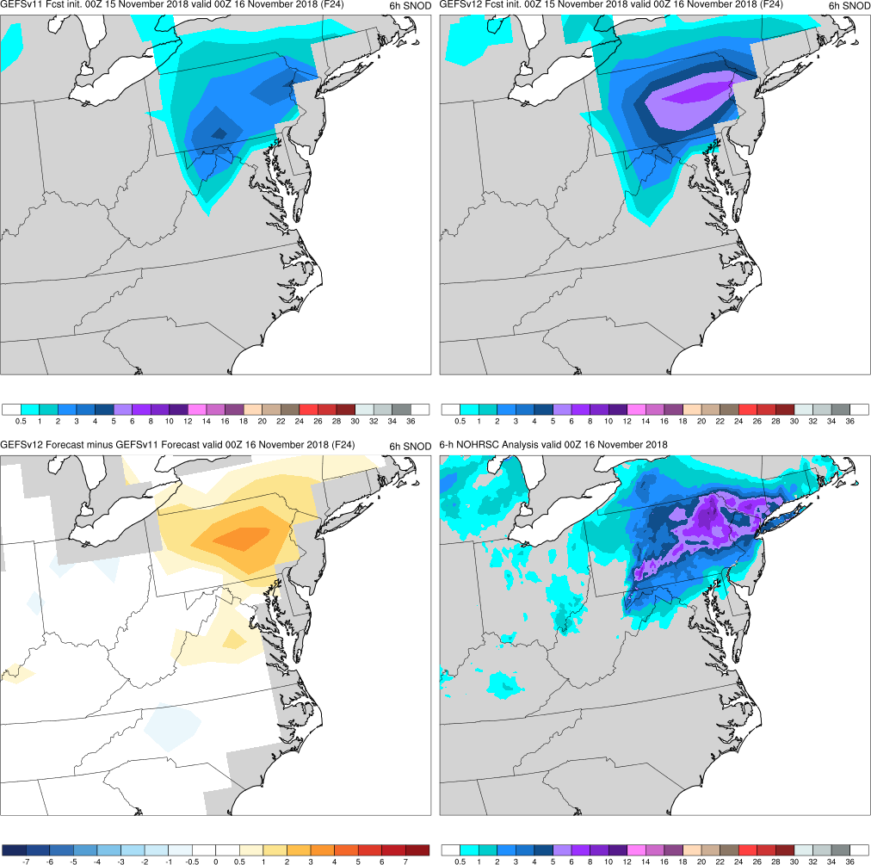
6-h SNOD
Mid-Atlantic Snowstorm
Init.: 0000 UTC 11/15/2018 (F024)
F096: GEFSv12 and GEFSv11 ens. means start forecasting snow in the Mid-Atlantic. GEFSv12 forecasts more than GEFSv11.
F072: GEFSv12 forecasts higher 6-h snowfall totals over a more accurate footprint than GEFSv11 (more surface lows)
F048: GEFSv12 continues to forecast higher 6-h snowfall totals over a more accurate footprint than GEFSv11
F024: GEFSv12 has a more accurate 6-h snowfall forecast than GEFSv11 in the short range (lead-time ≤24 h)
GEFSv11
GEFSv12
v12−v11
NOHRSC

Slide 33
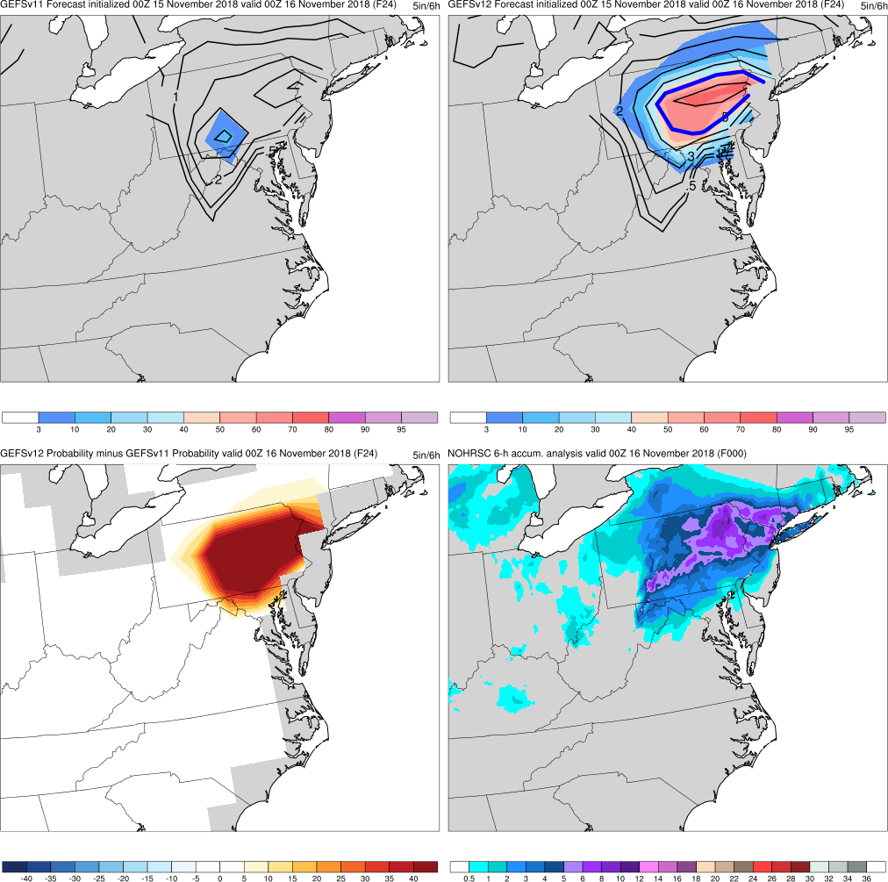
Mid-Atlantic Snowstorm
Init.: 0000 UTC 11/15/2018 (F024)
GEFSv12 was able to forecast much higher probabilities of ≥5” of snow in 6 h than GEFSv11, even as late as F024
NOHRSC regions with ≥5” of snow in 6 h are shaded in purple (bottom right), which matches well w/ higher probabilities of ≥5” of snow in 6 h in GEFSv12 (upper right)
Example of plots depicting the probability of ≥5” of snow in 6 h (also available online), with the ensemble mean (contoured), probability of occurrence (%; shaded), and prob. diff. (shaded)
GEFSv11
GEFSv12
v12−v11
NOHRSC

Slide 34
NATIONAL OCEANIC AND ATMOSPHERIC ADMINISTRATION
GEFSv12 Retrospectives: Winter Storms
East Coast Extratropical Cyclones
Mid-Atlantic Windstorm (Mar 2018)
East Coast “Bomb” Cyclone (Jan 2018)
Mid-Atlantic Snowstorm (Nov 2018)
Southeast U.S. Snowstorm (Dec 2017)

Slide 35
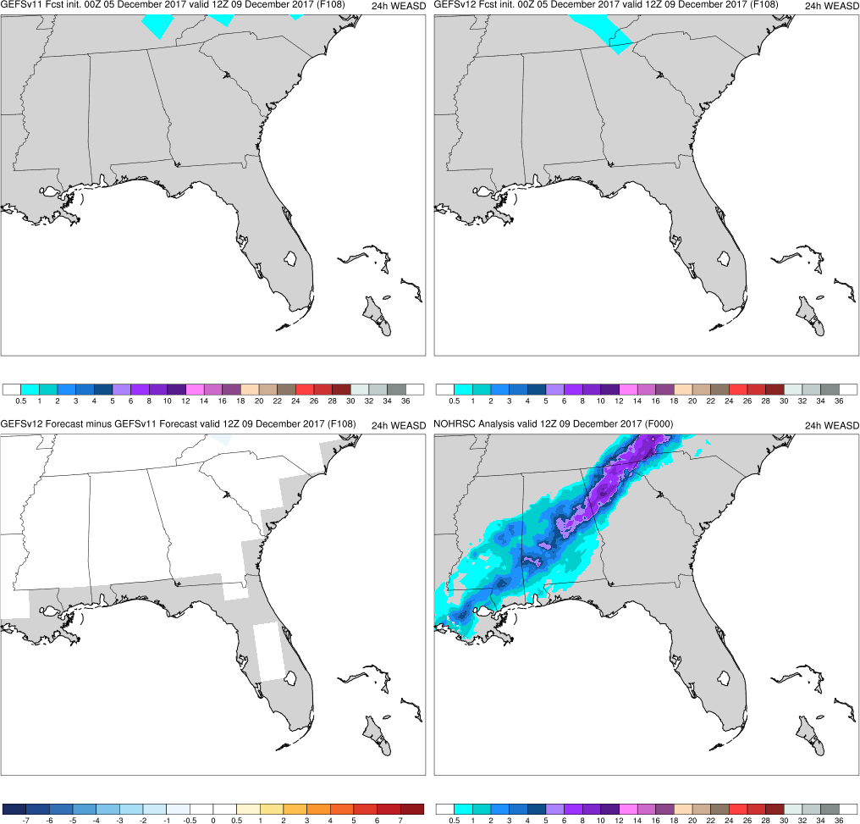
24-h WEASD
Southeast U.S. Snowstorm
Init.: 0000 UTC 12/05/2017 (F108)
F108: Neither GEFSv11 nor GEFSv12 has 24-h snowfall totals across the Southeast
GEFSv11
GEFSv12
v12−v11
NOHRSC

Slide 36
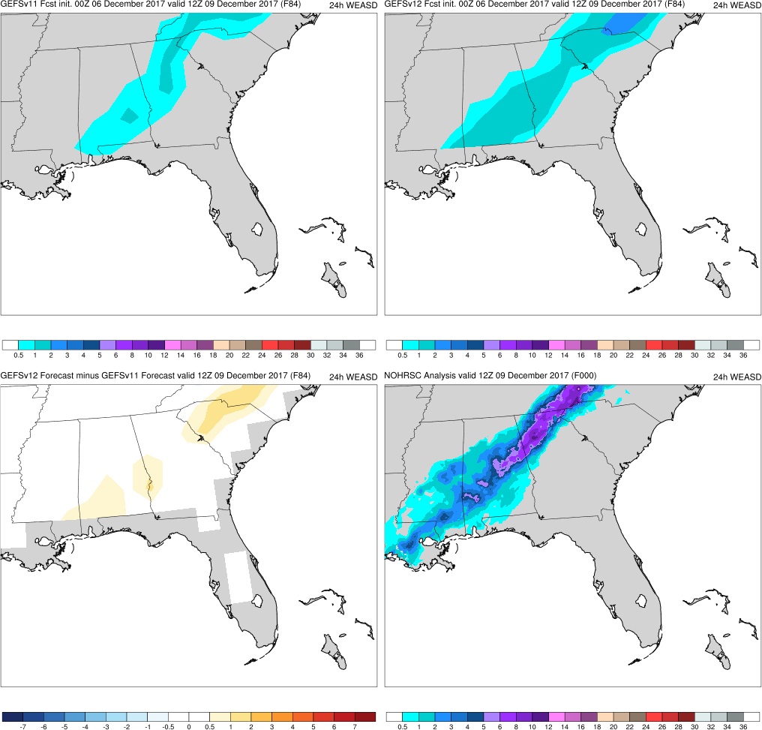
24-h WEASD
Southeast U.S. Snowstorm
Init.: 0000 UTC 12/06/2017 (F084)
F108: Neither GEFSv11 nor GEFSv12 has 24-h snowfall totals across the Southeast
F084: Both GEFSv11 and GEFSv12 begin to forecast 24-h snowfall totals across the Southeast. GEFSv12 has higher totals.
GEFSv11
GEFSv12
v12−v11
NOHRSC

Slide 37
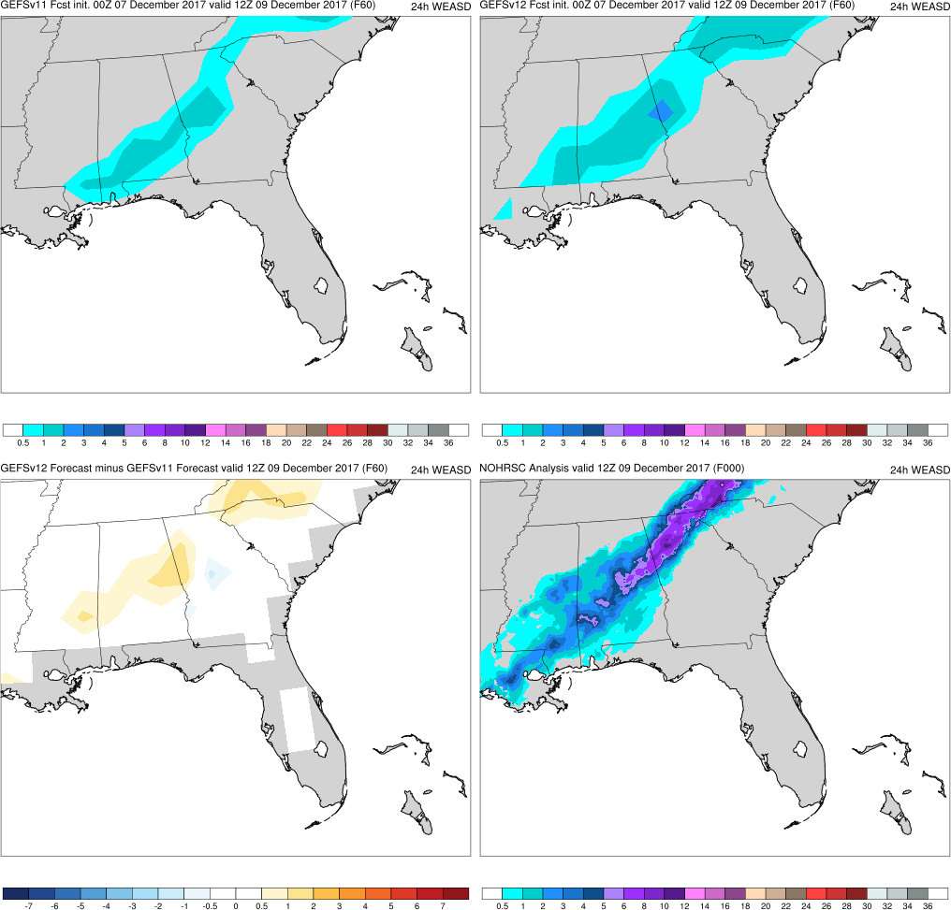
24-h WEASD
Southeast U.S. Snowstorm
Init.: 0000 UTC 12/07/2017 (F060)
F108: Neither GEFSv11 nor GEFSv12 has 24-h snowfall totals across the Southeast
F084: Both GEFSv11 and GEFSv12 begin to forecast 24-h snowfall totals across the Southeast. GEFSv12 has higher totals.
F060: Both GEFSv11 and GEFSv12 have 24-h snowfall totals >1” across Alabama. GEFSv12 has higher totals in Carolinas.
GEFSv11
GEFSv12
v12−v11
NOHRSC

Slide 38
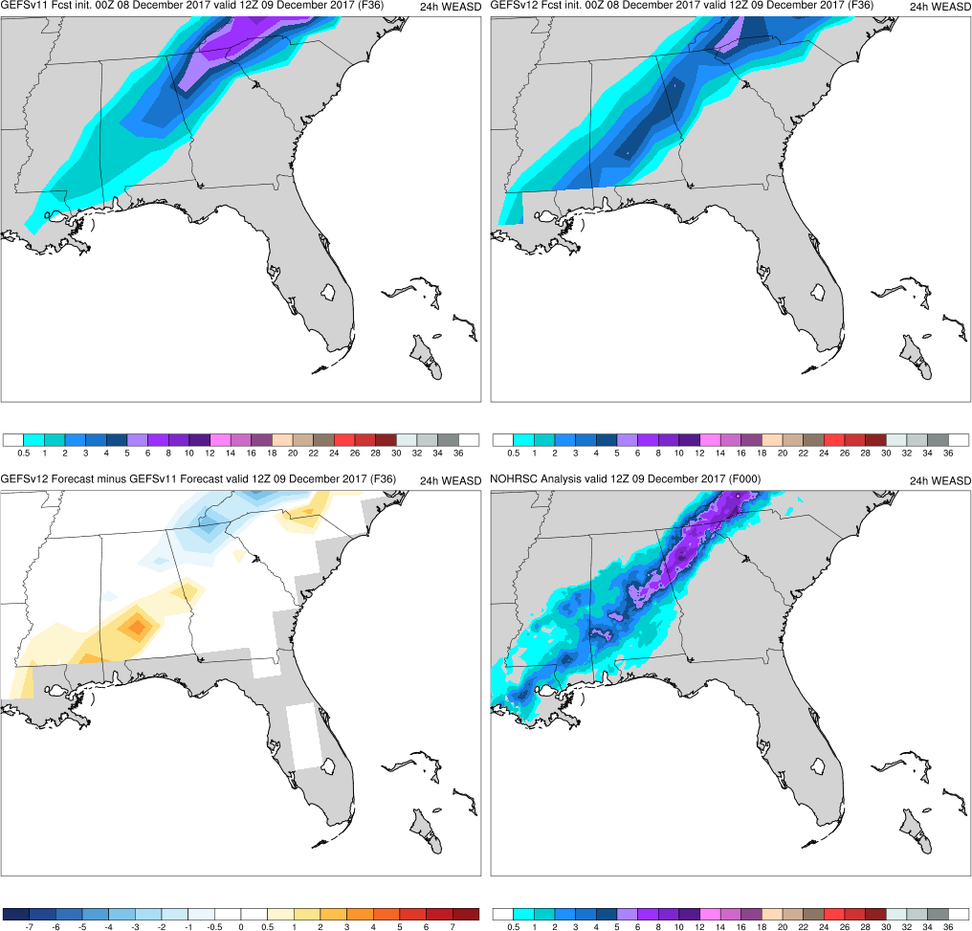
24-h WEASD
Southeast U.S. Snowstorm
Init.: 0000 UTC 12/08/2017 (F036)
F108: Neither GEFSv11 nor GEFSv12 has 24-h snowfall totals across the Southeast
F084: Both GEFSv11 and GEFSv12 begin to forecast 24-h snowfall totals across the Southeast. GEFSv12 has higher totals.
F060: Both GEFSv11 and GEFSv12 have 24-h snowfall totals >1” across Alabama. GEFSv12 has higher totals in Carolinas.
F036: GEFSv12 correctly forecasts >2” of snow in 24 h for southwest Alabama/ Mississippi. GEFSv11 does not, but does a better job with snow in Carolinas.
GEFSv11
GEFSv12
v12−v11
NOHRSC

Slide 39
NATIONAL OCEANIC AND ATMOSPHERIC ADMINISTRATION
GEFSv12 Retrospectives: Winter Storms
Central/Western U.S. Winter Storms
Central U.S. “Bomb” Cyclone (Mar 2019)
West Coast Atmospheric River (Mar 2018)
Pacific Northwest Snowstorm (Feb 2019)
Alaskan Cyclone (Apr 2018)

Slide 40
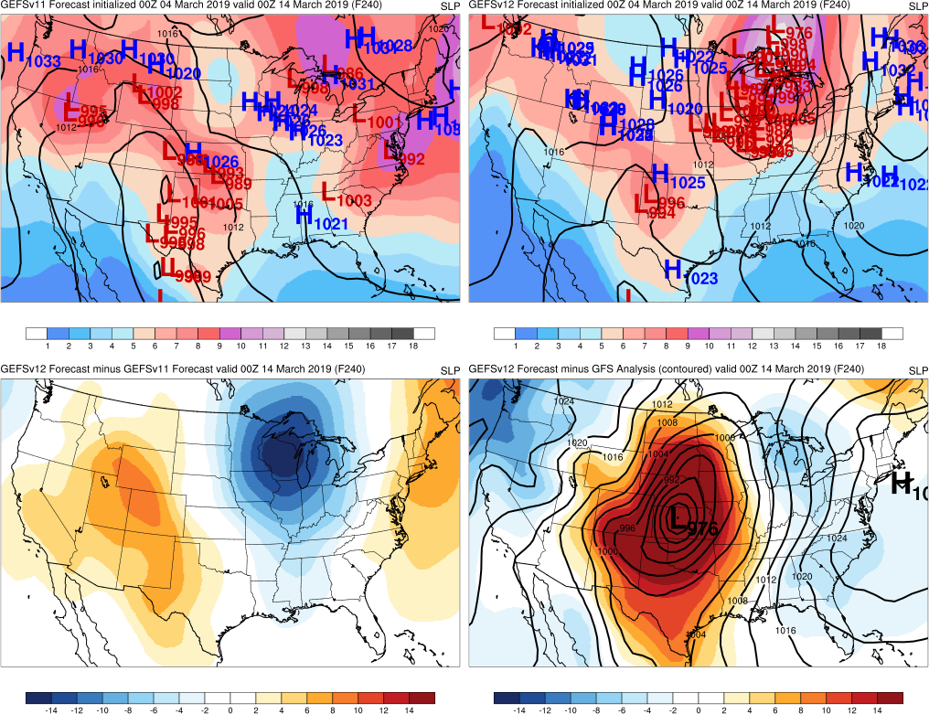
Init.: 0000 UTC 03/04/2018 (F240)
Central U.S. “Bomb” Cyclone
F240: GEFSv12 forecasts a potential cyclone over the upper Midwest. GEFSv11 is further S.
GEFSv11
GEFSv12
v12−v11
GFS Anl.

Slide 41
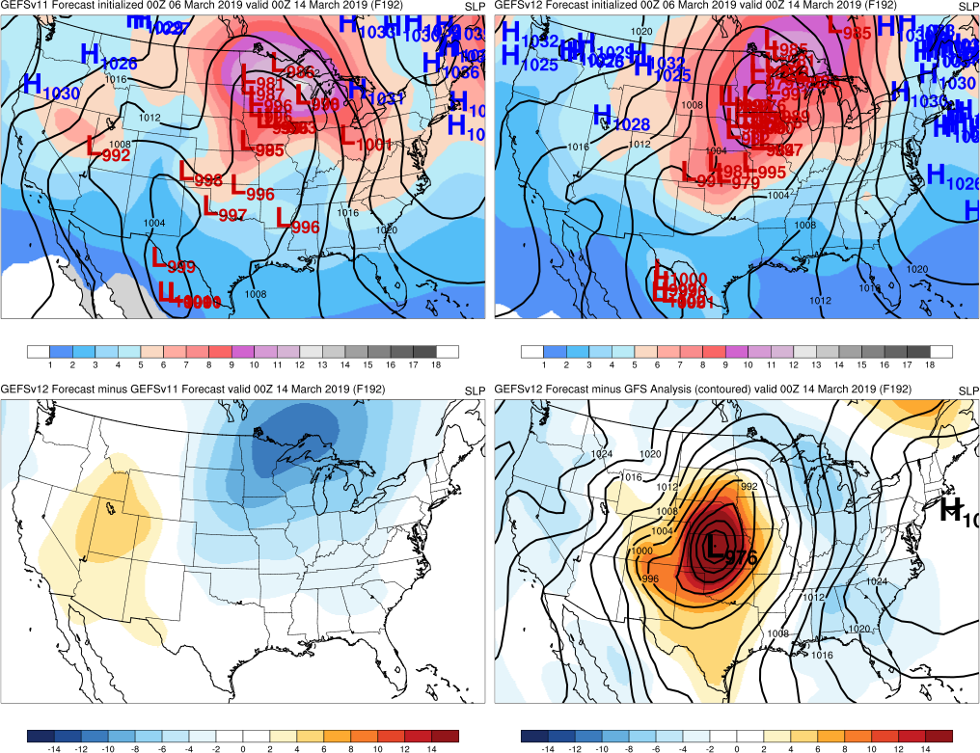
Init.: 0000 UTC 03/06/2018 (F192)
Central U.S. “Bomb” Cyclone
F240: GEFSv12 forecasts a potential cyclone over the upper Midwest. GEFSv11 is further S.
F192: GEFSv11 starts to forecast a cyclone over the upper Midwest, & both have lows over central U.S.
GEFSv11
GEFSv12
v12−v11
GFS Anl.

Slide 42
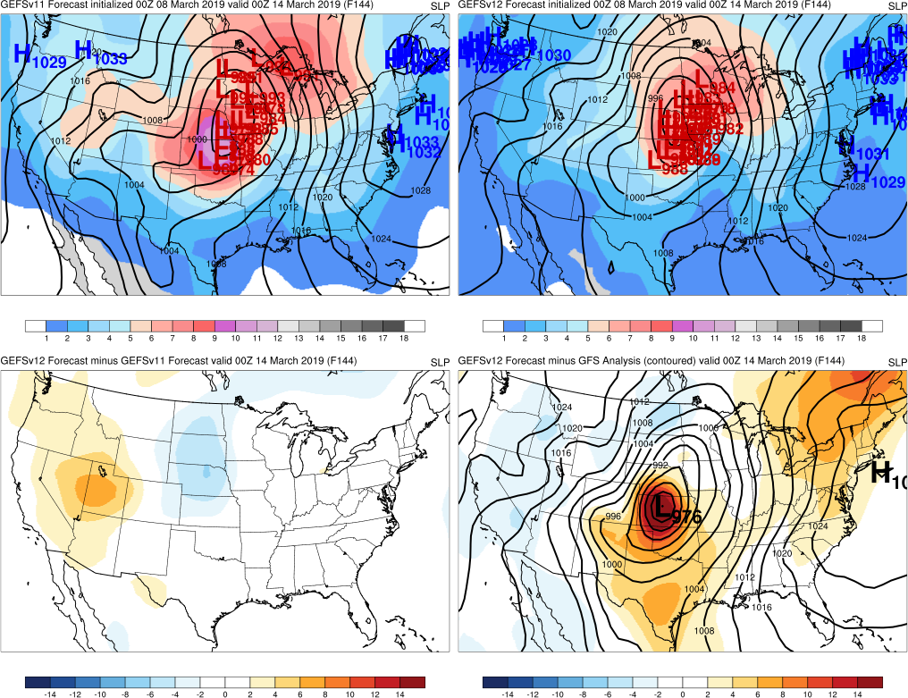
Init.: 0000 UTC 03/08/2018 (F144)
Central U.S. “Bomb” Cyclone
F240: GEFSv12 forecasts a potential cyclone over the upper Midwest. GEFSv11 is further S.
F192: GEFSv11 starts to forecast a cyclone over the upper Midwest, & both have lows over central U.S.
F144: GEFSv12 and GEFSv11 start to shift cyclones to the SW
GEFSv11
GEFSv12
v12−v11
GFS Anl.

Slide 43
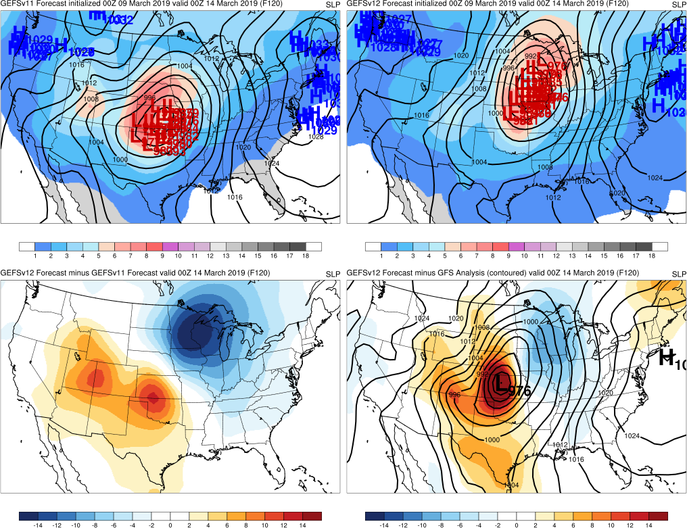
Init.: 0000 UTC 03/09/2018 (F120)
Central U.S. “Bomb” Cyclone
F240: GEFSv12 forecasts a potential cyclone over the upper Midwest. GEFSv11 is further S.
F192: GEFSv11 starts to forecast a cyclone over the upper Midwest, & both have lows over central U.S.
F144: GEFSv12 and GEFSv11 start to shift cyclones to the SW
F120: GEFSv11 correctly shifts cyclone over Kansas/Oklahoma before GEFSv12 does
GEFSv11
GEFSv12
v12−v11
GFS Anl.

Slide 44
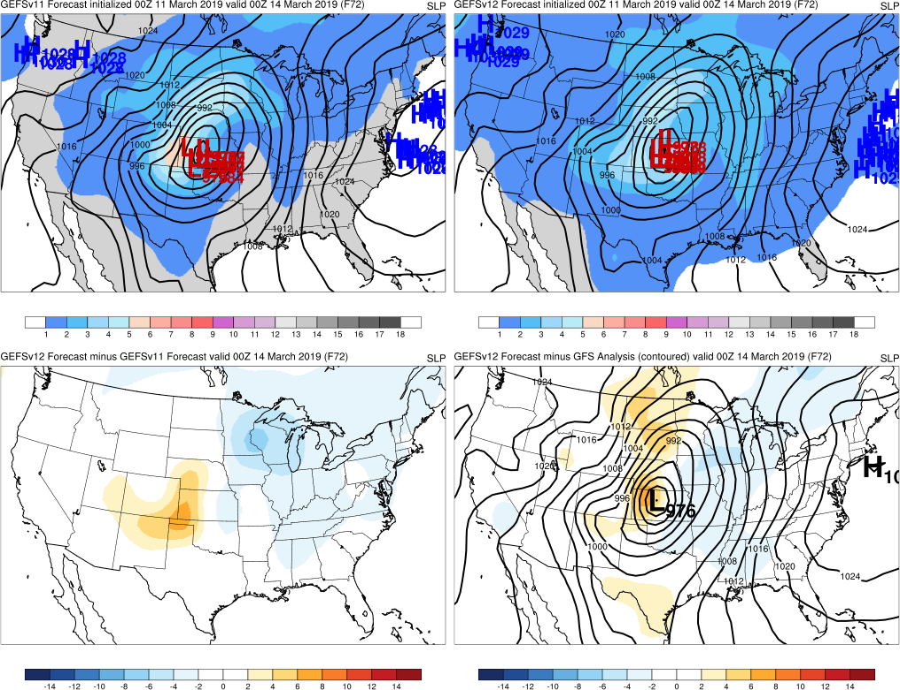
Init.: 0000 UTC 03/11/2018 (F072)
Central U.S. “Bomb” Cyclone
F240: GEFSv12 forecasts a potential cyclone over the upper Midwest. GEFSv11 is further S.
F192: GEFSv11 starts to forecast a cyclone over the upper Midwest, & both have lows over central U.S.
F144: GEFSv12 and GEFSv11 start to shift cyclones to the SW
F120: GEFSv11 correctly shifts cyclone over Kansas/Oklahoma before GEFSv12 does
F072: GEFSv12 takes another 48h to correctly shift to the southwest
GEFSv11
GEFSv12
v12−v11
GFS Anl.

Slide 45
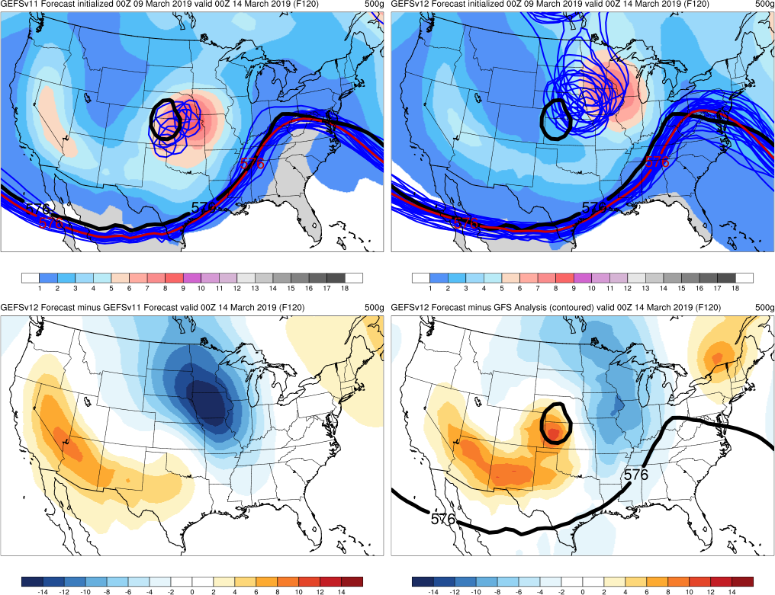
Init.: 0000 UTC 03/09/2018 (F120)
Central U.S. “Bomb” Cyclone
GEFSv12 took longer to shift the cyclone to the SW due to the presence of a progressive 500-hPa cutoff low that tried to rapidly rejoin the midlatitude waveguide Cutoff lows trying to rapidly rejoin the midlatitude waveguide is a known bias of the FV3-based global models (i.e., progressive)
Example of 500-hPa spaghetti plots (also available online), with analyzed 576-dam and 534-dam contours (black), ensemble mean (red), and ensemble members (blue)
GEFSv11
GEFSv12
v12−v11
GFS Anl.

Slide 46
NATIONAL OCEANIC AND ATMOSPHERIC ADMINISTRATION
GEFSv12 Retrospectives: Winter Storms
Central/Western U.S. Winter Storms
Central U.S. “Bomb” Cyclone (Mar 2019)
West Coast Atmospheric River (Mar 2018)
Pacific Northwest Snowstorm (Feb 2019)
Alaskan Cyclone (Apr 2018)

Slide 47
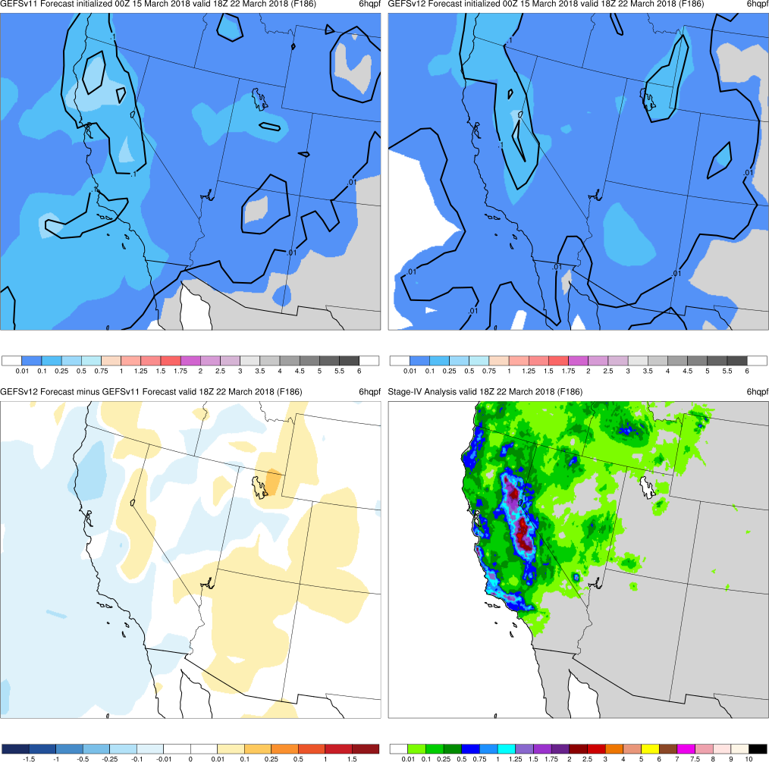
West Coast Atmo. River
Init.: 0000 UTC 3/15/2018 (F186)
F186: GEFSv12 & GEFSv11 forecast high precip totals in Sierra Nevada Mtns, but GEFSv11 has highest amounts shifted N
GEFSv11
GEFSv12
v12−v11
Stage IV

Slide 48
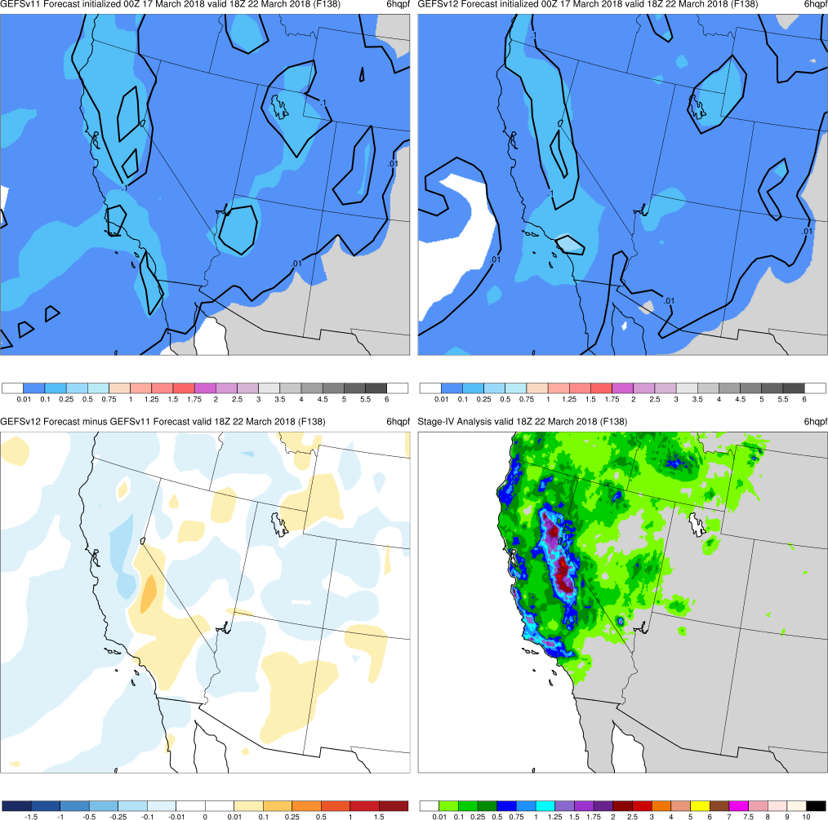
West Coast Atmo. River
Init.: 0000 UTC 3/17/2018 (F138)
F186: GEFSv12 & GEFSv11 forecast high precip totals in Sierra Nevada Mtns, but GEFSv11 has highest amounts shifted N
F138: GEFSv11 shifts highest precipitation amounts south toward Sierra Nevada Mtns
GEFSv11
GEFSv12
v12−v11
Stage IV

Slide 49
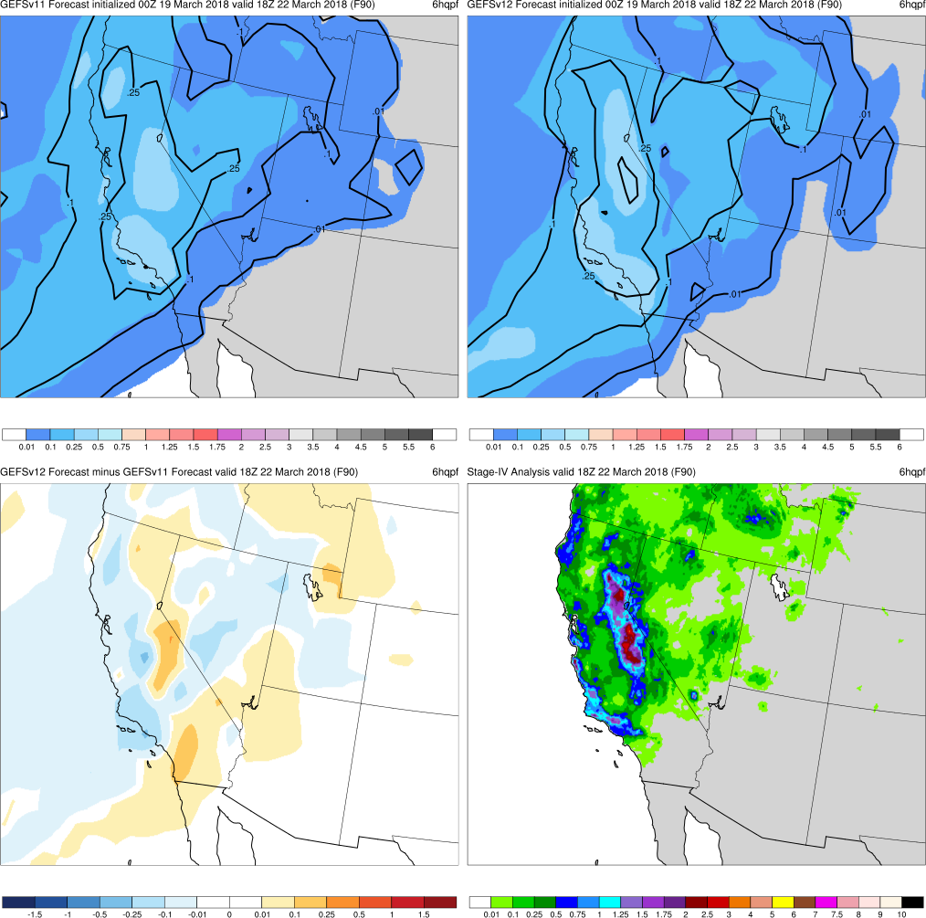
West Coast Atmo. River
Init.: 0000 UTC 3/19/2018 (F090)
F186: GEFSv12 & GEFSv11 forecast high precip totals in Sierra Nevada Mtns, but GEFSv11 has highest amounts shifted N
F138: GEFSv11 shifts highest precipitation amounts south toward Sierra Nevada Mtns
F090: GEFSv12 and GEFSv11 increase precip totals along Santa Barbara coast
GEFSv11
GEFSv12
v12−v11
Stage IV

Slide 50
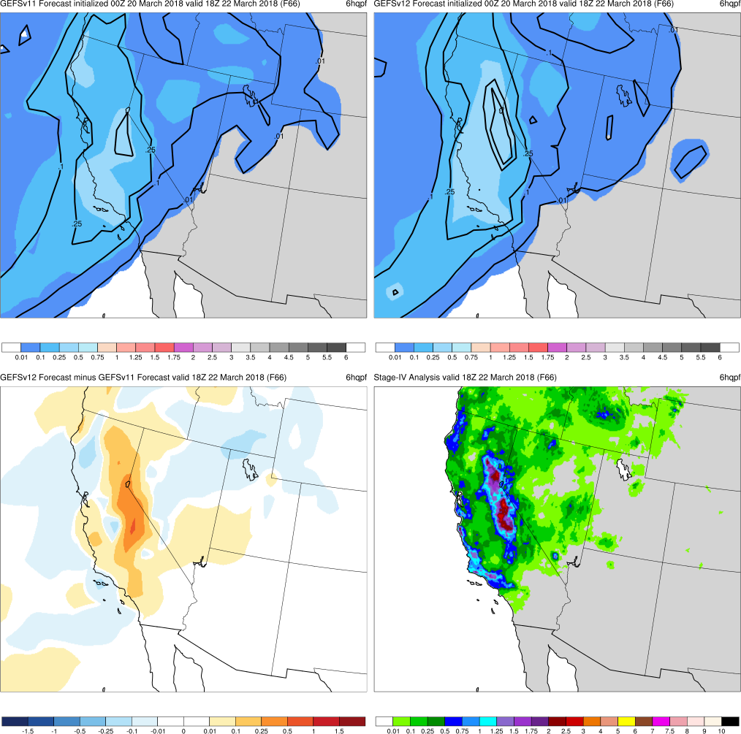
West Coast Atmo. River
Init.: 0000 UTC 3/20/2018 (F066)
F186: GEFSv12 & GEFSv11 forecast high precip totals in Sierra Nevada Mtns, but GEFSv11 has highest amounts shifted N
F138: GEFSv11 shifts highest precipitation amounts south toward Sierra Nevada Mtns
F090: GEFSv12 and GEFSv11 increase precip totals along Santa Barbara coast
F066: GEFSv12 correctly forecasts higher precip totals across Sierra Nevada Mtns
GEFSv11
GEFSv12
v12−v11
Stage IV

Slide 51
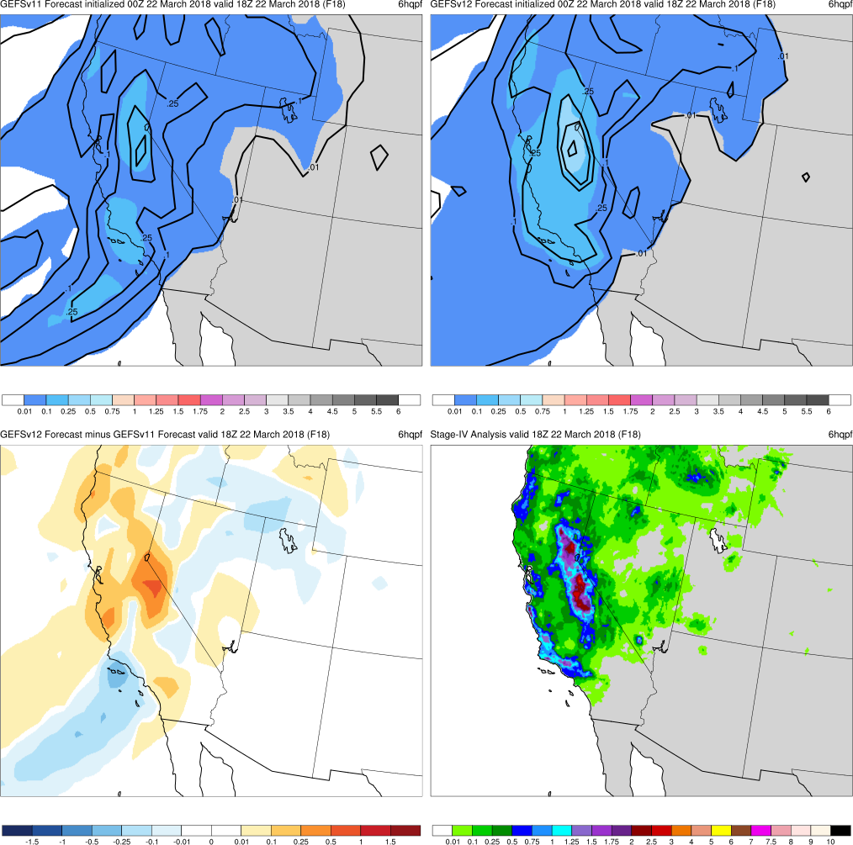
West Coast Atmo. River
Init.: 0000 UTC 3/20/2018 (F066)
F186: GEFSv12 & GEFSv11 forecast high precip totals in Sierra Nevada Mtns, but GEFSv11 has highest amounts shifted N
F138: GEFSv11 shifts highest precipitation amounts south toward Sierra Nevada Mtns
F090: GEFSv12 and GEFSv11 increase precip totals along Santa Barbara coast
F066: GEFSv12 correctly forecasts higher precip totals across Sierra Nevada Mtns
F018: GEFSv12 correctly forecasts higher precip totals across Sierra Nevada Mtns
GEFSv11
GEFSv12
v12−v11
Stage IV

Slide 52
24-h QPF
West Coast Atmo. River
Init.: 0000 UTC 3/20/2018 (F066)
F186: GEFSv12 & GEFSv11 forecast high precip totals in Sierra Nevada Mtns, but GEFSv11 has highest amounts shifted N
F138: GEFSv11 shifts highest precipitation amounts south toward Sierra Nevada Mtns
F090: GEFSv12 and GEFSv11 increase precip totals along Santa Barbara coast
F066: GEFSv12 correctly forecasts higher precip totals across Sierra Nevada Mtns
F018: GEFSv12 correctly forecasts higher precip totals across Sierra Nevada Mtns
GEFSv11
GEFSv12
v12−v11
Stage IV

Slide 53
NATIONAL OCEANIC AND ATMOSPHERIC ADMINISTRATION
GEFSv12 Retrospectives: Winter Storms
Central/Western U.S. Winter Storms
Central U.S. “Bomb” Cyclone (Mar 2019)
West Coast Atmospheric River (Mar 2018)
Pacific Northwest Snowstorm (Feb 2019)
Alaskan Cyclone (Apr 2018)

Slide 54
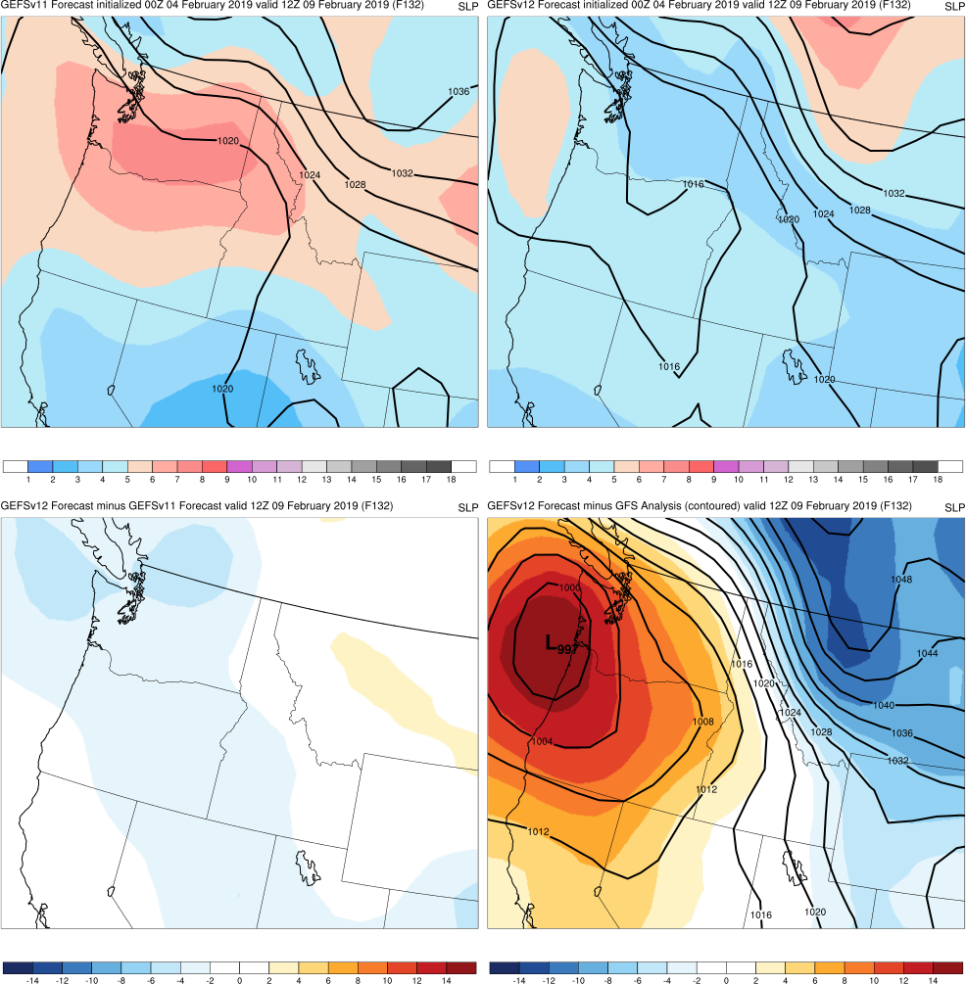
Pacific Northwest Snowstorm
Init.: 0000 UTC 2/04/2019 (F132)
F132: Neither the GEFSv12 nor GEFSv11 mean shows a cyclone off the West Coast
GEFSv11
GEFSv12
v12−v11
GFS Anl.

Slide 55
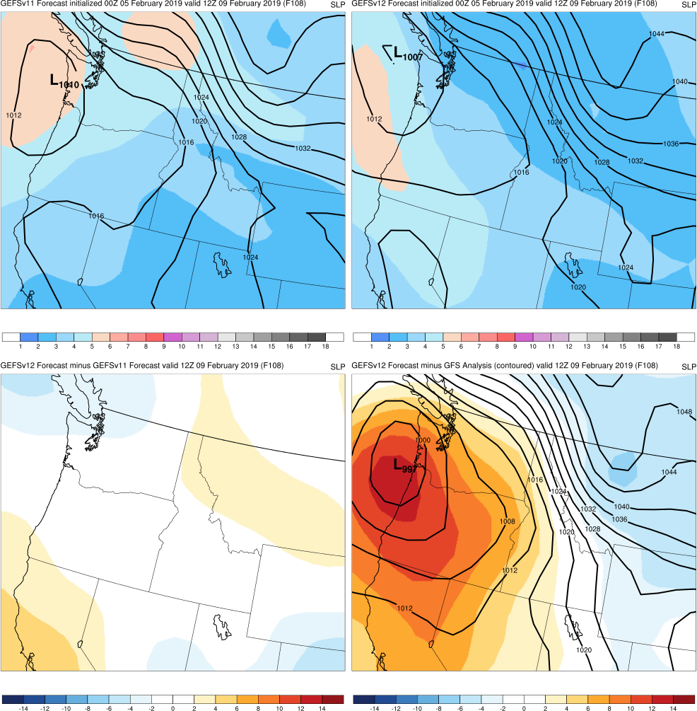
Pacific Northwest Snowstorm
Init.: 0000 UTC 2/05/2019 (F108)
F132: Neither the GEFSv12 nor GEFSv11 mean shows a cyclone off the West Coast
F108: Both the GEFSv12 and GEFSv11 mean show a cyclone off the West Coast & start to forecast snow for interior WA/OR
GEFSv11
GEFSv12
v12−v11
GFS Anl.

Slide 56
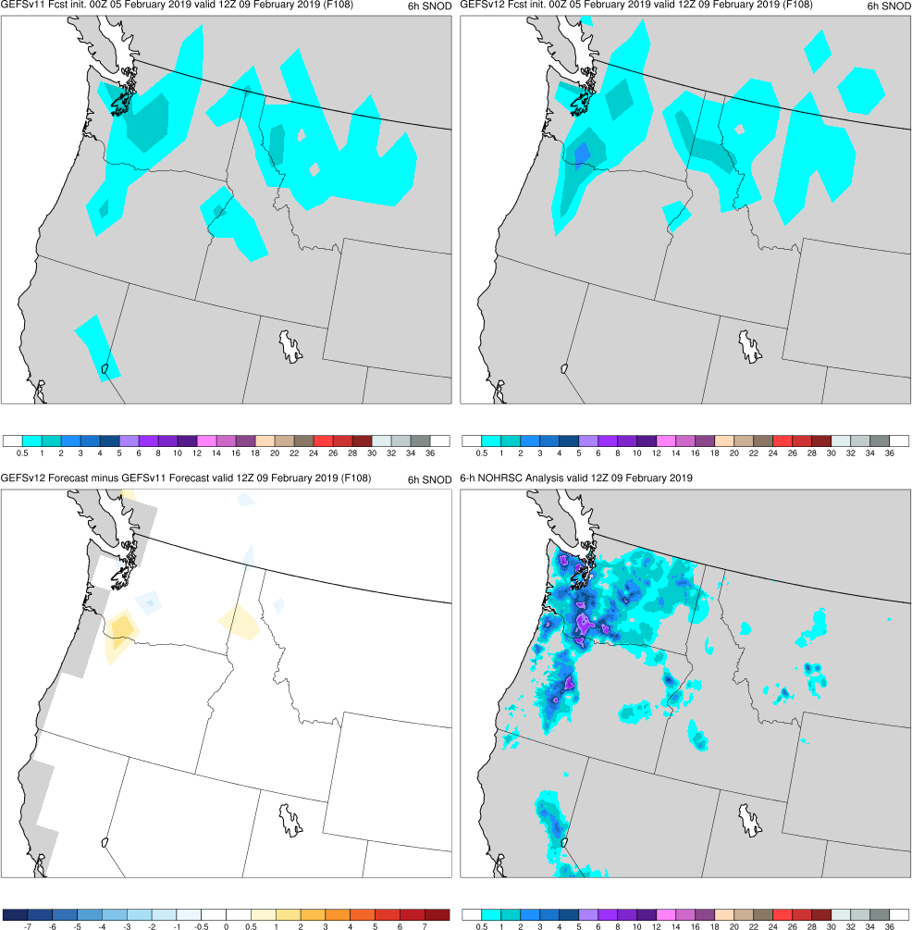
6-h SNOD
Pacific Northwest Snowstorm
Init.: 0000 UTC 2/05/2019 (F108)
F132: Neither the GEFSv12 nor GEFSv11 mean shows a cyclone off the West Coast
F108: Both the GEFSv12 and GEFSv11 mean show a cyclone off the West Coast & start to forecast snow for interior WA/OR
GEFSv11
GEFSv12
v12−v11
NOHRSC

Slide 57
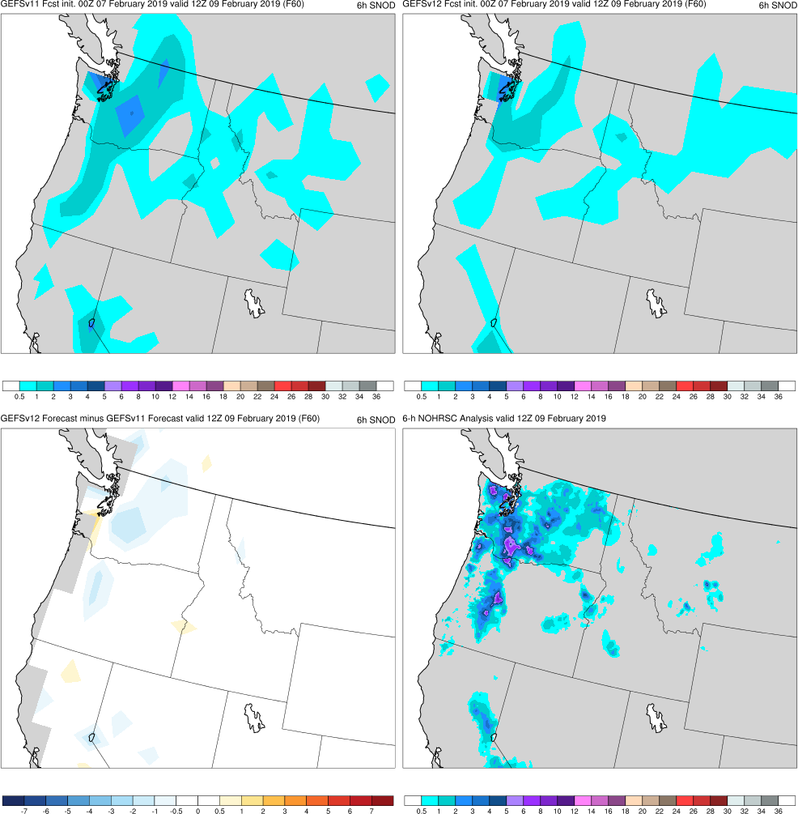
6-h SNOD
Pacific Northwest Snowstorm
Init.: 0000 UTC 2/07/2019 (F060)
F132: Neither the GEFSv12 nor GEFSv11 mean shows a cyclone off the West Coast
F108: Both the GEFSv12 and GEFSv11 mean show a cyclone off the West Coast & start to forecast snow for interior WA/OR
F060: GEFSv11 correctly has slightly higher totals than GEFSv12 across WA/OR
GEFSv11
GEFSv12
v12−v11
NOHRSC

Slide 58
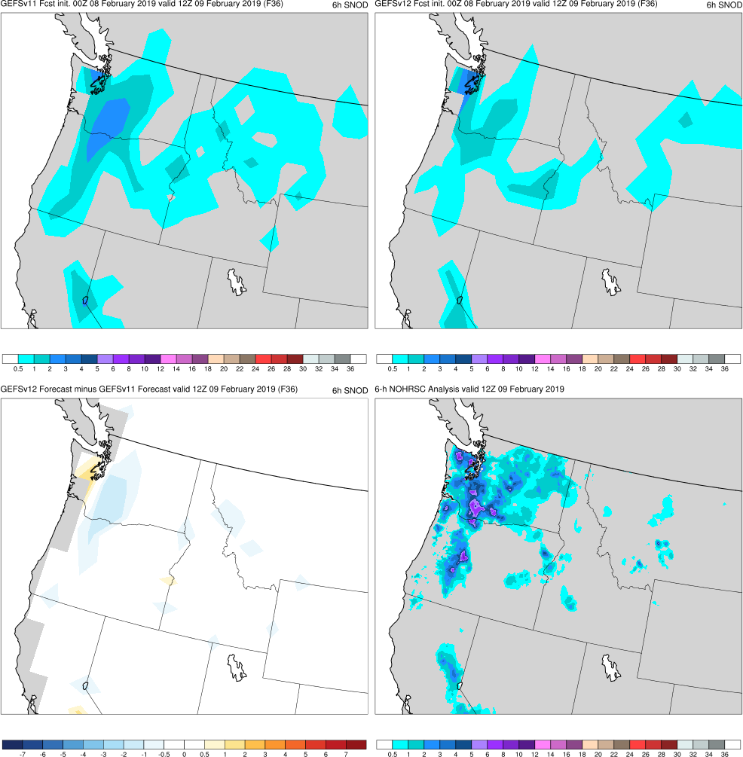
6-h SNOD
Pacific Northwest Snowstorm
Init.: 0000 UTC 2/08/2019 (F036)
F132: Neither the GEFSv12 nor GEFSv11 mean shows a cyclone off the West Coast
F108: Both the GEFSv12 and GEFSv11 mean show a cyclone off the West Coast & start to forecast snow for interior WA/OR
F060: GEFSv11 correctly has slightly higher totals than GEFSv12 across WA/OR
F036: GEFSv11 correctly has slightly higher totals than GEFSv12 across WA/OR
GEFSv11
GEFSv12
v12−v11
NOHRSC

Slide 59
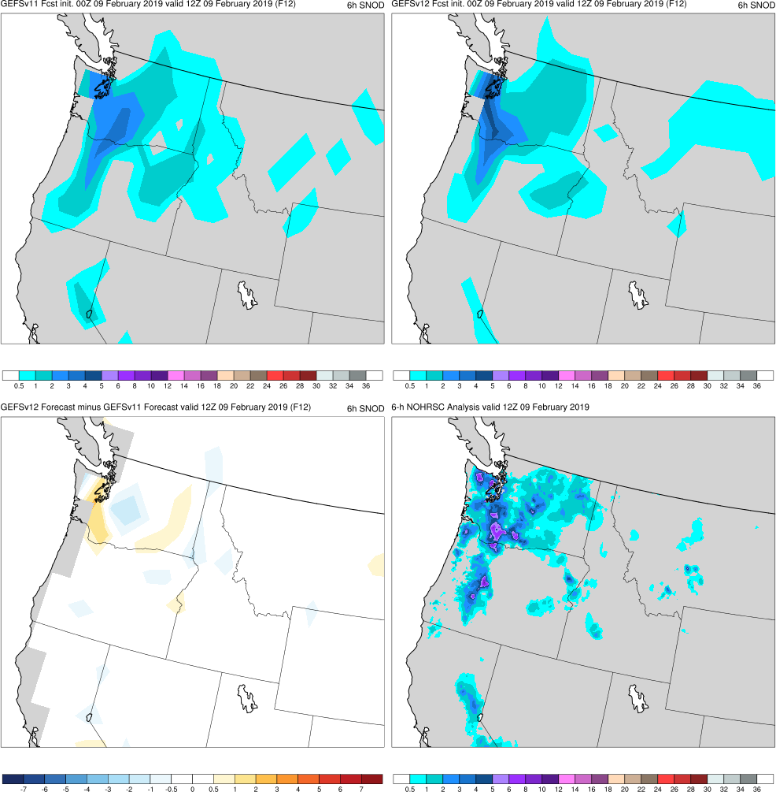
6-h SNOD
Pacific Northwest Snowstorm
Init.: 0000 UTC 2/09/2019 (F012)
F132: Neither the GEFSv12 nor GEFSv11 mean shows a cyclone off the West Coast
F108: Both the GEFSv12 and GEFSv11 mean show a cyclone off the West Coast & start to forecast snow for interior WA/OR
F060: GEFSv11 correctly has slightly higher totals than GEFSv12 across WA/OR
F036: GEFSv11 correctly has slightly higher totals than GEFSv12 across WA/OR
F012: GEFSv12 correctly increases totals across WA/OR above the GEFSv11 totals
GEFSv11
GEFSv12
v12−v11
NOHRSC

Slide 60
Pacific Northwest Snowstorm
Init.: 0000 UTC 2/03/2019 (F144)
GEFSv12 and GEFSv11 both struggled to capture the 500-hPa flow pattern associated with this event in the long and even medium range, causing the Pacific NW cyclone and its associated snowfall to be misplaced
Example of 500-hPa spaghetti plots (also available online), with analyzed 576-dam and 534-dam contours (black), ensemble mean (red), and ensemble members (blue)
GEFSv11
v12−v11
GEFSv12
GEFSv12

Slide 61
NATIONAL OCEANIC AND ATMOSPHERIC ADMINISTRATION
GEFSv12 Retrospectives: Winter Storms
Central/Western U.S. Winter Storms
Central U.S. “Bomb” Cyclone (Mar 2019)
West Coast Atmospheric River (Mar 2018)
Pacific Northwest Snowstorm (Feb 2019)
Alaskan Cyclone (Apr 2018)

Slide 62
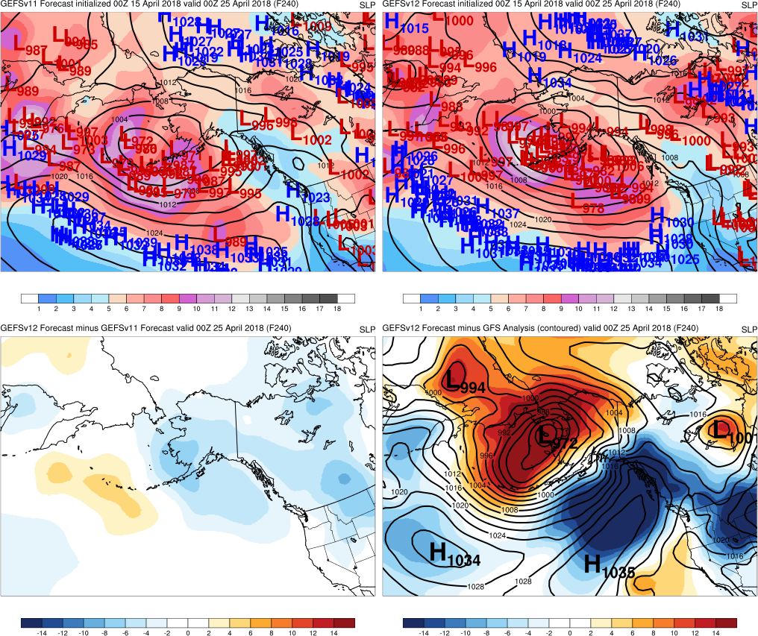
Init.: 0000 UTC 4/15/2018 (F240)
Alaskan Cyclone
F240: Both GEFSv12 and GEFSv11 forecast a potential Alaskan cyclone
GEFSv11
GEFSv12
v12−v11
GFS Anl.

Slide 63
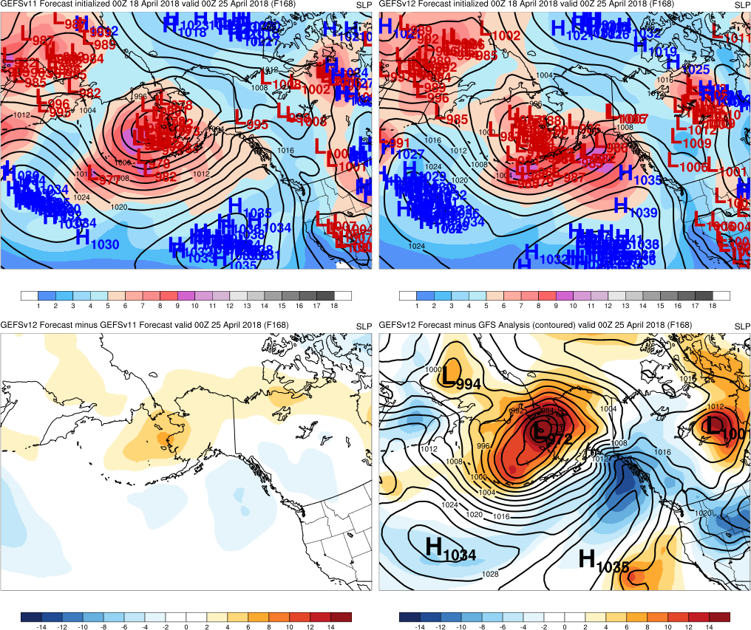
Init.: 0000 UTC 4/18/2018 (F168)
Alaskan Cyclone
F240: Both GEFSv12 and GEFSv11 forecast a potential Alaskan cyclone
F168: Placement of Alaskan cyclone improves in GEFSv12 and GEFSv11
GEFSv11
GEFSv12
v12−v11
GFS Anl.

Slide 64
Init.: 0000 UTC 4/20/2018 (F120)
Alaskan Cyclone
F240: Both GEFSv12 and GEFSv11 forecast a potential Alaskan cyclone
F168: Placement of Alaskan cyclone improves in GEFSv12 and GEFSv11
F120: Both GEFSv12 and GEFSv11 correctly shift cyclone N of Aleutians
GEFSv11
GEFSv12
v12−v11
GFS Anl.

Slide 65
Init.: 0000 UTC 4/22/2018 (F072)
Alaskan Cyclone
F240: Both GEFSv12 and GEFSv11 forecast a potential Alaskan cyclone
F168: Placement of Alaskan cyclone improves in GEFSv12 and GEFSv11
F120: Both GEFSv12 and GEFSv11 correctly shift cyclone N of Aleutians
F072: Both GEFSv12 and GEFSv11 split into two camps for low location (near Aleutians or W central Alaska)
GEFSv11
GEFSv12
v12−v11
GFS Anl.

Slide 66
Init.: 0000 UTC 4/23/2018 (F048)
Alaskan Cyclone
F240: Both GEFSv12 and GEFSv11 forecast a potential Alaskan cyclone
F168: Placement of Alaskan cyclone improves in GEFSv12 and GEFSv11
F120: Both GEFSv12 and GEFSv11 correctly shift cyclone N of Aleutians
F072: Both GEFSv12 and GEFSv11 split into two camps for low location (near Aleutians or W central Alaska)
F048: GEFSv12 correctly shifts all members northward before GEFSv11
GEFSv11
GEFSv12
v12−v11
GFS Anl.

Slide 67
Init.: 0000 UTC 4/24/2018 (F024)
Alaskan Cyclone
F240: Both GEFSv12 and GEFSv11 forecast a potential Alaskan cyclone
F168: Placement of Alaskan cyclone improves in GEFSv12 and GEFSv11
F120: Both GEFSv12 and GEFSv11 correctly shift cyclone N of Aleutians
F072: Both GEFSv12 and GEFSv11 split into two camps for low location (near Aleutians or W central Alaska)
F048: GEFSv12 correctly shifts all members northward before GEFSv11
F024: GEFSv11 correctly shifts N too
GEFSv11
GEFSv12
v12−v11
GFS Anl.

Slide 68
NATIONAL OCEANIC AND ATMOSPHERIC ADMINISTRATION
GEFSv12 Winter Storms: Summary
Overall, GEFSv12 produces as good or better cyclone forecasts than GEFSv11
Cyclones are often forecast at longer lead times in GEFSv12 than they are in GEFSv11 due to a better handling of the synoptic pattern
Overall, GEFSv12 produces as good or better snowfall forecasts than GEFSv11
Snow events are often forecast at longer lead times in GEFSv12 than they are in GEFSv11, and snow totals tend to be (correctly) larger
Overall, GEFSv12 produces as good or better cyclone forecasts than GEFSv11
Cyclones are often forecast at longer lead times in GEFSv12 than they are in GEFSv11 due to a better handling of the synoptic pattern
Overall, GEFSv12 produces as good or better snowfall forecasts than GEFSv11
Snow events are often forecast at longer lead times in GEFSv12 than they are in GEFSv11, and snow totals tend to be (correctly) larger
Like GEFSv11, GEFSv12 tends to shift cyclone tracks from east to west (←) as forecast lead time decreases
GEFSv12 can be too progressive in situations where a cutoff low rejoins the midlatitude waveguide during the forecast (similar to the FV3-based GFSv15)

