Slide 1
NATIONAL OCEANIC AND ATMOSPHERIC ADMINISTRATION
Overview of GEFSv12 Verification Statistics
Alicia Bentley EMC Model Evaluation Group Webinar
12 March 2020
Special thanks to Yan Luo and Jiayi Peng for generating these graphics

Slide 2
NATIONAL OCEANIC AND ATMOSPHERIC ADMINISTRATION
Quick Facts about GEFSv12
 | GEFSv11 (PROD) | GEFSv12 (RETRO)
Model | GSM (hydro) | FV3 (non-hydro)
Microphysics | ZHAO-CARR MP | GFDL MP
IC uncertainty | EnKF TC perturbed after relocation | EnKF No relocation
Model uncertainty | STTP | Stochastic physics (SPPT + SKEB)
Resolution | TL574L64 (~33km), 0-8 days TL382L64 (~50km), 8-16 days | C384L64 (~25km)
Forecast days | 16 days | 16 days (06Z, 12Z and 18Z) 35 days (00Z)
Ensemble size | 21 members | 31 members
Ocean forcing | Persistent + relaxation SST | NSST and 2-tiered SST

Slide 3
NATIONAL OCEANIC AND ATMOSPHERIC ADMINISTRATION
GEFSv12 Retrospectives
Out to 10 days
June 2017–November 2018, 0000 UTC (1.5 years)
Three hurricane seasons
Summer 2017 (July – October), 1200 UTC
Summer 2018 (July – October), 1200 UTC
Summer 2019 (July – October), 1200 UTC
Out to 16 days (coupling to wave ensemble)
December 2018–November 2019, 0000 UTC (1 year)
The following verification statistics go out to 10 days

Slide 4
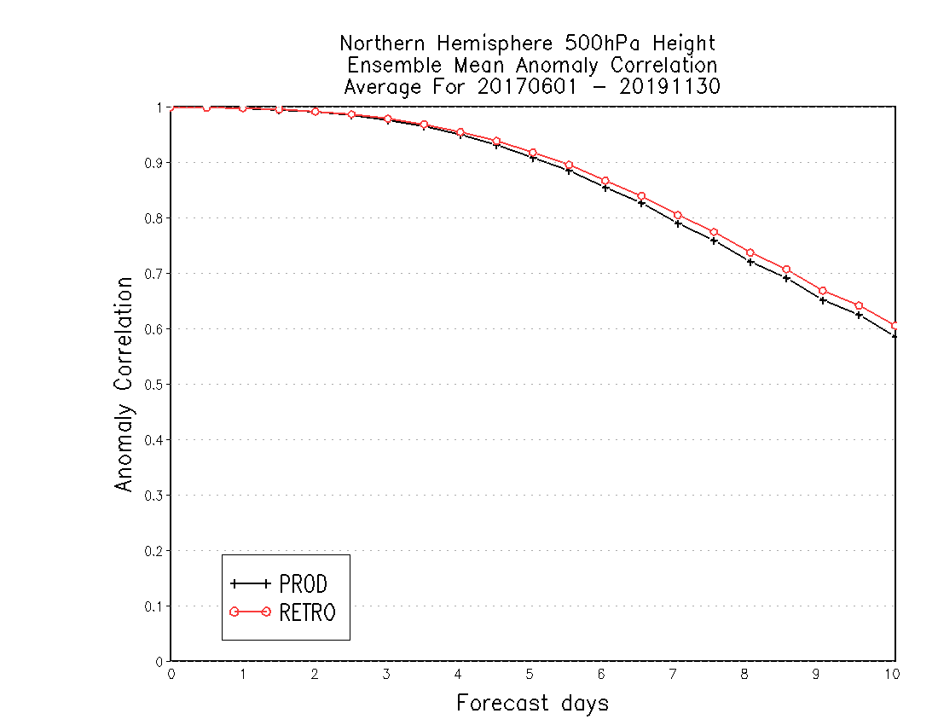
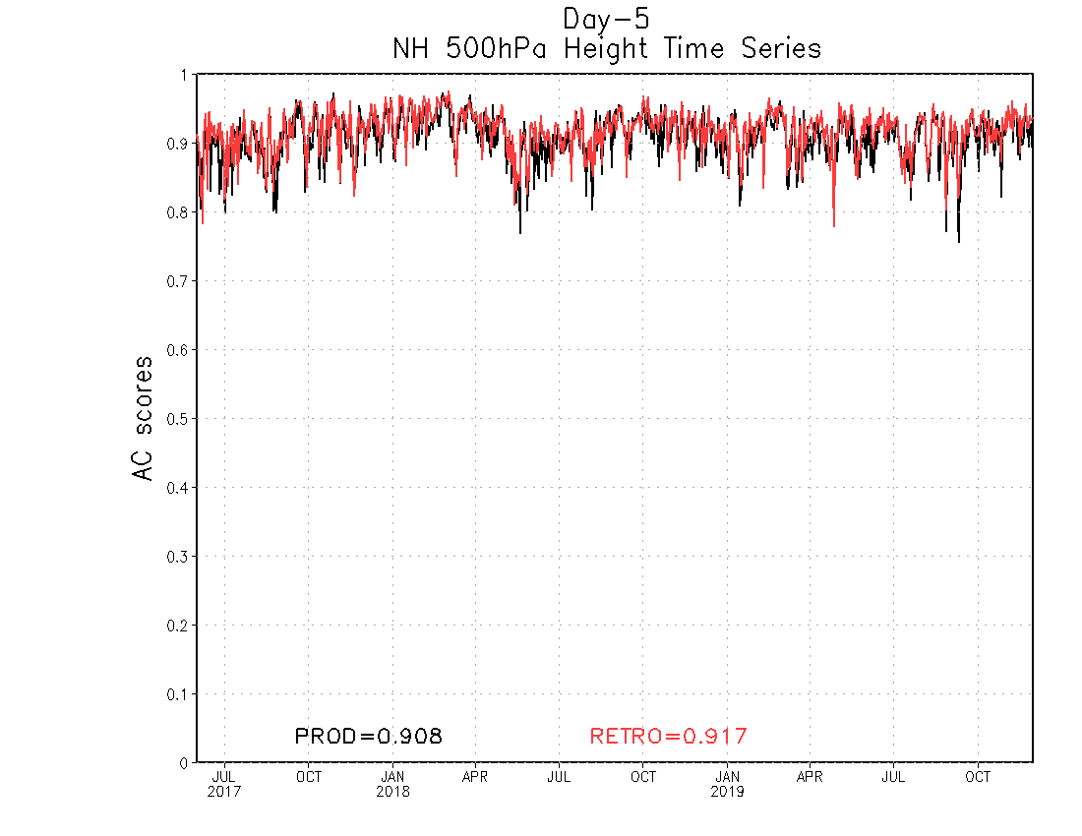
NATIONAL OCEANIC AND ATMOSPHERIC ADMINISTRATION
GEFSv12 Anomaly Correlation (AC) Scores
DAY 5 – NH 500-hPa Time Series
NH by Lead Time (6/2017–11/2019)
GEFSv12 has higher 500-hPa AC scores than GEFSv11 at Day 5
GEFSv12 has higher NH 500-hPa AC scores than GEFSv11 at all lead times from Day 0 to Day 10
GEFSv11 = .908 GEFSv12 = .917
June 2017
Sep 2018
Dec 2019

Slide 5
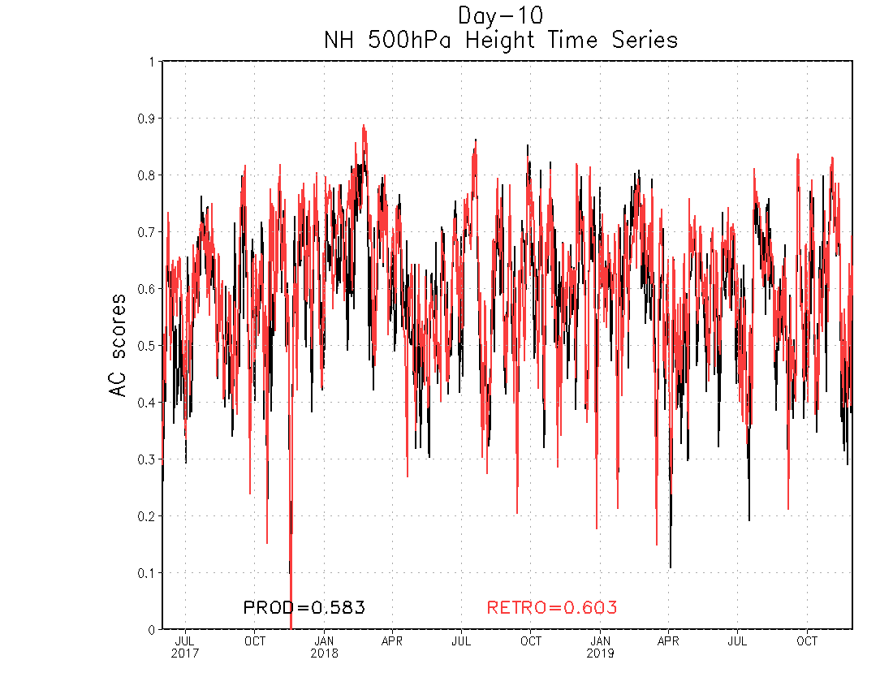
NATIONAL OCEANIC AND ATMOSPHERIC ADMINISTRATION
GEFSv12 Anomaly Correlation (AC) Scores
DAY 10 – NH 500-hPa Time Series
NH by Lead Time (6/2017–11/2019)
GEFSv12 has higher 500-hPa AC scores than GEFSv11 at Day 10
GEFSv12 has higher NH 500-hPa AC scores than GEFSv11 at all lead times from Day 0 to Day 10
GEFSv11 = .583 GEFSv12 = .603
June 2017
Sep 2018
Dec 2019

Slide 6
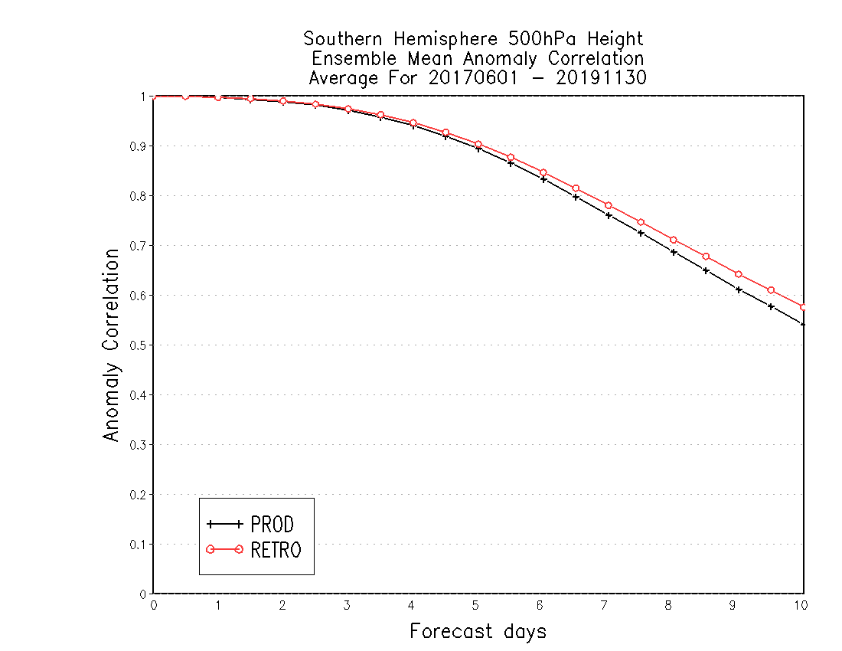
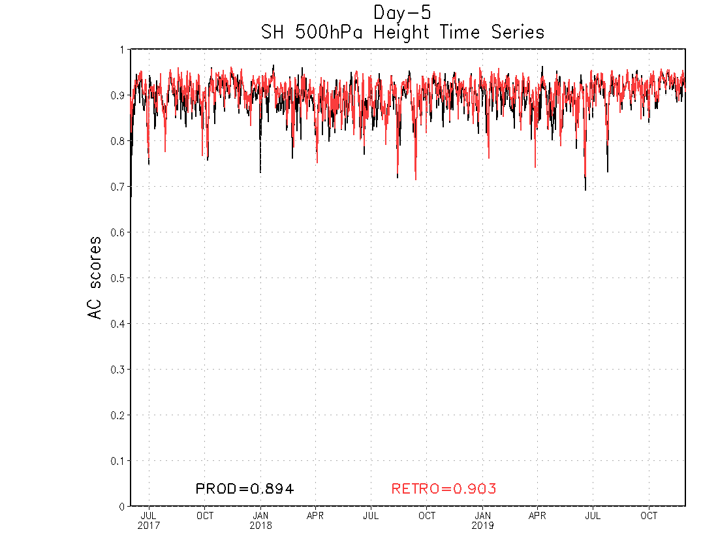
NATIONAL OCEANIC AND ATMOSPHERIC ADMINISTRATION
GEFSv12 Anomaly Correlation (AC) Scores
DAY 5 – SH 500-hPa Time Series
SH by Lead Time (6/2017–11/2019)
GEFSv12 has higher 500-hPa AC scores than GEFSv11 at Day 5
GEFSv12 has higher SH 500-hPa AC scores than GEFSv11 at all lead times from Day 0 to Day 10
GEFSv11 = .894 GEFSv12 = .903
June 2017
Sep 2018
Dec 2019

Slide 7
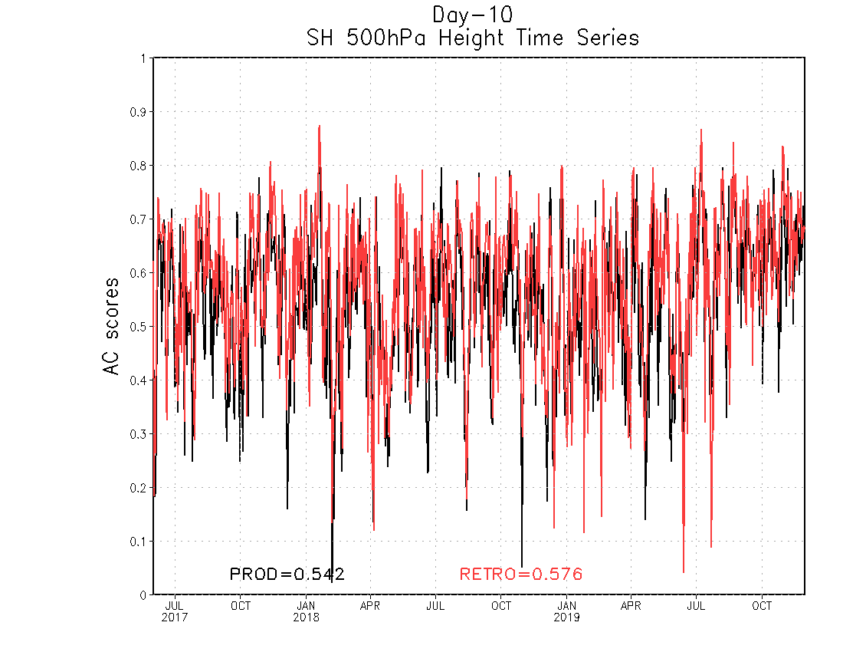
NATIONAL OCEANIC AND ATMOSPHERIC ADMINISTRATION
GEFSv12 Anomaly Correlation (AC) Scores
DAY 10 – SH 500-hPa Time Series
SH by Lead Time (6/2017–11/2019)
GEFSv12 has higher 500-hPa AC scores than GEFSv11 at Day 10
GEFSv12 has higher SH 500-hPa AC scores than GEFSv11 at all lead times from Day 0 to Day 10
GEFSv11 = .542 GEFSv12 = .576
June 2017
Sep 2018
Dec 2019

Slide 8
NATIONAL OCEANIC AND ATMOSPHERIC ADMINISTRATION
GEFSv12 AC Scores (500-hPa Z at Day 5)
 | GEFSv11 (PROD) | GEFSv12 (RETRO)
Fall 2019 | 0.909 | 0.920
Summer 2019 | 0.902 | 0.912
Spring 2019 | 0.901 | 0.912
Winter 2018/2019 | 0.910 | 0.918
Fall 2018 | 0.923 | 0.928
Summer 2018 | 0.899 | 0.908
Spring 2018 | 0.907 | 0.916
Winter 2017/2018 | 0.929 | 0.939
Fall 2017 | 0.913 | 0.921
Summer 2017 | 0.884 | 0.896

Slide 9
NATIONAL OCEANIC AND ATMOSPHERIC ADMINISTRATION
GEFSv12 AC Scores (500-hPa Z at Day 10)
 | GEFSv11 (PROD) | GEFSv12 (RETRO)
Fall 2019 | 0.564 | 0.589
Summer 2019 | 0.575 | 0.594
Spring 2019 | 0.537 | 0.573
Winter 2018/2019 | 0.621 | 0.620
Fall 2018 | 0.607 | 0.604
Summer 2018 | 0.590 | 0.608
Spring 2018 | 0.574 | 0.588
Winter 2017/2018 | 0.671 | 0.706
Fall 2017 | 0.560 | 0.577
Summer 2017 | 0.538 | 0.578

Slide 10
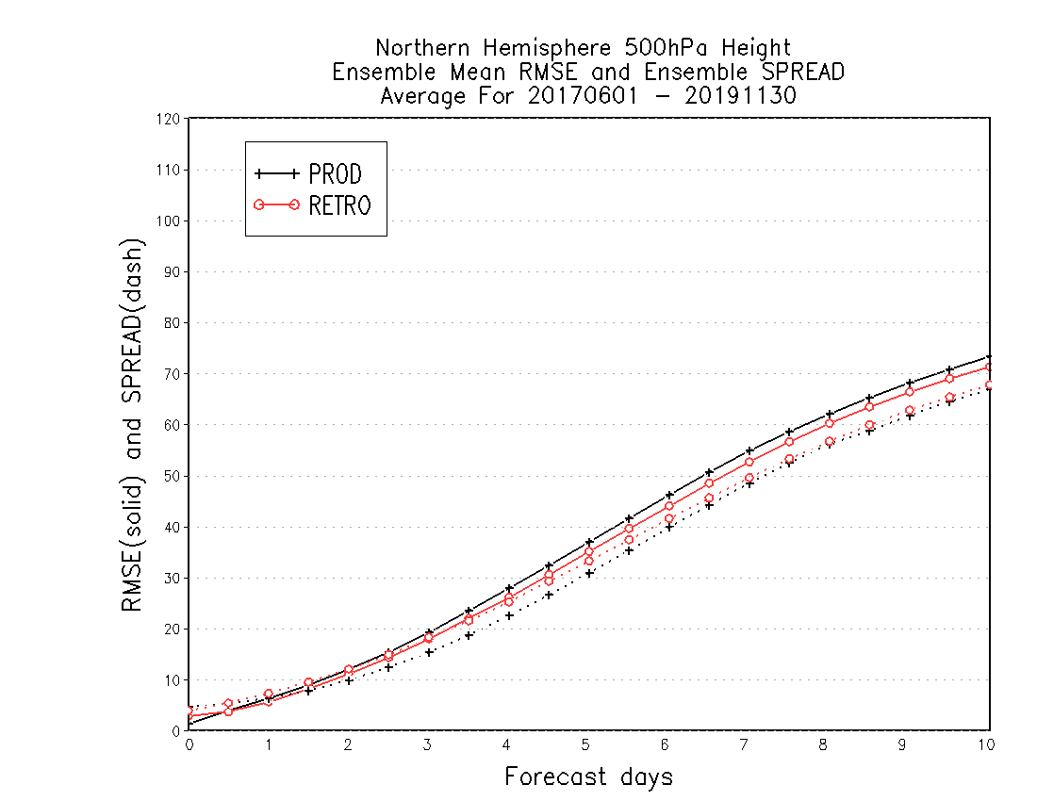
NATIONAL OCEANIC AND ATMOSPHERIC ADMINISTRATION
GEFSv12 RMSE and Spread
DAY 5 – NH 500-hPa Time Series
NH by Lead Time (6/2017–11/2019)
GEFSv12 has lower RMSE than GEFSv11 at Day 5 and a RMSE-to-Spread ratio closer to 1
GEFSv12 has lower RMSE and more spread than GEFSv11 in the medium range
RMSE = solid
Spread = dashed
June 2017
Sep 2018
Dec 2019

Slide 11
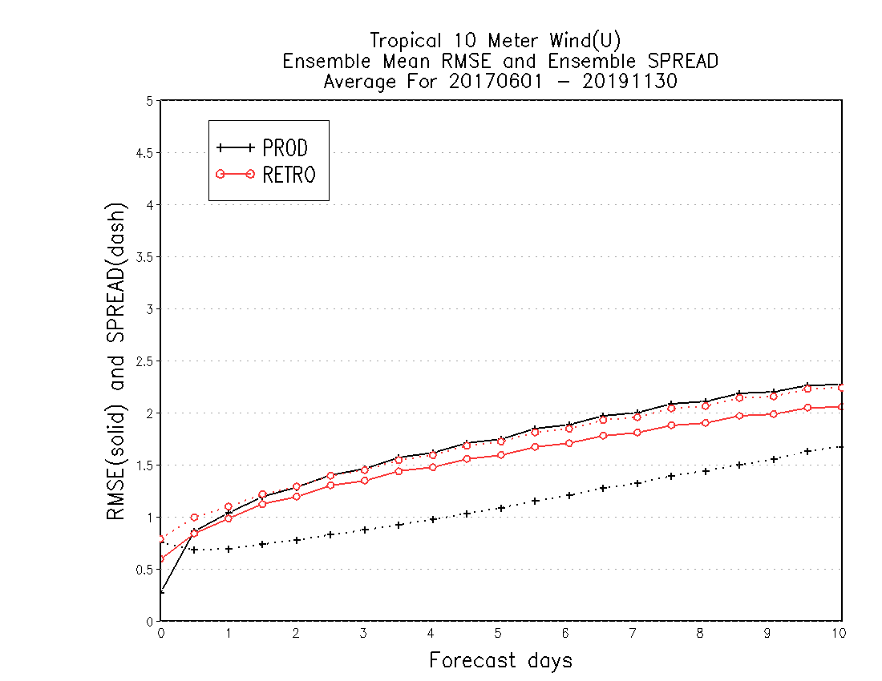
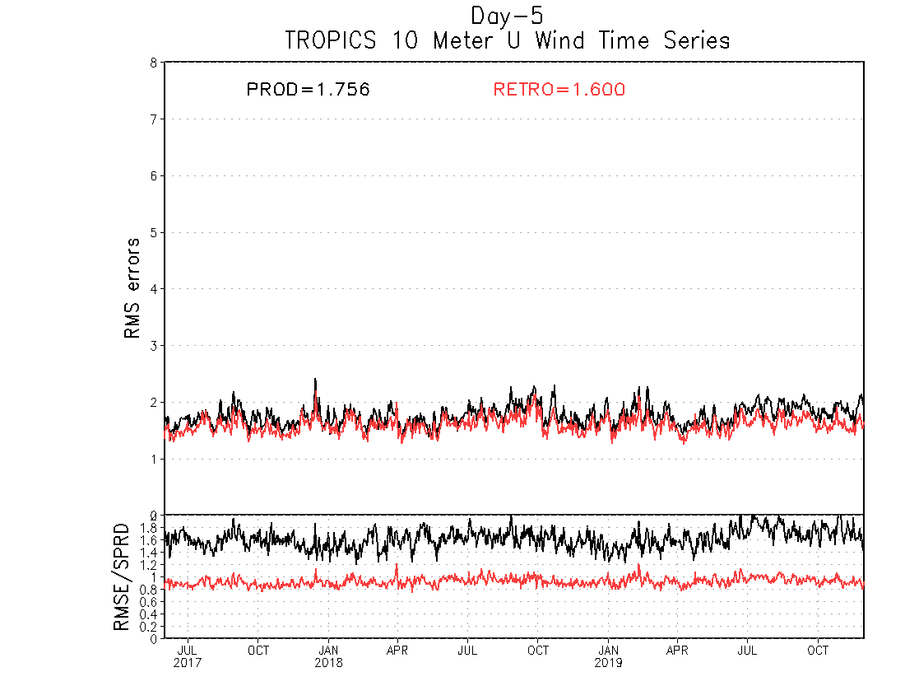
NATIONAL OCEANIC AND ATMOSPHERIC ADMINISTRATION
GEFSv12 RMSE and Spread
DAY 5 – Tropics 10-m uwind Time Series
Tropics by Lead Time (6/2017–11/2019)
GEFSv12 has lower RMSE than GEFSv11 at Day 5 and a RMSE-to-Spread ratio closer to 1
GEFSv12 has lower RMSE and more spread than GEFSv11 at almost all forecast lead times
RMSE = solid
Spread = dashed
June 2017
Sep 2018
Dec 2019

Slide 12
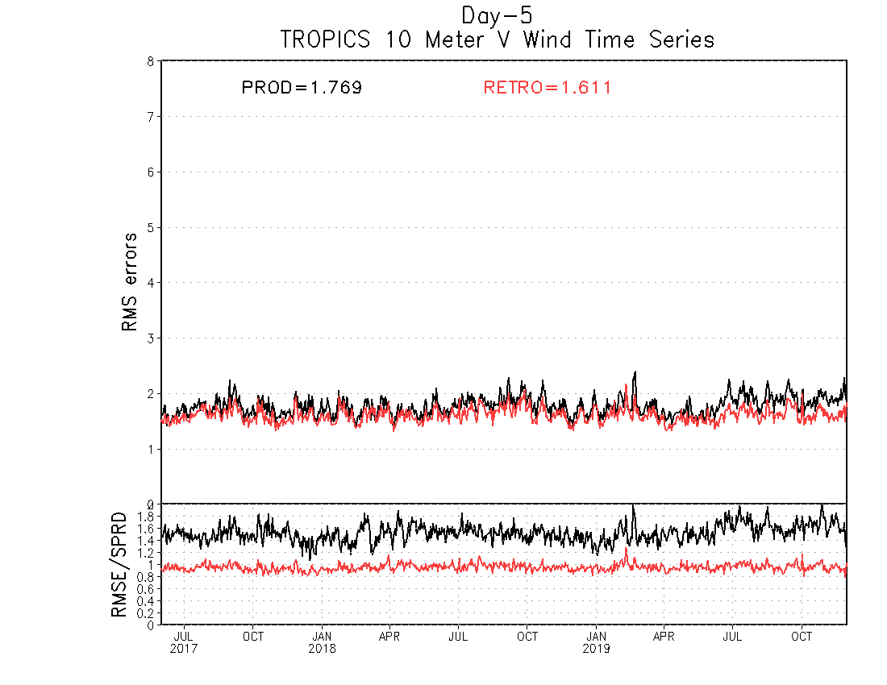
NATIONAL OCEANIC AND ATMOSPHERIC ADMINISTRATION
GEFSv12 RMSE and Spread
DAY 5 – Tropics 10-m vwind Time Series
Tropics by Lead Time (6/2017–11/2019)
GEFSv12 has lower RMSE than GEFSv11 at Day 5 and a RMSE-to-Spread ratio closer to 1
GEFSv12 has lower RMSE and more spread than GEFSv11 at almost all forecast lead times
RMSE = solid
Spread = dashed
June 2017
Sep 2018
Dec 2019

Slide 13
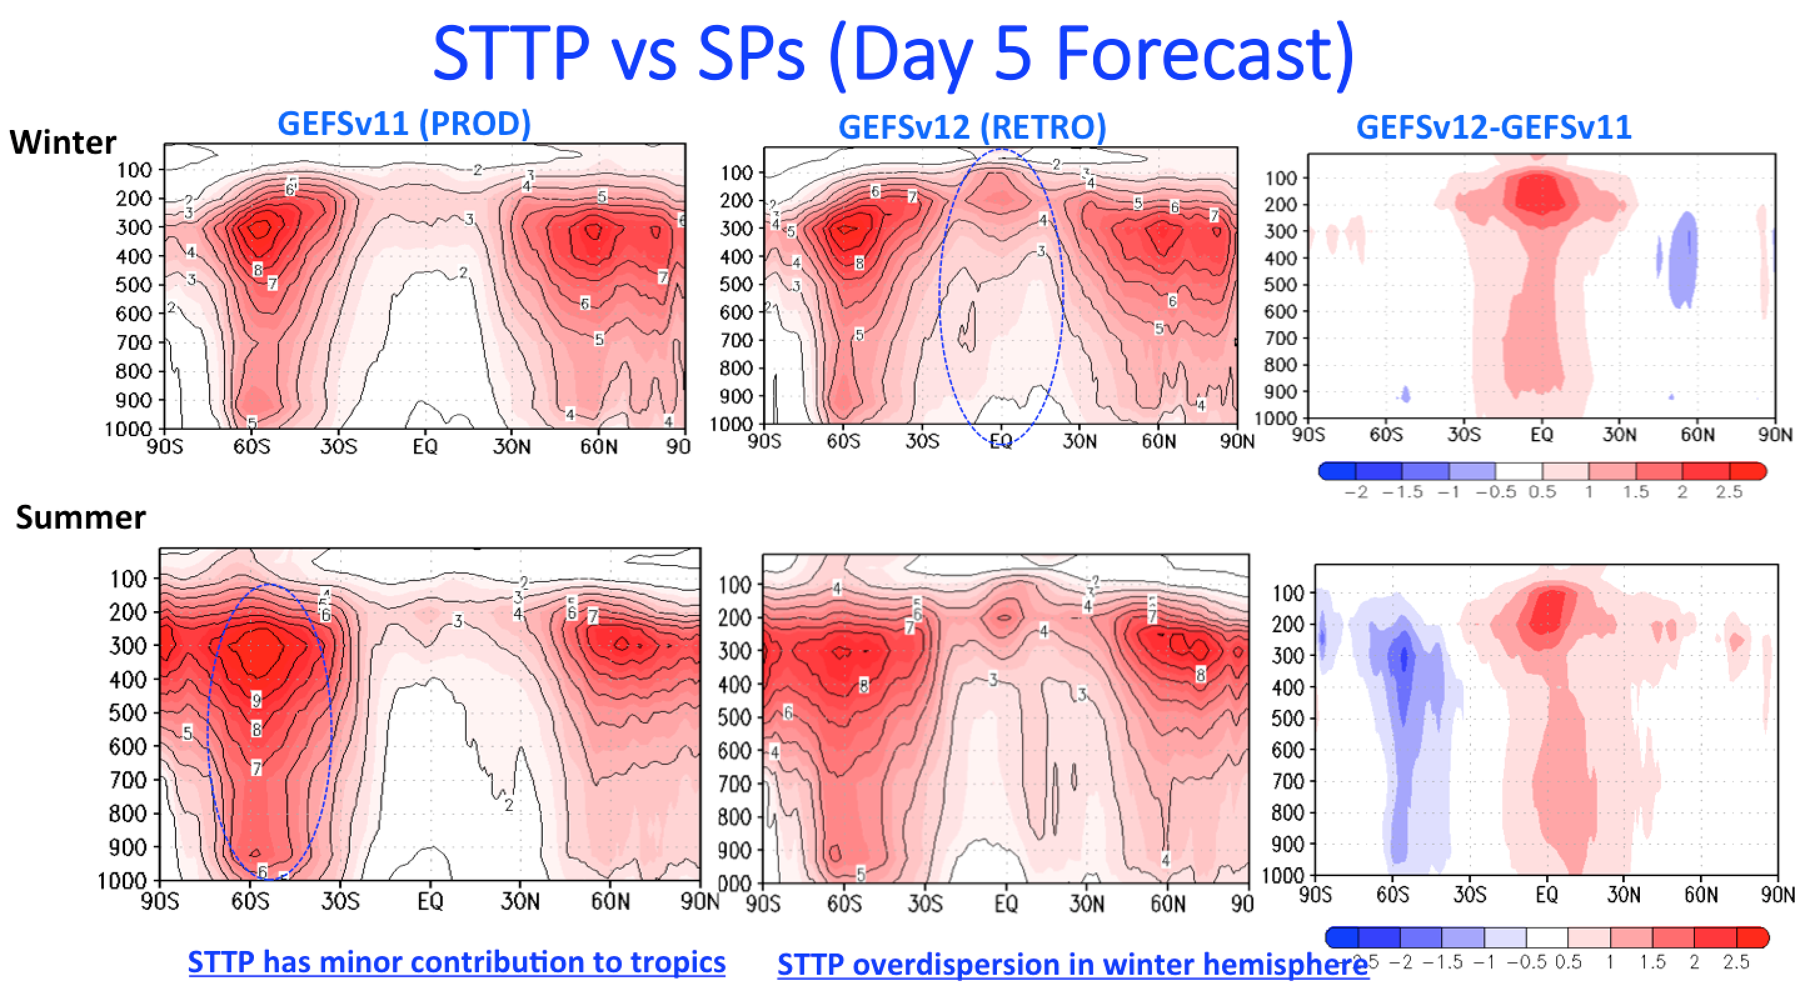
NATIONAL OCEANIC AND ATMOSPHERIC ADMINISTRATION
GEFSv12 RMSE and Spread
STTP has minor contribution to tropics
STTP overdispersion in winter hemisphere

Slide 14
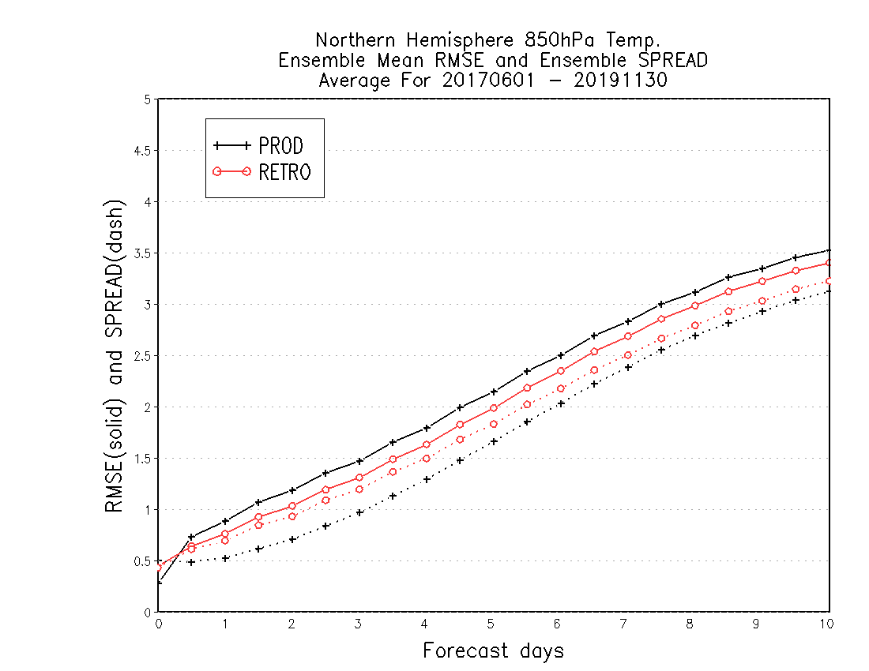
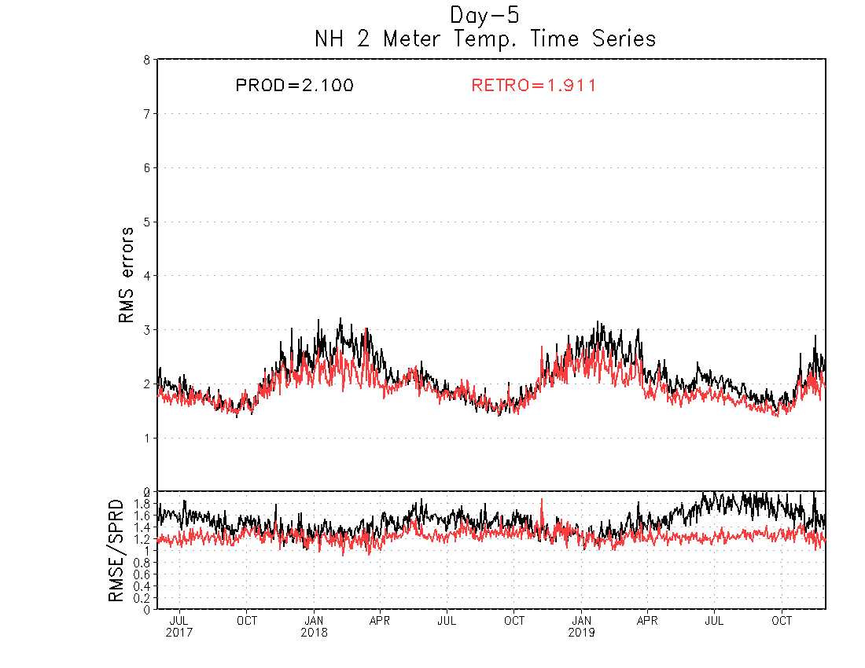
NATIONAL OCEANIC AND ATMOSPHERIC ADMINISTRATION
GEFSv12 RMSE and Spread
DAY 5 – NH 2-m temps Time Series
NH 850-hPa temps (6/2017–11/2019)
GEFSv12 has lower RMSE than GEFSv11 at Day 5 and a RMSE-to-Spread ratio closer to 1
GEFSv12 has lower RMSE and more spread than GEFSv11 at almost all lead times
RMSE = solid
Spread = dashed
June 2017
Sep 2018
Dec 2019

Slide 15
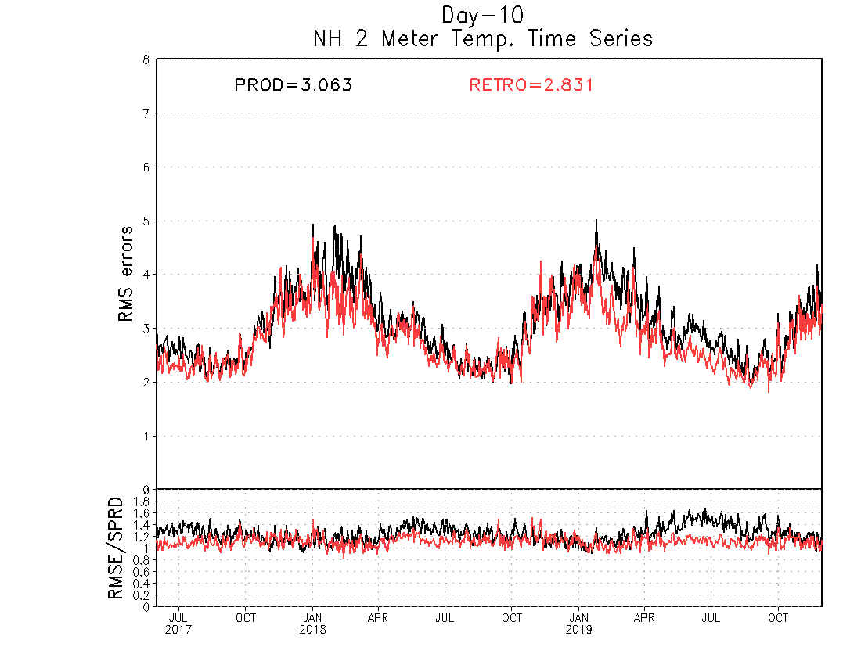
NATIONAL OCEANIC AND ATMOSPHERIC ADMINISTRATION
GEFSv12 RMSE and Spread
DAY 10 – NH 2-m temps Time Series
NH 850-hPa temps (6/2017–11/2019)
GEFSv12 has lower RMSE than GEFSv11 at Day 5 and a RMSE-to-Spread ratio closer to 1
GEFSv12 has lower RMSE and more spread than GEFSv11 at almost all lead times
RMSE = solid
Spread = dashed
June 2017
Sep 2018
Dec 2019

Slide 16
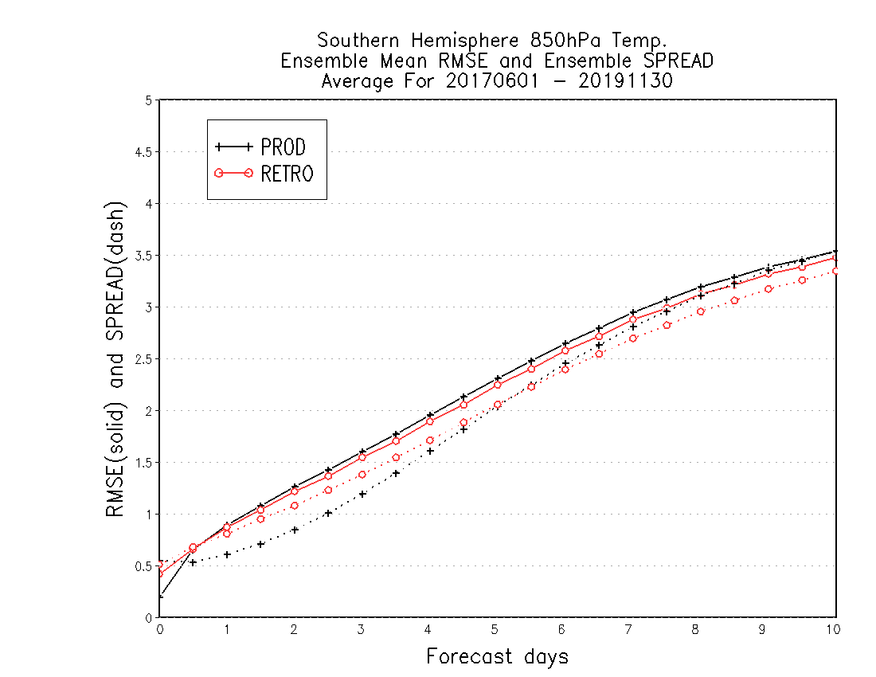
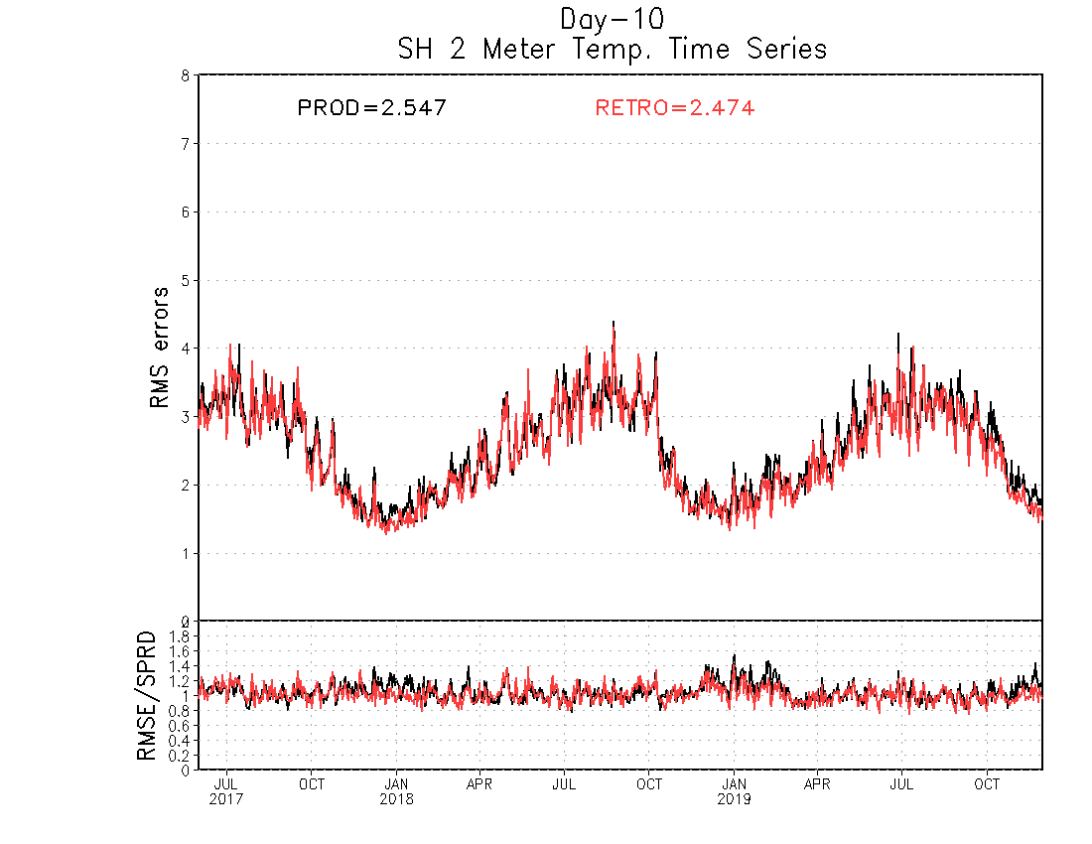
NATIONAL OCEANIC AND ATMOSPHERIC ADMINISTRATION
GEFSv12 RMSE and Spread
DAY 10 – SH 2-m temps Time Series
SH 850-hPa temps (6/2017–11/2019)
GEFSv12 has slightly lower RMSE than GEFSv11 at Day 5 and a RMSE-to-Spread ratio closer to 1
GEFSv12 has lower RMSE and more spread than GEFSv11 at shorter lead times
RMSE = solid
Spread = dashed
June 2017
Sep 2018
Dec 2019

Slide 17
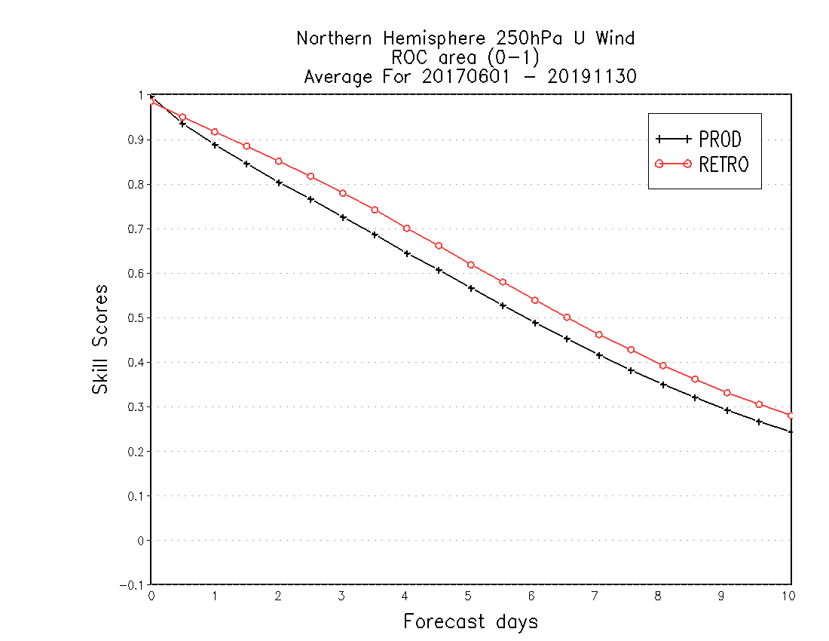
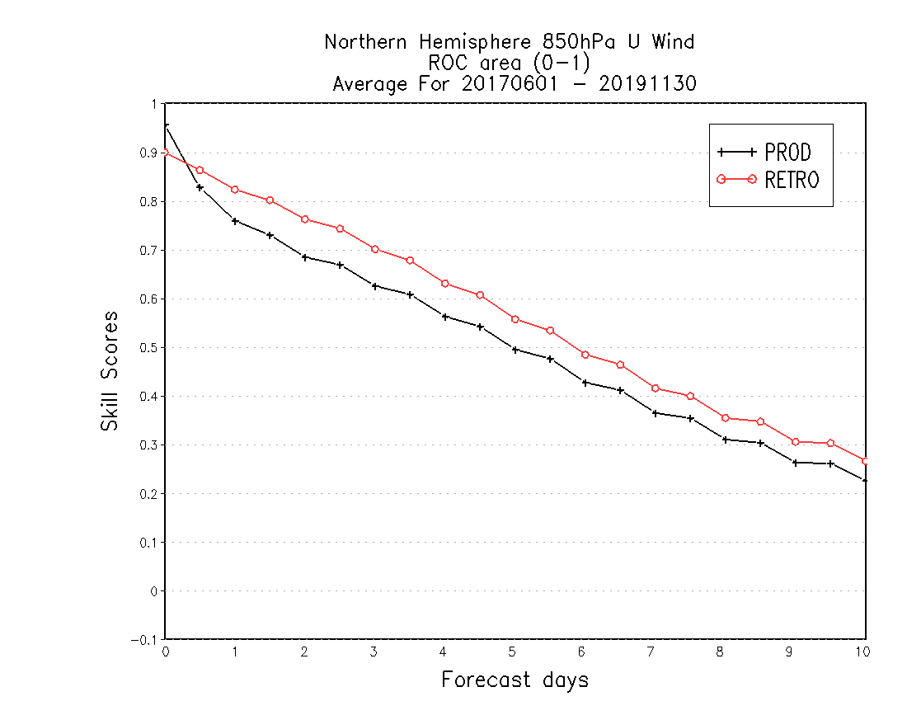
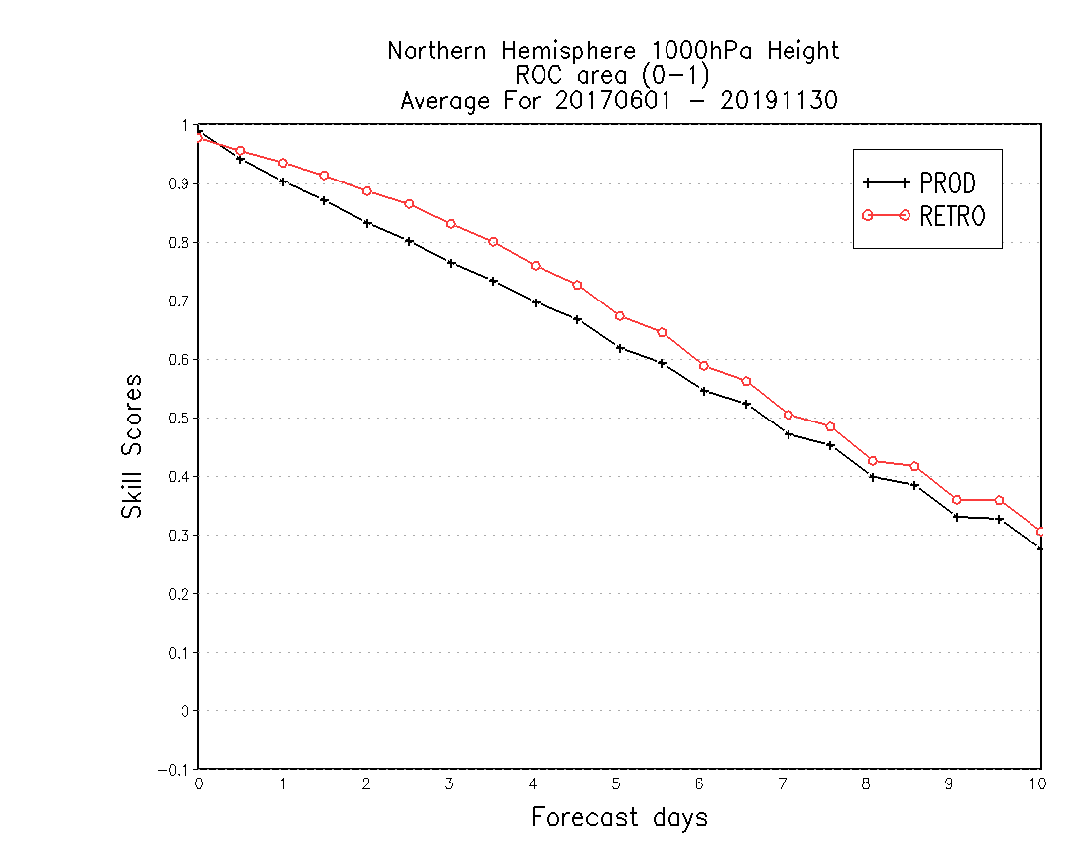
NATIONAL OCEANIC AND ATMOSPHERIC ADMINISTRATION
GEFSv12 ROC Area
250-hPa u wind
850-hPa u wind
1000-hPa height
Better (→)
Forecast Lead Time (→)
Forecast Lead Time (→)
Forecast Lead Time (→)
GEFSv12 has higher ROC area than GEFSv11 at almost all lead times (Days 0–10) and for all of the variables examined (250 u/v, 500 g, 850 u/v/t, 1000 g, 10-m u/v)
STTP has minor contribution to tropics
STTP overdispersion in winter hemisphere

Slide 18
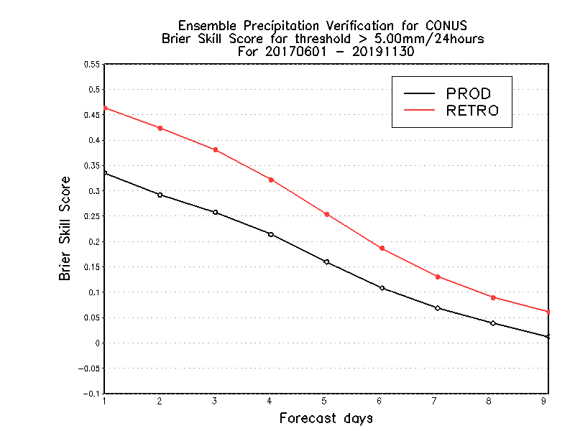
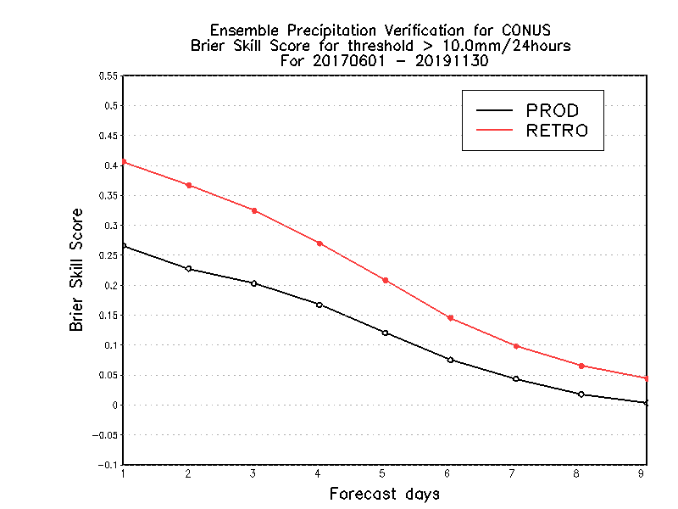
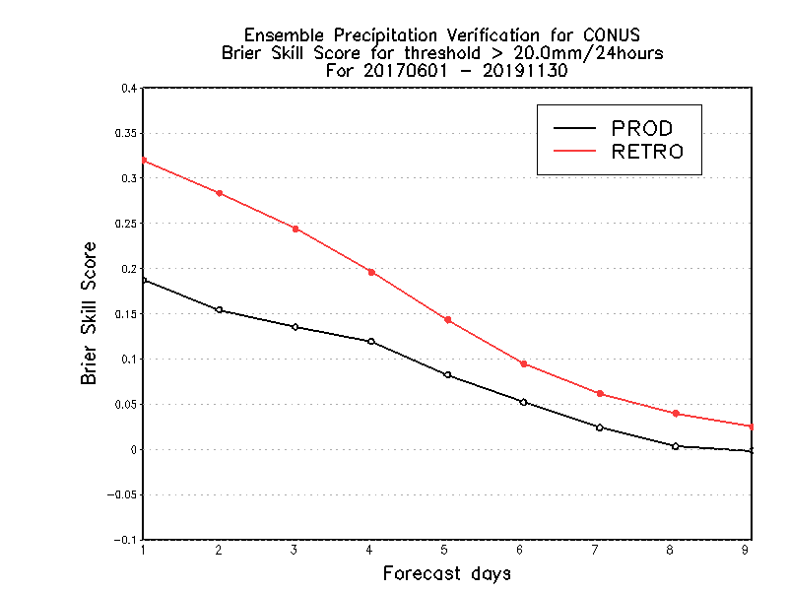
NATIONAL OCEANIC AND ATMOSPHERIC ADMINISTRATION
GEFSv12 CONUS Precip.: Brier Skill Score
5mm/24h
10mm/24h
20mm/24h
Brier Skill Score (→)
Forecast Lead Time (→)
Forecast Lead Time (→)
Forecast Lead Time (→)
GEFSv12 mean has higher Brier Skill Scores than GEFSv11 mean at all lead times and thresholds
STTP has minor contribution to tropics
STTP overdispersion in winter hemisphere

Slide 19
NATIONAL OCEANIC AND ATMOSPHERIC ADMINISTRATION
GEFSv12 CONUS Precip.: Equitable Threat Score
5mm/24h
10mm/24h
20mm/24h
ETS
BIAS
GEFSv12 mean has higher ETS values than GEFSv11 mean at lower precip thresholds
GEFSv12 mean has a larger low bias than GEFSv11 mean at higher precip thresholds
STTP has minor contribution to tropics
STTP overdispersion in winter hemisphere

Slide 20
NATIONAL OCEANIC AND ATMOSPHERIC ADMINISTRATION
GEFSv12 CONUS Precip.: Equitable Threat Score
ETS
BIAS
GEFSv12 mean has higher ETS values than GEFSv11 mean at lower precip thresholds
GEFSv12 mean has a larger low bias than GEFSv11 mean at higher precip thresholds

Slide 21
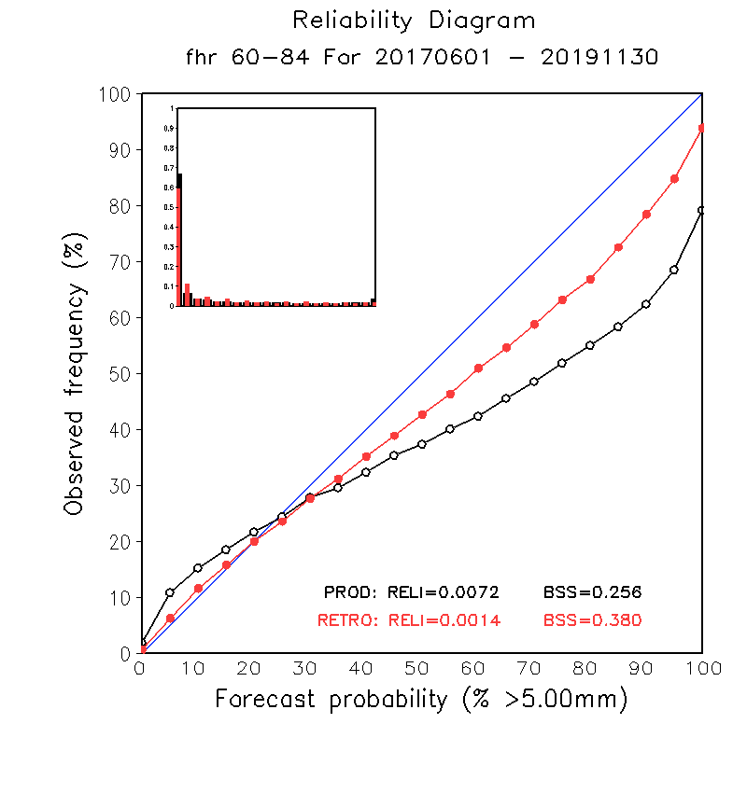
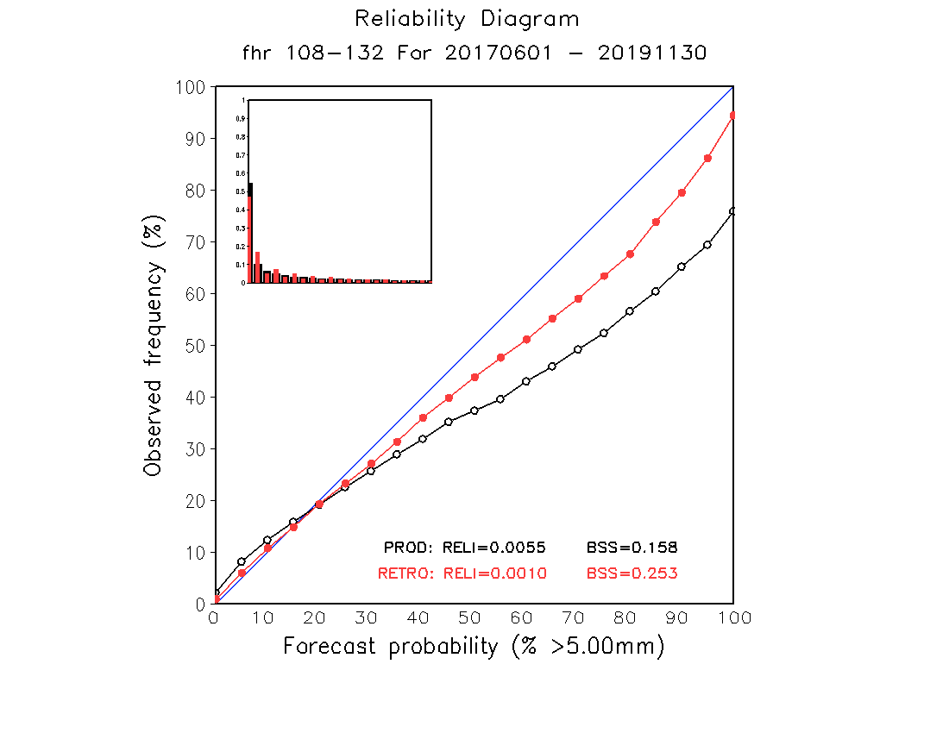
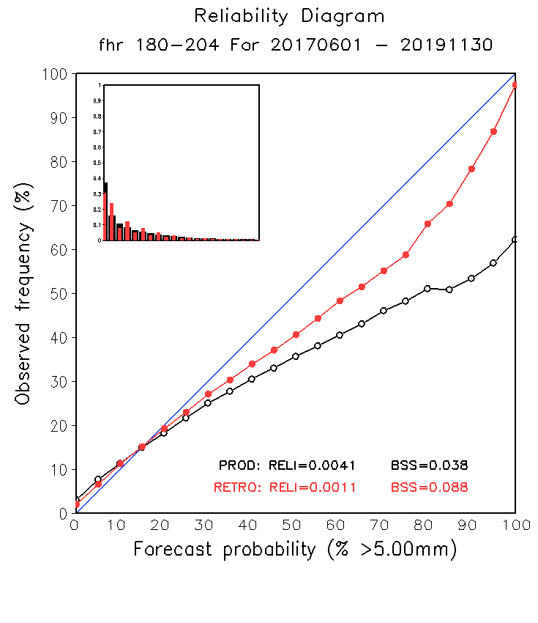
NATIONAL OCEANIC AND ATMOSPHERIC ADMINISTRATION
GEFSv12 CONUS Precip.: Reliability Diagrams
DAY 3
DAY 5
DAY 8
GEFSv12 is “more reliable” than GEFSv11 (line closer to diagonal) at all lead times and at all precipitation thresholds

Slide 22
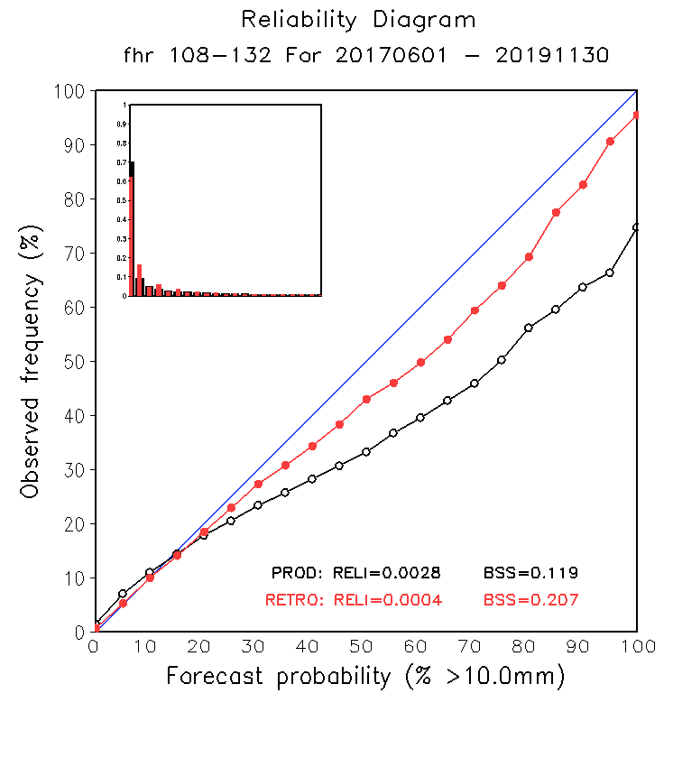
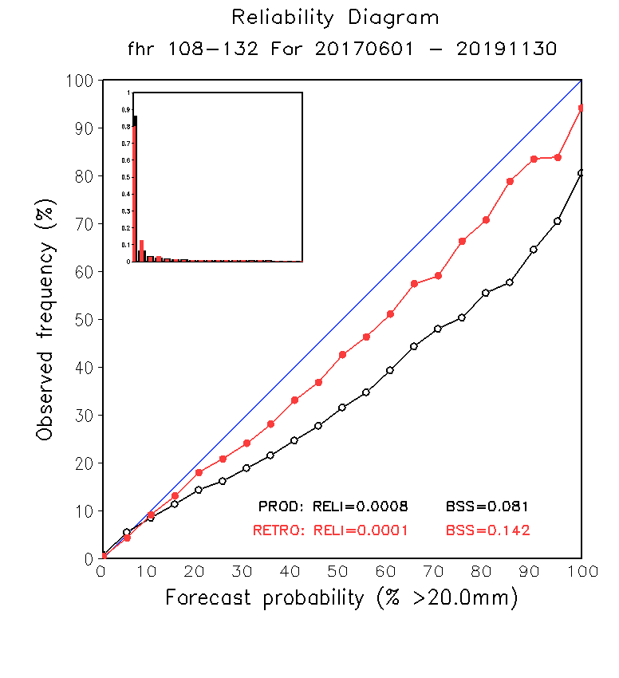
NATIONAL OCEANIC AND ATMOSPHERIC ADMINISTRATION
GEFSv12 CONUS Precip.: Reliability Diagrams
5mm/ 24h
10mm/ 24h
20mm/ 24h
GEFSv12 is “more reliable” than GEFSv11 (line closer to diagonal) at all lead times and at all precipitation thresholds

Slide 23
NATIONAL OCEANIC AND ATMOSPHERIC ADMINISTRATION
GEFSv12 Day-5 CONUS Precipitation RMSE
 | GEFSv11 (PROD) | GEFSv12 (RETRO)
Fall 2019 | 4.834 | 4.706
Summer 2019 | 5.458 | 5.005
Spring 2019 | 5.231 | 4.825
Winter 2018/2019 | 4.652 | 4.426
Fall 2018 | 5.537 | 5.351
Summer 2018 | 5.418 | 5.013
Spring 2018 | 4.432 | 4.137
Winter 2017/2018 | 3.841 | 3.727
Fall 2017 | 4.255 | 3.976
Summer 2017 | 5.854 | 5.513

Slide 24
NATIONAL OCEANIC AND ATMOSPHERIC ADMINISTRATION
GEFSv12: Low Height and Cold Bias?
GFS w/ FV3 core & GFDL microphysics (operational) has a known low height/cold bias
GFSv14
GFSv14
500Z
Bias
GFSv15
850T Bias
GFSv15

Slide 25
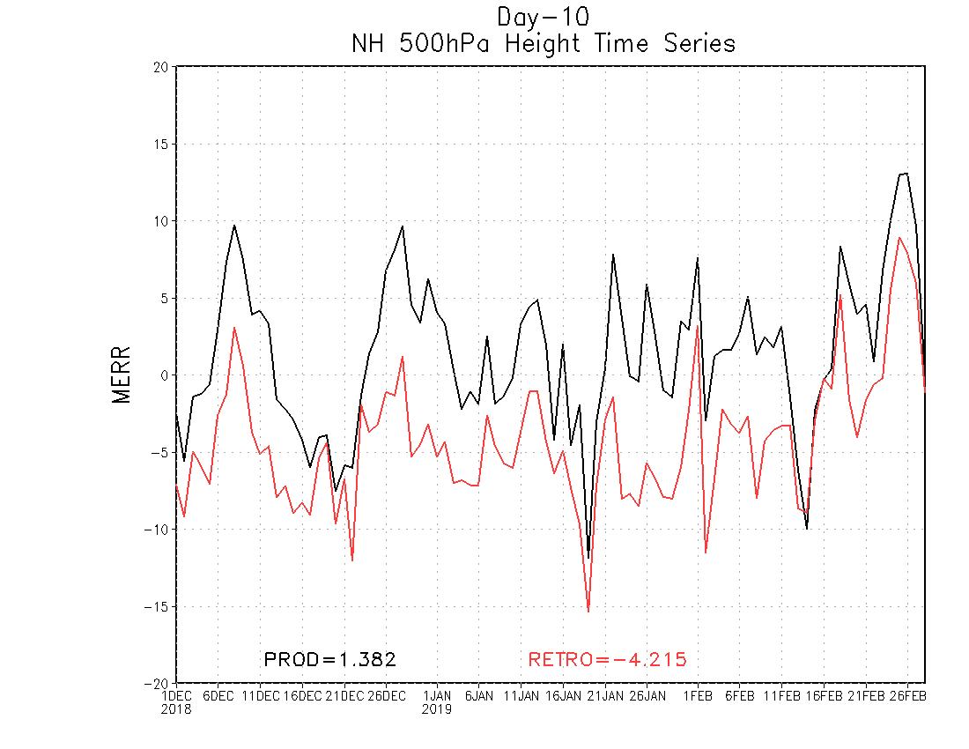
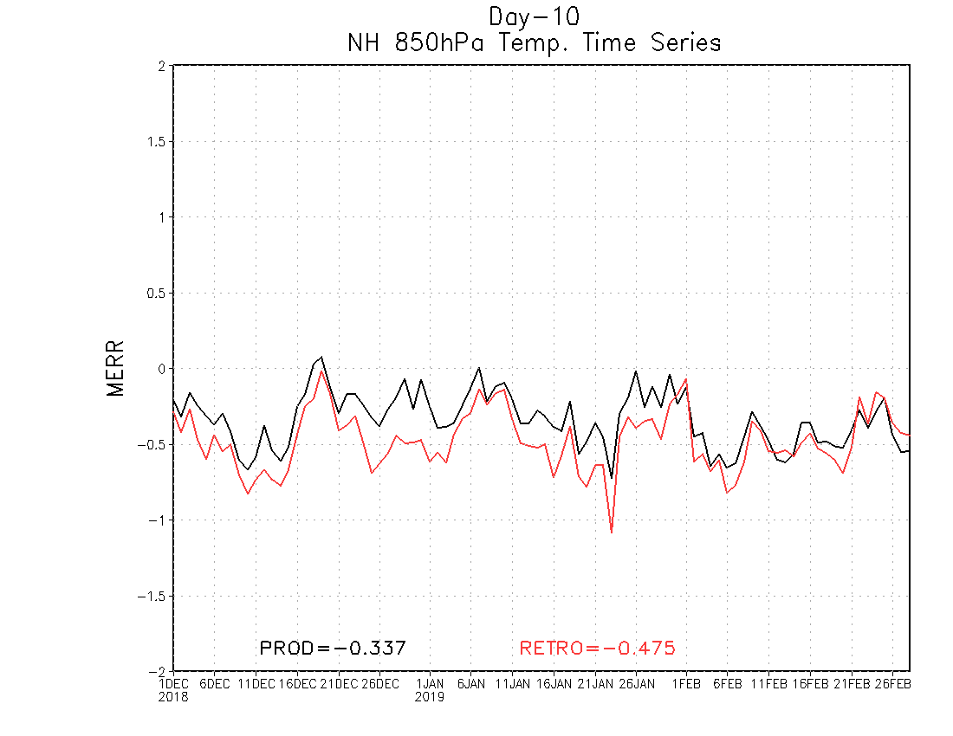
NATIONAL OCEANIC AND ATMOSPHERIC ADMINISTRATION
GEFSv12: Low Height and Cold Bias?
DAY 10 – NH 500-hPa height bias
DAY 10 – NH 850-hPa temp bias
GEFSv12 has a larger low height bias at 500 hPa than GEFSv11 at Day 10
GEFSv12 has a larger cold temp bias in 850 hPa than GEFSv11 at Day 10
GEFSv11 = 1.382 GEFSv12 = −4.215
GEFSv11 = −.337 GEFSv12 = −.475
Dec 2018
Mar 2019
Dec 2018
Mar 2019

Slide 26
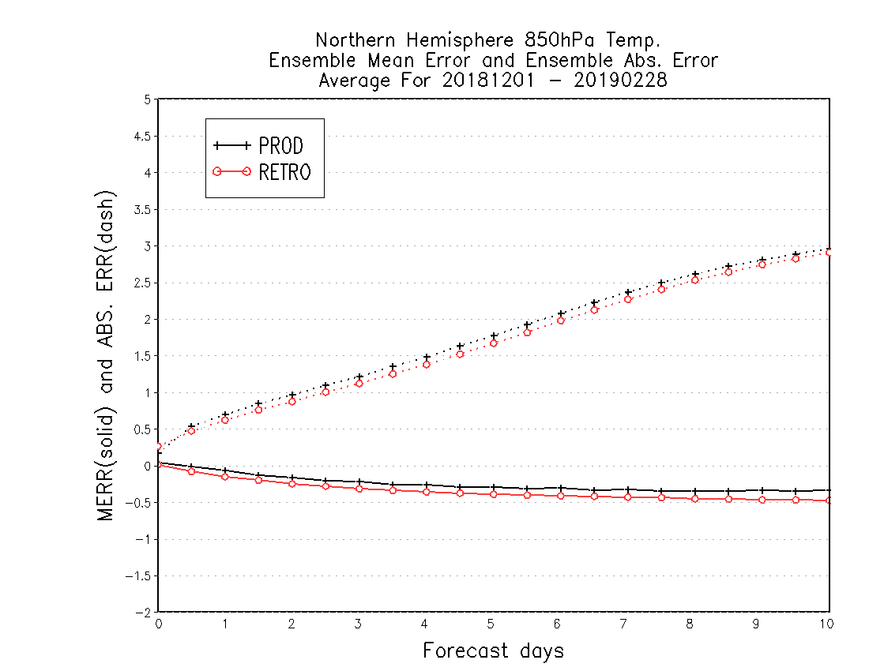
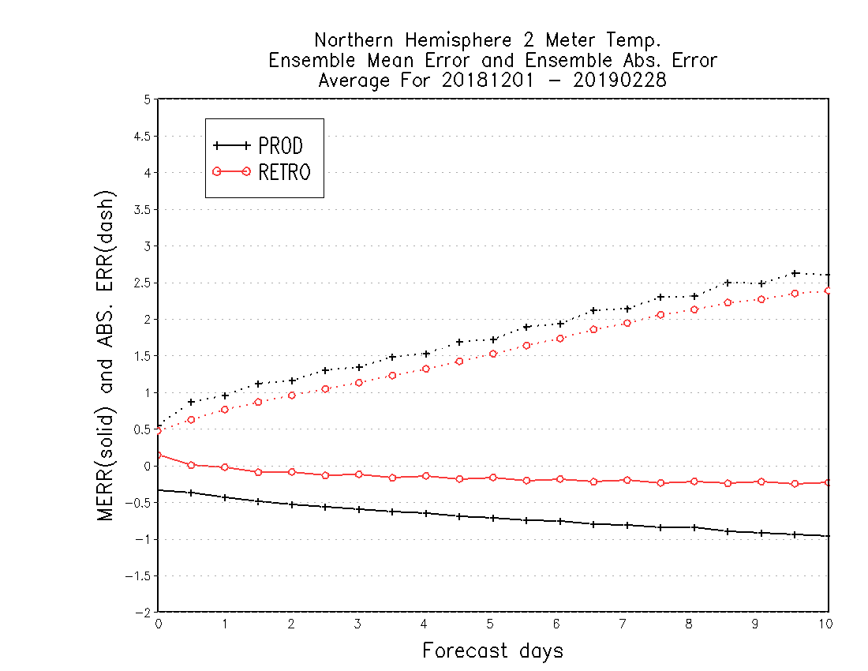
NATIONAL OCEANIC AND ATMOSPHERIC ADMINISTRATION
GEFSv12: Low Height and Cold Bias?
NH 850-hPa temp bias (Winter 2018/19)
NH 2-m temp bias (Winter 2018/19)
GEFSv12 has a larger cold bias and less absolute error than GEFSv11
GEFSv12 has a smaller cold bias and less absolute error than GEFSv11 (changes to ground heat flux)

Slide 27
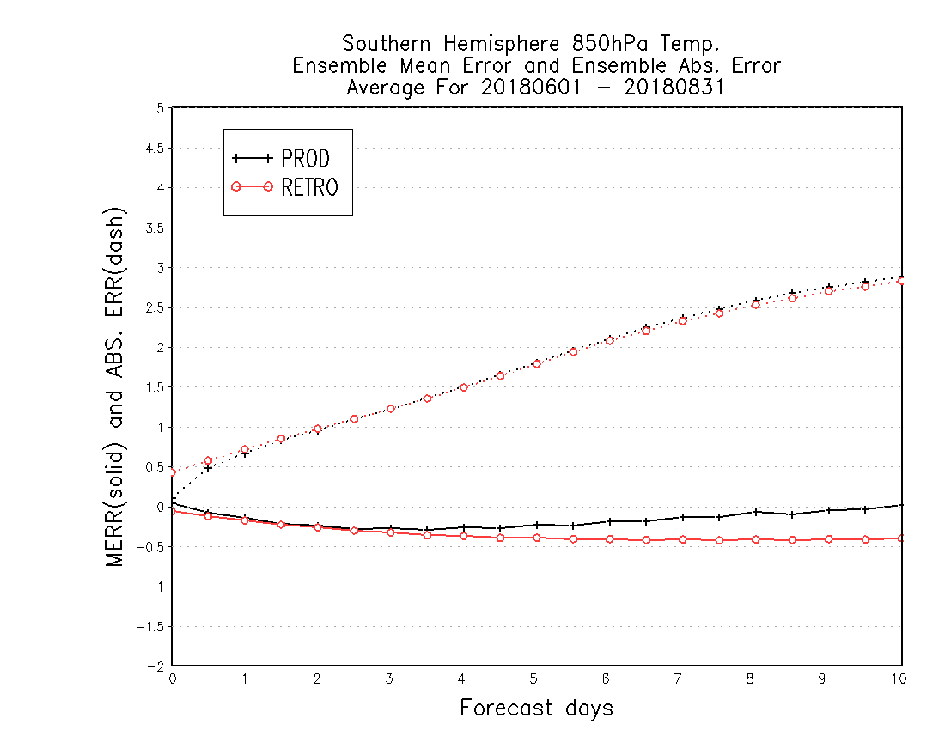
NATIONAL OCEANIC AND ATMOSPHERIC ADMINISTRATION
GEFSv12: Low Height and Cold Bias?
SH 850-hPa temp bias (Winter 2018)
SH 2-m temp bias (Winter 2018)
GEFSv12 has a larger cold bias and similar abs. error to GEFSv11
GEFSv12 has a smaller cold bias and similar abs. error to GEFSv11 (changes to ground heat flux)

Slide 28
NATIONAL OCEANIC AND ATMOSPHERIC ADMINISTRATION
GEFSv12 Tropical Cyclone Statistics
Periods of TC verification
2017: 0000 UTC (06/01–11/30) 1200 UTC (07/01–10/31) 2018: 0000 UTC (05/01–11/30) 1200 UTC (07/01–10/31) 2019: 0000 UTC (05/01–11/30) 1200 UTC (07/01–10/31)

Slide 29
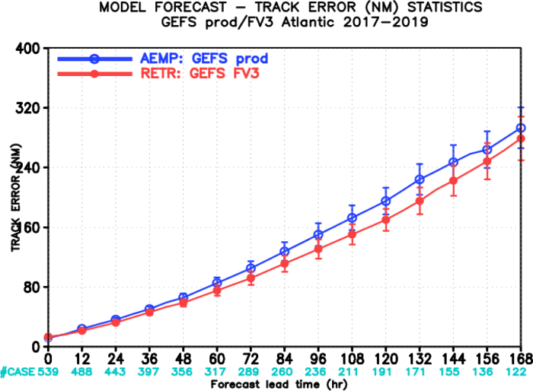
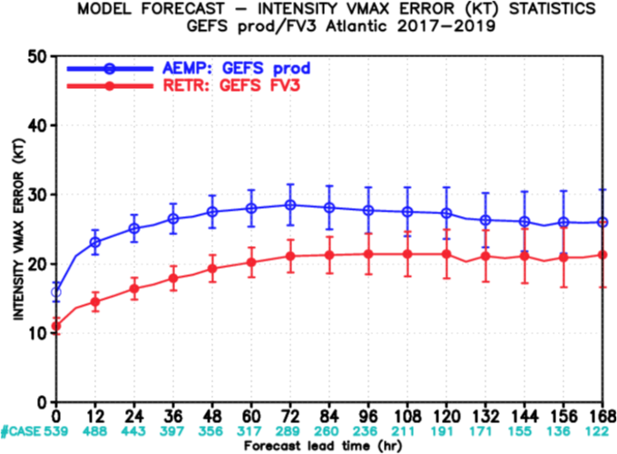
NATIONAL OCEANIC AND ATMOSPHERIC ADMINISTRATION
GEFSv12 Tropical Cyclone Statistics
NATL Track Error
NATL Intensity Error
GEFSv12 has less track and intensity error than GEFSv11 at all lead times
GEFSv12 intensity forecasts are S.S. better than GEFSv11 at shorter lead times

Slide 30
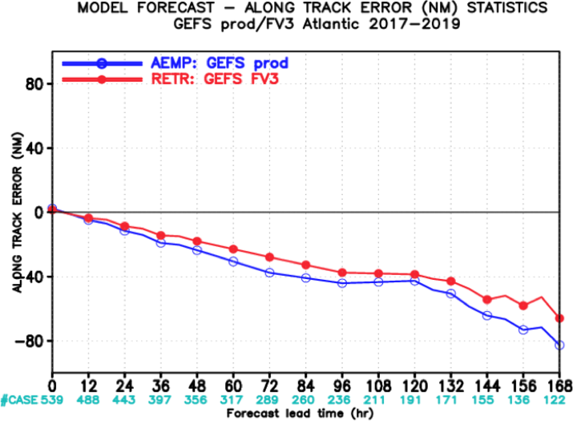
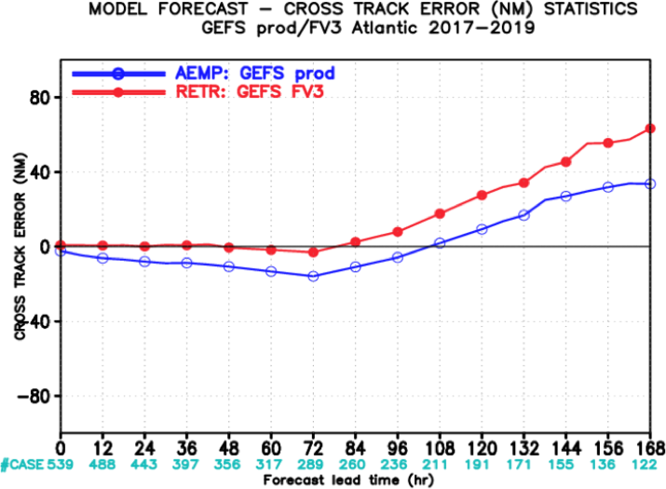
NATIONAL OCEANIC AND ATMOSPHERIC ADMINISTRATION
GEFSv12 Tropical Cyclone Statistics
NATL Along Track Error
NATL Across Track Error
GEFSv12 has less along-track error than GEFSv11 (less of a slow bias)
GEFSv12 has more right-of-track error than GEFSv11 at longer lead times

Slide 31
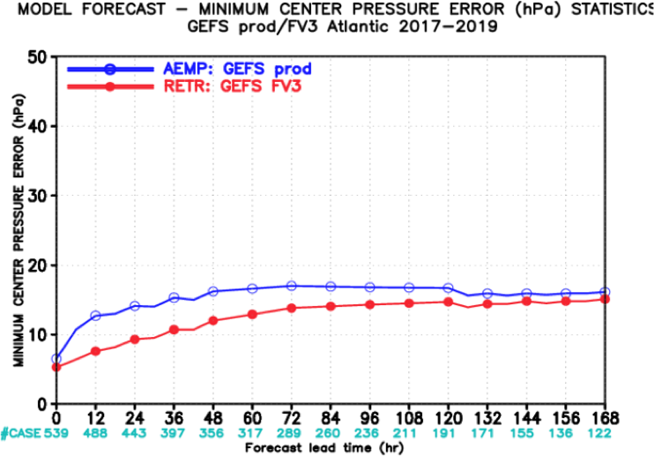
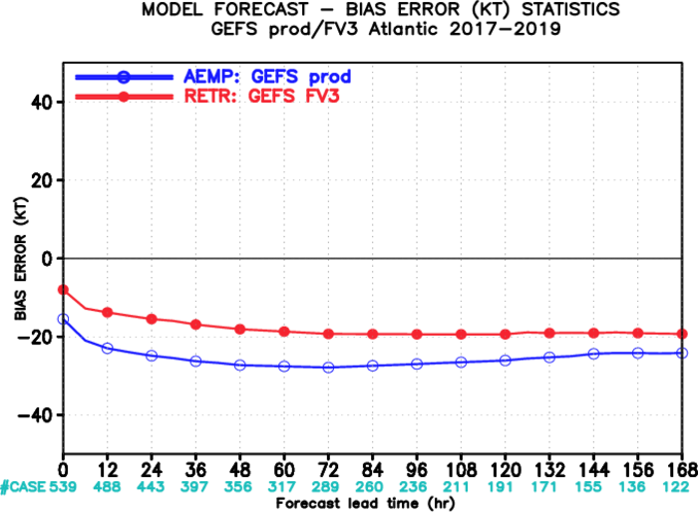
NATIONAL OCEANIC AND ATMOSPHERIC ADMINISTRATION
GEFSv12 Tropical Cyclone Statistics
NATL Intensity Error (hPa)
NATL Intensity Bias (kt)
GEFSv12 has less intensity error than GEFSv11 at all lead times
GEFSv12 has less of a weak wind-speed bias than GEFSv11 at all lead times

Slide 32
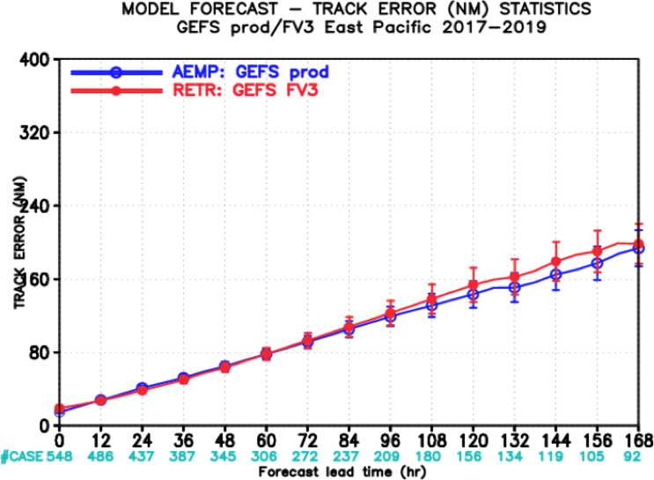
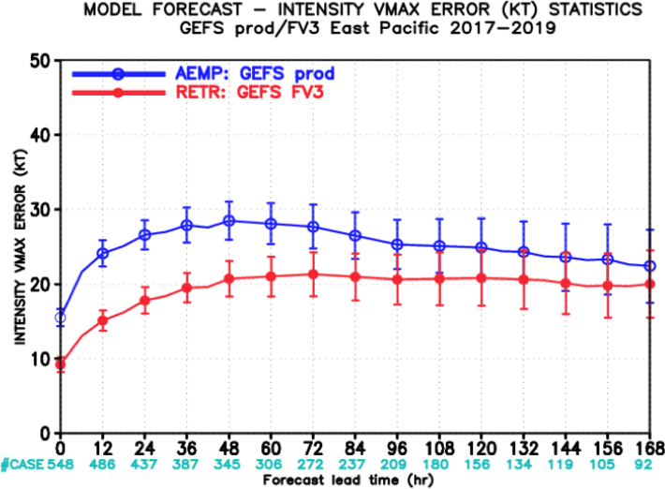
NATIONAL OCEANIC AND ATMOSPHERIC ADMINISTRATION
GEFSv12 Tropical Cyclone Statistics
EPAC Track Error
EPAC Intensity Error
GEFSv12 has comparable or slightly worse track error than GEFSv11 (not S.S.)
GEFSv12 intensity forecasts are S.S. better than GEFSv11 at shorter lead times

Slide 33
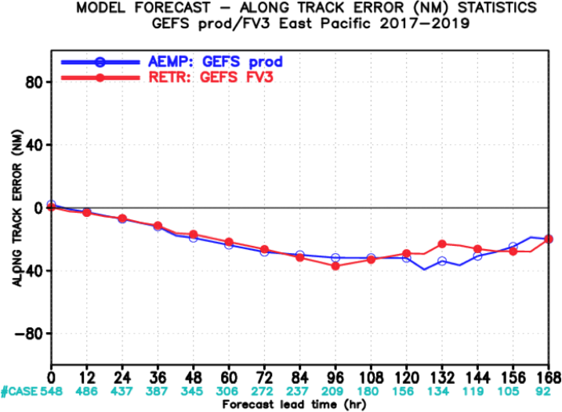
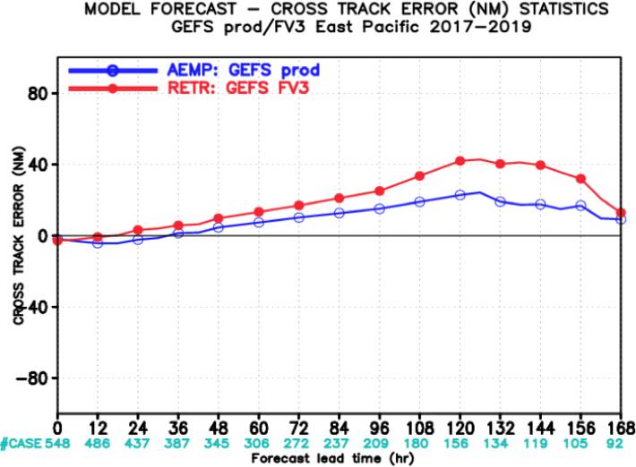
NATIONAL OCEANIC AND ATMOSPHERIC ADMINISTRATION
GEFSv12 Tropical Cyclone Statistics
EPAC Along Track Error
EPAC Across Track Error
GEFSv12 has comparable along-track error to GEFSv11 (still has a slow bias)
GEFSv12 has more right-of-track error than GEFSv11, especially at longer lead times

Slide 34
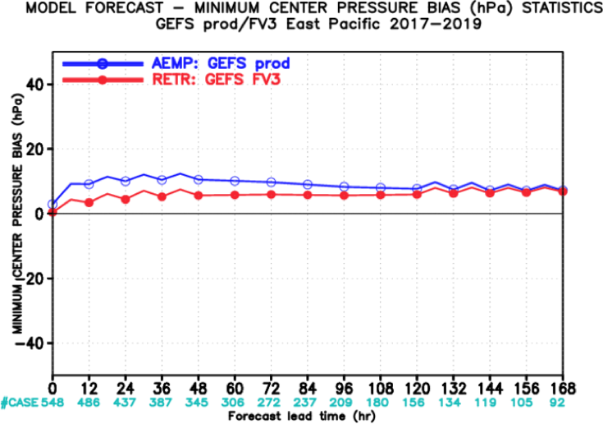
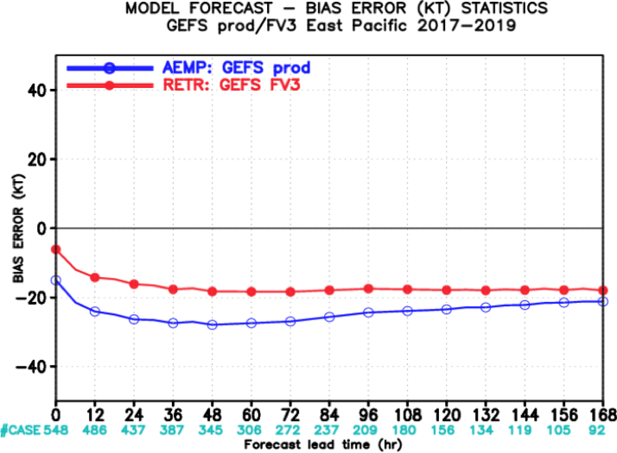
NATIONAL OCEANIC AND ATMOSPHERIC ADMINISTRATION
GEFSv12 Tropical Cyclone Statistics
EPAC Intensity Error (hPa)
EPAC Intensity Bias (kt)
GEFSv12 has comparable or less intensity error than GEFSv11 at all lead times
GEFSv12 has less of a weak wind-speed bias than GEFSv11 at all lead times

Slide 35
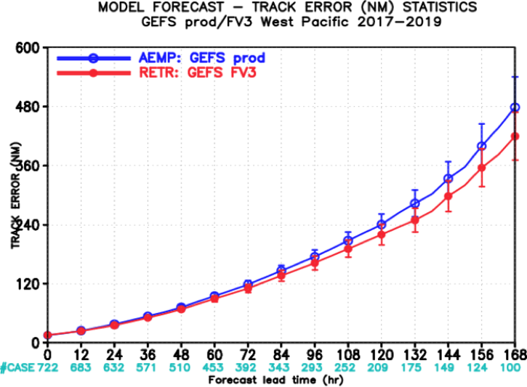
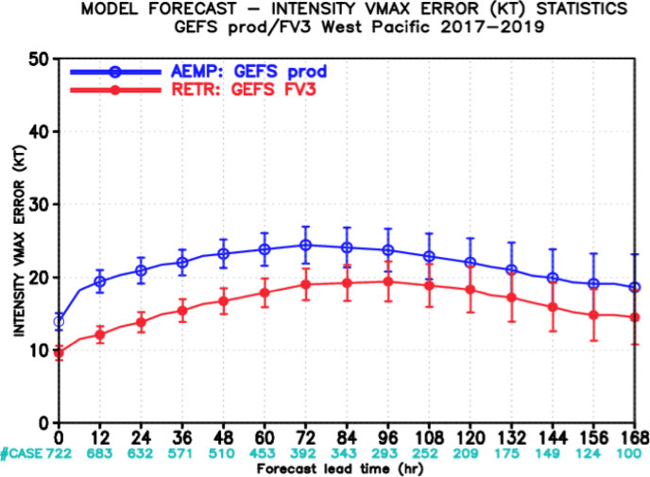
NATIONAL OCEANIC AND ATMOSPHERIC ADMINISTRATION
GEFSv12 Tropical Cyclone Statistics
WPAC Track Error
WPAC Intensity Error
GEFSv12 has comparable or slightly less track error than GEFSv11 (not S.S.)
GEFSv12 intensity forecasts are S.S. better than GEFSv11 at shorter lead times

Slide 36
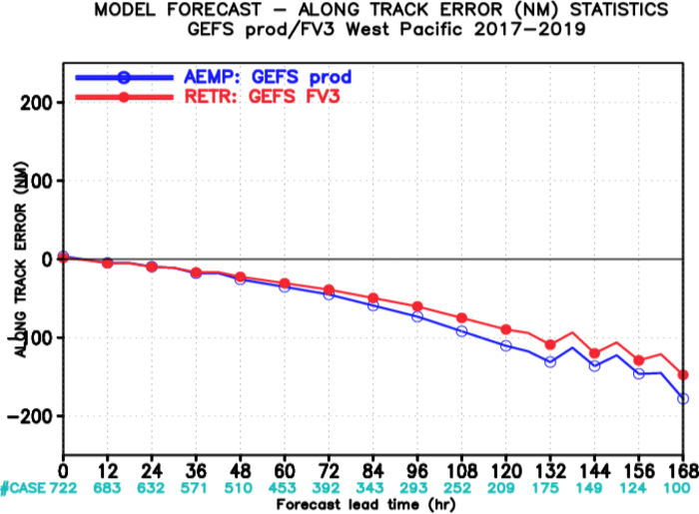
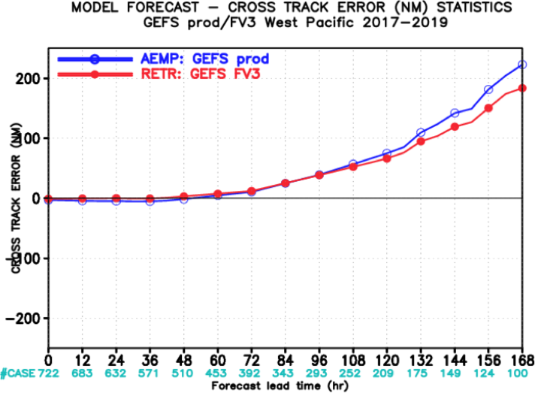
NATIONAL OCEANIC AND ATMOSPHERIC ADMINISTRATION
GEFSv12 Tropical Cyclone Statistics
WPAC Along Track Error
WPAC Across Track Error
GEFSv12 has comparable or less along-track error than GEFSv11 (still slow bias)
GEFSv12 has comparable or less right-of-track error than GEFSv11 (unlike in NATL)

Slide 37
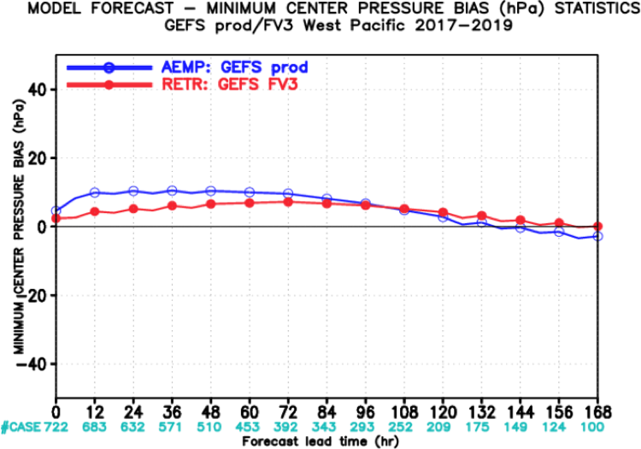
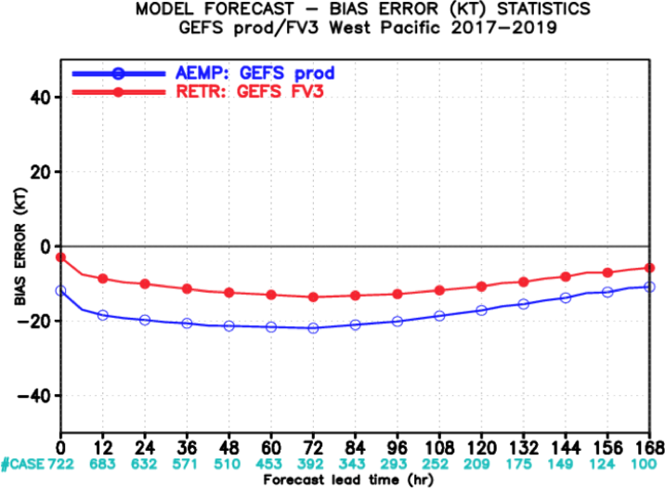
NATIONAL OCEANIC AND ATMOSPHERIC ADMINISTRATION
GEFSv12 Tropical Cyclone Statistics
WPAC Intensity Error (hPa)
WPAC Intensity Bias (kt)
GEFSv12 has comparable or less intensity error than GEFSv11 at all lead times
GEFSv12 has less of a weak wind-speed bias than GEFSv11 at all lead times

Slide 38
NATIONAL OCEANIC AND ATMOSPHERIC ADMINISTRATION
GEFSv12 Verification Statistics: Summary
GEFSv12 has higher 500-hPa AC scores than GEFSv11 at all lead times
GEFSv12 has higher 500-hPa AC scores than GEFSv11 at Day 5 during all seasons between Summer 2017 and Fall 2019
GEFSv12 has less RMSE and more spread than GEFSv11 in the short and medium range for all variables (i.e., less underdispersive)
GEFSv12 has higher CONUS precip Brier Skill Scores than GEFSv11 at all lead times and for all 24-h precipitation thresholds
GEFSv12 has more reliable 24-h CONUS precip forecasts than GEFSv11
GEFSv12 has a larger low bias at higher precip thresholds than GEFSv11
GEFSv12 has higher 500-hPa AC scores than GEFSv11 at all lead times
GEFSv12 has higher 500-hPa AC scores than GEFSv11 at Day 5 during all seasons between Summer 2017 and Fall 2019
GEFSv12 has less RMSE and more spread than GEFSv11 in the short and medium range for all variables (i.e., less underdispersive)

Slide 39
NATIONAL OCEANIC AND ATMOSPHERIC ADMINISTRATION
GEFSv12 Verification Statistics: Summary
GEFSv12 has a larger 850-hPa temp bias than GEFSv11 in winter, but a smaller 2-m temp bias due to changes to the ground heat flux over snow
GEFSv12 has comparable or less TC track error than GEFSv11 in the NATL/WPAC, and comparable or slightly more track error in the EPAC
GEFSv12 has comparable or less along-track error than GEFSv11 in the all basins (still has a slow bias)
GEFSv12 has comparable or more right-of-track error than GEFSv11 in the NATL/EPAC, and comparable or less right-of-track error in the WPAC
GEFSv12 has less TC intensity error than GEFSv11 in all basins (less of a weak wind-speed bias)

