Slide 1
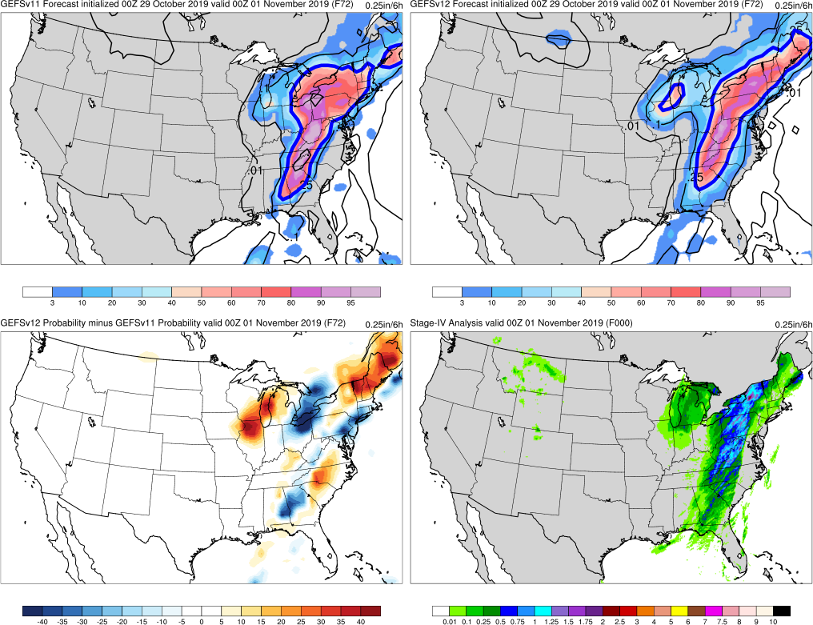
NATIONAL OCEANIC AND ATMOSPHERIC ADMINISTRATION
GEFSv12 Retrospective Case Studies: Excessive QPF
GEFSv11
GEFSv12
Stage-IV Anl.
Shannon Shields
EMC MEG Meeting
12 March 2020

Slide 2
NATIONAL OCEANIC AND ATMOSPHERIC ADMINISTRATION
GEFSv12 Precipitation Verification
From Alicia Bentley’s 3/12/20 MEG presentation on QPF stats:
GEFSv12 has higher 500-hPa AC scores than GEFSv11 at all lead times
GEFSv12 has higher 500-hPa AC scores than GEFSv11 at Day 5 during all seasons between Summer 2017 and Fall 2019i.e., less underdispersive)
GEFSv12 has higher CONUS precip Brier Skill Scores than GEFSv11 at all lead times and for all 24-h precipitation thresholds
GEFSv12 has more reliable 24-h CONUS precip forecasts than GEFSv11
GEFSv12 has a larger low bias at higher precip thresholds than GEFSv11

Slide 3
NATIONAL OCEANIC AND ATMOSPHERIC ADMINISTRATION
GEFSv12 Retrospectives: Excessive QPF
GEFSv12 retrospectives initialized at 0000 UTC during 6/1/17–11/30/19
Extra hurricane initializations at 1200 UTC during 6/1–9/30 (2017, 2018, 2019)
GEFSv12 Excessive QPF case studies include:
Summer Nor’easter (July 2017)
California Storm (Jan 2018)
TX/OK Bust Case (Dec 2018)
Central U.S. Cyclone (Apr 2019)
Spring CA Storm (May 2019)
TC Imelda (Sep 2019)
Halloween Storm (Oct/Nov 2019)
Post-Thanksgiving Storm (Nov/Dec 2019)
Consolidates NCEP/EMC verification and evaluation functions to efficiently and consistently support all modeling groups
Removes evaluation functions from the model science chain of command, ensuring independent model evaluations

Slide 4
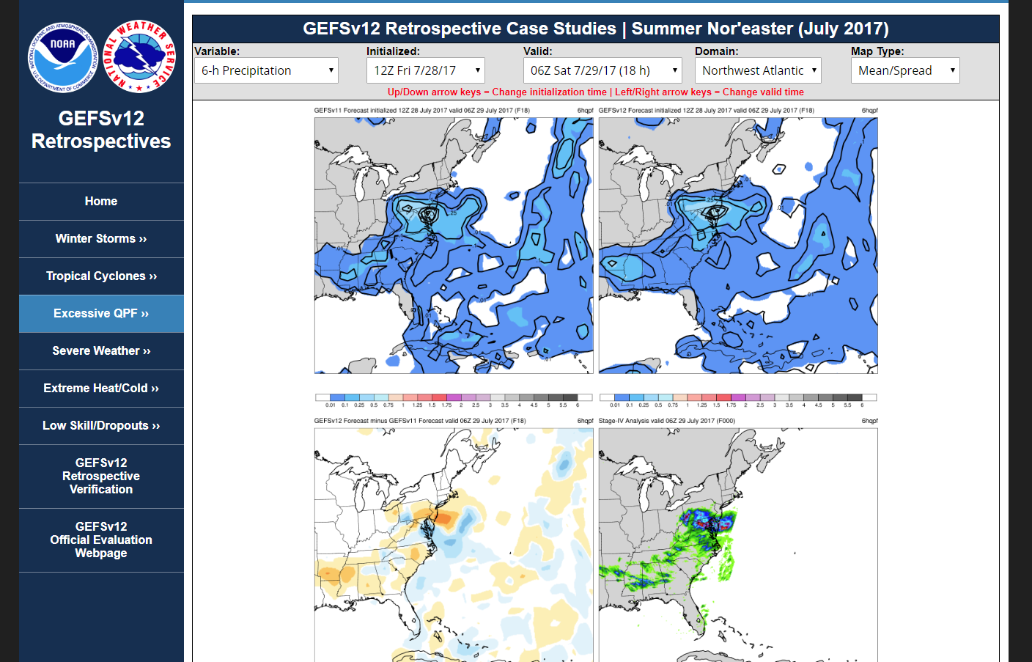
NATIONAL OCEANIC AND ATMOSPHERIC ADMINISTRATION
GEFSv12 Retrospectives: Excessive QPF
https://www.emc.ncep.noaa.gov/users/meg/gefsv12/retros/

Slide 5
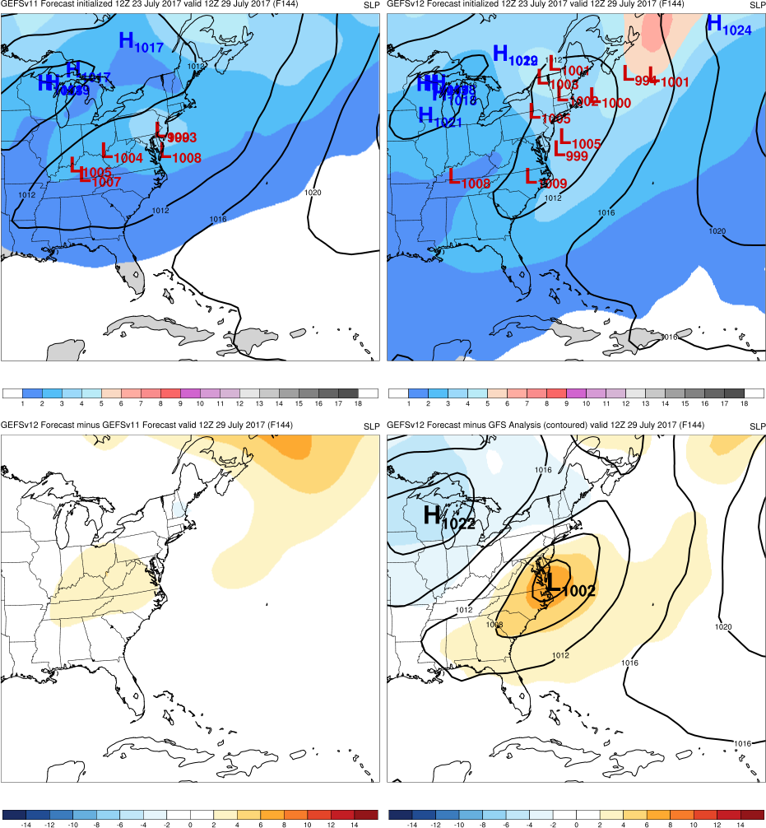
NATIONAL OCEANIC AND ATMOSPHERIC ADMINISTRATION
GEFSv12 Retrospectives: Excessive QPF
Top: Mean (contours)
Spread (shaded)
Low Locations
Graphics Setup
GEFSv11
GEFSv12
Bottom Left: GEFSv12−GEFSv11 (shaded)
Bottom Right: GFS analysis (contours)
GEFSv12−GFS analysis (shaded)
v12−v11
GFS Anl.

Slide 6
NATIONAL OCEANIC AND ATMOSPHERIC ADMINISTRATION
GEFSv12 Retrospectives: Excessive QPF
Eastern U.S. Cases
Summer Nor’easter (July 2017)
Halloween Storm (Oct/Nov 2019)
Post-Thanksgiving Storm (Nov/Dec 2019)

Slide 7
Summer Nor’easter
Init.: 12Z 7/23/2017 (F144)
Valid: 12Z 7/29/2017
F144: GEFSv12 accurately predicts a 1012 hPa closed contour with low centers in correct vicinity off the coast, but some members are too far north
GEFSv11
GEFSv12
v12−v11
GFS Anl.

Slide 8
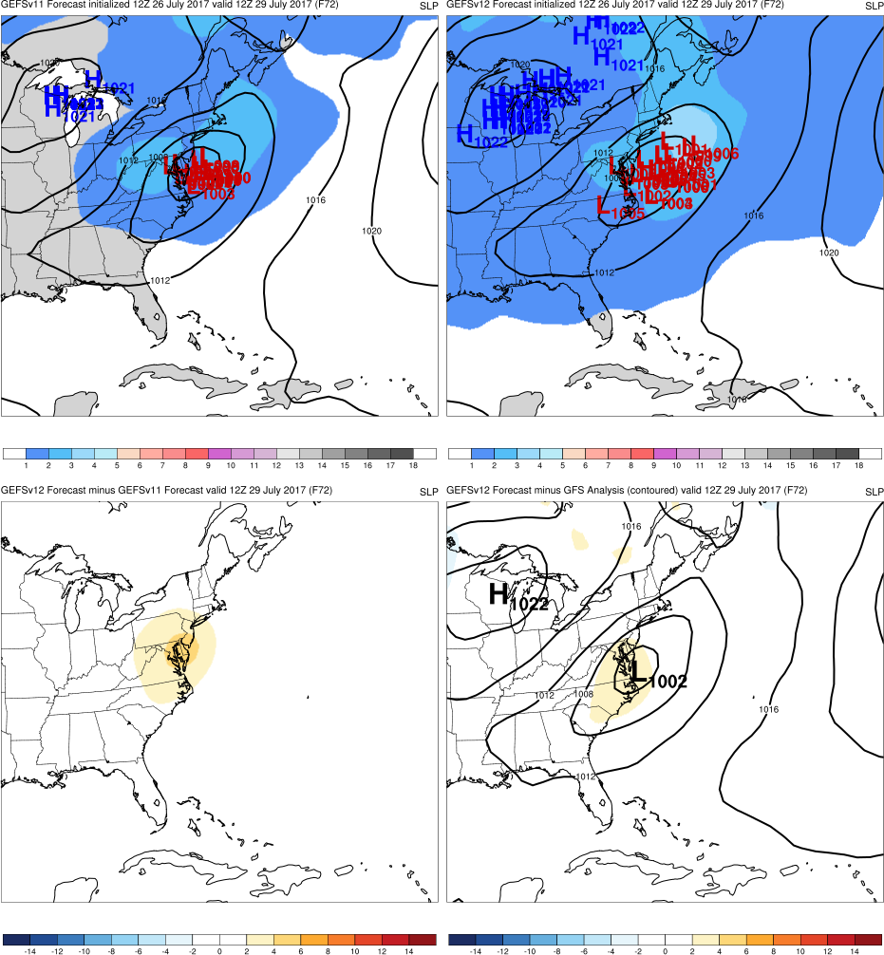
Summer Nor’easter
Init.: 12Z 7/26/2017 (F072)
Valid: 12Z 7/29/2017
F144: GEFSv12 accurately predicts a 1012 hPa closed contour with low centers in correct vicinity off the coast, but some members are too far north
F072: GEFSv11 is more accurately located along the coast while GEFSv12 has more members further out to sea until F024
GEFSv11
GEFSv12
v12−v11
GFS Anl.

Slide 9
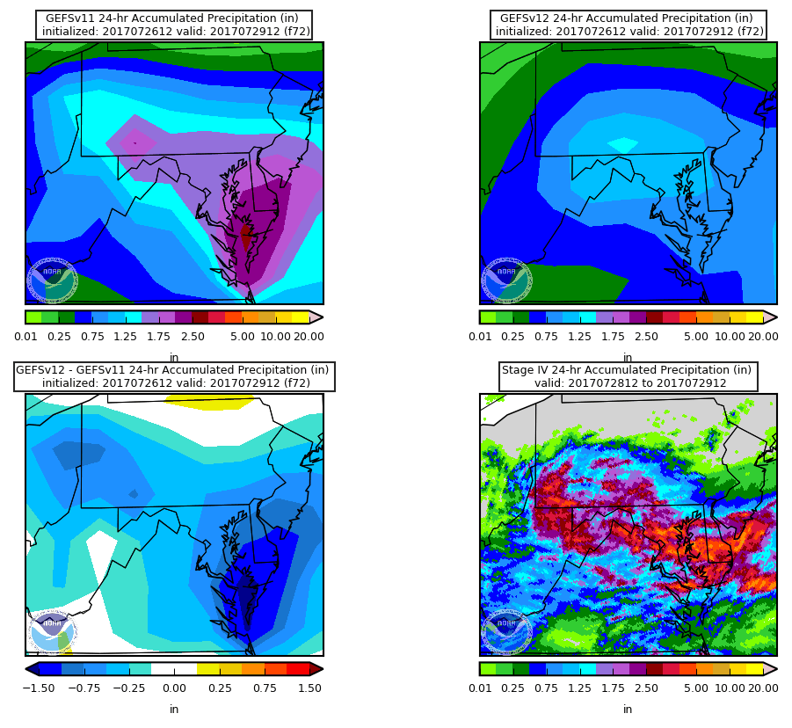
24-h Mean Accum. Precip
Summer Nor’easter
Init.: 12Z 7/26/2017 (F072)
Valid: 12Z 7/29/2017
F072: GEFSv12 displays a very low precip bias, completely missing the highest amounts of rainfall
GEFSv11
GEFSv12
v12−v11
Stage-IV

Slide 10
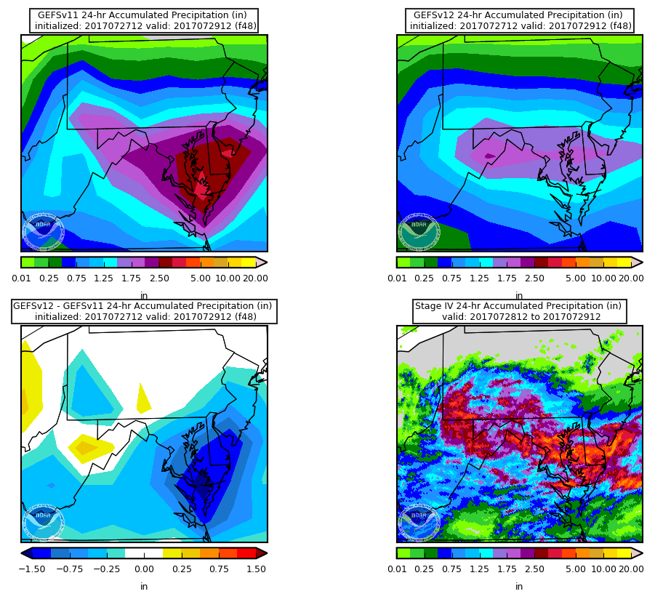
24-h Mean Accum. Precip
Summer Nor’easter
Init.: 12Z 7/27/2017 (F048)
Valid: 12Z 7/29/2017
F072: GEFSv12 displays a very low precip bias, completely missing the highest amounts of rainfall
F048: GEFSv12 misses the maximum rainfall over MD and DE, while GEFSv11 correctly captures these extreme amounts
GEFSv11
GEFSv12
v12−v11
Stage-IV

Slide 11
NATIONAL OCEANIC AND ATMOSPHERIC ADMINISTRATION
GEFSv12 Retrospectives: Excessive QPF
Eastern U.S. Cases
Summer Nor’easter (July 2017)
Halloween Storm (Oct/Nov 2019)
Post-Thanksgiving Storm (Nov/Dec 2019)

Slide 12
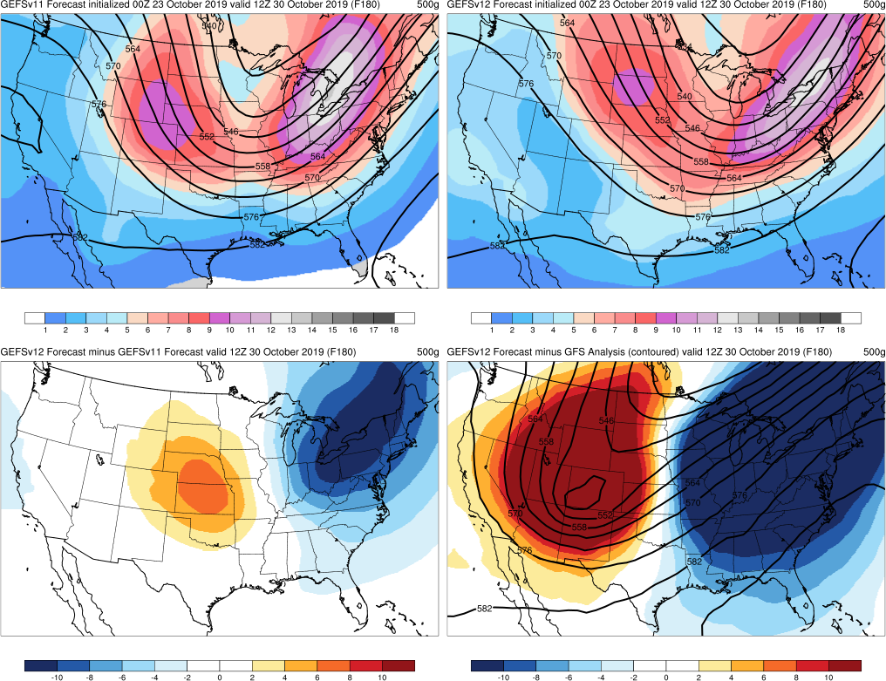
Halloween Storm
Init.: 00Z 10/23/2019 (F180)
Valid: 12Z 10/30/2019
Both GEFSv12 and GEFSv11 are too progressive with trough, but GEFSv12 is even more progressive than GEFSv11
This is observed between F204 and F108
Major forecast problem noted by WPC
GEFSv11
GEFSv12
v12−v11
GFS Anl.

Slide 13
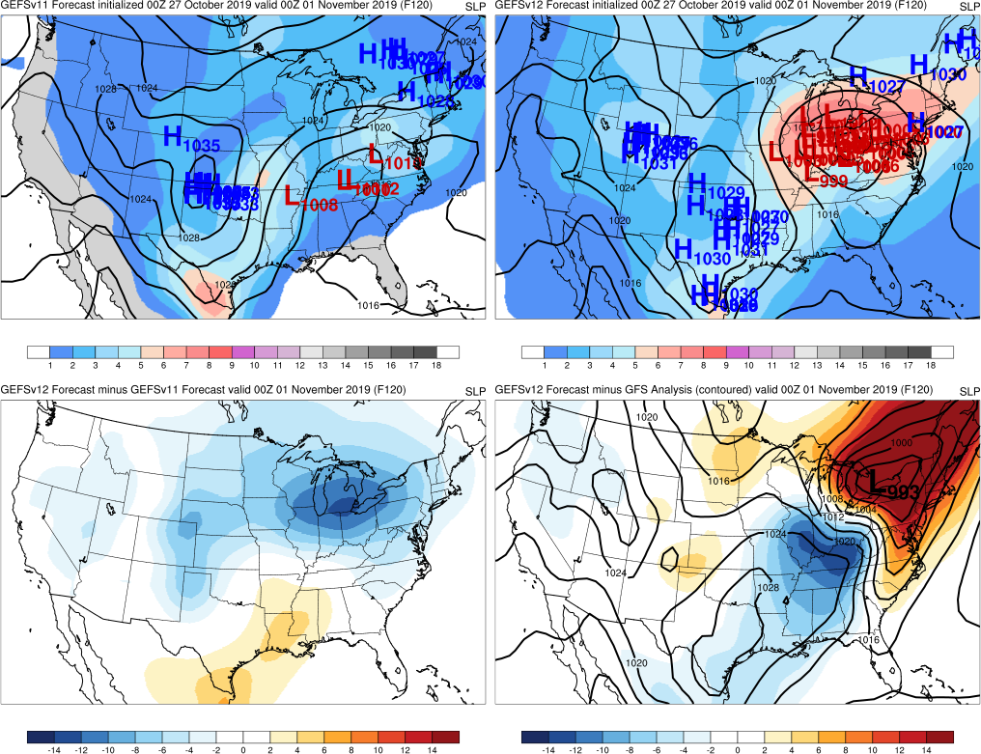
Halloween Storm
Init.: 00Z 10/27/2019 (F120)
Valid: 00Z 11/1/2019
GEFSv12 members predict the low’s location and intensity much more accurately than GEFSv11 members
GEFSv11
GEFSv12
v12−v11
GFS Anl.

Slide 14
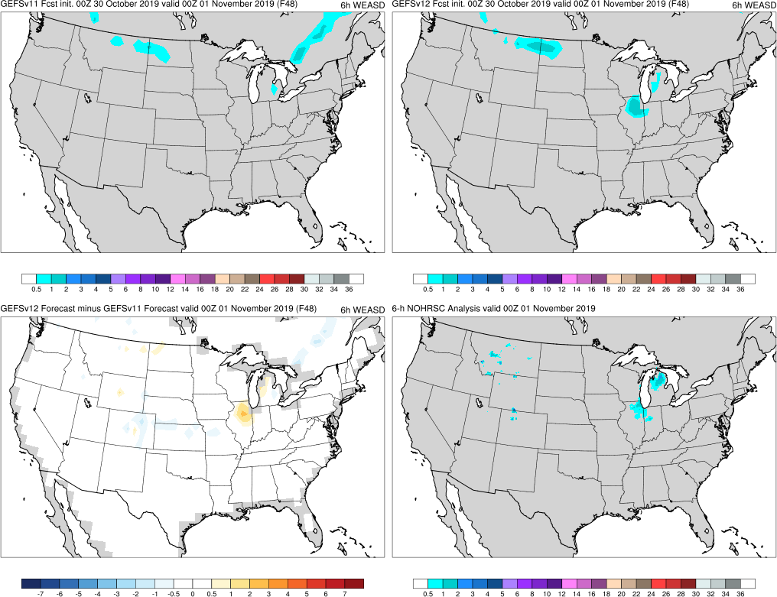
Halloween Storm
Init.: 00Z 10/30/2019 (F048)
Valid: 00Z 11/1/2019
F048: GEFSv12 forecasts snow in northern IL while GEFSv11 does not; GEFSv12 is also more accurate with snowfall location in MI
GEFSv11
GEFSv12
v12−v11
NOHRSC

Slide 15
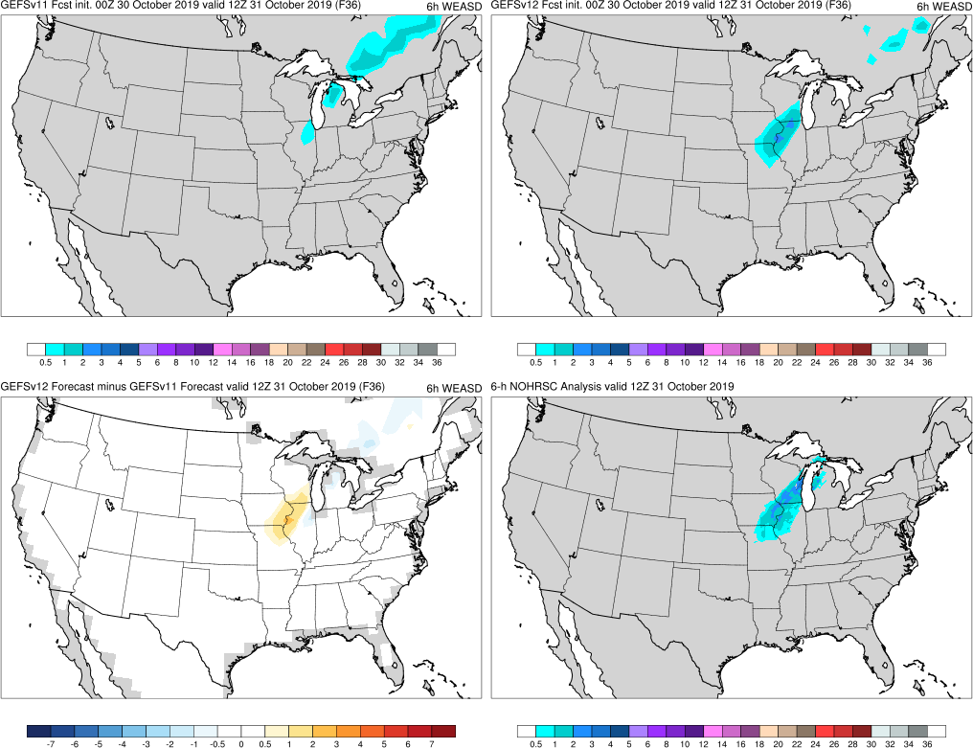
Halloween Storm
Init.: 00Z 10/30/2019 (F036)
Valid: 12Z 10/31/2019
F036: GEFSv12 is more accurate with snow band compared to GEFSv11
GEFSv11
GEFSv12
v12−v11
NOHRSC

Slide 16
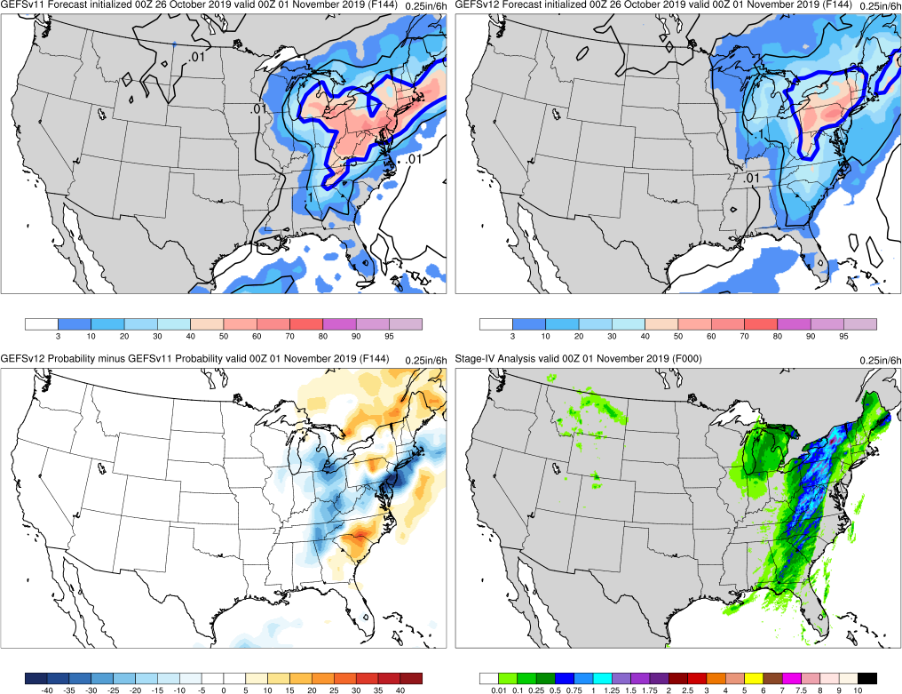
Probability of rain ≥ 0.25”/6 h
Halloween Storm
Init.: 00Z 10/26/2019 (F144)
Valid: 00Z 11/1/2019
F144: GEFSv12 encompasses the correct region of max precip, but does not extend far enough south with the highest amounts
Plots depicting the probability of ≥ 0.25” of rain in 6 h, with the ensemble mean (contoured), probability of occurrence (%; shaded), and prob. diff. (shaded)
GEFSv11
GEFSv12
v12−v11
Stage-IV

Slide 17
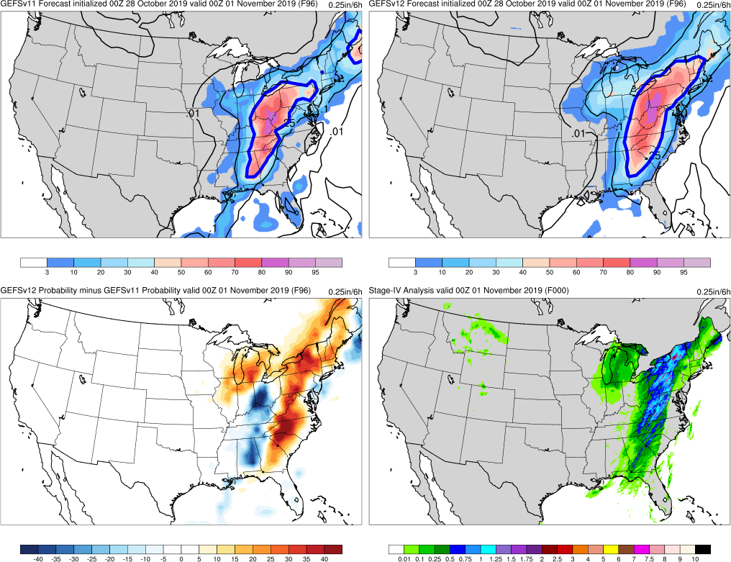
Probability of rain ≥ 0.25”/6 h
Halloween Storm
Init.: 00Z 10/28/2019 (F096)
Valid: 00Z 11/1/2019
F144: GEFSv12 encompasses the correct region of max precip, but does not extend far enough south with the highest amounts
F096: GEFSv12 region of high precip is correctly shifted towards the east and captures the NY max, while GEFSv11 region is shifted too far west and misses the NY max
Plots depicting the probability of ≥ 0.25” of rain in 6 h, with the ensemble mean (contoured), probability of occurrence (%; shaded), and prob. diff. (shaded)
GEFSv11
GEFSv12
v12−v11
Stage-IV

Slide 18
NATIONAL OCEANIC AND ATMOSPHERIC ADMINISTRATION
GEFSv12 Retrospectives: Excessive QPF
Eastern U.S. Cases
Summer Nor’easter (July 2017)
Halloween Storm (Oct/Nov 2019)
Post-Thanksgiving Storm (Nov/Dec 2019)

Slide 19
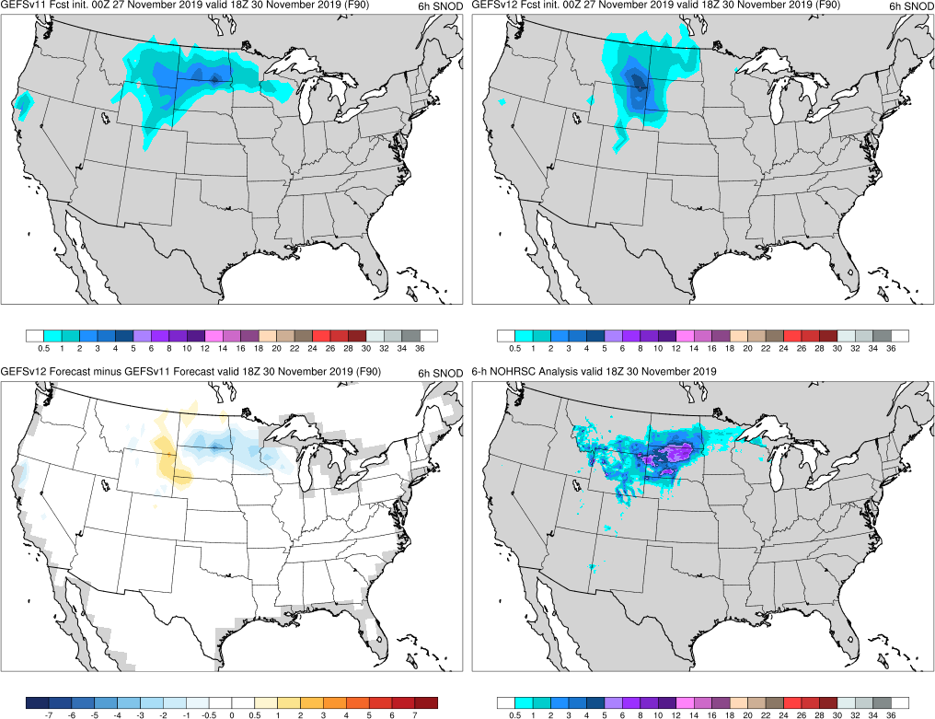
Post-Thanksgiving Storm
Init.: 00Z 11/27/2019 (F090)
Valid: 18Z 11/30/2019
F090: GEFSv12 overall orientation of snowfall is misaligned, misplacing max region and missing MN snow band
GEFSv11
GEFSv12
v12−v11
NOHRSC

Slide 20
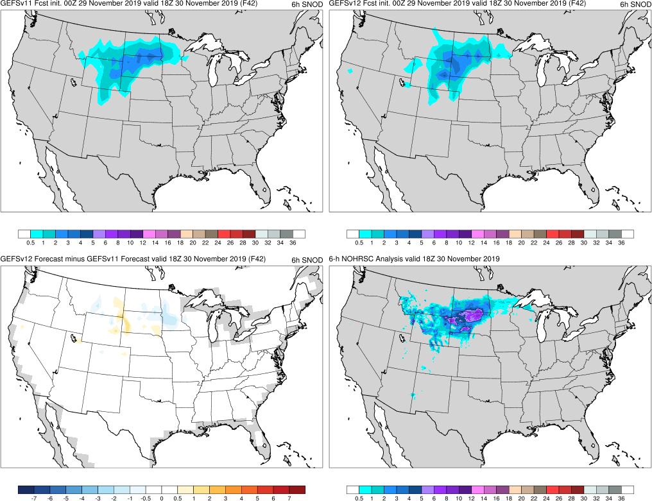
Post-Thanksgiving Storm
Init.: 00Z 11/29/2019 (F042)
Valid: 18Z 11/30/2019
F090: GEFSv12 overall orientation of snowfall is misaligned, misplacing max region and missing MN snow band
F042: GEFSv12 correctly shifts orientation of snowfall (capturing MN snow band)
Both GEFSv12 and GEFSv11 do not forecast the correct amount of max snow
GEFSv11
GEFSv12
v12−v11
NOHRSC

Slide 21
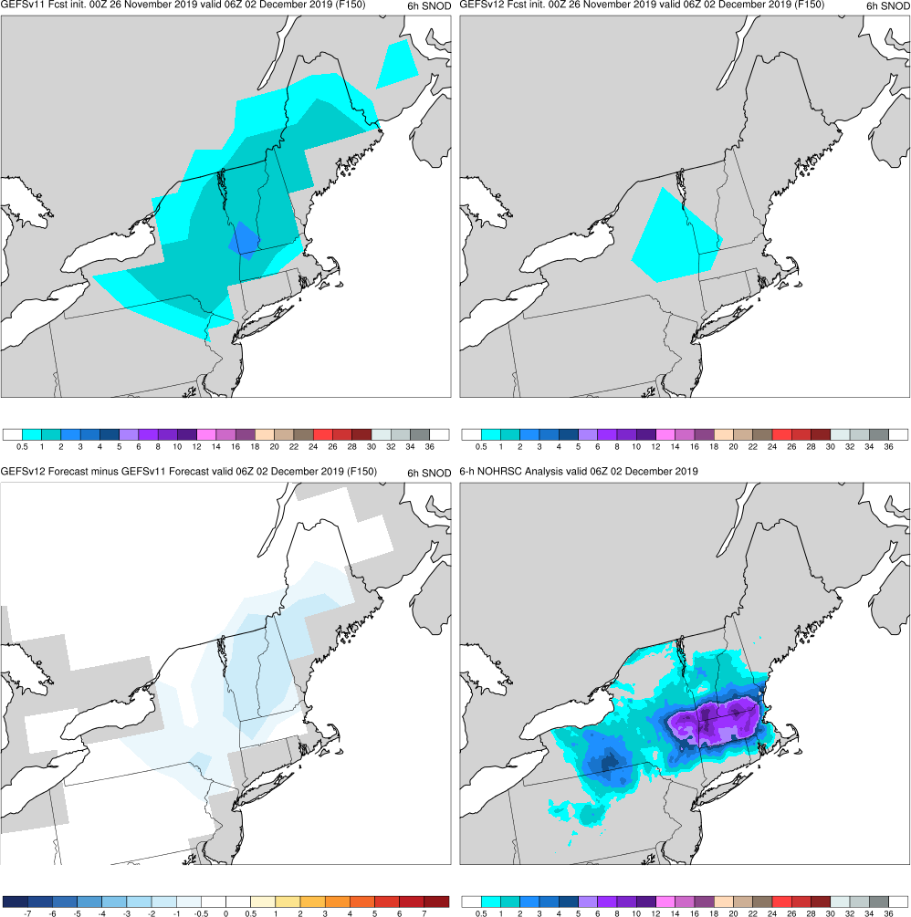
Post-Thanksgiving Storm
Init.: 00Z 11/26/2019 (F150)
Valid: 06Z 12/2/2019
F150: GEFSv11 forecasts more coverage and higher amounts of snow than GEFSv12
GEFSv11
GEFSv12
v12−v11
NOHRSC

Slide 22
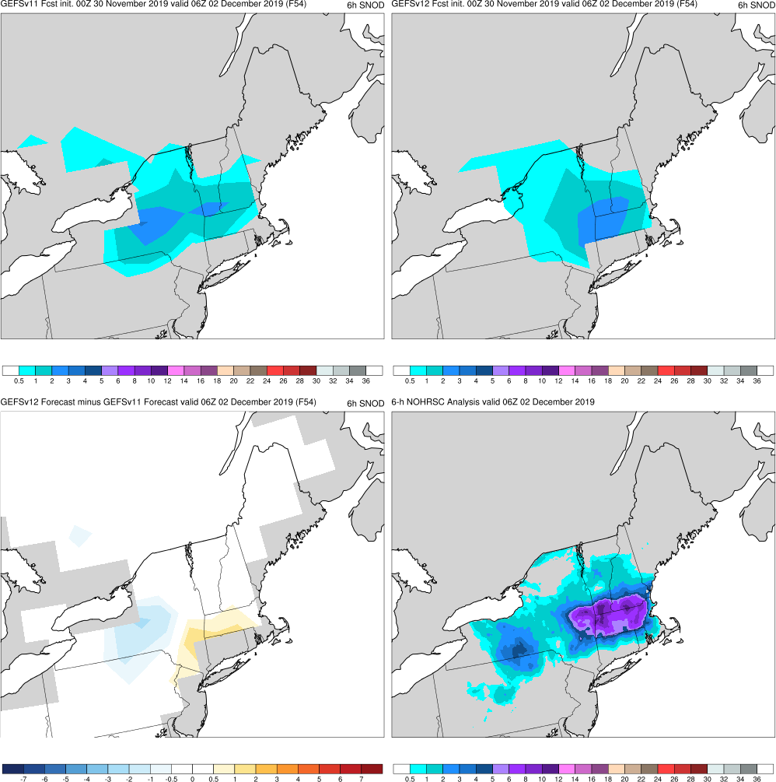
Post-Thanksgiving Storm
Init.: 00Z 11/30/2019 (F054)
Valid: 06Z 12/2/2019
F150: GEFSv11 forecasts more coverage and higher amounts of snow than GEFSv12
F054: GEFSv12 has more accurate spatial distribution of max snowfall
Again, both GEFSv12 and GEFSv11 do not forecast the correct amount of max snow
GEFSv11
GEFSv12
v12−v11
NOHRSC

Slide 23
NATIONAL OCEANIC AND ATMOSPHERIC ADMINISTRATION
GEFSv12 Retrospectives: Excessive QPF
California Cases
California Storm (Jan 2018)
Spring CA Storm (May 2019)

Slide 24
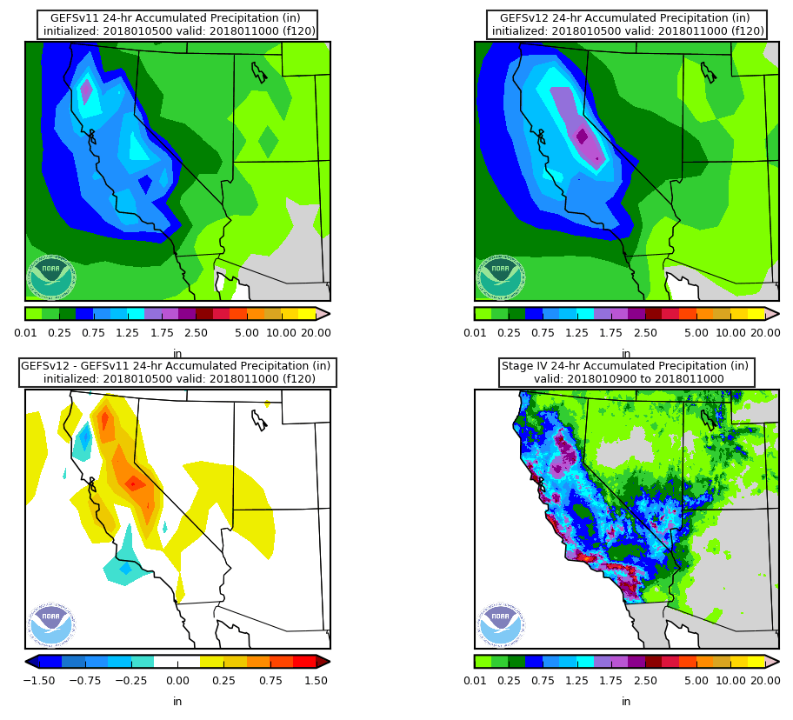
24-h Mean Accum. Precip
Jan California Storm
Init.: 00Z 1/5/2018 (F120)
Valid: 00Z 1/10/2018
F120: Although a little displaced, GEFSv12 forecasts higher amounts of precip in central CA than GEFSv11
GEFSv11
GEFSv12
v12−v11
Stage-IV

Slide 25
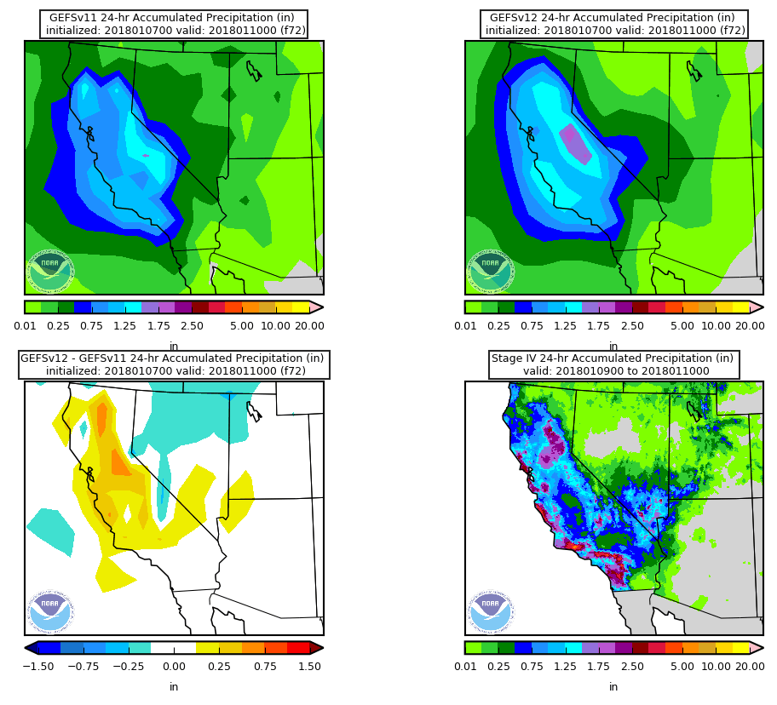
24-h Mean Accum. Precip
Jan California Storm
Init.: 00Z 1/7/2018 (F072)
Valid: 00Z 1/10/2018
F120: Although a little displaced, GEFSv12 forecasts higher amounts of precip in central CA than GEFSv11
F072: Again, GEFSv12 forecasts higher amounts of precip in CA than GEFSv11
In the short range, GEFSv12 forecasts more precip than GEFSv11 as well
GEFSv11
GEFSv12
v12−v11
Stage-IV

Slide 26
NATIONAL OCEANIC AND ATMOSPHERIC ADMINISTRATION
GEFSv12 Retrospectives: Excessive QPF
California Cases
California Storm (Jan 2018)
Spring CA Storm (May 2019)

Slide 27
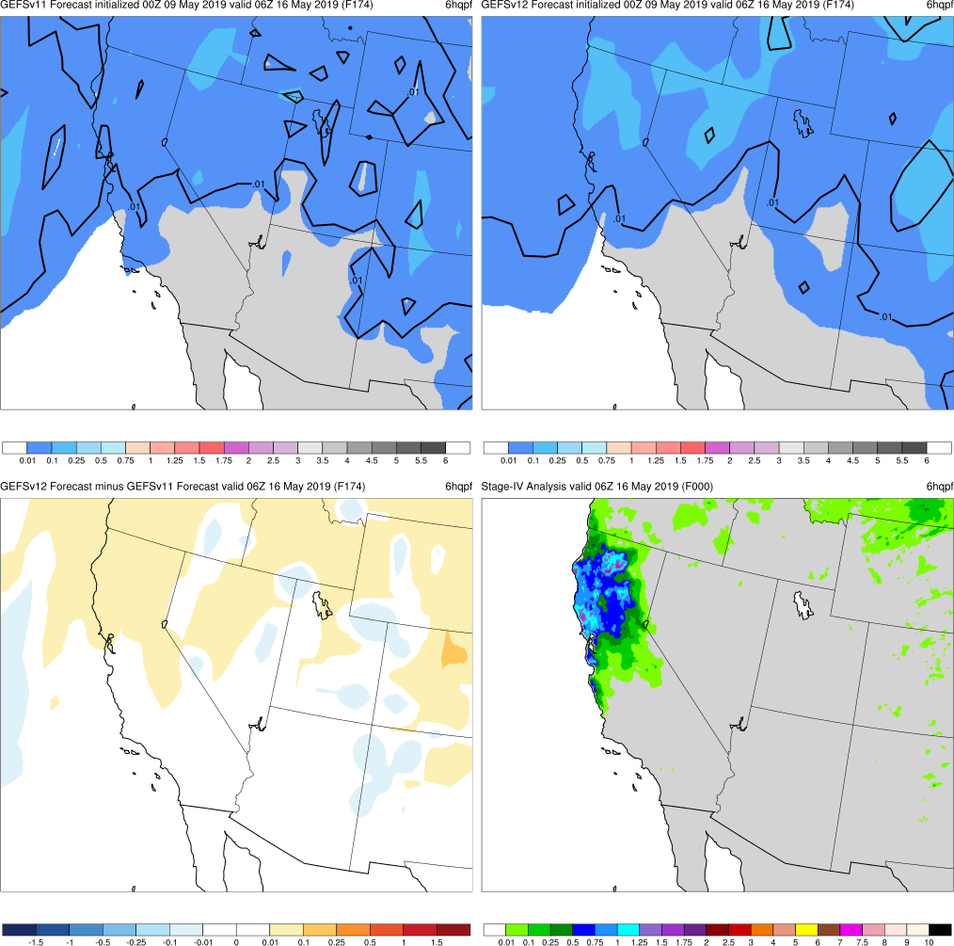
Spring California Storm
Init.: 00Z 5/9/2019 (F174)
Valid: 06Z 5/16/2019
F174: GEFSv12 has more spread in northern CA than GEFSv11
GEFSv11
GEFSv12
v12−v11
Stage-IV

Slide 28
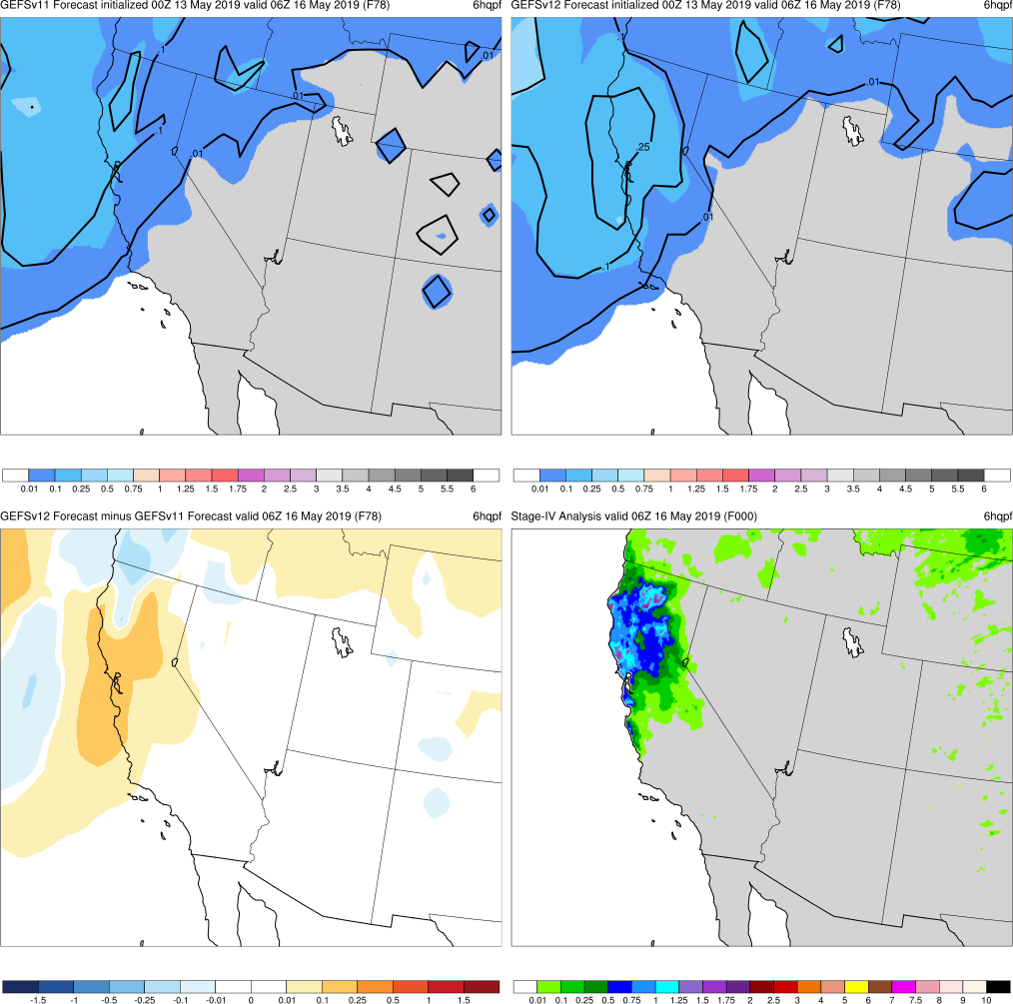
Spring California Storm
Init.: 00Z 5/13/2019 (F078)
Valid: 06Z 5/16/2019
F174: GEFSv12 has more spread in northern CA than GEFSv11
F078: GEFSv12 correctly forecasts more precip in northern CA than GEFSv11
GEFSv11
GEFSv12
v12−v11
Stage-IV

Slide 29
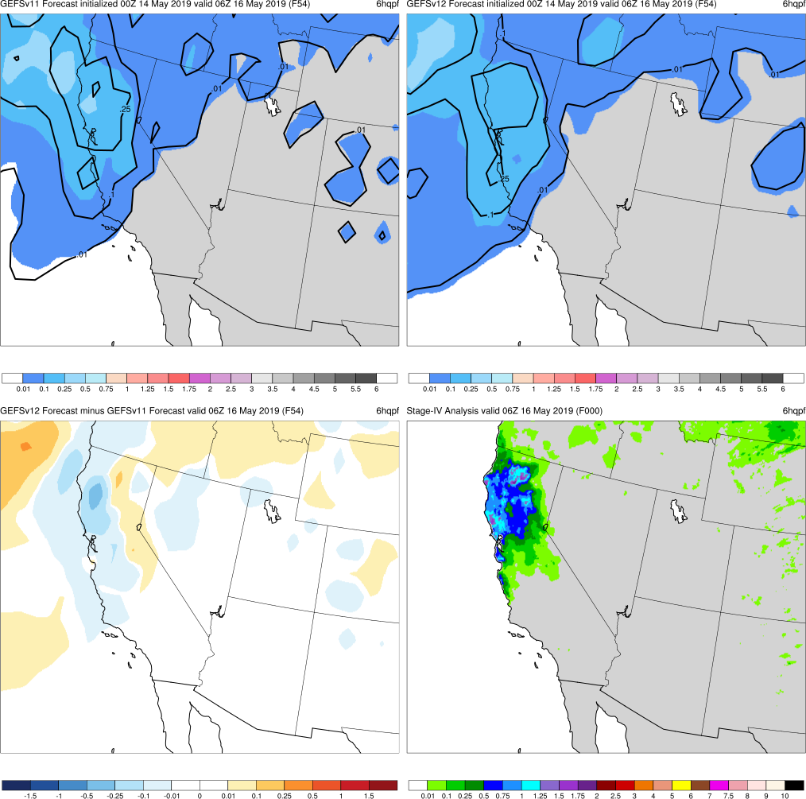
Spring California Storm
Init.: 00Z 5/14/2019 (F054)
Valid: 06Z 5/16/2019
F174: GEFSv12 has more spread in northern CA than GEFSv11
F078: GEFSv12 correctly forecasts more precip in northern CA than GEFSv11
F054: GEFSv11 forecasts a higher max region in northern CA earlier than GEFSv12
GEFSv11
GEFSv12
v12−v11
Stage-IV

Slide 30
NATIONAL OCEANIC AND ATMOSPHERIC ADMINISTRATION
GEFSv12 Retrospectives: Excessive QPF
TX/Central U.S. Cases
TX/OK Bust Case (Dec 2018)
TC Imelda (Sep 2019)
Central U.S. Cyclone (Apr 2019)

Slide 31
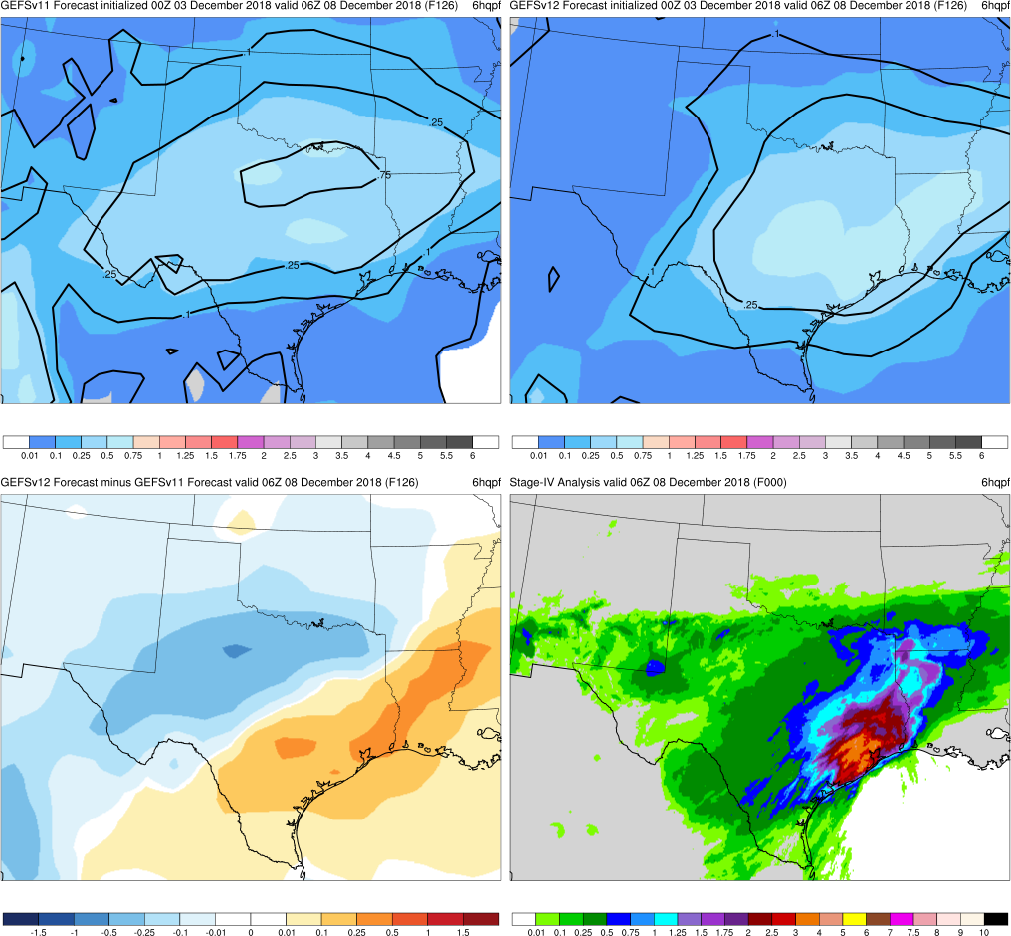
TX/OK Bust
Init.: 00Z 12/3/2018 (F126)
Valid: 06Z 12/8/2018
F126: GEFSv12 correctly forecasts more precip along TX coast than GEFSv11; northern edge of precip is too far north
GEFSv11
GEFSv12
v12−v11
Stage-IV

Slide 32
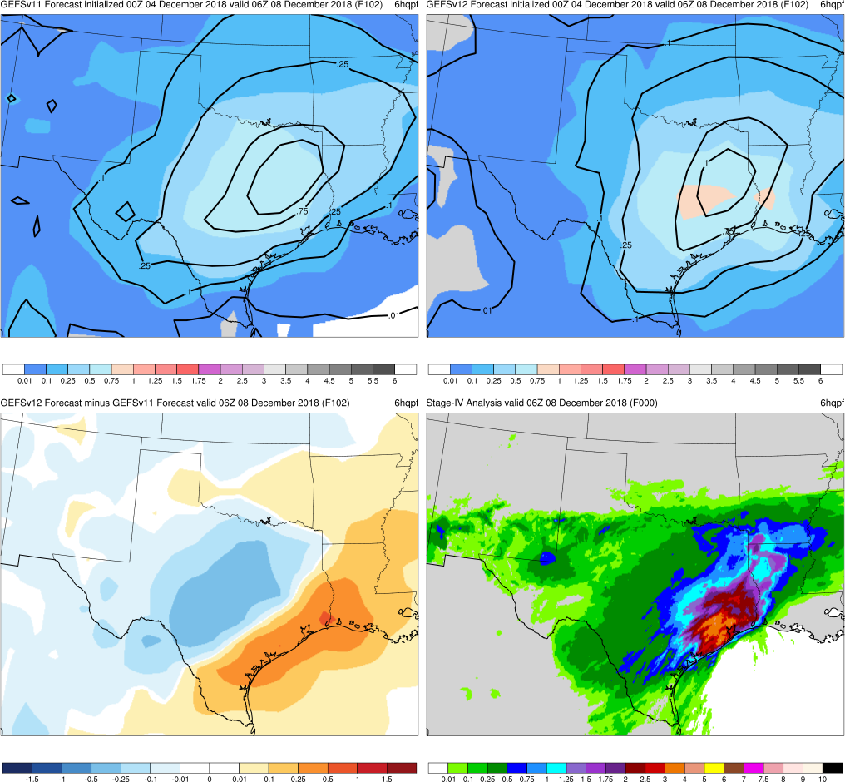
TX/OK Bust
Init.: 00Z 12/4/2018 (F102)
Valid: 06Z 12/8/2018
F126: GEFSv12 correctly forecasts more precip along TX coast than GEFSv11; northern edge of precip is too far north
F102: GEFSv12 again forecasts more precip along TX coast than GEFSv11; both have precip too far north into OK/KS
GEFSv11
GEFSv12
v12−v11
Stage-IV

Slide 33
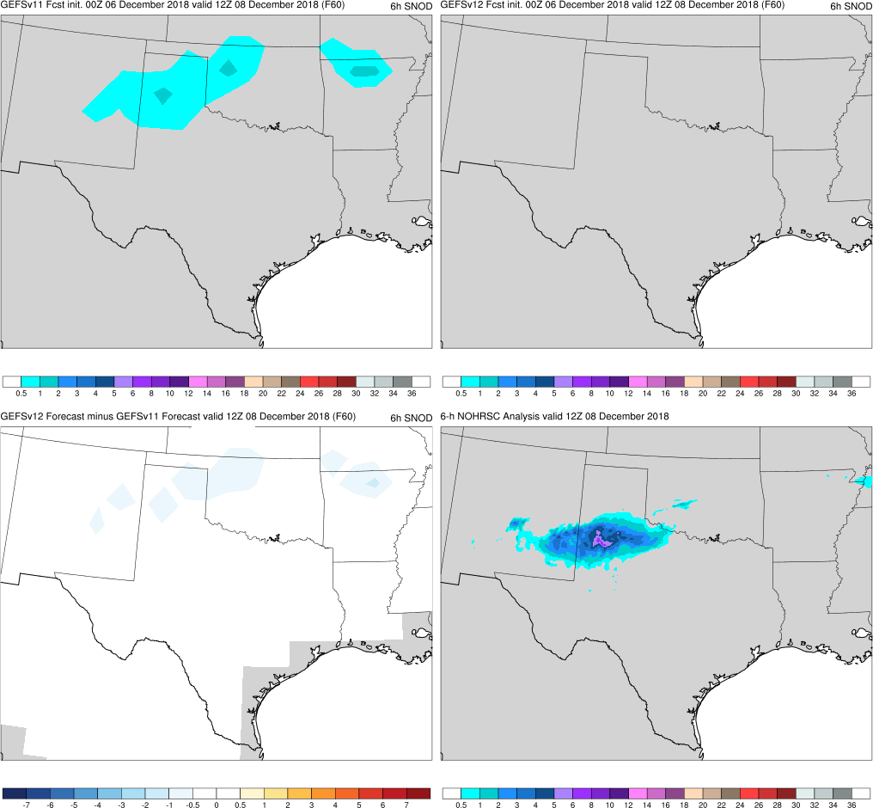
TX/OK Bust
Init.: 00Z 12/6/2018 (F060)
Valid: 12Z 12/8/2018
F060: GEFSv11 forecasts snow while GEFSv12 does not
GEFSv11
GEFSv12
v12−v11
NOHRSC

Slide 34
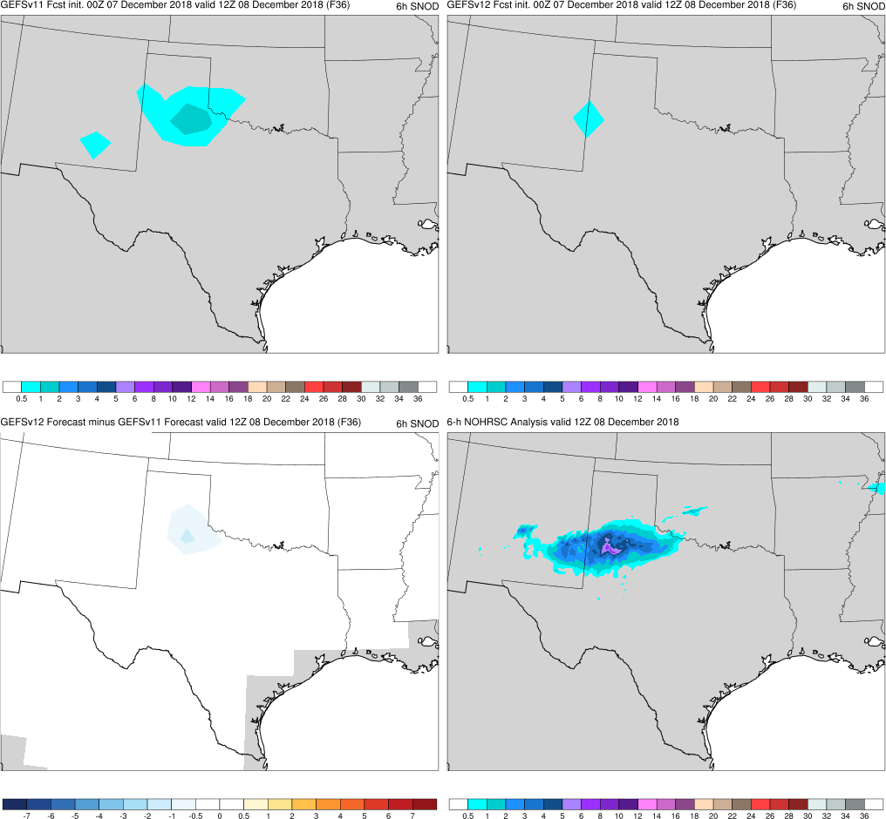
TX/OK Bust
Init.: 00Z 12/7/2018 (F036)
Valid: 12Z 12/8/2018
F060: GEFSv11 forecasts snow while GEFSv12 does not
F036: GEFSv11 has more accurate forecast with snow band oriented across northern TX
GEFSv11
GEFSv12
v12−v11
NOHRSC

Slide 35
NATIONAL OCEANIC AND ATMOSPHERIC ADMINISTRATION
GEFSv12 Retrospectives: Excessive QPF
TX/Central U.S. Cases
TX/OK Bust Case (Dec 2018)
TC Imelda (Sep 2019)
Central U.S. Cyclone (Apr 2019)

Slide 36
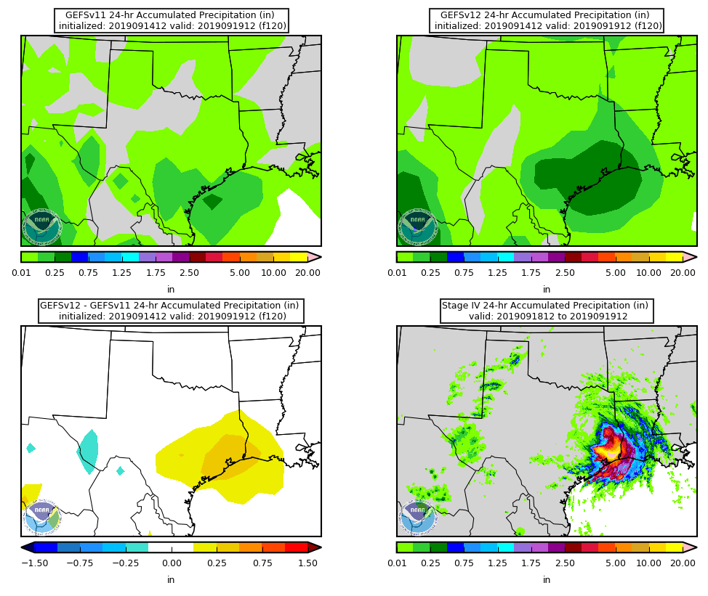
24-h Mean Accum. Precip
TC Imelda
Init.: 12Z 9/14/2019 (F120)
Valid: 12Z 9/19/2019
F120: GEFSv12 has better spatial distribution of rainfall that extends higher amounts than GEFSv11 into LA
GEFSv11
GEFSv12
v12−v11
Stage-IV

Slide 37
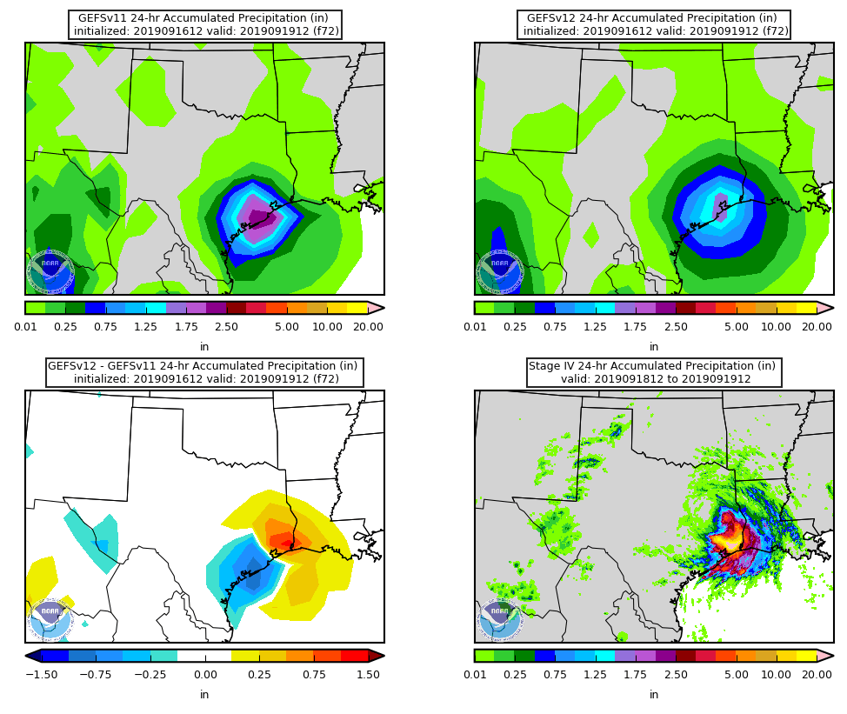
24-h Mean Accum. Precip
TC Imelda
Init.: 12Z 9/16/2019 (F072)
Valid: 12Z 9/19/2019
F120: GEFSv12 has better spatial distribution of rainfall that extends higher amounts than GEFSv11 into LA
F072: GEFSv11 predicts a greater amount of precip than GEFSv12, but GEFSv12 has max precip region in more accurate location than GEFSv11 (this is also observed at F048 and F024)
GEFSv11
GEFSv12
v12−v11
Stage-IV

Slide 38
NATIONAL OCEANIC AND ATMOSPHERIC ADMINISTRATION
GEFSv12 Retrospectives: Excessive QPF
TX/Central U.S. Cases
TX/OK Bust Case (Dec 2018)
TC Imelda (Sep 2019)
Central U.S. Cyclone (Apr 2019)

Slide 39
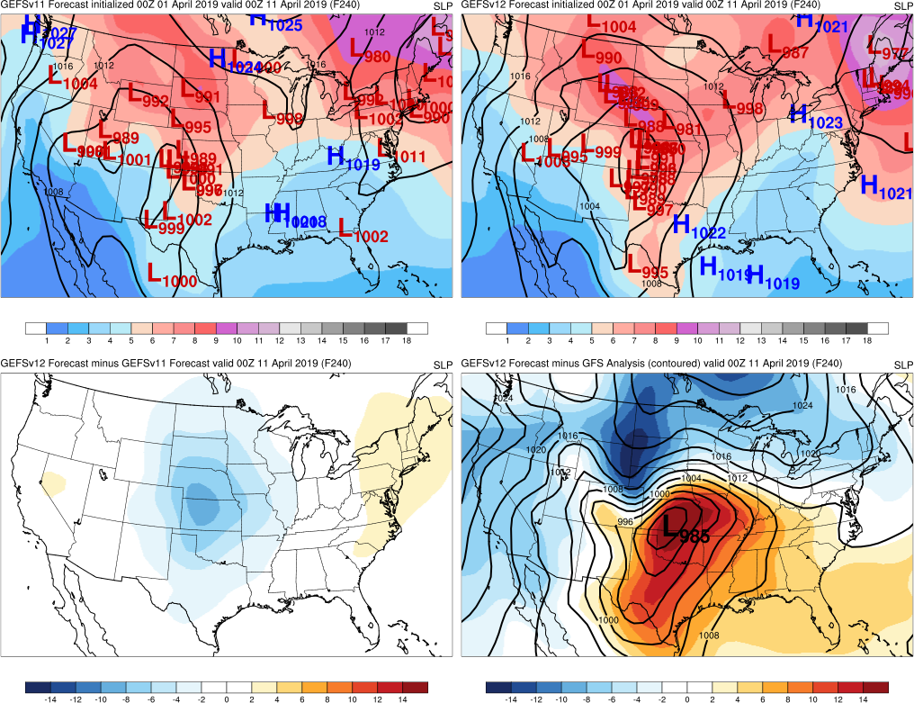
Central U.S. Cyclone
Init.: 00Z 4/1/2019 (F240)
Valid: 00Z 4/11/2019
F240: More GEFSv12 members forecast a low in the correct region and have a stronger cyclone compared to GEFSv11
GEFSv11
GEFSv12
v12−v11
GFS Anl.

Slide 40
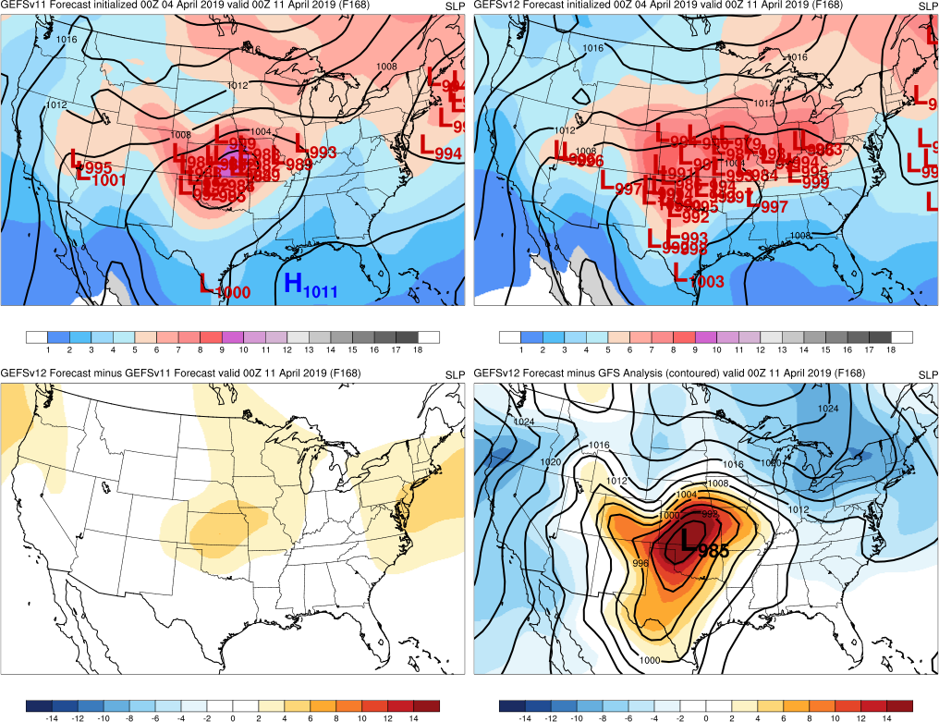
Central U.S. Cyclone
Init.: 00Z 4/4/2019 (F168)
Valid: 00Z 4/11/2019
F240: More GEFSv12 members forecast a low in the correct region and have a stronger cyclone compared to GEFSv11
F168: GEFSv12 members are too spread out and cyclone is too weak
GEFSv11
GEFSv12
v12−v11
GFS Anl.

Slide 41
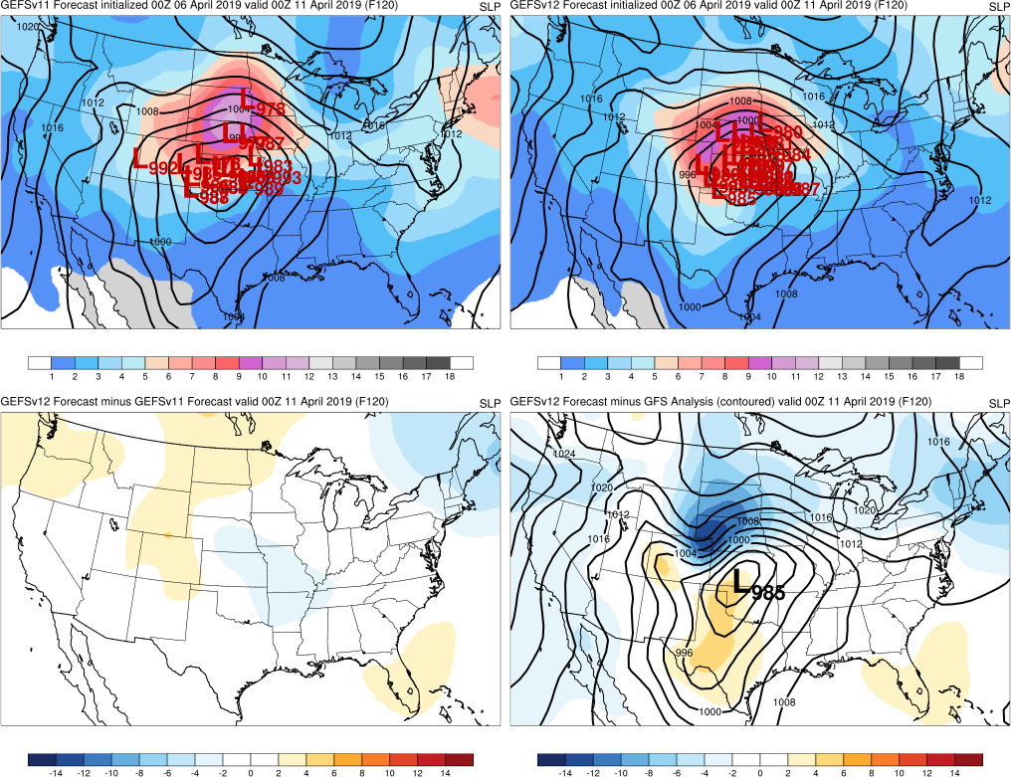
Central U.S. Cyclone
Init.: 00Z 4/6/2019 (F120)
Valid: 00Z 4/11/2019
F240: More GEFSv12 members forecast a low in the correct region and have a stronger cyclone compared to GEFSv11
F168: GEFSv12 members are too spread out and cyclone is too weak
F120: GEFSv12 members have locked in on cyclone location while GEFSv11 members are slightly spread out
GEFSv11
GEFSv12
v12−v11
GFS Anl.

Slide 42
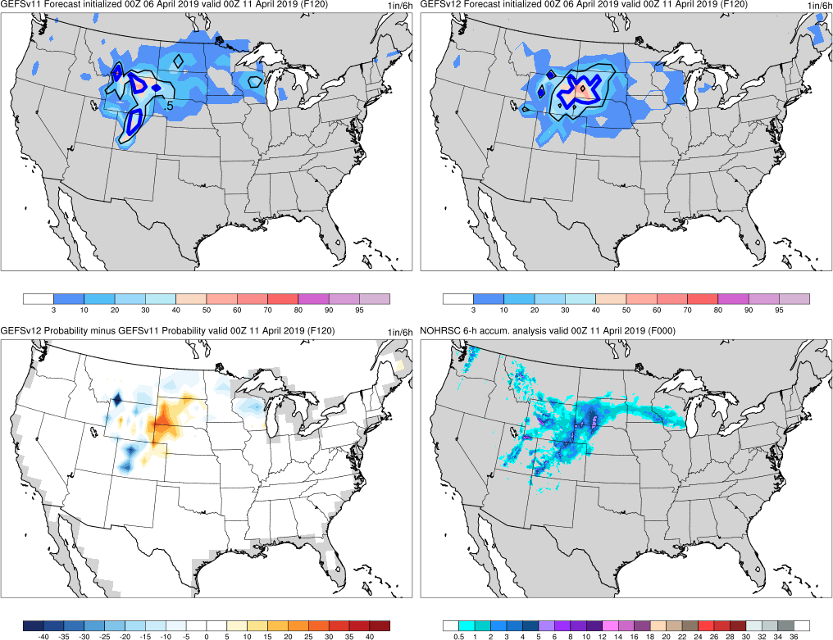
Probability of snow ≥ 1”/6 h
Central U.S. Cyclone
Init.: 00Z 4/6/2019 (F120)
Valid: 00Z 4/11/2019
GEFSv12 1” contour associated with higher probability over eastern WY and western SD is more accurate at capturing maximums in that area
However, GEFSv11 has a more accurate snow forecast for CO
Plots depicting the probability of ≥ 1” of snow in 6 h, with the ensemble mean (contoured), probability of occurrence (%; shaded), and prob. diff. (shaded)
GEFSv11
GEFSv12
v12−v11
NOHRSC

Slide 43
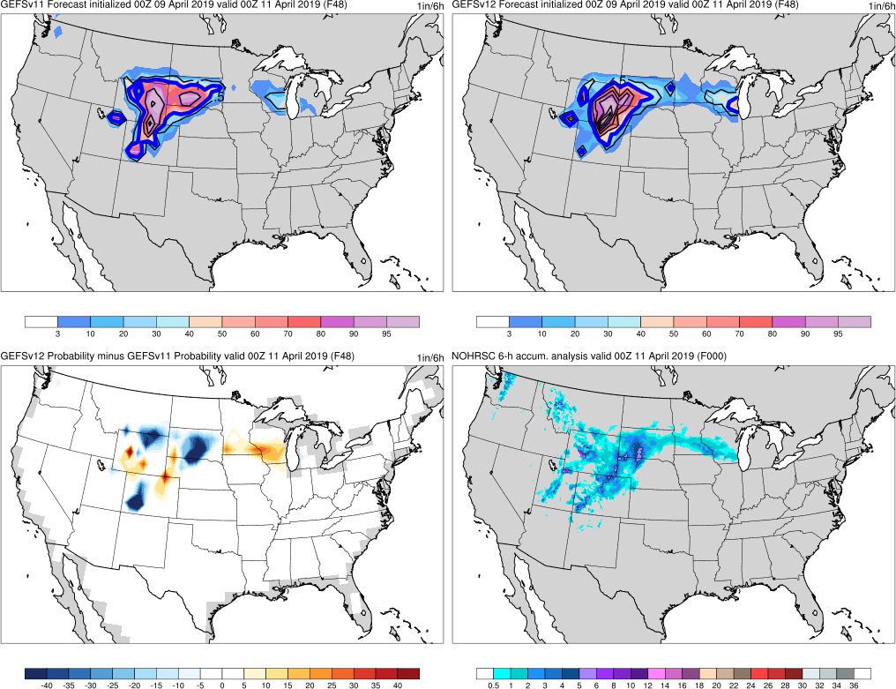
Probability of snow ≥ 1”/6 h
Central U.S. Cyclone
Init.: 00Z 4/9/2019 (F048)
Valid: 00Z 4/11/2019
GEFSv12 predicts a greater overall max than GEFSv11 and has a more accurate probability of occurrence in southern MN and WI
Plots depicting the probability of ≥ 1” of snow in 6 h, with the ensemble mean (contoured), probability of occurrence (%; shaded), and prob. diff. (shaded)
GEFSv11
GEFSv12
v12−v11
NOHRSC

Slide 44
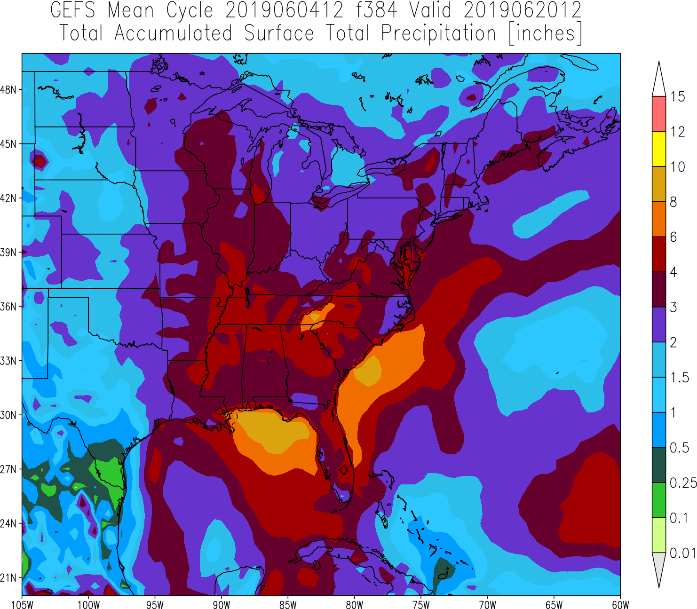
NATIONAL OCEANIC AND ATMOSPHERIC ADMINISTRATION
GEFSv11 Coastal QPF Issue
In May 2019, Eastern Region alerted the MEG about large precip accumulations off the Gulf and Southeast coasts in GEFSv11 forecasts
These large totals appeared tied to low-level convergence and at least modest instability
12Z 6/4/19 GEFS Mean (F384)

Slide 45
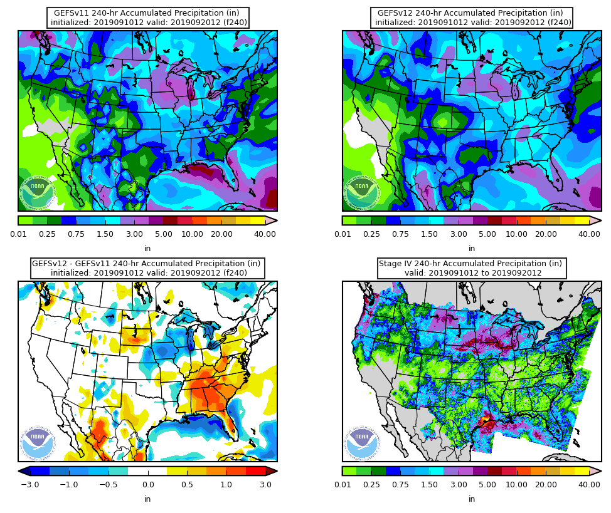
NATIONAL OCEANIC AND ATMOSPHERIC ADMINISTRATION
GEFSv11 Coastal QPF Issue
Initial indications suggest this issue is mitigated in GEFSv12
GEFSv11 uses an older version of the SAS convective scheme
GEFSv12 uses the latest version of SAS, which includes changes targeted at making it more difficult to trigger convection over water

Slide 46
NATIONAL OCEANIC AND ATMOSPHERIC ADMINISTRATION
GEFSv12 Excessive QPF: Summary
Overall, GEFSv12 predicts rainfall as well as GEFSv11 in the examined cases
However, in several cases, GEFSv12 had a low precip bias compared to GEFSv11 (consistent with the stats, possibly due to increased spread)
Overall, GEFSv12 predicts snowfall as well as GEFSv11 in the examined cases
However, in some cases/cycles, GEFSv12 had a low bias compared to GEFSv11
Overall, GEFSv12 predicts cyclone locations as well or better than GEFSv11
For a few cases, low locations are forecasted better at longer lead times in GEFSv12 than in GEFSv11
Preliminary analysis shows that increased spread in GEFSv12 overall adds more utility to forecast process
(but there are exceptions, such as the April 2019 Central U.S. cyclone case)
Consolidates NCEP/EMC verification and evaluation functions to efficiently and consistently support all modeling groups
Removes evaluation functions from the model science chain of command, ensuring independent model evaluations

