Slide 1
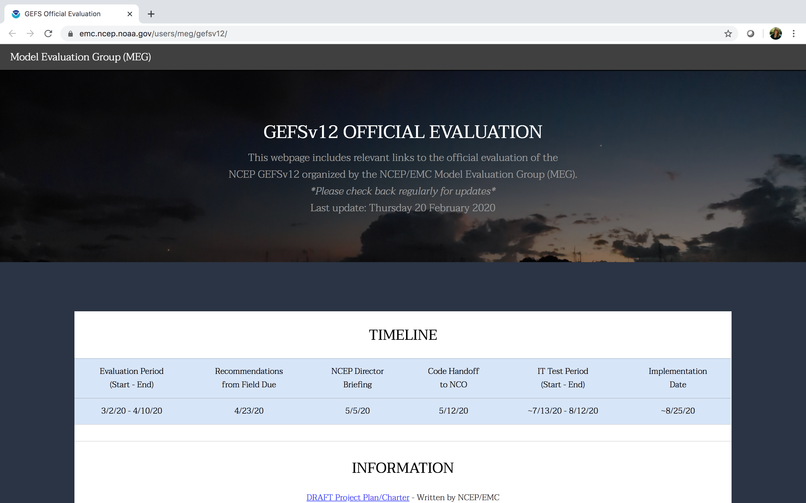
NATIONAL OCEANIC AND ATMOSPHERIC ADMINISTRATION
GEFSv12 Official Evaluation Webpages
Alicia Bentley, Shannon Shields, Logan Dawson, Geoff Manikin
NCEP/EMC MEG Meeting
27 February 2020

Slide 2
NATIONAL OCEANIC AND ATMOSPHERIC ADMINISTRATION
GEFSv12 Official Evaluation Webpages
All links related to the GEFSv12 official evaluation can be found here:
https://www.emc.ncep.noaa.gov/users/meg/gefsv12/
Maintained by the NCEP/EMC Model Evaluation Group (MEG)

Slide 4
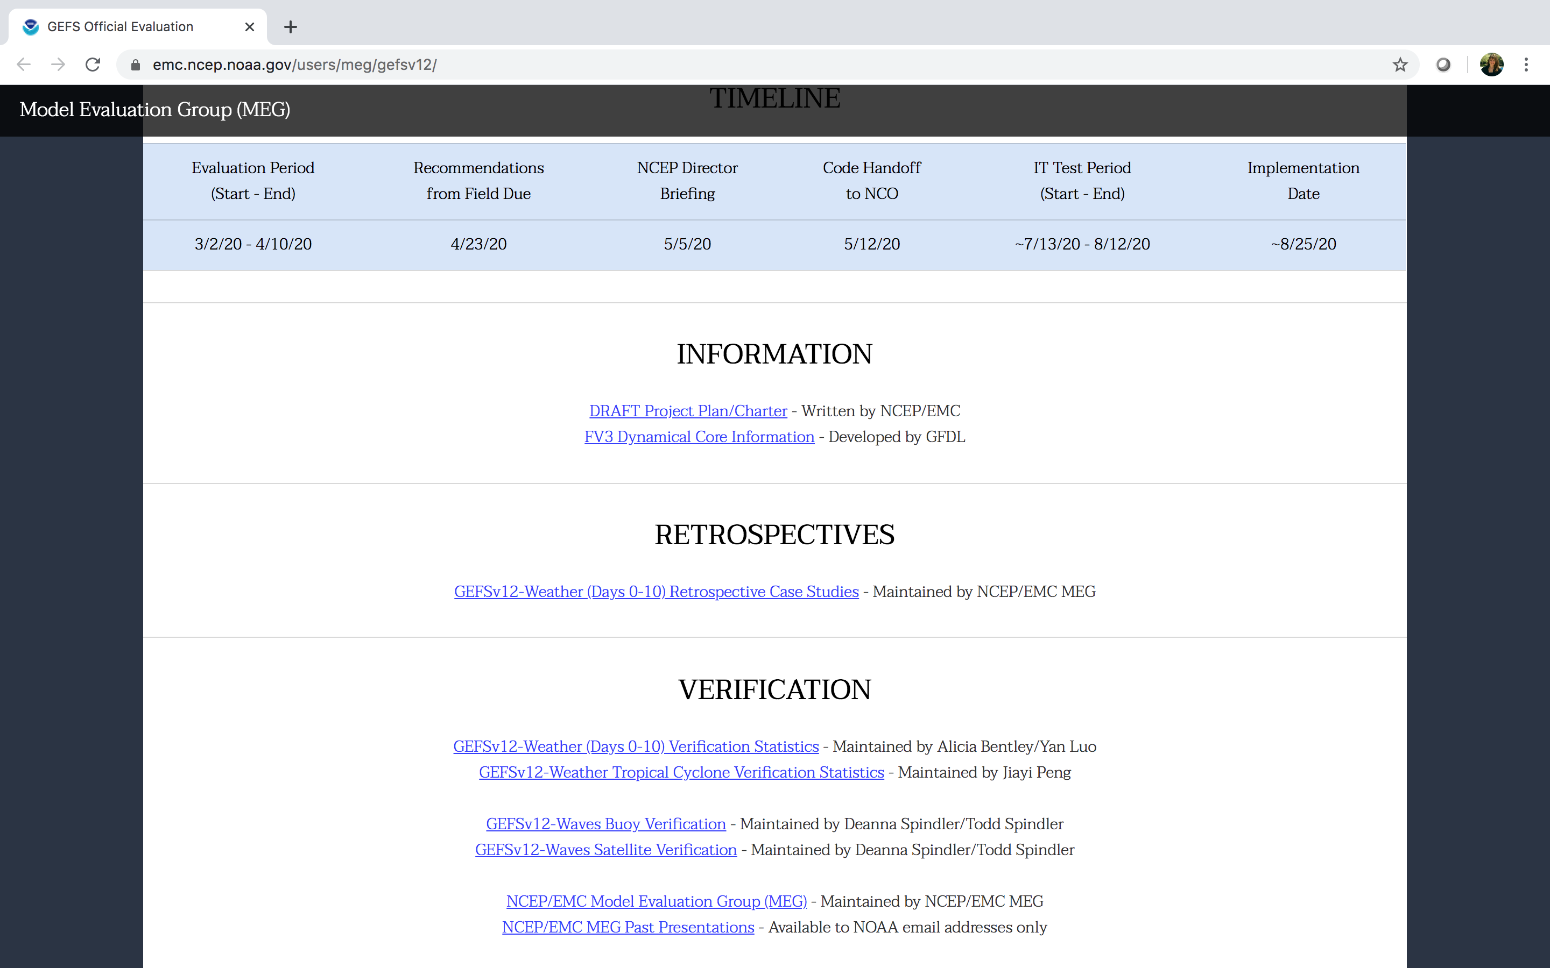

Slide 13
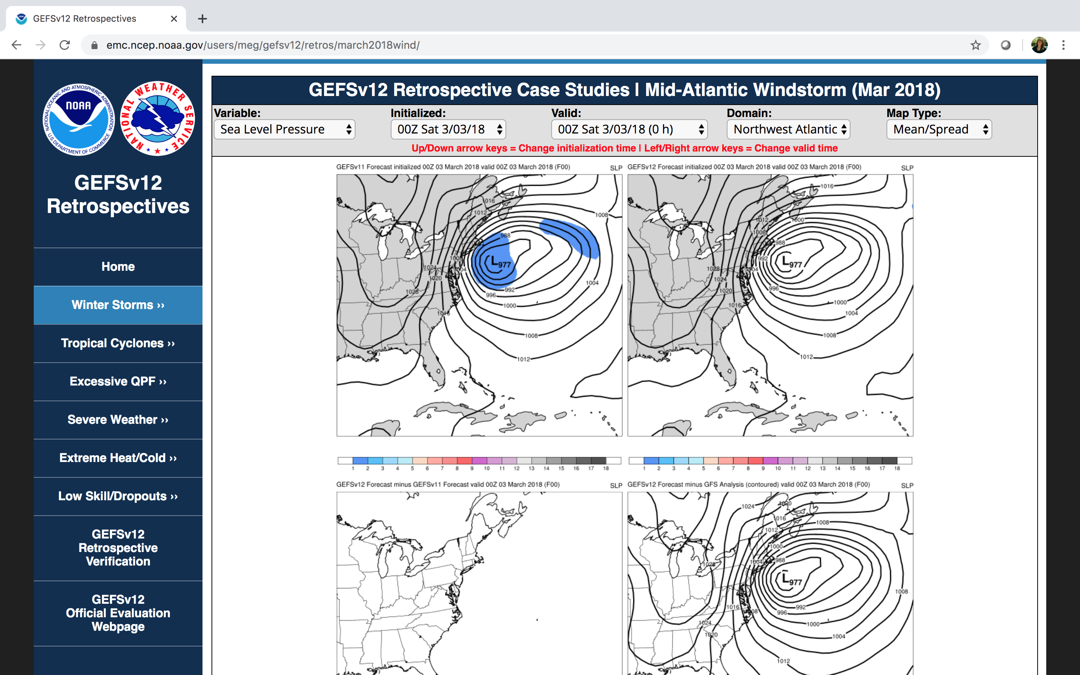

Slide 14
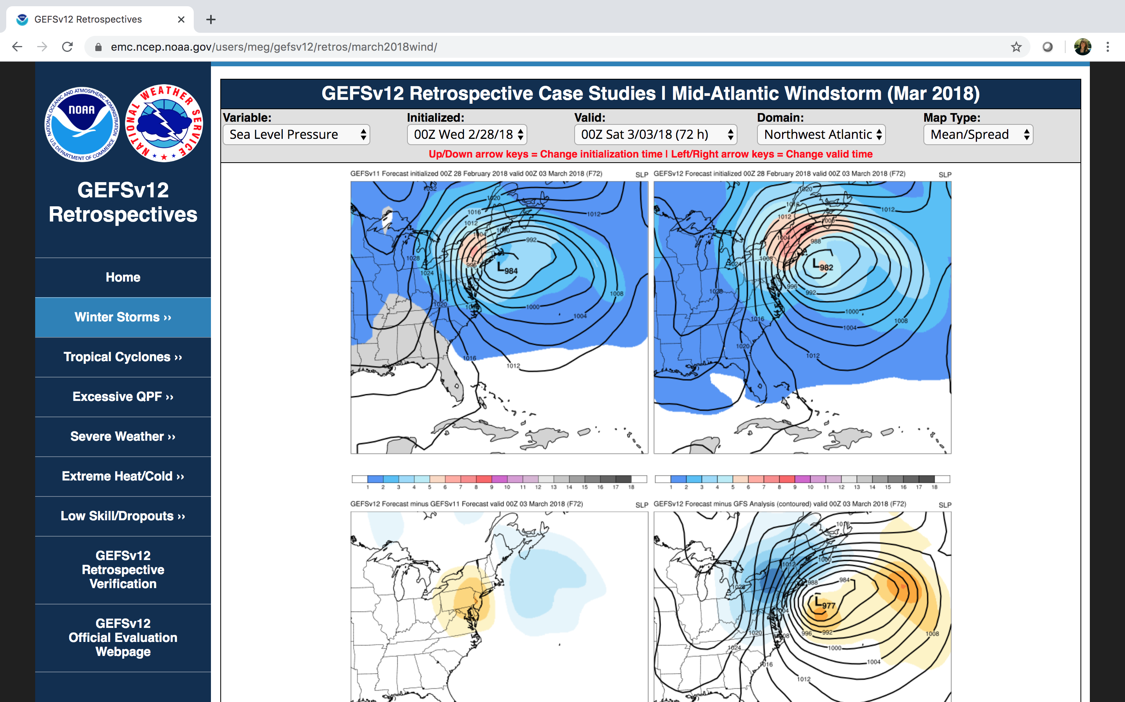

Slide 15
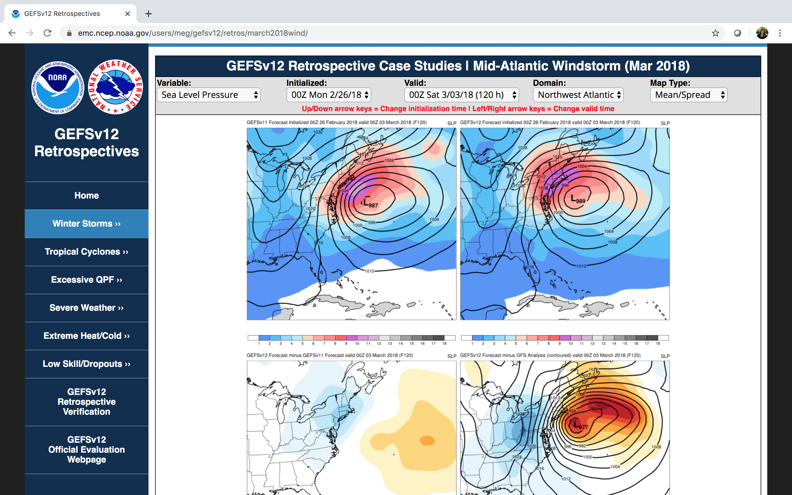

Slide 16
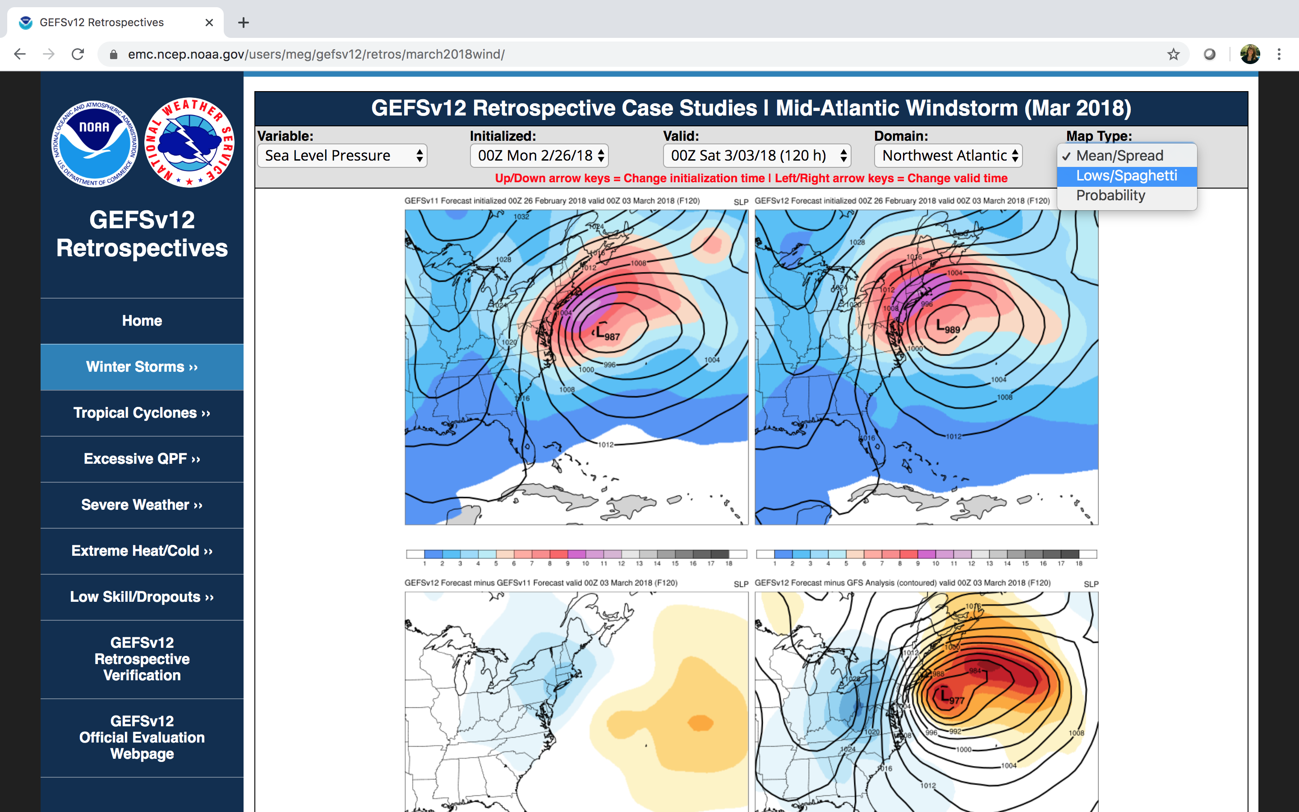

Slide 17
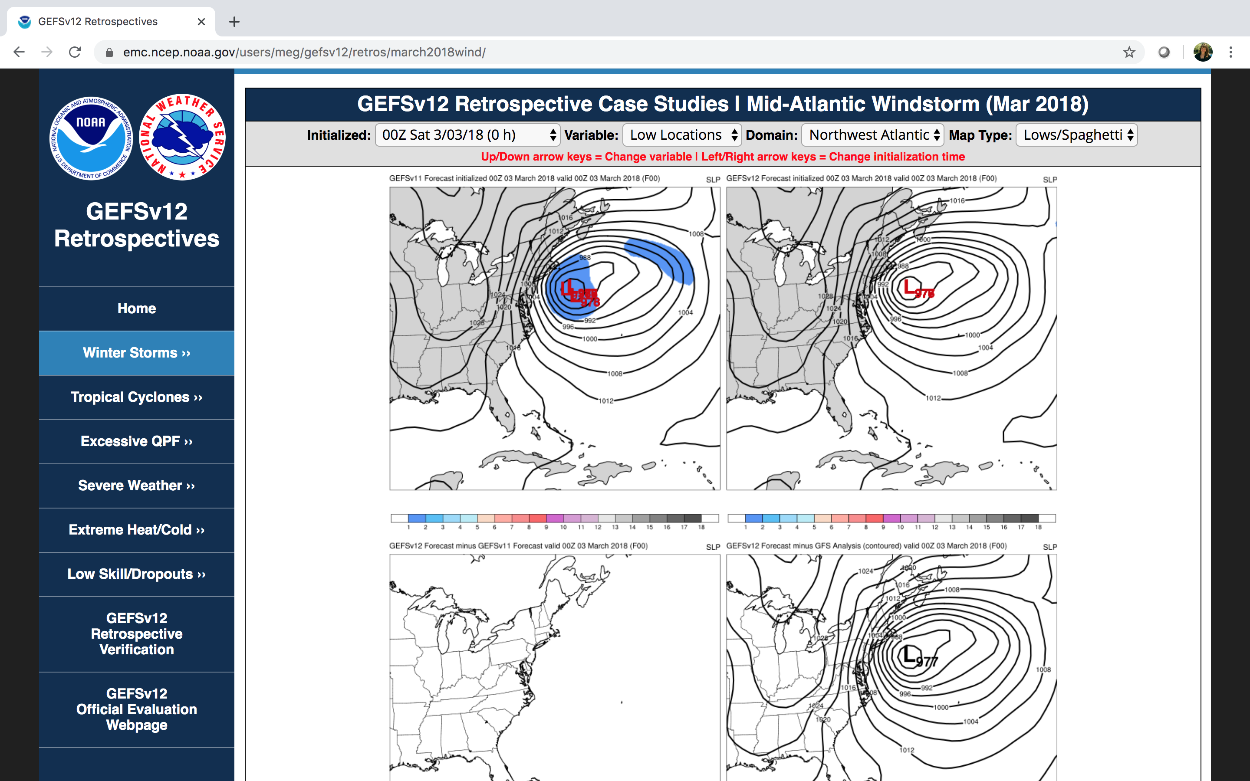

Slide 18
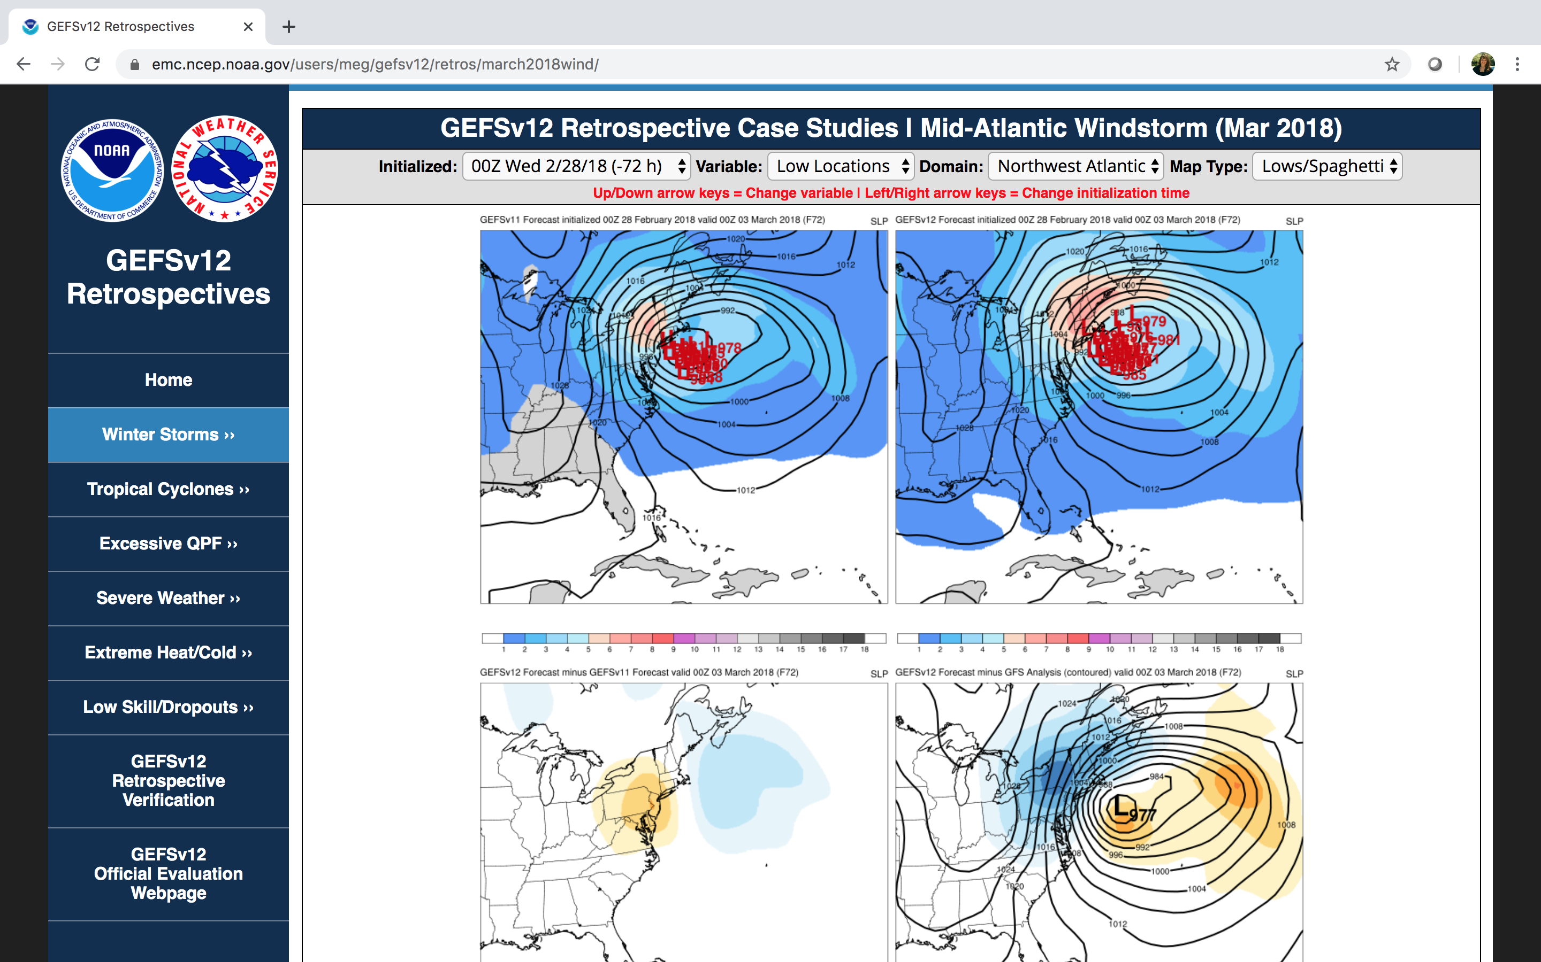

Slide 19
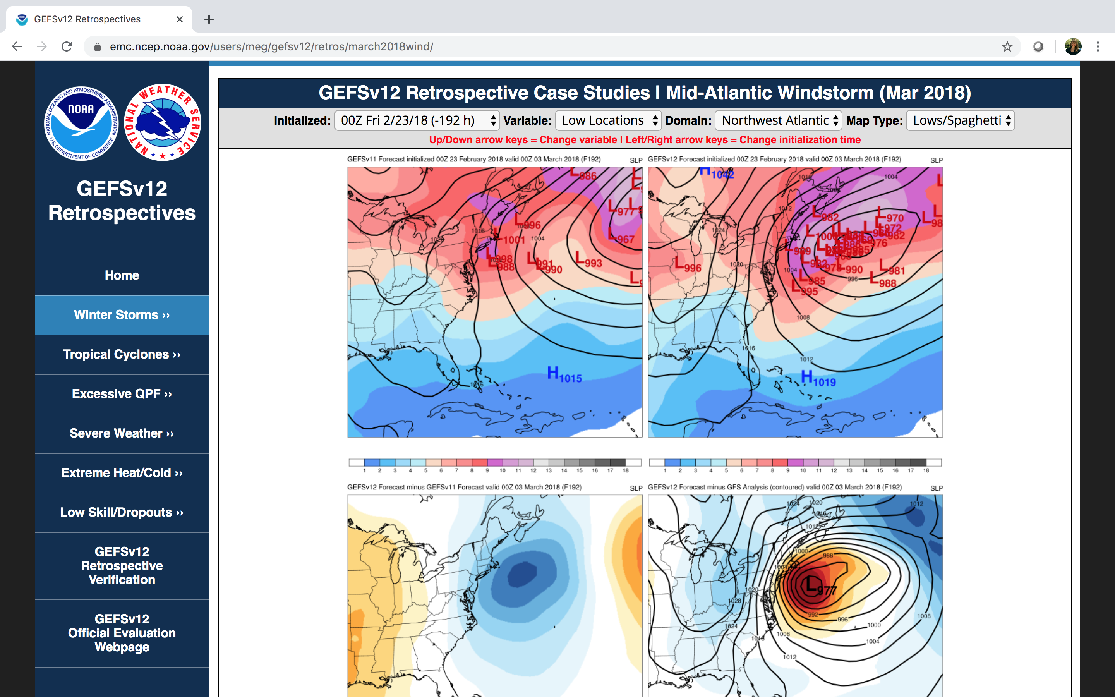

Slide 20
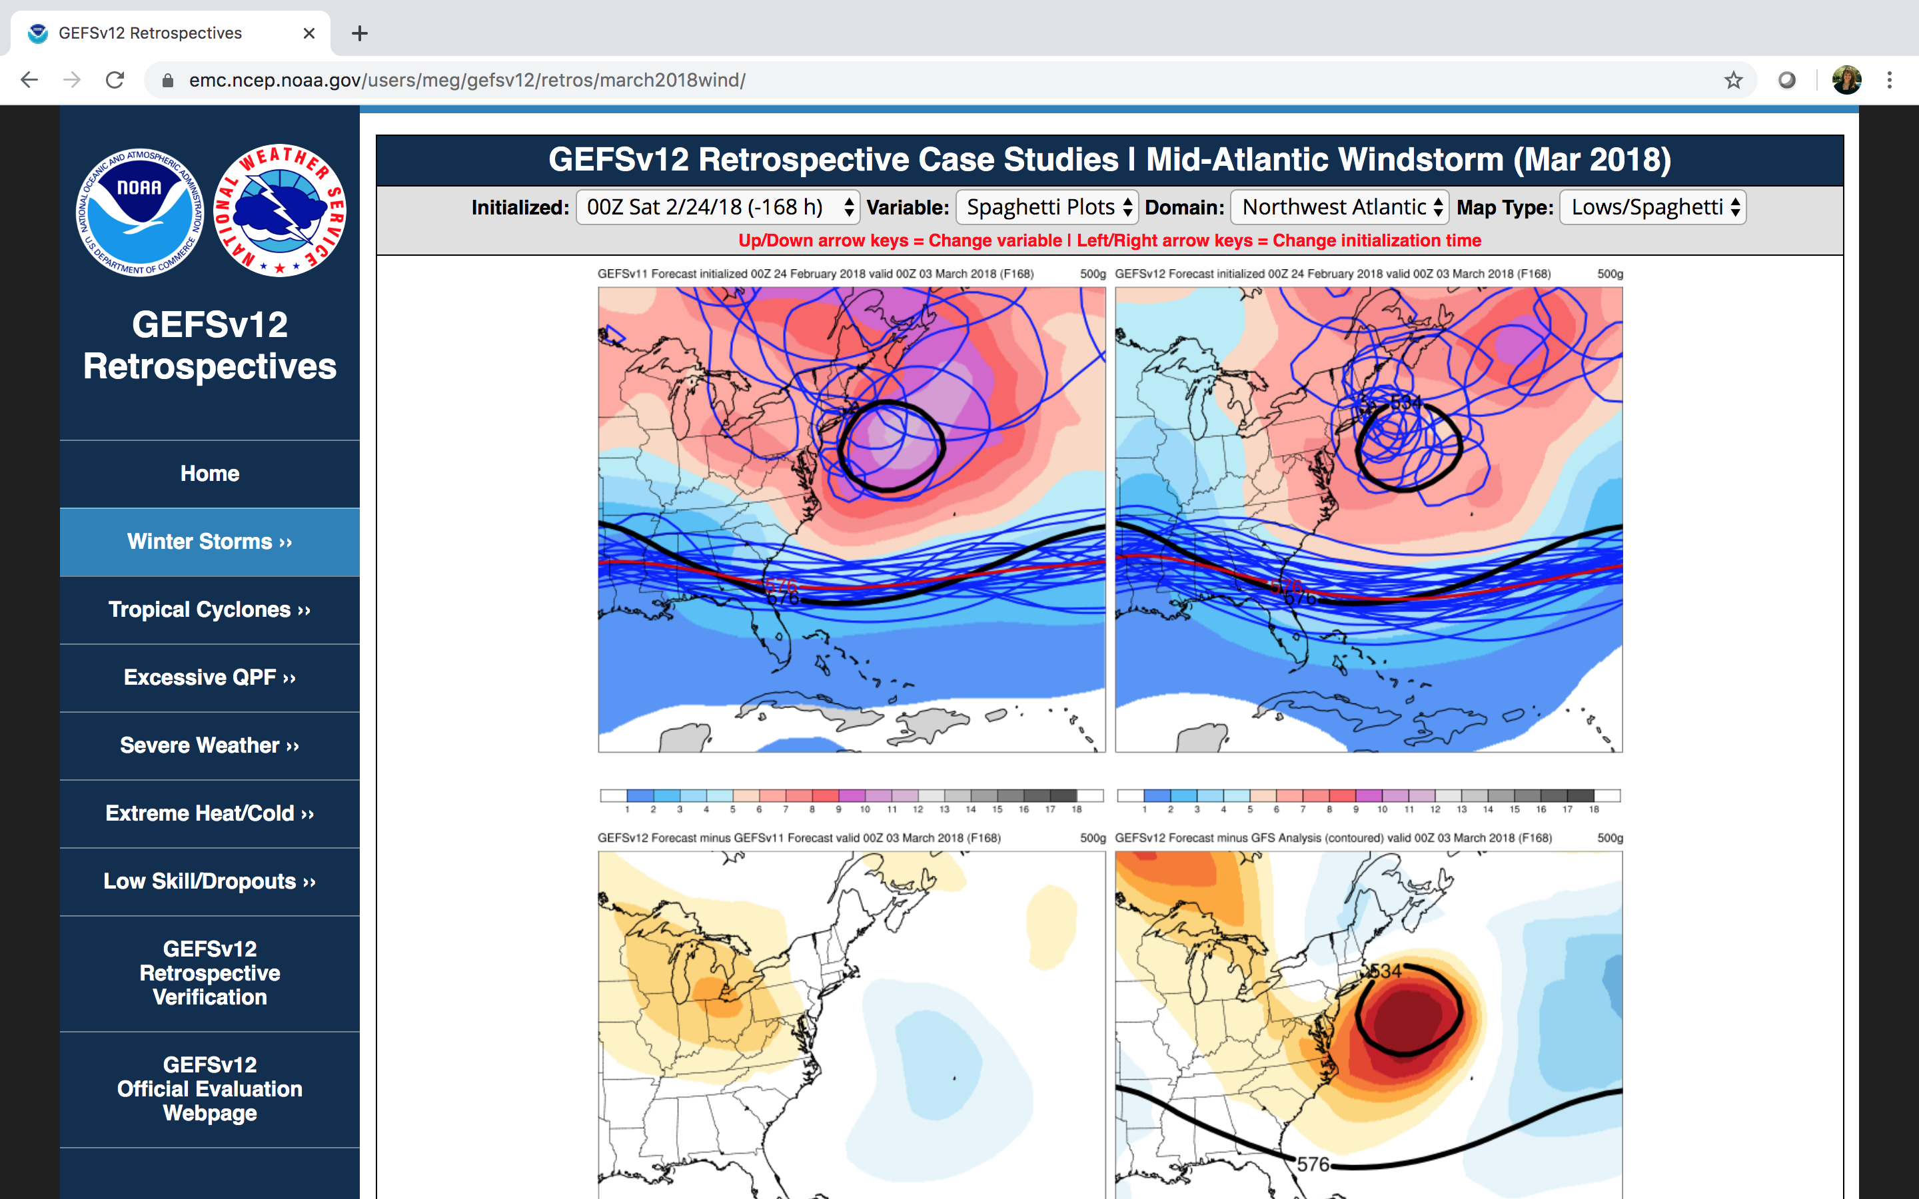

Slide 21
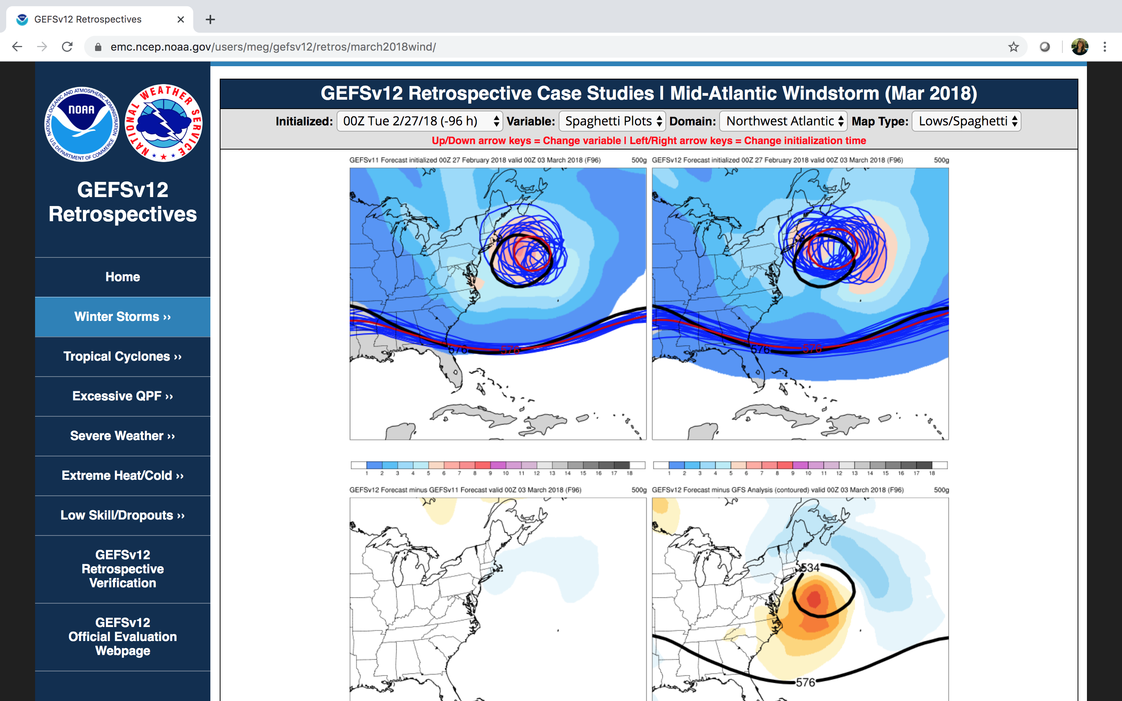

Slide 22
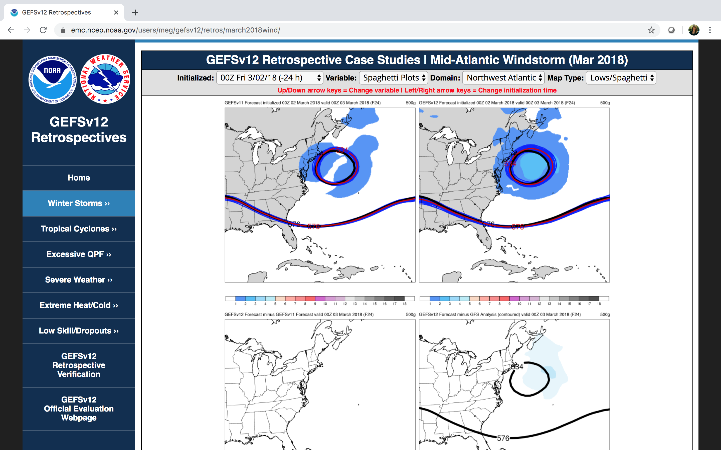

Slide 23
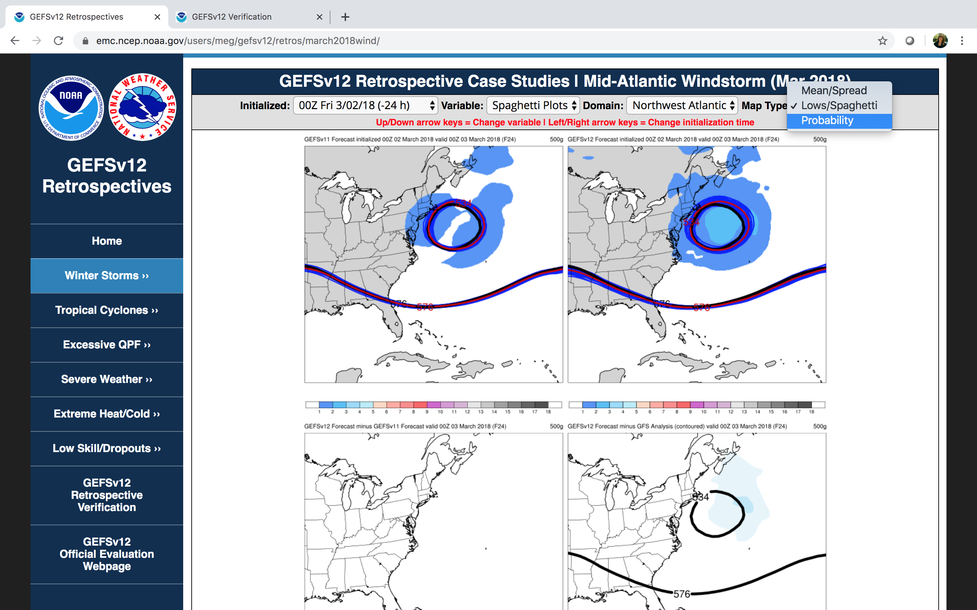

Slide 24
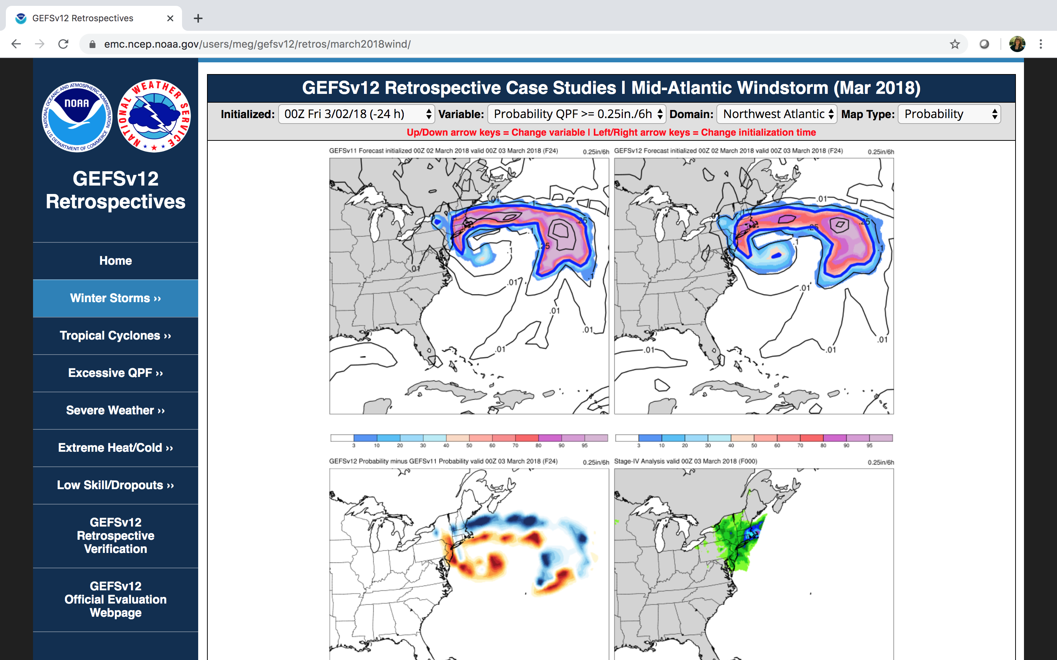

Slide 25
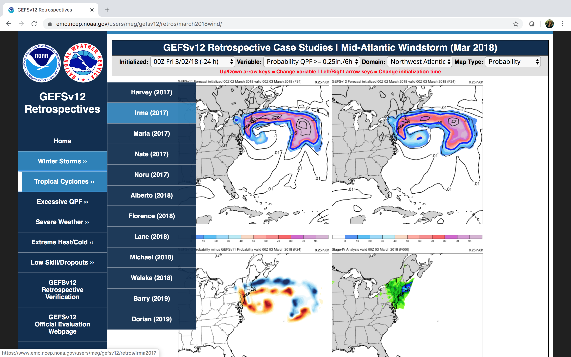

Slide 26
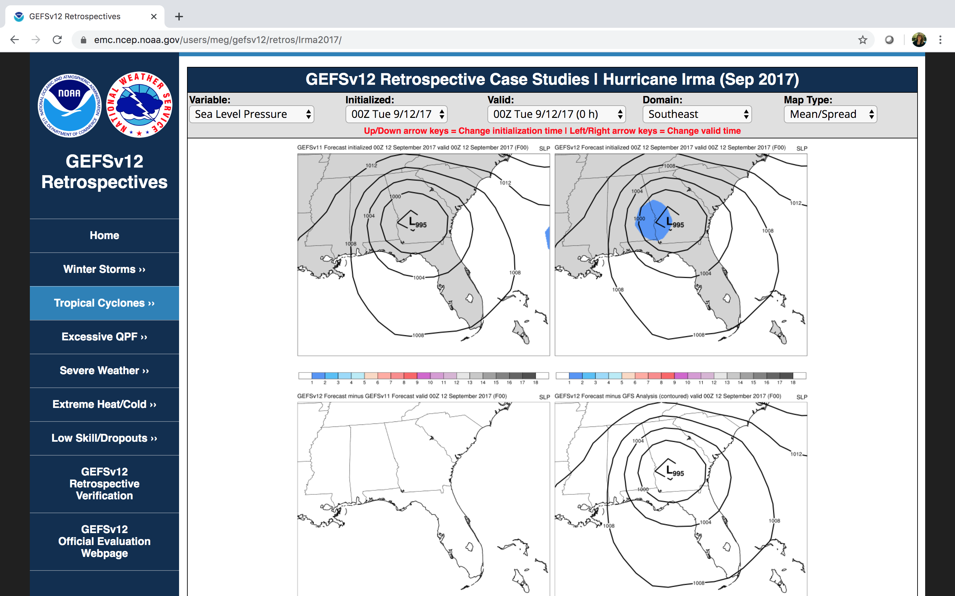

Slide 27
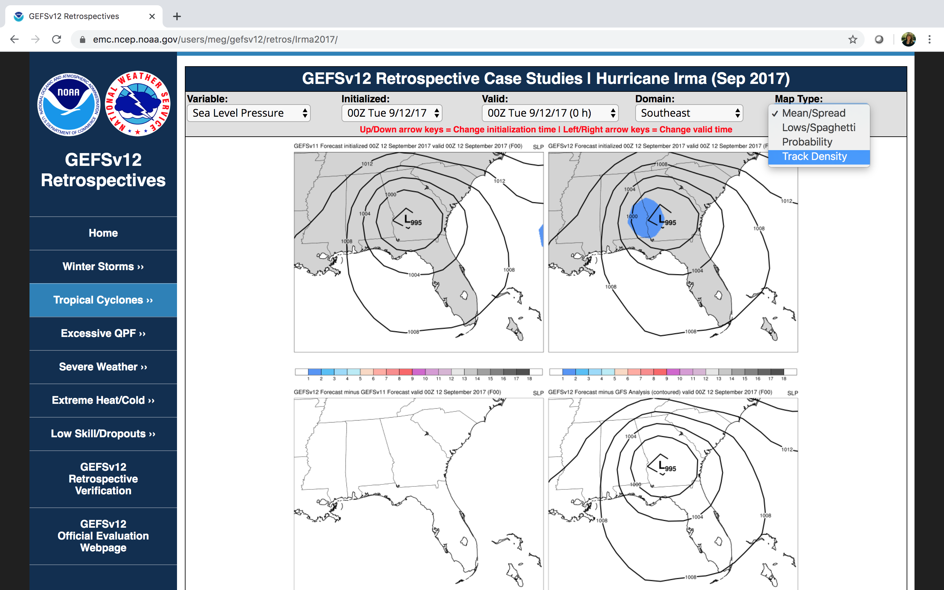

Slide 28
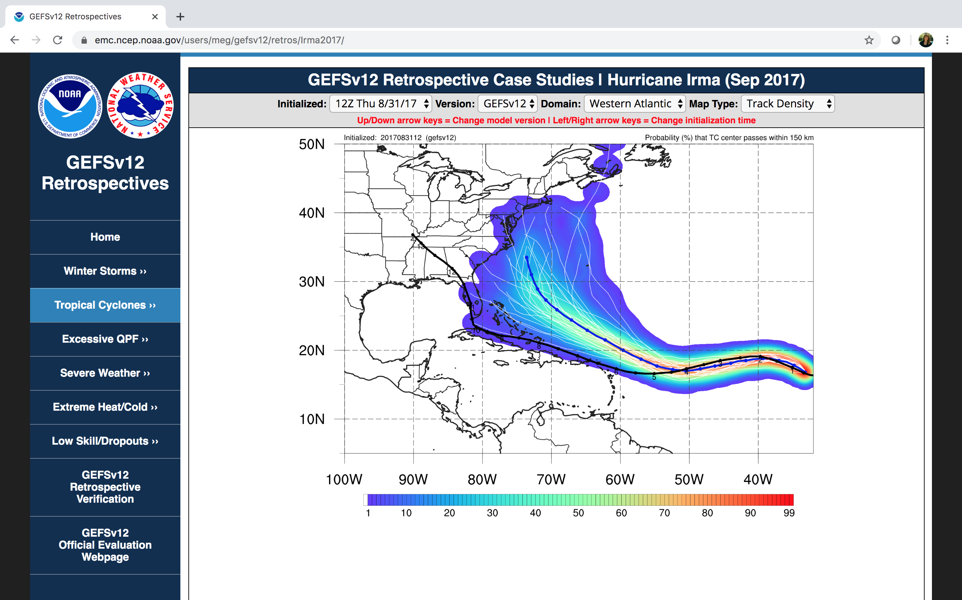

Slide 29
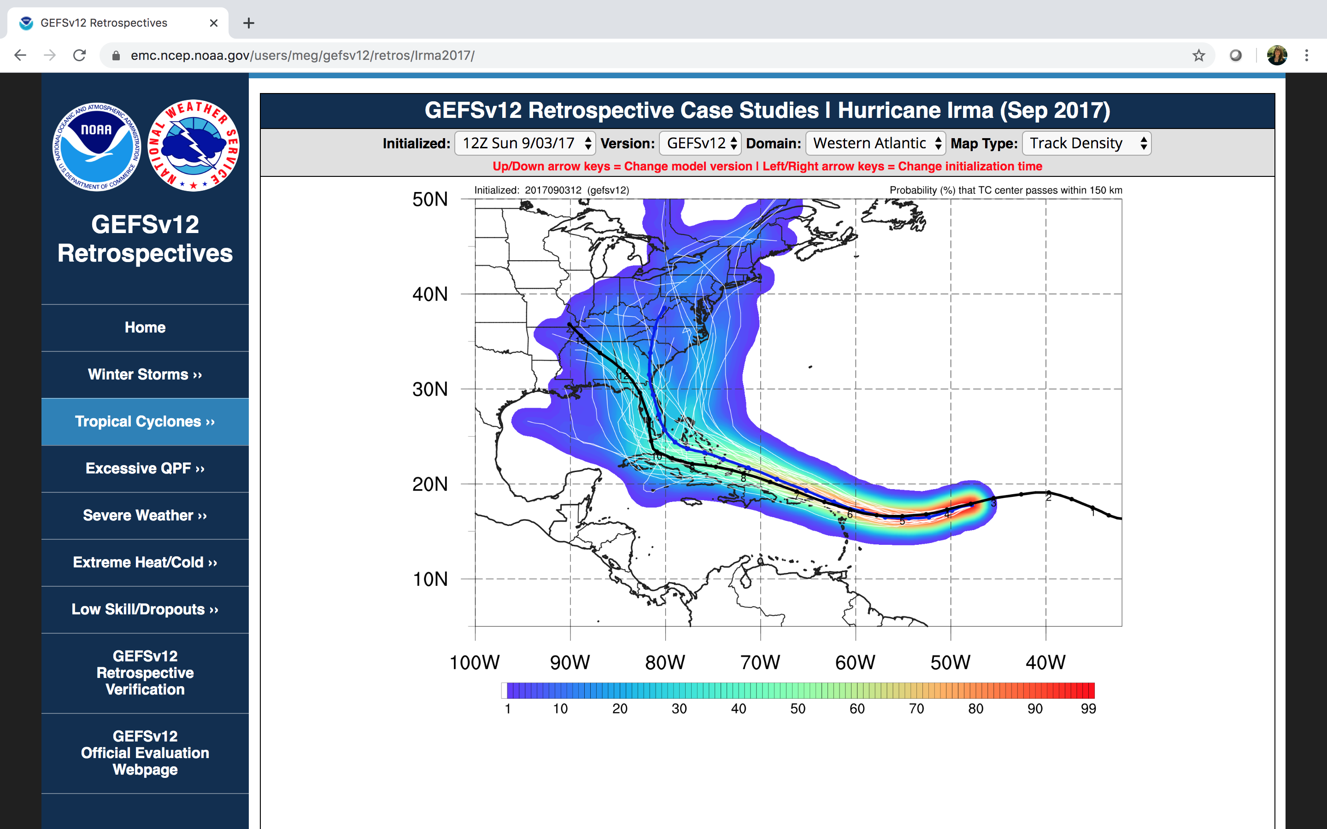

Slide 31
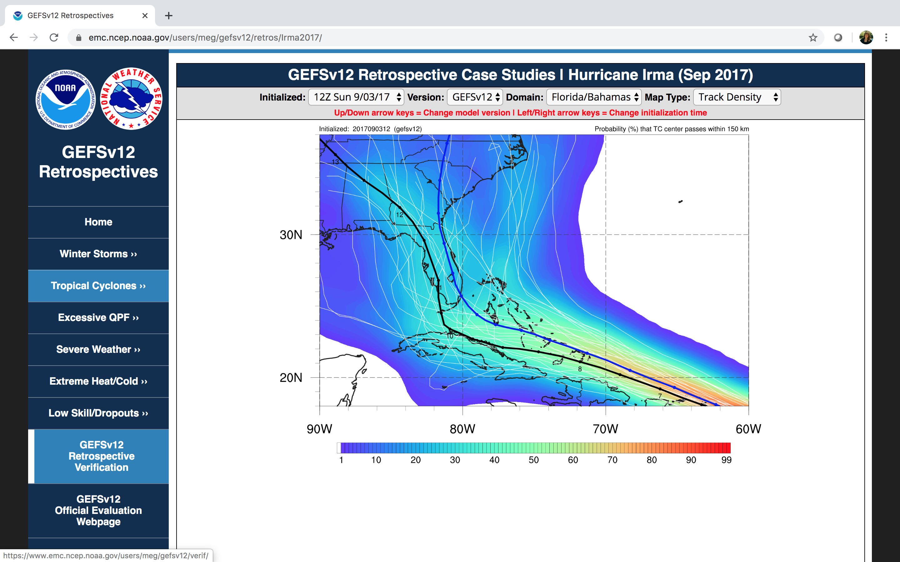

Slide 33
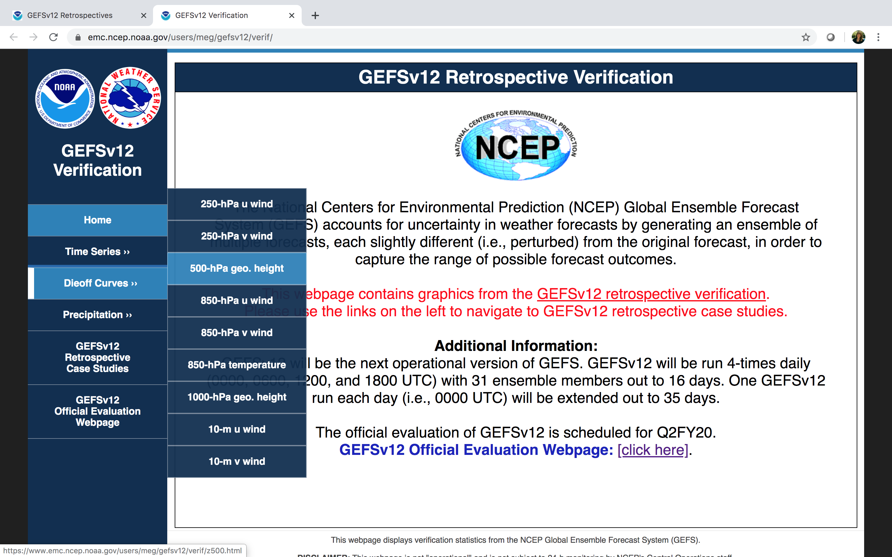

Slide 41
NATIONAL OCEANIC AND ATMOSPHERIC ADMINISTRATION
GEFSv12 Official Evaluation Webpages
All links related to the GEFSv12 official evaluation can be found here:
https://www.emc.ncep.noaa.gov/users/meg/gefsv12/
Maintained by the NCEP/EMC Model Evaluation Group (MEG)

