Slide 1
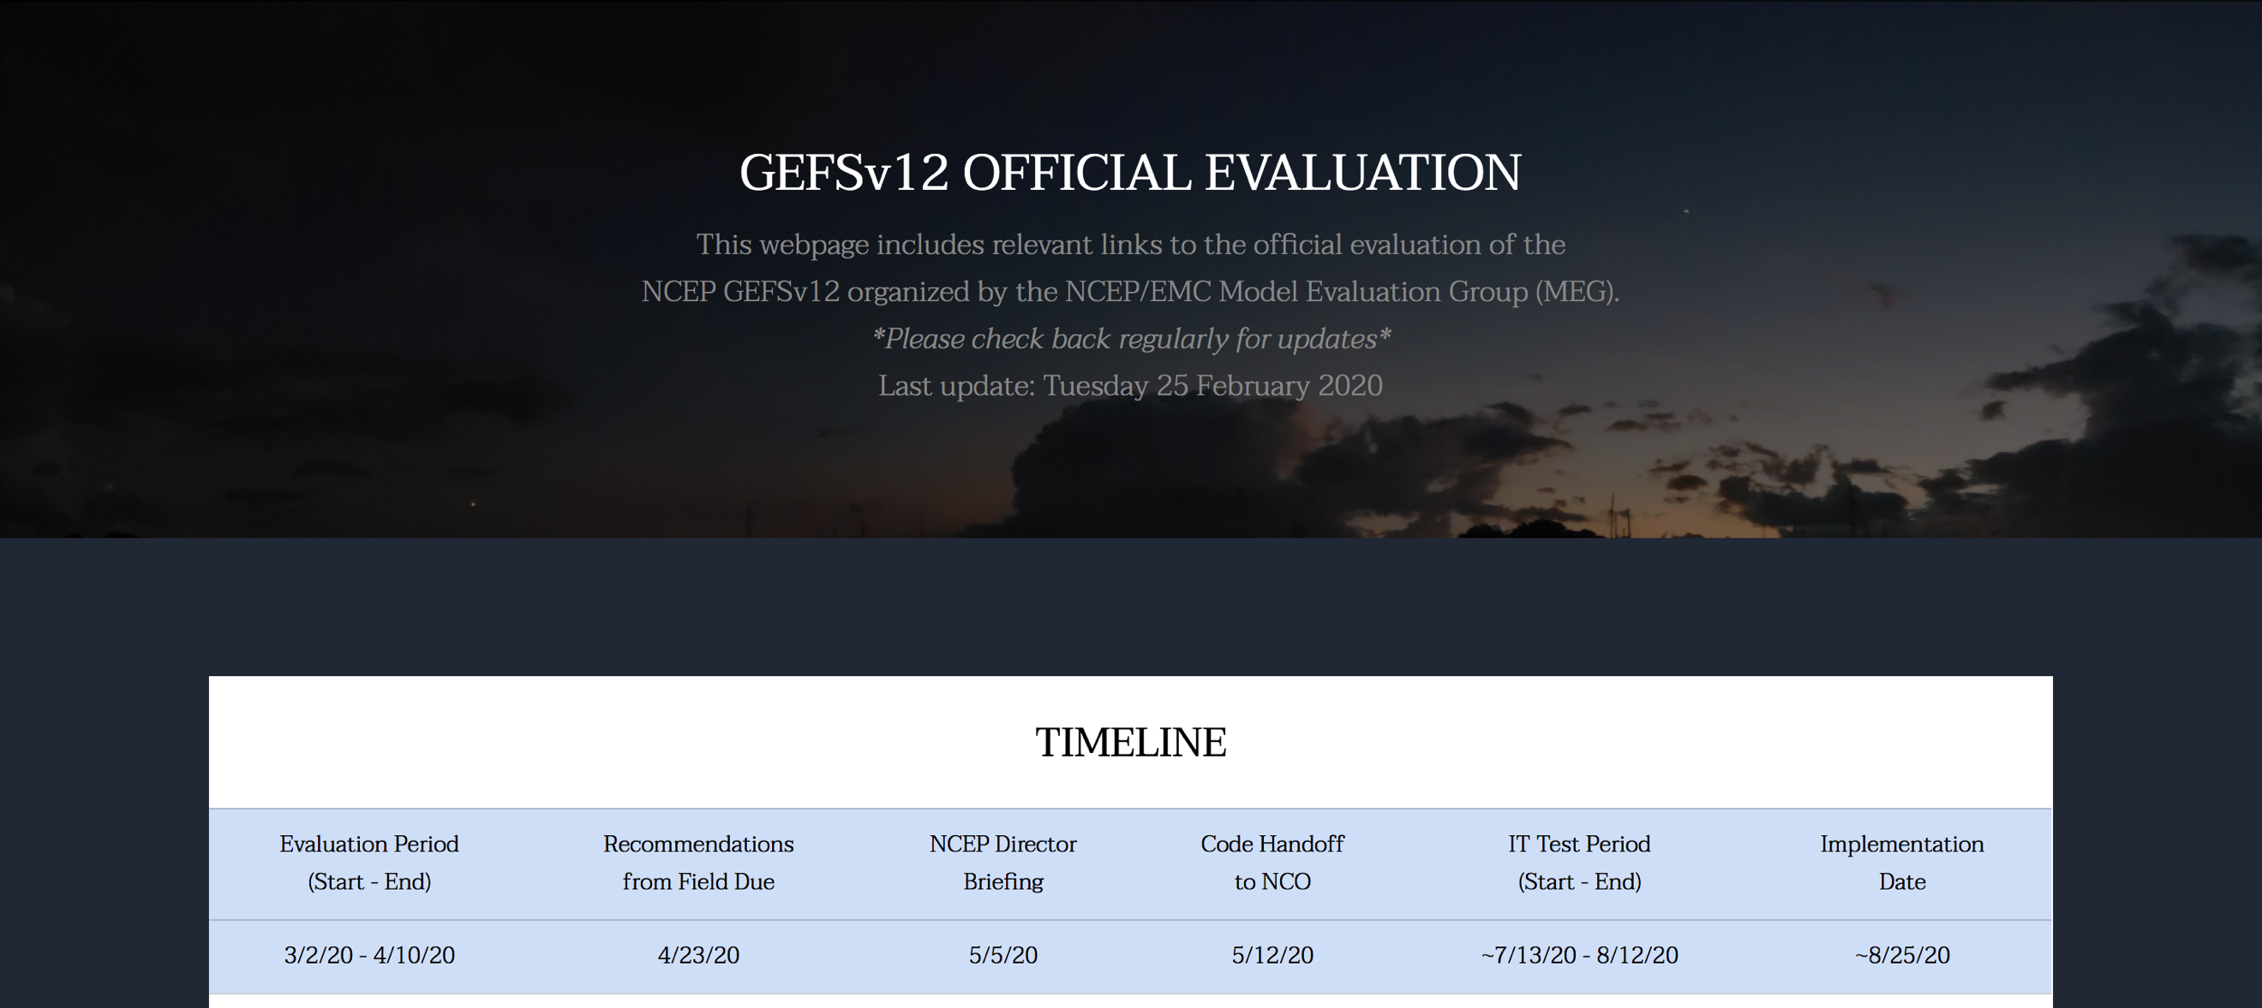
NATIONAL OCEANIC AND ATMOSPHERIC ADMINISTRATION
Kickoff for the Evaluation of GEFSv12
Geoff Manikin, Alicia Bentley, Shannon Shields, and Logan Dawson
EMC Model Evaluation Group Webinar
February 27, 2020

Slide 2
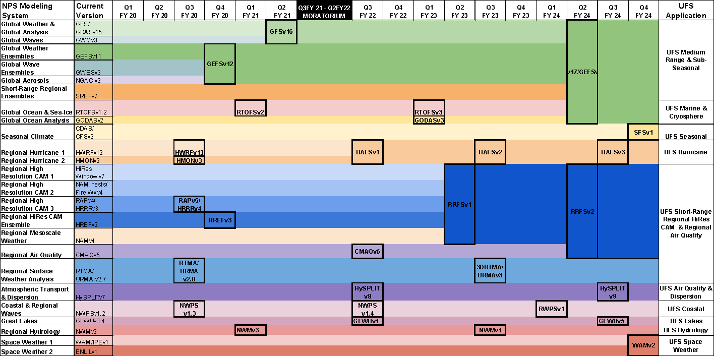
Toward a simpler, UFS-based Production Suite (notional)
Disclaimer: This is a plan; all decisions will be driven by evidence

Slide 3
The NCEP Global Ensemble Forecast System
Project lead: Yuejian Zhu Project manager: Vijay.Tallapragada
Members: Dingchen Hou, Xiaqiong Zhou, Bing Fu, Jiayi Peng, Xianwu Xue,
Yan Luo, Wei Li, Hong Guan, Bo Cui, Eric Sinsky, Walter Kolczynski
Acknowledgement:
Based on the work done by many EMC developers, GFDL and PSD collaborators.

Slide 4
Evolution of NCEP GEFS configuration
Version | Implementation | Initial uncertainty | TS relocation | Model uncertainty | Resolution | FCST length | Ens Size members | Daily frequency
V1.0 | 1992.12 | BV | None | None | T62L18 | 12 | 2+1 | 00UTC
V2.0 | 1994.3 |  |  |  | T62L18 | 16 | 10+1 (00UTC) 4+1 12UTC) | 00,12UTC
V3.0 | 2000.6
V4.0 | 2001.1 |  |  |  | T126L28(0-2.5) T62L28(2.5-16) |  | 10+1
 |  |  |  |  | T126(0-3.5) T62L28(3.5-16)
V5.0 | 2004.3
 |  |  |  |  | T126L28(0-7.5) T62L28(7.5-16) |  |  | 00,06,12, 18UTC
V6.0 | 2005.8
V7.0 | 2006.5 | BV- ETR | TSR |  | T126L28 |  | 14+1
V8.0 | 2007.3 |  |  |  |  |  | 20+1
V9.0 | 2010.2 |  |  | STTP | T190L28
V10.0 | 2012.2 |  |  |  | T254L42 (0-8) T190L42 (8-16)
V11.0 | 2015.12 | EnKF (f06) |  |  | TL574L64 (0-8) TL382L64 (8-16)
V12.0 | Q4FY20 |  | None | SPPT + SKEB | C384L64 (0-35) | 35 | 30+1
Notes:
Note (YZ) – you need to spend time to talk about current GEFS (operational v11) which is implemented on Dec. 2 2015, it is nearly 4 years right now.

Slide 5
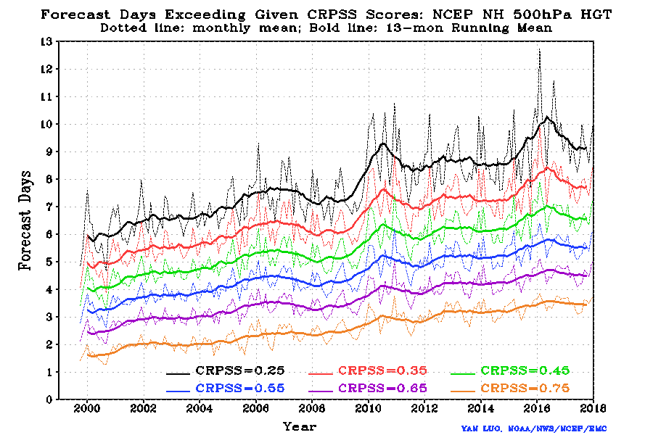
CRPSS for NH 500hPa geopotential height (2000-2018)
Note: CRPSS=0.25 is equivalent to ACC=0.60
10 days
6 days
Notes:
1)Meet THORPEX goal
2)Influenced not only GEFS update but also DA
3)Prediction variation

Slide 6
Known issues With the GEFS
Strong warm/dry bias for most of CONUS in summer
Tropical cyclone issues
Weak TC storm intensity
Degradation of track forecast over ATL and East Pac at longer lead times
Lack of spread in TC tracks
Overall lack of spread
* Outcome can fall outside of the envelope of solutions
Notes:
Notes from YZ: we can not solve all issue, but will review most of them, you could mention Hong will review temperature bias in particularly on Thursday.
Our collections through
Annual NPSR, user workshop and etc…
Strong warm/dry bias for most CONUS in summer time
Weaker storm intensity and degradation of track forecast
For longer lead time, Atlantic and East Pacific basin, not West Pacific
Under-dispersion mainly
This is not a new problem, mainly surface elements
ECMWF has similar problem
Less spread for TC track forecast?
New from introducing “4DEnsV” in May 2016

Slide 7
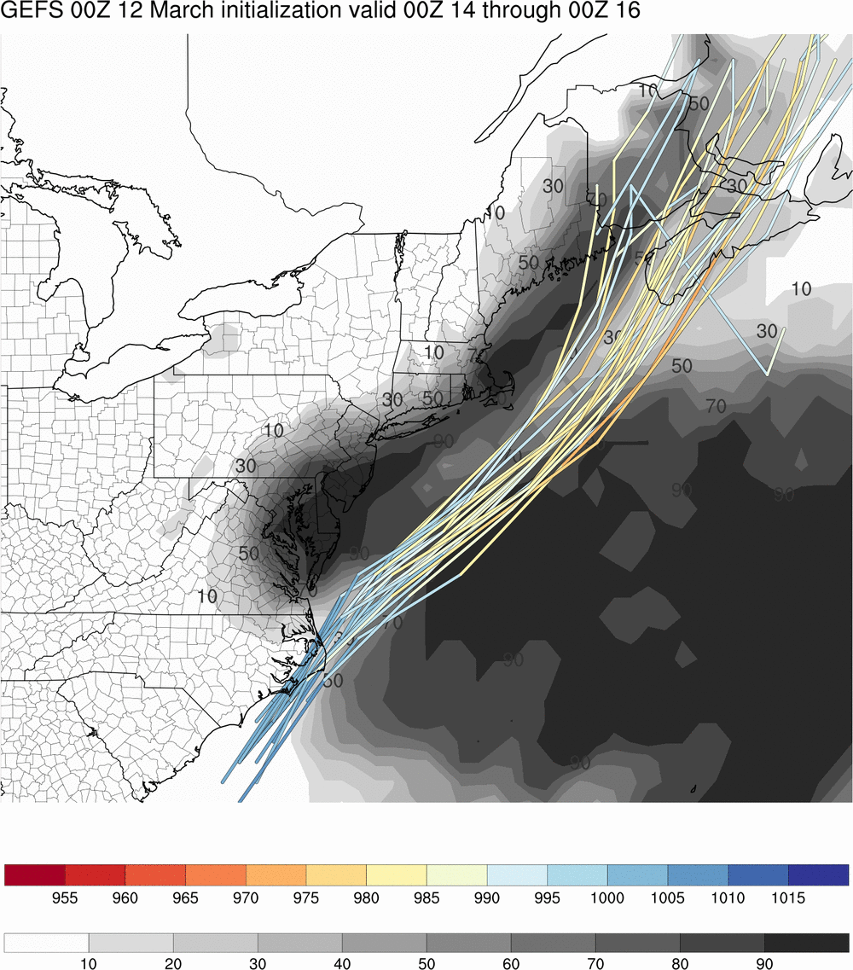
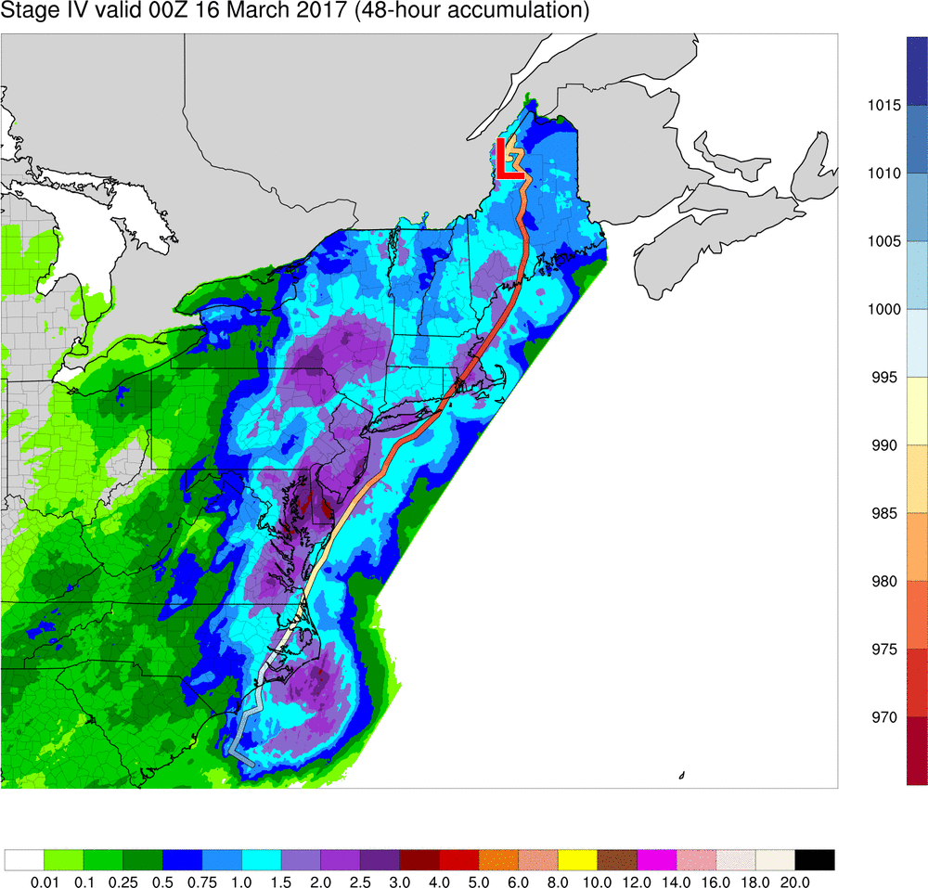
00Z 3/12/17 GEFS
48-h probability of precipitation $≥$ 1.0 inch (grayscale) and low tracks
Stage IV QPE and low track from 00Z 14 to 00Z 16 March 2017 using HRRR analyses
Actual storm track
outside of ensemble
envelope
Tracks severely underdispersive, with less than 10 percent probability of precipitation greater than an inch in much of New York, Vermont, and New Hampshire where significant snow fell

Slide 8
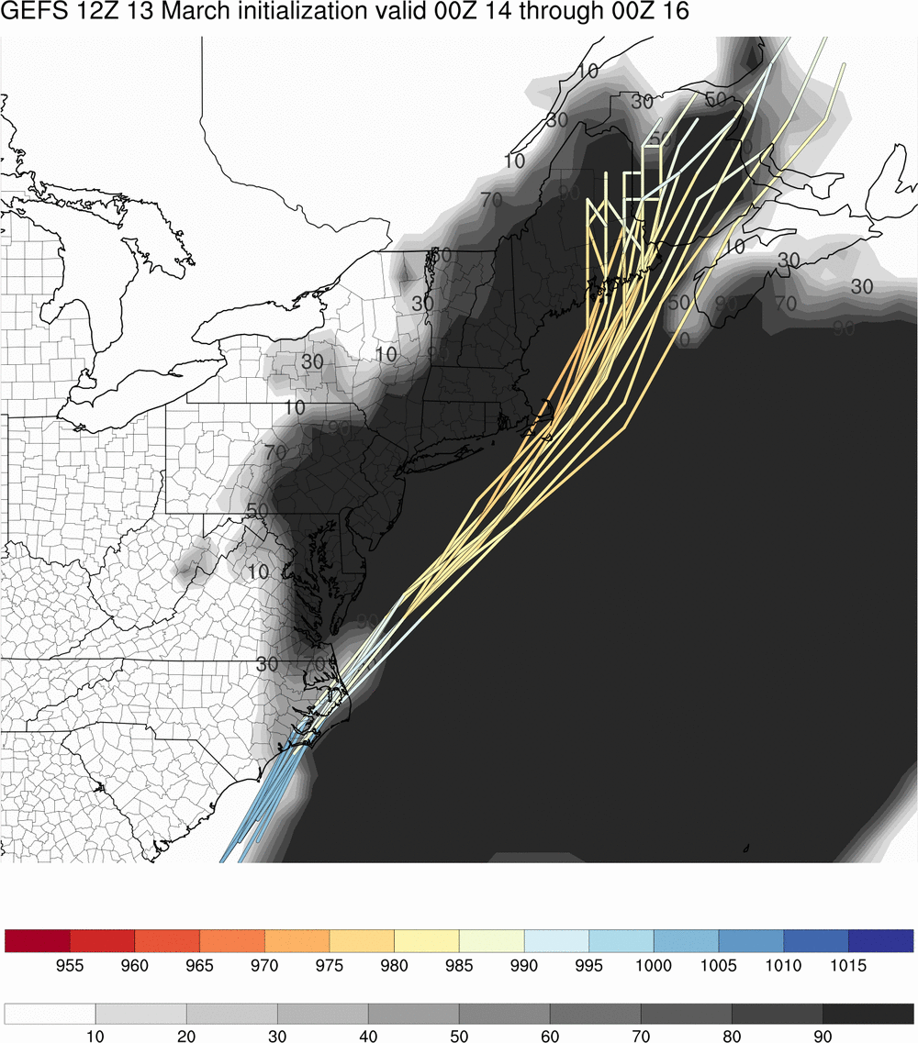
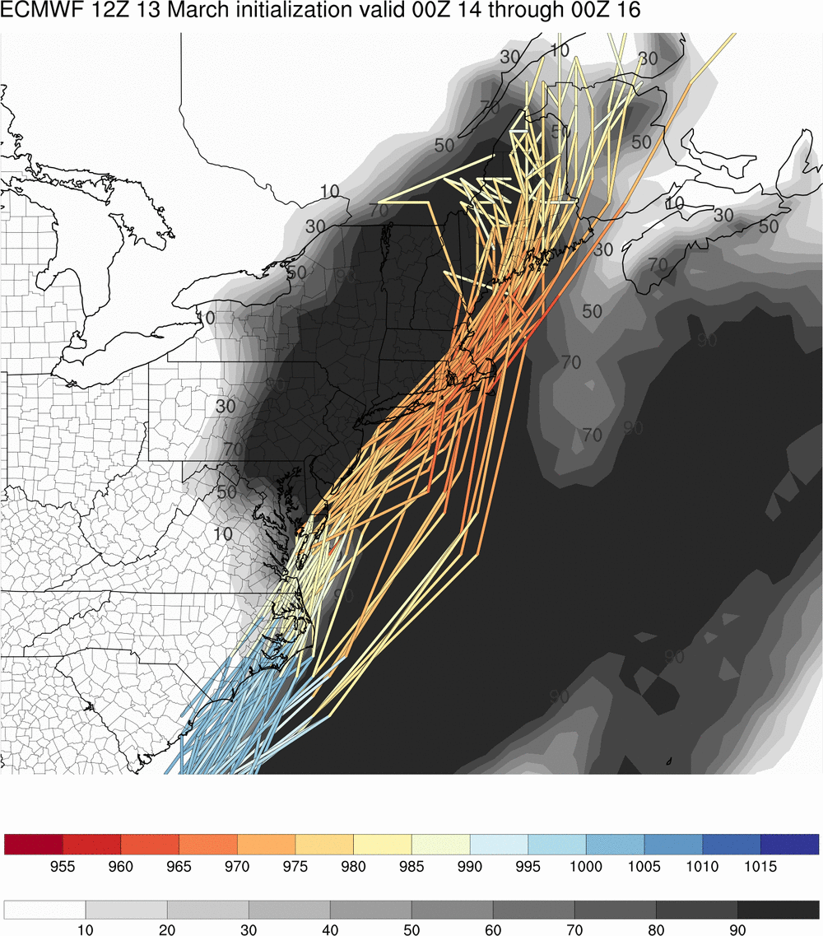
12Z 3/13/17 GEFS
12Z 3/13/17 ECMWF ensemble
48-h probability of precipitation $≥$ 1.0 inch (grayscale) and low tracks
48-h probability of precipitation $≥$ 1.0 inch (grayscale) and low tracks
Lack of dispersion relative to EPS

Slide 9
GEFS v12
First GEFS upgrade in 5 years
This is the FV3-based version of the GEFS system
Membership increased from 21 to 31 members
Like the GFSv15, it retains most of the “old” GFS physics but has the new GFDL microphysics
Updated method of generating initial perturbations
00z extension to day 35

Slide 10
Other Major Changes in GEFS v12
Integrate current Global Wave Ensemble (GWES) into GEFS
0-16 day Forecast
Add a second control member running GEFS-Aerosol Forecast
To replace current NGAC
0-120h forecast
Forecast job is one way coupled:
Forcing WW3 or AEROSOL models by FV3
Extend the ATM component to 35 days forecast once per day
16-35 day ATM forecast is done outside the current GEFS time window on WCOSS

Slide 11
PROD-GEFS (v11) .vs. FV3-GEFS (v12)
 | PROD-GEFS | FV3-GEFS
Model | GSM (hydro) | FV3 (non-hydro)
Microphysics | ZHAO-CARR MP | GFDL MP
IC uncertainty | EnKF TC perturbed after relocation | EnKF No relocation
Model uncertainty | STTP | Stochastic physics (SPPT + SKEB)
Resolution | TL574L64 (~33km), 0-8 days TL382L64 (~50km), 8-16 days | C384L64 (~25km)
Forecast days | 16 days | 16 days (06Z, 12Z and 18Z) 35 days (00Z)
Ensemble size | 21 members | 31 members
Ocean forcing | Persistent + relaxation SST | NSST and 2-tiered SST
Notes:
Increasing ensemble size from 20 to 30
Switching from Stochastic Total Tendency Perturbation (STTP) to a suite of two “stochastic physics” methods.
Extending 16-day forecast to 35-day forecast (00Z only)
Changing the dynamical core from the global spectral model (GSM) to GFDL FV3.
Changing Zhao-Carr MP to GFDL MP
….

Slide 12
Major model physics upgrades since last implementation
Physics updates in GSM (GFS v13 & v14)
Corrected the land surface characteristics for grassland and cropland categories to reduce summertime warm and dry biases over Great Plains
Upgraded convective gravity wave drag
Updated the convective scheme with scale- and aerosol-aware features along with convective cloudiness enhancement
Upgraded surface layer parameterization scheme to prevent the land-atmosphere system from decoupling.
NSST
Physics updates in FV3GFS (GFS v15)
Replaced Zhao-Carr microphysics with the more advanced GFDL microphysics
New parameterization of middle atmospheric water vapor photochemistry
A revised bare soil evaporation scheme to reduce summer warm/dry bias over the Great Plains
Updated parameterization of ozone photochemistry with additional production and loss terms
Modify convective scheme to reduce excessive cloud top cooling
Physics update in GEFSv12 (not in GFS yet)
Fixed ground flux calculation under snow cover

Slide 13
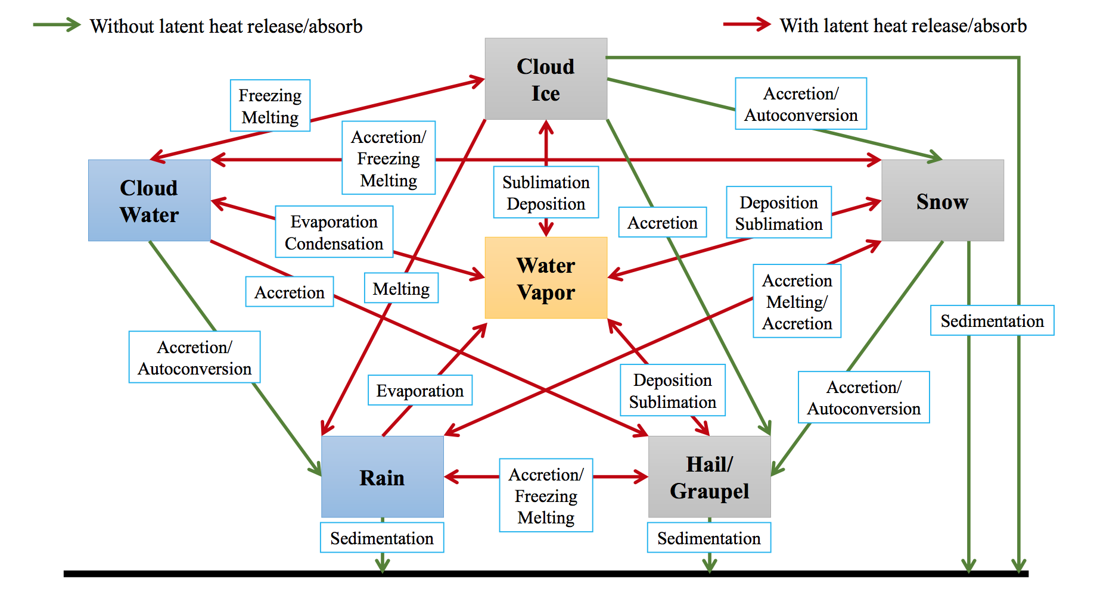
Microphysics Scheme
Zhao-Carr MP (GEFSv11)
only one prognostic cloud species: total cloud water
GFDL MP (GEFSv12)
Five prognostics cloud species: Liquid, ice, snow, graupel, rain + more sophisticated cloud processes
From Fanglin Yang

Slide 14
Near Surface Sea Temperature Scheme (NSST)
Courtesy of Dr. Xu Li

Slide 15
SST forcing in the GEFS operation and FV3GEFS
Operational: Persistent + relaxation
analysis - climatology
at t0
Climatology
at t
FV3GEFS: Two-tiered SST
Analysis + Climatological tendency
Bias-corrected CFSv2 forecasts

Slide 16
Initial perturbations in FV3 GEFS
IC perturbations generated from EnKF 6h forecasts as done in production
Both high-resolution FV3GFS analysis and low-resolution EnKF forecasts are interpolated from Gaussian grid to FV3 native grid and then the ensemble member is re-centered to the analysis
No TC relocation process to perturb tropical cyclone and environment separately, which simplifies the initialization process
Include non-hydrostatic variables and 7 tracers in ICs
Cold start the model
Notes:
Notes from YZ: give more explanation of cold start means, or write out. Why we can not run warm start? Explain?

Slide 17
Stochastic physics schemes
Dynamics uncertainty: Stochastic Energy Backscatter (SKEB)
Energy at non-resolved scales cannot cascade to larger scales due to the model’s finite resolution
Approach: Estimate energy lost each time step, and then transfer back to resolved scales
Stream function is randomly perturbed to represent upscale kinetic energy transfer
Physics uncertainty: Stochastically perturbed physics tendencies (SPPT) [ECWMF tech memo #598]
Represents uncertainties in physical parameterizations
Multiplicative noise modifies total parameterized tendency
Above schemes (+ Shum) has been implemented to NCEP EnKF/hybrid DA in 2015
Notes:
to counteract excessive energy dissipation coming from numerical diffusion and interpolation, mountain and gravity wave drag, and deep convection.

Slide 18
SPs for FV3GEFS
Tested/tuned all three schemes and different combination
No SPs under dividing streamline over mountain area
Increase model stability but reduce spread for lower levels
Reduced SKEB’s contribution
Amplitude is reduced from 1.0 to 0.6 when we select a less diffusive advection scheme (Hord=5)
5-scale SPPT (next slide)
No SHUM
To reduce tropical wind spread of lower levels

Slide 19
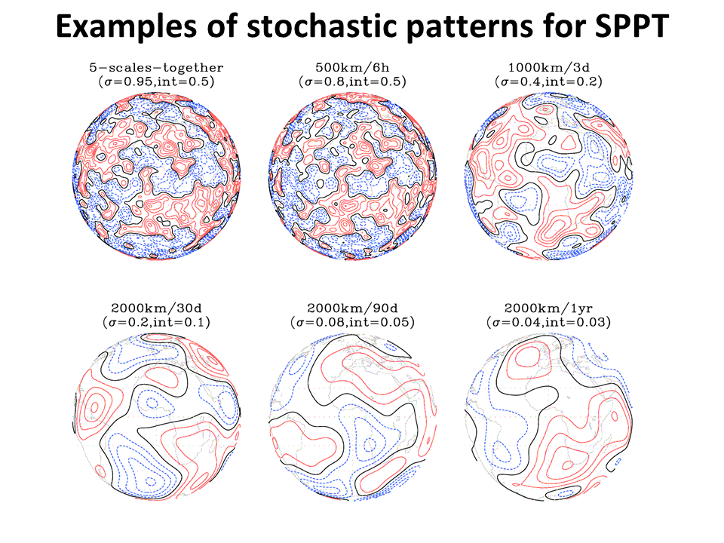
Examples of stochastic patterns for SPPT
Fig. 2: 5-scale random patterns used in Stochastic Perturbed Physics Tendencies (SPPT). On the top of each plot, the numbers (except for upper left) represent the scales of spatial and temporal perturbations with the maximum amplitude and contour intervals in the bracket. Zhu et al, 2018: JGR

Slide 20
STTP vs SPs (fcst=120hr)
Winter
PROD
FV3GEFS
FV3GEFS-PROD
Summer
STTP has low spread in tropics
STTP overdispersion in winter hemisphere

Slide 21
Evaluation Details
Previous GEFS evaluations were driven completely by statistics
There will again be no real-time parallel for this evaluation (due to resource constraints)
Retrospective runs covering a 2.5 year period (summer 2017-current) have been made; 00z cycles only, except 00 and 12z cycles for TC cases
Full stats are available
The MEG has generated graphics for 44 cases covering a full spectrum of meteorological phenomena and geographic diversity to add a much-needed subjective component to the evaluation
There will be separate evaluations for wave and aerosols as well as the forecast extensions – these will not be the focus of the MEG

Slide 22
EXPECTATIONS FOR GEFSv12
Fairly substantial differences are expected in the day-to-day forecast plots
Overall synoptic performance appears improved
Initial impression that spread is larger and more realistic
Concern of cold bias, as is found in the FV3-based GFS, but stats so far have not shown it
Overall improved tropical tracks and intensity, although northward moving storms may move too fast

Slide 23
Retrospective runs
Out to 10 days
Jun. 2017 – Nov 2018 , 00UTC (1.5 years)
Three hurricane seasons
Summer 2017 (July – October), 12UTC
Summer 2018 (July – October), 12UTC
Summer 2019 (July – October); 12UTC
Out to 16 days (coupling to wave ensemble)
Dec. 2018 – Nov.2019, 00UTC (one year)

Slide 24
CASES PLOTTED by the MEG
TROPICAL
WINTER
Harvey (2017)
Irma (2017)
Maria (2017)
Nate (2018)
Noru (2017)
Alberto (2018)
Florence (2018)
Lane (2018)
Michael (2018)
Walaka (2018)
Barry (2019)
Dorian (2019)
Alaskan Cyclone (Sep 2017)
Southeast Snowstorm (Dec 2017)
East Coast Bomb (Jan 2018)
West Coast Atmos River (March 2018)
Mid-Atlantic Windstorm (March 2018)
Alaska Cyclone (Apr 2018)
Mid-Atlantic Snowstorm (Nov 2018)
Pacific NW Snowstorm (Feb 2019)
Central U.S. Bomb (Mar 2019)

Slide 25
CASES PLOTTED by the MEG
QPF
SVR
Summer Nor’easter (Jul 2017)
California Storm (Jan 2018)
Southern Plains Bust (Dec 2018)
Central U.S. Cyclone (Apr 2019)
Spring California Storm (May 2019)
TC Imelda (September 2019)
Halloween Storm (Oct 2019)
Post-Thanksgiving Storm (Nov/Dec 2019)
Early November Outbreak (Nov 2017)
OH Valley Outbreak (Feb 2018)
ArLaTex Event (Apr 2018)
Neg Tilt Trough (May 2018)
Late May (2019)

Slide 26
CASES PLOTTED by the MEG
LOW PREDICTABILITY
EXTREME TEMPS
Atlantic Pattern Issues (Aug 2017)
North America Pattern Issues (Sep 2017)
Western U.S. Pattern Issues (Dec 2018)
Low Skill Case (Feb 2018)
Low Skill Case (Jan 2019)
Bay Area Heat (Sep 2017)
Arctic Air Outbreak (Dec 17- Jan 18)
Arctic Air Outbreak (Jan 2019)
Alaskan Wildfires (Aug 2019)
Intermountain West Cold (Oct 2019)

Slide 27
PARAMETERS PLOTTED by the MEG
QPF
Snow
SLP
2-m T
10-m U, V
850 mb U, V, T
PW
500 mb Z
250 mb U, V
CAPE
Mean/Spread
Lows/Spaghetti
Tropical Cylone Density
Probs
- CAPE > X
- 2m T < 0 C
- 850 T < 0 C
- QPF > X”/6h
- Snow > X”/6h

Slide 28
FV3 GEFS real-time products
3 hourly out to 10 days at 0.25 degree resolution
6 hourly beyond 10 days at 0.5 degree resolution (out to 35 days)
(GEFS v 11) 3 hourly out to 8 days then 6 hourly at 0.5 degree
All Low-Res GEFS products are discontinued in v12
New products– station time series BUFR data
All ensemble forecasts will insert to global sounding locations
Include individual member, and ensemble mean
Addition of 76 parameters
Surface variables (3)
HGT On Cloud Ceiling
SNOHF and SNOWC
PV on isentropic levels (2)
310 and 350K levels
Vertical velocity on pressure levels (5)
10, 20, 30, 50 and 70 hPa levels
More isentropic levels (4x3=12)
450, 550 and 650 K levels
U, V, T, PV
More Pressure levels (6x5=30)
1, 2, 3, 5, 7 hPa levels
H, T, U, V, q, w
Sigma levels (6x4=24)
Lowest 4 sigma levels
H, T, P, U, V, RH

Slide 29
PRODUCT DELAYS
Fitting the 31 member configuration onto the current computing system requires that a smaller number of nodes be used, creating a longer run time
The start time will be moved up, but a delay in product delivery time will occur starting around 8 days into the forecast
A period for public comments is about to start to offer the opportunity to express concerns about these delays

Slide 30
TIMELINE
MEG Evaluation Kickoff webinar: February 27, 2020
Field Evaluation: March 2, 2020 - April 10, 2020
MEG Evaluation Briefing: April 16, 2020
Field Recommendations due: April 23, 2020
NCEP Director Briefing: May 5, 2020
Code delivery to NCO: May 12, 2020
NCO 30-Day IT Test begins: July 13, 2020 (tentative)
NCO IT Briefing: August 21, 2020 (tentative)
Implementation date: August 25, 2020 (tentative)

Slide 31
TENTATIVE MEG TIMELINE
February 27 - GEFSv12 Evaluation Kickoff
March 5 - likely recap of Carolina winter storm (not part of GEFSv12)
March 12 – GEFSv12 Stats Overview + QPF cases
March 19 – GEFSv12 Winter Storms / Cyclones
March 26 – GEFSv12 Tropical Cyclones
April 2 - HREFv3 Kickoff
April 9 – GEFS Low Skill Cases + SVR + SOO team presentation
April16 - MEG Evaluation Overview (atmosphere only)
April 23 - No Webinar
April 30 - Summarize Field Evaluations (include aerosols and waves)
May 7 - MEG Recovery

Slide 32
Official GEFSv12 Evaluation Web site
https://www.emc.ncep.noaa.gov/users/meg/gefsv12

