Slide 1
Implementation of Global Ensemble Forecast System - GEFS v12.0, Q4FY20 UFS Sub-Seasonal Weather Application
Presented by:
Yuejian Zhu, Vijay Tallapragada, Jose-Henrique Alves, Jeff McQueen & Geoff Manikin
Environmental Modeling Center
NCEP/NWS/NOAA
Briefing for EMC CCB
May 1, 2020

Slide 2
Acknowledgements
Ensemble Project Team: Global ensemble development, Lead: Dingchen Hou
Wave Project Team: Wave development, unification, and support, Lead: Henrique Alves
Aerosol Project Team: Aerosol development, unification, and support, Lead: Jeff McQueen
GFS Project Team: Support for ensemble development, Leads: Fanglin Yang and Russ Treadon
PSL DA/Ensemble Group: Production of 20 years reanalysis and support for ensemble development including stochastic physics, Leads: Tom Hamill and Jeff Whitaker
GSL Aerosol/Chemistry Group: GOCART/GSL-Chemistry development and support for the coupled system, Lead: Georg Grell
Model Evaluation Group: Evaluation of ensemble performance, coordination with the field, Lead: Geoff Manikin
EIB: Support for global workflow, EE2 compliance, and resource optimization, Leads: Walter, Xianwu, Lin Gan
NCO SPA team: EE2 coordination and final implementation, Lead: Steven Earle
STI staff: Project management support and technical coordination, Lead: Farida Adimi
CPC staff: Evaluate ensemble performance for week-2, and weeks 3&4 (sub-seasonal), Lead: Matt Rosencrans
Water Center: Validate reanalysis and reforecast products, develop HEFS based on GEFSv12, Lead: Ernie Wells & Mark Fresch
Centers and Regions: Evaluate ensemble performance for GEFSv12
EMC management: Support for the ensemble development project and NPS unification
And many more….

Slide 3
G
GEFS Version 12
Status as of 5/1/20
G
Schedule
Project Information & Highlights
Project Manager: Vijay Tallapragada
Leads: Yuejian Zhu & Dingchen Hou (EMC), Steven Earle (NCO)
Scope: Incorporate new upgrades to the NCEP GEFS to extend forecasts to weeks 3&4. This includes upgrades to stochastic physics, and unification of Global Wave Ensembles and NGAC capabilities, and increase the resolution and number of members. This development also includes efforts towards producing re-analysis datasets and reforecast (Draft project plan and charter).
Expected benefits: Extend forecasts to week 3&4 and unify with wave ensemble and GOCART
Implemented with: NA
Dependencies: Wave ensemble and GOCART development and Compute resources
Milestones & Deliverables | Date | Status
Freeze system’s configuration | Q4FY18 | Completed
Submit Product Change Notice (PNS) for retiring products | Dec 2019 | Completed
Submit PNS for extending running window | 3/2020 | Completed
Complete full retrospective experiments | 2/15/20 | On track
Complete field evaluation | 4/27/20 | Completed
Conduct NCEP OD brief, and deliver final code to NCO | 5/5/20; 5/15/20 | Scheduled
Disseminate Service Change Notice (SCN) | 8/3/2020 | Planned
Start the 30-day evaluation and IT testing | 8/3/2020 | TBD
Operational Implementation | 9/9/2020 | Planned
EMC | NCO | Blue text indicates change from previous quarter
G
Issues/Risks
G
Resources
Risk::
Mitigation:
Staff: 2 Fed FTEs + 12 contractor FTEs including development for all components)
Funding Source: STI and OWAQ/CPO
Compute: EMC Dev: varies (x6); Parallels: 500+100+40 nodes (x6); Ops: 420 nodes (Dell 3.5)
Management Attention Required | Potential Management Attention Needed | On Target
R
Y
G

Slide 4
Evolution of NCEP GEFS
Version | Implementation | Initial uncertainty | TS relocation | Model uncertainty | Resolution | FCST length | Ens. size (members) | Daily frequency
V1.0 | 1992.12 | Bred vector | None | None | T62L18 ~200km | 12 | 2+1 | 00UTC
V2.0 | 1994.03 |  |  |  | T62L18 ~200km | 16 | 10+1 (00UTC) 4+1 (12UTC) | 00UTC 12UTC
V3.0 | 2000.06
V4.0 | 2001.01 |  |  |  | T126L28(0-2.5) ~100km T62L28(2.5-16) ~200km |  | 10+1
V5.0 | 2004.03 |  |  |  | T126(0-3.5) ~100km T62L28(3.5-16) ~200km
V6.0 | 2005.08 |  |  |  | T126L28(0-7.5) ~100km T62L28(7.5-16) ~200km
V7.0 | 2006.05 |  | TSR |  | T126L28 ~100km |  | 14+1 | 00UTC 06UTC 12UTC 18UTC (16 days) 00UTC (35 days)
V8.0 | 2007.03 | (BV- ETR) |  |  |  |  | 20+1
V9.0 | 2010.02 |  |  | STTP | T190L28 ~70k
V10.0 | 2012.02 |  |  |  | T254L42 (0-8) ~50km T190L42 (8-16) ~70km
V11.0 | 2015.12 | EnKF (f06) |  |  | TL574L64 (0-8) ~33km TL382L64 (8-16) ~50km
V12.0* | 2020.09 |  | None | SPPT+SKEB | C384L64 (0-35) ~25km | 16(35) | 30+1+1
* V12 is 1st Unified Forecast System (UFS) to combine global ensemble, wave ensemble and aerosols

Slide 5
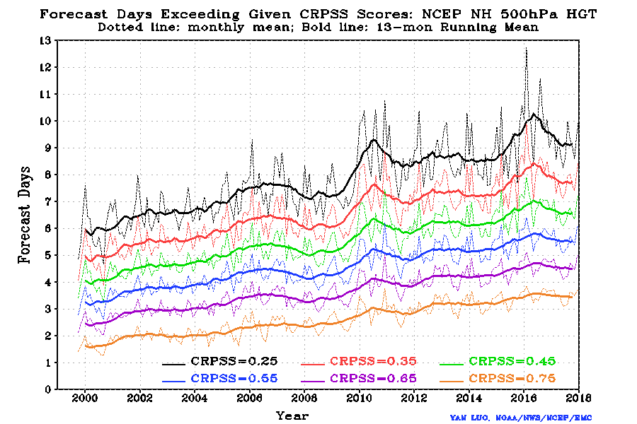
History of GEFS Performance: CRPSS NH 500hPa HGT
THORPEX (2005-2014) project goal: to accelerate improvements in the accuracy and the social, economic, and environmental benefits of 1-d to 2-w high impact weather forecast
CRPSS – Continuous Ranked Probabilistic Skill Score is one of evaluation tools to measure ensemble based probabilistic forecast.
Projection – 0.25 CRPSS is very close to 0.6 AC score to estimate the days with skillful probabilistic forecast
Performance – GEFS has provided useful skill reaching to around 10 days in recent years
~ 20 years
6 days
ENSO year???

Slide 6
Proposed GEFS v12 Configuration
Components | V11 (Dec. 2015) | V12 (Sept. 2020)
GFS Model | Semi-Lagrangian, 2015 version | FV3 (Finite-Vol Cubed-Sphere) GFSv15.1 version
Physics | GFSv13 package (Zhao-Carr MP) | GFSv15.1 package (GFDL MP)
Initial perturbations | EnKF f06 | EnKF f06
Model uncertainty | STTP (Stoch. Total Tend. Pert) | 5-scale SPPT and SKEB
Boundary forcing | SST - Climatology relaxation | NSST + 2-tiered SST
Tropical storm | Relocation for all members | No relocation
Horizontal Resolution | T_{L}574 (34km)/T_{L}382 (55km) | C384 (25km)
Vertical resolution | L64 (hybrid) | L64 (hybrid)
Daily frequency | 00, 06, 12 and 18UTC | 00, 06, 12 and 18UTC
Forecast length | 16 days | 16 days, 35 days (00UTC) - Support SubX
Members | Control + 20 pert members | Control + 30 pert members + 1 aerosol member
Output resolution | 0.5º x 0.5º | 0.25º x 0.25º and 0.5º x 0.5º
Output frequency | 3hly for the first 8 days; 6hly for the rest | 3hly for the first 10 days; 6hly for the rest
Reforecast | EMC offline – 20 years | 30 years (1989-2018)
Implementation | December 2, 2015 | September 2020

Slide 7
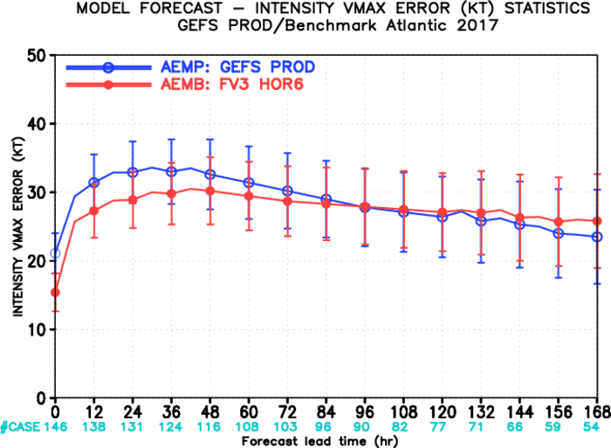
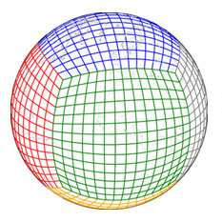
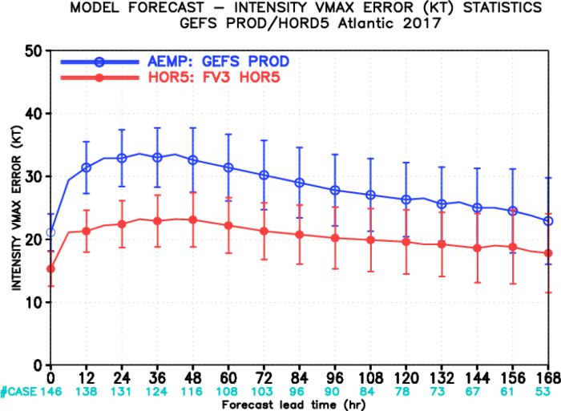
GEFSv12: Transition from Spectral to FV3 Dycore
The Finite Volume Cubed Sphere
(FV3) dynamic core
Hord=6
Key parameters
Time step=450s; but use 300s for aerosol integration
ksplit=2; for vertical mapping
nsplit=6; for acoustic wave
hord=5; horizontal advection scheme; see impact for TS intensity (right plot)
nord=2; divergence damping – 6 order diffusion; impact SKEB scheme
d4_bg=0.12; is coefficient for background higher-order divergence damping.
Vtdm4=0.02; is coefficient for damping other-variables like vorticity, non-hydrostatic vertical velocity.
Others similar to GFSv15.2
Early experiments
Atlantic Hurricane Intensity
Hord=5
C384L64 ~ 25km resolution
Non-hydrostatic
Final experiments
Atlantic Hurricane Intensity

Slide 8
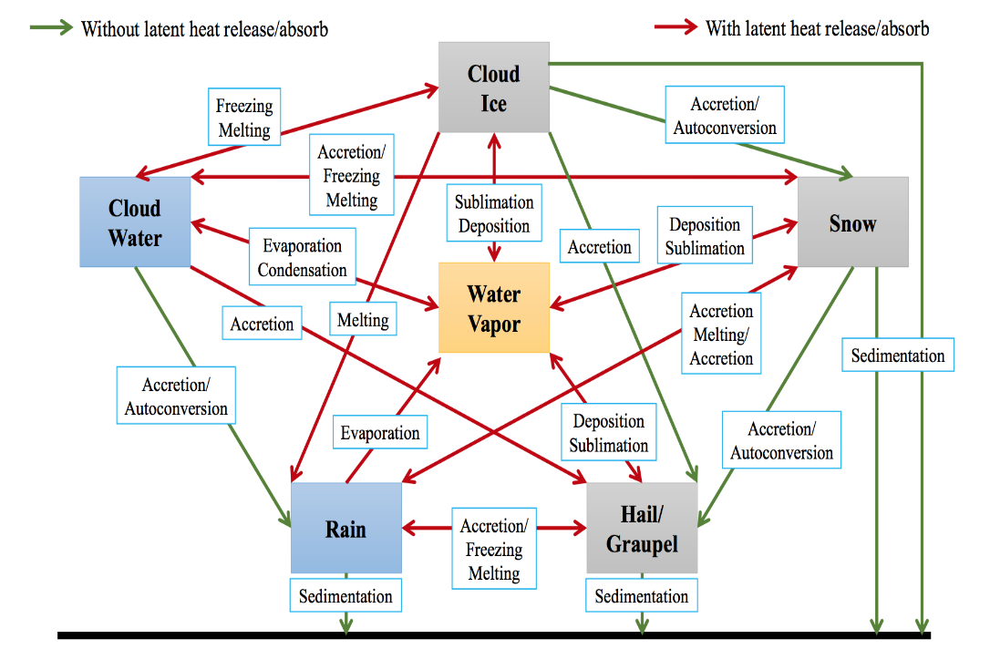
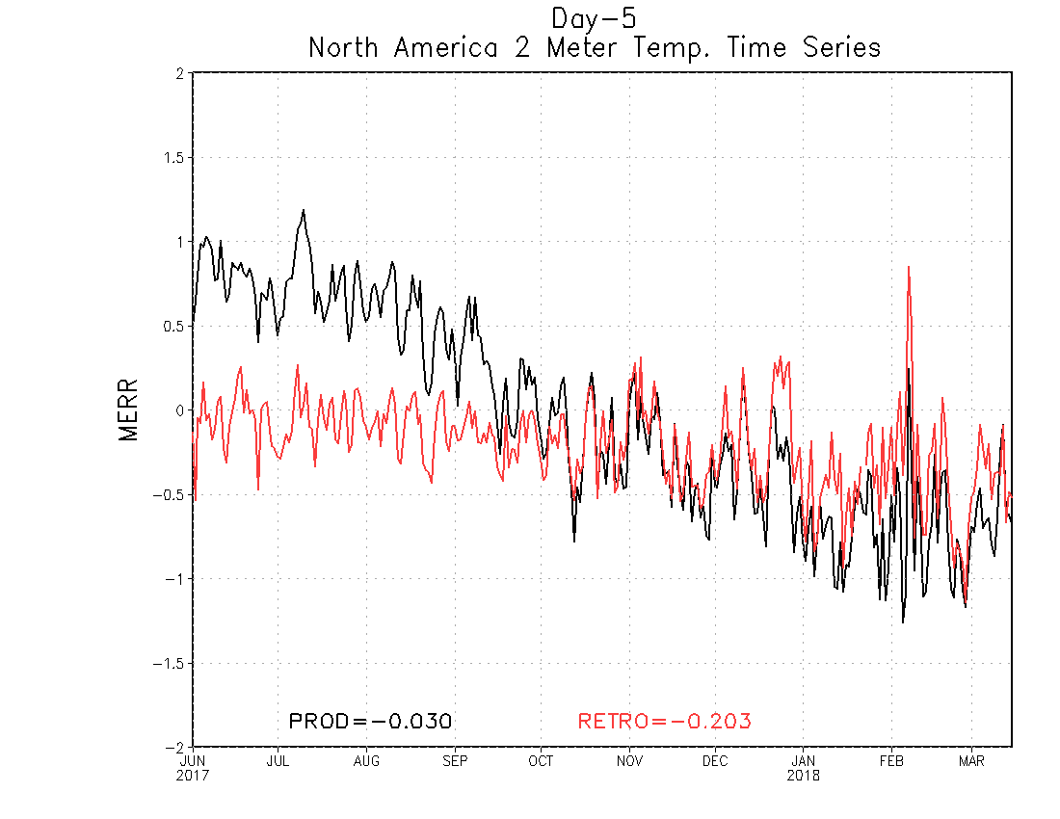
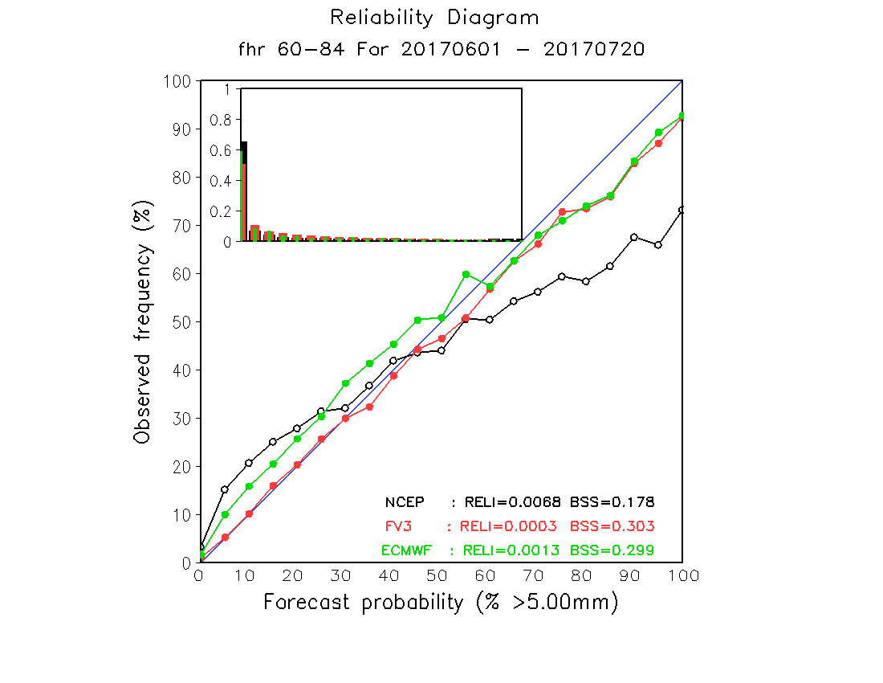
GEFSv12 Physics Changes
Replace Zhao-Carr MP with GFDL MP
Five prognostics cloud species: Liquid, ice, snow, graupel, rain more sophisticated cloud processes
Tuning parameters and coefficients:
Increase the conversion rate of ice cloud water to snow (psauto from 4.e-4 4.e-4 to psauto=8.e-4 8.e-4)
Test 5 different sets of geographic gravity wave drag and mountain block coefficients, finally to use cdmbgwd=1.2;1.0
Many others..
Northern American 2-m temperature bias
Winter
Summer
Top: NA 2-m temperature bias is much reduced in summer (warm) and winter (cold).
Left: increase CONUS precipitation spread, and improve forecast reliability
Processes and interactions of GFDL MP scheme
CONUS precipitation
>=5mm/day and f64-84

Slide 9
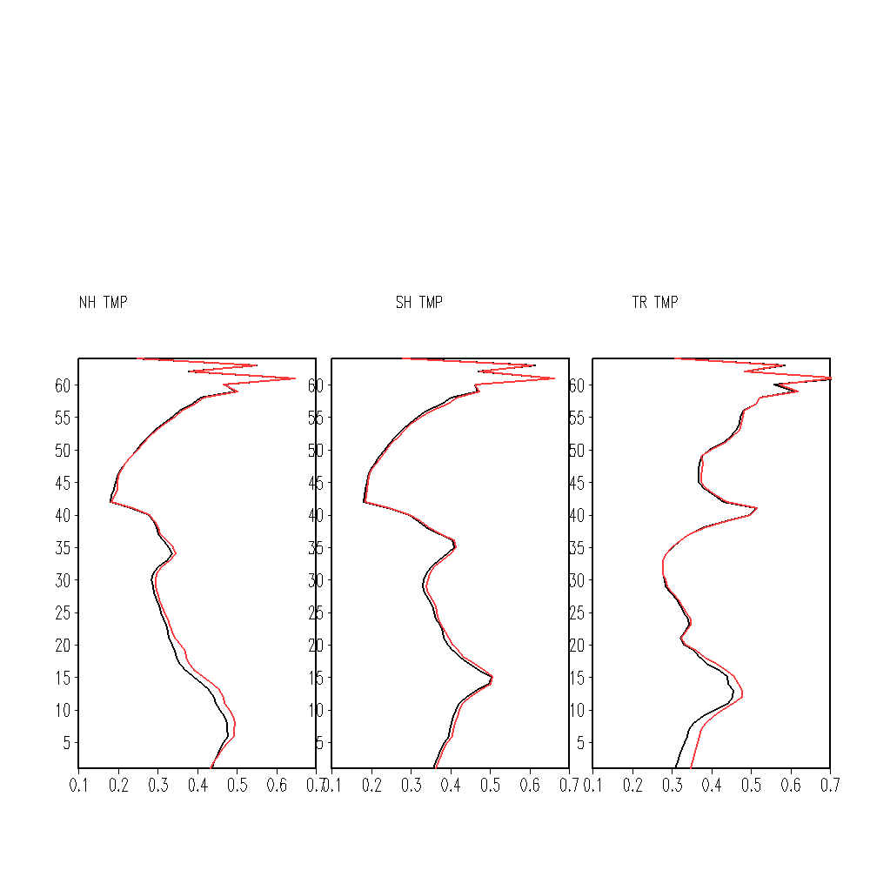
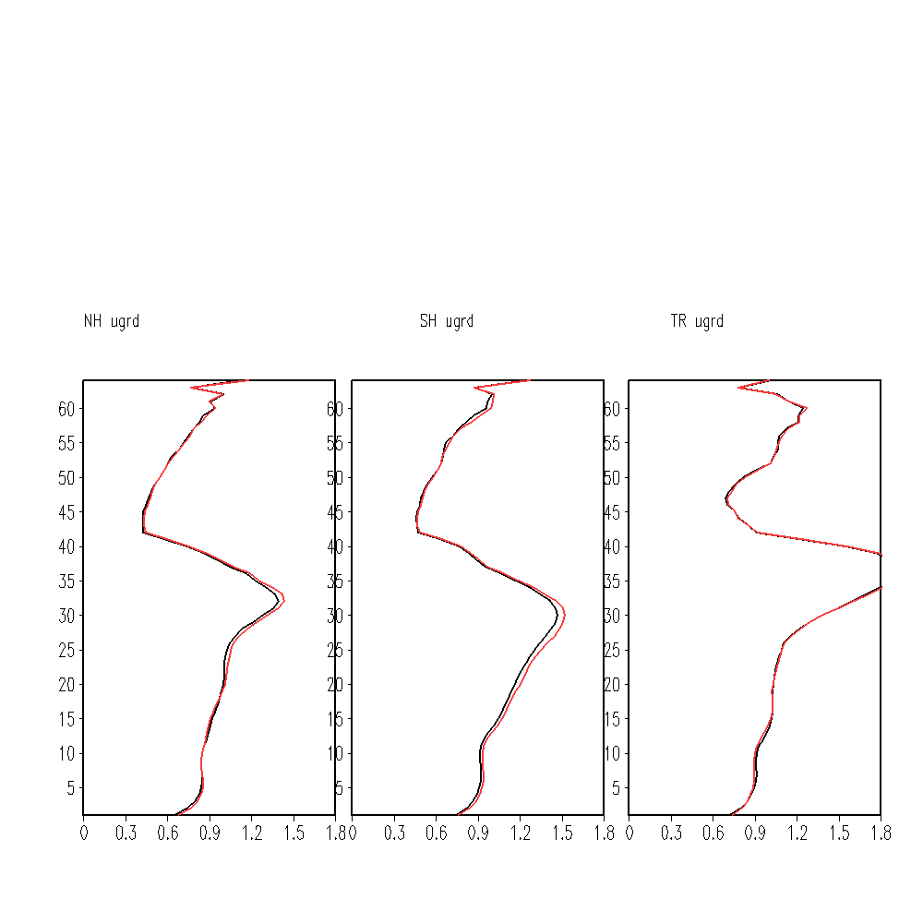
IC Uncertainty from EnKF 6-hr forecasts, No TSR
Example of FV3-EnKF spread vertical profile
EnKF –
Ensemble Kalman Filter is providing background error covariance to data assimilation and initial uncertainty (or perturbations)
Spread of 80 ensemble members has demonstrated its growth in 6 hours
Why f06 ? –
Current EnKF is running in final hybrid DA (GDAS), it is late for GEFS initialization
There is less difference of anl and f06 in the structure (left)
Re-center –
GEFS takes 1-30; 21-50; 41-70; 61-10 GDAS ensemble members for 00; 06; 12; 18 UTC respectively
Ensemble re-centering applied for selected 30 perturbations.
Remove TC relocation –
Tropical storm relocation was introduced in 2006 for lower horizontal model/analysis resolution (~55km), but ~13km today, it is no longer necessary (similar to GFSv15.1)
Less impact when we take out TSR process for GEFS.
NH
SH
TR
----- anl
----- f06
Temperature
NH
SH
TR
----- anl
----- f06
Zonal wind

Slide 10
Model uncertainty in GEFSv12: SPPT and SKEB
SKEB: Estimate energy lost each time step and inject this energy in the resolved scales. a.k.a stochastic energy backscatter (SKEB; Berner et al. 2009)
SPPT and SHUM: perturb the results from the physical parameterizations, and boundary layer humidity (Palmer et al. 2009), and inspired by Tompkins and Berner 2008, we call it SPPT and SHUM
Replace STTP for GEFSv12 with SPPT and modified SKEB (amplitude reduced to 0.5 from 1.0), no SHUM

Slide 11
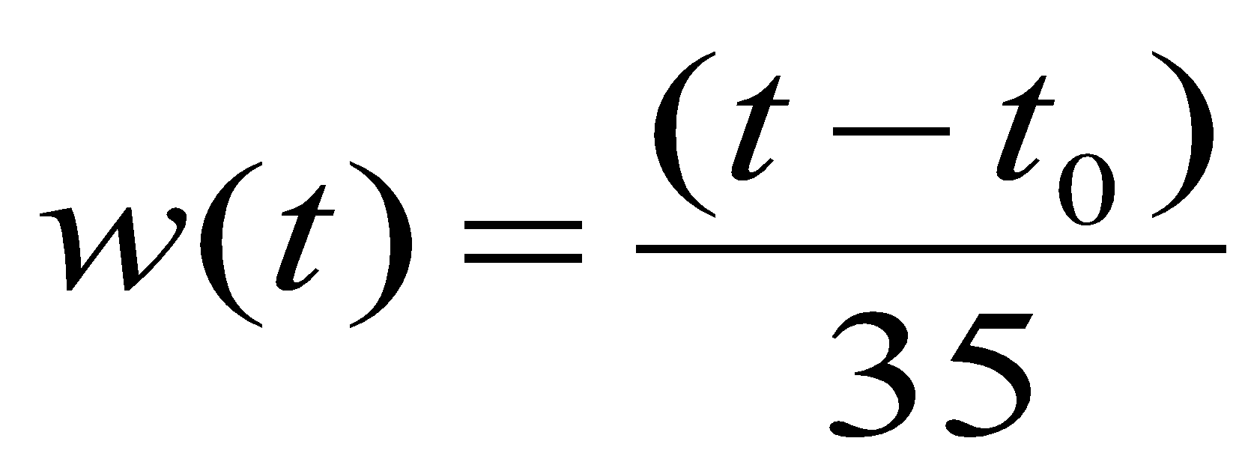
Ocean Forcing: NSST and 2-tiered SST
NSST is assimilating diurnal variation of SST Courtesy of Dr. Xu Li
V12: NSST+ Two-tiered SST
Analysis + Climatological tendency
Bias-corrected CFSv2 forecasts
Two-tiered SST technique has been used for SubX project to provide real-time 35 days GEFS forecast to support CPC’s subseasonal guidance. It has been demonstrated the value to improve tropical forecasts

Slide 12
GEFSv12 Reanalysis and Reforecast
to support sub-seasonal (weeks 3&4) forecasts
20-year Reanalysis (2000-2019), Led by PSL
31-year Reforecast (1989-2019), Led by EMC

Slide 13
Analysis, Perturbations and SSTs for GEFSv12 Reforecasts
CFSR analysis + BV-ETR initial perturbations
Resolution similar to GEFS v10
Phase 1
01/01/1989
OI SST for analysis; NSST+2 tiered SST for forecasts
Old (categories) soil moisture for analysis, new for forecasts
12/31/1999
GSI/EnKF hybrid analysis with IAU; EnKF perturbation
Lower resolution of GFS (C384) and GEFS (C128)
Phase 2
01/01/2000
OI SST for analysis; NSST+2 tiered SST for forecasts
New (categories) soil moisture for analysis, new for forecasts
12/31/2019
31 years GEFS v12 reforecasts (Jan. 1989 – Dec. 2019)

Slide 14
FV3-GEFS reforecast configuration
Model configurations:
The same as GEFSv12 (C384L64)
Period of retrospective:
31 years (1989 – 2019)
1989 – 1999 (11 years) CFS analysis
2000 – 2019 (20 years) Hybrid FV3 GFS/EnKF reanalysis (ESRL/PSD)
Frequency and ensemble size
Initialized at 00UTC for every day; 5 members out to 16 days, except for 11 members out to 35 days every 7 days
Output data (Grib2 format)
Frequency and resolution
3 hrly out to 10 days at 0.25º resolution
6 hly beyond 10 days at 0.5º resolution
Save all variables (totally 590) on HPSS
Save selected 77 variables on disk for CPC, MDL and NWC’s applications
ESRL/PSD converting Grib format data to NetCDF for public access
11/5 members, every day at 00UTC
35d (11m)
35d (11m)
Reforecast lead times
5 members
16d
16d
16d
16d
16d
16d

Slide 15
GEFSv12-Wave Component
Evolution of NCEP’s Global Wave Ensemble
GWES→GEFSv12-Wave
“The first global-scale UFS coupled system at NCEP”
Integration of wave model to GFS global-workflow,
Improved source-terms ; Objective optimization with hourly GFS surface-wind forcing,
Additional (third) swell partition in gridded outputs,
Increased ensemble membership (21→31),
Increased spherical grid resolution: ½º to ¼º global,
Extended forecast range: 240h to 384h (16 days).
Courtesy: Jose-Henrique Alves

Slide 16
GEFSv12-Wave Configuration
Components | GWESv3.0 (Jul. 2014) | GEFSv12-Waves (Sept. 2020)
WAVEWATCH III | WW3v4.15 | WW3v7.00
Physics | Ardhuin et al (2010) + DIA | Ardhuin et al (2010) + DIA
Initialization | 24h Hindcast | Previous cycle 6h
Wind Forcing | GEFS grib2 3h | GEFS-coupled in-line 1h
Ice Forcing | NCEP/EMC daily 1/12º analysis | NCEP/EMC daily 1/12º analysis
Horizontal Resolution | 0.5º x 0.5º | 0.25º x 0.25º
Daily frequency | 00, 06, 12 and 18UTC | 00, 06, 12 and 18UTC
Forecast length | 10 days | 16 days
Members | Control + 20 pert members | Control + 30 pert members
Output resolution | 0.5º x 0.5º | 0.25º x 0.25º
Output frequency | 3h the first 8 days; 6h the rest | 3h the first 10 days; 6h the rest
Implementation | December 2nd 2015 | September 2020
Courtesy: Jose-Henrique Alves

Slide 17
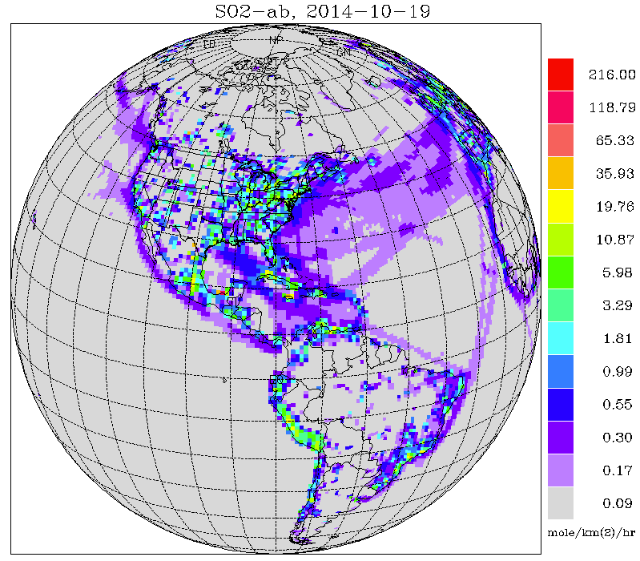
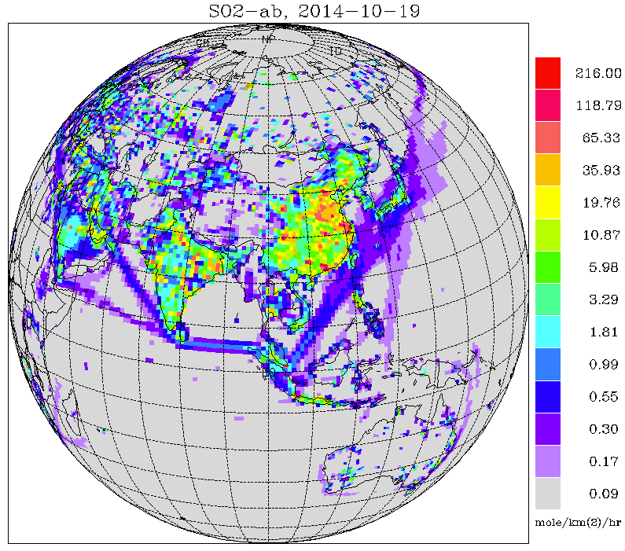
GEFSv12-Aerosol member
One additional member of GEFSv12 for aerosols
Replace operational NGACv2
GEFS meteorology (based on GFSv15) at C384 (~25 km), 64 levels, to 120 hrs, 4x/day
Inline aerosol representation based on GOCART (GSD-Chem)
Sulfate, Organic Carbon, Black Carbon, Dust, Sea Salt
Emissions: CEDS-2014 (SO2, PSO4, POC, PEC), GBBEPx biomass burning, FENGSHA dust, GEOS-5 sea salt, marine DMS
Initial conditions: cycled for aerosols, but from GFSv15 analysis for meteorology
Smoke plume rise: Wind shear dependent 1-d cloud model to simulate tilt of plume. Fire Radiative Power is used to calculate convective heat flux and determine injection height
Tracer transport and wet scavenging are included in Simplified Arakawa-Schubert (SAS) scheme. Fluxes are calculated positive definite. Scavenging coefficient is α=0.2 for all aerosol species.
CEDS-2014 SO2 emissions
Courtesy: Ivanka Stajner

Slide 18
Statistical Evaluation of GEFSv12-Atmosphere
based on 2.5 yr retrospective forecasts (June 2017 – Nov. 2019)

Slide 19
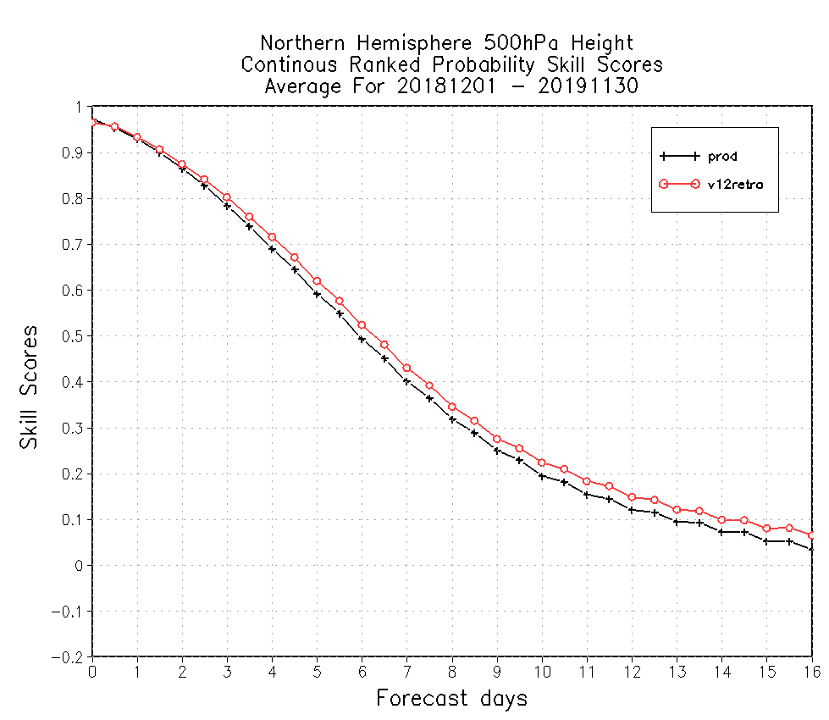
CRPS Skill of 500hPa geopotential height
Extend skill by 12-hours
Extend skill by 12-hours
9.5 days
9.5 days
9 days
9 days
Northern Hemisphere
Southern Hemisphere
CRPSS – Continuous Ranked Probabilistic Skill Score is one of evaluation tools to measure ensemble based probabilistic forecast. CRPSS=1 is for perfect forecast, CRPSS=0 is for no skill from reference (climatology), CRPSS=0.25 is similar to PAC=0.6 (pattern anomaly correlation of ensemble mean). GEFS v12 has better CRPSS for both hemispheres of 500hPa heights.

Slide 20
CRPS Skill of 500hPa geopotential height
0.628
0.601
0.603
0.581
Northern Hemisphere
Southern Hemisphere
0.214
0.179
0.239
0.209
GEFS v12 has better CRPSS for 500hPa heights for both hemispheres, day-5 and day-10, all two and half years.

Slide 21
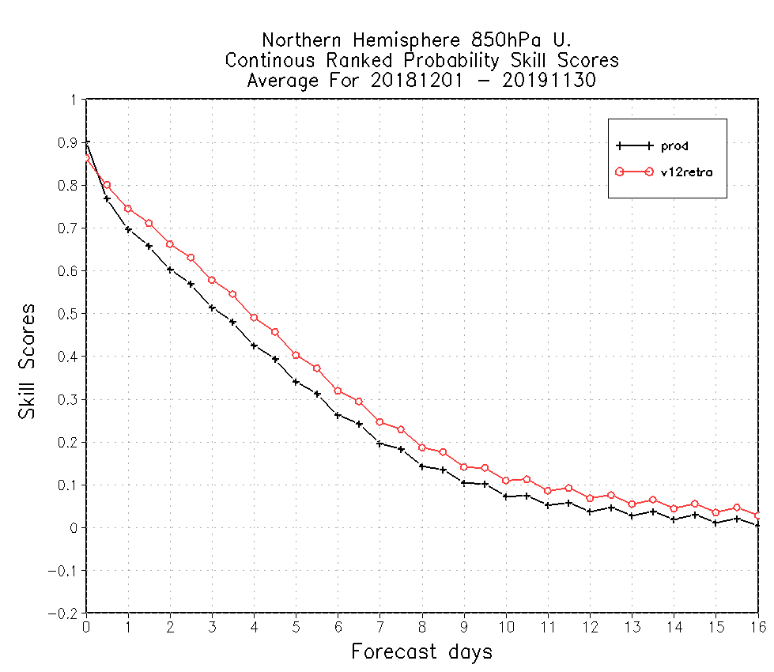
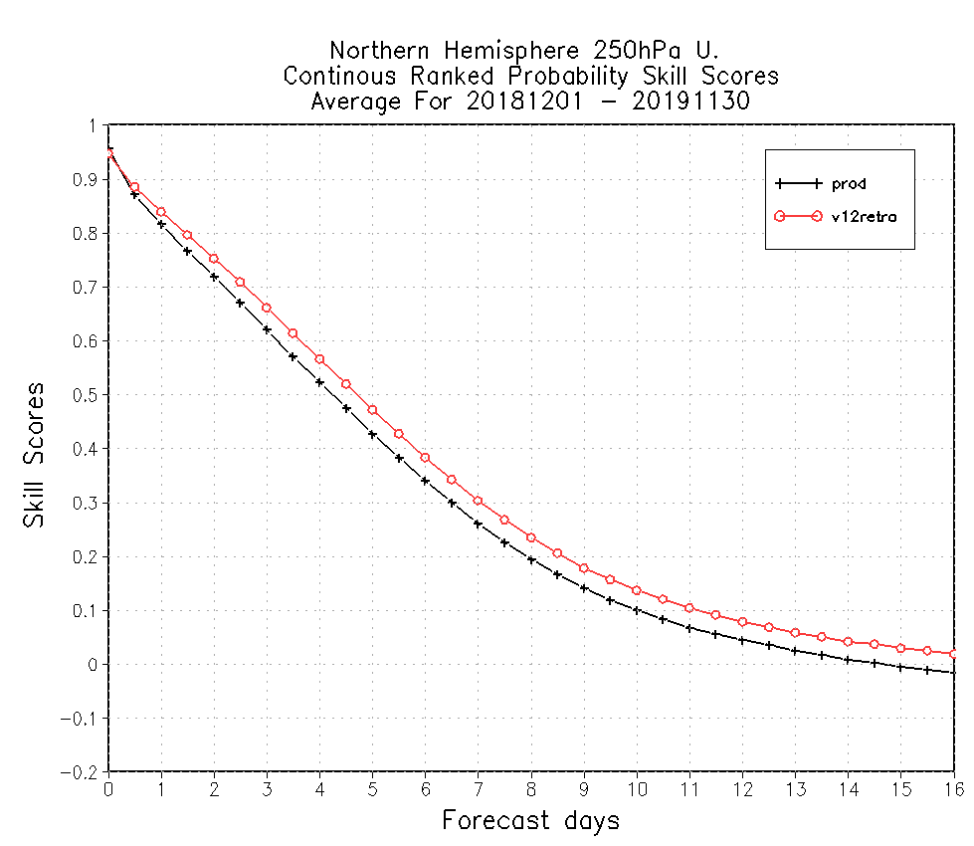
CRPS Skill of 850hPa and 250hPa zonal winds
Extend skill by 14-hours
Extend skill by 12-hours
7.0 days
7.8 days
6.5 days
7.2 days
Northern Hemisphere 850hPa
Northern Hemisphere 250hPa
GEFS v12 has better CRPSS for both hemispheres of 850hPa and 250hPa winds.

Slide 22
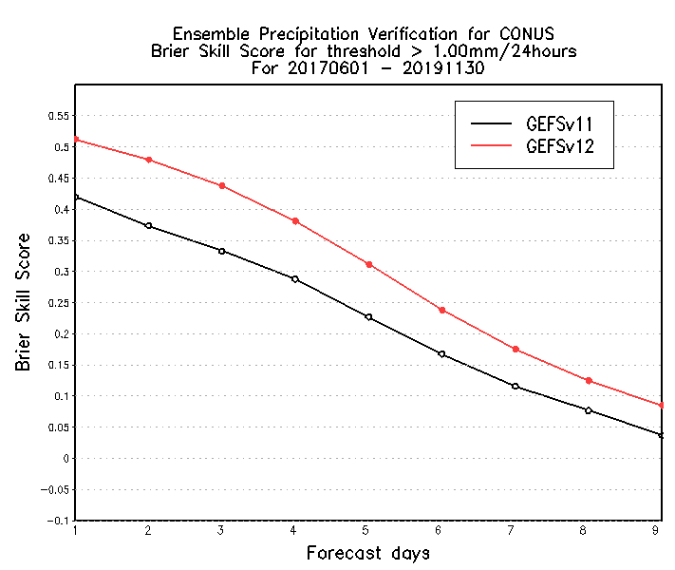
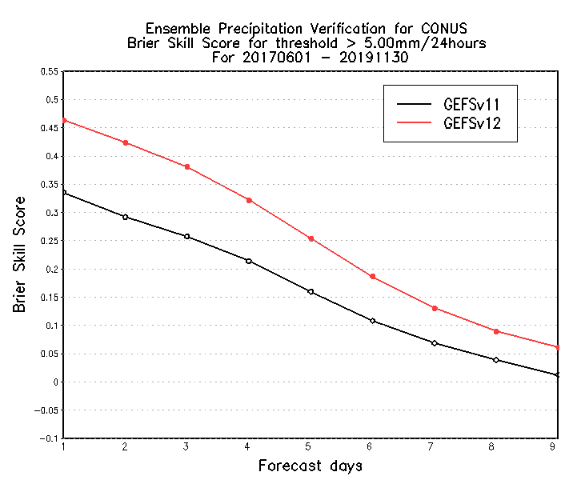
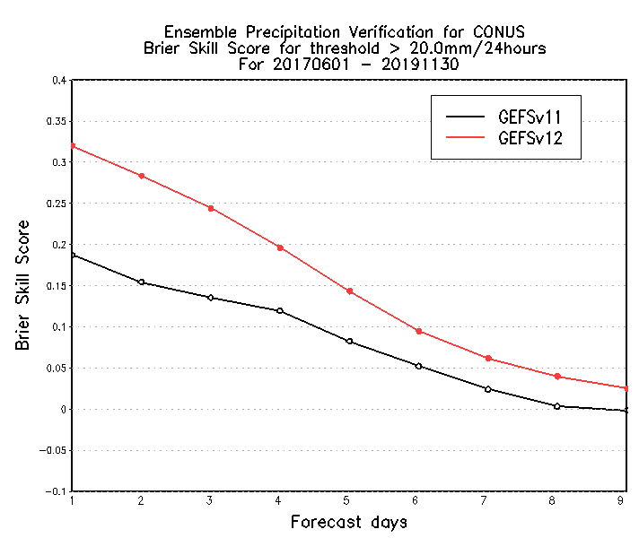
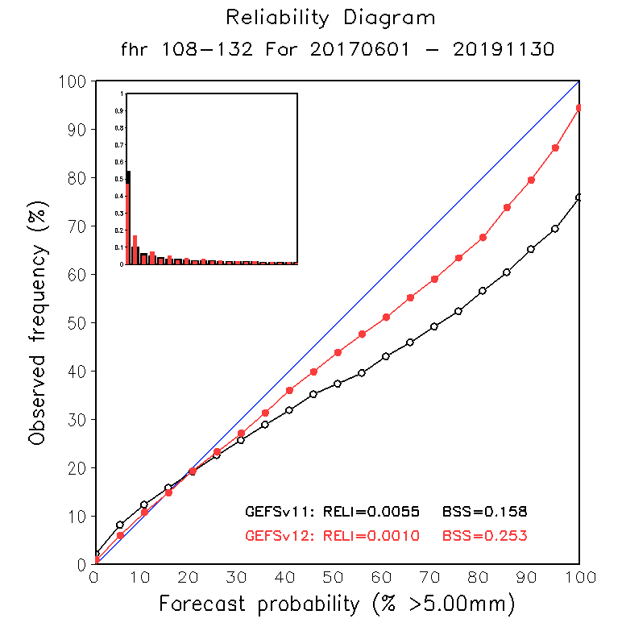
Brier Skill Scores of the CONUS PQPF
0.628
0.601
0.603
0.581
Extend skill ~ 1 days
Extend skill ~ 1 days
Extend skill ~ 1 days
North Hemisphere
South Hemisphere
0.214
0.179
>=1.00mm/24hours
>=5.00mm/24hours
0.239
0.209
>=20.00mm/24hours
Brier Skill Score: BSS=1 is for perfect forecast, BSS=0 is for no skill from reference climatology.
Statistically, GEFSv12 has extended one additional day of useful probabilistic forecast skill over GEFSv11.
The forecast is more reliable (left plot) than GEFSv11.

Slide 23
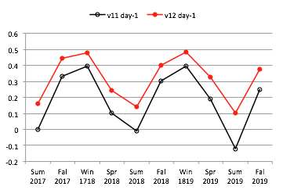
Brier Skill Scores of the CONUS PQPF
0.479
0.372
0.310
0.226
0.319
0.187
>= 1.0mm/day
>= 20.0mm/day
GEFSv12 probabilistic Quantitative Precipitation Forecast (PQPF) performs better than GEFSv11 for all forecast categories, at all forecast lead-times.
Statistically, PQPF has higher skills in the winter period, and less skills in the summer.
The PQPF skills are more challenging for heavy precipitation (>20 mm/day).

Slide 24
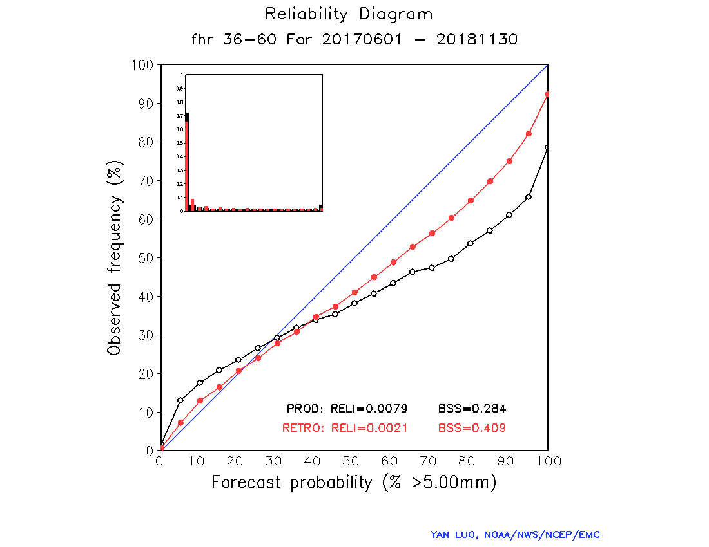
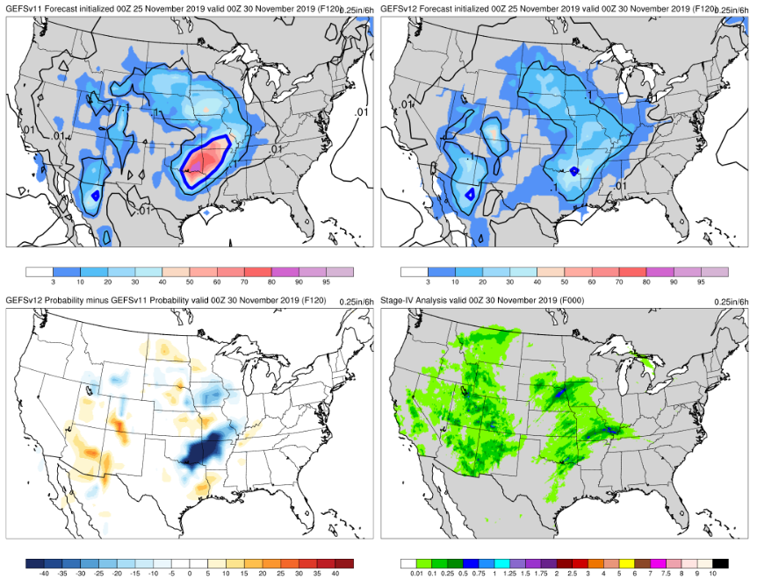
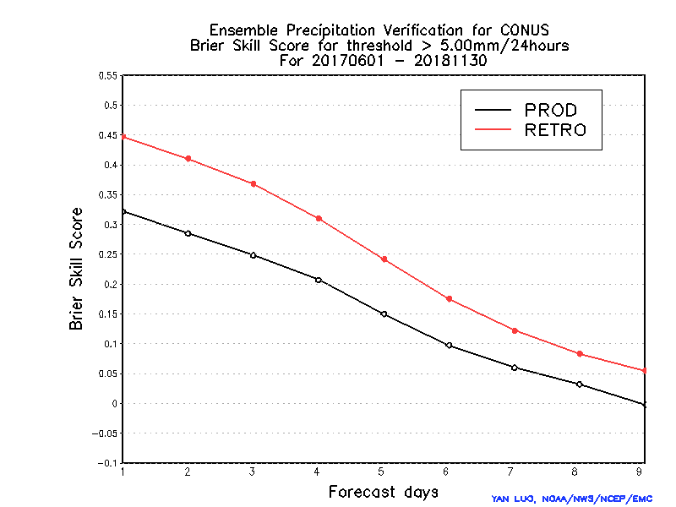
Probabilistic Quantitative Precipitation Forecast
Summary: FV3-GEFS (v12) demonstrated a significant improvement of Probabilistic Quantitative Precipitation Forecast (PQPF) for all categories in terms of reliability (left top) and Brier Skill Score (BSS – left bottom). The diagrams shows here are for 24 hour accumulation precipitation greater than 5mm. The improvement are benefited from improved stochastic perturbation schemes, FV3 dynamics, GFDL MP, higher model resolution and etc…
Reliability
V11
V12
Diff
OBS
Brier Skill Score
>= 5mm/day
GEFS v11 is extremely overconfident here in a rainfall event (PQPF >=0.25 inch/24 hours of 120-hour forecast), while GEFSv12 has more reasonable probabilities due to increased spread

Slide 25
Hurricane track forecast error and spread Include WNP/EP/ATL (all retrospective cases)
GEFS v11 error (solid)
GEFS v11 spread (dash)
GEFS v12 error (solid)
GEFS v12 spread (dash)
Track error /spread (NM)
2017
2018
2019
Forecast hours
Forecast hours
Forecast hours
GEFSv12 shows increasing the track spread (significantly) and reducing error for all three years (2017, 2018 and 2019).

Slide 26
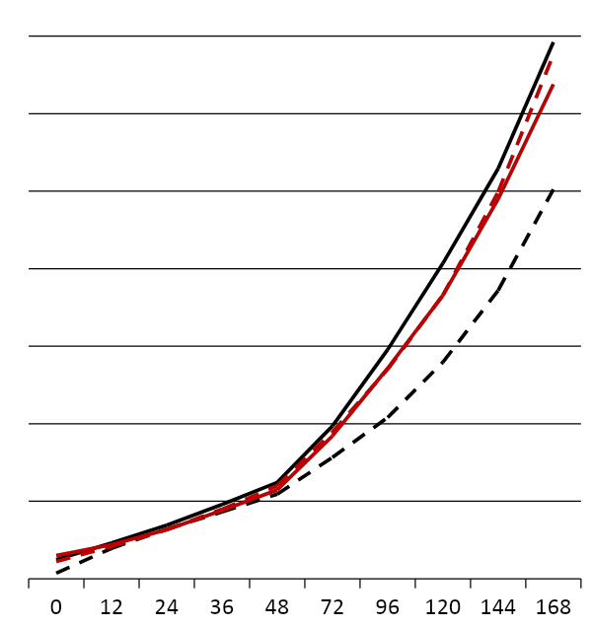
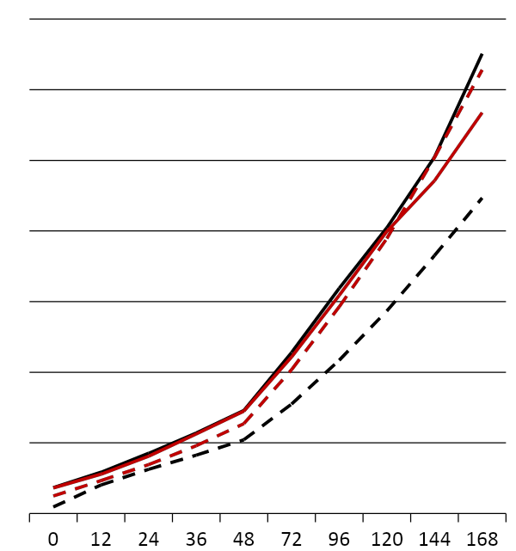
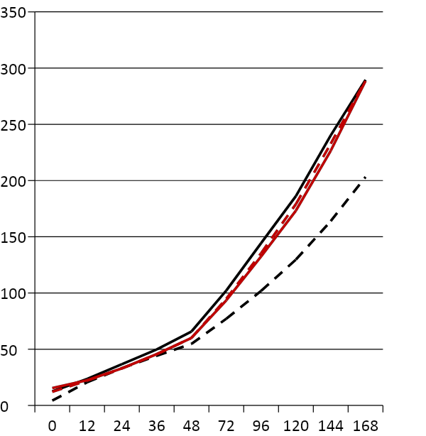
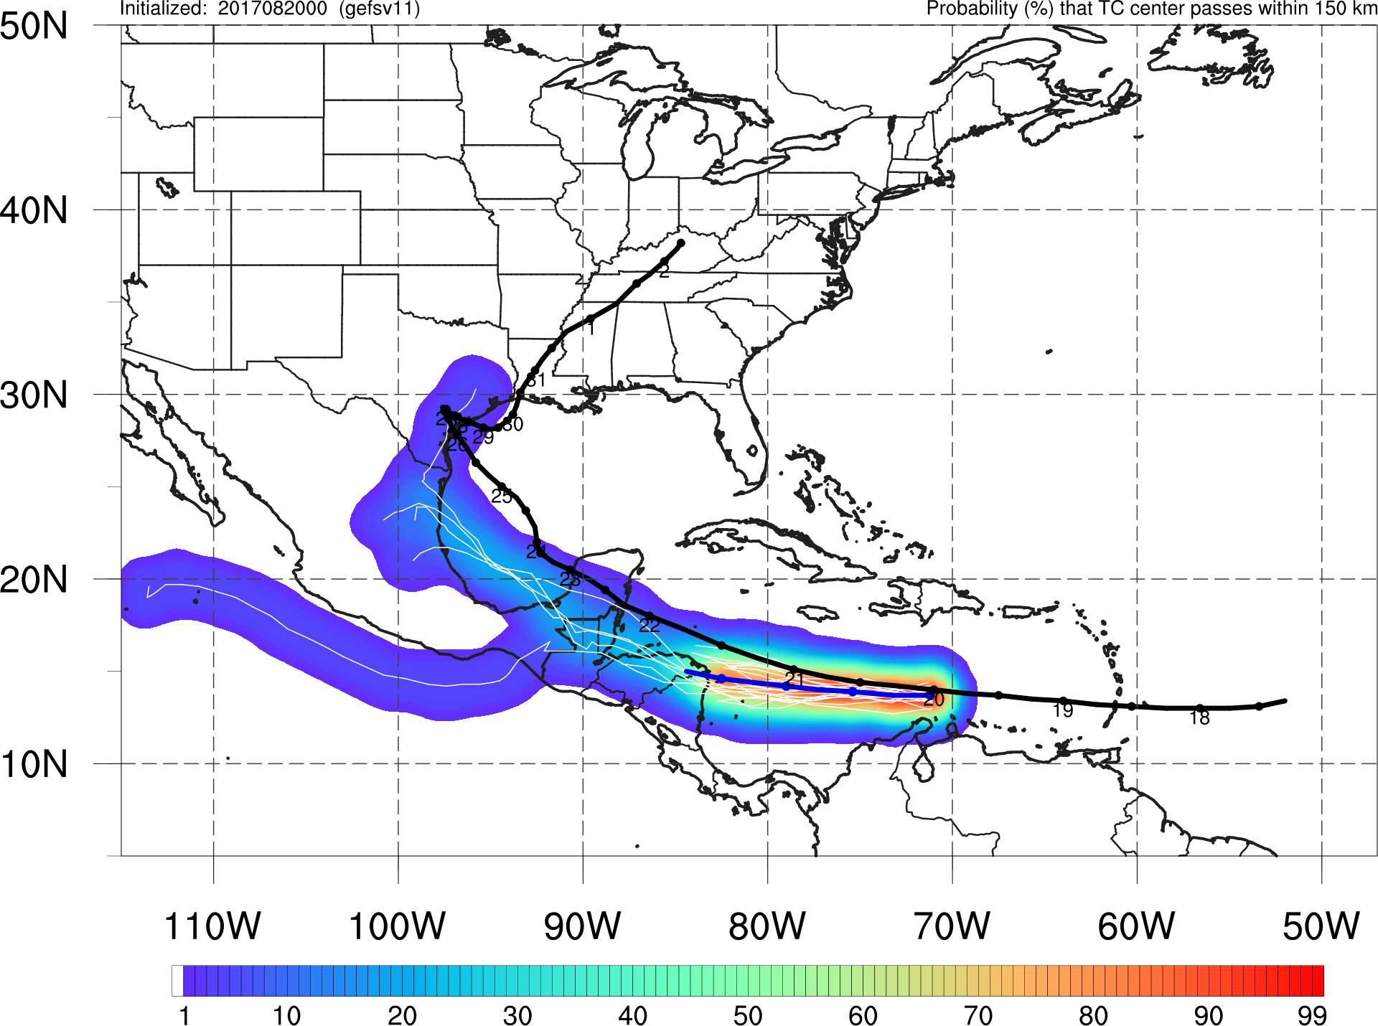
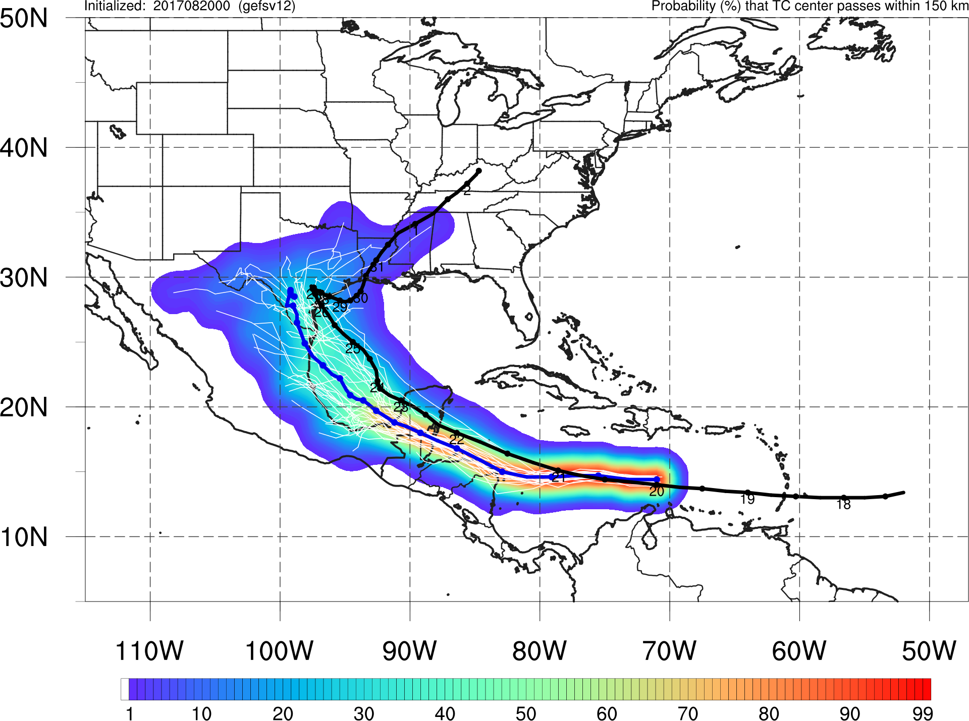
Hurricane track forecast error and spread Include WNP/EP/ATL (all retrospective cases)
Strike probability of hurricane Harvey
GEFS v11 error (solid)
GEFS v11 spread (dash)
GEFS v12 error (solid)
GEFS v12 spread (dash)
V11
Track error /spread (NM)
2017
2018
2019
V12
Forecast hours
Forecast hours
Forecast hours
GEFSv12 shows increasing the track spread (significantly) and reducing error for all three years (2017, 2018 and 2019).

Slide 27
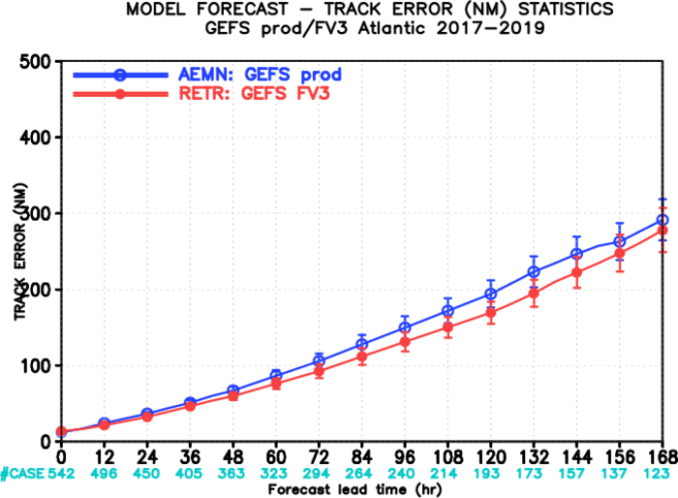
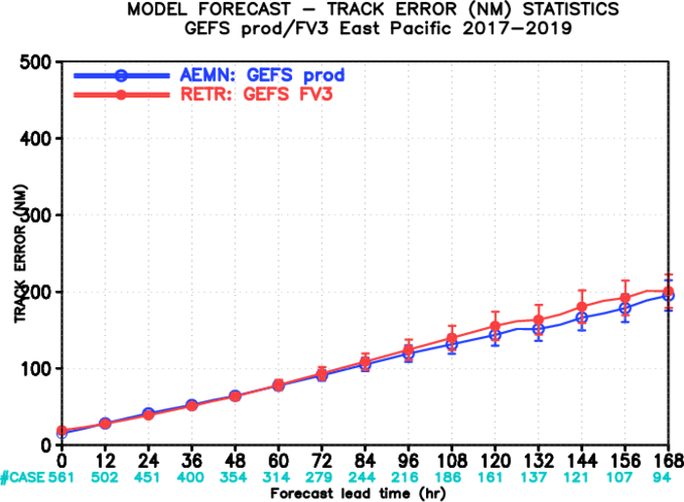
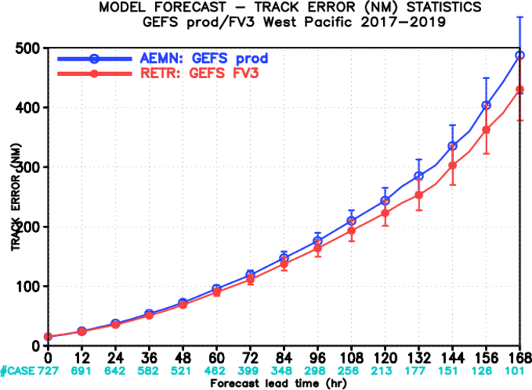
TC track verification
2017: 00Z 06/01----11/30 ; 12Z 07/01----10/31 2018: 00Z 05/01----11/30; 12Z 07/01----10/31 2019: 00Z 05/01----11/30; 12Z 07/01----10/31
Atlantic basin
East Pacific basin
West Pacific basin
Degraded,
But insignificant

Slide 28
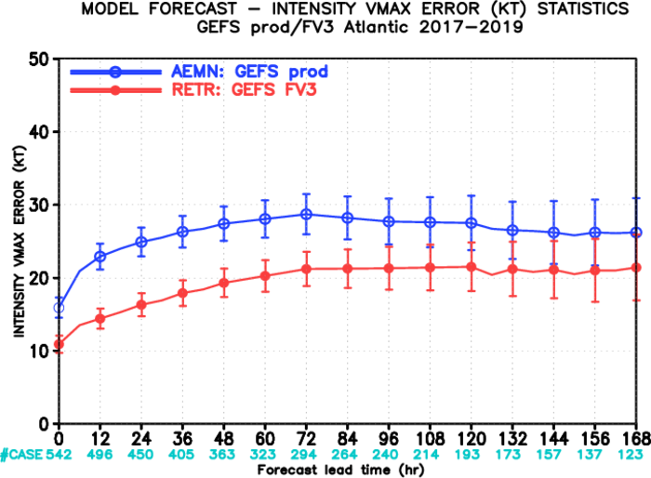
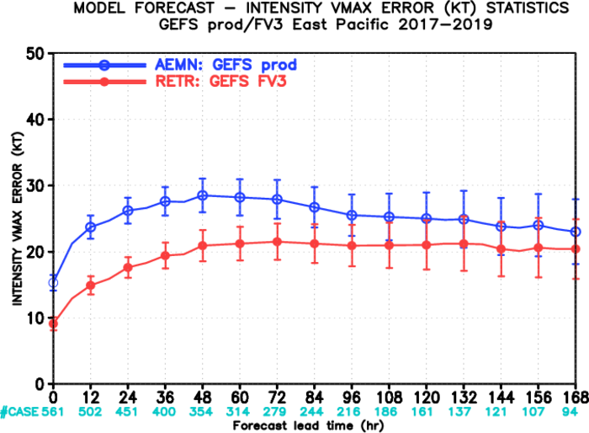
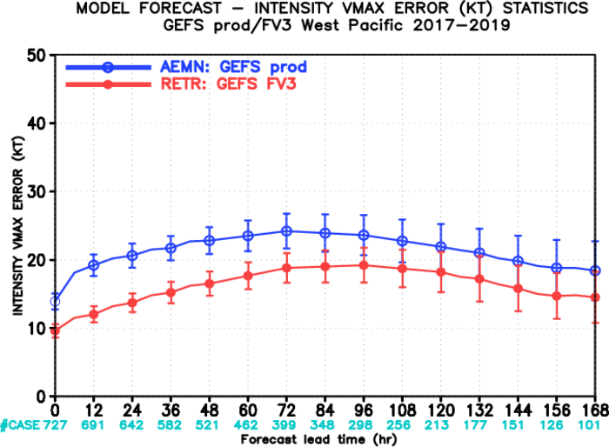
TC intensity verification
2017: 00Z 06/01----11/30; 12Z 07/01----10/31 2018: 00Z 05/01----11/30; 12Z 07/01----10/31 2019: 00Z 05/01----11/30; 12Z 07/01----10/31
Atlantic basin
East Pacific basin
West Pacific basin

Slide 29
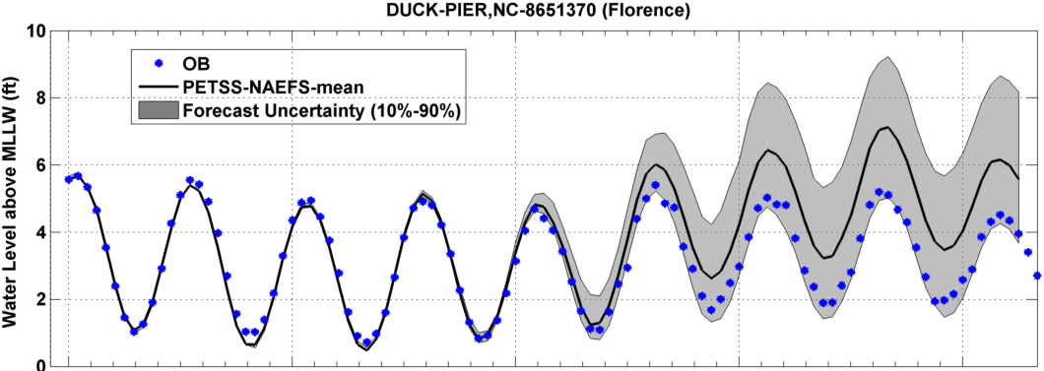
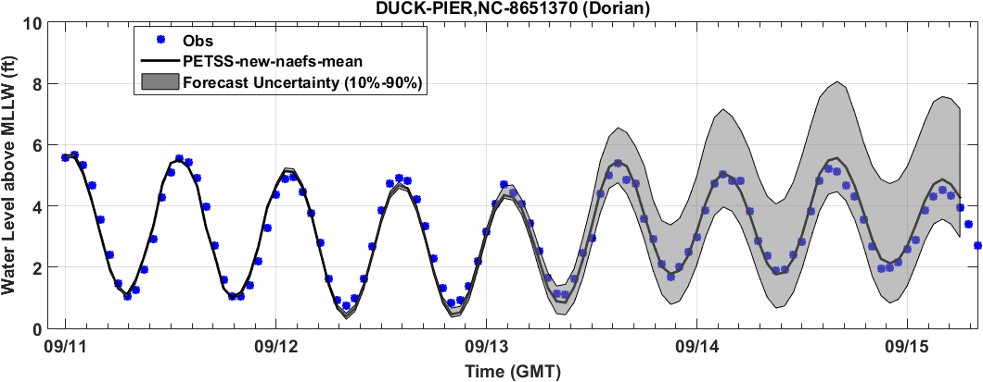
Downstream Application - Hurricane Florence (Sep 11, 2018 00Z)
42 NAEFS members
P-ETSS v1.1 Wind (52 New NAEFS members) Improvements
Ensemble mean guidance is significantly improved
52 New NAEFS members
Courtesy: Drs Huiqing Liu and Peter Arthur (MDL)

Slide 30
More Verifications ……
GEFS retrospective verification (include 40+ cases)
https://www.emc.ncep.noaa.gov/users/meg/gefsv12/verif/
Presentations: https://www.emc.ncep.noaa.gov/users/meg/gefsv12/
Following are presentation lists
FV3 Dynamical Core Information - Developed by GFDL Kickoff to the GEFSv12 Official Evaluation - Presented by Geoff Manikin (2/27/20 MEG Meeting) GEFSv12 Official Evaluation Webpages - Presented by Alicia Bentley (2/27/20 MEG Meeting) Overview of GEFSv12 Verification Statistics - Presented by Alicia Bentley (3/12/20 MEG Meeting) GEFSv12 Retrospective Case Studies: Excessive QPF - Presented by Shannon Shields (3/12/20 MEG Meeting) GEFSv12 Retrospective Case Studies: Winter Storms - Presented by Alicia Bentley (3/19/20 MEG Meeting) GEFSv12 Retrospective Case Studies: Tropical Cyclones - Presented by Shannon Shields/Alicia Bentley (3/26/20 MEG Meeting) GEFSv12 Retrospective Case Studies: Severe Weather - Presented by Logan Dawson (4/2/20 MEG Meeting) GEFSv12 Retrospective Case Studies: Low Skill/Dropouts - Presented by Shannon Shields (4/2/20 MEG Meeting) GEFSv12 Retrospective Case Studies: Cold-Air Outbreaks - Presented by Geoff Manikin (4/2/20 MEG Meeting) GEFSv12 SOO Team Evaluation Overview - Presented by NWS SOO Team (4/16/20 MEG Meeting) The MEG GEFSv12 Evaluation Overview - Presented by Alicia Bentley/Geoff Manikin (4/23/20 MEG Meeting)
GEFS v12 Field Evaluations (Waves/Aerosols/Weeks 2-4) – Presented by Henrique Alves/Deanna Spindler/Jeff McQueen/Shannon Shields (4/30/20 MEG Meeting) GEFS v12 Field Evaluations (Days 1-10 Weather)- Presented by Alicia Bentley (4/30/20 MEG Meeting)

Slide 31
Evaluation of GEFSv12
Week-2, Weeks 3&4 Forecasts

Slide 32
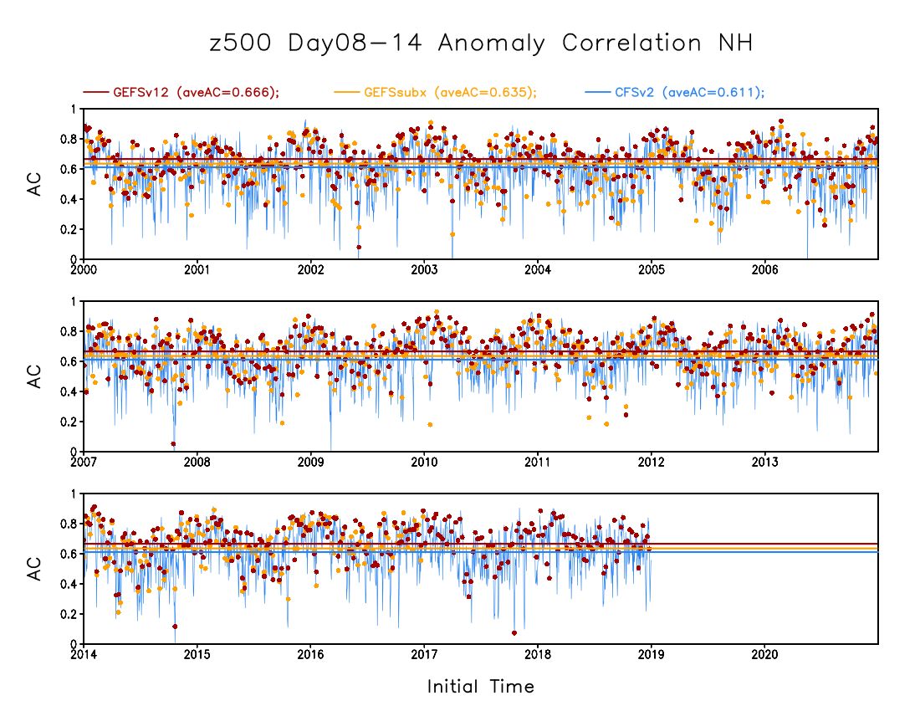
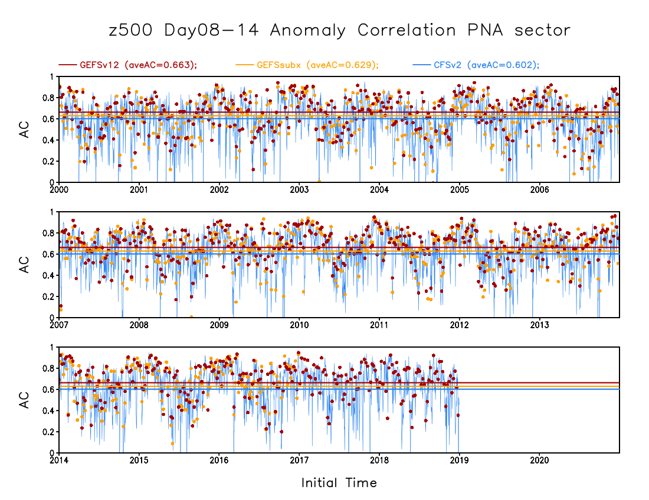
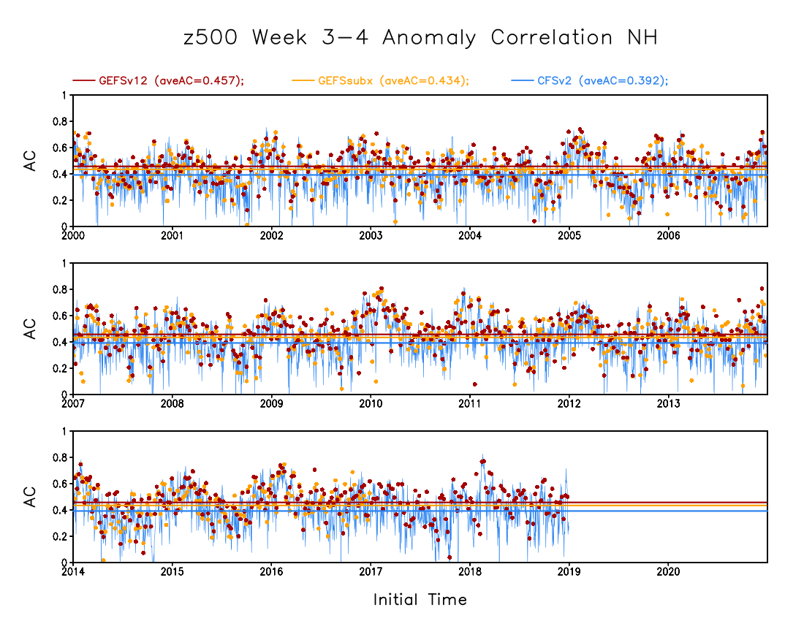
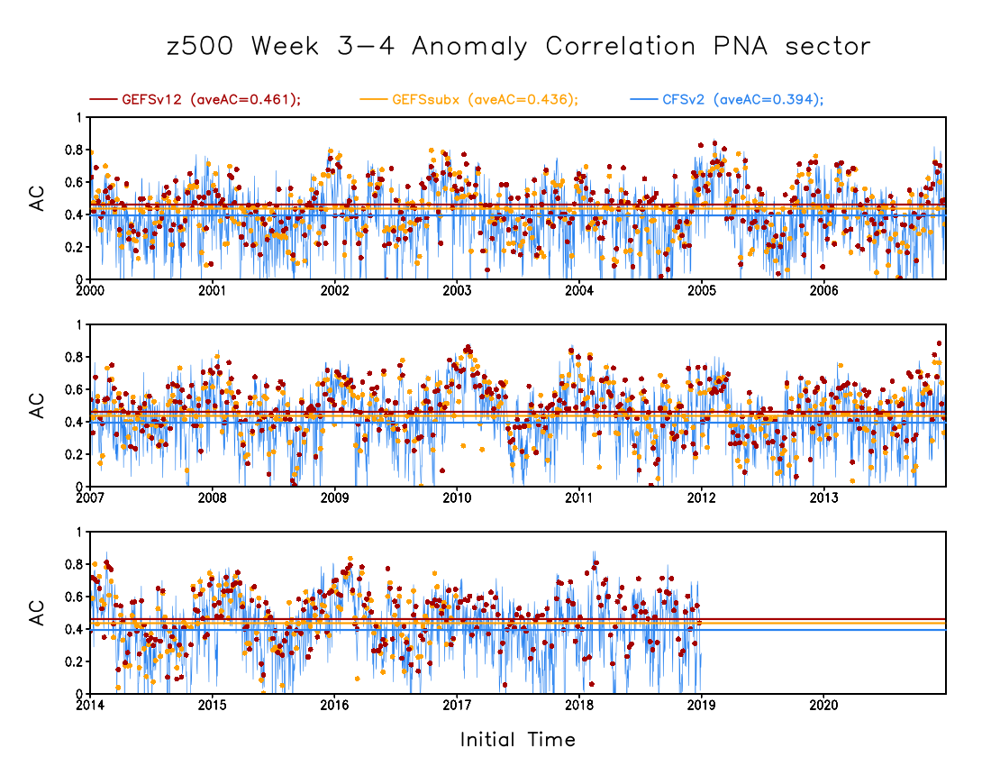
500hPa height PAC scores (2000-2019)
GEFSv12 – 0.666
SubX – 0.635
CFSv2 – 0.611
GEFSv12 – 0.663
SubX – 0.629
CFSv2 – 0.602
NH week-2
PNA week-2
GEFSv12 – 0.457
SubX – 0.432
CFSv2 – 0.394
GEFSv12 – 0.461
SubX – 0.439
CFSv2 – 0.394
NH weeks 3&4
PNA weeks 3&4
Courtesy of Dr. Mingyue Chen (CPC)

Slide 33
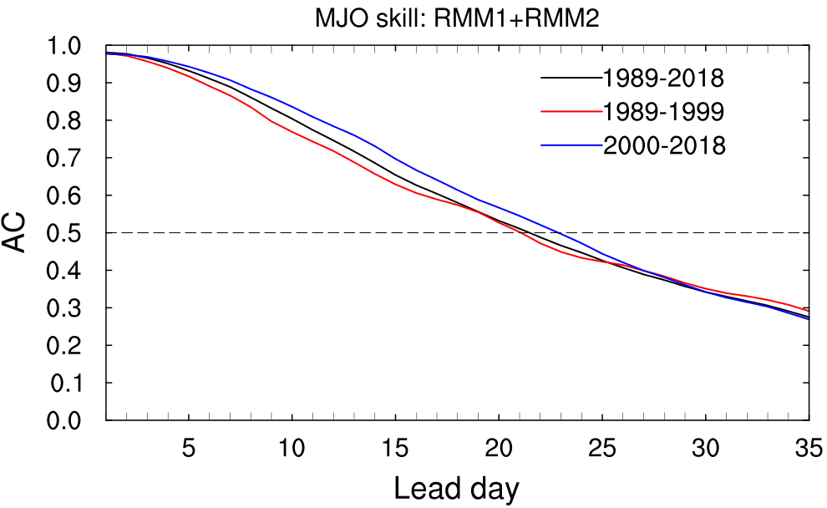
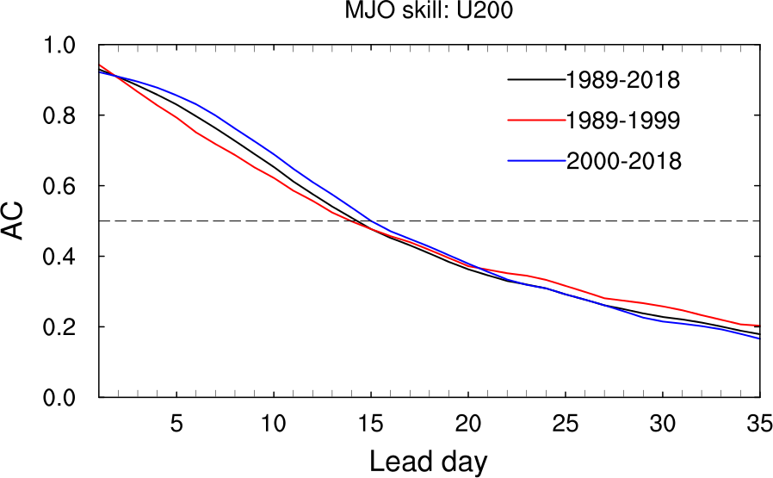
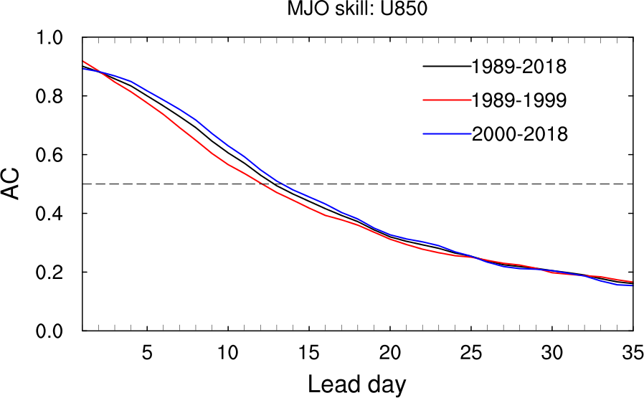
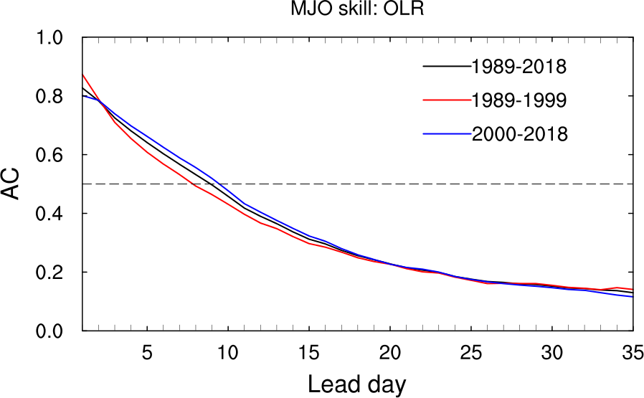
MJO RMM Skill during Different Periods
Use dependent climatology
CFSR climatology (1989-1999)
GEFS reanalysis climatology (2000-2018)
GEFS reforecast climatology (1989-2018)
MJO skill (RMM1+RMM2)
Latest years (2000-2018) is best
Early years (1089-1999) is least
Average scores (1989-2018) is about 21 days
U200
U850
OLR

Slide 34
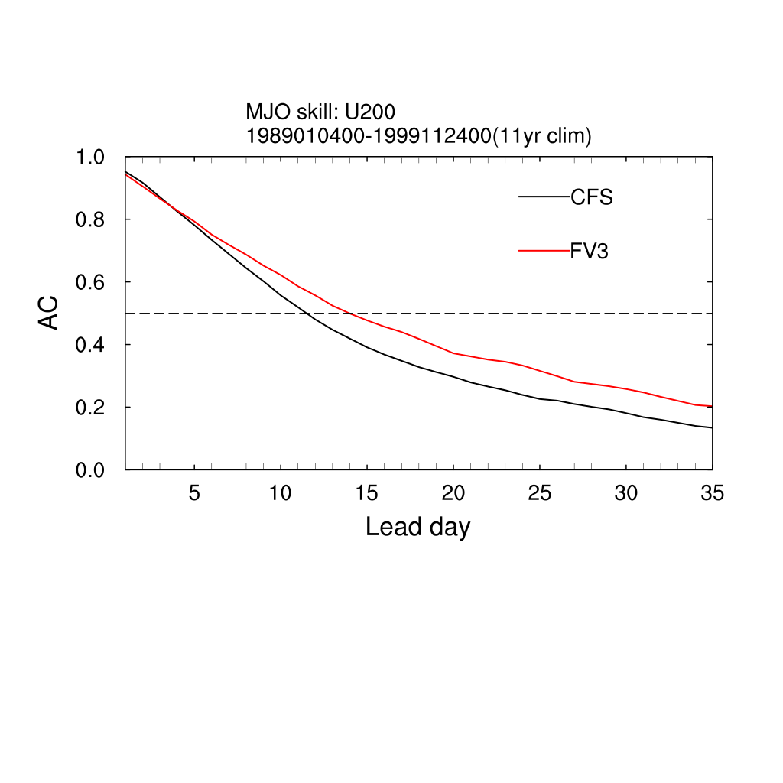
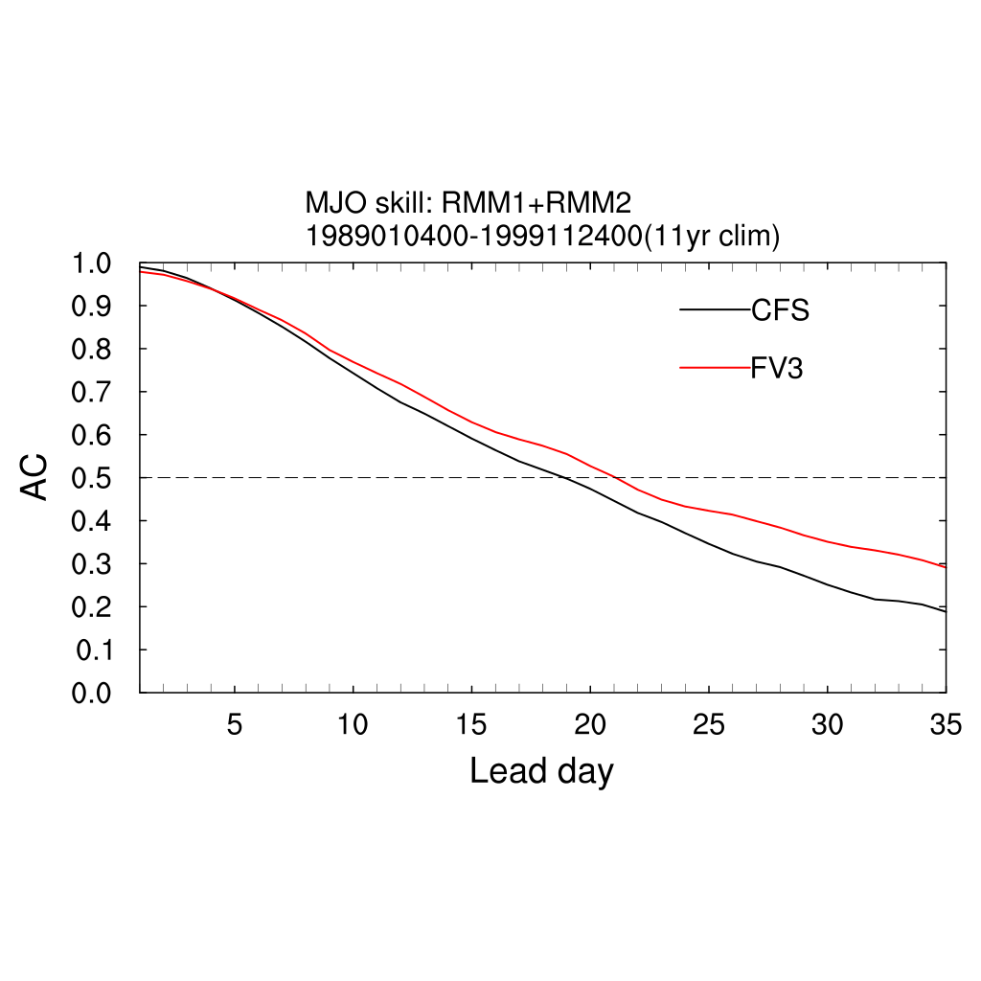
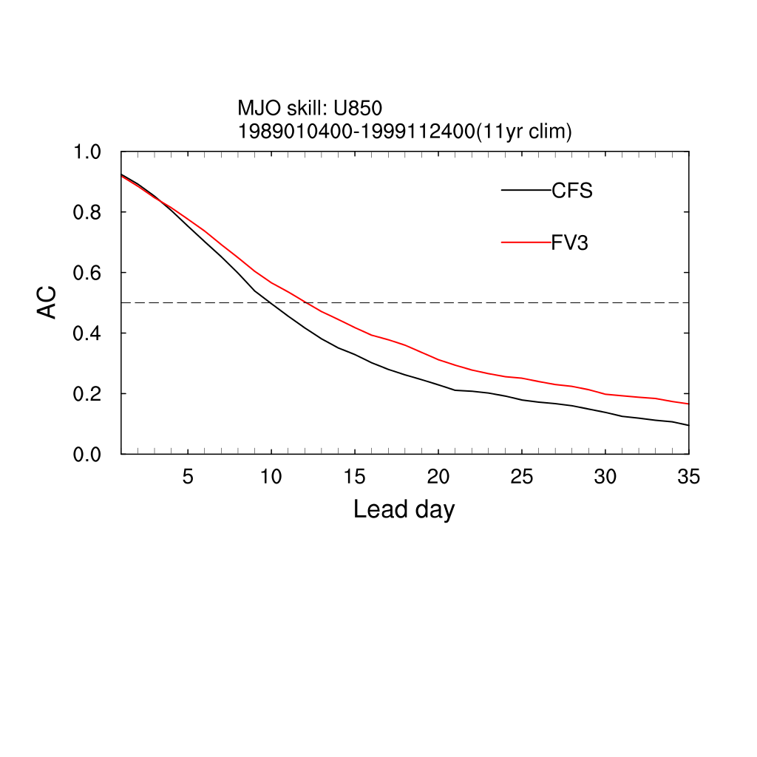
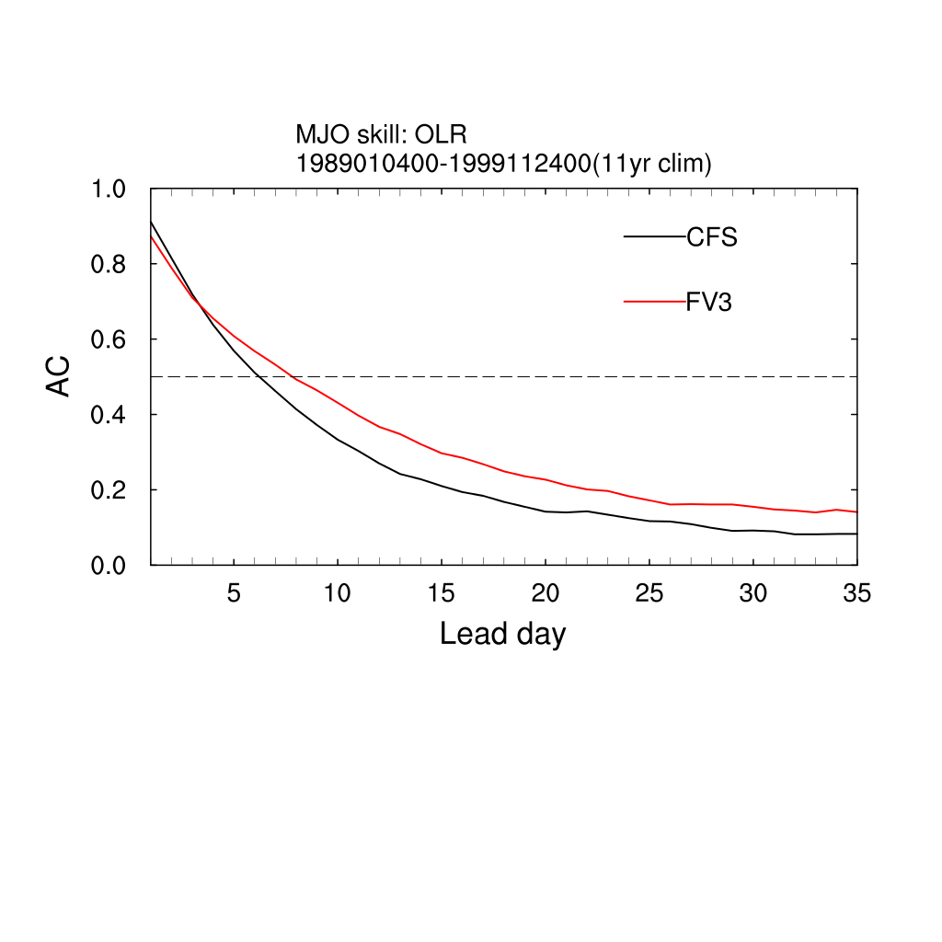
MJO skills comparison (1989-1999)
GEFSv12 vs. CFSv2
MJO RMMs ACC
U200
MJO Components
U850
OLR
Both MJO skills are lower, but GEFSv12 is better than CFSv2 about 2 days
The same for MJO components skill, GEFSv12 is better than CFSv2
OLR

Slide 35
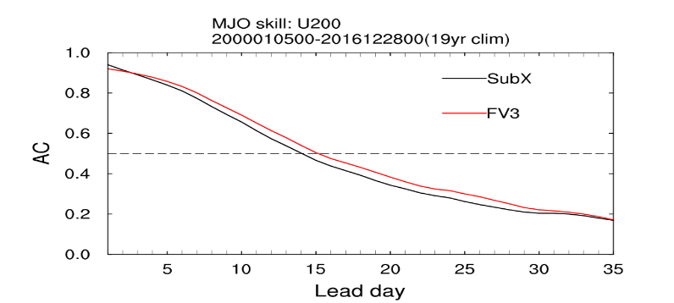
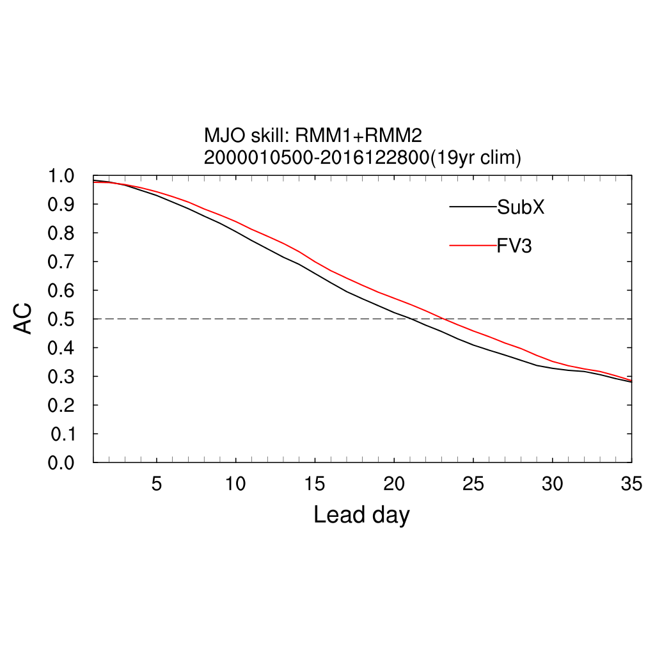
MJO skills comparison (2000-2016)
GEFSv12 vs. SubX
MJO RMMs ACC
U200
MJO Components
U850
OLR
For MJO RMM skill (bias corrected), GEFSv12 (23+ days) > SubX GEFS for ~ 2 days
For MJO components skill, GEFSv12 > SubX GEFS
OLR

Slide 36
Propagation of MJO in GEFSv12
1989 - 1999
Spatial and time correlation (anomaly) in the Central Indian Ocean /time-lag of 11 years analysis (CFSR; left) and 30-day forecast (GEFSv12 ensemble mean; right). The correlation coefficient of OLR is in shaded and 850 zonal wind is in contours. The statistics indicate that there is a very good eastward propagation of signal (or MJO) from India Ocean. However, it is challenging to capture northward propagation of Intra-Seasonal Oscillations.

Slide 37
Statistical Evaluation of GEFSv12-Wave Component
based on 1 yr retrospective forecasts (Nov. 2018–Oct. 2019)
Retrospectives: Dec 1, 2018 - Nov 30, 2019; 00Z Cycle; 31 Members; 16 days
Validation Statistics
Parameters: Significant wave height - Hs and Peak Period - Tp
Bias, RMSE, CRPS; Talagrand, Brier SS
NDBC network (~150 buoys) and Jason-3/SARAL altimeters
Verified vs op GWES and deterministic wave model (multi_1)

Slide 38
Monthly Hs Statistics - Days 1 & 5 - Altimeters
Significantly reduced Hs error and bias consistently in short and long fcst ranges
Ensemble wave-heights from GEFSv12 have higher accuracy and predictability.
Storm waves better predicted through year in short and long fcst ranges
CRPS
RMSE
BIAS
95th quantile
CRPS
RMSE
BIAS
95th quantile

Slide 39
Monthly Hs Statistics - Days 1 & 5 - Buoys
Buoy data confirms altimeter validation: significantly reduced Hs error and bias. Also note larger spread, and closer relationship between RMSE and spread.
Hs ensemble from GEFSv12 is more accurate, provides higher predictability.
Storm waves better predicted in short and long fcst ranges.
BIAS
CRPS
RMSE
95th quantile
CRPS
RMSE
BIAS
95th quantile

Slide 40
Hs Statistics Entire Retro by Forecast Range
Data from the entire validation period confirms: in all forecast ranges, relative to buoys and altimeters, Hs from upgrade significantly reduces Hs error and bias, improves predictability and forecasts of storm waves. Note that extended forecast range provides skillful forecast. GEFSv12 10-day forecast is equivalent in skill to 5-day current operational, 16-day, equivalent to 10-day.
NDBC Buoys
95th quantile
CRPS
RMSE
BIAS
Jason-3/SARAL Altimeters
BIAS
RMSE
CRPS
95th quantile

Slide 41
Statistical Evaluation of GEFSv12-Aerosol Component
based on 9-month retrospective forecasts (July 2019 – March 2020)

Slide 42
Mean behavior: Organic carbon AOD bias
NGAC day 1 prediction – GEOS-5 analysis
550 nm AOD, 7/5/19-11/30/19
GEFS-Aerosol day 1 prediction – GEOS-5 analysis
550 nm AOD , 7/5/19-11/30/19
Organic carbon AOD (Aerosol Optical Depth) biases with respect to GEOS-5 analyses are smaller for GEFS-Aerosols (right) than those for NGAC (left).
Same is true for dust and sulfate (not shown).
Courtesy of Dr. Ivanka Stajner
42

Slide 43
Correlation (R) based on Day 1 forecast of NGACv2 and AERONET
Correlation (R) based on Day 1 forecast of GEFSv12-Aersol and AERONET
Significant improvement in aerosol forecasts from GEFSv12-Aerosol

Slide 44
Variability: AERONET comparisons
Comparison against AERONET AOD (Aerosol Optical Depth) in biomass burning impacted region in Africa. GEFS-Aerosol tracks observed total AOD magnitude and variability much better than NGAC in western (Gabon) and eastern (Misamfu) Africa.
Gabon
Misamfu
GEFS-Aerosol
Courtesy of Dr. Ivanka Stajner
44

Slide 45
Time series of Day-1 AOD forecasts compare to MERRA2 reanalysis
Black – MERRA2 reanalysis
Green – NGACv2
Blue – GEFSv12
Major global regions
(from top left to bottom right)
N. Africa
N. Atlantic
S. Africa
S. Atlantic
S. America
Europe
E. Asia
E. USA
W. USA
An improvement is over all major global regions. A significant improvement is for S. Africa, S Atlantic, S America and E. Asia.

Slide 46
Field/MEG evaluations of GEFSv12
Geoff Manikin, Alicia Bentley,
Shannon Shields, and Logan Dawson

Slide 47
The MEG Evaluation of GEFSv12
Built web site featuring verification, retrospective case graphics, and information about the upgrade and assessment
Conducted 7 webinars covering different components of the GEFSv12 evaluation
Generated GEFSv11 vs GEFSv12 comparison graphics for 45 different cases covering a variety of challenging/high-impact cases; with no real-time parallel, this was the only way for the field to visualize the changes
Led a national SOO team to complement the evaluation
Gathered and organized all evaluations covering the atmospheric, aerosol, and wave components of GEFSv12

Slide 48
Summary of Atmospheric Metrics (Days 1-10)
PARAMETER | SKILL | SPREAD | BIAS
250-hPa winds (NH) | Improved | Improved | Somewhat Improved
500-hPa height (NH) | Improved | Improved | Somewhat Degraded
850-hPa winds (NH) | Improved | Improved | Neutral
850-hPa temp. (NH) | Improved | Improved | Somewhat Degraded
1000-hPa height (NH) | Improved | Improved | Somewhat Degraded
10-m winds (NH) | Improved | Improved | Neutral
2-m temp. (NH) | Improved | Improved | Improved
Precipitation (NH) | Improved | Improved | Degraded (higher amts)
TC Tracks (N. Atlantic) | Somewhat Improved | Improved | Degraded (across track)
TC Tracks (E. Pacific) | Somewhat Degraded | Improved | Degraded (across track)

Slide 49
Summary of Atmospheric Metrics (Days 1-10)
PARAMETER | SKILL | SPREAD | BIAS
250-hPa winds (SH) | Improved | Neutral | Somewhat Improved
500-hPa height (SH) | Improved | Neutral | Somewhat Degraded
850-hPa winds (SH) | Improved | Somewhat Improved | Somewhat Degraded
850-hPa temp. (SH) | Improved | Somewhat Improved | Degraded
1000-hPa height (SH) | Improved | Somewhat Improved | Somewhat Degraded
10-m winds (SH) | Improved | Improved | Neutral
2-m temp. (SH) | Improved | Improved | Improved
250-hPa winds (Tropics) | Improved | Considerably Improved | Neutral
850-hPa winds (Tropics) | Improved | Considerably Improved | Somewhat Improved
10-m winds (Tropics) | Improved | Considerably Improved | Somewhat Degraded

Slide 50
Summary of Waves Metrics
Metric | Significant Wave Height | Peak Wave Period
 |  | Windseas | Swell
Skill | Improved | Neutral | Neutral
Reliability | Improved | N/A | N/A
RMSE | Improved | Neutral | Neutral
Spread | Improved | Improved | Improved
Bias | Improved | Slightly Improved | Neutral
95% Quantile | Improved | N/A | N/A

Slide 51
Summary of Aerosols Metrics
Bias for Day 1 Aerosol Optical Depth (AOD) forecast (July 2019 – March 2020)
Event | Period | Bias | Comment
African Dust | Full | Improved
African Biomass Burning | Summer | Neutral | NESDIS GBBEPx adjustment
South America Biomass Burning | Summer | Improved
Asian Sulfate | Fall/Winter | Neutral | Strong overprediction (COVID related)
North America | Full | Improved | Overpredict ag fires
Ocean sea-salt | Full | Neutral | Wet scavenging likely too low

Slide 52
Summary of Atmospheric Weeks 1-2 Evaluations
Region | Recommendation | Key Remarks
Eastern Region | Implement | GEFSv12 had significantly better synoptic performance. Improved spread in TC tracks, with increased right-of-track bias.
Central Region | Implement | GEFSv12 outperformed GEFSv11 synoptically. Improved spread, which better encapsulated the envelope of potential solutions and highlighted important gradients. Improved performance in areas of complex terrain.
Southern Region | Implement | A noticeable step forward in ensemble modeling. Overall improved spread in nearly all fields.
Western Region | Implement | Overall improvements in AC scores, dispersion, terrain resolved features, etc. Concerned with the performance of a few of the cases in the West showing long-range forecast degradation.
Alaska Region | Implement | GEFSv12 shows definite benefits over GEFSv11, mainly due to its increased spread. GEFSv12 can have a progressive bias.

Slide 53
Summary of Atmospheric Weeks 1-2 Evaluations
Center | Recommendation | Key Remarks
Pacific Region | Implement | No concerns.
WPC | Implement | Major improvements in QPF reliability and over complex terrain. Probabilistic fields will provide more useful guidance. Concerned about the low mean QPF bias at moderate to heavy amounts. Increased spread (particularly in regions with tight gradients), provides better uncertainty information to forecasters.
SPC | Implement | Impressive general statistical improvement. Systematic biases: progressive shortwave troughs and overmixing in the PBL along and near moisture gradients. Improved dispersion, probabilistic thunderstorm proxy forecasts, and 2-m dewpoint z-scores.
NHC | Implement | Large improvements in hurricane intensity skill. Hurricane track forecasts are improved in the NATL and degraded in EPAC. Right-of-track track bias gets worse at longer lead times. Larger spread in GEFSv12 better captures range of potential tracks.

Slide 54
Summary of National SOO Team Ratings For Overall Utility
 | Mean Rating -3 to +3 | % of Cases Rated as Good or Better than v11 | % of Cases Rated Worse than v11
Day 10 | 0.18 | 82 | 18
Day 9 | 0.14 | 74 | 26
Day 8 | 0.23 | 70 | 30
Day 7 | 0.32 | 70 | 30
Day 6 | 0.23 | 74 | 26
Day 5 | 0.30 | 74 | 26
Day 4 | 0.44 | 74 | 26
Day 3 | 0.53 | 82 | 18
Day 2 | 0.58 | 84 | 16
Day 1 | 0.44 | 95 | 5
Mean rating favors v12 at all forecast lengths
Some clear utility in the short range
In the aggregate, the SOO team clearly found GEFSv12 to be as good or better than GEFSv11

Slide 55
Summary of Atmos Weeks 3-4 Evaluation (CPC)
The parallel version is an improvement over GEFSv10 in week 2 and over GEFSv11 and CFSv2 in weeks 3 and 4
GEFSv12 was an improvement for temperature and 500 hPa heights during weeks 2, 3, and 4; there was also some likely improvement in precipitation
GEFSv12 was an improvement over CFSv2 for week 2 tropical cyclone forecasts and similar to the ECMWF; GEFSv12 was an improvement at weeks 3 and 4 for tropical cyclones, but all models struggle
GEFSv12 was largely an improvement in the stratosphere (improved T and u), but there is much room for improvement
Supports proposed implementation of GEFSv12

Slide 56
Summary of Waves Evaluations
Region | Recommendation | Key Remarks
Ocean Prediction Center | Implement | For all time steps GEFS-Wave is showing reduced bias and lower RMSE. A clear improvement. The increased resolution, extension of the forecast range to 384 hours, increasing the number of members from 21 to 31, and adding a third swell partition are significant upgrades.
Alaska Region | Implement | The bias is significantly lower during the typically difficult to forecast winter season. This has important implications for Alaska - which often experiences intense and difficult to forecast storms in the winter. Skill is particularly apparent on the day 7 where forecast skill typically depreciates. It seemed that especially for the Gulf of Alaska that the spread would often be quite high and above the final verification.
Canadian Meteorological Center - ECCC | Implement | The most noticeable improvement is in spread. RMSE and bias of the ensemble mean appear to have improved in the North Hemisphere winter, this is notable considering the operational ensemble was already good with respect to this. No systematic degradation was noticed.
National Hurricane Center | Implement | There are substantial upgrades to the overall system. Significant wave height verification is greatly improved for the ensemble mean while peak period is more neutral. The model improvements and verification statistics more than support implementation.

Slide 57
Common Themes in Waves Evaluations
Overall, the parallel version is an improvement over the operational GWES. All participating evaluators support the proposed implementation.
Alaska Region Concern:
Overdispersive in Gulf of Alaska
Common Positives:
Reduced bias & lower RMSE in winter season
Improved reliability in forecasts of ocean waves
Overall larger and more meaningful spread in GEFS-Wave
Extension of forecast range to 16 days

Slide 58
Summary of Aerosols Evaluations
Region | Recommendation | Key Remarks
Western Region | Implement | Not a huge amount of wildfire cases to examine, regarding smoke in the West. However, the few cases looked at, as well as Aug. 2019 stats, indicated improvement over NGAC.
Air Resources Laboratory | Implement | GEFS-Aerosol model gave superior input than that from NGAC for National Air Quality Forecasting Capability. Model-simulated elemental carbon and black carbon fields showed more accurate signals from the GEFS-Aerosol system than the NGAC system.
Southern Region | Implement | It appears there is indeed ample reflection of the higher-resolution aerosol information provided in the GEFSv12 data. Comparing errors of GEFSv12 vs NGAC relative to MERR/IMME (observed), GEFSv12 appears to have smaller errors; almost always in area, and often in magnitude as well. Improvement seems to be even better in the dust forecasts, vs the Total AOD views.
Alaska Region | Implement | Greatest strength for long-term transport events; does not seem to detect local fire and smoke events due to lower resolution. Appears to hold promise to help our aviation forecasters handle ash resuspension events. In case study of greatest concern, the correct smoke did not occur, but this may have been due to unavailability of GBBEPx emissions.

Slide 59
Summary of Aerosols Evaluations
Region | Recommendation | Key Remarks
U.S. Naval Research Laboratory | Implement | Significant biases still exist, but overall GEFS-Aerosols member looks much better than NGAC. With improved biomass burning, GEFS-Aerosols would likely also be improved. However, in some places like Africa, the bias is only shifting signs.
Climate Prediction Center | Implement | Aerosol forecasts will improve UV Index forecasts; current product uses seasonal climatology that does not capture smoke at all. Higher resolution in GEFS-Aerosols. Expect smoke to be advected better than NGAC.
Connecticut Dept of Energy and Environmental Protection | Implement | Wildfire smoke prediction will be a major improvement, especially when 1-day old fire data can be used.
NESDIS | Implement | Mode predictions are very encouraging. Comparisons with VIIRS AOD show that model is slightly underpredicting.

Slide 60
Common Themes in Aerosol Evaluations
Overall, the parallel version is an improvement over the operational NGAC. All participating evaluators support the proposed implementation.
Alaska Region Concern:
GEFS-Aerosols member did not seem to detect local fire and smoke events
Common Positives:
5 out of 8 evaluators saw overall improvement in the dust prediction of GEFS-Aerosols compared to NGAC (3 were unsure)
More accurate signals and smaller errors in GEFSv12-Aerosols compared to NGAC

Slide 61
Common Positive Themes in MEG and Field
Atmospheric Evaluations
Higher 500-hPa AC scores and improved synoptic predictability
Increased ensemble spread (improved ensemble dispersion), with spread located in meaningful areas
Improved TC tracks, spread, and location of precip. maxima
Better handling of deepening extratropical cyclones
More reliable precipitation forecasts
Improved representation of weather events near topography
Mitigation of exaggerated offshore QPF maxima

Slide 62
Improved Synoptic Predictability and Cyclone Deepening
More lead time in v12 for threat of
strong coastal storm
More lead time in v12 for threat of
strong coastal storm
GEFSv11
GEFSv12
GEFSv11
v12−v11
GFS Anl.
GEFSv12

Slide 63
Increased and More Useful Spread
Arctic Air Outbreak 2019 Init: 00Z 1/26/19 F120
GEFSv12 is better & GEFSv11 is too aggressive w/ the cold dome into the Great Lakes & OH Valley
v11 is overconfident in its temps; v12 has more spread all along the tight baroclinic zone
SOO Team Finding: GEFSv12 often exhibited quality spread in highlighting areas of uncertainty (e.g., baroclinic zones, noses of low level jets/moisture plumes)
GEFSv11
GEFSv12
v12−v11
GFS Anl.

Slide 64
Increased and More Useful Spread
120-h fcst valid at 00Z 1 Nov 2019
Numerous cases in which GEFSv12 had greater spread and captured the eventual solution, which was outside the envelope of the GEFSv11 members
GEFSv11
GEFSv12

Slide 65
IMPROVED REPRESENTATION OF TOPOGRAPHICALLY-INFLUENCED EVENTS
GEFSv11
GEFSv12
v12−v11
Stage IV
SOO Team Finding: “GEFSv12 routinely captured details in complex terrain better than GEFSv11”

Slide 66
Improved TC Tracks and Spread
Florence Init: 00Z 9/06/18
GEFSv11
GEFSv12
GEFSv11 indicates a high probability of Florence recurving well before reaching the East Coast, while Best Track (no recurvature) is well within the GEFSv12 envelope of possible solutions

Slide 67
Common Concerns for Atmospheric GEFSv12 Evaluations
Progressiveness of some upper troughs
Right of track bias for tropical cyclones
Low QPF bias at higher thresholds
Spread is occasionally too large
Issues with West Coast performance
Handling of Arctic air
Reduced instability
Overmixing in the PBL along moisture gradients

Slide 68
Issued Related to FV3 Configuration
Some issues are being inherited by GEFSv12 from the GFSv15 configuration
Progressiveness of some upper troughs
Low QPF bias at higher thresholds
Handling of Arctic air
Reduced instability

Slide 69
Progressiveness
Cutoff lows trying to rapidly rejoin the midlatitude waveguide is a known bias of the FV3-based global models (i.e., progressive)
Example of 500-hPa spaghetti plots (also available online), with analyzed 576-dam and 534-dam contours (black), ensemble mean (red), and ensemble members (blue)
GEFSv11
GEFSv12
v12−v11
GFS Anl.

Slide 70
Low QPF Bias at Higher Thresholds
Some of the low bias for higher amounts of mean QPF is clearly due to the increased spread, with the means being muted
The mean is widely used, so forecasters will need to be prepared for the change in the character of mean QPF. Products like probability-matched mean are recommended for future versions.
But the issue is also partially driven by a low bias for higher amounts associated with the global configuration, as seen during the evaluation of GFSv15
GEFSv11
GEFSv12
24-h Mean
Accum.
Precip
v12−v11
Stage-IV

Slide 71
All GEFSv11 Members
- Spread is limited for sure, but we are only 48 hours from the start of the rainfall period
- 20 of 21 GEFSv11 members have at least some coverage of 2.5” on land

Slide 72
All GEFSv12 Members
Only 21/31 GEFSv12 members reach the 2.5” threshold
Only 10/31 GEFSv12 members reach the 2.5” threshold over land

Slide 73
Instability / PBL Mixing
Numerous cases with reduced instability
forecasts in v12
Dryline can be forecasted too far east due to
overly aggressive PBL mixing

Slide 74
Arctic Air Mass Intrusions
2m TEMP ERRORS (ANALYSIS – FORECAST)
F240
GFSv15 has a clear low-level cold bias that grows with forecast length and is most pronounced in winter
GEFSv12 shows this cold bias at 850 mb in stats
But the cold bias is not seen at 2m, potentially due to some land-sfc changes
2m temps are clearly warmer in v12, which is an overall positive, but a clear warm bias was seen at longer forecast ranges in multiple arctic air intrusions
The warm bias in these cases was typically resolved between day 4 and 6
GEFSv11
GEFSv12
F192
F144

Slide 75
TC Right-of-Track Bias
Irma
Init: 12Z 9/05/17
GEFSv11
GEFSv12
GEFSv11 is in good agreement with Best Track at shorter lead times, but becomes right of Best Track at longer lead times. GEFSv12 is further right than GEFSv11 at all lead times.

Slide 76
Summary
Benefits:
GEFSv12 is much improved from GEFSv11/GWESv3/NGACv2:
Higher 500-hPa AC scores and improved synoptic predictability
Increased ensemble spread (improved ensemble dispersion)
Improved TC tracks, spread, and location of QPF maxima
Better handling of deepening extratropical cyclones
More reliable precipitation forecasts
Improved representation of weather events near topography
Mitigation of exaggerated offshore QPF maxima
For sub-seasonal forecasts, GEFSv12 has demonstrated an extension of MJO skill by 2-3 days compared to GEFS SubX version.
GEFSv12 shows much better scores than GEFS SubX version and CFSv2 for 500hPa height PAC scores of NH and PNA.
GEFSv12-Waves significantly reduced Hs error and bias in short and long fcst ranges
Hs forecasts from GEFSv12 are more accurate and provide higher predictability.
GEFSv12 10-day (16-day) waves forecasts are equivalent in skill to current operational 5-day (10-day) forecasts
Significant improvement in AOD forecasts from GEFSv12-Aerosol in all global regions

Slide 77
Summary
Issues and concerns for future improvement:
Temperature bias – adding low-level cold bias, as seen in GFSv15 (although surface is exempt) - reforecasts can help to reduce the bias and advance the skill through bias correction and calibration.
Intensity and position of heavy (or convective) precipitation – could be a challenging issue related to model dynamics and physical parameterizations.
Cross-track bias of hurricane tracks for longer lead-times – could be related to model dynamics, the intensity and position of westerly jet streams and storm internal structure.
Reduced instability – need improvement in PBL scheme
Extreme weather? – improve ensemble spread to better present the tail of distributions
Weak MJO amplitude? – looking for further improvement from coupling and convective schemes
GEFSv12-Aerosol may have made things worse for spring biomass burning in Africa (AOD initialization issues/lack of DA?)

Slide 78
New Products from GEFSv12 to Support Stakeholders and Community
High resolution (25 km) data (selected 35 variables).
Top 5 pressure levels (stratosphere) data included in the ensemble mean and spread to support (and development) of stratospheric applications.
BUFR sounding for all 31 ensemble members and ensemble mean to show ensemble plumes at observation locations (2082 stations).
Daily mean products to support sub-seasonal guidance, we could stop GEFS SubX experiments after GEFS v12 is implemented.
Wave ensemble provides higher grid resolution (25km) to stakeholders and community (10 additional members, 50% increase of data). Grib2 data is updated to latest WMO wave products tables and third swell partition is added to the output.
Aerosol 25km 2d data of all species will provide much higher resolution to the community

Slide 79
GEFSv12 forecast timeline and HPC requirements
GEFSv12
3hrs 421 nodes
0-16 days; 00Z
GEFSv12
3hrs 421 nodes
0-16 days; 06Z
GEFSv12
3hrs 421 nodes
0-16 days; 12Z
GEFSv12
3hrs 421 nodes
0-16 days; 18Z
OPR
16-35 days
8 mem
75 nodes
OPR
16-35 days
8 mem
75 nodes
OPR
16-35 days
8 mem
75 nodes
OPR
16-35 days
7 mem
66 nodes
0:00
6:00
12:00
18:00
0:00
8:00am EDT
4:30pm EDT
421 nodes
421 nodes
421 nodes
421 nodes
75 nodes
75 nodes
75 nodes
66 nodes
3:30
6:00
12:00
18:00
0:00
GEFSv12 nodes usage for 24 hours cycling window

Slide 80
Summary of HPC Resources Requirements
 | Atmosphere |  | Wave |  | Aerosol |  | Total |  | Notes
 | GEFSv11 | GEFSv12 | GEFSv11 | GEFSv12 | GEFSv11 | GEFSv12 | GEFSv11 | GEFSv12
WCOSS (node) | 200n/60m | 421n/3h 80n/3h | N/A | Included | N/A | Included | 200n/60m | 421n/3h 80n/3h
WCOSS (disk) | 7,000GB | 68,000GB | 220GB | 1,040GB | 66GB | 1,800GB | 7,286GB | 70,840GB
Retention days | 3-18 | 3-18 | 10 | 10 | 10 | 10
ftp/nomads (day) | 1,500GB | 4,000GB | 100GB | 240GB | 12GB | 200GB | 1,612GB | 4,440GB
HPSS 1-y | 500GB
HPSS 2-y | 900GB |  | 35GB |  |  | 24GB*
HPSS 5-y |  |  |  |  | 54GB | 54GB
HPSS permt | 200GB |  | 25GB |  | 12GB | 12GB
HPSS total | 1,600GB |  | 60GB |  | 66GB | 90GB (?) | 1,726GB | 1,800GB* | NCO request

Slide 81
Public Notifications for Changes
Scientific advancements and benefits associated with the GEFSv12 upgrade along with changes in the timelines of GEFS product availability are described in the PNS issued on March 4, 2020:
https://www.weather.gov/media/notification/pns20-07gefs.pdf
Certain forecast products from GEFS v11.3 will be discontinued as described in the PNS issued on December 2, 2019:
https://www.weather.gov/media/notification/pns19-37gefs_product_removal.pdf
Certain forecast products from Global Wave Ensemble System (GWES) described in the PNS issued on April 7, 2020:
https://www.weather.gov/media/notification/pns20-20gwes_removal.pdf

Slide 82
GEFS v12 Development and T2O Timeline
Freeze GEFS-Atmosphere configuration for reanalysis/reforecast - Q1FY19
Freeze GEFS-Atmosphere configuration for retrospectives - Q3FY19
Freeze GEFS-Wave configuration/code for retrospectives - Q4FY19
Freeze GEFS-Aerosols configuration/code - Q2FY20
Produce 20 years reanalysis datasets (ESRL/PSD): Q1FY20
Produce 30 years reforecast extended to 35 days: Q1FY20
Produce 2.5 years retrospectives for atmosphere: Q2FY20
Produce one year retrospectives for wave ensemble: Q2FY20
Produce 9-month retrospectives for aerosol: Q2FY20
Final IT and EE2 compliance - 4/23/2020
EE2 process and coordination with NCO: Q4FY20
Deliver PNS to HQ: PNS1 (12/2019), PNS2 (04/2020), PNS3-Wave (5/2020), SCN (30 days before )
Field evaluation for all components: 4/27/20
MEG final briefing: 4/30/2020
EMC CCB: 05/1/2020 → Completed Today
Science briefing to NCEP OD: 5/5/2020
Deliver final package to NCO: 05/15/20
Transition to Operations: 09/09/20 (TBD)

Slide 83
Thanks for your attention!!!

