Slide 1




NATIONAL OCEANIC AND ATMOSPHERIC ADMINISTRATION
NCEP OD Science and Decisional Brief
AQMv6.0: Upgrades to the Air Quality Model for implementation in Q4FY21
GFSv16-NACC-CMAQv5.3.1
Presented by:
Vijay Tallapragada and Geoff Manikin
Environmental Modeling Center
9 April 2021

Slide 2
NATIONAL OCEANIC AND ATMOSPHERIC ADMINISTRATION
AQM6.0 Acknowledgements
Project Managers: Vijay Tallapragada & Fanglin Yang (EMC)
Project Leads: Jeff McQueen & Jianping Huang (EMC)
AQ Team: Ho-Chun Huang, Ed Strobach, Li Pan, Binyu Yang, Partha Bhattacharjee, Perry Shafran, Boi Voung and Dan Iredell (EMC)
Rick Saylor, Barry Baker, Youhua Tang, Patrick Campbell, and Daniel Tong (ARL)
Jim Wilczak, Irina Djalalova and Dave Allurud (PSL)
Shobha Kondragunta and Xiaoyang Zhang (NESDIS)
EMC Management: Brian Gross, Ivanka Stajner, Arun Chawla, and Jason Levit
NCO: Steven Earle
Project Sponsors: Youngsun Jung (AQ Program Manager), Jose Tirado Delgado and Dorothy Koch (OSTI)
EPA: CMAQ Support

Slide 3
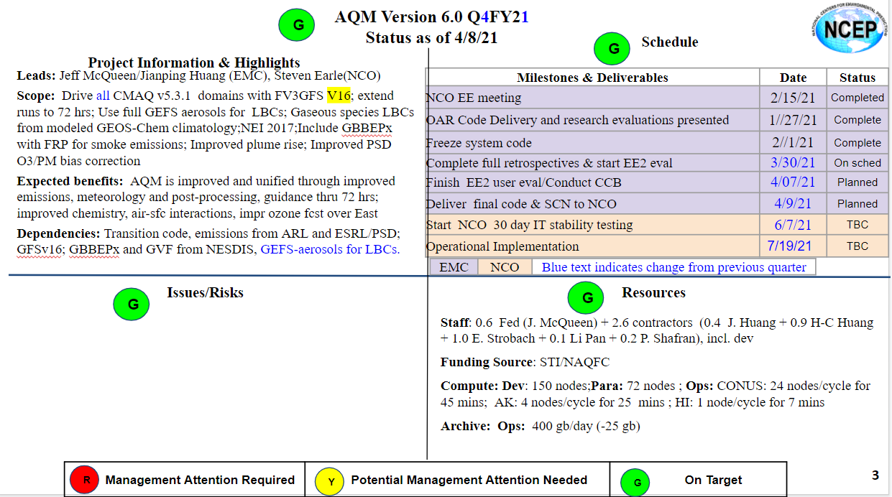
NATIONAL OCEANIC AND ATMOSPHERIC ADMINISTRATION
AQMv6.0 Status as of 04/08/21
2016

Slide 4
NATIONAL OCEANIC AND ATMOSPHERIC ADMINISTRATION
Contents
Scope and objectives of AQMv6.0 upgrade
Science Improvements and Product changes
Retrospective performance evaluation
System configuration and resource requirements

Slide 5
NATIONAL OCEANIC AND ATMOSPHERIC ADMINISTRATION
Scope of AQMv6.0 Upgrade
Replace meteorological forcing from NAM to GFSv16
Upgrade AQ model components (CMAQv5.3.1, NACC)
Upgrade Chemistry (CB6/AERO-7)
Upgrade Emission Datasets (NEI2016, GBBEPx, BEIS+BELDv5)
VIIRS based GVF and LAI
Extend forecast length from 48hrs to 72hrs
General improvements in AQ predictions

Slide 6
NATIONAL OCEANIC AND ATMOSPHERIC ADMINISTRATION
AQMv5 vs. AQMv6
 | AQMv5 | AQMv6
CMAQ Version | V5.0.2 | V5.3.1
Met driver | NAM 12km to 48 hrs | GFSv16 ~13 km to 72hrs
Chemistry | Carbon bond 5/AERO-6 | CB6/AERO-7
Anthropogenic emissions | NEI2014v2 | NEI2016
Fire emissions | CONUS only: Modified HMS/no fires from oct-june | NESDIS GBBEPx for all domains (CONUS, AK, HI)
Biogenic Emissions | Biogenic Emissions Processor (BEIS) | BEIS plus upgrade to Biomass Environmental Land Database v5
Air surface exchange | Climatological Green Vegetation fraction Constant Leaf Area Index | Real-time updated daily (weekly averaged) VIIRS based climatology

Slide 7
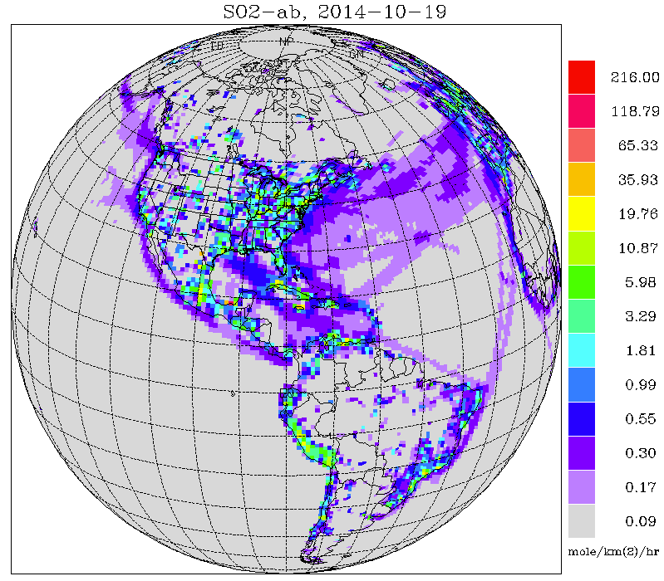
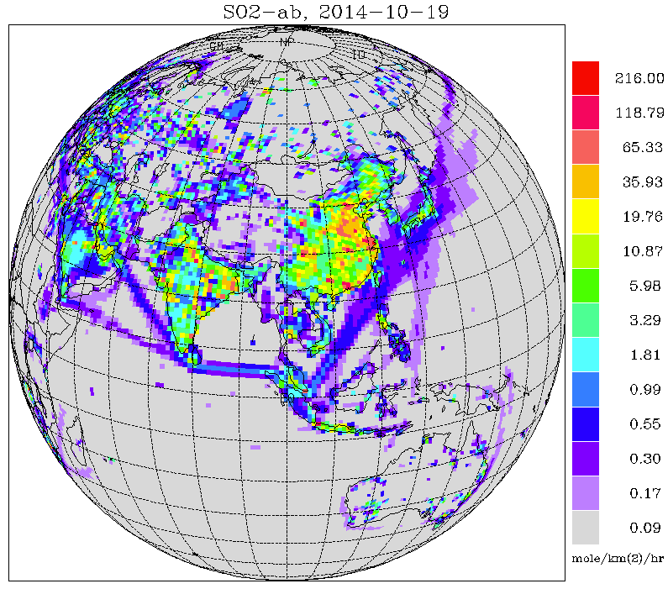
NATIONAL OCEANIC AND ATMOSPHERIC ADMINISTRATION
Aerosol Boundary Conditions from GEFS-Aerosol
One additional member of GEFSv12 for aerosols
Implemented Sept. 23, 2020
GEFS meteorology (based on GFSv15) at C384 (~25 km), 64 levels, to 120 hrs, 4x/day
Inline aerosol representation based on GOCART (GSD-Chem)
Sulfate, Organic Carbon, Black Carbon, Dust, Sea Salt
Emissions: CEDS-2014 (SO2, PSO4, POC, PEC), GBBEPx biomass burning, FENGSHA dust, GEOS-5 sea salt, marine DMS
Initial conditions: cycled for aerosols, but from GFSv15 analysis for meteorology
Smoke plume rise: Wind shear dependent 1-d cloud model to simulate tilt of plume. Fire Radiative Power is used to calculate convective heat flux and determine injection height
Conservative tracer transport and wet scavenging are included in Simplified Arakawa-Schubert (SAS) scheme. Fluxes are calculated positive definite. Scavenging coefficient is α=0.2 for all aerosol species.
CEDS-2014 SO2 emissions

Slide 8
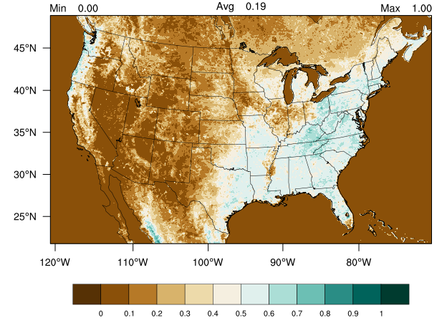
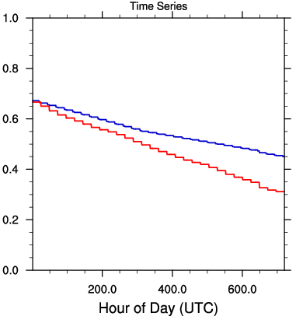
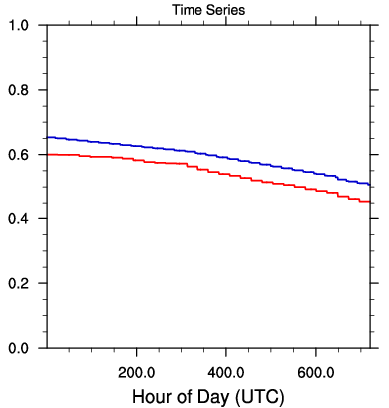
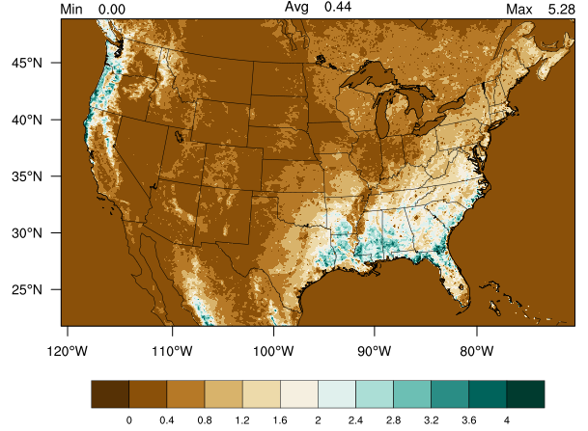
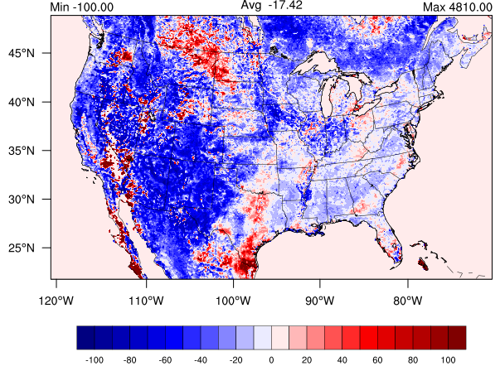
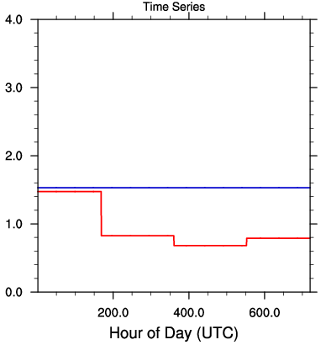
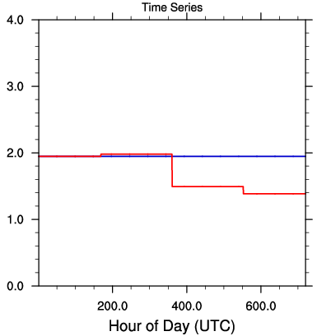
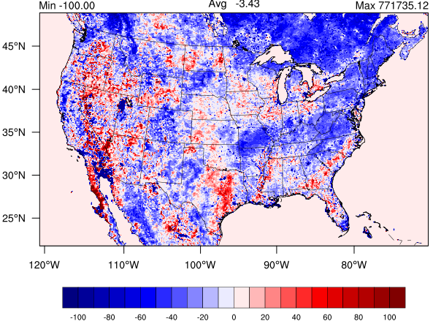
NATIONAL OCEANIC AND ATMOSPHERIC ADMINISTRATION
New VIIRS based GVF and LAI
VIIRS GVF
VIIRS LAI
Northeast
Southeast
GVF Time series
% VIIRS-FV3 GVF
October 2020
% VIIRS-MODIS LAI
Northeast
Southeast
LAI Time series

Slide 9
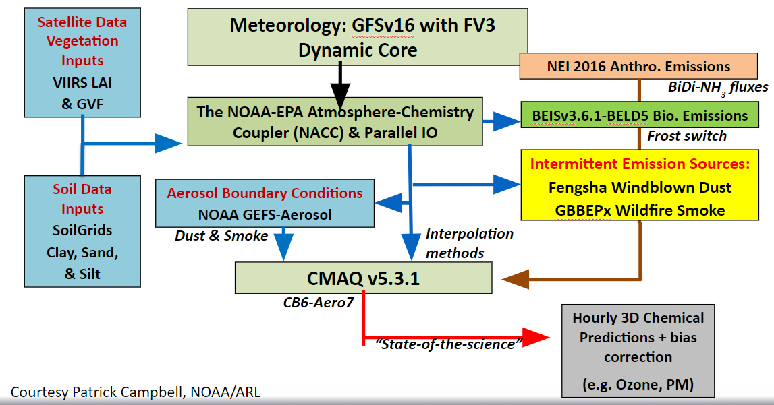
NATIONAL OCEANIC AND ATMOSPHERIC ADMINISTRATION
The Advanced NAQFC: NACC-CMAQ

Slide 10
NATIONAL OCEANIC AND ATMOSPHERIC ADMINISTRATION
EPA CMAQ v5.3.1
Photochemistry
Revision of halogen-mediated first-order ozone loss (improved marine chem)
Adding detailed halogen and DMS chemistry to CB6r3
Updates to the chlorine chemistry in CB6r3 in CMAQv5.3
Aerosols
AERO7
Monoterpene SOA
Hydrophilic organic aerosol
Corrected the conversion of inorganic to organic sulfate
Aerosol Dry Deposition Algorithm Updated and inlined in CMAQ
New NH₃ bi-directional flux in M3Dry deposition

Slide 11
NATIONAL OCEANIC AND ATMOSPHERIC ADMINISTRATION
Carbon-Bond 6 Gas-Phase Chemistry
Some notable reaction rate changes from CB05 to CB6:
• OH + NO2 = HNO3 increased by 5% => greater radical sink
• HCHO + hν = 2 HO2 + CO increased by 23% => greater radical source
• HO2 + NO = OH + NO2 increased by 5% => more efficient ozone formation
• NO2 +hν=NO+O increased by 7%=>more ozone
• N2O5 + H2O = 2 HNO3 decreased by ~80%
- Less NOx removal at night
- Very important to include heterogeneous N2O5 reaction on aerosol surfaces
Process | CB5 (Ops) | CB6 (para)
Gas-Phase Reactions | 156 | 218
Photolysis reactions | 23 | 28
Gas phase Species | 51 | 77
Ozone emissions species | 16 | 21

Slide 12
NATIONAL OCEANIC AND ATMOSPHERIC ADMINISTRATION
NACC Coupler
The NOAA-ARL Atmosphere-Chemistry Coupler version (NACC) (i.e., “knack”: meaning an acquired skill) is adapted from the EPA’s Meteorology-Chemistry Interface Processor (MCIP) version 5 (Otte and Pleim, 2010).
NACC offline-couples NOAA’s Finite­-Volume Cubed-Sphere Dynamical Core - Global Forecast System, version 16 (FV3-GFSv16) with the Community Multiscale Air Quality Model, version 5.3.1 (CMAQv5.3.1).
NACC-CMAQv5.3.1 is being developed for the next operational NOAA National Air Quality Forecasting Capability (NAQFC) and will be available to the greater scientific community at the NOAA ARL’s GitHub page.
Courtesy: Patrick Campbell, NOAA/ARL

Slide 13
NATIONAL OCEANIC AND ATMOSPHERIC ADMINISTRATION
New Wildfire Emission Source for GBBEPx
The NESDIS GBBEPx provides the emissions and associated fire radiative power (FRP) once per day. CMAQ uses the USGS landuse data:
11 Deciduous Broadleaf Forest
12 Deciduous Needleleaf Forest
13 Evergreen Broadleaf Forest
14 Evergreen Needleleaf Forest
15 Mixed Forest
If the sum of the forest fraction is less than 40%, the fire is treated as agriculture fire, and supposed to last less than 24 hours.
Additionally, Few fires are persistent in GBBEPx over Eastern U.S. (East of -100°W). So, ARL implemented an eastern mask, which only emits smoke from daytime fires for the pre-analysis run period.

Slide 14
NATIONAL OCEANIC AND ATMOSPHERIC ADMINISTRATION
Anthropogenic Emissions: NEI2016
Tried two different anthropogenic emissions datasets:
  NEI2017 (PARA6C)
  NEI2016 (PARA6D)
PARA6C: Old experimental run
Latest standard NEI 2017 (Apr 2020/Jan. 2021 release)
Led to enhanced underprediction of ozone over West and around wild fires
Missed O₃ exceedances over Western U.S.
PARA6D: New retrospective: Aug/Sep 2020, Jan/Feb 2021
Same as 6C except for use of NEI 2016
Adjusted from NEI 2014 using old SMOKE processor

Slide 15
NATIONAL OCEANIC AND ATMOSPHERIC ADMINISTRATION
AQMv6.0 Retrospective Experiments
Model | Fire location information | Fire smoke Emissions | Fire Duration | Fcst length | Comments
PROD NAM-CMAQ V5.0.2 | 24h old NESDIS Haz Mapping Sys (HMS) fire points | USFS BlueSky | Full during 24h pre-analysis 75% reduction during forecast | 48 h | Since 12/18/2018
PARA6D GFSv16 CMAQ v5.3.1 | 24h old VIIRS/MODIS Fire Radiative Power (FRP) | 100% of GBBEPx | “ “, day 2 fire emissions off over East (simplified ag fire treatment) | 72 h | *Weekly averaged GVF * VIIRS Climo LAI *NEI 2016 * NOx fire emissions
Official evaluation web page: https://www.emc.ncep.noaa.gov/users/meg/cmaqv6/
August 2 - September 30, 2020
Jan 1. - February 28, 2021

Slide 16
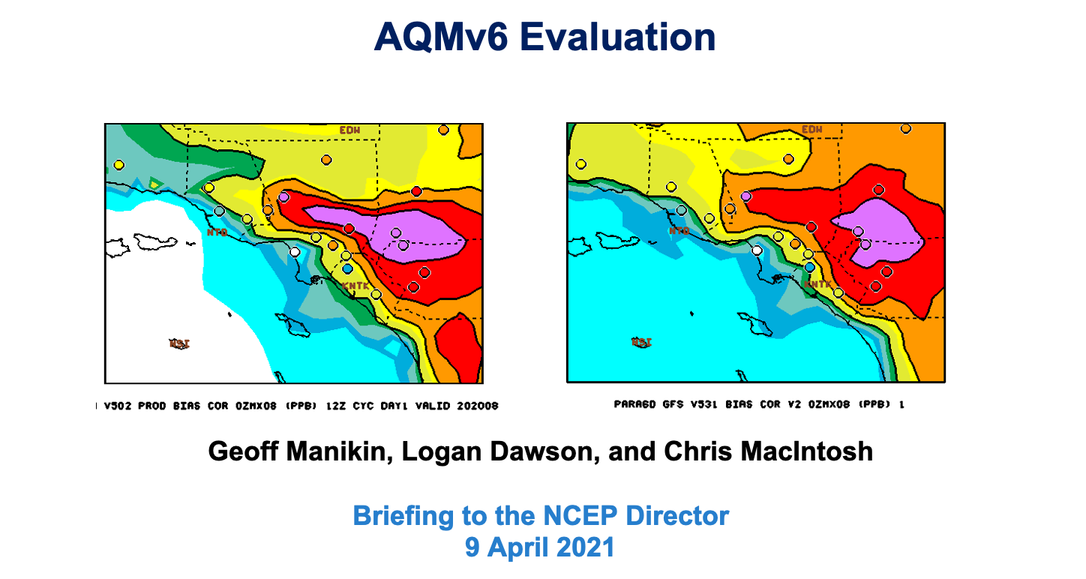
NATIONAL OCEANIC AND ATMOSPHERIC ADMINISTRATION
Evaluation of AQMv6.0 Performance

Slide 17
NATIONAL OCEANIC AND ATMOSPHERIC ADMINISTRATION
Evaluation Details
The AQMv6 official evaluation primarily focused on retrospective evaluation of fine particulate matter (PM2.5) and ozone guidance from AQMv6 configurations
- Retrospective periods included August-September 2020 and January-February 2021
Evaluation included 1) subjective assessment of forecast maps with validating observations available for comparison, 2) examination of objective verification statistics for AQ parameters, and 3) assessment of time series diagnostics for relevant meteorological fields
The MEG created a central web site for the evaluation
The MEG performed an independent assessment of the stats and cases and obtained formal recommendations from members of the National Air Quality Forecasting Capability (NAQFC) Focus Group

Slide 18
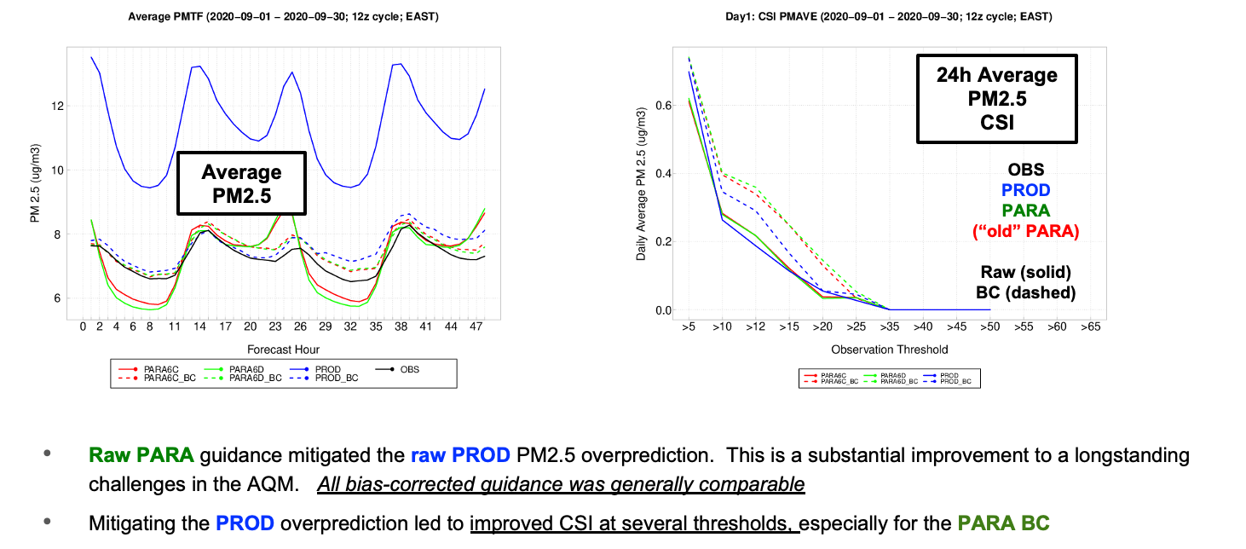
NATIONAL OCEANIC AND ATMOSPHERIC ADMINISTRATION
Sept. 2020 PM2.5 Prediction in the East

Slide 19
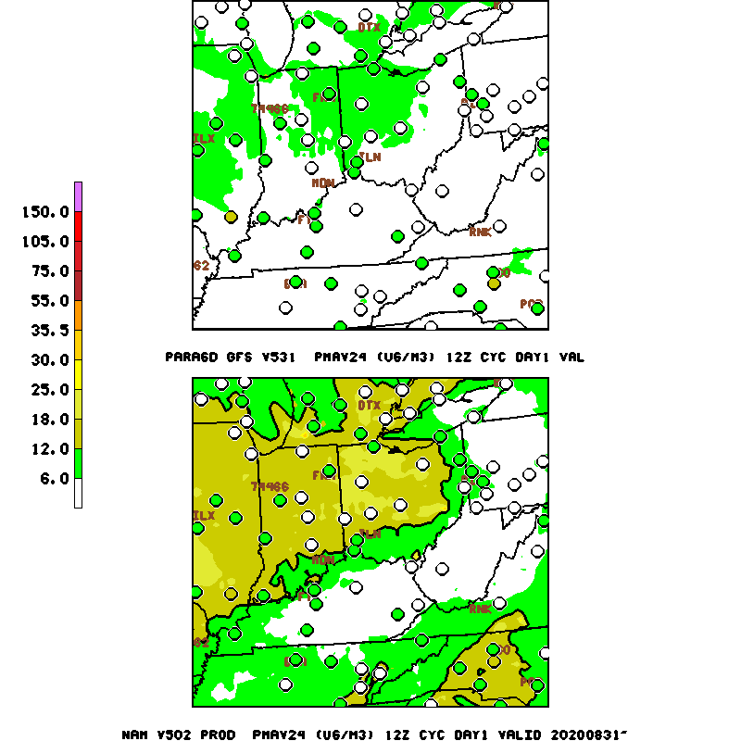
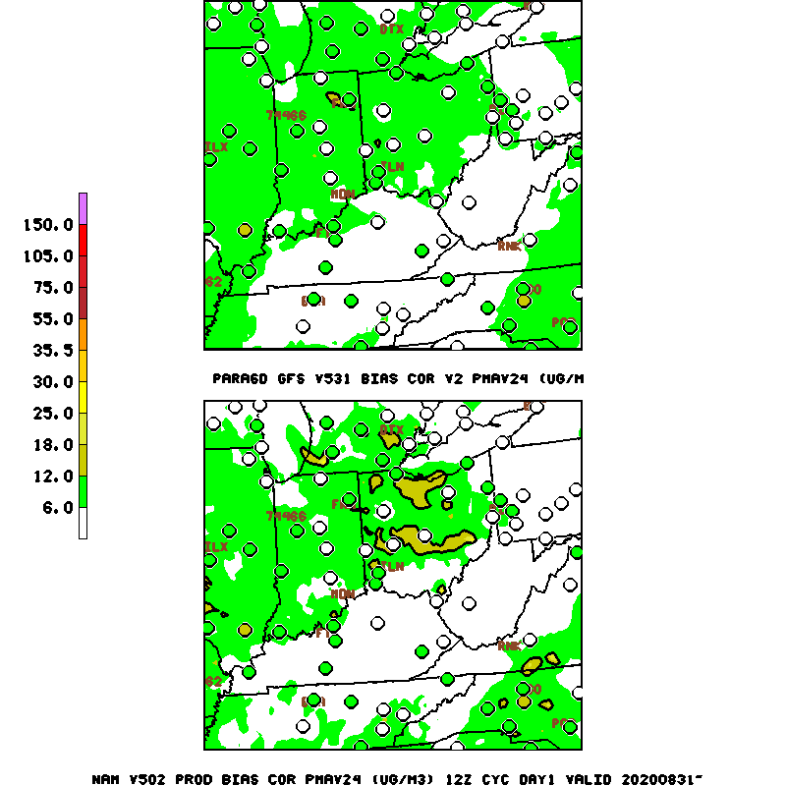
NATIONAL OCEANIC AND ATMOSPHERIC ADMINISTRATION
PM2.5 Example in the East
Ohio Valley (24h AVG PM2.5)
Valid: 12z 8/31/20
PARA
RAW
PARA
BC
Consistent with the stats, the raw PROD has a huge
over-prediction, while the
raw PARA has a slight
under-prediction
The BC forecasts look fairly similar
PROD
RAW
PROD
BC

Slide 20
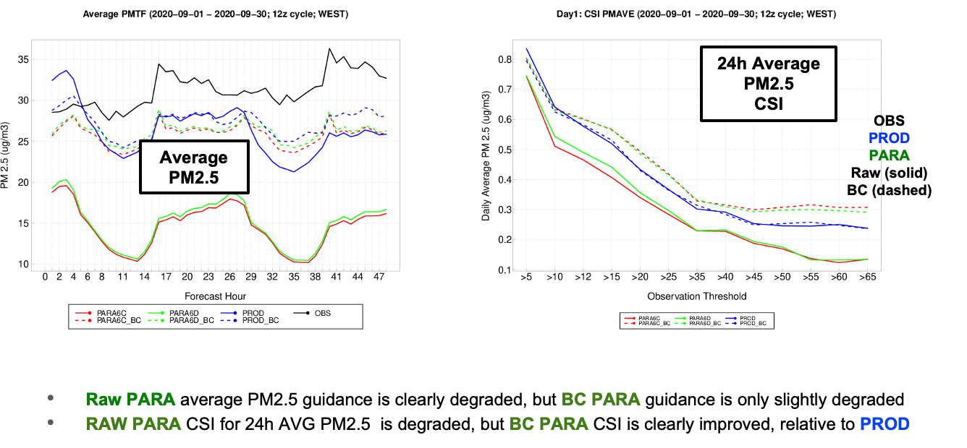
NATIONAL OCEANIC AND ATMOSPHERIC ADMINISTRATION
Sept. 2020 PM2.5 Prediction in the West

Slide 21
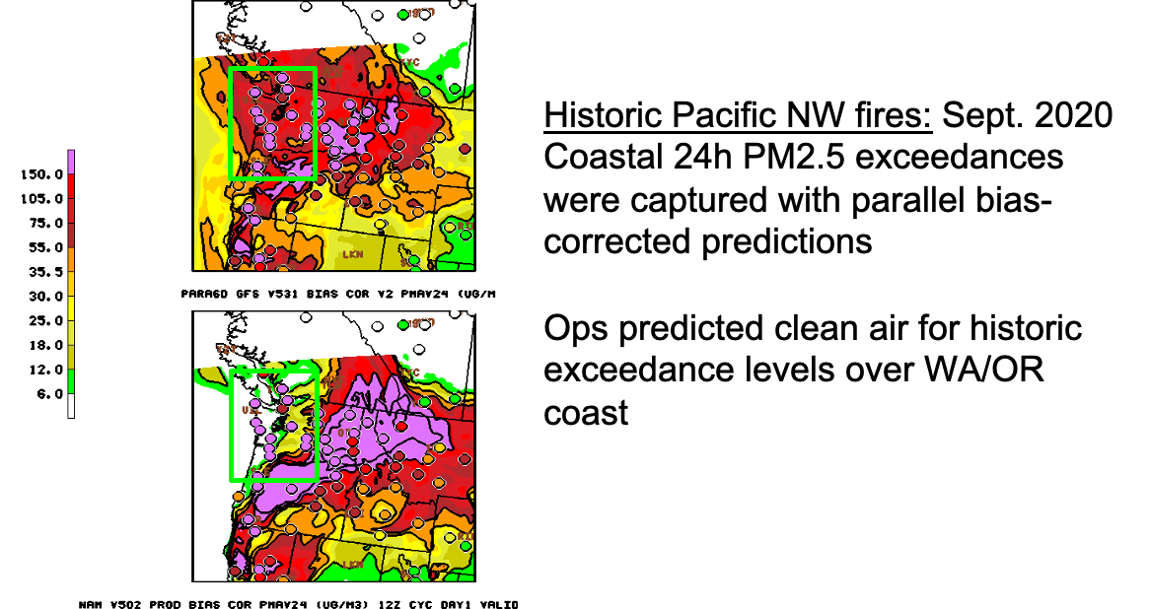
NATIONAL OCEANIC AND ATMOSPHERIC ADMINISTRATION
Improved PM2.5 Forecast Example

Slide 22
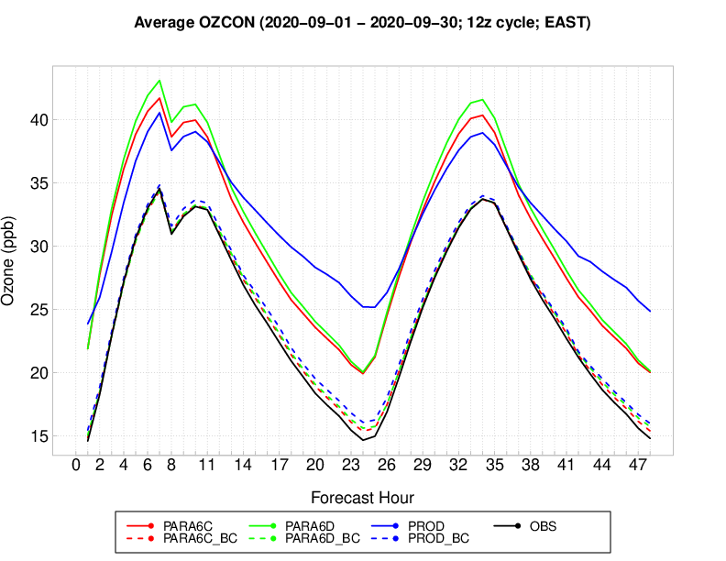
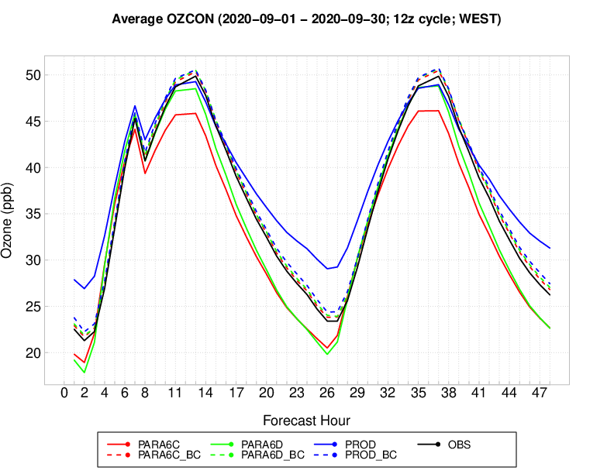
NATIONAL OCEANIC AND ATMOSPHERIC ADMINISTRATION
Sept. 2020 Ozone Prediction
Average
Ozone
EAST
WEST
Raw PARA in the east nicely reduces the overprediction by the Raw PROD at night/early morning, although Raw PARA has a slightly larger overprediction during the day
In the west, the Raw PROD overprediction at night is replaced by a Raw PARA underprediction
Despite the large para/prod raw differences, the bias-corrected guidance is very similar

Slide 23
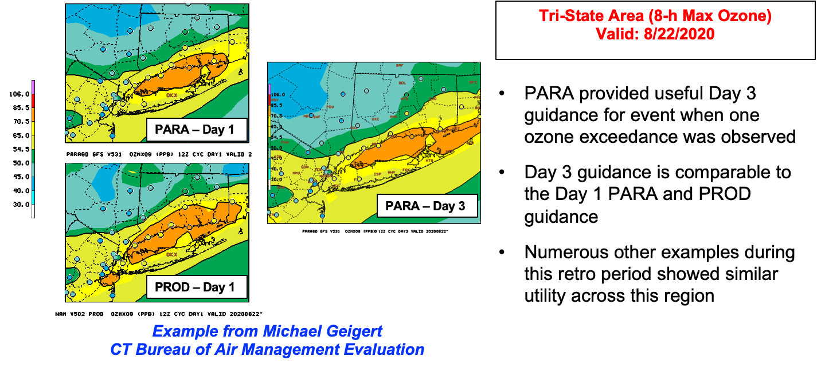
NATIONAL OCEANIC AND ATMOSPHERIC ADMINISTRATION
New Day 3 Guidance Has Utility

Slide 24
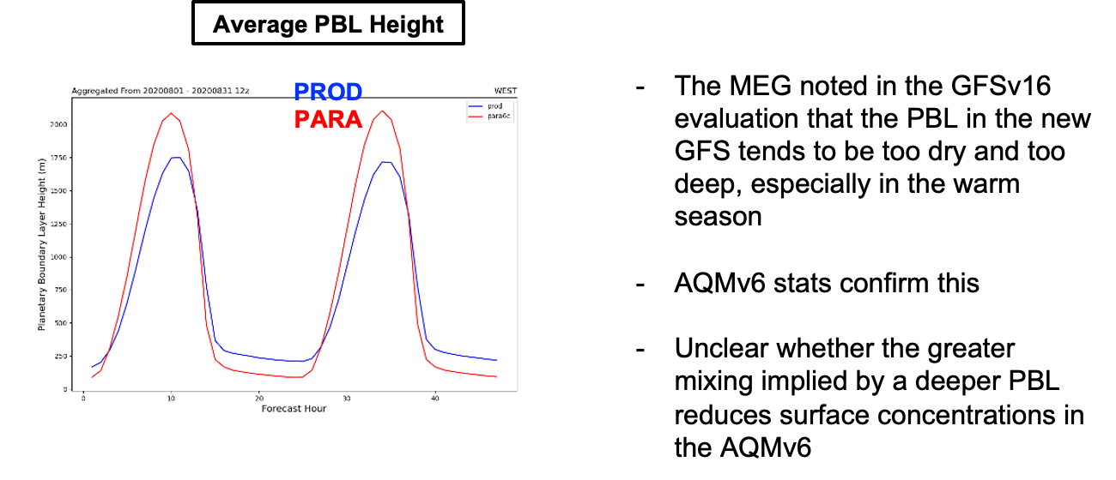
NATIONAL OCEANIC AND ATMOSPHERIC ADMINISTRATION
Deeper PBLs from GFSv16

Slide 25
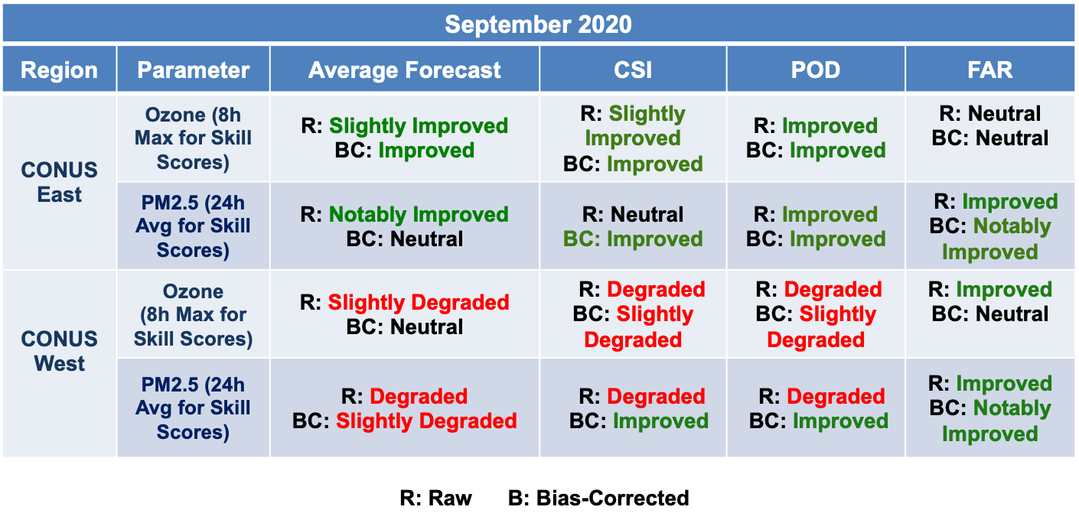
NATIONAL OCEANIC AND ATMOSPHERIC ADMINISTRATION
Summary of AQMv6 Verification Statistics

Slide 26

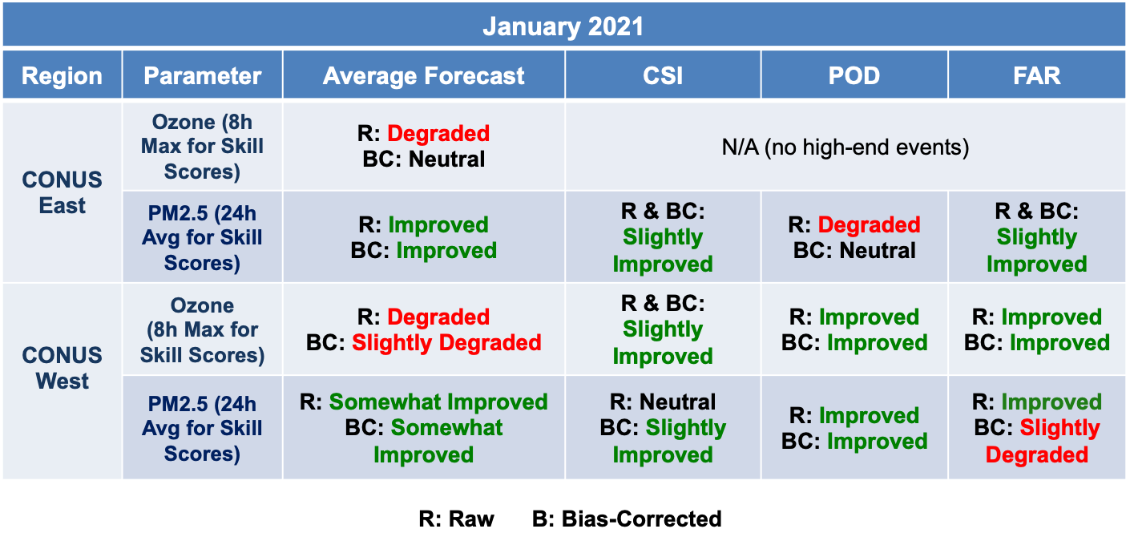
NATIONAL OCEANIC AND ATMOSPHERIC ADMINISTRATION
Summary of AQMv6 Verification Statistics
Major takeaway from the stats: when the para raw forecast is degraded, relative to the prod, the bias-corrected para forecast is usually fairly close to the prod

Slide 27
NATIONAL OCEANIC AND ATMOSPHERIC ADMINISTRATION
Summary of Field Recommendations

Slide 28
NATIONAL OCEANIC AND ATMOSPHERIC ADMINISTRATION
Field Impressions of AQMv6
Evaluator | Recommendation | Key Remarks
Maine DEP | Implement | Ozone predictions are better in AQMv6. Disappointed that no January graphics were available, given major winter PM challenges. Forecast extensions are invaluable for weekends.
Virginia DEQ | Implement | Concerns about limited evaluation period. Notable ozone over-prediction, but likely caused by reduction in emissions due to COVID. Improvement in summer PM forecasts. Strong support for forecast extension.
Florida DEP | Implement | Reduction in overforecasting seen in FL. No observed ozone values above the critical threshold during the retro period to assess. Degradation in fire-related PM predictions. Extended ozone forecasts will be useful.
Connecticut DEEP | Implement | New version is overall a better product. Utility in the forecast extension. Promising results for ozone and PM2.5 Noted a particularly bad January PM case that warrants analysis. Continued problems with integrating agricultural fires into the model.
Maryland DOE | Implement | Slight improvement in all day 2 forecasts. Thrilled with the new day 3 forecasts. Slight improvement in the ozone forecasts, but small sample size noted.

Slide 29
NATIONAL OCEANIC AND ATMOSPHERIC ADMINISTRATION
Invitation to the Evaluators to Speak

Slide 30
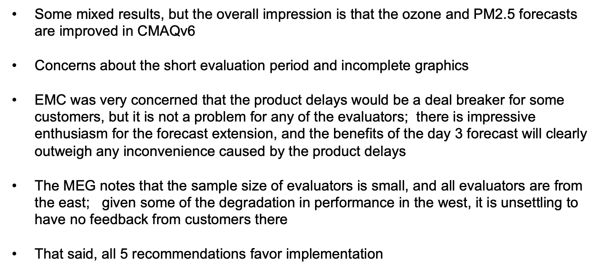
NATIONAL OCEANIC AND ATMOSPHERIC ADMINISTRATION
Common Themes from Evaluators

Slide 31
NATIONAL OCEANIC AND ATMOSPHERIC ADMINISTRATION
Product changes
Extended hourly AQ outputs to 72 forecast hours (06/12 UTC)
    Surface ozone
    Surface PM_{2.5}
    Turn off 3-D sigma file generation
Product delay of 20 minutes ( 11:20 and 17:20 UTC).
    Model init waits for GFS 72 hr forecast availability (~15:50 UTC)
Extend retention time of 2D surface ozone and pm2.5 predictions from 2 to 10 days on NOMADS

Slide 32
NATIONAL OCEANIC AND ATMOSPHERIC ADMINISTRATION
Impact on Computational Resources
12z: Start when 48h NAM/ 72h GFS files available
AQM-CMAQ | AQM v5 (14:30Z start); 12Z finish | Nodes | AQM v6 (15:50Z start); 12Z finish | Nodes
(prephyb+premaq)/Prep | 15:40 UTC (70 min) | 1 | 15:55 UTC (5 min) | 10
Model | 16:25 UTC (45 min) | 24 | 17:10 UTC (75 m) | 24
Post1 (O3/PM final prod) | 16:28 UTC (3 min) | 1 | 17:13 UTC (3 min) | 1
Bias correction | 16:33 UTC (8 min) | 1 | 17:18 UTC (5 min) | 1
TOTAL | 131 mins Distribute: 17:00 Z |  | 88 mins Distribute: 17:20 Z
The 20 minute delay is mainly caused by delay in run start time (15:50z to wait for GFS vs 14:30 for NAM)

Slide 33
NATIONAL OCEANIC AND ATMOSPHERIC ADMINISTRATION
Impact on Computational Resources
Data Volume in COMROOT CONUS (GB, 4 cycles per day)
Data Volume in HPSS CONUS (GB, per day)
Daily totals (Gb) | AQMv5 (48h) | AQMv6 (72h) | Notes
00z | 10GB | 13GB | variable 84-> 220
06z | 75GB | 147GB | Fcst : 48 -> 72 hr, variable 84-> 220
12z | 75GB | 147GB | Fcst : 48 -> 72 hr, variable 84-> 220
18z | 10GB | 13GB | variable 84-> 220
TOTAL Daily | 170 GB | 350 GB
Daily totals (Gb) | AQMv5 | AQMv6 | notes
Input | 55.5 | 65 | Fcst : 48 -> 72 hr
Output | 107.5 | 50 | Fcst : 48 -> 72 hr,
Post | 7.0 | 11 | Fcst : 48 -> 72 hr
TOTAL | 170 GB | 125 GB | #var decreased

Slide 34
NATIONAL OCEANIC AND ATMOSPHERIC ADMINISTRATION
AQMv6.0 Upstream/Downstream Dependencies
Upstream dependencies
GFSv16
NESDIS GBBEPx
NESDIS weekly averaged GVF
GEFS-Aerosols for LBC, 2x/year update point srcs
Anthro emissions: NEI 2016
Climatological LAI file
Dust soil type configuration file
Downstream dependencies
VERF-g2o
VERF-g2g
MDL NDGD/AWS servers
IDP GIS

Slide 35
NATIONAL OCEANIC AND ATMOSPHERIC ADMINISTRATION
Request for Approval of AQMv6 Implementation
The primary objectives of Q4FY21 AQMv6 upgrades are met:
  Scientific upgrades to AQMv6.0 include upgrading model components (CMAQv5.3, NACC), chemistry and aerosols (CB6/AERO-7), emission datasets (NEI2016, GBBEPx, BEIS+BELDv5), meteorological forcing from NAM to GFSv16, and VIIRS based green vegetation fraction and leaf area index; remove dependency on unsupported USFS BlueSky fire emissions code; and for the first time, provision of 72-hr forecasts.
  Evaluation based on 4-month retrospective experiments:
    Summertime (Aug/Sep 2020) Ozone predictions improved for all regions (slight degradation in the West)
  Use of NEI2016 emissions boosted results further
  Day-3 forecasts yield similar skill to day-1 and day-2
    Summertime PM2.5 predictions yield underprediction bias
  Bias correction skill improved with longer training period and with NEI2016 emissions
    Wintertime (Jan/Feb 2021) PM2.5 predictions reduced error and improved skill especially at night time daily max
  The longstanding overprediction error over East significantly reduced
  Subjective and objective evaluation show that AQMv6 bias-corrected guidance is fairly comparable to the production AQMv5 bias-corrected guidance
Favorable endorsement from stakeholders who participated in this evaluation (NAQFC Focus Group)
EMC requests NCEP Director to approve implementation of Q4FY21 AQMv6.0 into operations

