Slide 1
Progress and Plans for Advances in Air Quality and Aerosol Modeling in UFS
Jeff McQueen, Fanglin Yang, Ivanka Stajner, Barry Baker, Jianping Huang, Ho-Chun Huang, Li Pan, Ed Strobach, Binyu Yang, Partha Bhatarchjee, Perry Shafran NWS/NCEP/EMC
Rick Saylor, Barry Baker, Youhua Tang, Patrick Campbell, Daniel Tong, NOAA/ARL
February 17 , 2021
Notes:
More real-time evaluation of code transferred from ARL

Slide 2
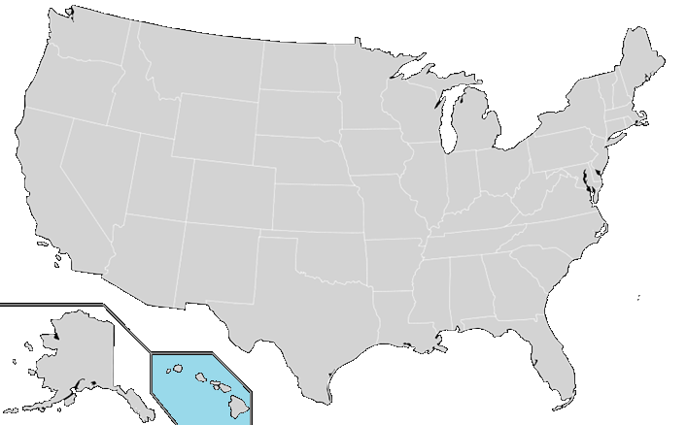
National Air Quality Forecast Capability
Improving the basis for air quality alerts
Providing air quality information for people at risk
Operations: 12/18/18
48 hour predictions
12 km NAM-CMAQ V5.0.2 O3 & PM2.5 nationwide
AQM V6.0: Proposed June 2021
72 hour predictions
12 km GFSv16 – CMAQ V5.3.1
Improved GBBEPx 0.1 deg smoke
Inline emissions, deposition
Real-time veg fraction (GVF)
Climatological LAI
2004: ozone
2007: ozone/ hys. smoke
2012: Hysplit dust
2016: + PM2.5
2018:O3/PM Bias correct.
2005: ozone
2009: Hy smoke(ak)
2010: Hy smoke(hi)
2010: ozone(ak/hi)
2016: PM2.5 (ak/hi)
Notes:
Progress slow except for bias correction:
Since 2004

Slide 3
Operational Community Model for Air Quality (CMAQ) System
AQM 5.1 implementation: Dec.18, 2018
NAM-CMAQv5.0.2 12 km/L35
Ensemble Kalman filter bias correction for surface O3 and PM2.5
Carbon Bond V/Aero-6 chemistry: nearly 200 species (so2,so4,N, VOC..)
Updates to NESDIS HMS fire smoke emissions
Off from Oct-June: Ag fire discernment issues
Anthropogenic: point, area, mobile, biogenics, dust, sea salt
EPA National Emissions Inventory for year 2014
Notes:
these projects were performed in fy20

Slide 4
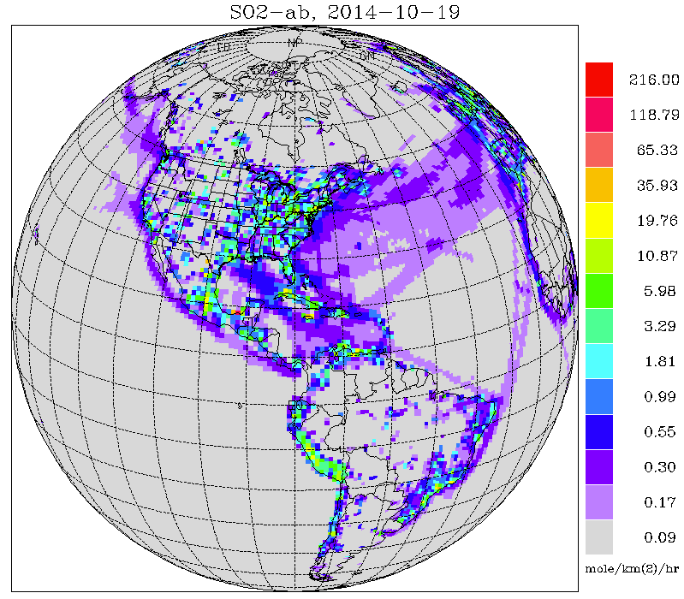
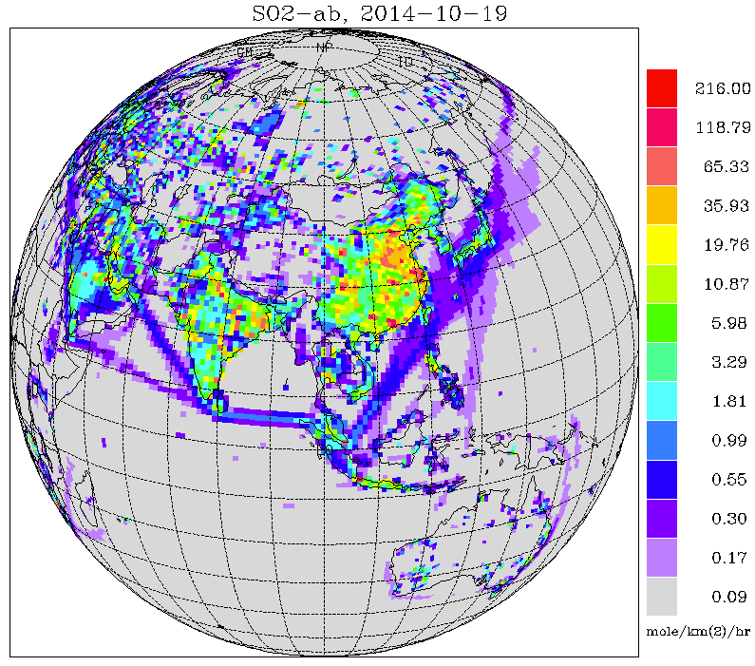
GEFSv12-Aerosol member
One additional member of GEFSv12 for aerosols
Implemented Sept. 23, 2020
GEFS meteorology (based on GFSv15) at C384 (~25 km), 64 levels, to 120 hrs, 4x/day
Inline aerosol representation based on GOCART (GSD-Chem)
Sulfate, Organic Carbon, Black Carbon, Dust, Sea Salt
Emissions: CEDS-2014 (SO2, PSO4, POC, PEC), GBBEPx biomass burning, FENGSHA dust, GEOS-5 sea salt, marine DMS
Initial conditions: cycled for aerosols, but from GFSv15 analysis for meteorology
Smoke plume rise: Wind shear dependent 1-d cloud model to simulate tilt of plume. Fire Radiative Power is used to calculate convective heat flux and determine injection height
Conservative tracer transport and wet scavenging are included in Simplified Arakawa-Schubert (SAS) scheme. Fluxes are calculated positive definite. Scavenging coefficient is α=0.2 for all aerosol species.
CEDS-2014 SO2 emissions
Li Pan, EMC; GSL; ARL;CSL
Notes:
boundary conditionsn to CMAQ
replacement for HYSPLIT...covers all of North America

Slide 5
Correlation (R) based on Day 1 forecast and AERONET (March – June, 2019)
Partha Bhatacharjee
GEFS-Aerosol
NGACv2

Slide 6
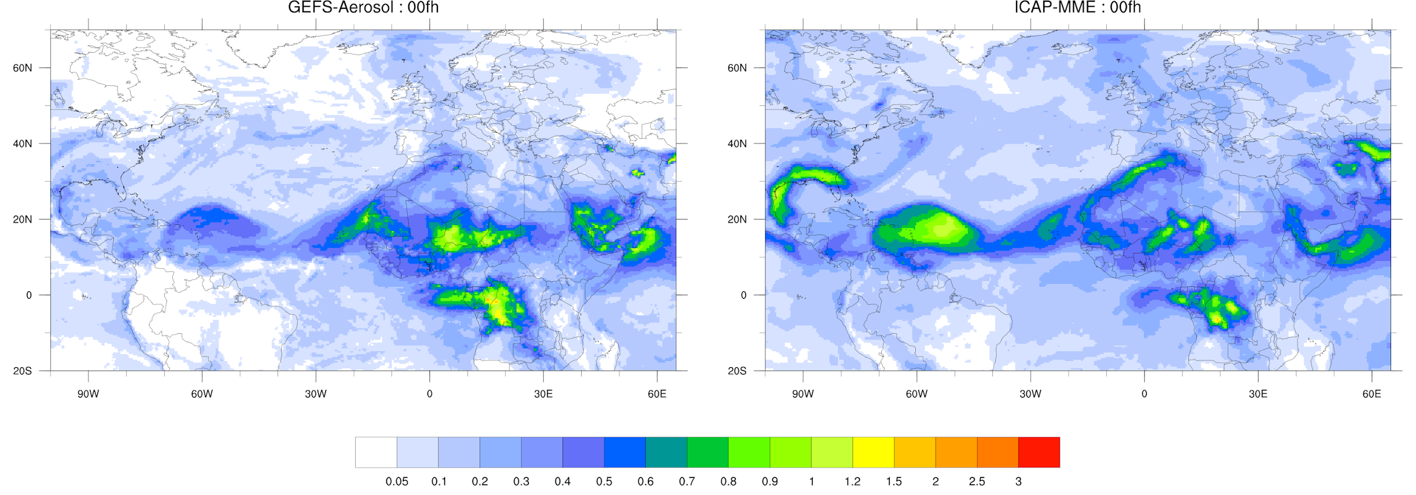
June 27, 2020 hr 00 Dust AOD forecasts
Historic Sahara dust event
Was Algerian source missed
Were winds properly captured…
Notes:
This case highlighted by focus group in October 2020

Slide 7
CMAQ Model runs
Model | Fire location information | Fire smoke Emissions | Fire Duration | Fcst length | Comments
PROD NAM-CMAQ V5.0.2 | 24h old NESDIS Haz Mapping Sys (HMS) fire points | USFS BlueSky | Full during 24h pre-analysis 75% reduction during forecast | 48 h | Since 12/18/2018
V1 GFSv16CMAQ v5.3.1 | 24h old VIIRS/MODIS Fire Radiative Power (FRP) | 10% of NESDIS GBBEPx | Fire fraction >0.4 continuous emissions | 72 h | NEI 2016
V2 GFSv16 CMAQ v5.3.1 Ho-Chun Huang | 24h old VIIRS/MODIS Fire Radiative Power (FRP) | 100% of GBBEPx | “ “, day 2 fire emissions off over East | 72 h | Weekly GVF Climo LAI NEI 2017 NOx fire emissions
Notes:
no fire emissions from Oct. 1 until June 1 with prod.
Improvement to ag fire identification needed

Slide 8
NATIONAL OCEANIC AND ATMOSPHERIC ADMINISTRATION
GFSv16: Possible impacts on AQ
Reduce the low-level cold bias seen in GFSv15 during the cool season
Improve handling of inversions in the planetary boundary layer (PBL)
Reduce near-surface temperature biases in all seasons
Improve forecasts of the upper atmosphere
Planned GFS only Implementation on March 17, 2021
Notes:
cold bias, inversions

Slide 9
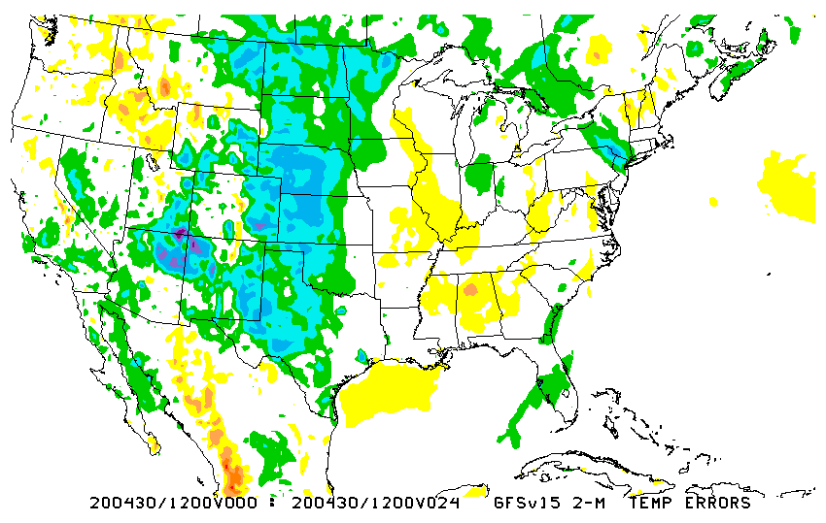
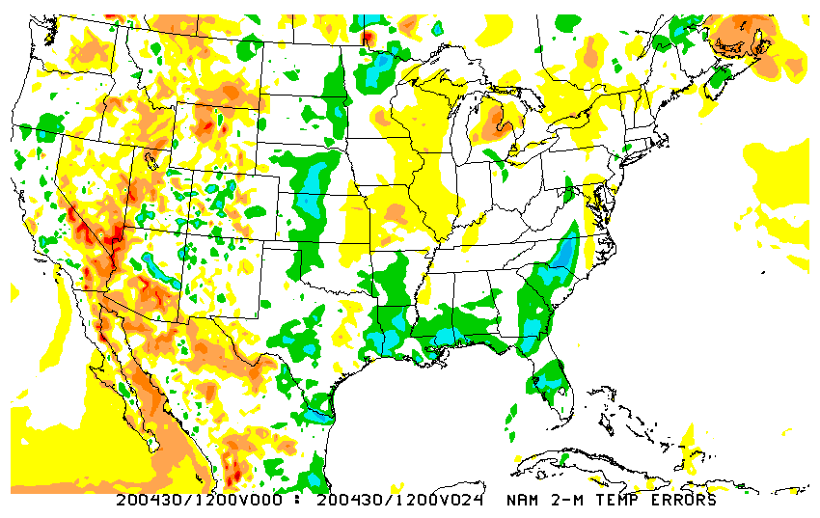
NATIONAL OCEANIC AND ATMOSPHERIC ADMINISTRATION
Inversions (from MEG)
2m Temp Errors Analysis - Forecast
Init: 12Z 29 April 2020
Valid: 12Z 30 April 2020 (F024)
Very large errors for a short range forecast. GFSv16 appears to offer very slight improvement, but both forecasts are far too warm over the Plains and upper Midwest
The lack of a sufficiently strong inversion shows up well in the soundings
GFS
v15
NAM error map for same case shows
that this type of case (strong radiational cooling) can be handled better
GFS
v16
Notes:
NAM keeps colder air in place over West….colder than analysis (red colors)

Slide 10
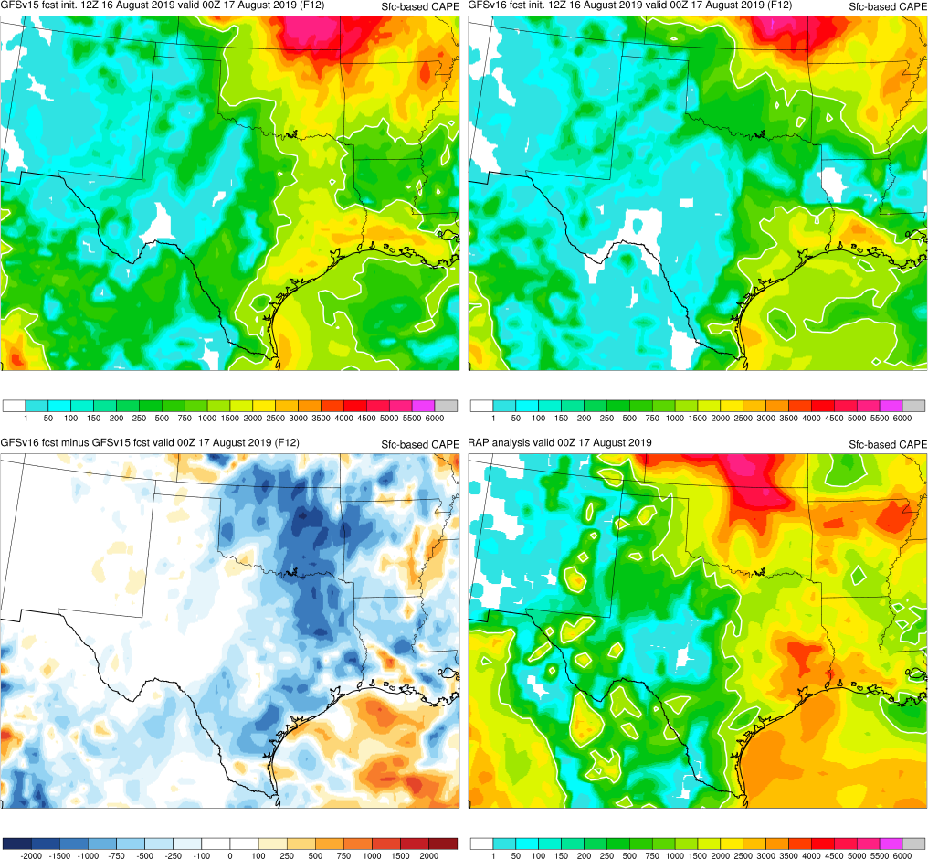
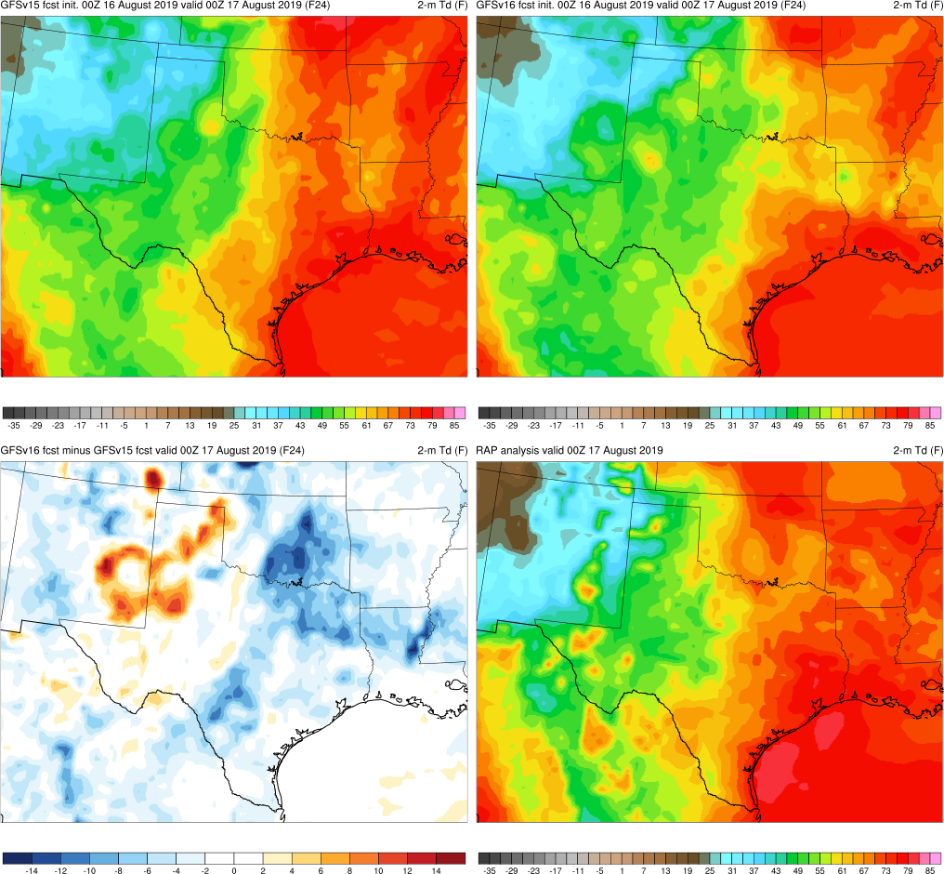
NATIONAL OCEANIC AND ATMOSPHERIC ADMINISTRATION
Tendency to Overmix the Boundary Layer
CAPE
2-m Td
GFSv15
GFSv16
GFSv15
GFSv16
RAP
ANL
RAP
ANL
v16 - v15
v16 - v15
Init: 12Z 16 August 2019 Valid: 00Z 17 August 2019 (F012)
Largest CAPE reductions are collocated with largest 2-m dewpoint reductions
Notes:
more well mxed pbl and dryer compared to RAP analysisi

Slide 11
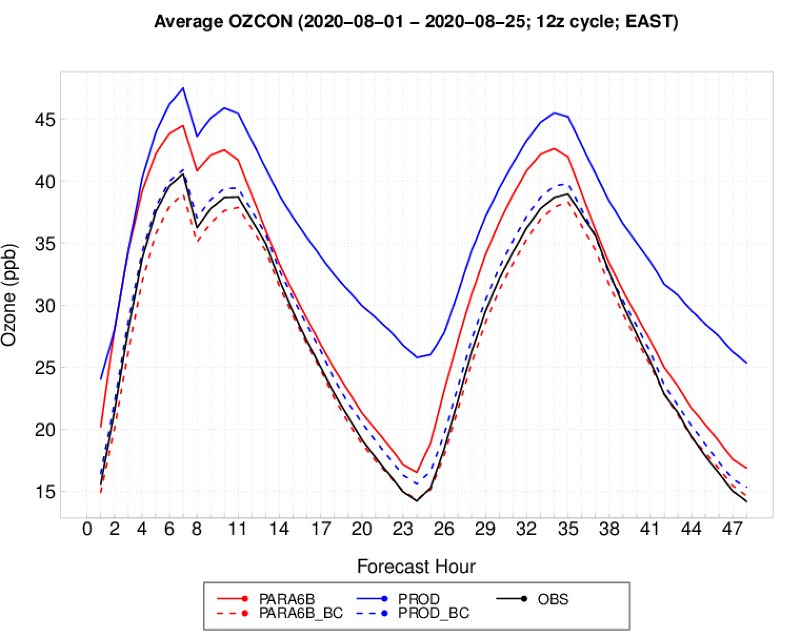
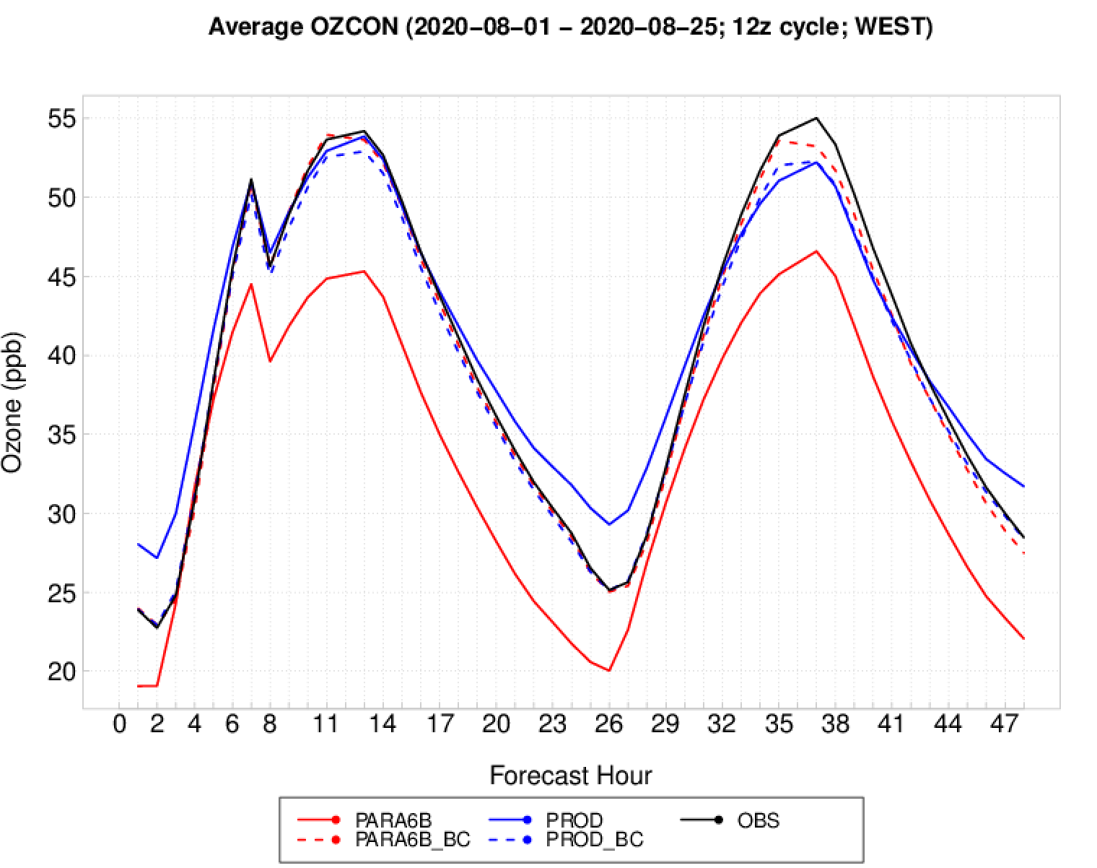
August, 2020: Surface Ozone
NOTE: analysis is really from 08/11/2020, not 08/01/2020; this is a typo.
Ozone uniformly decreases for para6b over both regions
Results in remarkable agreement with observations out EAST while large under-predictions remain out WEST
Bias correction components conform well for observations for both regions
Ed Strobach, EMC

Slide 12
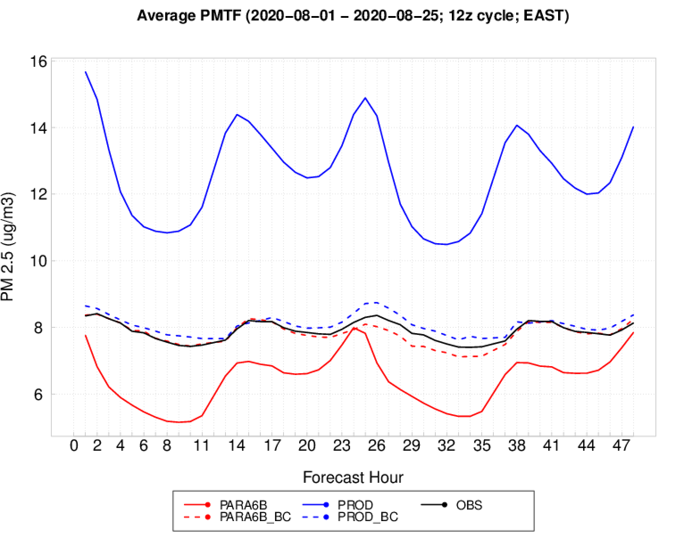
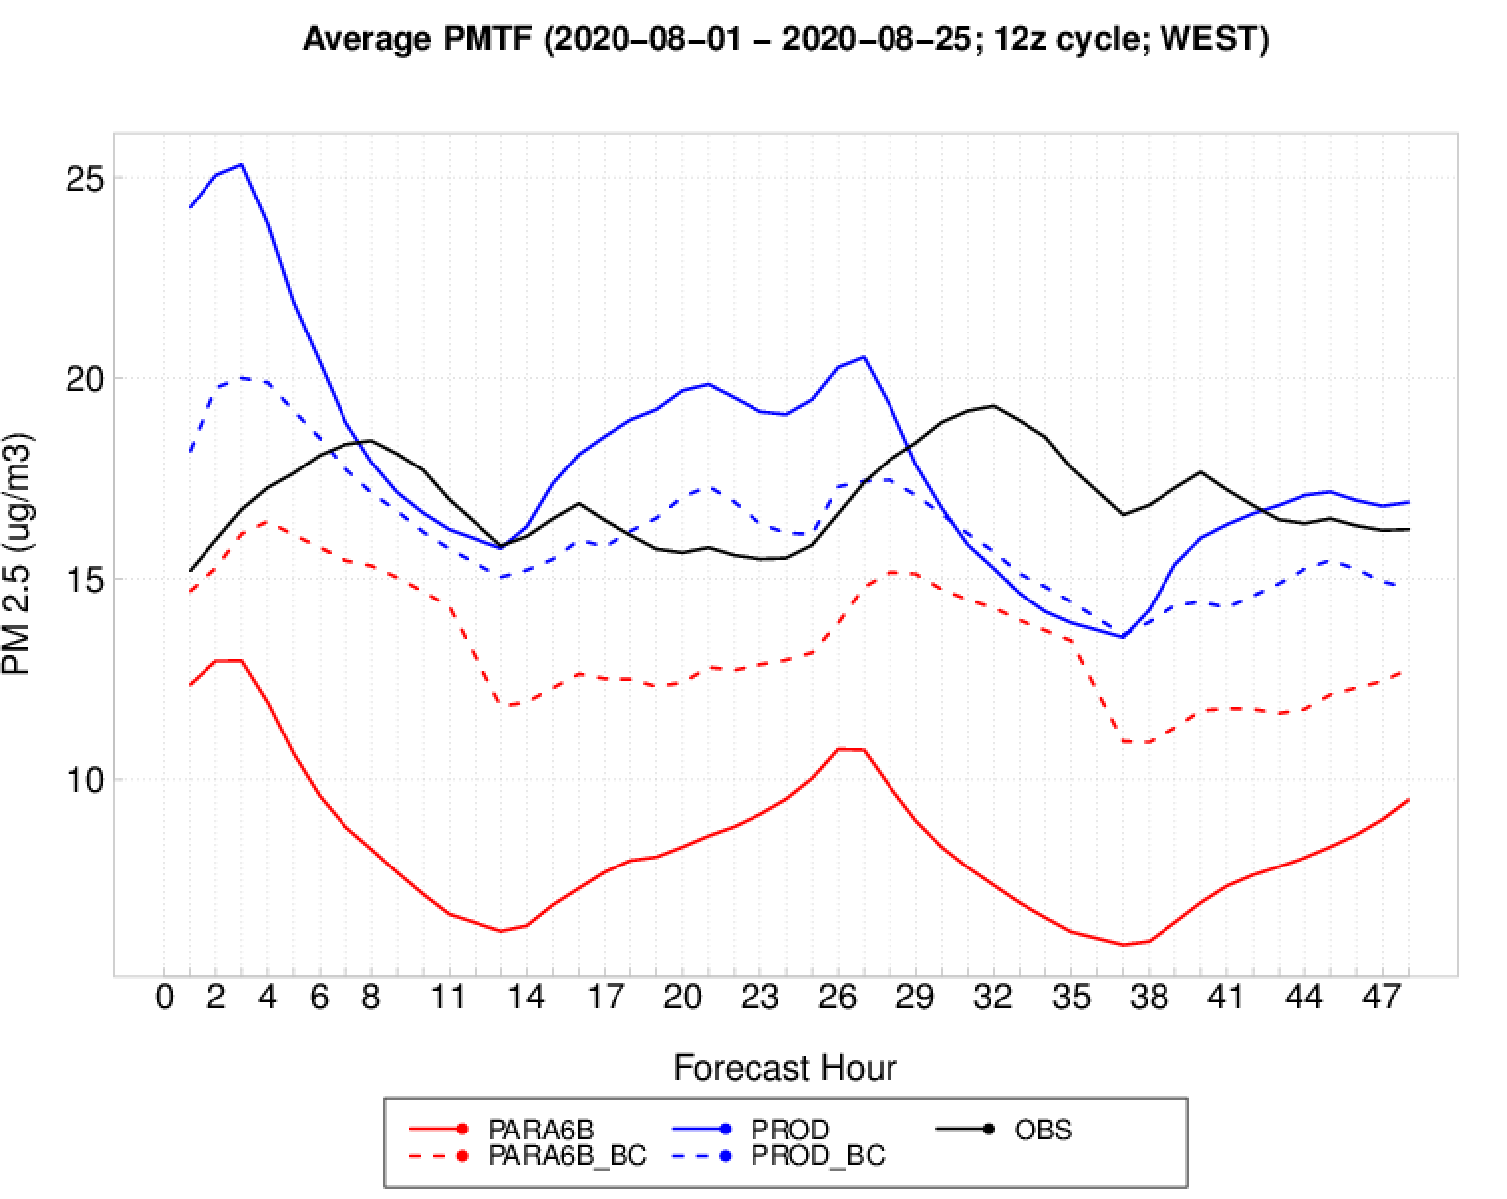
August, 2020: Surface PM2.5
NOTE: analysis is really from 08/11/2020, not 08/01/2020; this is a typo.
PM2.5 uniformly decreases for para6b over both regions
Results in much better agreement with observations out EAST while large under-predictions remain out WEST
Bias correction components do pretty well except with some obvious departures out WEST for para6b.

Slide 13
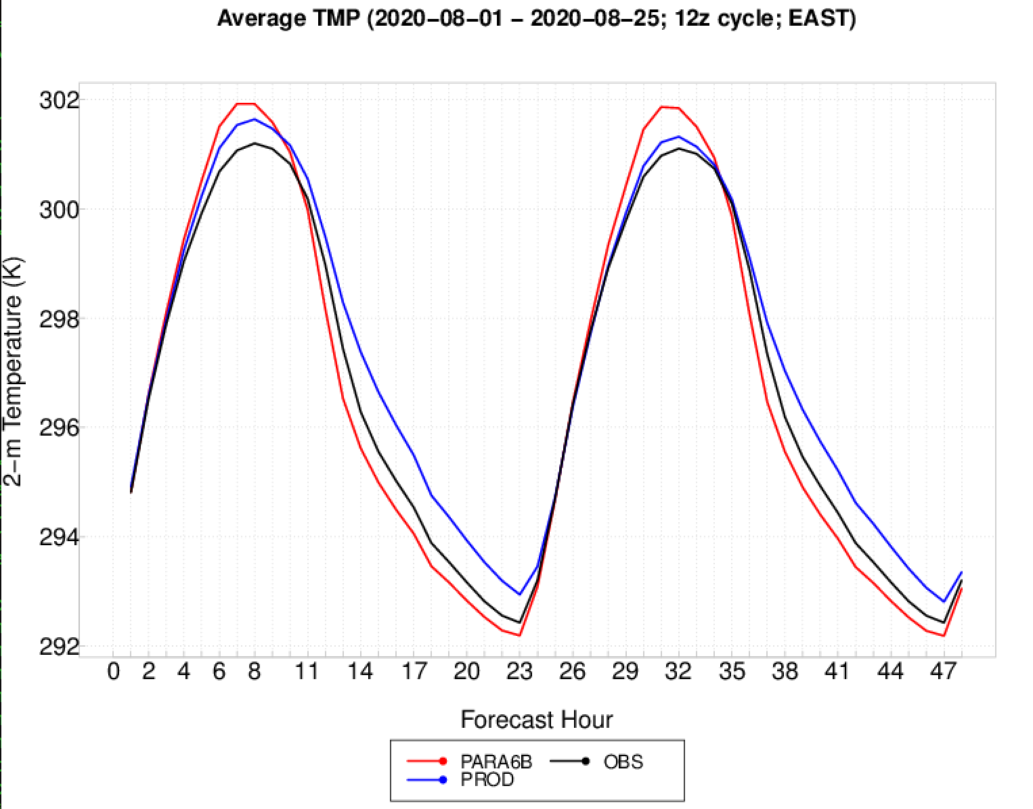
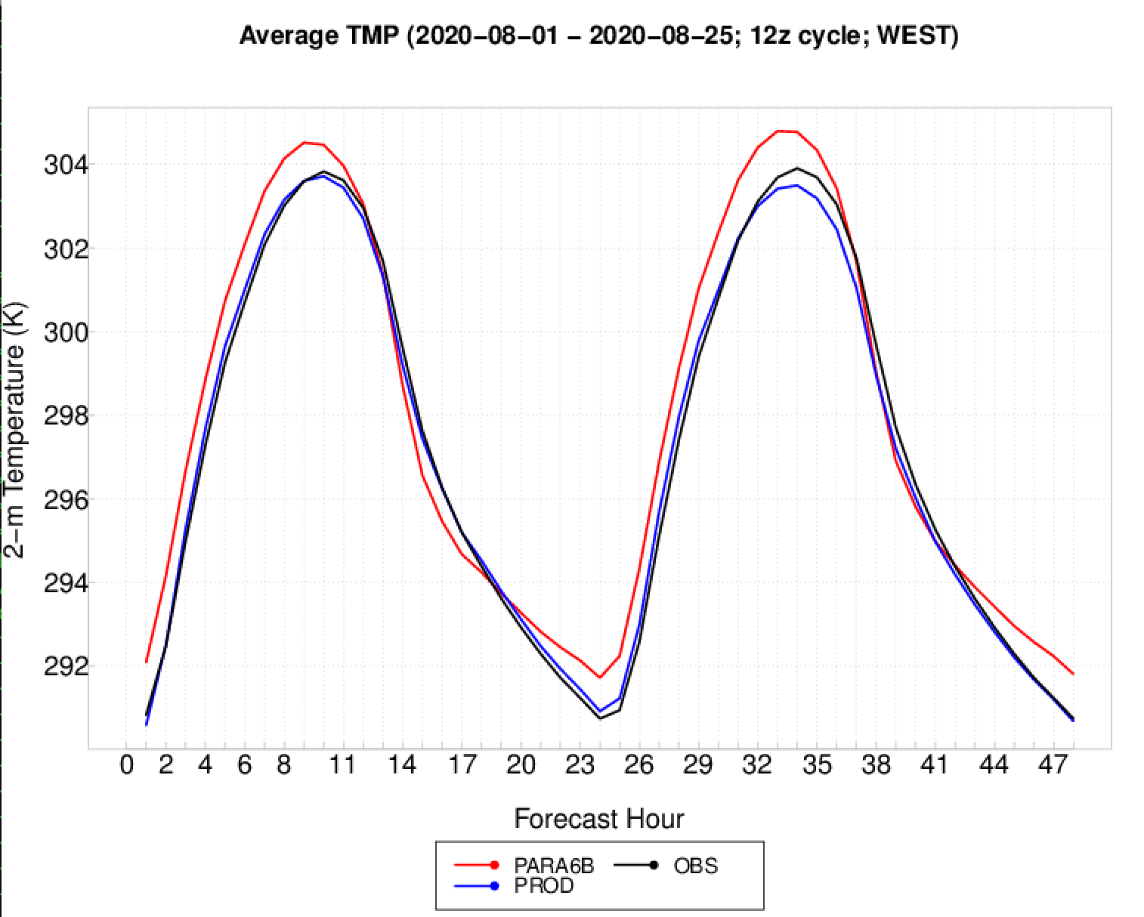
August, 2020: 2-m Temperature
NOTE: analysis is really from 08/11/2020, not 08/01/2020; this is a typo.
GFS arguably agrees better with observations out EAST, especially at night while degrading out WEST

Slide 14
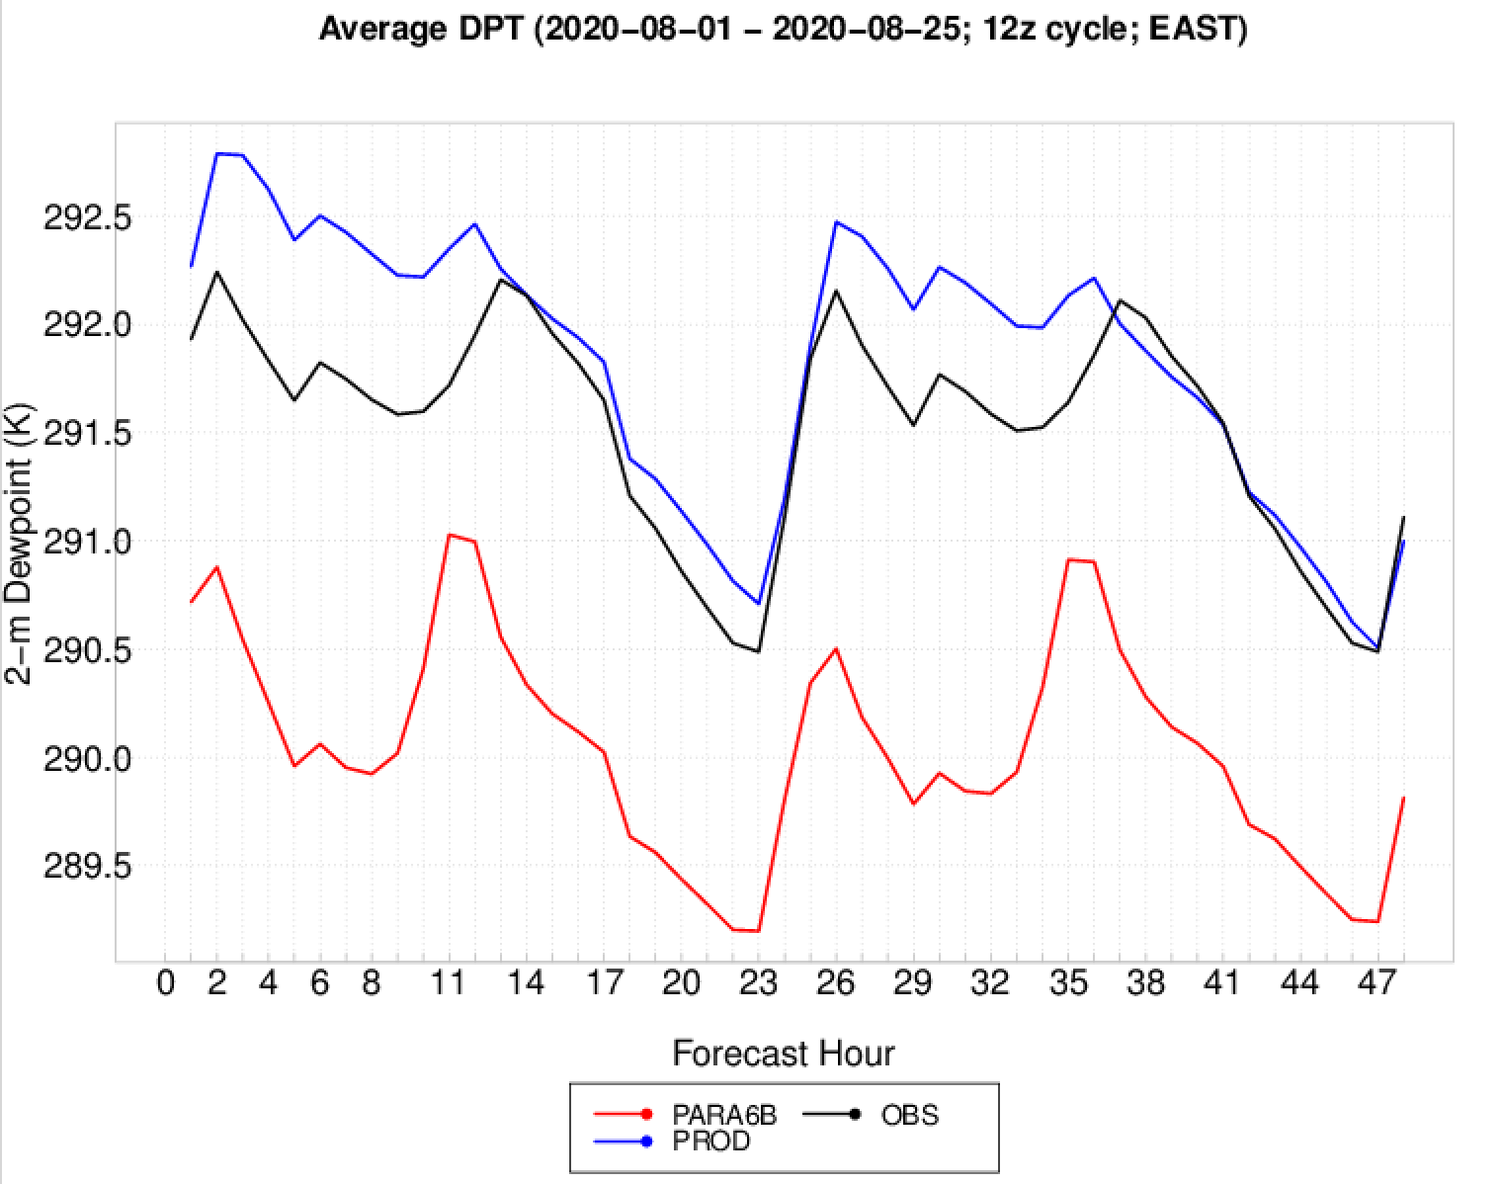
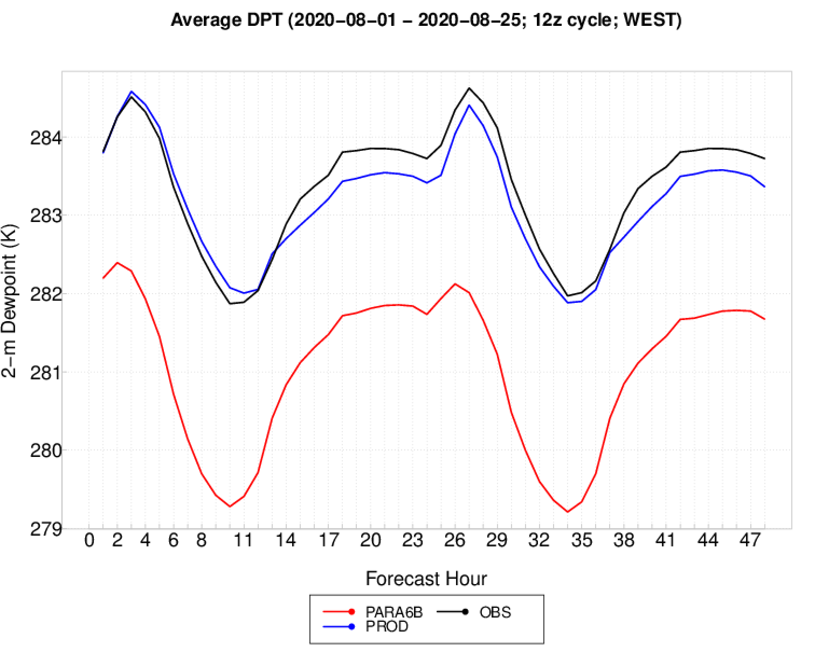
August, 2020: 2-m Dewpoint
NOTE: analysis is really from 08/11/2020, not 08/01/2020; this is a typo.
Consistently drier PBL for GFS as was seen also during December.
Prod does much better at predicting low-level moisture
Again, any improvements to physics that improves quantities such as these may have a degrading impact on chemistry. Currently we tune to a poorer performing model

Slide 15
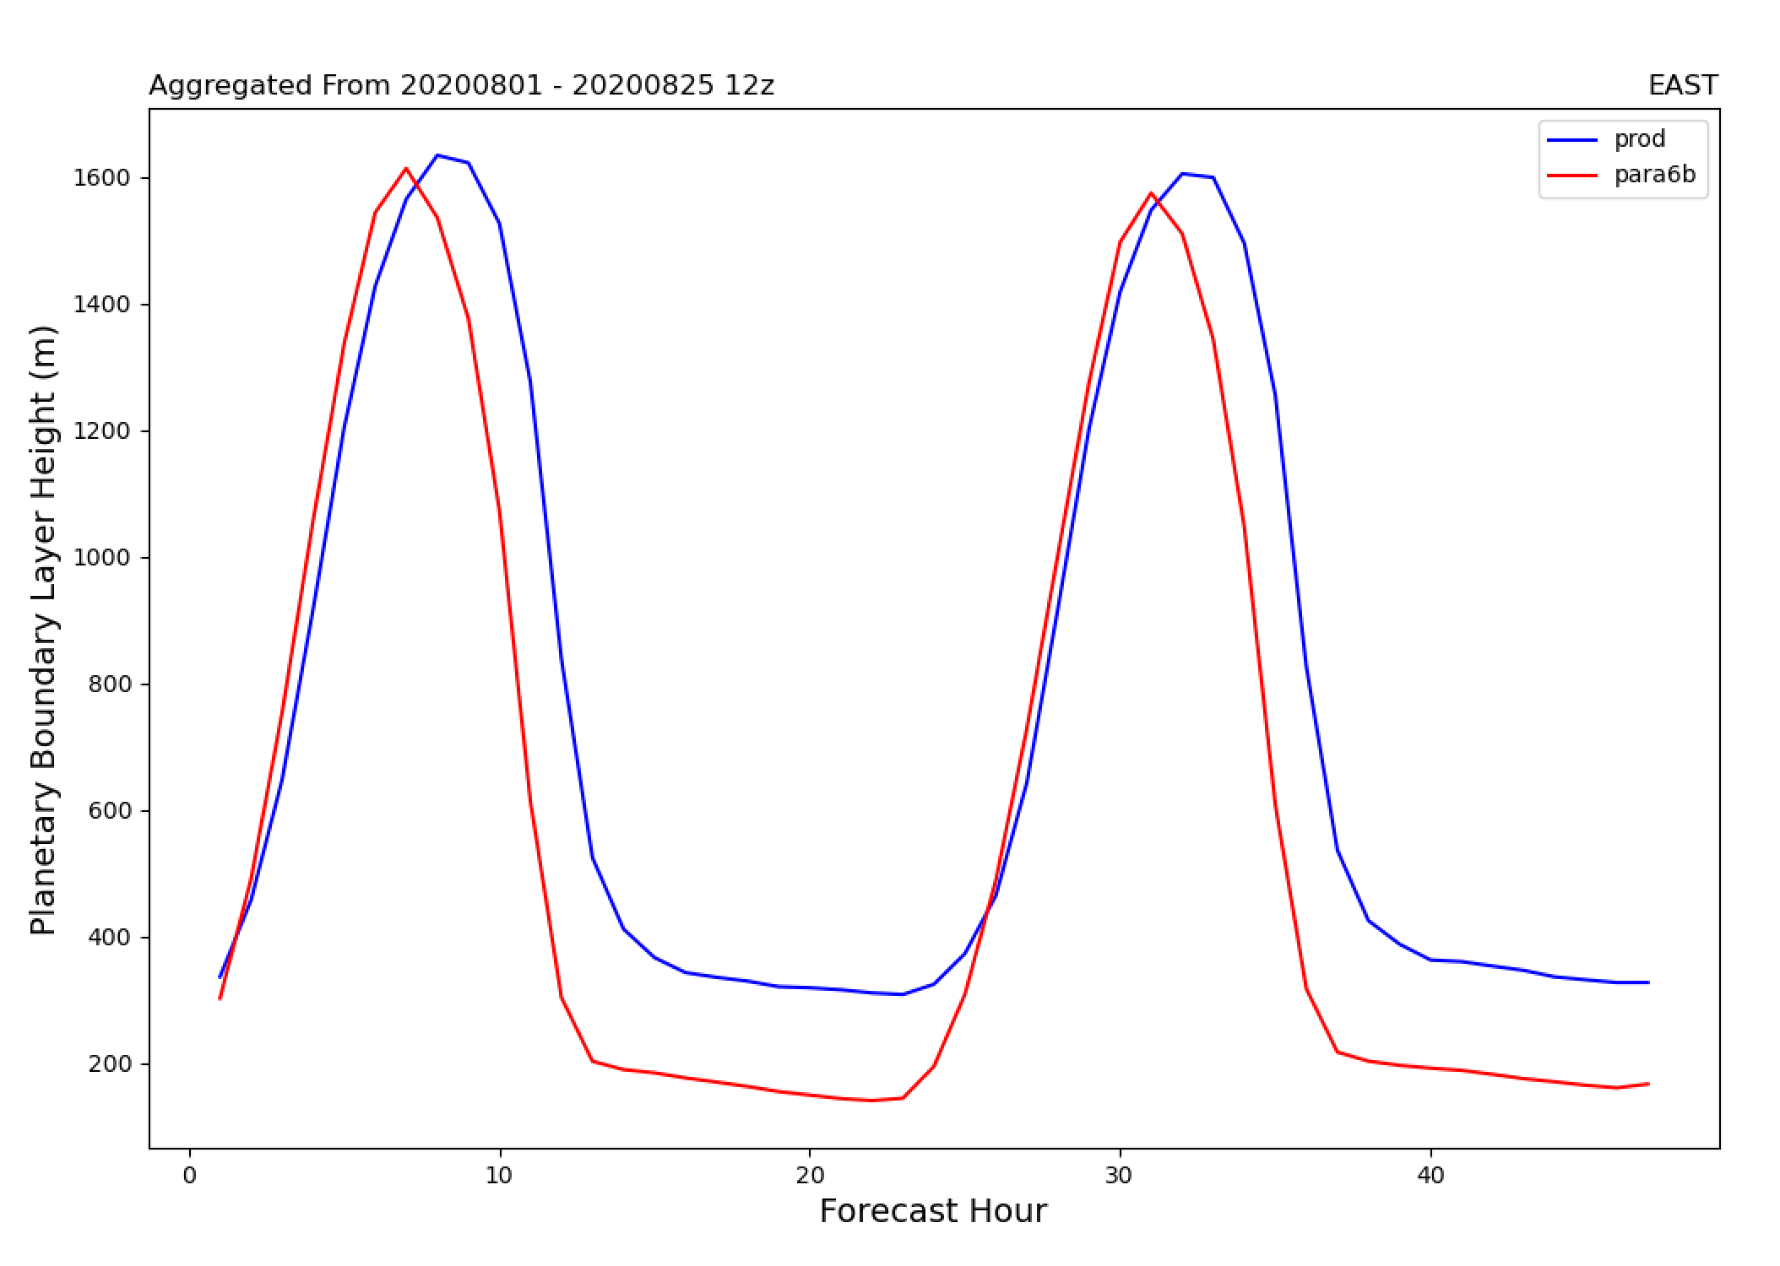
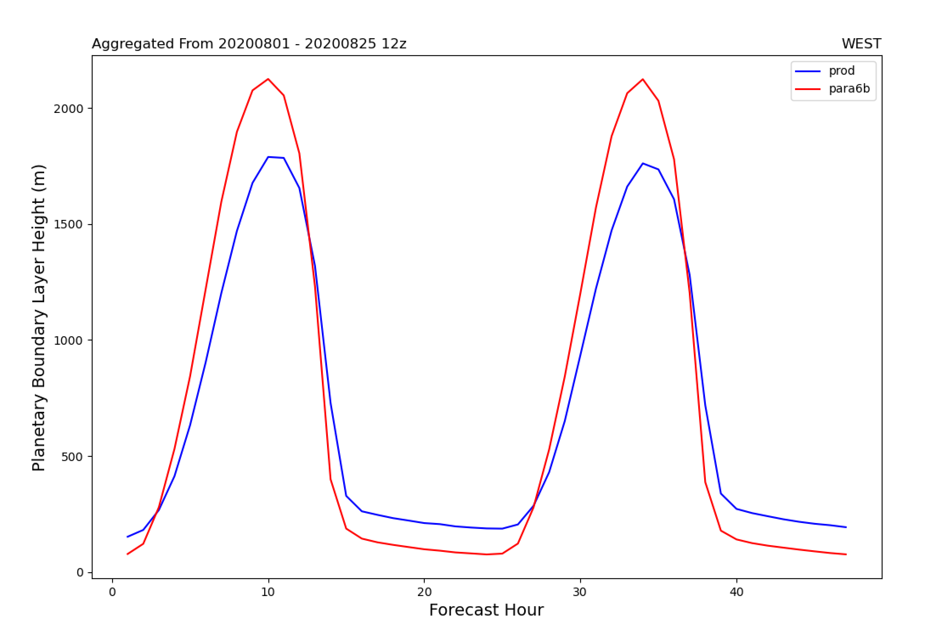
August, 2020: PBL Height
EAST: PBL heights are comparable between configurations during the day with a noted lag in prod. As is typical, the PBL heights are shallower during the evening for para6b
WEST: More aggressive PBL growth during the day for GFS-CMAQ . This is inline with increased 2-m temps, drier dew points, and more momentum mixing toward the surface
It’s not uncommon to see a more mixed PBL for GFS-CMAQ relative to NAM-CMAQd during the day.

Slide 16
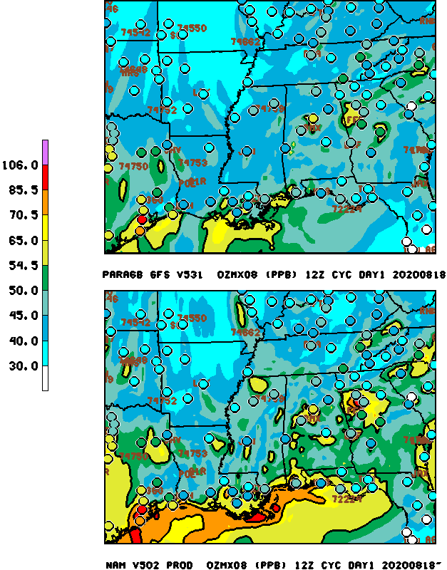
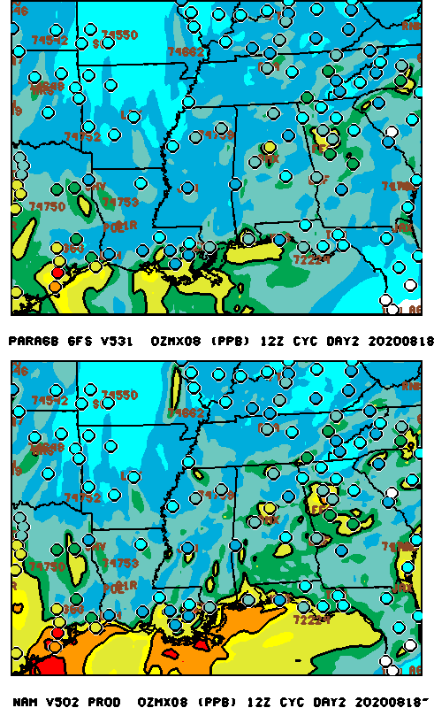
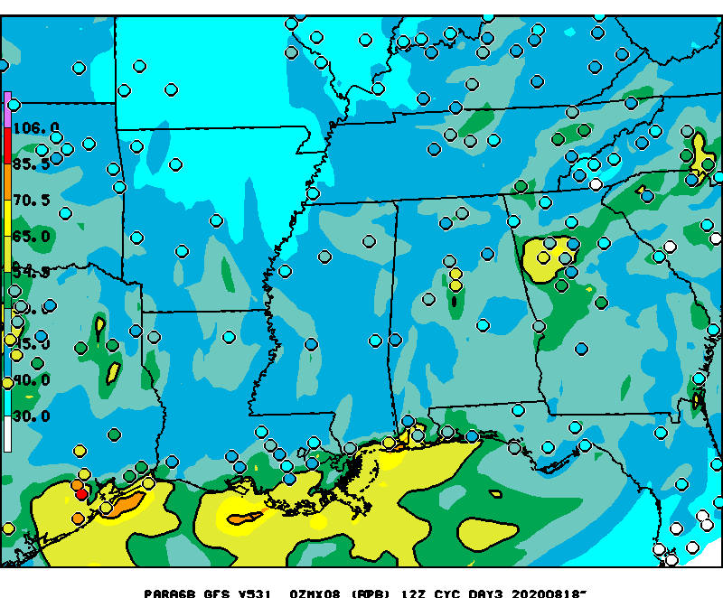
Valid: August 18 2020 Ozone episode Exp FV3GFS-CMAQ vs Prod NAM-CMAQ
EXPERIMENTAL
OPERATIONAL
Day 3
Daily maximum of 8 h ozone (ppb) .
Observed values are in circles.
Day 1
Day 2
Notes:
Day 3 skill similar to day 1 for this code orange event
Both models over predicted..how much due to reduced activity from COVID

Slide 17
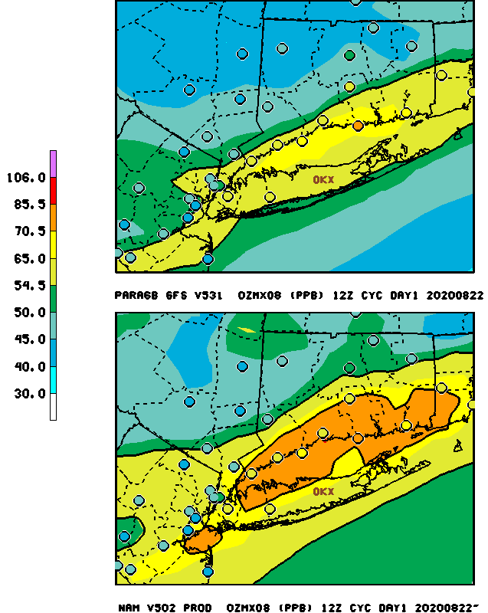
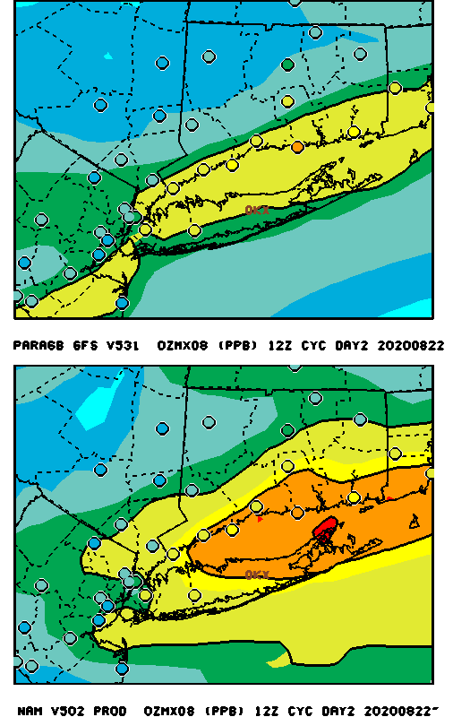
Valid : August 22 2020 Ozone episode Exp FV3GFS-CMAQ vs Prod NAM-CMAQ
Day 3
EXPERIMENTA L
Day 3
Daily maximum of 8 h ozone (ppb)
valid on August 22, 2020.
Observed values are in circles.
Day 2
Day 1
OPERATIONAL
Notes:
Day 3 skill similar to day 1 for this code orange event
Both models over predicted..how much due to reduced activity from COVID

Slide 18
Valid: 9/5/20. 8h max O3 exceedance RAW Model Predictions
V2
GFSV16-
CMAQv5.3.1
PROD
V1: GFSv16-CMAQ 5.3.1
NOTE strong underprediction of ozone from GFS driven CMAQ
Notes:
para6 underprediction...need for NOx gas phase emissions from fires

Slide 19
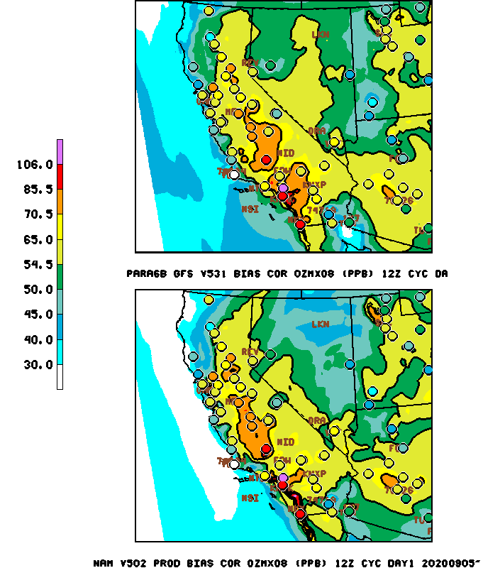
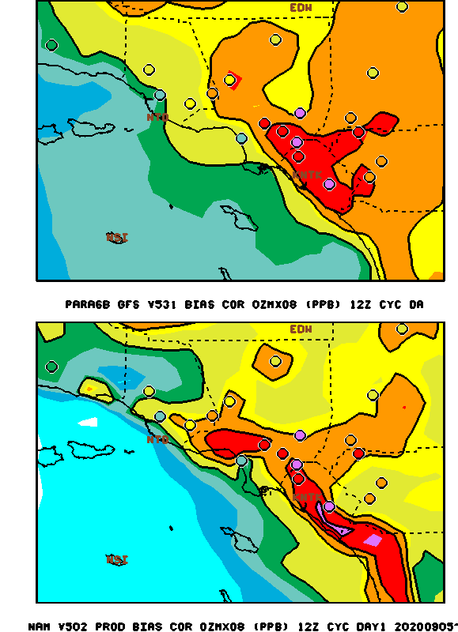
8h max O3 exceedance Valid: 9/5/20 Bias Corrected Model Predictions
V2
GFSV16-
CMAQv5.3.1
PROD
Notes:
para6 underprediction...need for NOx gas phase emissions from fires

Slide 20
The Western U.S. 2020 fires RAW 24 h avg PM2.5 Valid: 9/5/20
Production
V1: GFS-CMAQv5.3.1
V2: GFS-CMAQv5.3.1
Significant reduction in PM2.5 from V2 GFS-CMAQ
Notes:
GBBEPx v16 more smoke downwind. More mixing ??

Slide 21
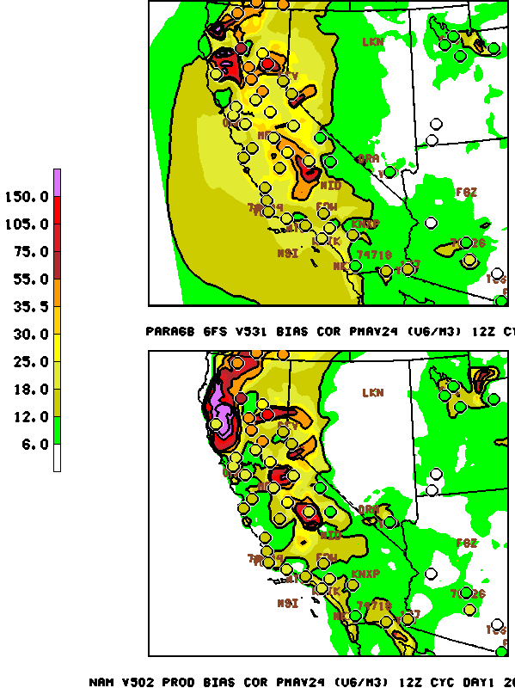
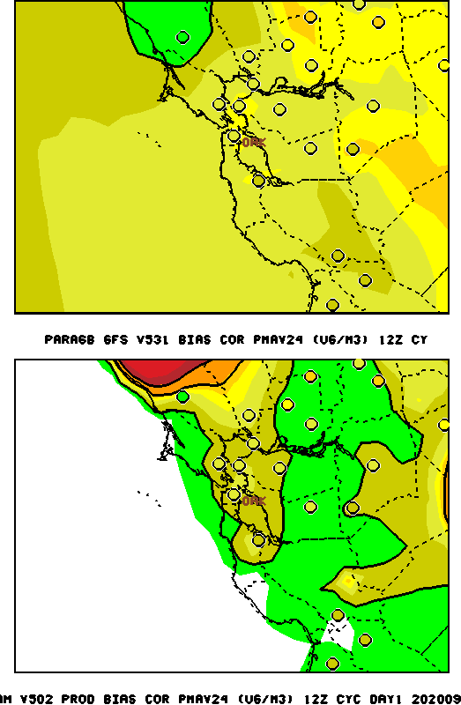
Bias Corrected 24 h avg PM2.5 Day 1 VALID: 9/5/2021
V2: GFS-CMAQv5.3.1
Operational: NAM CMAQ V5.0.2
Notes:
GBBEPx v16 more smoke downwind. More mixing ??

Slide 22
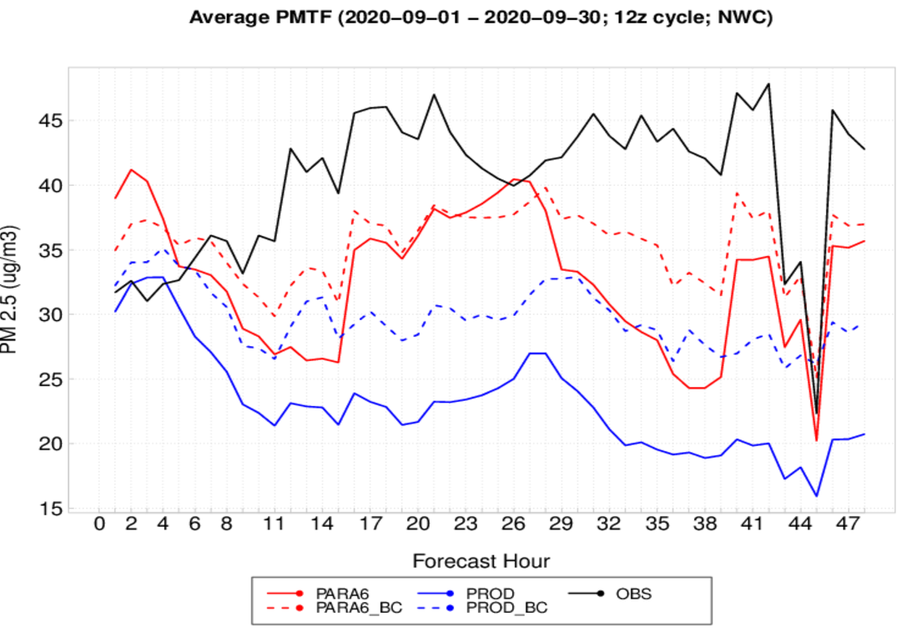
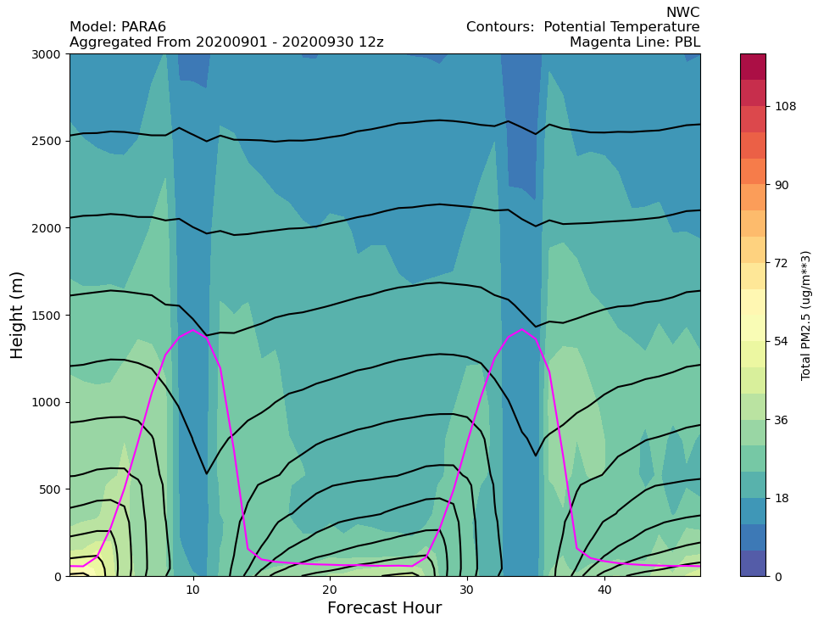
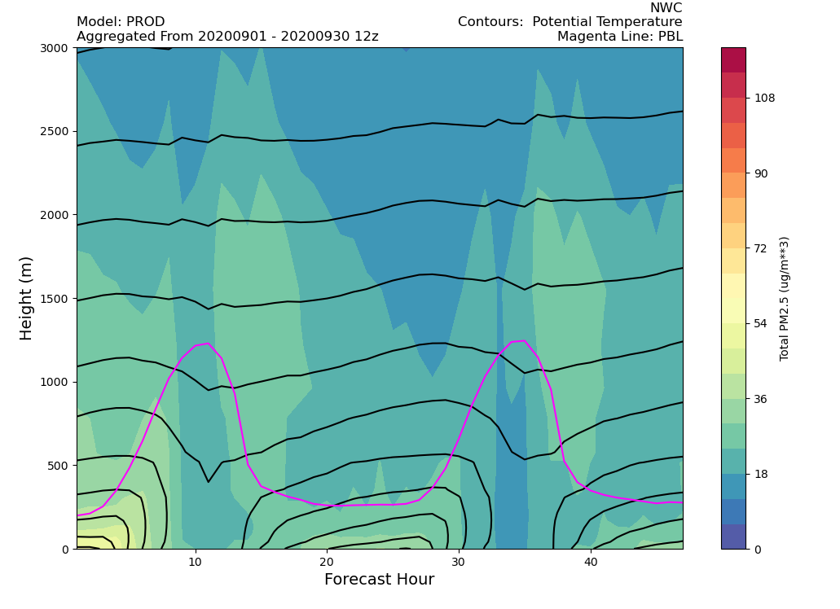
Northwest Coast: PM2.5
PARA
Daytime: PBL ramps up more aggressively in para6
The depth of decreased PM2.5 during solar maxima greatly exceeds PBL height. Deep convection also a possible culprit, not just PBL
Night-time: Stronger surface inversion (i.e. higher density of theta contours in para6) coincides with shallower PBLs and possibly higher concentrations near surface
Reduced winds prevent PM2.5 from mixing out more
PROD

Slide 23
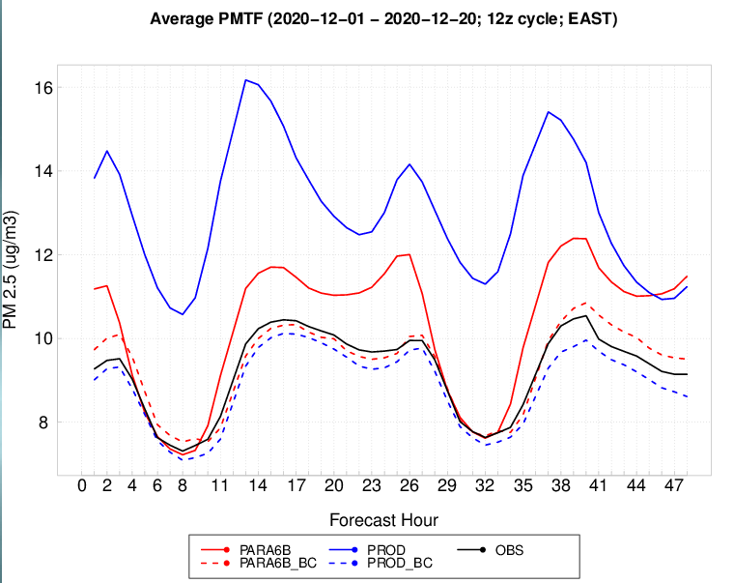
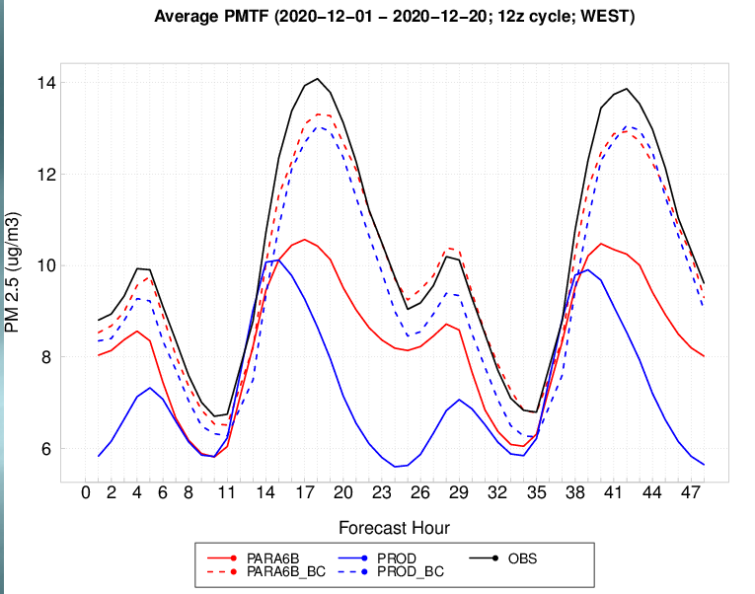
December, 2020: PM2.5
Note: most days between 12/01/20 and 12/20/20 were processed
EAST: Significant improvement throughout the day, particularly in the afternoon hours
Both models overdo PM2.5 during the night while AQM V6.0 is spot on during the day
WEST: Night-time values of PM2.5 improved during the night while prod and parallel remain similar during the day
Bias-correction performs remarkably well, regardless of model, during the days examined for December.

Slide 24
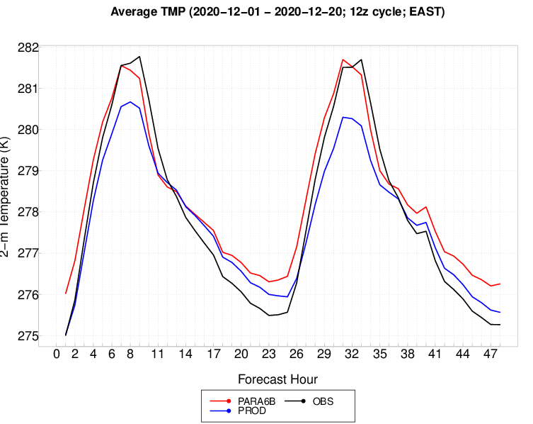
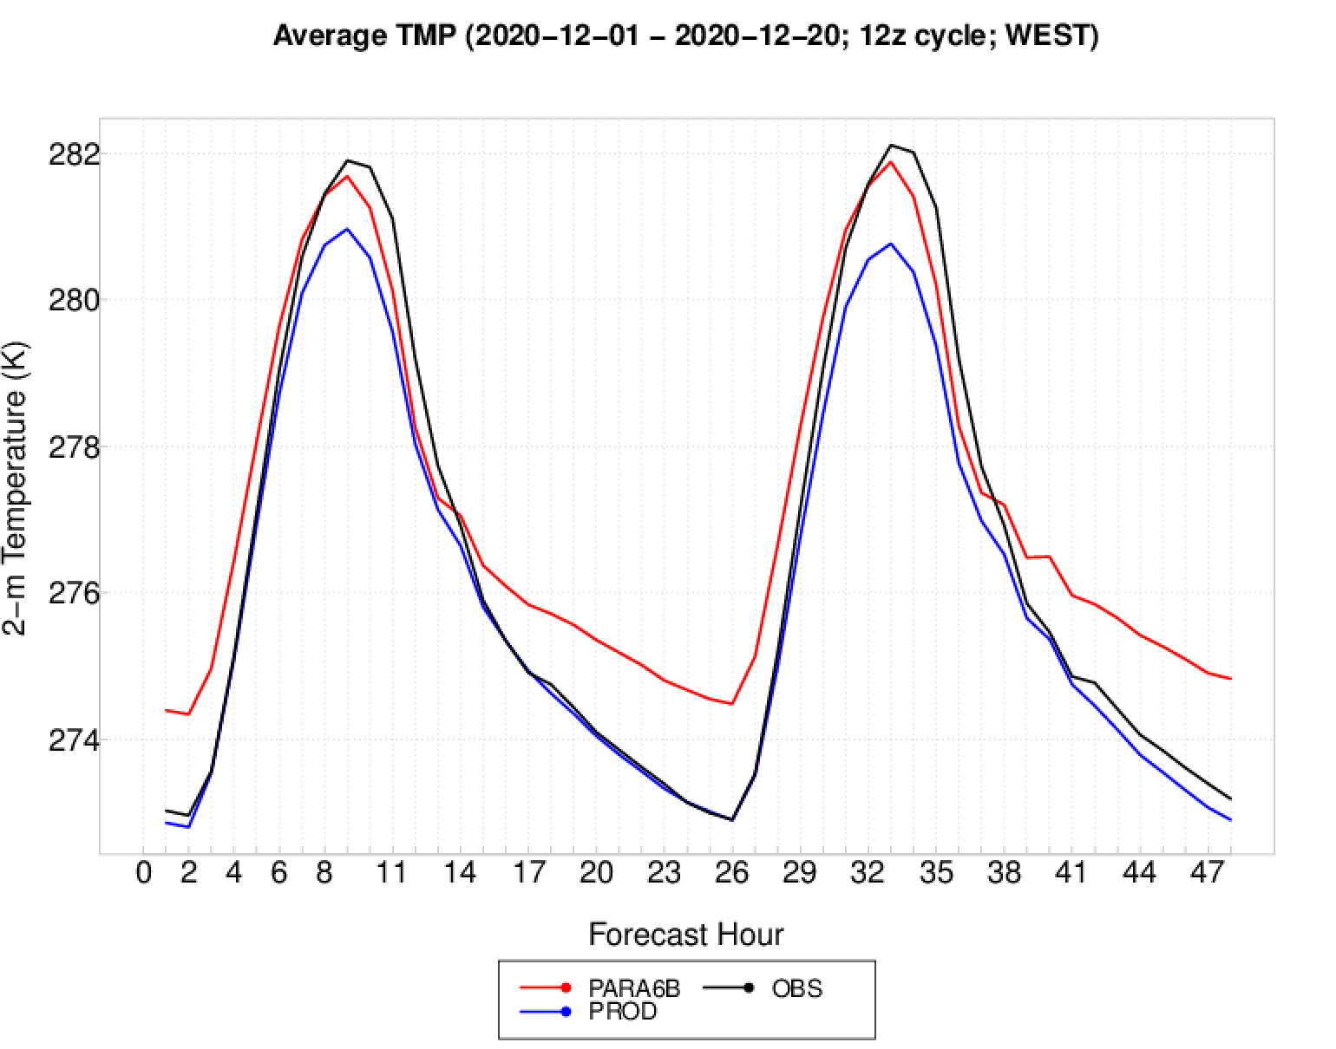
December, 2020: 2-m Temperature
Note: most days between 12/01/20 and 12/20/20 were processed
Para6b runs warmer than prod throughout the 48-hour forecast for both WEST and EAST.
Para6b agrees better with observations during the daytime while Prod performs better at predicting 2-m temperature during the night
Even though 2-m temperature during evening is better for Prod, Prod still over-predicts PM2.5 relative to Para6b.
Differences in day-time temperature between Prod and Para6b are similar between EAST and WEST; yet Prod predicts too much PM2.5 EAST relative to Para6b. Day-time PM2.5 is similar between models out WEST

Slide 25
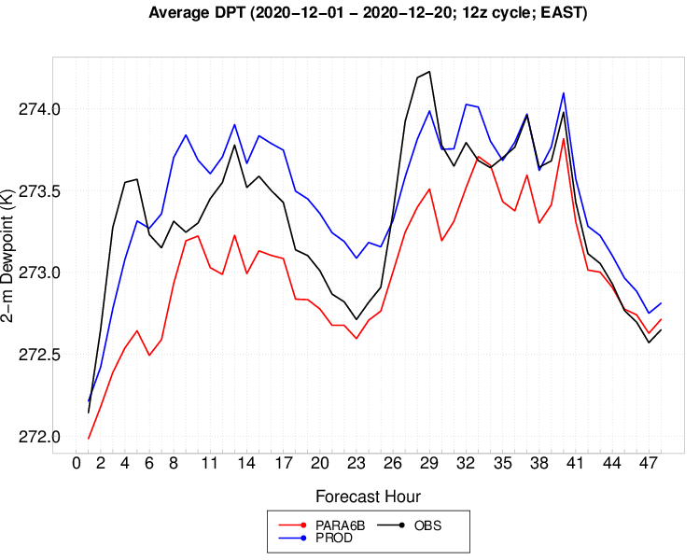
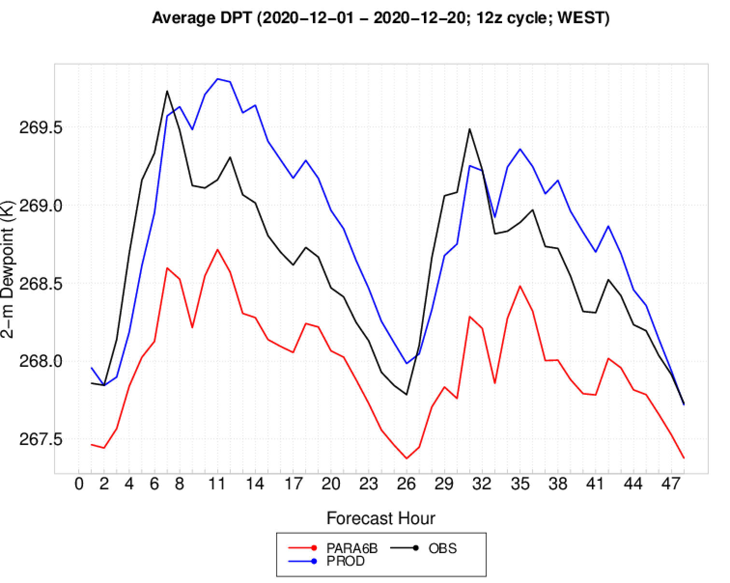
December, 2020: 2-m Dewpoint
Note: most days between 12/01/20 and 12/20/20 were processed
Very typical pattern of 2-m dewpoint temperature in para configurations being biased low relative to observations and prod, regardless of region
Prod always agrees better with observations for 2-m dewpoint
It’s possible that some of our tuning for enhanced AQ prediction is partially rooted in dealing with a dry-biased PBL
The impacts have not yet been disentangled and probably needs to be addressed

Slide 26
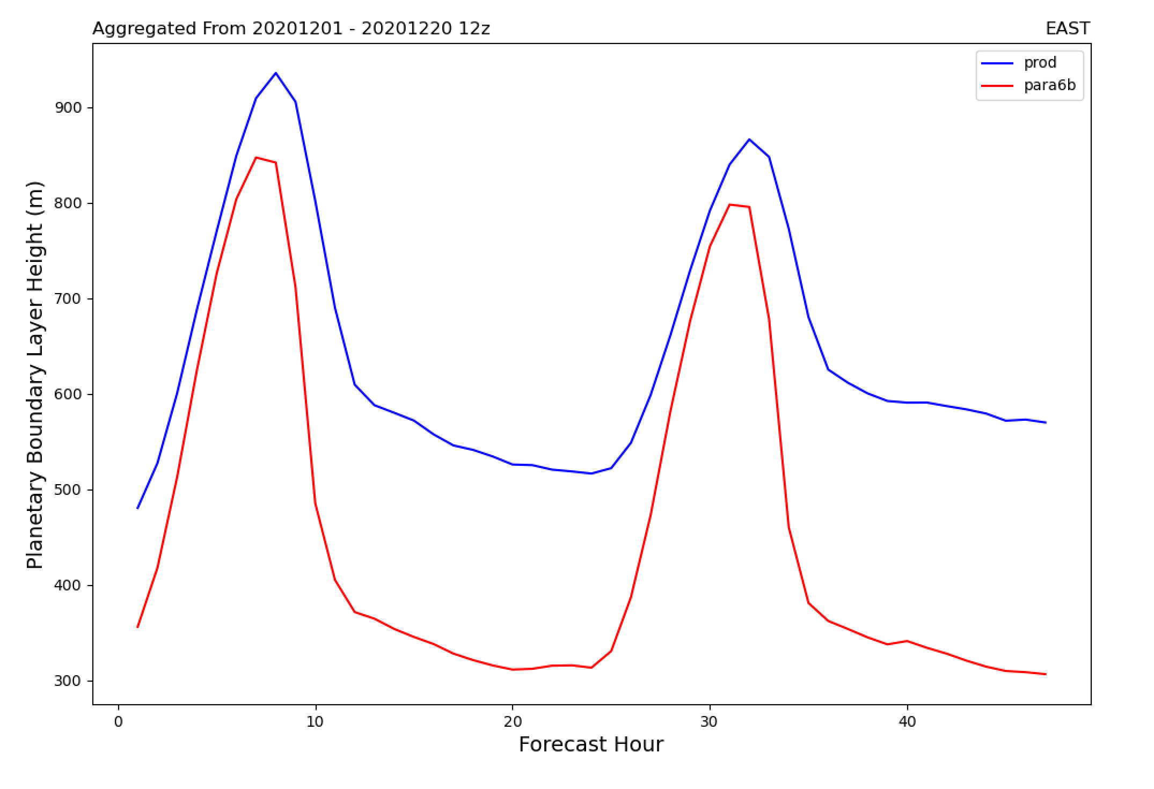
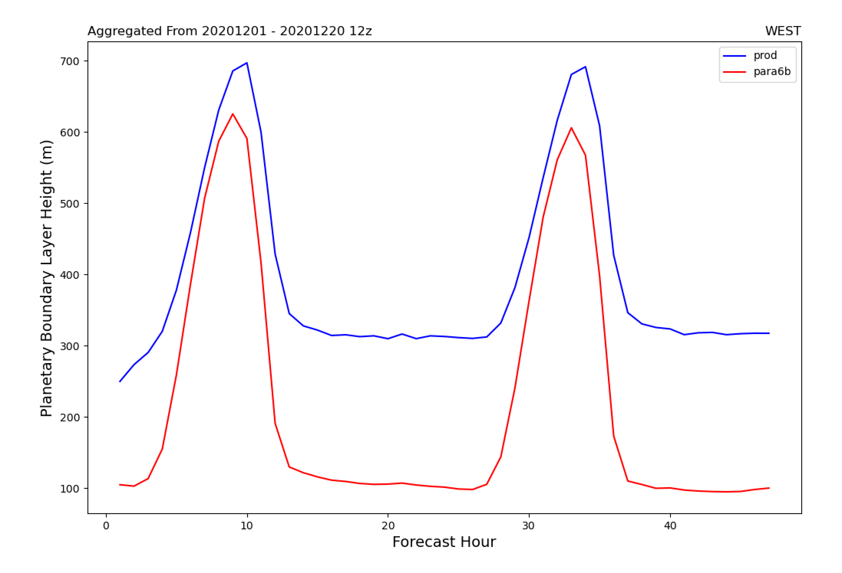
December, 2020: PBL Height
Note: Geographical points coincident with PM2.5 observations are grouped for non-verifiables and processed similarly.
PBL heights for Prod are consistently higher in Prod relative to Para6b
Night-time: Formulation of mixing lengths much different: MYJ (prod) prognoses its mixing length while GFS uses the Bougealeut-Lacarre formulation (fine for day time but probably not okay for the night-time given that its non-local in design).
Unexpected that Prod has higher PBL heights during the day since 2-m temps are higher, 2-m dewpoints are drier, 10-m winds are stronger, and sensible heat fluxes larger (not shown) during the day for Para6b.

Slide 27
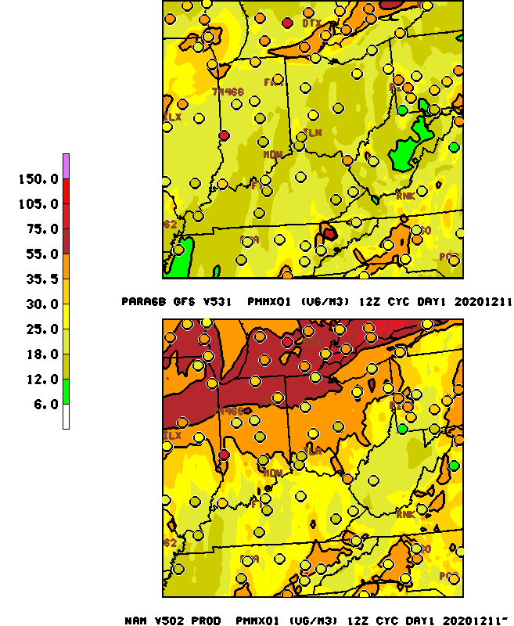
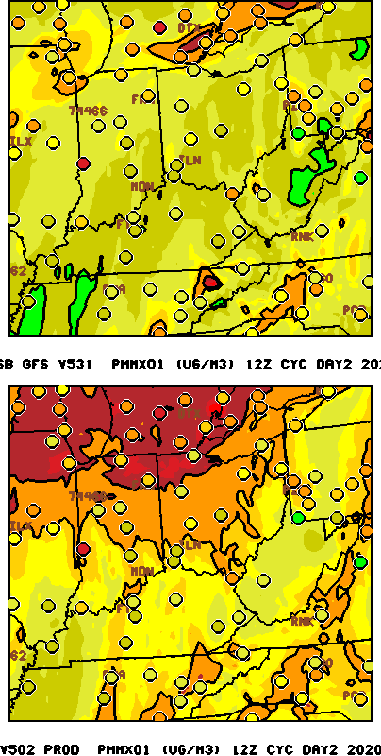
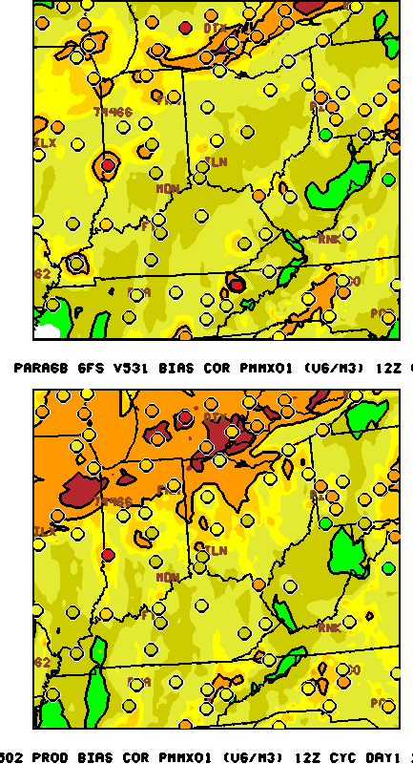
Bias Corrected 24 h avg PM2.5 VALID 12/11/20 12 UTC run forecast
Day1 RAW
Day2 RAW
Day1 Bias Corrected
V2: GFS-CMAQv5.3.1
Operational
Notes:
GBBEPx v16 more smoke downwind. More mixing ??

Slide 28
AQM v6.0 Evaluation Request
Evaluation Letter : February 22, 2021
Link to evaluation form
Link to verification statistic web site
Link to retrospective and near real-time run graphical maps
Return Evaluations : March 31, 2021
Impression of upgrade impacts on AQM forecasts for your area
Model performance for events impacted by wild fires
Skillfulness if any of 72 hour forecasts
Evaluation summary webinar: April 6, 2021
Director’s briefing: April 9, 2021
EMC AQ web site: http://www.emc.ncep.noaa.gov/mmb/aq
Notes:
these projects were performed in fy20

Slide 29
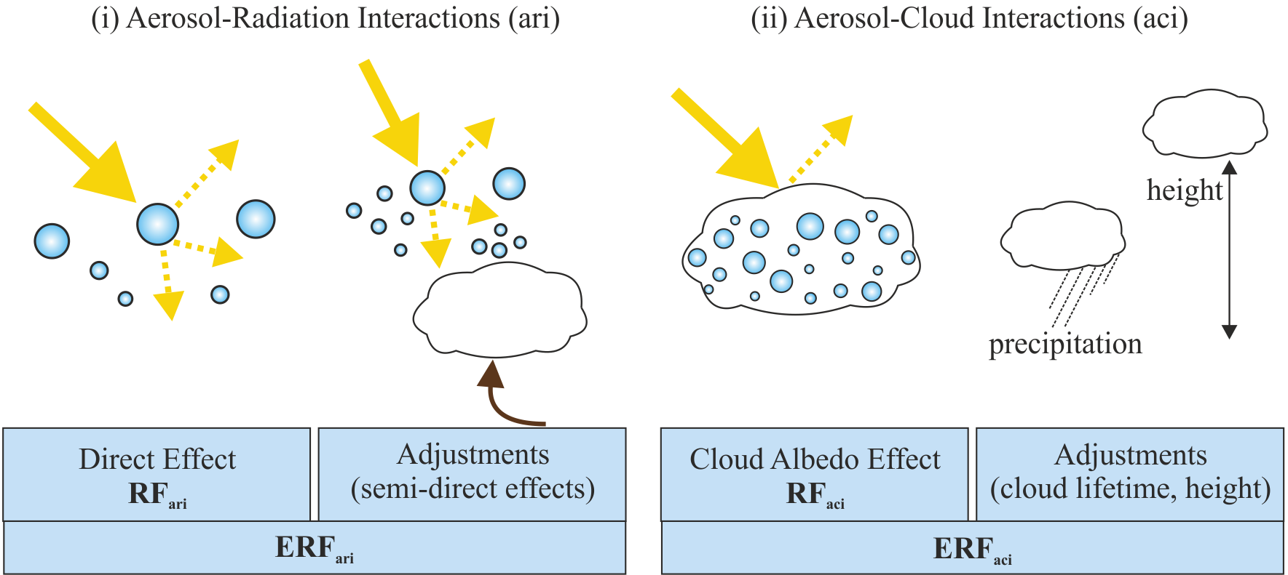
Future Emphasis Aerosol-Cloud/radiation interactions
,
Courtesy
Exeter CLARIFY
project
Notes:
We’ve shown that incorporating more near realtime emissions would likely have improved operational model pm and perhaps ozone forecast.s Here are some ideas for testing and providing more up to date emissions.

Slide 30
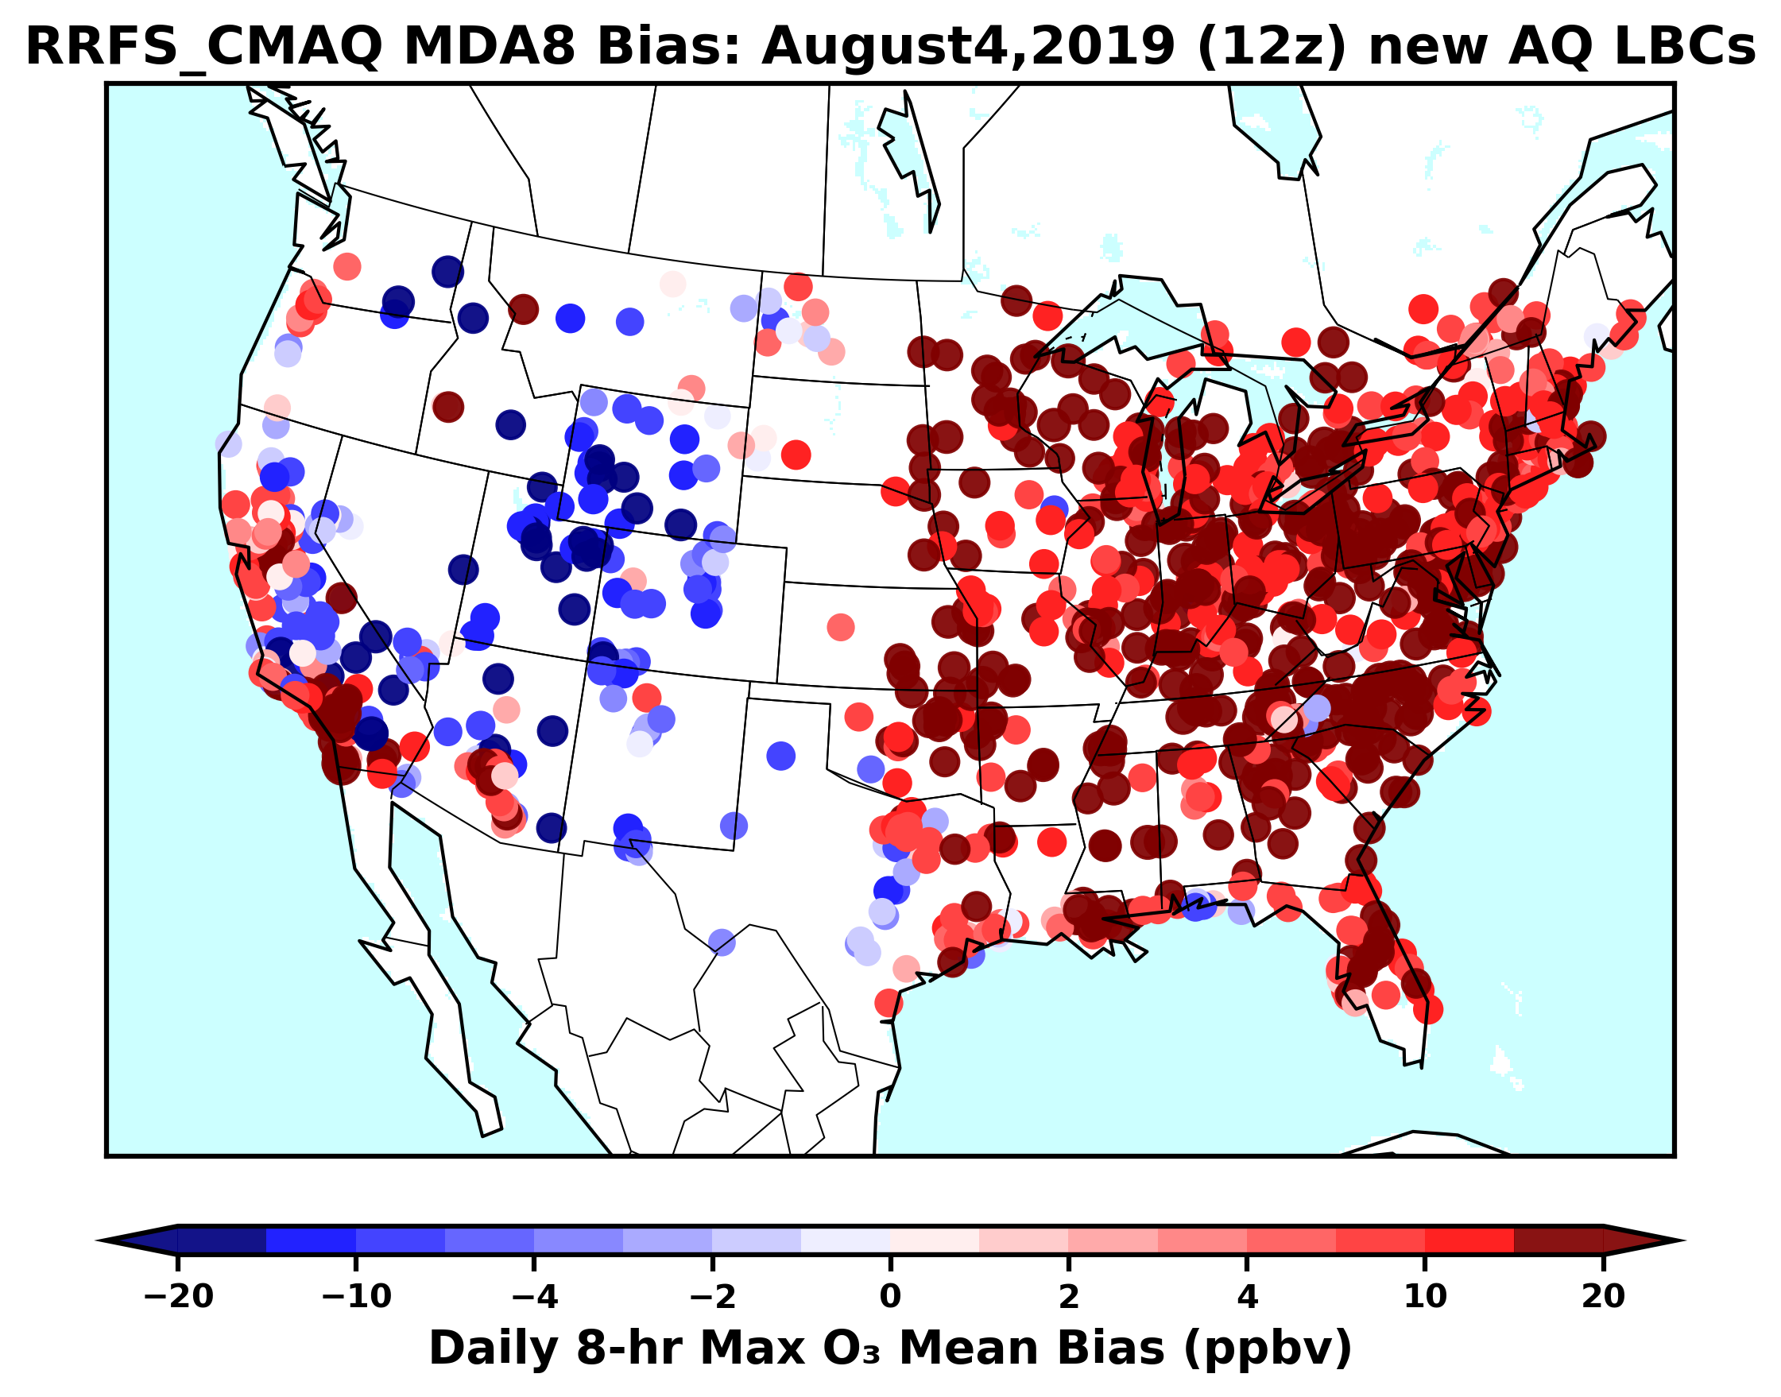
RRFS-Chem inline CMAQ
FY24-25: 3km
The RRFS-CMAQ inline system was continually tested on a CONUS domain at a 25-km resolution with updated chemical lateral boundary condition and anthropogenic emissions.
Previous over-predictions of organic particulate matter (e.g., primary organic carbon and primary organic matter) and aerosol optical depth (AOD) were traced to excessive anthropogenic emissions and corrected.
Accumulating forecast bias in surface ozone prediction is under investigation.
FY24
AOD prediction showing a reasonable performance
Daily 8-hr maximum ozone prediction bias on August 4, 2019
Jianping Huang, Raffaele Montouro

Slide 31
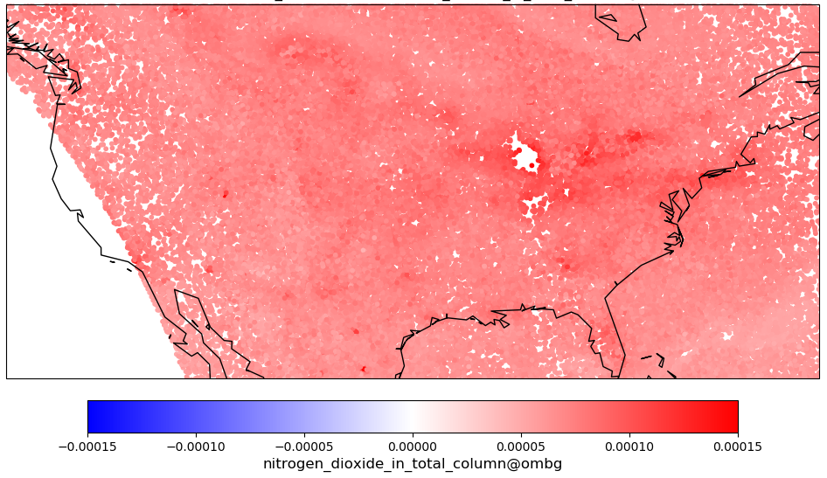
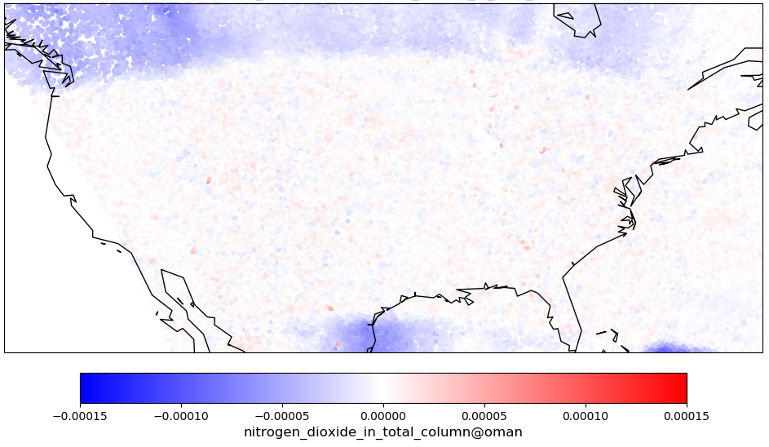
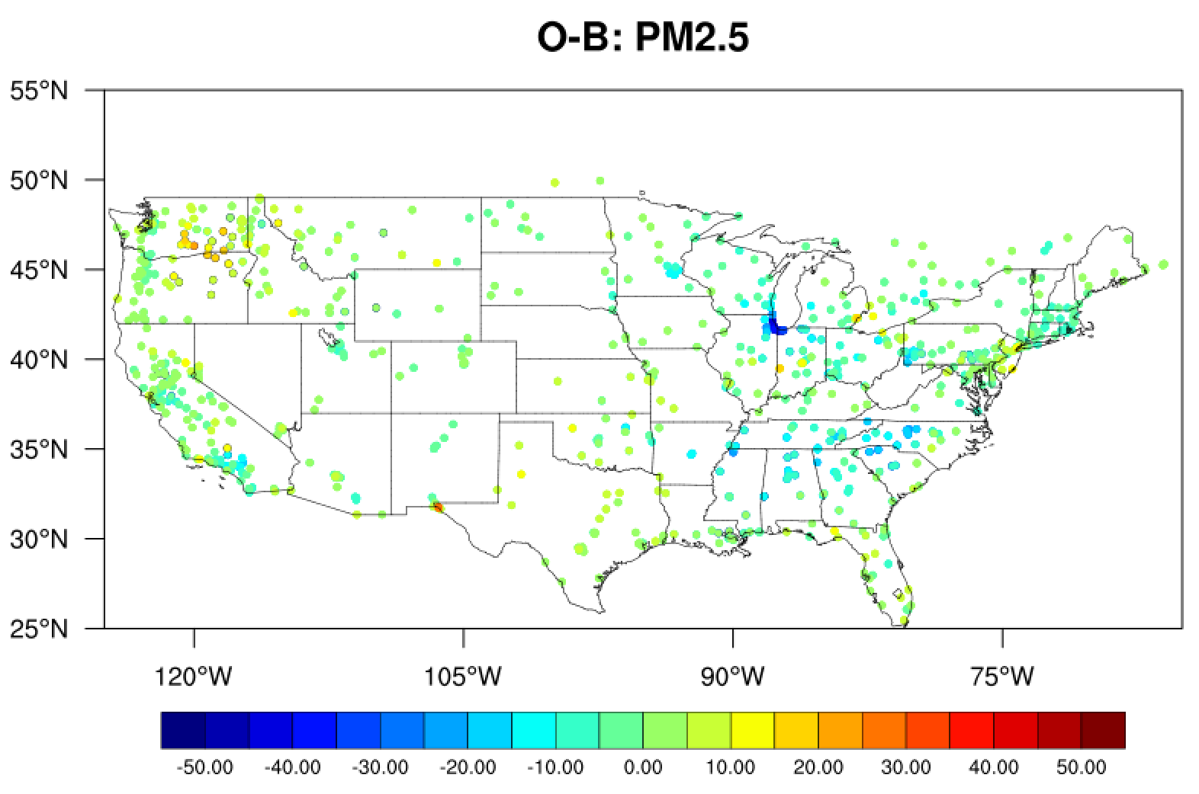
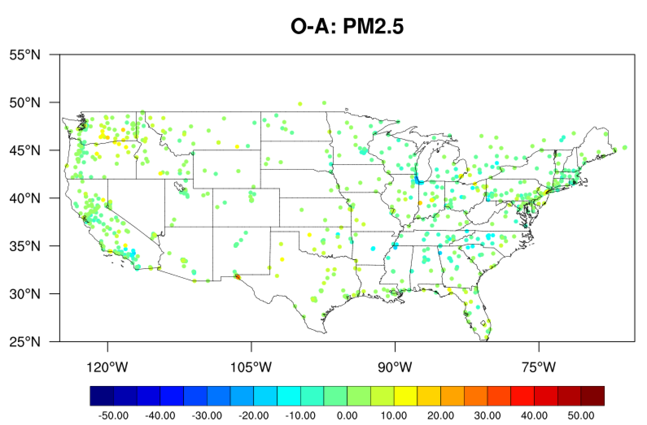
RRFS-Chem Data Assimilation
NO2 (Cory Martin):
Added three new unit tests to the FV3-JEDI repository to 1) create idealized background error covariance matrix 2) perform variational DA using TROPOMI NO2 observations and RRFS-CMAQ background and 3) compute analysis increment
Performed initial 3DVar analysis using TROPOMI NO2 and RRFS-CMAQ 25km 6 hour forecasts for two weeks in August 2019
Found that FV3-JEDI does not remove observations outside of a regional domain and creating a filter to remove them
Aerosols:
Generated GSI Background Error Statistics
Developed Preliminary GSI PM2.5 DA Capability
NO2 JEDI DA:
Observation-minus-forecast values, show a consistent low forecast bias across the domain
Observation-minus-analysis values, show reduced biases in the model domain
Aerosol GSI DA: PM_{2.5} Analysis is closer to observations than forecast

Slide 32
Proposed Schedule 2021-2022
Run | Jn-Mar 2021 | Apr-Jun | Jul-Sep | FY22
GFS- CMAQ AQMv6 NAQFC -VIIRS GVF, LAI -Ag fires H.Huang/ARL | -Freeze code -Begin real-time& retros | BC Training data Aug-->present update emiss also GFS-aero | Official EE2 Evaluation | Implement
Inline 3 km RRFS-CMAQ J. Huang/R. Montouro/ARL | Test initial 12 km | Improve smoke emissions, NO2 DA working | Test 3 km full chemistry | Final code configuration/ tests/optimiz FY24 Implement
Verification/ Diagnostics E. Strobach, J. McQueen | Move METplus to operations (o3,pm) | AOD verification from GOES 0.1, VIIRS .25 deg | AERONET AOD for CMAQ

Slide 33
Challenges
NACC-CMAQ smoke/dust overpredictions in summer, NE valleys in Winter
GBBEPx source ?
Overmixing of plume down ?
plume rise too strong
scavenging too weak ?
Transition to RRFS-CMAQ
While continuing to support offline NACC-CMAQ
Retire HYSPLIT smoke/dust
Replace w/ HRRR-smoke/GEFS-Aero/CMAQ
Transition to unified NASA-NOAA GOCARTg2
Constituent verification (smoke/dust) for NAQFC
Code transition to WCOSS 2
Notes:
some risks in moving to 3 km online system too quickly

Slide 34
UFS Atmospheric Composition Modeling Goals 2024-25
Capability | Global GEFSv13 (~25 km, 15 d) | Regional inline LAM-Chem (3 km) | Hazards dispersion HYSPLIT
Anthro Emissions | NEXUS/HEMCO (UFS) | NEXUS/HEMCO (HSUP) | Inverse modeling
Biomass Burning Emissions | Improved GBBEPx esp. over Africa | Improved GBBEPx esp. for Rx/ag fires/impr. speciatiation (HSUP) | On-demand local fires
Data Assimilation | VIIRS AOD (UFS) | AOD, TROPOMI NO2 (HSUP) | Volcanic Ash
Atmospheric Composition module | Unified GOCART w/ nitrates (R2O) | Online Optimized CMAQ: CB-VI, Aero7 (HSUP) | N/A
Post-processing | Improved AOD calculations (UFS) | Machine learning for bias correction, chemistry (HSUP) | Ensemble products(JTTI19)
Physical processes UFS | Improved dust (albedo), Aerosol-wx interactions | Improved dust, Aerosol-wx interactions | Trans. Coeff. Matrix src term calc.

