Slide 1
Nearshore Wave Prediction System v1.3
EE Meeting
André van der Westhuysen, Jian Kuang, Roberto Padilla (NCEP)
Dennis Atkinson (OST); John Kuhn (AFS);
Pablo Santos, Joe Maloney (WFO-MFL); Alex Gibbs (WFO-HFO); Doug Gaer (NCO); Ray Ball (WFO-MOB); Troy Nicolini, Sten Tjaden (WFO-EKA); Donnie King, Scott Kennedy (WFO-MHX), Carlos Anselmi (WFO-SJU); Paul Stanko (WFO-GUM), Emily Niebuhr (WFO-ALU)
Jeffrey Hansson (USACE/CHL), Eve-Marie Devaliere (NESDIS/STAR),
Joe Long, Kara Doran and Hilary Stockdon (USGS)
Internal presentation to NCO, July 31, 2019
1

Slide 2
Outline
Timeline of project (Quad chart)
Scope of changes
Resource changes
Timing of jobs
Data input/output additions
EE2 Review
2

Slide 3
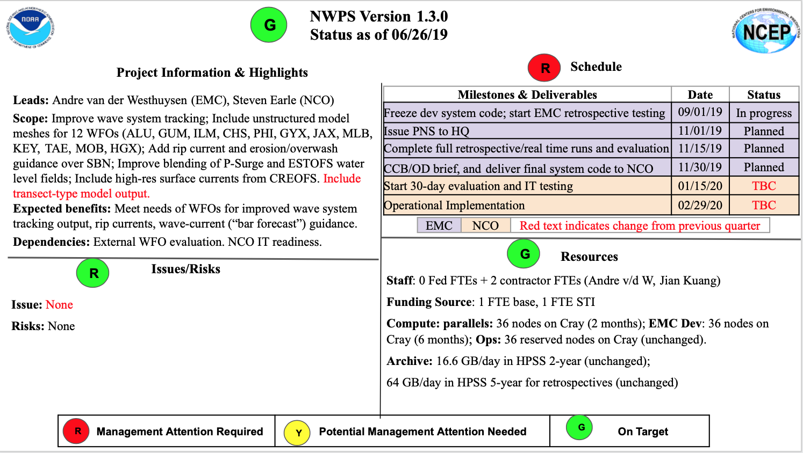
3

Slide 4
Scope of changes (1):
System upgrades
Improve wave system tracking using ML methods (clustering)
Transition 12 WFO domains from regular to unstructured: ALU, GUM, KEY, MLB, JAX, CHS, ILM, PHI, GYX, TAE, MOB, HGX
Include rip current and erosion/overwash on SBN
Include surface currents from NOS’s CREOFS model
Include transect output graphics
Major Bugzilla fixes
Eliminated all application-level Python libraries (e.g. basemap, matplotlib, scikit-learn) by using prod module python/3.6.3
4

Slide 5
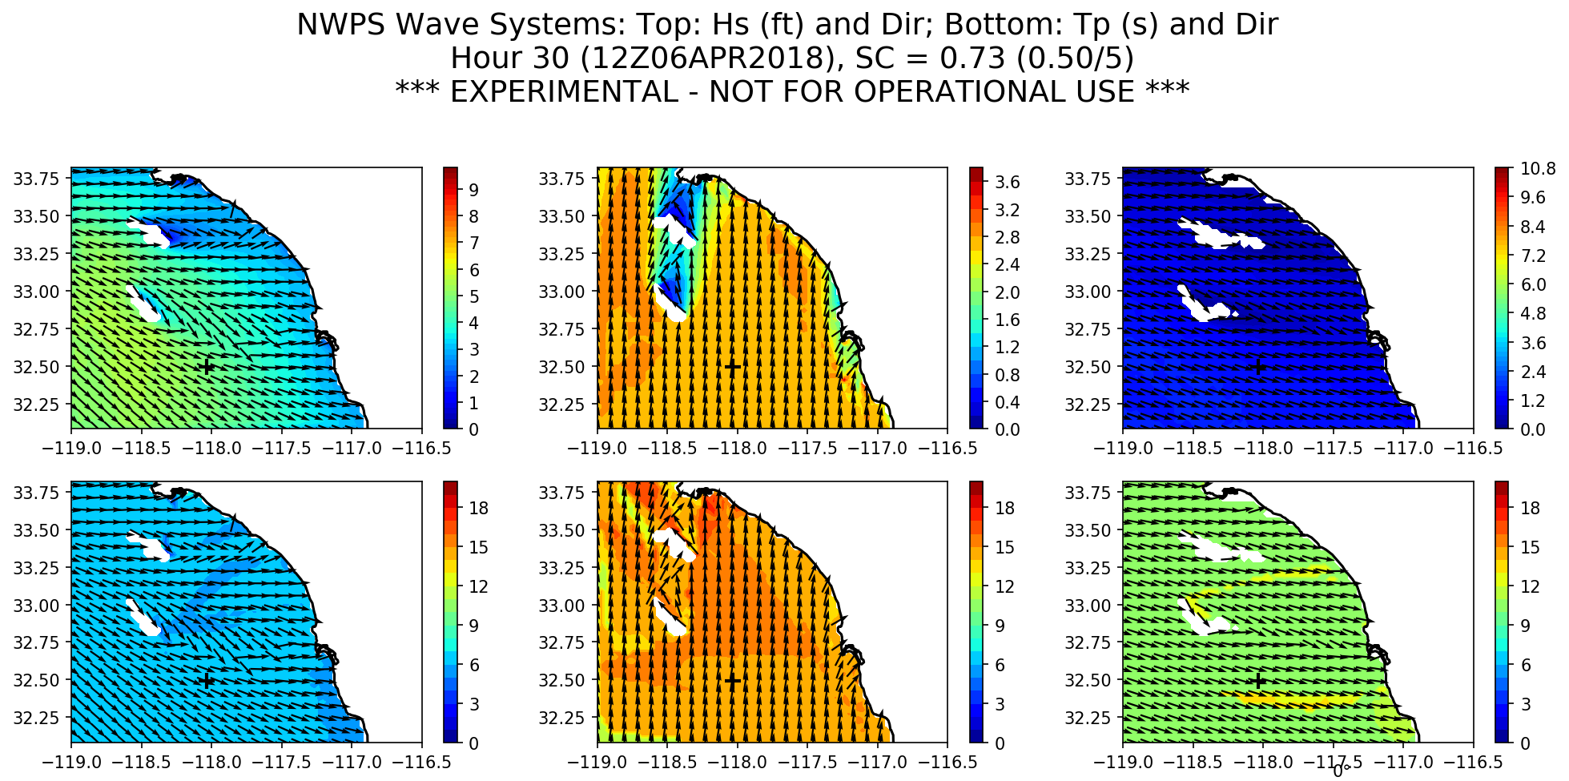
Scope of changes (2):
Improved procedure for wave system tracking
Uses new module scikit-learn, in Python 3.6.3 (WCOSS production)
*Dataflow: No impact
5

Slide 6
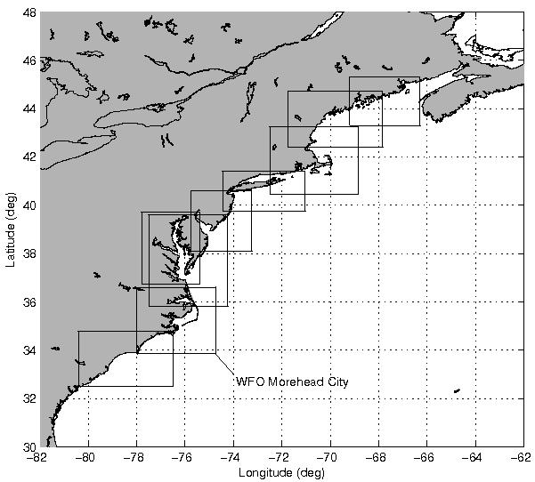
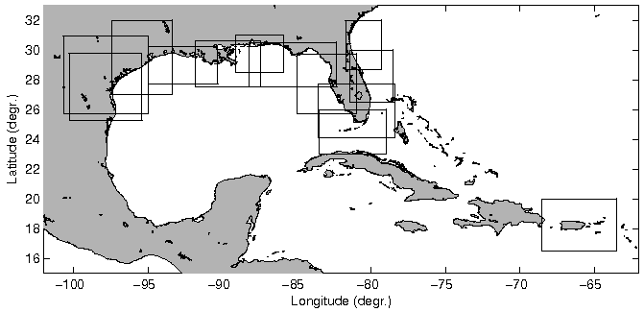
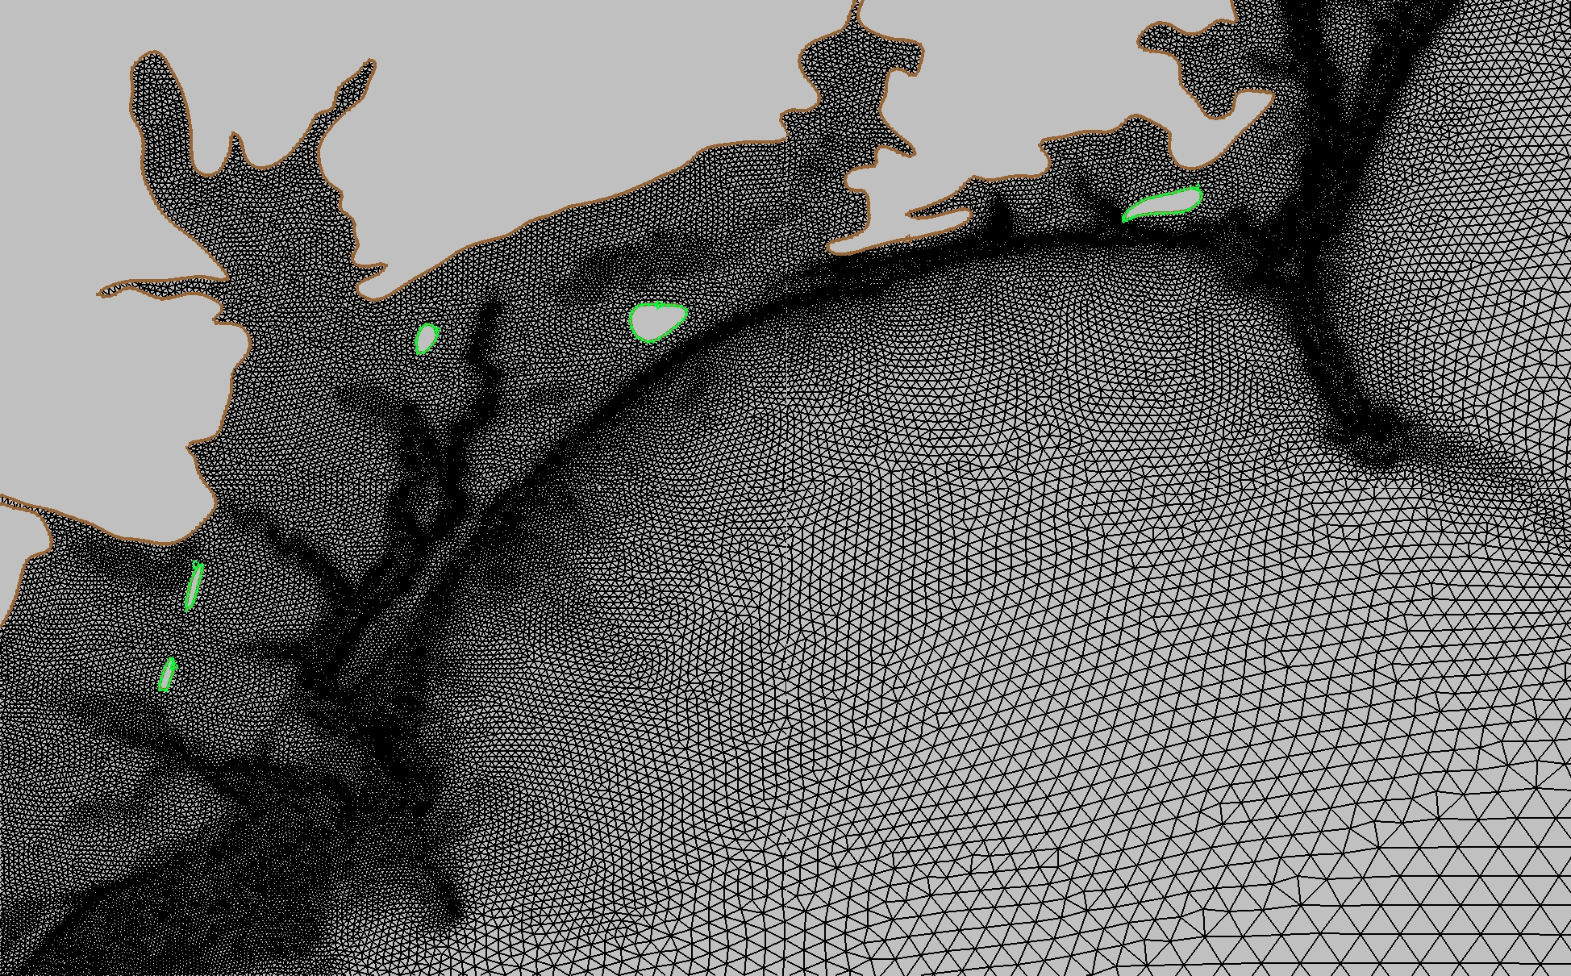
Scope of changes (3):
Transition 12 WFO domains to unstructured meshes
+ WFO ALU and GUM
6

Slide 7
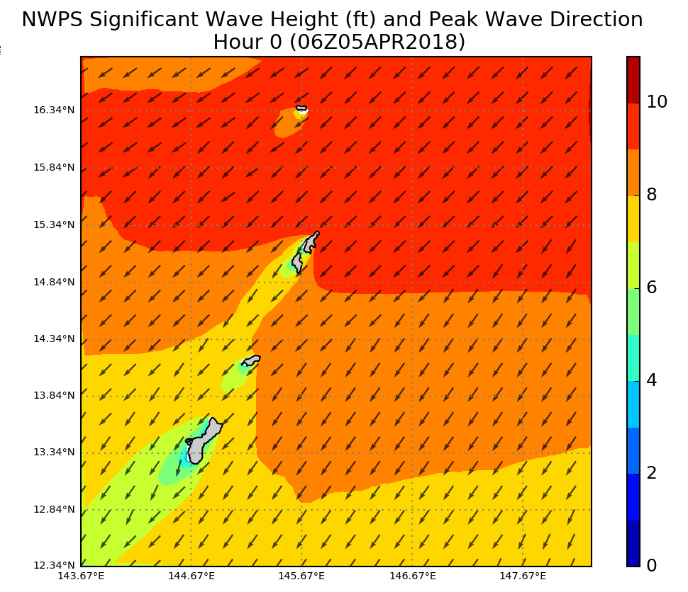
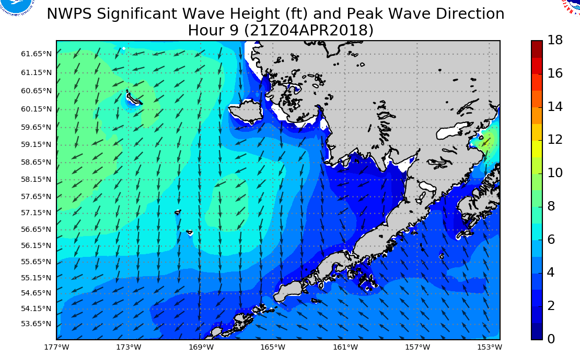
Scope of changes (3):
Transition 12 WFO domains to unstructured meshes
WFO GUM (Guam, PR)
WFO ALU (Aleutian Islands, AR)
*Dataflow: 30% Increase in WFO GUM domain size – additional 24 MB/day
7

Slide 8
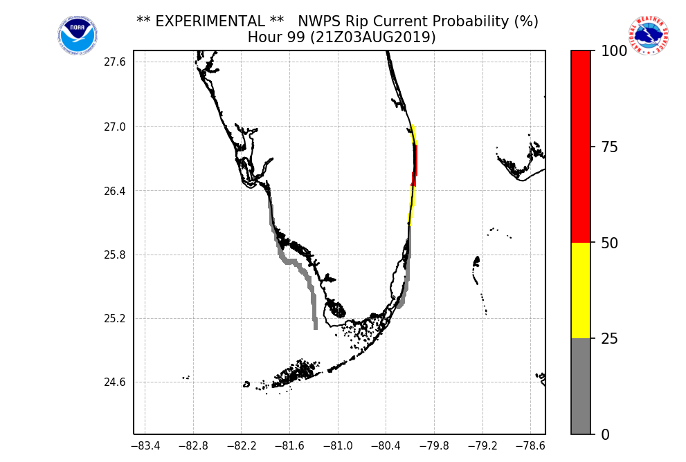
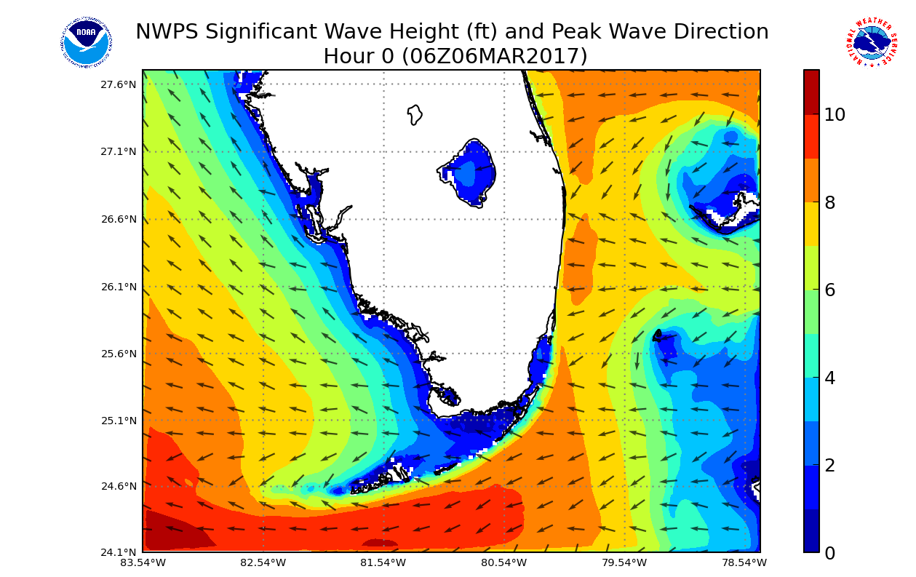
Scope of changes (4):
New Rip Current and Erosion/Overwash guidance
New rip current guidance:
*Dataflow: 8 additional (sparse) fields
Additional 213MB/day over SBN (peak of 48 MB)
8

Slide 9
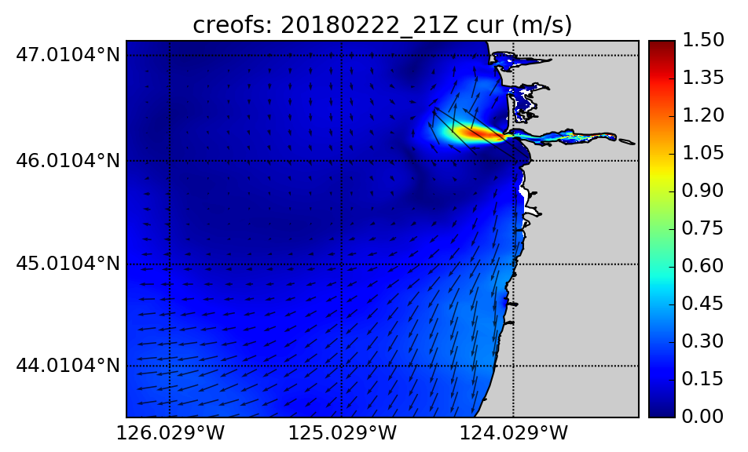
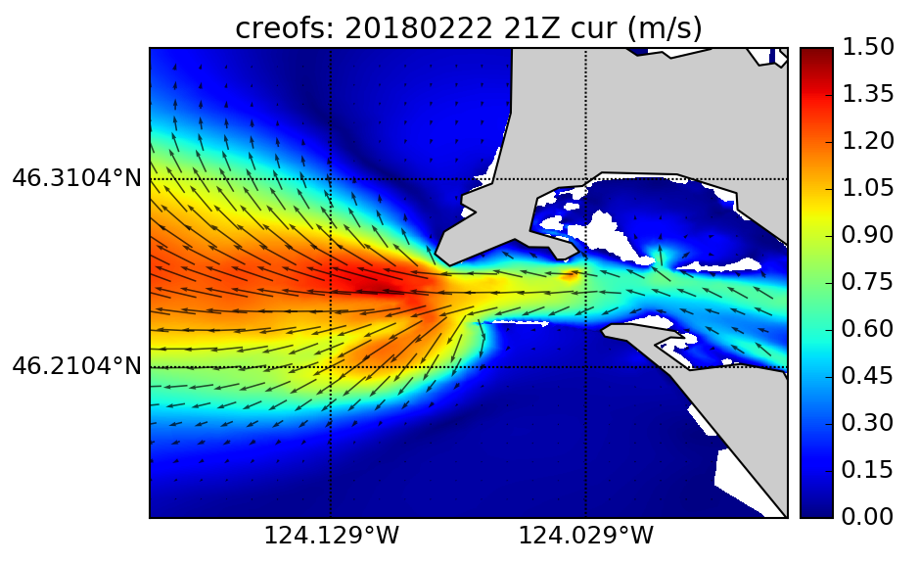
Scope of changes (5):
Include surface currents from NOS CREOFS model
WFO PQR (CG1 domain)
WFO PQR (CG3 domain)
*Dataflow: No impact
9

Slide 10
Scope of changes (6):
Transect output
*Dataflow: No impact (Web graphics hosted on rzdm polar)
10

Slide 11
Resource changes
Compute
On-demand runs: Unchanged at 36 nodes (864 cores) reserved.
OFS prep step: Additional 4 nodes for 30 min to extract CREOFS data (4x daily).
11

Slide 12
Timing of jobs (unchanged)
NWPS run started on Thu Dec 3 17:59:34 UTC 2015
MFL wind file: 201512031756_WIND.txt
Run was configured with forecaster settings
Run settings: RUNLEN=102 WNA=WNAWave NESTS=Yes RTOFS=Yes WINDS=FORECASTER WEB=Yes PLOT=Yes USERDELTAC=600 HOTSTART=TRUE WATERLEVELS=ESTOFS MODELCORE=SWAN
Forecast analysis time: 20151203 18Z
12

Slide 13
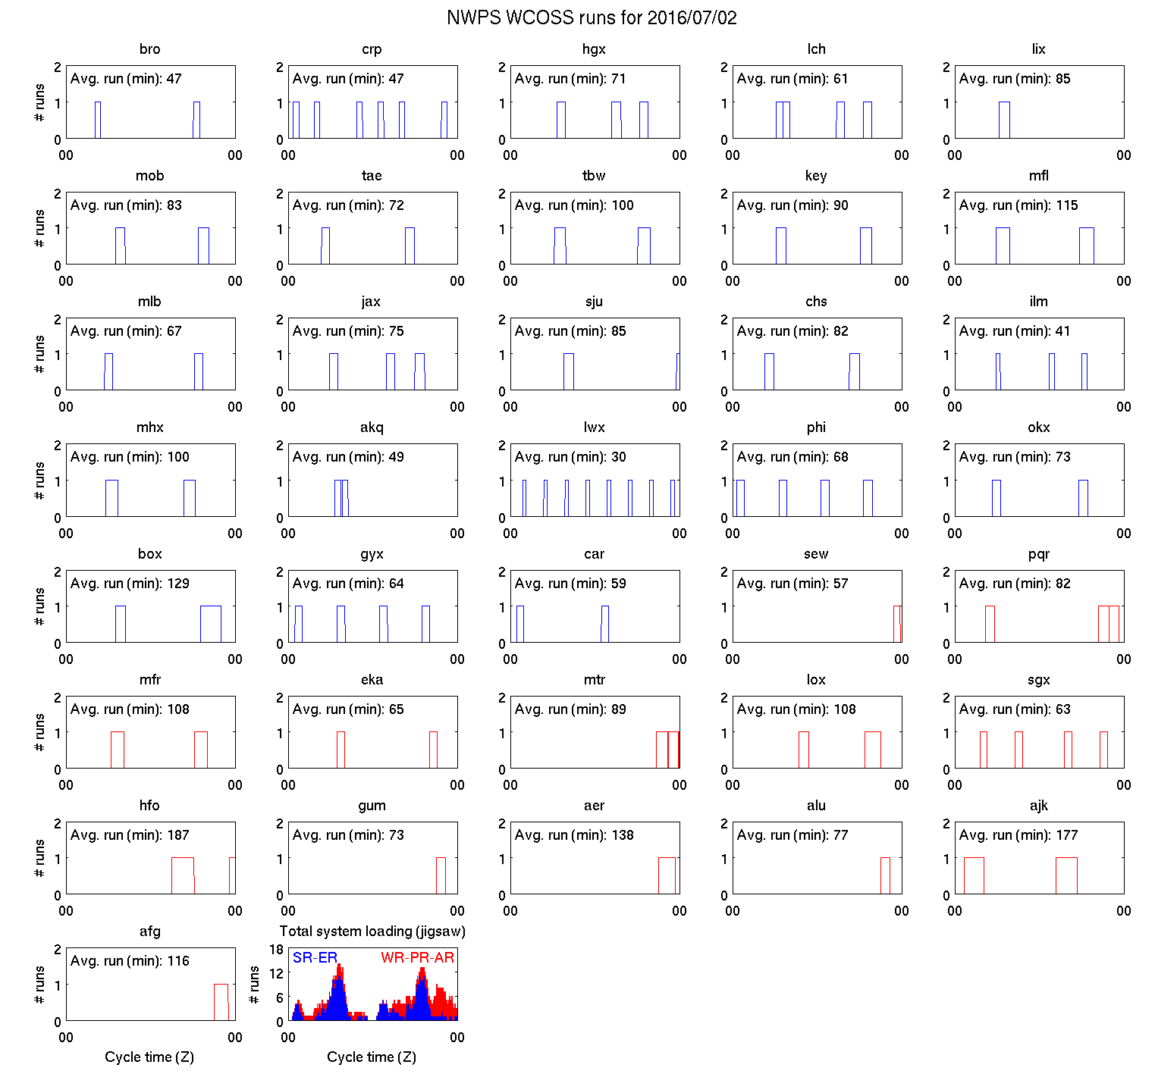
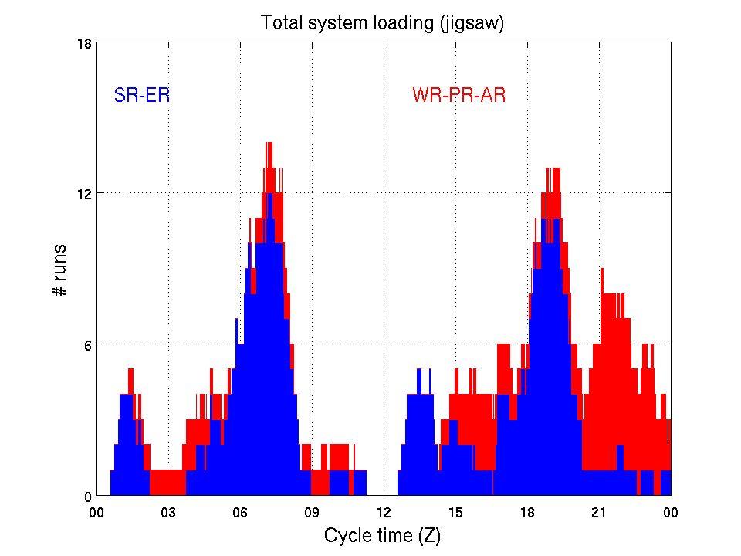
Timing of jobs, cont. (unchanged)
Blue: SR/ER WFO runs
Red: WR/PR/AR WFO runs
Total runs: ~90/day
Avg. run times = 30-150 min
13

Slide 14
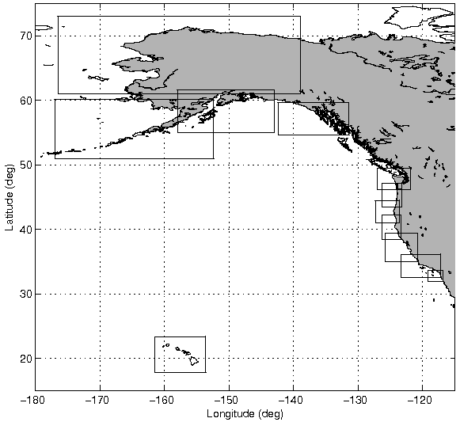
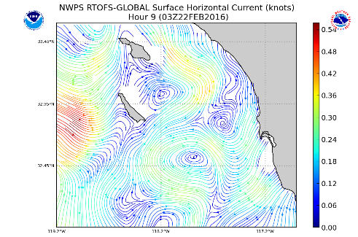
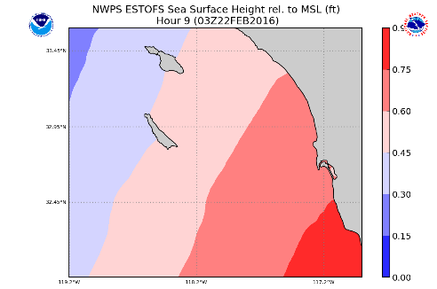
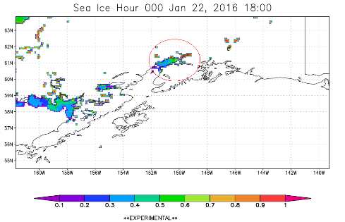
Data input additions, WCOSS
1. WAVEWATCH III boundary spectra/GFS winds
2. RTOFS surface current fields
3. NEW: CREOFS surface current
4. ESTOFS water levels (txt)
(Extra-tropical conditions)
5. Ice analysis fields (txt)
14

Slide 15
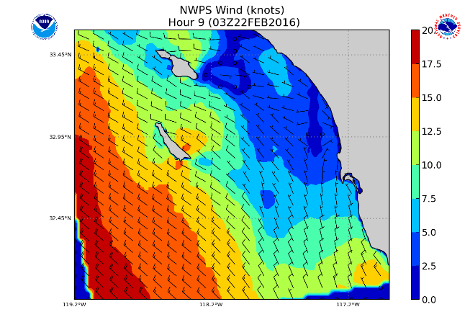
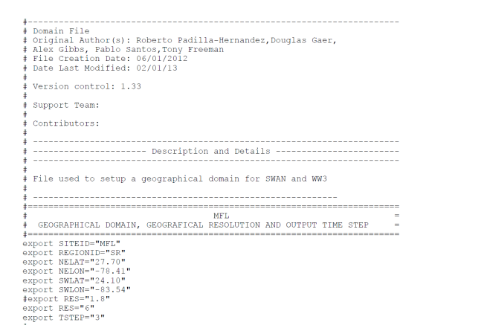
Data input additions, via LDM (unchanged)
1. GFE wind file (GRIB2)
(produced in AWIPS)
2. DOMAIN file (txt)
3. CONTROL file (txt)
(produced in AWIPS)
Size = ~2 Mb zipped/WFO site
15

Slide 16
Data output additions
NEW GRIB2 rip current/runup output for 20 WFOs: 213 MB/day (48 MB peak)
GRIB2 increase for larger WFO GUM domain: 24 MB/day
Total data volume increase of 237 MB/day
16

Slide 17
Data output additions (2)
3. NEW Wave system tracking bulletin text files (2 MB/day)
Location : SGX domain spatial average
Model : Cluster-based wave system tracking
Cycle : 20190730 18 UTC
+-------+-----------+--------------------+--------------------+--------------------+--------------------+--------------------+
| day & | Hst n x | Hs Tp dir Cov | Hs Tp dir Cov | Hs Tp dir Cov | Hs Tp dir Cov | Hs Tp dir Cov |
| hour | (m) - - | (m) (s) (d) (pc)| (m) (s) (d) (pc)| (m) (s) (d) (pc)| (m) (s) (d) (pc)| (m) (s) (d) (pc)|
+-------+-----------+--------------------+--------------------+--------------------+--------------------+--------------------+
| 30 18 | 1.29 4 | 0.06 25.0 225 29 | 0.26 15.6 229 95 | 0.55 12.2 177 98 | 1.14 8.4 288 100 | |
| 30 19 | 1.28 4 | 0.07 24.2 226 26 | 0.26 15.7 229 95 | 0.56 12.2 177 98 | 1.12 8.4 288 99 | |
| 30 20 | 1.27 4 | 0.08 23.6 227 48 | 0.26 15.8 229 95 | 0.56 12.2 177 98 | 1.10 8.4 288 99 | |
| 30 21 | 1.25 4 | 0.08 23.4 227 69 | 0.26 15.8 230 95 | 0.57 12.2 176 98 | 1.08 8.4 288 99 | |
| 30 22 | 1.24 4 | 0.09 23.3 227 79 | 0.26 15.7 230 95 | 0.58 12.1 176 98 | 1.06 8.4 288 99 | |
| 30 23 | 1.23 4 | 0.09 23.2 228 82 | 0.26 15.7 230 95 | 0.58 12.1 176 98 | 1.05 8.4 288 99 | |
| 31 00 | 1.22 4 | 0.10 23.1 228 84 | 0.26 15.5 230 95 | 0.59 12.1 176 98 | 1.03 8.3 288 99 | |
| 31 01 | 1.21 4 | 0.10 23.1 228 85 | 0.26 15.3 230 95 | 0.59 12.1 176 98 | 1.02 8.3 288 99 | |
| 31 02 | 1.21 4 | 0.10 23.0 228 85 | 0.27 15.3 230 95 | 0.59 12.0 176 98 | 1.01 8.3 288 99 | |
| 31 03 | 1.20 4 | 0.10 23.0 227 86 | 0.27 15.3 229 95 | 0.60 12.0 176 98 | 1.00 8.2 288 99 | |
| 31 04 | 1.20 4 | 0.10 23.0 227 86 | 0.27 15.3 229 95 | 0.60 11.9 176 98 | 1.00 8.1 288 99 | |
| 31 05 | 1.20 4 | 0.10 23.0 227 86 | 0.27 15.2 229 96 | 0.60 11.9 176 98 | 1.00 8.1 288 99 | |
| 31 06 | 1.21 4 | 0.10 23.0 226 87 | 0.28 15.0 229 96 | 0.61 11.9 176 98 | 1.00 8.0 288 99 | |
| 31 07 | 1.21 4 | 0.10 23.0 225 87 | 0.28 14.9 229 95 | 0.61 11.8 176 98 | 1.01 7.9 287 99 | |
| 31 08 | 1.22 4 | 0.10 23.0 225 86 | 0.28 14.8 228 96 | 0.61 11.8 175 98 | 1.01 7.9 288 99 | |
| 31 09 | 1.23 4 | 0.10 23.0 224 86 | 0.28 14.7 228 96 | 0.61 11.7 175 98 | 1.02 7.9 288 99 | |
| 31 10 | 1.23 4 | 0.10 22.9 224 86 | 0.28 14.7 228 96 | 0.61 11.7 174 98 | 1.03 7.8 287 99 | |
| 31 11 | 1.23 4 | 0.10 22.9 225 86 | 0.28 14.7 228 96 | 0.61 11.7 173 98 | 1.03 7.8 287 99 | |
| 31 12 | 1.24 4 | 0.11 22.8 226 87 | 0.28 14.7 228 96 | 0.61 11.6 173 98 | 1.03 7.7 288 99 | |
| 31 13 | 1.23 4 | 0.12 22.6 227 88 | 0.27 14.6 228 96 | 0.61 11.6 173 98 | 1.03 7.7 287 99 | |
| 31 14 | 1.23 4 | 0.13 22.5 228 89 | 0.27 14.6 228 96 | 0.60 11.6 173 98 | 1.02 7.6 287 99 | |
| 31 15 | 1.22 4 | 0.14 22.3 228 90 | 0.27 14.5 228 96 | 0.60 11.5 173 98 | 1.01 7.6 287 99 | |
| 31 16 | 1.20 4 | 0.14 22.2 228 91 | 0.27 14.4 228 96 | 0.60 11.5 173 98 | 1.00 7.5 287 99 | |
| 31 17 | 1.19 4 | 0.15 22.0 228 92 | 0.27 14.3 228 96 | 0.60 11.4 173 98 | 0.98 7.5 287 99 | |
| 31 18 | 1.18 4 | 0.15 21.8 228 93 | 0.27 14.3 228 96 | 0.60 11.4 174 98 | 0.96 7.4 287 99 | |
| 31 19 | 1.16 4 | 0.15 21.7 227 94 | 0.27 14.2 228 96 | 0.59 11.3 174 98 | 0.95 7.3 287 99 |
*Dataflow: No impact (Hosted on rzdm polar ftp)
17

Slide 18
Data output additions (3)
4. NEW Track output graphics
*Dataflow: No impact (Web graphics hosted on rzdm polar)
18

Slide 19
EE2 Review
Code repo (but large fix files stored on rzdm): https://vlab.ncep.noaa.gov/code-review/EMC_nwps
First time code is being submitted for EE2 review
Source code languages: Fortran 90/95 (models), C++ (utilities)
Scripting languages: Bash, Perl (older), Python 3 (newer)
19

