Slide 1
FV3GFS QPF Stats
Tracey Dorian
IMSG at NOAA/NCEP/EMC
Thanks to Ying Lin and Logan Dawson
for helping to create the plots in this presentation
September 13, 2018

Slide 2
ETS (GSS)/Bias
* All stats in this ppt are for the CONUS

Slide 3
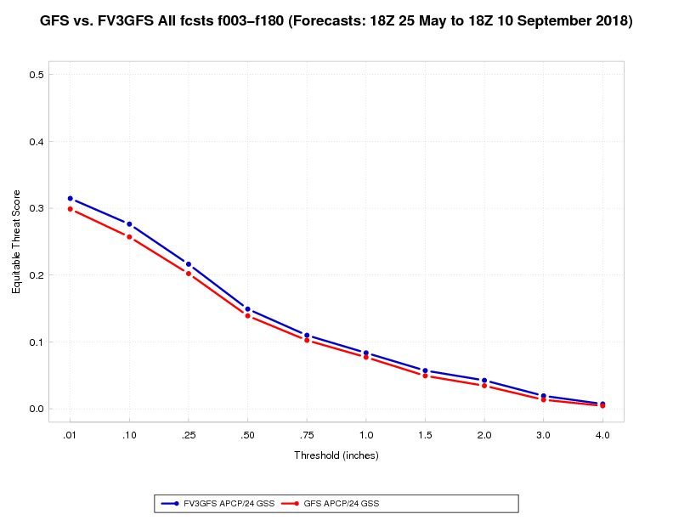
24h periods
Using all forecast leads between 0-180 h
F003-f180
FV3GFS has slightly higher ETS than the GFS for all thresholds, differences however are likely not statistical significant (based on Ying Lin’s plots on her webpage)
GFS
FV3GFS

Slide 4
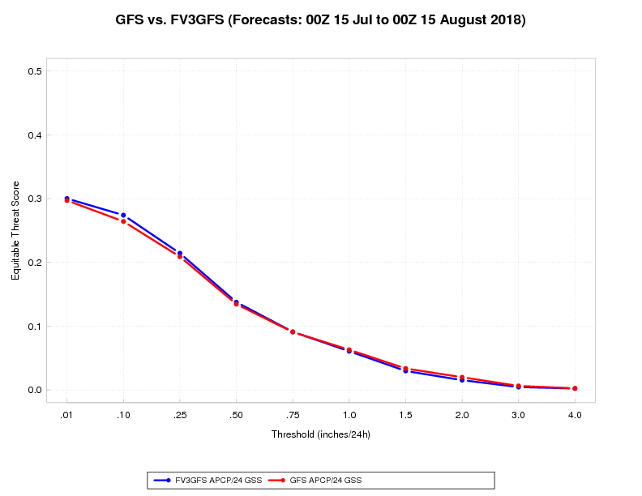
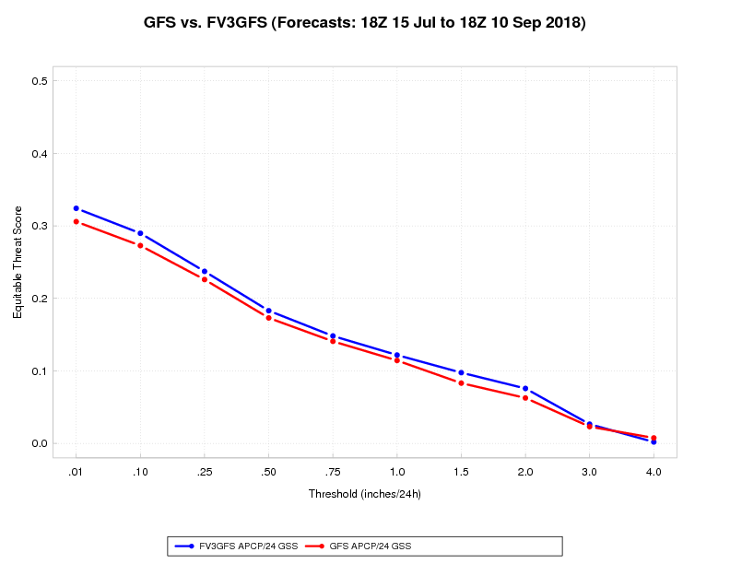
BEFORE HORD=5 CHANGE
(HORD=6)
AFTER HORD=5 CHANGE
(HORD=5)
FV3GFS and GFS ETS scores are very similar
FV3GFS has higher ETS than the GFS
HORD=5 change occurred 18Z August 15, 2018

Slide 5
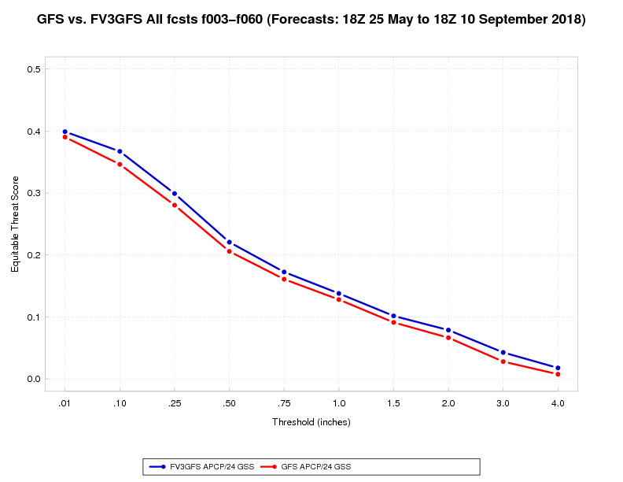
24h periods
Using all forecast leads between 0-60 h
F003-f060
FV3GFS has slightly higher ETS than the GFS for all thresholds
Improvement in the scores for higher thresholds seems to come from short-range forecasts
GFS
FV3GFS

Slide 6
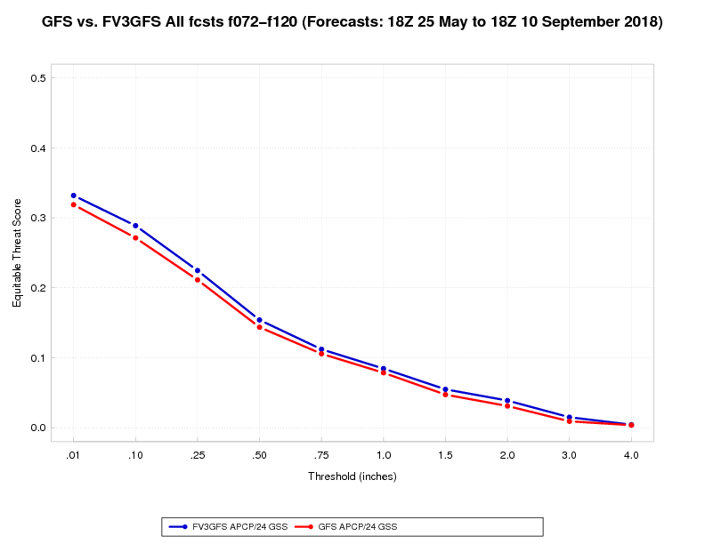
24h periods
Using all forecast leads between 72-120 h
F072-f120
FV3GFS has slightly higher ETS than the GFS for all thresholds
GFS
FV3GFS

Slide 7
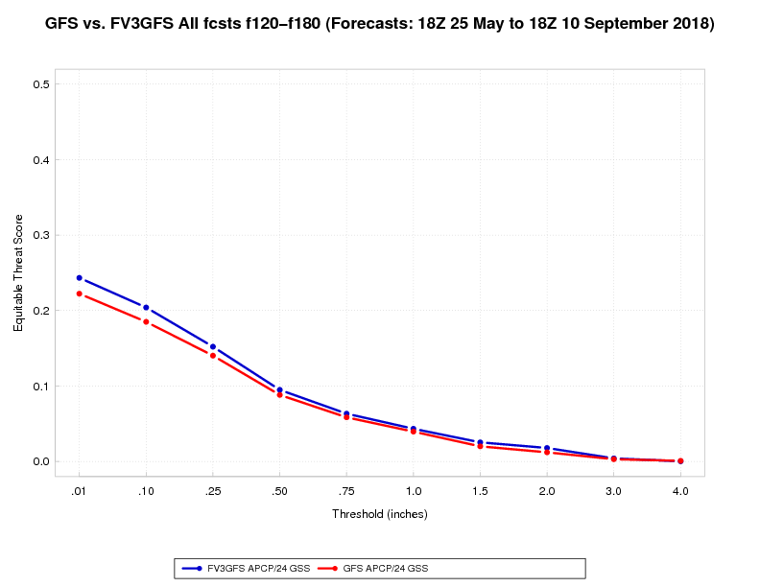
24h periods
Using all forecast leads between 120-180 h
F120-f180
FV3GFS has slightly higher ETS than the GFS for thresholds < 0.50 “, scores are similar for higher thresholds
GFS
FV3GFS

Slide 8
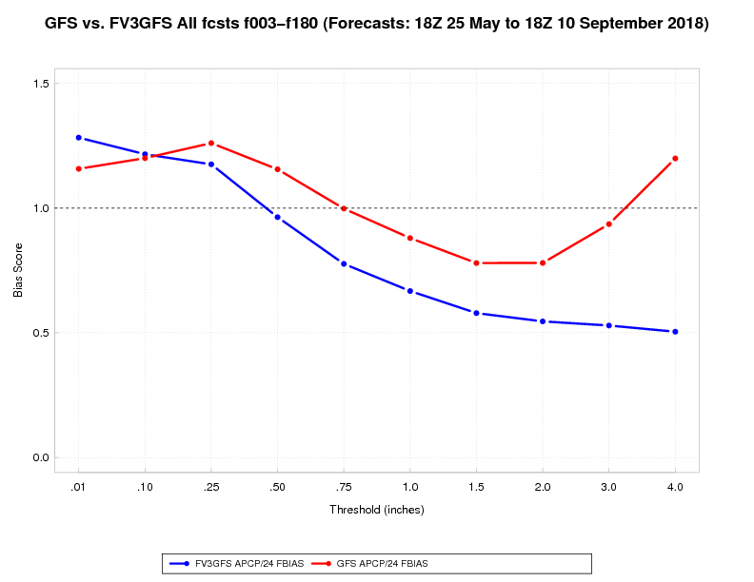
24h periods
Using all forecast leads between 0-180 h
F003-f180
FV3GFS displays more of a dry bias above 0.25’’ threshold
There is likely significance in the lower bias scores in the low to mid-range thresholds but marginal or no significance at the higher thresholds (based on Ying Lin’s plots on her webpage in the extra slides)
GFS
FV3GFS

Slide 9
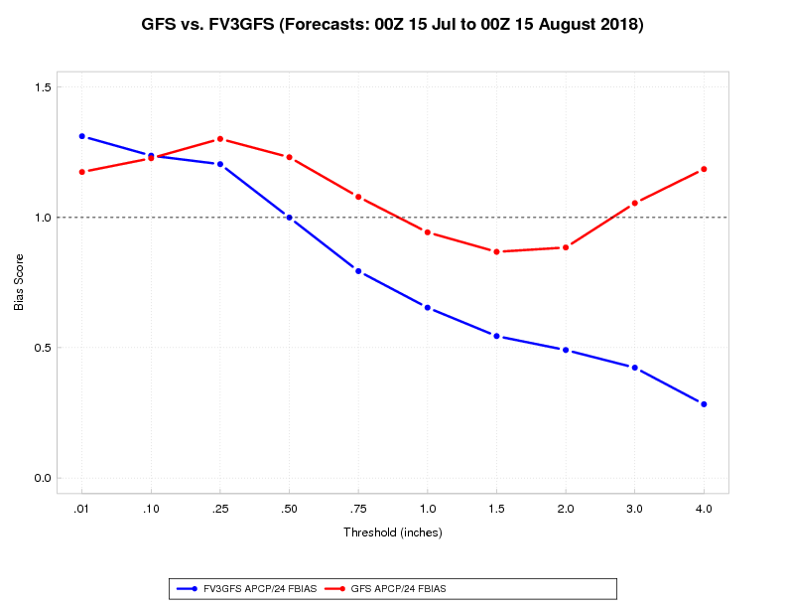
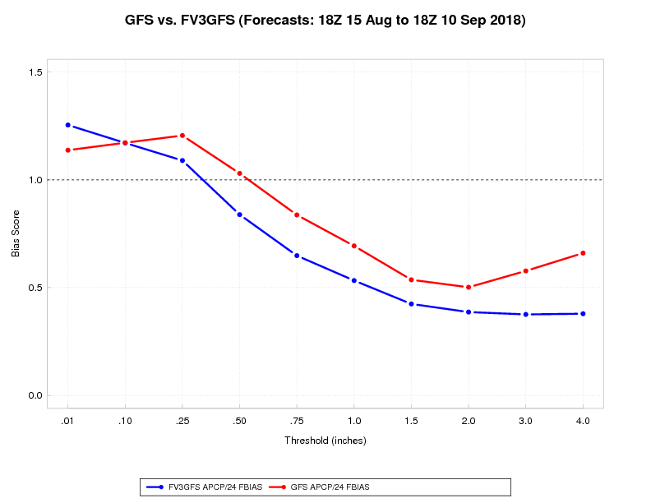
BEFORE HORD=5 CHANGE
(HORD=6)
AFTER HORD=5 CHANGE
(HORD=5)
FV3GFS has a dry bias for thresholds over 0.75”, gets worse with increasing thresholds
FV3GFS has a dry bias for 0.50” that was not present when HORD=6, GFS has more of a dry bias in late August/early September compared to late July/early August
HORD=5 change occurred 18Z August 15, 2018

Slide 10
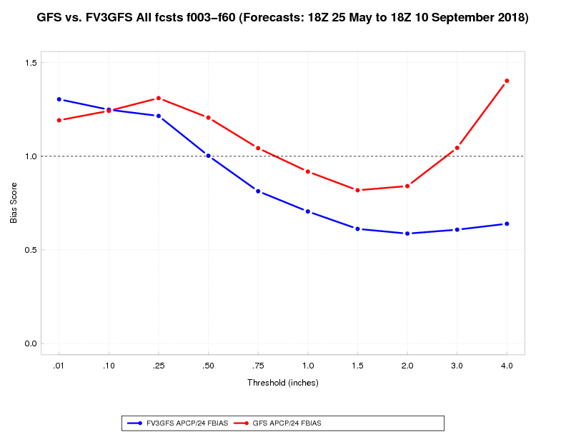
24h periods
Using all forecast leads between 0-60 h
F003-f060
FV3GFS displays more of a dry bias above 0.25’’ threshold
GFS
FV3GFS

Slide 11
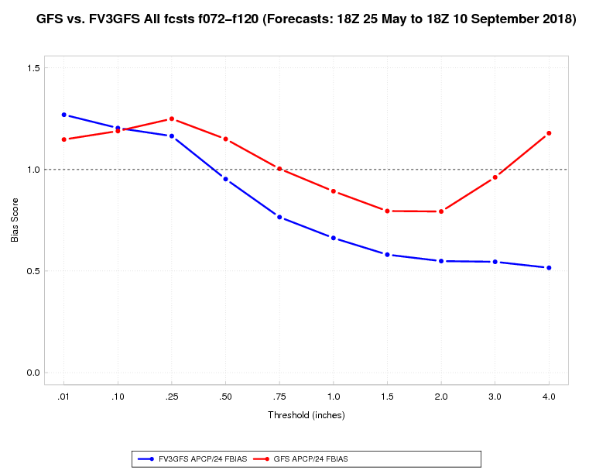
24h periods
Using all forecast leads between 72-120 h
F072-f120
FV3GFS displays more of a dry bias above 0.25’’ threshold
GFS
FV3GFS

Slide 12
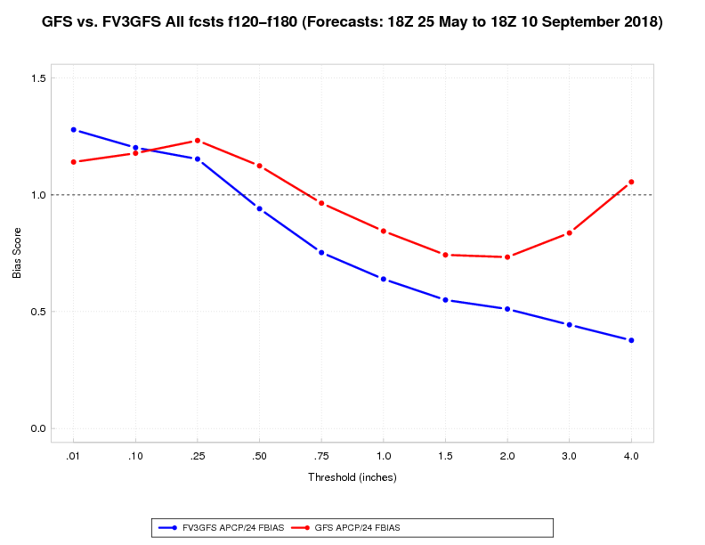
24h periods
Using all forecast leads between 120-180 h
F120-f180
FV3GFS displays more of a dry bias above 0.25’’ threshold
GFS wet bias at threshold = 4” decrease with forecast lead time
FV3GFS dry bias at threshold=4” gets worse with forecast lead time
GFS
FV3GFS

Slide 13
Diurnal Cycle

Slide 14
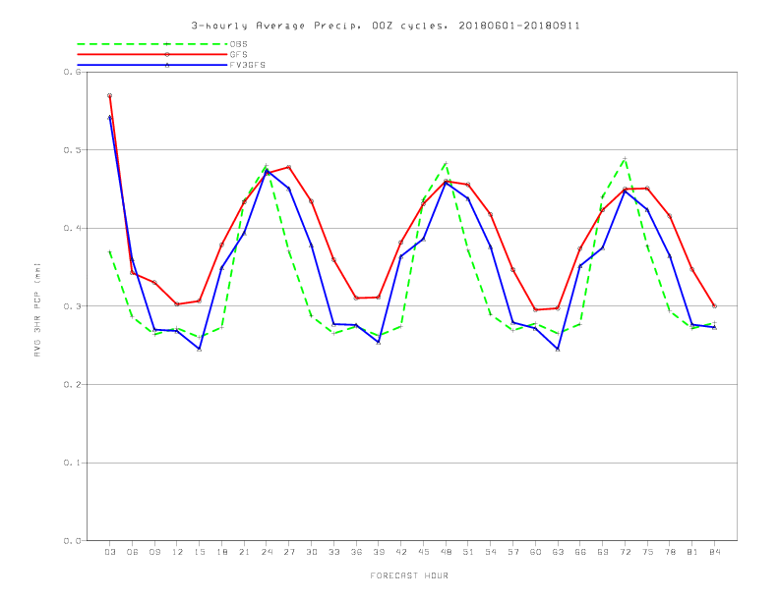
00Z cycles
00Z
00Z
00Z
12Z
12Z
12Z
12Z
The FV3 handles warm season diurnal cycle much better than the GFS, FV3GFS is better with reducing precip in the early morning and with showing a max around 00z with a sharp drop off after that
CCPA
GFS
FV3GFS

Slide 15
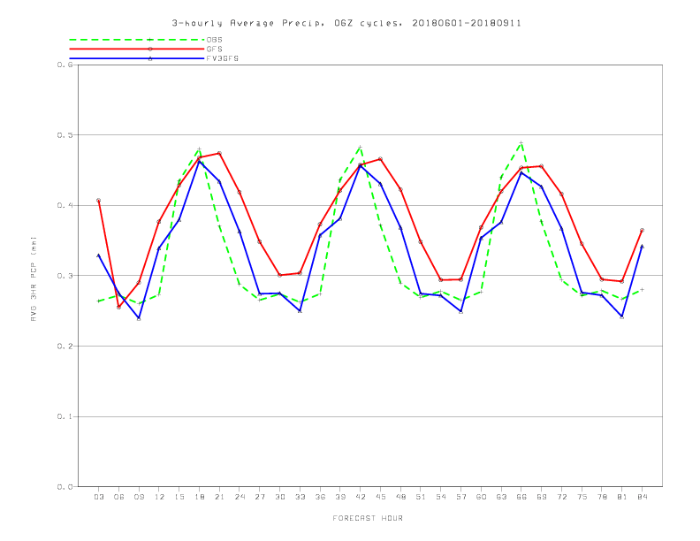
06Z cycles
00Z
00Z
00Z
12Z
12Z
12Z
12Z
CCPA
GFS
FV3GFS

Slide 16
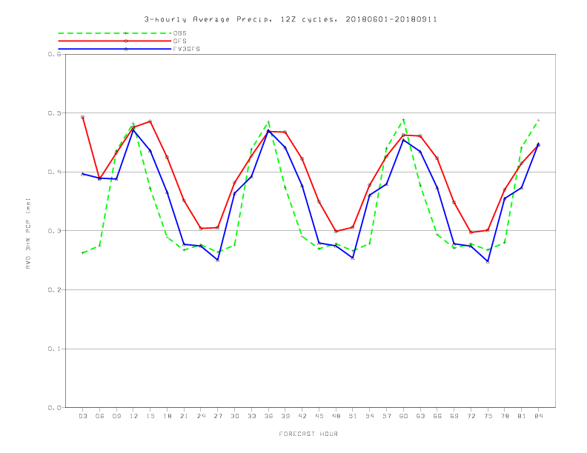
12Z cycles
00Z
00Z
00Z
00Z
12Z
12Z
12Z
CCPA
GFS
FV3GFS
FV3GFS ability to capture max rainfall in late evening seems to decrease with forecast lead time, the forecasts of the minimum in the mornings however seems consistent

Slide 17
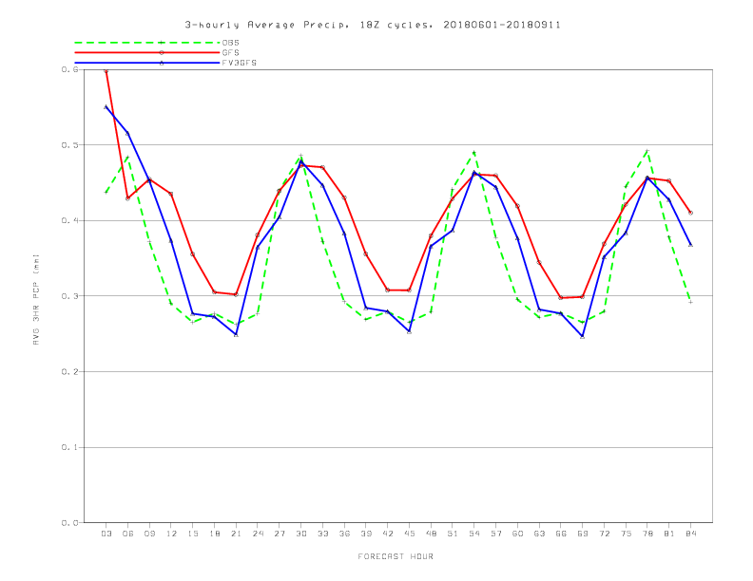
18Z cycles
00Z
00Z
00Z
12Z
12Z
12Z
CCPA
GFS
FV3GFS

Slide 18
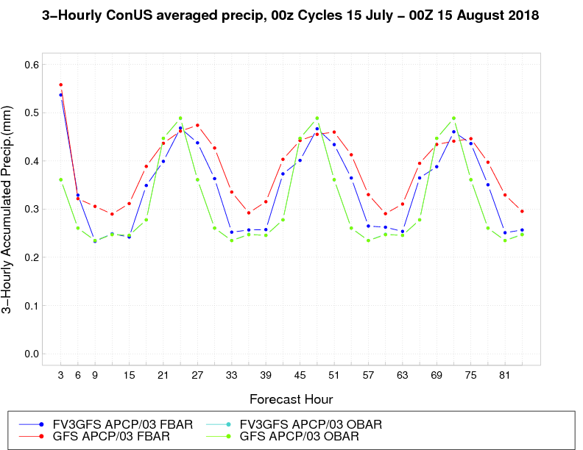
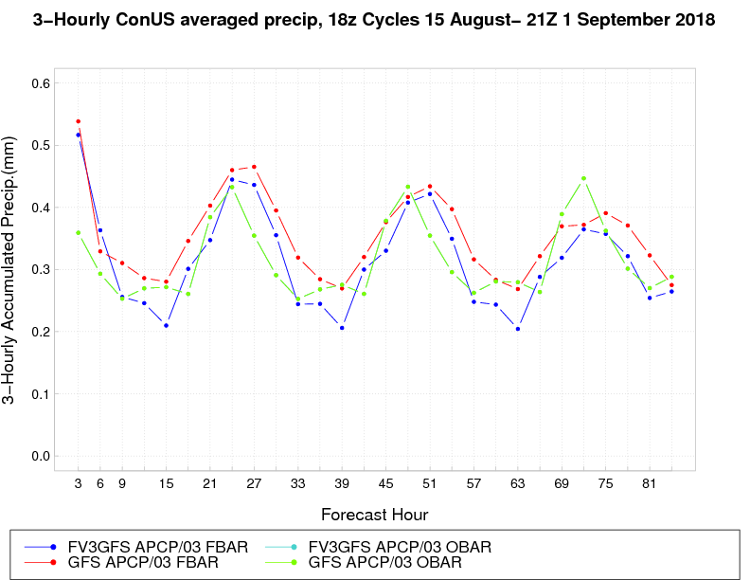
BEFORE HORD=5 CHANGE
(HORD=6)
AFTER HORD=5 CHANGE
(HORD=5)
CCPA
GFS
FV3GFS
CCPA
GFS
FV3GFS
GFS actually does better with the minimum, FV3GFS drops too low
At 72 hour forecast, FV3GFS underestimates the max
HORD=5 change occurred 18Z August 15, 2018

Slide 19
Contour Plots

Slide 20
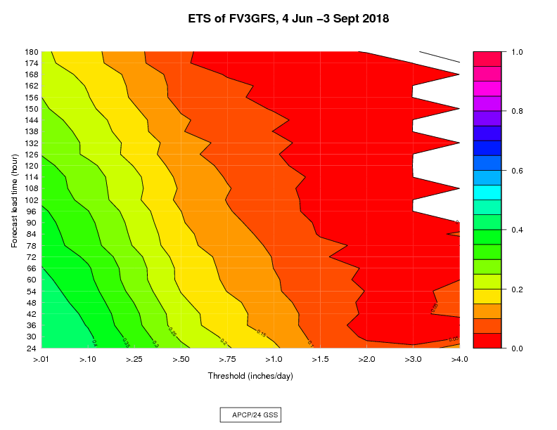
SUMMER
GSS < 0 unskillful
GSS = 1 perfect forecast
Courtesy of Ying Lin

Slide 21
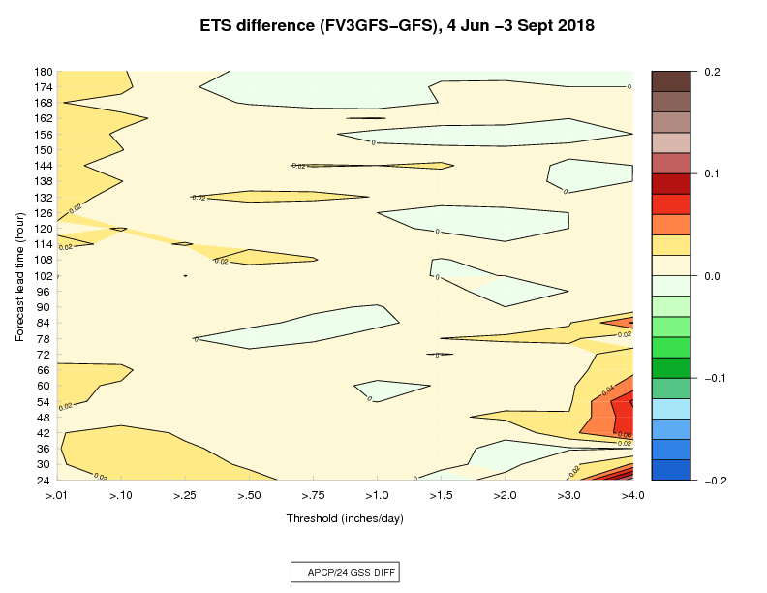
SUMMER
Greens, blues → FV3GFS had lower ETS score
Yellows, reds → FV3GFS had higher ETS score
Courtesy of Ying Lin

Slide 22
Different Verification Methods

Slide 23

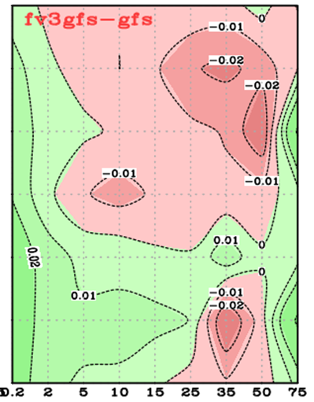


From Fanglin Yang’s website which uses only gauges
Gauges are clustered in different parts of the country and quality control is limited
WINTER
The ETS seems generally lower in gauge-based than in CCPA-based plots
Source of plot: http://www.emc.ncep.noaa.gov/gmb/emc.glopara/vsdb/prfv3rt1/
0.07’’
0.2’’
0.39’’
0.6’’
1’’
1.4’’
2’’
3’’

Slide 24
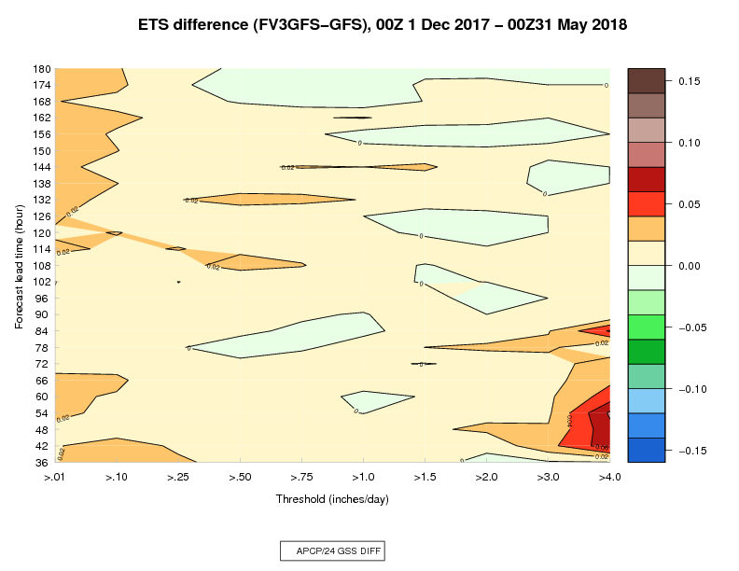
Ying Lin’s CCPA-based method

Slide 25


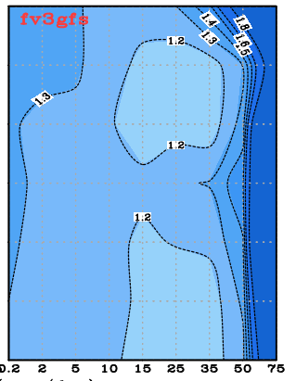

From Fanglin Yang’s website which uses only gauges
Gauges are clustered in different parts of the country and quality control is limited
WINTER
The bias scores seem to be higher in gauge-based than in CCPA-based plots
Source of plot: http://www.emc.ncep.noaa.gov/gmb/emc.glopara/vsdb/prfv3rt1/

Slide 26
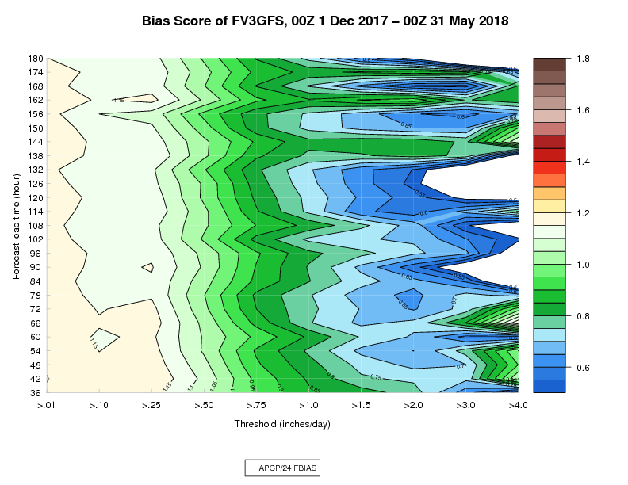
Ying Lin’s CCPA-based method

Slide 27
Findings
From May 25 – September 10, the FV3GFS had higher equitable threat scores than the GFS for all thresholds, though differences were overall small and indication is that they are not statistically-significant
Despite higher GSS scores, the FV3GFS displayed a larger dry bias than the GFS for thresholds > 0.25’’ in the warm season, significance in low to mid-range thresholds
Both the GFS and the FV3GFS had a positive bias of precipitation for thresholds < 0.25” in the warm season
The FV3 handles warm season diurnal cycle much better overall than the GFS, better with reducing precip in the early morning and with showing a max around 00z with a sharp drop off after that (this was different for after HORD=5 period though)
Different methods of precipitation verification sometimes give different results and interpretations, CCPA is a better method than gauge-only since gauge-only is not evenly distributed and also does not go through much quality control
Recommended that all precip verification should move to the CCPA going forward

Slide 28
Extra Slides

Slide 29
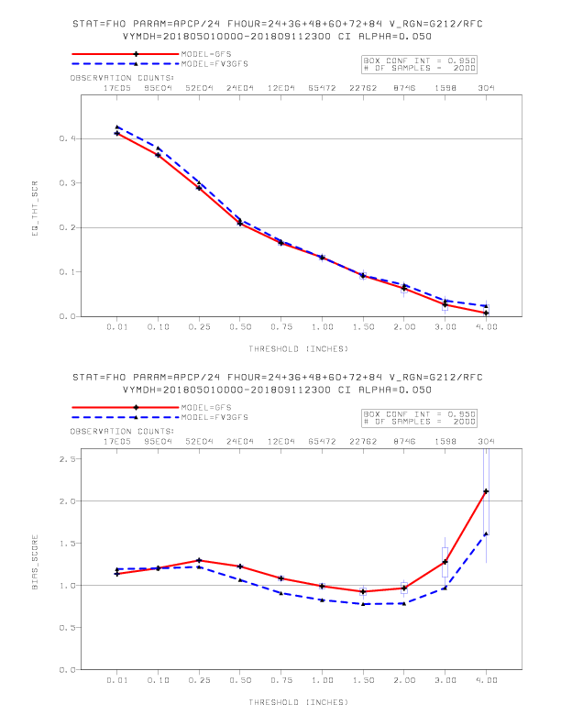
24-84h forecasts: ETS/Bias 5/1/18-9/11/18
GFS
FV3GFS
FV3GFS displays more of a dry bias than the GFS
Scores available at this link

Slide 30
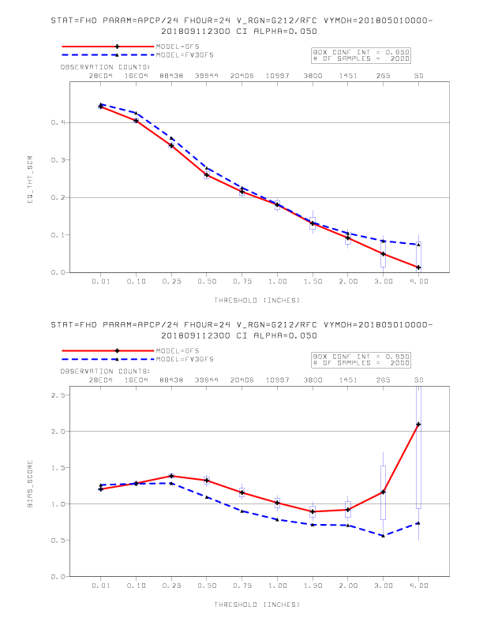
24h forecasts: ETS/Bias 5/1/18-9/11/18
GFS
FV3GFS
FV3GFS displays more of a dry bias than the GFS
Scores available at this link

Slide 31
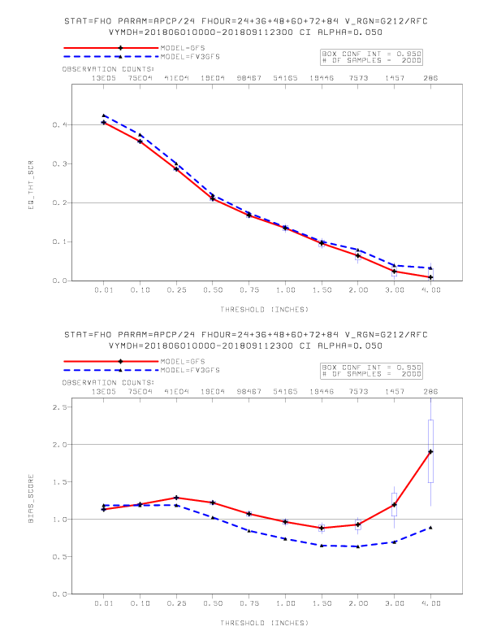
84h forecasts: ETS/Bias 6/1/18-9/11/18
GFS
FV3GFS
FV3GFS displays more of a dry bias than the GFS
Scores available at this link

Slide 32
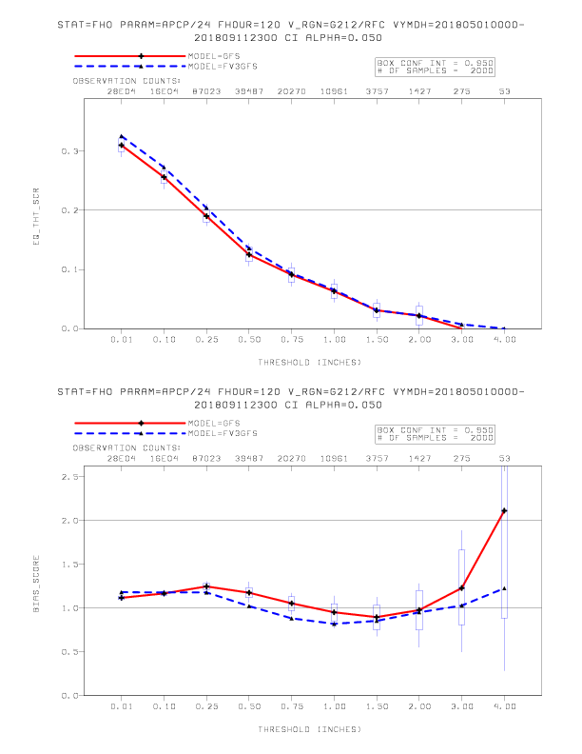
120h forecasts: ETS/Bias 5/1/18-9/11/18
GFS
FV3GFS
FV3GFS dry bias significant for higher thresholds
Scores available at this link

Slide 33
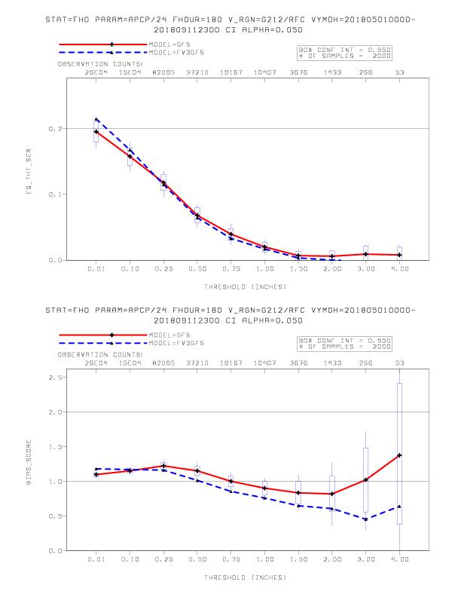
180h forecasts: ETS/Bias 5/1/18-9/11/18
GFS
FV3GFS
FV3GFS displays a dry bias above 0.25’’ threshold
Scores available at this link

Slide 34
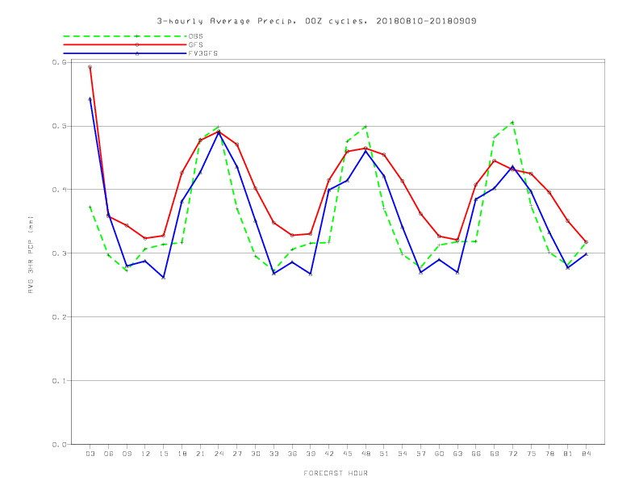
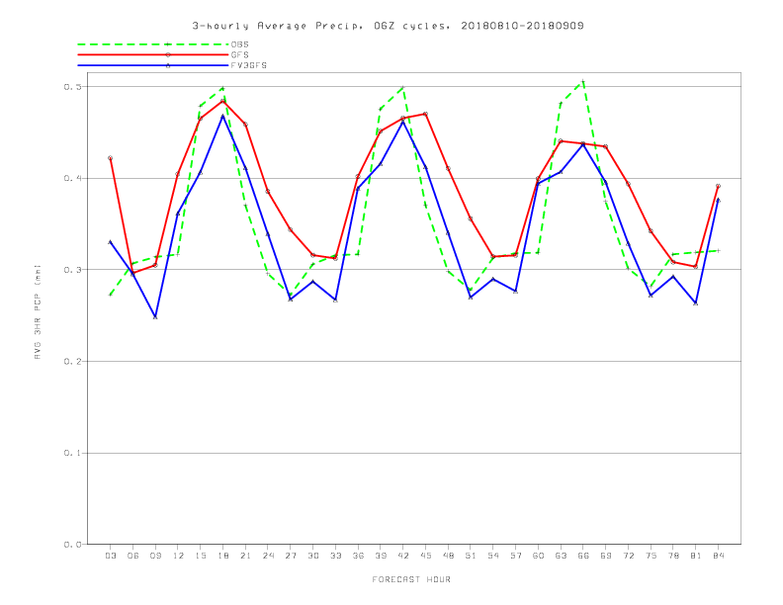
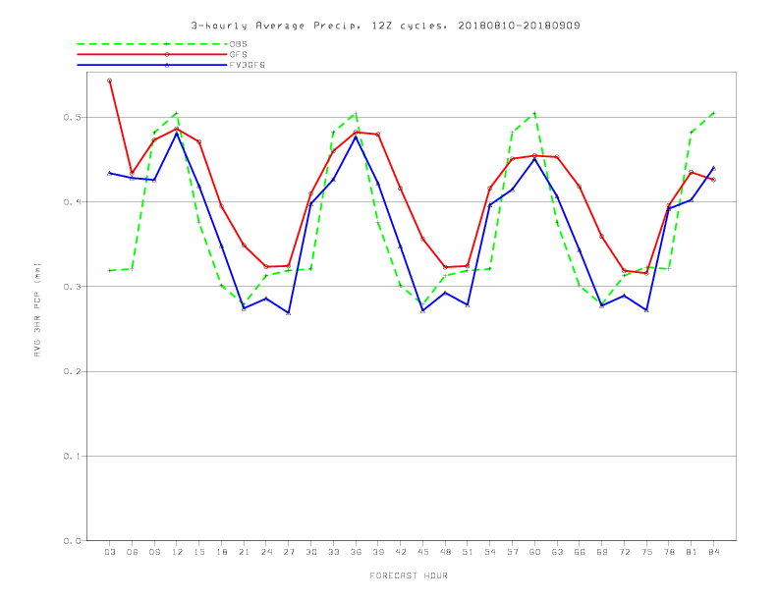
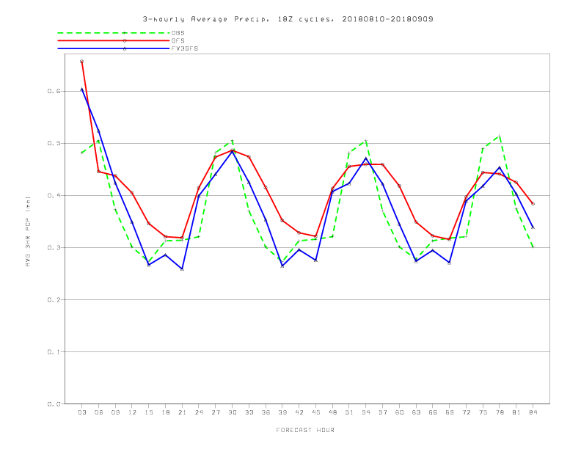
00Z cycles
OBS
GFS
FV3GFS
06Z cycles
GFS struggles more with min, both struggle with max
12Z cycles
18Z cycles

Slide 35
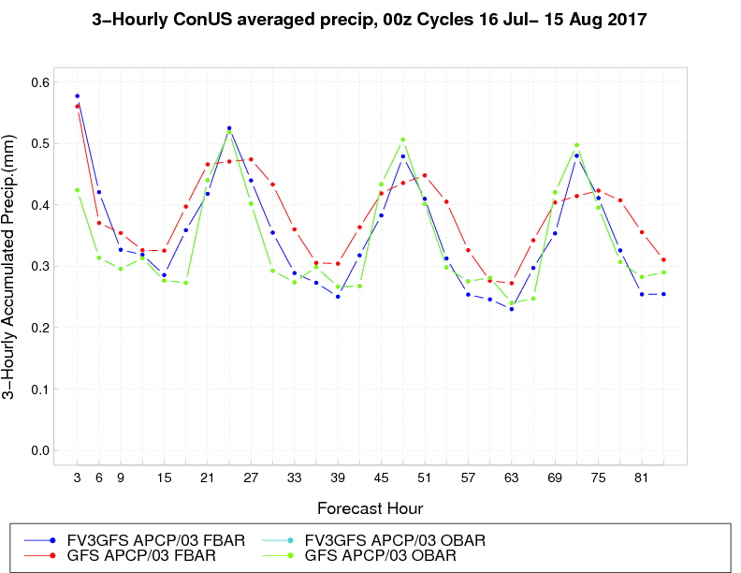
The FV3 is handles warm season diurnal cycle much better than the GFS, better with reducing precip in the early morning and with showing a max around 00z with a sharp drop off after that
CCPA
GFS
FV3GFS

