Slide 1
FV3GFS QPF Retrospectives
192-h QPF valid 0000 UTC 1 May 2017
FV3GFS
Stage IV
Alicia Bentley
NCEP/EMC Model Evaluation Group
13 September 2018

Slide 2
http://www.emc.ncep.noaa.gov/users/Alicia.Bentley/fv3gfs/

Slide 3
http://www.emc.ncep.noaa.gov/users/Alicia.Bentley/fv3gfs/
FV3GFS Evaluations Due: 9/24/18

Slide 4
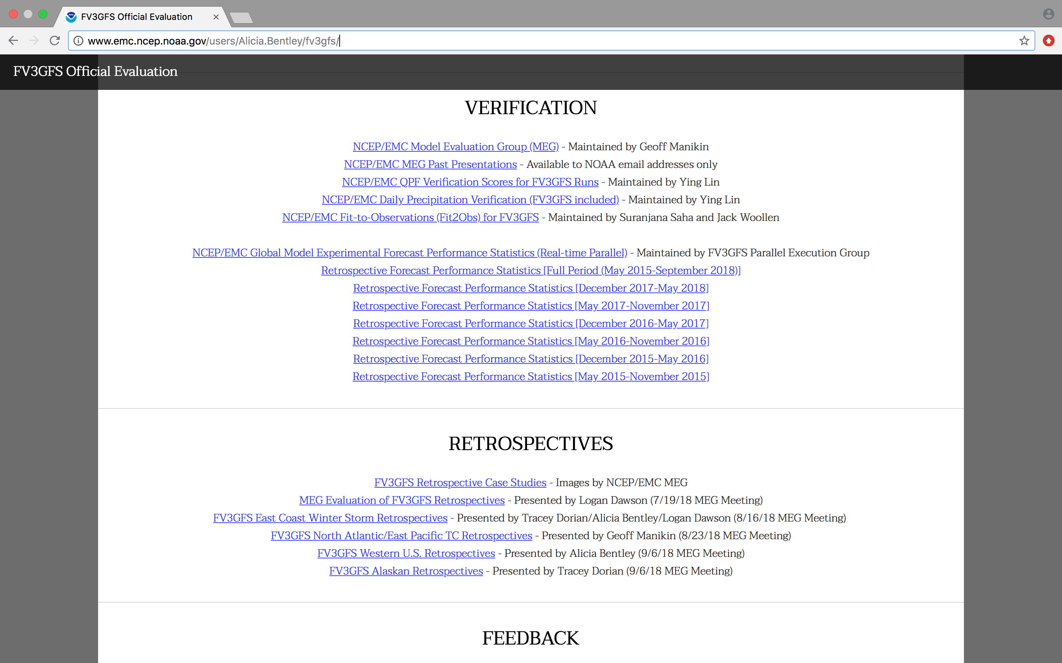
http://www.emc.ncep.noaa.gov/users/Alicia.Bentley/fv3gfs/

Slide 5
FV3GFS QPF Retrospective Cases
South Carolina Flooding (1–5 Oct 2015)
Mississippi Valley Flooding (25 April–7 May 2017)
TC Cindy Flooding (19–24 Jun 2017)
Mid-Atlantic July Nor’easter (29–30 Jun 2017)
West Coast Atmospheric River (21–23 Mar 2018)

Slide 6
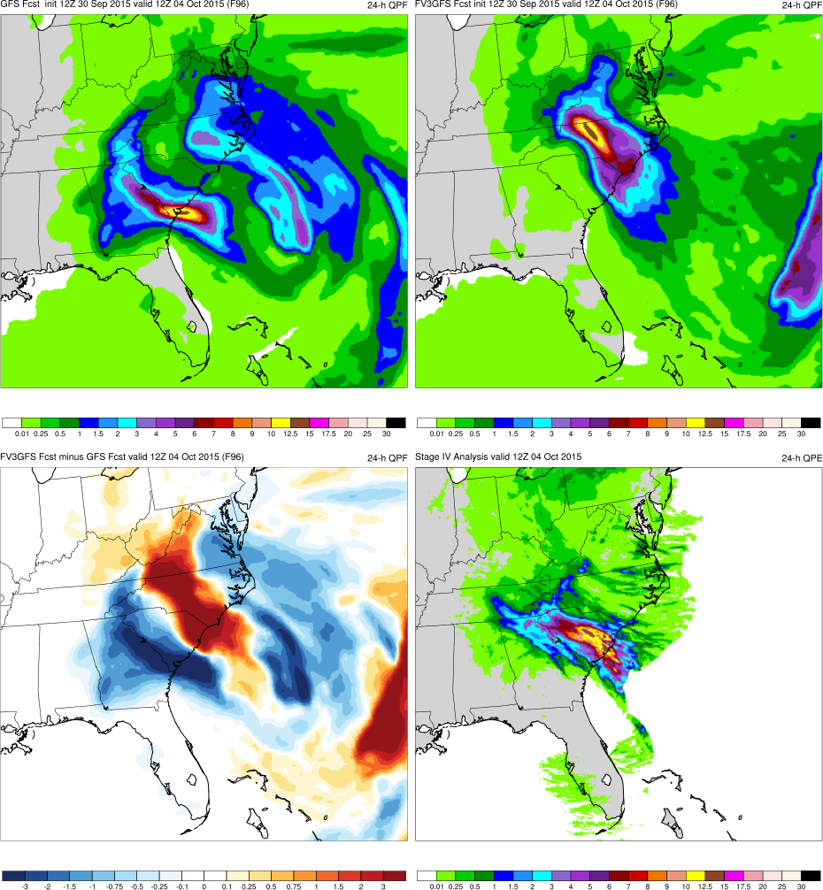
Retrospective Image Layout
GFS
FV3GFS
KEY:
Blue = FV3GFS is wetter (more precip.)
Red = FV3GFS is drier (less precip.)
FV3GFS−GFS
Stage IV

Slide 7
South Carolina Flooding (Oct 2015)
Images Valid: 1200 UTC 4 Oct 2015 (500-hPa) 1200 UTC 4 Oct 2015 (24-h QPF)

Slide 8
South Carolina Flooding & TC Joaquin (2015)
FV3GFS 500-hPa Geopotential Height (F000)
Cutoff Low
Joaquin

Slide 9
South Carolina Flooding & TC Joaquin (2015)
FV3GFS 6-h Precipitation (F000)
Cutoff Low
Joaquin

Slide 10
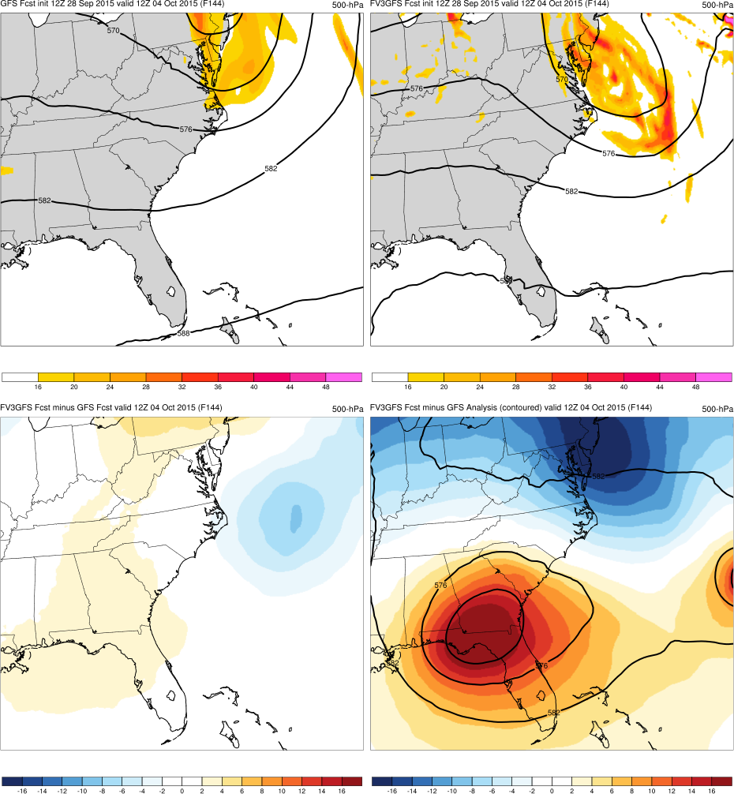
(F144)
GFS
FV3GFS
GFS
FV3GFS
MAIN POINTS:
Neither FV3GFS or GFS forecast cutoff low over SE U.S.
FV3GFS−GFS
FV3GFS−GFS Anl.
FV3GFS−GFS
FV3GFS−GFS Anl.
KEY:
Blue = FV3GFS has lower geo. heights
Red = FV3GFS has higher geo. heights
Joaquin
Cutoff Low

Slide 11
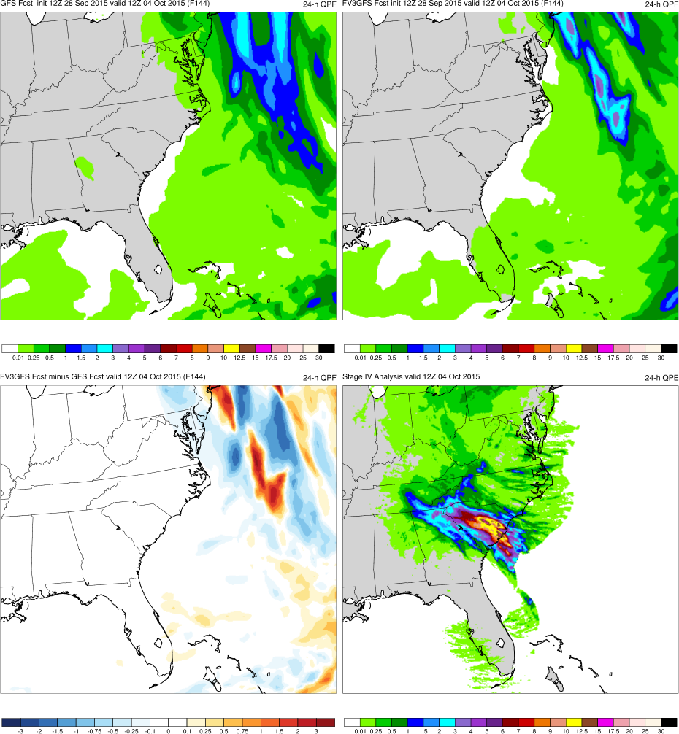
(F144)
GFS
FV3GFS
GFS
FV3GFS
MAIN POINTS:
Neither FV3GFS or GFS forecast cutoff low over SE U.S.
Heavy precipitation located over NE U.S. and not SE U.S.
FV3GFS−GFS
FV3GFS−GFS Anl.
FV3GFS−GFS
Stage IV
KEY:
Blue = FV3GFS is wetter (more precip.)
Red = FV3GFS is drier (less precip.)

Slide 12
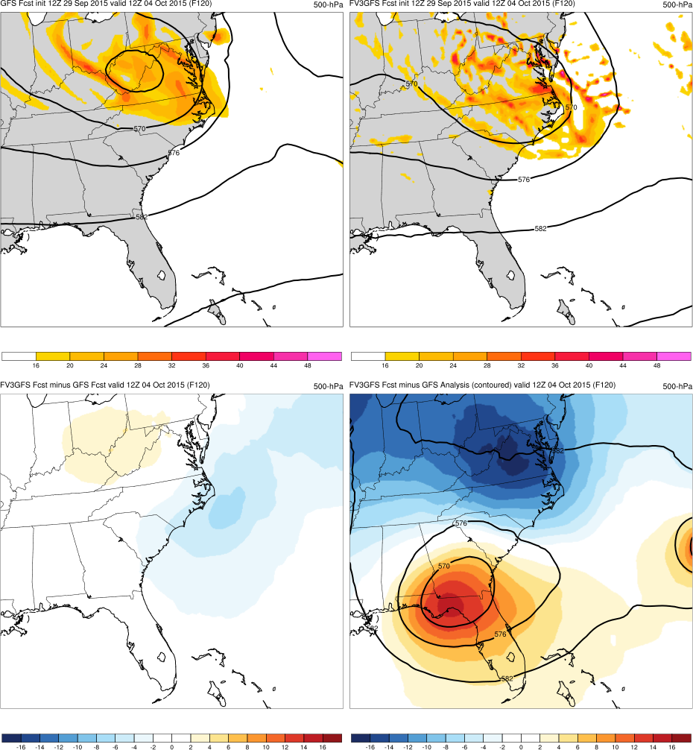
(F120)
GFS
FV3GFS
GFS
FV3GFS
MAIN POINTS:
FV3GFS and GFS both forecast cutoff low that rejoins flow as neg. tilted trough
FV3GFS−GFS
FV3GFS−GFS Anl.
FV3GFS−GFS
FV3GFS−GFS Anl.
KEY:
Blue = FV3GFS has lower geo. heights
Red = FV3GFS has higher geo. heights
Joaquin
Cutoff Low

Slide 13
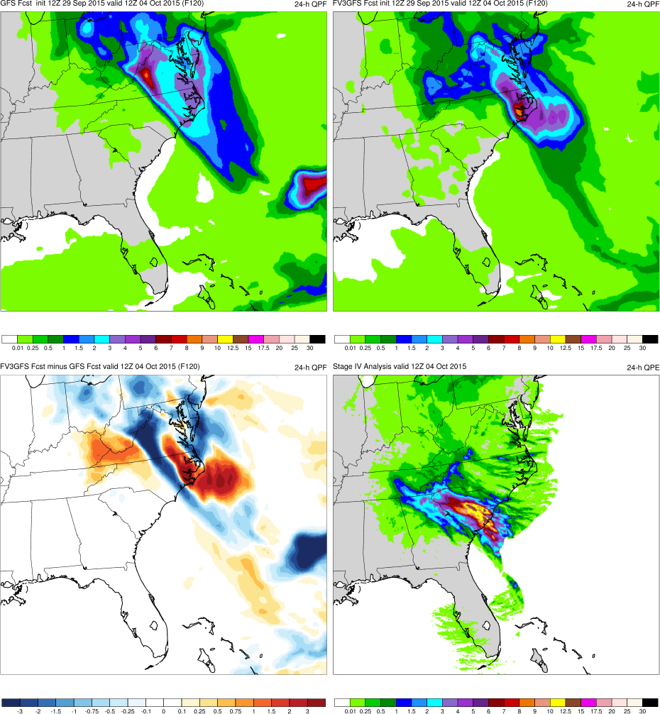
(F120)
GFS
FV3GFS
GFS
FV3GFS
MAIN POINTS:
FV3GFS and GFS both forecast cutoff low that rejoins flow as neg. tilted trough
FV3GFS and GFS shift heavy precip. over Mid-Atlantic
FV3GFS−GFS
FV3GFS−GFS Anl.
FV3GFS−GFS
Stage IV
KEY:
Blue = FV3GFS is wetter (more precip.)
Red = FV3GFS is drier (less precip.)

Slide 14
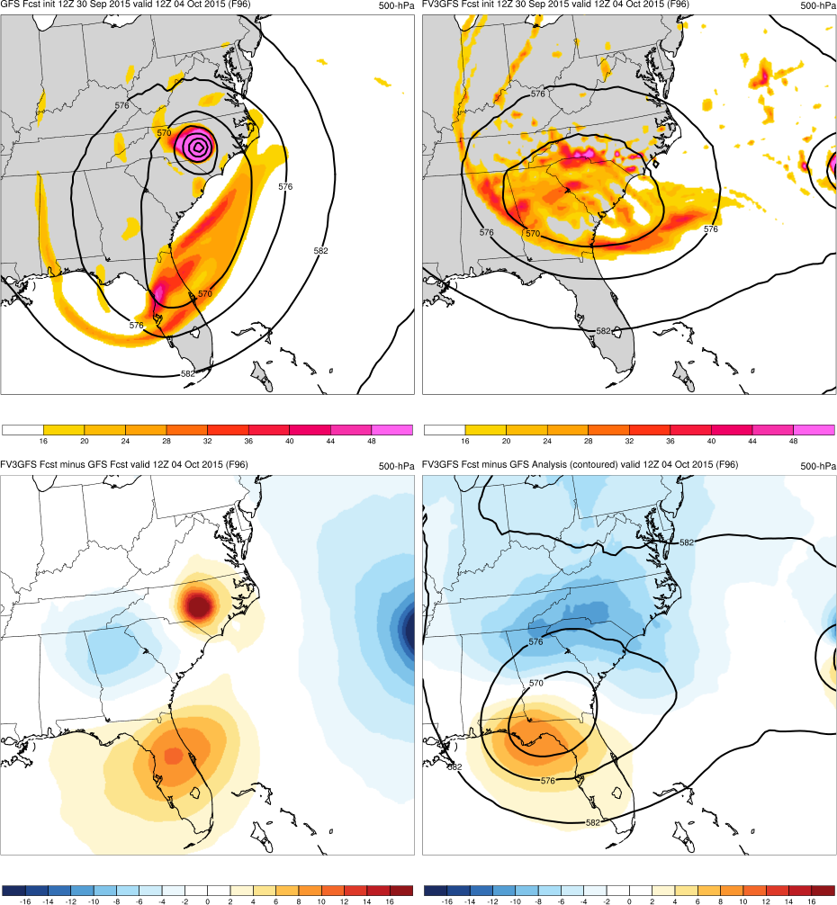
(F096)
GFS
FV3GFS
GFS
FV3GFS
MAIN POINTS:
FV3GFS and GFS both forecast cutoff low, but GFS brings Joaquin into U.S.
Joaquin
Joaquin
FV3GFS−GFS
FV3GFS−GFS Anl.
FV3GFS−GFS
FV3GFS−GFS Anl.
KEY:
Blue = FV3GFS has lower geo. heights
Red = FV3GFS has higher geo. heights
Joaquin
Cutoff Low

Slide 15
(F096)
GFS
FV3GFS
GFS
FV3GFS
MAIN POINTS:
FV3GFS and GFS both forecast cutoff low, but GFS brings Joaquin into U.S.
FV3GFS and GFS both forecast heavy precip. in Carolinas
Joaquin
Joaquin
FV3GFS−GFS
FV3GFS−GFS Anl.
FV3GFS−GFS
Stage IV
KEY:
Blue = FV3GFS is wetter (more precip.)
Red = FV3GFS is drier (less precip.)

Slide 16
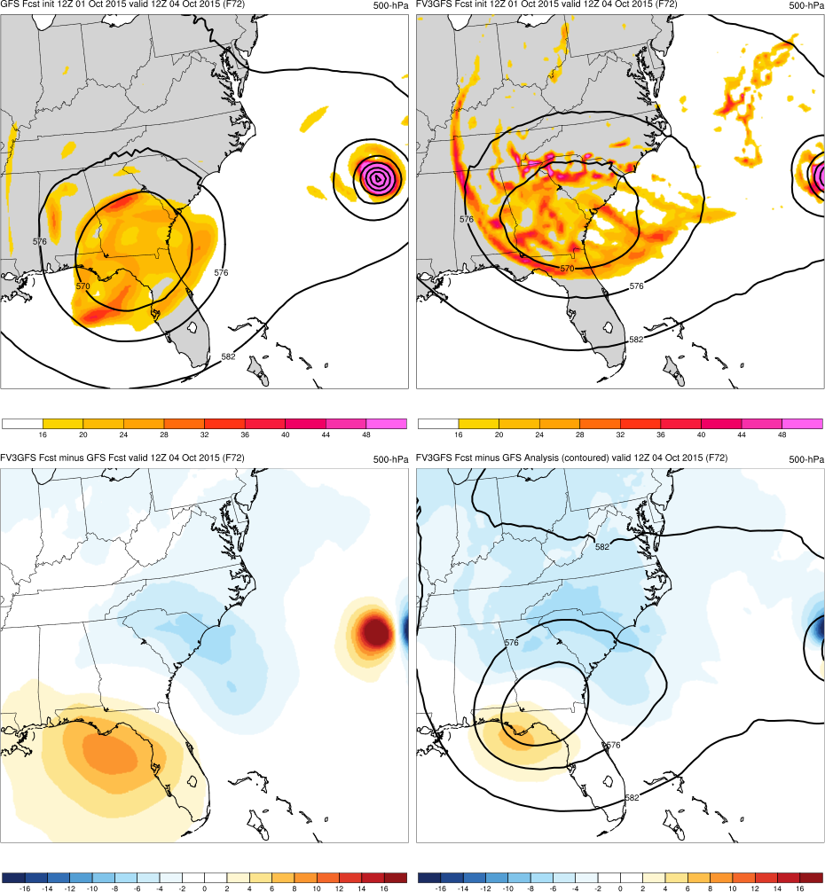
(F072)
GFS
FV3GFS
GFS
FV3GFS
MAIN POINTS:
FV3GFS positions cutoff low too far NE (too progressive)
FV3GFS−GFS
FV3GFS−GFS Anl.
FV3GFS−GFS
FV3GFS−GFS Anl.
KEY:
Blue = FV3GFS has lower geo. heights
Red = FV3GFS has higher geo. heights
Joaquin
Cutoff Low

Slide 17
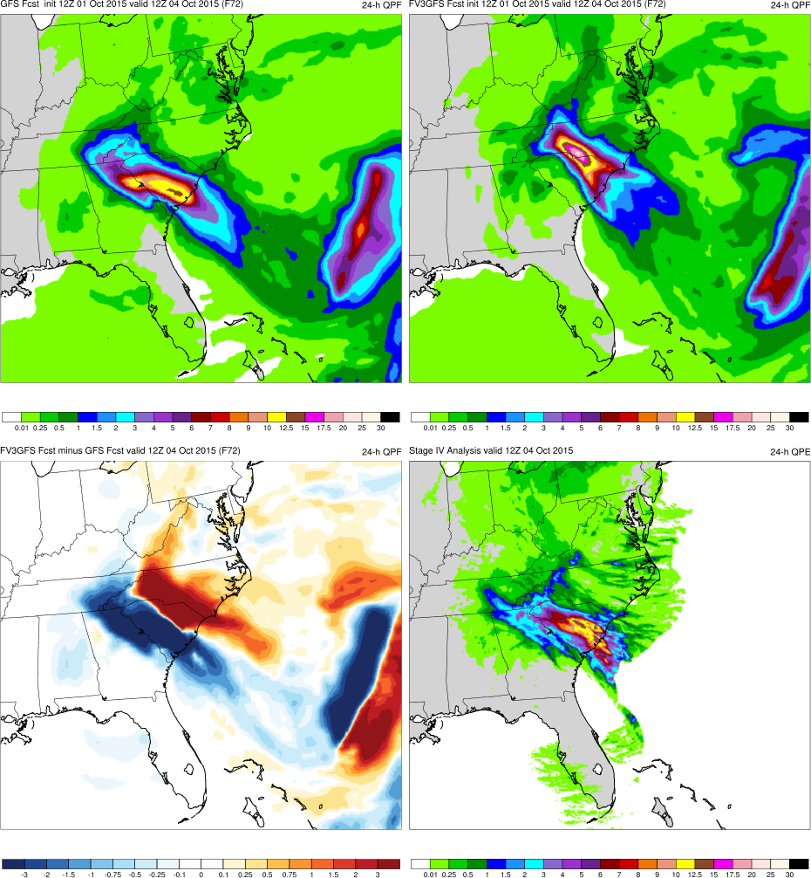
(F072)
GFS
FV3GFS
GFS
FV3GFS
MAIN POINTS:
FV3GFS positions cutoff low too far NE (too progressive)
FV3GFS has heavy precip. too far NE, GFS more accurate
FV3GFS−GFS
FV3GFS−GFS Anl.
FV3GFS−GFS
Stage IV
KEY:
Blue = FV3GFS is wetter (more precip.)
Red = FV3GFS is drier (less precip.)

Slide 18
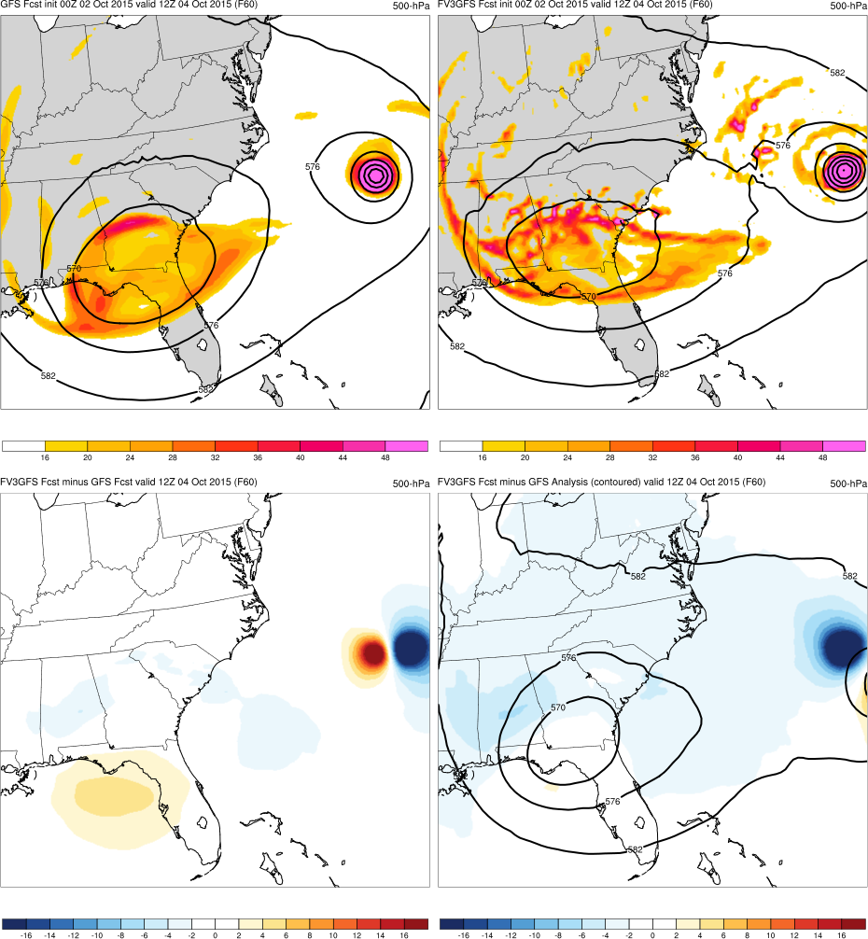
(F060)
GFS
FV3GFS
GFS
FV3GFS
MAIN POINTS:
FV3GFS and GFS both have cutoff low over S. GA/N. FL
FV3GFS−GFS
FV3GFS−GFS Anl.
FV3GFS−GFS
FV3GFS−GFS Anl.
KEY:
Blue = FV3GFS has lower geo. heights
Red = FV3GFS has higher geo. heights
Joaquin
Cutoff Low

Slide 19
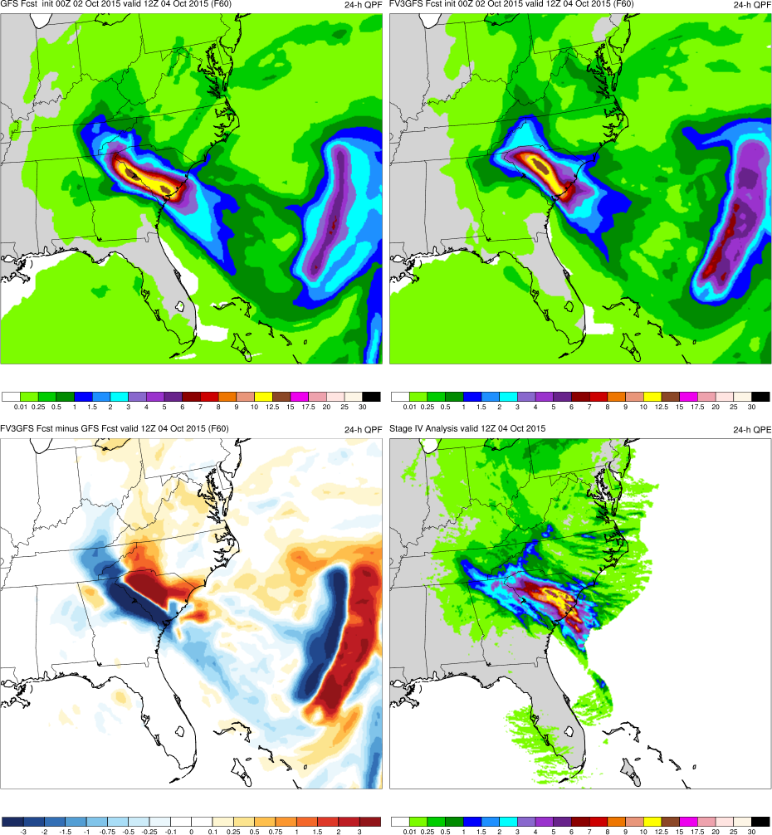
(F060)
GFS
FV3GFS
GFS
FV3GFS
MAIN POINTS:
FV3GFS and GFS both have cutoff low over S. GA/N. FL
Correct cutoff low location => correct precip. location
FV3GFS−GFS
FV3GFS−GFS Anl.
FV3GFS−GFS
Stage IV
KEY:
Blue = FV3GFS is wetter (more precip.)
Red = FV3GFS is drier (less precip.)

Slide 20
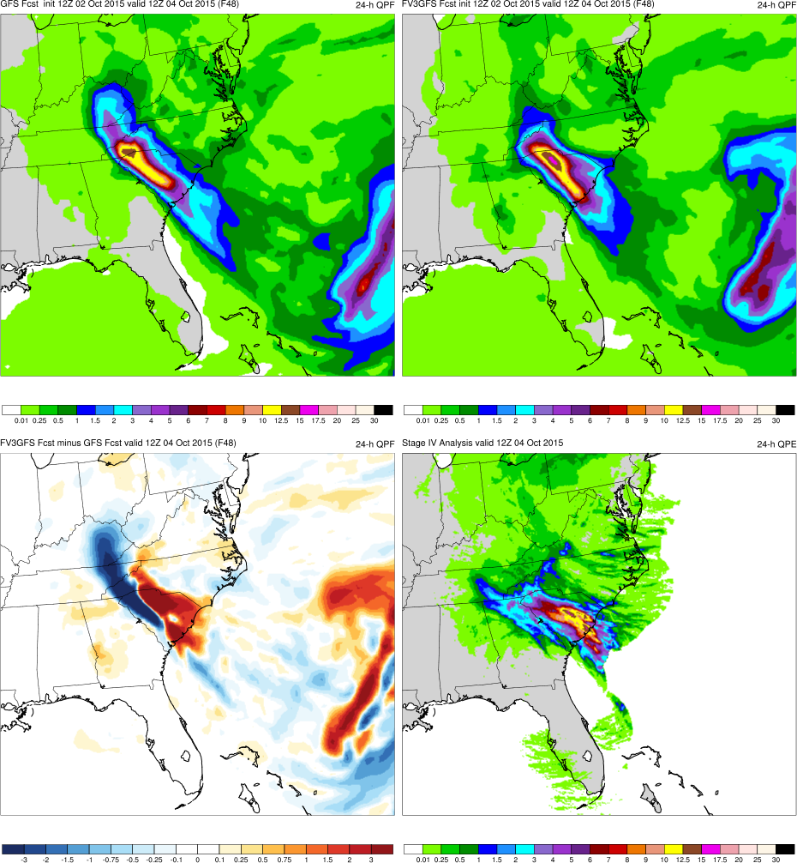
(F048)
GFS
FV3GFS
GFS
FV3GFS
MAIN POINTS:
FV3GFS and GFS both have cutoff low over S. GA/N. FL
FV3GFS and GFS both have heavy precip. over SC
FV3GFS−GFS
FV3GFS−GFS Anl.
FV3GFS−GFS
Stage IV
KEY:
Blue = FV3GFS is wetter (more precip.)
Red = FV3GFS is drier (less precip.)

Slide 21
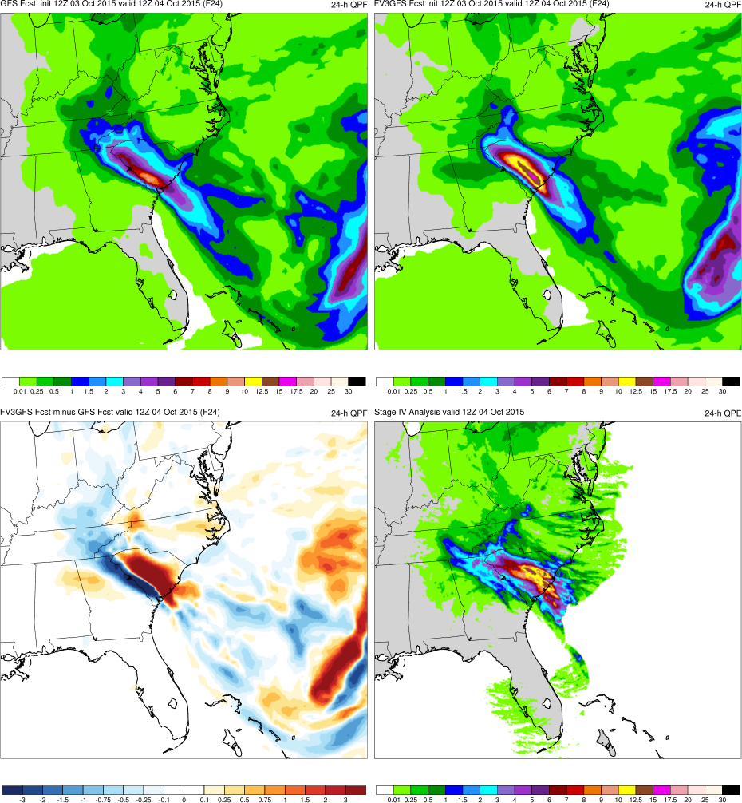
(F024)
GFS
FV3GFS
GFS
FV3GFS
MAIN POINTS:
FV3GFS and GFS both have cutoff low over S. GA/N. FL
FV3GFS has correct QPF amounts over central SC, GFS is slightly too dry
FV3GFS−GFS
FV3GFS−GFS Anl.
FV3GFS−GFS
Stage IV
KEY:
Blue = FV3GFS is wetter (more precip.)
Red = FV3GFS is drier (less precip.)

Slide 22
South Carolina Flooding (Oct 2015) Summary
FV3GFS and GFS forecast formation of a cutoff low over the southeast U.S. at the same lead time
FV3GFS correctly keeps TC Joaquin offshore (no landfall)
FV3GFS positions cutoff low and precip. too far NE in the medium range, suggesting FV3GFS is too progressive
GFS forecasts heavy precip. over SC 12-h prior to FV3GFS

Slide 23
Mississippi Valley Flooding (Apr/May 2017)
Images Valid: 1200 UTC 30 Apr 2017 (500-hPa) 1200 UTC 30 Apr 2017 (24-h QPF)

Slide 24
Mississippi Valley Flooding (Apr/May 2017)
240-h QPE from Stage IV Analysis (25 April 2017–5 May 2017)

Slide 25
Mississippi Valley Flooding (Apr/May 2017)
500-hPa Geopotential Height (0600 UTC 30 April 2017)
GFS Analysis

Slide 26
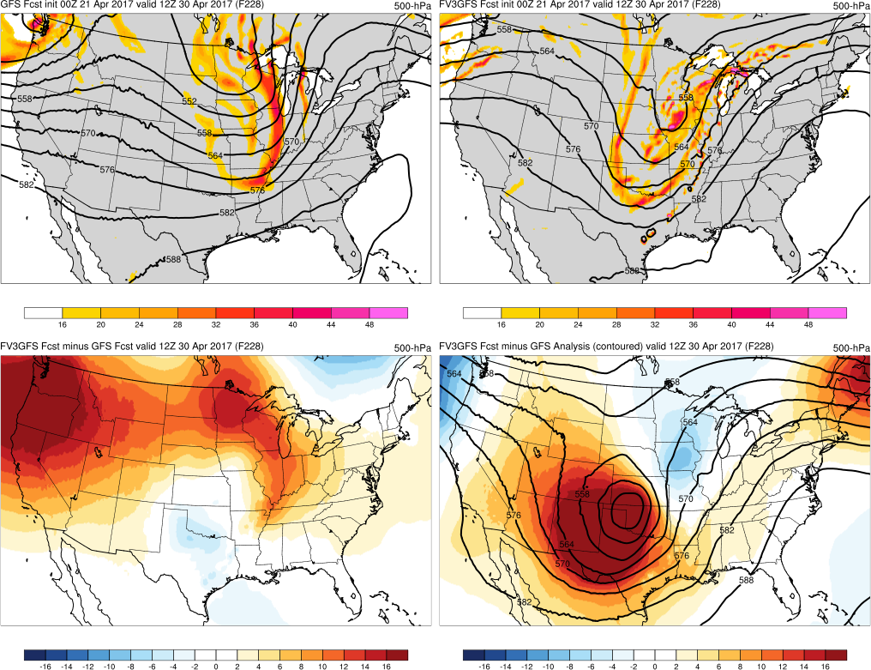
GFS
FV3GFS
(F228)
Too progressive, too far N, and negatively tilted
Too progressive, less amp., and positively tilted
FV3GFS−GFS
FV3GFS−GFS Anl.

Slide 27
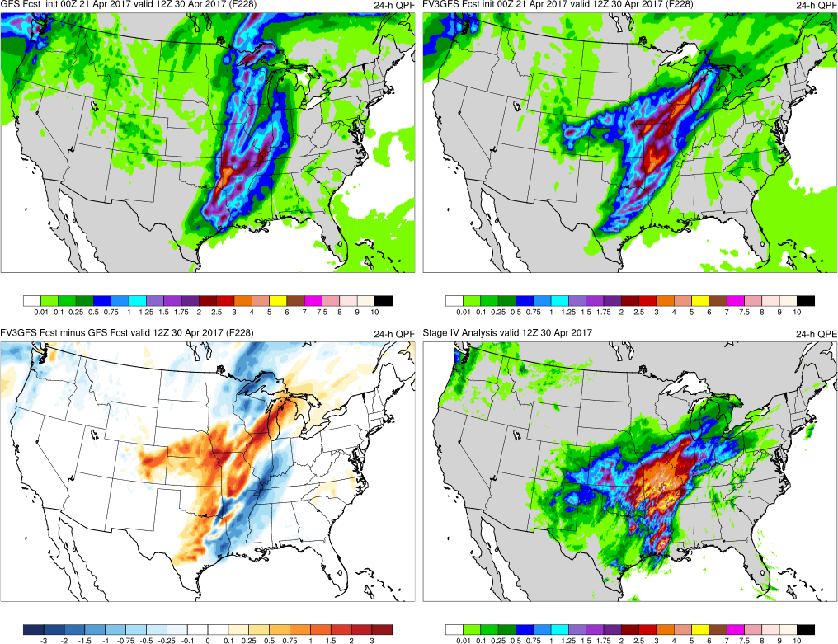
GFS
FV3GFS
(F228)
Wrong orientation, extends too far N and E
Better orientation, good backwards extension
FV3GFS−GFS
Stage IV

Slide 28
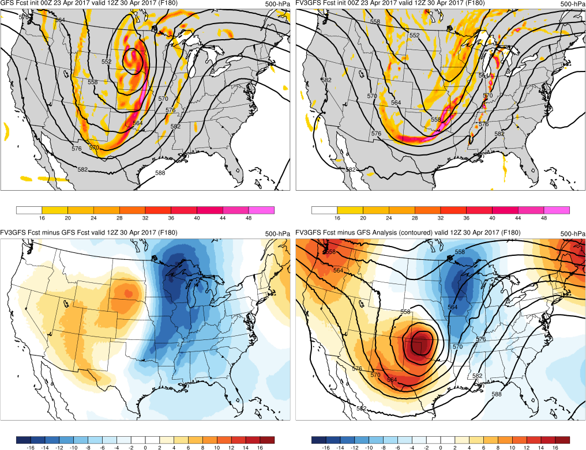
GFS
FV3GFS
(F180)
Good trough placement/amp., cutoff too far N
No cutoff low, trough further E = progressive
FV3GFS−GFS
FV3GFS−GFS Anl.

Slide 29
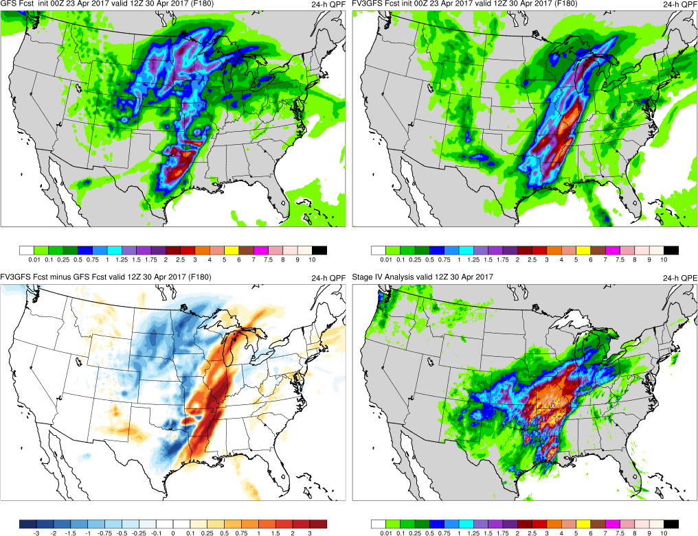
GFS
FV3GFS
(F180)
Precip too far N (cutoff), not enough in MS Vly
Precip shifted too far E b/c more progressive
FV3GFS−GFS
Stage IV

Slide 30
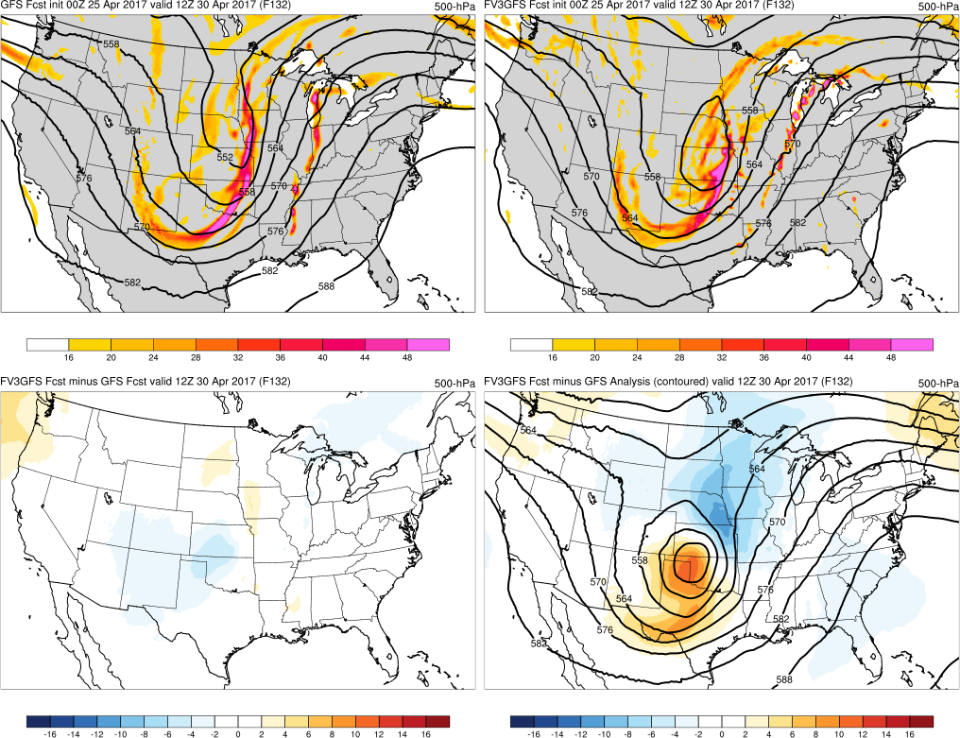
GFS
FV3GFS
(F132)
Good location, but no cutoff and positive tilt
Cutoff too far N, trough positively tilted
FV3GFS−GFS
FV3GFS−GFS Anl.

Slide 31
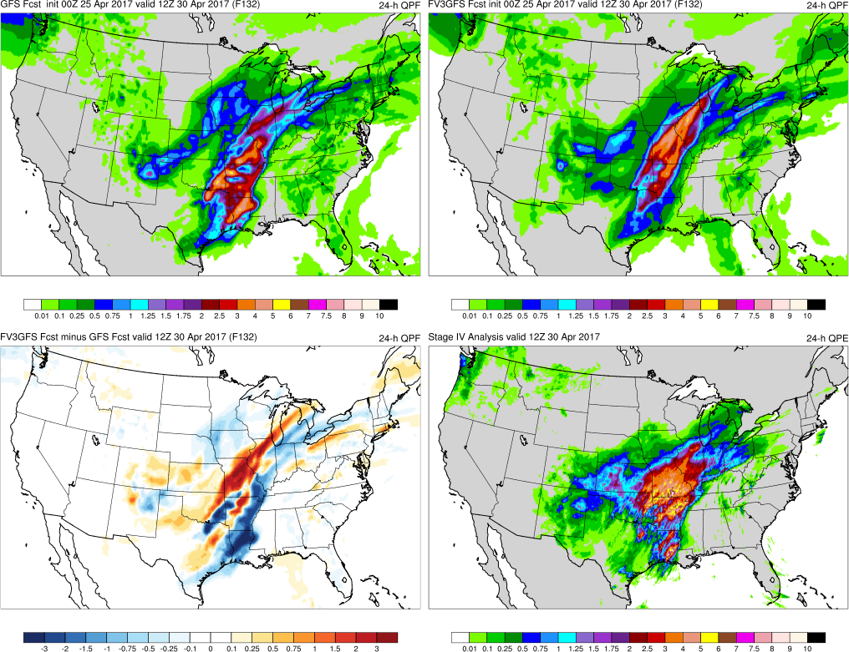
GFS
FV3GFS
(F132)
Too much precip over east TX and IA
Too much precip over east TX, better over IA
FV3GFS−GFS
Stage IV

Slide 32
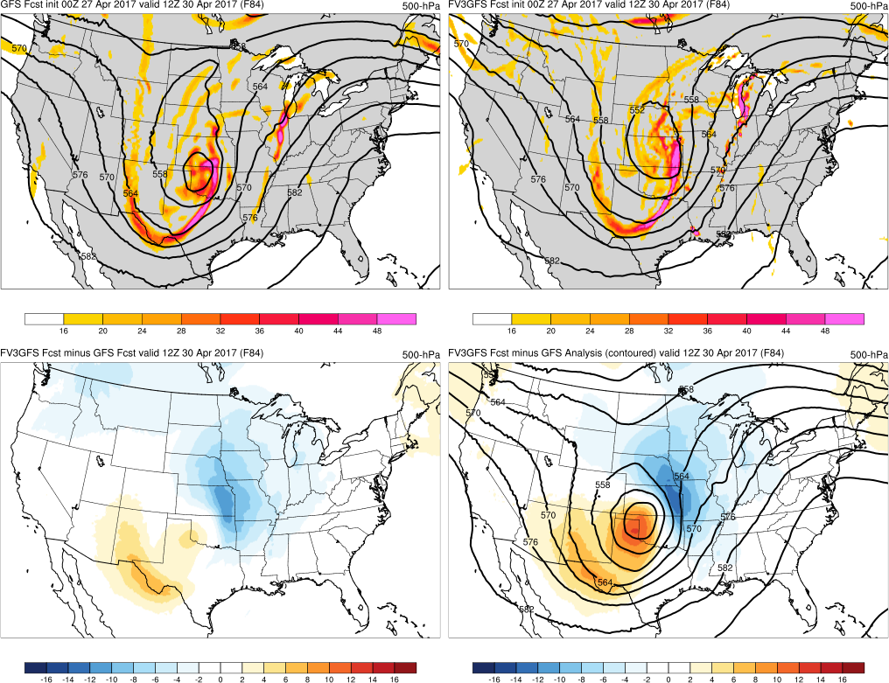
GFS
FV3GFS
(F084)
Good trough tilt and cutoff location, weak amp.
Good trough tilt, cutoff too far NE = progressive
FV3GFS−GFS
FV3GFS−GFS Anl.

Slide 33
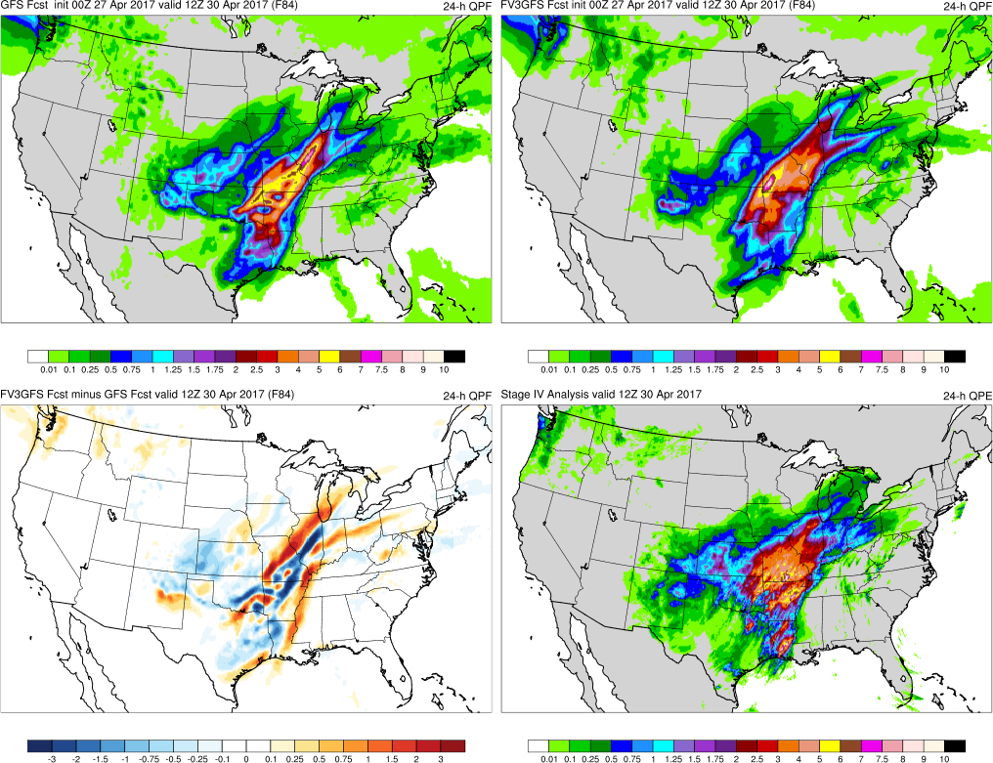
GFS
FV3GFS
(F084)
Too much precip over IL/MO and E TX
Good totals over IL/MO, too much over E TX
FV3GFS−GFS
Stage IV

Slide 34
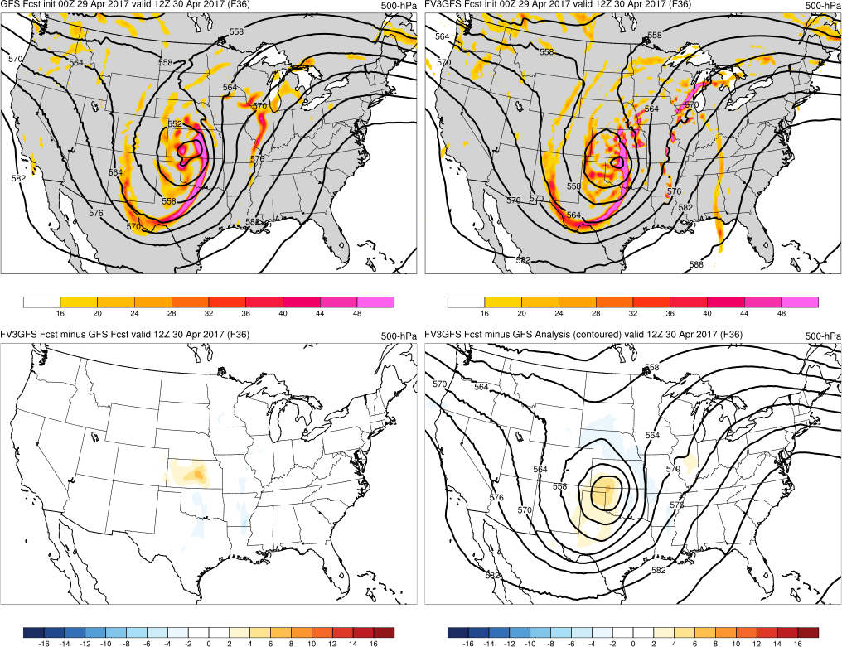
GFS
FV3GFS
(F036)
Good trough tilt, cutoff location/amplitude
Good trough tilt, cutoff location, weaker amp.
FV3GFS−GFS
FV3GFS−GFS Anl.

Slide 35
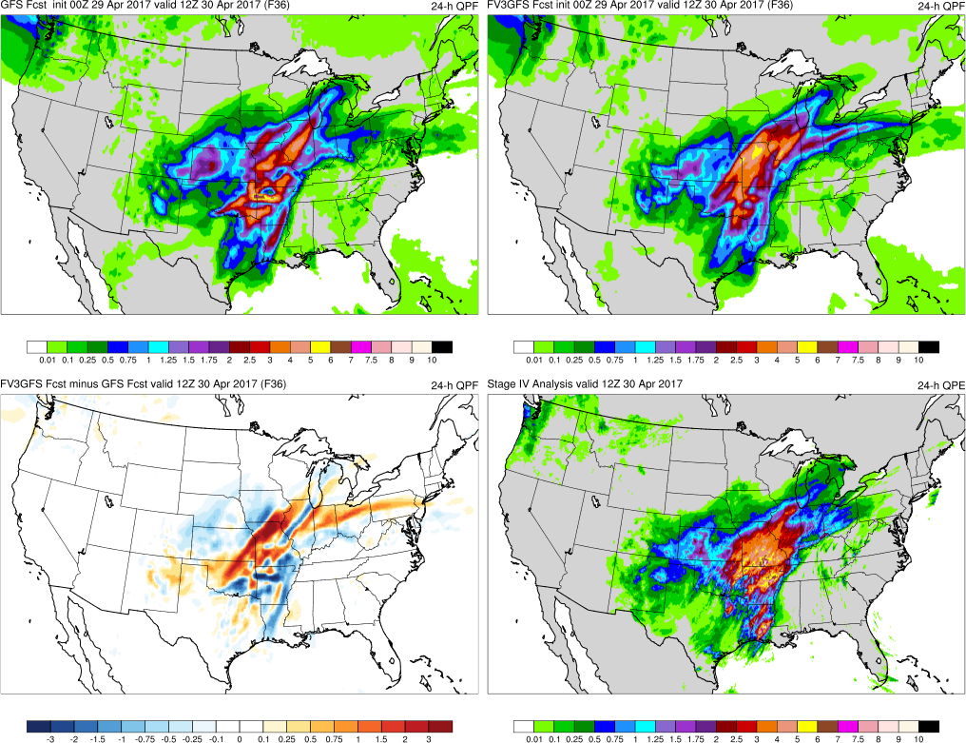
GFS
FV3GFS
(F036)
Too little/splotchy over MO, good extension W
Good amts/coverage over MO, low over AR
FV3GFS−GFS
Stage IV

Slide 36
MS Valley Flooding (Apr/May 2017) Summary
FV3GFS and GFS forecast an amplified trough and heavy rain event over the central U.S. with 228-h of lead time
FV3GFS is occasionally more progressive than GFS with 500-hPa trough and precipitation in the medium range
FV3GFS does a better job with the location and amount of precipitation over the central U.S. at shorter lead times

Slide 37
TC Cindy Flooding (June 2017)
Images Valid: 0000 UTC 22 June 2017 (24-h QPF)

Slide 38
TC Cindy Flooding (June 2017)
GFS Analysis of MSLP (12Z 22 June 2017)
L₉₉₅
Cindy

Slide 39
TC Cindy Flooding (June 2017)
156-h QPE from Stage IV Analysis (12Z 24 June 2017)
L₉₉₅
Cindy

Slide 40
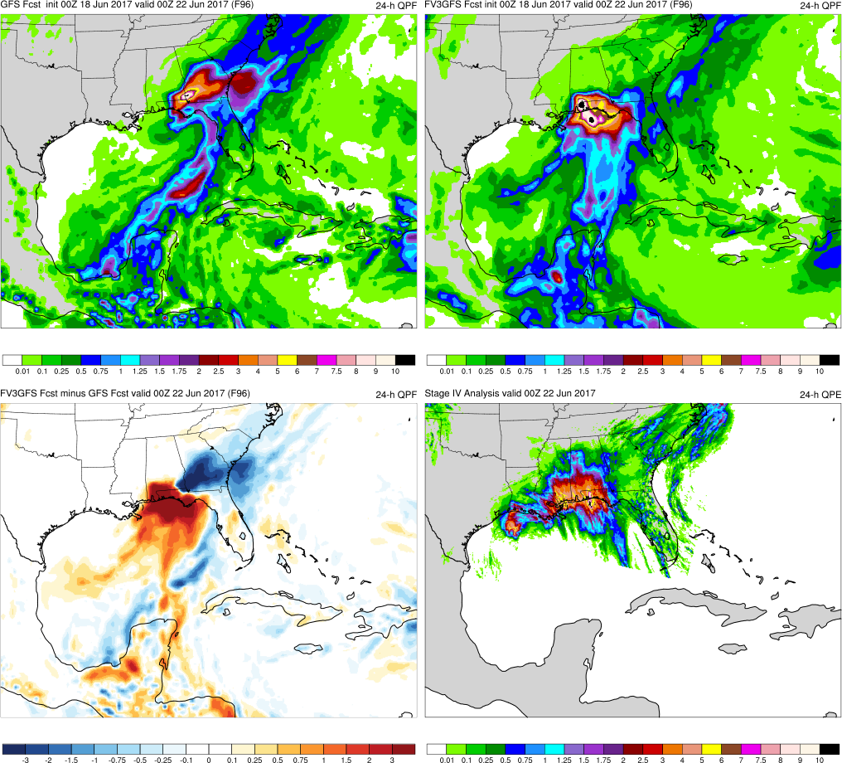
(F096)
GFS
FV3GFS
MAIN POINTS:
TCs in FV3GFS and GFS are too far east relative to GFS anl.
FV3GFS has more accurate TC & precip locations than GFS
L₁₀₀₄
L₁₀₀₃
KEY:
Blue = FV3GFS is wetter (more precip.)
Red = FV3GFS is drier (less precip.)
L₉₉₅
L₉₉₅
FV3GFS−GFS
Stage IV

Slide 41
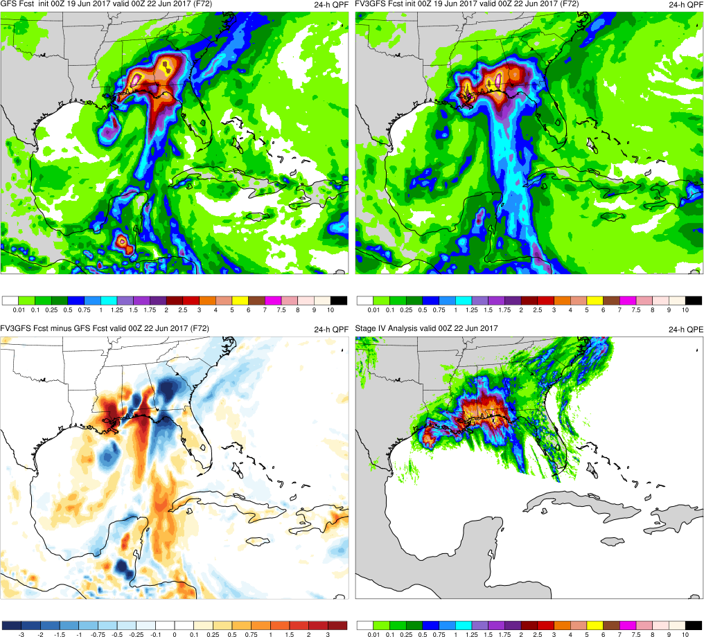
(F072)
GFS
FV3GFS
MAIN POINTS:
FV3GFS has more accurate TC & precip location than GFS
FV3GFS has higher values over MS/LA, while GFS does not
L₁₀₀₁
L₉₉₉
KEY:
Blue = FV3GFS is wetter (more precip.)
Red = FV3GFS is drier (less precip.)
L₉₉₅
L₉₉₅
FV3GFS−GFS
Stage IV

Slide 42
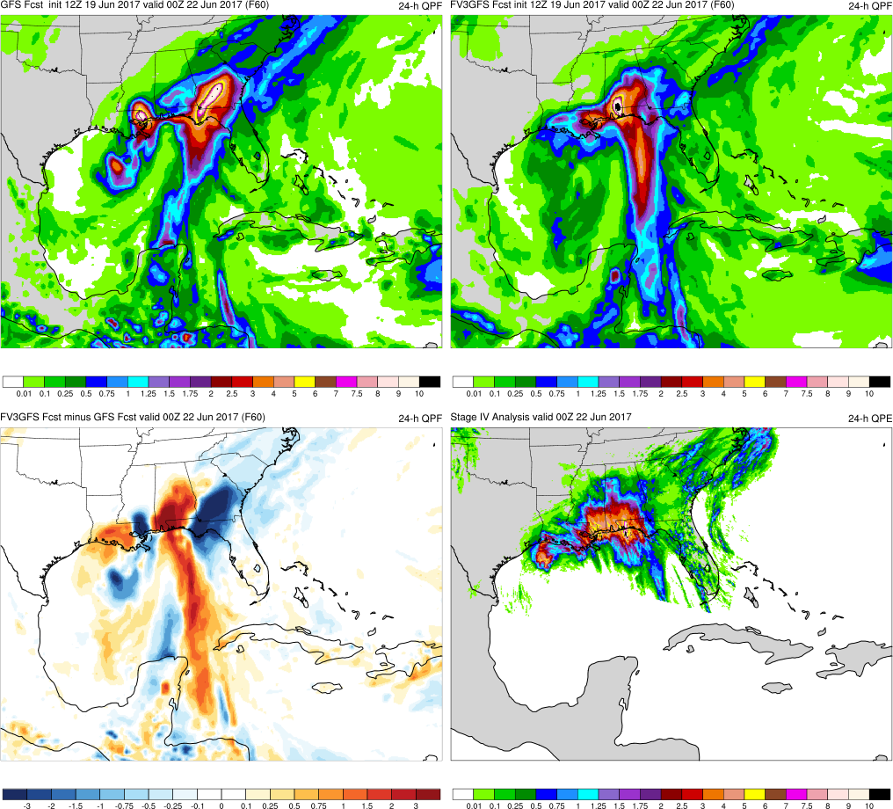
(F060)
GFS
FV3GFS
MAIN POINTS:
FV3GFS has more accurate TC & precip location than GFS
GFS divides precip into two regions, near TC & over GA, FV3GFS does not
L₉₉₇
L₉₉₉
KEY:
Blue = FV3GFS is wetter (more precip.)
Red = FV3GFS is drier (less precip.)
L₉₉₅
L₉₉₅
FV3GFS−GFS
Stage IV

Slide 43
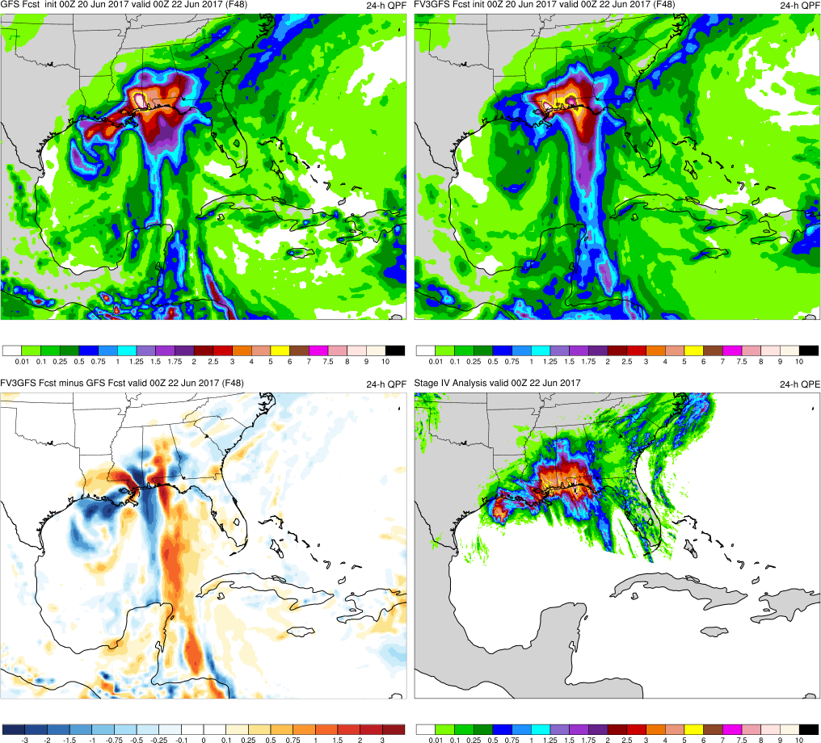
(F048)
GFS
FV3GFS
MAIN POINTS:
FV3GFS and GFS both position TCs south of Louisiana
FV3GFS and GFS have highest precip. values over correct locations
L₉₉₆
L₉₉₉
KEY:
Blue = FV3GFS is wetter (more precip.)
Red = FV3GFS is drier (less precip.)
L₉₉₅
L₉₉₅
FV3GFS−GFS
Stage IV

Slide 44
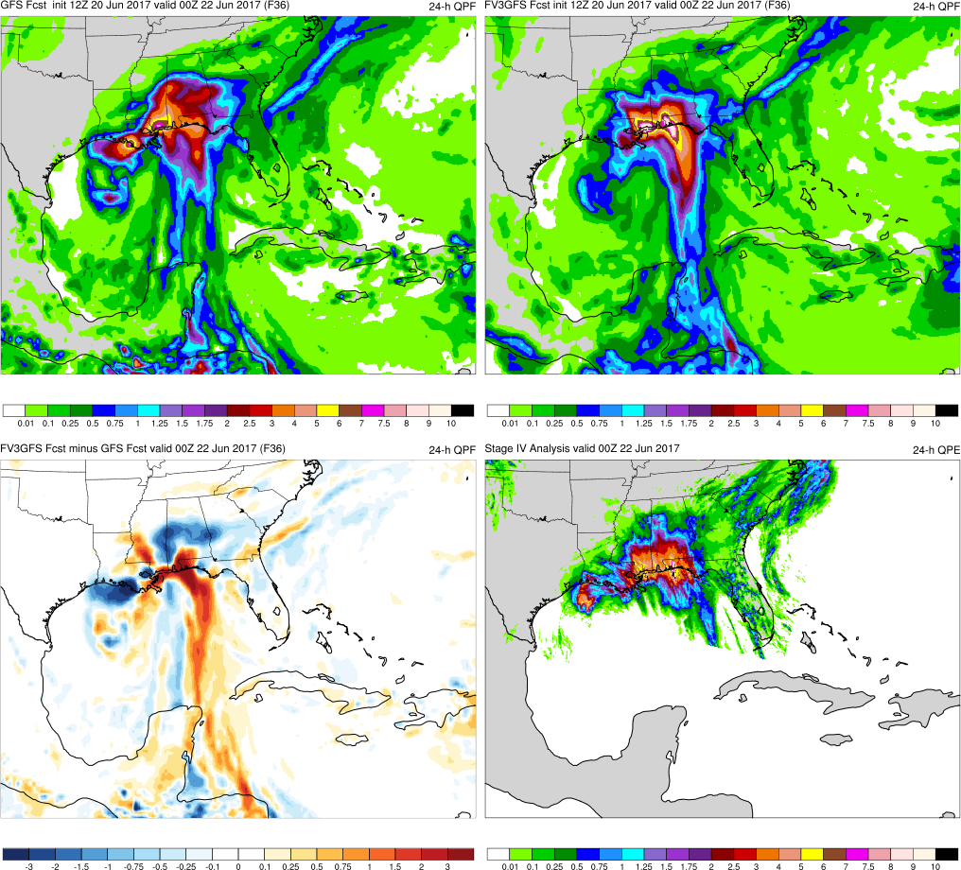
(F036)
GFS
FV3GFS
MAIN POINTS:
FV3GFS and GFS both position TCs south of Louisiana
GFS precip is better near TC, but worse over MS/AL (extends too far north)
L₉₉₆
L₉₉₈
KEY:
Blue = FV3GFS is wetter (more precip.)
Red = FV3GFS is drier (less precip.)
L₉₉₅
FV3GFS−GFS
Stage IV

Slide 45
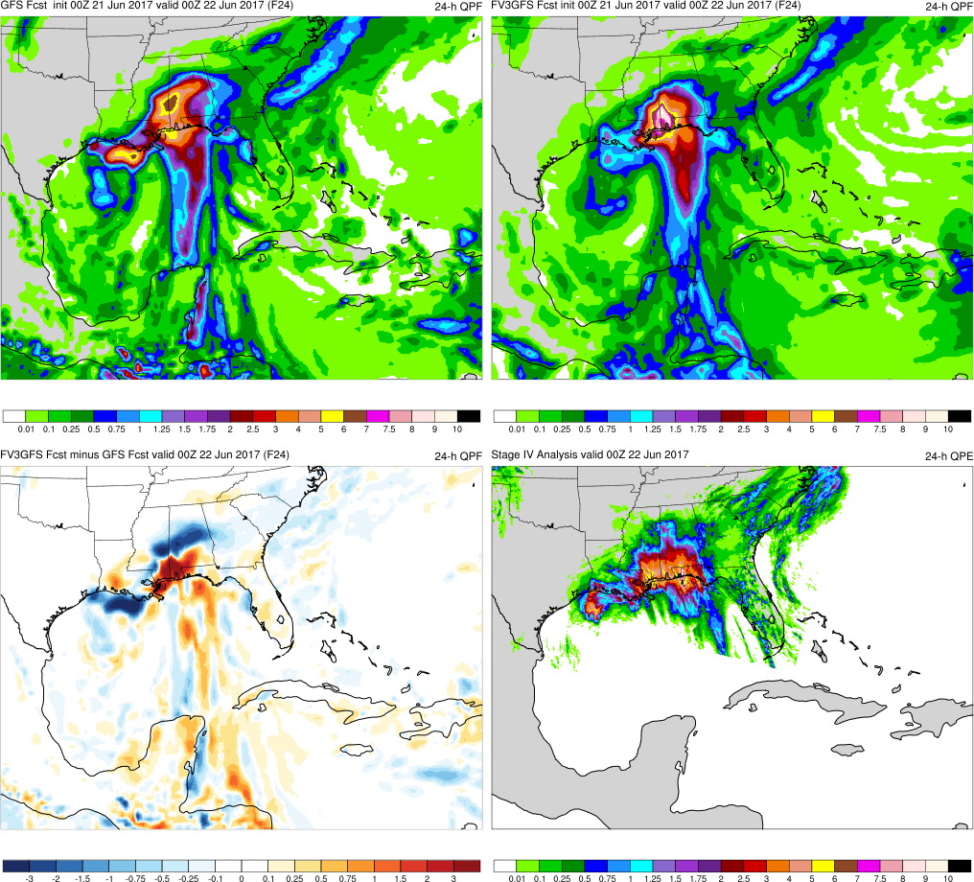
(F024)
GFS
FV3GFS
MAIN POINTS:
FV3GFS and GFS both position TCs south of Louisiana
Highest precip totals over correct location in FV3GFS & GFS, but amounts too big
L₉₉₆
L₉₉₈
KEY:
Blue = FV3GFS is wetter (more precip.)
Red = FV3GFS is drier (less precip.)
L₉₉₅
FV3GFS−GFS
Stage IV

Slide 46
TC Cindy Flooding (June 2017) Summary
FV3GFS forecasts the track of TC Cindy better than GFS in medium range
FV3GFS forecasts the location/magnitude of heavy rainfall east of TC Cindy more accurately than GFS
FV3GFS forecasts the location/magnitude of heavy rainfall near the center of TC Cindy less accurately than GFS

Slide 47
Mid-Atlantic July Nor’easter (July 2017)
Images Valid: 1200 UTC 29 July 2017 (24-h QPF)

Slide 48
Mid-Atlantic July Nor’easter (July 2017)
GFS Analysis of MSLP (1200 UTC 29 July 2017)
L₁₀₀₂

Slide 49
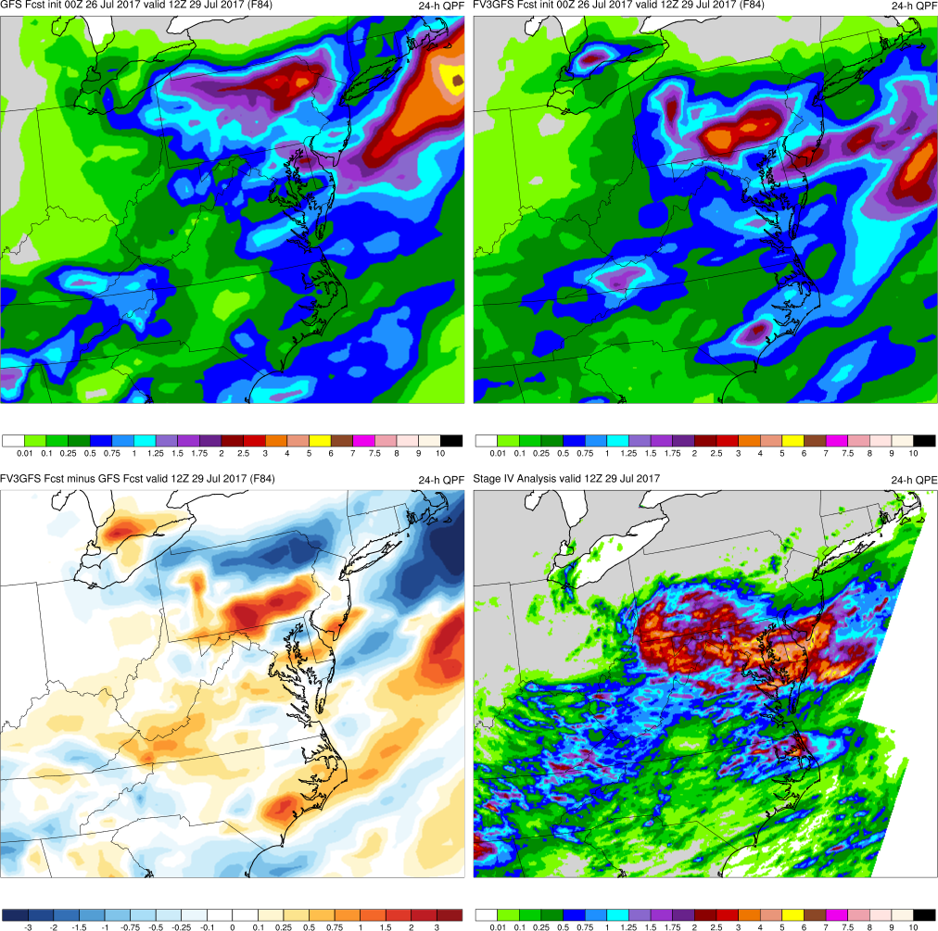
(F084)
GFS
FV3GFS
MAIN POINTS:
FV3GFS and GFS forecast max precip. too far to the north
FV3GFS and GFS forecast too little precip. over WV
FV3GFS−GFS
Stage IV
KEY:
Blue = FV3GFS is wetter (more precip.)
Red = FV3GFS is drier (less precip.)

Slide 50
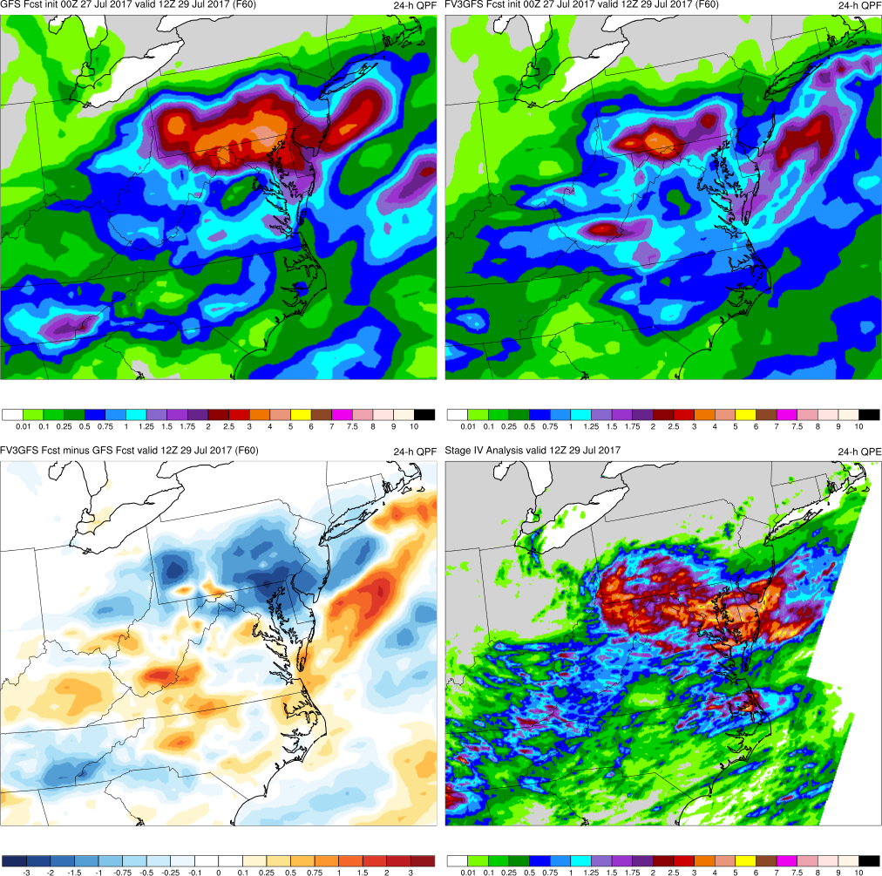
(F060)
GFS
FV3GFS
MAIN POINTS:
Max precip. shifts south in both GFS and FV3GFS, but FV3GFS too weak
FV3GFS and GFS forecast too much precip. over VA
FV3GFS−GFS
Stage IV
KEY:
Blue = FV3GFS is wetter (more precip.)
Red = FV3GFS is drier (less precip.)

Slide 51
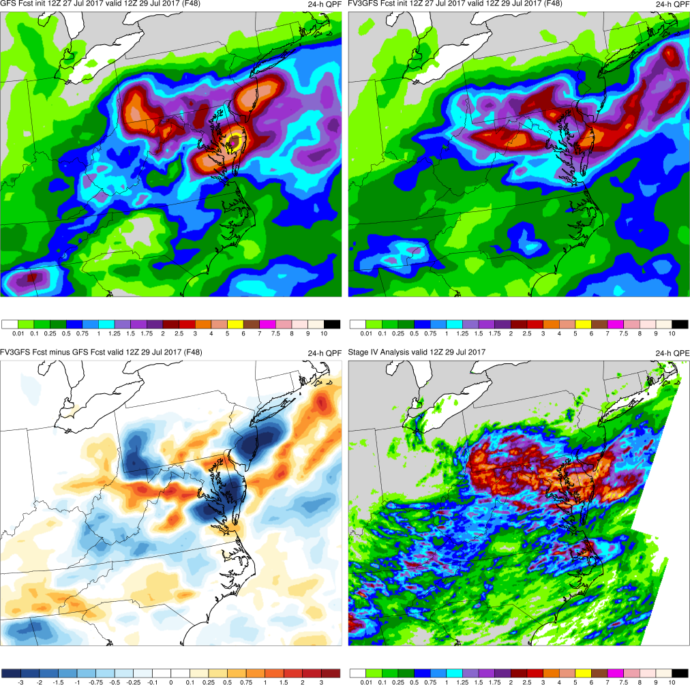
(F048)
GFS
FV3GFS
MAIN POINTS:
Max precip shifts south and amounts increase in FV3GFS and GFS
FV3GFS is less accurate over WV and Appalachian Mtns than GFS
FV3GFS−GFS
Stage IV
KEY:
Blue = FV3GFS is wetter (more precip.)
Red = FV3GFS is drier (less precip.)

Slide 52
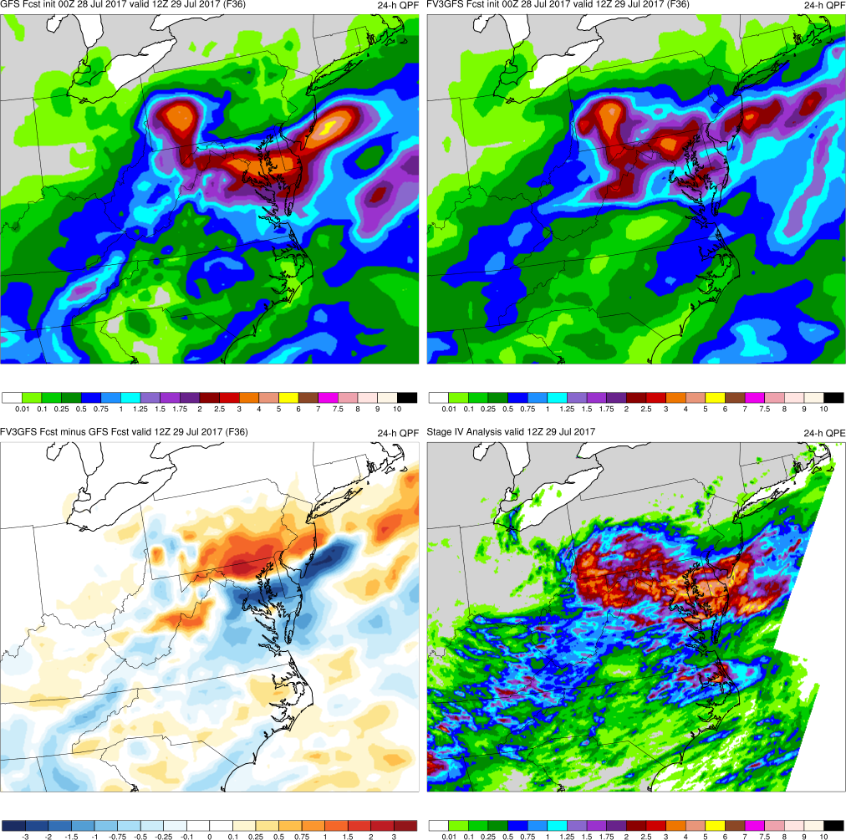
(F036)
GFS
FV3GFS
MAIN POINTS:
FV3GFS more accurate than GFS over southern PA
FV3GFS and GFS both forecast higher precip totals over Appalachians
FV3GFS−GFS
Stage IV
KEY:
Blue = FV3GFS is wetter (more precip.)
Red = FV3GFS is drier (less precip.)

Slide 53
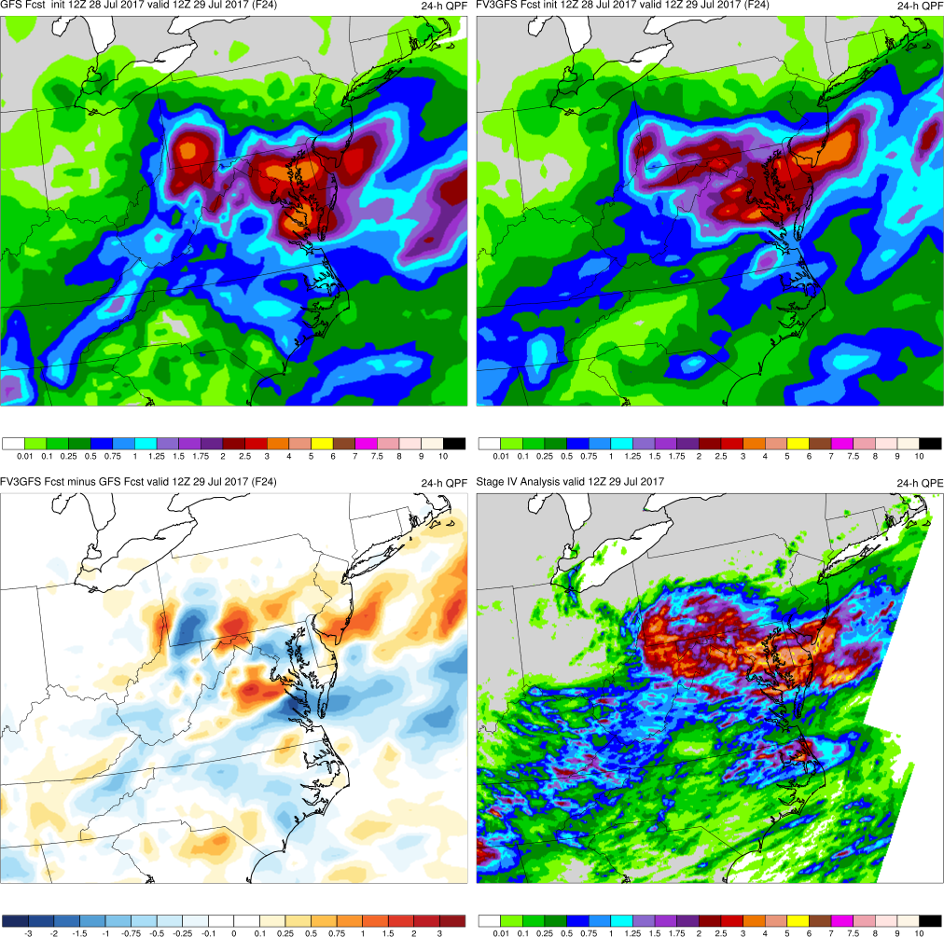
(F024)
GFS
FV3GFS
MAIN POINTS:
FV3GFS and GFS accurately forecast region of highest precip totals
FV3GFS and GFS both forecast higher precip totals over Appalachians
FV3GFS−GFS
Stage IV
KEY:
Blue = FV3GFS is wetter (more precip.)
Red = FV3GFS is drier (less precip.)

Slide 54
Mid-Atlantic July Nor’easter (2017) Summary
FV3GFS and GFS position the heaviest precip. too far north in the medium range, shifting precip. south with time
FV3GFS and GFS correctly forecast the location of max. precipitation with 48-h of lead time
FV3GFS forecasts higher precipitation totals over WV and Appalachian Mountains 12-h after GFS

Slide 55
West Coast Atmospheric River (Mar 2018)
Images Valid: 0000 UTC 22 Mar 2018 (24-h QPF)

Slide 56
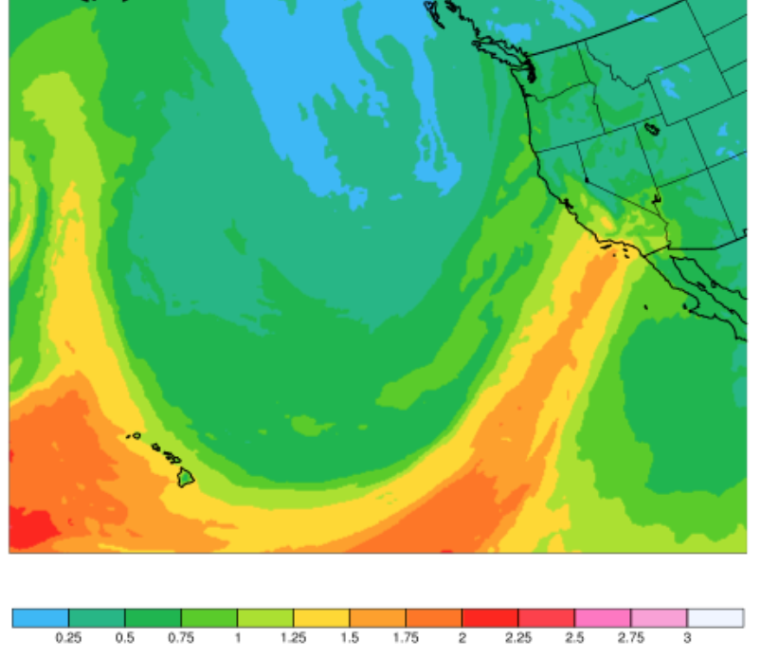
West Coast Atmospheric River (Mar 2018)
FV3GFS 72-h Fcst of PW (Valid: 00Z 22 March 2018)

Slide 57
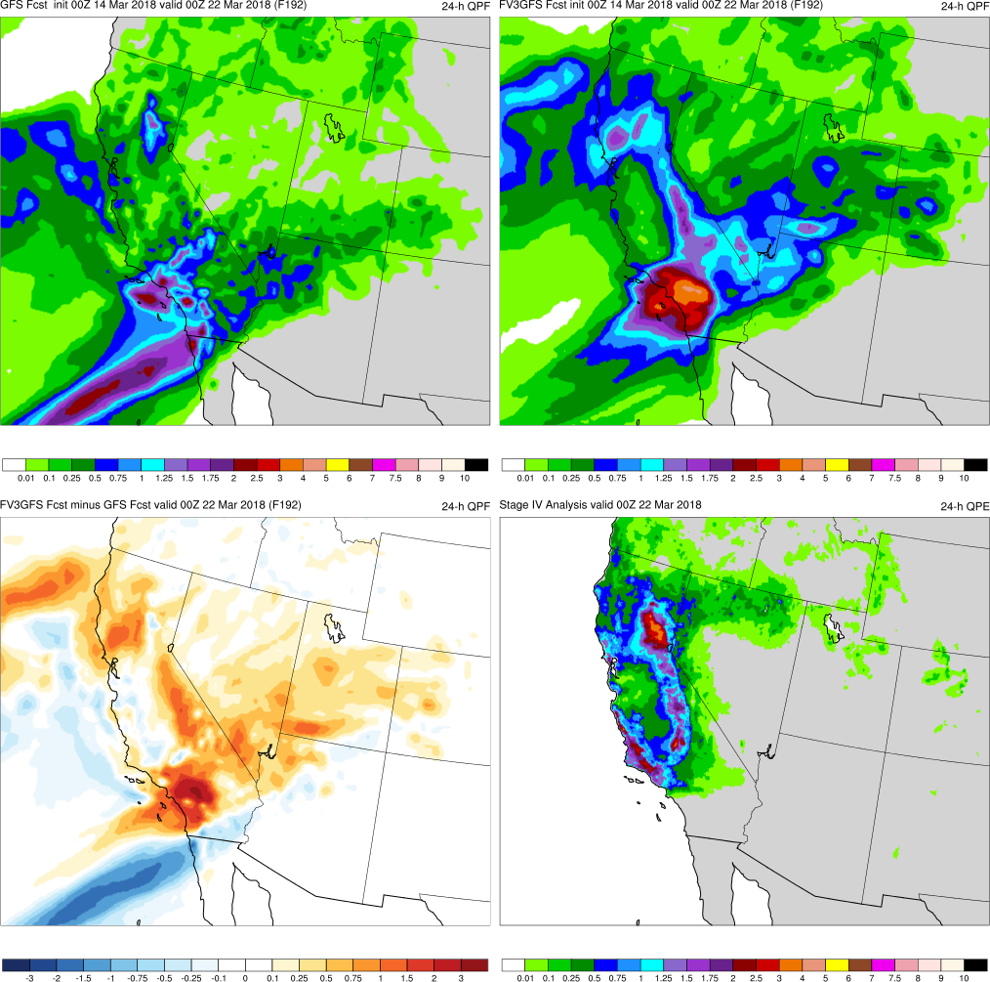
(F192)
MAIN POINTS:
FV3GFS and GFS have max precip values too far south
FV3GFS forecasts precip over Sierra Nevada Mtns more accurately than GFS
GFS
FV3GFS
KEY:
Blue = FV3GFS is drier (lower QPF)
Red = FV3GFS is wetter (higher QPF)
FV3GFS−GFS
Stage IV

Slide 58
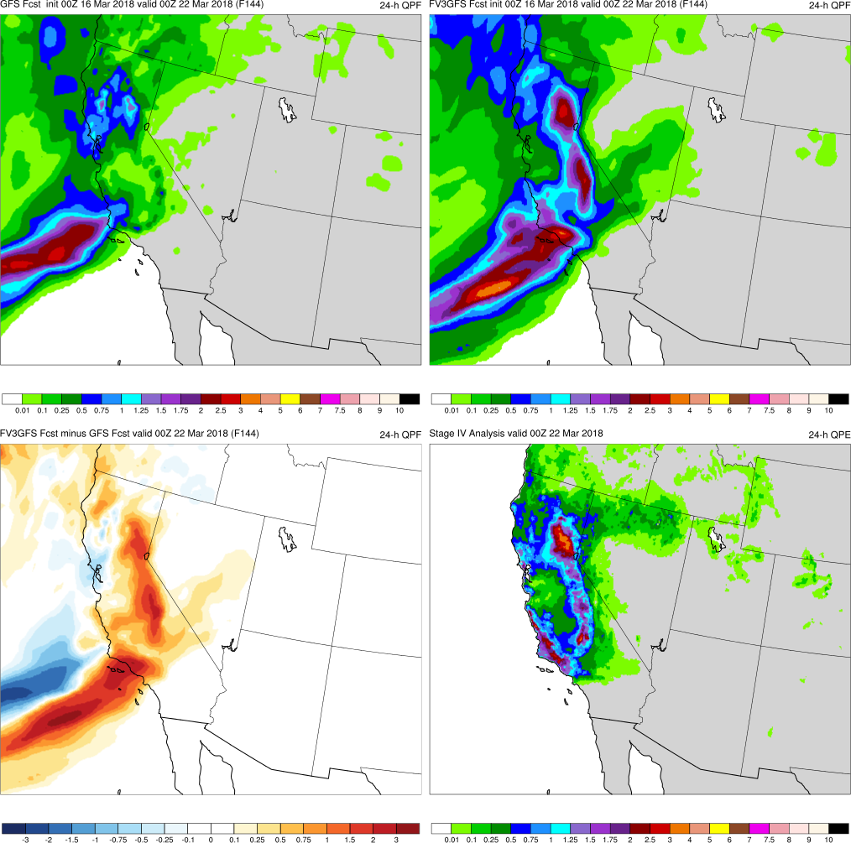
(F144)
MAIN POINTS:
FV3GFS is more accurate w/ precip over Sierra Nevada Mtns and along CA coastline than GFS
GFS
FV3GFS
KEY:
Blue = FV3GFS is drier (lower QPF)
Red = FV3GFS is wetter (higher QPF)
FV3GFS−GFS
Stage IV

Slide 59
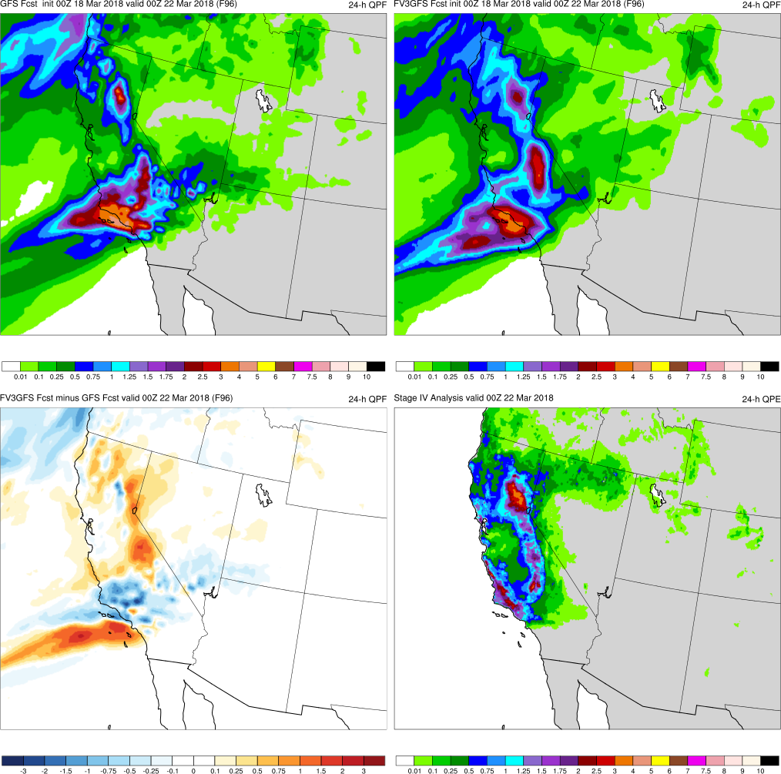
(F096)
MAIN POINTS:
FV3GFS forecasts are more accurate over Sierra Nevada Mtns than GFS
FV3GFS and GFS have too much QPF over SW California
GFS
FV3GFS
KEY:
Blue = FV3GFS is drier (lower QPF)
Red = FV3GFS is wetter (higher QPF)
FV3GFS−GFS
Stage IV

Slide 60
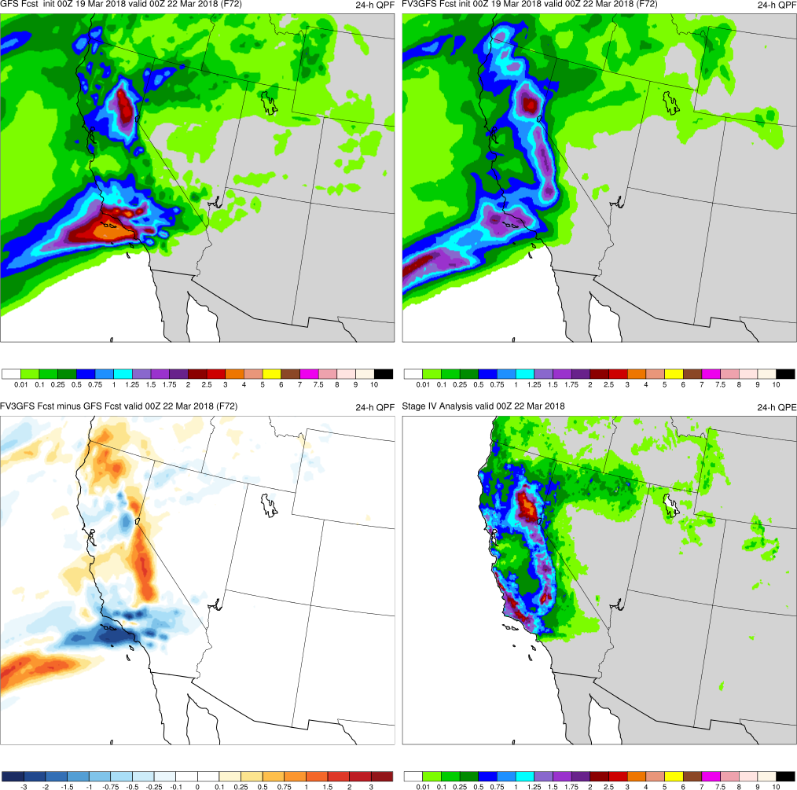
(F072)
MAIN POINTS:
FV3GFS forecasts are more accurate over Sierra Nevada Mtns than GFS
FV3GFS forecasts too much precip over north CA
GFS
FV3GFS
KEY:
Blue = FV3GFS is drier (lower QPF)
Red = FV3GFS is wetter (higher QPF)
FV3GFS−GFS
Stage IV

Slide 61
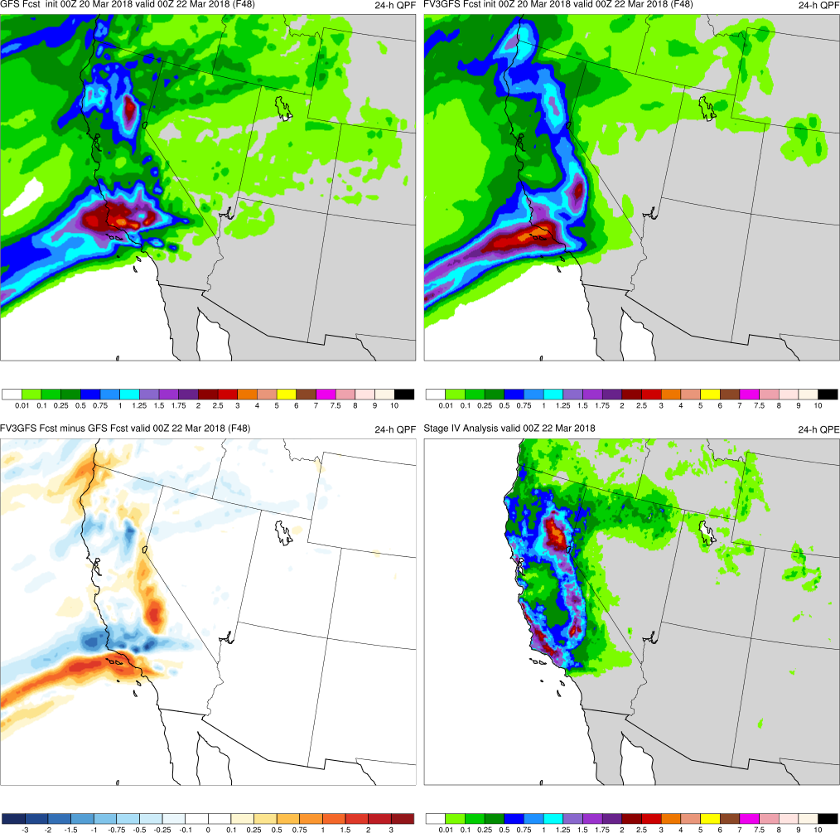
(F048)
MAIN POINTS:
FV3GFS forecasts are more accurate over Sierra Nevada Mtns than GFS
FV3GFS and GFS have too much precip over north CA
GFS
FV3GFS
KEY:
Blue = FV3GFS is drier (lower QPF)
Red = FV3GFS is wetter (higher QPF)
FV3GFS−GFS
Stage IV

Slide 62
West Coast AR (March 2018) Summary
FV3GFS forecasts the location and magnitude of 24-h precipitation totals more accurately than the GFS
FV3GFS forecasts precipitation along the Sierra Nevada Mountains and outside the San Joaquin Valley more accurately than GFS

Slide 63
FV3GFS QPF Retrospectives Summary
FV3GFS does not have TC Joaquin making landfall, but positions heavy precipitation over SC ~12-h after GFS
FV3GFS and GFS forecast an amplified trough and heavy rain event over the Mississippi Valley w/ 228-h of lead time
FV3GFS forecasts the location and magnitude of heavy rainfall east of TC Cindy more accurately than GFS
FV3GFS forecasts precipitation over Sierra Nevada Mtns and San Joaquin Valley more accurately than GFS
FV3GFS is occasionally more progressive than GFS with 500-hPa troughs and precipitation in the medium range

