Slide 1
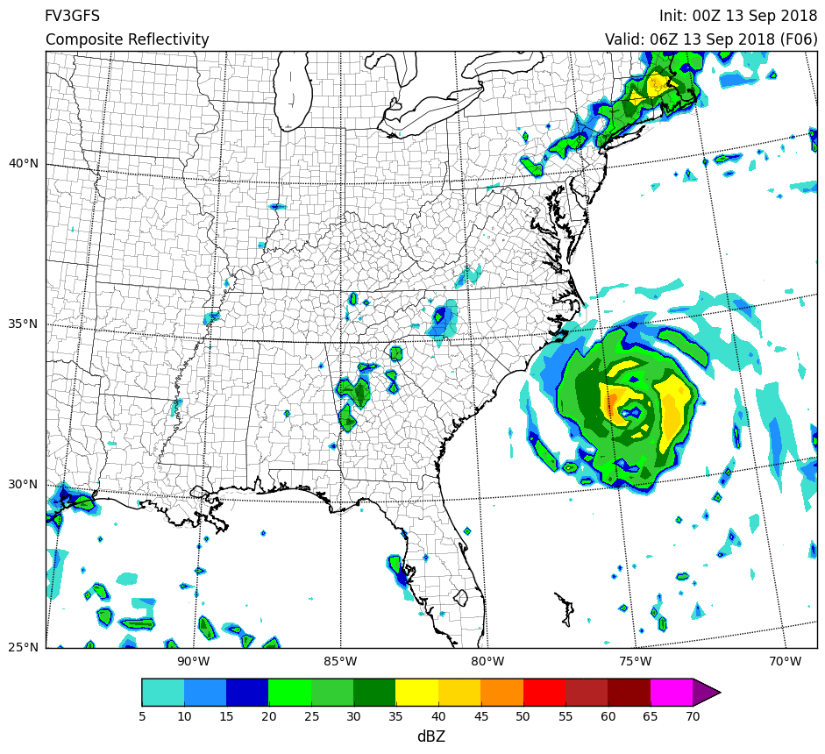
FV3GFS Post-Processed Products Update
13 September 2018 MEG Briefing
Logan Dawson
EMC Model Evaluation Group

Slide 2
Topic
Summary and final update on FV3GFS post-processed products
Issues with FV3GFS simulated 1-km reflectivity and visibility were noted and discussed in several MEG meetings beginning in late May
Throughout the summer, test runs were conducted and evaluated to identify the cause(s) of the issues and validate bug fixes
All of this work was a very collaborative effort between the MEG and members of EMC’s Physics and Post teams.

Slide 3
1-km AGL Reflectivity

Slide 4
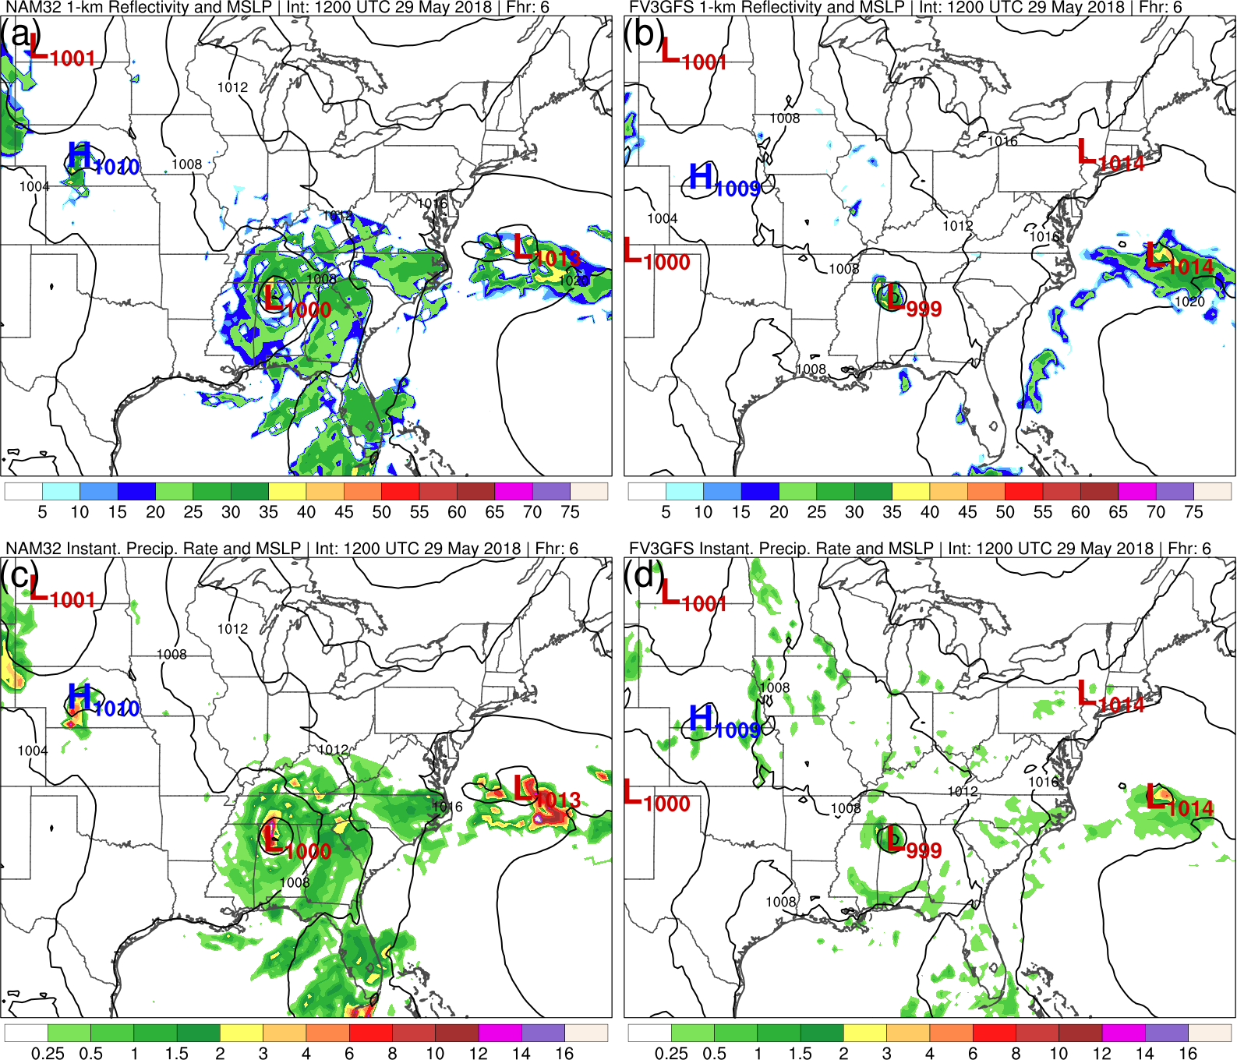
Initial Problems: FV3GFS Reflectivity Was Underdone and Precip. Rate Looked “Off”
NAM
FV3GFS
NAM
FV3GFS
Images courtesy of A. Bentley

Slide 5
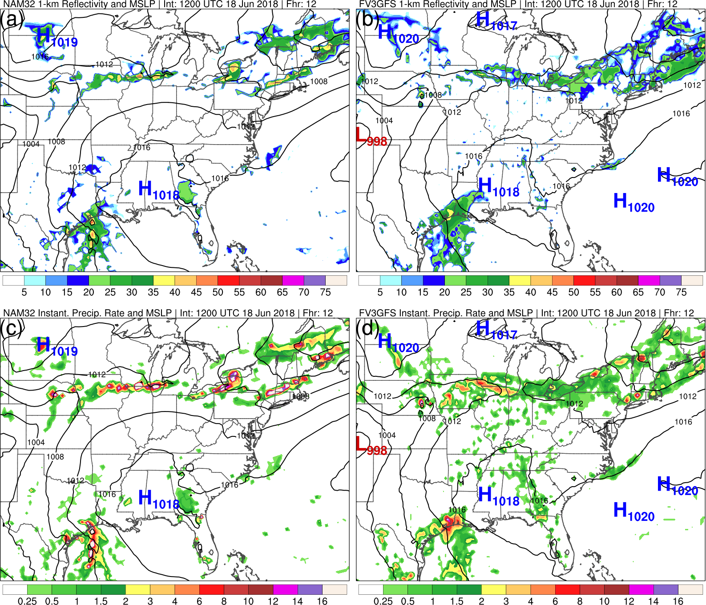
Addressing Precip. Rate and Adding Convective Contribution Improved Reflectivity
NAM
FV3GFS
NAM
FV3GFS
Images courtesy of A. Bentley

Slide 6
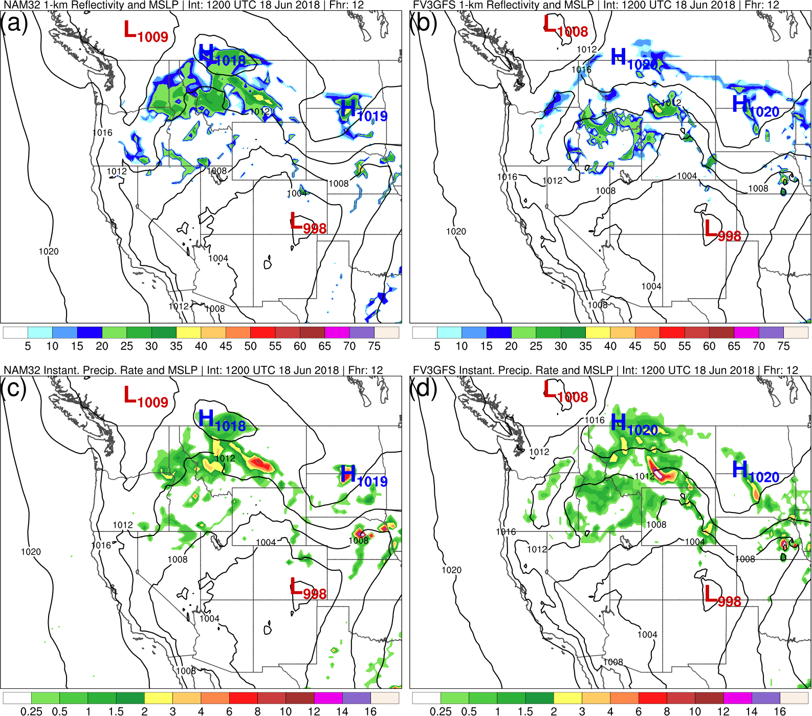
Areas of Concern Remained in Regions of Lighter, Grid-Scale Precipitation
NAM
FV3GFS
NAM
FV3GFS

Slide 7
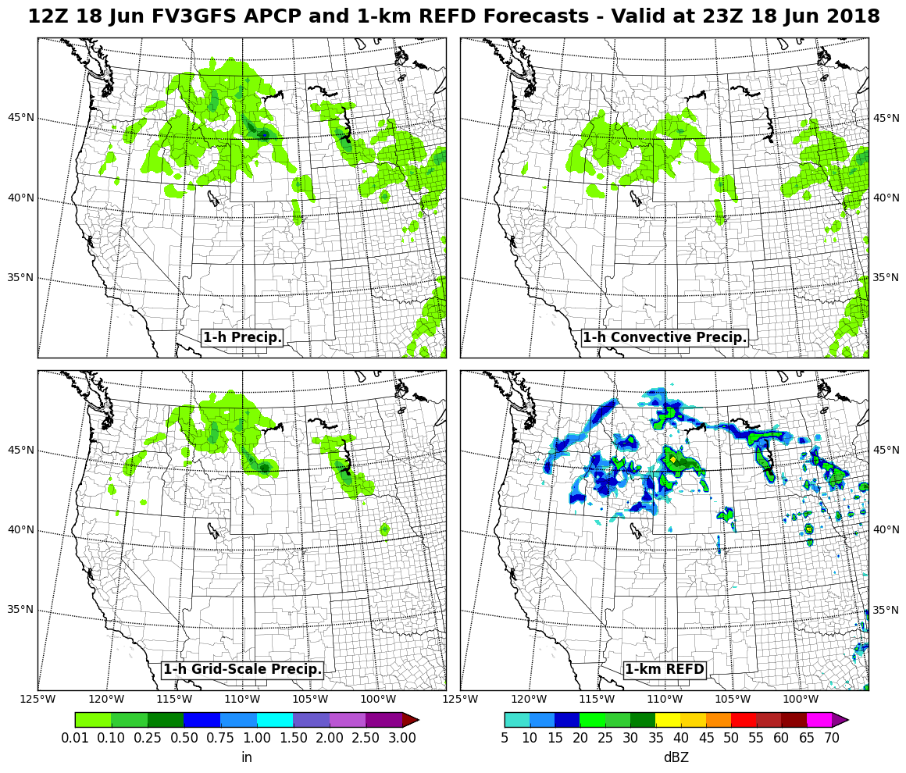
1-km Reflectivity Missing Where Precipitation Was Accumulating at the Surface

Slide 8
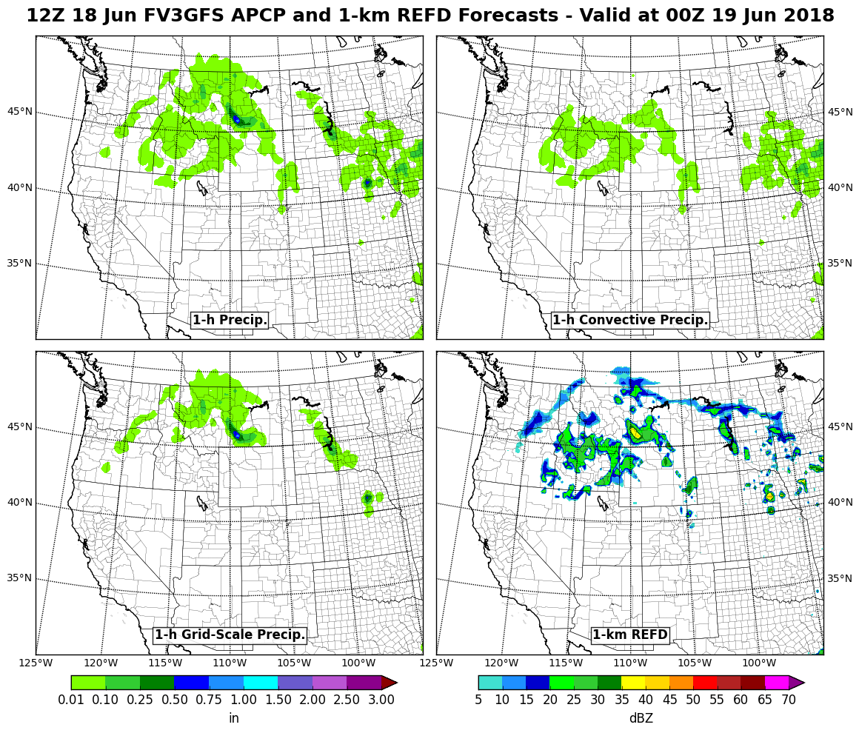
1-km Reflectivity Missing Where Precipitation Was Accumulating at the Surface

Slide 9
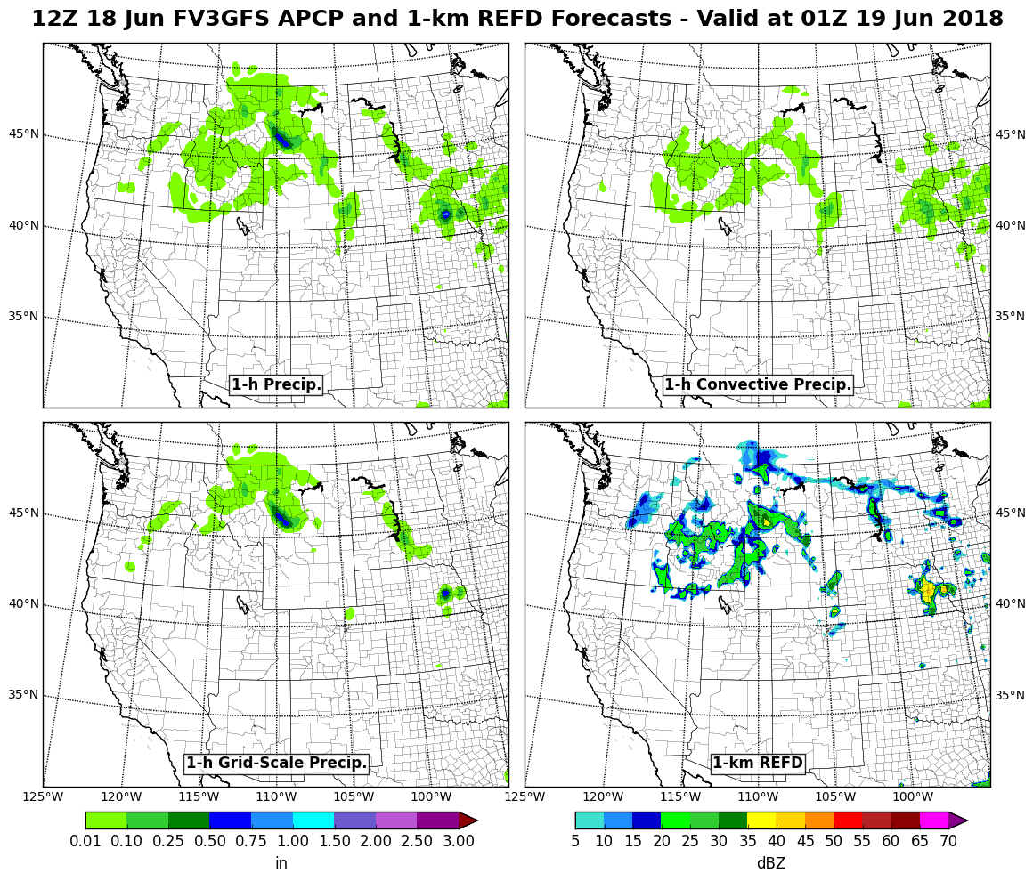
1-km Reflectivity Missing Where Precipitation Was Accumulating at the Surface

Slide 10
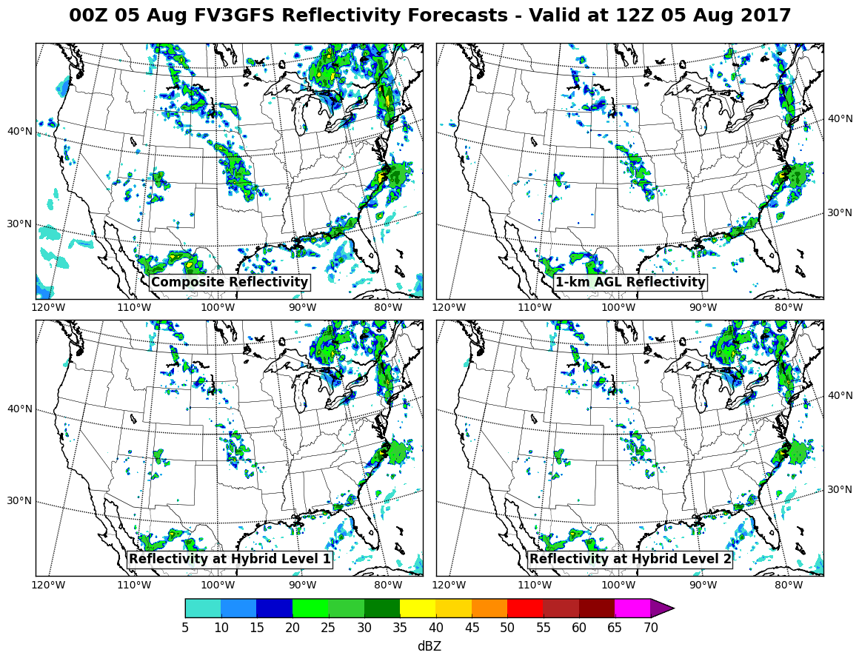
FV3GFS Reflectivity at Hybrid Levels 1 & 2 Shows More Coverage than Reflectivity at 1 km AGL

Slide 11
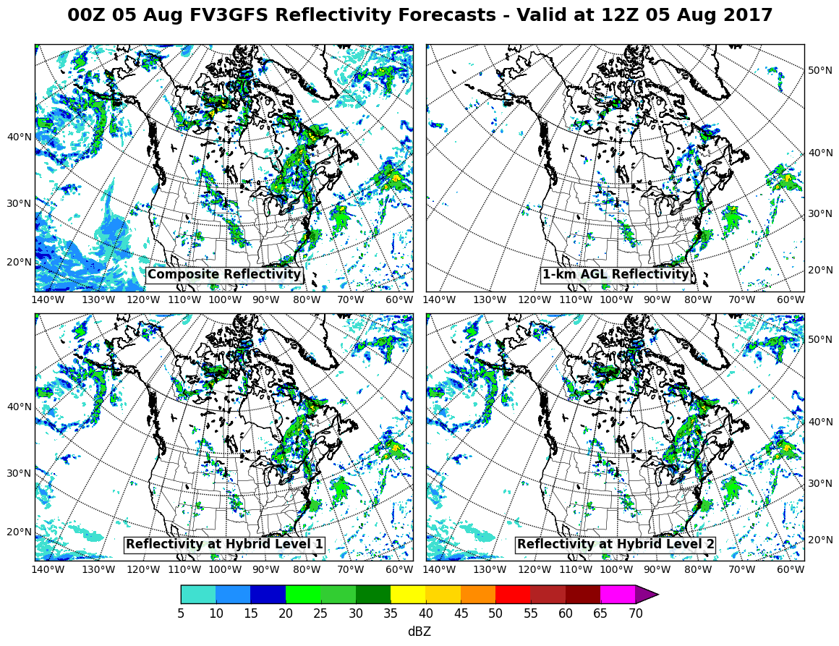
FV3GFS Reflectivity at Hybrid Levels 1 & 2 Showed More Coverage than Reflectivity at 1 km AGL

Slide 12
Summary
Since the issue was first raised in late May, we have made the following changes:
Fixed a bug where instantaneous precipitation rate was in incorrect units
Added a reflectivity contribution based on the instantaneous convective precipitation rate (in line with the computation of simulated reflectivity for the 12-km NAM, for example)
Removed 1-km simulated reflectivity from the FV3GFS output
Composite reflectivity appears reasonable and remains in the FV3GFS output.

Slide 13
Visibility

Slide 14
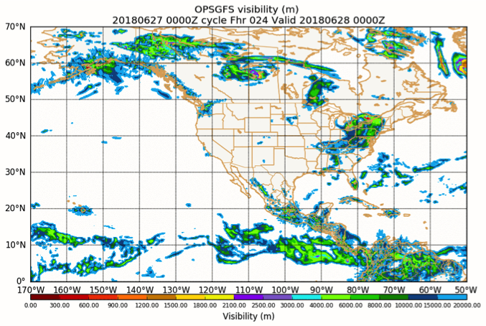
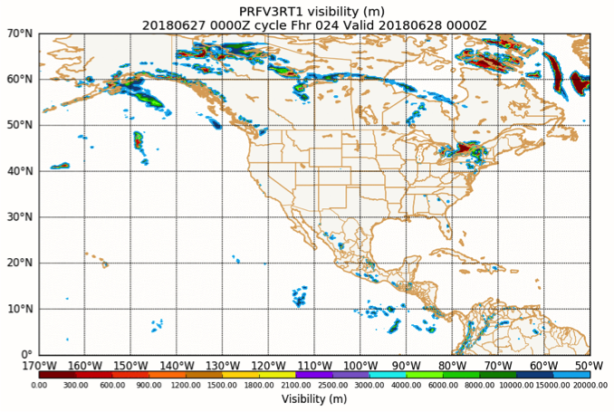
Several Initial Concerns with FV3GFS Visibility Product
GFS
FV3GFS visibility reductions occurred over smaller areas compared to ops GFS
Visibility reductions along the ITCZ were not very apparent in FV3GFS
Was not caused by early issue with instantaneous precip. rate units
FV3GFS
Images courtesy of M. Pyle

Slide 15
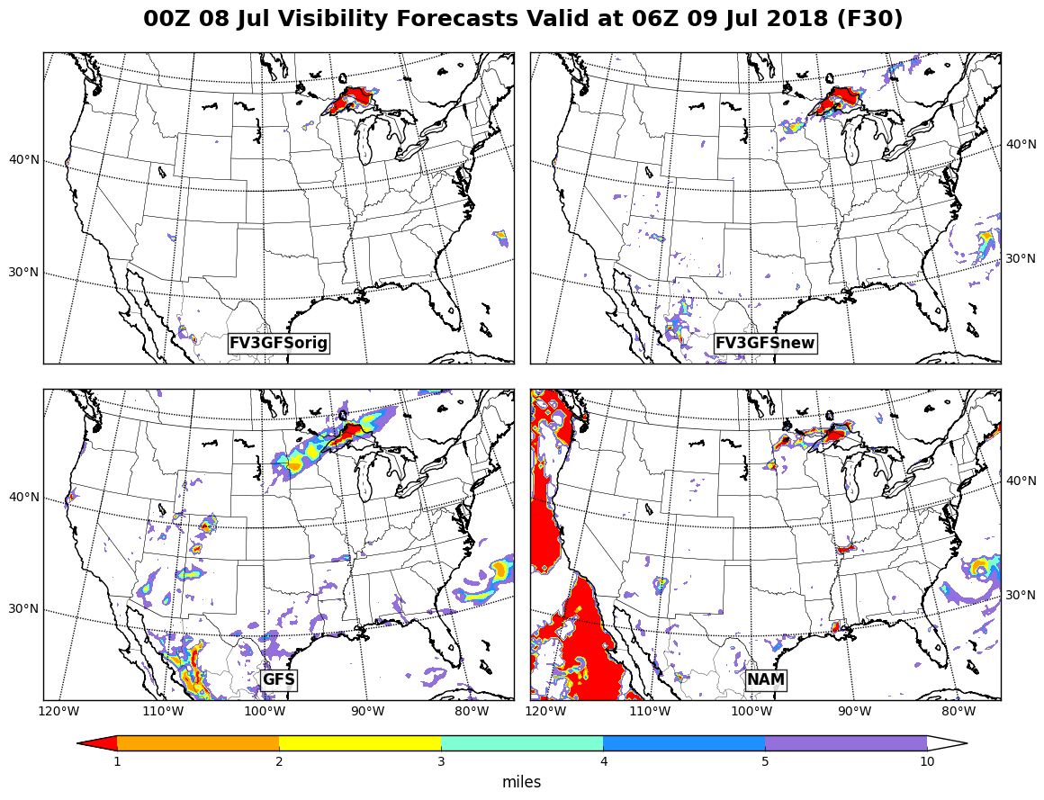
Bug Fix Was Made to Account for Visibility Reductions due to Convection (Bug Came About with Change from Zhao-Carr MP to GFDL MP)
FV3GFS “old”
FV3GFS “new”
GFS
NAM

Slide 16
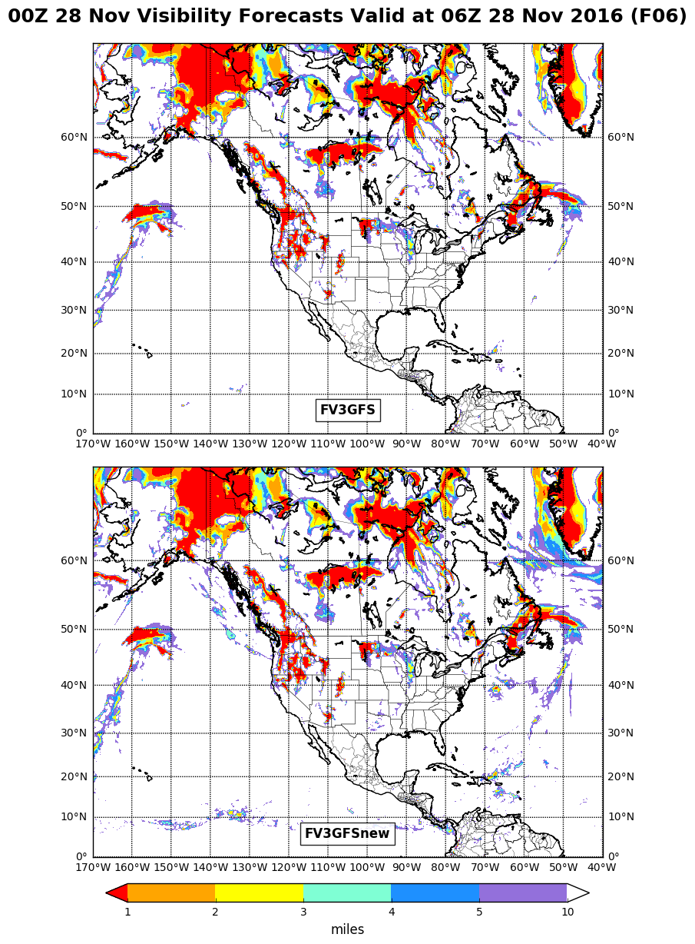
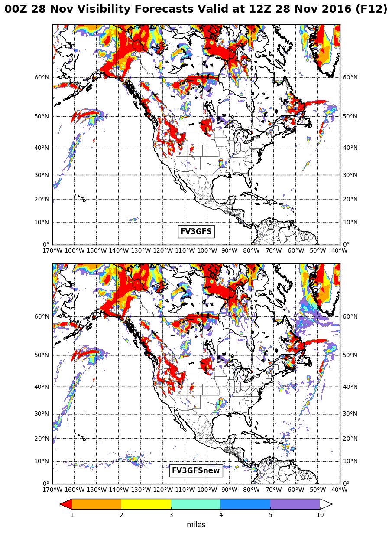
Convective Contribution Had Most Notable Impact Along ITCZ and in Areas of Frontal Precipitation
FV3GFS “old”
FV3GFS “old”
FV3GFS “new”
FV3GFS “new”

Slide 17
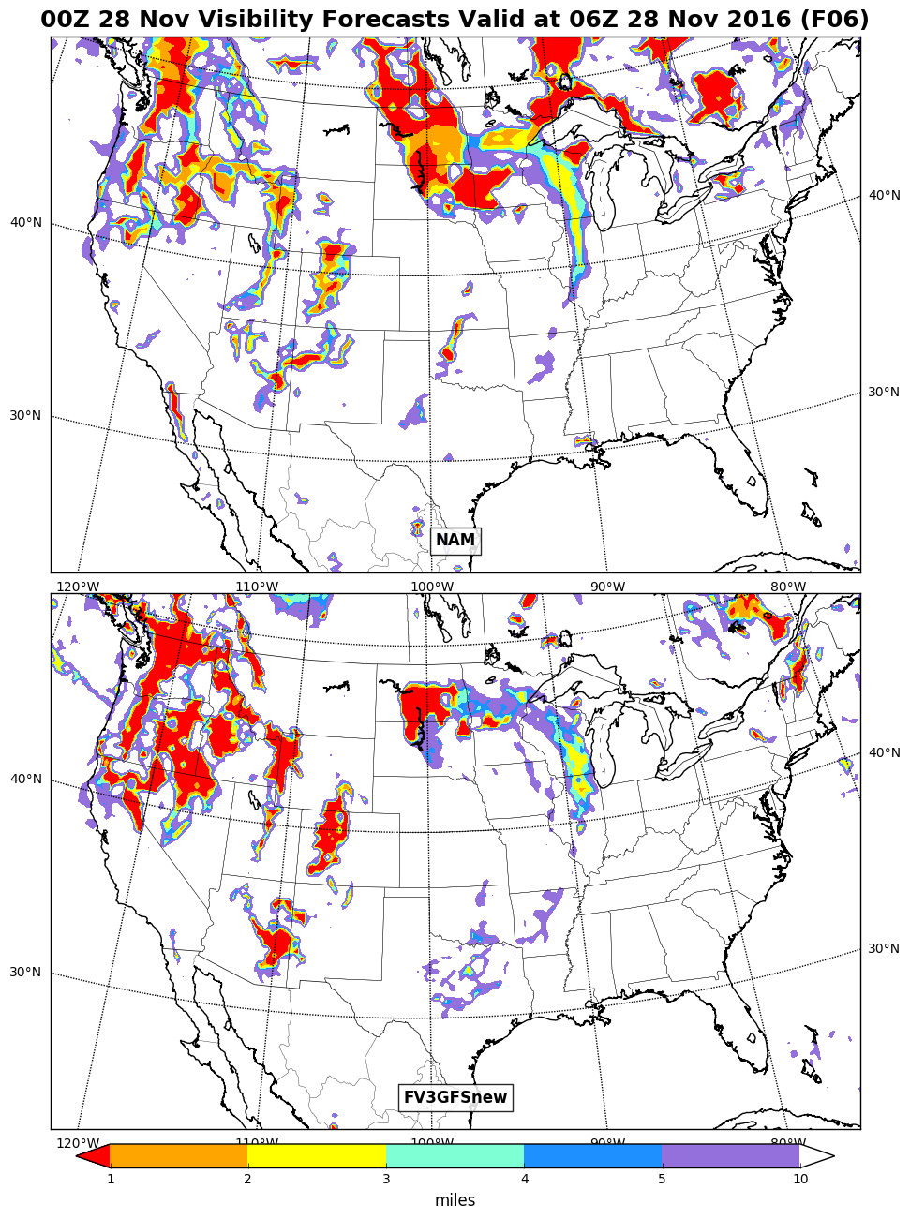
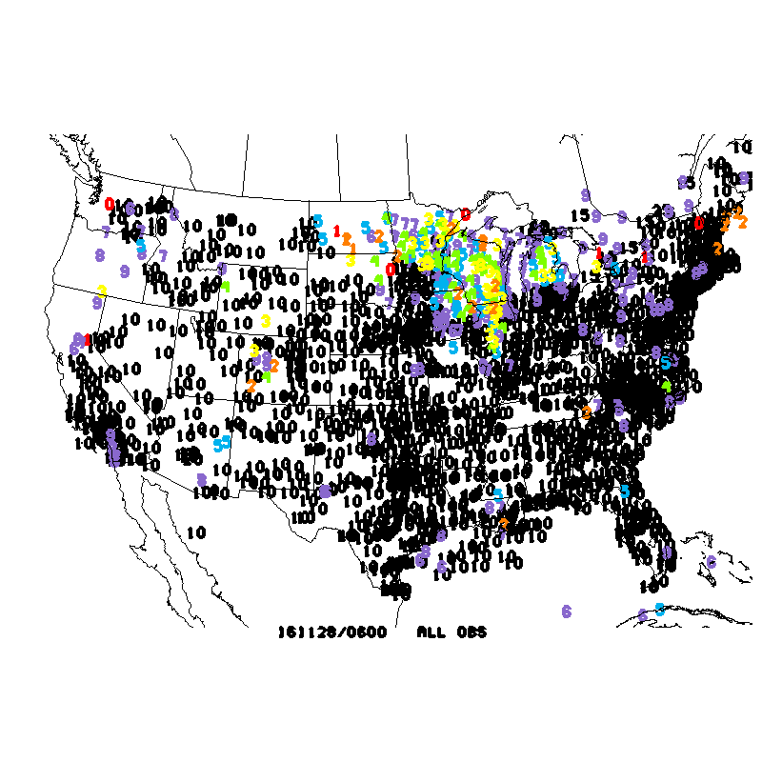
FV3GFS Visibility Looks Reasonable for Cool Season Case
OBS
NAM
FV3GFS with bug fix is a reasonable comparison with NAM and obs in this cool season case
FV3GFS

Slide 18
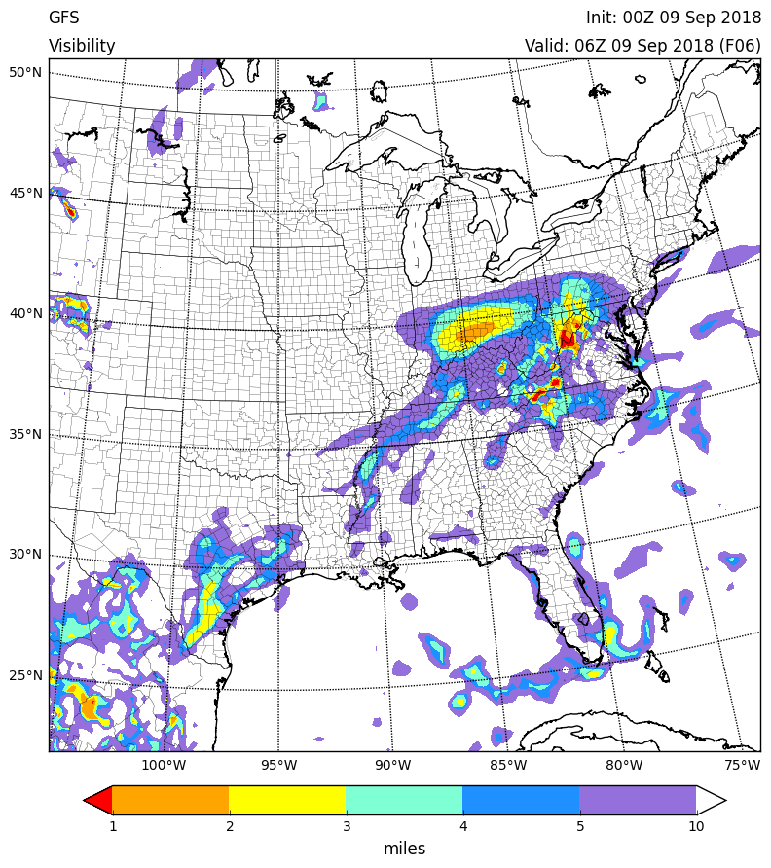
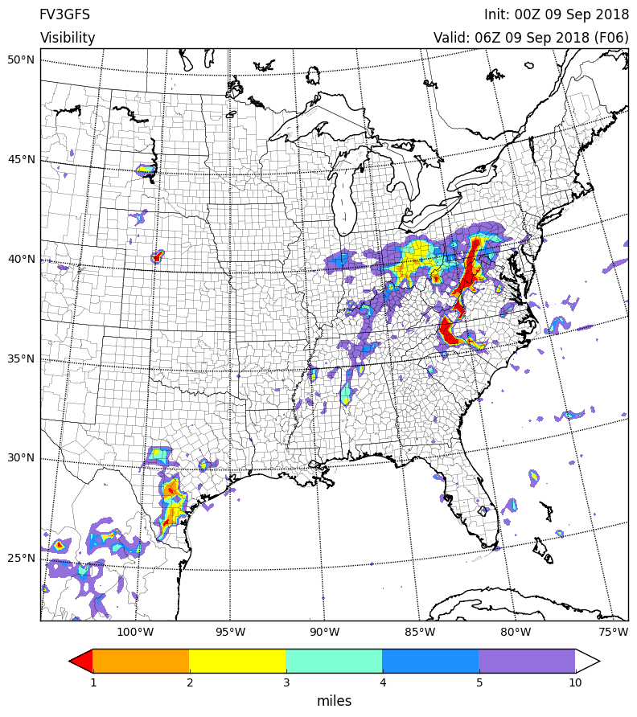
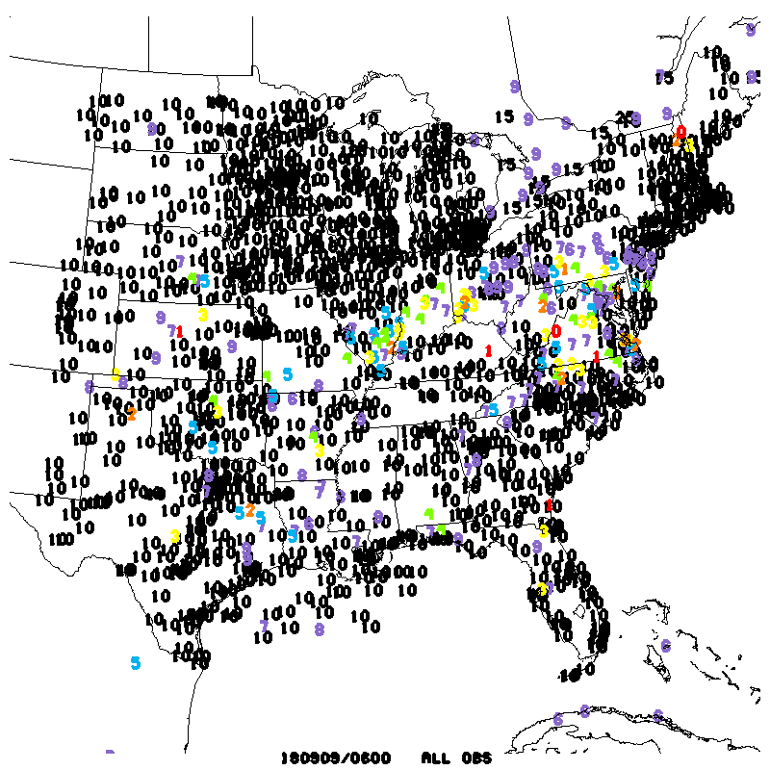
Less Smooth Field in FV3GFS Showing More Significant Visibility Reductions
GFS
FV3GFS
OBS
Impression is that use of instantaneous precipitation rate (as opposed to a 6-h averaged rate) appropriately changes appearance of the product
Though, FV3GFS visibility has verified less favorably than NAM/RAP

Slide 19
Summary
Since the issue was first raised in late May, we have made the following changes:
Fixed a bug to ensure that convective precipitation contributes to visibility reductions (in line with the computation of visibility in other NCEP models)
Ultimately…
We’re confident that visibility is computed properly in the FV3GFS output
Due to the precipitation rate used, FV3GFS visibility will have a characteristically and appropriately different appearance than GFS visibility
MDL has validated the FV3GFS and found little impact on LAMP visibility guidance
Additionally, GFS visibility is currently only used for the NBM’s ocean domain, so FV3GFS visibility should minimally impact NBM

Slide 20
Final List of New Products from the FV3GFS
Composite radar reflectivity
Instantaneous precipitation type
Instantaneous precipitation rate
Instantaneous convective precipitation rate
Continuous bucket total precipitation
Continuous bucket convective precipitation
20-, 30-, 40-, and 50-m AGL wind
Simulated GOES brightness temperatures (waiting to be pushed to AWIPS)
Hydrometeor mixing ratios on 39 isobaric levels
Hydrometeor mixing ratios on the lowest model level
Total cloud fraction on 22 isobaric levels
Vertical velocity (dz/dt… i.e., w) at 37 isobaric levels
Height, temperature, and abs. vorticity at 0.4, 15, and 40 hPa
Ozone mixing ratio at 7 additional isobaric levels

