Slide 1
FV3GFS Western U.S. Retrospectives
FV3GFS
Stage IV
Alicia Bentley
NCEP/EMC Model Evaluation Group
6 September 2018

Slide 2
http://www.emc.ncep.noaa.gov/users/Alicia.Bentley/fv3gfs/

Slide 3
http://www.emc.ncep.noaa.gov/users/Alicia.Bentley/fv3gfs/
FV3GFS Evaluations Due: 9/24/18

Slide 4
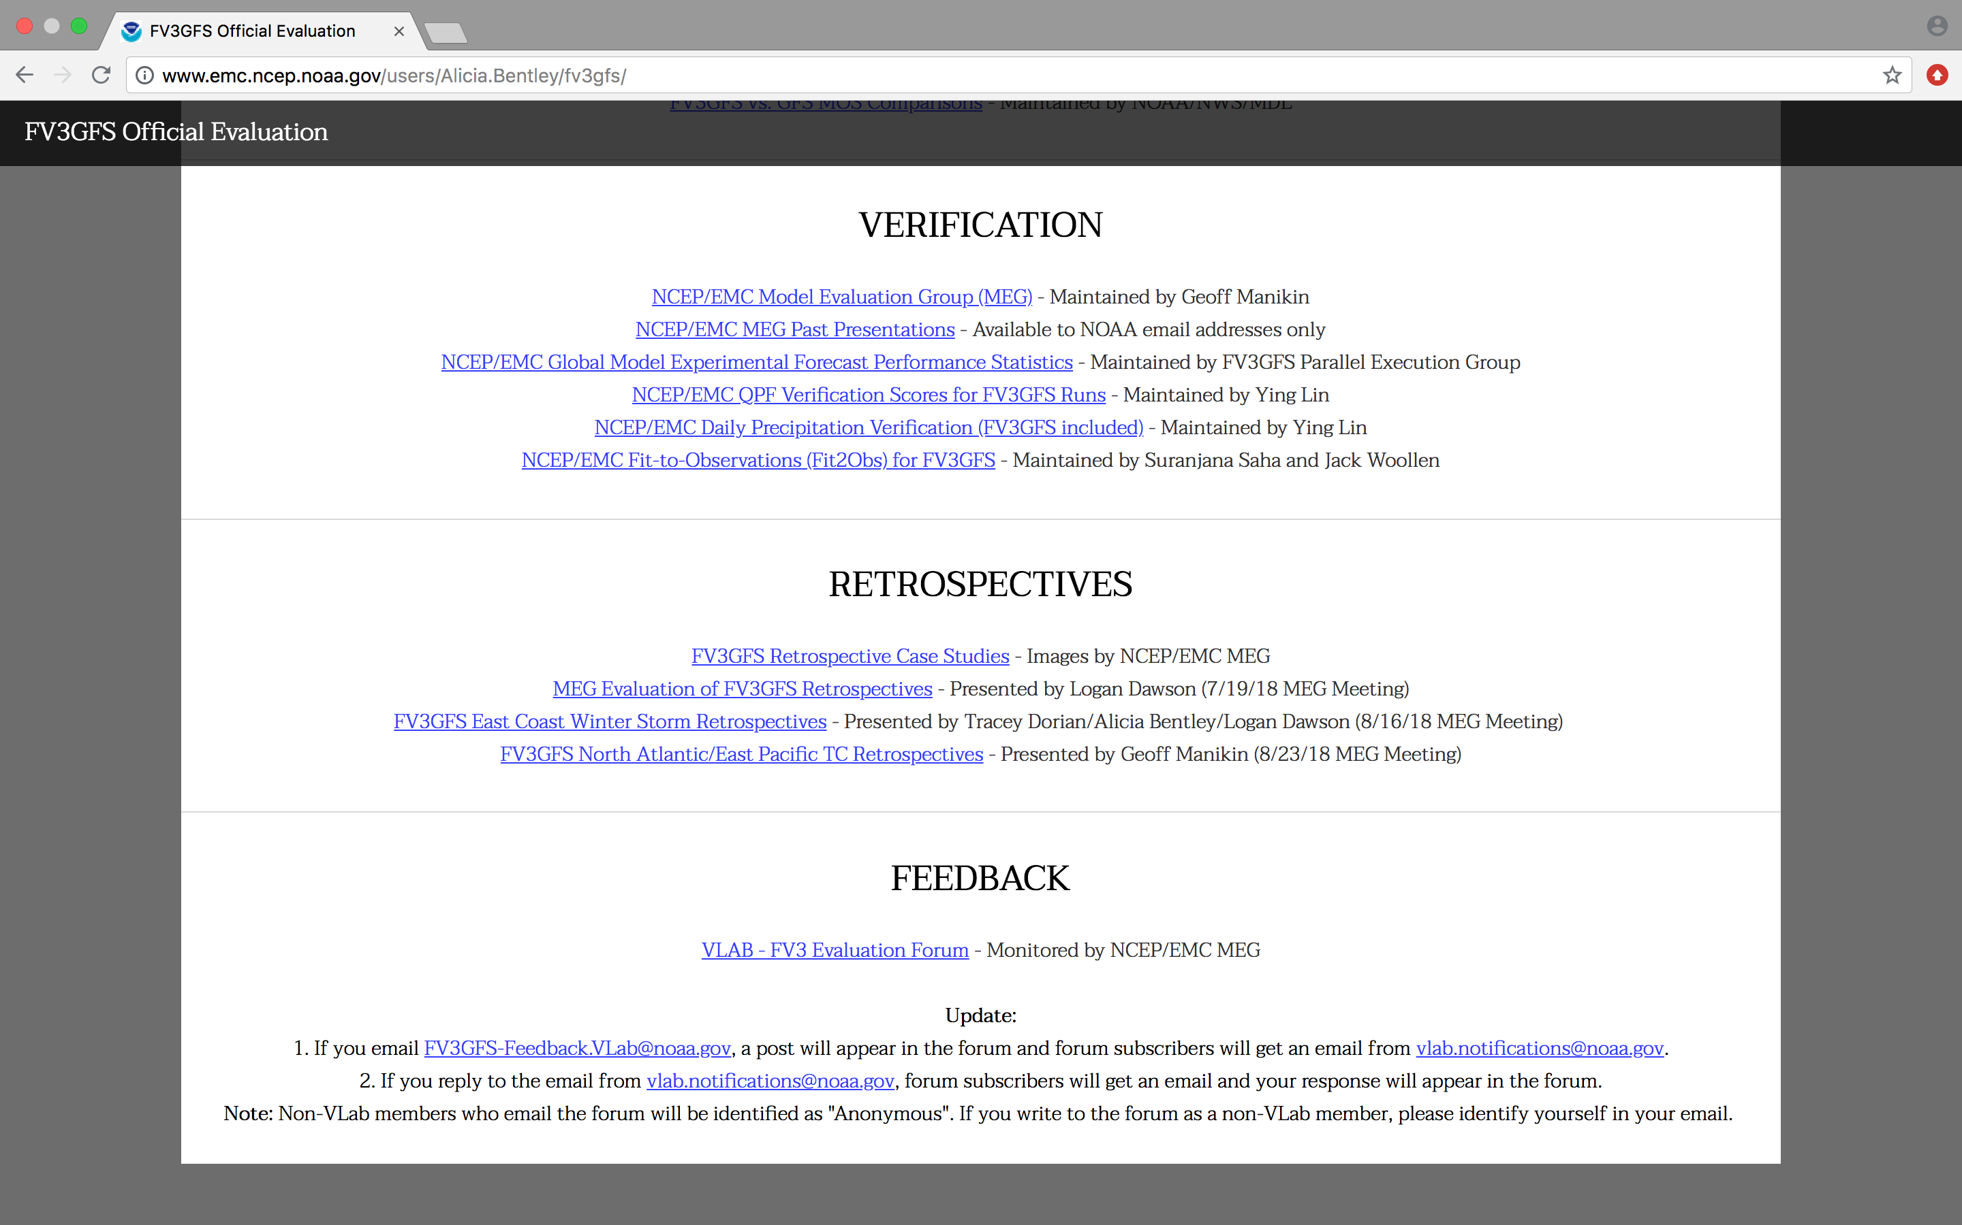
http://www.emc.ncep.noaa.gov/users/Alicia.Bentley/fv3gfs/

Slide 5
Western U.S. Retrospective Cases
Pacific Northwest Wind Storm (29 Aug 2015)
Pacific Northwest Wind Storm (13–16 Oct 2016)
West Coast Atmospheric River (6–11 Feb 2017)
West Coast Atmospheric River (21–23 Mar 2018)
Interior California Heat (1–2 Aug 2017)
Cold Air Outbreak (25 Dec 2017–7 Jan 2018)

Slide 6
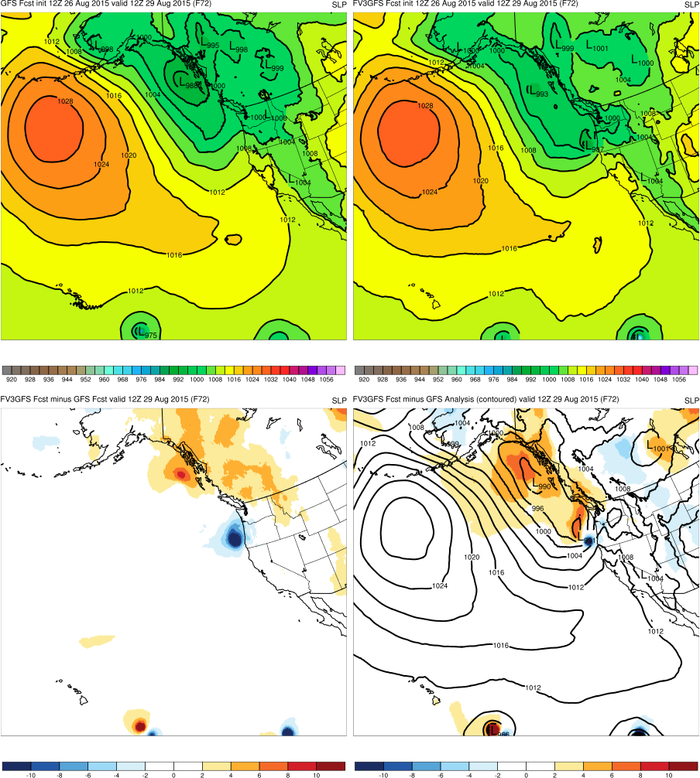
Retrospective Image Layout
GFS
FV3GFS
KEY:
Blue = FV3GFS is stronger (lower MSLP)
Red = FV3GFS is weaker (higher MSLP)
FV3GFS−GFS
FV3GFS−GFS Anl.

Slide 7
Pacific Northwest Windstorm (Aug 2015)
Images Valid: 1200 UTC 29 Aug 2015 (MSLP) 1800 UTC 29 Aug 2015 (Sfc. gusts)

Slide 8
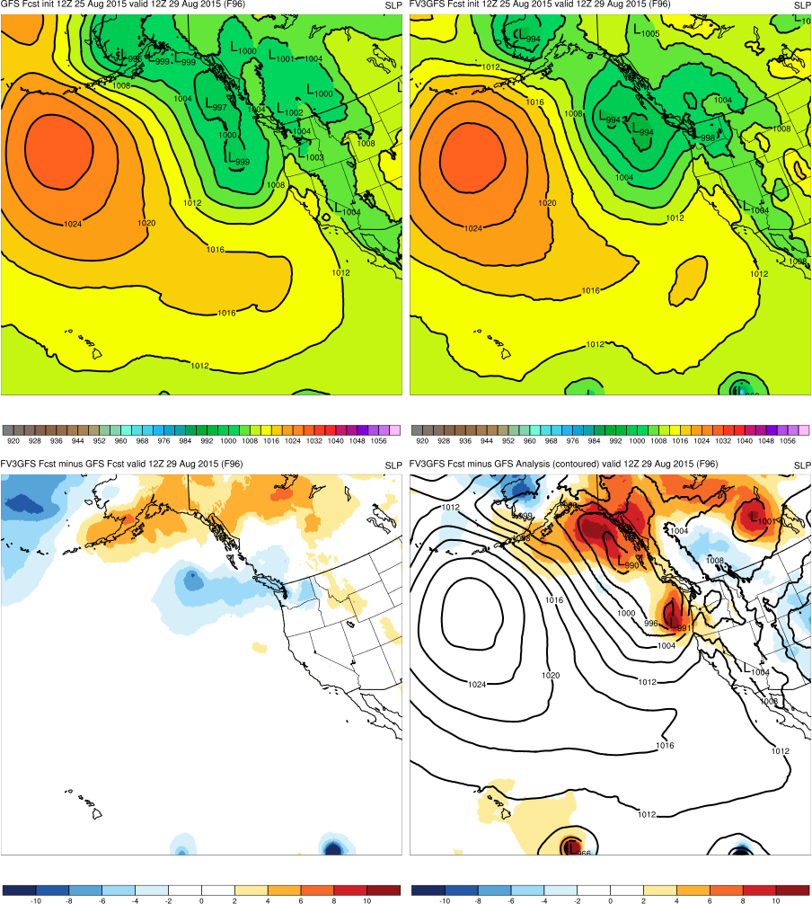
(F096)
GFS
FV3GFS
MAIN POINTS:
Neither FV3GFS or GFS forecast cyclone off of the WA/OR Coast
FV3GFS−GFS
FV3GFS−GFS Anl.
KEY:
Blue = FV3GFS is stronger (lower MSLP)
Red = FV3GFS is weaker (higher MSLP)
991

Slide 9
(F072)
GFS
FV3GFS
MAIN POINTS:
FV3GFS forecasts cyclone off of the WA/OR coast, but GFS does not
987
FV3GFS−GFS
FV3GFS−GFS Anl.
KEY:
Blue = FV3GFS is stronger (lower MSLP)
Red = FV3GFS is weaker (higher MSLP)
991

Slide 10
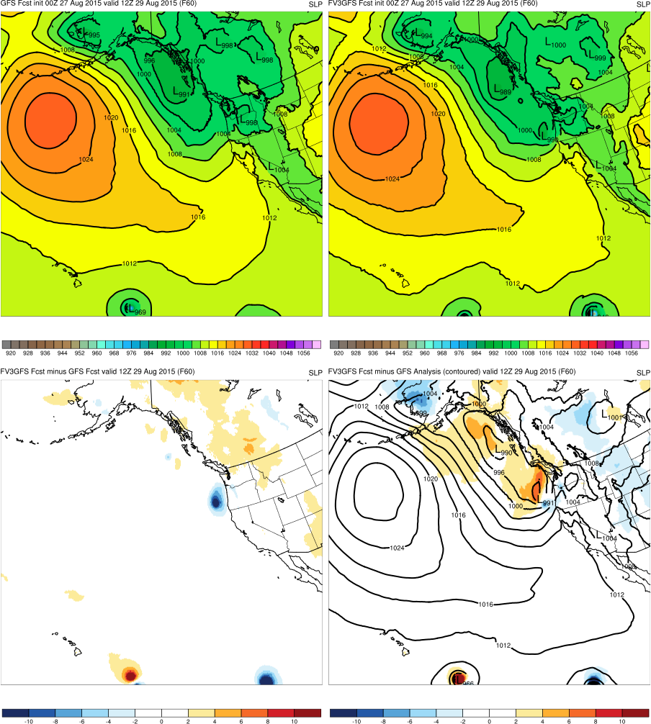
(F060)
GFS
FV3GFS
MAIN POINTS:
FV3GFS continues to forecast cyclone off WA/OR coast, but GFS does not
990
FV3GFS−GFS
FV3GFS−GFS Anl.
KEY:
Blue = FV3GFS is stronger (lower MSLP)
Red = FV3GFS is weaker (higher MSLP)
991

Slide 11
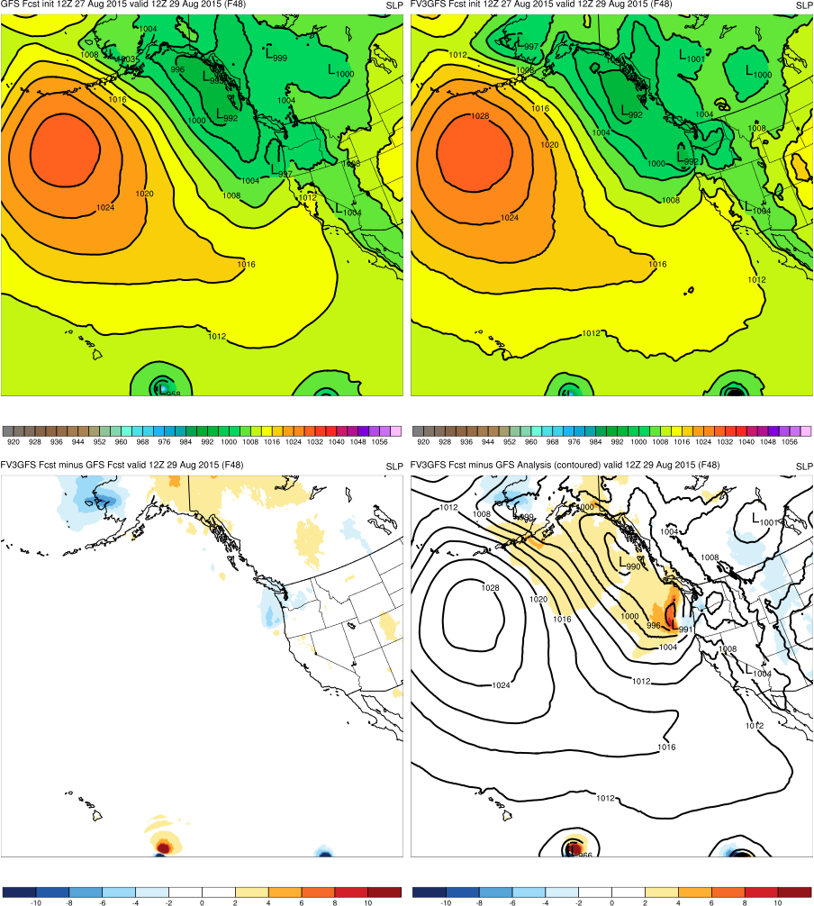
(F048)
GFS
FV3GFS
MAIN POINTS:
GFS begins to forecast cyclone off of the WA/OR coast
FV3GFS central pressure is closer to GFS anl. than GFS
997
992
FV3GFS−GFS
FV3GFS−GFS Anl.
KEY:
Blue = FV3GFS is stronger (lower MSLP)
Red = FV3GFS is weaker (higher MSLP)
991

Slide 12
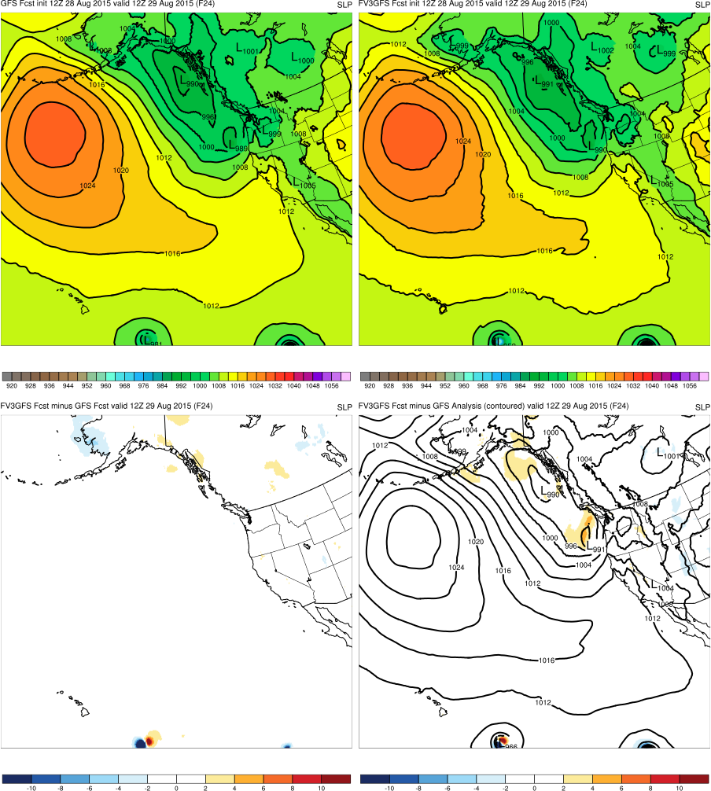
(F024)
GFS
FV3GFS
MAIN POINTS:
FV3GFS and GFS forecast similar location and intensity of cyclone
989
990
FV3GFS−GFS
FV3GFS−GFS Anl.
KEY:
Blue = FV3GFS is stronger (lower MSLP)
Red = FV3GFS is weaker (higher MSLP)
991

Slide 13
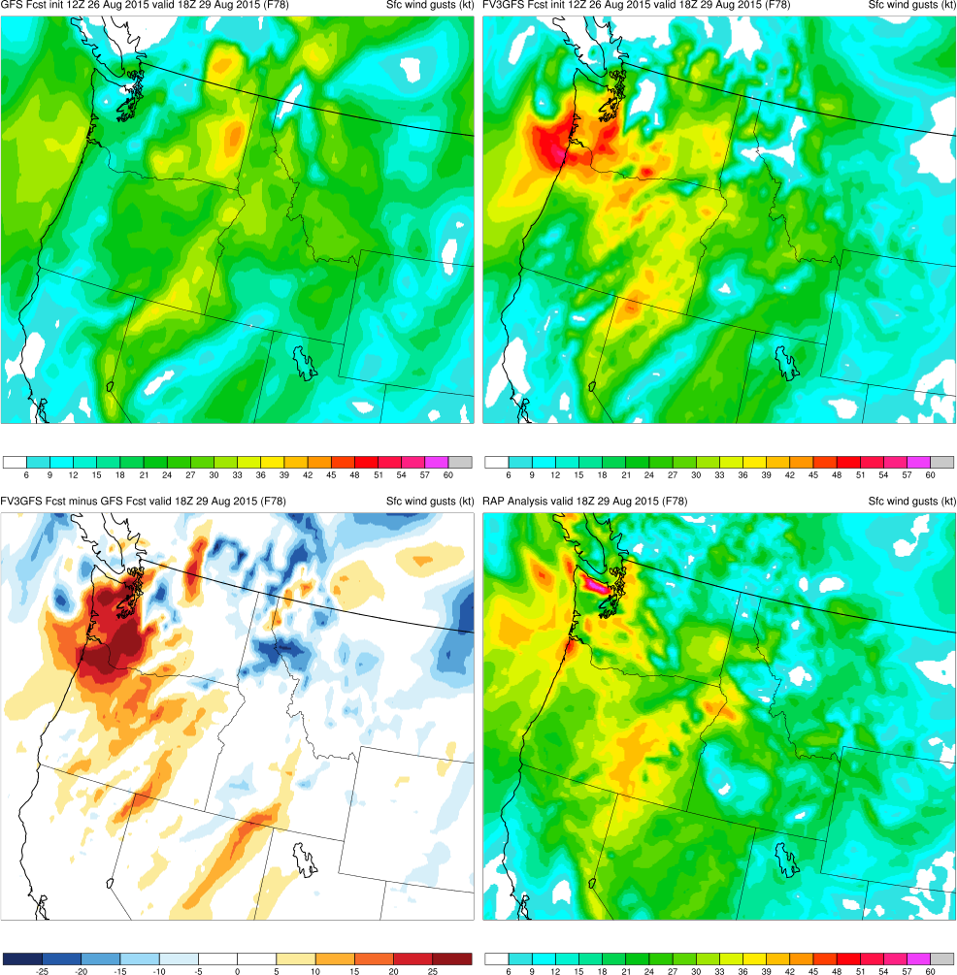
(F078)
MAIN POINTS:
FV3GFS forecasts windstorm 78-h prior, but GFS does not
Location of strongest sfc gusts too far east due to low’s position
GFS
FV3GFS
KEY:
Blue = FV3GFS gusts are weaker (slower winds)
Red = FV3GFS gusts are stronger (faster winds)
FV3GFS−GFS
RAP Anl.

Slide 14
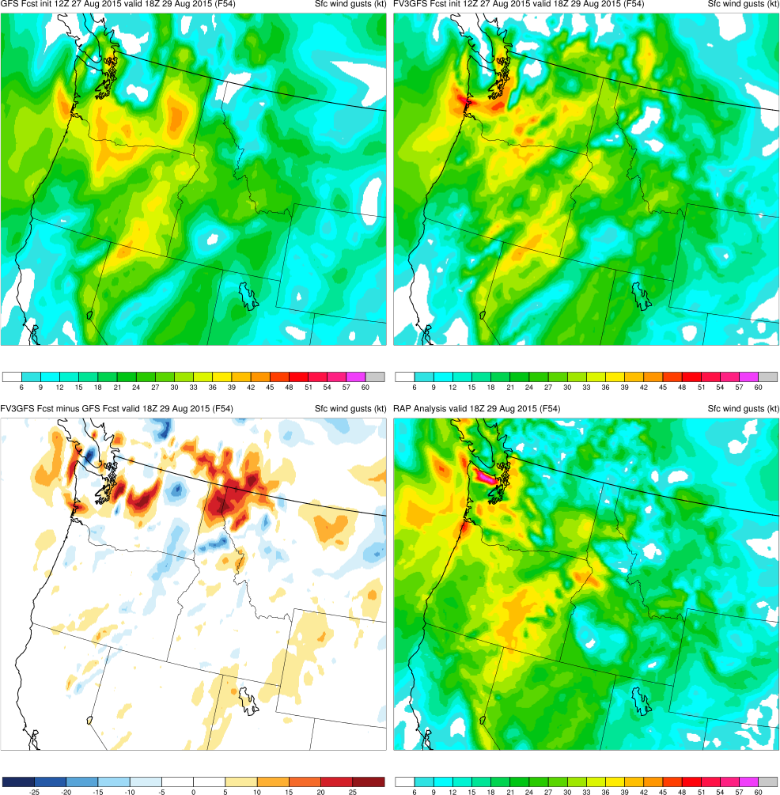
(F054)
MAIN POINTS:
FV3GFS and GFS both forecast high-wind event
Gust magnitudes are similar to RAP, with FV3GFS stronger south of Olympics
GFS
FV3GFS
KEY:
Blue = FV3GFS gusts are weaker (slower winds)
Red = FV3GFS gusts are stronger (faster winds)
FV3GFS−GFS
RAP Anl.

Slide 15
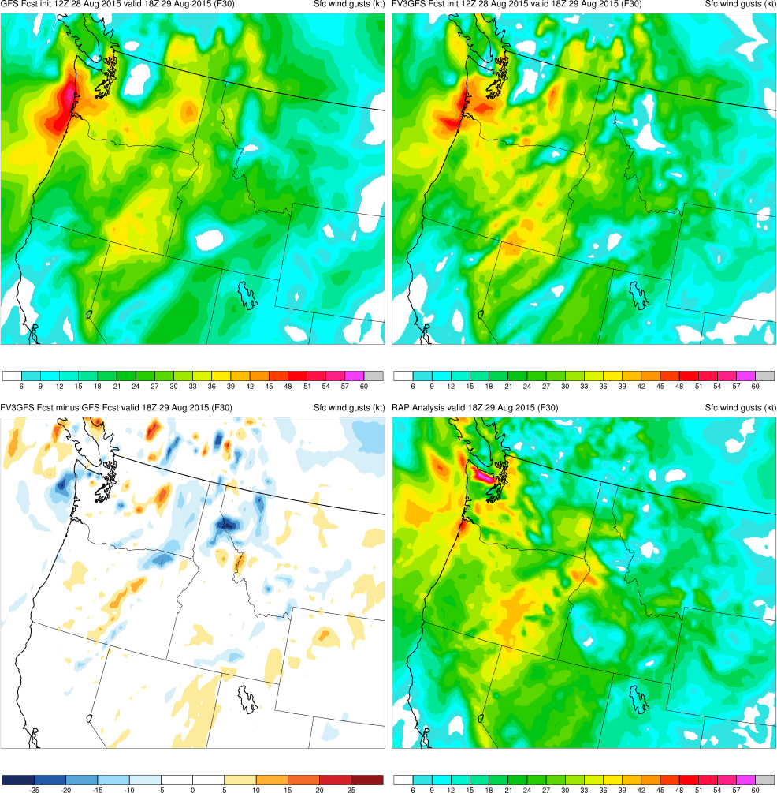
(F030)
MAIN POINTS:
Strongest gusts in FV3GFS and GFS correctly shift west as low shifts west
Magnitude of wind gusts in FV3GFS comparable to RAP
GFS
FV3GFS
KEY:
Blue = FV3GFS gusts are weaker (slower winds)
Red = FV3GFS gusts are stronger (faster winds)
FV3GFS−GFS
RAP Anl.

Slide 16
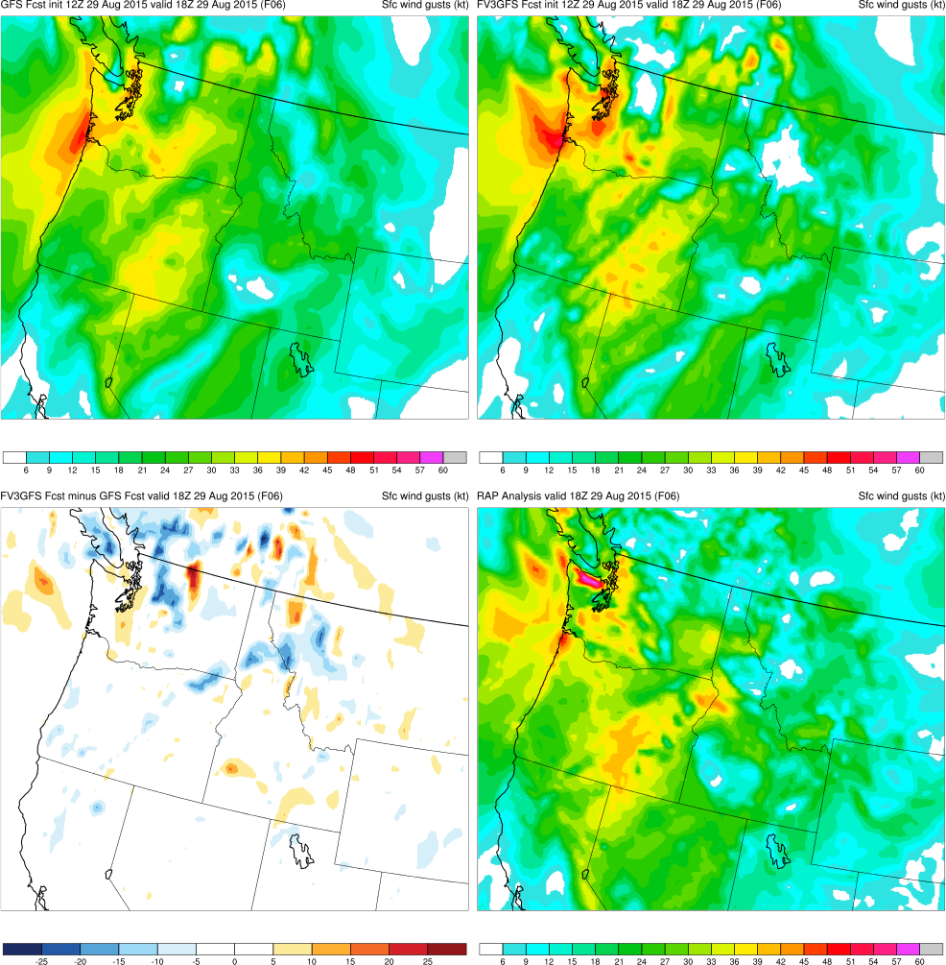
(F006)
MAIN POINTS:
Magnitude of FV3GFS wind gusts comparable to RAP
FV3GFS correctly forecasts strong wind gusts to the north of Olympics
GFS
FV3GFS
KEY:
Blue = FV3GFS gusts are weaker (slower winds)
Red = FV3GFS gusts are stronger (faster winds)
FV3GFS−GFS
RAP Anl.

Slide 17
Pacific NW Windstorm (Aug 2015) Summary
FV3GFS forecasts Pacific NW windstorm with 78 h of lead time and 24 h prior to the operational GFS
FV3GFS has consistently more accurate minimum central pressure than the GFS
FV3GFS surface wind gusts (magnitude and location) are consistent with those in the RAP analysis

Slide 18
Pacific Northwest Windstorm (Oct 2016)
Images Valid: 1200 UTC 14 Oct 2016 (MSLP) 1800 UTC 14 Oct 2016 (Sfc. gusts)

Slide 19
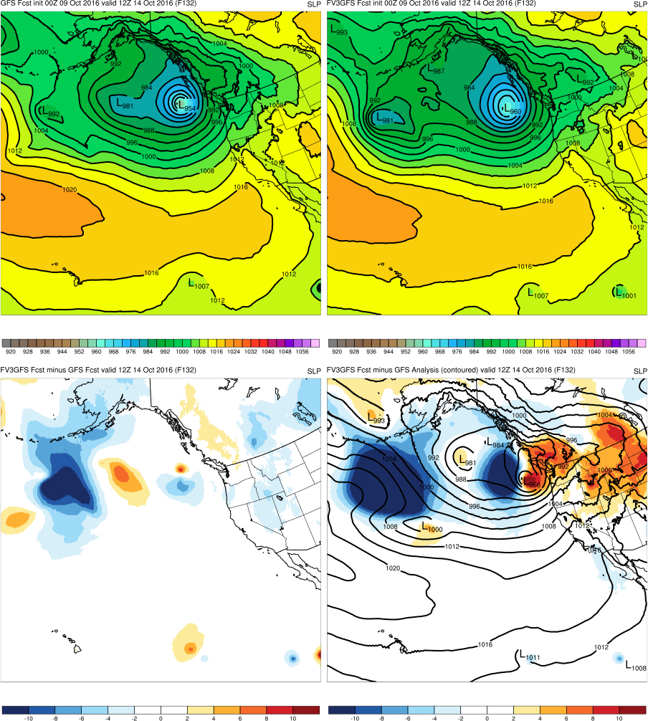
(F132)
GFS
FV3GFS
MAIN POINTS:
Neither FV3GFS or GFS forecast cyclone close enough to coast
FV3GFS and GFS are both too strong
954
960
FV3GFS−GFS
FV3GFS−GFS Anl.
KEY:
Blue = FV3GFS is stronger (lower MSLP)
Red = FV3GFS is weaker (higher MSLP)
968

Slide 20
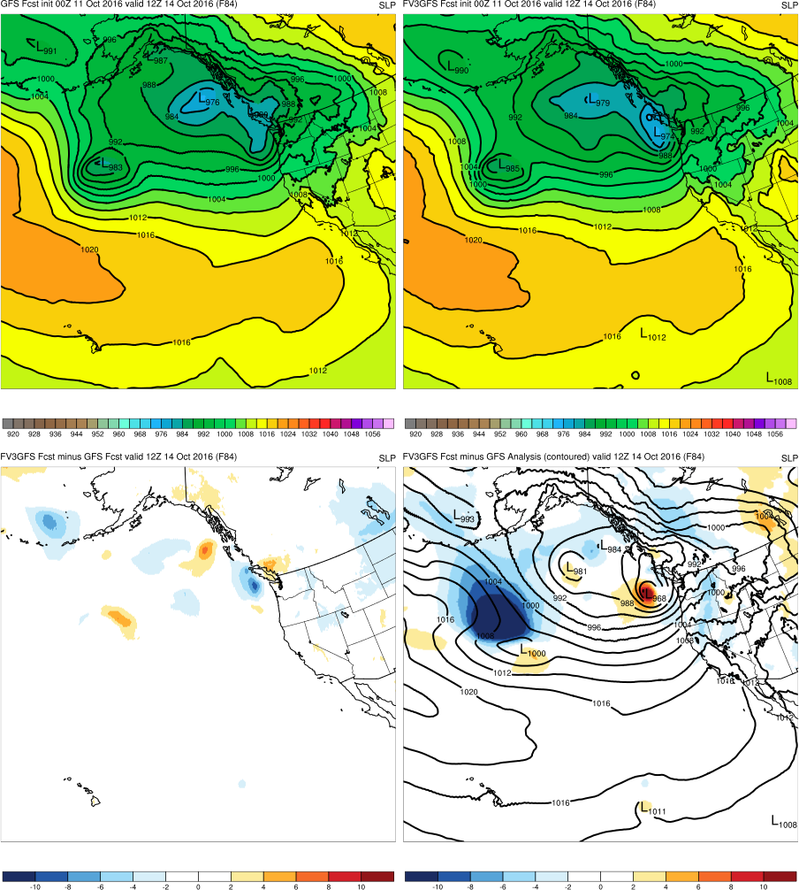
(F084)
GFS
FV3GFS
MAIN POINTS:
FV3GFS and GFS elongate cyclone and move it toward the WA coast
FV3GFS has more accurate central pressure than GFS
989
974
FV3GFS−GFS
FV3GFS−GFS Anl.
KEY:
Blue = FV3GFS is stronger (lower MSLP)
Red = FV3GFS is weaker (higher MSLP)
968

Slide 21
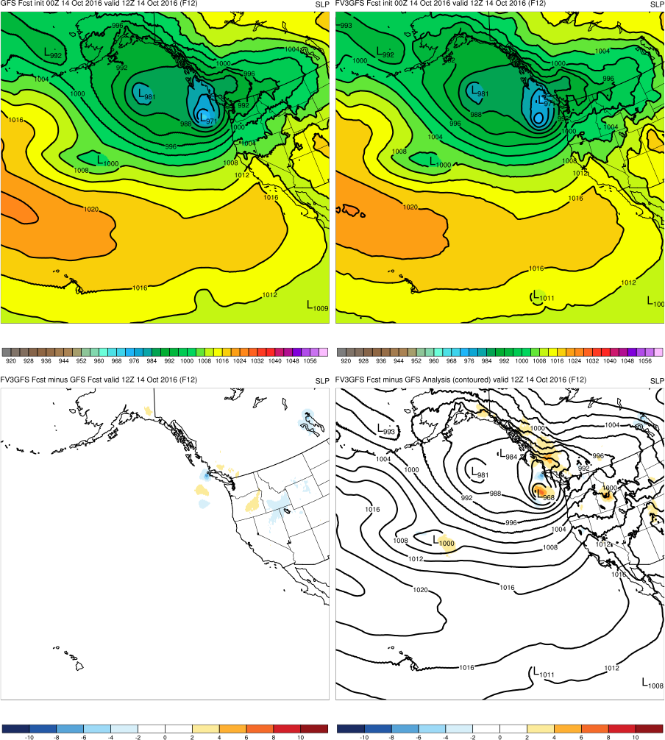
(F012)
GFS
FV3GFS
MAIN POINTS:
FV3GFS and GFS accurately place cyclone along coast
FV3GFS and GFS have similar (weak) central pressures
971
972
FV3GFS−GFS
FV3GFS−GFS Anl.
KEY:
Blue = FV3GFS is stronger (lower MSLP)
Red = FV3GFS is weaker (higher MSLP)
968

Slide 22
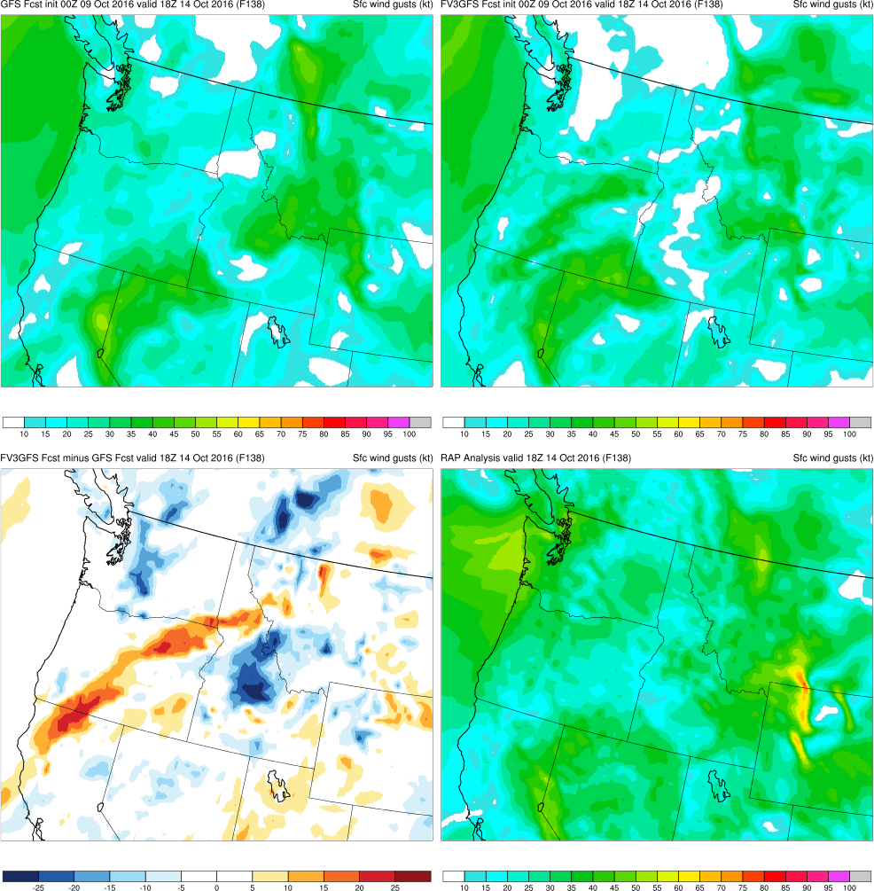
(F138)
MAIN POINTS:
FV3GFS and GFS had cyclone too far to the west
FV3GFS and GFS gust magnitudes less than those in RAP
GFS
FV3GFS
KEY:
Blue = FV3GFS gusts are weaker (slower winds)
Red = FV3GFS gusts are stronger (faster winds)
FV3GFS−GFS
RAP Anl.

Slide 23
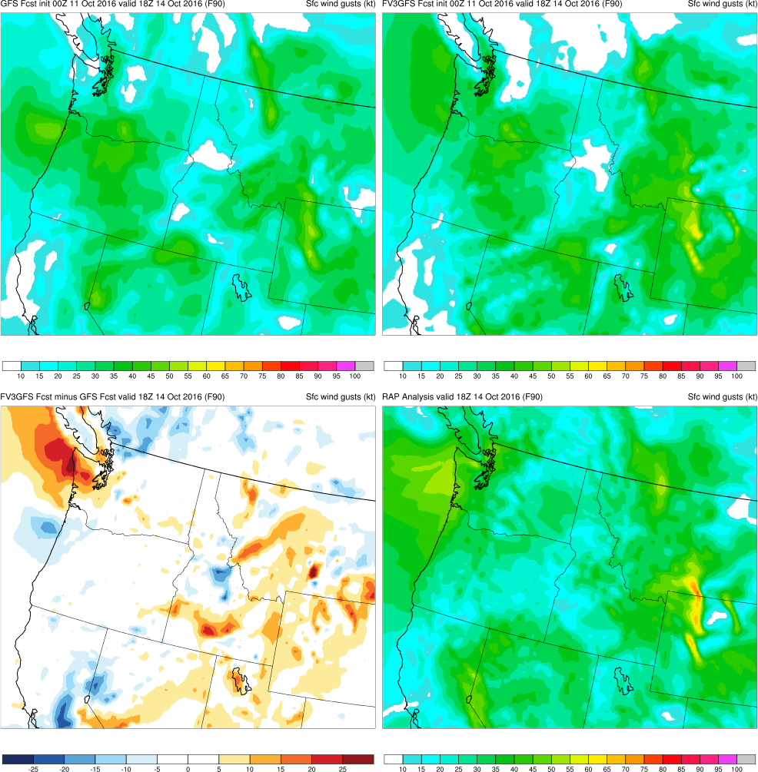
(F090)
MAIN POINTS:
FV3GFS and GFS forecast widespread windstorm by 90 h
Gust magnitudes are similar to RAP, with FV3GFS better over NW Wyoming
GFS
FV3GFS
KEY:
Blue = FV3GFS gusts are weaker (slower winds)
Red = FV3GFS gusts are stronger (faster winds)
FV3GFS−GFS
RAP Anl.

Slide 24
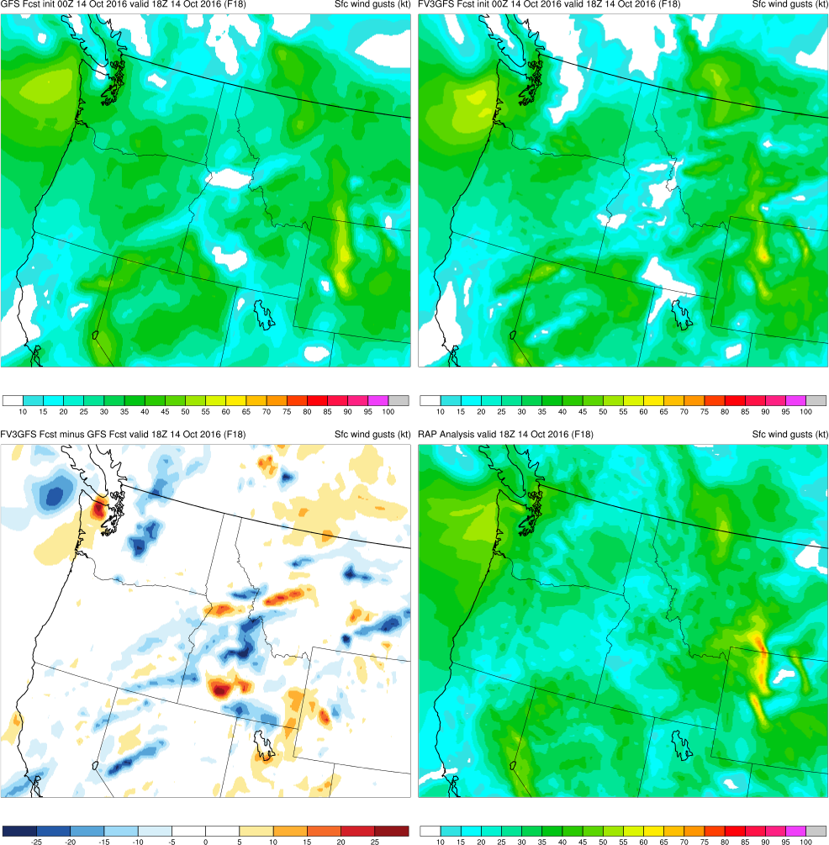
(F018)
MAIN POINTS:
Magnitude and location of sfc wind gusts in FV3GFS and GFS are similar to RAP
GFS
FV3GFS
KEY:
Blue = FV3GFS gusts are weaker (slower winds)
Red = FV3GFS gusts are stronger (faster winds)
FV3GFS−GFS
RAP Anl.

Slide 25
Pacific NW Windstorm (Oct 2016) Summary
FV3GFS forecasts cyclone associated with Pacific NW windstorm just off Washington coast with 84 h of lead time
FV3GFS and GFS have similarly accurate minimum central pressures at shorter lead times
FV3GFS surface wind gusts (magnitude and location) are consistent with those in the RAP analysis

Slide 26
West Coast Atmospheric River (Feb 2017)
Images Valid: 0000 UTC 10 Feb 2017 (PW) 1200 UTC 10 Feb 2017 (24-h QPF)

Slide 27
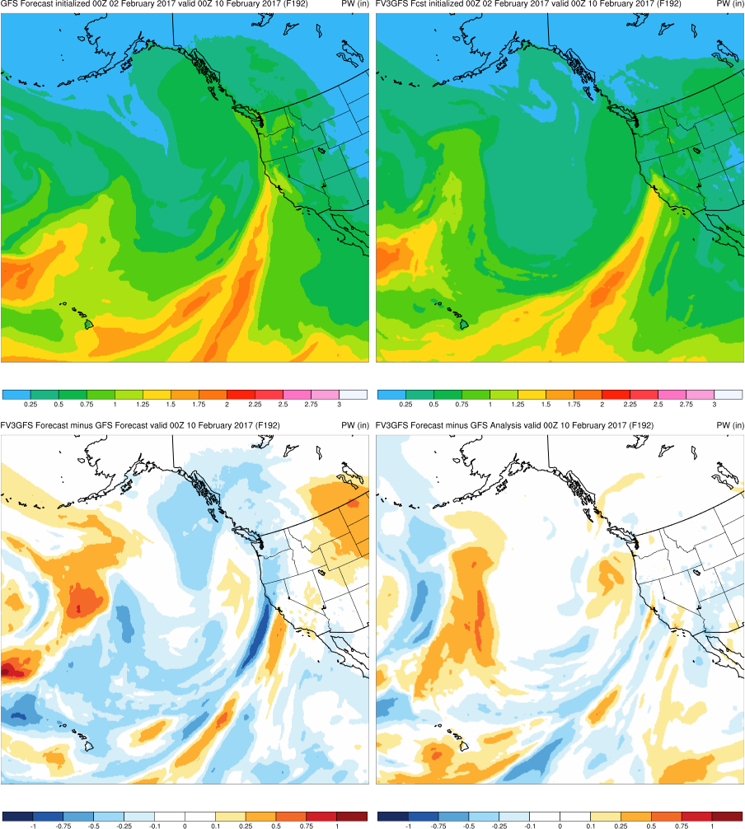
(F192)
GFS
FV3GFS
MAIN POINTS:
FV3GFS is more progressive with AR than GFS
FV3GFS is more accurate with AR position than GFS
FV3GFS−GFS
FV3GFS−GFS Anl.
KEY:
Blue = FV3GFS is drier (lower PW)
Red = FV3GFS is wetter (higher PW)

Slide 28
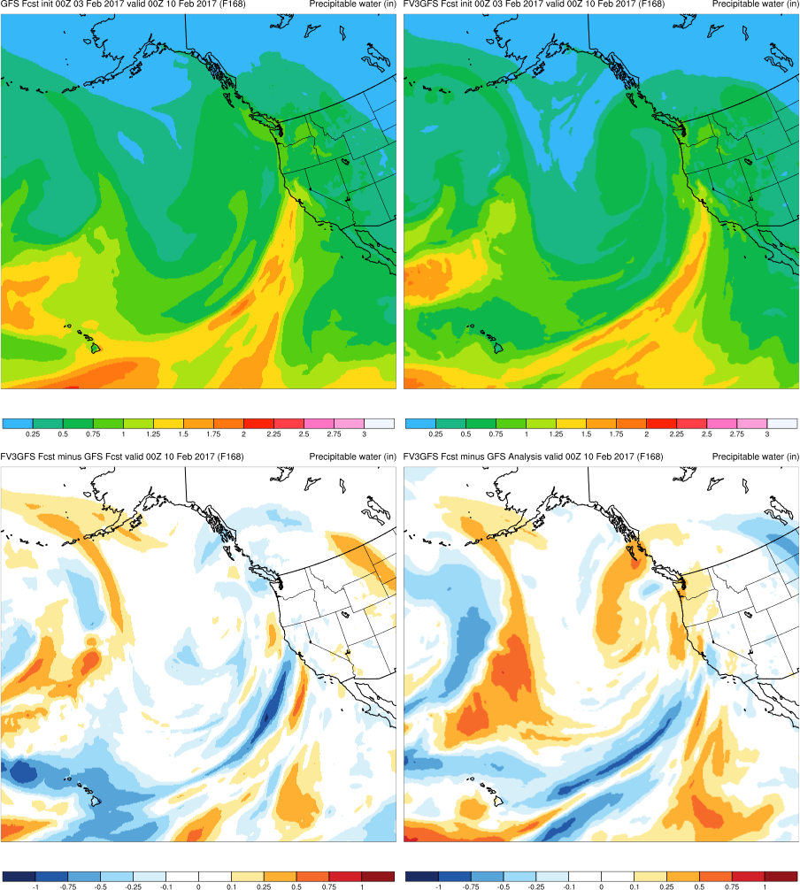
(F168)
GFS
FV3GFS
MAIN POINTS:
FV3GFS is more progressive with AR than GFS
FV3GFS is too progressive, while GFS is too slow
FV3GFS−GFS
FV3GFS−GFS Anl.
KEY:
Blue = FV3GFS is drier (lower PW)
Red = FV3GFS is wetter (higher PW)

Slide 29
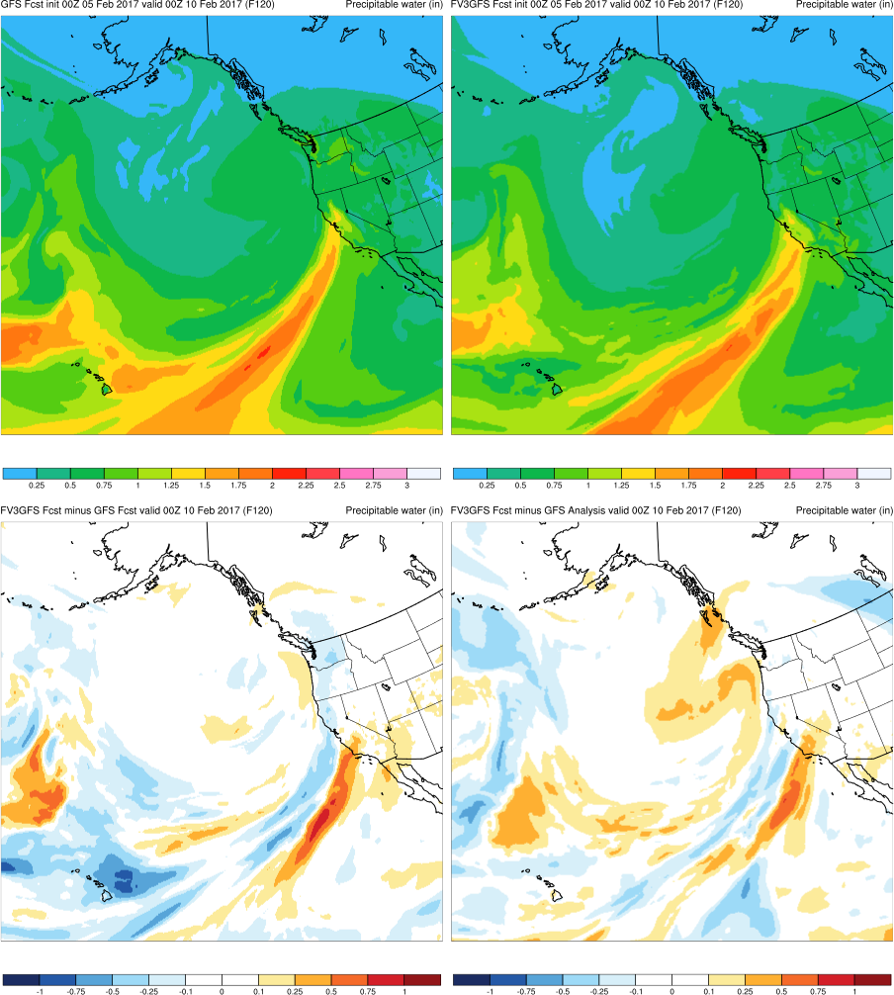
(F120)
GFS
FV3GFS
MAIN POINTS:
FV3GFS is more progressive with AR than GFS
FV3GFS is less accurate with AR position than GFS
FV3GFS−GFS
FV3GFS−GFS Anl.
KEY:
Blue = FV3GFS is drier (lower PW)
Red = FV3GFS is wetter (higher PW)

Slide 30
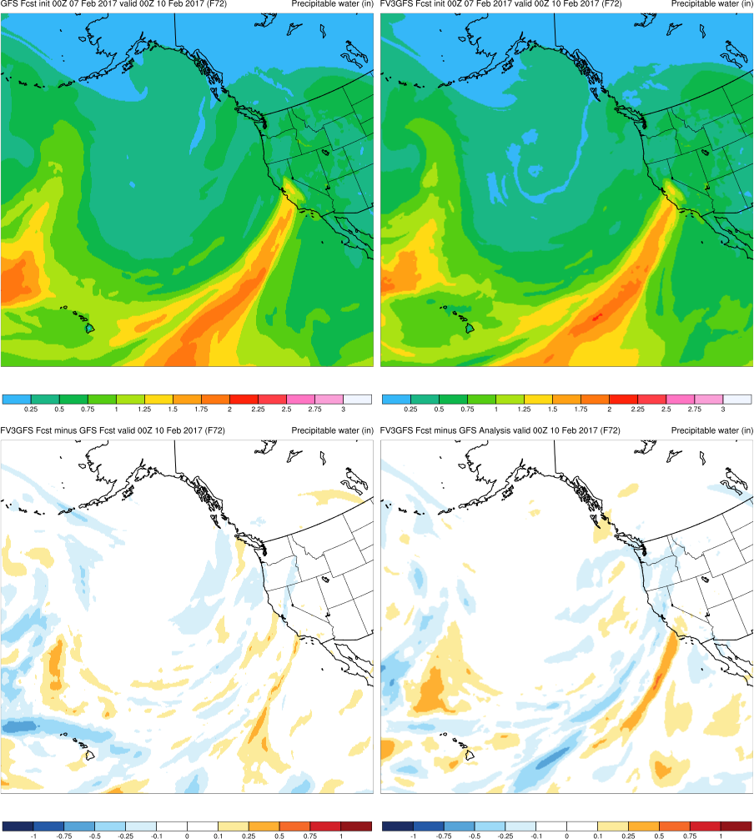
(F072)
GFS
FV3GFS
MAIN POINTS:
FV3GFS and GFS ARs located over similar regions
FV3GFS and GFS both slightly too progressive with AR
FV3GFS−GFS
FV3GFS−GFS Anl.
KEY:
Blue = FV3GFS is drier (lower PW)
Red = FV3GFS is wetter (higher PW)

Slide 31
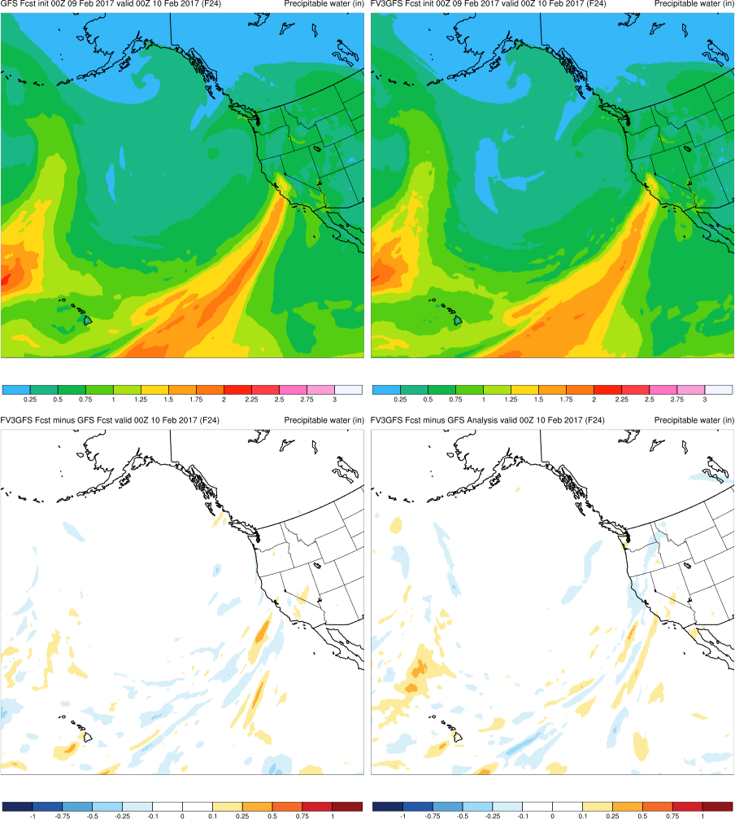
(F024)
GFS
FV3GFS
MAIN POINTS:
FV3GFS and GFS ARs located over similar regions
FV3GFS and GFS are equally accurate
FV3GFS−GFS
FV3GFS−GFS Anl.
KEY:
Blue = FV3GFS is drier (lower PW)
Red = FV3GFS is wetter (higher PW)

Slide 32
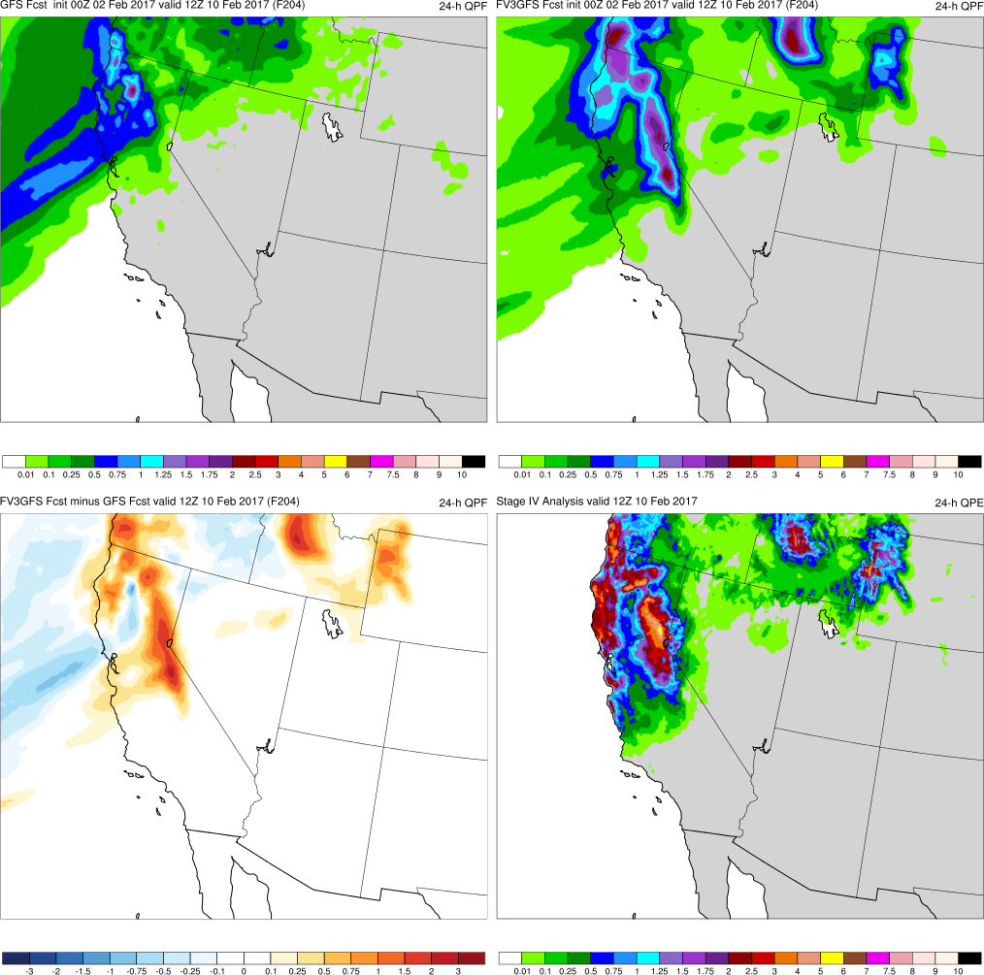
(F204)
MAIN POINTS:
FV3GFS was more accurate with AR position than GFS
FV3GFS has more accurate 24-h QPF forecast than GFS
GFS
FV3GFS
KEY:
Blue = FV3GFS is drier (lower QPF)
Red = FV3GFS is wetter (higher QPF)
FV3GFS−GFS
Stage IV

Slide 33
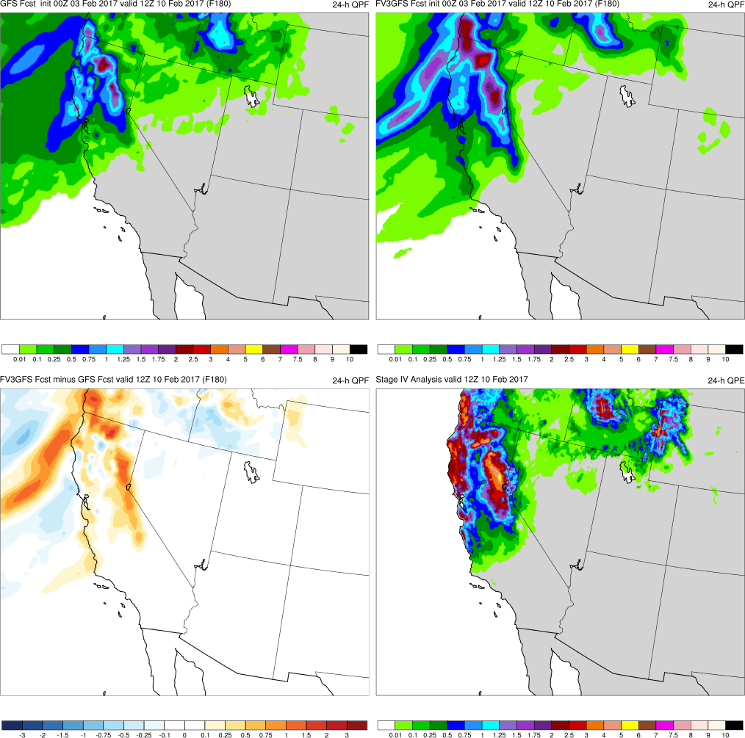
(F180)
MAIN POINTS:
FV3GFS was more progressive with AR than GFS (slow)
FV3GFS has more accurate 24-h QPF forecast than GFS
GFS
FV3GFS
KEY:
Blue = FV3GFS is drier (lower QPF)
Red = FV3GFS is wetter (higher QPF)
FV3GFS−GFS
Stage IV

Slide 34
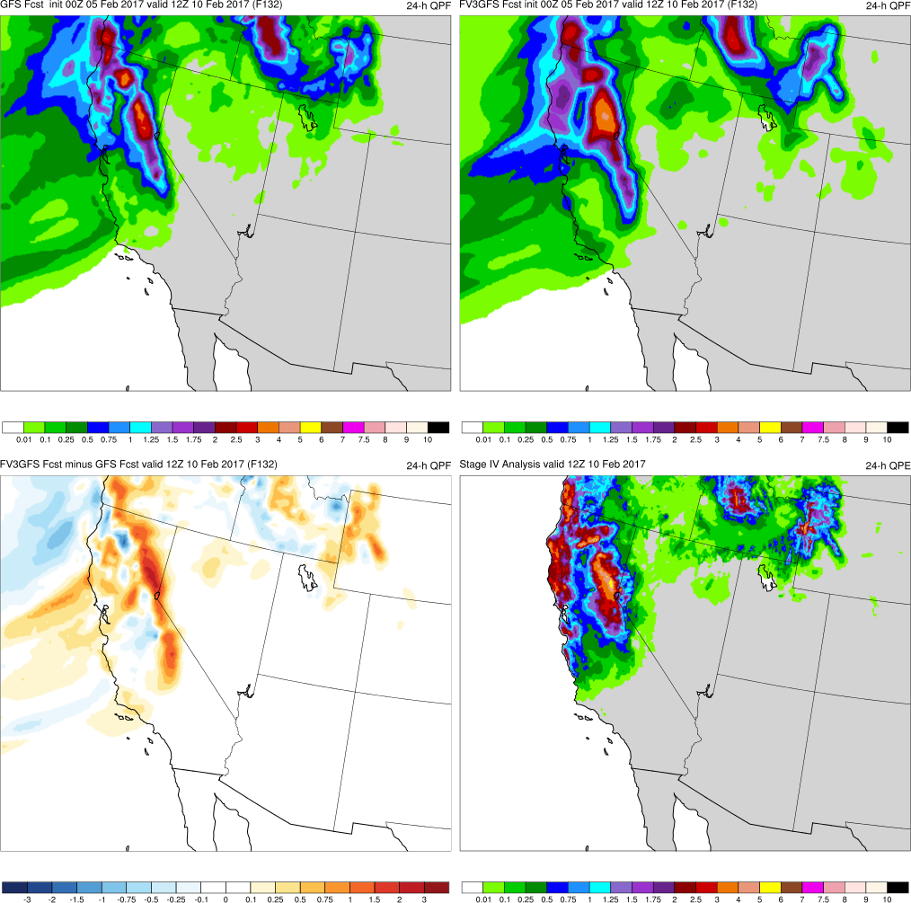
(F132)
MAIN POINTS:
FV3GFS was more progressive with AR than GFS (slow)
FV3GFS has precip. extending too far south into California
GFS
FV3GFS
KEY:
Blue = FV3GFS is drier (lower QPF)
Red = FV3GFS is wetter (higher QPF)
FV3GFS−GFS
Stage IV

Slide 35
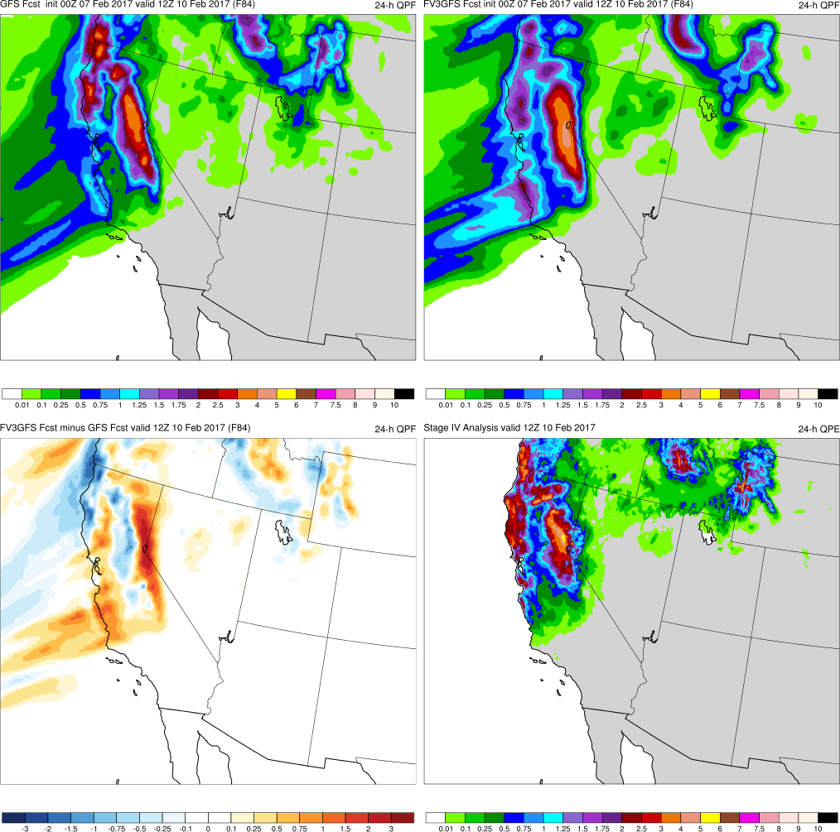
(F084)
MAIN POINTS:
FV3GFS and GFS both slightly too progressive with AR
FV3GFS and GFS have precip. too far south, but better along coastline
GFS
FV3GFS
KEY:
Blue = FV3GFS is drier (lower QPF)
Red = FV3GFS is wetter (higher QPF)
FV3GFS−GFS
Stage IV

Slide 36
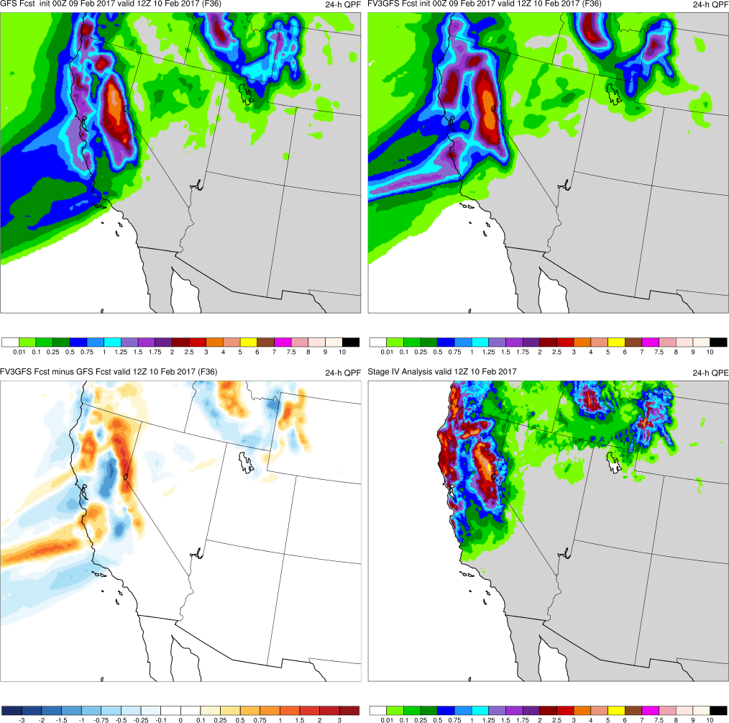
(F036)
MAIN POINTS:
FV3GFS and GFS ARs located over similar regions
FV3GFS and GFS are similar, but GFS is slightly more acc.
GFS
FV3GFS
KEY:
Blue = FV3GFS is drier (lower QPF)
Red = FV3GFS is wetter (higher QPF)
FV3GFS−GFS
Stage IV

Slide 37
West Coast AR (Feb 2017) Summary
FV3GFS accurately forecasts AR axis with 192 h of lead time
FV3GFS is typically more progressive w/ AR than GFS, with no notable accuracy bias (fcst can be better/worse than GFS)
FV3GFS QPF was more accurate than GFS QPF at longer lead times, but extends too far south when FV3GFS is too progressive in medium range
Accuracy of AR axis assoc. w/ accuracy of orographic precip.

Slide 38
West Coast Atmospheric River (Mar 2018)
Images Valid: 0000 UTC 21 Mar 2018 (PW) 0000 UTC 22 Mar 2018 (24-h QPF)

Slide 39
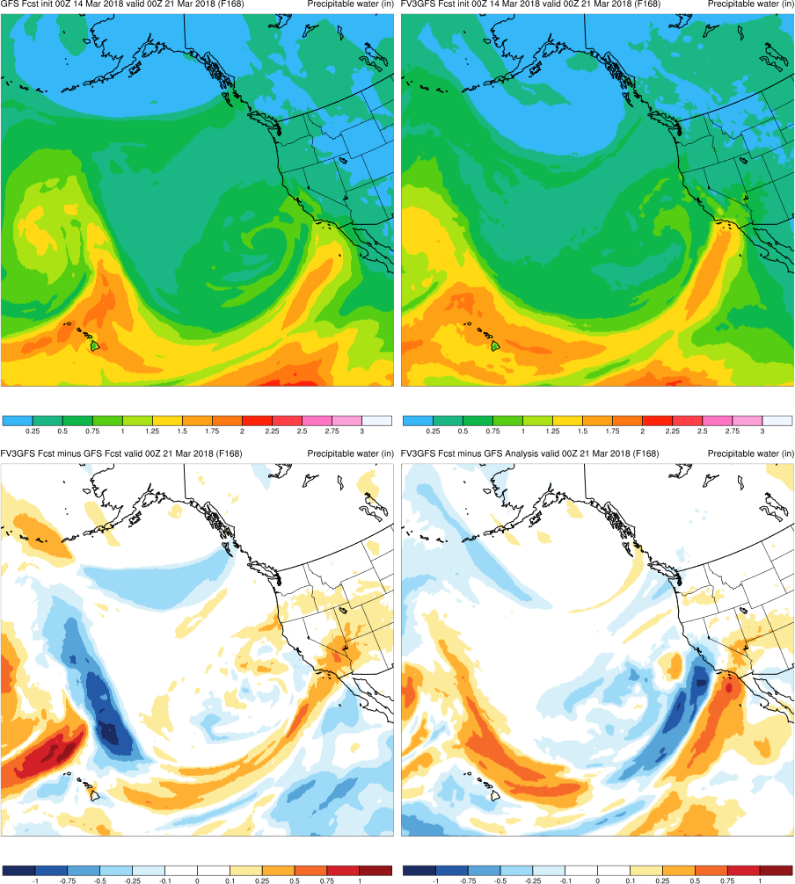
(F168)
GFS
FV3GFS
MAIN POINTS:
FV3GFS and GFS both too progressive
FV3GFS is less progressive than GFS (reversed difference colors)
FV3GFS−GFS
FV3GFS−GFS Anl.
KEY:
Blue = FV3GFS is drier (lower PW)
Red = FV3GFS is wetter (higher PW)

Slide 40
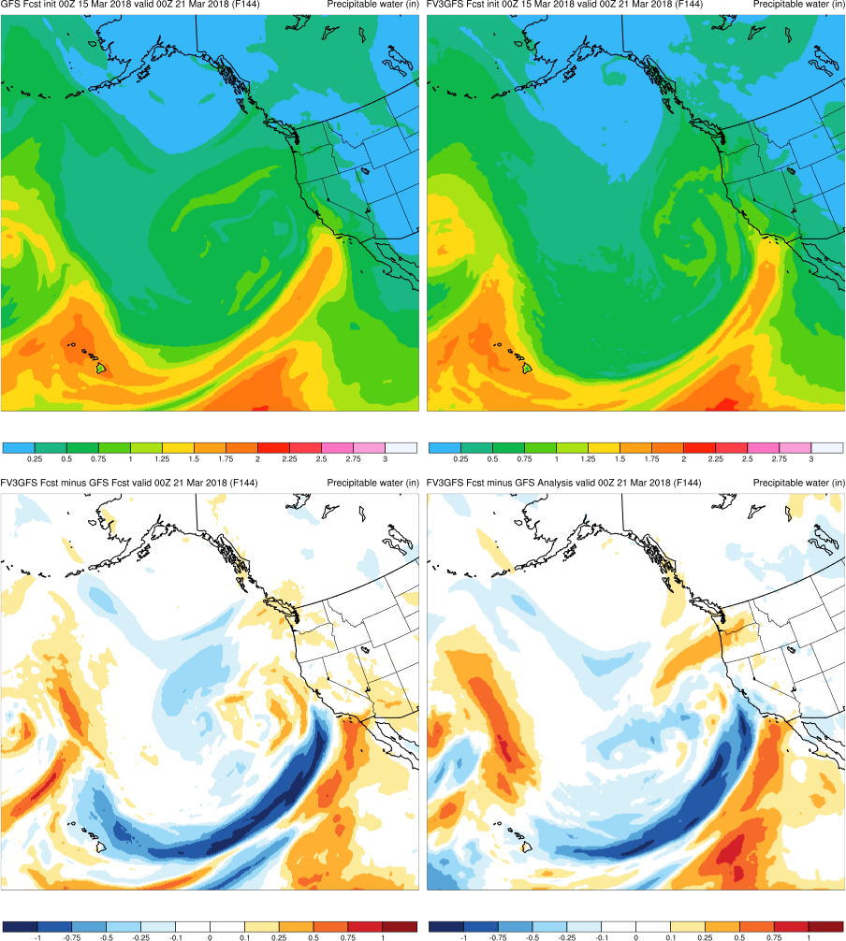
(F144)
GFS
FV3GFS
MAIN POINTS:
GFS shifts AR west before FV3GFS
FV3GFS is more progressive with AR than GFS
FV3GFS−GFS
FV3GFS−GFS Anl.
KEY:
Blue = FV3GFS is drier (lower PW)
Red = FV3GFS is wetter (higher PW)

Slide 41
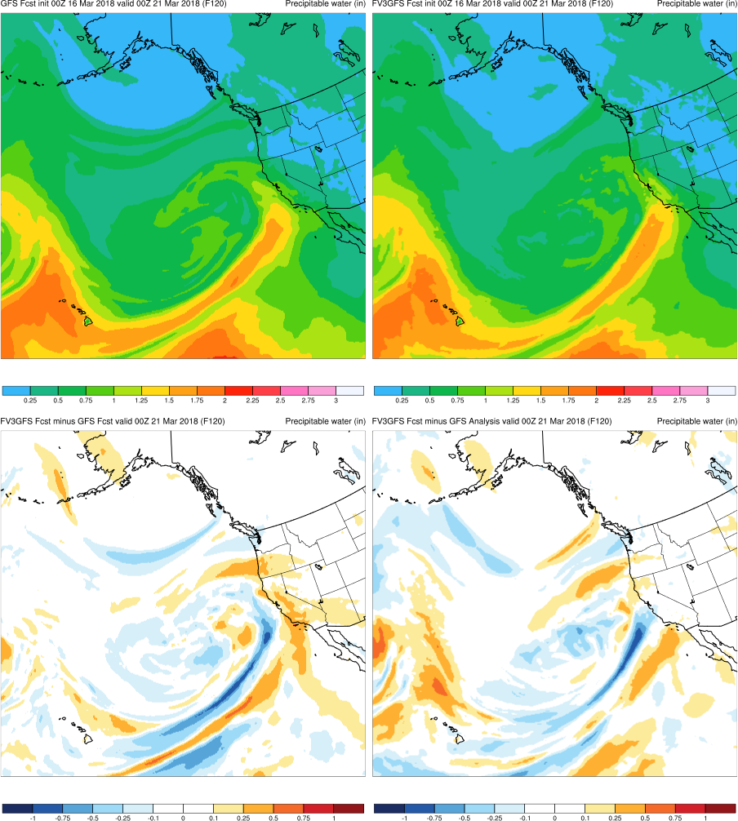
(F120)
GFS
FV3GFS
MAIN POINTS:
FV3GFS shifts AR west, closer to anl.
FV3GFS is slightly more progressive with AR than GFS
FV3GFS−GFS
FV3GFS−GFS Anl.
KEY:
Blue = FV3GFS is drier (lower PW)
Red = FV3GFS is wetter (higher PW)

Slide 42
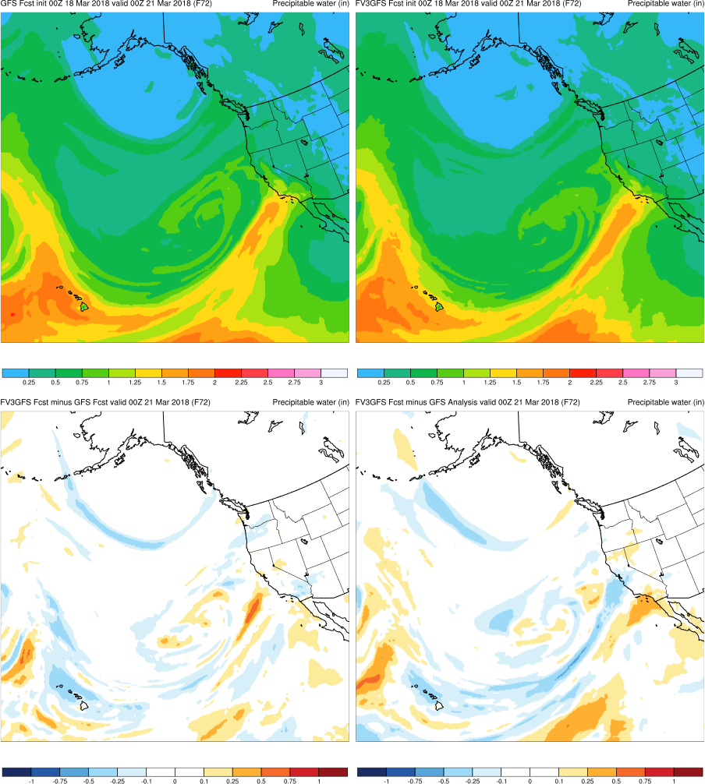
(F072)
GFS
FV3GFS
MAIN POINTS:
FV3GFS and GFS ARs located over similar regions
FV3GFS and GFS both slightly too progressive on coast
FV3GFS−GFS
FV3GFS−GFS Anl.
KEY:
Blue = FV3GFS is drier (lower PW)
Red = FV3GFS is wetter (higher PW)

Slide 43
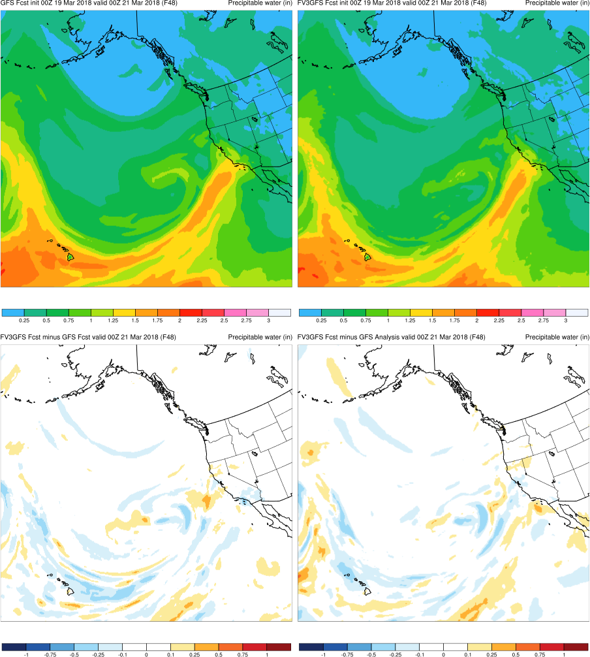
(F048)
GFS
FV3GFS
MAIN POINTS:
FV3GFS and GFS ARs located over similar regions
FV3GFS and GFS are in line with GFS analysis
FV3GFS−GFS
FV3GFS−GFS Anl.
KEY:
Blue = FV3GFS is drier (lower PW)
Red = FV3GFS is wetter (higher PW)

Slide 44
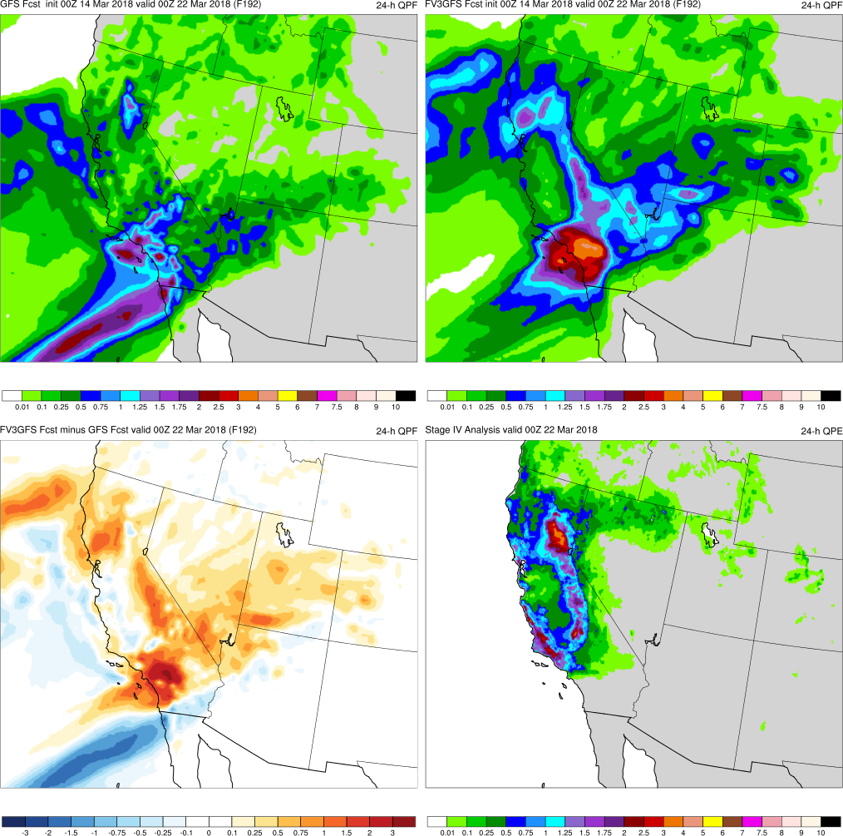
(F192)
MAIN POINTS:
FV3GFS was more accurate with AR position than GFS
FV3GFS has more accurate 24-h QPF forecast than GFS
GFS
FV3GFS
KEY:
Blue = FV3GFS is drier (lower QPF)
Red = FV3GFS is wetter (higher QPF)
FV3GFS−GFS
Stage IV

Slide 45
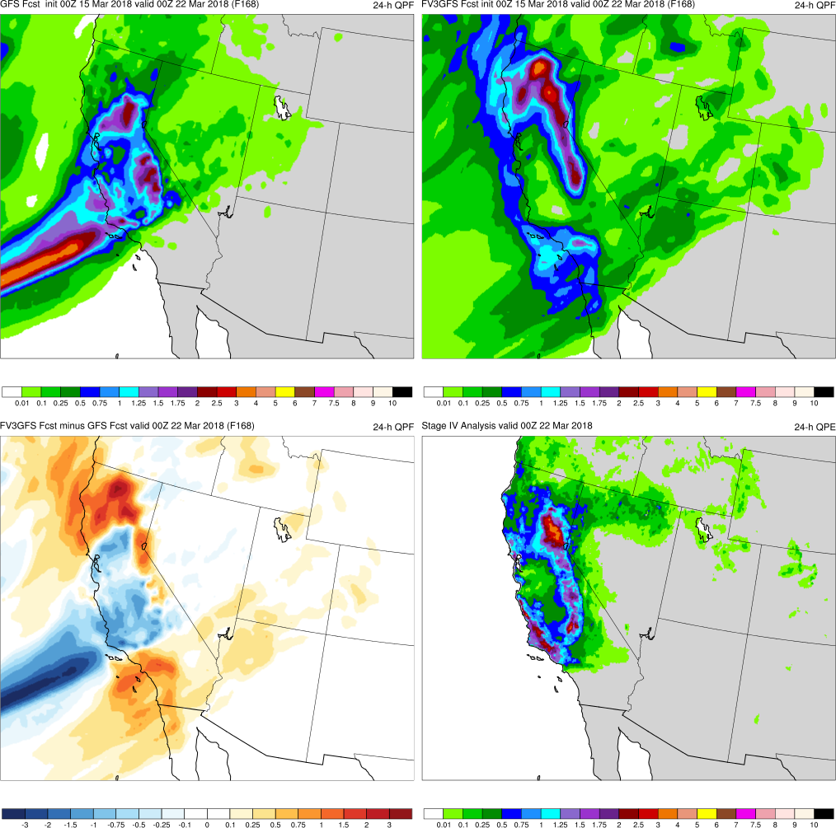
(F168)
MAIN POINTS:
FV3GFS is more progressive with AR than GFS
FV3GFS has precip. extending too far south into California
GFS
FV3GFS
KEY:
Blue = FV3GFS is drier (lower QPF)
Red = FV3GFS is wetter (higher QPF)
FV3GFS−GFS
Stage IV

Slide 46
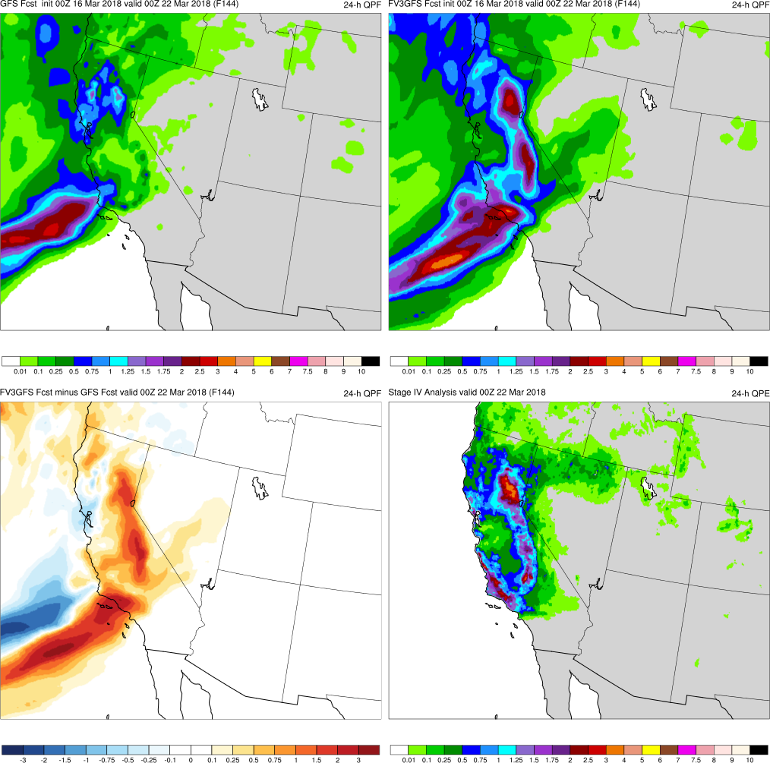
(F144)
MAIN POINTS:
FV3GFS is slightly more progressive with AR than GFS
FV3GFS has more accurate 24-h QPF forecast than GFS
GFS
FV3GFS
KEY:
Blue = FV3GFS is drier (lower QPF)
Red = FV3GFS is wetter (higher QPF)
FV3GFS−GFS
Stage IV

Slide 47
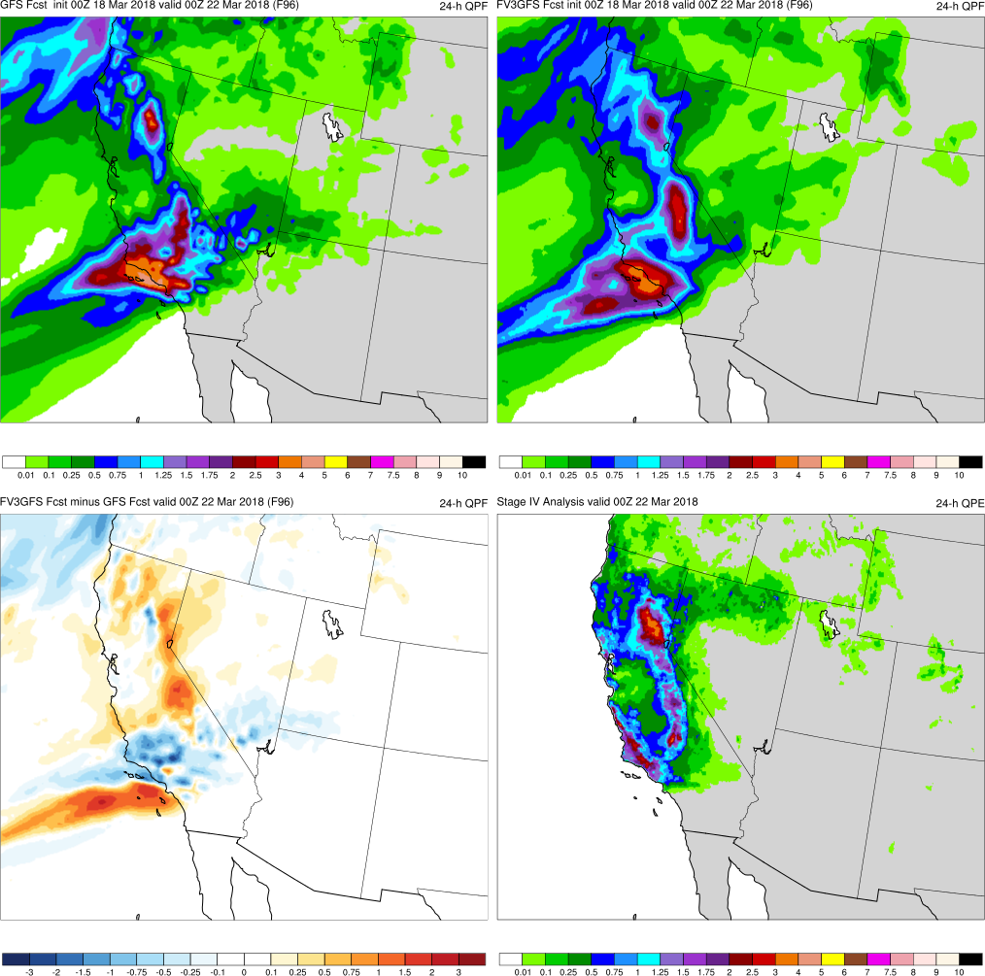
(F096)
MAIN POINTS:
FV3GFS and GFS both slightly too progressive on coast
FV3GFS and GFS have too much QPF over SW California
GFS
FV3GFS
KEY:
Blue = FV3GFS is drier (lower QPF)
Red = FV3GFS is wetter (higher QPF)
FV3GFS−GFS
Stage IV

Slide 48
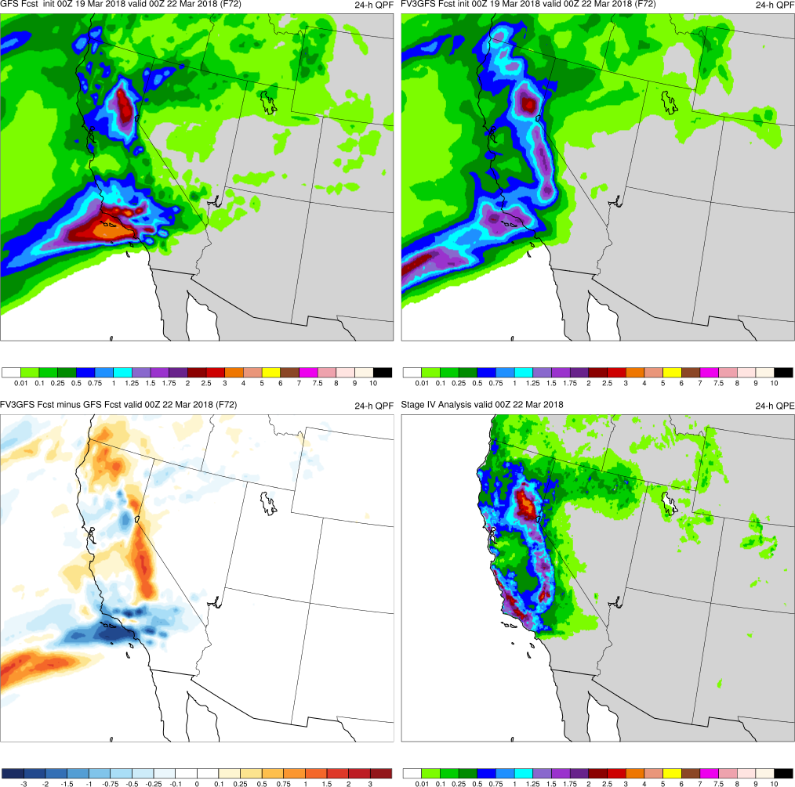
(F072)
MAIN POINTS:
FV3GFS and GFS ARs located over correct regions
FV3GFS has more accurate 24-h QPF forecast than GFS
GFS
FV3GFS
KEY:
Blue = FV3GFS is drier (lower QPF)
Red = FV3GFS is wetter (higher QPF)
FV3GFS−GFS
Stage IV

Slide 49
West Coast AR (March 2018) Summary
GFS accurately captured AR axis 24-h prior to FV3GFS
FV3GFS is typically more progressive w/ AR than GFS, with no notable accuracy bias (fcst can be better/worse than GFS)
FV3GFS QPF was more accurate than GFS QPF at longer lead times, but extends too far south when FV3GFS is too progressive in medium range
Accuracy of AR axis assoc. w/ accuracy of orographic precip.

Slide 50
Interior California Heat (Aug 2017)
Images Valid: 0000 UTC 2 Aug 2017 (2-m temp)

Slide 51
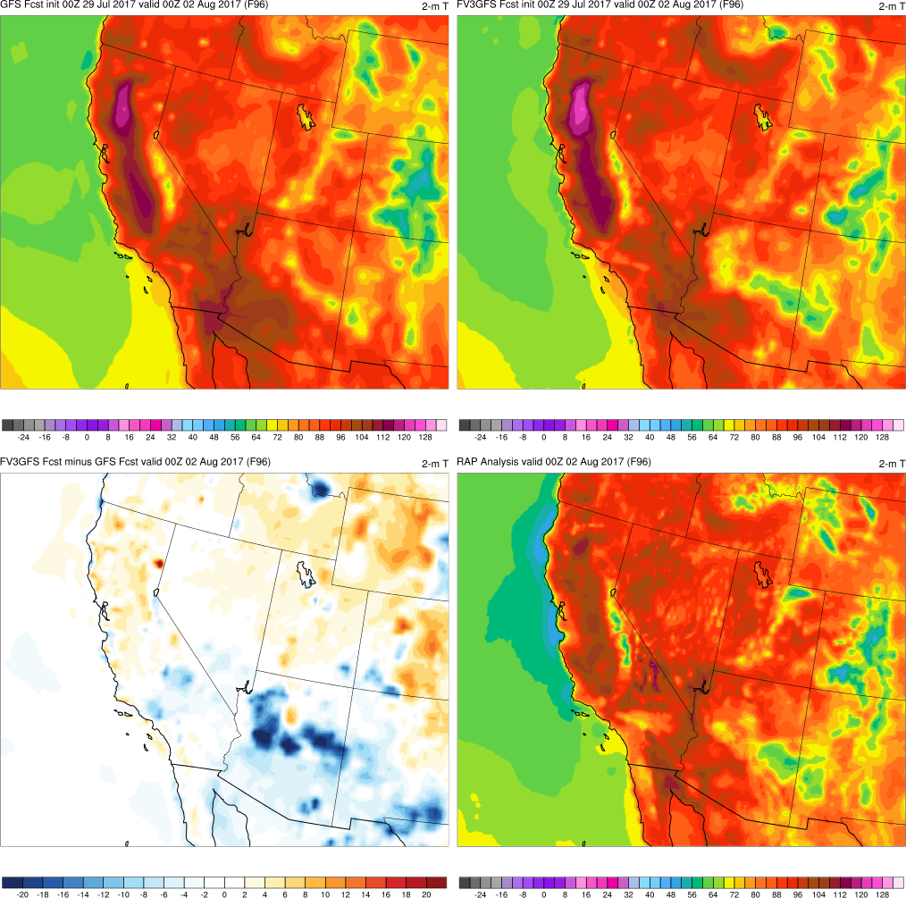
(F096)
MAIN POINTS:
FV3GFS slightly warmer than GFS across central CA
FV3GFS and GFS 2-m temps warmer than RAP analysis
GFS
FV3GFS
KEY:
Blue = FV3GFS is colder (lower temp)
Red = FV3GFS is warmer (higher temp)
FV3GFS−GFS
RAP Anl.

Slide 52
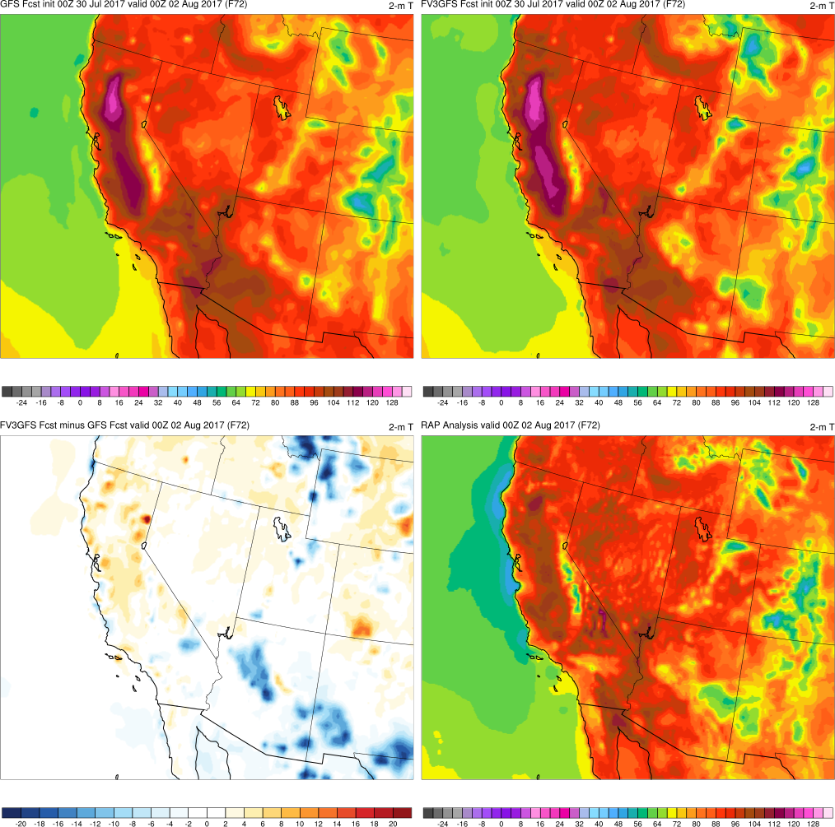
(F072)
MAIN POINTS:
FV3GFS slightly warmer than GFS across central CA
FV3GFS and GFS 2-m temps warmer than RAP analysis
GFS
FV3GFS
KEY:
Blue = FV3GFS is colder (lower temp)
Red = FV3GFS is warmer (higher temp)
FV3GFS−GFS
RAP Anl.

Slide 53
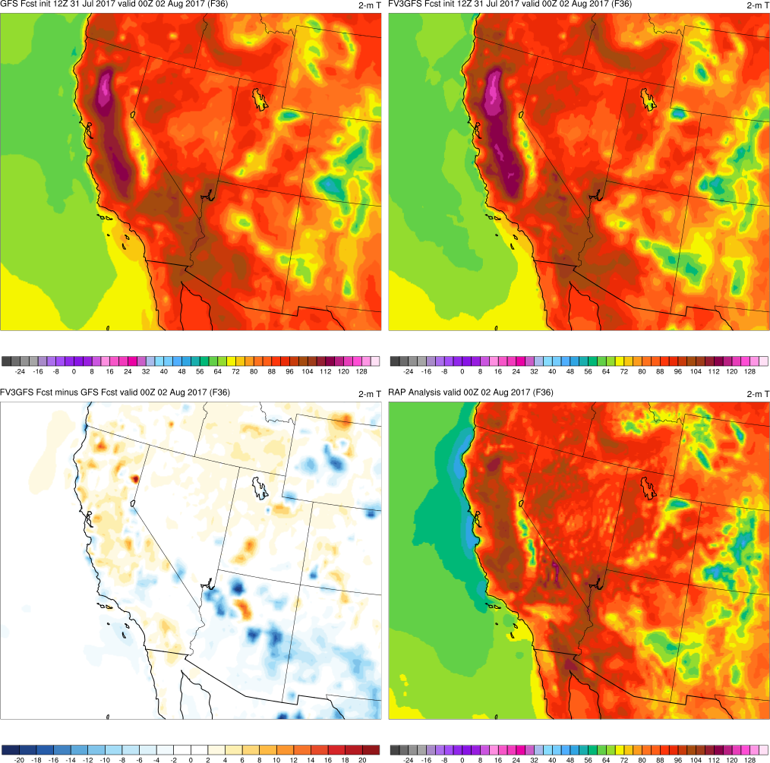
(F036)
MAIN POINTS:
FV3GFS slightly warmer than GFS across central CA
FV3GFS and GFS 2-m temps warmer than RAP analysis
GFS
FV3GFS
KEY:
Blue = FV3GFS is colder (lower temp)
Red = FV3GFS is warmer (higher temp)
FV3GFS−GFS
RAP Anl.

Slide 54
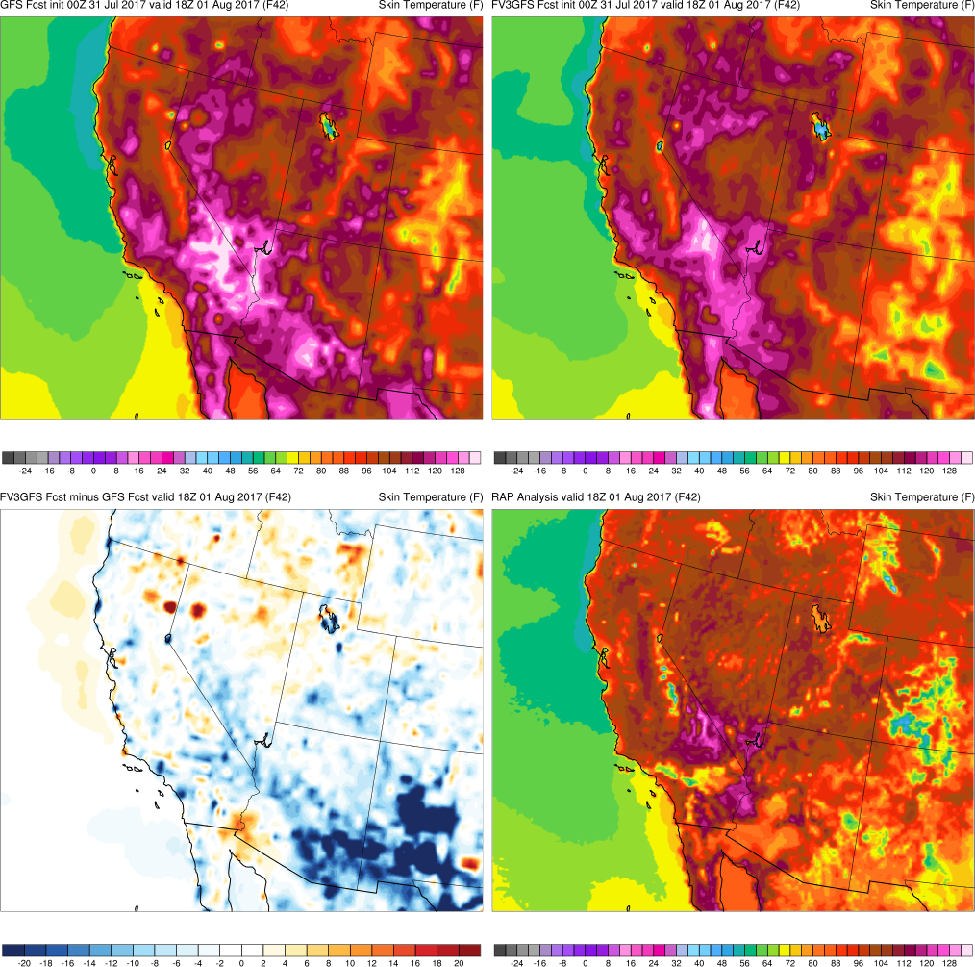
Skin Temp.
Valid: 18Z
MAIN POINTS:
GFS warmer than FV3GFS at 18Z
FV3GFS warmer than GFS at 00Z
Suggests diurnal cycle is shifted in FV3GFS
GFS
FV3GFS
Valid: 00Z
GFS
FV3GFS

Slide 55
Init: 00Z 9/5/18
F144
2-m T
GFS
FV3GFS
FV3GFS is warmer than GFS over the West at 00z valid times
True at all forecast lead times
Example from the 00z 9/5/18 cycle
FV3GFS-GFS

Slide 56
Init: 00Z 9/5/18
REDDING, CA
2-m T
EDWARDS AFB, CA
NAM
RAP
GFS
FV3GFS
COEUR D’ALENE, ID

Slide 57
Interior CA Heat (Aug 2017) Summary
FV3GFS 2-m temperatures are consistently slightly warmer than GFS 2-m temperatures over central California
GFS is warmer than FV3GFS at 18Z, whereas FV3GFS is warmer than GFS at 00Z
FV3GFS 2-m temperatures are fairly consistent with GFS, NAM, and RAP 2-m temperatures across western U.S.
Daily maximum 2-m temperatures occur at ~00Z and drop off slowly over the western U.S., consistent with local obs

Slide 58
Cold Air Outbreak (Dec 2017/Jan 2018)
Images Valid: 1200 UTC 4 Jan 2018 (850-hPa T) 1200 UTC 4 Jan 2018 (2-m T)

Slide 59
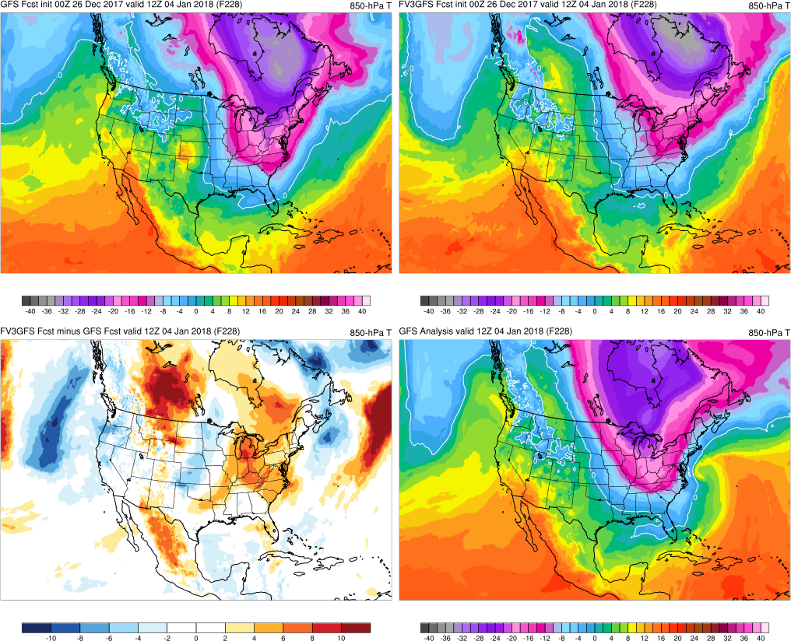
850T
(F228)
GFS
Too amplified, wrong tilt (pos.)
FV3
Too progressive, wrong amplitude
FV3GFS−GFS

Slide 60
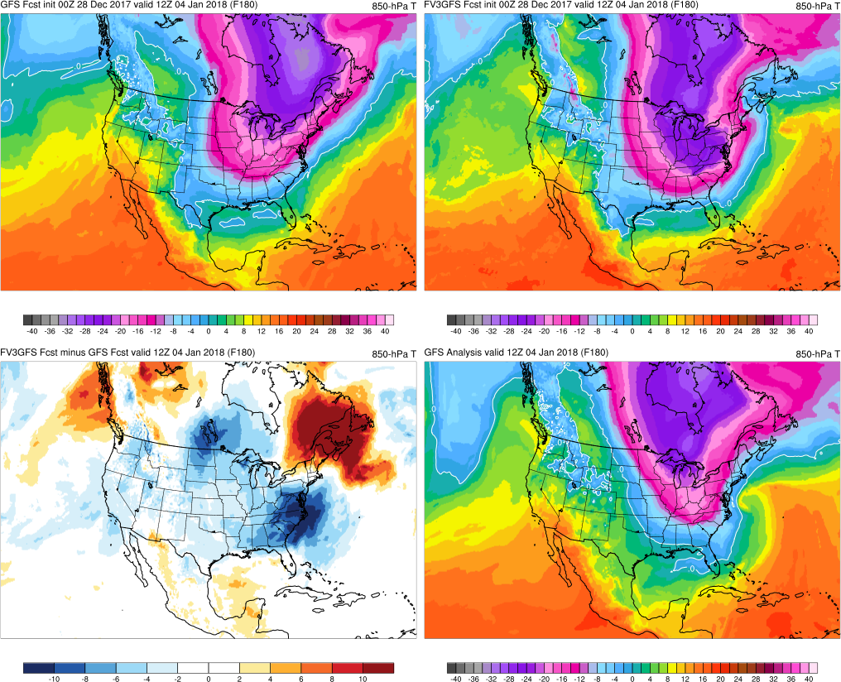
850T
(F180)
GFS
Shifts west, maintains positive tilt
FV3
Amplifies, negative tilt to cold axis
FV3GFS−GFS
GFS Anl.

Slide 61
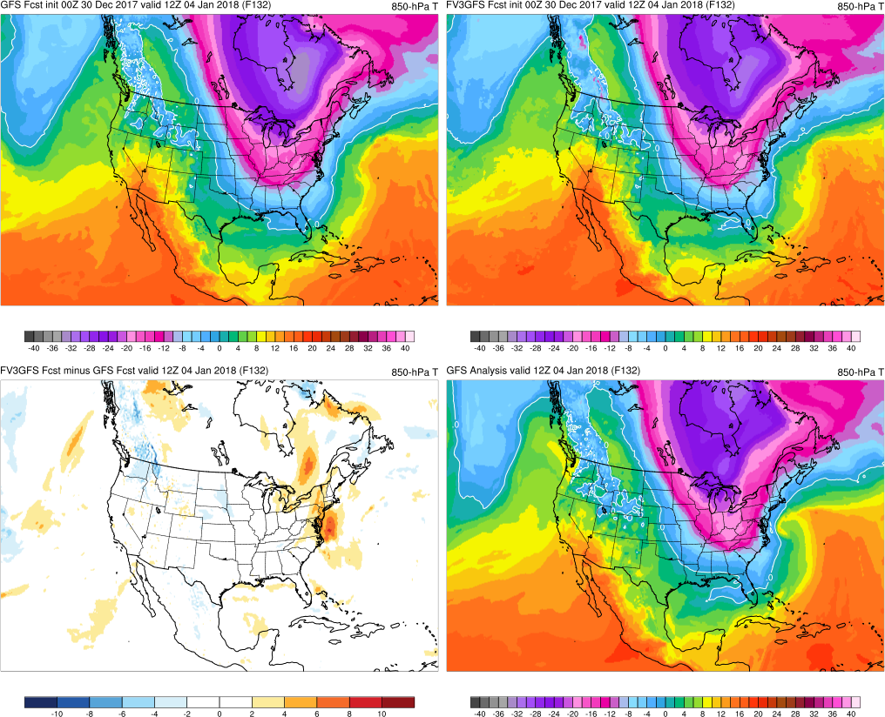
850T
(F132)
GFS
Amplitude improves, neutral tilt
FV3
Amplitude improves, neutral tilt
FV3GFS−GFS
GFS Anl.

Slide 62
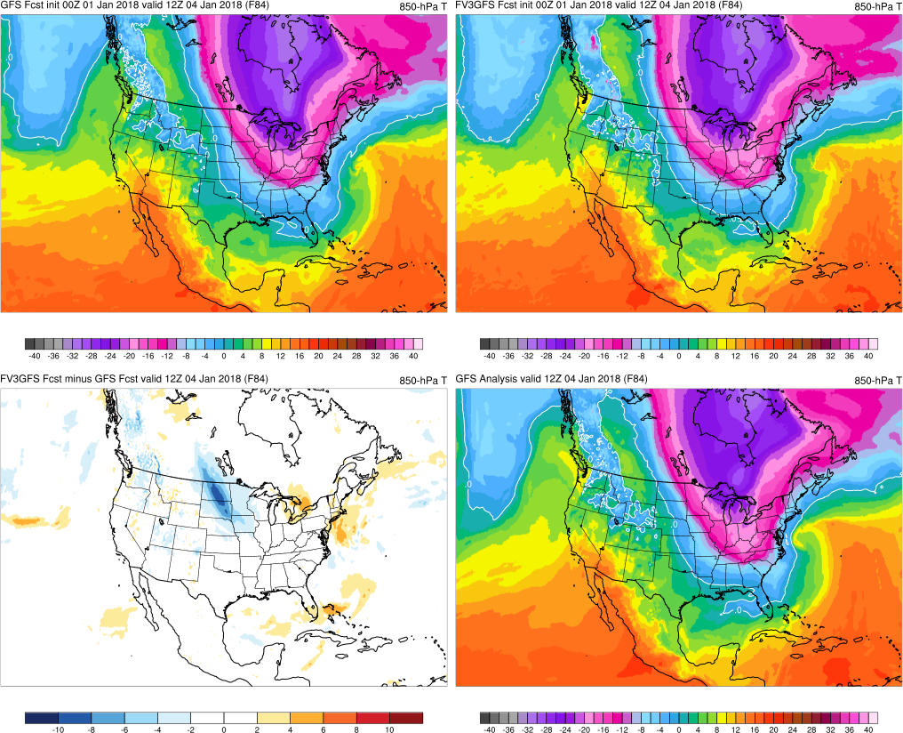
850T
(F084)
GFS
Accurate amplitude, negative tilt
FV3
Good, becomes neutrally tilted
Good, becomes neutrally tilted
Accurate amplitude, negative tilt
FV3GFS−GFS
GFS Anl.

Slide 63
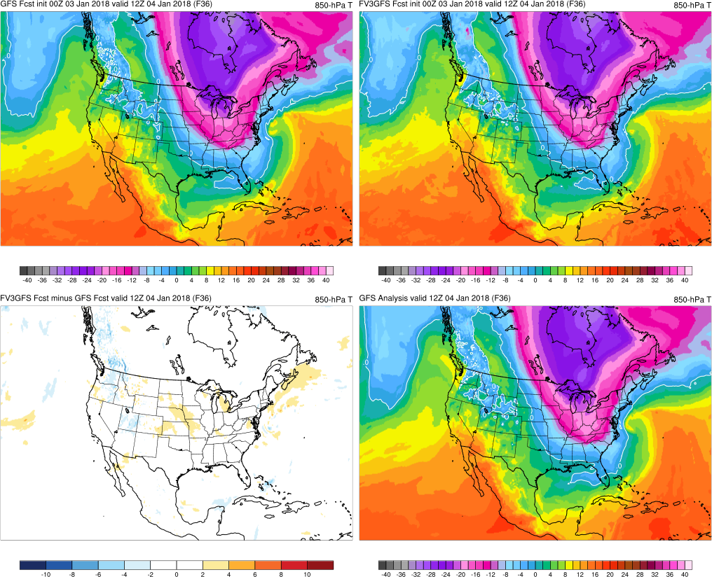
850T
(F036)
GFS
Wavelength shortens, neg. tilt
FV3
Good, becomes neutrally tilted
Good, becomes neutrally tilted
Wavelength shortens, neg. tilt
FV3GFS−GFS
GFS Anl.

Slide 64
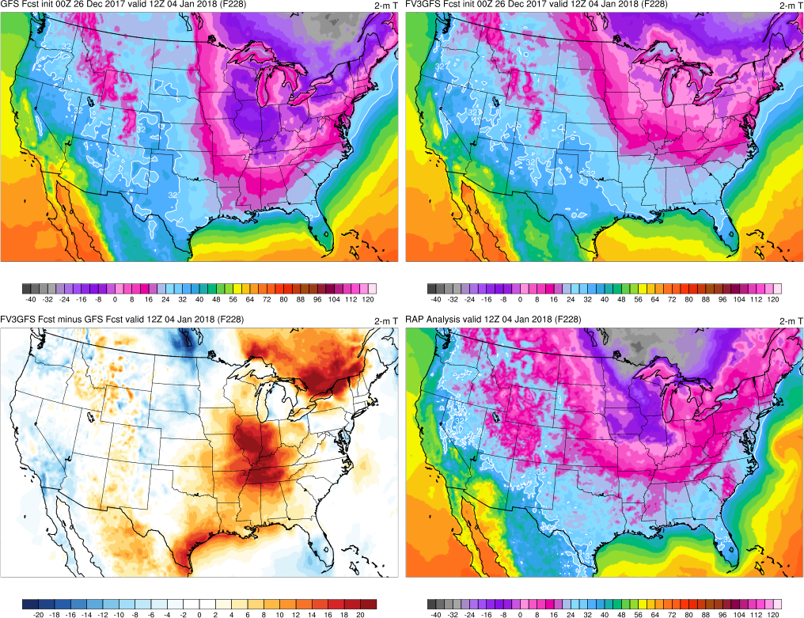
(F228)
GFS
Too amplified, wrong tilted (pos.)
FV3
Too progressive, wrong amplitude
FV3GFS−GFS
GFS Anl.

Slide 65
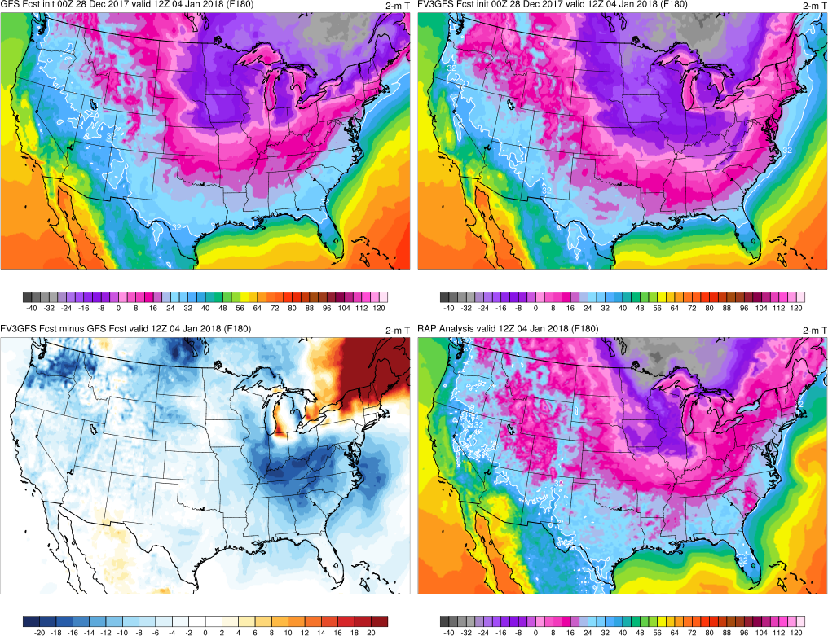
(F180)
GFS
Shifts west, maintains pos. tilt
FV3
Amplifies, negative tilt to cold axis
FV3GFS−GFS
GFS Anl.

Slide 66
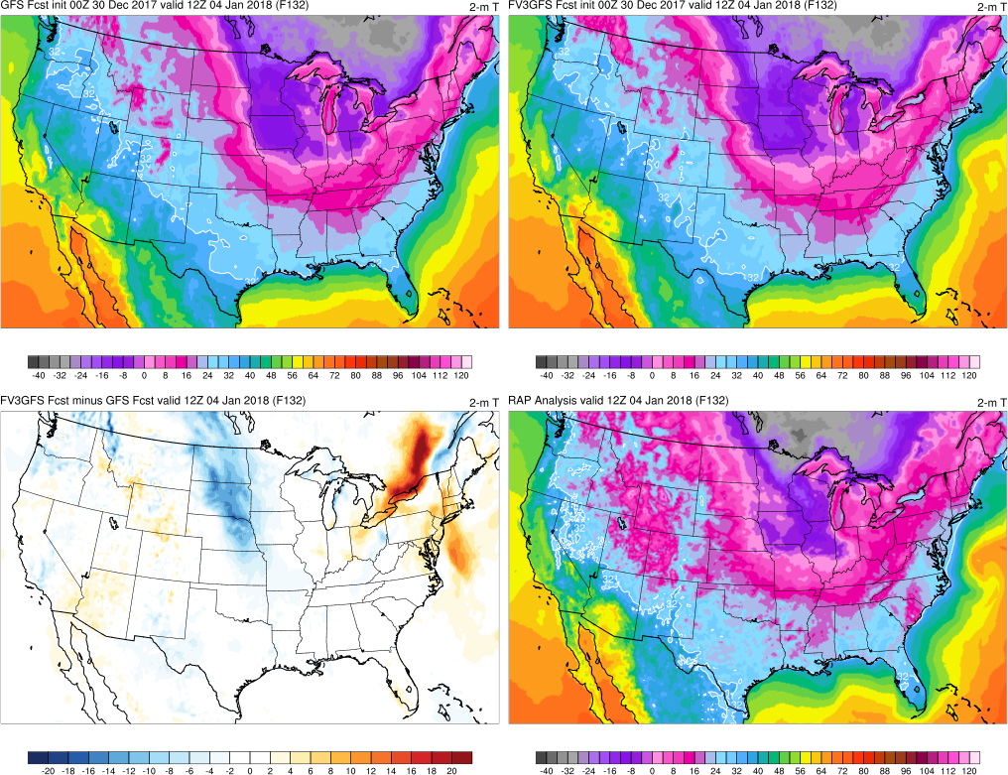
(F132)
GFS
Shifts east, neutral tilt to axis
FV3
Shifts east, more neutral tilt to axis
FV3GFS−GFS
GFS Anl.

Slide 67
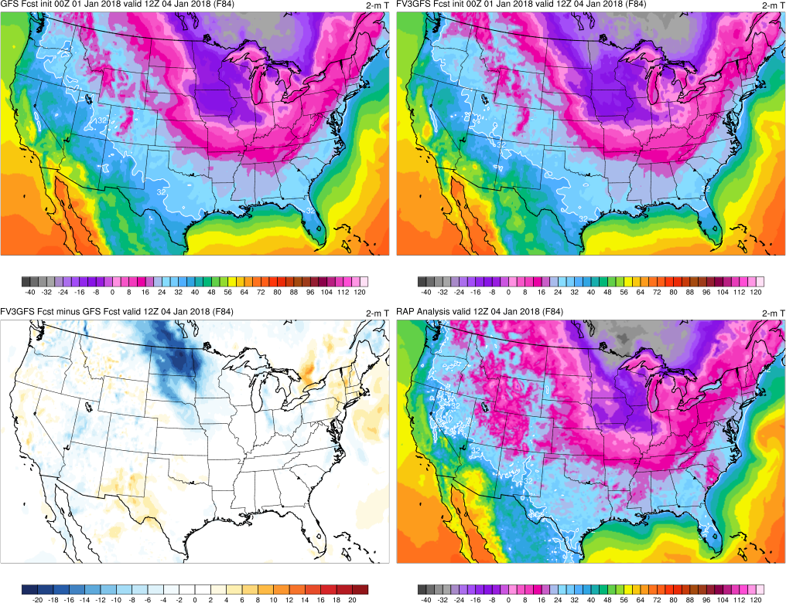
(F084)
GFS
Increasingly neutral tilt to CA axis
FV3
Increasingly neutral tilt to CA axis
FV3GFS−GFS
GFS Anl.

Slide 68
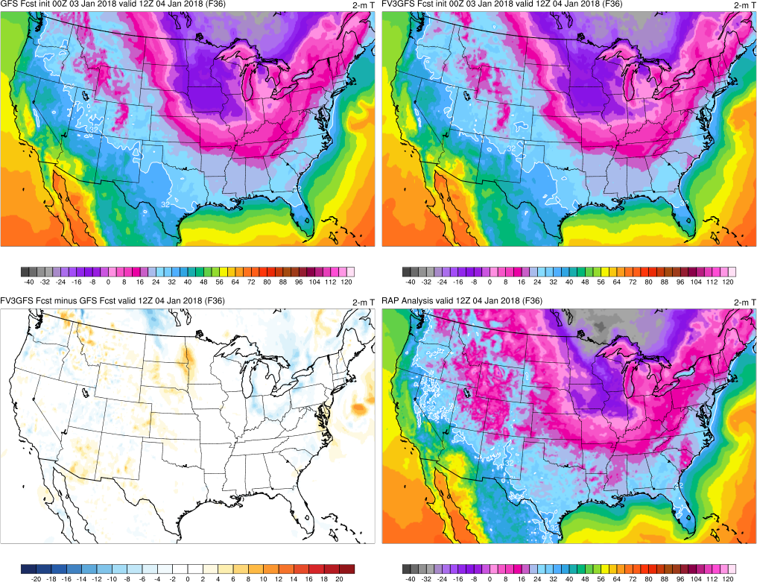
(F036)
GFS
Wavelength shortens (EC)
FV3
Wavelength shortens (EC)
FV3GFS−GFS
GFS Anl.

Slide 69
Cold Air Outbreak (Dec 2017/Jan 2018) Summary
FV3GFS 850-hPa temperature axis shifts from positive to negative tilt the before the GFS 850-hPa temperature axis
FV3GFS and GFS 2-m temperatures are similar in location and magnitude to RAP analysis by 132-h forecast lead time
FV3GFS shows no systematic errors associated with cold air outbreak temperature forecasts

Slide 70
Western U.S. Retrospectives Summary
FV3GFS forecasted Pacific Northwest windstorms as well as or better than GFS
FV3GFS typically more progressive with ARs than GFS
FV3GFS 24-h QPF forecasts are comparable to GFS
FV3GFS 2-m temperature forecasts are comparable to GFS
FV3GFS has a delayed diurnal cycle compared to GFS, which maybe more accurate (according to observations)

